Slide 1
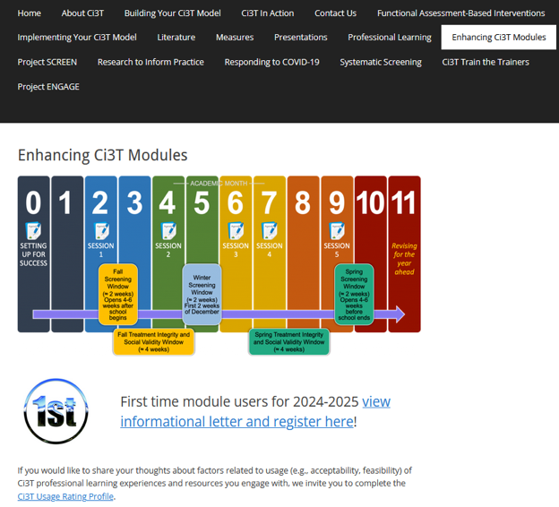
A 6-Step Instructional Approach for Responding to Challenging Behavior:
A Tier 1 Practice
EMPOWER+ Session 5
If you have not done so already, we invite you to visit ci3t.org/enhance to access modules after a one-time registration process!

Slide 2
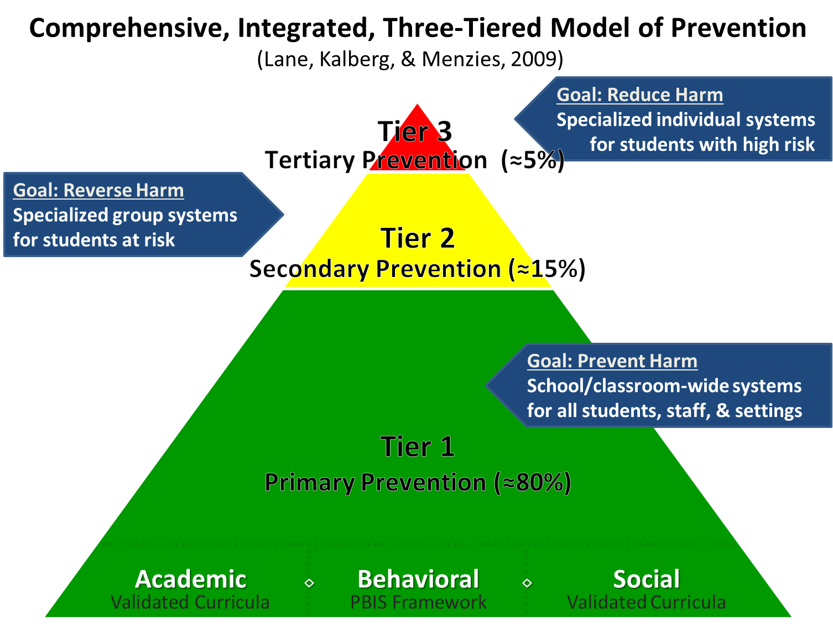
Comprehensive, Integrated, Three-Tiered Model of Prevention

Slide 3
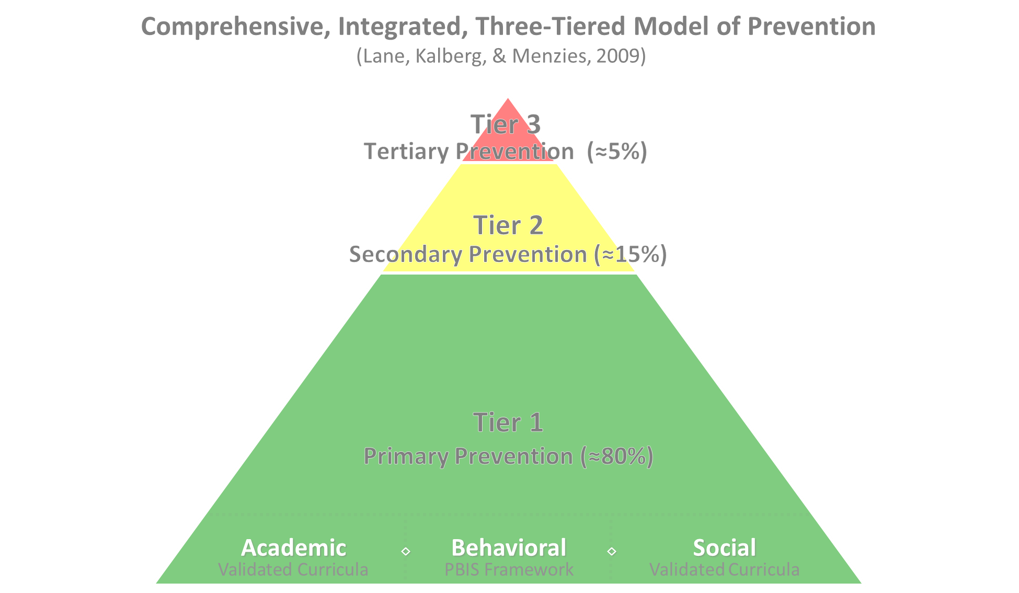

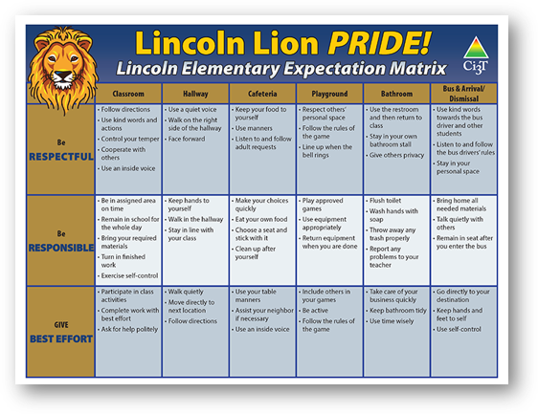
Positive Behavioral Interventions and Supports
District & State Standards Quality Instruction
Validated Curricula and Resources

Slide 4

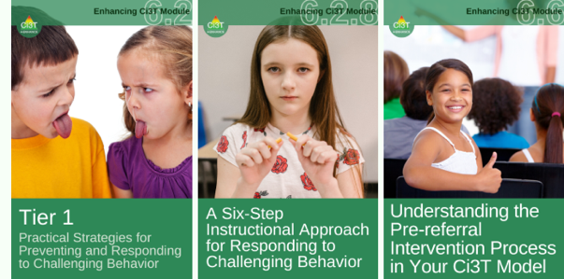
Primary Prevention (Tier 1)

Slide 5

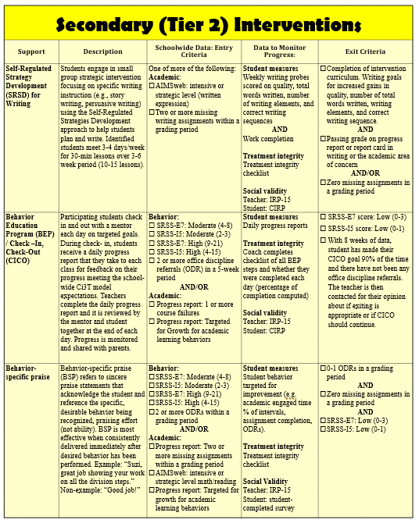
Secondary (Tier 2) Intervention Grid
Notes:
In addition to the module featured here outlining how to use multiple sources of data to connect students with Tier 2 supports, we offer a full suite of modules highlighting validated Tier 2 interventions such as Self-Regulated Strategy Development (SRSD) for Writing and Check-In/Check Out that may appear in your Secondary (Tier 2) Intervention Grid

Slide 6

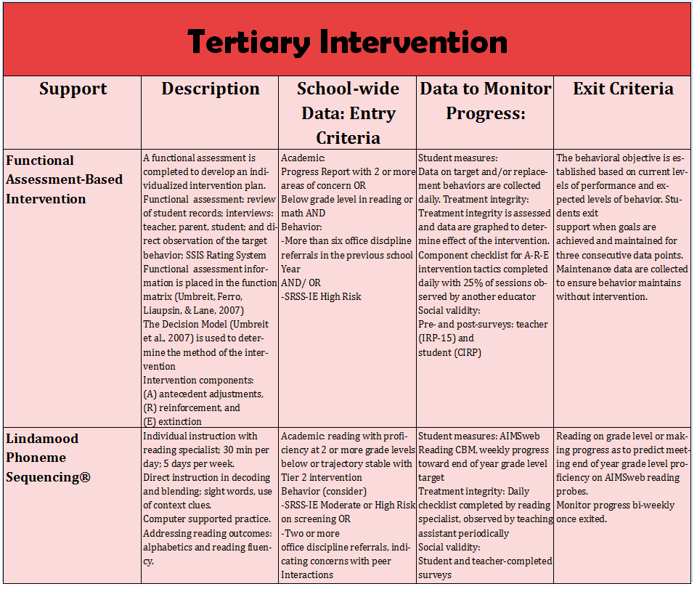
Tertiary (Tier 3) Intervention Grid
Notes:
In addition to the module featured here outlining how to use multiple sources of data to connect students with Tier 3 supports, we offer a full suite of modules highlighting validated Tier 3 interventions such as Functional Assessment-Based Intervention (FABI) that may appear in your Tertiary (Tier 3) Intervention Grid

Slide 7
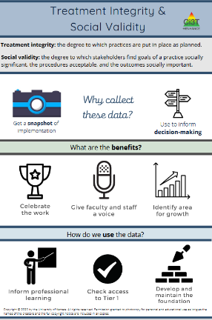
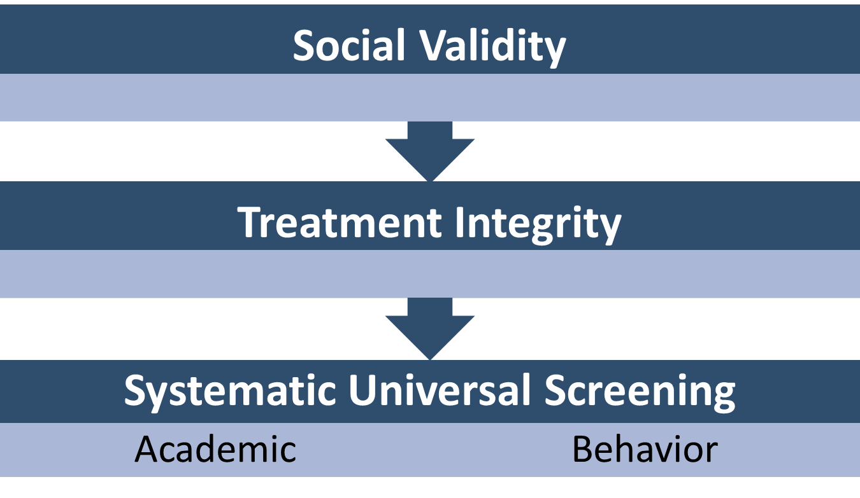
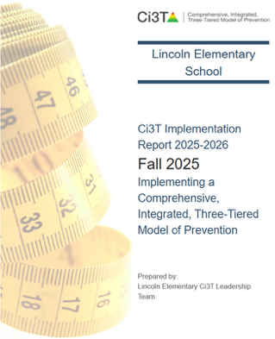
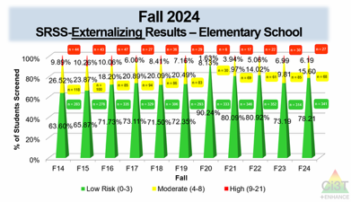
Essential Components of Primary (Tier 1) Prevention Efforts

Slide 8



Enhancing Ci3T Modules
ci3t.org/enhance

Slide 9
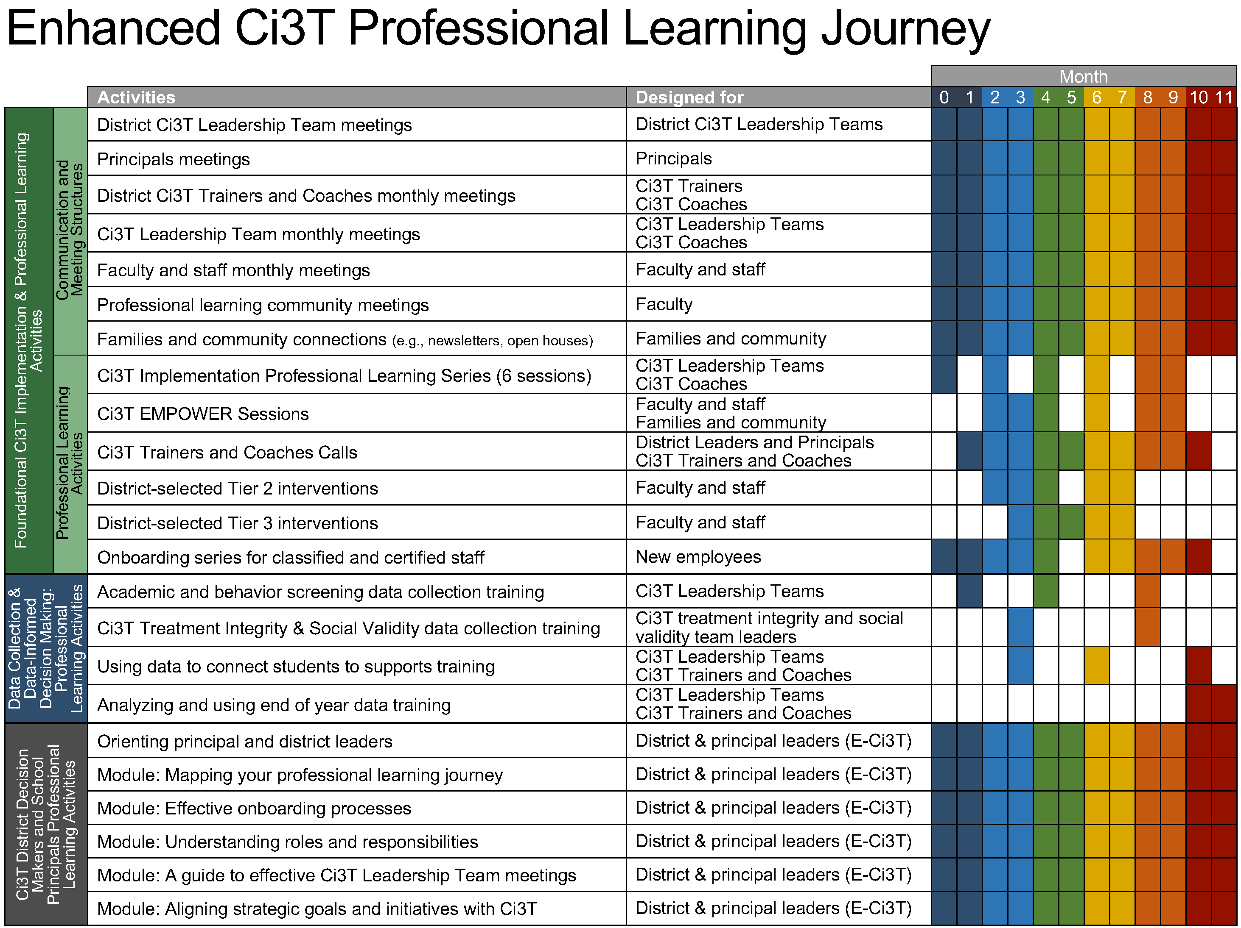
Enhanced Ci3T Implementation Series and Delivery

Slide 10
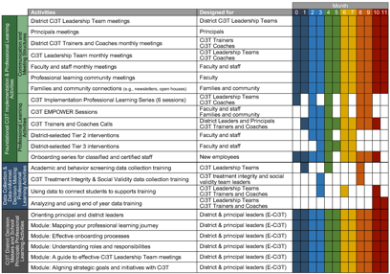

Session Outcomes
Describe a 6-step instructional approach for responding to challenging behaviors
Identify what to do (examples), why to do it, and what not to do (non-examples) for each step
Describe potential Tier 2 and Tier 3 interventions for students needing more than Tier 1 practices
If you are a Board Certified Behavior Analyst (BCBA), you may accrue up to 2 learning continuing education units (CEUs) for attending this session. See agenda for task list alignment. Throughout the session we will share 4 key words, write those down to turn in after the session!

Slide 11


Agenda
Welcome
Building Understanding of Challenging Behaviors: A-B-Cs
Describing a 6-step Instructional Approach for Responding to Challenging Behavior
Connecting Students to More Intensive Interventions
Wrapping Up and Moving Forward

Slide 12
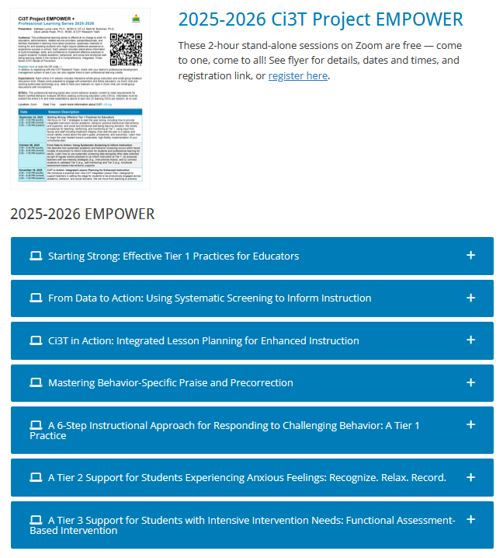
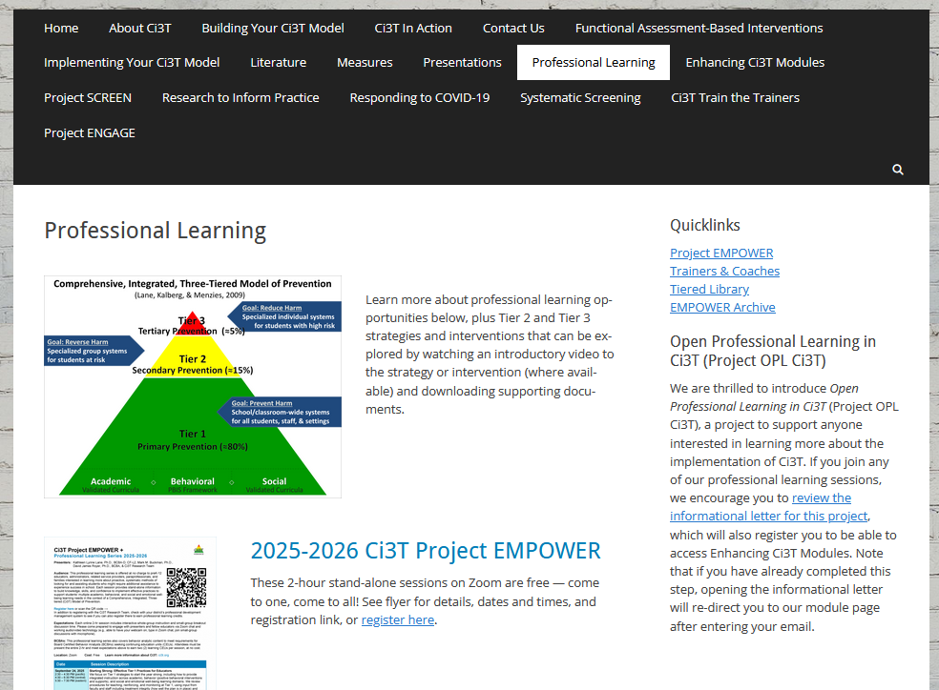
Accessing Professional Learning Materials
ci3t.org/pl

Slide 13
Building Understanding of Challenging Behaviors:
A-B-Cs

Slide 14
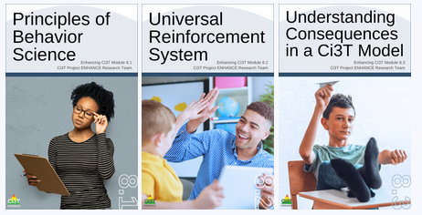
Comprehensive, Integrated, Three-Tiered Model of Prevention

Slide 15

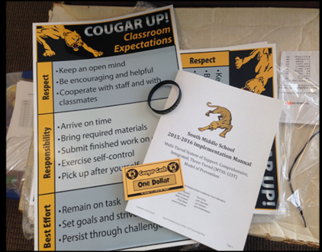
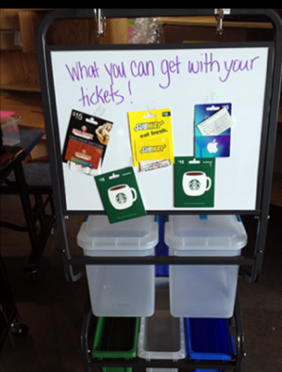
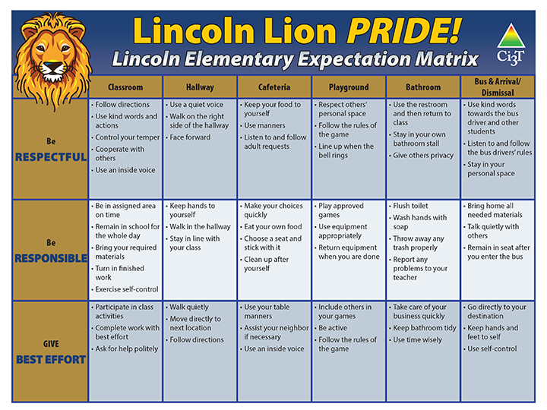
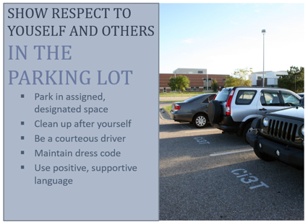
Tier 1 Efforts: ABA Principles in Action
Area II: Academics Responsibilities Faculty and Staff: Teach core programs according to district and state standards with integrity: Use teacher-delivered, low-intensity strategies to support students’ active engagement | Area II: Behavior Responsibilities Faculty and Staff: Implement Positive Behavioral Interventions and Supports (PBIS) with integrity. Teach all setting Expectations within the first week of school and reteach Expectations (monthly). Display and model school-wide expectations in classrooms and other key settings. Provide behavior specific praise and intermittently pair praise with delivering the schoolwide ticket to students who display school-wide expectations throughout school settings. Implement the reactive plan with integrity. | Area II: Social Responsibilities Faculty and Staff: Teach schoolwide social skills/ character education curricula with integrity: Teach daily Second Step ® lessons (link to grade level instructional schedules) Seek ways to engage parents as partners in the school program

Slide 16


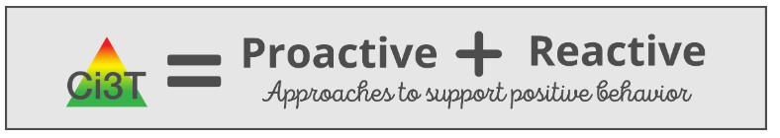
Tier 1: Support for All
Notes:
From module:
Each Ci3T Implementation Manual features proactive and reactive components to set the stage for positive, productive environments and enable faculty and staff be prepared to respond effectively when challenges arise.
Reactive approaches are instructional and respectful, providing an opportunity to empower teachers with the specific tools to navigate day-to-day challenges and model for students how to handle conflict.
Ci3T models prioritize building healthy teacher-student relationships.

Slide 17
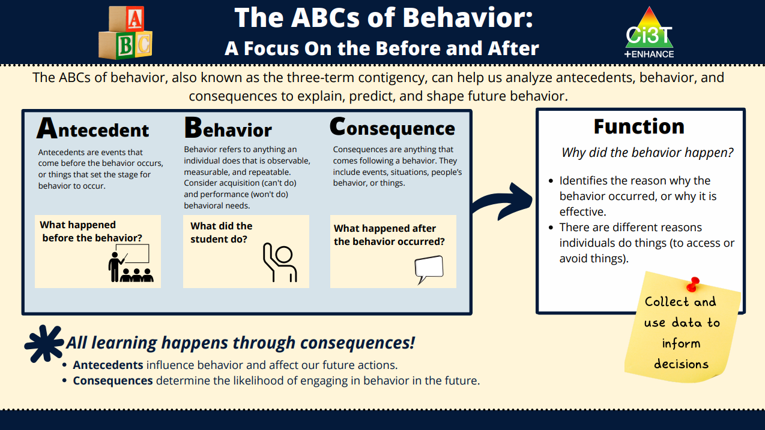

Slide 18
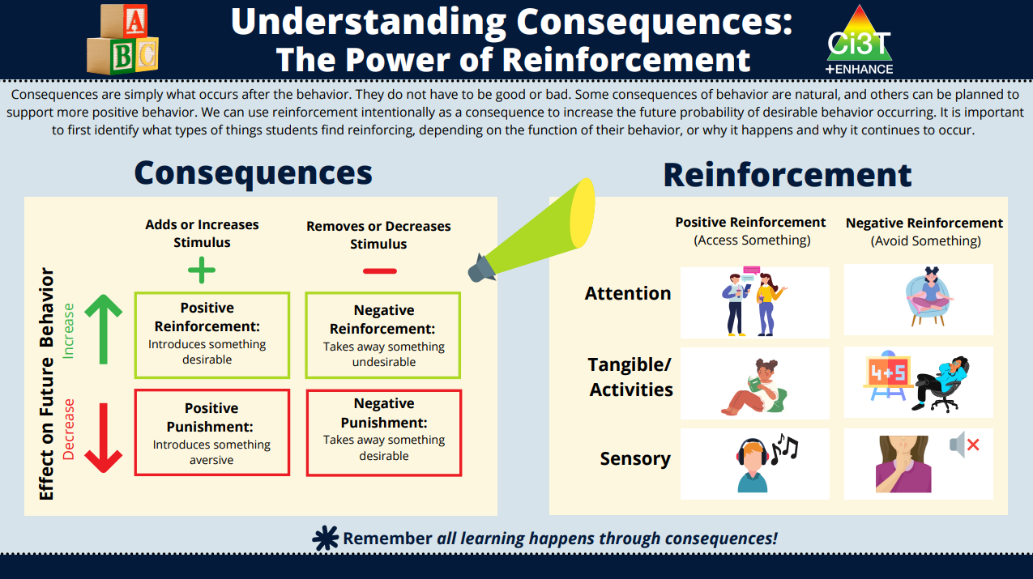

Slide 19
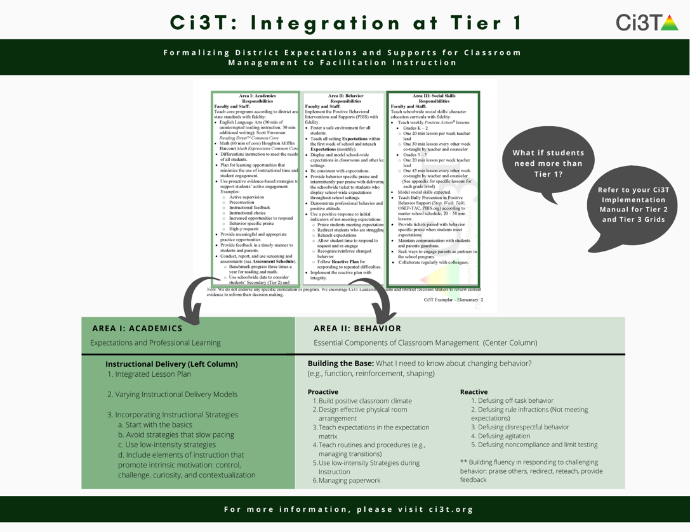
Comprehensive Support

Slide 20

Antecedent adjustments
Consequences

Slide 21

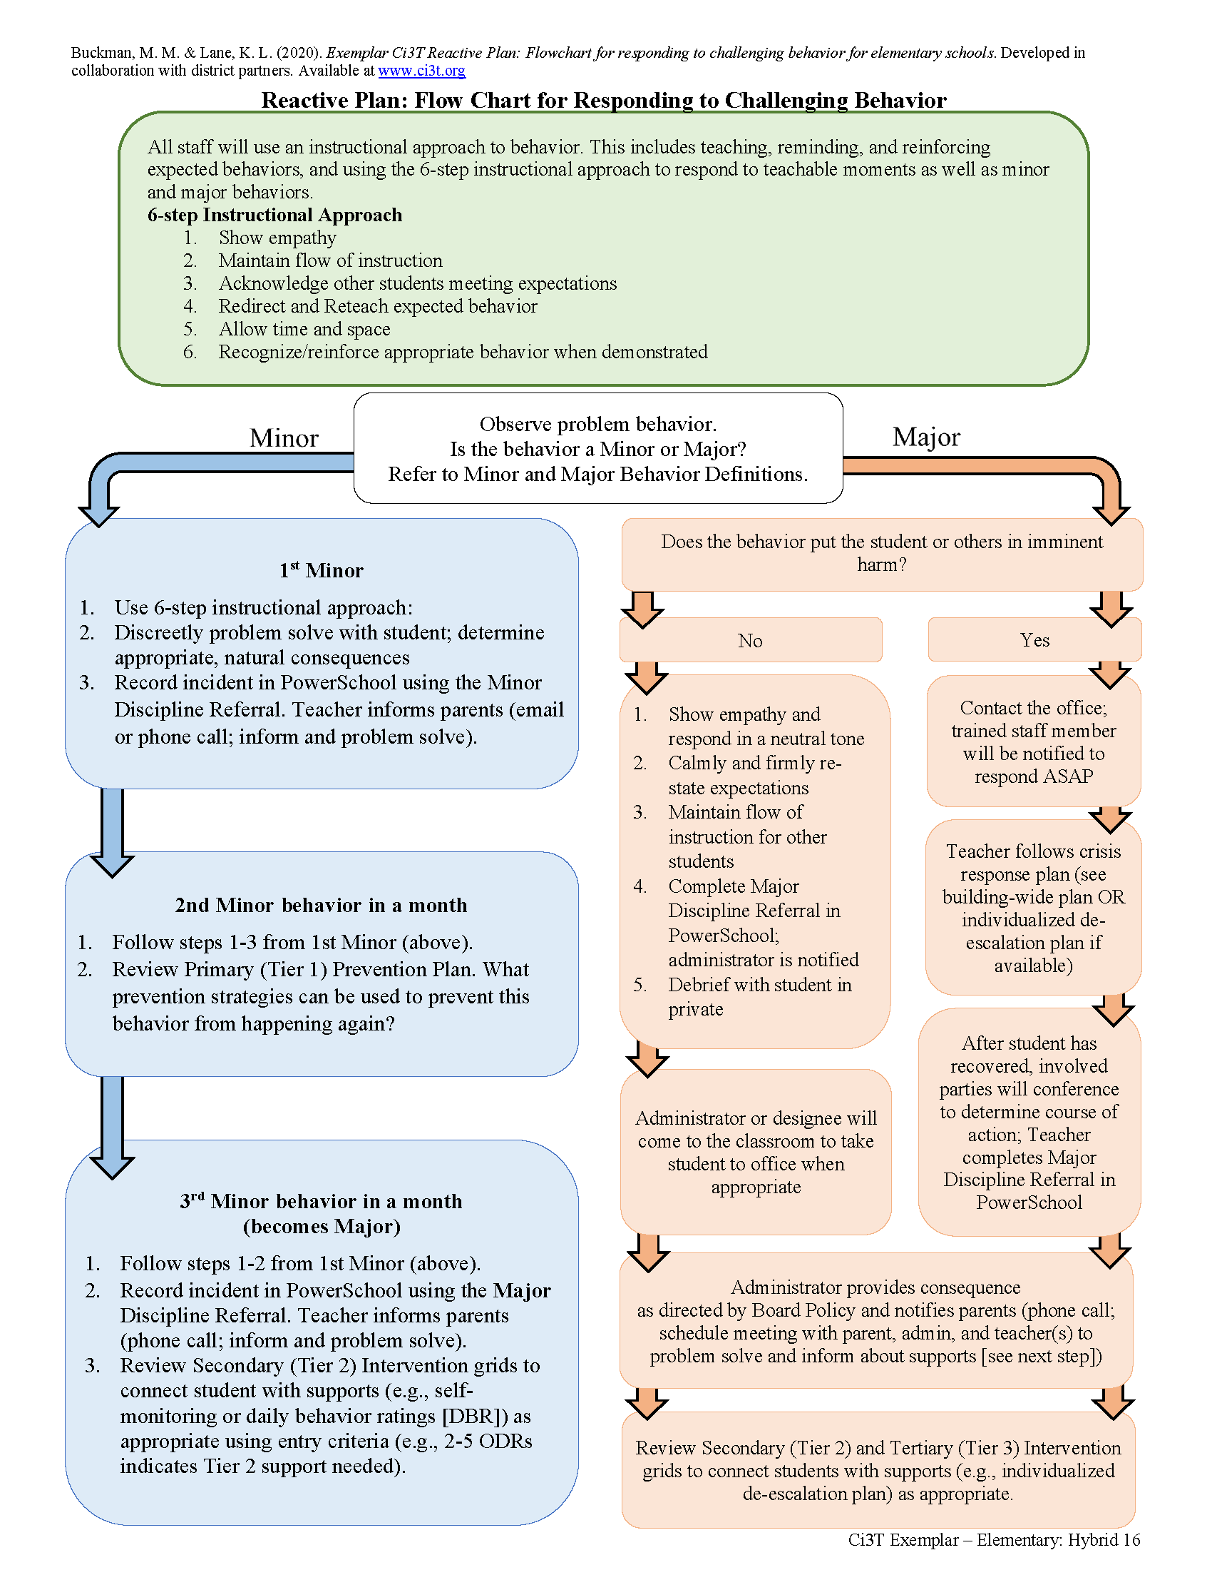
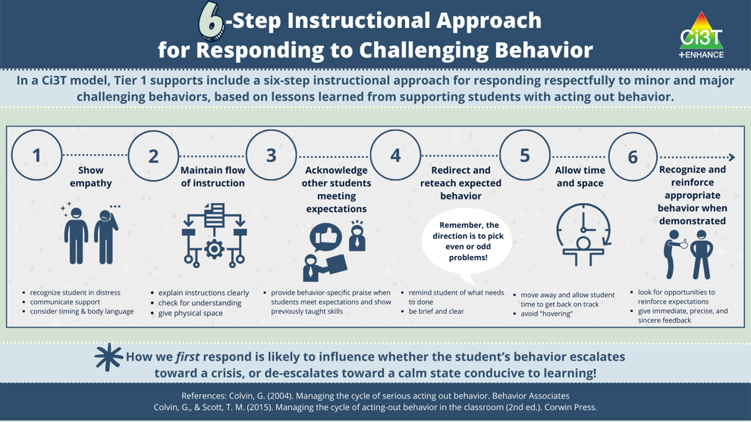

Slide 22












Let’s Talk!
How do you typically respond to challenging behavior?
How well is it working?
How are you using your school’s reactive plan?
Notes:
10-min timer

Slide 23
Describing a 6-step Instructional Approach for Responding to Challenging Behavior

Slide 24


Slide 25
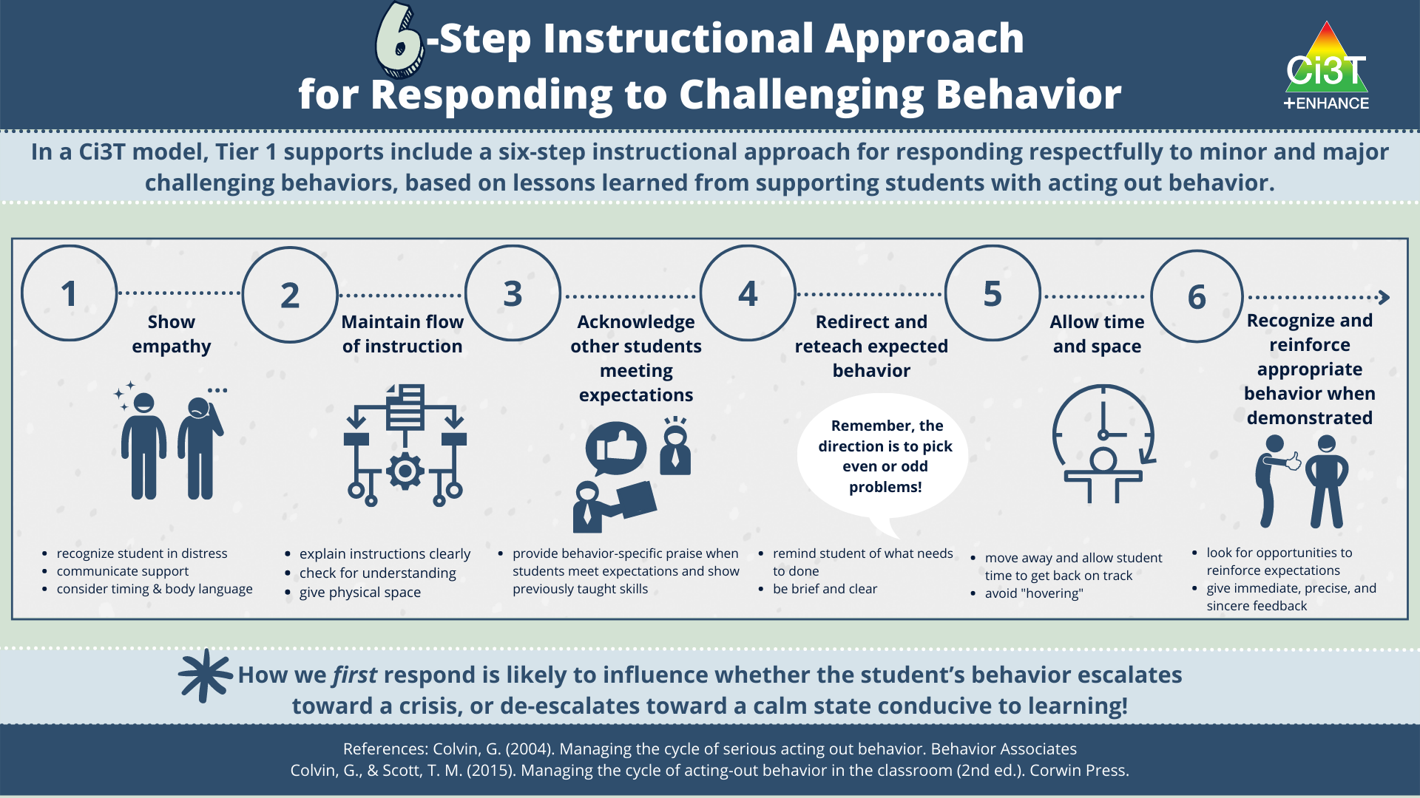

Slide 26

How Do I Implement a 6-Step Instructional Approach at My School?
Step 1
  Show empathy
Step 2
  Maintain the flow of instruction
Step 3
  Acknowledge other students meeting expectations
Step 4
  Redirect and reteach expected behavior
Step 5
  Allow time and space
Step 6
  Recognize and reinforce expected behavior when demonstrated

Slide 27


Step 1: Show empathy
What to do
Why to do it
What to avoid

Slide 28
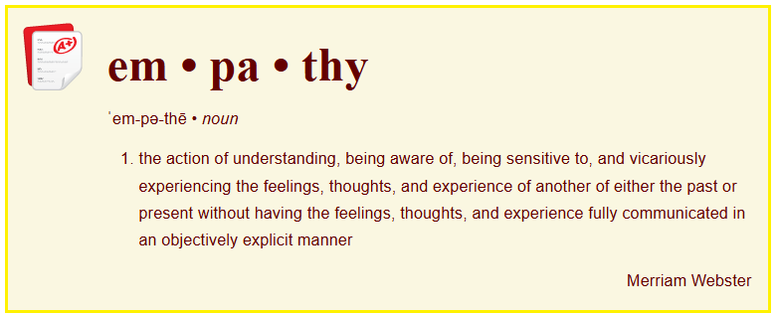
Step 1: Show empathy

Slide 29

Illustration Background
Setting: 6th grade Science Classroom
Time: 8:30 a.m.
Date: October 25

Slide 30

Illustration
Mrs. Hill heads over to Paul’s desk. She sits in a chair next to him at the back of the room at the lab station. She makes sure to be respectful of Paul’s personal space. In a confidential manner, Mrs. Hill says, “Hey, Paul. I noticed you’re sitting away from the desks today. Is there something I can do to help you get started on the bellringer?” “No,” he mumbles into his crossed arms. “I don’t want to do this right now.”

Slide 31
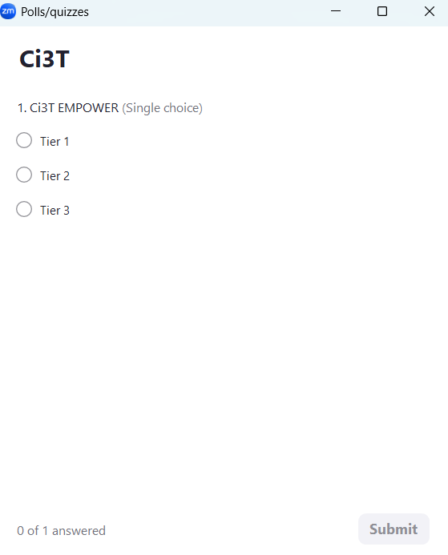


Let’s Chat!
What could Mrs. Hill say to Paul?
Nothing, walk away.
You know the rules, move.
I understand. I’ll check back in a minute

Slide 32
Step 1: Show empathy
What to do
Connect privately
Strategically pause instruction
Body language
Verbally acknowledge & validate emotions
Why to do it
What to avoid

Slide 33
Step 1: Show empathy
What to do
Why to do it
Builds relationships
Less likely to lead to escalation
What to avoid

Slide 34
Step 1: Show empathy
What to do
Why to do it
What to avoid
Harsh & public communication
Overbearing
Long winded

Slide 35
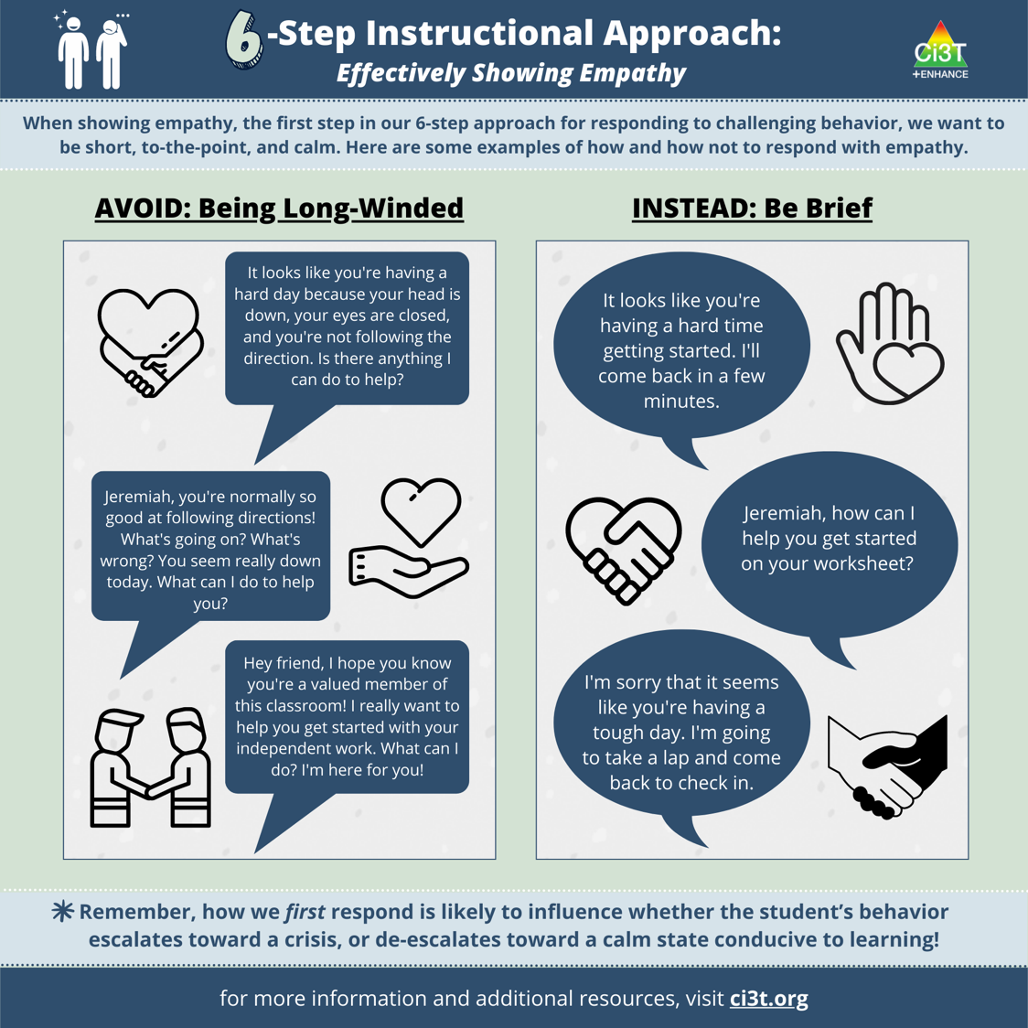

Slide 36

Step 2: Maintain the flow of instruction
What to do
Repeat instructions in a positive, friendly tone
Physical movement
Why to do it
What to avoid

Slide 37
Step 2: Maintain the flow of instruction
What to do
Why to do it
Creates solutions-based environments
What to avoid

Slide 38
Step 2: Maintain the flow of instruction
What to do
Why to do it
What to avoid
Engaging in arguments
Providing too much attention

Slide 39
Illustration
Even though Mrs. Hill sees that Paul is still sitting in the lab station, she keeps instruction moving forward by moving on to check on other students who are getting started on their assignments. She uses active supervision by moving through the classroom, visually scanning the room to see who might need help, and providing positive verbal interactions to acknowledge students who are meeting expectations.

Slide 40


Activity:
Show Empathy Examples and Non-Examples
Come on, just get it done!
It looks like you’re having a hard time getting started, I’ll come back in a few minutes
How can I help you get started on your worksheet?
You need to stop wasting time, please focus.
I'm sorry that it seems like you're having a tough day. I'm going to take a lap and come back to check in.
Nothing (give the student space)

Slide 41
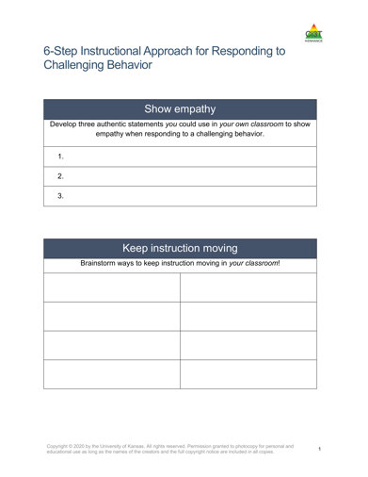
Handout: Show Empathy
Use your handout to record 2-3 empathy statements you could you in your setting!
  Use the examples from the previous slide OR create your own!
www.ci3t.org/pl

Slide 42

Step 3: Acknowledge other students meeting expectations
What to do
Behavior-specific praise
Keep instruction moving forward
Be calm and sincere
Why to do it
What to avoid

Slide 43
Step 3: Acknowledge other students meeting expectations
What to do
Why to do it
Creates a positive, praise-rich environment to reinforce what is expected
What to avoid

Slide 44
Step 3: Acknowledge other students meeting expectations
What to do
Why to do it
What to avoid
Raising voice
Body language that communicates distress or frustration

Slide 45
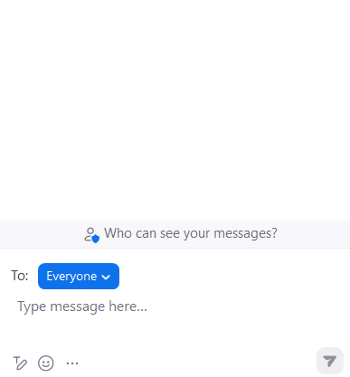
Let’s Chat!
On her way back to Paul, Mrs. Hill notices some students doing an excellent job of solving their selected problems and starting to check their work with their shoulder partner.
What could Mrs. Hill say/do
with other students?

Slide 46
Illustration
Mrs. Hill looks at Liza and Bree and tells them, “You both are doing a great job of explaining your answers.” She hands them a ticket.
Next, Mrs. Hill takes a calming breath, smiles at Paul who is looking her way, and walks over to the lab station. In her mind, she thinks to herself, “You’ve got this…”

Slide 47

Step 4: Redirect and reteach expected behavior
What to do
Redirect the student to the task
Provide reminders
Reteach expected behavior
Why to do it
What to avoid

Slide 48
Step 4: Redirect and reteach expected behavior
What to do
Why to do it
Gives the student a way to get back on track quickly and respectfully
What to avoid

Slide 49
Step 4: Redirect and reteach expected behavior
What to do
Why to do it
What to avoid
Long conversations

Slide 50
Illustration
Mrs. Hill smiles at Paul and makes eye contact. She says, “Paul, you did great with these problems yesterday. Remember, the digestive system diagram you will need is right here in the book [pointing to the box with the diagram].
The good news is you can pick any five questions you would like.” Mrs. Hill points to the answer sheet and says, “Which one would you like to start with?”

Slide 51
Let’s Chat:
How could you keep instruction moving in your setting?

Slide 52
Handout: Keep Instruction Moving
Write down ways you can keep instruction moving in your setting
  Consider new ideas shared in the chat!
www.ci3t.org/pl

Slide 53

Step 5: Allow time and space
What to do
Offer choice to get back on track
Why to do it
What to avoid

Slide 54
Step 5: Allow time and space
What to do
Why to do it
Reduces perceived tension or pressure
What to avoid

Slide 55
Step 5: Allow time and space
What to do
Why to do it
What to avoid
Hovering

Slide 56
Illustration
After suggesting to Paul, he begin either #1 or #5 to, Mrs. Hill steps away and checks on Ben, a student seated close to the lab station.
She smiles at Ben, nodding at the progress he has made thus far and says, “Great progress, Ben. Looks like you are just about ready to talk through your answers with Paul.”

Slide 57
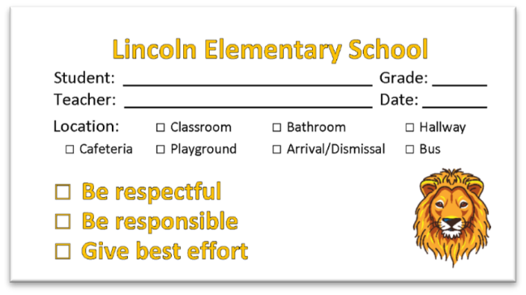
Step 6: Recognize and reinforce expected behavior when demonstrated
What to do
Provide the student with
a reinforcer
Why to do it
What to avoid

Slide 58
Step 6: Recognize and reinforce
expected behavior when demonstrated
What to do
Why to do it
Performance feedback
What to avoid

Slide 59
Step 6: Recognize and reinforce
expected behavior when demonstrated
What to do
Why to do it
What to avoid
Being too enthusiastic

Slide 60
Illustration
Out of the corner of her eye, Mrs. Hill notices Paul has moved to sitting in a desk next to Ben and completed #5. Mrs. Hill says, “Terrific, Paul. I appreciate you getting started. Thank you for sitting with Ben to talk through your answers.”
She hands both Paul and Ben a ticket. Paul somewhat reluctantly takes the ticket from Mrs. Hill’s hand and smirks a half-smile. “Thanks, Mrs. Hill. Are you ready, Ben?” says Paul.

Slide 62
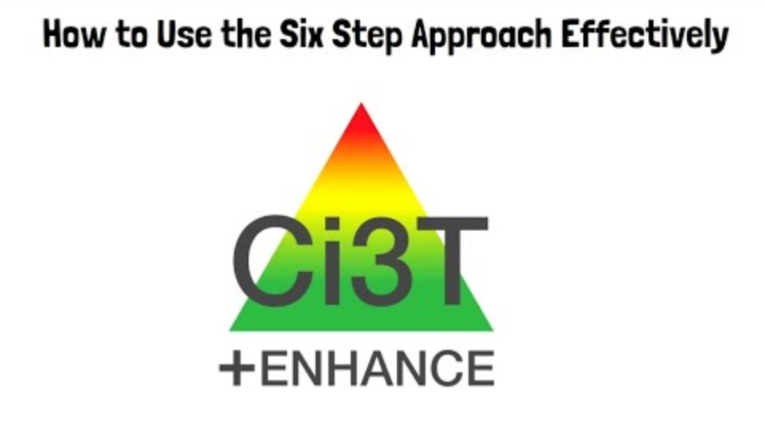
Notes:
Frame: video show what the 6-step looks like from start to finish. You might consider sharing this illustration with your PLC ,grade-level team, or with full faculty and staff

Slide 63




















Let’s Talk!
Open the module A Six-Step Instructional Approach to Responding to Challenging Behavior
Complete one of the simulations
Discuss:
  What about the 6-Step approach do you find easiest to implement?
  What about the 6-Step approach might be challenging?
  What are some potential ways to address these challenges?
Notes:
15-min timer

Slide 64
Connecting Students to More Intensive Interventions

Slide 66
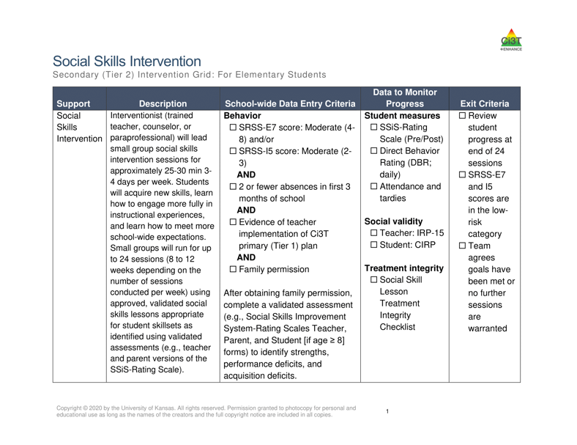
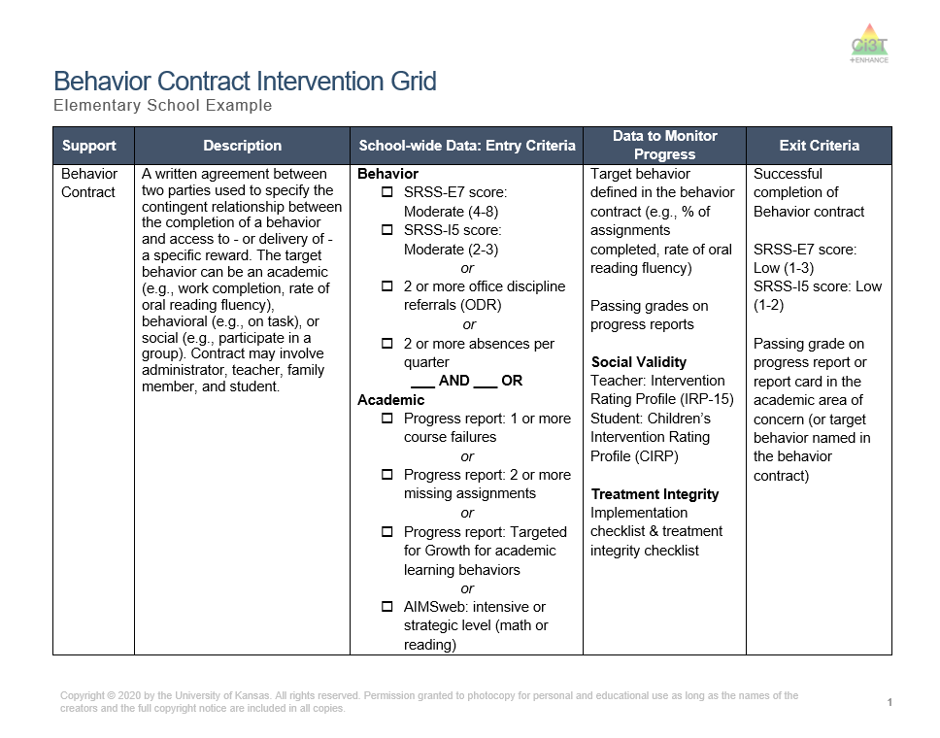


Tier 2 Supports
Notes:
Tier 1 is not always going to be enough. Tier 2 supports such as behavior contracts or social skills might be needed. The Secondary (Tier 2) Intervention Grids in your Ci3T Implementation Manual highlight the Tier 2 interventions offered at your school. Use the grids alongside screening data to connect students with Tier 2 intervention.

Slide 67

Join us at future EMPOWER+ to learn more!
EMPOWER+ Session | Date
Starting Strong: Effective Tier 1 Practices for Educators | September 24, 2025 (Wednesday)
From Data to Action: Using Systematic Screening to Inform Instruction | October 8, 2025 (Wednesday)
Ci3T In Action: Integrated Lesson Planning for Enhanced Instruction | November 18, 2025 (Tuesday)
Mastering Behavior Specific Praise and Precorrection | January 21, 2026 (Wednesday)
A 6-Step Instructional Approach for Responding to Challenging Behaviors: A Tier 1 Practice | February 10, 2026 (Tuesday)
A Tier 2 Support for Students Experiencing Anxious Feelings: Recognize. Relax. Record. | March 25, 2026 (Wednesday)
A Tier 3 Support for Students with Intensive Intervention Needs: Functional Assessment-Based Intervention (FABI) | April 28, 2026 (Tuesday)

Slide 68
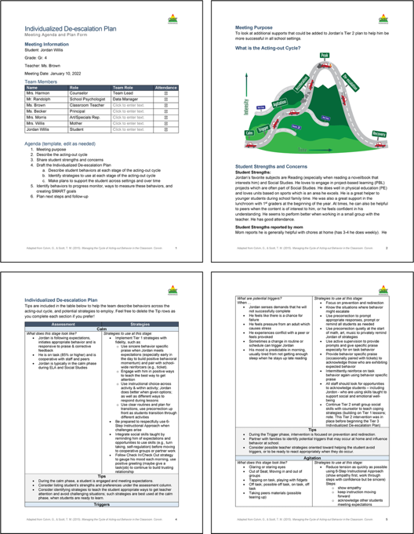
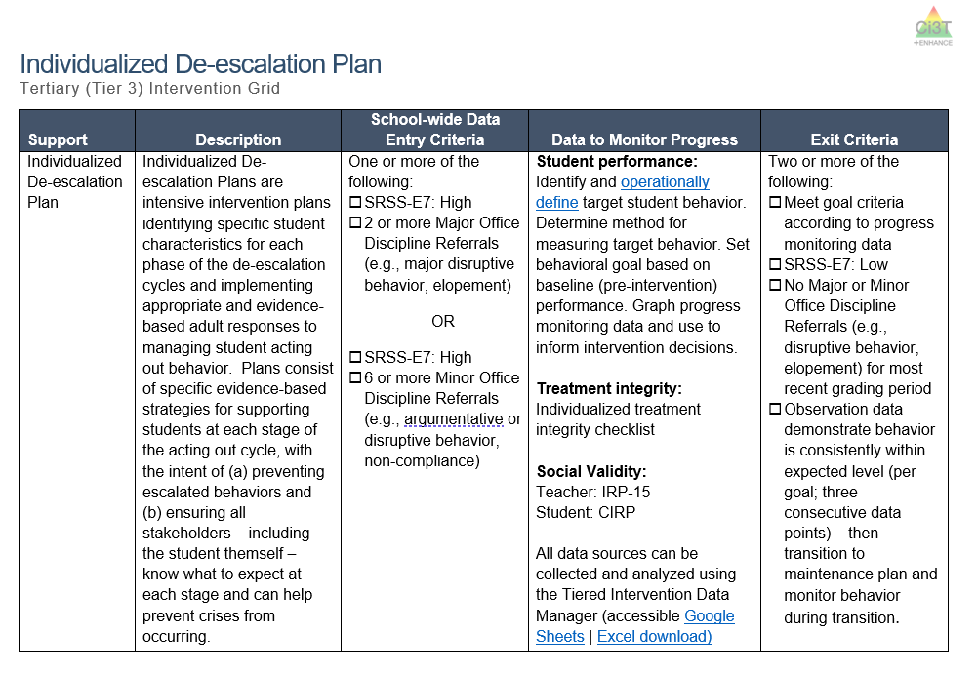
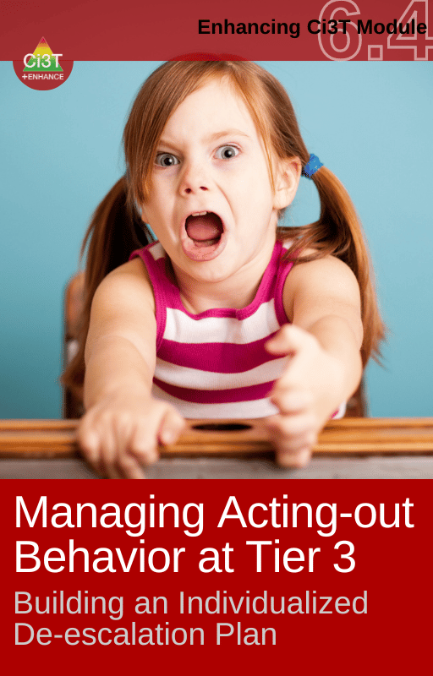
Tier 3 Supports
Notes:
For students with exceptionally challenging behaviors, Tier 3 supports such as an individualized de-escalation plan may be needed.

Slide 69

Join us at future EMPOWER+ to learn more!
EMPOWER+ Session | Date
Starting Strong: Effective Tier 1 Practices for Educators | September 24, 2025 (Wednesday)
From Data to Action: Using Systematic Screening to Inform Instruction | October 8, 2025 (Wednesday)
Ci3T In Action: Integrated Lesson Planning for Enhanced Instruction | November 18, 2025 (Tuesday)
Mastering Behavior Specific Praise and Precorrection | January 21, 2026 (Wednesday)
A 6-Step Instructional Approach for Responding to Challenging Behaviors: A Tier 1 Practice | February 10, 2026 (Tuesday)
A Tier 2 Support for Students Experiencing Anxious Feelings: Recognize. Relax. Record. | March 25, 2026 (Wednesday)
A Tier 3 Support for Students with Intensive Intervention Needs: Functional Assessment-Based Intervention (FABI) | April 28, 2026 (Tuesday)

Slide 70
Wrapping Up and Moving Forward

Slide 71
Action Items
Action Item | Person(s) Responsible | Planned Completion Date | Date Completed
Submit BCBA CEU form with four passwords | Kathleen
Locate my school’s Reactive Plan: Is the 6-step instructional approach for responding to challenging behavior included? | Kathleen
Print out the infographic, email to grade level and department team, post in my classroom | Kathleen & Amy

Slide 72
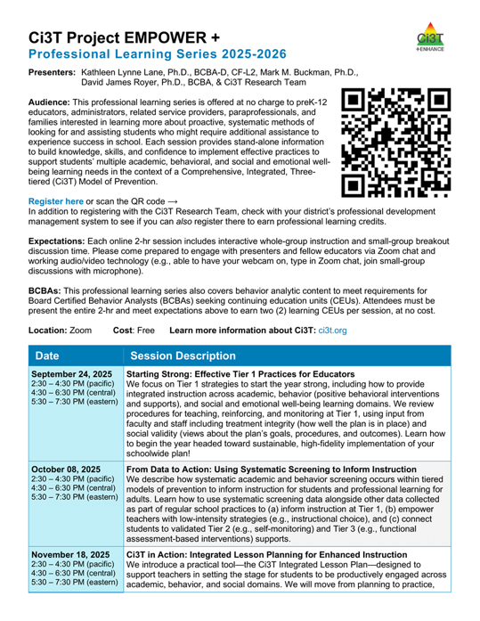
Project EMPOWER+
EMPOWER+ Session | Date
Starting Strong: Effective Tier 1 Practices for Educators | September 24, 2025 (Wednesday)
From Data to Action: Using Systematic Screening to Inform Instruction | October 8, 2025 (Wednesday)
Ci3T In Action: Integrated Lesson Planning for Enhanced Instruction | November 18, 2025 (Tuesday)
Mastering Behavior Specific Praise and Precorrection | January 21, 2026 (Wednesday)
A 6-Step Instructional Approach for Responding to Challenging Behaviors: A Tier 1 Practice | February 10, 2026 (Tuesday)
A Tier 2 Support for Students Experiencing Anxious Feelings: Recognize. Relax. Record. | March 25, 2026 (Wednesday)
A Tier 3 Support for Students with Intensive Intervention Needs: Functional Assessment-Based Intervention (FABI) | April 28, 2026 (Tuesday)

Slide 73
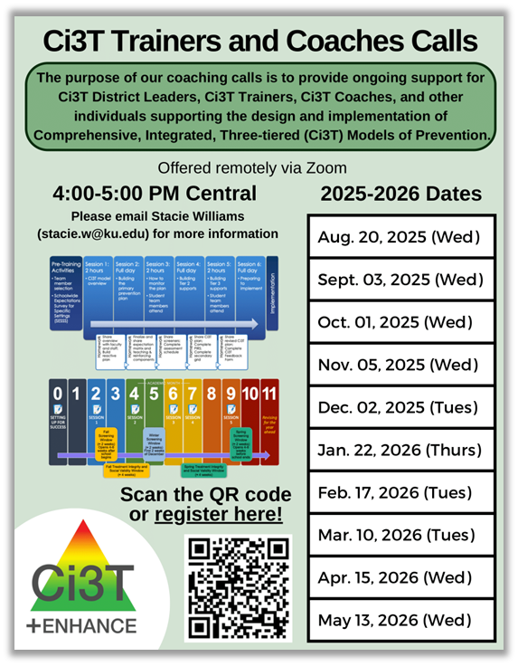
Ci3T Trainers and Coaches Calls
Ci3T Trainers and Coaches Calls Session | Date
Ci3T Trainers and Coaches Call 1 | August 20, 2025 (Wednesday)
Ci3T Trainers and Coaches Call 2 | September 3, 2025 (Wednesday)
Ci3T Trainers and Coaches Call 3 | October 1, 2025 (Wednesday)
Ci3T Trainers and Coaches Call 4 | November 5, 2025 (Wednesday)
Ci3T Trainers and Coaches Call 5 | December 2, 2025 (Tuesday)
Ci3T Trainers and Coaches Call 6 | January 22, 2026 (Thursday)
Ci3T Trainers and Coaches Call 7 | February 17, 2026 (Tuesday)
Ci3T Trainers and Coaches Call 8 | March 10, 2026 (Tuesday)
Ci3T Trainers and Coaches Call 9 | April 15, 2026 (Wednesday)
Ci3T Trainers and Coaches Call 10 | May 13, 2026 (Wednesday)

Slide 74

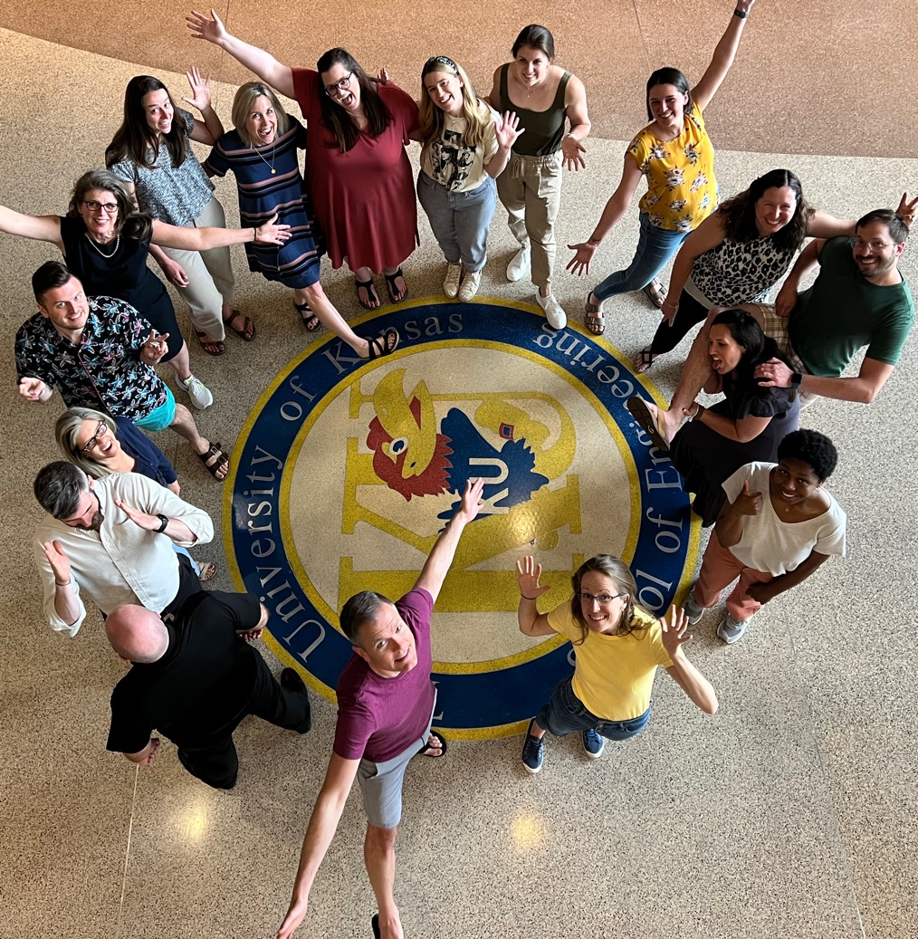

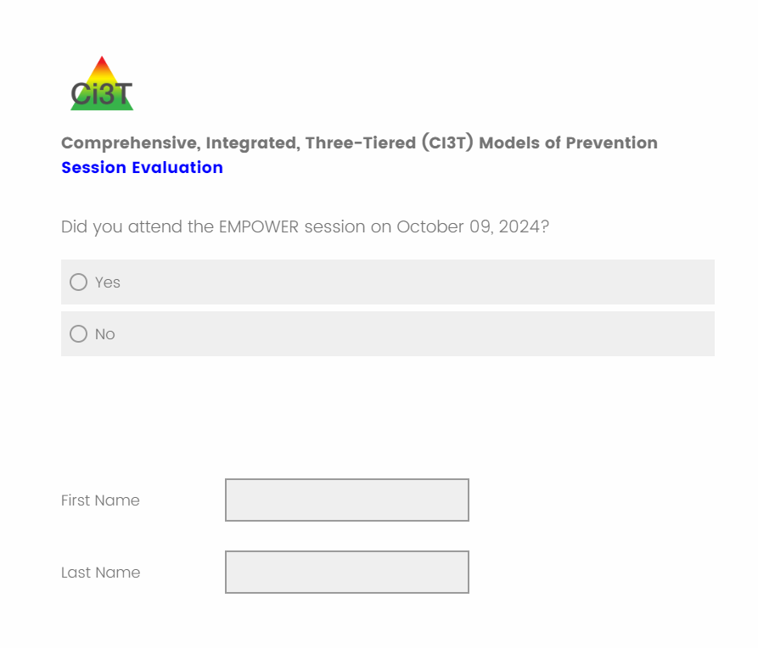
Thank you!
Thank you!
ci3t.org
#Ci3T
@Ci3Tmodel
Tag us in your Ci3T highlights, we love to see Ci3T in action!
Follow us on Instagram for updates and new resources!
Notes:
Tag us in your Ci3T highlights- we would love to see Ci3T in action! Follow us on Instagram for updates and links to resources! @Ci3TModel
You will receive a brief session evaluation – we value your feedback and would greatly appreciate you taking a few minutes to share your thoughts on what you liked about the session and how we can improve

