Slide 1
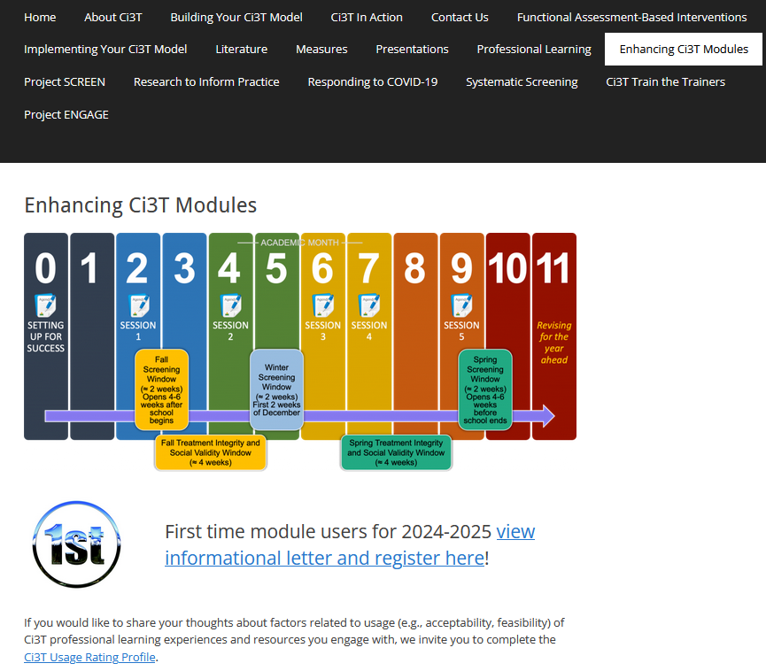
Ci3T in Action: Integrated Lesson Planning for Enhanced Instruction
EMPOWER+ Session 3
If you have not done so already, we invite you to visit ci3t.org/enhance to access modules after a one-time registration process!

Slide 2
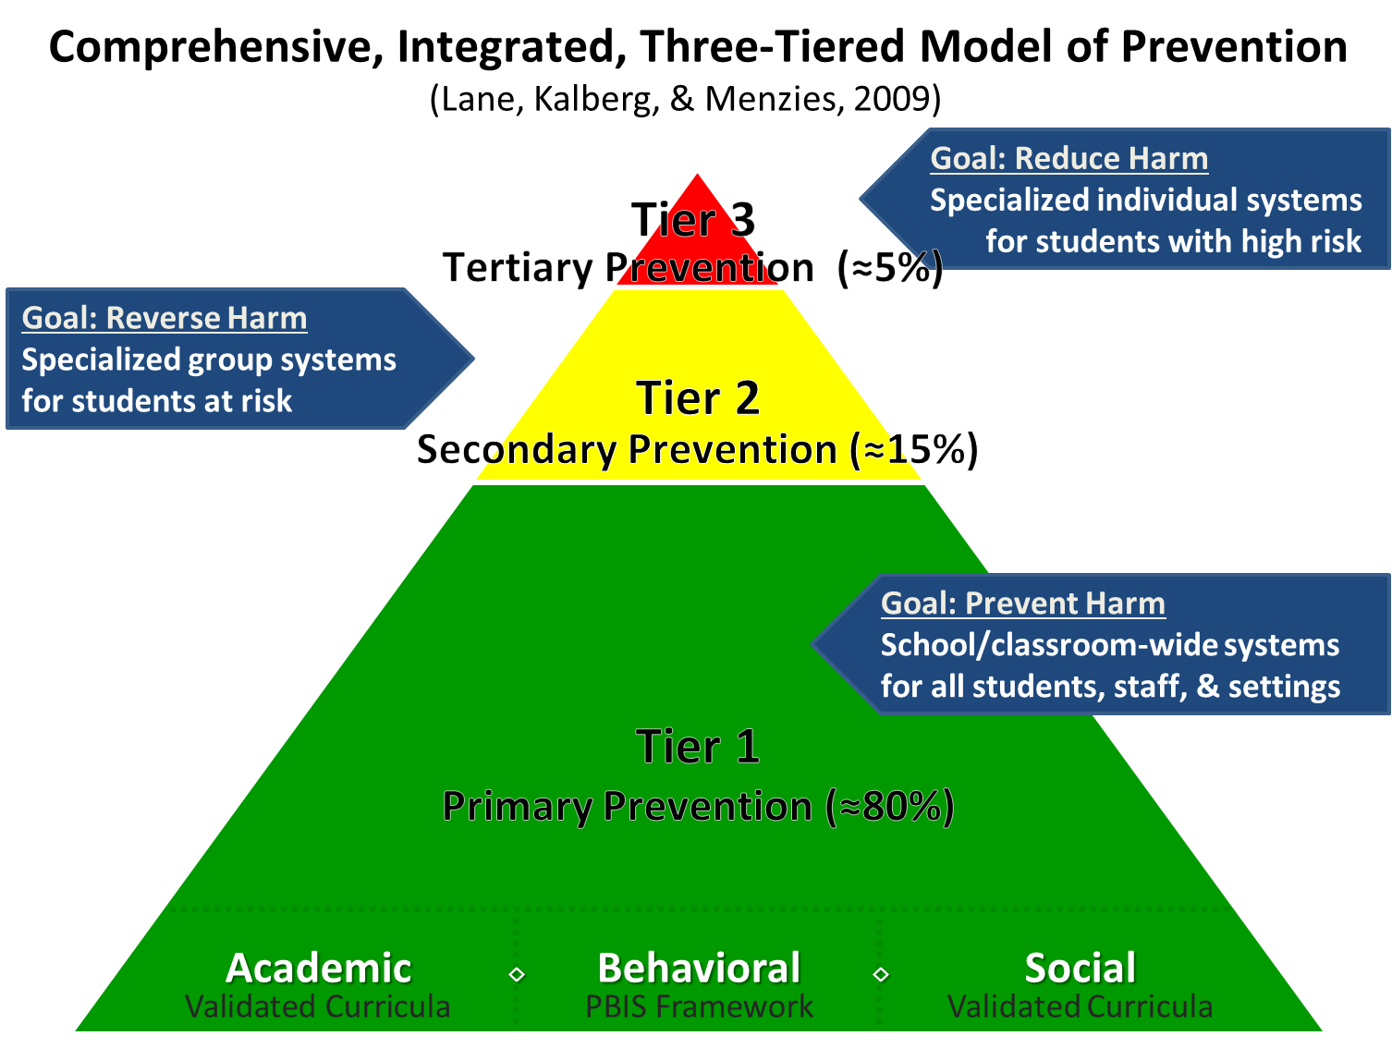
Comprehensive, Integrated, Three-Tiered Model of Prevention

Slide 3
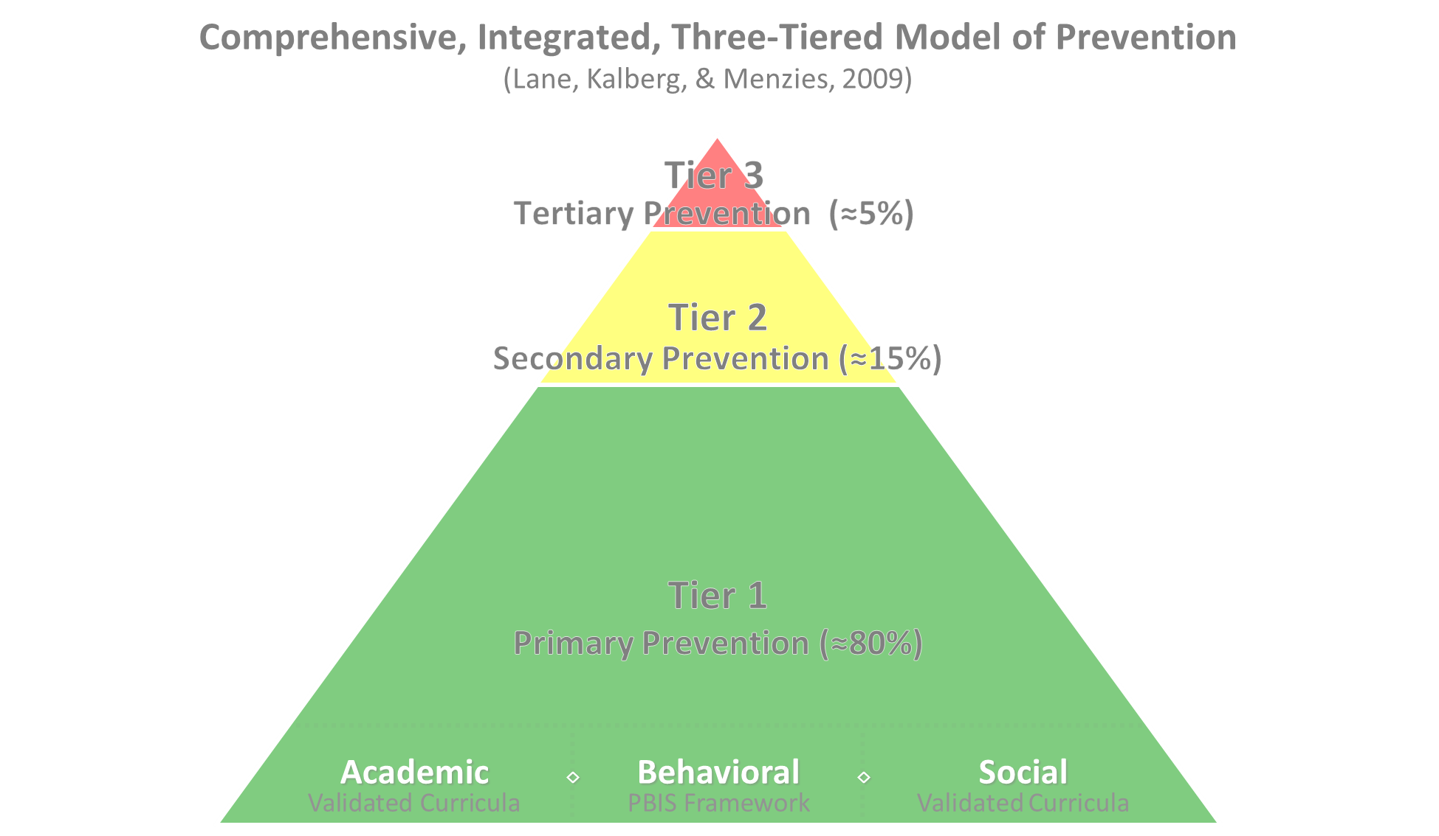


Positive Behavioral Interventions and Supports
District & State Standards Quality Instruction
Validated Curricula and Resources

Slide 4

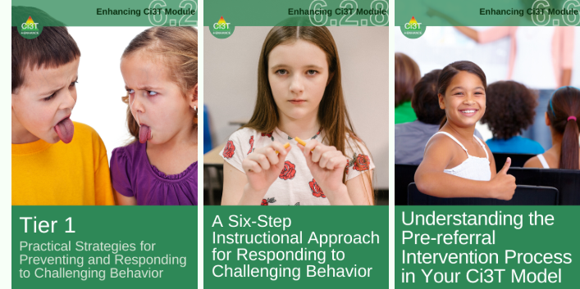
Primary Prevention (Tier 1)

Slide 5

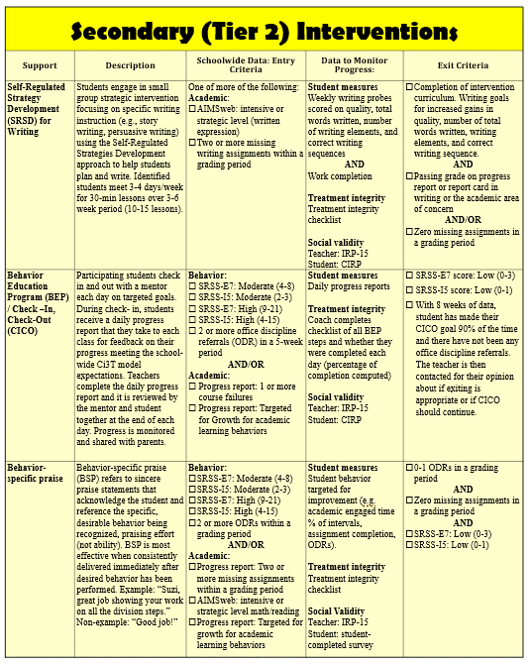
Secondary (Tier 2) Intervention Grid
Notes:
In addition to the module featured here outlining how to use multiple sources of data to connect students with Tier 2 supports, we offer a full suite of modules highlighting validated Tier 2 interventions such as Self-Regulated Strategy Development (SRSD) for Writing and Check-In/Check Out that may appear in your Secondary (Tier 2) Intervention Grid

Slide 6

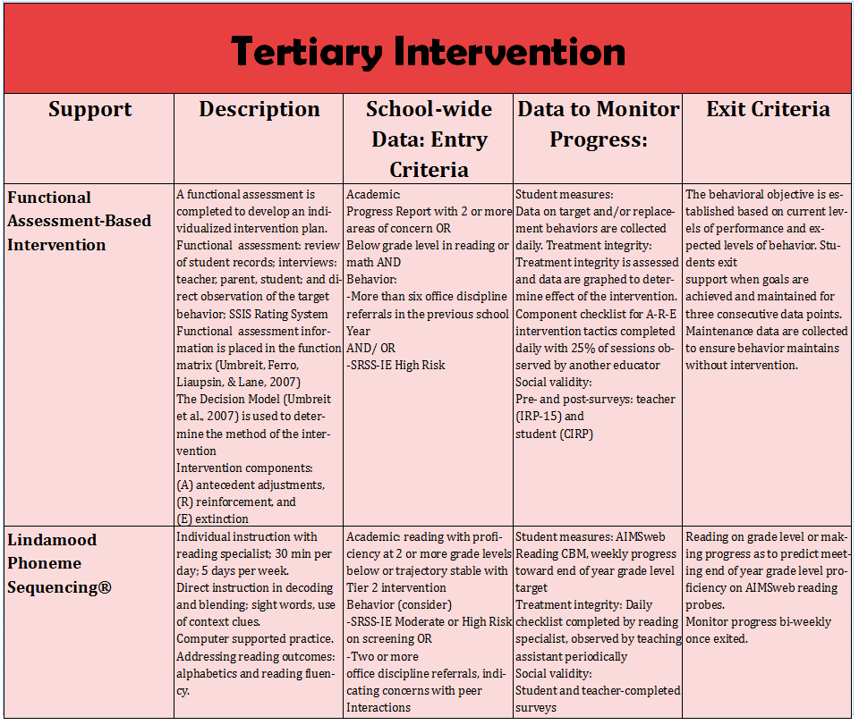
Tertiary (Tier 3) Intervention Grid
Notes:
In addition to the module featured here outlining how to use multiple sources of data to connect students with Tier 3 supports, we offer a full suite of modules highlighting validated Tier 3 interventions such as Functional Assessment-Based Intervention (FABI) that may appear in your Tertiary (Tier 3) Intervention Grid

Slide 7

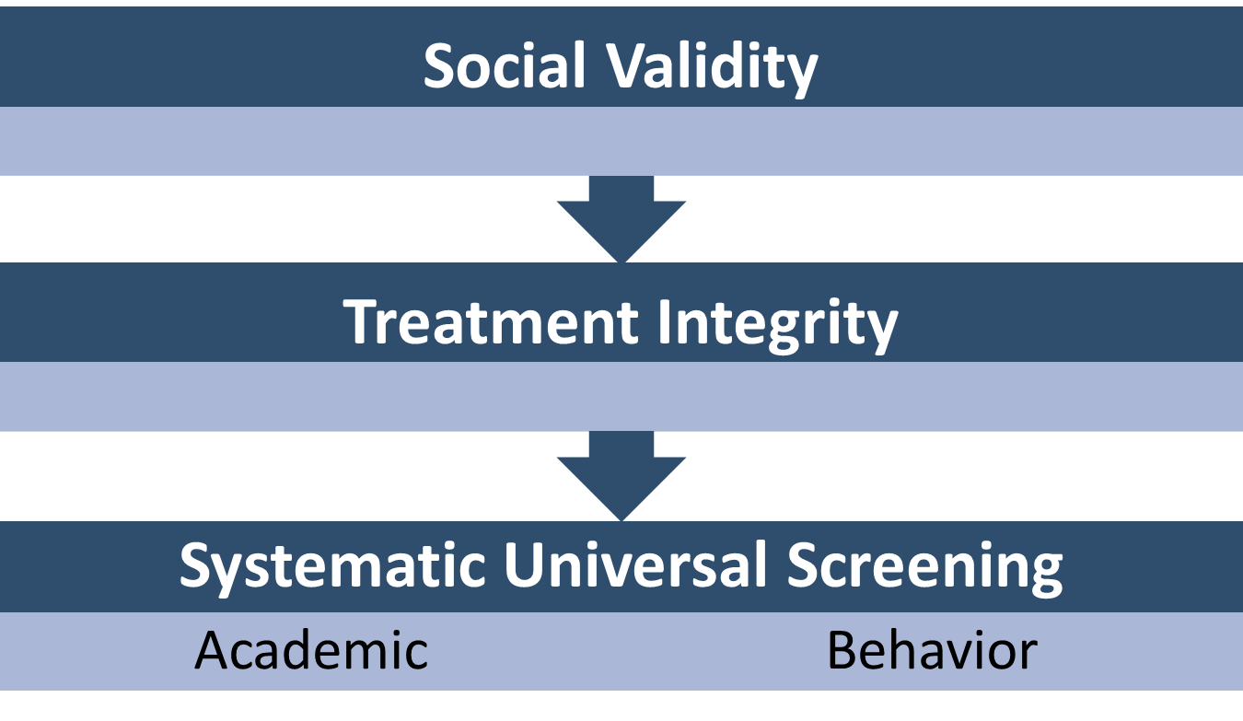

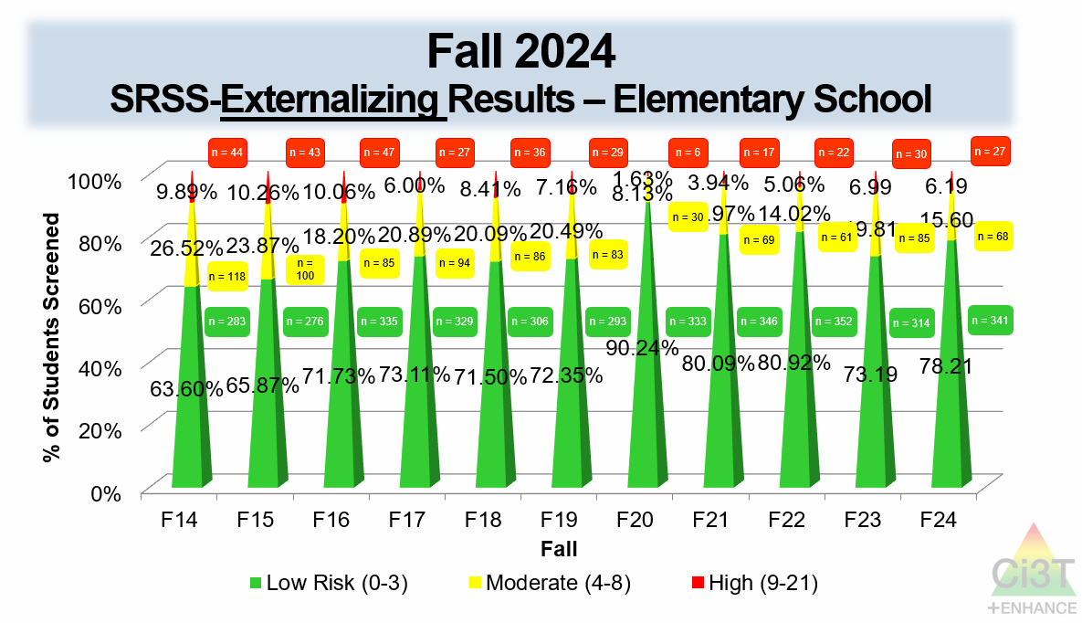
Essential Components of Primary (Tier 1) Prevention Efforts

Slide 8


Enhancing Ci3T Modules
ci3t.org/enhance

Slide 9
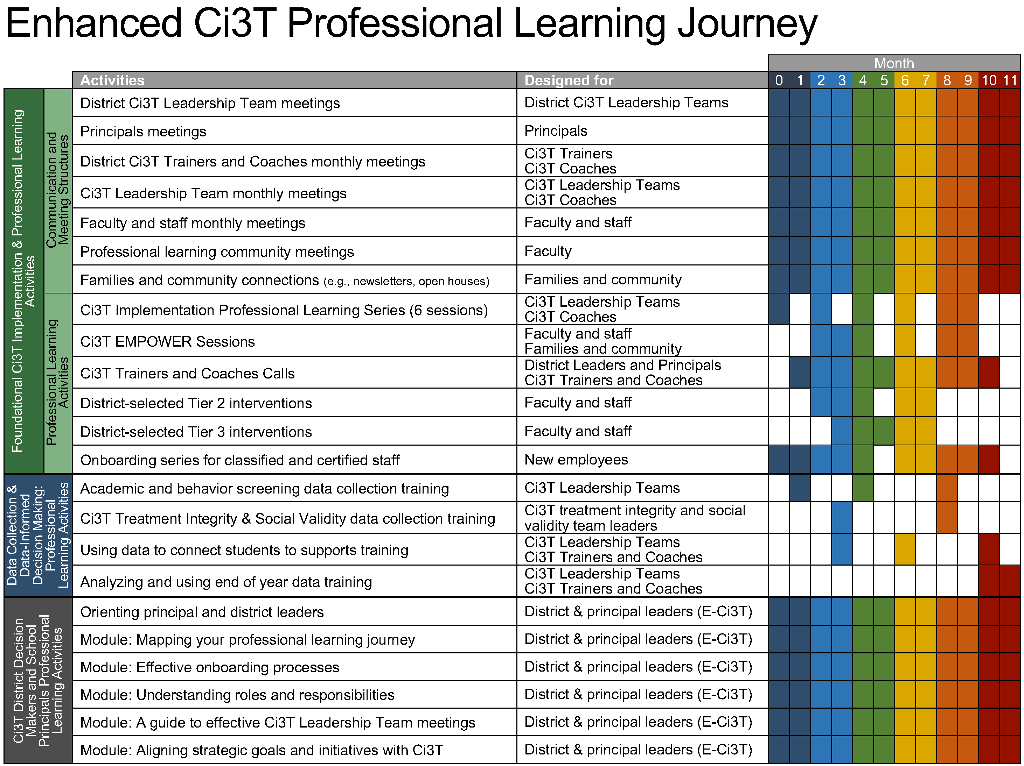
Enhanced Ci3T Implementation Series and Delivery

Slide 10

Session Outcomes
Describe key features of the Ci3T Integrated Lesson Plan
Prepare learning objectives for academic, behavior, and social and emotional well-being learning domains
Identify opportunities to incorporate low-intensity strategies into instruction
If you are a Board Certified Behavior Analyst (BCBA), you may accrue up to 2 learning continuing education units (CEUs) for attending this session. See agenda for task list alignment. Throughout the session we will share 4 key words, write those down to turn in after the session!

Slide 11
Agenda
Welcome
Describing Key Features of Ci3T Integrated Lesson Plans
Developing Clear Objectives for Learning Domains
Incorporating Low-intensity Strategies to Increase Engagement
Wrapping Up and Moving Forward

Slide 12
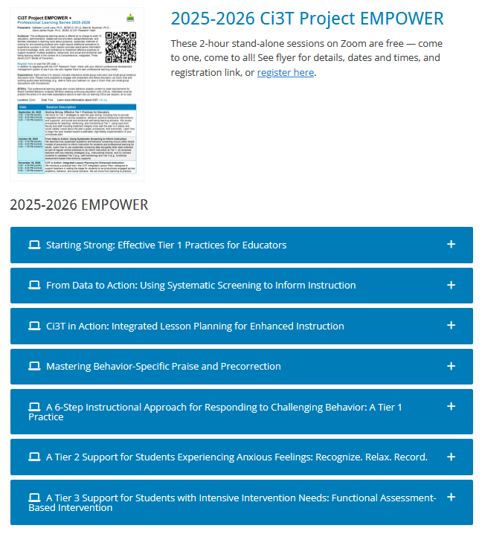
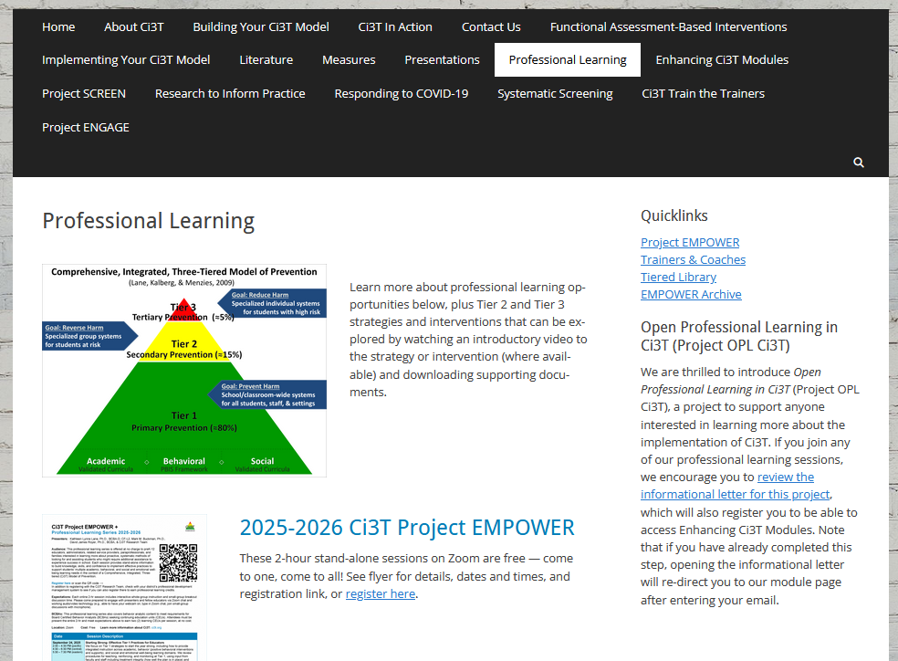
Accessing Professional Learning Materials
ci3t.org/pl

Slide 13
Describing Key Features of Ci3T Integrated Lesson Plans

Slide 14

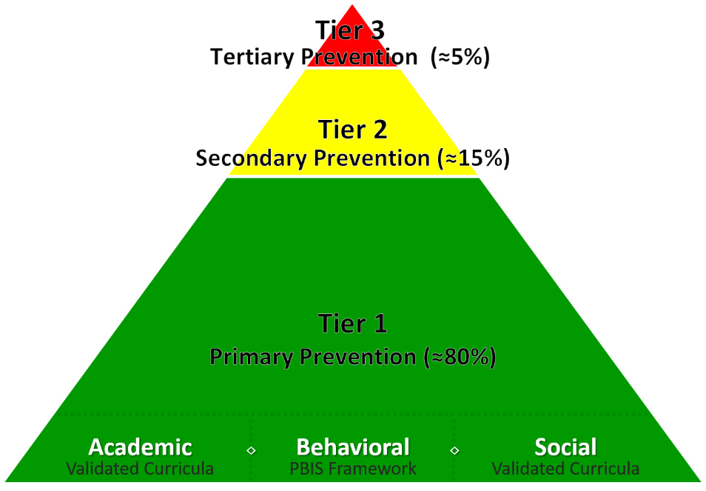
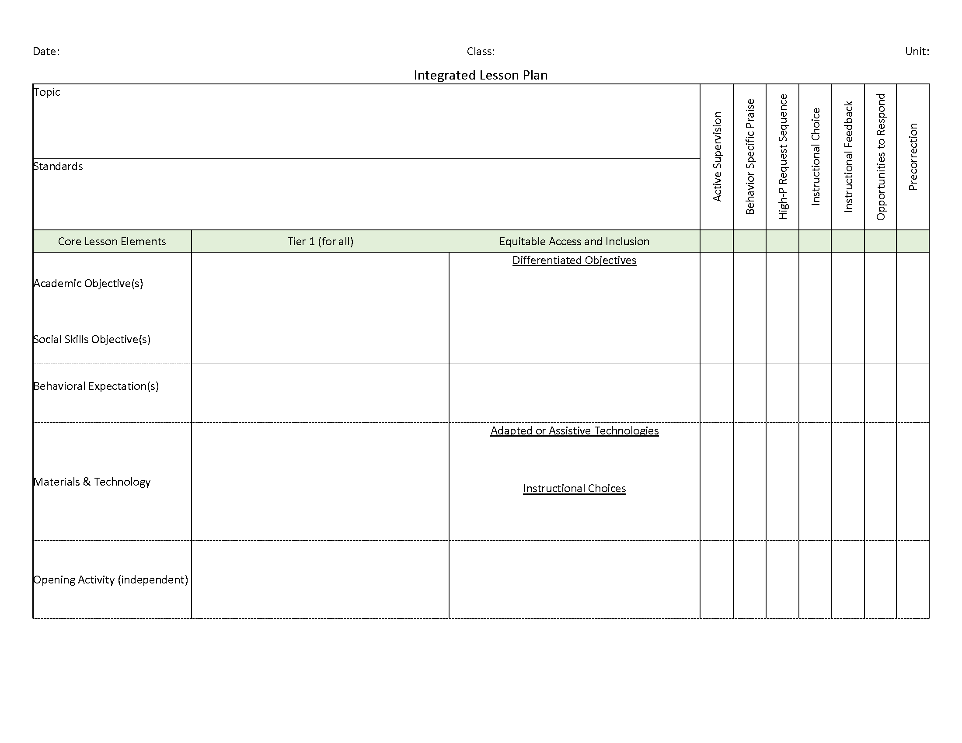
Ci3T Integrated Lesson Planning
Citation. Oakes, W. P., Lane, K. L., Lane, K. S., & Buckman, M. M. (2019). Ci3T integrated lessons plan template. www.ci3t.org.
Completed examples available in: Ci3T Project ENHANCE Research Team. (2022, July). Embedding and integrating Ci3T domains into daily instruction. Author. https://doi.org/10.17161/ci3t.42880

Slide 15
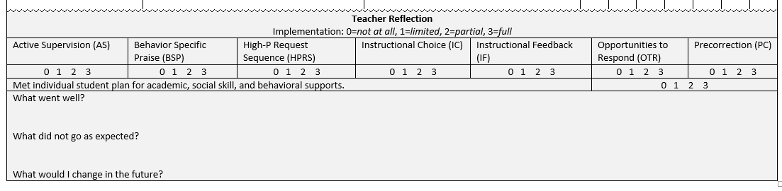
Integrated Lesson Plan
Citation. Oakes, W. P., Lane, K. L., Lane, K. S., & Buckman, M. M. (2019). Ci3T integrated lessons plan template. www.ci3t.org.​

Slide 16
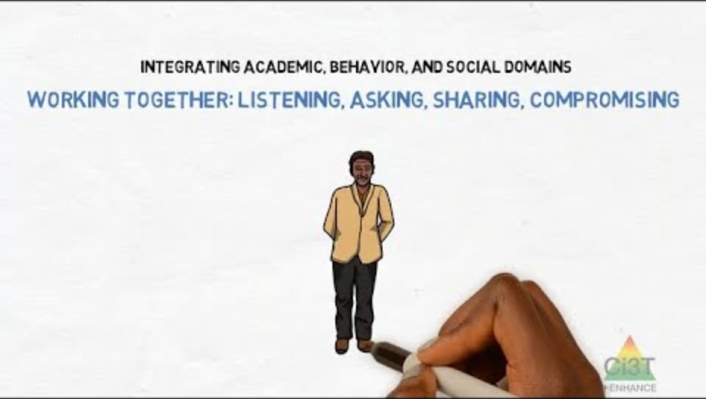
Integrated Lesson Plan: An Illustration
Notes:
Watch video 01:40

Slide 17
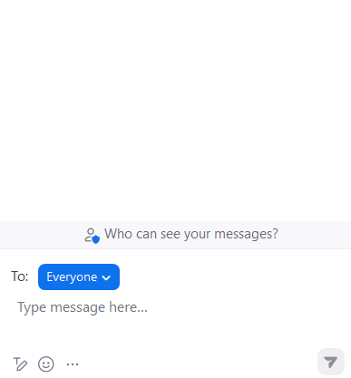


Let’s Chat!
What are your initial thoughts and reactions?
  What seems most feasible?
  What seems most challenging?

Slide 18

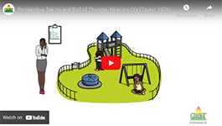
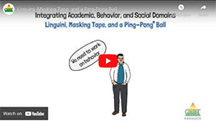
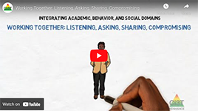
Ci3T: An Integrated Approach
Citation. Oakes, W. P., Lane, K. L., Lane, K. S., & Buckman, M. M. (2019). Ci3T integrated lessons plan template. www.ci3t.org.​
Completed examples available in: Ci3T Project ENHANCE Research Team. (2022, July). Embedding and integrating Ci3T domains into daily instruction. Author. https://doi.org/10.17161/ci3t.42880

Slide 19
Developing Clear Objectives for Learning Domains

Slide 20
Clarifying Lesson Objectives
What academic skills (see standards) will students practice?
What social skills (see Tier 1 curriculum) will students apply?
What behavior expectations (see Expectation Matrix) will students demonstrate?
Citation. Oakes, W. P., Lane, K. L., Lane, K. S., & Buckman, M. M. (2019). Ci3T integrated lessons plan template. www.ci3t.org.​
Completed examples available in: Ci3T Project ENHANCE Research Team. (2022, July). Embedding and integrating Ci3T domains into daily instruction. Author. https://doi.org/10.17161/ci3t.42880

Slide 21
Social Skills Objective
Which social skills do students need to successfully engage in the lesson?
Are there opportunities to make connections to the Tier 1 social skills curriculum?

Slide 22
Example Social Skills Objectives
Share materials with peers and return them upon request without argument
Use encouraging language (e.g., “good try,” “nice work”) with teammates
Listen without interruption while their partner explains their thinking
Demonstrate active listening behaviors (e.g., eye contact, nodding, paraphrasing)
During peer-editing, students will provide at least two positive comments and one constructive suggestion to their partner
Disagree with peers by using respectful sentence starters (e.g., “I see your point, but I think…”)

Slide 23
Tip: From General to Specific
General | Specific
Participate in Class Discussion | allow others to question their reasoning without interruption use evidence-based arguments and respond to peers without personal attacks wait until peers finish speaking before responding acknowledge different viewpoints during class discussions by paraphrasing or summarizing a peer’s idea before responding with their own
Navigate conflict | negotiate roles (e.g., lead experimenter, data analyst) and carry them out with minimal teacher intervention resolve disagreements by revisiting steps and agreeing on the final answer collaboratively use an “I statement” (e.g., “I feel…when…because…”) to address concerns respectfully resolve disagreements by proposing at least one compromise rather than relying on teacher intervention

Slide 24
Elementary Illustration
Lesson Overview: The teacher models solving addition problems with regrouping using base-ten blocks. Students then work in pairs to solve problems, first with manipulatives, then on paper
Academic Objective: Students will be able to use base-10 blocks to model and solve two-digit addition problems with regrouping

Slide 25
Elementary Illustration : Social Skills Objective
Which social skills do students need to successfully engage in the lesson

Slide 26

Behavioral Expectations
Which behaviors from our expectation matrix will students demonstrate during the lesson?

Slide 27
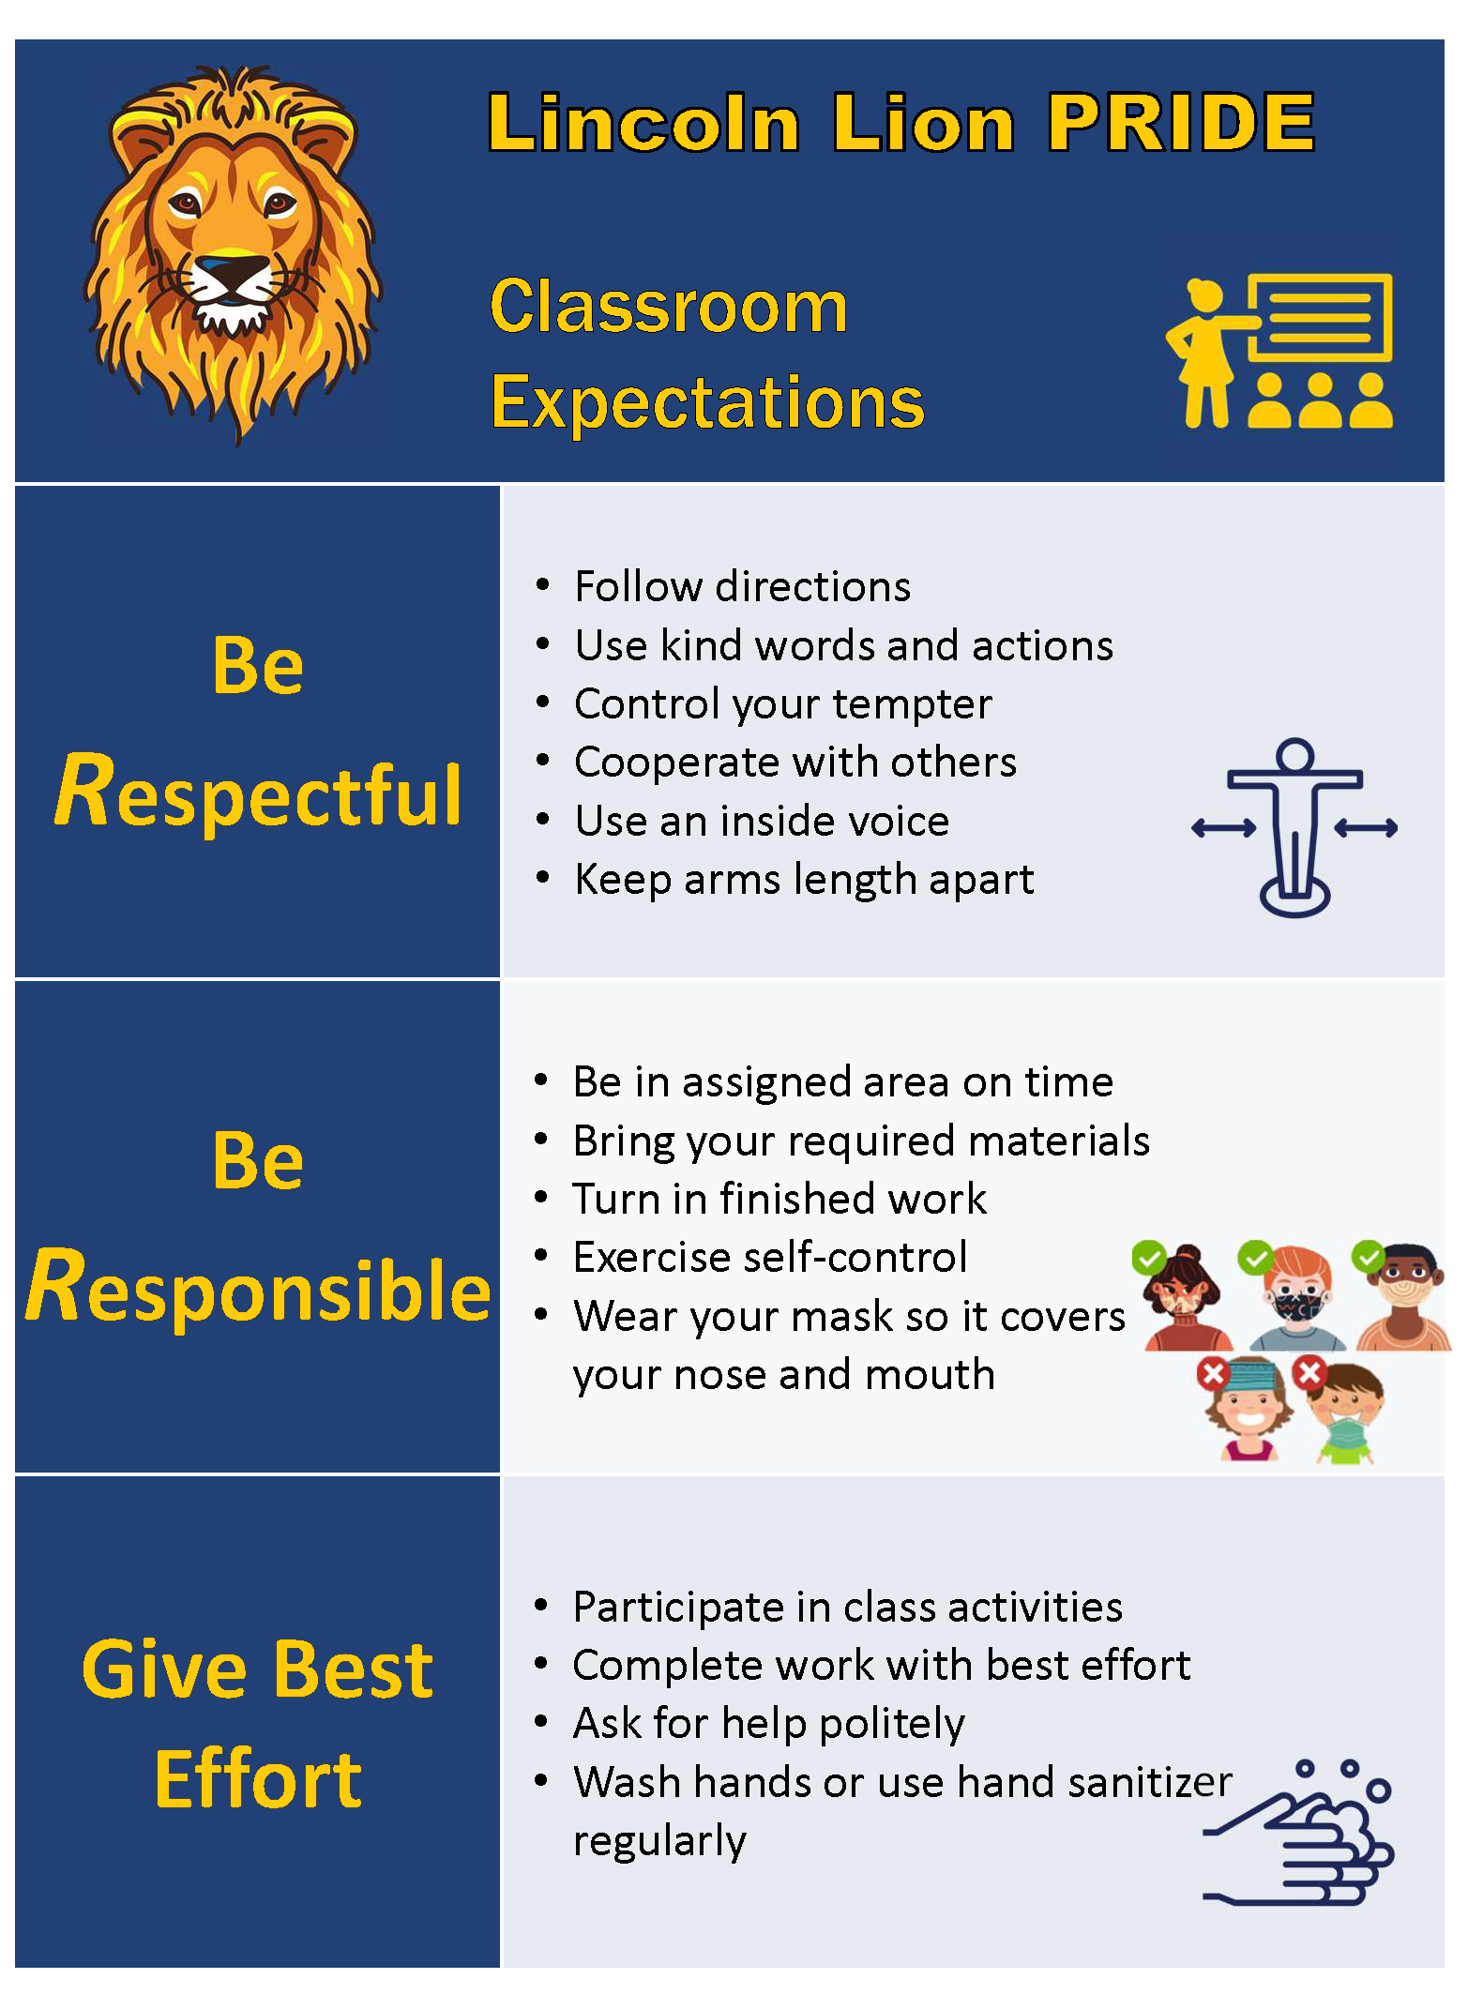
Example Behavioral Expectations
Use digital tools and online platforms responsibly
Listen when a teacher or peer is talking
Arrive on-time with required materials (e.g., notebook, charged device, homework)
Keep hands, feet, and objects to yourself
Raise your hand to ask for help
Sit “crisscross” or in your own space during group time

Slide 28
Secondary Illustration
Lesson Overview: After reading a short story in class, students work in pairs to brainstorm possible themes and evidence. The class then holds a structured discussion where students practice connecting ideas and supporting claims with text.
Academic Objective: Students will be able to identify the theme of a short story and cite two pieces of textual evidence to support their claim

Slide 29
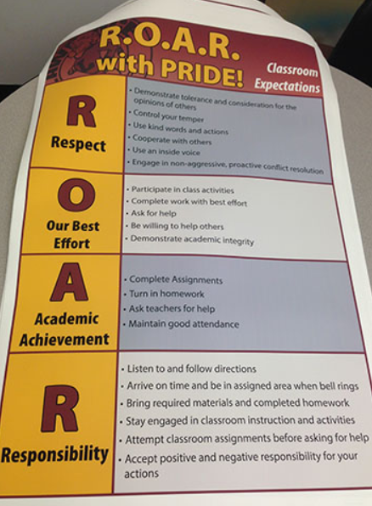
Secondary Illustration: Behavioral Expectations
Which behaviors will students demonstrate during the lesson

Slide 30
Accessing Professional Learning Materials
ci3t.org/pl

Slide 31

















Work Time
Open an upcoming lesson plan or the sample lesson handout
Write a social skills objective based on:
  social skills students will need to successfully engage in the lesson
  connections to your district’s Tier 1 social skills curriculum
Write a behavioral objective connected to your school-wide expectations
Notes:
15-min timer

Slide 32
Incorporating Low-intensity Strategies to Increase Engagement

Slide 33
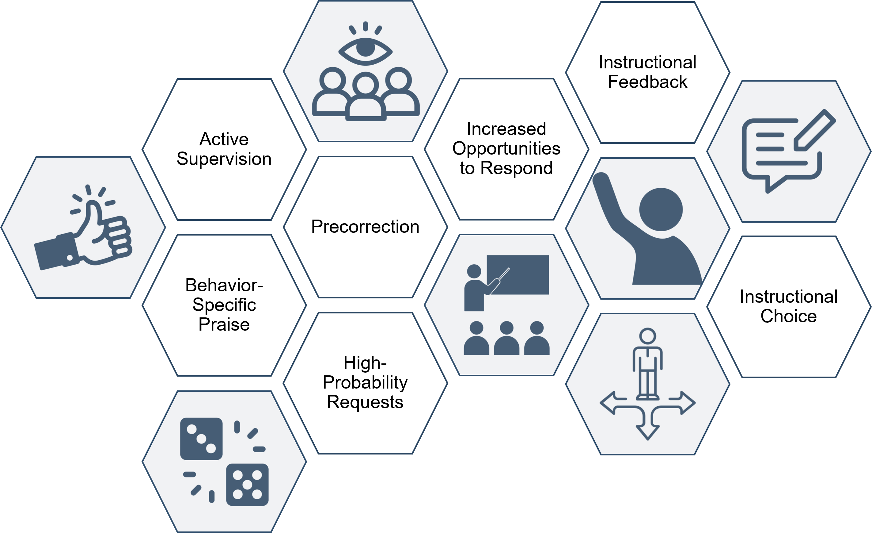
Opportunities to Incorporate Low-Intensity Strategies
Where in my lesson might I incorporate a low-intensity strategy?
Citation. Oakes, W. P., Lane, K. L., Lane, K. S., & Buckman, M. M. (2019). Ci3T integrated lessons plan template. www.ci3t.org.​
Completed examples available in: Ci3T Project ENHANCE Research Team. (2022, July). Embedding and integrating Ci3T domains into daily instruction. Author. https://doi.org/10.17161/ci3t.42880

Slide 34
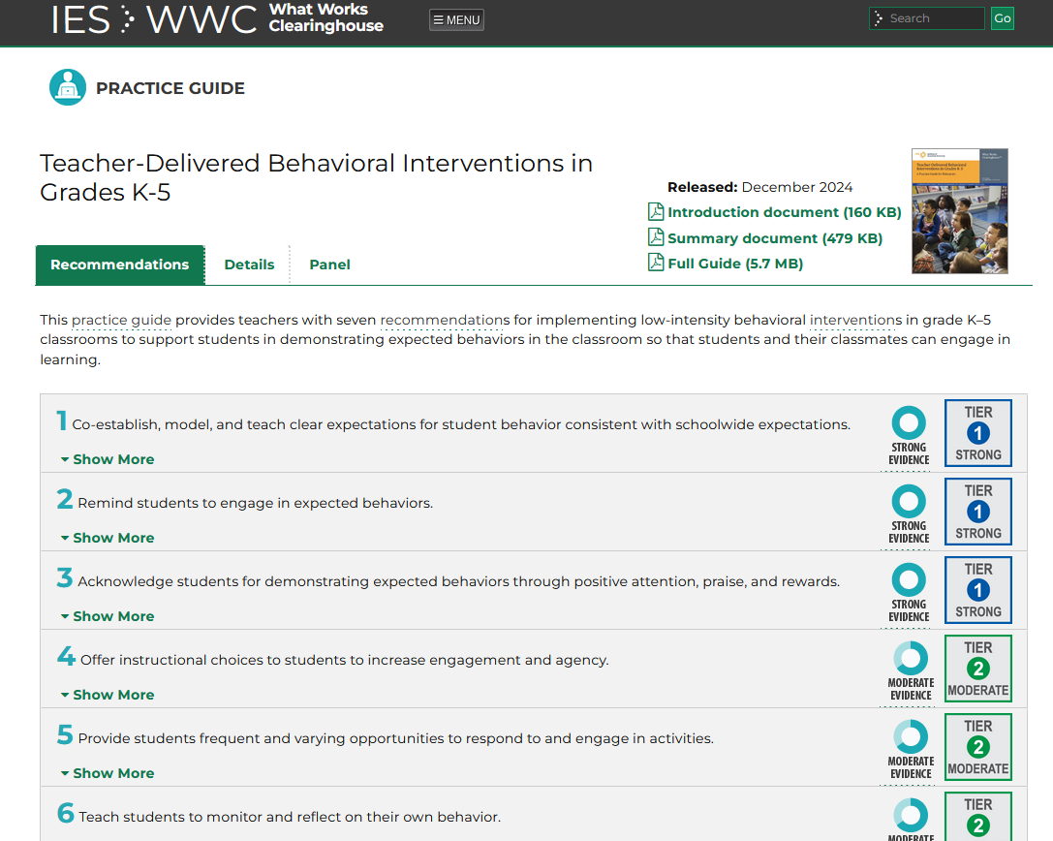

Resource Spotlight!
Notes:
What Works Clearing House Practice Guide – Teacher-Delivered Behavioral Interventions in Grades K-5- https://ies.ed.gov/ncee/wwc/PracticeGuide/31
Notice similar strategies and connections. In this presentation, we will situate these low-intensity strategies withing Ci3T

Slide 35

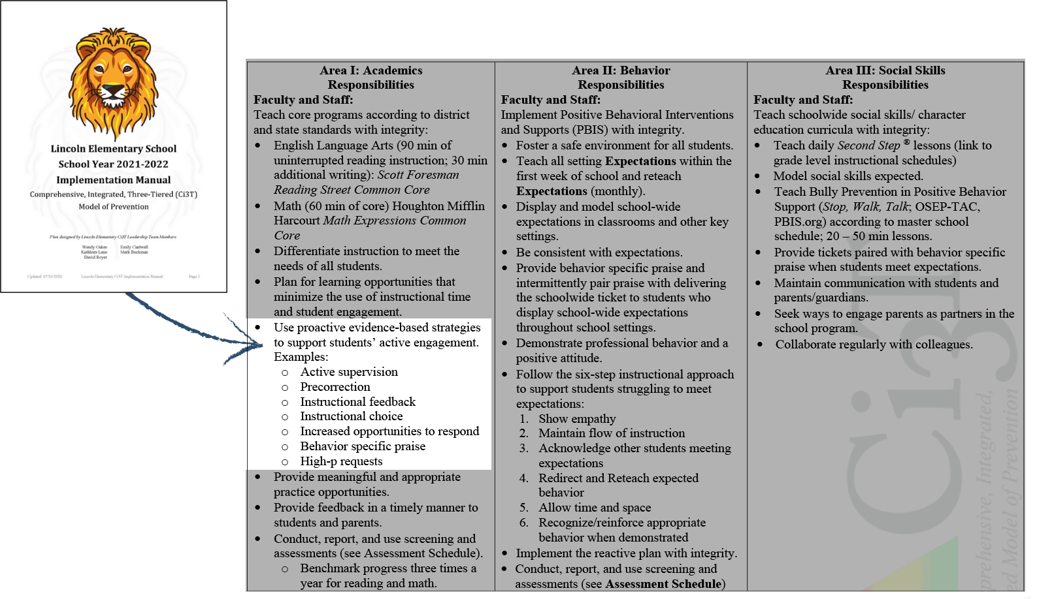
Low-Intensity, Teacher-Delivered Strategies at Tier 1
Notes:
If you have Ci3T in place, here’s where it is in your manual

Slide 36


Embedding Low-Intensity Supports in Daily Instruction
Notes:
Video = 2:45

Slide 37
Let’s Chat!
Which low-intensity teacher-delivered strategy do you use most often?
How is it built into your lessons or daily routines?

Slide 38
Elementary Illustration: Opportunities to Incorporate Low-Intensity Strategies
Lesson Overview: The teacher models solving addition problems with regrouping using base-ten blocks. Students then work in pairs to solve problems, first with manipulatives, then on paper
Academic Students will be able to use base-10 blocks to model and solve two-digit addition problems with regrouping
Social Skills Objective: share materials and using kind words when working with peers
Behavioral Expectation: try your best, use math tools responsibly, put supplies back where they belong, listen when a teacher or classmate is talking

Slide 39
Elementary Illustration: Opportunities to Incorporate Low-Intensity Strategies
Behavior-Specific Praise
  “Elise – great job setting up your base-10 blocks on the mat. I can see you are ready to begin the lesson!”
Precorrection
  “remember, when we are done, the base-10 blocks go back in the bag”
Active Supervision – during clean up
Instructional Choice
  choose a partner
  choose 3 equations to solve
  choose where to sit (e.g., floor or desk)

Slide 40

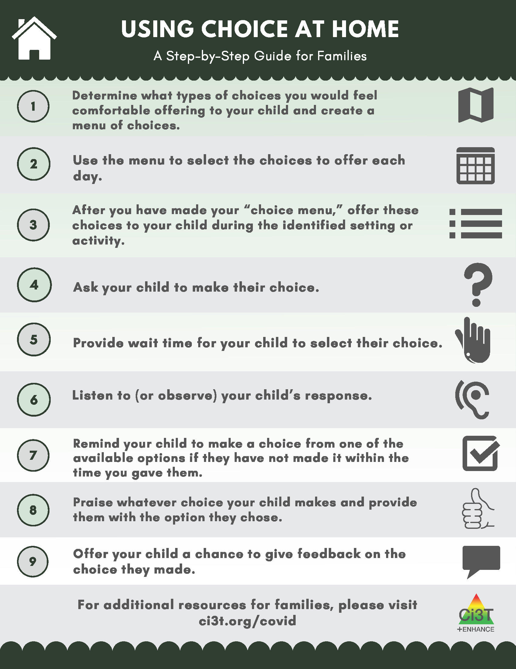
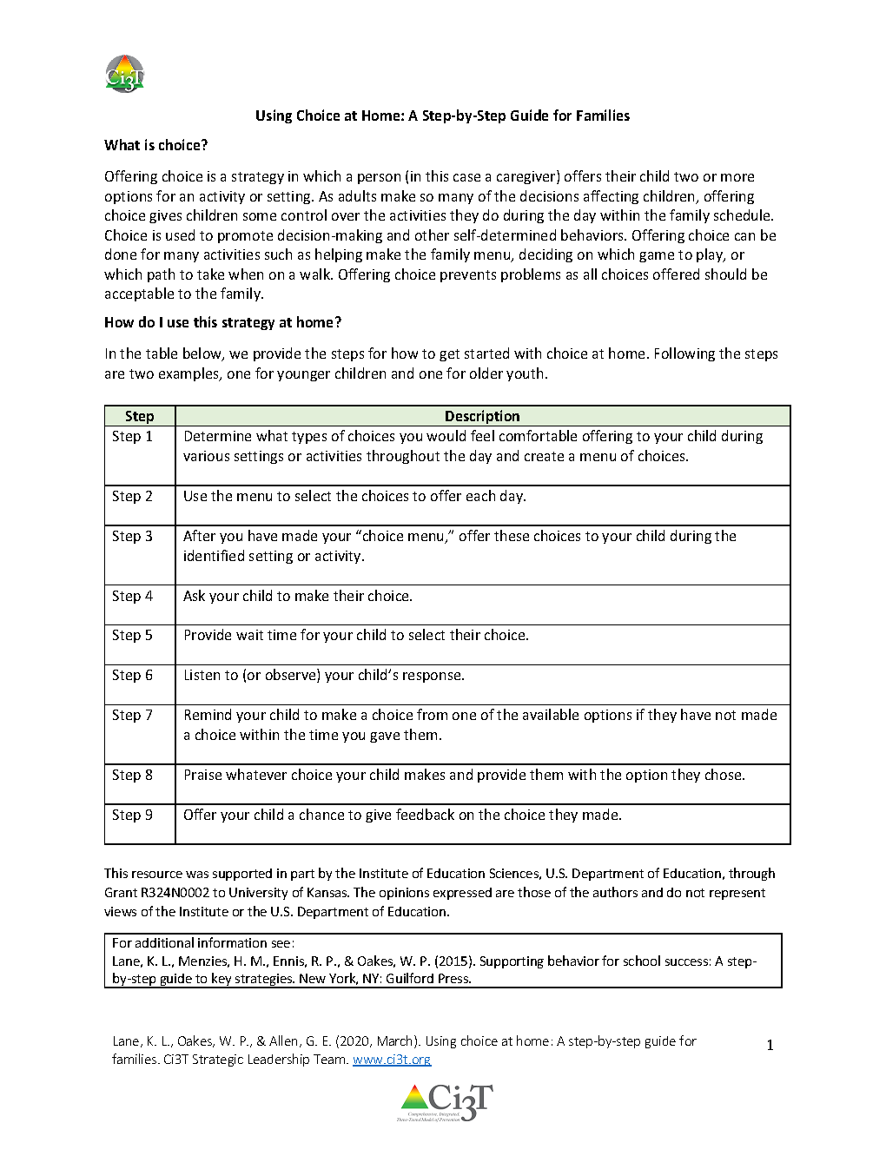

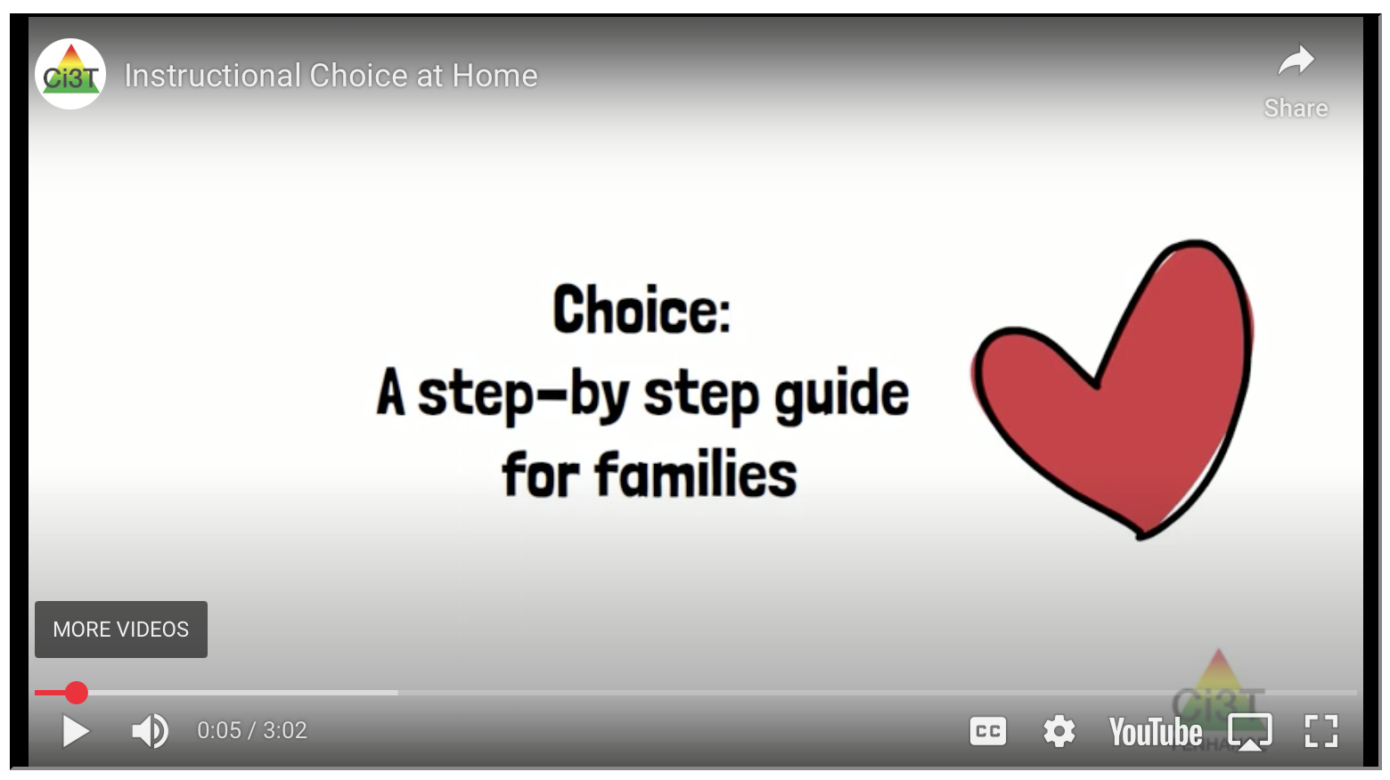
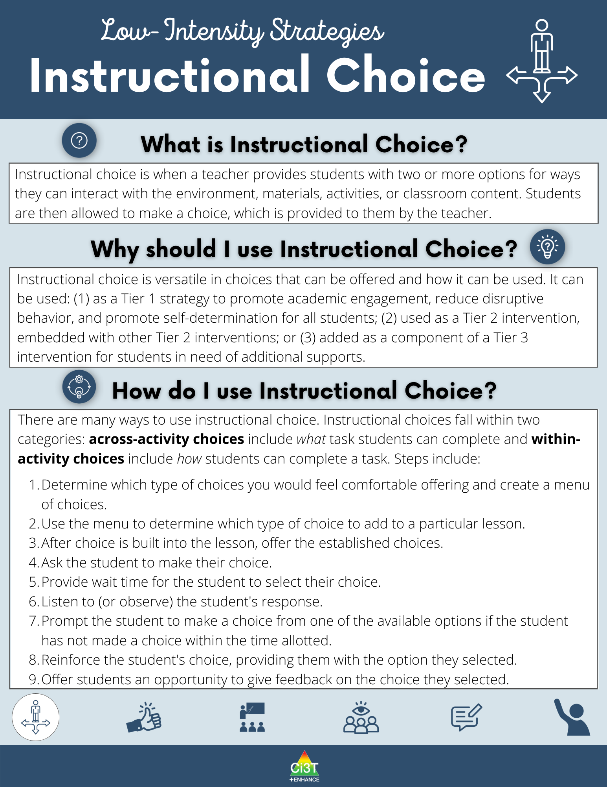

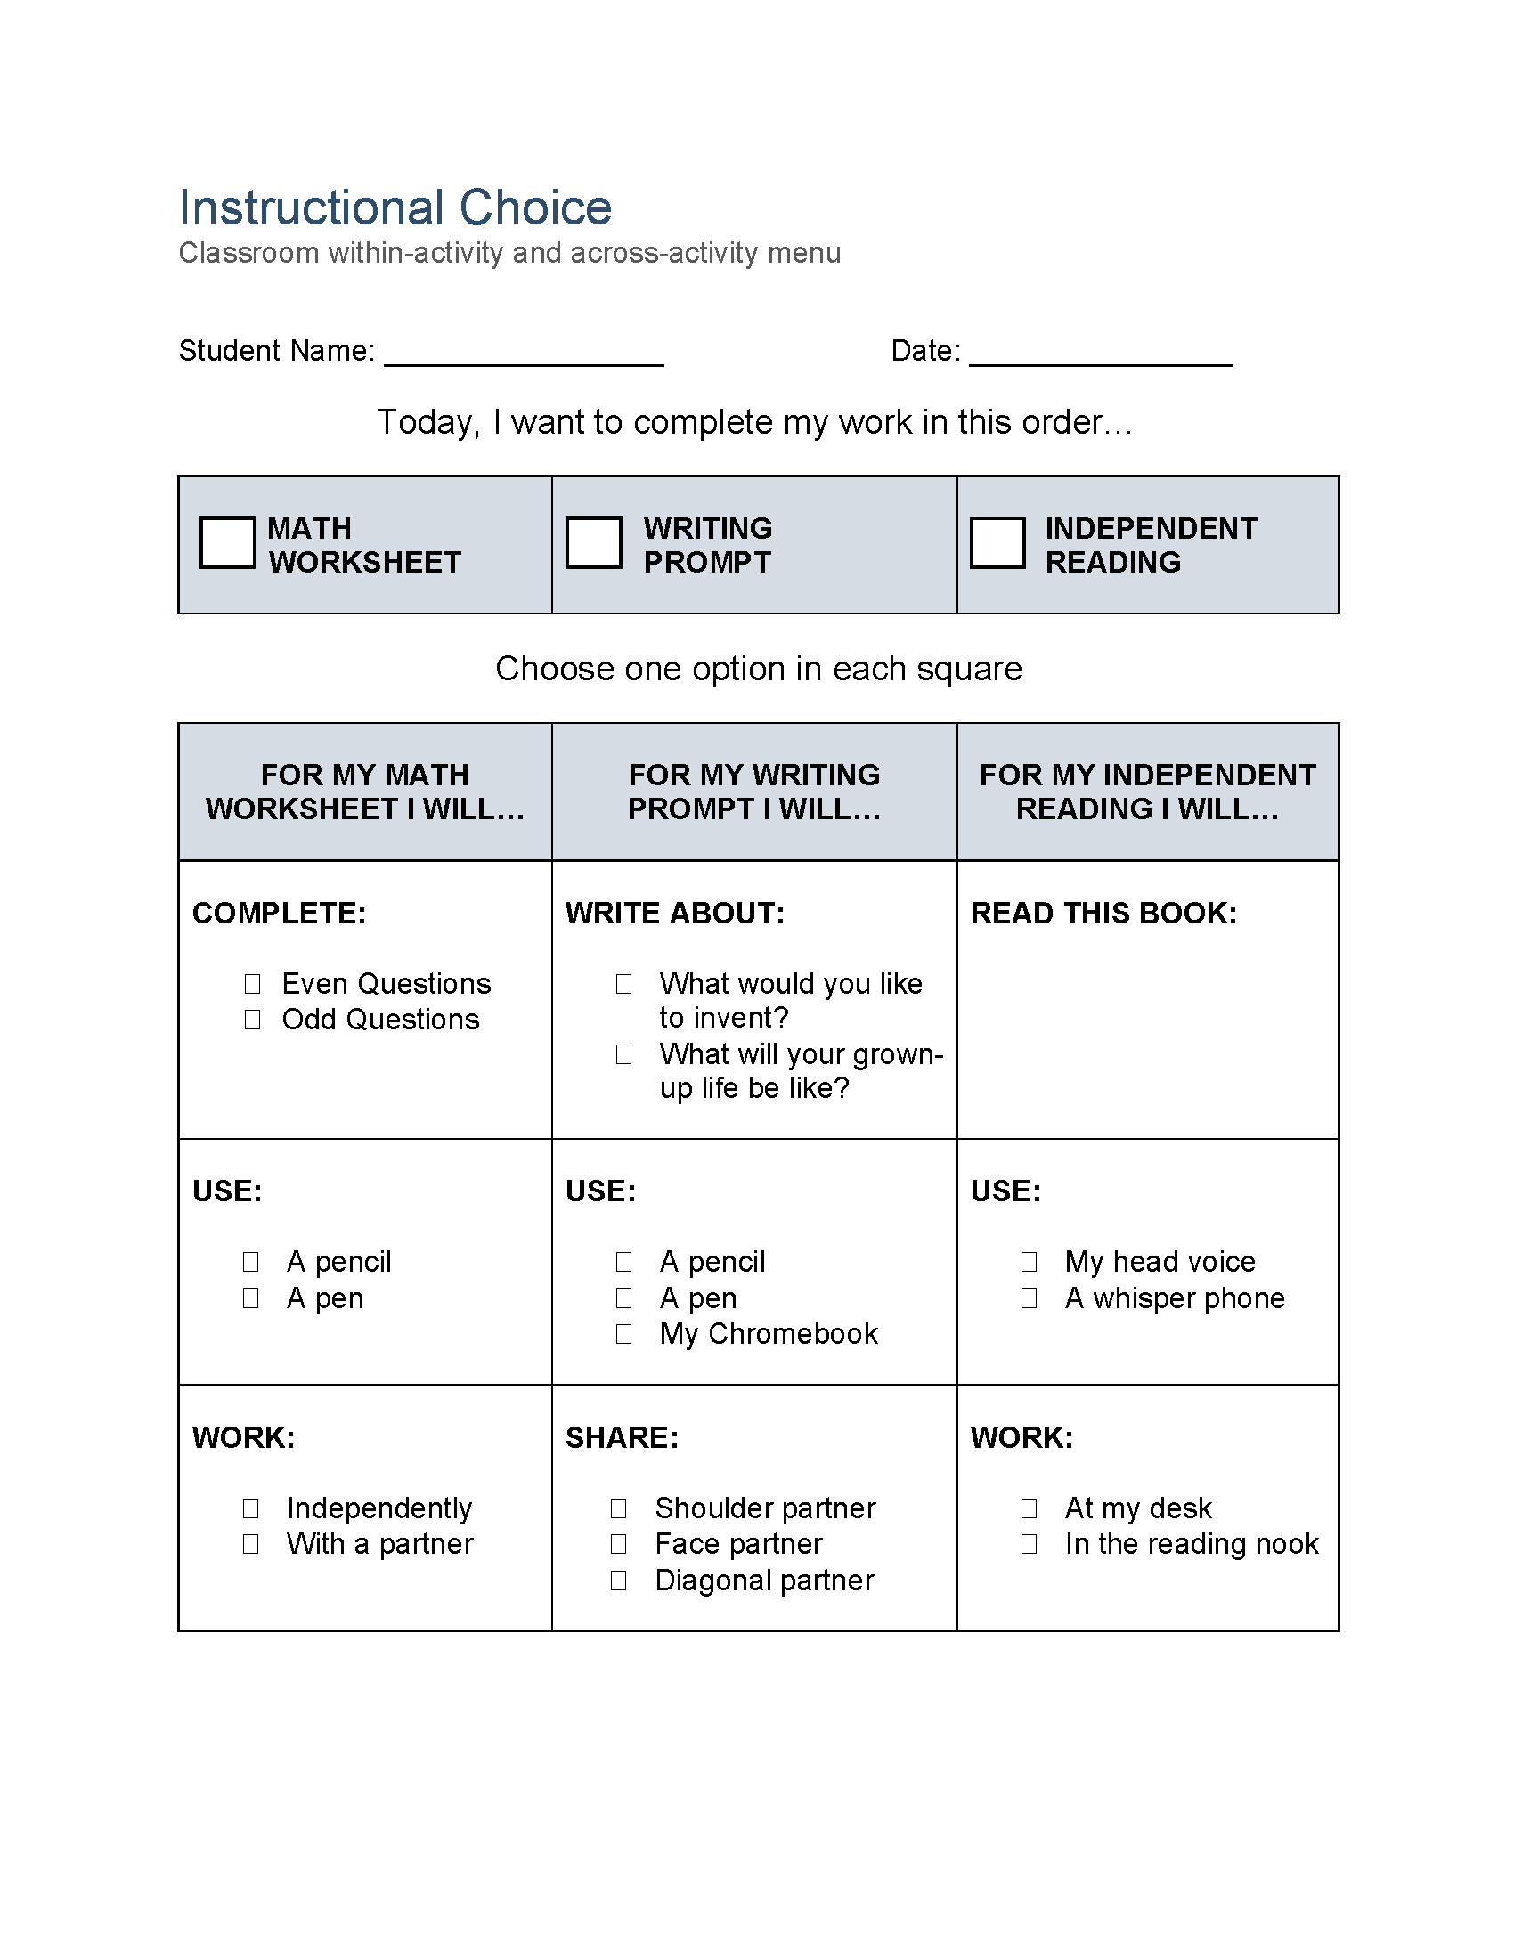
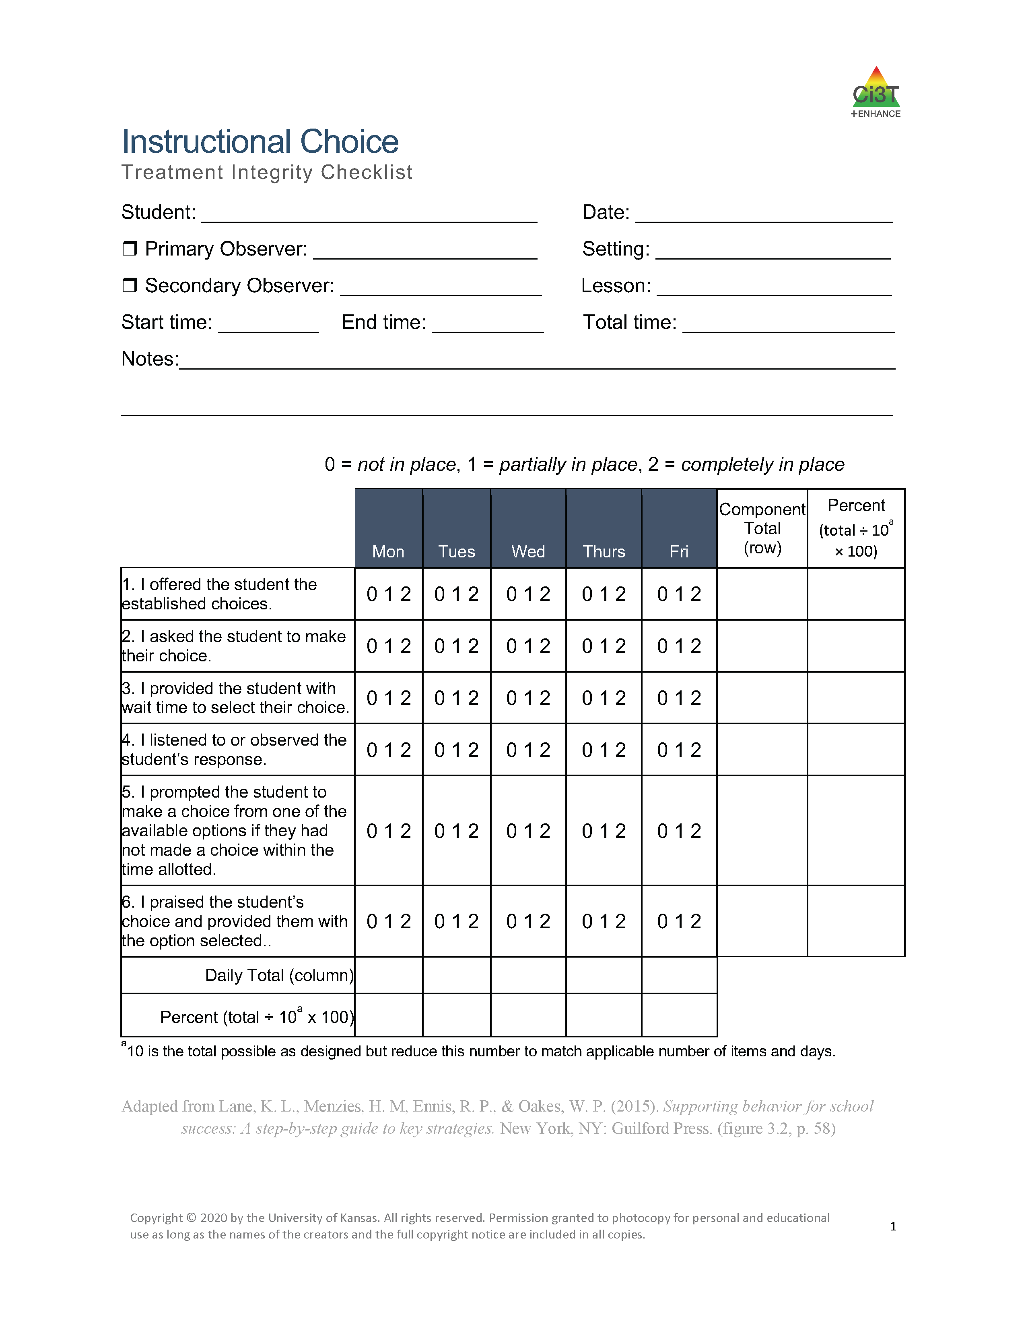
Module Connection!
Instructional Choice
Notes:
LIS modules contain:
Videos and infographics to easily share key information re: strategy
Resources to support implementation – templates, implementation checklist, treatment integrity forms, social validity, data-tracker
Family resources

Slide 41


Join us at future EMPOWER+ to learn more!
Join us at future EMPOWER+ to learn more! 2
EMPOWER+ Session | Date
Starting Strong: Effective Tier 1 Practices for Educators | September 24, 2025 (Wednesday)
From Data to Action: Using Systematic Screening to Inform Instruction | October 8, 2025 (Wednesday)
Ci3T In Action: Integrated Lesson Planning for Enhanced Instruction | November 18, 2025 (Tuesday)
Mastering Behavior Specific Praise and Precorrection | January 21, 2026 (Wednesday)
A 6-Step Instructional Approach for Responding to Challenging Behaviors: A Tier 1 Practice | February 10, 2026 (Tuesday)
A Tier 2 Support for Students Experiencing Anxious Feelings: Recognize. Relax. Record. | March 25, 2026 (Wednesday)
A Tier 3 Support for Students with Intensive Intervention Needs: Functional Assessment-Based Intervention (FABI) | April 28, 2026 (Tuesday)

Slide 42
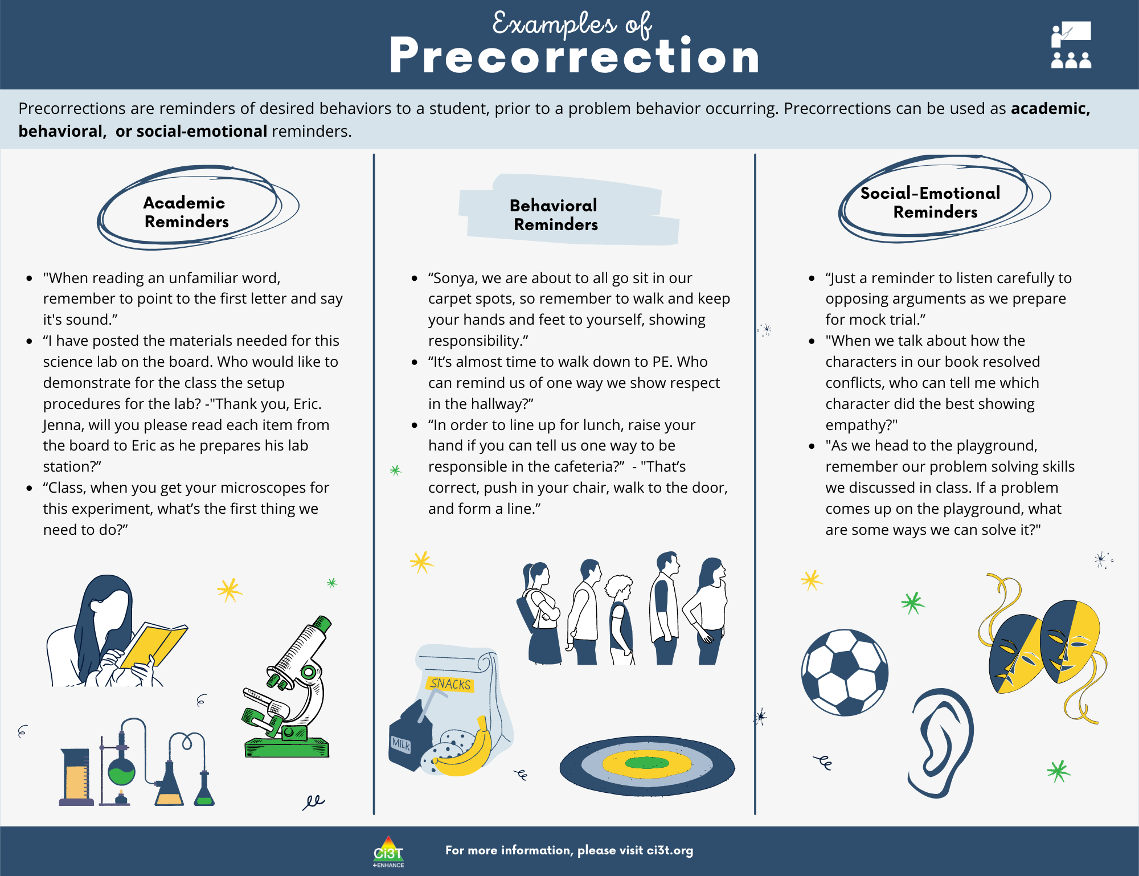

Slide 43
Secondary Illustration: Opportunities to Incorporate Precorrection
Lesson Overview: After reading a short story in class, students work in pairs to brainstorm possible themes and evidence. The class then holds a structured discussion where students practice connecting ideas and supporting claims with text.
Academic Objective: Students will be able to identify the theme of a short story and cite two pieces of textual evidence to support their claim
Social Skills Objective: Build on a peer’s comment by paraphrasing or connecting their own idea to what was said
Behavioral Expectation: arrive to class prepared (e.g., charged device, book), remain on-task

Slide 44
Secondary Illustration: Opportunities to Incorporate Precorrection
“Before we begin, who can remind me of our partner work expectations?”
“If you want to connect to what someone else said, you might say, ‘Building on that idea…’.”
“Remember, if you’d like to share, raise your hand and wait to be called on.”
“Different people may see different themes in the story — that’s okay, we can learn from each other. If you disagree, you might say something like ‘I see it a little differently because…’”

Slide 45
Let’s Chat!
Pull up the social skills objective and behavioral expectations you worked on earlier
Write 1 precorrection statement you could use in that lesson

Slide 46







Low-Intensity Strategies Work Time
Choose a low-intensity strategy to learn more about and apply to your lesson!
Behavior Specific Praise | Instructional Choice | Opportunities to Respond

Slide 47
Wrapping Up and Moving Forward

Slide 48
Action Items
Action Item | Person(s) Responsible | Planned Completion Date | Date Completed
Submit BCBA CEU form with four passwords | Allison | 11/18/25
Sign up for EMPOWER Session 4 (Mastering Behavior Specific Praise and Precorrection) | Allison | 11/18/25
All integrated lesson planning to PLC agenda. Hyperlink to module. | Allison | 11/20/25

Slide 49
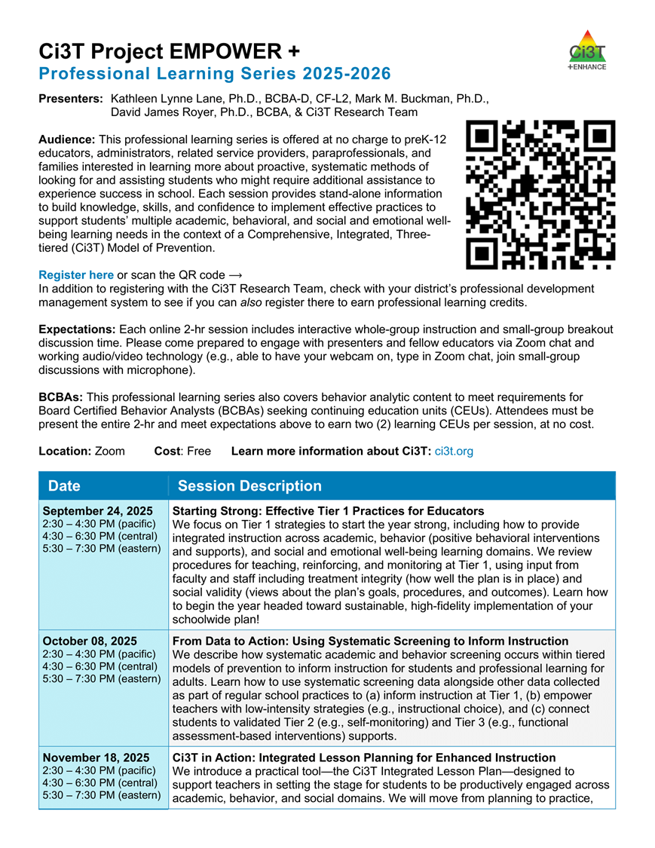
Project EMPOWER+
EMPOWER+ Session | Date
Starting Strong: Effective Tier 1 Practices for Educators | September 24, 2025 (Wednesday)
From Data to Action: Using Systematic Screening to Inform Instruction | October 8, 2025 (Wednesday)
Ci3T In Action: Integrated Lesson Planning for Enhanced Instruction | November 18, 2025 (Tuesday)
Mastering Behavior Specific Praise and Precorrection | January 21, 2026 (Wednesday)
A 6-Step Instructional Approach for Responding to Challenging Behaviors: A Tier 1 Practice | February 10, 2026 (Tuesday)
A Tier 2 Support for Students Experiencing Anxious Feelings: Recognize. Relax. Record. | March 25, 2026 (Wednesday)
A Tier 3 Support for Students with Intensive Intervention Needs: Functional Assessment-Based Intervention (FABI) | April 28, 2026 (Tuesday)

Slide 50
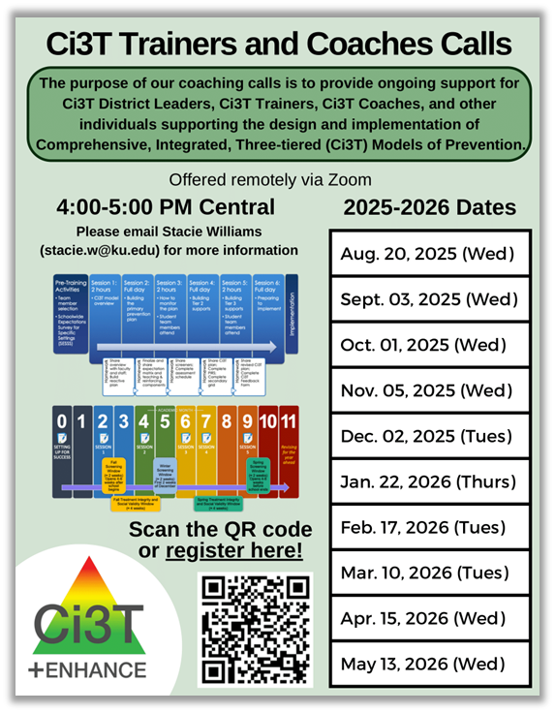
Ci3T Trainers and Coaches Calls
Ci3T Trainers and Coaches Calls Session | Date
Ci3T Trainers and Coaches Call 1 | August 20, 2025 (Wednesday)
Ci3T Trainers and Coaches Call 2 | September 3, 2025 (Wednesday)
Ci3T Trainers and Coaches Call 3 | October 1, 2025 (Wednesday)
Ci3T Trainers and Coaches Call 4 | November 5, 2025 (Wednesday)
Ci3T Trainers and Coaches Call 5 | December 2, 2025 (Tuesday)
Ci3T Trainers and Coaches Call 6 | January 22, 2026 (Thursday)
Ci3T Trainers and Coaches Call 7 | February 17, 2026 (Tuesday)
Ci3T Trainers and Coaches Call 8 | March 10, 2026 (Tuesday)
Ci3T Trainers and Coaches Call 9 | April 15, 2026 (Wednesday)
Ci3T Trainers and Coaches Call 10 | May 13, 2026 (Wednesday)

Slide 51



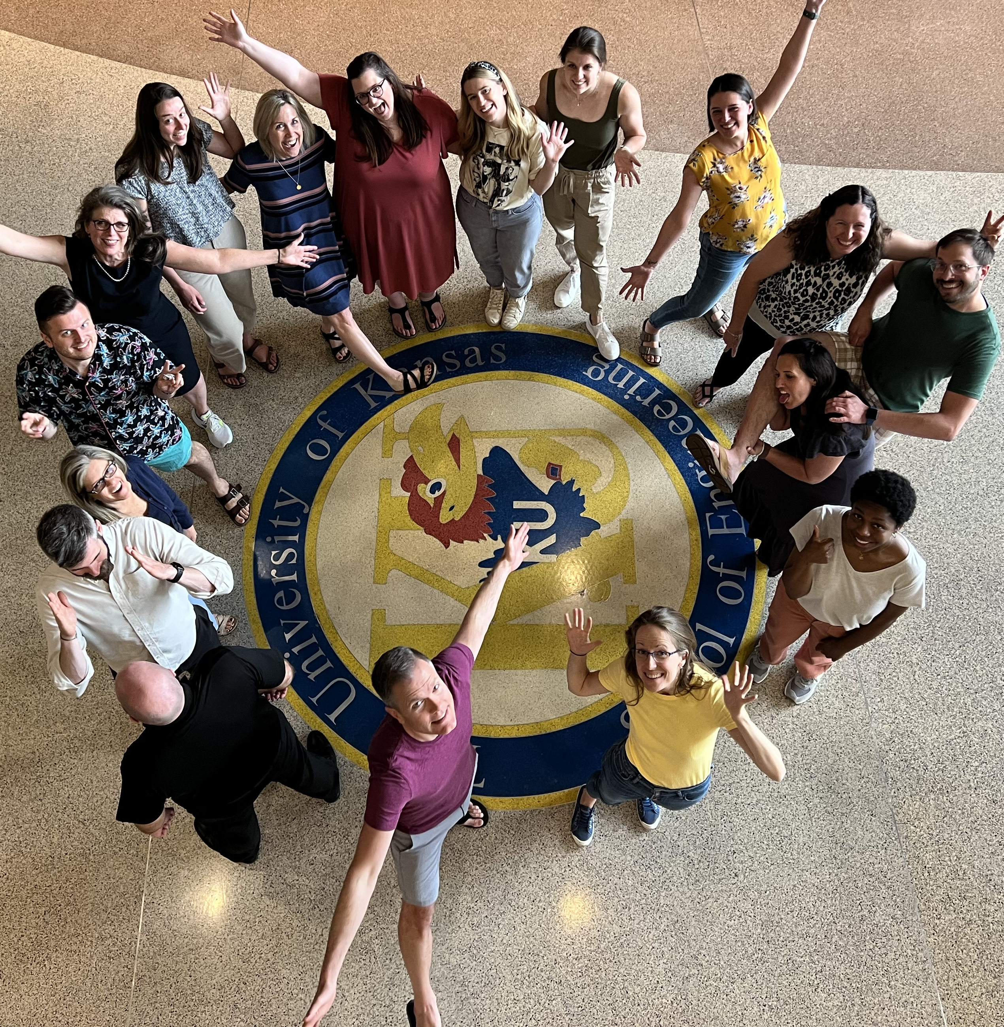

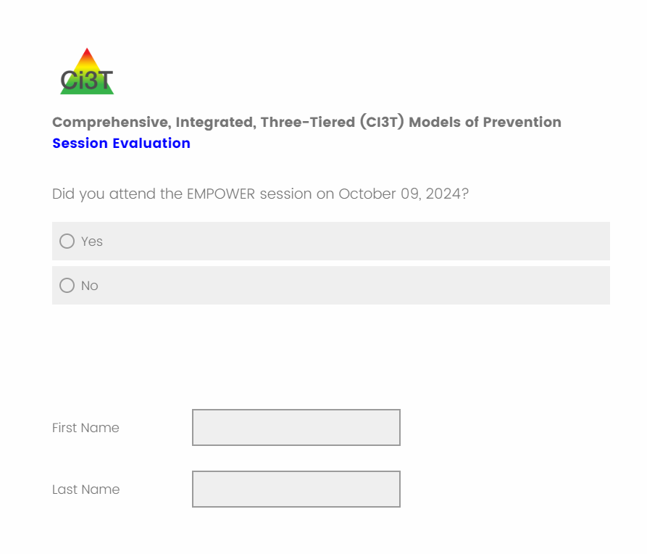
Thank you!
Thank you!
ci3t.org
@Ci3Tmodel
@Ci3Tmodel
Tag us in your Ci3T highlights, we love to see Ci3T in action!
Follow us on X and Instagram for updates and new resources!
#Ci3T
Notes:
Tag us in your Ci3T highlights- we’d love to see Ci3T in action! Follow us on Twitter or Instagram for updates and links to resources! @Ci3TModel
You will receive a brief session evaluation – we value your feedback and would greatly appreciate you taking a few minutes to share your thoughts on what you liked about the session and how we can improve

