Slide 1
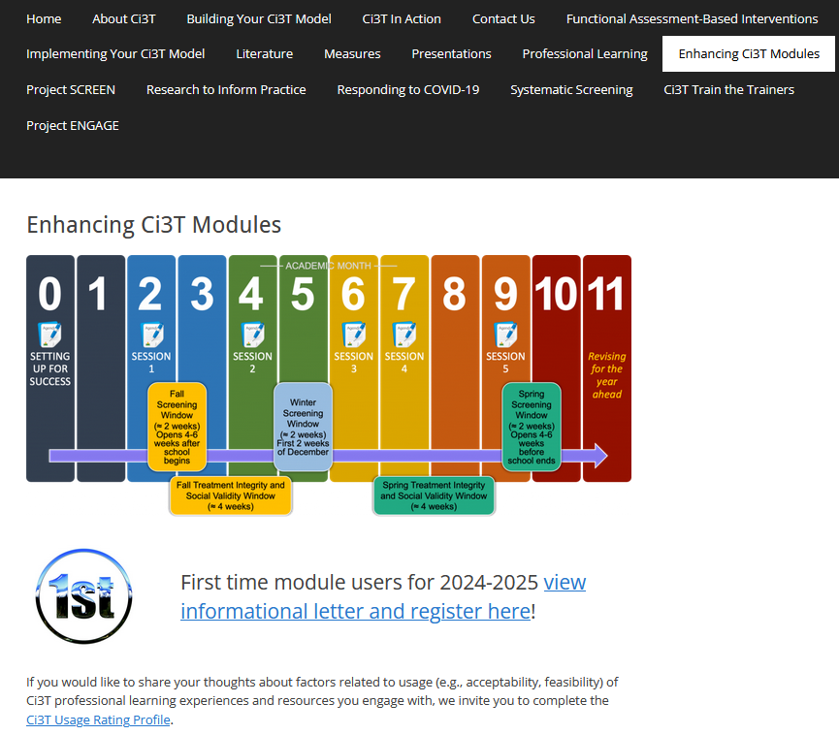
From Data to Action: Using Systematic Screening Data to Inform Instruction
EMPOWER+ Session 2
If you have not done so already, we invite you to visit ci3t.org/enhance to access modules after a one-time registration process!

Slide 2
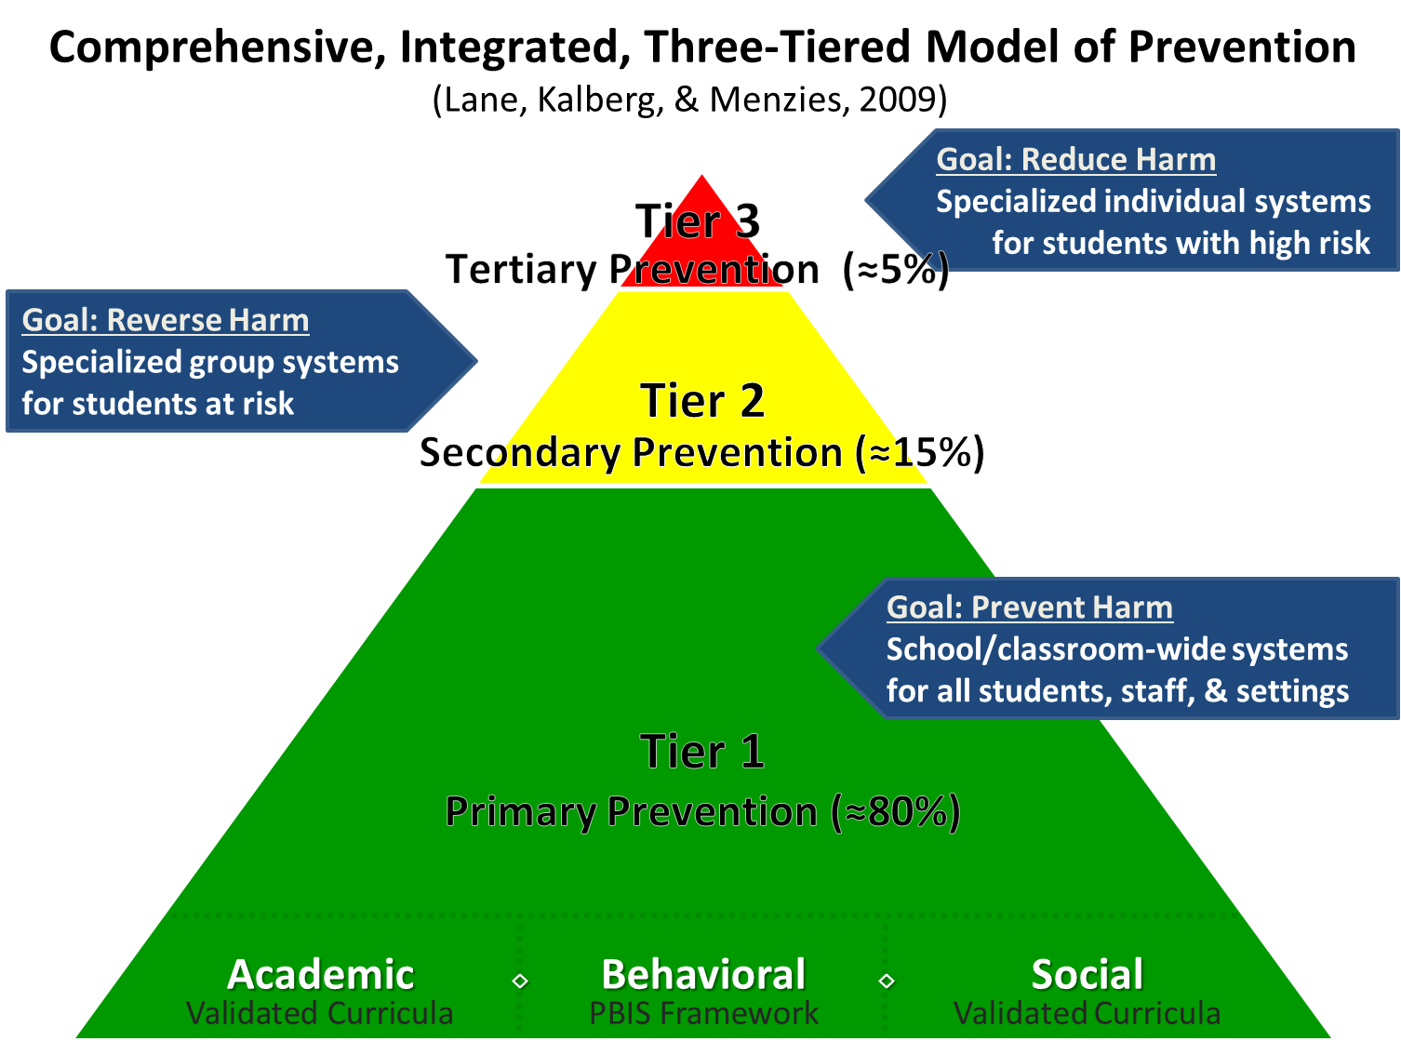
Comprehensive, Integrated, Three-Tiered Model of Prevention 1

Slide 3
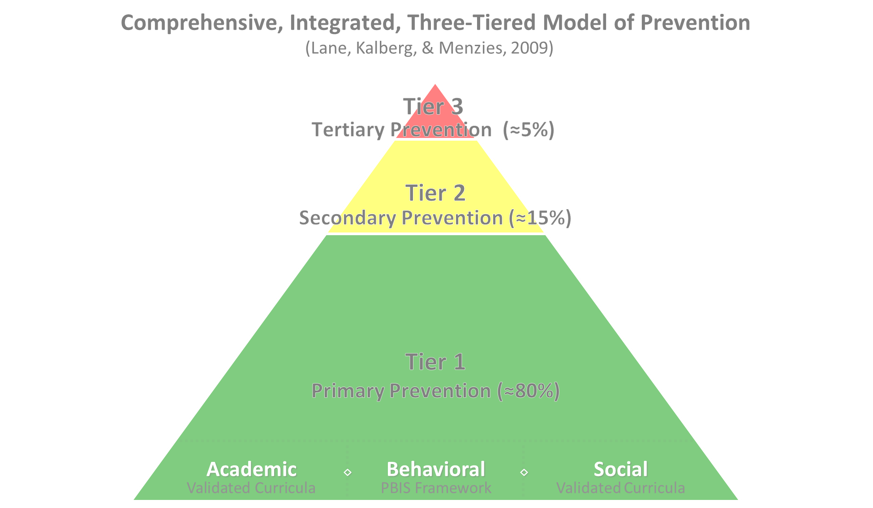

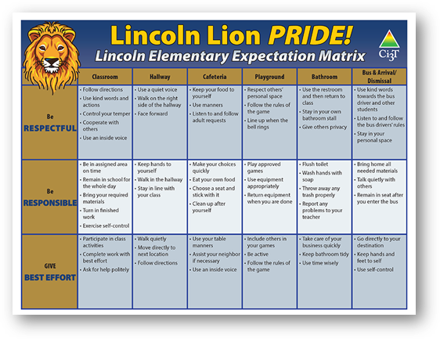
Comprehensive, Integrated, Three-Tiered Model of Prevention 2
Positive Behavioral Interventions and Supports
District & State Standards Quality Instruction
Validated Curricula and Resources

Slide 4


Primary Prevention (Tier 1)

Slide 5

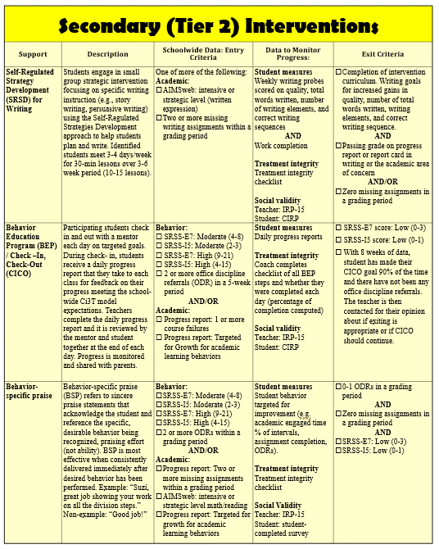
Secondary (Tier 2) Intervention Grid
Notes:
In addition to the module featured here outlining how to use multiple sources of data to connect students with Tier 2 supports, we offer a full suite of modules highlighting validated Tier 2 interventions such as Self-Regulated Strategy Development (SRSD) for Writing and Check-In/Check Out that may appear in your Secondary (Tier 2) Intervention Grid

Slide 6

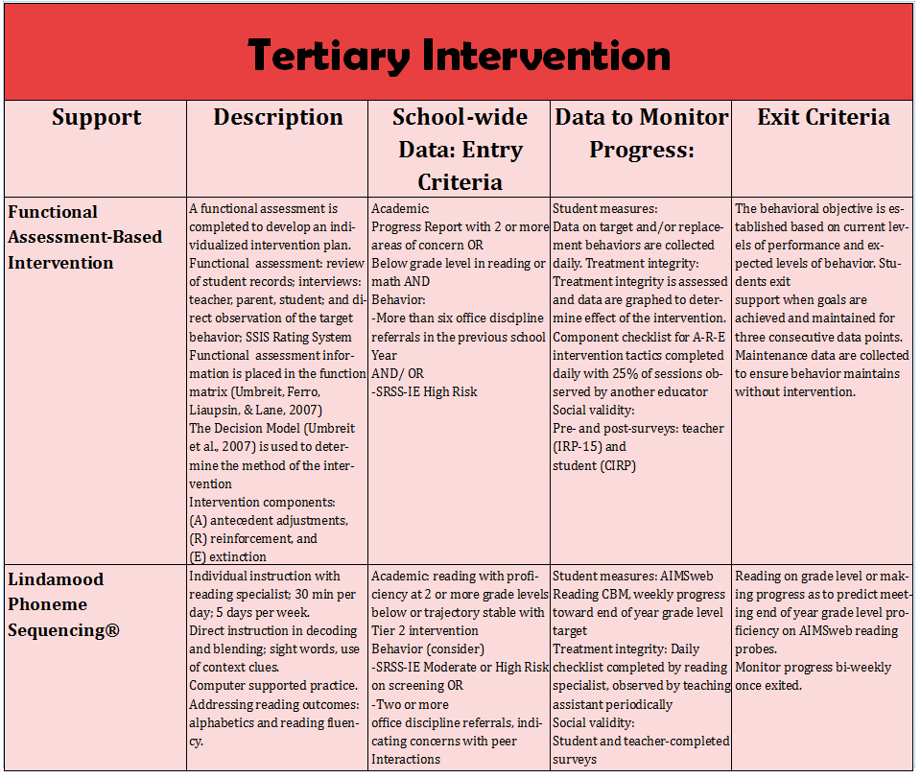
Tertiary (Tier 3) Intervention Grid
Notes:
In addition to the module featured here outlining how to use multiple sources of data to connect students with Tier 3 supports, we offer a full suite of modules highlighting validated Tier 3 interventions such as Functional Assessment-Based Intervention (FABI) that may appear in your Tertiary (Tier 3) Intervention Grid

Slide 7
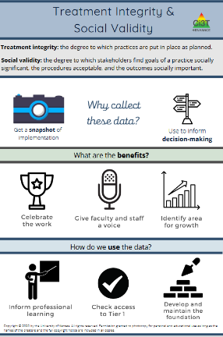
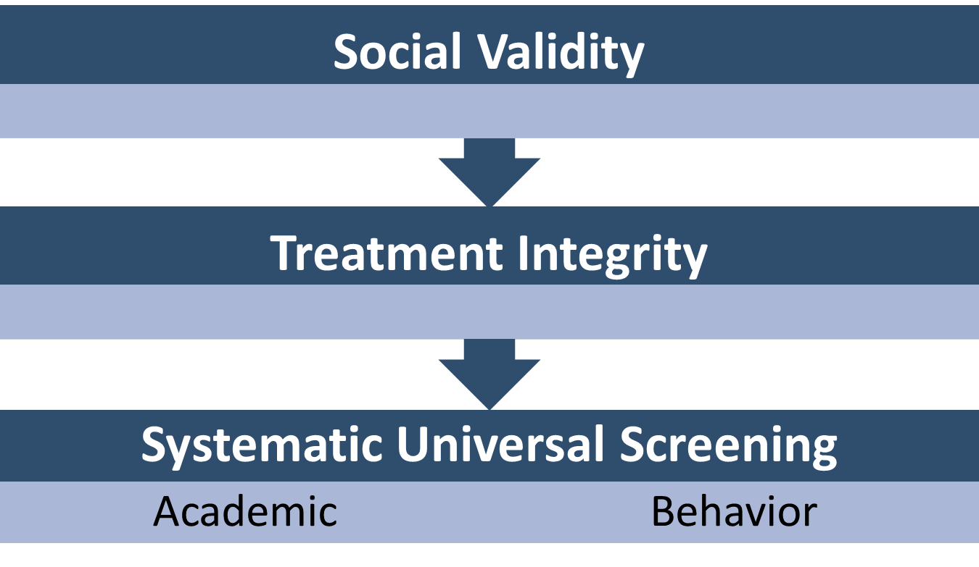
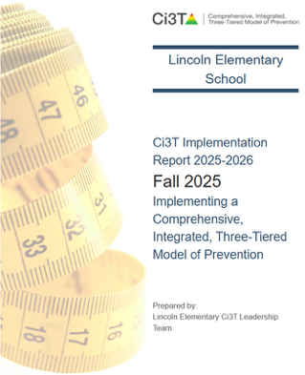
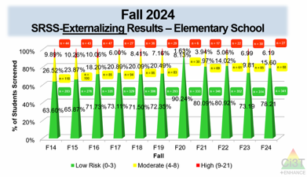
Essential Components of Primary (Tier 1) Prevention Efforts
Essential Components of Primary (Tier 1) Prevention Efforts 1

Slide 8



Enhancing Ci3T Modules
ci3t.org/enhance

Slide 9
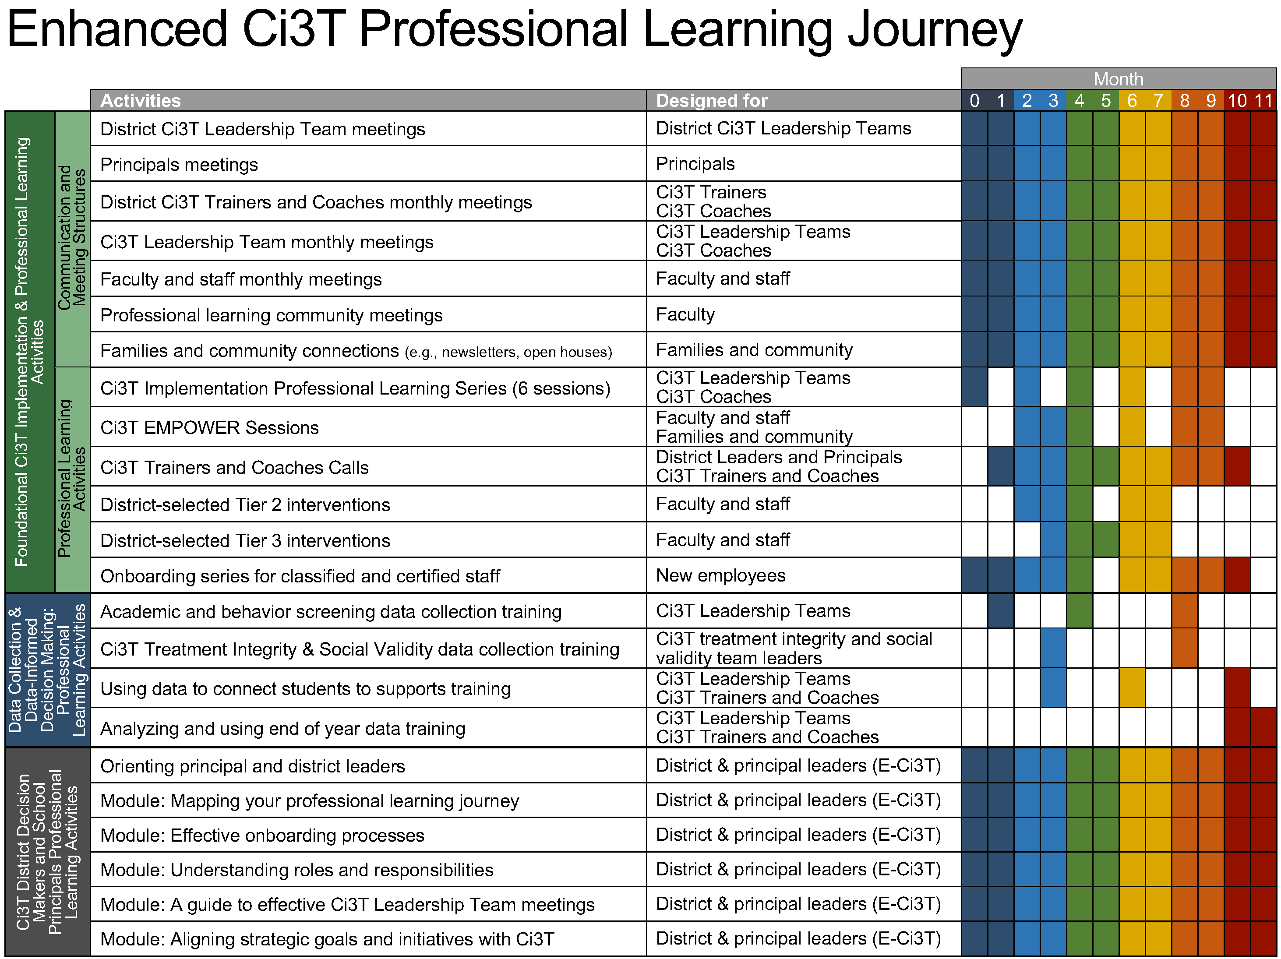
Enhanced Ci3T Implementation Series and Delivery

Slide 10
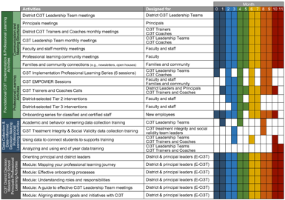

Session Outcomes
Explain the purpose and key features of systematic screening within Comprehensive, Integrated, Three-tiered (Ci3T) models of prevention.
Describe how to use systematic screening data to inform instruction at Tier 1, empower teachers use of low-intensity strategies, and connect students to validated Tier 2 and Tier 3 supports.
Explain the importance of monitoring treatment integrity, social validity, and student performance at each level of prevention.
If you are a Board Certified Behavior Analyst (BCBA), you may accrue up to 2 learning continuing education units (CEUs) for attending this session. See agenda for task list alignment. Throughout the session we will share 4 key words, write those down to turn in after the session!

Slide 11

Agenda
Welcome
Situating Systematic Screening in Ci3T Models
Using Systematic Screening Data to:
  Inform Instruction at Tier 1
  Empower Teachers with Low-Intensity Strategies
  Connect Students to Validated Tier 2 and Tier 3 Supports
Wrapping Up and Moving Forward

Slide 12
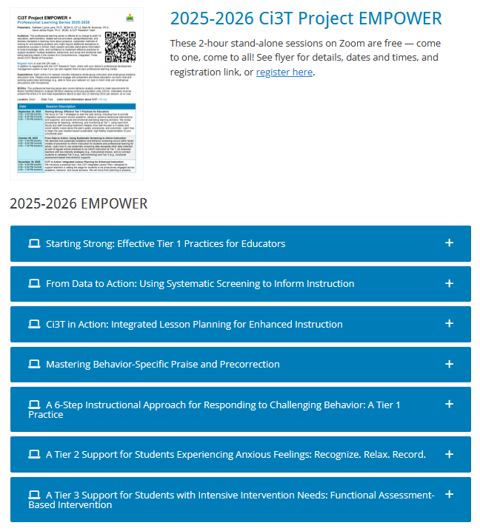
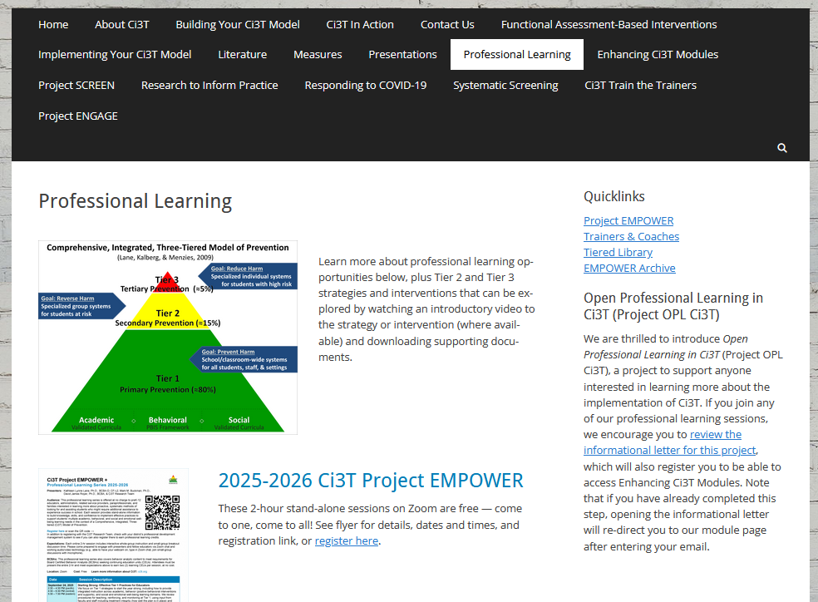
Accessing Professional Learning Materials
ci3t.org/pl

Slide 13
Situating Systematic Screening in Ci3T Models

Slide 14
Essential Components of Primary (Tier 1) Prevention Efforts
Essential Components of Primary (Tier 1) Prevention Efforts 2

Slide 15
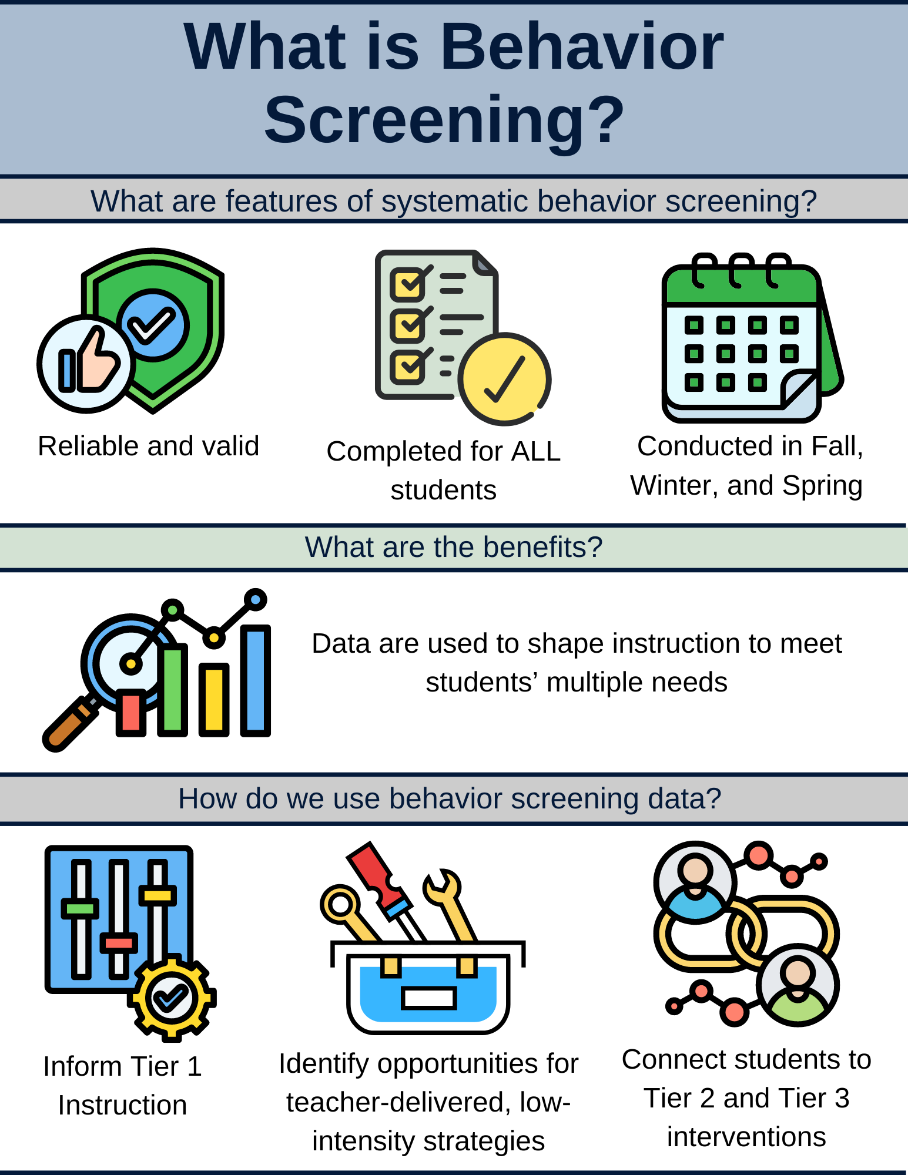
What is Behavior Screening? 1

Slide 16
What is Behavior Screening? 2

Slide 17
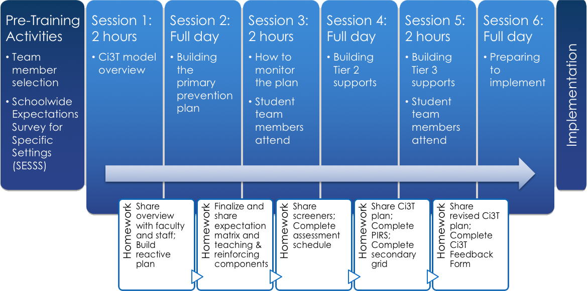

Selecting a Systematic Screener
Notes:
https://www.pbis.org/resource/selecting-a-universal-behavior-screening-tool-questions-to-consider

Slide 18

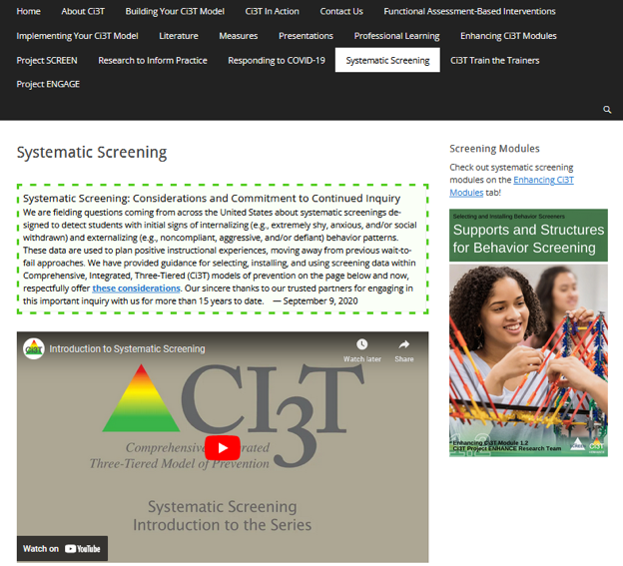
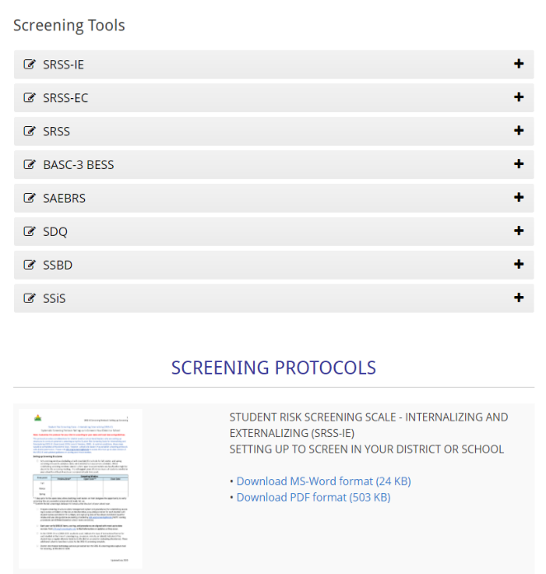
Finding the SRSS-IE on the Ci3T Website
https://www.ci3t.org/screening

Slide 19
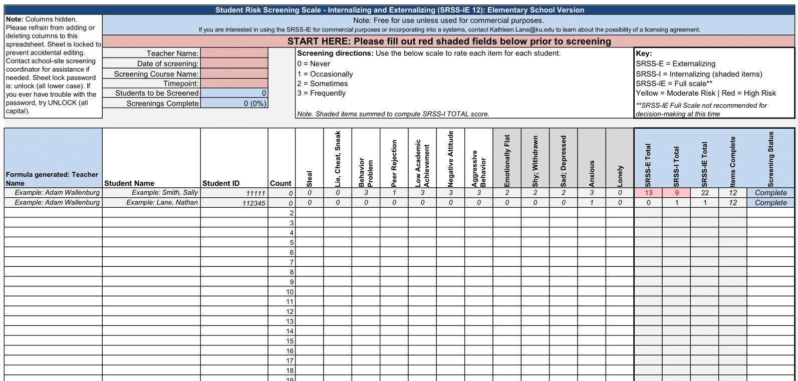
Student Risk Screening Scale – Internalizing and Externalizing (SRSS-IE; Drummond, 1994; Lane & Menzies, 2009)
Elementary

Slide 20
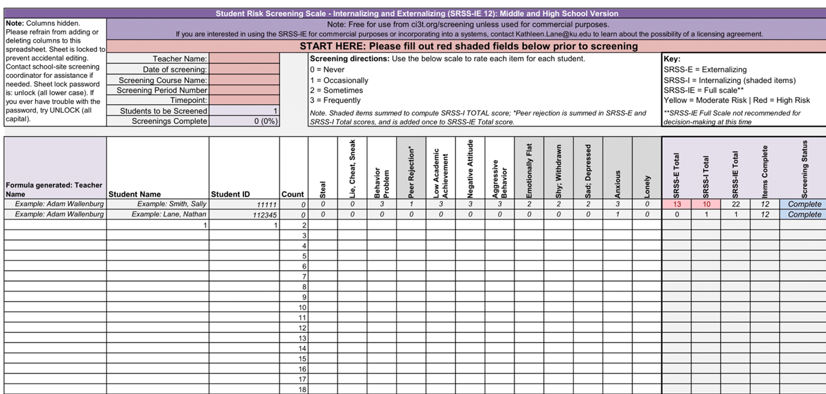
Student Risk Screening Scale – Internalizing and Externalizing (SRSS-IE; Drummond, 1994; Lane & Menzies, 2009)
Secondary

Slide 21
SRSS-IE: Cut Scores
Elementary School
Middle and High School
SRSS-E7 | SRSS-I5
Items 1-7 | Items 8-12
0-3 = low risk 4-8 = moderate risk 9-21 = high risk | 0-1 = low risk 2-3 = moderate risk 4-15 = high risk
SRSS-E7 | SRSS-I6
Items 1-7 | Items 4, 8-12
0-3 = low risk 4-8 = moderate risk 9-21 = high risk | 0-3 = low risk 4-5 = moderate risk 6-18 = high risk
Elementary School Level:
Lane, K. L., Oakes, W. P., Swogger, E. D., Schatschneider, C., Menzies, H., M., & Sanchez, J. (2015). Student risk screening scale for internalizing and externalizing behaviors: Preliminary cut scores to support data-informed decision making. Behavioral Disorders, 40, 159-170.
Middle and High School Levels:
Lane, K. L., Oakes, W. P., Cantwell, E. D., Schatschneider, C., Menzies, H., Crittenden, M., & Messenger, M. (2016). Student Risk Screening Scale for Internalizing and Externalizing Behaviors: Preliminary cut scores to support data-informed decision making in middle and high schools. Behavioral Disorders, 42(1), 271-284

Slide 22
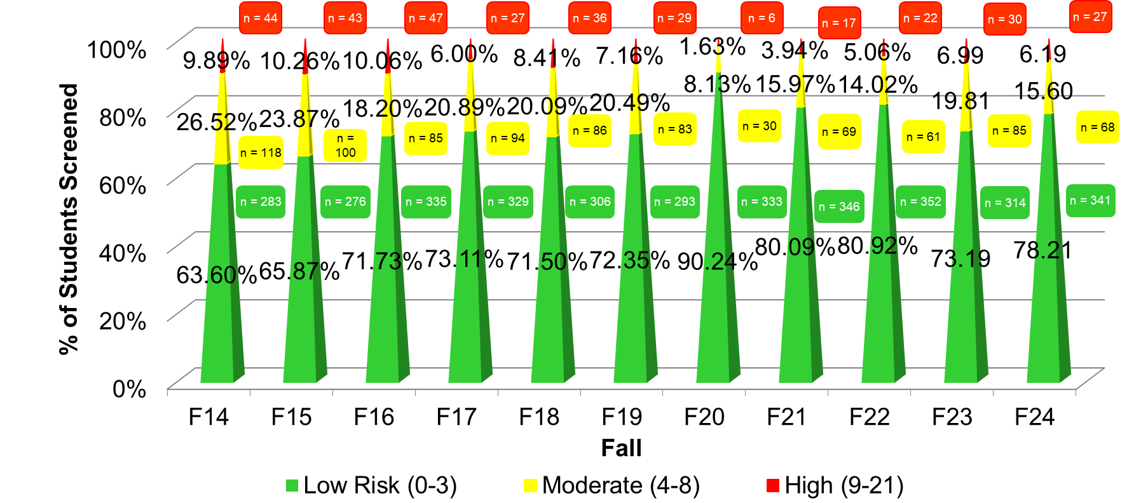
Fall 2024
SRSS-Externalizing Results – Elementary School

Slide 23
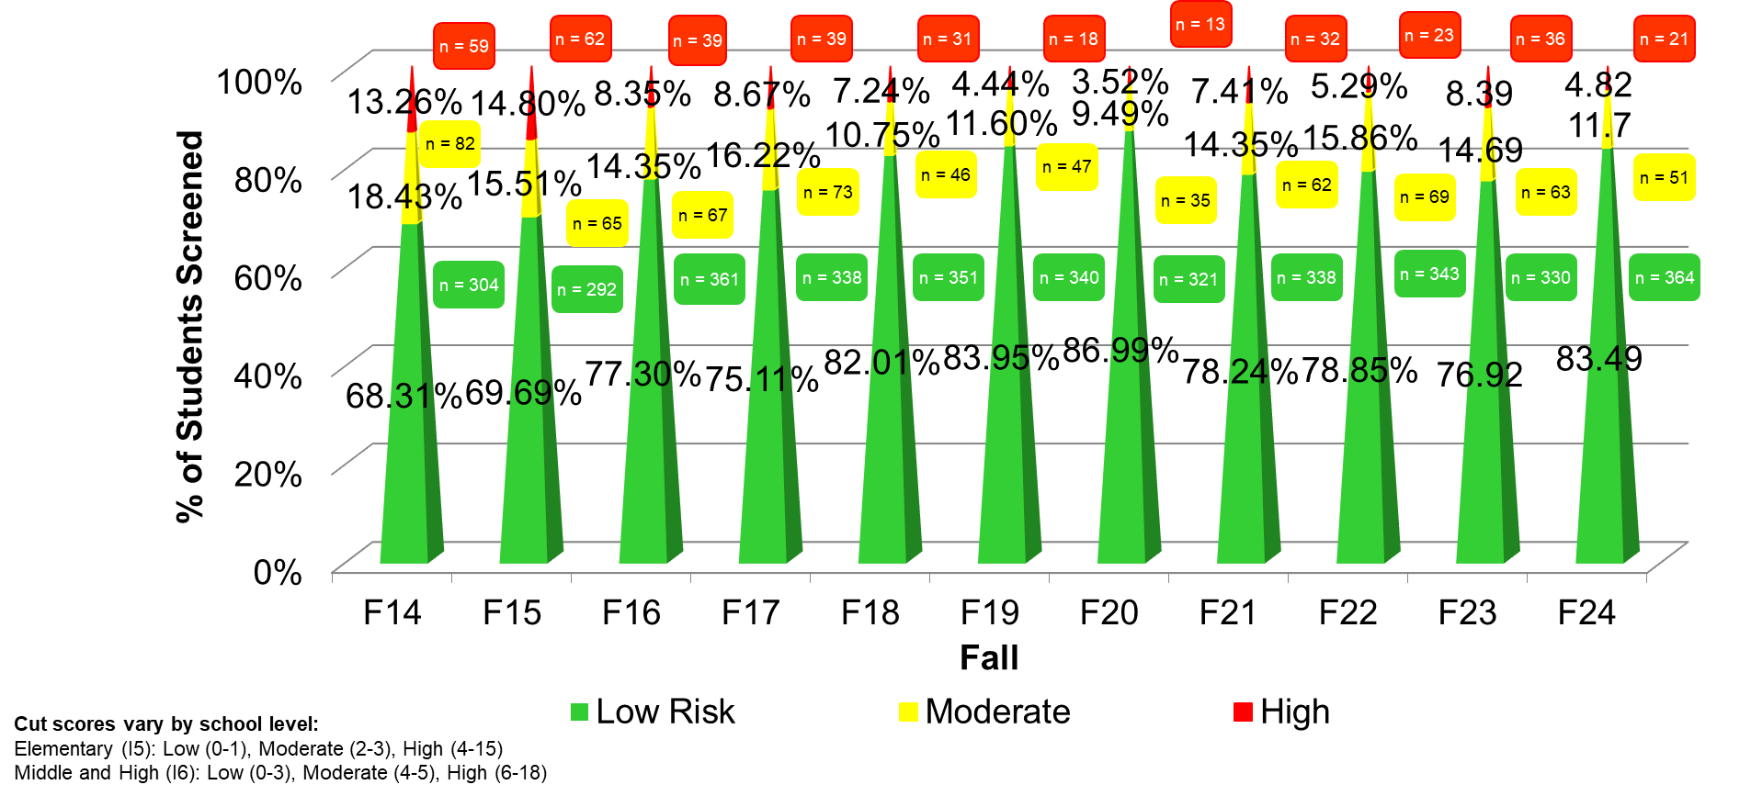
Fall 2024
SRSS-Internalizing Results – Elementary School

Slide 24
Fall 2022
SRSS-Internalizing Results – Elementary School
Grade Level | N Screened | Low n (%) | Moderate n (%) | High n (%)
K | 64 | 52 (81.25%) | 7 (10.94%) | 5 (7.81%)
1 | 81 | 69 (85.19%) | 9 (11.11%) | 3 (3.70%)
2 | 56 | 44 (78.57%) | 11 (19.64%) | 1 (1.79%)

Slide 25
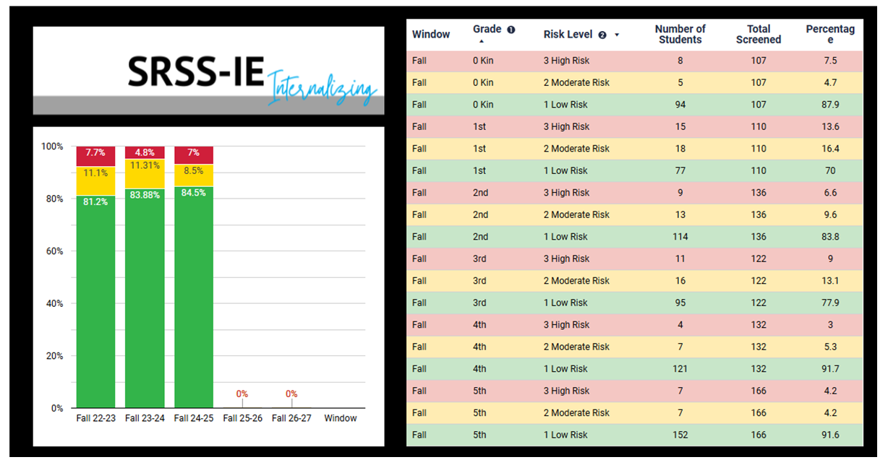
SRSS-IE Internalizing Summary

Slide 26

Academic Screening

Slide 27
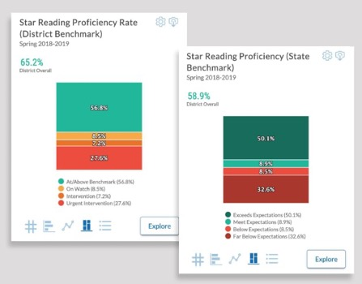
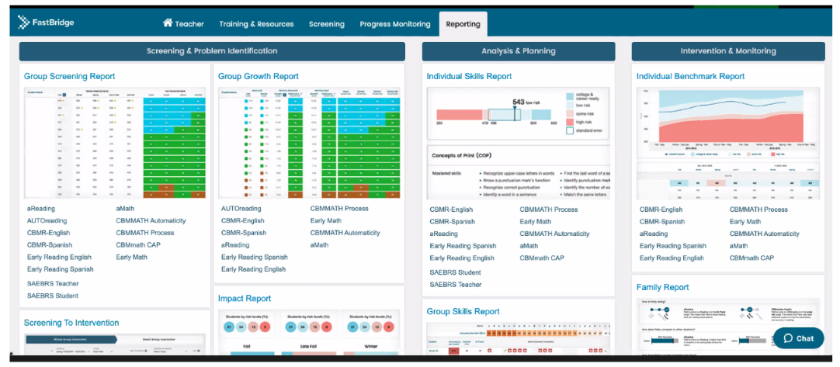
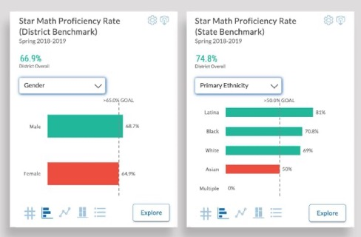

Academic Screening: Examples

Slide 28
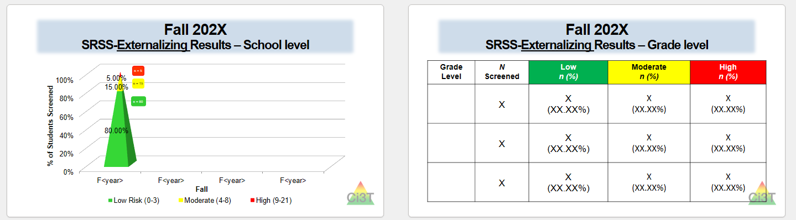
Sharing Systematic Screening Data
Once academic and behavior screening data are collected, data are shared at the:
Schoolwide level
Grade/department/class level
Individual student level

Slide 29
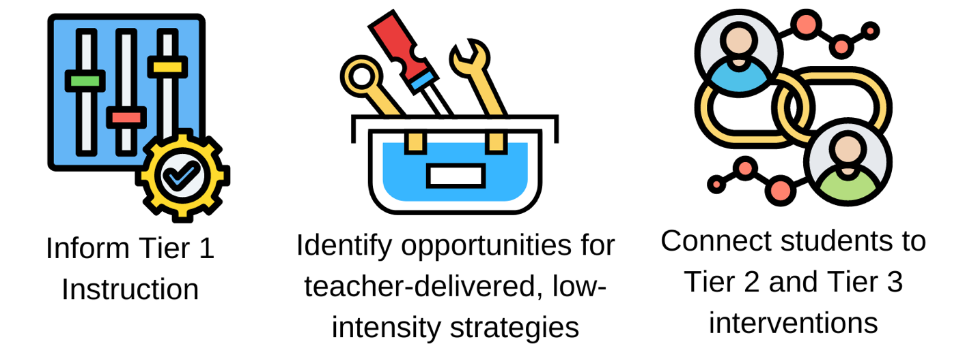
Using Systematic Screening Data
These academic and behavior screening data are then reviewed alongside other data collected as part of typical school practices (e.g., attendance, office discipline referrals, grades) to:

Slide 30



Systematic Screening Resources

Slide 31

Let’s Talk
What are some of the potential benefits of systematic screening?
What are some of the potential challenges of systematic screening?
What questions do you have about systematic screening?
Notes:
10-min timer

Slide 32
Using Systematic Screening Data to…
Inform Instruction at Tier 1
Empower Teachers with Low-Intensity Strategies
Connect Students to Validated Tier 2 and Tier 3 Supports

Slide 33
Inform Instruction at Tier 1

Slide 34
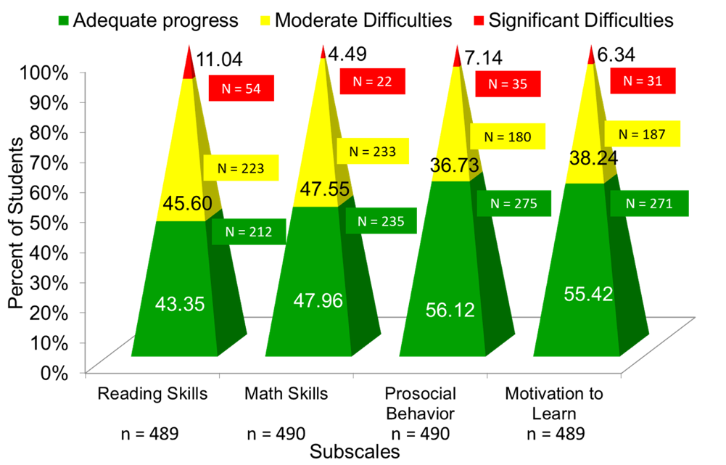
Data to Indicate a Focus on Tier 1: School Level
Social Skills Improvement System – Performance Screening Guide Spring 2012 – Total School
Lane, K. L., Oakes, W. P., & Magill, L. (2013). Primary prevention efforts: How do we implemented and monitor the Tier 1 component of our Comprehensive, Integrated, Three-Tiered (Ci3T) Model?, Preventing School Failure, 58(1), 143-158.

Slide 35
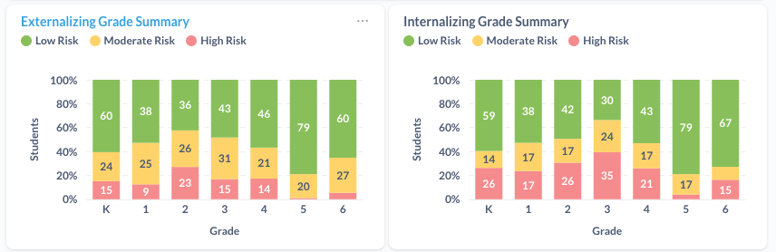
Data to Indicate a Focus on Tier 1: Breakdown by Grade-Level

Slide 36

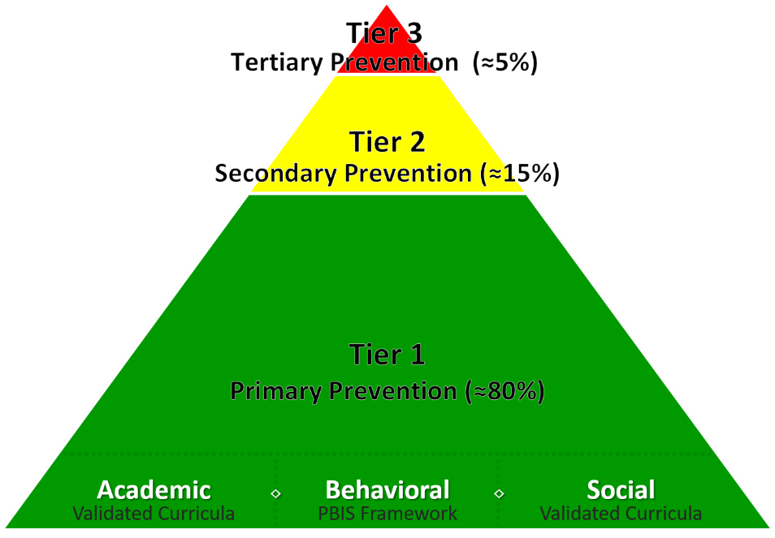
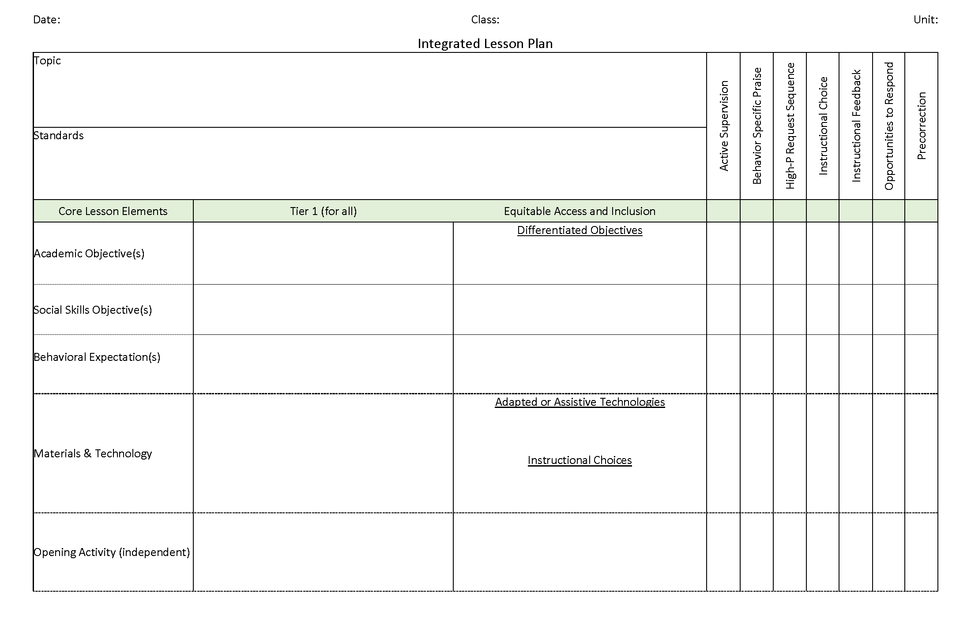
Ci3T Integrated Lesson Planning
Citation. Oakes, W. P., Lane, K. L., Lane, K. S., & Buckman, M. M. (2019). Ci3T integrated lessons plan template. www.ci3t.org.
Completed examples available in: Ci3T Project ENHANCE Research Team. (2022, July). Embedding and integrating Ci3T domains into daily instruction. Author. https://doi.org/10.17161/ci3t.42880

Slide 37
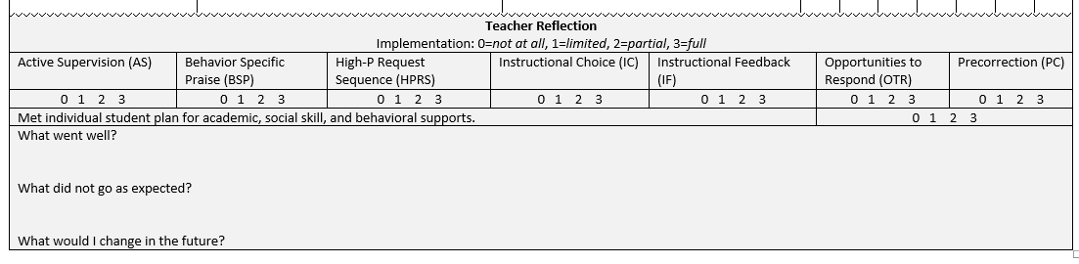
Integrated Lesson Plan
Citation. Oakes, W. P., Lane, K. L., Lane, K. S., & Buckman, M. M. (2019). Ci3T integrated lessons plan template. www.ci3t.org.​

Slide 38

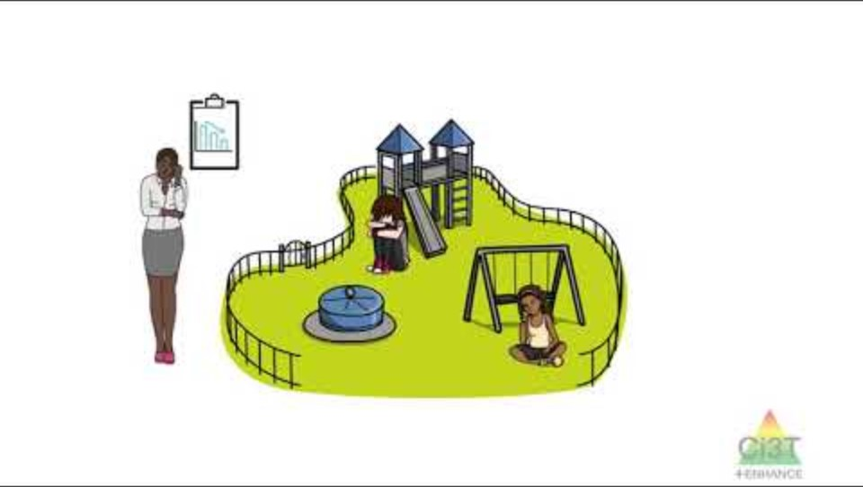
Integrating Academic, Behavior and Social Domains Video
Notes:
Watch video 01:24
https://youtu.be/vNypqs6YVjA

Slide 39
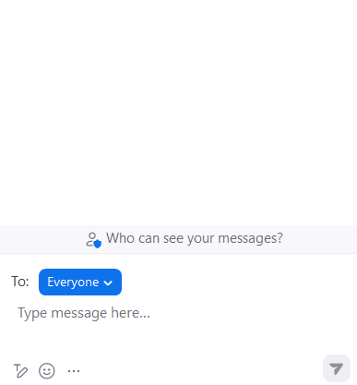


Let’s Chat!
Let’s Chat! 1
What is one way you could integrate social skills or a behavioral objective into an upcoming lesson?
What low-intensity teacher-delivered strategies might you be able to integrate into an upcoming lesson?

Slide 40
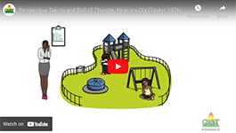
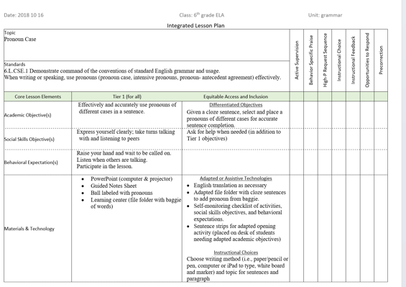

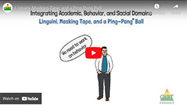
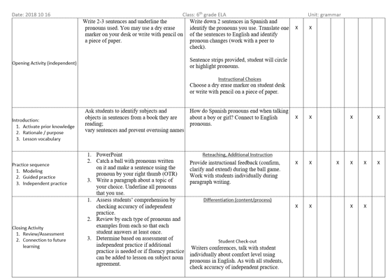
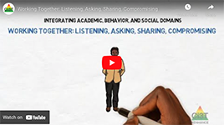
Module Connection 1
Module Connection!
6-Step Instructional Approach for Responding to Challenging Behavior

Slide 41
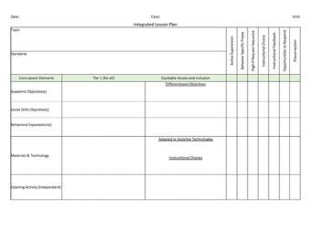
Join us at future EMPOWER+ to learn more! 1
Join us at future EMPOWER+ to learn more!
EMPOWER+ Session | Date
Starting Strong: Effective Tier 1 Practices for Educators | September 24, 2025 (Wednesday)
From Data to Action: Using Systematic Screening to Inform Instruction | October 8, 2025 (Wednesday)
Ci3T In Action: Integrated Lesson Planning for Enhanced Instruction | November 18, 2025 (Tuesday)
Mastering Behavior Specific Praise and Precorrection | January 21, 2026 (Wednesday)
A 6-Step Instructional Approach for Responding to Challenging Behaviors: A Tier 1 Practice | February 10, 2026 (Tuesday)
A Tier 2 Support for Students Experiencing Anxious Feelings: Recognize. Relax. Record. | March 25, 2026 (Wednesday)
A Tier 3 Support for Students with Intensive Intervention Needs: Functional Assessment-Based Intervention (FABI) | April 28, 2026 (Tuesday)

Slide 42

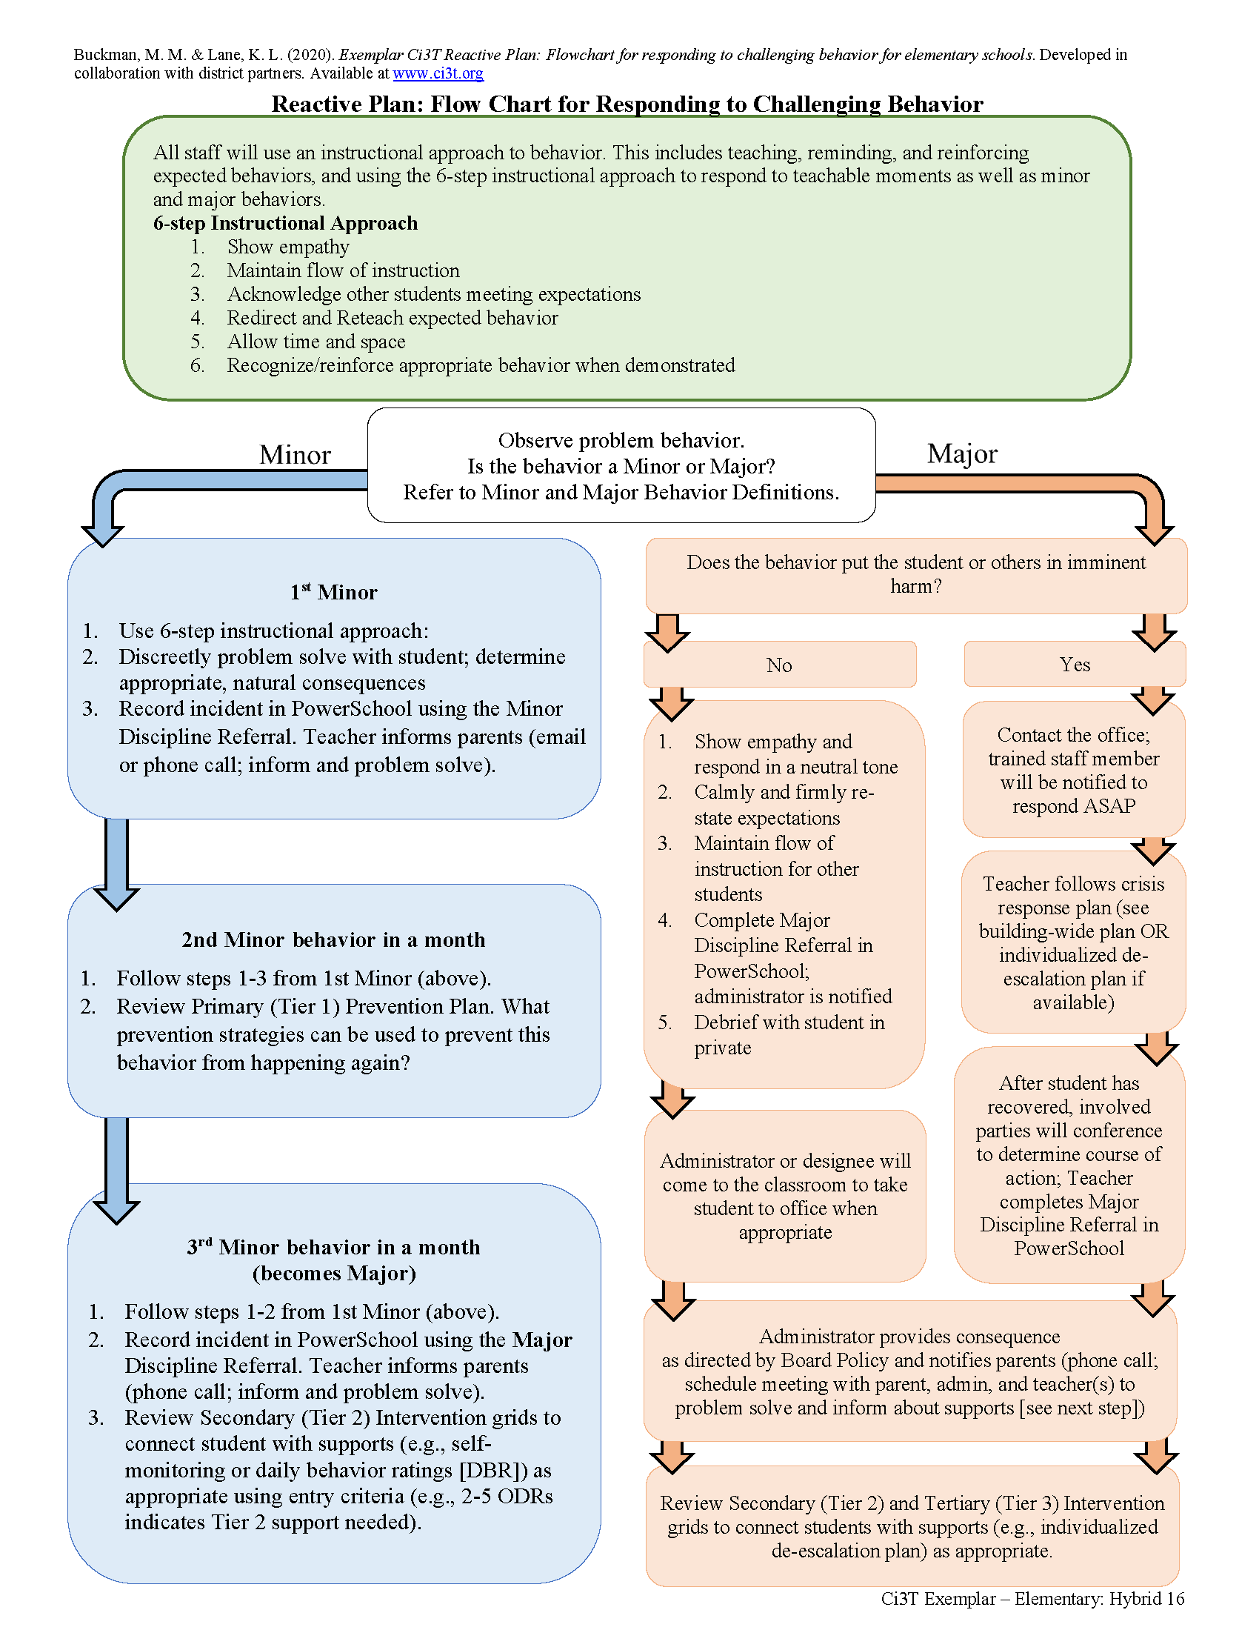

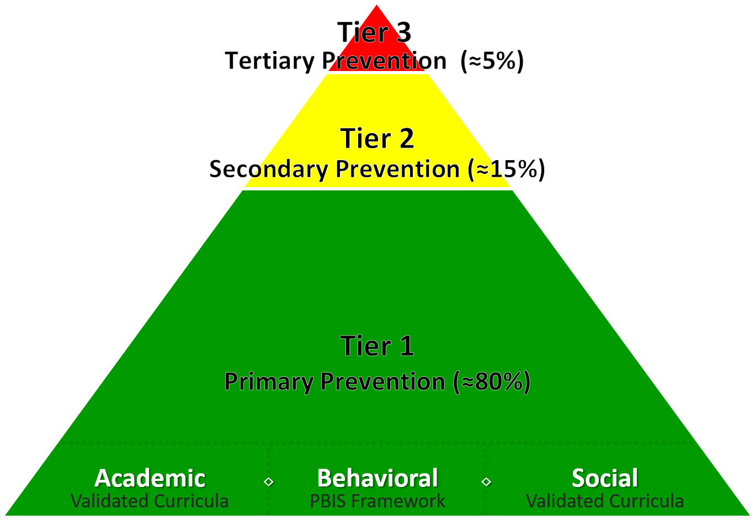
A Focus on: Responding to Challenging Behavior

Slide 43
Reactive Plan: Flow Chart for Responding to Challenging Behavior

Slide 44

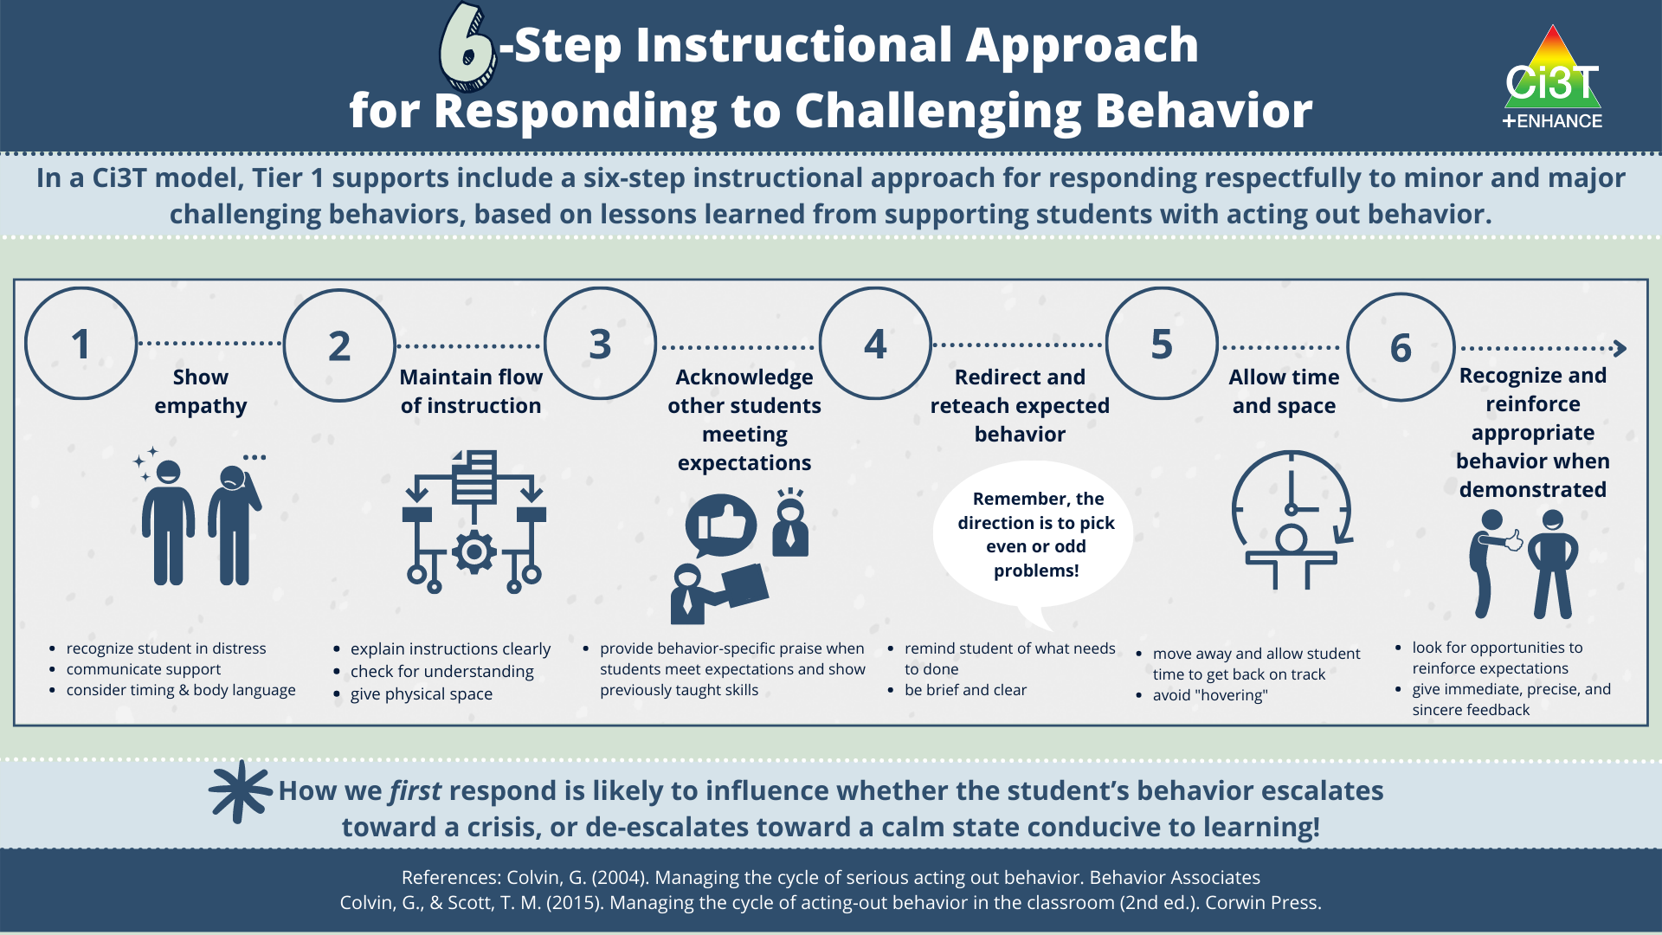
6-Step Instructional Approach for Responding to Challenging Behavior

Slide 45
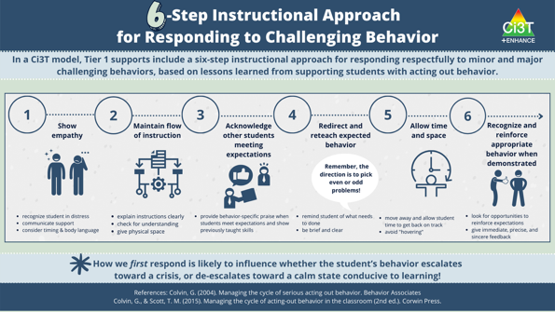
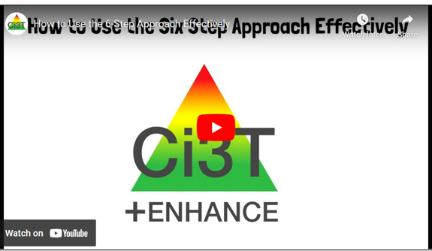



Module Connection!
6-Step Instructional Approach for Responding to Challenging Behavior
Module Connection 2

Slide 46

Join us at future EMPOWER+ to learn more! 2
Join us at future EMPOWER+ to learn more!
EMPOWER+ Session | Date
Starting Strong: Effective Tier 1 Practices for Educators | September 24, 2025 (Wednesday)
From Data to Action: Using Systematic Screening to Inform Instruction | October 8, 2025 (Wednesday)
Ci3T In Action: Integrated Lesson Planning for Enhanced Instruction | November 18, 2025 (Tuesday)
Mastering Behavior Specific Praise and Precorrection | January 21, 2026 (Wednesday)
A 6-Step Instructional Approach for Responding to Challenging Behaviors: A Tier 1 Practice | February 10, 2026 (Tuesday)
A Tier 2 Support for Students Experiencing Anxious Feelings: Recognize. Relax. Record. | March 25, 2026 (Wednesday)
A Tier 3 Support for Students with Intensive Intervention Needs: Functional Assessment-Based Intervention (FABI) | April 28, 2026 (Tuesday)

Slide 47
Empower Teachers with Low-Intensity Strategies

Slide 48
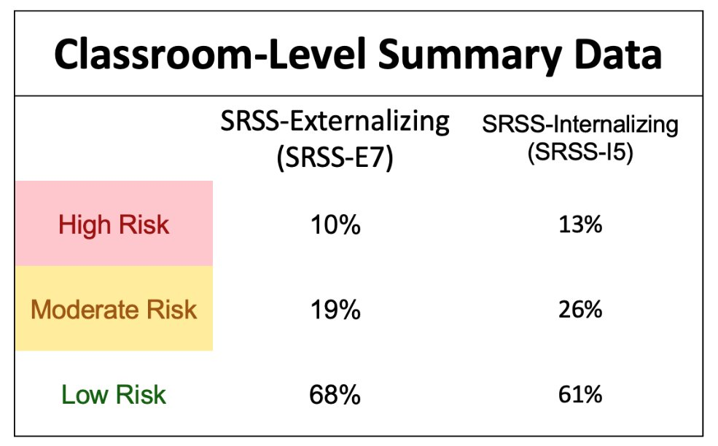
Data to Indicate a Focus on Low-Intensity Teacher-Delivered Strategies

Slide 49
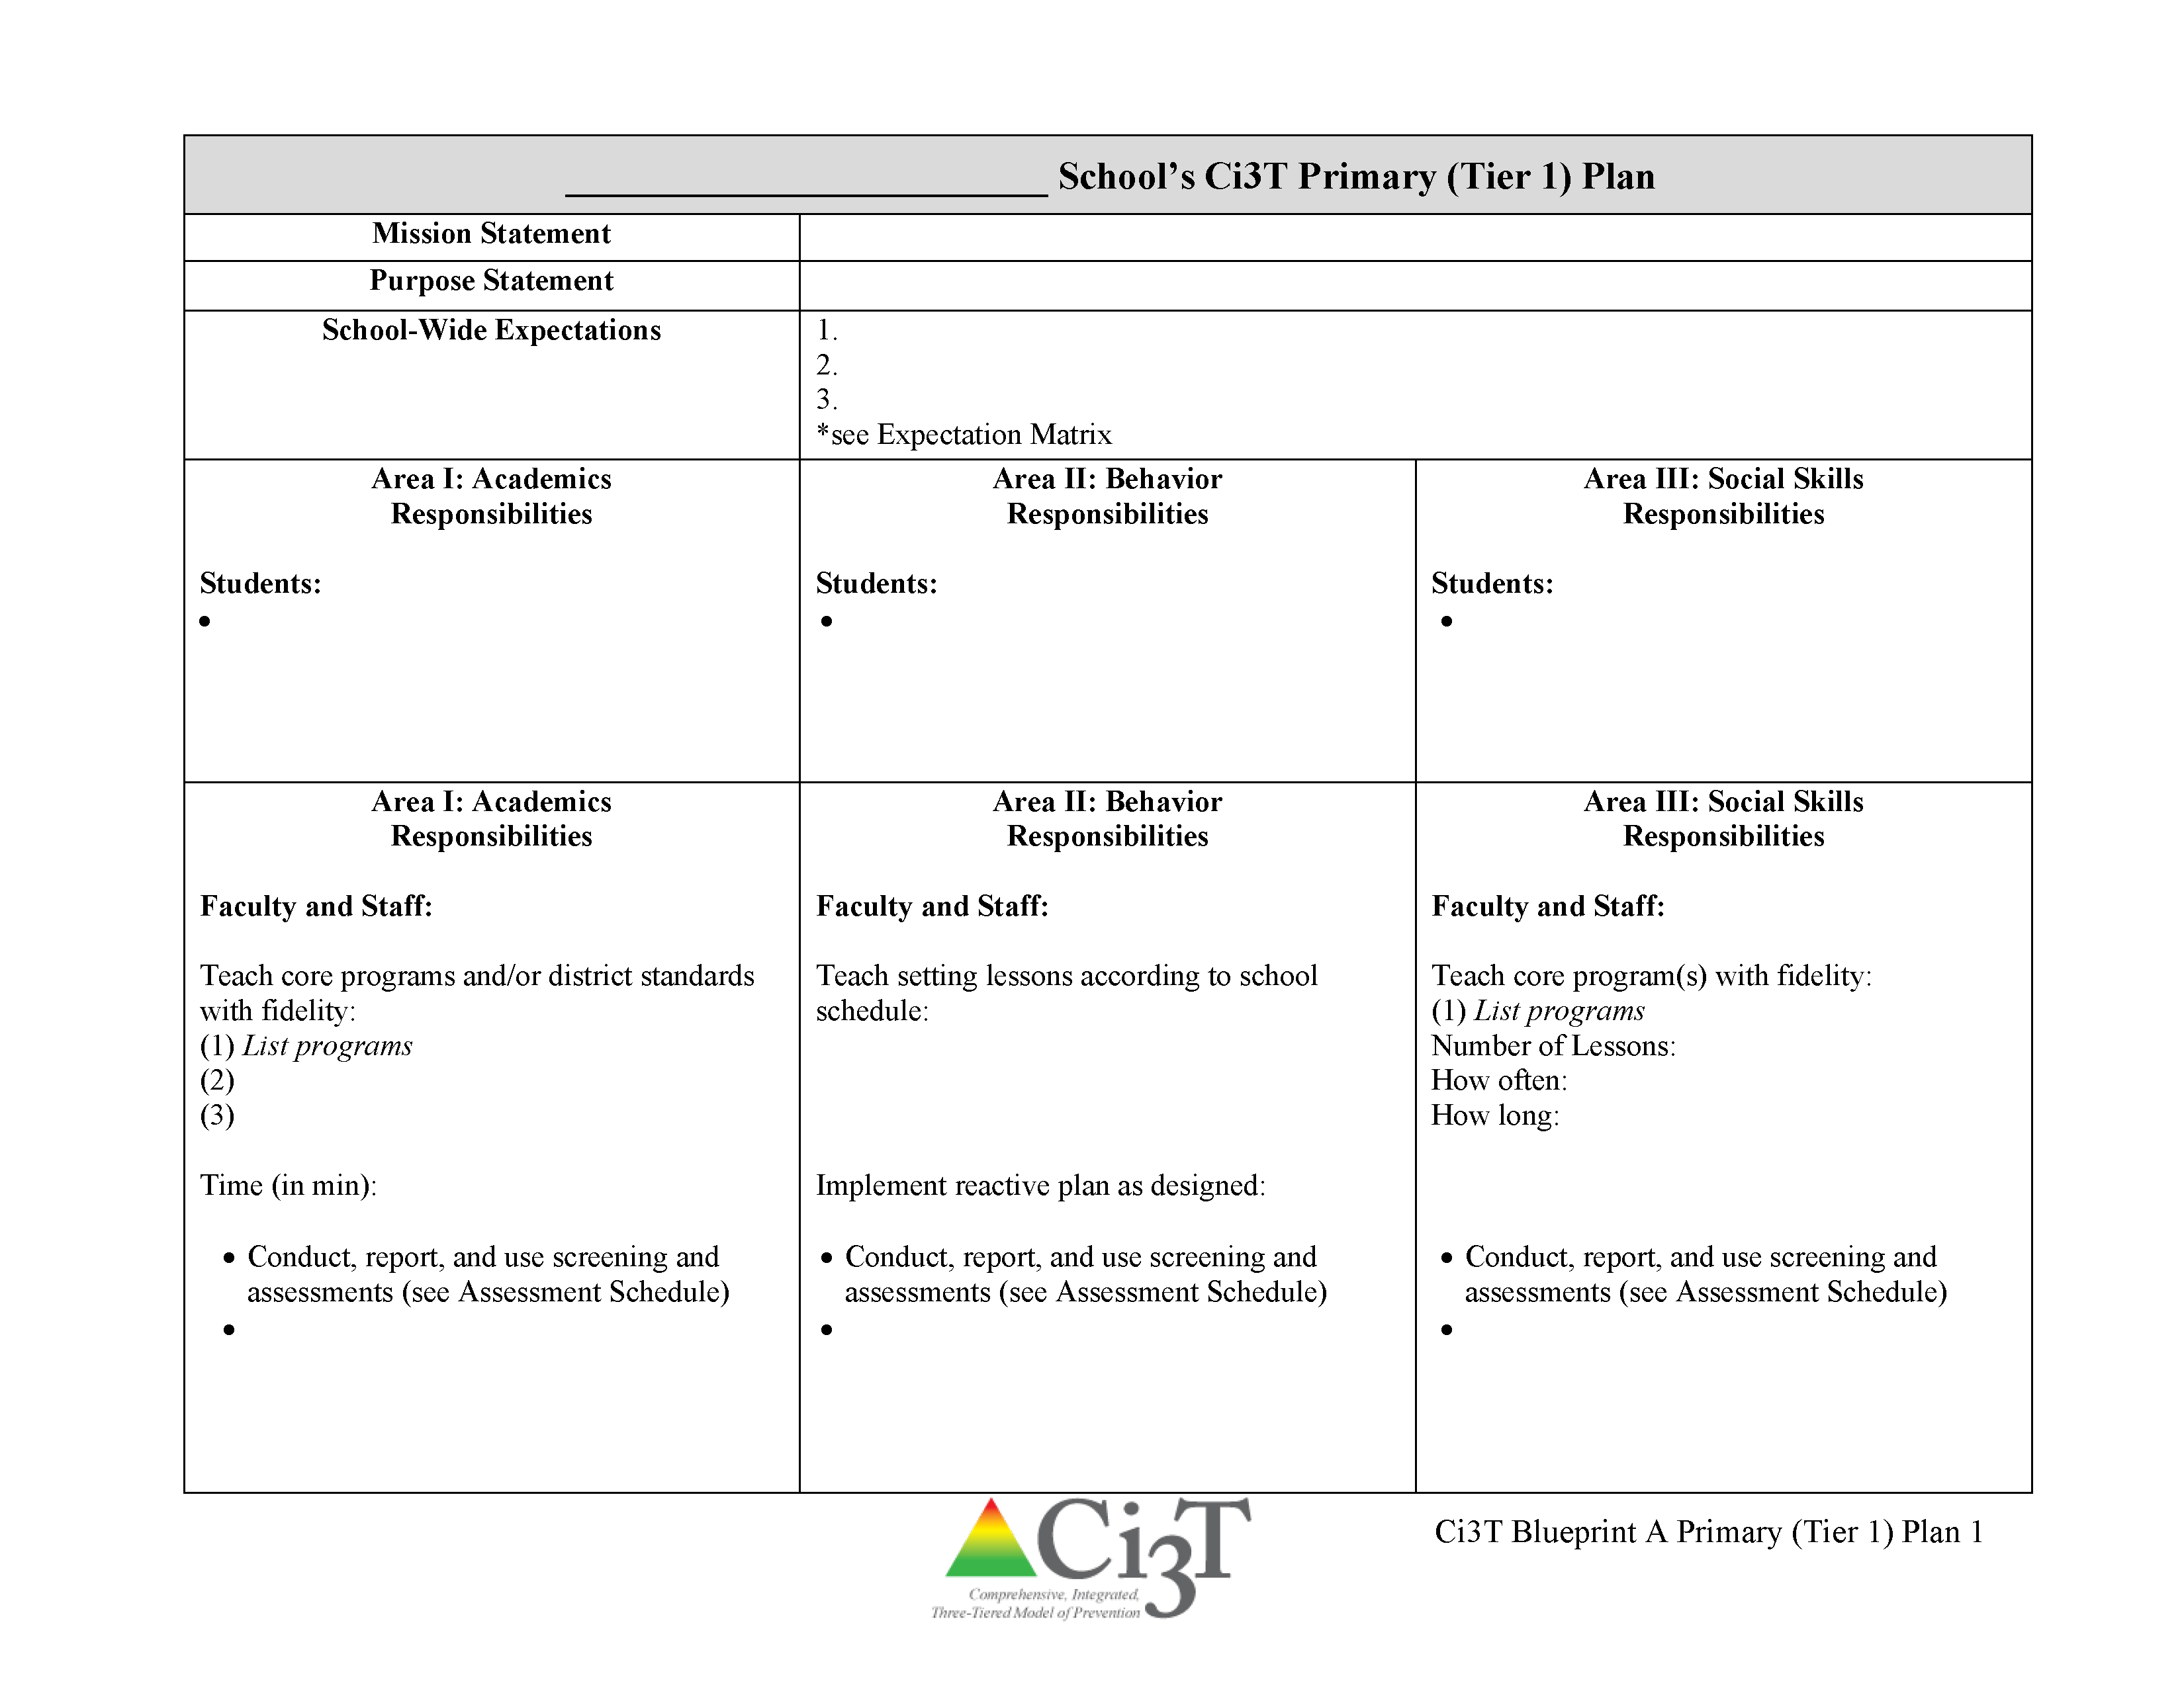

Low-Intensity Teacher-Delivered Strategies

Slide 50

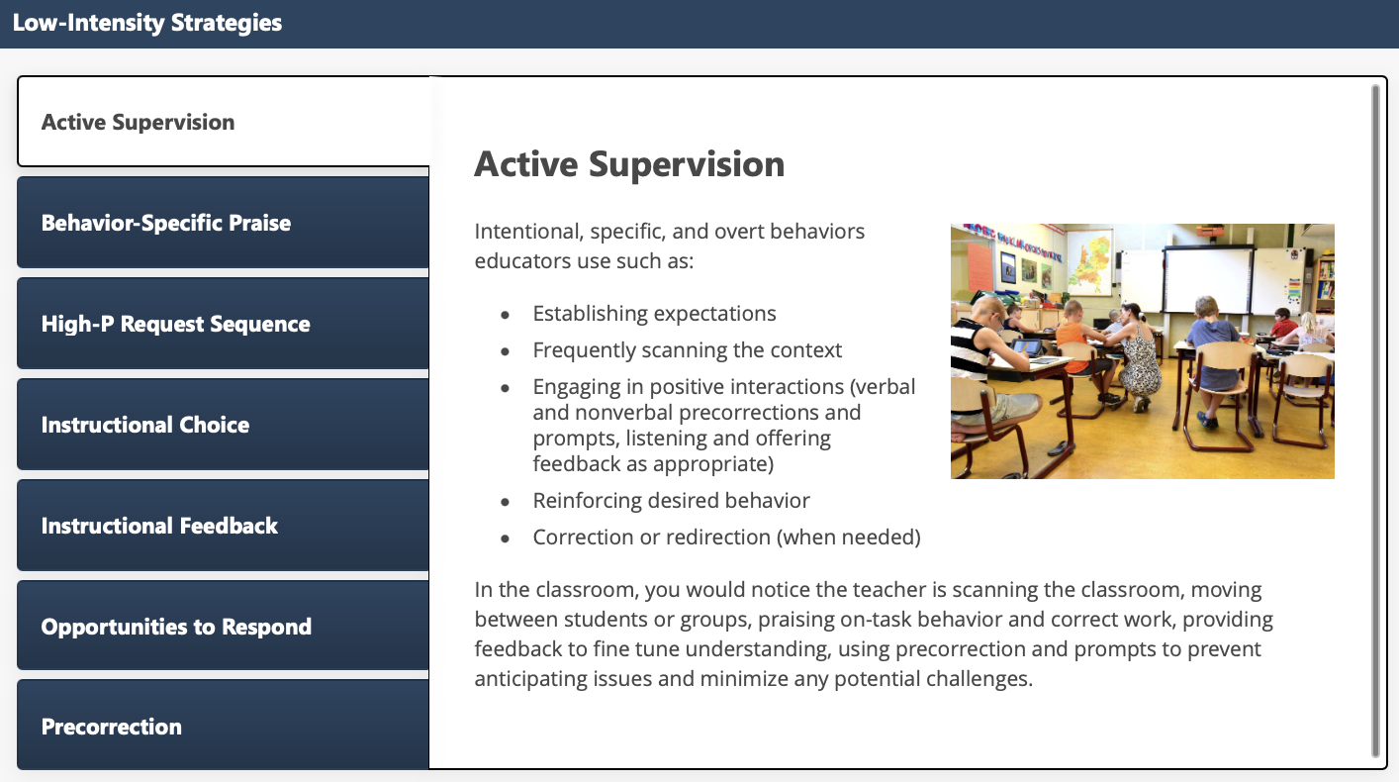
Low-Intensity Strategies: Academic Supervision

Slide 51
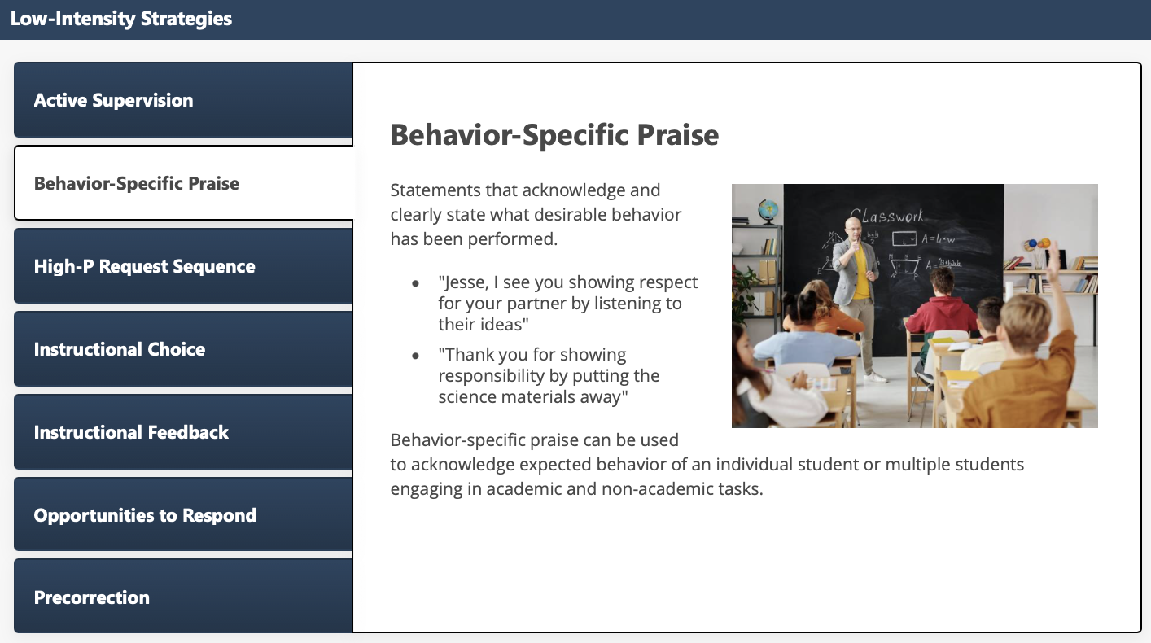
Low-Intensity Strategies: Behavior-Specific Praise

Slide 52

Low-Intensity Strategies: High-P Request Sequence

Slide 53

Low-Intensity Strategies: Instructional Choice

Slide 54

Low-Intensity Strategies: Instructional Feedback

Slide 55

Low-Intensity Strategies: Opportunities to Respond

Slide 56

Low-Intensity Strategies: Precorrection

Slide 57









Module Connection!
Instructional Choice
Notes:
LIS modules contain:
Videos and infographics to easily share key information
Resources to support implementation – templates, implementation checklist, treatment integrity forms, social validity, data-tracker
Family resources

Slide 58


Resource Spotlight!
Notes:
What Works Clearing House Practice Guide – Teacher-Delivered Behavioral Interventions in Grades K-5 https://ies.ed.gov/ncee/wwc/PracticeGuide/31

Slide 59


Join us at future EMPOWER+ to learn more!
EMPOWER+ Session | Date
Starting Strong: Effective Tier 1 Practices for Educators | September 24, 2025 (Wednesday)
From Data to Action: Using Systematic Screening to Inform Instruction | October 8, 2025 (Wednesday)
Ci3T In Action: Integrated Lesson Planning for Enhanced Instruction | November 18, 2025 (Tuesday)
Mastering Behavior Specific Praise and Precorrection | January 21, 2026 (Wednesday)
A 6-Step Instructional Approach for Responding to Challenging Behaviors: A Tier 1 Practice | February 10, 2026 (Tuesday)
A Tier 2 Support for Students Experiencing Anxious Feelings: Recognize. Relax. Record. | March 25, 2026 (Wednesday)
A Tier 3 Support for Students with Intensive Intervention Needs: Functional Assessment-Based Intervention (FABI) | April 28, 2026 (Tuesday)

Slide 60






Breakout Rooms
Notes:
15-min timer
Facilitators provide overview/orientation to module (< 2 min)
Prompt to register if have not done so already
Point out key features – table of resources (model how to use)
Independent Exploration
Someone in main room to manage difficulty accessing modules

Slide 61
Connect Students to Validated Tier 2 and Tier 3 Supports

Slide 62




Getting Started with Data-Informed Decision Making

Slide 63

Tier 2 and Tier 3 Intervention Grids
Notes:
Support is the name of the strategy, practice, or program. Notice this is not the name of a person or role.

Slide 64
Secondary (Tier 2) Intervention Grid

Slide 65


Tier 2: Recognize.Relax.Record

Slide 66

Join us at future EMPOWER+ to learn more! 3
Join us at future EMPOWER+ to learn more!
EMPOWER+ Session | Date
Starting Strong: Effective Tier 1 Practices for Educators | September 24, 2025 (Wednesday)
From Data to Action: Using Systematic Screening to Inform Instruction | October 8, 2025 (Wednesday)
Ci3T In Action: Integrated Lesson Planning for Enhanced Instruction | November 18, 2025 (Tuesday)
Mastering Behavior Specific Praise and Precorrection | January 21, 2026 (Wednesday)
A 6-Step Instructional Approach for Responding to Challenging Behaviors: A Tier 1 Practice | February 10, 2026 (Tuesday)
A Tier 2 Support for Students Experiencing Anxious Feelings: Recognize. Relax. Record. | March 25, 2026 (Wednesday)
A Tier 3 Support for Students with Intensive Intervention Needs: Functional Assessment-Based Intervention (FABI) | April 28, 2026 (Tuesday)

Slide 67
Tertiary (Tier 3) Intervention Grid

Slide 68


Tier 3: Functional Assessment-Based Intervention

Slide 69

Join us at future EMPOWER+ to learn more! 4
Join us at future EMPOWER+ to learn more!
EMPOWER+ Session | Date
Starting Strong: Effective Tier 1 Practices for Educators | September 24, 2025 (Wednesday)
From Data to Action: Using Systematic Screening to Inform Instruction | October 8, 2025 (Wednesday)
Ci3T In Action: Integrated Lesson Planning for Enhanced Instruction | November 18, 2025 (Tuesday)
Mastering Behavior Specific Praise and Precorrection | January 21, 2026 (Wednesday)
A 6-Step Instructional Approach for Responding to Challenging Behaviors: A Tier 1 Practice | February 10, 2026 (Tuesday)
A Tier 2 Support for Students Experiencing Anxious Feelings: Recognize. Relax. Record. | March 25, 2026 (Wednesday)
A Tier 3 Support for Students with Intensive Intervention Needs: Functional Assessment-Based Intervention (FABI) | April 28, 2026 (Tuesday)

Slide 70




Selecting an Intervention
Selecting an Intervention 1

Slide 71


Selecting an Intervention
Selecting an Intervention 2
Collaborate with families, colleagues, and the student to review available options
Consider what you know about the student (e.g., strengths, preferences, pre-requisite skills)
Consider possible function of the behavior
  Check-In Check Out is may be more effective for students who find accessing adult attention reinforcing
Consider your own strengths, support available (e.g., coach, professional learning), and feasibility of available options
Adjust as needed based on pre-intervention social validity

Slide 72

Let’s Practice Together!
Notes:
Facilitator has copy of Ci3T Data Dashboard- https://docs.google.com/spreadsheets/d/135hDmcTOIjAwb_8Ci-hNR38uF9vs7oUcVzjeSxVM2a8/edit?usp=sharing
Model:
Filter
Moderate internalizing
Below grade level reading
Attendance – now what do you notice
Ci3T Implementation Manual
What intervention(s) might be appropriate for this student? (e.g., self-monitoring w/ reading, breathing strategy)

Slide 73

Document Decisions and Plan for Next Steps
Document Decisions and Plan for Next Steps 1

Slide 74

Document Decisions and Plan for Next Steps
Document Decisions and Plan for Next Steps 2

Slide 75





Module Connection!
The Tier 2 Process: Using Data to Connect Students to Validated Supports

Slide 76





Module Connection!
The Tier 3 Process: Using Data to Connect Students to Validated Supports

Slide 77




Breakout Rooms: Choose Your Own Adventure!
Explore Tier 2 Module Independently explore The Tier 2 Process: Using Data to Connect Students to Validated Supports module | Explore Tier 3 Module Independently explore The Tier 3 Process: Using Data to Connect Students to Validated Supports module | Facilitated Breakout Room Guided practice connecting students to validated Tier 2 and Tier 3 supports using Ci3T Data Dashboard and Exemplar Ci3T Manual
Notes:
15-min timer

Slide 78
Wrapping Up and Moving Forward

Slide 79
Action Items
Action Item | Person(s) Responsible | Planned Completion Date | Date Completed
Submit BCBA CEU form with four passwords | Carrie | 10/08/25
Sign up for EMPOWER Session 4 (Mastering Behavior Specific Praise and Precorrection) | Carrie | 10/08/25
Email instructional coach to schedule time to review Fall screening data to connect students with Tier 2 supports | Carrie | 10/09/25

Slide 80

Project EMPOWER+
EMPOWER+ Session | Date
Starting Strong: Effective Tier 1 Practices for Educators | September 24, 2025 (Wednesday)
From Data to Action: Using Systematic Screening to Inform Instruction | October 8, 2025 (Wednesday)
Ci3T In Action: Integrated Lesson Planning for Enhanced Instruction | November 18, 2025 (Tuesday)
Mastering Behavior Specific Praise and Precorrection | January 21, 2026 (Wednesday)
A 6-Step Instructional Approach for Responding to Challenging Behaviors: A Tier 1 Practice | February 10, 2026 (Tuesday)
A Tier 2 Support for Students Experiencing Anxious Feelings: Recognize. Relax. Record. | March 25, 2026 (Wednesday)
A Tier 3 Support for Students with Intensive Intervention Needs: Functional Assessment-Based Intervention (FABI) | April 28, 2026 (Tuesday)

Slide 81

Ci3T Trainers and Coaches Calls
Ci3T Trainers and Coaches Calls Session | Date
Ci3T Trainers and Coaches Call 1 | August 20, 2025 (Wednesday)
Ci3T Trainers and Coaches Call 2 | September 3, 2025 (Wednesday)
Ci3T Trainers and Coaches Call 3 | October 1, 2025 (Wednesday)
Ci3T Trainers and Coaches Call 4 | November 5, 2025 (Wednesday)
Ci3T Trainers and Coaches Call 5 | December 2, 2025 (Tuesday)
Ci3T Trainers and Coaches Call 6 | January 22, 2026 (Thursday)
Ci3T Trainers and Coaches Call 7 | February 17, 2026 (Tuesday)
Ci3T Trainers and Coaches Call 8 | March 10, 2026 (Tuesday)
Ci3T Trainers and Coaches Call 9 | April 15, 2026 (Wednesday)
Ci3T Trainers and Coaches Call 10 | May 13, 2026 (Wednesday)

Slide 82




Thank you!
Thank you!
ci3t.org
#Ci3T
@Ci3Tmodel
Tag us in your Ci3T highlights, we love to see Ci3T in action!
Follow us on Instagram for updates and new resources!
Notes:
Tag us in your Ci3T highlights- we would love to see Ci3T in action! Follow us on Instagram for updates and links to resources! @Ci3TModel
You will receive a brief session evaluation – we value your feedback and would greatly appreciate you taking a few minutes to share your thoughts on what you liked about the session and how we can improve

