Slide 1
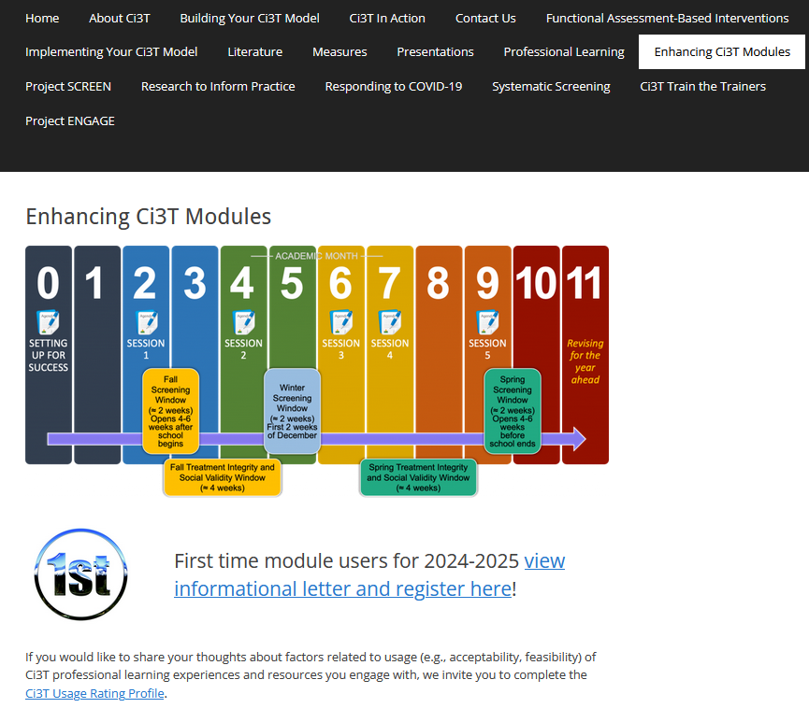
The Tier 2 Process
Auburn Washburn District-Based Professional Learning Session
Elise Sarasin, M.S.E, The University of Kansas
If you have not done so already, we invite you to visit ci3t.org/enhance to access modules after a one-time registration process!
This project was funded in part by Project EPIC (USDE, OSEP Award Number: H325D220011) and Project ENHANCE (IES Project Number R324N190002)

Slide 2
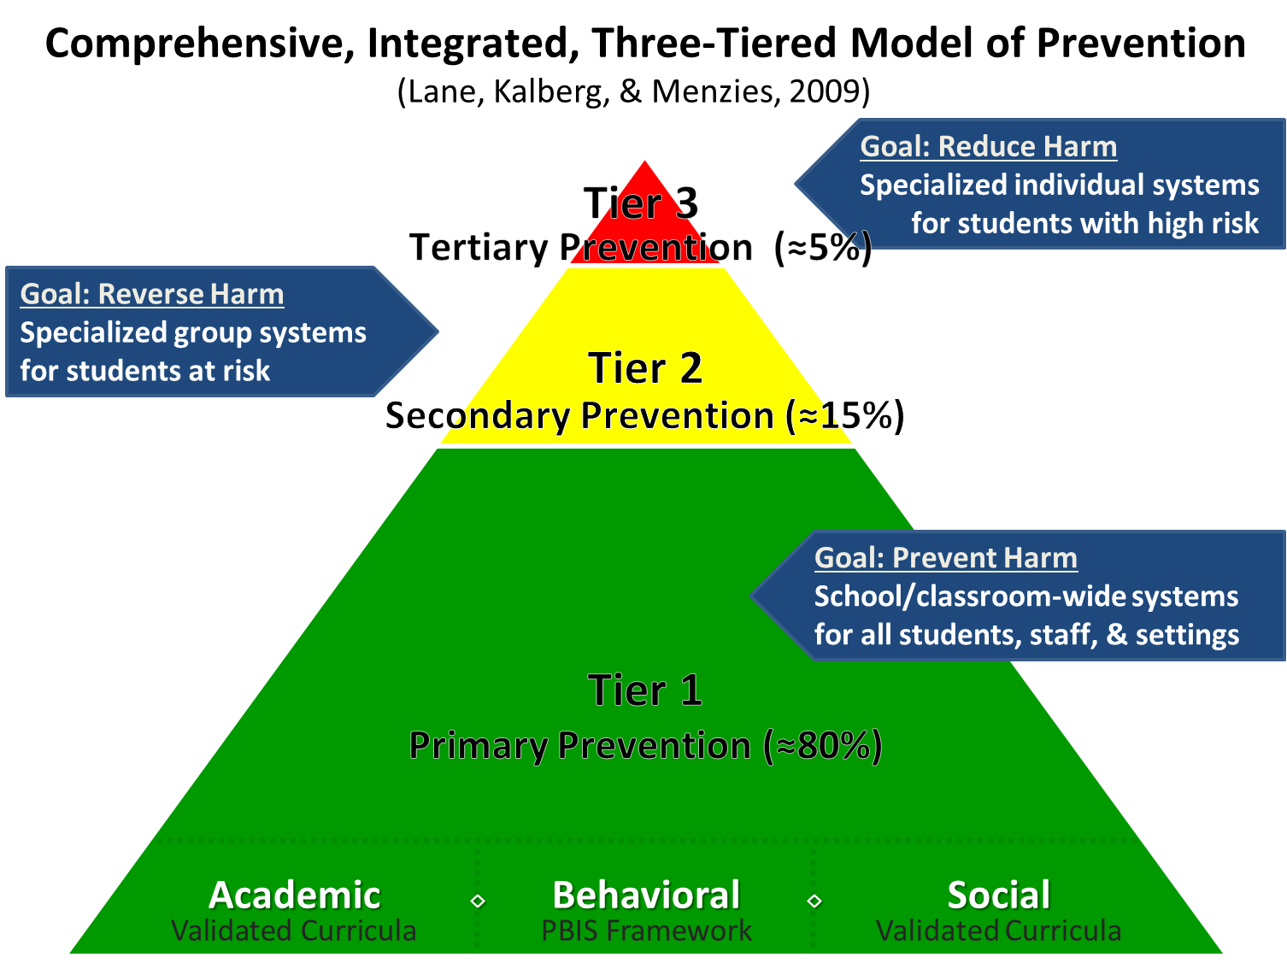
Comprehensive, Integrated, Three-Tiered Model of Prevention 1

Slide 3
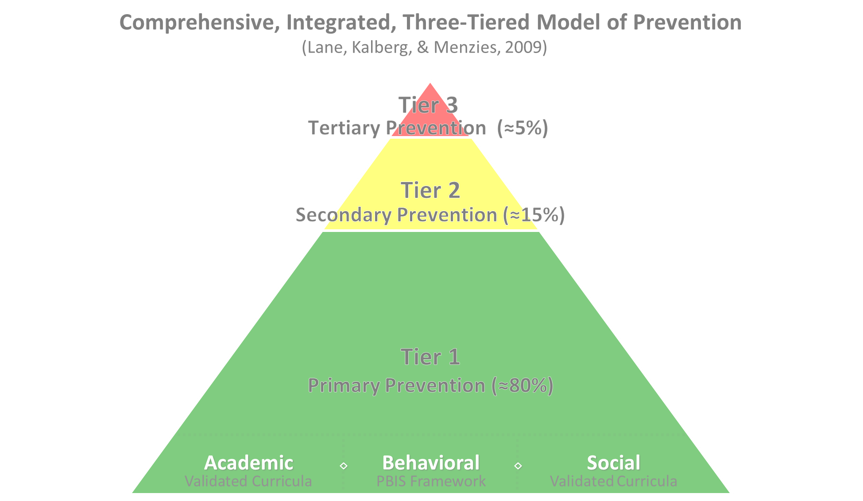

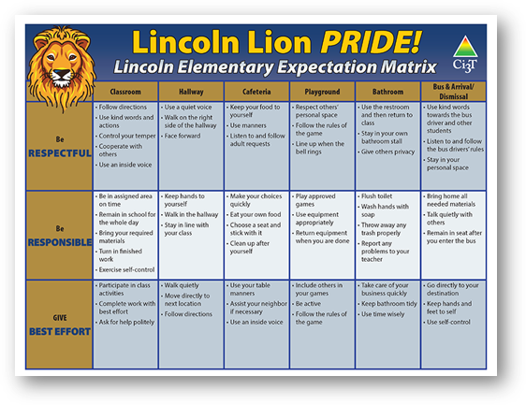
Comprehensive, Integrated, Three-Tiered Model of Prevention 2
Positive Behavioral Interventions and Supports
District & State Standards Quality Instruction
Validated Curricula and Resources

Slide 4

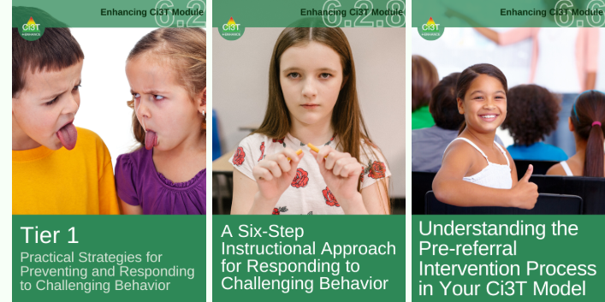
Primary Prevention (Tier 1)

Slide 5

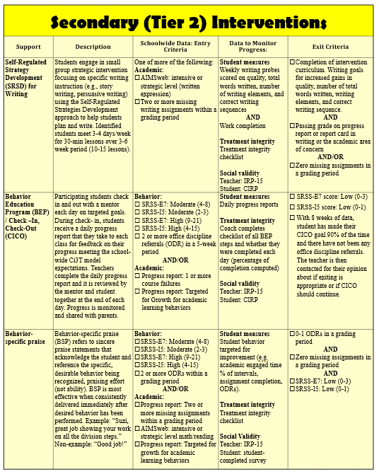
Secondary (Tier 2) Intervention Grid
Secondary (Tier 2) Intervention Grid 1
Notes:
In addition to the module featured here outlining how to use multiple sources of data to connect students with Tier 2 supports, we offer a full suite of modules highlighting validated Tier 2 interventions such as Self-Regulated Strategy Development (SRSD) for Writing and Check-In/Check Out that may appear in your Secondary (Tier 2) Intervention Grid

Slide 6

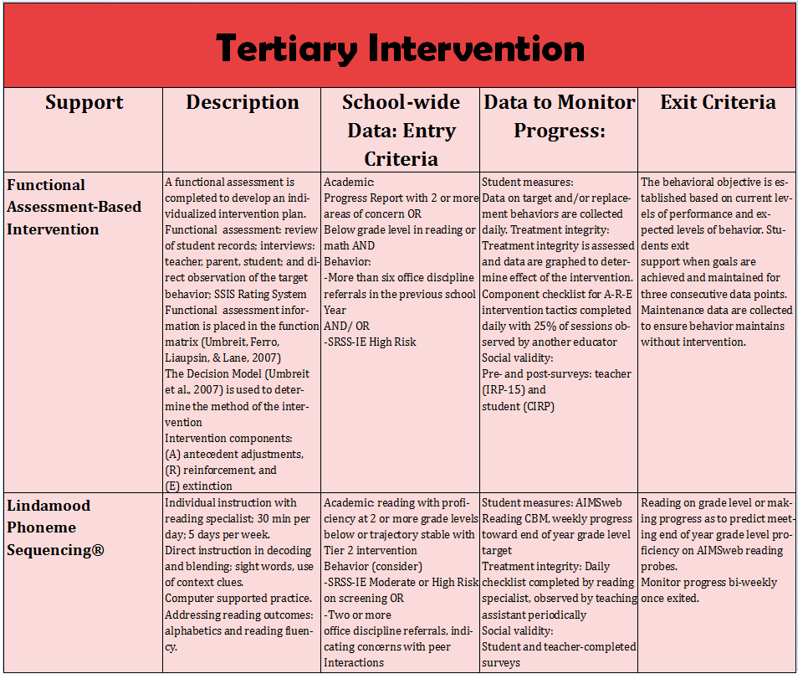
Tertiary (Tier 3) Intervention Grid
Notes:
In addition to the module featured here outlining how to use multiple sources of data to connect students with Tier 3 supports, we offer a full suite of modules highlighting validated Tier 3 interventions such as Functional Assessment-Based Intervention (FABI) that may appear in your Tertiary (Tier 3) Intervention Grid

Slide 7


Enhancing Ci3T Modules
ci3t.org/enhance

Slide 8
Session Outcome
Explain how to use school-wide data to connect students to validated Tier 2 supports

Slide 9
Agenda
Welcome
Situating Secondary (Tier 2) Interventions within Ci3T Models
Using Systematic Screening Data to Connect Students to Validated Tier 2 Supports
Wrapping Up and Moving Forward

Slide 10
Situating Secondary (Tier 2) Interventions in Ci3T Models

Slide 11

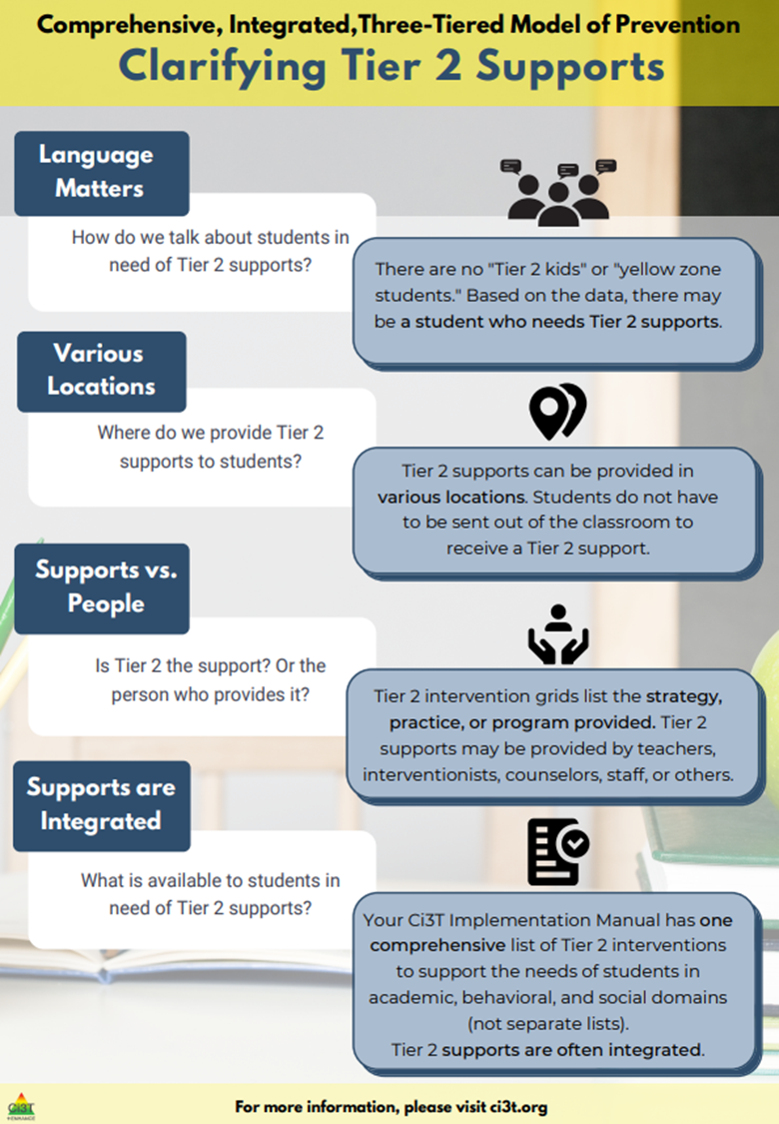
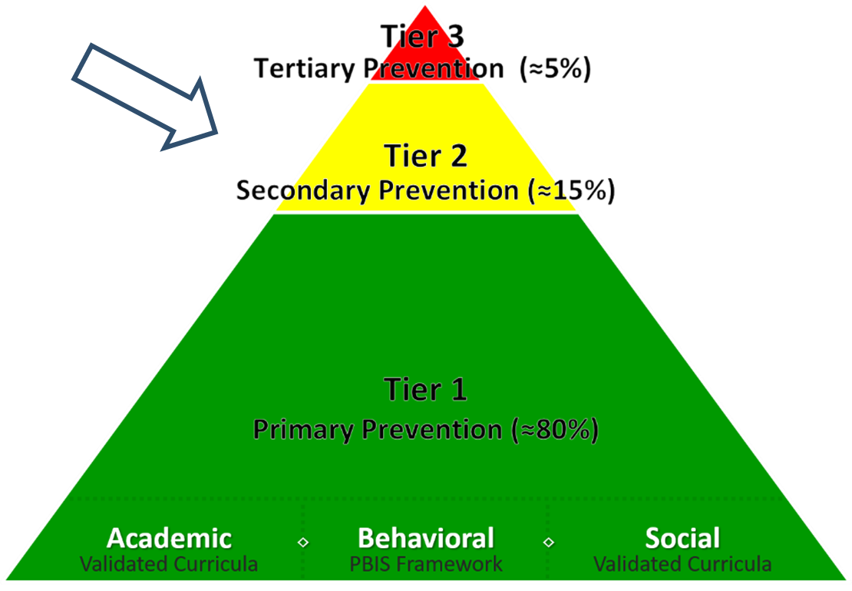
What are Tier 2 Interventions?
What are Tier 2 Interventions? 1

Slide 12

Clarifying Tier 2 Supports 2

Slide 13
Clarifying Tier 2 Supports 3

Slide 14
What are Tier 2 Interventions?
What are Tier 2 Interventions? 2
Evidenced-based or research-based strategies, practices, and programs
Additive (i.e., compliment rather than replace Tier 1 efforts)
Implemented by teachers, interventionists, counselors, paraprofessionals, and other staff
Occur in a variety of formats and locations (e.g., small-group, 1:1, embedded within whole group instruction)

Slide 15

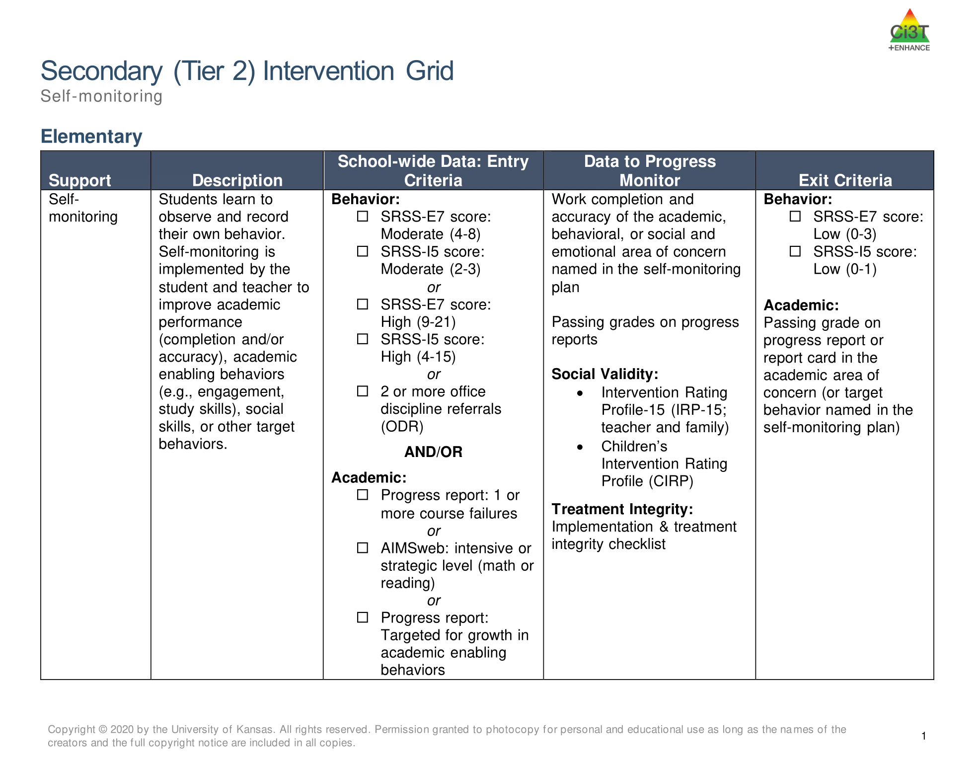
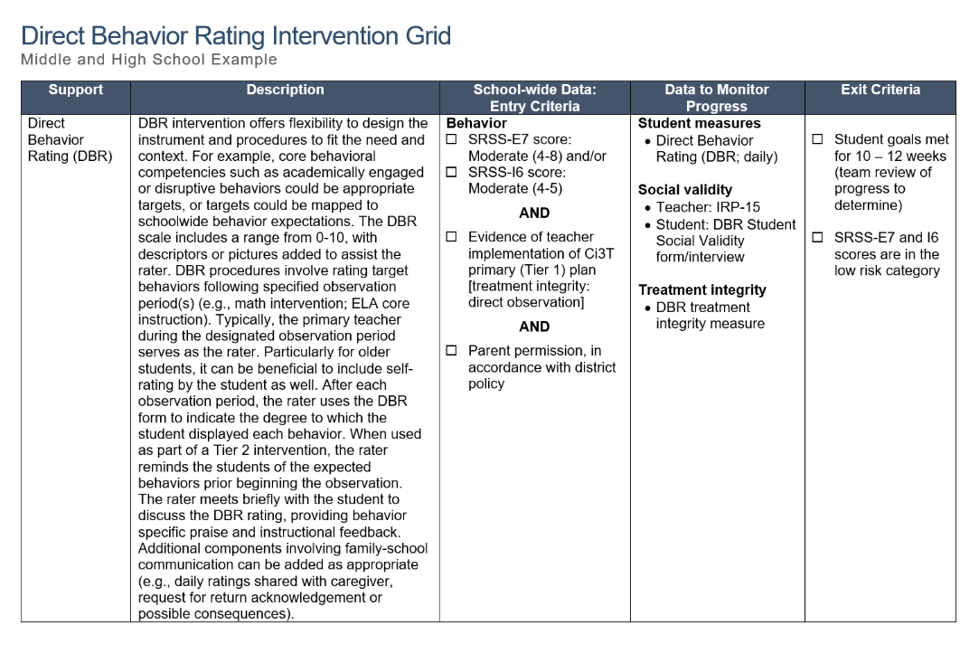
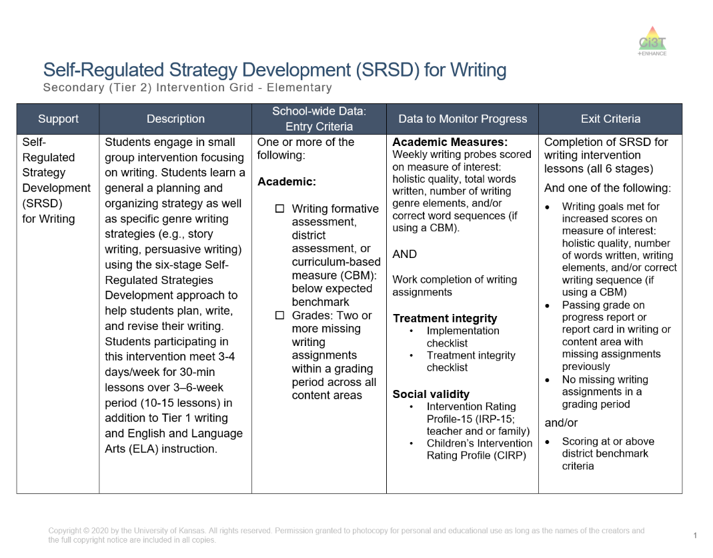
Secondary (Tier 2) Intervention Grid
Secondary (Tier 2) Intervention Grid 2

Slide 16

Components of Secondary (Tier 2) Intervention Grid

Slide 17
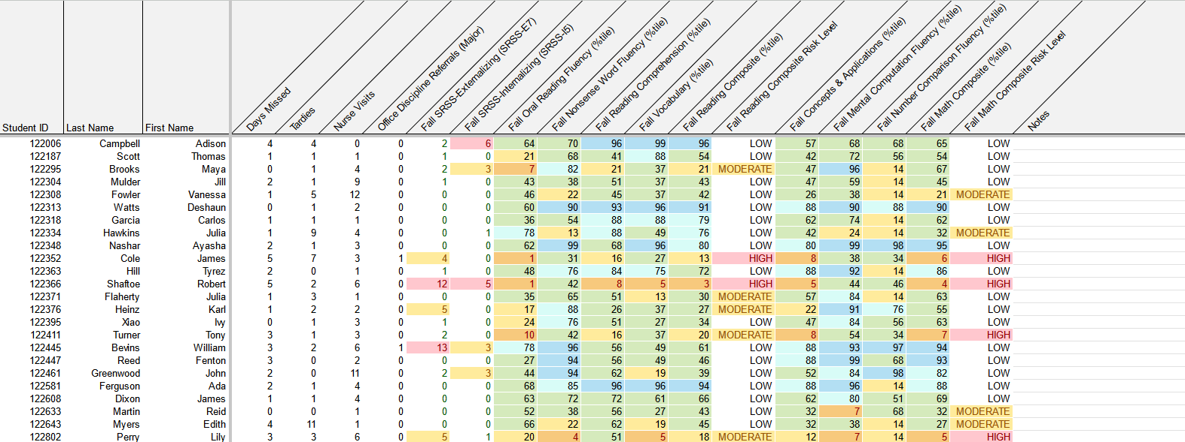
School-Wide Data Sources to Consider
attendance
behavior
screening
academic screening

Slide 18

SRSD for Writing

Slide 19

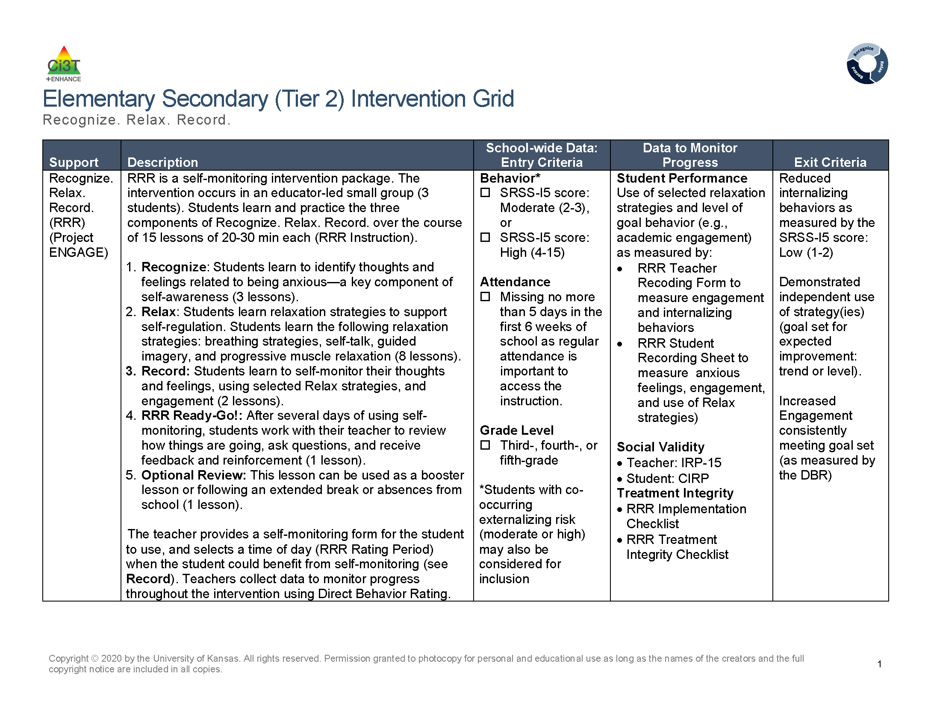
Recognize.Relax.Record

Slide 20
Join us at future EMPOWER+ to learn more!
EMPOWER+ Session | Date
Starting Strong: Effective Tier 1 Practices for Educators | September 24, 2025 (Wednesday)
From Data to Action: Using Systematic Screening to Inform Instruction | October 8, 2025 (Wednesday)
Ci3T In Action: Integrated Lesson Planning for Enhanced Instruction | November 18, 2025 (Tuesday)
Mastering Behavior Specific Praise and Precorrection | January 21, 2026 (Wednesday)
A 6-Step Instructional Approach for Responding to Challenging Behaviors: A Tier 1 Practice | February 10, 2026 (Tuesday)
A Tier 2 Support for Students Experiencing Anxious Feelings: Recognize. Relax. Record. | March 25, 2026 (Wednesday)
A Tier 3 Support for Students with Intensive Intervention Needs: Functional Assessment-Based Intervention (FABI) | April 28, 2026 (Tuesday)

Slide 21

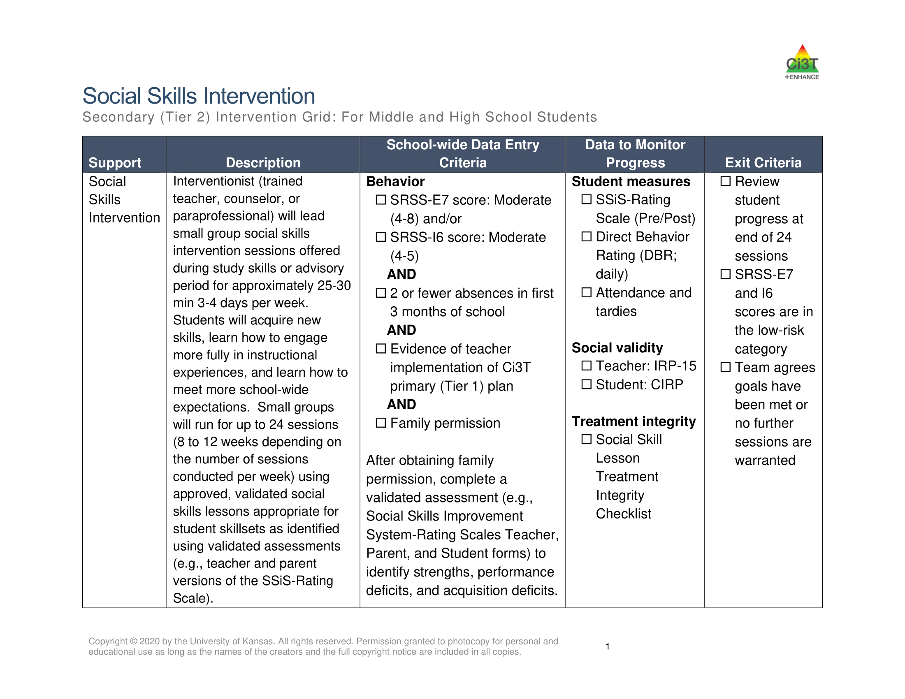
Social Skills

Slide 22

Tier 2 Modules

Slide 23
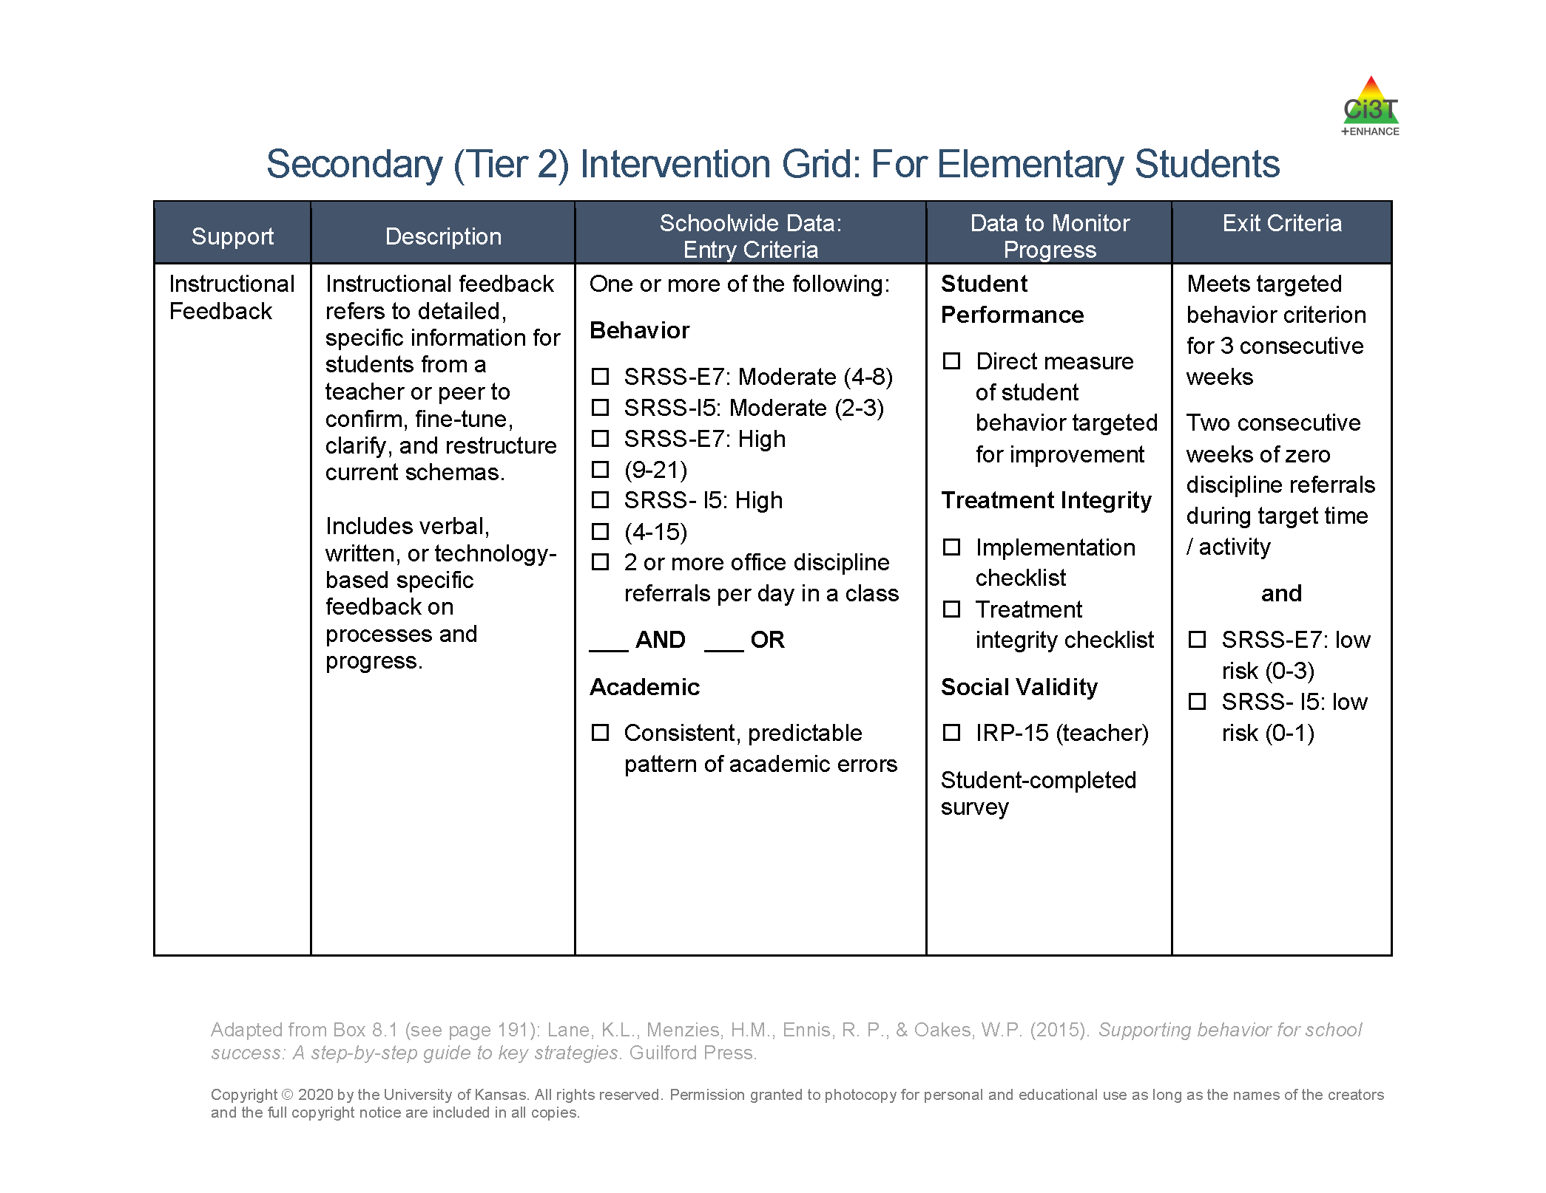

Low-Intensity, Teacher-Delivered Strategies as a Stand-Alone Tier 2 Intervention

Slide 24






Table Talk
Introduce yourself – name, school, grade level taught
What Tier 2 interventions are offered at your school?
Notes:
10-min timer

Slide 25
Using Systematic Screening Data to Connect Students to Validated Tier 2 Supports

Slide 26

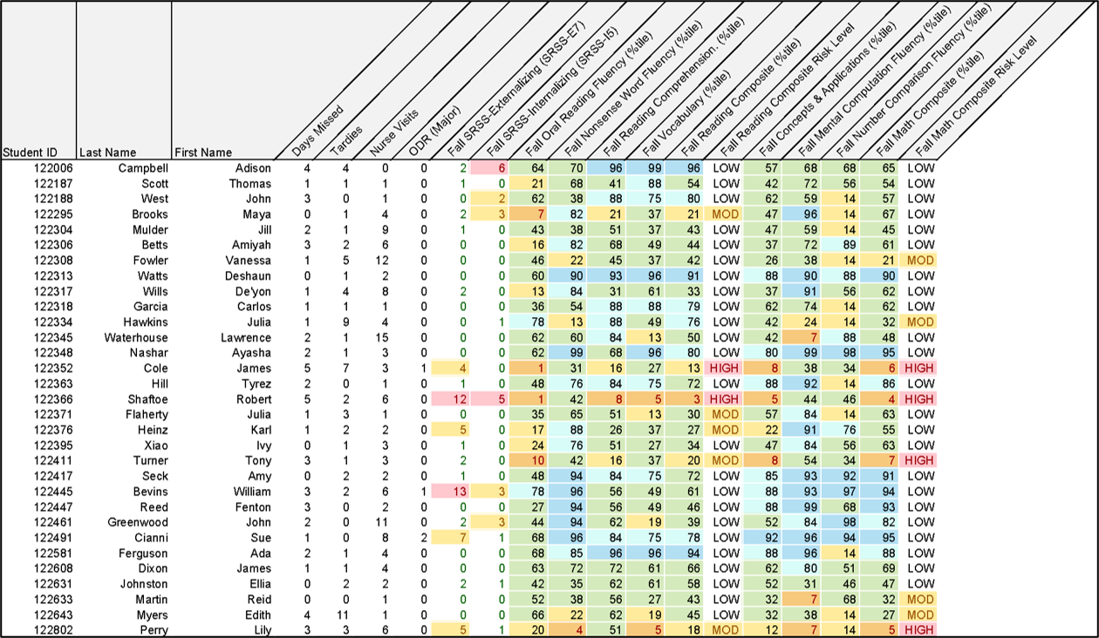
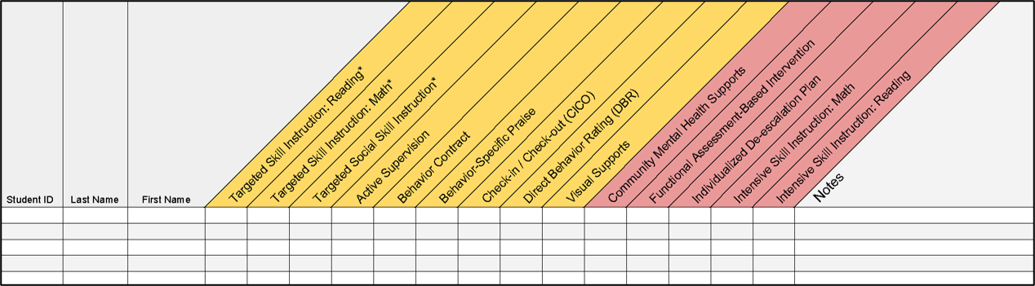
Getting Started with Data-Informed Decision Making

Slide 27
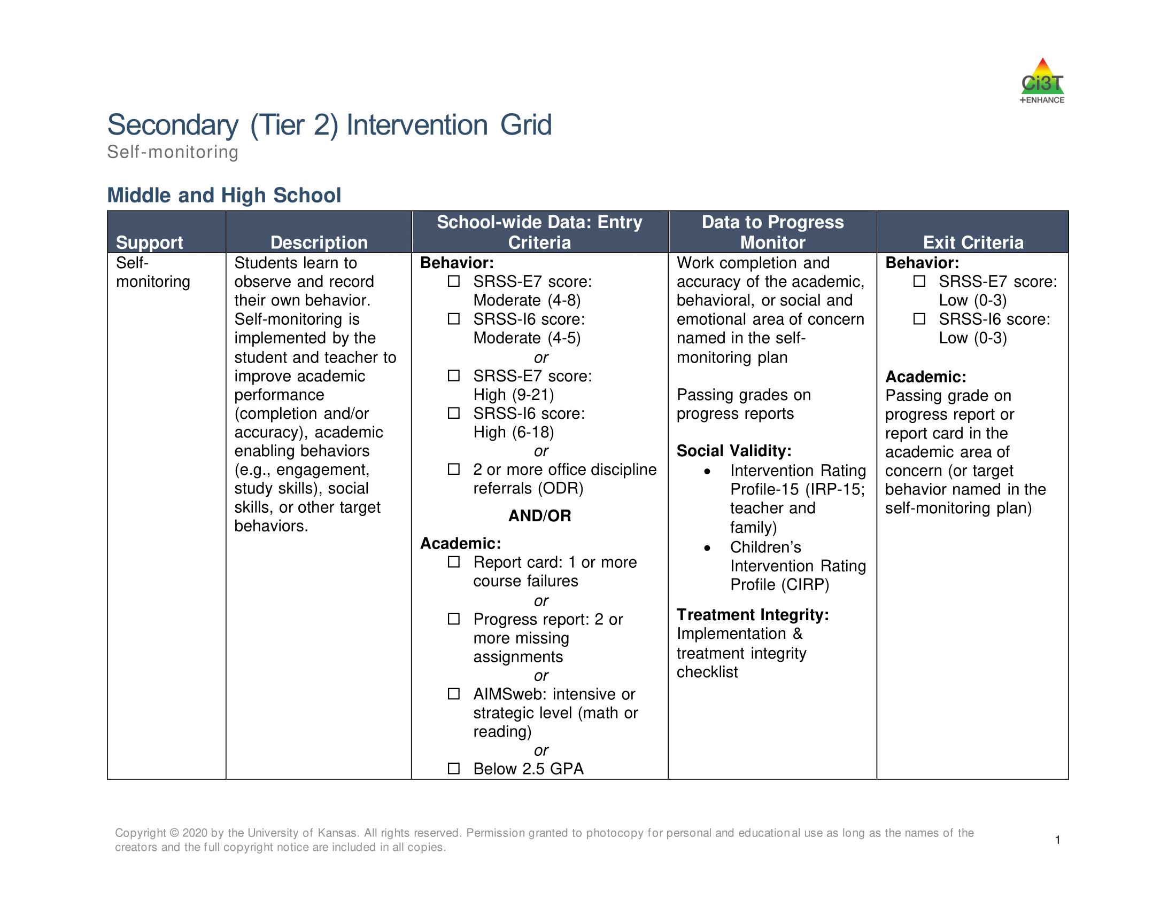
Tier 2 Intervention Grid

Slide 28

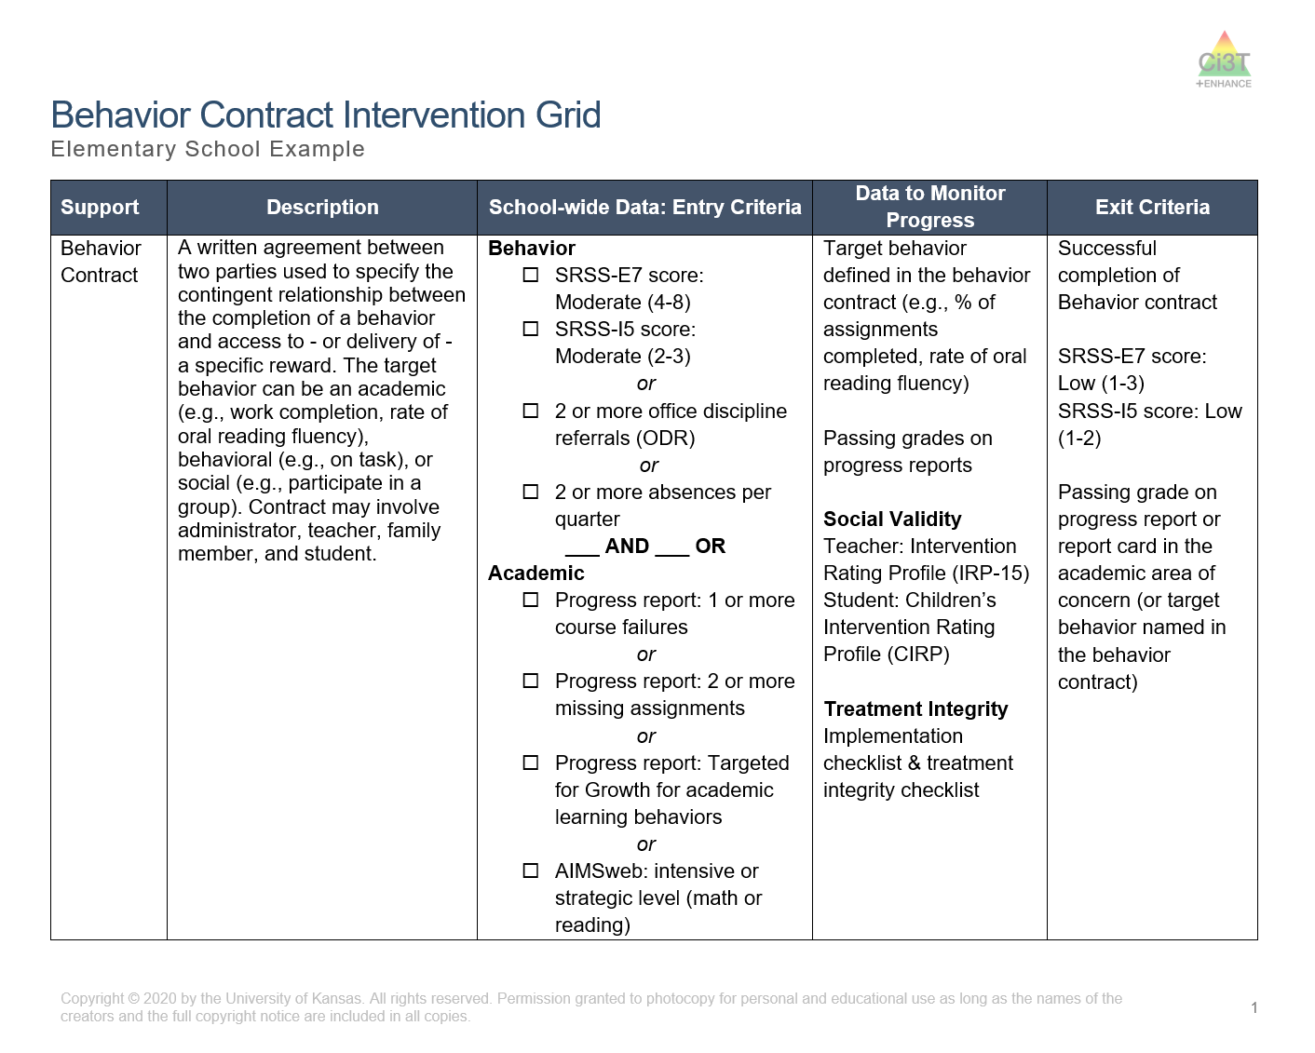
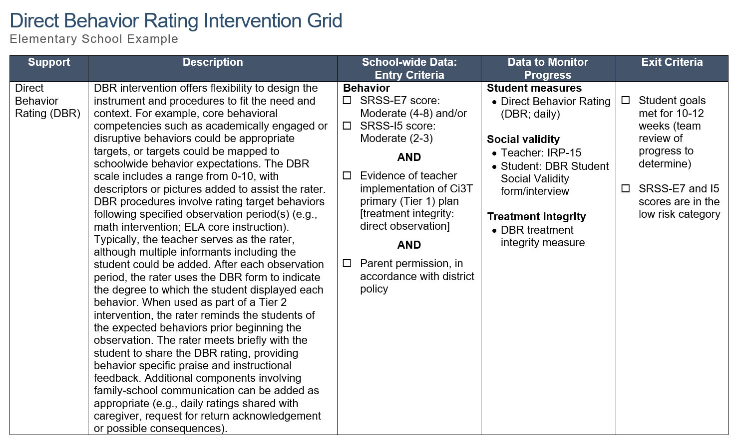
Selecting an Intervention
Selecting an Intervention 1

Slide 29
Selecting an Intervention
Selecting an Intervention 2
Collaborate with families, colleagues, and the student to review available options
Consider what you know about the student (e.g., strengths, preferences, pre-requisite skills)
Consider possible function of the behavior
  Check-In Check Out is may be more effective for students who find accessing adult attention reinforcing
Consider your own strengths, support available (e.g., coach, professional learning), and feasibility of available options
Adjust as needed based on pre-intervention social validity

Slide 30
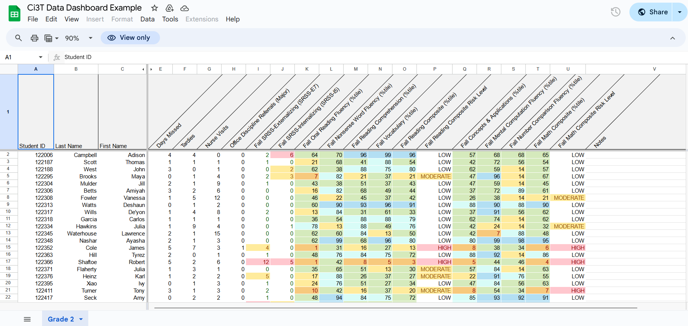
Let’s Practice Together!
Notes:
Facilitator has copy of Ci3T Data Dashboard- https://docs.google.com/spreadsheets/d/135hDmcTOIjAwb_8Ci-hNR38uF9vs7oUcVzjeSxVM2a8/edit?usp=sharing
Model:
Filter
Moderate internalizing
Below grade level reading
Attendance – now what do you notice
Ci3T Implementation Manual
What intervention(s) might be appropriate for this student? (e.g., self-monitoring w/ reading, breathing strategy)

Slide 31
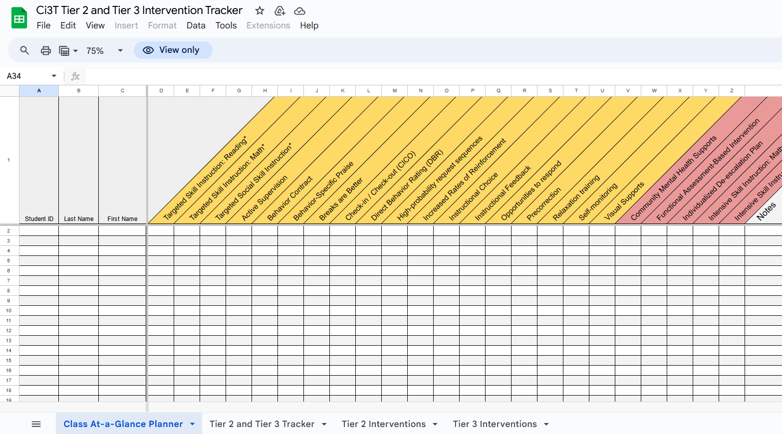
Document Decisions and Plan for Next Steps
Document Decisions and Plan for Next Steps 1

Slide 32
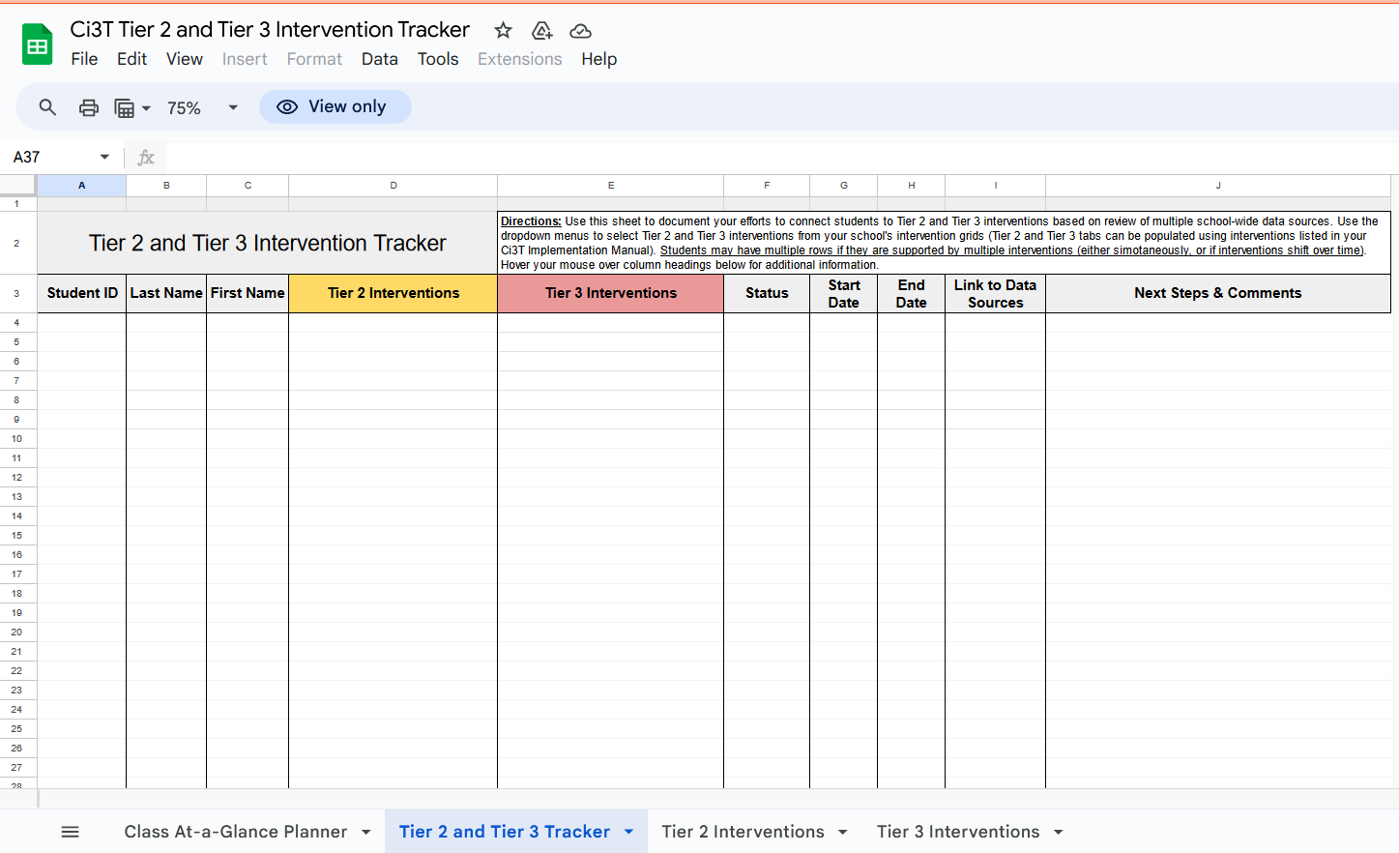
Document Decisions and Plan for Next Steps
Document Decisions and Plan for Next Steps 2

Slide 33
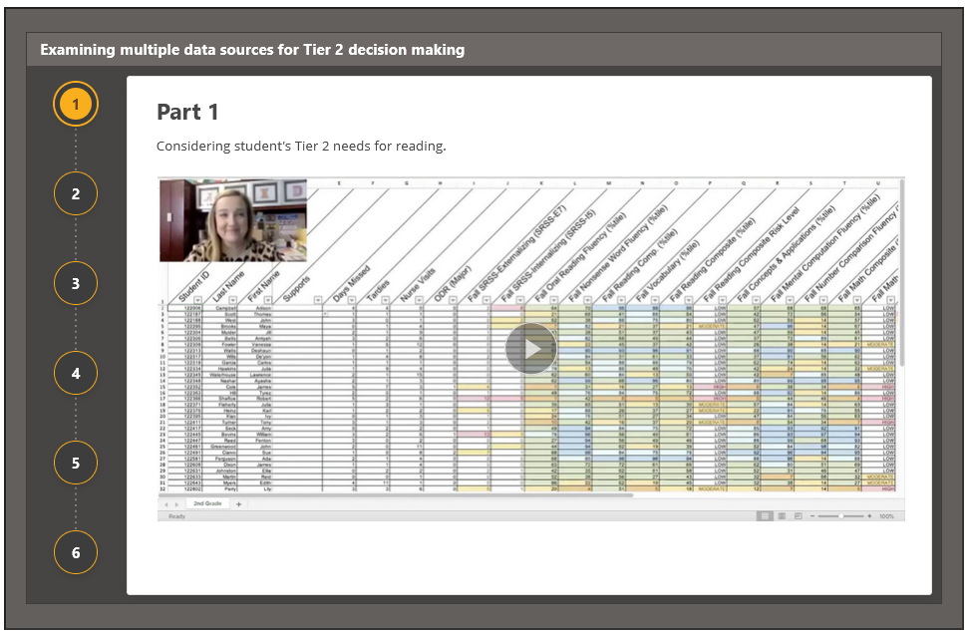
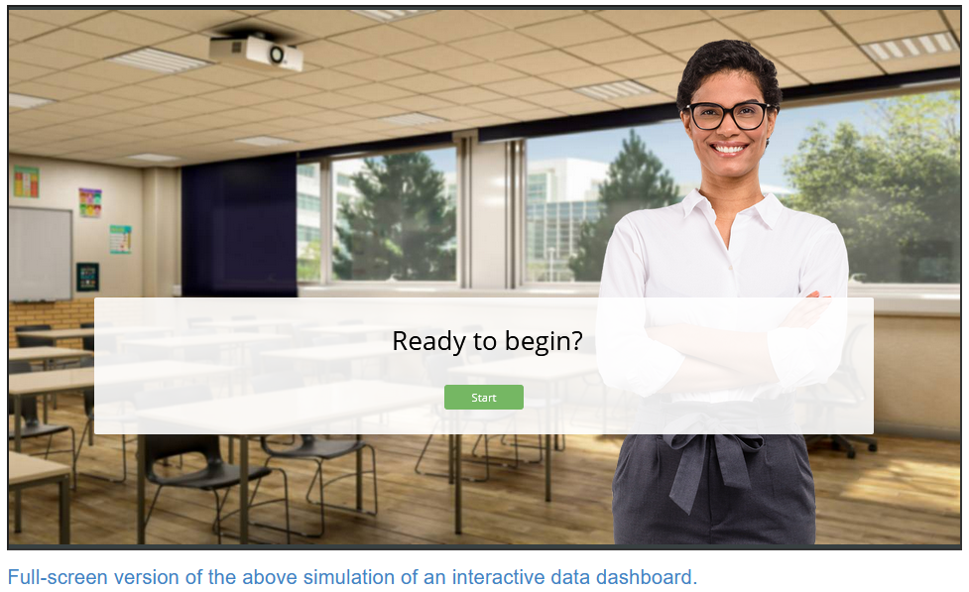

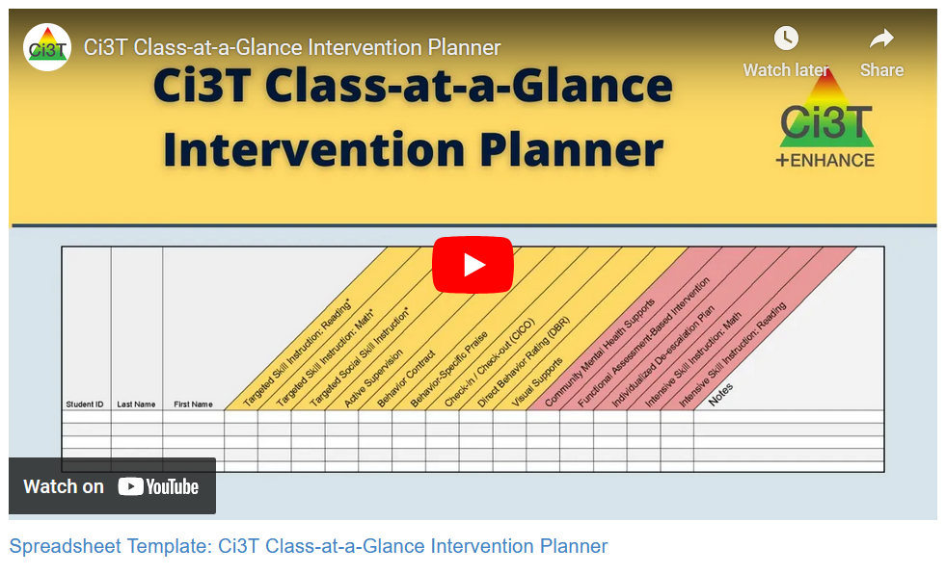
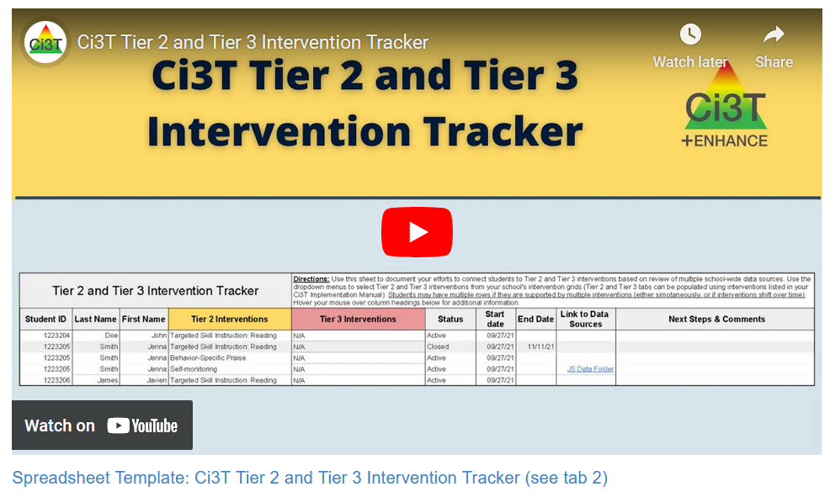
Module Connection!
The Tier 2 Process: Using Data to Connect Students to Validated Supports

Slide 34

Work Time
Explore Tier 2 Module Independently explore The Tier 2 Process: Using Data to Connect Students to Validated Supports module | Module Exploration Independently explore a Low-Intensity Strategy or Tier 2 Intervention module | Connect Students to Tier 2 Interventions Practice connecting students to validated Tier 2 supports using your data OR Ci3T Data Dashboard and Exemplar Ci3T Manual
Notes:
15-min timer

Slide 35
Wrapping Up and Moving Forward

Slide 36
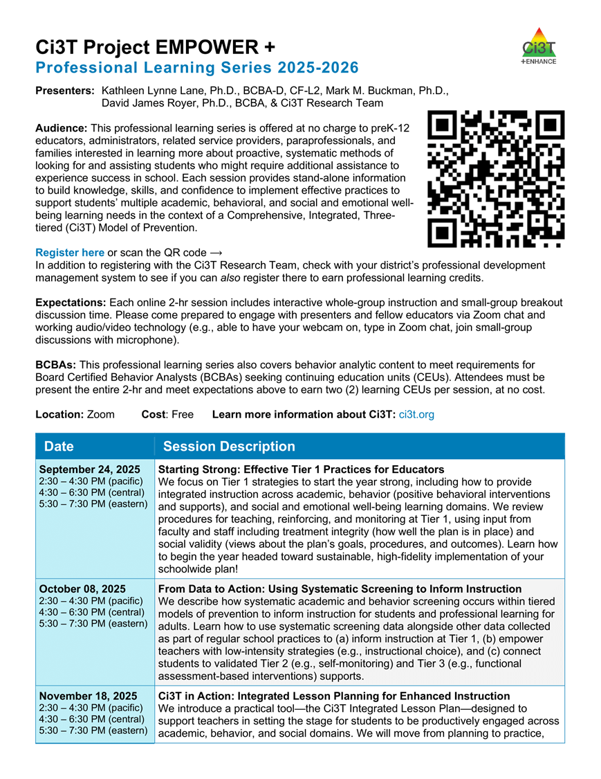
Project EMPOWER+
EMPOWER+ Session | Date
Starting Strong: Effective Tier 1 Practices for Educators | September 24, 2025 (Wednesday)
From Data to Action: Using Systematic Screening to Inform Instruction | October 8, 2025 (Wednesday)
Ci3T In Action: Integrated Lesson Planning for Enhanced Instruction | November 18, 2025 (Tuesday)
Mastering Behavior Specific Praise and Precorrection | January 21, 2026 (Wednesday)
A 6-Step Instructional Approach for Responding to Challenging Behaviors: A Tier 1 Practice | February 10, 2026 (Tuesday)
A Tier 2 Support for Students Experiencing Anxious Feelings: Recognize. Relax. Record. | March 25, 2026 (Wednesday)
A Tier 3 Support for Students with Intensive Intervention Needs: Functional Assessment-Based Intervention (FABI) | April 28, 2026 (Tuesday)

Slide 37
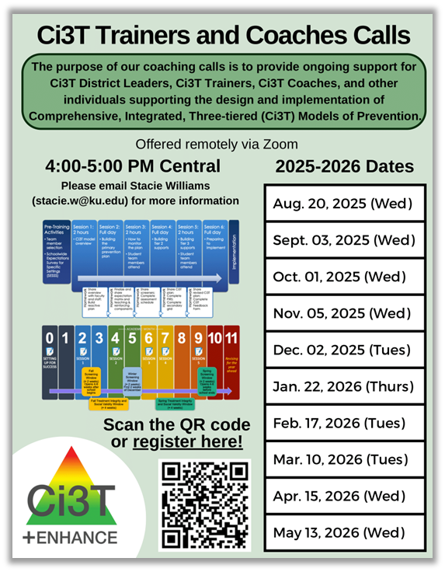
Ci3T Trainers and Coaches Calls
Ci3T Trainers and Coaches Calls Session | Date
Ci3T Trainers and Coaches Call 1 | August 20, 2025 (Wednesday)
Ci3T Trainers and Coaches Call 2 | September 3, 2025 (Wednesday)
Ci3T Trainers and Coaches Call 3 | October 1, 2025 (Wednesday)
Ci3T Trainers and Coaches Call 4 | November 5, 2025 (Wednesday)
Ci3T Trainers and Coaches Call 5 | December 2, 2025 (Tuesday)
Ci3T Trainers and Coaches Call 6 | January 22, 2026 (Thursday)
Ci3T Trainers and Coaches Call 7 | February 17, 2026 (Tuesday)
Ci3T Trainers and Coaches Call 8 | March 10, 2026 (Tuesday)
Ci3T Trainers and Coaches Call 9 | April 15, 2026 (Wednesday)
Ci3T Trainers and Coaches Call 10 | May 13, 2026 (Wednesday)

Slide 38

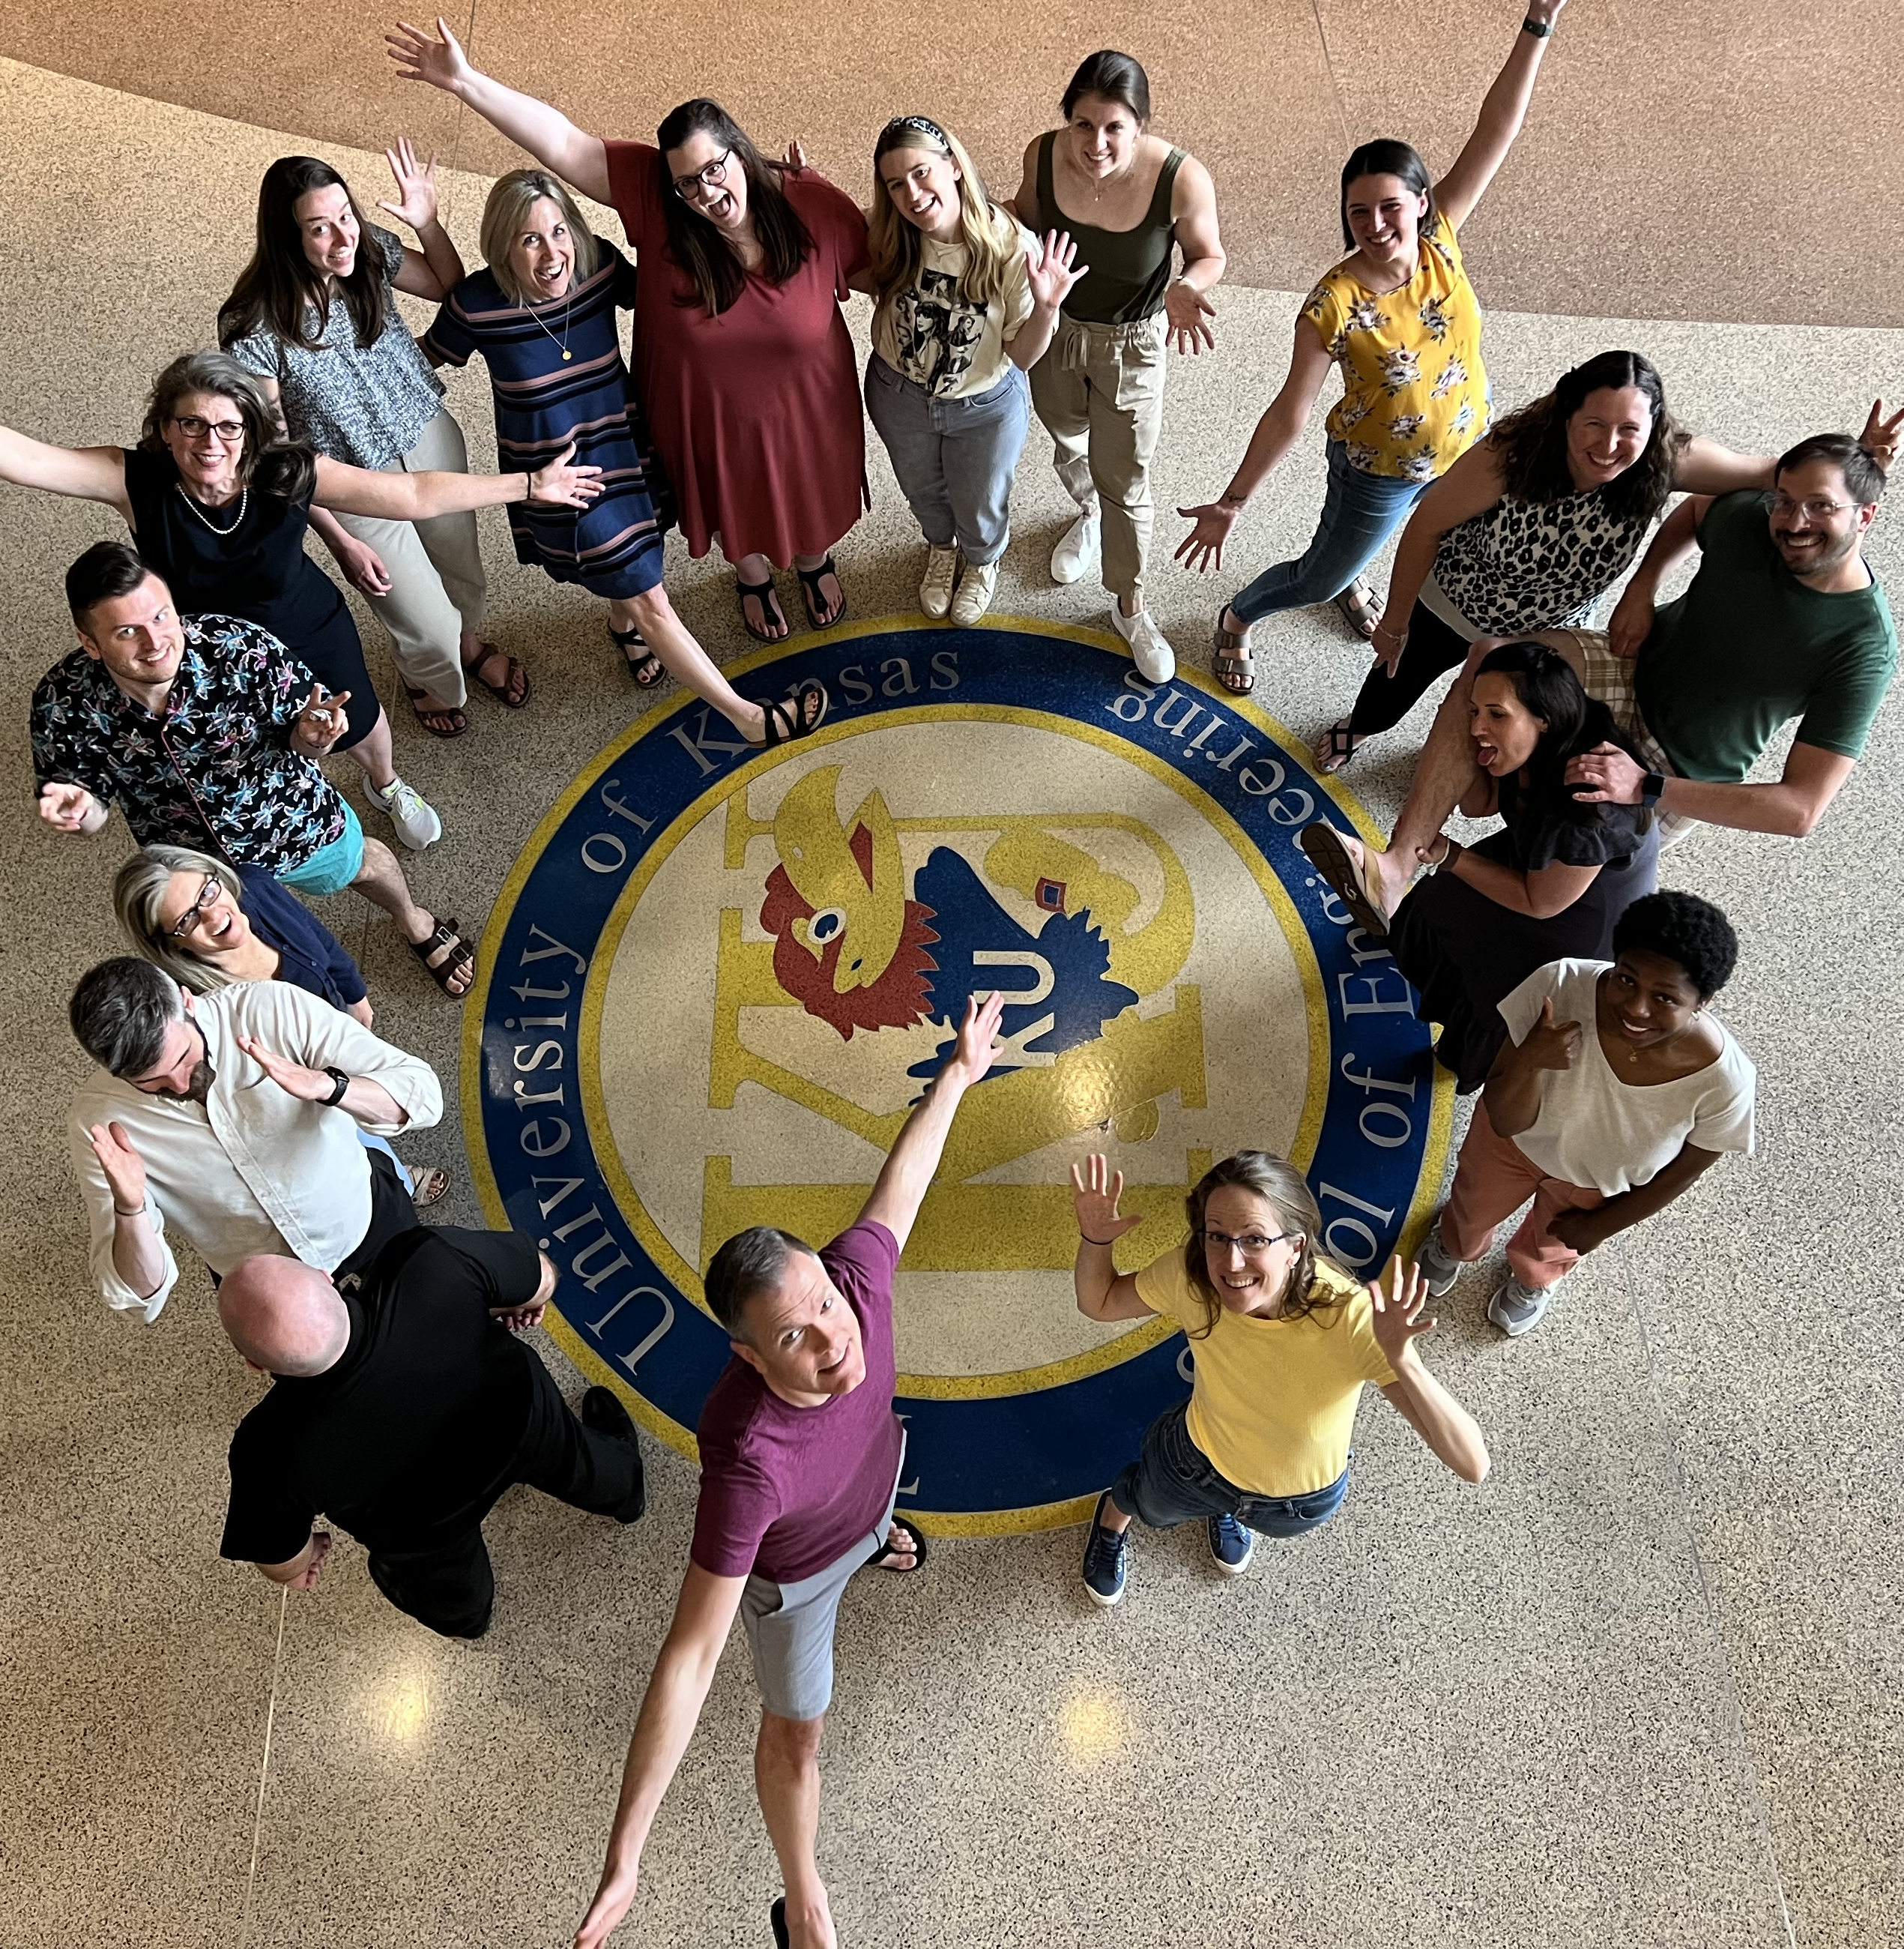

Thank you!
Thank you!
ci3t.org
#Ci3T
@Ci3Tmodel
Tag us in your Ci3T highlights, we love to see Ci3T in action!
Follow us on Instagram for updates and new resources!
Elise Sarasin
elise.sarasin@ku.edu
Notes:
Tag us in your Ci3T highlights- we would love to see Ci3T in action! Follow us on Instagram for updates and links to resources! @Ci3TModel
You will receive a brief session evaluation – we value your feedback and would greatly appreciate you taking a few minutes to share your thoughts on what you liked about the session and how we can improve

