Slide 1
Preparing for Implementation
Ci3T Professional Learning Series Session 6

Slide 2
Agenda
Welcome!
What have we built thus far?
What are our next steps for finalizing our Tier 2 and Tier 3 supports?
What feedback did your faculty and staff offer on your revised Ci3T Blueprint? Reviewing information from the Ci3T Feedback Form
How can we use the Ci3T Feedback Form data to revise our Ci3T Blueprints A-F?
What have you learned over the course of this year? Completing your post-training survey
How do we prepare for implementation next year?
  Making plans
  Preparing materials
Where do we go from here? Setting goals for implementation

Slide 3
Agenda
Conversation Closer
Table Talk Note Taker
R04 PL Plan Note Taker
Task Divider
Technology Wrangler
Please take a moment to assign team roles:
Welcome!
What have we built thus far?
What are our next steps for finalizing our Tier 2 and Tier 3 supports?
What feedback did your faculty and staff offer on your revised Ci3T Blueprint? Reviewing information from the Ci3T Feedback Form
How can we use the Ci3T Feedback Form data to revise our Ci3T Blueprints A-F?
What have you learned over the course of this year? Completing your post-training survey
How do we prepare for implementation next year?
  Making plans
  Preparing materials
Where do we go from here? Setting goals for implementation

Slide 4
Review and Preview
Last Session’s Review
Today’s Preview
Discussed faculty and staff PIRS feedback and made any minor revisions
  Decided how to share feedback summary and revisions with faculty and staff
Reviewed structure for organizing tertiary (Tier 3) interventions
Drafted Ci3T Blueprint F Tertiary (Tier 3) Intervention Grid
Made plans for final feedback loop with Ci3T Feedback Form
Review and polish Ci3T Blueprints A-D
Polish Ci3T Blueprints E & F Secondary (Tier 2) & Tertiary (Tier 3) Intervention Grids
Prepare implementation materials
Make a plan for implementation in the fall

Slide 5
Homework: Last time we met…
Informal collection of information from faculty
  Determine existing tertiary (Tier 3) supports (Ci3T Blueprint F)
  Generate new ideas for supports
Share R08 PIRS Feedback to Faculty and Staff
  Share positive feedback
  Share what changed in the plan based on faculty and staff comments
  Explain why certain things could not be changed
  Clarify any misconceptions
Obtain feedback on the revised plan with Ci3T Feedback Form
  Completed by whole faculty and staff
  Contact Ci3T Trainers if faculty and staff meeting date or time changes
  XX/XX/XX is the deadline to return Ci3T Feedback Form data in order to have it analyzed and back to you at Session 6

Slide 6
Homework: Last time we met…
Divide up tertiary (Tier 3) interventions among your
team and fully develop all grid columns
Write a detailed description of each support
Support | Description
Students Taking a Right Stand (STARS) Individual Counseling | Individualized counseling program designed to support students with issues including substance abuse, violence, bullying, harassment, family conflicts and divorce, loss, and grief. Weekly; 30 min with STARS counselor during the regular school day.

Slide 7

What have we built thus far?

Slide 9
Core features of the Ci3T model of prevention
Academic
Behavior
Social

Slide 10


Academic Component
Coordinated instruction within and across grade levels
Instruction linked to College and Career-Ready Standards, early learning standards, state, or district standards
Benchmarking student progress to inform instruction
Progress monitoring for students identified for secondary (Tier 2) and tertiary (Tier 3) supports
Source: Lane, K.L., Oakes, W.P., & Menzies, H.M. (2014). Comprehensive, integrated, three-tiered models of prevention: Why does my school—and district—need an integrated approach to meet students’ academic, behavioral, and social needs? Preventing School Failure: Alternative Education for Children and Youth, 58, 121-128.

Slide 11

Academic Component
Why?
  Academic performance influences student behavior
  Teachers’ behavior will reflect students’ behavior
How?
  Academic expectations should be stated clearly and enforced consistently
  Expectations foster an environment which sets the stage for productive academic time
  Academic engagement is related to lower levels of problem behavior
  Consider procedures:
    High traffic areas
    Praise / corrective statement ratio
    Starting activities
    Closing activities
Skinner, E. A., & Belmont, M. J. (1993). Motivation in the classroom: reciprocal effect of teacher behavior and student engagement across the school year. Journal of Educational Psychology, 85,
571-581. http://dx.doi.org/10.1037/0022- 0663.85.4.571
Wang, M., & Eccles, J. S. (2013). School context, achievement motivation, and academic engagement: A longitudinal study of school engagement using a multidimensional perspective. Learning and Instruction, 28, 12-23.

Slide 12
Behavioral Component:
Positive Behavioral Interventions and Supports (PBIS)
A Framework, Not a Curriculum
Establish, clarify, and define expectations
Teach all students the expectations, planned and implemented by all adults
Give opportunities to practice
Reinforce students consistently, facilitate success
Consider rules, routines, and physical arrangements
Monitor the plan using school-wide data to identify students who need more support
Monitor student progress
Source: Horner, R.H., & Sugai, G. (2015). School-wide PBIS: An example of applied behavior analysis implemented at a scale of social importance. Behavior Analysis in Practice, 8, 80-85.

Slide 13
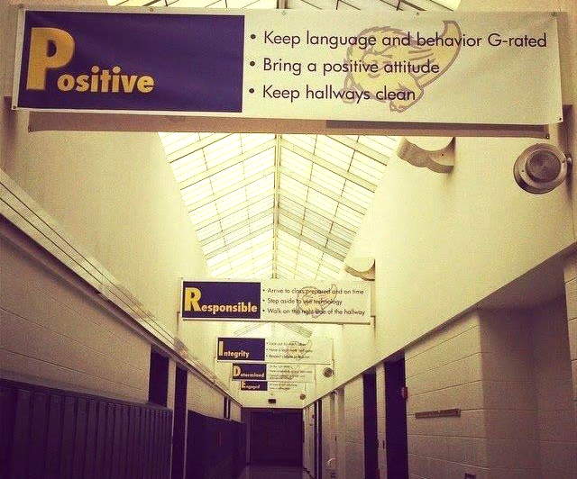
Shared with permission (principal, 2014-2015)

Slide 14
Social Skills Component
    Character education
    Teaches students basic human values including honesty, kindness, generosity, courage, freedom, equality, and respect (McBrien & Brandt, 1997)
    Goal: raise children to become morally responsible, self-disciplined citizens (Berkowitz & Bier, 2005)
    School-based programs designed to promote
    the character development of students
    (Person, Moiduddin, Angus, & Malone, 2009)
    Selected according to the 11 principles of effective character education (Lickona, Schaps, & Lewis, 2007)
Five core competencies of social and emotional learning
  self-awareness
  self-management
  social awareness
  relationship skills
  responsible decision making (CASEL, 2017)
Considerations:
  Evidence-based program
  Implemented throughout the district to facilitate consistency
Academic
Behavior
Social
Collaborative for Academic, Social, and Emotional Learning (2017). Retrieved from https://casel.org/core-competencies/
Notes:
Character education citations:
Berkowitz, M. W., & Bier, M. C. (2005). What works in character education: A research-driven guide for educators. Washington, DC: Character Education Partnership.
Lickona, T., Schaps, E., & Lewis, C. (2007). CEP's Eleven Principles of Effective Character Education. Character Education Partnership.
McBrien, J. L. & Brandt, R. S. (1997) The Language of Learning: A Guide to Education Terms. Alexandria, VA: Association for Supervision and Curriculum Development
Person, A. E., Moiduddin, E., Hague-Angus, M., & Malone, L. M. (2009). Survey of Outcomes Measurement in Research on Character Education Programs. NCEE 2009-006. National Center for Education Evaluation and Regional Assistance.

Slide 15
Social Component:
Identifying a Validated Curriculum
Violence Prevention
  Second Step Violence Prevention (cfchildren.org)
Character Education
  Positive Action (positiveaction.net)
  Caring School Community (characterplus.org)
Social Skills
  Social Skills Improvement System: Classwide Intervention Program (Elliott & Gresham, 2007)
Source: Elliott, S. N., & Gresham, F. M. (2007). Social Skills Improvement System: Classwide intervention program teacher’s guide. Bloomington, MN: Pearson Assessments.

Slide 16
Social Component:
Examples of Schoolwide Programs
Social-emotional
Connect With Kids
connectwithkids.com
Character Education
A curricula using real stories presented through documentary-style videos, non-fiction books, teaching guides and patent resources.
Attendance and achievement
Bullying and violence prevention
Character and Life skills
Digital citizenship
Alcohol and drug prevention
Health and Wellness
Customizable units are:
Positive Action
positiveaction.net
Improves academics, behavior, and character
Curriculum-based approach
Effectively increases positive behaviors and decreases negative behaviors
6-7 units per grade
Optional components:
site-wide climate development
drug education
bullying / conflict resolution
counselor, parent, and family classes
community/coalition components

Slide 17


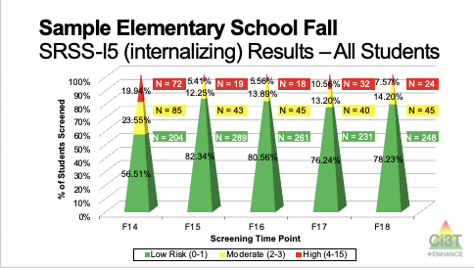
Essential Components of Primary (Tier 1) Prevention Efforts
Social Validity
Systematic Universal Screening
Academic
Behavior
Treatment Integrity
ci3t.org/measures
ci3t.org/screening
for behavior

Slide 18



Assessment Schedule
Ci3T Blueprint D Assessment Schedule

Slide 19


How to Ensure Fidelity
Not About Punishment
About Providing Support

Slide 20
Academic Screening: Reading and Math Benchmarks
READING
Grade: | % (n) of Students
Teacher: | Benchmark | Strategic | Intensive
Fall | x% (n = x) | x% (n = x) | x% (n = x)
Winter | x% (n = x) | x% (n = x) | x% (n = x)
Spring | x% (n = x) | x% (n = x) | x% (n = x)
Set Goal
By spring, % will be at benchmark on reading screening measures.
MATH
Grade: | % (n) of Students
Teacher: | Benchmark | Strategic | Intensive
Fall | x% (n = x) | x% (n = x) | x% (n = x)
Winter | x% (n = x) | x% (n = x) | x% (n = x)
Spring | x% (n = x) | x% (n = x) | x% (n = x)
Set Goal
By spring, % will be at benchmark on math screening measures.

Slide 21

What are our next steps for finalizing our Tier 2 and Tier 3 supports?

Slide 23
A Systematic Approach to Designing Secondary (Tier 2) and Tertiary (Tier 3) Interventions
Step 1: Construct your assessment schedule
Step 2: Identify your secondary (Tier 2) and tertiary (Tier 3) supports
  Existing and new interventions
Step 3: Determine entry criteria
  Academic failure, behavior and academic screening scores, attendance data, etc.
Step 4: Identify data to monitor progress
  Student performance: pre- and post-tests, curriculum-based measures, office discipline referral data, GPA, etc.
  Treatment integrity
  Social validity
Step 5: Identify exit criteria
  Reduction of discipline contacts, demonstration of grade level performance based on academic progress monitoring data, reduction of truancies and absences, etc.
Step 6: Consider additional needs
Notes:
23

Slide 24
Step 1: Construct Assessment Schedule
Ci3T Blueprint D Assessment Schedule

Slide 25
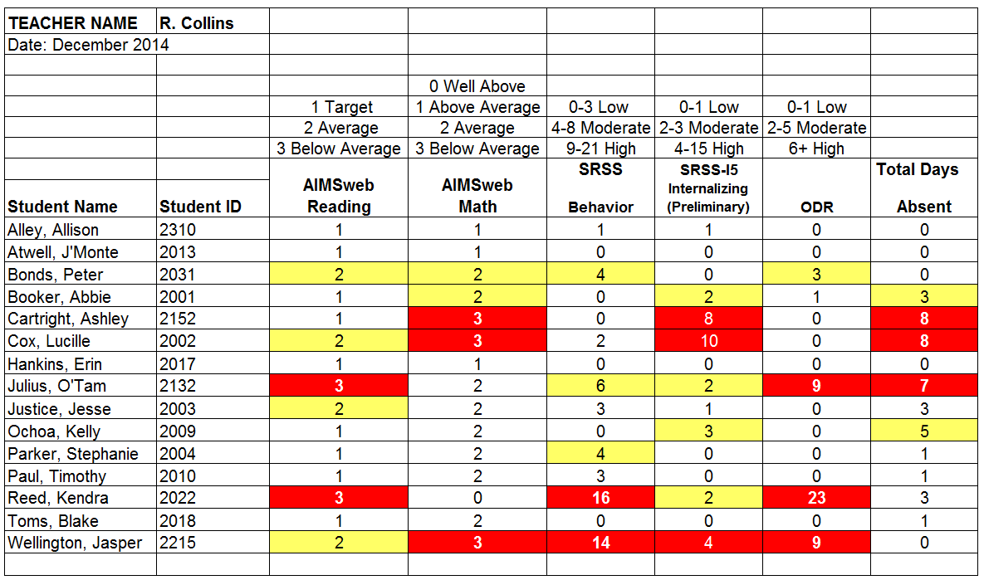
Using Data to Consider Interventions Elementary School
Increased Rates of Reinforcement
Intensive Reading Intervention with Self Monitoring
Lane, K. L., Oakes, W. P., Ennis, R. P., & Hirsch, S. E. (2014). Identifying students for secondary and tertiary prevention efforts: How do we determine which students have Tier 2 and Tier 3 needs? Preventing School Failure, 58, 171-182, DOI: 10.1080/1045988X.2014.895573

Slide 26
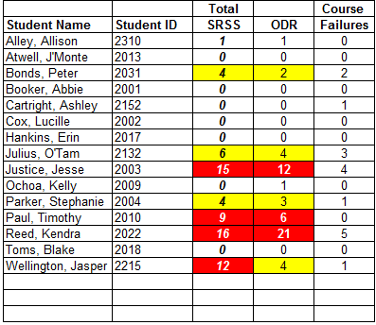
Using Data to Consider Interventions – MS/HS
Check In Check Out (Mentoring);
Study Hall Tutoring
Functional Assessment-Based Intervention

Slide 27

Step 2: Identify your secondary
(Tier 2) and tertiary (Tier 3) supports
Behavior Contracts
(example for your
Tier 2 grid)
  A written agreement between at least two individuals
  Also known as a “contingency contract”
  Used to specify the contingent relationship between the completion of a behavior and access to or delivery of a specific reward (Cooper, Heron, & Howard, 2007)
  The goal(s) of behavior contracts:
    Increase desired behaviors
    Decrease undesired behaviors
Ch. 5

Slide 28

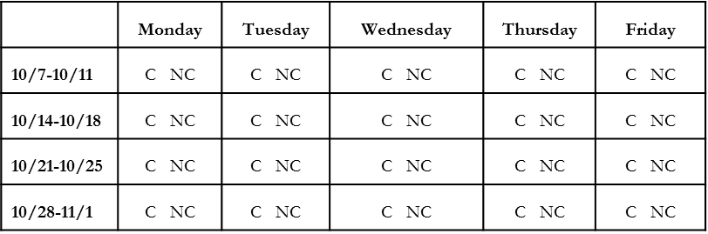
CONTRACT
I, Janelle, will complete my homework each day. Homework completion is defined as all assignment criteria done to the best of my ability and turned in to the homework basket or posted online by the start of class on the due date. Mr. James will determine if it is complete and on time. If I complete my homework, I will receive a ticket from Mr. Valdez at the start of class. If I complete my homework for 5 consecutive days, then I can choose 1 of 3 rewards:
  a pass to work in Mr. James’ class during lunchtime
  listen to music during one independent class assignment
  30 min of time to help Ms. Castle with school therapy dog, Max
Daily Log: Mr. James will circle “complete” or “not complete” each day
Bonus clause: If I complete homework for 20 consecutive days, I will early one HW pass to use in an emergency (late night gymnastics meet).
____
Janelle’s signature Date
____
Mr. James’ signature Date
Adapted from Lane, K. L., Menzies, H., Bruhn, A., & Crnobori, M. (2011). Research-based practices for preventing and responding to behavior problems: Effective, practical strategies that work. New York: Guilford Press

Slide 29
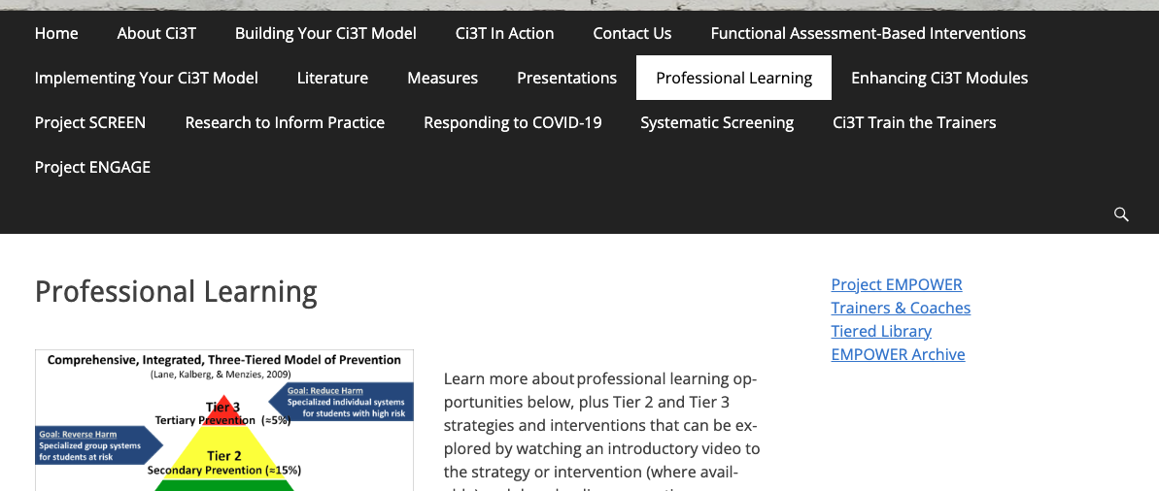
ci3t.org
Professional Learning tab: PowerPoints, literature, professional learning resources, measures
Systematic Screening tab: instructional videos, PowerPoint presentations, resources
Measures tab: Tools and measures available for viewing and downloading
Notes:
On-demand resources

Slide 30



Enhancing Ci3T Modules
ci3t.org/enhance

Slide 31
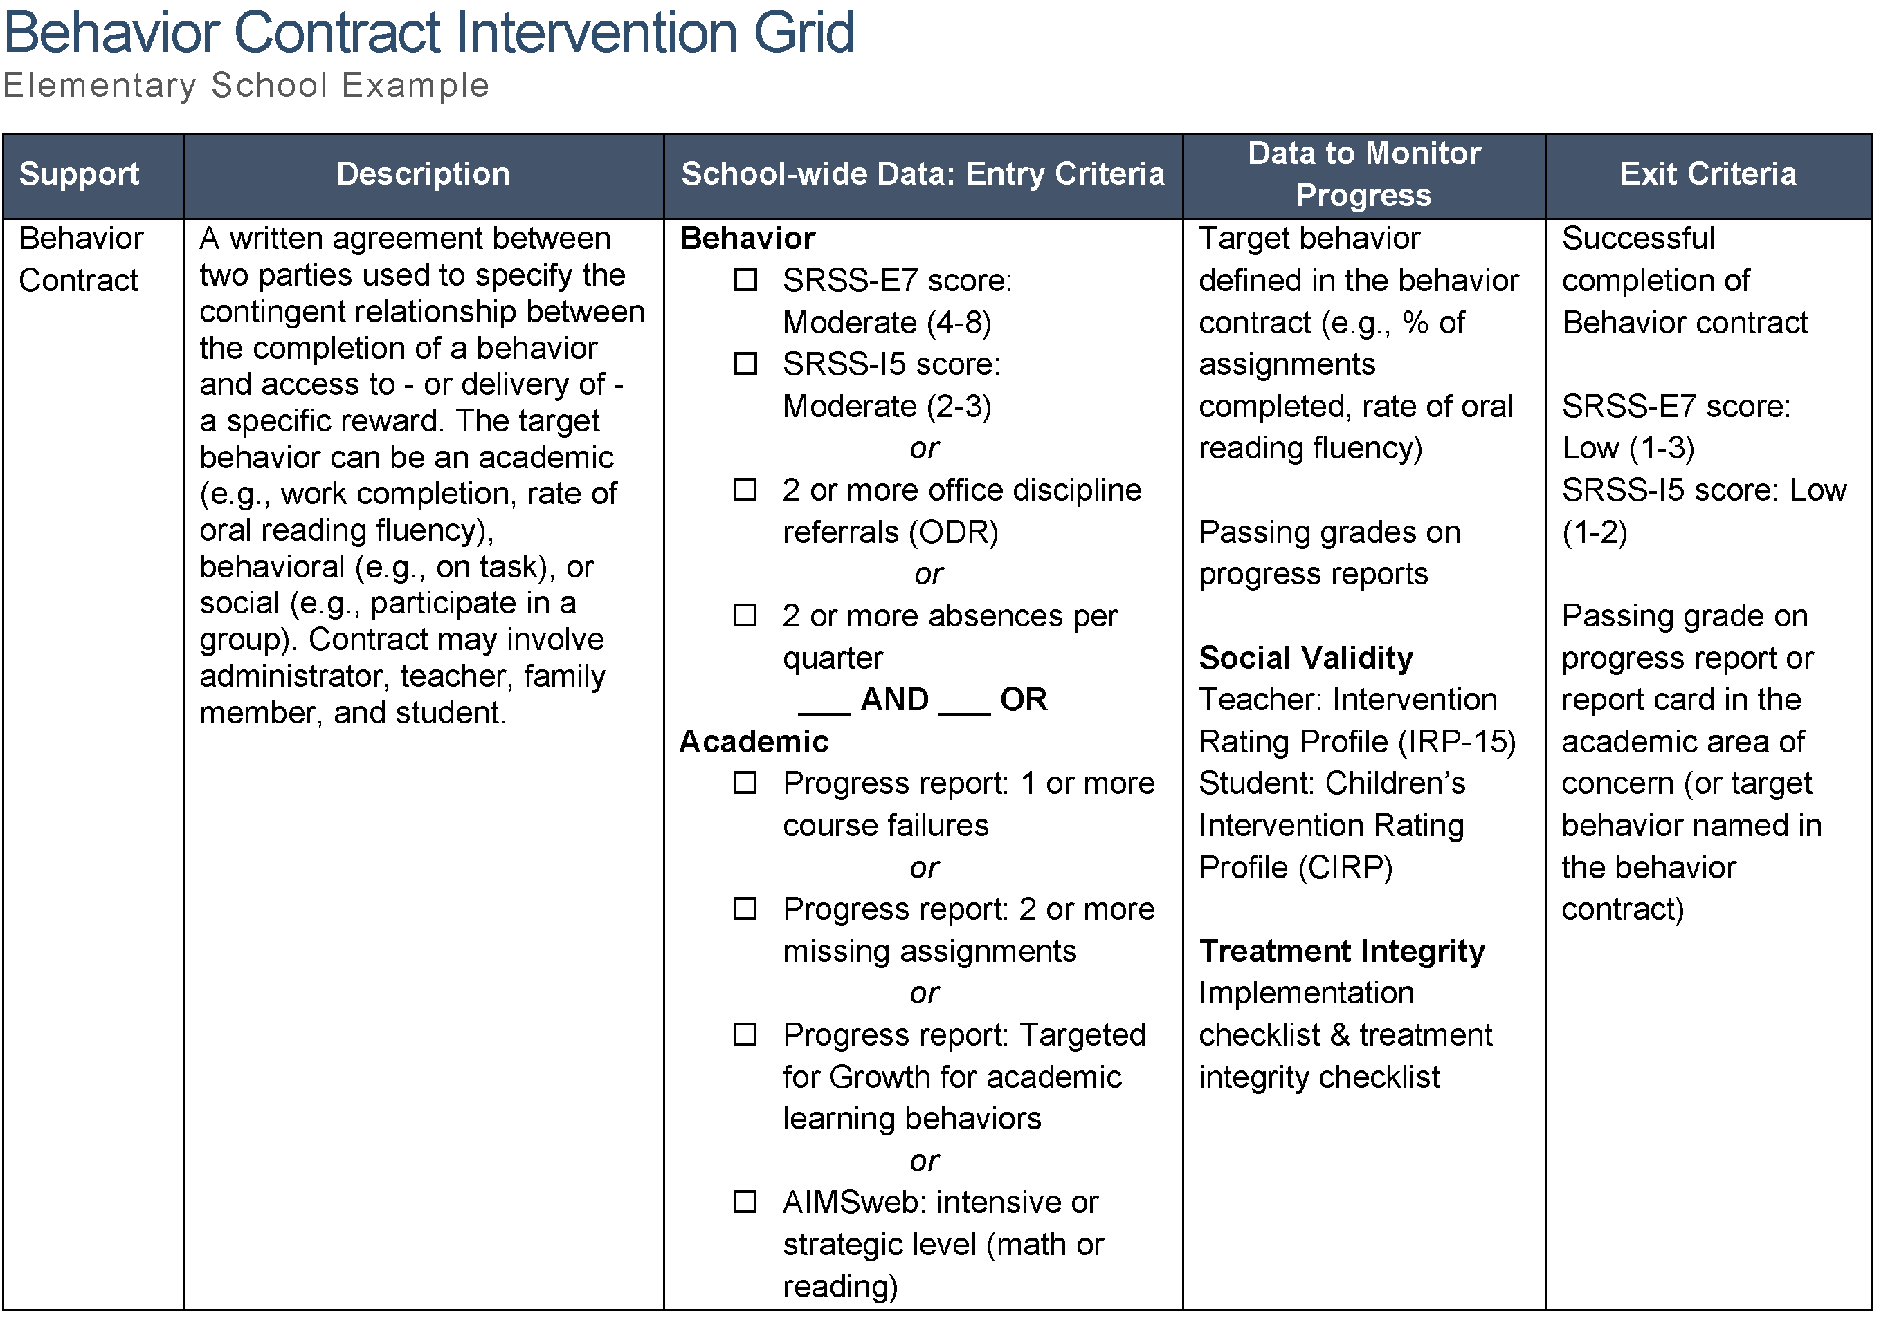

Step 3: Determine Entry Criteria
Ch. 5

Slide 32
Step 4: Identify Data to Monitor Progress
Ch. 5

Slide 33
Step 5: Identify Exit Criteria
Ch. 5

Slide 34
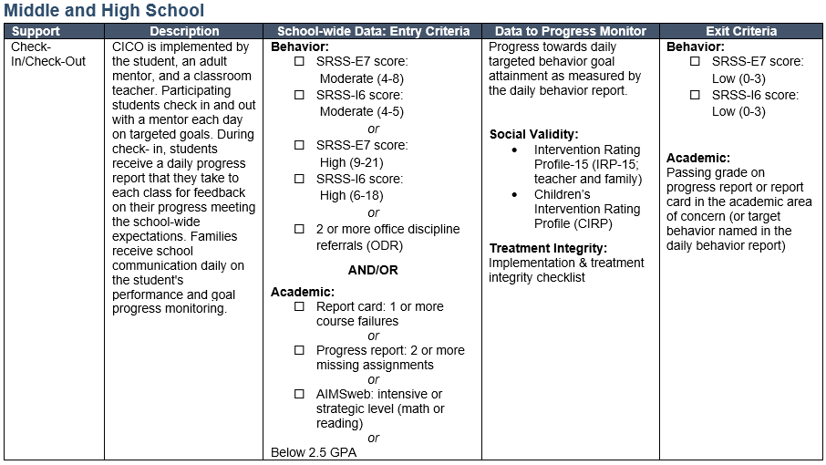

Check-In/Check-Out

Slide 35
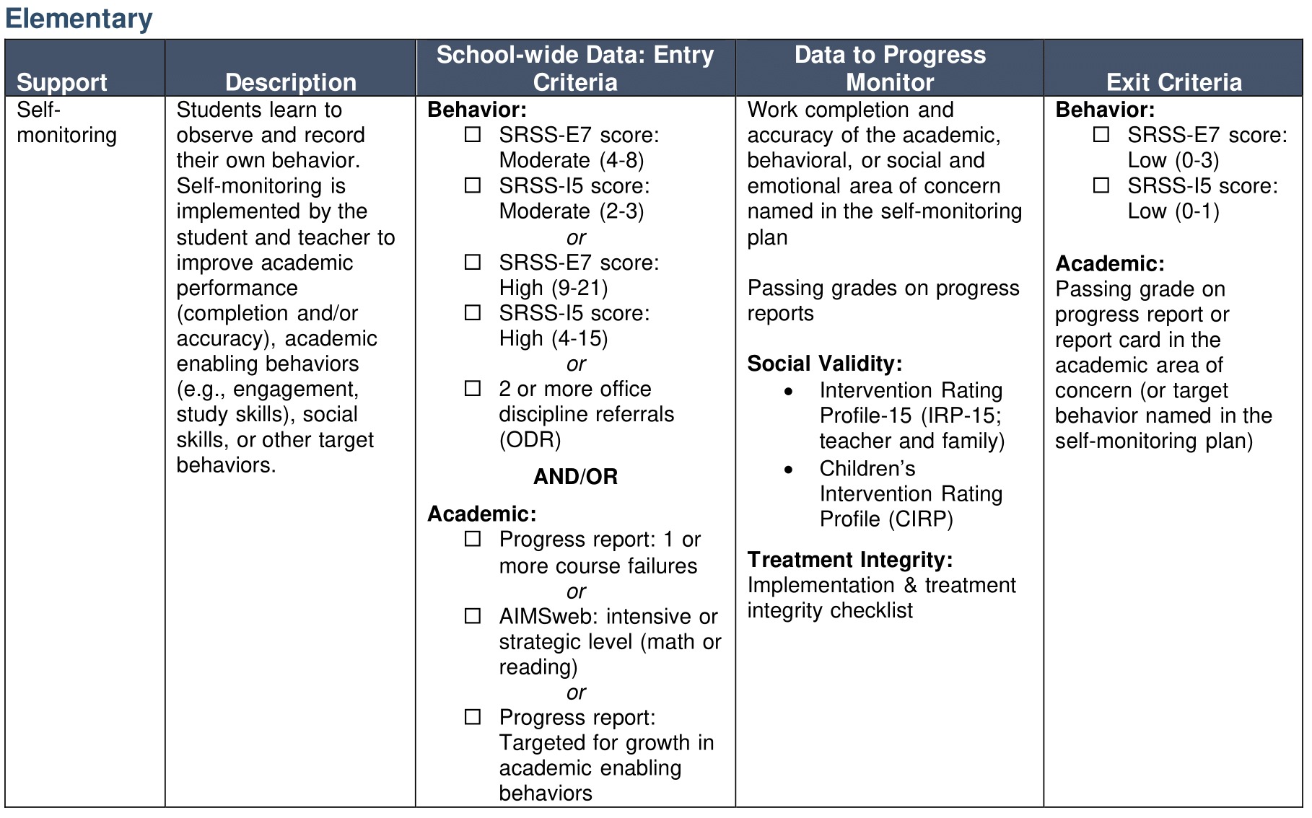

Self-Monitoring
Ch. 6

Slide 36
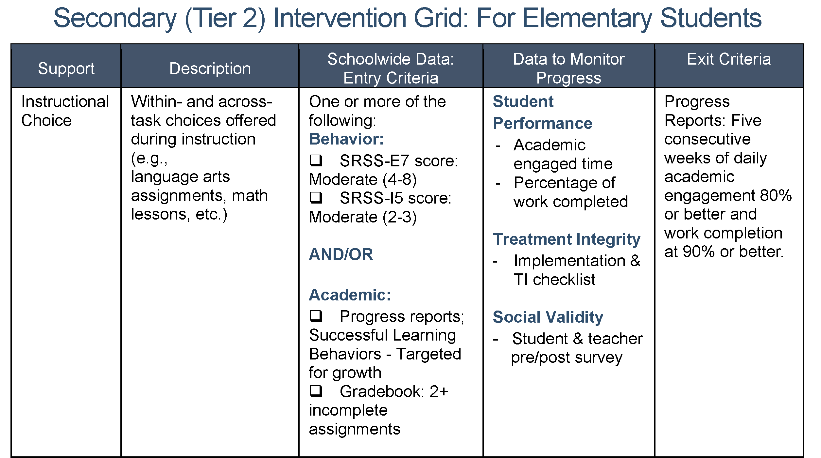


Instructional Choice
Ch. 8

Slide 37
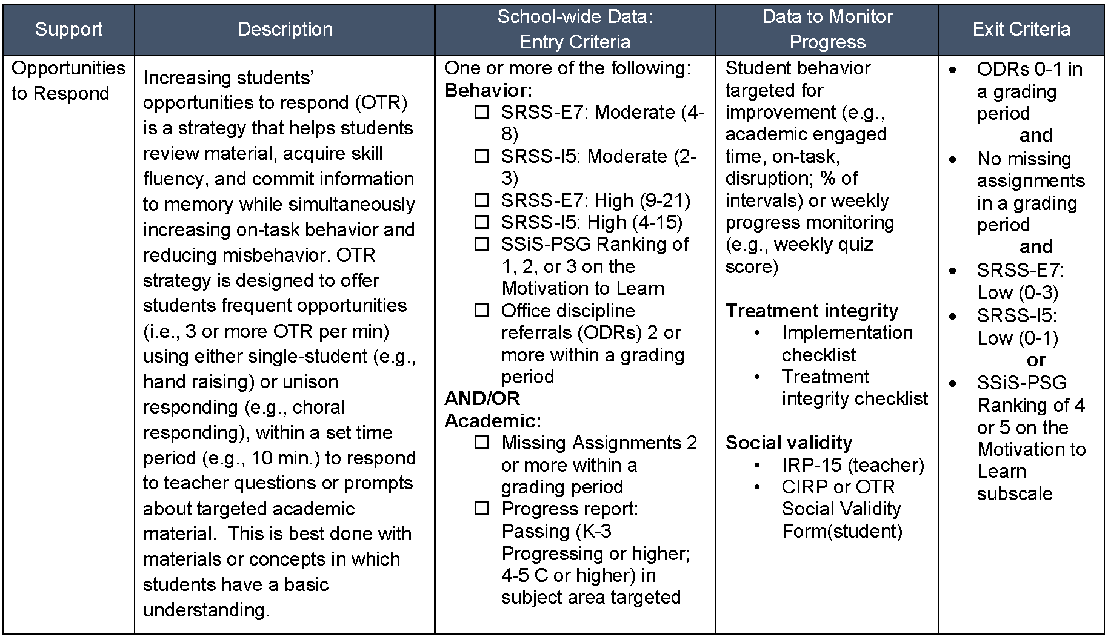


Opportunities to Respond
Ch. 2

Slide 38
Step 6: Consider additional needs
Additional needs, questions, concerns?
Please add to
  R04 Ci3T Professional Learning Plan
  Agenda for technical assistance support meetings
R04 PL Plan Note Taker
Add to
R04 Ci3T Professional Learning Plan

Slide 39
Do we have everything?
Add new rows!

Slide 40
A Systematic Approach to Designing Secondary (Tier 2) and Tertiary (Tier 3) Interventions
Step 1: Construct your assessment schedule
Step 2: Identify your secondary (Tier 2) and tertiary (Tier 3) supports
  Existing and new interventions
Step 3: Determine entry criteria
  Academic failure, behavior and academic screening scores, attendance data, etc.
Step 4: Identify data to monitor progress
  Student performance: pre- and post-tests, curriculum-based measures, office discipline referral data, GPA, etc.
  Treatment integrity
  Social validity
Step 5: Identify exit criteria
  Reduction of discipline contacts, demonstration of grade level performance based on academic progress monitoring data, reduction of truancies and absences, etc.
Step 6: Consider additional needs
Notes:
40

Slide 41
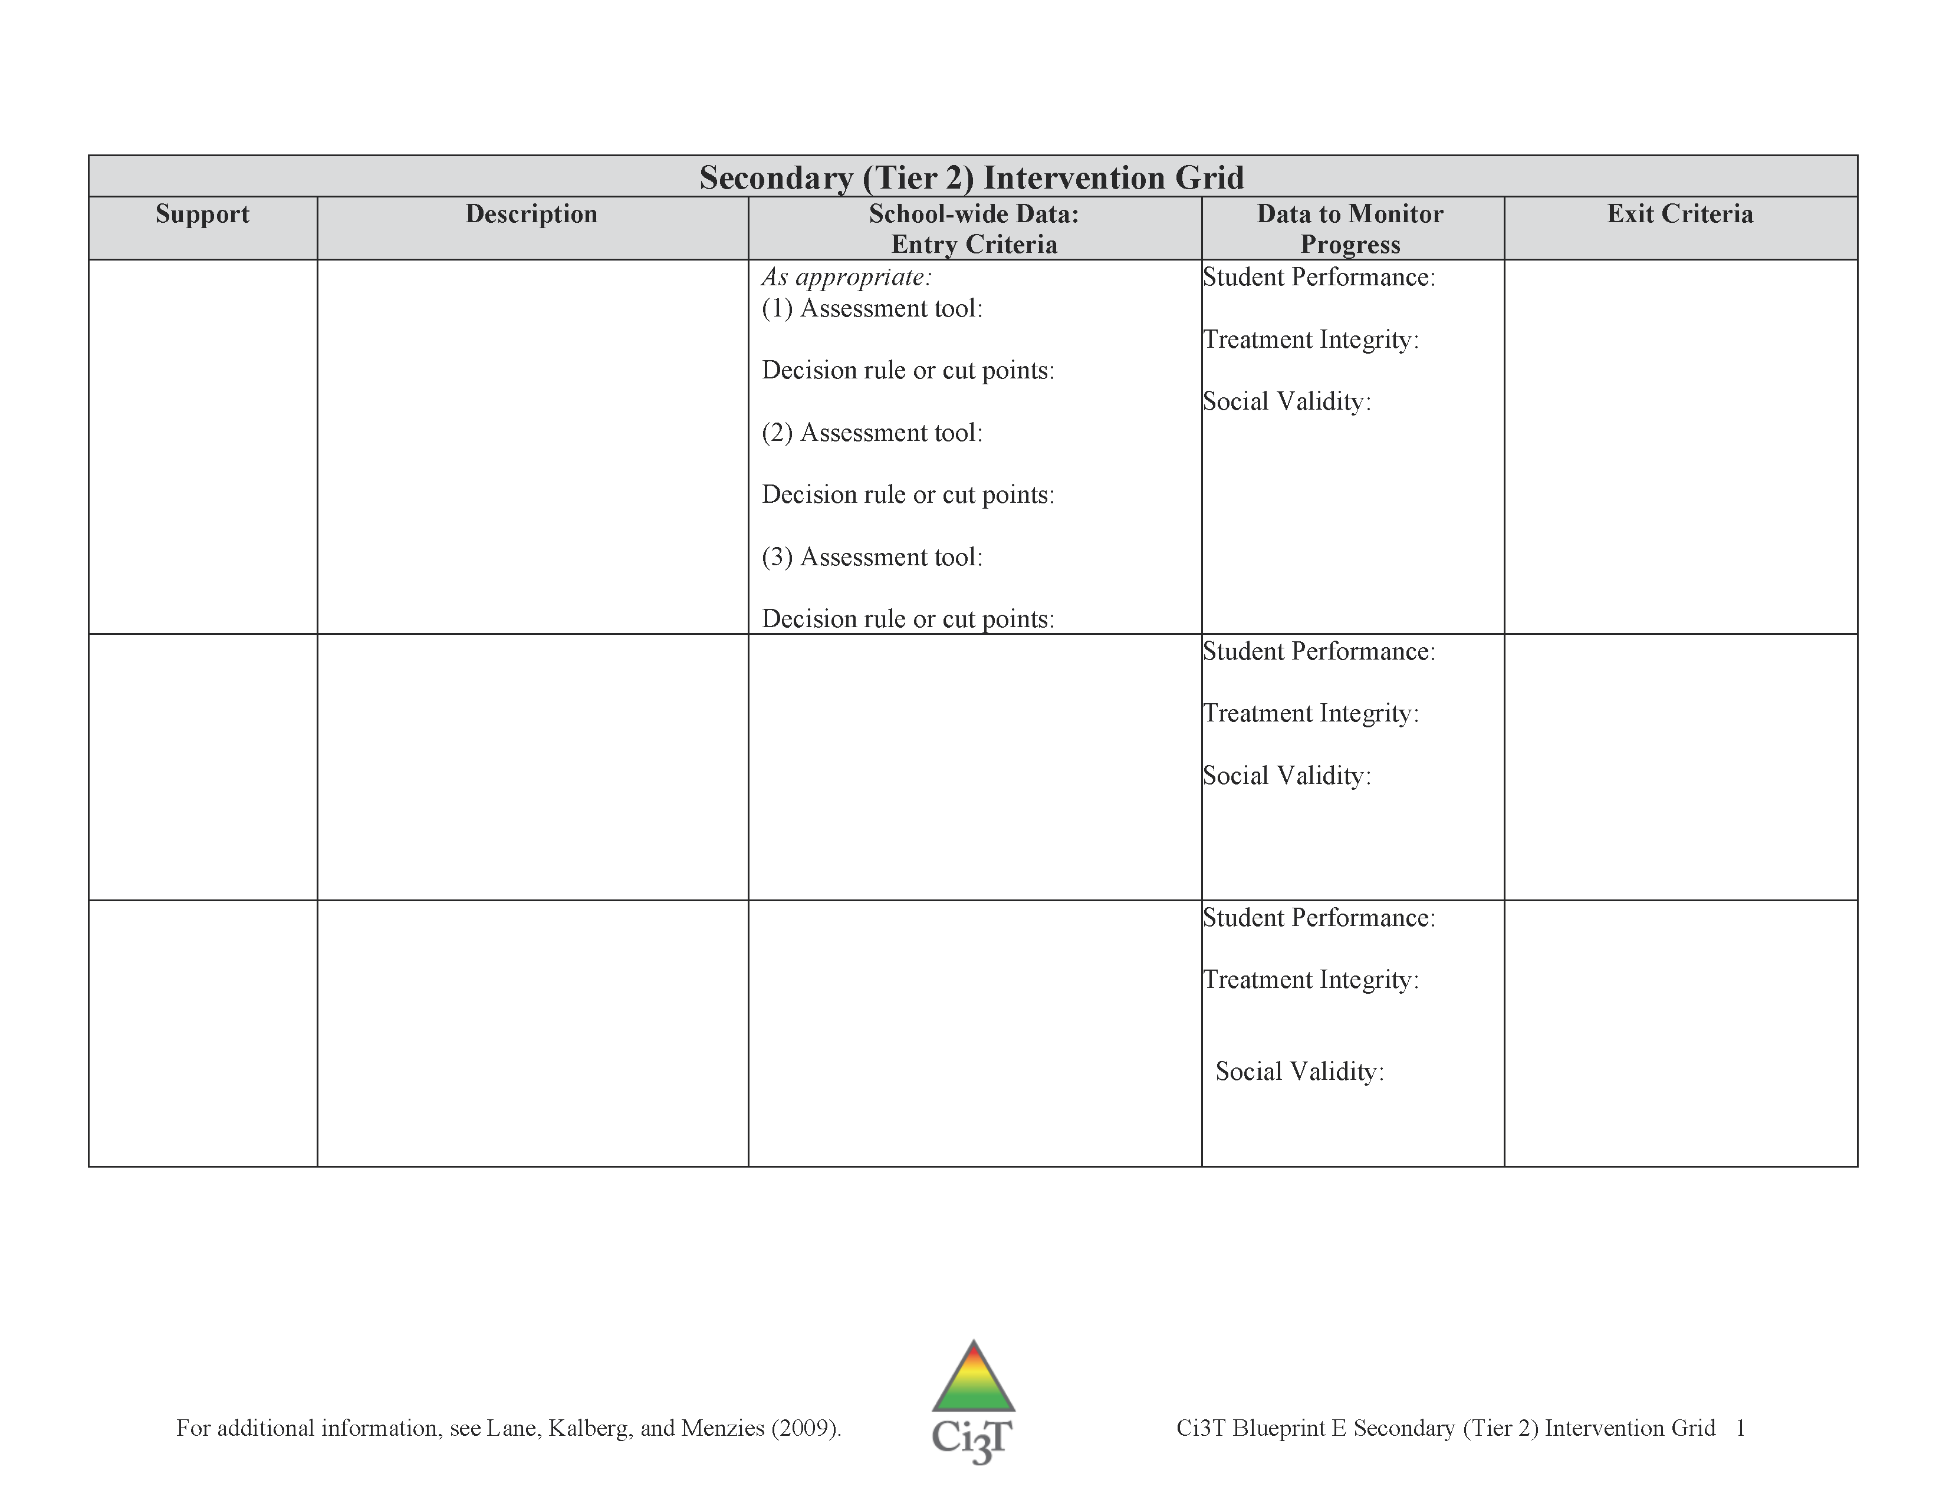
Secondary (Tier 2) and Tertiary (Tier 3) Intervention Grids
Ci3T Blueprint E Secondary (Tier 2) and Ci3T Blueprint F Tertiary (Tier 3) Intervention Grids

Slide 42
Record Tier 2 and Tier 3 supports currently available
  Ci3T Blueprint E Secondary (Tier 2) Intervention Grid
  Ci3T Blueprint F Tertiary (Tier 3) Intervention Grid
Polish intervention grids with new ideas from your faculty
Confirm data for decision making are specific with cut scores

Slide 43

















Record Tier 2 and Tier 3 supports currently available on Ci3T Blueprint E and F Intervention Grids.
Please name each support and type a description
(Columns 1 and 2).
15 minutes
Notes:
15 min

Slide 44
A Systematic Approach to Designing Secondary (Tier 2) and Tertiary (Tier 3) Interventions
Step 1: Construct your assessment schedule
Step 2: Identify your secondary (Tier 2) and tertiary (Tier 3) supports
  Existing and new interventions
Step 3: Determine entry criteria
  Academic failure, behavior and academic screening scores, attendance data, etc.
Step 4: Identify data to monitor progress
  Student performance: pre- and post-tests, curriculum-based measures, office discipline referral data, GPA, etc.
  Treatment integrity
  Social validity
Step 5: Identify exit criteria
  Reduction of discipline contacts, demonstration of grade level performance based on academic progress monitoring data, reduction of truancies and absences, etc.
Step 6: Consider additional needs
Notes:
44

Slide 45
Secondary (Tier 2) and Tertiary
(Tier 3) Intervention Grids
Ci3T Blueprint E Secondary (Tier 2) and Ci3T Blueprint F Tertiary (Tier 3) Intervention Grids

Slide 46
Establish entry criteria, data to monitor progress, and exit criteria on
Ci3T Blueprint E and F Intervention Grids
15 minutes
Notes:
15 min

Slide 47
A Systematic Approach to Designing Secondary (Tier 2) and Tertiary (Tier 3) Interventions
Step 1: Construct your assessment schedule
Step 2: Identify your secondary (Tier 2) and tertiary (Tier 3) supports
  Existing and new interventions
Step 3: Determine entry criteria
  Academic failure, behavior and academic screening scores, attendance data, etc.
Step 4: Identify data to monitor progress
  Student performance: pre- and post-tests, curriculum-based measures, office discipline referral data, GPA, etc.
  Treatment integrity
  Social validity
Step 5: Identify exit criteria
  Reduction of discipline contacts, demonstration of grade level performance based on academic progress monitoring data, reduction of truancies and absences, etc.
Step 6: Consider additional needs
Notes:
47

Slide 48
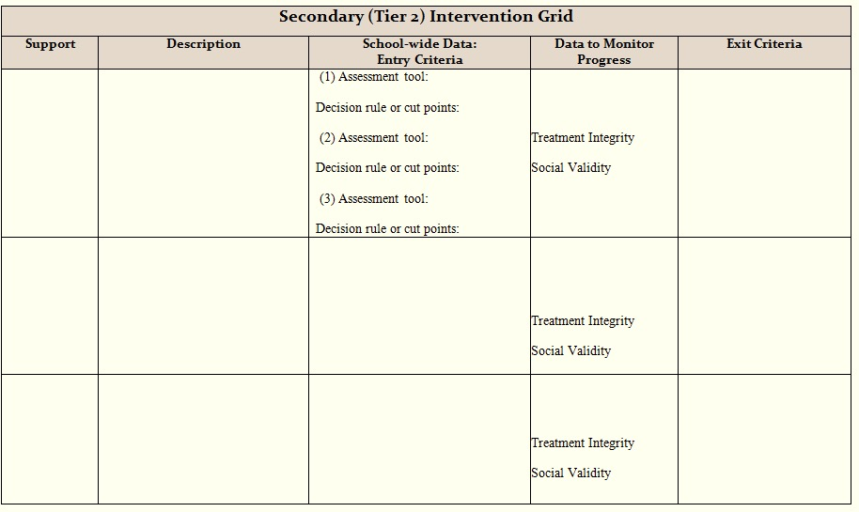















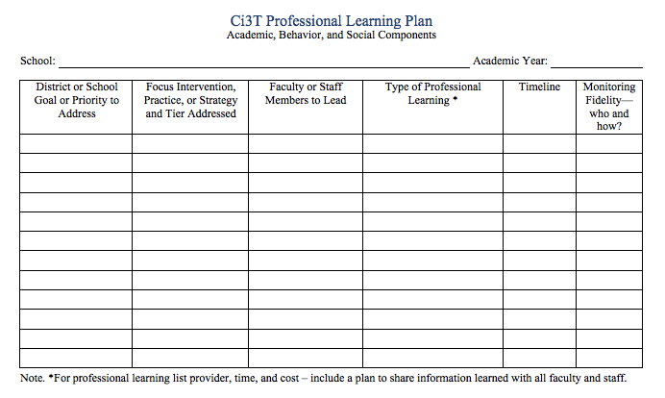
Block 1 of 2:
60 min
Continue developing Ci3T Blueprint E (Tier 2) Intervention Grid
30 minutes
R04 PL Plan Note Taker
Add to R04 Ci3T Professional Learning Plan
Notes:
30 min

Slide 49
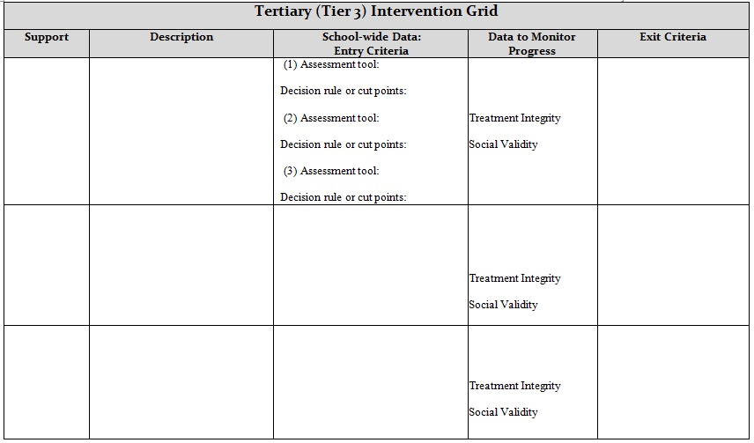
Block 2 of 2:
60 min
Continue developing Ci3T Blueprint F (Tier 3) Intervention Grid
30 minutes
R04 PL Plan Note Taker
Add to R04 Ci3T Professional Learning Plan
Notes:
30 min

Slide 50


What feedback did your faculty and staff offer on your revised Ci3T Blueprint?
Reviewing information from the Ci3T Feedback Form

Slide 51
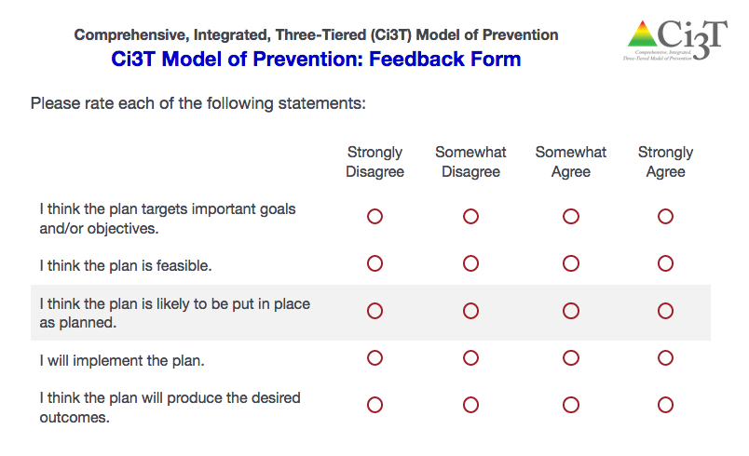
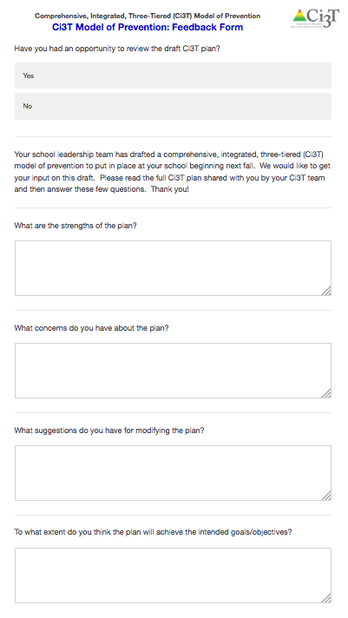

Assessing Social Validity
Ci3T Feedback Form
Purpose: to obtain information that will aid in determining the effectiveness and usefulness of the Ci3T plan for your school
Survey data are aggregated and presented in this report

Slide 52
Comprehensive, Integrated, Three-Tiered (Ci3T) Model of Prevention: Feedback Form Sample School Data | Strongly Disagree | Somewhat Disagree | Somewhat Agree | Strongly Agree | Mean | Standard Deviation
I think the plan targets important goals and/or objectives. | 3 | 3 | 17 | 21 | 3.27 | 0.87
2. I think the plan is feasible. | 1 | 5 | 17 | 21 | 3.32 | 0.77
3. I think the plan is likely to be put in place as planned. | 4 | 2 | 17 | 21 | 3.25 | 0.92
4. I will implement the plan. | 4 | 0 | 12 | 28 | 3.45 | 0.90
5. I think the plan will produce the desired outcomes. | 2 | 5 | 19 | 18 | 3.20 | 0.82
1 2 3 4

Slide 53
Ci3T Feedback Form
Range: 1 – 4
Higher scores reflect stronger agreement
School (district; number completed; response rate %) | Mean (SD) Total
Friendship Elementary School (Jackson City Schools; n = 44; 41.86%) | 3.66 (0.53)
Preston Intermediate School (Hobbs School District; n = 28; 51.85%) | 3.45 (0.61)
College and Career High School (Bailey Unified School District; n = 6; 35.29%) | 3.70 (0.14)
Steadman Middle School (Jackson City Schools; n = 47; 51.65%) | 3.30 (0.76)
Shaker Heights Elementary School (Shaker Public Schools; n = 37; 54.41%) | 3.25 (0.53)
Cardinal Elementary School (Bailey Unified School; n = 28; 56.00%) | 3.50 (0.51)

Slide 54
Ci3T Feedback Form: Comments
What are the strengths of the plan?
  The plan has a clear outline and lays out what is expected for student, Faculty/staff, Administrators and parents. It enforces a common language for everyone to use and the focus being on the positive.
What concerns do you have about the plan?
  consistency all-staff buy-in being sure we reward/acknowledge the "good kids" (they are often overlooked) full and efficient/timely record-keeping that is clear to all stake-holders
What suggestions do you have for modifying the plan?
  I'd like to see a computer system or some other means of tracking data besides our current system. It simply doesn't meet the needs of the entire staff.
To what extent do you think the plan will achieve the intended goals/objectives?
  Teachers need modeled, effective management strategies and structures that they can buy in to. With that, I believe the plan will be effective. I believe it will be a process that will take several years before we see the full impact. I would really like to see a parental involvement piece that is strong, and includes strategies for home as well.
R04 PL Plan Note Taker
Add to R04 Ci3T Professional Learning Plan

Slide 55
Review data from Ci3T Feedback Form report with team
15 minutes
R04 PL Plan Note Taker
Add to R04 Ci3T Professional Learning Plan
Notes:
15 min

Slide 56

How can we use the Ci3T Feedback Form data to revise our Ci3T Blueprints A-F?

Slide 57
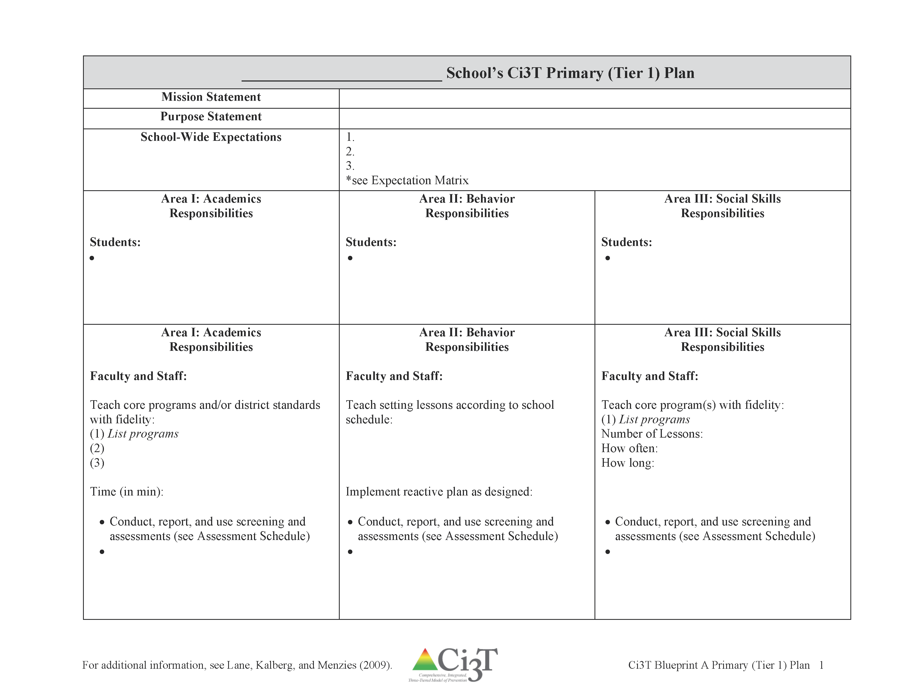
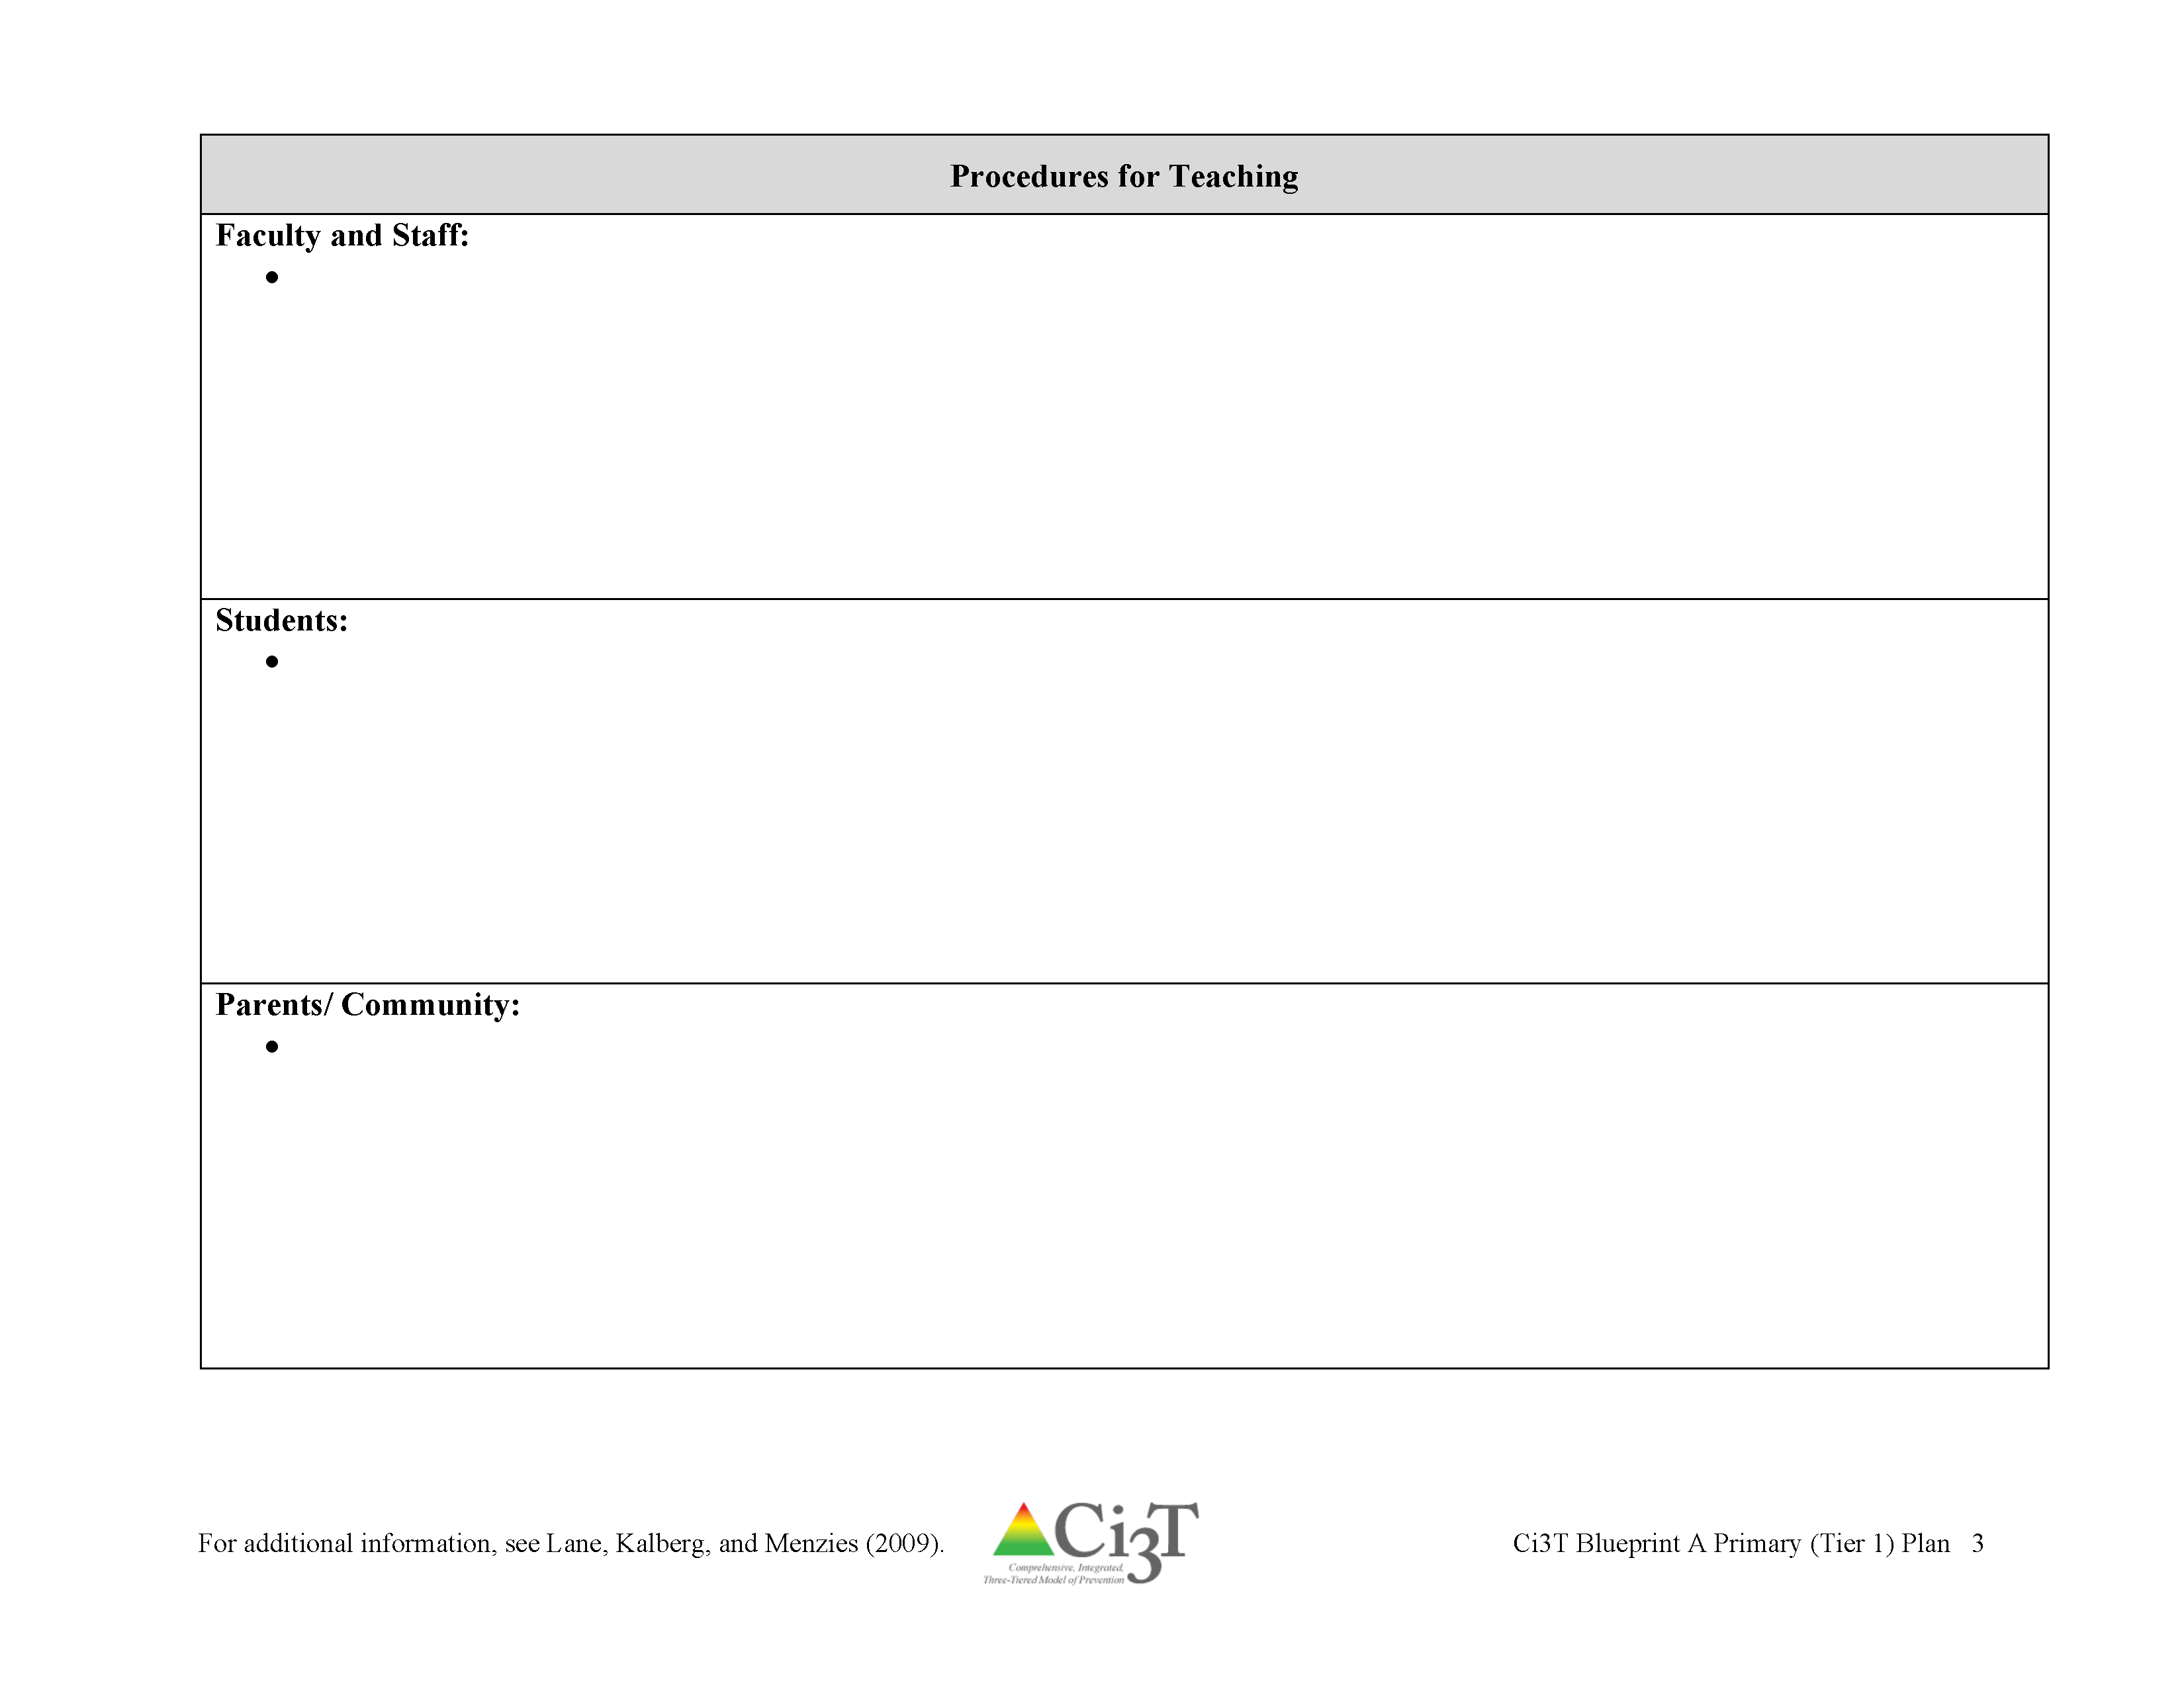
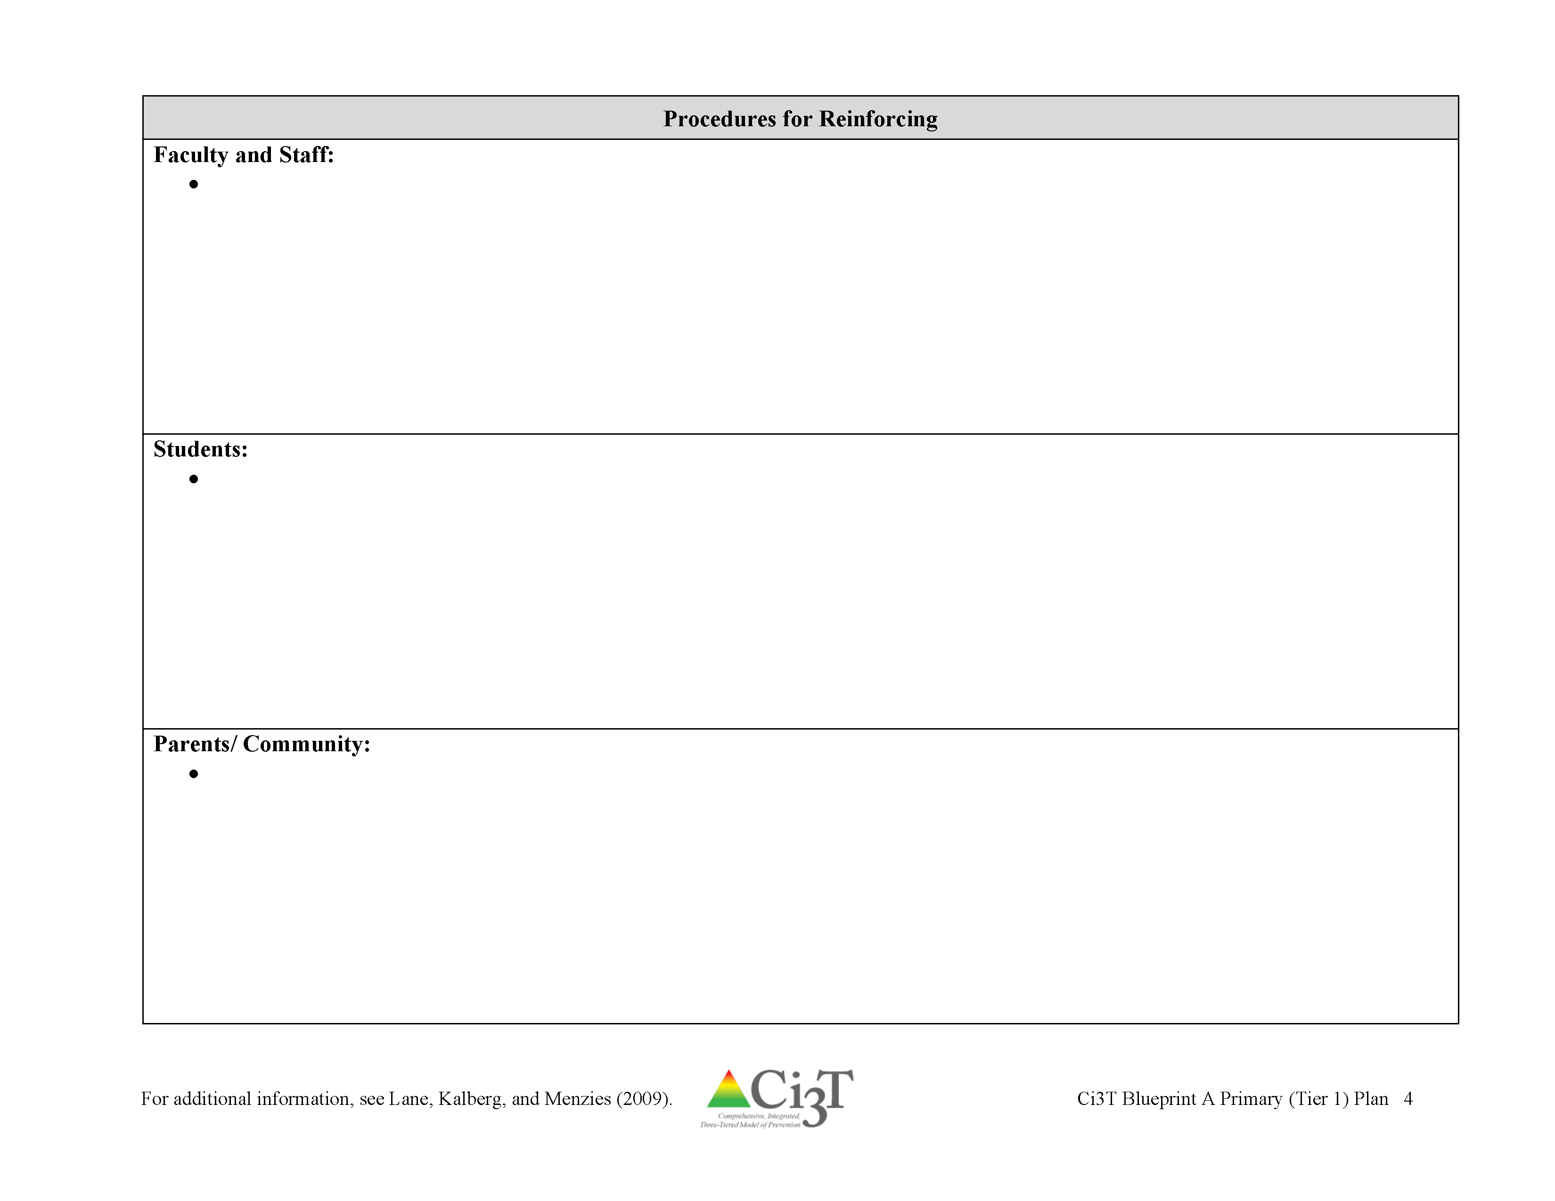
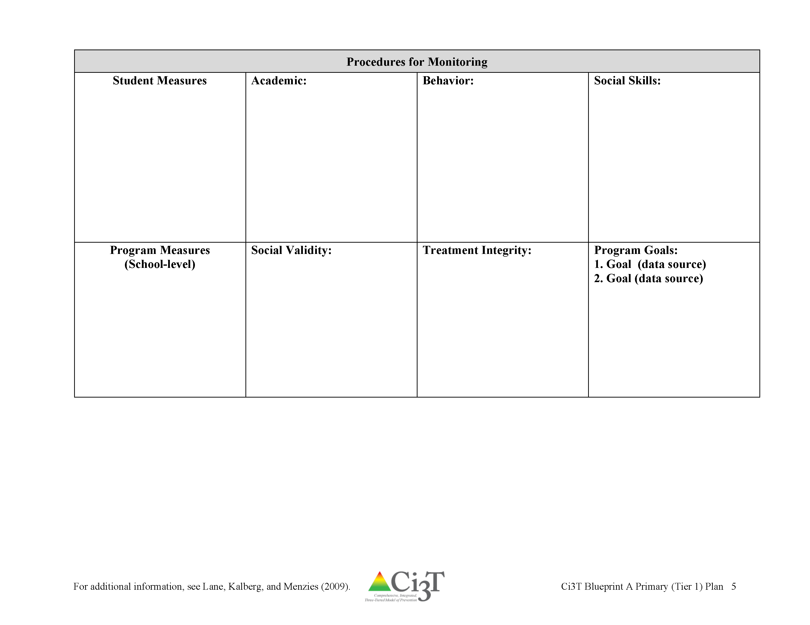
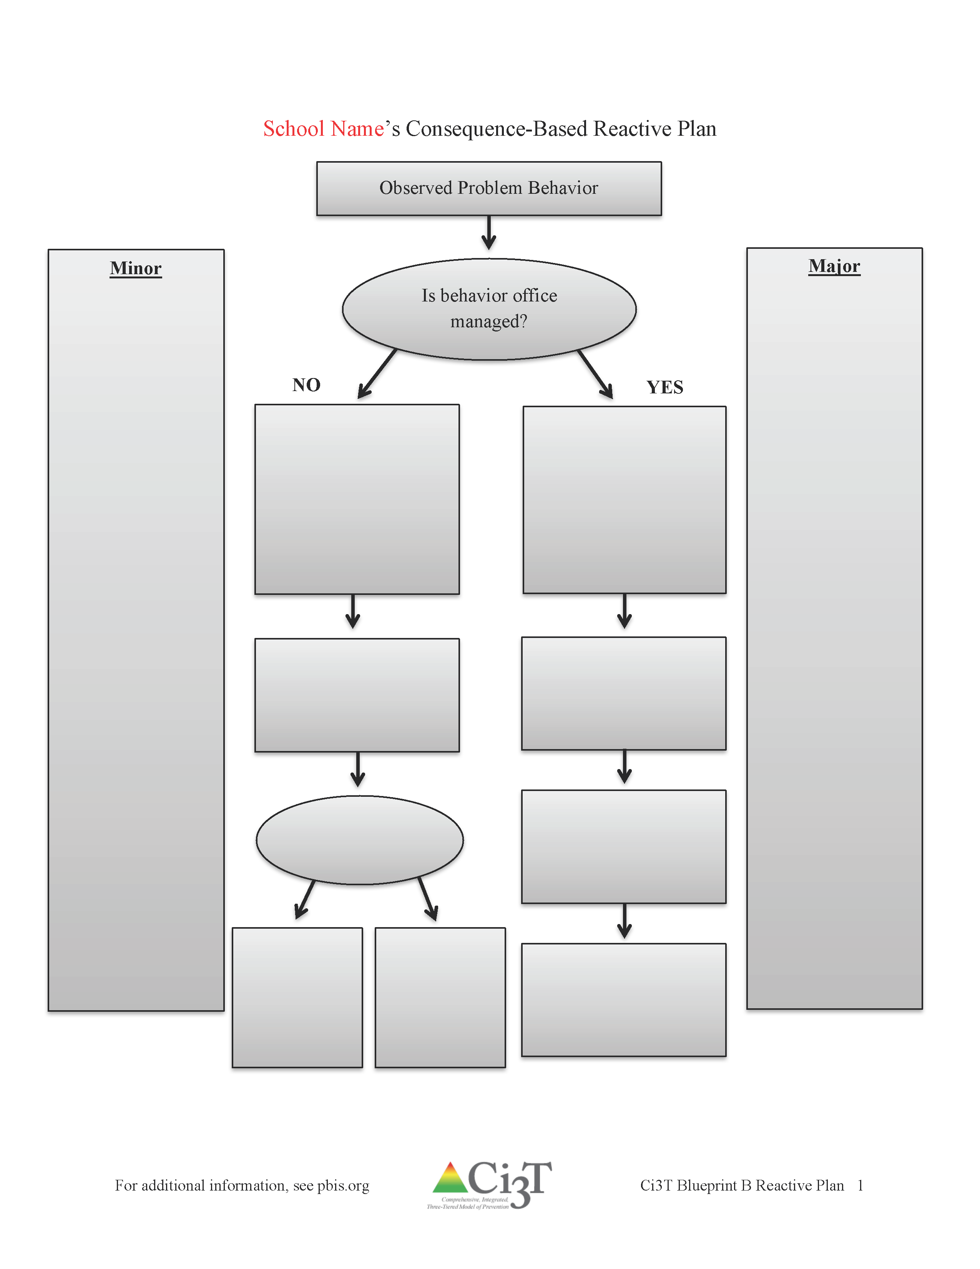
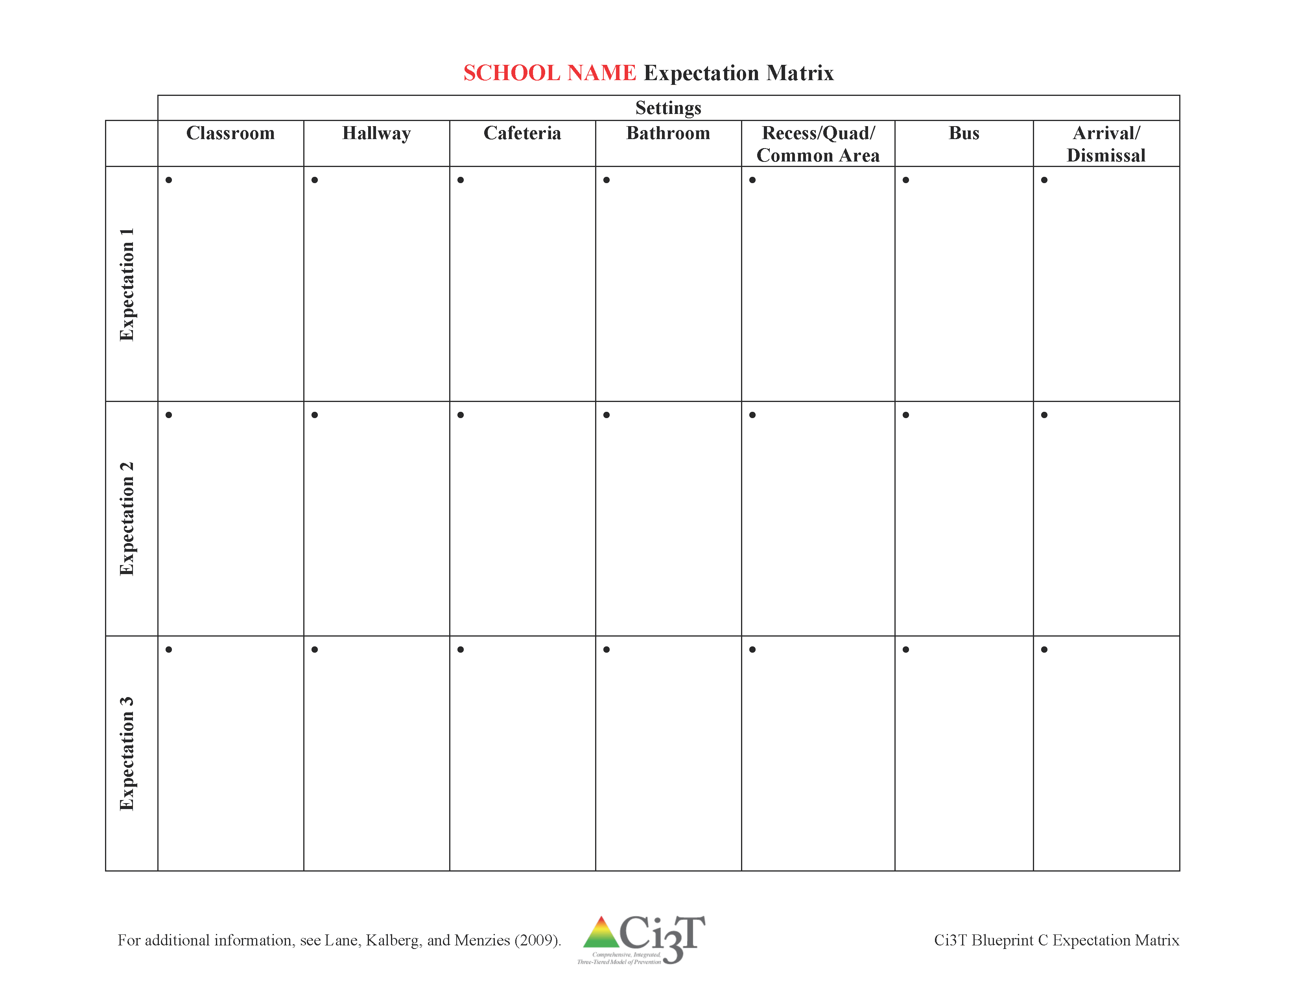
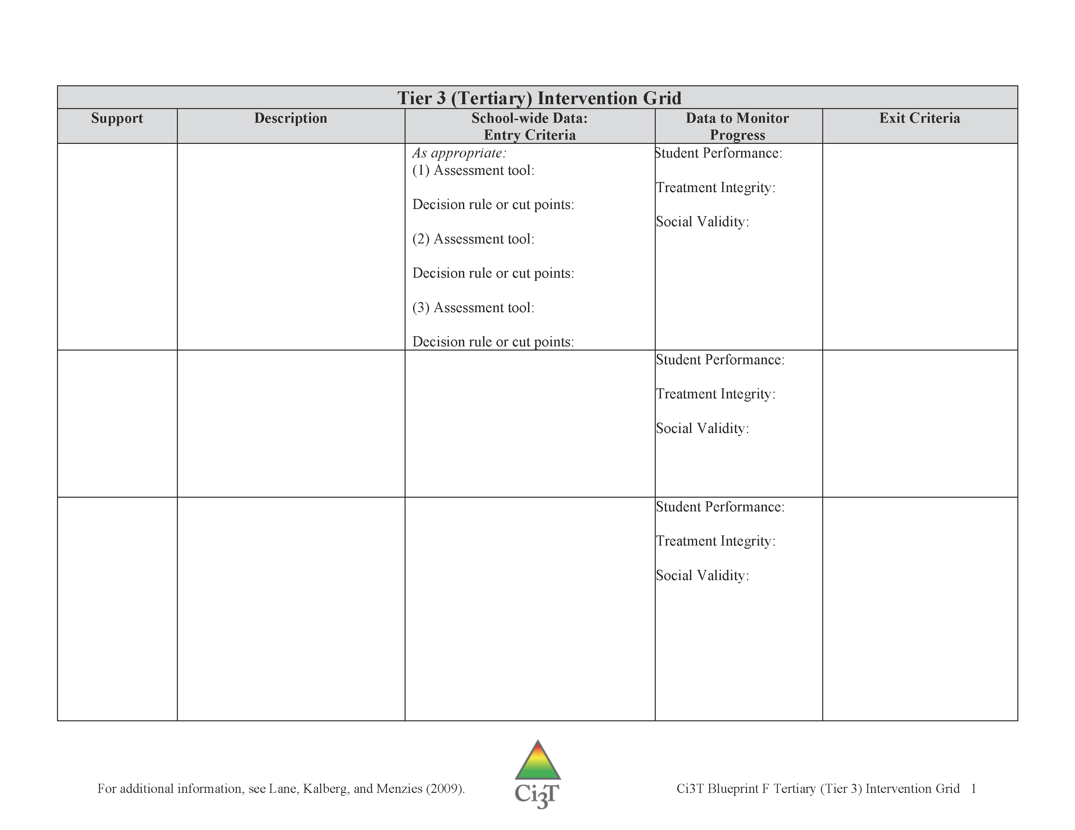
Finalizing your Ci3T Blueprint
Ci3T Blueprint A Primary (Tier 1) Plan
  Roles and responsibilities
  Procedures for teaching
  Procedures for reinforcing
  Procedures for monitoring
Ci3T Blueprint B Reactive Plan
Ci3T Blueprint C Expectation Matrix
Ci3T Blueprint D Assessment Schedule
  Ci3T Blueprint E Secondary (Tier 2) Intervention Grid
  Ci3T Blueprint F Tertiary (Tier 3) Intervention Grid
Notes:
Revisions

Slide 59
Discuss Ci3T Feedback Form report with team. What changes can you make to finalize your plan?
15 minutes
R04 PL Plan Note Taker
Add to R04 Ci3T Professional Learning Plan
Notes:
15 min

Slide 60

Polish
Ci3T Blueprint A Primary (Tier 1) Plan
15 minutes
R04 PL Plan Note Taker
Add to R04 Ci3T Professional Learning Plan
Notes:
15 min

Slide 61

Polish
Ci3T Blueprint A
Primary (Tier 1) Plan
Ci3T Blueprint B
Reactive Plan
Ci3T Blueprint C
Expectation Matrix
15 minutes
R04 PL Plan Note Taker
Add to R04 Ci3T Professional Learning Plan
Notes:
15 min

Slide 62

Polish
Ci3T Blueprint A
Primary (Tier 1) Plan
15 minutes
Use
R5 Reinforcement Logistics
IM01 Implementation Materials Checklist
R04 PL Plan Note Taker
Add to R04 Ci3T Professional Learning Plan
Please review Ci3T Student Session 5 Materials Created.pptx
Notes:
15 min

Slide 63
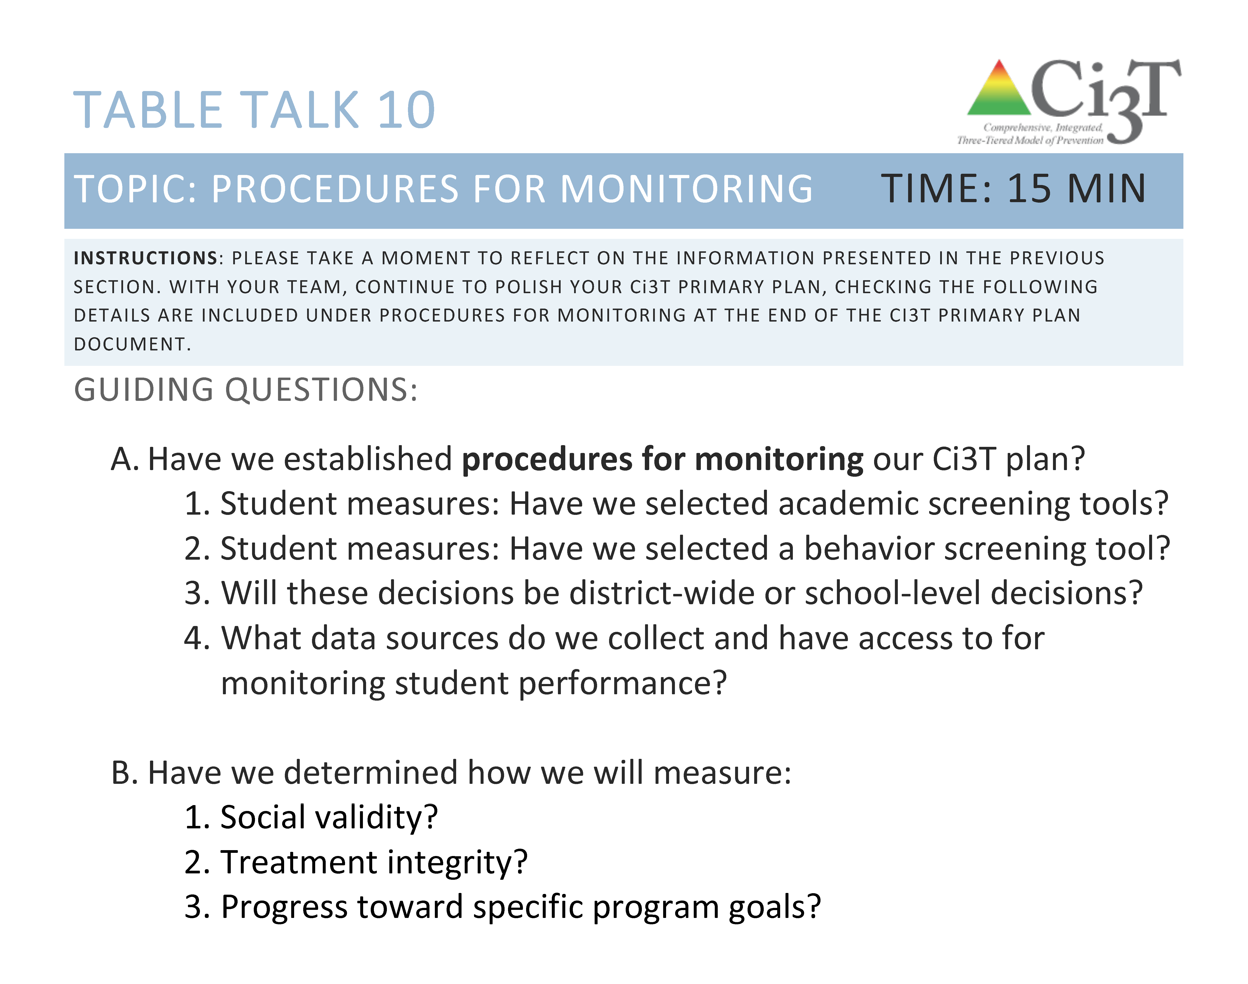
Polish
Ci3T Blueprint A Primary (Tier 1) Plan
and
Ci3T Blueprint D Assessment Schedule
15 minutes
R04 PL Plan Note Taker
Add to R04 Ci3T Professional Learning Plan
Notes:
15 min

Slide 64

Polish
Ci3T Blueprint E Secondary (Tier 2) Intervention Grid
and
Ci3T Blueprint F Secondary (Tier 3) Intervention Grid
30 minutes
See exemplars and interactive blueprints for tips for success!
R04 PL Plan Note Taker
Add to R04 Ci3T Professional Learning Plan
Notes:
30 min

Slide 65

What have you learned over the course of this year?

Slide 66
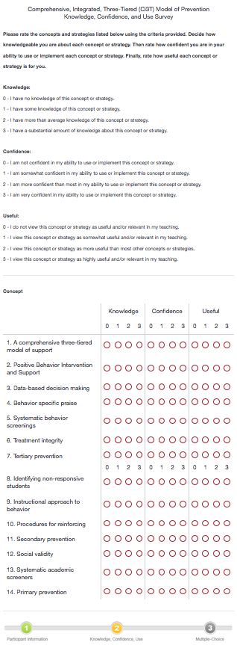
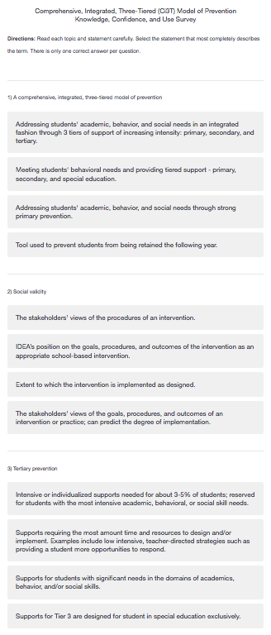
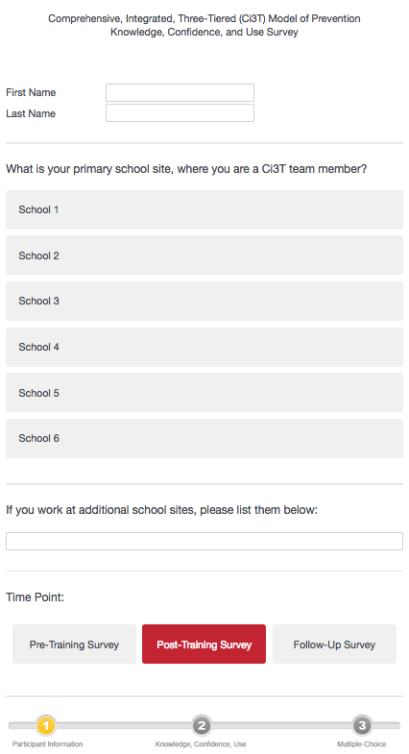
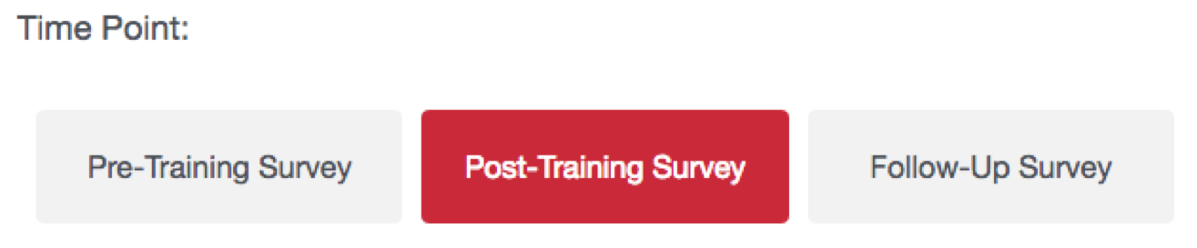
Knowledge, Confidence, and Use (KCU) Survey – Post Training
Before you leave today…
Please check your email and complete the post-training KCU

Slide 67


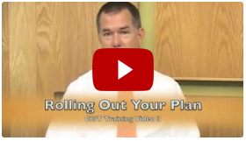
Complete Your Post-Training Survey
Please use this working time to
check your email for a link to Qualtrics and complete the KCU post-training survey.
watch one or two panel discussion videos on ci3t.org

Slide 68
Please use this working time to
check your email for a link to Qualtrics and complete the KCU post-training survey
watch one or two panel discussion videos on ci3t.org
Complete
KCU post-training survey
30 minutes
Notes:
30 min

Slide 69

How do we prepare for implementation next year?
Making Plans
Preparing Materials

Slide 70

Making Plans

Slide 71

Next Steps for Implementation
Schedule time with your Ci3T Coach to polish implementation materials before June XX
Prepare and/or order all implementation materials
Schedule first faculty and staff meeting for fall
  Send calendar invitation and schedule a week-before and day-before reminder email
Present your final Ci3T plan to all faculty and staff
  Give everyone IM03 Ci3T Implementation Manual (electronic and/or paper)
  Show everyone how to use the implementation manual
  Provide all needed materials
  Share your first student day kick off plan

Slide 72
Ci3T Implementation Support
Technical assistance or Ci3T coaching
Attend Ci3T Leadership Team monthly meetings
Support program evaluation
  treatment integrity (fall and spring)
  social validity (fall and spring)
  other measures of implementation (see pbisapps.org)
Support academic and behavioral screening
  implementation, scoring, and data-based decision making
Teams share data summaries with faculty and staff three times per year (fall, winter, spring)
Provide professional learning opportunities

Slide 73
Ongoing Professional Learning
Sep | Oct | Nov | Dec | Jan | Feb | Mar | Apr
Ci3T Elem-1 Strategies for high implementation |  | Ci3T Elem-2 Using your screening data to inform reading instruction |  | Ci3T Elem-3 Strategies to facilitate instruction |  | Ci3T Elem-4 Honing in: TBA | Ci3T Elem-5 Preparing for Next Year
­Ci3T MS/HS-1 Getting Started: Tier 1 |  | Ci3T MS/HS-2 Using data to support engagement |  | Ci3T MS/HS-3 High Leverage Practices |  | Ci3T MS/HS-4 Using data for instructional planning | Ci3T MS/HS-5 Preparing for Next Year
Empower 1: Getting Started with Ci3T | Empower 2: Beyond Tier 1—Building Your Tier 2 Library | Empower 3: A Look at Evidence-based Reading Instruction | Empower 4: Classroom Management Strategies: Choice, Feedback, & OTRs | Empower 5: Preventing and Responding to Challenging Behaviors | Empower 6: Tier 2 Library: Self- Monitoring, Check-in/Check-out & Behavior Contracts | Empower 7: Going Deeper in your Social Skills Instruction | Empower 8: Planning for Next Year
Ci3T Leadership Team Sessions
Professional Learning Sessions
Monthly personalized professional learning based on team needs
R04 Ci3T Professional Learning Plan

Slide 74

Ci3T Treatment Integrity
Teacher Self-Report
(Ci3T TI: TSR)
Tiered Fidelity Inventory
(TFI)
Version 3.0 addresses multiple learning domains
  academic
  behavioral
  social and emotional
  well-being
Checklist of items on procedures for
  Teaching
  Reinforcing
  Monitoring
Direct Observation
(Ci3T TI: DO)
Subset of Ci3T TI: TSR
30-min observations
  Teacher perspective
  Observer perspective
Tiered Fidelity Inventory was developed as part of the U.S. Department of Education’s Office of Special Education Programs National Technical Assistance Center on Positive Behavioral Interventions and Supports.
Notes:
Staff goes through TSR items and rate selves for how they have implemented plan. Done in fall/spring.

Slide 75
Schedule time with your Ci3T Coach to polish implementation materials
Schedule date and plan logistics
  roll out finalized plan to faculty and staff
  first day student kick off plan
Schedule a faculty and staff kick off
(see your Procedures for Teaching)
Plan for technical assistance, if desired
Schedule your professional learning for Ci3T Leadership Teams, plus sessions open to all stakeholders
Access measures for treatment integrity measures selected (see your Procedures for Monitoring)
Notes:
15 min

Slide 76

Preparing Materials

Slide 77
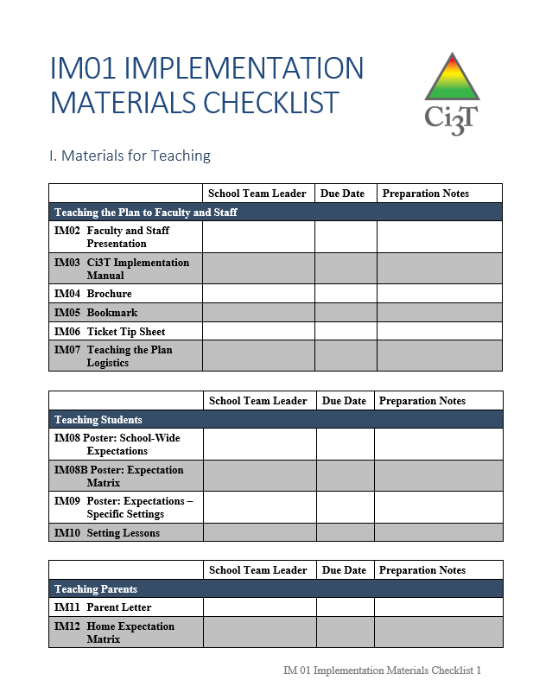
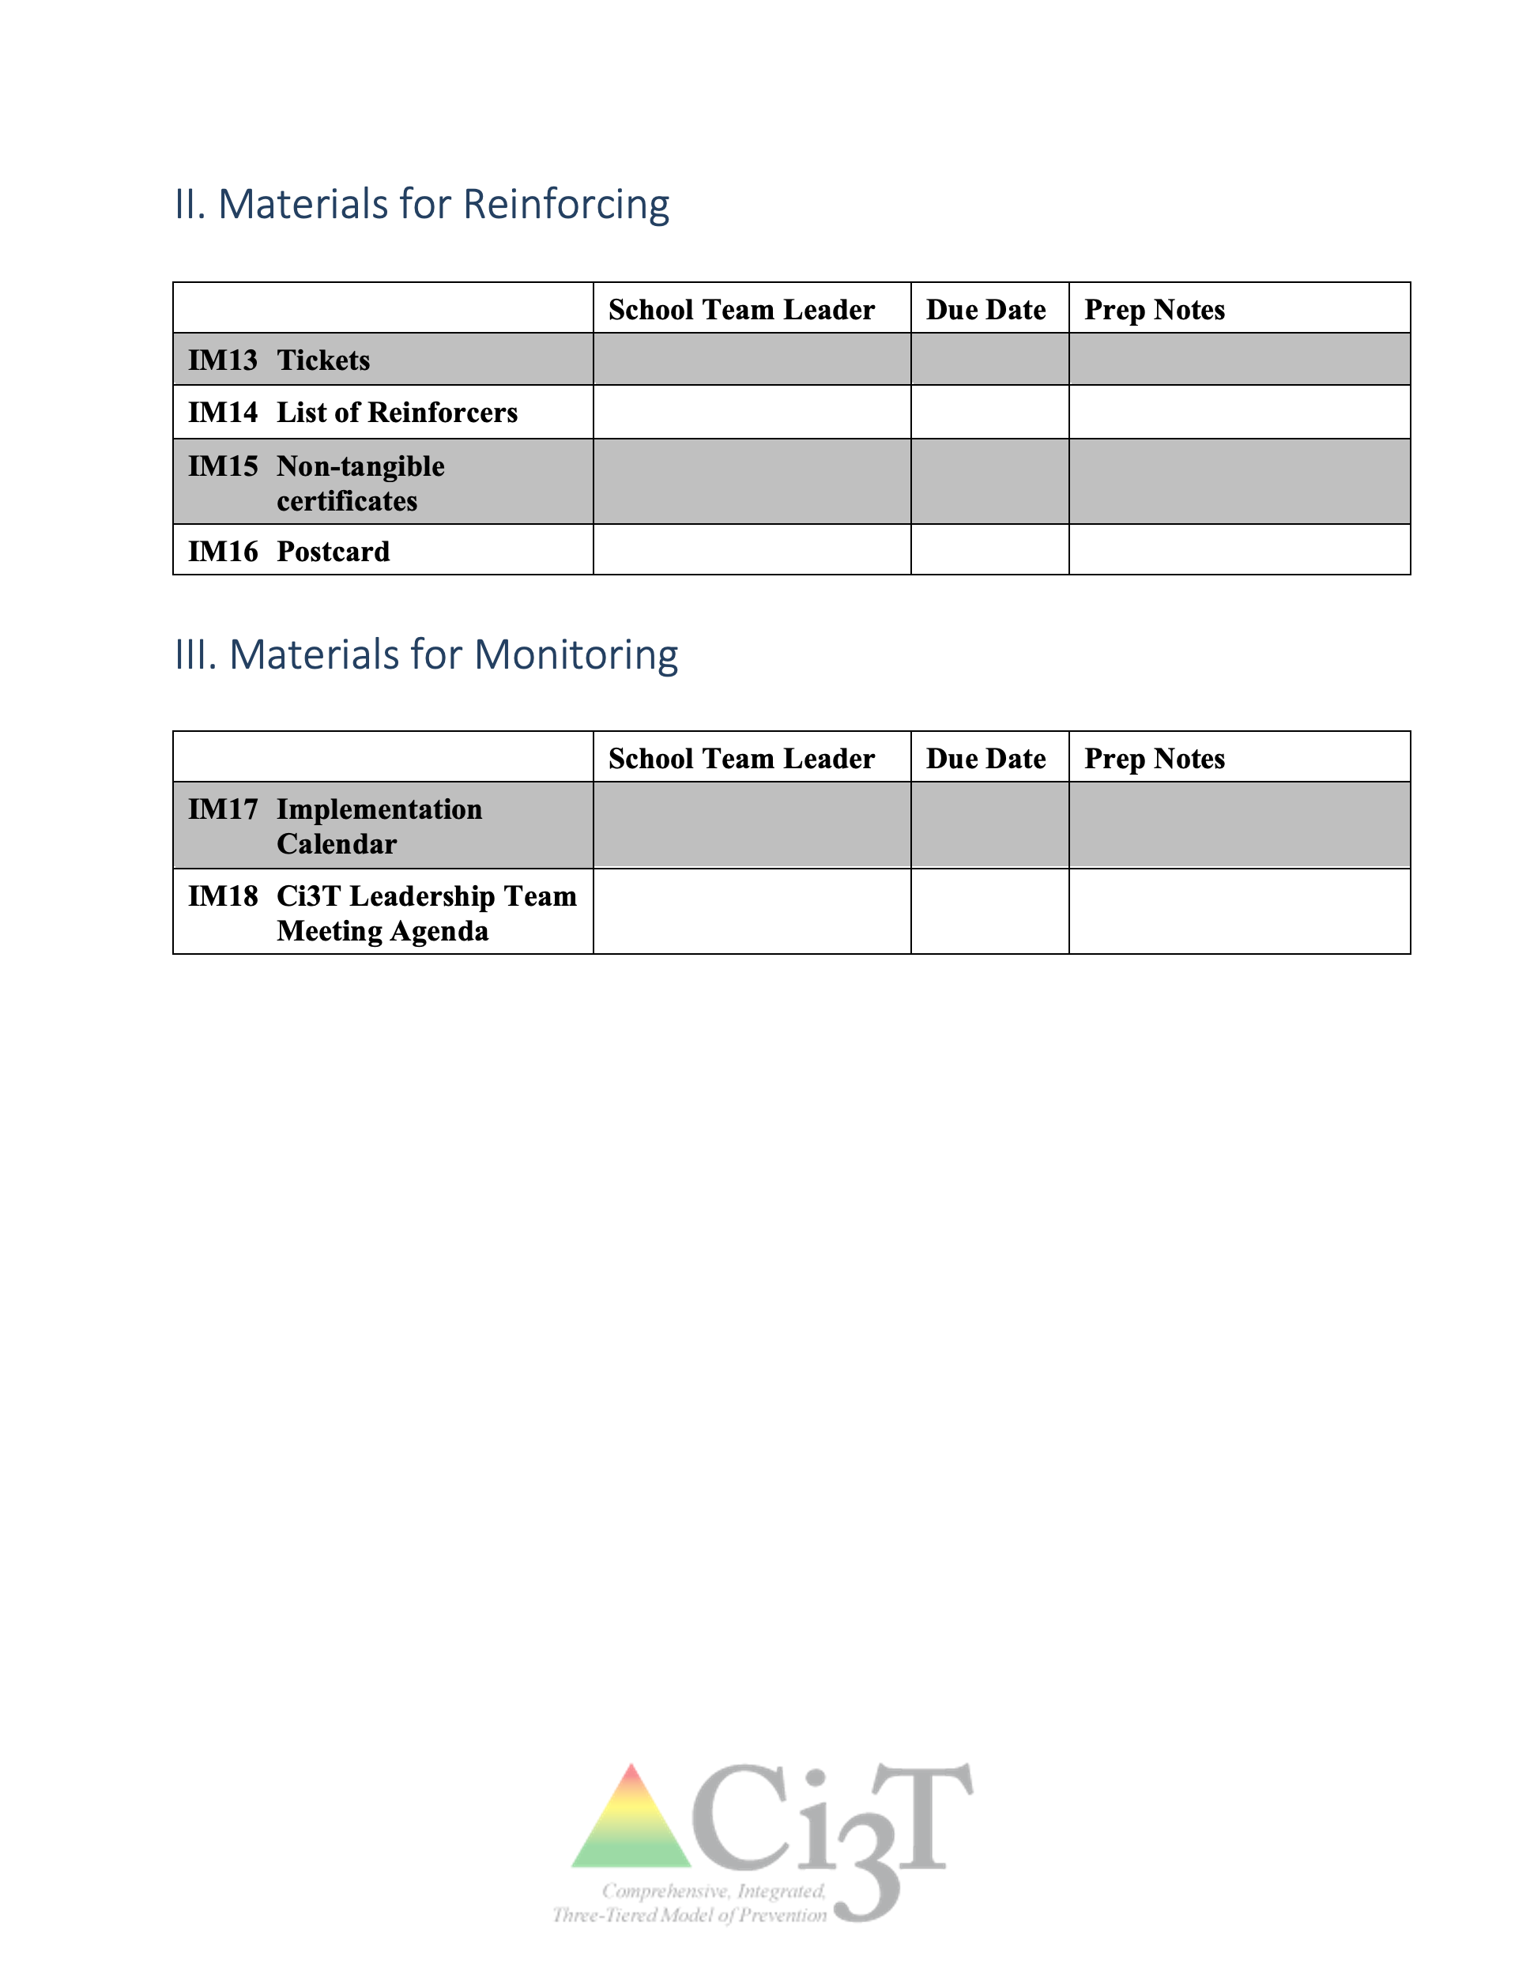

Slide 78



Preparing for your Kickoff
Teaching Faculty
Teaching Students
Implementation Manual
Kickoff Assembly
Faculty Roll-Out
Setting Lessons

Slide 79






Ci3T Implementation Manuals
Shared with permission.

Slide 80

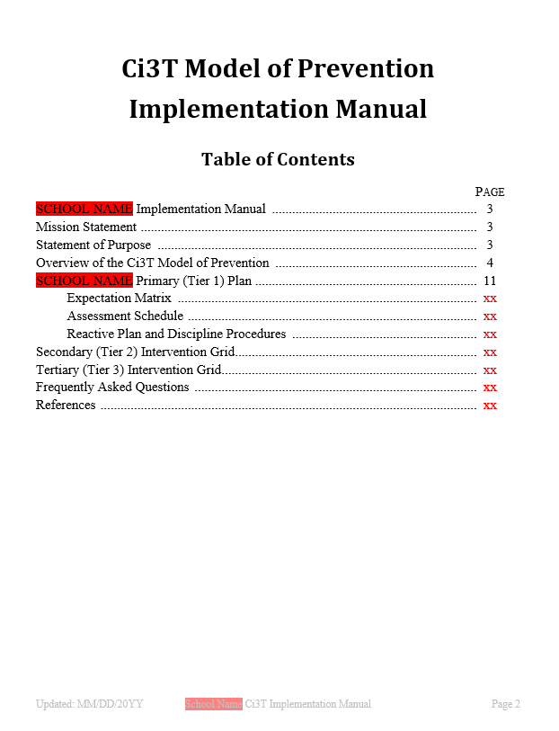
Teaching Faculty and Staff –
IM03 Ci3T Implementation Manual
Quick reference for all stakeholders
Includes procedures, supports, and other information about Ci3T model of prevention
Notes:
A sample table of contents is included for reference

Slide 81
Teaching Faculty and Staff –
IM03 Ci3T Implementation Manual
    Overview of Ci3T model of prevention
    Ci3T Blueprint A Primary (Tier 1) Plan
  Mission Statement
  Purpose Statement
  Roles and responsibilities
  Procedures for teaching
  Procedures for reinforcing
  Procedures for monitoring
    Ci3T Blueprint B Reactive Plan
    Ci3T Blueprint C Expectation Matrix
    Ci3T Blueprint D Assessment Schedule
    Ci3T Blueprint E Secondary (Tier 2) Intervention Grid
    Ci3T Blueprint F Tertiary (Tier 3) Intervention Grid
    Frequently Asked Questions (FAQ)
    Resources

Slide 82
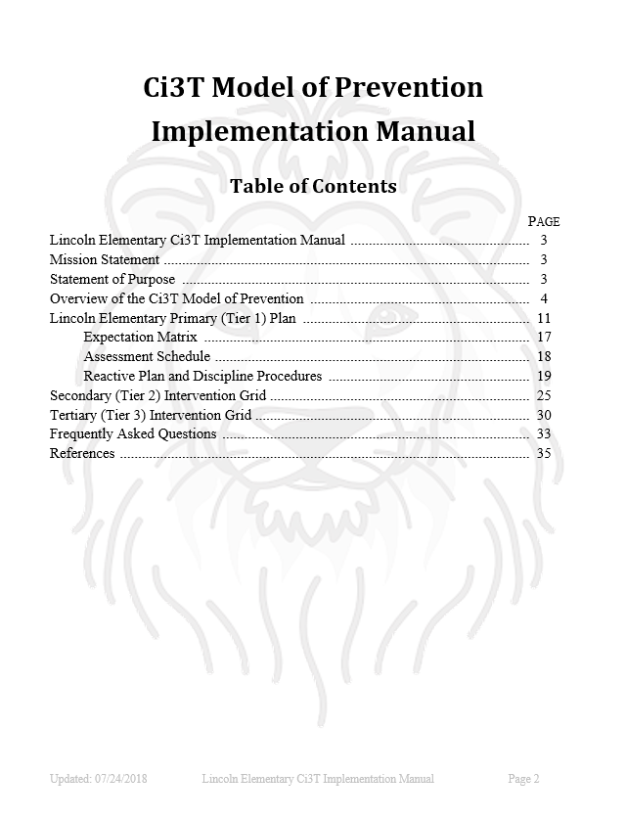

Teaching Faculty and Staff
IM03 Ci3T Implementation Manual
IM03
Work with your team to compile Ci3T Blueprints A-F into IM03 Ci3T Implementation Manual

Slide 83
Assemble
IM03 Ci3T Implementation Manual
30 minutes
Notes:
30 min

Slide 84
  REMEMBER
  This is a school-wide plan: ALL students, faculty, and staff are included. Practices are used across all school settings
Consider feedback prior to presenting
Notes:
84

Slide 85
IM01 Implementation Materials Checklist lists materials for your team to select and assign
who will take the lead
on creating them
Notes:
85

Slide 86
IM01 Implementation Materials Checklist
Decide which materials you would like
15 minutes
Notes:
15 min

Slide 87
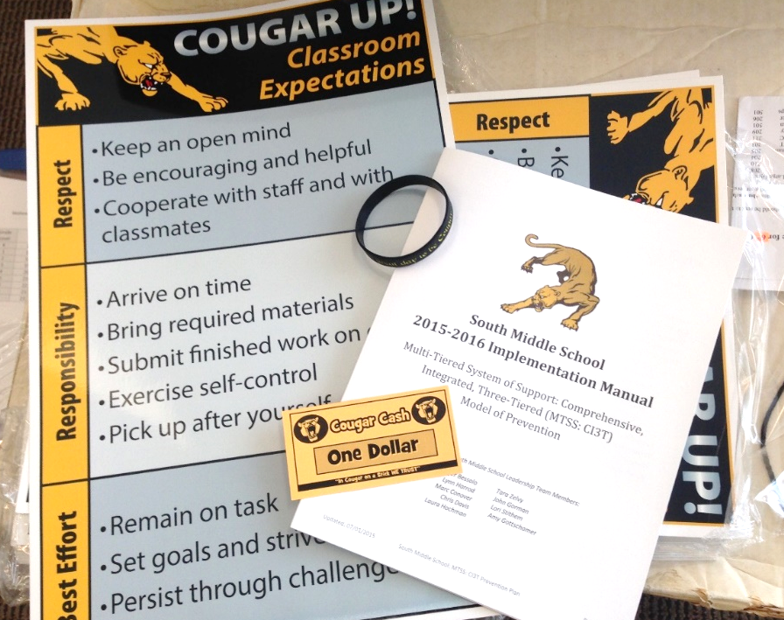
Preparing for your Kickoff
Teaching Faculty
Teaching Students
Implementation Manual
Kickoff Assembly
First things first
Faculty Roll-Out
Setting Lessons

Slide 89

Procedures for Teaching: Parents and Community
A Parent Letter

Slide 90
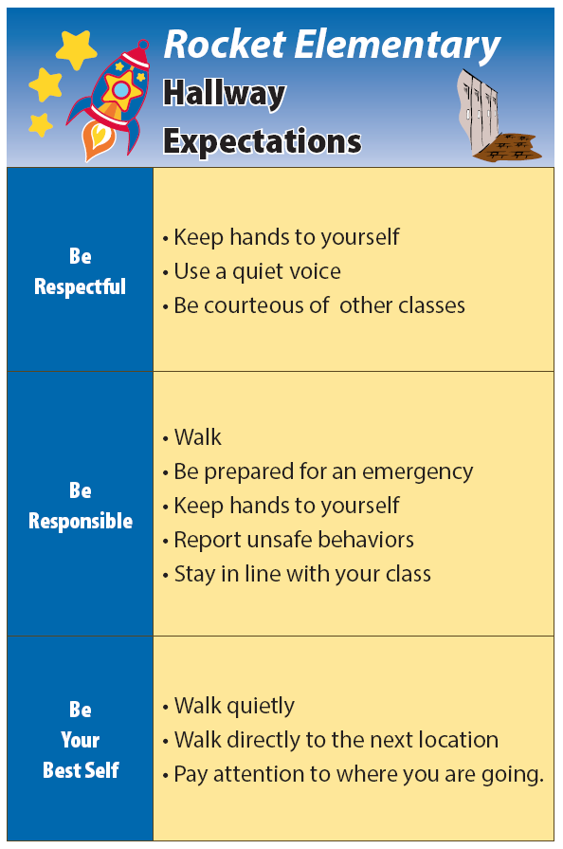

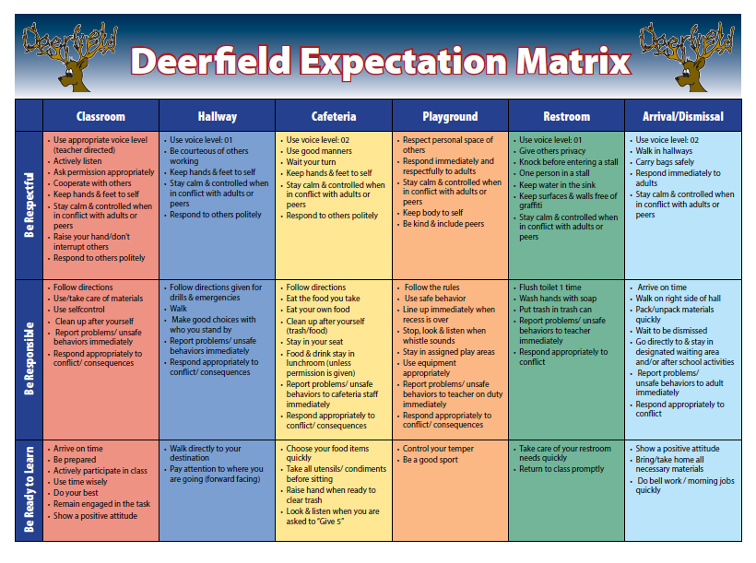
Teaching Students
IM08 Poster: School-Wide Expectations
IM08B Poster: Expectation Matrix
IM09 Poster: Expectations – Specific Settings
IM10 Setting Lessons
IM09
IM08
Shared with permission.
IM08B

Slide 91
REMEMBER: Student engagement increases student ownership!

Slide 92

Start the Year Off with Excitement

Slide 93


Teaching Students – Kick-off Assembly
Schedule a time for your team to meet to plan your kick-off assembly

Slide 94

Utilize the Talent of Students to Spread the Message

Slide 95

Student Skits to Teach Expectations

Slide 96

Student-made Videos

Slide 97


Offer Multiple Activities
http://www.schooltube.com/video/776d7a709d8a9173f1ae/Imma%20Be
Notes:
https://vimeo.com/38387470?share=copy#t=15
This video was written, directed, produced, and edited by Mr. Rob Dennis from John Early Magnet Charter School in Nashville, Tennessee. Imma Be features several students from the John Early Student Body, and promotes a very positive message for meeting expectations and dreaming big! This is one of the very best PBIS videos ever made (in my opinion).
Uploaded on Mar 12, 2012 at 3:27 pm

Slide 98
Customize Posters
Include students on your posters
Collect photos
Make sure to have signed release forms from parents

Slide 99


Teaching Students – Setting Lessons
Plan how and when you will teach setting expectation lessons.

Slide 100
Teaching Students – Setting Lessons
How and when will you teach the expectations in each setting?
  Videos
  Morning announcements
  Homeroom presentations
  Rotation through settings
Use your
Ci3T Blueprint A Primary (Tier 1) Plan
Procedures for Teaching
REMEMBER: Teach Setting Lessons the first week of school

Slide 101

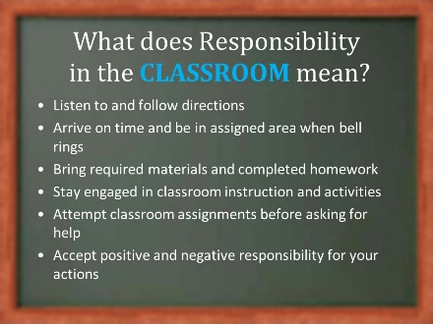

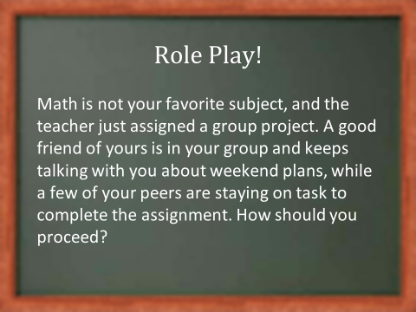
An Instructional Approach
IM10

Slide 102
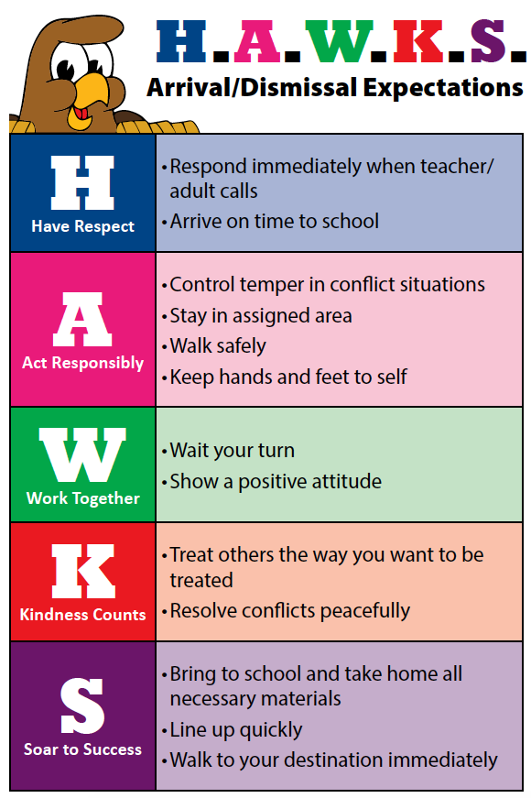
Sample Setting Expectations Poster
Elementary
Shared with permission.

Slide 103
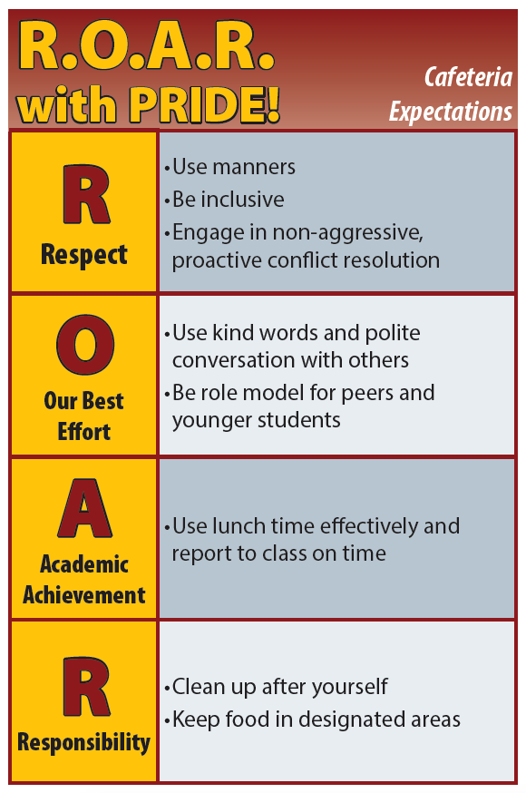
Sample Setting Expectations Poster
High School
Shared with permission.

Slide 104

IM17 Implementation Calendar
Work with your team to
create an implementation calendar

Slide 105
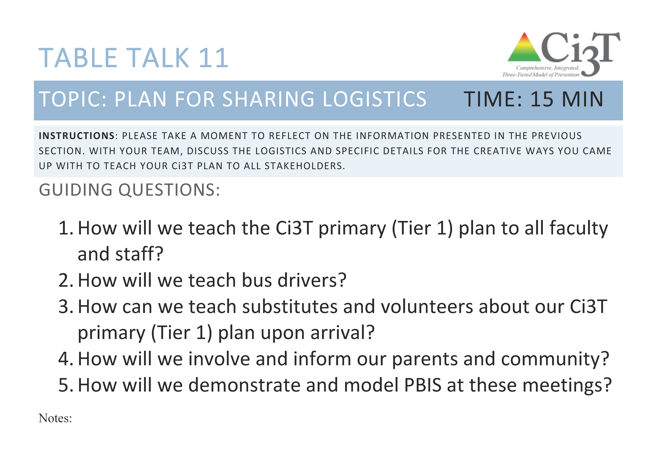
Use Table Talk 11
and your Procedures for Teaching. Plan for all faculty and staff.
15 minutes
Notes:
15 min

Slide 106
Materials Build Time!
Use IM01 Implementation Materials Checklist to delegate tasks to the team

Slide 107
































Use
IM01 Implementation Materials Checklist
Build your implementation materials
60 minutes
Notes:
60 min

Slide 108

Next Steps
Schedule a meeting with Ci3T Coach
Prepare and/or order implementation materials and curricula
Explore available technical assistance support
  Consider a partnership with local university researchers
Schedule kick-off meeting with full faculty and staff at the start of the school year

Slide 109

Where do we go from here?

Slide 110
Comprehensive, Integrated, Three-Tiered (Ci3T) Model of Prevention Professional Learning Series
Each school has selected a Ci3T Leadership Team to attend Ci3T training this year. Only team members are asked to attend the trainings.
Ci3T Professional Learning Series Traditional Timeline
1: Two-Hour
After School
4: Full Day
2: Full Day
3: Two-Hour
After School *With Students
6: Full Day
5: Two-Hour
After School
*With Students
November
December
January
February
April
May

Slide 112

Please Take a Minute to Get Organized
Please stay until all materials are organized
Place all materials in your table box:
  Name badges
  Role magnets
  Table cards (CASEL, What Works Clearinghouse)
  Extra postcards (take some with you!)
  Clearly identify the technology person on your team in charge of keeping Dropbox / Google Drive organized (move old versions into Previous folder)
    Consider saving docs with your school initials at the beginning and the date at the end of the file name
    Example: P_LES_Ci3T Blueprint A Primary (Tier 1) Plan_2027 05 09

Slide 113
Wrap Up and Preview
Today’s Review
Future Training Opportunities
Reviewed and polished Ci3T Blueprints A-D
Polished Ci3T Blueprint E Secondary (Tier 2) Intervention Grid and Ci3T Blueprint F Tertiary (Tier 3) Intervention Grid
Prepared implementation materials
Made a plan for implementation in the fall!
Look for professional learning opportunities related to identified needs
  for faculty, staff, and Ci3T Leadership Team
Check ci3t.org, pbis.org, and intensiveintervention.org for more updates and resources

Slide 114
Homework
Finalize all logistics for teaching your plan
to faculty & staff and students (kick off)
Complete IM03 Ci3T Implementation Manual
Complete IM17 Implementation Calendar
Schedule follow-up meeting with your Ci3T Coach
Prepare and/or order all implementation materials and curricula
Schedule summer Ci3T team
meeting if you would like further
Ci3T support
Follow Up Supports:
Let your Ci3T Coach or Ci3T Trainer know when
your team will meet over summer and if you would like support

Slide 115
Ci3T Feedback Form Report Template Slides
The following slides are templates for Ci3T Trainers’ use.

Slide 116
Comprehensive, Integrated, Three-Tiered (Ci3T) Model of Prevention: Feedback Form Example School Data | Strongly Disagree | Somewhat Disagree | Somewhat Agree | Strongly Agree | Mean | Standard Deviation
I think the plan targets important goals and/or objectives. | X | X | X | X | X.XX | X.XX
2. I think the plan is feasible. | X | X | X | X | X.XX | X.XX
3. I think the plan is likely to be put in place as planned. | X | X | X | X | X.XX | X.XX
4. I will implement the plan. | X | X | X | X | X.XX | X.XX
5. I think the plan will produce the desired outcomes. | X | X | X | X | X.XX | X.XX
1 2 3 4

Slide 117
Ci3T Feedback Form
Range: 1 – 4
Higher scores reflect stronger agreement
School (district; number completed; response rate %) | Mean (SD) Total
SCHOOL A (District Name; n = X, X.XX%) | X.XX (X.XX)
SCHOOL B (District Name; n = X, X.XX%) | X.XX (X.XX)
SCHOOL C (District Name; n = X, X.XX%) | X.XX (X.XX)
SCHOOL D (District Name; n = X, X.XX%) | X.XX (X.XX)
SCHOOL E (District Name; n = X, X.XX%) | X.XX (X.XX)
SCHOOL F (District Name; n = X, X.XX%) | X.XX (X.XX)

Slide 118
Ci3T Feedback Form: Comments
What are the strengths of the plan?
  Sample
What concerns do you have about the plan?
  Sample
What suggestions do you have for modifying the plan?
  Sample
To what extent do you think the plan will achieve the intended goals/objectives?
  Sample
R04 PL Plan Note Taker
Add to R04 Ci3T Professional Learning Plan

