Slide 1
Building Tertiary (Tier 3) Prevention Efforts
Ci3T Professional Learning Series Session 5

Slide 2
Agenda
Welcome!
How did your faculty and staff perceive the plan? Obtaining feedback on the Ci3T Blueprint A Primary (Tier 1) Plan
How can we use the Primary Intervention Rating Scale (PIRS) data to revise our Ci3T Blueprint A Primary (Tier 1) Plan?
How do we coordinate supports at the tertiary (Tier 3) level? Drafting the Ci3T Blueprint F Tertiary (Tier 3) Intervention Grid
Where do we go from here? Setting goals for Session 6

Slide 3
Agenda
Conversation Closer
Table Talk Note Taker
R04 PL Plan Note Taker
Task Divider
Technology Wrangler
Please take a moment to assign team roles:
Welcome!
How did your faculty and staff perceive the plan? Obtaining feedback on the Ci3T Blueprint A Primary (Tier 1) Plan
How can we use the Primary Intervention Rating Scale (PIRS) data to revise our Ci3T Blueprint A Primary (Tier 1) Plan?
How do we coordinate supports at the tertiary (Tier 3) level? Drafting the Ci3T Blueprint F Tertiary (Tier 3) Intervention Grid
Where do we go from here? Setting goals for Session 6

Slide 4
Review and Preview
Last Session’s Review
Today’s Preview
Finalized Ci3T Blueprint D Assessment Schedule
Finalized procedures for monitoring
Final revisions made to the full draft of the Ci3T Blueprint A Primary (Tier 1) Plan
Created IM02 Faculty and Staff Presentation
Started Ci3T Blueprint E Secondary (Tier 2) Intervention Grid
Revise plan based on faculty feedback (PIRS Pre-Implementation)
Decide how to share feedback and revisions with faculty (R08 PIRS Feedback to Faculty and Staff)
Begin Ci3T Blueprint F Tertiary (Tier 3) Intervention Grid
Discuss Ci3T Feedback Form

Slide 5
Homework:
Last time we met…
At your next faculty meeting:
  Share IM02 Faculty and Staff Presentation of your Ci3T Blueprint with faculty and staff
  Ask faculty and staff to complete the PIRS Pre-Implementation survey (electronic link will be sent to all faculty and staff)
  Surveys must be completed by [DATE] for reports to be available for the next session
At your next Ci3T Leadership Team meeting:
  Complete the Ci3T Blueprint E Secondary (Tier 2) Intervention Grid with the name and description of currently available supports
  Draft student entry criteria, data to monitor progress, and exit criteria

Slide 6

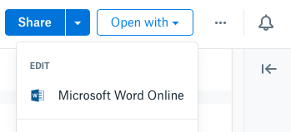
Open your school’s folder on dropbox.com
Open the “Ci3T Blueprint Materials” folder
Make a copy of Ci3T Blueprint A Primary (Tier 1) Plan and rename to add the date to the end of the file name
Click the new file to start a preview
Click “Open with” in the top right, then Microsoft Word Online, which allows multiple people to edit together
Notes:
Use the “Hide Slide” feature to hide the file sharing system not being used. Do not delete the slide. Hiding the slide will preserve correspondence to the pacing guide slide numbers.

Slide 7

Open your school’s Google Drive folder online
Open the “Ci3T Blueprint Materials” folder
Find Ci3T Blueprint A Primary (Tier 1) Plan
Right-click and select “Rename”
  Update the end of the file name to today’s date
  Add your school initials in the front
and/or open the doc and click File > Version history > Name current version and type today’s date
Ex: P_LES Ci3T-Blueprint-A-Primary-Tier-1-Plan 2027 03 24
Notes:
Use the “Hide Slide” feature to hide the file sharing system not being used. Do not delete the slide. Hiding the slide will preserve correspondence to the pacing guide slide numbers.

Slide 8

How did your faculty and staff perceive the plan?
Obtaining feedback on the Ci3T Blueprint A Primary (Tier 1) Plan

Slide 9
Primary Plan Presentations
How did your faculty and staff perceive the plan?
Successes?
Challenges?
Questions?

Slide 10
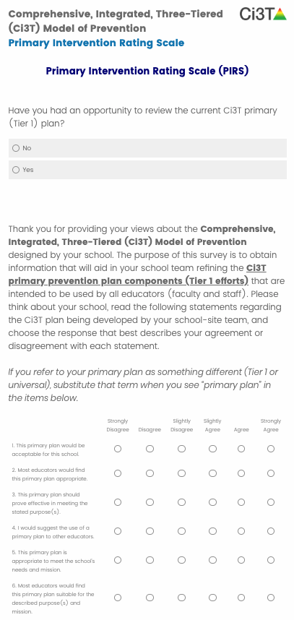
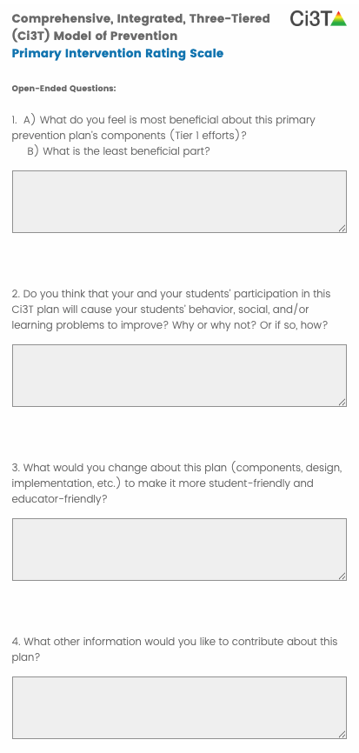

Assessing
Social Validity
Primary Intervention Rating Scale (PIRS)
A formal way for faculty and staff to provide feedback
Results used to guide professional learning and Ci3T plan revisions each year

Slide 11
Primary Intervention Rating Scale (PIRS) Lincoln Elementary | Strongly Disagree | Disagree | Slightly Disagree | Slightly Agree | Agree | Strongly Agree | Mean | Standard Deviation
1. This primary plan is acceptable for this school. | 0 | 0 | 0 | 0 | 17 | 19 | 5.53 | 0.51
2. Most educators find the primary plan appropriate. | 0 | 0 | 0 | 0 | 21 | 15 | 5.42 | 0.50
3. The primary plan should prove effective in meeting the purpose(s). | 0 | 0 | 0 | 0 | 18 | 18 | 5.50 | 0.51
4. I would suggest the use of a primary plan to other educators. | 0 | 0 | 0 | 1 | 15 | 20 | 5.53 | 0.56
5. The primary plan is appropriate to meet the school’s needs and mission. | 0 | 0 | 0 | 0 | 17 | 19 | 5.53 | 0.51
6. Most educators would find the primary plan suitable for the described purpose(s) and mission. | 0 | 0 | 0 | 0 | 21 | 15 | 5.42 | 0.50
1 2 3 4 5 6

Slide 12
Primary Intervention Rating Scale (PIRS) Lincoln Elementary | Strongly Disagree | Disagree | Slightly Disagree | Slightly Agree | Agree | Strongly Agree | Mean | Standard Deviation
7. I would be willing to use the primary plan in this school setting. | 0 | 0 | 0 | 0 | 15 | 21 | 5.58 | 0.50
8. This primary plan will not result in negative side-effects for the students. | 0 | 0 | 0 | 3 | 15 | 17 | 5.40 | 0.65
9. This primary plan is appropriate for a variety of students. | 0 | 0 | 0 | 2 | 18 | 16 | 5.39 | 0.60
10. This primary plan is consistent with those I have used in other school settings. | 1 | 2 | 3 | 7 | 14 | 9 | 4.61 | 1.27
11. The primary plan components are a fair way to fulfill the plan’s purposes. | 0 | 0 | 0 | 0 | 21 | 15 | 5.42 | 0.50
12. The primary plan is reasonable to meet the stated purpose(s). | 0 | 0 | 0 | 0 | 20 | 16 | 5.44 | 0.50
1 2 3 4 5 6

Slide 13
Primary Intervention Rating Scale (PIRS) Lincoln Elementary | Strongly Disagree | Disagree | Slightly Disagree | Slightly Agree | Agree | Strongly Agree | Mean | Standard Deviation
13. I like the procedures used in the primary plan. | 0 | 0 | 0 | 1 | 19 | 16 | 5.44 | 0.50
14. The primary plan is a good way to meet the specified purpose(s). | 0 | 0 | 0 | 0 | 18 | 18 | 5.50 | 0.51
15. The primary plan’s monitoring procedures are manageable. | 0 | 0 | 0 | 8 | 18 | 10 | 5.06 | 0.71
16. The primary plan’s monitoring procedures give the necessary information to evaluate the plan. | 0 | 0 | 0 | 2 | 18 | 16 | 5.39 | 0.60
17. Overall, this primary plan is beneficial for this age group of students. | 0 | 0 | 0 | 1 | 16 | 19 | 5.50 | 0.56
Mean Percentage (SD; Range) | 89.72% (SD = 7.62; 78.43-100)
1 2 3 4 5 6

Slide 14
Primary Intervention Rating Scale
Higher Scores Reflect Stronger Agreement
School (district; number completed; response rate) | Mean % (SD) Total
Lincoln Elementary School (Presidential School District; N = 36; 41.86%) | 89.72 (7.67)
Coolidge Middle School (Presidential School District; N = 28; 51.85%) | 81.19 (11.44)
College and Career Extension (Presidential School District; N = 6; 35.29%) | 79.58 (9.71)
Pierce High School (Presidential School District; N = 47; 51.65%) | 80.96 (13.13)
Lincoln Preschool (Presidential School District; N = 12; 84.41%) | 81.82 (8.40)
King Elementary School (Freedom County Schools; N = 28; 56.00%) | 84.82 (6.73)
Parks Middle School (Freedom County Schools; N = 39; 58.21%) | 77.15 (15.42)
Marshall High School (Freedom County Schools; N = 29; 43.28%) | 82.35 (11.82)

Slide 15
PIRS Comments
1. A) What do you feel is most beneficial about this primary
prevention plan’s components (Tier 1 efforts)?
  I love that it looks at academic, behavior, and social skills. I also like that it has student, parent, and teacher expectations.
  The building-wide (all school) approach to improving social-emotional-behavioral-academic performance of our students
  I think everyone will be on the same page as far as expectations. Some may have issues with specific pieces. I like having this foundation all in one place.
  The most beneficial part is the focus placed on social skill instruction.
B) What is the least beneficial part?
  The monitoring components are the only area that I am a little concerned about.
  I feel that the least beneficial part is finding a way to get parents to buy in to what we're doing.
  Right now we are waiting to hear more about the assessment piece, so that will be interesting information once we know for sure what we will be using.

Slide 16
PIRS Comments
2. Do you think that your and your students’ participation in this
Ci3T plan will cause your students’ behavior, social, and/or
learning problems to improve? Why or why not? or If so, how?
  I think that this plan, if carried out with fidelity, will help in all areas.
  Yes, I think it will help it improve, because most students like being praised for the things they do. They take pride when they are recognized for doing a good job (be it academically, socially, or behaviorally).
  I think clearly stating expectations gives students the best opportunity to succeed. Behaviors must be under control to have the best academic experience.
  Having school-wide expectations are crucial and it will make things more consistent for students throughout the building, as well as from year to year.
  I just think it develops a sense of cohesion and teamwork.
  I think overuse of the tickets could lead to students expecting to be rewarded for behaviors when in fact, we expect certain behaviors to occur, HOWEVER, I am a proponent of positive behavioral supports and generally support this.

Slide 17
PIRS Comments
3. What would you change about this plan (components, design, implementation, etc.) to make it more student-friendly and
educator-friendly?
  My concern is too many assessments for students to take and teachers to implement.
  Clearly defined consequences for choosing not to follow school expectations-without paperwork. Life has consequences for making bad choices, school should help students be successful in life.
  The monitor how much assessing we are needing to conduct. Currently we do have a lot and too much will be overwhelming to staff and students alike.
  The plan seems very straight-forward and appropriate. I would not recommend any changes at this time.
  I find it very educator and student friendly. However, I do see that it would be very overwhelming to new staff members who come aboard. It looks like there is a plan in place for professional development for newcomers.

Slide 18
PIRS Comments
4. What other information would you like to contribute about
this plan?
  Great job on all the hard work. I know the work you have done will pay off dividends with our students and staff. Keep it up!
  It is a good beginning for communicating the IMPORTANCE of student attendance. We are taking great steps to encourage this, and we need to try to change the culture/perceptions of WHY ATTENDANCE IS IMPORTANT - with our parents!
  I LOVE the plan and greatly appreciate the support of the Ci3T Team!!! Thank you!
  I think we put a lot of focus on behavior and our school climate is much better. We have a great school and I'm proud to work here. I now think we now need to put more of a focus on the ways to improve academics.

Slide 19


PIRS Report: Examining Results
Please review item level scores, mean scores, and narrative comments.
Look for common themes. Consider your faculty’s ideas, concerns, and suggestions.

Slide 20












How did your faculty and staff
perceive the plan?
Review PIRS scores and narrative comments
10 minutes
Notes:
10 min

Slide 21
How can we use the Primary Intervention Rating Scale (PIRS) data to revise our Ci3T Blueprint A Primary (Tier 1) Plan?

Slide 22

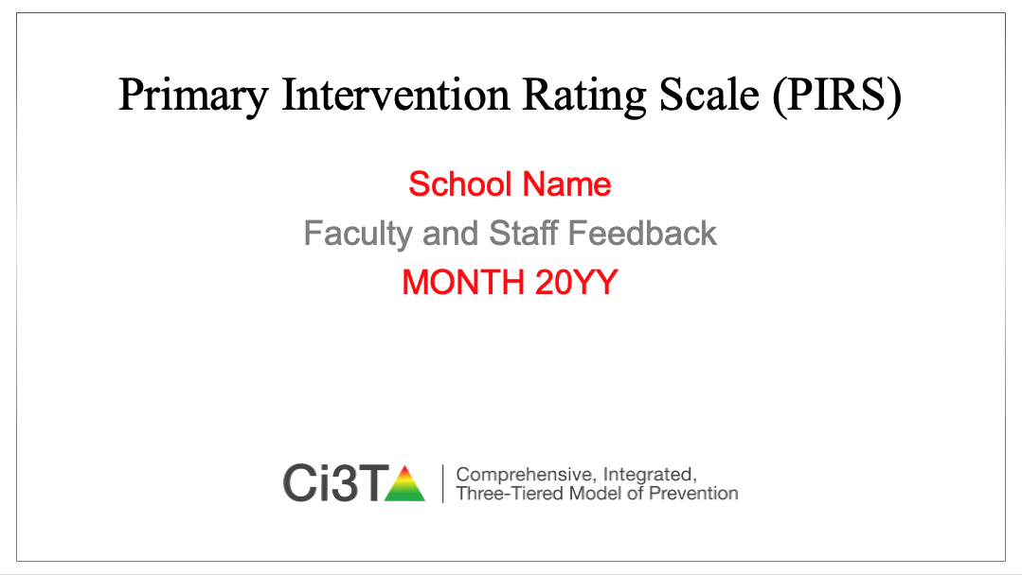
Revising Your Ci3T Plan
R08 PIRS Feedback to Faculty and Staff is in Ci3T Leadership Team Resources folder
Please
Revise Ci3T Blueprints A-D based on
PIRS feedback and be sure to name your programs and curricula (e.g., reading curriculum, social skills program).
Use R08 PIRS Feedback to Faculty and Staff to highlight feedback and explain changes.
Use the draft email slide to send your presentation to faculty and staff along with Ci3T Feedback Form instructions.

Slide 23
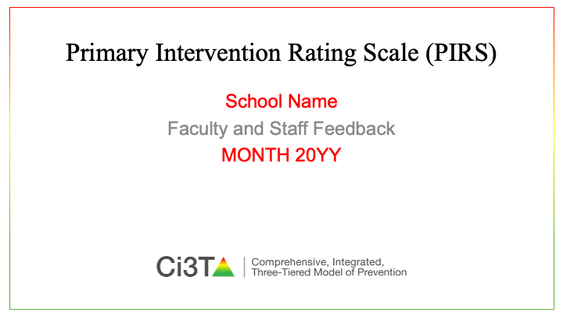
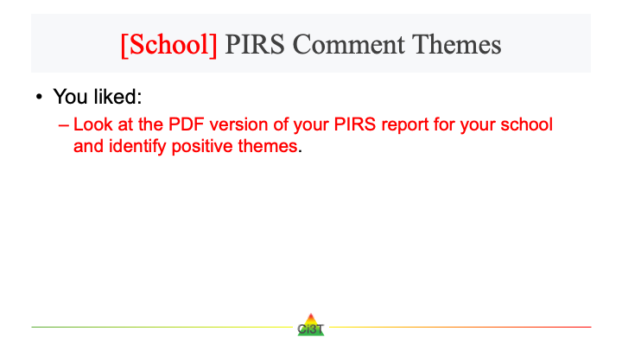
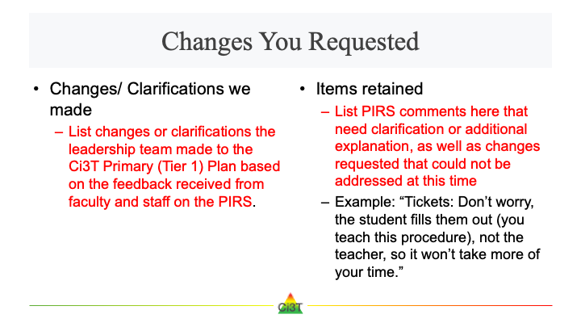
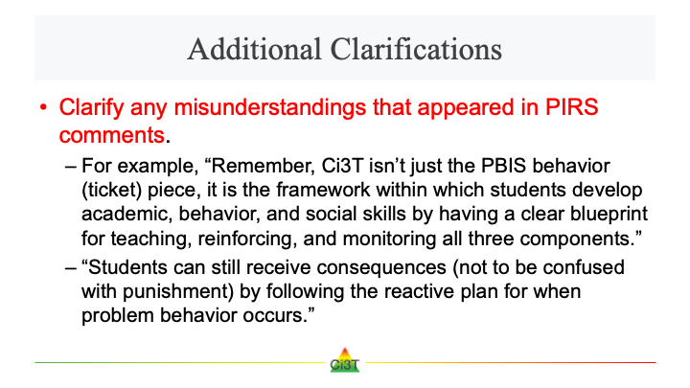

R08 PIRS Feedback to Faculty and Staff is in Ci3T Leadership Team Resources folder

Slide 24
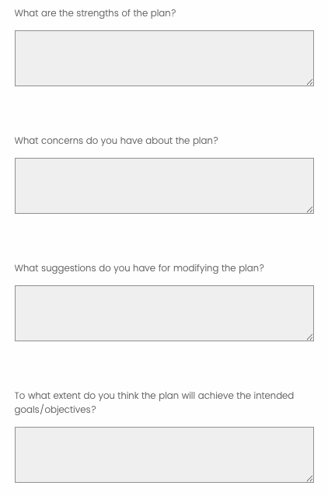
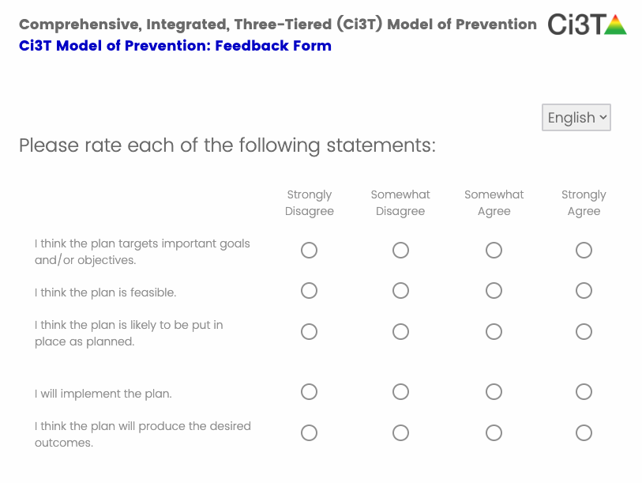
Comprehensive, Integrated, Three-Tiered (Ci3T) Model of Prevention: Feedback Form
Social validity measure
Short
Complete by xx/xx/xx
  to have your data by Session 6 on XX/XX/XX
We will email Qualtrics links at each school’s scheduled time
A faculty and staff meeting is encouraged but not required
Draft email to faculty and staff now
  We will follow your email with a survey link

Slide 25










How and what should we revise in our school’s
Ci3T Blueprints A-D?
Revise Ci3T Blueprints A-D
Create R08 PIRS Feedback to Faculty and Staff
Draft email to faculty and staff
20 minutes
R08 PIRS Feedback to Faculty and Staff is in Ci3T Leadership Team Resources folder
Notes:
20 min

Slide 26

How do we coordinate supports at the tertiary
(Tier 3) level?
Drafting the Ci3T Blueprint F Tertiary (Tier 3) Intervention Grid

Slide 28

Tertiary (Tier 3) Supports
Student specific
The most intensive level of support within general education
Offered to students who receive special education services and those who do not
Used along with both primary (Tier 1) and secondary (Tier 2) interventions
May address academic, behavioral, or social skill concerns or multiple concerns within one intervention
Notes:
Multiple concerns in one intervention example: reading fluency and engagement

Slide 29
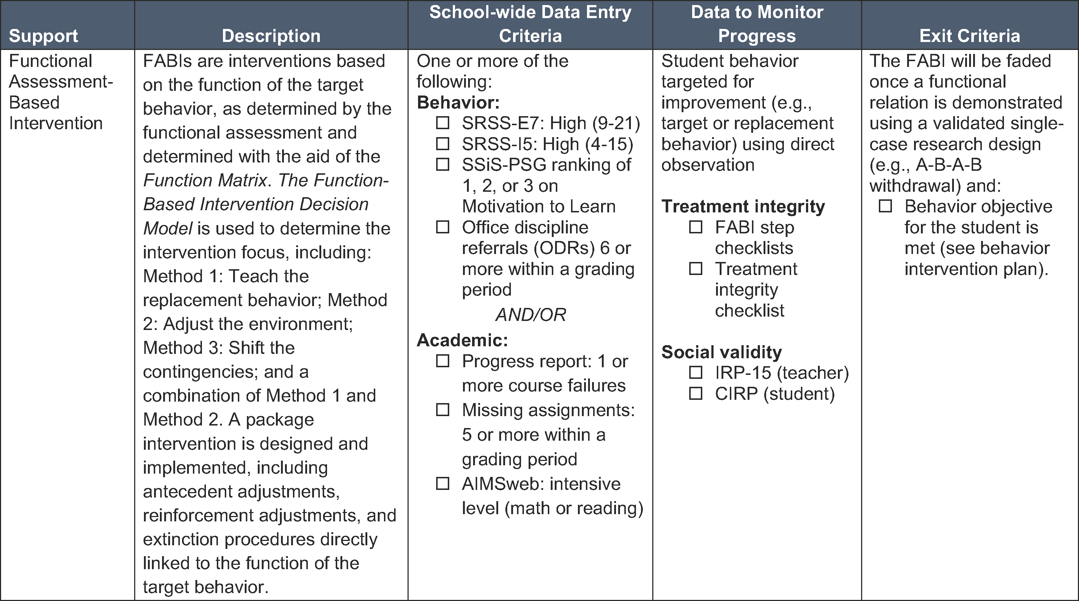
Tertiary (Tier 3) Intervention Grid

Slide 30
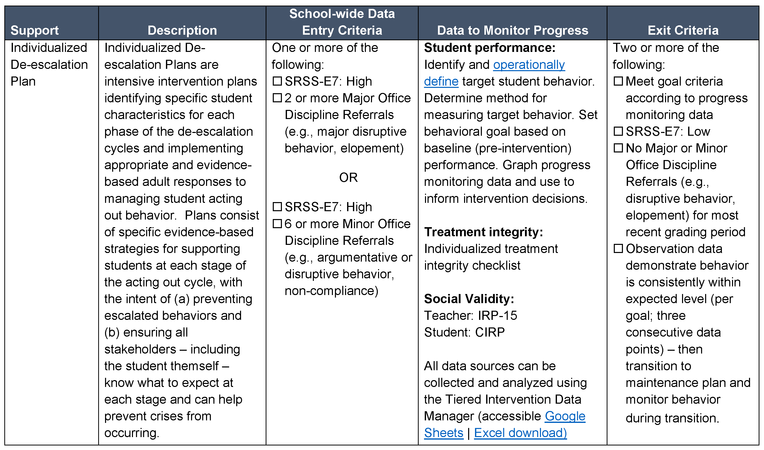
Tertiary (Tier 3) Intervention Grid

Slide 31
A Systematic Approach to Designing
Tertiary (Tier 3) Interventions
Step 1: Construct your assessment schedule
Step 2: Identify your tertiary (Tier 3) supports
  Existing and new interventions
Step 3: Determine entry criteria
  Academic failure, behavior and academic screening scores, attendance data, etc.
Step 4: Identify data to monitor progress
  Student performance: pre- and post-tests, curriculum-based measures, office discipline referral data, GPA, etc.
  Treatment integrity
  Social validity
Step 5: Identify exit criteria
  Reduction of discipline contacts, demonstration of grade level performance based on academic progress monitoring data, reduction of truancies and absences, etc.
Step 6: Consider additional needs
Notes:
31

Slide 32
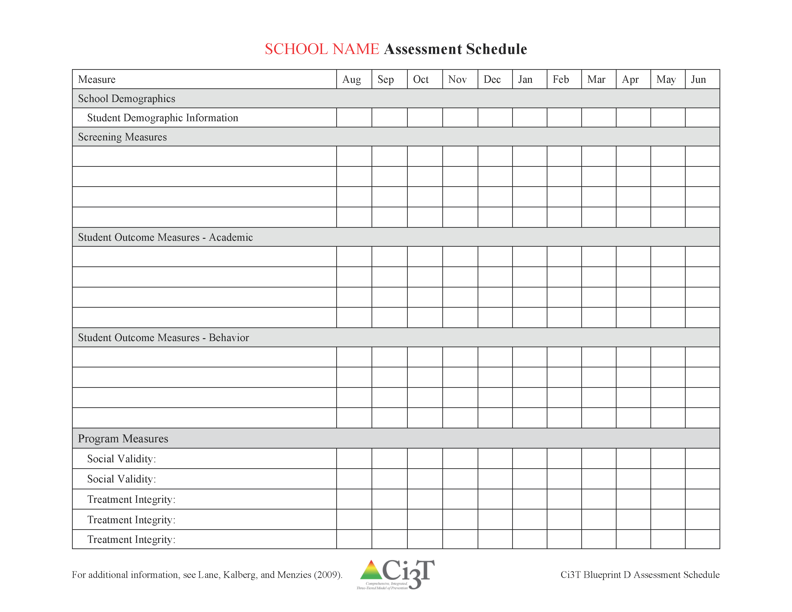
Ci3T Blueprint D Assessment Schedule

Slide 33
A Systematic Approach to Designing
Tertiary (Tier 3) Interventions
Step 1: Construct your assessment schedule
Step 2: Identify your tertiary (Tier 3) supports
  Existing and new interventions
Step 3: Determine entry criteria
  Academic failure, behavior and academic screening scores, attendance data, etc.
Step 4: Identify data to monitor progress
  Student performance: pre- and post-tests, curriculum-based measures, office discipline referral data, GPA, etc.
  Treatment integrity
  Social validity
Step 5: Identify exit criteria
  Reduction of discipline contacts, demonstration of grade level performance based on academic progress monitoring data, reduction of truancies and absences, etc.
Step 6: Consider additional needs
Notes:
33

Slide 34
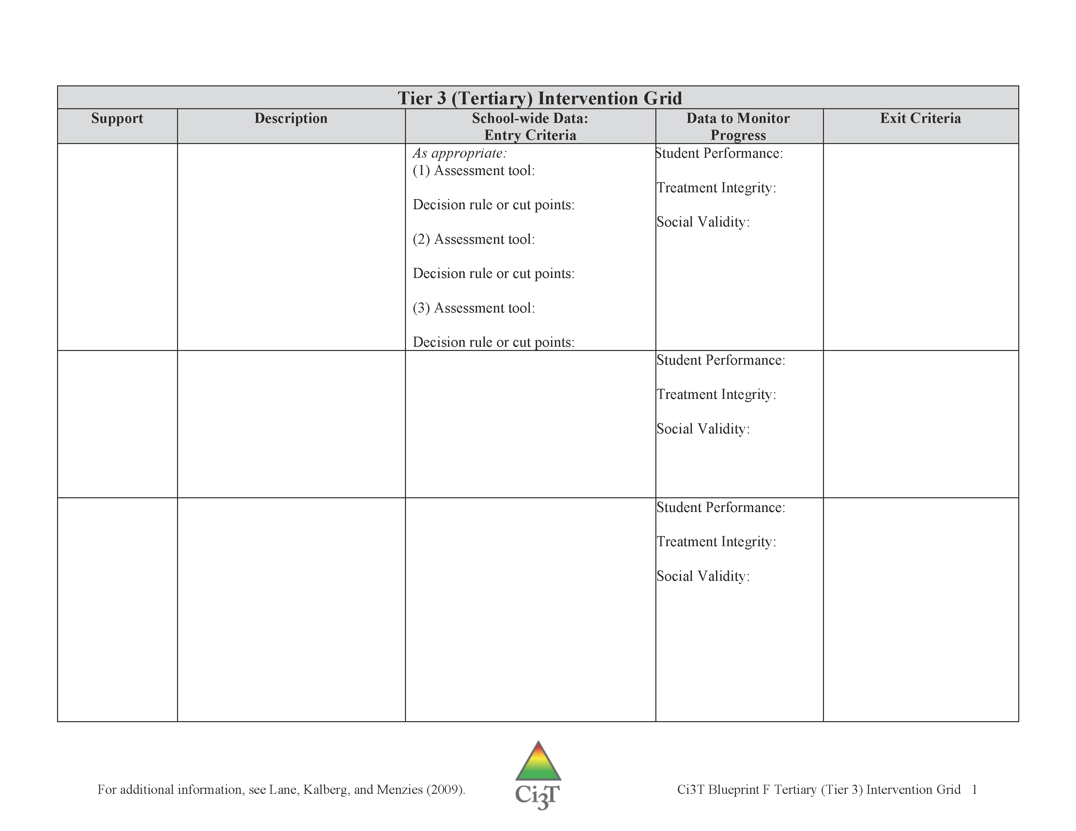
Tertiary (Tier 3) Intervention Grid
Remember these supports are strategies, practices, or programs.
A support is not a person (e.g., counselor).
A support is not a pre-referral intervention team or a multi-disciplinary team.
Ci3T Blueprint F Tertiary (Tier 3) Intervention Grid

Slide 35
Record tertiary (Tier 3) supports currently available on Ci3T Blueprint F Tertiary (Tier 3) Intervention Grid
Please name each support and type a description
(Columns 1 and 2)
15 minutes

Slide 36
Record tertiary (Tier 3) supports currently available on Ci3T Blueprint F Tertiary (Tier 3) Intervention Grid
Please name each support and type a description
(Columns 1 and 2)
15 minutes
Notes:
15 min

Slide 37
A Systematic Approach to Designing
Tertiary (Tier 3) Interventions
Step 1: Construct your assessment schedule
Step 2: Identify your tertiary (Tier 3) supports
  Existing and new interventions
Step 3: Determine entry criteria
  Academic failure, behavior and academic screening scores, attendance data, etc.
Step 4: Identify data to monitor progress
  Student performance: pre- and post-tests, curriculum-based measures, office discipline referral data, GPA, etc.
  Treatment integrity
  Social validity
Step 5: Identify exit criteria
  Reduction of discipline contacts, demonstration of grade level performance based on academic progress monitoring data, reduction of truancies and absences, etc.
Step 6: Consider additional needs
Notes:
37

Slide 38
Tertiary (Tier 3) Intervention Grid
Ci3T Blueprint F Tertiary (Tier 3) Intervention Grid

Slide 39
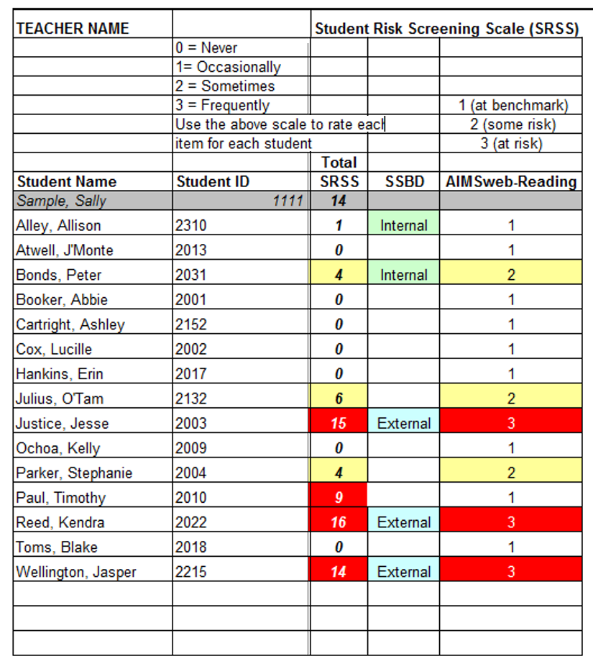
Using Data to Consider Interventions – Elementary
Increased Rates of Reinforcement
Intensive Reading Intervention with Self-Monitoring

Slide 40
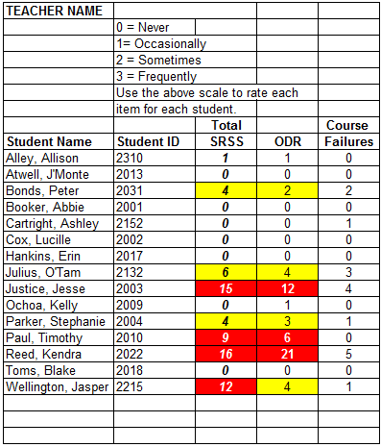
Using Data to Consider Interventions – MS/HS
Check-In/Check-Out (Mentoring);
Study Hall Tutoring
Functional Assessment-Based Intervention

Slide 41


In teams of two, refine your tertiary (Tier 3) grid by editing current supports and getting feedback from your colleagues
Task Divider
Define Entry / Exit Criteria and Data to Monitor Progress
Edit Tertiary Support
Edit Tertiary Support

Slide 42
Begin to record entry criteria, data to monitor progress, and exit criteria on
Ci3T Blueprint F Tertiary (Tier 3) Grid
15 minutes
R04 PL Plan Note Taker
Add to R04 Ci3T Professional Learning Plan
Notes:
15 min

Slide 43

Where do we go from here?

Slide 44
Comprehensive, Integrated, Three-Tiered (Ci3T) Model of Prevention Professional Learning Series
Each school has selected a Ci3T Leadership Team to attend Ci3T training this year. Only team members are asked to attend the trainings.
Ci3T Professional Learning Series Traditional Timeline
1: Two-Hour
After School
4: Full Day
2: Full Day
3: Two-Hour
After School *With Students
6: Full Day
5: Two-Hour
After School
*With Students
November
December
January
February
April
May

Slide 46

Please Take a Minute to Get Organized
Please stay until all materials are organized
Place all materials in your table box:
  Name badges
  Role magnets
  Table cards (CASEL, What Works Clearinghouse)
  Extra postcards (take some with you!)
  Clearly identify the technology person on your team in charge of keeping Dropbox / Google Drive organized (move old versions into Previous folder)
    Consider saving docs with your school initials at the beginning and the date at the end of the file name
    Example: P_LES_Ci3T Blueprint A Primary (Tier 1) Plan_2027 03 24

Slide 47
Comprehensive, Integrated, Three-Tiered (Ci3T) Model of Prevention: Feedback Form
Social validity measure
Short
Complete by xx/xx/xx
  to have your data by Session 6 on XX/XX/XX
We will email Qualtrics links at each school’s scheduled time
A faculty and staff meeting is encouraged but not required
Draft email to faculty and staff now
  We will follow your email with a survey link

Slide 48
Wrap Up and Preview
Today’s Review
Next Session Preview
Discussed faculty and staff PIRS feedback and made any minor revisions
  Decided how to share feedback summary and revisions with faculty and staff
Reviewed structure for organizing tertiary (Tier 3) interventions
Drafted Ci3T Blueprint F Tertiary (Tier 3) Intervention Grid
Made plans for final feedback loop with Ci3T Feedback Form
Review and polish Ci3T Blueprints A-D
Polish Ci3T Blueprints E & F Secondary (Tier 2) & Tertiary (Tier 3) Intervention Grids
Prepare implementation materials
Make a plan for implementation in the fall

Slide 49
Homework
Informal collection of information from faculty
  Determine existing tertiary (Tier 3) supports (Ci3T Blueprint F)
  Generate new ideas for supports
Share R08 PIRS Feedback to Faculty and Staff
  Share positive feedback
  Share what changed in the plan based on faculty and staff comments
  Explain why certain things could not be changed
  Clarify any misconceptions
Obtain feedback on the revised plan with Ci3T Feedback Form
  Completed by whole faculty and staff
  Contact Ci3T Trainers if faculty and staff meeting date or time changes
  XX/XX/XX is the deadline to return Ci3T Feedback Form data in order to have it analyzed and back to you at Session 6

Slide 50
Homework (cont.)
Divide up tertiary (Tier 3) interventions among your
team and fully develop all grid columns
Write a detailed description of each support
Support | Description
Students Taking a Right Stand (STARS) Individual Counseling | Individualized counseling program designed to support students with issues including substance abuse, violence, bullying, harassment, family conflicts and divorce, loss, and grief. Weekly; 30 min with STARS counselor during the regular school day.

Slide 51
PIRS Report Template Slides
The following slides are templates for Ci3T Trainer use

Slide 52
Primary Intervention Rating Scale (PIRS) Lincoln Elementary | Strongly Disagree | Disagree | Slightly Disagree | Slightly Agree | Agree | Strongly Agree | Mean | Standard Deviation
1. This primary plan is acceptable for this school. | 0 | 0 | 0 | 0 | 0 | 0 | 0.00 | 0.00
2. Most educators find the primary plan appropriate. | 0 | 0 | 0 | 0 | 0 | 0 | 0.00 | 0.00
3. The primary plan should prove effective in meeting the purpose(s). | 0 | 0 | 0 | 0 | 0 | 0 | 0.00 | 0.00
4. I would suggest the use of a primary plan to other educators. | 0 | 0 | 0 | 0 | 0 | 0 | 0.00 | 0.00
5. The primary plan is appropriate to meet the school’s needs and mission. | 0 | 0 | 0 | 0 | 0 | 0 | 0.00 | 0.00
6. Most educators would find the primary plan suitable for the described purpose(s) and mission. | 0 | 0 | 0 | 0 | 0 | 0 | 0.00 | 0.00
1 2 3 4 5 6

Slide 53
Primary Intervention Rating Scale (PIRS) Lincoln Elementary | Strongly Disagree | Disagree | Slightly Disagree | Slightly Agree | Agree | Strongly Agree | Mean | Standard Deviation
7. I would be willing to use the primary plan in this school setting. | 0 | 0 | 0 | 0 | 0 | 0 | 0.00 | 0.00
8. This primary plan will not result in negative side-effects for the students. | 0 | 0 | 0 | 0 | 0 | 0 | 0.00 | 0.00
9. This primary plan is appropriate for a variety of students. | 0 | 0 | 0 | 0 | 0 | 0 | 0.00 | 0.00
10. This primary plan is consistent with those I have used in other school settings. | 0 | 0 | 0 | 0 | 0 | 0 | 0.00 | 0.00
11. The primary plan components are a fair way to fulfill the plan’s purposes. | 0 | 0 | 0 | 0 | 0 | 0 | 0.00 | 0.00
12. The primary plan is reasonable to meet the stated purpose(s). | 0 | 0 | 0 | 0 | 0 | 0 | 0.00 | 0.00
1 2 3 4 5 6

Slide 54
Primary Intervention Rating Scale (PIRS) Lincoln Elementary | Strongly Disagree | Disagree | Slightly Disagree | Slightly Agree | Agree | Strongly Agree | Mean | Standard Deviation
13. I like the procedures used in the primary plan. | 0 | 0 | 0 | 0 | 0 | 0 | 0.00 | 0.00
14. The primary plan is a good way to meet the specified purpose(s). | 0 | 0 | 0 | 0 | 0 | 0 | 0.00 | 0.00
15. The primary plan’s monitoring procedures are manageable. | 0 | 0 | 0 | 0 | 0 | 0 | 0.00 | 0.00
16. The primary plan’s monitoring procedures give the necessary information to evaluate the plan. | 0 | 0 | 0 | 0 | 0 | 0 | 0.00 | 0.00
17. Overall, this primary plan is beneficial for this age group of students. | 0 | 0 | 0 | 0 | 0 | 0 | 0.00 | 0.00
Mean Percentage (SD; Range) | 00.00% (SD = 0.00; range = 00-102)
1 2 3 4 5 6

Slide 55
Primary Intervention Rating Scale
Higher Scores Reflect Stronger Agreement
School (district; number completed; response rate) | Mean % (SD) Total
SCHOOL A (DISTICT NAME; N = X; XX.XX%) | XX.XX (X.XX)
SCHOOL B (DISTICT NAME; N = X; XX.XX%) | XX.XX (X.XX)
SCHOOL C (DISTICT NAME; N = X; XX.XX%) | XX.XX (X.XX)
SCHOOL D (DISTICT NAME; N = X; XX.XX%) | XX.XX (X.XX)
SCHOOL E (DISTICT NAME; N = X; XX.XX%) | XX.XX (X.XX)
SCHOOL F (DISTICT NAME; N = X; XX.XX%) | XX.XX (X.XX)
SCHOOL G (DISTICT NAME; N = X; XX.XX%) | XX.XX (X.XX)

Slide 56
Primary Intervention Rating Scale Comments
1. A) What do you feel is most beneficial about this primary prevention plan’s components (Tier 1 Efforts)?
B) What is the least beneficial part?

Slide 57
Primary Intervention Rating Scale Comments
2. Do you think that your and your students’ participation in this Ci3T plan will cause your students’ behavior, social, and/or learning problems to improve? Why or why not? or If so, how?

Slide 58
Primary Intervention Rating Scale Comments
3. What would you change about this plan (components, design, implementation, etc.) to make it more student-friendly and educator-friendly?

Slide 59
Primary Intervention Rating Scale Comments
4. What other information would you like to contribute about this plan?

