Slide 1
Building Secondary (Tier 2) Prevention Efforts
Ci3T Professional Learning Series Session 4

Slide 2
Agenda
Welcome!
How do we refine our assessment schedule and procedures for monitoring?
  Revising Ci3T Blueprint D Assessment Schedule
  Revising procedures for monitoring your plan (Ci3T Blueprint A Primary [Tier 1] Plan)
How do we polish our Ci3T Blueprint?
How do we present our Ci3T Blueprint A Primary (Tier 1) Plan to our faculty and staff? Drafting a plan to present to faculty and staff
How do we coordinate supports at the secondary (Tier 2) level?
  Tier 1 efforts: How is Tier 1 going?
  Teacher-delivered strategies: How can we empower teachers with low-intensity supports?
  Organizing secondary (Tier 2) supports
Where do we go from here? Setting goals for Session 5 (student Ci3T Leadership
Team members attend!)

Slide 3
Agenda
Conversation Closer
Table Talk Note Taker
R04 PL Plan Note Taker
Task Divider
Technology Wrangler
Please take a moment to assign team roles:
Welcome!
How do we refine our assessment schedule and procedures for monitoring?
  Revising Ci3T Blueprint D Assessment Schedule
  Revising procedures for monitoring your plan (Ci3T Blueprint A Primary [Tier 1] Plan)
How do we polish our Ci3T Blueprint?
How do we present our Ci3T Blueprint A Primary (Tier 1) Plan to our faculty and staff? Drafting a plan to present to faculty and staff
How do we coordinate supports at the secondary (Tier 2) level?
  Tier 1 efforts: How is Tier 1 going?
  Teacher-delivered strategies: How can we empower teachers with low-intensity supports?
  Organizing secondary (Tier 2) supports
Where do we go from here? Setting goals for Session 5
  Student Ci3T Leadership Team members attend!

Slide 4
Wrap Up and Preview
Last Session’s Review
Today’s Preview
Examined how to evaluate your Ci3T model of prevention
Examined screening tools
Drafted procedures for monitoring: Ci3T Blueprint A Primary (Tier 1) Plan
Drafted Ci3T Blueprint D Assessment Schedule
Examined how the program is influencing risk using academic and behavioral systematic screening tools
Finalize Ci3T Blueprint D Assessment Schedule
Finalize procedures for monitoring: Ci3T Blueprint A Primary (Tier 1) Plan
Final revisions to the full draft of Ci3T Blueprint A Primary (Tier 1) Plan
Create a presentation for faculty and staff
Tier 2 intervention planning

Slide 5

Homework: Last time we met…
At your next faculty meeting:
  Introduce Procedures for Monitoring Ci3T Blueprint A Primary (Tier 1) Plan
  Share chosen screener
At your next Ci3T Leadership Team meeting:
  Revise and polish Ci3T Blueprint D Assessment Schedule
  Plan for professional development for screenings for faculty
    R04 Ci3T Professional Learning Plan

Slide 6

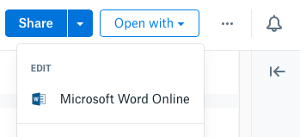
Open your school’s folder on dropbox.com
Open the “Ci3T Blueprint Materials” folder
Make a copy of Ci3T Blueprint A Primary (Tier 1) Plan and rename to add the date to the end of the file name
Click the new file to start a preview
Click “Open with” in the top right, then Microsoft Word Online, which allows multiple people to edit together
Also, please review feedback from your students (Ci3T Student Session 3 Responses.pptx)
Notes:
Use the “Hide Slide” feature to hide the file sharing system not being used. Do not delete the slide. Hiding the slide will preserve correspondence to the pacing guide slide numbers.

Slide 7

Open your school’s Google Drive folder online
Open the “Ci3T Blueprint Materials” folder
Find Ci3T Blueprint A Primary (Tier 1) Plan
Right-click and select “Rename”
  Update the end of the file name to today’s date
  Add your school initials in the front
and/or open the doc and click File > Version history > Name current version and type today’s date
Ex: P_LES Ci3T-Blueprint-A-Primary-Tier-1-Plan 2027 02 24
Also, please review feedback from your students (Ci3T Student Session 3 Responses.pptx)
Notes:
Use the “Hide Slide” feature to hide the file sharing system not being used. Do not delete the slide. Hiding the slide will preserve correspondence to the pacing guide slide numbers.

Slide 8
How do we refine our assessment schedule and procedures for monitoring?
Revising Ci3T Blueprint D Assessment Schedule
Revising procedures for monitoring your plan
(Ci3T Blueprint A Primary [Tier 1] Plan)

Slide 9

Which data should be collected?
Data to answer your questions
  What do you want to know about your students?
  What will you do with this information?
Data you will use
  What is readily accessible?
  What requires extra resources?
  Who, When, Where, How?
Balance between reliability
and accessibility
  Systems approach
Data Teams
What are the capabilities of your management systems?

Slide 10

When should data be collected?
Natural cycles, meeting times
  Weekly, monthly, quarterly
Level of system addressed
  School-wide: monthly, quarterly
  Small group: daily, weekly
  Individual: daily, weekly

Slide 11
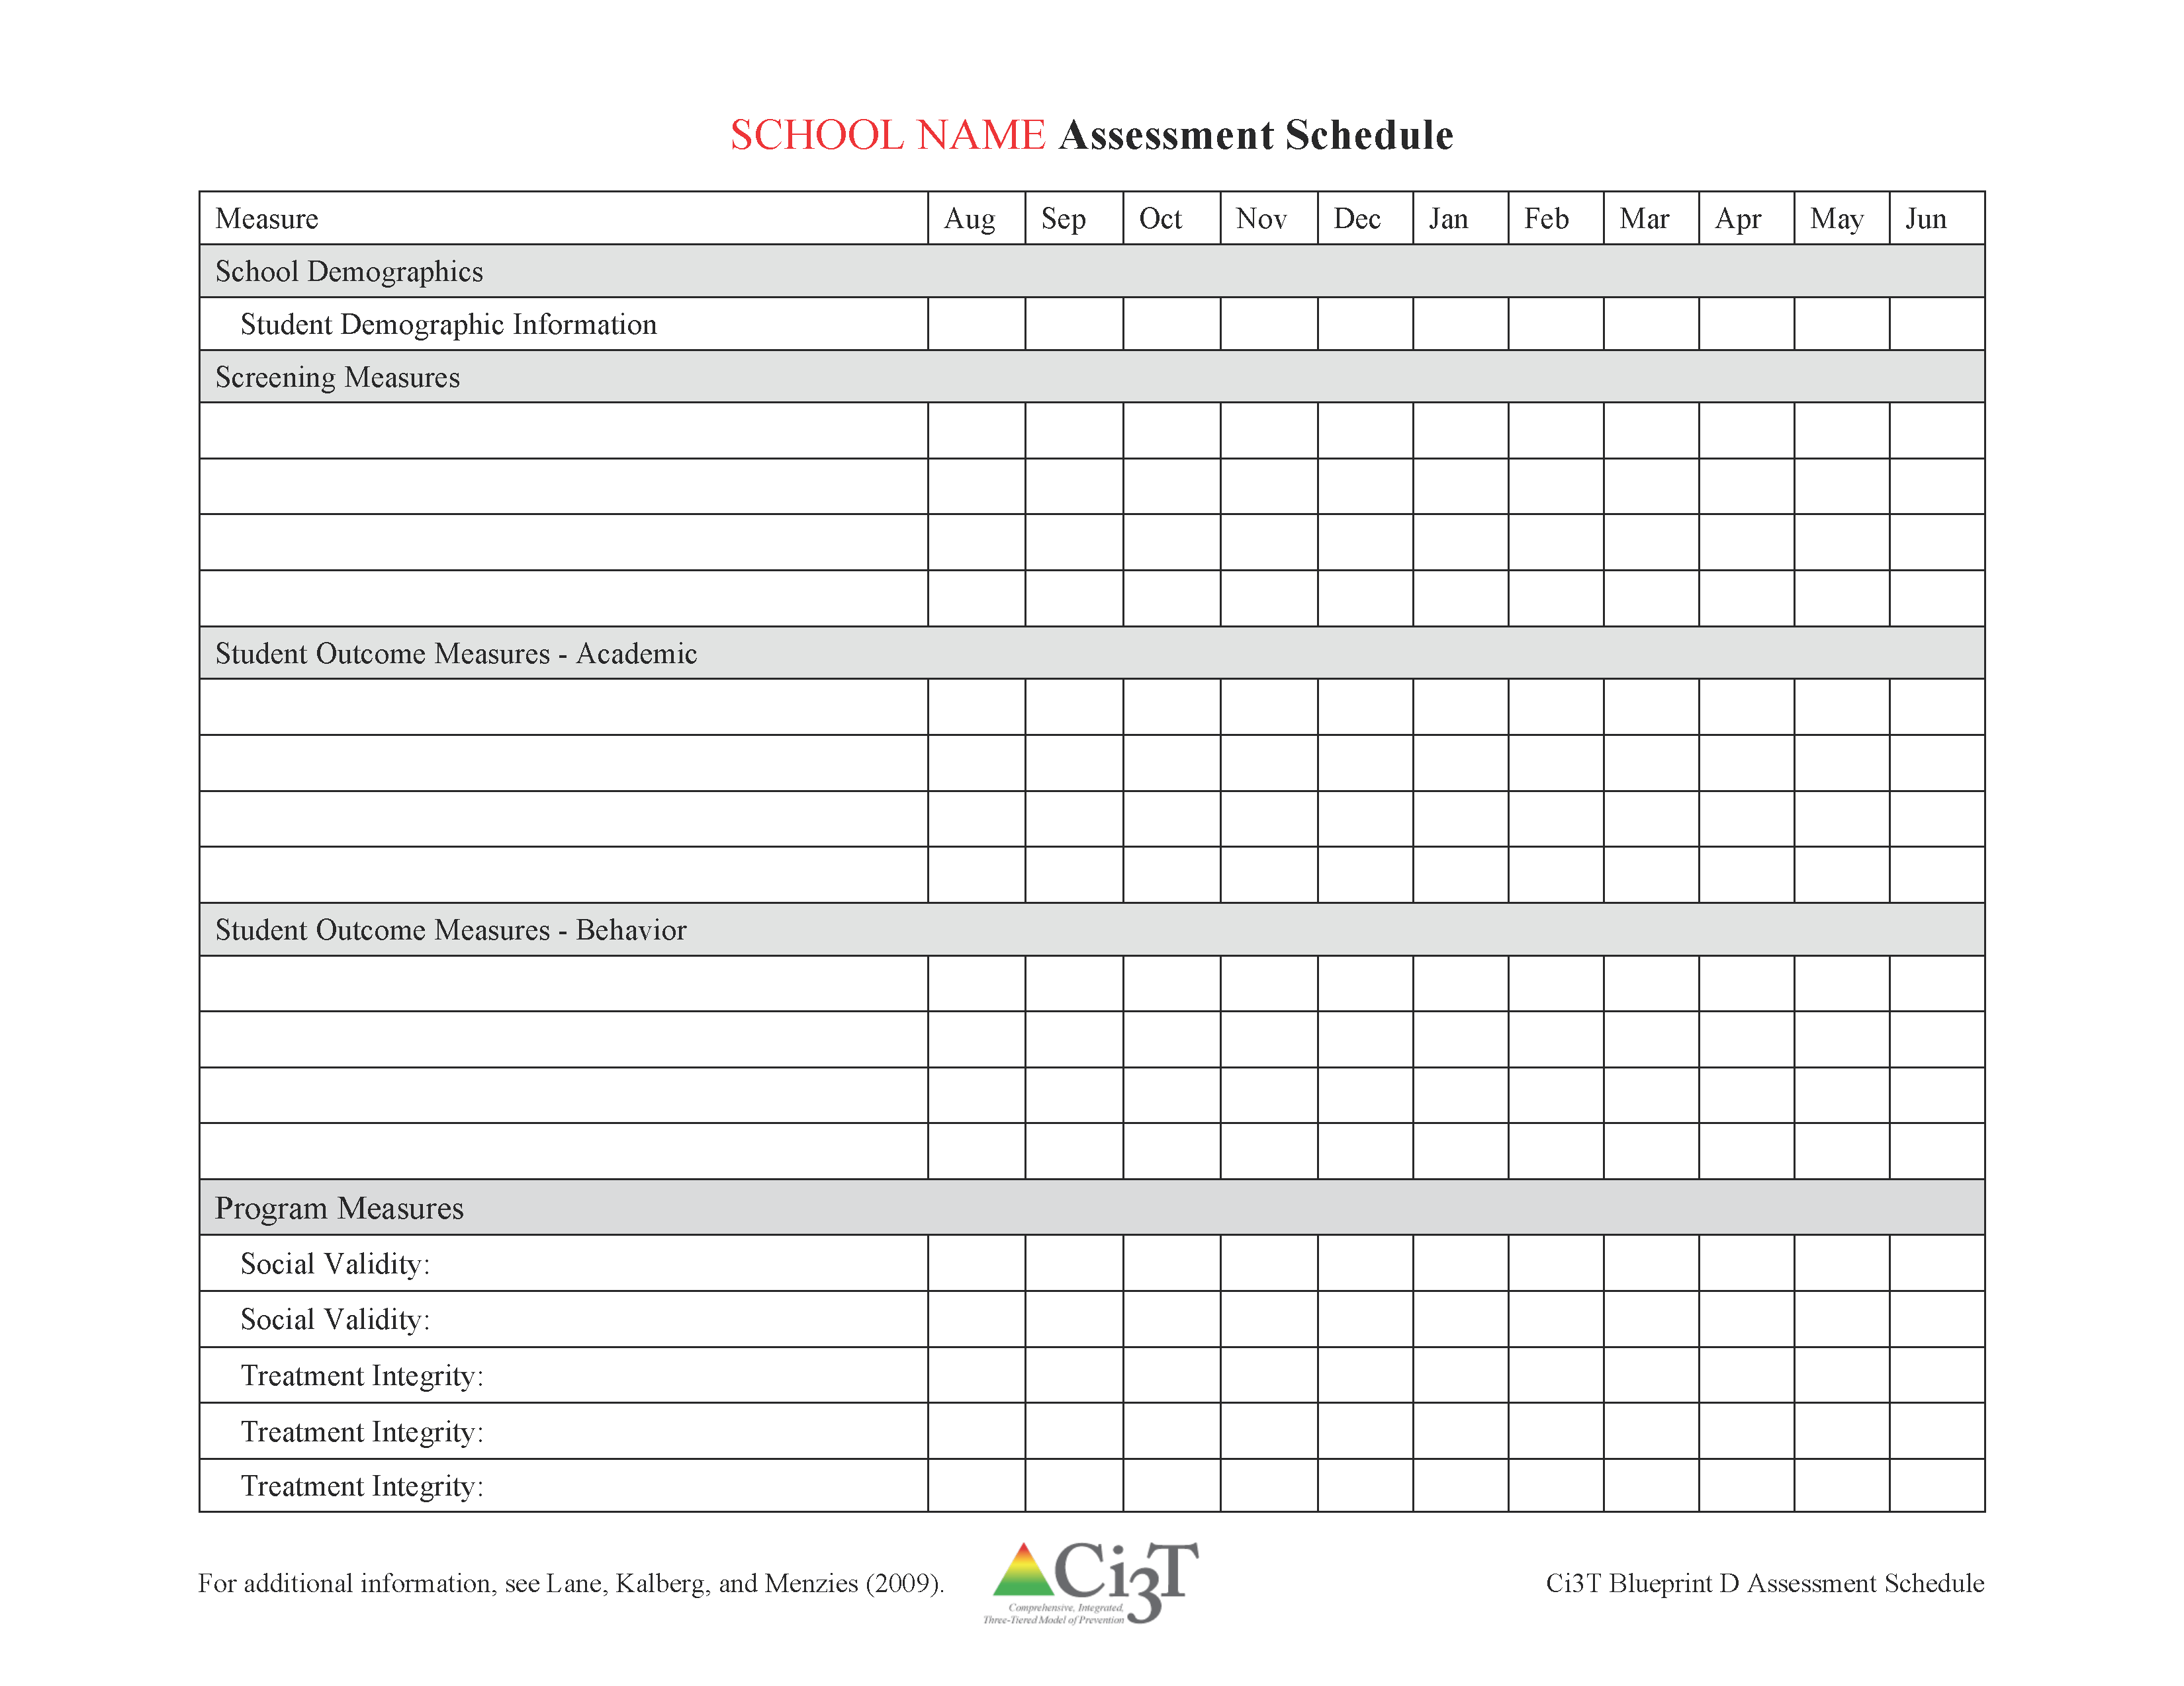


Ci3T Blueprint D Assessment Schedule

Slide 12
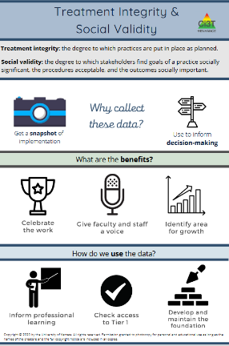
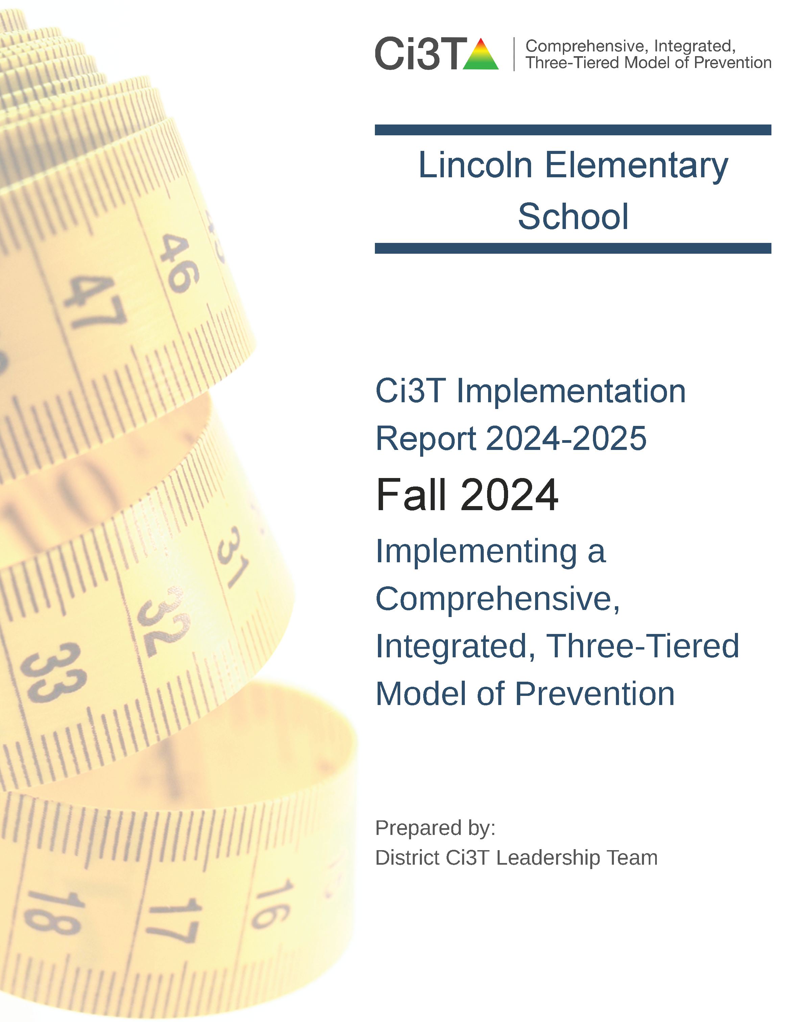
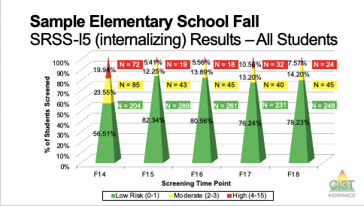
Essential Components of Primary (Tier 1) Prevention Efforts
Social Validity
Systematic Universal Screening
Academic
Behavior
Treatment Integrity
ci3t.org/measures
ci3t.org/screening
for behavior

Slide 13

Procedures for Monitoring
You have sample measures at your table (ci3t.org/measures)
Program measures
TI | SV
Treatment Integrity How is the plan being implemented? | Social Validity What do people think about the goals, procedures, and outcomes?
For more information: Lane, K. L., & Beebe-Frankenberger, M. E. (2004). School-based interventions: The tools you need to succeed. Allyn & Bacon.

Slide 14
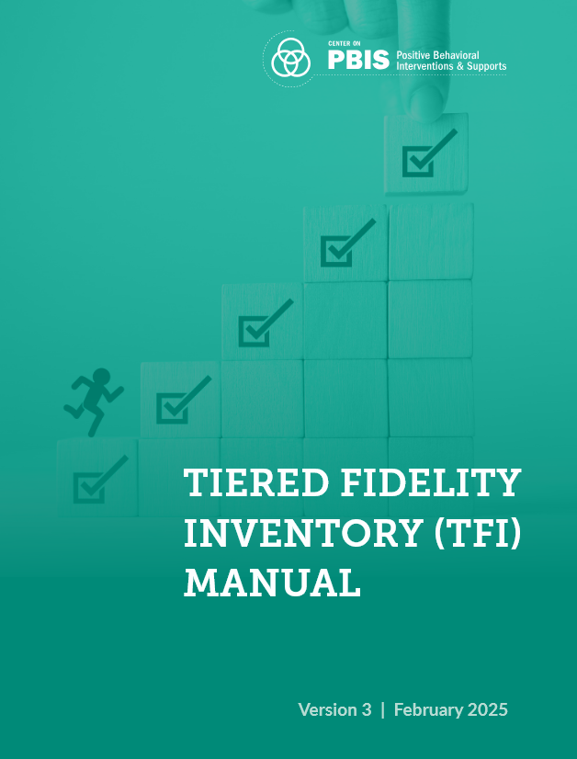
Treatment Integrity
Tiered Fidelity Inventory (TFI)
  Version 3.0 addresses multiple learning domains
    academic
    behavioral
    social and emotional well-being
Tiered Fidelity Inventory was developed as part of the U.S. Department of Education’s Office of Special Education Programs National Technical Assistance Center on Positive Behavioral Interventions and Supports.

Slide 15
Ci3T Treatment Integrity
Teacher Self-Report
(Ci3T TI: TSR)
Direct Observation
(Ci3T TI: DO)
Checklist of items on procedures for
  Teaching
  Reinforcing
  Monitoring
Beginning of year to current date
Rated
  0 = no, not at all
  1 = yes, some of the time
  2 = yes, most of the time
  3 = yes, all of the time
Comments
Subset of Ci3T TI: TSR
  Procedures for teaching
  Procedures for reinforcing
Stratified, random selection of classroom teachers
Observers trained to criterion
30-min observations
  Teacher perspective
  Observer perspective
Notes:
Staff goes through TSR items and rate selves for how they have implemented plan. Done in fall/spring.

Slide 16
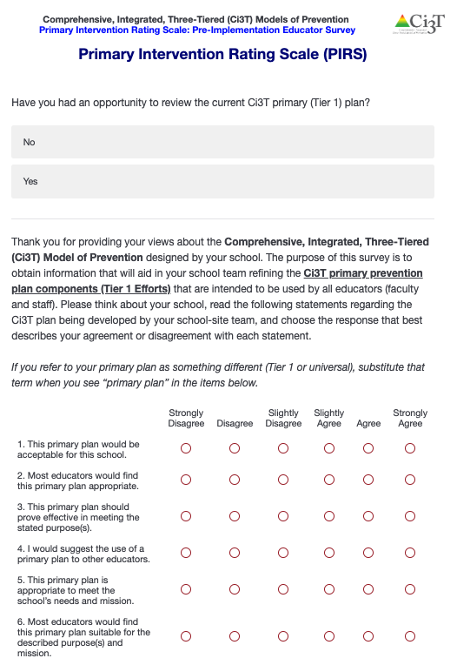
Social Validity:
Primary Intervention Rating Scale (PIRS)
(Lane, Robertson, & Wehby 2002)
Used during training and implementation
AFTER the person has had an opportunity to learn about the Ci3T plan
Adapted from Intervention Rating Profile-15 (Witt & Elliott, 1985)
17 items for Ci3T primary (Tier 1) plan
  Rated from 1 = strongly disagree to
  6 = strongly agree
4 open-ended questions
Fall and spring
PIRS scores have predicted implementation in previous studies!
Notes:
If you are an adult in the school, and paid to be there, you should fill out the PIRS. Opportunity to give feedback about the plan, to determine perceived usefulness and effectiveness of Ci3T Tier 1 plan.
The school mean percentage predicts implementation fidelity.
80% and above indicates positive perceptions.

Slide 17
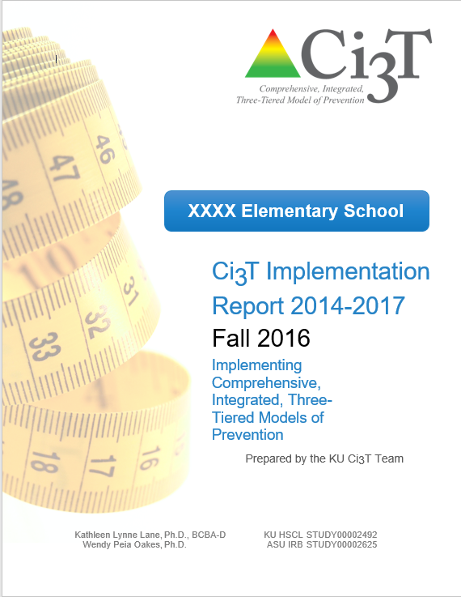
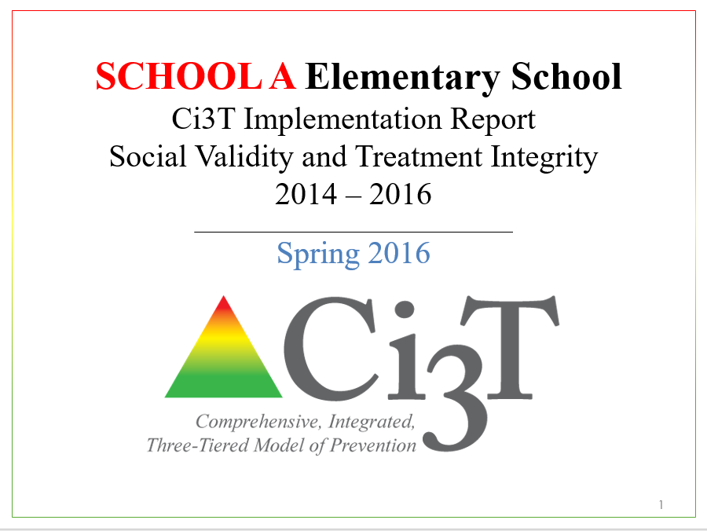
Using Data to Monitor Our Plan: Sharing Schoolwide Data with Faculty and Staff

Slide 18
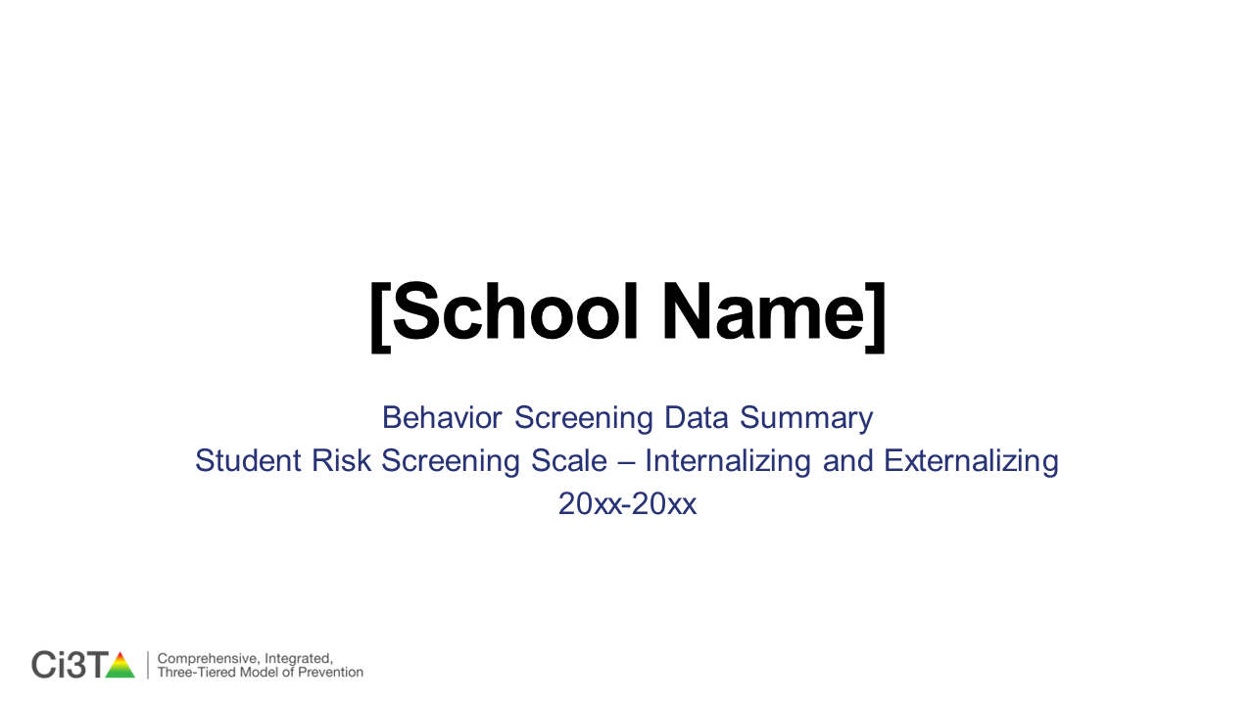
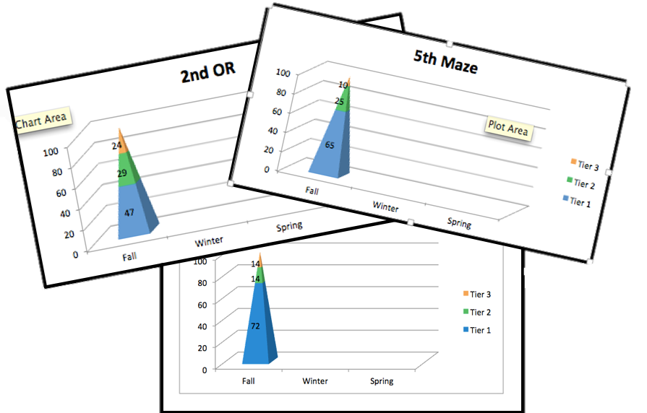
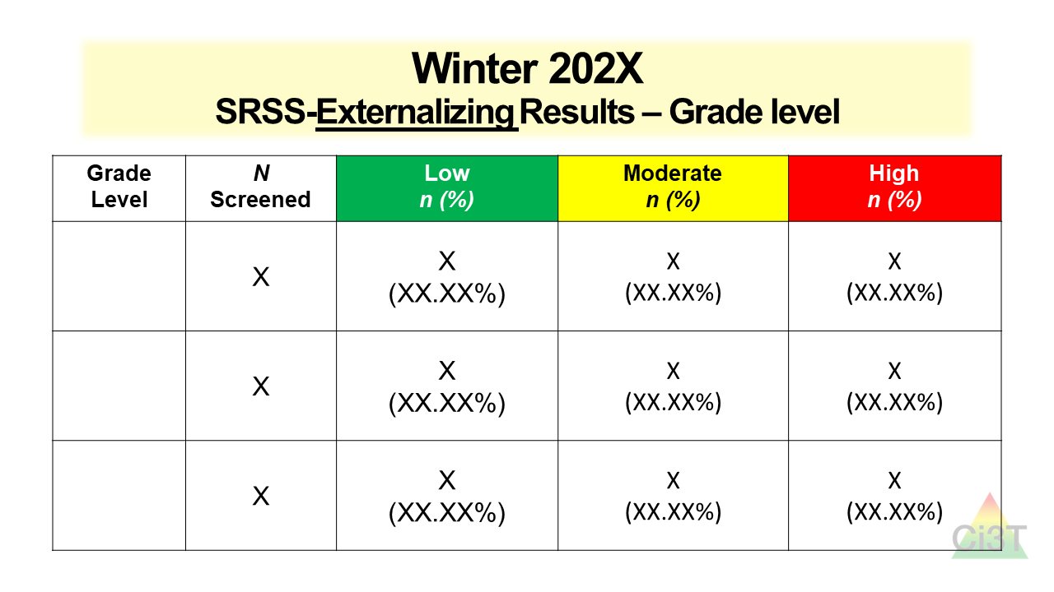
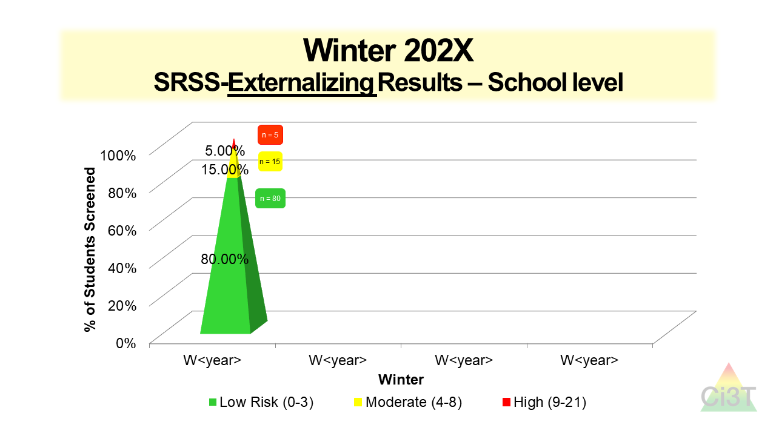

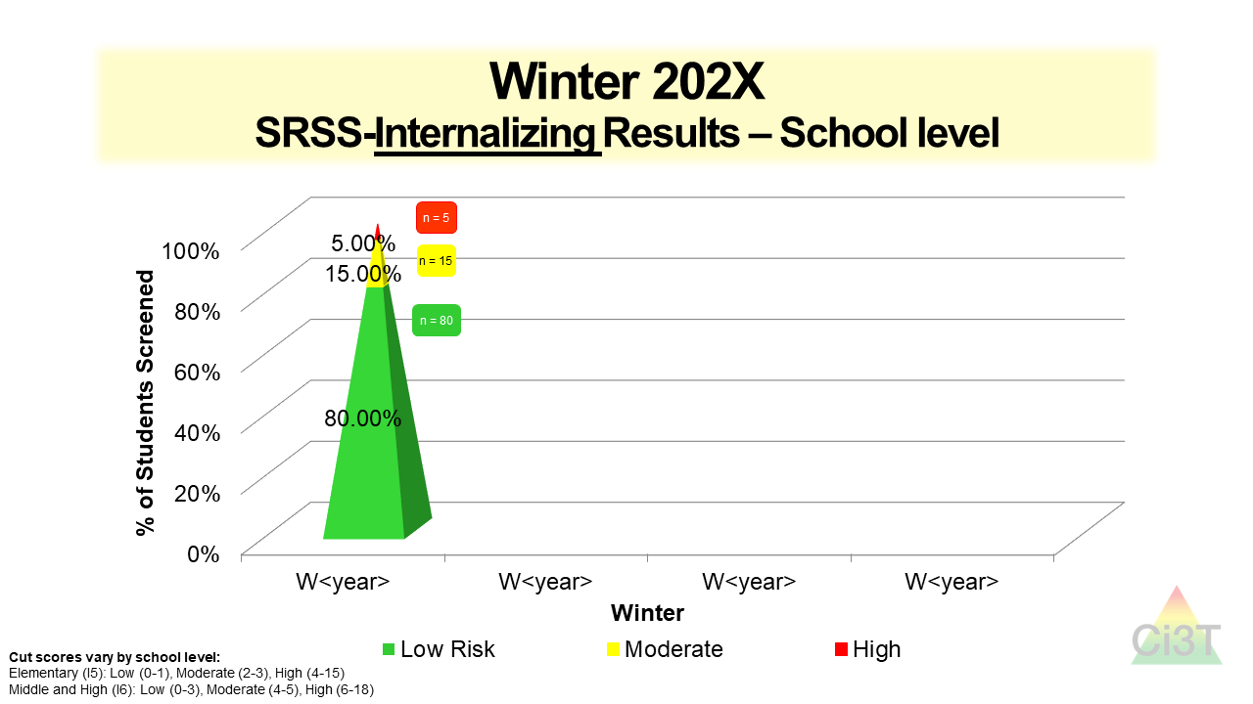
Using Data to Monitor Our Plan:
Sharing Student Performance Data with Faculty and Staff

Slide 19
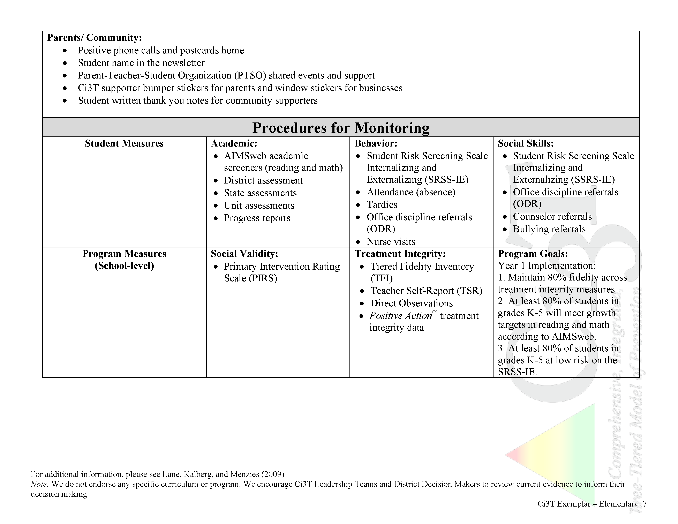
In future years, consider alternative program goals
80% of students meeting reading and math targets on assessments
Ci3T Blueprint A Primary
(Tier 1) Plan: ELEMENTARY

Slide 20
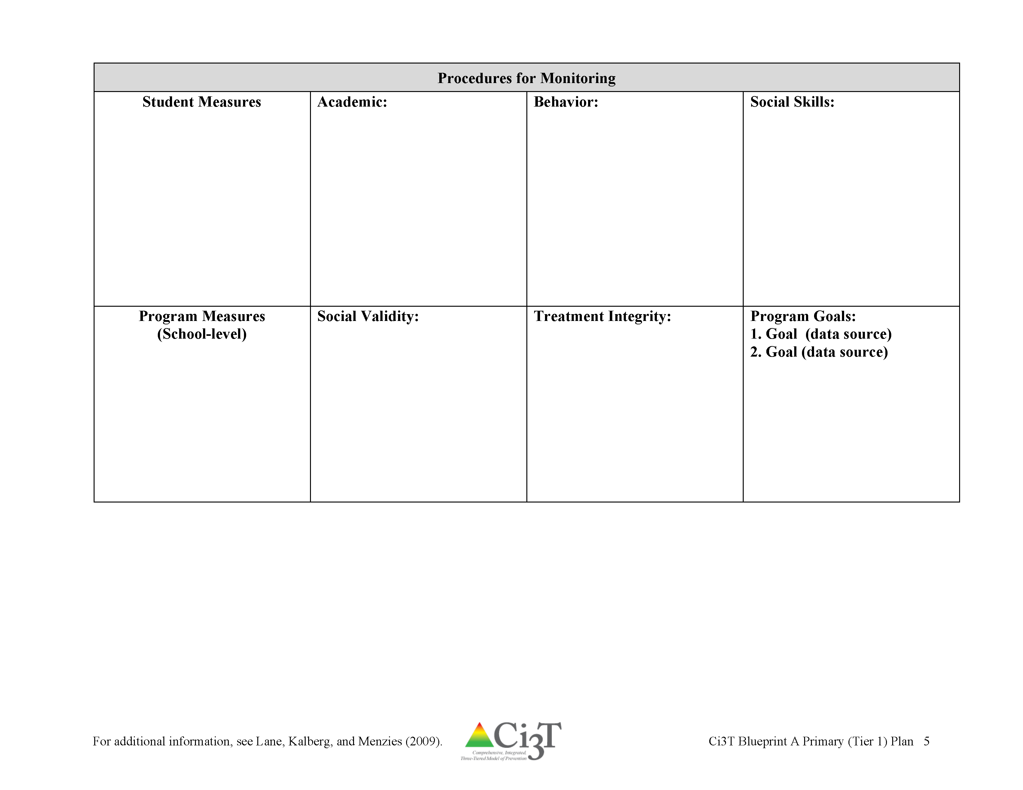
Ci3T Blueprint A Primary
(Tier 1) Plan

Slide 21
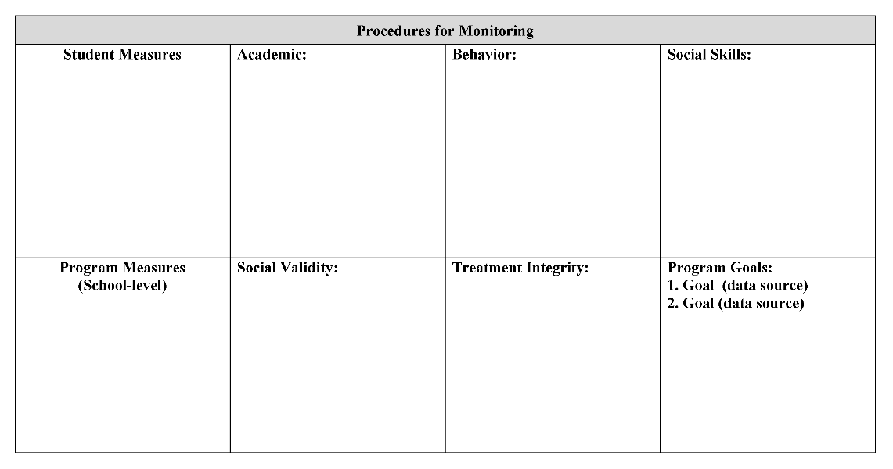



















Next draft of:
Ci3T Blueprint A Primary (Tier 1) Plan and
Ci3T Blueprint D
Assessment Schedule
15 minutes
Notes:
15 min

Slide 22

How do we polish our Ci3T Blueprint?
It is time to polish your Ci3T plan draft and prepare to present it to your faculty and staff for feedback!

Slide 23



2 members of your team will later draft a presentation to share with your faculty and staff at your next meeting
(IM02 Faculty and Staff Presentation)
IM02
Add each section of your plan to the PPT as you polish the draft

Slide 24

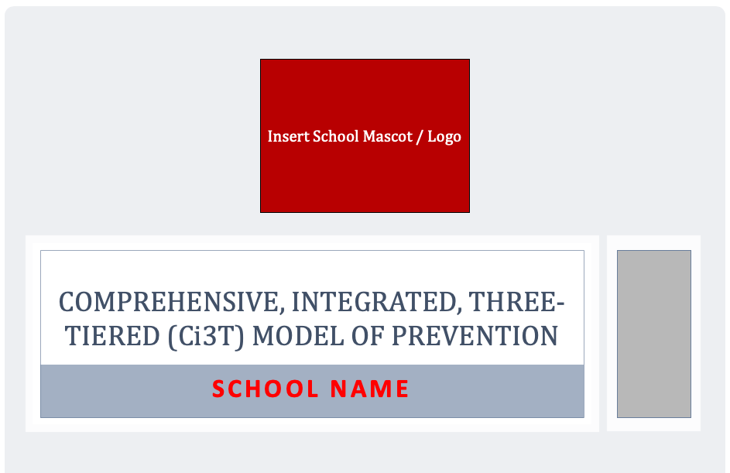

Task Divider
Select 2 team members to work on IM02 during the work session later today.

Slide 25

Polish
Ci3T Blueprint A
Primary (Tier 1) Plan
15 minutes
Notes:
15 min

Slide 26
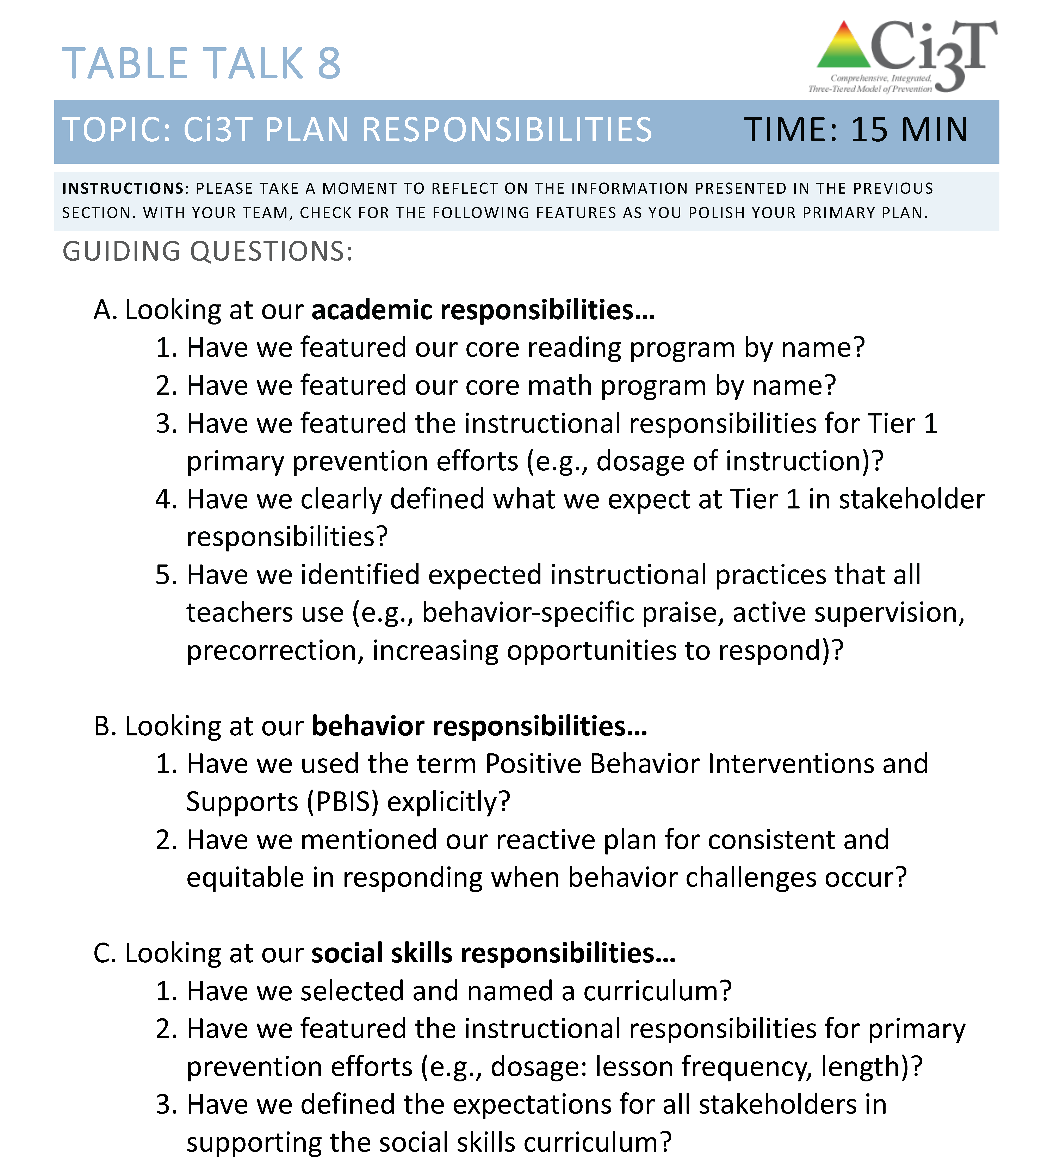
Polish
Ci3T Blueprint A
Primary (Tier 1) Plan
15 minutes
Notes:
15 min

Slide 27

Polish
Ci3T Blueprint A
Primary (Tier 1) Plan
15 minutes
Use
R5 Reinforcement Logistics
Please review Ci3T Student Session 3 Responses.pptx
Notes:
15 min

Slide 28
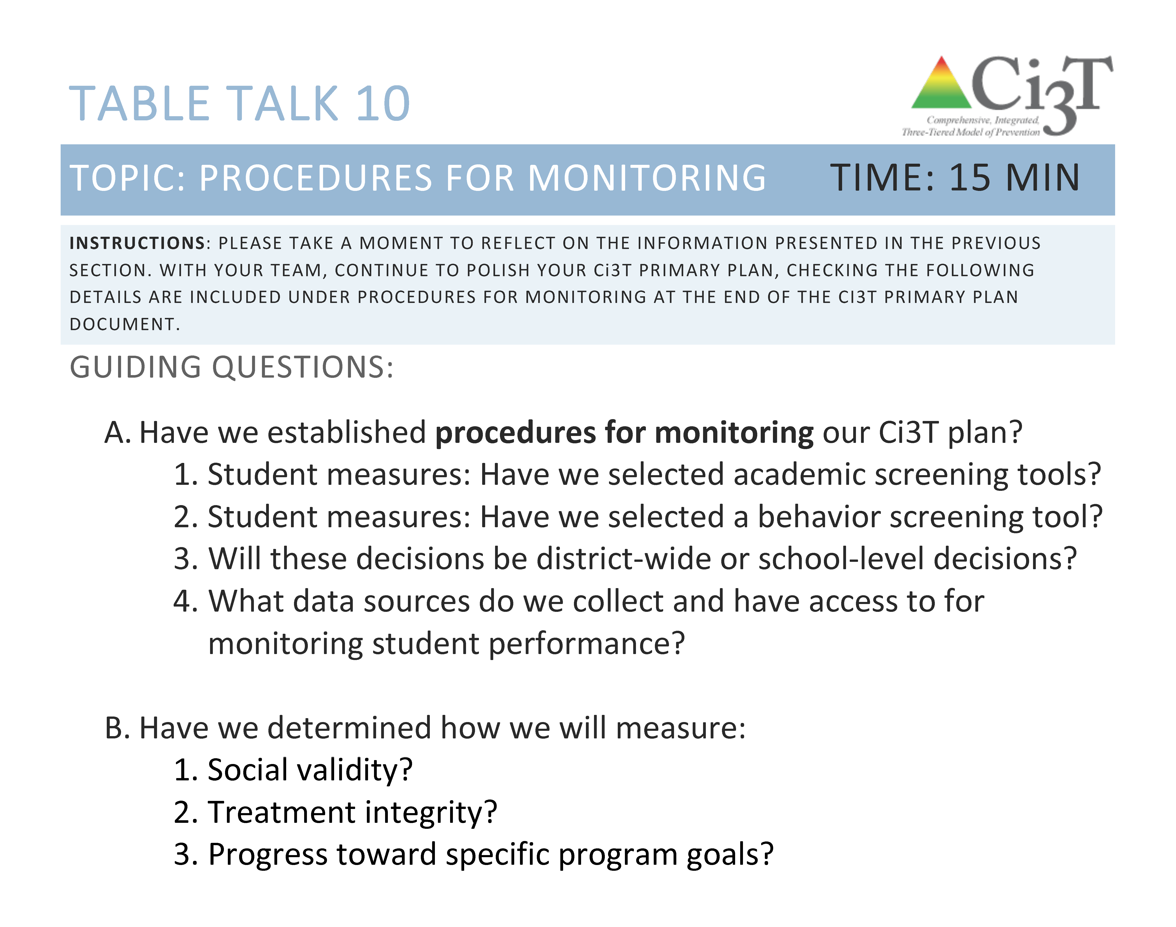
Polish
Ci3T Blueprint A
Primary (Tier 1) Plan
15 minutes
Notes:
15 min

Slide 29
How do we present our Ci3T Blueprint A Primary (Tier 1) Plan to our faculty and staff?
Drafting a plan to present to faculty and staff

Slide 30
Using the blank presentation
(IM02), 2 members of your team will later draft a presentation to share with your faculty and staff at your next meeting
IM02
Discuss logistics of sharing your first draft with your faculty and staff

Slide 31
Task Divider
The two team members taking the lead on drafting the PPT should add each section as polished

Slide 32
Discuss logistics of sharing your first draft with your faculty and staff
10 minutes
Notes:
10 min

Slide 33
How do we coordinate supports at the secondary (Tier 2) level?
Tier 1 efforts: How is Tier 1 going?
Teacher-delivered strategies: How can we empower teachers with low-intensity supports?
Organizing secondary (Tier 2) supports

Slide 35
Secondary (Tier 2) Prevention: Reverse Harm
Students who need more than the primary prevention plan, 10-15% of students
Focused intervention to address academic, behavior, and/or social concerns
  Acquisition (can’t do)
  Fluency (trouble doing)
  Performance (won’t do)
Examples
  Small group instruction in anger management
  Reading comprehension strategies
  Comprehensive math intervention
Dwyer, Osher, & Warger, 1998; Kern & Manz, 2004; MacMillan, Gresham, & Forness, 1996; Satcher, 2001

Slide 36

Before Thinking About
Tier 2 for Students,
Consider…
Tier 1 efforts: How is Tier 1 going?
See Lane, K. L., Menzies, H. M., Bruhn, A. L., & Crnobori, M. (2011). Managing challenging behaviors in schools: Research-based strategies that work. Guilford Press.

Slide 37
Social Skills Improvement System – Performance Screening Guide
Spring 2012 – Total School
N = 54
N = 22
N = 35
N = 31
N = 223
N = 233
N = 180
N = 187
N = 212
N = 235
N = 275
N = 271
n = 489 n = 490 n = 490 n = 489
Lane, K. L., Oakes, W. P., & Magill, L. (2014). Primary prevention efforts: How do we implement and monitor the tier 1 component of our comprehensive, integrated, three-tiered (CI3T) model? Preventing School Failure: Alternative Education for Children and Youth, 58(3), 143-158.

Slide 38
Elementary AIMSweb Reading Grade 5
Fall, Winter, Spring Benchmarks
Screening Measure and Time Point

Slide 39
Student Risk Screening Scale
Fall 2004-2012 • Middle School
N=534
N=502
N=454
N=490
N=477
N=476
N=524
N=539
Lane, K. L., Oakes, W. P., & Magill, L. (2013). Primary prevention efforts: How do we implemented and monitor the Tier 1 component of our comprehensive, integrated, three-tiered (Ci3T) model? Preventing School Failure, 58(3), 143-158. https://doi.org/10.1080/1045988X.2014.893978

Slide 40


Teacher-delivered strategies: How can we empower teachers with low-intensity supports?
Instructional and General Classroom Management Considerations and Low-intensity Strategies

Slide 41
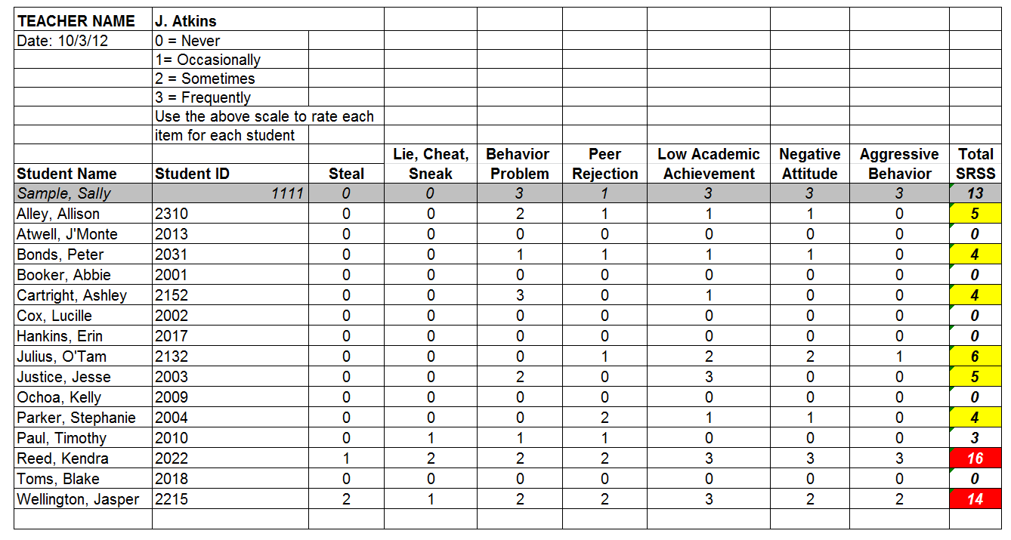
Student Risk Screening Scale (SRSS)

Slide 42


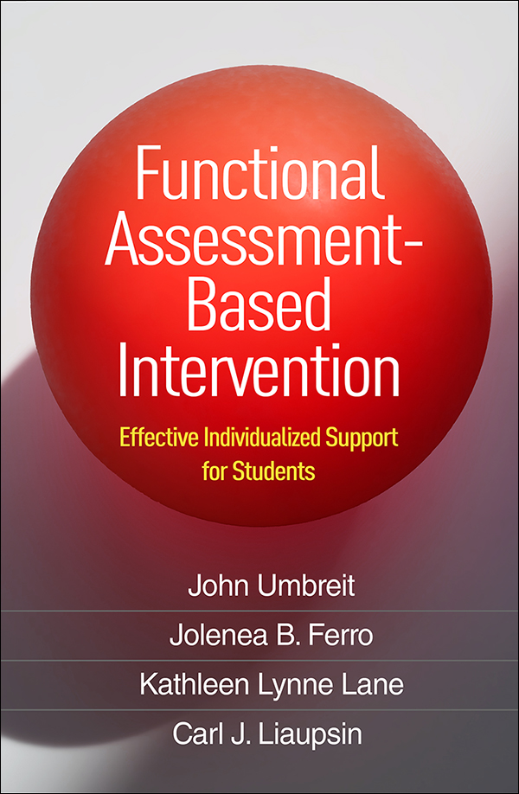
Schoolwide Positive
Behavior Support
Comprehensive, Integrated,
Three-Tiered (Ci3T)
Models of Support
Low-Intensity Strategies
Basic Classroom Management
Effective Instruction
Low-Intensity Strategies
Behavior Contracts
Self-Monitoring
- -
Functional Assessment-Based
Interventions
Higher-Intensity Strategies
Assess, Design, Implement, and
Evaluate
Assessment
Adapted from Lane, K. L., Menzies, H. M., Bruhn, A. L., & Crnobori, M. (2011). Managing challenging behaviors in schools: Research-based strategies that work. Guilford.

Slide 43


Essential Components of
Classroom Management
Classroom climate
Physical room arrangement
Routines and procedures
Managing paperwork
See Lane, K. L., Menzies, H. M., Bruhn, A. L., & Crnobori, M. (2011). Managing challenging behaviors in schools: Research-based strategies that work. Guilford.

Slide 44

Instructional Considerations
How motivating is my classroom?
  Am I using a variety of instructional strategies?
  How am I differentiating instruction?
    Content – Process – Product
Control
Challenge
Curiosity
Context
Curiosity
Context
See Lane, K. L., Menzies, H. M., Bruhn, A. L., & Crnobori, M. (2011). Managing challenging behaviors in schools: Research-based strategies that work. Guilford.

Slide 45
Schoolwide Positive
Behavior Support
Comprehensive, Integrated,
Three-Tiered (Ci3T)
Models of Support
Low-Intensity Strategies
Basic Classroom Management
Effective Instruction
Low-Intensity Strategies
Behavior Contracts
Self-Monitoring
- -
Functional Assessment-Based
Interventions
Higher-Intensity Strategies
Assess, Design, Implement, and
Evaluate
Assessment
Adapted from Lane, K. L., Menzies, H. M., Bruhn, A. L., & Crnobori, M. (2011). Managing challenging behaviors in schools: Research-based strategies that work. Guilford.

Slide 46

Low-Intensity Strategies for Academics and Behavior
Opportunities to Respond
Behavior-Specific Praise
Active Supervision
Instructional Feedback
High-p Requests
Precorrection
Incorporating Choice
Notes:
See Lane, K. L., Menzies, H. M., Ennis, R. P., & Oakes, W. P. (2015). Supporting behavior for school success: A step-by-step guide to key strategies. Guildford.

Slide 47

Consider a book study to build school site capacity
Classroom management
Instructional delivery
Proximity
Low-intensity strategies
Overlappingness
With-it-ness
Pacing
Self-Monitoring
Behavior Contracts
Notes:
See Lane, K. L., Menzies, H. M., Bruhn, A. L., & Crnobori, M. (2011). Managing challenging behaviors in schools: Research-based strategies that work. Guilford.

Slide 48
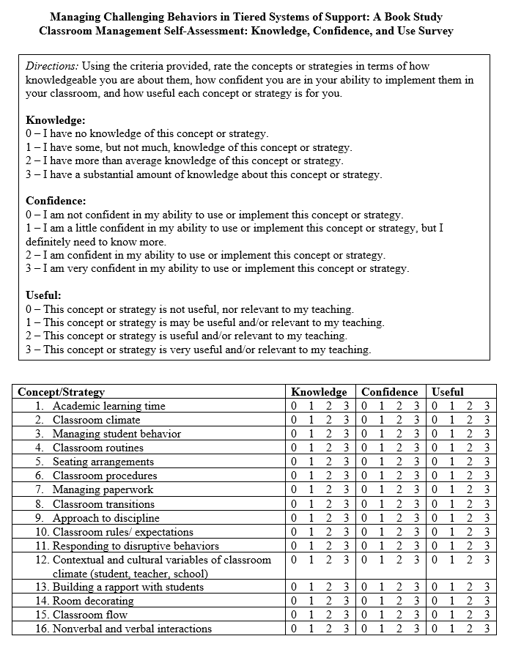
Identify site-level experts using self-assessment tools
Instructional choice
Behavior-specific praise
Increased opportunities to respond
Active supervision
Lane, K. L., Menzies, H. M., Bruhn, A. L., & Crnobori, M. (2011). Managing challenging behaviors in schools: Research-based strategies that work. Guilford.
Oakes, W. P., Cantwell, E. D., Lane, K. L., Royer, D. J., & Common, E. A. (2019). Examining educator’s views of classroom management and instructional strategies: School-site capacity for supporting students’ behavioral needs. Preventing School Failure:Alternative Education for Children and Youth, 64(1), 1-11.

Slide 49
Using Screening Data to Support Teachers
Data Used for Instructional Decision Making | If Yes | Data to Monitor Progress
SRSS: 20% of students are at moderate or high risk Class Grades: 20% or more of students are receiving lower than a C on progress report or report card | Pacing: Moving through a lesson with appropriate momentum facilitates student involvement Opportunities to Respond: Providing students with a high number of opportunities to answer or actively respond to academic requests | SRSS: Less than 10% of students at moderate/high risk Class Grades: 5% or fewer students receive lower than a C on progress report or report card
SDQ: 20% of students or more have a high total score Work Completion: 10% or more of students have at least one missing or late assignment per week | Routines and Procedures: Establish a procedure for communicating missed work (file folders, online assignment list, parental access to grades); pair visual directions with verbal directions Instructional Feedback: Acknowledge contributions and extend learning (if a student asks, “Does heavy mean weighs a lot?” The teacher could say, “In this case, yes. It could also mean very important.” | SDQ: 10% or less students or more have a high total score Work Completion: 5% or fewer students have one or more missing or late assignments per week

Slide 50

Using an Implementation Calendar:
Team Meeting Time
Ci3T Leadership Teams meet at least monthly
  Agenda sent out prior to meeting
  Adhere to time
  Address systems level implementation
Ci3T Leadership Team members serve on committees with other faculty and staff for specific issues
  Tier 2 and Tier 3 intervention team
  Data team
  Schoolwide reinforcement team
  Parent team

Slide 51
School Implementation Calendar
Sun. | Mon. | Tues. | Wed. | Thurs. | Fri. | Sat.
1 | 2 | 3 School-wide Reinforcement Team Meeting | 4 | 5 | 6 Assembly @ 2:50 | 7
8 | 9 | 10 Monthly Meeting | 11 | 12 Teach Social Skills Lesson | 13 | 14
15 | 16 6th Grade Prize Drawing | 17 Data Team Meeting | 18 | 19 Ci3T Leadership Team Meeting | 20 | 21
22 | 23 | 24 | 25 | 26 Teach Social Skills Lesson | 27 | 28 Fundraiser Lock-in
Calendar your Ci3T Leadership Team meetings

Slide 52
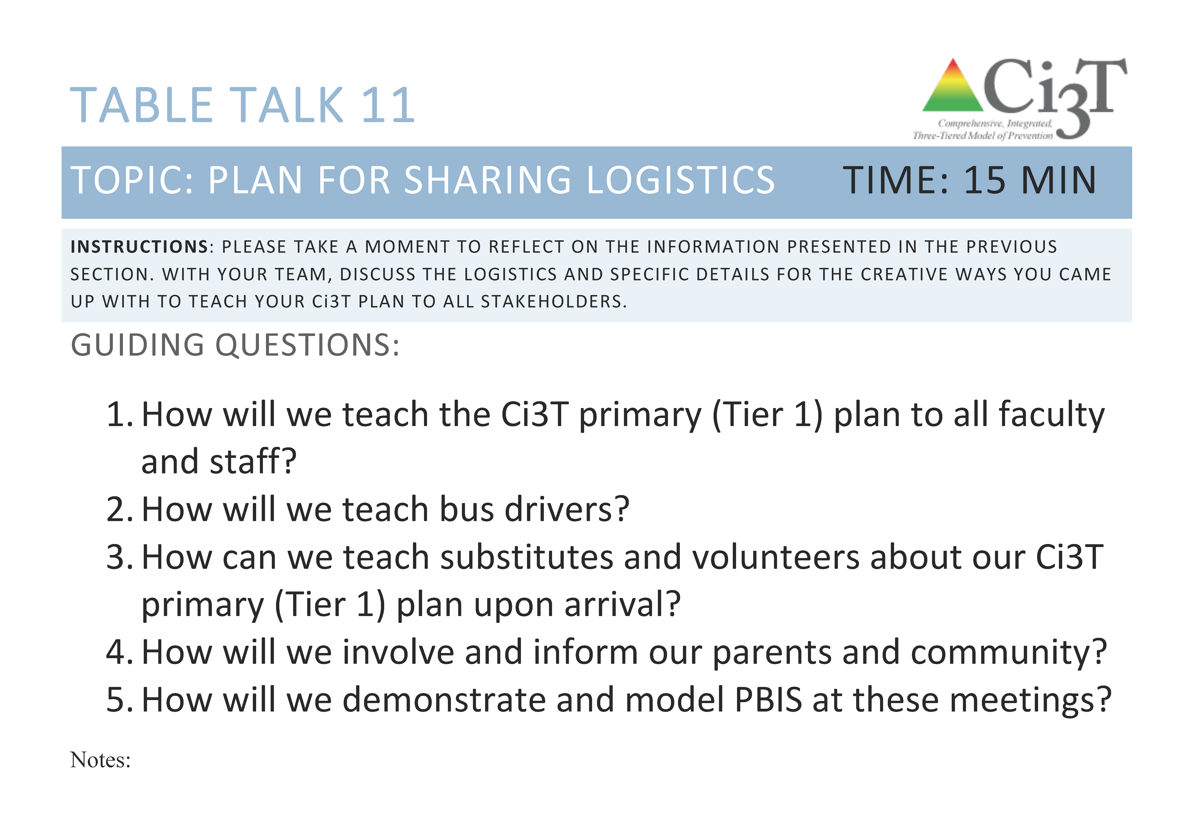
Discuss possibilities for supporting teachers in making these small shifts
Table Talk 11
15 minutes
Notes:
15 min

Slide 53

Organizing Secondary
(Tier 2) Supports
A Step-by-Step Process for Building Your Secondary (Tier 2) Intervention Grid

Slide 55
Schoolwide Positive
Behavior Support
Comprehensive, Integrated,
Three-Tiered (Ci3T)
Models of Support
Low-Intensity Strategies
Basic Classroom Management
Effective Instruction
Low-Intensity Strategies
Behavior Contracts
Self-Monitoring
- -
Functional Assessment-Based
Interventions
Higher-Intensity Strategies
Assess, Design, Implement, and
Evaluate
Assessment
Adapted from Lane, K. L., Menzies, H. M., Bruhn, A. L., & Crnobori, M. (2011). Managing challenging behaviors in schools: Research-based strategies that work. Guilford.

Slide 56
BASC² – Behavior and Emotional Screening Scale Spring 2012
N = 24
N = 67
N = 533
N = 624 n = 219 n = 202 n = 203
Lane, K. L., Oakes, W. P., Common, E. A., Brunsting, N., Zorigian, K., Hicks, T., & Lane, N. A. (2019). A comparison between SRSS-IE and BASC-2 BESS scores at the middle school level. Behavioral Disorders, 44(3), 162-174.

Slide 57
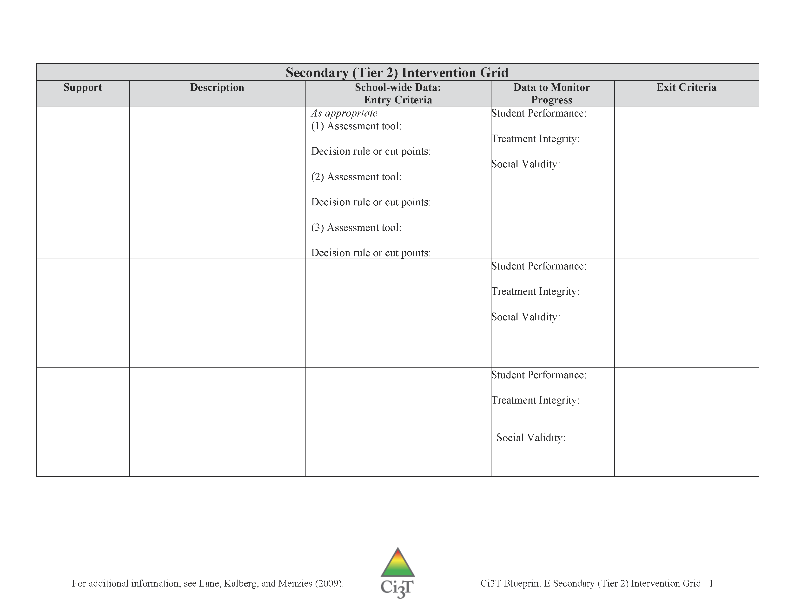
Secondary (Tier 2) Intervention Grid

Slide 58
A Systematic Approach to Designing Secondary (Tier 2) Interventions
Step 1: Construct your assessment schedule
Step 2: Identify your secondary (Tier 2) supports
  Existing and new interventions
Step 3: Determine entry criteria
  Academic failure, behavior and academic screening scores, attendance data, etc.
Step 4: Identify data to monitor progress
  Student performance: pre- and post-tests, curriculum-based measures, office discipline referral data, GPA, etc.
  Treatment integrity
  Social validity
Step 5: Identify exit criteria
  Reduction of discipline contacts, demonstration of grade level performance based on academic progress monitoring data, reduction of truancies and absences, etc.
Step 6: Consider additional needs
Notes:
58

Slide 59
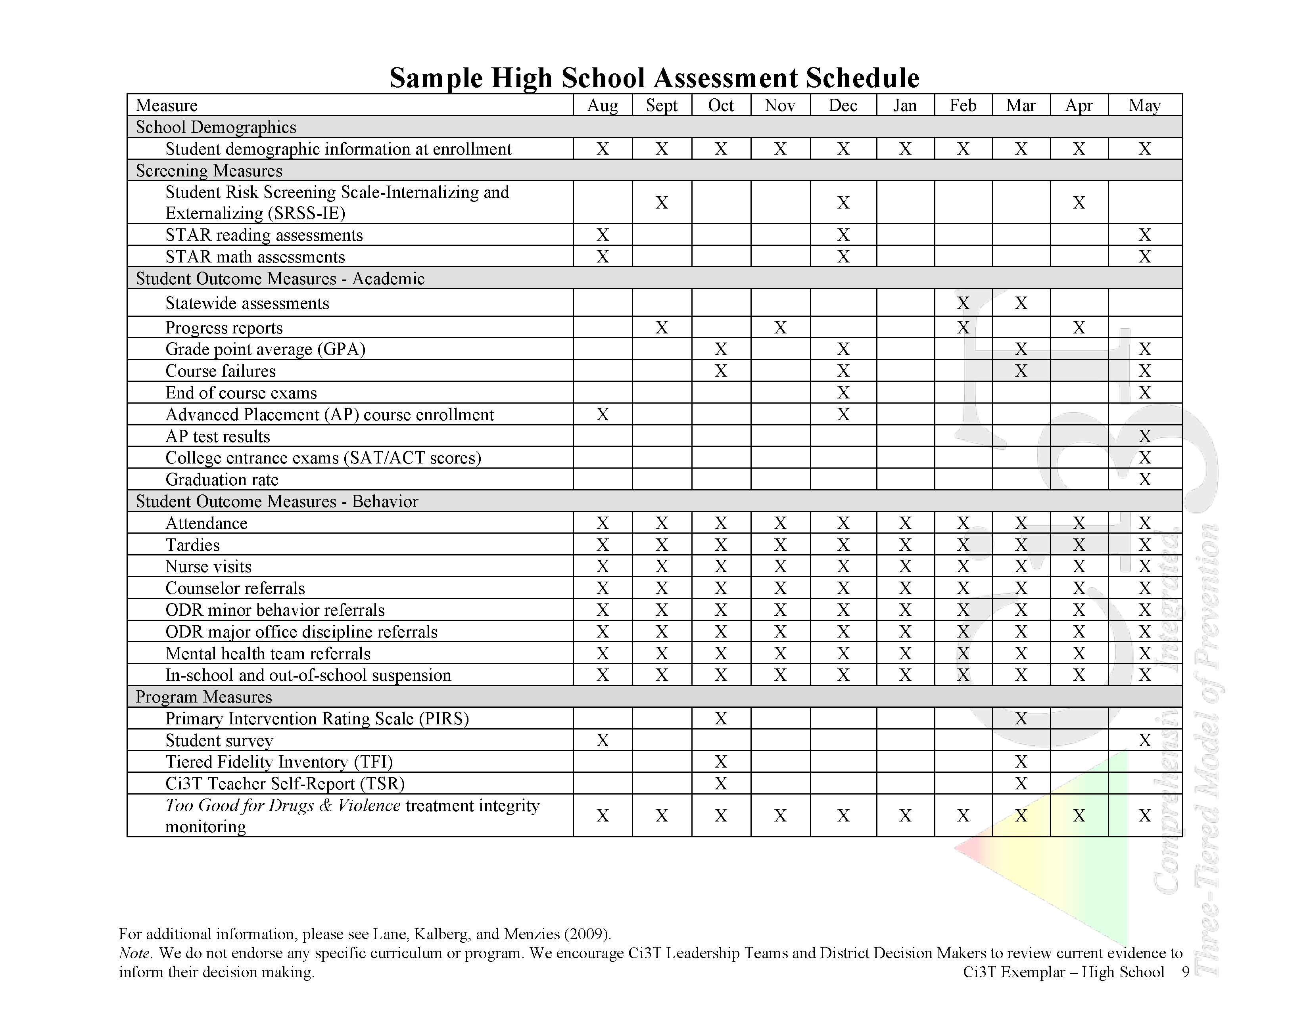

Slide 60
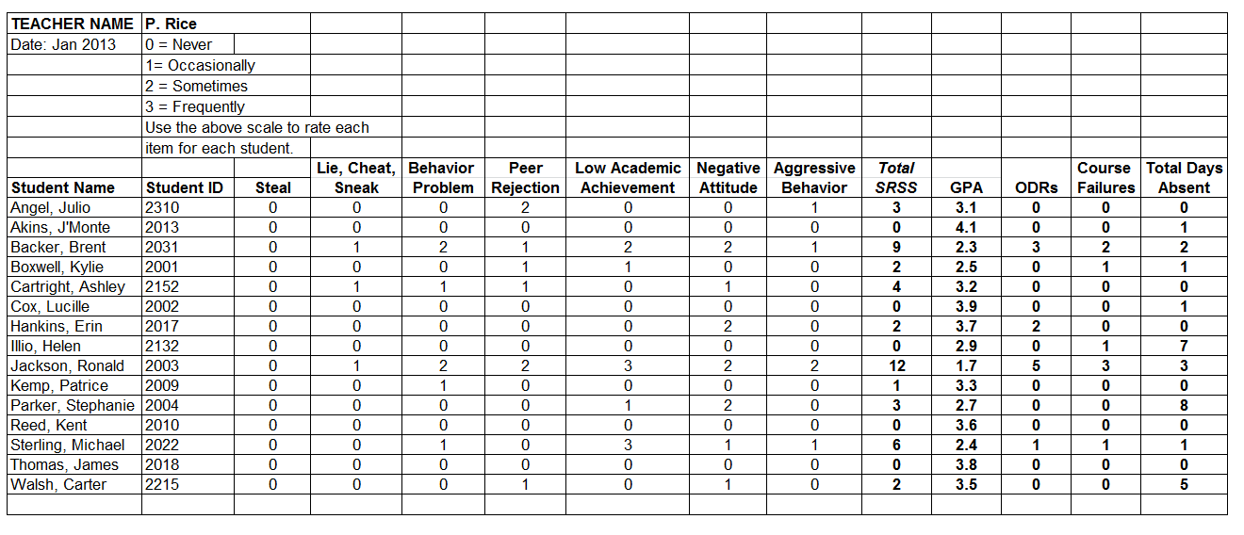
Examining Academic and Behavioral Data: Middle and High School Levels

Slide 61
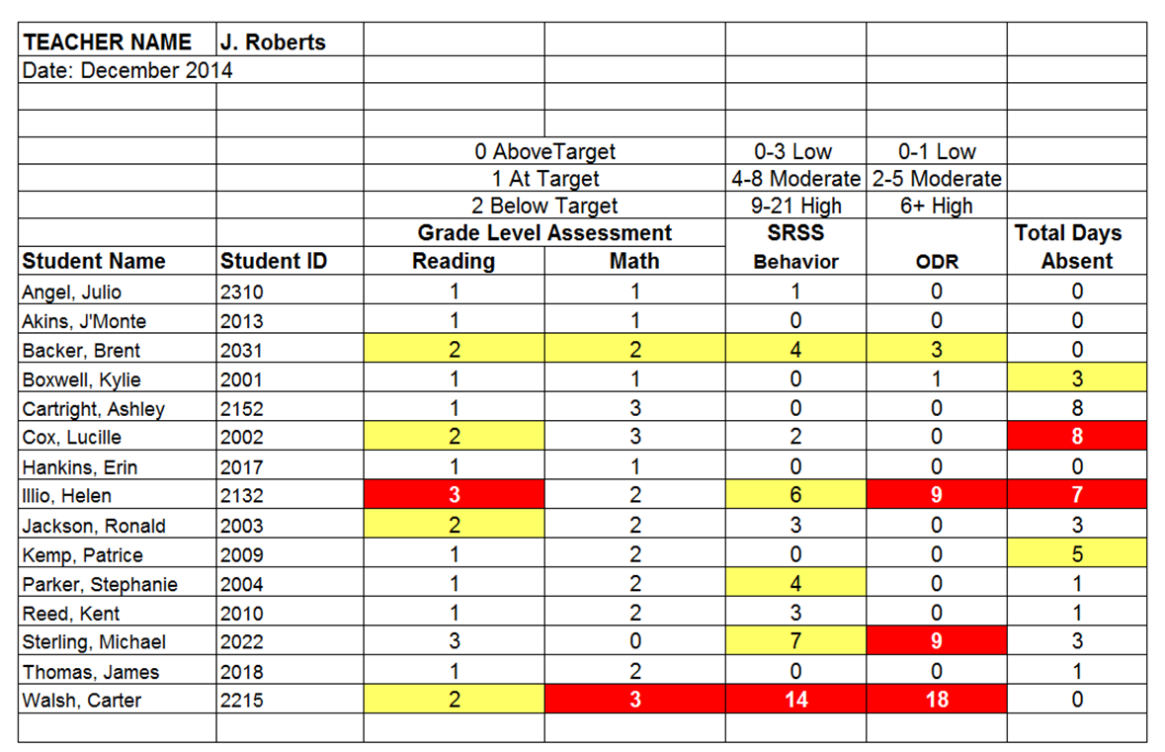
Examining Academic and Behavioral Data: Middle and High School Levels
Lane, K. L., Oakes, W. P., Ennis, R. P., & Hirsch, S. E. (2014). Identifying students for secondary and tertiary prevention efforts: How do we determine which students have Tier 2 and Tier 3 needs? Preventing School Failure, 58, 171-182, DOI: 10.1080/1045988X.2014.895573

Slide 62
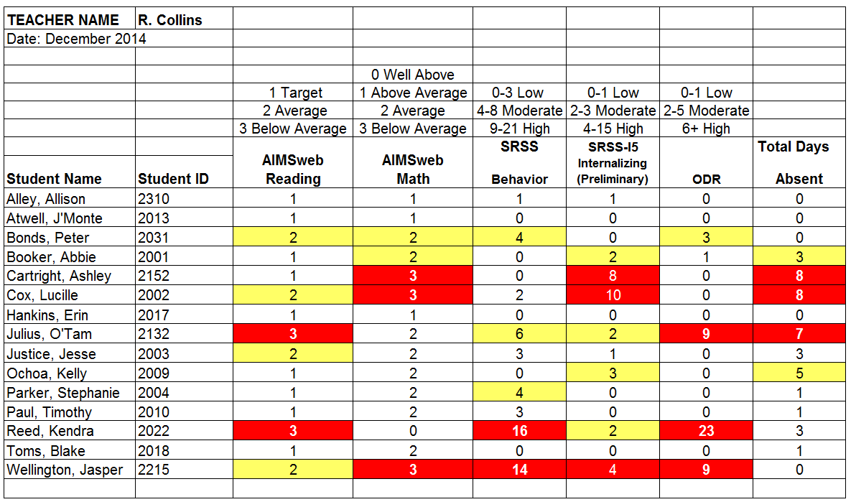
Examining Academic and Behavioral Data:
Elementary Level
Lane, K. L., Oakes, W. P., Ennis, R. P., & Hirsch, S. E. (2014). Identifying students for secondary and tertiary prevention efforts: How do we determine which students have Tier 2 and Tier 3 needs? Preventing School Failure, 58, 171-182, DOI: 10.1080/1045988X.2014.895573

Slide 63
Review Ci3T Blueprint D Assessment Schedule
Then
Make a master list of all “extra” supports
Create an intervention grid
Select additional supports with sufficient evidence to support their use
Enlist needed professional development to assist with implementation

Slide 64
A Systematic Approach to Designing Secondary (Tier 2) Interventions
Step 1: Construct your assessment schedule
Step 2: Identify your secondary (Tier 2) supports
  Existing and new interventions
Step 3: Determine entry criteria
  Academic failure, behavior and academic screening scores, attendance data, etc.
Step 4: Identify data to monitor progress
  Student performance: pre- and post-tests, curriculum-based measures, office discipline referral data, GPA, etc.
  Treatment integrity
  Social validity
Step 5: Identify exit criteria
  Reduction of discipline contacts, demonstration of grade level performance based on academic progress monitoring data, reduction of truancies and absences, etc.
Step 6: Consider additional needs
Notes:
64

Slide 65
Sample Secondary (Tier 2) Intervention Grid
Support | Description | Schoolwide Data: Entry Criteria | Data to Monitor Progress | Exit Criteria
Behavior Contract | A written agreement between two parties used to specify the contingent relationship between the completion of a behavior and access to or delivery of a specific reward. Contract may involve administrator, teacher, parent, and student.
Stepping Stones to Literacy (Nelson, Cooper, & Gonzalez, 2004) | Supplemental reading program to address rapid automatic naming, print awareness, alphabetic phonics, phonological awareness, listening comprehension. K-3 Students Small Group (<5) or one-on-one format. Five days/week for 15-20 minutes
For additional information, please see Lane, Kalberg, and Menzies (2009).
Notes:
*See Systematic Screenings of Behavior to Support Instruction page 54 for Stepping Stones to Literacy

Slide 66
A Systematic Approach to Designing Secondary (Tier 2) Interventions
Step 1: Construct your assessment schedule
Step 2: Identify your secondary (Tier 2) supports
  Existing and new interventions
Step 3: Determine entry criteria
  Academic failure, behavior and academic screening scores, attendance data, etc.
Step 4: Identify data to monitor progress
  Student performance: pre- and post-tests, curriculum-based measures, office discipline referral data, GPA, etc.
  Treatment integrity
  Social validity
Step 5: Identify exit criteria
  Reduction of discipline contacts, demonstration of grade level performance based on academic progress monitoring data, reduction of truancies and absences, etc.
Step 6: Consider additional needs
Notes:
66

Slide 67
Sample Secondary (Tier 2) Intervention Grid
Support | Description | Schoolwide Data: Entry Criteria | Data to Monitor Progress | Exit Criteria
Behavior Contract | A written agreement between two parties used to specify the contingent relationship between the completion of a behavior and access to or delivery of a specific reward. Contract may involve administrator, teacher, parent, and student. | Behavior: SRSS - mod to high risk Academic: 2 or more missing assignments within a grading period
Stepping Stones to Literacy (Nelson, Cooper, & Gonzalez, 2004) | Supplemental reading program to address rapid automatic naming, print awareness, alphabetic phonics, phonological awareness, listening comprehension. K-3 Students Small Group (<5) or one-on-one format. Five days/week for 15-20 minutes | Academic: K-3 Students AIMSweb reading—deficient or emerging in Fall and Winter And Behavior: SSBD exceeded normative criteria for internalizing or externalizing dimension
For additional information, please see Lane, Kalberg, and Menzies (2009).

Slide 68
A Systematic Approach to Designing Secondary (Tier 2) Interventions
Step 1: Construct your assessment schedule
Step 2: Identify your secondary (Tier 2) supports
  Existing and new interventions
Step 3: Determine entry criteria
  Academic failure, behavior and academic screening scores, attendance data, etc.
Step 4: Identify data to monitor progress
  Student performance: pre- and post-tests, curriculum-based measures, office discipline referral data, GPA, etc.
  Treatment integrity
  Social validity
Step 5: Identify exit criteria
  Reduction of discipline contacts, demonstration of grade level performance based on academic progress monitoring data, reduction of truancies and absences, etc.
Step 6: Consider additional needs
Notes:
68

Slide 69
Sample Secondary (Tier 2) Intervention Grid
Support | Description | Schoolwide Data: Entry Criteria | Data to Monitor Progress | Exit Criteria
Behavior Contract | A written agreement between two parties used to specify the contingent relationship between the completion of a behavior and access to or delivery of a specific reward. Contract may involve administrator, teacher, parent, and student. | Behavior: SRSS - mod to high risk Academic: 2 or more missing assignments within a grading period | Work completion, or other behavior addressed in contract Treatment Integrity Social Validity
Stepping Stones to Literacy (Nelson, Cooper, & Gonzalez, 2004) | Supplemental reading program to address rapid automatic naming, print awareness, alphabetic phonics, phonological awareness, listening comprehension. K-3 Students Small Group (<5) or one-on-one format. Five days/week for 15-20 minutes | Academic: K-3 Students AIMSweb reading—deficient or emerging in Fall and Winter And Behavior: SSBD exceeded normative criteria for internalizing or externalizing dimension | Weekly reading probes—AIMSweb Treatment Integrity Social Validity
For additional information, please see Lane, Kalberg, and Menzies (2009).

Slide 70
A Systematic Approach to Designing Secondary (Tier 2) Interventions
Step 1: Construct your assessment schedule
Step 2: Identify your secondary (Tier 2) supports
  Existing and new interventions
Step 3: Determine entry criteria
  Academic failure, behavior and academic screening scores, attendance data, etc.
Step 4: Identify data to monitor progress
  Student performance: pre- and post-tests, curriculum-based measures, office discipline referral data, GPA, etc.
  Treatment integrity
  Social validity
Step 5: Identify exit criteria
  Reduction of discipline contacts, demonstration of grade level performance based on academic progress monitoring data, reduction of truancies and absences, etc.
Step 6: Consider additional needs
Notes:
70

Slide 71
Sample Secondary (Tier 2) Intervention Grid
Support | Description | Schoolwide Data: Entry Criteria | Data to Monitor Progress | Exit Criteria
Behavior Contract | A written agreement between two parties used to specify the contingent relationship between the completion of a behavior and access to or delivery of a specific reward. Contract may involve administrator, teacher, parent, and student. | Behavior: SRSS - mod to high risk Academic: 2 or more missing assignments within a grading period | Work completion, or other behavior addressed in contract Treatment Integrity Social Validity | Successful completion of behavior contract
Stepping Stones to Literacy (Nelson, Cooper, & Gonzalez, 2004) | Supplemental reading program to address rapid automatic naming, print awareness, alphabetic phonics, phonological awareness, listening comprehension. K-3 Students Small Group (<5) or one-on-one format. Five days/week for 15-20 minutes | Academic: K-3 Students AIMSweb reading—deficient or emerging in Fall and Winter And Behavior: SSBD exceeded normative criteria for internalizing or externalizing dimension | Weekly reading probes—AIMSweb Treatment Integrity Social Validity | Academic: AIMSweb –meet reading bench mark at spring time point
For additional information, please see Lane, Kalberg, and Menzies (2009).

Slide 72
A Systematic Approach to Designing Secondary (Tier 2) Interventions
Step 1: Construct your assessment schedule
Step 2: Identify your secondary (Tier 2) supports
  Existing and new interventions
Step 3: Determine entry criteria
  Academic failure, behavior and academic screening scores, attendance data, etc.
Step 4: Identify data to monitor progress
  Student performance: pre- and post-tests, curriculum-based measures, office discipline referral data, GPA, etc.
  Treatment integrity
  Social validity
Step 5: Identify exit criteria
  Reduction of discipline contacts, demonstration of grade level performance based on academic progress monitoring data, reduction of truancies and absences, etc.
Step 6: Consider additional needs
Notes:
72

Slide 73
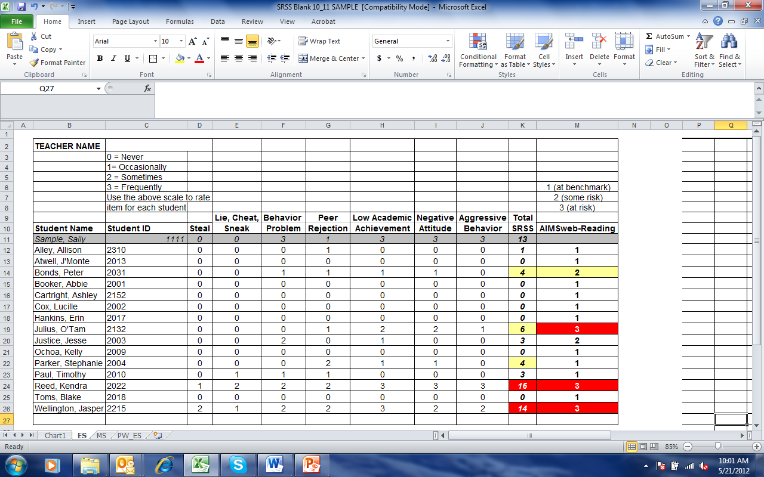
Small group Reading Instruction with Self-Monitoring
Lane, K. L., Oakes, W. P., Ennis, R. P., & Hirsch, S. E. (2014). Identifying students for secondary and tertiary prevention efforts: How do we determine which students have Tier 2 and Tier 3 needs?. Preventing School Failure: Alternative Education for Children and Youth, 58(3), 171-182.

Slide 74
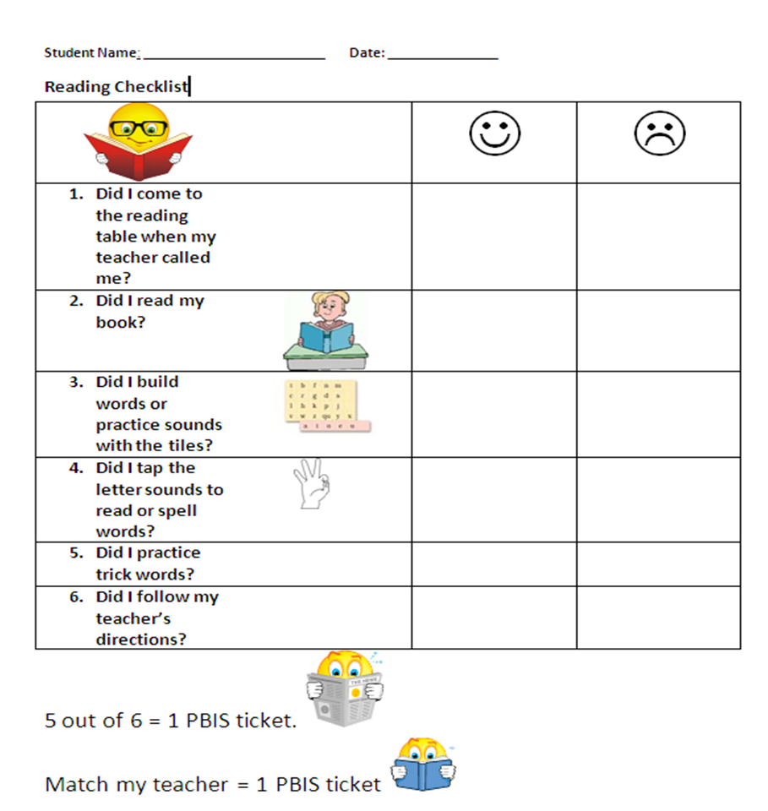
First Grade Student Self-Monitoring Form
Altmann, S. A. (2010). Project support and include: the additive benefits of self-monitoring on students’ reading acquisition. Unpublished master’s thesis, Vanderbilt University.

Slide 75
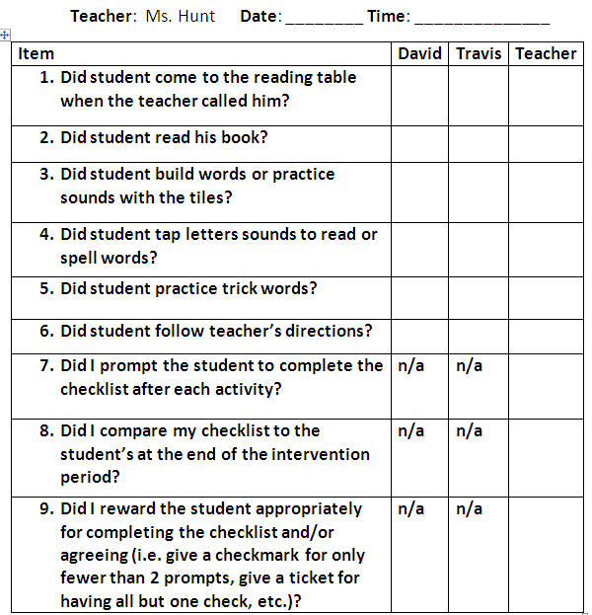
Treatment integrity
Social validity
Monitor student progress
Altmann, S. A. (2010). Project support and include: the additive benefits of self-monitoring on students’ reading acquisition. Unpublished master’s thesis, Vanderbilt University.

Slide 76
Brainstorm a list of all extra supports offered in your building.
1.
2.
3.
4
5.

Slide 77

Select one team member to record supports on large poster paper.
Brainstorm a list of all extra supports offered in your building
10 minutes
Notes:
10 min

Slide 78

Putting the Pieces Together: Scheduling for Success
Tier 2 & 3 … scheduling is key!
Tier 2 & 3 … immediate
feedback
Tier 2 & 3 validated strategies, practices,
& programs
Tier 2 & 3 …
increase in
intensity
Tier 2 & 3 are additive … beyond Tier 1
Tier 2 & 3 …
progress
monitoring

Slide 79
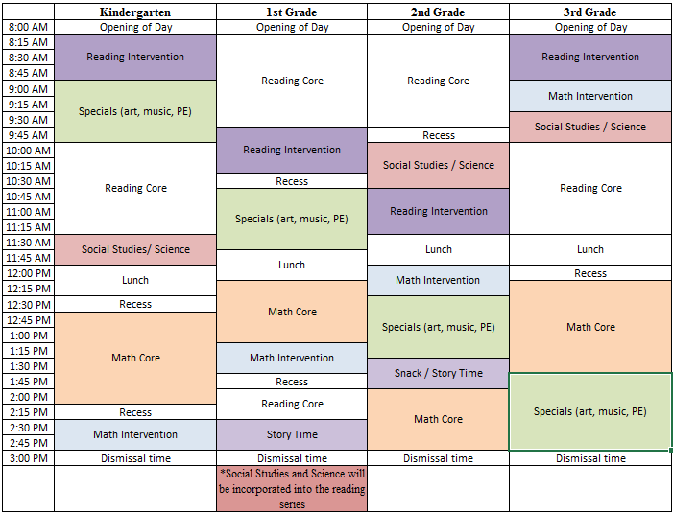
Blocking Out an Intervention Schedule K-3 (example)
“We will never teach all our students to read if we do not teach our students who have the greatest difficulties to read. Getting to 100% requires going through the bottom 20%.”
Torgeson, 2006

Slide 80

Big 5 in Reading
Comprehension
Phonics
Fluency
Phonemic Awareness
Vocabulary
National Reading Panel
http://reading.uoregon.edu/big_ideas/
http://www.fcrr.org/assessment/ET/essentials/components/components.html

Slide 81
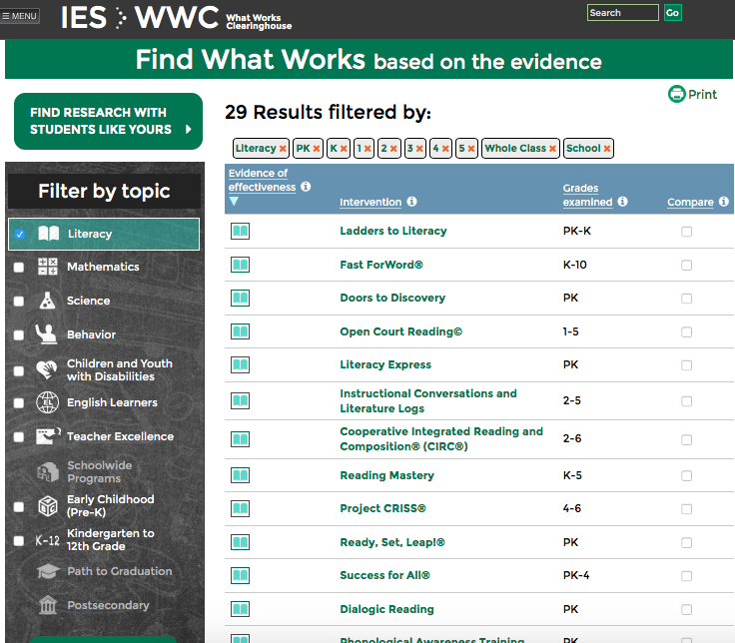
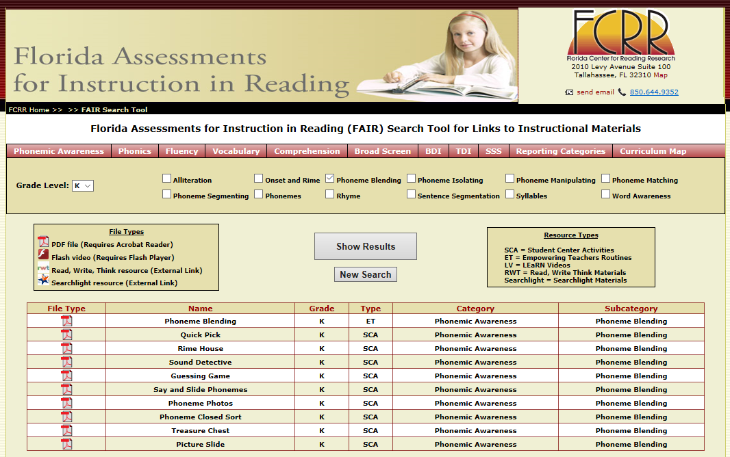
Resources to Identify and Select Reading Programs
Florida Assessments for Instruction in Reading (FCRR)
http://www.fcrr.org/FAIR_Search_Tool/FAIR_Search_Tool.aspx
What Works Clearinghouse http://ies.ed.gov/ncee/wwc/findwhatworks.aspx

Slide 82
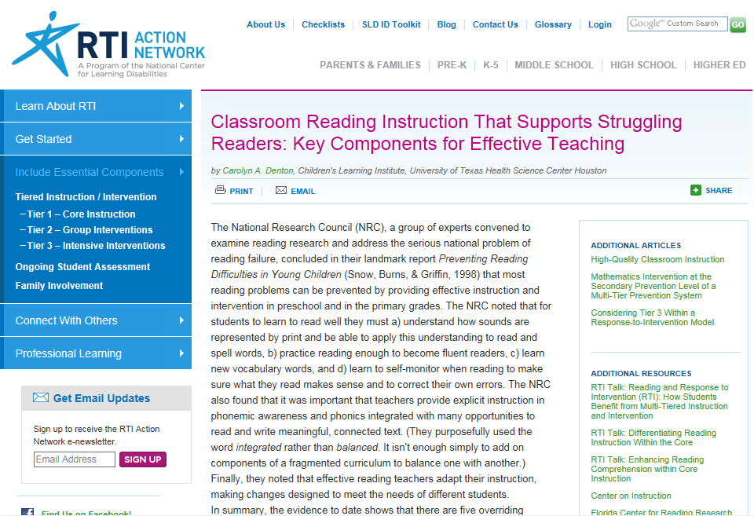
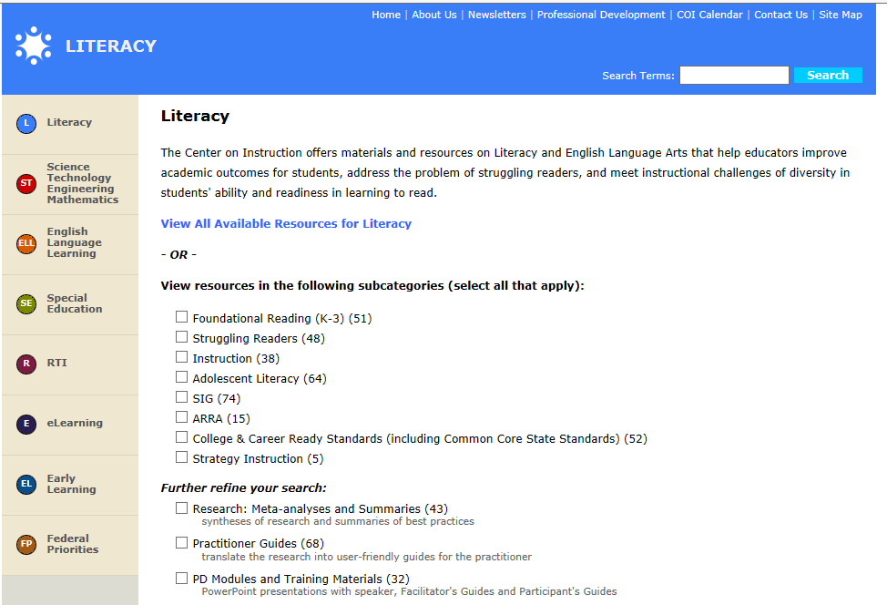
Supplemental Resources
Center on Instruction
http://www.centeroninstruction.org
RTI Action Network
http://www.rtinetwork.org

Slide 83
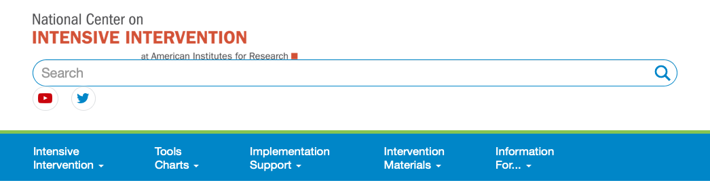

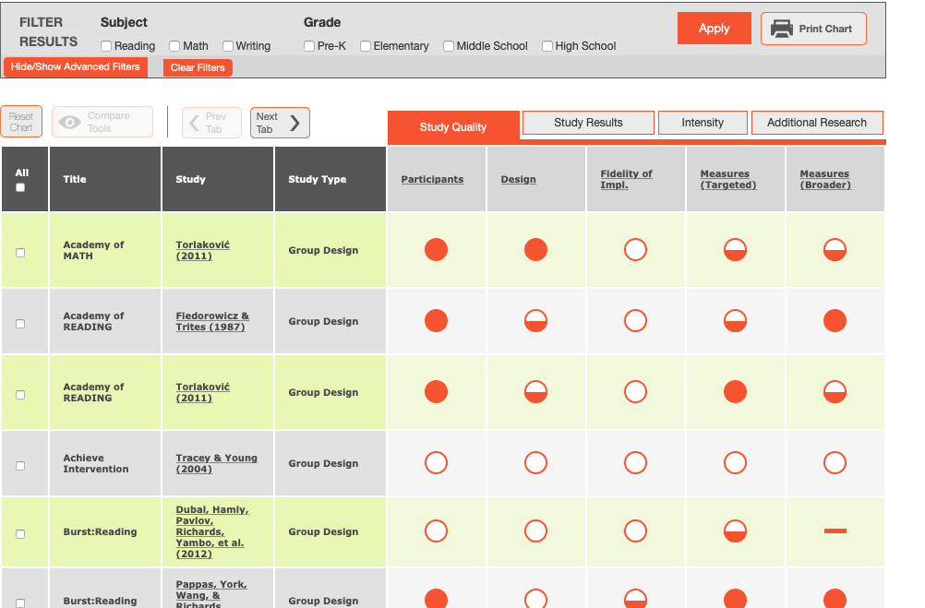
Supplemental Resources
Collaborative for Academic, Social, and Emotional Learning
http://www.casel.org
National Center on Intensive Intervention
http://www.intensiveintervention.org

Slide 84
Acquisition, Fluency, Performance
Acquisition
Can’t do
Fluency
Trouble doing
Performance
Won’t do

Slide 85
Sample Secondary (Tier 2) Intervention Grid
Support | Description | School-wide Data: Entry Criteria | Data to Monitor Progress: | Exit Criteria
PALS Math (Fuchs, Fuchs, Hamlett, et al., 1997) | PALS strategies are taught to peer partners by math specialist and then monitored closely to encourage and reinforce practice and positive relationships. 30 minute instruction 3 days/week with instruction and monitoring by math specialist (student pairs) | *All the following criteria must be met Students in K-4 Voluntary participation by student and parent permission Academic: 3. Math CBM in the strategic range (some risk) Behavior: 4. SDQ—peer problems abnormal range And 5. Two or more ODRs Peer Partners Academic: 3. At benchmark on math assessment Behavior: 4. 0 ODRs 5. Normal range on SDQ and low risk on SRSS | Math progress based on CBM administered by teacher SDQ behavior data at spring screening (peer problems reduced, prosocial behaviors improved) Weekly participation report—self-and partner ratings (e.g., Did I participate in the math activities with my partner? Did my partner participate in the math activities with me?) Rate on a Likert scale: 0=never, 5=all of the time. Average of 3 or higher needed for week. Treatment Integrity Social Validity | Math CBM benchmark score improvements Improved prosocial behaviors and decrease in peer problems and ODRs Successful peer pairs will be offered participation in monthly privileges (e.g., lunch bunch, special recess, buddy math games time) to maintain gains Participation is gained by earning preset number of schoolwide Bear Bucks PBIS tickets
Source: Lane, Menzies, Oakes & Kalberg (2012)
Notes:
**See Systematic Screenings of Behavior to Support Instruction page 164

Slide 86

Commonly Used Secondary (Tier 2) Interventions to Support Behavior
Check in/check out
Social groups
Focused academic intervention
Behavior plan / contract
Daily pre-teaching

Slide 87
Support | Description | Schoolwide Data: Entry Criteria | Data to Monitor Progress: | Exit Criteria
ACT Intervention | Depending on GPA and PLAN test, student will receive targeted intervention related to achieving the HOPE college scholarship. Direct instruction on test taking strategies and skills for achieving a 21 on the ACT or increasing GPA to 3.O on Tennessee Uniform GPA (not county calculations). | 11th graders SRSS: High (9-21) or Moderate (4-8) by either 2nd or 7th period teacher GPA ≤ 2.50-3.20 and/or Score on the PLAN test (predicted score on ACT below Hope Scholarship qualifying score of 21) | Student Measures: Completion of course/assignments Attendance in ACT targeted courses Communication with students/parent Treatment Integrity: Teacher completed component checklist of lessons completed. Social Validity: Pre and post, student and parent surveys | Completion of individual target plan.
Source: Lane, K. L., Oakes, W. P., Menzies, H. M., Oyer, J., & Jenkins, A. (2013). Working within the context of three-tiered models of prevention: Using school wide data to identify high school students for targeted supports. Journal of Applied School Psychology, 29, 203-229.

Slide 88
Support | Description | Schoolwide Data: Entry Criteria | Data to Monitor Progress: | Exit Criteria
Project Self Determination | Direct instruction of self-determination skills taught individually by a research assistant during students’ study hall class. Tell, Show, Do lesson format to teach the following skills: Organizational skills Study skills Note taking Participating in discussions Decision making Asking for help 3 days per week; 30 min lesson; 8 weeks | (1) Students in 10th or 11th grades (2) Academic: 2+ Course Failures (D or F/E) in first semester (3) Behavior: SRSS – Moderate (4 – 8) or High (9 – 21) Risk (4) Schedule: Enrolled in a Study Hall Period | Student Measures: (1) AIR Self Determination Scale (pre and post intervention) (2) Social Skills Rating Scale (SSRS, Gresham & Elliott, 1990; pre and post) (3) Student and Classroom Teachers completed check out form with 7 items related to the SD skills taught (weekly) (4) Attendance rates (5) Office Discipline Referrals Treatment Integrity: Daily completion of component checklist of critical lesson elements by interventionist, 25% of lessons observed by a second rater for reliability. Social Validity of the intervention (teachers and student; pre and post). | Completion of Project Self Determination (8 week course – one quarter)
Source: Lane, K. L., Oakes, W. P., Menzies, H. M., Oyer, J., & Jenkins, A. (2013). Working within the context of three-tiered models of prevention: Using school wide data to identify high school students for targeted supports. Journal of Applied School Psychology, 29, 203-229.

Slide 89
Support | Description | Schoolwide Data: Entry Criteria | Data to Monitor Progress: | Exit Criteria
Targeted Algebra II Study Hall | Direct, targeted instruction of Algebra II learning targets by math teachers. Time will be used to re-teach concepts, provide one-on-one or small group instruction and offer greater supports for students struggling to pass the graduation requirement course. 50 min per day until exit criteria is met. | (1) 12th graders (2) Algebra II grade drops below a 75 at any point in the semester (3) Have study hall time available and permission of 5th period teacher (4) Self-selecting to engage in study hall | Student Measures: Algebra II classroom grades Daily class average if grade is ≤ 75 Treatment Integrity: Daily monitoring of the lessons covered and student attendance Social Validity: Pre and Post Student Surveys | Algebra II Grade increases to satisfactory level (above 75%).
Source: Lane, K. L., Oakes, W. P., Menzies, H. M., Oyer, J., & Jenkins, A. (2013). Working within the context of three-tiered models of prevention: Using school wide data to identify high school students for targeted supports. Journal of Applied School Psychology, 29, 203-229.

Slide 90
Sample Secondary (Tier 2) Intervention Grid
Support | Description | School-wide Data: Entry Criteria | Data to Monitor Progress: | Exit Criteria
Stepping Stones to Literacy (Nelson, Cooper, & Gonzalez, 2004) | Supplemental reading program to address rapid automatic naming, print awareness, alphabetic phonics, phonological awareness, listening comprehension. K-3 Students Small Group (<5) or one-on-one format. Five days/week for 15-20 minutes | Academic: K-3 Students AIMSweb reading—deficient or emerging in Fall and Winter And Behavior: SSBD exceeded normative criteria for internalizing or externalizing dimension | Weekly reading probes—AIMSweb Treatment Integrity Social Validity | Academic: AIMSweb –meet reading bench mark at Spring time point
Source: Lane, Menzies, Oakes & Kalberg (2012)

Slide 91
Sample Secondary (Tier 2) Intervention Grid
Support | Description | School-wide Data: Entry Criteria | Data to Monitor Progress: | Exit Criteria
PALS (Fuchs, Fuchs, Hamlett, et al., 1997)—Math | PALS strategies are taught to peer partners by math specialist and then monitored closely to encourage and reinforce practice and positive relationships. 30 minute instruction 3 days/week with instruction and monitoring by math specialist (student pairs) | *All the following criteria must be met Students in K-4 Voluntary participation by student and parent permission Academic: 3. Math CBM in the strategic range (some risk) Behavior: 4. SDQ—peer problems abnormal range And 5. Two or more ODRs Peer Partners Academic: 3. At benchmark on math assessment Behavior: 4. 0 ODRs 5. Normal range on SDQ and low risk on SRSS | Math progress based on CBM administered by teacher SDQ behavior data at spring screening (peer problems reduced, prosocial behaviors improved) Weekly participation report—self-and partner ratings (e.g., Did I participate in the math activities with my partner? Did my partner participate in the math activities with me?) Rate on a Likert scale: 0=never, 5=all of the time. Average of 3 or higher needed for week. Treatment Integrity Social Validity | Math CBM benchmark score improvements Improved prosocial behaviors and decrease in peer problems and ODRs Successful peer pairs will be offered participation in monthly privileges (e.g., lunch bunch, special recess, buddy math games time) to maintain gains Participation is gained by earning preset number of schoolwide Bear Bucks PBIS tickets
Source: Lane, Menzies, Oakes & Kalberg (2012)

Slide 92
Sample Secondary (Tier 2) Intervention Grid: Elementary
Support | Description | School-wide Data: Entry Criteria | Data to Monitor Progress | Exit Criteria
Self-monitoring | Strategy implemented by student and teacher to improve academic performance (completion/ accuracy), academic behavior, or other target behavior. | Behavior: SRSS-E7 score: Moderate (4-8) SRSS-I5 score: Moderate (2-3) or SRSS-E7 score: High (9-21) SRSS-I5 score: High (4-15) or 2 or more office discipline referrals (ODR) AND/OR Academic: Progress report: 1 or more course failures or AIMSweb: intensive or strategic level (math or reading) or Progress report: Targeted for Growth for academic learning behaviors | Work completion and accuracy of the academic area of concern (or target behavior named in the self-monitoring plan) Passing grades on progress reports Social Validity: Teacher: IRP-15 Student: CIRP Treatment Integrity: Implementation & treatment integrity checklist | SRSS-E7 score: Low (1-3) SRSS-I5 score: Low (1-2) Passing grade on progress report or report card in the academic area of concern (or target behavior named in the self-monitoring plan)
For additional information, please see Lane, Kalberg, and Menzies (2009). Source http://www.ci3t.org/pl

Slide 93
Sample Secondary (Tier 2) Intervention Grid: Elementary
Support | Description | School-wide Data: Entry Criteria | Data to Monitor Progress | Exit Criteria
Self-Regulated Strategy Development (SRSD) for Writing | Students engage in small group strategic intervention focusing on specific writing instruction (e.g., story writing, persuasive writing) using the Self-Regulated Strategies Development approach to help students plan and write. Identified students meet 3-4 days/week for 30-min lessons over 3-6 week period (10-15 lessons). | One of more of the following: Academic: AIMSweb: intensive or strategic level (written expression) Two or more missing writing assignments within a grading period | Academic Measures: Weekly writing probes scored on quality, total words written, number of writing elements, and correct writing sequence AND Work completion Treatment Integrity: Implementation & treatment integrity checklist Social Validity: Teacher: IRP-15 Student: CIRP | Completion of intervention curriculum. Writing goals met for increased gains in quality, number of total words written, writing elements, and correct writing sequence AND Passing grade on progress report or report card in writing or the academic area of concern AND/OR Zero missing assignments in a grading period
For additional information, please see ci3t.org/pl
For additional information, please see ci3t.org/pl

Slide 94
Sample Secondary (Tier 2) Intervention Grid: MS/HS
Support | Description | School-wide Data: Entry Criteria | Data to Monitor Progress | Exit Criteria
Check, Connect, and Expect | This program involves checking in with a mentor at the beginning and end of the day to receive a performance goal for the day. | Behavior: SRSS Moderate or High Risk on screening Academic: overall GPA < 2.5 or 2 or more course failures at any report card or progress report | Daily BEP Progress Reports Treatment Integrity Social Validity | Students who have met there goal consistently for 3 weeks will move to the self-monitoring phase.
For additional information, please see Lane, Kalberg, and Menzies (2009).

Slide 95
Sample Secondary (Tier 2) Intervention Grid: MS/HS
Support | Description | School-wide Data: Entry Criteria | Data to Monitor Progress | Exit Criteria
Behavior Contract | A written agreement between two parties used to specify the contingent relationship between the completion of a behavior and access to - or delivery of - a specific reward. The target behavior can be an academic (e.g., work completion, rate of oral reading fluency), behavioral (e.g., on task), or social (e.g., participate in a group). Contract may involve administrator, teacher, parent, and student. | Behavior SRSS-E7 score: Moderate (4-8) or SRSS-E7 score: High (9-21) or 2 or more office discipline referrals (ODR) or 2 or more tardies/absences per quarter ___ AND ___ OR Academic Report card: 1 or more course failures or Skyward: 2 or more missing assignments or AIMSweb: intensive or strategic level (math or reading) or Below 2.5 GPA | Target behavior defined in the behavior contract (e.g., % of assignments completed, rate of oral reading fluency) Passing grades on progress reports Social Validity Teacher: IRP-15 Student: CIRP Treatment Integrity Implementation checklist & treatment integrity checklist | Successful completion of Behavior contract SRSS-E7 score: Low (1-3) Passing grade on progress report or report card in the academic area of concern (or target behavior named in the behavior contract)
For additional information, please see Lane, Kalberg, and Menzies (2009). Source: ci3t.org/pl

Slide 96
Sample Secondary (Tier 2) Intervention Grid: MS/HS
Support | Description | School-wide Data: Entry Criteria | Data to Monitor Progress | Exit Criteria
Mentoring Program | Focus is on academic achievement, character development, problem-solving skills, improving self-esteem, relationships with adults and peers, and school attendance. Solicit teachers (volunteers) to serve as mentors. | 10th/11th graders Behavior: SRSS: High (9-21) or Moderate (4-8) by either 2nd or 7th period teacher; ODR ≥ 2 Academic: GPA ≤ 2.75 | Increase of GPA Decrease of ODR Treatment Integrity Social Validity | Yearlong support Students who no longer meet criteria next fall
Star Counseling | Individual or group counseling (as deemed appropriate by STARS Specialist) to focus on skills to create school success. Counseling services will be determined by STARS intake paperwork and individual specific needs. | 9th -12th graders Behavior: SRSS: High (9-21) or Moderate (4-8) by either 2nd or 7th period teacher; ODR ≥ 2 Academic: GPA ≤ 2.75 | Participation in interventions recommended by the STARS counselor. Treatment Integrity Social Validity | STARS counselor determination
For additional information, please see Lane, Kalberg, and Menzies (2009).

Slide 97
Building Your Ci3T Blueprint E Secondary (Tier 2) Intervention Grid
Work with your grade level teams or departments to make a list of the supports currently in your building
Write a brief description of each support (behavioral, academic, and social)
Support | Description
Study Skills Group | Identified students meet three days a week during the enrichment block in which 30 min lessons are taught focusing on study skill strategies. This group can be run by teachers, trained parent volunteers, or paraprofessionals in a designated classroom, an office, or in the school library or cafeteria.

Slide 98
Secondary (Tier 2) Intervention Grid
Please remember these are supports, interventions, and instruction, NOT people who provide them (e.g., behavior specialist, counselor). Nor are these the mechanism for getting the support such as a student support team.

Slide 99
Ci3T Blueprint E Secondary (Tier 2) Intervention Grid
Please list Support and Description
(Columns 1 and 2) for a few of your brainstormed interventions

Slide 100
Ci3T Blueprint E Secondary (Tier 2) Intervention Grid
Please list Support and Description
(Columns 1 and 2)
15 minutes
Notes:
15 min

Slide 101
A Systematic Approach to Designing Secondary (Tier 2) Interventions
Step 1: Construct your assessment schedule
Step 2: Identify your secondary (Tier 2) supports
  Existing and new interventions
Step 3: Determine entry criteria
  Academic failure, behavior and academic screening scores, attendance data, etc.
Step 4: Identify Data to Monitor Progress
  Student performance: pre- and post-tests, curriculum-based measures, office discipline referral data, GPA, etc.
  Treatment integrity
  Social validity
Step 5: Identify exit criteria
  Reduction of discipline contacts, demonstration of grade level performance based on academic progress monitoring data, reduction of truancies and absences, etc.
Step 6: Consider additional needs
Notes:
101

Slide 102
Secondary (Tier 2) Intervention Grid
Ci3T Blueprint E Secondary
(Tier 2) Intervention Grid

Slide 103
A Systematic Approach to Designing Secondary (Tier 2) Interventions
Step 1: Construct your assessment schedule
Step 2: Identify your secondary (Tier 2) supports
  Existing and new interventions
Step 3: Determine entry criteria
  Academic failure, behavior and academic screening scores, attendance data, etc.
Step 4: Identify Data to Monitor Progress
  Student performance: pre- and post-tests, curriculum-based measures, office discipline referral data, GPA, etc.
  Treatment integrity
  Social validity
Step 5: Identify exit criteria
  Reduction of discipline contacts, demonstration of grade level performance based on academic progress monitoring data, reduction of truancies and absences, etc.
Step 6: Consider additional needs
Notes:
103

Slide 104
Secondary Tier 2 Intervention Grid
Ci3T Blueprint E Secondary
(Tier 2) Intervention Grid

Slide 105
Using Data to Consider Interventions
Elementary School
Increased Rates of Reinforcement
Intensive Reading Intervention with Self-Monitoring
Lane, K. L., Oakes, W. P., Ennis, R. P., & Hirsch, S. E. (2014). Identifying students for secondary and tertiary prevention efforts: How do we determine which students have Tier 2 and Tier 3 needs? Preventing School Failure, 58, 171-182, DOI: 10.1080/1045988X.2014.895573

Slide 106
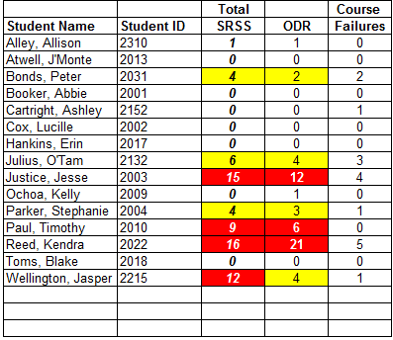
Using Data to Consider Interventions
Middle and High School
Check In Check Out (Mentoring);
Study Hall Tutoring
Functional Assessment-Based Intervention

Slide 107
A Systematic Approach to Designing Secondary (Tier 2) Interventions
Step 1: Construct your assessment schedule
Step 2: Identify your secondary (Tier 2) supports
  Existing and new interventions
Step 3: Determine entry criteria
  Academic failure, behavior and academic screening scores, attendance data, etc.
Step 4: Identify Data to Monitor Progress
  Student performance: pre- and post-tests, curriculum-based measures, office discipline referral data, GPA, etc.
  Treatment integrity
  Social validity
Step 5: Identify exit criteria
  Reduction of discipline contacts, demonstration of grade level performance based on academic progress monitoring data, reduction of truancies and absences, etc.
Step 6: Consider additional needs
Notes:
107

Slide 108
Task Divider
Team Work Time
(1) Two members to work on
IM02 Faculty and Staff Presentation
(2) Split the remaining team members into groups to work on Ci3T Blueprint E Secondary Intervention Grid
60 minutes

Slide 109













































Team Work Time
(1) Two members to work on
IM02 Faculty and Staff Presentation
(2) Split the remaining team members into groups to work on Ci3T Blueprint E Secondary Intervention Grid
60 minutes
Notes:
30 min

Slide 110

Where do we go from here?

Slide 111
Comprehensive, Integrated, Three-Tiered (Ci3T) Model of Prevention Professional Learning Series
Each school has selected a Ci3T Leadership Team to attend Ci3T training this year. Only team members are asked to attend the trainings.
Ci3T Professional Learning Series Traditional Timeline
1: Two-Hour
After School
4: Full Day
2: Full Day
3: Two-Hour
After School *With Students
6: Full Day
5: Two-Hour
After School
*With Students
November
December
January
February
April
May

Slide 113

Please Take a Minute to Get Organized
Please stay until all materials are organized
Place all materials in your table box:
  Name badges
  Role magnets
  Table cards (CASEL, What Works Clearinghouse)
  Extra postcards (take some with you!)
  Clearly identify the technology person on your team in charge of keeping Dropbox / Google Drive organized (move old versions into Previous folder)
    Consider saving docs with your school initials at the beginning and the date at the end of the file name
    Example: P_LES_Ci3T Blueprint A Primary (Tier 1) Plan_2027 02 24

Slide 114
Wrap Up and Preview
Today’s Review
Next Session Preview
Finalized Ci3T Blueprint D Assessment Schedule
Finalized procedures for monitoring
Final revisions made to the full draft of the Ci3T Blueprint A Primary (Tier 1) Plan
Created IM02 Faculty and Staff Presentation
Started Ci3T Blueprint E Secondary (Tier 2) Intervention Grid
Revise plan based on faculty feedback (PIRS Pre-Implementation)
Decide how to share feedback and revisions with faculty (R08 PIRS Feedback to Faculty and Staff)
Begin Ci3T Blueprint F Tertiary (Tier 3) Intervention Grid
Discuss Ci3T Feedback Form

Slide 115
Homework
Follow Up Supports:
Provide your Ci3T Coach with the date
of your planned meeting with faculty and staff
At your next faculty meeting:
  Share IM02 Faculty and Staff Presentation of your Ci3T Blueprint with faculty and staff
  Ask faculty and staff to complete the PIRS Pre-Implementation survey (electronic link will be sent to all faculty and staff)
  Surveys must be completed by [DATE] for reports to be available for the next session
At your next Ci3T Leadership Team meeting:
  Complete the Ci3T Blueprint E Secondary (Tier 2) Intervention Grid with the name and description of currently available supports
  Draft student entry criteria, data to monitor progress, and exit criteria

