Slide 1
Building Primary (Tier 1) Prevention Efforts:
Monitoring
Ci3T Professional Learning Series Session 3

Slide 2
Agenda
Welcome!
How will we know if our Ci3T model is making a difference?
How do we evaluate our Ci3T model? Academic, behavior, social, and program implementation measures
What data do we currently collect and how do these data inform decision making?
  Assessment schedule
  Data-informed decision making
How does our Ci3T model influence risk?
How do we monitor implementation, stakeholders’ views, and student performance? Establishing procedures for monitoring
Where do we go from here? Setting goals for Session 4

Slide 3
Agenda
Conversation Closer
Table Talk Note Taker
R04 PL Plan Note Taker
Task Divider
Technology Wrangler
Please take a moment to assign team roles:
Welcome!
How will we know if our Ci3T model is making a difference?
How do we evaluate our Ci3T model? Academic, behavior, social, and program implementation measures
What data do we currently collect and how do these data inform decision making?
  Assessment schedule
  Data-informed decision making
How does our Ci3T model influence risk?
How do we monitor implementation, stakeholders’ views, and student performance? Establishing procedures for monitoring
Where do we go from here? Setting goals for Session 4

Slide 4
Wrap Up and Preview
Last Session’s Review
Today’s Preview
Schoolwide expectations: academic, behavior, and social skills
Ci3T scheduling for core instruction
Procedures for teaching primary (Tier 1) plans
Procedures for reinforcing primary (Tier 1) plans
Wisdom from currently implementing schools
Examine how to evaluate your Ci3T model of prevention
Examine screening tools
Draft procedures for monitoring: Ci3T Blueprint A Primary (Tier 1) Plan
Draft Ci3T Blueprint D Assessment Schedule
Examine how the program is influencing risk using academic and behavior systematic screening tools

Slide 5
Homework:
Last time we met…
At your next faculty meeting:
  Introduce drafted Ci3T Blueprint C Expectation Matrix to faculty
  Obtain faculty feedback for revising
At your next Ci3T Leadership Team meeting:
  Revise Ci3T Blueprint C Expectation Matrix based on feedback
  Finalize procedures for teaching and reinforcing in Ci3T Blueprint A Primary (Tier 1) Plan

Slide 6

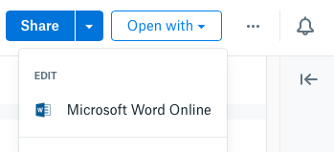
Open your school’s folder on dropbox.com
Open the “Ci3T Blueprint Materials” folder
Make a copy of Ci3T Blueprint A Primary (Tier 1) Plan and rename to add the date to the end of the file name
Click the new file to start a preview
Click “Open with” in the top right, then Microsoft Word Online, which allows multiple people to edit together
Notes:
Use the “Hide Slide” feature to hide the file sharing system not being used. Do not delete the slide. Hiding the slide will preserve correspondence to the pacing guide slide numbers.

Slide 7

Open your school’s Google Drive folder online
Open the “Ci3T Blueprint Materials” folder
Find Ci3T Blueprint A Primary (Tier 1) Plan
Right-click and select “Rename”
  Update the end of the file name to today’s date
  Add your school initials in the front
and/or open the doc and click File > Version history > Name current version and type today’s date
Ex: P_LES Ci3T-Blueprint-A-Primary-Tier-1-Plan 2027 01 13
Notes:
Use the “Hide Slide” feature to hide the file sharing system not being used. Do not delete the slide. Hiding the slide will preserve correspondence to the pacing guide slide numbers.

Slide 8
How will we know if our Ci3T model is making a difference?

Slide 9
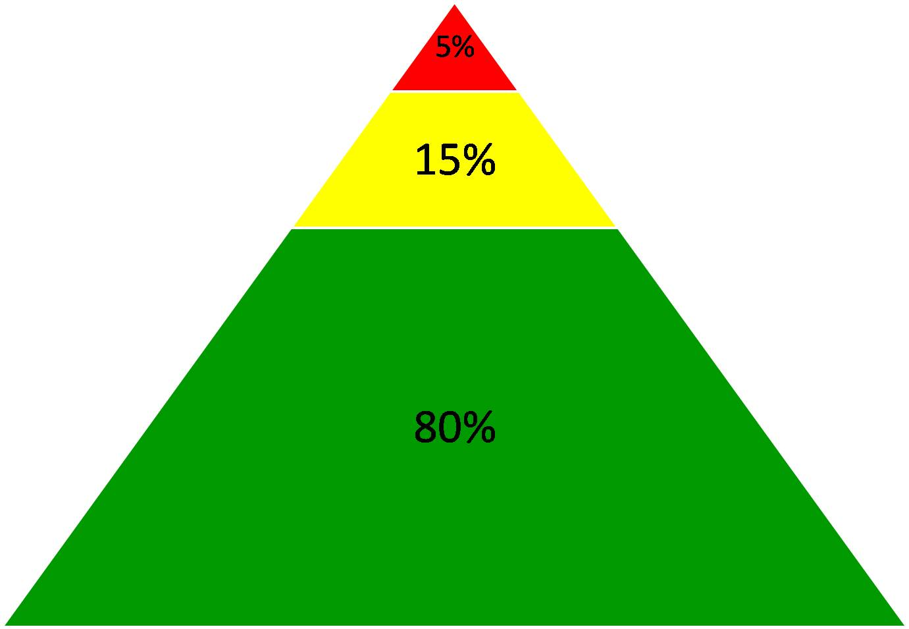

Slide 10


Procedures for Monitoring
How will you know if the plan is
  improving academic outcomes?
  reducing problem behaviors?
  improving social interactions?
How will you monitor performance over time for your school and for individual students?
How will you find and assist students who need additional academic support (remediation or enrichment)?
How will you find and assist students with externalizing
(e.g., noncompliance, aggression) and internalizing difficulties (e.g., extreme shyness, anxiety)?

Slide 11
The Use of Schoolwide Data
Enables monitoring of the overall level of risk and progress in the school as a whole
Allows teachers to identify students who may require additional supports in academic, behavioral, and social domains
Facilitates accurate decision making

Slide 12

How do we evaluate our Ci3T model?
Academic, behavior, social, and program implementation measures

Slide 13
Procedures for
Monitoring
Academic
Behavior
Social

Slide 14
Procedures for Monitoring
Academic
Academic:
Curriculum-based measures
District assessments
State achievement assessment
Grade point average (GPA)
AP exams/ACT or SAT scores
Referrals to student intervention
teams
Course failures

Slide 15
Procedures for Monitoring
Social:
Attendance
Office discipline referrals (ODR)
Suspensions & expulsions
Behavior screeners
Referrals to school and district
support services

Slide 16
Procedures for Monitoring
Behavior:
Attendance
Office discipline referrals (ODR)
Suspensions & expulsions
Behavior screeners

Slide 17
Procedures for Monitoring
You have sample measures at your table (ci3t.org/measures)
Program measures
TI | SV
Treatment Integrity How is the plan being implemented? | Social Validity What do people think about the goals, procedures, and outcomes?
For more information: Lane, K. L., & Beebe-Frankenberger, M. E. (2004). School-based interventions: The tools you need to succeed. Allyn & Bacon.

Slide 18
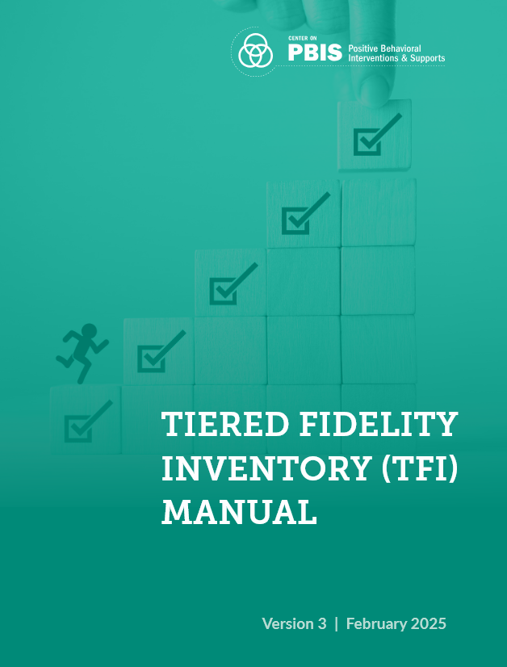
Treatment Integrity
Tiered Fidelity Inventory (TFI)
  Version 3.0 addresses multiple learning domains
    academic
    behavioral
    social and emotional well-being
Tiered Fidelity Inventory was developed as part of the U.S. Department of Education’s Office of Special Education Programs National Technical Assistance Center on Positive Behavioral Interventions and Supports.

Slide 19
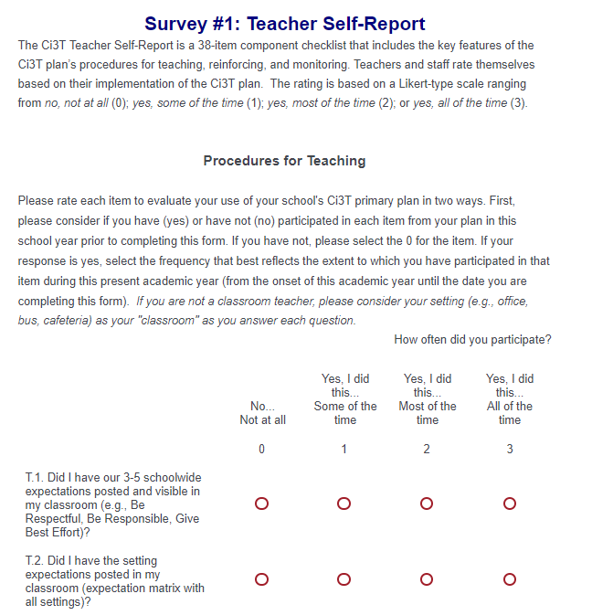
Ci3T Treatment Integrity:
Teacher Self-Report (Ci3T TI: TSR)
Checklist of items on procedures for
  Teaching
  Reinforcing
  Monitoring
Beginning of year to current date
Rated
  0 = no, not at all
  1 = yes, some of the time
  2 = yes, most of the time
  3 = yes, all of the time
Comments
Faculty and staff receive an emailed link to Qualtrics
Notes:
Staff goes through these and rate selves for how they have implemented plan.
Done in fall/spring.

Slide 20
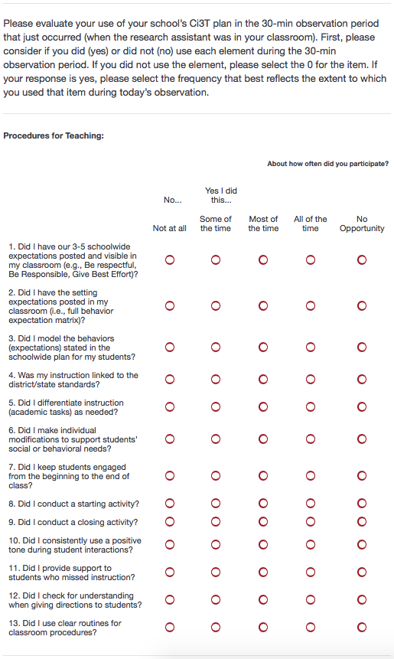
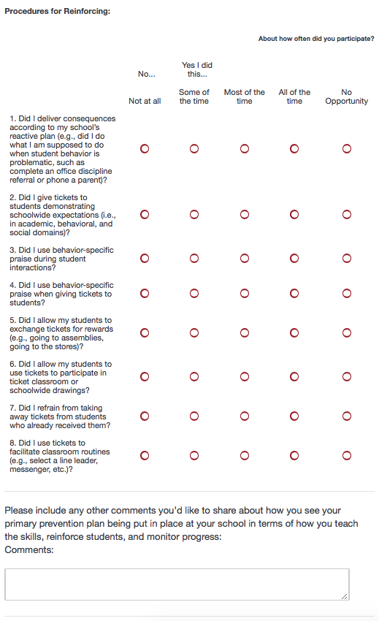
Ci3T Treatment Integrity
Direct Observation (Ci3T TI: DO)
Subset of Ci3T TI: TSR
  Procedures for teaching
  Procedures for reinforcing
Stratified, random selection of classroom teachers
Observers trained to criterion
30-min observations
  Teacher perspective
  Observer perspective
Notes:
Done in fall and spring.
Stratified sampling of school (e.g., 25% of each grade level teachers).
Ci3T Research Team can help schools with generating random sampling.
Same sampling of educators in spring as in fall to enable comparisons.

Slide 21
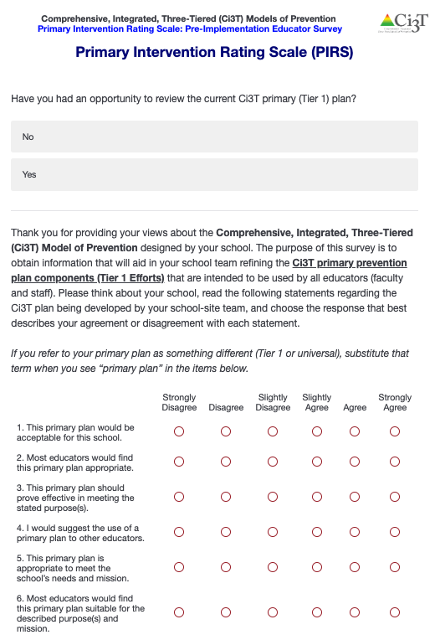
Social Validity:
Primary Intervention Rating Scale (PIRS)
(Lane, Robertson, & Wehby 2002)
Used during training and implementation
AFTER the person has had an opportunity to learn about the Ci3T plan
Adapted from Intervention Rating Profile-15 (Witt & Elliott, 1985)
17 items for Ci3T primary (Tier 1) plan
  Rated from 1 = strongly disagree to
  6 = strongly agree
4 open-ended questions
Fall and spring
PIRS scores have predicted implementation in previous studies!
Notes:
If you are an adult in the school, and paid to be there, you should fill out the PIRS. Opportunity to give feedback about the plan, to determine perceived usefulness and effectiveness of Ci3T Tier 1 plan.
The school mean percentage predicts implementation fidelity.
80% and above indicates positive perceptions.

Slide 22
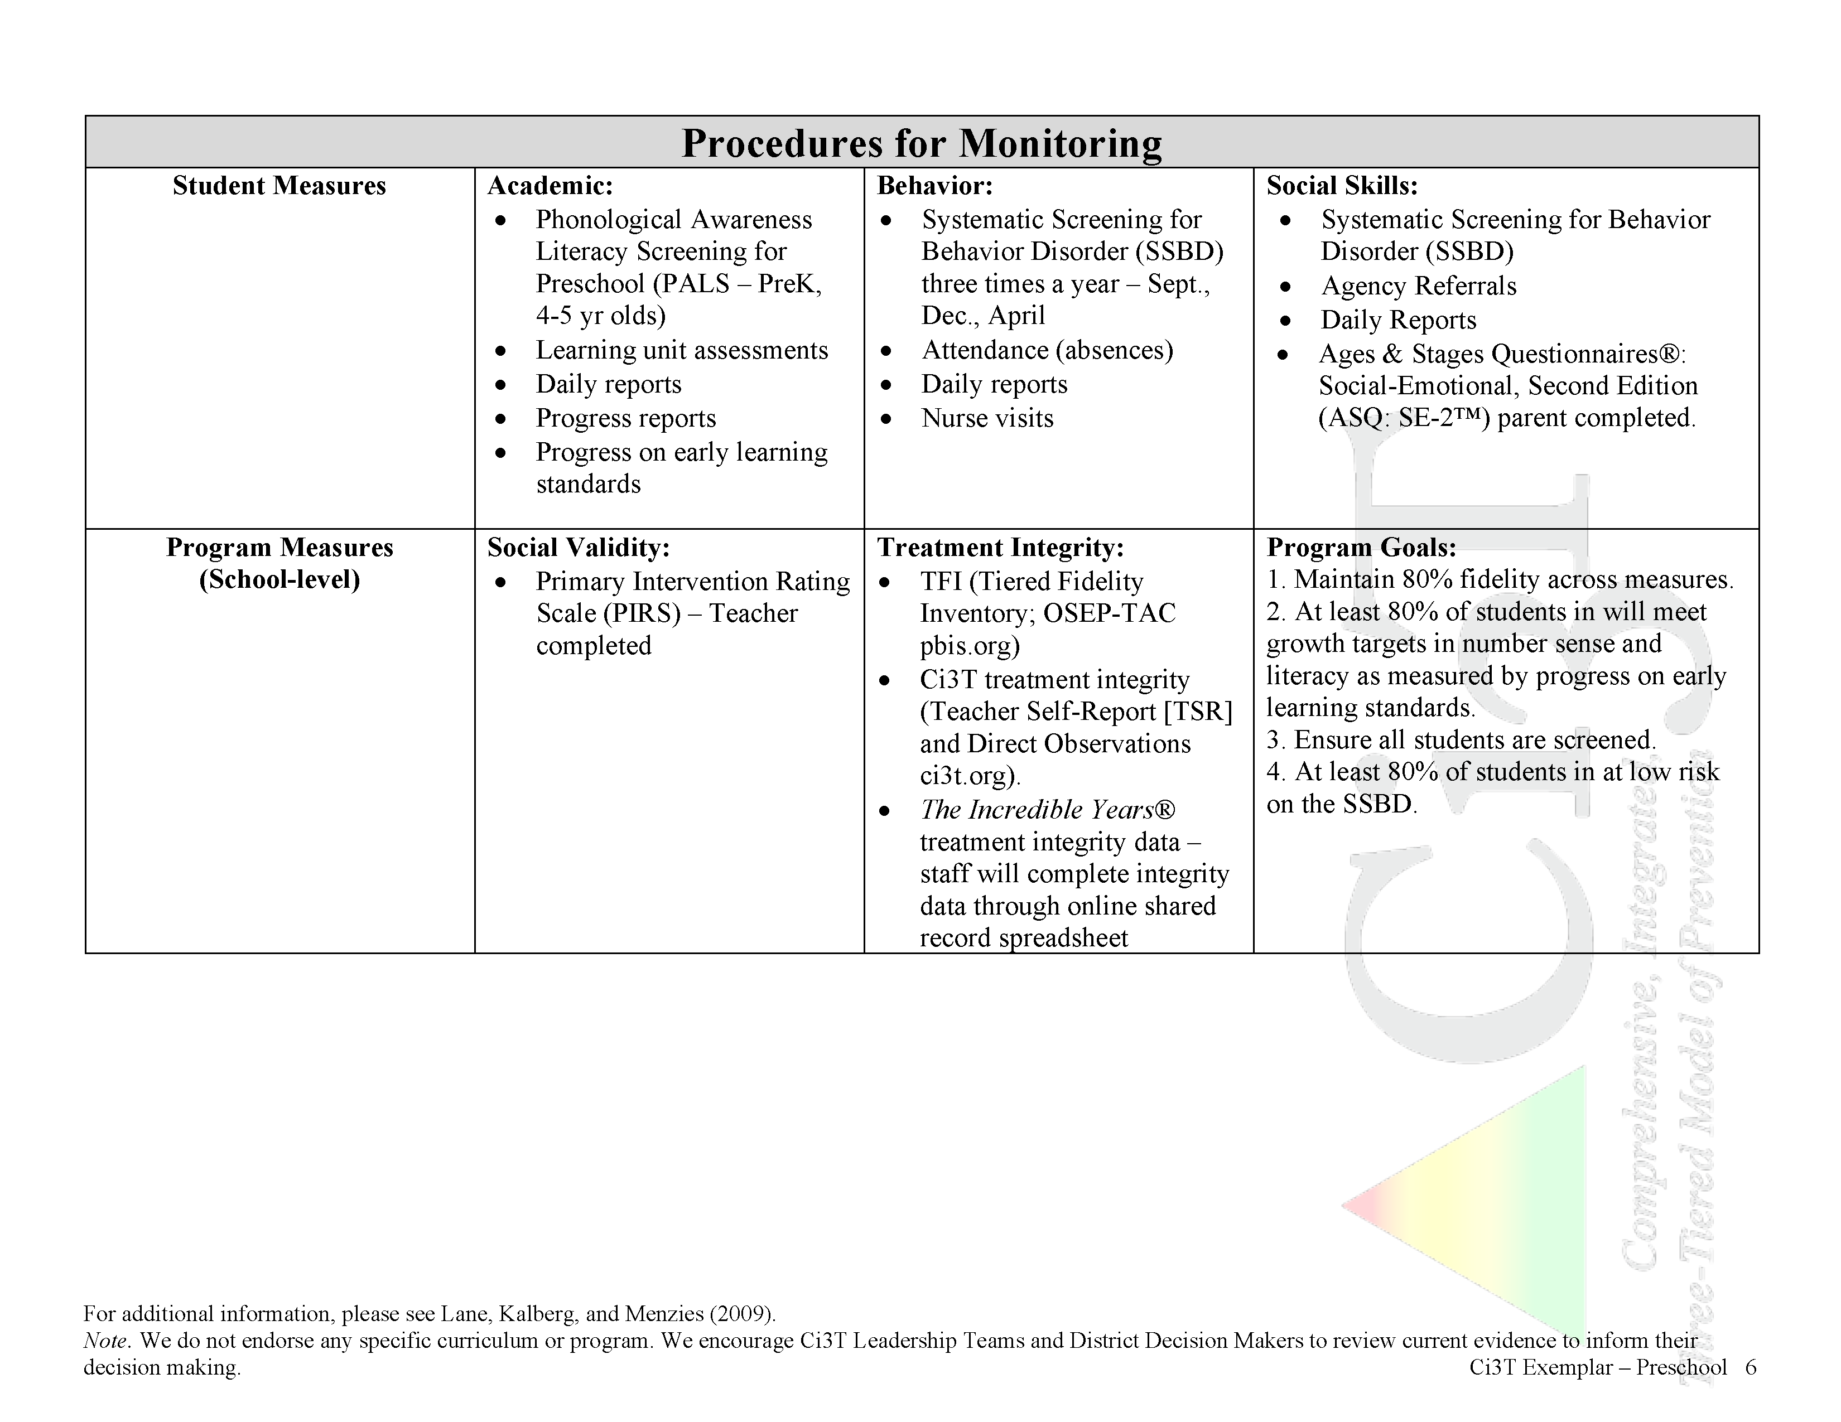


In future years, consider alternative program goals
Increase students’ readiness for Kindergarten in literacy and numeracy
Ci3T Blueprint A Primary
(Tier 1) Plan: PRESCHOOL

Slide 23
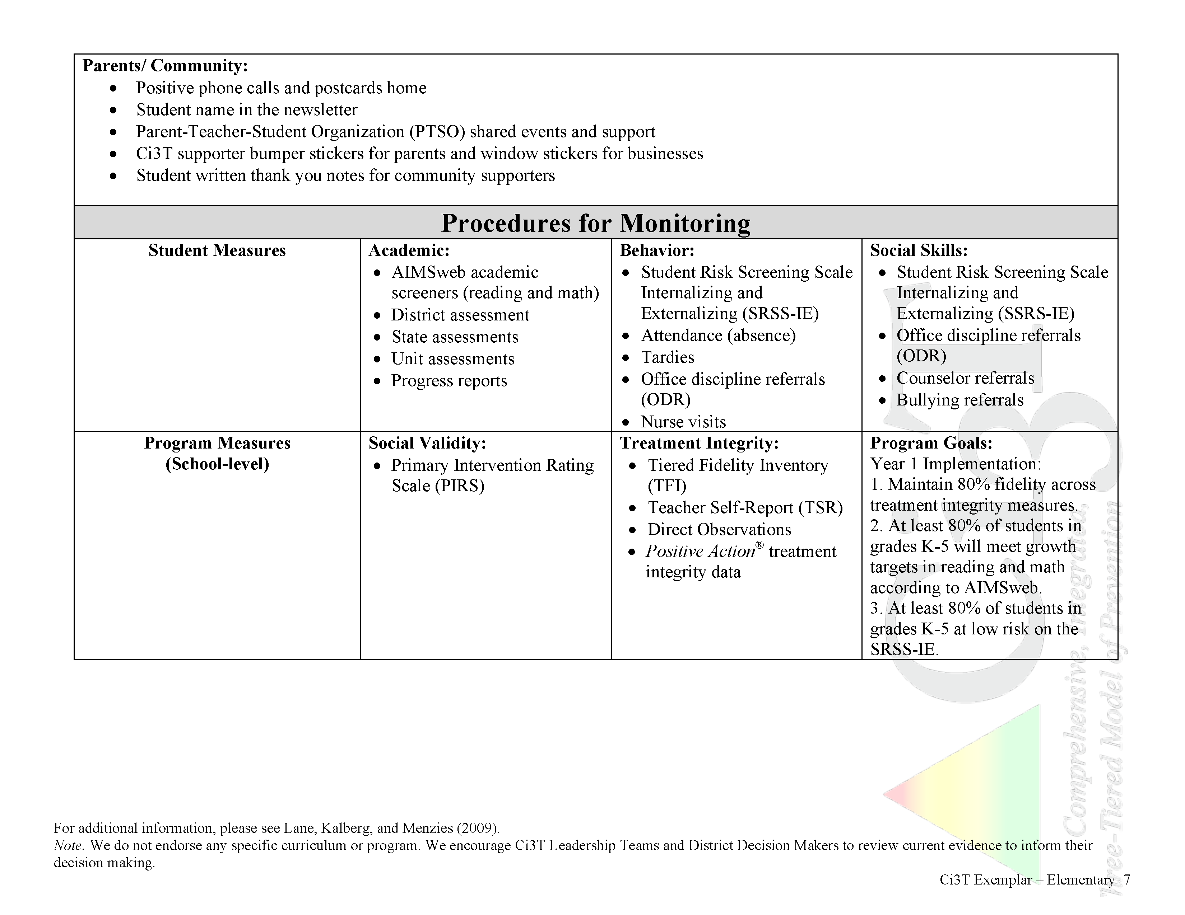
In future years, consider alternative program goals
80% of students meeting reading and math targets on assessments
Ci3T Blueprint A Primary
(Tier 1) Plan: ELEMENTARY

Slide 24
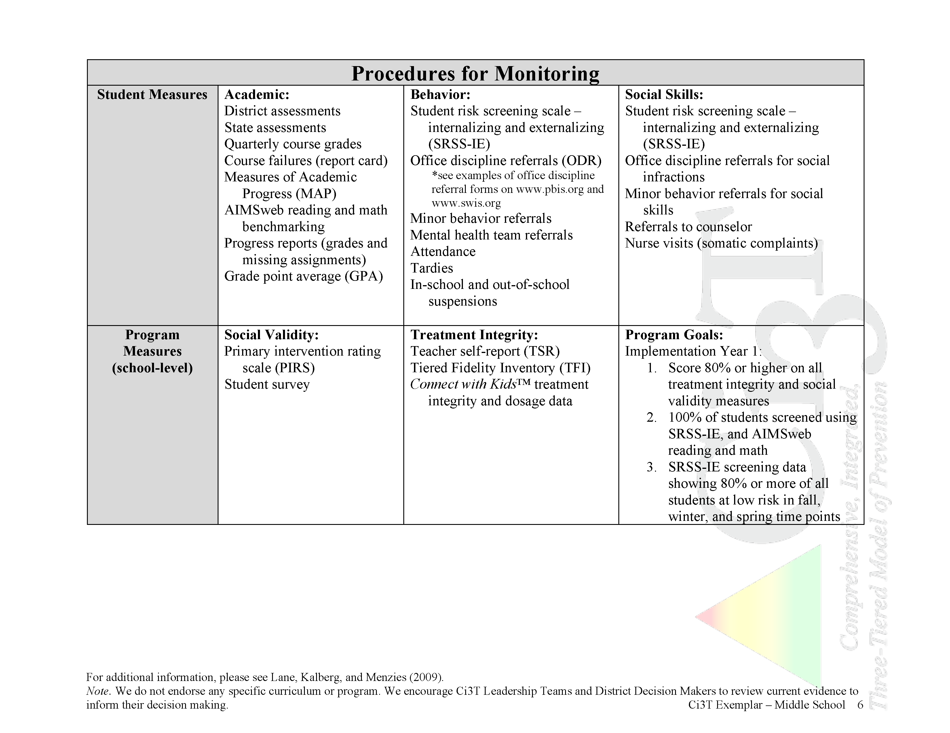
In future years, consider alternative program goals (e.g., course failures, reduce ODRs)
Ensure data are collected on every student for behavior and academic screening
Ci3T Blueprint A Primary
(Tier 1) Plan: MIDDLE SCHOOL

Slide 25
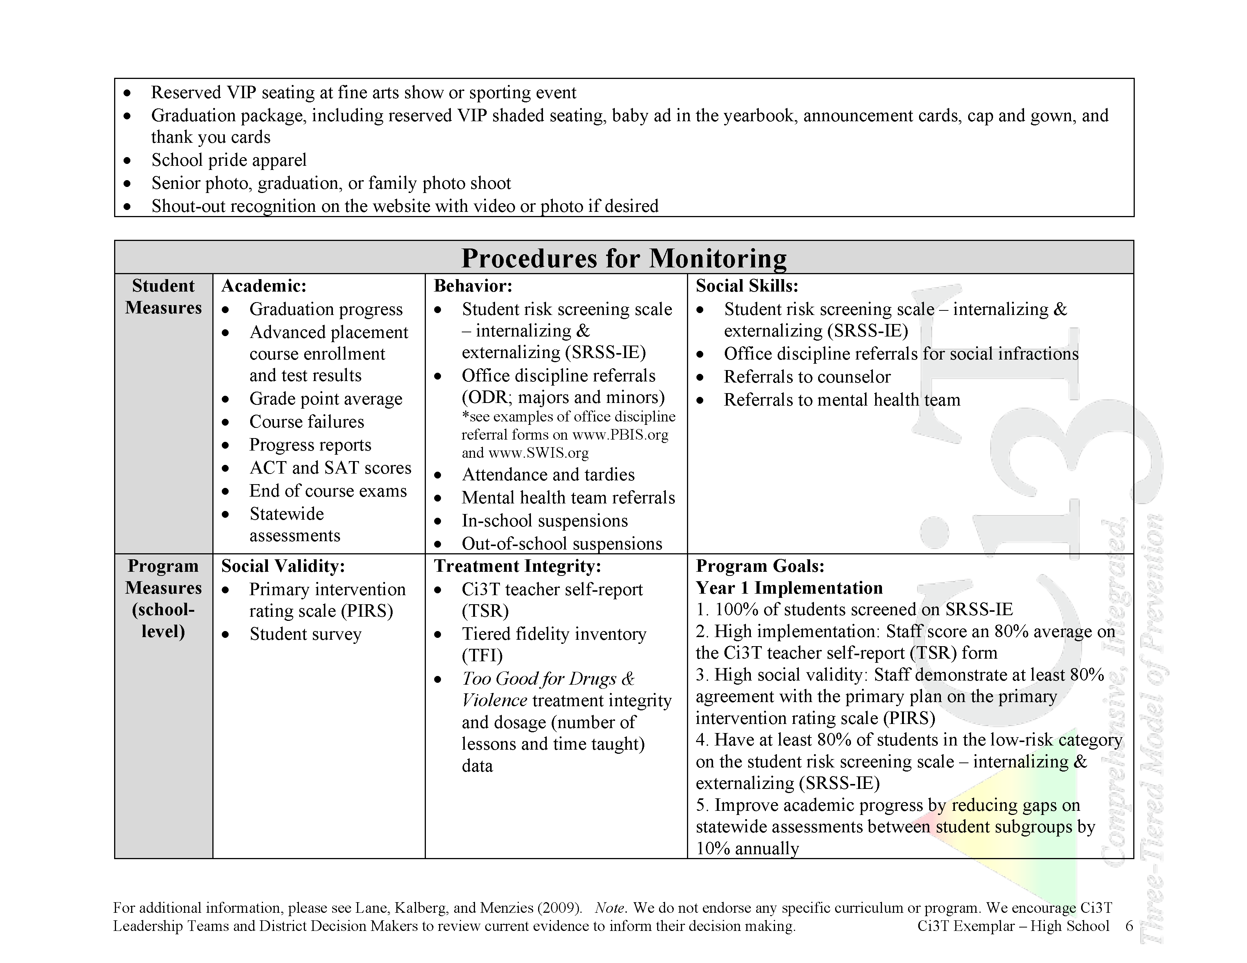
In future years, consider alternative program goals (e.g., ACT and SAT scores)
Decrease achievement gaps between subgroups
Ci3T Blueprint A Primary
(Tier 1) Plan: HIGH SCHOOL

Slide 26
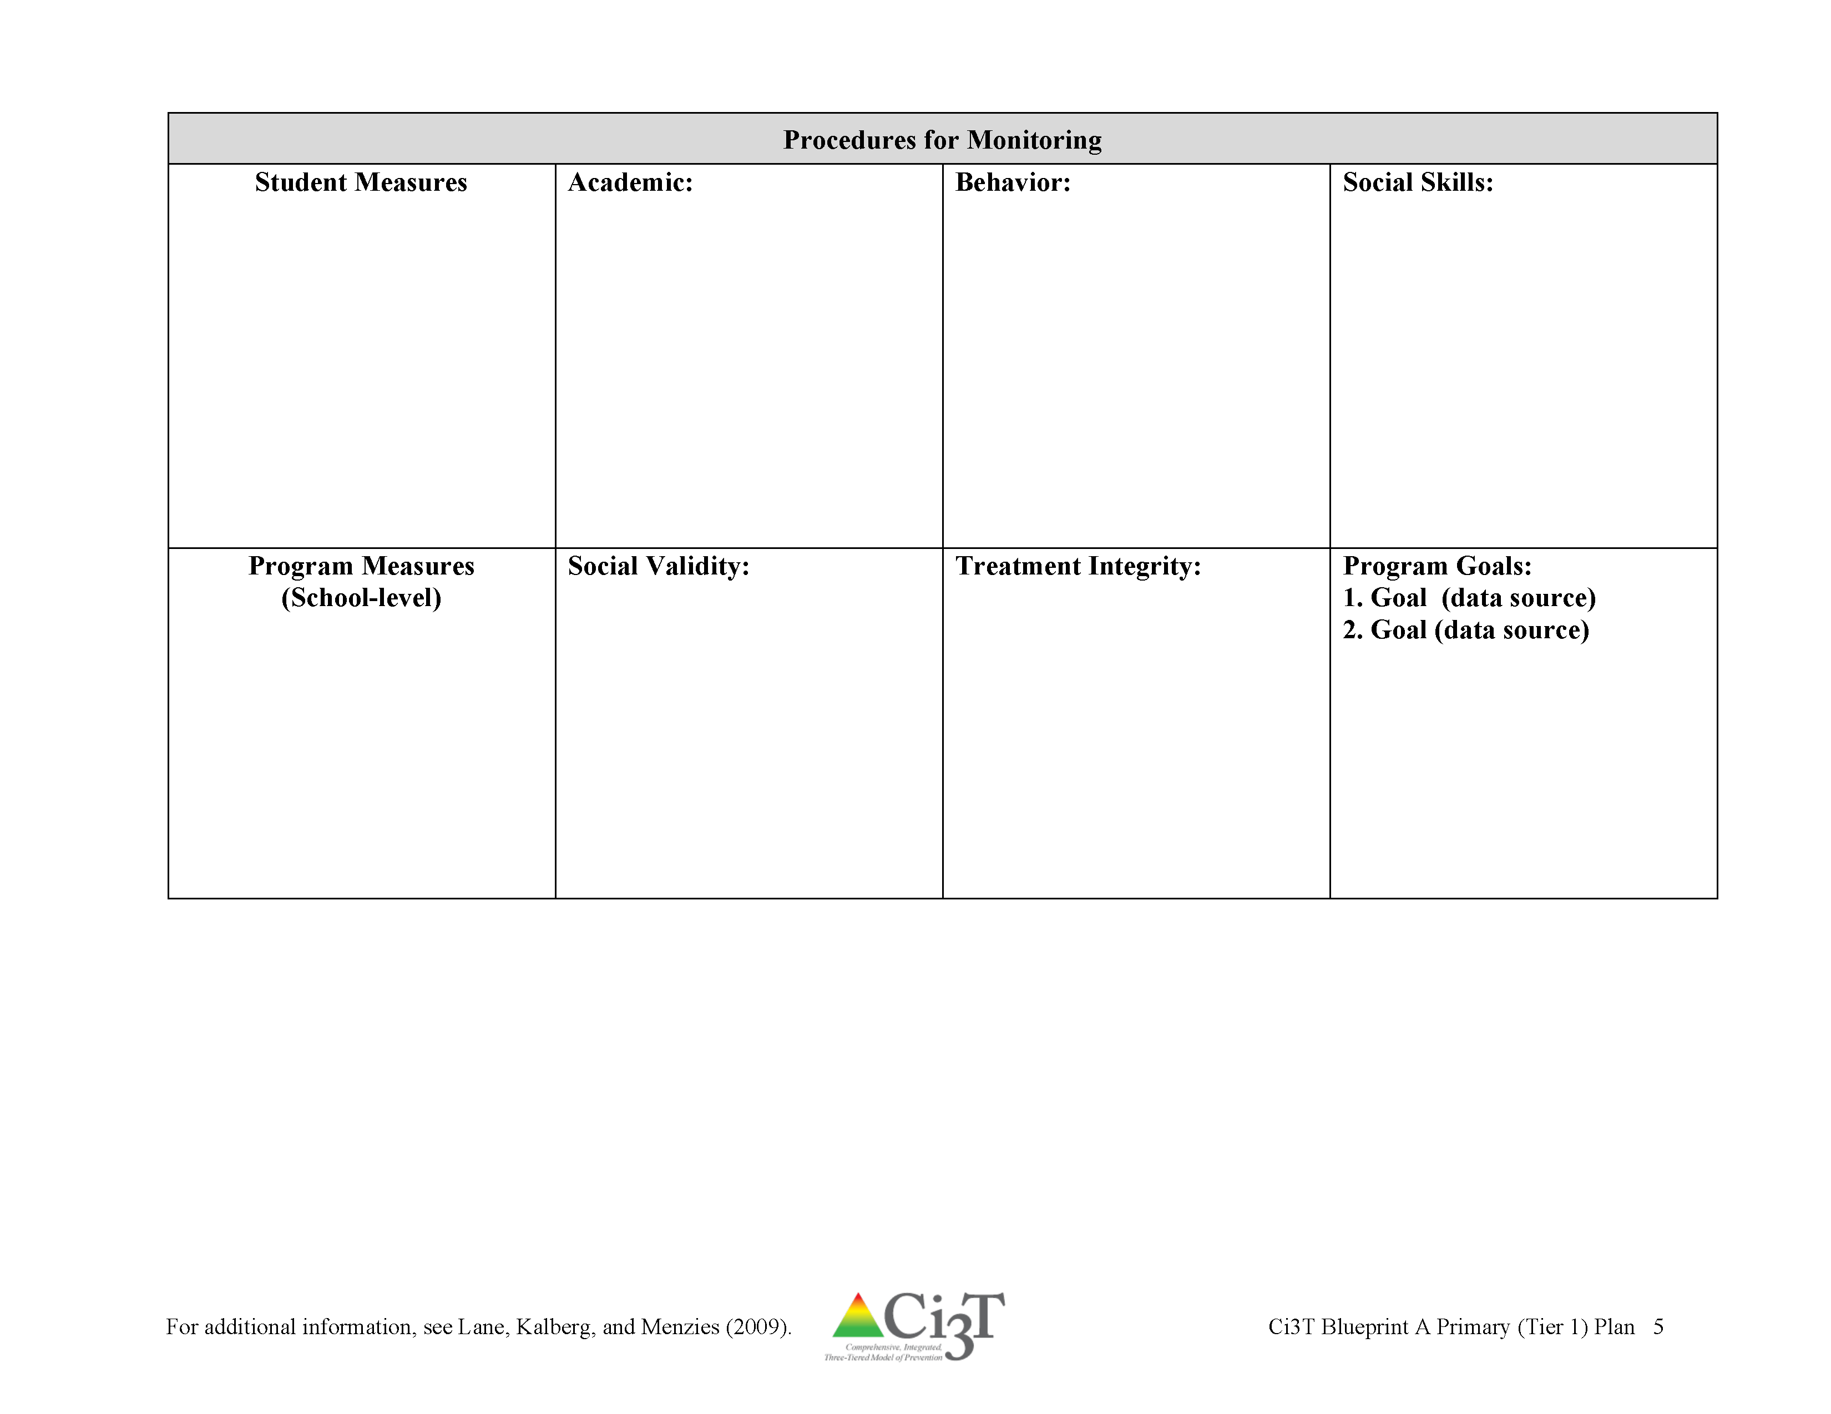
Ci3T Blueprint A Primary
(Tier 1) Plan

Slide 27

What data do we currently collect and how do these data inform decision making?

Slide 28

Which data should be collected?
Data to answer your questions
  What do you want to know about your students?
  What will you do with this information?
Data you will use
  What is readily accessible?
  What requires extra resources?
  Who, When, Where, How?
Balance between reliability
and accessibility
  Systems approach
Data Teams
What are the capabilities of your management systems?

Slide 29

When should data be collected?
Natural cycles, meeting times
  Weekly, monthly, quarterly
Level of system addressed
  School-wide: monthly, quarterly
  Small group: daily, weekly
  Individual: daily, weekly

Slide 30
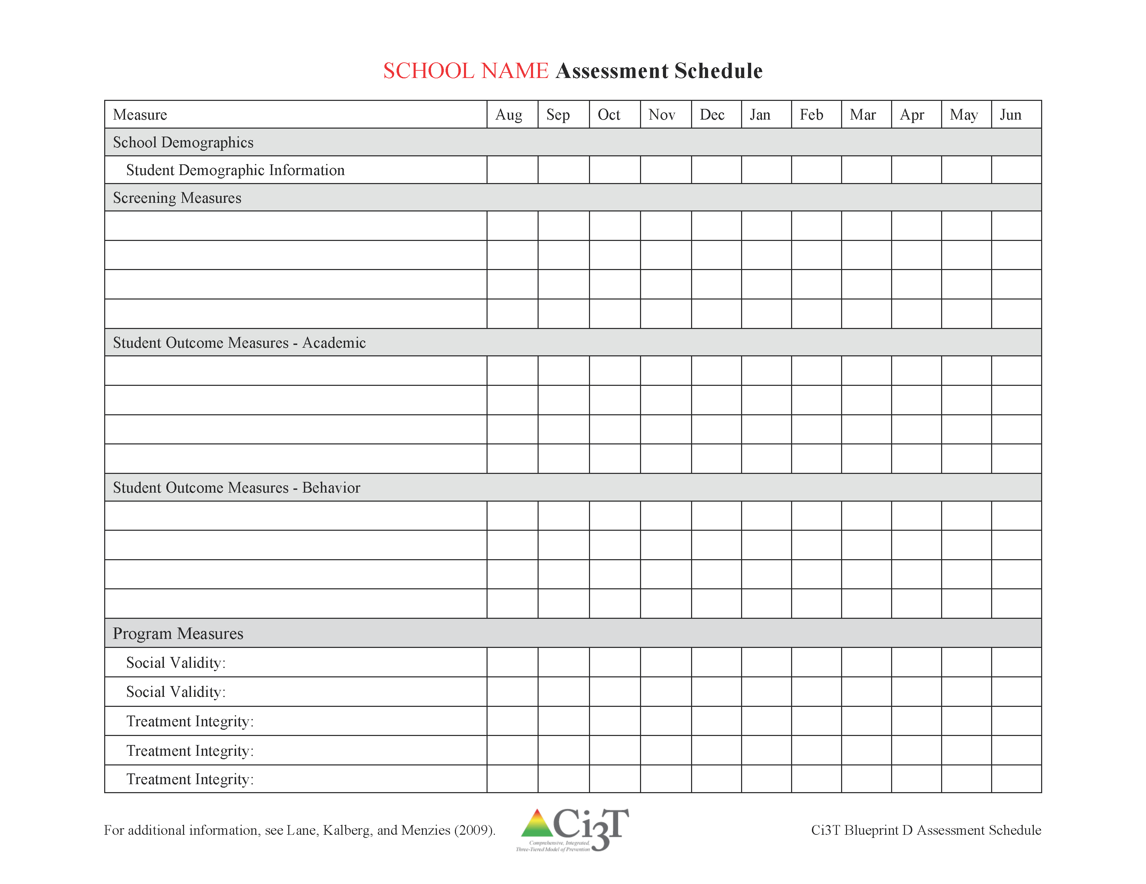
Ci3T Blueprint D Assessment Schedule

Slide 31
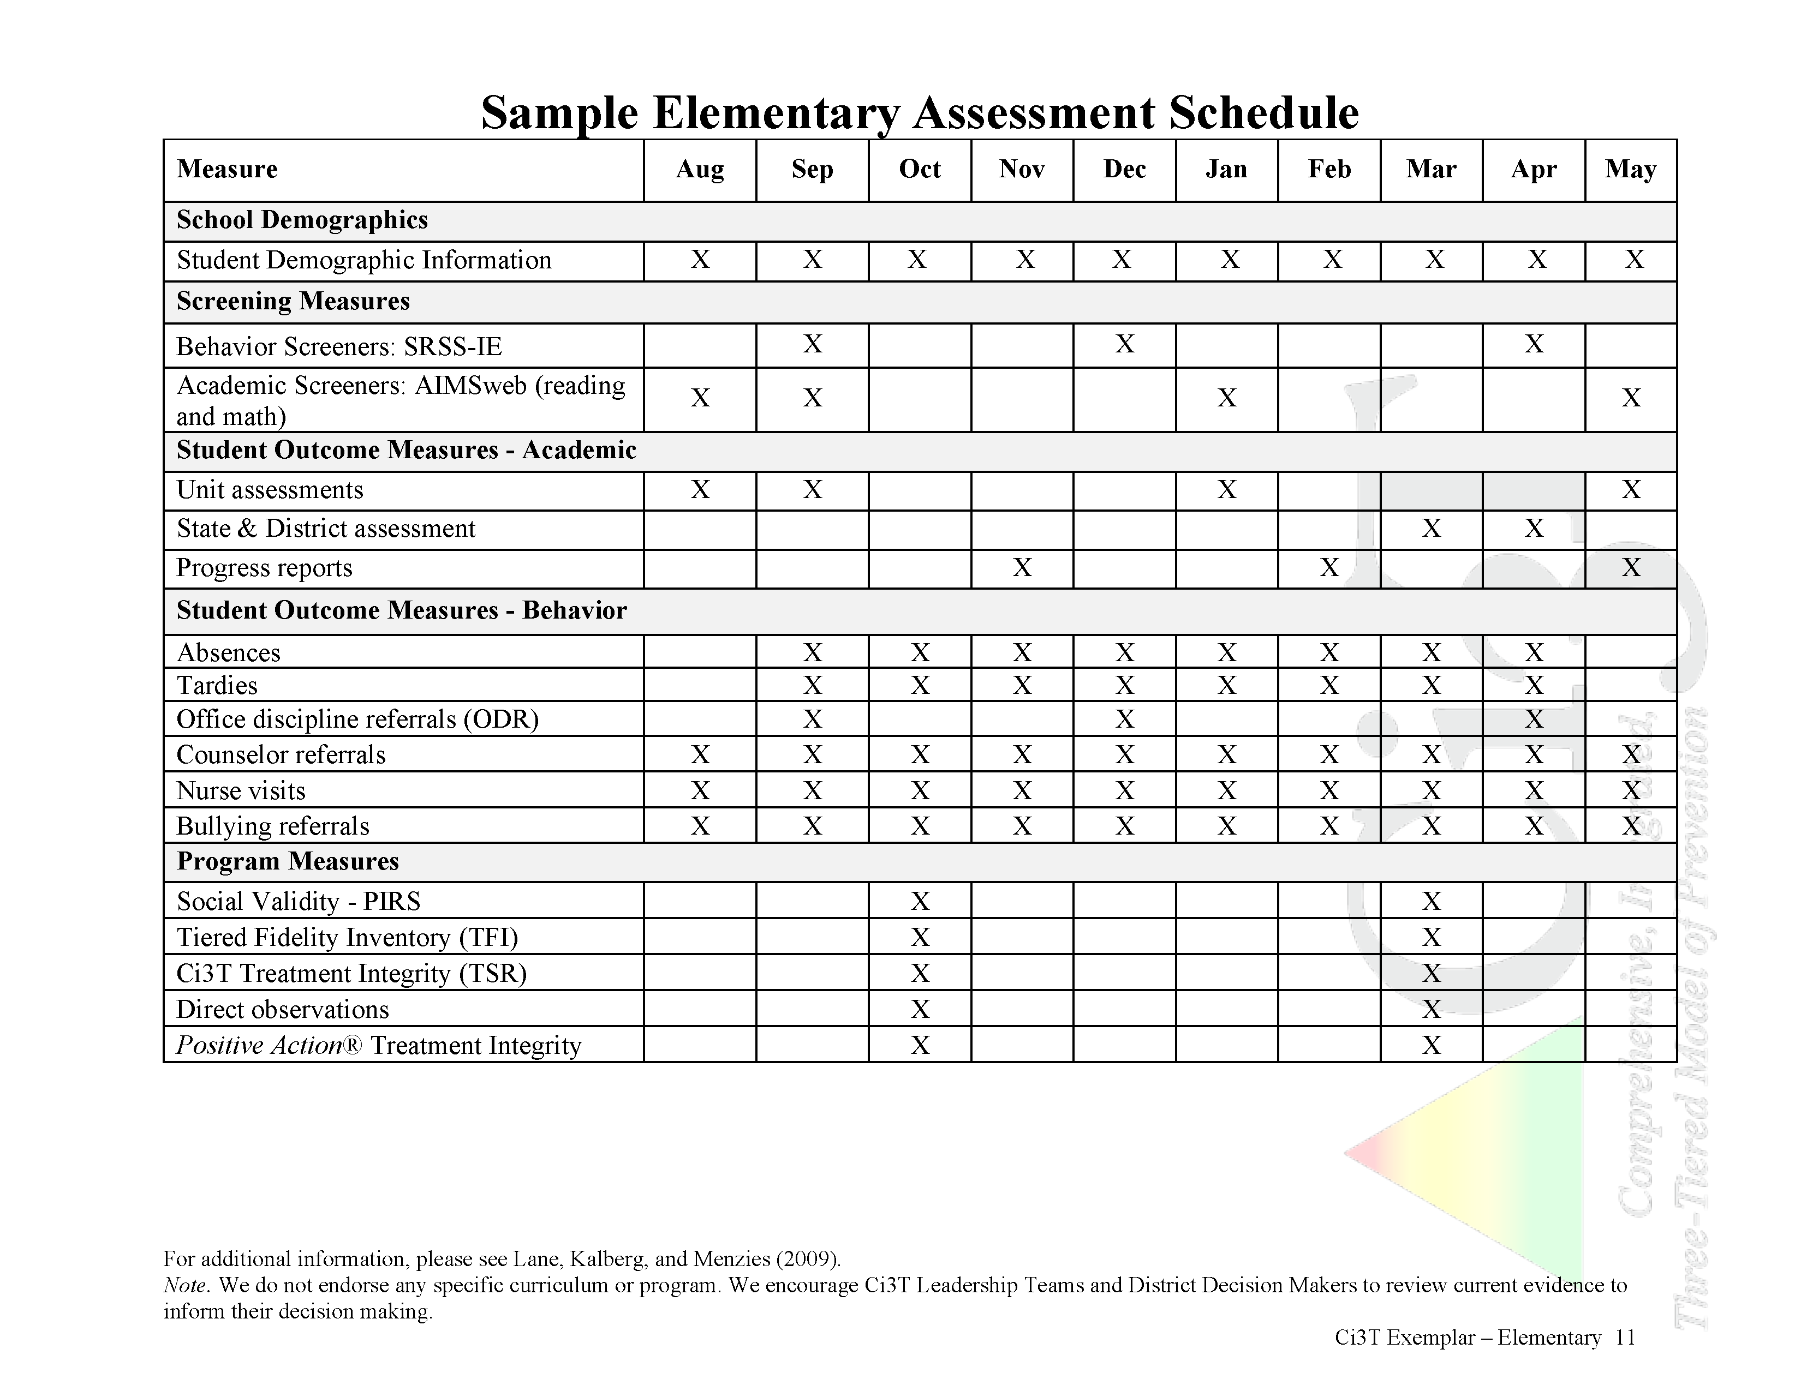

Slide 32
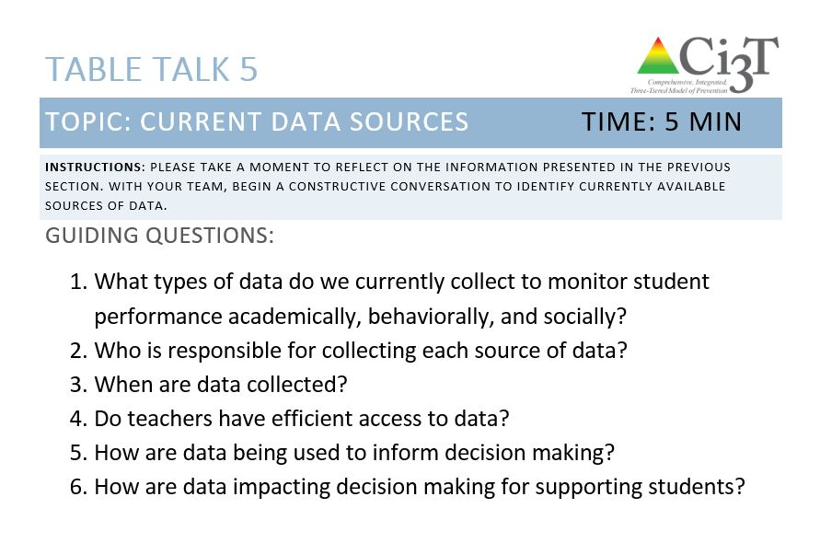
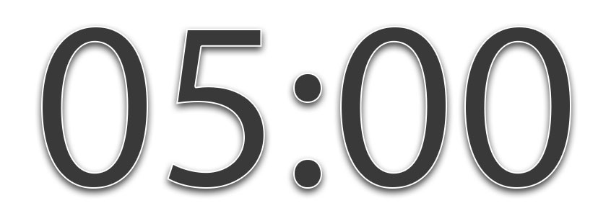
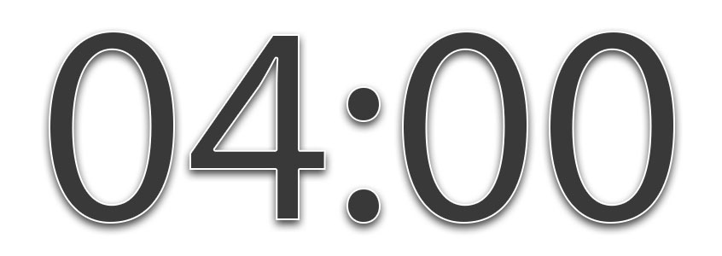
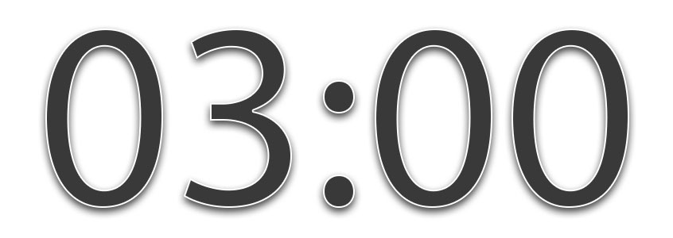
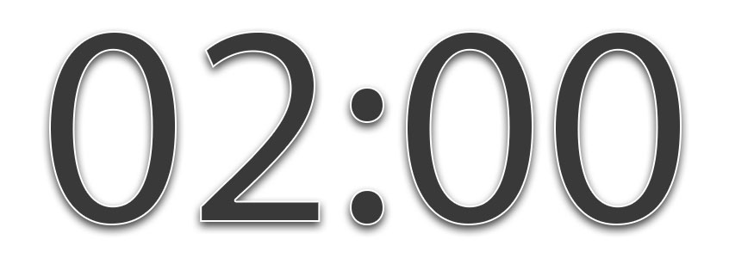



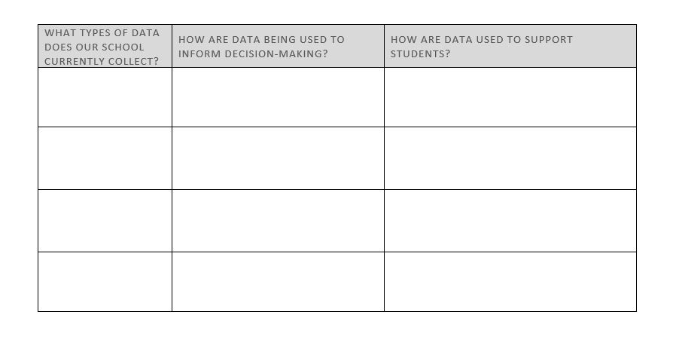
Table Talk 05
Current Data Sources
5 minutes
Notes:
5 min

Slide 33

Data-Informed Decision Making

Slide 34
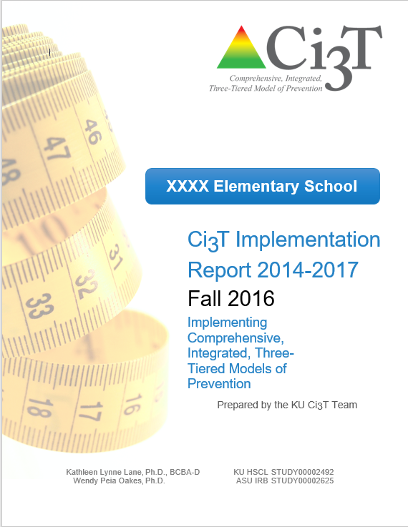
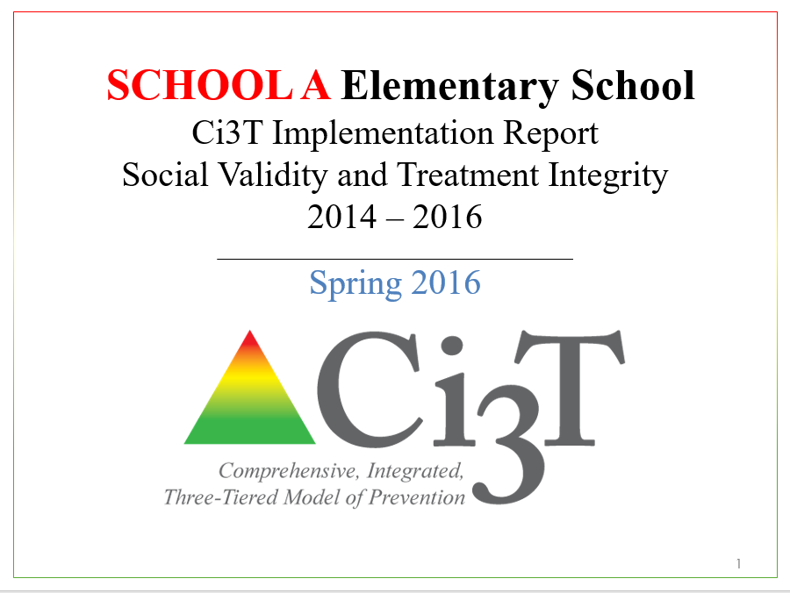
Using Data to Monitor Our Plan: Sharing Schoolwide Data with Faculty and Staff

Slide 35
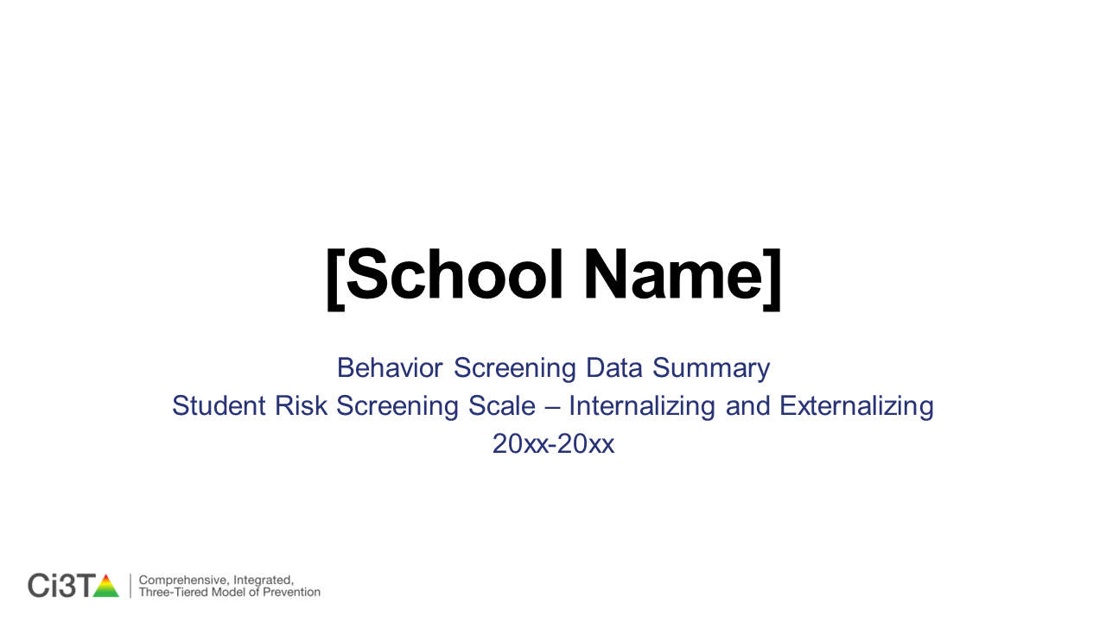
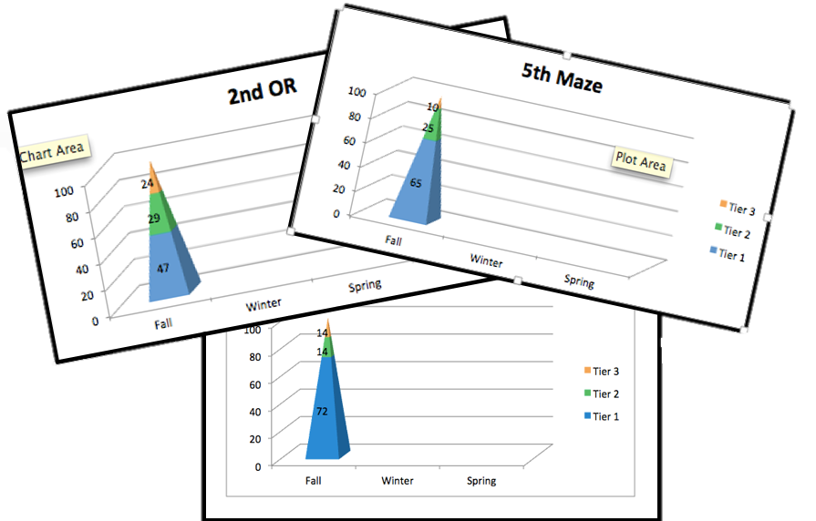
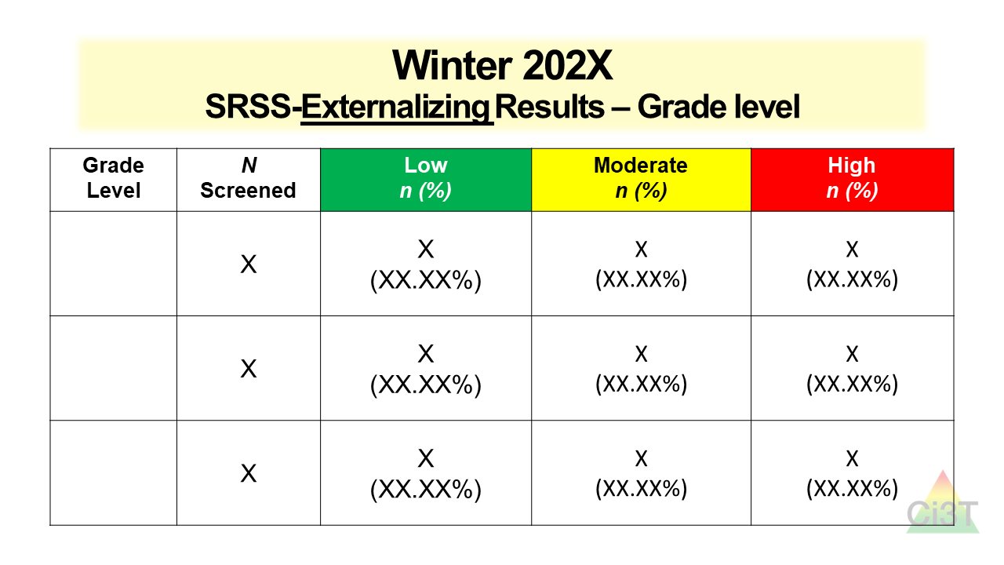
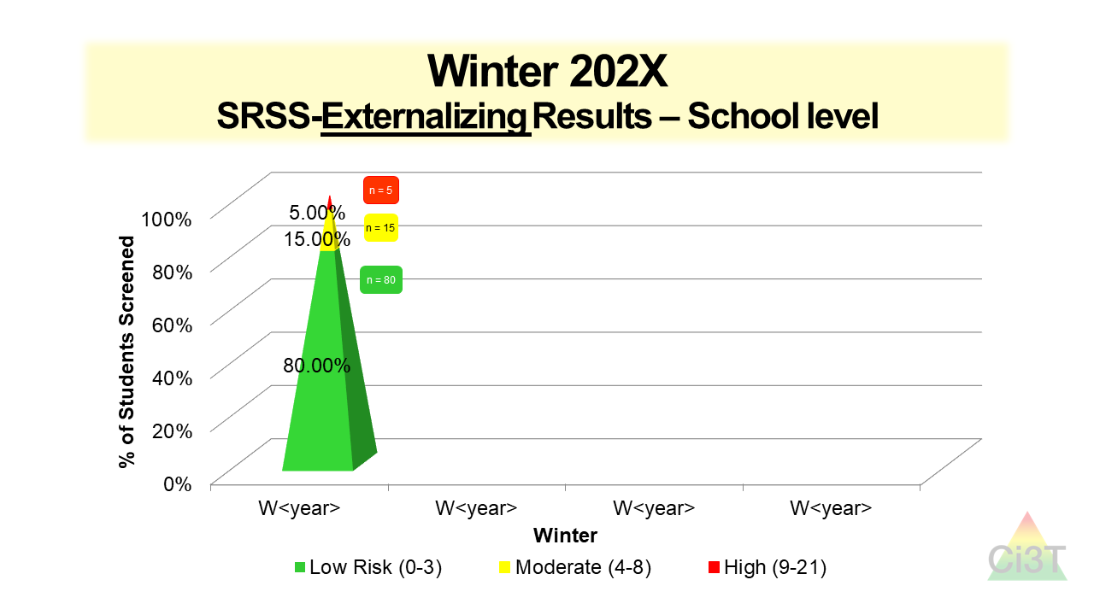

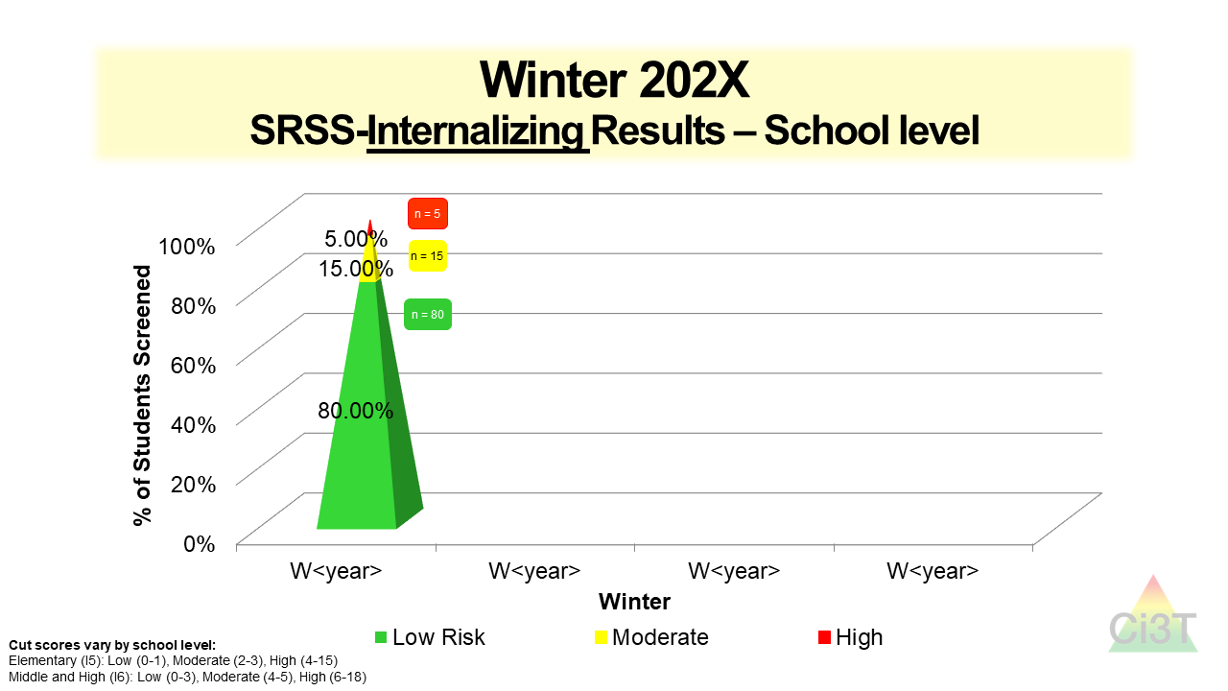
Using Data to Monitor Our Plan:
Sharing Student Performance Data with Faculty and Staff

Slide 36
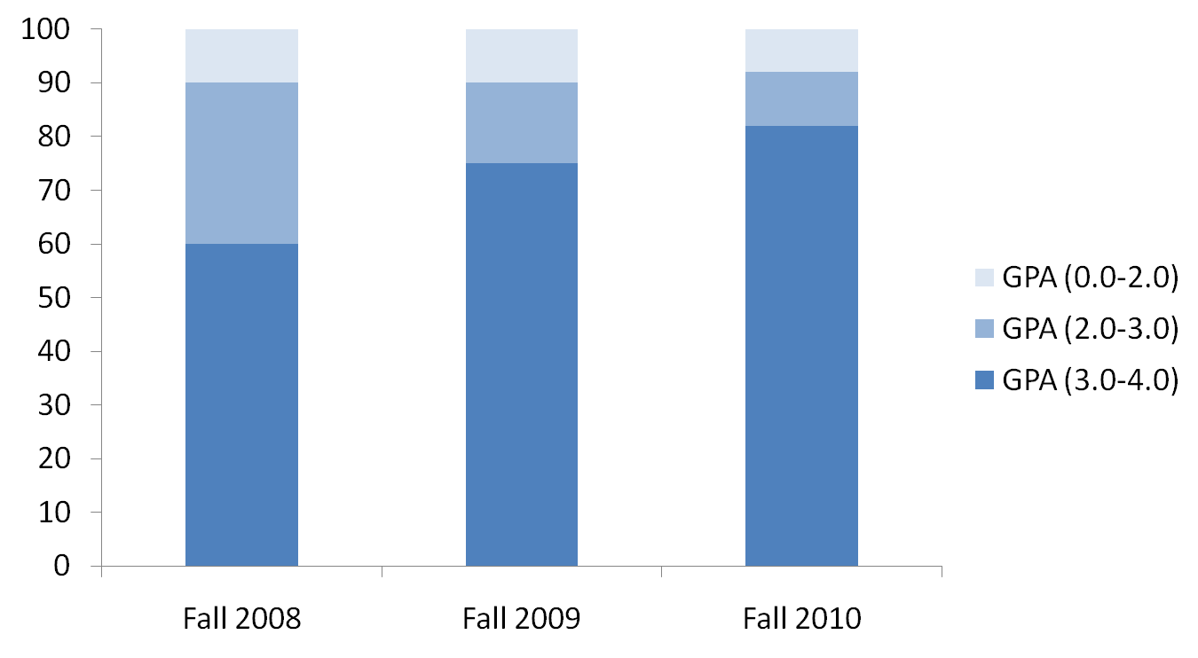
Sample Data: Grade Point Average
First Semester Over Time 2008 - 2010
10%
(n = 100)
10%
(n = 100)
8%
(n = 80)
Percentage of Students
15%
(n = 150)
10%
(n = 100)
30%
(n = 300)
60%
(n = 600)
75%
(n = 750)
82%
(n = 820)
Time Point N = 1000 Students

Slide 37
Elementary School Attendance: Quarter 1 2005-2006 to Quarter 1 2006-2007
These numbers represent the total numbers for the school as a whole divided by the number of schools days in a given quarter.
Rate (per instructional day)

Slide 38
Elementary School Discipline Comparison Quarter 1 2005-2006 to Quarter 1 2006-2007
These numbers represent the total numbers for the school as a whole divided by the number of school days in a given quarter.
Rate (per instructional day)
Source: Lane, K.L., Kalberg, J.R., & Menzies, H.M. (2009). Developing schoolwide programs to prevent and manage problem behaviors: A step-by-step approach. New York, NY: Guilford Press.

Slide 39

Considerations
Psychometrically Sound
Socially Valid
If social validity is lacking, even psychometrically strong tools are likely to remain unused by educators.

Slide 40

Academic Measures

Slide 41
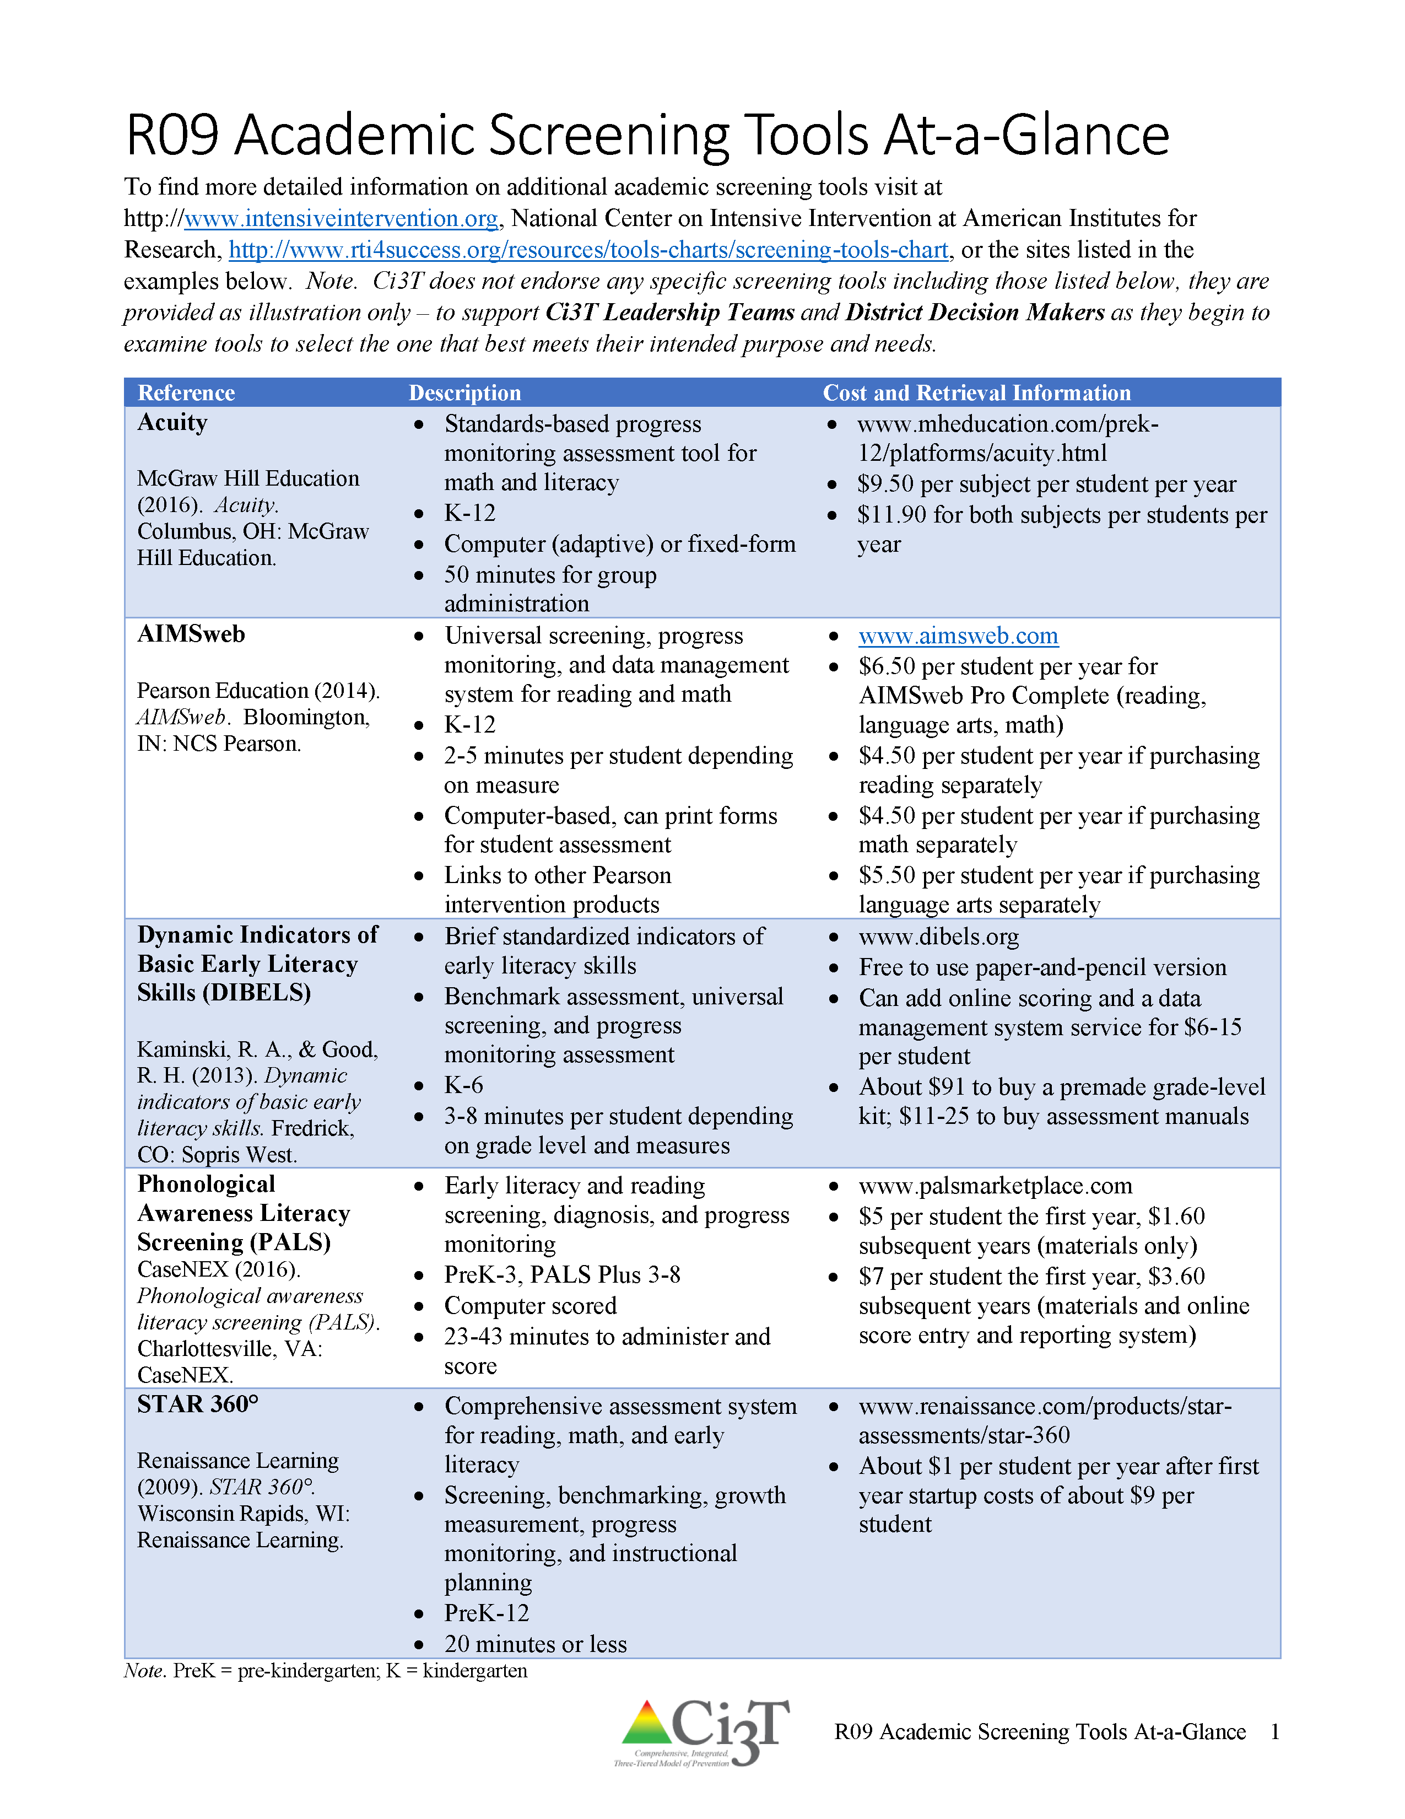
Selecting the best academic screening tool(s) for our school

Slide 42

Behavior Screening Tools

Slide 43
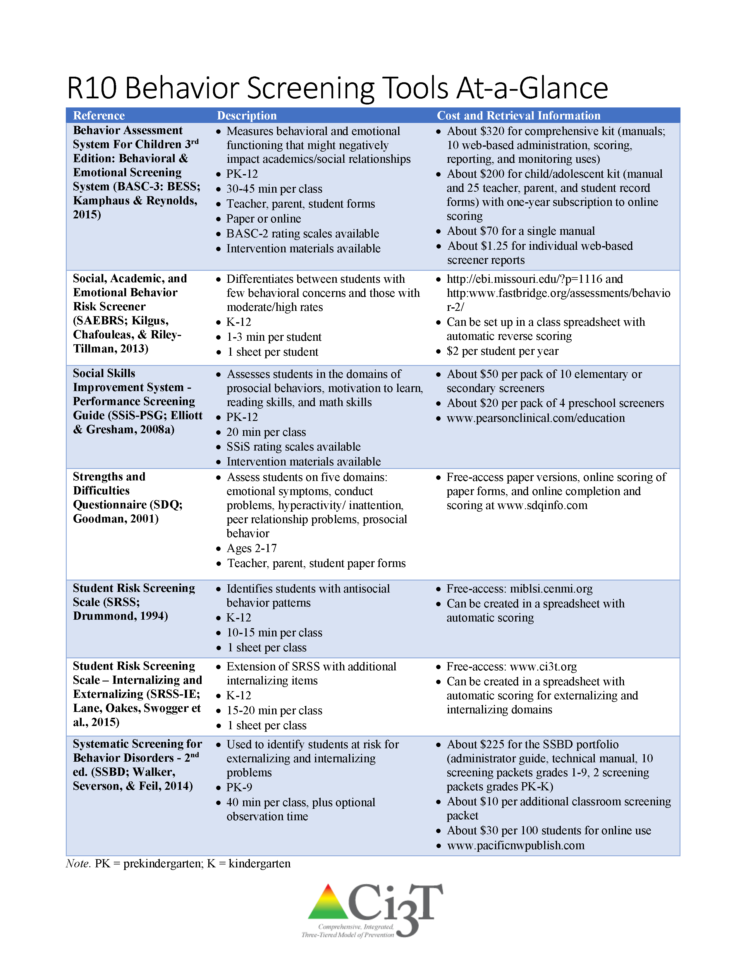
Selecting the best behavior screening tool for our school

Slide 44

How does our Ci3T model influence risk?

Slide 45

Systematic Screener for Behavior Disorders
Available from
Pacific Northwest Publishing
(SSBD 2nd ed.; Walker, Severson, & Feil, 2014)
Notes:
https://pacificnwpublish.com/products/SSBD-Online.html

Slide 46
SSBD Results – Winter 2007 through Winter 2009
Risk Status of Nominated Students
Externalizing
% computed based on total no. students screened
6.18%
3.50%
3.18%
8.90%
6.50%
2.73%
Source. Lane, Menzies, Oakes, & Kalberg, 2012. Figure 2.2 WES Elementary Systematic Screening for Behavior Disorders (SSBD; Walker & Severson, 1992) results comparing the percentage of students nominated and exceeding normative criteria for both externalizing and internalizing behavior disorders over a three year period.
Notes:
46

Slide 47
Sample Data – SSBD 2007-2011 Risk Status for Nominated Students Externalizing
Number of students
47
13
63
7
57
9
66
11
78
14
6.8%
2.61%
1.5%
2.17%
2.41%
Note. The numbers represent totals for the students for whom the SSBD was completed.

Slide 48
Sample Data – SSBD 2007-2011 Risk Status for Nominated Students Internalizing
Number of students
46
17
60
6
66
12
78
12
55
13
4.4%
2.78%
2.63%
2.24%
1.44%
Note. The numbers represent totals for the students for whom the SSBD was completed.

Slide 49
Sample Data: SSBD Winter 2009-2010
Critical Need Comparison By Grade Level
Grade Level | Total No. of Students Screened | Students Nominated | Students with Critical Need | Critical Internalizing | Critical Externalizing
K | 72 *5 | 24 | 4 (5.56%) | 1 (1.39%) | 3 (4.17%)
1st | 66 *9E / 8I | 24 | 1 (1.54%) | 0 (0.00%) | 1 (1.54%)
2nd | 60 *10 | 18 | 3 (5.00%) | 2 (3.33%) | 1 (1.67%)
* Students missing
Notes:
49

Slide 50
SSBD Data Over Time
Comparing Fall 2007 to Winter 2007
Percent
6.23%
(29)
5.17%
(24)
3.65%
(17)
1.29%
(6)
n = 465
n = 464
n = 465
n = 464
Source: Lane, K. L., Kalberg, J. R., Menzies, H., Bruhn, A., Eisner, S., & Crnobori, M. (2011). Using systematic screening data to assess risk and identify students for targeted supports: Illustrations across the K-12 continuum. Remedial and Special Education, 32, 39-54.
Notes:
50

Slide 51
Student Risk Screening Scale
Available from ci3t.org
(SRSS; Drummond, 1994)

Slide 52
Student Risk Screening Scale
(Drummond, 1994)
The SRSS is 7-item mass screener used to identify students who are at risk for antisocial behavior.
Uses 4-point Likert-type scale:
never = 0, occasionally = 1, sometimes = 2, frequently = 3
Teachers evaluate each student on the following items
  - Steal - Low Academic Achievement
  - Lie, Cheat, Sneak - Negative Attitude
  - Behavior Problems - Aggressive Behavior
  - Peer Rejection
Student Risk is divided into 3 categories
  Low 0 – 3
  Moderate 4 – 8
  High 9 - 21

Slide 53
Student Risk Screening Scale
(Drummond, 1994)

Slide 54
Student Risk Screening Scale
Fall 2004-2012 • Middle School
N=534
N=502
N=454
N=490
N=477
N=476
N=524
N=539
Lane, K. L., Oakes, W. P., & Magill, L. (2013). Primary prevention efforts: How do we implemented and monitor the Tier 1 component of our comprehensive, integrated, three-tiered (Ci3T) model? Preventing School Failure, 58(3), 143-158. https://doi.org/10.1080/1045988X.2014.893978

Slide 55
Sample Data: SRSS by Grade
Grade Level | No. of Students in Grade Level | Low (0-3) | Moderate (4-8) | High (9 +)
K | 99 | 73 (73.74%) | 16 (16.16%) | 10 (10.10%)
1st | 100 | 85 (85.00%) | 9 (9.00%) | 6 (6.00%)
2nd | 99 | 89 (89.90%) | 9 (9.09%) | 1 (1.01%)
Percentage refers to the percentage of the grade level population screened.

Slide 56
Middle School
Behavior & Academic Characteristics of SRSS Risk Groups
Variable |  | Risk
 | Low (n = 422) M (SD) | Moderate (n = 51) M (SD) | High (n = 12) M (SD) | Significance Testing
ODR | 1.50 (2.85) | 5.02 (5.32) | 8.42 (7.01) | L<M<H
In-School Suspensions | 0.08 (0.38) | 0.35 (1.04) | 1.71 (2.26) | L<M<H
GPA | 3.35 (0.52) | 2.63 (0.65) | 2.32 (0.59) | L>M, H M=H
Course Failures | 0.68 (1.50) | 2.78 (3.46) | 4.17 (3.49) | L<M, H M=H
(Lane, Parks, Kalberg, & Carter, 2007)

Slide 57
High School
Behavior & Academic Characteristics of SRSS Risk Groups (non-instructional raters)
Variable |  | Risk
 | Low (n = 328) M (SD) | Moderate (n = 52) M (SD) | High (n = 35) M (SD) | Significance Testing
ODR | 3.53 (5.53) | 8.27 (7.72) | 8.97 (9.39) | L < M, H M = H
GPA | 3.10 (0.82) | 2.45 (0.84) | 2.38 (0.88) | L > M, H M = H
(Lane, Kalberg, Parks, & Carter, 2008)

Slide 58
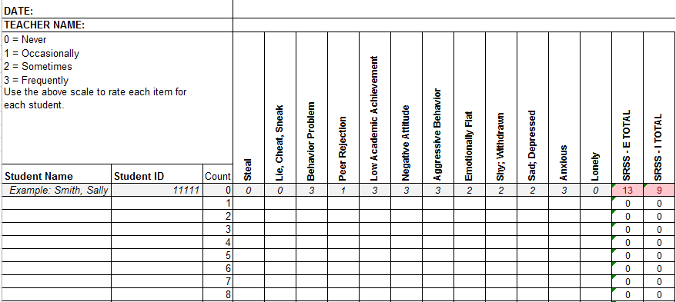
Student Risk Screening Scale for Internalizing and Externalizing
Available from ci3t.org
(SRSS-IE; Drummond, 1994
and Lane & Menzies, 2009)

Slide 59
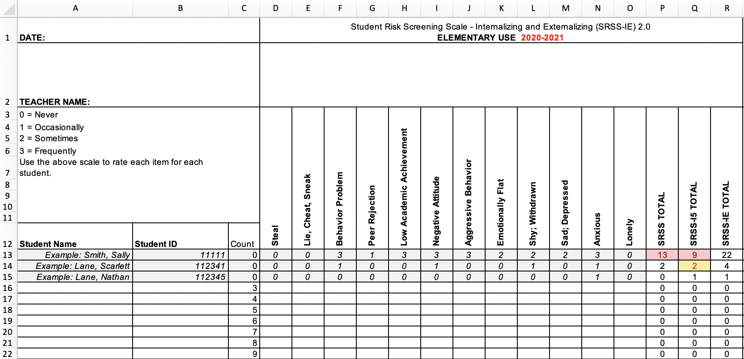
Student Risk Screening Scale – Internalizing and Externalizing (SRSS-IE; Drummond, 1994; Lane & Menzies, 2009)
Elementary

Slide 60
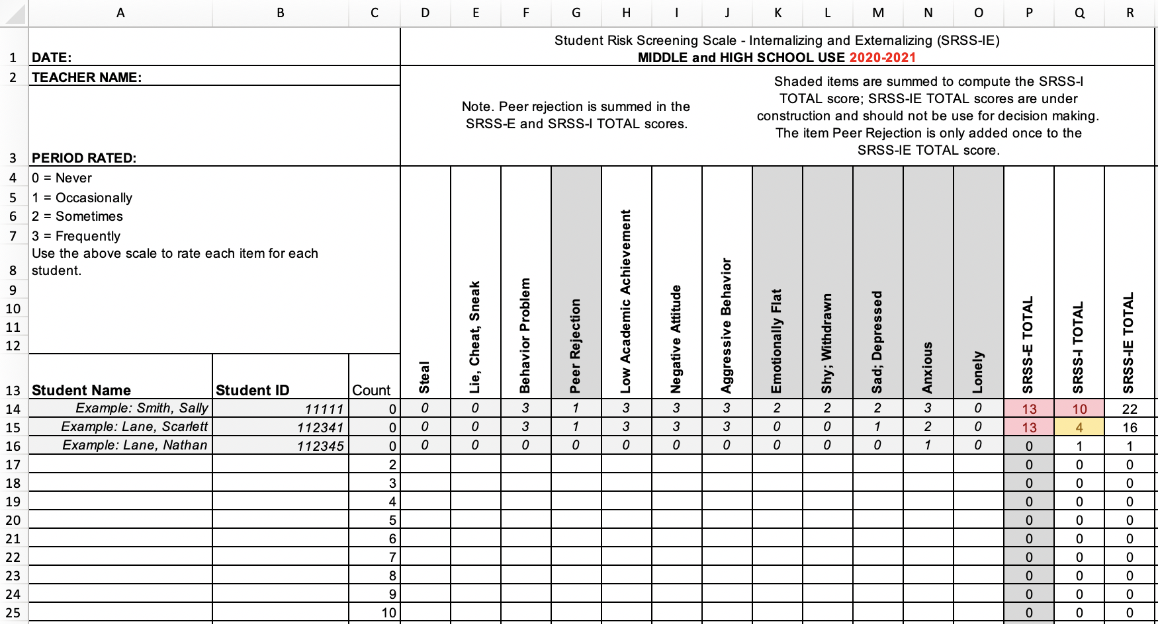
Student Risk Screening Scale – Internalizing and Externalizing (SRSS-IE; Drummond, 1994; Lane & Menzies, 2009)
Secondary

Slide 61
SRSS-IE: Cut Scores
Elementary School |  | Middle and High School
SRSS-E7 | SRSS-I5 | SRSS-E7 | SRSS-I6
Items 1-7 | Items 8-12 | Items 1-7 | Items 4, 8-12
0-3 = low risk 4-8 = moderate risk 9-21 = high risk | 0-1 = low risk 2-3 = moderate risk 4-15 = high risk | 0-3 = low risk 4-8 = moderate risk 9-21 = high risk | 0-3 = low risk 4-5 = moderate risk 6-18 = high risk
Elementary School Level:
Lane, K. L., Oakes, W. P., Swogger, E. D., Schatschneider, C., Menzies, H., M., & Sanchez, J. (2015). Student risk screening scale for internalizing and externalizing behaviors: Preliminary cut scores to support data-informed decision making. Behavioral Disorders, 40, 159-170.
Middle and High School Levels:
Lane, K. L., Oakes, W. P., Cantwell, E. D., Schatschneider, C., Menzies, H., Crittenden, M., & Messenger, M. (2016). Student Risk Screening Scale for Internalizing and Externalizing Behaviors: Preliminary cut scores to support data-informed decision making in middle and high schools. Behavioral Disorders, 42(1), 271-284

Slide 62
Sample Elementary School
SRSS-IE Externalizing Results: School Level
n = 44
n = 43
n = 47
n = 27
n = 36
n = 29
n = 6
n = 17
n = 22
n = 118
n = 100
n = 85
n = 94
n = 86
n = 83
n = 30
n = 69
n = 61
n = 283
n = 276
n = 335
n = 329
n = 306
n = 293
n = 333
n = 346
n = 352
Notes:
Note:
Hide and/or unhide various school-level slides to feature relevant data (e.g., focus on elementary, hide middle and high school slides).
You can update this slide with data from your school or district by right-clicking and selecting “Edit data in Excel”

Slide 63
Sample Elementary School
SRSS-IE Internalizing Results: School Level
n = 59
n = 62
n = 39
n = 39
n = 31
n = 18
n = 13
n = 32
n = 23
n = 82
n = 65
n = 67
n = 73
n = 46
n = 47
n = 35
n = 62
n = 69
n = 304
n = 292
n = 361
n = 338
n = 351
n = 340
n = 321
n = 338
n = 343
Cut scores vary by school level:
Elementary (I5): Low (0-1), Moderate (2-3), High (4-15)
Middle and High (I6): Low (0-3), Moderate (4-5), High (6-18)
Notes:
IMPORTANT NOTE: The INTERNALIZING subscale and CUT SCORES are specific to school level.
Elementary: SRSS-I5, Items 8-12, 0-1 = low risk, 2-3 = moderate risk, 4-15 = high risk
Middle and High: SRSS-I6, Items 4, 8-12, 0-3 = low risk, 4-5 = moderate risk, 6-18 = high risk

Slide 64
Sample Elementary School Fall 2022
SRSS-IE Internalizing Results: Grade Level
Grade Level | N Screened | Low n (%) | Moderate n (%) | High n (%)
K | 64 | 52 (81.3%) | 7 (10.9%) | 5 (7.8%)
1 | 81 | 69 (85.2%) | 9 (11.1%) | 3 (3.7%)
2 | 56 | 44 (78.6%) | 11 (19.6%) | 1 (1.8%)

Slide 65
Sample High School
SRSS-IE Externalizing Results: School Level
n = 29
n = 39
n = 23
n = 25
n = 30
n = 13
n = 26
n = 38
n = 96
n = 95
n = 90
n = 82
n = 69
n = 55
n = 95
n = 129
n = 1072
n = 1404
n = 1339
n = 1222
n = 692
n = 1119
n = 1270
n = 1242

Slide 66
Sample High School
SRSS-IE Internalizing Results: School Level
n = 112
n = 87
n = 76
n = 62
n = 63
n = 70
n = 78
n = 91
n = 64
n = 56
n = 42
n = 38
n = 41
n = 66
n = 106
n = 124
n = 961
n = 1387
n = 1320
n = 1225
n = 690
n = 1076
n = 1247
n = 1212
Cut scores vary by school level:
Elementary (I5): Low (0-1), Moderate (2-3), High (4-15)
Middle and High (I6): Low (0-3), Moderate (4-5), High (6-18)
Notes:
IMPORTANT NOTE: The INTERNALIZING subscale and CUT SCORES are specific to school level.
Elementary: SRSS-I5, Items 8-12, 0-1 = low risk, 2-3 = moderate risk, 4-15 = high risk
Middle and High: SRSS-I6, Items 4, 8-12, 0-3 = low risk, 4-5 = moderate risk, 6-18 = high risk

Slide 67
Sample High School Fall 2016
SRSS-IE Externalizing Results: Grade Level
Grade Level | N Screened | Low n (%) | Moderate n (%) | High n (%)
9 | 397 | 353 (88.9%) | 24 (6.1%) | 20 (5.0%)
10 | 428 | 388 (90.7%) | 14 (3.3%) | 26 (6.1%)
11 | 396 | 353 (89.1%) | 16 (4.0%) | 27 (6.8%)
12 | 317 | 293 (92.4%) | 10 (3.2%) | 14 (4.4%)

Slide 68
Strengths and Difficulties Questionnaire
Available from sdqinfo.org
(SDQ; Goodman, 1997)

Slide 69
SDQ: Screening Results by Domain
Elementary School Winter 2009
Percent of Students
Subscale
Source: Adapted from Figure 5.2, p. 162 in Lane, K. L., Menzies, H. M., Oakes, W. P., & Kalberg, J. R. (2012). Systematic screenings of behavior to support instruction: From preschool to high school. Guilford.

Slide 70
SDQ Results: 2nd Grade Student
Domain | No. of Students Screened | Normal | Borderline | Abnormal
Total Difficulties | N=77 *6 | n=40 (51.95%) | n=12 (15.58%) | n=25 (32.47%)
Emotional Symptoms | N=78 *5 | n=64 (82.05%) | n=3 (3.85%) | n=11 (14.10%)
Conduct Problems | N=78 *5 | n=37 (47.44%) | n=7 (8.97%) | n=34 (43.59%)
Hyperactivity | N=78 *5 | n=51 (65.38%) | n=5 (6.41%) | n=22 (28.21%)
Peer Problems | N=77 *6 | n=54 (70.13%) | n=11 (14.29%) | n=12 (15.58%)
Prosocial Behavior | N=78 *5 | n=64 (82.05%) | n=3 (3.85%) | n=11 (14.10%)
* = number of students not rated (or missing items)
Notes:
70

Slide 71
BASC³ Behavioral and Emotional Screening Scale©
Available from Pearson Education, PsychCorpTM
(BASC³ BESS;
Kamphaus & Reynolds, 2015)
Copyright NCS Pearson, 2007
Notes:
http://www.pearsonclinical.com/education/products/100001482/basc3-behavioral-and-emotional-screening-system--basc-3-bess.html

Slide 72
BASC² – Behavior and Emotional Screening Scale Spring 2012
N = 24
N = 67
N = 533
N = 624 n = 219 n = 202 n = 203
Lane, K. L., Oakes, W. P., Common, E. A., Brunsting, N., Zorigian, K., Hicks, T., & Lane, N. A. (2019). A comparison between SRSS-IE and BASC-2 BESS scores at the middle school level. Behavioral Disorders, 44(3), 162-174.

Slide 73
Social Skills Improvement System – Performance Screening Guide
Available from Pearson Education, PsychCorpTM
(SSiS-PSG; Elliott & Gresham, 2007)

Slide 74
Social Skills Improvement System – Performance Screening Guide
Spring 2012 – Total School
N = 54
N = 22
N = 35
N = 31
N = 223
N = 233
N = 180
N = 187
N = 212
N = 235
N = 275
N = 271
n = 489 n = 490 n = 490 n = 489
Lane, K. L., Oakes, W. P., & Magill, L. (2014). Primary prevention efforts: How do we implement and monitor the tier 1 component of our comprehensive, integrated, three-tiered (CI3T) model? Preventing School Failure: Alternative Education for Children and Youth, 58(3), 143-158.

Slide 75
Social, Academic, and Emotional Behavior Risk Screener
Available from Fastbridge Learning
(SAEBRS; Kilgus, Chafouleas, & Riley-Tillman, 2013)

Slide 76
Sample Data: SAEBRS
Large Urban Elementary
Note. Percentage of students by risk category on the total scale and each subscale. Developers found the two-step approach to subscale interpretation is the most defensible. Source: Kilgus, S. P., von der Embse, N. P., Allen, A. N., Taylor, C. N., & Eklund, K. (2018). Examining SAEBRS technical adequacy and the moderating influence of criterion type on cut score performance. Remedial and Special Education, 39, 377-388. doi:10.1177/0741932517748421

Slide 77
Sample Data: SAEBRS
Large Urban Elementary - Fall
Kilgus, S. P., von der Embse, N. P., Allen, A. N., Taylor, C. N., & Eklund, K. (2018). Examining SAEBRS technical adequacy and the moderating influence of criterion type on cut score performance. Remedial and Special Education, 39, 377-388. doi:10.1177/0741932517748421

Slide 78


Resource 10:
Behavior Screening Tools At-a-Glance

Slide 79
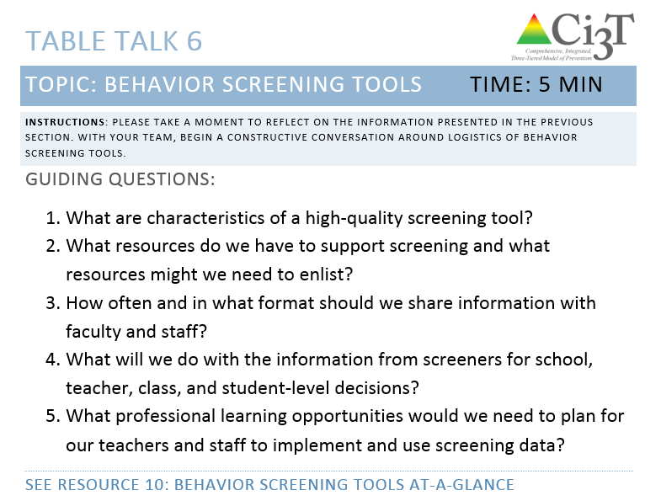
Use Resource 10
Table Talk 6
Behavior Screening Tools
5 minutes
Notes:
5 min

Slide 80
How do we monitor implementation, stakeholders’ views, and student performance?
Establishing procedures for monitoring

Slide 81


Begin drafting Procedures for Monitoring
Ci3T Blueprint A Primary (Tier 1) Plan
10 minutes

Slide 82
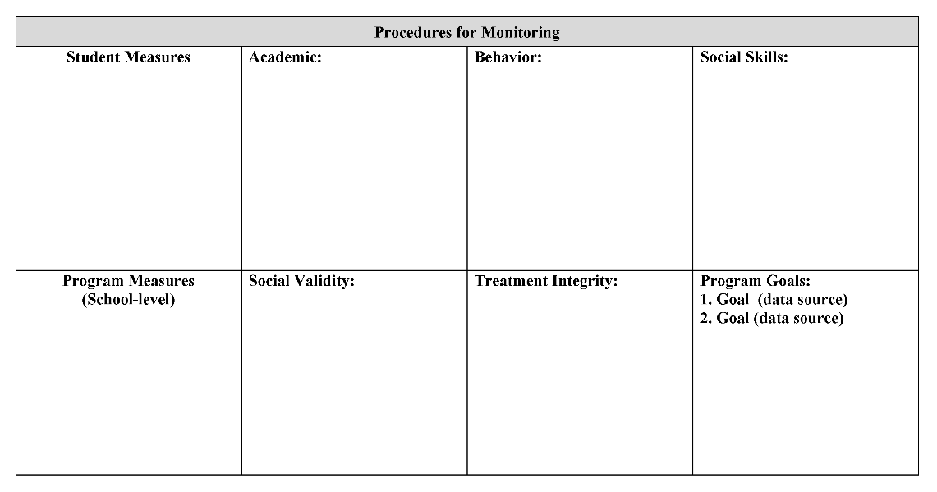

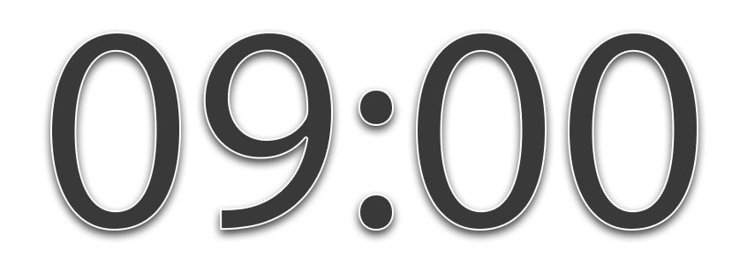
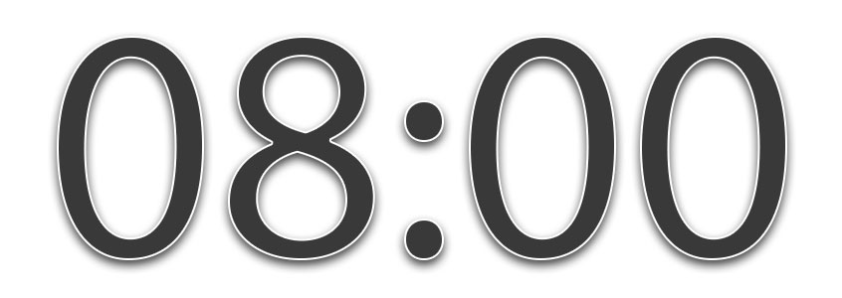
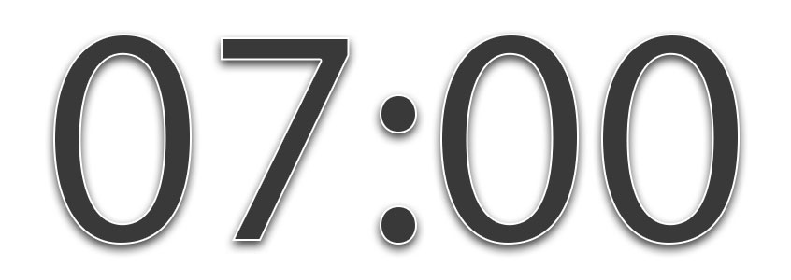

Begin drafting Procedures for Monitoring
Ci3T Blueprint A Primary (Tier 1) Plan
10 minutes
Notes:
10 min

Slide 83

Draft
Ci3T Blueprint D Assessment Schedule
10 minutes

Slide 84
Draft
Ci3T Blueprint D Assessment Schedule
10 minutes
Notes:
10 min

Slide 85

Monitoring video
Notes:
ci3t.org/building
or https://youtu.be/hCL_Pwy5ReU

Slide 86

Where do we go from here?
Setting goals for Session 4

Slide 87
Comprehensive, Integrated, Three-Tiered (Ci3T) Model of Prevention Professional Learning Series
Each school has selected a Ci3T Leadership Team to attend Ci3T training this year. Only team members are asked to attend the trainings.
Ci3T Professional Learning Series Traditional Timeline
1: Two-Hour
After School
4: Full Day
2: Full Day
3: Two-Hour
After School *With Students
6: Full Day
5: Two-Hour
After School
*With Students
November
December
January
February
April
May

Slide 89

Please Take a Minute to Get Organized
Please stay until all materials are organized
Place all materials in your table box:
  Name badges
  Role magnets
  Table cards (CASEL, What Works Clearinghouse)
  Extra postcards (take some with you!)
  Clearly identify the technology person on your team in charge of keeping Dropbox / Google Drive organized (move old versions into Previous folder)
    Consider saving docs with your school initials at the beginning and the date at the end of the file name
    Example: P_LES_Ci3T Blueprint A Primary (Tier 1) Plan_2027 01 13

Slide 90
Wrap Up and Preview
Today’s Review
Next Session Preview
Examine how to evaluate your Ci3T model of prevention
Examine screening tools
Draft procedures for monitoring: Ci3T Blueprint A Primary (Tier 1) Plan
Draft Ci3T Blueprint D Assessment Schedule
Examine how the program is influencing risk using academic and behavioral systematic screening tools
Finalize Ci3T Blueprint D Assessment Schedule
Finalize procedures for monitoring: Ci3T Blueprint A Primary (Tier 1) Plan
Final revisions to the full draft of Ci3T Blueprint A Primary (Tier 1) Plan
Create a presentation for faculty and staff
Tier 2 intervention planning

Slide 91

Homework
At your next faculty meeting:
  Introduce Procedures for Monitoring in Ci3T Blueprint A Primary (Tier 1) Plan
  Share chosen screener
At your next Ci3T Leadership Team meeting:
  Revise and polish Ci3T Blueprint D Assessment Schedule
  Plan for professional development for screenings for faculty
    R04 Ci3T Professional Learning Plan

