Slide 1
Building Primary (Tier 1) Prevention Efforts:
Teaching and Reinforcing
Ci3T Professional Learning Series Session 2

Slide 2
Agenda
Welcome!
How did your faculty and staff respond to the Ci3T Overview? Sharing faculty and staff feedback
What do we expect from our students and how do we facilitate their success?
  Establishing roles and responsibilities for academic, behavior, and social domains
  Establishing expectations: Ci3T Blueprint C Expectation Matrix
How can we support implementation of Tier 1 roles and responsibilities in academic, behavioral, and social domains? Establishing procedures for teaching: Ci3T Blueprint A Primary (Tier 1) Plan
How do we reinforce stakeholders for implementing the Ci3T Blueprint? Establishing procedures for reinforcing: Ci3T Blueprint A Primary (Tier 1) Plan
Where do we go from here? Setting goals for Session 3 (student Ci3T Leadership Team members attend!)

Slide 3
Agenda
Conversation Closer
Table Talk Note Taker
R04 PL Plan Note Taker
Task Divider
Technology Wrangler
Please take a moment to assign team roles:
Welcome!
How did your faculty and staff respond to the Ci3T Overview? Sharing faculty and staff feedback
What do we expect from our students and how do we facilitate their success?
  Establishing roles and responsibilities for academic, behavior, and social domains
  Establishing expectations: Ci3T Blueprint C Expectation Matrix
How can we support implementation of Tier 1 roles and responsibilities in academic, behavioral, and social domains? Establishing procedures for teaching: Ci3T Blueprint A Primary (Tier 1) Plan
How do we reinforce stakeholders for implementing the Ci3T Blueprint? Establishing procedures for reinforcing: Ci3T Blueprint A Primary (Tier 1) Plan
Where do we go from here? Setting goals for Session 3 (student Ci3T Leadership Team members attend!)

Slide 4
Review and Preview
Last Session Review
Today’s Preview
Gained an understanding of comprehensive, integrated, three-tiered models of prevention
Began to design Ci3T Blueprint A Primary
(Tier 1) Plan
Examined current concerns and teacher expectations
Reviewed Ci3T Professional Learning Series
Schoolwide expectations: academic, behavior, and social skills
Ci3T scheduling for core instruction
Procedures for teaching primary (Tier 1) plans
Procedures for reinforcing primary (Tier 1) plans
Wisdom from currently implementing schools

Slide 5
Homework … Last Time We Met
At your next faculty and staff meeting:
  Show narrated slide show Introductory Overview of the Ci3T Model of Prevention to faculty and staff to explain the three-tiered model
At your next Ci3T Leadership Team meeting:
  Finalize mission and purpose statements on the
  Ci3T Blueprint A Primary (Tier 1) Plan
  Put a copy of your school’s reactive plan in your training binder and upload it to your school-site folder for the next training

Slide 6


How did your faculty and staff respond to the Ci3T Overview?
Revisit
Table Talk 1
Sharing Faculty Feedback Questions, Comments, and Concerns

Slide 8
Core features of the Ci3T model of prevention
Academic
Behavior
Social

Slide 9


Academic Component
Coordinated instruction within and across grade levels
Instruction linked to College and Career-Ready Standards, early learning standards, state, or district standards
Benchmarking student progress to inform instruction
Progress monitoring for students identified for secondary (Tier 2) and tertiary (Tier 3) supports
Source: Lane, K.L., Oakes, W.P., & Menzies, H.M. (2014). Comprehensive, integrated, three-tiered models of prevention: Why does my school—and district—need an integrated approach to meet students’ academic, behavioral, and social needs? Preventing School Failure: Alternative Education for Children and Youth, 58, 121-128.

Slide 10
Behavioral Component:
Positive Behavioral Interventions and Supports (PBIS)
A Framework, Not a Curriculum
Establish, clarify, and define expectations
Teach all students the expectations, planned and implemented by all adults
Give opportunities to practice
Reinforce students consistently, facilitate success
Consider rules, routines, and physical arrangements
Monitor the plan using school-wide data to identify students who need more support
Monitor student progress
Source: Horner, R.H., & Sugai, G. (2015). School-wide PBIS: An example of applied behavior analysis implemented at a scale of social importance. Behavior Analysis in Practice, 8, 80-85.

Slide 11
Social Component:
Identifying a Validated Curriculum
Violence Prevention
  Second Step Violence Prevention (cfchildren.org)
Character Education
  Positive Action (positiveaction.net)
  Caring School Community (characterplus.org)
Social Skills
  Social Skills Improvement System: Classwide Intervention Program (Elliott & Gresham, 2007)
Source: Elliott, S. N., & Gresham, F. M. (2007). Social Skills Improvement System: Classwide intervention program teacher’s guide. Bloomington, MN: Pearson Assessments.

Slide 12













How did your faculty and staff respond to the Ci3T Overview?
Share faculty feedback questions, comments, and concerns
Talk Time
10 minutes
Notes:
10 min

Slide 13

What do we expect from our students and how do we facilitate their success?
Determining Roles and Responsibilities for Academic, Behavior, and Social Domains

Slide 14
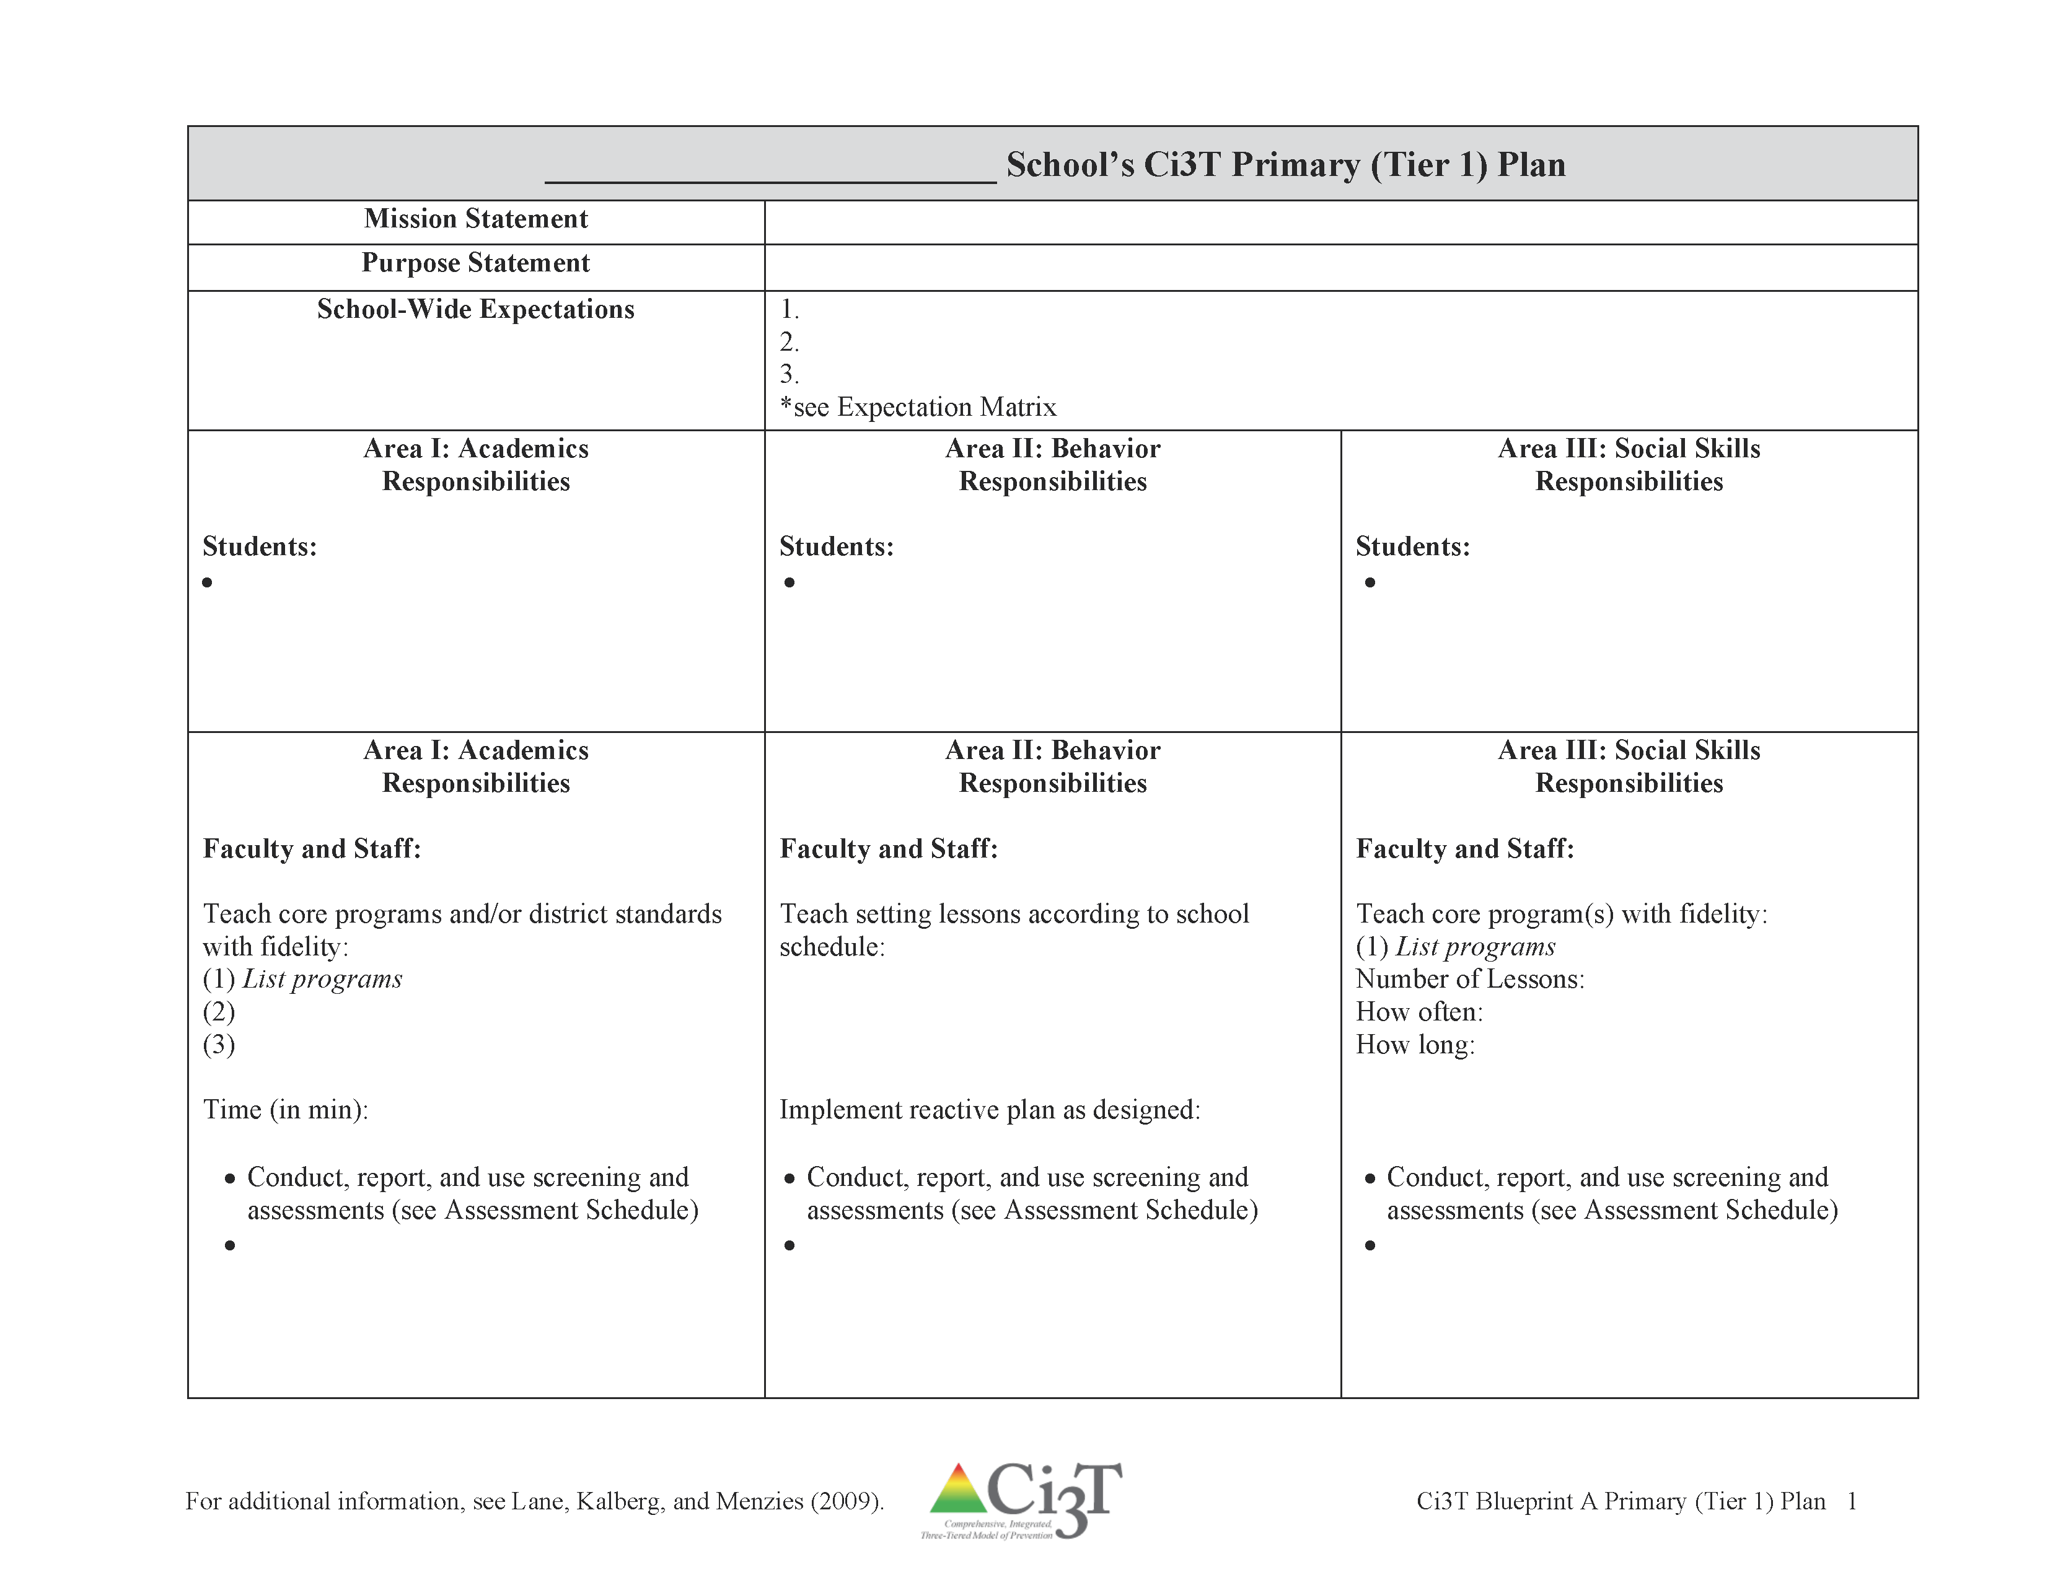
Ci3T Blueprint A Primary (Tier 1) Plan

Slide 15

What do we expect as a school from our students academically?

Slide 16



Academic Component
How?
Why?
Academic expectations should be stated clearly and enforced consistently
Expectations foster an environment which sets the stage for productive academic time
Academic engagement is related to lower levels of problem behavior
Consider procedures:
  High traffic areas
  Praise / corrective statement ratio
  Starting activities
  Closing activities
Academic performance
Teacher Behavior
Student Behavior
Skinner, E. A., & Belmont, M. J. (1993). Motivation in the classroom: reciprocal effect of teacher behavior and student engagement across the school year. Journal of Educational Psychology, 85, 571e581. http://dx.doi.org/10.1037/0022- 0663.85.4.571; Wang, M., & Eccles, J. S. (2013). School context, achievement motivation, and academic engagement: A longitudinal study of school engagement using a multidimensional perspective. Learning and Instruction, 28, 12-23.
Notes:
Academic performance influences student behavior
Teachers’ behavior will reflect students’ behavior

Slide 17
Defining Tier 1 Strategies, Practices and Programs: Curriculum Selection Process
Evidence-based core curricula
Taught with fidelity to all students
Goal: at least 80% of students at benchmark
Sources for further support in selection:
  http://www.centeroninstruction.org/reviewing-a-reading-program-professional-development-module
Notes:
This two-day professional development module based on the Florida Center for Reading Research's "Guidelines for Reviewing a Reading Program" is designed to guide reviewers of reading programs through the review process to determine if a program is consistent with the scientific research on reading.

Slide 18

Critical Features of Instruction
Evidence-based practices
Differentiated
Explicit
Systematic
Scaffolded
Practice opportunities with instructive feedback
Butler, D. L., & Winne, P. H. (1995). Feedback and self-regulated learning: A theoretical synthesis. Review of Educational Research, 65(3), 245-281.
Cook, B. G., & Odom, S. L. (2013). Evidence-based practices and implementation science in special education. Exceptional Children, 79(2), 135-144.
Lane, K. L., Menzies, H. M., Ennis, R. P., & Oakes, W. P. (2015). Supporting behavior for school success: A step-by-step guide to key strategies. New York, NY: Guildford Press

Slide 19

College and Career Ready Standards
Purpose: have fewer, clearly articulated, more rigorous standards based on current educational research evidence
Benchmarked to high performing countries
Emphasize:
  conceptual understanding
  skill and fluency
  problem solving
  intensive application of content
Council of Chief State School Officers & the National Governors Association Center for Best Practices (2011). Common Core State Standards Initiative. Washington, DC: Author.
Notes:
To ensure students are globally competitive, the standards have been benchmarked to high performing countries
Designed to help teachers and students understand the expectations for college and workforce readiness

Slide 20

How is student academic growth evaluated?
Academic
Behavior
Social
Universal screening and benchmarks
Formative and summative assessment
School improvement goals
District goals
Basic common goals
  Grade point average (GPA)
  Course grades; pass/fail
  End of course (EOC)
  State achievement tests
  Advanced placement (AP) scores

Slide 21

How are schools’ academic growth evaluated?
Academic
Behavior
Social
Closing achievement gap
State achievement test scores
Discipline incidents
Attendance rates
Graduation rates
Teacher evaluations

Slide 22


Academic Expectations
Consider:
Formative assessment standards
District standards and goals for improvement
Teacher input to identify academic expectations
Identify your academic goals
Table Talk 2: Goals

Slide 23
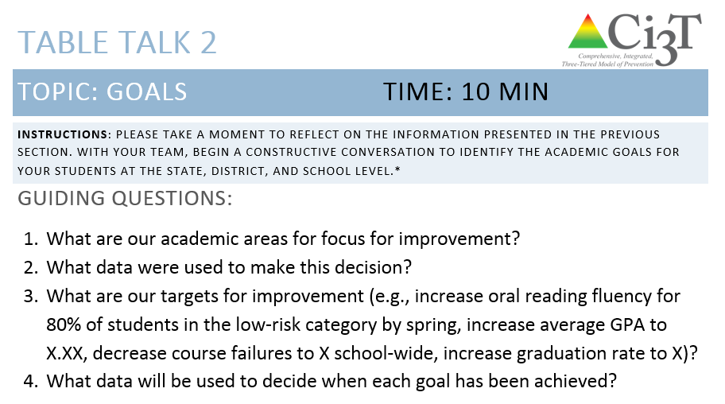
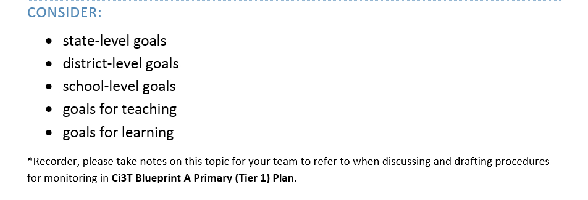
Table Talk 2 Goals
10 minutes
Notes:
10 min

Slide 24

Sufficient Time for Instruction: Scheduling for Success

Slide 25
Core (Tier 1) Academic Instruction Elementary
Reading Instruction
Mathematics Instruction
90 minutes
ALL students
Uninterrupted
Recommended: 50-60 minutes
ALL students
May be split
Hilt-Panahon, A., & Gischlar, K. L., Implementing RTI: Developing Effective Schedules at the Elementary Level. A webinar presented by the National Center on Response to Intervention. Washington, DC: U.S. Department of Education, Office of Special Education Programs, National Center on Response to Intervention. http://www.rti4success.org/video/rti-implementation-developing-effective-schedules-elementary-level
National Center on Response to Intervention (July 2011). RTI scheduling processes for middle schools. Washington, DC: U.S. Department of Education, Office of Special Education Programs, National Center on Response to Intervention. Retrieved from http://www.rti4success.org/video/rti-scheduling-processes-middle-schools

Slide 26
Scheduling for Core (Tier 1) Instruction
Start with non-negotiable times
Itinerant/shared teachers’ schedule
Core reading and math instruction
Intervention
Lunch
Resources for tiered instructional groups

Slide 27
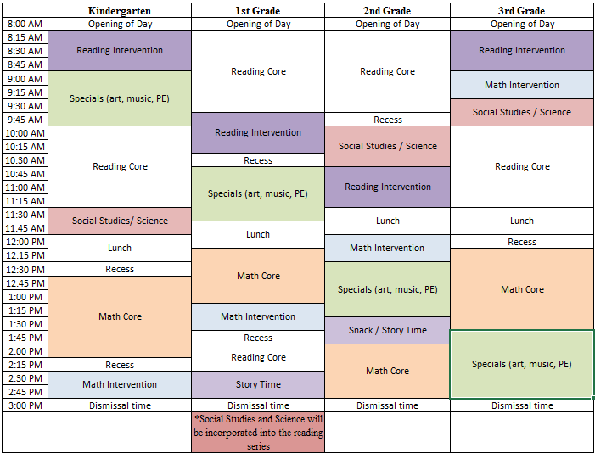
Blocking Out an Intervention Schedule K-3 (example)
See R02: Sample Schedule

Slide 28

Considerations for Scheduling
Common collaboration time
Minimize transitions
Availability of specialists
Recommended time allocations for core instruction
Harlacher, J. E., Sanford, A., & Walker, N. N. (n.d.). Distinguishing between tier 2 and tier 3 introduction in order to support implementation of RTI. National Center for Learning Difficulties. http://www.rtinetwork.org/essential/tieredinstruction/tier3/distinguishing-between-tier-2-and-tier-3-instruction-in-order-to-support-implementation-of-rti

Slide 29
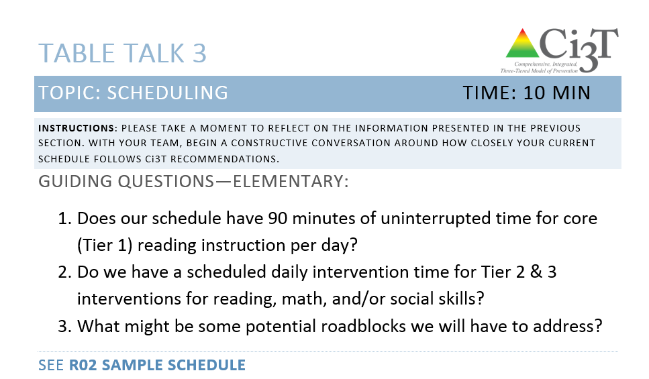

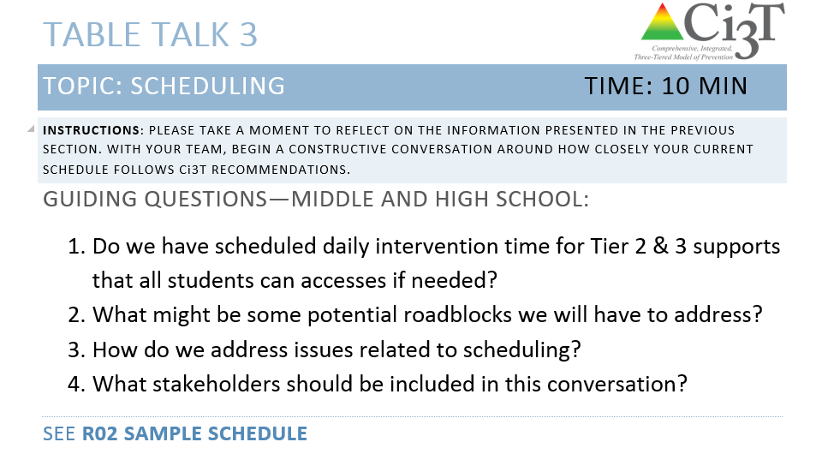
Table Talk 3:
Scheduling
10 minutes
Use R02 Sample Schedule
Notes:
10 min

Slide 30

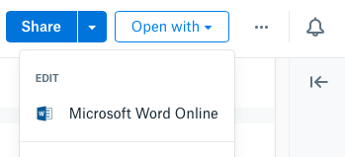
Open your school’s folder on dropbox.com
Open the “Ci3T Blueprint Materials” folder
Make a copy of Ci3T Blueprint A Primary (Tier 1) Plan and rename to add the date to the end of the file name
Click the new file to start a preview
Click “Open with” in the top right, then Microsoft Word Online, which allows multiple people to edit together
Notes:
Use the “Hide Slide” feature to hide the file sharing system not being used. Do not delete the slide. Hiding the slide will preserve correspondence to the pacing guide slide numbers.

Slide 31

Open your school’s Google Drive folder online
Open the “Ci3T Blueprint Materials” folder
Find Ci3T Blueprint A Primary (Tier 1) Plan
Right-click and select “Rename”
  Update the end of the file name to today’s date
  Add your school initials in the front
and/or open the doc and click File > Version history > Name current version and type today’s date
Ex: P_LES Ci3T-Blueprint-A-Primary-Tier-1-Plan 2026 12 12
Notes:
Use the “Hide Slide” feature to hide the file sharing system not being used. Do not delete the slide. Hiding the slide will preserve correspondence to the pacing guide slide numbers.

Slide 32
Ci3T Blueprint A Primary (Tier 1) Plan
What are ALL students accessing?

Slide 33

What are the responsibilities of students, faculty and staff, parents, and administrators in achieving academic performance expectations?

Slide 34
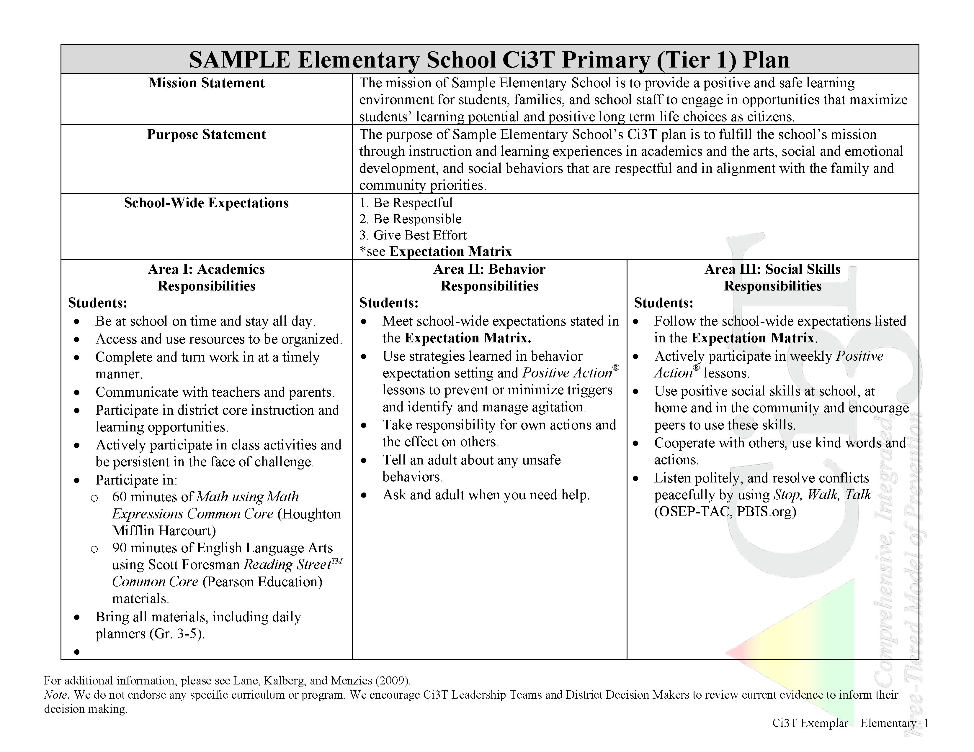

Slide 35
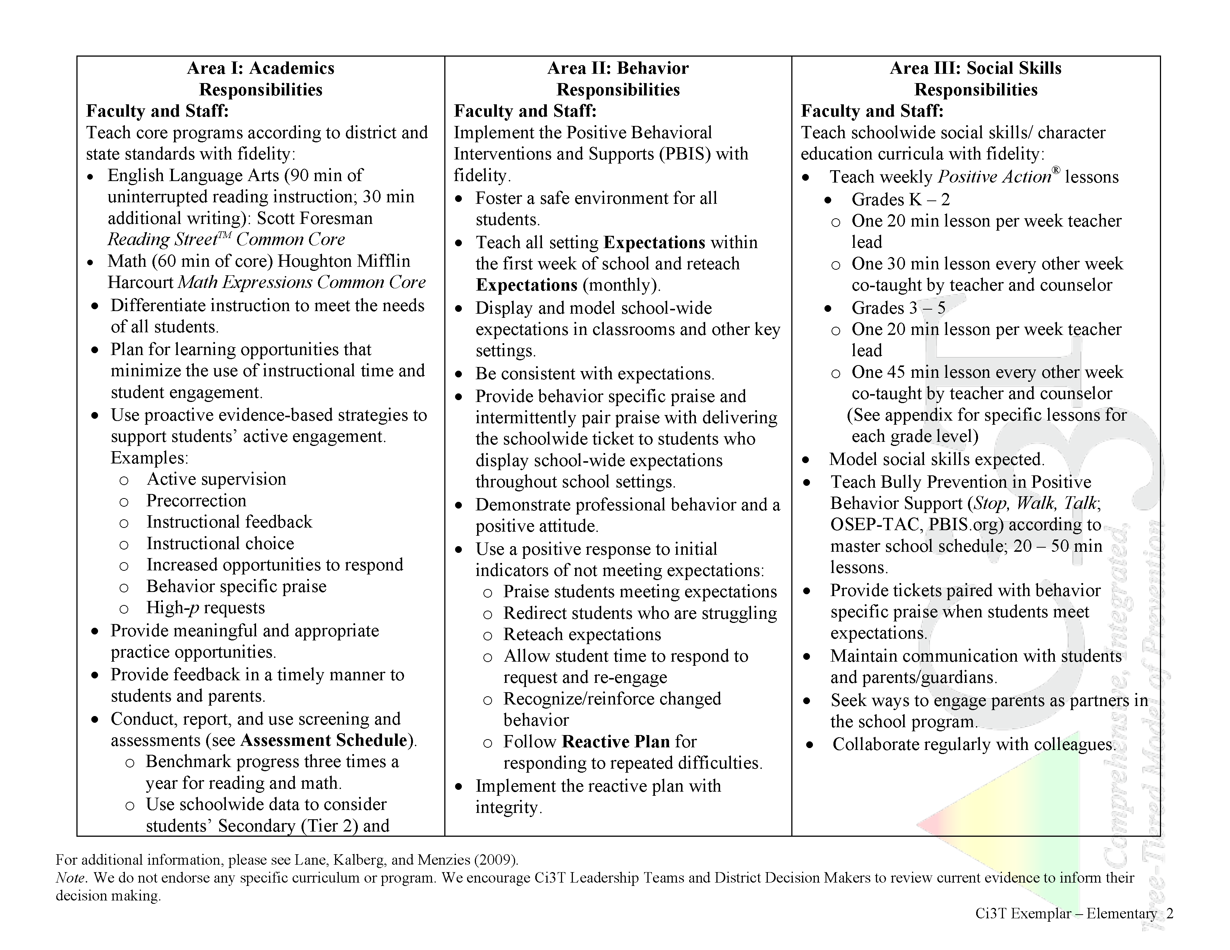
List your core academic programs here
List your schoolwide schedule for expected core (primary, Tier 1) instruction here
Expectations for screening, progress monitoring, and assessment

Slide 36
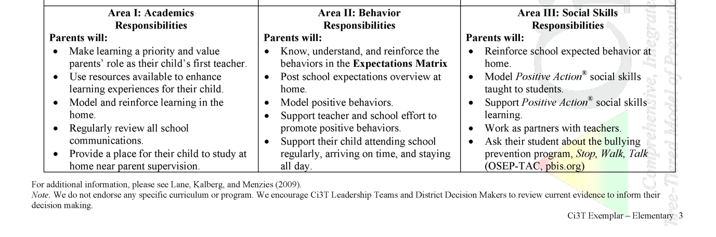
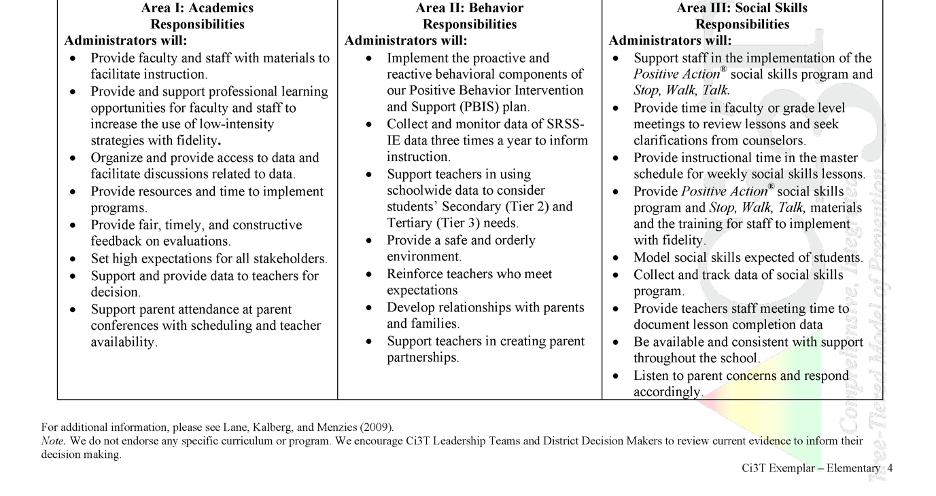

Slide 37
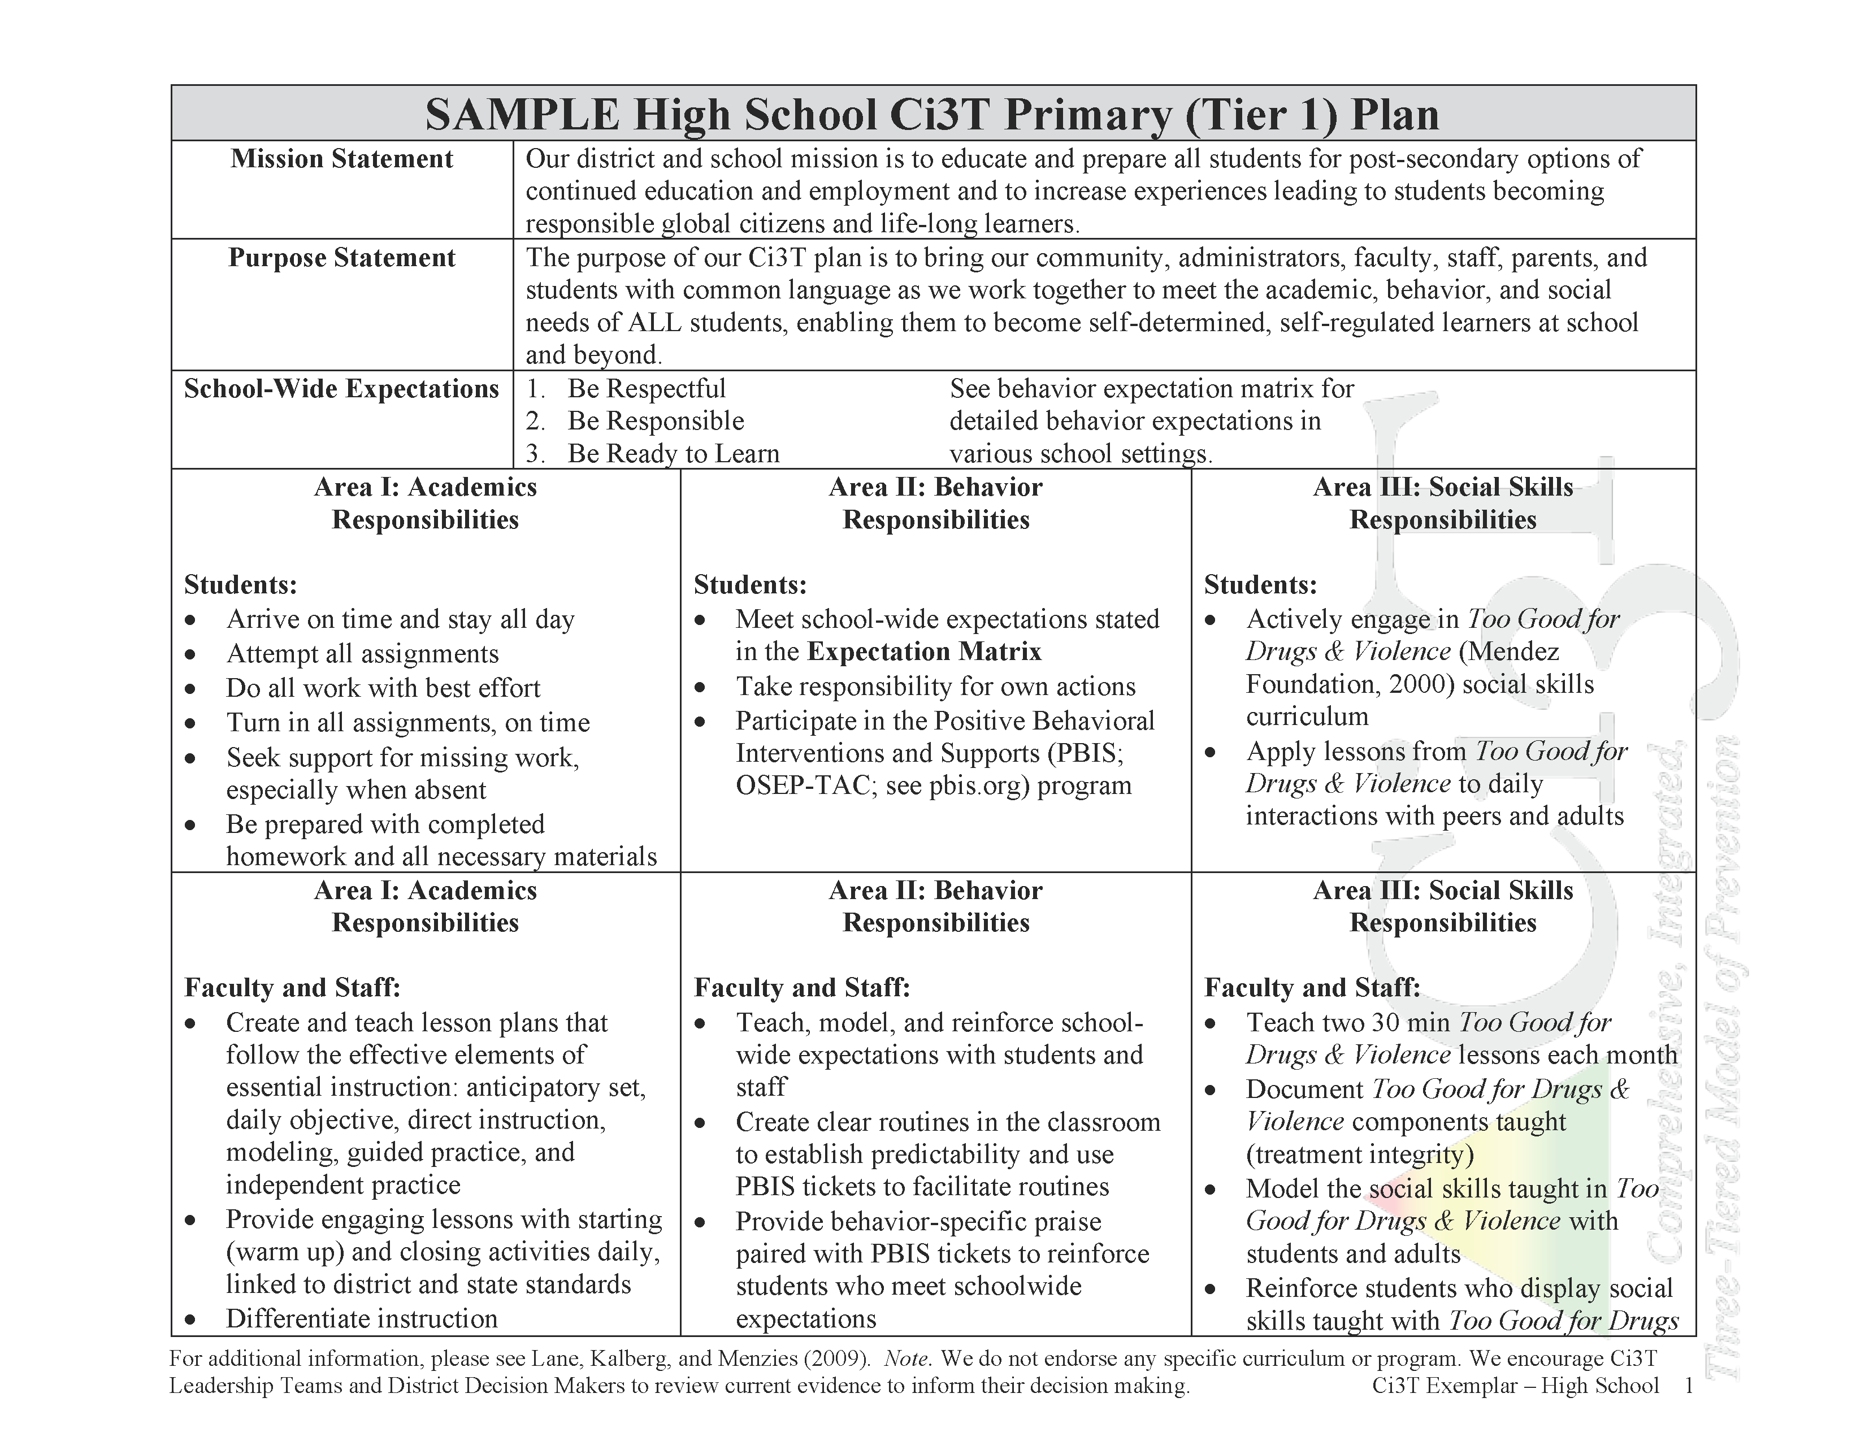

Slide 38
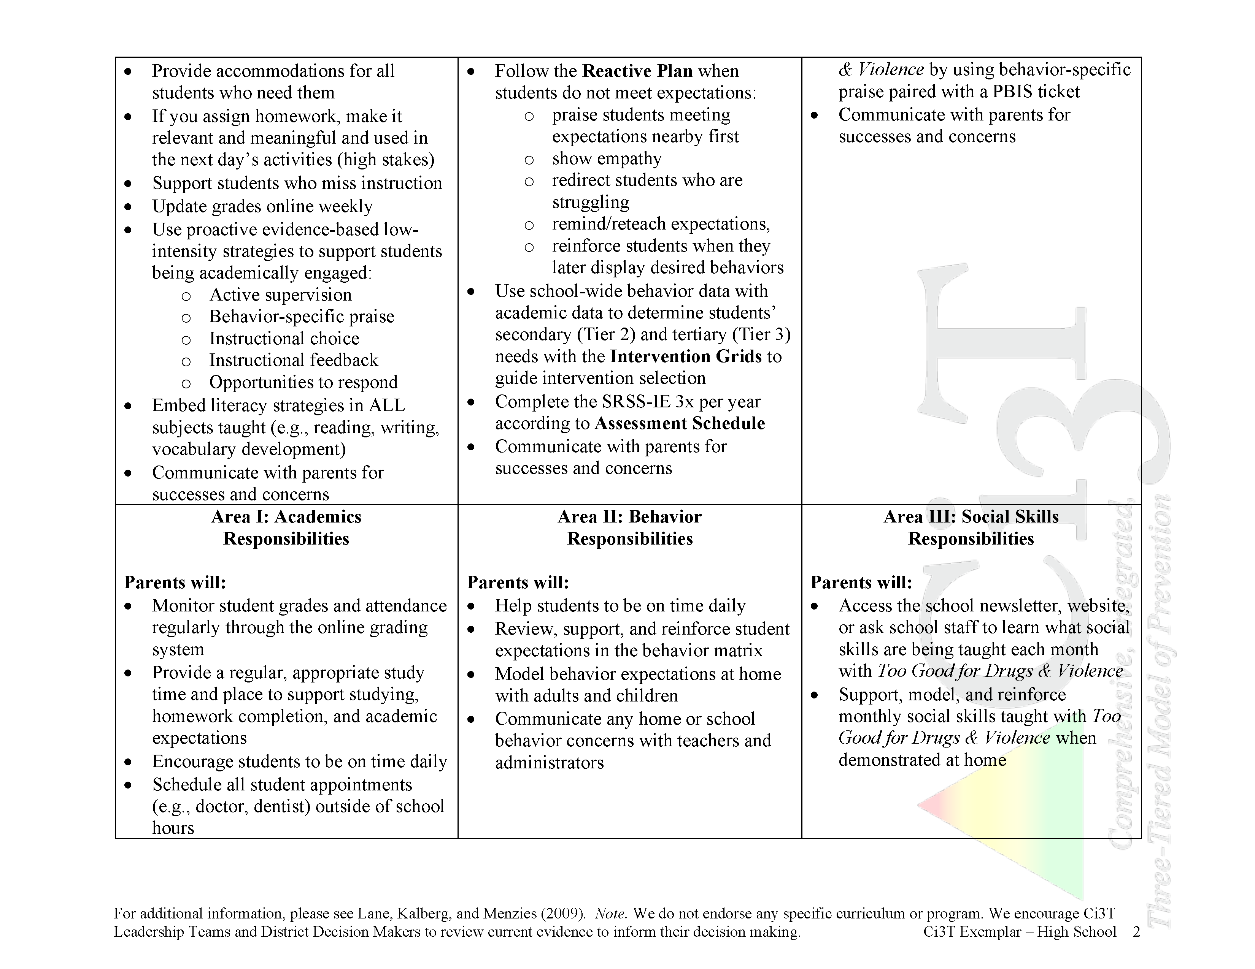

Slide 39
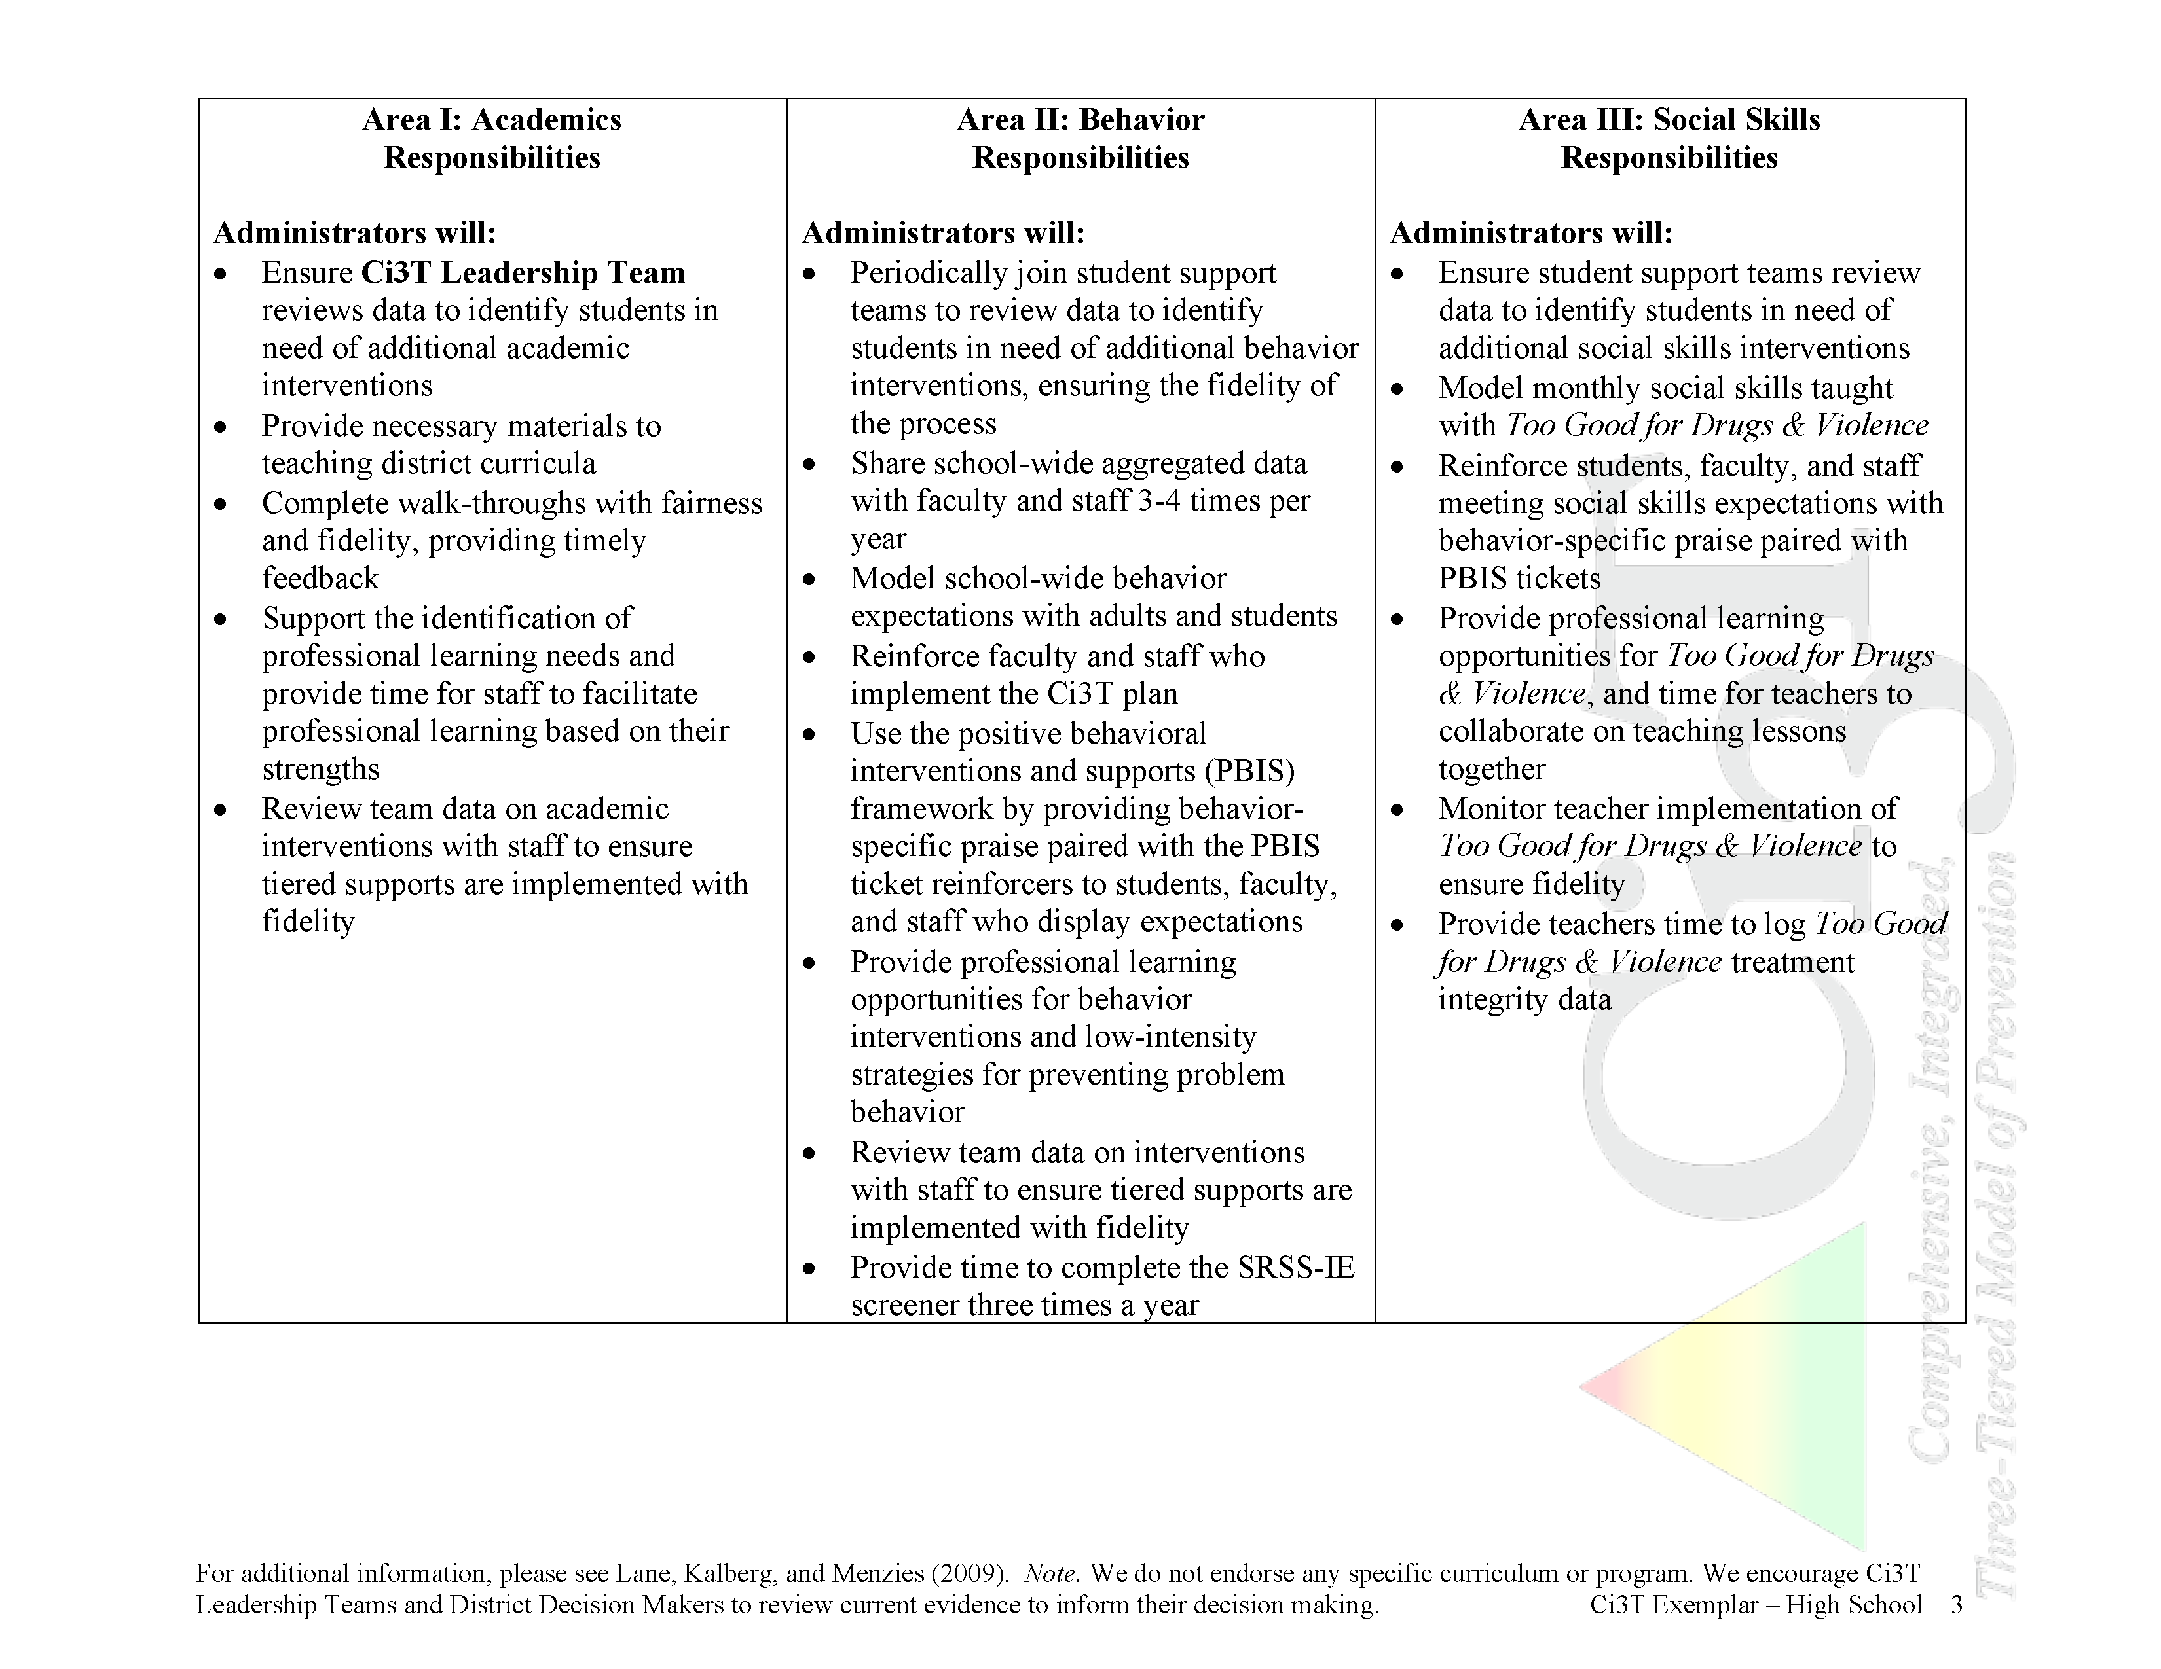

Slide 40



What are the responsibilities for students, teachers, parents, and administrators?
Use Table Talk 2: Goals
as a guide to draft
the Academic Component
of your
Ci3T Blueprint A Primary (Tier 1) Plan

Slide 41
Ci3T Blueprint A

Slide 42


Use Table Talk 2
Draft the
Academic Component
of your
Ci3T Blueprint A Primary (Tier 1) Plan
10 minutes
Notes:
10 min

Slide 43

What do we expect from our students socially?

Slide 44
Social Skills Expectations
What do we expect from our students socially?
  Cooperation
  Taking turns
  Playing by the rules
  Self-control
  Self-determination
  Honesty
  Kindness
  Tolerance
Academic
Behavior
Social

Slide 45
Social Skills Component
    Character education
    Teaches students basic human values including honesty, kindness, generosity, courage, freedom, equality, and respect (McBrien & Brandt, 1997)
    Goal: raise children to become morally responsible, self-disciplined citizens (Berkowitz & Bier, 2005)
    School-based programs designed to promote
    the character development of students
    (Person, Moiduddin, Angus, & Malone, 2009)
    Selected according to the 11 principles of effective character education (Lickona, Schaps, & Lewis, 2007)
Academic
Behavior
Social
Five core competencies of social and emotional learning
  self-awareness
  self-management
  social awareness
  relationship skills
  responsible decision making
  (CASEL, 2017)
Considerations:
  Evidence-based program
  Implemented throughout the district to facilitate consistency
Collaborative for Academic, Social, and Emotional Learning (2017). Retrieved from https://casel.org/core-competencies/
Notes:
Character education citations:
Berkowitz, M. W., & Bier, M. C. (2005). What works in character education: A research-driven guide for educators. Washington, DC: Character Education Partnership.
Lickona, T., Schaps, E., & Lewis, C. (2007). CEP's Eleven Principles of Effective Character Education. Character Education Partnership.
McBrien, J. L. & Brandt, R. S. (1997) The Language of Learning: A Guide to Education Terms. Alexandria, VA: Association for Supervision and Curriculum Development
Person, A. E., Moiduddin, E., Hague-Angus, M., & Malone, L. M. (2009). Survey of Outcomes Measurement in Research on Character Education Programs. NCEE 2009-006. National Center for Education Evaluation and Regional Assistance.

Slide 46
Social Component:
Examples of Schoolwide Programs
SEL & Bullying Prevention
cfchildren.org
Social Skills
Social Skills Improvement System (SSiS)
Elliott and Gresham, 2008
pearsonassessments.com
Includes a range of tools and intervention materials
Linking the Interests of Families and Teachers (LIFT)
Eddy, Reid, and Fetrow, 2000
Second Step
Committee for Children
~$430 per grade
elementary, middle, high school, families, staff, Spanish
Notes:
Sources: Committee for Children (1992). Second Step: A violence prevention curriculum grades 1-3. Seattle, WA: Author.
Eddy, J. M., Reid, J. B., & Fetrow, R. A. (2000). An elementary school-based prevention program targeting modifiable antecedents of youth delinquency and violence: Linking the interests of families and teachers (LIFT). Journal of Emotional and Behavioral Disorders, 8, 165-176.
Elliott, S. N., & Gresham, F. M. (2007). Social Skills Improvement System: Classwide intervention program teacher’s guide. Bloomington, MN: Pearson Assessments.

Slide 47
Social Component:
Examples of Schoolwide Programs
Social-emotional
Connect With Kids
connectwithkids.com
Character Education
A curricula using real stories presented through documentary-style videos, non-fiction books, teaching guides and patent resources.
Attendance and achievement
Bullying and violence prevention
Character and Life skills
Digital citizenship
Alcohol and drug prevention
Health and Wellness
Customizable units are:
Positive Action
positiveaction.net
Improves academics, behavior, and character
Curriculum-based approach
Effectively increases positive behaviors and decreases negative behaviors
6-7 units per grade
Optional components:
site-wide climate development
drug education
bullying / conflict resolution
counselor, parent, and family classes
community/coalition components

Slide 48
Social Component:
Examples of Schoolwide Programs
Violence Prevention
Too Good for Drugs and Violence
mendezfoundation.org
Violence Prevention
Grades 9-12
14 core lessons; 12 additional lessons that can be infused into other subject areas
Role-play and cooperative learning activities
Optional family and community involvement components
Has assessment materials to measure program effectiveness, fidelity of implementation, and student knowledge
Too Good for Violence
mendezfoundation.org
Grades K-8
character values, social-emotional skills, and healthy beliefs
7-9 lessons per grade
Has assessment materials to measure program effectiveness, fidelity of implementation, and student knowledge

Slide 49
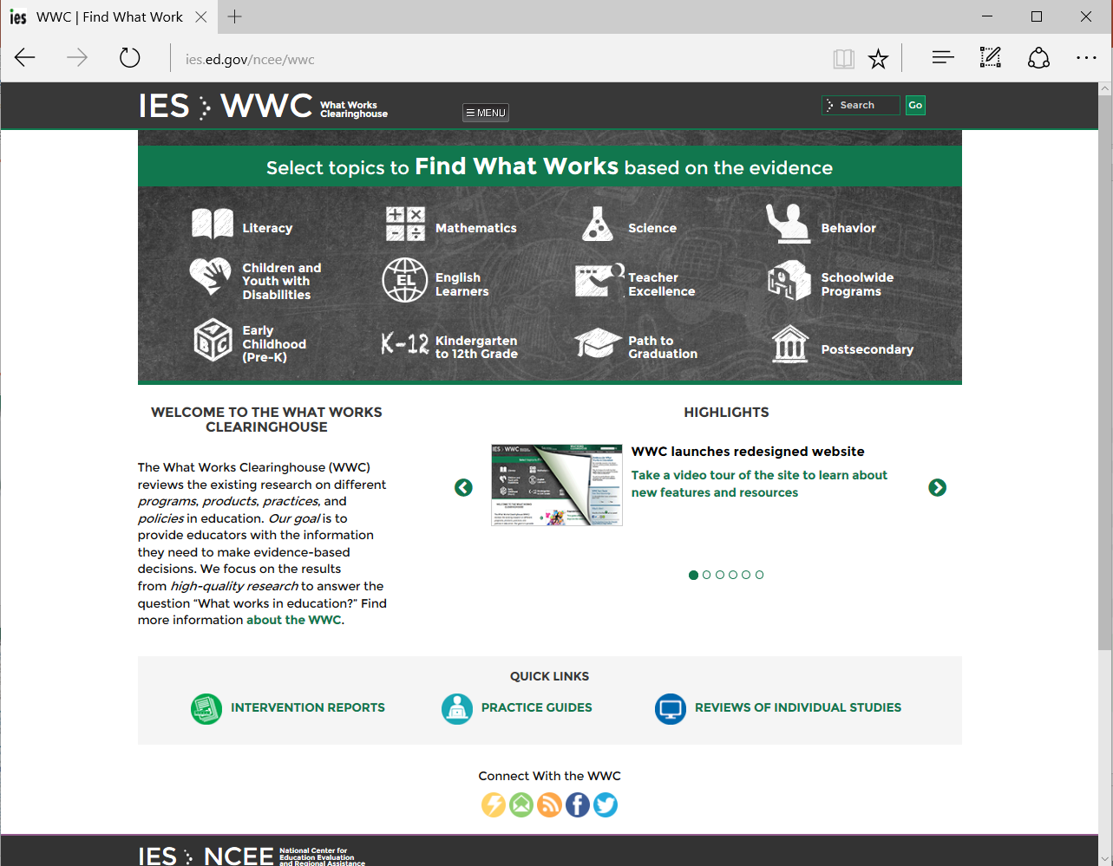
What Works Clearinghouse
ies.ed.gov/ncee/wwc

Slide 50
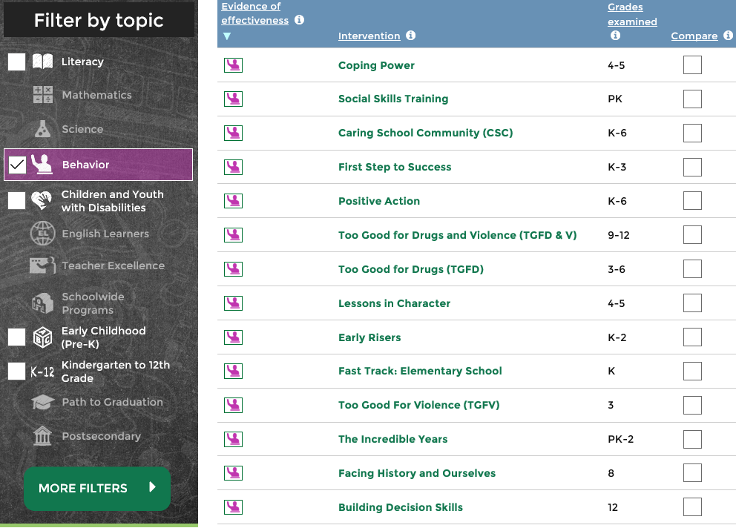
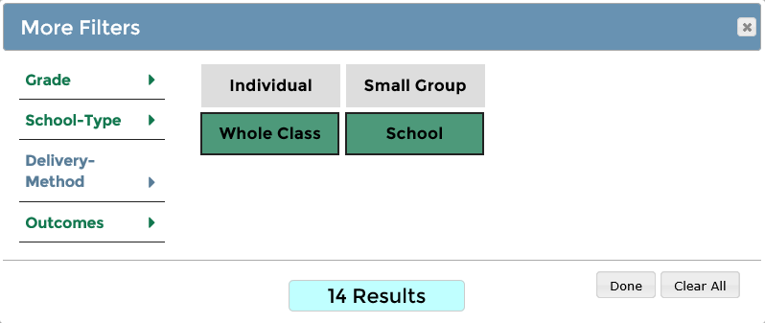
ies.ed.gov/ncee/wwc

Slide 51
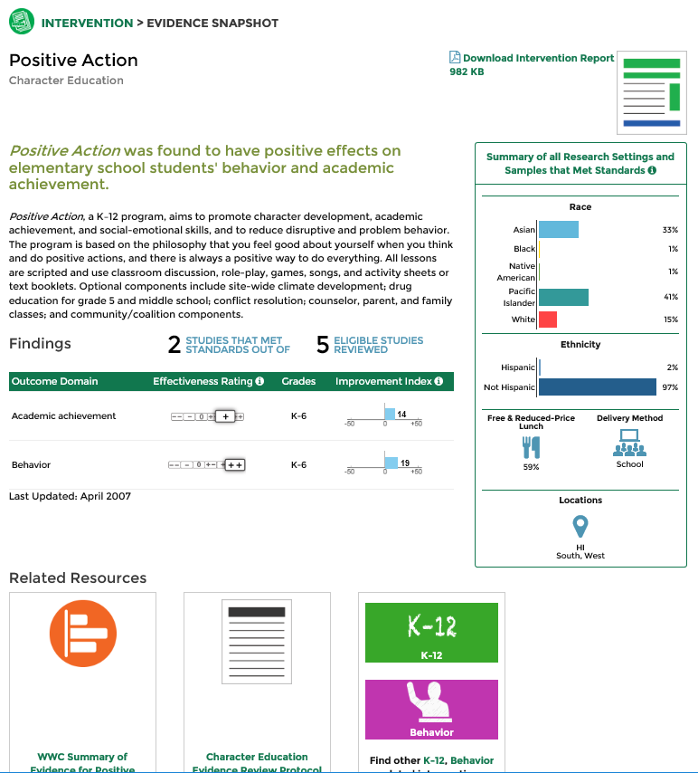
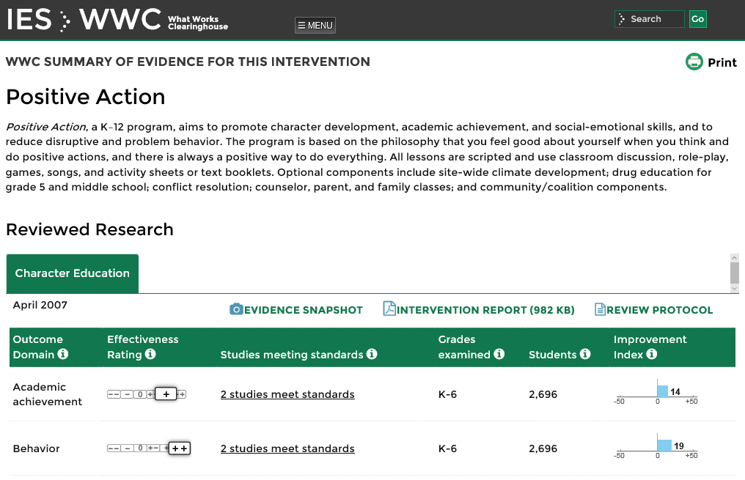
ies.ed.gov/ncee/wwc

Slide 52

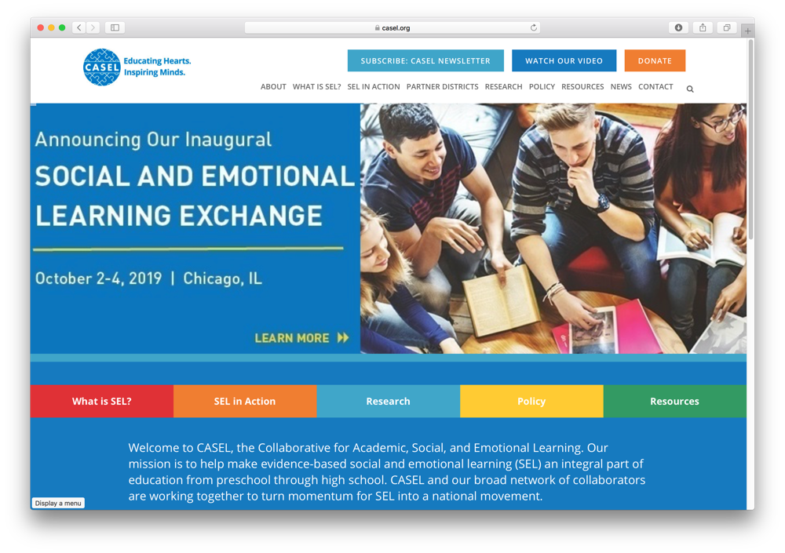
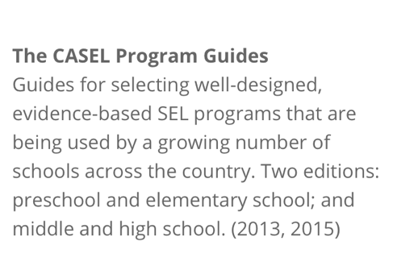
Collaborative for Academic, Social, and Emotional Learning
casel.org
See CASEL program guides https://casel.org/resources-support/
  Secondary schools:
  http://secondaryguide.casel.org

Slide 53

Substance Abuse and Mental Health Services Administration
samhsa.gov
The Substance Abuse and Mental Health Services Administration may have additional resources of interest

Slide 54
Social Skills Expectations
Ways to identify important social skills
Schoolwide Expectations Survey for Specific Settings (SESSS)
Review office discipline referrals to identify specific needs
Taking an instructional approach to social skills
Social skills lessons based on critical skills identified by faculty and staff (one lesson per month)

Slide 55
What Works Clearinghouse
ies.ed.gov/ncee/wwc
Collaborative for Academic, Social, and Emotional Learning
casel.org
Review websites
10 minutes
Notes:
10 min

Slide 56

What are the responsibilities for each stakeholder in supporting students’ social and emotional performance?

Slide 63
What are the responsibilities for students, teachers, parents, and administrators?
Draft the
Social Skills Component
of your
Ci3T Blueprint A Primary (Tier 1) Plan

Slide 64
Ci3T Blueprint A

Slide 65


What Works Clearinghouse
ies.ed.gov/ncee/wwc
Collaborative for Academic, Social, and Emotional Learning
casel.org
Draft the
Social Skills Component
of your
Ci3T Blueprint A Primary (Tier 1) Plan
10 minutes
Notes:
10 min

Slide 66


What do we expect from our students in terms of behavioral performance?

Slide 67
Behavior Component
Two-Fold
1. Reactive
  Clearly articulate schoolwide consequences for inappropriate behaviors
  Plan for accurate data collection (consistent across district schools)
2. Proactive
  Clearly state behavioral expectations
  Explicitly teach to all students
  Model expectations
  Give students opportunities to display expectations
  Provide feedback and reinforcement
  Monitor behavior
Reactive
Proactive

Slide 68

Reactive Plan

Slide 69
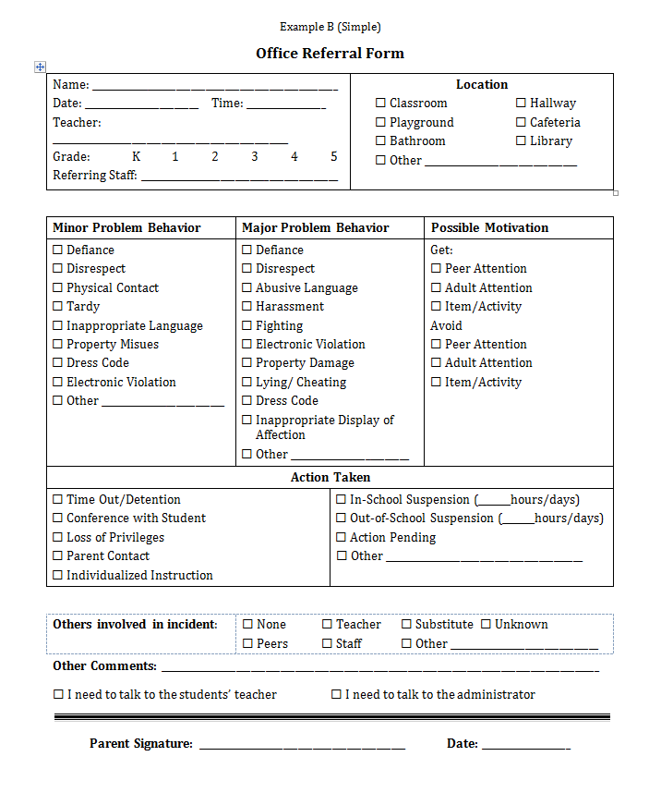
Office Discipline Referral Forms
Minor Behavior | Definition
Defiance/ Insubordination/ Non-Compliance | Student engages in brief or low-intensity failure to follow directions or talks back.
Disrespect | Student delivers low-intensity, socially rude or dismissive messages to adults or students.
Disruption | Student engages in low-intensity, but inappropriate disruption.
Dress Code Violation | Student wears clothing that is near, but not within, the dress code guidelines defined by the school/district.
Inappropriate Language | Student engages in low-intensity instance of inappropriate language.
Physical Contact/ Aggression | Student engages in non-serious, but inappropriate physical contact.
Property Misuse | Student engages in low-intensity property misuse.
Tardy | Student arrives at class after the bell
Clearly define behaviors
Minors and Majors
Examples from School-Wide Information Systems (SWIS) pbisapps.org

Slide 70
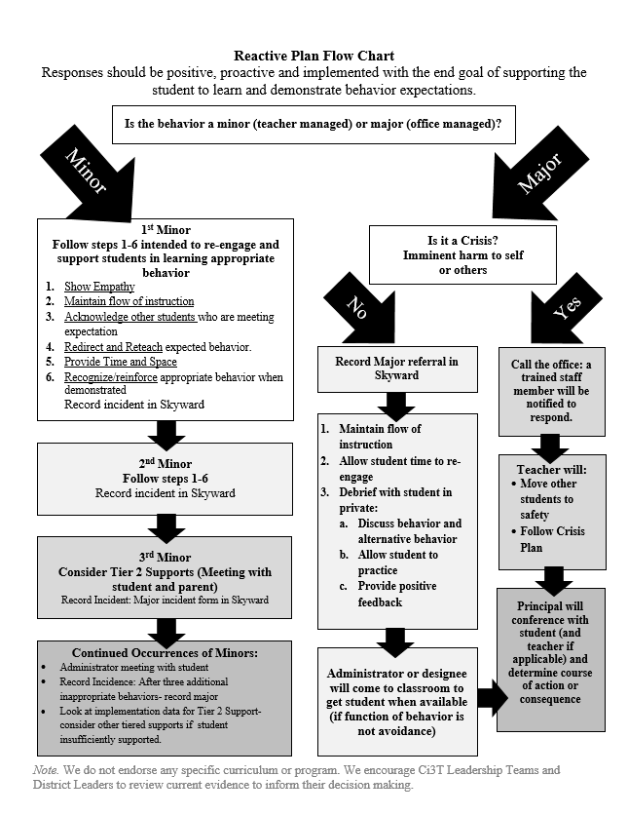
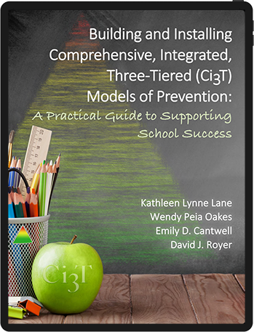
Reactive Plan Example
For additional examples see pbis.org and the Ci3T exemplar plans for preschool, elementary, middle, and high school

Slide 71
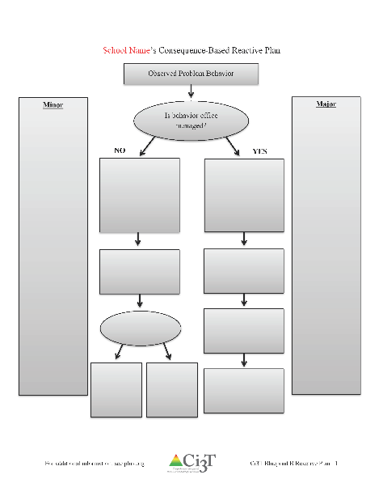
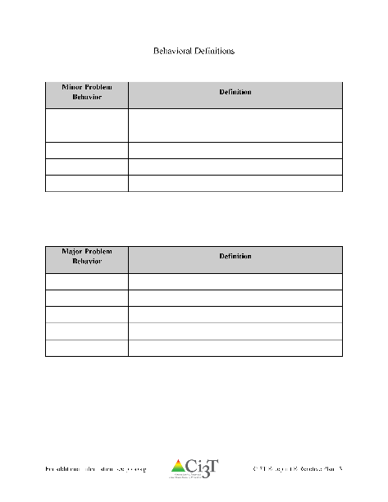

Consider the Ci3T Exemplars (preschool, elementary, middle, high) when drafting
Draft
Ci3T Blueprint B Reactive Plan
10 minutes
Notes:
10 min

Slide 72

Proactive Behavior Component
Proactive

Slide 73
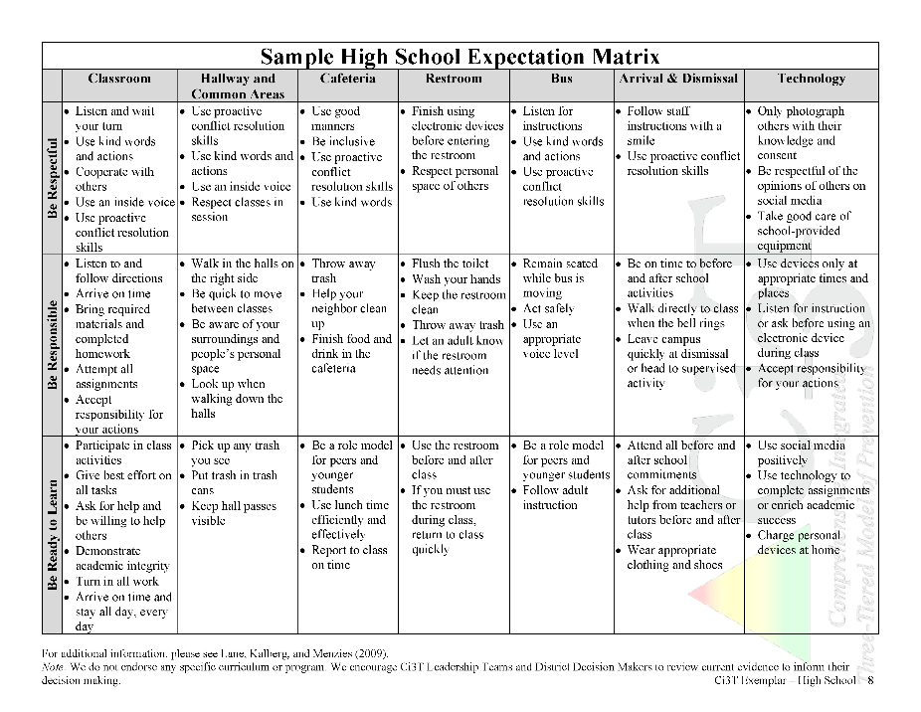
Proactive Behavior Component
Common approach to discipline
Clear set of positive behavioral expectations
Procedures for
  teaching expected behavior
  encouraging expected behavior
  discouraging inappropriate behavior
  on-going monitoring and evaluation
Notes:
Lane, K. L., Kalberg, J. R., & Menzies, H. M. (2009). Developing schoolwide programs to prevent and manage problem behaviors: A step-by-step approach. New York, NY: Guilford Press.
Sugai, G., & Horner, R. H. (2009). Responsiveness-to-intervention and school-wide positive behavior supports: Integration of multi-tiered system approaches. Exceptionality, 17(4), 223-237.
Turnbull, A., Edmondson, H., Griggs, P., Wickham, D., Sailor, W., Beech … Wilcox, B. (2002). A blueprint for schoolwide positive behavior support: Implementation of three components. Exceptional Children, 68(3), 337-402.

Slide 74
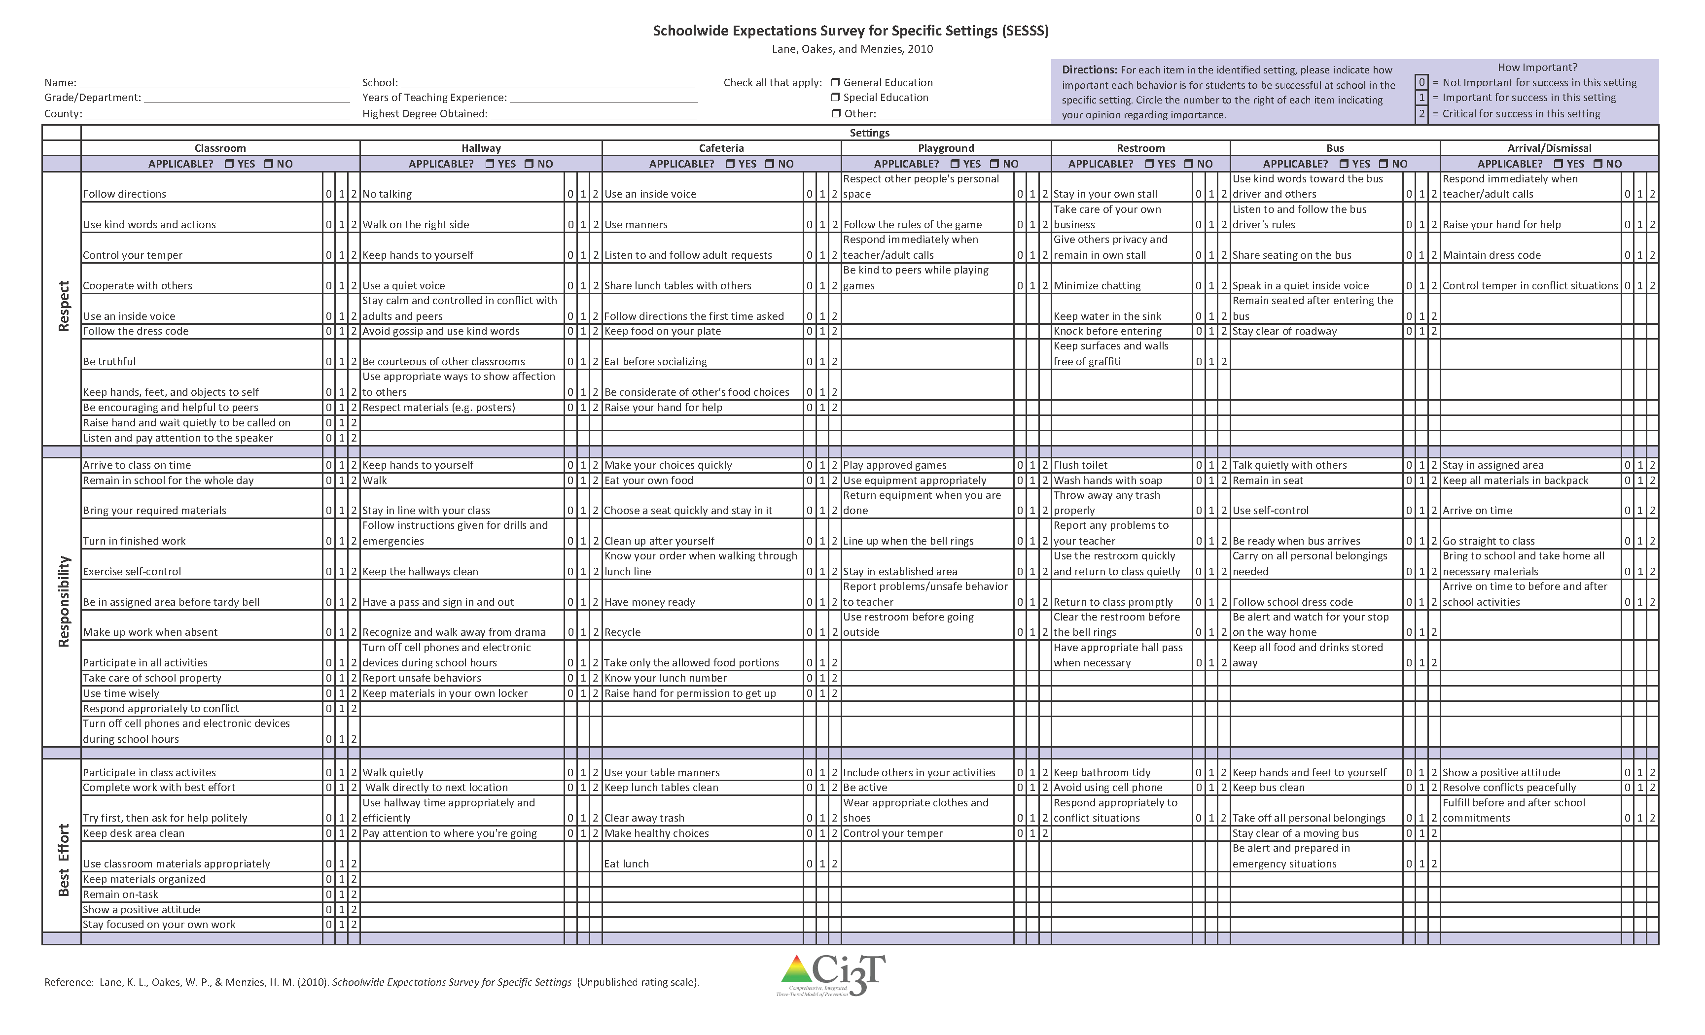
Schoolwide Expectations
Ci3T Blueprint C
Expectation Matrix
3-5 Expectations
  Clearly stated
  Taught
  Reinforced
Explicitly defined for each school setting
Use your Schoolwide Expectations for Specific School Settings (SESSS) results to establish school priorities
  Google drive folder 05 Reports

Slide 75
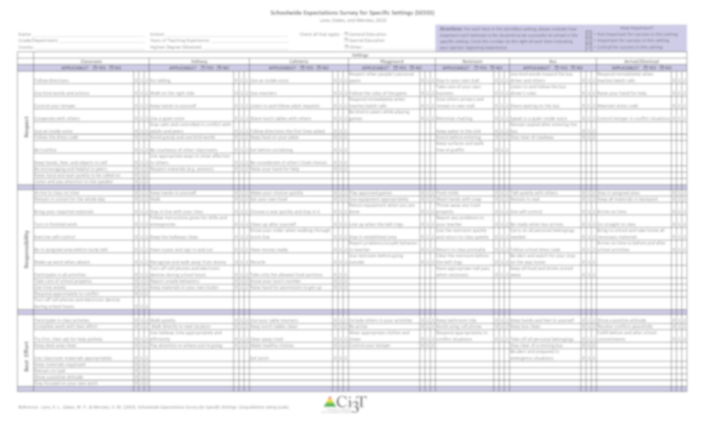
Interpreting the SESSS
All school site personnel were given the opportunity to participate
  If they did not have a district email (e.g., bus drivers), a paper SESSS was left for them in their box
The information you have reflects the responses for the school personnel who returned the forms
The results also show the number and percentage of total school personnel who rated each behavior as critical for student success
Lane, K. L., Oakes, W.P., Jenkins, A., Menzies, H.M., & Kalberg, J.R. (2014). A team-based process for designing comprehensive, integrated, three-tiered (Ci3T) models of prevention: How does my school-site leadership team design a Ci3T model? Preventing School Failure: Alternative Education for Children and Youth, 58, 129-142. doi: 10.1080/1045988x.2014.893976

Slide 76
Schoolwide Expectations Survey for Specific Settings
Classroom
Follow Directions 0 1 2
Use kind words 0 1 2
Control your temper 0 1 2
Cooperate with others 0 1 2
Use an inside voice 0 1 2
Respect
Arrive to class on time 0 1 2
Remain in school for the whole day 0 1 2
Bring your required materials 0 1 2
Turn in finished work 0 1 2
Exercise self-control 0 1 2
Responsibility
Participate in class activities 0 1 2
Complete work with best effort 0 1 2
Ask for help politely 0 1 2
Best Effort
Notes:
Source: Lane, K. L., Oakes, W. P., & Menzies, H. M. (2010). Schoolwide Expectations Survey for Specific School Settings. Unpublished survey.

Slide 77
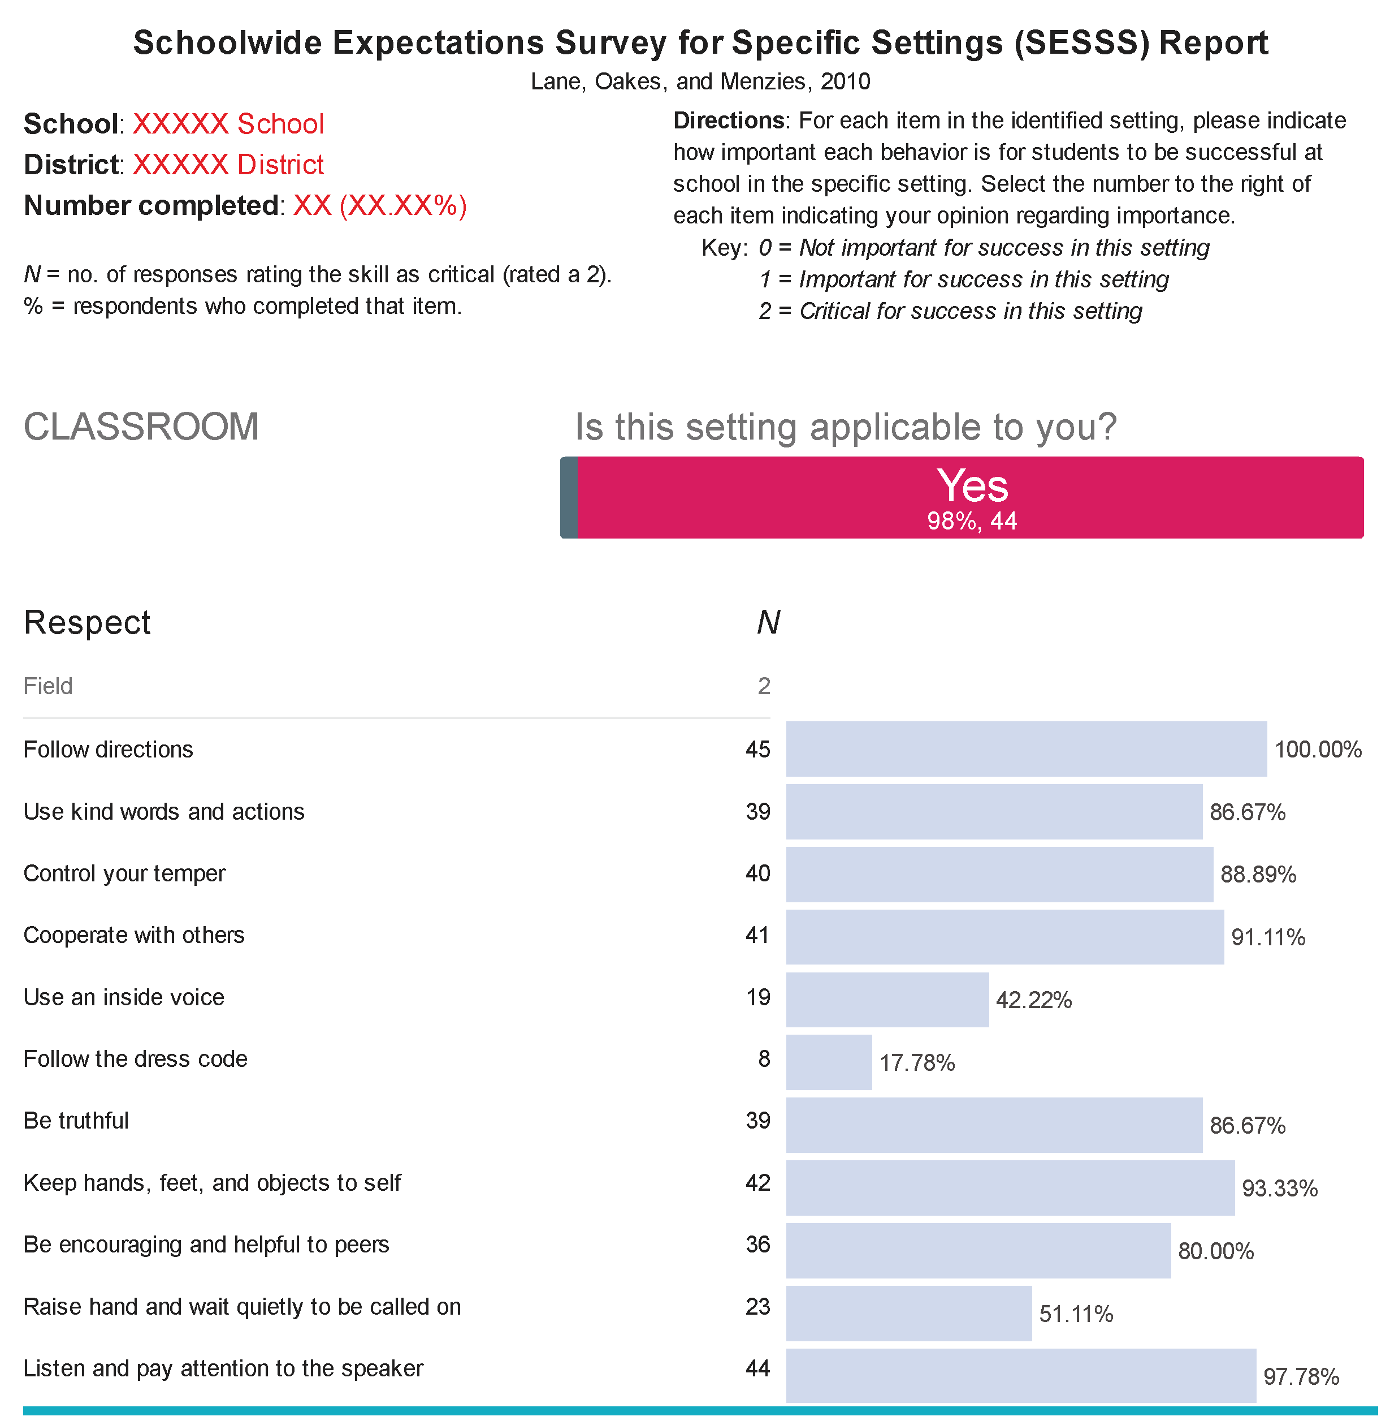
Number of school personnel who returned the survey
Interpreting the SESSS Data
Number and percentage of total school personnel who rated the behavior as (2) critical for student success
NUMBER
PERCENTAGE
Source: Lane, K. L., Oakes, W. P., & Menzies, H. M. (2010). Schoolwide Expectations Survey for Specific School Settings. Unpublished rating scale.

Slide 78
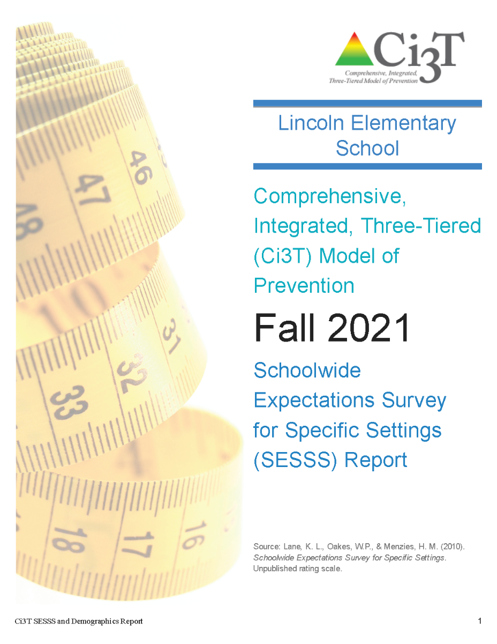


Select 3-5 expectations for each setting using your
SESSS Report
10 minutes
Notes:
10 min

Slide 79
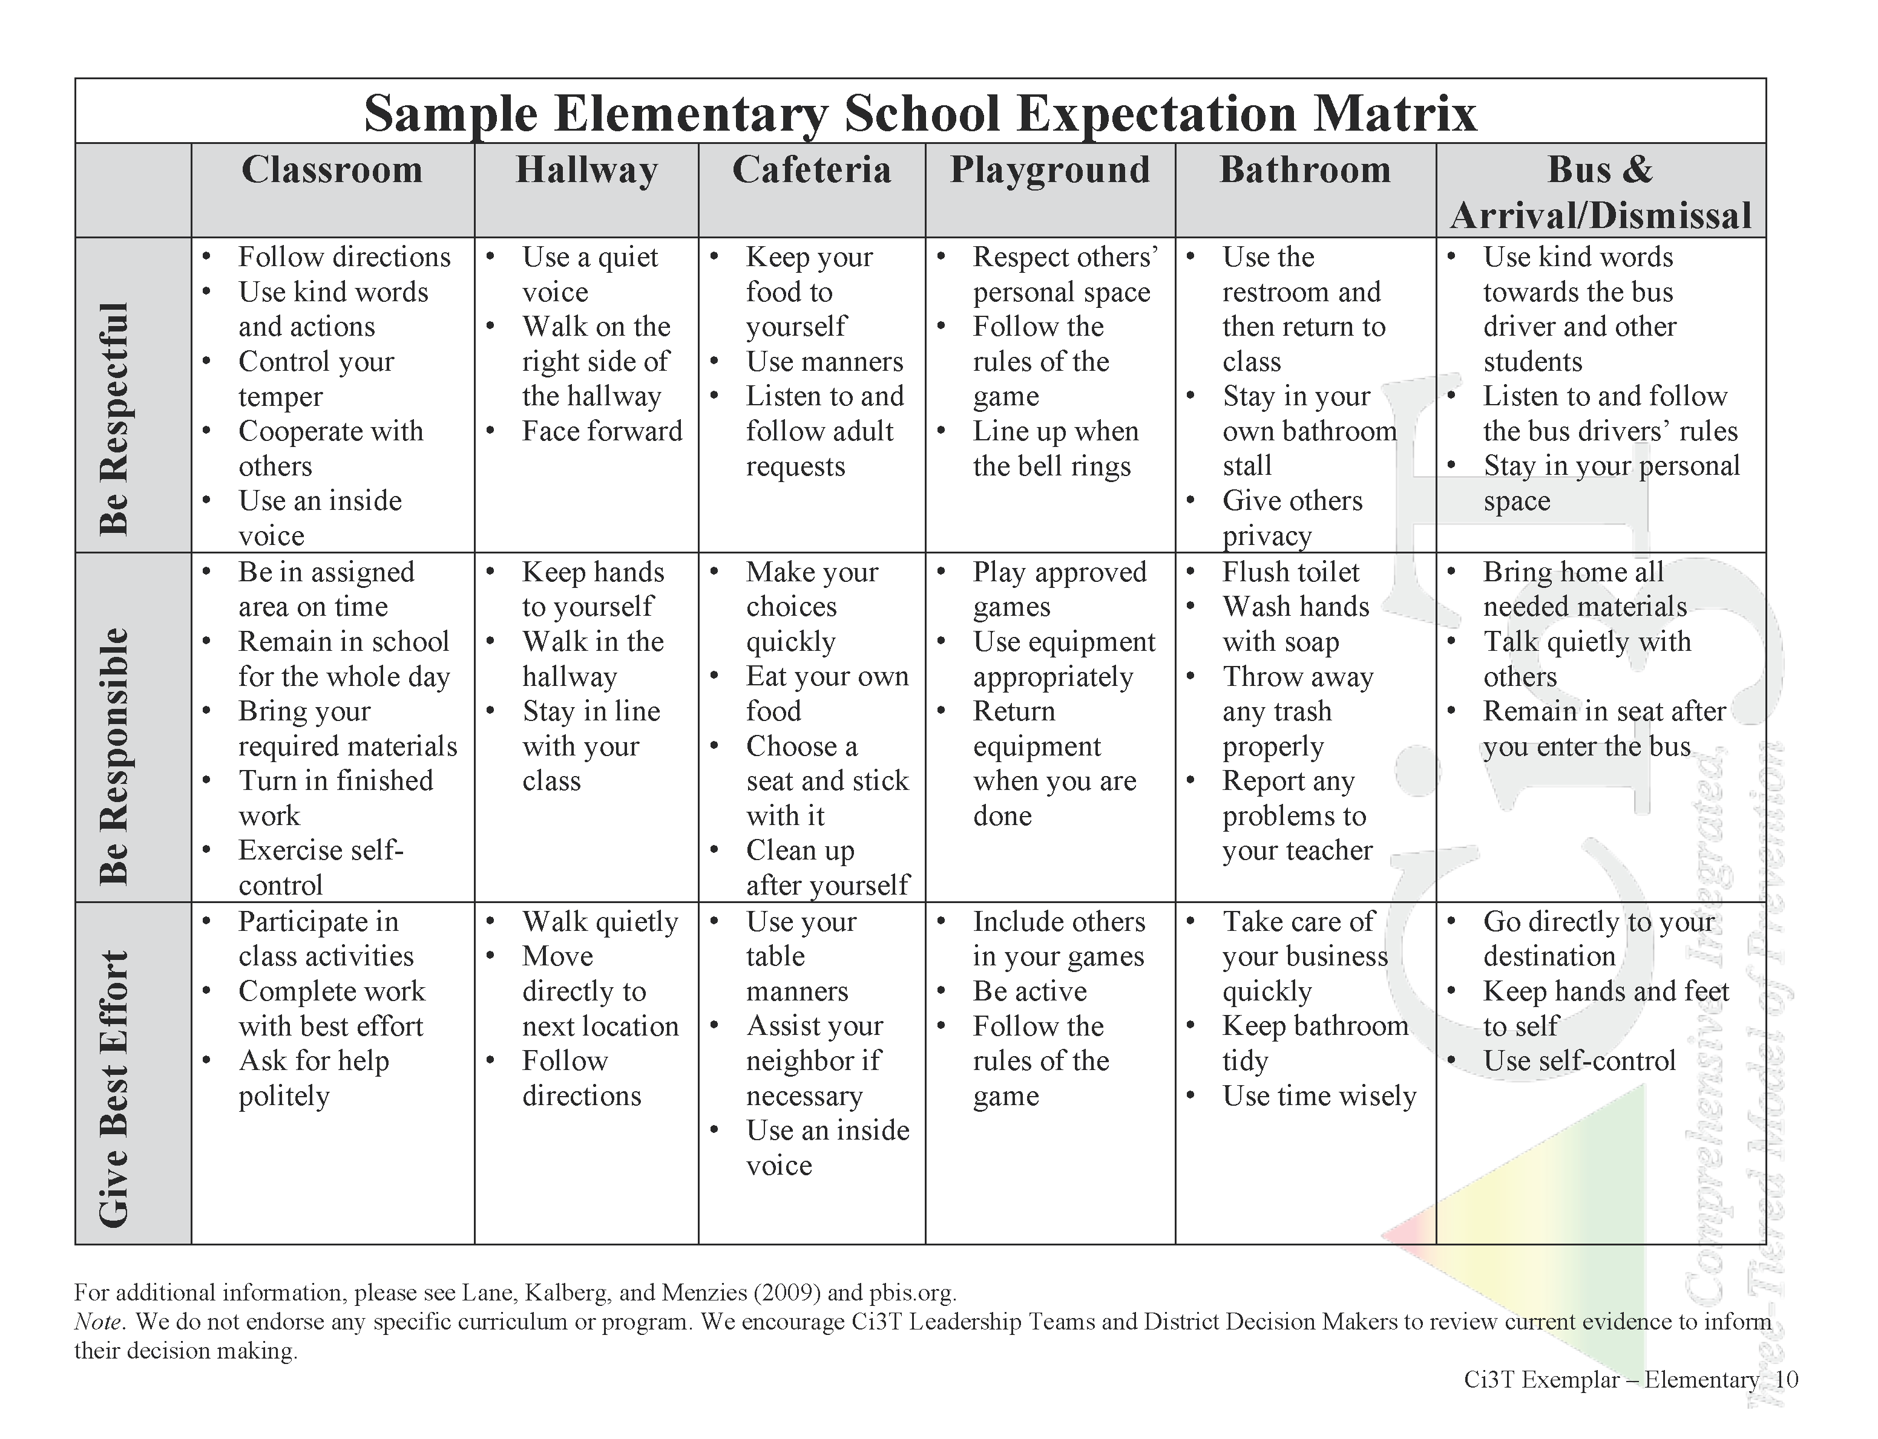

Slide 80
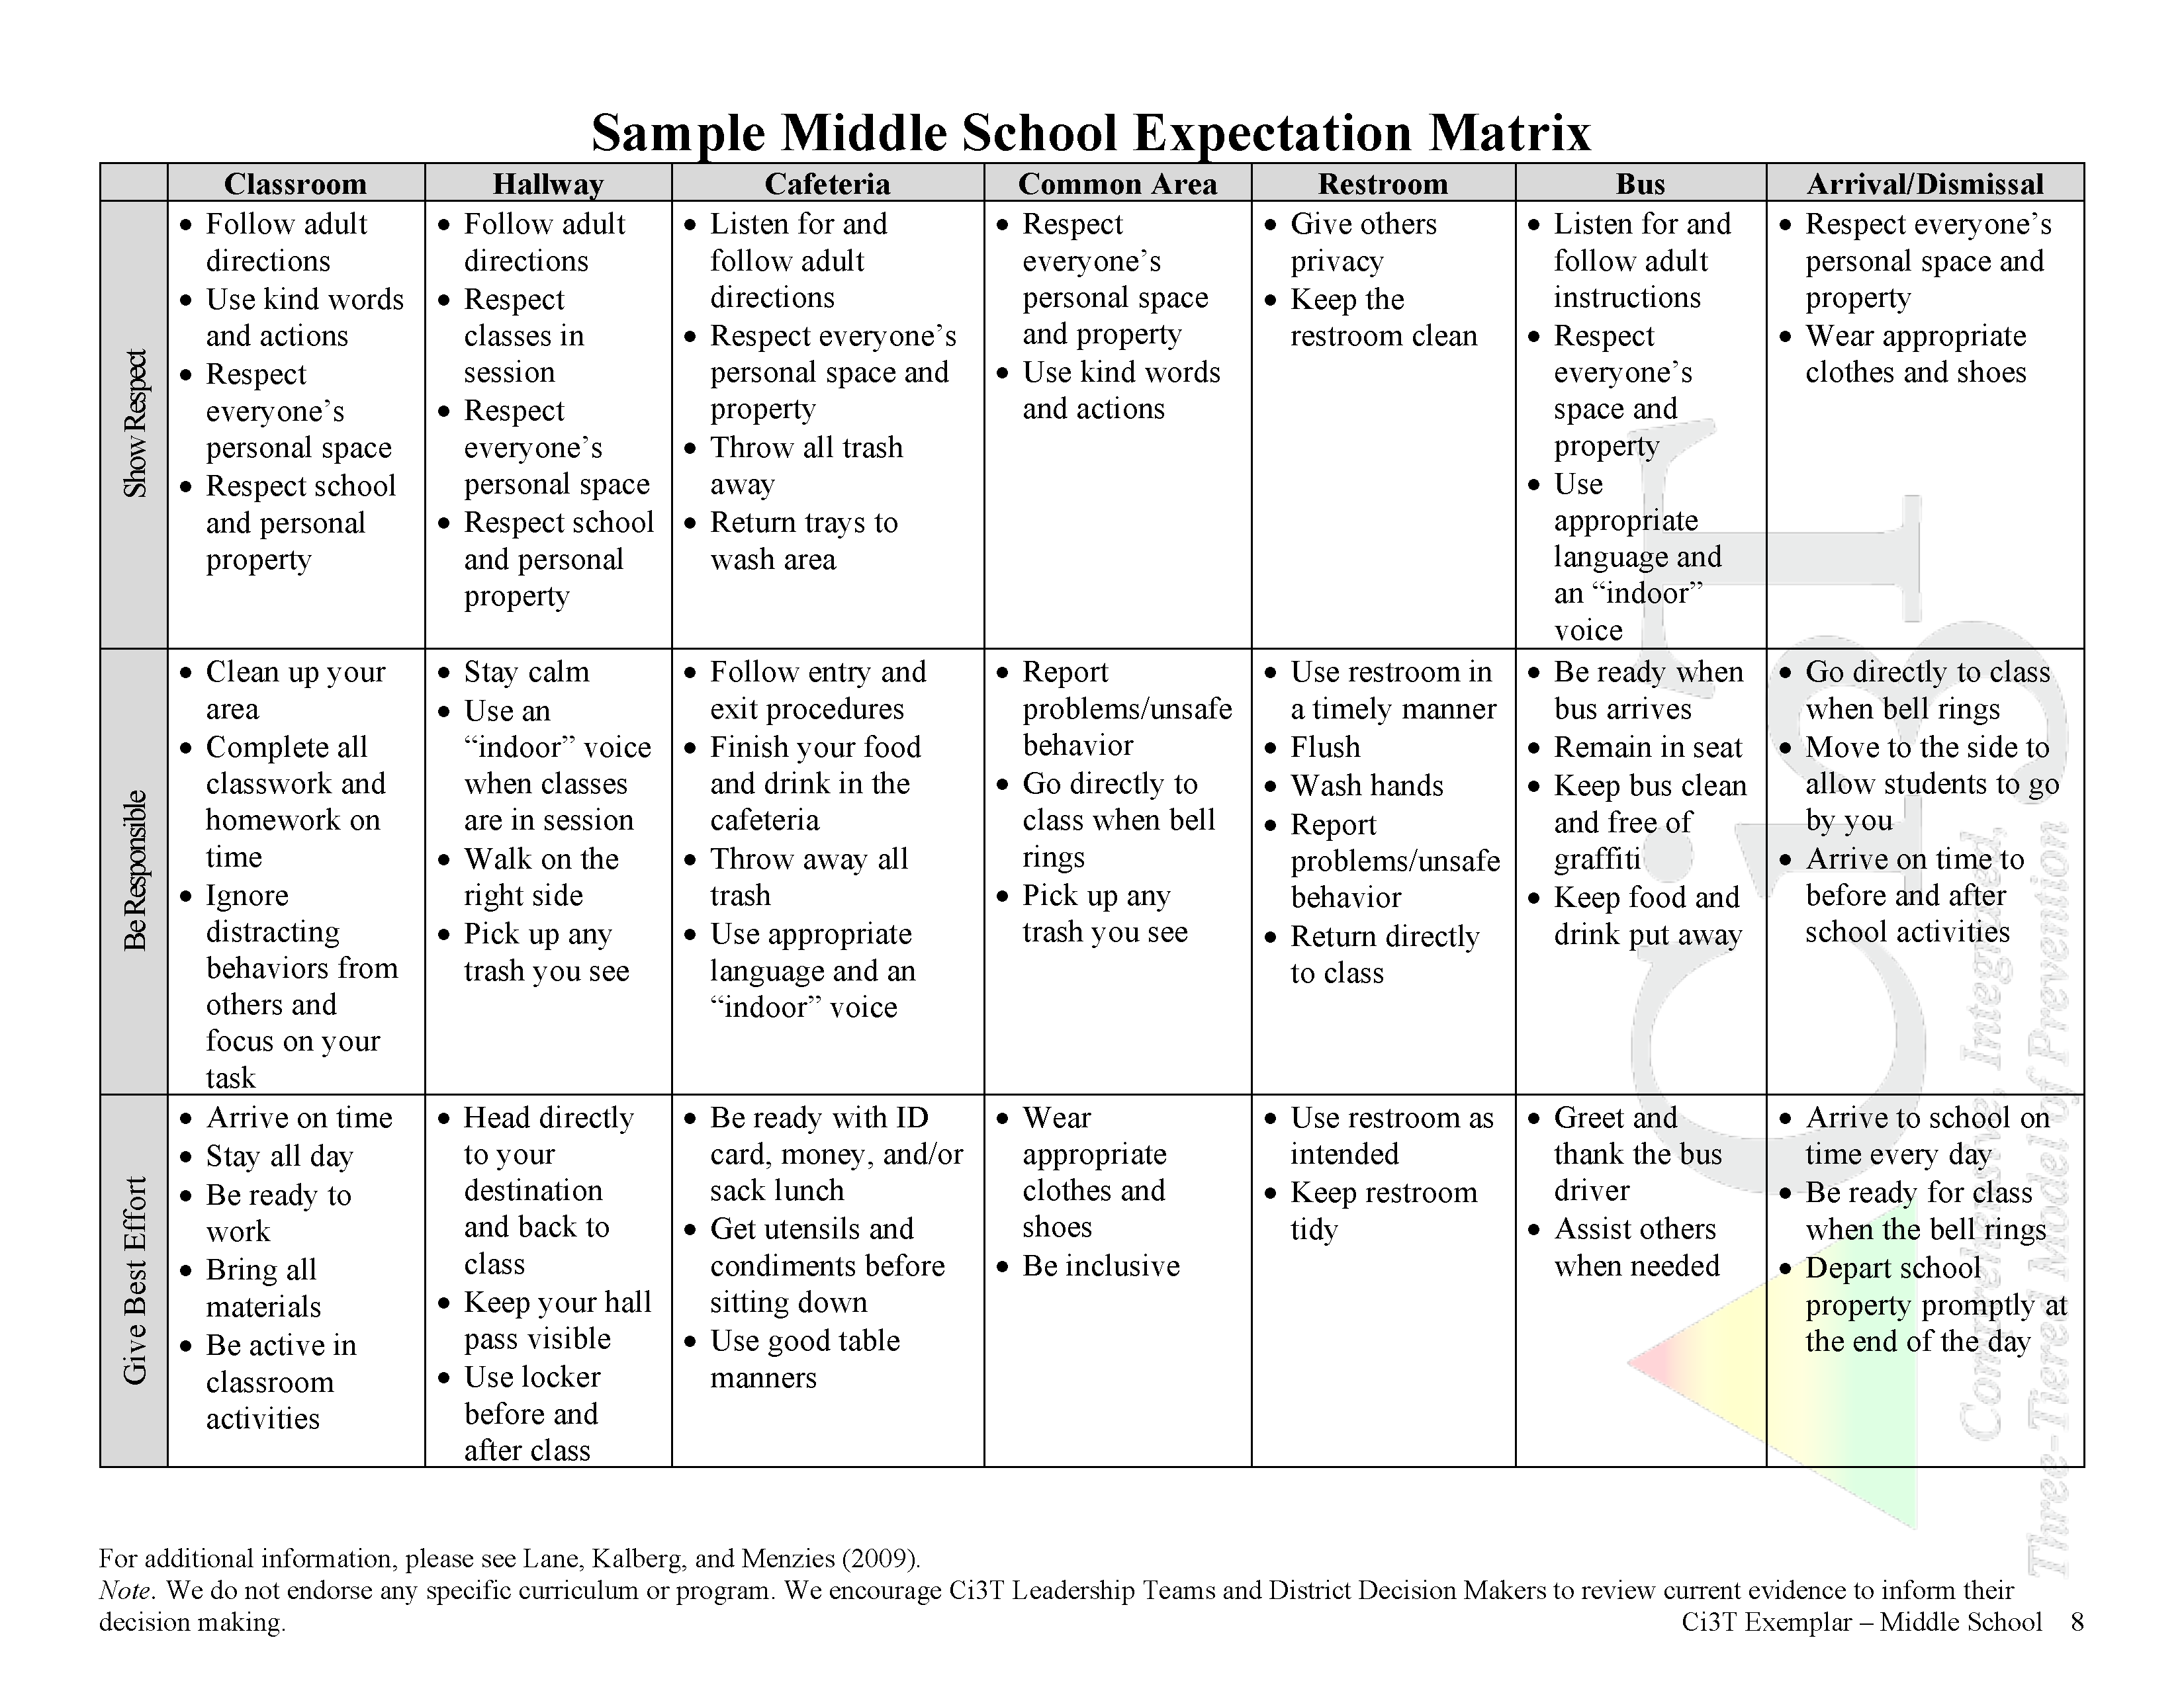

Slide 81
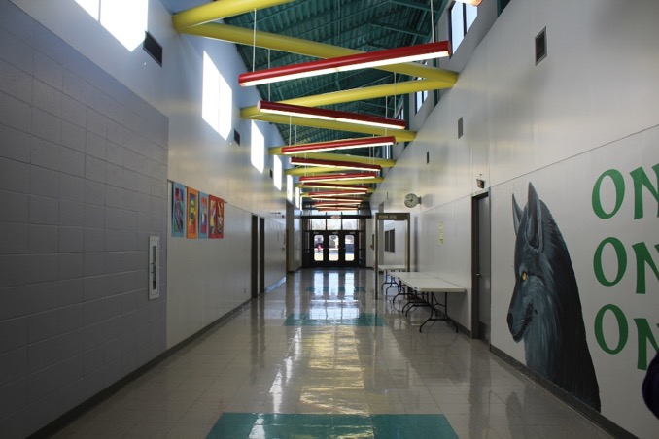
Identify Key Settings in Your Building
Consider
  Hallways
  Transition areas
    courtyards, outside areas, bus lines, bike areas
  Classrooms
  Specials areas
    gym, library, athletic fields
  Cafeteria
  Bathrooms
  Buses
Ci3T Blueprint C
Expectation Matrix

Slide 82
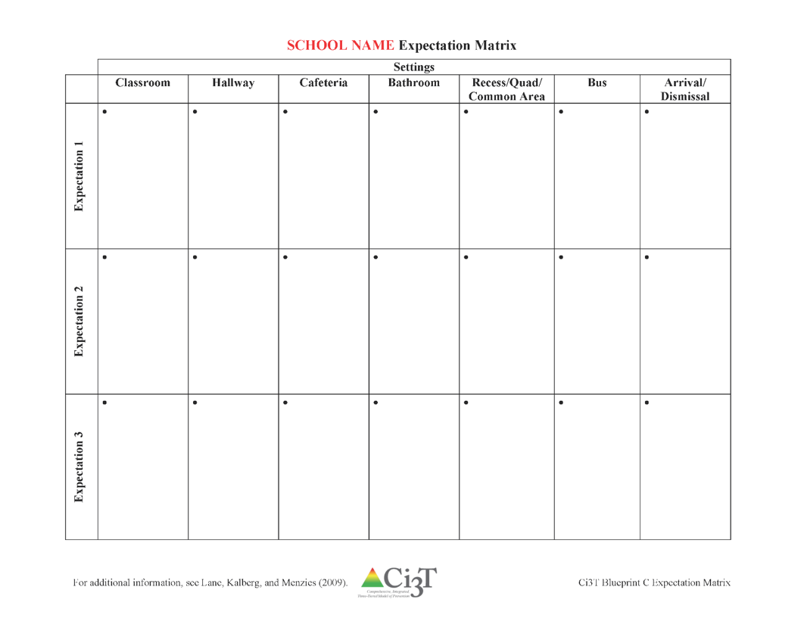

Identify Expectations in Each Setting
Use data from your SESSS to guide your conversation
Begin drafting your Expectation Matrix
Select 3-5 expectations for each setting
using your
SESSS Report

Slide 83










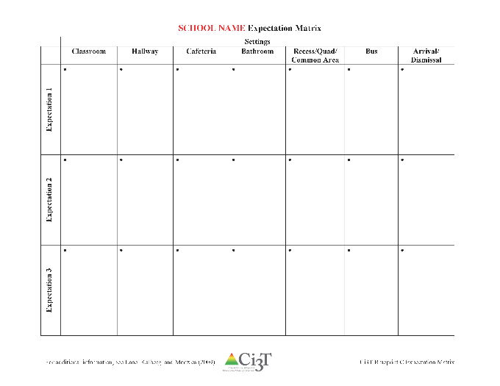

Begin drafting
Ci3T Blueprint C Expectation Matrix
20 minutes
Notes:
20 min

Slide 84

What are the responsibilities of students, faculty and staff, parents, and administrators in supporting desired behavior?

Slide 91

What are the responsibilities for students, teachers, parents, and administrators?
Draft the
Behavior Component
of your
Ci3T Blueprint A Primary (Tier 1) Plan

Slide 92
Ci3T Blueprint A

Slide 93










Draft the
Behavior Component
of your
Ci3T Blueprint A Primary (Tier 1) Plan
30 minutes
Notes:
30 min

Slide 94
How can we support implementation of Tier 1 roles and responsibilities in academic, behavior, and social domains?
Establishing procedures for teaching all stakeholders the primary prevention (Tier 1) plan roles and responsibilities in academic, behavior, and social domains

Slide 95
Procedures for Teaching the Plan to:
Faculty and Staff
Students
Parents and Community
Focuses on teaching more appropriate functional skills that promote success in school and provides context for the practice and reinforcement of these skills
Lewis, T. J., Powers, L. J., Kely, M. J., & Newcomer, L. L. (2002). Reducing problem behaviors on the playground: An investigation of the application of schoolwide positive behavior supports. Psychology in the Schools, 39(2), 181-190; Turnbull, A., Edmonson, H., Griggs, P., Wickham, D., Sailor, W., Freeman, R., ... & Riffel, L. (2002). A blueprint for schoolwide positive behavior support: Implementation of three components. Exceptional Children, 68(3), 377-402.
Notes:
More than preventing problem behavior from occurring.

Slide 96
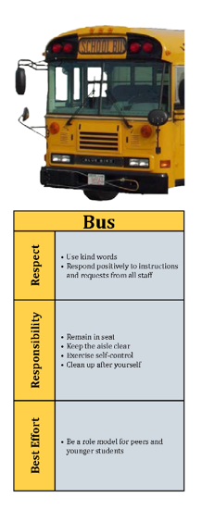
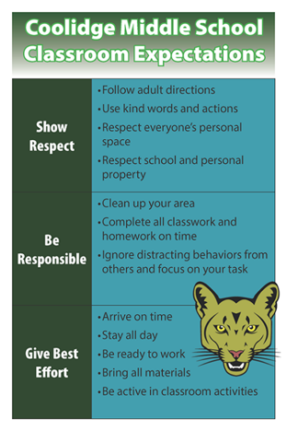

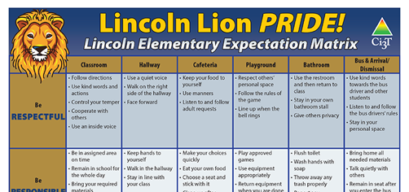
How will primary prevention (Tier 1) efforts be taught to all stakeholders?
Faculty and staff
  Implementation manual
  Expectation matrix
  Bookmarks
  Collaborative teams
  Posters
  Ticket tip sheet
  Professional learning
Students • Parents and community
  Lessons ○ Letters to parents
  Posters ○ Contacts with community
  Videos businesses
Shared with permission.
Notes:
Lessons: setting expectations, social skills
Posters: setting expectations, full expectation matrix

Slide 97
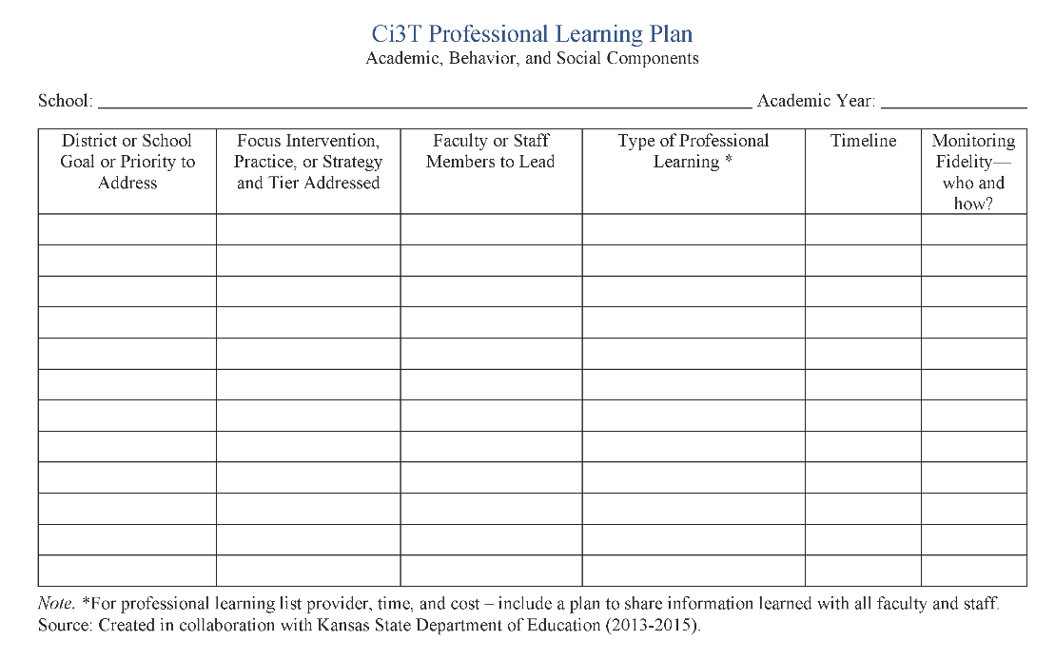


Professional Learning
Faculty and staff participate in
selection of new evidence-based programs
feedback loops
professional learning across all areas
R04
PL Plan

Slide 98
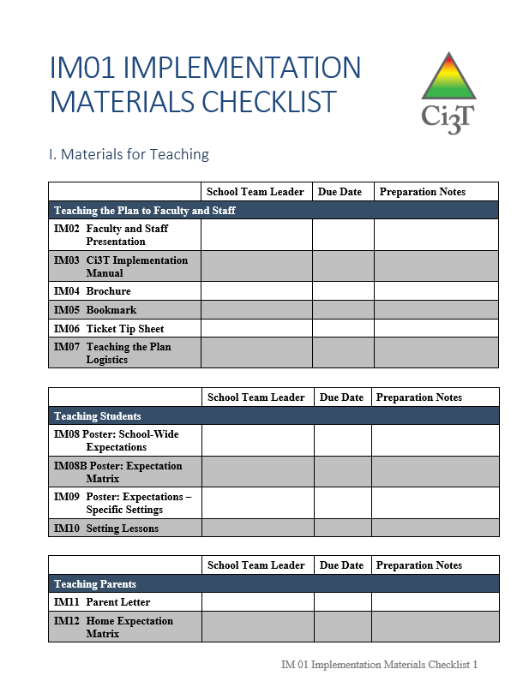
In future sessions you will use IM01 Implementation Materials Checklist to create materials for teaching

Slide 99
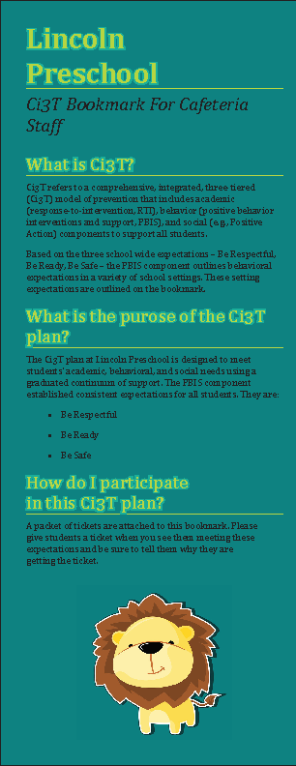
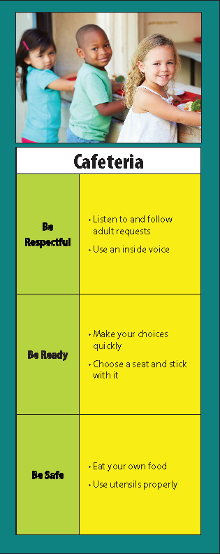
Teaching the Plan to Faculty and Staff
Faculty presentation
Implementation manual
Brochure
Bookmarks
Ticket tip sheet
Draft in Session 6!

Slide 100



Visual Prompts
Keep Hands and Feet to Yourself
Bring Materials to Class
Use Materials Appropriately
Notes:
Expectations illustrated on key setting posters.

Slide 101

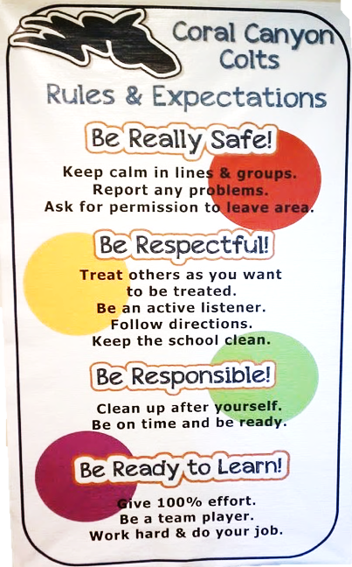

Hang Posters in Every Room
Shared with permission.

Slide 102
Teaching the Ci3T Plan to
Faculty and Staff
Group presentation
Skits to demonstrate examples and non-examples
Implementation manual
Videos
PowerPoint presentation
Demonstration
Posters and expectation matrix posted in all classrooms, common areas, teacher planning rooms
Weekly newsletter
Daily/weekly announcements
Daily/weekly emails
Calendar of events and activities
Regular discussions at faculty and team meetings
Bookmarks

Slide 103
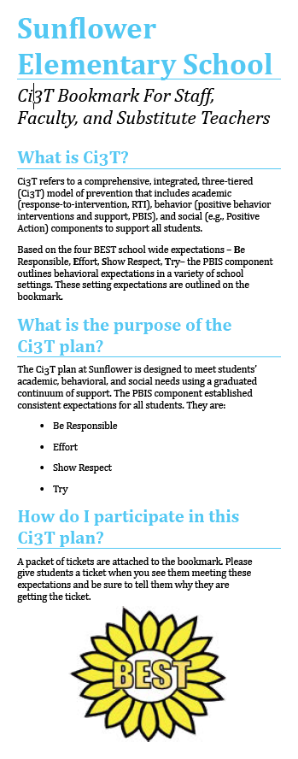
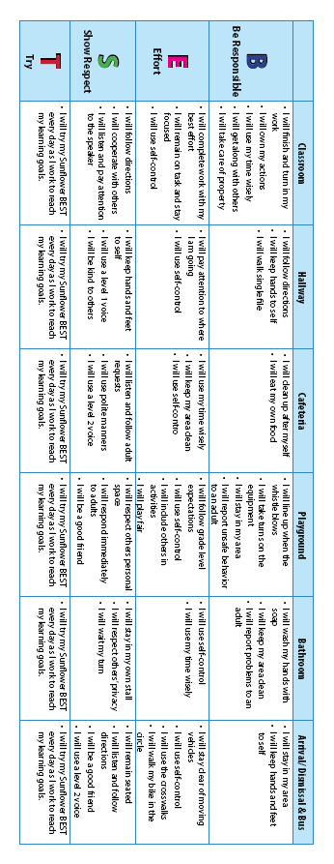
For teaching all staff
Shared with permission.

Slide 104

Ticket Tip Sheet
Ticket Tip Sheet
When giving a ticket for positive behavior, always pair behavior specific praise. Example, “Lori, thank you for walking down the hallway with a quiet voice and your hands at your side. For showing responsibility, you have earned a PAWS ticket.”
In the first days and weeks of implementing a Positive Behavior Interventions and Support system, flood students with tickets to increase effectiveness. Overtime fade tickets and provide intermittent reinforcement.
School staff should try to be consistent with ticket distribution. Portions of staff meetings can be used to discuss ticket distribution.
To ensure student buy-in, survey students to gain an understanding of what reinforcements are desired.
Explicitly teach students how tickets can be earned and what tickets can be used for once they are received.
Weekly emails

Slide 105
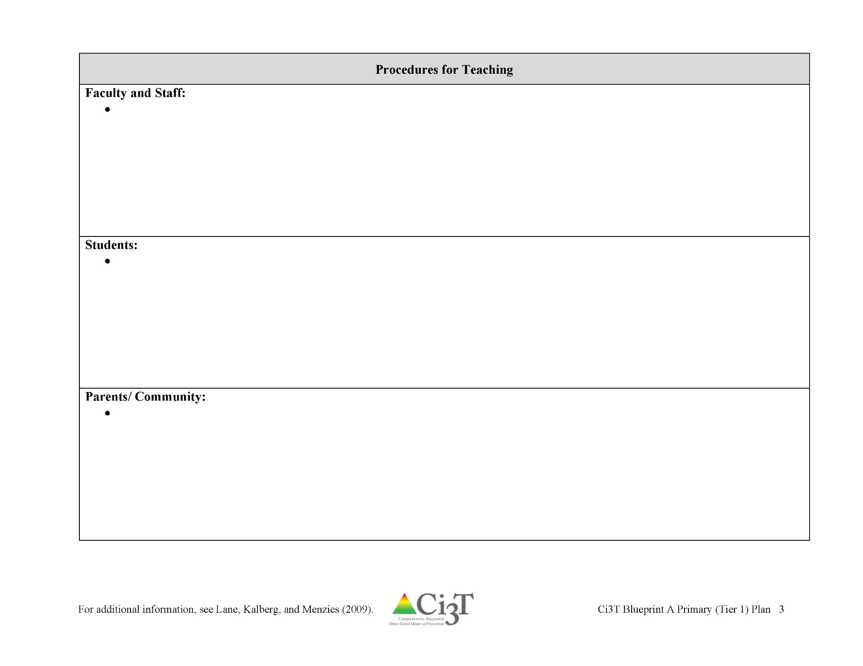


Ci3T Blueprint A Primary (Tier 1) Plan

Slide 106
Draft your
Procedures for Teaching: Faculty and Staff
Ci3T Blueprint A Primary (Tier 1) Plan
10 minutes
Notes:
10 min

Slide 107

Teaching the Plan to Students
Schoolwide expectation posters with photos
Expectation matrix posters
Setting lessons
Draft in Session 6!
Consider collecting photos of students this school year and obtain photo releases!

Slide 108
Teaching the Plan to Students
First day of school kick-off assembly
Setting expectation lessons in the first weeks of school
Videos (during school and on website)
Modeling
Expectation matrix poster
Setting expectation posters
Student handbook
Back to school boot camp
Student ambassadors for new students mid-year
Expectation-themed contests: poster, video, art
Notes:
Using behavior-specific praise

Slide 109

Start the Year Off with Excitement

Slide 110

Utilize the Talent of Students to Spread the Message

Slide 111

Student Skits to Teach Expectations

Slide 112

Student-made Videos

Slide 113


Offer Multiple Activities
http://www.schooltube.com/video/776d7a709d8a9173f1ae/Imma%20Be
Notes:
https://vimeo.com/38387470?share=copy#t=15
This video was written, directed, produced, and edited by Mr. Rob Dennis from John Early Magnet Charter School in Nashville, Tennessee. Imma Be features several students from the John Early Student Body, and promotes a very positive message for meeting expectations and dreaming big! This is one of the very best PBIS videos ever made (in my opinion).
Uploaded on Mar 12, 2012 at 3:27 pm

Slide 114

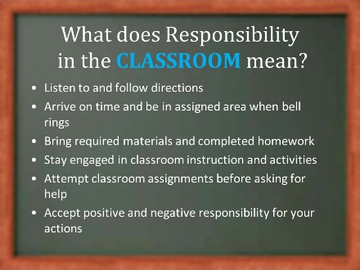
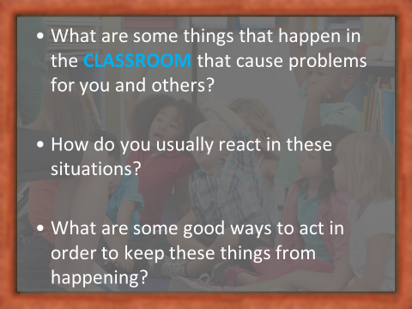
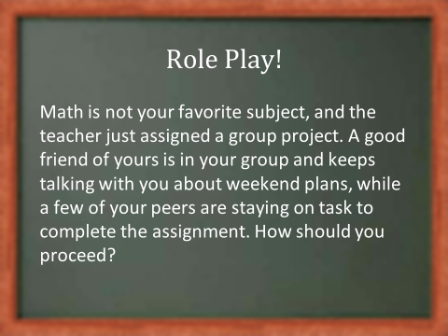
An Instructional Approach
IM10

Slide 115



Slide 116

Sample Setting Expectations Poster
Shared with permission.

Slide 117
Ci3T Blueprint A Primary (Tier 1) Plan

Slide 118
Draft your
Procedures for Teaching: Students
Ci3T Blueprint A Primary (Tier 1) Plan
10 minutes
Notes:
10 min

Slide 119

Teaching the Plan to Parents
Draft in Session 6!
Parent letter
Home expectation matrix

Slide 120
Teaching the Plan to Parents and Community
Back to school night
Parent handbook with expectation matrix
Email or phone call blasts
Monthly calendar or newsletter updates
Character fair
  demonstration of student-made projects
Host pot-luck or community discussion groups
Thank you posters for community sponsors
Refrigerator magnets with expectations
Parenting seminars
  how to tie the school expectations to home

Slide 121

Procedures for Teaching: Parents and Community
A Parent Letter

Slide 122

Thank you for helping make _______ Middle School’s Ci3T plan a success!
Thank you posters hanging in local businesses build community awareness!

Slide 123
Ci3T Blueprint A Primary (Tier 1) Plan

Slide 124
Draft your
Procedures for Teaching: Parents/Community
Ci3T Blueprint A Primary (Tier 1) Plan
10 minutes
Notes:
10 min

Slide 125

What does teaching the primary (Tier 1) plan look like in other schools?
Video interviews of currently implementing teams

Slide 126


Introduction and Questions
and
Rolling Out Your Plan videos
(ci3t.org/building)
20 minutes
Notes:
Panel discussion videos at https://www.ci3t.org/building

Slide 127
Polish your Procedures
for Teaching
Ci3T Blueprint A Primary (Tier 1) Plan

Slide 128
Polish your
Procedures for Teaching
Ci3T Blueprint A Primary (Tier 1) Plan
10 minutes
Polish your Procedures for Teaching: (HO 2)
10 minutes

Slide 129

How do we reinforce stakeholders for implementing the Ci3T blueprint?
Establishing procedures for reinforcing

Slide 130
Procedures for Reinforcing
How will you reinforce…
Faculty and staff for
  Participation and support
  Modeling schoolwide expectations
  Taking an instructional approach to behavior
  Implementing the Ci3T plan with fidelity
  Making instructional shifts in traditional practices
Students for
  Demonstrating the expectations across
  academic, behavioral, and social skill domains
Parents and community for
  Communication with school staff
  Reinforcing expectations
  Supporting the social skills lessons at home and in the community
Notes:
4

Slide 131


Slide 132

Procedures for Reinforcing Faculty and Staff
Reward faculty and staff for:
  Participation and support
  Modeling the school expectations
  Taking an instructional approach to behavior
Teacher motivation is key to the plan’s overall success!
Notes:
4

Slide 133
Procedures for Reinforcing Faculty and Staff
Consider
  Free periods
  Relief of daily duties (cafeteria monitoring, bus duty)
  Jeans day
  Gift certificates
  Special breakfast or lunch
Reward teachers along with students
  When student ticket is drawn for a prize, the teacher who awarded the ticket also receives a prize
Notes:
4

Slide 134

Ci3T Blueprint A Primary (Tier 1) Plan

Slide 135

Draft your
Procedures for Reinforcing: Faculty and Staff
Ci3T Blueprint A Primary (Tier 1) Plan
10 minutes
Use R05 Reinforcement Logistics
Notes:
10 min

Slide 136



Procedures for Reinforcing Students
Think about: what, how, who, when?
Tickets
Determining appropriate reinforcers
  Tangibles
  Non-tangibles
Tip sheet for reinforcing
Preferred Seating at Lunch Movie Tickets
Notes:
4

Slide 137





Slide 138


Procedures for Reinforcing Students:
Determining Appropriate Reinforcers
Tangible reinforcers: Items worth monetary value
Non-tangible reinforcers: Non-material items such as lunch with the principal, homework pass,
or front of the lunch line pass
While tangible reinforcers are typically desired by young students, it is important to begin to pair non-tangible reinforcement with tangible reinforcement and decrease the use of tangible reinforcers over time.
Notes:
4
Tangible examples: school supplies, toys, comic books, coloring books, or gift cards

Slide 139

Tangibles – Sure Things
books
school supplies
special pencils
erasers
School friendly “stuff” students can purchase

Slide 140



Tangibles – Drawings
Consider drawings
for students who
like the excitement
of a chance!

Slide 141

Fundraising
“Lock-ins” are
helpful to parents
and enjoyed by
students

Slide 142


Non-Tangibles
Students of all ages
like to spend time
with friends
Extra
Recess

Slide 143

Non-Tangibles
Students enjoy using
earned tickets to
purchase privileges
Get comfy!
Sit in your favorite spot coupon!

Slide 144


Consider the Obvious
Thirsty?
Get a drink whenever you want!
Listen to music during independent work time!

Slide 145

Join Ranks – It is a Schoolwide Effort
Organize PTO
celebrations to tie in
to your schoolwide plan
Coordinate activities

Slide 146
Procedures for Reinforcing Students:
Determining Appropriate Reinforcers
Seeking or
Avoiding
Consider:
  What is rewarding to the student?
  Is the student seeking or trying to avoid attention?
  Is the student seeking to trying to avoid participating
  in something?
Ask your students!
R06 Reinforcer Student Questionnaire
Notes:
4

Slide 147

Procedures for Reinforcing Students:
Determining Appropriate Reinforcers
Notes:
4

Slide 148



Use R07 Reinforcement Menu
Table Talk 4
Reinforcement
10 minutes
Notes:
10 min

Slide 149
School Implementation Calendar
Sun. | Mon. | Tues. | Wed. | Thurs. | Fri. | Sat.
1 | 2 | 3 School-wide Reinforcement Team Meeting | 4 | 5 | 6 Assembly @ 2:50 | 7
8 | 9 | 10 Monthly Meeting | 11 | 12 Teach Social Skills Lesson | 13 | 14
15 | 16 6th Grade Prize Drawing | 17 Data Team Meeting | 18 | 19 Ci3T Leadership Team Meeting | 20 | 21
22 | 23 | 24 | 25 | 26 Teach Social Skills Lesson | 27 | 28 Fundraiser Lock-in
Schedule Schoolwide Reinforcement Opportunities

Slide 150
Ci3T Blueprint A Primary (Tier 1) Plan

Slide 151
Include ideas for reinforcers
Draft your
Procedures for Reinforcing: Students
Ci3T Blueprint A Primary (Tier 1) Plan
10 minutes
Notes:
10 min

Slide 152
Procedures for Reinforcing
Parents and Community
Reinforce parents and community for:
  Supporting students in using social skills at home and in the community
  Reinforcing school expectations
  Communicating regularly with school staff
  Checking agendas and homework logs
  Making donations to support activities (community business partners)
Consider the following reinforcers:
  Postcards home to celebrate student success
  Recognition of donations or volunteers in school newsletter
  Thank you posters in school and community

Slide 153

Procedures for Reinforcing
Parents and Community
Thank you for
helping make
Lincoln Elementary’s
Ci3T plan a success!
Gigi’s Flowers
Lincoln Elementary School Faculty and Staff
Notes:
4

Slide 154
Complete before next session!
Ci3T Blueprint A Primary (Tier 1) Plan

Slide 155

Reinforcement Logistics
Who will be in charge of ticket distribution?
Where will tickets be kept?
  By teachers
  By staff
What will students do with tickets?
How often will prizes be awarded?
Notes:
4

Slide 156

What does reinforcing the Ci3T plan look like in other schools?
Video:
Reinforcement
Notes:
Watch panel discussion video on reinforcement on ci3t.org -- Direct link: https://youtu.be/SJN5gRV4Tfs

Slide 157
Discuss reinforcement
logistics using
R05 Reinforcement Logistics

Slide 158


Creative Ticket
Collectors
School-wide Drawing Tickets
Ci3T
1st Grade
Tickets
Notes:
See more at https://www.ci3t.org/action

Slide 159

Volunteers
Team Members
Faculty
Staff
Parents
Older mentor
students or buddies
Community
members

Slide 160
Discuss your
R05 Reinforcement Logistics
10 minutes
Notes:
10 min

Slide 161

Where do we go from here?
Setting Goals for Session 3

Slide 162
Comprehensive, Integrated, Three-Tiered (Ci3T) Model of Prevention Professional Learning Series
Each school has selected a Ci3T Leadership Team to attend Ci3T training this year. Only team members are asked to attend the trainings.
Ci3T Professional Learning Series Traditional Timeline
1: Two-Hour
After School
4: Full Day
2: Full Day
3: Two-Hour
After School *With Students
6: Full Day
5: Two-Hour
After School
*With Students
November
December
January
February
April
May

Slide 164

Please Take a Minute to Get Organized
Please stay until all materials are organized
Place all materials in your table box:
  Name badges
  Role magnets
  Table cards (CASEL, What Works Clearinghouse)
  Extra postcards (take some with you!)
  Clearly identify the technology person on your team in charge of keeping Dropbox / Google Drive organized (move old versions into Previous folder)
    Consider saving docs with your school initials at the beginning and the date at the end of the file name
    Example: P_LES_Ci3T Blueprint A Primary (Tier 1) Plan_2026 12 14

Slide 165
Wrap Up and Preview
Today’s Review
Next Session Preview
Schoolwide expectations: academic, behavior, and social skills
Ci3T scheduling for core instruction
Procedures for teaching primary (Tier 1) plans
Procedures for reinforcing primary (Tier 1) plans
Wisdom from currently implementing schools
Examine how to evaluate your Ci3T model of prevention
Examine screening tools
Draft procedures for monitoring: Ci3T Blueprint A Primary (Tier 1) Plan
Draft Ci3T Blueprint D Assessment Schedule
Examine how the program is influencing risk using academic and behavioral systematic screening tools

Slide 166
Homework
At your next faculty meeting:
  Introduce drafted Ci3T Blueprint C Expectation Matrix to faculty
  Obtain faculty feedback for revising
At your next Ci3T Leadership Team meeting:
  Revise Ci3T Blueprint C Expectation Matrix based on feedback
  Finalize procedures for teaching and reinforcing in Ci3T Blueprint A Primary (Tier 1) Plan

