Slide 1
Getting Started:
Building Comprehensive, Integrated, Three-Tiered (Ci3T) Models of Prevention
Ci3T Professional Learning Series Session 1

Slide 2

Welcome, School Teams!
_______________ Schools
We are excited to welcome you to the first session of the Ci3T Professional Learning Series!
Your dedication to helping all students succeed in academics, behavior, and social skills is appreciated!
Notes:
Instructions: Insert the name of the participating schools and districts.
Participating school district(s) logos can be added as well.

Slide 3
Agenda
Welcome!
Why are you here? Identifying current successes and concerns
How can a Ci3T model address your priorities? Providing an overview of Ci3T models
What do we want to accomplish as a school? Defining our mission and purpose statements
What do our faculty and staff expect from students? Using the Schoolwide Expectations Survey for Specific Settings (SESSS)
How will the Ci3T professional learning series assist us in meeting our goals, mission, and purpose? Providing an overview of the Ci3T professional learning series
Where do we go from here? Setting goals for your Ci3T Leadership Team and faculty and staff

Slide 4
Agenda
Conversation Closer
Table Talk Note Taker
R04 PL Plan Note Taker
Task Divider
Technology Wrangler
Please take a moment to assign team roles:
Welcome!
Why are you here? Identifying current successes and concerns
How can a Ci3T model address your priorities? Providing an overview of Ci3T models
What do we want to accomplish as a school? Defining our mission and purpose statements
What do our faculty and staff expect from students? Using the Schoolwide Expectations Survey for Specific Settings (SESSS)
How will the Ci3T professional learning series assist us in meeting our goals, mission, and purpose? Providing an overview of the Ci3T professional learning series
Where do we go from here? Setting goals for your Ci3T Leadership Team and faculty and staff

Slide 5

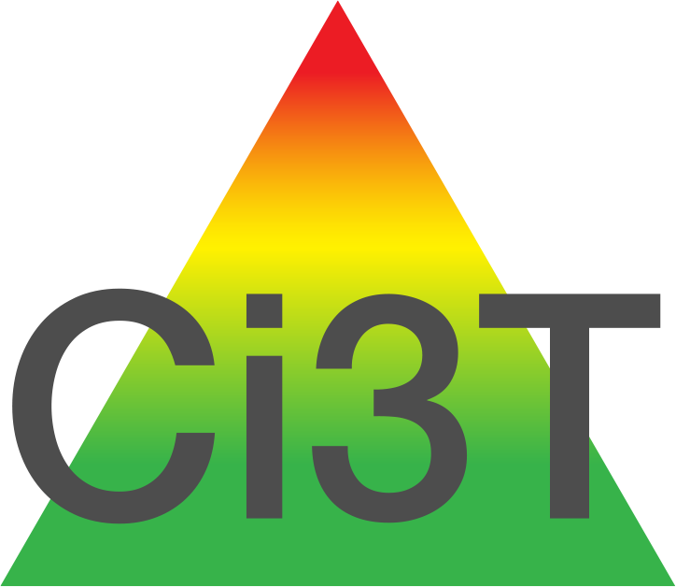

Goals for this Planning Year
Understand Design
Develop plans to
  implement your Ci3T blueprint
  leverage bridges and address barriers of implementation
  have regular feedback loops from stakeholders
  identify areas of additional professional learning for faculty and staff
Notes:
Gain an understanding of a comprehensive, integrated, three-tiered (Ci3T) framework
Design the Ci3T blueprint specific to your school’s needs
For addressing barriers, plan to get technical assistance

Slide 6






Why are you here?
Identifying Current Successes and Concerns
Notes:
3-min timer
Turn to a neighbor and tell them your why.

Slide 7
National Concerns
Administrators and educators are faced with a number of challenges
  Increasingly diverse population – cultural background, academic, behavioral, social skill sets
  (Lane, Wehby, & Robertson, 2008)
  Increasingly higher academic standards
  (e.g., Every Student Succeeds Act, 2015)
  Accommodating students with exceptionalities in inclusive settings
  (MacMillian, Gresham, & Forness, 1996; SWIFT Center, 2013)
  Preventing the development of antisocial behavior
  (Satcher, 2001; Walker, Ramsey, & Gresham, 2004)
  Serving students with antisocial behavior
  (Walker, 2003)
Source: Lane, K. L., Kalberg, J. R., & Menzies, H. M. (2009). Developing schoolwide programs to prevent and manage problem behaviors: A step-by-step approach. New York: Guilford Press.
National Center on Schoolwide Inclusive School Reform (The SWIFT Center). (2013). Research supporting SWIFT domains and features. Lawrence, KS: Author.

Slide 8


National Concerns
Title IV of Improving America’s Schools Act (1994)
Safe and Drug-Free Schools and Communities Act (1994)
Gun-Free Schools Act (1994)
Surgeon General’s Report on Youth Violence (2001)
Individuals with Disabilities Education Improvement Act (IDEA; 2004)
tolerance
EBP
Source: Lane, K. L., Kalberg, J. R., & Menzies, H. M. (2009). Developing schoolwide programs to prevent and manage problem behaviors: A step-by-step approach. New York: Guilford Press.
Notes:
Title IV of Improving America’s Schools Act of 1994, the Safe and Drug-Free Schools and Communities Act (1994), and Gun-Free Schools Act (1994) all spurred a zero tolerance stance on weapons, drugs, and alcohol. In theory this would deter violence and drugs but all it did was increase suspensions and expulsions [and referrals to juvenile justice system], which we know are not effective disciplinary tools (up to 40% are repeat offenders) and don’t treat underlying problems (e.g., substance abuse). Many districts expanded zero tolerance to cough drops, over-the-counter painkillers, and other harmless items. When behavior violations do occur students need consequences that are educational and supportive to help treat problems and prevent future challenges. The most severe may need alternative ways of learning, not to be rejected from school.
Surgeon General’s Report on Youth Violence (2001) first defined the magnitude of youth violence and why young become get involved in violence, then outlined how to determine what works to prevent and reduce it (meta-analysis of rigorous experimental designs). Then requested the use of evidence-based practices to dismantle antisocial networks by increasing academic success, developing positive school climates, and subscribing to a primary prevention model (Satcher, 2001).
Individuals with Disabilities Education Improvement Act (IDEA; 2004) included language to support this call “providing incentives for whole-school approaches … positive behavior interventions.” Schools must consider the use of positive interventions to help students learn prosocial replacement behaviors when their challenging behavior impedes learning.

Slide 9
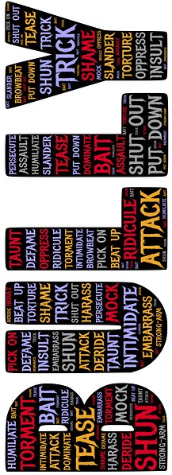
National Concerns
According to the results of a 2021 high school youth risk behavior survey
  15.0% of students reported being bullied at school in the past year (17.0% of females; 12.8% of males)
  6.6% of students reported being threatened or injured with a weapon at school in the past year (5.9% of females; 7.0% of males)
  15.9% of students reported being cyber bullied through email, social media, websites, or texting in the past year (20.5% of females; 11.2% of males)
  8.6% of students did not attend school for at least one day in the month preceding the survey because they felt unsafe (10.5% of females; 6.6% of males)
Source: Centers for Disease Control and Prevention. 2021 Youth Risk Behavior Survey. Available at cdc.gov
Notes:
2021 Source: https://www.cdc.gov/healthyyouth/data/yrbs/index.htm
Arrow indicate change from previous 2013 high school youth risk behavior survey (CDC): http://www.cdc.gov/mmwr/pdf/ss/ss6304.pdf
19.6% of students reported being bullied at school in the past year (23.7% of females; 15.6% of males)
6.9% of students reported being threatened or injured with a weapon at school in the past year (6.1% of females; 7.7% of males)
14.8% of students reported being cyber bullied through email, chat rooms, websites or texting in the past year (21.0% of females; 8.5% of males)
7.1% of students did not attend school for at least one day in the month preceding the survey because they felt unsafe (8.7% of females; 5.4% of males)

Slide 10
National Concerns
NAEP data on U.S. public school students
2019
MATH
  40%
  33%
  24%
READING
  35%
  34%
  37%
  4th graders scored proficient or above
  8th graders scored proficient or above
  12th graders scored proficient or above
  4th graders scored proficient or above
  8th graders scored proficient or above
  12th graders scored proficient or above
2022
MATH
  35%
  26%
READING
  33%
  31%
Source: U.S. Department of Education, Institute of Education Sciences, National Center for Education Statistics, National Assessment of Educational Progress (NAEP). Available at http://www.nationsreportcard.gov
Notes:
Many students struggle academically, not just students with EBD!
Sources:
https://www.nationsreportcard.gov/mathematics/nation/achievement/?grade=4
https://www.nationsreportcard.gov/reading/nation/achievement/?grade=12

Slide 11
Student deficits in either academics or behavior puts them at risk for long-term negative outcomes.
Academic
Difficulties
Behavioral or Social Difficulties
Source: Morgan, P. L., Farkas, G., Tufis, P. A., & Sperling, R. A. (2008). Are reading and behavior problems risk factors for each other? Journal of Learning Disabilities, 41, 417-436.

Slide 12
Emotional and Behavioral Disorders (EBD)
Internalizing
Externalizing

Slide 13
Classroom Concerns
ED <1%
EBD 12-20%
High numbers of teachers wish they had more practical training in behavior management strategies (Louis & Harris, 1991)
Even teachers trained to teach students with and at risk for emotional and behavioral disorders (EBD) report difficulties in managing students’ behavior efficiently (Walker, Ramsey, & Gresham, 2004)
Source: Forness, S.R., Freeman, S.F., Paparella, T., Kauffman, J.M., & Walker, H.M. (2012). Special education implications of point and cumulative prevalence for children with emotional or behavioral disorders. Journal of Emotional and Behavioral Disorders, 20, 4-18.

Slide 14
Why prevention frameworks are needed
Antisocial behavior patterns are most malleable before age 8
(Walker, Ramsey, & Gresham, 2004)
Students’ academic success is highly dependent on academic enablers (engagement, interpersonal skills, study skills, and motivation; DiPerna & Elliott, 2002)
Academic intervention at 3rd or 4th grade takes 4 times longer than if delivered at kindergarten
(Lyon, 1998)
1 in 6 children not reading proficiently at 3rd grade do not graduate from high school on time
(Hernandez, 2011)
Sources: DiPerna, J. C., Volpe, R. J., & Elliott, S. N. (2002). A model for academic enablers and elementary reading/language arts achievement. School Psychology Review, 31, 298-312.
Faggella‐Luby, M. N., & Deshler, D. D. (2008). Reading comprehension in adolescents with LD: What we know; what we need to learn. Learning Disabilities Research & Practice, 23(2), 70-78.
Hernandez, D. J. (2011). Double jeopardy: How third-grade reading skills and poverty influence high school graduation. Baltimore, MD: Annie E. Casey Foundation.
Lyon, R. G. (1998). The NICHD research program in reading development, reading disorders and reading instruction: A summary of research findings. New York, NY: National Center for Learning Disabilities.
Walker, H. M., Ramsey, E., & Gresham, F. M. (2004). Antisocial behavior in school: Evidence-based practices. Belmont, CA: Wadsworth Publishing Company.
Notes:
Asst. Secretary for the Office of Special Educaiton and Rehabilitation of the US DOE, Michael Yudin in 2014 said we have to pay as much attention to student’s social and behavioral needs as we do academics.

Slide 15
How does a prevention framework address this need?
Creating the context to maximize instruction and learning time
Instruction is responsive to student needs
Reducing
  Lack of appropriate instruction
  The cumulative effect of insufficient learning
  The difficulty of content area work
  Excessive absenteeism resulting in splinter skills
  The presence of significant behavior problems that impede student learning
Source: Shores, C., & Chester, K. (2008). Using RTI for school improvement: Raising every student’s achievement scores. Thousand Oaks, CA: Corwin Press.

Slide 16
Classroom Concerns
Many teachers are not equipped to handle the complex academic and behavioral needs of students with EBD (Lane, 2004)
Some pre-service teachers lack the necessary training in academic instruction for this population (Wehby, Lane, & Falk, 2003)
Ineffective teaching practices exacerbate the academic deficits of students with EBD (Shores, Gunter, & Jack, 1993)
Teachers who demonstrate instructional competence can produce significant improvements in students’ academic and behavioral performance (Sutherland, Wehby, & Yoder, 2002)
Sources: Lane, K. L. (2004). Academic instruction and tutoring interventions for students with emotional/behavioral disorders: 1990 to present. In R. B. Rutherford, M. M. Quinn, & S. R. Mathur (Eds.), Handbook of research in emotional and behavioral disorders (pp. 462-486). New York, NY: Guilford Press.
Shores, R. E., Gunter, P. L., & Jack, S. L. (1993). Classroom management strategies: Are they setting events for coercion? Behavioral Disorders, 18, 92-102.
Sutherland, K. S., & Wehby, J. H. (2001). Exploring the relationship between increased opportunities to respond to academic requests and the academic and behavioral outcomes of students with EBD: A review. Remedial and Special Education, 22, 113-121.
Sutherland, K. S., Wehby, J. H., & Yoder, P. J. (2002). Examination of the relationship between teacher praise and opportunities for students with EBD to respond to academic requests. Journal of Emotional and Behavioral Disorders, 10, 5-13.
Wehby, J. H., Lane, K. L., & Falk, K. B. (2003). Academic instruction for students with emotional and behavioral disorders. Journal of Emotional and Behavioral Disorders, 11, 194-197.

Slide 17
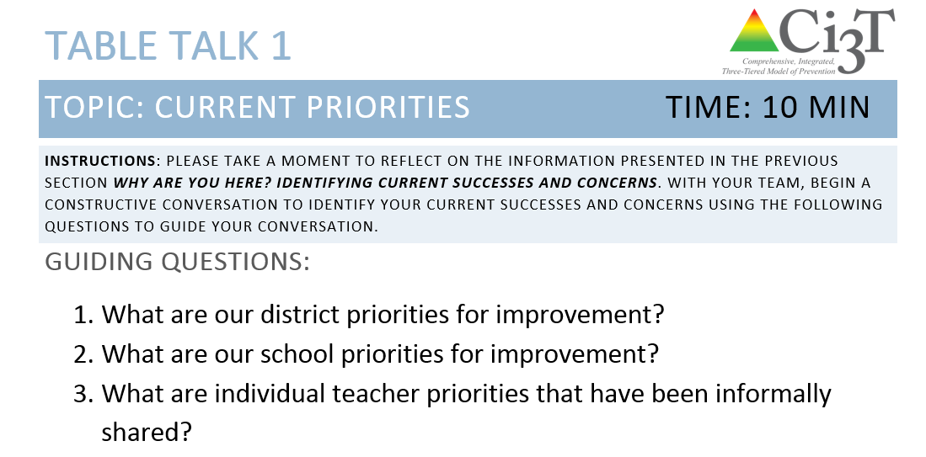









Table Talk 1
Current Priorities
10 minutes
Notes:
10 min

Slide 18

How can a Ci3T model address your priorities?
Providing an Overview of Ci3T Models

Slide 20


Serving Students… A Shift in Focus
Focus: A systems-level approach
Underlying premises:
  The collective and focused energies of teachers, administrators, parents, and other school personnel are more effective than fragmented efforts
  Academic, behavioral, and social support for students should be proactive and supplemental, not reactive and remedial
Proactive
Sources: Horner, R. H., & Sugai, G. (2015). School-wide PBIS: An example of applied behavior analysis implemented at a scale of social importance. Behavior Analysis in Practice, 8, 80-85.
Lane, K. L., Oakes, W. P., Menzies, H. M., Oyer, J., & Jenkins, A. (2013). Working within the context of three-tiered models of prevention: Using schoolwide data to identify high school students for targeted supports. Journal of Applied School Psychology, 29, 203-229.

Slide 21

A Response of Prevention
Given school-based violence and the multiple needs of students with and at risk for EBD:
  evidence-based programs are essential to prevent and respond to instances of antisocial behavior
Academic, behavioral, and social concerns co-occur and interact, therefore:
  it is important for prevention and remediation efforts to address this interconnected relationship
Source: Lane, K.L., Oakes, W.P., & Menzies, H.M. (2014). Comprehensive, integrated, three-tiered models of prevention: Why does my school—and district—need an integrated approach to meet students’ academic, behavioral, and social needs? Preventing School Failure: Alternative Education for Children and Youth, 58, 121-128.

Slide 22
Three-Tiered Models of Prevention
Primary (Tier 1), secondary (Tier 2), and tertiary (Tier 3) levels of prevention
  Response to Intervention
  (RtI; Gresham, 2002; Sugai, Horner, & Gresham, 2002)
  Positive Behavioral Interventions and Supports
  (PBIS; Horner & Sugai, 2015; Office of Special Education Programs Technical Assistance Center at pbis.org; Sugai & Horner, 2002)
  Interconnected Systems Framework
  (ISF; Barrett, Eber, & Weist, 2013)
Each level of prevention increases in intensity
Systematic, data-driven method to identify and support students
Sources: Barrett, S., Eber, L., & Weist, M. (Eds.). (2013). Advancing education effectiveness Interconnecting school mental health and school-wide positive behavior support. Baltimore, MD: Center for School Mental Health.Gresham, F.M. (2002). Responsiveness to intervention: An alternative approach to the identification of learning disabilities. In R. Bradley, L. C. Danielson & D. P. Hallahan (Eds.), Identification of learning disabilities: Research to practice (pp. 467-519). Mahwah, NJ: Lawrence Erlbaum Associates Publishers.
Horner, R.H., & Sugai, G. (2015). School-wide PBIS: An example of applied behavior analysis implemented at a scale of social importance. Behavior Analysis in Practice, 8, 80-85.
Sugai, G., & Horner, R.R. (2002). The evolution of discipline practices: School-wide positive behavior supports. Child & Family Behavior Therapy, 24, 23-50.
Sugai, G., Horner, R. H., & Gresham, F. M. (2002). Behaviorally effective school environments. In M. R. Shinn, H. M. Walker, & G. Stoner (Eds.) Interventions for academic and behavior problems: II. Preventive and remedial approaches (pp. 315-350). Washington, DC: National Association of School Psychologists.

Slide 24
Primary (Tier 1) Prevention
All students are eligible for participation (Lane, Robertson et al., 2006)
About 80% of students respond to this level
(Gresham, Sugai, Horner, Quinn, & McInerney, 1998; Sugai & Horner, 2006)
Examples of primary (Tier 1) prevention
  Validated literacy curricula
  Violence prevention
  Conflict resolution programs
  Anti-bullying programs
  Schoolwide social skills instruction
  Character education programs
Sources: Gresham, F. M., Sugai, G., Horner, R. H., Quinn, M. M., & McInerney, M. (1998). Classroom and schoolwide practices that support students’ social competence: A synthesis of research. Washington, DC: Office of Special Education Programs.
Lane, K. L., Robertson, E. J., & Graham-Bailey, M. A. L. (2006). An examination of school-wide interventions with primary level efforts conducted in secondary schools: Methodological considerations. In T. E. Scruggs & M. A. Mastropieri (Eds.) Applications of research methodology: Advances in learning and behavioral disabilities (Vol. 19), pp. 157-199. Oxford, UK: Elsevier.
Sugai, G., & Horner, R.R. (2006). A promising approach for expanding and sustaining school-wide positive behavior support. School psychology review, 35, 245.

Slide 25
Secondary (Tier 2) Prevention
Students who need more than the primary prevention plan, 10-15% of students
Focused intervention to address academic, behavior, and/or social concerns
  Acquisition (can’t do)
  Fluency (trouble doing)
  Performance (won’t do)
Examples of secondary (Tier 2) prevention
  Small group instruction in anger management
  Reading comprehension strategies
Source: Lane, K.L., Oakes, W.P., Ennis, R.P., & Hirsch, S.E. (2014). Identifying students for secondary and tertiary prevention efforts: How do we determine which students have tier 2 and tier 3 needs? Preventing School Failure, 58, 171-182.

Slide 26
Tertiary (Tier 3) Prevention
Students who need more than primary or secondary prevention, 5-7% of students
Intensive individualized interventions
Examples of tertiary (Tier 3) prevention
  Functional assessment-based interventions
  (Umbreit, Ferro, Liaupsin, & Lane, 2007)
  Multisystemic therapy program
  (Schoenwald, Brown, & Henggeler, 2000)
Sources: Lane, K.L., Oakes, W.P., Ennis, R.P., & Hirsch, S.E. (2014). Identifying students for secondary and tertiary prevention efforts: How do we determine which students have Tier 2 and Tier 3 needs? Preventing School Failure, 58, 171-182.
Schoenwald, S. K., Brown, T. L., & Henggeler, S. W. (2000). Inside multisystemic therapy therapist, supervisory, and program practices. Journal of Emotional and Behavioral Disorders, 8, 113-127.
Umbreit, J., Ferro, J.B., Liaupsin, C.J., & Lane, K.L. (2007). Functional behavioral assessment and function-based intervention: An effective, practical approach. Upper Saddle River, NJ: Prentice-Hall.

Slide 27

Three Core Features

Slide 28


Academic Component
Coordinated instruction within and across grade levels
Instruction linked to College and Career-Ready Standards, early learning standards, state, or district standards
Benchmarking student progress to inform instruction
Progress monitoring for students identified for secondary (Tier 2) and tertiary (Tier 3) supports
Source: Lane, K.L., Oakes, W.P., & Menzies, H.M. (2014). Comprehensive, integrated, three-tiered models of prevention: Why does my school—and district—need an integrated approach to meet students’ academic, behavioral, and social needs? Preventing School Failure: Alternative Education for Children and Youth, 58, 121-128.

Slide 29
Social Component:
Identifying a Validated Curriculum
Violence Prevention
  Second Step Violence Prevention (cfchildren.org)
Character Education
  Positive Action (positiveaction.net)
  Caring School Community (characterplus.org)
Social Skills
  Social Skills Improvement System: Classwide Intervention Program (Elliott & Gresham, 2007)
Source: Elliott, S. N., & Gresham, F. M. (2007). Social Skills Improvement System: Classwide intervention program teacher’s guide. Bloomington, MN: Pearson Assessments.

Slide 30
Social Component:
Examples of Schoolwide Programs
SEL & Bullying Prevention
cfchildren.org
Social Skills
Social Skills Improvement System (SSiS)
Elliott and Gresham, 2008
pearsonassessments.com
Includes a range of tools and intervention materials
Linking the Interests of Families and Teachers (LIFT)
Eddy, Reid, and Fetrow, 2000
Second Step
Committee for Children
~$430 per grade
elementary, middle, high school, families, staff, Spanish
Notes:
Sources: Committee for Children (1992). Second Step: A violence prevention curriculum grades 1-3. Seattle, WA: Author.
Eddy, J. M., Reid, J. B., & Fetrow, R. A. (2000). An elementary school-based prevention program targeting modifiable antecedents of youth delinquency and violence: Linking the interests of families and teachers (LIFT). Journal of Emotional and Behavioral Disorders, 8, 165-176.
Elliott, S. N., & Gresham, F. M. (2007). Social Skills Improvement System: Classwide intervention program teacher’s guide. Bloomington, MN: Pearson Assessments.

Slide 31
Social Component:
Examples of Schoolwide Programs
Social-emotional
Connect With Kids
connectwithkids.com
Character Education
A curricula using real stories presented through documentary-style videos, non-fiction books, teaching guides and patent resources.
Attendance and achievement
Bullying and violence prevention
Character and Life skills
Digital citizenship
Alcohol and drug prevention
Health and Wellness
Customizable units are:
Positive Action
positiveaction.net
Improves academics, behavior, and character
Curriculum-based approach
Effectively increases positive behaviors and decreases negative behaviors
6-7 units per grade
Optional components:
site-wide climate development
drug education
bullying / conflict resolution
counselor, parent, and family classes
community/coalition components

Slide 32
Behavioral Component:
Positive Behavioral Interventions and Supports (PBIS)
A Framework, Not a Curriculum
Establish, clarify, and define expectations
Teach all students the expectations, planned and implemented by all adults
Give opportunities to practice
Reinforce students consistently, facilitate success
Consider rules, routines, and physical arrangements
Monitor the plan using school-wide data to identify students who need more support
Monitor student progress
Source: Horner, R.H., & Sugai, G. (2015). School-wide PBIS: An example of applied behavior analysis implemented at a scale of social importance. Behavior Analysis in Practice, 8, 80-85.

Slide 33
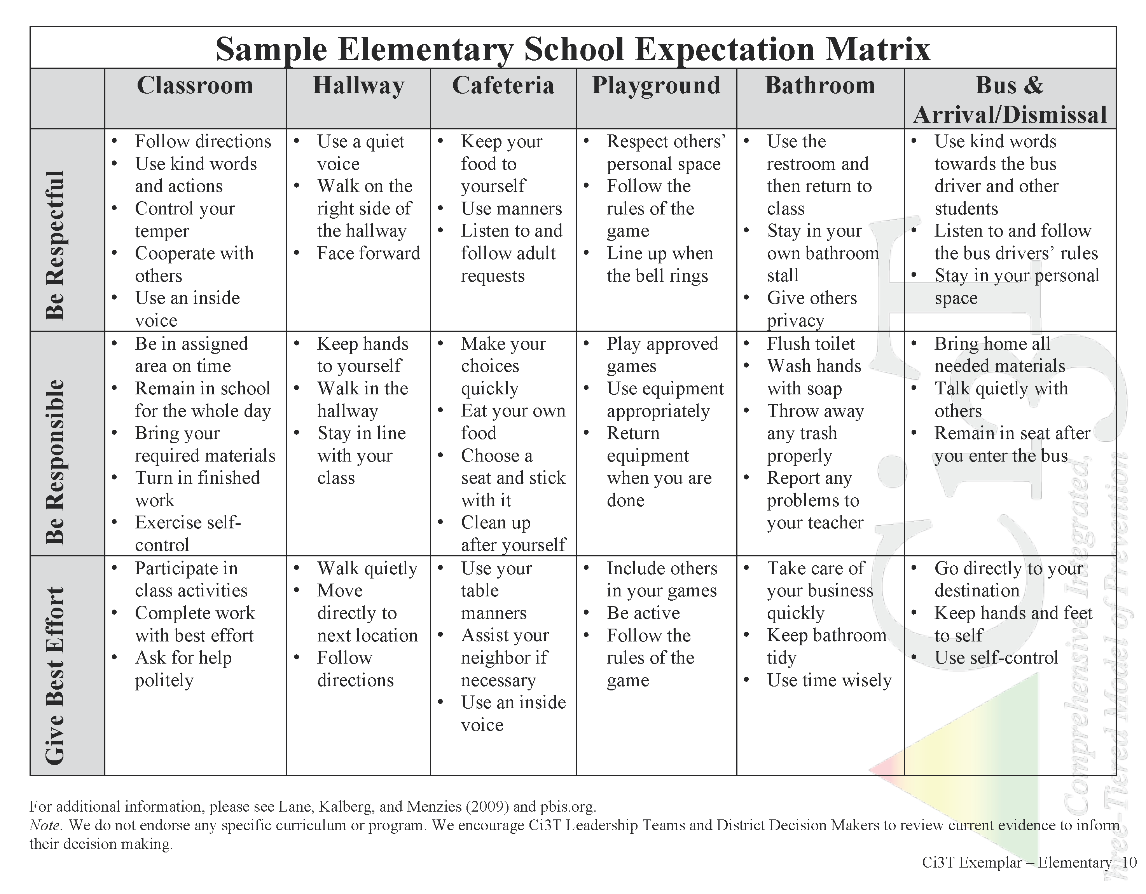
Establish, Teach, Acknowledge

Slide 34
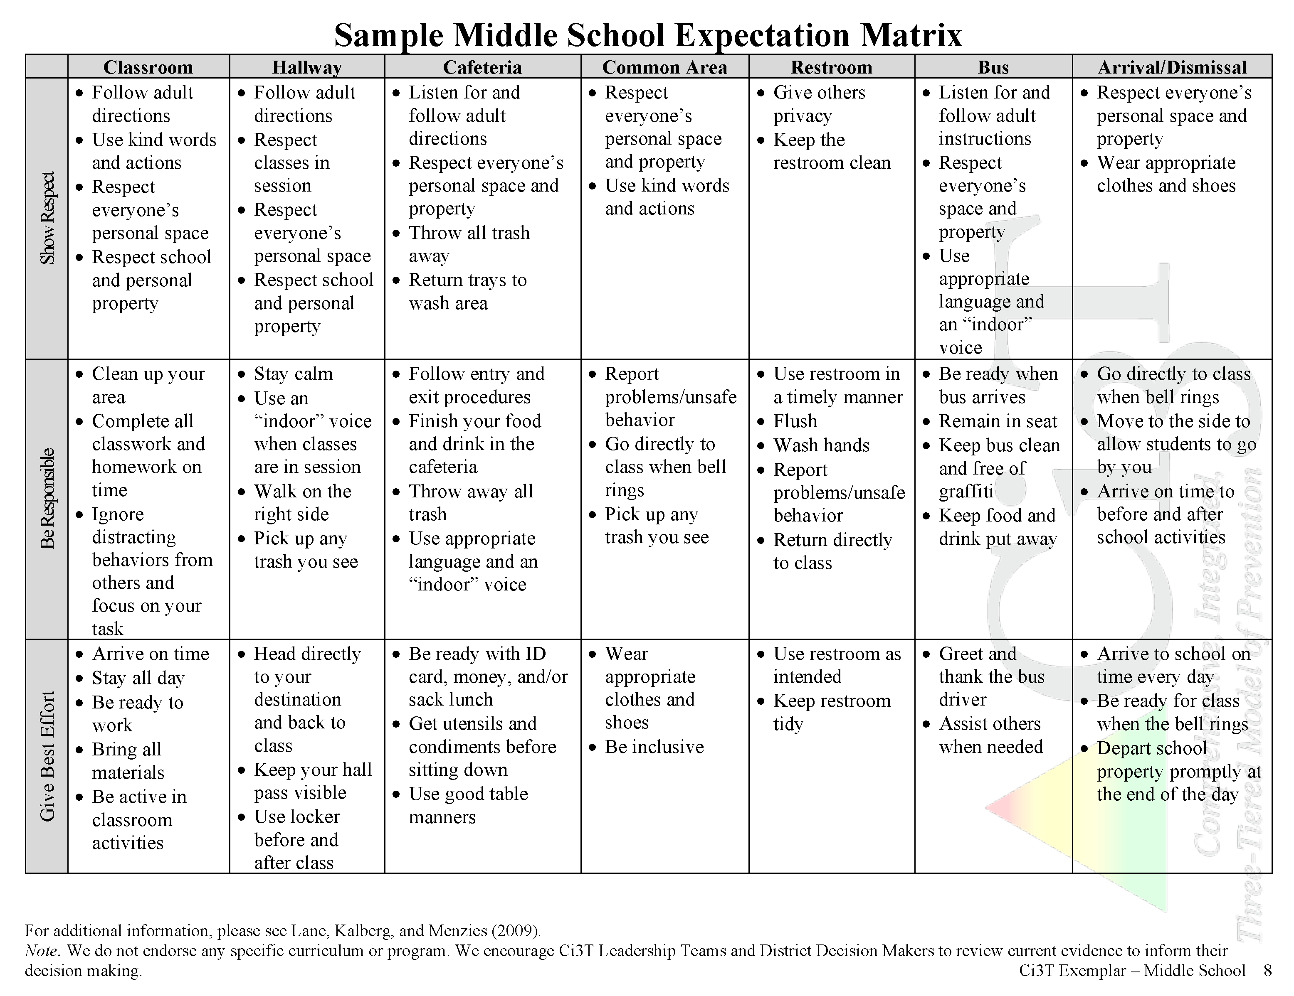
Establish, Teach, Acknowledge

Slide 35
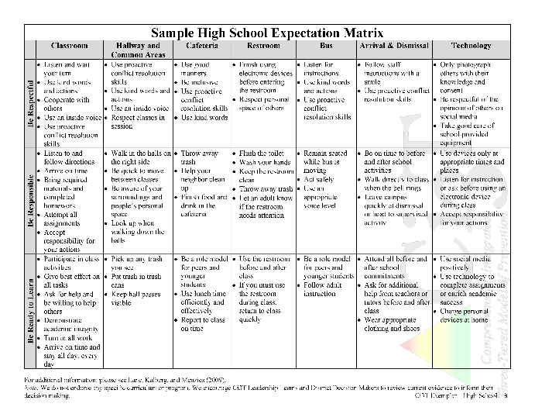
Evidence for the Behavioral Component of the Ci3T Framework: PBIS
Why Behavior Matters for Academic Outcomes

Slide 36

Randomized Control Trial Results
Participants
37 elementary schools from districts in Maryland (rural and urban)
  21 received SWPBIS training and implementation, 16 did not train or implement
Results
Reduction in ODRs
Reduction in Suspensions
Increase in Academics
Sources: Bradshaw, C.P., Mitchell, M. M., & Leaf, P. J. (2010). Examining the effects of schoolwide positive behavioral interventions and supports on student outcomes: Results from a randomized controlled effectiveness trial in elementary schools. Journal of Positive Behavior Interventions, 12, 133-148.
Scott, T. M., & Barrett, S. B. (2004). Using staff and student time engaged in disciplinary procedures to evaluate the impact of school-wide PBS. Journal of Positive Behavior Interventions, 6, 21-28.
Notes:
Results:
Reduction in ODRs: Significant reduction percentage and rate of students earning ODRs. Fewer ODRs per 100 students per day relative to the national SWIS data for elementary schools.
Reduction in Suspensions: Percentage of suspensions dropped significantly over time for schools implementing PBIS, but not for the comparison schools.
Increase in Academics: 5th graders in PBIS schools increased in mathematics on the state of Maryland assessment in contrast to the comparison schools. “Theorized that training in SWPBIS may translate into academic outcomes for students by reducing the rates of behavior problems in the classroom, which could increase opportunities for learning (Scott & Barrett, 2004)”
References to newer Bradshaw studies:
Pas, E. T., Ryoo, J. H., Musci, R. J., & Bradshaw, C. P. (2019). A state-wide quasi-experimental effectiveness study of the scale-up of school-wide Positive Behavioral Interventions and Supports. Journal of school psychology, 73, 41-55.
Pas, E. T., Waasdorp, T. E., & Bradshaw, C. P. (2015). Examining contextual influences on classroom-based implementation of positive behavior support strategies: Findings from a randomized controlled effectiveness trial. Prevention Science, 16(8), 1096-1106.
Bradshaw, C. P., Waasdorp, T. E., & Leaf, P. J. (2015). Examining variation in the impact of school-wide positive behavioral interventions and supports: Findings from a randomized controlled effectiveness trial. Journal of Educational Psychology, 107(2), 546.
Waasdorp, T. E., Bradshaw, C. P., & Leaf, P. J. (2012). The impact of schoolwide positive behavioral interventions and supports on bullying and peer rejection: A randomized controlled effectiveness trial. Archives of pediatrics & adolescent medicine, 166(2), 149-156.

Slide 37


Randomized Control Trial Results
Participants
K-5 elementary schools in Hawai‘i and Illinois that had not had prior training in SWPBIS
Schools were assigned to be either a treatment or control-delay group (treatment groups received SWPBIS training)
Results
After 1 year implementing PBIS as designed:
  Increased perception of school safety
  Increased reading performance on state assessments
Source: Horner, R. H., Sugai, G., Smolkowski, K., Eber, L., Nakasato, J., Todd, A. W., & Esperanza, J. (2009). A randomized, wait-list controlled effectiveness trial assessing school-wide positive behavior support in elementary schools. Journal of Positive Behavior Interventions, 11, 133-144.

Slide 38
Benefits for School Environment
More friendly and inviting work environment for school staff (Bradshaw, Koth et al., 2008)
Regular team meetings, using data, and having parent and community buy in were facilitators to PBIS success
(Kincaid, Childs, Blasé, & Wallace, 2007)
Teacher perceptions of PBIS improved over a 3 year period: PBIS helped them in the classroom and provided more opportunities for instruction
(Cheney, Blum, & Walker, 2004)
Sources: Bradshaw, C. P., Koth, C. W., Bevans, K. B., Ialongo, N., & Leaf, P. J. (2008). The impact of school-wide positive behavioral interventions and supports (PBIS) on the organizational health of elementary schools. School Psychology Quarterly, 23, 462.
Cheney, D., Blum, C., & Walker, B. (2004). An analysis of leadership teams' perceptions of positive behavior support and the outcomes of typically developing and at-risk students in their schools. Assessment for Effective Intervention, 30, 7-24.
Kincaid, D., Childs, K., Blase, K. A., & Wallace, F. (2007). Identifying barriers and facilitators in implementing schoolwide positive behavior support. Journal of Positive Behavior Interventions, 9, 174-184.

Slide 39

Evidence at the High School
Participants
1 urban high school in Chicago with 1,800 students
89% free/reduced-price lunch, 21% English language learner, 20% special education, 19% dropout
Implemented PBIS with professional development and implementation supports
Results
Changes from Year 2 to Year 3 implementation:
  20% reductions in average ODRs
  Dress code violations from 26.63% to 8.93%
  Serious disobedience from 1.64% to 0.05%
Sources: Bohanon, H., Fenning, P., Carney, K. L., Minnis-Kim, M. J., Anderson-Harriss, S., Moroz, K. B., ... & Pigott, T. D. (2006). Schoolwide application of positive behavior support in an urban high school: A case study. Journal of Positive Behavior Interventions, 8, 131-145.
Todd, A.W., Lewis-Palmer. T., Horner, R.H., Sugai, G., Sampson, N.K., & Phillips, D. (2012). School-wide Evaluation Tool (SET) Implementation Manual, Version 2.0. Eugene, OR: University of Oregon.

Slide 40

Why include components?
Academic
Behavior
Social
An instructional approach to behavior gives teachers
more time to teach academics and social competencies
A data-driven framework allows educators to:
  Monitor overall level of risk and progress in the school
  Identify students who may require additional supports in academic, behavioral, and social domains
An evidence-based social skills curriculum provides a common foundation for all students’ success
Sources: Lane, K. L., Oakes, W. P., Menzies, H. M., Oyer, J., & Jenkins, A. (2013). Working within the context of three-tiered models of prevention: Using schoolwide data to identify high school students for targeted supports. Journal of Applied School Psychology, 29(2), 203-229. DOI: 10.1080/15377903.2013.778773
Shogren, K. A., Wehmeyer, M. L., & Lane, K. L. (2016). Embedding interventions to promote self-determination within multitiered systems of supports. Exceptionality, 1-12. doi: 10.1080/09362835.2015.1064421

Slide 41
Commitment for Successful Implementation
Ci3T school-site leadership teams have:
  A district Ci3T leadership team for support
  Active participation of school administrator(s) with decision making authority
  A commitment to meeting needs of all students
  A commitment to installing evidence-based practices
  A commitment to sustainability using implementation sciences
Sources: Mathews, S., McIntosh, K., Frank, J. L., & May, S. L. (2013). Critical features predicting sustained implementation of school-wide positive behavioral interventions and supports. Journal of Positive Behavior Interventions, 16(3). doi:1098300713484065
McIntosh, K., Mercer, S. H., Nese, R. N., Strickland-Cohen, M. K., & Hoselton, R. (2015). Predictors of sustained implementation of school-wide positive behavioral interventions and supports. Journal of Positive Behavior Interventions. doi: 10.1177/1098300715599737

Slide 42

Ci3T School-site
Leadership Team
Collectively, the team’s role is:
  To successfully create an integrated and sustainable Ci3T model of prevention
  To work collaboratively with all stakeholder groups
  To establish the structures to allow the system to function effectively
Source: Lane, K.L., Oakes, W.P., Jenkins, A., Menzies, H.M., & Kalberg, J.R. (2014). A team-based process for designing comprehensive, integrated, three-tiered (Ci3T) models of prevention: How does my school-site leadership team design a Ci3T model? Preventing School Failure: Alternative Education for Children and Youth, 58, 129-142.

Slide 43
Ci3T School-site Leadership Team
In your role as a team member, you:
Have primary responsibilities for designing, implementing, and evaluating your school’s plan
Will support stakeholders affected by the changes
Have authority to make decisions
Have the ability to allocate resources, including time, to support the plan’s design and implementation
Sources: Lane, K.L., Oakes, W.P., Jenkins, A., Menzies, H.M., & Kalberg, J.R. (2014). A team-based process for designing comprehensive, integrated, three-tiered (Ci3T) models of prevention: How does my school-site leadership team design a Ci3T model? Preventing School Failure: Alternative Education for Children and Youth, 58, 129-142.
McIntosh, K., MacKay, L. D., Hume, A. E., Doolittle, J., Vincent, C. G., Horner, R. H., & Ervin, R. A. (2011). Development and initial validation of a measure to assess factors related to sustainability of school-wide positive behavior support. Journal of Positive Behavior Interventions, 13, 208-218. doi: 10.1177/1098300710385348.

Slide 44
The Ci3T Model

Slide 45

Importance of Unified Systems of Measurement
Accurate measurement of key variables to enable accurate decision making
  attendance
  academic progress (e.g., curriculum-based measurement)
  behavior screenings
  office discipline referrals (ODRs)
The ability to analyze academic and behavioral data in tandem
Information sharing regarding
  progress for school as a whole and
  identification and support of students who require additional supports in the form of secondary (Tier 2) and tertiary (Tier 3) levels of prevention
Source: Lane, K.L., Oakes, W.P., & Magill, L. (2014). Primary prevention efforts: How do we implement and monitor the Tier 1 component of our comprehensive, integrated, three-tiered (Ci3T) model? Preventing School Failure, 58, 143-158.

Slide 46
Academic Screening
DIBELS® or AIMSweb® or I-Ready® or STAR® are curriculum-based measures used to identify students who are at risk for difficulties with foundational academic skills
Uses criterion scoring and places students in three need levels of support: benchmark (Tier 1), secondary (Tier 2), or tertiary (Tier 3)
https://charts.intensiveintervention.org/ascreening
Sources: Good, R.H., & Kaminski, R. A. (Eds.) (2002). Dynamic Indicators of Basic Early Literacy Skills (6th ed.). Eugene, OR: Institute for the Development of Educational Achievement.
Shinn, M. R., & Shinn, M. M. (2002). AIMSweb® Training Workbook. Eden Prairie, MN: Edformation.
Notes:
Link takes you to National Center for Intensive Intervention where they have a tools chart (like consumer reports ratings) for academic screeners.

Slide 47
Behavior Screening Example
Student Risk Screening Scale (SRSS; Drummond, 1994)
The SRSS is a 7-item mass screener used to identify students who are at risk for antisocial behavior
Uses 4-point Likert-type scale:
never = 0, occasionally = 1, sometimes = 2, frequently = 3
Teachers evaluate each student on the following items
  Steal Low Academic Achievement
  Lie, Cheat, Sneak Negative Attitude
  Behavior Problem Aggressive Behavior
  Peer Rejection
Student risk is divided into 3 categories
  Low 0 – 3
  Moderate 4 – 8
  High 9 – 21
Source: Drummond, T. (1994). The Student Risk Screening Scale (SRSS). Grants Pass, OR: Josephine County Mental Health Program.

Slide 48
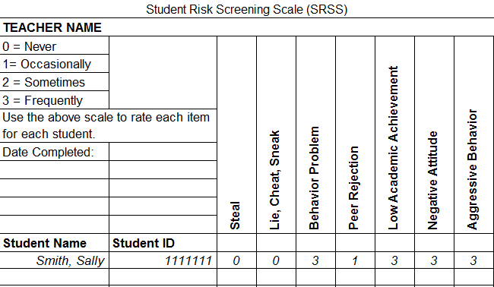
Student Risk Screening Scale
Source: Drummond, T. (1994). The Student Risk Screening Scale (SRSS). Grants Pass, OR: Josephine County Mental Health Program.

Slide 49
Student Risk Screening Scale
Fall 2004-2012 • Middle School
N=534
N=502
N=454
N=490
N=477
N=476
N=524
N=539
Lane, K. L., Oakes, W. P., & Magill, L. (2013). Primary prevention efforts: How do we implemented and monitor the Tier 1 component of our comprehensive, integrated, three-tiered (Ci3T) model? Preventing School Failure, 58(3), 143-158. https://doi.org/10.1080/1045988X.2014.893978

Slide 50
Middle School
Behavior & Academic Characteristics of SRSS Risk Groups
Variable |  | Risk
 | Low (n = 422) M (SD) | Moderate (n = 51) M (SD) | High (n = 12) M (SD) | Significance Testing
ODR | 1.50 (2.85) | 5.02 (5.32) | 8.42 (7.01) | L<M<H
In-School Suspensions | 0.08 (0.38) | 0.35 (1.04) | 1.71 (2.26) | L<M<H
GPA | 3.35 (0.52) | 2.63 (0.65) | 2.32 (0.59) | L>M, H M=H
Course Failures | 0.68 (1.50) | 2.78 (3.46) | 4.17 (3.49) | L<M, H M=H
Source: Lane, K. L., Parks, R. J., Kalberg, J. R., & Carter, E. W. (2007). Systematic screening at the middle school level: Score reliability and validity of the Student Risk Screening Scale. Journal of Emotional and Behavioral Disorders, 15, 209-222.

Slide 51
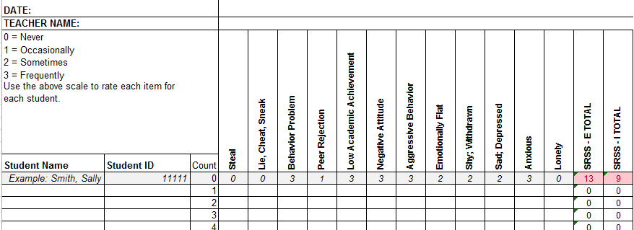
SRSS-IE for Elementary Schools
12 items scale
No total scale score
Externalizing and internalizing subscale scores are used for interpretation
Source: Drummond, 1994; Lane, K. L., & Menzies, H. M. (2009). Student Risk Screening Scale: Internalizing and Externalizing (SRSS-IE). Unpublished rating scale.
Notes:
51

Slide 52
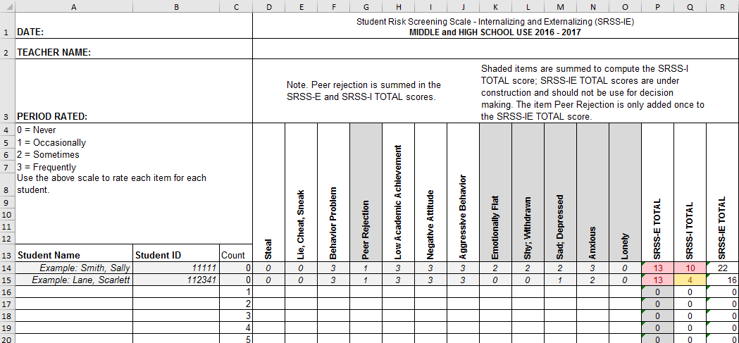
SRSS-IE for Middle and High Schools
Source: Drummond, 1994; Lane, K. L., & Menzies, H. M. (2009). Student Risk Screening Scale: Internalizing and Externalizing (SRSS-IE). Unpublished rating scale.

Slide 53
SRSS-IE: Externalizing Subscale Elementary
Fall Externalizing
Winter
Spring
ORF
MAP Reading
Nurse Visit
Suspensions
Variable | Risk |  |  | Significance Testing
 | Low M (SD) n | Moderate M (SD) n | High M (SD) n
Oral Reading Fluency | 163.23 (39.66) 468 | 138.62 (42.70) 107 | 115.82 (46.21) 46 | L > M > H
MAP Reading | 66.54 (26.48) 2,047 | 42.91 (30.37) 443 | 33.32 (29.82) 199 | L > M > H
Nurse Visits | 6.14 (6.81) 3,256 | 9.18 (9.59) 820 | 11.83 (9.89) 389 | L < M < H
In-School Suspensions | 0.0052 (0.08) 3,256 | 0.0427 (0.30) 820 | 0.1080 (0.46) 389 | L < M < H

Slide 54
SRSS-IE: Internalizing Subscale Elementary
Variable | Risk |  |  | Significance Testing
 | Low M (SD) n | Moderate M (SD) n | High M (SD) n
Oral Reading Fluency | 159.04 (41.45) 459 | 150.59 (45.76) 88 | 139.18 (46.53) 74 | L > H L = M; M = H
MAP Reading | 63.38 (28.32) 2,070 | 53.93 (32.15) 356 | 43.57 (30.47) 263 | L > M > H
Nurse Visits | 6.84 (7.37) 3,387 | 7.59 (8.05) 628 | 9.33 (10.81) 450 | L < M < H
In-School Suspensions | 0.0142 (0.15) 3,387 | 0.0510 (0.36) 628 | 0.0311 (0.20) 450 | L < M, H M = H
Fall Internalizing
Winter Internalizing
Spring
ORF*
MAP Reading
Nurse Visit
Suspensions*

Slide 55
Elementary School Discipline Comparison Quarter 1 2005-2006 to Quarter 1 2006-2007
These numbers represent the total numbers for the school as a whole divided by the number of school days in a given quarter.
Rate (per instructional day)
Source: Lane, K.L., Kalberg, J.R., & Menzies, H.M. (2009). Developing schoolwide programs to prevent and manage problem behaviors: A step-by-step approach. New York, NY: Guilford Press.

Slide 56

What do we want to accomplish as a school?
Defining Our Mission and Purpose Statements

Slide 57

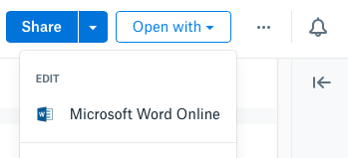
Open your school’s folder on dropbox.com
Open the “Ci3T Blueprint Materials” folder
Make a copy of Ci3T Blueprint A Primary (Tier 1) Plan and rename to add the date to the end of the file name
Click the new file to start a preview
Click “Open with” in the top right, then Microsoft Word Online, which allows multiple people to edit together
Notes:
Use the “Hide Slide” feature to hide the file sharing system not being used. Do not delete the slide. Hiding the slide will preserve correspondence to the pacing guide slide numbers.

Slide 58

Open your school’s Google Drive folder online
Open the “Ci3T Blueprint Materials” folder
Find Ci3T Blueprint A Primary (Tier 1) Plan
Right-click and select “Rename”
  Update the end of the file name to today’s date
  Add your school initials in the front
and/or open the doc and click File > Version history > Name current version and type today’s date
Ex: P_LES Ci3T-Blueprint-A-Primary-Tier-1-Plan 2026 11 14
Notes:
Use the “Hide Slide” feature to hide the file sharing system not being used. Do not delete the slide. Hiding the slide will preserve correspondence to the pacing guide slide numbers.

Slide 59
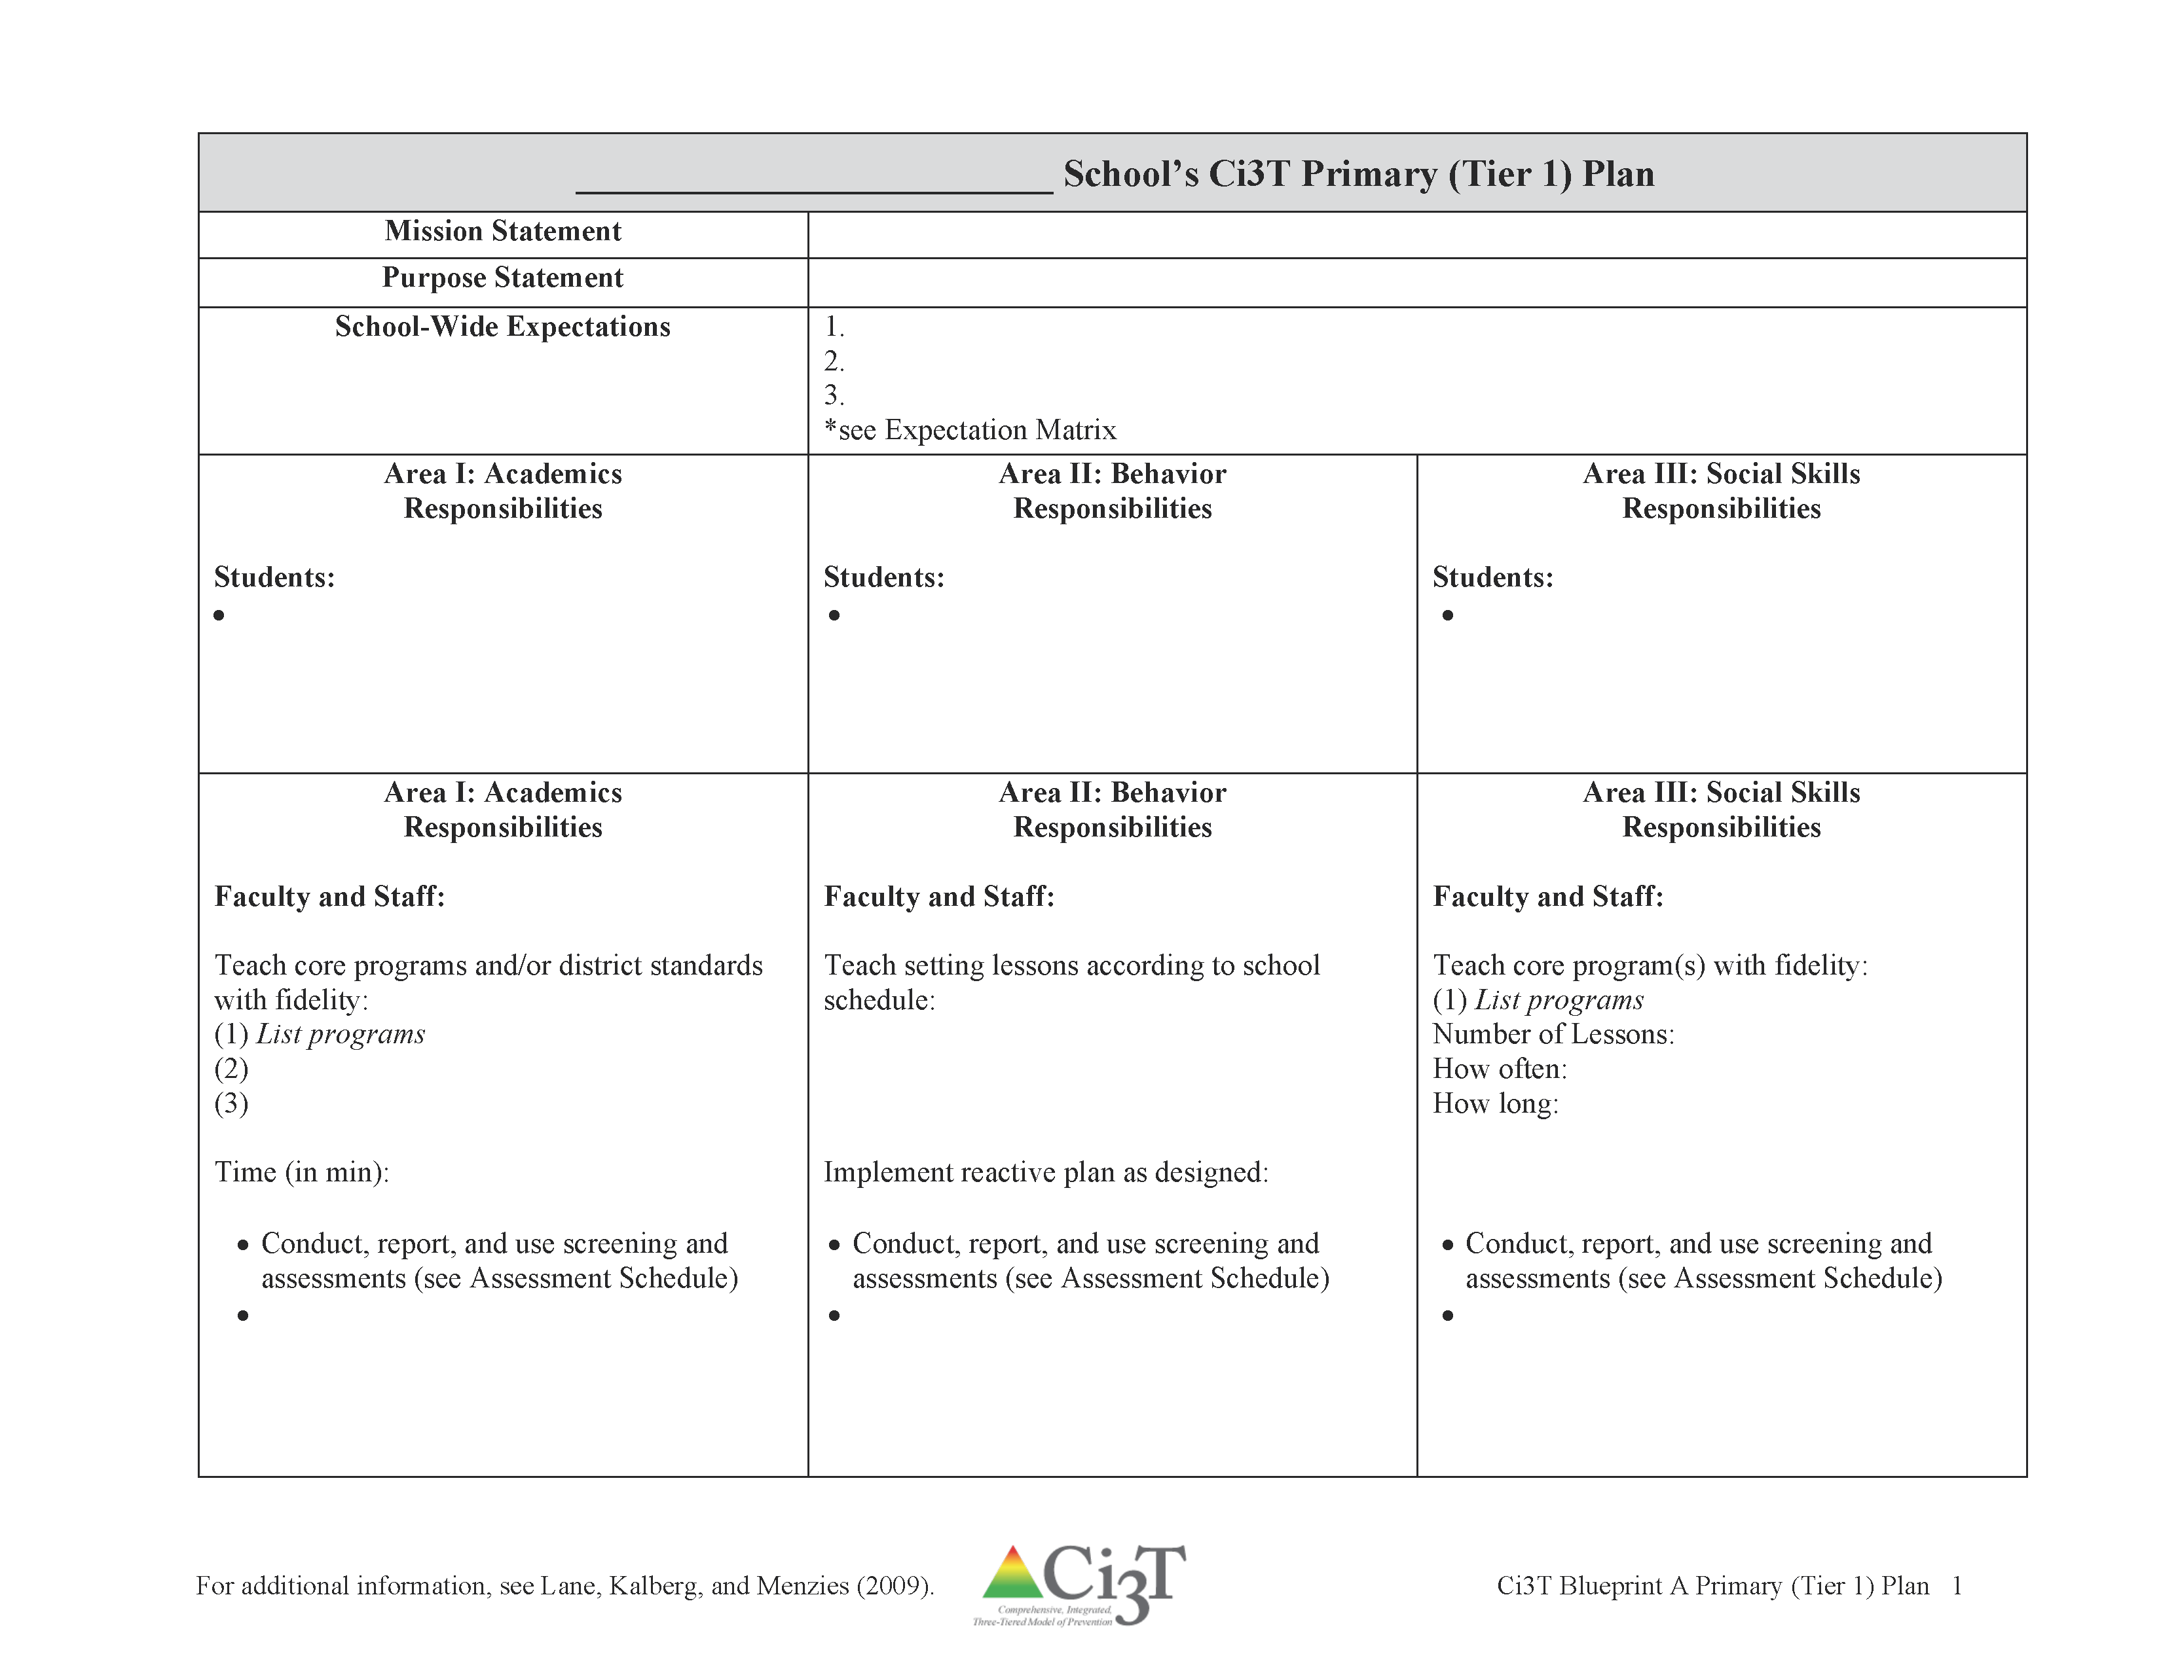
Ci3T Blueprint A Primary (Tier 1) Plan
Revisit your existing mission statement

Slide 60





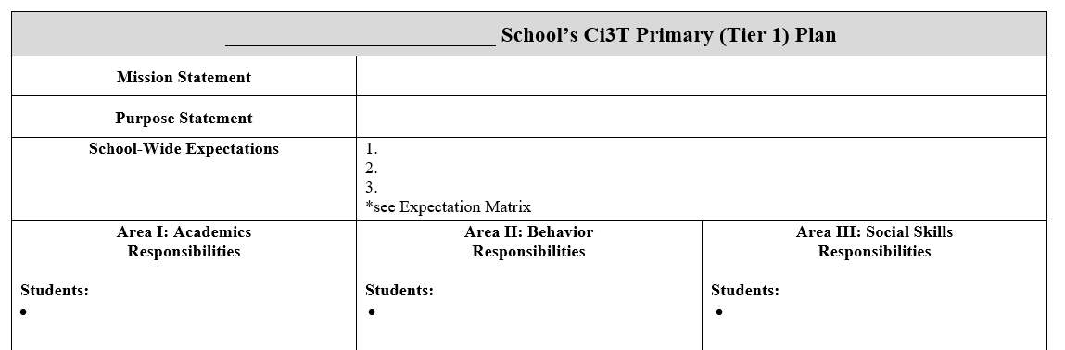
Use Table Talk 1 Current Priorities to guide you
Draft Mission and Purpose Statements
Ci3T Blueprint A Primary (Tier 1) Plan
15 minutes
Notes:
15 min

Slide 61
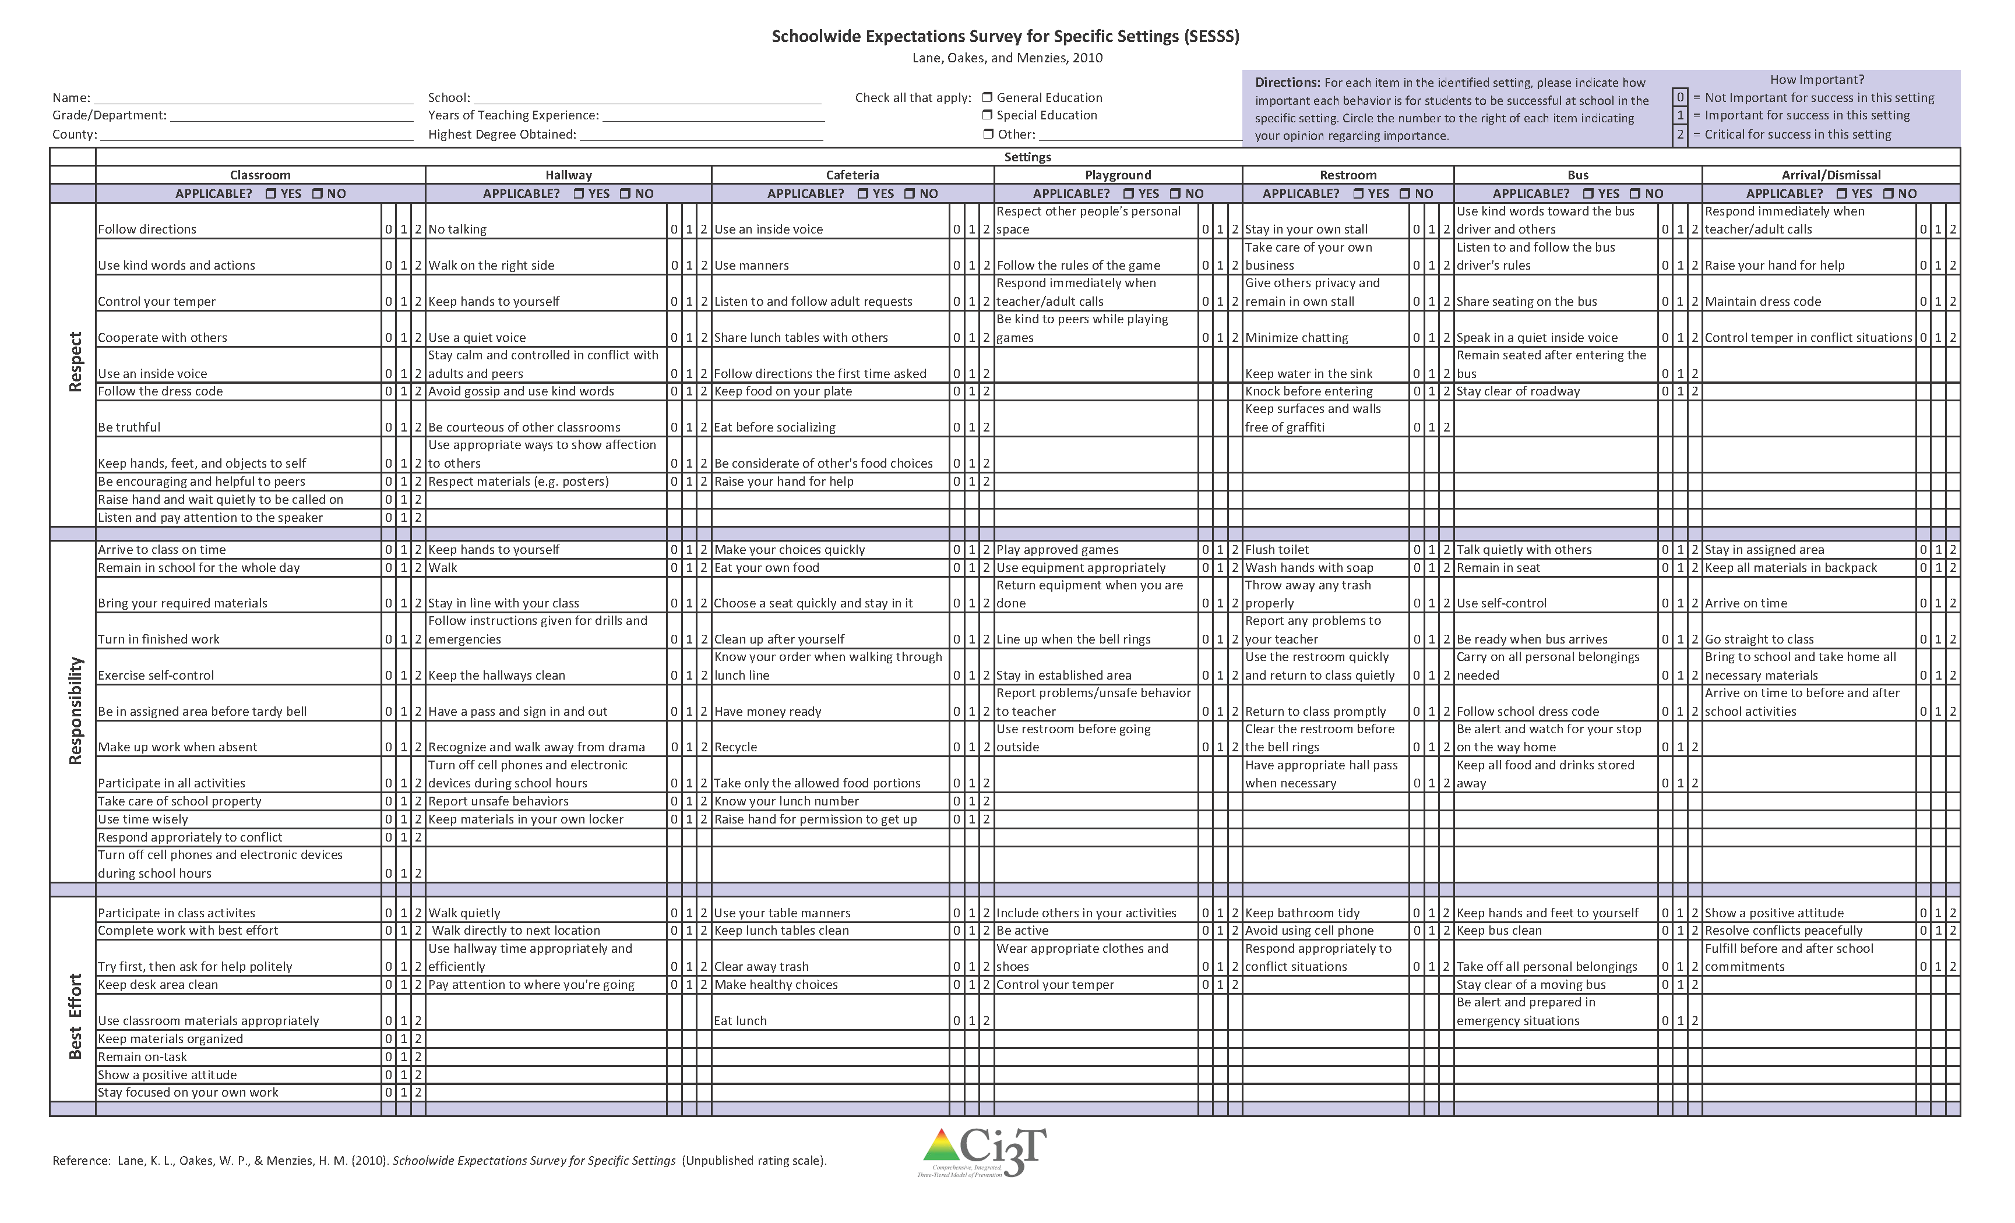
Using the Schoolwide Expectations Survey for Specific Settings (SESSS) Results
What do your faculty and staff expect from students?
Source: Lane, K. L., Oakes, W. P., & Menzies, H. M. (2010). Schoolwide Expectations Survey for Specific School Settings. Unpublished survey.

Slide 62
Interpreting the SESSS
All school site personnel were given the opportunity to participate
Results show number and percentage of school personnel who rated each behavior as critical for student success
Source: Lane, K. L., Oakes, W. P., & Menzies, H. M. (2010). Schoolwide Expectations Survey for Specific School Settings. Unpublished survey.
Notes:
If they were not present at the meeting, the information was left for them in their box or sent via email.
The information you have reflects the responses for the school personnel who returned the forms.

Slide 63
Schoolwide Expectations Survey for Specific Settings
Classroom
Follow Directions 0 1 2
Use kind words 0 1 2
Control your temper 0 1 2
Cooperate with others 0 1 2
Use an inside voice 0 1 2
Respect
Arrive to class on time 0 1 2
Remain in school for the whole day 0 1 2
Bring your required materials 0 1 2
Turn in finished work 0 1 2
Exercise self-control 0 1 2
Responsibility
Participate in class activities 0 1 2
Complete work with best effort 0 1 2
Ask for help politely 0 1 2
Best Effort
Notes:
Source: Lane, K. L., Oakes, W. P., & Menzies, H. M. (2010). Schoolwide Expectations Survey for Specific School Settings. Unpublished survey.

Slide 64
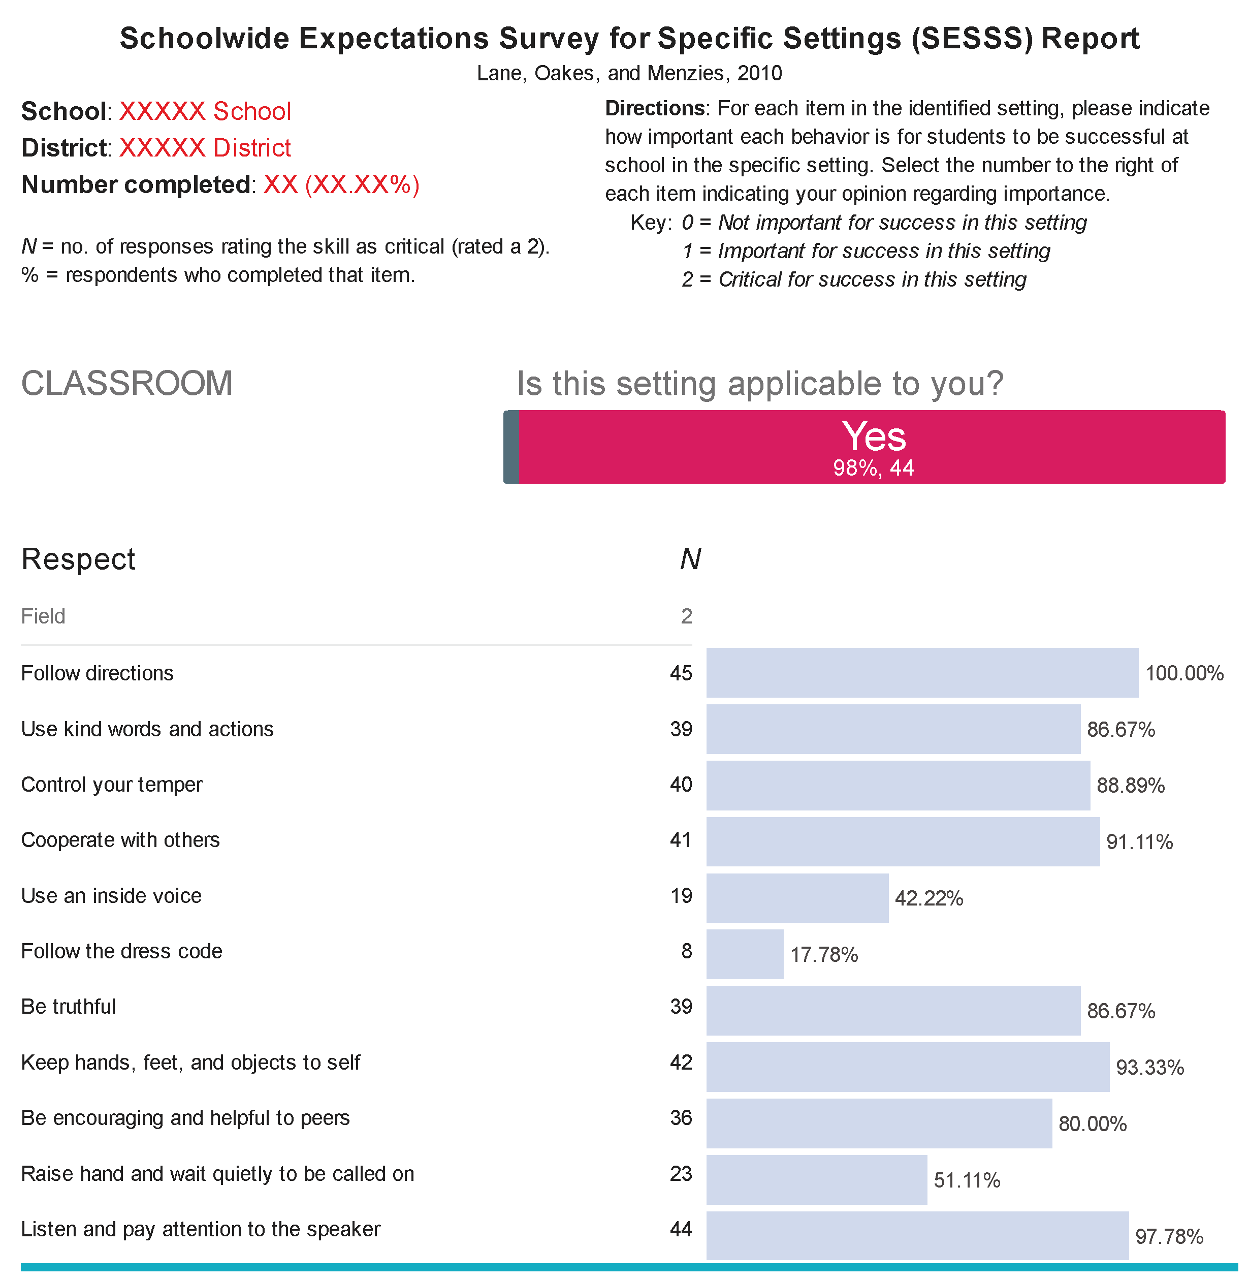
Number of school personnel who returned the survey
Interpreting the SESSS Data
Number and percentage of total school personnel who rated the behavior as (2) critical for student success
NUMBER
PERCENTAGE
Source: Lane, K. L., Oakes, W. P., & Menzies, H. M. (2010). Schoolwide Expectations Survey for Specific School Settings. Unpublished rating scale.

Slide 65
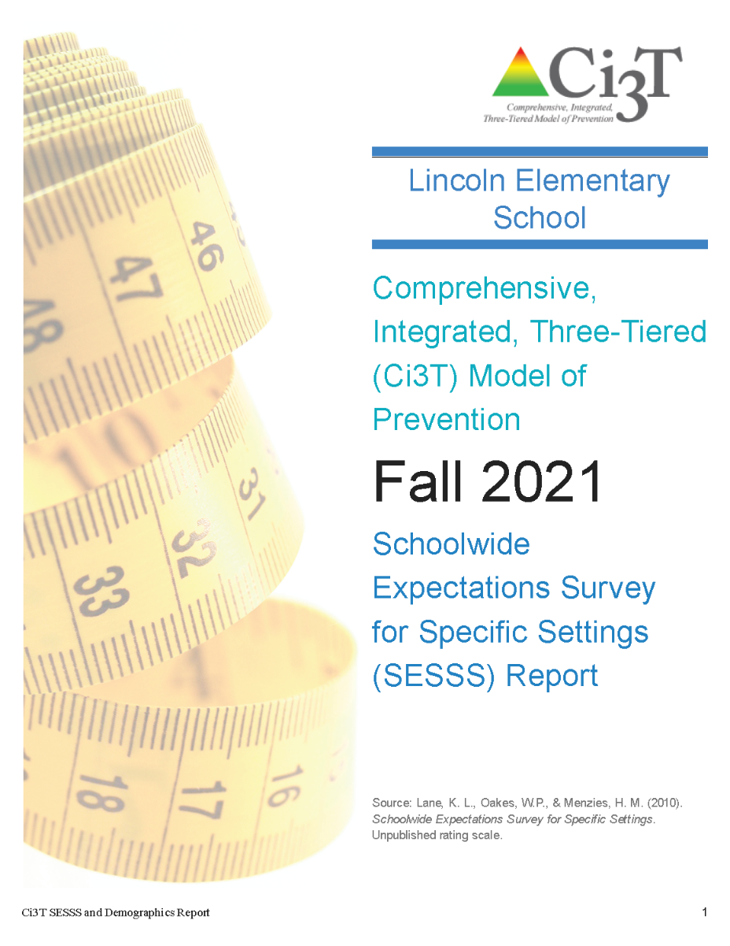
Interpreting the SESSS
10 minutes
Notes:
10 min

Slide 66

How will the Ci3T professional learning series assist us in meeting our goals, mission, and purpose?
Providing an Overview of the Ci3T Professional Learning Series

Slide 67
Comprehensive, Integrated, Three-Tiered (Ci3T) Model of Prevention Professional Learning Series
Each school has selected a Ci3T Leadership Team to attend Ci3T training this year. Only team members are asked to attend the trainings.
Ci3T Professional Learning Series Traditional Timeline
1: Two-Hour
After School
4: Full Day
2: Full Day
3: Two-Hour
After School *With Students
6: Full Day
5: Two-Hour
After School
*With Students
November
December
January
February
April
May

Slide 68


Slide 69

Where do we go from here?
Setting Goals for Your Ci3T Leadership Team and Faculty and Staff

Slide 71

How will the Ci3T professional learning series assist us in meeting our goals, mission, and purpose?
Providing an Overview of the Ci3T Professional Learning Series

Slide 72
Goals for this Planning Year
Understand Design
Develop plans to
  implement your Ci3T blueprint
  leverage bridges and address barriers of implementation
  have regular feedback loops from stakeholders
  identify areas of additional professional learning for faculty and staff
Notes:
Gain an understanding of a comprehensive, integrated, three-tiered (Ci3T) framework
Design the Ci3T blueprint specific to your school’s needs
For addressing barriers, plan to get technical assistance

Slide 73

Please Take a Minute to Get Organized
Please stay until all materials are organized
Place all materials in your table box:
  Name badges
  Role magnets
  Table cards (CASEL, What Works Clearinghouse)
  Extra postcards (take some with you!)
  Clearly identify the technology person on your team in charge of keeping Dropbox / Google Drive organized (move old versions into Previous folder)
    Consider saving docs with your school initials at the beginning and the date at the end of the file name
    Example: P_LES_Ci3T Blueprint A Primary (Tier 1) Plan_2026 11 19

Slide 74
Wrap Up and Preview
Today’s Review
Next Session Preview
Gained an understanding of comprehensive, integrated, three-tiered models of prevention
Began to design primary plans: Ci3T Blueprint A Primary (Tier 1) Plan
Examined current concerns and teacher expectations
Reviewed Ci3T Professional Learning Series
Schoolwide expectations: academic, behavior and social skills
Ci3T scheduling for core instruction
Procedures for teaching primary (Tier 1) plans
Procedures for reinforcing primary (Tier 1) plans
Wisdom from currently implementing schools

Slide 75
Homework
At your next faculty and staff meeting:
  Show Introduction Overview of the Ci3T Model of Prevention video to faculty and staff to explain the three-tiered model: https://www.ci3t.org/about
At your next Ci3T Leadership Team meeting:
  Finalize mission and purpose statements on the
  Ci3T Blueprint A Primary (Tier 1) Plan
  Put a copy of your school’s reactive plan in your Dropbox / Google Drive folder for the next session

