Slide 1
Implementing Comprehensive, Integrated, Three-Tiered (Ci3T) Models: Planning for the Year Ahead
Ci3T Implementation Series and Delivery: Session 5
Presenters and Contributors | Contributors
Allison M. Bernard | Wendy Peia Oakes
Mark M. Buckman | Elise Sarasin
Kathleen Lynne Lane | Rebecca L. Sherod
Notes:
Greetings! We have included a few additional slides (currently hidden) for you to use if you would like when sharing information about treatment integrity and social validity with faculty and staff. These additional slides may be useful in providing additional details, especially to those new to Ci3T and data-informed professional learning activities at Tier 1.

Slide 3
Let’s Connect on Social Media!
Tag us in your Ci3T highlights- we’d love to see Ci3T in action!
Follow us on Twitter or Instagram for updates and links to resources!
@Ci3TModel

Slide 4
Ci3T Professional Learning Calendar
 | July | Aug | Sep | Oct | Nov | Dec | Jan | Feb | Mar | Apr | May | Jun
Ci3T Training |  |  |  |  | Ci3T Professional Learning Series Session 1 | Ci3T Professional Learning Series Session 2 | Ci3T Professional Learning Series Session 3 | Ci3T Professional Learning Series Session 4 |  | Ci3T Professional Learning Series Session 5 | Ci3T Professional Learning Series Session 6
Ci3T Implementation Support | Ci3T Implementation Series Prep Session |  | Ci3T Implementation Series Session 1 |  | Ci3T Implementation Series Session 2 |  | Ci3T Implementation Series Session 3 |  | Ci3T Implementation Series Session 4 | Ci3T Implementation Series Session 5
Ci3T EMPOWER |  |  | Ci3T EMPOWER Session 1 | Ci3T EMPOWER Session 2 | Ci3T EMPOWER Session 3 |  | Ci3T EMPOWER Session 4 |  | Ci3T EMPOWER Session 5 | Ci3T EMPOWER Session 6
Ci3T Trainers & Coaches Calls |  | Trainers & Coaches Call Session 1 | Trainers & Coaches Call Session 2 | Trainers & Coaches Call Session 3 | Trainers & Coaches Call Session 4 | Trainers & Coaches Call Session 5 | Trainers & Coaches Call Session 6 | Trainers & Coaches Call Session 7 | Trainers & Coaches Call Session 8 | Trainers & Coaches Call Session 9 | Trainers & Coaches Call Session 10

Slide 5
Agenda
Welcome
Procedures for Monitoring
Review your School’s Social Validity & Treatment Integrity Data
Review your School’s Spring Screening Data
Planning for the Year Ahead 2024-2025
Focusing on Data-Informed Professional Learning
Wrapping Up and Moving Forward

Slide 6
Review and Preview
Last Time
Today…
Data-Informed Decision-Making
Integrated Lesson Planning at Tier 1
Planning and Implementing Tier 2 Interventions
Planning and Implementing Tier 3 Interventions
Welcome
Procedures for Monitoring
Review your School’s Social Validity & Treatment Integrity Data
Review your School’s Spring Screening Data
Planning for the Year Ahead 2024-2025
Focusing on Data-Informed Professional Learning
Wrapping Up and Moving Forward

Slide 7
Welcome
Please pull up your Ci3T Implementation Manual

Slide 8
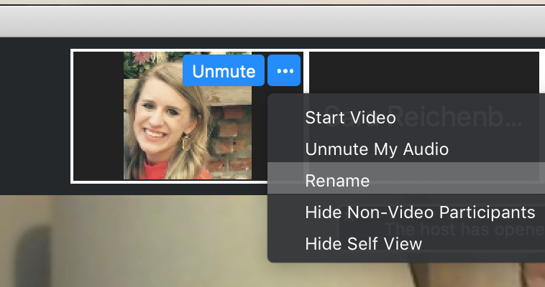
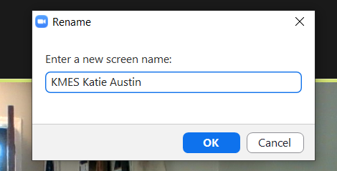
Renaming: School Initials + First and Last Name
To help us put you in breakout rooms with your colleagues today…
1. Click the three dots at the top
right corner of your video square.
2. Rename yourself with your
school initials then first and last name.

Slide 9
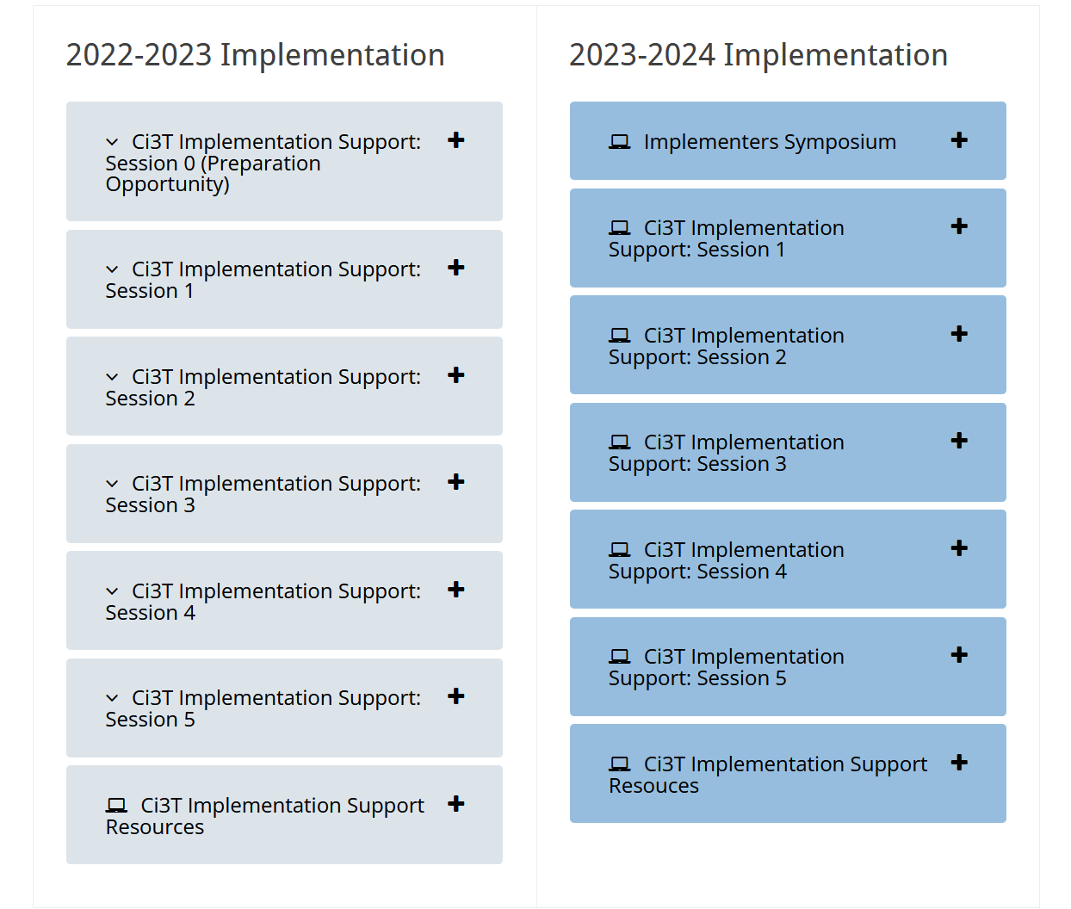
Accessing Professional Learning Materials
Navigate to ci3t.org/imp

Slide 10
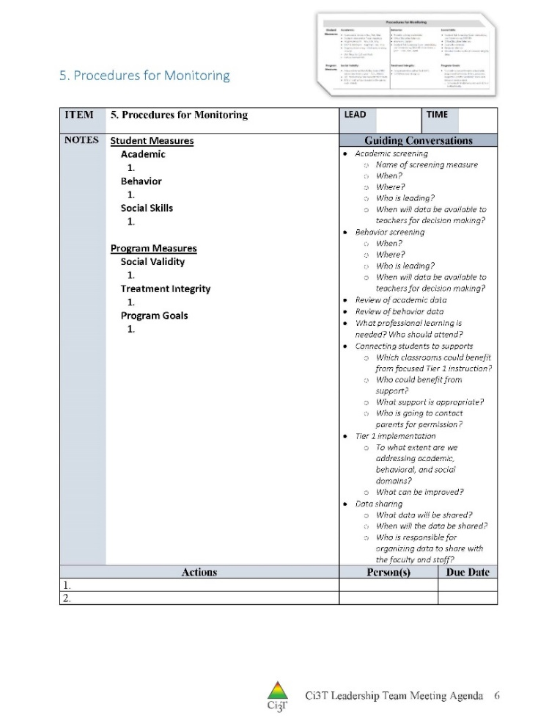
IM18 Ci3T Leadership Team Meeting Agenda TEMPLATE
Predictability

Slide 11
Goals for this Implementation Year
Establish effective Ci3T leadership structures
Gain a deeper understanding of Ci3T models of prevention
Implement your school’s plan with high fidelity
Collect and use social validity and treatment integrity data to monitor Ci3T plan implementation
Collect student academic and behavioral outcome data to inform Ci3T implementation efforts
Share data with all stakeholders regularly (e.g., monthly, quarterly)
Identify areas of additional professional learning for faculty and staff and support faculty and staff access to professional learning
Address any barriers to implementing your Ci3T model

Slide 12
Procedures for Monitoring
Review your School’s Social Validity & Treatment Integrity Data
Review your School’s Spring Screening Data

Slide 13
Essential Components of Primary Prevention Efforts
Social Validity
Systematic Screening
Academic
Behavior
Treatment Integrity
ci3t.org/measures
Notes:
Infographic - https://www.ci3t.org/measures

Slide 14
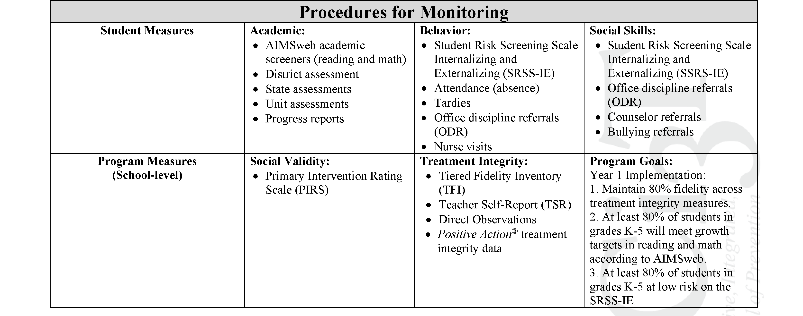
Ci3T Primary Plan Procedures for Monitoring: Elementary
Program Measures and Goals

Slide 15
Sample Elementary Assessment Schedule
Measure | Aug | Sep | Oct | Nov | Dec | Jan | Feb | Mar | Apr | May
School Demographics
Student Demographic Information | X | X | X | X | X | X | X | X | X | X
Screening Measures
Behavior Screeners: SRSS-IE |  | X |  |  | X |  |  |  | X
Academic Screeners: AIMSWeb | X | X |  |  |  | X |  |  |  | X
Student Outcome Measures - Academic
State & District assessment |  |  |  |  |  |  |  | X | X
Progress reports |  |  |  | X |  |  | X |  |  | X
Student Outcome Measures - Behavior
Absences |  | X | X | X | X | X | X | X | X
Office discipline referrals (ODR) |  | X |  |  | X |  |  |  | X
Counselor referrals | X | X | X | X | X | X | X | X | X | X
Nurse visits | X | X | X | X | X | X | X | X | X | X
Program Measures
Primary Intervention Rating Scale |  |  | X |  |  |  |  | X
School-wide Evaluation Tool |  |  | X |  |  |  |  | X
Ci3T TI: Teacher Self-Report |  |  | X |  |  |  |  | X
Ci3T TI: Direct Observation |  |  | X |  |  |  |  | X
Second Step® Treatment Integrity |  |  | X |  |  |  |  | X
Adapted from Lane, K. L., Oakes, W. P., Cantwell, E. D., & Royer, D. J. (2018). Building and installing comprehensive, integrated, three-tiered (Ci3T) models of prevention: A practical guide to supporting school success V1.2. KOI Education. (Interactive eBook)

Slide 16
Procedures for Monitoring
Review your School’s Social Validity & Treatment Integrity Data
Review your School’s Spring Screening Data

Slide 17
Treatment Integrity and Social Validity Data Sources
Primary Intervention Rating Scale (Social Validity)
Ci3T Treatment Integrity: Teacher Self Report
Ci3T Treatment Integrity: Direct Observation
Tiered Fidelity Inventory

Slide 18
Social Validity How do stakeholders view the plan?
Social validity refers to the level of:
Social significance of intervention goals
Social acceptability of intervention procedures
Social importance of intervention outcomes
(Wolf, 1978)
Assessed using the Primary Intervention Rating Scale (PIRS)
Social Validity: PIRS Results
Year | Fall |  | Spring
 | n | % (SD) | n | % (SD)
2020-2021 | 32 | 85.39 (8.89) | TBD | TBD

Slide 19
Treatment Integrity Is Ci3T being implemented as planned?
Three measures of treatment integrity:
Ci3T Treatment Integrity: Teacher Self-Report (Ci3T TI: TSR)
Ci3T Treatment Integrity: Direct Observation (Ci3T TI: DO)
Tiered Fidelity Inventory (TFI)

Slide 20
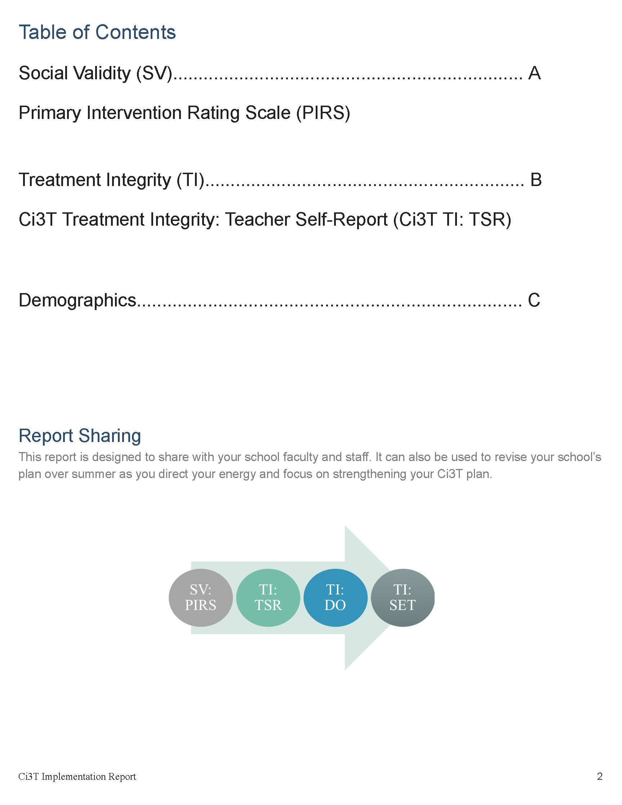

Slide 21
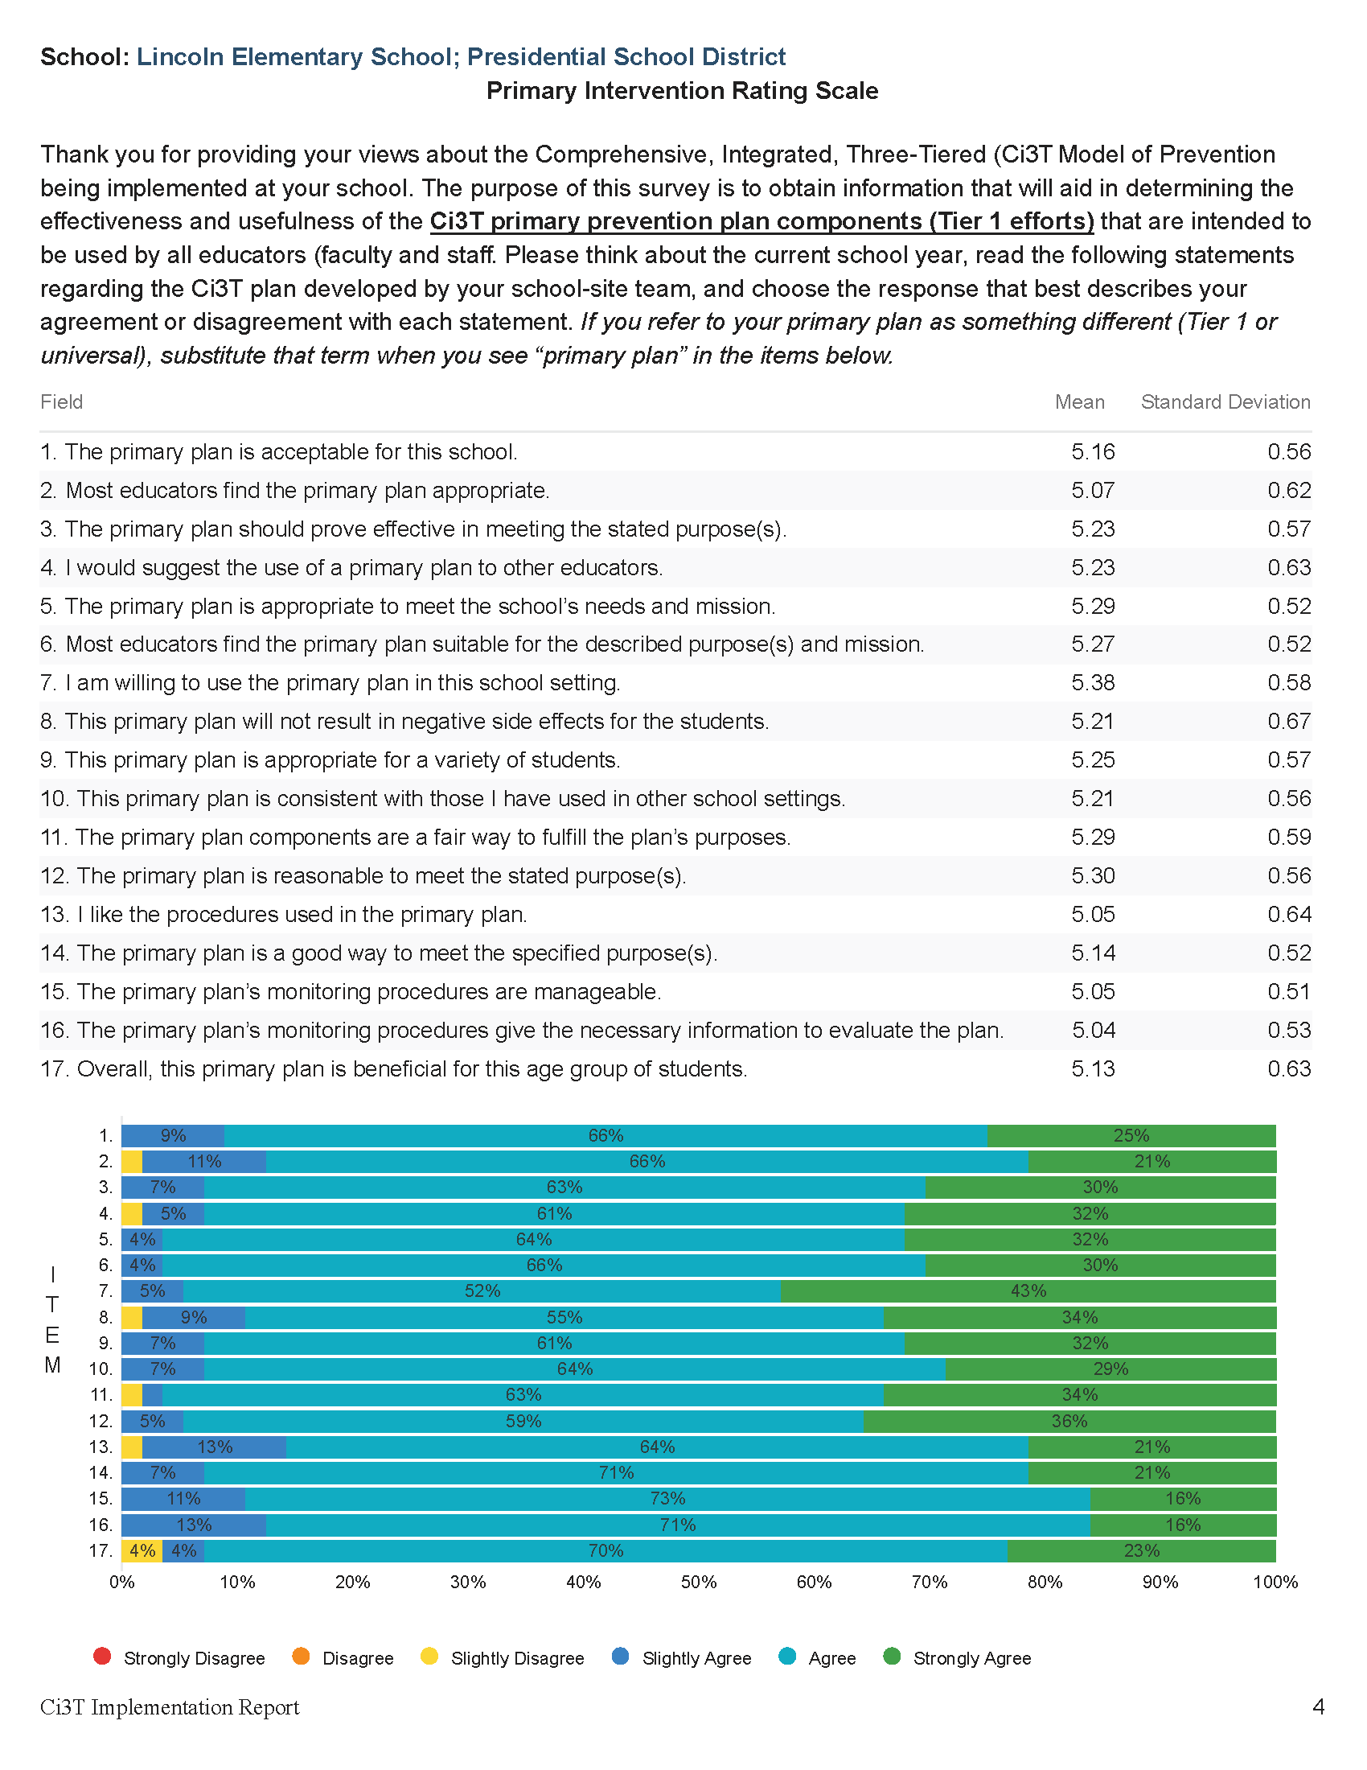

Slide 24
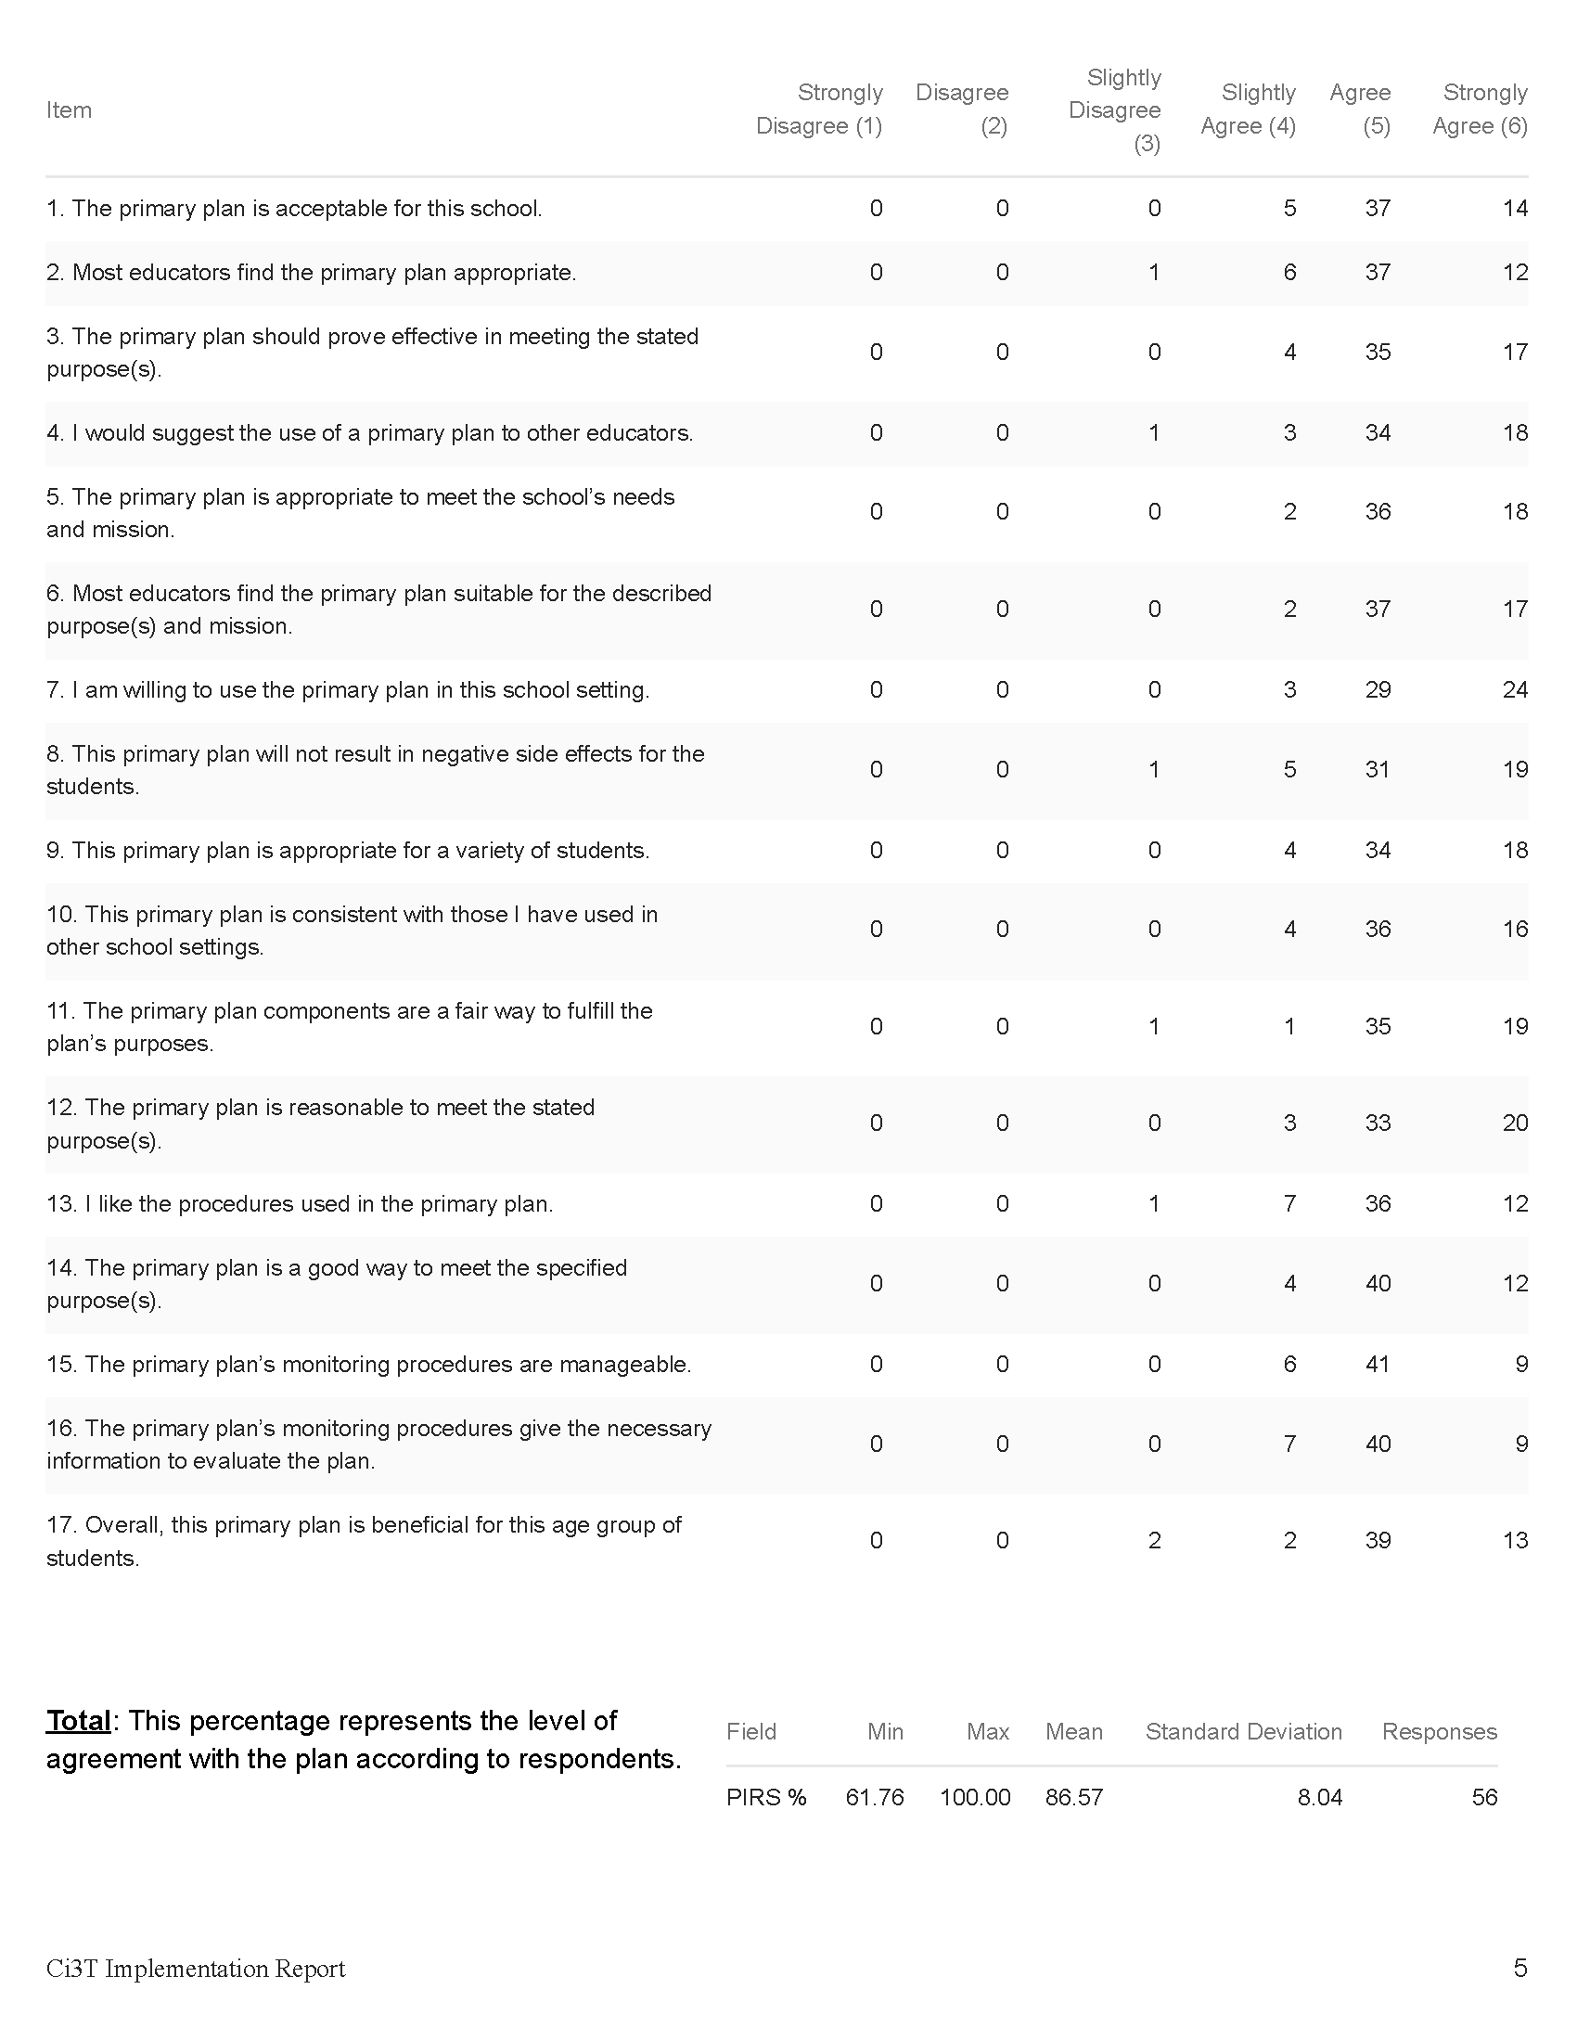

Slide 26
Open-Ended Questions:
A) What do you feel is most beneficial about this primary prevention plan’s components (Tier 1 efforts)? B) What is the least beneficial part?
Do you think that your and your students’ participation in this Ci3T plan will cause your students’ behavior, social, and/or learning problems to improve? Why or why not? Or if so, how?
What would you change about this plan (components, design, implementation etc.) to make it more student-friendly and educator-friendly?
What other information would you like to contribute about this plan?
Read through comments
Highlight success (literally!)
Look for themes for celebrations and focus areas

Slide 27
Treatment Integrity and Social Validity Data Sources
Primary Intervention Rating Scale (Social Validity)
Ci3T Treatment Integrity: Teacher Self Report
Ci3T Treatment Integrity: Direct Observation
Tiered Fidelity Inventory

Slide 28
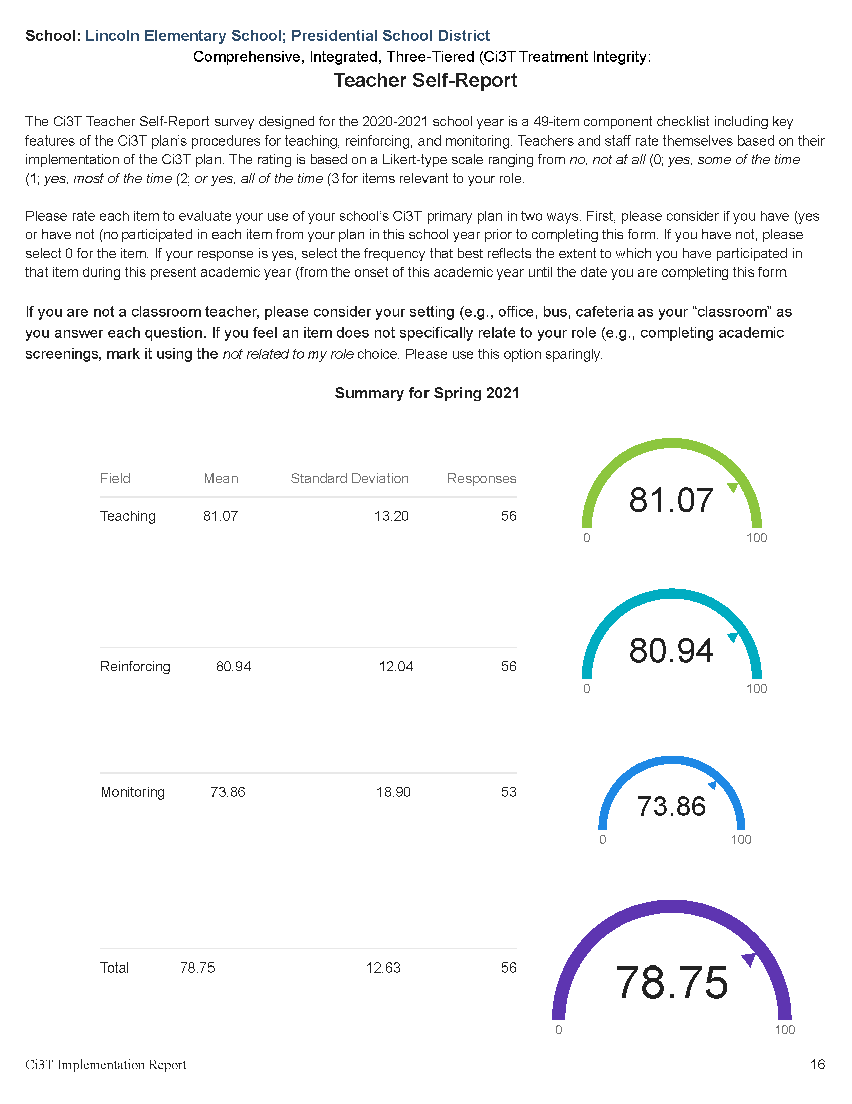

Slide 30
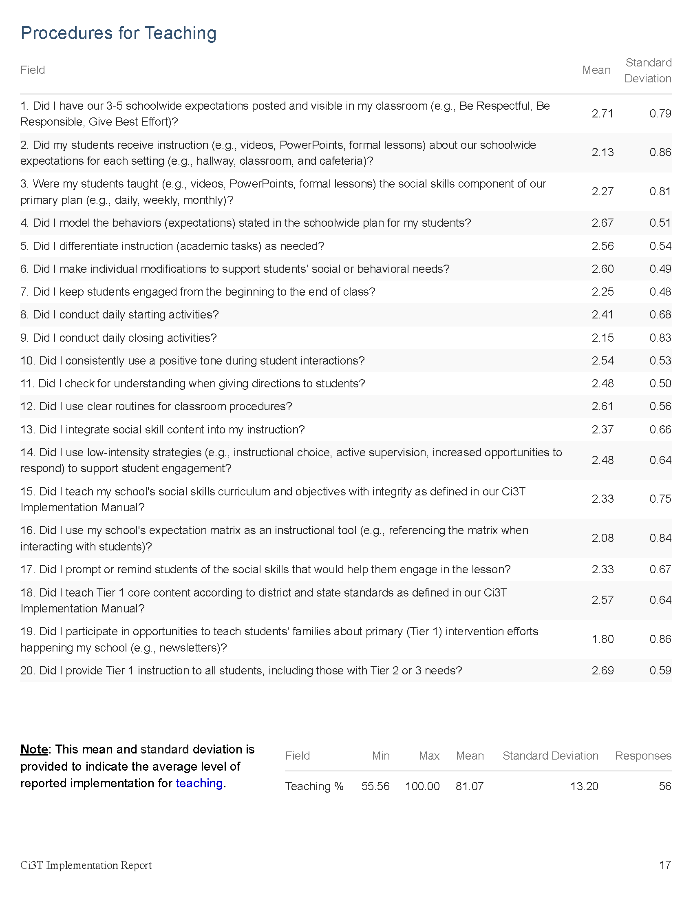

Slide 32
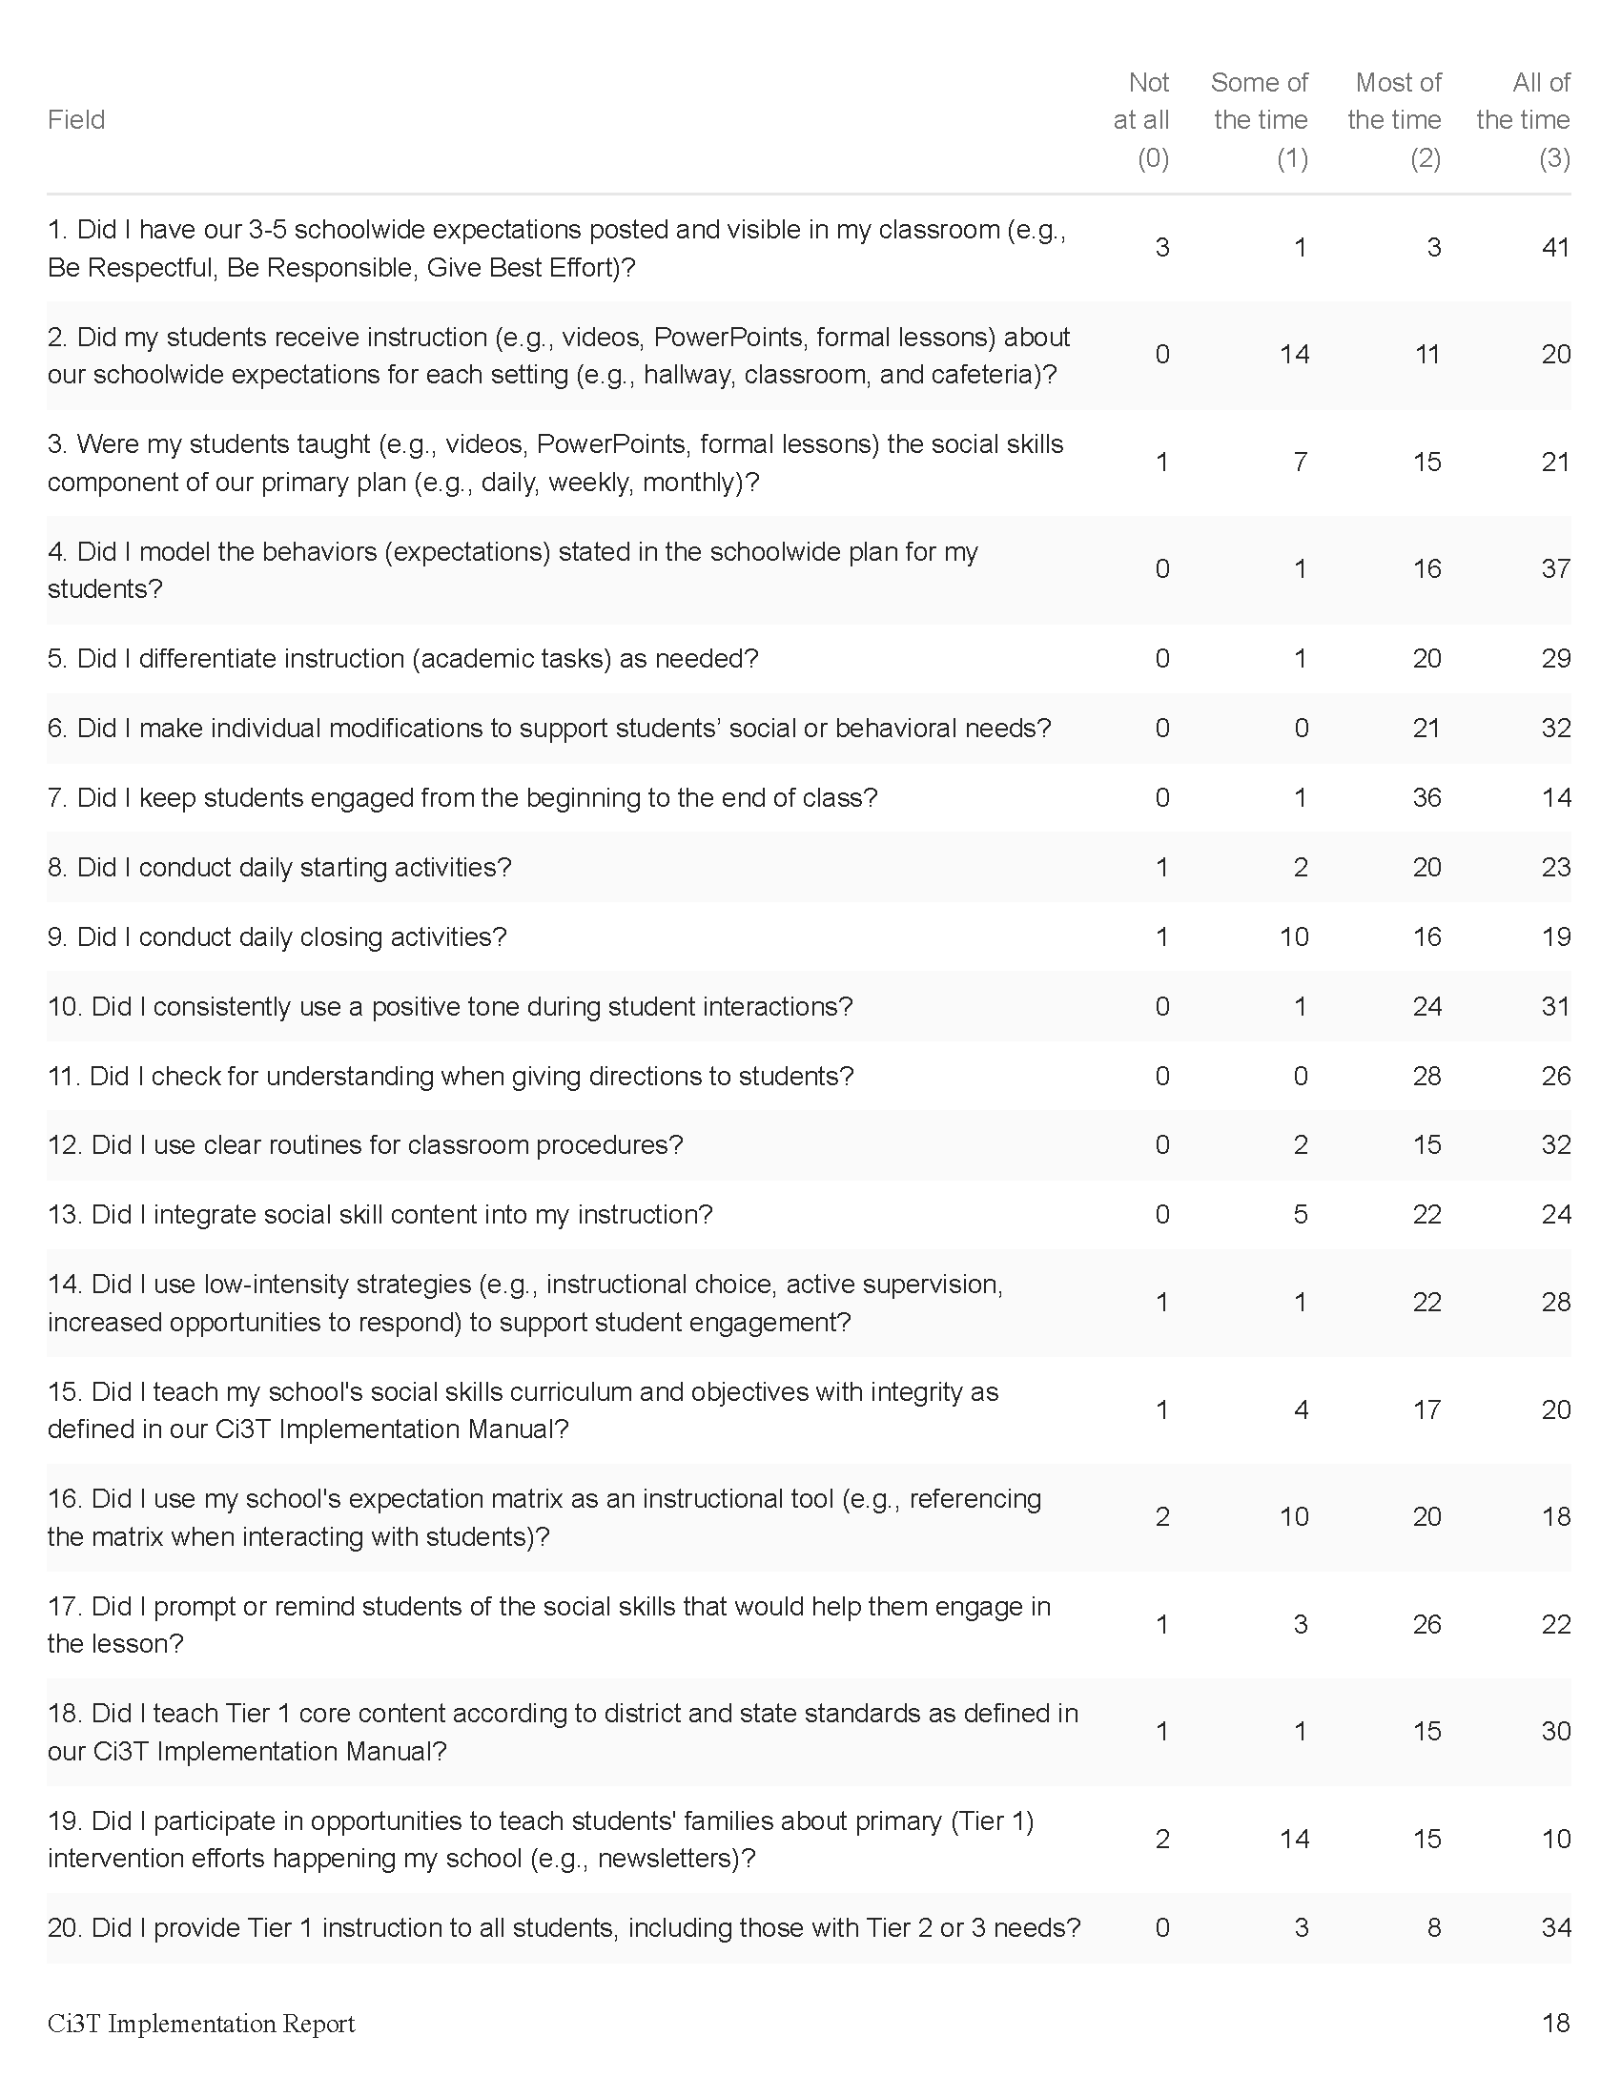

Slide 34
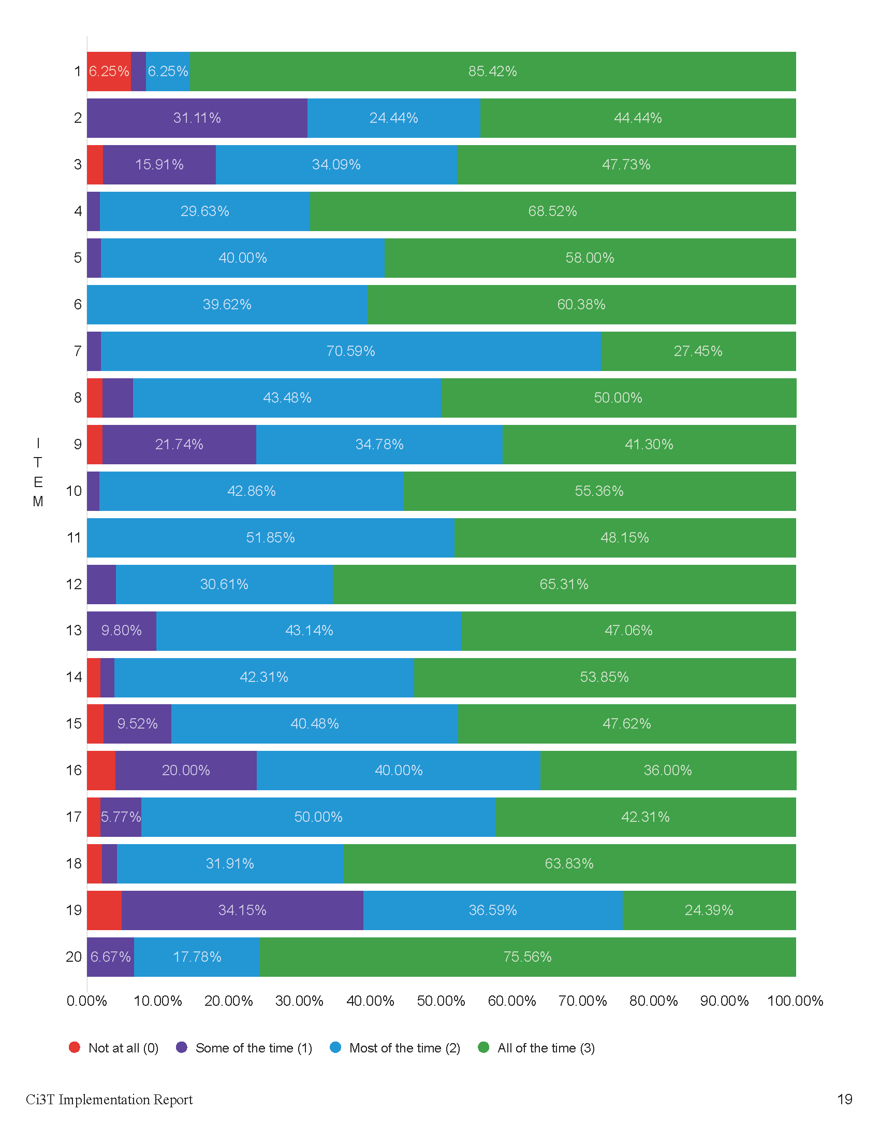

Slide 36
Treatment Integrity and Social Validity Data Sources
Primary Intervention Rating Scale (Social Validity)
Ci3T Treatment Integrity: Teacher Self Report
Ci3T Treatment Integrity: Direct Observation
Tiered Fidelity Inventory

Slide 37
Ci3T Treatment Integrity Direct Observation (Ci3T TI: DO)
Subset of Ci3T TI: TSR
Stratified, random selection of educators
Personnel who directly instruct students
Observers trained to criterion
30-min observations
Educator perspective
Observer perspective
CC0 No rights reserved

Slide 38
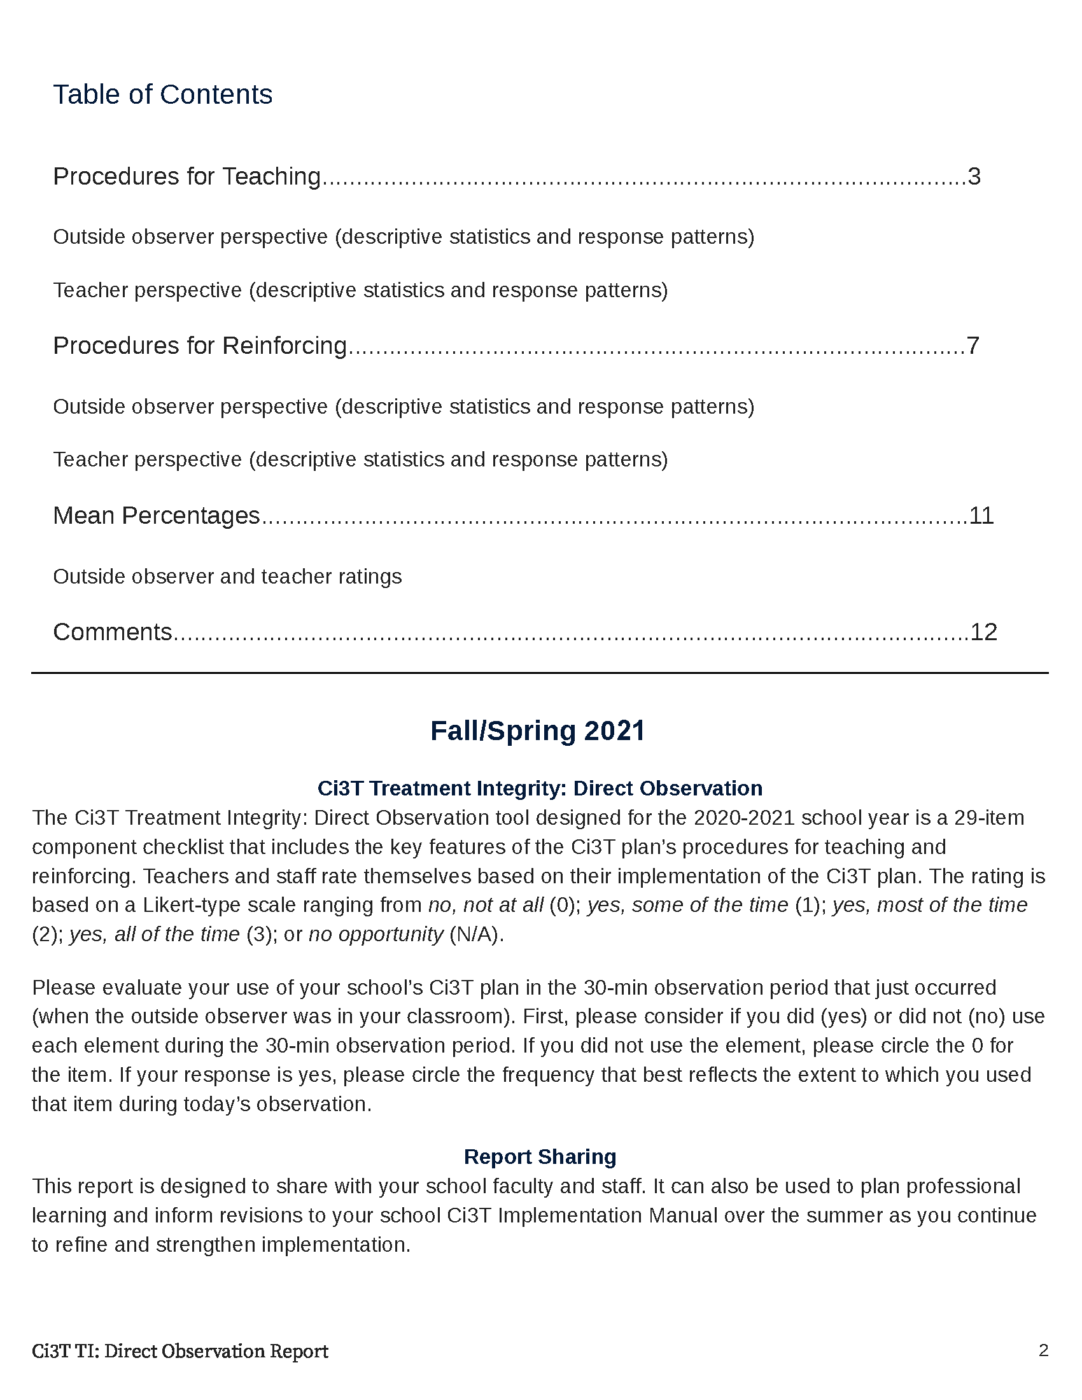

Slide 39
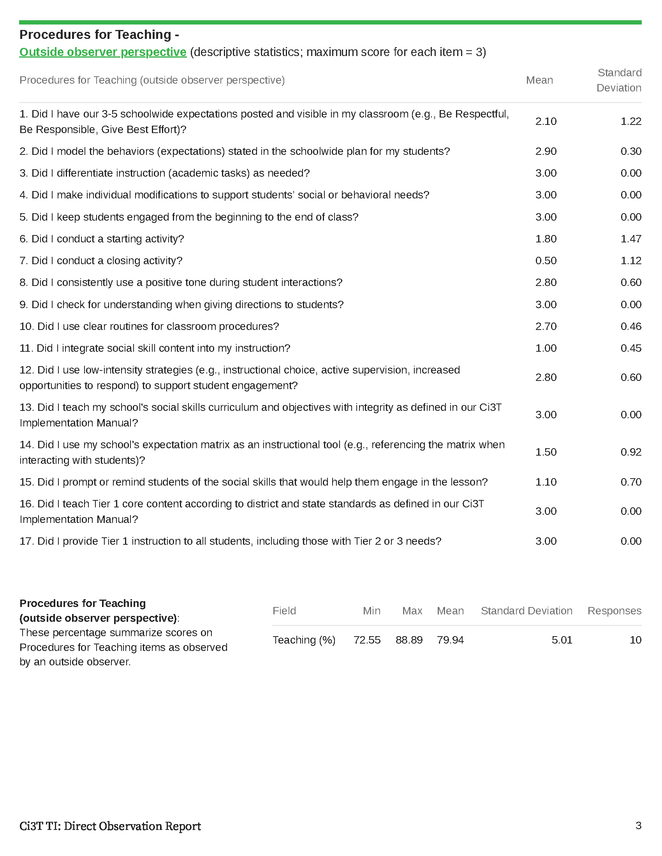

Slide 42
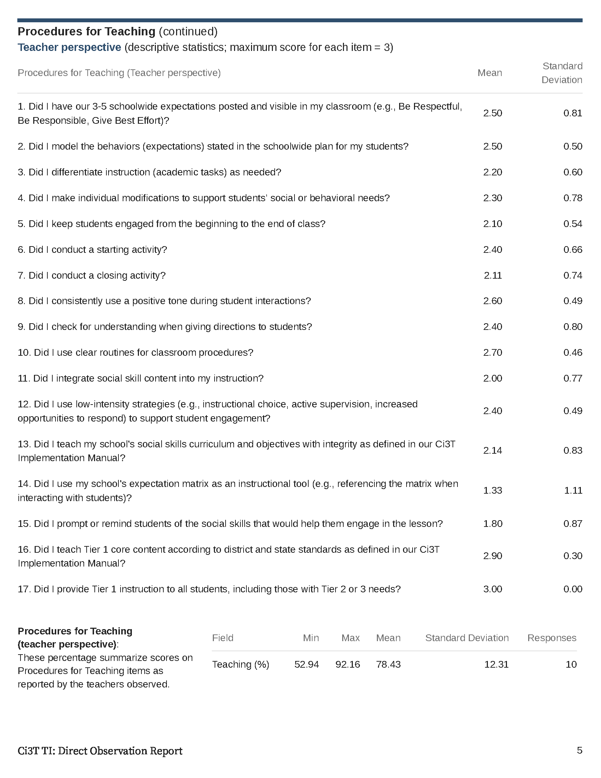

Slide 43
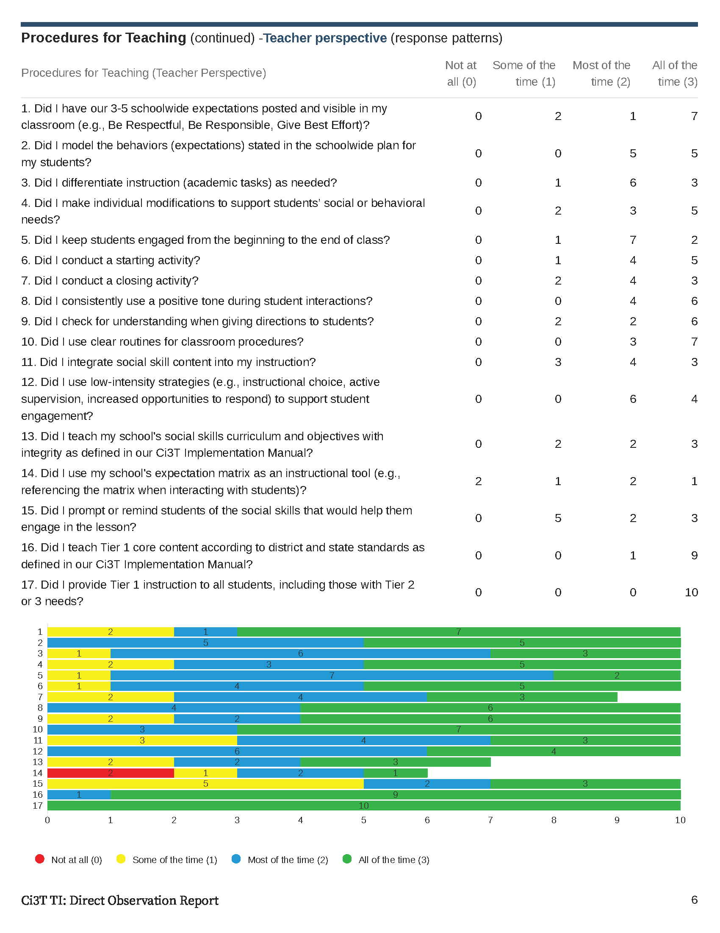

Slide 44
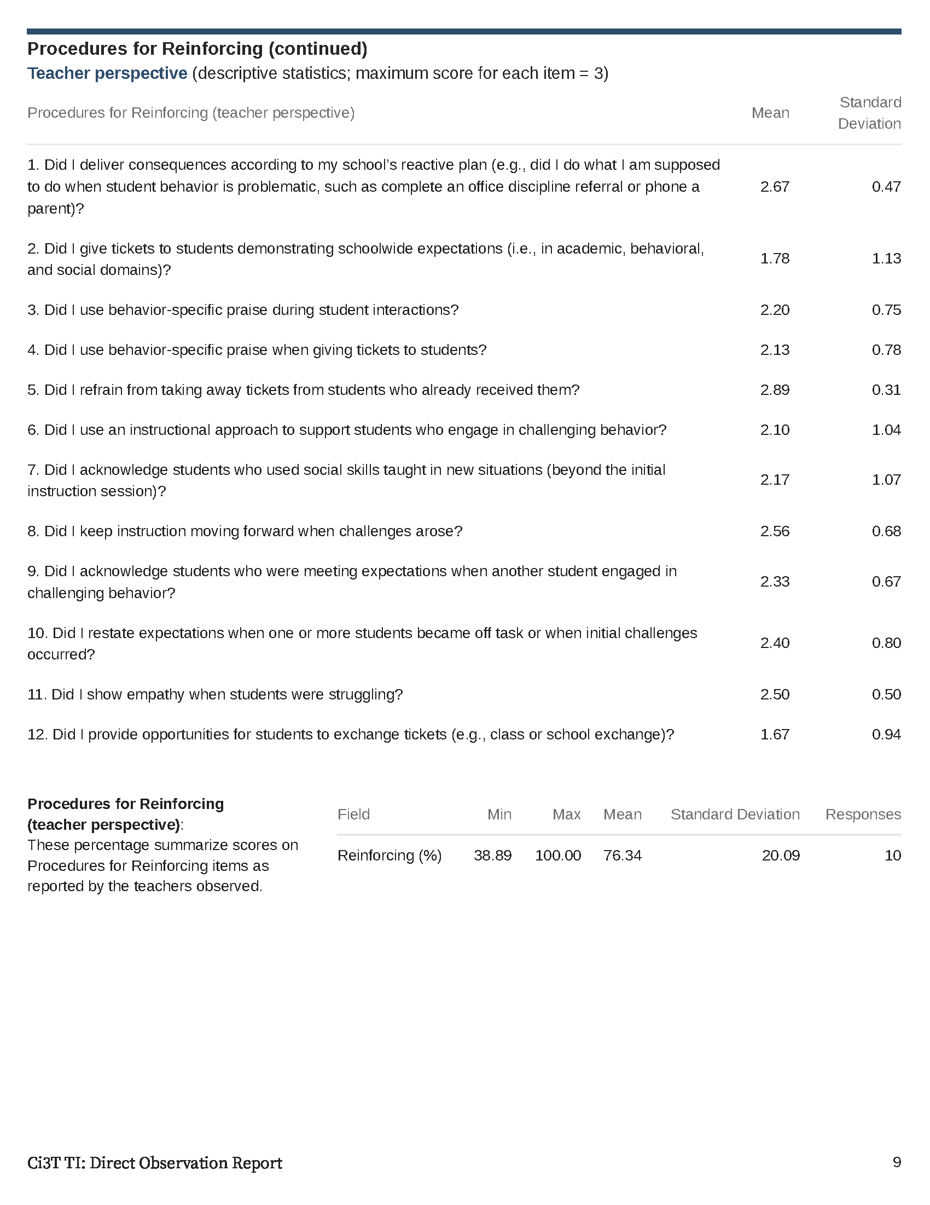
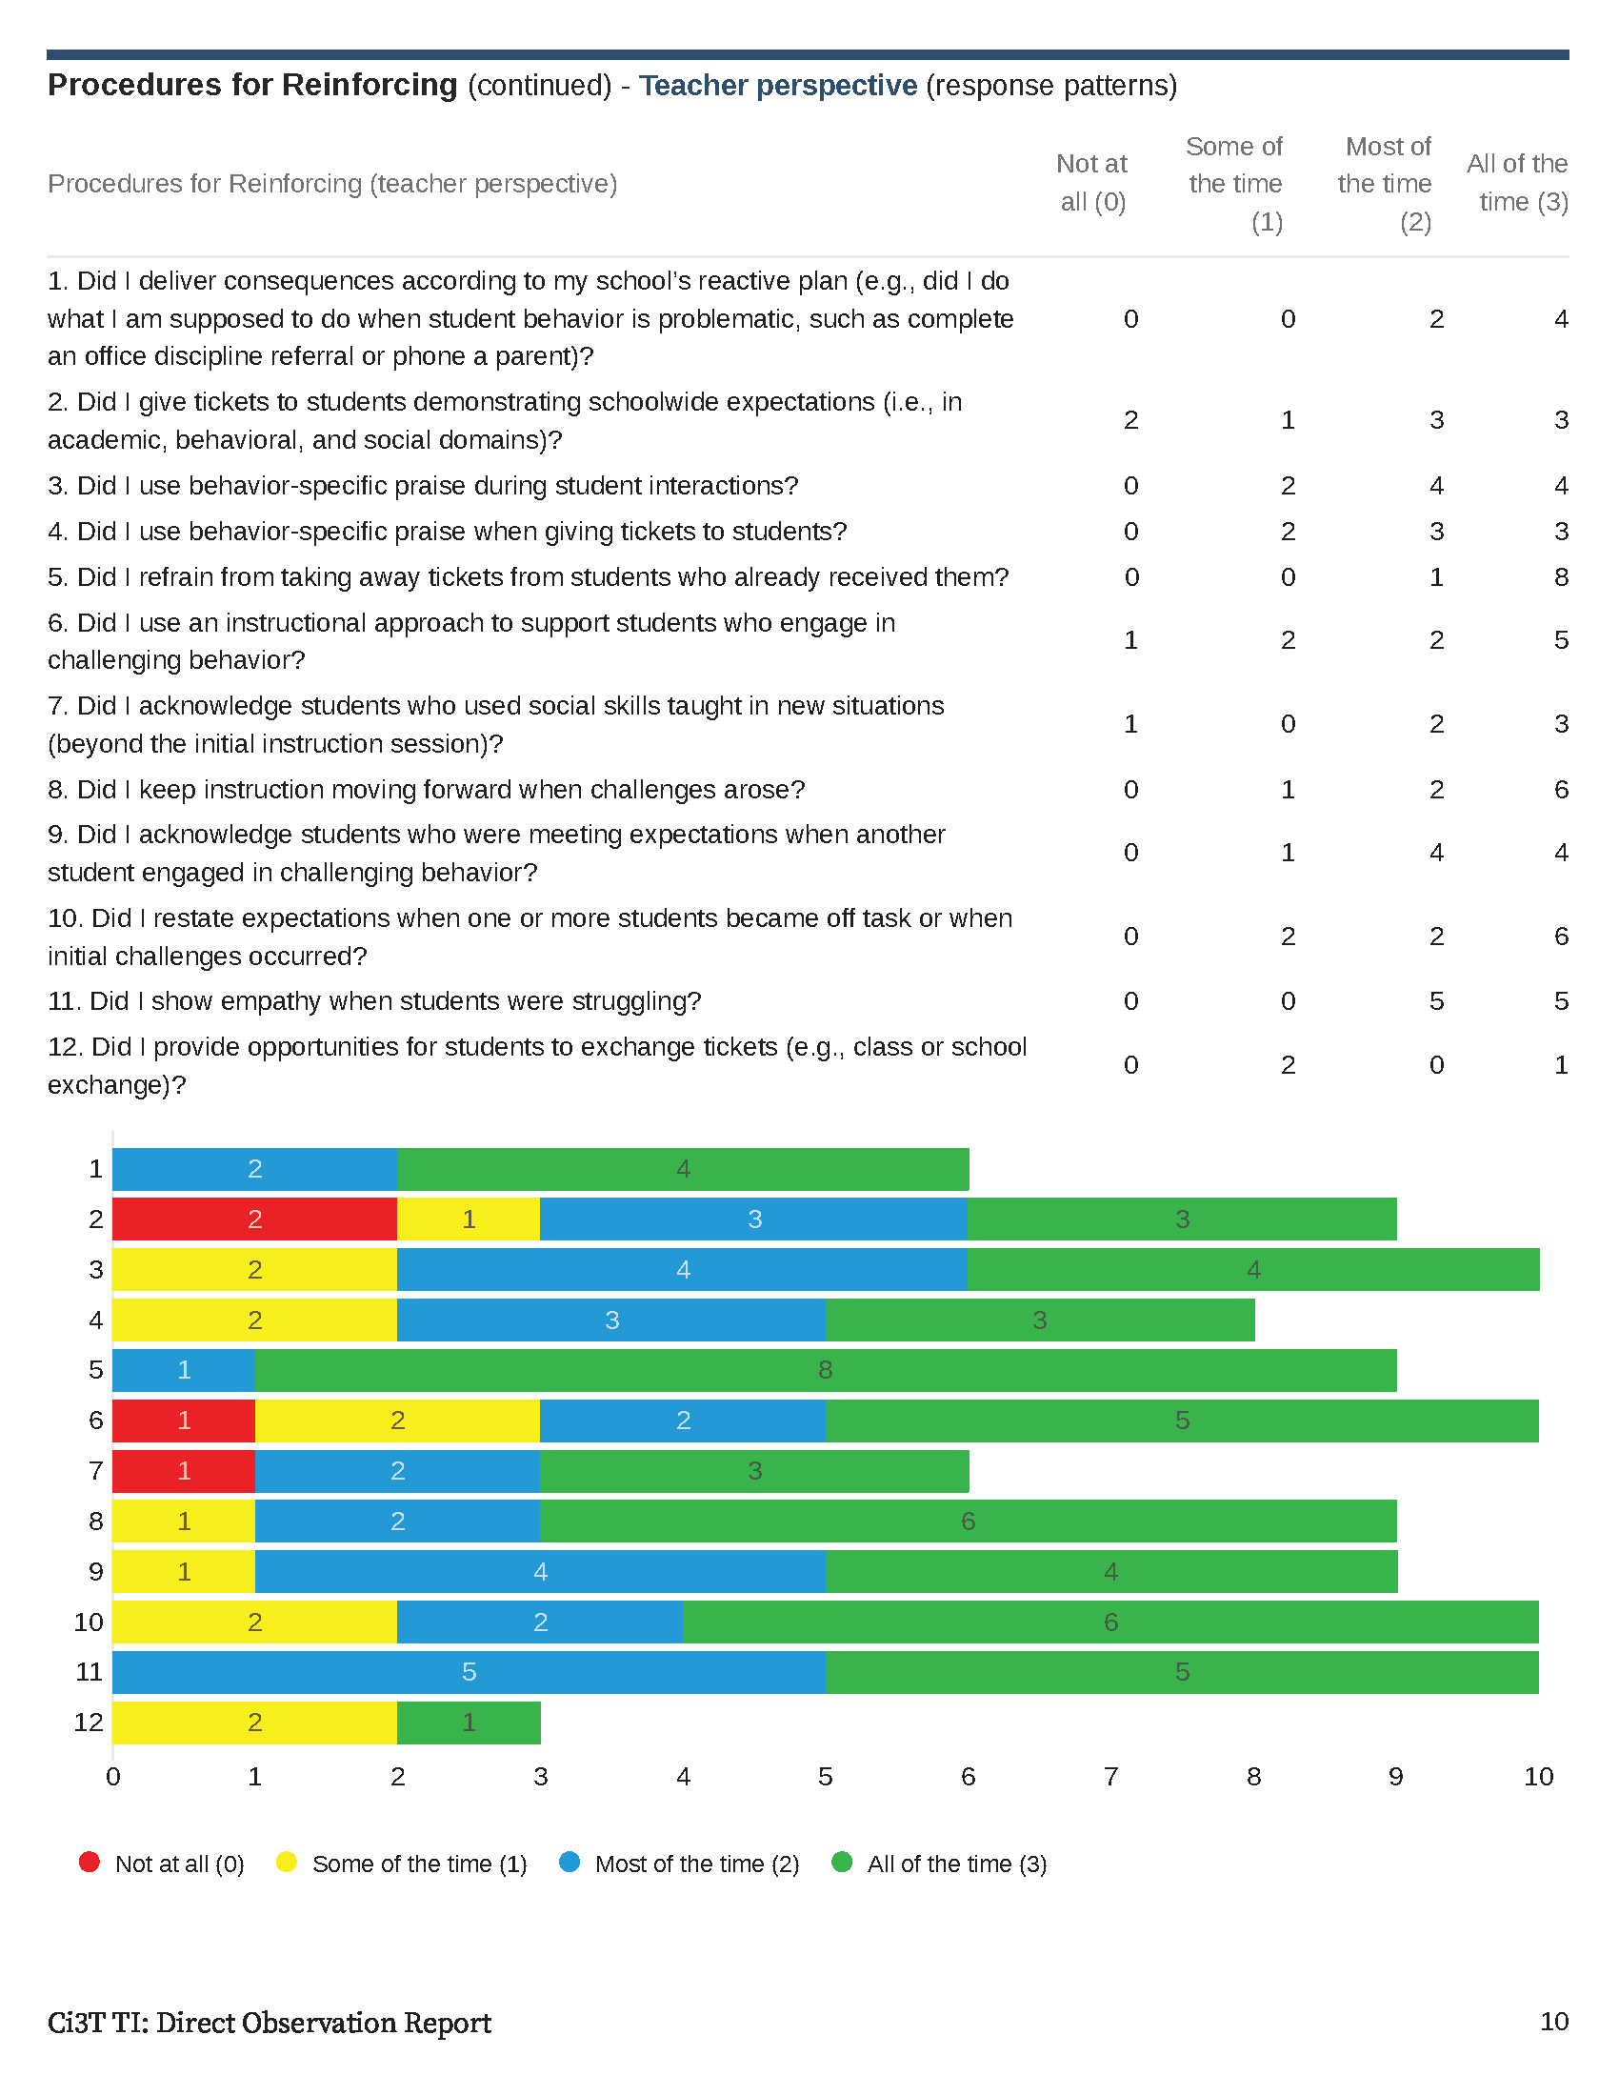

Slide 45
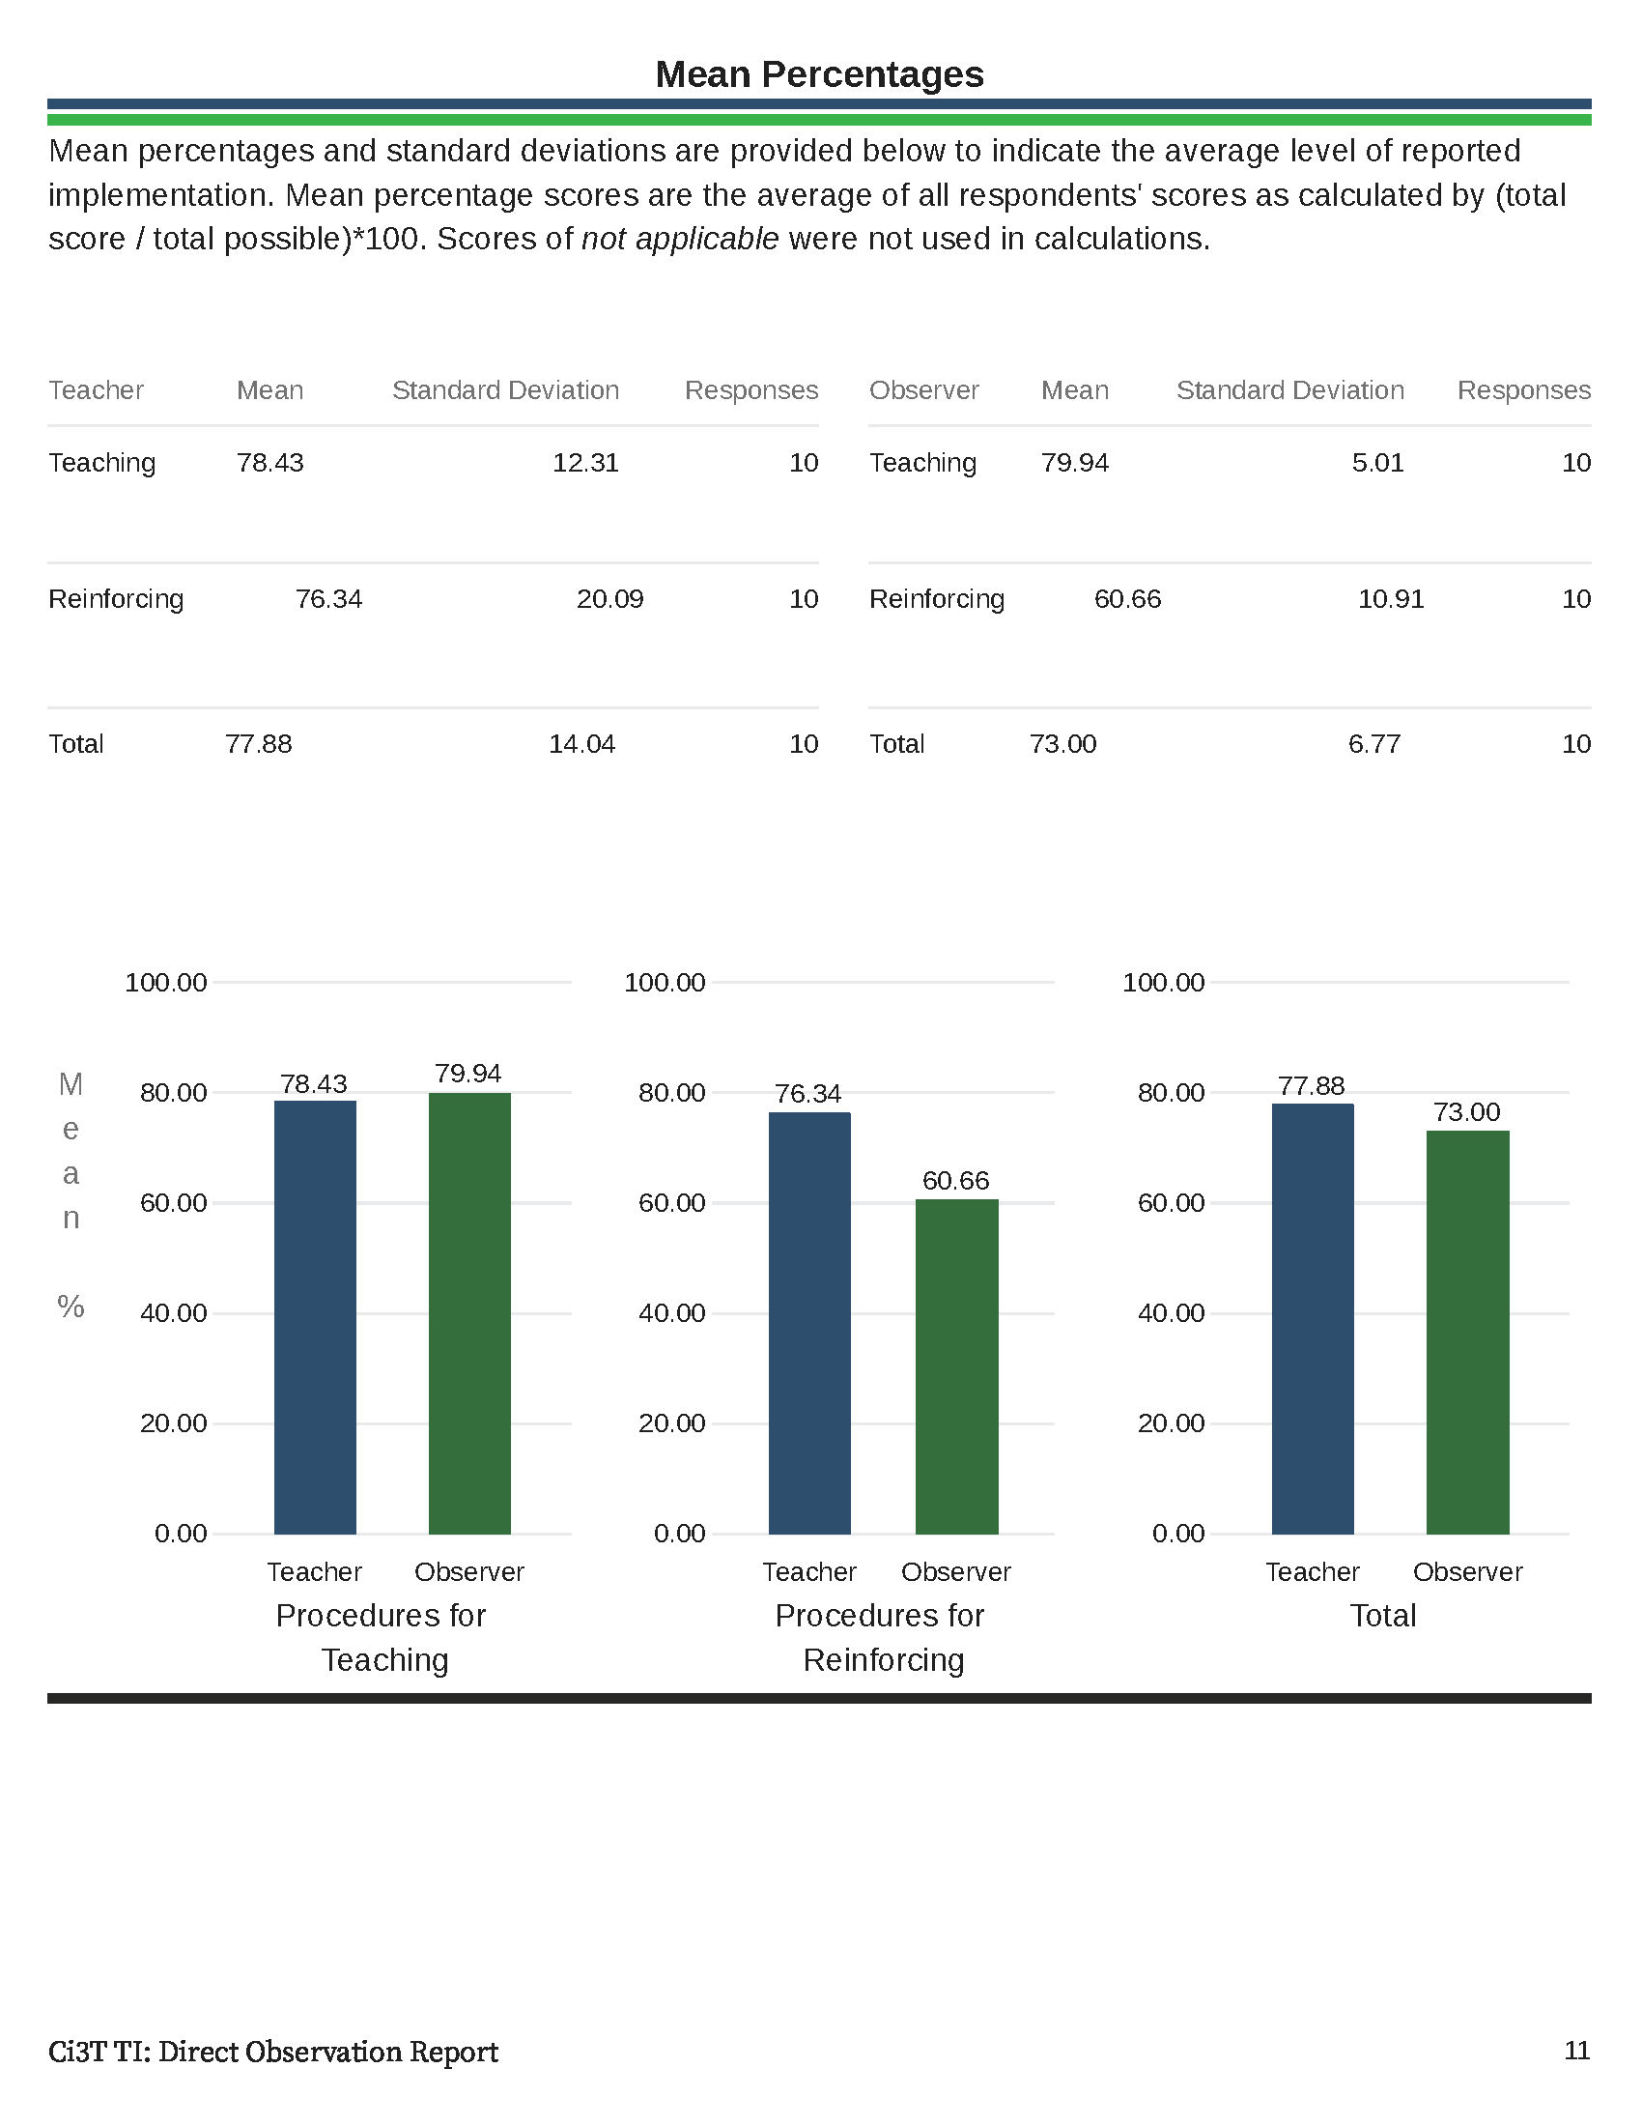

Slide 47
Treatment Integrity and Social Validity Data Sources
Primary Intervention Rating Scale (Social Validity)
Ci3T Treatment Integrity: Teacher Self Report
Ci3T Treatment Integrity: Direct Observation
Tiered Fidelity Inventory

Slide 48
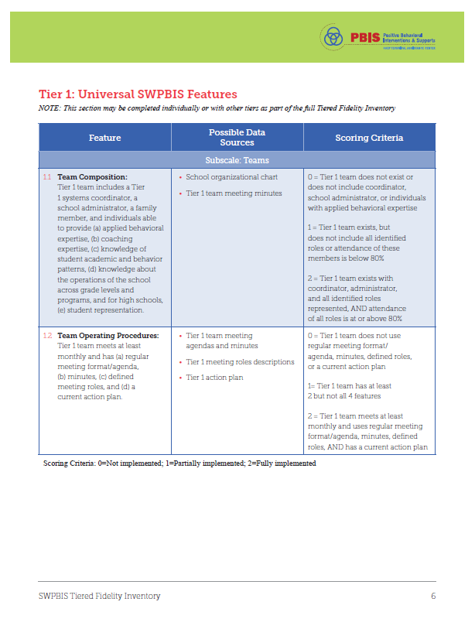
Tiered Fidelity Inventory (TFI)

Slide 49
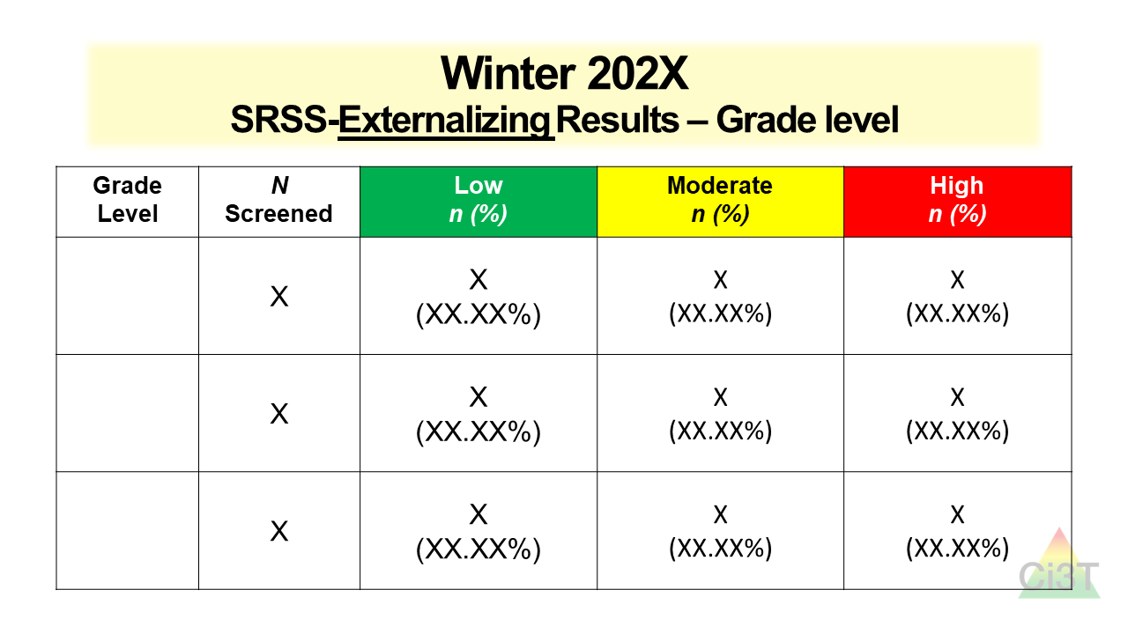
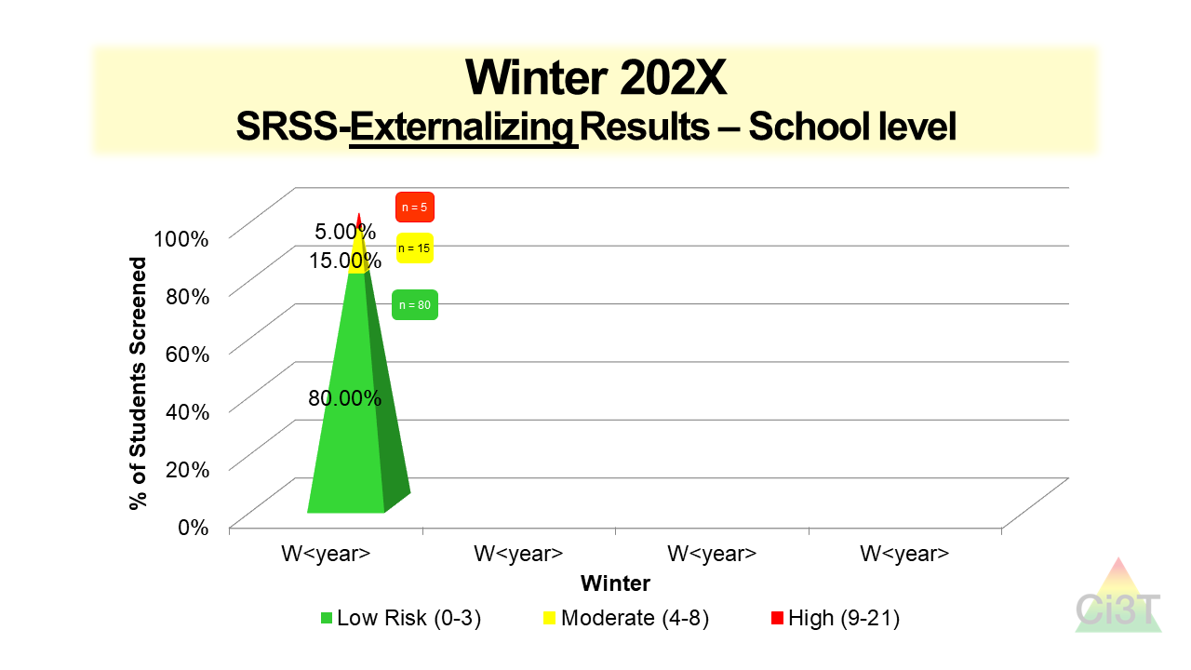
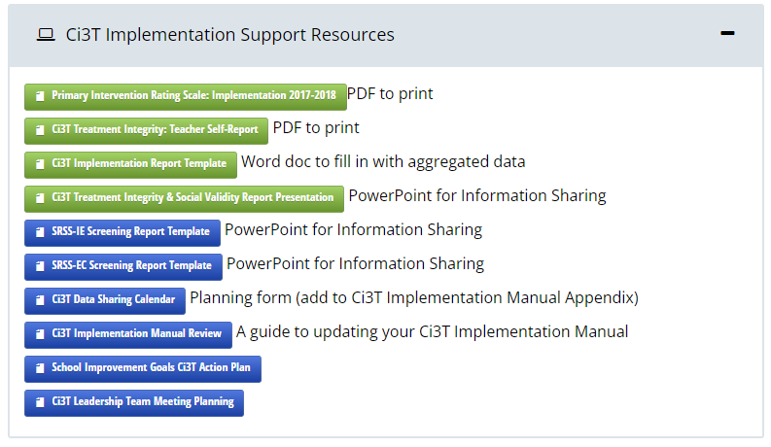
Sharing Screening Data with Faculty and Staff

Slide 50
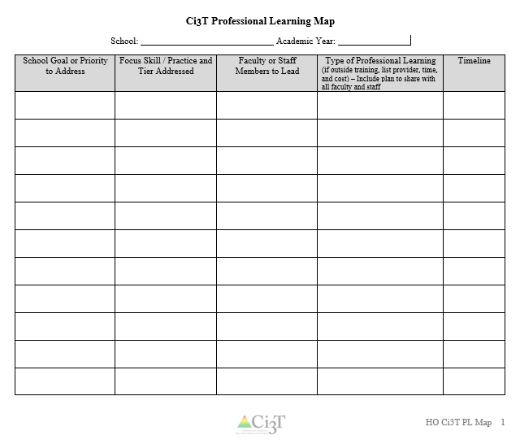
Let’s Talk!
Locate your school’s Ci3T Implementation Report and Ci3T Treatment Integrity: Direct Observation Report.
Then:
Highlight the positives
Discuss concerns and plans for addressing these focus areas
Make plans to share data and plans back with stakeholders
Write action items on HO Ci3T PL Map
Notes:
15-min timer

Slide 51
Procedures for Monitoring
Review your School’s Social Validity & Treatment Integrity Data
Review your School’s Spring Screening Data

Slide 52
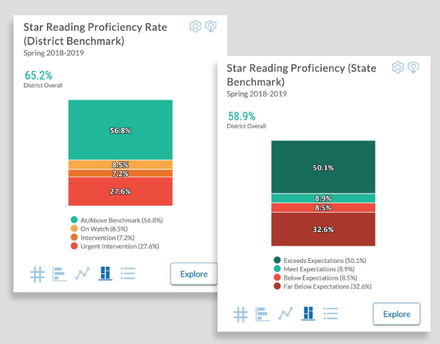
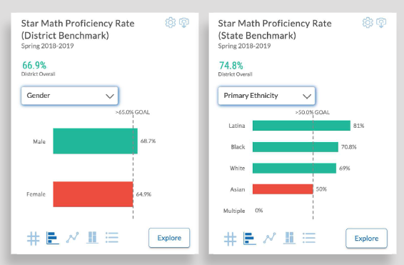
Academic Screening
Notes:
Might consider beginning by looking at data broadly
compared against district or state benchmarks
Subgroup analyses

Slide 53
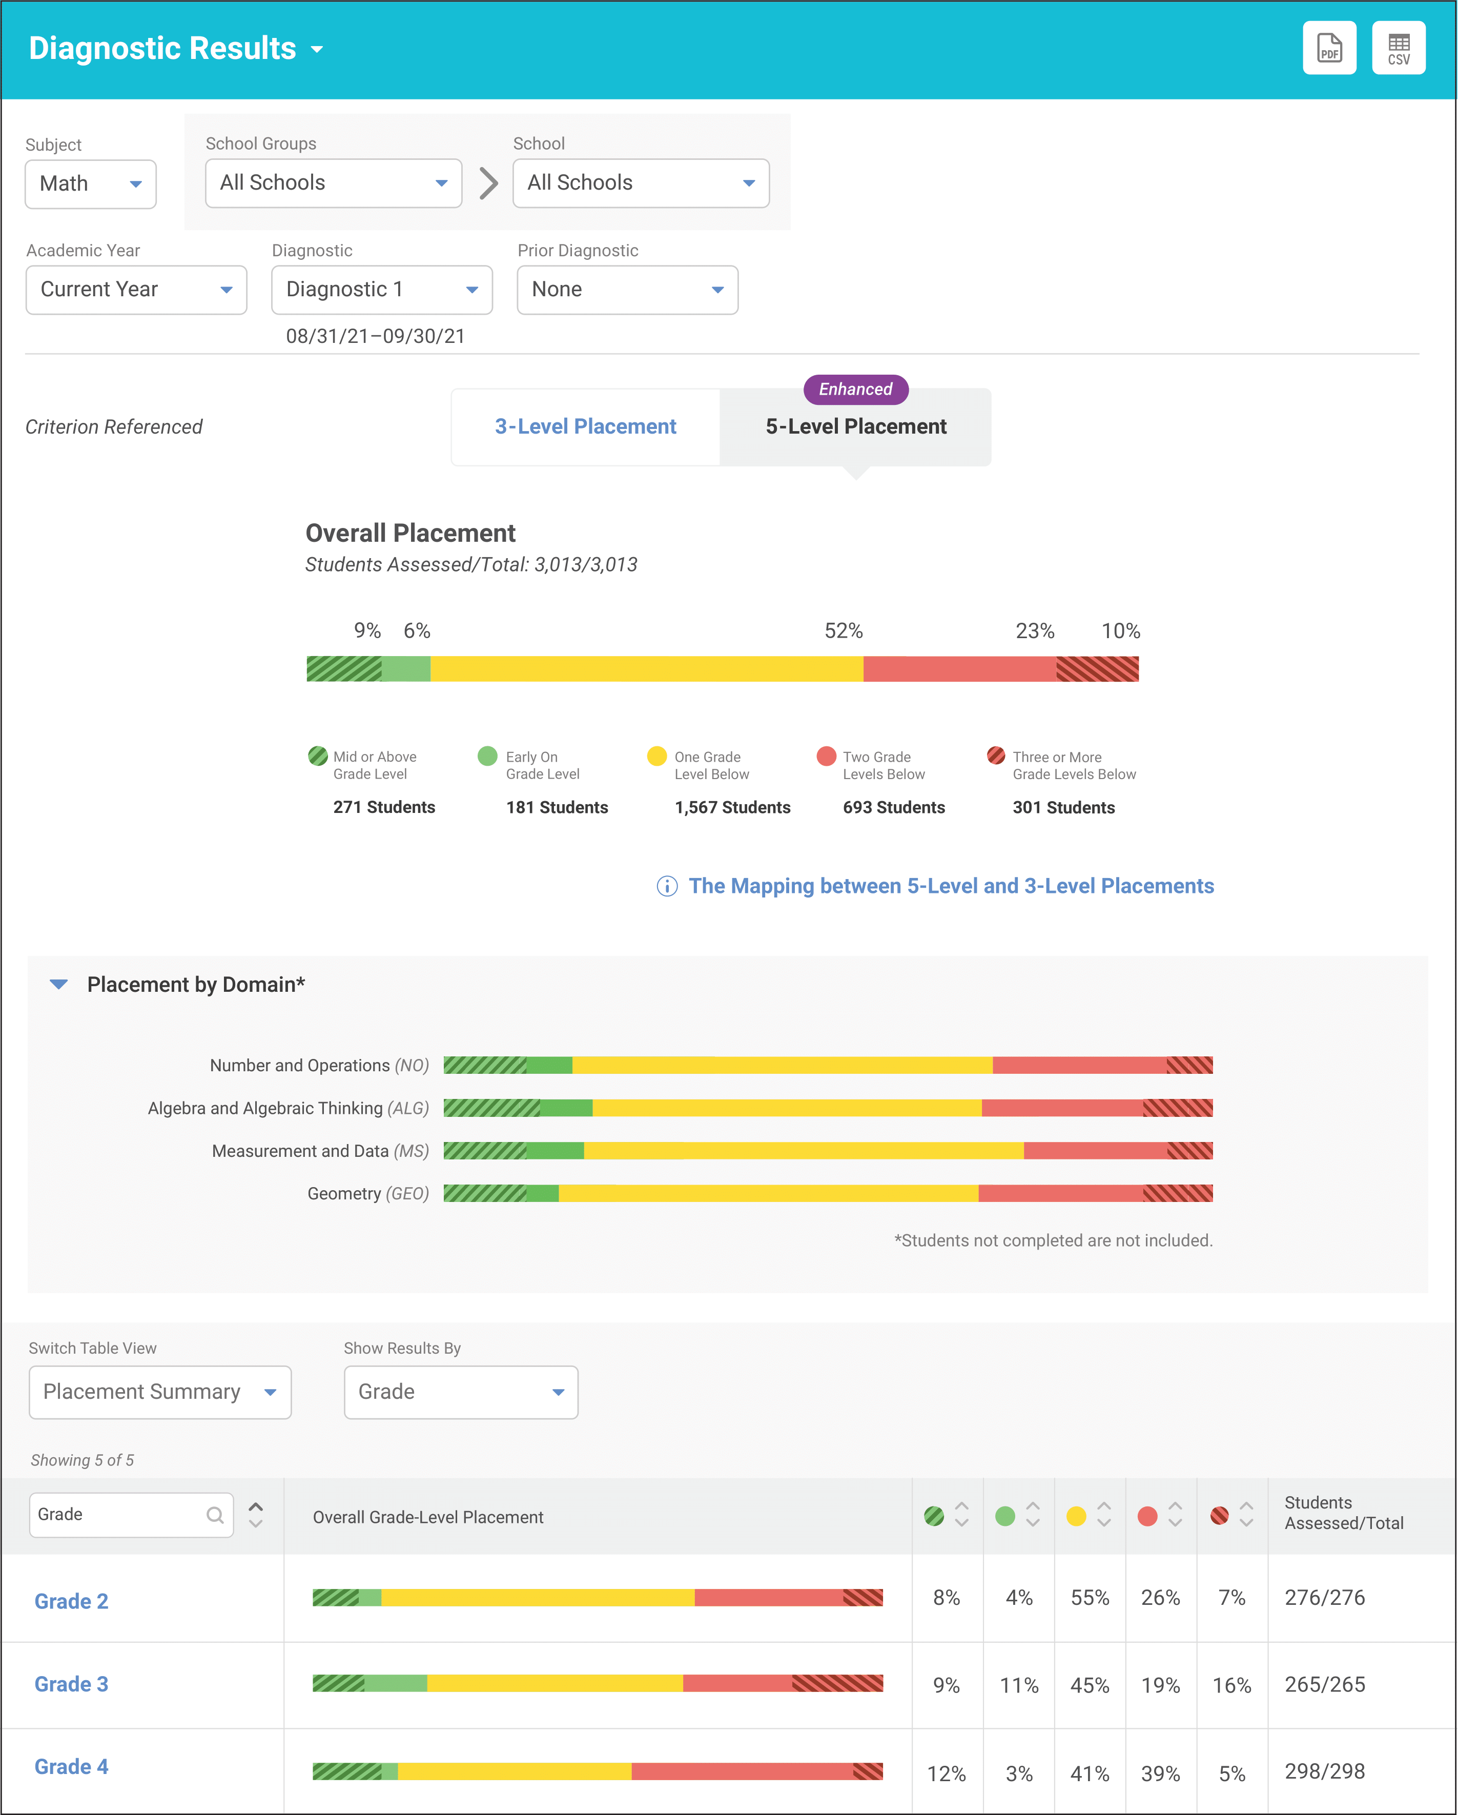
Academic Screening
Notes:
Then, might zoom in at the grade-level looking at distribution across risk category, mastery, or growth

Slide 56
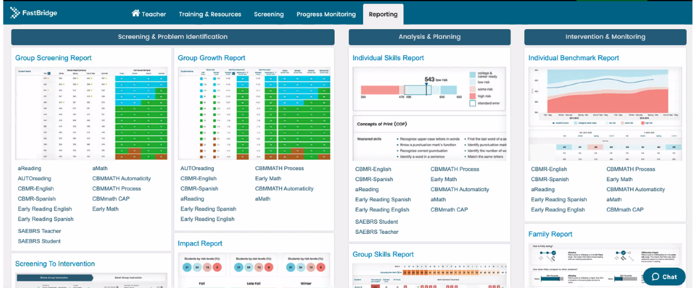
Academic Screening

Slide 57
Spring 2023 SRSS-Externalizing Results – Elementary School level
n = 70
n = 43
n = 45
n = 5
n = 43
n = 7
n = 25
n = 31
n = 38
n = 87
n = 95
n = 129
n = 123
n = 110
n = 11
n = 103
n = 241
n = 298
n = 289
n = 31
n = 288
n = 297
n = 314
n = 330
Notes:
Fill in <year> based on current academic year. This is located in column A of the data sheet. Edit by right clicking and selecting “Edit data”.

Slide 58
Spring 2023 SRSS-Externalizing Results – Elementary Grade level
Grade Level | N Screened | Low n (%) | Moderate n (%) | High n (%)
K | 66 | 43 (65.15%) | 20 (30.30%) | 3 (4.55%)
1 | 79 | 65 (82.28%) | 9 (11.39%) | 5 (6.33%)
2 | 78 | 54 (69.23%) | 20 (25.64%) | 4 (5.13%)

Slide 59
Spring 2023 SRSS-Internalizing Results – Elementary School Level
n = 54
n = 42
n = 36
n = 103
n = 70
n = 68
n = 283
n = 352
n = 340
Cut scores vary by school level:
Elementary (I5): Low (0-1), Moderate (2-3), High (4-15)
Middle and High (I6): Low (0-3), Moderate (4-5), High (6-18)
Notes:
Fill in <year> based on current academic year. This is located in column A of the data sheet. Edit by right clicking and selecting “Edit data”.
IMPORTANT NOTE: The INTERNALIZING subscale and CUT SCORES are specific to school level.
Elementary: SRSS-I5, Items 8-12, 0-1 = low risk, 2-3 = moderate risk, 4-15 = high risk
Middle and High: SRSS-I6, Items 4, 8-12, 0-3 = low risk, 4-5 = moderate risk, 6-18 = high risk

Slide 60
Spring 2023 SRSS-Internalizing Results – Elementary Grade Level
Grade Level | N Screened | Low n (%) | Moderate n (%) | High n (%)
3 | 62 | 51 (82.26%) | 11 (17.74%) | 0 (0.00%)
4 | 81 | 62 (76.54%) | 13 (16.05%) | 6 (7.41%)
5 | 90 | 64 (71.11%) | 13 (14.44%) | 13 (14.44%)

Slide 61
Spring 2023 SRSS-Externalizing Results – Middle School Level
n = 68
n = 36
n = 47
n = 38
n = 35
n = 10
n = 27
n = 42
n = 43
n = 50
n = 71
n = 76
n = 72
n = 124
n = 94
n = 109
n = 493
n = 531
n = 474
n = 436
n = 497
n = 501
n = 486
n = 472
Notes:
Fill in <year> based on current academic year. This is located in column A of the data sheet. Edit by right clicking and selecting “Edit data”.

Slide 62
Spring 2023 SRSS-Externalizing Results – Middle Grade Level
Grade Level | N Screened | Low n (%) | Moderate n (%) | High n (%)
6 | 190 | 162 (85.26%) | 20 (10.53%) | 8 (4.21%)
7 | 210 | 150 (71.43%) | 39 (18.57%) | 21 (10.00%)
8 | 186 | 160 (86.02%) | 13 (6.99%) | 13 (6.99%)

Slide 63
Spring 2023 SRSS-Internalizing Results – Middle School Level
n = 148
n = 26
n = 68
n = 59
n = 48
n = 29
n = 35
n = 64
n = 43
n = 32
n = 40
n = 44
n = 35
n = 34
n = 94
n = 118
n = 464
n = 519
n = 454
n = 520
n = 481
n = 479
n = 488
n = 419
Notes:
Fill in <year> based on current academic year. This is located in column A of the data sheet. Edit by right clicking and selecting “Edit data”.

Slide 64
Spring 2023 SRSS-Internalizing Results – Grade level
Grade Level | N Screened | Low n (%) | Moderate n (%) | High n (%)
6 | 190 | 160 (84.21%) | 16 (8.42%) | 14 (7.37%)
7 | 210 | 170 (80.95%) | 13 (6.19%) | 27 (12.86%)
8 | 186 | 158 (84.95%) | 5 (2.69%) | 23 (12.37%)

Slide 65
Spring 2023 SRSS-Externalizing Results – High School Level
n = 43
n = 35
n = 54
n = 35
n = 28
n = 8
n = 21
n = 34
n = 133
n = 112
n = 145
n = 121
n = 69
n = 86
n = 95
n = 120
n = 859
n = 1120
n = 1232
n = 1142
n = 739
n = 1060
n = 1012
n = 1030
Notes:
Fill in <year> based on current academic year. This is located in column A of the data sheet. Edit by right clicking and selecting “Edit data”.

Slide 66
Spring 2023 SRSS-Externalizing Results – High Grade Level
Grade Level | N Screened | Low n (%) | Moderate n (%) | High n (%)
9 | 313 | 257 (82.11%) | 41 (13.10%) | 15 (4.79%)
10 | 346 | 298 (86.13%) | 37 (10.69%) | 11 (3.18%)
11 | 304 | 270 (88.82%) | 29 (9.54%) | 5 (1.64%)
12 | 221 | 205 (92.76%) | 13 (5.88%) | 3 (1.36%)

Slide 67
Spring 2023 SRSS-Externalizing Results – High School Level
n = 135
n = 130
n = 100
n = 94
n = 55
n = 73
n = 75
n = 84
n = 61
n = 35
n = 55
n = 90
n = 85
n = 91
n = 127
n = 138
n = 773
n = 999
n = 1242
n = 1143
n = 746
n = 1026
n = 1011
n = 1009
Notes:
Fill in <year> based on current academic year. This is located in column A of the data sheet. Edit by right clicking and selecting “Edit data”.

Slide 68
Spring 2023 SRSS-Internalizing Results – Grade level
Grade Level | N Screened | Low n (%) | Moderate n (%) | High n (%)
9 | 313 | 245 (78.27%) | 36 (11.50%) | 32 (10.22%)
10 | 346 | 296 (85.55%) | 31 (8.96%) | 19 (5.49%)
11 | 304 | 267 (87.83%) | 16 (5.26%) | 21 (6.91%)
12 | 221 | 201 (90.95%) | 8 (3.62%) | 12 (5.43%)

Slide 69
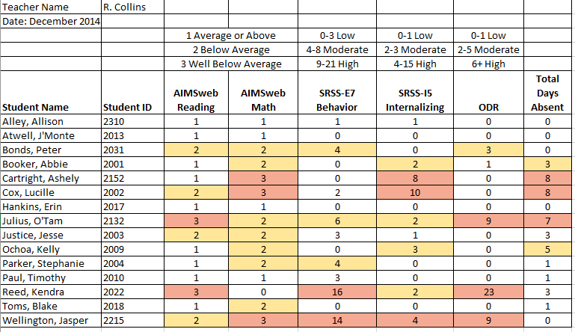
Consider this class….

Slide 71
Sharing Screening Data with Faculty and Staff

Slide 72
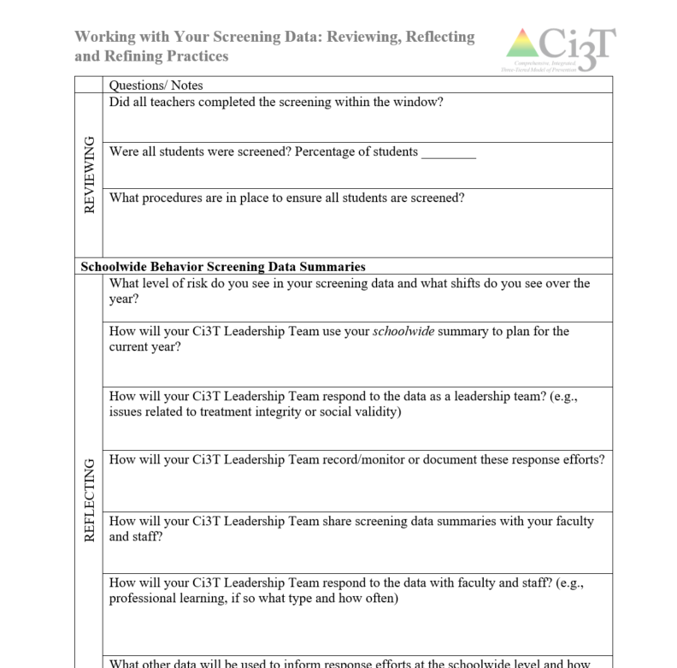
Reflect & Plan
Review spring screening data (if available).
Consider implications for
Primary (Tier 1) prevention efforts
Teacher-delivered, low-intensity strategies
Secondary (Tier 2) and Tertiary (Tier 3) supports
What professional learning is necessary to respond these data?
Make plans to share your data – and corresponding plans – with faculty and staff
Notes:
15-min timer

Slide 73
Planning for the Year Ahead 2024-2025
Ci3T District Masters A Careful Look at Your Ci3T Implementation Manual Using Data to Revise Your Ci3T Plan

Slide 74
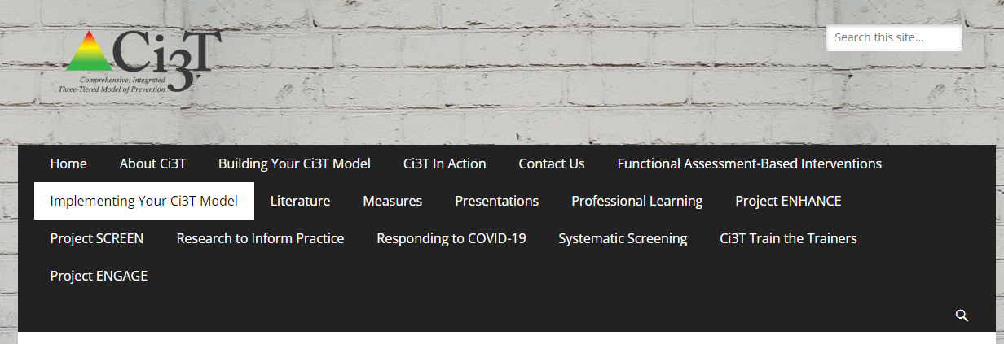
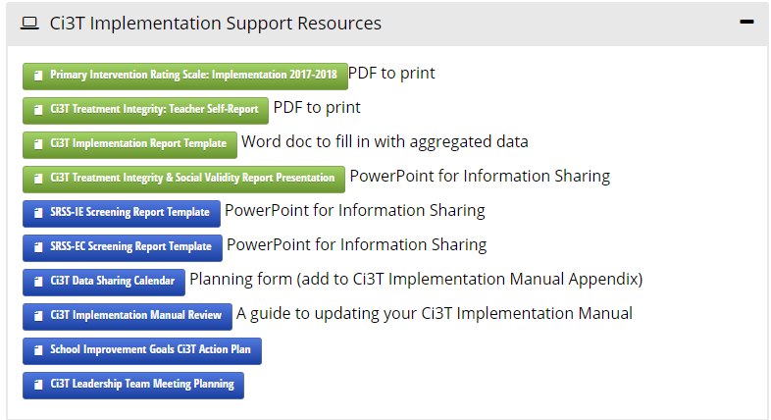
2024-2025 Ci3T Implementation Manual Review
https://www.ci3t.org/imp

Slide 75
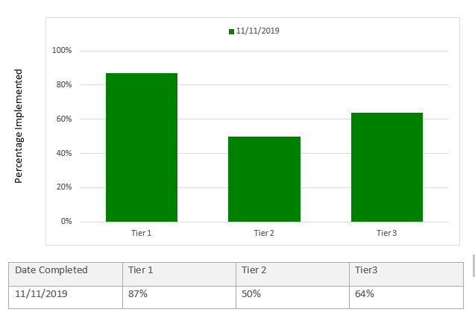
Using Data to Revise Your Ci3T Plan
Add in plans for Tier 2 & 3

Slide 76
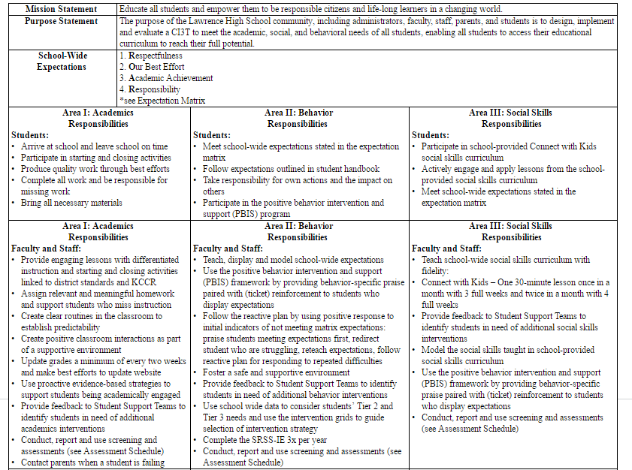
Check to see if your district has updated their District Master Blueprint
Teach, display, and model school-wide expectations
Teach school-wide social skills…, model social skills
Notes:
As you look at your Primary Plan where to you see this expectations for teachers. If you so not see it explicitly stated consider adding this to your summer revision list.

Slide 77
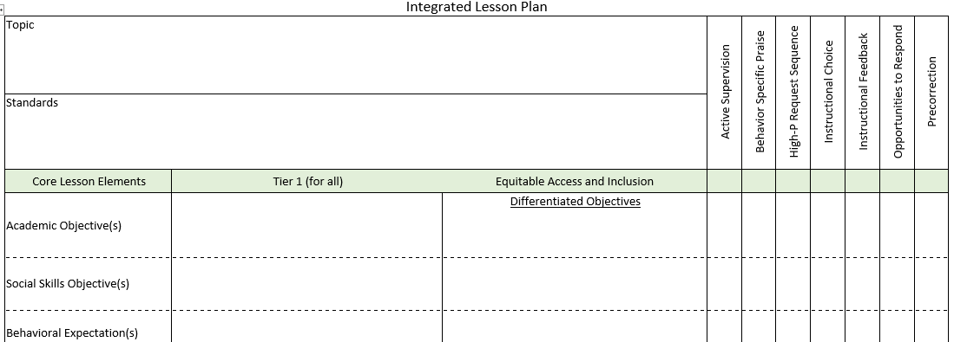
Integrated Lesson Planning

Slide 78
Secondary (Tier 2) Intervention Grid
Support | Description | School-wide Data: Entry Criteria | Data to Monitor Progress | Exit Criteria
READ 180 (Stage C) Reading Intervention | Students participate in a 50 min reading instructional block during their study hall period. Students meet in the computer lab for participation in the online portion 20 min daily. Instruction is relevant to high school students. Students use a progress management system to monitor and track their own progress. Instruction is taught by special education teachers and general education teachers with training in the READ 180 Curriculum. | (1) Students in grades 9 – 12. (2) Reading performance basic or below basic on state assessment (but above 4th grade reading level). (3) SRSS risk scores in the moderate range (4 – 8). | Student Measures: Meeting individual READ 180 reading goals: (1) Progress Monitoring with Scholastic Reading Inventory (2) Writing Assessments (3) formative assessments (vocabulary, comprehension and spelling) (4) Curriculum-based Assessments (5) Attendance in class Treatment Integrity: Teachers monitor performance and attendance in class. Completion of weekly checklists for activities completed. Social Validity: Students and teachers complete surveys regarding the importance of the goals, program procedures, and outcomes. | Students meet instructional reading goals. SRSS score in the low risk category (0 – 3) on the next screening time point.
Kathleen Lynne Lane, Wendy Peia Oakes, Holly Mariah Menzies, Juli Oyer & Abbie Jenkins (2013) Working Within the Context of Three-Tiered Models of Prevention: Using Schoolwide Data to Identify High School Students for Targeted Supports, Journal of Applied School Psychology, 29:2, 203-229, DOI: 10.1080/15377903.2013.778773

Slide 79
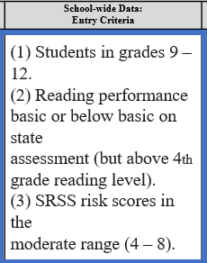
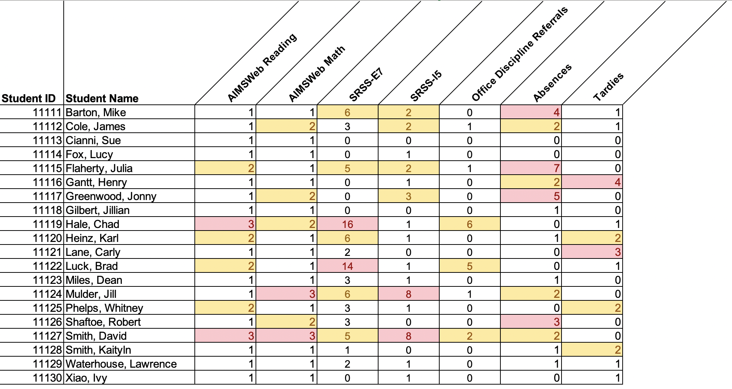
Data in action

Slide 80
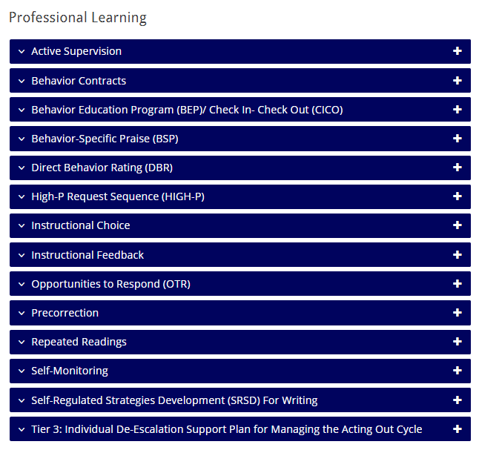
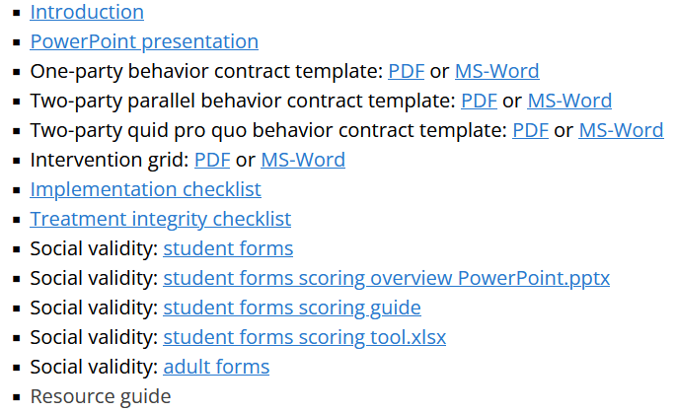
Tier 2 and Tier 3 Considerations
https://www.ci3t.org/pl

Slide 81
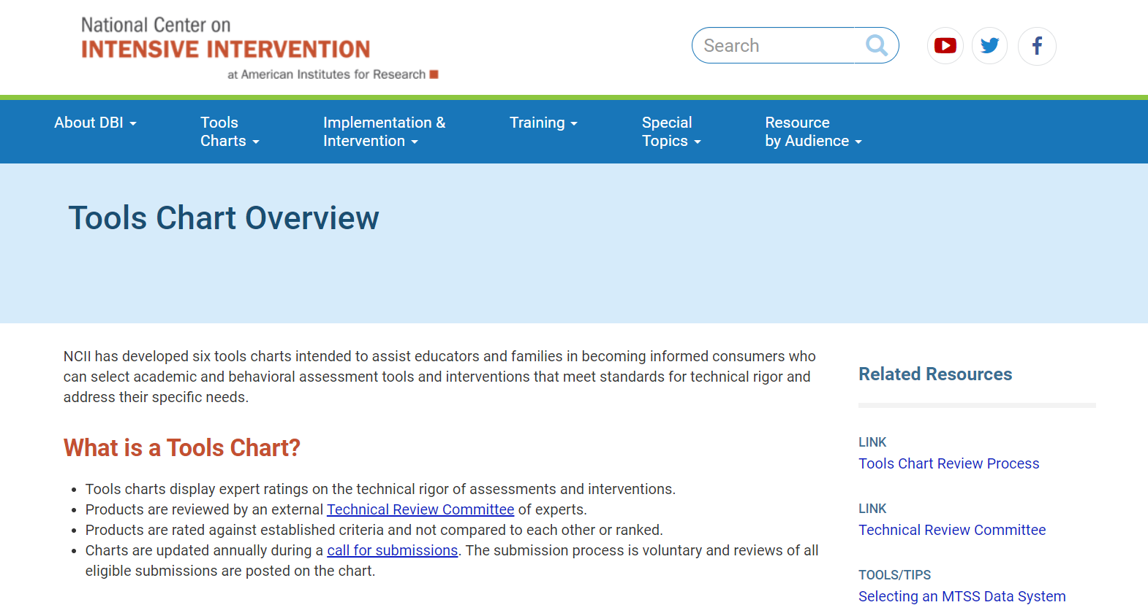
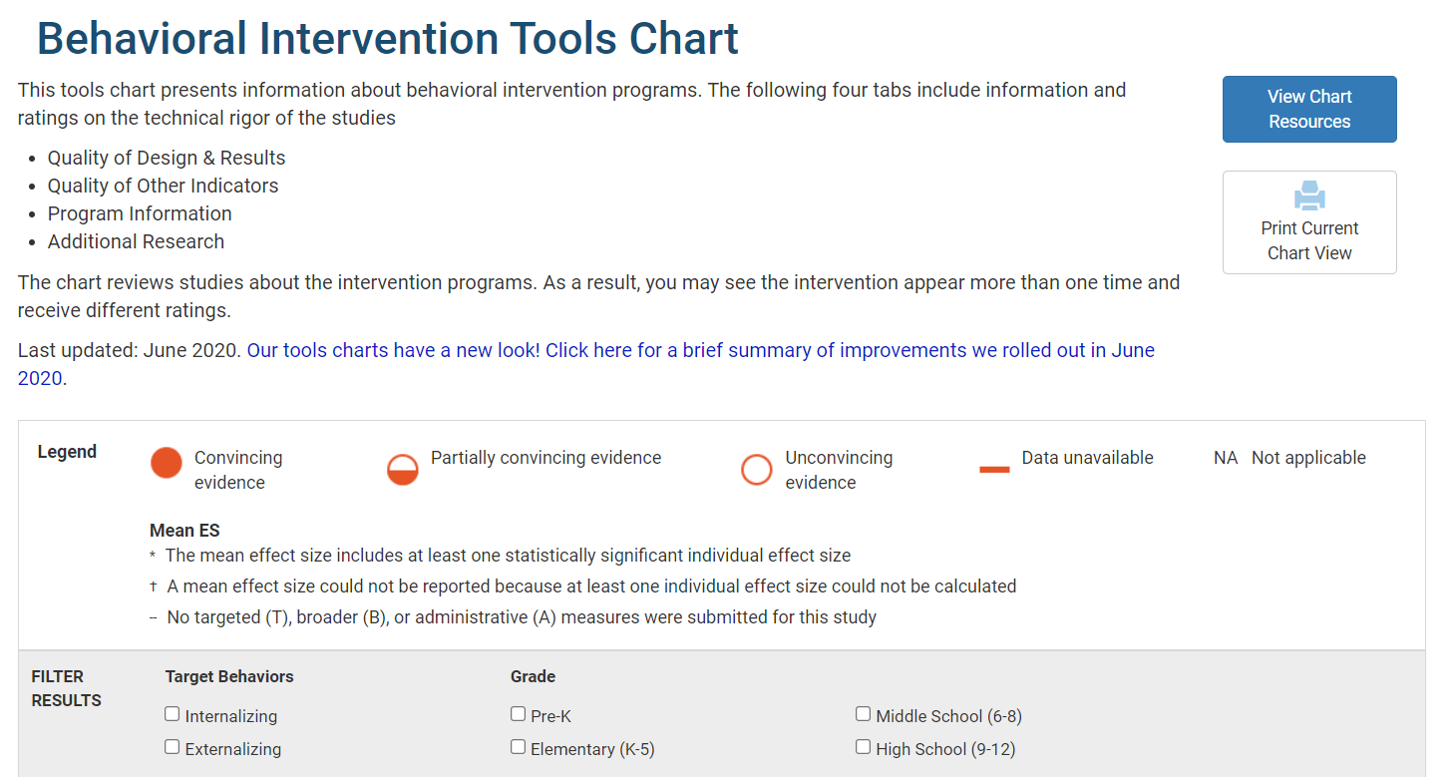
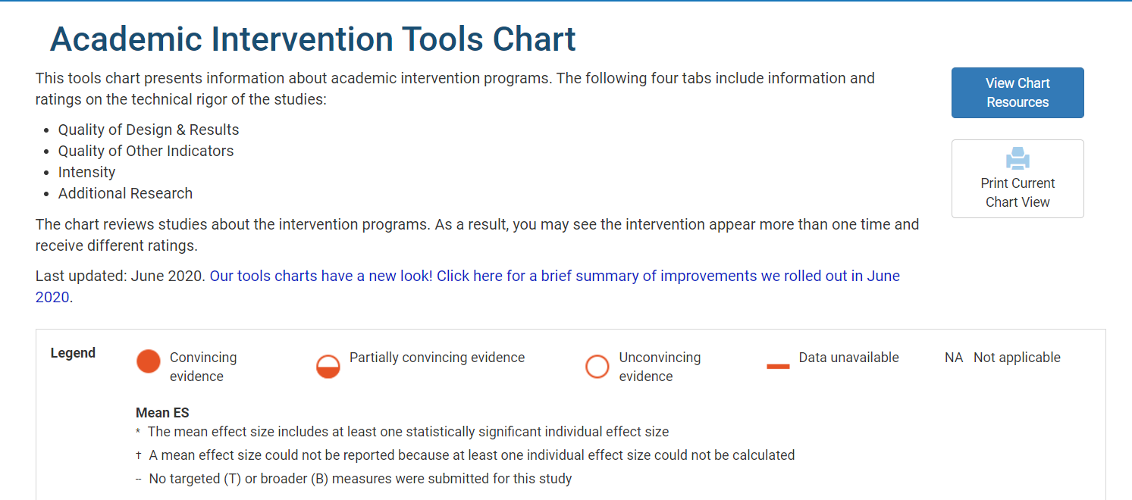
Tier 2 and Tier 3 Considerations
https://intensiveintervention.org
Academic and behavioral interventions
Information on group size
Duration of intervention
Study Results
Evidence base
Academic and behavioral progress monitoring
Psychometric standards
Progress monitoring standards
Data-based individualization standards

Slide 82
Focusing on Data-Informed Professional Learning
Ci3T Monthly Ci3T Leadership Team Meetings
Project EMPOWER: Building Capacity
Ci3T Trainer and Coaches Calls
Ci3T Summer Symposium

Slide 83
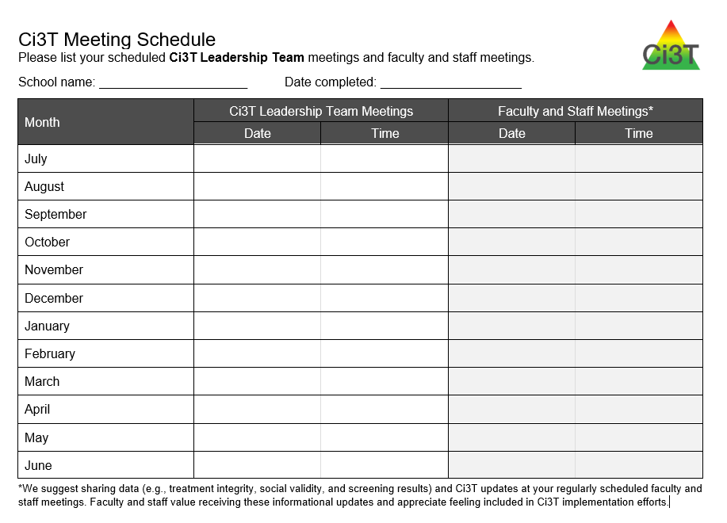
Ci3T Monthly Leadership Team Meetings

Slide 84
Ci3T Professional Learning Calendar
 | July | Aug | Sep | Oct | Nov | Dec | Jan | Feb | Mar | Apr | May | Jun
Ci3T Training |  |  |  |  | Ci3T Professional Learning Series Session 1 | Ci3T Professional Learning Series Session 2 | Ci3T Professional Learning Series Session 3 | Ci3T Professional Learning Series Session 4 |  | Ci3T Professional Learning Series Session 5 | Ci3T Professional Learning Series Session 6
Ci3T Implementation Support | Ci3T Implementation Series Prep Session |  | Ci3T Implementation Series Session 1 |  | Ci3T Implementation Series Session 2 |  | Ci3T Implementation Series Session 3 |  | Ci3T Implementation Series Session 4 | Ci3T Implementation Series Session 5
Ci3T EMPOWER |  |  | Ci3T EMPOWER Session 1 | Ci3T EMPOWER Session 2 | Ci3T EMPOWER Session 3 |  | Ci3T EMPOWER Session 4 |  | Ci3T EMPOWER Session 5 | Ci3T EMPOWER Session 6
Ci3T Trainers & Coaches Calls |  | Trainers & Coaches Call Session 1 | Trainers & Coaches Call Session 2 | Trainers & Coaches Call Session 3 | Trainers & Coaches Call Session 4 | Trainers & Coaches Call Session 5 | Trainers & Coaches Call Session 6 | Trainers & Coaches Call Session 7 | Trainers & Coaches Call Session 8 | Trainers & Coaches Call Session 9 | Trainers & Coaches Call Session 10

Slide 85
ENHANCE Ci3T Implementation Professional Learning Series
Ci3T Implementation Professional Learning Series Location: Remote via Zoom Attended by: School Ci3T Leadership Teams Sessions A and B available: Ci3T Leadership Teams can select which they would like to attend.
Session | Date | Times (Session A and B)
 |  | Pacific | Central | Eastern
Summer Session | June. 24, 2024 (Mon) | 07:30 am – 01:30 pm | 09:30 am – 03:30 pm | 10:30 am – 04:30 pm
Session 1 | Sept. 10, 2024 (Tues) | 09:00 am – 11:00 am | 11:00 am – 01:00 pm | 12:00 pm – 02:00 pm
 |  | 02:30 pm – 04:30 pm | 04:30 pm – 06:30 pm | 05:30 pm – 07:30 pm
Session 2 | Nov. 12, 2024 (Tues) | 09:00 am – 11:00 am | 11:00 am – 01:00 pm | 12:00 pm – 02:00 pm
 |  | 02:30 pm – 04:30 pm | 04:30 pm – 06:30 pm | 05:30 pm – 07:30 pm
Session 3 | Jan. 14, 2025 (Tues) | 09:00 am – 11:00 am | 11:00 am – 01:00 pm | 12:00 pm – 02:00 pm
 |  | 02:30 pm – 04:30 pm | 04:30 pm – 06:30 pm | 05:30 pm – 07:30 pm
Session 4 | Mar. 04, 2025 (Tues) | 09:00 am – 11:00 am | 11:00 am – 01:00 pm | 12:00 pm – 02:00 pm
 |  | 02:30 pm – 04:30 pm | 04:30 pm – 06:30 pm | 05:30 pm – 07:30 pm
Session 5 | Apr. 15, 2025 (Tues) | 09:00 am – 11:00 am | 11:00 am – 01:00 pm | 12:00 pm – 02:00 pm
 |  | 02:30 pm – 04:30 pm | 04:30 pm – 06:30 pm | 05:30 pm – 07:30 pm

Slide 86
Building Capacity & Supporting Sustainability Professional Learning Offerings for 2023-2024
Sign up now for 2024-2025 EMPOWER sessions!

Slide 87
Project EMPOWER +
Ci3T EMPOWER⁺ Sessions Location: Remote via Zoom Attended by: School Ci3T Leadership Teams, Ci3T District Trainers and Coaches, Faculty and Staff, Families (adults only). Community Members
Session | Date | Times
1. Ci3T FIT: Start the Year Strong | Sep. 24, 2024 (Tues) | 2:30 - 4:30 p.m. (Pacific) 4:30 - 6:30 p.m. (Central) 5:30 - 7:30 p.m. (Eastern)
2. Data-Informed Instruction: This is how we do it! | Oct. 9, 2024 (Wed) | 2:30 - 4:30 p.m. (Pacific) 4:30 - 6:30 p.m. (Central) 5:30 - 7:30 p.m. (Eastern)
3. Practical, Low Intensity Strategies to Maximize Engagement and Limit Disruption: Part 1 | Precorrection & Active Supervision | Nov. 19, 2024 (Tues) | 2:30 - 4:30 p.m. (Pacific) 4:30 - 6:30 p.m. (Central) 5:30 - 7:30 p.m. (Eastern)
4. Practical, Low Intensity Strategies to Maximize Engagement and Limit Disruption: Part 2 | Instructional Choice and Increased Opportunities to Respond | Jan. 22, 2025 (Wed) | 2:30 - 4:30 p.m. (Pacific) 4:30 - 6:30 p.m. (Central) 5:30 - 7:30 p.m. (Eastern)
5. Tier 2: Behavior Contracts | Feb. 11, 2025 (Tues) | 2:30 - 4:30 p.m. (Pacific) 4:30 - 6:30 p.m. (Central) 5:30 - 7:30 p.m. (Eastern)
6. Tier 2: Direct Behavior Ratings (DBR) | Mar. 26, 2025 (Wed) | 2:30 - 4:30 p.m. (Pacific) 4:30 - 6:30 p.m. (Central) 5:30 - 7:30 p.m. (Eastern)
7. Tier 3: Functional Assessment-based Interventions (FABI) | Apr. 29, 2025 (Tues) | 2:30 - 4:30 p.m. (Pacific) 4:30 - 6:30 p.m. (Central) 5:30 - 7:30 p.m. (Eastern)

Slide 88
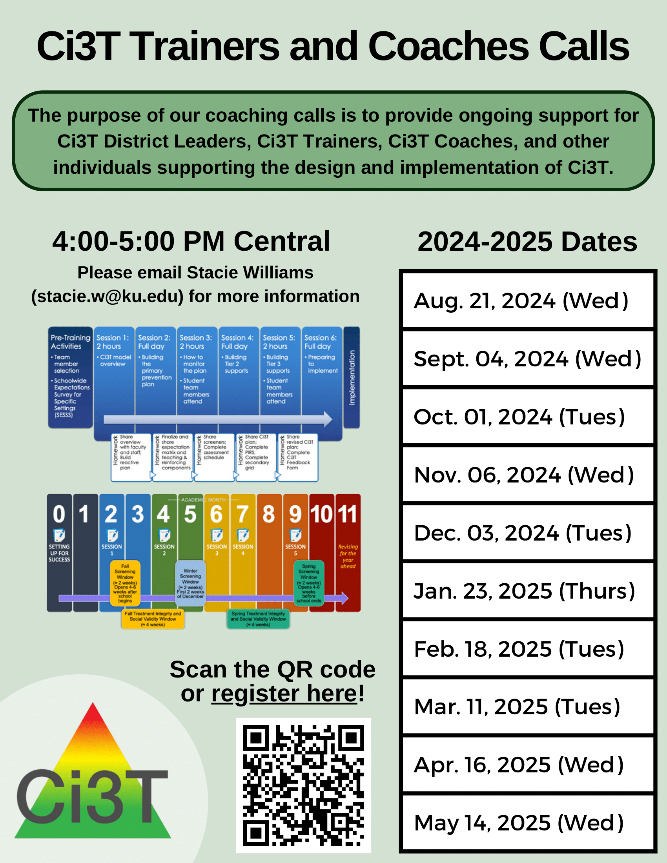
Ci3T Trainers and Coaches Calls
2024-2025 Ci3T Trainers and Coaches Call information will be posted online after the last call this year!

Slide 89
Ci3T Trainers and Coaches Calls
Ci3T EMPOWER⁺ Sessions Location: Remote via Zoom Attended by: School Ci3T Leadership Teams, Ci3T District Trainers and Coaches, Faculty and Staff, Families (adults only). Community Members
Session | Date | Times (Central
Ci3T Trainers and Coaches Call | Aug. 21, 2024 (Wed) | 4:00 – 5:00 p.m.
Ci3T Trainers and Coaches Call | Sept. 04, 2024 (Wed) | 4:00 – 5:00 p.m.
Ci3T Trainers and Coaches Call | Oct. 01, 2024 (Tues) | 4:00 – 5:00 p.m.
Ci3T Trainers and Coaches Call | Nov. 06, 2024 (Wed) | 4:00 – 5:00 p.m.
Ci3T Trainers and Coaches Call | Dec. 03, 2024 (Tues) | 4:00 – 5:00 p.m.
Ci3T Trainers and Coaches Call | Jan. 23, 2025 (Thurs) | 4:00 – 5:00 p.m.
Ci3T Trainers and Coaches Call | Feb. 18, 2025 (Tues) | 4:00 – 5:00 p.m.
Ci3T Trainers and Coaches Call | Mar. 11, 2025 (Tues) | 4:00 – 5:00 p.m.
Ci3T Trainers and Coaches Call | Apr. 16, 2025 (Wed) | 4:00 – 5:00 p.m.
Ci3T Trainers and Coaches Call | May 14, 2025 (Wed) | 4:00 – 5:00 p.m.

Slide 90
Ci3T Implementers Symposium
Monday June 24, 2024
7:30 a.m. – 1:30 p.m. (Pacific)
9:30 a.m. – 3:30 p.m. (Central)
10:30 a.m. – 4:30 p.m. (Eastern)

Slide 91
Reflect & Plan
Plan and schedule action items for closing out 2023-2024 and preparing for 2024-2025 Identify potential Ci3T Implementation Manual revisions Schedule time with your Ci3T Leadership Team to complete Ci3T Implementation Manual revisions prepare for implementation in 2024-2025 Make plans for spring data sharing | What are strengths of our current communication systems? How can we share data with staff more regularly? What resources and professional learning do faculty and staff require? Consider Ci3T Leadership Team Meetings Empower Sessions Ci3T Trainers and Coaches Calls
Use “Ci3T Imp Manual Review” to revise
Notes:
15-min timer

Slide 92
Wrapping Up and Moving Forward

Slide 93
Ci3T
Comprehensive Professional Learning Plan
Ci3T: Primary Prevention
Session 1:
Overview of Ci3T Prevention Models
Setting a Purpose
Establish team meetings and roles
Session 2:
Mission and Purpose
Establish Roles and Responsibilities
Procedures for Teaching
Procedures for Reinforcing
Reactive Plan
Session 3:
Procedures for Monitoring
Session 4:
Revise Primary Plan using Stakeholder feedback
Prepare presentation
Ci3T: Secondary Prevention
Session 5:
Overview of Teacher focused Strategies
Overview of Student Focused Strategies
Using data to determine which students may need Secondary (Tier 2) supports
Draft the Secondary Intervention Grid based on existing supports
Ci3T: Tertiary Prevention
Session 6:
Final revisions of Ci3T Plan based on stakeholder feedback
Draft Tertiary (Tier 3) Prevention Intervention Grids
Design Implementation Manual and Plan for roll out to faculty, students, and parents
Ci3T Leadership Team Training Sequence
Implementation Stages of Tier 2 and 3 within Ci3T
Additional Professional Development on Specific Topics
Core Content Curriculum
Check In - Check Out
Functional Assessment-based Interventions
Reading, Math, Writing Benchmarking and Progress Monitoring Tools
Interventions, Strategies, & Practices
Additional Tier 3 Supports
Instructional Techniques to Improve Students’ Motivation; Classroom Management Practices;
Low-Intensity Behavior Supports

Slide 94
Ci3T Professional Learning Calendar
 | July | Aug | Sep | Oct | Nov | Dec | Jan | Feb | Mar | Apr | May | Jun
Ci3T Training |  |  |  |  | Ci3T Professional Learning Series Session 1 | Ci3T Professional Learning Series Session 2 | Ci3T Professional Learning Series Session 3 | Ci3T Professional Learning Series Session 4 |  | Ci3T Professional Learning Series Session 5 | Ci3T Professional Learning Series Session 6
Ci3T Implementation Support | Ci3T Implementation Series Prep Session |  | Ci3T Implementation Series Session 1 |  | Ci3T Implementation Series Session 2 |  | Ci3T Implementation Series Session 3 |  | Ci3T Implementation Series Session 4 | Ci3T Implementation Series Session 5
Ci3T EMPOWER |  |  | Ci3T EMPOWER Session 1 | Ci3T EMPOWER Session 2 | Ci3T EMPOWER Session 3 |  | Ci3T EMPOWER Session 4 |  | Ci3T EMPOWER Session 5 | Ci3T EMPOWER Session 6
Ci3T Trainers & Coaches Calls |  | Trainers & Coaches Call Session 1 | Trainers & Coaches Call Session 2 | Trainers & Coaches Call Session 3 | Trainers & Coaches Call Session 4 | Trainers & Coaches Call Session 5 | Trainers & Coaches Call Session 6 | Trainers & Coaches Call Session 7 | Trainers & Coaches Call Session 8 | Trainers & Coaches Call Session 9 | Trainers & Coaches Call Session 10

Slide 95
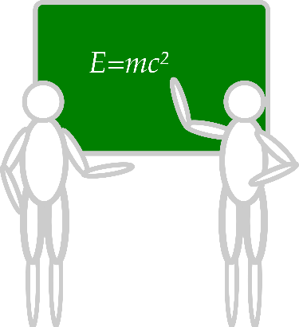
Sustaining and Disseminating Professional Learning
Designate two staff to attend trainings to become on-site coaches
10 min @ next Faculty and Staff meeting
Ci3T Setting Up for Success
Systematic Screening
Low-Intensity Supports
Tier 2
Planning Ahead
Tier 3

Slide 96
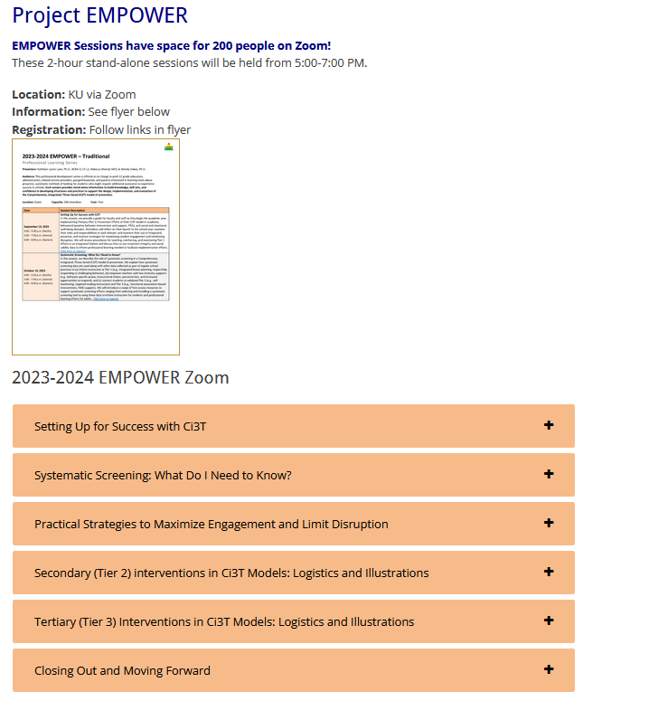
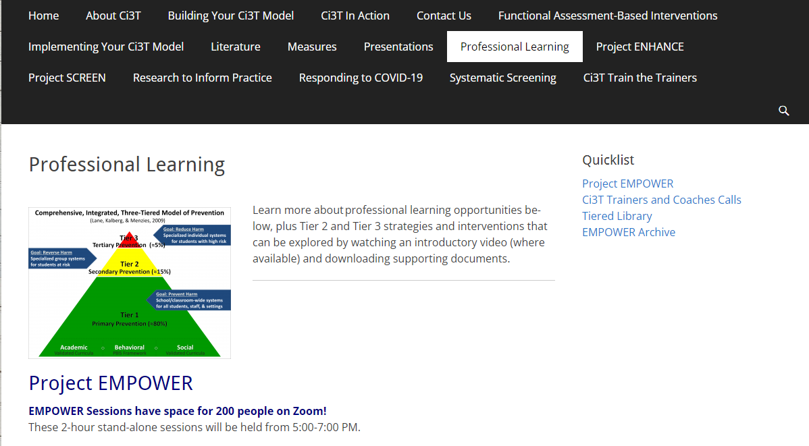
Accessing Project EMPOWER Professional Learning

Slide 97
Project EMPOWER - Traditional
Ci3T EMPOWER Sessions Location: Remote via Zoom Attended by: School Ci3T Leadership Teams, Ci3T District Trainers and Coaches, Faculty and Staff, Families (adults only), Community Members |  | Times (Pacific) | Times (Central) | Times (Eastern)
1. Getting Started | Sep. 19, 2023 (Tu) | 3:00 – 5:00 p.m. | 5:00 – 7:00 p.m. | 6:00 – 8:00 p.m.
2. Screening | Oct. 19, 2023 (Th) | 3:00 – 5:00 p.m. | 5:00 – 7:00 p.m. | 6:00 – 8:00 p.m.
3. Low Intensity Supports (3) | Nov. 30, 2023 (Th) | 3:00 – 5:00 p.m. | 5:00 – 7:00 p.m. | 6:00 – 8:00 p.m.
4. Tier 2 | Jan. 9, 2024 (Tu) | 3:00 – 5:00 p.m. | 5:00 – 7:00 p.m. | 6:00 – 8:00 p.m.
5. Tier 3 | Mar. 28, 2024 (Th) | 3:00 – 5:00 p.m. | 5:00 – 7:00 p.m. | 6:00 – 8:00 p.m.
6. Moving Forward | Apr. 23, 2024 (Wed) | 3:00 – 5:00 p.m. | 5:00 – 7:00 p.m. | 6:00 – 8:00 p.m.

Slide 98
Wrap Up and Preview
Today
Next Steps
Procedures for Monitoring
Review your School’s Social Validity & Treatment Integrity Data
Review your School’s Spring Screening Data
Planning for the Year Ahead 2024-2025
Focusing on Data-Informed Professional Learning
Summer Support
Ci3T Implementation Professional Learning Series 2024-2025
Ci3T EMPOWER Sessions 2024-2025
We hope you have a wonderful conclusion to the school year!

Slide 99
Please Take a Minute to Get Organized
Please stay until all materials are organized.
Team Materials:
Make sure your notes are in your Ci3T Leadership Team agenda and that document is saved in your Ci3T Leadership Team Drive.
Clearly identify the person(s) on your team in charge of each action item listed on the agenda.
Thank you!

Slide 100
Homework
At your next Ci3T Leadership Team meeting:
Begin planning updates to your Ci3T Implementation Manual for next year; consider:
Takeaways from data reviews conducted this year (social validity, treatment integrity, student outcomes)
District Master updates
Update your Ci3T Leadership Team structures for next year, including membership, meeting dates, agendas
Plan data-informed professional learning to support your staff in 2024-2025
At your next faculty meeting:
Share successes
Share spring implementation report and screening data
Share revisions to Ci3T Implementation Manual based on spring data
Share professional learning resources and opportunities

Slide 101
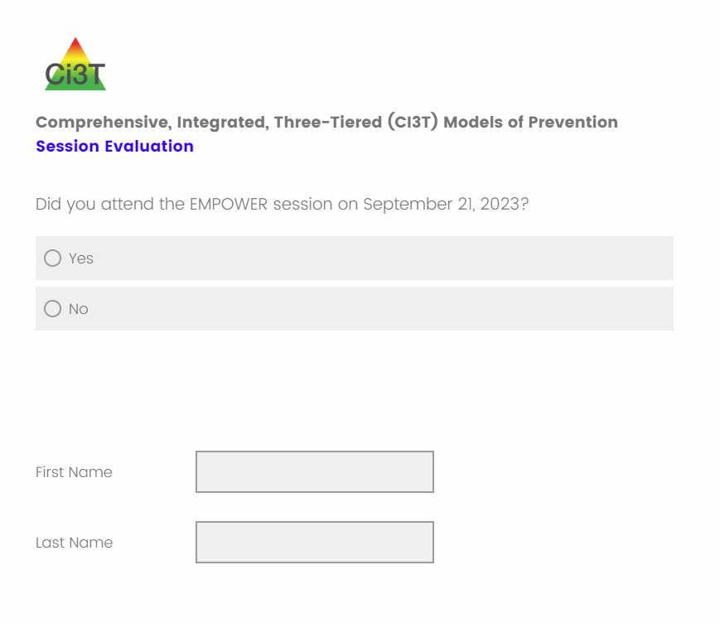
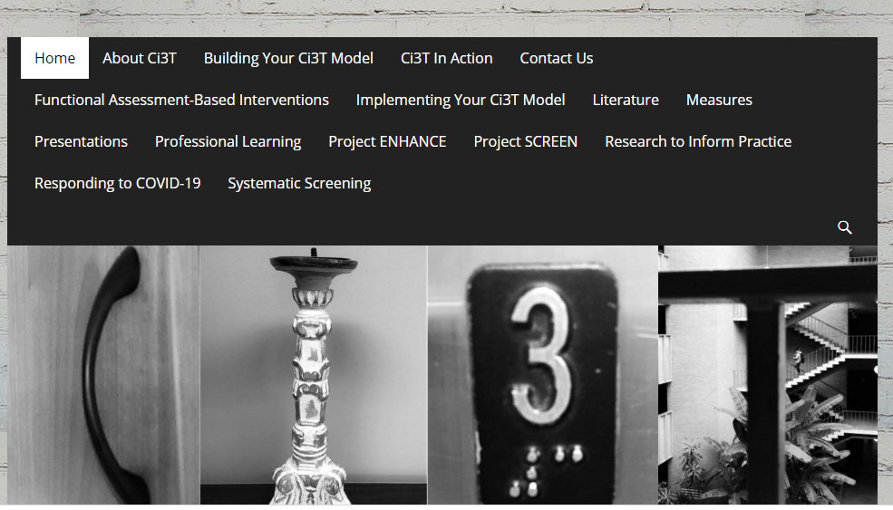
Comprehensive, Integrated, Three-tiered (Ci3T) Model of Prevention
Thank you!
Notes:
Tag us in your Ci3T highlights- we’d love to see Ci3T in action! Follow us on Twitter or Instagram for updates and links to resources! @Ci3TModel
You will receive a brief session evaluation – we value your feedback and would greatly appreciate you taking a few minutes to share your thoughts on what you liked about the session and how we can improve

