Slide 1
Keeping Students Engaged: Practical Strategies for
Teachers and Families
Midwest Symposium for Leadership in Behavior Disorders
Kansas City, Missouri
February 2023
Kathleen Lynne Lane, Ph.D., BCBA-D, CF-L2, University of Kansas
Grant Edmund Allen, Ph.D., University of Wisconsin-Stout
Paloma Pérez, Ph.D., University of Virginia
David James Royer, Ph.D., BCBA, University of Louisville
Eric Alan Common, Ph.D., BCBA-D, LBA (MI), University of Michigan, Flint
Elise Marie Sarasin, MSE, University of Kansas
ci3t.org
This project was funded in part by Project ENHANCE (IES Project Number: R324N190002)
Notes:
In this session, we provide teachers and families with effective, practical strategies to increase student engagement and minimize disruption in remote, in person, and hybrid learning environments. We provide step-by-step guidance for using behavior specific praise, precorrection, active supervision, and instructional choice. These strategies are often incorporated as foundational elements of integrated tiered systems of support such as Comprehensive, Integrated, Three-tiered (Ci3T) models of prevention and can be used by teachers and families in schools without tiered systems in place.

Slide 2
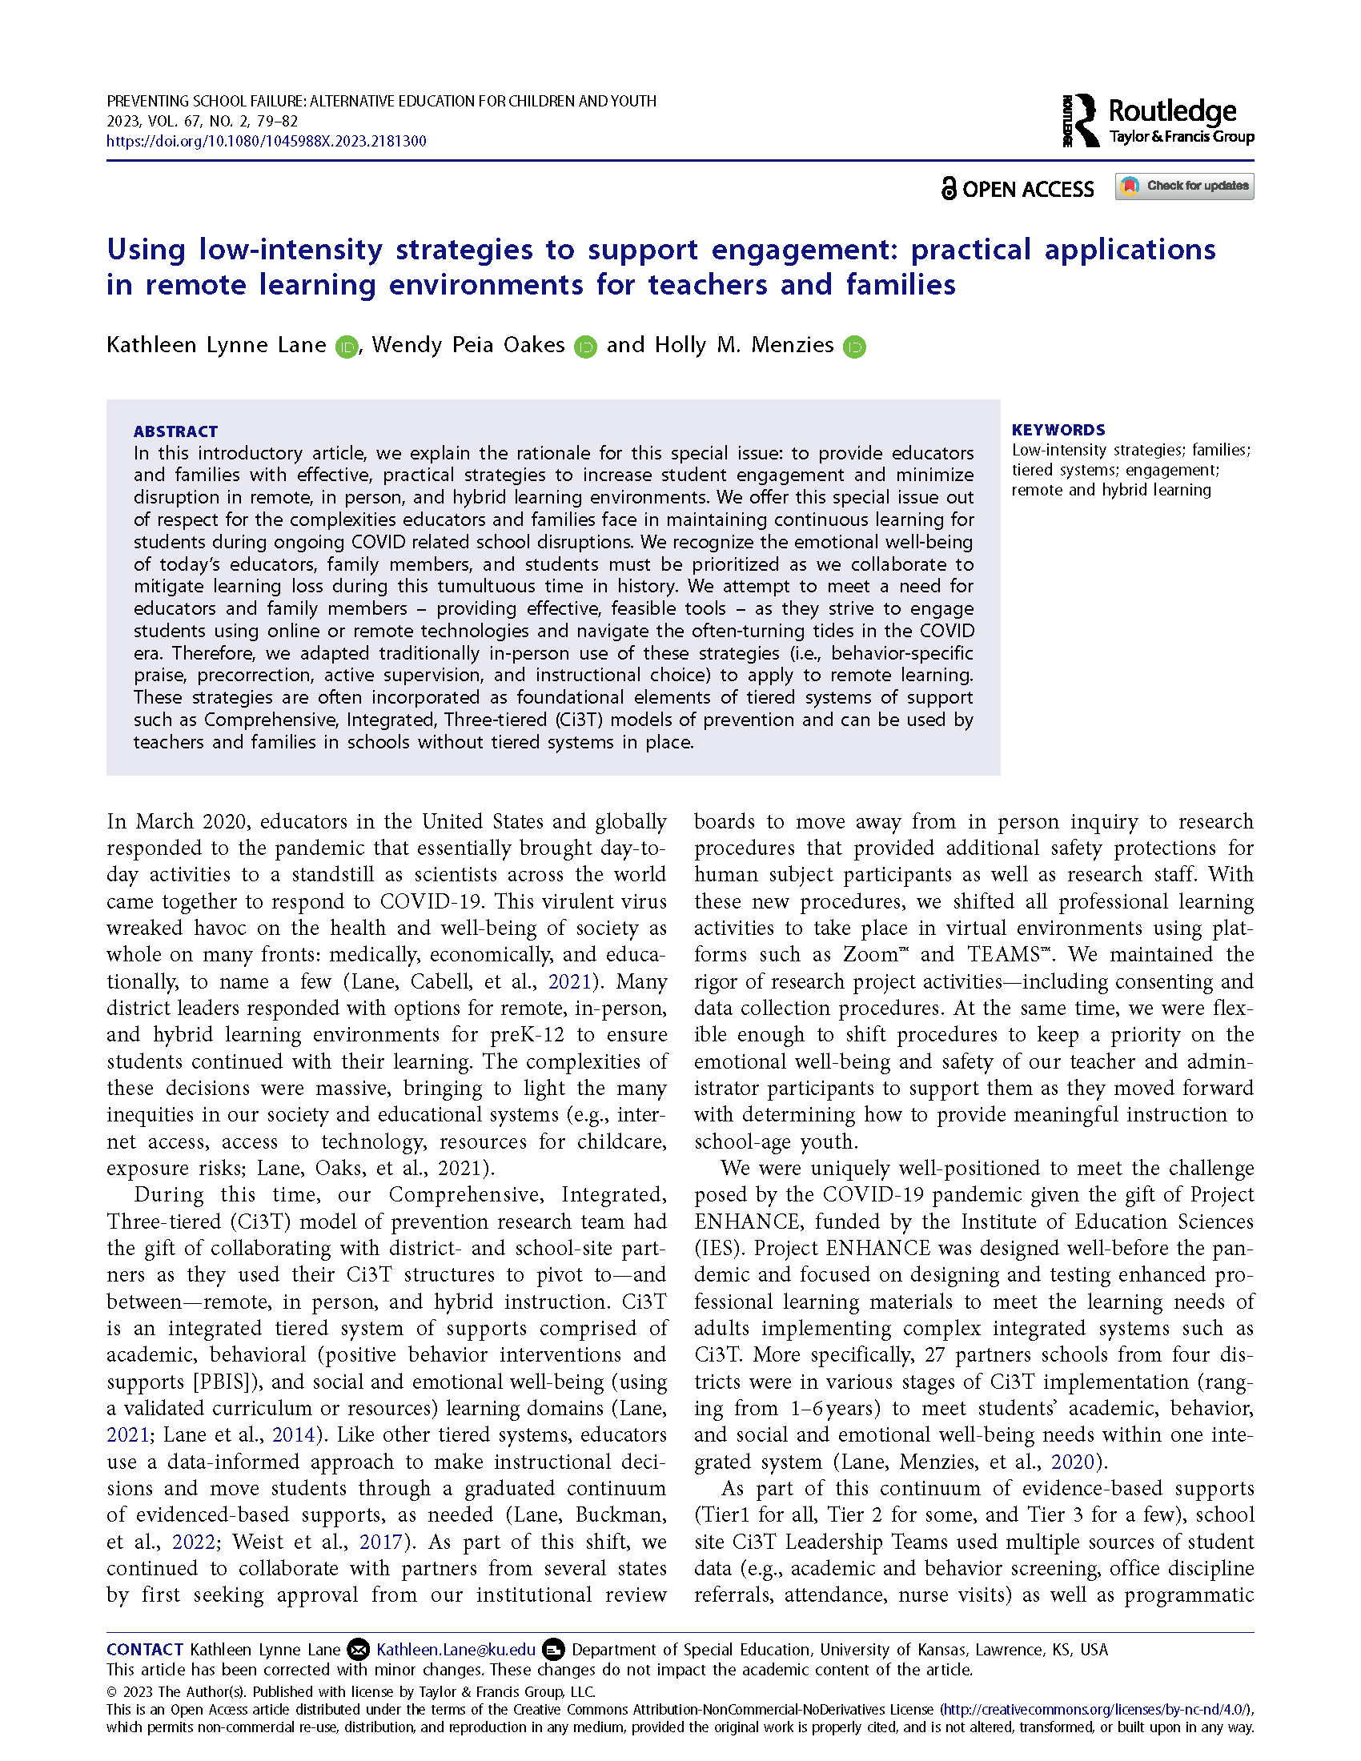
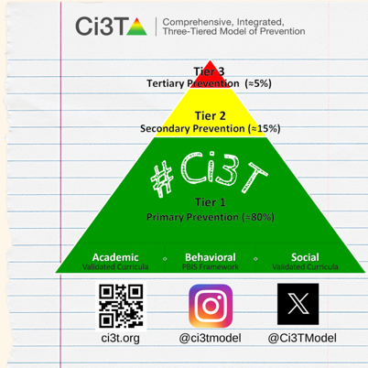


Agenda
Welcome
An Introduction to Low-Intensity Strategies
Behavior-Specific Praise
Precorrection
Active Supervision
Instructional Choice
Next Steps: New Resources Coming Soon!
ci3t.org
Notes:
Participants will:
understand how to implement four strategies for enhancing engagement: behavior specific praise, precorrection, active supervision, and instructional choice
learn to access free, web-based tools to support implementation, including treatment integrity and social validity.
Learn how to locate open access practitioner articles to support implementation efforts

Slide 3
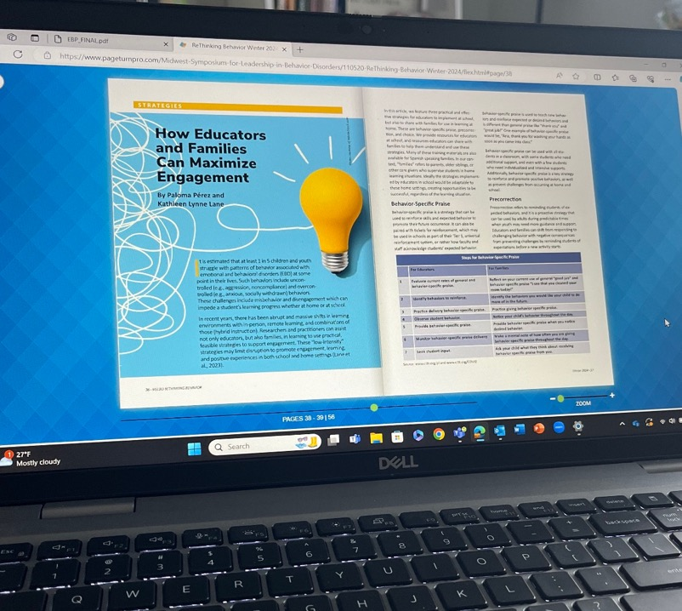

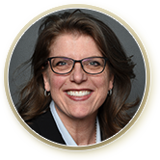




Welcome & Introduction

Slide 4
Comprehensive, Integrated, Three-Tiered Model of Prevention
(Lane, Kalberg, & Menzies, 2009)
Tier 3
Tertiary Prevention (≈5%)
Tier 2
Secondary Prevention (≈15%)
Tier 1
Primary Prevention (≈80%)
Academic ◇ Behavioral ◇ Social
Validated Curricula PBIS Framework Validated Curricula

Slide 5



Ci3T Implementation Manual

Slide 6
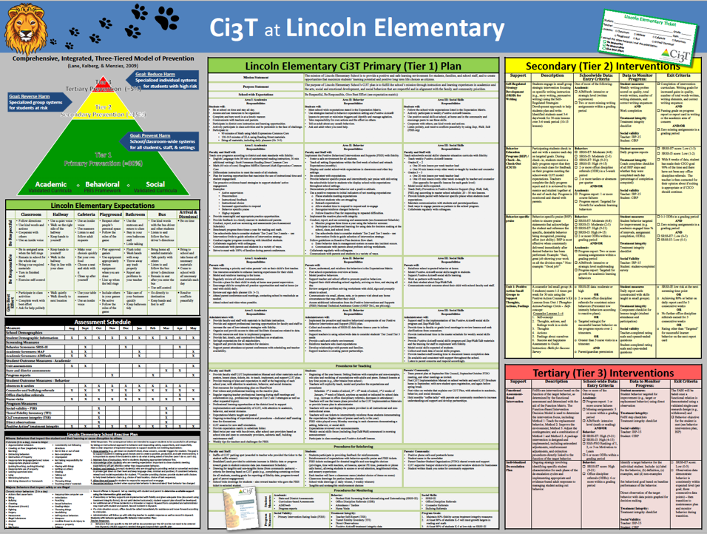
Everything connects to the Primary (Tier 1) Plan
Including procedures for teaching, reinforcing, and monitoring across academic, behavior, and social roles and responsibilities.

Slide 7
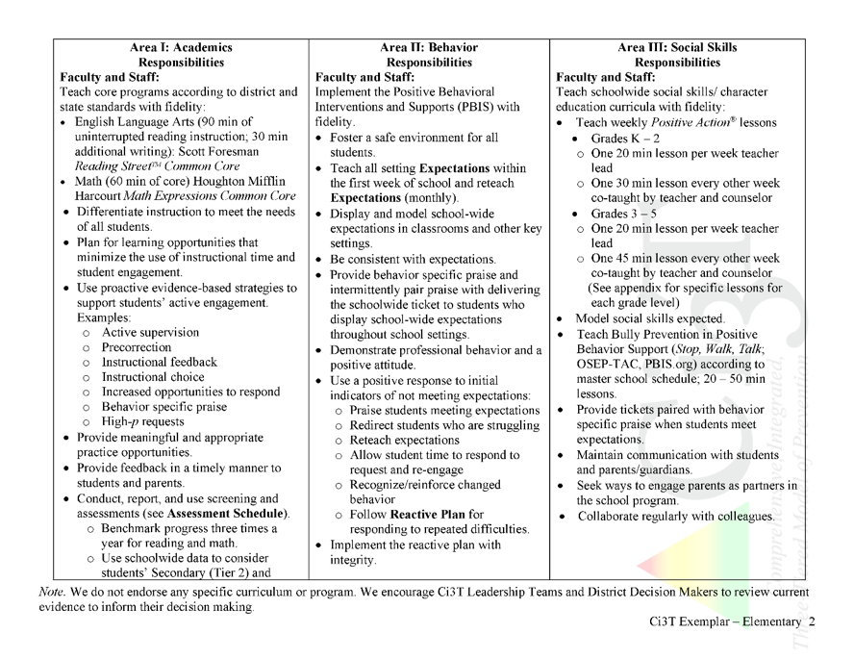
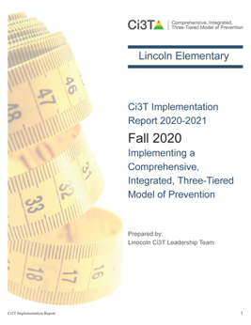

Ci3T Primary Plan: Procedures for Teaching
Ci3T Primary Plan: Procedures for Reinforcing
Ci3T Primary Plan: Procedures for Monitoring

Slide 8
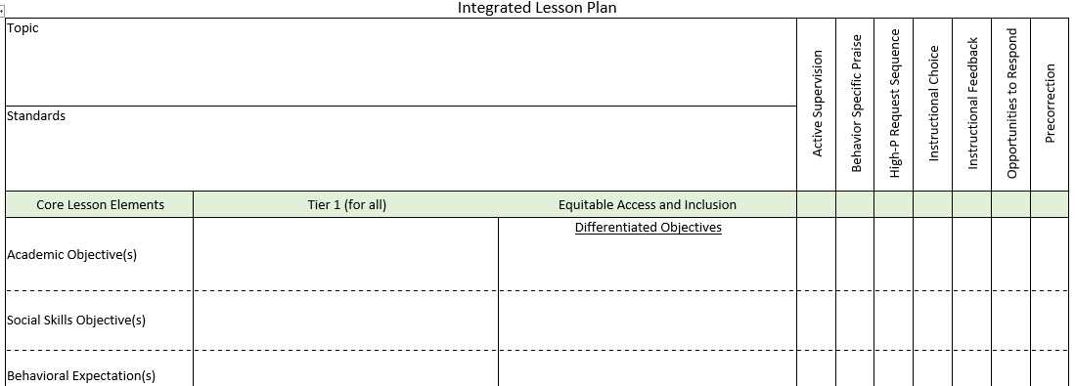
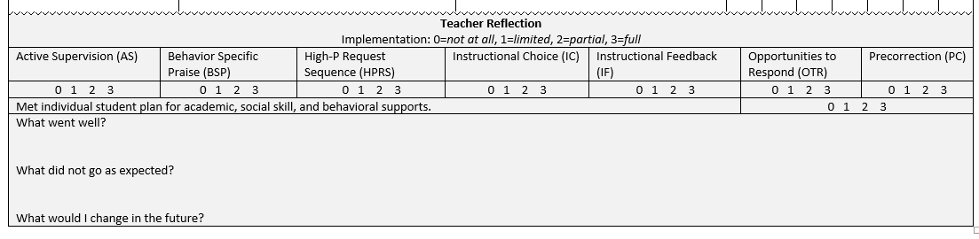
An Integrated Approach
Notes:
We will revisit at the end

Slide 9


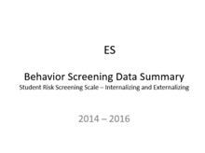
Essential Components of
Primary Prevention Efforts
Social Validity
Systematic Screening
Academic
Behavior
Treatment Integrity
Notes:
We support our school partners in administering surveys to their faculty and staff to garner understanding of social validity, conduct observations and self-reports to assess treatment integrity, and support systematic screening of all students for academics and behavior. We believe that schools thrive when faculty and staff are keenly aware of their school-wide data (show the next three slides)
KEEP THIS FOR LATER IN SLIDE: All schools wanted to continue “how” not “should”

Slide 10

Secondary (Tier 2) Intervention Grids
Notes:
Low-intensity strategies can also be Tier 2 interventions, or components of Tier 3 interventions.

Slide 11

Tertiary (Tier 3) Intervention Grids

Slide 12


Building a Ci3T Tier Library
Teacher Delivered Strategies
Tier 1
Tier 2
Tier 3

Slide 13

Consider Teacher-Delivered Strategies Across Tiers
Opportunites to Respond
Behavior-Specific Praise
Active Supervision
Instructional Feedback
High-Probability Requests
Precorrection
Instructional Choice

Slide 14
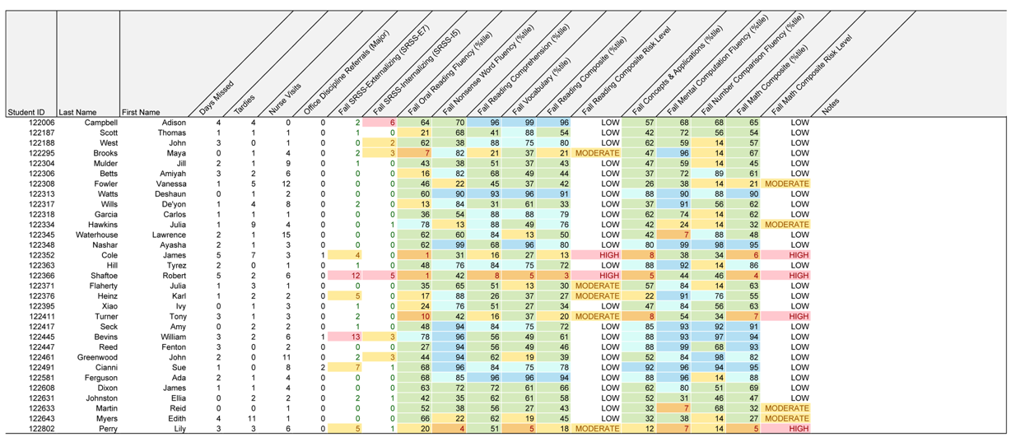

Examining Academic and Behavioral Data
Lane, K. L., Menzies, H. M., Ennis, R. P., & Oakes, W. P. (2015). Supporting Behavior for School Success: A Step-by-Step Guide to Key Strategies. Guilford Press.
Notes:
Lane, K. L., Oakes, W. P., Ennis, R. P., & Hirsch, S. E. (2014). Identifying students for secondary and tertiary prevention efforts: How do we determine which students have Tier 2 and Tier 3 needs? Preventing School Failure, 58, 171-182, DOI: 10.1080/1045988X.2014.895573

Slide 15
Low-Intensity Strategy | Franklin High School On-Site Expert
Behavior-Specific Praise: Identifying the specific expectation the student met. “Niama, great job using your graphic organizer to draft your essay.” “Justice, thank you for pushing in your chair to keep the walkway safe.” | Eric Common, Behavior Specialist Mark Buckman, Special Education Grant Allen, Parent Volunteer
Opportunities to Respond: Providing 4-6 opportunities per minute for students to respond individually, choral, verbal, written, gesture, or symbol. “Show me thumbs or thumbs down if...” “Show me on your white board what…” “Turn to your elbow partner and say…” “All together now, what is…” | David Royer, Administration Emily Cantwell, 5th Grade Scarlett Lane, 3rd Grade Mallory Messenger, Counselor
Instructional Choice: Providing within-task or between task choices to increase academic engaged time and motivation. “Ronaldo, of these 3 tasks today, which would you like to work on first?” “Suzy, do you want to work with colored pencils, crayons, or sparkly markers?” | Abbie Jenkins, 2nd Grade Scarlett Lane, 3rd Grade Bryan Simmons, PE Liane Johl, Kindergarten

Slide 16



Slide 17
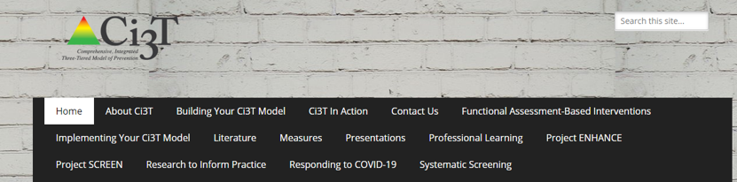
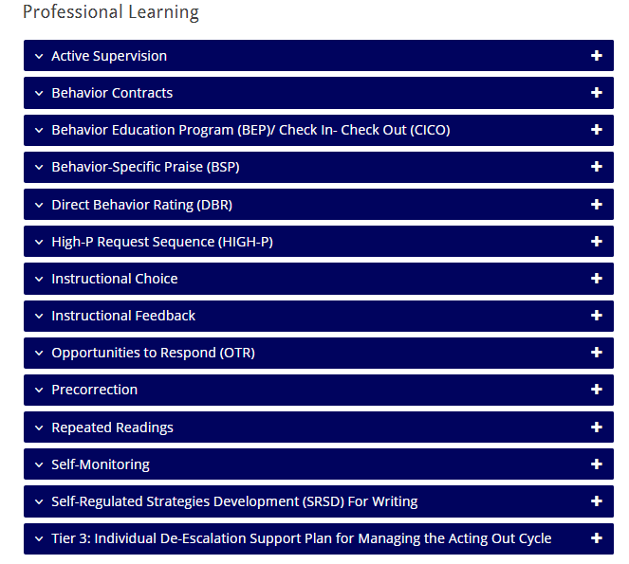
ci3t.org/pl

Slide 18
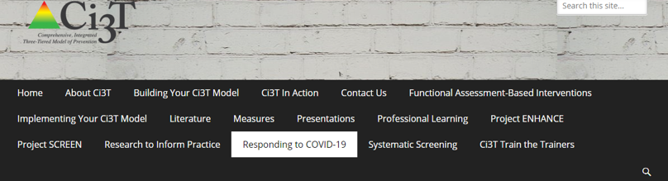
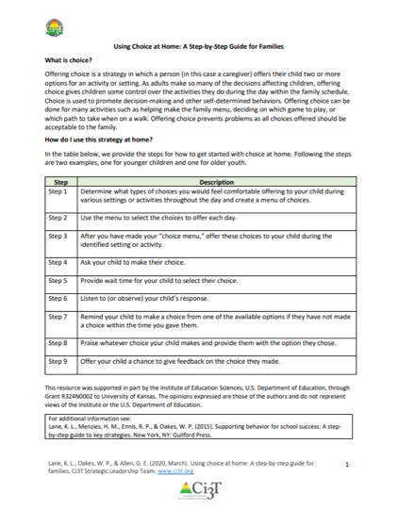
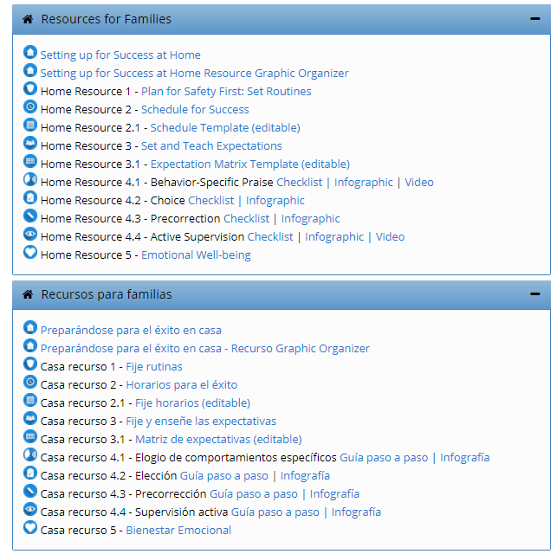
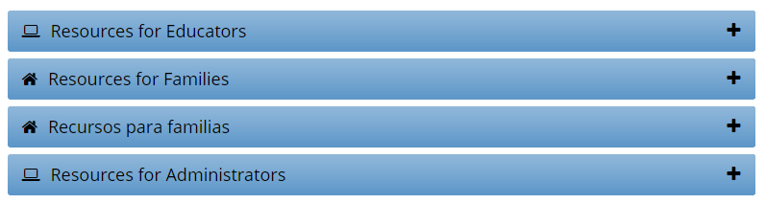
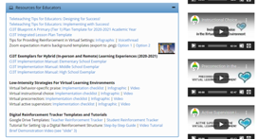
ci3t.org/covid
Notes:
However, by mid-march of 2020, it become clear that different types of professional learning resources would be necessary to help schools meet the challenge of providing instruction in remote settings, often with extremely limited time to make plans for this unprecedented shift.
So, we began to create resources for educators, families, and administrators with the aim of creating free-to-access materials that addressed needs shared with us by our school partners. For example, finding ways to motivate and engage students during remote learning was a huge need, as was supporting parents in helping their children be successful at home. These are the resources we’ll be sharing today, which are all available at ci3t.org/covid

Slide 19
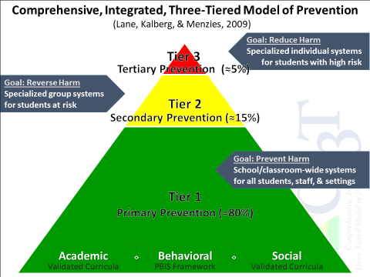


Notes:
In addition to creating free-access resources on specific topics, such as infographics, videos, and step-by-step checklists, we also created Ci3T Implementation exemplars to assist school leaders in conceptualizing how to use their Ci3T structures to adapt procedures for remote learning environments.

Slide 20





The Journey of Ci3T: Respectful Partnerships
1996
Notes:
CA & AZ start→ Tennessee → North Carolina→ Kansas
Trainings (MO, KANSAS, VERMONT, AZ)
MO, KS, UAB
HI

Slide 22
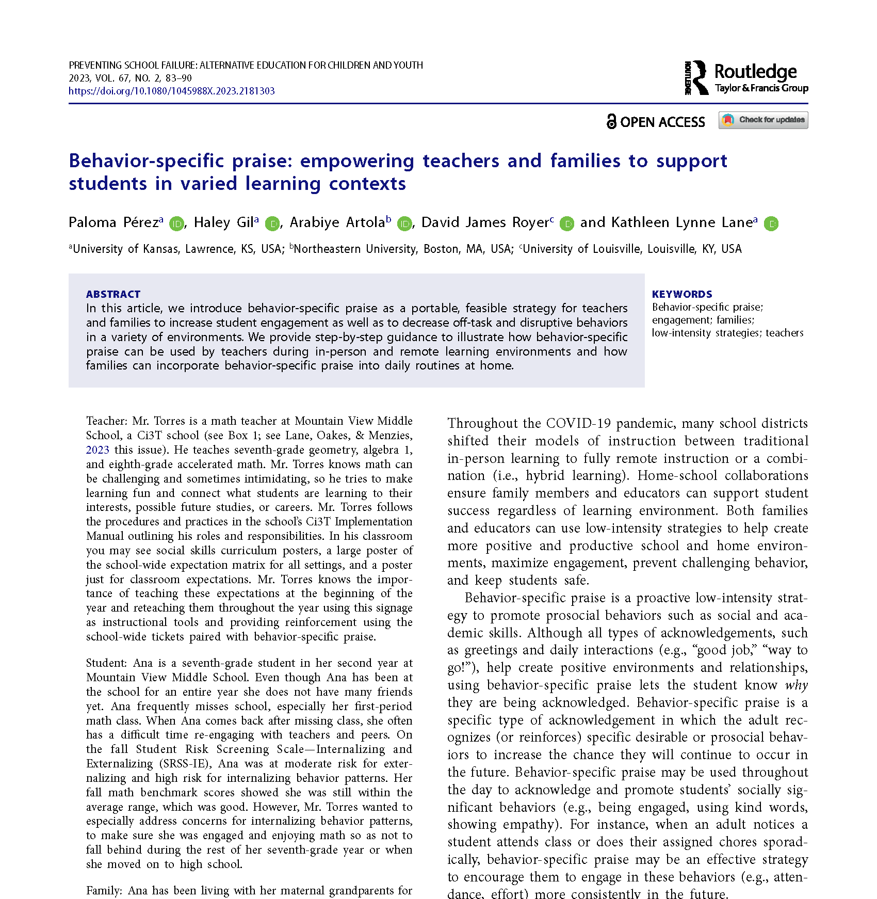

Behavior-Specific Praise
Educators
Families

Slide 23
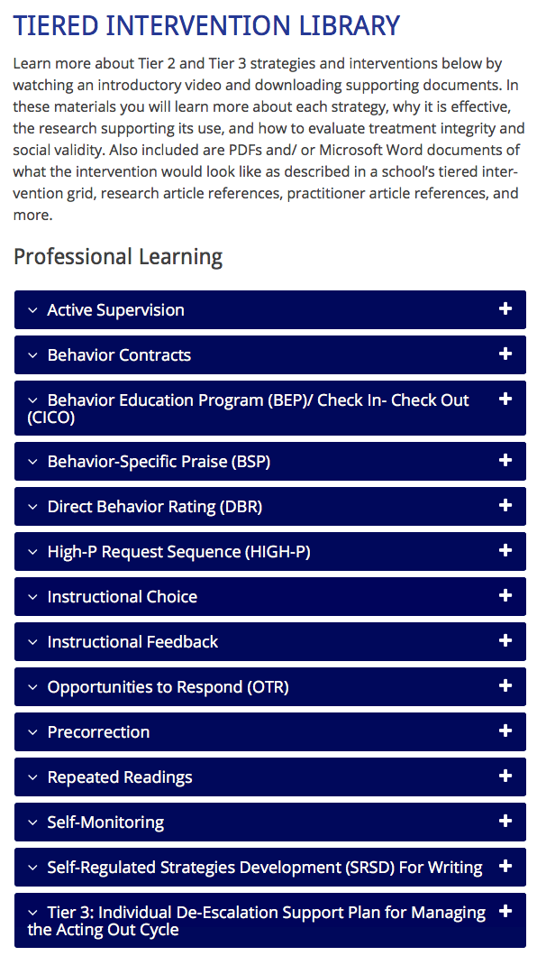
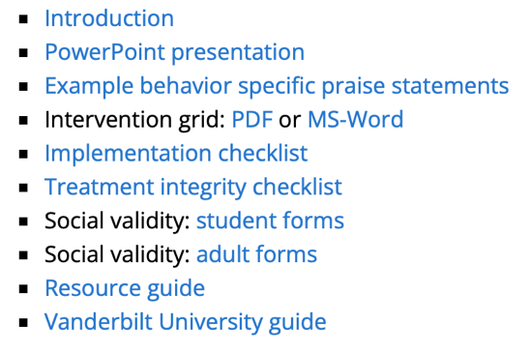
Professional Learning
Resources
ci3t.org/pl

Slide 24
What is Behavior-Specific Praise?
Behavior-Specific Praise (BSP): Praise statements that include reference to the specific behavior for which the student is being recognized
(Brophy, 1981; Sutherland, Wehby, & Copeland, 2000)
Key Components
  Praise statement must be linked to a behavior
  Provide feedback specific to the behavior
  Be sincere
  Reflect skill level
  Evaluate effectiveness
  Praise effort – not ability (Haydon & Musti-Rao, 2011, p. 31)
General v. Specific

Slide 25
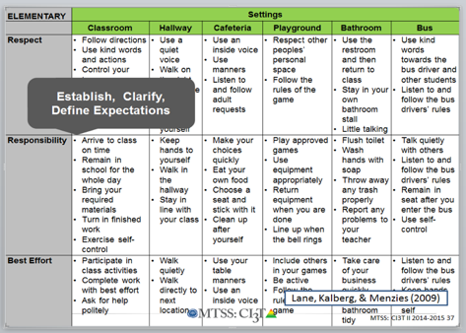
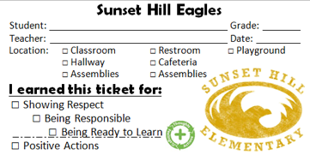
Examples
“Bob, great job showing your work on your math homework.”
“I appreciate how you pushed in your chair on the way to line up for lunch. That keeps the walkways safe.”
BSP is a form of positive reinforcement

Slide 26
Why is Behavior-Specific Praise effective?
More effective when
  it is behavior specific rather than general praise
  teachers use strategies to intentionally increase their rate of BSP and target their delivery of BSP to identified students
  (Thompson, Marchant, Anderson, Prater, & Gibb, 2012).
Simple, effective, requires minimal effort
Instructional feedback delivered at a rate of four positive to one negative (4:1 ratio) (Myers, Simonsen, & Sugai, 2011)
Most effective when delivered consistently and immediately after desired behavior
Establishes supportive and positive classroom environment
(Marchant & Anderson, 2012; Kennedy & Jolivette, 2008; Stormont & Reinke, 2009)
IFEED-AV
Immediately,
Frequently,
Enthusiasm,
Eye Contact,
Describe,
Anticipation,
Variety
(Rhode, Jenson, & Reavis, 1992)

Slide 27


Wow, that was awesome!
You are so smart!
Thank you for being on time.
Good job picking up around your area.
You do a lot for our school, thanks!
General Praise
Behavior-Specific Praise

Slide 28









Activity
Stand and meet someone new
Read a praise statement from a card
Identify if it is general or specific
Find another new person!
Notes:
5-min timer for activity
“Do this with your faculty and staff, too!”

Slide 29

How do I implement behavior-specific praise in my classroom?
Checklist for Success
Step 1
Evaluate current rates of general and behavior- specific praise.
Step 2
Identify behaviors to reinforce.
Step 3
Practice delivery of BSP.
Step 4
Observe student behavior.

Slide 30
How do I implement behavior-specific praise in my classroom?
Checklist for Success
Step 5
Provide BSP.
Step 6
Monitor BSP delivery.
Step 7
Seek student input.

Slide 31
Resources

Slide 32
Sample Elementary Intervention Grid
Support | Description | School-wide Data: Entry Criteria | Data to Monitor Progress | Exit Criteria
Behavior- specific praise | Behavior- specific praise (BSP) refers to sincere praise statements that acknowledge the student and reference specific, desirable behavior being recognized, praising effort (not ability). | One or more of the following: Behavior: SRSS-E7: Moderate (4-8) SRSS-I5: Moderate (2-3) SRSS-E7: High (9-21) SRSS-I5: High (4-15) Ranking of 1, 2, or 3 on the Motivation to Learn subscale of SSiS-PSG 2 or more ODRs within a grading period AND/OR Academic: Two of more missing assignments within a grading period AIMSweb: intensive or strategic level (math or reading) Progress report: Targeted for Growth for academic learning behaviors | Student behavior targeted for improvement (e.g., academic engaged time % of intervals, assignment completion, ODRs). Treatment integrity Implementation checklist Treatment integrity checklist Social validity IRP-15 (teacher) Student-completed survey | 0-1 ODRs in a grading period and Zero missing assignments in a grading period and SRSS-E7: Low (0-3) SRSS-I5: Low (0-1) or Ranking of 4 or 5 on the Motivation to Learn subscale of SSiS-PSG
(Lane, Menzies, Ennis, & Oakes, 2015)

Slide 33
Sample Middle/High School Intervention Grid
Support | Description | School-wide Data: Entry Criteria | Data to Monitor Progress | Exit Criteria
Behavior- specific praise | Behavior- specific praise (BSP) refers to sincere praise statements that acknowledge the student and reference specific, desirable behavior being recognized, praising effort (not ability). | One of more of the following: Behavior: SRSS: Moderate (4-8) SRSS: High (9-21) Ranking of 1, 2, or 3 on the Motivation to Learn subscale of the SSiS-PSG 2 office discipline referrals (ODRs) within a grading period AND/OR Academic: Report card: 1 or more course failures Two of more missing assignments within a grading period in a class AIMSweb: intensive or strategic level (math or reading) Below 2.5 GPA | Student behavior targeted for improvement (e.g., academic engaged time % of intervals, assignment completion, ODRs). Treatment integrity Implementation checklist Treatment integrity checklist Social validity IRP-15 (teacher) Student-completed survey | 0-1 ODRs in a grading period and 2.5 GPA or higher Zero missing assignments per class in a grading period and SRSS: Low (0-3) or Ranking of 4 or 5 on the Motivation to Learn subscale of the SSiS-PSG
(Lane, Menzies, Ennis, & Oakes, 2015)

Slide 34
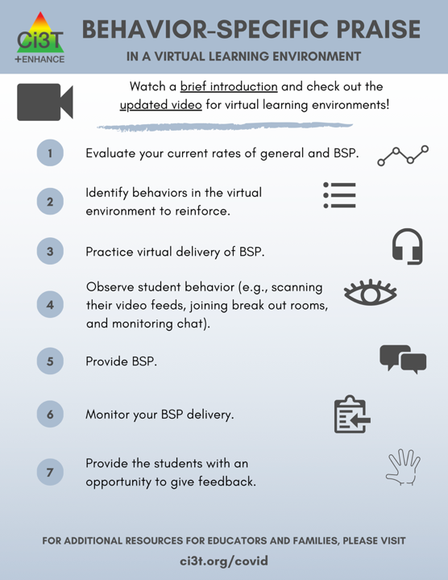
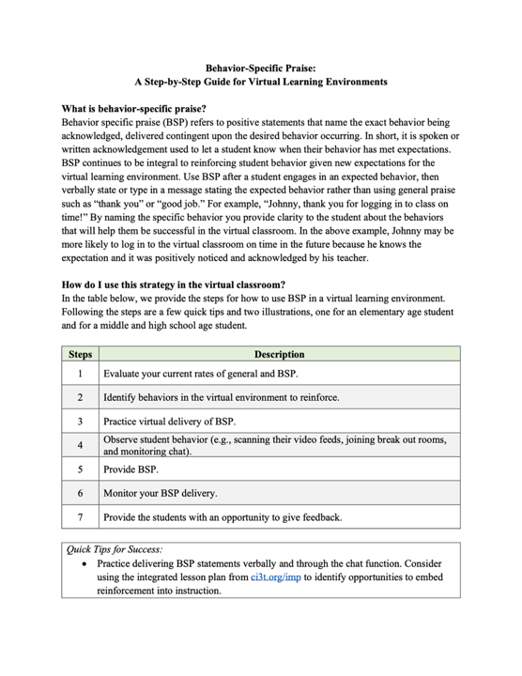
ci3t.org/covid

Slide 35
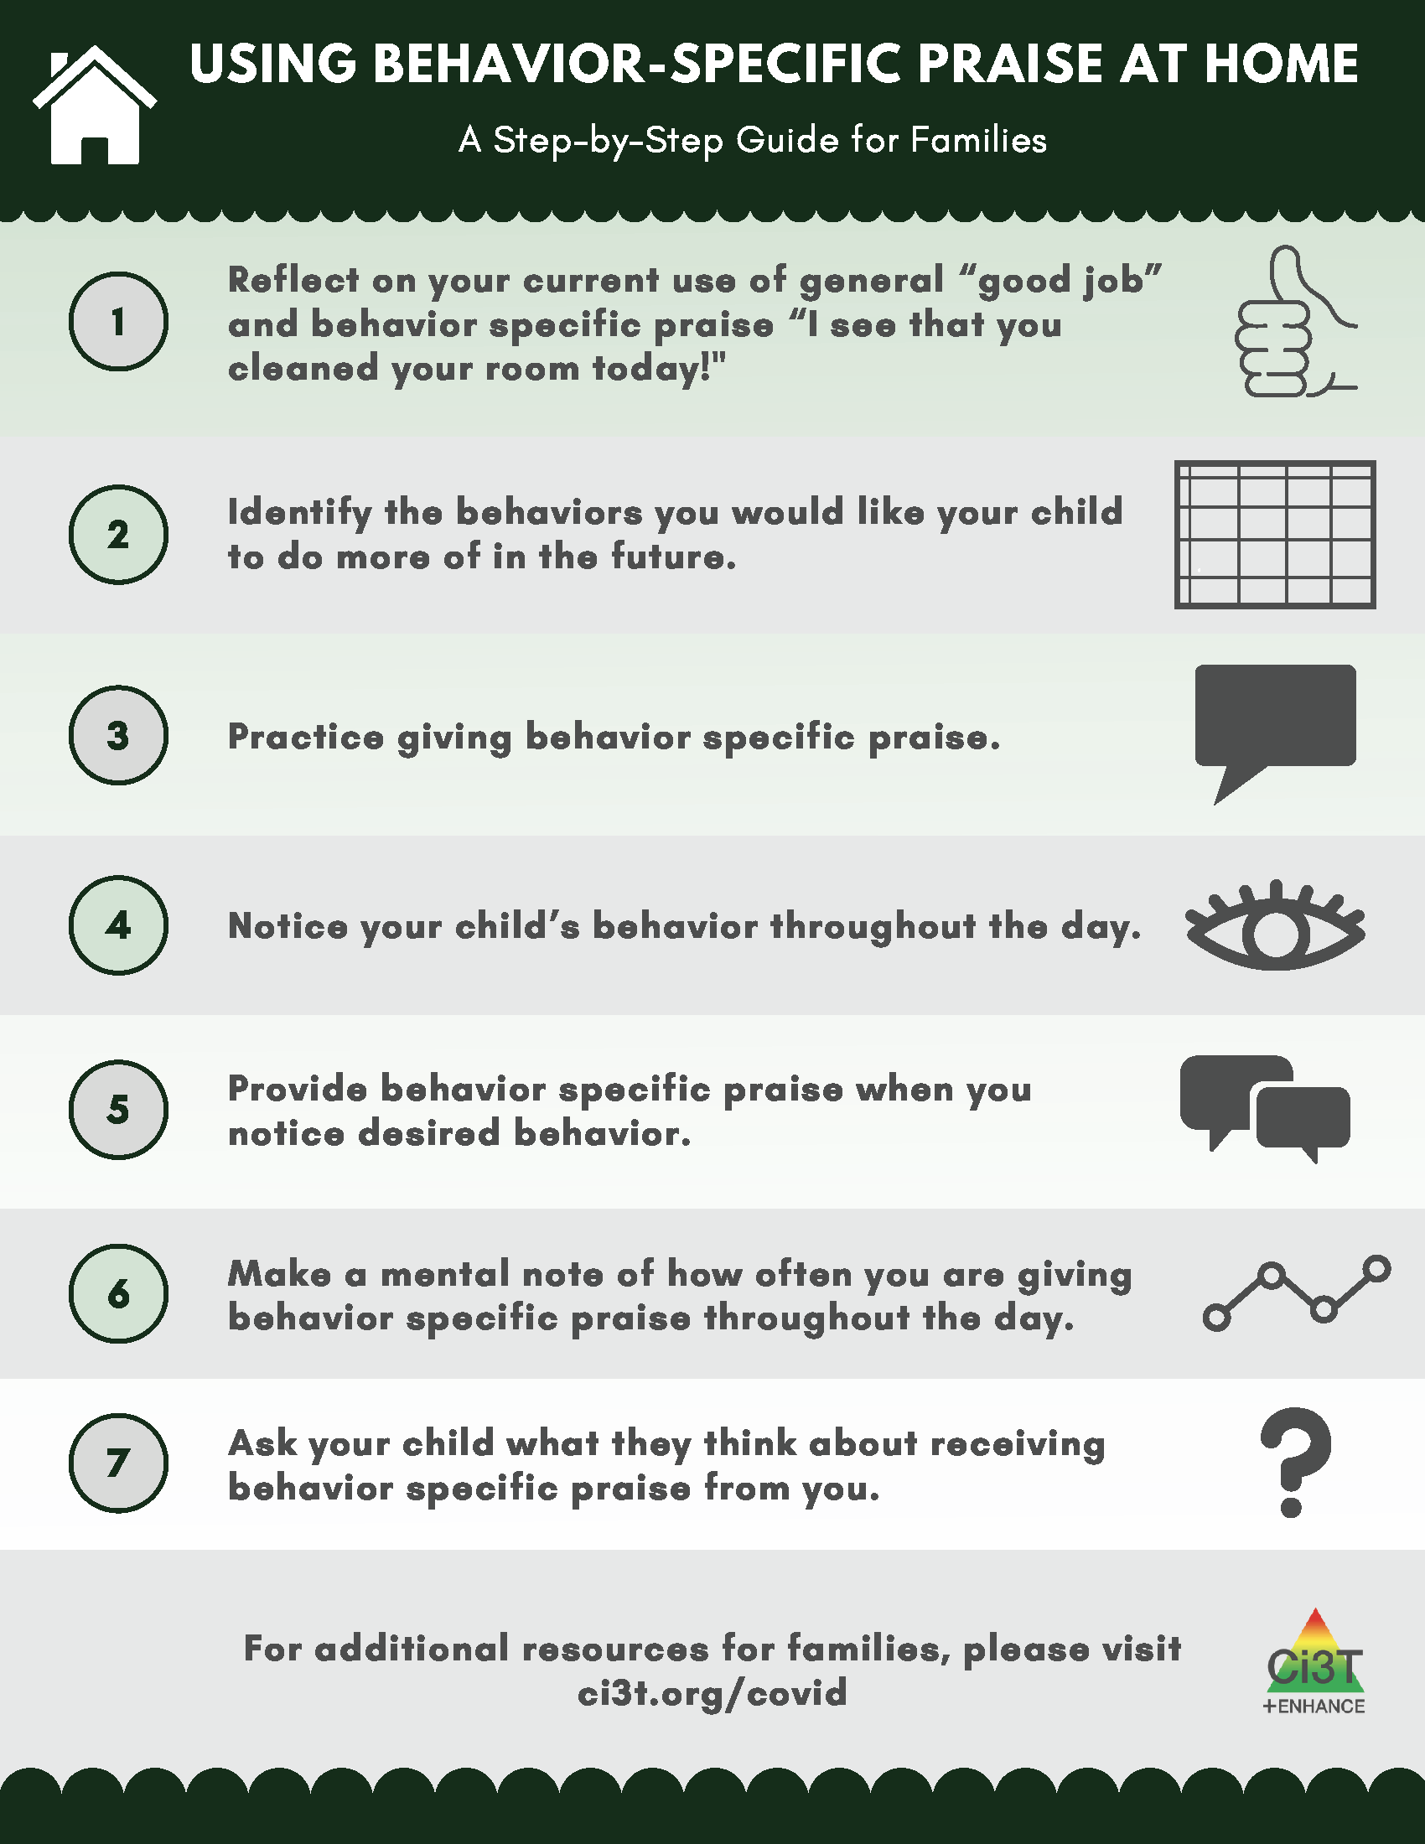
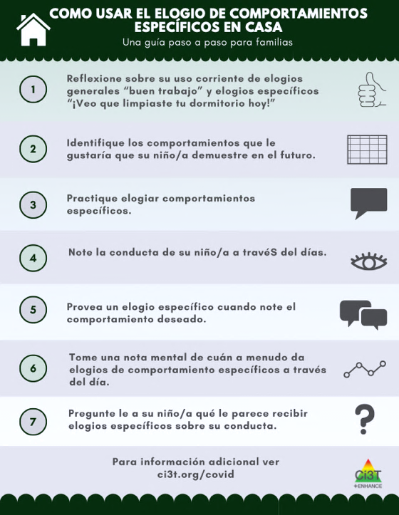
ci3t.org/covid

Slide 36

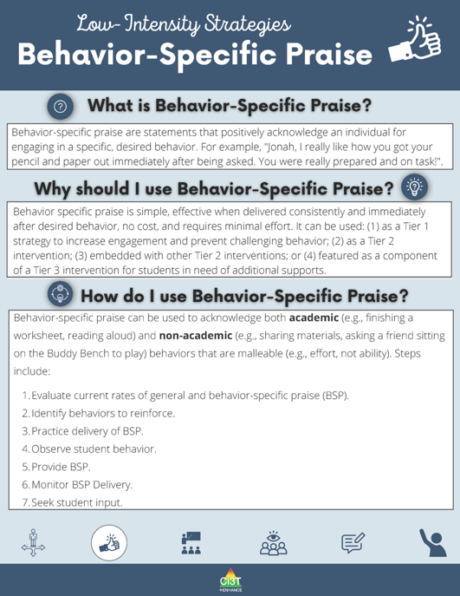
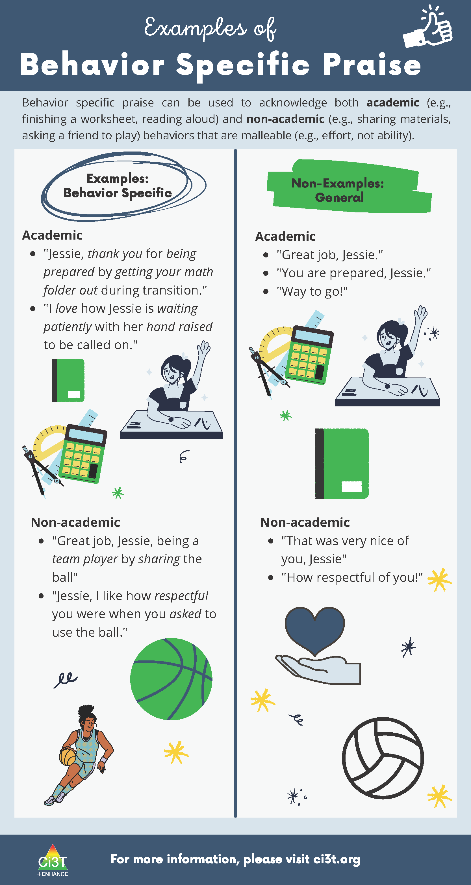
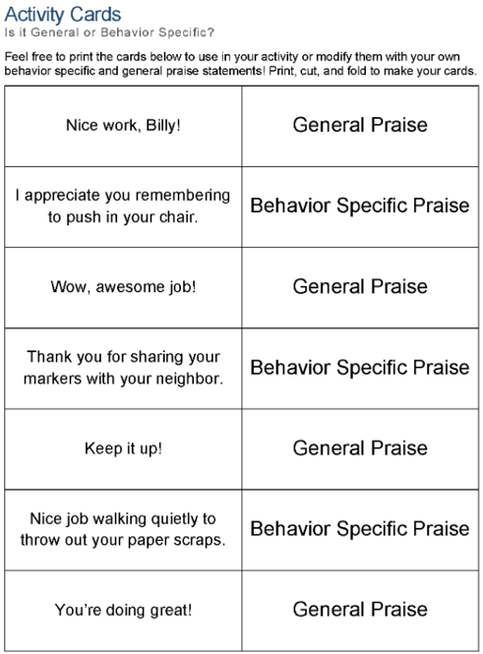

Slide 37
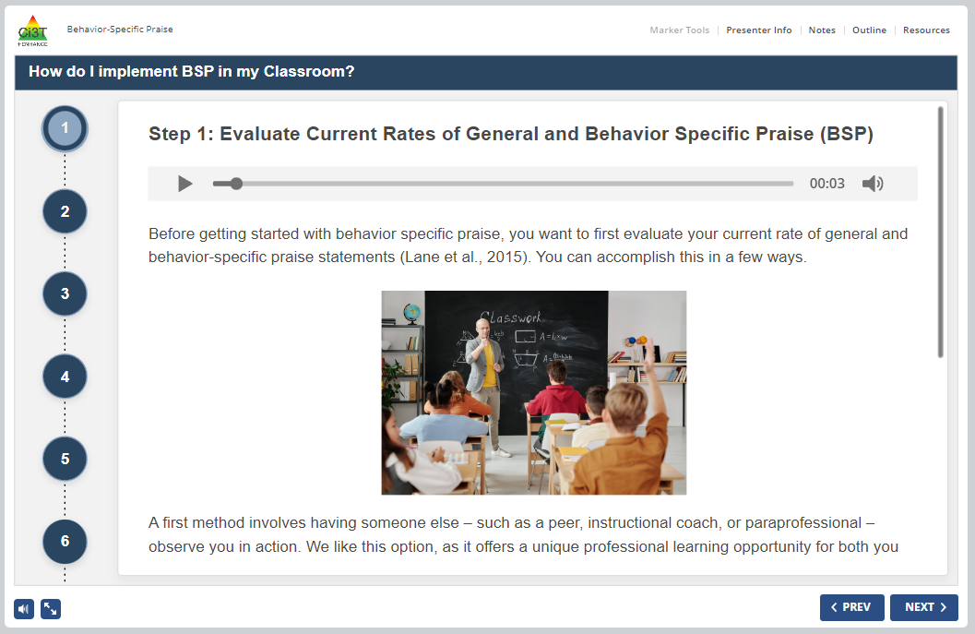
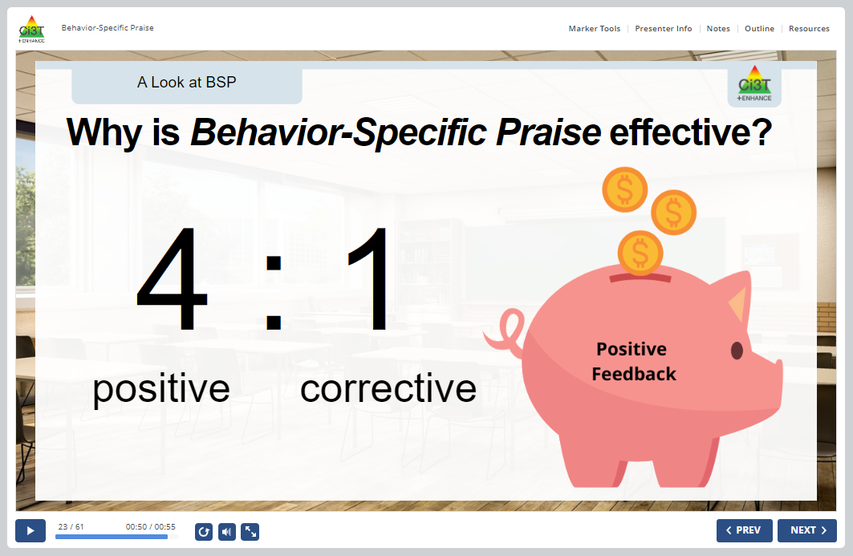
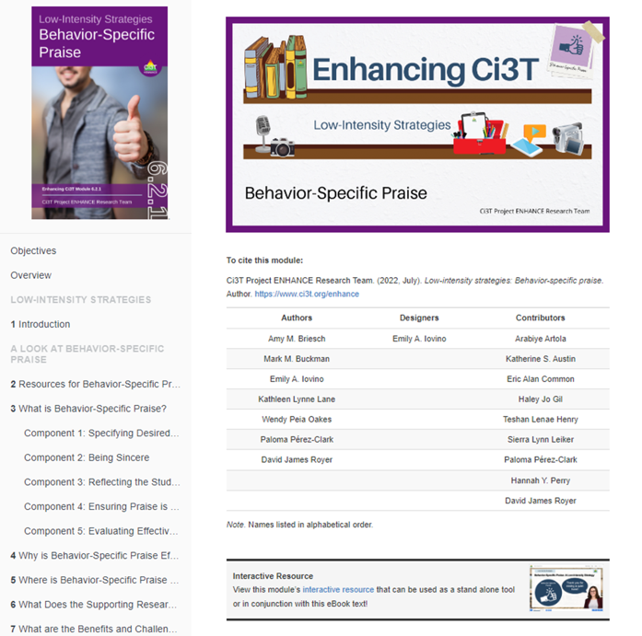
Notes:
Slide 12 (video summary; 3 min); Slides 13-18 (What is behavior-specific praise section; about 3.5 minutes)

Slide 38








How might you increase your use of behavior-specific praise in your classroom and noninstructional areas?
How could you share this strategy with others?
Notes:
5-min timer

Slide 39
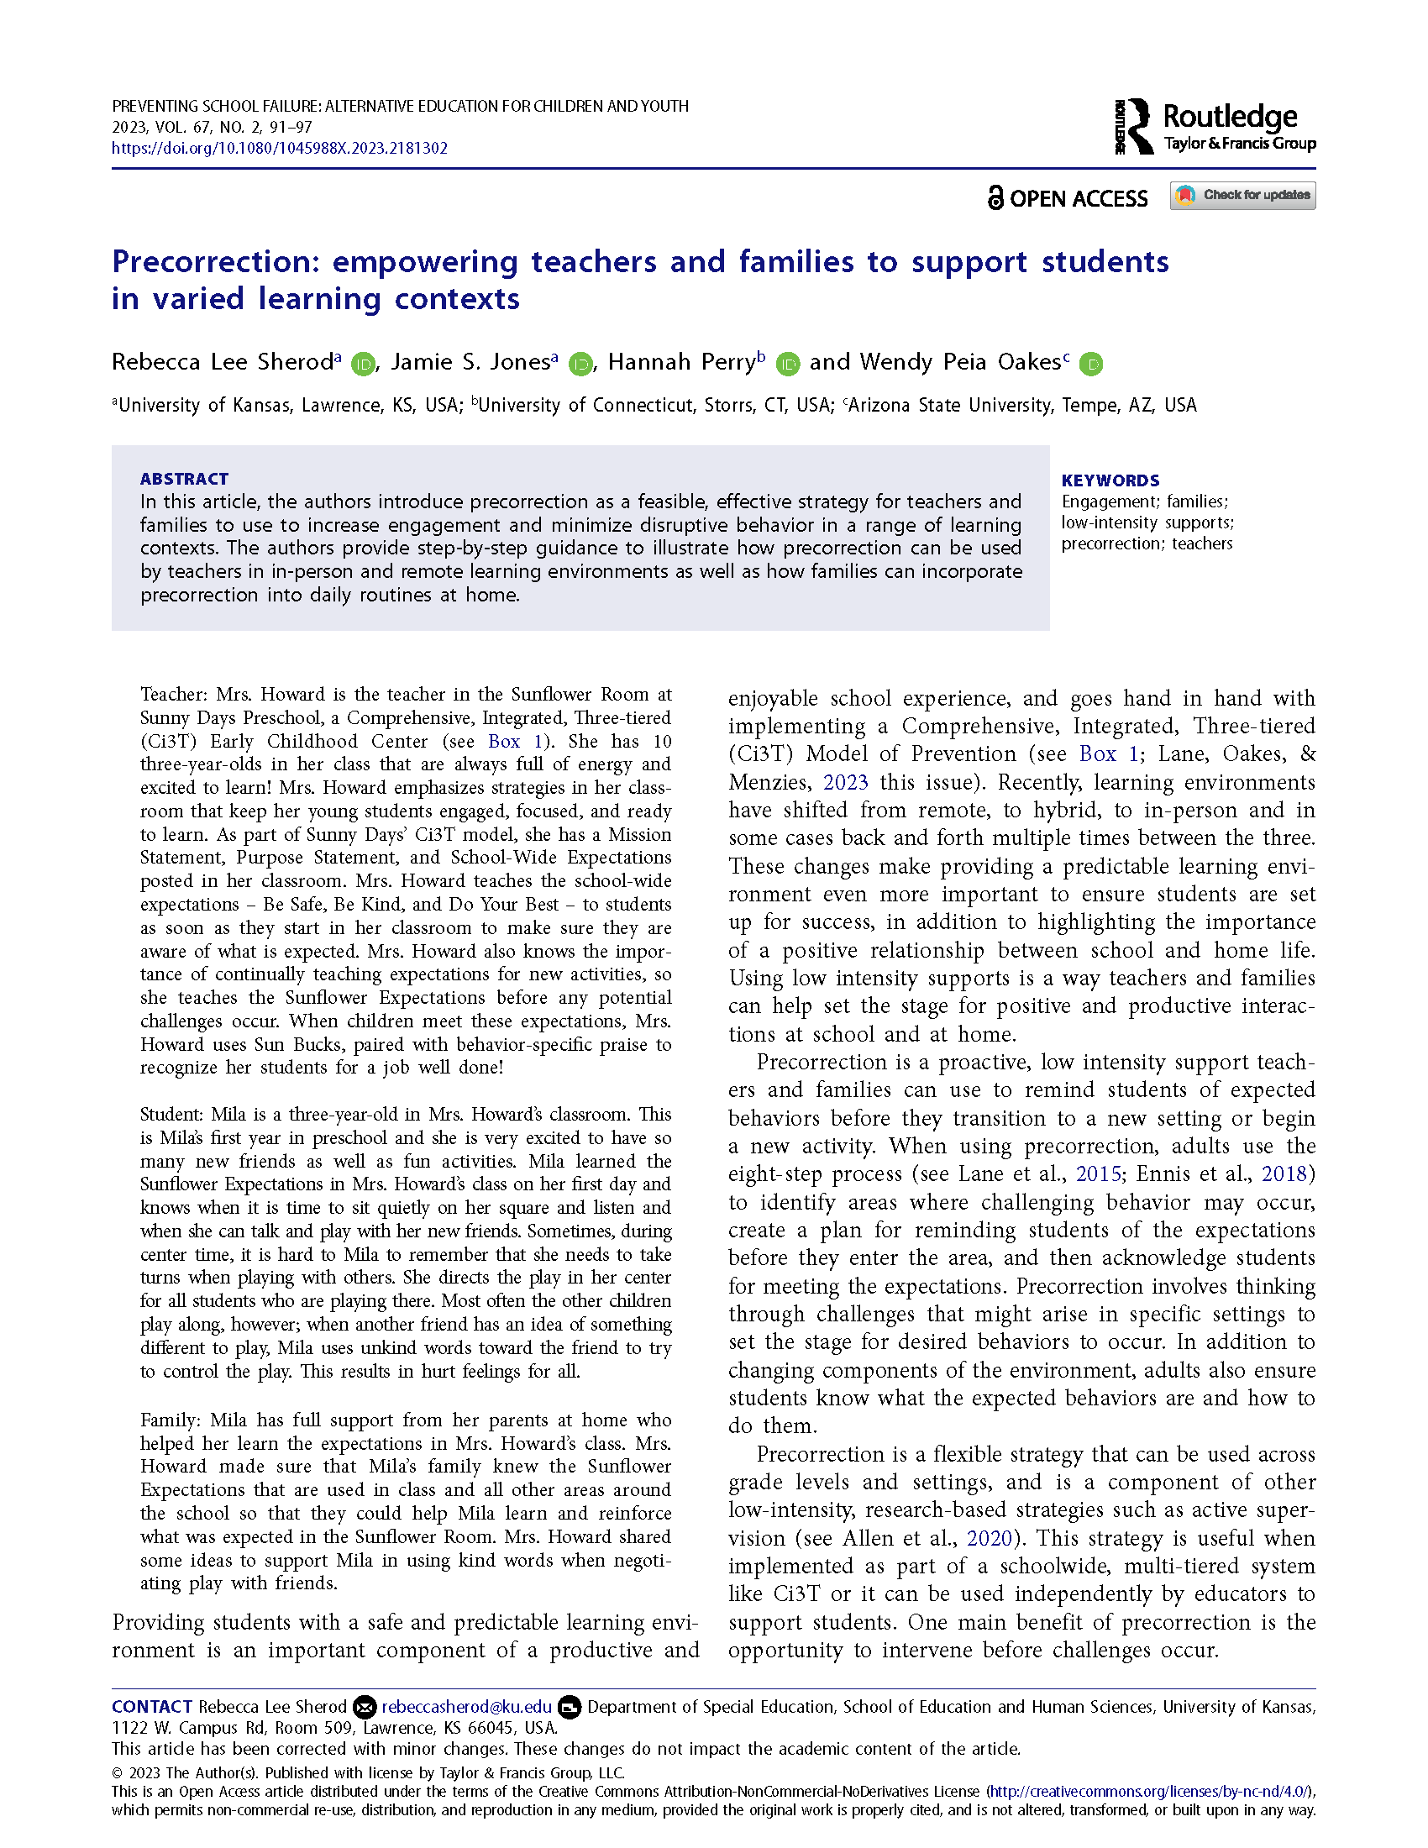

Precorrection
Educators
Families

Slide 40

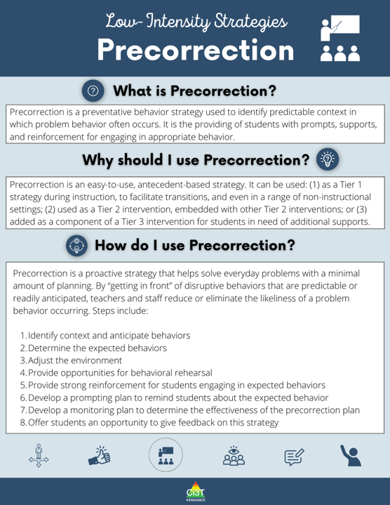

Slide 41


Slide 43
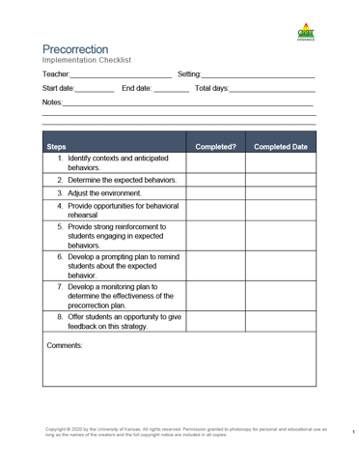
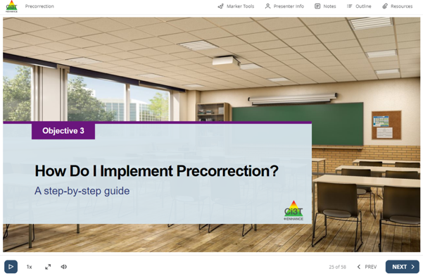
8 Steps to Implement Precorrection
Notes:
Play slides 26-34 of Interactive Resource (https://www.ci3t.org/ispring/M627) – This will take ~8 minutes [of the 15 mins allotted – see pacing guide]
Model how to access Interactive Resource and use outline tab to navigate to correct page(s)

Slide 44
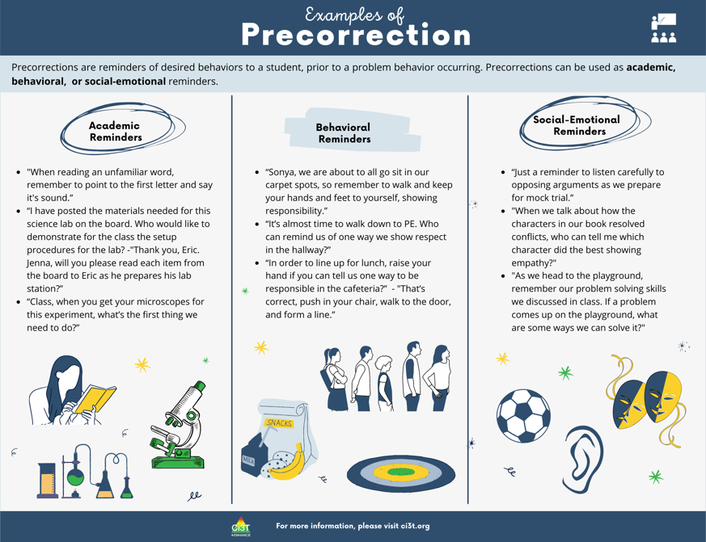
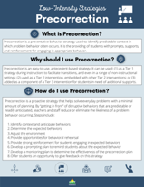

Slide 46
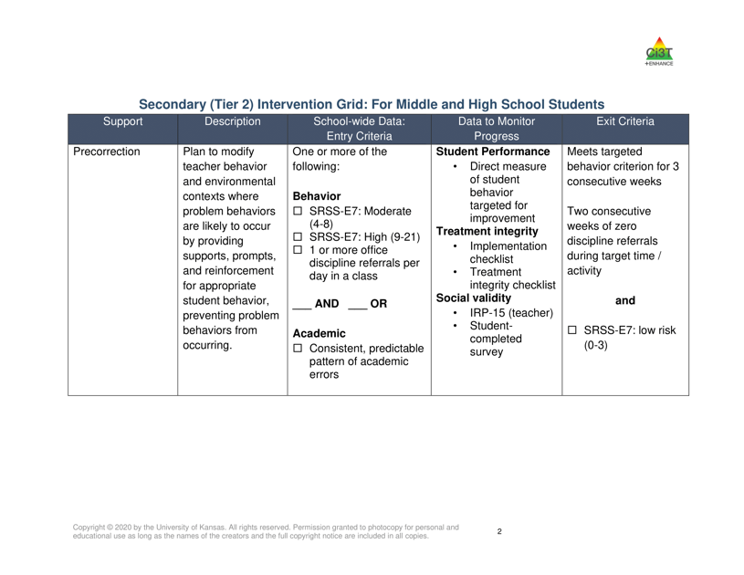
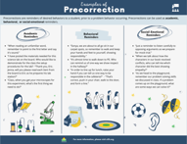

Slide 47
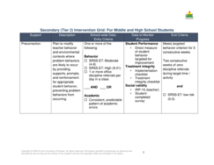



Slide 48
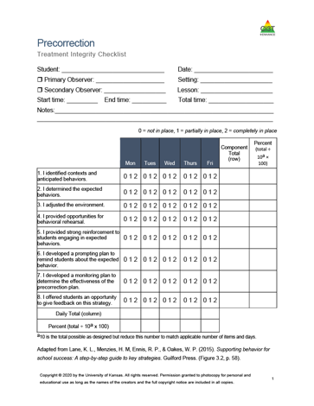
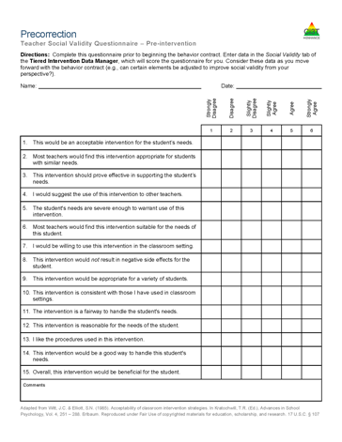



Slide 49
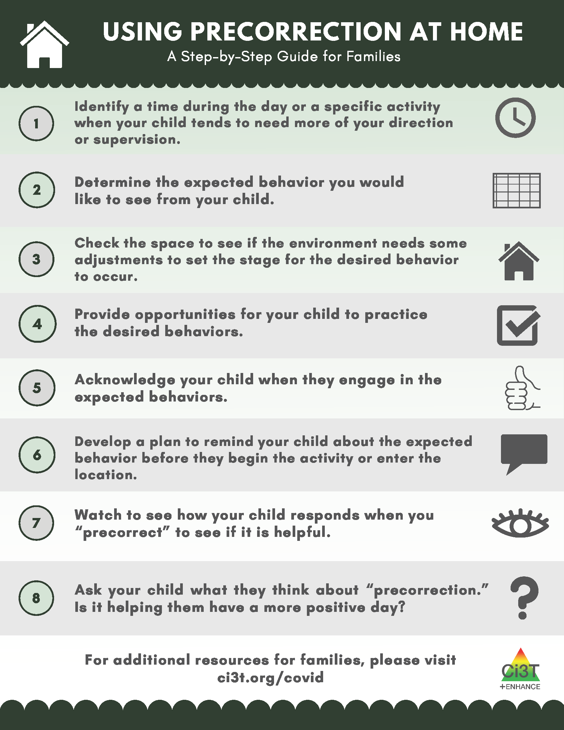
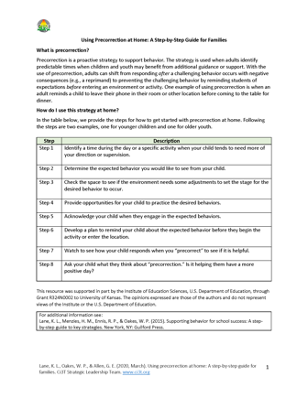
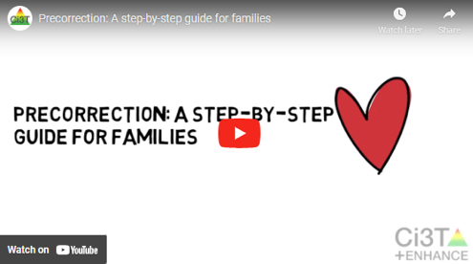


Materials for families / Materiales para familias

Slide 50
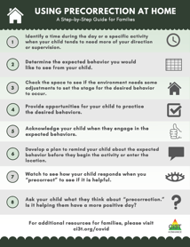
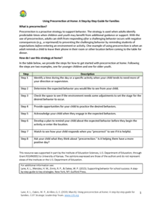

Precorrection
ci3t.org/covid
Precorrection for Families
Develop a plan to remind your child about the expected behavior before they begin an activity in which they tend to need more of your direction or supervision
  Supporting children with homework
  Facilitating study time
  Helping children be successful doing chores at home

Slide 51


Active Supervision
Educators
Families

Slide 52



Slide 53


Slide 55

Visit ci3t.org/pl to access a PowerPoint presentation on active supervision!
Notes:
Navigate to PowerPoint: Active supervision tiered library strategy, present slides 13-22 steps to highlight 8 steps to implement Active Supervision. This should take ~5 mins [of the 10 mins allotted to this section – see pacing guide]

Slide 56
What is active supervision?
Use of “Specific and overt behaviors (scanning, escorting, interacting) designed to prevent problem behavior and promote rule-following behavior”
(Colvin, Sugai, Good, & Lee, 1997, p. 346).
Effectiveness is increased when used with precorrections.
Distinct Elements:
Established expectations
Frequent scanning of context
Positive interactions (verbal and nonverbal precorrections and prompts)
Reinforcement of desired behavior
When necessary, correction to help success
(De Pry & Sugai, 2002; Haydon & Scott, 2008)
(Lane, Menzies, Ennis, & Oakes, 2015)

Slide 57
Why is active supervision effective?
Proactive: It is more efficient to prevent problems from occurring or escalating than addressing them after they occurred (Colvin, 2004).
Provides routines and structures to avoid problem behavior caused by overcrowding and impersonalized learning (Jackson, 1990).
Systematically averts challenges while prompting prosocial behaviors — PBIS (Sugai & Horner, 2006).
(Lane, Menzies, Ennis, & Oakes, 2015)

Slide 58
What are the benefits and challenges?
Benefits
Challenges
Reduces problem behavior in multiple school contexts
Improves time spent on-task
Can target specific behaviors
Essential part of school safety
Proactive
Performing consistently is difficult
Requires some innate ability to monitor student activity
Requires prerequisite familiarity and fluency of precorrection, prompting, and reinforcement
(Lane, Menzies, Ennis, & Oakes, 2015)

Slide 59
How do I implement active supervision in my classroom?
Step 1
Identify the activity or transition period that would benefit most from active supervision.
Step 2
Ensure that the routine for the target activity is familiar and understood by students. If not, routines and expectations must be established.
Step 3
Provide the cue or prompt to begin the activity.
Step 4
As the activity unfolds, scan and monitor the area.
(Lane, Menzies, Ennis, & Oakes, 2015)

Slide 60
How do I implement active supervision in my classroom?
Step 5
Signal your awareness of students’ actions through proximity, prompts, and non-verbal communication.
Step 6
Manage infractions and off-task behavior efficiently: privately, in a businesslike way, and with opportunities for positive interactions.
Step 7
At appropriate intervals and at the end of the activity or transition, reinforce students’ good behavior with positive comments and gestures.
Step 8
Provide the students with an opportunity to give feedback.
(Lane, Menzies, Ennis, & Oakes, 2015)

Slide 61




Slide 62


Slide 63



Slide 64





Slide 65








Active Supervision

Slide 66





Active Supervision
www.ci3t.org/pl
Materials to support in-person learning
Professional Learning
Materials
Implementation and
Planning Forms
Treatment Integrity and Social Validity
Checklists
Notes:
Next, these are materials to implement a third low-intensity strategy, active supervision. As with previous strategies, these materials are available to facilitate in-person learning at school. A PowerPoint presentation containing an overview of active supervision, implementation, and planning forms, as well as treatment integrity and social validity checklists are offered.

Slide 67



Active Supervision
www.ci3t.org/covid
Materials to support remote learning
Step-by-step Video
Step-by-step Checklist
Infographic
Notes:
On this next slide, we show our recently developed materials for using active supervision during remote learning environments. As with other strategies shown previously, a step-by step checklist, an infographic, and videos are available for virtual educators. Now we will take a closer look at our infographic outlining the steps to implement active supervision:

Slide 68

Notes:
As shown, the infographic has links to an introductory video of active supervision, and one video specific to implementing the strategy in virtual environments.
The first step to implementing active supervision is to examine data to identify a time when active supervision would be most beneficial. Second, it is important to ensure the routines for that specific time identified are understood by students, and if not, those must be established first. To implement the strategy, the educator would initially provide a cue or prompt to start the activity. Once it starts, the educator can begin to implement active supervision by scanning and monitoring the video feed for signs of engagement. The educator must then signal their awareness of students’ actions through acknowledgement, chat messages, and prompts as needed.

Slide 69
Notes:
Educators then manage off-task behaviors efficiently, privately, and discreetly, and reinforce desired behaviors with praise, gestures, and reactions. Finally, the opportunity for students to give feedback is presented, with a poll or other features, as an example.

Slide 70


Active Supervision
ci3t.org/covid
Active Supervision for Families
Supporting children with homework
Facilitating study time
Helping children be successful doing chores at home
Notes:
We have developed the accompanying set of materials for home. Next, we will briefly look at a step-by step video to implement active supervision at home:

Slide 71



Active Supervision
ci3t.org/covid
Materials for families / Materiales para familias
Step-by-step Video
Step-by-step Guide
Infographic
Notes:
We have developed the accompanying set of materials for home. Next, we will briefly look at a step-by step video to implement active supervision at home:

Slide 72



Active Supervision
Examples for educators and families (English & Español)
Notes:
In this next slide we show, as with previous strategies presented earlier, the examples for how to use active supervision in virtual and home settings, including illustrations for elementary and secondary-aged children and youth. These examples may help both educators and families connect to specific times and activities when active supervision may be a proactive way to support behavior at school (virtually and in person) as well as home.

Slide 73


Talk Time
Visit ci3t.org/pl, find the “Precorrection” or “Active Supervision” accordion, and explore the resources.
Turn to a neighbor and discuss:
How might these strategies be useful in your context?
How might these strategy be useful to your colleagues and the families you work with?
Notes:
5-min timer

Slide 74


Instructional Choice
Educators
Families

Slide 75
How do I implement instructional choice in my classroom?
Implementation Checklist
!
Step 1
Determine which type of choices you feel comfortable offering and create a menu of choices.
Step 2
Use the menu to determine which type of choice to add to a particular lesson.
Step 3
After choice is built into the lesson, offer the established choices.
Step 4
Ask the student to make his or her choice.

Slide 76
How do I implement instructional choice in my classroom?
Implementation Checklist
Step 5
Provide wait time for the student to select their choice.
Step 6
Listen to (or observe) the student’s response
Step 7
Prompt the student to make a choice from one of the available options if the student has not made a choice within the time allotted.
Step 8
Reinforce the student’s choice, providing them with the option they selected.

Slide 77
How do I implement instructional choice in my classroom?
Implementation Checklist
Step 9
Offer students an opportunity to give feedback on the choice they selected.

Slide 78



Slide 79


Slide 81



Slide 82


Slide 84
Choice
Across-activity
Pick a learning center?
Think-Tac-Toe Boards
Make your schedule for the day
Paper, presentation, or YouTube video to show me what you know?
Which activity would you like to do first?

Slide 85
Choice
Within-activity
Crayons or sparkly markers?
At your desk or in the library?
In the reading corner or at your desk?
Which book would you like to read?
Finish in class or at home?
Typed or hand written?
Even or odds?
Work independently or with a partner?

Slide 86



Slide 87




Slide 89


Instructional choice across tiers

Slide 90


Instructional choice across tiers

Slide 91


Slide 92





Choice
ci3t.org/covid
Materials to support in-person learning
Professional Learning
Materials
Implementation and
Planning Forms
Treatment Integrity and Social Validity
Checklists
Notes:
Finally, we introduce choice as a low-intensity strategy and in this slide, we show materials to support in person learning. For school, instructional choice refers to the opportunities a student has to make choices from two or more options, and they are allowed to independently choose one. The set of in person materials, as all other shown previously, can be accessed in the Professional Learning tab of our website.

Slide 93



Choice
ci3t.org/covid
Materials to support remote learning
Step-by-step Video
Step-by-step Checklist
Infographic
Notes:
Next, our more recently developed materials to support engagement in virtual learning environments are featured. These sets of in person and virtual learning materials complement each other to support not only the implementation of these low-intensity strategies by virtual and in person educators and parents, but also to increase the chances that children and youth will be able to benefit from behavior support across different environments and people.

Slide 94



Choice
ci3t.org/covid
Materials for families / Materiales para familias
Checklist
(English & Español)
Infographics
(English & Español)
Notes:
As shown with each of the strategies we shared, materials for families to implement choice are also available to share. For example, Usando la eleccion en casa, una guía paso a paso para familias, is the Spanish version for home use. Educators may choose to share these materials with families not only electronically via emails and newsletters, but also in print, to ensure everyone has access from home even without a device.

Slide 95




Slide 96

Talk Time
Visit ci3t.org/pl, find the “Instructional Choice” accordion, and explore the resources.
Turn to a neighbor and discuss:
How might instructional choice be useful in your context?
How might instructional choice be useful to your colleagues and the families you work with?
Notes:
5-min timer

Slide 97
Next Steps:
New Resources Coming Soon

Slide 98
Integrated Lesson Planning

Slide 99





Notes:
Talking point like “over the next few months we will continue to publish low-intensity modules. If there’s a low-intensity strategy that you want to focus on that we haven’t yet published you can visit the “professional learning” tab

Slide 100
ci3t.org/covid
Notes:
However, by mid-march of 2020, it become clear that different types of professional learning resources would be necessary to help schools meet the challenge of providing instruction in remote settings, often with extremely limited time to make plans for this unprecedented shift.
So, we began to create resources for educators, families, and administrators with the aim of creating free-to-access materials that addressed needs shared with us by our school partners. For example, finding ways to motivate and engage students during remote learning was a huge need, as was supporting parents in helping their children be successful at home. These are the resources we’ll be sharing today, which are all available at ci3t.org/covid

Slide 103


Sustaining and Disseminating Professional Learning
Designate two staff to attend trainings to become on-site coaches
10 min @ next Faculty and Staff meeting
Ci3T Setting Up for Success
Systematic Screening
Low-Intensity Supports
Tier 2
Planning Ahead
Tier 3

Slide 104



Ci3T Trainer and Coaches Calls

Slide 105



Project EPIC
FULL
Funded by the
Office of Special Education Programs (OSEP)
U.S. Department Of Education

Slide 106
Thank you!
Kathleen.Lane@ku.edu

