Slide 1
Tertiary (Tier 3) Interventions in Ci3T Models: Logistics and Illustrations
EMPOWER Session 5
Presenters and Contributors | Contributors
Allison M. Bernard | Elise Sarasin
Mark M. Buckman | Rebecca L. Sherod
Kathleen Lynne Lane | Stacie Williams
Wendy Peia Oakes

Slide 3
Let’s Connect on Social Media!
Tag us in your Ci3T highlights- we’d love to see Ci3T in action!
Follow us on Twitter or Instagram for updates and links to resources!
@Ci3TModel

Slide 4
Ci3T Professional Learning Calendar
 | July | Aug | Sep | Oct | Nov | Dec | Jan | Feb | Mar | Apr | May | Jun
Ci3T Training |  |  |  |  | Ci3T Professional Learning Series Session 1 | Ci3T Professional Learning Series Session 2 | Ci3T Professional Learning Series Session 3 | Ci3T Professional Learning Series Session 4 |  | Ci3T Professional Learning Series Session 5 | Ci3T Professional Learning Series Session 6
Ci3T Implementation Support | Ci3T Implementation Series Prep Session |  | Ci3T Implementation Series Session 1 |  | Ci3T Implementation Series Session 2 |  | Ci3T Implementation Series Session 3 |  | Ci3T Implementation Series Session 4 | Ci3T Implementation Series Session 5
Ci3T EMPOWER |  |  | Ci3T EMPOWER Session 1 | Ci3T EMPOWER Session 2 | Ci3T EMPOWER Session 3 |  | Ci3T EMPOWER Session 4 |  | Ci3T EMPOWER Session 5 | Ci3T EMPOWER Session 6
Ci3T Trainers & Coaches Calls |  | Trainers & Coaches Call Session 1 | Trainers & Coaches Call Session 2 | Trainers & Coaches Call Session 3 | Trainers & Coaches Call Session 4 | Trainers & Coaches Call Session 5 | Trainers & Coaches Call Session 6 | Trainers & Coaches Call Session 7 | Trainers & Coaches Call Session 8 | Trainers & Coaches Call Session 9 | Trainers & Coaches Call Session 10

Slide 5
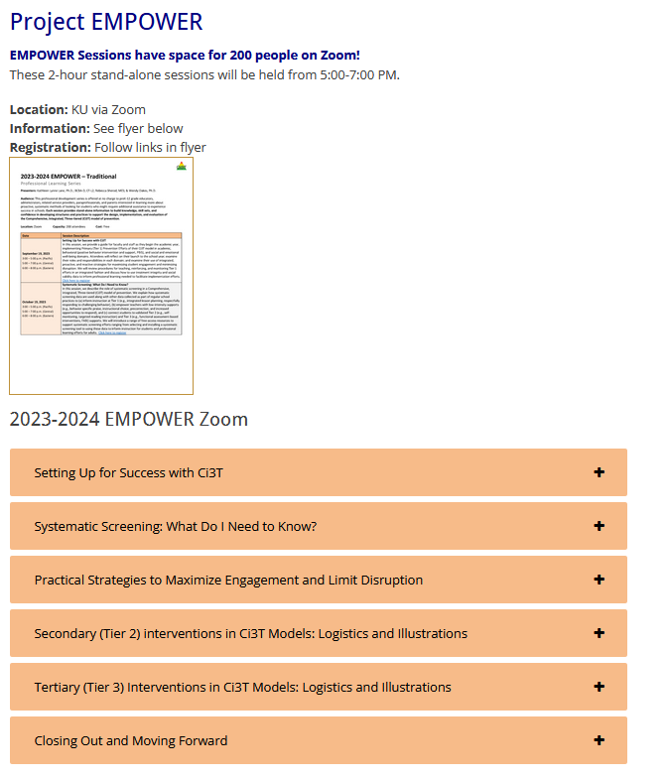
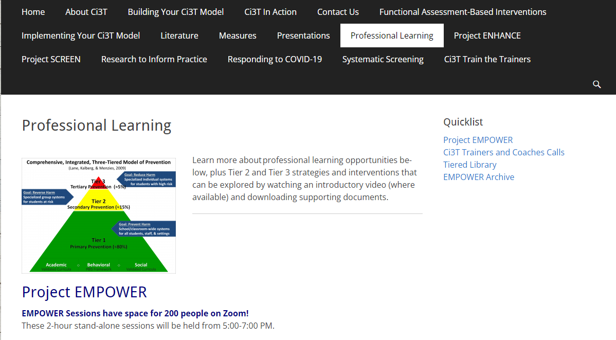
Accessing Project EMPOWER Professional Learning

Slide 6
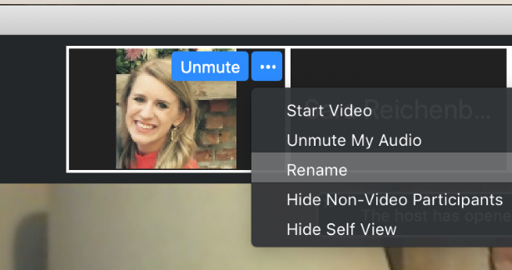
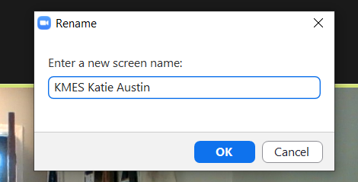
Renaming: School Initials + First and Last Name
To help us put you in breakout rooms with your colleagues today…
1. Click the three dots at the top
right corner of your video square.
2. Rename yourself with your
school initials then first and last name.

Slide 7
Agenda
Welcome
Overview of Tertiary (Tier 3) Interventions in Ci3T Models: Data-informed Decision-making
Illustrations: Supporting Students with Intensive Intervention Needs
Supporting students with acting out behaviors
Supporting students with internalizing issues
Exploring Other Tertiary (Tier 3) Interventions in Ci3T Models
Wrapping Up and Moving Forward

Slide 8
Welcome

Slide 9
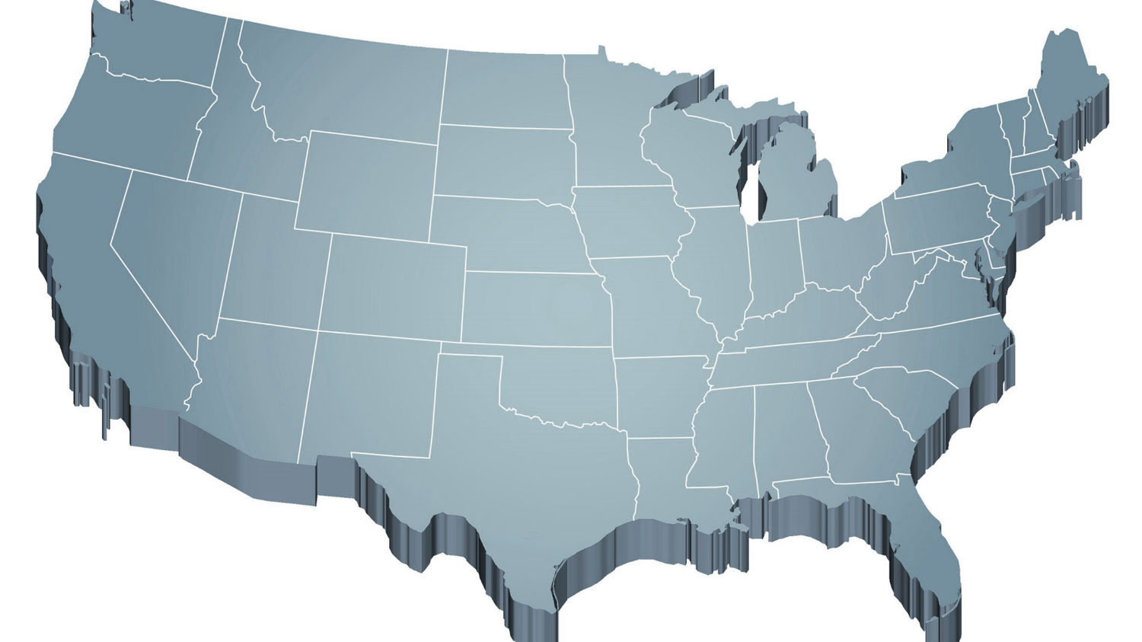
The Journey of Ci3T: Respectful Partnerships
1997
Notes:
CA & AZ start→ Tennessee → North Carolina→ Kansas
Trainings (MO, KANSAS, VERMONT, AZ)
MO, KS, UAB
HI

Slide 11
Overview of Tertiary (Tier 3) Interventions in Ci3T Models: Data-informed Decision-making

Slide 12
Comprehensive, Integrated, Three-Tiered Model of Prevention
(Lane, Kalberg, & Menzies, 2009)
Tier 3
Tertiary Prevention (≈5%)
Tier 2
Secondary Prevention (≈15%)
Tier 1
Primary Prevention (≈80%)
Academic ◇ Behavioral ◇ Social
Validated Curricula PBIS Framework Validated Curricula

Slide 13
Ci3T Implementation Manual

Slide 14
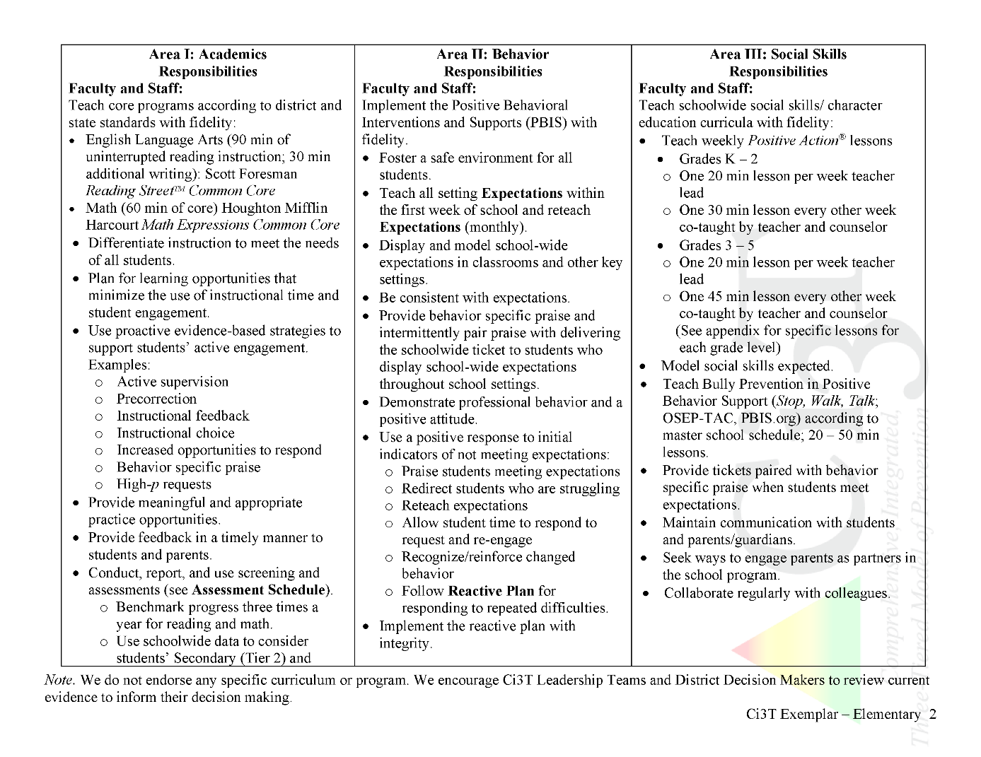
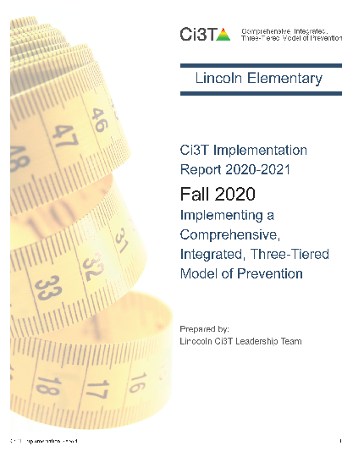
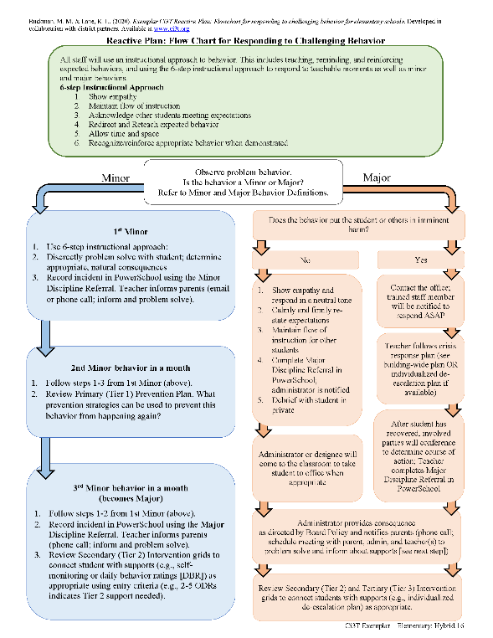
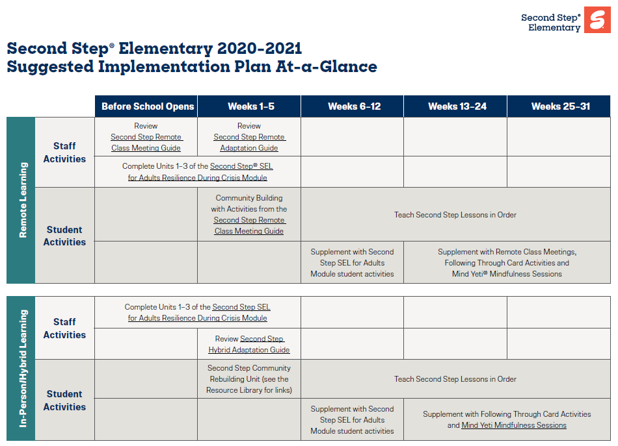
Ci3T Primary Plan: Procedures for Teaching
Opportunities to Respond
Behavior-Specific Praise
Ci3T Primary Plan: Procedures for Reinforcing
Active Supervision
Instructional Feedback
High-p Requests
Ci3T Primary Plan: Procedures for Monitoring
Precorrection
Instructional Choice
Notes:
Continued to keep implementation manuals, which are foundational to Ci3T, updated and current

Slide 15
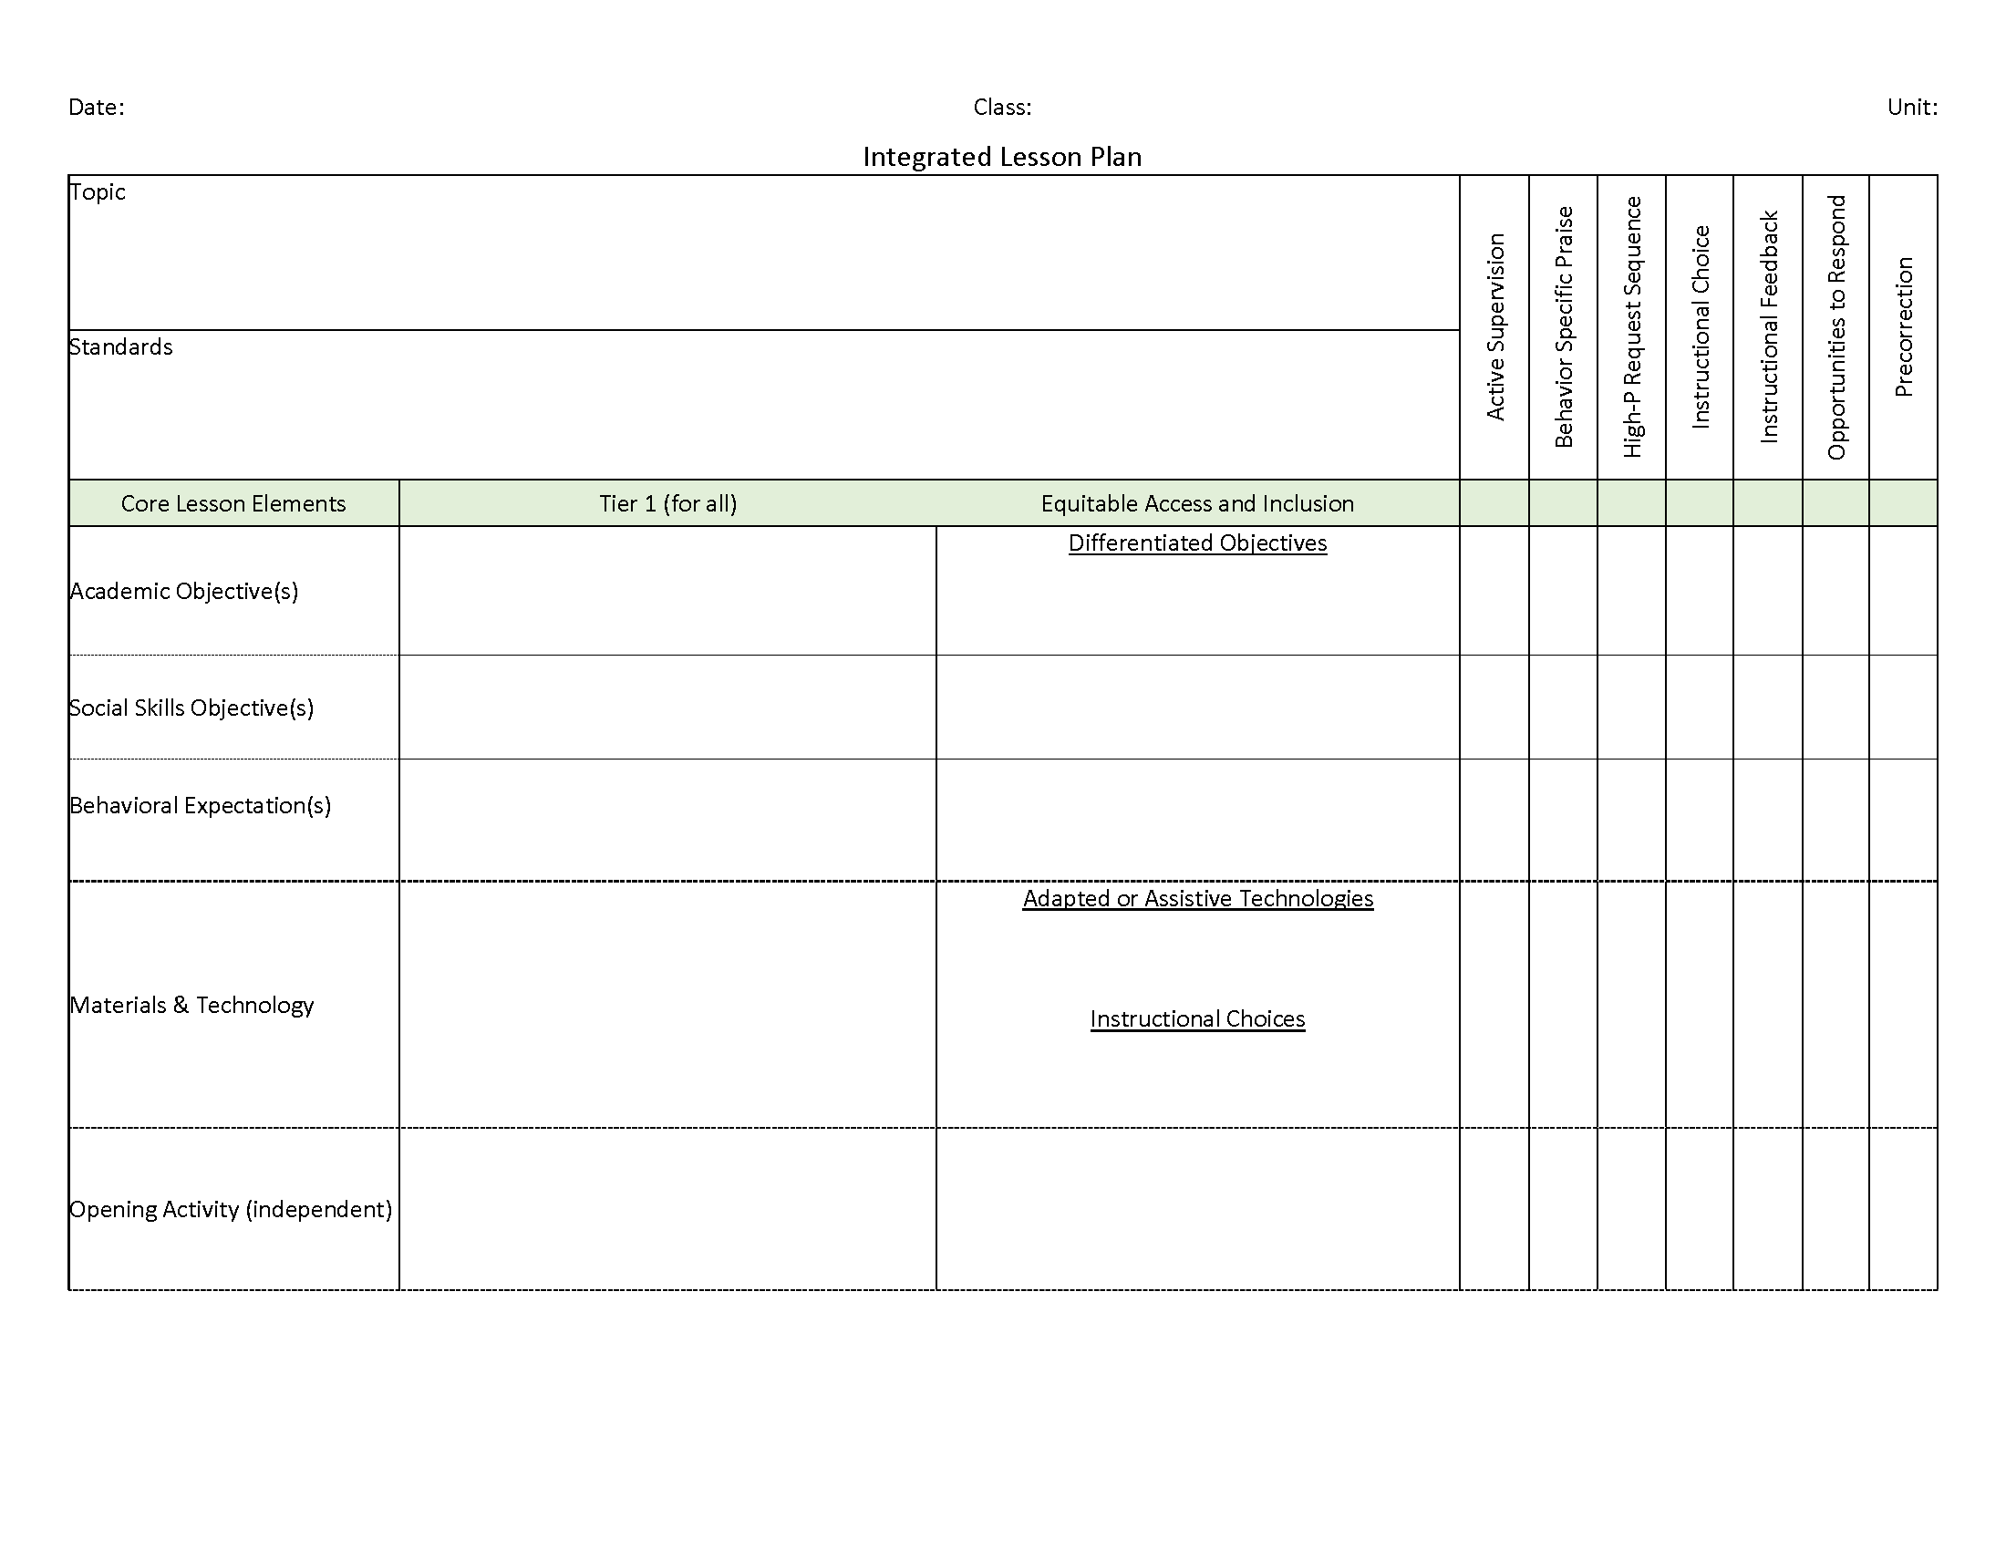
Ci3T: Integrated Lesson Planning

Slide 16
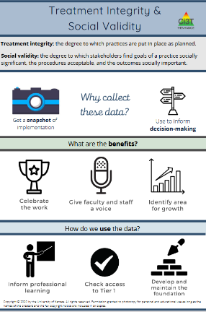
Essential Components of Primary Prevention Efforts
Social Validity
Systematic Screening
Academic
Behavior
Treatment Integrity
ci3t.org/measures
Notes:
Infographic - https://www.ci3t.org/measures

Slide 19
Comprehensive, Integrated, Three-Tiered Model of Prevention
(Lane, Kalberg, & Menzies, 2009)
Tier 3
Tertiary Prevention (≈5%)
Tier 2
Secondary Prevention (≈15%)
Tier 1
Primary Prevention (≈80%)
Academic ◇ Behavioral ◇ Social
Validated Curricula PBIS Framework Validated Curricula

Slide 20
Winter 2022 SRSS-Externalizing Results – Elementary School Level
n = 66
n = 44
n = 33
n = 35
n = 38
n = 37
n = 2
n = 17
n = 32
n = 32
n = 69
n = 74
n = 128
n = 109
n = 97
n = 92
n = 101
n = 125
n = 305
n = 297
n = 287
n = 332
n = 309
n = 263
n = 294
n = 346
n = 355
Notes:
***note to presenter*** If you would like to feature middle or high school data – hide the elementary slides (20-21) and unhide the middle or high school slides
If you would like to update this slide with data from your school or district- Fill in <year> based on current academic year. This is located in column A of the data sheet. Edit by right clicking and selecting “Edit data”.

Slide 21
Winter 2022 SRSS-Internalizing Results – Elementary School Level
n = 75
n = 46
n = 29
n = 41
n = 35
n = 25
n = 16
n = 40
n = 38
n = 27
n = 65
n = 69
n = 59
n = 48
n = 69
n = 72
n = 87
n = 86
n = 334
n = 337
n = 335
n = 354
n = 354
n = 328
n = 285
n = 346
n = 351
Notes:
If you would like to update this slide with data from your school or district- Fill in <year> based on current academic year. This is located in column A of the data sheet. Edit by right clicking and selecting “Edit data”.

Slide 22
Winter 2022 SRSS-Externalizing Results – Middle School Level
n = 21
n = 27
n = 27
n = 13
n = 6
n = 17
n = 26
n = 47
n = 96
n = 68
n = 71
n = 53
n = 42
n = 54
n = 491
n = 448
n = 383
n = 346
n = 445
n = 518
n = 527
Notes:
If you would like to update this slide with data from your school or district- Fill in <year> based on current academic year. This is located in column A of the data sheet. Edit by right clicking and selecting “Edit data”.

Slide 23
Winter 2022 SRSS-Internalizing Results – Middle School Level
n = 79
n = 52
n = 54
n = 60
n = 23
n = 44
n = 42
n = 41
n = 37
n = 40
n = 32
n = 45
n = 30
n = 31
n = 55
n = 70
n = 306
n = 312
n = 356
n = 342
n = 349
n = 351
n = 432
n = 229
Notes:
If you would like to update this slide with data from your school or district- Fill in <year> based on current academic year. This is located in column A of the data sheet. Edit by right clicking and selecting “Edit data”.

Slide 24
Winter 2022 SRSS-Externalizing Results – High School Level
n = 47
n = 72
n = 36
n = 36
n = 40
n = 8
n = 17
n = 38
n = 119
n = 113
n = 47
n = 137
n = 134
n = 114
n = 90
n = 65
n = 1259
n = 1280
n = 1188
n = 994
n = 447
n = 717
n = 750
n = 920
Notes:
If you would like to update this slide with data from your school or district- Fill in <year> based on current academic year. This is located in column A of the data sheet. Edit by right clicking and selecting “Edit data”.

Slide 25
Winter 2022 SRSS-Internalizing Results – High School Level
n = 165
n = 106
n = 83
n = 99
n = 55
n = 65
n = 52
n = 87
n = 73
n = 65
n = 50
n = 34
n = 59
n =48
n = 56
n = 167
n = 1111
n = 1307
n = 1109
n = 1000
n = 445
n = 691
n = 710
n = 923
Notes:
If you would like to update this slide with data from your school or district- Fill in <year> based on current academic year. This is located in column A of the data sheet. Edit by right clicking and selecting “Edit data”.

Slide 27
Building a Ci3T Tier Library
Teacher Delivered Strategies
Tier 1
Tier 2
Tier 3

Slide 28
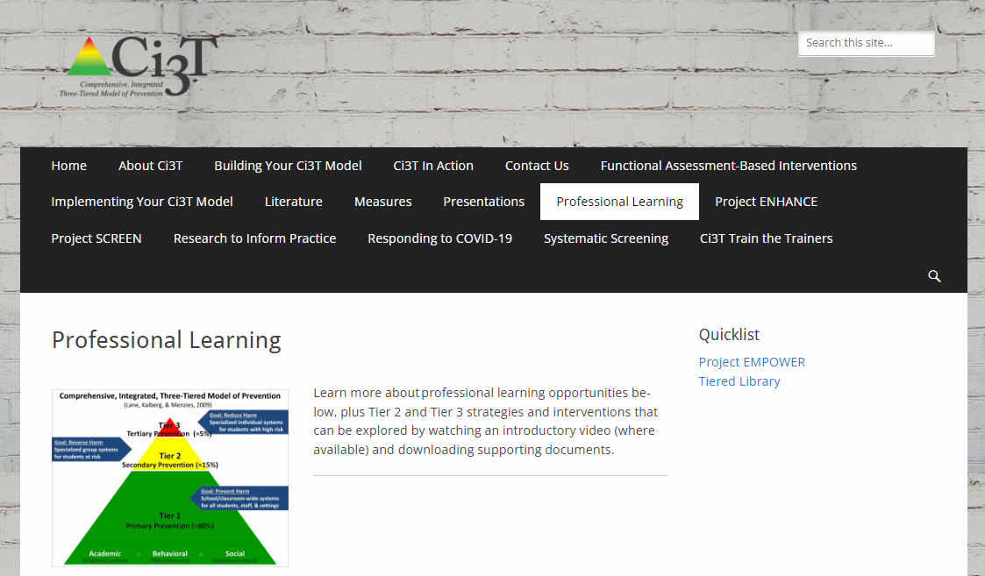
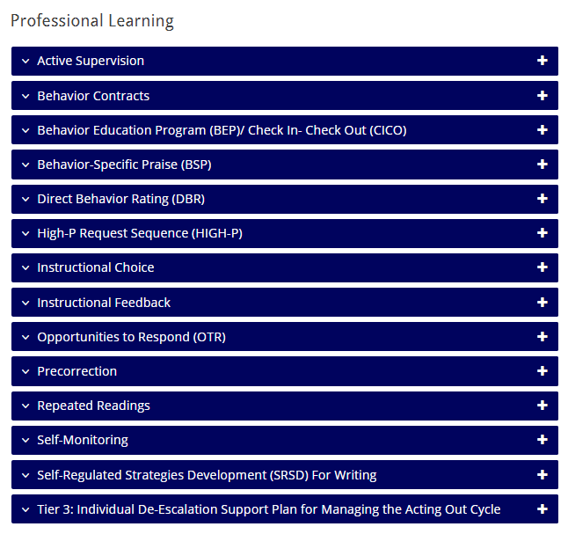
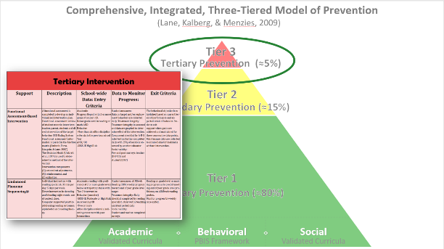
Tiered Intervention Library

Slide 29
Illustrations: Supporting Students with Intensive Intervention Needs
Supporting students with acting out issues
Supporting students with internalizing behaviors

Slide 30
Supporting Students with Acting Out Issues
A Look at Acting Out Behavior: Timing is Everything!

Slide 31
Sample Intervention Grid
Support | Description | School-wide Data: Entry Criteria | Data to Monitor Progress | Exit Criteria
Individualized De-escalation Plan | Ongoing strategy involving identifying specific student characteristics for each phase of the De-escalation cycles and implementing appropriate and evidence-based adult responses to managing student acting out behavior. | One or more of the following: Behavior: SRSS-E7: High (9-21) Office discipline referrals (ODRs) 6 or more within a grading period | Identify a target behavior for the individual student. Include: (a) label for the behavior, (b) definition, (c) examples, and (d) non examples Set behavioral goal based on baseline performance of the behavior. Direct observation of the target behavior with data points graphed for decision making. Treatment Integrity: Treatment integrity checklist Social Validity: Teacher: IRP-15 Student: CIRP | SRSS-E7 score: Low (0-3) Observation data demonstrate behavior is consistently within expected level (per goal; three consecutive data points) – then transition to maintenance plan and monitor behavior during transition.

Slide 32
Antecedents -Behavior - Consequences
Function!
A
B
C
Precorrection: Identifies predictable contexts that often result in problem behavior and provides students with supports, prompts, and reinforcement for engaging in appropriate behavior

Slide 33
Managing Acting Out Behaviors
ED … <1%
EBD … 12%
Classrooms are becoming increasingly more diverse
Culturally
Academically
Behaviorally
Social skill sets
(Lane, Wehby, & Robertson, 2008)
Students with exceptionalities are accommodated in inclusive settings (MacMillian, Gresham, & Forness, 1996)

Slide 34
The Acting-Out Cycle
5. Peak
4. Acceleration
6. De-escalation
2. Trigger
1. Calm 7. Recovery
Whether the problem behavior is managed safely or not
or is defused
in a large measure depends on
YOUR INITIAL RESPONSE
-Dr. Geoff Colvin
Intensity
3. Agitation
Time
Colvin, 2004
Overview of the Acting Out Cycle--Vanderbilt IRIS Module

Slide 35
Behavior Chains
Each ensuing behavior in a given behavior chain becomes more serious than the one preceding it.
(Walker, Ramsey, & Gresham, 2004)

Slide 36
Change the Behavioral Momentum (Nevin, 1970)
Interrupt the behavioral chain at any time to prevent the occurrence of more serious types of behavior.

Slide 37
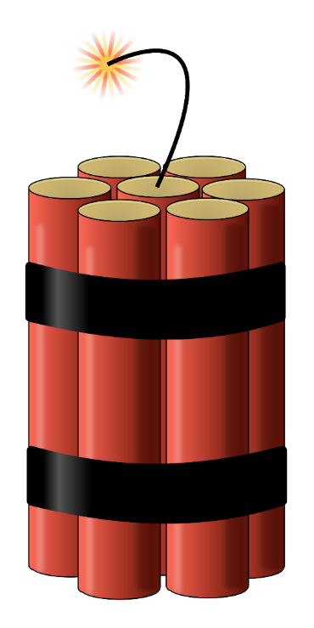
Stages of the Acting Out Cycle Colvin (1992)
Calm
Triggers
Agitation
Acceleration
Peak
De-Escalation
Recovery

Slide 38
Managing Acting Out Behavior: Seven Phases
Notes:
10-min timer

Slide 39
The Model: Seven Phases of The Escalation or Acting-out Cycle
5. Peak
4. Acceleration
6. De-escalation
2. Trigger
1. Calm 7. Recovery
Whether the problem behavior is managed safely or not
or is defused
in a large measure depends on
YOUR INITIAL RESPONSE
-Dr. Geoff Colvin
Intensity
3. Agitation
Time
Colvin, 2004
Overview of the Acting Out Cycle--Vanderbilt IRIS Module

Slide 40
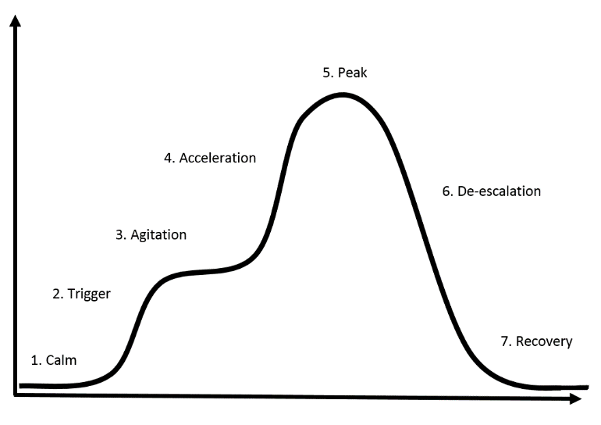
Calm Overall behavior is cooperative, compliant, and desirable.
Academically Engaged
Following Rules & Expectations
Responsive to Praise and Feedback
Initiates Interactions
Goal Directed Behaviors
Colvin, G., & Scott, T. (2015). Managing the cycle of acting-out behavior in the classroom (2nd Edition). Thousand Oaks, CA: Corwin.

Slide 41
Calm O
Strategies:
Intervention is focused on proactive strategies. Focus on instruction and positive behavior support.
Implement the schoolwide Ci3T plan
Vary instructional delivery
Provide behavior specific praise
Implement low-intensity teacher managed strategies (e.g. precorrection, active supervision, providing opportunities to respond)
Carefully plan instruction and implement clear routines and procedures
Attend to the physical environment for potential problem areas
Colvin, G., & Scott, T. (2015). Managing the cycle of acting-out behavior in the classroom (2nd Edition). Thousand Oaks, CA: Corwin.

Slide 42
Triggers Overall behavior involve a series of unresolved problems.
School-Based Triggers
Nonschool-Based Triggers
Conflicts
Changes in Routine
Peer Provocations
Pressure
Ineffective Problem Solving
Facing Errors in Instruction
Facing Correction Procedures
Denial of Something Needed
Dysfunctional Home Life
Health Problems
Nutritional Needs
Inadequate Sleep
Substance Abuse
Gangs
Colvin, G., & Scott, T. (2015). Managing the cycle of acting-out behavior in the classroom (2nd Edition). Thousand Oaks, CA: Corwin.

Slide 43
Triggers Overall behavior involve a series of unresolved problems.
Strategies:
Intervention is focused on prevention and redirection.
Identify the situation where the behavior is likely to occur.
Use precorrection to teach appropriate response.
Rehearse the expectations, prompt or remind students as needed, provide specific praise and reinforcement.
Work with all staff and faculty to teach and reinforce social skills.
Group social skills, anger management, community services.
Work with families for outside supports of nonschool-based triggers
Colvin, G., & Scott, T. (2015). Managing the cycle of acting-out behavior in the classroom (2nd Edition). Thousand Oaks, CA: Corwin.

Slide 44
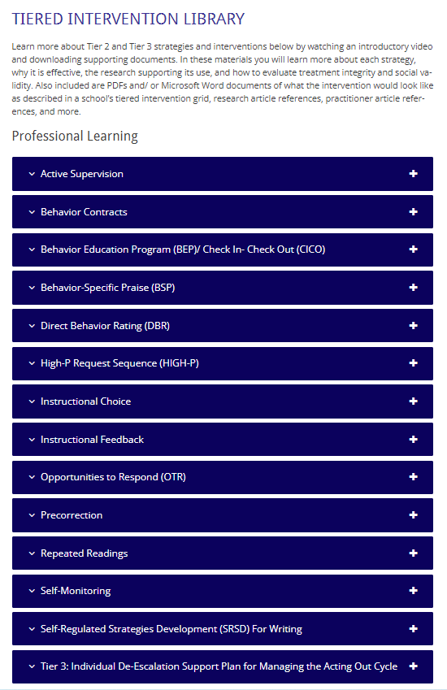
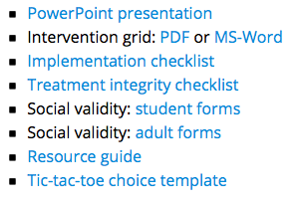
Low Intensity Strategies
https://www.ci3t.org/pl

Slide 45
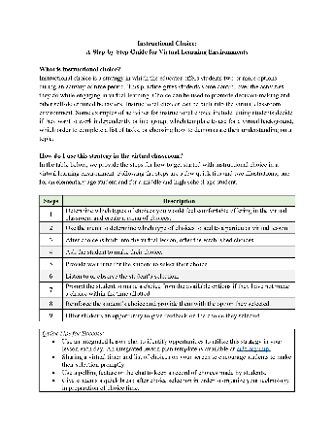
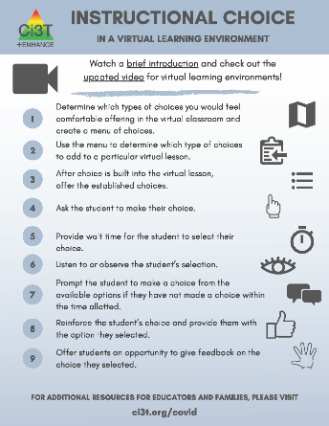
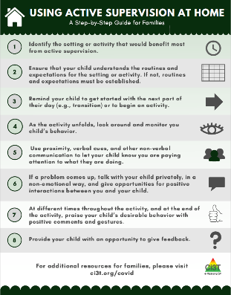
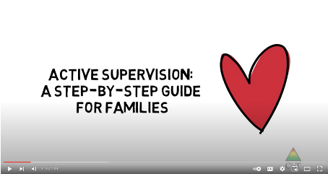
Low Intensity Strategies
https://www.ci3t.org/covid

Slide 46
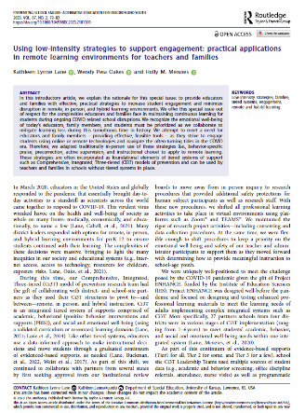
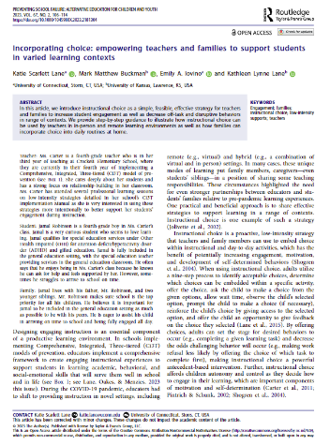
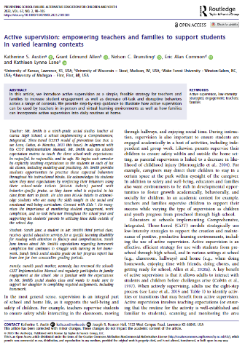
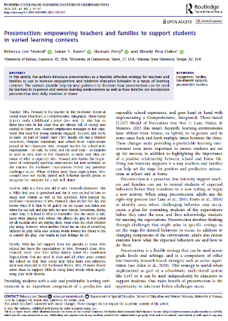
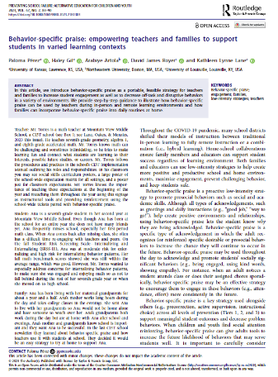
Low Intensity Strategies
https://www.ci3t.org/literature

Slide 47
Agitation Overall behavior is unfocused and off task.
Increases in Behavior
Decreases in Behavior
Darting Eyes
Non-conversational Language
Busy Hands
Moving In and Out of Groups
Off-task, Then On-task Behavior
Staring into Space
Veiled Eyes
Non-conversational Language
Contained Hands
Withdrawal
Colvin, G., & Scott, T. (2015). Managing the cycle of acting-out behavior in the classroom (2nd Edition). Thousand Oaks, CA: Corwin.

Slide 48
Agitation Overall behavior is unfocused and off task.
Strategies:
Intervention is focused on reducing anxiety.
Show empathy
Provide reasonable options and choices
Allow wait time for student to decide (usually less than a minute)
During wait time, walk away from student, attend to other students, or engage in some other task
Involve in successful engagement (behavior momentum)
Colvin, G., & Scott, T. (2015). Managing the cycle of acting-out behavior in the classroom (2nd Edition). Thousand Oaks, CA: Corwin.

Slide 49
Acceleration Overall behavior is teacher-engaging.
Questioning and Arguing
Noncompliance and Defiance
Off-Task Behavior
Provocation of Others
Compliance with Accompanying Inappropriate Behaviors
Criterion Problems
Whining and Crying
Avoidance and Escape
Threats, Intimidation
Destruction of Property
Verbal Abuse
Colvin, G., & Scott, T. (2015). Managing the cycle of acting-out behavior in the classroom (2nd Edition). Thousand Oaks, CA: Corwin.

Slide 50
Acceleration Overall behavior is teacher-engaging.
Strategies:
Intervention is focused on safety.
Remove all triggering factors
Avoid escalating prompts
Maintain calmness, respect and detachment
Approach the student in a nonthreatening manner
Utilize non-confrontational limit-setting procedures
Colvin, G., & Scott, T. (2015). Managing the cycle of acting-out behavior in the classroom (2nd Edition). Thousand Oaks, CA: Corwin.

Slide 51
Peak Overall behavior is out of control.
Serious Destruction of Property
Assault
Self-Abuse
Severe Tantrums
Hyperventilation
Running Away/Elopement
Colvin, G., & Scott, T. (2015). Managing the cycle of acting-out behavior in the classroom (2nd Edition). Thousand Oaks, CA: Corwin.

Slide 52
Peak Overall behavior is out of control.
Strategies:
Focus on safety only!
Remain calm
Crisis management
Safe strategies- emergency safety intervention (ESI) if there is immediate danger (if ESI used, document & notify)
Learn from it…(FBA, BIP, Mental Health Assessment, etc.)
Colvin, G., & Scott, T. (2015). Managing the cycle of acting-out behavior in the classroom (2nd Edition). Thousand Oaks, CA: Corwin.

Slide 53
De-Escalation Overall behavior displays confusion
Confusion
Reconciliation
Withdrawal
Denial
Blaming Others
Responsiveness to Directions
Responsive to Manipulative or Mechanical Tasks
Avoidance of Discussion
Avoidance of Debriefing
Colvin, G., & Scott, T. (2015). Managing the cycle of acting-out behavior in the classroom (2nd Edition). Thousand Oaks, CA: Corwin.

Slide 54
De-Escalation Overall behavior displays confusion
Strategies:
Intervention is focused on monitoring for re-escalation of behavior.
Monitor for health/safety of all involved
Avoid blaming- provide opportunity for non-judgmental discussion
Allow cool-down time and space
Engage in independent work- provide easy/concrete tasks
Colvin, G., & Scott, T. (2015). Managing the cycle of acting-out behavior in the classroom (2nd Edition). Thousand Oaks, CA: Corwin.

Slide 55
Recovery Overall behaviors show eagerness for busy work and reluctance to interact or discuss.
Eagerness for Independent Work or Activity
Subdued Behavior in Group Work
Subdued Behavior in Class Discussions
Defensive Behavior
Avoidance of Debriefing
Colvin, G., & Scott, T. (2015). Managing the cycle of acting-out behavior in the classroom (2nd Edition). Thousand Oaks, CA: Corwin.

Slide 56
Recovery Overall behaviors show eagerness for busy work and reluctance to interact or discuss.
Strategies:
Intervention focuses on returning to normal activities.
Follow through with consequences-but do not disrupt flow of instruction.
Positively reinforce any displays of appropriate behavior
Debrief/rehearse problem solving routine
Colvin, G., & Scott, T. (2015). Managing the cycle of acting-out behavior in the classroom (2nd Edition). Thousand Oaks, CA: Corwin.

Slide 57
Debriefing Session
Facilitates transition back to task/activity… not further negative consequence.
Goal is to increase appropriate behavior
Focus on problem solving
Pinpoint events that contributed to the incident
Teach replacement behaviors
Debriefing activities and forms

Slide 58
Tier 3: Building a De-escalation Plan

Slide 59
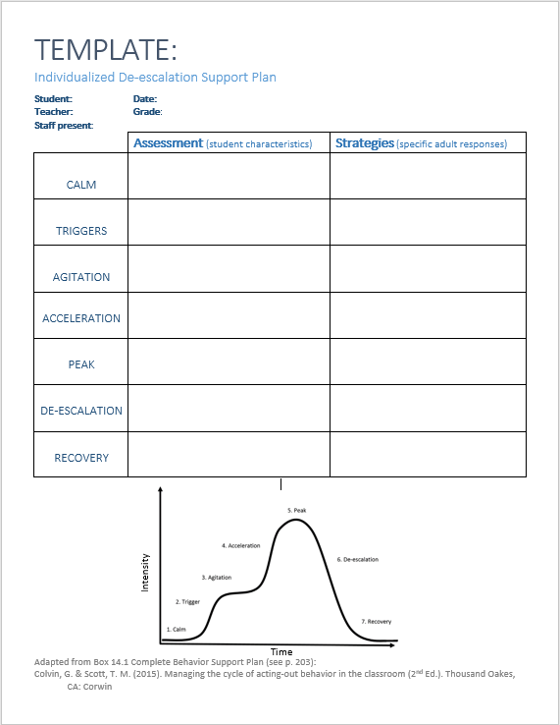
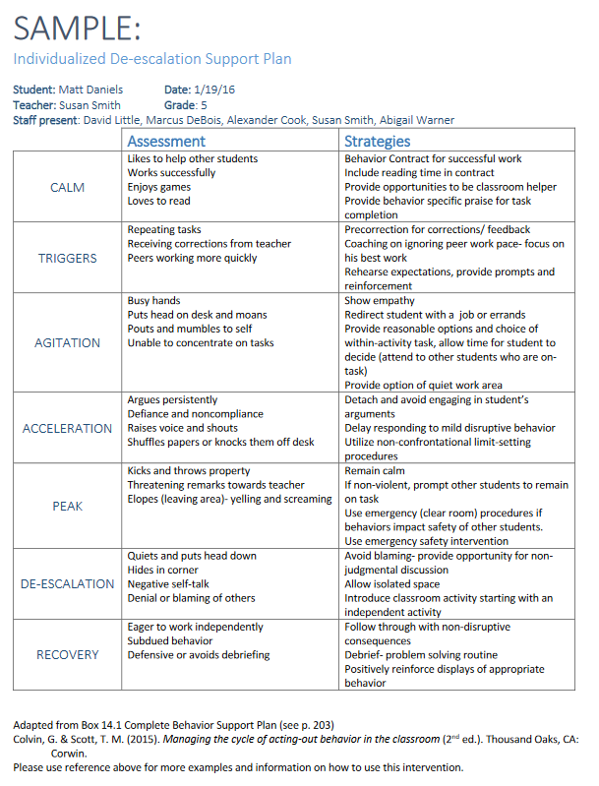
Planning
https://www.ci3t.org/pl

Slide 60
Sample Intervention Grid

Slide 61
Talk Time
https://www.ci3t.org/pl
Do you have this in place as a Tier 3 intervention?
How might this be useful for the work you do?
What questions do you have?
What challenges do you anticipate and how might you overcome those challenges?
Notes:
15-min timer

Slide 62
Supporting Students with Internalizing Issues
What do I need to know?

Slide 63
What are Internalizing Behaviors?
Anxiety
Depression
Social
Withdrawal
Somatic Complaints
A mental health issue as well as a behavioral challenge
Patterns of behavior directed inward, toward the self, rather than outward upon the environment
Social and academic impairments are associated with internalizing behaviors
McIntosh, Ty, & Miller, 2014; Gresham & Kern, 2005; Morris, Shah, & Morris, 2002

Slide 64
How many students experience these challenges?
20% of experience challenges related to internalizing and/or externalizing concerns (Danielson et al., 2020; Forness et al., 2012)
40% of students who exhibit disruptive behaviors also experience internalizing concerns
(Mahendran et al., 2021)
30.1% of people experience an anxiety disorder at some time during adolescence (Merikangas et al., 2010)
12.5% of adolescents experienced a major depressive episode in 2015 (Center for Behavioral Health Statistics and Quality, 2016)

Slide 65
Research on Internalizing Behaviors
Shaping and positive reinforcement have been shown to decrease social withdrawal and promote social interaction in children (Morris & Kratochwill, 1983)
Students with internalizing behaviors tend to respond well to schoolwide positive behavior supports when implemented with fidelity (Lane, Wehby, Robertson, & Rogers, 2007)
Check-in/Check-out has been successfully utilized to increase school participation (Hunter, Chenier, & Gresham, 2013)
Cognitive Behavioral Therapy (CBT) used to successfully treat depression and anxiety in children (Beck, Rush, Shaw, & Emery, 1979)

Slide 66
Anxiety Disorders
Include …
panic disorders,
obsessive-compulsive disorder (OCD),
post-traumatic stress disorder (PTSD),
social phobia (Social Anxiety Disorder),
specific phobias,
and generalized anxiety disorder (GAD; American Psychiatric Association, 2013 ).
Symptoms for each of these disorders are different, but the commonality is an excessive and/or irrational level of fear and worry.

Slide 67
What does anxiety look like in children and youth?
Overwhelmed easily
Sense of dread
Experience obsessive, intrusive, and bothersome thoughts.
Often accompanied by somatic complaints (e.g., muscle weakness, cramps, fatigue, frequent bathroom trips)
May itself be a symptom of depression

Slide 68
How does anxiety impact school experiences?
Students with anxiety may…
have difficulty with academic engagement
experience social withdrawal
Internalizing behaviors may lead to social and academic impairments (Mychailyszyn, Mendez, & Kendall, 2010)
(Erath, 2007; Rapee & Heimberg, 1997)

Slide 69
Anxiety: General Strategies
Relaxation Training: Tier 1, 2, and 3
Self-Monitoring: Tier 2
Cognitive Restructuring: Tier 2 and 3
Functional Assessment-based Intervention: Tier 3

Slide 70
Intervention Name | Prevent | Early Intervention | Intensive Intervention
Cognitive Behavior Therapy
Cognitive Restructuring
Contingency Management
Exposure-Based Techniques
Family Therapy
Modeling (live and video)
Psychoeducation
Relaxation Training
Self-Monitoring / Self-Assessment
TBD
TBD
TBD

Slide 71
Relaxation Training
A strategy for use across the tiers

Slide 72
What is Relaxation Training?
Notes:
Relaxation training teaches children to begin using ways to relax.
It focuses on monitoring muscle tension created by stressful situations and events and by controlling irregular breathing.
Relaxation techniques include counting, breathing exercises, recall, mental imagery, and progressive muscle relaxation (Kahn, Kehle, Jenson, & Clarke, 1990).

Slide 73
GOAL: Relaxation lowers anxiety through physiologic responses to slower breathing and slower thinking.
Identify the context in which anxiety occur.
Provide options for relaxation training based on student strengths and interest.
Teach procedures through modeling, practice, and feedback.

Slide 74
Why Relaxation Training?
Physical discomfort caused by tension can exacerbate common anxiety symptoms, causing a child to become even more anxious.

Slide 75
Relaxation Protocol
Photo credit. Rebecca Sherod
Morris, R. J., Shah, K., & Morris, Y. P. (2002). Internalizing behavior disorders. In K. L. Lane, F. M. Gresham, & T.E., O’Shaughnessy (Ed.) Interventions for children with or at risk for emotional and behavioral disorders (pp. 223-241). Allyn & Bacon.​

Slide 76
Secondary (Tier 2) Intervention Grids

Slide 77
Self-Monitoring
A secondary (Tier 2) intervention for students experiencing internalizing challenges

Slide 78
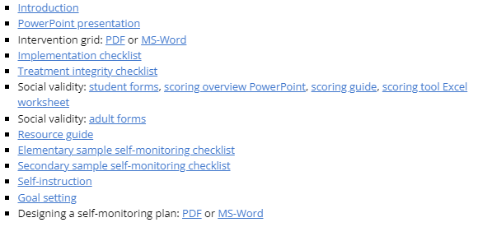
Self-Monitoring
https://www.ci3t.org/pl

Slide 79
Sample Elementary Secondary (Tier 2) Intervention Grid
Support | Description | School-wide Data: Entry Criteria | Data to Monitor Progress | Exit Criteria
Self-monitoring | Strategy implemented by student and teacher to improve academic performance (completion/ accuracy), academic behavior, or other target behavior. | Behavior: SRSS-E7 score: Moderate (4-8) SRSS-I5 score: Moderate (2-3) or SRSS-E7 score: High (9-21) SRSS-I5 score: High (4-15) or 2 or more office discipline referrals (ODR) AND/OR Academic: Progress report: 1 or more course failures or AIMSweb: intensive or strategic level (math or reading) or Progress report: Targeted for Growth for academic learning behaviors | Work completion and accuracy of the academic area of concern (or target behavior named in the self-monitoring plan) Grades on progress reports Social Validity: Teacher: IRP-15 Student: CIRP Treatment Integrity: Implementation & treatment integrity checklist | SRSS-E7 score: Low (1-3) SRSS-I5 score: Low (1-2) Passing grade on progress report or report card in the academic area of concern (or target behavior named in the self-monitoring plan)
Notes:
Sample

Slide 80
Tertiary (Tier 3) Intervention Grids

Slide 81
Cognitive Behavioral Therapy
A tertiary (Tier 3) intervention for students experiencing internalizing challenges

Slide 82
What is Cognitive Behavioral Therapy?
Thoughts
Feelings
Behaviors
CBT
Psychoeducation
Cognitive Restructuring
Activity Scheduling
Relaxation Training
Systematic De-sensitization
Cognitive Behavioral Therapy
(CBT)
Common CBT Components

Slide 83
Coordinating Supports
Generalization and Maintenance
Connections across the tiers
Generalization
Generalization: occurrence of the desired behavior(s) in new settings or contexts or with new people (Stokes & Baer, 1977).
Maintenance
continued occurrence of the desired behavior(s) over time (Stokes & Osnes, 1989).
Connections to Tier 1 to social-emotional well-being instruction
Low-intensity strategies
Precorrection
Behavior-specific praise
Procedures for Reinforcing

Slide 84
A closer look at cognitive restructuring
CBT
Psychoeducation
Cognitive Restructuring
Activity Scheduling
Relaxation Training
Systematic De-sensitization

Slide 85
GOAL: To modify the cognitions associated with anxiety, thereby reducing it.
Identify erroneous beliefs or anxious thinking.
Challenge the reality of these beliefs or thoughts.
Change the thinking to something more rational or probable.

Slide 86
What is Cognitive Restructuring?
Includes teaching students to:
Identify irrational thoughts and replace them with more realistic ones
Identify and classify irrational thoughts during anxiety-provoking events
Modify irrational thoughts by making realistic appraisals of the events

Slide 87
Cognitive Restructuring
De-catastrophizing
Rational analysis
Decentering
Re-attribution training
Reframing / relabeling

Slide 88
Sample Elementary Tertiary (Tier 3) Intervention Grid
Support | Description | School-wide Data: Entry Criteria | Data to Monitor Progress | Exit Criteria
Cognitive Restructuring | Individual or small group intervention lead by related service provider (e.g., counselor) using strategies rooted in Cognitive Behavior Therapy (CBT) to teach students to identify irrational emotions or thoughts, test the reality of those thoughts, and develop rational thoughts to replace depressive/anxious ones (Vannest et al., 2015). Intervention provided over 5-12 sessions. | Behavior: SRSS-E7 score: Moderate (4-8) SRSS-I5 score: Moderate (2-3) AND/OR 2 or more office discipline referrals (ODR) AND/OR 4 or more nurse visits AND/OR 2 or more unexcused absences over the past 4 weeks AND Parent permission | Student measures: Attendance Student record of self-monitoring Permanent products (e.g., assignments completed) Treatment integrity: Treatment integrity checklist (e.g., adherence to intervention protocol) Social validity: Teacher: IRP 15 Student: CIRP | SRSS-E7 score: Low (0-3) SRSS-I5 score: Low (0-1) AND/OR no ODR over last 6 weeks AND/OR No nurse visits over 4-week period (except for visits necessary for medication, injury, illness) AND/OR Attendance: no unexcused absences over 4-week period
Notes:
Sample

Slide 89
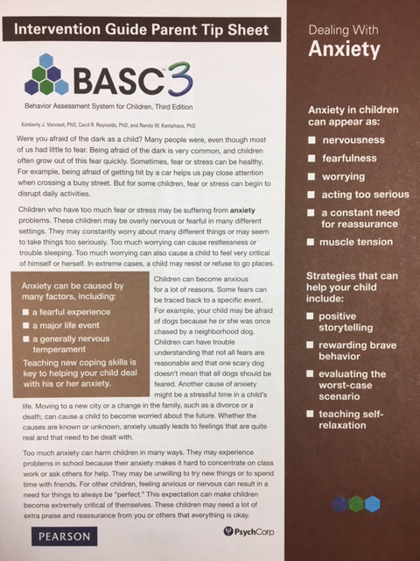
Strategies and resources
Positive storytelling
Rewarding brave behavior
Evaluating the worst-case scenario
Teaching self-relaxation
Notes:
https://www.pearsonassessments.com/store/usassessments/en/Store/Professional-Assessments/Behavior/Comprehensive/BASC-3-Intervention-Guide-%26-Materials/p/100001522.html?tab=product-details

Slide 90
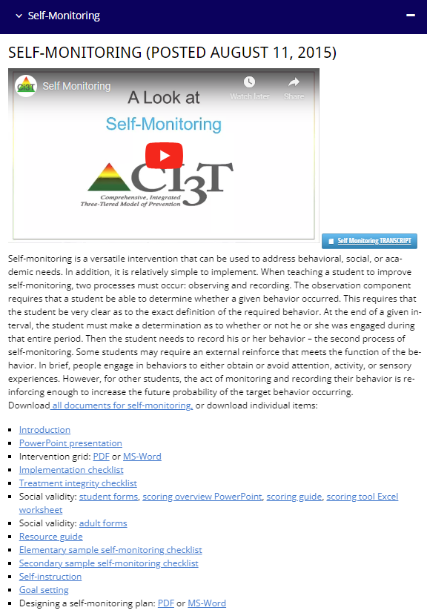
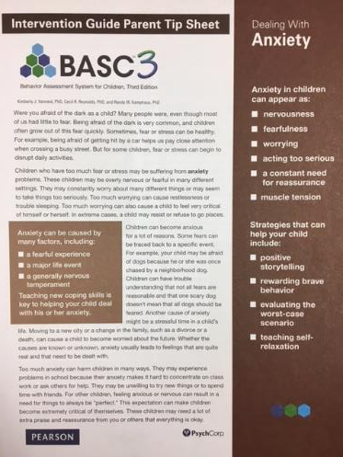
Talk Time
Which strategies would you like to explore?
Relaxation Training (Tiers 1-3)
Self-Monitoring (Tier 2)
Cognitive Behavioral Therapy (Tier 3)
How could you collaborate with families to support students with internalizing concerns?
Notes:
15-min timer

Slide 91
Exploring Other Tertiary (Tier 3) Interventions in Ci3T Models

Slide 92
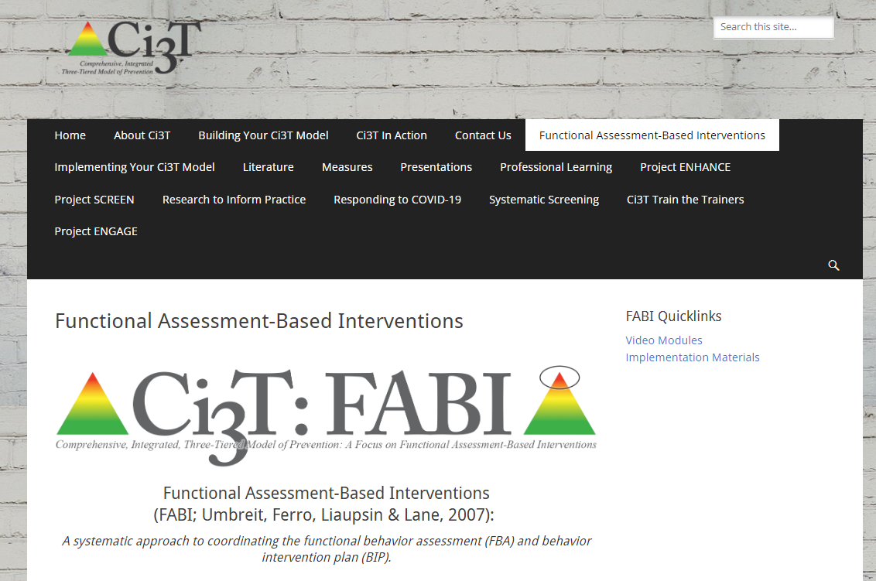
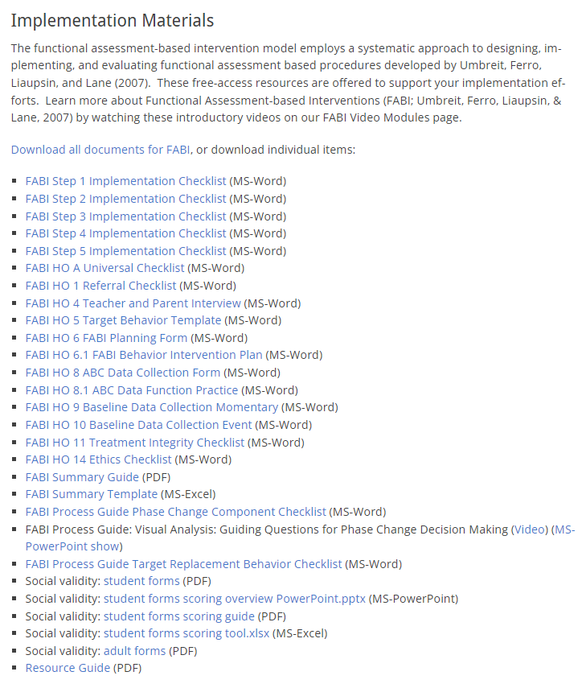
Functional Assessment-based Interventions (FABI)
https://www.ci3t.org/fabi

Slide 93
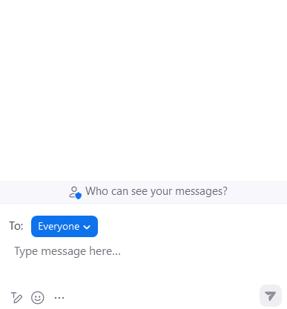
Let’s Chat
What Tier 3 interventions are listed in your Ci3T implementation manual to support students with externalizing behavior needs?
What Tier 3 interventions are listed in your Ci3T implementation manual to support students with internalizing behavior needs?

Slide 94
Wrapping Up and Moving Forward

Slide 95
Project EMPOWER - Traditional
Ci3T EMPOWER Sessions Location: Remote via Zoom Attended by: School Ci3T Leadership Teams, Ci3T District Trainers and Coaches, Faculty and Staff, Families (adults only). Community Members |  | Times (Pacific) | Times (Central) | Times (Eastern)
1. Getting Started | Sep. 19, 2023 (Tu) | 3:00 – 5:00 p.m. | 5:00 – 7:00 p.m. | 6:00 – 8:00 p.m.
2. Screening | Oct. 19, 2023 (Th) | 3:00 – 5:00 p.m. | 5:00 – 7:00 p.m. | 6:00 – 8:00 p.m.
3. Low Intensity Strategies | Nov. 30, 2023 (Th) | 3:00 – 5:00 p.m. | 5:00 – 7:00 p.m. | 6:00 – 8:00 p.m.
4. Tier 2 | Jan. 9, 2024 (Tu) | 3:00 – 5:00 p.m. | 5:00 – 7:00 p.m. | 6:00 – 8:00 p.m.
5. Tier 3 | Mar. 28, 2024 (Th) | 3:00 – 5:00 p.m. | 5:00 – 7:00 p.m. | 6:00 – 8:00 p.m.
6. Moving Forward | Apr. 23, 2024 (Tu) | 3:00 – 5:00 p.m. | 5:00 – 7:00 p.m. | 6:00 – 8:00 p.m.

Slide 96
Ci3T
Comprehensive Professional Learning Plan
Ci3T: Primary Prevention
Session 1:
Overview of Ci3T Prevention Models
Setting a Purpose
Establish team meetings and roles
Session 2:
Mission and Purpose
Establish Roles and Responsibilities
Procedures for Teaching
Procedures for Reinforcing
Reactive Plan
Session 3:
Procedures for Monitoring
Session 4:
Revise Primary Plan using Stakeholder feedback
Prepare presentation
Ci3T: Secondary Prevention
Session 5:
Overview of Teacher focused Strategies
Overview of Student Focused Strategies
Using data to determine which students may need Secondary (Tier 2) supports
Draft the Secondary Intervention Grid based on existing supports
Ci3T: Tertiary Prevention
Session 6:
Final revisions of Ci3T Plan based on stakeholder feedback
Draft Tertiary (Tier 3) Prevention Intervention Grids
Design Implementation Manual and Plan for roll out to faculty, students, and parents
Ci3T Leadership Team Training Sequence
Implementation Stages of Tier 2 and 3 within Ci3T
Additional Professional Development on Specific Topics
Core Content Curriculum
Check In - Check Out
Functional Assessment-based Interventions
Reading, Math, Writing Benchmarking and Progress Monitoring Tools
Interventions, Strategies, & Practices
Additional Tier 3 Supports
Instructional Techniques to Improve Students’ Motivation; Classroom Management Practices;
Low-Intensity Behavior Supports

Slide 97
School Ci3T Implementation Calendar
Sun. | Mon. | Tues. | Wed. | Thurs. | Fri. | Sat.
1 | 2 | 3 | 4 | 5 | 6 Professional learning session: Internalizing | 7
8 | 9 | 10 Ci3T Team Meeting | 11 | 12 Teach Social Skills Lesson | 13 | 14
15 | 16 Faculty meeting with a look at BSP | 17 | 18 | 19 | 20 | 21
22 | 23 | 24 | 25 | 26 Teach Social Skills Lesson | 27 | 28
Schedule time for communication
Notes:
.

Slide 98
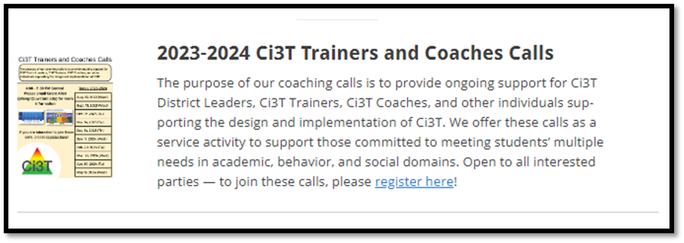
Ci3T Trainer and Coaches Calls

Slide 99
Ci3T Professional Learning Calendar
 | July | Aug | Sep | Oct | Nov | Dec | Jan | Feb | Mar | Apr | May | Jun
Ci3T Training |  |  |  |  | Ci3T Professional Learning Series Session 1 | Ci3T Professional Learning Series Session 2 | Ci3T Professional Learning Series Session 3 | Ci3T Professional Learning Series Session 4 |  | Ci3T Professional Learning Series Session 5 | Ci3T Professional Learning Series Session 6
Ci3T Implementation Support | Ci3T Implementation Series Prep Session |  | Ci3T Implementation Series Session 1 |  | Ci3T Implementation Series Session 2 |  | Ci3T Implementation Series Session 3 |  | Ci3T Implementation Series Session 4 | Ci3T Implementation Series Session 5
Ci3T EMPOWER |  |  | Ci3T EMPOWER Session 1 | Ci3T EMPOWER Session 2 | Ci3T EMPOWER Session 3 |  | Ci3T EMPOWER Session 4 |  | Ci3T EMPOWER Session 5 | Ci3T EMPOWER Session 6
Ci3T Trainers & Coaches Calls |  | Trainers & Coaches Call Session 1 | Trainers & Coaches Call Session 2 | Trainers & Coaches Call Session 3 | Trainers & Coaches Call Session 4 | Trainers & Coaches Call Session 5 | Trainers & Coaches Call Session 6 | Trainers & Coaches Call Session 7 | Trainers & Coaches Call Session 8 | Trainers & Coaches Call Session 9 | Trainers & Coaches Call Session 10

Slide 100
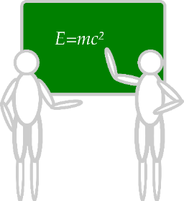
Sustaining and Disseminating Professional Learning
Designate two staff to attend trainings to become on-site coaches
10 min @ next Faculty and Staff meeting
Ci3T Setting Up for Success
Systematic Screening
Low-Intensity Strategies
Tier 2
Planning Ahead
Tier 3

Slide 101
Accessing Project EMPOWER Professional Learning

Slide 102
Wrapping Up & Previewing Next Session
Today
Next time
Overview of Tertiary (Tier 3) Interventions in Ci3T Models: Data-informed Decision-making
Illustrations: Supporting Students with Intensive Intervention Needs
Supporting students with acting out behaviors
Supporting students with internalizing issues
Exploring Other Tertiary (Tier 3) Interventions in Ci3T Models
Overview of Ci3T: Identifying Successes and Areas for Reinforcement
Closing out the School Year: Positive, Productive Learning Environments
Planning for the 2024-2025 Academic Year
Establishing Professional Learning Goals

Slide 103
Comprehensive, Integrated, Three-Tiered Model of Prevention
(Lane, Kalberg, & Menzies, 2009)
Thank you!
Notes:
Tag us in your Ci3T highlights- we’d love to see Ci3T in action! Follow us on Twitter or Instagram for updates and links to resources! @Ci3TModel
You will receive a brief session evaluation – we value your feedback and would greatly appreciate you taking a few minutes to share your thoughts on what you liked about the session and how we can improve

