Slide 1
Implementing Comprehensive, Integrated, Three-tiered (Ci3T) Models:
Supporting Student Success Across the Tiers
Ci3T Implementation Series and Delivery – Session 4
Presenters and Contributors | Contributors
Allison M. Bernard | Wendy Peia Oakes
Mark M. Buckman | Elise Sarasin
Kathleen Lynne Lane | Rebecca L. Sherod

Slide 3
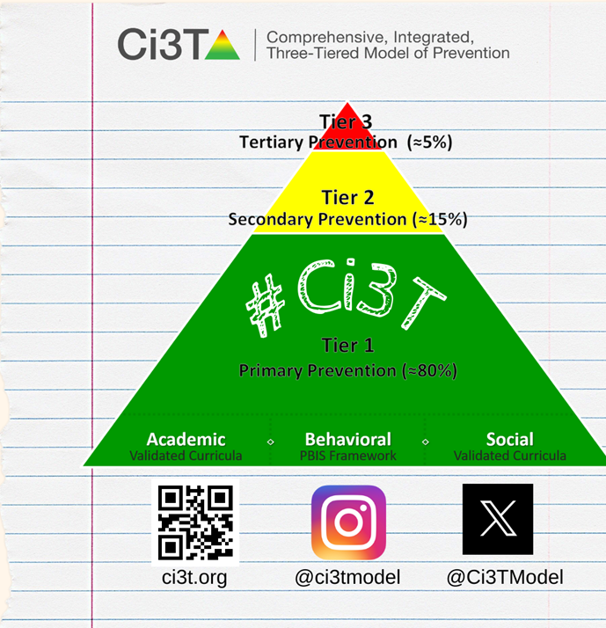
Let’s Connect on Social Media!
Tag us in your Ci3T highlights- we’d love to see Ci3T in action!
Follow us on Twitter or Instagram for updates and links to resources!
  @Ci3TModel

Slide 4
Ci3T Professional Learning Calendar
 | July | Aug | Sep | Oct | Nov | Dec | Jan | Feb | Mar | Apr | May | Jun
Ci3T Training |  |  |  |  | Ci3T Professional Learning Series Session 1 | Ci3T Professional Learning Series Session 2 | Ci3T Professional Learning Series Session 3 | Ci3T Professional Learning Series Session 4 |  | Ci3T Professional Learning Series Session 5 | Ci3T Professional Learning Series Session 6
Ci3T Implementation Support | Ci3T Implementation Series Prep Session |  | Ci3T Implementation Series Session 1 |  | Ci3T Implementation Series Session 2 |  | Ci3T Implementation Series Session 3 |  | Ci3T Implementation Series Session 4 | Ci3T Implementation Series Session 5
Ci3T EMPOWER |  |  | Ci3T EMPOWER Session 1 | Ci3T EMPOWER Session 2 | Ci3T EMPOWER Session 3 |  | Ci3T EMPOWER Session 4 |  | Ci3T EMPOWER Session 5 | Ci3T EMPOWER Session 6
Ci3T Trainers & Coaches Calls |  | Trainers & Coaches Call Session 1 | Trainers & Coaches Call Session 2 | Trainers & Coaches Call Session 3 | Trainers & Coaches Call Session 4 | Trainers & Coaches Call Session 5 | Trainers & Coaches Call Session 6 | Trainers & Coaches Call Session 7 | Trainers & Coaches Call Session 8 | Trainers & Coaches Call Session 9 | Trainers & Coaches Call Session 10

Slide 5
Agenda
Welcome
Data-Informed Decision-Making
  Sharing Data with Stakeholders
  Using Data to Inform Professional Learning and Instruction
Integrated Lesson Planning at Tier 1
Planning and Implementing Tier 2 Interventions
Planning and Implementing Tier 3 Interventions
Wrapping Up and Moving Forward

Slide 6
Review and Preview
Last Time
Today…
Procedures for Monitoring
  Review your School’s Social Validity & Treatment Integrity Data
  Review your School’s Winter Screening Data
Data-informed Decision-making
  Professional Learning Targets and Resources
  Communication Plans
Data-Informed Decision-Making
  Sharing Data with Stakeholders
  Using Data to Inform Professional Learning and Instruction
Integrated Lesson Planning at Tier 1
Planning and Implementing Tier 2 Interventions
Planning and Implementing Tier 3 Interventions

Slide 7
Welcome
Please pull up your Ci3T Implementation Manual

Slide 8
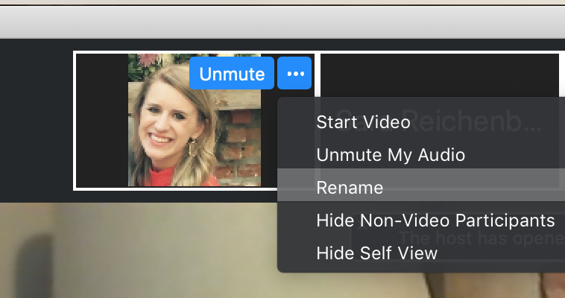
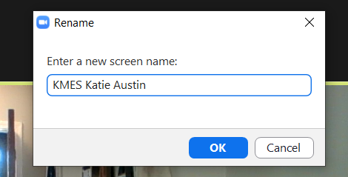
Renaming: School Initials + First and Last Name
To help us put you in breakout rooms with your colleagues today…
1. Click the three dots at the top
right corner of your video square.
2. Rename yourself with your
school initials then first and last name.

Slide 9
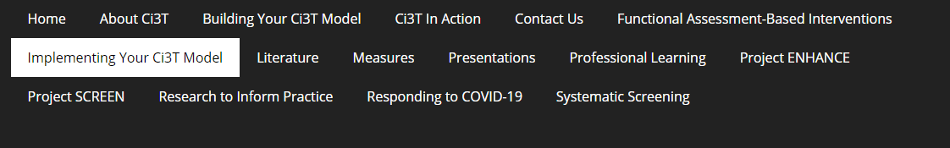
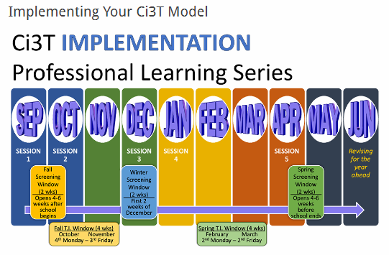
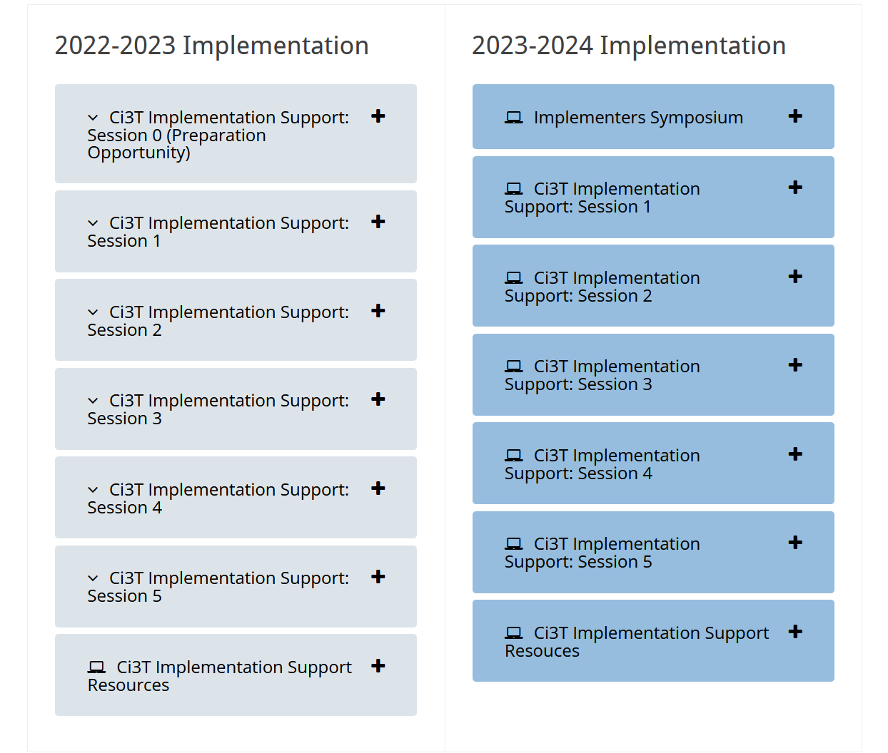
Accessing Professional Learning Materials
Navigate to ci3t.org/imp

Slide 10

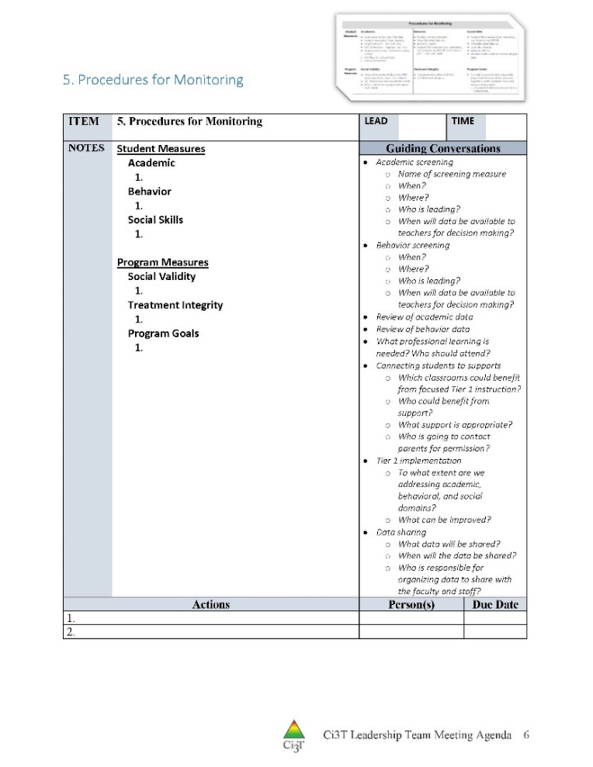
IM18 Ci3T Leadership Team Meeting Agenda TEMPLATE
Predictability

Slide 11

Goals for this Implementation Year
Establish effective Ci3T leadership structures
Gain a deeper understanding of Ci3T models of prevention
Implement your school’s plan with high fidelity
Collect and use social validity and treatment integrity data to monitor Ci3T plan implementation
Collect student academic and behavioral outcome data to inform Ci3T implementation efforts
Share data with all stakeholders regularly (e.g., monthly, quarterly)
Identify areas of additional professional learning for faculty and staff and support faculty and staff access to professional learning
Address any barriers to implementing your Ci3T model

Slide 12
Data-Informed Decision-Making
Sharing Data with Stakeholders
Using Data to Inform Professional Learning and Instruction

Slide 13
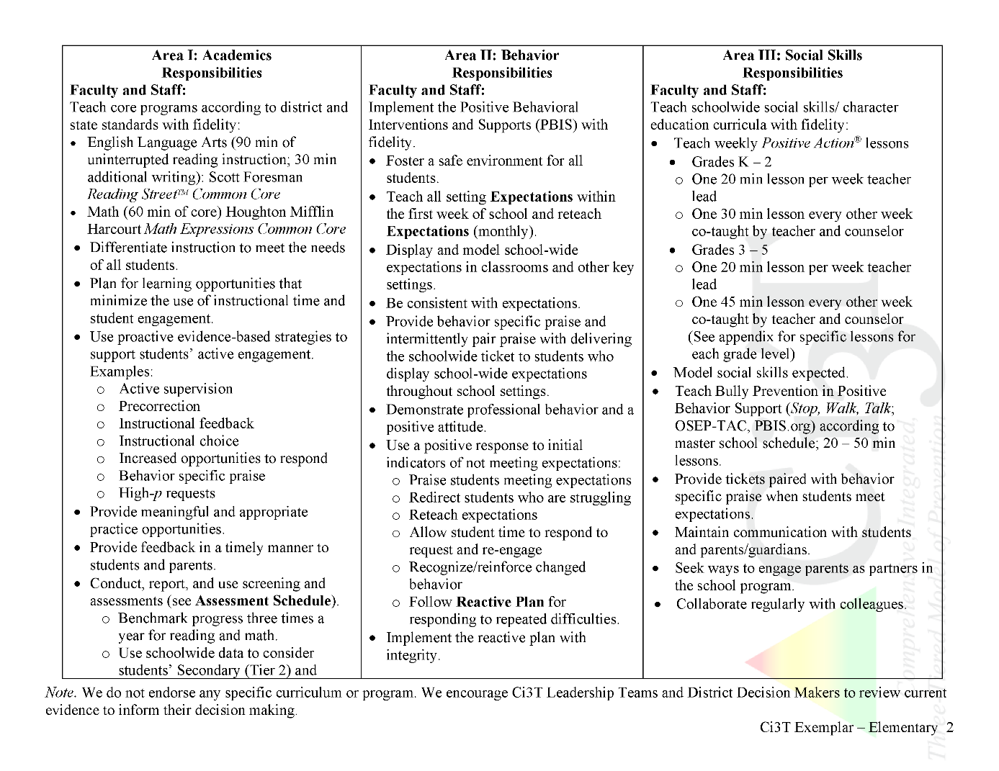

Slide 14
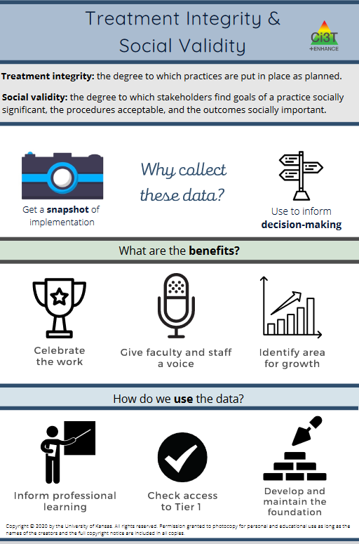

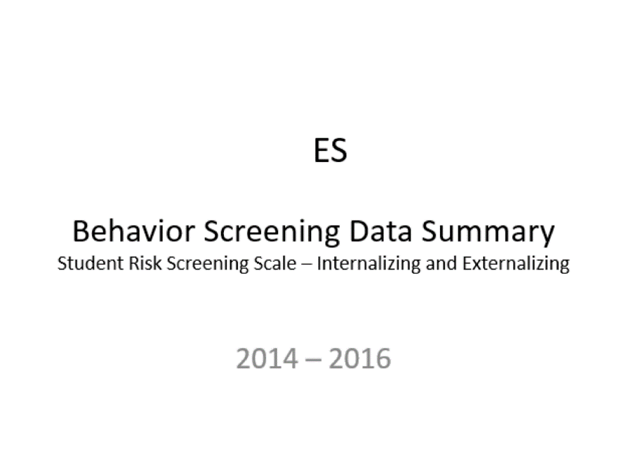
Essential Components of
Primary Prevention Efforts
Social Validity
Systematic Screening
Academic
Behavior
Treatment Integrity
ci3t.org/measures
Notes:
Infographic - https://www.ci3t.org/measures

Slide 15
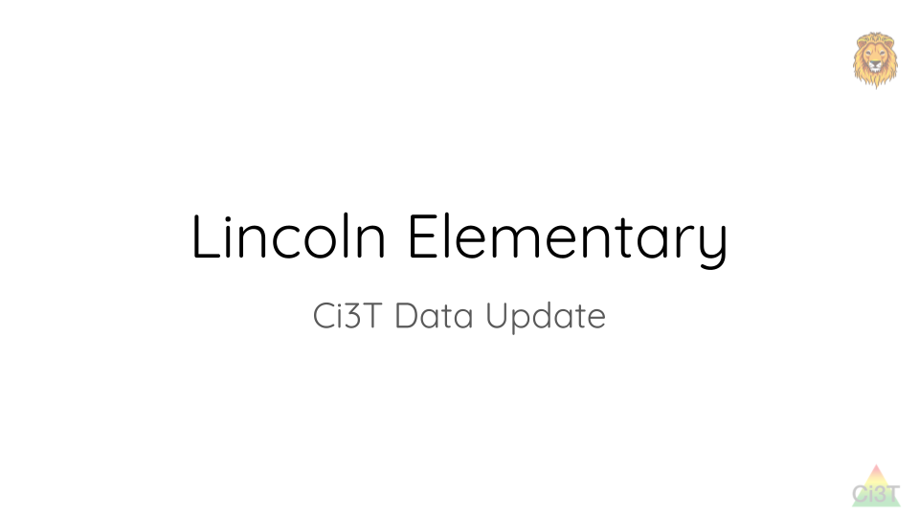
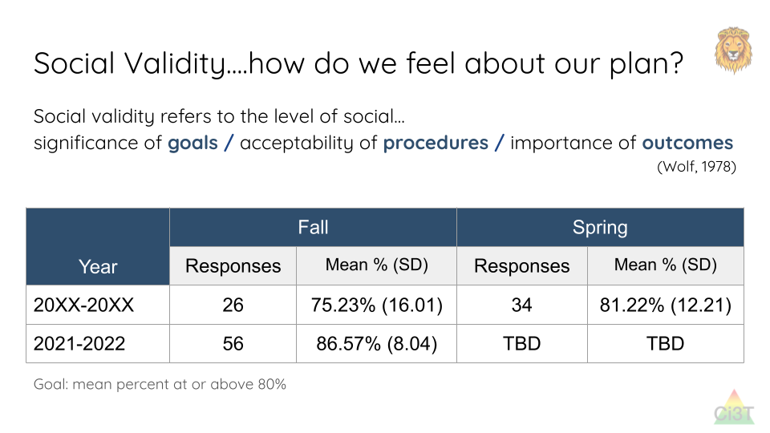
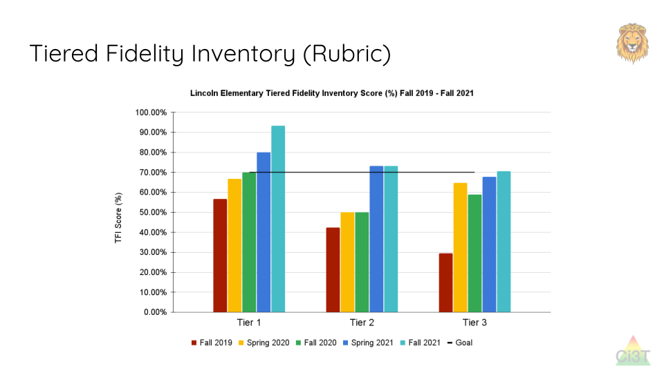
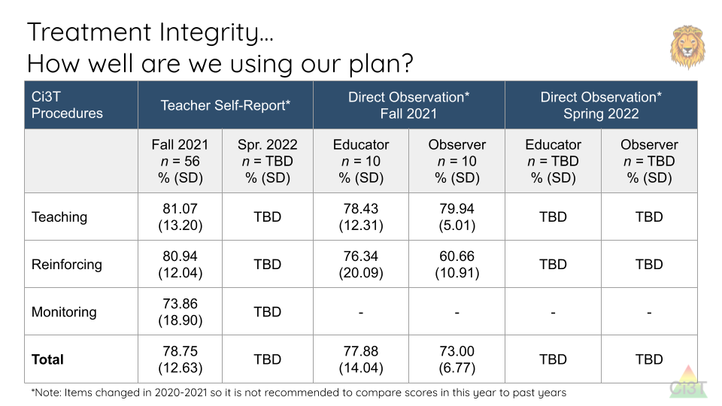
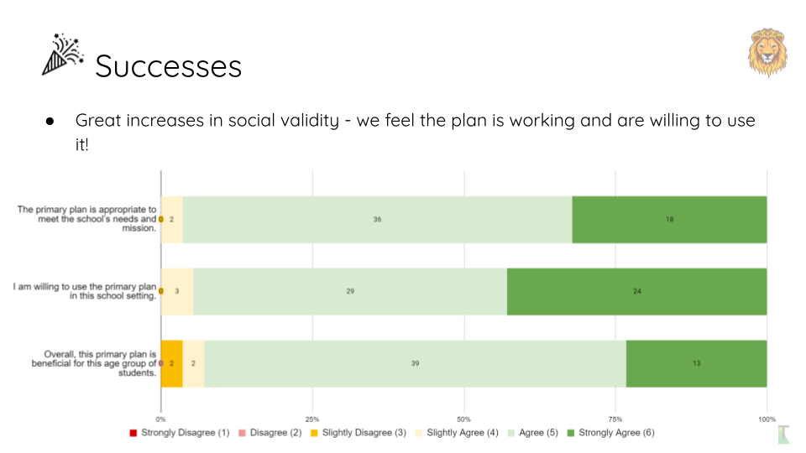
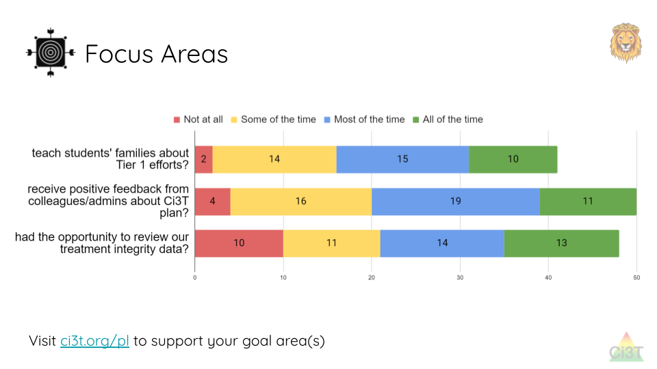
Sharing and Using Your Data

Slide 16
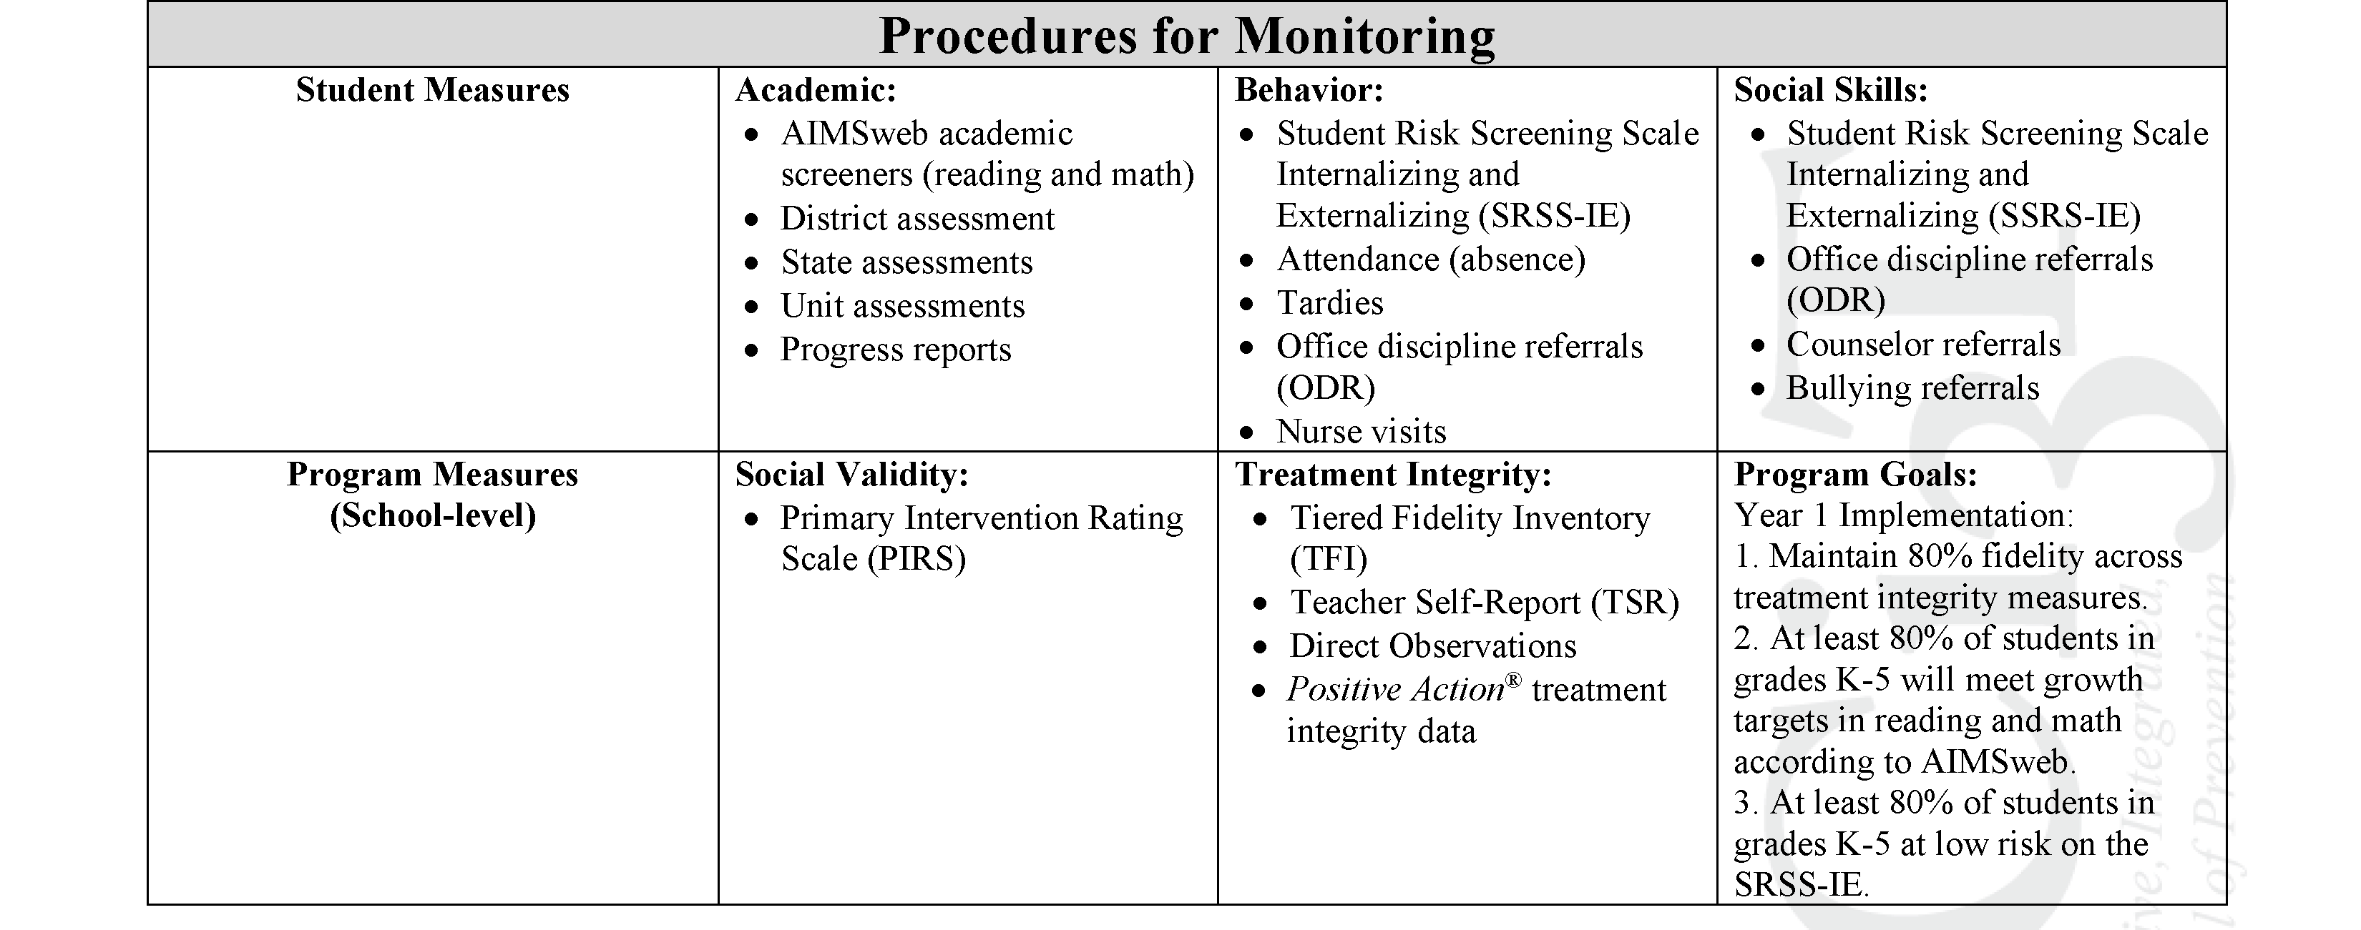
Ci3T Primary Plan
Procedures for Monitoring: Elementary
Program Measures and Goals

Slide 17
Sample Elementary Assessment Schedule
Measure | Aug | Sep | Oct | Nov | Dec | Jan | Feb | Mar | Apr | May
School Demographics
Student Demographic Information | X | X | X | X | X | X | X | X | X | X
Screening Measures
Behavior Screeners: SRSS-IE |  | X |  |  | X |  |  |  | X
Academic Screeners: AIMSWeb | X | X |  |  |  | X |  |  |  | X
Student Outcome Measures - Academic
State & District assessment |  |  |  |  |  |  |  | X | X
Progress reports |  |  |  | X |  |  | X |  |  | X
Student Outcome Measures - Behavior
Absences |  | X | X | X | X | X | X | X | X
Office discipline referrals (ODR) |  | X |  |  | X |  |  |  | X
Counselor referrals | X | X | X | X | X | X | X | X | X | X
Nurse visits | X | X | X | X | X | X | X | X | X | X
Program Measures
Primary Intervention Rating Scale |  |  | X |  |  |  |  | X
School-wide Evaluation Tool |  |  | X |  |  |  |  | X
Ci3T TI: Teacher Self-Report |  |  | X |  |  |  |  | X
Ci3T TI: Direct Observation |  |  | X |  |  |  |  | X
Second Step® Treatment Integrity |  |  | X |  |  |  |  | X
Adapted from Lane, K. L., Oakes, W. P., Cantwell, E. D., & Royer, D. J. (2018). Building and installing comprehensive, integrated, three-tiered (Ci3T) models of prevention: A practical guide to supporting school success V1.2. KOI Education. (Interactive eBook)

Slide 18
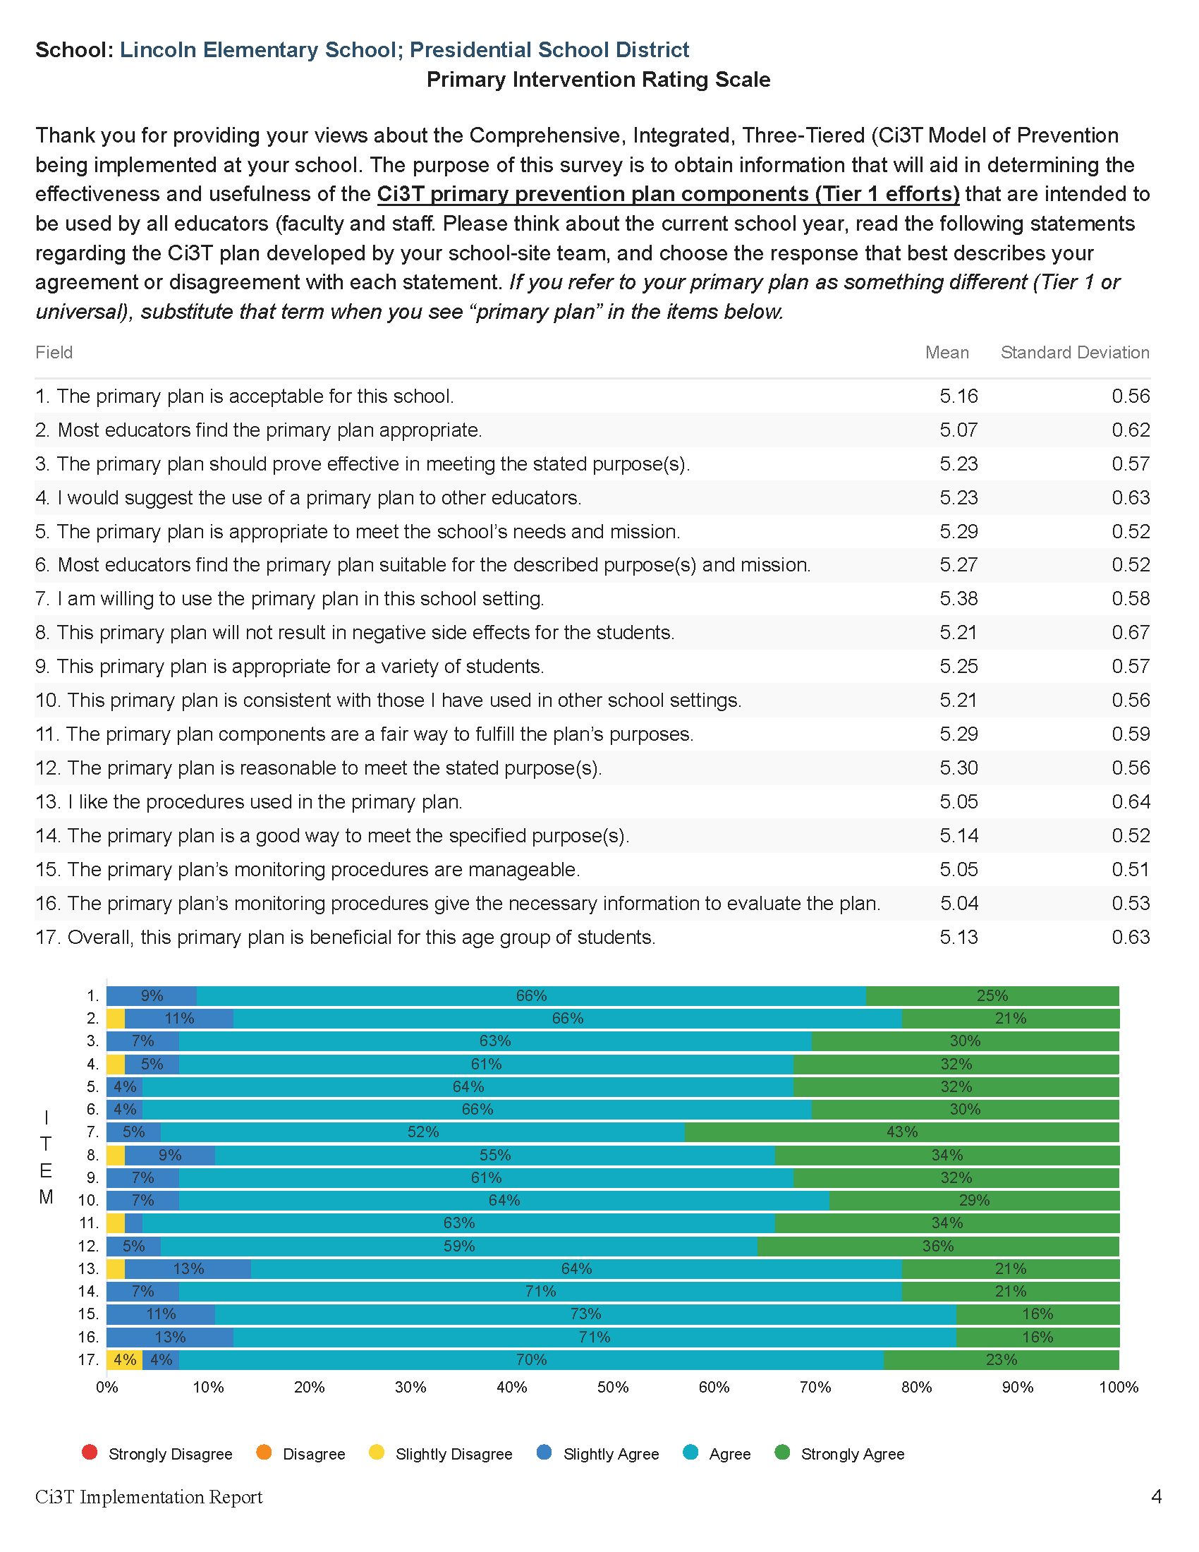

Slide 19
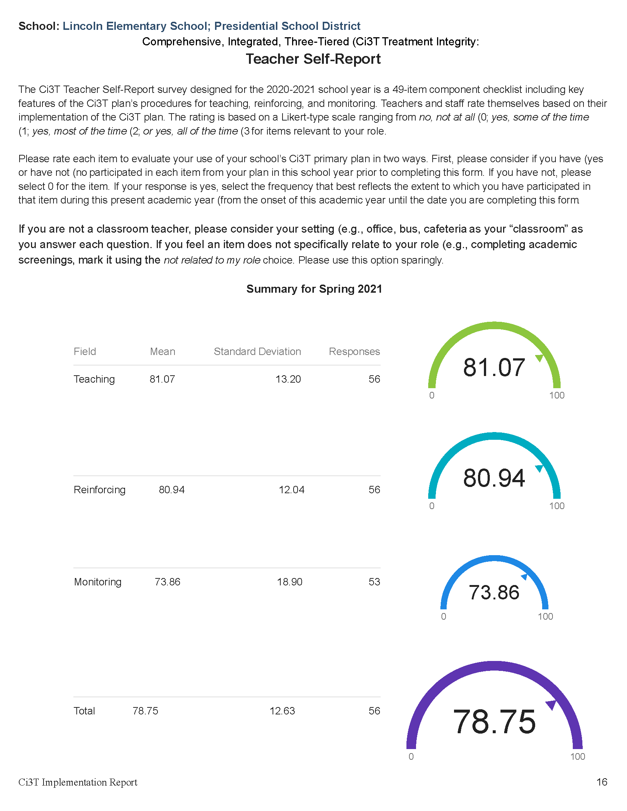

Slide 20
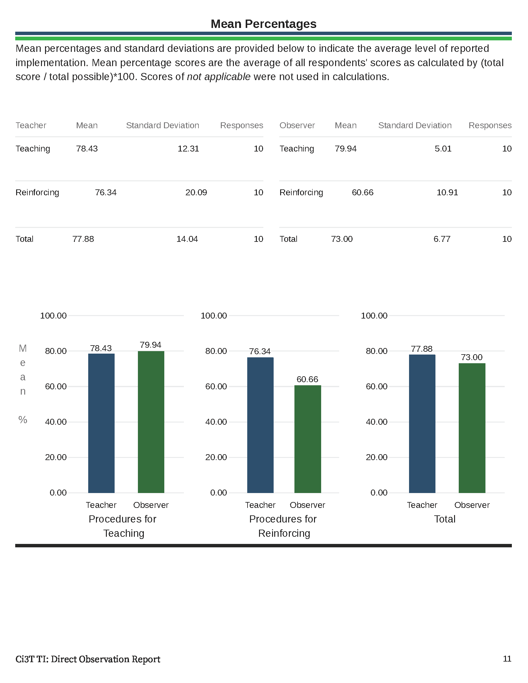

Slide 21
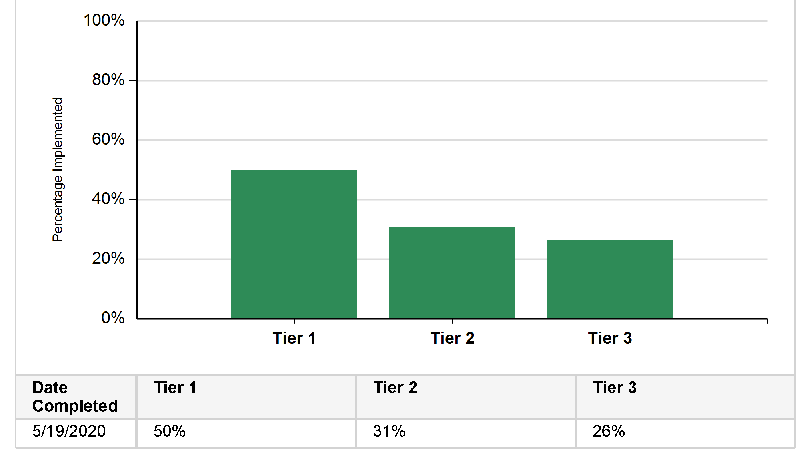
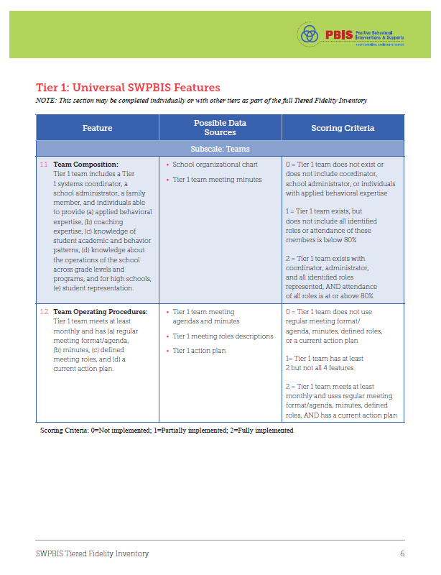
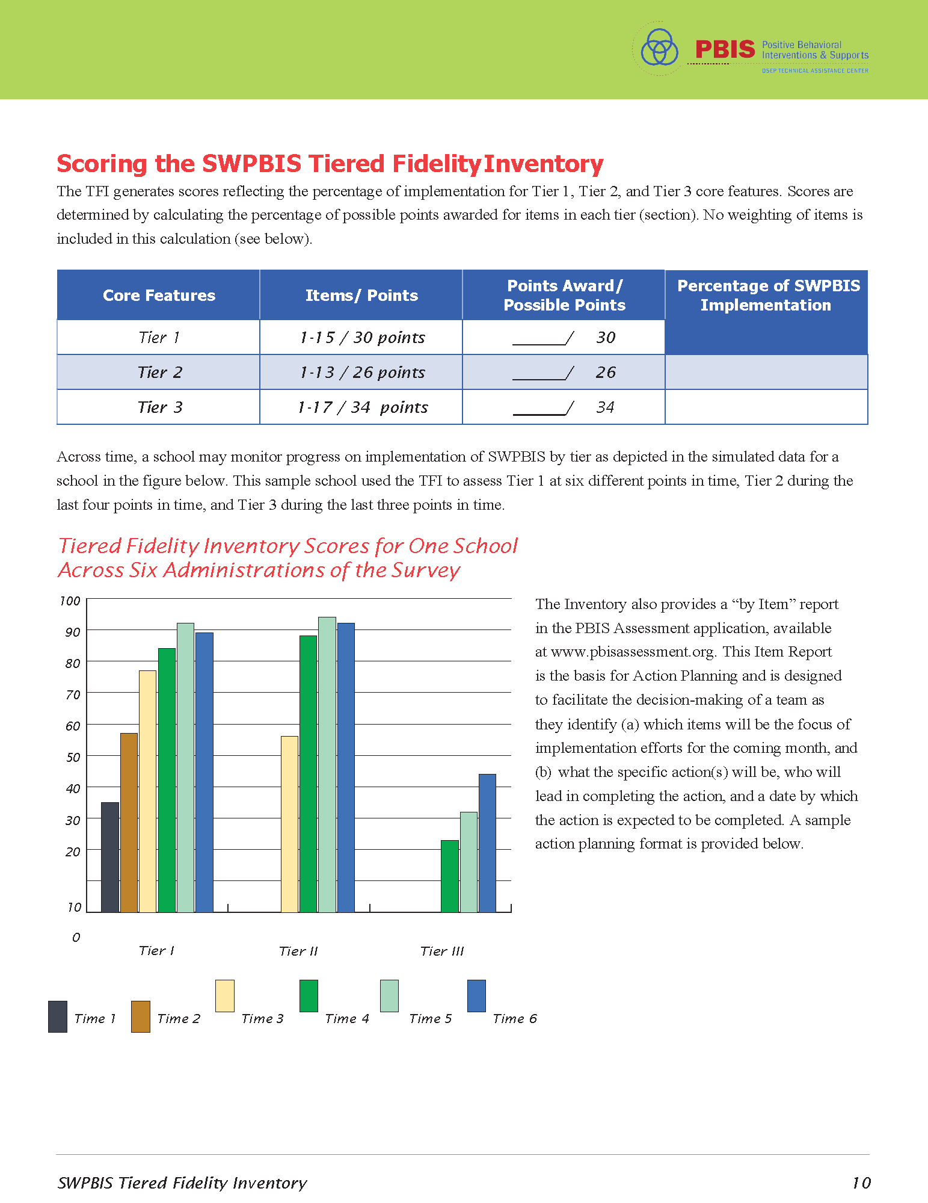

Tiered Fidelity Inventory (TFI)

Slide 22
Winter 2022
SRSS-Externalizing Results – Elementary School Level
n = 66
n = 44
n = 33
n = 35
n = 38
n = 37
n = 2
n = 17
n = 32
n = 32
n = 69
n = 74
n = 128
n = 109
n = 97
n = 92
n = 101
n = 125
n = 305
n = 297
n = 287
n = 332
n = 309
n = 263
n = 294
n = 346
n = 355
Notes:
***note to presenter*** If you would like to feature middle or high school data – hide the elementary slides (22-23) and unhide the middle or high school slides
If you would like to update this slide with data from your school or district- Fill in <year> based on current academic year. This is located in column A of the data sheet. Edit by right clicking and selecting “Edit data”.

Slide 23
Winter 2022
SRSS-Internalizing Results – Elementary School Level
n = 75
n = 46
n = 29
n = 41
n = 35
n = 25
n = 16
n = 40
n = 38
n = 27
n = 65
n = 69
n = 59
n = 48
n = 69
n = 72
n = 87
n = 86
n = 334
n = 337
n = 335
n = 354
n = 354
n = 328
n = 285
n = 346
n = 351
Notes:
If you would like to update this slide with data from your school or district- Fill in <year> based on current academic year. This is located in column A of the data sheet. Edit by right clicking and selecting “Edit data”.

Slide 24
Winter 2022
SRSS-Externalizing Results – Middle School Level
n = 21
n = 27
n = 27
n = 13
n = 6
n = 17
n = 26
n = 47
n = 96
n = 68
n = 71
n = 53
n = 42
n = 54
n = 491
n = 448
n = 383
n = 346
n = 445
n = 518
n = 527
Notes:
If you would like to update this slide with data from your school or district- Fill in <year> based on current academic year. This is located in column A of the data sheet. Edit by right clicking and selecting “Edit data”.

Slide 25
Winter 2022
SRSS-Internalizing Results – Middle School Level
n = 79
n = 52
n = 54
n = 60
n = 23
n = 44
n = 42
n = 41
n = 37
n = 40
n = 32
n = 45
n = 30
n = 31
n = 55
n = 70
n = 306
n = 312
n = 356
n = 342
n = 349
n = 351
n = 432
n = 229
Notes:
If you would like to update this slide with data from your school or district- Fill in <year> based on current academic year. This is located in column A of the data sheet. Edit by right clicking and selecting “Edit data”.

Slide 26
Winter 2022
SRSS-Externalizing Results – High School Level
n = 47
n = 72
n = 36
n = 36
n = 40
n = 8
n = 17
n = 38
n = 119
n = 113
n = 47
n = 137
n = 134
n = 114
n = 90
n = 65
n = 1259
n = 1280
n = 1188
n = 994
n = 447
n = 717
n = 750
n = 920
Notes:
If you would like to update this slide with data from your school or district- Fill in <year> based on current academic year. This is located in column A of the data sheet. Edit by right clicking and selecting “Edit data”.

Slide 27
Winter 2022
SRSS-Internalizing Results – High School Level
n = 165
n = 106
n = 83
n = 99
n = 55
n = 65
n = 52
n = 87
n = 73
n = 65
n = 50
n = 34
n = 59
n =48
n = 56
n = 167
n = 1111
n = 1307
n = 1109
n = 1000
n = 445
n = 691
n = 710
n = 923
Notes:
If you would like to update this slide with data from your school or district- Fill in <year> based on current academic year. This is located in column A of the data sheet. Edit by right clicking and selecting “Edit data”.

Slide 28
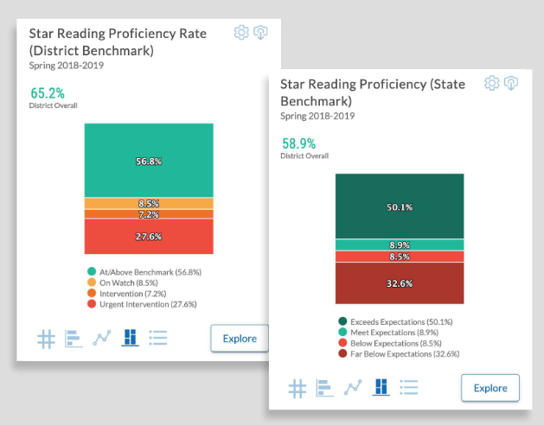
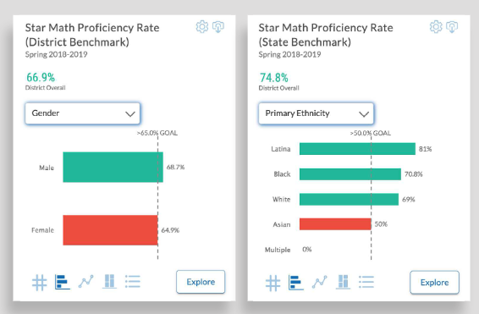

Academic Screening
Notes:
Might consider beginning by looking at data broadly
compared against district or state benchmarks
Subgroup analyses

Slide 29
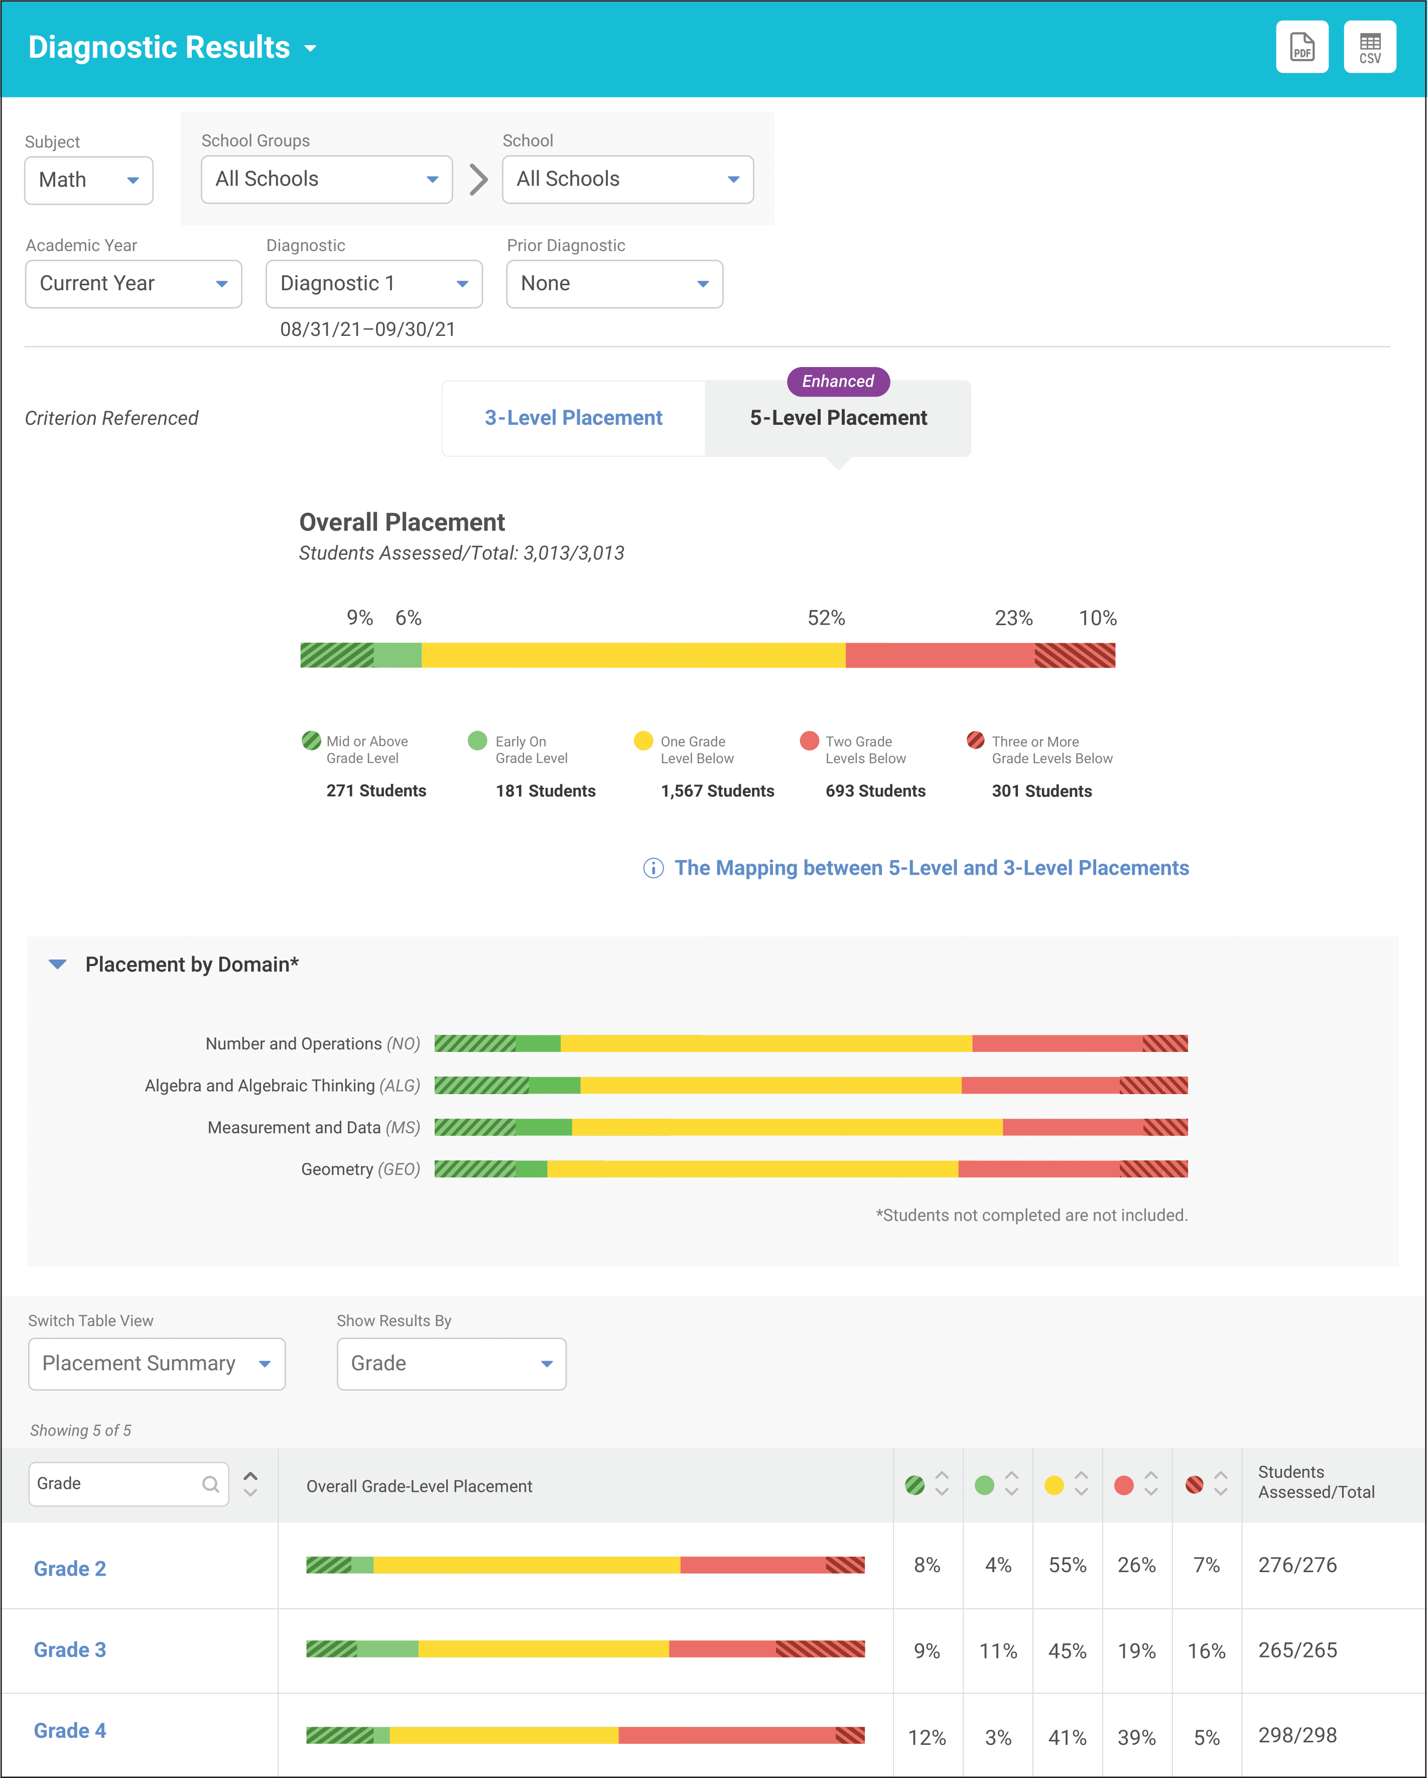
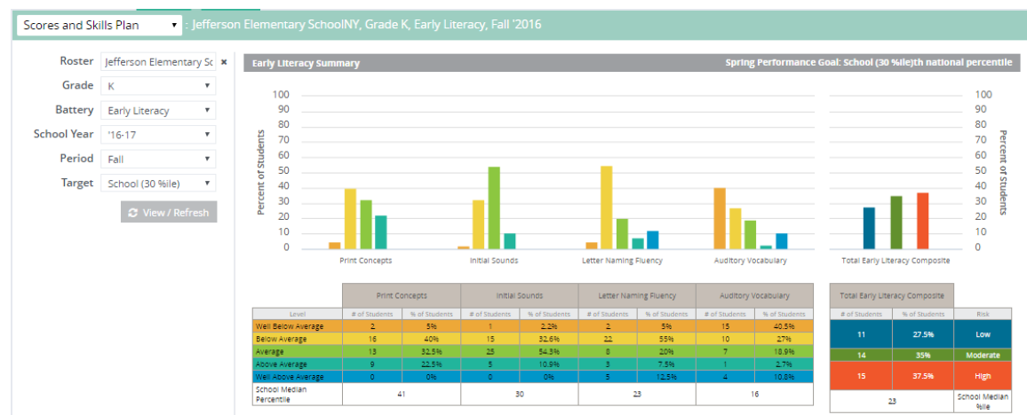
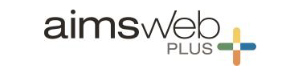

Academic Screening
Notes:
Then, might zoom in at the grade-level looking at distribution across risk category, mastery, or growth

Slide 32
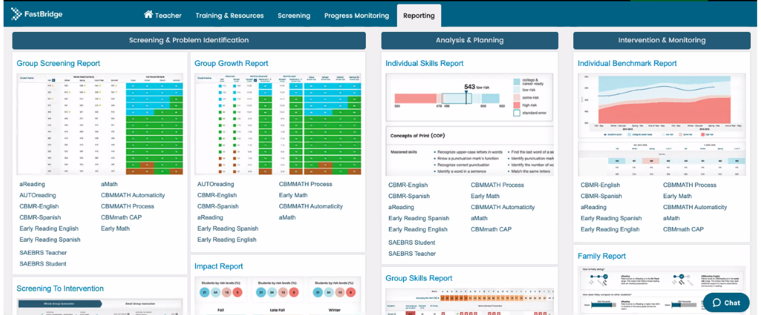
Academic Screening

Slide 33
Academic Screening

Slide 34
Academic Screening

Slide 35
Integrating Data Sources
Academic screening
Behavioral screening
Other school-wide data
Attendance
Office discipline referrals
Nurse visits
Common formative assessments
Remember treatment integrity and social validity data – is Tier 1 in place?

Slide 36
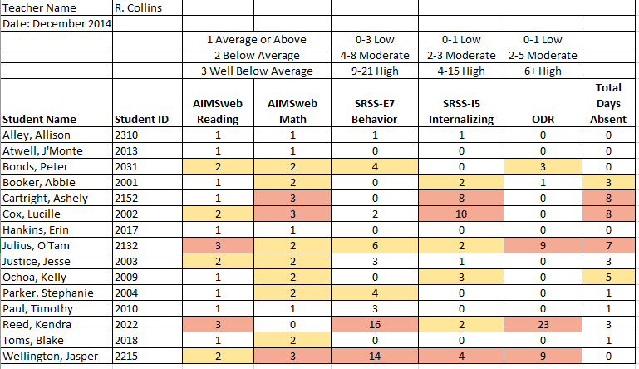
Consider this class….

Slide 37
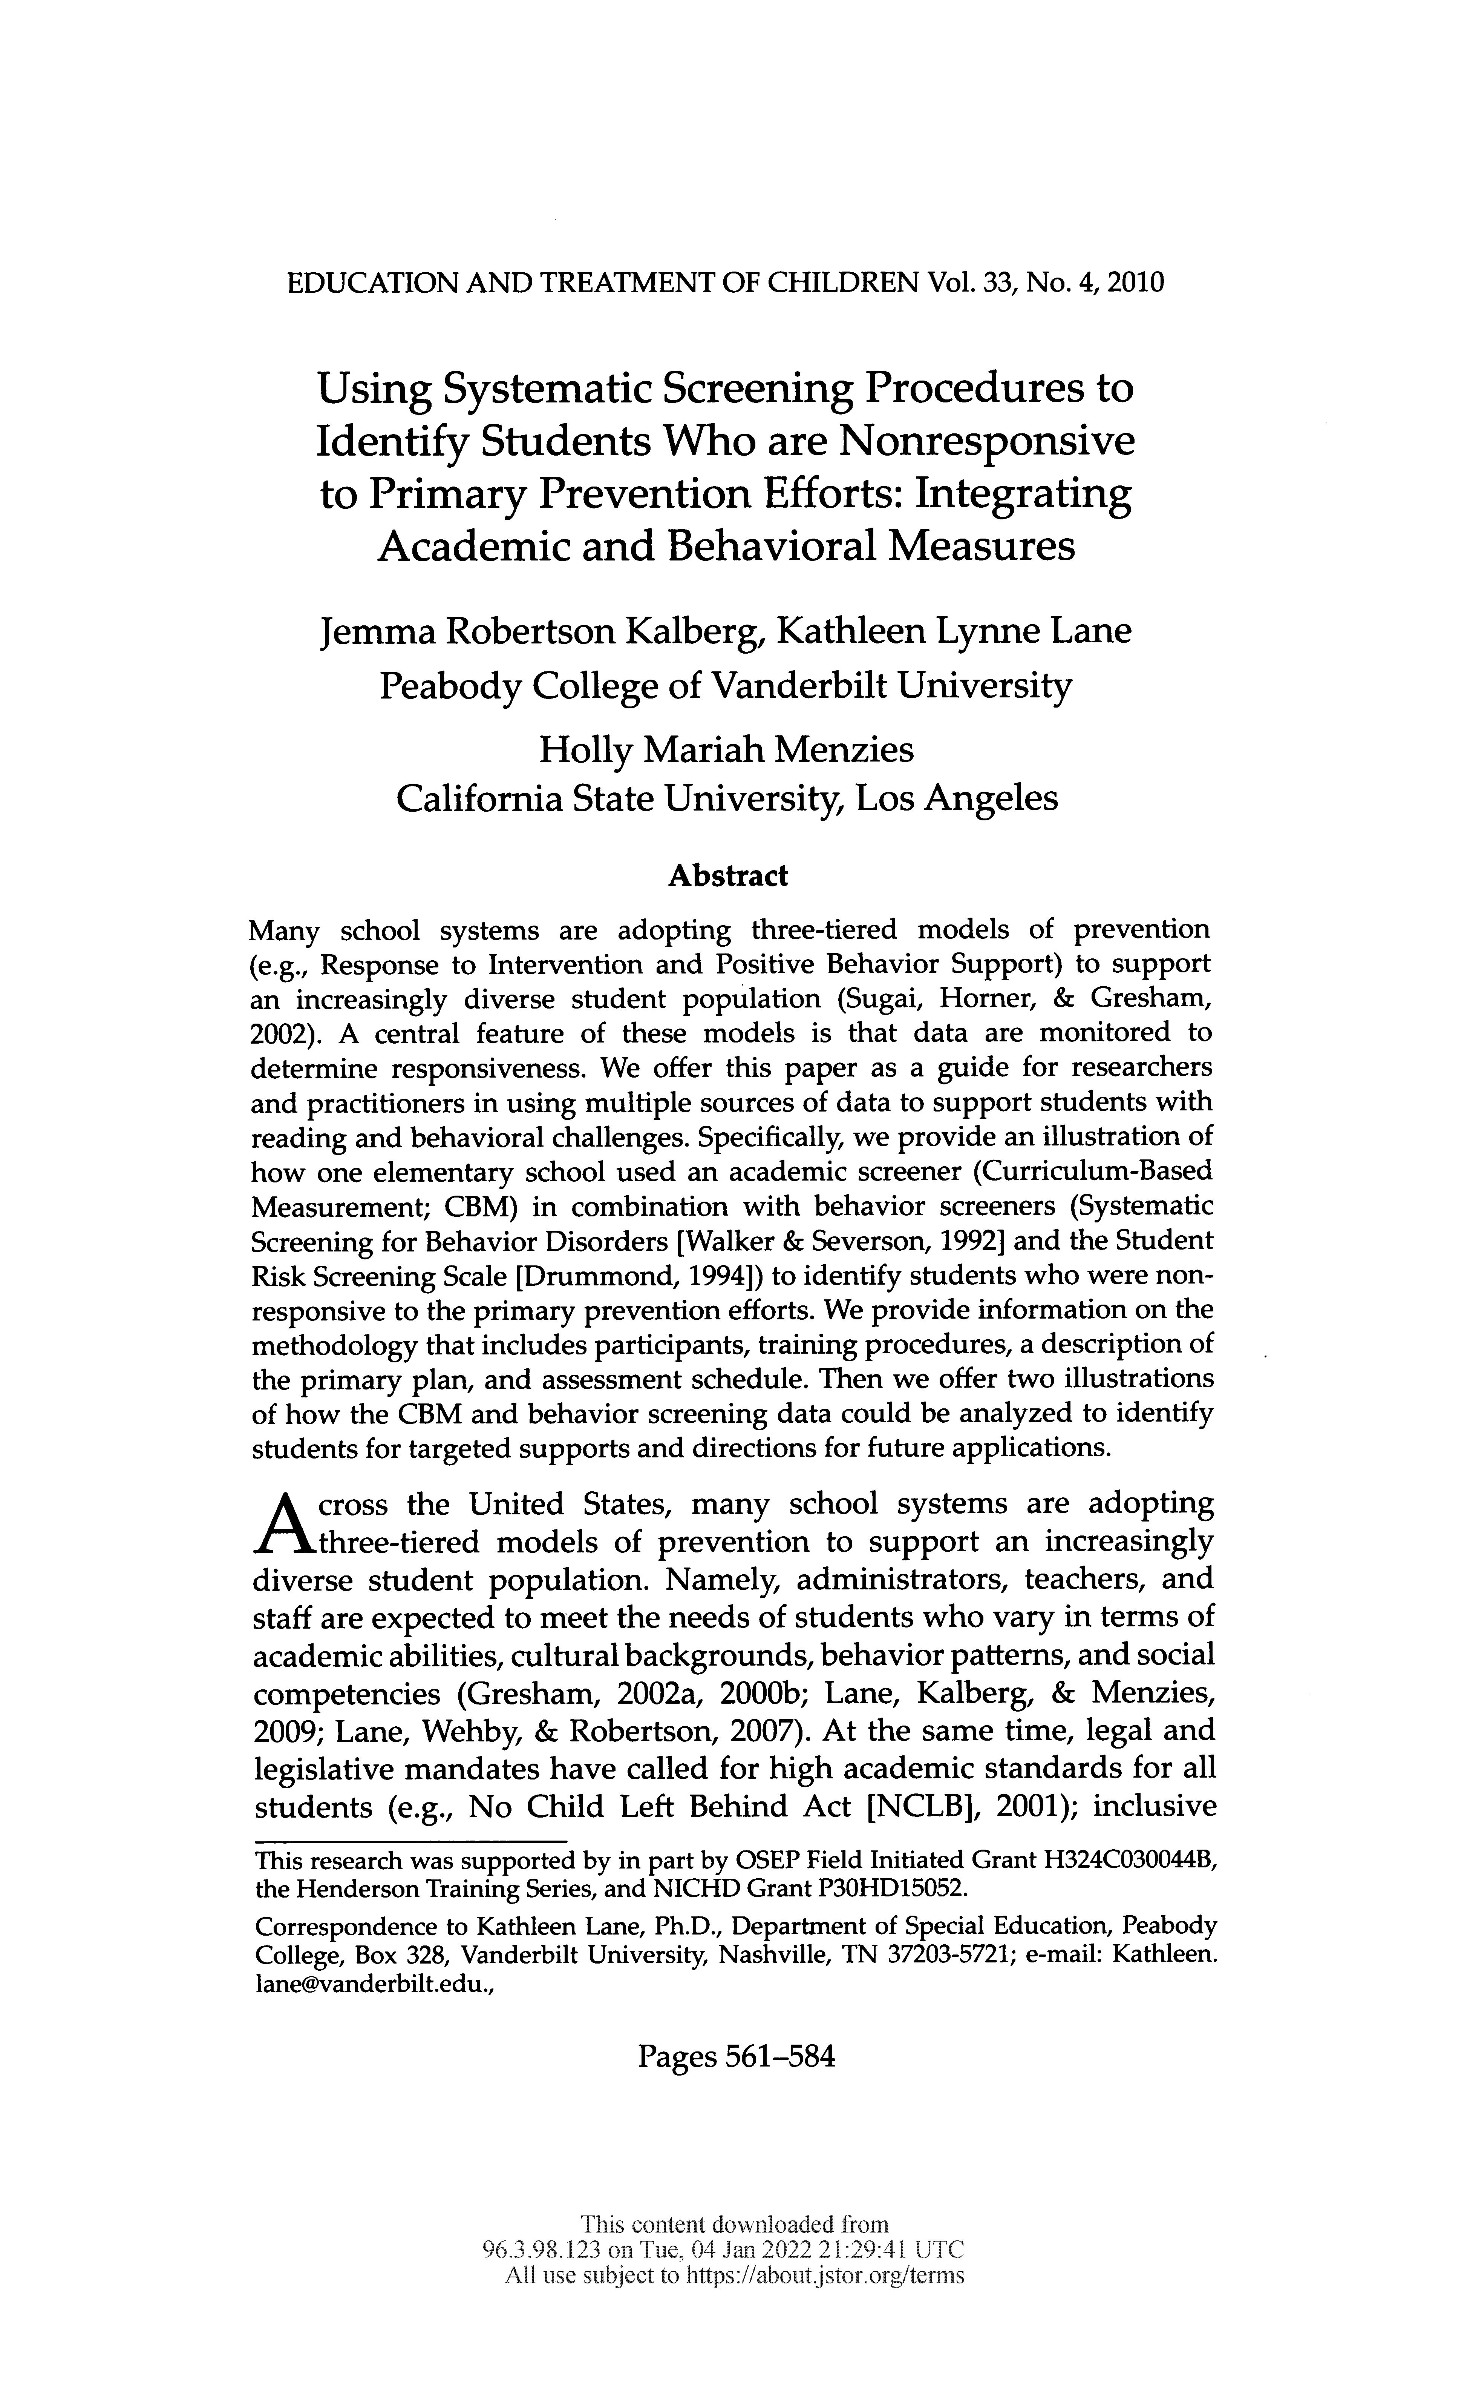
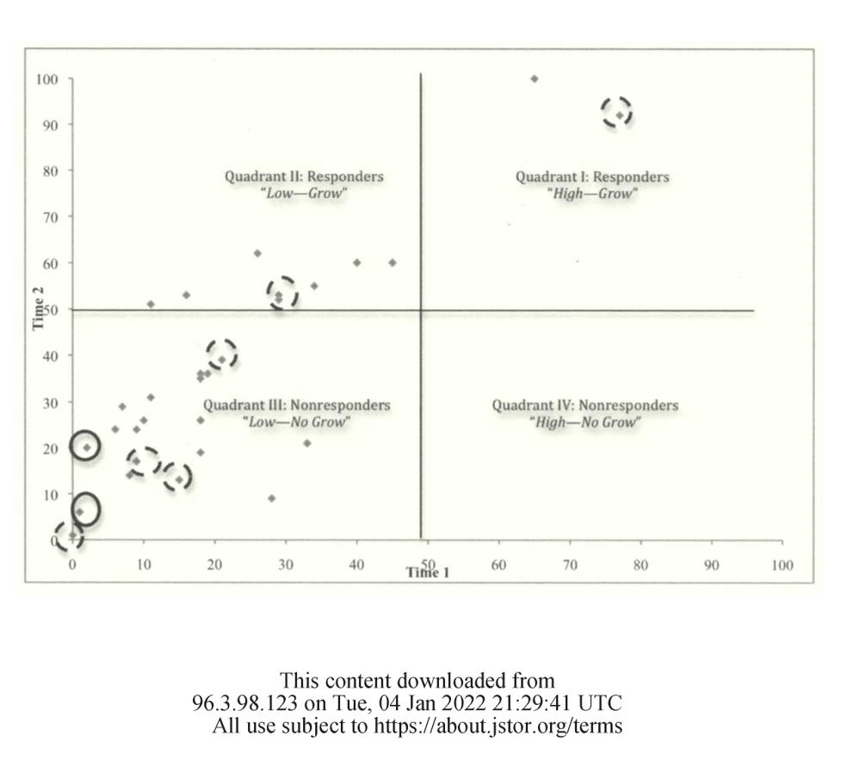

Slide 38
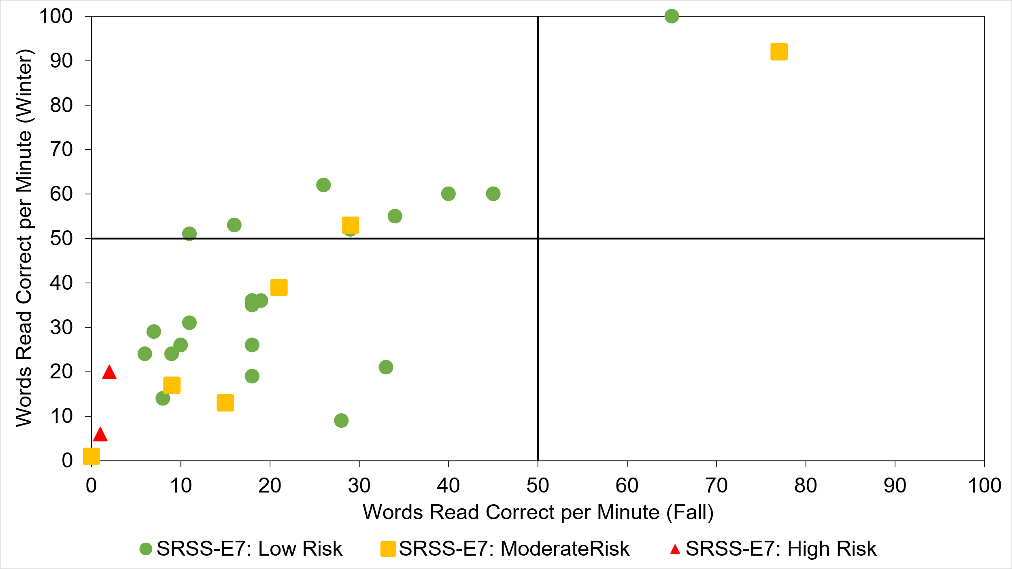
Quadrant 2: Responsive
“Low—Grow”
Quadrant 1: Responsive
“High—Grow”
Quadrant 3: Not responding
“Low—No Grow”
Quadrant 4: Not responding
“High—No Grow”

Slide 39
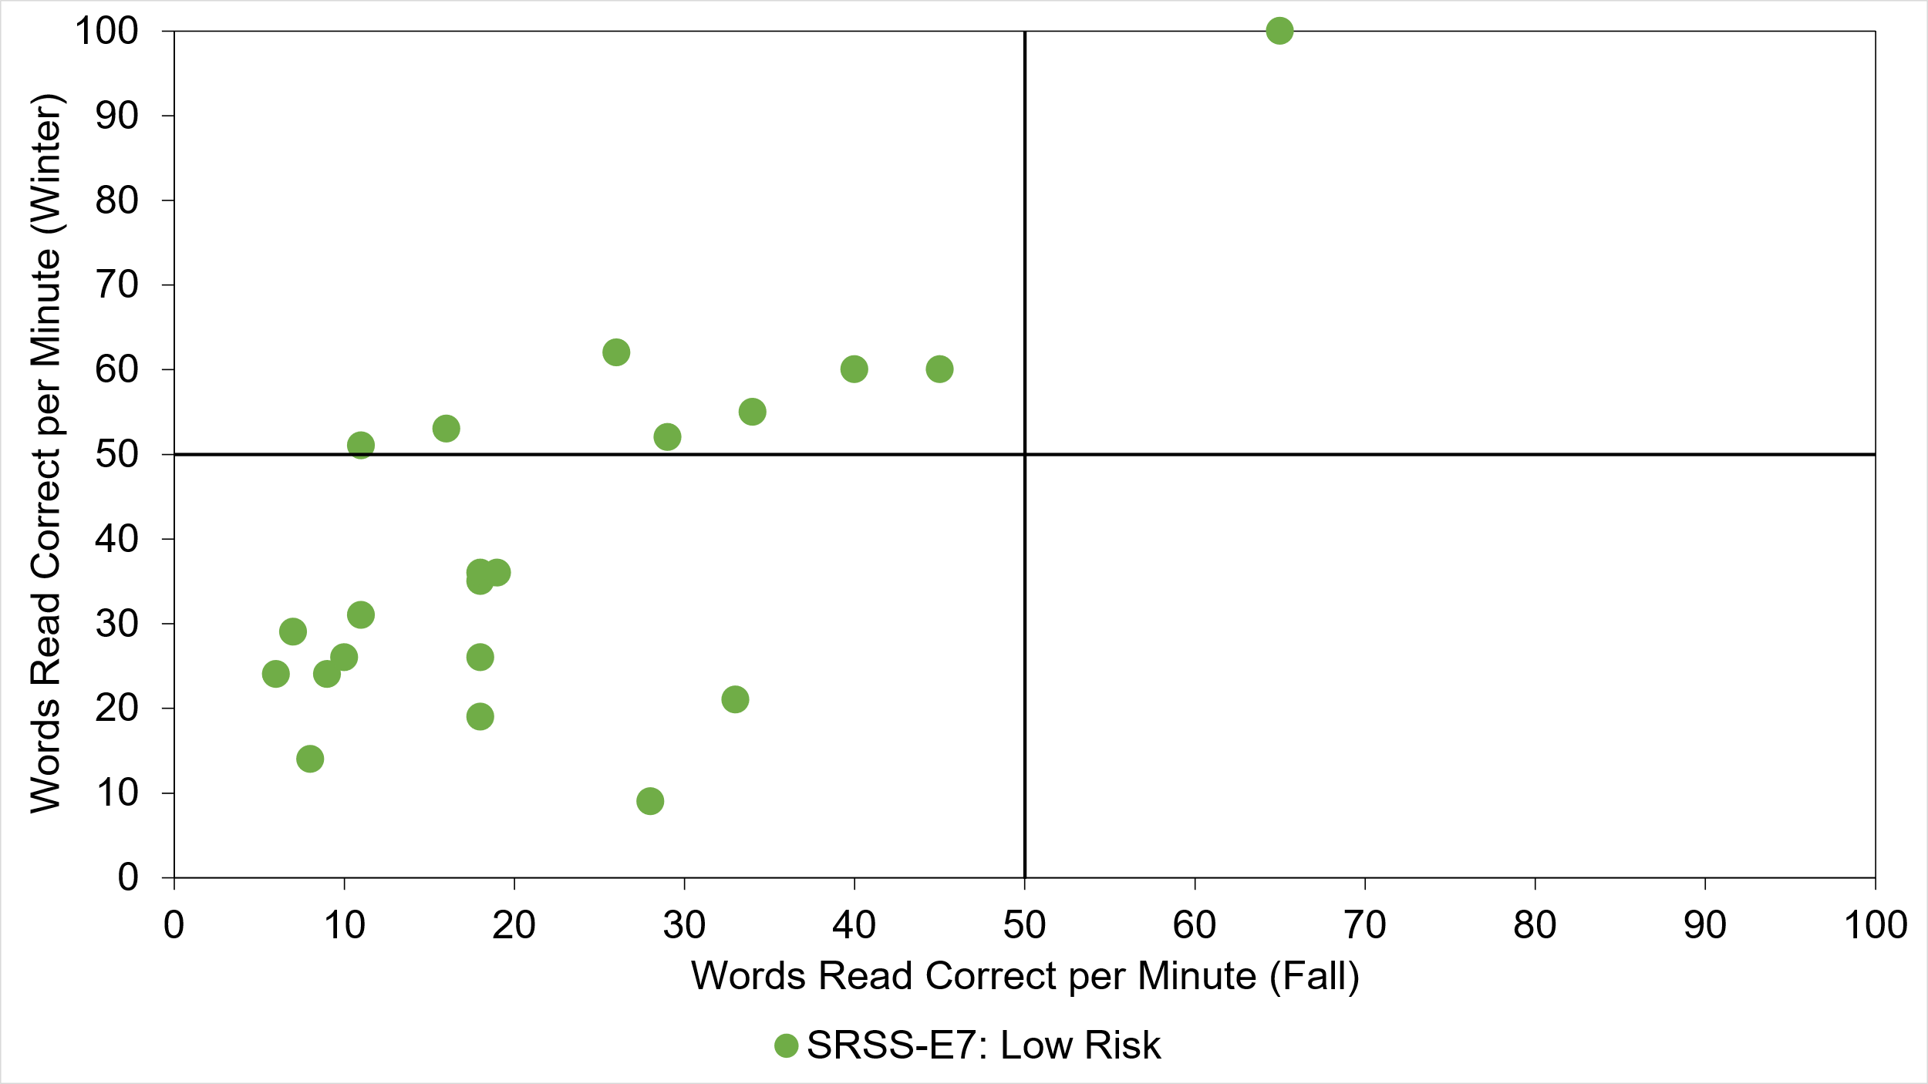
Quadrant 2: Responsive
“Low—Grow”
Quadrant 1: Responsive
“High—Grow”
Quadrant 3: Not responding
“Low—No Grow”
Quadrant 4: Not responding
“High—No Grow”

Slide 40
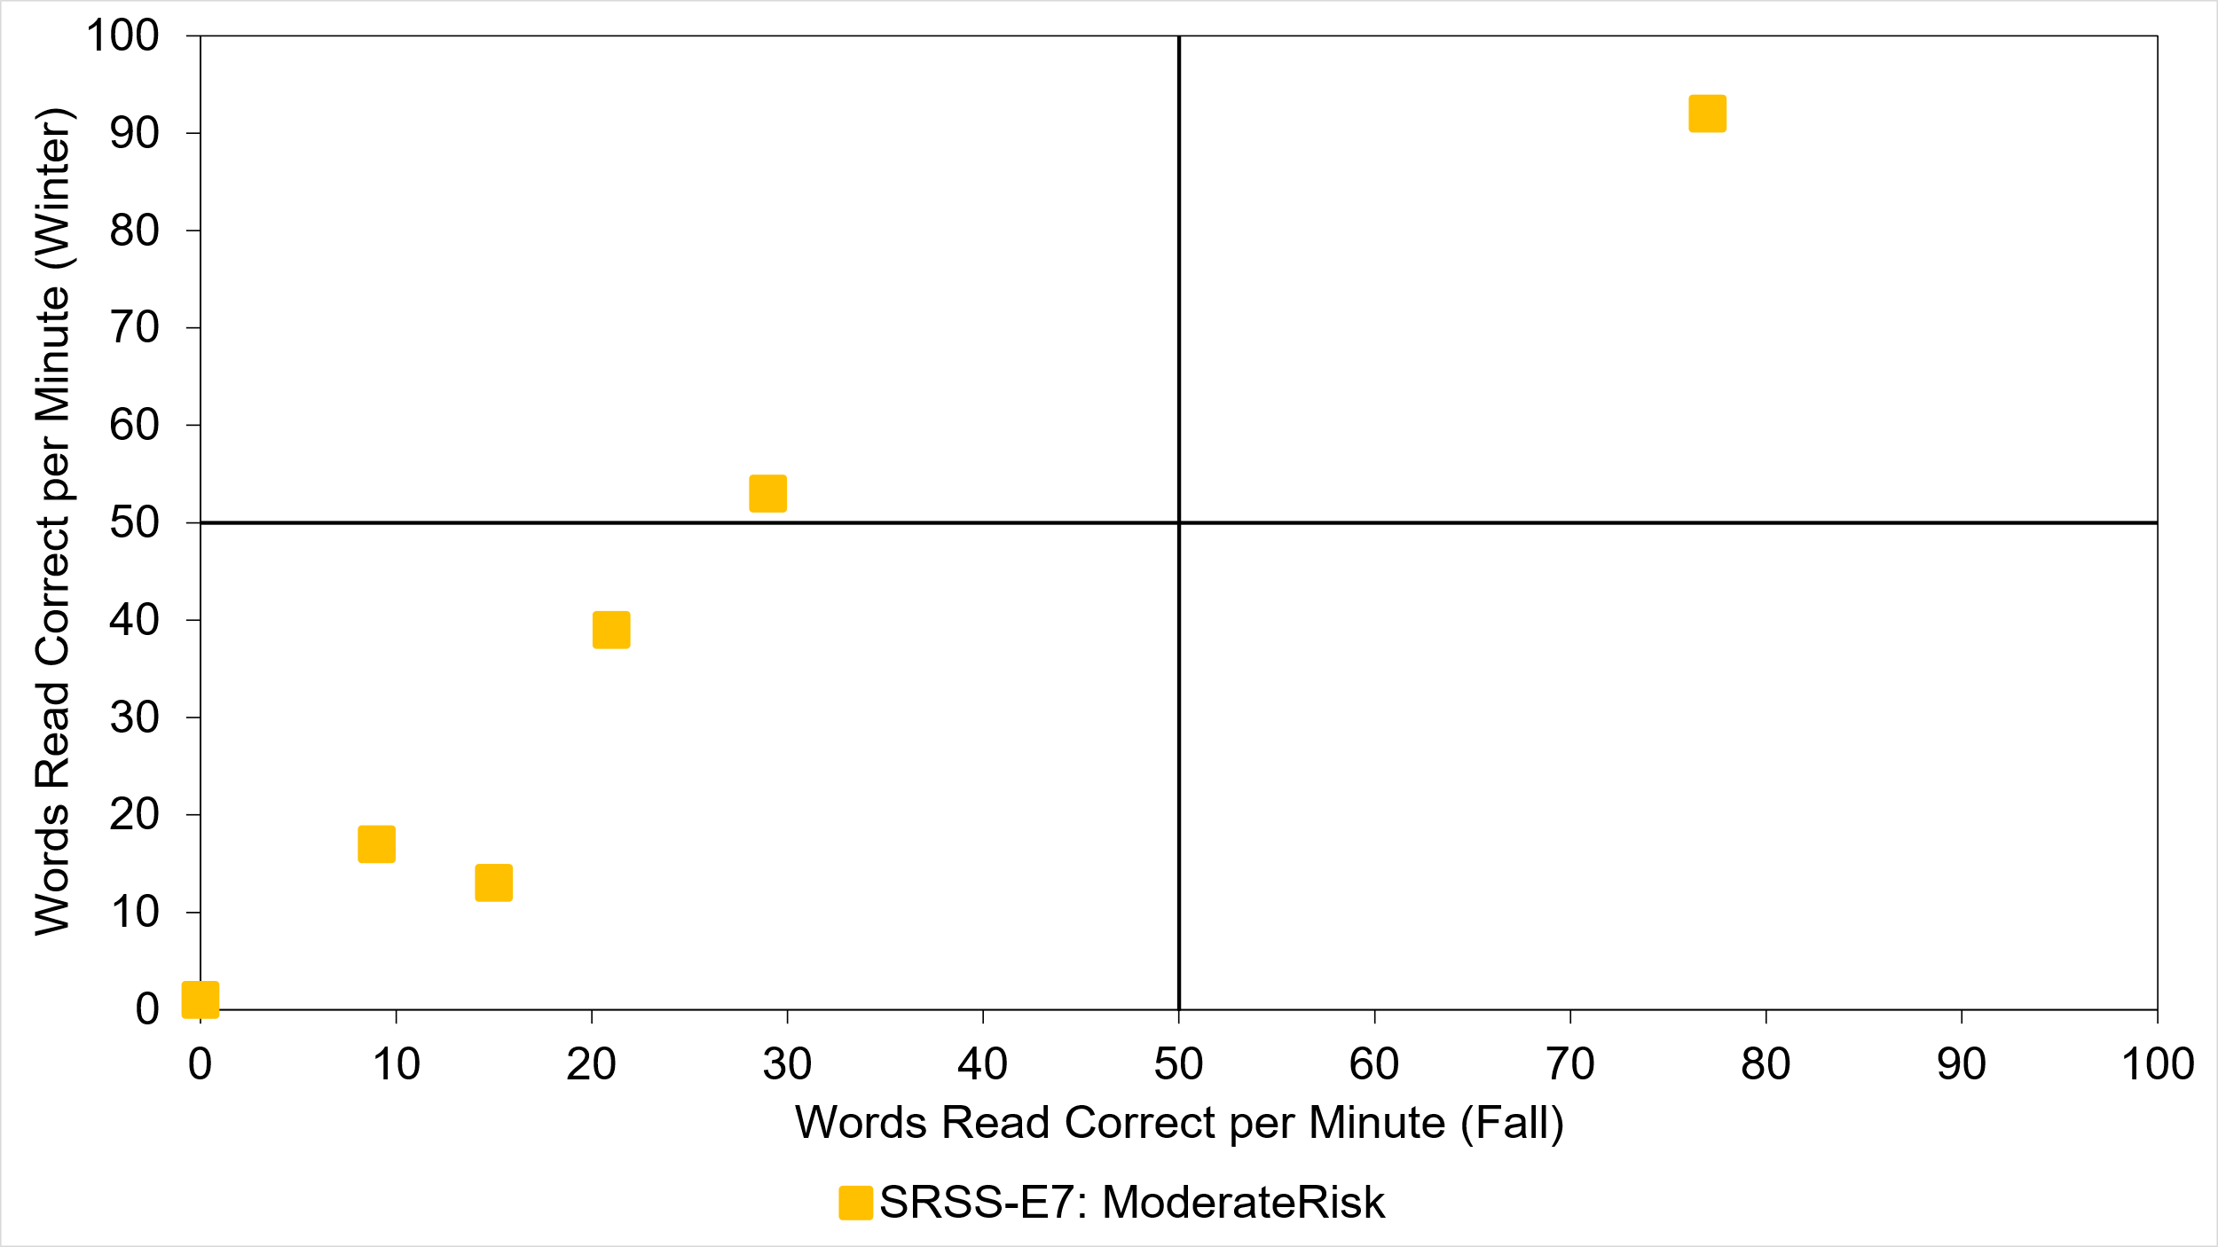
Quadrant 2: Responsive
“Low—Grow”
Quadrant 1: Responsive
“High—Grow”
Quadrant 3: Not responding
“Low—No Grow”
Quadrant 4: Not responding
“High—No Grow”

Slide 41
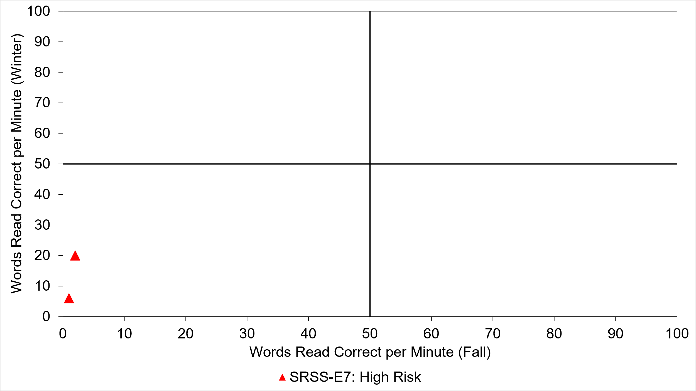


Quadrant 2: Responsive
“Low—Grow”
Quadrant 1: Responsive
“High—Grow”
Quadrant 3: Not responding
“Low—No Grow”
Quadrant 4: Not responding
“High—No Grow”

Slide 42
Quadrant 2: Responsive
“Low—Grow”
Quadrant 1: Responsive
“High—Grow”
Quadrant 3: Not responding
“Low—No Grow”
Quadrant 4: Not responding
“High—No Grow”

Slide 43

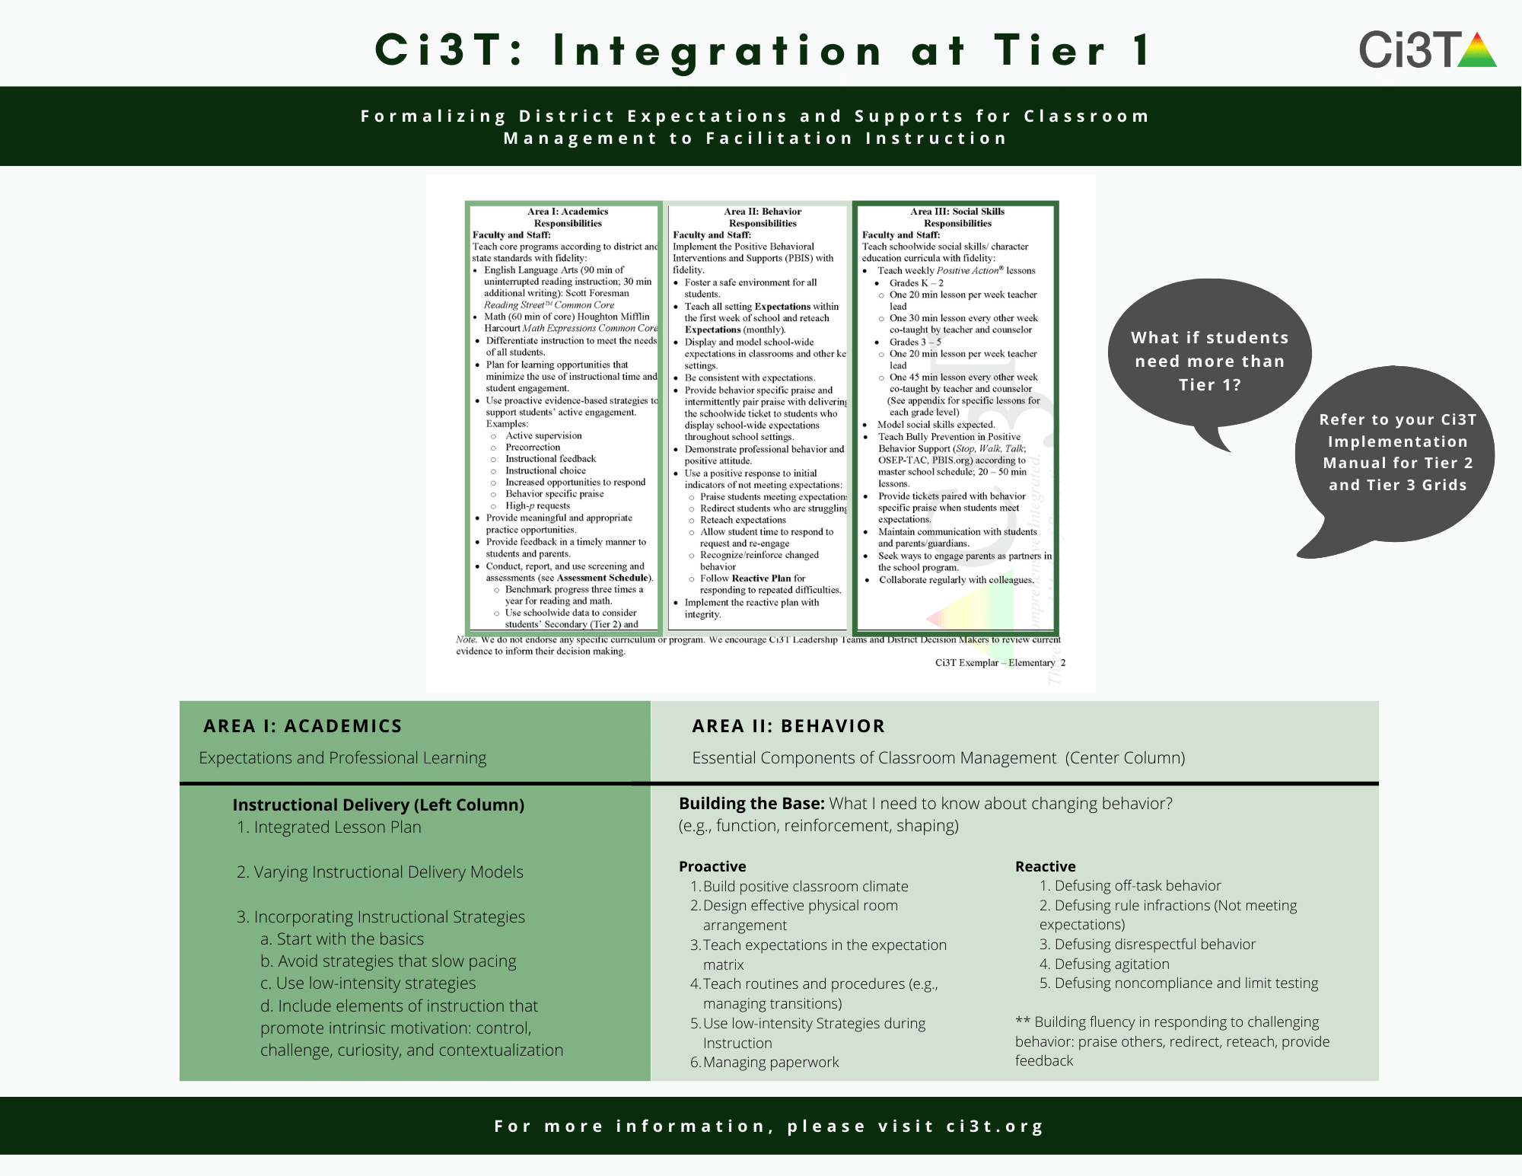







What if we need to focus on Tier 1?
Structured Literacy

Slide 44
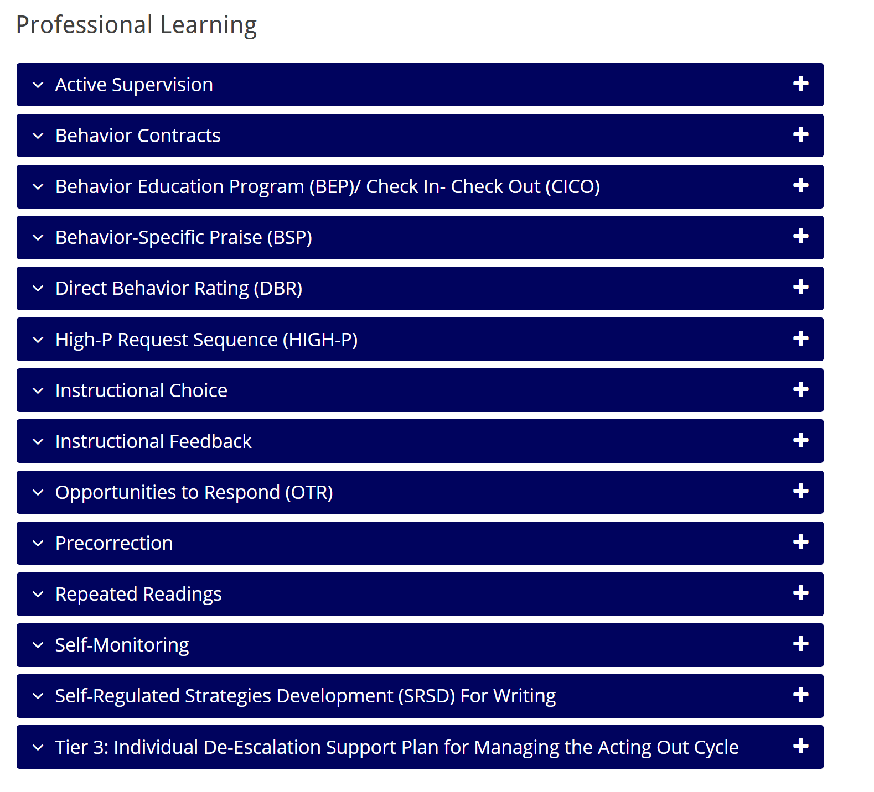

Solutions-based planning
https://www.ci3t.org/pl
Identify areas of strength
Identify focus areas
Let the data drive the conversation
Connect to available resources for professional learning

Slide 45
Integrated Lesson Planning at Tier 1

Slide 47
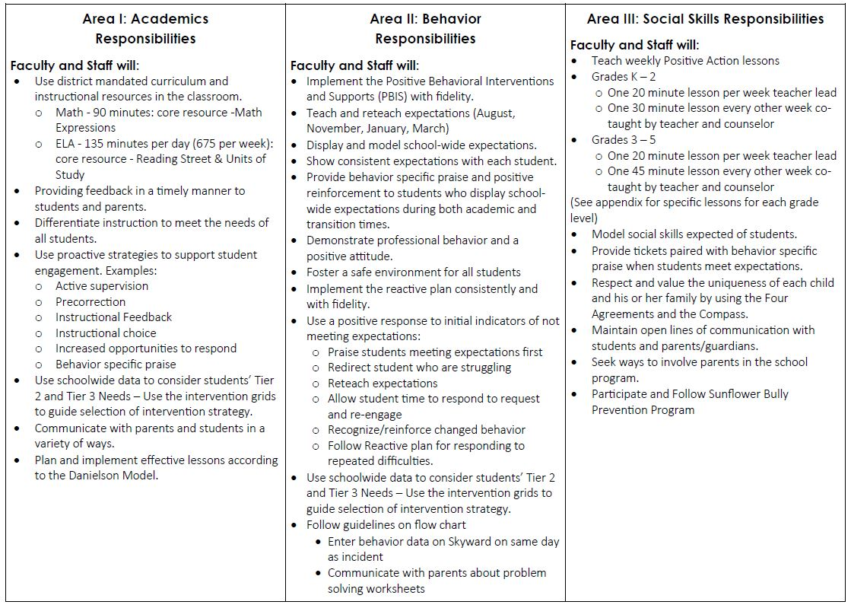
Ci3T Primary (Tier 1) Plan: Procedures for
Teaching
Ci3T Primary (Tier 1) Plan: Procedures for Reinforcing
Ci3T Primary (Tier 1) Plan: Procedures for Monitoring

Slide 48
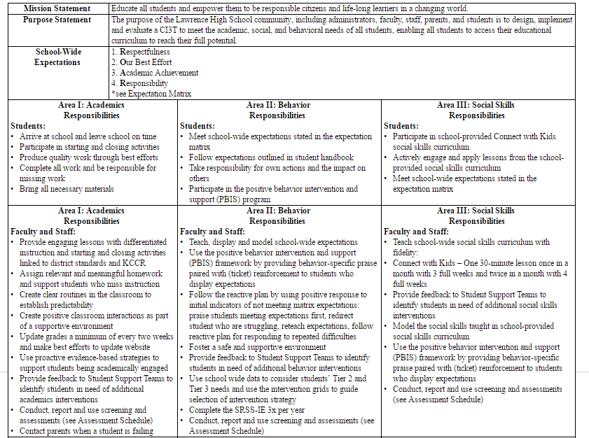
Teach, display, and model school-wide expectations
Teach school-wide social skills; model social skills

Slide 49
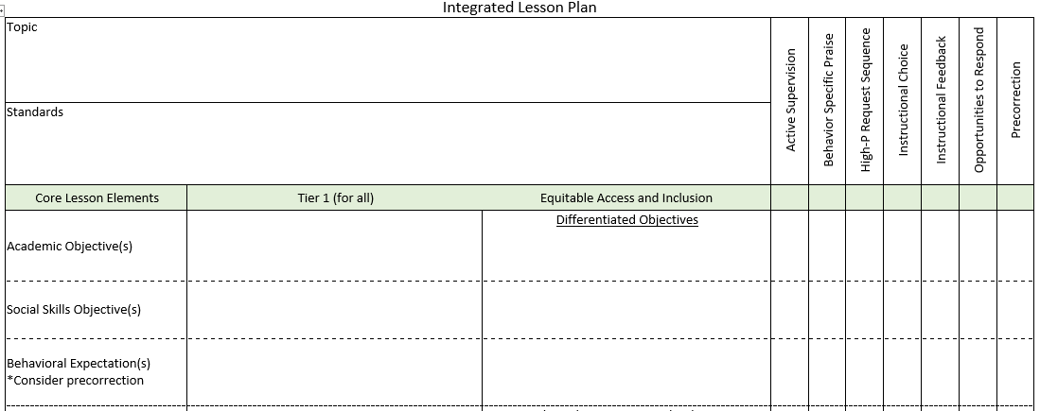
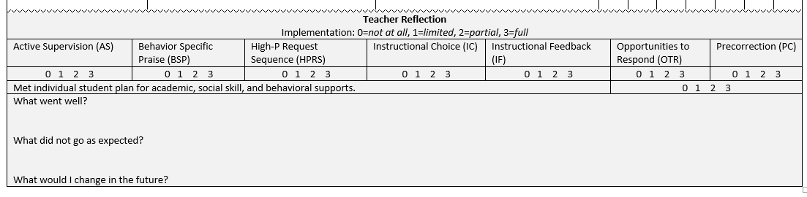
Planning for an integrated approach
Notes:
Identify the academic learning objectives.
Identify the social skills objectives.
Selected the behavioral expectations needed

Slide 50
Student deficits in either academics or behavior puts them at risk for long-term negative outcomes.
Academic
Difficulties
Behavioral or Social Difficulties
Source: Morgan, P. L., Farkas, G., Tufis, P. A., & Sperling, R. A. (2008). Are reading and behavior problems risk factors for each other? Journal of Learning Disabilities, 41, 417-436.

Slide 51
Clearly Define Objectives
Identify the academic learning objectives and standards for the lesson.
Plan lesson activities.
Consider what social skill(s) have been taught and/or are needed for successful participation by all.
Select the specific behavioral expectations that will be important for prosocial lesson engagement.
Notes:
For example,
Does the lesson require team work? Discussions from multiple perspectives? Sharing materials? Use of digital media? Use of classroom materials?
Social skills needed to engage in those activities… respect ideas different than you own, seek to understand the perspective of others, take turns, offer your own ideas, listen to others, use of reliable resources online,
Behaviors: treat materials with care, look at the speaker, one speaker at a time, keep unrelated materials put away, ask for a turn, ask questions to understand others, include only your original work or properly cited work in your assignment.

Slide 52

Embedding Social Skill Objectives in Academic Instruction
Linking social skills taught to classroom activities
Promote generalization
Maximize engagement
Notes:
1 minute video
Second Step - https://www.youtube.com/watch?v=gjaZ05kKQWc

Slide 53
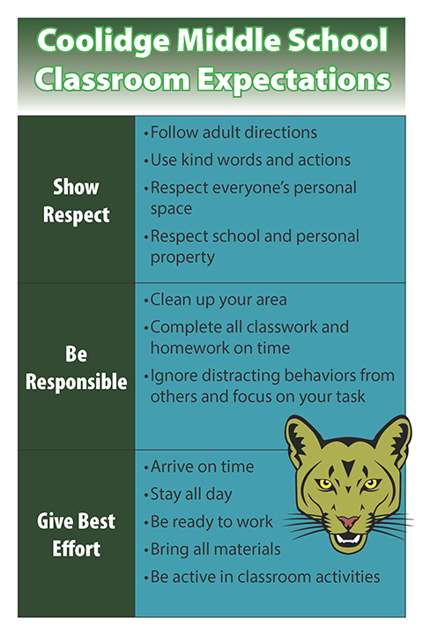
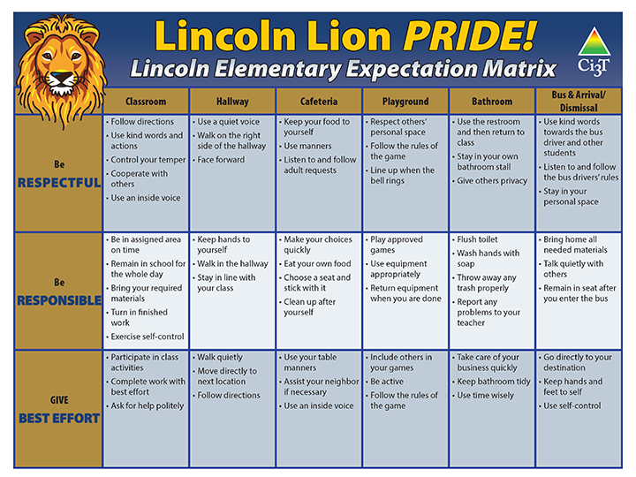
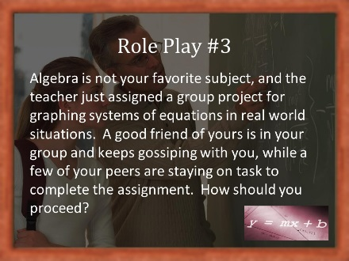
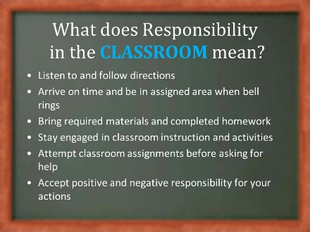
Teaching and Re-teaching Behavior Expectations

Slide 55

















Let’s Talk!
In what ways does your school take an integrated approach to supporting students’ academic, behavioral, and social needs?
Where and how might you make integrations stronger within your own classroom or school?
How do your data support areas to target, and how can you share those data with stakeholders (e.g., faculty and staff, district administrators, families)?
Notes:
15-min timer

Slide 56
Planning and Implementing Tier 2 Interventions

Slide 57

Secondary (Tier 2) Intervention Grids

Slide 58
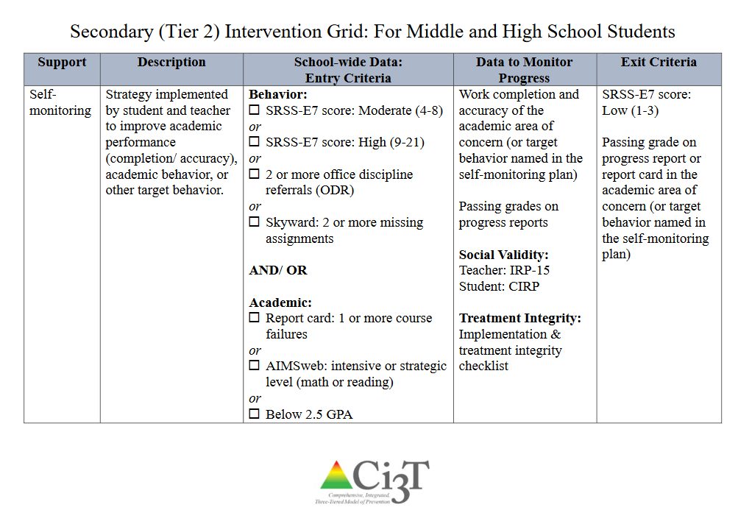

Slide 59
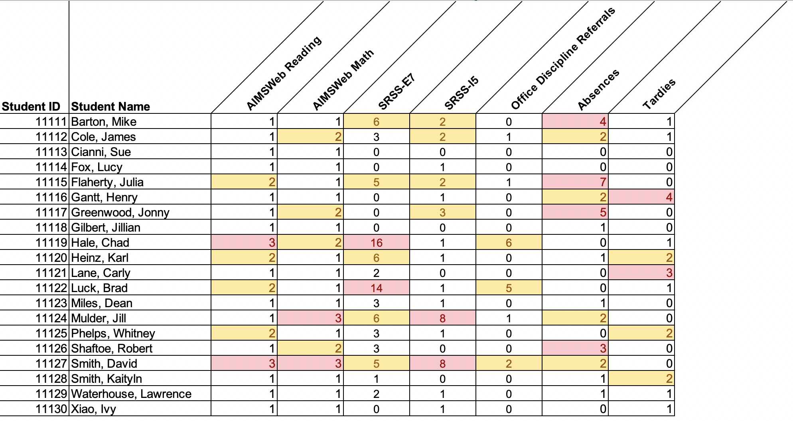
Data in action

Slide 60
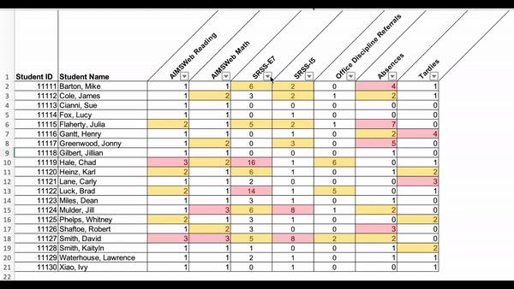
Data in action

Slide 61
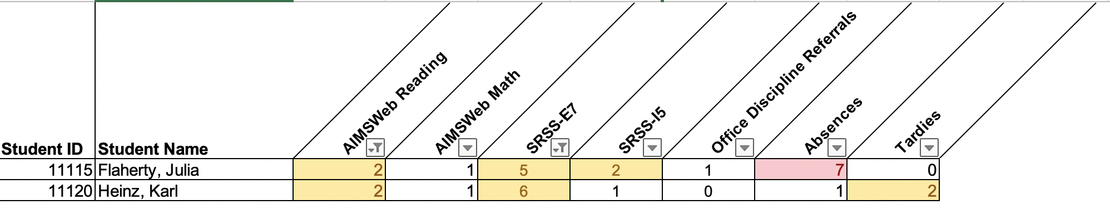
Data in action
Other Tier 2 options…
Precorrection
Behavior Contracts
Behavior Specific Praise
Instructional Choice

Slide 62
Planning Tier 2 Supports
Considering Treatment Integrity data to inform next steps:
TFI Item 2.3
Screening: Tier 2 team uses decision rules and multiple sources of data (e.g., ODRs, academic progress, screening tools, attendance, teacher/ family/student nominations) to identify students who require Tier 2 supports. | Multiple data sources used (e.g., ODRs, time out of instruction, attendance, academic performance) Team decision rubric Team meeting minutes School policy | 0 = No specific rules for identifying students who qualify for Tier 2 supports 1 = Data decision rules established but not consistently followed or used with only one data source 2 = Written policy exists that (a) uses multiple data sources for identifying students, and (b) ensures that families are notified promptly when students enter Tier 2 supports

Slide 63


Planning Tier 2 Supports
TFI Item 2.6
Options for Tier 2 Interventions: Tier 2 team has multiple ongoing behavior support interventions with documented evidence of effectiveness matched to student need. | School Tier 2 handbook Targeted Interventions Reference Guide | 0 = No Tier 2 interventions with documented evidence of effectiveness are in use 1 = Only 1 Tier 2 intervention with documented evidence of effectiveness is in use 2 = Multiple Tier 2 interventions with documented evidence of effectiveness matched to student need

Slide 64




Planning Tier 2 Supports:
An Example
https://www.ci3t.org/pl
Notes:
This slide is a prompt for the presenter to pause, navigate to the website, download the behavior contracts PowerPoint, and use that to present for ~15 minutes (see pacing guide)

Slide 65


Project EMPOWER Session #4 Recording
https://www.ci3t.org/pl
Notes:
EMPOWER Session 4 included a deep dive into Behavior Contracts and Self-Regulated Strategy Development for Writing. You can find a recording of that session along with the PowerPoint and pacing guide in the accordion on the professional learning tab

Slide 66
Planning and Implementing Tier 3 Interventions

Slide 67

Tertiary (Tier 3) Intervention Grids

Slide 68
Schoolwide Positive
Behavior Support
Comprehensive, Integrative,
Three-Tiered (Ci₃T)
Models of Support
Low-Intensity Strategies
Basic Classroom Management
Effective Instruction
Low-Intensity Strategies
Behavior Contracts
Self-Monitoring
- -
Functional Assessment-Based
Interventions
Higher-Intensity
Strategies
Assess, Design, Implement,
and
Evaluate
Assessment

Slide 69



Slide 70

Changes in Harry’s Behavior
Cox, M., Griffin, M. M., Hall, R., Oakes, W. P., & Lane, K. L. (2012). Using a functional assessment-based intervention to increase academic engaged time in an inclusive middle school setting. Beyond Behavior, 2, 44 – 54.

Slide 71





Slide 72


Slide 73


Deep dive into this at EMPOWER Sessions 5!
Designate two staff to attend trainings to become on-site coaches
10 min @ next Faculty and Staff meeting
Ci3T Setting Up for Success
Systematic Screening
Low-Intensity Supports
Tier 2
Planning Ahead
Tier 3

Slide 74


Jigsaw - Ci3T Professional Learning Resources

Slide 75



Let’s Talk!
Read over the list of Tier 2 and Tier 3 supports listed in your school’s Ci3T Implementation Manual.
Jigsaw: For this breakout session, divide up your team members to attend these sessions:
  Tier 2 Direct Behavior Rating
  Tier 2 Self-monitoring
  Tier 2 Self-regulated Strategy Development (SRSD) for writing
  Tier 3 Individualized De-escalation Plan
  Tier 3 Functional Assessment-based Intervention (FABI)
Post in the chat the one you would like to attend so your Ci3T Leadership Team members can divide up to learn more!
Notes:
15-min timer

Slide 76
Tier 2 Direct Behavior Rating

Slide 77
Tier 2 Self-monitoring

Slide 78
Tier 2 Self-regulated Strategy Development (SRSD) for Writing

Slide 79
Tier 3 Individualized De-escalation Plan

Slide 80
Tier 3 Functional Assessment-based Intervention (FABI)

Slide 81


Building a Ci3T Tier Library
Teacher-Delivered Strategies (T1 T2)
Tier 1
Tier 2
Tier 3

Slide 82



Planning Tier 2 and Tier 3 Supports:
Structures for Success
Example of Tier 2 Intervention Drive in shared digital space

Slide 83

Planning Tier 2 and Tier 3 Supports:
Structures for Success

Slide 84
Find students who need support
Identify classrooms in which Tier 1 is implemented with integrity
Use screening data to find students with moderate risk
Consider students demonstrating risk across academic
and
behavioral domains…

Slide 85

Planning Tier 2 and Tier 3 Supports
Monitor who is receiving Tier 2 and Tier 3 supports
Store data in a secure location accessible to relevant parties

Slide 86
Planning Tier 2 and Tier 3 Supports
Considering Treatment Integrity data to inform next steps:
TFI Item 2.3
Level of Use: Team follows written process to track proportion of students participating in Tier 2 supports, and access is proportionate. | Tier 2 enrollment data Tier 2 team meeting minutes Progress monitoring tool | 0 = Team does not track number of students responding to Tier 2 interventions 1 = Team defines criteria for responding to each Tier 2 intervention and tracks students, but fewer than 5% of students are enrolled 2 = Team defines criteria and tracks proportion, with at least 5% of students receiving Tier 2 supports

Slide 87

Planning Tier 2 and Tier 3 Supports :
Structures for Success

Slide 88

Planning Tier 2 and Tier 3 Supports :
Structures for Success

Slide 89


Planning Tier 2 and Tier 3 Supports

Slide 90
Planning Tier 2 and Tier 3 Supports

Slide 91
Let’s Talk!
Share out with your team:
  Tier 2 Direct Behavior Rating
  Tier 2 Self-monitoring
  Tier 2 Self-regulated Strategy Development (SRSD) for writing
  Tier 3 Individualized De-escalation Plan
  Tier 3 Functional Assessment-based Intervention (FABI)
What structures are in place to support teachers using data to connect students to Tier 2 and 3 supports?
Action Planning: What would you like to share out with your faculty and staff about Tier 2 and Tier 3 supports?
Notes:
15-min timer

Slide 92
Wrapping Up and Moving Forward

Slide 93
Ci3T
Comprehensive Professional Learning Plan
Ci3T: Primary Prevention
Session 1:
Overview of Ci3T Prevention Models
Setting a Purpose
Establish team meetings and roles
Session 2:
Mission and Purpose
Establish Roles and Responsibilities
Procedures for Teaching
Procedures for Reinforcing
Reactive Plan
Session 3:
Procedures for Monitoring
Session 4:
Revise Primary Plan using Stakeholder feedback
Prepare presentation
Ci3T: Secondary Prevention
Session 5:
Overview of Teacher focused Strategies
Overview of Student Focused Strategies
Using data to determine which students may need Secondary (Tier 2) supports
Draft the Secondary Intervention Grid based on existing supports
Ci3T: Tertiary Prevention
Session 6:
Final revisions of Ci3T Plan based on stakeholder feedback
Draft Tertiary (Tier 3) Prevention Intervention Grids
Design Implementation Manual and Plan for roll out to faculty, students, and parents
Ci3T Leadership Team Training Sequence
Implementation Stages of Tier 2 and 3 within Ci3T
Additional Professional Development on Specific Topics
Core Content Curriculum
Check In - Check Out
Functional Assessment-based Interventions
Reading, Math, Writing Benchmarking and Progress Monitoring Tools
Interventions, Strategies, & Practices
Additional Tier 3 Supports
Instructional Techniques to Improve Students’ Motivation; Classroom Management Practices;
Low-Intensity Behavior Supports

Slide 94
Ci3T Professional Learning Calendar
 | July | Aug | Sep | Oct | Nov | Dec | Jan | Feb | Mar | Apr | May | Jun
Ci3T Training |  |  |  |  | Ci3T Professional Learning Series Session 1 | Ci3T Professional Learning Series Session 2 | Ci3T Professional Learning Series Session 3 | Ci3T Professional Learning Series Session 4 |  | Ci3T Professional Learning Series Session 5 | Ci3T Professional Learning Series Session 6
Ci3T Implementation Support | Ci3T Implementation Series Prep Session |  | Ci3T Implementation Series Session 1 |  | Ci3T Implementation Series Session 2 |  | Ci3T Implementation Series Session 3 |  | Ci3T Implementation Series Session 4 | Ci3T Implementation Series Session 5
Ci3T EMPOWER |  |  | Ci3T EMPOWER Session 1 | Ci3T EMPOWER Session 2 | Ci3T EMPOWER Session 3 |  | Ci3T EMPOWER Session 4 |  | Ci3T EMPOWER Session 5 | Ci3T EMPOWER Session 6
Ci3T Trainers & Coaches Calls |  | Trainers & Coaches Call Session 1 | Trainers & Coaches Call Session 2 | Trainers & Coaches Call Session 3 | Trainers & Coaches Call Session 4 | Trainers & Coaches Call Session 5 | Trainers & Coaches Call Session 6 | Trainers & Coaches Call Session 7 | Trainers & Coaches Call Session 8 | Trainers & Coaches Call Session 9 | Trainers & Coaches Call Session 10

Slide 95
Accessing Project EMPOWER Professional Learning
Notes:
Can sign up for sessions OR access the recording!

Slide 96

Project EMPOWER - Traditional
Ci3T EMPOWER Sessions Location: Remote via Zoom Attended by: School Ci3T Leadership Teams, Ci3T District Trainers and Coaches, Faculty and Staff, Families (adults only). Community Members |  | Times (Pacific) | Times (Central) | Times (Eastern)
1. Getting Started | Sep. 19, 2023 (Tu) | 3:00 – 5:00 p.m. | 5:00 – 7:00 p.m. | 6:00 – 8:00 p.m.
2. Screening | Oct. 19, 2023 (Th) | 3:00 – 5:00 p.m. | 5:00 – 7:00 p.m. | 6:00 – 8:00 p.m.
3. Low Intensity Supports (3) | Nov. 30, 2023 (Th) | 3:00 – 5:00 p.m. | 5:00 – 7:00 p.m. | 6:00 – 8:00 p.m.
4. Tier 2 | Jan. 9, 2024 (Tu) | 3:00 – 5:00 p.m. | 5:00 – 7:00 p.m. | 6:00 – 8:00 p.m.
5. Tier 3 | Mar. 28, 2024 (Th) | 3:00 – 5:00 p.m. | 5:00 – 7:00 p.m. | 6:00 – 8:00 p.m.
6. Moving Forward | Apr. 23, 2024 (Wed) | 3:00 – 5:00 p.m. | 5:00 – 7:00 p.m. | 6:00 – 8:00 p.m.

Slide 97
Wrap Up and Preview
Today
Next time
Data-Informed Decision-Making
Integrated Lesson Planning at Tier 1
Planning and Implementing Tier 2 Interventions
Planning and Implementing Tier 3 Interventions
Procedures for Monitoring
  Review your School’s Social Validity & Treatment Integrity Data
  Review your School’s Spring Screening Data
Planning for the Year Ahead 2024-2025
Focusing on Data-Informed Professional Learning

Slide 98
Please Take a Minute to Get Organized
Please stay until all materials are organized.
Team Materials:
  Make sure your notes are in your Ci3T Leadership Team agenda and that document is saved in your Ci3T Leadership Team Drive.
  Clearly identify the person(s) on your team
  in charge of each action item listed on the agenda.
Thank you!

Slide 99

Homework
At your next Ci3T Leadership Team meeting:
  Confirm plans to support completion of spring screening
  Refine and implement plans to share resources and support faculty and staff around Tier 2 and Tier 3 supports
  Make preliminary plans for faculty and staff to complete
    Treatment integrity and social validity surveys during the spring timepoint
    Teacher well-being and input measures during the spring timepoint
  Complete Tiered Fidelity Inventory (TFI) protocols for the spring timepoint
At your next faculty meeting:
  Share professional learning resources and opportunities around Tier 2 and Tier 3 interventions (see ci3t.org/pl and ci3t.org/fabi)

Slide 100


Slide 101


Comprehensive, Integrated, Three-tiered (Ci3T) Model of Prevention
Thank you!
Notes:
Tag us in your Ci3T highlights- we’d love to see Ci3T in action! Follow us on Twitter or Instagram for updates and links to resources! @Ci3TModel
You will receive a brief session evaluation – we value your feedback and would greatly appreciate you taking a few minutes to share your thoughts on what you liked about the session and how we can improve

