Slide 1
An Overview of Behavior Screening Tools within Three-tiered Models of Support
Pennsylvania Training and Technical Assistance Network PaTTAN
December 13, 2023
Kathleen Lynne Lane, Ph.D., BCBA-D, CF-L2

Slide 2
ci3t.org

Slide 3
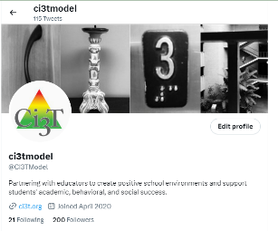
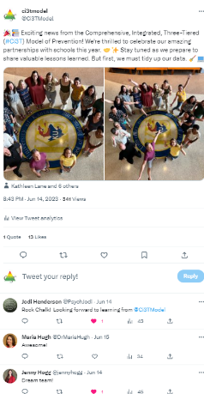
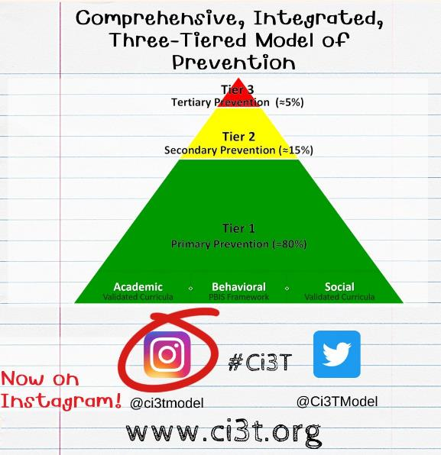
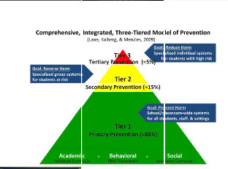
Building Our Online Presence
Beyond ci3t.org

Slide 4
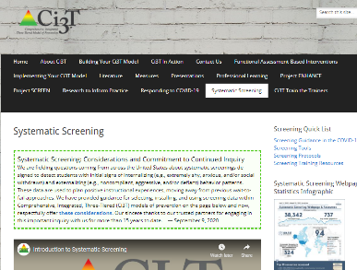
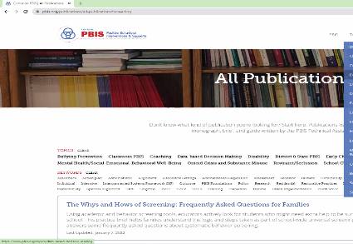
Resource Alert!
ci3t.org
pbis.org
Journal Article

Slide 5
Agenda
Introducing Ci3T … a Comprehensive, Integrated, Three-Tiered Model of Prevention
Systematic Screening: Tools and Logistics
The Role of Screening: Using Screening Data to Shape Instruction
At Tier 1: Primary Preventions Efforts
At all Tiers: Teacher-delivered Strategies
At Tiers 2 & 3: Secondary & Tertiary Prevention Efforts
Reviewing Resources to Support Systematic Screening
Planning for Next Steps

Slide 6
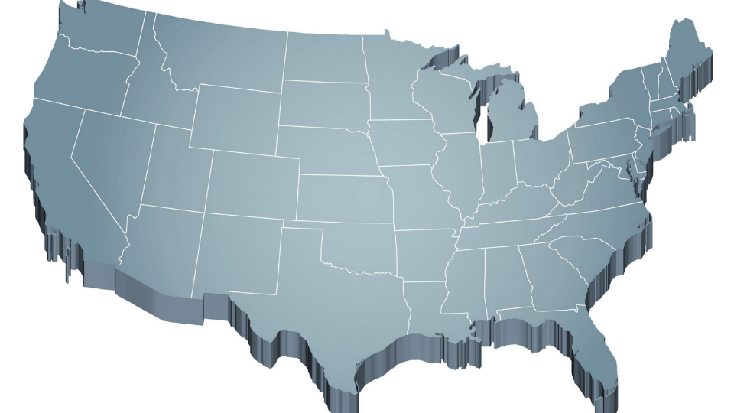
Thank you… For Your Commitment
Internalizing
Externalizing
ED <1%
EBD 12-20%
Source: Forness, S.R., Freeman, S.F., Paparella, T., Kauffman, J.M., & Walker, H.M. (2012). Special education implications of point and cumulative prevalence for children with emotional or behavioral disorders. Journal of Emotional and Behavioral Disorders, 20, 4-18.

Slide 7
Agenda
Introducing Ci3T … a Comprehensive, Integrated, Three-Tiered Model of Prevention
Systematic Screening: Tools and Logistics
The Role of Screening: Using Screening Data to Shape Instruction
At Tier 1: Primary Preventions Efforts
At all Tiers: Teacher-delivered Strategies
At Tiers 2 & 3: Secondary & Tertiary Prevention Efforts
Considerations for Screening PK-12 in the COVID-19 Era
Planning for Next Steps

Slide 8
Comprehensive, Integrated, Three-Tiered Model of Prevention
(Lane, Kalberg, & Menzies, 2009)
Tier 3
Tertiary Prevention (≈5%)
Tier 2
Secondary Prevention (≈15%)
Tier 1
Primary Prevention (≈80%)
Academic ◇ Behavioral ◇ Social
Validated Curricula PBIS Framework Validated Curricula

Slide 9
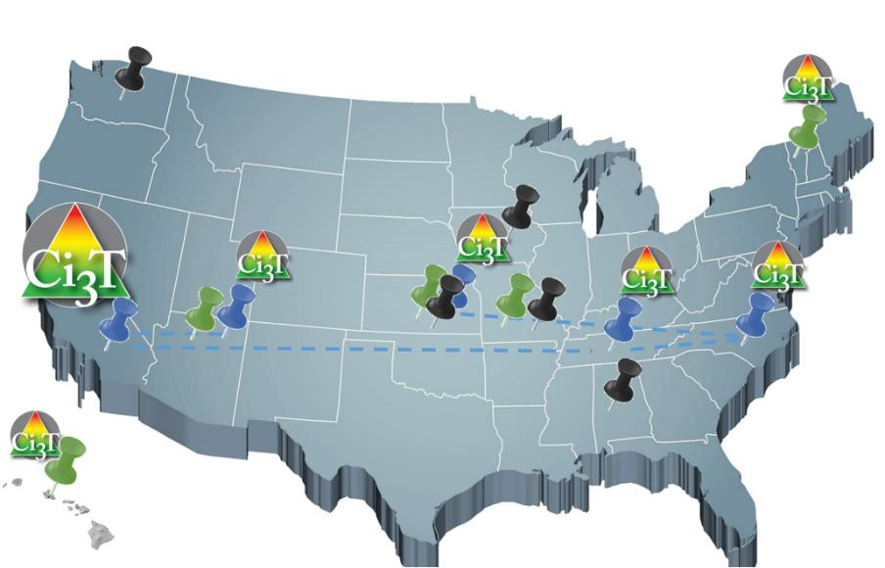
Implementing Ci3T Models: A Respectful Partnership

Slide 10
Comprehensive, Integrated, Three-Tiered Model of Prevention
(Lane, Kalberg, & Menzies, 2009)
Tier 3
Tertiary Prevention (≈5%)
Reading Street
Tier 2
Secondary Prevention (≈15%)
District & State Standards
High Quality Instruction
Tier 1
Primary Prevention (≈80%)
Academic ◇ Behavioral ◇ Social
Validated Curricula PBIS Framework Validated Curricula

Slide 11
Comprehensive, Integrated, Three-Tiered Model of Prevention
(Lane, Kalberg, & Menzies, 2009)
Tier 3
Tertiary Prevention (≈5%)
Tier 2
Secondary Prevention (≈15%)
Positive Behavior Interventions and Supports (PBIS)
Tier 1
Primary Prevention (≈80%)
Academic ◇ Behavioral ◇ Social
Validated Curricula PBIS Framework Validated Curricula

Slide 12
Behavioral Component: Positive Behavioral Interventions and Supports (PBIS)
A Framework, Not a Curriculum
Establish, clarify, and define expectations
Teach all students the expectations, planned and implemented by all adults in the school
Give opportunities to practice
Reinforce students consistently, facilitate success
Consider rules, routines, and physical arrangements
Monitor the plan using school-wide data to identify students who need more support
Monitor student progress
Source: Horner, R.H., & Sugai, G. (2015). School-wide PBIS: An example of applied behavior analysis implemented at a scale of social importance. Behavior Analysis in Practice, 8, 80-85.

Slide 13
ELEMENTARY | Settings
 | Classroom | Hallway | Cafeteria | Playground | Bathroom | Bus
Respect | - Follow directions -Use kind words and actions - Control your temper - Cooperate with others - Use an inside voice | - Use a quiet voice - Walk on the right side of the hallway - Keep hands to yourself | - Use an inside voice - Use manners - Listen to and follow adult requests | - Respect other peoples’ personal space - Follow the rules of the game | - Use the restroom and then return to class - Stay in your own bathroom stall - Little talking | - Use kind words towards the bus driver and other students - Listen to and follow the bus drivers’ rules
Responsibility | - Arrive to class on time - Remain in school for the whole day - Bring your required materials - Turn in finished work - Exercise self-control | - Keep hands to yourself - Walk in the hallway - Stay in line with your class | - Make your choices quickly - Eat your own food - Choose a seat and stick with it - Clean up after yourself | - Play approved games - Use equipment appropriately - Return equipment when you are done - Line up when the bell rings | - Flush toilet - Wash hands with soap - Throw away any trash properly - Report any problems to your teacher | - Talk quietly with others - Listen to and follow the bus drivers’ rules - Remain in seat after you enter the bus - Use self-control
Best Effort | - Participate in class activities - Complete work with best effort - Ask for help politely | - Walk quietly - Walk directly to next location | - Use your table manners - Use an inside voice | - Include others in your games - Be active - Follow the rules of the game | - Take care of your business quickly - Keep bathroom tidy | - Listen to and follow the bus drivers’ rules - Keep hands and feet to self
Establish, Clarify, Define Expectations
Source: Lane, K.L., Kalberg, J.R., & Menzies, H.M. (2009). Developing schoolwide programs to prevent and manage problem behaviors: A step-by-step approach. Guilford Press.

Slide 14
Comprehensive, Integrated, Three-Tiered Model of Prevention
(Lane, Kalberg, & Menzies, 2009)
Tier 3
Tertiary Prevention (≈5%)
Tier 2
Secondary Prevention (≈15%)
Positive Action
Tier 1
Primary Prevention (≈80%)
Academic ◇ Behavioral ◇ Social
Validated Curricula PBIS Framework Validated Curricula

Slide 15
The Five Social and Emotional Learning Core Competencies
Self-awareness
Responsible Decision making
Relationship Skills
Social Awareness
Self-management
Social & Emotional Learning
(CASEL, 2013)

Slide 16
Outcomes Associated with Social Skills Training
Explicit social-emotional learning (SEL) skills instruction
SEL skills acquisition
Improved attitudes about self, others, and school
Positive social behavior
Fewer conduct problems
Less emotional distress
Academic success
(CASEL, 2013)

Slide 17
Social Component: Examples of Schoolwide Programs
Social-emotional
Connect With Kids connectwithkids.com
Character Education
A curricula using real stories presented through documentary-style videos, non-fiction books, teaching guides and patent resources.
Attendance and achievement
Bullying and violence prevention
Character and Life skills
Digital citizenship
Alcohol and drug prevention
Health and Wellness
Customizable units are:
Positive Action www.positiveaction.net
Improves academics, behavior, and character
Curriculum-based approach
Effectively increases positive behaviors and decreases negative behaviors
6-7 units per grade
Optional components:
site-wide climate development
drug education
bullying / conflict resolution
counselor, parent, and family classes
community/coalition components

Slide 18
Top 10 School-related Social Skills
Listens to Others
Follows Directions
Follows Classroom Rules
Ignores Peer Distractions
Asks for Help
Takes Turns in Conversations
Cooperates With Others
Controls Temper in Conflict Situations
Acts Responsibly With Others
Shows Kindness to Other
(Lane et al. 2004, 2007; Gresham & Elliott, 2008)

Slide 19
Comprehensive, Integrated, Three-Tiered Model of Prevention
(Lane, Kalberg, & Menzies, 2009)
Tier 3
Tertiary Prevention (≈5%)
Tier 2
Secondary Prevention (≈15%)
Tier 1
Primary Prevention (≈80%)
Academic ◇ Behavioral ◇ Social
Validated Curricula PBIS Framework Validated Curricula

Slide 21
The Journey … Ci3T Training & Implementation
Phase |  |  |  | Year
 | 2013-14 | 14-15 | 15-16 | 16-17 | 17-18 | 18-19 | 19-20
Elementary School
Ci3T Training
Implementation Year 1
Implementation Year 2
Sustain and Develop Practices
Middle and High Schools
Ci3T Training
Implementation Year 1
Implementation Year 2
Sustain and Develop Practices
College and Career Center
Ci3T Training
Implementation Year 1
Implementation Year 2
Sustain and Develop Practices

Slide 22
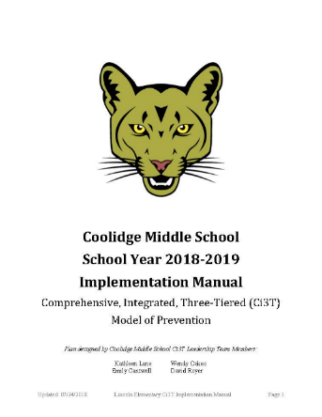
Ci3T Implementation Manual

Slide 23
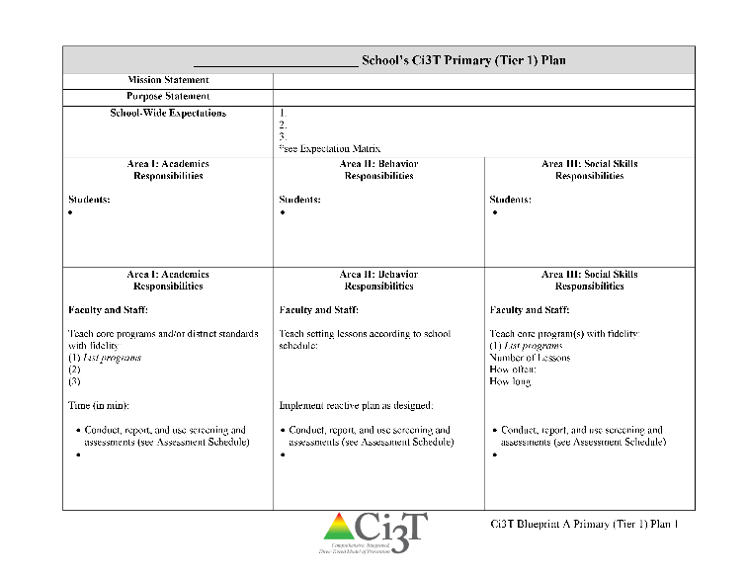
Ci3T Primary Plan: Roles and Responsibilities
all stakeholder groups

Slide 24
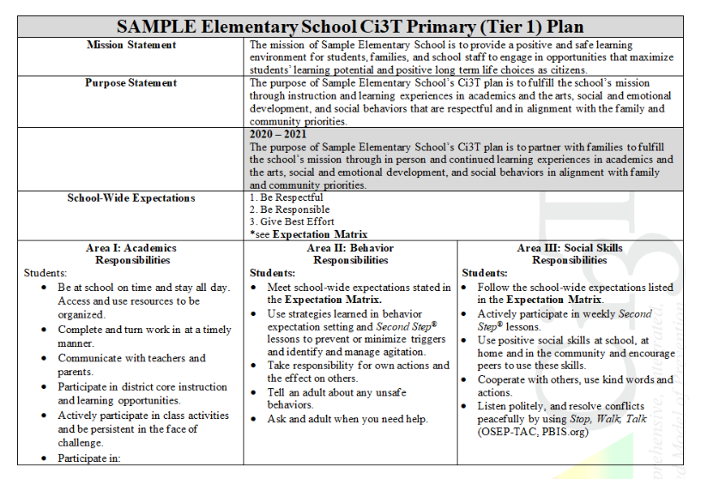

Slide 25
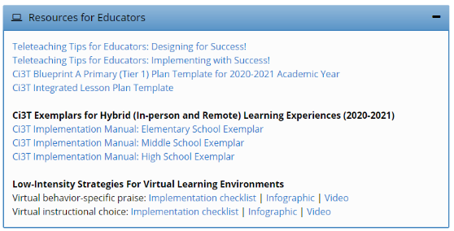
Opportunities to Respond
Area II: Academics Responsibilities Faculty and Staff: Teach core programs according to district and state standards with integrity: Use proactive evidence-based strategies to support students’ active engagement
Behavior-Specific Praise
Active Supervision
Opportunities to Respond
Instructional Feedback
High p Requests
Behavior-Specific Praise
Precorrection
Active Supervision
Remote Learning Use proactive evidence-based strategies to support students’ active engagement. Maintain online classroom platforms with learning activities connected to the weekly learning outcomes. Communicate at least weekly with families and students.
Incorporating Choice
Instructional Feedback
High-p Requests
Precorrection
Incorporating Choice

Slide 26
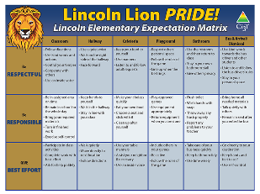
Area II: Behavior Responsibilities Faculty and Staff: Implement Positive Behavioral Interventions and Supports (PBIS) with integrity. Teach all setting Expectations within the first week of school and reteach Expectations (monthly). Display and model school-wide expectations in classrooms and other key settings.
Remote Learning Teach Expectations for remote learning. Set clear Expectations for your students’ learning times allowing for flexibility for unique family needs.

Slide 27
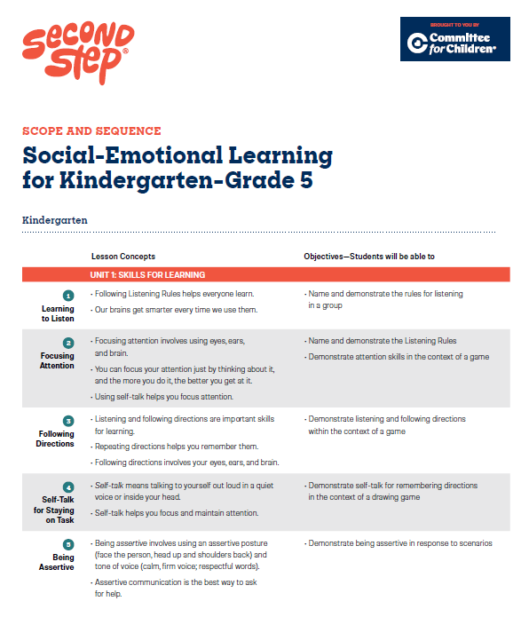
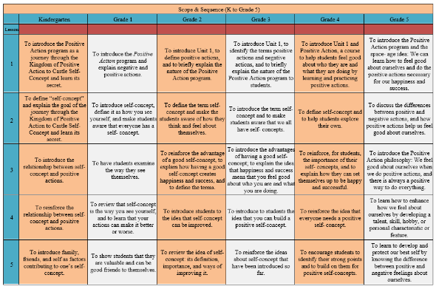
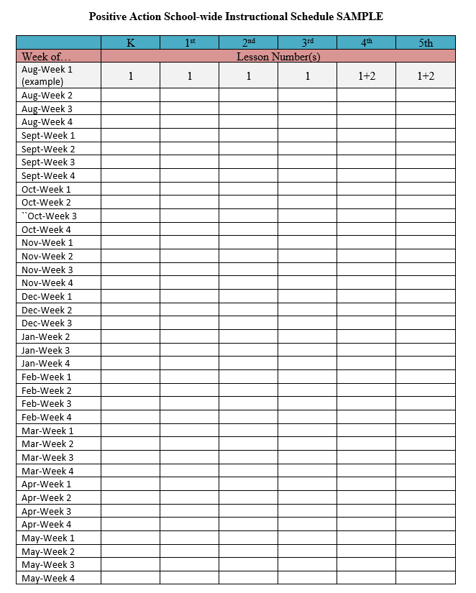
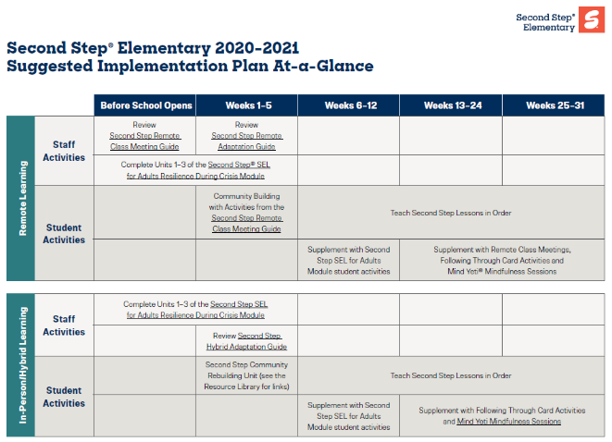
Area II: Social Responsibilities Faculty and Staff: Teach schoolwide social skills/ character education curricula with integrity: Teach daily Second Step® lessons (link to grade level instructional schedules) Seek ways to engage parents as partners in the school program
Remote Learning Begin each lesson with a connection to the social skills needed to fully engage in the lesson. Utilize online Second Step® resources to continue regular social skill lessons with asynchronous activities as well as synchronous lessons.

Slide 28
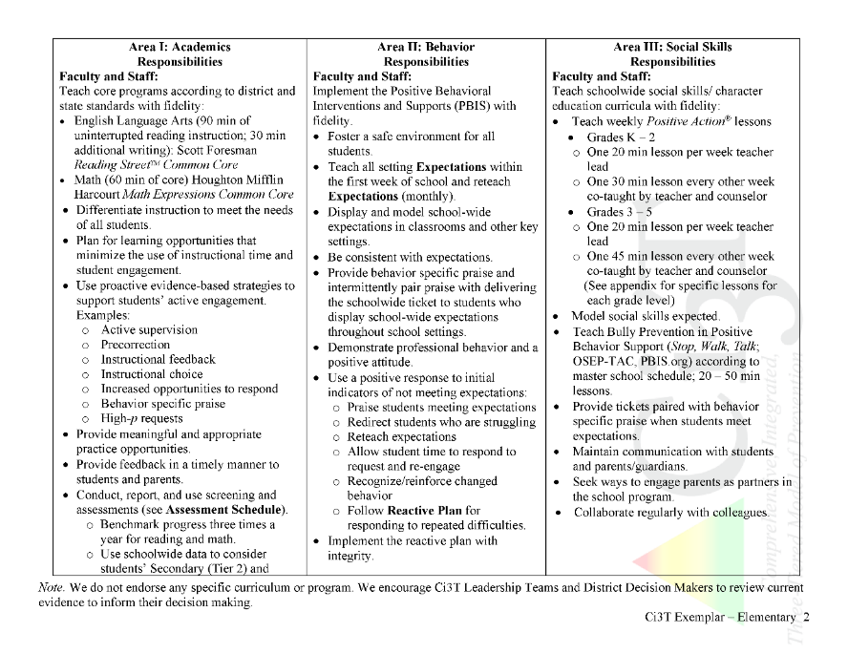
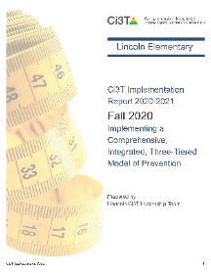
Ci3T Primary Plan: Procedures for Teaching
Ci3T Primary Plan: Procedures for Reinforcing
Ci3T Primary Plan: Procedures for Monitoring
Notes:
Continued to keep implementation manuals, which are foundational to Ci3T, updated and current

Slide 29
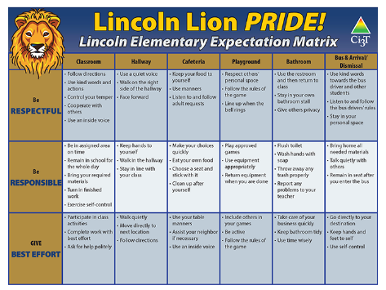
A look at Procedures for Teaching at Tier 1
Procedures for Teaching
Faculty and Staff: Ci3T Leadership Teams and District Leaders will teach procedures to faculty and staff by: Provide faculty and staff Ci3T Implementation Manual and other materials such as posters, lesson plans, tickets, etc. to teach, implement and support our Ci3T plan. Professional learning opportunities at the district level to support implementation and sustainability of Ci3T, with attention to academic, behavior, and social domains. Expectations Matrix taught and posted. Ongoing re-teaching of expectations and procedures – dedicated staff meeting time for discussions.
Continued Learning: Ci3T Leadership Teams and District Leaders will teach procedures to faculty and staff by: Providing faculty and staff materials for remote access to the Ci3T Implementation Manual, digital ‘posters’ and e-tickets. Professional learning sessions and access guides for online materials for teaching social skills lessons. Beginning of year online meeting small-group breakout rooms for faculty and staff to review Ci3T Implementation Manual updates, get questions answered, and share ideas
Ci3T Primary Plan: Procedures for Teaching

Slide 30
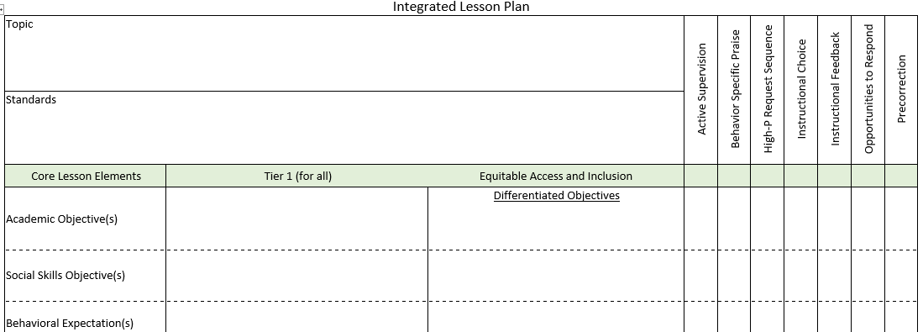
Ci3T Primary Plan: Procedures for Teaching
BSP
OTR
Active Supervision
Choice
Precorrection

Slide 31
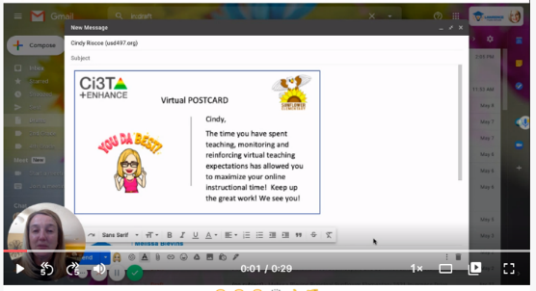
Ci3T Primary Plan: Procedures for Reinforcing

Slide 32
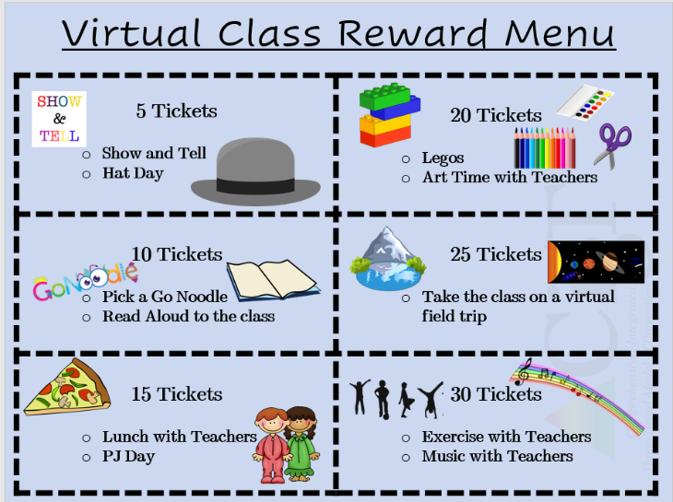
Virtual Learning Incentives
FREE Incentives:
Stay after on ZOOM with a friend for a chat
Virtual lunch date with the teacher, principal, etc. (check with that staff member before offering them up of course)
Teacher wears stickers or has a sign with the student’s name
Dress up ZOOM day (hats, PJs, costumes, etc.)
Virtual Greeting Cards (sent via email)
Show & Tell Time (or some kind of star student spotlight time)
Personalized stickers in See Saw (2nd grade has been using this)
Virtual Class Reinforcement Menu
Ci3T Primary Plan: Procedures for Reinforcing
Adapted and shared with permission from a district partner

Slide 33
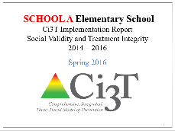
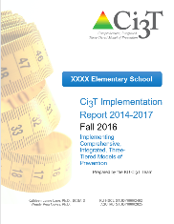
Essential Components of Primary Prevention Efforts
Social Validity
Systematic Screening
Academic
Behavior
Treatment Integrity

Slide 34
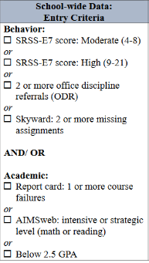
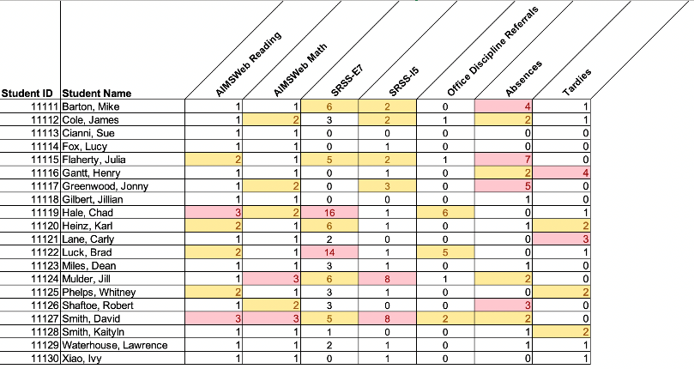
Using multiple data sources

Slide 35
Comprehensive, Integrated, Three-Tiered Model of Prevention
(Lane, Kalberg, & Menzies, 2009)
Tier 3
Tertiary Prevention (≈5%)
Tier 2
Secondary Prevention (≈15%)
Secondary (Tier 2) Intervention Grids
Tier 1
Primary Prevention (≈80%)
Academic ◇ Behavioral ◇ Social
Validated Curricula PBIS Framework Validated Curricula

Slide 36
Comprehensive, Integrated, Three-Tiered Model of Prevention
(Lane, Kalberg, & Menzies, 2009)
Tier 3
Tertiary Prevention (≈5%)
Tier 2
Secondary Prevention (≈15%)
Tertiary (Tier 3) Intervention Grids
Tier 1
Primary Prevention (≈80%)
Academic ◇ Behavioral ◇ Social
Validated Curricula PBIS Framework Validated Curricula

Slide 37
Implementation Science Adapted from Fixsen & Blasé, 2005
Exploration & Adoption
Installation
Initial Implementation
We think we know what we need so we are planning to move forward (evidence-based)
Let’s make sure we’re ready to implement (capacity infrastructure)
Let’s give it a try & evaluate (demonstration)
Full Implementation
Let’s make it our way of doing business (institutionalized use)
Sustainability & Continuous Regeneration
That worked, let’s do it for real (investment)

Slide 38
Transparency, Access, & Collaboration
Benefits of Ci3T Models

Slide 39
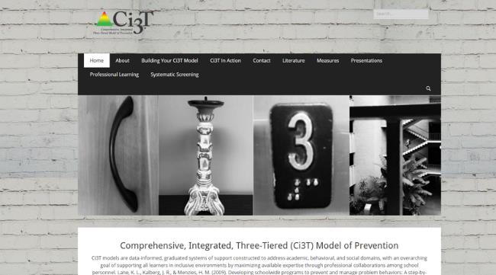
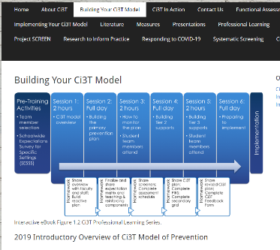
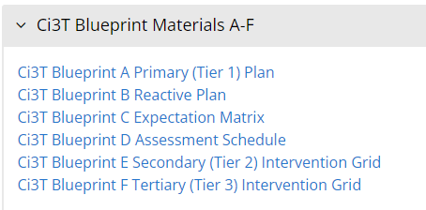
Consider the core components of Ci3T?
What components do you currently have in place?
Notes:
15-min timer

Slide 40
Agenda
Introducing Ci3T … a Comprehensive, Integrated, Three-Tiered Model of Prevention
Systematic Screening: Tools and Logistics
The Role of Screening: Using Screening Data to Shape Instruction
At Tier 1: Primary Preventions Efforts
At all Tiers: Teacher-delivered Strategies
At Tiers 2 & 3: Secondary & Tertiary Prevention Efforts
Reviewing Resources to Support Systematic Screening
Planning for Next Steps

Slide 41
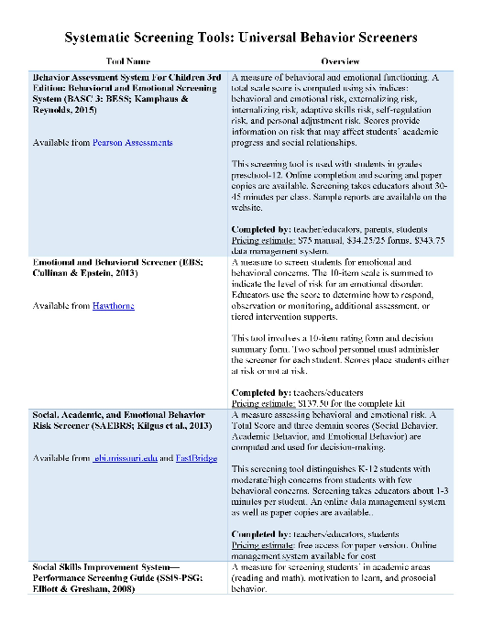
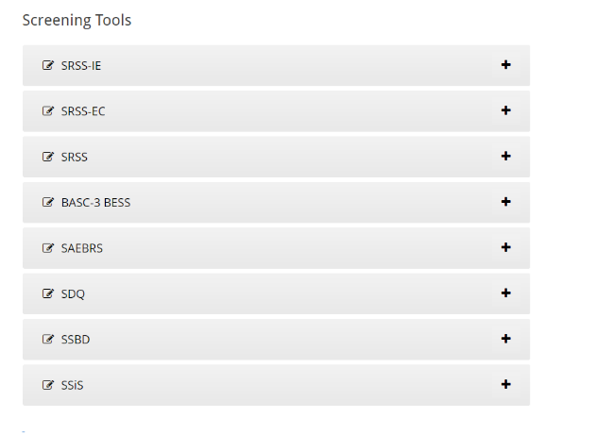
Learning More About Options
www.ci3t.org
www.pbis.org

Slide 42
Considerations
Psychometrically Sound
Socially Valid
If social validity is lacking, even psychometrically strong tools are likely to remain unused by educators.

Slide 43
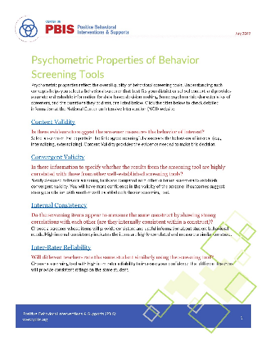
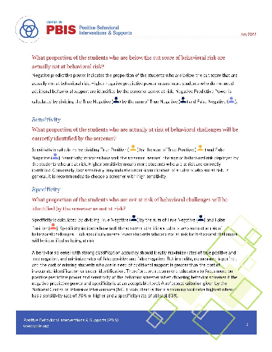
Psychometric Properties of Behavior Screening Tools

Slide 44
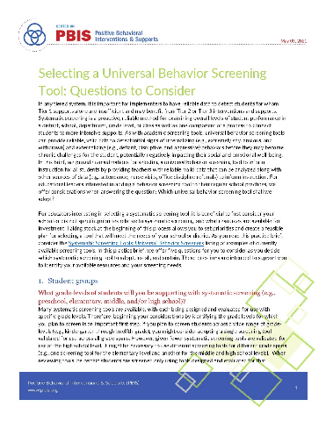
Selecting a Universal Behavior Screening Tool: Questions to Consider
Guiding Questions around
Student groups
Behaviors of interest
Cost
Time and expertise
Person providing information

Slide 45
Systematic Screening … Logistics
Fall
Winter
Spring
Selecting
Installing
Analyzing

Slide 46
Systematic Screener for Behavior Disorders
Available from
Pacific Northwest Publishing
(SSBD 2nd ed.; Walker, Severson, & Feil, 2014)

Slide 47
SSBD Results – Winter 2007 through Winter 2009
Risk Status of Nominated Students
Externalizing
% computed based on total # students screened
6.18%
3.50%
3.18%
8.90%
6.50%
2.73%
1.44%
Source. Lane, Menzies, Oakes, & Kalberg, 2012. Figure 2.2 WES Elementary Systematic Screening for Behavior Disorders (SSBD; Walker & Severson, 1992) results comparing the percentage of students nominated and exceeding normative criteria for both externalizing and internalizing behavior disorders over a three year period.
Notes:
47

Slide 48
Sample Data – SSBD
2007-2011 Risk Status for Nominated Students
Externalizing
Number of students
47
13
57
9
66
11
78
14
63
7
6.8%
2.17%
2.41%
2.61%
1.5%
Note. The numbers represent totals for the students for whom the SSBD was completed.
Notes:
48

Slide 49
Sample Data – SSBD
2007-2011 Risk Status for Nominated Students
Internalizing
Number of students
46
17
66
12
78
12
55
13
60
6
4.4%
2.78%
1.44%
2.63%
2.24%
Note. The numbers represent totals for the students for whom the SSBD was completed.
Notes:
49

Slide 50
SAMPLE DATA: SSBD
WINTER 2009-2010
CRITICAL NEED COMPARISON BY GRADE LEVEL
Grade Level | Total Number of Students Screened | Students Nominated | Students w/ Critical Need | Critical Internalizing | Critical Externalizing
K | 72 *5 | 24 | 4 (5.56%) | 1 (1.39%) | 3 (4.17%)
1st | 66 *9E/ 8I | 24 | 1 (1.54%) | 0 (0.00%) | 1 (1.54%)
2nd | 60 *10 | 18 | 3 (5.00%) | 2 (3.33%) | 1 (1.67%)
* Students missing
Notes:
50

Slide 51
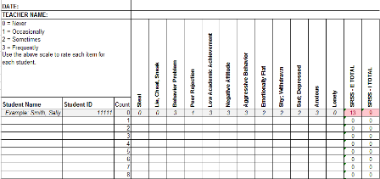
Student Risk Screening Scale for Internalizing and Externalizing
Available on ci3t.org
(SRSS-IE; Drummond, 1994 and Lane & Menzies, 2009)

Slide 52
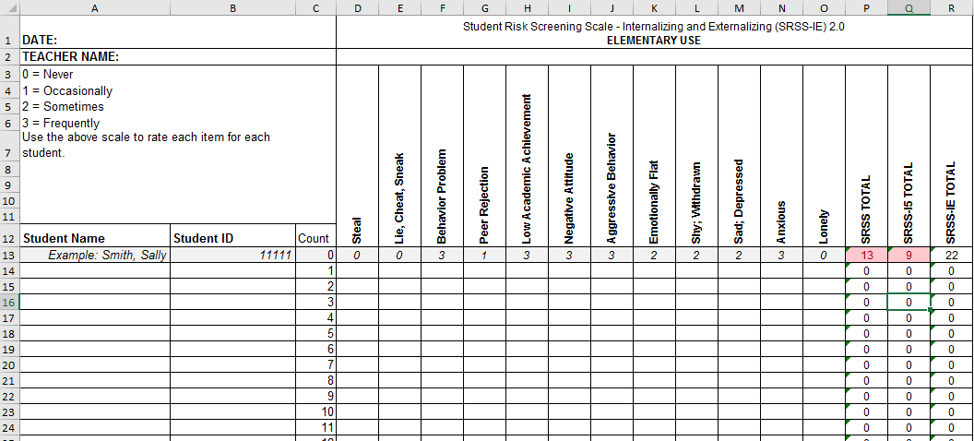
Student Risk Screening Scale for Internalizing and Externalizing (SRSS-IE; Drummond, 1994; Lane & Menzies, 2009) for Elementary Schools

Slide 53
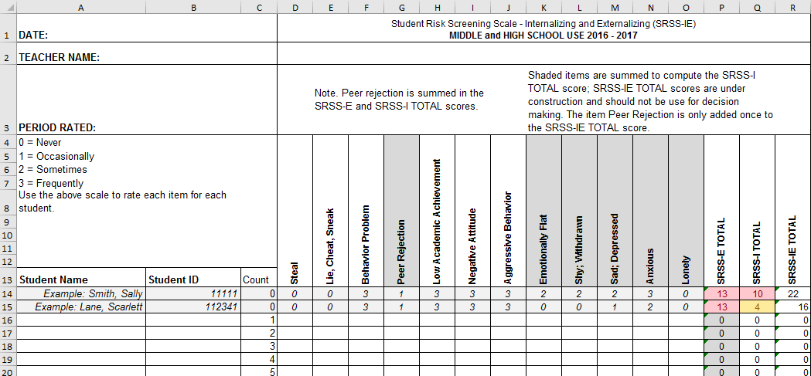
Student Risk Screening Scale for Internalizing and Externalizing (SRSS-IE; Drummond, 1994; Lane & Menzies, 2009)

Slide 54
SRSS-IE: Cut Scores
Elementary School |  | Middle and High School
SRSS-E7 | SRSS-I5 | SRSS-E7 | SRSS-I6
Items 1-7 | Items 8-12 | Items 1-7 | Items 4, 8-12
0-3 = low risk 4-8 = moderate risk 9-21 = high risk | 0-1 = low risk 2-3 = moderate risk 4-15 = high risk | 0-3 = low risk 4-8 = moderate risk 9-21 = high risk | 0-3 = low risk 4-5 = moderate risk 6-18 = high risk
Elementary School Level:
Lane, K. L., Oakes, W. P., Swogger, E. D., Schatschneider, C., Menzies, H., M., & Sanchez, J. (2015). Student risk screening scale for internalizing and externalizing behaviors: Preliminary cut scores to support data-informed decision making. Behavioral Disorders, 40, 159-170.
Middle and High School Levels:
Lane, K. L., Oakes, W. P., Cantwell, E. D., Schatschneider, C., Menzies, H., Crittenden, M., & Messenger, M. (2016). Student Risk Screening Scale for Internalizing and Externalizing Behaviors: Preliminary cut scores to support data-informed decision making in middle and high schools. Behavioral Disorders, 42(1), 271-284

Slide 55
Fall 2022 SRSS-Externalizing Results – Elementary School level
n = 44
n = 43
n = 47
n = 27
n = 36
n = 29
n = 6
n = 17
n = 22
n = 118
n = 100
n = 85
n = 94
n = 86
n = 83
n = 30
n = 69
n = 61
n = 276
n = 335
n = 329
n = 306
n = 293
n = 333
n = 283
n = 346
n = 352
Notes:
Fill in <year> based on current academic year. This is located in column A of the data sheet. Edit by right clicking and selecting “Edit data”.

Slide 56
Fall 2022 SRSS-Internalizing Results – Elementary School level
n = 59
n = 62
n = 39
n = 39
n = 31
n = 18
n = 13
n = 32
n = 23
n = 82
n = 65
n = 67
n = 73
n = 46
n = 47
n = 35
n = 62
n = 69
n = 304
n = 292
n = 361
n = 338
n = 351
n = 340
n = 321
n = 338
n = 343
Cut scores vary by school level:
Elementary (I5): Low (0-1), Moderate (2-3), High (4-15)
Middle and High (I6): Low (0-3), Moderate (4-5), High (6-18)
Notes:
Fill in <year> based on current academic year. This is located in column A of the data sheet. Edit by right clicking and selecting “Edit data”.
IMPORTANT NOTE: The INTERNALIZING subscale and CUT SCORES are specific to school level.
Elementary: SRSS-I5, Items 8-12, 0-1 = low risk, 2-3 = moderate risk, 4-15 = high risk
Middle and High: SRSS-I6, Items 4, 8-12, 0-3 = low risk, 4-5 = moderate risk, 6-18 = high risk

Slide 57
Fall 2022 SRSS-Internalizing Results – Elementary School Level
Grade Level | N Screened | Low n (%) | Moderate n (%) | High n (%)
K | 64 | 52 (81.25%) | 7 (10.94%) | 5 (7.81%)
1 | 81 | 69 (85.19%) | 9 (11.11%) | 3 (3.70%)
2 | 56 | 44 (78.57%) | 11 (19.64%) | 1 (1.79%)

Slide 58
SRSS-Externalizing Results: Grade level
Fall 2018
Grade Level | N Screened | Low n (%) | Moderate n (%) | High n (%)
K | 58 | 51 (87.93%) | 6 (10.34%) | 1 (1.72%)
1st | 52 | 40 (76.92%) | 8 (15.38%) | 4 (7.69%)
2nd | 61 | 51 (83.61%) | 6 (9.84%) | 4 (6.56%)

Slide 59
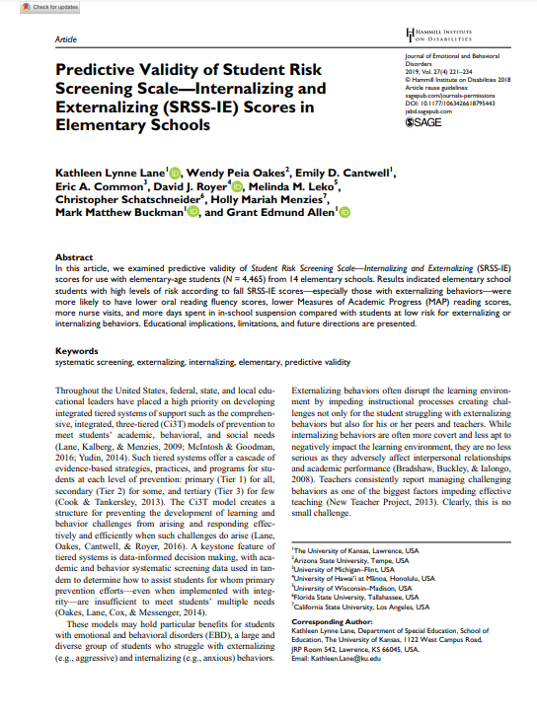
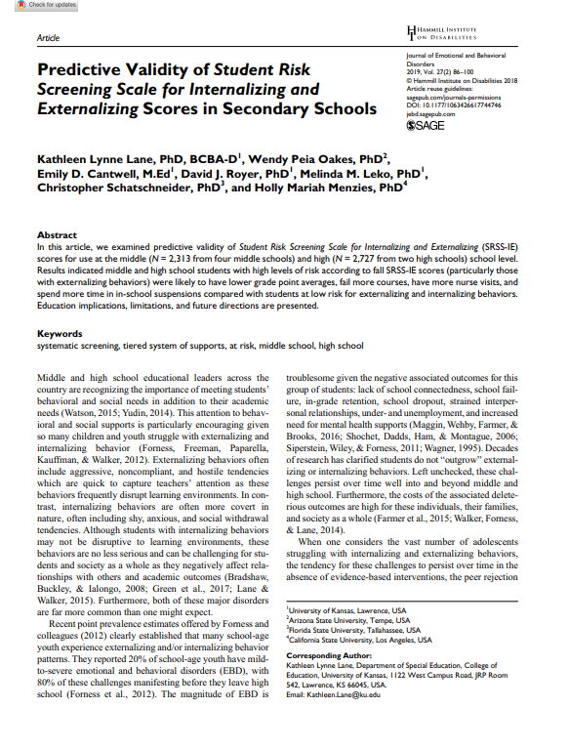
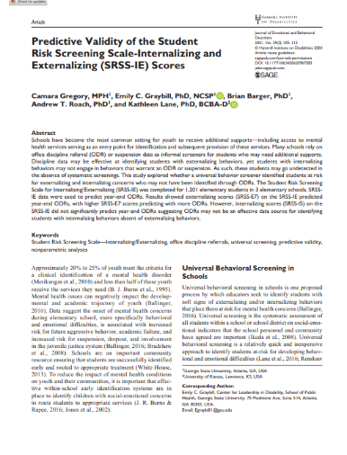
SRSS-IE Scores Predict Student Outcomes
Fall
Winter
Year End
ODR Suspensions
Nurse Visits
Course Failures

Slide 60
Results:
SRSS-IE: Externalizing Subscale Elementary
Fall Externalizing
Winter
Spring
ORF
MAP Reading
Nurse Visit
Suspensions
Variable | Risk |  |  | Significance Testing
 | Low M (SD) n | Moderate M (SD) n | High M (SD) n
Oral Reading Fluency | 163.23 (39.66) 468 | 138.62 (42.70) 107 | 115.82 (46.21) 46 | L > M > H
MAP Reading | 66.54 (26.48) 2,047 | 42.91 (30.37) 443 | 33.32 (29.82) 199 | L > M > H
Nurse Visits | 6.14 (6.81) 3,256 | 9.18 (9.59) 820 | 11.83 (9.89) 389 | L < M < H
In-School Suspensions | 0.0052 (0.08) 3,256 | 0.0427 (0.30) 820 | 0.1080 (0.46) 389 | L < M < H

Slide 61
Results:
SRSS-IE: internalizing Subscale Elementary
Variable | Risk |  |  | Significance Testing
 | Low M (SD) n | Moderate M (SD) n | High M (SD) n
Oral Reading Fluency | 159.04 (41.45) 459 | 150.59 (45.76) 88 | 139.18 (46.53) 74 | L > H L = M; M = H
MAP Reading | 63.38 (28.32) 2,070 | 53.93 (32.15) 356 | 43.57 (30.47) 263 | L > M > H
Nurse Visits | 6.84 (7.37) 3,387 | 7.59 (8.05) 628 | 9.33 (10.81) 450 | L < M < H
In-School Suspensions | 0.0142 (0.15) 3,387 | 0.0510 (0.36) 628 | 0.0311 (0.20) 450 | L < M, H M = H
Fall Internalizing
Winter Internalizing
Spring
ORF*
MAP Reading
Nurse Visit
Suspensions*

Slide 62
Student Risk Screening Scale Fall 2004 – 2012 Middle School
Source: Lane, K. L., Oakes, W. P., & Magill, L. M., (2014). Primary prevention efforts: How do we implement and monitor the Tier 1 component of our comprehensive, integrated, three-tiered model of prevention. Preventing School Failure, 58, 143-158. 10.1080/1045988X.2014.893978 [Figure 4. Middle school behavior screening data over time at the fall time point. Adapted from Figure 4.6 p. 127 Lane, K. L., Menzies, H. M, Oakes, W. P., & Kalberg, J. R. (2012). Systematic screenings of behavior to support instruction: From preschool to high school. Guilford Press.]

Slide 63
Middle School Study 1: Behavioral & Academic Characteristics of SRSS Risk Groups
Variable |  | Risk
 | Low (n = 422) M (SD) | Moderate (n = 51) M (SD) | High (n = 12) M (SD) | Significance Testing
ODR | 1.50 (2.85) | 5.02 (5.32) | 8.42 (7.01) | L<M<H
In-School Suspensions | 0.08 (0.38) | 0.35 (1.04) | 1.71 (2.26) | L<M<H
GPA | 3.35 (0.52) | 2.63 (0.65) | 2.32 (0.59) | L>M, H M=H
Course Failures | 0.68 (1.50) | 2.78 (3.46) | 4.17 (3.49) | L<M, H M=H
(Lane, Parks, Kalberg, & Carter, 2007)

Slide 64
SRSS-IE: Externalizing Subscale
High school
Fall
Winter
Spring
GPA
Course Failures
Nurse Visit
ODR
Suspensions
Variable |  | Risk |  | Significance Testing
 | Low M (SD) n = 2,363 | Moderate M (SD) n = 212 | High M (SD) n = 59
GPA | 3.07 (0.79) | 2.08 (0.81) | 1.96 (0.89) | L > M, H M = H
Course Failures | 1.16 (2.07) | 3.45 (3.18) | 3.08 (2.84) | L < M, H M = H
Nurse Visits | 1.34 (3.19) | 4.00 (5.62) | 5.85 (7.66) | L < M, H M = H
In-School Suspensions | 0.07 (0.44) | 0.67 (1.48) | 1.03 (1.86) | L < M, H M = H
L < M, H
M = H

Slide 65
SRSS-IE: Internalizing Subscale
High school
Variable |  | Risk |  | Significance Testing
 | Low M (SD) n = 2,379 | Moderate M (SD) n = 123 | High M (SD) n = 132
GPA | 3.04 (0.82) | 2.44 (0.83) | 2.27 (0.98) | L > M, H M = H
Course Failures | 1.25 (2.17) | 2.59 (2.66) | 2.83 (3.21) | L < M, H M = H
Nurse Visits | 1.43 (3.33) | 3.54 (6.05) | 4.04 (5.80) | L < M, H M = H
In-School Suspensions | 0.11 (0.57) | 0.41 (1.36) | 0.42 (1.28) | L < M, H M = H
Fall Internalizing
Winter Internalizing
Spring
GPA
Course Failures
Nurse Visit
ODR
Suspensions
L < M, H
M = H

Slide 66
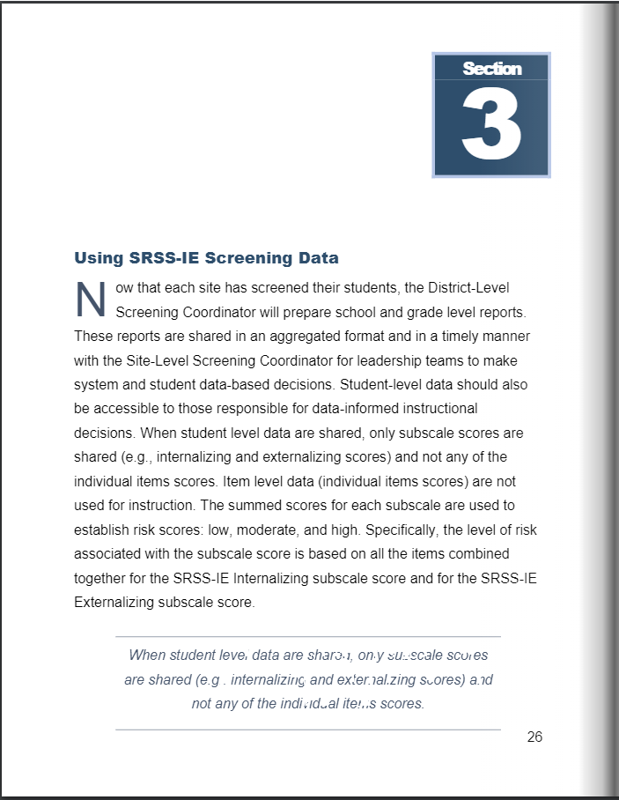
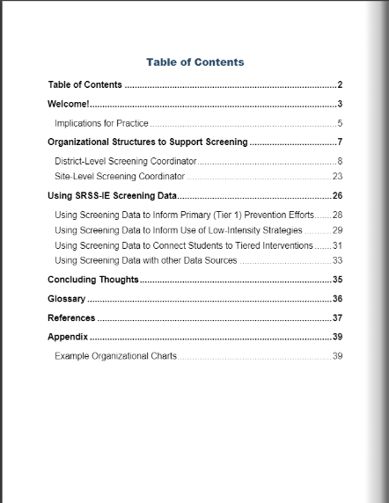
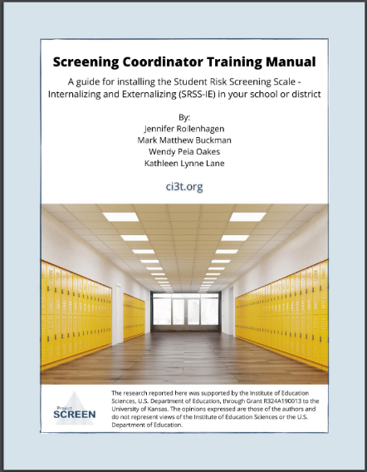
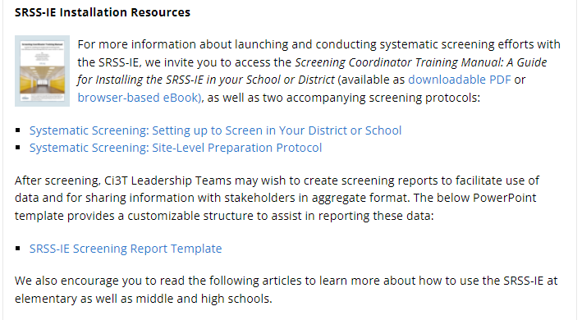
Screening Coordinator Training Manual

Slide 67
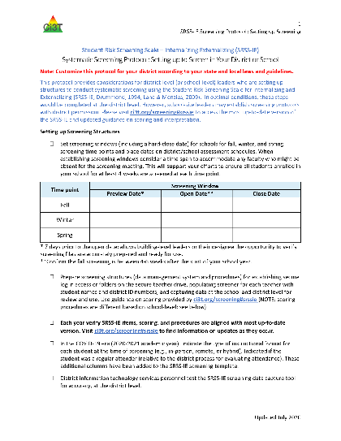
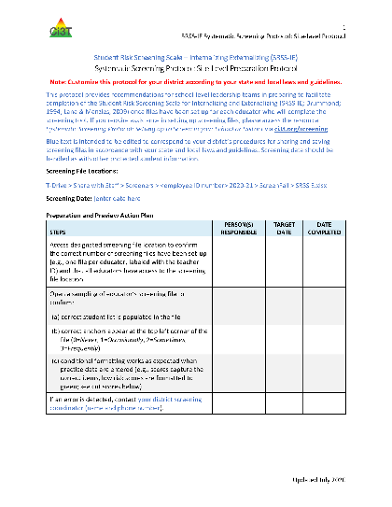
Screening Protocols

Slide 68
BASC³ Behavioral and Emotional Screening Scale©
Available from Pearson Education, PsychCorpTM
(BASC³ BESS;
Kamphaus & Reynolds, 2015)
Copyright NCS Pearson, 2007
Notes:
http://www.pearsonclinical.com/education/products/100001482/basc3-behavioral-and-emotional-screening-system--basc-3-bess.html

Slide 69
BASC² – Behavior and Emotional Screening Scale Spring 2012
N = 24
N = 67
N = 533
N = 624 n = 219 n = 202 n = 203
Lane, K. L., Oakes, W. P., Common, E. A., Zorigian, K., & Brunsting, N. (2012). Project Screen and Support: Initial
evidence between the SRSS-IE and the BASC2-BESS at the middle school level. Behavioral Disorders, 44(3), 162-174. https://doi.org/10.1177/0198742918794843

Slide 70
Social Skills Improvement System – Performance Screening Guide
Available from Pearson Education, PsychCorpTM
(SSiS- PSG; Elliott & Gresham, 2007)

Slide 71
Social Skills Improvement System – Performance Screening Guide Spring 2012 – Total School
N = 54
N = 22
N = 35
N = 31
N = 223
N = 233
N = 180
N = 187
N = 212
N = 235
N = 275
N = 271
n = 489 n = 490 n = 490 n = 489
Lane, K. L., Oakes, W. P., & Magill, L. (2013). Primary prevention efforts: How do we implemented and monitor the Tier 1 component of our Comprehensive, Integrated, Three-Tiered (Ci3T) Model?, Preventing School Failure, 58(1), 143-158.

Slide 72
Social, Academic, and Emotional Behavior Risk Screener
Available from Fastbridge Learning
(SAEBRS; Kilgus, Chafouleas, & Riley-Tillman, 2013)

Slide 73
SAMPLE DATA: SAEBRS
Large Urban Elementary - Fall Screening Data
Note - we present the percentage of students by risk category on the total scale and each subscale, as we find the two-step approach to subscale interpretation is the most defensible). Source. Kilgus, Kilpatrick, Taylor, Eklund, & von der Embse, 2016

Slide 75
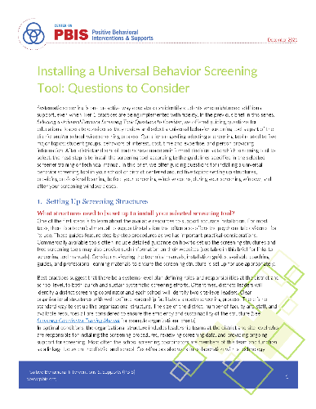
Installing a Universal Behavior Screening Tool: Questions to Consider
Guiding Questions around
Setting Up Screening Structures
Providing Professional Learning
Before your Screening Window Opens
During your Screening Window
After your Screening Window

Slide 76
Tips for Communicating with Your Community about Systematic Screening

Slide 77
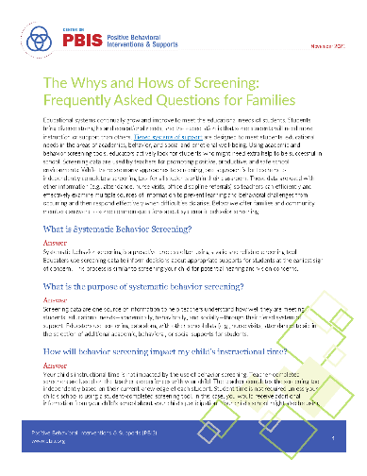
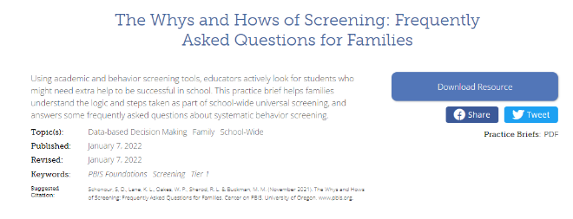
The Whys and Hows of Screening: Frequently Asked Questions for Families

Slide 78
Sample Middle School: Fall
SRSS-E7 Results – All Students
N = 26
N = 12
N = 89
N = 66
N = 554
N = 550

Slide 79
Screening Data: High School Yrs1-3
Fall- SRSSIE-I |  | Low |  | Moderate |  | High |  | Fall- SRSSIE-E |  | Low |  | Moderate |  | High
2016 |  | 80.28% |  | 10.36% |  | 9.36% |  | 2016 |  | 89.56% |  | 8.02% |  | 2.42%
2017 |  | 90.18% |  | 4.16% |  | 5.66% |  | 2017 |  | 91.29% |  | 6.18% |  | 2.54%
2018 |  | 90.91% |  | 3.86% |  | 5.23% |  | 2018 |  | 92.22% |  | 6.20% |  | 1.58%
WTR-SRSSIE-I |  | Low |  | Moderate |  | High |  | WTR-SRSSIE-E |  | Low |  | Moderate |  | High
2016 |  | 87.25% |  | 9.49% |  | 3.26% |  | 2016 |  | 87.25% |  | 9.49% |  | 3.26%
2017 |  | 86.14% |  | 9.02% |  | 4.85% |  | 2017 |  | 86.14% |  | 9.02% |  | 4.85%
2018 |  | 88.79% |  | 8.52% |  | 2.69% |  | 2018 |  | 88.79% |  | 8.52% |  | 2.69%

Slide 80
Data sharing…
Schoolwide data
…decisions related to primary prevention efforts
Grade / Department / Class
…implications for teachers’ practice
Individual student
…decisions about student-based interventions

Slide 81
Interpreting Universal Behavior Screening Data: Questions to Consider
Guiding Questions around
Examining Student Performance for the School as a Whole
Considering Teacher-Delivered, Low-Intensity Supports
Making Decisions for Students Who Might Require Tier 2 and Tier 3 Supports

Slide 82
Communication and Continuous Improvement
Effective
Teams
Ci3T District Leadership Team
College & Career
Ci3T School Leadership Team
Ci3T School Leadership Team
Ci3T School Leadership Team
Ci3T School Leadership Team
Ci3T School Leadership Team
Ci3T School Leadership Team
Ci3T School Leadership Team
Ci3T School Leadership Team
Ci3T School Leadership Team
Ci3T School Leadership Team
Ci3T School Leadership Team
Ci3T School Leadership Team
Ci3T School Leadership Team
Ci3T School Leadership Team
Ci3T School Leadership Team
High
Ci3T School Leadership Team
Ci3T School Leadership Team
Middle
Ci3T School Leadership Team
Ci3T School Leadership Team
Ci3T School Leadership Team
Ci3T School Leadership Team
Elementary

Slide 83
What are some of the potential benefits of systematic screening? Challenges? Questions?
Notes:
15-min timer

Slide 84
Agenda
Introducing Ci3T … a Comprehensive, Integrated, Three-Tiered Model of Prevention
Systematic Screening: Tools and Logistics
The Role of Screening: Using Screening Data to Shape Instruction
At Tier 1: Primary Preventions Efforts
At all Tiers: Teacher-delivered Strategies
At Tiers 2 & 3: Secondary & Tertiary Prevention Efforts
Reviewing Resources to Support Systematic Screening
Planning for Next Steps

Slide 85
Comprehensive, Integrated, Three-Tiered Model of Prevention
(Lane, Kalberg, & Menzies, 2009)
Tier 3
Tertiary Prevention (≈5%)
Tier 2
Secondary Prevention (≈15%)
Tier 1
Primary Prevention (≈80%)
Academic ◇ Behavioral ◇ Social
Validated Curricula PBIS Framework Validated Curricula

Slide 86
Agenda
Introducing Ci3T … a Comprehensive, Integrated, Three-Tiered Model of Prevention
Systematic Screening: Tools and Logistics
The Role of Screening: Using Screening Data to Shape Instruction
At Tier 1: Primary Preventions Efforts
At all Tiers: Teacher-delivered Strategies
At Tiers 2 & 3: Secondary & Tertiary Prevention Efforts
Reviewing Resources to Support Systematic Screening
Planning for Next Steps

Slide 87
Social Skills Improvement System – Performance Screening Guide Spring 2012 – Total School
N = 54
N = 22
N = 35
N = 31
N = 223
N = 233
N = 180
N = 187
N = 212
N = 235
N = 275
N = 271
n = 489 n = 490 n = 490 n = 489
Lane, K. L., Oakes, W. P., & Magill, L. (2013). Primary prevention efforts: How do we implemented and monitor the Tier 1 component of our Comprehensive, Integrated, Three-Tiered (Ci3T) Model?, Preventing School Failure, 58(1), 143-158.

Slide 88
Student Risk Screening Scale Fall 2004 – 2012 Middle School
Source: Lane, K. L., Oakes, W. P., & Magill, L. M., (2014). Primary prevention efforts: How do we implement and monitor the Tier 1 component of our comprehensive, integrated, three-tiered model of prevention. Preventing School Failure, 58, 143-158. doi:10.1080/1045988X.2014.893978 [Figure 4. Middle school behavior screening data over time at the fall time point. Adapted from Figure 4.6 p. 127 Lane, K. L., Menzies, H. M, Oakes, W. P., & Kalberg, J. R. (2012). Systematic screenings of behavior to support instruction: From preschool to high school. Guilford Press.]

Slide 89
Agenda
Introducing Ci3T … a Comprehensive, Integrated, Three-Tiered Model of Prevention
Systematic Screening: Tools and Logistics
The Role of Screening: Using Screening Data to Shape Instruction
At Tier 1: Primary Preventions Efforts
At all Tiers: Teacher-delivered Strategies
At Tiers 2 & 3: Secondary & Tertiary Prevention Efforts
Reviewing Resources to Support Systematic Screening
Planning for Next Steps

Slide 90
Examining Academic and Behavioral Data
Lane, K. L., Menzies, H. M., Ennis, R. P., & Oakes, W. P. (2015). Supporting Behavior for School Success: A Step-by-Step Guide to Key Strategies. Guilford Press.
Notes:
Lane, K. L., Oakes, W. P., Ennis, R. P., & Hirsch, S. E. (2014). Identifying students for secondary and tertiary prevention efforts: How do we determine which students have Tier 2 and Tier 3 needs? Preventing School Failure, 58, 171-182, DOI: 10.1080/1045988X.2014.895573

Slide 91
An Integrated Approach
Notes:
We will revisit at the end

Slide 92
Low Intensity Strategies
https://www.ci3t.org/literature

Slide 93
Low Intensity Strategies
https://www.ci3t.org/pl

Slide 95
ci3t.org
Professional Learning tab

Slide 96
Low-Intensity Strategy | Lincoln Elementary On-Site Expert
Behavior-Specific Praise: Identifying the specific expectation the student met. “Niama, great job using your graphic organizer to draft your essay.” “Justice, thank you for pushing in your chair to keep the walkway safe.” | Eric Common, Behavior Specialist Mark Buckman, Special Education Grant Allen, Parent Volunteer
Opportunities to Respond: Providing 4-6 opportunities per minute for students to respond individually, choral, verbal, written, gesture, or symbol. “Show me thumbs or thumbs down if...” “Show me on your white board what…” “Turn to your elbow partner and say…” “All together now, what is…” | David Royer, Administration Emily Cantwell, 5th Grade Scarlett Lane, 3rd Grade Mallory Messenger, Counselor
Instructional Choice: Providing within-task or between task choices to increase academic engaged time and motivation. “Ronaldo, of these 3 tasks today, which would you like to work on first?” “Suzy, do you want to work with colored pencils, crayons, or sparkly markers?” | Abbie Jenkins, 2nd Grade Scarlett Lane, 3rd Grade Bryan Simmons, PE Liane Johl, Kindergarten

Slide 97
Exploring Teacher-Delivered, Low-Intensity Supports …
Literature & Ci3T Professional Learning Pages
Notes:
15-min timer

Slide 98
Agenda
Introducing Ci3T … a Comprehensive, Integrated, Three-Tiered Model of Prevention
Systematic Screening: Tools and Logistics
The Role of Screening: Using Screening Data to Shape Instruction
At Tier 1: Primary Preventions Efforts
At all Tiers: Teacher-delivered Strategies
At Tiers 2 & 3: Secondary & Tertiary Prevention Efforts
Reviewing Resources to Support Systematic Screening
Planning for Next Steps

Slide 99
Comprehensive, Integrated, Three-Tiered Model of Prevention
(Lane, Kalberg, & Menzies, 2009)
Tier 3
Tertiary Prevention (≈5%)
Tier 2
Secondary Prevention (≈15%)
Secondary (Tier 2) Intervention Grids
Tier 1
Primary Prevention (≈80%)
Academic ◇ Behavioral ◇ Social
Validated Curricula PBIS Framework Validated Curricula

Slide 102
An illustration
Support | Description | Schoolwide Data: Entry Criteria | Data to Monitor Progress: | Exit Criteria
Small group reading instruction with self-monitoring | Small group reading instruction (30 min, 3 days per week). Students monitored their participation in the reading instructional tasks. Students used checklists of reading lesson components each day to complete and compare to teachers’ rating. K – 1. | Students who: Behavior: Fall SRSS at moderate (4 -8) or high (9 – 21) risk Academic: Fall AIMSweb LNF at the strategic or intensive level | AIMSweb reading PSF and NWF progress monitoring probes (weekly). Daily self-monitoring checklists Treatment Integrity Social Validity | Meet AIMSweb reading benchmark at next screening time point. Low Risk on SRSS at next screening time point.

Slide 103
Small group Reading Instruction with Self-Monitoring
Lane, K. L., Oakes, W. P., & Magill, L. (2013). Primary prevention efforts: How do we implemented and monitor the Tier 1 component of our Comprehensive, Integrated, Three-Tiered (Ci3T) Model?, Preventing School Failure, 58(1), 143-158.
Notes:
Citation: Lane, K.L., & Oakes, W. P. (2012). Identifying Students for Secondary and Tertiary Prevention Efforts: How do we determine which students have Tier 2 and Tier 3 needs? In preparation.

Slide 104
First Grade Students’ Self Monitoring Form
Altmann, S. A. (2010). Project support and include: the additive benefits of self-monitoring on students’ reading acquisition. Unpublished master’s thesis, Vanderbilt University.

Slide 105
Treatment Integrity Social Validity Monitor student progress
Altmann, S. A. (2010). Project support and include: the additive benefits of self-monitoring on students’ reading acquisition. Unpublished master’s thesis, Vanderbilt University.

Slide 106
Sample Elementary Intervention Grid: PA
Support | Description | School-wide Data: Entry Criteria | Data to Monitor Progress | Exit Criteria
Positive Action (PA) – counselor-led small group | Counselors and/or social workers will lead small group Positive Action sessions for approximately 30-40 min 2-3 days per week. Students will acquire new skills, learn how to engage more fully in instructional experiences, and learn how to meet more school-wide expectations. Small groups will run for up to 24 sessions (8 to 12 weeks depending on the number of sessions conducted per week) using a subset of Positive Action lessons appropriate for student skillsets as identified using Skills For Greatness (teacher, counselor, parent versions) and SSiS-Rating Scale (teacher and parent version). | Behavior SRSS-E7 score: Moderate (4-8) and/or SRSS-I5 score: Moderate (2-3) AND 2 or fewer absences in first 3 months of school AND Evidence of teacher implementation of Ci3T primary (Tier 1) plan [treatment integrity: direct observation] AND Parent permission AND Academic Student is in grade 2 or 3 | Student measures SSiS-Rating Scale (Pre/Post) Skills for Greatness (Pre/Post) Daily behavior report (DBR; daily) Attendance and tardies Social validity Teacher: IRP-15 Student: CIRP Treatment integrity Tier 2 treatment integrity measures Ci3T TI: Direct observation (30 min if needed) | Review student progress at end of 24 sessions Team agrees goals have been met or no further Positive Action small group sessions are warranted SRSS-E7 and I5 scores are in the low risk category

Slide 107
Sample Elementary Intervention Grid: SSiS
Support | Description | School-wide Data: Entry Criteria | Data to Monitor Progress | Exit Criteria
Social Skills Improvement System (SSiS) – counselor-led small group | Counselors and/or social workers will lead small group SSiS sessions for approximately 30-40 min 2-3 days per week. Students will acquire new skills, learn how to engage more fully in instructional experiences, and learn how to meet more school-wide expectations. Small groups will run for up to 24 sessions (8 to 12 weeks depending on the number of sessions conducted per week) using a subset of SSiS lessons appropriate for student skillsets as identified using SSiS-Rating Scale (teacher and parent version). | Behavior SRSS-E7 score: Moderate (4-8) and/or SRSS-I5 score: Moderate (2-3) AND 2 or fewer absences in first 3 months of school AND Evidence of teacher implementation of Ci3T primary (Tier 1) plan [treatment integrity: direct observation] AND Parent permission AND Academic Student is in grade 2 or 3 | Student measures SSiS-Rating Scale (Pre/Post) Skills for Greatness (Pre/Post) Daily behavior report (DBR; daily) Attendance and tardies Social validity Teacher: IRP-15 Student: CIRP Treatment integrity Tier 2 treatment integrity measures Ci3T TI: Direct observation (30 min if needed) | Review student progress at end of 24 sessions Team agrees goals have been met or no further SSiS small group sessions are warranted SRSS-E7 and I5 scores are in the low risk category

Slide 108
Active Supervision
https://eclkc.ohs.acf.hhs.gov/safety-practices

Slide 109
Support | Description | Schoolwide Data: Entry Criteria | Data to Monitor Progress: | Exit Criteria
READ 180 (Stage C) Reading Intervention | Students participate in a 50 min reading instructional block during their study hall period. Students meet in the computer lab for participation in the online portion 20 min daily. Instruction is relevant to high school students. Students use a progress management system to monitor and track their own progress. Instruction is taught by special education teachers and general education teachers with training in the READ 180 Curriculum. | (1) Students in grades 9 – 12. (2) Reading performance basic or below basic on state assessment (but above 4th grade reading level). (3) SRSS risk scores in the moderate range (4 – 8). | Student Measures: Meeting individual READ 180 reading goals: (1) Progress Monitoring with Scholastic Reading Inventory (2) Writing Assessments (3) formative assessments (vocabulary, comprehension and spelling) (4) Curriculum-based Assessments (5) Attendance in class Treatment Integrity: Teachers monitor performance and attendance in class. Completion of weekly checklists for activities completed. Social Validity: Students and teachers complete surveys | Students meet instructional reading goals. SRSS score in the low risk category (0 – 3) on the next screening time point.
Lane, K. L., Oakes, W. P., Menzies, H. M., Oyer, J., & Jenkins, A. (2013). Working within the context of three-tiered models of prevention: Using school wide data to identify high school students for targeted supports. Journal of Applied School Psychology, 29, 203-229.

Slide 110
Support | Description | Schoolwide Data: Entry Criteria | Data to Monitor Progress: | Exit Criteria
Mentoring Program (Sophomores/ Juniors/ Seniors) | Focus is on academic achievement, character development, problem-solving skills, improving self-esteem, relationships with adults and peers, and school attendance. Volunteer teachers serve as mentors; meeting weekly (30 – 60 min) with students during the school day. | (1) 10th/11th/ 12th graders (2) Behavior: SRSS: High (9-21) or Moderate (4-8) by either 2nd or 7th period teacher ODR ≥ 2 Absences ≥ 5 days in one grading period (3) Academic: GPA ≤ 2.75 | Student Measures: (1) Increase of GPA at mid-term and semester report cards. (2) Decrease of ODR monitored weekly. (3) Reduced absences (fewer than one per quarter) Treatment Integrity: Mentors complete weekly mentoring checklists to report meeting time and activities. Social Validity: Pre and post surveys for students and mentors. | Yearlong support Students who no longer meet criteria next fall Seniors: graduation
Lane, K. L., Oakes, W. P., Menzies, H. M., Oyer, J., & Jenkins, A. (2013). Working within the context of three-tiered models of prevention: Using school wide data to identify high school students for targeted supports. Journal of Applied School Psychology, 29, 203-229

Slide 111
Support | Description | Schoolwide Data: Entry Criteria | Data to Monitor Progress: | Exit Criteria
Targeted Algebra II Study Hall | Direct, targeted instruction of Algebra II learning targets by math teachers. Time will be used to re-teach concepts, provide one-on-one or small group instruction and offer greater supports for students struggling to pass the graduation requirement course. 50 min per day until exit criteria is met. | (1) 12th graders (2) Algebra II grade drops below a 75 at any point in the semester (3) Have study hall time available and permission of 5th period teacher (4) Self-selecting to engage in study hall | Student Measures: Algebra II classroom grades Daily class average if grade is ≤ 75 Treatment Integrity: Daily monitoring of the lessons covered and student attendance Social Validity: Pre and Post Student Surveys | Algebra II Grade increases to satisfactory level (above 75%).
Lane, K. L., Oakes, W. P., Menzies, H. M., Oyer, J., & Jenkins, A. (2013). Working within the context of three-tiered models of prevention: Using school wide data to identify high school students for targeted supports. Journal of Applied School Psychology, 29, 203-229.

Slide 112
Comprehensive, Integrated, Three-Tiered Model of Prevention
(Lane, Kalberg, & Menzies, 2009)
Tier 3
Tertiary Prevention (≈5%)
Tier 2
Secondary Prevention (≈15%)
Tertiary (Tier 3) Intervention Grids
Tier 1
Primary Prevention (≈80%)
Academic ◇ Behavioral ◇ Social
Validated Curricula PBIS Framework Validated Curricula

Slide 113
SAMPLE TERTIARY (Tier 3) INTERVENTION GRID
Support | Description | Schoolwide Data: Entry Criteria | Data to Monitor Progress | Exit Criteria
Functional Assessment-Based Intervention | Individualized interventions developed by the behavior specialist and PBS team | Students who: Behavior -scored in the high risk category on the Student Risk Screening Scale (SRSS), or scored in the clinical range on one following Strengths and Difficulties (SDQ) subscales: Emotional Symptoms, Conduct Problems, Hyperactivity, or Prosocial Behavior, -earned more than 5 office discipline referrals (ODR) for major events during a grading period OR Academic identified at highest risk for school failure: recommended for retention; or scored far below basic on state-wide or district-wide assessments | Data will be collected on both the (a) target (problem) behavior and (b) replacement (desirable) behavior identified by the team on an on-going basis. Weekly teacher report on academic status ODR data collected weekly Treatment Integrity Social Validity | The function-based intervention will be faded once a functional relation is demonstrated using a validated single case methodology design (e.g., withdrawal design) and the behavioral objectives specified in the plan are met.
State of Tennessee DOE Technical Assistance Grant IRB # 090935

Slide 114
Changes in Harry’s Behavior
Cox, M., Griffin, M. M., Hall, R., Oakes, W. P., & Lane, K. L. (2012). Using a functional assessment-based intervention to increase academic engaged time in an inclusive middle school setting. Beyond Behavior, 2, 44 – 54.

Slide 116
What are some Tier 2 and 3 interventions you currently have at your school? What data are used for decision making? How might screening data be used to support current efforts?
Notes:
15-min timer

Slide 117
Agenda
Introducing Ci3T … a Comprehensive, Integrated, Three-Tiered Model of Prevention
Systematic Screening: Tools and Logistics
The Role of Screening: Using Screening Data to Shape Instruction
At Tier 1: Primary Preventions Efforts
At all Tiers: Teacher-delivered Strategies
At Tiers 2 & 3: Secondary & Tertiary Prevention Efforts
Reviewing Resources to Support Systematic Screening
Planning for Next Steps

Slide 118
Resource Alert!
ci3t.org
pbis.org
Journal Article

Slide 119
Screening Coordinator Training Manual

Slide 120
Screening Protocols

Slide 121
Guidance for Systematic Screening: Lessons Learned from Practitioners

Slide 122
Lessons Learned
At the Elementary School Level
At the Middle & High School Level

Slide 123
PBIS Resource Infographic
coming soon!

Slide 125
Agenda
Introducing Ci3T … a Comprehensive, Integrated, Three-Tiered Model of Prevention
Systematic Screening: Tools and Logistics
The Role of Screening: Using Screening Data to Shape Instruction
At Tier 1: Primary Preventions Efforts
At all Tiers: Teacher-delivered Strategies
At Tiers 2 & 3: Secondary & Tertiary Prevention Efforts
Reviewing Resources to Support Systematic Screening
Planning for Next Steps

Slide 126
Planning for Next Steps

Slide 128
District Decision Makers

Slide 129
MTSS: CI3T Training Series
CI3T: Primary Prevention
Session 1:
Overview of CI3T Prevention Models
Setting a Purpose
Establish team meetings and roles
Session 2:
Mission and Purpose
Establish Roles and Responsibilities
Procedures for Teaching
Procedures for Reinforcing
Reactive Plan
Session 3:
Procedures for Monitoring
Session 4:
Revise Primary Plan using Stakeholder feedback
Prepare presentation
CI3T: Secondary Prevention
Session 5:
Overview of Teacher focused Strategies
Overview of Student Focused Strategies
Using data to determine
Draft the Secondary Intervention Grid based on existing supports
CI3T: Tertiary Prevention
Session 6:
Final revisions of CI3T Plan based on stakeholder feedback
Draft Tertiary Prevention Intervention Grids
Design Implementation Manual and Plan for roll out to faculty, students, and parents
CI3T Team Training Sequence
Implementation Stages of Tier 2 and 3 within CI3T
Additional Professional Development on Specific Topics
Core Content Curriculum
Check In - Check Out
Functional Assessment-based Interventions
Reading, Math, Writing Benchmarking and Progress Monitoring Tools
Student Driven Interventions, Strategies, & Practices
Additional Tier 3 Supports
Teacher Drive Supports: Instructional Techniques to Improve Students’ Motivation; General Classroom Management Practices; Low Intensity Behavior Supports

Slide 131
Come Join Us! Professional Learning Offerings

Slide 132
Come Join Us! Professional Learning Offerings

Slide 133
Tips for Communicating with Your Community about Systematic Screening

Slide 134
Project EPIC
Funded by the
Office of Special Education Programs (OSEP)
U.S. Department Of Education

Slide 135
Building Our Online Presence
Beyond ci3t.org

Slide 136
Kathleen.Lane@ku.edu
Thank you!

