Slide 1
Session 3I– Systematic Screening in Tiered Systems: We’ve Got This!
Presenters: Kathleen Lynne Lane, University of Kansas
Rebecca Sherod University of Kansas
Amber Smith, Fort Mill School District (SC)
Jessica Poppe, Sedro-Woolley School District (WA)
Topic: Data-based Decision Making
Keywords: Behavior, Screening, Tier 1
Notes:
Sample title slide with topic & keyword information (for all presenters)

Slide 2
Learning Objectives
Use screening data to inform Tier 1 practices
Empower teachers with strategies to maximize engagement
Collaborate with families and other stakeholders to connect students to Tier 2 and Tier 3 interventions
Access freely available practice guides and briefs to select, install, and interpret screening data
Notes:
Learning Objectives

Slide 3
Agenda
Welcome and Introductions
Starting with a Ci3T Framework
The How and Why of Systematic Screening
Illustrations
Fort Mill School District
Sedro-Woolley School District
Closing Out and Moving Forward

Slide 4
Welcome and Introductions

Slide 5
Meet our Ci3T Partners!
Kathleen Lynne Lane
Rebecca Sherod
Amber Smith
Jessica Poppe

Slide 6
Starting with a Ci3T Framework

Slide 7
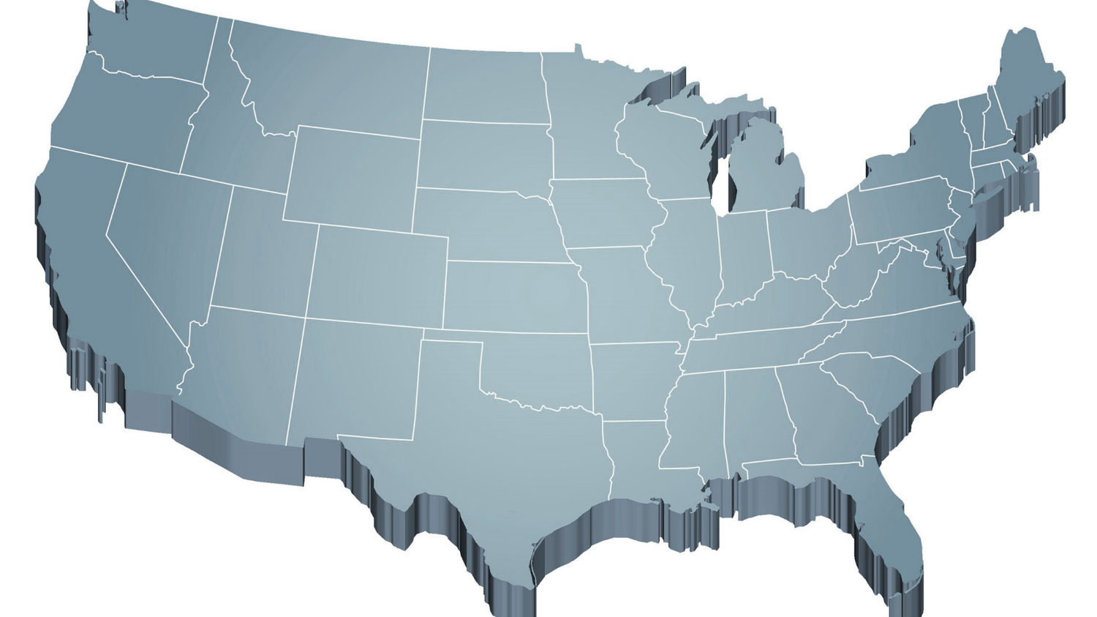
Thank you for your commitment
Shift to a systems level perspective
Internalizing
Externalizing
ED <1%
EBD 12-20%
Source: Forness, S.R., Freeman, S.F., Paparella, T., Kauffman, J.M., & Walker, H.M. (2012). Special education implications of point and cumulative prevalence for children with emotional or behavioral disorders. Journal of Emotional and Behavioral Disorders, 20, 4-18.

Slide 9
Primary (Tier 1) Prevention
All students are eligible for participation (Lane, Robertson et al., 2006)
About 80% of students respond to this level (Gresham, Sugai, Horner, Quinn, & McInerney, 1998; Sugai & Horner, 2006)
Examples of primary (Tier 1) prevention
Validated literacy curricula
Violence prevention
Conflict resolution programs
Anti-bullying programs
Schoolwide social skills instruction
Character education programs
Notes:
Sources: Gresham, F. M., Sugai, G., Horner, R. H., Quinn, M. M., & McInerney, M. (1998). Classroom and schoolwide practices that support students’ social competence: A synthesis of research. Washington, DC: Office of Special Education Programs.
Lane, K. L., Robertson, E. J., & Graham-Bailey, M. A. L. (2006). An examination of school-wide interventions with primary level efforts conducted in secondary schools: Methodological considerations. In T. E. Scruggs & M. A. Mastropieri (Eds.) Applications of research methodology: Advances in learning and behavioral disabilities (Vol. 19), pp. 157-199. Oxford, UK: Elsevier.
Sugai, G., & Horner, R.R. (2006). A promising approach for expanding and sustaining school-wide positive behavior support. School psychology review, 35, 245.

Slide 10
Secondary (Tier 2) Prevention
Students who need more than the primary prevention plan, 10-15% of students
Focused intervention to address academic, behavior, and/or social concerns
Acquisition (can’t do)
Fluency (trouble doing)
Performance (won’t do)
Examples of secondary (Tier 2) prevention
Small group instruction in anger management
Reading comprehension strategies
Notes:
Source: Lane, K.L., Oakes, W.P., Ennis, R.P., & Hirsch, S.E. (2014). Identifying students for secondary and tertiary prevention efforts: How do we determine which students have tier 2 and tier 3 needs? Preventing School Failure, 58, 171-182.

Slide 11
Tertiary (Tier 3) Prevention
Students who need more than primary or secondary prevention, 5-7% of students
Intensive individualized interventions
Examples of tertiary (Tier 3) prevention
Functional assessment-based interventions (Umbreit, Ferro, Liaupsin, & Lane, 2007)
Multisystemic therapy program (Schoenwald, Brown, & Henggeler, 2000)
Notes:
Sources: Lane, K.L., Oakes, W.P., Ennis, R.P., & Hirsch, S.E. (2014). Identifying students for secondary and tertiary prevention efforts: How do we determine which students have Tier 2 and Tier 3 needs? Preventing School Failure, 58, 171-182.
Schoenwald, S. K., Brown, T. L., & Henggeler, S. W. (2000). Inside multisystemic therapy therapist, supervisory, and program practices. Journal of Emotional and Behavioral Disorders, 8, 113-127.
Umbreit, J., Ferro, J.B., Liaupsin, C.J., & Lane, K.L. (2007). Functional behavioral assessment and function-based intervention: An effective, practical approach. Upper Saddle River, NJ: Prentice-Hall.

Slide 12
Core features of the Ci3T model of prevention
Academic
Behavior
Social

Slide 13
Academic Component
Coordinated instruction within and across grade levels
Instruction linked to College and Career-Ready Standards, early learning standards, state, or district standards
Benchmarking student progress to inform instruction
Progress monitoring for students identified for secondary (Tier 2) and tertiary (Tier 3) supports

Slide 14
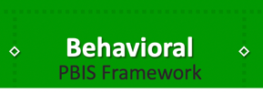
Behavioral Component
A Framework,
Not a Curriculum
Positive Behavioral Interventions and Supports (PBIS)
Establish, clarify, and define expectations
Teach all students the expectations, planned and implemented by all adults in the school
Give opportunities to practice
Reinforce students consistently, facilitate success
Consider rules, routines, and physical arrangements
Monitor the plan using school-wide data to identify students who need more support
Monitor student progress

Slide 15
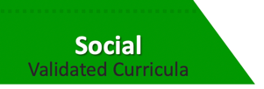
Social Component: Identifying a Validated Curriculum
Violence Prevention
Second Step Violence Prevention (www.cfchildren.org)
Character Education
Positive Action (www.positiveaction.net)
Caring School Community (www.characterplus.org)
Social Skills
Social Skills Improvement System: Classwide Intervention Program (Elliott & Gresham, 2007)

Slide 16
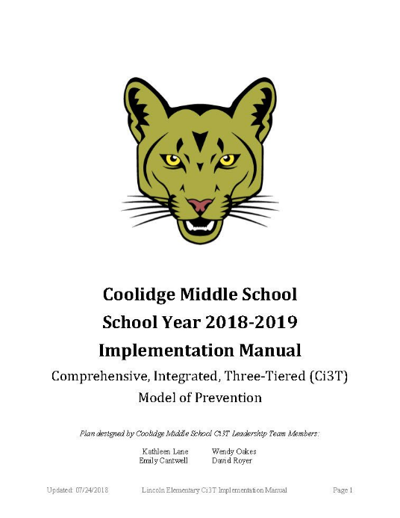
Ci3T Implementation Manual

Slide 17
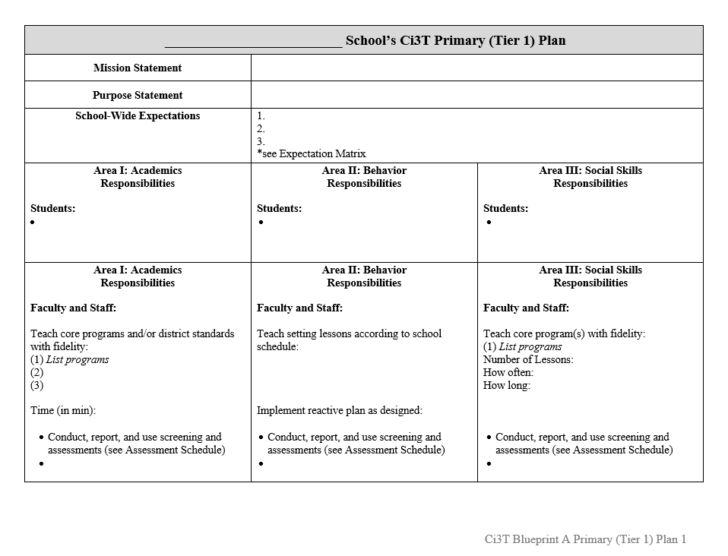
Ci3T Implementation Manual Primary (Tier 1) Plan
What are ALL students accessing?

Slide 18
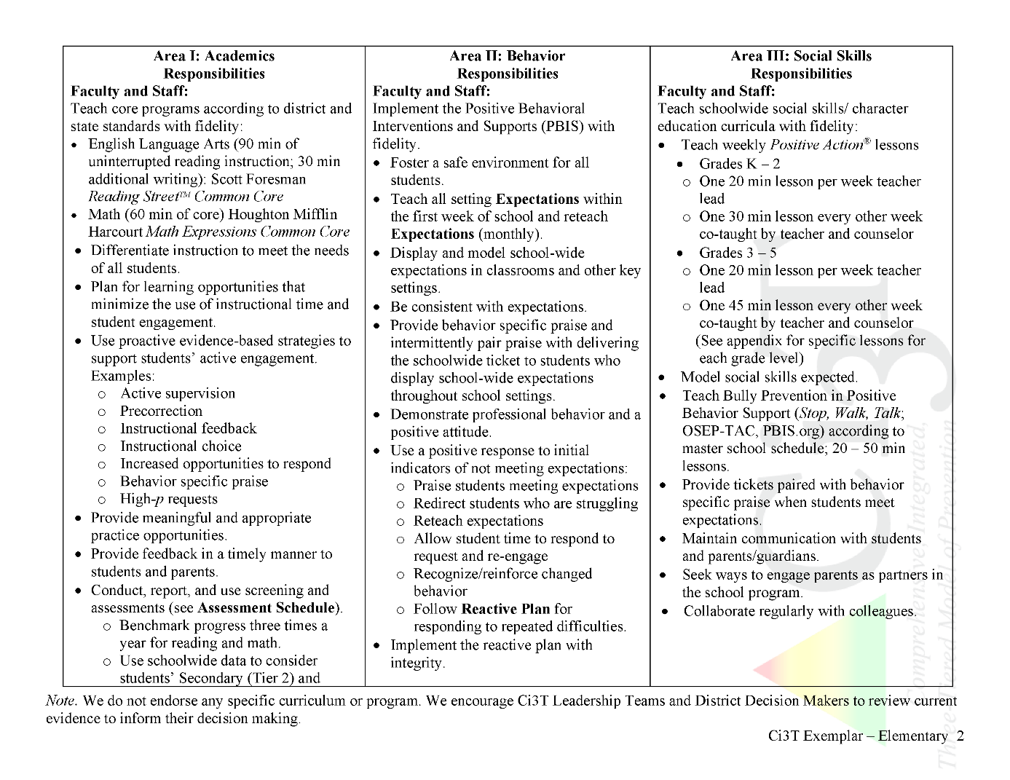
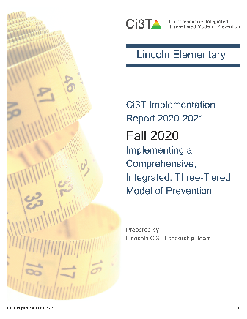
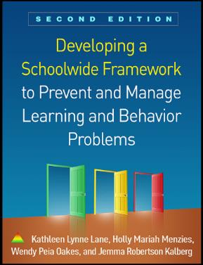
Ci3T Primary Plan: Procedures for Teaching
Ci3T Primary Plan: Procedures for Reinforcing
Ci3T Primary Plan: Procedures for Monitoring
Notes:
Continued to keep implementation manuals, which are foundational to Ci3T, updated and current

Slide 19
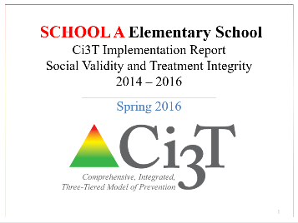
Essential Components of Primary Prevention Efforts
Social Validity
Systematic Screening
Academic
Behavior
Treatment Integrity

Slide 22
The How and Why of Systematic Screening

Slide 23
Essential Components of Primary Prevention Efforts
Social Validity
Systematic Screening
Academic
Behavior
Treatment Integrity

Slide 24
Comprehensive, Integrated, Three-Tiered Model of Prevention
(Lane, Kalberg, & Menzies, 2009)
Tier 3
Tertiary Prevention (≈5%)
Tier 2
Secondary Prevention (≈15%)
Tier 1
Primary Prevention (≈80%)
Academic ◇ Behavioral ◇ Social
Validated Curricula PBIS Framework Validated Curricula

Slide 25
Systematic Screening … Logistics
Fall
Winter
Spring
Selecting
Installing
Analyzing

Slide 26
Considerations
Psychometrically Sound
Socially Valid
If social validity is lacking, even psychometrically strong tools are likely to remain unused by educators.

Slide 27
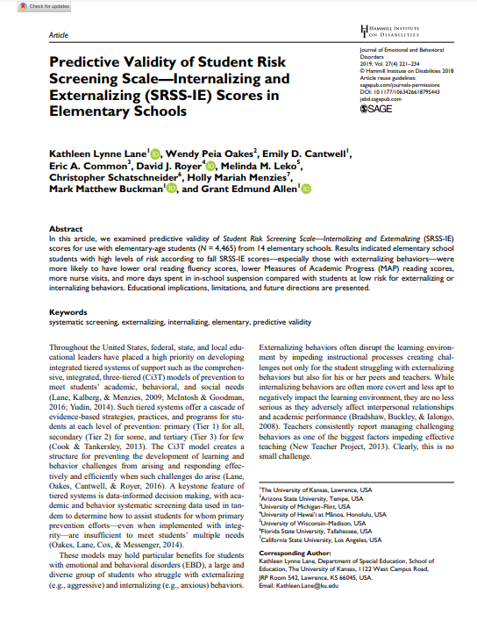
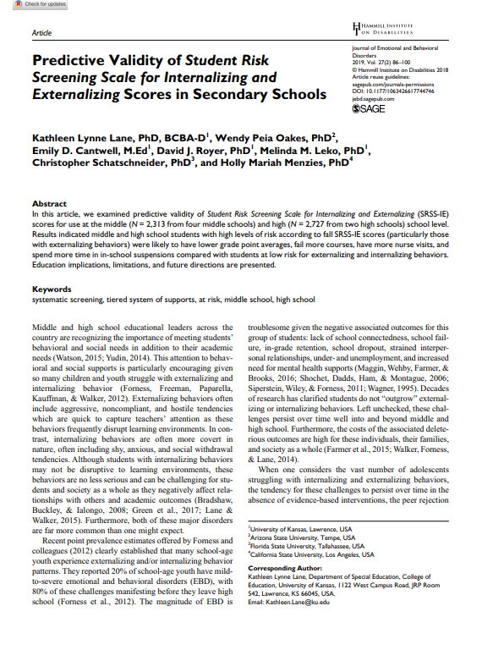
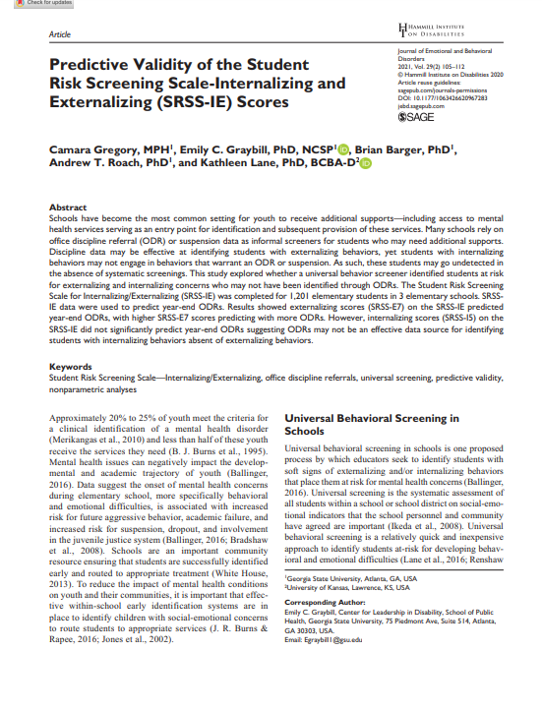
SRSS-IE Scores Predict Student Outcomes
Fall
Winter
Year End
ODR Suspensions
Nurse Visits
Course Failures

Slide 28
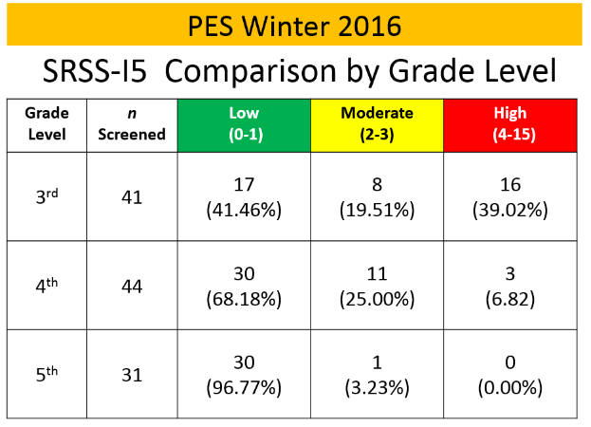
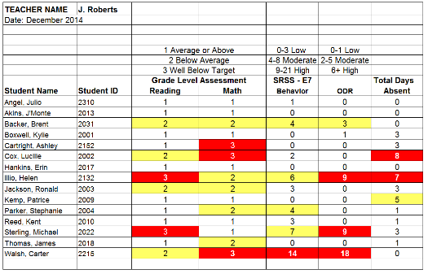
Data Sharing
Schoolwide data
decisions related to primary prevention efforts
Grade / department / class
implications for teachers’ practice
Individual student
decisions about student- based interventions

Slide 29
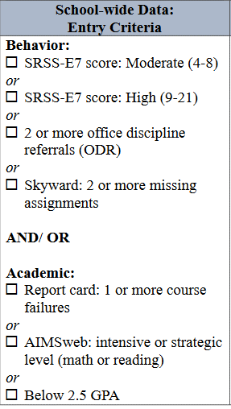
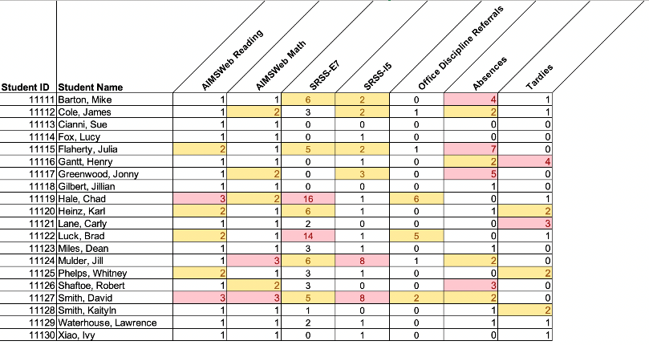
Using multiple data sources

Slide 30
Student Risk Screening Scale – Internalizing and Externalizing (SRSS-IE; Drummond, 1994; Lane & Menzies, 2009) Elementary

Slide 31
SRSS-IE: Cut Scores
Elementary School |  | Middle and High School
SRSS-E7 | SRSS-I5 | SRSS-E7 | SRSS-I6
Items 1-7 | Items 8-12 | Items 1-7 | Items 4, 8-12
0-3 = low risk 4-8 = moderate risk 9-21 = high risk | 0-1 = low risk 2-3 = moderate risk 4-15 = high risk | 0-3 = low risk 4-8 = moderate risk 9-21 = high risk | 0-3 = low risk 4-5 = moderate risk 6-18 = high risk
Elementary School Level:
Lane, K. L., Oakes, W. P., Swogger, E. D., Schatschneider, C., Menzies, H., M., & Sanchez, J. (2015). Student risk screening scale for internalizing and externalizing behaviors: Preliminary cut scores to support data-informed decision making. Behavioral Disorders, 40, 159-170.
Middle and High School Levels:
Lane, K. L., Oakes, W. P., Cantwell, E. D., Schatschneider, C., Menzies, H., Crittenden, M., & Messenger, M. (2016). Student Risk Screening Scale for Internalizing and Externalizing Behaviors: Preliminary cut scores to support data-informed decision making in middle and high schools. Behavioral Disorders, 42(1), 271-284

Slide 32
Fall 2022 SRSS-Externalizing Results – Elementary School level
n = 44
n = 43
n = 47
n = 27
n = 36
n = 29
n = 6
n = 17
n = 22
n = 118
n = 100
n = 85
n = 94
n = 86
n = 83
n = 30
n = 69
n = 61
n = 276
n = 335
n = 329
n = 306
n = 293
n = 333
n = 283
n = 346
n = 352
Notes:
Fill in <year> based on current academic year. This is located in column A of the data sheet. Edit by right clicking and selecting “Edit data”.

Slide 33
Fall 2022 SRSS-Internalizing Results – Elementary School level
n = 59
n = 62
n = 39
n = 39
n = 31
n = 18
n = 13
n = 32
n = 23
n = 82
n = 65
n = 67
n = 73
n = 46
n = 47
n = 35
n = 62
n = 69
n = 304
n = 292
n = 361
n = 338
n = 351
n = 340
n = 321
n = 338
n = 343
Cut scores vary by school level:
Elementary (I5): Low (0-1), Moderate (2-3), High (4-15)
Middle and High (I6): Low (0-3), Moderate (4-5), High (6-18)
Notes:
Fill in <year> based on current academic year. This is located in column A of the data sheet. Edit by right clicking and selecting “Edit data”.
IMPORTANT NOTE: The INTERNALIZING subscale and CUT SCORES are specific to school level.
Elementary: SRSS-I5, Items 8-12, 0-1 = low risk, 2-3 = moderate risk, 4-15 = high risk
Middle and High: SRSS-I6, Items 4, 8-12, 0-3 = low risk, 4-5 = moderate risk, 6-18 = high risk

Slide 34
Fall 2022 SRSS-Internalizing Results – Elementary School Level
Grade Level | N Screened | Low n (%) | Moderate n (%) | High n (%)
K | 64 | 52 (81.25%) | 7 (10.94%) | 5 (7.81%)
1 | 81 | 69 (85.19%) | 9 (11.11%) | 3 (3.70%)
2 | 56 | 44 (78.57%) | 11 (19.64%) | 1 (1.79%)

Slide 35
Fall 2022 SRSS-Externalizing Results – Middle School level
n = 24
n = 11
n = 3
n = 18
n = 19
n = 23
n = 9
n = 16
n = 75
n = 53
n = 27
n = 67
n = 75
n = 57
n = 31
n = 53
n = 515
n = 517
n = 552
n = 518
n = 541
n = 475
n = 400
n = 460
Notes:
Fill in <year> based on current academic year. This is located in column A of the data sheet. Edit by right clicking and selecting “Edit data”.

Slide 36
Fall 2022 SRSS-Internalizing Results – Middle School level
n = 87
n = 43
n = 37
n = 13
n = 21
n = 19
n = 53
n = 37
n = 88
n = 26
n = 39
n = 13
n = 30
n = 27
n = 40
n = 42
n = 460
n = 486
n = 518
n = 414
n = 550
n = 536
n = 510
n = 450
Cut scores vary by school level:
Elementary (I5): Low (0-1), Moderate (2-3), High (4-15)
Middle and High (I6): Low (0-3), Moderate (4-5), High (6-18)
Notes:
Fill in <year> based on current academic year. This is located in column A of the data sheet. Edit by right clicking and selecting “Edit data”.
IMPORTANT NOTE: The INTERNALIZING subscale and CUT SCORES are specific to school level.
Elementary: SRSS-I5, Items 8-12, 0-1 = low risk, 2-3 = moderate risk, 4-15 = high risk
Middle and High: SRSS-I6, Items 4, 8-12, 0-3 = low risk, 4-5 = moderate risk, 6-18 = high risk

Slide 37
Fall 2022 SRSS-Internalizing Results – Middle School Level
Grade Level | N Screened | Low n (%) | Moderate n (%) | High n (%)
6 | 176 | 151 (85.80%) | 15 (8.52%) | 10 (5.68%)
7 | 176 | 141 (80.11%) | 17 (9.66%) | 18 (10.23%)
8 | 177 | 158 (89.21%) | 10 (5.65%) | 9 (5.08%)

Slide 38
Fall 2022 SRSS-Externalizing Results – High School level
n = 29
n = 39
n = 23
n = 25
n = 30
n = 13
n = 26
n = 38
n = 96
n = 95
n = 90
n = 82
n = 69
n = 55
n = 129
n = 95
n = 1339
n = 1222
n = 1072
n = 1404
n = 692
n = 1242
n = 1119
n = 1270
Notes:
Fill in <year> based on current academic year. This is located in column A of the data sheet. Edit by right clicking and selecting “Edit data”.

Slide 39
Fall 2022 SRSS-Internalizing Results – High School level
n = 112
n = 87
n = 76
n = 62
n = 63
n = 70
n = 78
n = 91
n = 124
n = 64
n = 56
n = 42
n = 38
n = 41
n = 66
n = 106
n = 961
n = 1387
n = 1320
n = 1225
n = 690
n = 1076
n = 1247
n = 1212
Cut scores vary by school level:
Elementary (I5): Low (0-1), Moderate (2-3), High (4-15)
Middle and High (I6): Low (0-3), Moderate (4-5), High (6-18)
Notes:
Fill in <year> based on current academic year. This is located in column A of the data sheet. Edit by right clicking and selecting “Edit data”.
IMPORTANT NOTE: The INTERNALIZING subscale and CUT SCORES are specific to school level.
Elementary: SRSS-I5, Items 8-12, 0-1 = low risk, 2-3 = moderate risk, 4-15 = high risk
Middle and High: SRSS-I6, Items 4, 8-12, 0-3 = low risk, 4-5 = moderate risk, 6-18 = high risk

Slide 40
Fall 2022 SRSS-Internalizing Results – High School Level
Grade Level | N Screened | Low n (%) | Moderate n (%) | High n (%)
9 | 367 | 308 (83.92%) | 30 (8.17%) | 29 (7.90%)
10 | 375 | 308 (82.13%) | 35 (9.33%) | 32 (8.53%)
11 | 367 | 321 (87.47%) | 24 (6.54%) | 22 (5.99%)
12 | 300 | 275 (91.67%) | 17 (5.67%) | 8 (2.67%)

Slide 41
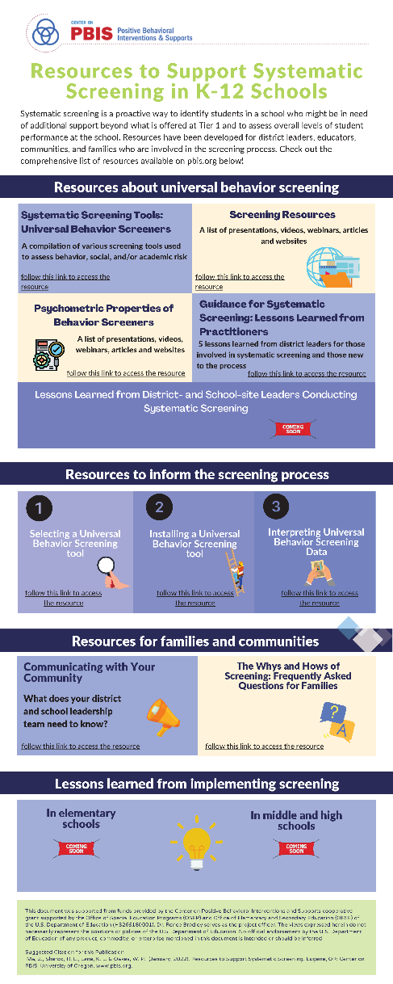
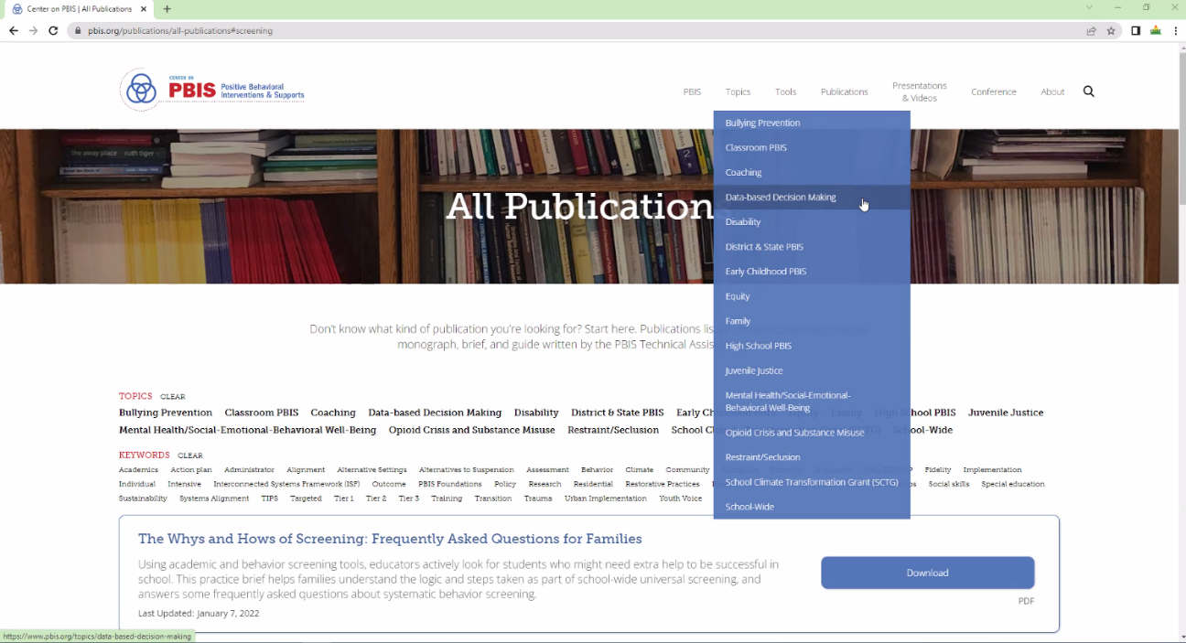
Resources for screening available on PBIS.org…
coming soon!

Slide 42
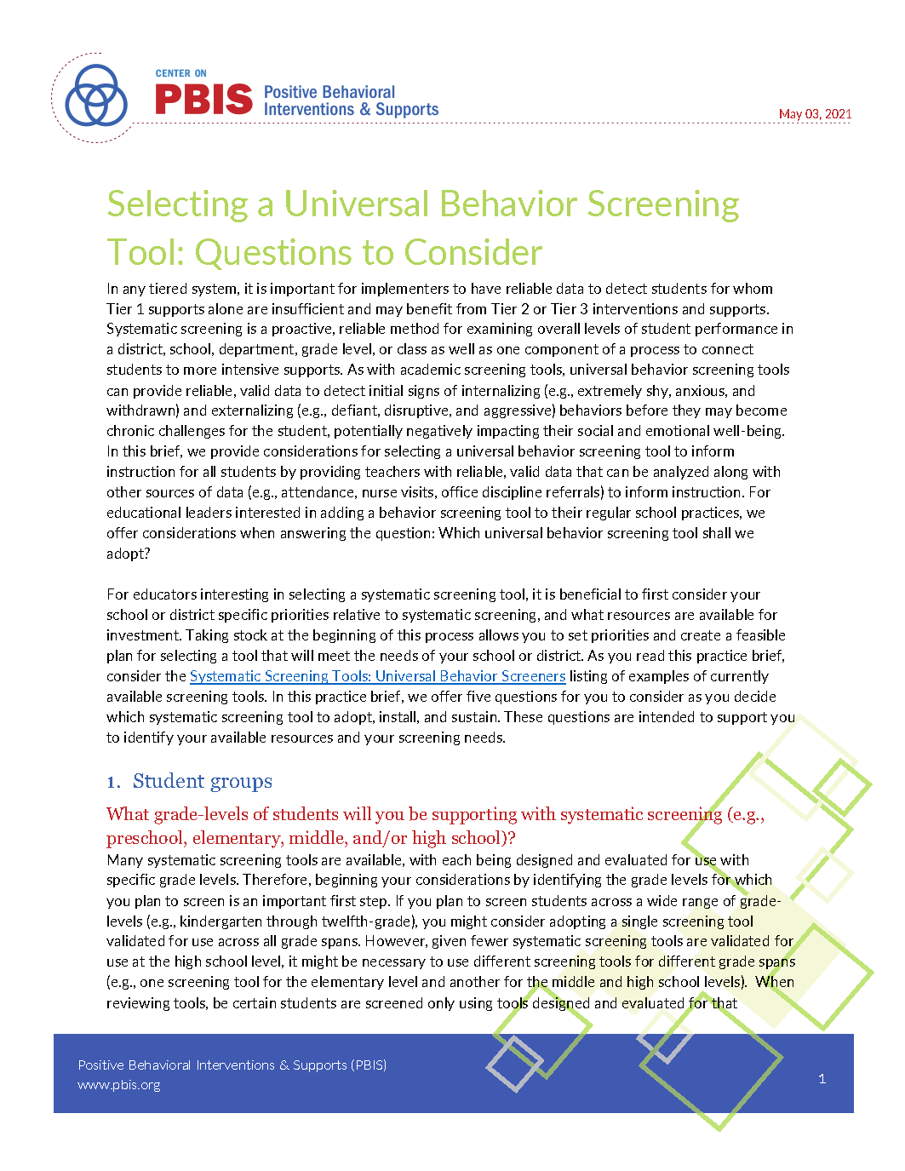
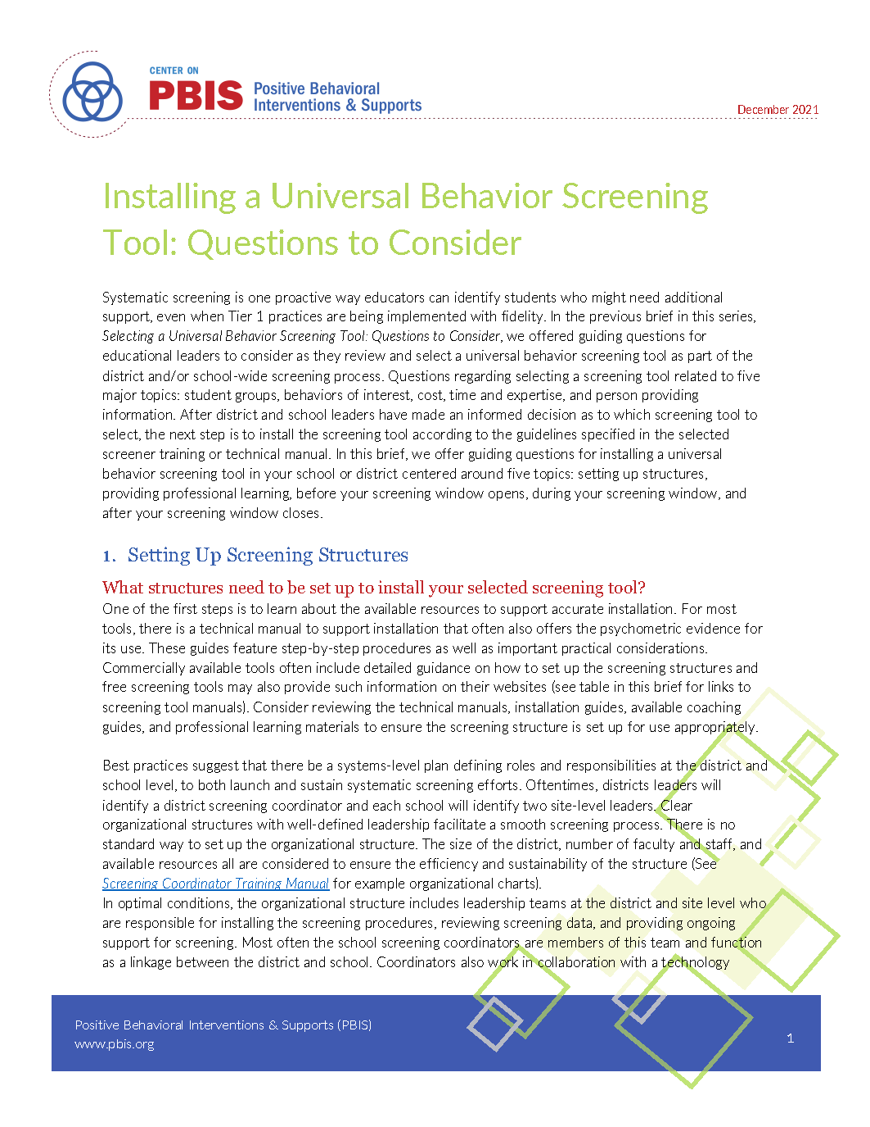
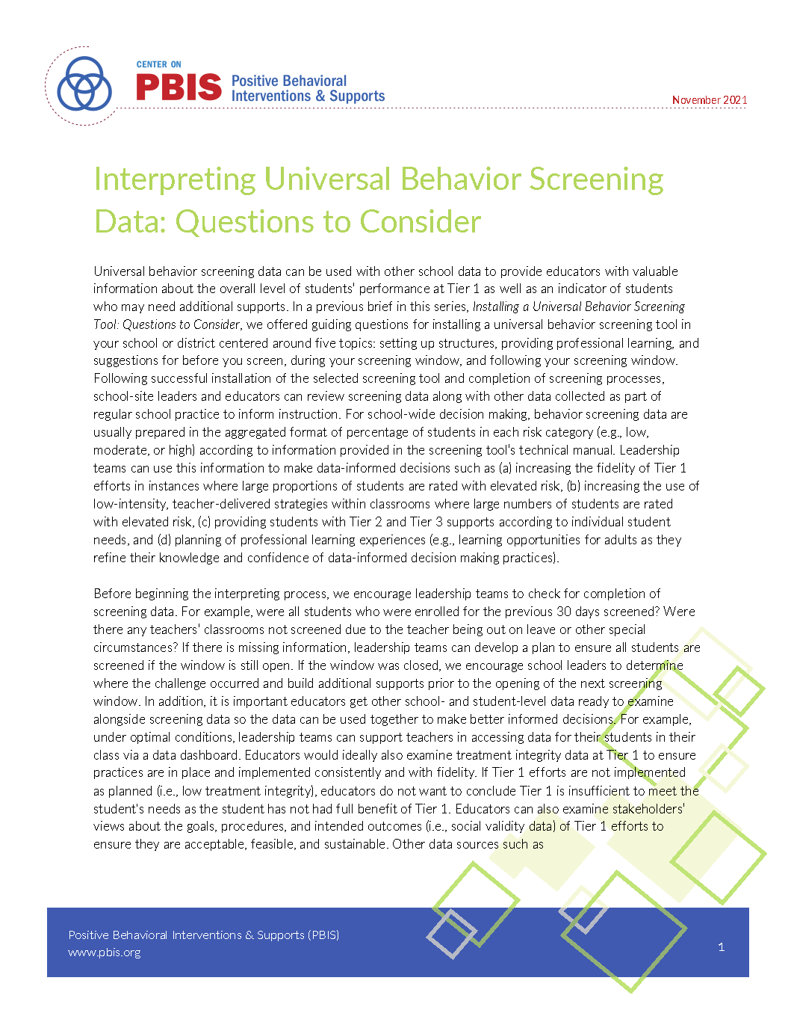
Resources About the Screening Process: Questions to consider for….
Selecting a Tool
Installing a Tool
Interpreting Data

Slide 43
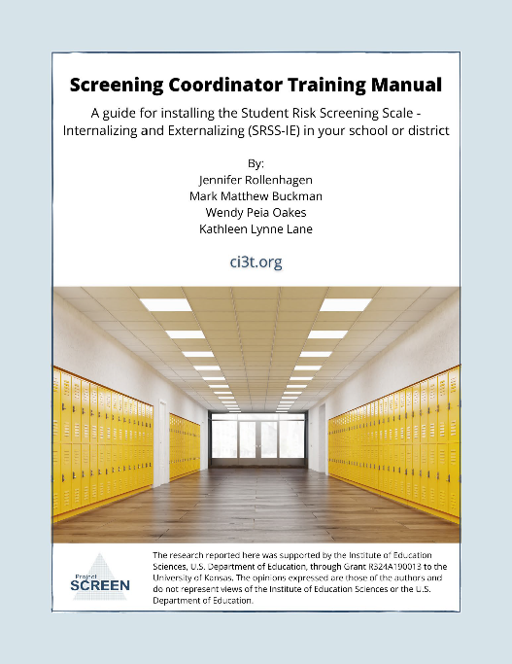
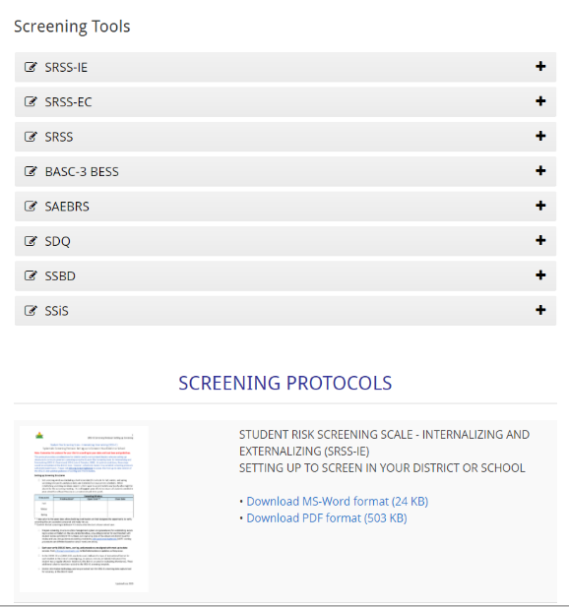

Slide 44
Illustration 1
Amber Smith – A journey with Ci3T Emphasizing: screening, integration at Tier 1, and professional learning

Slide 45
One District’s Journey
In September 2020, the South Carolina Department of Education hosted a virtual showcase highlighting nine commonly used behavior screeners. One of those screeners, the Student Risk Screening Scale – Internalizing and Externalizing (SRSS-IE; Drummond, 1994; Lane & Menzies, 2009), was presented within the Ci3T model by Dr. Kathleen Lane.
Intrigued by the design of the Ci3T model, the district engaged in a book study for Developing a Schoolwide Framework to Prevent and Manage Learning and Behavior Problems. This book study resulted in the decision to move forward with Ci3T implementation. The district reached out to Dr. Lane with questions and a research partnership was born.

Slide 46
Implementation Timeline
 | 2021-22 | 2022-23 | 2023-24 | 2024-25 | 2025-26 | 2026-27+
Elementary Schools
Ci3T Manual-Building & Training
Implementation Year 1
Implementation Year 2
Sustain & Develop Practices
Middle & High Schools
Ci3T Manual-Building & Training
Implementation Year 1
Implementation Year 2
Sustain & Develop Practices

Slide 47
Expectations from South Carolina Legislation
Act 195 (2016) declares the Profile of the South Carolina Graduate to be the standard by which the state’s high school graduates should be measured. It focuses on three core areas:
World Class Knowledge
World Class Skills
Life & Career Characteristics
Act 213 (2018) directs districts to implement a multi-tiered system of supports (MTSS) beginning in the 2019–20 school year. MTSS addresses the needs of the whole child – academically, behaviorally, socially, and emotionally – through a framework of increasing supports in the areas of academics, social emotional learning and behavior.

Slide 48
Making a Case for Ci3T: It’s the Plate!

Slide 49
The Profile Fills the Plate
World-Class Knowledge
World-Class Skills
Life & Career Characteristics

Slide 50
Academics Develop World-Class Knowledge
The district commonly ranks at the top of the state for academic achievement as measured by state assessments.
Despite being a high achieving district, prior to Ci3T, state testing scores indicated approximately 65-75% of students tested met or exceeded state expectations. This leaves about 25-35% of students falling below benchmark.

Slide 51
Tier 1 Academic
Validated Curricula
State Standards PLC-Created Units of Instruction
Universal Screeners
K-8: STAR 9-12: Course Failures by Marking Period
High Quality Instruction
Practices identified in South Carolina Teaching Standards Integration of STEAM principles, differentiation, PBL, and other evidence-based practices
Notes:
More confident in Tier 1 Academics. Established universal screeners.

Slide 52
Professional Learning Needs: Academic
Understanding the Ci3T model in each grade band
Removing data silos and analyzing it holistically
Using universal screeners to look at the “health” of instruction (sending boats instead of life preservers)
Establishing entry and exit criteria for more equitable access to tiered supports

Slide 53
Behavior Develops World-Class Skills
Data from 2021-22 indicate that the district declined in daily attendance increased in chronic absences, increased office in referral rates, and increased in suspension rates.

Slide 54
Tier 1 Behavior
Validated Curricula
PBIS Framework
Universal Screeners
School-wide expectation matrix Common plan for minor & major discipline, Educator’s Handbook
High Quality Instruction
Instructional Approach to Behavior Active Supervision Behavior-Specific Praise Instructional Choice Instructional Feedback Opportunities to Respond Precorrection
Notes:
Recognized a need to have consistent data collection on student behavior, collaboration with student services, revamp of existing majors/minors/consequences

Slide 55
Professional Learning Needs: Behavior
Teaching behavioral expectations
Low-intensity strategies
Responding to behavior using an instructional approach
Examining beliefs and practices related to consequences & punishment

Slide 56
Social-Emotional Well-Being Develops Life & Career Characteristics
Risk assessment data collected in 2021-22 indicated an increase in risk. Suicidal ideation and self injury doubled in number of reports at all levels. Threat screeners and assessments tripled. The rate of increase outpaces the rate of student growth, indicating that “new” students that are not accounting for this increasing risk.

Slide 57
Tier 1 Social-Emotional Well-Being
Validated Curricula
Based on CASEL 5 Core Competencies (Harmony, Character Strong, Second Step)
Universal Screeners
All Levels: The Student Risk Screening Scale – Internalizing and Externalizing (SRSS-IE)
High Quality Instruction
Integrates CASEL 5 Core Competencies Self-Awareness Self-Management Responsible Decision-Making Relationship Skills Social Awareness
Notes:
Movement from DESSA to SRSS-IE, which found more students especially those with internalizing needs. Much of this was and continues to be new learning.

Slide 58
Professional Learning Needs: Social-Emotional
Understanding SEL as it relates to Tier 1 by teaching skills for social-emotional well-being
Low-intensity strategies
Communicating with families about SEL and what it looks like in school

Slide 59
Looking Back and Looking Ahead
Preparing
Strategic Planning Goals
Implementing
Interconnected System
Sustaining
Consistency & Predictability
Staggered Implementation
Research Partnership
Responding to Data
Interdepartmental Collaboration
Laser focus on purpose and intent
Notes:
Preparing: What served us well as we began this work?
Implementing: What is helping us do the work?
Sustaining: What will it take to keep the work moving forward?

Slide 60
Illustration 2
Jessica Poppe - Sedro-Woolley School District Journey with Ci3T

Slide 61
It all started at a conference….
In 2018 SWSD sent a team of educators to the state’s MTSSfest. During a breakout session one of our team members sat in on a presentation on the Ci3T framework. She gathered all the information she could brought it back to our Assistant Superintendent. After a few phone calls with Dr. Lane and district leadership Sedro-Woolley was ready to start the work. We strategically worked with Dr. Lane and her team to focus on four schools to begin the learning year in 2019. From here our journey has grown into all SWSD schools (7 elementary, 1 middle school, 2 high schools) having implementation plans. We have worked through district level leadership changes, building level leadership changes, a pandemic, and many revised implementation plans to support our school community.

Slide 62
Washington Office of Superintendent of Public Instruction’s (OSPI) MTSS Values 2019
To ensure every student has equitable access to the instruction and supports they need to thrive, district and school teams:
Identify and address biases and systemic barriers that drive inequitable access and disparate outcomes for Black, Indigenous, and students of color, students experiencing poverty, students receiving special education or English learner services, students who identify as LGBTQ+, and highly mobile student populations.
Collaborate with students, families, and community partners to leverage the unique cultural and linguistic assets of their communities in order to provide every student an inclusive and responsive learning environment.
Deliver comprehensive supports that consistently meet every student’s needs and accelerate student academic, social, emotional, and behavioral learning.
https://ospi.k12.wa.us/student-success/support-programs/multi-tiered-system-supports-mtss

Slide 63
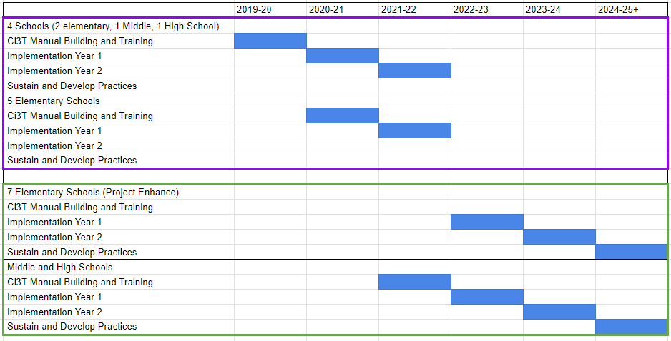
SWSD Implementation Timeline

Slide 64
Screening
Academic
Behavior
Social Emotional
2020 SWSD Implemented iReady for grades K-8
2021 SWSD Implemented NAVVY for grades 9-12
2020 SWSD resurrected PBIS frameworks in all buildings, aligning the work with Ci3T evidence based structure and strategies.
2020 SWSD Integrated Attendance and Office Referrals into proactive strategies to support students
2020 Building Teams K-12 were redesigned to address all student needs within the tiered level of proactive support.
2020 SWSD Implemented the SRSS-IE grades K-8, and at Alternative High school
2021 SWSD Screened all students K-12 with the SRSS-IE

Slide 65
Professional Learning: Integrating at Tier 1
Academic
Behavior
Social Emotional
Priority Standards
School Board Adopted Curriculum
Analyzing iReady Data at the building level, classroom level, student level in teams
Aligned School-Wide Expectations: Teaching, Monitoring and Reinforcing
Analyzing School-Wide ODR Data to inform instruction
SRSS-IE
Adoption of Second Step K-8, Spark 9-12, Give Thx Alternative High School
Integrating SRSS-IE Data with SEL Curriculum
Comprehensive Tiered Level of Prevention and Low-Intensity Strategies

Slide 66
Closing Out and Moving Forward

Slide 68
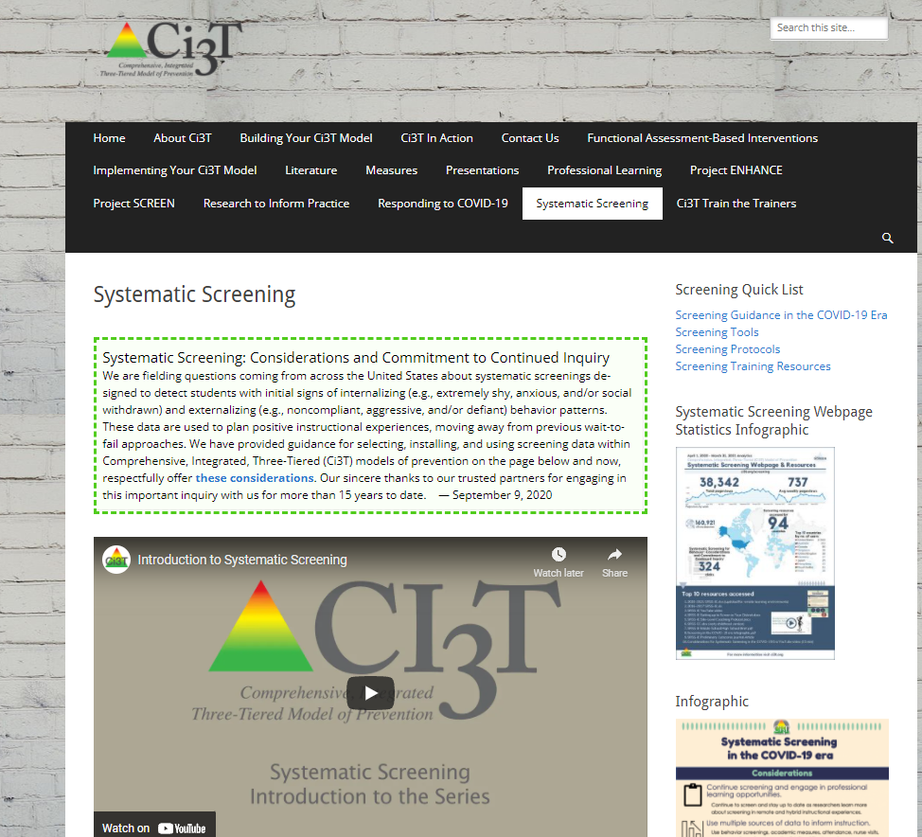
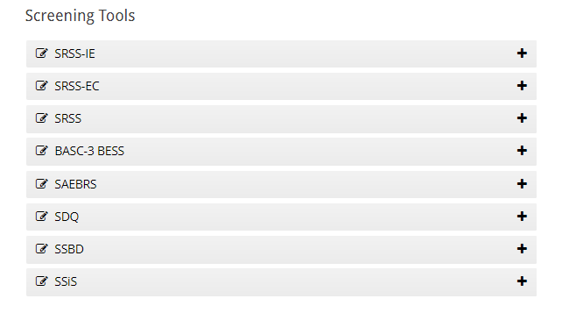
Website www.ci3t.org

Slide 69
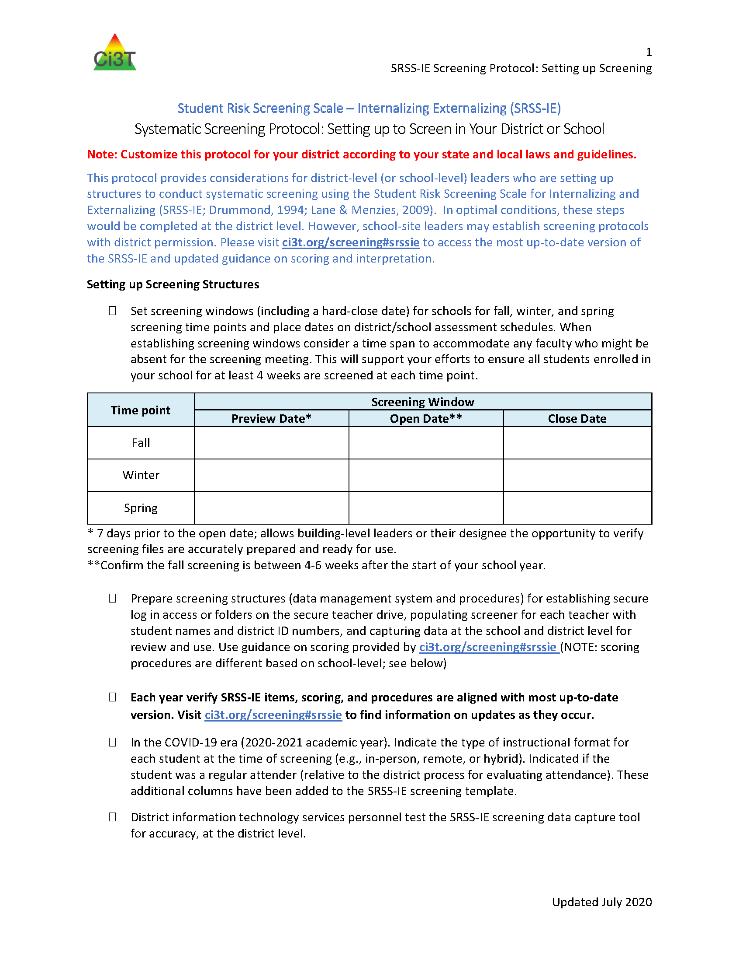
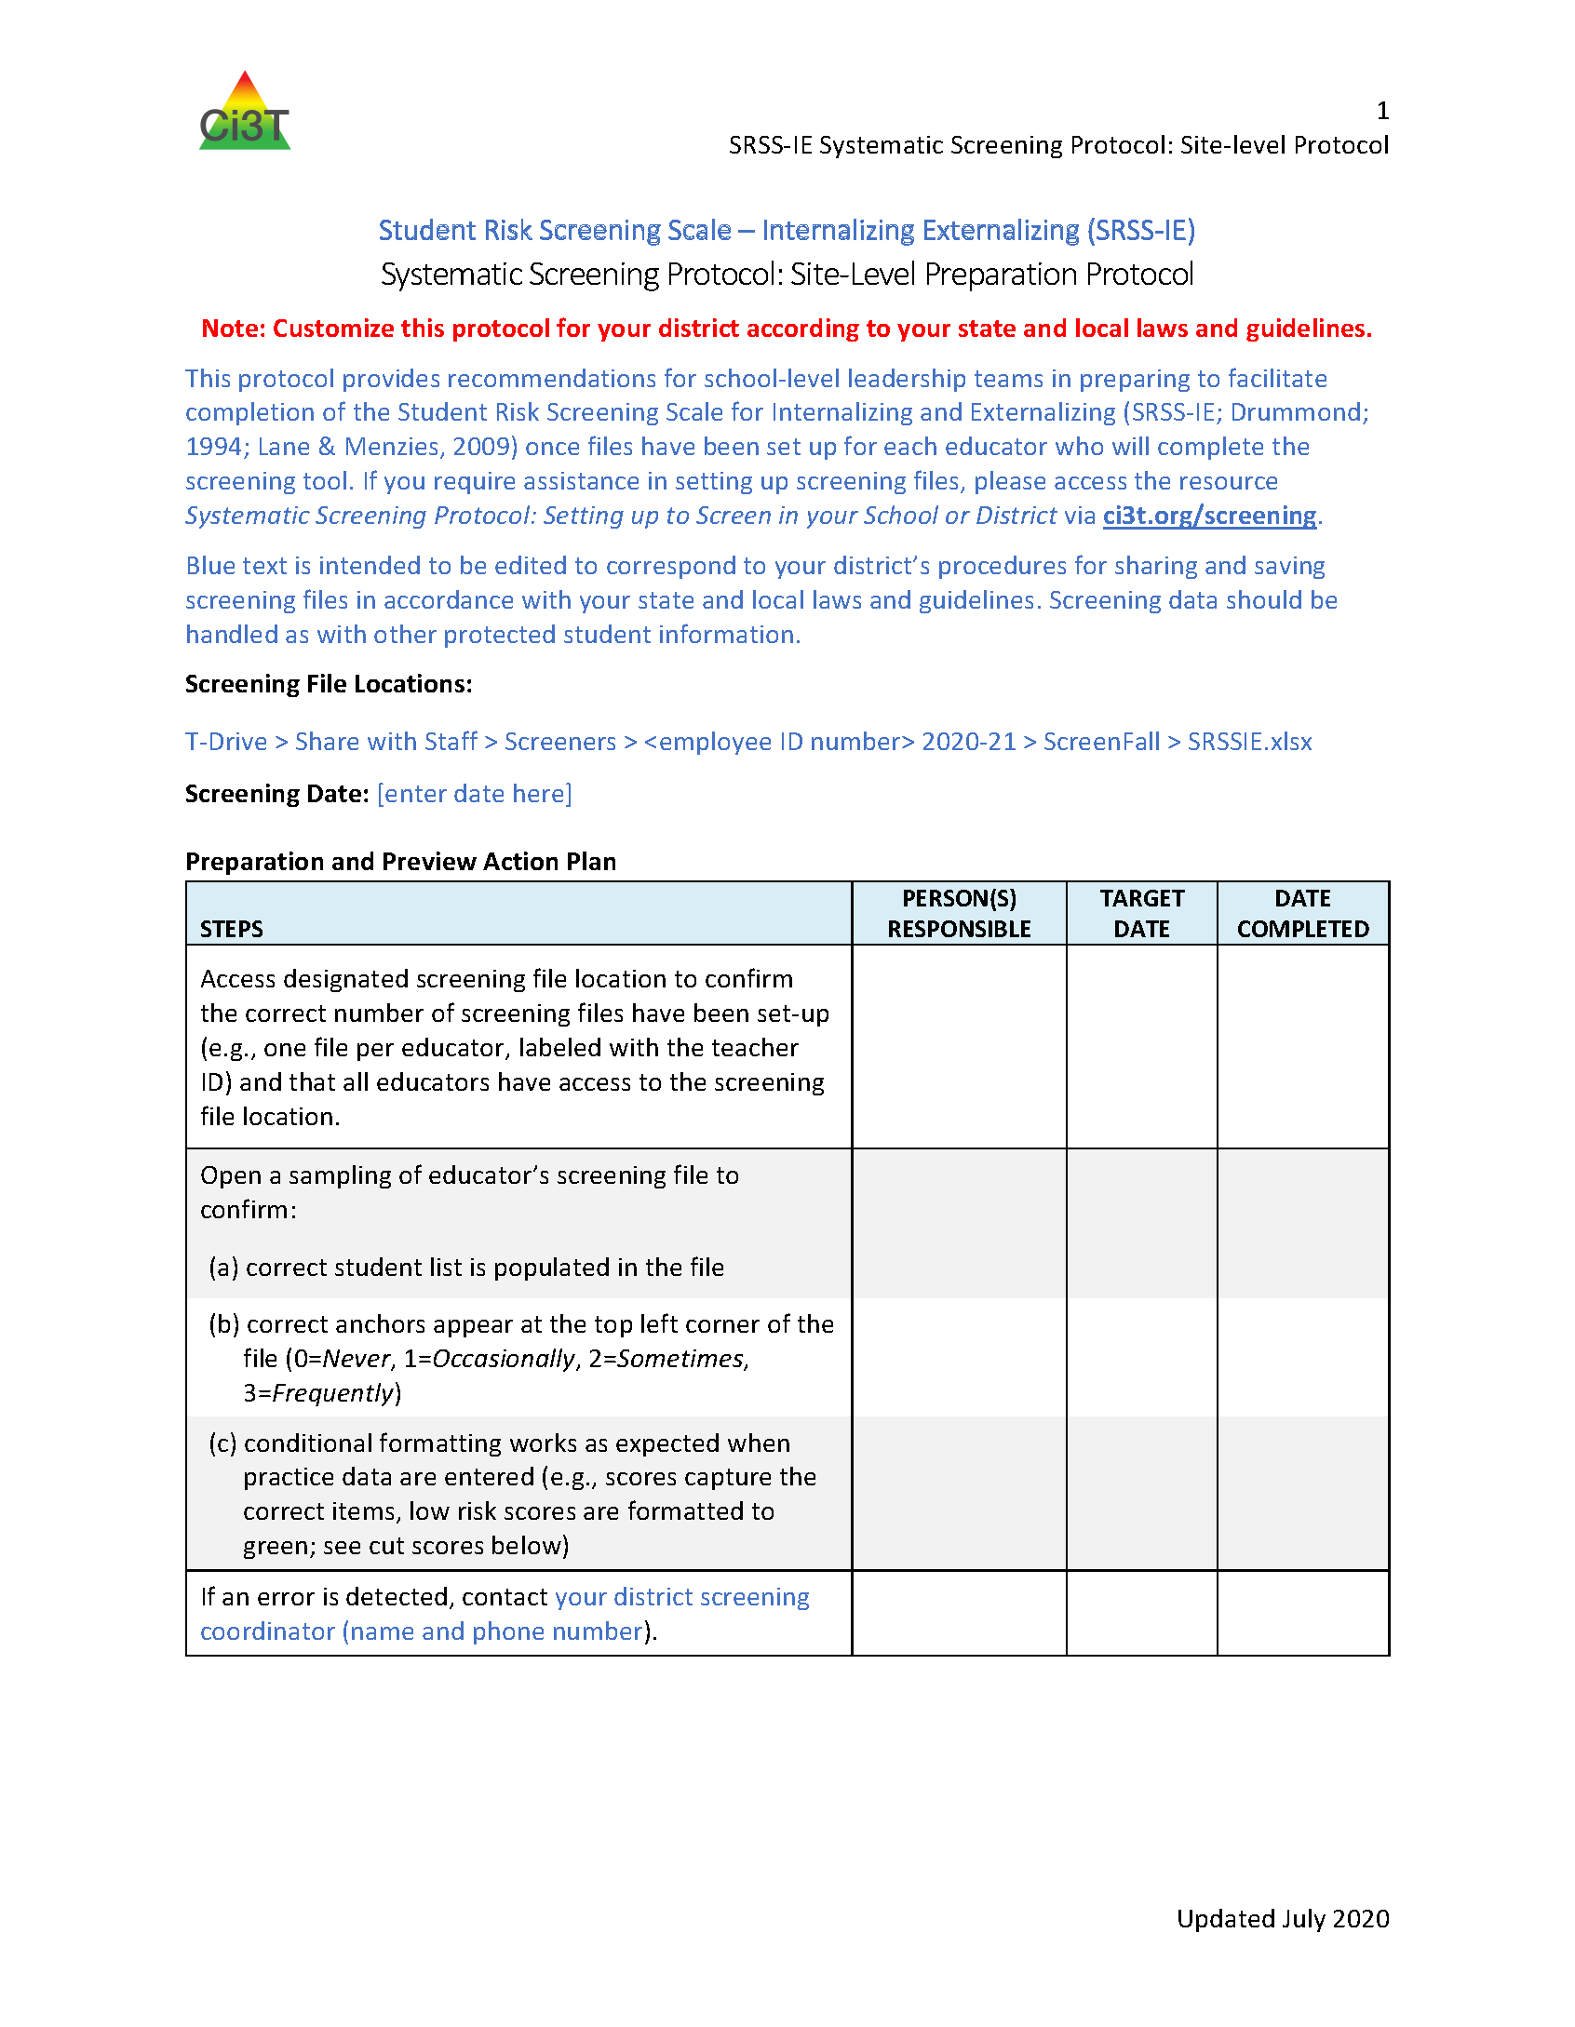
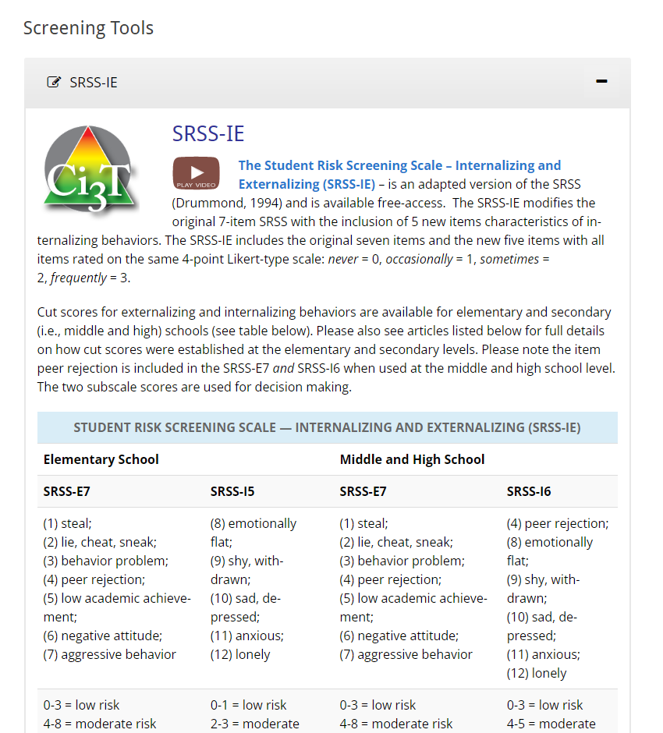
Protocols

Slide 70
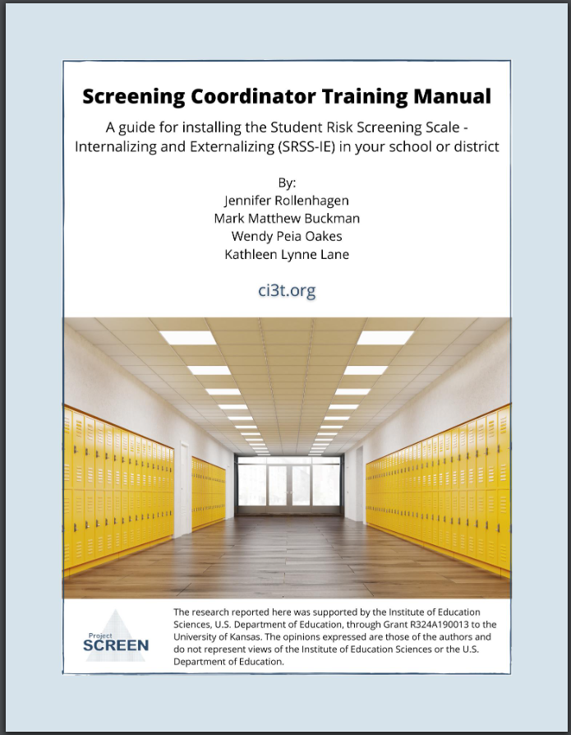
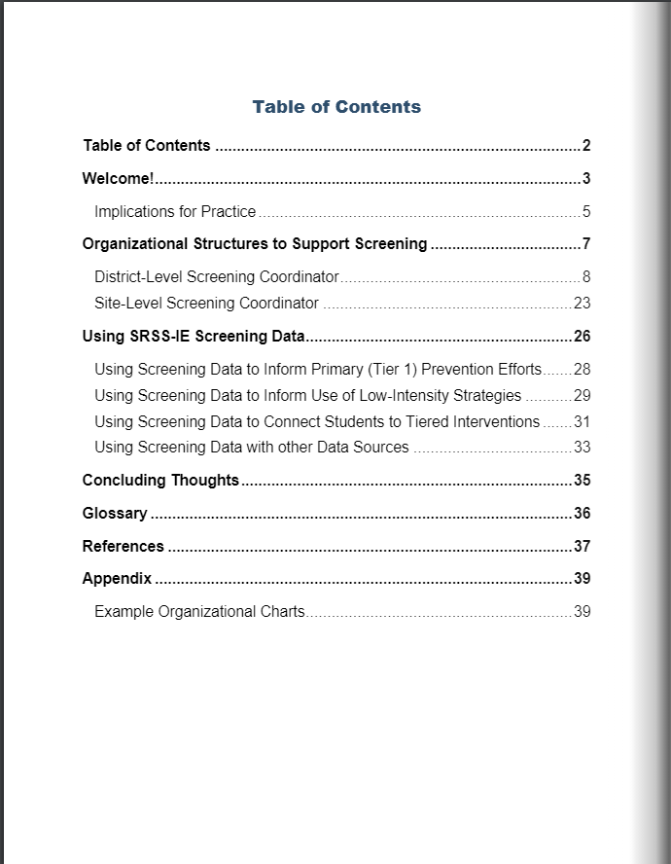
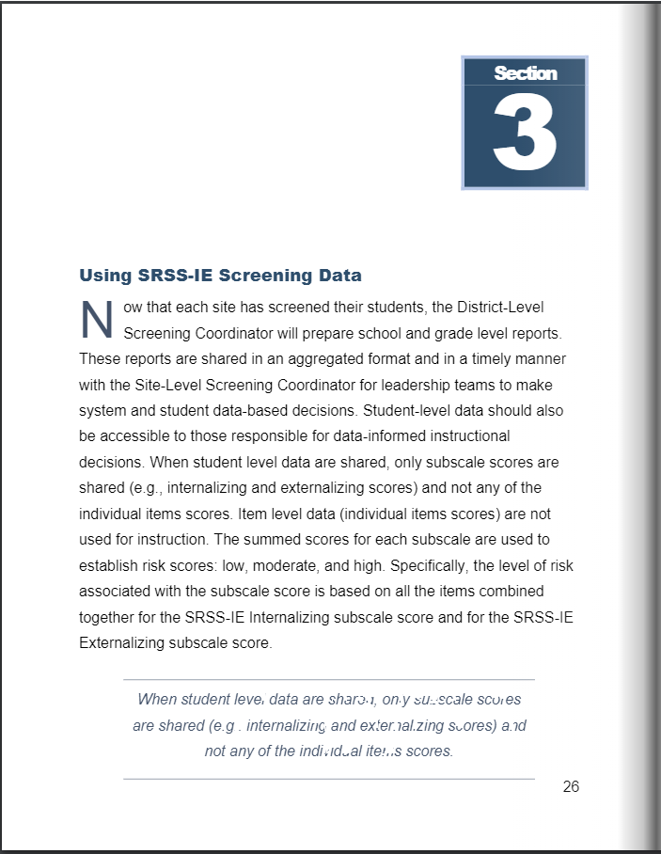
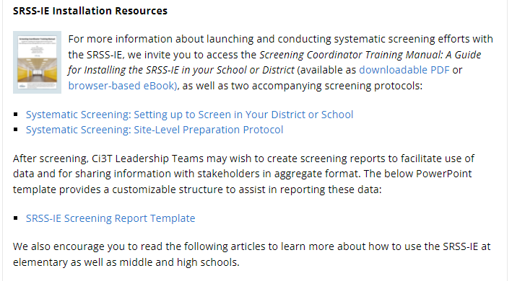
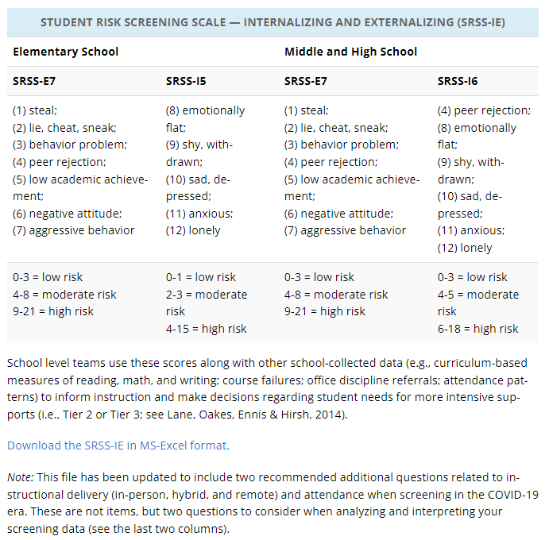
Manual

Slide 71
Tips for Communicating with Your Community about Systematic Screening

Slide 72
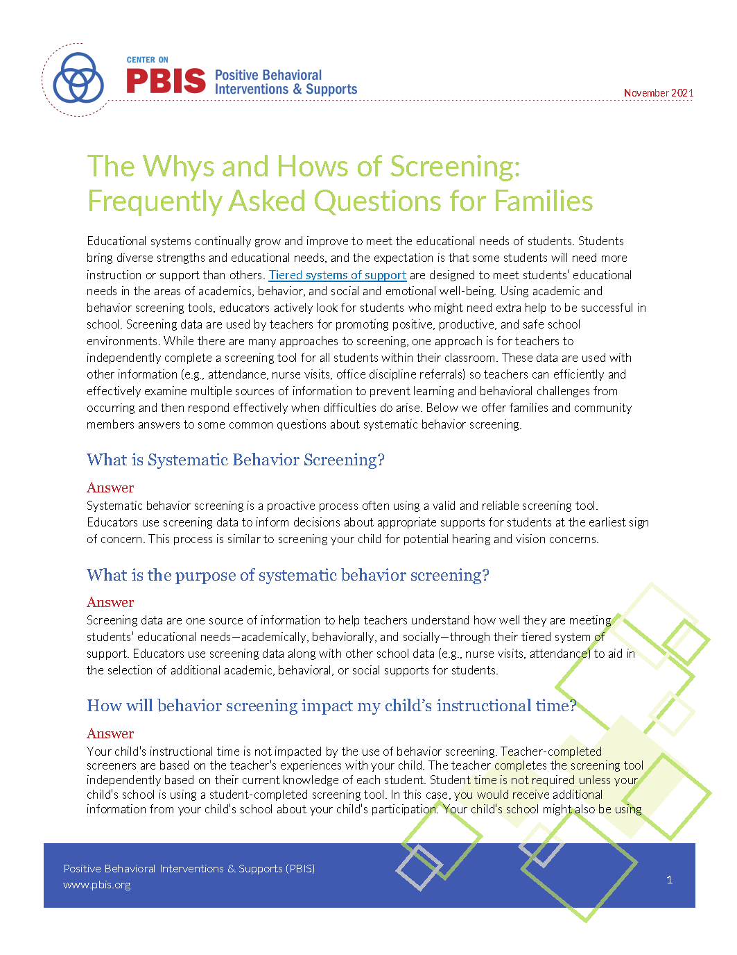
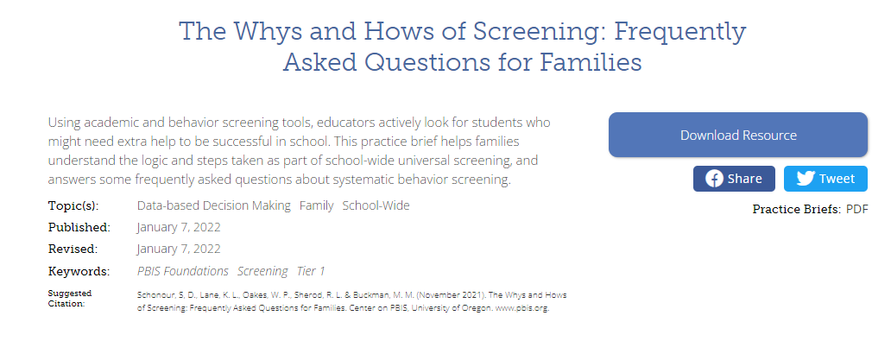
The Whys and Hows of Screening: Frequently Asked Questions for Families

Slide 73
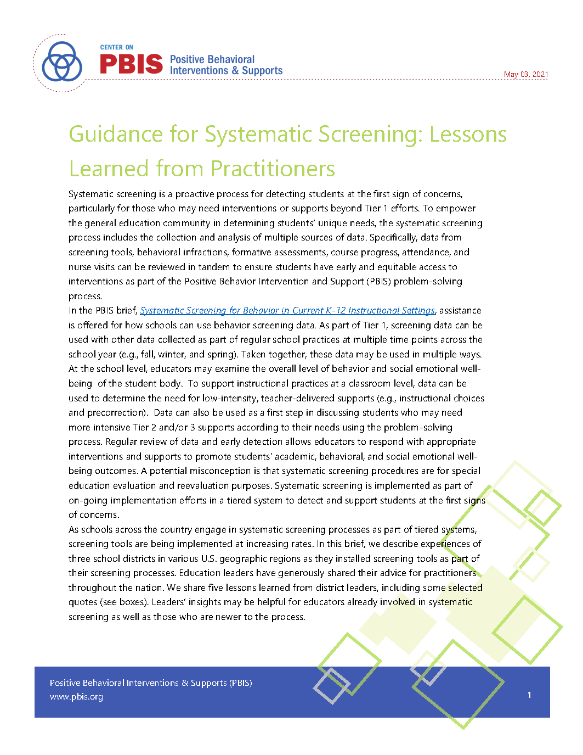
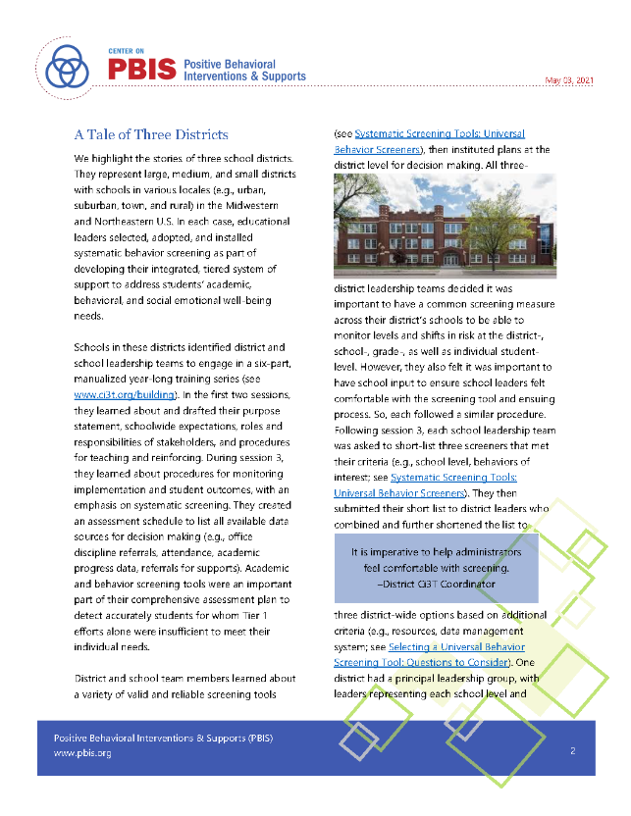
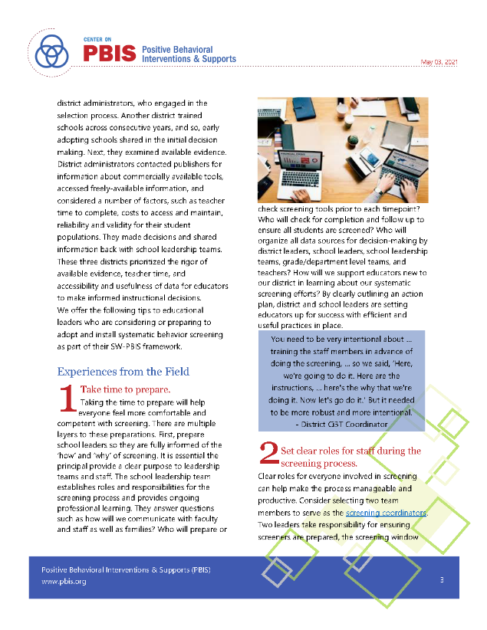
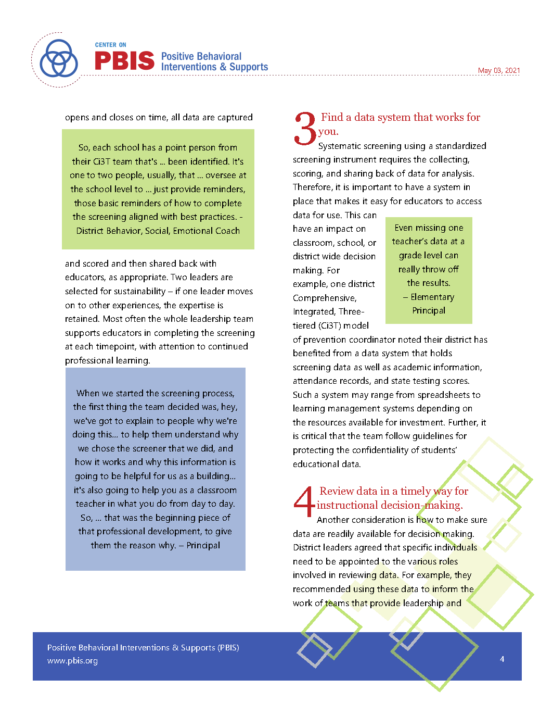
Guidance for Systematic Screening: Lessons Learned from Practitioners

Slide 74
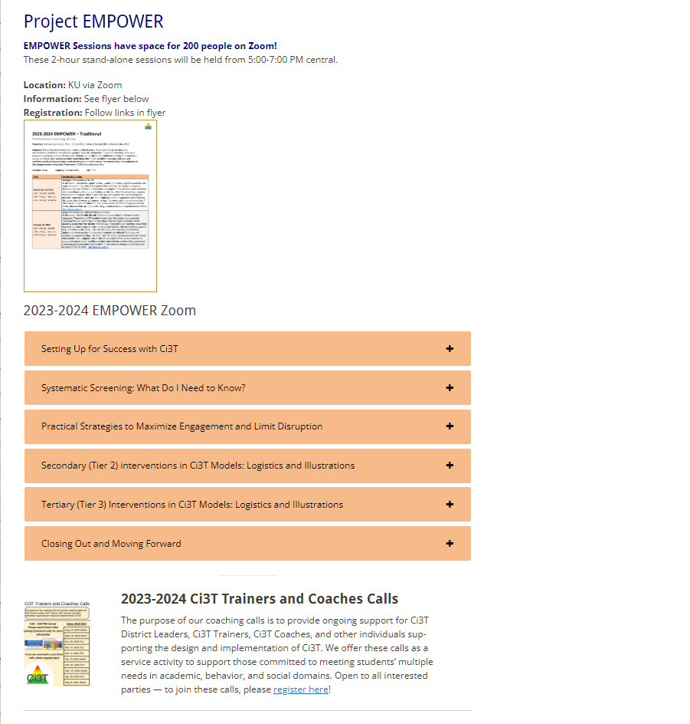
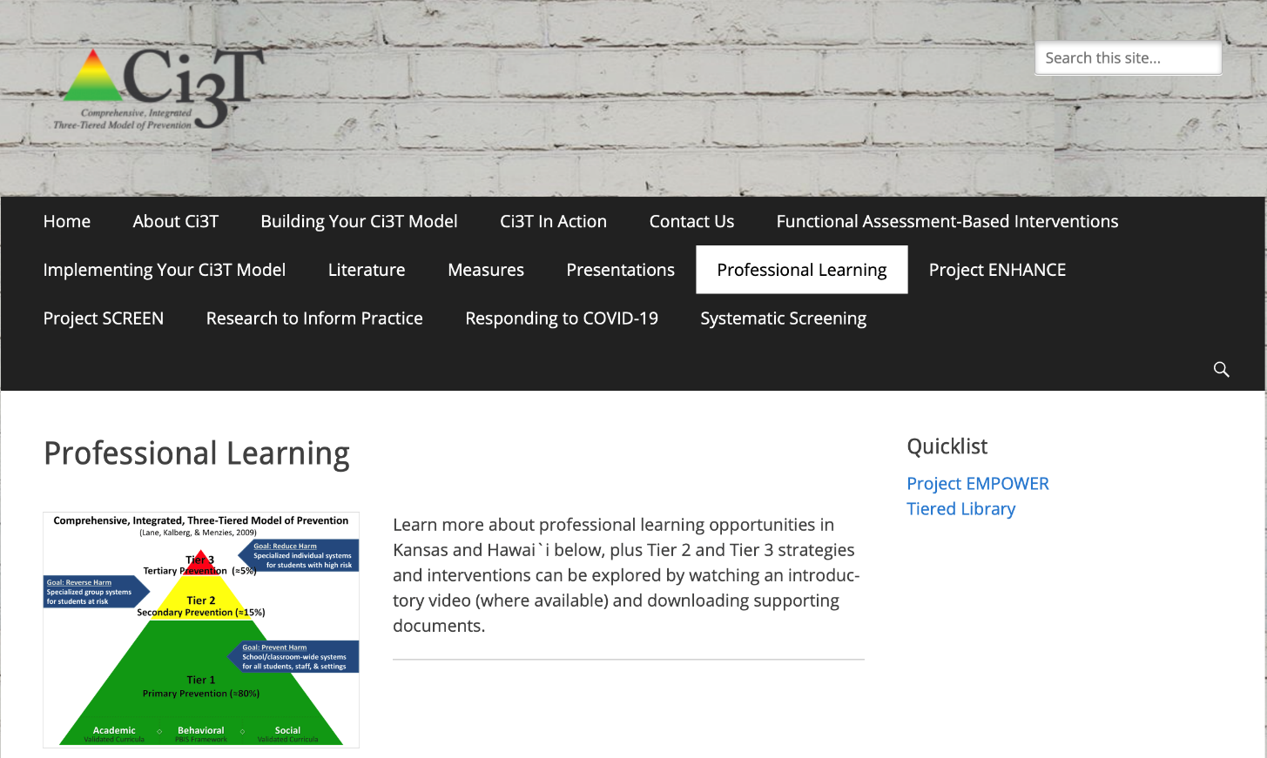
Come Join Us! Professional Learning Offerings

Slide 75
Come Join Us! Professional Learning Offerings

Slide 76
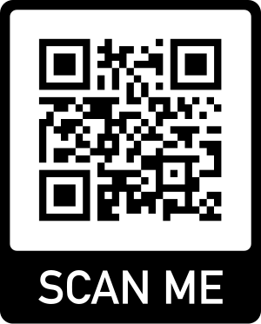
Please Complete this Session’s Evaluation
10/26/2023
Session ID– 3I - Systematic Screening in Tiered Systems: We’ve Got This!
Four options, pick one!
1. Mobile App Click “Take Survey" under the session description.
2. QR Code Scan the code on this slide.
3. Online Click on the link located next to the downloadable session materials posted online at:
www.pbis.org/conference-and-presentations/pbis-leadership-forum
4. Direct Link Click the link provided in the email reminder you receive after your session ends.
Evaluations are anonymous! We send reminder emails to all participants.
After you submit each session evaluation, click the link to enter the gift card raffle!

