Slide 1
Implementing Comprehensive, Integrated, Three-tiered (Ci3T) Models: Using Data to Inform Professional Learning
Ci3T Implementation Series and Delivery– Session 3
Presenters and Contributors | Contributors
Allison M. Bernard | Wendy Peia Oakes
Mark M. Buckman | Elise Sarasin
Kathleen Lynne Lane | Rebecca L. Sherod

Slide 3
Let’s Connect on Social Media!
Tag us in your Ci3T highlights- we’d love to see Ci3T in action!
Follow us on Twitter or Instagram for updates and links to resources!
@Ci3TModel

Slide 4
Ci3T Professional Learning Calendar
 | July | Aug | Sep | Oct | Nov | Dec | Jan | Feb | Mar | Apr | May | Jun
Ci3T Training |  |  |  |  | Ci3T Professional Learning Series Session 1 | Ci3T Professional Learning Series Session 2 | Ci3T Professional Learning Series Session 3 | Ci3T Professional Learning Series Session 4 |  | Ci3T Professional Learning Series Session 5 | Ci3T Professional Learning Series Session 6
Ci3T Implementation Support | Ci3T Implementation Series Prep Session |  | Ci3T Implementation Series Session 1 |  | Ci3T Implementation Series Session 2 |  | Ci3T Implementation Series Session 3 |  | Ci3T Implementation Series Session 4 | Ci3T Implementation Series Session 5
Ci3T EMPOWER |  |  | Ci3T EMPOWER Session 1 | Ci3T EMPOWER Session 2 | Ci3T EMPOWER Session 3 |  | Ci3T EMPOWER Session 4 |  | Ci3T EMPOWER Session 5 | Ci3T EMPOWER Session 6
Ci3T Trainers & Coaches Calls |  | Trainers & Coaches Call Session 1 | Trainers & Coaches Call Session 2 | Trainers & Coaches Call Session 3 | Trainers & Coaches Call Session 4 | Trainers & Coaches Call Session 5 | Trainers & Coaches Call Session 6 | Trainers & Coaches Call Session 7 | Trainers & Coaches Call Session 8 | Trainers & Coaches Call Session 9 | Trainers & Coaches Call Session 10

Slide 5
Agenda
Welcome
Procedures for Monitoring
Review your School’s Social Validity & Treatment Integrity Data
Review your School’s Winter Screening Data
Data-informed Decision-making
Professional Learning Targets and Resources
Communication Plans
Wrapping Up and Moving Forward

Slide 6
Review and Preview
Last Time
Today…
Preparing to Collect and Use Social Validity & Treatment Integrity Data
Using Fall Screening Data to Inform Instruction:
Facilitating Clear Communication and Collaborations with Stakeholders
Procedures for Monitoring
Review your School’s Social Validity & Treatment Integrity Data
Review your School’s Winter Screening Data
Data-informed Decision-making
Professional Learning Targets and Resources
Communication Plans

Slide 7
Welcome
Please pull up your Ci3T Implementation Manual

Slide 8
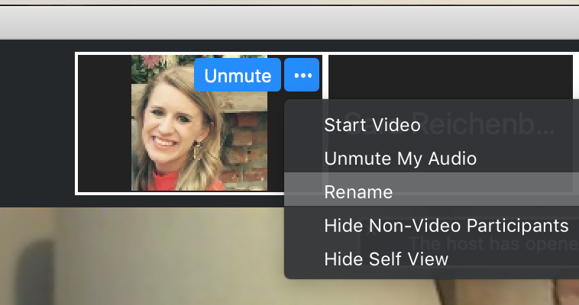
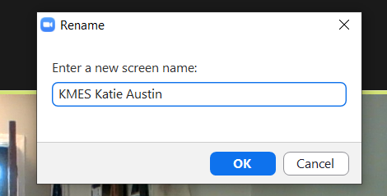
Renaming: School Initials + First and Last Name
To help us put you in breakout rooms with your colleagues today…
1. Click the three dots at the top
right corner of your video square.
2. Rename yourself with your
school initials then first and last name.

Slide 9
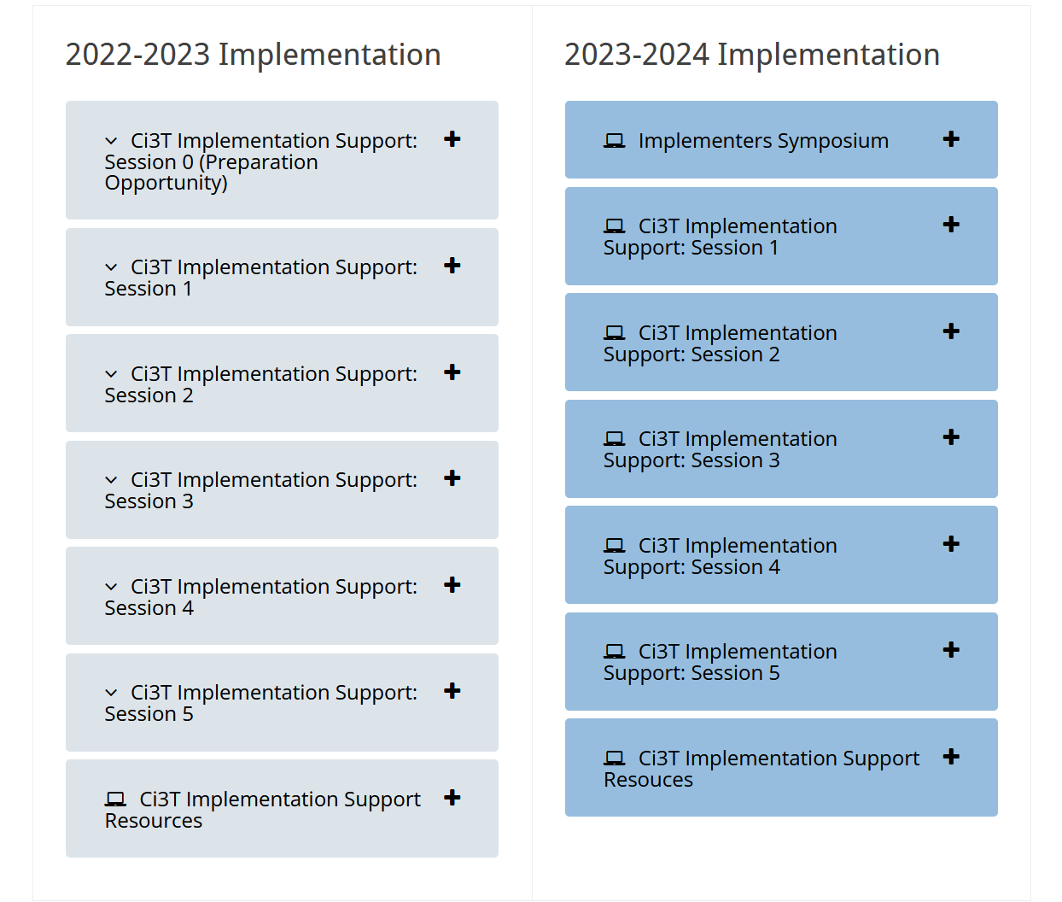
Accessing Professional Learning Materials
Navigate to ci3t.org/imp

Slide 10
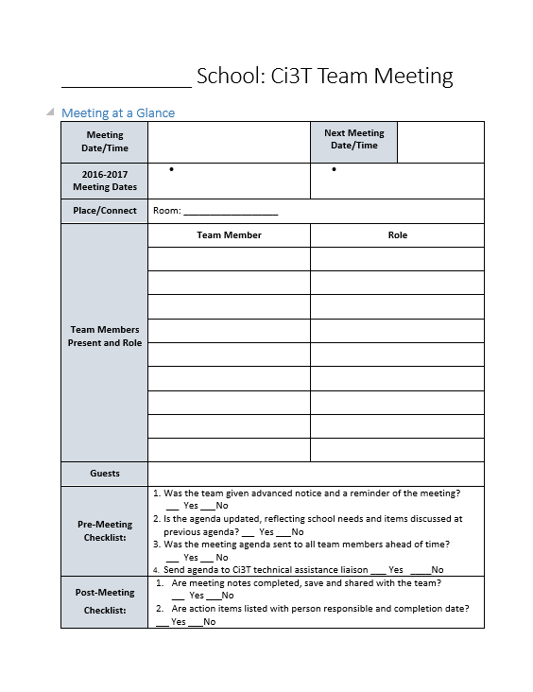
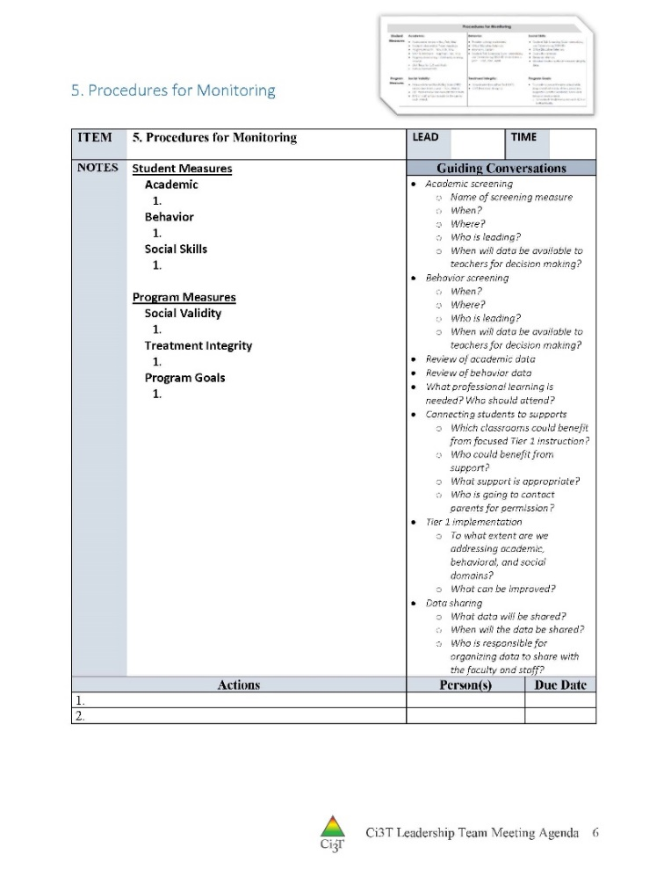
IM18 Ci3T Leadership Team Meeting Agenda TEMPLATE
Predictability

Slide 11
Goals for this Implementation Year
Establish effective Ci3T leadership structures
Gain a deeper understanding of Ci3T models of prevention
Implement your school’s plan with high fidelity
Collect and use social validity and treatment integrity data to monitor Ci3T plan implementation
Collect student academic and behavioral outcome data to inform Ci3T implementation efforts
Share data with all stakeholders regularly (e.g., monthly, quarterly)
Identify areas of additional professional learning for faculty and staff and support faculty and staff access to professional learning
Address any barriers to implementing your Ci3T model

Slide 12
Procedures for Monitoring
Review your School’s Social Validity & Treatment Integrity Data
Review your School’s Winter Screening Data

Slide 13
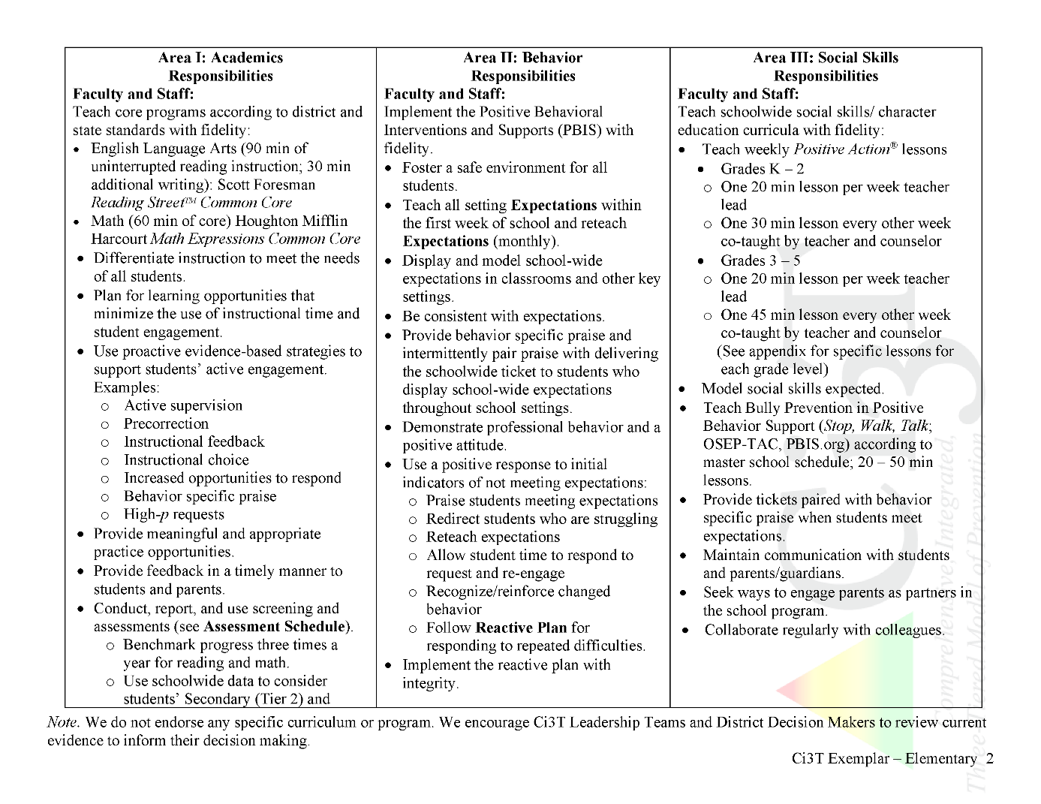
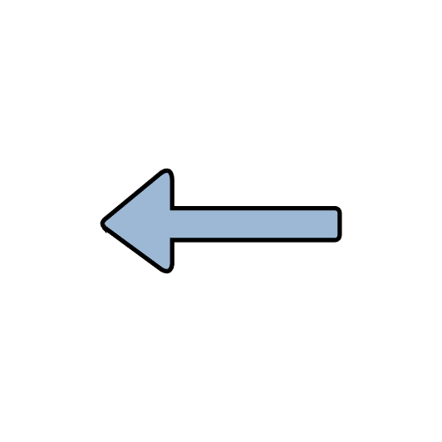
Ci3T Primary Plan: Procedures for Teaching
Ci3T Primary Plan: Procedures for Reinforcing
Ci3T Primary Plan: Procedures for Monitoring

Slide 14
Essential Components of Primary Prevention Efforts
Social Validity
Systematic Screening
Academic
Behavior
Treatment Integrity
ci3t.org/measures
Notes:
Infographic - https://www.ci3t.org/measures

Slide 15
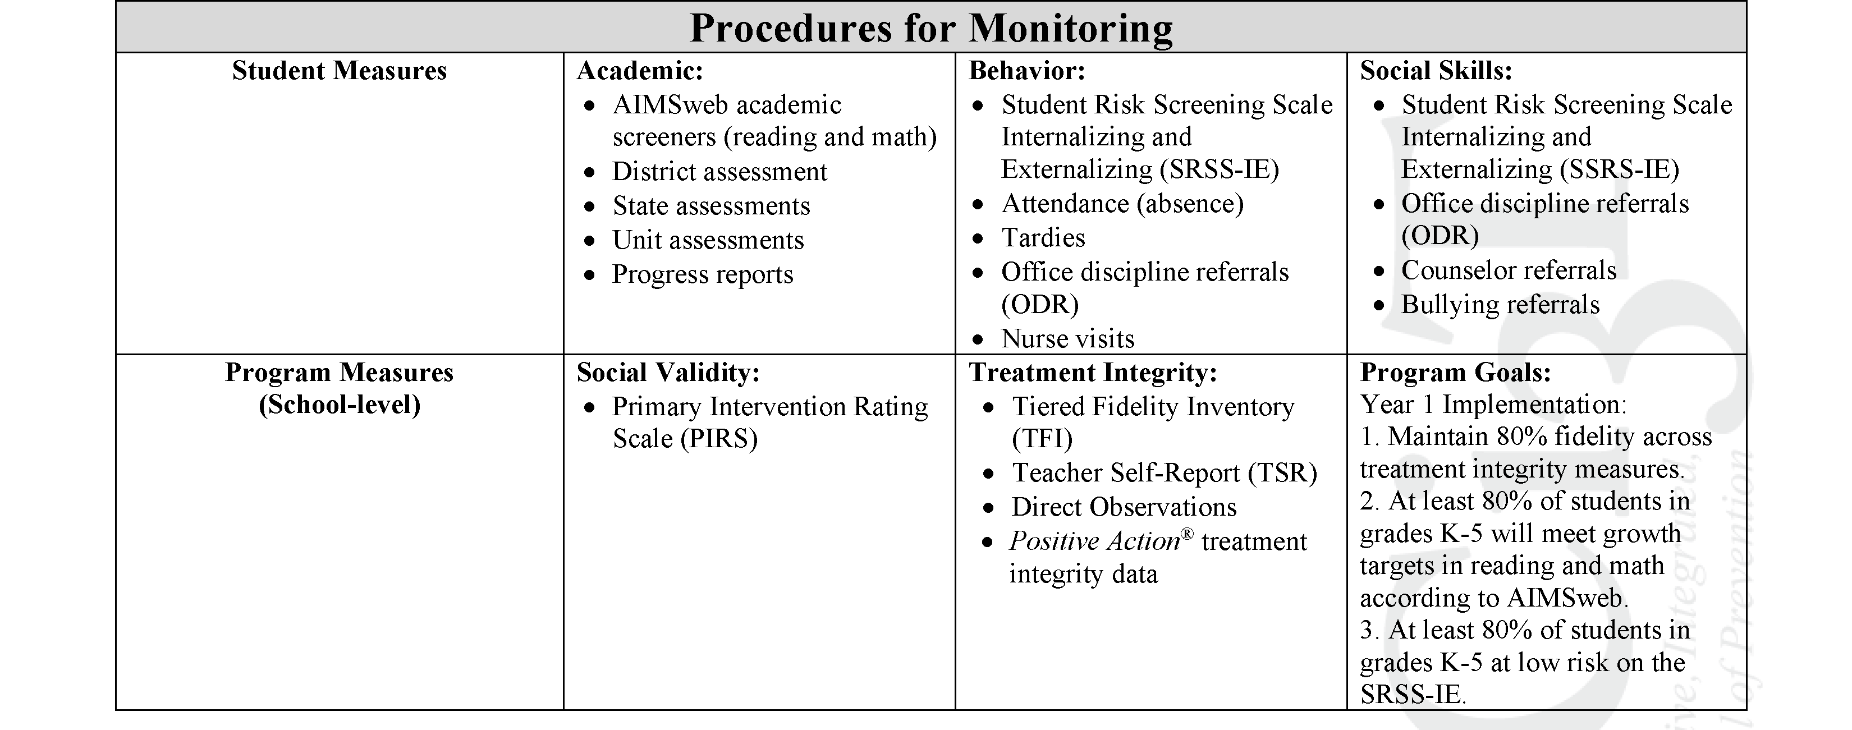
Ci3T Primary Plan Procedures for Monitoring: Elementary
Program Measures and Goals

Slide 16
Sample Elementary Assessment Schedule
Measure | Aug | Sep | Oct | Nov | Dec | Jan | Feb | Mar | Apr | May
School Demographics
Student Demographic Information | X | X | X | X | X | X | X | X | X | X
Screening Measures
Behavior Screeners: SRSS-IE |  | X |  |  | X |  |  |  | X
Academic Screeners: AIMSWeb | X | X |  |  |  | X |  |  |  | X
Student Outcome Measures - Academic
State & District assessment |  |  |  |  |  |  |  | X | X
Progress reports |  |  |  | X |  |  | X |  |  | X
Student Outcome Measures - Behavior
Absences |  | X | X | X | X | X | X | X | X
Office discipline referrals (ODR) |  | X |  |  | X |  |  |  | X
Counselor referrals | X | X | X | X | X | X | X | X | X | X
Nurse visits | X | X | X | X | X | X | X | X | X | X
Program Measures
Primary Intervention Rating Scale |  |  | X |  |  |  |  | X
School-wide Evaluation Tool |  |  | X |  |  |  |  | X
Ci3T TI: Teacher Self-Report |  |  | X |  |  |  |  | X
Ci3T TI: Direct Observation |  |  | X |  |  |  |  | X
Second Step® Treatment Integrity |  |  | X |  |  |  |  | X
Adapted from Lane, K. L., Oakes, W. P., Cantwell, E. D., & Royer, D. J. (2018). Building and installing comprehensive, integrated, three-tiered (Ci3T) models of prevention: A practical guide to supporting school success V1.2. KOI Education. (Interactive eBook)

Slide 17
Procedures for Monitoring
Review your School’s Social Validity & Treatment Integrity Data
Review your School’s Winter Screening Data

Slide 18
Social Validity How do stakeholders view the plan?
Social validity refers to the level of:
Social significance of intervention goals
Social acceptability of intervention procedures
Social importance of intervention outcomes
(Wolf, 1978)
Assessed using the Primary Intervention Rating Scale (PIRS)
Social Validity: PIRS Results
Year | Fall |  | Spring
 | n | % (SD) | n | % (SD)
2020-2021 | 32 | 85.39 (8.89) | TBD | TBD

Slide 19
Treatment Integrity Is Ci3T being implemented as planned?
Three measures of treatment integrity:
Ci3T Treatment Integrity: Teacher Self-Report (Ci3T TI: TSR)
Ci3T Treatment Integrity: Direct Observation (Ci3T TI: DO)
Tiered Fidelity Inventory (TFI)

Slide 20
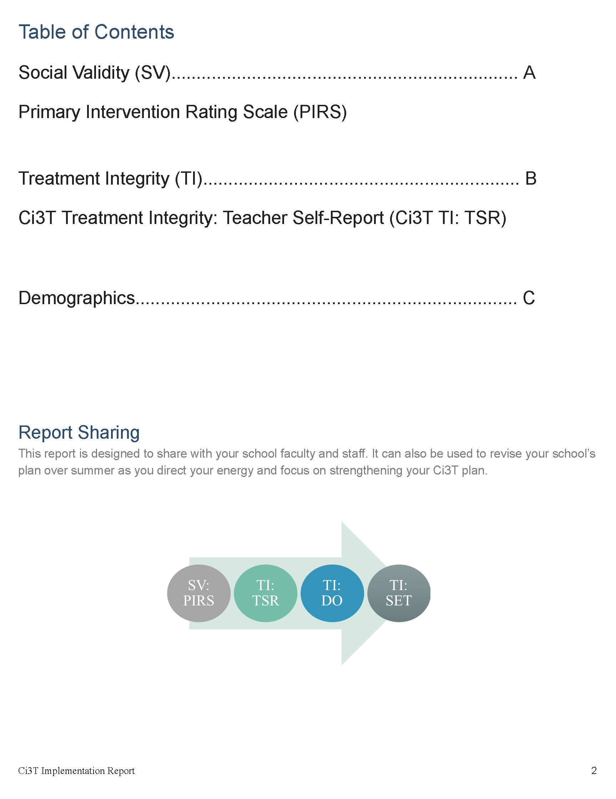

Slide 21
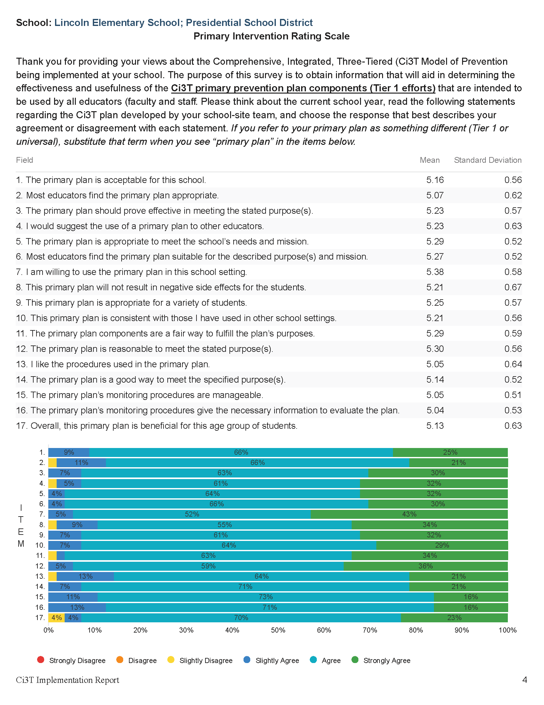

Slide 22
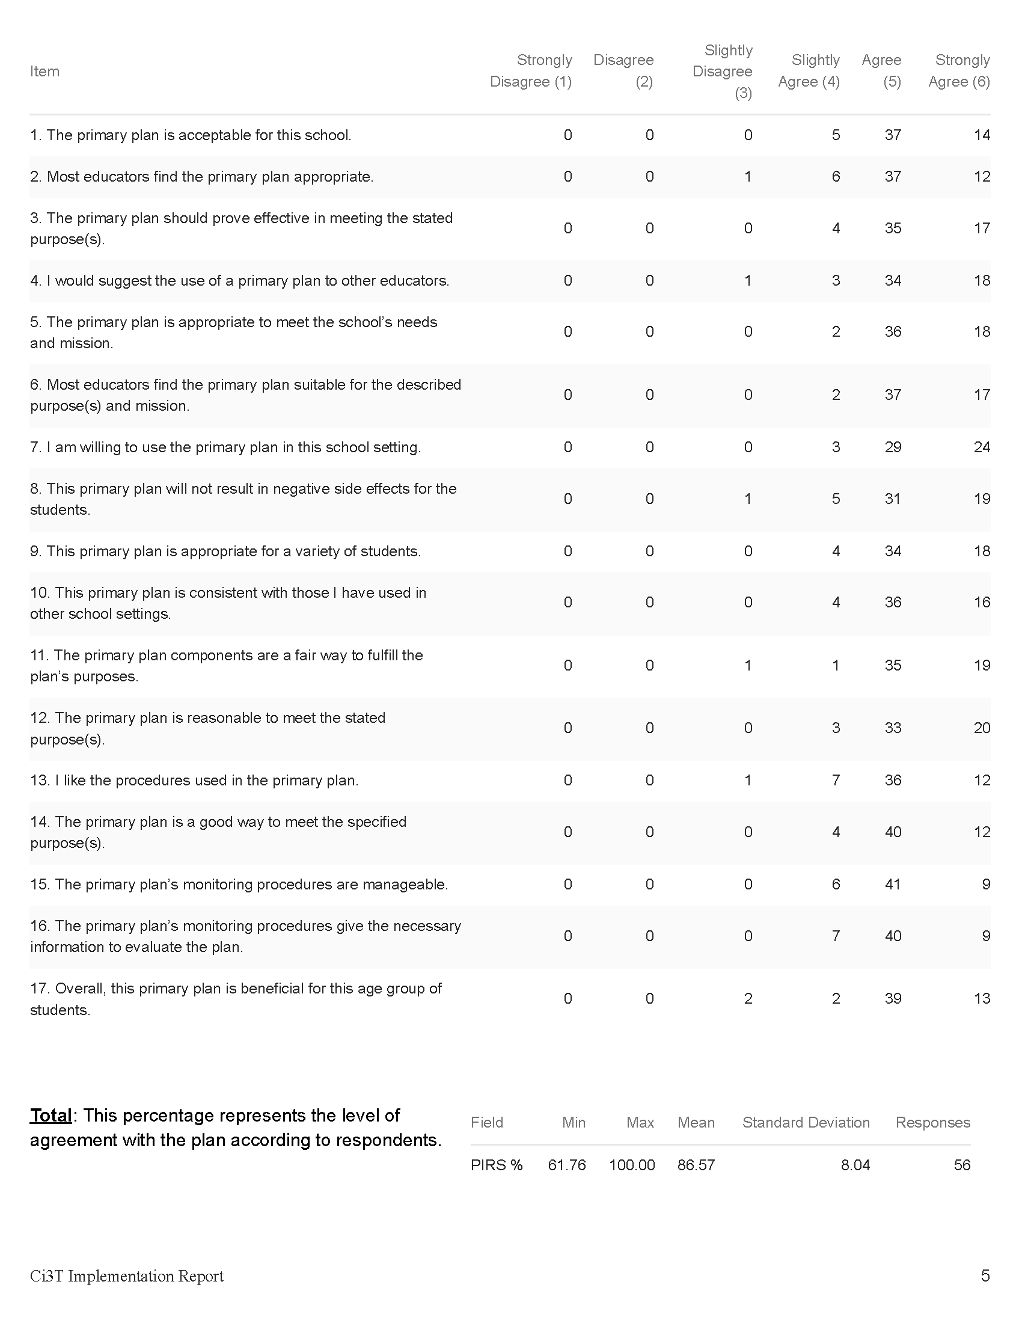

Slide 24
Open-Ended Questions:
A) What do you feel is most beneficial about this primary prevention plan’s components (Tier 1 efforts)? B) What is the least beneficial part?
Do you think that your and your students’ participation in this Ci3T plan will cause your students’ behavior, social, and/or learning problems to improve? Why or why not? Or if so, how?
What would you change about this plan (components, design, implementation etc.) to make it more student-friendly and educator-friendly?
What other information would you like to contribute about this plan?
Read through comments
Highlight success (literally!)
Look for themes for celebrations and focus areas

Slide 25
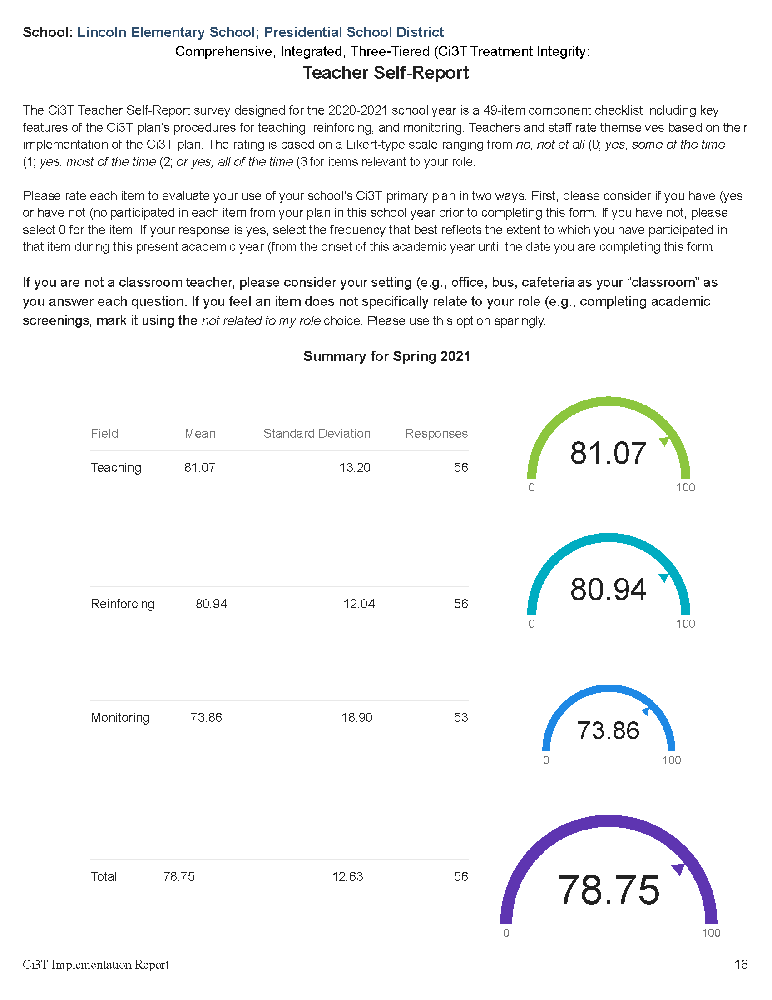

Slide 26
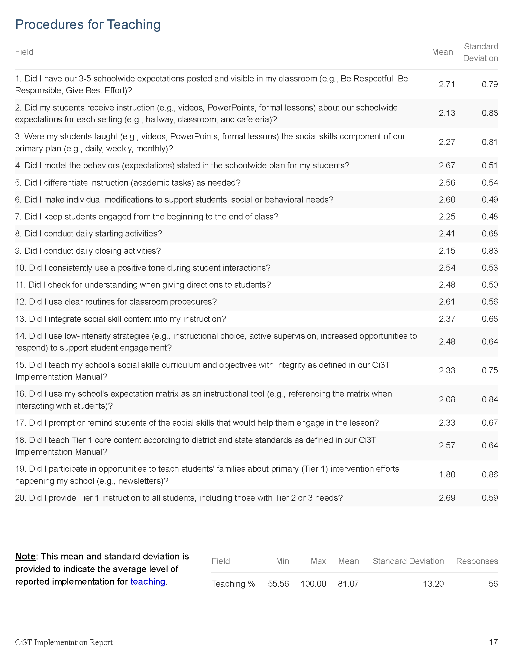

Slide 27
Notes:
#11 = bright spot. Might be helpful to consider- what led to this success? Could we replicate those strategies in other areas?
#16 = potential area of emphasis

Slide 28
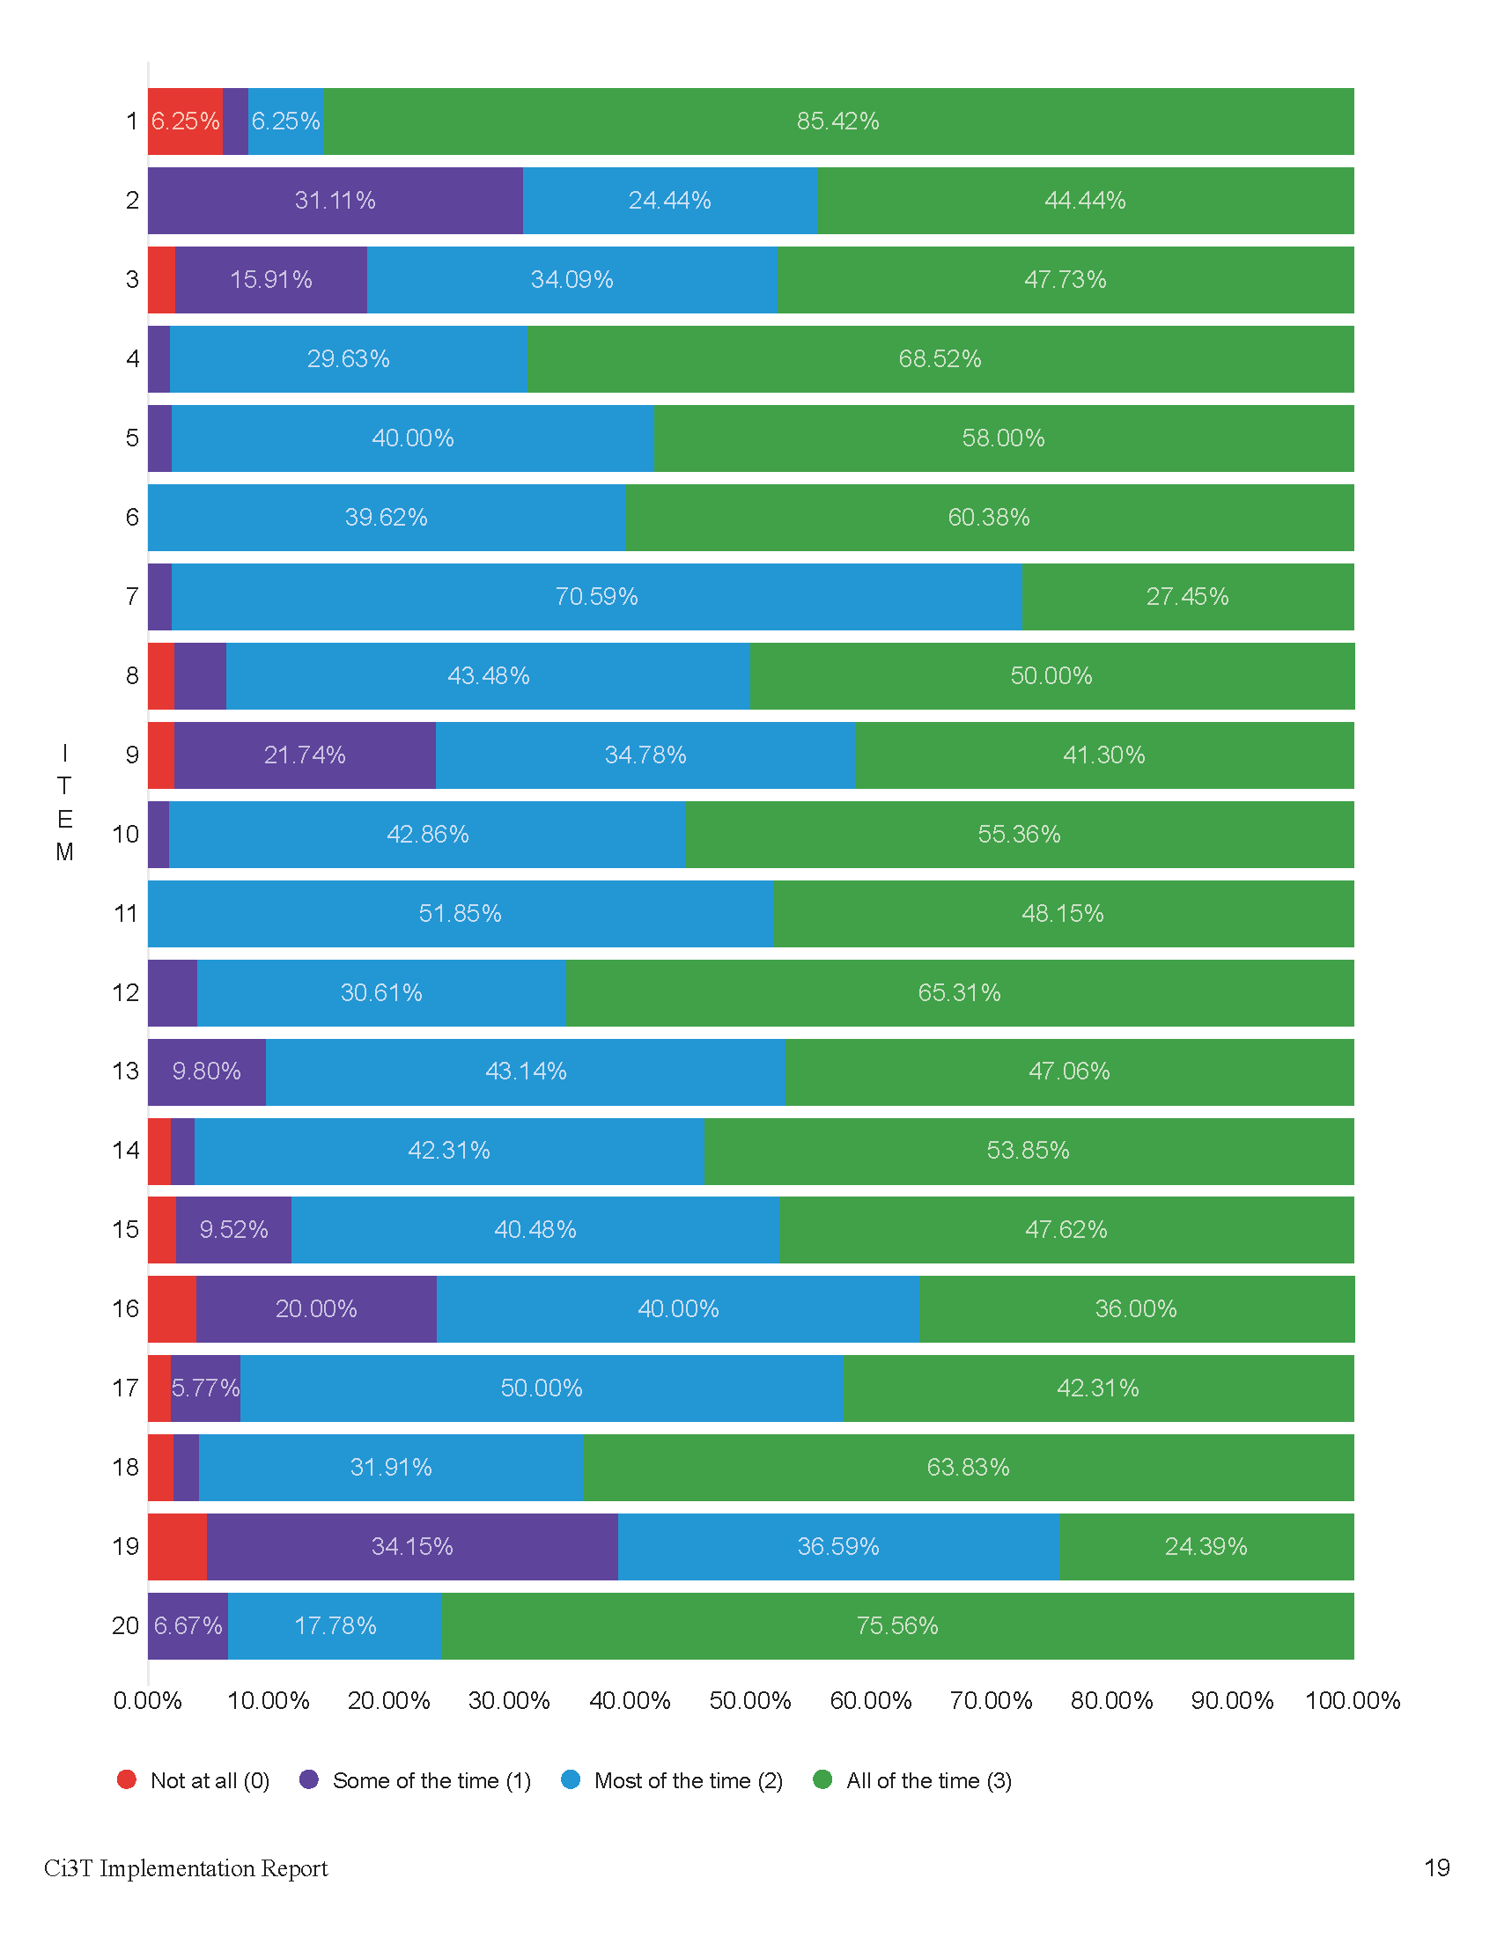

Slide 29
Notes:
Graphs provide a visual way to look at the data. For example:
#11 = Did I check for understanding when giving directions to students?
This visual representation helps us see that everyone responded “most of the time” or “all of the time” to this question. This is worth celebrating!
#16 – Did I use my school’s expectation matrix as an instructional tool (e.g., referencing the matrix when interacting with students)?
This visual representation of the data underscores that this might be an area to focus on – 20% responding some of the time and ~4% not at all

Slide 30
Ci3T Treatment Integrity Direct Observation (Ci3T TI: DO)
Subset of Ci3T TI: TSR
Stratified, random selection of educators
Personnel who directly instruct students
Observers trained to criterion
30-min observations
Educator perspective
Observer perspective

Slide 31
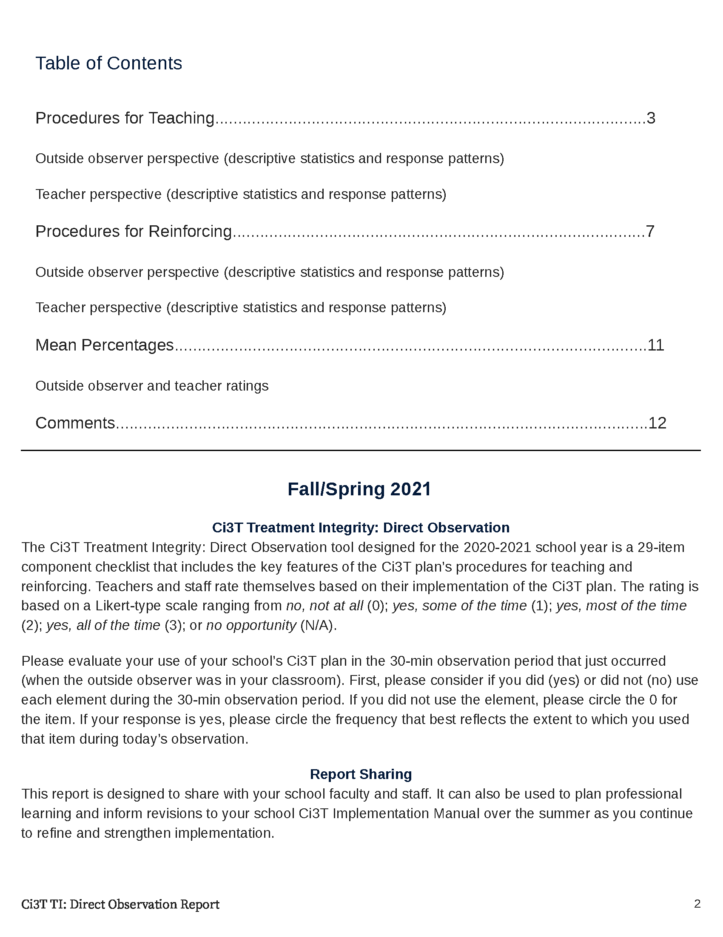

Slide 32
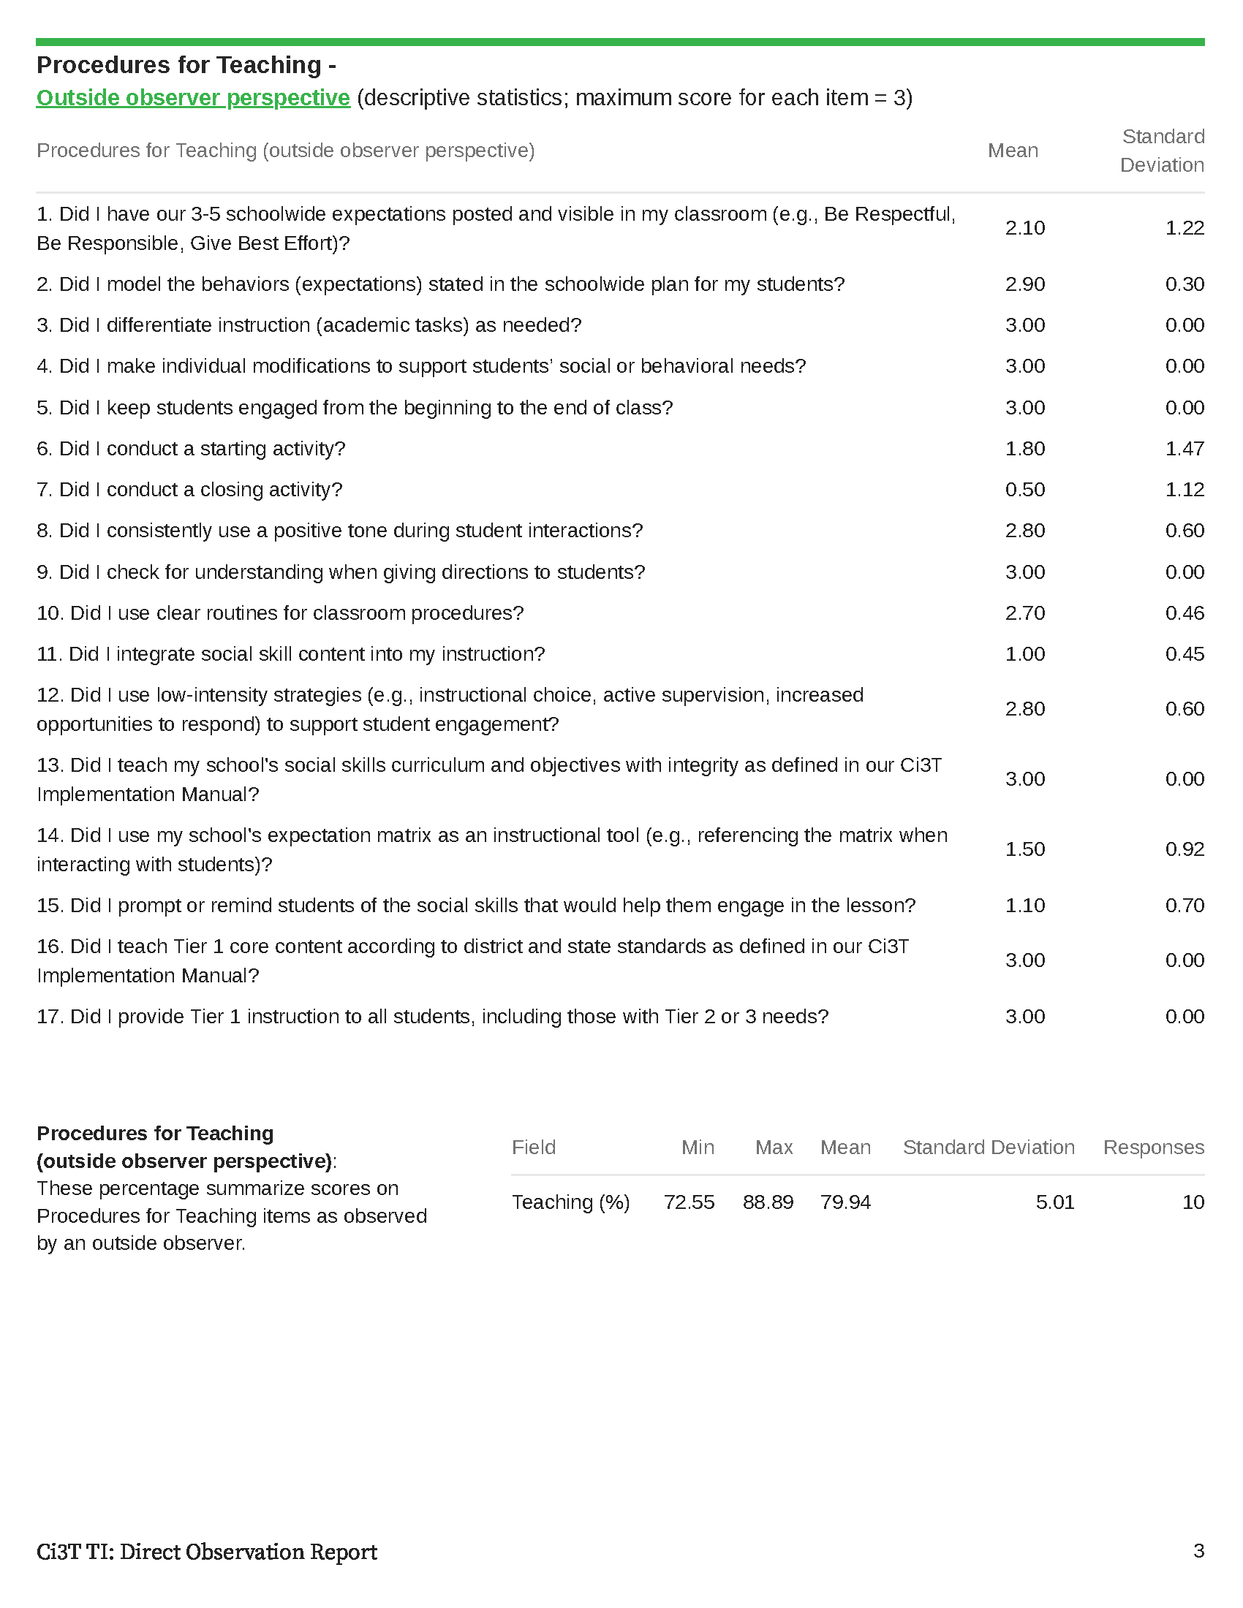

Slide 33
Notes:
Convergent validity between what entire staff reported on teacher self-report and what outside observer saw during direct observations. This further suggests that increasing use of the expectation matrix as an instructional tool might be a helpful area of focus.

Slide 35
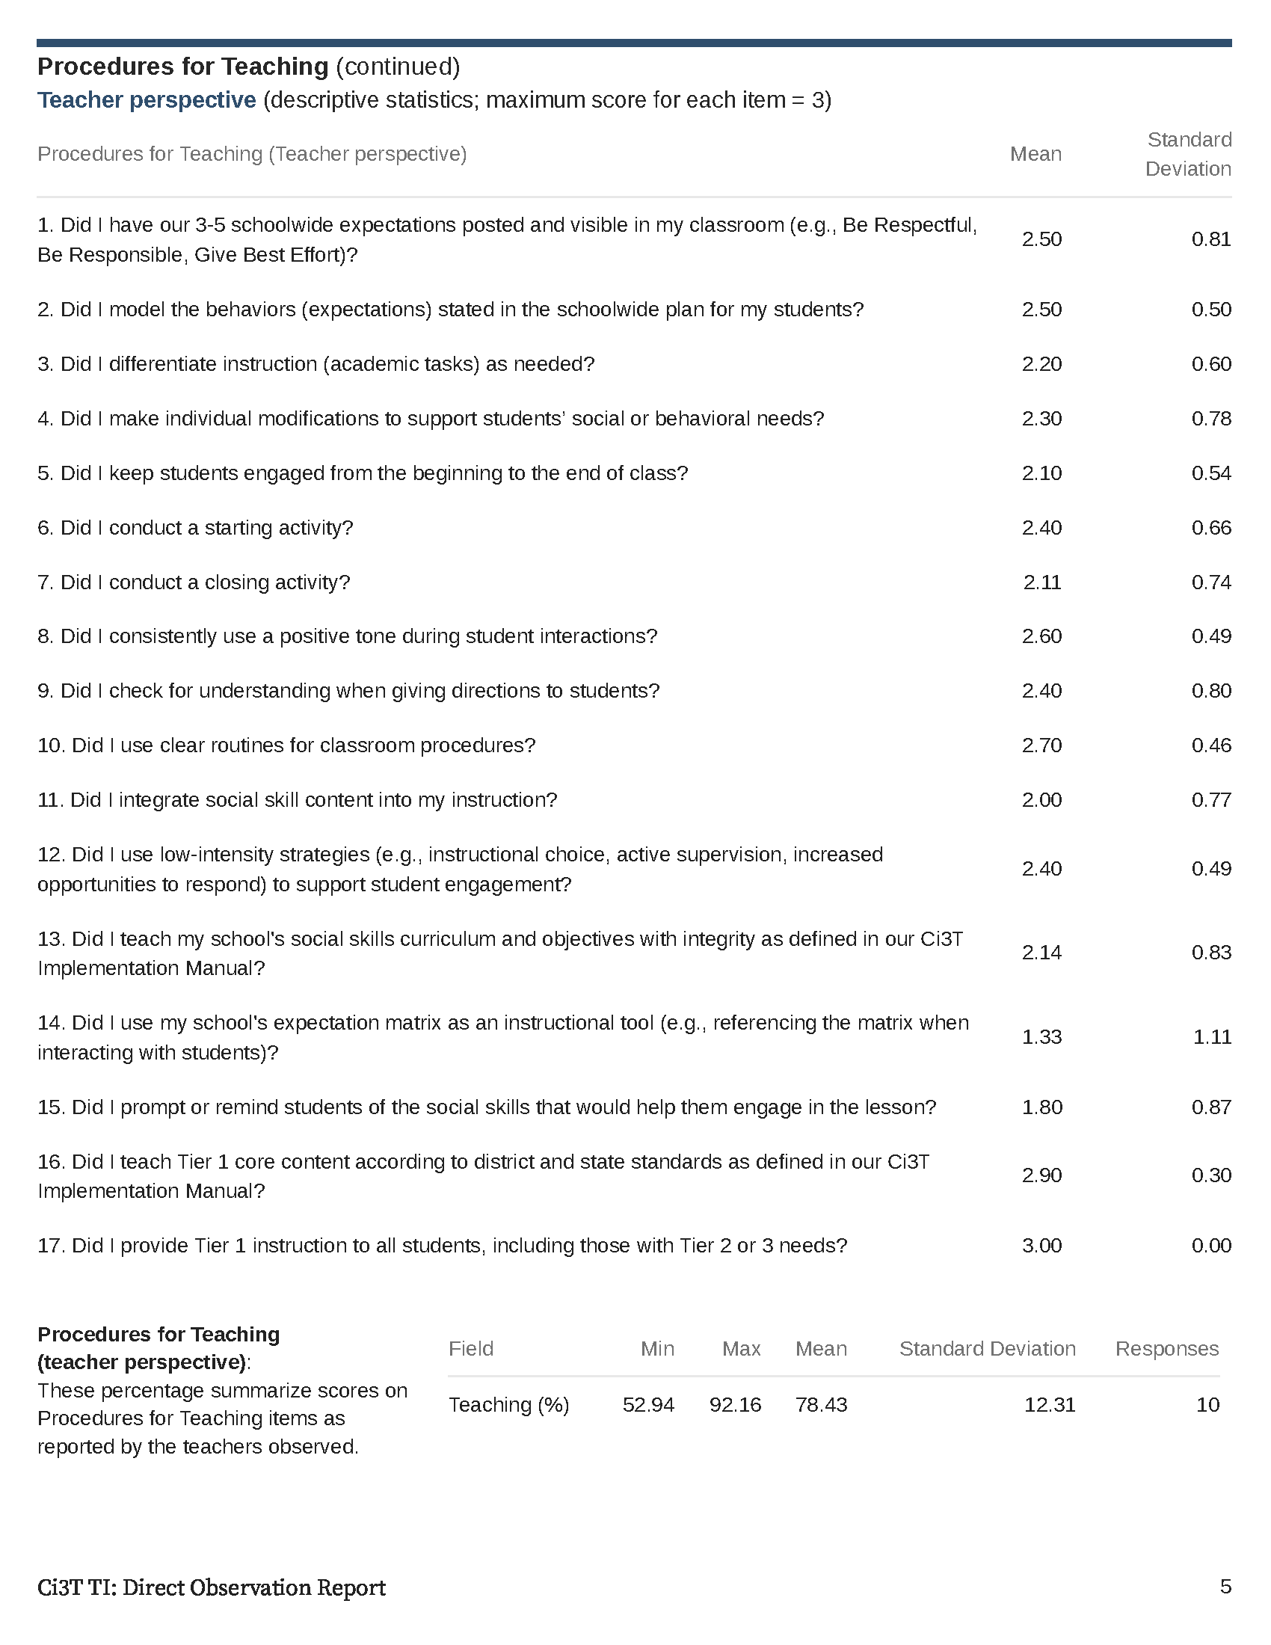

Slide 36
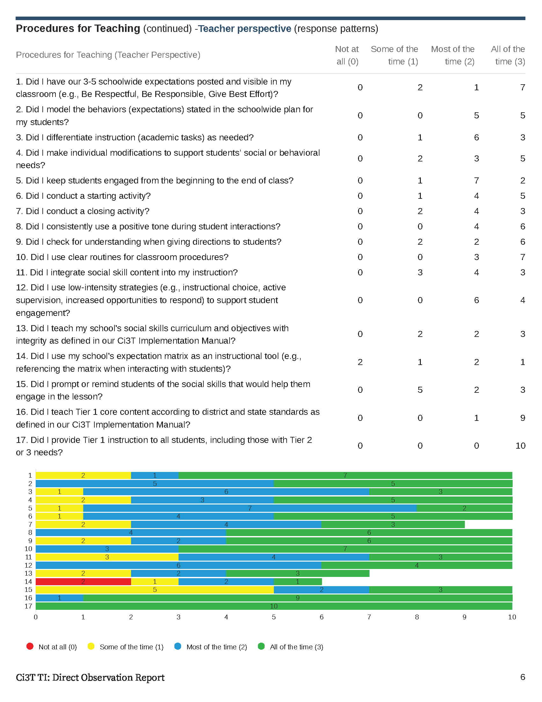

Slide 37
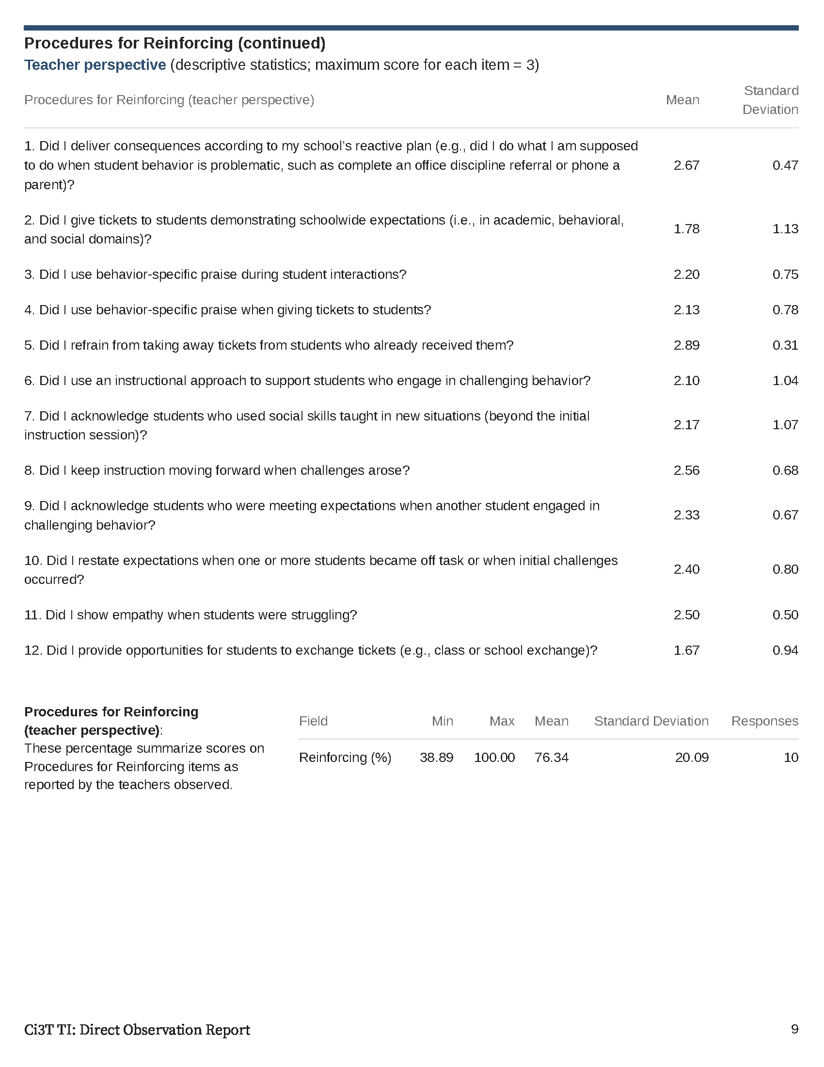
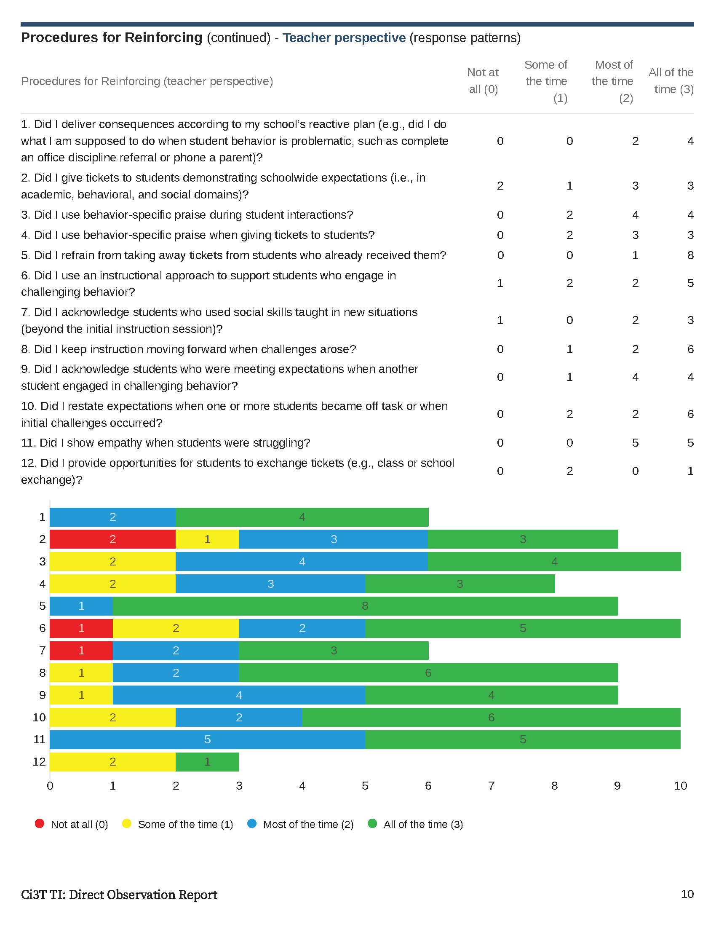

Slide 38
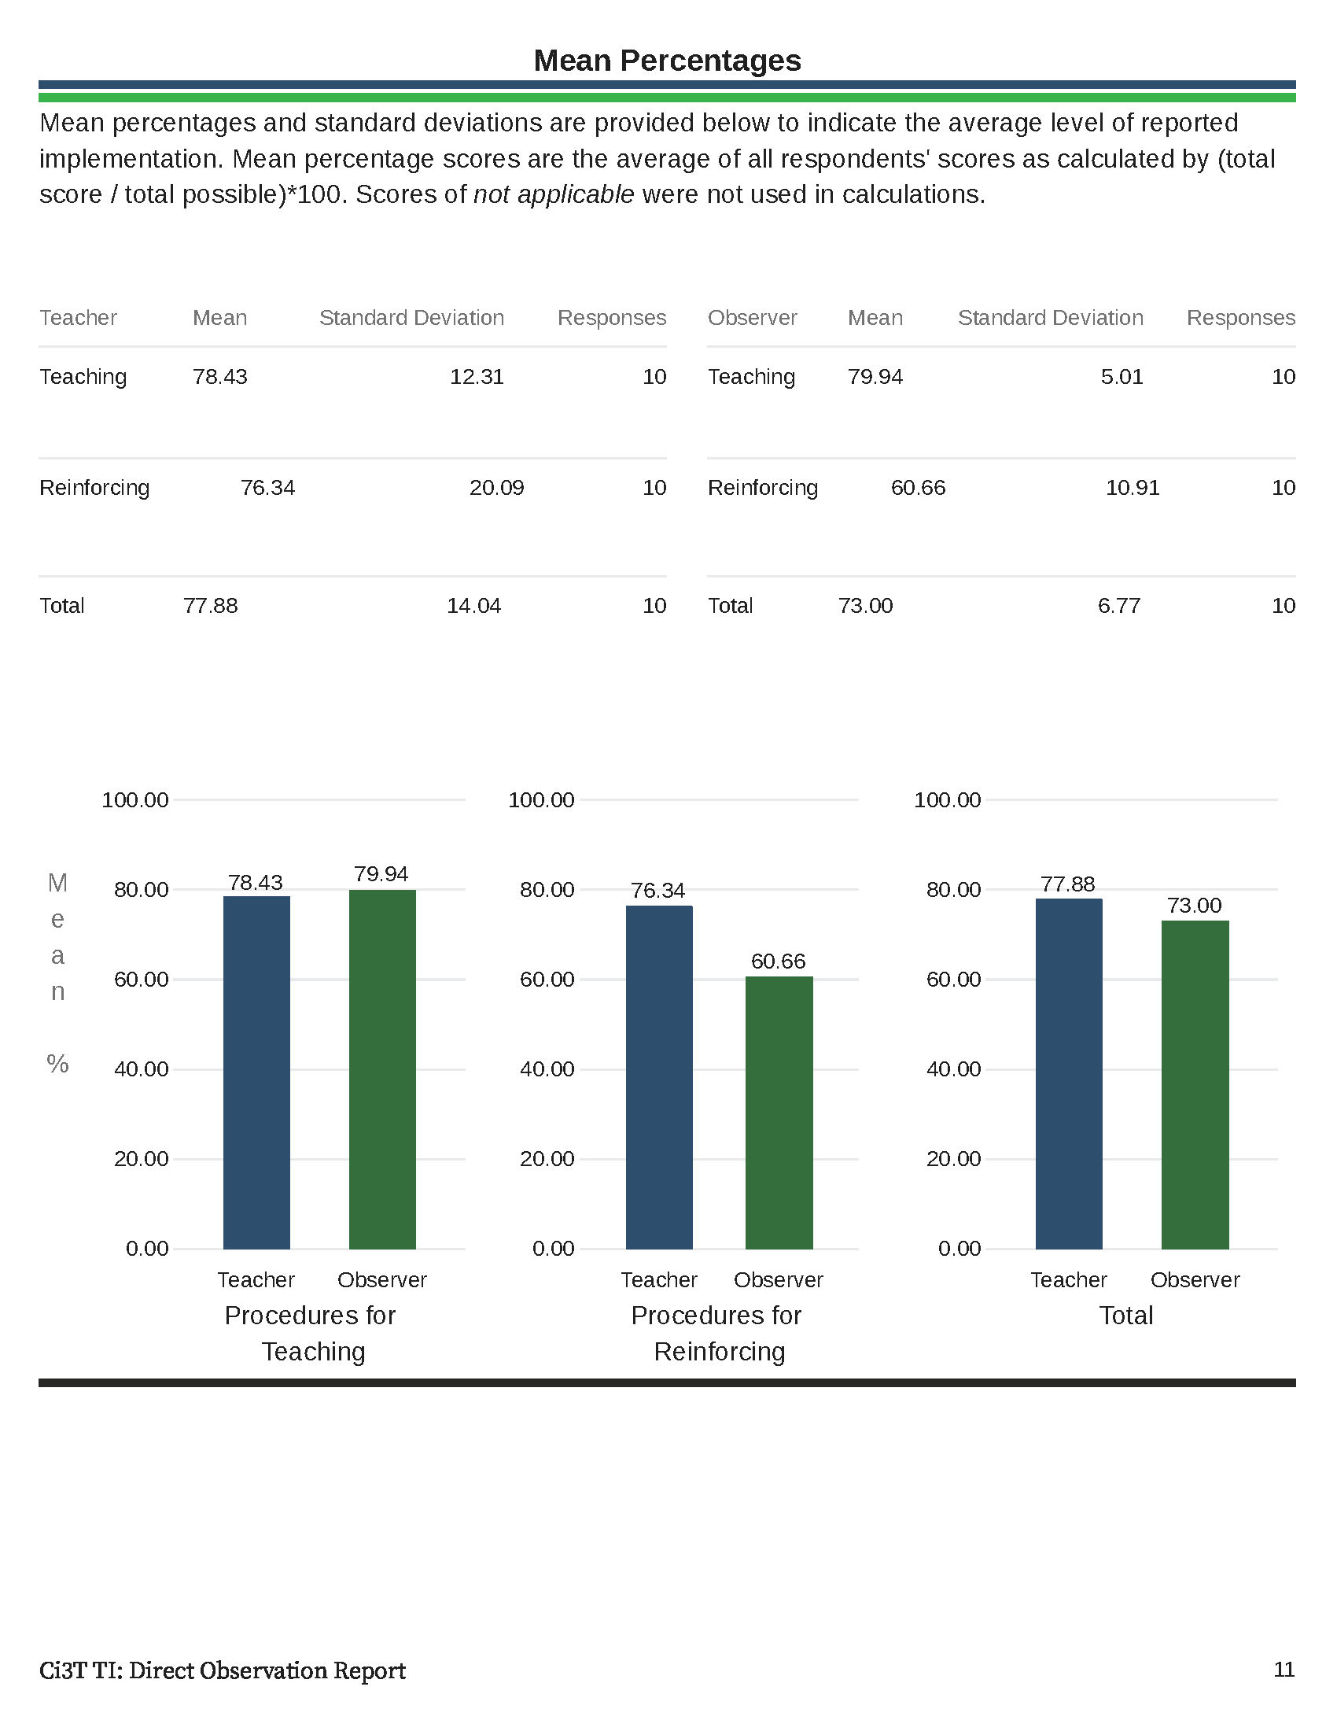

Slide 39
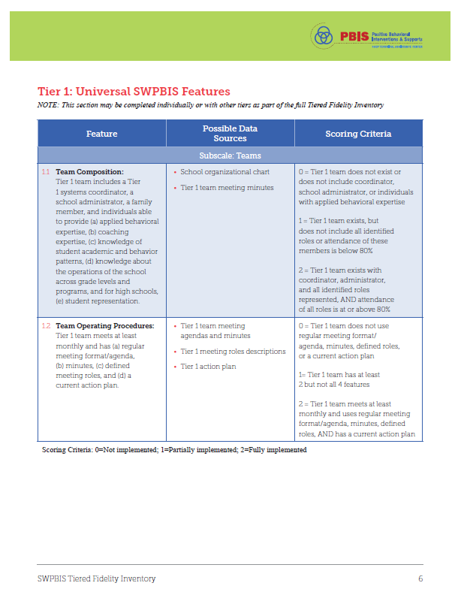
Tiered Fidelity Inventory (TFI)

Slide 40
Treatment Integrity
Tiered Fidelity Inventory (TFI)
Survey for all faculty and staff
Measures treatment integrity and social validity of Tier 1 Ci3T implementation
Measures treatment integrity of SW-PBIS
Tier 1 Walkthrough
Tier 1, 2, and 3 protocols completed by Ci3T Leadership Team
Observe 25% of instructional staff
Measures treatment integrity of Tier 1 Ci3T implementation
Educator and observer perspectives
Ci3T TI: TSR & PIRS
Ci3T TI: Direct Observation

Slide 41
Treatment Integrity and Social Validity Window: Sample
*Measures include: Ci3T Treatment Integrity: Teacher Self-Report (Ci3T TI: TSR); Ci3T Treatment Integrity: Direct Observation (Ci3T TI: DO); Tiered Fidelity Inventory (TFI); Primary Intervention Rating Scale (PIRS)
Screening
Measures | SRSS-IE |  |  |  | Academic
Timepoint | Preview | Open |  | Close | Open | Close
Fall | 09/28/23 | 10/05/23 |  | 10/19/23 | 09/11/23 | 09/29/23
Winter | 11/27/23 | 12/04/23 |  | 12/18/23 | 01/15/24 | 02/02/24
Spring | 04/10/24 | 04/17/24 |  | 05/01/24 | 05/13/24 | 06/07/24
Treatment Integrity & Social Validity
Timepoint | Open | Close | Close |  | Report
Fall | 11/01/23 |  | 12/15/23 |  | 12/22/23
Spring | 02/22/24 |  | 04/04/24 |  | 04/11/24

Slide 42
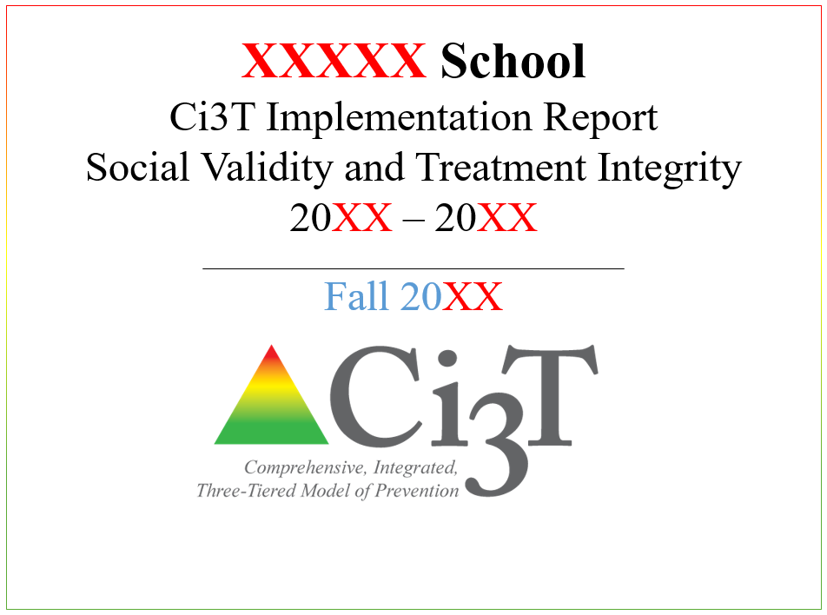
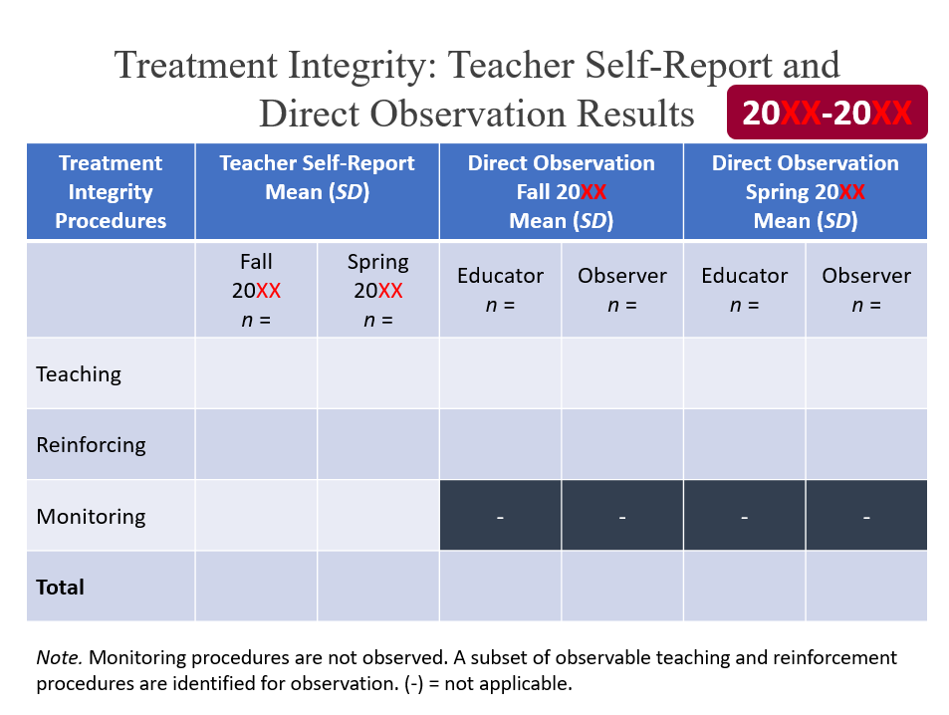
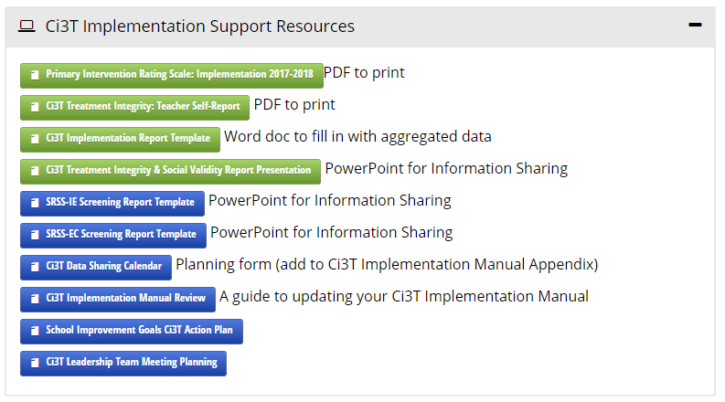
Sharing Treatment Integrity and Social Validity Data with Faculty and Staff
PowerPoint presentation template available at ci3t.org/imp under TECHNOLOGY Support (click “Ci3T Treatment Integrity & Social Validity Report Presentation” to download)

Slide 43
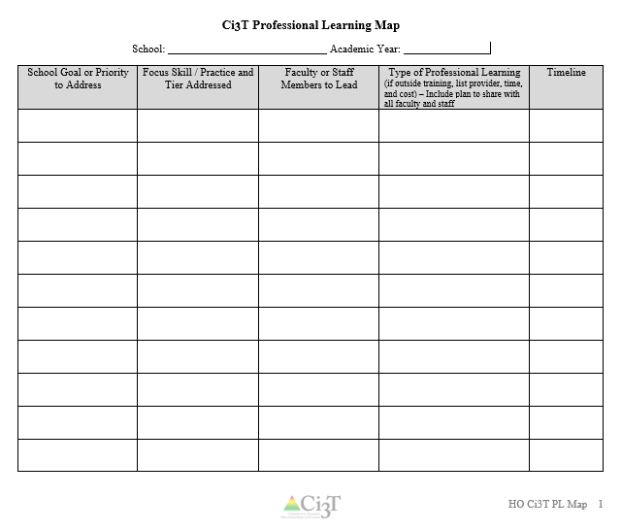
Let’s Talk!
Locate your school’s Ci3T Implementation Report and Ci3T Treatment Integrity: Direct Observation Report.
Then:
Highlight the positives
Discuss concerns and plans for addressing these focus areas
Make plans to share data and plans back with stakeholders
Write action items on HO Ci3T PL Map
Notes:
10-min timer

Slide 44
Procedures for Monitoring
Review your School’s Social Validity & Treatment Integrity Data
Review your School’s Winter Screening Data

Slide 45
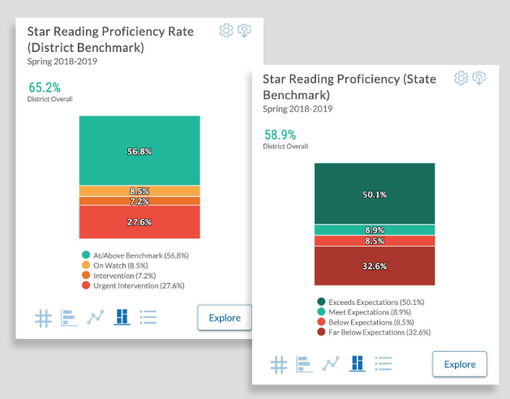
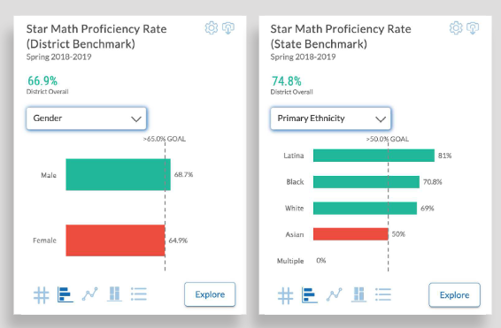
Academic Screening
Notes:
Might consider beginning by looking at data broadly
compared against district or state benchmarks
Subgroup analyses

Slide 46
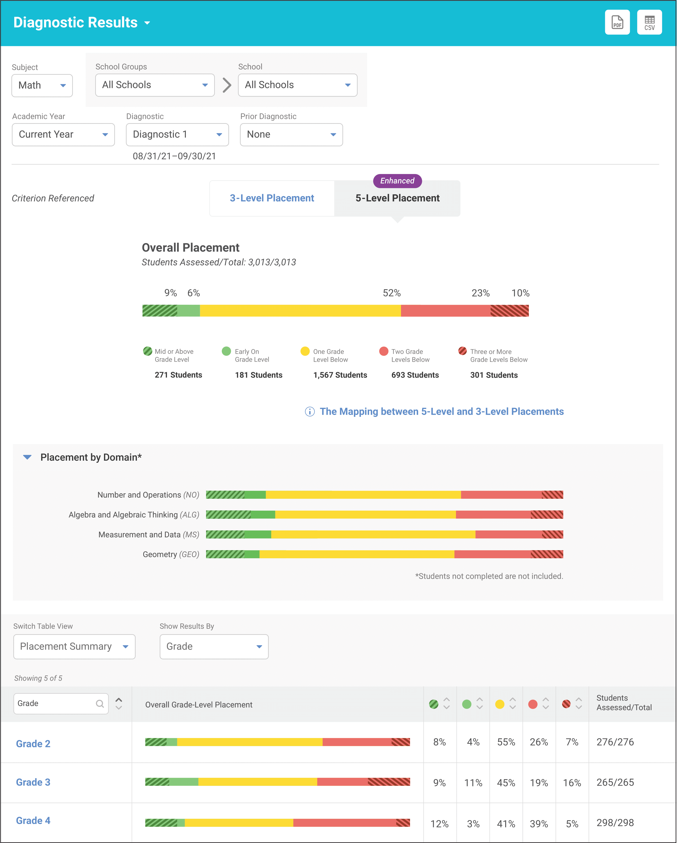
Academic Screening
Notes:
Then, might zoom in at the grade-level looking at distribution across risk category, mastery, or growth

Slide 49
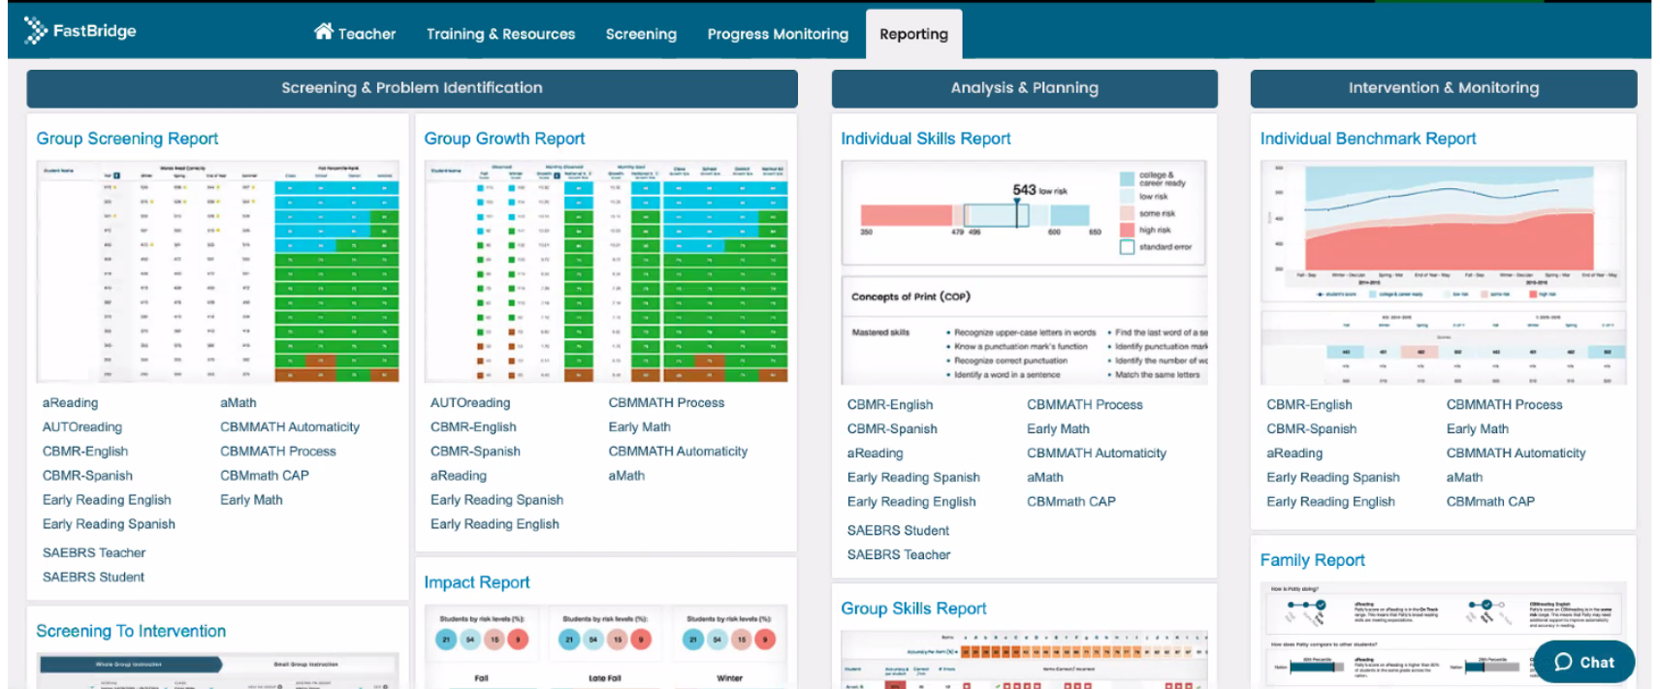
Academic Screening

Slide 50
Academic Screening

Slide 51
Academic Screening

Slide 52
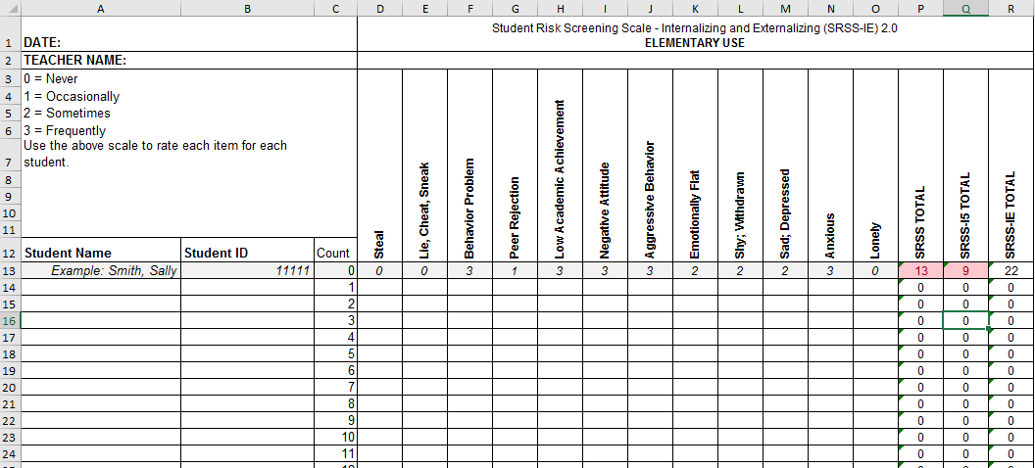
Student Risk Screening Scale for Internalizing and Externalizing (SRSS-IE; Drummond, 1994; Lane & Menzies, 2009)

Slide 53
SRSS-IE: Cut Scores
Elementary School |  | Middle and High School
SRSS-E7 | SRSS-I5 | SRSS-E7 | SRSS-I6
Items 1-7 | Items 8-12 | Items 1-7 | Items 4, 8-12
0-3 = low risk 4-8 = moderate risk 9-21 = high risk | 0-1 = low risk 2-3 = moderate risk 4-15 = high risk | 0-3 = low risk 4-8 = moderate risk 9-21 = high risk | 0-3 = low risk 4-5 = moderate risk 6-18 = high risk
Elementary School Level:
Lane, K. L., Oakes, W. P., Swogger, E. D., Schatschneider, C., Menzies, H., M., & Sanchez, J. (2015). Student risk screening scale for internalizing and externalizing behaviors: Preliminary cut scores to support data-informed decision making. Behavioral Disorders, 40, 159-170.
Middle and High School Levels:
Lane, K. L., Oakes, W. P., Cantwell, E. D., Schatschneider, C., Menzies, H., Crittenden, M., & Messenger, M. (2016). Student Risk Screening Scale for Internalizing and Externalizing Behaviors: Preliminary cut scores to support data-informed decision making in middle and high schools. Behavioral Disorders, 42(1), 271-284

Slide 54
Winter 2022 SRSS-Externalizing Results – Elementary School Level
n = 66
n = 44
n = 33
n = 35
n = 38
n = 37
n = 2
n = 17
n = 32
n = 32
n = 69
n = 74
n = 128
n = 109
n = 97
n = 92
n = 101
n = 125
n = 305
n = 297
n = 287
n = 332
n = 309
n = 263
n = 294
n = 346
n = 355
Notes:
***note to presenter*** If you would like to feature middle or high school data – hide the elementary slides (54-57) and unhide the middle or high school slides
If you would like to update this slide with data from your school or district- Fill in <year> based on current academic year. This is located in column A of the data sheet. Edit by right clicking and selecting “Edit data”.

Slide 55
Winter 2022 SRSS-Externalizing Results – Elementary Grade level
Grade Level | N Screened | Low n (%) | Moderate n (%) | High n (%)
K | 66 | 47 (71.21%) | 12 (18.18%) | 7 (10.61%)
1 | 82 | 67 (81.71%) | 11 (13.41%) | 4 (4.88%)
2 | 77 | 64 (83.12%) | 9 (11.69%) | 4 (5.19%)

Slide 56
Winter 2022 SRSS-Internalizing Results – Elementary School Level
n = 75
n = 46
n = 29
n = 41
n = 35
n = 25
n = 16
n = 40
n = 38
n = 27
n = 65
n = 69
n = 59
n = 48
n = 69
n = 72
n = 87
n = 86
n = 334
n = 337
n = 335
n = 354
n = 354
n = 328
n = 285
n = 346
n = 351
Notes:
If you would like to update this slide with data from your school or district- Fill in <year> based on current academic year. This is located in column A of the data sheet. Edit by right clicking and selecting “Edit data”.

Slide 57
Winter 2022 SRSS-Internalizing Results – Elementary Grade Level
Grade Level | N Screened | Low n (%) | Moderate n (%) | High n (%)
3 | 63 | 49 (77.78%) | 8 (12.70%) | 6 (9.52%)
4 | 83 | 63 (75.90%) | 11 (13.25%) | 9 (10.84%)
5 | 90 | 69 (76.67%) | 15 (16.67%) | 6 (6.67%)

Slide 58
Winter 2022 SRSS-Externalizing Results – Middle School Level
n = 21
n = 27
n = 27
n = 13
n = 6
n = 17
n = 26
n = 47
n = 96
n = 68
n = 71
n = 53
n = 42
n = 54
n = 491
n = 448
n = 383
n = 346
n = 445
n = 518
n = 527
Notes:
If you would like to update this slide with data from your school or district- Fill in <year> based on current academic year. This is located in column A of the data sheet. Edit by right clicking and selecting “Edit data”.

Slide 59
Winter 2022 SRSS-Externalizing Results – Middle School Grade level
Grade Level | N Screened | Low n (%) | Moderate n (%) | High n (%)
6 | 96 | 68 (70.83%) | 17 (17.71%) | 11 (11.46%)
7 | 126 | 79 (62.70%) | 32 (25.40%) | 15 (11.90%)
8 | 79 | 48 (60.76%) | 19 (24.05%) | 12 (15.19%)

Slide 60
Winter 2022 SRSS-Internalizing Results – Middle School Level
n = 79
n = 52
n = 54
n = 60
n = 23
n = 44
n = 42
n = 41
n = 37
n = 40
n = 32
n = 45
n = 30
n = 31
n = 55
n = 70
n = 306
n = 312
n = 356
n = 342
n = 349
n = 351
n = 432
n = 229
Notes:
If you would like to update this slide with data from your school or district- Fill in <year> based on current academic year. This is located in column A of the data sheet. Edit by right clicking and selecting “Edit data”.

Slide 61
Winter 2022 SRSS-Internalizing Results – Middle School Grade Level
Grade Level | N Screened | Low n (%) | Moderate n (%) | High n (%)
6 | 96 | 76 (79.17%) | 8 (8.33%) | 12 (12.50%)
7 | 126 | 93 (73.81%) | 14 (11.11%) | 19 (15.08%)
8 | 79 | 60 (75.95%) | 9 (11.39%) | 10 (12.66%)

Slide 62
Winter 2022 SRSS-Externalizing Results – High School Level
n = 47
n = 72
n = 36
n = 36
n = 40
n = 8
n = 17
n = 38
n = 119
n = 113
n = 47
n = 137
n = 134
n = 114
n = 90
n = 65
n = 1259
n = 1280
n = 1188
n = 994
n = 447
n = 717
n = 750
n = 920
Notes:
If you would like to update this slide with data from your school or district- Fill in <year> based on current academic year. This is located in column A of the data sheet. Edit by right clicking and selecting “Edit data”.

Slide 63
Winter 2022 SRSS-Externalizing Results – High School Grade level
Grade Level | N Screened | Low n (%) | Moderate n (%) | High n (%)
9 | 271 | 207 (76.38%) | 44 (16.24%) | 20 (7.38%)
10 | 303 | 259 (85.48%) | 34 (11.22%) | 10 (3.30%)
11 | 256 | 229 (89.45%) | 20 (7.81%) | 7 (2.73%)
12 | 241 | 225 (93.36%) | 15 (6.22%) | 1 (0.41%)

Slide 64
Winter 2022 SRSS-Internalizing Results – High School Level
n = 165
n = 106
n = 83
n = 99
n = 55
n = 65
n = 52
n = 87
n = 73
n = 65
n = 50
n = 34
n = 59
n =48
n = 56
n = 167
n = 1111
n = 1307
n = 1109
n = 1000
n = 445
n = 691
n = 710
n = 923
Notes:
If you would like to update this slide with data from your school or district- Fill in <year> based on current academic year. This is located in column A of the data sheet. Edit by right clicking and selecting “Edit data”.

Slide 65
Winter 2022 SRSS-Internalizing Results – High School Grade Level
Grade Level | N Screened | Low n (%) | Moderate n (%) | High n (%)
9 | 271 | 222 (81.92%) | 19 (7.01%) | 30 (11.07%)
10 | 303 | 265 (87.46%) | 20 (6.60%) | 18 (5.94%)
11 | 256 | 216 (84.38%) | 9 (3.52%) | 31 (12.11%)
12 | 241 | 225 (93.36%) | 8 (3.32%) | 8 (3.32%)

Slide 66
Consider this class….
Teacher Name | R. Collins
Date: December 2022
 |  | 1 Average or Above |  | 0-3 Low | 0-1 Low | 0-1 Low
 |  | 2 Below Average |  | 4-8 Moderate | 2-3 Moderate | 2-5 Moderate
 |  | 3 Well Below Average |  | 9-21 High | 4-15 High | 6+ High
Student Name | Student ID | AIMSweb Reading | AIMSweb Math | SRSS-E7 Behavior | SRSS-I5 Internalizing | ODR | Total Days Absent
Alley, Allison | 2310 | 1 | 1 | 1 | 1 | 0 | 0
Atwell, J'Monte | 2013 | 1 | 1 | 0 | 0 | 0 | 0
Bonds, Peter | 2031 | 2 | 2 | 4 | 0 | 3 | 0
Booker, Abbie | 2001 | 1 | 2 | 0 | 2 | 1 | 3
Cartright, Ashely | 2152 | 1 | 3 | 0 | 8 | 0 | 8
Cox, Lucille | 2002 | 2 | 3 | 2 | 10 | 0 | 8
Hankins, Erin | 2017 | 1 | 1 | 0 | 0 | 0 | 0
Julius, O'Tam | 2132 | 3 | 2 | 6 | 2 | 9 | 7
Justice, Jesse | 2003 | 2 | 2 | 3 | 1 | 0 | 3
Ochoa, Kelly | 2009 | 1 | 2 | 0 | 3 | 0 | 5
Parker, Stephanie | 2004 | 1 | 2 | 4 | 0 | 0 | 1
Paul, Timothy | 2010 | 1 | 1 | 3 | 0 | 0 | 1
Reed, Kendra | 2022 | 3 | 0 | 16 | 2 | 23 | 3
Toms, Blake | 2018 | 1 | 2 | 0 | 0 | 0 | 1
Wellington, Jasper | 2215 | 2 | 3 | 14 | 4 | 9 | 0

Slide 68
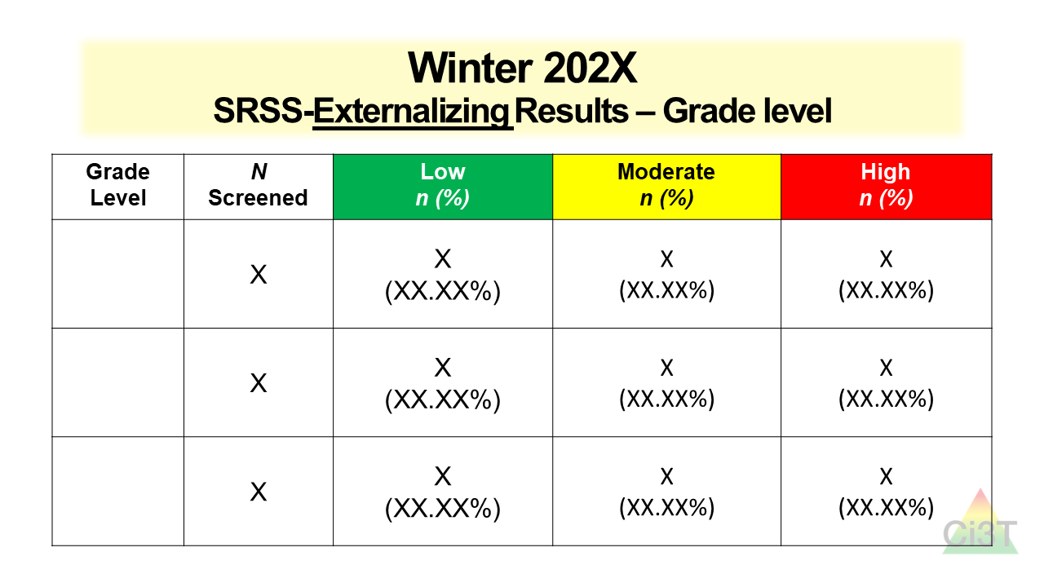
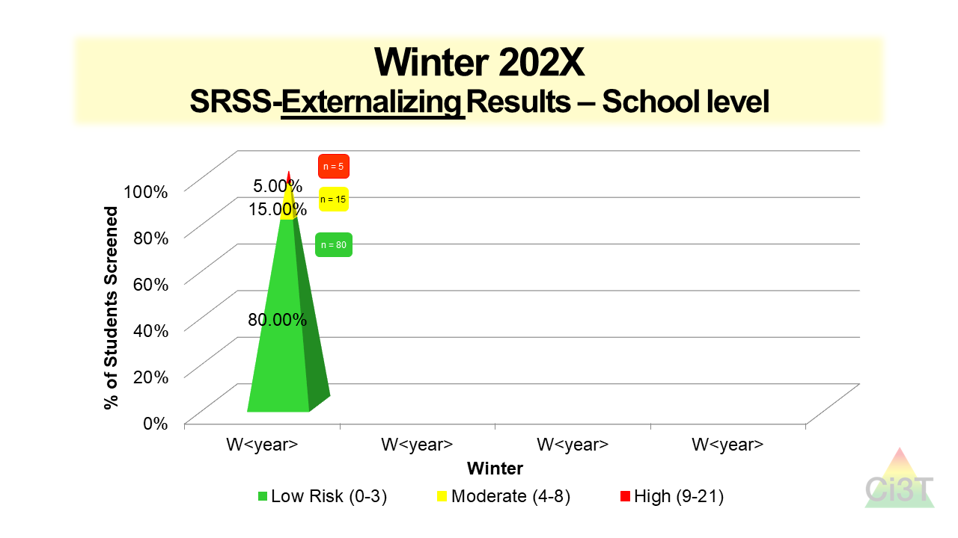
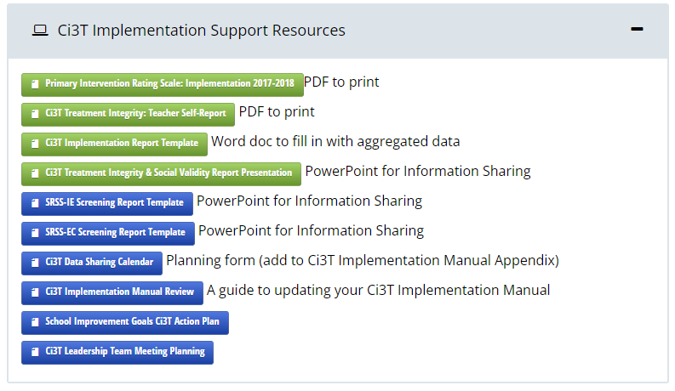
Sharing Screening Data with Faculty and Staff

Slide 70
Data-Informed Decision-Making
Professional Learning Targets and Resources
Communication Plans

Slide 72
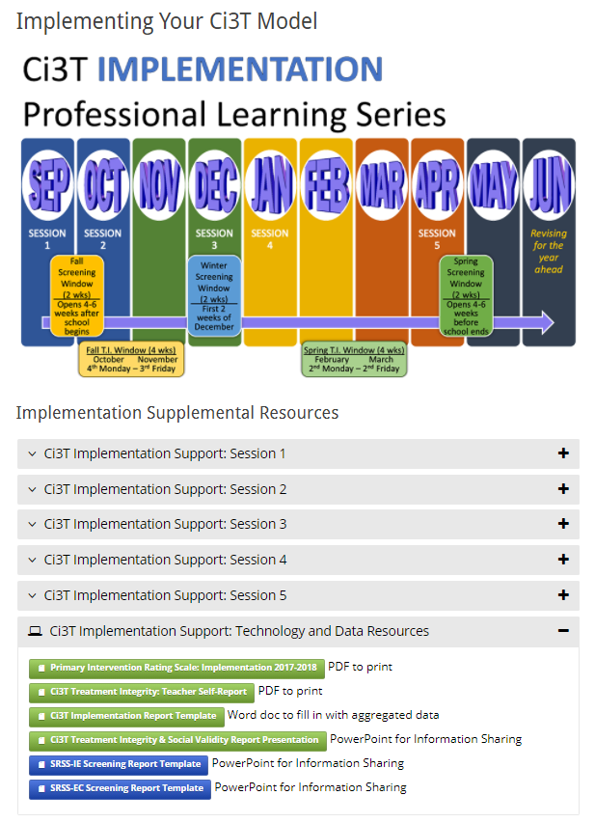
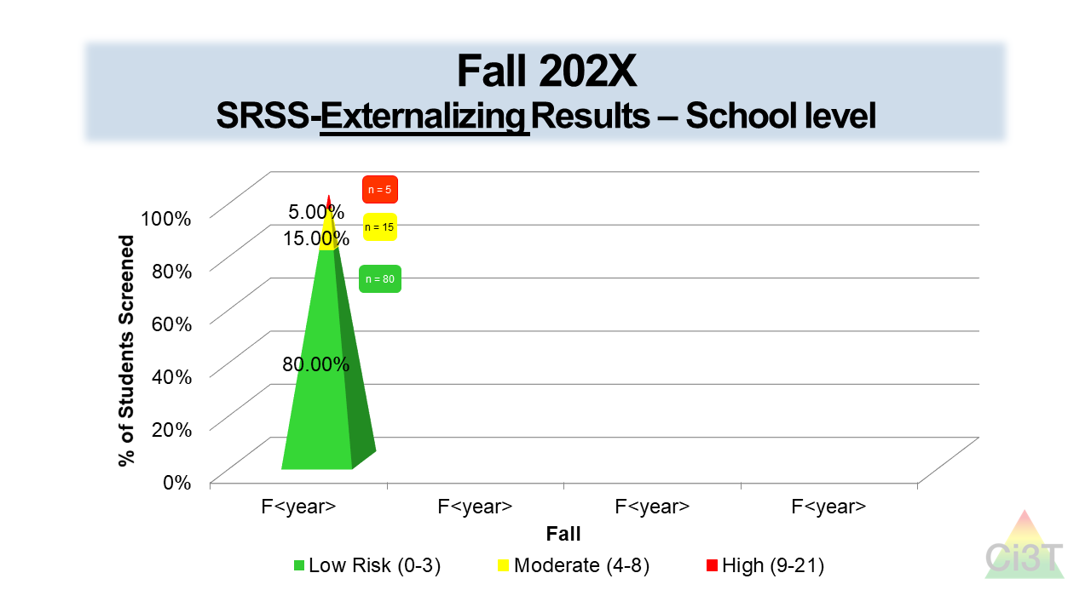
Sharing Screening Data with Faculty and Staff

Slide 73
Data-Informed Decision Making
Non-evaluative
Solutions-based
Identify areas of strength
Let the data drive the conversation

Slide 74
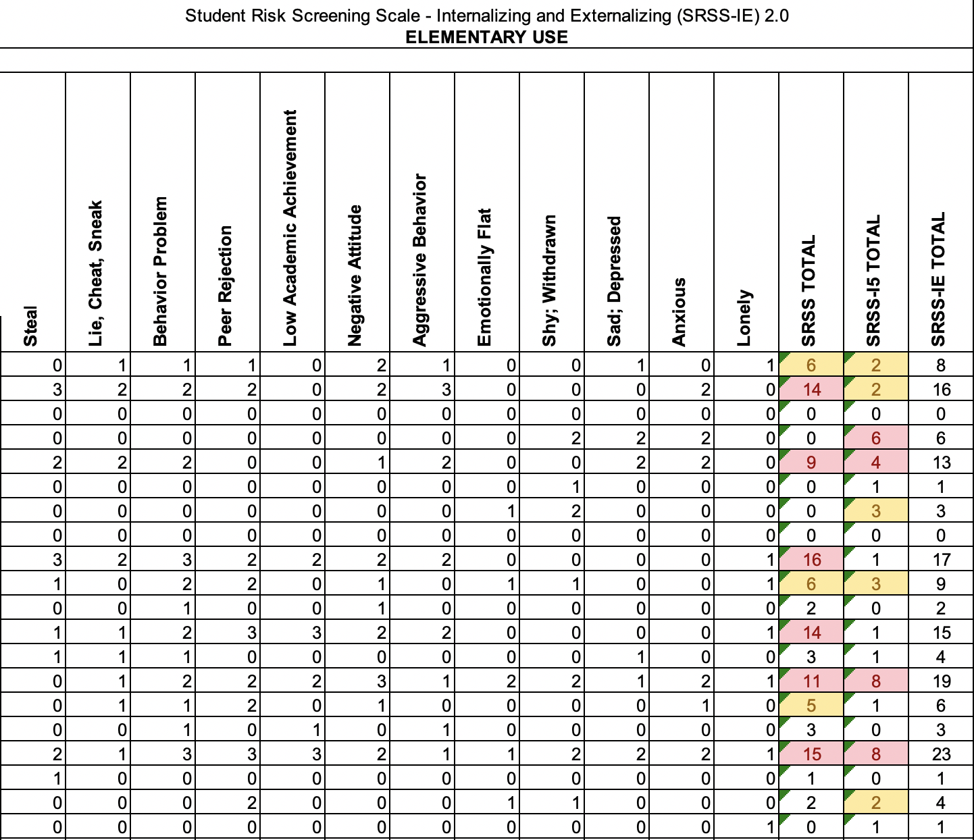
An Illustration
 | Low Risk | Moderate Risk | High Risk
Externalizing | 11 (55%) | 3 (15%) | 6 (30%)
Internalizing | 11 (55%) | 5 (25%) | 4 (20%)

Slide 75
Consider this class…
An Illustration

Slide 76
Consider this class…
An Illustration

Slide 77
Consider this class…
An Illustration

Slide 78
Consider this class…
An Illustration

Slide 79
Consider this class…
An Illustration

Slide 80
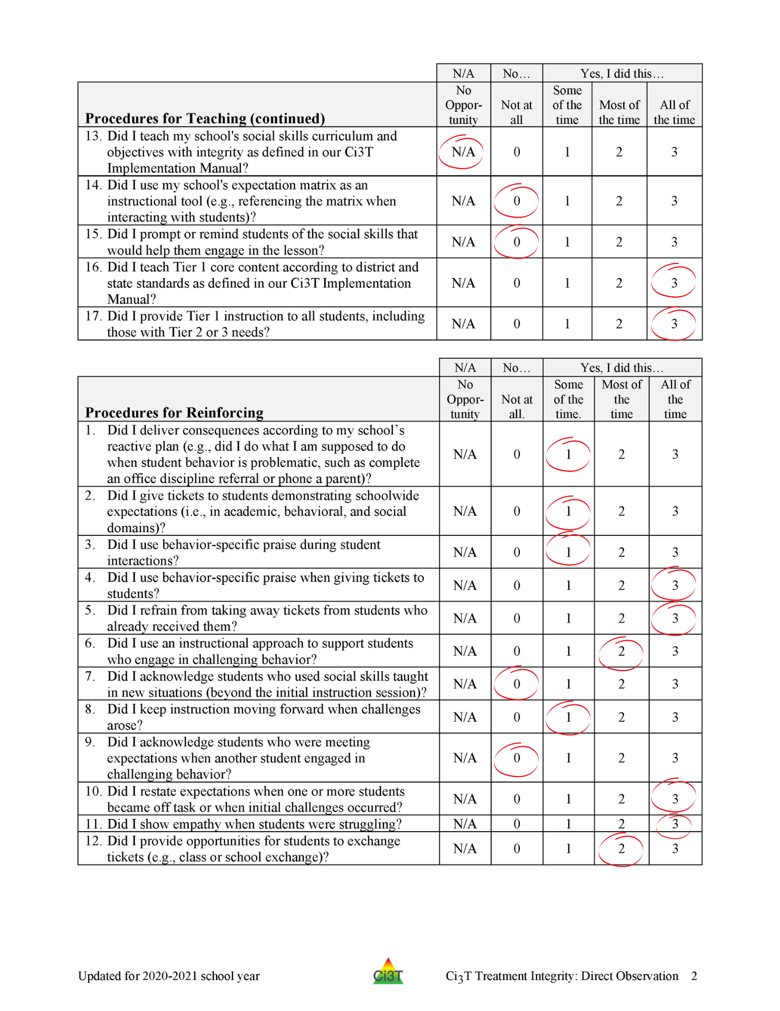
An Illustration

Slide 81
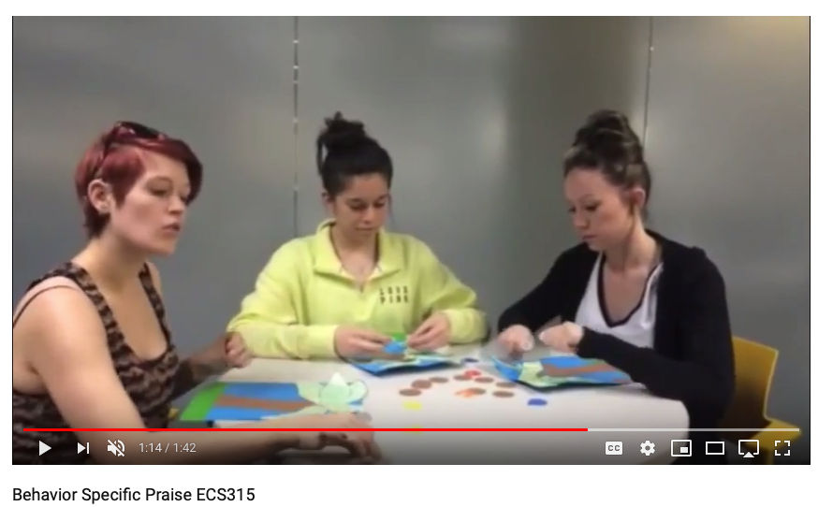
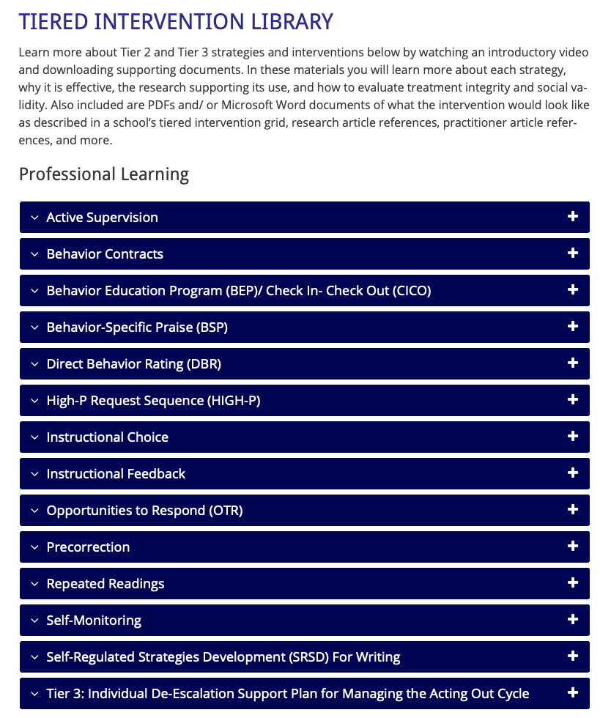
Solutions-based Planning
Re-teach Behavior Specific Praise
An Illustration
Notes:
This slide intended to cover some ideas…e.g., teacher who struggles to engage students and has not taught Social skill curriculum..idea: have learning coach or strong instructional lead co-teach PA lessons while modeling 1 low-intensity strategy (e.g., our “on-site expert” idea). Try to model how effective programs can be when combined with effective instructional strategies.

Slide 82
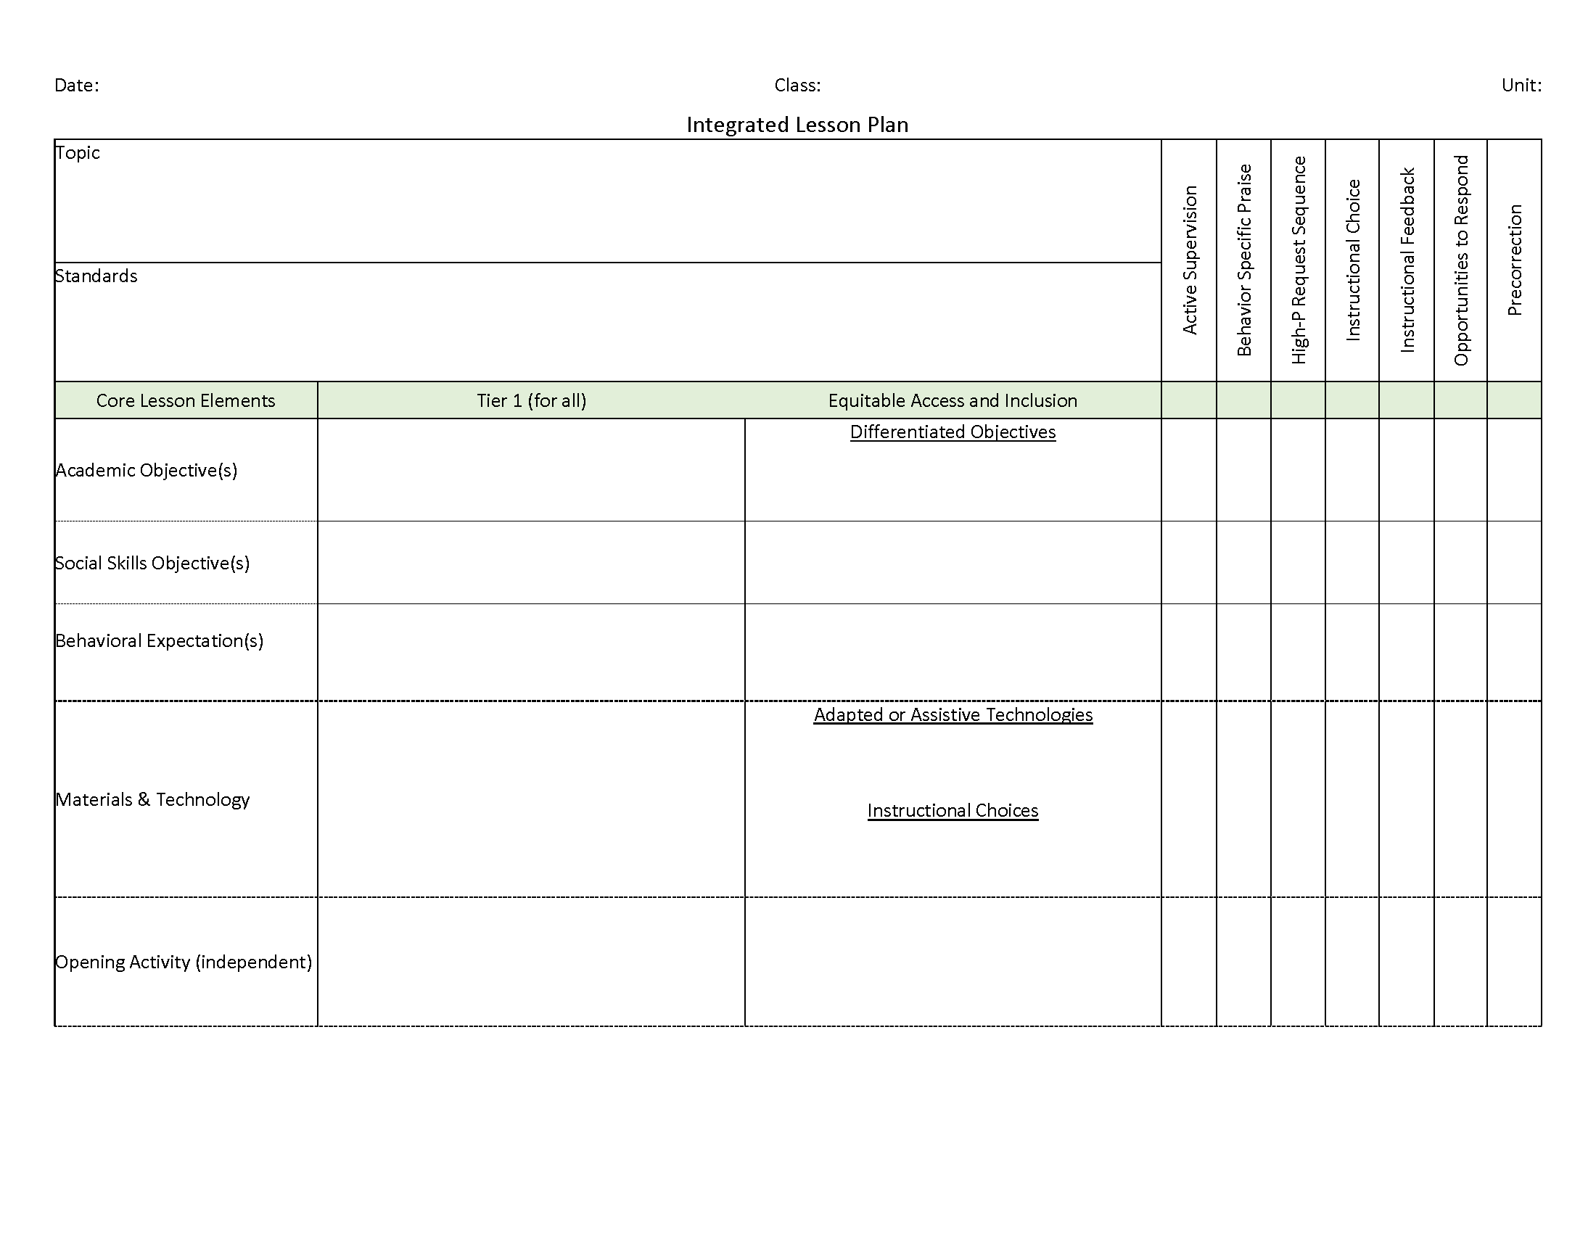
Solutions-based Planning
Support increasing instruction and prompting connected to:
school-wide expectations
social-emotional well-being skills
Tell
Show
Do
Practice & Follow Through
An Illustration
Please visit https://www.ci3t.org/covid for an integrated lesson plan template!
Notes:
This slide intended to cover some ideas…e.g., teacher who struggles to engage students and has not taught Social skill curriculum..idea: have learning coach or strong instructional lead co-teach PA lessons while modeling 1 low-intensity strategy (e.g., our “on-site expert” idea). Try to model how effective programs can be when combined with effective instructional strategies.

Slide 83
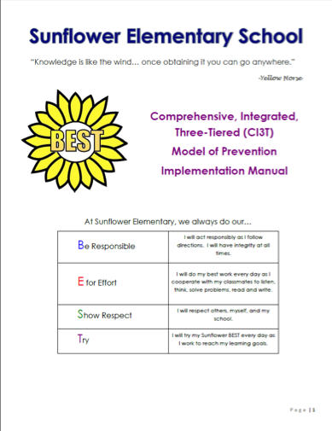
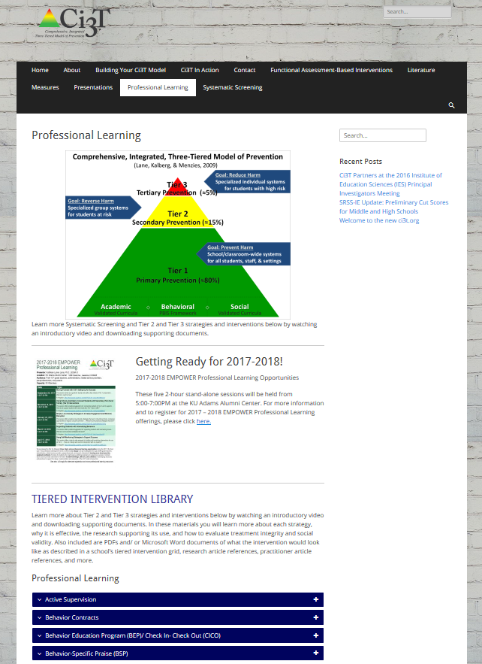
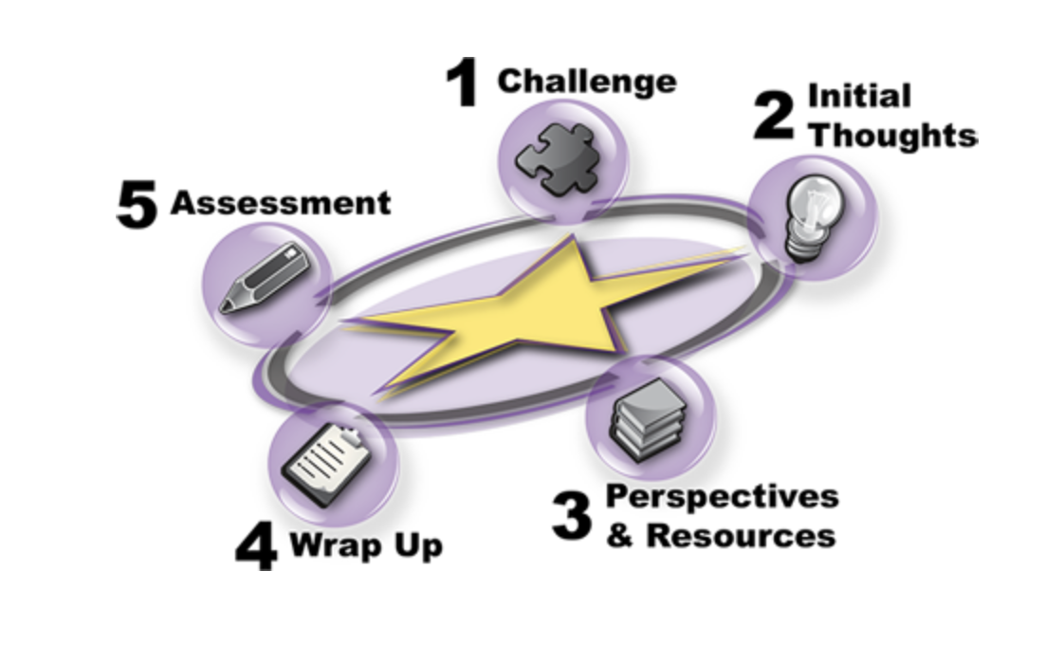
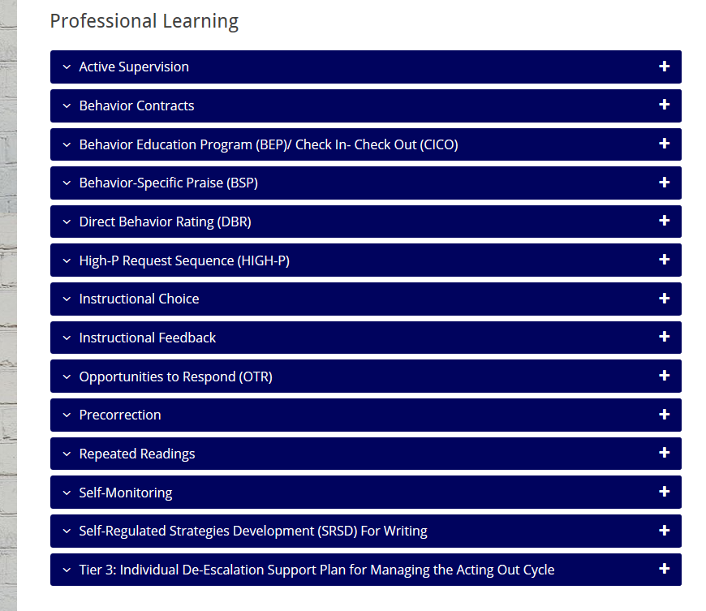
Solutions-based Planning
Connect to Ci3T Implementation Manual
Connect to evidence-based practices
An Illustration

Slide 84
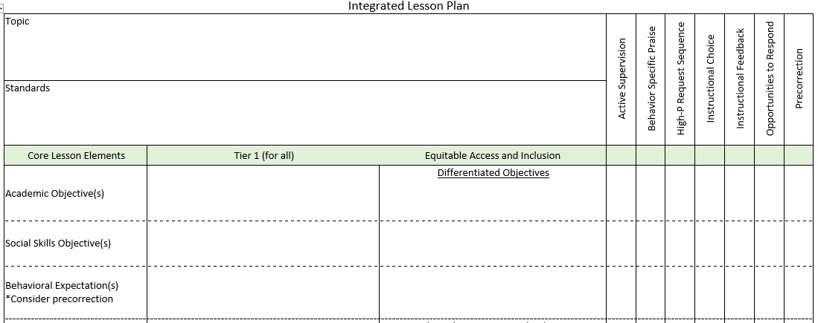
Planning for an integrated approach
An Illustration

Slide 85
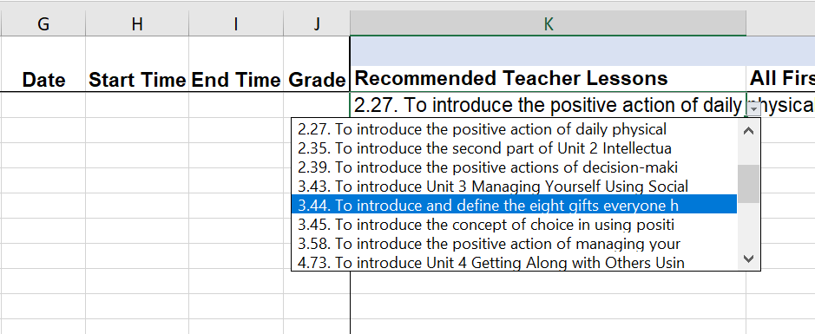
Solutions-based Planning
Data-based planning and collaboration
Emphasize integration of Tier 1 components
An Illustration
Notes:
This slide intended to cover some ideas…e.g., teacher who struggles to engage students and has not taught Social skill curriculum..idea: have learning coach or strong instructional lead co-teach PA lessons while modeling 1 low-intensity strategy (e.g., our “on-site expert” idea). Try to model how effective programs can be when combined with effective instructional strategies.

Slide 86
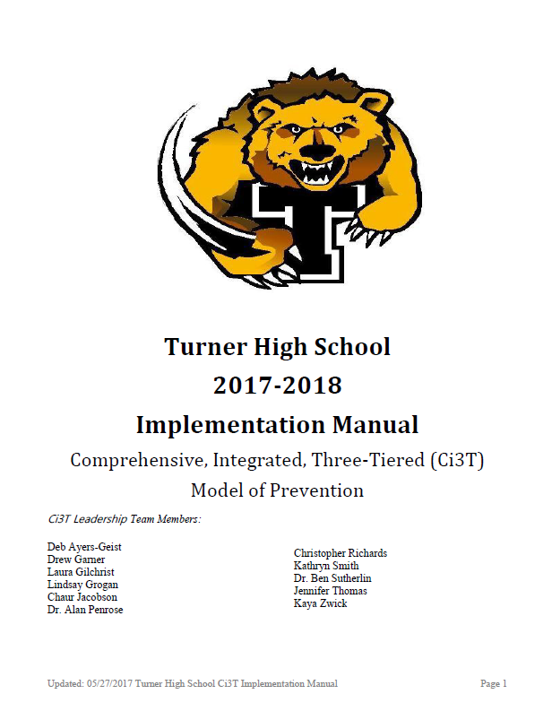
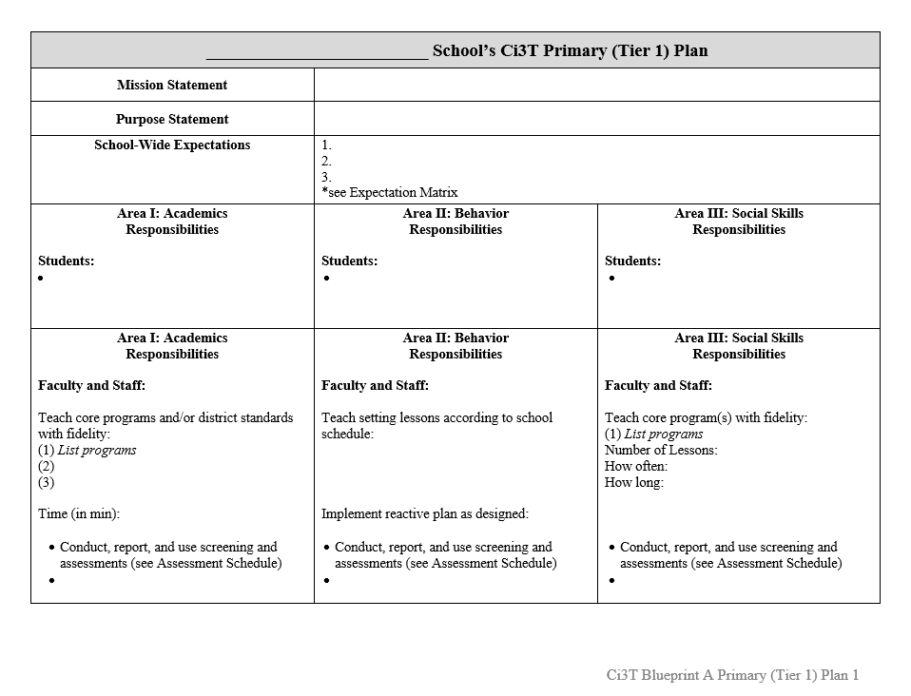
Coaching & Feedback
Grounded in Ci3T Implementation Manual
Goal setting
Connecting to resources
A plan for follow through
An Illustration
Roles and Responsibilities
Notes:
Picture source: https://pixabay.com/en/goal-setting-goal-dart-target-plan-1955809/https://pixabay.com/en/goal-setting-goal-dart-target-plan-1955809/

Slide 87
Antecedents - Behavior - Consequences
Function!
A
B
C
Precorrection:
Identify predictable contexts that often result in problem behavior and provide students with supports, prompts, and reinforcement for engaging in appropriate behavior
Notes:
Managing behavior with precorrections:
Anticipate what activities may cause inappropriate behaviors
“Getting in front” of problem behaviors
Example: Gentle reminder of expected behaviors in the hallway before dismissing for lunch

Slide 88
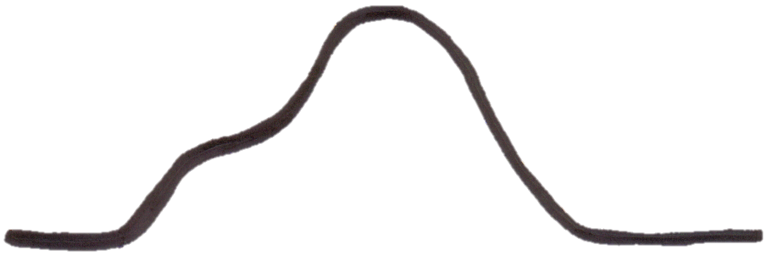
The Acting-Out Cycle
5. Peak
4. Acceleration
6. De-escalation
2. Trigger
1. Calm 7. Recovery
Whether the problem behavior is managed safely or not
or is defused
in a large measure depends on
YOUR INITIAL RESPONSE
-Dr. Geoff Colvin
3. Agitation
Intensity
Time
Colvin, 2004
Overview of the Acting Out Cycle--Vanderbilt IRIS Module

Slide 89
Deep dive into this at EMPOWER Sessions 5!
Designate two staff to attend trainings to become on-site coaches
10 min @ next Faculty and Staff meeting
Ci3T Setting Up for Success
Systematic Screening
Low-Intensity Supports
Tier 2
Planning Ahead
Tier 3

Slide 90
Accessing Project EMPOWER Professional Learning

Slide 91
Building a Ci3T Tier Library
Teacher-Delivered Strategies (T1 T2)
Tier 1
Tier 2
Tier 3

Slide 92
Low-Intensity Strategy | Lincoln Elementary On-Site Expert
Behavior-Specific Praise: Identifying the specific expectation the student met. “Niama, great job using your graphic organizer to draft your essay.” “Justice, thank you for pushing in your chair to keep the walkway safe.” | Eric Common, Behavior Specialist Mark Buckman, Special Education Grant Allen, Parent Volunteer
Opportunities to Respond: Providing 4-6 opportunities per minute for students to respond individually, choral, verbal, written, gesture, or symbol. “Show me thumbs or thumbs down if...” “Show me on your white board what…” “Turn to your elbow partner and say…” “All together now, what is…” | David Royer, Administration Emily Cantwell, 5th Grade Scarlett Lane, 3rd Grade Mallory Messenger, Counselor
Instructional Choice: Providing within-task or between task choices to increase academic engaged time and motivation. “Ronaldo, of these 3 tasks today, which would you like to work on first?” “Suzy, do you want to work with colored pencils, crayons, or sparkly markers?” | Abbie Jenkins, 2nd Grade Scarlett Lane, 3rd Grade Bryan Simmons, PE Liane Johl, Kindergarten
Notes:
Identify on-site experts!

Slide 93
Low Intensity Strategies
https://www.ci3t.org/literature

Slide 94
Low Intensity Strategies
https://www.ci3t.org/pl

Slide 95
Low Intensity Strategies
https://www.ci3t.org/covid

Slide 96
Secondary (Tier 2) Intervention Grids

Slide 97
Daily Behavior Report Cards
Support | Description | School-wide Data: Entry Criteria | Data to Monitor Progress | Exit Criteria
Daily Behavior Report (DBR) Card | DBR will be completed by the classroom teacher during daily observation periods (e.g., core instruction during English Language Arts) and parents will sign the form each day. DBR will be used to rate academic engagement, respect, and disruption. At the conclusion of each observation period, the teacher will indicate the degree to which the student displayed each behavior. The teacher will meet briefly with the student to share the teacher’s DBR rating and home-school communication procedures will be established for student to bring a paper copy or email to parent or caregiver each day DBR was implemented for a parent/caregiver to sign. | Behavior SRSS-E7 score: Moderate (4-8) and/or SRSS-I5 score: Moderate (2-3) AND Evidence of teacher implementation of Ci3T primary (Tier 1) plan [treatment integrity: direct observation] AND Parent permission AND Academic Student is in grade 2 or 3 | Student measures Daily behavior report (DBR; daily) Attendance and tardies Social validity Teacher: IRP-15 Student: CIRP Treatment integrity Tier 2 treatment integrity measures Ci3T TI: Direct observation (30 min if needed) | Review student progress at end of 24 sessions Team agrees goals have been met or no further Positive Action small group sessions are warranted SRSS-E7 and I5 scores are in the low risk category
http://dbr.education.uconn.edu/

Slide 99
Data in action

Slide 100
Data in action

Slide 101
Data in action
Other Tier 2 options…
Precorrection
Behavior Contracts
Behavior Specific Praise
Instructional Choice

Slide 103
Tertiary (Tier 3) Intervention Grids

Slide 104
Schoolwide Positive
Behavior Support
Comprehensive, Integrative,
Three-Tiered (Ci₃T)
Models of Support
Low-Intensity Strategies
Basic Classroom Management
Effective Instruction
Low-Intensity Strategies
Behavior Contracts
Self-Monitoring
- -
Functional Assessment-Based
Interventions
Higher-Intensity
Strategies
Assess, Design, Implement,
and
Evaluate
Assessment

Slide 106
Reflect & Plan
Review winter screening data (if available). Consider implications for:
Primary (Tier 1) prevention efforts
Teacher-delivered, low-intensity supports
Secondary (Tier 2) and Tertiary (Tier 3) supports
Make plans to implement data-informed professional learning with your faculty and staff. Consider:
Leveraging upcoming, available building-wide professional development times
Discussing capacity to provide individual implementation supports to classrooms in which data suggest support is needed (e.g., coaching, mentoring)
How will you communicate your plans with faculty and staff?
Write action items on HO Ci3T PL Map
Notes:
15-min timer

Slide 107
Wrapping Up and Moving Forward

Slide 108
Ci3T
Comprehensive Professional Learning Plan
Ci3T: Primary Prevention
Session 1:
Overview of Ci3T Prevention Models
Setting a Purpose
Establish team meetings and roles
Session 2:
Mission and Purpose
Establish Roles and Responsibilities
Procedures for Teaching
Procedures for Reinforcing
Reactive Plan
Session 3:
Procedures for Monitoring
Session 4:
Revise Primary Plan using Stakeholder feedback
Prepare presentation
Ci3T: Secondary Prevention
Session 5:
Overview of Teacher focused Strategies
Overview of Student Focused Strategies
Using data to determine which students may need Secondary (Tier 2) supports
Draft the Secondary Intervention Grid based on existing supports
Ci3T: Tertiary Prevention
Session 6:
Final revisions of Ci3T Plan based on stakeholder feedback
Draft Tertiary (Tier 3) Prevention Intervention Grids
Design Implementation Manual and Plan for roll out to faculty, students, and parents
Ci3T Leadership Team Training Sequence
Implementation Stages of Tier 2 and 3 within Ci3T
Additional Professional Development on Specific Topics
Core Content Curriculum
Check In - Check Out
Functional Assessment-based Interventions
Reading, Math, Writing Benchmarking and Progress Monitoring Tools
Interventions, Strategies, & Practices
Additional Tier 3 Supports
Instructional Techniques to Improve Students’ Motivation; Classroom Management Practices;
Low-Intensity Behavior Supports

Slide 109
Ci3T Professional Learning Calendar
 | July | Aug | Sep | Oct | Nov | Dec | Jan | Feb | Mar | Apr | May | Jun
Ci3T Training |  |  |  |  | Ci3T Professional Learning Series Session 1 | Ci3T Professional Learning Series Session 2 | Ci3T Professional Learning Series Session 3 | Ci3T Professional Learning Series Session 4 |  | Ci3T Professional Learning Series Session 5 | Ci3T Professional Learning Series Session 6
Ci3T Implementation Support | Ci3T Implementation Series Prep Session |  | Ci3T Implementation Series Session 1 |  | Ci3T Implementation Series Session 2 |  | Ci3T Implementation Series Session 3 |  | Ci3T Implementation Series Session 4 | Ci3T Implementation Series Session 5
Ci3T EMPOWER |  |  | Ci3T EMPOWER Session 1 | Ci3T EMPOWER Session 2 | Ci3T EMPOWER Session 3 |  | Ci3T EMPOWER Session 4 |  | Ci3T EMPOWER Session 5 | Ci3T EMPOWER Session 6
Ci3T Trainers & Coaches Calls |  | Trainers & Coaches Call Session 1 | Trainers & Coaches Call Session 2 | Trainers & Coaches Call Session 3 | Trainers & Coaches Call Session 4 | Trainers & Coaches Call Session 5 | Trainers & Coaches Call Session 6 | Trainers & Coaches Call Session 7 | Trainers & Coaches Call Session 8 | Trainers & Coaches Call Session 9 | Trainers & Coaches Call Session 10

Slide 110
Sustaining and Disseminating Professional Learning
Designate two staff to attend trainings to become on-site coaches
10 min @ next Faculty and Staff meeting
Ci3T Setting Up for Success
Systematic Screening
Low-Intensity Supports
Tier 2
Planning Ahead
Tier 3

Slide 111
Accessing Project EMPOWER Professional Learning

Slide 112
Project EMPOWER - Traditional
Ci3T EMPOWER Sessions Location: Remote via Zoom Attended by: School Ci3T Leadership Teams, Ci3T District Trainers and Coaches, Faculty and Staff, Families (adults only). Community Members |  | Times (Pacific) | Times (Central) | Times (Eastern)
1. Getting Started | Sep. 19, 2023 (Tu) | 3:00 – 5:00 p.m. | 5:00 – 7:00 p.m. | 6:00 – 8:00 p.m.
2. Screening | Oct. 19, 2023 (Th) | 3:00 – 5:00 p.m. | 5:00 – 7:00 p.m. | 6:00 – 8:00 p.m.
3. Low Intensity Supports (3) | Nov. 30, 2023 (Th) | 3:00 – 5:00 p.m. | 5:00 – 7:00 p.m. | 6:00 – 8:00 p.m.
4. Tier 2 | Jan. 9, 2024 (Tu) | 3:00 – 5:00 p.m. | 5:00 – 7:00 p.m. | 6:00 – 8:00 p.m.
5. Tier 3 | Mar. 28, 2024 (Th) | 3:00 – 5:00 p.m. | 5:00 – 7:00 p.m. | 6:00 – 8:00 p.m.
6. Moving Forward | Apr. 23, 2024 (Wed) | 3:00 – 5:00 p.m. | 5:00 – 7:00 p.m. | 6:00 – 8:00 p.m.

Slide 113
Wrap Up and Preview
Today
Next time
Procedures for Monitoring
Review your School’s Social Validity & Treatment Integrity Data
Review your School’s Winter Screening Data
Data-informed Decision-making
Professional Learning Targets and Resources
Communication Plans
Data-Informed Decision-Making
Sharing Data with Stakeholders
Using Data to Inform Professional Learning and Instruction
Integrated Lesson Planning at Tier 1
Planning and Implementing Tier 2 Interventions
Planning and Implementing Tier 3 Interventions

Slide 114
Please Take a Minute to Get Organized
Please stay until all materials are organized.
Team Materials:
Make sure your notes are in your Ci3T Leadership Team agenda and that document is saved in your Ci3T Leadership Team Drive.
Clearly identify the person(s) on your team in charge of each action item listed on the agenda.
Thank you!

Slide 115
Homework
At your next Ci3T Leadership Team meeting:
Complete remaining Tiered Fidelity Inventory (TFI) protocols if needed
Review winter screening data once available
Plan professional learning opportunities for faculty and staff for spring
Make plans for information sharing to all stakeholders
Make preliminary plans for faculty and staff to complete
Treatment integrity and social validity surveys during the spring timepoint
Teacher well-being and input measures during the spring timepoint
At your next faculty meeting:
Share treatment integrity and social validity data (successes, focus areas)
Review Ci3T implementation procedures
Share professional learning resources and opportunities (see ci3t.org/pl)

Slide 116
Comprehensive, Integrated, Three-Tiered Model of Prevention
(Lane, Kalberg, & Menzies, 2009)
Thank you!
Notes:
Tag us in your Ci3T highlights- we’d love to see Ci3T in action! Follow us on Twitter or Instagram for updates and links to resources! @Ci3TModel
You will receive a brief session evaluation – we value your feedback and would greatly appreciate you taking a few minutes to share your thoughts on what you liked about the session and how we can improve

