Slide 1
Implementing Comprehensive, Integrated, Three-tiered (Ci3T) Models: Using Data to Inform Instruction
Ci3T Implementation Series and Delivery – Session 2
Presenters and Contributors | Contributors
Allison M. Bernard | Wendy Peia Oakes
Mark M. Buckman | Elise Sarasin
Kathleen Lynne Lane | Rebecca L. Sherod

Slide 3
Let’s Connect on Social Media!
Tag us in your Ci3T highlights- we’d love to see Ci3T in action!
Follow us on Twitter or Instagram for updates and links to resources!
@Ci3TModel

Slide 4
Ci3T Professional Learning Calendar
 | 0 | 1 | 2 | 3 | 4 | 5 | 6 | 7 | 8 | 9 | 10 | 11
 | July | Aug | Sep | Oct | Nov | Dec | Jan | Feb | Mar | Apr | May | Jun
Ci3T Training |  |  |  |  | Ci3T Professional Learning Series Session 1 | Ci3T Professional Learning Series Session 2 | Ci3T Professional Learning Series Session 3 | Ci3T Professional Learning Series Session 4 |  | Ci3T Professional Learning Series Session 5 | Ci3T Professional Learning Series Session 6
Ci3T Implementation Support | Ci3T Implementation Series Prep Session |  | Ci3T Implementation Series Session 1 |  | Ci3T Implementation Series Session 2 |  | Ci3T Implementation Series Session 3 |  | Ci3T Implementation Series Session 4 | Ci3T Implementation Series Session 5
Ci3T EMPOWER |  |  | Ci3T EMPOWER Session 1 | Ci3T EMPOWER Session 2 | Ci3T EMPOWER Session 3 |  | Ci3T EMPOWER Session 4 |  | Ci3T EMPOWER Session 5 | Ci3T EMPOWER Session 6
Ci3T Trainers & Coaches Calls |  | Trainers & Coaches Call Session 1 | Trainers & Coaches Call Session 2 | Trainers & Coaches Call Session 3 | Trainers & Coaches Call Session 4 | Trainers & Coaches Call Session 5 | Trainers & Coaches Call Session 6 | Trainers & Coaches Call Session 7 | Trainers & Coaches Call Session 8 | Trainers & Coaches Call Session 9 | Trainers & Coaches Call Session 10

Slide 5
Agenda
Welcome
Preparing to Collect and Use Social Validity & Treatment Integrity Data
Using Fall Screening Data to Inform Instruction:
Primary (Tier 1) Prevention Efforts
Teacher-Delivered, Low-Intensity Strategies
Secondary (Tier 2) and Tertiary (Tier 3) Interventions
Facilitating Clear Communication and Collaborations with Stakeholders
Communication and Collaboration: Plans & Timelines
Data-informed Professional Learning
Wrapping Up and Moving Forward

Slide 6
Review and Preview
Last Time
Today…
Scheduling for Success
Implementing Your Primary (Tier 1) Prevention Efforts
Preparing to Collect Treatment Integrity Data
Ci3T Treatment Integrity Team Leader Training
Preparing to Collect and Use Social Validity & Treatment Integrity Data
Using Fall Screening Data to Inform Instruction
Facilitating Clear Communication and Collaborations with Stakeholders

Slide 7
Welcome
Please pull up your Ci3T Implementation Manual

Slide 8
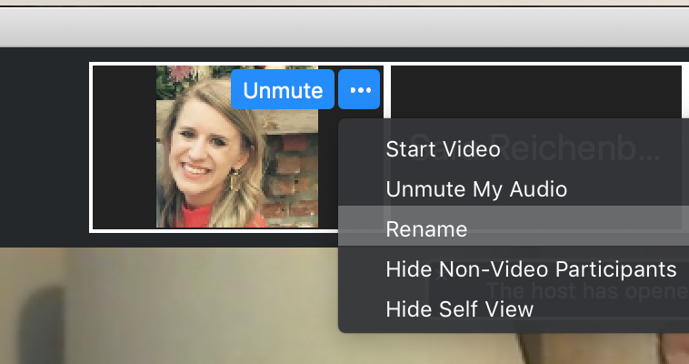
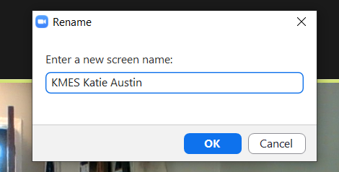
Renaming: School Initials + First and Last Name
To help us put you in breakout rooms with your colleagues today…
1. Click the three dots at the top
right corner of your video square.
2. Rename yourself with your
school initials then first and last name.

Slide 9
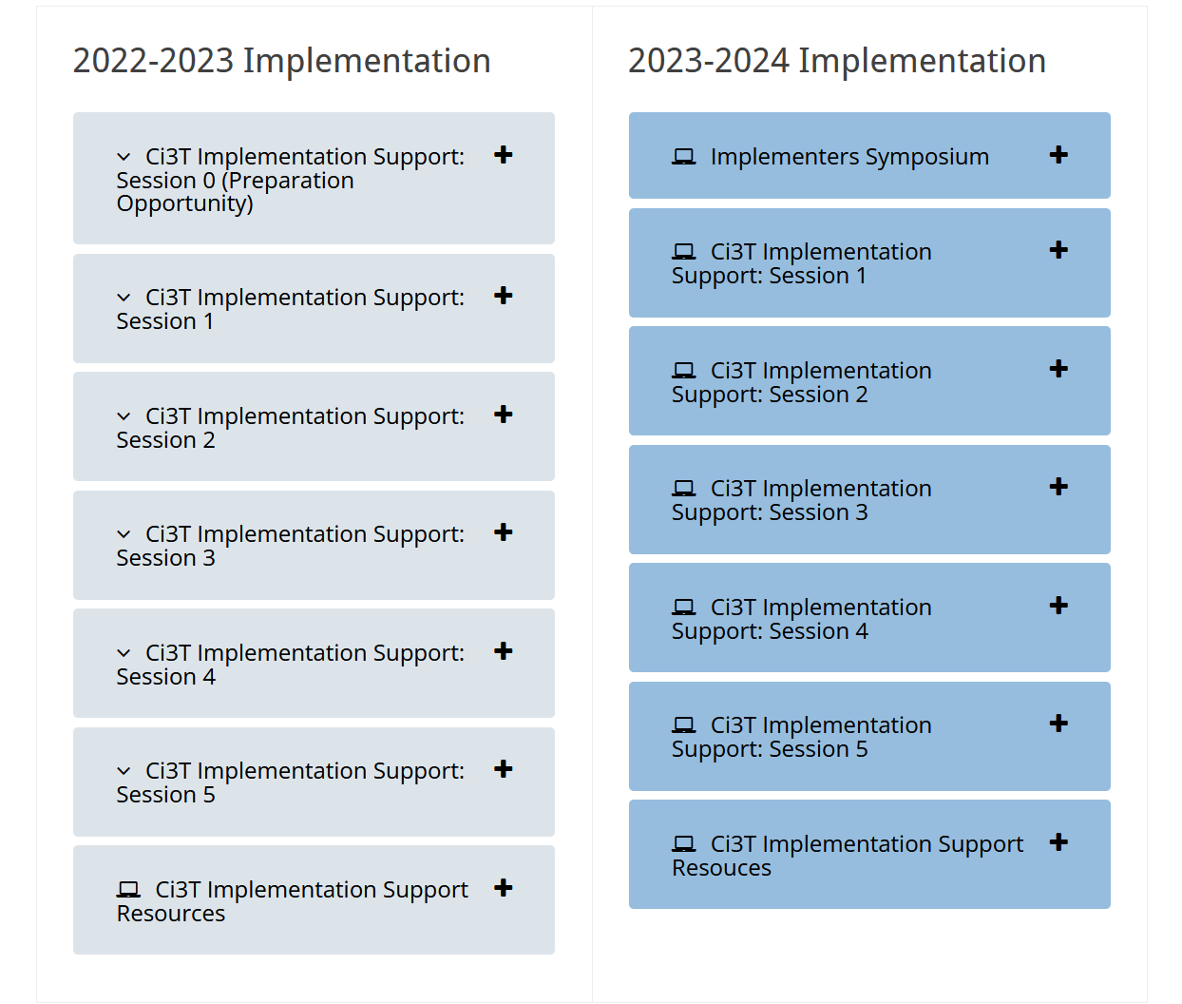
Accessing Professional Learning Materials
Navigate to ci3t.org/imp

Slide 10
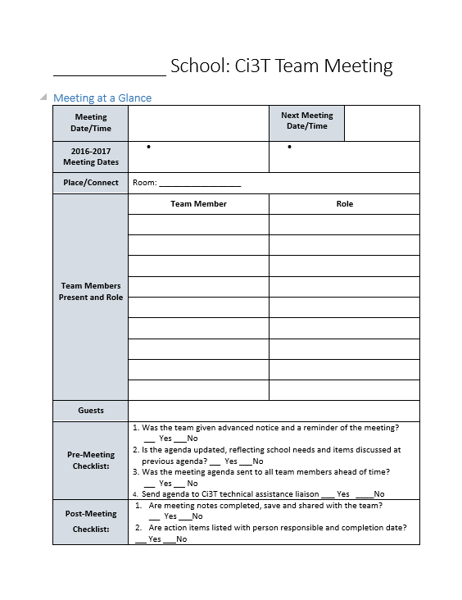
IM18 Ci3T Leadership Team Meeting Agenda TEMPLATE
Predictability

Slide 11
Goals for this Implementation Year
Establish effective Ci3T leadership structures
Gain a deeper understanding of Ci3T models of prevention
Implement your school’s plan with high fidelity
Collect and use social validity and treatment integrity data to monitor Ci3T plan implementation
Collect student academic and behavioral outcome data to inform Ci3T implementation efforts
Share data with all stakeholders regularly (e.g., monthly, quarterly)
Identify areas of additional professional learning for faculty and staff and support faculty and staff access to professional learning
Address any barriers to implementing your Ci3T model

Slide 12
Preparing to Collect and Use Social Validity and Treatment Integrity Data

Slide 13
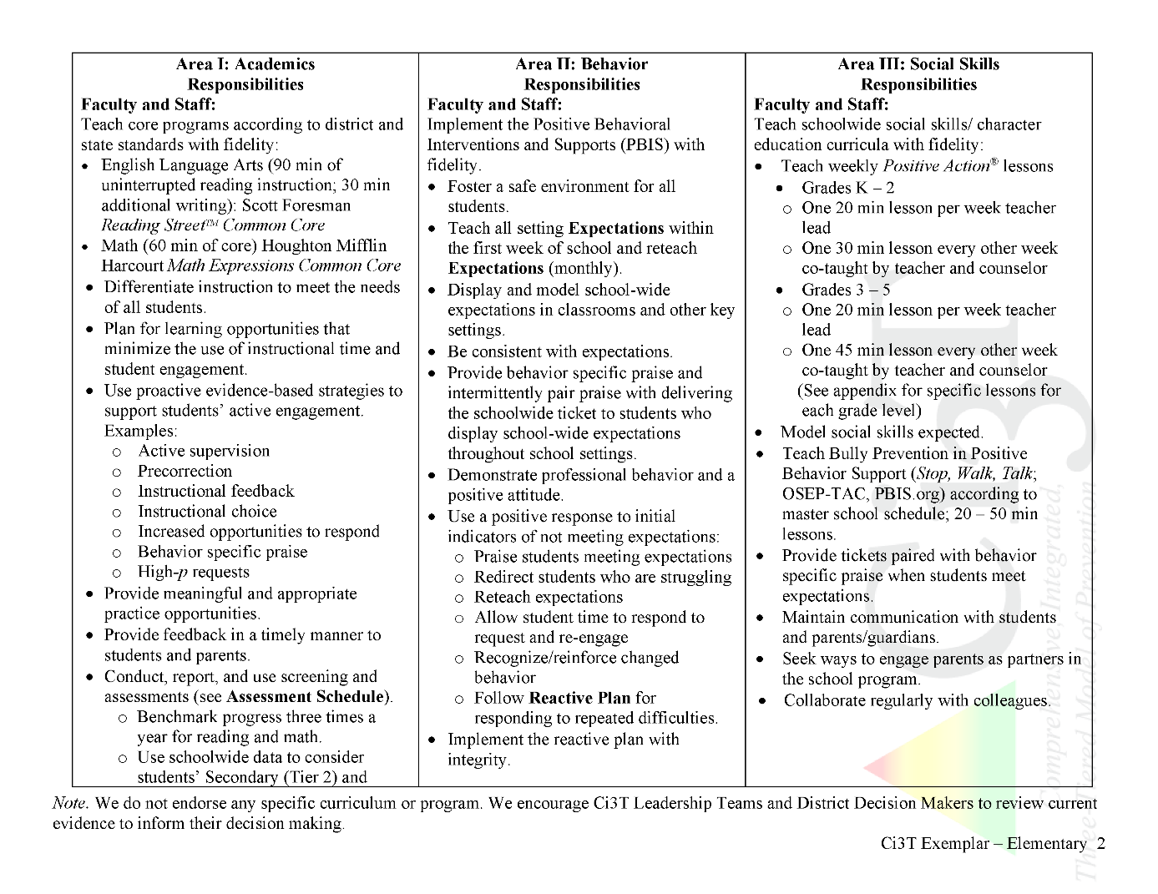
Ci3T Primary Plan: Procedures for Teaching
Ci3T Primary Plan: Procedures for Reinforcing
Ci3T Primary Plan: Procedures for Monitoring

Slide 14
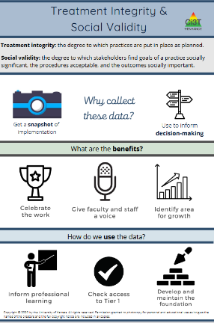
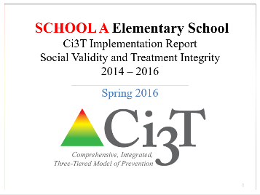
Essential Components of Primary Prevention Efforts
Social Validity
Systematic Screening
Academic
Behavior
Treatment Integrity
ci3t.org/measures
Notes:
Infographic - https://www.ci3t.org/measures

Slide 15
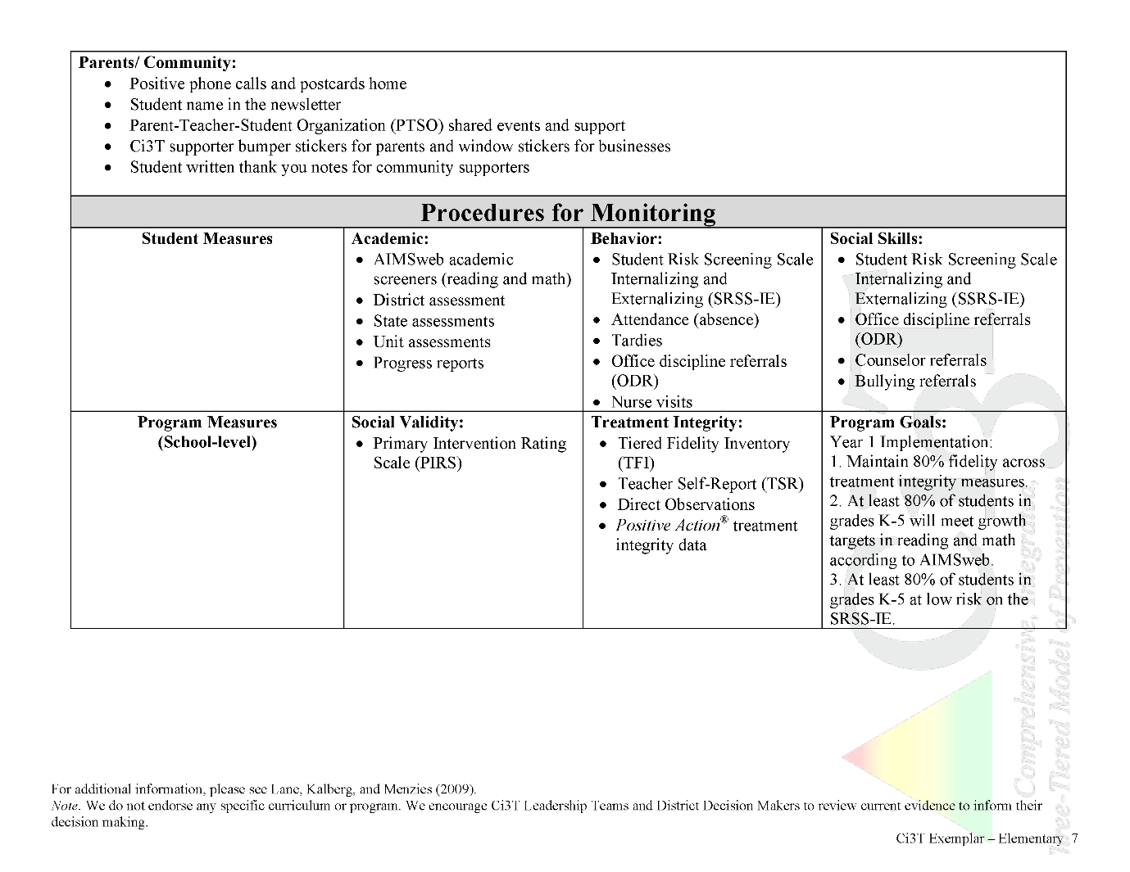
In future years, consider alternative program goals.
80% of students meeting reading and math targets on assessments
Locate in your Ci3T Implementation Manual

Slide 16
Sample Elementary Assessment Schedule
Measure | Aug | Sep | Oct | Nov | Dec | Jan | Feb | Mar | Apr | May
School Demographics
Student Demographic Information | X | X | X | X | X | X | X | X | X | X
Screening Measures
Behavior Screeners: SRSS-IE |  | X |  |  | X |  |  |  | X
Academic Screeners: AIMSWeb | X | X |  |  |  | X |  |  |  | X
Student Outcome Measures - Academic
State & District assessment |  |  |  |  |  |  |  | X | X
Progress reports |  |  |  | X |  |  | X |  |  | X
Student Outcome Measures - Behavior
Absences |  | X | X | X | X | X | X | X | X
Office discipline referrals (ODR) |  | X |  |  | X |  |  |  | X
Counselor referrals | X | X | X | X | X | X | X | X | X | X
Nurse visits | X | X | X | X | X | X | X | X | X | X
Program Measures
Primary Intervention Rating Scale |  |  | X |  |  |  |  | X
School-wide Evaluation Tool |  |  | X |  |  |  |  | X
Ci3T TI: Teacher Self-Report |  |  | X |  |  |  |  | X
Ci3T TI: Direct Observation |  |  | X |  |  |  |  | X
Second Step® Treatment Integrity |  |  | X |  |  |  |  | X
Adapted from Lane, K. L., Oakes, W. P., Cantwell, E. D., & Royer, D. J. (2018). Building and installing comprehensive, integrated, three-tiered (Ci3T) models of prevention: A practical guide to supporting school success V1.2. KOI Education. (Interactive eBook)

Slide 17
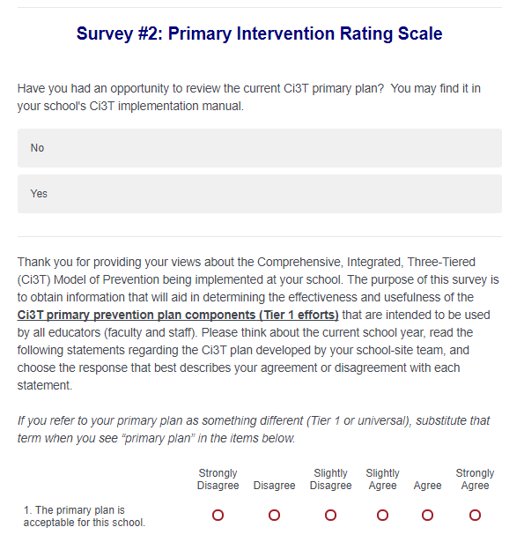
Social Validity: Primary Intervention Rating Scale
Ensure all faculty and staff receive an emailed link to Qualtrics for the PIRS and TSR surveys

Slide 18
Social Validity How do stakeholders view the plan?
Social validity refers to the level of:
Social significance of intervention goals
Social acceptability of intervention procedures
Social importance of intervention outcomes
(Wolf, 1978)
Assessed using the Primary Intervention Rating Scale (PIRS)
Social Validity: PIRS Results
Year | Fall |  | Spring
 | n | % (SD) | n | % (SD)
2020-2021 | 32 | 85.39 (8.89) | TBD | TBD

Slide 19
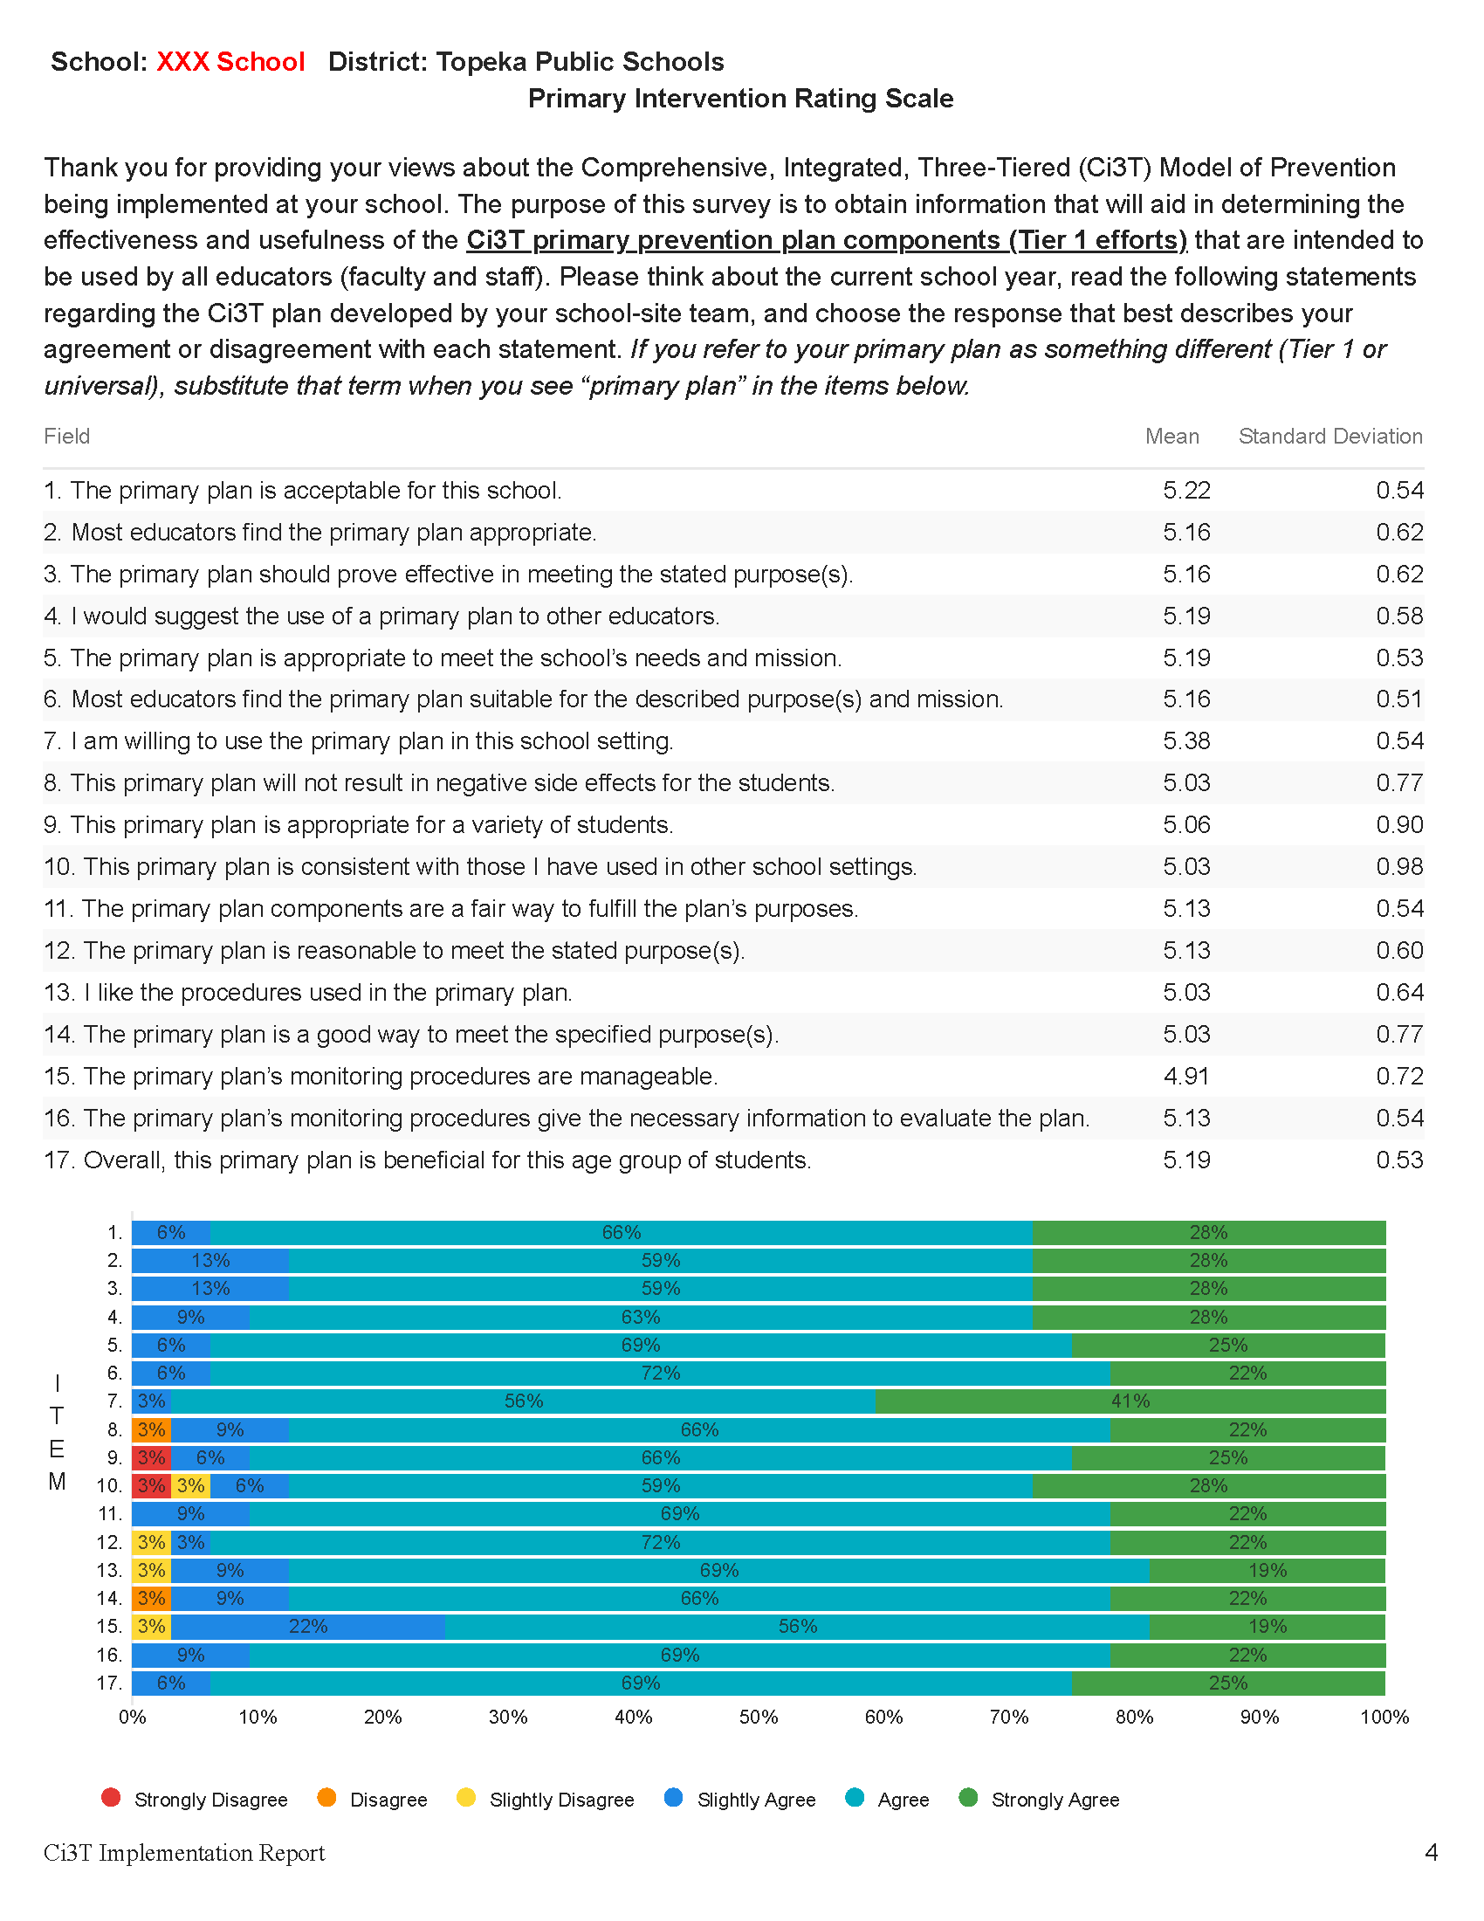
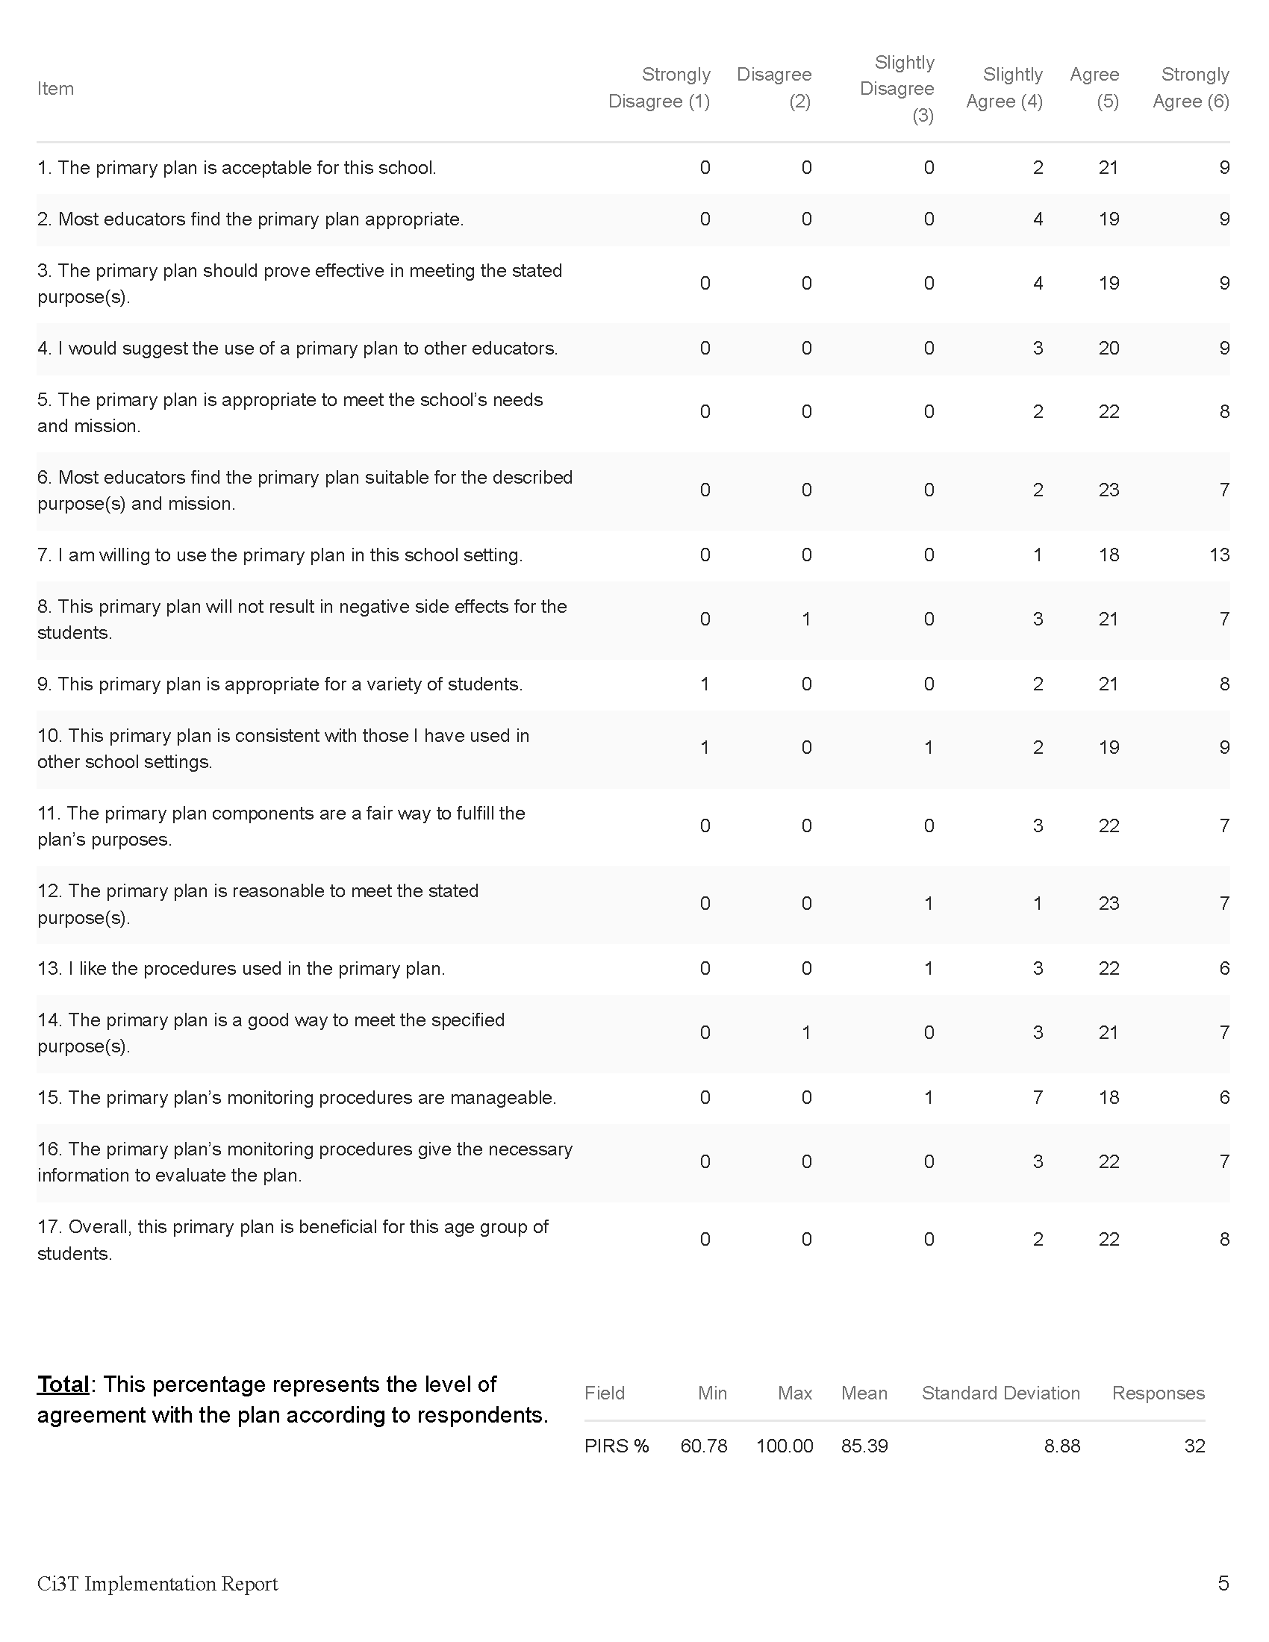

Slide 20
Treatment Integrity
Is Ci3T being implemented as planned?
Three measures of treatment integrity:
Ci3T Treatment Integrity: Teacher Self-Report (Ci3T TI: TSR)
Ci3T Treatment Integrity: Direct Observation (Ci3T TI: DO)
Tiered Fidelity Inventory (TFI)

Slide 21
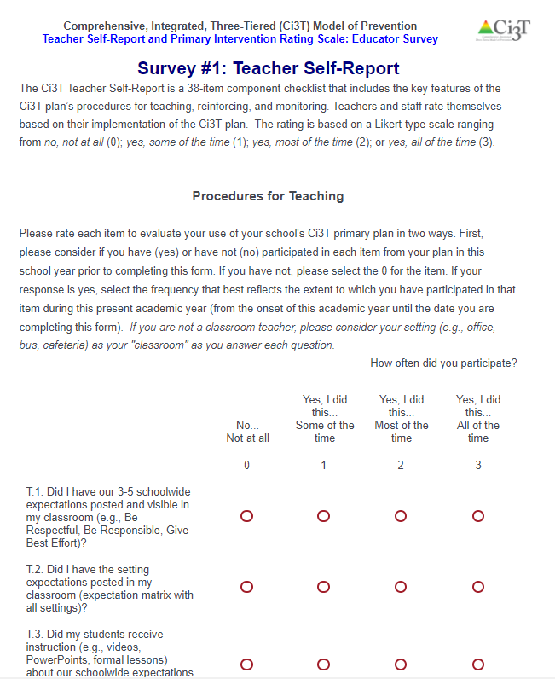
Teacher Self-Report (Ci3T TI: TSR)
Faculty and staff receive an emailed link to a Qualtrics survey

Slide 22
Ci3T Treatment Integrity: Teacher Self-Report (Ci3T TI: TSR)
49-item checklist with procedures for
Teaching
Reinforcing
Monitoring
Timepoint: beginning of year to current date
Likert-type scale ranging from
0 = no, not at all
1 = yes, some of the time
2 = yes, most of the time
3 = yes, all of the time
Comments
Ci3T TI: TSR was updated in 2020-2021. Do not compare scores on the updated measure to data from years before 2020-2021
CC0 No rights reserved
Notes:
Staff goes through these and rate selves for how they have implemented plan.
Done in Fall/Spring.

Slide 23
Ci3T Treatment Integrity Direct Observation (Ci3T TI: DO)
Subset of Ci3T TI: TSR
Stratified, random selection of educators
Personnel who directly instruct students
Observers trained to criterion
30-min observations
Teacher perspective
Observer perspective
Notes:
Done in Fall/Spring.
Stratified and even sampling of school. Ie) 20% of each grade level teachers, etc.
KU can help us with generating our random sampling.
Same sampling of educators in Spring as in Fall.

Slide 24
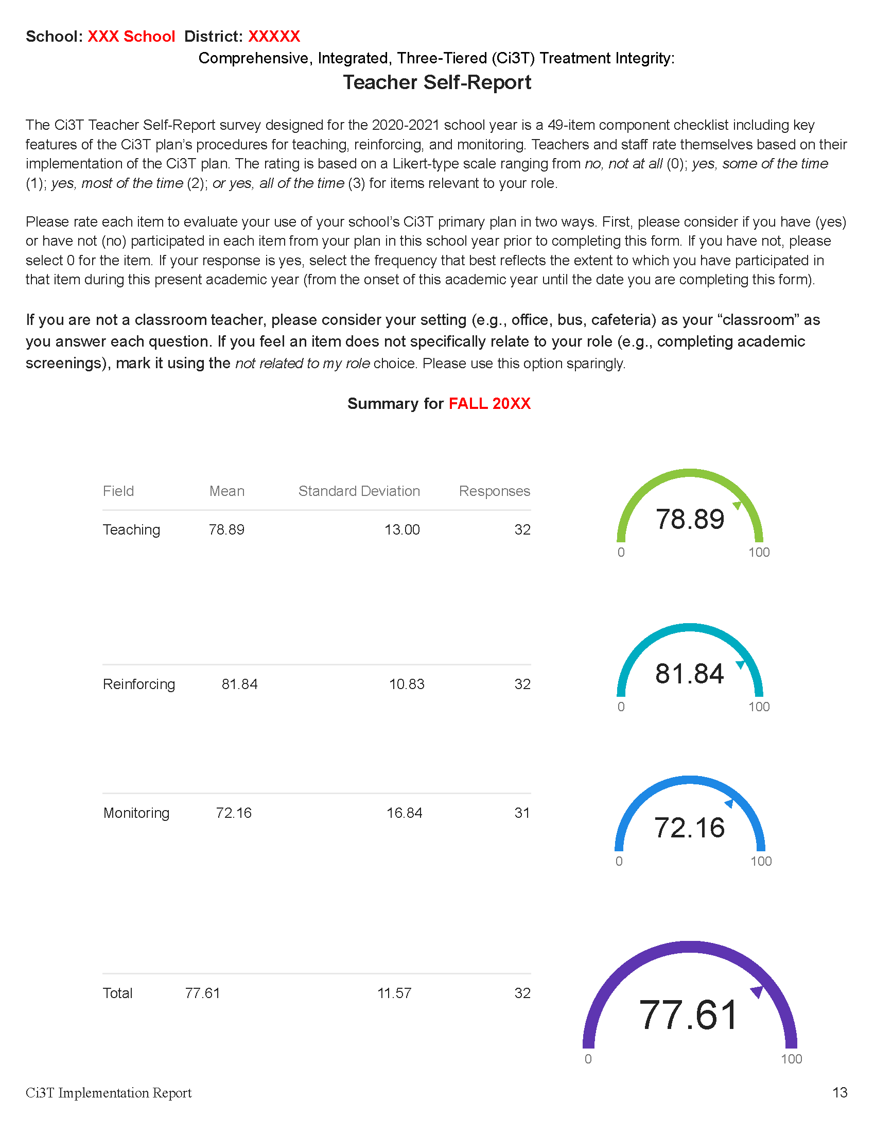
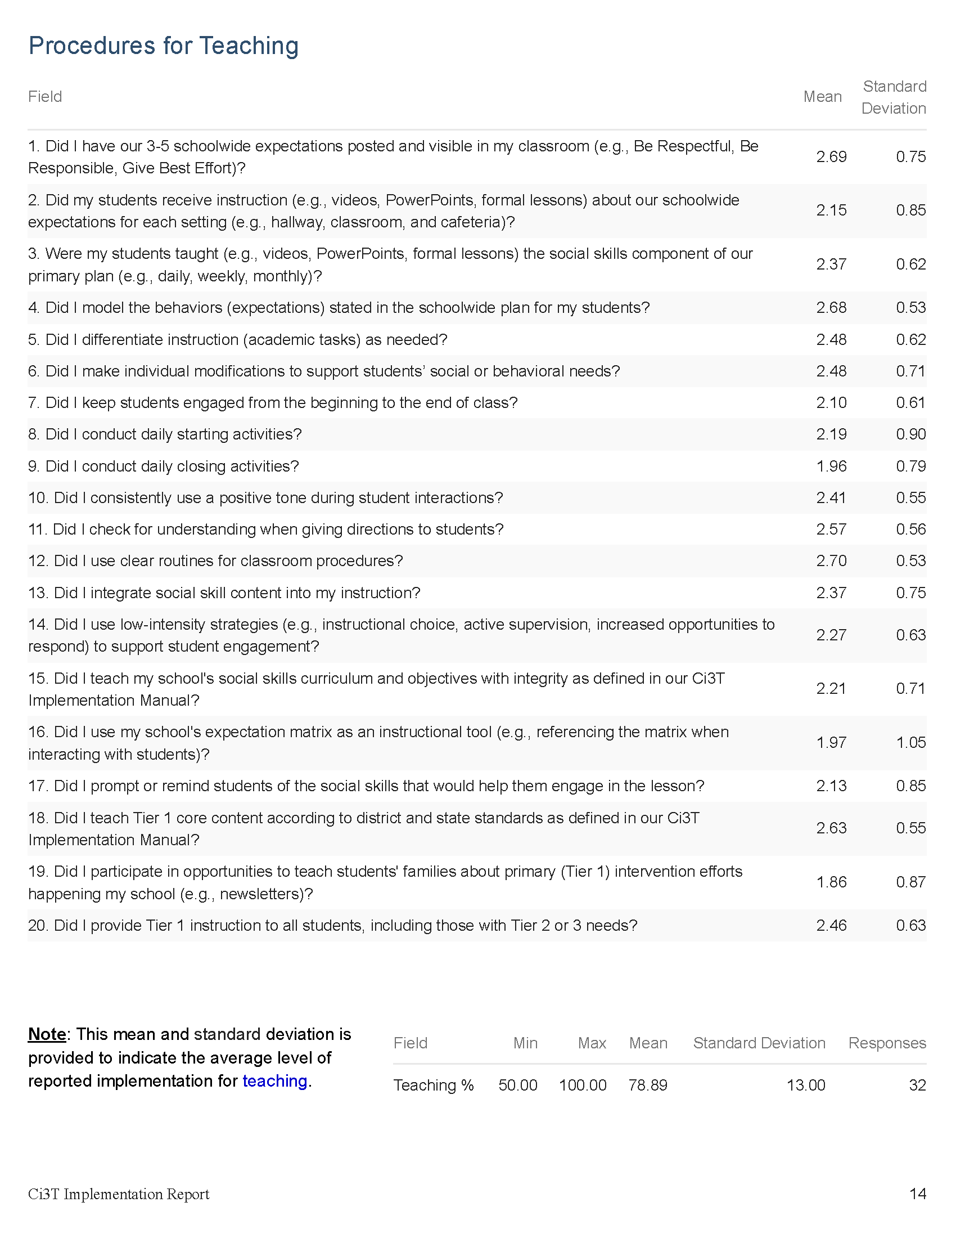
Updated in 2020
*do not compare to data from earlier years

Slide 25
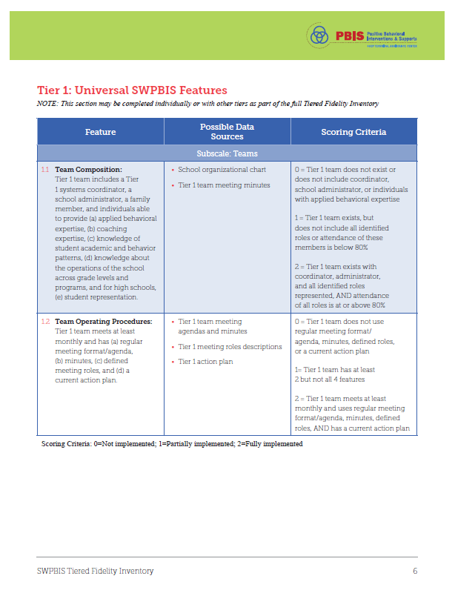
Tiered Fidelity Inventory (TFI)

Slide 26
What is the TFI?
“The TFI gives teams a single, efficient, valid, reliable survey to guide implementation and sustained use of SWPBIS. Using the TFI, teams measure the extent to which school personnel apply the core features of SWPBIS at all three tiers – either individually or collectively.”(PBISApps)
For Ci3T Purposes, the TFI serves as:
An initial assessment
A guide for implementation of Tier I, Tier II, and/or Tier III practices
An index of sustained implementation
Note: The TFI is based on existing fidelity surveys (e.g., SET, BoQ, TIC, SAS, BAT, MATT) and can be used to replace any or all of them.

Slide 27
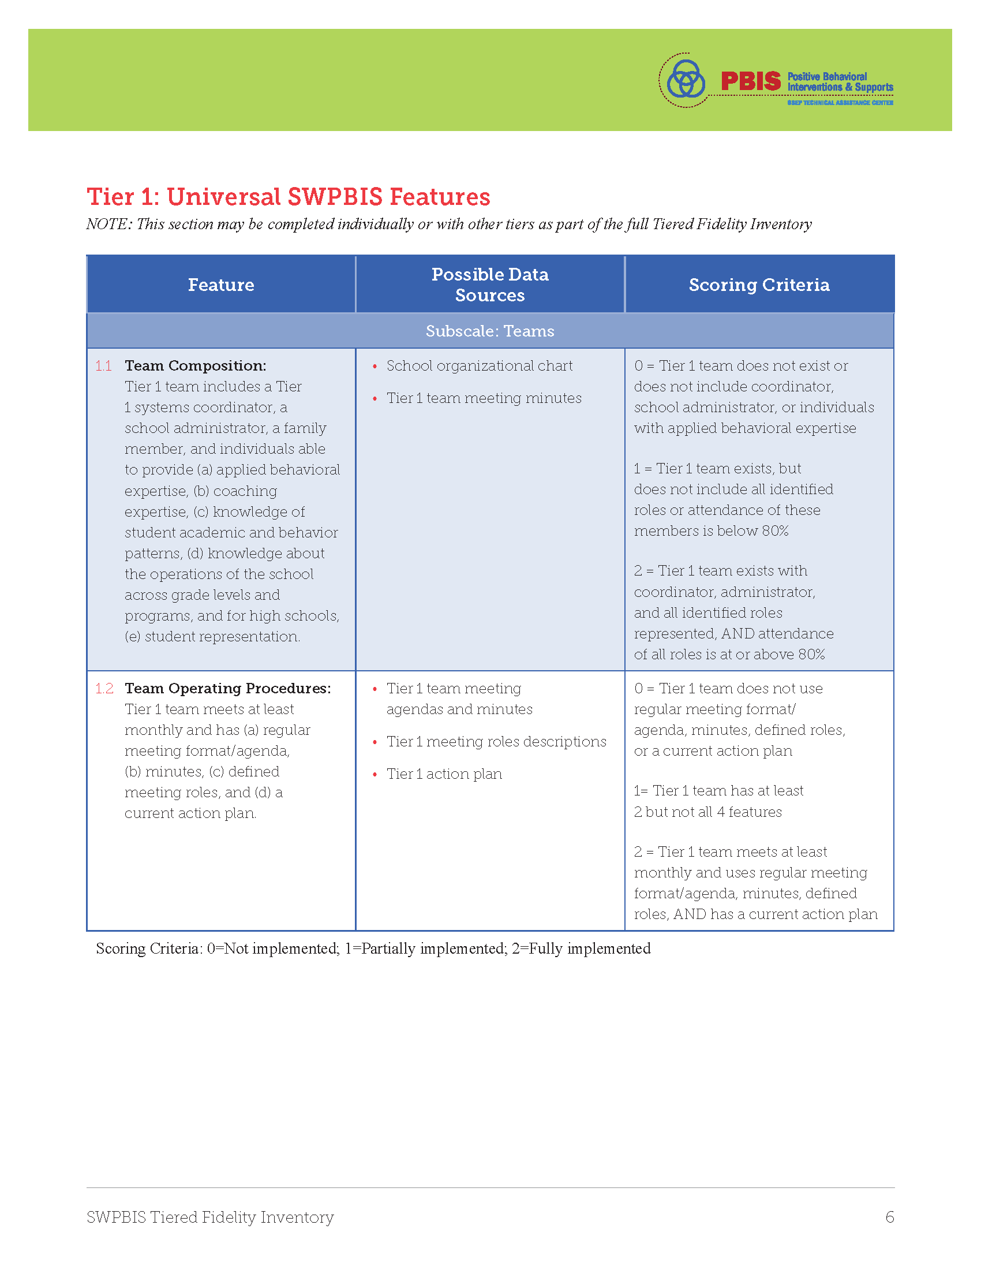
Conducting the TFI: Before the Meeting
Walkthrough
-Completed by an external party
-Interviews students and staff (chosen at random) using a scripted guide
-Provides information regarding school-wide expectations and acknowledgements
Pre-Meeting Prep
-Review the completed walkthrough information
-Review the TFI for the tier to be completed
-Prepare scores independently to prepare for voting as a group in the meeting

Slide 28
Download Tiered Fidelity Inventory (TFI) materials here
https://www.pbis.org/resource/tfi

Slide 29
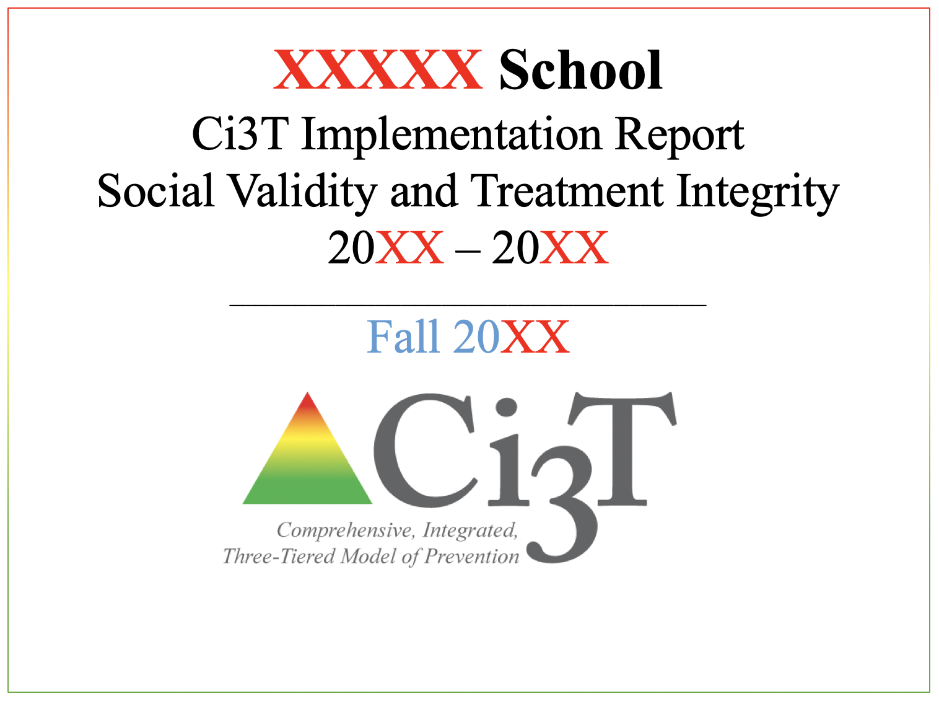
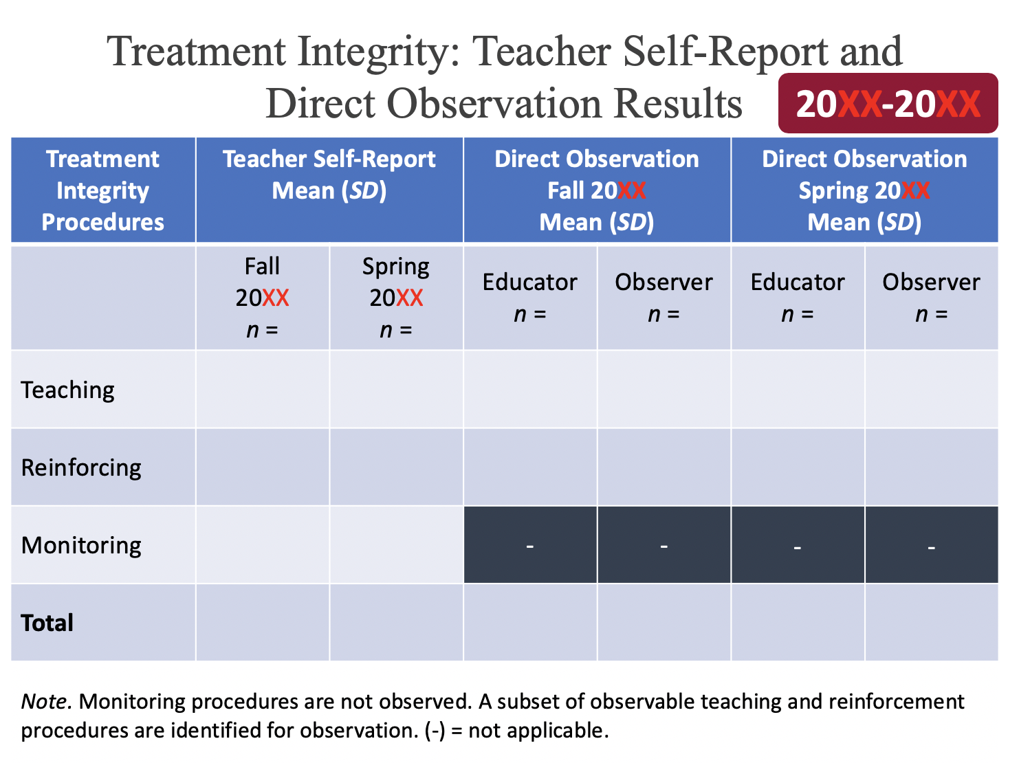
Sharing Data with Faculty and Staff
Templates available at https://www.ci3t.org/imp

Slide 30
Treatment Integrity
Tiered Fidelity Inventory (TFI)
Survey for all faculty and staff
Measures treatment integrity and social validity of Tier 1 Ci3T implementation
Measures treatment integrity of SW-PBIS
Tier 1 Walkthrough
Tier 1, 2, and 3 protocols completed by Ci3T Leadership Team
Observe 25% of instructional staff
Measures treatment integrity of Tier 1 Ci3T implementation
Educator and observer perspectives
Ci3T TI: TSR & PIRS
Ci3T TI: Direct Observation

Slide 31
Treatment Integrity and Social Validity Window: Template – insert your district dates here
Screening
Measures | SRSS-IE |  |  |  | Academic
Timepoint | Preview | Open |  | Close | Open | Close
Fall | 09/28/23 | 10/05/23 |  | 10/19/23 | 09/11/23 | 09/29/23
Winter | 11/27/23 | 12/04/23 |  | 12/18/23 | 01/15/24 | 02/02/24
Spring | 04/10/24 | 04/17/24 |  | 05/01/24 | 05/13/24 | 06/07/24
Treatment Integrity & Social Validity
Timepoint | Open | Close | Close |  | Report
Fall | 11/01/23 |  | 12/15/23 |  | 12/22/23
Spring | 02/22/24 |  | 04/04/24 |  | 04/11/24

Slide 32
Reflect & Plan
Make plans for when your faculty and staff will complete the Ci3T Treatment Integrity: Teacher Self-Report & Primary Intervention Rating Scale Survey
Make plans for completing Tiered Fidelity Inventory (TFI) protocols
Make plans for using and sharing treatment integrity and social validity data
Put data review and action planning on agenda for team meetings in November and/or December
Check with your coach to see about drafting materials to summarize and share data
Notes:
10-min timer

Slide 33
Using Fall Screening Data to Inform Instruction
Primary (Tier 1) Prevention Efforts
Teacher-Delivered, Low-Intensity Strategies
Secondary (Tier 2) and Tertiary (Tier 3) Interventions

Slide 34
Comprehensive, Integrated, Three-Tiered Model of Prevention
(Lane, Kalberg, & Menzies, 2009)
Tier 3
Tertiary Prevention (≈5%)
Tier 2
Secondary Prevention (≈15%)
Tier 1
Primary Prevention (≈80%)
Academic ◇ Behavioral ◇ Social
Validated Curricula PBIS Framework Validated Curricula

Slide 35
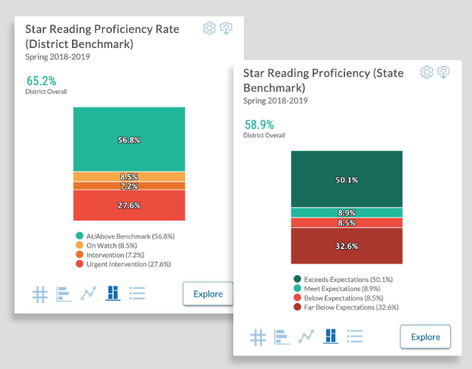
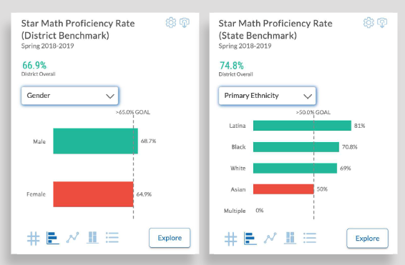
Academic Screening
Notes:
Might consider beginning by looking at data broadly
compared against district or state benchmarks
Subgroup analyses

Slide 36
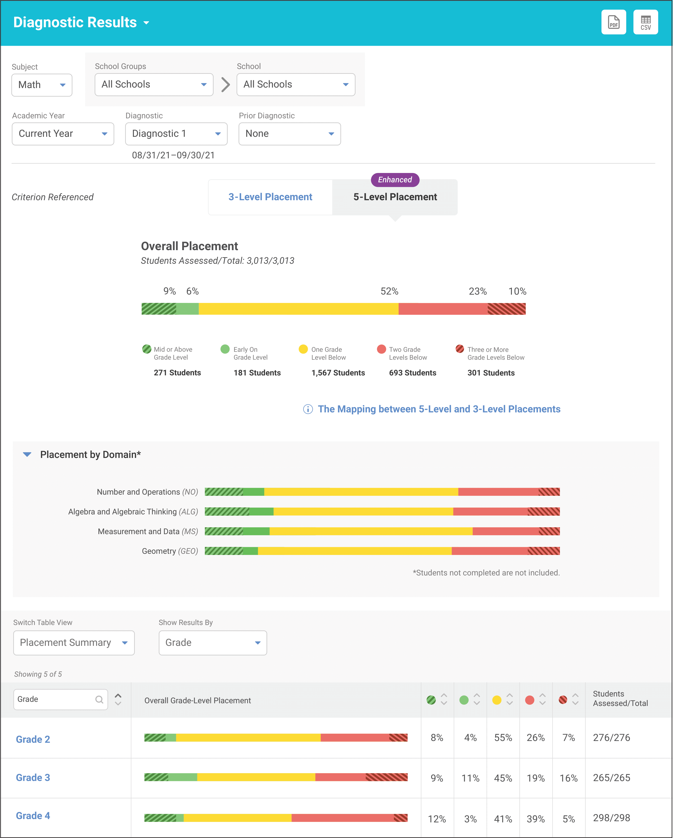
Academic Screening
Notes:
Then, might zoom in at the grade-level looking at distribution across risk category, mastery, or growth

Slide 39
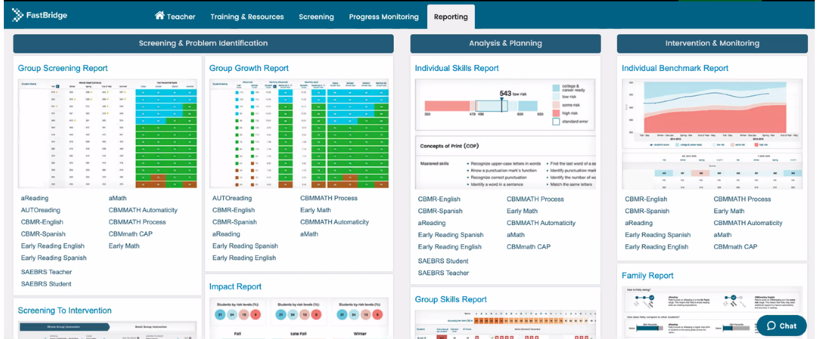
Academic Screening

Slide 40
Academic Screening

Slide 41
Academic Screening

Slide 42
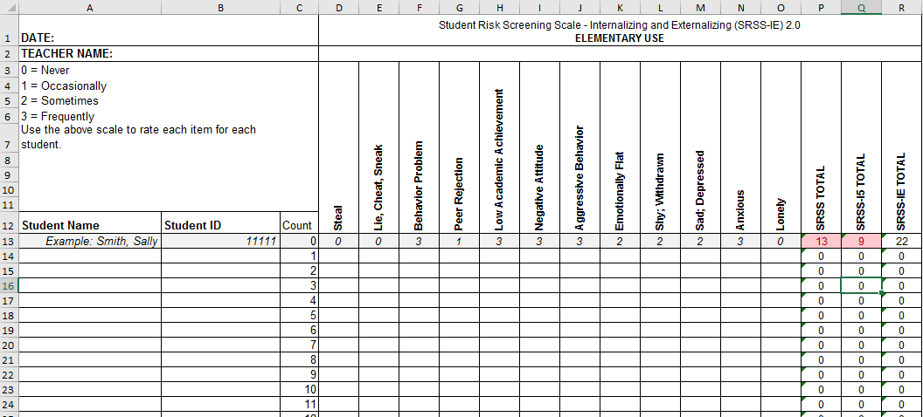
Student Risk Screening Scale for Internalizing and Externalizing (SRSS-IE; Drummond, 1994; Lane & Menzies, 2009)

Slide 43
SRSS-IE: Cut Scores
Elementary School |  | Middle and High School
SRSS-E7 | SRSS-I5 | SRSS-E7 | SRSS-I6
Items 1-7 | Items 8-12 | Items 1-7 | Items 4, 8-12
0-3 = low risk 4-8 = moderate risk 9-21 = high risk | 0-1 = low risk 2-3 = moderate risk 4-15 = high risk | 0-3 = low risk 4-8 = moderate risk 9-21 = high risk | 0-3 = low risk 4-5 = moderate risk 6-18 = high risk
Elementary School Level:
Lane, K. L., Oakes, W. P., Swogger, E. D., Schatschneider, C., Menzies, H., M., & Sanchez, J. (2015). Student risk screening scale for internalizing and externalizing behaviors: Preliminary cut scores to support data-informed decision making. Behavioral Disorders, 40, 159-170.
Middle and High School Levels:
Lane, K. L., Oakes, W. P., Cantwell, E. D., Schatschneider, C., Menzies, H., Crittenden, M., & Messenger, M. (2016). Student Risk Screening Scale for Internalizing and Externalizing Behaviors: Preliminary cut scores to support data-informed decision making in middle and high schools. Behavioral Disorders, 42(1), 271-284

Slide 44
Fall 2022 SRSS-Externalizing Results – Elementary School
n = 44
n = 43
n = 47
n = 27
n = 36
n = 29
n = 6
n = 17
n = 22
n = 30
n = 69
n = 61
n = 85
n = 94
n = 86
n = 83
n = 118
n = 100
n = 283
n = 276
n = 335
n = 329
n = 306
n = 293
n = 333
n = 346
n = 352
Notes:
***note to presenter***
If you would like to feature middle or high school data – hide the elementary slides (44-46) and unhide the middle or high school slides
If you would like to update this slide with data from your school or district- Fill in <year> based on current academic year. This is located in column A of the data sheet. Edit by right clicking and selecting “Edit data”.

Slide 45
Fall 2022 SRSS-Internalizing Results – Elementary School
n = 59
n = 62
n = 39
n = 39
n = 31
n = 18
n = 13
n = 32
n = 23
n = 82
n = 65
n = 67
n = 46
n = 47
n = 35
n = 69
n = 73
n = 62
n = 304
n = 292
n = 361
n = 338
n = 351
n = 340
n = 321
n = 338
n = 343
Cut scores vary by school level:
Elementary (I5): Low (0-1), Moderate (2-3), High (4-15)
Middle and High (I6): Low (0-3), Moderate (4-5), High (6-18)
Notes:
Fill in <year> based on current academic year. This is located in column A of the data sheet. Edit by right clicking and selecting “Edit data”.
IMPORTANT NOTE: The INTERNALIZING subscale and CUT SCORES are specific to school level.
Elementary: SRSS-I5, Items 8-12, 0-1 = low risk, 2-3 = moderate risk, 4-15 = high risk
Middle and High: SRSS-I6, Items 4, 8-12, 0-3 = low risk, 4-5 = moderate risk, 6-18 = high risk

Slide 46
Fall 2022 SRSS-Internalizing Results – Elementary School
Grade Level | N Screened | Low n (%) | Moderate n (%) | High n (%)
K | 64 | 52 (81.25%) | 7 (10.94%) | 5 (7.81%)
1 | 81 | 69 (85.19%) | 9 (11.11%) | 3 (3.70%)
2 | 56 | 44 (78.57%) | 11 (19.64%) | 1 (1.79%)

Slide 47
Fall 2022 SRSS-Externalizing Results – Middle School
n = 19
n = 23
n = 24
n = 9
n = 11
n = 3
n = 18
n = 16
n = 31
n = 27
n = 75
n = 57
n = 53
n = 75
n = 67
n = 53
n = 541
n = 475
n = 517
n = 400
n = 515
n = 552
n = 518
n = 460
Notes:
Fill in <year> based on current academic year. This is located in column A of the data sheet. Edit by right clicking and selecting “Edit data”.

Slide 48
Fall 2022 SRSS-Internalizing Results – Middle School
n = 87
n = 43
n = 37
n = 13
n = 21
n = 19
n = 53
n = 37
n = 13
n = 42
n = 26
n = 39
n = 30
n = 27
n = 40
n = 88
n = 460
n = 486
n = 518
n = 414
n = 550
n = 536
n = 510
n = 450
Cut scores vary by school level:
Elementary (I5): Low (0-1), Moderate (2-3), High (4-15)
Middle and High (I6): Low (0-3), Moderate (4-5), High (6-18)
Notes:
Fill in <year> based on current academic year. This is located in column A of the data sheet. Edit by right clicking and selecting “Edit data”.
IMPORTANT NOTE: The INTERNALIZING subscale and CUT SCORES are specific to school level.
Elementary: SRSS-I5, Items 8-12, 0-1 = low risk, 2-3 = moderate risk, 4-15 = high risk
Middle and High: SRSS-I6, Items 4, 8-12, 0-3 = low risk, 4-5 = moderate risk, 6-18 = high risk

Slide 49
Fall 2022 SRSS-Internalizing Results – Middle School
Grade Level | N Screened | Low n (%) | Moderate n (%) | High n (%)
6 | 176 | 151 (85.80%) | 15 (8.52%) | 10 (5.68%)
7 | 176 | 141 (80.11%) | 17 (9.66%) | 18 (10.23%)
8 | 177 | 158 (89.21%) | 10 (5.65%) | 9 (5.08%)

Slide 50
Fall 2022 SRSS-Externalizing Results – High School
n = 29
n = 39
n = 23
n = 25
n = 30
n = 13
n = 26
n = 38
n = 96
n = 95
n = 90
n = 82
n = 69
n = 55
n = 95
n = 129
n = 1072
n = 1404
n = 1339
n = 1222
n = 692
n = 1119
n = 1270
n = 1242
Notes:
Fill in <year> based on current academic year. This is located in column A of the data sheet. Edit by right clicking and selecting “Edit data”.

Slide 51
Fall 2022 SRSS-Internalizing Results – High School
n = 112
n = 87
n = 76
n = 62
n = 63
n = 70
n = 78
n = 91
n = 124
n = 64
n = 56
n = 42
n = 38
n = 41
n = 66
n = 106
n = 961
n = 1387
n = 1320
n = 1225
n = 690
n = 1076
n = 1247
n = 1212
Cut scores vary by school level:
Elementary (I5): Low (0-1), Moderate (2-3), High (4-15)
Middle and High (I6): Low (0-3), Moderate (4-5), High (6-18)
Notes:
Fill in <year> based on current academic year. This is located in column A of the data sheet. Edit by right clicking and selecting “Edit data”.
IMPORTANT NOTE: The INTERNALIZING subscale and CUT SCORES are specific to school level.
Elementary: SRSS-I5, Items 8-12, 0-1 = low risk, 2-3 = moderate risk, 4-15 = high risk
Middle and High: SRSS-I6, Items 4, 8-12, 0-3 = low risk, 4-5 = moderate risk, 6-18 = high risk

Slide 52
Fall 2022 SRSS-Internalizing Results – High School
Grade Level | N Screened | Low n (%) | Moderate n (%) | High n (%)
9 | 367 | 308 (83.92%) | 30 (8.17%) | 29 (7.90%)
10 | 375 | 308 (82.13%) | 35 (9.33%) | 32 (8.53%)
11 | 367 | 321 (87.47%) | 24 (6.54%) | 22 (5.99%)
12 | 300 | 275 (91.67%) | 17 (5.67%) | 8 (2.67%)

Slide 53
Screening Data: High School Yrs1-3
Fall- SRSSIE-I |  | Low |  | Moderate |  | High |  | Fall- SRSSIE-E |  | Low |  | Moderate |  | High
2016 |  | 80.28% |  | 10.36% |  | 9.36% |  | 2016 |  | 89.56% |  | 8.02% |  | 2.42%
2017 |  | 90.18% |  | 4.16% |  | 5.66% |  | 2017 |  | 91.29% |  | 6.18% |  | 2.54%
2018 |  | 90.91% |  | 3.86% |  | 5.23% |  | 2018 |  | 92.22% |  | 6.20% |  | 1.58%
WTR-SRSSIE-I |  | Low |  | Moderate |  | High |  | WTR-SRSSIE-E |  | Low |  | Moderate |  | High
2016 |  | 87.25% |  | 9.49% |  | 3.26% |  | 2016 |  | 87.25% |  | 9.49% |  | 3.26%
2017 |  | 86.14% |  | 9.02% |  | 4.85% |  | 2017 |  | 86.14% |  | 9.02% |  | 4.85%
2018 |  | 88.79% |  | 8.52% |  | 2.69% |  | 2018 |  | 88.79% |  | 8.52% |  | 2.69%

Slide 55
Sample Middle School: Fall
SRSS-E7 Results – All Students
N = 26
N = 12
N = 89
N = 66
N = 554
N = 550

Slide 56
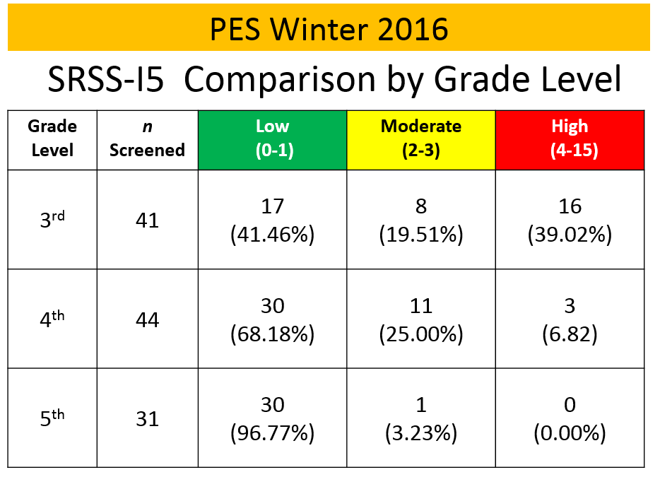
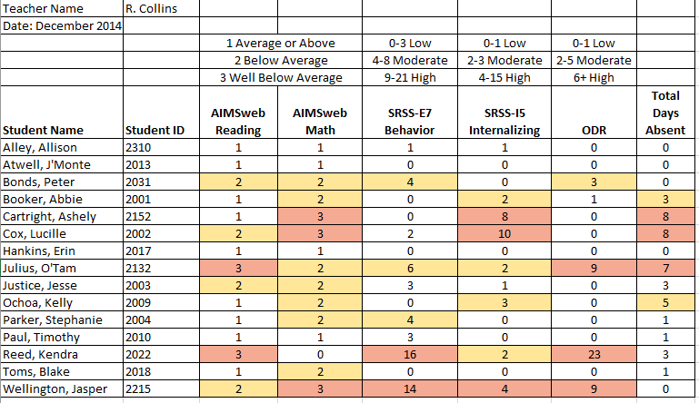
Data sharing…
Schoolwide data
…decisions related to primary prevention efforts
Grade / Department / Class
…implications for teachers’ practice
Individual student
…decisions about student-based interventions

Slide 57
Using Fall Screening Data to Inform Instruction
Primary (Tier 1) Prevention Efforts
Teacher-Delivered, Low-Intensity Supports
Secondary (Tier 2) and Tertiary (Tier 3) Interventions

Slide 58
Social Skills Improvement System – Performance Screening Guide Spring 2012 – Total School
N = 54
N = 22
N = 35
N = 31
N = 223
N = 233
N = 180
N = 187
N = 212
N = 235
N = 275
N = 271
n = 489 n = 490 n = 490 n = 489
Lane, K. L., Oakes, W. P., & Magill, L. (2013). Primary prevention efforts: How do we implemented and monitor the Tier 1 component of our Comprehensive, Integrated, Three-Tiered (Ci3T) Model?, Preventing School Failure, 58(1), 143-158.

Slide 59
Fall 2022 SRSS-Internalizing Results – Elementary
n = 61
n = 46
n = 49
n = 31
n = 42
n = 39
n = 18
n = 26
n = 38
n = 30
n = 46
n = 44
n = 37
n = 35
n = 27
n = 31
n = 97
n = 101
n = 136
n = 153
n = 148
n = 128
n = 137
n = 134
Cut scores vary by school level:
Elementary (I5): Low (0-1), Moderate (2-3), High (4-15)
Middle and High (I6): Low (0-3), Moderate (4-5), High (6-18)
Notes:
Fill in <year> based on current academic year. This is located in column A of the data sheet. Edit by right clicking and selecting “Edit data”.
IMPORTANT NOTE: The INTERNALIZING subscale and CUT SCORES are specific to school level.
Elementary: SRSS-I5, Items 8-12, 0-1 = low risk, 2-3 = moderate risk, 4-15 = high risk
Middle and High: SRSS-I6, Items 4, 8-12, 0-3 = low risk, 4-5 = moderate risk, 6-18 = high risk

Slide 60
Student Risk Screening Scale Fall 2004 – 2012 Middle School
Source: Lane, K. L., Oakes, W. P., & Magill, L. M., (2014). Primary prevention efforts: How do we implement and monitor the Tier 1 component of our comprehensive, integrated, three-tiered model of prevention. Preventing School Failure, 58, 143-158. doi:10.1080/1045988X.2014.893978 [Figure 4. Middle school behavior screening data over time at the fall time point. Adapted from Figure 4.6 p. 127 Lane, K. L., Menzies, H. M, Oakes, W. P., & Kalberg, J. R. (2012). Systematic screenings of behavior to support instruction: From preschool to high school. Guilford Press.]

Slide 61
Using Fall Screening Data to Inform Instruction
Primary (Tier 1) Prevention Efforts
Teacher-Delivered, Low-Intensity Strategies
Secondary (Tier 2) and Tertiary (Tier 3) Interventions

Slide 62
Essential Components of Classroom Management
Classroom climate
Physical room arrangement
Routines and procedures
Managing paperwork
See Lane, K. L., Menzies, H. M., Bruhn, A. L., & Crnobori, M. (2011). Managing challenging behaviors in schools: Research-based strategies that work. Guilford Press.

Slide 63
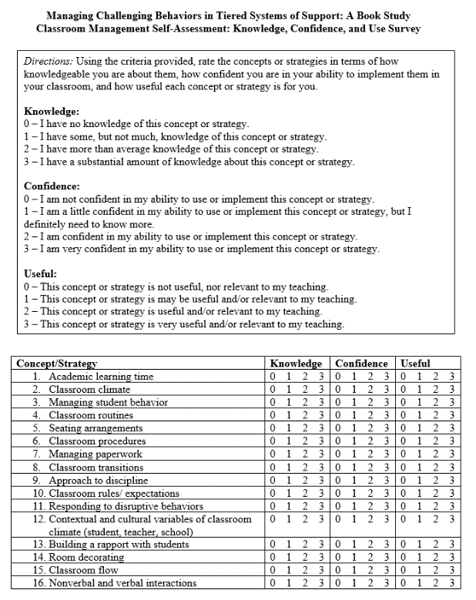
Identify site-level experts using self-assessment tools
Instructional choice
Behavior-specific praise
Increased opportunities to respond
Active supervision
Lane, K. L., Menzies, H. M., Bruhn, A. L., & Crnobori, M. (2011). Managing challenging behaviors in schools: Research-based strategies that work. Guilford Press.
Oakes, W. P., Cantwell, E. D., Lane, K. L., Royer, D. J., & Common, E. A. (2019). Examining educator’s views of classroom management and instructional strategies: School-site capacity for supporting students’ behavioral needs. Preventing School Failure.

Slide 64
Examining Academic and Behavioral Data
Lane, K. L., Menzies, H. M., Ennis, R. P., & Oakes, W. P. (2015). Supporting Behavior for School Success: A Step-by-Step Guide to Key Strategies. Guilford Press.
Notes:
Lane, K. L., Oakes, W. P., Ennis, R. P., & Hirsch, S. E. (2014). Identifying students for secondary and tertiary prevention efforts: How do we determine which students have Tier 2 and Tier 3 needs? Preventing School Failure, 58, 171-182, DOI: 10.1080/1045988X.2014.895573

Slide 65
Opportunities to Respond
Behavior-Specific Praise
Active Supervision
Instructional Feedback
High-p Requests
Precorrection
Instructional Choice

Slide 66
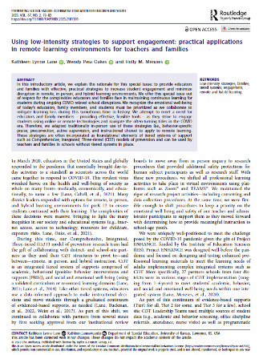
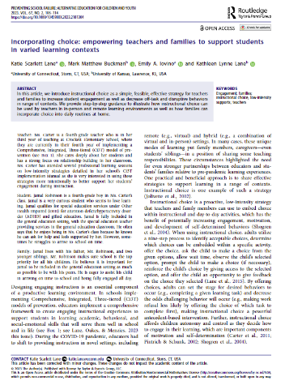
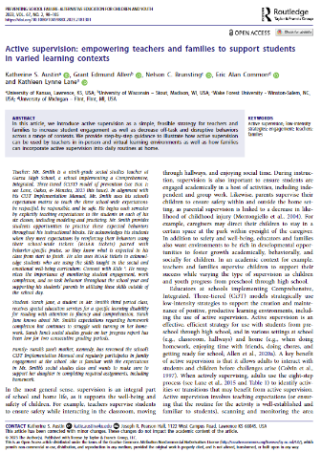
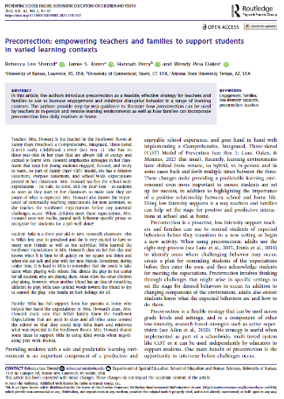
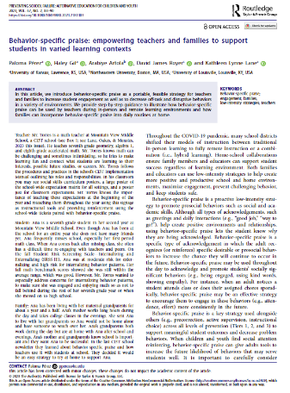
Low Intensity Strategies
https://www.ci3t.org/literature

Slide 67
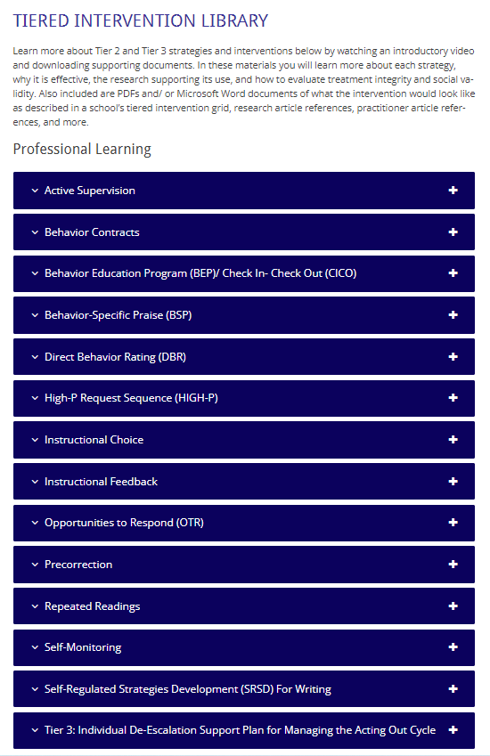
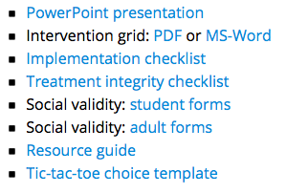
Low Intensity Strategies
https://www.ci3t.org/pl

Slide 68
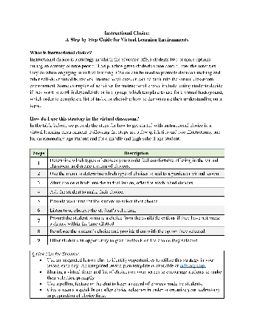
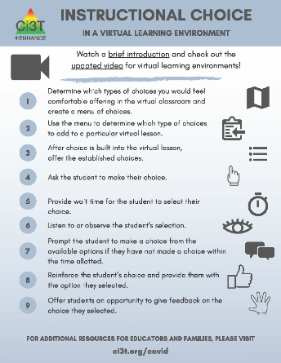
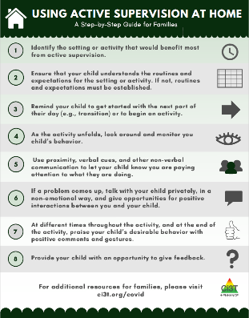
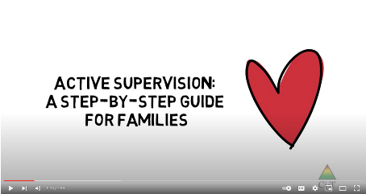
Low Intensity Strategies
https://www.ci3t.org/covid

Slide 69
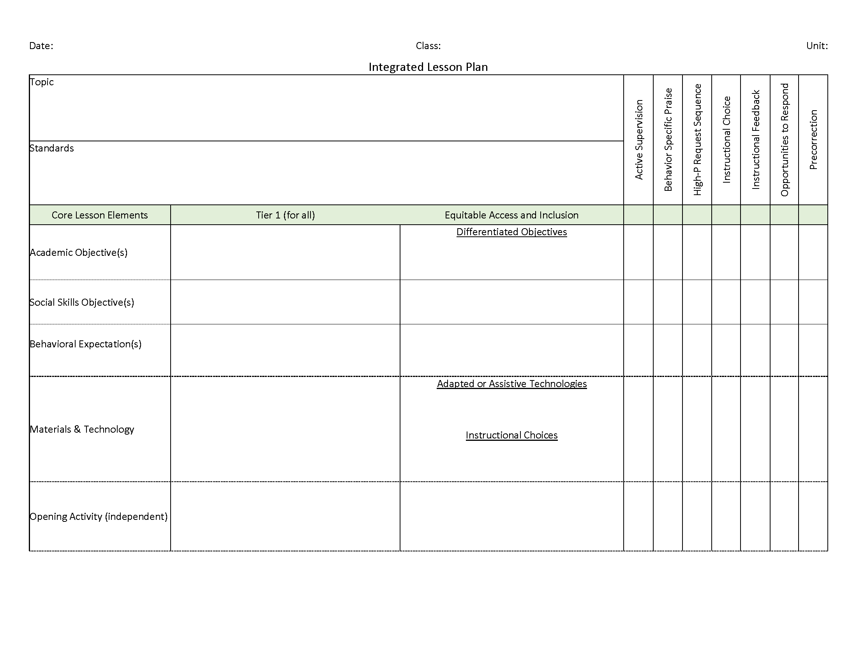
Ci3T: Integrated Lesson Planning
Please visit https://www.ci3t.org/covid for an integrated lesson plan template!

Slide 70
Low-Intensity Strategy | Franklin High School On-Site Expert
Behavior-Specific Praise: Identifying the specific expectation the student met. “Niama, I noticed you outlined your paper and used the graphic organizer to draft your essay. Well done!” “Justice, thank you for pushing in your chair to keep the walkway safe.” | Eric Common, Behavior Specialist Mark Buckman, Special Education Grant Allen, Parent Volunteer Paloma Pérez-Clark, School Psychologist
Opportunities to Respond: Providing 4-6 opportunities per minute for students to respond individually, choral, verbal, written, gesture, or symbol. “Show me thumbs or thumbs down if...” “Show me on your white board what…” “Turn to your elbow partner and say…” “All together now, what is…” | David Royer, Administration Emily Cantwell, 12th Grade Scarlett Lane, 11rd Grade Mallory Messenger, Counselor
Instructional Choice: Providing within-task or between task choices to increase academic engaged time and motivation. “Ronaldo, our of our 3 learning objectives today, which would you like to work on first?” “Suzy, do you want to work on the laptop, or handwrite your answers for this assignment?” | Abbie Jenkins, 10th Grade Scarlett Lane, 11th Grade José Sousa, PE Liane Johl, 9th Grade

Slide 71
Consider Teacher-Delivered Strategies Across Tiers
Opportunites to Respond
Behavior-Specific Praise
Active Supervision
Instructional Feedback
High-Probability Requests
Precorrection
Instructional Choice

Slide 72
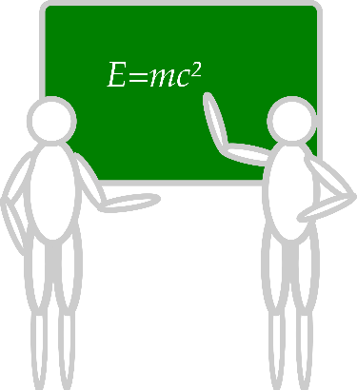
Deep dive into this at EMPOWER Sessions 3!
Designate two staff to attend trainings to become on-site coaches
10 min @ next Faculty and Staff meeting
Ci3T Setting Up for Success
Systematic Screening
Low-Intensity Strategies
Tier 2
Planning Ahead
Tier 3

Slide 73
Using Fall Screening Data to Inform Instruction
Primary (Tier 1) Prevention Efforts
Teacher-Delivered, Low-Intensity Strategies
Secondary (Tier 2) and Tertiary (Tier 3) Interventions

Slide 74
Comprehensive, Integrated, Three-Tiered Model of Prevention
(Lane, Kalberg, & Menzies, 2009)
Tier 3
Tertiary Prevention (≈5%)
Tier 2
Secondary Prevention (≈15%)
Secondary (Tier 2) Intervention Grids
Tier 1
Primary Prevention (≈80%)
Academic ◇ Behavioral ◇ Social
Validated Curricula PBIS Framework Validated Curricula

Slide 75
Building a Ci3T Tier Library
Teacher Delivered Strategies
Tier 1
Tier 2
Tier 3

Slide 76
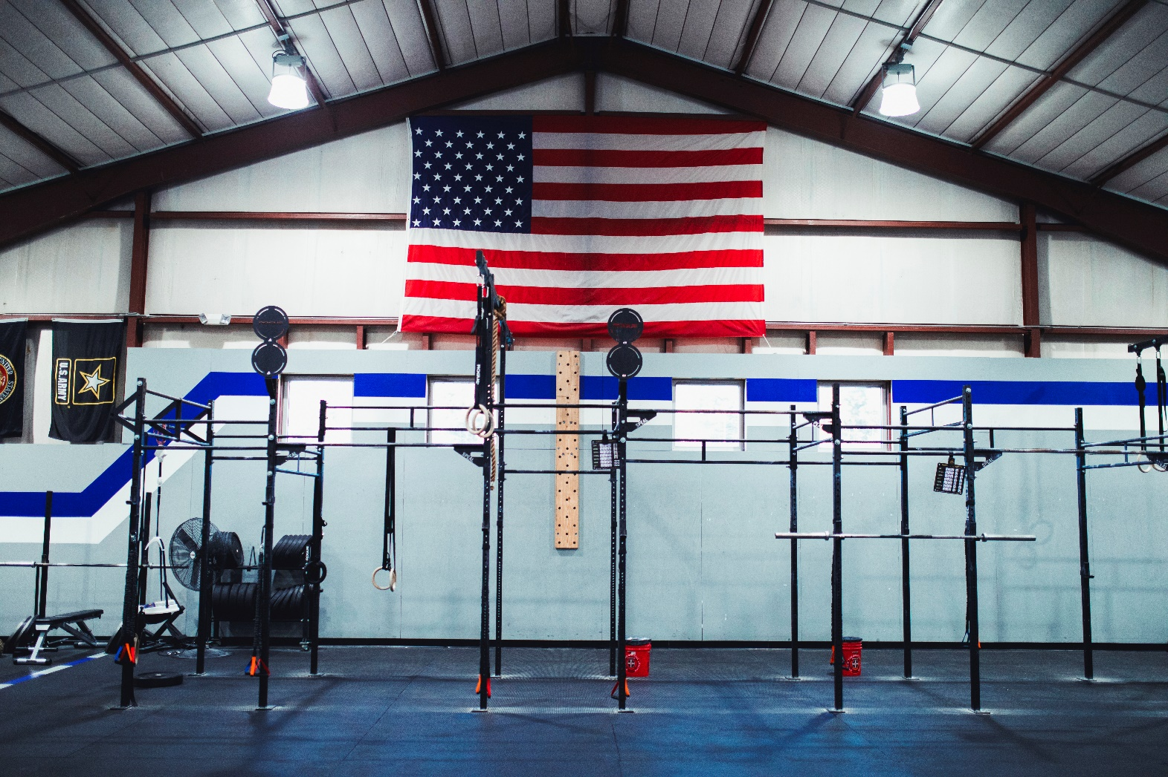

Slide 77
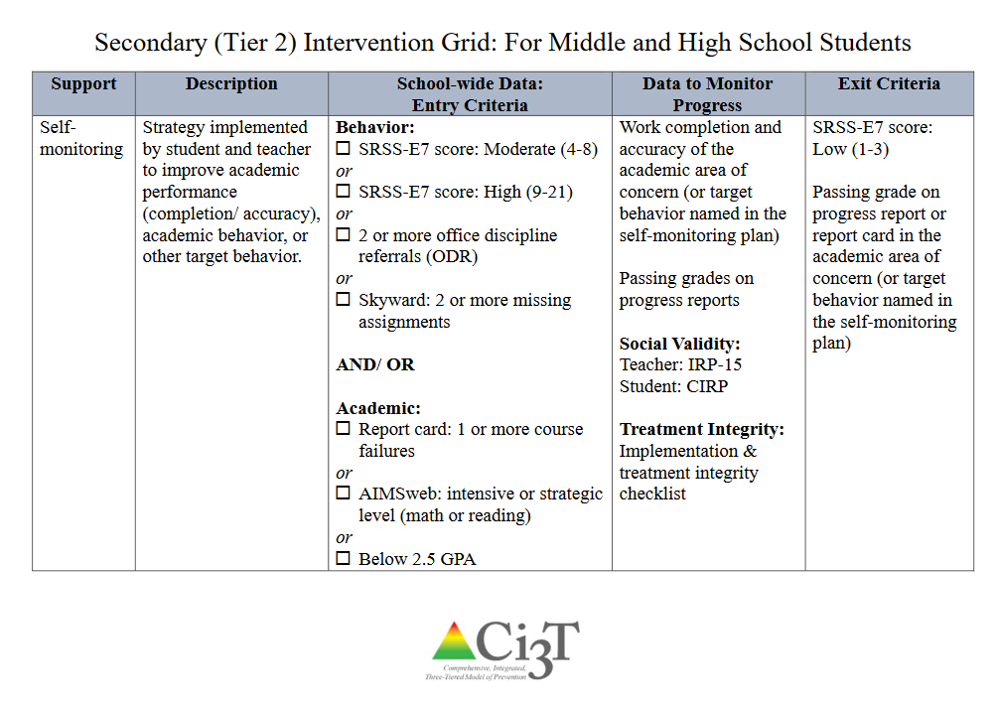

Slide 78
An illustration
Support | Description | Schoolwide Data: Entry Criteria | Data to Monitor Progress: | Exit Criteria
Small group reading instruction with self-monitoring | Small group reading instruction (30 min, 3 days per week). Students monitored their participation in the reading instructional tasks. Students used checklists of reading lesson components each day to complete and compare to teachers’ rating. K – 1. | Students who: Behavior: Fall SRSS at moderate (4 -8) or high (9 – 21) risk Academic: Fall AIMSweb LNF at the strategic or intensive level | AIMSweb reading PSF and NWF progress monitoring probes (weekly). Daily self-monitoring checklists Treatment Integrity Social Validity | Meet AIMSweb reading benchmark at next screening time point. Low Risk on SRSS at next screening time point.

Slide 79
Small group Reading Instruction with Self-Monitoring
Lane, K. L., Oakes, W. P., & Magill, L. (2013). Primary prevention efforts: How do we implemented and monitor the Tier 1 component of our Comprehensive, Integrated, Three-Tiered (Ci3T) Model?, Preventing School Failure, 58(1), 143-158.
Notes:
Citation: Lane, K.L., & Oakes, W. P. (2012). Identifying Students for Secondary and Tertiary Prevention Efforts: How do we determine which students have Tier 2 and Tier 3 needs? In preparation.

Slide 80
First Grade Students’ Self Monitoring Form
Altmann, S. A. (2010). Project support and include: the additive benefits of self-monitoring on students’ reading acquisition. Unpublished master’s thesis, Vanderbilt University.

Slide 81
Treatment Integrity Social Validity Monitor student progress
Altmann, S. A. (2010). Project support and include: the additive benefits of self-monitoring on students’ reading acquisition. Unpublished master’s thesis, Vanderbilt University.

Slide 82
Sample Elementary Intervention Grid: SSiS
Support | Description | School-wide Data: Entry Criteria | Data to Monitor Progress | Exit Criteria
Social Skills Improvement System (SSiS) – counselor-led small group | Counselors and/or social workers will lead small group SSiS sessions for approximately 30-40 min 2-3 days per week. Students will acquire new skills, learn how to engage more fully in instructional experiences, and learn how to meet more school-wide expectations. Small groups will run for up to 24 sessions (8 to 12 weeks depending on the number of sessions conducted per week) using a subset of SSiS lessons appropriate for student skillsets as identified using SSiS-Rating Scale (teacher and parent version). | Behavior SRSS-E7 score: Moderate (4-8) and/or SRSS-I5 score: Moderate (2-3) AND 2 or fewer absences in first 3 months of school AND Evidence of teacher implementation of Ci3T primary (Tier 1) plan [treatment integrity: direct observation] AND Parent permission AND Academic Student is in grade 2 or 3 | Student measures SSiS-Rating Scale (Pre/Post) Skills for Greatness (Pre/Post) Daily behavior report (DBR; daily) Attendance and tardies Social validity Teacher: IRP-15 Student: CIRP Treatment integrity Tier 2 treatment integrity measures Ci3T TI: Direct observation (30 min if needed) | Review student progress at end of 24 sessions Team agrees goals have been met or no further SSiS small group sessions are warranted SRSS-E7 and I5 scores are in the low risk category

Slide 83
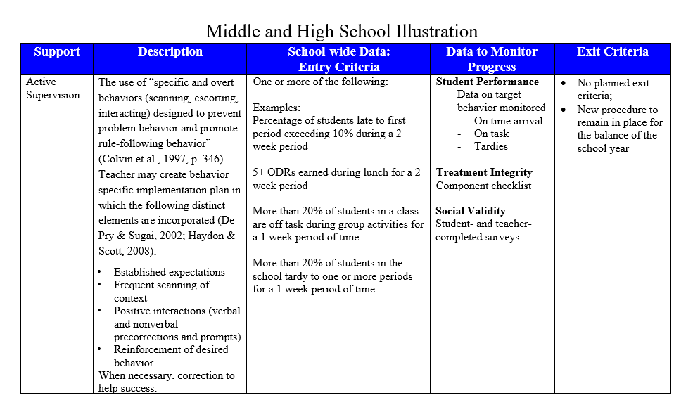
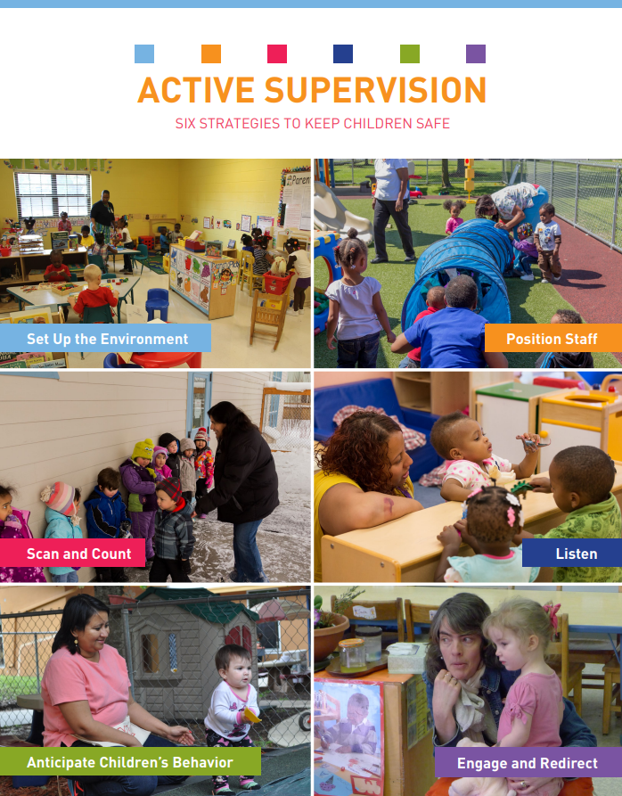
Active Supervision
https://eclkc.ohs.acf.hhs.gov/safety-practices

Slide 84
Support | Description | Schoolwide Data: Entry Criteria | Data to Monitor Progress: | Exit Criteria
READ 180 (Stage C) Reading Intervention | Students participate in a 50 min reading instructional block during their study hall period. Students meet in the computer lab for participation in the online portion 20 min daily. Instruction is relevant to high school students. Students use a progress management system to monitor and track their own progress. Instruction is taught by special education teachers and general education teachers with training in the READ 180 Curriculum. | (1) Students in grades 9 – 12. (2) Reading performance basic or below basic on state assessment (but above 4th grade reading level). (3) SRSS risk scores in the moderate range (4 – 8). | Student Measures: Meeting individual READ 180 reading goals: (1) Progress Monitoring with Scholastic Reading Inventory (2) Writing Assessments (3) formative assessments (vocabulary, comprehension and spelling) (4) Curriculum-based Assessments (5) Attendance in class Treatment Integrity: Teachers monitor performance and attendance in class. Completion of weekly checklists for activities completed. Social Validity: Students and teachers complete surveys | Students meet instructional reading goals. SRSS score in the low risk category (0 – 3) on the next screening time point.
Lane, K. L., Oakes, W. P., Menzies, H. M., Oyer, J., & Jenkins, A. (2013). Working within the context of three-tiered models of prevention: Using school wide data to identify high school students for targeted supports. Journal of Applied School Psychology, 29, 203-229.

Slide 85
Comprehensive, Integrated, Three-Tiered Model of Prevention
(Lane, Kalberg, & Menzies, 2009)
Tier 3
Tertiary Prevention (≈5%)
Tier 2
Secondary Prevention (≈15%)
Tertiary (Tier 3) Intervention Grids
Tier 1
Primary Prevention (≈80%)
Academic ◇ Behavioral ◇ Social
Validated Curricula PBIS Framework Validated Curricula

Slide 86
Tertiary (Tier 3) Intervention Grid: For Middle and High School Students
Support | Description | Schoolwide Data: Entry Criteria | Data to Monitor Progress | Exit Criteria
Functional Assessment-based Intervention | FABIs are interventions based on the function of the target behavior, as determined by the functional assessment and determined with the aid of the Function Matrix. The Function-Based Intervention Decision Model is used to determine the intervention focus, including: Method 1: Teach the replacement behavior; Method 2: Improve the environment; Method 3: Adjust the contingencies; and a combination of Method 1 and Method 2. A package intervention is designed and implemented, including antecedent adjustments, reinforcement adjustments, and extinction procedures directly linked to the function of the target behavior. | One or more of the following: Behavior: SRSS-E7: High (9-21) SRSS-I6: High (6-18) Office discipline referrals (ODRs) 6 or more within a grading period AND/OR Academic: Progress report: 1 or more course failures Missing Assignments 5 or more within a grading period AIMSweb: intensive level (math or reading) Below 2.5 GPA | Student behavior targeted for improvement (e.g., target or replacement behavior) using direct observation Treatment integrity FABI Step checklists Treatment integrity checklist Social validity IRP-15 (teacher) CIRP (student) | The FABI will be faded once a functional relation is demonstrated using a validated single-case research design (e.g., withdrawal) and: Behavior objective for the student is met (See Behavior Intervention Plan [BIP]).

Slide 87
Changes in Harry’s Behavior
Cox, M., Griffin, M. M., Hall, R., Oakes, W. P., & Lane, K. L. (2012). Using a functional assessment-based intervention to increase academic engaged time in an inclusive middle school setting. Beyond Behavior, 2, 44 – 54.

Slide 88
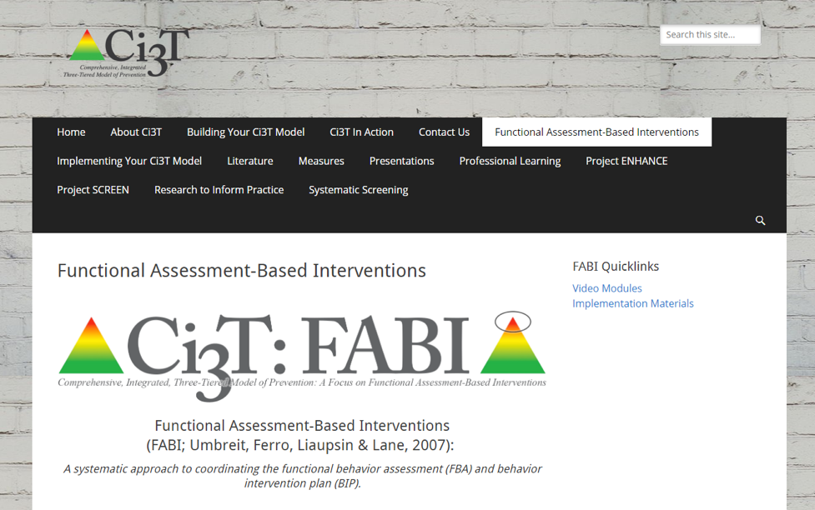
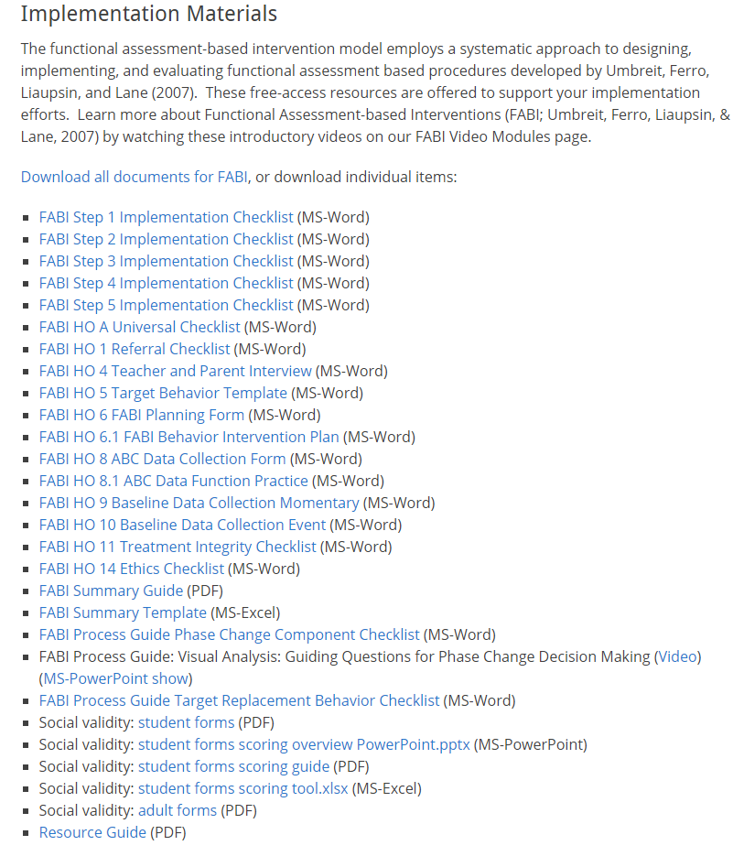

Slide 89
Deep dive into this at EMPOWER Sessions 4 and 5!
Designate two staff to attend trainings to become on-site coaches
10 min @ next Faculty and Staff meeting
Ci3T Setting Up for Success
Systematic Screening
Low-Intensity Strategies
Tier 2
Planning Ahead
Tier 3

Slide 90
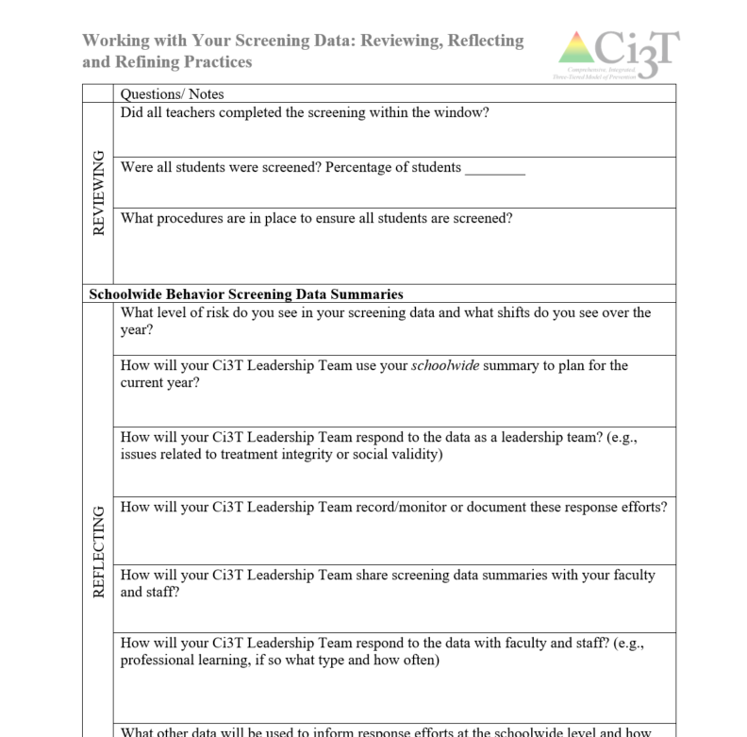
Reflect & Plan
Review fall screening data. Consider implications for:
Primary (Tier 1) prevention efforts
Teacher-delivered, low-intensity strategies
Secondary (Tier 2) and Tertiary (Tier 3) supports
What professional learning is necessary to respond these data?
Make plans to share your data – and corresponding plans – with faculty and staff?
Notes:
15-min timer

Slide 91
Facilitating Clear Communication and Collaborations with Stakeholders
Communication and Collaboration: Plans & Timelines
Data-Informed Professional Learning

Slide 92
Monitoring Implementation: Develop Action Items for Communication with Stakeholders
District
Ci3T Leadership Team
Faculty and Staff
Students, Parents, & Community
Notes:
Honor those who are on time
Starting the meeting on time
Start with sharing successes
Respect everyone’s time
End the meeting on time, one hour maximum
Assign tasks to individuals or temporary subcommittees as needed to keep the meeting on track
Schedule a follow-up meeting as needed or make plans to conduct final business by email
Be efficient with time
Be solution-based, spending time on action plans instead of “admiring the problem

Slide 93
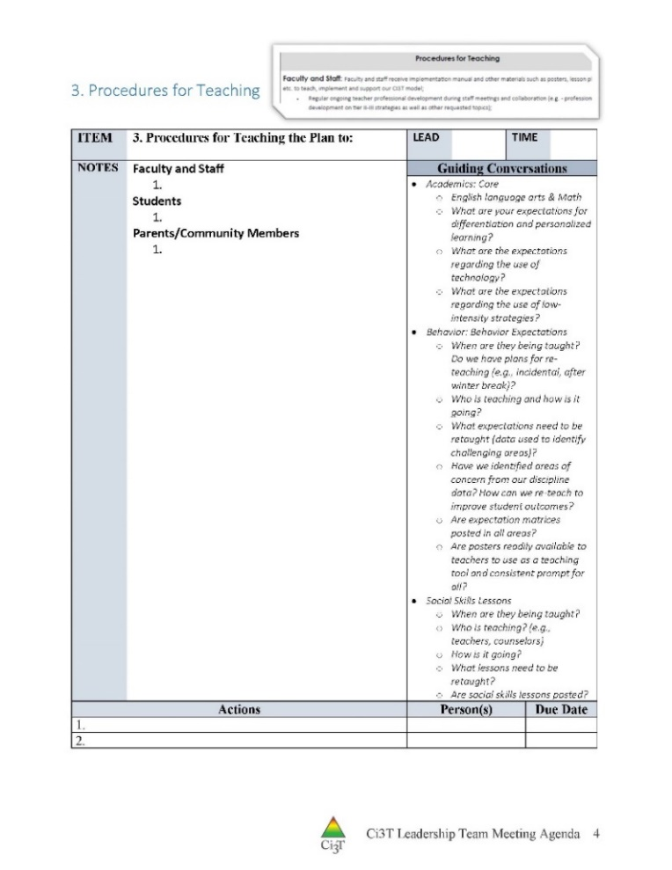
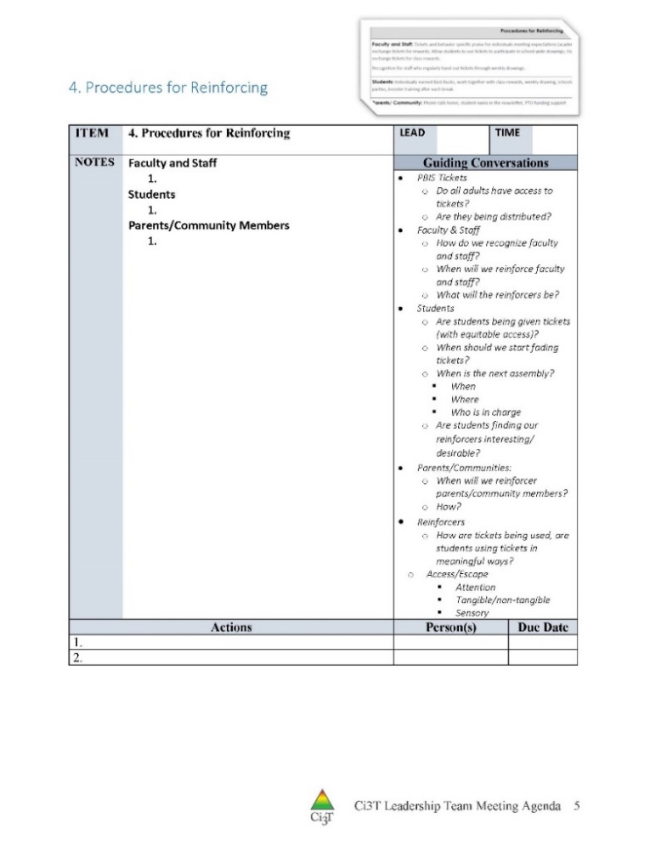
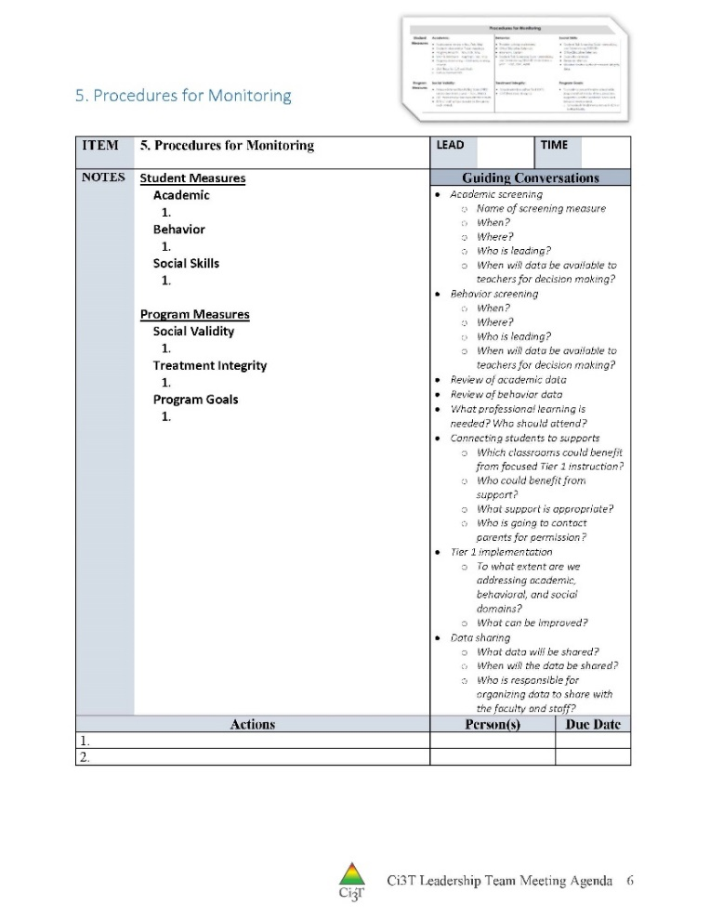
Procedures for Teaching, Reinforcing, and Monitoring
Communicating and Collaborating with your:
District
Ci3T Leadership Team
Faculty and Staff
Students, Parents, and Community
Policy Makers

Slide 94
Building Capacity and Sustainability
of Tiered Prevention Models
For Academic Achievement, Behavior, and Social Competencies

Slide 95
District Communication with Stakeholders

Slide 96
Reflect & Plan: Communication with Stakeholders
How will you use multiple sources of data to inform professional learning for developing school capacity for low intensity strategies and tiered supports?
How will you use your Ci3T Team meeting time effectively and plan to communicate with all stakeholders?
How will you share program level data (treatment integrity and social validity) as well as student progress?
Notes:
10-min timer

Slide 97
Wrapping Up and Moving Forward

Slide 98
Ci3T
Comprehensive Professional Learning Plan
Ci3T: Primary Prevention
Session 1:
Overview of Ci3T Prevention Models
Setting a Purpose
Establish team meetings and roles
Session 2:
Mission and Purpose
Establish Roles and Responsibilities
Procedures for Teaching
Procedures for Reinforcing
Reactive Plan
Session 3:
Procedures for Monitoring
Session 4:
Revise Primary Plan using Stakeholder feedback
Prepare presentation
Ci3T: Secondary Prevention
Session 5:
Overview of Teacher focused Strategies
Overview of Student Focused Strategies
Using data to determine which students may need Secondary (Tier 2) supports
Draft the Secondary Intervention Grid based on existing supports
Ci3T: Tertiary Prevention
Session 6:
Final revisions of Ci3T Plan based on stakeholder feedback
Draft Tertiary (Tier 3) Prevention Intervention Grids
Design Implementation Manual and Plan for roll out to faculty, students, and parents
Ci3T Leadership Team Training Sequence
Implementation Stages of Tier 2 and 3 within Ci3T
Additional Professional Development on Specific Topics
Core Content Curriculum
Check In - Check Out
Functional Assessment-based Interventions
Reading, Math, Writing Benchmarking and Progress Monitoring Tools
Interventions, Strategies, & Practices
Additional Tier 3 Supports
Instructional Techniques to Improve Students’ Motivation; Classroom Management Practices;
Low-Intensity Behavior Supports

Slide 99
Ci3T Professional Learning Calendar
 | 0 | 1 | 2 | 3 | 4 | 5 | 6 | 7 | 8 | 9 | 10 | 11
 | July | Aug | Sep | Oct | Nov | Dec | Jan | Feb | Mar | Apr | May | Jun
Ci3T Training |  |  |  |  | Ci3T Professional Learning Series Session 1 | Ci3T Professional Learning Series Session 2 | Ci3T Professional Learning Series Session 3 | Ci3T Professional Learning Series Session 4 |  | Ci3T Professional Learning Series Session 5 | Ci3T Professional Learning Series Session 6
Ci3T Implementation Support | Ci3T Implementation Series Prep Session |  | Ci3T Implementation Series Session 1 |  | Ci3T Implementation Series Session 2 |  | Ci3T Implementation Series Session 3 |  | Ci3T Implementation Series Session 4 | Ci3T Implementation Series Session 5
Ci3T EMPOWER |  |  | Ci3T EMPOWER Session 1 | Ci3T EMPOWER Session 2 | Ci3T EMPOWER Session 3 |  | Ci3T EMPOWER Session 4 |  | Ci3T EMPOWER Session 5 | Ci3T EMPOWER Session 6
Ci3T Trainers & Coaches Calls |  | Trainers & Coaches Call Session 1 | Trainers & Coaches Call Session 2 | Trainers & Coaches Call Session 3 | Trainers & Coaches Call Session 4 | Trainers & Coaches Call Session 5 | Trainers & Coaches Call Session 6 | Trainers & Coaches Call Session 7 | Trainers & Coaches Call Session 8 | Trainers & Coaches Call Session 9 | Trainers & Coaches Call Session 10

Slide 100
Sustaining and Disseminating Professional Learning
Designate two staff to attend trainings to become on-site coaches
10 min @ next Faculty and Staff meeting
Ci3T Setting Up for Success
Systematic Screening
Low-Intensity Strategies
Tier 2
Planning Ahead
Tier 3

Slide 101
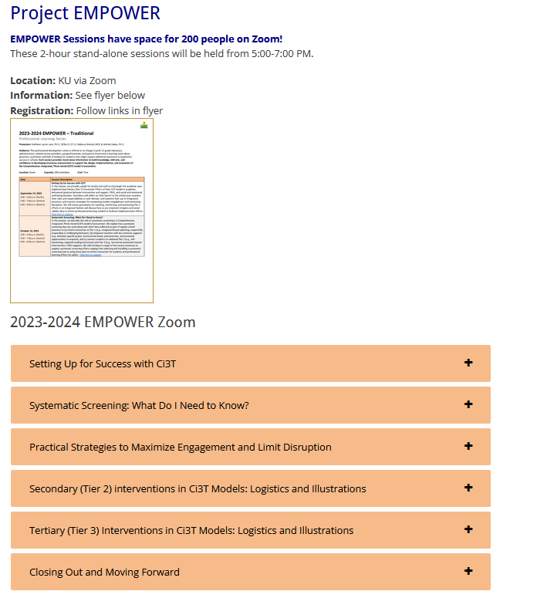
Accessing Project EMPOWER Professional Learning

Slide 102
Project EMPOWER - Traditional
Ci3T EMPOWER Sessions Location: Remote via Zoom Attended by: School Ci3T Leadership Teams, Ci3T District Trainers and Coaches, Faculty and Staff, Families (adults only). Community Members |  | Times (Pacific) | Times (Central) | Times (Eastern)
1. Getting Started | Sep. 19, 2023 (Tu) | 3:00 – 5:00 p.m. | 5:00 – 7:00 p.m. | 6:00 – 8:00 p.m.
2. Screening | Oct. 19, 2023 (Th) | 3:00 – 5:00 p.m. | 5:00 – 7:00 p.m. | 6:00 – 8:00 p.m.
3. Low Intensity Strategies (3) | Nov. 30, 2023 (Th) | 3:00 – 5:00 p.m. | 5:00 – 7:00 p.m. | 6:00 – 8:00 p.m.
4. Tier 2 | Jan. 9, 2024 (Tu) | 3:00 – 5:00 p.m. | 5:00 – 7:00 p.m. | 6:00 – 8:00 p.m.
5. Tier 3 | Mar. 28, 2024 (Th) | 3:00 – 5:00 p.m. | 5:00 – 7:00 p.m. | 6:00 – 8:00 p.m.
6. Moving Forward | Apr. 23, 2024 (Wed) | 3:00 – 5:00 p.m. | 5:00 – 7:00 p.m. | 6:00 – 8:00 p.m.

Slide 103
Wrap Up and Preview
Today
Next time
Preparing to Collect and Use Social Validity & Treatment Integrity Data
Using Fall Screening Data to Inform Instruction
Facilitating Clear Communication and Collaborations with Stakeholders
Procedures for Monitoring
Review your School’s Social Validity & Treatment Integrity Data
Review your School’s Winter Screening Data
Data-informed Decision-making
Professional Learning Targets and Resources
Communication Plans

Slide 104
Please Take a Minute to Get Organized
Please stay until all materials are organized.
Team Materials:
Save all documents with your school initials at the beginning and the date at the end of the file name.
XXS IM18 Ci3T Leadership Team Meeting Agenda YYYY MM DD.docx
Save to your school’s shared folder
Clearly identify the person(s) on your team in charge of each action item listed on the agenda.
Thank you!

Slide 105
Homework
Schedule time for your faculty and staff to complete:
Ci3T Treatment Integrity: Teacher Self-Report & Primary Intervention Rating Scale Survey
Efficacy and Burnout Survey (≈ 2 weeks following open of treatment integrity and social validity window)*
Ci3T Usability Rating Profile (≈ 4 weeks following open of treatment integrity and social validity window)*
*Please share your selected date with your Stacie Williams (stacie.w@ku.edu) and your Ci3T Coach
At your next Ci3T Leadership Team meeting:
Complete the Tiered Fidelity Inventory
At your next faculty meeting:
Share systematic screening data, takeaways, and professional learning with faculty and staff (e.g., emphasis on use of teacher-delivered, low-intensity strategies, Tier 2 and Tier 3 strategies)

Slide 106
Comprehensive, Integrated, Three-Tiered Model of Prevention
(Lane, Kalberg, & Menzies, 2009)
Thank you!
Notes:
Tag us in your Ci3T highlights- we’d love to see Ci3T in action! Follow us on Twitter or Instagram for updates and links to resources! @Ci3TModel
You will receive a brief session evaluation – we value your feedback and would greatly appreciate you taking a few minutes to share your thoughts on what you liked about the session and how we can improve

