Slide 1
Implementing Comprehensive, Integrated, Three-tiered (Ci3T) Models: Setting up for Success
Ci3T Implementation Series and Delivery – Session 1
Presenters and Contributors | Contributors
Allison M. Bernard | Wendy Peia Oakes
Mark M. Buckman | Elise Sarasin
Kathleen Lynne Lane | Rebecca L. Sherod

Slide 3
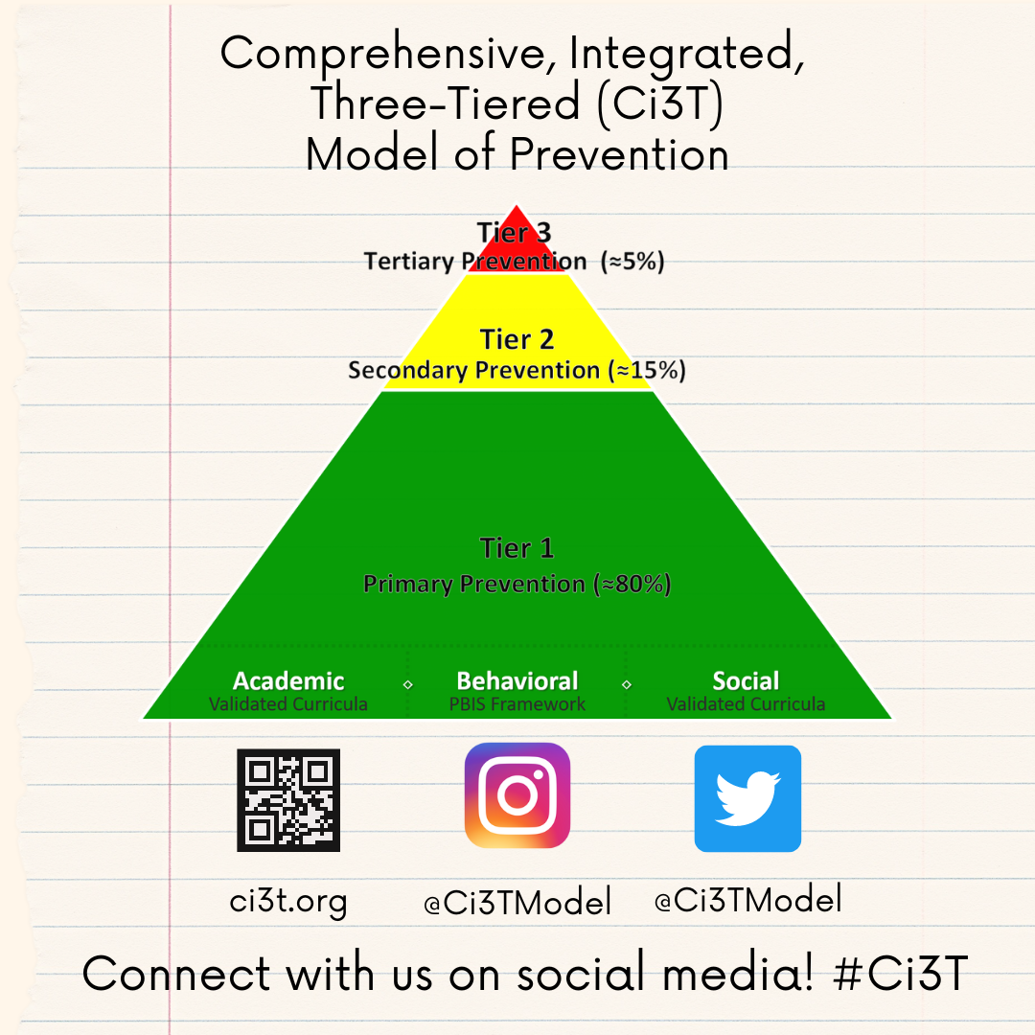
Let’s Connect on Social Media!
Tag us in your Ci3T highlights- we’d love to see Ci3T in action!
Follow us on Twitter or Instagram for updates and links to resources!
  @Ci3TModel

Slide 4
Ci3T Professional Learning Calendar
 | July | Aug | Sep | Oct | Nov | Dec | Jan | Feb | Mar | Apr | May | Jun
Ci3T Training |  |  |  |  | Ci3T Professional Learning Series Session 1 | Ci3T Professional Learning Series Session 2 | Ci3T Professional Learning Series Session 3 | Ci3T Professional Learning Series Session 4 |  | Ci3T Professional Learning Series Session 5 | Ci3T Professional Learning Series Session 6
Ci3T Implementation Support | Ci3T Implementation Series Prep Session |  | Ci3T Implementation Series Session 1 |  | Ci3T Implementation Series Session 2 |  | Ci3T Implementation Series Session 3 |  | Ci3T Implementation Series Session 4 | Ci3T Implementation Series Session 5
Ci3T EMPOWER |  |  | Ci3T EMPOWER Session 1 | Ci3T EMPOWER Session 2 | Ci3T EMPOWER Session 3 |  | Ci3T EMPOWER Session 4 |  | Ci3T EMPOWER Session 5 | Ci3T EMPOWER Session 6
Ci3T Trainers & Coaches Calls |  | Trainers & Coaches Call Session 1 | Trainers & Coaches Call Session 2 | Trainers & Coaches Call Session 3 | Trainers & Coaches Call Session 4 | Trainers & Coaches Call Session 5 | Trainers & Coaches Call Session 6 | Trainers & Coaches Call Session 7 | Trainers & Coaches Call Session 8 | Trainers & Coaches Call Session 9 | Trainers & Coaches Call Session 10

Slide 5
Agenda
Welcome
Scheduling for Success
Implementing Your Primary (Tier 1) Prevention Efforts
Preparing to Collect Treatment Integrity Data
  Preview: Ci3T Treatment Integrity Team Leader Training
Wrapping Up and Moving Forward

Slide 6
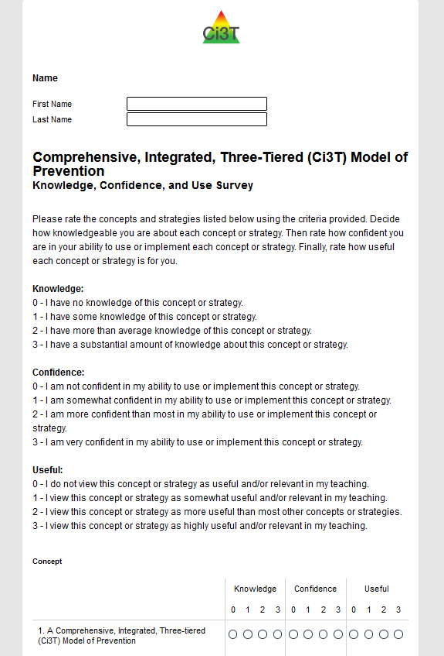
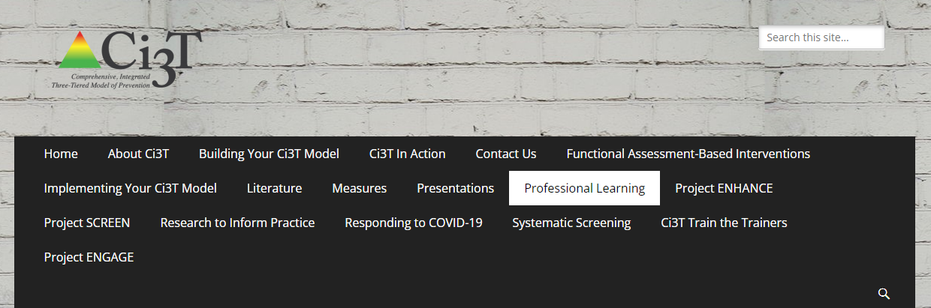
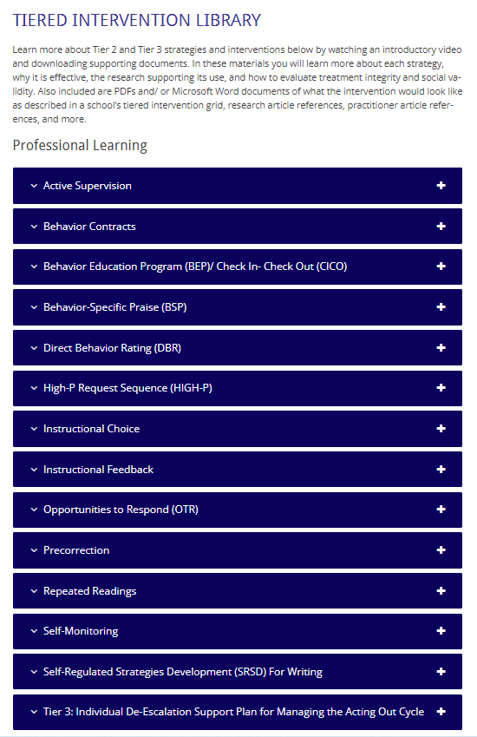
Once you have completed your KCU, we encourage you to check out professional learning resources at ci3t.org/pl and ci3t.org/fabi
Notes:
10 minutes to complete KCU
For those who have already finished – explore website
PL tab = https://www.ci3t.org/pl

Slide 7
Welcome
Please pull up your Ci3T Implementation Manual

Slide 8
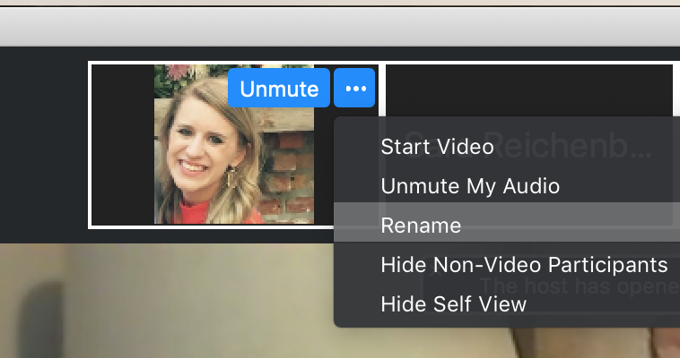
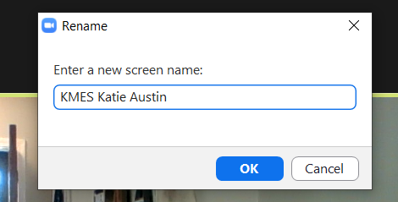
Renaming: School Initials + First and Last Name
To help us put you in breakout rooms with your colleagues today…
1. Click the three dots at the top
right corner of your video square.
2. Rename yourself with your
school initials then first and last name.

Slide 9
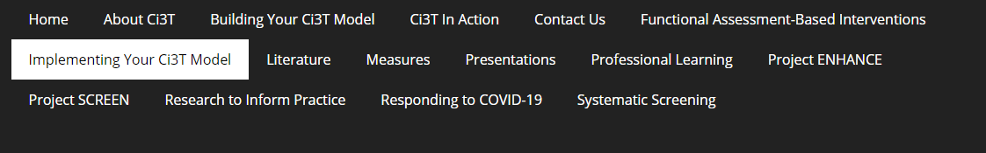
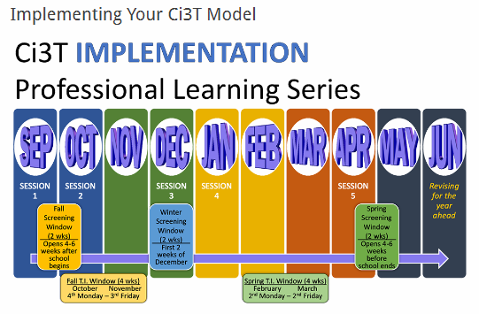
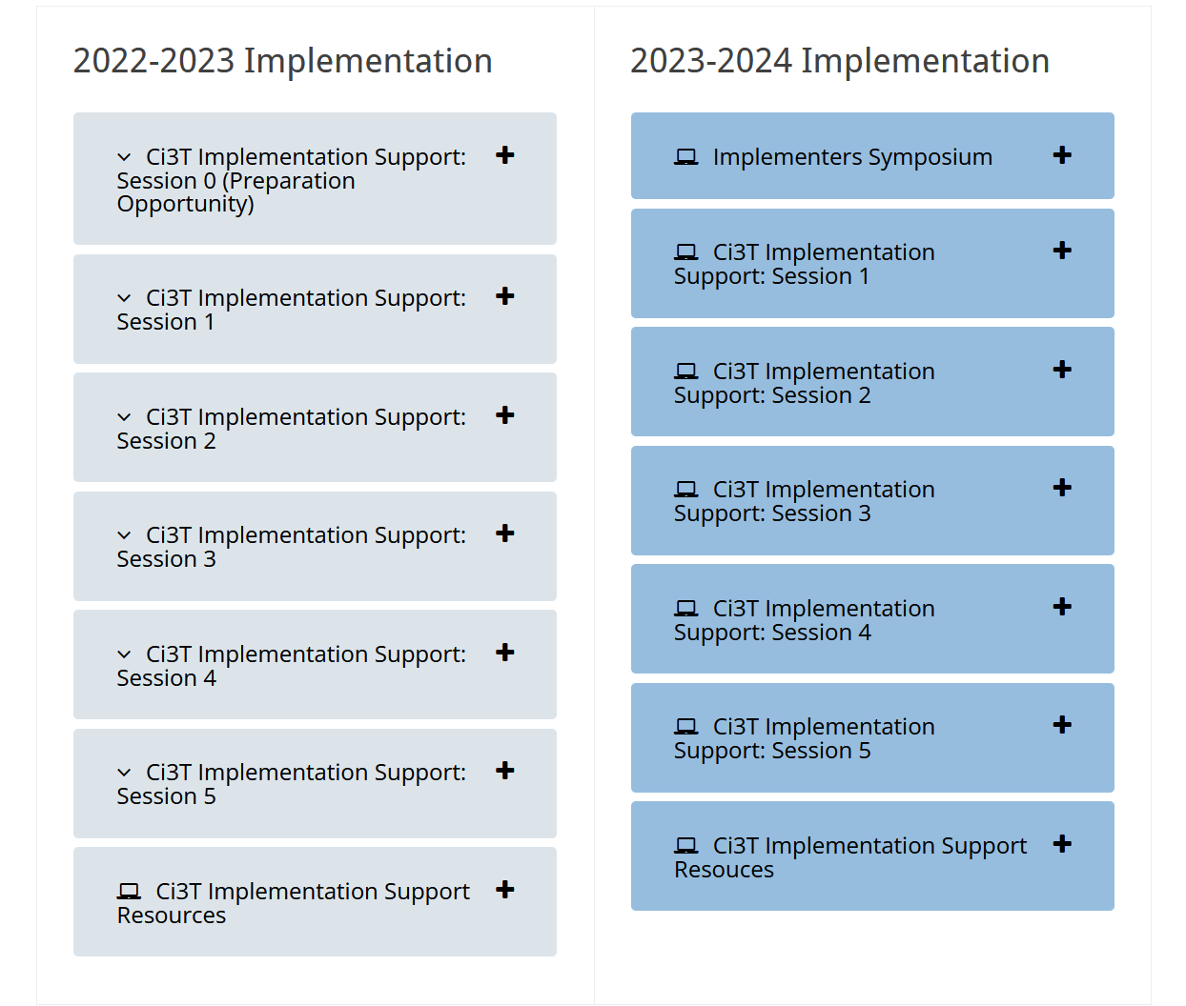
Accessing Professional Learning Materials
Navigate to ci3t.org/imp

Slide 10

Goals for this Implementation Year
Establish effective Ci3T leadership structures
Gain a deeper understanding of Ci3T models of prevention
Implement your school’s plan with high fidelity
Collect and use social validity and treatment integrity data to monitor Ci3T plan implementation
Collect student academic and behavioral outcome data to inform Ci3T implementation efforts
Share data with all stakeholders regularly (e.g., monthly, quarterly)
Identify areas of additional professional learning for faculty and staff and support faculty and staff access to professional learning
Address any barriers to implementing your Ci3T model

Slide 11


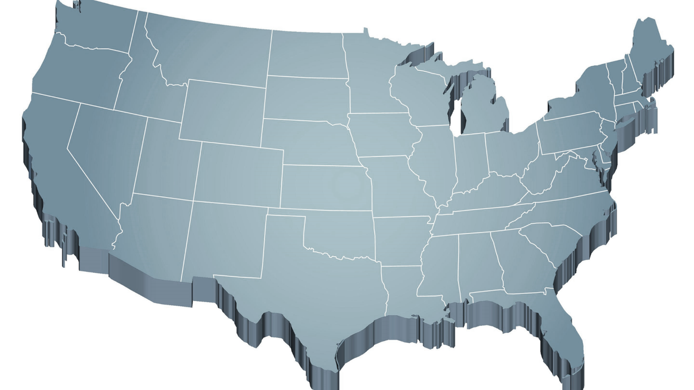


The Journey of Ci3T: Respectful Partnerships
1997
Notes:
CA & AZ start→ Tennessee → North Carolina→ Kansas
Trainings (MO, KANSAS, VERMONT, AZ)
MO, KS, UAB
HI

Slide 13
Primary (Tier 1) Prevention
All students are eligible for participation
(Lane, Robertson et al., 2006)
About 80% of students respond to this level
(Gresham, Sugai, Horner, Quinn, & McInerney, 1998; Sugai & Horner, 2006)
Examples of primary (Tier 1) prevention
  Validated literacy curricula
  Violence prevention
  Conflict resolution programs
  Anti-bullying programs
  Schoolwide social skills instruction
  Character education programs
Sources: Gresham, F. M., Sugai, G., Horner, R. H., Quinn, M. M., & McInerney, M. (1998). Classroom and schoolwide practices that support students’ social competence: A synthesis of research. Washington, DC: Office of Special Education Programs.
Lane, K. L., Robertson, E. J., & Graham-Bailey, M. A. L. (2006). An examination of school-wide interventions with primary level efforts conducted in secondary schools: Methodological considerations. In T. E. Scruggs & M. A. Mastropieri (Eds.) Applications of research methodology: Advances in learning and behavioral disabilities (Vol. 19), pp. 157-199. Oxford, UK: Elsevier.
Sugai, G., & Horner, R.R. (2006). A promising approach for expanding and sustaining school-wide positive behavior support. School psychology review, 35, 245.

Slide 14
Secondary (Tier 2) Prevention
Students who need more than the primary prevention plan, 10-15% of students
Focused intervention to address academic, behavior, and/or social concerns
  Acquisition (can’t do)
  Fluency (trouble doing)
  Performance (won’t do)
Examples of secondary (Tier 2) prevention
  Small group instruction in anger management
  Reading comprehension strategies
Source: Lane, K.L., Oakes, W.P., Ennis, R.P., & Hirsch, S.E. (2014). Identifying students for secondary and tertiary prevention efforts: How do we determine which students have tier 2 and tier 3 needs? Preventing School Failure, 58, 171-182.

Slide 15
Tertiary (Tier 3) Prevention
Students who need more than primary or secondary prevention, 5-7% of students
Intensive individualized interventions
Examples of tertiary (Tier 3) prevention
  Functional assessment-based interventions
  (Umbreit, Ferro, Liaupsin, & Lane, 2007)
  Multisystemic therapy program
  (Schoenwald, Brown, & Henggeler, 2000)
Sources: Lane, K.L., Oakes, W.P., Ennis, R.P., & Hirsch, S.E. (2014). Identifying students for secondary and tertiary prevention efforts: How do we determine which students have Tier 2 and Tier 3 needs? Preventing School Failure, 58, 171-182.
Schoenwald, S. K., Brown, T. L., & Henggeler, S. W. (2000). Inside multisystemic therapy therapist, supervisory, and program practices. Journal of Emotional and Behavioral Disorders, 8, 113-127.
Umbreit, J., Ferro, J.B., Liaupsin, C.J., & Lane, K.L. (2007). Functional behavioral assessment and function-based intervention: An effective, practical approach. Upper Saddle River, NJ: Prentice-Hall.

Slide 16

Core Features

Slide 17


Academic Component
Coordinated instruction within and across grade levels
Instruction linked to College and Career-Ready Standards, early learning standards, state, or district standards
Benchmarking student progress to inform instruction
Progress monitoring for students identified for secondary (Tier 2) and tertiary (Tier 3) supports
Source: Lane, K.L., Oakes, W.P., & Menzies, H.M. (2014). Comprehensive, integrated, three-tiered models of prevention: Why does my school—and district—need an integrated approach to meet students’ academic, behavioral, and social needs? Preventing School Failure: Alternative Education for Children and Youth, 58, 121-128.

Slide 18
Behavioral Component: Positive Behavioral Interventions and Supports (PBIS)
A Framework, Not a Curriculum
Establish, clarify, and define expectations
Teach all students the expectations, planned and implemented by all adults in the school
Give opportunities to practice
Reinforce students consistently, facilitate success
Consider rules, routines, and physical arrangements
Monitor the plan using school-wide data to identify students who need more support
Monitor student progress
Source: Horner, R.H., & Sugai, G. (2015). School-wide PBIS: An example of applied behavior analysis implemented at a scale of social importance. Behavior Analysis in Practice, 8, 80-85.

Slide 19
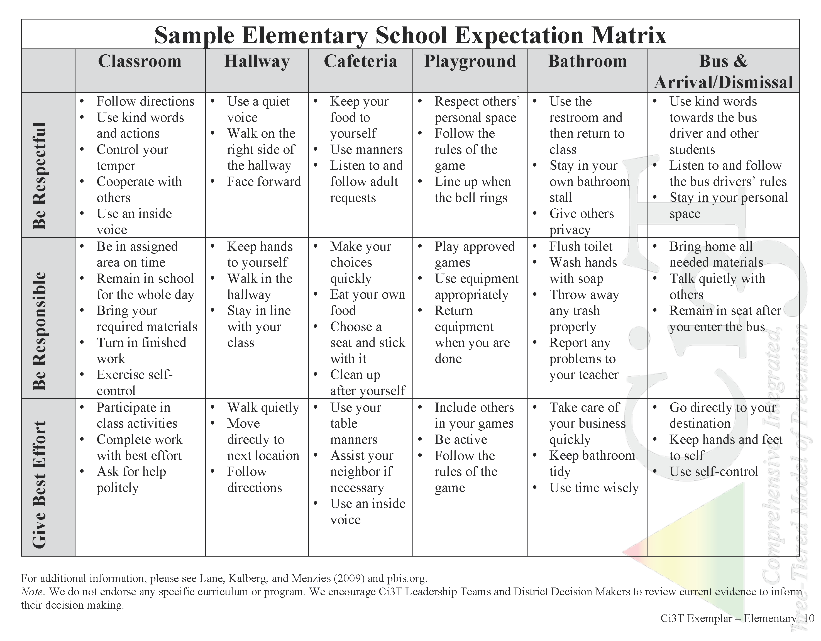
Establish, Teach, Acknowledge

Slide 20
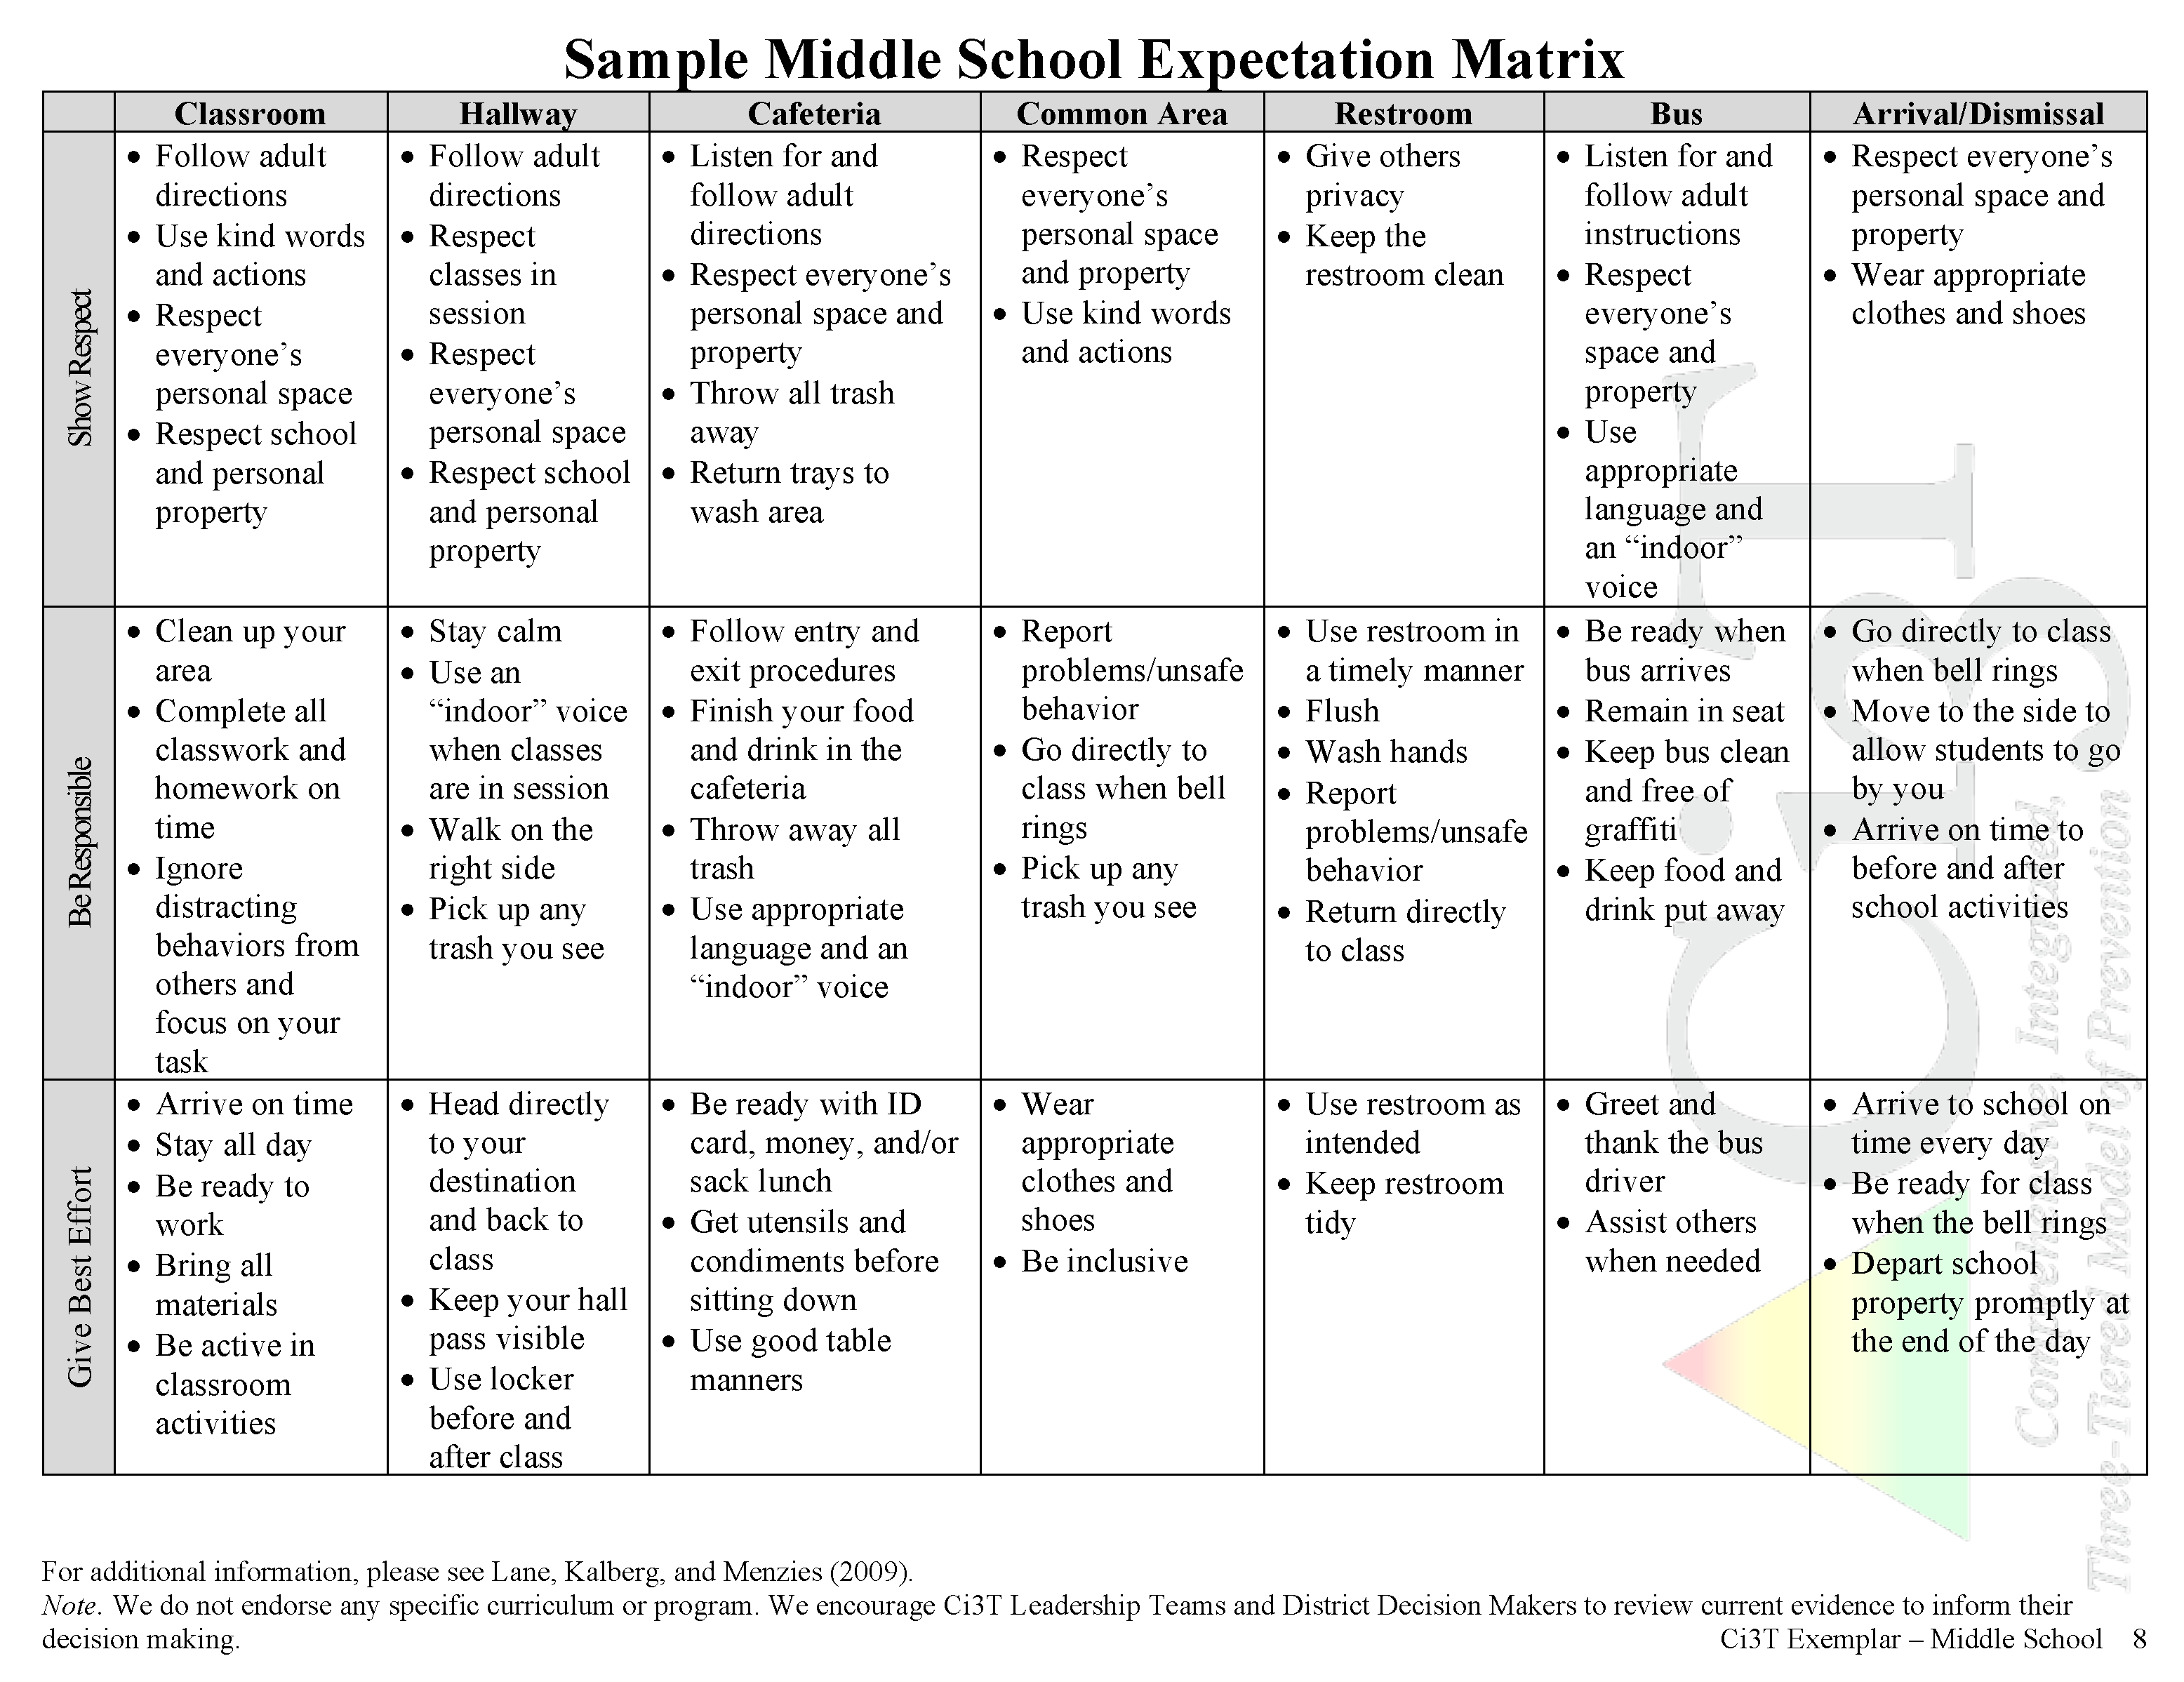
Establish, Teach, Acknowledge

Slide 21
Social Component:
Identifying a Validated Curriculum
Violence Prevention
  Second Step Violence Prevention (www.cfchildren.org)
Character Education
  Positive Action (www.positiveaction.net)
  Caring School Community (www.characterplus.org)
Social Skills
  Social Skills Improvement System: Classwide Intervention Program (Elliott & Gresham, 2007)
Source: Elliott, S. N., & Gresham, F. M. (2007). Social Skills Improvement System: Classwide intervention program teacher’s guide. Pearson Assessments.

Slide 22
Social Component:
Examples of Schoolwide Programs
Character Education
Violence Prevention
    www.characterstrong.com
    Character Strong
Improves engagement, increase belonging, promotes well-being
Curriculum-based approach
Over 100 online lessons for a educators with various backgrounds
Optional components:
  On Demand Professional Development
  Webinars
  Podcast
  Implementation Coaching Packages
    www.cfchildren.org
    The Second Step Violence Prevention Program
    Committee for Children, 1992
    $159 per grade (elementary, middle, high school, families, Spanish)
Sources: Committee for Children (1992). Second Step: A violence prevention curriculum grades 1-3. Author.
Character Strong (n.d.) Character strong: Create a school focused on engagement, well-being, and belonging. www.characterstrong.com

Slide 24



Ci3T Implementation Manual

Slide 25
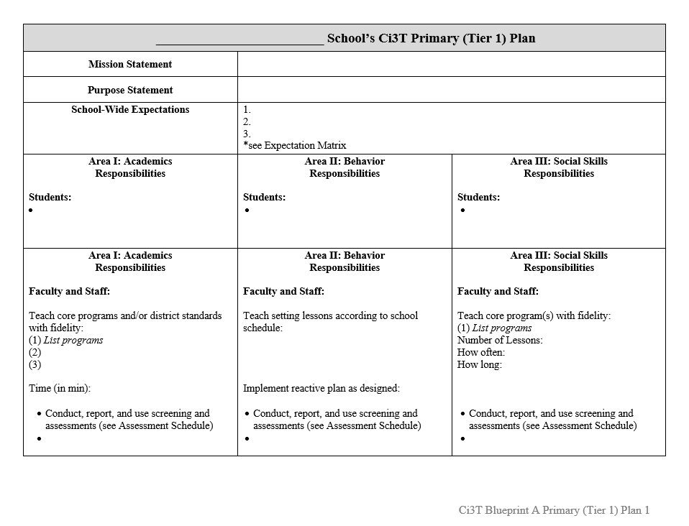
Ci3T Implementation Manual Primary (Tier 1) Plan
What are ALL students accessing?

Slide 26
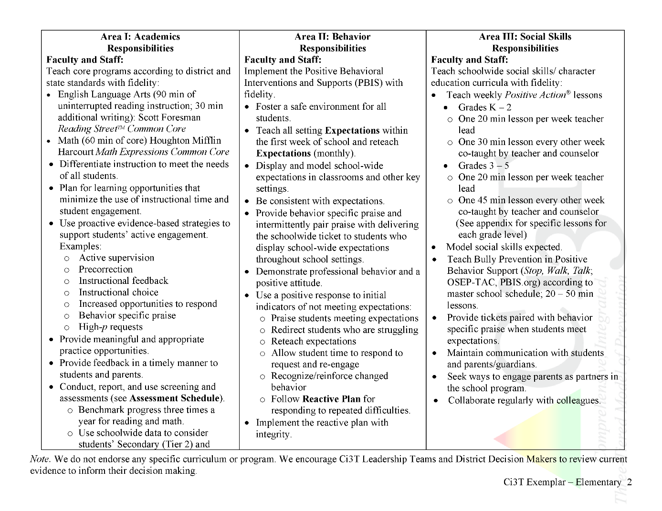

Ci3T Primary Plan: Procedures for Teaching
Ci3T Primary Plan: Procedures for Reinforcing
Ci3T Primary Plan: Procedures for Monitoring
Notes:
Continued to keep implementation manuals, which are foundational to Ci3T, updated and current

Slide 27
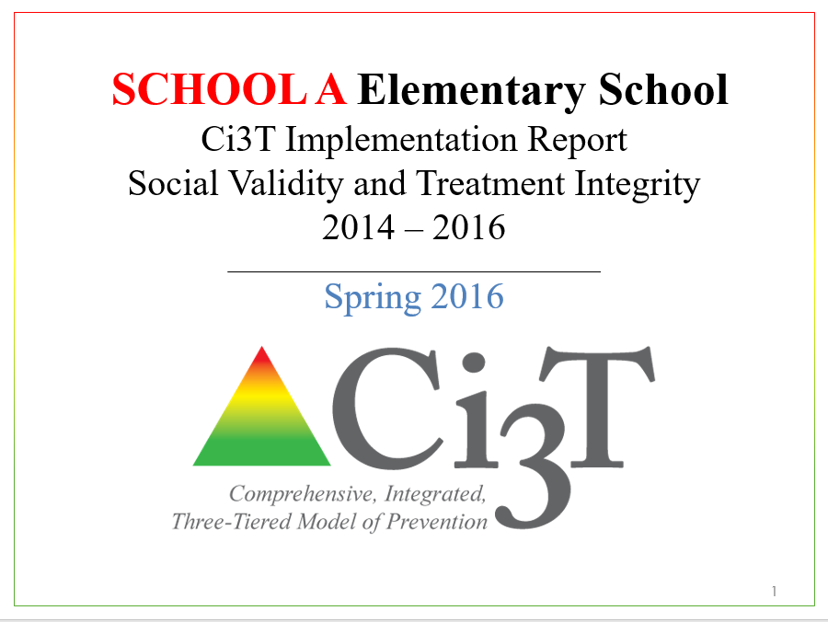
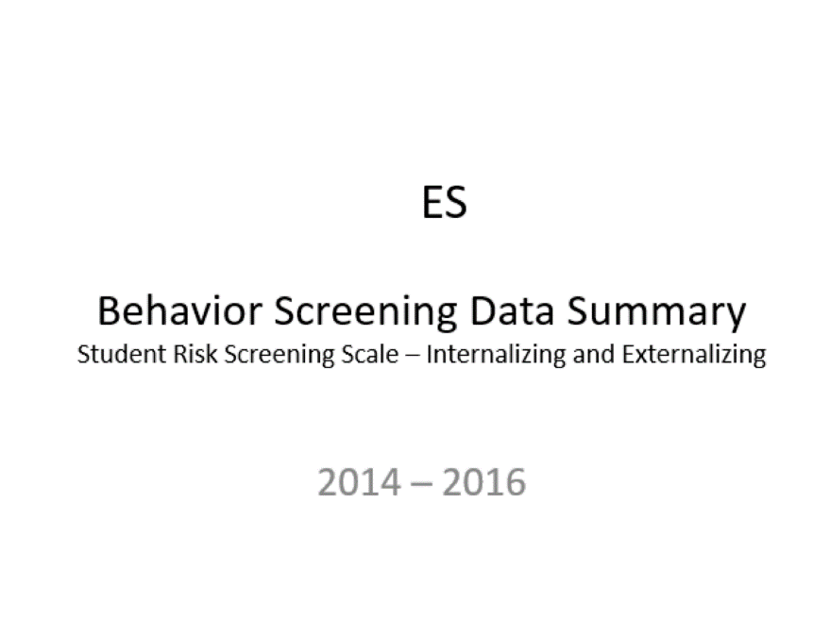
Essential Components of
Primary Prevention Efforts
Social Validity
Systematic Screening
Academic
Behavior
Treatment Integrity
Notes:
We support our school partners in administering surveys to their faculty and staff to garner understanding of social validity, conduct observations and self-reports to assess treatment integrity, and support systematic screening of all students for academics and behavior. We believe that schools thrive when faculty and staff are keenly aware of their school-wide data (show the next three slides)
KEEP THIS FOR LATER IN SLIDE: All schools wanted to continue “how” not “should”

Slide 28


Slide 29


Slide 30
Scheduling for Success
Long-range Planning: The Importance of Planning Ahead
Structuring your Ci3T Team
Conducting Effective Meetings
Communicating with Your Stakeholders

Slide 31
  Long-range Planning:
  The Importance of Planning Ahead
Keeping the values that lead our mission statement in mind:
Where are we and how are we doing as of today?
Establish clear and explicit objectives: Mission-based
Prioritize objectives
Establish timelines, due dates, and persons responsible for each objective with regular check-ins

Slide 32
School Ci3T Implementation Calendar
Sun. | Mon. | Tues. | Wed. | Thurs. | Fri. | Sat.
1 | 2 | 3 | 4 | 5 | 6 Professional learning session: OTR | 7
8 | 9 | 10 Ci3T Team Meeting | 11 | 12 Teach Social Skills Lesson | 13 | 14
15 | 16 Faculty meeting with a look at BSP | 17 | 18 | 19 | 20 | 21
22 | 23 | 24 | 25 | 26 Teach Social Skills Lesson | 27 | 28
Schedule time for communication
Notes:
.

Slide 33
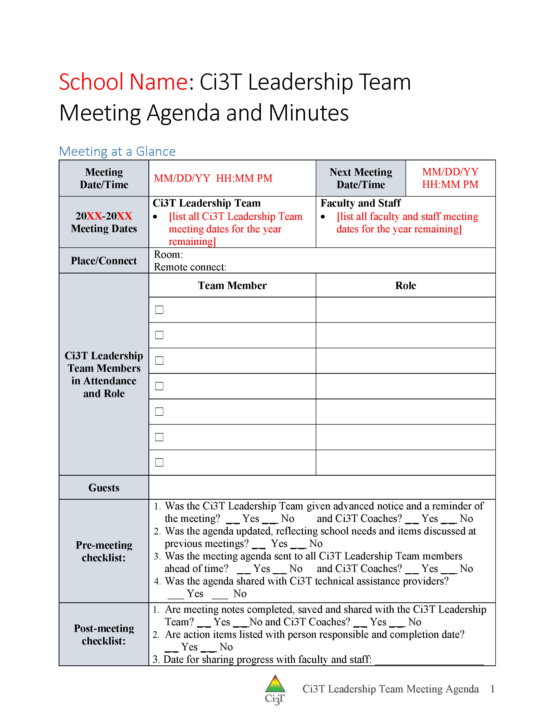

Scheduling Your Ci3T Leadership Team Meetings

Slide 34
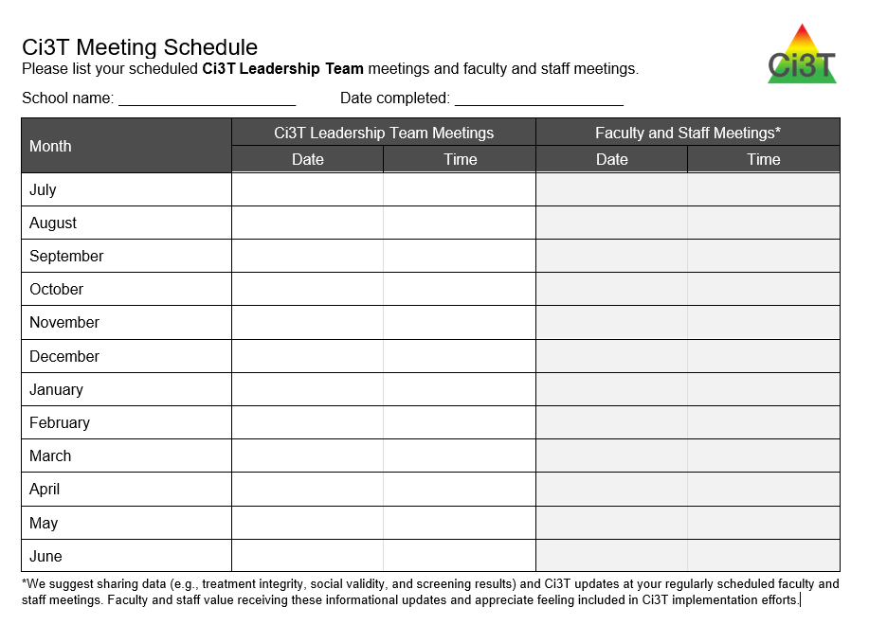
Scheduling Your Ci3T Leadership Team Meetings & Faculty and Meetings
Ci3T Implementation Sessions
Ci3T Leadership Team Meeting
Faculty & Staff Meeting

Slide 35
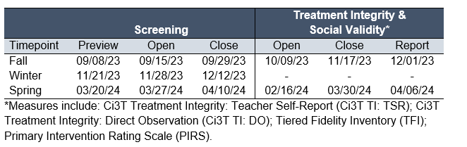
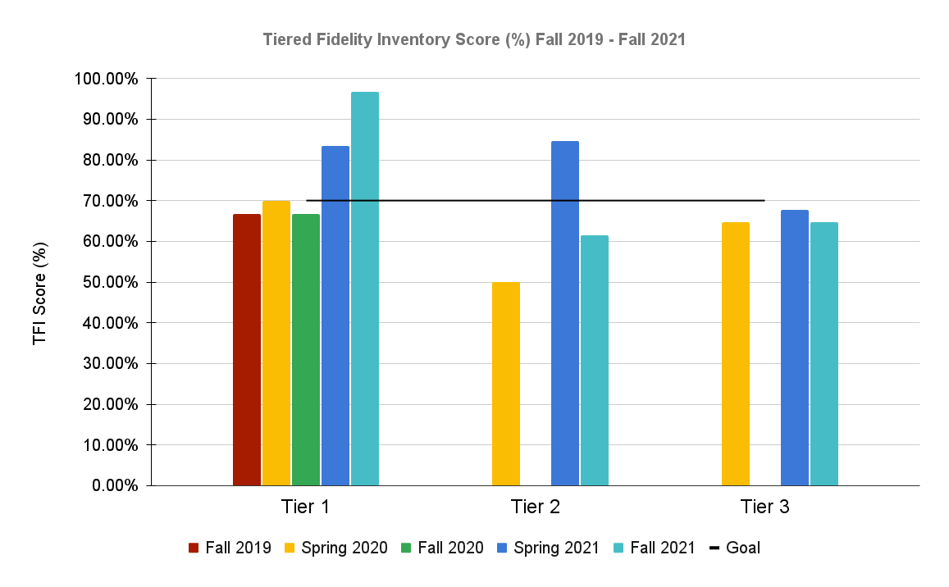
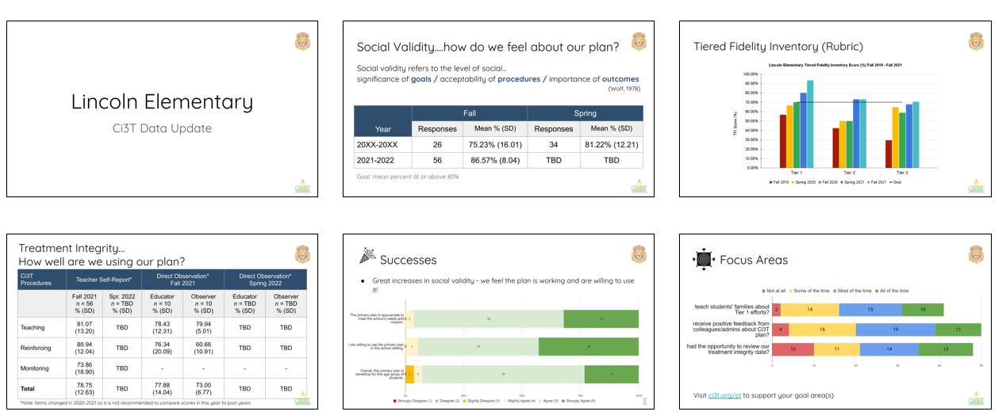


Scheduling Your Ci3T Leadership Team Meetings & Faculty and Meetings
When during this window can we set aside time during a faculty meeting for staff to complete these measures?
When will our Ci3T Leadership team meet to review these data?
When will we share out these data with faculty and staff?
We also need to complete the TFI during this window. When will our Ci3T Leadership Team meet to do this?
Notes:
As you’re scheduling your Ci3T Leadership Team and Faculty & Staff meetings, be sure to backwards plan from your academic and behavior screening windows and treatment integrity and social validity windows
Be sure to consider:
Agenda items for Ci3T Leadership Team Meeting (e.g., complete TFI)
Faculty & Staff Meetings (e.g., share screening results)
Additional Professional Learning

Slide 36
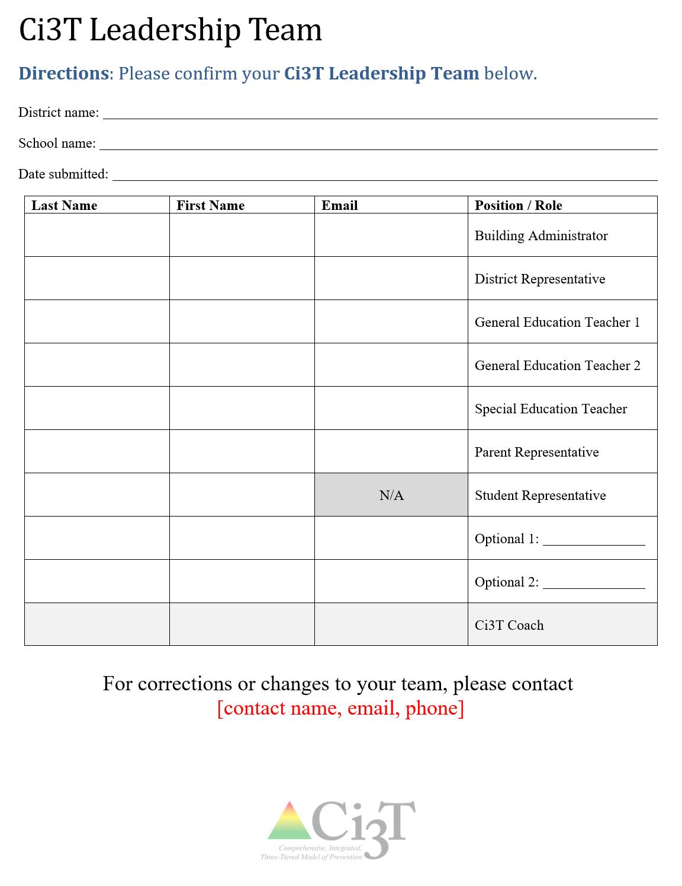
Structuring your Ci3T Team
Administrator(s)
General education teachers representative of your school
  Elementary: a lower-grades and an upper-grades teacher
  Secondary: a teacher from each grade level or department
Special education teacher(s)
Support staff
  e.g., counselor, psychologist, social worker
Parent representative(s)
Student representative(s) such as from student council

Slide 37

Conducting Effective Meetings
Notes:
Honor those who are on time
Starting the meeting on time
Start with sharing successes
Respect everyone’s time
End the meeting on time, one hour maximum
Assign tasks to individuals or temporary subcommittees as needed to keep the meeting on track
Schedule a follow-up meeting as needed or make plans to conduct final business by email
Be efficient with time
Be solution-based, spending time on action plans instead of “admiring the problem

Slide 38
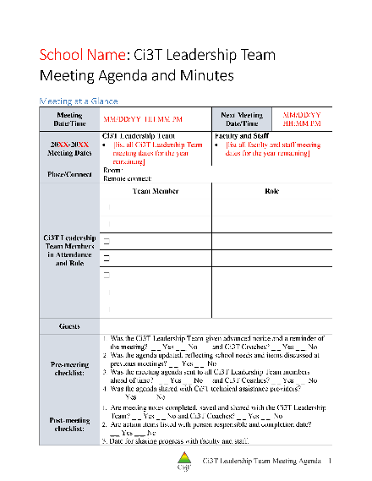
Using your Ci3T Meeting Agenda
Meeting logistics
  Date, time, who is present, who is absent
  Next meeting date/time/location/roles
  Discussion points for current meeting
Procedural Checklist
Record of discussion according to key Ci3T features
  Procedures for teaching, reinforcing and monitoring
  Academics
  Behavior
  Social skills
  Data (student level, program level, Ci3T reports)

Slide 39
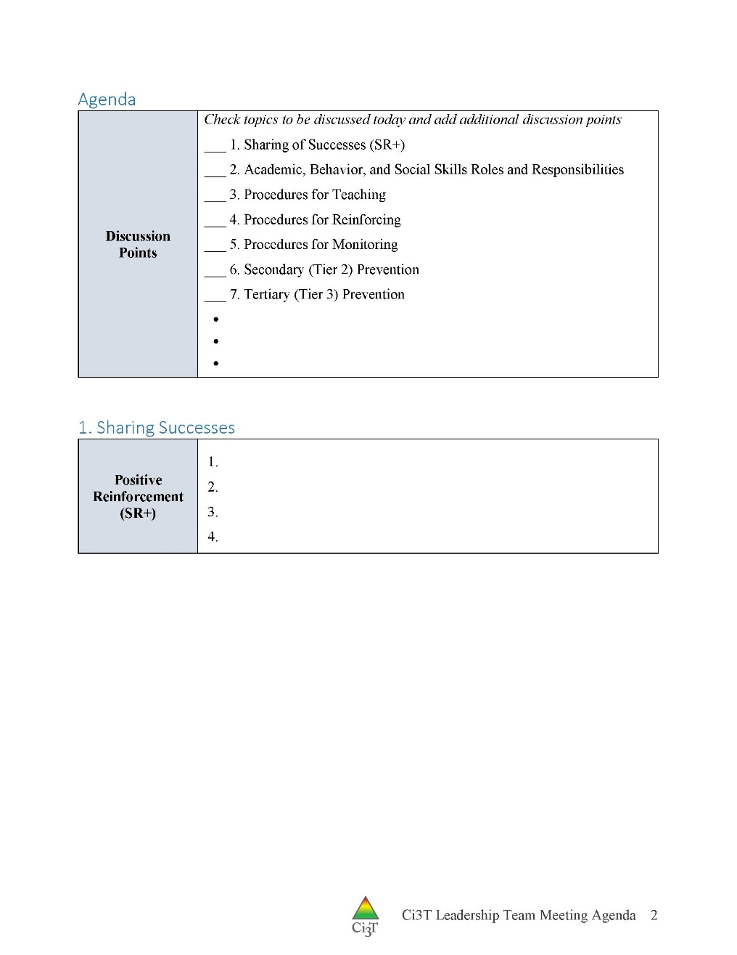
Using your Ci3T Meeting Agenda
Meeting logistics
  Date, time, who is present, who is absent
  Next meeting date/time/location/roles
  Discussion points for current meeting
Procedural Checklist
Record of discussion according to key Ci3T features
  Procedures for teaching, reinforcing and monitoring
  Academics
  Behavior
  Social skills
  Data (student level, program level, Ci3T reports)

Slide 40
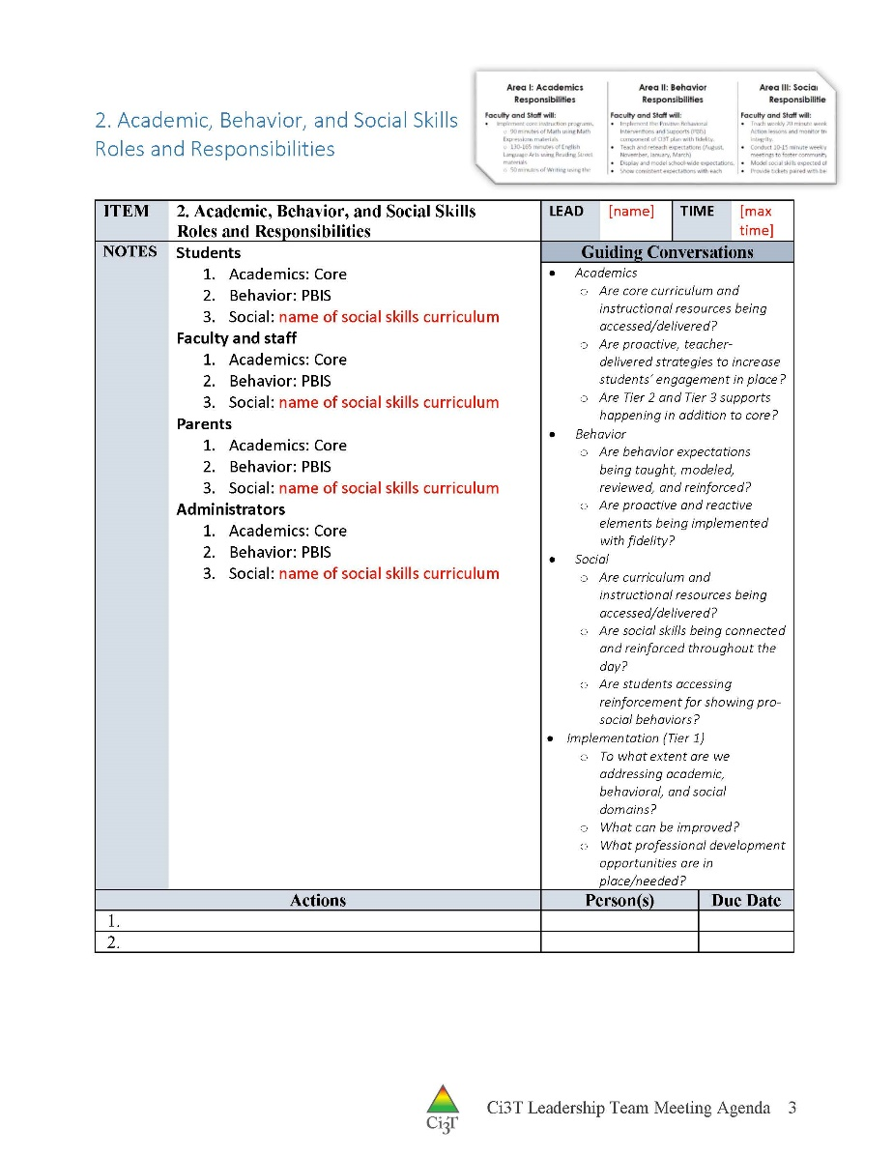
Primary Prevention:
Academics, Behavior, and Social Skills

Slide 41
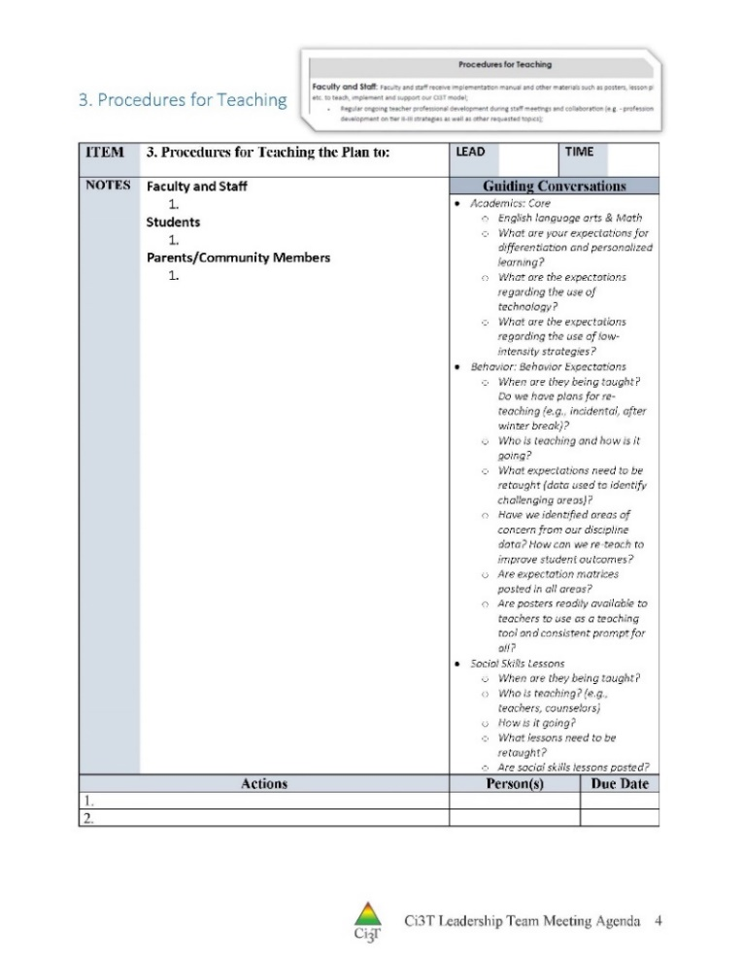
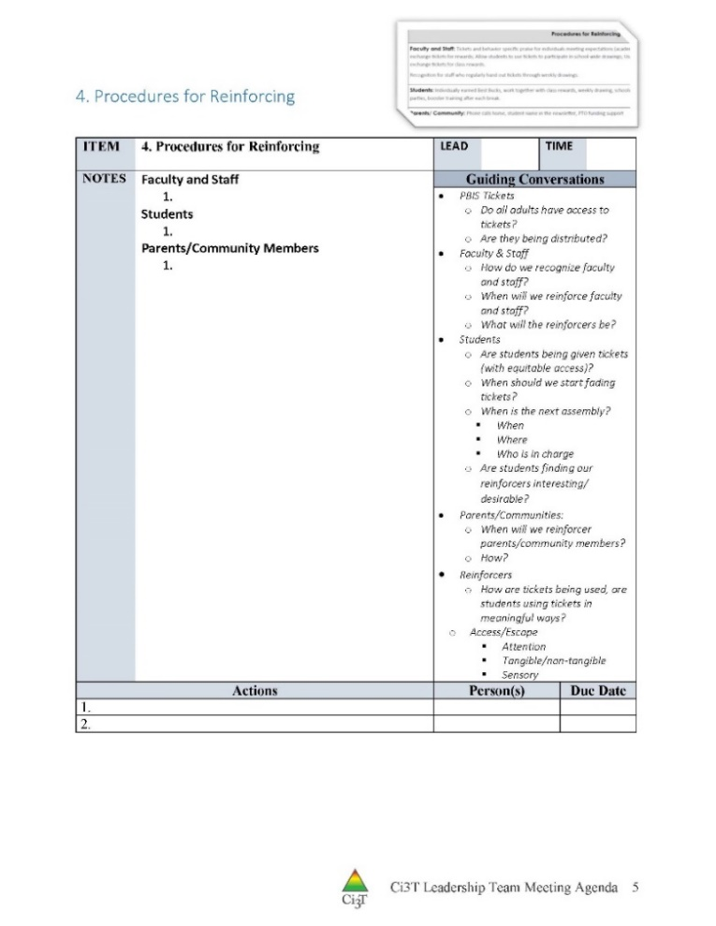
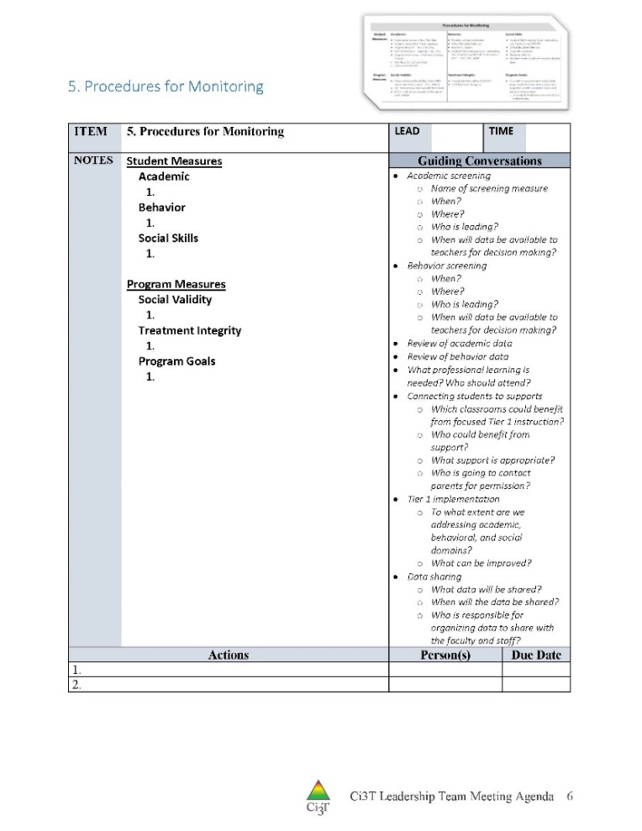
Procedures for Teaching, Reinforcing, and Monitoring

Slide 42
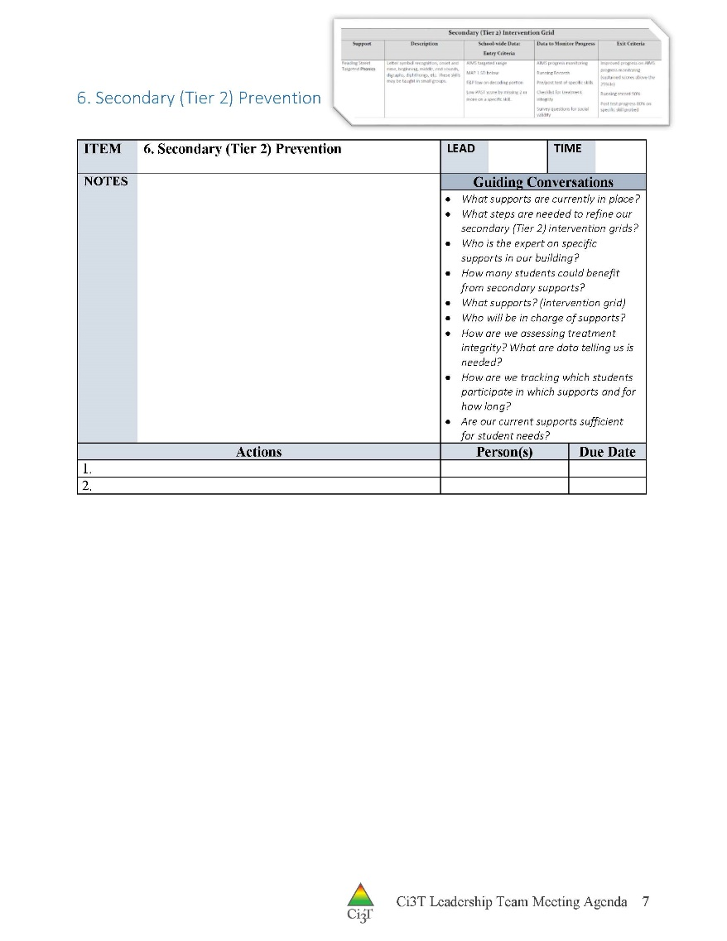
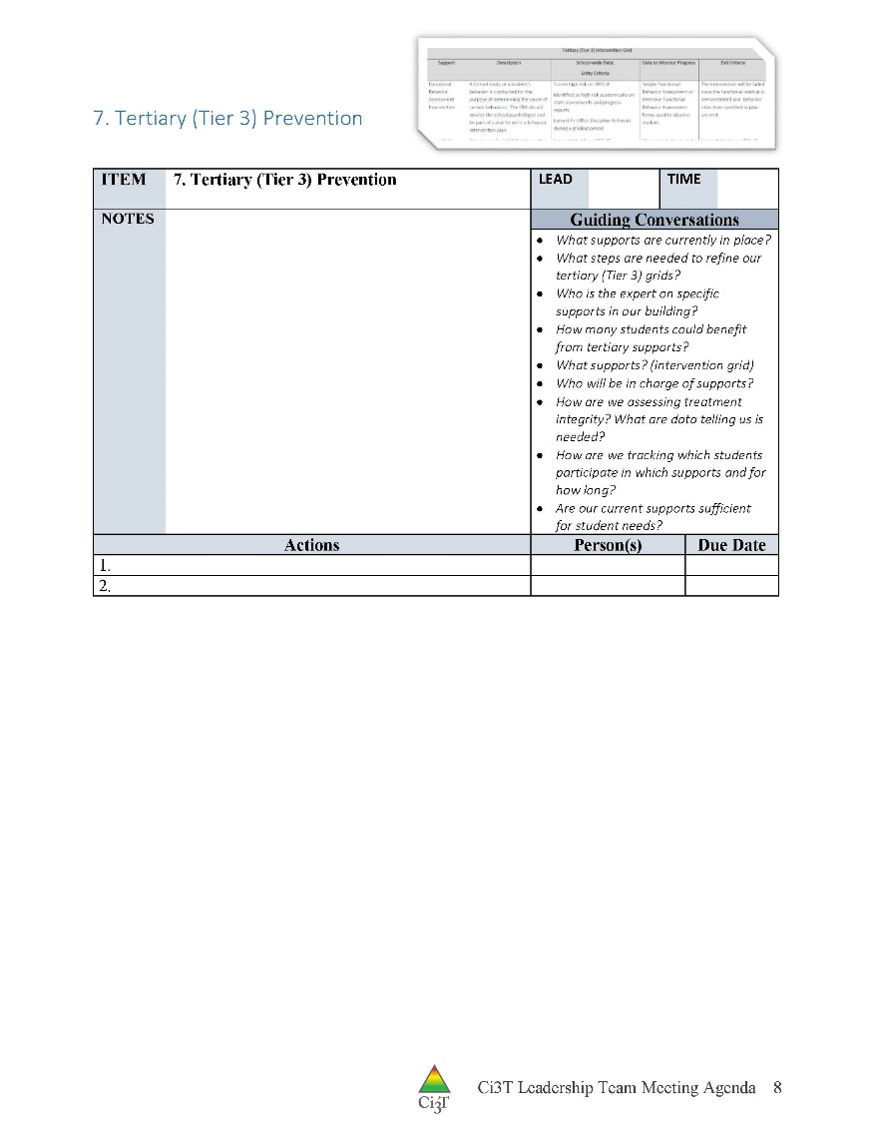
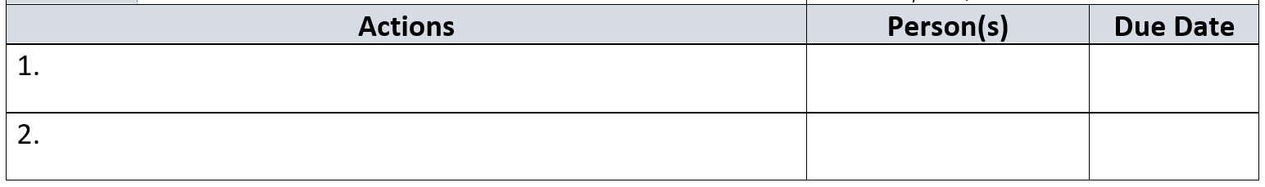
Secondary and Tertiary Prevention Discussions
Notes:
Need to emphasize collaborative teaming for BCBA Task List G-06 Provide behavior-analytic services in collaboration with others who support and/or provide services to one’s clients …
ALSO: I think Tier 2 and Tier 3 interventions are likely underdiscussed in many meetings. Emphasize the need to have solutions-based discussions about providing interventions at scale (using CICO, self-monitoring, other Tier 2 supports) AND TRACKING WHO RECEIVES THOSE SUPPORTS

Slide 43
IM18 Ci3T Leadership Team Meeting Agenda TEMPLATE
Predictability
  Assign roles

Slide 44
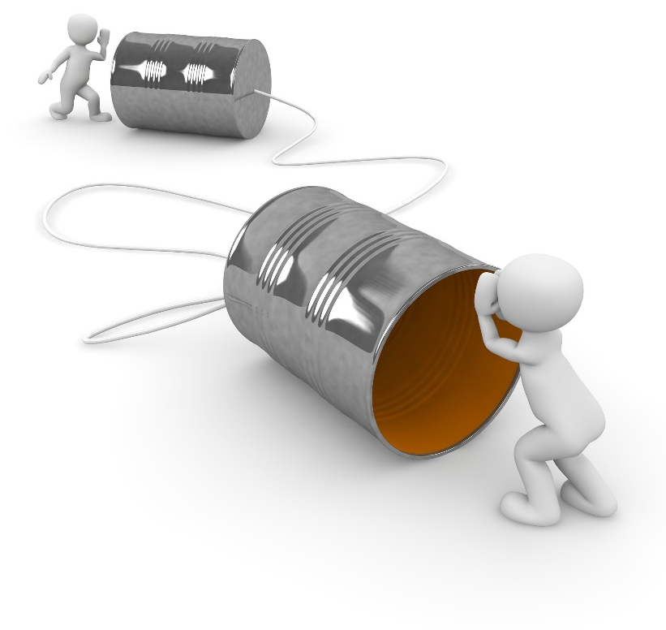
Communicating with Your Stakeholders
How will you share data and Ci3T Leadership Team updates with stakeholders?
  Faculty and staff
    Include plans for sharing updates with cafeteria, custodial, transportation, office, paraeducators, itinerant related service providers, and others
  District leaders
  Students
  Parents & Families
  Community
    Consider dedicating space on school website
    to give parents and community members
    access to updates

Slide 45

















Let’s talk… and make plans!
Explore IM18 Ci3T Leadership Team Meeting Agenda
Schedule Ci3T Leadership Team meetings
Schedule faculty and staff meetings
Assign responsibilities
  Facilitator
  Minute taker
  Data analyst
  Active team member
  Administrator
Notes:
15-min timer

Slide 46
Implementing Your Primary (Tier 1) Prevention Efforts
Rolling out Tier 1
Implementing Procedures

Slide 47
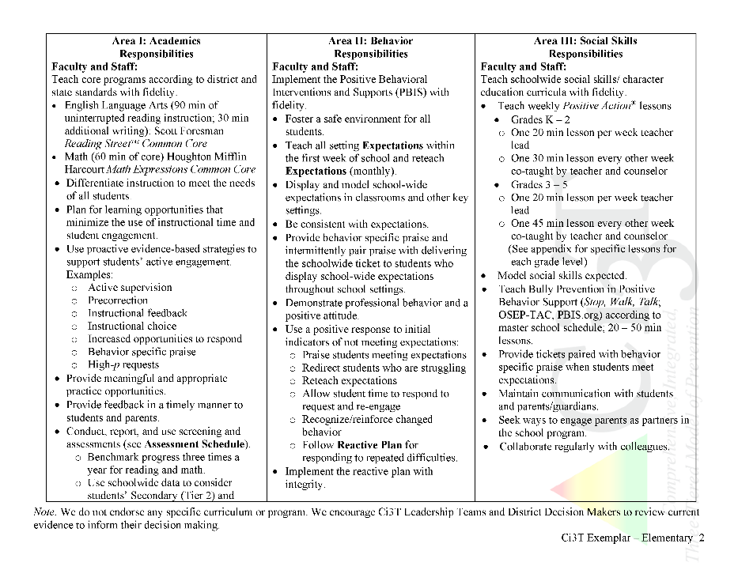
Rolling out at Tier 1: Academic Domain
Teaching
Reinforcing
Monitoring

Slide 48
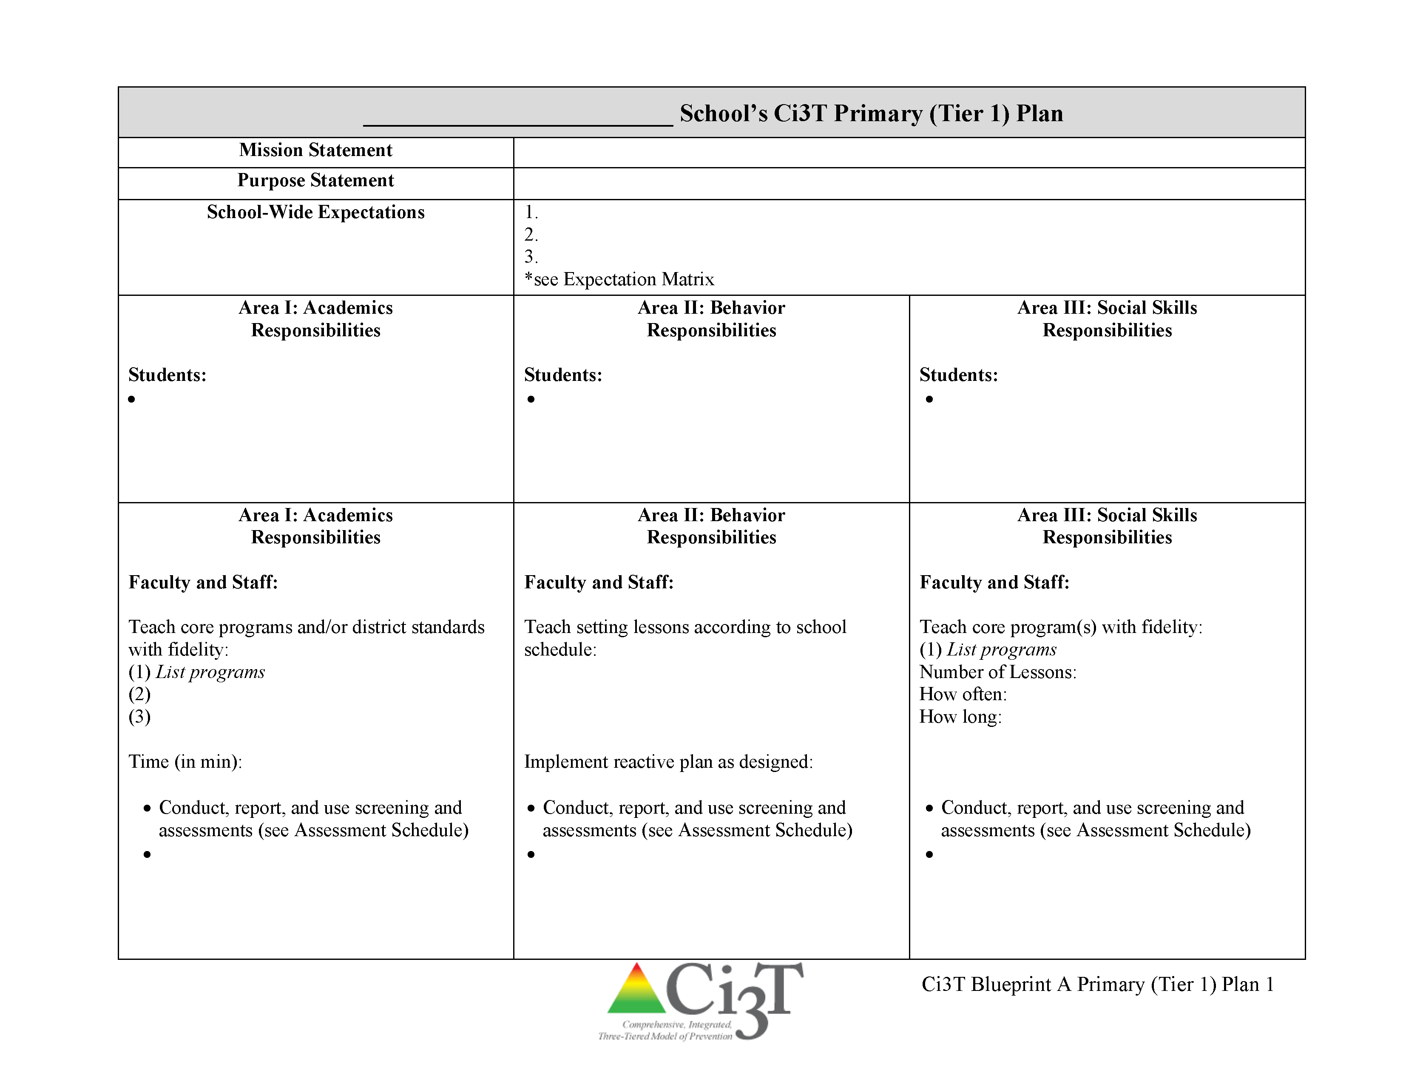
Ci3T Primary Plan: Faculty and Staff Roles and Responsibilities
Notes:
BCBA Task List K-02 Identify the contingencies governing the behavior of those responsible for carrying out behavior-change procedures and design interventions accordingly – emphasize shift to clearly stating expectations for staff and students

Slide 49


Slide 50

Academics
Area II: Academics Responsibilities Faculty and Staff: Teach core programs according to district and state standards with integrity Use teacher-delivered, low-intensity strategies to support students’ active engagement | Area II: Behavior Responsibilities Faculty and Staff: Implement Positive Behavioral Interventions and Supports (PBIS) with integrity. Teach all setting Expectations within the first week of school and reteach Expectations (monthly). Display and model school-wide expectations in classrooms and other key settings. Implement the reactive plan with integrity. | Area II: Social Responsibilities Faculty and Staff: Teach schoolwide social skills/ character education curricula with integrity: Teach daily Second Step ® lessons (link to grade level instructional schedules) Seek ways to engage parents as partners in the school program

Slide 51

Academics
Opportunities to Respond
Area II: Academics Responsibilities Faculty and Staff: Teach core programs according to district and state standards with integrity Use teacher-delivered, low-intensity strategies to support students’ active engagement | Area II: Behavior Responsibilities Faculty and Staff: Implement Positive Behavioral Interventions and Supports (PBIS) with integrity. Teach all setting Expectations within the first week of school and reteach Expectations (monthly). Display and model school-wide expectations in classrooms and other key settings. Implement the reactive plan with integrity. | Area II: Social Responsibilities Faculty and Staff: Teach schoolwide social skills/ character education curricula with integrity: Teach daily Second Step ® lessons (link to grade level instructional schedules) Seek ways to engage parents as partners in the school program
Behavior-Specific Praise
Active Supervision
Instructional Feedback
High-p Requests
Precorrection
Incorporating Choice

Slide 52
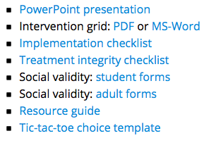
Professional Learning Resources
https://www.ci3t.org/pl

Slide 53

What do I need to know?
Ci3T Exemplar - Elementary
Notes:
BCBA Task List K-02 Identify the contingencies governing the behavior of those responsible for carrying out behavior-change procedures and design interventions accordingly – emphasize shift to clearly stating expectations for staff and students

Slide 54
Rolling out at Tier 1: Academics
Reviewing Roles & Responsibilities
  What do I need to know?
Procedures for Teaching
  How am I doing with using low-intensity supports?
Procedures for Reinforcing
  How have I been reinforcing students for meeting expectations?
Procedures for Monitoring
  How am I doing with implementation?
Questions & Considerations?
Successes!

Slide 55
Rolling out at Tier 1: Behavioral Domain
Teaching
Reinforcing
Monitoring

Slide 56
Ci3T Primary Plan: Faculty and Staff Roles and Responsibilities

Slide 57
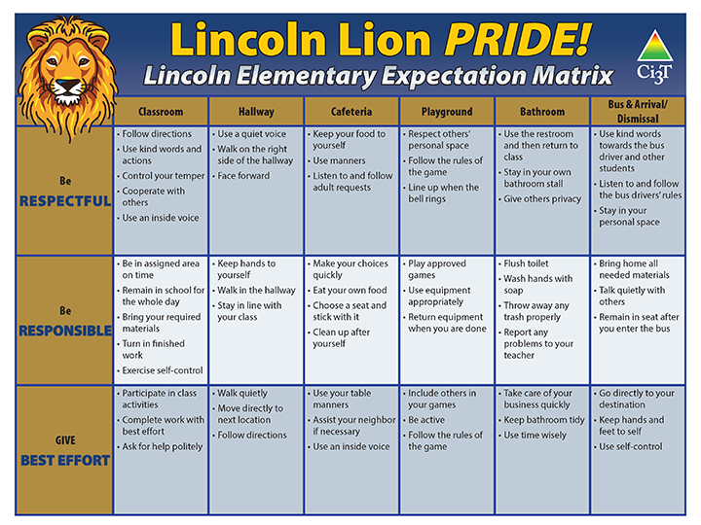
Behavioral
Area II: Academics Responsibilities Faculty and Staff: Teach core programs according to district and state standards with integrity: Use teacher-delivered, low-intensity strategies to support students’ active engagement | Area II: Behavior Responsibilities Faculty and Staff: Implement Positive Behavioral Interventions and Supports (PBIS) with integrity. Teach all setting Expectations within the first week of school and reteach Expectations (monthly). Display and model school-wide expectations in classrooms and other key settings. Implement the reactive plan with integrity. | Area II: Social Responsibilities Faculty and Staff: Teach schoolwide social skills/ character education curricula with integrity: Teach daily Second Step ® lessons (link to grade level instructional schedules) Seek ways to engage parents as partners in the school program

Slide 58
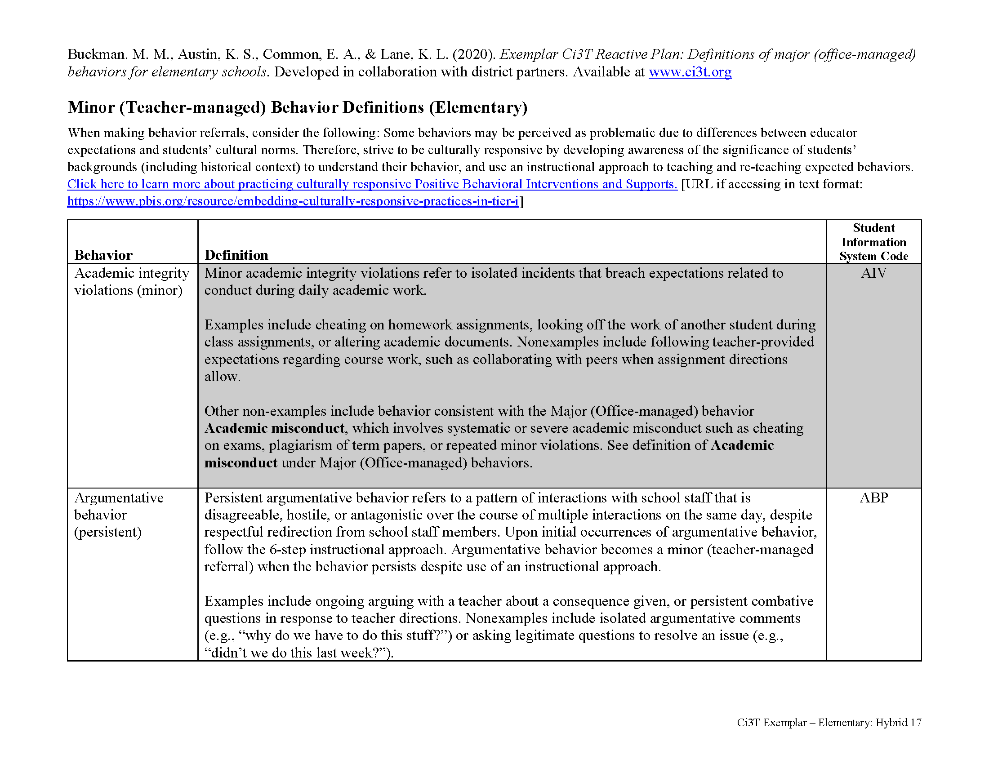
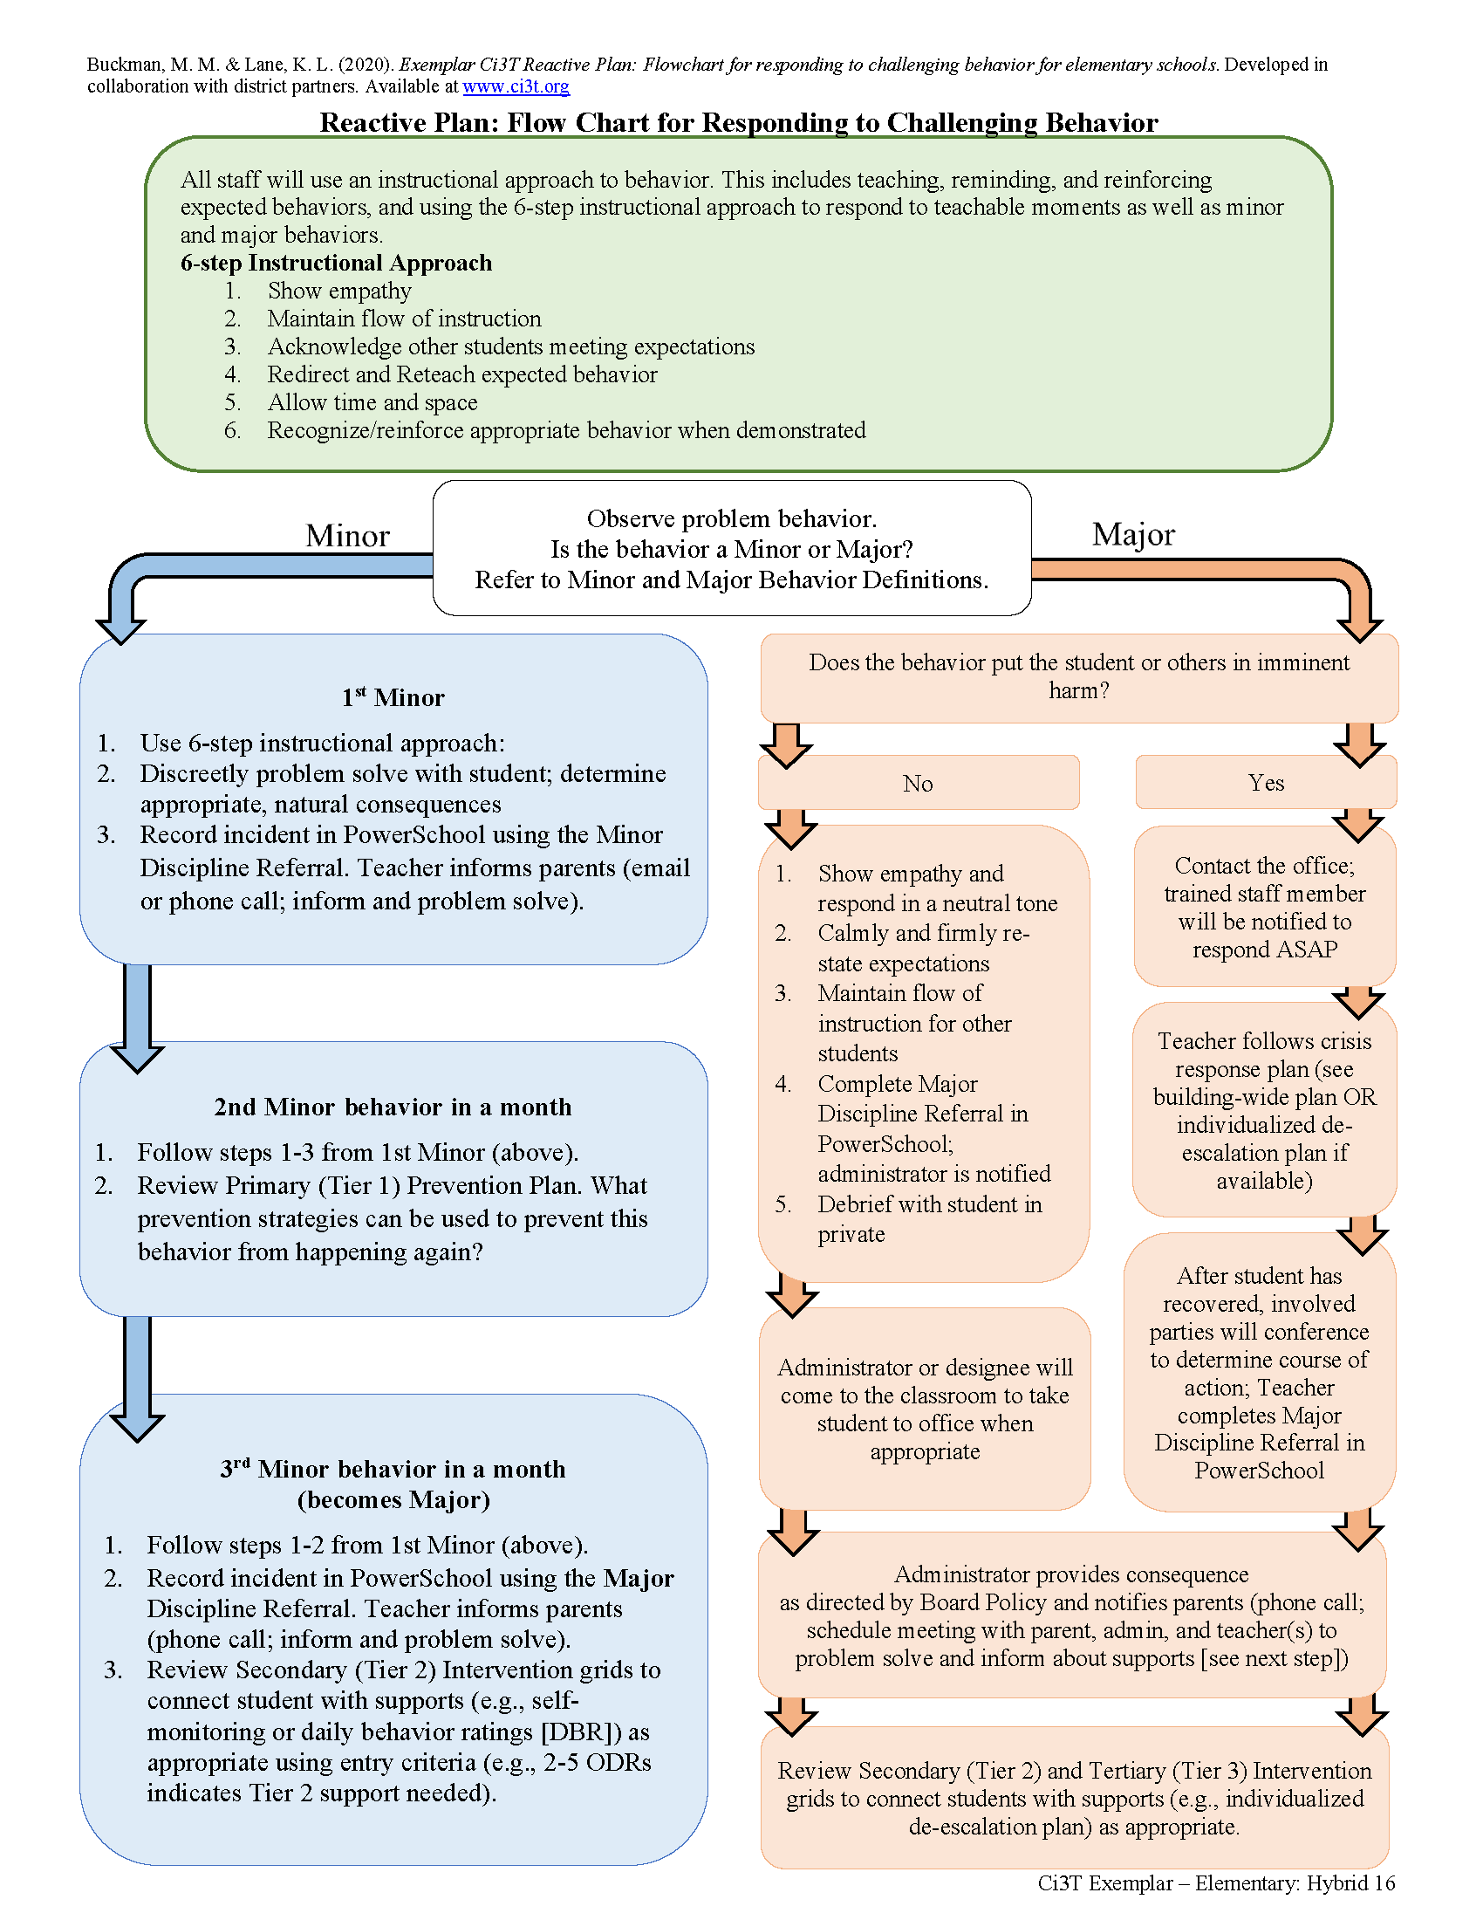
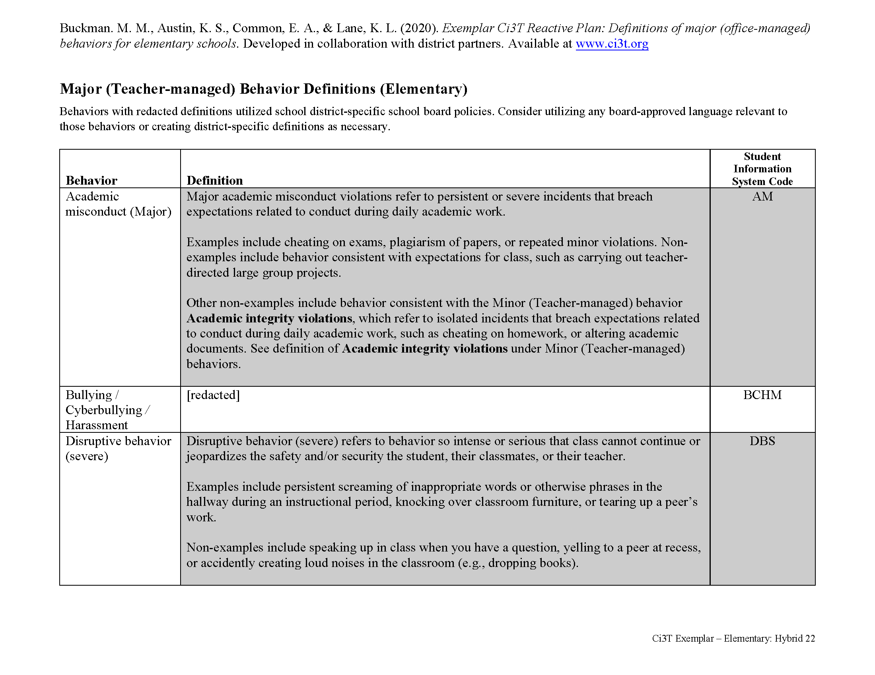
Behavioral
Area II: Academics Responsibilities Faculty and Staff: Teach core programs according to district and state standards with integrity: Use teacher-delivered, low-intensity strategies to support students’ active engagement | Area II: Behavior Responsibilities Faculty and Staff: Implement Positive Behavioral Interventions and Supports (PBIS) with integrity. Teach all setting Expectations within the first week of school and reteach Expectations (monthly). Display and model school-wide expectations in classrooms and other key settings. Implement the reactive plan with integrity. | Area II: Social Responsibilities Faculty and Staff: Teach schoolwide social skills/ character education curricula with integrity: Teach daily Second Step ® lessons (link to grade level instructional schedules) Seek ways to engage parents as partners in the school program

Slide 61
What do I need to know?
Ci3T Exemplar - Elementary

Slide 62
Rolling out at Tier 1: Behavior
Reviewing Roles & Responsibilities
  What do I need to know?
Procedures for Teaching
  How am I doing with teaching expectations for specific settings?
Procedures for Reinforcing
  How have I been reinforcing students for meeting expectations?
Procedures for Monitoring
  How am I doing with implementation?
Questions & Considerations?
Successes!

Slide 63
Rolling out at Tier 1: Social Domain
Teaching
Reinforcing
Monitoring

Slide 64
Ci3T Primary Plan: Faculty and Staff Roles and Responsibilities
Notes:
BCBA Task List K-02 Identify the contingencies governing the behavior of those responsible for carrying out behavior-change procedures and design interventions accordingly – Emphasize shift to clearly stating expectations for staff and students

Slide 65
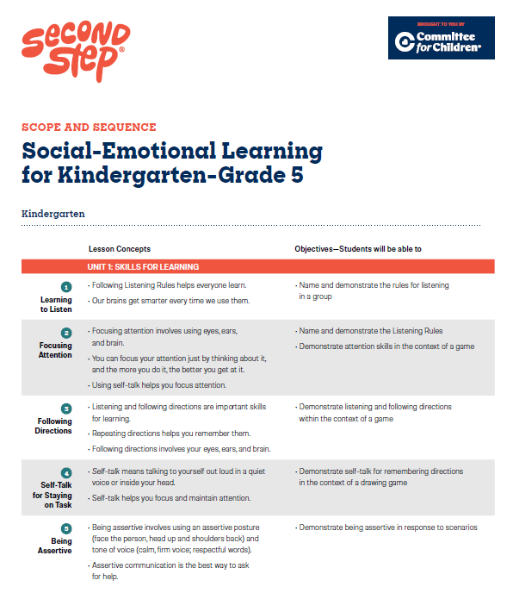
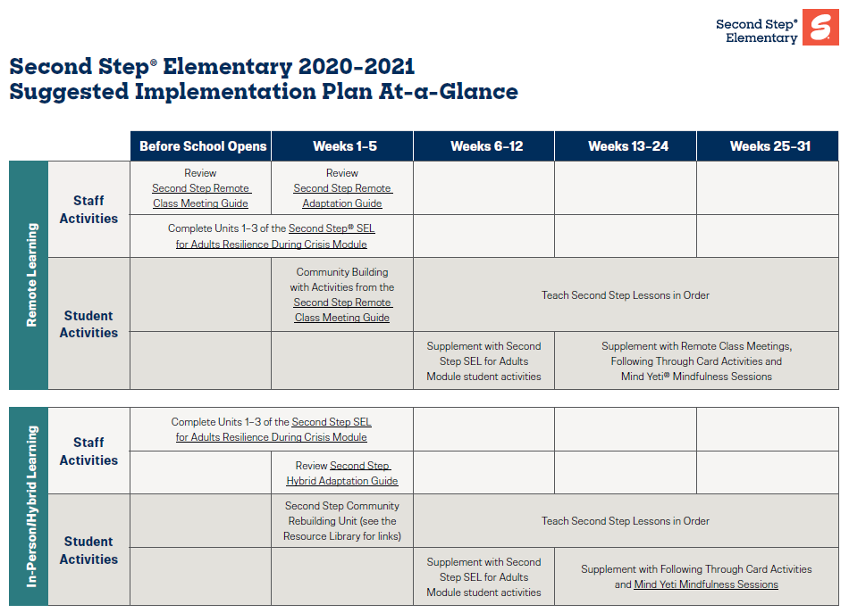
Social-Emotional Well-being
Area II: Academics Responsibilities Faculty and Staff: Teach core programs according to district and state standards with integrity: Use teacher-delivered, low-intensity strategies to support students’ active engagement | Area II: Behavior Responsibilities Faculty and Staff: Implement Positive Behavioral Interventions and Supports (PBIS) with integrity. Teach all setting Expectations within the first week of school and reteach Expectations (monthly). Display and model school-wide expectations in classrooms and other key settings. Implement the reactive plan with integrity. | Area II: Social Responsibilities Faculty and Staff: Teach schoolwide social skills/ character education curricula with integrity: Teach daily Second Step ® lessons (link to grade level instructional schedules) Seek ways to engage parents as partners in the school program

Slide 66
What do I need to know?
Ci3T Exemplar - Elementary

Slide 67
Rolling out at Tier 1: Social Skills
Reviewing Roles & Responsibilities
  What do I need to know?
Procedures for Teaching
  How am I doing with teaching the validated social skills curriculum?
Procedures for Reinforcing
  How have I been reinforcing students for meeting expectations?
Procedures for Monitoring
  How am I doing with implementation?
Questions & Considerations?
Successes!

Slide 68
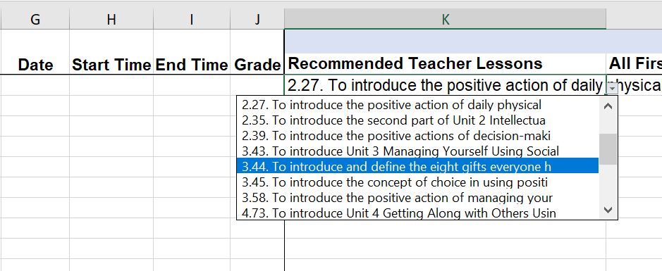
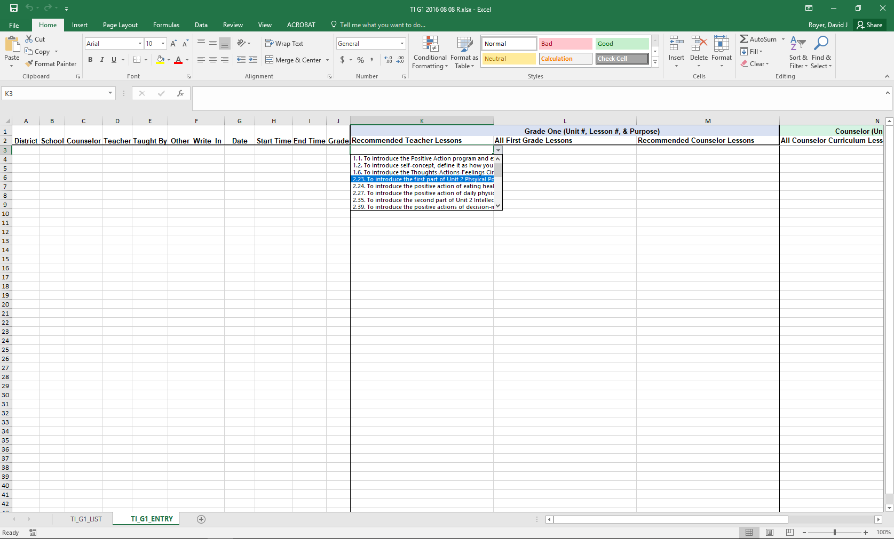
Treatment Integrity:
Tracking Lessons Taught
Example social skills lesson implementation tracker

Slide 69
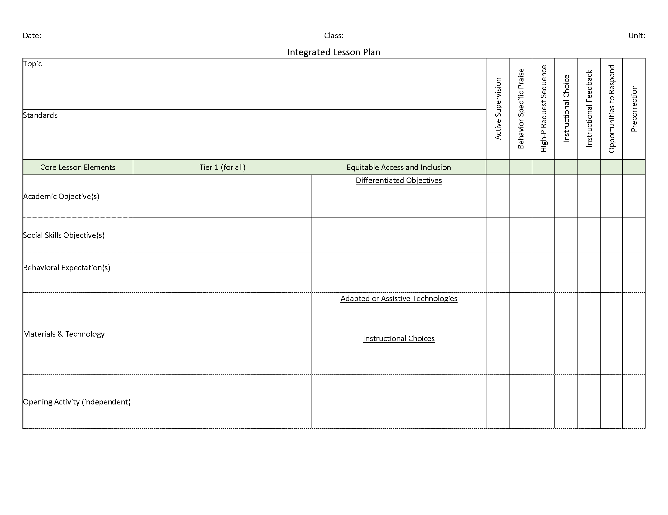
Social-Emotional Well-being
Area II: Academics Responsibilities Faculty and Staff: Teach core programs according to district and state standards with integrity: Use teacher-delivered, low-intensity strategies to support students’ active engagement | Area II: Behavior Responsibilities Faculty and Staff: Implement Positive Behavioral Interventions and Supports (PBIS) with integrity. Teach all setting Expectations within the first week of school and reteach Expectations (monthly). Display and model school-wide expectations in classrooms and other key settings. Implement the reactive plan with integrity. | Area II: Social Responsibilities Faculty and Staff: Teach schoolwide social skills/ character education curricula with integrity: Teach daily Second Step ® lessons (link to grade level instructional schedules) Seek ways to engage parents as partners in the school program

Slide 70
Let’s talk… and make plans!
Reviewing Roles & Responsibilities
(across academic, behavioral, and social-emotional well-being domains)
  What do our faculty and staff need to know?
Procedures for Teaching
  How am I doing with using low-intensity supports?
  How am I doing with teaching expectations for specific settings?
  How am I doing with teaching the validated social skills curriculum?
Procedures for Reinforcing
  How have I been reinforcing students for meeting expectations?
Procedures for Monitoring
  How am I doing with implementation?
Questions & Considerations?
Notes:
15-min timer

Slide 71
Implementing Your Primary (Tier 1) Prevention Efforts
Rolling out Tier 1
Implementing Procedures

Slide 72
Procedures for Teaching
Faculty and Staff
Students
Families and Community
Notes:
More than preventing problem behavior from occurring.
Lewis, T. J., Powers, L. J., Kely, M. J., & Newcomer, L. L. (2002). Reducing problem behaviors on the playground: An investigation of the application of schoolwide positive behavior supports. Psychology in the Schools, 39(2), 181-190;
Turnbull, A., Edmonson, H., Griggs, P., Wickham, D., Sailor, W., Freeman, R., ... & Riffel, L. (2002). A blueprint for schoolwide positive behavior support: Implementation of three components. Exceptional Children, 68(3), 377-402.

Slide 73
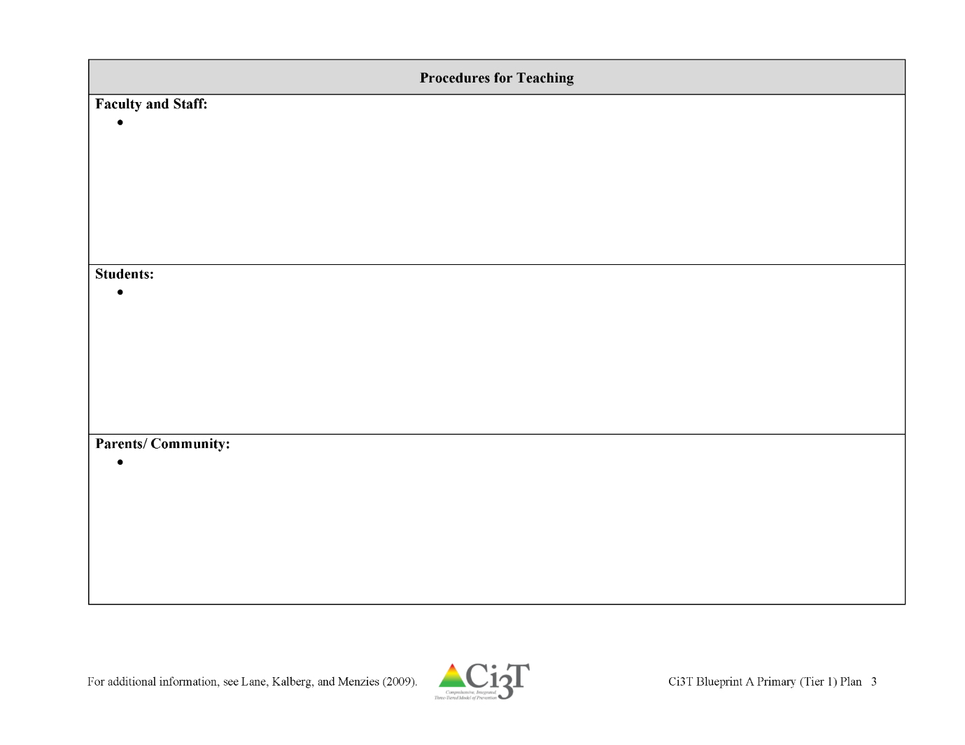


Locate in your Ci3T Implementation Manual

Slide 74
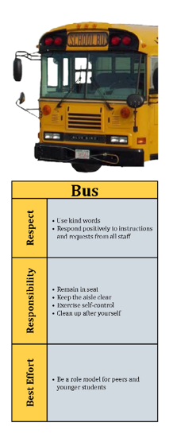

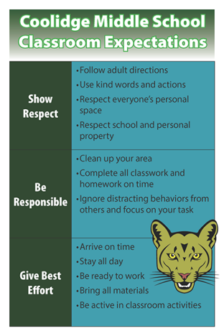
How will primary prevention (Tier 1) efforts be taught to all stakeholders?
Faculty and Staff
  Implementation manual
  Expectation matrix
  Bookmarks
  Collaborative teams
  Posters
  Ticket tip sheet
  Professional learning
Students
  Lessons
  Posters
  Videos
Parents and Community
  Letters to parents
  Contacts with community businesses
Shared with permission.
Notes:
Lessons: setting expectations, social skills
Posters: setting expectations, full expectation matrix

Slide 76
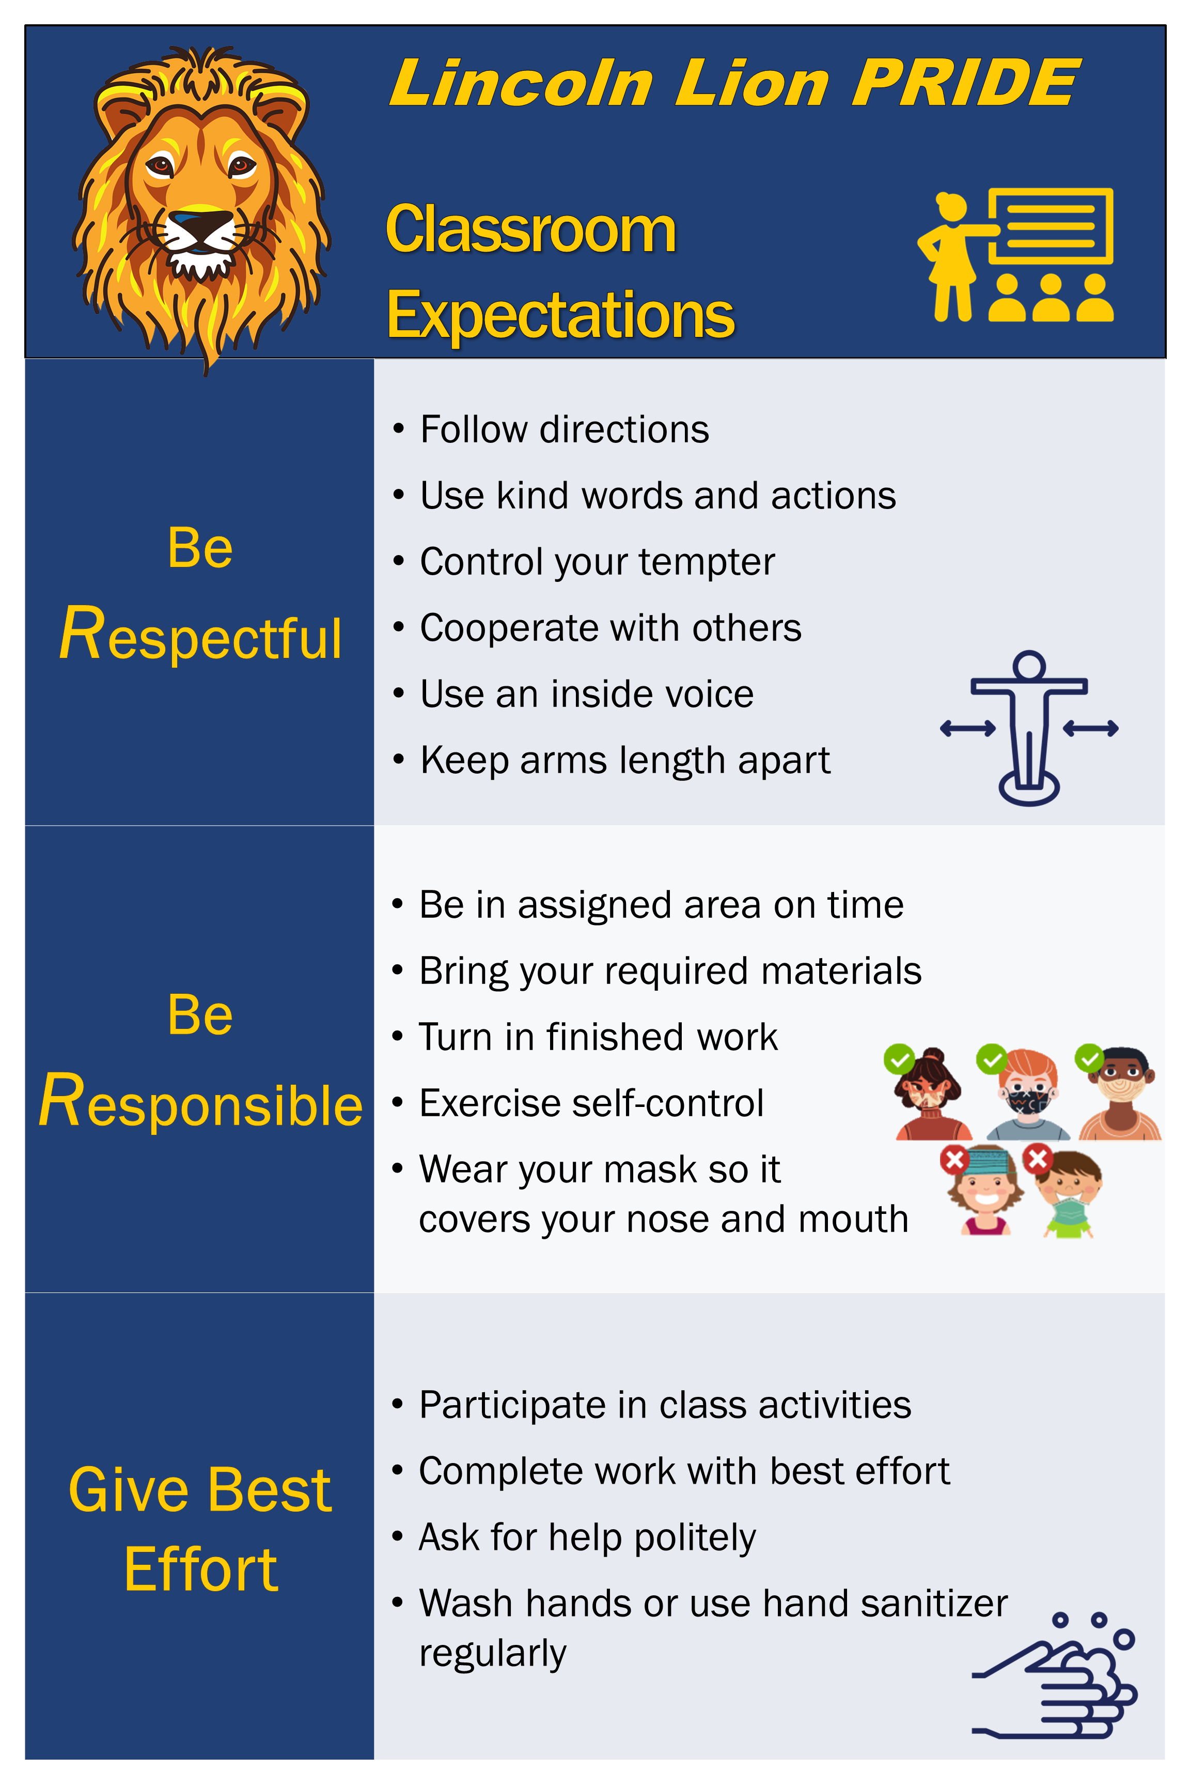
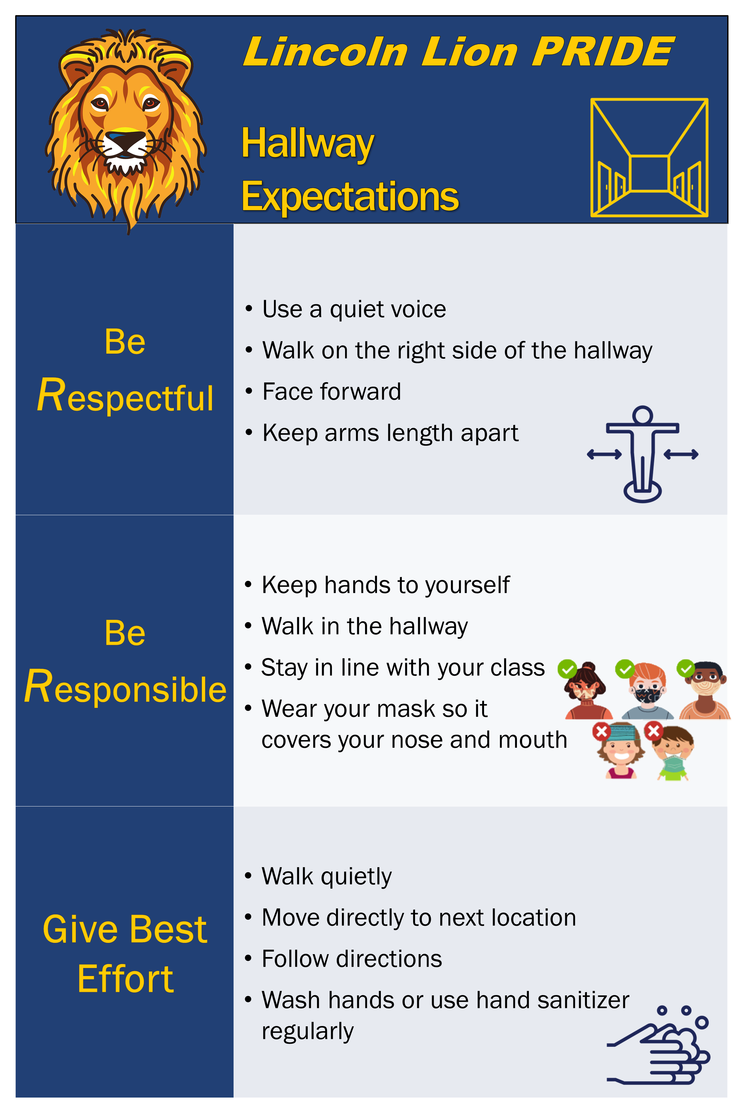

Slide 77
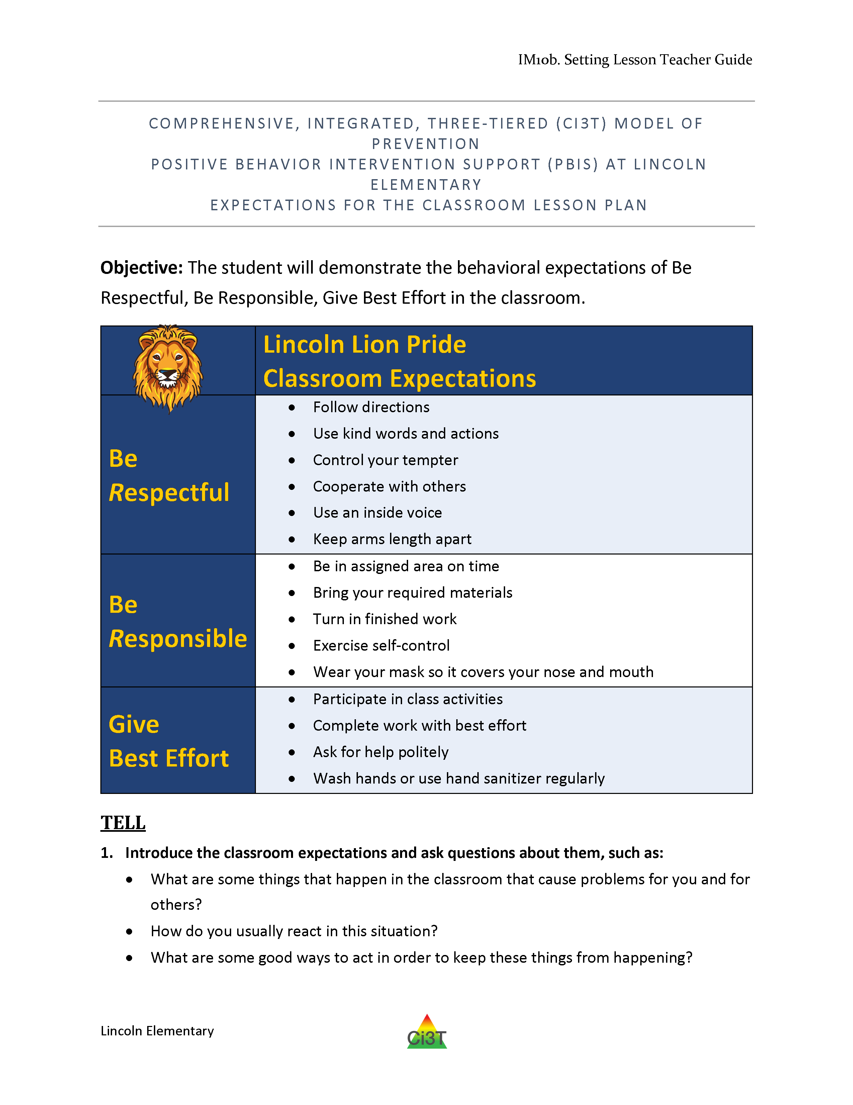
Tell
Show
Do
Practice & Follow Through

Slide 78
Tell
Show
Do
Define behaviors and discuss key terms
Practice & Follow Through
Discuss why behaviors are important

Slide 79
Tell
Show
Do
Practice & Follow Through
Explain and model examples
Explain and model non-examples
Discuss hypothetical situations

Slide 80
Tell
Show
Do
Practice & Follow Through
Students explain why expectations are important
Students think of ways to help them remember expectations
Students restate expectations

Slide 81
Tell
Show
Do
Practice & Follow Through
Students rehearse demonstrating expectations
Students practice in hypothetical situations
Incidental teaching
Reinforce!

Slide 82




Other ideas…
Videos
Announcements
Virtual assemblies
Link teaching of classroom routines to school-wide expectations

Slide 83


Integrated lesson planning is a core feature of Ci3T. Please visit https://www.ci3t.org/covid to learn more!

Slide 84







Locate in your Ci3T Implementation Manual
Procedures for Reinforcing
Faculty and Staff:
Students: ROAR zone Parking spaces
Parents/ Community:
Donation Coupon:
1 box of Macaroni and Cheese to Community Food Drive

Slide 85
Procedures for Reinforcing
How will you reinforce?
Faculty and staff for
  Participation and support
  Modeling schoolwide expectations
  Taking an instructional approach to behavior
  Implementing the Ci3T plan with fidelity
  Making instructional shifts in traditional practices
Students for
  Demonstrating the expectations across
  academic, behavioral, and social skill domains
Parents and community for
  Communication with school staff
  Reinforcing expectations
  Supporting the social skills lessons at home and in the community
Notes:
4

Slide 86




What is reinforcement?
Consequence
Behavior
Consequence
Increases likelihood of future occurrence
Strengthens behavior

Slide 87
What is reinforcement?
Positive
(Access)
Negative
(Avoid)
ALERT
Negative reinforcement is not punishment

Slide 88

What’s in a ticket?
“An object awarded contingent on appropriate behavior and that serves as the medium of exchange for…reinforcers”
-Cooper, Heron, & Heward (2020)
Tickets are a tool for
communicating
successful use of a behavior

Slide 89


Templates & Resources
https://www.ci3t.org/building

Slide 90

Templates & Resources
https://www.ci3t.org/building

Slide 91




Templates & Resources
https://www.ci3t.org/building

Slide 92



In future years, consider alternative program goals.
80% of students meeting reading and math targets on assessments
Locate in your Ci3T Implementation Manual

Slide 93

Essential Components of
Primary Prevention Efforts
Social Validity
Systematic Screening
Academic
Behavior
Treatment Integrity
ci3t.org/measures

Slide 94


Slide 95




Why monitor implementation?
Do our students have access to Tier 1?
What are our strengths and areas for growth?
What professional learning opportunities can we give our staff?
How can we improve our plan?

Slide 96

Social Validity & Treatment Integrity
Schools will receive fall and spring reports outlining:
…faculty and staff opinions about the Ci3T plan at the start of the year and after it has been implemented for the majority of the school year.
…degree to which the practices of your Ci3T plan are being implemented.

Slide 97
Social Validity
How do stakeholders view the plan?
Social validity refers to the level of:
Social significance of intervention goals
Social acceptability of intervention procedures
Social importance of intervention outcomes
(Wolf, 1978)
Assessed using the Primary Intervention Rating Scale (PIRS)
Social Validity: PIRS Results
Year | Fall |  | Spring
 | n | % (SD) | n | % (SD)
2020-2021 | 32 | 85.39 (8.89) | TBD | TBD

Slide 98

Treatment Integrity
Is Ci3T being implemented as planned?
Three measures of treatment integrity:
Ci3T Treatment Integrity: Teacher Self-Report (Ci3T TI: TSR)
Ci3T Treatment Integrity: Direct Observation (Ci3T TI: DO)
Tiered Fidelity Inventory (TFI)

Slide 99


Treatment Integrity

Slide 100
Let’s talk… and make plans!
Review your Ci3T Implementation Manual
Do faculty and staff have access to the plan?
How did you teach roles and responsibilities to each stakeholder?
How will you review and reteach the plan?
How do you plan to teach and re-teach expectations to students?
How are behavior-specific praise and tickets being used in your school?
What types of reinforcers are most meaningful to your students?
How do you plan to adjust reinforcement rates?
How will you involve your student leaders?
Write any action items in your IM18 agenda
How will you know what faculty and staff think about Tier 1 efforts?
How will you know if Tier 1 is happening?
How will you know how students are responding?
What resources are needed to support our faculty and staff in Tier 1 implementation?
What can our Ci3T leadership team provide?
Notes:
15-min timer

Slide 101

Preparing to Collect Treatment Integrity Data
Preview: Ci3T Treatment Integrity Team Leader Training

Slide 102
Wrapping Up and Moving Forward

Slide 103

RCT
Traditional Ci3T Implementation Series and Deliver (T-Ci3T)
Project ENHANCE T-Ci3T Ci3T Implementation Series and Delivery Location: Remote via Zoom Attended by: Washington and South Carolina School Ci3T Leadership Teams Ci3T District Trainers and Coaches |  | Times (Pacific) | Times (Central) | Time (Eastern)
 | Date
Ci3T Implementers Symposium (summer session) | Jun. 22, 2023 (Th) | 7:30 – 1:30 | 9:30 – 3:30 | 10:30 – 4:30
Session 1 | Sept. 12, 2023 (Tu) | 9:00-11:00 | 11:00-1:00 | 12:00-2:00
Session 2 | Nov. 7, 2023 (Tu) | 9:00-11:00 | 11:00-1:00 | 12:00-2:00
Session 3 | Jan. 16, 2024 (Tu) | 9:00-11:00 | 11:00-1:00 | 12:00-2:00
Session 4 | Mar. 5, 2024 (Tu) | 9:00-11:00 | 11:00-1:00 | 12:00-2:00
Session 5 | Apr. 16, 2024 (Tu) | 9:00-11:00 | 11:00-1:00 | 12:00-2:00

Slide 104
Ci3T
Comprehensive Professional Learning Plan
Ci3T: Primary Prevention
Session 1:
Overview of Ci3T Prevention Models
Setting a Purpose
Establish team meetings and roles
Session 2:
Mission and Purpose
Establish Roles and Responsibilities
Procedures for Teaching
Procedures for Reinforcing
Reactive Plan
Session 3:
Procedures for Monitoring
Session 4:
Revise Primary Plan using Stakeholder feedback
Prepare presentation
Ci3T: Secondary Prevention
Session 5:
Overview of Teacher focused Strategies
Overview of Student Focused Strategies
Using data to determine which students may need Secondary (Tier 2) supports
Draft the Secondary Intervention Grid based on existing supports
Ci3T: Tertiary Prevention
Session 6:
Final revisions of Ci3T Plan based on stakeholder feedback
Draft Tertiary (Tier 3) Prevention Intervention Grids
Design Implementation Manual and Plan for roll out to faculty, students, and parents
Ci3T Leadership Team Training Sequence
Implementation Stages of Tier 2 and 3 within Ci3T
Additional Professional Development on Specific Topics
Core Content Curriculum
Check In - Check Out
Functional Assessment-based Interventions
Reading, Math, Writing Benchmarking and Progress Monitoring Tools
Interventions, Strategies, & Practices
Additional Tier 3 Supports
Instructional Techniques to Improve Students’ Motivation; Classroom Management Practices;
Low-Intensity Behavior Supports

Slide 105
Ci3T Professional Learning Calendar
 | July | Aug | Sep | Oct | Nov | Dec | Jan | Feb | Mar | Apr | May | Jun
Ci3T Training |  |  |  |  | Ci3T Professional Learning Series Session 1 | Ci3T Professional Learning Series Session 2 | Ci3T Professional Learning Series Session 3 | Ci3T Professional Learning Series Session 4 |  | Ci3T Professional Learning Series Session 5 | Ci3T Professional Learning Series Session 6
Ci3T Implementation Support | Ci3T Implementation Series Prep Session |  | Ci3T Implementation Series Session 1 |  | Ci3T Implementation Series Session 2 |  | Ci3T Implementation Series Session 3 |  | Ci3T Implementation Series Session 4 | Ci3T Implementation Series Session 5
Ci3T EMPOWER |  |  | Ci3T EMPOWER Session 1 | Ci3T EMPOWER Session 2 | Ci3T EMPOWER Session 3 |  | Ci3T EMPOWER Session 4 |  | Ci3T EMPOWER Session 5 | Ci3T EMPOWER Session 6
Ci3T Trainers & Coaches Calls |  | Trainers & Coaches Call Session 1 | Trainers & Coaches Call Session 2 | Trainers & Coaches Call Session 3 | Trainers & Coaches Call Session 4 | Trainers & Coaches Call Session 5 | Trainers & Coaches Call Session 6 | Trainers & Coaches Call Session 7 | Trainers & Coaches Call Session 8 | Trainers & Coaches Call Session 9 | Trainers & Coaches Call Session 10

Slide 106
Wrap Up and Preview
Today
Next time
Scheduling for Success
Implementing Your Primary
(Tier 1) Prevention Efforts
Preparing to Collect Treatment Integrity Data
  Ci3T Treatment Integrity Team Leader Training
Preparing to Collect and Use Social Validity & Treatment Integrity Data
Using Fall Screening Data to Inform Instruction
Facilitating Clear Communication and Collaborations with Stakeholders

Slide 107

Homework
Consider sending calendar invites for each
action item due date on your agenda
Send the agenda to team members in a week-before reminder email to give time to finish action items
At your next Ci3T Leadership Team meeting:
  Use IM18 Ci3T Leadership Team Meeting Agenda to conduct an effective meeting with
    clearly defined roles and responsibilities of team members
    action items, persons responsible, and due dates
At your next faculty meeting:
  Share successes
  Review implementation procedures

Slide 108



Comprehensive, Integrated, Three-tiered (Ci3T) Model of Prevention
Thank you!
Notes:
Tag us in your Ci3T highlights- we’d love to see Ci3T in action! Follow us on Twitter or Instagram for updates and links to resources! @Ci3TModel
You will receive a brief session evaluation – we value your feedback and would greatly appreciate you taking a few minutes to share your thoughts on what you liked about the session and how we can improve

