Slide 1
Setting up for Success with Ci3T
Presenters and Contributors | Contributors
Allison M. Bernard | Elise Sarasin
Mark M. Buckman | Rebecca L. Sherod
Kathleen Lynne Lane | Stacie Williams
Wendy Peia Oakes

Slide 2
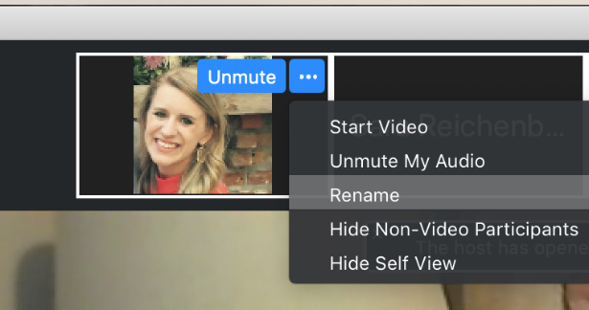
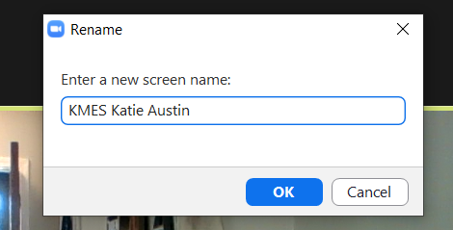
Renaming:
School Initials + First and Last Name
To help us put you in breakout rooms …
1. Click the three dots at the top
right corner of your video square.
2. Rename yourself with your
school initials then first and last name.

Slide 4
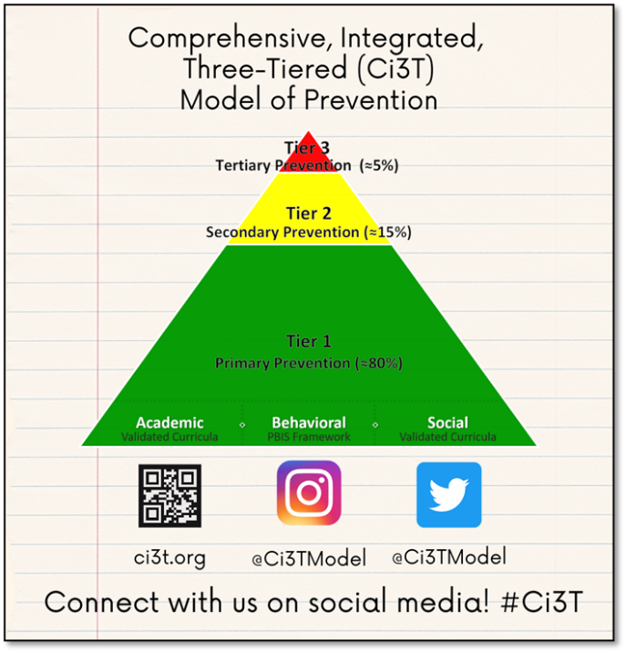
Let’s Connect on Social Media!
Tag us in your Ci3T highlights- we’d love to see Ci3T in action!
Follow us on Twitter or Instagram for updates and links to resources!
  @Ci3TModel

Slide 5
Ci3T Professional Learning Calendar
 | July | Aug | Sep | Oct | Nov | Dec | Jan | Feb | Mar | Apr | May | Jun
Ci3T Training |  |  |  |  | Ci3T Professional Learning Series Session 1 | Ci3T Professional Learning Series Session 2 | Ci3T Professional Learning Series Session 3 | Ci3T Professional Learning Series Session 4 |  | Ci3T Professional Learning Series Session 5 | Ci3T Professional Learning Series Session 6
Ci3T Implementation Support | Ci3T Implementation Series Prep Session |  | Ci3T Implementation Series Session 1 |  | Ci3T Implementation Series Session 2 |  | Ci3T Implementation Series Session 3 |  | Ci3T Implementation Series Session 4 | Ci3T Implementation Series Session 5
Ci3T EMPOWER |  |  | Ci3T EMPOWER Session 1 | Ci3T EMPOWER Session 2 | Ci3T EMPOWER Session 3 |  | Ci3T EMPOWER Session 4 |  | Ci3T EMPOWER Session 5 | Ci3T EMPOWER Session 6
Ci3T Trainers & Coaches Calls |  | Trainers & Coaches Call Session 1 | Trainers & Coaches Call Session 2 | Trainers & Coaches Call Session 3 | Trainers & Coaches Call Session 4 | Trainers & Coaches Call Session 5 | Trainers & Coaches Call Session 6 | Trainers & Coaches Call Session 7 | Trainers & Coaches Call Session 8 | Trainers & Coaches Call Session 9 | Trainers & Coaches Call Session 10

Slide 6
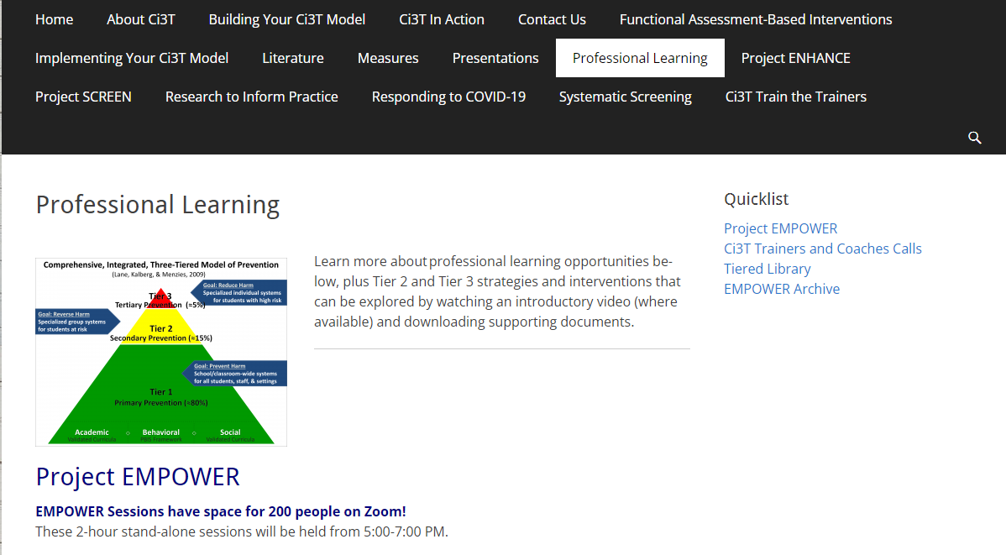
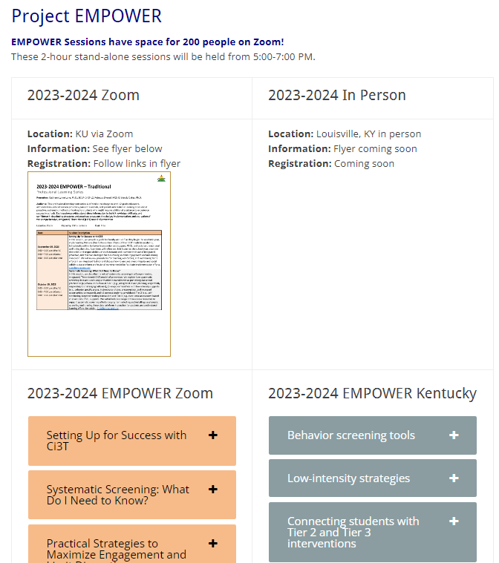
Accessing Project EMPOWER Professional Learning

Slide 7
Agenda
Welcome
Overview of Ci3T
Rolling out your Ci3T Plan … Sharing Success!
Implementing Tier 1
  Academics
  Behavior: Positive Behavior Interventions and Support (PBIS)
  Social and Emotional Well-being: Your Validated Curricula and Resources
Procedures for …
  Teaching
  Reinforcing
  Monitoring
Wrapping Up and Moving Forward

Slide 8
Welcome

Slide 9

Thank you for your commitment
Shift to a systems level perspective
Internalizing
Externalizing
ED <1%
EBD 12-20%
Source: Forness, S.R., Freeman, S.F., Paparella, T., Kauffman, J.M., & Walker, H.M. (2012). Special education implications of point and cumulative prevalence for children with emotional or behavioral disorders. Journal of Emotional and Behavioral Disorders, 20, 4-18.

Slide 10




The Journey of Ci3T: Respectful Partnerships
1997
Notes:
CA & AZ start→ Tennessee → North Carolina→ Kansas
Trainings (MO, KANSAS, VERMONT, AZ)
MO, KS, UAB
HI

Slide 12
Overview of Ci3T

Slide 14
Primary (Tier 1) Prevention
All students are eligible for participation
(Lane, Robertson et al., 2006)
About 80% of students respond to this level
(Gresham, Sugai, Horner, Quinn, & McInerney, 1998; Sugai & Horner, 2006)
Examples of primary (Tier 1) prevention
  Validated literacy curricula
  Violence prevention
  Conflict resolution programs
  Anti-bullying programs
  Schoolwide social skills instruction
  Character education programs
Notes:
Sources: Gresham, F. M., Sugai, G., Horner, R. H., Quinn, M. M., & McInerney, M. (1998). Classroom and schoolwide practices that support students’ social competence: A synthesis of research. Washington, DC: Office of Special Education Programs.
Lane, K. L., Robertson, E. J., & Graham-Bailey, M. A. L. (2006). An examination of school-wide interventions with primary level efforts conducted in secondary schools: Methodological considerations. In T. E. Scruggs & M. A. Mastropieri (Eds.) Applications of research methodology: Advances in learning and behavioral disabilities (Vol. 19), pp. 157-199. Oxford, UK: Elsevier.
Sugai, G., & Horner, R.R. (2006). A promising approach for expanding and sustaining school-wide positive behavior support. School psychology review, 35, 245.

Slide 15
Secondary (Tier 2) Prevention
Students who need more than the primary prevention plan, 10-15% of students
Focused intervention to address academic, behavior, and/or social concerns
  Acquisition (can’t do)
  Fluency (trouble doing)
  Performance (won’t do)
Examples of secondary (Tier 2) prevention
  Small group instruction in anger management
  Reading comprehension strategies
Notes:
Source: Lane, K.L., Oakes, W.P., Ennis, R.P., & Hirsch, S.E. (2014). Identifying students for secondary and tertiary prevention efforts: How do we determine which students have tier 2 and tier 3 needs? Preventing School Failure, 58, 171-182.

Slide 16
Tertiary (Tier 3) Prevention
Students who need more than primary or secondary prevention, 5-7% of students
Intensive individualized interventions
Examples of tertiary (Tier 3) prevention
  Functional assessment-based interventions
  (Umbreit, Ferro, Liaupsin, & Lane, 2007)
  Multisystemic therapy program
  (Schoenwald, Brown, & Henggeler, 2000)
Notes:
Sources: Lane, K.L., Oakes, W.P., Ennis, R.P., & Hirsch, S.E. (2014). Identifying students for secondary and tertiary prevention efforts: How do we determine which students have Tier 2 and Tier 3 needs? Preventing School Failure, 58, 171-182.
Schoenwald, S. K., Brown, T. L., & Henggeler, S. W. (2000). Inside multisystemic therapy therapist, supervisory, and program practices. Journal of Emotional and Behavioral Disorders, 8, 113-127.
Umbreit, J., Ferro, J.B., Liaupsin, C.J., & Lane, K.L. (2007). Functional behavioral assessment and function-based intervention: An effective, practical approach. Upper Saddle River, NJ: Prentice-Hall.

Slide 17

Core Features

Slide 18
Core features of the Ci3T model of prevention
Academic
Behavior
Social

Slide 19

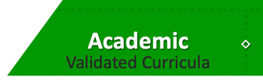
Academic Component
Coordinated instruction within and across grade levels
Instruction linked to College and Career-Ready Standards, early learning standards, state, or district standards
Benchmarking student progress to inform instruction
Progress monitoring for students identified for secondary (Tier 2) and tertiary (Tier 3) supports

Slide 20
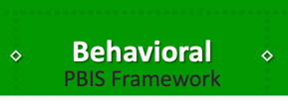
Behavioral Component
A Framework,
Not a Curriculum
Positive Behavioral Interventions and Supports (PBIS)
  Establish, clarify, and define expectations
  Teach all students the expectations, planned and implemented by all adults in the school
  Give opportunities to practice
  Reinforce students consistently, facilitate success
  Consider rules, routines, and physical arrangements
  Monitor the plan using school-wide data to identify students who need more support
  Monitor student progress

Slide 21
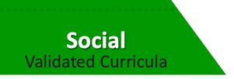
Social Component:
Identifying a Validated Curriculum
Violence Prevention
  Second Step Violence Prevention (www.cfchildren.org)
Character Education
  Positive Action (www.positiveaction.net)
  Caring School Community (www.characterplus.org)
Social Skills
  Social Skills Improvement System: Classwide Intervention Program (Elliott & Gresham, 2007)

Slide 22



Ci3T Implementation Manual

Slide 23
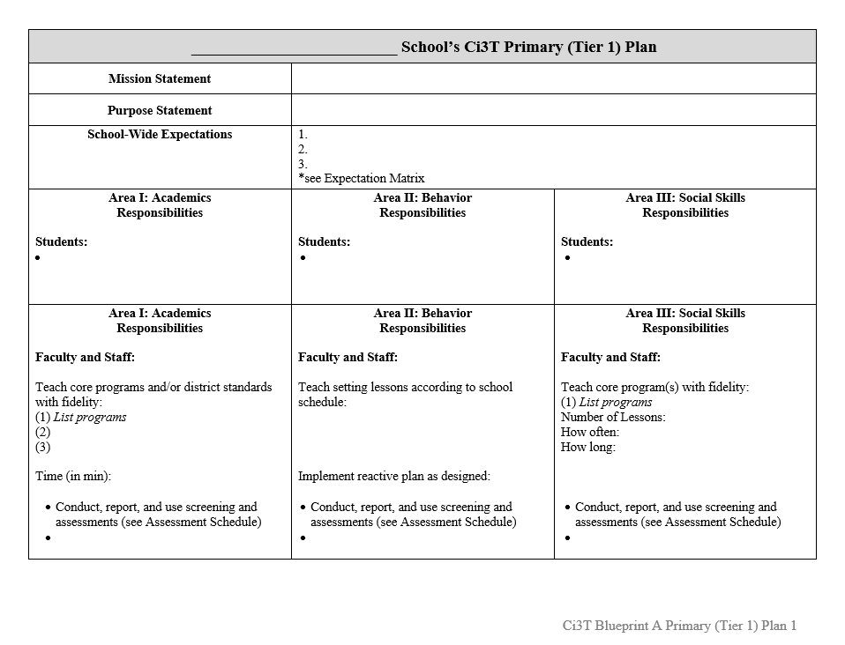
Ci3T Implementation Manual Primary (Tier 1) Plan
What are ALL students accessing?

Slide 24
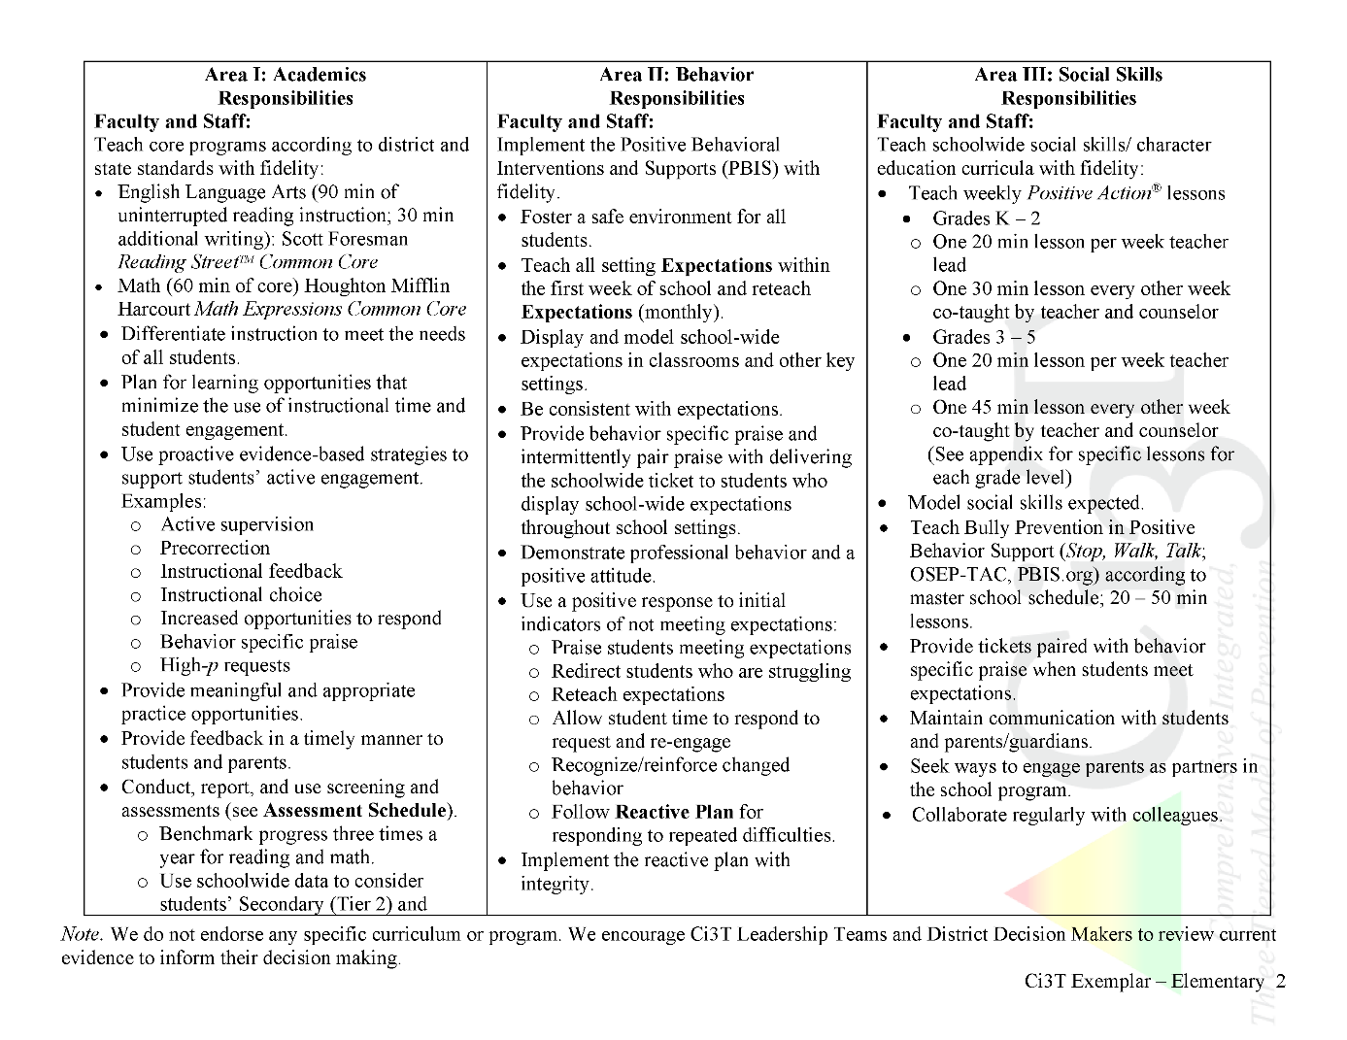
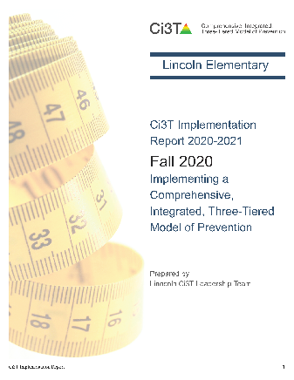


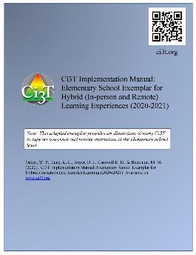
Ci3T Primary Plan: Procedures for Teaching
Ci3T Primary Plan: Procedures for Reinforcing
Ci3T Primary Plan: Procedures for Monitoring
Notes:
Continued to keep implementation manuals, which are foundational to Ci3T, updated and current

Slide 25


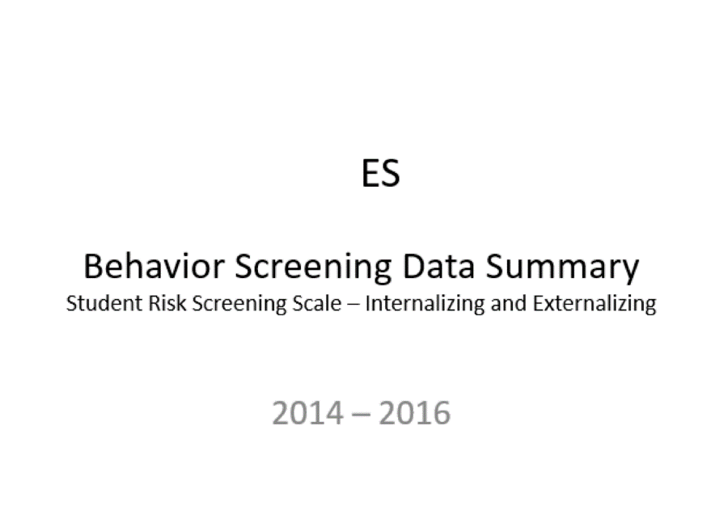
Essential Components of
Primary Prevention Efforts
Social Validity
Systematic Screening
Academic
Behavior
Treatment Integrity

Slide 26


Slide 27


Slide 28
Rolling out Your Ci3T Plan…
Sharing Successes!

Slide 29
Rolling out the plan to Ci3T Stakeholders
Faculty and Staff
Students
Families and Community

Slide 30
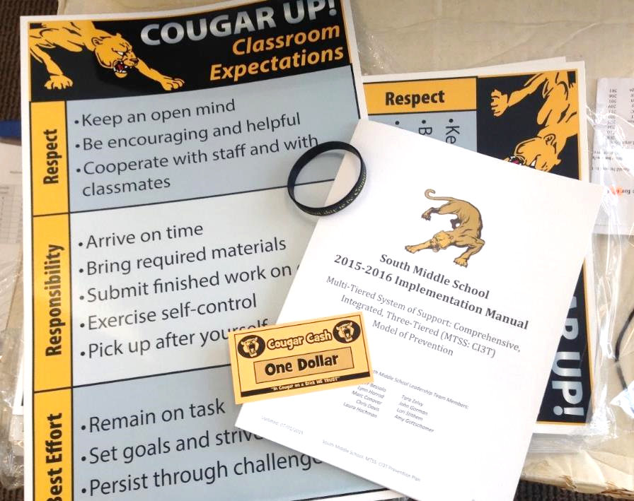
Ci3T Faculty and Staff Orientation

Slide 32
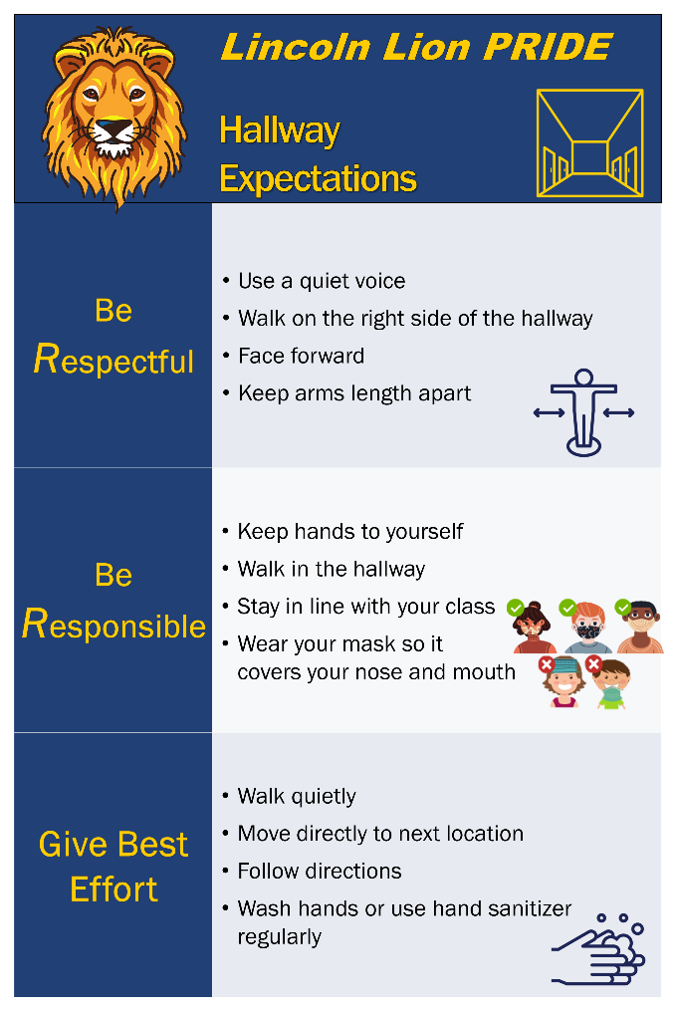
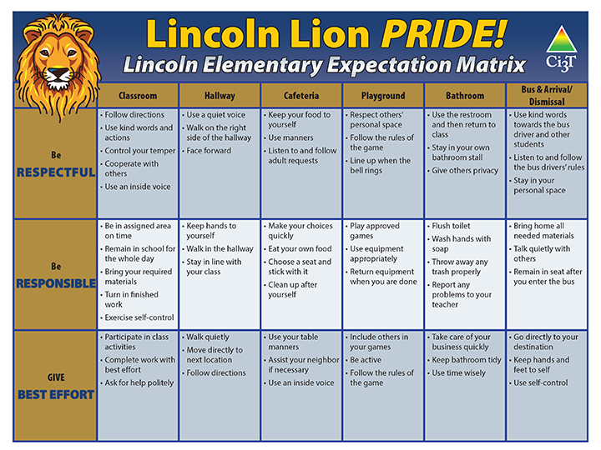
Post up!
Ci3T Signage

Slide 33



Start the Year Off with Excitement!
Kick-off Assemblies

Slide 34
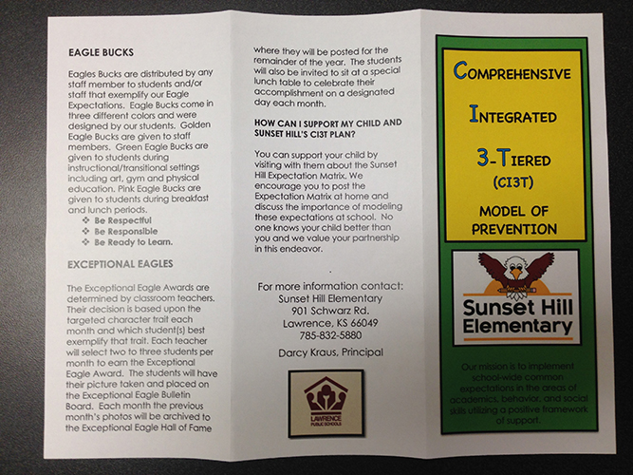
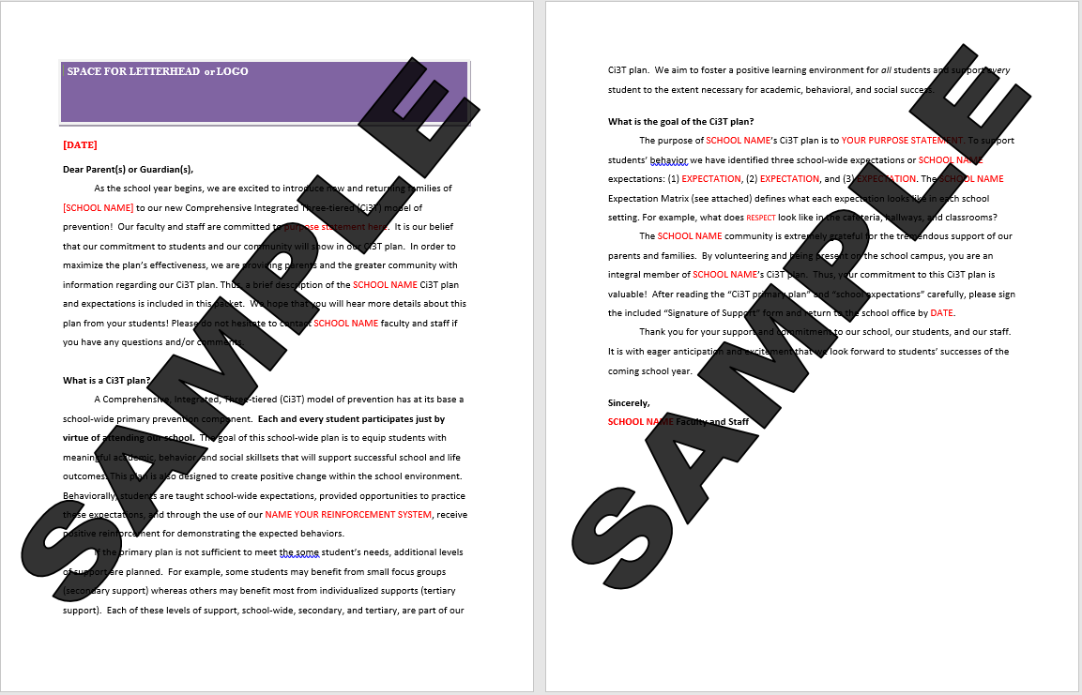
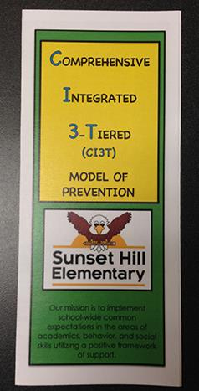
Ci3T Sharing with Parents and Families

Slide 35
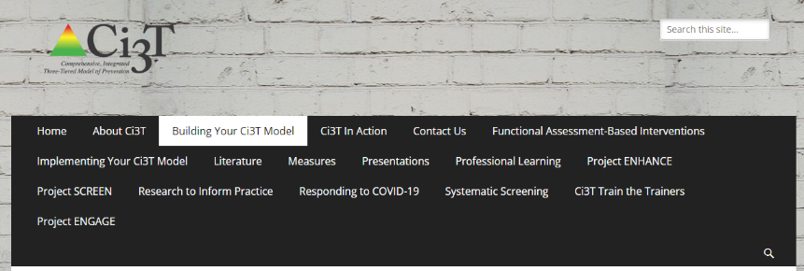
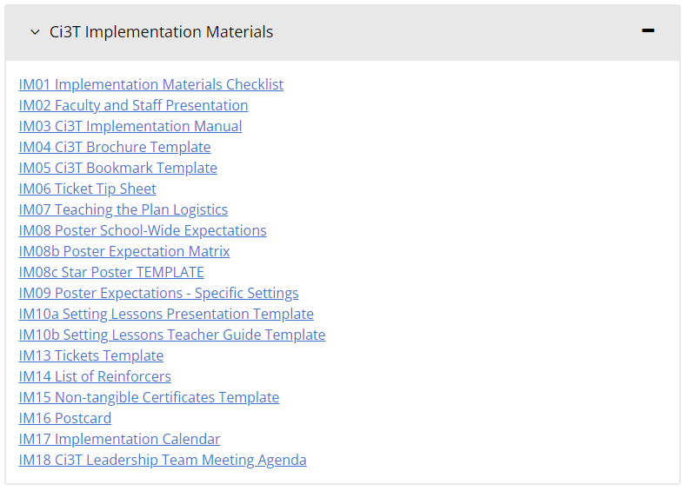
Templates & Resources
https://www.ci3t.org/building

Slide 36
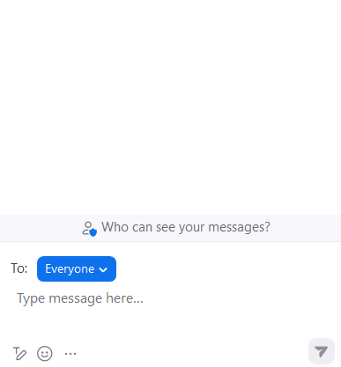
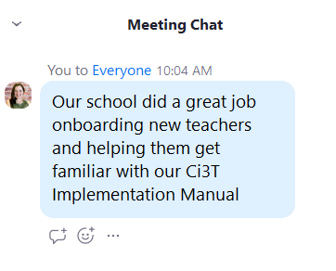


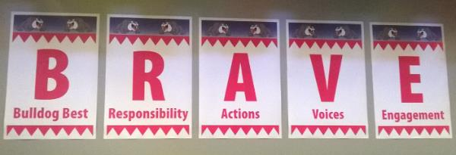
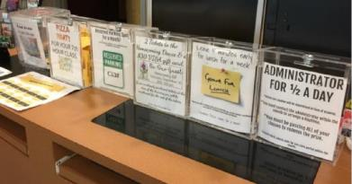
Rolling out Your Plan … Sharing Successes!
Do you know where your Ci3T Implementation Manual is located?
What have you seen done well at your building?
What are you looking forward to in the coming year?

Slide 37
Implementing Tier 1…
Teaching
Reinforcing
Monitoring
Academics
Behavior: Positive Behavior Interventions and Supports (PBIS)
Social and Emotional Well-being: Your Validated Curricula and Resources

Slide 38
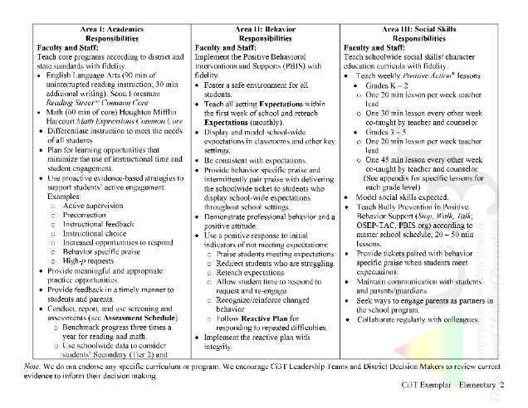
Rolling out at Tier 1: Academic Domain
Teaching
Reinforcing
Monitoring

Slide 39

Academics
Area II: Academics Responsibilities Faculty and Staff: Teach core programs according to district and state standards with integrity Use teacher-delivered, low-intensity strategies to support students’ active engagement | Area II: Behavior Responsibilities Faculty and Staff: Implement Positive Behavioral Interventions and Supports (PBIS) with integrity. Teach all setting Expectations within the first week of school and reteach Expectations (monthly). Display and model school-wide expectations in classrooms and other key settings. Implement the reactive plan with integrity. | Area II: Social Responsibilities Faculty and Staff: Teach schoolwide social skills/ character education curricula with integrity: Teach daily Second Step ® lessons (link to grade level instructional schedules) Seek ways to engage parents as partners in the school program

Slide 40

Academics
Opportunities to Respond
Area II: Academics Responsibilities Faculty and Staff: Teach core programs according to district and state standards with integrity Use teacher-delivered, low-intensity strategies to support students’ active engagement | Area II: Behavior Responsibilities Faculty and Staff: Implement Positive Behavioral Interventions and Supports (PBIS) with integrity. Teach all setting Expectations within the first week of school and reteach Expectations (monthly). Display and model school-wide expectations in classrooms and other key settings. Implement the reactive plan with integrity. | Area II: Social Responsibilities Faculty and Staff: Teach schoolwide social skills/ character education curricula with integrity: Teach daily Second Step ® lessons (link to grade level instructional schedules) Seek ways to engage parents as partners in the school program
Behavior-Specific Praise
Active Supervision
Instructional Feedback
High-p Requests
Precorrection
Incorporating Choice

Slide 41
What do I need to know?
Ci3T Exemplar - Elementary

Slide 42
Rolling out at Tier 1: Academics
Reviewing Roles & Responsibilities
  What do I need to know?
Procedures for Teaching
  How am I doing with using low-intensity supports?
Procedures for Reinforcing
  How have I been reinforcing students for meeting expectations?
Procedures for Monitoring
  How am I doing with implementation?
Questions & Considerations?
Successes!

Slide 43
Rolling out at Tier 1: Behavioral Domain
Teaching
Reinforcing
Monitoring

Slide 44
Behavioral
Area II: Academics Responsibilities Faculty and Staff: Teach core programs according to district and state standards with integrity: Use teacher-delivered, low-intensity strategies to support students’ active engagement | Area II: Behavior Responsibilities Faculty and Staff: Implement Positive Behavioral Interventions and Supports (PBIS) with integrity. Teach all setting Expectations within the first week of school and reteach Expectations (monthly). Display and model school-wide expectations in classrooms and other key settings. Implement the reactive plan with integrity. | Area II: Social Responsibilities Faculty and Staff: Teach schoolwide social skills/ character education curricula with integrity: Teach daily Second Step ® lessons (link to grade level instructional schedules) Seek ways to engage parents as partners in the school program

Slide 45
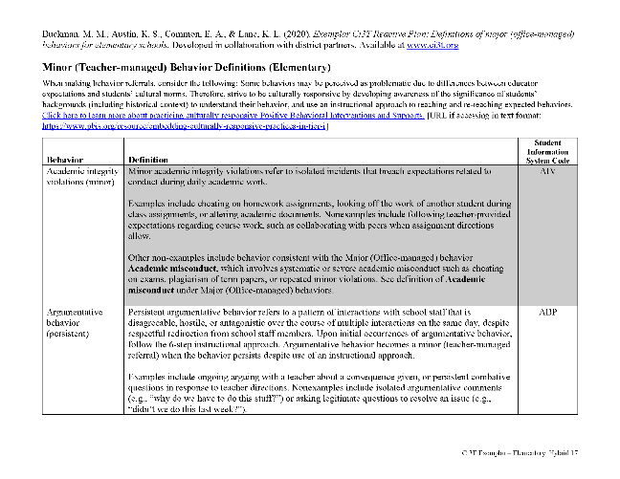
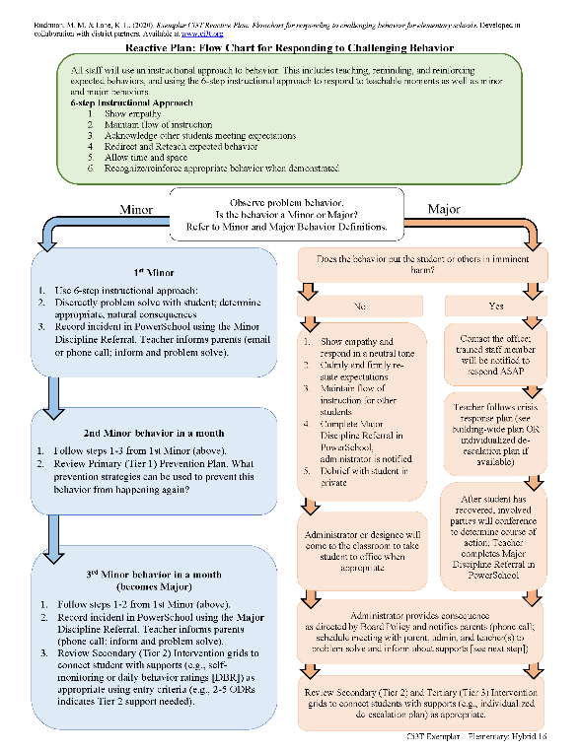
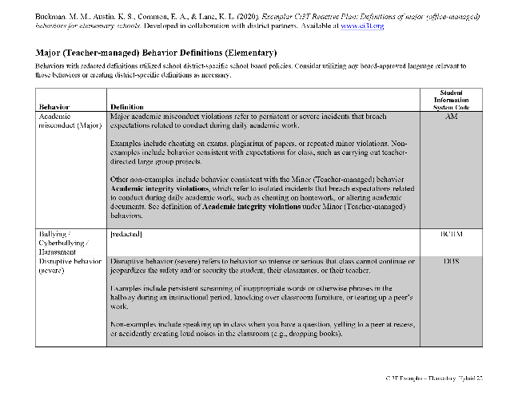
Behavioral
Area II: Academics Responsibilities Faculty and Staff: Teach core programs according to district and state standards with integrity: Use teacher-delivered, low-intensity strategies to support students’ active engagement | Area II: Behavior Responsibilities Faculty and Staff: Implement Positive Behavioral Interventions and Supports (PBIS) with integrity. Teach all setting Expectations within the first week of school and reteach Expectations (monthly). Display and model school-wide expectations in classrooms and other key settings. Implement the reactive plan with integrity. | Area II: Social Responsibilities Faculty and Staff: Teach schoolwide social skills/ character education curricula with integrity: Teach daily Second Step ® lessons (link to grade level instructional schedules) Seek ways to engage parents as partners in the school program

Slide 46
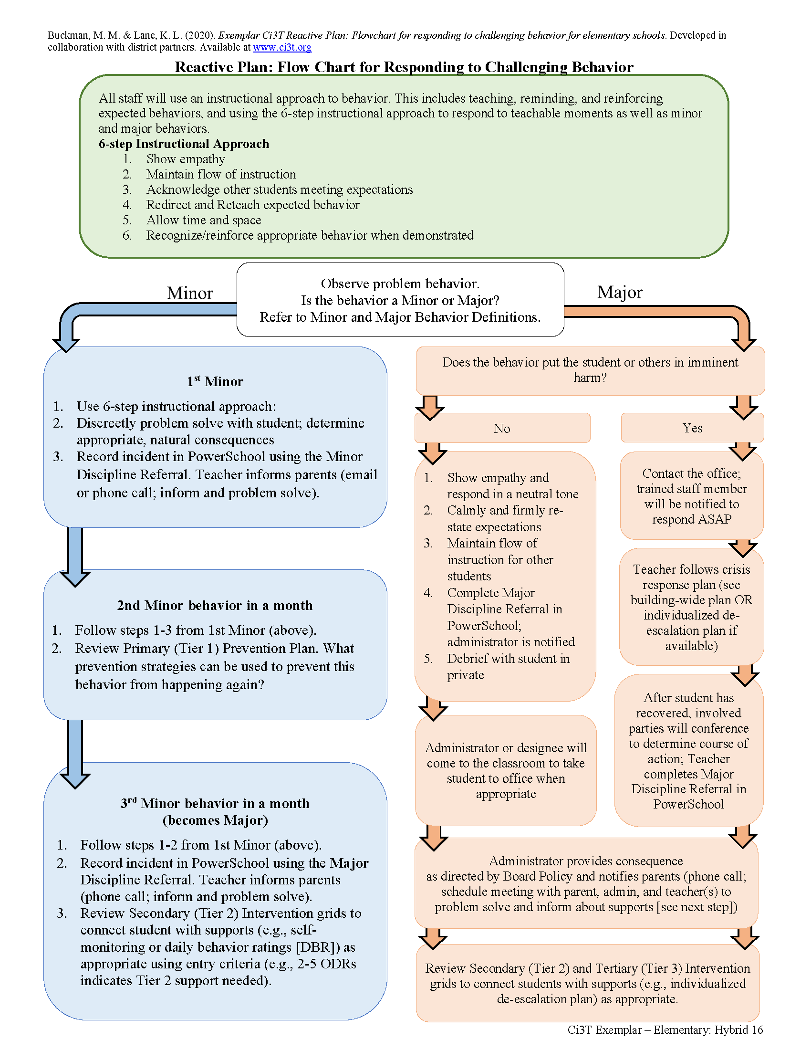

Slide 48
What do I need to know?
Ci3T Exemplar - Elementary

Slide 49
Rolling out at Tier 1: Behavior
Reviewing Roles & Responsibilities
  What do I need to know?
Procedures for Teaching
  How am I doing with teaching expectations for specific settings?
Procedures for Reinforcing
  How have I been reinforcing students for meeting expectations?
Procedures for Monitoring
  How am I doing with implementation?
Questions & Considerations?
Successes!

Slide 50
Rolling out at Tier 1: Social Domain
Teaching
Reinforcing
Monitoring

Slide 51
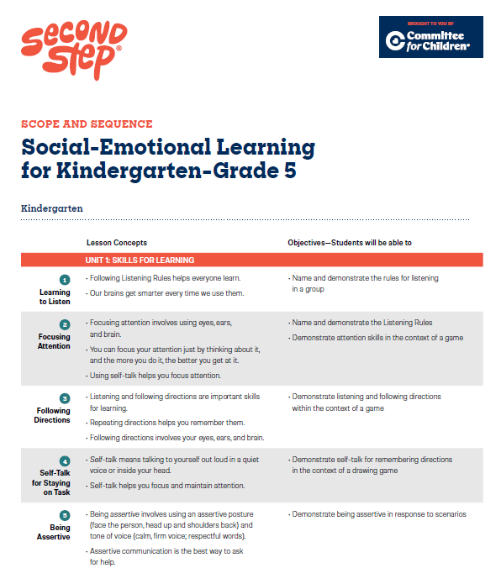
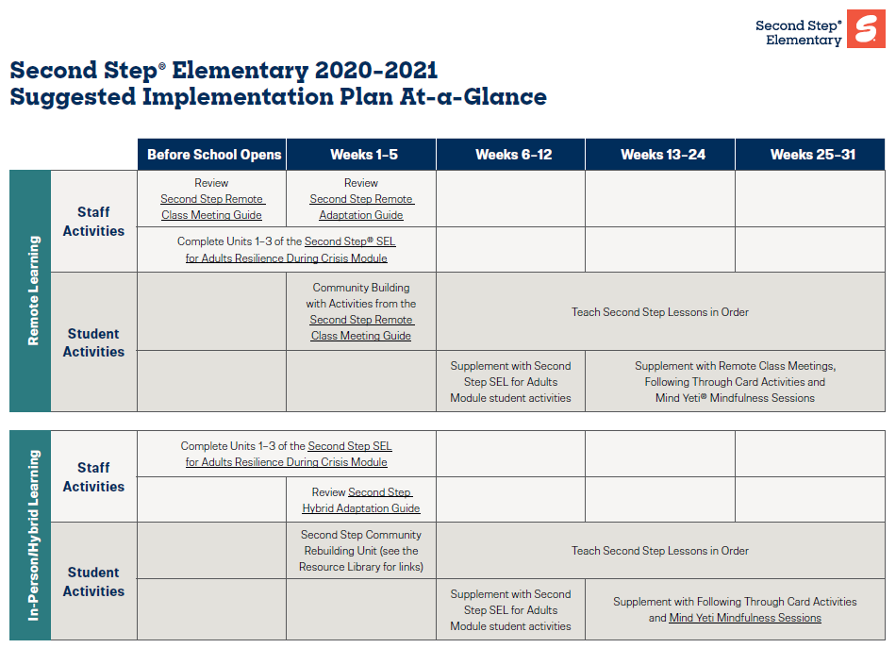
Social-Emotional Well-being
Area II: Academics Responsibilities Faculty and Staff: Teach core programs according to district and state standards with integrity: Use teacher-delivered, low-intensity strategies to support students’ active engagement | Area II: Behavior Responsibilities Faculty and Staff: Implement Positive Behavioral Interventions and Supports (PBIS) with integrity. Teach all setting Expectations within the first week of school and reteach Expectations (monthly). Display and model school-wide expectations in classrooms and other key settings. Implement the reactive plan with integrity. | Area II: Social Responsibilities Faculty and Staff: Teach schoolwide social skills/ character education curricula with integrity: Teach daily Second Step ® lessons (link to grade level instructional schedules) Seek ways to engage parents as partners in the school program

Slide 52
What do I need to know?
Ci3T Exemplar - Elementary

Slide 53
Rolling out at Tier 1: Social and Emotional Well-being
Reviewing Roles & Responsibilities
  What do I need to know?
Procedures for Teaching
  How am I doing with teaching social and emotional well-being lessons at Tier 1? Am I weaving them into daily instruction?
Procedures for Reinforcing
  How have I been acknowledging students who are using these skills throughout the day?
Procedures for Monitoring
  How am I doing with implementation?
Questions & Considerations?
Successes!

Slide 54
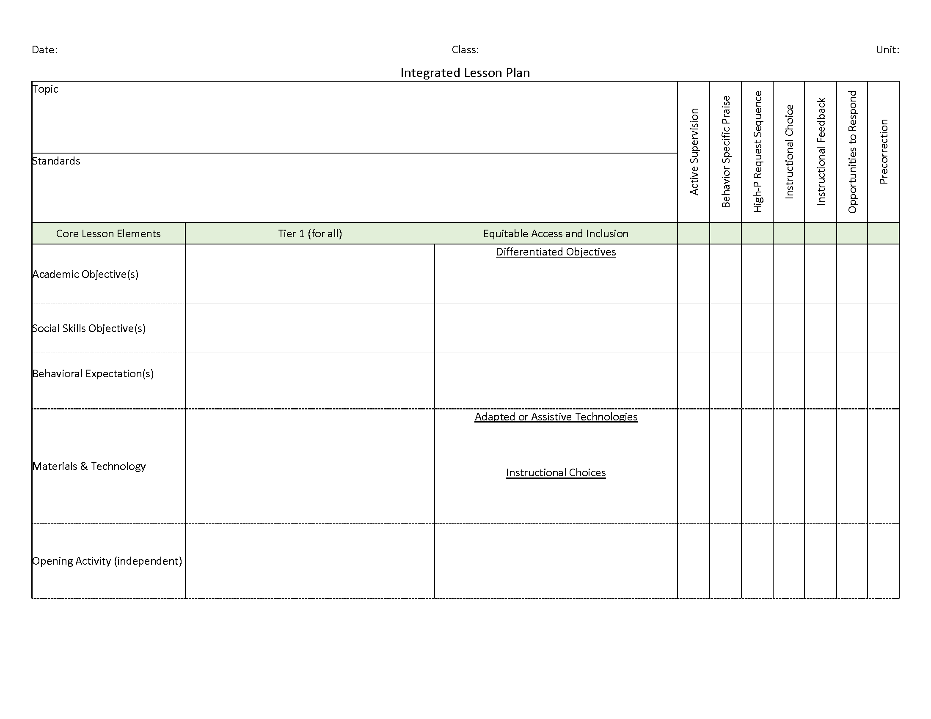

Slide 55












Talk Time
Reviewing Roles & Responsibilities: Do I know what my roles and responsibilities are in teaching academic skills? Do I know what my roles and responsibilities are in teaching expectations? Do I know what my roles and responsibilities are in teaching social and emotional well being skills to my students? Procedures for Teaching How often am I implementing low-intensity strategies? Do I receive support or offer support to others? How comfortable do I feel incorporating social and emotional well-being lesson content into daily instruction? Procedures for Reinforcing How have I been reinforcing expectations when students meet them?
Notes:
10-min timer

Slide 56
Procedures for …
Teaching
Reinforcing
Monitoring

Slide 57
Procedures for Teaching the Plan to:
Faculty and Staff
Students
Families and Community
Notes:
More than preventing problem behavior from occurring.
Lewis, T. J., Powers, L. J., Kely, M. J., & Newcomer, L. L. (2002). Reducing problem behaviors on the playground: An investigation of the application of schoolwide positive behavior supports. Psychology in the Schools, 39(2), 181-190;
Turnbull, A., Edmonson, H., Griggs, P., Wickham, D., Sailor, W., Freeman, R., ... & Riffel, L. (2002). A blueprint for schoolwide positive behavior support: Implementation of three components. Exceptional Children, 68(3), 377-402.

Slide 58
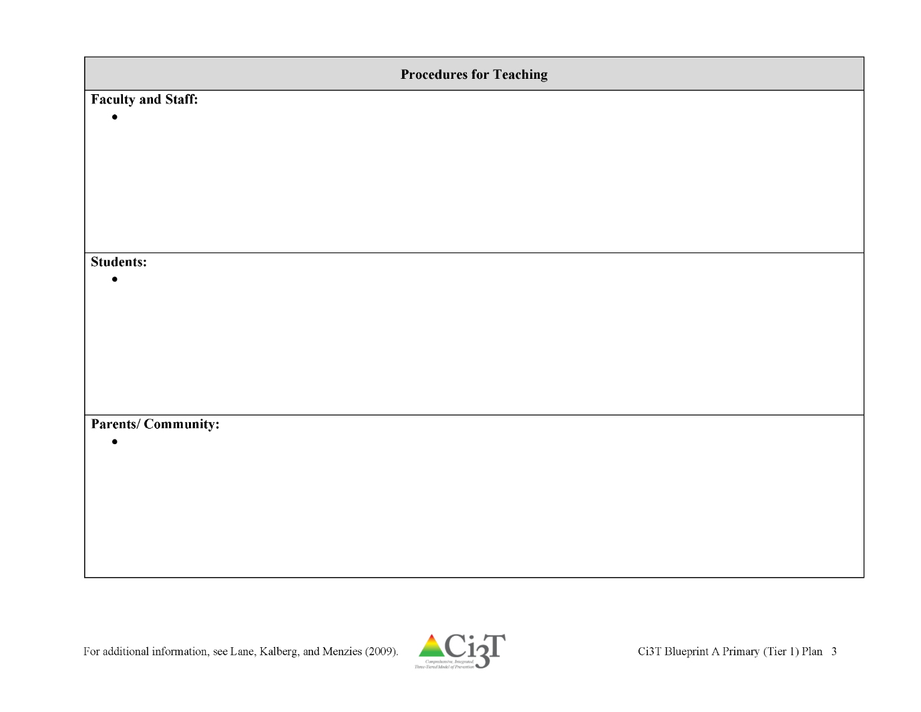


Locate in your Ci3T Implementation Manual

Slide 59
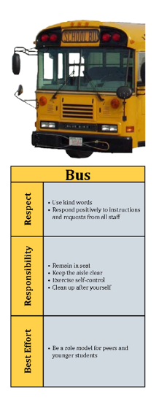

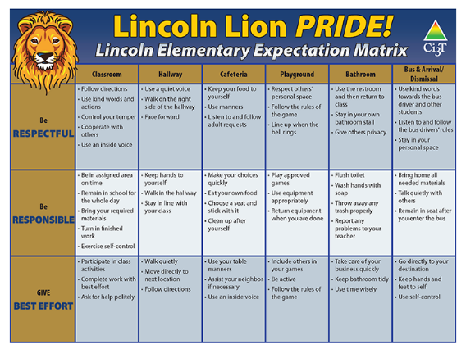
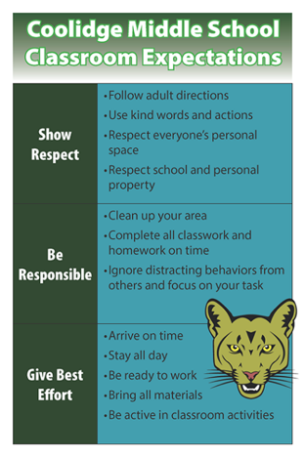
How will primary prevention (Tier 1) efforts be taught to all stakeholders?
Faculty and Staff
  Implementation manual
  Expectation matrix
  Bookmarks
  Collaborative teams
  Posters
  Ticket tip sheet
  Professional learning
Students
  Lessons
  Posters
  Videos
Parents and Community
  Letters to parents
  Contacts with community businesses
Shared with permission.
Notes:
Lessons: setting expectations, social skills
Posters: setting expectations, full expectation matrix

Slide 61
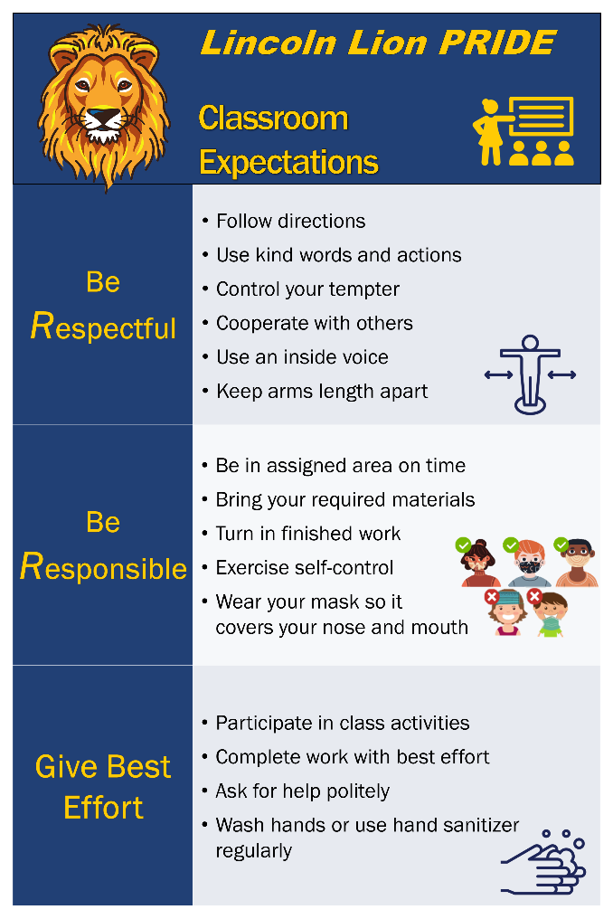

Slide 62
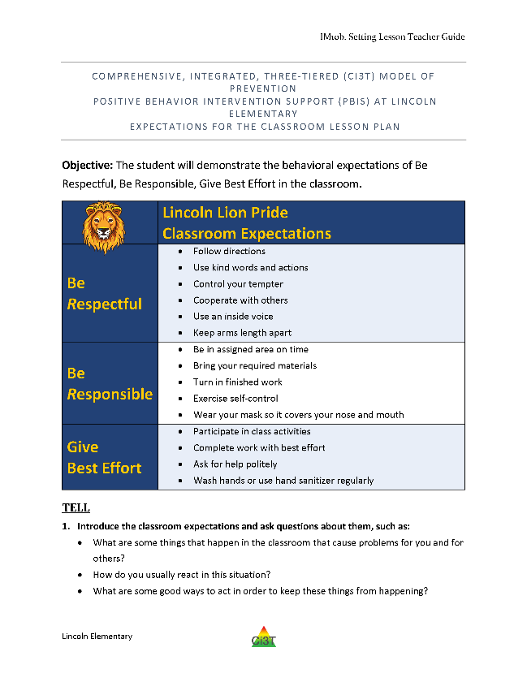
Tell
Show
Do
Practice & Follow Through

Slide 63
Tell
Show
Do
Define behaviors and discuss key terms
Practice & Follow Through
Discuss why behaviors are important

Slide 64
Tell
Show
Do
Practice & Follow Through
Explain and model examples
Explain and model non-examples
Discuss hypothetical situations

Slide 65
Tell
Show
Do
Practice & Follow Through
Students explain why expectations are important
Students think of ways to help them remember expectations
Students restate expectations

Slide 66
Tell
Show
Do
Practice & Follow Through
Students rehearse demonstrating expectations
Students practice in hypothetical situations
Incidental teaching
Reinforce!

Slide 67

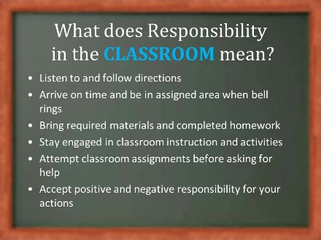
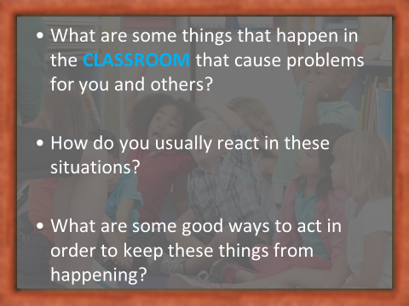
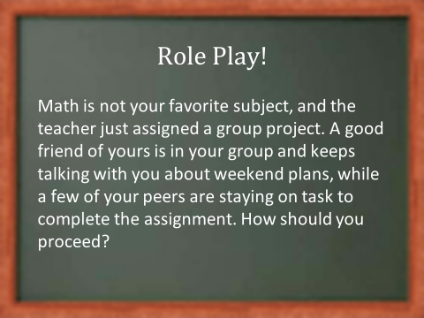
Other ideas…
Videos
Announcements
Virtual assemblies
Link teaching of classroom routines to school-wide expectations

Slide 68



Tips for engaging instruction
Explain the why…
…and help students think about their why
Pacing, pacing, pacing
Active student participation
  Low-intensity strategies
  …opportunities to respond
  …instructional choice
Make it fun!

Slide 69
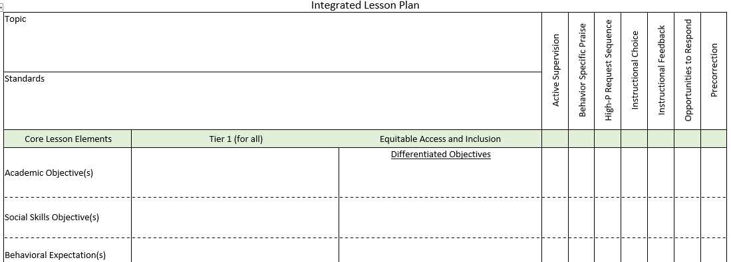
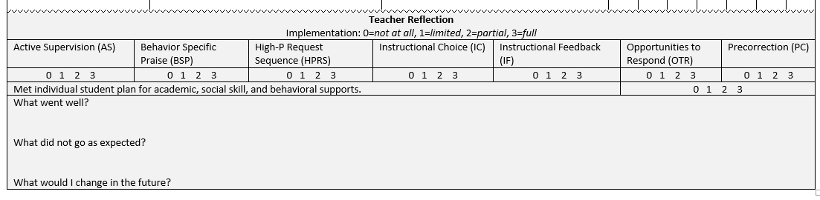
Integrated lesson planning is a core feature of Ci3T. Please visit https://www.ci3t.org/covid to learn more!

Slide 70



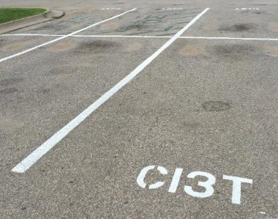
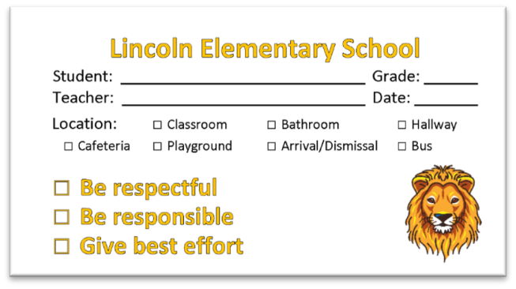
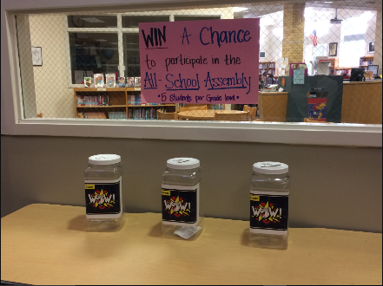
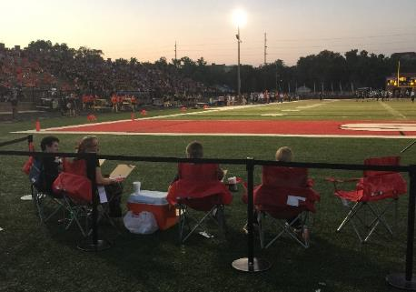
Locate in your Ci3T Implementation Manual
Procedures for Reinforcing
Faculty and Staff:
Students: ROAR zone Parking spaces
Parents/ Community:
Donation Coupon:
1 box of Macaroni and Cheese to Community Food Drive

Slide 71




What is reinforcement?
Consequence
Behavior
Consequence
Increases likelihood of future occurrence
Strengthens behavior

Slide 72
What is reinforcement?
Positive
(Access)
Negative
(Avoid)
ALERT
Negative reinforcement is not punishment

Slide 73
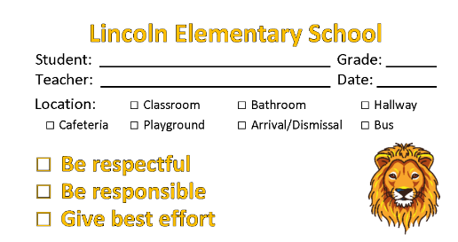
What’s in a ticket?
“An object awarded contingent on appropriate behavior and that serves as the medium of exchange for…reinforcers”
-Cooper, Heron, & Heward (2020)
Tickets are a tool for
communicating
successful use of a behavior

Slide 74
Tips for using tickets
to communicate
effectively

Slide 75
Ticket tips…
Teach expectations
Reinforce behaviors when students meet expectations
Pair tickets with behavior specific praise
Notes:
Provide reinforcement as near to the occurrence of the behavior as possible
Behavior-specific praise: praise statements that include reference to the specific behavior for which the student is being recognized
“Bob, great job showing your work on your math homework”
“I appreciate how you pushed in your chair on the way to line up for lunch. That keeps the walkways safe.”

Slide 76
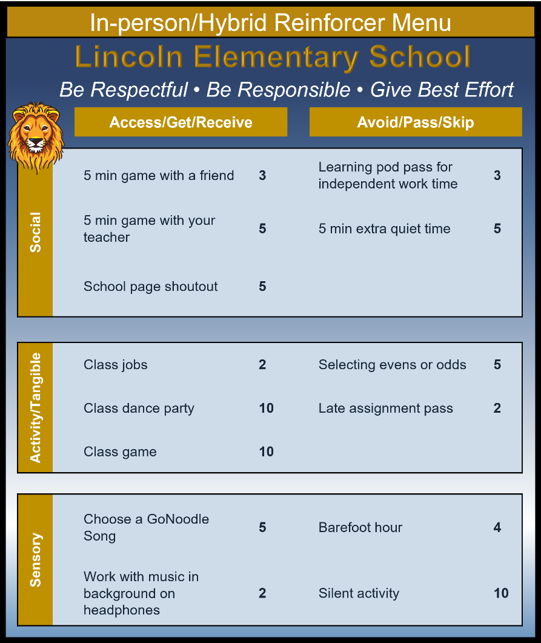
Ticket tips…
Offer a variety of opportunities for students to exchange tickets
Consider mapping opportunities onto a function matrix to ensure all possible functions are considered

Slide 77


Slide 78

Ticket tips…
How often should I be giving tickets?
4:1 positive to negative feedback ratio
Tickets should be given sporadically so students do not “expect” to get a ticket for meeting expectations
Feedback can be verbal or nonverbal responses contingent on behavior. Feedback is more than a reinforcer or punisher; it is a powerful tool to guide future behavior and learning.
Malott, 2008
+ BSP
BSP
or
Notes:
Tickets paired with BSP, or BSP alone, but never tickets alone.

Slide 79



Ticket tips…
The goal is to fade and transition to natural reinforcers
Faded but not forgotten…even as the rate of reinforcement goes down be sure to keep a functioning system. It’s likely some students will still need high rates!

Slide 80
Ticket tips…some dos and don’ts
Avoid…
Instead, try..
“If you follow directions, I’ll give you a ticket”
“Remember, the expectation is to…”
“You got the correct answer, you get two tickets!”
“I love that participation – and I can tell you’ve been paying attention. Awesome job!”
“You can’t earn tickets behaving that way”
Find a different student who is following expectations. Acknowledge their behavior!

Slide 81
Templates & Resources
https://www.ci3t.org/building

Slide 82












Talk Time | Talk Time
Teaching | Reinforcing
What are your plans for teaching expectations to your students? What are your plans for teaching lessons to support social and emotional well-being? What are your plans for utilizing integrated lesson planning? What support do you need from your Ci3T Leadership Team? Signage? Lesson plans? | What are your plans for reinforcing students? Consider the types of reinforcement (social/attention, tangible/activity, sensory)…which ones do you need to do some brainstorming on to provide? How would you support a colleague who requested assistance with procedures for reinforcing?
Consider sharing ideas with colleagues in your buildings!
Notes:
10-min timer

Slide 83



In future years, consider alternative program goals.
80% of students meeting reading and math targets on assessments
Locate in your Ci3T Implementation Manual

Slide 84


Essential Components of
Primary Prevention Efforts
Social Validity
Systematic Screening
Academic
Behavior
Treatment Integrity

Slide 85
Notes:
Infographic can be downloaded at: https://www.ci3t.org/measures

Slide 86
Notes:
Infographic can be downloaded at: https://www.ci3t.org/measures

Slide 87
Social Validity
How do stakeholders view the plan?
Social validity refers to the level of:
Social significance of intervention goals
Social acceptability of intervention procedures
Social importance of intervention outcomes
(Wolf, 1978)
Assessed using the Primary Intervention Rating Scale (PIRS)
Social Validity: PIRS Results
Year | Fall |  | Spring
 | n | % (SD) | n | % (SD)
2020-2021 | 32 | 85.39 (8.89) | TBD | TBD

Slide 88


Treatment Integrity

Slide 89


Slide 90
Wrapping Up and Moving Forward

Slide 91

Project EMPOWER - Traditional
Ci3T EMPOWER Sessions Location: Remote via Zoom Attended by: School Ci3T Leadership Teams, Ci3T District Trainers and Coaches, Faculty and Staff, Families (adults only). Community Members |  | Times (Pacific) | Times (Central) | Times (Eastern)
1. Getting Started | Sep. 19, 2023 (Tu) | 3:00 – 5:00 p.m. | 5:00 – 7:00 p.m. | 6:00 – 8:00 p.m.
2. Screening | Oct. 19, 2023 (Th) | 3:00 – 5:00 p.m. | 5:00 – 7:00 p.m. | 6:00 – 8:00 p.m.
3. Low Intensity Supports (3) | Nov. 30, 2023 (Th) | 3:00 – 5:00 p.m. | 5:00 – 7:00 p.m. | 6:00 – 8:00 p.m.
4. Tier 2 | Jan. 9, 2024 (Tu) | 3:00 – 5:00 p.m. | 5:00 – 7:00 p.m. | 6:00 – 8:00 p.m.
5. Tier 3 | Mar. 28, 2024 (Th) | 3:00 – 5:00 p.m. | 5:00 – 7:00 p.m. | 6:00 – 8:00 p.m.
6. Moving Forward | Apr. 23, 2024 (Wed) | 3:00 – 5:00 p.m. | 5:00 – 7:00 p.m. | 6:00 – 8:00 p.m.

Slide 92
Ci3T
Comprehensive Professional Learning Plan
Ci3T: Primary Prevention
Session 1:
Overview of Ci3T Prevention Models
Setting a Purpose
Establish team meetings and roles
Session 2:
Mission and Purpose
Establish Roles and Responsibilities
Procedures for Teaching
Procedures for Reinforcing
Reactive Plan
Session 3:
Procedures for Monitoring
Session 4:
Revise Primary Plan using Stakeholder feedback
Prepare presentation
Ci3T: Secondary Prevention
Session 5:
Overview of Teacher focused Strategies
Overview of Student Focused Strategies
Using data to determine which students may need Secondary (Tier 2) supports
Draft the Secondary Intervention Grid based on existing supports
Ci3T: Tertiary Prevention
Session 6:
Final revisions of Ci3T Plan based on stakeholder feedback
Draft Tertiary (Tier 3) Prevention Intervention Grids
Design Implementation Manual and Plan for roll out to faculty, students, and parents
Ci3T Leadership Team Training Sequence
Implementation Stages of Tier 2 and 3 within Ci3T
Additional Professional Development on Specific Topics
Core Content Curriculum
Check In - Check Out
Functional Assessment-based Interventions
Reading, Math, Writing Benchmarking and Progress Monitoring Tools
Interventions, Strategies, & Practices
Additional Tier 3 Supports
Instructional Techniques to Improve Students’ Motivation; Classroom Management Practices;
Low-Intensity Behavior Supports

Slide 93



Examining your screening data…
…Inform Instruction at Tier 1
…Empower Teachers with Low-intensity Supports
…Connect Students to Tier 2 and Tier 3 Interventions

Slide 94


Ci3T Trainer and Coaches Calls

Slide 95

Ci3T Professional Learning Calendar
 | July | Aug | Sep | Oct | Nov | Dec | Jan | Feb | Mar | Apr | May | Jun
Ci3T Training |  |  |  |  | Ci3T Professional Learning Series Session 1 | Ci3T Professional Learning Series Session 2 | Ci3T Professional Learning Series Session 3 | Ci3T Professional Learning Series Session 4 |  | Ci3T Professional Learning Series Session 5 | Ci3T Professional Learning Series Session 6
Ci3T Implementation Support | Ci3T Implementation Series Prep Session |  | Ci3T Implementation Series Session 1 |  | Ci3T Implementation Series Session 2 |  | Ci3T Implementation Series Session 3 |  | Ci3T Implementation Series Session 4 | Ci3T Implementation Series Session 5
Ci3T EMPOWER |  |  | Ci3T EMPOWER Session 1 | Ci3T EMPOWER Session 2 | Ci3T EMPOWER Session 3 |  | Ci3T EMPOWER Session 4 |  | Ci3T EMPOWER Session 5 | Ci3T EMPOWER Session 6
Ci3T Trainers & Coaches Calls |  | Trainers & Coaches Call Session 1 | Trainers & Coaches Call Session 2 | Trainers & Coaches Call Session 3 | Trainers & Coaches Call Session 4 | Trainers & Coaches Call Session 5 | Trainers & Coaches Call Session 6 | Trainers & Coaches Call Session 7 | Trainers & Coaches Call Session 8 | Trainers & Coaches Call Session 9 | Trainers & Coaches Call Session 10

Slide 96


Sustaining and Disseminating Professional Learning
Designate two staff to attend trainings to become on-site coaches
10 min @ next Faculty and Staff meeting
Setting Up for Success with Ci3T
Systematic Screening
Low-Intensity Supports
Tier 2
Planning Ahead
Tier 3

Slide 97
Wrapping Up & Previewing Next Session
Today
Next time
Overview of Ci3T
Rolling out your Ci3T Plan … Sharing Success!
Implementing Tier 1
  Academics
  Behavior: Positive Behavior Interventions and Support (PBIS)
  Social and Emotional Well-being: Your Validated Curricula and Resources
Procedures for …
  Teaching
  Reinforcing
  Monitoring
Overview of Systematic Screening in Ci3T Models
Using Systematic Screening to
  Inform Instruction at Tier 1
  Empower Teachers with Low-Intensity Supports
  Connect Students to Tier 2 and Tier 3 Interventions
Exploring Resources to Support Systematic Screening Efforts

Slide 98



Comprehensive, Integrated, Three-Tiered Model of Prevention
(Lane, Kalberg, & Menzies, 2009)
Thank you!
Notes:
Tag us in your Ci3T highlights- we’d love to see Ci3T in action! Follow us on Twitter or Instagram for updates and links to resources! @Ci3TModel
You will receive a brief session evaluation – we value your feedback and would greatly appreciate you taking a few minutes to share your thoughts on what you liked about the session and how we can improve

