Slide 1
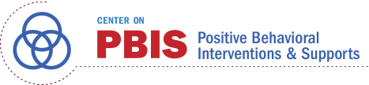
Systematic Screening in Tiered Systems: What do I need to know?
Lincoln Public Schools: Supporting Positive Behavior Conference
Lincoln, Nebraska
Kathleen Lynne Lane, Ph.D., BCBA-D, CF-L2
Institute of Education Sciences, U.S. Department of Education
R324A190013 University of Kansas
Notes:
Title: Systematic Screening in Tiered Systems: What do I need to know?
Abstract: In this session, we explain how to use systematic screening tools in tiered systems such as Comprehensive, Integrated, Three-Tiered (Ci3T) models of prevention to meet students’ multiple needs. We will explain how to use screening data to inform (a) Tier 1 efforts, (b) empower teachers with low-intensity supports to maximize engagement and limit disruption, and (c) connect students to Tier 2 and Tier 3 supports.

Slide 2
Agenda
Systematic Screening in Tiered Systems
Using Screening Data to Inform Instruction
  At Tier 1: Primary Preventions Efforts
  At all Tiers: Teacher-delivered Strategies
  At Tiers 2 & 3: Secondary & Tertiary Prevention Efforts
Resources for Getting Started

Slide 3
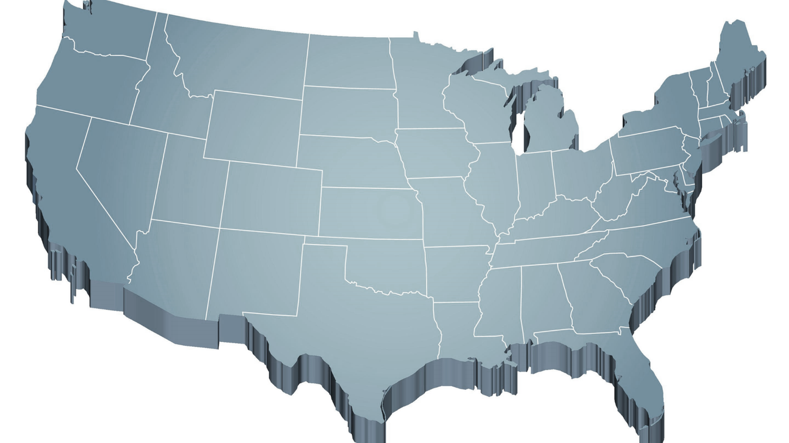
Creating Positive, Productive Systems
Internalizing
Externalizing
ED <1%
EBD 12-20%
Source: Forness, S.R., Freeman, S.F., Paparella, T., Kauffman, J.M., & Walker, H.M. (2012). Special education implications of point and cumulative prevalence for children with emotional or behavioral disorders. Journal of Emotional and Behavioral Disorders, 20, 4-18.

Slide 4
Agenda
Systematic Screening in Tiered Systems
Using Screening Data to Inform Instruction
  At Tier 1: Primary Preventions Efforts
  At all Tiers: Teacher-delivered Strategies
  At Tiers 2 & 3: Secondary & Tertiary Prevention Efforts
Resources for Getting Started

Slide 5
Comprehensive, Integrated, Three-Tiered Model of Prevention
(Lane, Kalberg, & Menzies, 2009)
Tier 3
Tertiary Prevention (≈5%)
Tier 2
Secondary Prevention (≈15%)
District & State Standards
High Quality Instruction
Tier 1
Primary Prevention (≈80%)
Academic ◇ Behavioral ◇ Social
Validated Curricula PBIS Framework Validated Curricula

Slide 6
Comprehensive, Integrated, Three-Tiered Model of Prevention
(Lane, Kalberg, & Menzies, 2009)
Tier 3
Tertiary Prevention (≈5%)
Tier 2
Secondary Prevention (≈15%)
Positive Behavior Interventions and Supports (PBIS)
Tier 1
Primary Prevention (≈80%)
Academic ◇ Behavioral ◇ Social
Validated Curricula PBIS Framework Validated Curricula

Slide 7
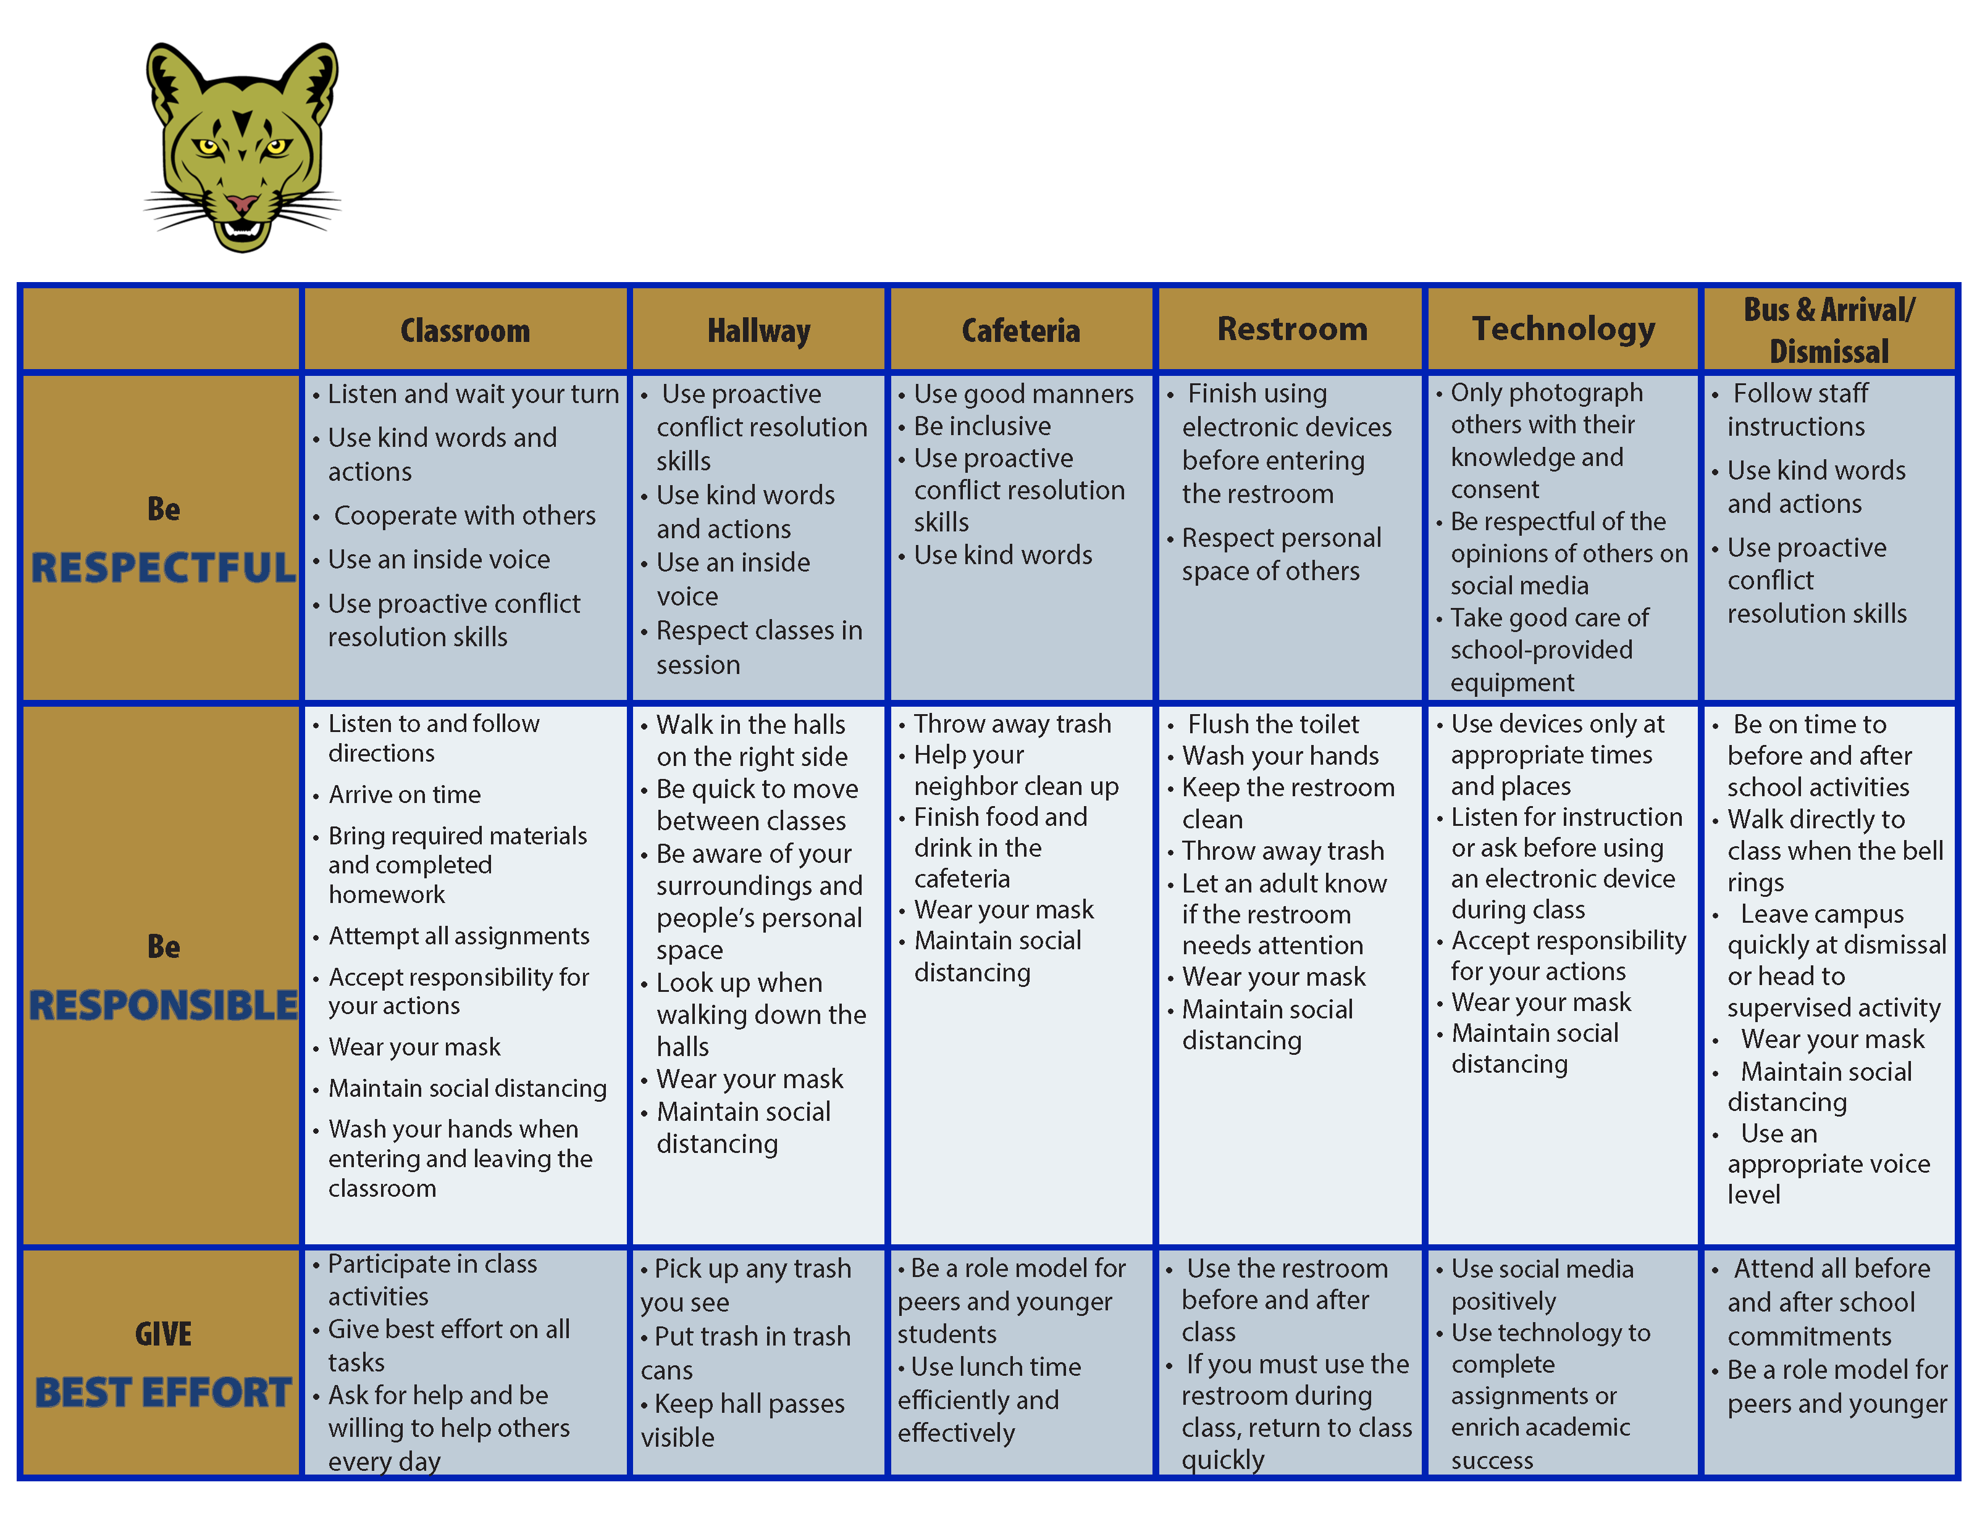
Coolidge Middle School
Expectation Matrix
Establish, Clarify, Define Expectations

Slide 8



Comprehensive, Integrated, Three-Tiered Model of Prevention
(Lane, Kalberg, & Menzies, 2009)
Tier 3
Tertiary Prevention (≈5%)
Tier 2
Secondary Prevention (≈15%)
Tier 1
Primary Prevention (≈80%)
Academic ◇ Behavioral ◇ Social
Validated Curricula PBIS Framework Validated Curricula

Slide 9
Outcomes Associated with Social Skills Training
Explicit social-emotional learning (SEL) skills instruction
SEL skills acquisition
Improved attitudes about self, others, and school
Positive social behavior
Fewer conduct problems
Less emotional distress
Academic success
(CASEL, 2020)

Slide 10
Comprehensive, Integrated, Three-Tiered Model of Prevention
(Lane, Kalberg, & Menzies, 2009)
Tier 3
Tertiary Prevention (≈5%)
Tier 2
Secondary Prevention (≈15%)
Tier 1
Primary Prevention (≈80%)
Academic ◇ Behavioral ◇ Social
Validated Curricula PBIS Framework Validated Curricula

Slide 11
The Journey… Ci3T Training & Implementation
Phase |  |  |  | Year
 | 2013-14 | 14-15 | 15-16 | 16-17 | 17-18 | 18-19 | 19-20
Elementary School
Ci3T Training
Implementation Year 1
Implementation Year 2
Sustain and Develop Practices
Middle and High Schools
Ci3T Training
Implementation Year 1
Implementation Year 2
Sustain and Develop Practices
College and Career Center
Ci3T Training
Implementation Year 1
Implementation Year 2
Sustain and Develop Practices

Slide 12
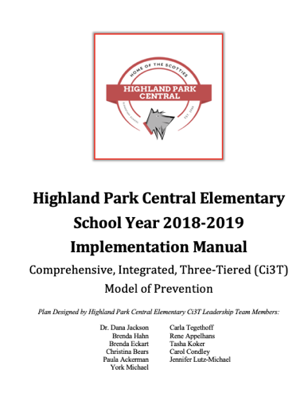
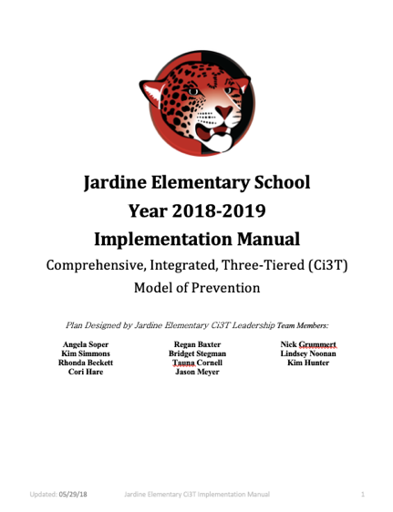
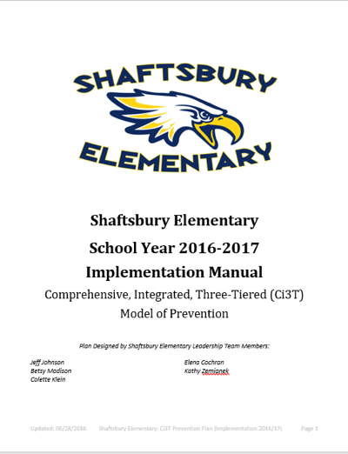
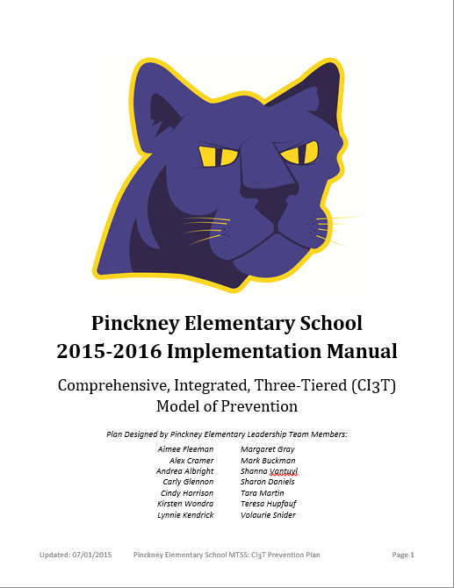
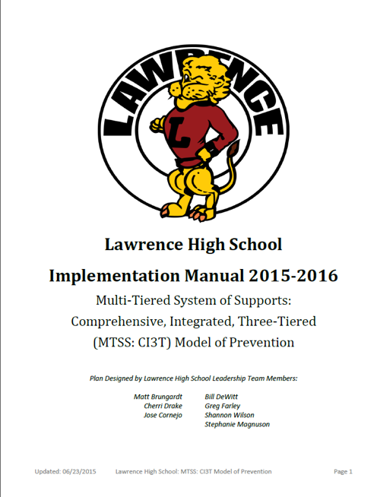
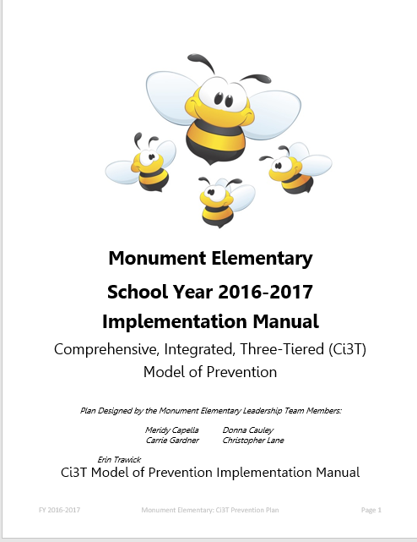
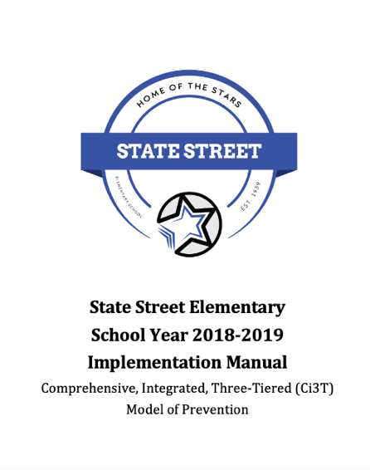
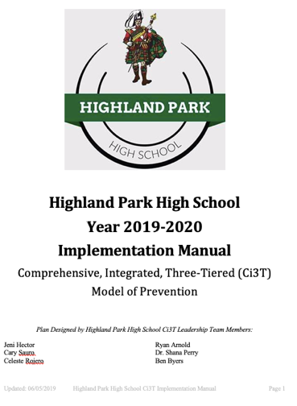
Ci3T Implementation Manuals

Slide 13
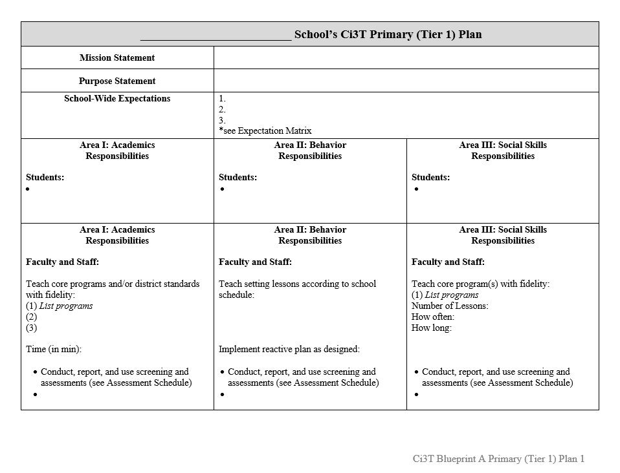
Ci3T Implementation Manual Primary (Tier 1) Plan
What are ALL students accessing?

Slide 14
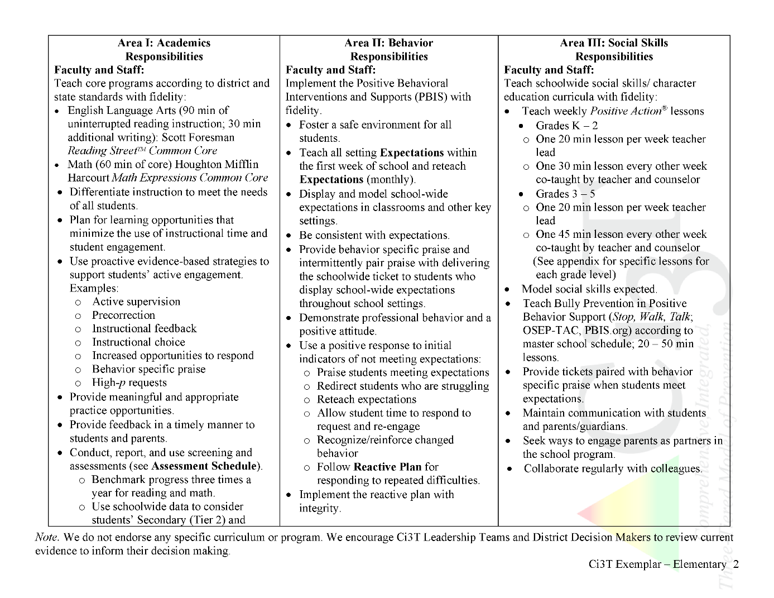

Ci3T Primary Plan: Procedures for Teaching
Ci3T Primary Plan: Procedures for Reinforcing
Ci3T Primary Plan: Procedures for Monitoring

Slide 15
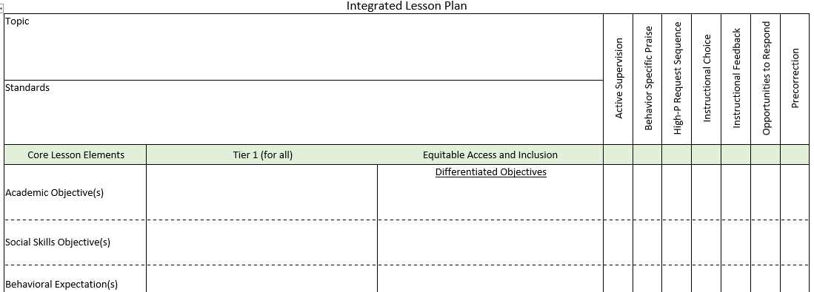
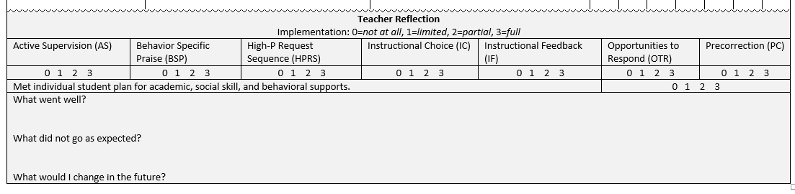

Ci3T Primary Plan: Procedures for Teaching
BSP
OTR
Active Supervision
Choice
Precorrection

Slide 16
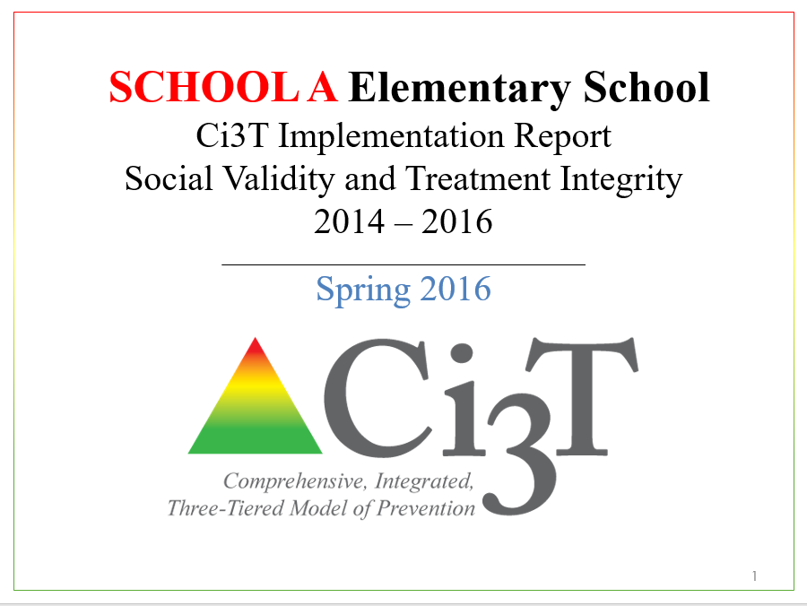
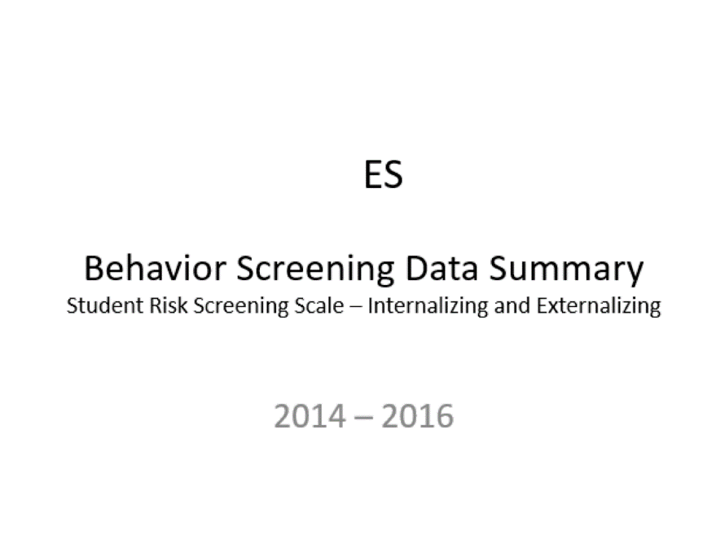
Essential Components of
Primary Prevention Efforts
Social Validity
Systematic Screening
Academic
Behavior
Treatment Integrity

Slide 17


Slide 18


Slide 19





Slide 20

Systematic Screening … Logistics
Fall
Winter
Spring
Selecting
Installing
Analyzing

Slide 21
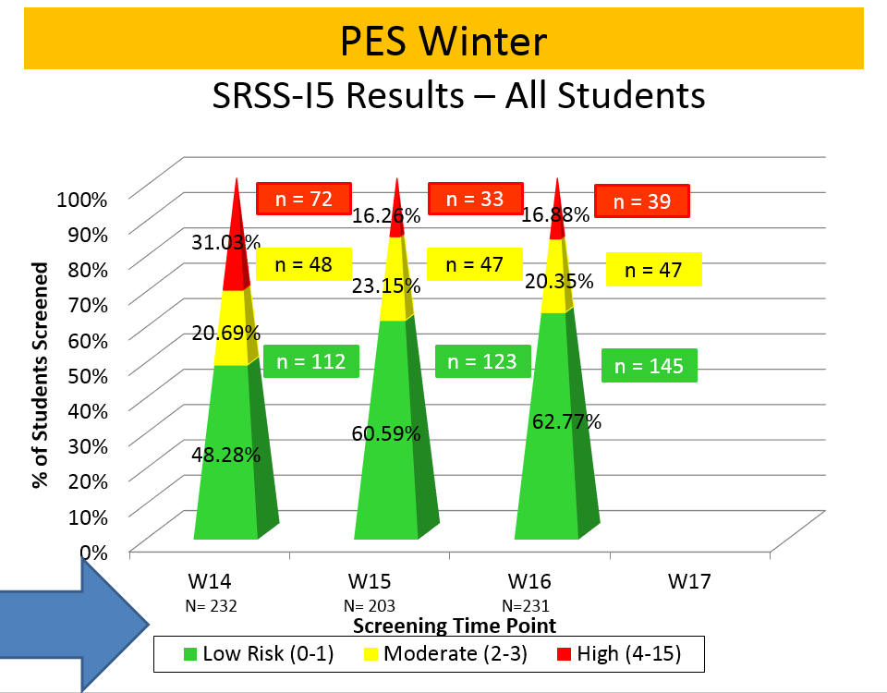
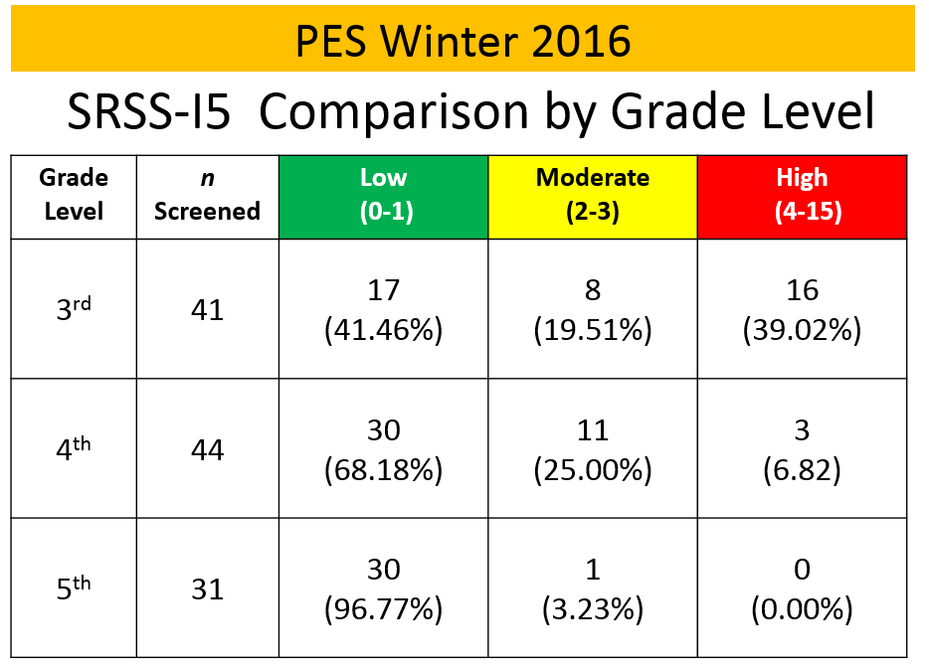
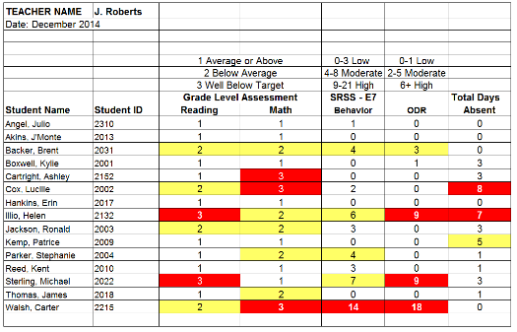
Data Sharing
Schoolwide data
  decisions related to primary prevention efforts
Grade / department / class
  implications for teachers’
  practice
Individual student
  decisions about student-
  based interventions

Slide 22
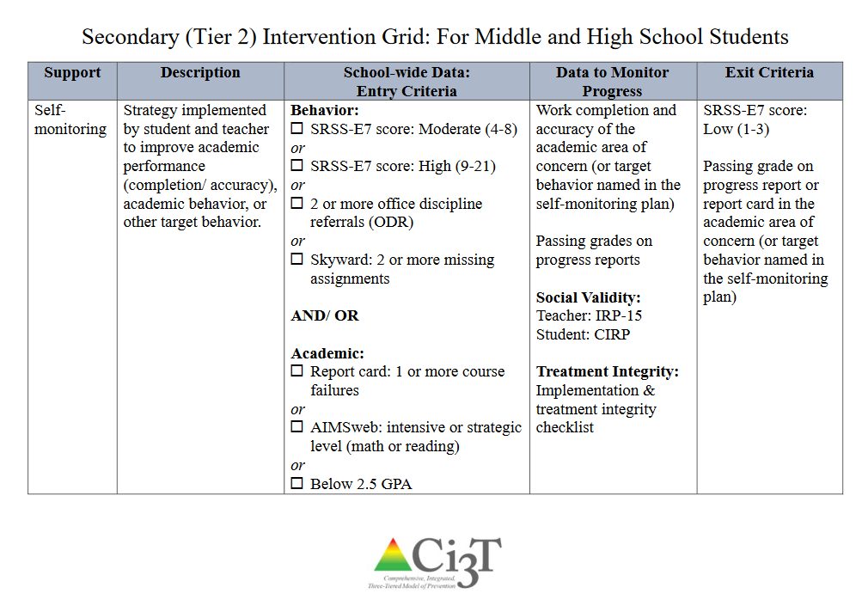
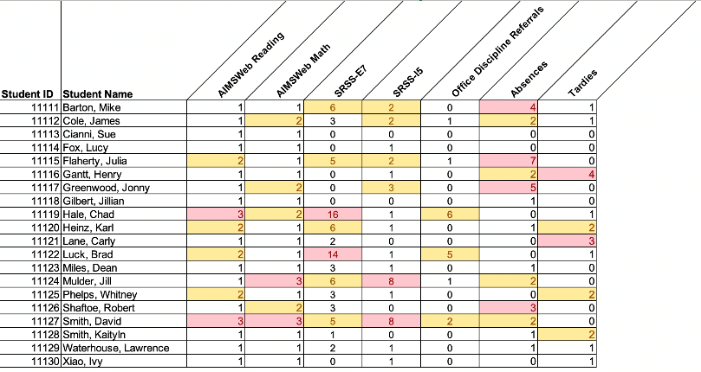
Using multiple data sources

Slide 23

Considerations
Psychometrically Sound
Socially Valid
If social validity is lacking, even psychometrically strong tools are likely to remain unused by educators.

Slide 24
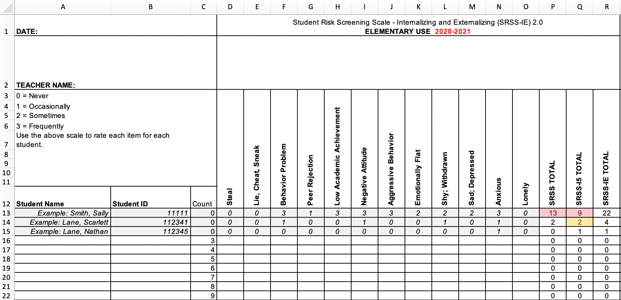
Student Risk Screening Scale – Internalizing and Externalizing (SRSS-IE; Drummond, 1994; Lane & Menzies, 2009)
Elementary

Slide 25
SRSS-IE: Cut Scores
Elementary School |  | Middle and High School
SRSS-E7 | SRSS-I5 | SRSS-E7 | SRSS-I6
Items 1-7 | Items 8-12 | Items 1-7 | Items 4, 8-12
0-3 = low risk 4-8 = moderate risk 9-21 = high risk | 0-1 = low risk 2-3 = moderate risk 4-15 = high risk | 0-3 = low risk 4-8 = moderate risk 9-21 = high risk | 0-3 = low risk 4-5 = moderate risk 6-18 = high risk
Elementary School Level:
Lane, K. L., Oakes, W. P., Swogger, E. D., Schatschneider, C., Menzies, H., M., & Sanchez, J. (2015). Student risk screening scale for internalizing and externalizing behaviors: Preliminary cut scores to support data-informed decision making. Behavioral Disorders, 40, 159-170.
Middle and High School Levels:
Lane, K. L., Oakes, W. P., Cantwell, E. D., Schatschneider, C., Menzies, H., Crittenden, M., & Messenger, M. (2016). Student Risk Screening Scale for Internalizing and Externalizing Behaviors: Preliminary cut scores to support data-informed decision making in middle and high schools. Behavioral Disorders, 42(1), 271-284

Slide 26
Fall 2021
SRSS-Externalizing Results – School level
n = 34
n = 40
n = 33
n = 10
n = 19
n = 35
n = 34
n = 35
n = 41
n = 52
n = 42
n = 26
n = 35
n = 52
n = 52
n = 61
n = 153
n = 135
n = 127
n = 146
n = 137
n = 109
n = 91
n = 135
Notes:
Fill in <year> based on current academic year. This is located in column A of the data sheet. Edit by right clicking and selecting “Edit data”.

Slide 27
Fall 2021
SRSS-Internalizing Results – School level
n = 31
n = 42
n = 39
n = 49
n = 18
n = 26
n = 61
n = 46
n = 44
n = 37
n = 35
n = 46
n = 27
n = 31
n = 38
n = 30
n = 153
n = 148
n = 128
n = 136
n = 137
n = 134
n = 97
n = 101
Cut scores vary by school level:
Elementary (I5): Low (0-1), Moderate (2-3), High (4-15)
Middle and High (I6): Low (0-3), Moderate (4-5), High (6-18)
Notes:
Fill in <year> based on current academic year. This is located in column A of the data sheet. Edit by right clicking and selecting “Edit data”.
IMPORTANT NOTE: The INTERNALIZING subscale and CUT SCORES are specific to school level.
Elementary: SRSS-I5, Items 8-12, 0-1 = low risk, 2-3 = moderate risk, 4-15 = high risk
Middle and High: SRSS-I6, Items 4, 8-12, 0-3 = low risk, 4-5 = moderate risk, 6-18 = high risk

Slide 28
Fall 2020
SRSS-Externalizing Results – Elementary
Grade Level | N Screened | Low n (%) | Moderate n (%) | High n (%)
K | 69 | 65 (94.20%) | 3 (4.35%) | 1 (1.45%)
1 | 47 | 44 (93.62%) | 2 (4.26%) | 1 (2.13%)
2 | 68 | 56 (82.35%) | 10 (14.71%) | 2 (2.94%)

Slide 29
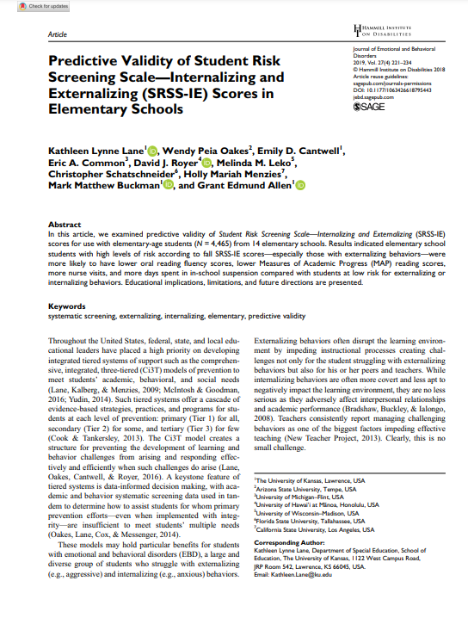
Results:
SRSS-IE: Externalizing Subscale Elementary
Fall Externalizing
Winter
Spring
ORF
MAP Reading
Nurse Visit
Suspensions
Variable | Risk |  |  | Significance Testing
 | Low M (SD) n | Moderate M (SD) n | High M (SD) n
Oral Reading Fluency | 163.23 (39.66) 468 | 138.62 (42.70) 107 | 115.82 (46.21) 46 | L > M > H
MAP Reading | 66.54 (26.48) 2,047 | 42.91 (30.37) 443 | 33.32 (29.82) 199 | L > M > H
Nurse Visits | 6.14 (6.81) 3,256 | 9.18 (9.59) 820 | 11.83 (9.89) 389 | L < M < H
In-School Suspensions | 0.0052 (0.08) 3,256 | 0.0427 (0.30) 820 | 0.1080 (0.46) 389 | L < M < H

Slide 30
Results:
SRSS-IE: internalizing Subscale Elementary
Variable | Risk |  |  | Significance Testing
 | Low M (SD) n | Moderate M (SD) n | High M (SD) n
Oral Reading Fluency | 159.04 (41.45) 459 | 150.59 (45.76) 88 | 139.18 (46.53) 74 | L > H L = M; M = H
MAP Reading | 63.38 (28.32) 2,070 | 53.93 (32.15) 356 | 43.57 (30.47) 263 | L > M > H
Nurse Visits | 6.84 (7.37) 3,387 | 7.59 (8.05) 628 | 9.33 (10.81) 450 | L < M < H
In-School Suspensions | 0.0142 (0.15) 3,387 | 0.0510 (0.36) 628 | 0.0311 (0.20) 450 | L < M, H M = H
Fall Internalizing
Winter Internalizing
Spring
ORF*
MAP Reading
Nurse Visit
Suspensions*

Slide 31
Student Risk Screening Scale Fall 2004 – 2012 Middle School
Source: Lane, K. L., Oakes, W. P., & Magill, L. M., (2014). Primary prevention efforts: How do we implement and monitor the Tier 1 component of our comprehensive, integrated, three-tiered model of prevention. Preventing School Failure, 58, 143-158. 10.1080/1045988X.2014.893978 [Figure 4. Middle school behavior screening data over time at the fall time point. Adapted from Figure 4.6 p. 127 Lane, K. L., Menzies, H. M, Oakes, W. P., & Kalberg, J. R. (2012). Systematic screenings of behavior to support instruction: From preschool to high school. Guilford Press.]

Slide 32
Middle School Study 1: Behavioral & Academic Characteristics of SRSS Risk Groups
Variable |  | Risk
 | Low (n = 422) M (SD) | Moderate (n = 51) M (SD) | High (n = 12) M (SD) | Significance Testing
ODR | 1.50 (2.85) | 5.02 (5.32) | 8.42 (7.01) | L<M<H
In-School Suspensions | 0.08 (0.38) | 0.35 (1.04) | 1.71 (2.26) | L<M<H
GPA | 3.35 (0.52) | 2.63 (0.65) | 2.32 (0.59) | L>M, H M=H
Course Failures | 0.68 (1.50) | 2.78 (3.46) | 4.17 (3.49) | L<M, H M=H
(Lane, Parks, Kalberg, & Carter, 2007)

Slide 33
Screening Data: High School Yrs1-3
Fall- SRSSIE-I |  | Low |  | Moderate |  | High |  | Fall- SRSSIE-E |  | Low |  | Moderate |  | High
2016 |  | 80.28% |  | 10.36% |  | 9.36% |  | 2016 |  | 89.56% |  | 8.02% |  | 2.42%
2017 |  | 90.18% |  | 4.16% |  | 5.66% |  | 2017 |  | 91.29% |  | 6.18% |  | 2.54%
2018 |  | 90.91% |  | 3.86% |  | 5.23% |  | 2018 |  | 92.22% |  | 6.20% |  | 1.58%
WTR-SRSSIE-I |  | Low |  | Moderate |  | High |  | WTR-SRSSIE-E |  | Low |  | Moderate |  | High
2016 |  | 87.25% |  | 9.49% |  | 3.26% |  | 2016 |  | 87.25% |  | 9.49% |  | 3.26%
2017 |  | 86.14% |  | 9.02% |  | 4.85% |  | 2017 |  | 86.14% |  | 9.02% |  | 4.85%
2018 |  | 88.79% |  | 8.52% |  | 2.69% |  | 2018 |  | 88.79% |  | 8.52% |  | 2.69%

Slide 34
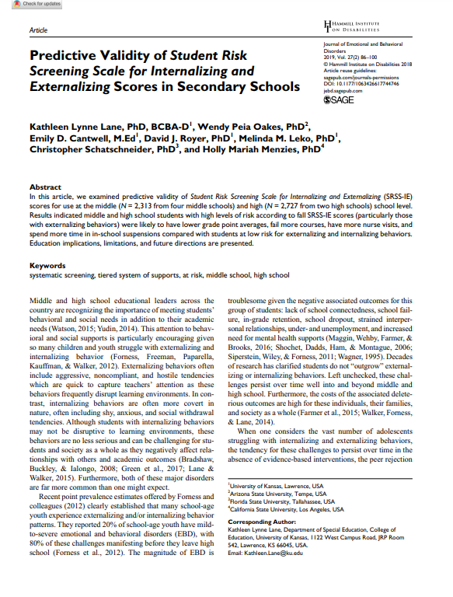
SRSS-IE: Externalizing Subscale
High school
Fall
Winter
Spring
GPA
Course Failures
Nurse Visit
ODR
Suspensions
Variable |  | Risk |  | Significance Testing
 | Low M (SD) n = 2,363 | Moderate M (SD) n = 212 | High M (SD) n = 59
GPA | 3.07 (0.79) | 2.08 (0.81) | 1.96 (0.89) | L > M, H M = H
Course Failures | 1.16 (2.07) | 3.45 (3.18) | 3.08 (2.84) | L < M, H M = H
Nurse Visits | 1.34 (3.19) | 4.00 (5.62) | 5.85 (7.66) | L < M, H M = H
In-School Suspensions | 0.07 (0.44) | 0.67 (1.48) | 1.03 (1.86) | L < M, H M = H

Slide 35
SRSS-IE: Internalizing Subscale
High school
Variable |  | Risk |  | Significance Testing
 | Low M (SD) n = 2,379 | Moderate M (SD) n = 123 | High M (SD) n = 132
GPA | 3.04 (0.82) | 2.44 (0.83) | 2.27 (0.98) | L > M, H M = H
Course Failures | 1.25 (2.17) | 2.59 (2.66) | 2.83 (3.21) | L < M, H M = H
Nurse Visits | 1.43 (3.33) | 3.54 (6.05) | 4.04 (5.80) | L < M, H M = H
In-School Suspensions | 0.11 (0.57) | 0.41 (1.36) | 0.42 (1.28) | L < M, H M = H
Fall Internalizing
Winter Internalizing
Spring
GPA
Course Failures
Nurse Visit
ODR
Suspensions
L < M, H
M = H

Slide 36










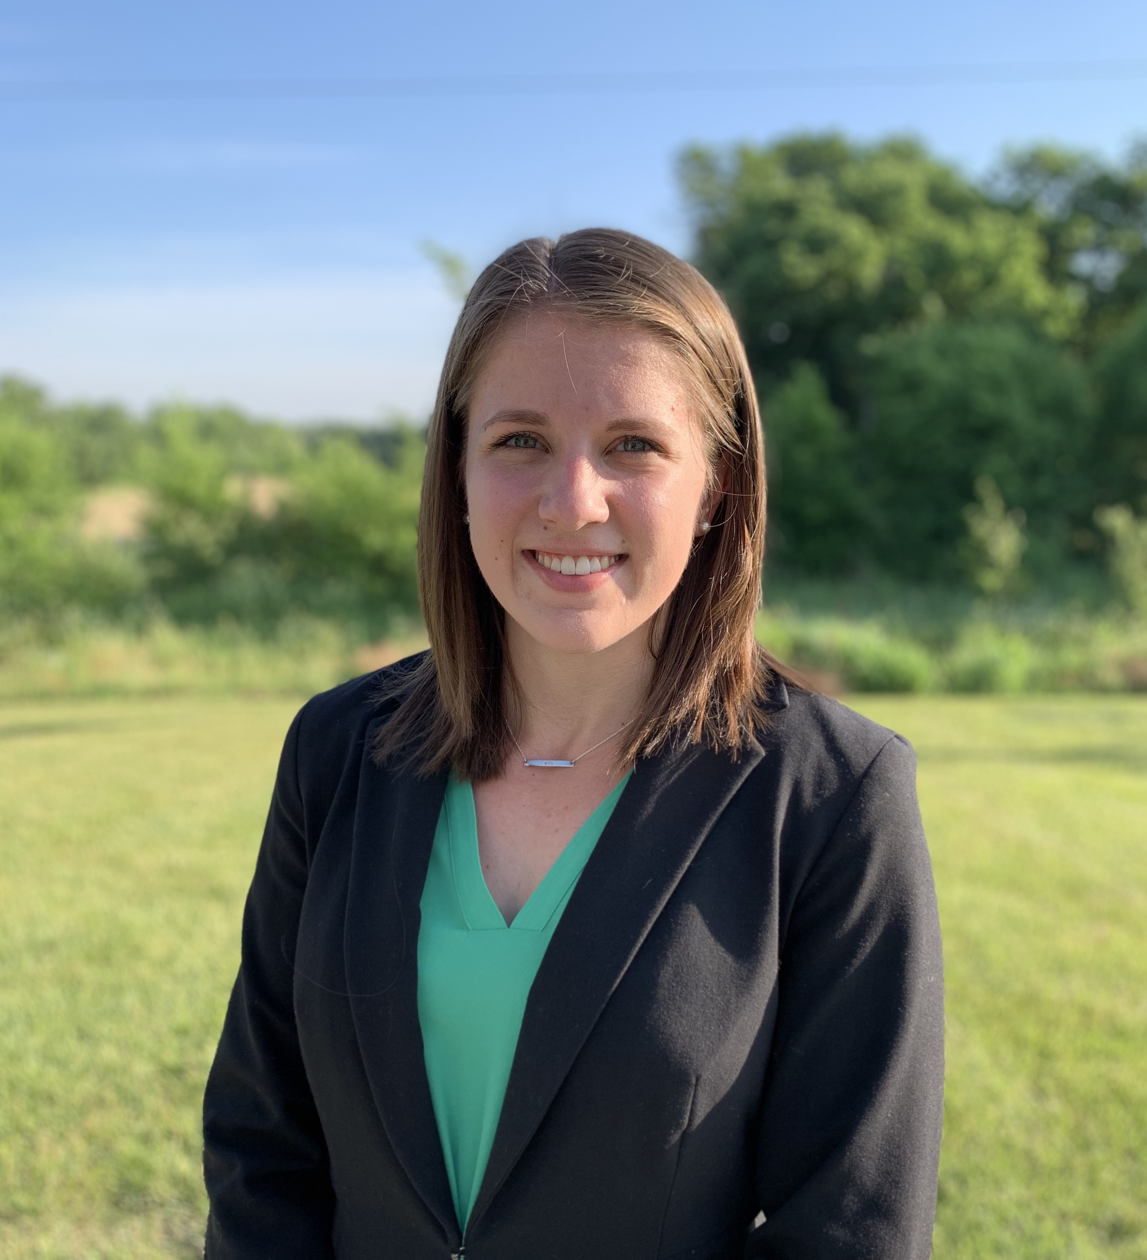

Project SCREEN: Research Project Team
Institute of Education Sciences, U.S. Department of Education
R324A190013 University of Kansas

Slide 37
Research Questions
RQ1: To what extent does the SRSS-IE consist of two correlated factors (externalizing and internalizing), measured with acceptable reliability?
RQ2: To what extent are internalizing and externalizing factors invariant across various groups of students as defined by gender, race, ethnicity, and special education status?
RQ3: To what extent do internalizing and externalizing factors exhibit invariance over time in fall, winter, and spring in one academic year?

Slide 38


Method: Participants & Setting
4 geographic regions
  West – AZ, CA, WA (n =19)
  Midwest – KS, MO (n =72)
  South – TN (n = 20)
  Northeast – PA, VT (n = 13)
52,845 K-12th grade students
Representing 124 Schools

Slide 39
Implementation Science
Adapted from Fixsen & Blasé, 2005
Exploration & Adoption
Installation
Initial Implementation
We think we know what we need so we are planning to move forward (evidence-based)
Let’s make sure we’re ready to implement (capacity infrastructure)
Let’s give it a try & evaluate (demonstration)
Full Implementation
Let’s make it our way of doing business (institutionalized use)
Sustainability & Continuous Regeneration
That worked, let’s do it for real (investment)

Slide 40
Agenda
Systematic Screening in Tiered Systems
Using Screening Data to Inform Instruction
  At Tier 1: Primary Preventions Efforts
  At all Tiers: Teacher-delivered Strategies
  At Tiers 2 & 3: Secondary & Tertiary Prevention Efforts
Resources for Getting Started

Slide 41
Social Skills Improvement System – Performance Screening Guide Spring 2012 – Total School
N = 54
N = 22
N = 35
N = 31
N = 223
N = 233
N = 180
N = 187
N = 212
N = 235
N = 275
N = 271
n = 489 n = 490 n = 490 n = 489
Lane, K. L., Oakes, W. P., & Magill, L. (2013). Primary prevention efforts: How do we implemented and monitor the Tier 1 component of our Comprehensive, Integrated, Three-Tiered (Ci3T) Model?, Preventing School Failure, 58(1), 143-158.

Slide 42
Student Risk Screening Scale Fall 2004 – 2012 Middle School
Source: Lane, K. L., Oakes, W. P., & Magill, L. M., (2014). Primary prevention efforts: How do we implement and monitor the Tier 1 component of our comprehensive, integrated, three-tiered model of prevention. Preventing School Failure, 58, 143-158. doi:10.1080/1045988X.2014.893978 [Figure 4. Middle school behavior screening data over time at the fall time point. Adapted from Figure 4.6 p. 127 Lane, K. L., Menzies, H. M, Oakes, W. P., & Kalberg, J. R. (2012). Systematic screenings of behavior to support instruction: From preschool to high school. Guilford Press.]

Slide 43
Agenda
Systematic Screening in Tiered Systems
Using Screening Data to Inform Instruction
  At Tier 1: Primary Preventions Efforts
  At all Tiers: Teacher-delivered Strategies
  At Tiers 2 & 3: Secondary & Tertiary Prevention Efforts
Resources for Getting Started
Notes:
Participants will be able to: 1. Discuss the benefits of systematic screening as part of regular school assessment practices. 2. Explain the utility of the SRSS-IE, including bias, with others at their school, district or state. 3. Locate and access resources for adopting and conducting systematic behavior screening in their schools.

Slide 44
Using multiple data sources

Slide 45

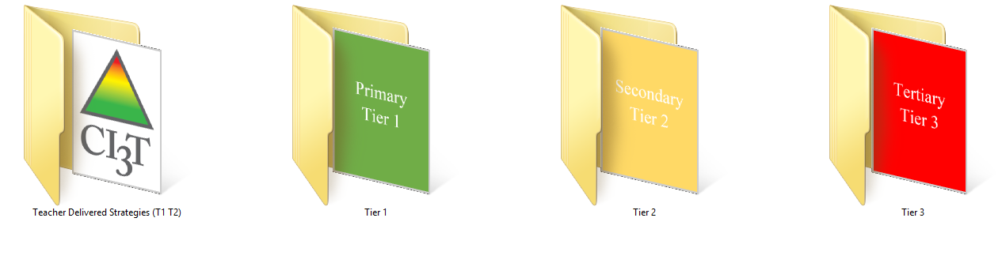
Building a Ci3T Tier Library
Teacher Delivered Strategies
Tier 1
Tier 2
Tier 3

Slide 46
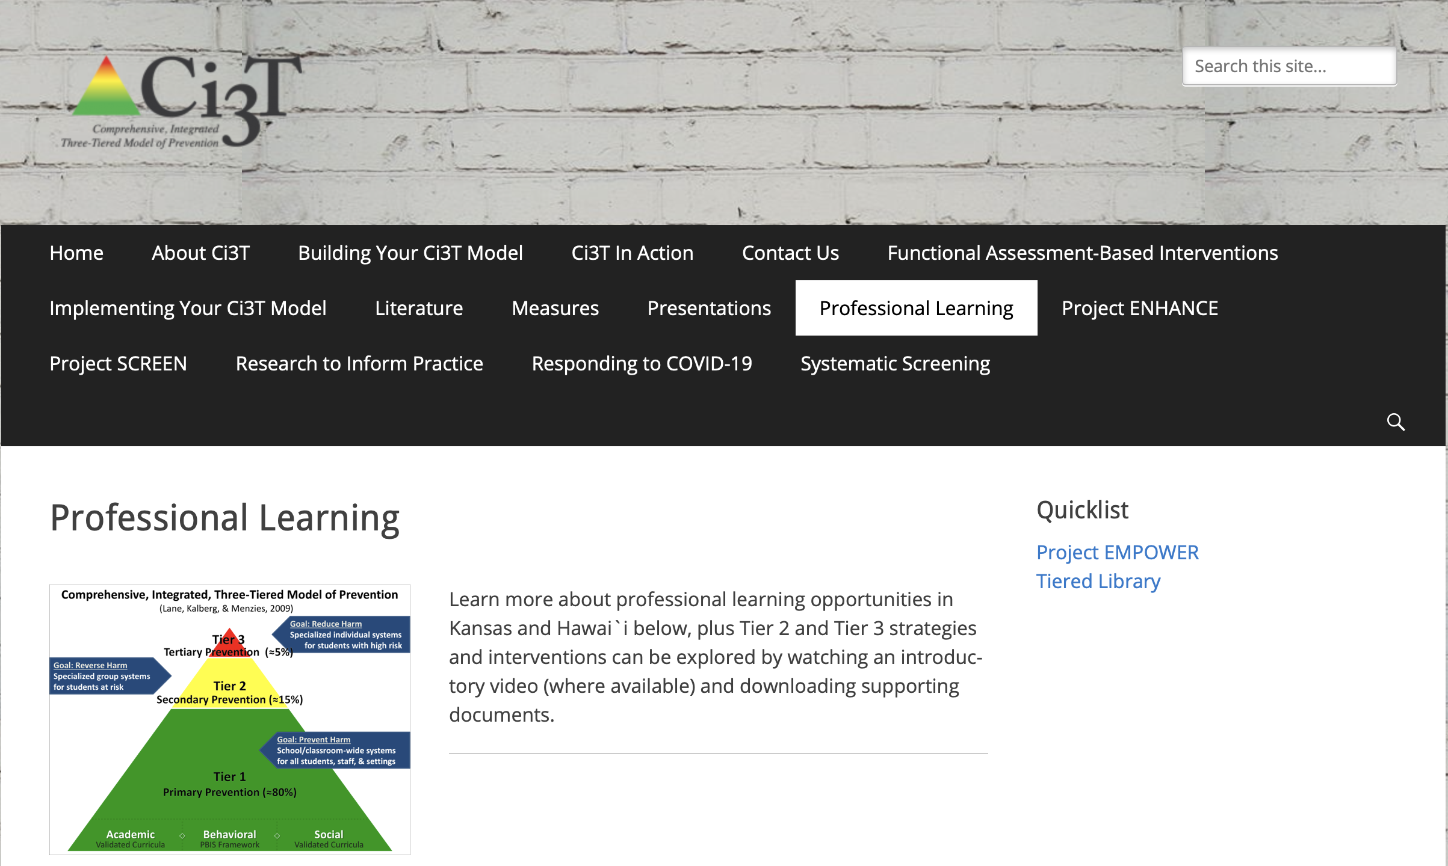
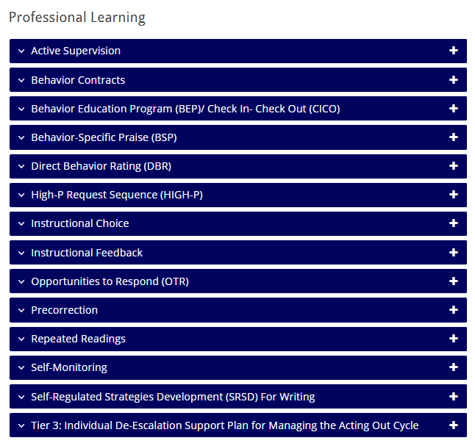


Low-Intensity Strategies

Slide 47
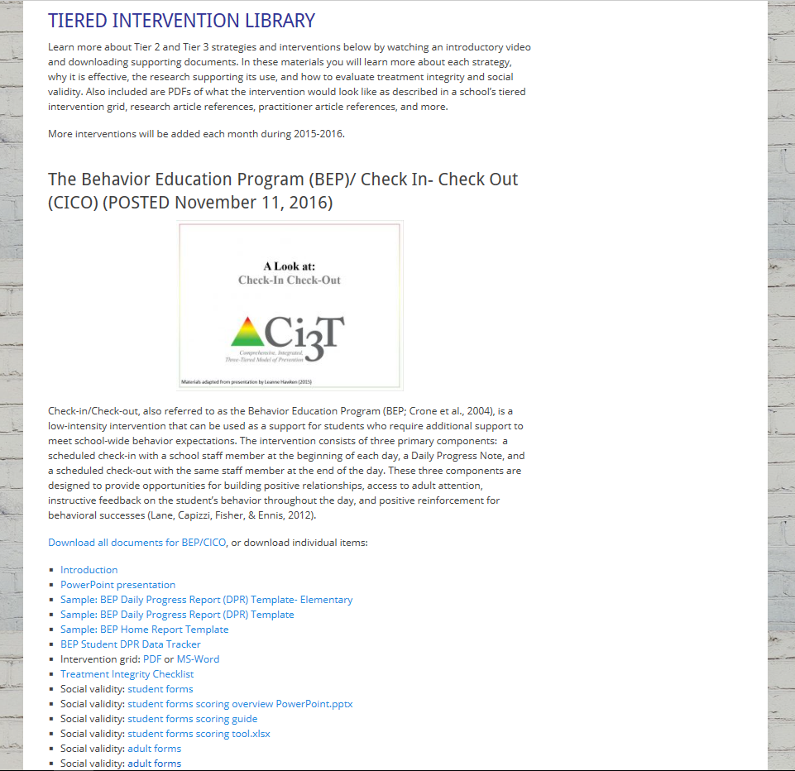
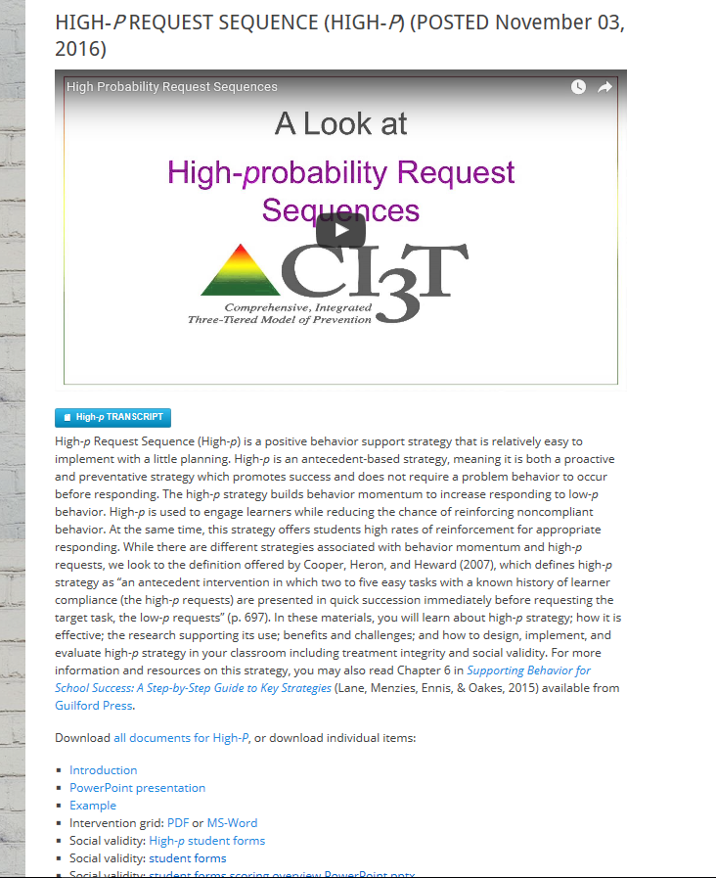
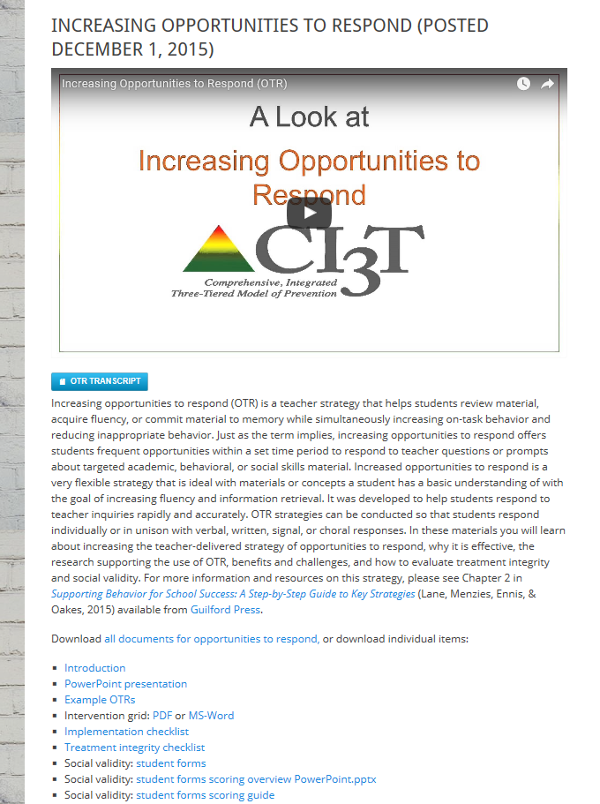
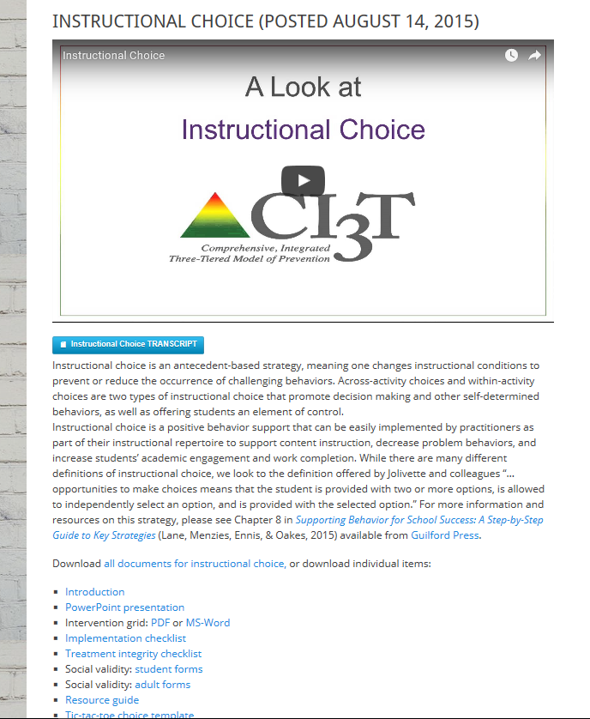
ci3t.org
Professional Learning tab

Slide 48
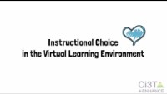
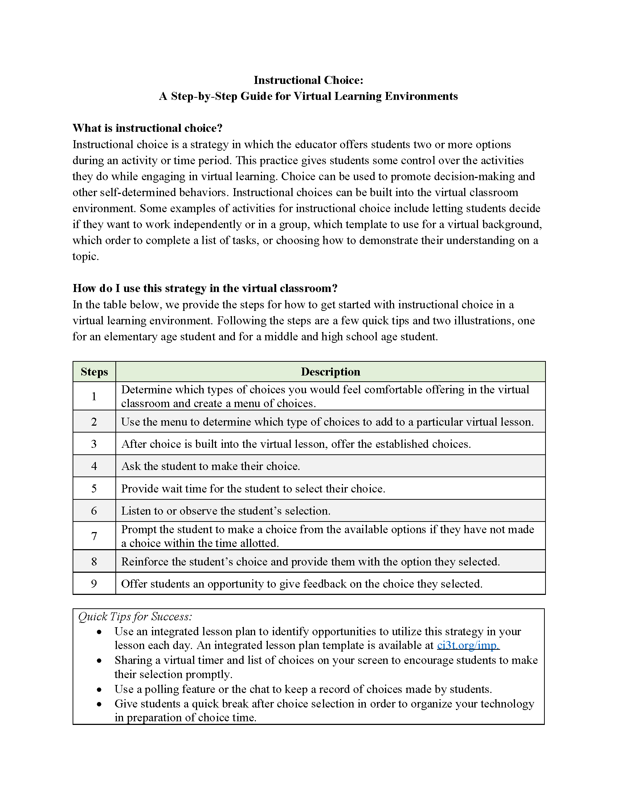


www.ci3t.org/covid
Choice
Materials to support remote learning
Step-by-step Video
Step-by-step Checklist
Infographic

Slide 49
Ci3T Primary Plan: Procedures for Teaching
BSP
OTR
Active Supervision
Choice
Precorrection

Slide 50
Low-Intensity Strategy | Franklin High School On-Site Expert
Behavior-Specific Praise: Identifying the specific expectation the student met. “Niama, I noticed you outlined your paper and used the graphic organizer to draft your essay. Well done!” “Justice, thank you for pushing in your chair to keep the walkway safe.” | Eric Common, Behavior Specialist Mark Buckman, Special Education Grant Allen, Parent Volunteer Paloma Pérez-Clark, School Psychologist
Opportunities to Respond: Providing 4-6 opportunities per minute for students to respond individually, choral, verbal, written, gesture, or symbol. “Show me thumbs or thumbs down if...” “Show me on your white board what…” “Turn to your elbow partner and say…” “All together now, what is…” | David Royer, Administration Emily Cantwell, 12th Grade Scarlett Lane, 11rd Grade Mallory Messenger, Counselor
Instructional Choice: Providing within-task or between task choices to increase academic engaged time and motivation. “Ronaldo, our of our 3 learning objectives today, which would you like to work on first?” “Suzy, do you want to work on the laptop, or handwrite your answers for this assignment?” | Abbie Jenkins, 10th Grade Scarlett Lane, 11th Grade José Sousa, PE Liane Johl, 9th Grade

Slide 51
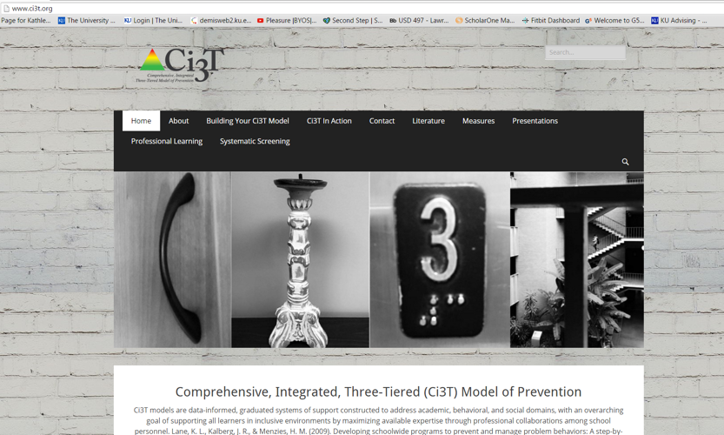

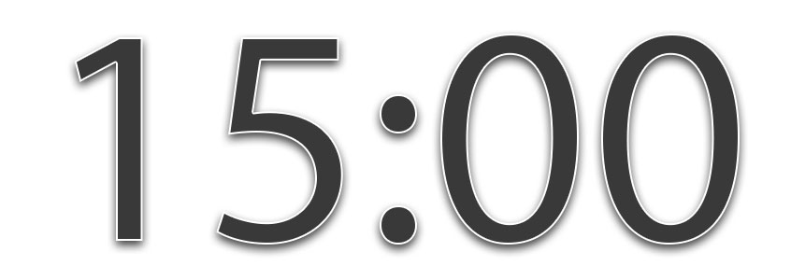





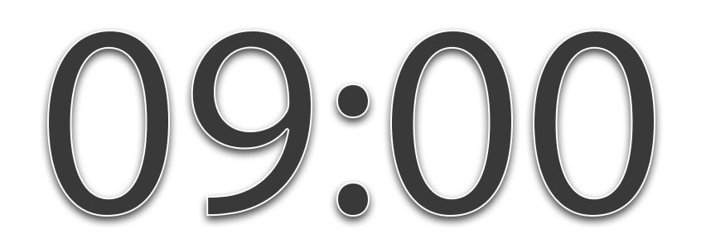
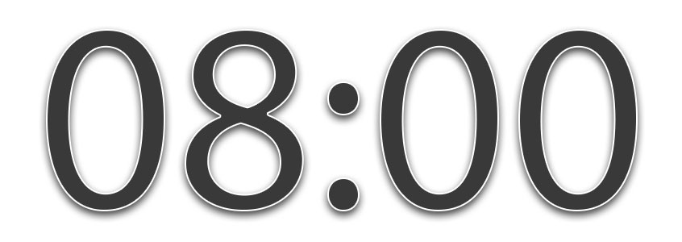
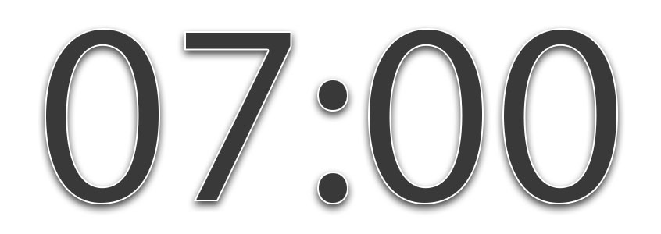

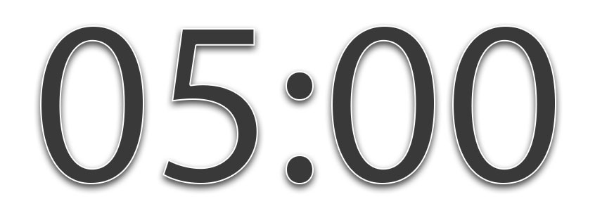

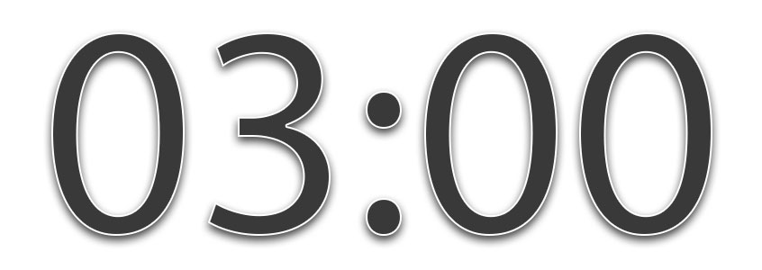
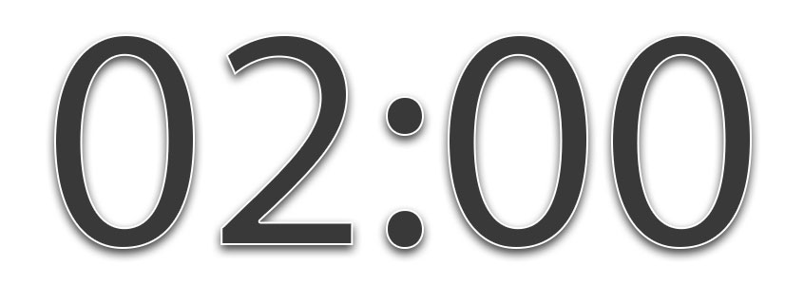



Exploring Teacher-Delivered, Low-Intensity Supports …
Ci3T Professional Learning Tab
Notes:
15-min timer

Slide 52
Agenda
Systematic Screening in Tiered Systems
Using Screening Data to Inform Instruction
  At Tier 1: Primary Preventions Efforts
  At all Tiers: Teacher-delivered Strategies
  At Tiers 2 & 3: Secondary & Tertiary Prevention Efforts
Resources for Getting Started
Notes:
Participants will be able to: 1. Discuss the benefits of systematic screening as part of regular school assessment practices. 2. Explain the utility of the SRSS-IE, including bias, with others at their school, district or state. 3. Locate and access resources for adopting and conducting systematic behavior screening in their schools.

Slide 53
Comprehensive, Integrated, Three-Tiered Model of Prevention
(Lane, Kalberg, & Menzies, 2009)
Tier 3
Tertiary Prevention (≈5%)
Tier 2
Secondary Prevention (≈15%)
Secondary (Tier 2) Intervention Grids
Tier 1
Primary Prevention (≈80%)
Academic ◇ Behavioral ◇ Social
Validated Curricula PBIS Framework Validated Curricula

Slide 54
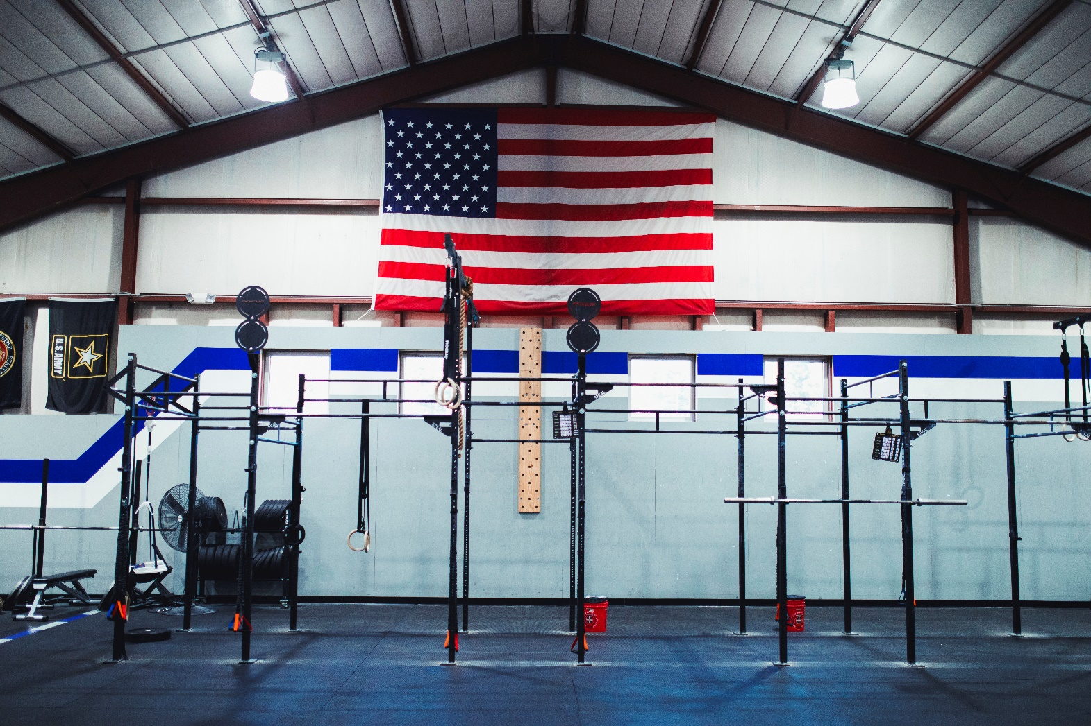

Slide 56
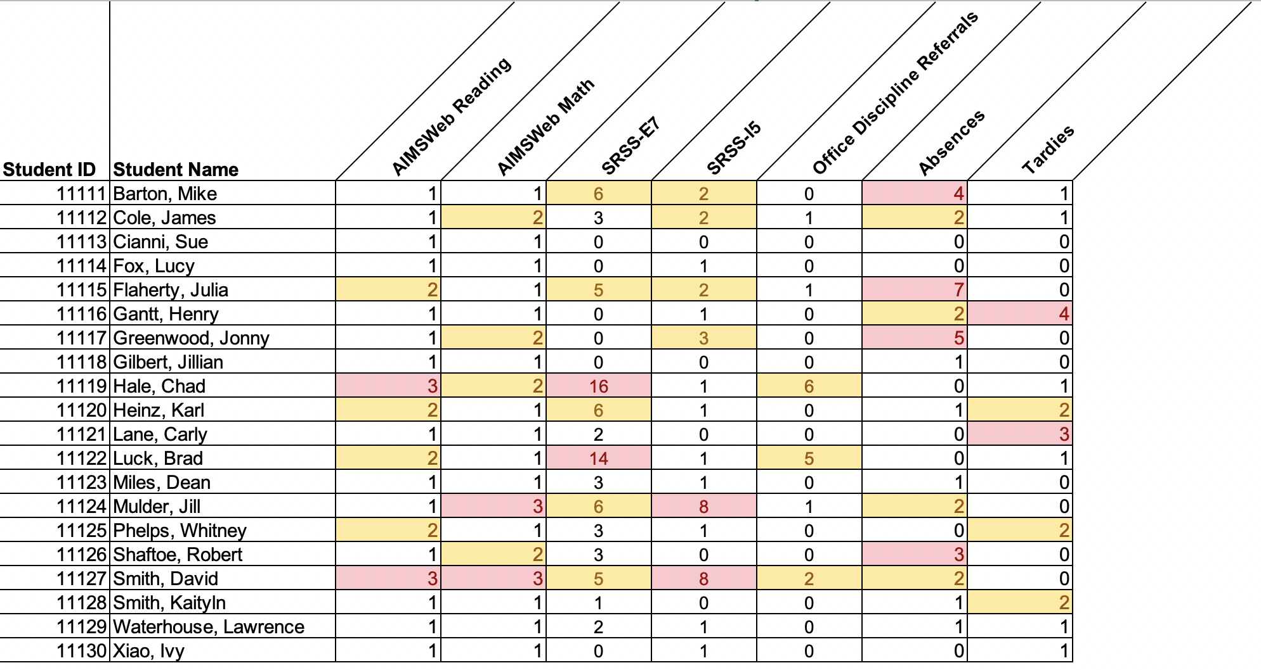
Data in action

Slide 57
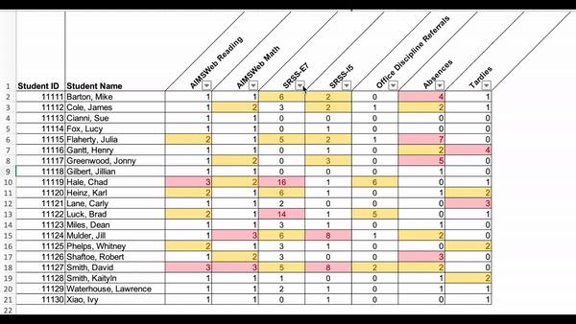
Data in action

Slide 58
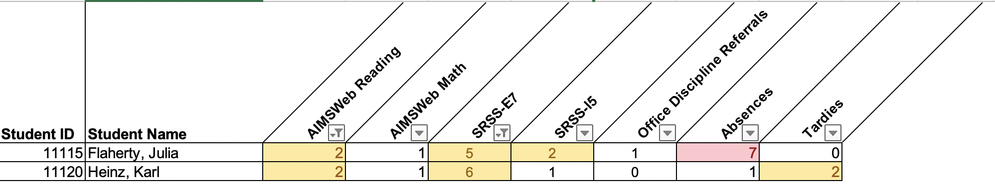
Data in action
Other Tier 2 options…
Precorrection
Behavior Contracts
Behavior-Specific Praise
Instructional Choice

Slide 59
Support | Description | Schoolwide Data: Entry Criteria | Data to Monitor Progress: | Exit Criteria
READ 180 (Stage C) Reading Intervention | Students participate in a 50 min reading instructional block during their study hall period. Students meet in the computer lab for participation in the online portion 20 min daily. Instruction is relevant to high school students. Students use a progress management system to monitor and track their own progress. Instruction is taught by special education teachers and general education teachers with training in the READ 180 Curriculum. | (1) Students in grades 9 – 12. (2) Reading performance basic or below basic on state assessment (but above 4th grade reading level). (3) SRSS risk scores in the moderate range (4 – 8). | Student Measures: Meeting individual READ 180 reading goals: (1) Progress Monitoring with Scholastic Reading Inventory (2) Writing Assessments (3) formative assessments (vocabulary, comprehension and spelling) (4) Curriculum-based Assessments (5) Attendance in class Treatment Integrity: Teachers monitor performance and attendance in class. Completion of weekly checklists for activities completed. Social Validity: Students and teachers complete surveys | Students meet instructional reading goals. SRSS score in the low risk category (0 – 3) on the next screening time point.
Lane, K. L., Oakes, W. P., Menzies, H. M., Oyer, J., & Jenkins, A. (2013). Working within the context of three-tiered models of prevention: Using school wide data to identify high school students for targeted supports. Journal of Applied School Psychology, 29, 203-229.

Slide 60
Support | Description | Schoolwide Data: Entry Criteria | Data to Monitor Progress: | Exit Criteria
Targeted Algebra II Study Hall | Direct, targeted instruction of Algebra II learning targets by math teachers. Time will be used to re-teach concepts, provide one-on-one or small group instruction and offer greater supports for students struggling to pass the graduation requirement course. 50 min per day until exit criteria is met. | (1) 12th graders (2) Algebra II grade drops below a 75 at any point in the semester (3) Have study hall time available and permission of 5th period teacher (4) Self-selecting to engage in study hall | Student Measures: Algebra II classroom grades Daily class average if grade is ≤ 75 Treatment Integrity: Daily monitoring of the lessons covered and student attendance Social Validity: Pre and Post Student Surveys | Algebra II Grade increases to satisfactory level (above 75%).
Lane, K. L., Oakes, W. P., Menzies, H. M., Oyer, J., & Jenkins, A. (2013). Working within the context of three-tiered models of prevention: Using school wide data to identify high school students for targeted supports. Journal of Applied School Psychology, 29, 203-229.

Slide 61
Comprehensive, Integrated, Three-Tiered Model of Prevention
(Lane, Kalberg, & Menzies, 2009)
Tier 3
Tertiary Prevention (≈5%)
Tier 2
Secondary Prevention (≈15%)
Tertiary (Tier 3) Intervention Grids
Tier 1
Primary Prevention (≈80%)
Academic ◇ Behavioral ◇ Social
Validated Curricula PBIS Framework Validated Curricula

Slide 62
Tertiary (Tier 3) Intervention Grid: For Middle and High School Students
Support | Description | Schoolwide Data: Entry Criteria | Data to Monitor Progress | Exit Criteria
Functional Assessment-based Intervention | FABIs are interventions based on the function of the target behavior, as determined by the functional assessment and determined with the aid of the Function Matrix. The Function-Based Intervention Decision Model is used to determine the intervention focus, including: Method 1: Teach the replacement behavior; Method 2: Improve the environment; Method 3: Adjust the contingencies; and a combination of Method 1 and Method 2. A package intervention is designed and implemented, including antecedent adjustments, reinforcement adjustments, and extinction procedures directly linked to the function of the target behavior. | One or more of the following: Behavior: SRSS-E7: High (9-21) SRSS-I6: High (6-18) Office discipline referrals (ODRs) 6 or more within a grading period AND/OR Academic: Progress report: 1 or more course failures Missing Assignments 5 or more within a grading period AIMSweb: intensive level (math or reading) Below 2.5 GPA | Student behavior targeted for improvement (e.g., target or replacement behavior) using direct observation Treatment integrity FABI Step checklists Treatment integrity checklist Social validity IRP-15 (teacher) CIRP (student) | The FABI will be faded once a functional relation is demonstrated using a validated single-case research design (e.g., withdrawal) and: Behavior objective for the student is met (See Behavior Intervention Plan [BIP]).

Slide 63

Changes in Harry’s Behavior
Cox, M., Griffin, M. M., Hall, R., Oakes, W. P., & Lane, K. L. (2012). Using a functional assessment-based intervention to increase academic engaged time in an inclusive middle school setting. Beyond Behavior, 2, 44 – 54.

Slide 64
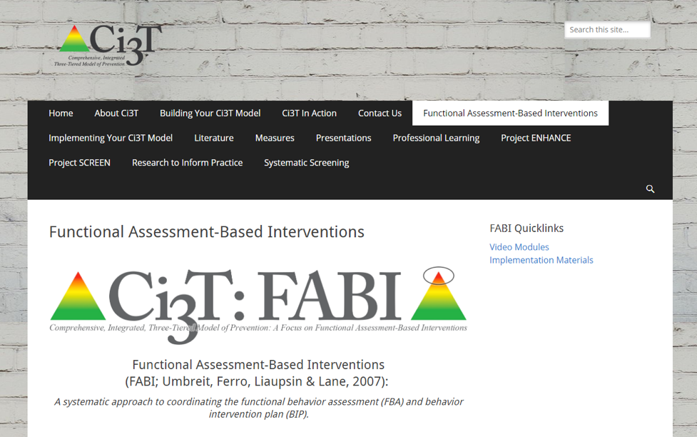
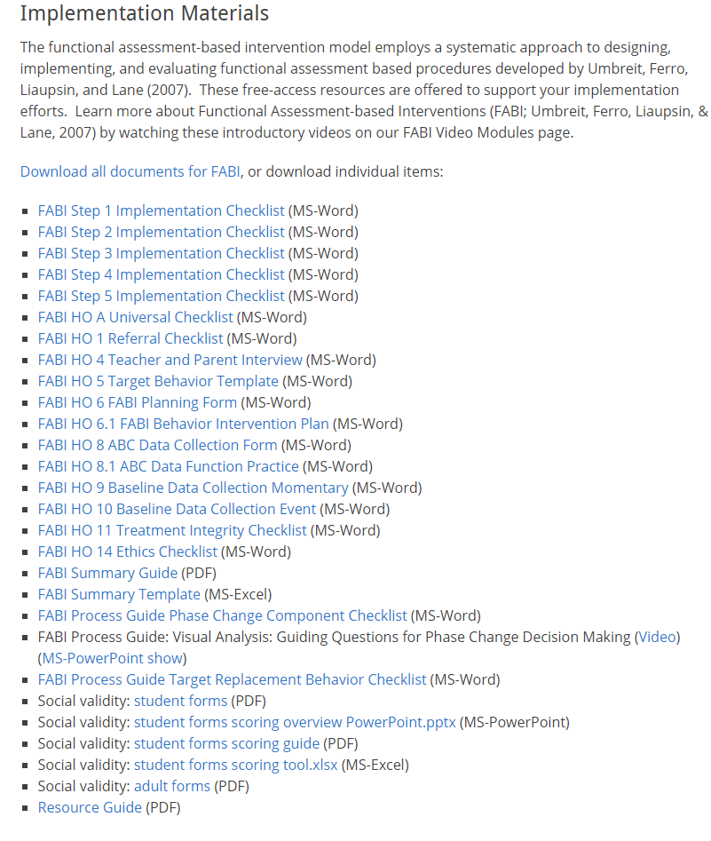
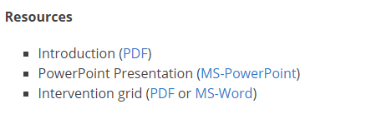


Slide 65
Agenda
Systematic Screening in Tiered Systems
Using Screening Data to Inform Instruction
  At Tier 1: Primary Preventions Efforts
  At all Tiers: Teacher-delivered Strategies
  At Tiers 2 & 3: Secondary & Tertiary Prevention Efforts
Resources for Getting Started
Notes:
Participants will be able to: 1. Discuss the benefits of systematic screening as part of regular school assessment practices. 2. Explain the utility of the SRSS-IE, including bias, with others at their school, district or state. 3. Locate and access resources for adopting and conducting systematic behavior screening in their schools.

Slide 66






Resources
Supporting educators in adopting, conducting screenings, and using screening data to support instructional decision making
Source: Instagram @ci3tmodel
Reference: Briesch, A.M., Lane, K.L., Common, E.A., Oakes, W.P., Buckman, M.B., Chafouleas, S.M., Iovino, E.A., Sherod, R.L., Abdulkerim, N., & Royer, D.J. (2022). Exploring views and professional learning needs of Comprehensive, Integrated, Three-Tiered (Ci3T) Leadership Teams related to universal behavior screening Implementation. Education and Treatment of Children, 45(3), 245–262. https://doi.org/10.1007/s43494-022-00080-8

Slide 67


Website www.ci3t.org

Slide 68




Protocols

Slide 69





Manual

Slide 70


Resources for screening available on PBIS.org…
coming soon!

Slide 71



Resources About the Screening Process: Questions to consider for….
Selecting a Tool
Installing a Tool
Interpreting Data

Slide 72


Tips for Communicating with Your Community about Systematic Screening

Slide 73


The Whys and Hows of Screening: Frequently Asked Questions for Families

Slide 74





Guidance for Systematic Screening: Lessons Learned from Practitioners

Slide 75
Explore All Publications: Data-Based Decision Making on www.pbis.org
Notes:
15-min timer

Slide 76

EMPOWER Sessions

Slide 77

Ci3T Trainers and Coaches Calls

Slide 78


Thank you!
www.Ci3T.org
Kathleen Lynne Lane, University of Kansas Kathleen.Lane@ku.edu

