Slide 1
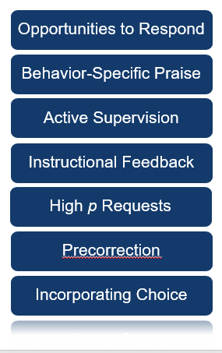
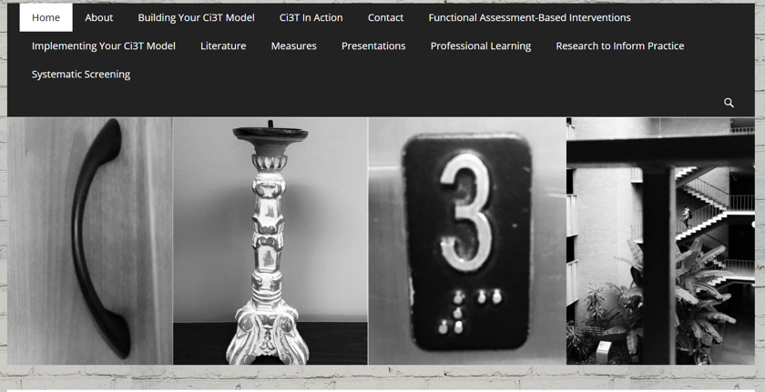
Keeping Students Engaged:
Practical Strategies that Work
Lincoln Public Schools: Supporting Positive Behavior Conference
Lincoln, Nebraska
Kathleen Lynne Lane, Ph.D., BCBA-D, CF-L2
www.ci3t.org
Notes:
Title: Keeping Student Engaged: Practical Strategies that Work
Abstract: In this session, we introduce low-intensity, teacher-delivered strategies (e.g., behavior specific praise, precorrection and instructional choice) maximize engagement and reduce disruption. We explain how to use these strategies at Tier 1, as stand-alone Tier 2 interventions, and as part of Tier 2 and Tier 3 intervention packages.

Slide 2


Agenda
Academic, behavioral and social needs: An integrated approach
Low-intensity, teacher-delivered strategies
  Instructional Choice
  Precorrection
  - Behavior Specific Praise
Evaluating and integrating low-intensity strategies
  Is it working?
  Integrated lesson planning
  School and home collaboration
Moving forward

Slide 3
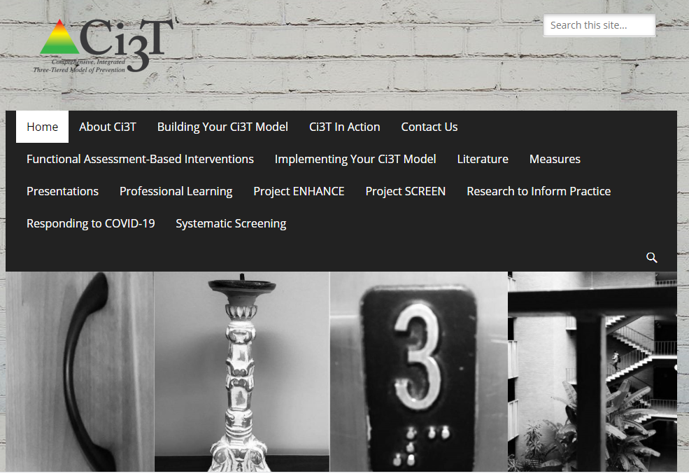
ci3t.org

Slide 4
Academic, behavioral and social needs
An integrated approach to working collaboratively to maximize engagement, limit disruption, and create positive environments

Slide 5

Thank you for your commitment
Shift to a systems level perspective
Internalizing
Externalizing
ED <1%
EBD 12-20%
Source: Forness, S.R., Freeman, S.F., Paparella, T., Kauffman, J.M., & Walker, H.M. (2012). Special education implications of point and cumulative prevalence for children with emotional or behavioral disorders. Journal of Emotional and Behavioral Disorders, 20, 4-18.
Notes:
Explain point prevalence estimates (Forness et al., 2012) versus students who receive special education support
Covid– current level

Slide 6
Comprehensive, Integrated, Three-Tiered Model of Prevention
(Lane, Kalberg, & Menzies, 2009)
Tier 3
Tertiary Prevention (≈5%)
Tier 2
Secondary Prevention (≈15%)
Tier 1
Primary Prevention (≈80%)
Academic ◇ Behavioral ◇ Social
Validated Curricula PBIS Framework Validated Curricula

Slide 7
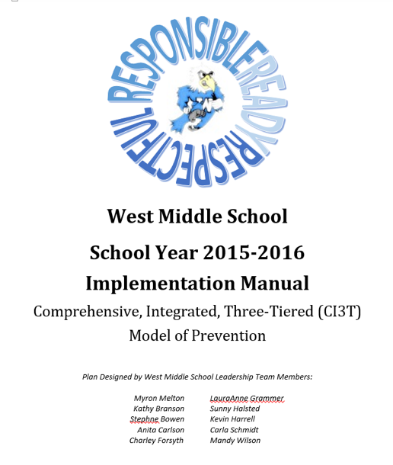
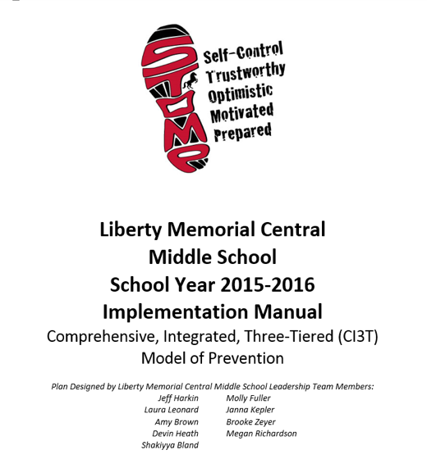
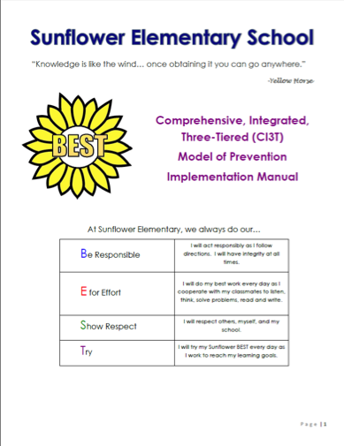

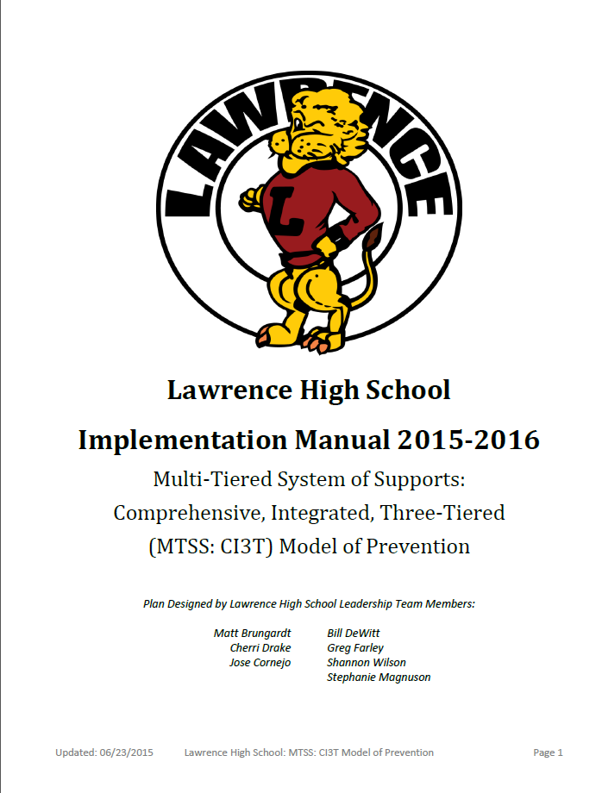




Slide 8
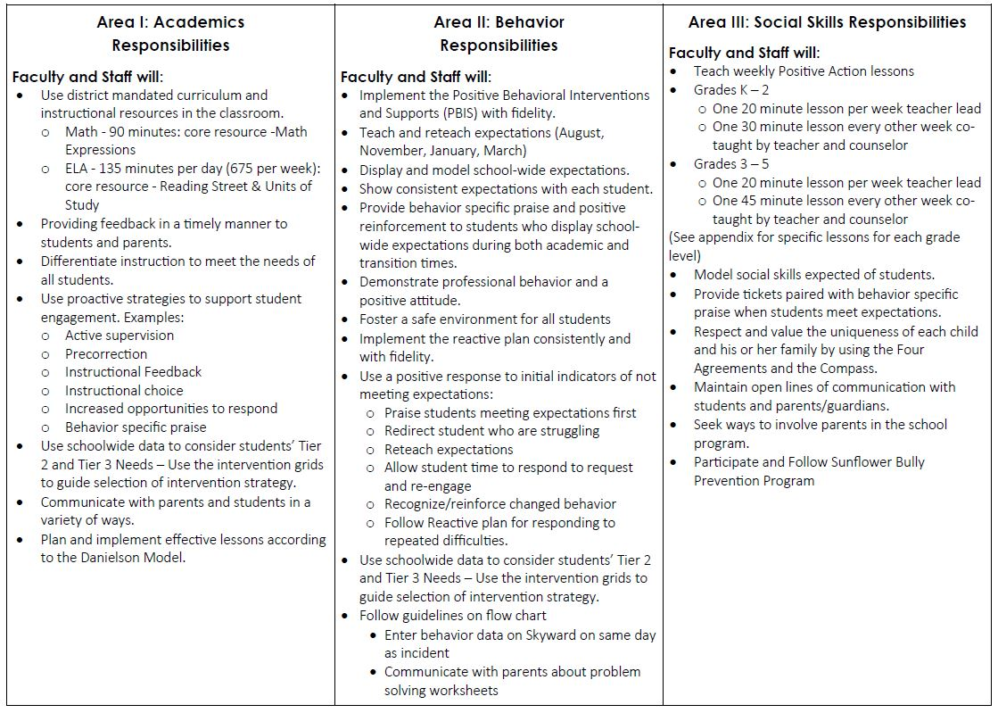
Notes:
Intentional about the plan

Slide 9
Fall 2021
SRSS-Externalizing Results – School level
n = 34
n = 40
n = 33
n = 10
n = 19
n = 35
n = 34
n = 35
n = 41
n = 52
n = 42
n = 26
n = 35
n = 52
n = 52
n = 61
n = 153
n = 135
n = 127
n = 146
n = 137
n = 109
n = 91
n = 135
Notes:
Fill in <year> based on current academic year. This is located in column A of the data sheet. Edit by right clicking and selecting “Edit data”.

Slide 10
Fall 2021
SRSS-Internalizing Results – School level
n = 31
n = 42
n = 39
n = 49
n = 18
n = 26
n = 61
n = 46
n = 44
n = 37
n = 35
n = 46
n = 27
n = 31
n = 38
n = 30
n = 153
n = 148
n = 128
n = 136
n = 137
n = 134
n = 97
n = 101
Cut scores vary by school level:
Elementary (I5): Low (0-1), Moderate (2-3), High (4-15)
Middle and High (I6): Low (0-3), Moderate (4-5), High (6-18)
Notes:
Fill in <year> based on current academic year. This is located in column A of the data sheet. Edit by right clicking and selecting “Edit data”.
IMPORTANT NOTE: The INTERNALIZING subscale and CUT SCORES are specific to school level.
Elementary: SRSS-I5, Items 8-12, 0-1 = low risk, 2-3 = moderate risk, 4-15 = high risk
Middle and High: SRSS-I6, Items 4, 8-12, 0-3 = low risk, 4-5 = moderate risk, 6-18 = high risk

Slide 11
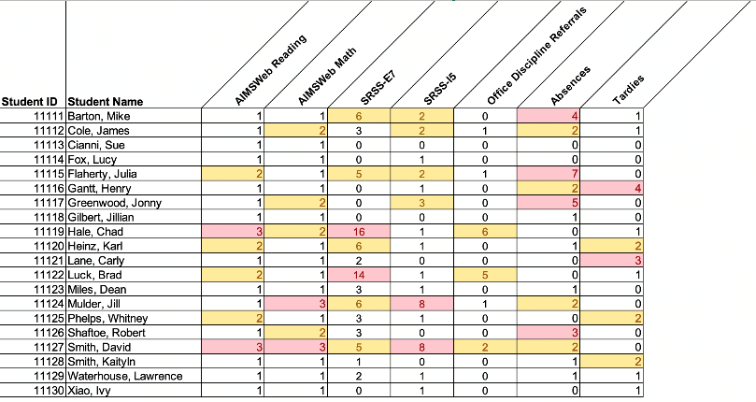
Using multiple data sources

Slide 12
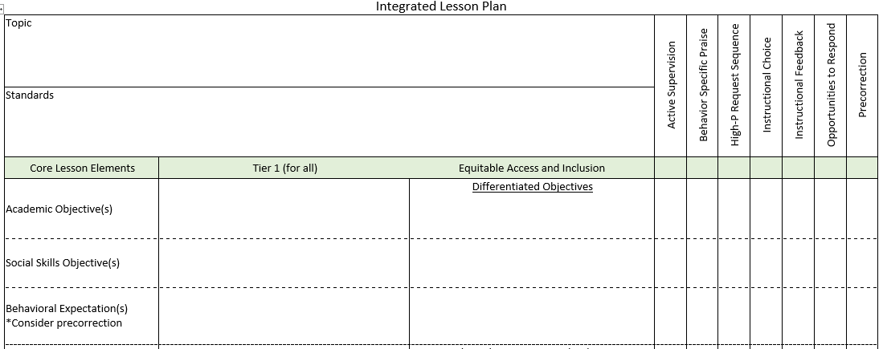
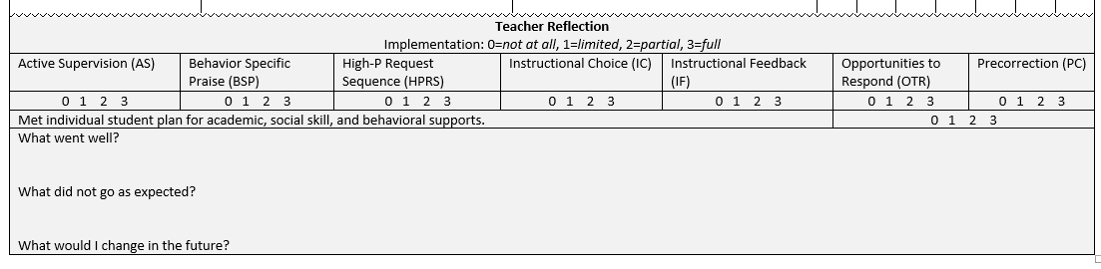

An Integrated Approach
BSP
OTR
Active Supervision
Choice
Precorrection
Notes:
We will revisit at the end

Slide 13
Low-Intensity Strategies: Practical & Effective
Opportunities to Respond
Behavior-Specific Praise
Active Supervision
Instructional Feedback
High p Requests
Precorrection
Incorporating Choice
Lane, K. L., Menzies, H. M., Ennis, R. P., & Oakes, W. P. (2015). Supporting behavior for school success: A step-by-step guide to key strategies. Guildford Press.

Slide 14
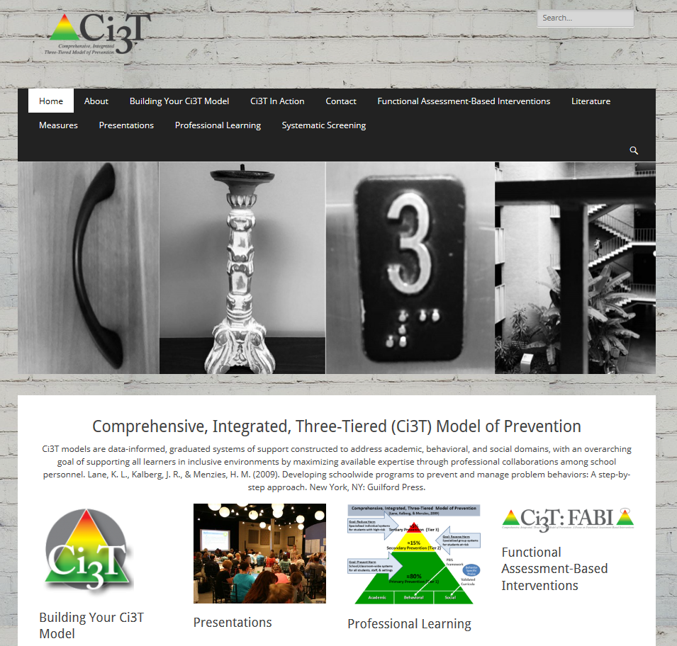
ci3t.org

Slide 15
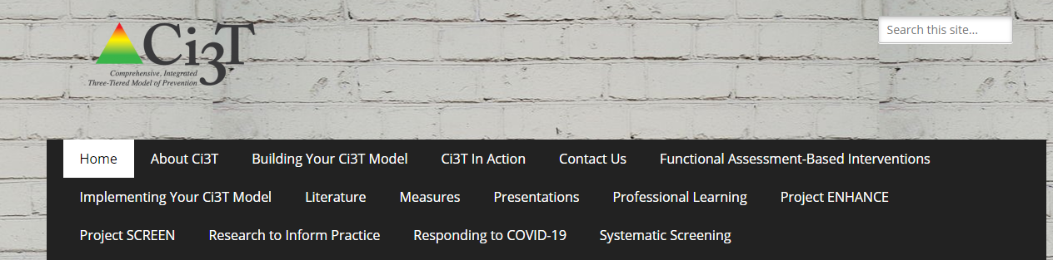
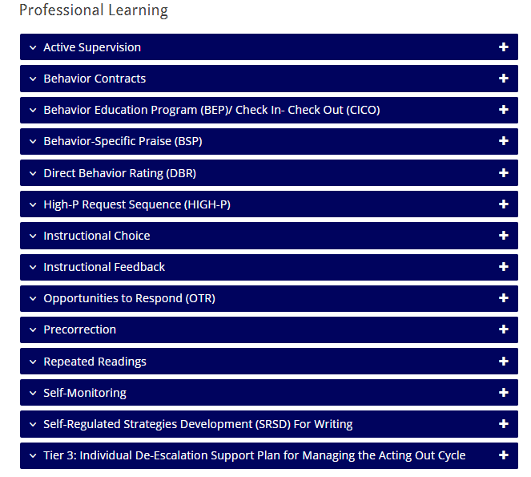
www.ci3t.org/pl

Slide 16
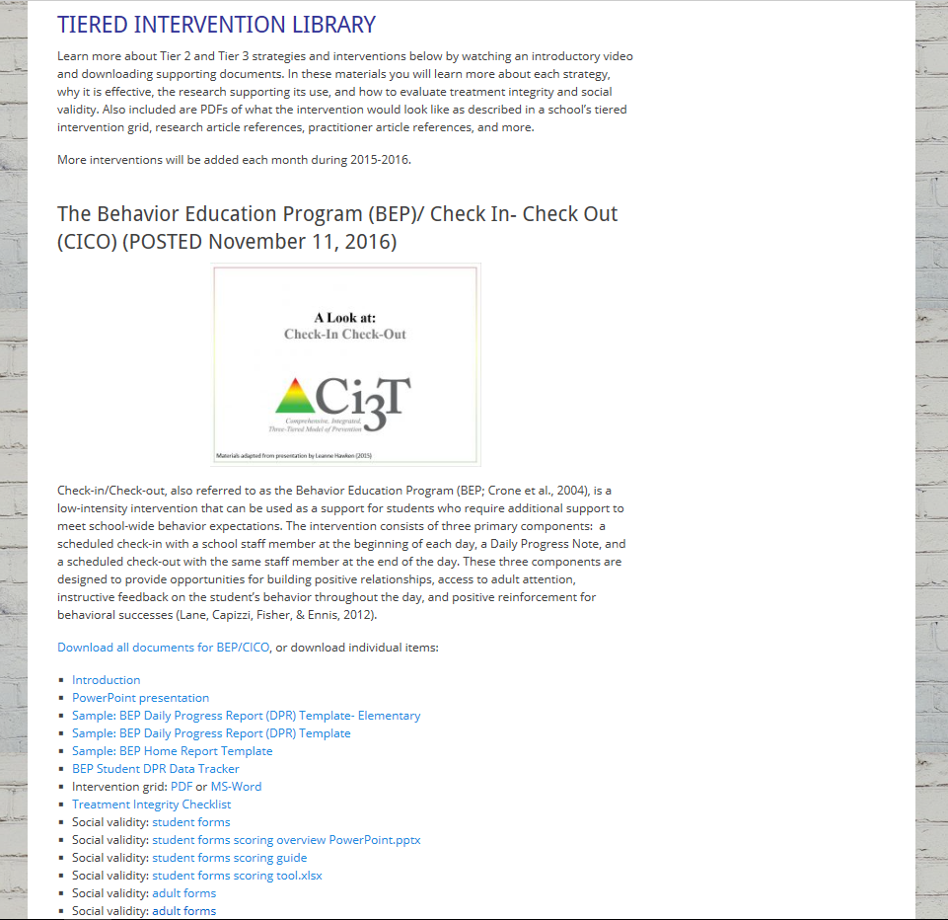

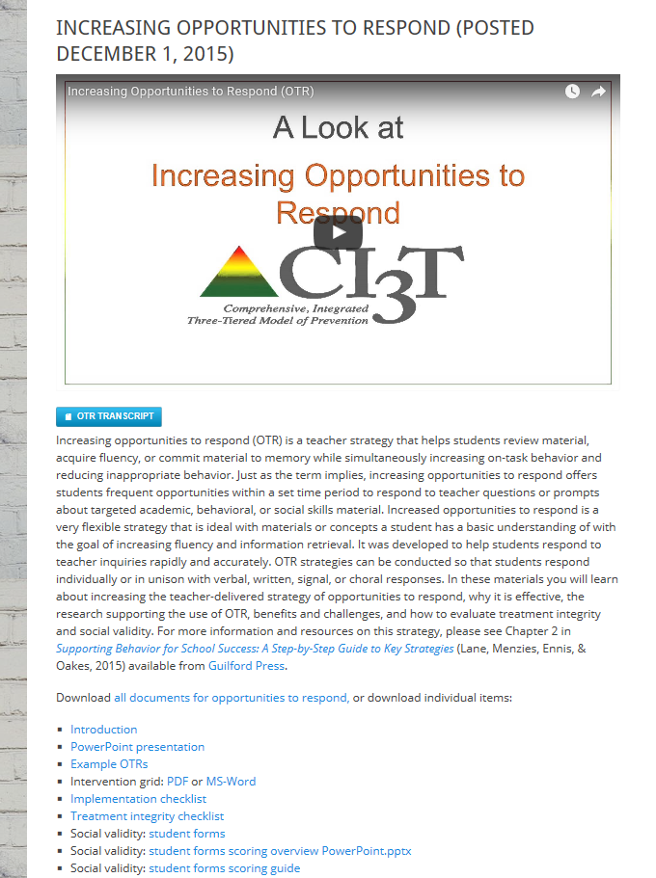
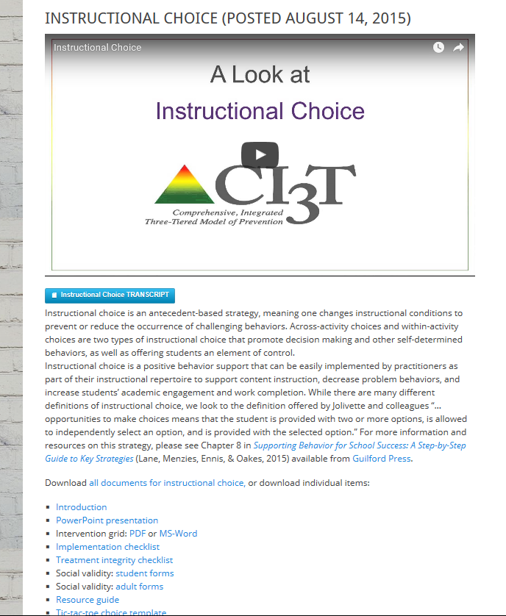
ci3t.org
Professional Learning tab

Slide 17
Monitoring Progress
Treatment Integrity
Is it happening?
Social Validity
What do stakeholders think about the goals, procedures, and outcomes?
Experimental Design
How well did this support work for this student?
Notes:
Lane, K. L., Oakes, W. P., Ennis, R. P., & Hirsch, S. E. (2014). Identifying students for secondary and tertiary prevention efforts: How do we determine which students have Tier 2 and Tier 3 needs? Preventing School Failure, 58, 171-182, DOI: 10.1080/1045988X.2014.895573

Slide 18
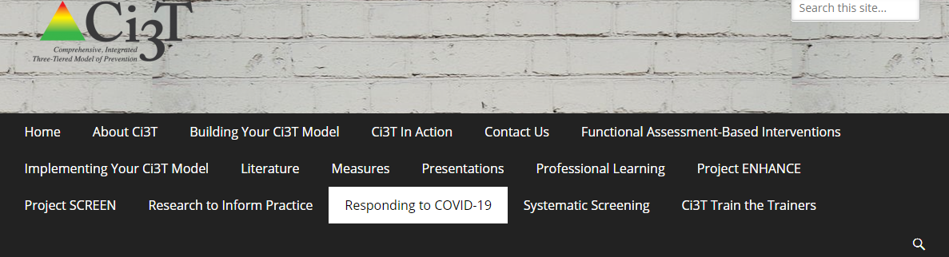
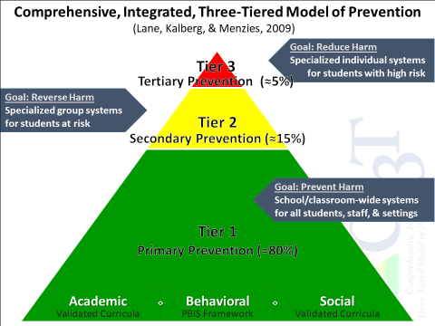
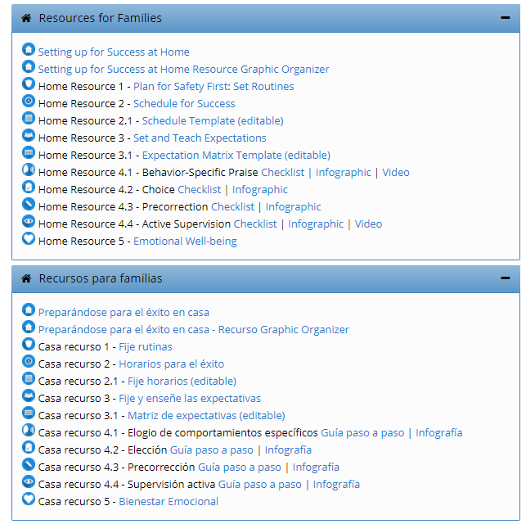

Notes:
In addition to creating free-access resources on specific topics, such as infographics, videos, and step-by-step checklists, we also created Ci3T Implementation exemplars to assist school leaders in conceptualizing how to use their Ci3T structures to adapt procedures for remote learning environments.

Slide 19
Low-intensity, Teacher-delivered Strategies
  - Instructional Choice
  - Behavior Specific Praise
  - Precorrection

Slide 20
Building Your Toolbox
Instructional Choice
Precorrection
Behavior Specific Praise

Slide 21
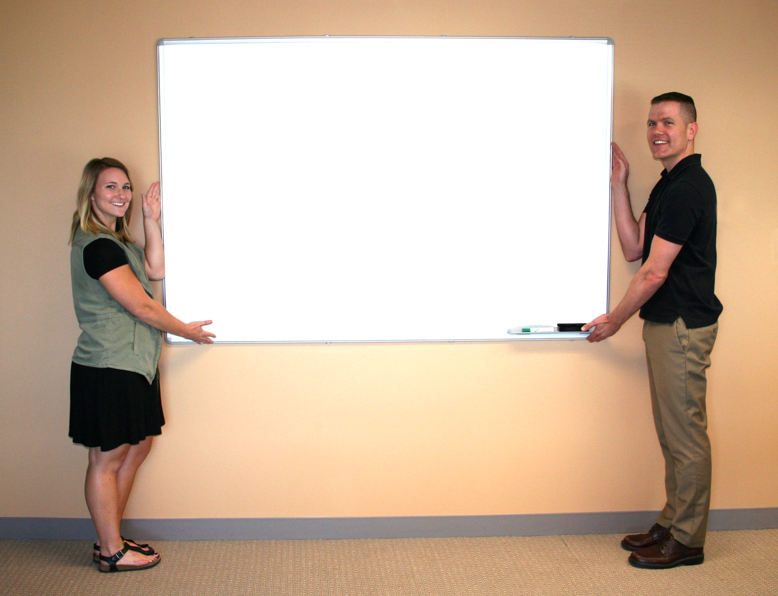












Explore “Professional Learning” on ci3t.org.
Download Instructional Choice
Precorrection
Behavior Specific Praise
Notes:
10 minute timer

Slide 22
Low Intensity Strategies:
A Look at Instructional Choice

Slide 23


Agenda
A Comprehensive, Integrated, Three-Tiered (CI3T) Model of Prevention
A Look at Instructional Choice
  What is instructional choice?
  Why is instructional choice effective?
  What does the supporting research for instructional choice say?
  What are the benefits and challenges?
  How do I implement instructional choice in my classroom?
Implementation Checklist
  How well is it working? Examining the Effects

Slide 24
Comprehensive, Integrated, Three-Tiered Model of Prevention (Lane, Kalberg, & Menzies, 2009)
Goal: Reduce Harm
Specialized Individual Systems
for Students with High-Risk
≈5%
Tertiary Prevention (Tier 3)
Goal: Reverse Harm
Specialized Group Systems
for Students At-Risk
≈15%
Secondary Prevention (Tier 2)
Goal: Prevent Harm
School/Classroom-Wide Systems for All Students, Staff, & Settings
PBIS Framework
≈80%
Validated Curricula
Primary Prevention (Tier 1)
Academic Behavioral Social
Notes:
Lane, K. L., Oakes, W. P., Ennis, R. P., & Hirsch, S. E. (2014). Identifying students for secondary and tertiary prevention efforts: How do we determine which students have Tier 2 and Tier 3 needs? Preventing School Failure, 58, 171-182, DOI: 10.1080/1045988X.2014.895573

Slide 25
Schoolwide Positive Behavior Support
Comprehensive, Integrative,
Three-tiered (CI3T)
Models of Support
Low Intensity Strategies
Basic Classroom Management
Effective Instruction
Low Intensity Strategies
Behavior Contracts
Self-Monitoring
- -
Functional Assessment-Based
Interventions
Higher Intensity Strategies
Assess, Design, Implement, and
Evaluate
Assessment

Slide 26


What is instructional choice?
Instructional Choice
  “…opportunities to make choices means that the student is provided with two or more options, is allowed to independently select an option, and is provided with the selected option" (Jolivette et al., 2002, p. 28).
  Types of instructional choices (Rispoli et al., 2013)
  Across-activity choices
  Within-activity choices

Slide 27
Examples of instructional choice
Across-activities Choices
Within-activity Choices
Paper, presentation, or YouTube video to show me what you know?
Which activity would you like to do first?
Pick a learning center?
Make your schedule for the day.
Think-Tac-Toe Boards
Crayons or sparkly markers?
At your desk or in the library?
In the reading corner or at your desk?
Work independently or with a partner?
Which book would you like to read?
Finish in class or at home?
Typed or handwritten?
Even or odds?

Slide 28



Why is instructional choice effective?
Easy
Little time
Offers students control
Promotes decision making and other self-determined behaviors

Slide 29

What does the supporting research for instructional choice say?
Increasing engagement and decreasing disruption in elementary self-contained classrooms (Dunlap et al., 1994)
Increasing time on-task, task completion, and accuracy in residential facilities (Ramsey et al., 2010)
Increasing task engagement and improving academic performance in an inclusive setting (Skerbetz & Kostweicz, 2013)

Slide 30
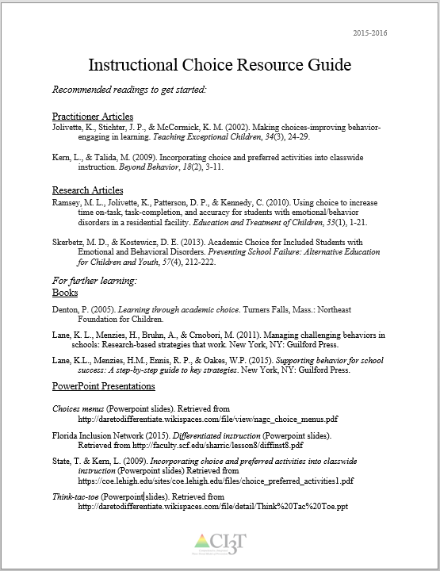
Supporting Research
See “Instructional Choice Resource Guide” for additional supporting research and information.

Slide 31
What are the benefits & challenges?
Benefits
Challenges
feasible, does not require excessive preparation, is easy to implement, and supports content instruction (Kern & State, 2008; Morgan, 2006; Ramsey et al., 2010).
teaches self-determined behaviors
challenges in preparing independent tasks for the time provided
important to think about procedures for collecting and evaluating different types of assignments

Slide 32

How do I implement instructional choice in my classroom?
Implementation Checklist
!
Step 1
Determine which type of choices you feel comfortable offering and create a menu of choices.
Step 2
Use the menu to determine which type of choice to add to a particular lesson.
Step 3
After choice is built into the lesson, offer the established choices.
Step 4
Ask the student to make his or her choice.

Slide 33
How do I implement instructional choice in my classroom?
Implementation Checklist
Step 5
Provide wait time for the student to select their choice.
Step 6
Listen to (or observe) the student’s response
Step 7
Prompt the student to make a choice from one of the available options if the student has not made a choice within the time allotted.
Step 8
Reinforce the student’s choice, providing them with the option they selected.

Slide 34
How do I implement instructional choice in my classroom?
Implementation Checklist
Step 9
Offer students an opportunity to give feedback on the choice they selected.

Slide 35
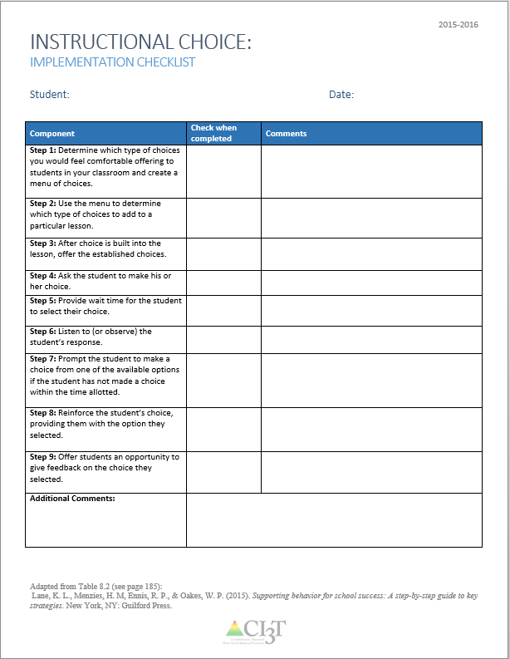
How do I implement instructional choice in my classroom?
Step 1: Determine which type of choices you would feel comfortable offering to students in your classroom and create a menu of choices.
  Consider within activity or across activity choices.
Step 2: Use the menu to determine which type of choices to add to a particular lesson.
Step 3: After choice is built into the lesson, offer the established choices
Step 4: Ask the student to make his or her choice.
See “Instructional Choice Implementation Checklist”

Slide 36
How do I implement instructional choice in my classroom?
Step 5: Provide wait time for the student to select their choice.
Step 6: Listen to (or observe) the student’s response.
Step 7: Prompt the student to make a choice from one of the available options if the student has not made a choice within the time allotted.
Step 8: Reinforce the student’s choice, providing them with the option they selected.
Step 9: Offer students an opportunity to give feedback on the choice they selected.

Slide 37
How well is it working?
Examining the Effects
Treatment Integrity
Is it happening?
Social Validity
What do stakeholders think about the goals, procedures, and outcomes?
Experimental Design
How well did this support work for this student?

Slide 38
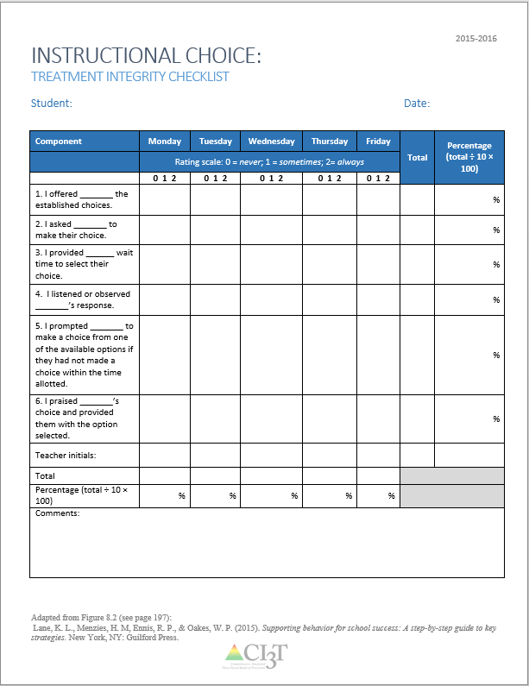
Making Certain the Strategy is in Place:
Treatment Integrity
Have structures in place to monitor whether instructional choice is carried out as intended:
Treatment integrity checklist
  Example items:
    I offered _______ the established choices.
    I asked _______ to make their choice.
    I provided ______ wait time to select their choice.
    I listened or observed _______’s response.
    I prompted _______ to make a choice from one of the available options if they had not made a choice within the time allotted.
    I praised _______’s choice and provided them with the option selected.
See “Instructional Choice Treatment Integrity Checklist”

Slide 39
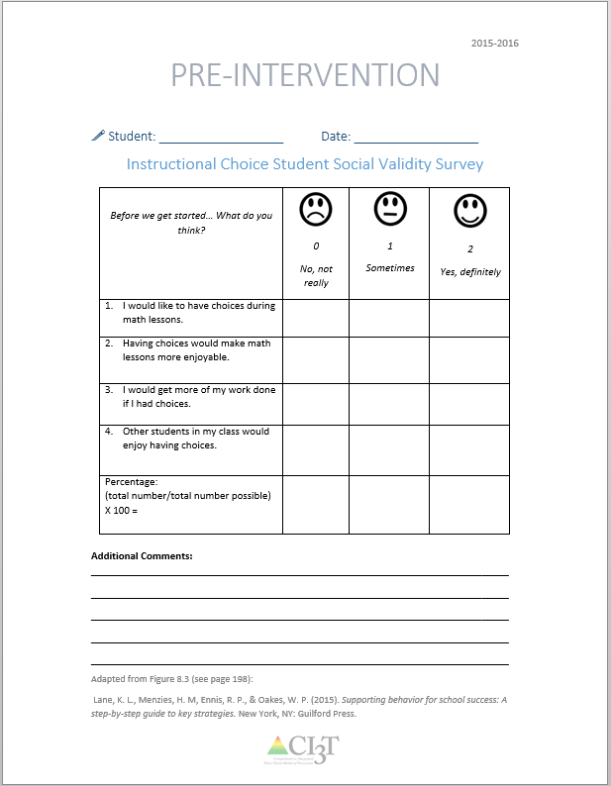
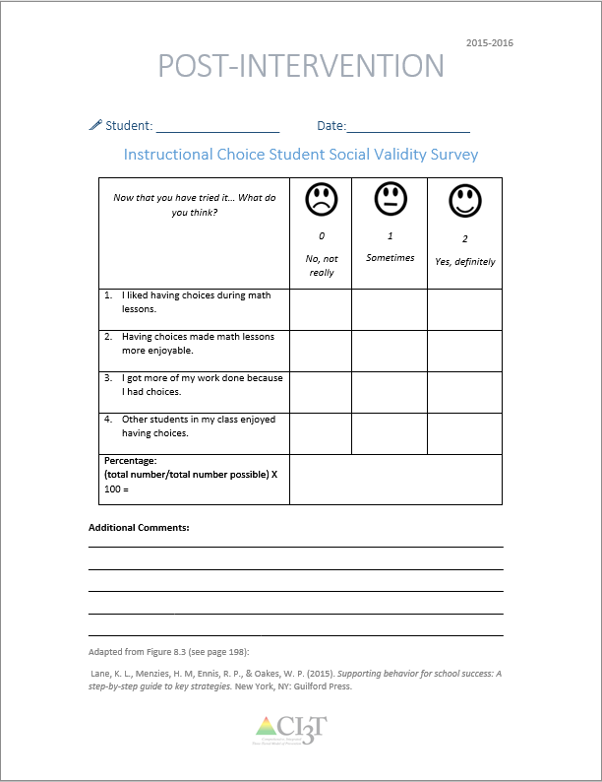
What does the student think about it?
See “Instructional Choice Social Validity Student”
Completed by the student participating in the intervention at two time points: Pre and post intervention

Slide 40
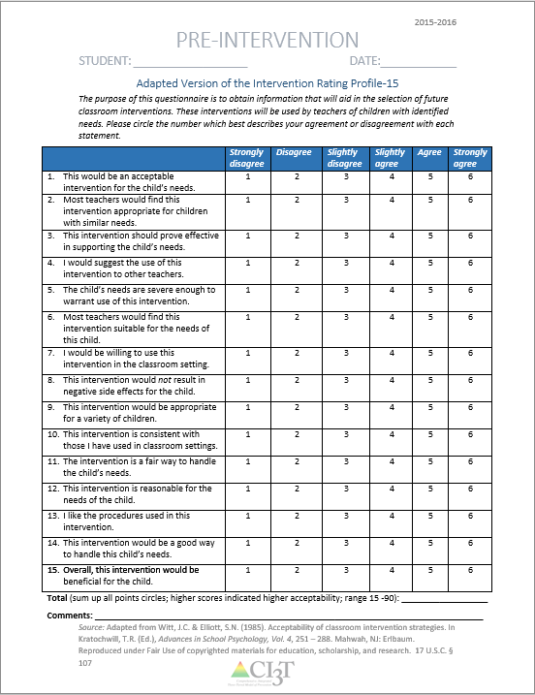
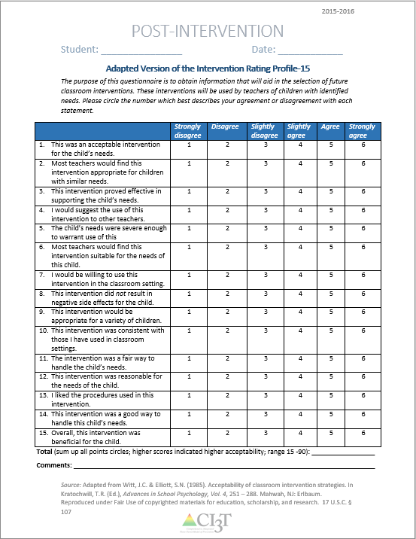
What does the teacher think about it?
See “Social Validity Adapted-IRP15 Adult”
Completed by the teacher and/or parent participating in the intervention at two time points: Pre and post intervention

Slide 41
Sample Intervention Grid
Support | Description | Schoolwide Data: Entry Criteria | Data to Monitor Progress | Exit Criteria
Instructional Choice | Within- and across-task choices offered during instruction (e.g., language arts assignments, math lessons, etc.) | One or more of the following: Behavior: SRSS-E7 Score: Moderate (4-8) SRSS-I5 Score: Moderate (2-3) ___ AND ___ OR Academic: □ Progress Reports; Successful Learning Behaviors - Targeted for growth □ Gradebook: 2+ incomplete assignments | Student Performance Academic engaged time Percentage of work completed Treatment Integrity Implementation & TI checklist Social Validity Student & teacher pre/post survey | Progress Reports: Five consecutive weeks of daily academic engagement 80% or better and work completion at 90% or better.
(Lane, Menzies, Ennis, & Oakes, 2015)

Slide 42




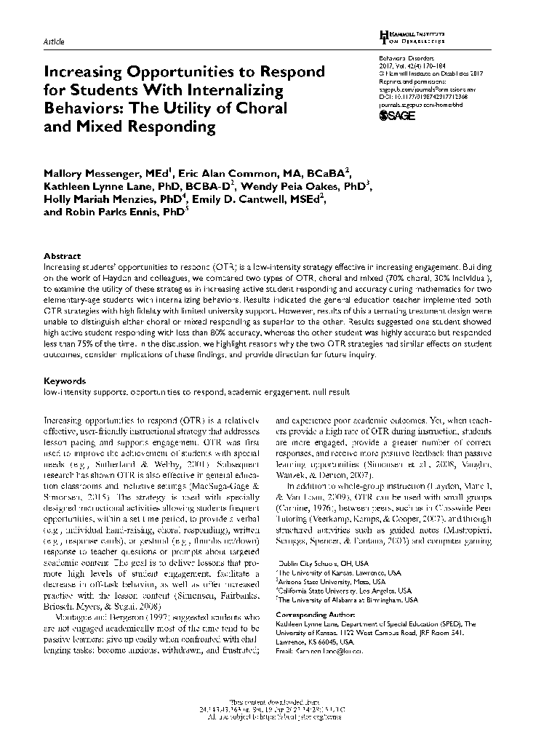





Choice

Slide 43
Choice
Across-activity
Pick a learning center?
Think-Tac-Toe Boards
Make your schedule for the day
Paper, presentation, or YouTube video to show me what you know?
Which activity would you like to do first?

Slide 44
Choice
Within-activity
Crayons or sparkly markers?
At your desk or in the library?
In the reading corner or at your desk?
Which book would you like to read?
Finish in class or at home?
Typed or hand written?
Even or odds?
Work independently or with a partner?

Slide 45
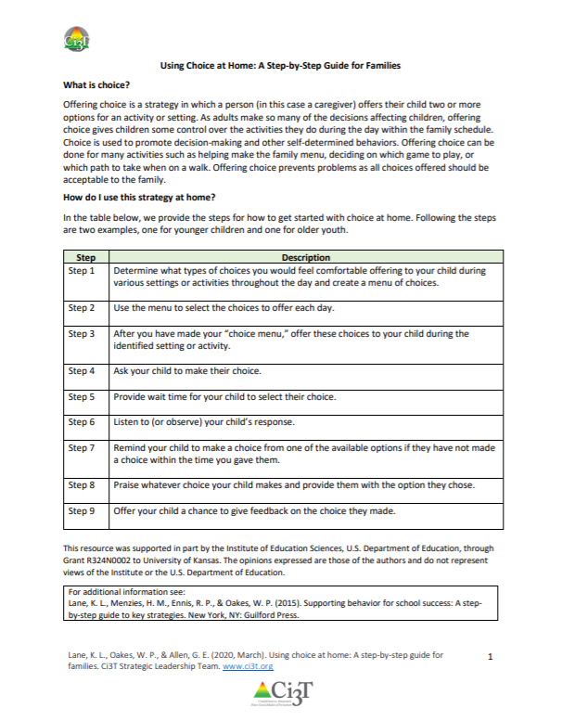
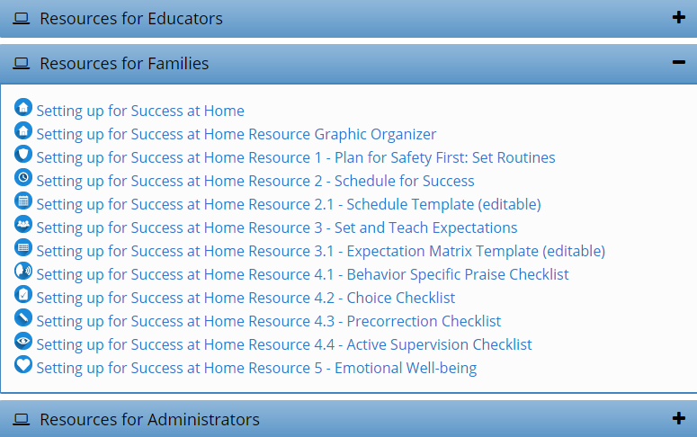
Setting up for Success at Home
  Low-Intensity Supports
http://www.ci3t.org/covid
Notes:
In the accordions below we will be uploading a series of brief practice guides that we hope you will find useful. Feel free to share these materials with fellow educators and families. We are sending positive thoughts to all our partners, colleagues, and the students you so tirelessly support.
Materials to support educators and families as we transition to continuous learning
Using your Ci3T structures to facilitate positive, productive environments for students, families, educators, and administrators

Slide 46
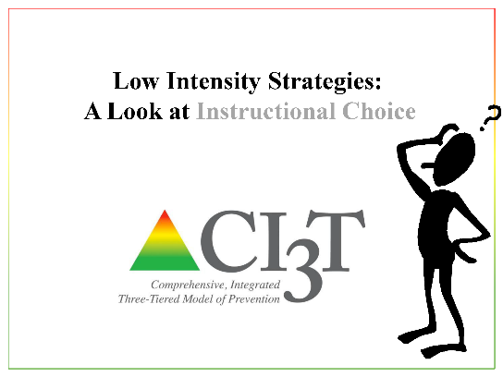
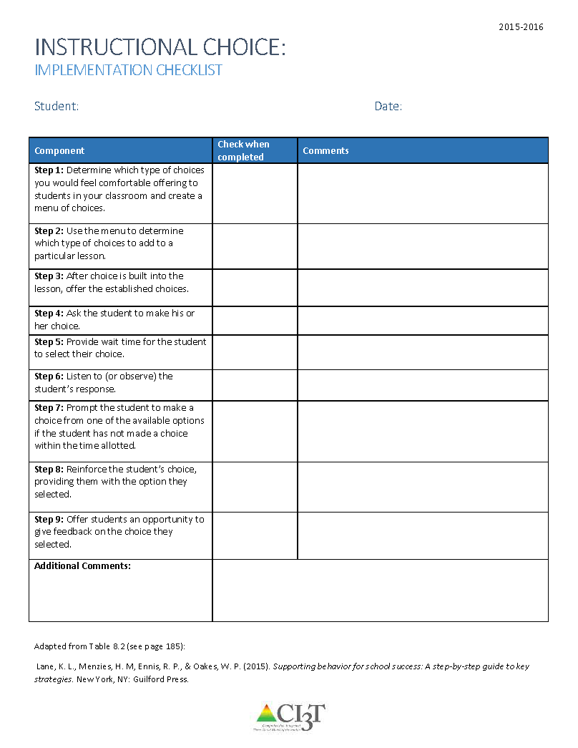
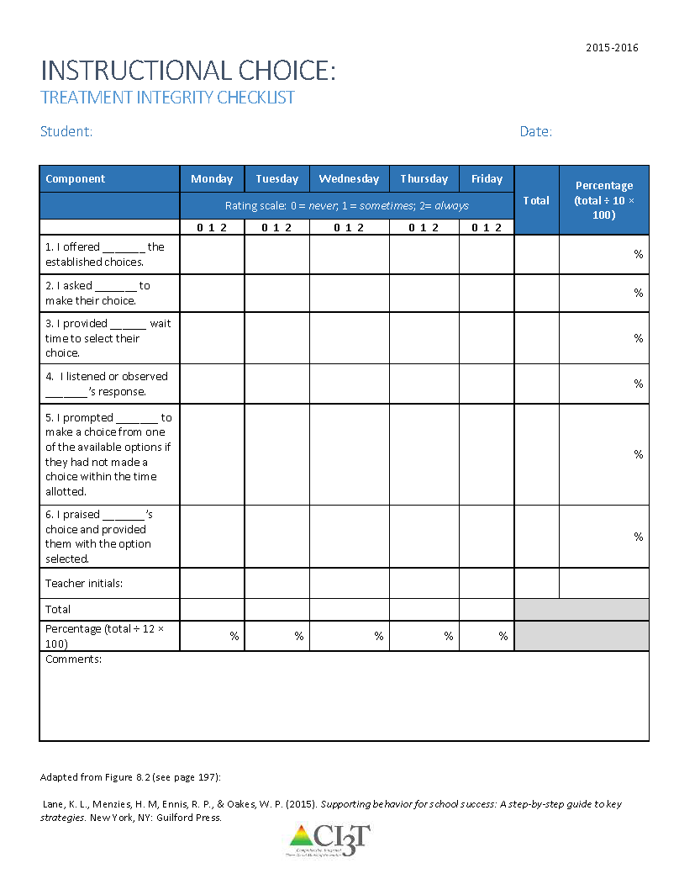
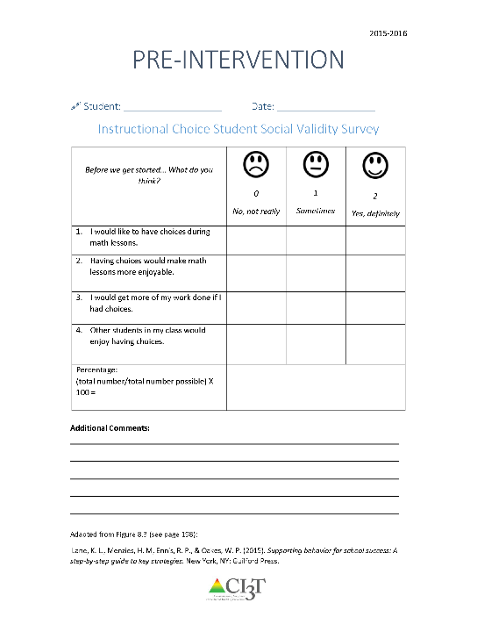
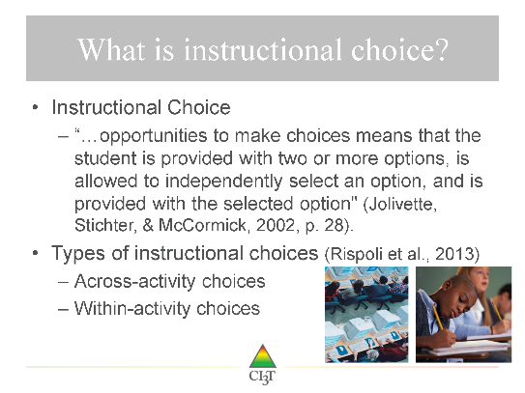
Choice
www.ci3t.org/pl
Materials to support in-person learning
Professional Learning
Materials
Implementation and
Planning Forms
Treatment Integrity and Social Validity
Checklists

Slide 47

A Look at Instructional Choice …
Step 1: Determine which type of choices you would feel comfortable offering to students in your classroom and create a menu of choices. Consider within-activity & across-activity choices.
Notes:
10-min timer

Slide 48
Building Your Toolbox
Instructional Choice
Precorrection
Behavior Specific Praise

Slide 49
Explore “Professional Learning” on ci3t.org.
Download Instructional Choice
Precorrection
Behavior Specific Praise
Notes:
10 minute timer

Slide 50



Low-Intensity Strategies for Academics and Behavior
Opportunities to Respond
Behavior Specific Praise
Active Supervision
Instructional Feedback
High p Requests
Precorrection
Self-monitoring
Incorporating Choice
Behavior Contracts
Notes:
Lane, K. L., Oakes, W. P., Ennis, R. P., & Hirsch, S. E. (2014). Identifying students for secondary and tertiary prevention efforts: How do we determine which students have Tier 2 and Tier 3 needs? Preventing School Failure, 58, 171-182, DOI: 10.1080/1045988X.2014.895573

Slide 51
Agenda
What is a precorrection?
Why is precorrection effective?
What does the supporting research for precorrection say?
What are the benefits and challenges?
How do I implement precorrection in my classroom?
Checklist for Success
How well is it working? Examining the Effects

Slide 52
What is a Precorrection?
A
B
C
Antecedent Behavior Consequence
Identifies predictable contexts that often result in problem behavior and provides students with supports, prompts, and reinforcement for engaging in appropriate behavior
Notes:
Managing behavior with precorrections:
An antecedent-based strategy: anticipate what activities may cause inappropriate behaviors
Identifies predictable contexts that often result in problem behavior and provides students with supports, prompts, and reinforcement for engaging in appropriate behavior
A shift from controlling behavior with consequence alone

Slide 53
What is a Precorrection?
Managing behavior with precorrection:
Managing behavior with consequences:
Anticipate what activities may cause inappropriate behaviors
“Getting in front” of problem behaviors
Example: Gentle reminder of expected behaviors in the hallway before dismissing for lunch
Requires waiting until the behavior occurs to respond
Example: Creating an action plan for three alternatives to yelling at a peer
vs.

Slide 54
Seven-step precorrection strategy
(Colvin, Sugai, & Patching, 1993)
Identify the context and predictably challenging behaviors
Define the expected behavior
Modify the context to support student success
Provide students with an opportunity to practice the expected behavior
Provide students with strong reinforcement for completing the expected behavior
Create a prompting plan to remind students to engage in the expected behavior
Develop a monitoring plan to determine the effectiveness of the precorrection plan

Slide 55
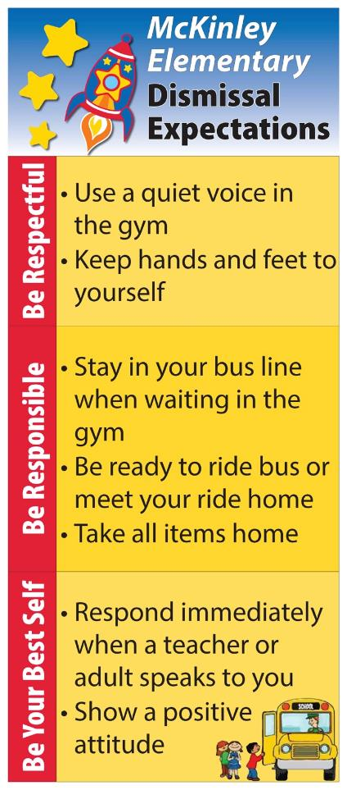
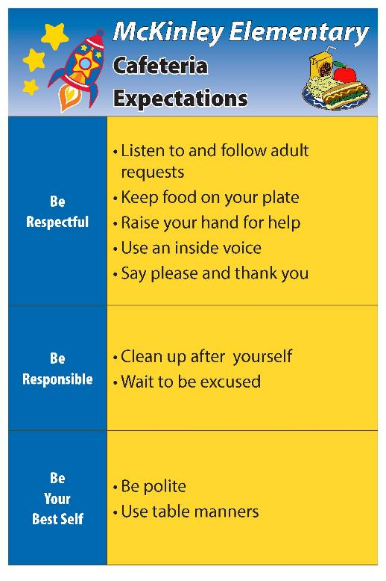
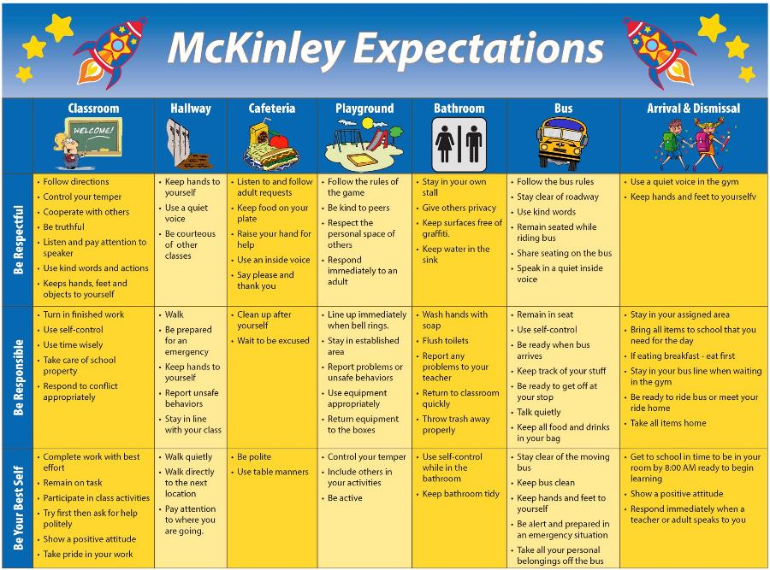
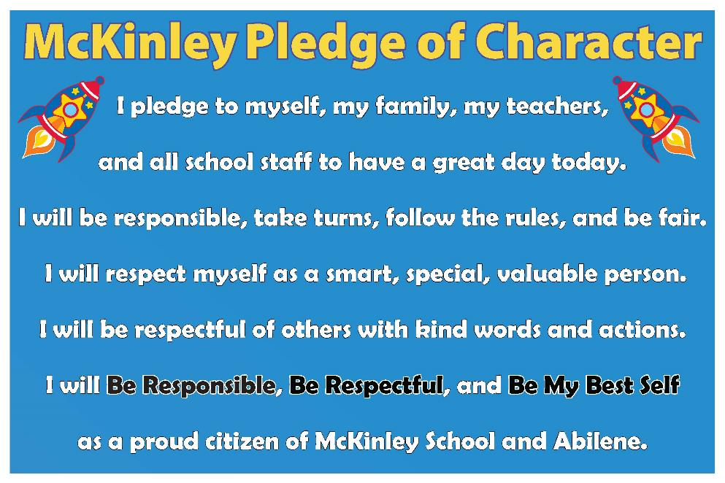

Examples

Slide 56
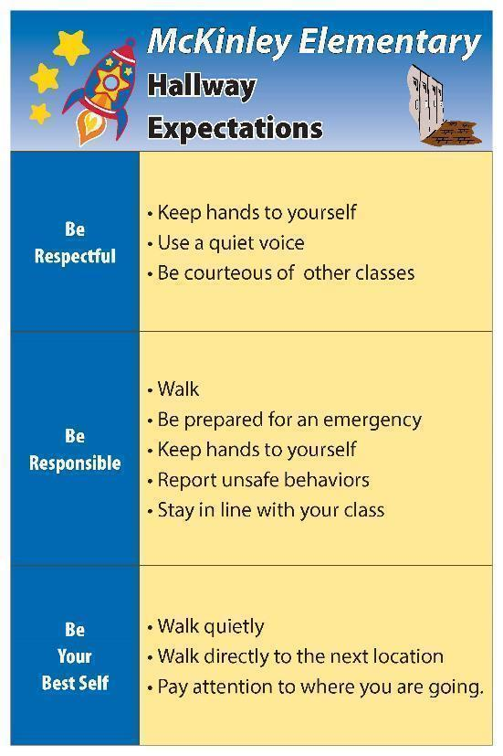
Examples
“It’s almost time to walk down to PE – who can remind us of one way we show respect in the hallway?”
“In order to line up for lunch, raise your hand if you can tell us one way to be responsible in the cafeteria?”

Slide 57
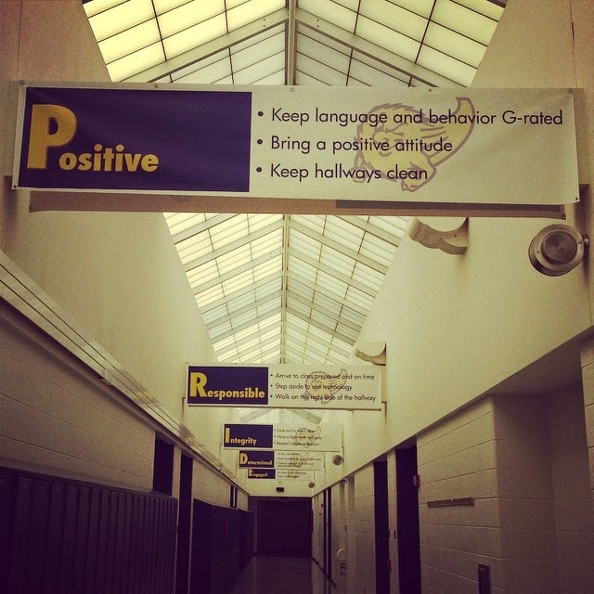
Why is Precorrection Effective?
Where might students currently have challenges?
Precorrection:
Get in front of problem behavior!
Manipulation of antecedents and consequences
Anticipates activities, settings, or time of day that could potentially result in problem behavior
Proactive
Focuses on what students should do instead of problem behaviors
Prevents the potential for escalating behavior patterns and allows more time for positive student-teacher interactions (Colvin et al, 1993)

Slide 58
Why is Precorrection Effective?
Fits seamlessly in a Ci3T framework
  Proactive strategy that seeks to teach, monitor, and reinforce appropriate behavior
  Used to teach behavioral expectations for common areas in the building where problem behaviors occur (e.g. lunchroom)
  May be used as a Tier 2 intervention
    Target a group of students

Slide 59
What does the supporting research for precorrection say?
Decreasing problem behaviors in Head Start classrooms
  Stormont, Smith, & Lewis, 2007
Decreasing problem behavior on an elementary school playground
  Lewis, Colvin, & Sugai, 2000
Decreasing problem behaviors during morning gym
  Haydon & Scott, 2008

Slide 60
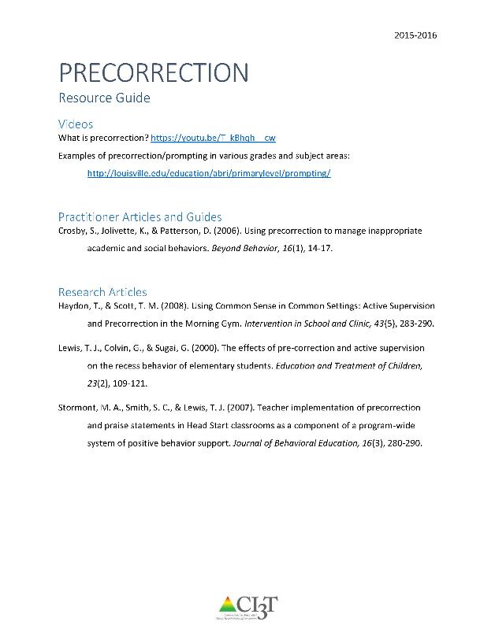
Supporting Research
See “Precorrection Resource Guide” for additional supporting research and information.

Slide 61
What are the benefits and challenges?
Benefits
Making contextual changes to activities/settings that traditionally occasion problem behaviors
Proactive
Varying levels of intensity
Challenges
Shift in thinking
Need to reflect on daily schedule and routines to anticipate when problem behaviors may arise
Must have some knowledge of a given setting

Slide 62
How do I implement a precorrection in my classroom?
Checklist for Success
Step 1
Identify contexts and anticipated behaviors
Step 2
Determine the expected behaviors
Step 3
Adjust the environment
Step 4
Provide opportunities for behavioral rehearsal

Slide 63
How do I implement a precorrection in my classroom?
Checklist for Success
Step 5
Provide strong reinforcement to students
engaging in expected behaviors
Step 6
Develop a prompting plan to remind students
about the expected behavior
Step 7
Develop a monitoring plan to determine the effectiveness of the precorrection plan
Step 8
Offer students an opportunity to
give feedback on this strategy

Slide 64
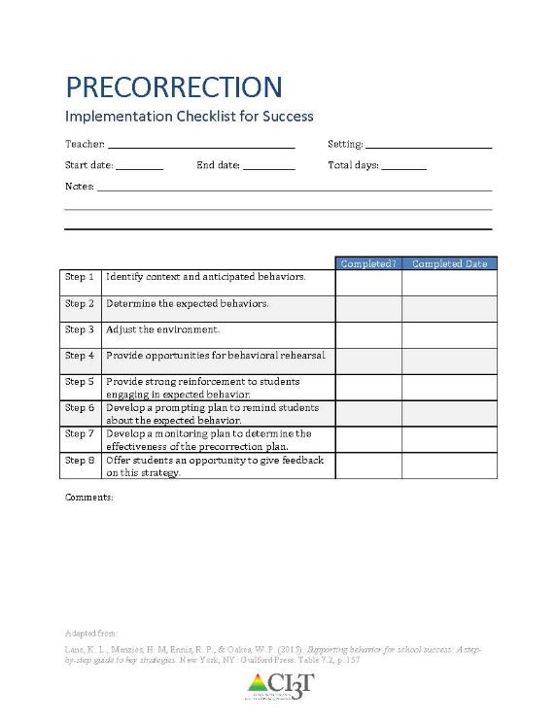
How do I implement precorrection in my classroom?
Identify context and anticipated behaviors.
Determine the expected behaviors.
Adjust the environment.
Provide opportunities for behavioral rehearsal.
Provide strong reinforcement to students engaging in expected behavior.
Develop a prompting plan to remind students about the expected behavior.
Develop a monitoring plan to determine the effectiveness of the precorrection plan.
Offer students an opportunity to give feedback on this strategy.
See “Precorrection Implementation Checklist for Success”

Slide 65
How well is it working?
Examining the Effects
Treatment Integrity
Is it happening?
Social Validity
What do stakeholders think about the goals, procedures, and outcomes?
Experimental Design
How well did this support work for this student?

Slide 66
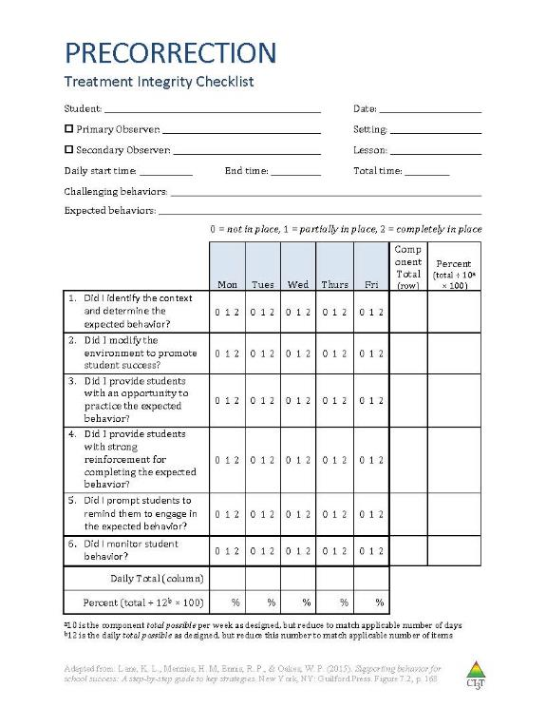
Ensuring the Strategy is in Place: Treatment Integrity
Have structures in place to monitor whether precorrection is carried out as intended:
Treatment integrity checklist
Example items:
Did I identify the context and determine the expected behavior?
Did I modify the environment to promote student success?
Did I provide students with an opportunity to practice the expected behavior?
Did I provide students with strong reinforcement for completing the expected behavior?
Did I prompt students to remind them to engage in the expected behavior?
Did I monitor student behavior?
See “Precorrection Treatment Integrity Checklist”

Slide 67
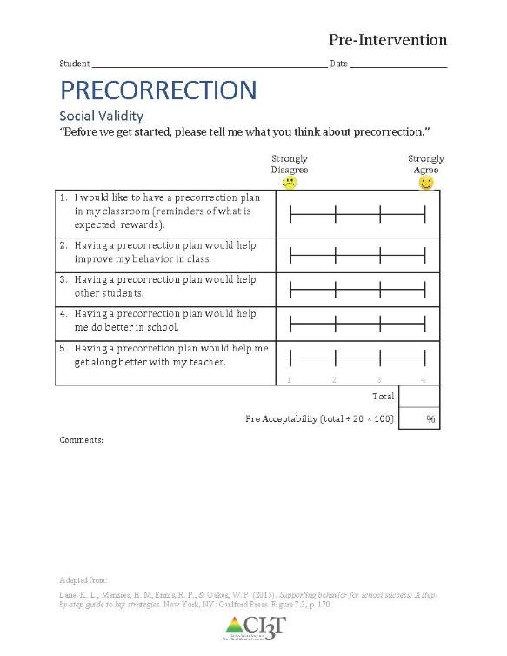
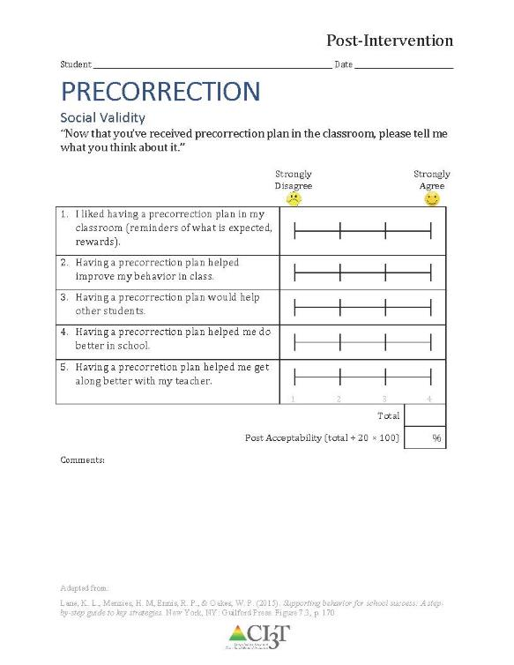
What do students think about it?
See “Precorrection Social Validity Student”
Completed by the student(s) participating in the intervention at two time points:
Pre and Post
Intervention

Slide 68
What does the teacher think about it?
See “Social Validity Adapted-IRP15 Adult”
Completed by the teacher(s) and parent(s) involved in the intervention at two time points:
Pre and Post
Intervention

Slide 69
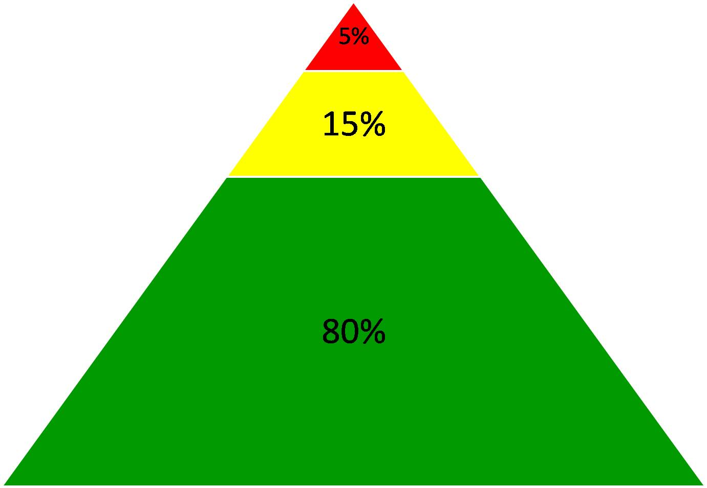
Comprehensive, Integrated, Three-Tiered Model of Prevention
Goal: Reduce Harm
Specialized individual systems for students with high-risk
(Lane, Kalberg, & Menzies, 2009)
≈5%
Tertiary Prevention (Tier 3)
Goal: Reverse Harm
Specialized group systems
for students at-risk
≈15%
Secondary Prevention (Tier 2)
Goal: Prevent Harm
School/classroom-wide systems for all students, staff, & settings
PBIS Framework
≈80%
Validated Curricula
Primary Prevention (Tier 1)
Academic Behavioral Social

Slide 70
Sample Elementary Intervention Grid
Support | Description | School-Wide Data: Entry Criteria | Data to Monitor Progress | Exit Criteria
Pre-correction | Plan to modify teacher behavior and environmental contexts where problem behaviors are likely to occur by providing supports, prompts, and reinforcement for appropriate student behavior, preventing problem behaviors from occurring | One or more of the following: Behavior SRSS-E7: Moderate (4-8) SRSS-I5: Moderate (2-3) SRSS-E7: High (9-21) SRSS-I5: High (4-15) 2 or more ODRs per day in a class __ AND __ OR Academic Consistent, predictable pattern of academic errors | Student Performance direct measure of student behavior targeted for improvement Treatment integrity implementation checklist treatment integrity checklist Social validity IRP-15 (teacher) student-completed survey | Meets targeted behavior criterion for 3 consecutive weeks Two consecutive weeks of zero discipline referrals during target time / activity and SRSS-E7: low risk (0-3) SRSS-I5: low risk (0-1)
(Lane, Menzies, Ennis, & Oakes, 2015)

Slide 71
Sample Middle/High School Intervention Grid
Support | Description | School-Wide Data: Entry Criteria | Data to Monitor Progress | Exit Criteria
Pre-correction | Plan to modify teacher behavior and environmental contexts where problem behaviors are likely to occur by providing supports, prompts, and reinforcement for appropriate student behavior, preventing problem behaviors from occurring | One or more of the following: Behavior SRSS-E7: Moderate (4-8) SRSS-E7: High (9-21) 2 or more ODRs per day in a class __ AND __ OR Academic Consistent, predictable pattern of academic errors | Student Performance direct measure of student behavior targeted for improvement Treatment integrity implementation checklist treatment integrity checklist Social validity IRP-15 (teacher) student-completed survey | Meets targeted behavior criterion for 3 consecutive weeks Two consecutive weeks of zero discipline referrals during target time / activity and SRSS-E7: low risk (0-3)
(Lane, Menzies, Ennis, & Oakes, 2015)

Slide 72
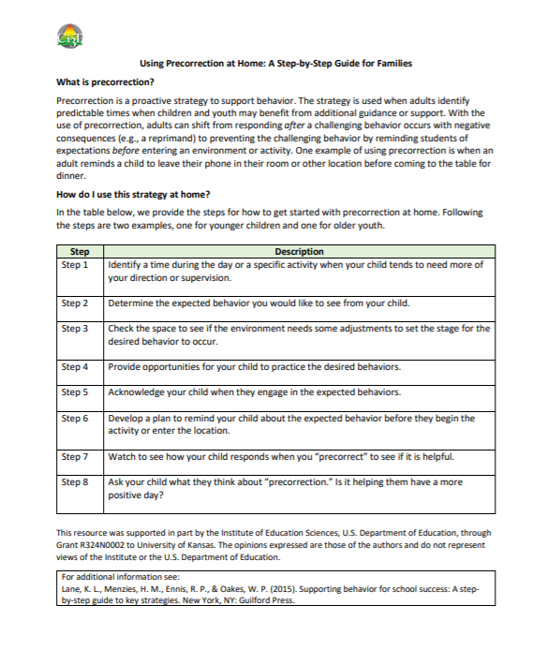
Setting up for Success at Home
  Low-Intensity Supports
http://www.ci3t.org/covid
Notes:
In the accordions below we will be uploading a series of brief practice guides that we hope you will find useful. Feel free to share these materials with fellow educators and families. We are sending positive thoughts to all our partners, colleagues, and the students you so tirelessly support.
Materials to support educators and families as we transition to continuous learning
Using your Ci3T structures to facilitate positive, productive environments for students, families, educators, and administrators

Slide 73
Explore “Professional Learning” on ci3t.org.
Download Instructional Choice
Precorrection
Behavior Specific Praise
Notes:
10 minute timer

Slide 74
Building Your Toolbox
Instructional Choice
Precorrection
Behavior Specific Praise

Slide 75

Behavior Specific Praise …
Notes:
10-min timer

Slide 76

Action Planning: Expanding Your Toolbox
Consider how you plan to use these materials.

Slide 77

Consider Teacher-Delivered Strategies
Opportunites to Respond
Behavior-Specific Praise
Active Supervision
Instructional Feedback
High-Probability Requests
Precorrection
Instructional Choice

Slide 78
Evaluating and integrating low-intensity strategies
  Is it working?
  Integrated lesson planning
  School and home collaboration

Slide 79
ci3t.org

Slide 80
How well is it working?
Examining the Effects
Treatment Integrity
Is it happening?
Social Validity
What do stakeholders think about the goals, procedures, and outcomes?
Experimental Design
How well did this support work for this student?

Slide 81
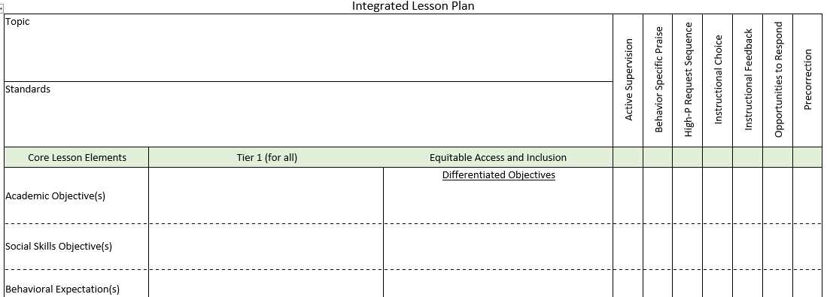
Integrated Lesson Planning
Notes:
The idea is called integrated lesson planning, which involves providing teachers with a structure in which to plan lessons that seamlessly weave together lesson objectives across academic, behavioral, and social domains, as well as embedding low-intensity strategies throughout the lesson in an intentional fashion to help ensure instruction is engaging, varied, and relevant for all students. We look forward to sharing more about integrated lesson planning in the future, but if you are interested in accessing a templated integrated lesson plan format, this can also be found under the Resources for Educators accordion on ci3t.org/covid.

Slide 82
www.ci3t.org/pl
Notes:
Lastly to close out, we want to encourage you all to check out resources available for teaching educators to use low-intensity strategies in in-person settings,

Slide 83
Low-Intensity Strategy | Franklin High School On-Site Expert
Behavior-Specific Praise: Identifying the specific expectation the student met. “Niama, I noticed you outlined your paper and used the graphic organizer to draft your essay. Well done!” “Justice, thank you for pushing in your chair to keep the walkway safe.” | Eric Common, Behavior Specialist Mark Buckman, Special Education Grant Allen, Parent Volunteer Paloma Pérez-Clark, School Psychologist
Opportunities to Respond: Providing 4-6 opportunities per minute for students to respond individually, choral, verbal, written, gesture, or symbol. “Show me thumbs or thumbs down if...” “Show me on your white board what…” “Turn to your elbow partner and say…” “All together now, what is…” | David Royer, Administration Emily Cantwell, 12th Grade Scarlett Lane, 11rd Grade Mallory Messenger, Counselor
Instructional Choice: Providing within-task or between task choices to increase academic engaged time and motivation. “Ronaldo, our of our 3 learning objectives today, which would you like to work on first?” “Suzy, do you want to work on the laptop, or handwrite your answers for this assignment?” | Abbie Jenkins, 10th Grade Scarlett Lane, 11th Grade José Sousa, PE Liane Johl, 9th Grade

Slide 84
Comprehensive, Integrated, Three-Tiered Model of Prevention
(Lane, Kalberg, & Menzies, 2009)
Tier 3
Tertiary Prevention (≈5%)
Tier 2
Secondary Prevention (≈15%)
Tier 1
Primary Prevention (≈80%)
Academic ◇ Behavioral ◇ Social
Validated Curricula PBIS Framework Validated Curricula

Slide 85
Using multiple data sources

Slide 86


Building a Ci3T Tier Library
Teacher Delivered Strategies
Tier 1
Tier 2
Tier 3

Slide 87
Ci3T Primary Plan: Procedures for Teaching
BSP
OTR
Active Supervision
Choice
Precorrection

Slide 88
Student Risk Screening Scale Fall 2004 – 2012 Middle School
Source: Lane, K. L., Oakes, W. P., & Magill, L. M., (2014). Primary prevention efforts: How do we implement and monitor the Tier 1 component of our comprehensive, integrated, three-tiered model of prevention. Preventing School Failure, 58, 143-158. 10.1080/1045988X.2014.893978 [Figure 4. Middle school behavior screening data over time at the fall time point. Adapted from Figure 4.6 p. 127 Lane, K. L., Menzies, H. M, Oakes, W. P., & Kalberg, J. R. (2012). Systematic screenings of behavior to support instruction: From preschool to high school. Guilford Press.]

Slide 89

Using multiple data sources

Slide 90


Slide 91


Slide 92


Notes:
As well as the resources available on ci3t.org/covid to support educators and families in using the approaches to help students at school and at home.

Slide 93


EMPOWER Sessions

Slide 94

Ci3T Trainers and Coaches Calls

Slide 95


Thank you!
ci3t.org

