Slide 1
Implementing Comprehensive, Integrated, Three-Tiered (Ci3T) Models: Planning for the Year Ahead
Ci3T Implementation Series and Delivery: Session 5
Kathleen Lynne Lane, Ph.D., BCBA-D, CF-L2
Mark Buckman, Ph.D.
Notes:
Greetings! We have included a few additional slides (currently hidden) for you to use if you would like when sharing information about treatment integrity and social validity with faculty and staff. These additional slides may be useful in providing additional details, especially to those new to Ci3T and data-informed professional learning activities at Tier 1.

Slide 3
Ci3T Professional Learning Calendar
 | July | Aug | Sep | Oct | Nov | Dec | Jan | Feb | Mar | Apr | May | Jun
Ci3T Training |  |  |  |  | Ci3T Professional Learning Series Session 1 | Ci3T Professional Learning Series Session 2 | Ci3T Professional Learning Series Session 3 | Ci3T Professional Learning Series Session 4 |  | Ci3T Professional Learning Series Session 5 | Ci3T Professional Learning Series Session 6
Ci3T Implementation Support | Ci3T Implementation Series Prep Session |  | Ci3T Implementation Series Session 1 |  | Ci3T Implementation Series Session 2 |  | Ci3T Implementation Series Session 3 |  | Ci3T Implementation Series Session 4 | Ci3T Implementation Series Session 5
Ci3T EMPOWER |  |  | Ci3T EMPOWER Session 1 | Ci3T EMPOWER Session 2 | Ci3T EMPOWER Session 3 |  | Ci3T EMPOWER Session 4 |  | Ci3T EMPOWER Session 5 | Ci3T EMPOWER Session 6
Ci3T Trainers & Coaches Calls |  | Trainers & Coaches Call Session 1 | Trainers & Coaches Call Session 2 | Trainers & Coaches Call Session 3 | Trainers & Coaches Call Session 4 | Trainers & Coaches Call Session 5 | Trainers & Coaches Call Session 6 | Trainers & Coaches Call Session 7 | Trainers & Coaches Call Session 8 | Trainers & Coaches Call Session 9 | Trainers & Coaches Call Session 10

Slide 4
Agenda
Welcome
Procedures for Monitoring
Review your School’s Social Validity & Treatment Integrity Data
Review your School’s Spring Screening Data
Planning for the Year Ahead 2023-2024
Focusing on Data-Informed Professional Learning
Wrapping Up and Moving Forward

Slide 5
Review and Preview
Last Time
Today…
Data-Informed Decision-Making
Integrated Lesson Planning at Tier 1
Planning and Implementing Tier 2 Interventions
Planning and Implementing Tier 3 Interventions
Welcome
Procedures for Monitoring
Review your School’s Social Validity & Treatment Integrity Data
Review your School’s Spring Screening Data
Planning for the Year Ahead 2023-2024
Focusing on Data-Informed Professional Learning
Wrapping Up and Moving Forward

Slide 6
Welcome
Please pull up your Ci3T Implementation Manual

Slide 7
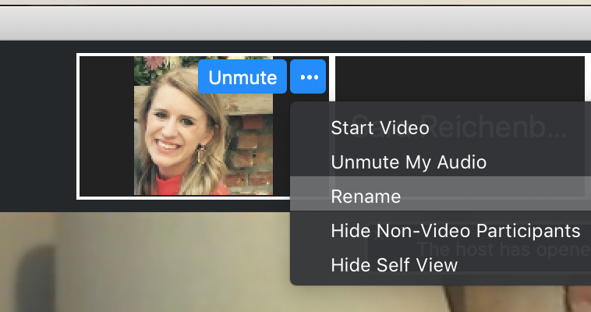
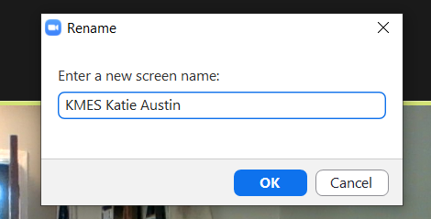
Renaming: School Initials + First and Last Name
To help us put you in breakout rooms with your colleagues today…
1. Click the three dots at the top
right corner of your video square.
2. Rename yourself with your
school initials then first and last name.

Slide 8
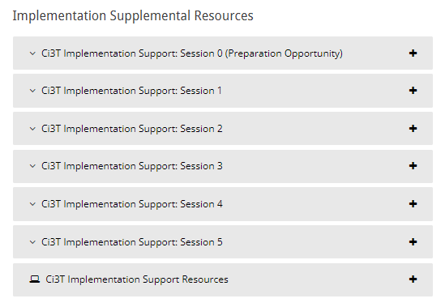
Accessing Professional Learning Materials
Navigate to ci3t.org/imp

Slide 9
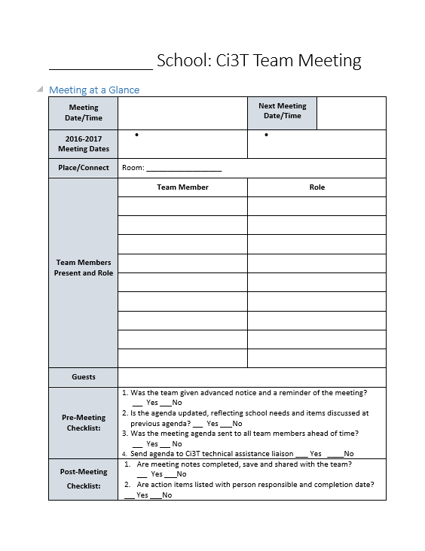
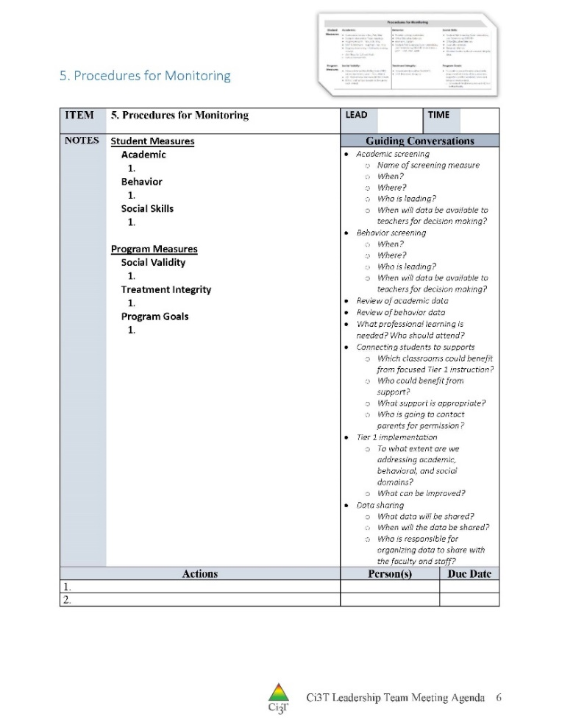
IM18 Ci3T Leadership Team Meeting Agenda TEMPLATE
Predictability

Slide 10
Goals for this Implementation Year
Establish effective Ci3T leadership structures
Gain a deeper understanding of Ci3T models of prevention
Implement your school’s plan with high fidelity
Collect and use social validity and treatment integrity data to monitor Ci3T plan implementation
Collect student academic and behavioral outcome data to inform Ci3T implementation efforts
Share data with all stakeholders regularly (e.g., monthly, quarterly)
Identify areas of additional professional learning for faculty and staff and support faculty and staff access to professional learning
Address any barriers to implementing your Ci3T model

Slide 11
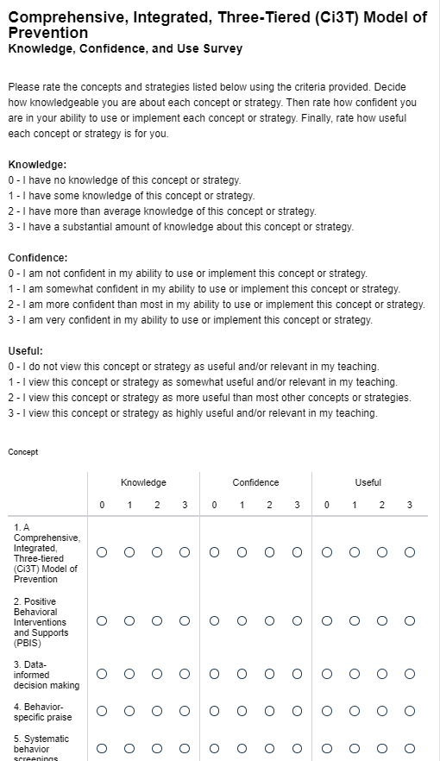
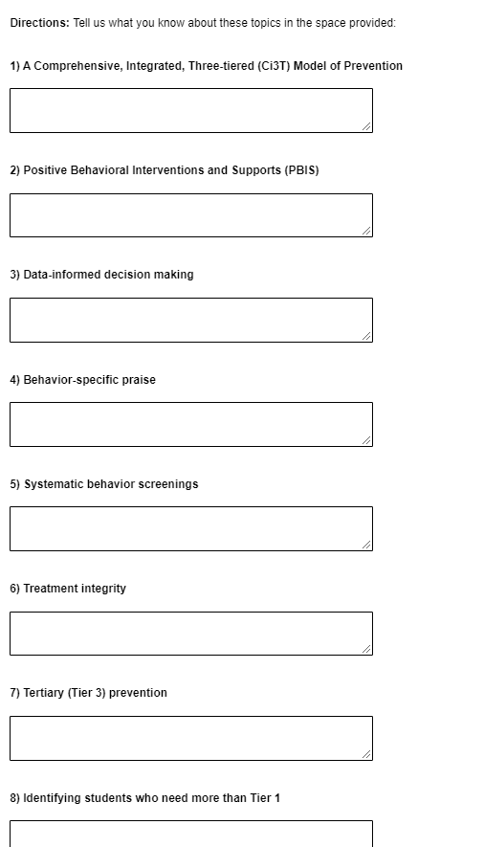
Checking in
Ci3T Knowledge, Confidence, and Use (KCU) Survey
Check you email to access the!
Please note, this link is personalized to you!

Slide 12
Procedures for Monitoring
Review your School’s Social Validity & Treatment Integrity Data
Review your School’s Spring Screening Data

Slide 13
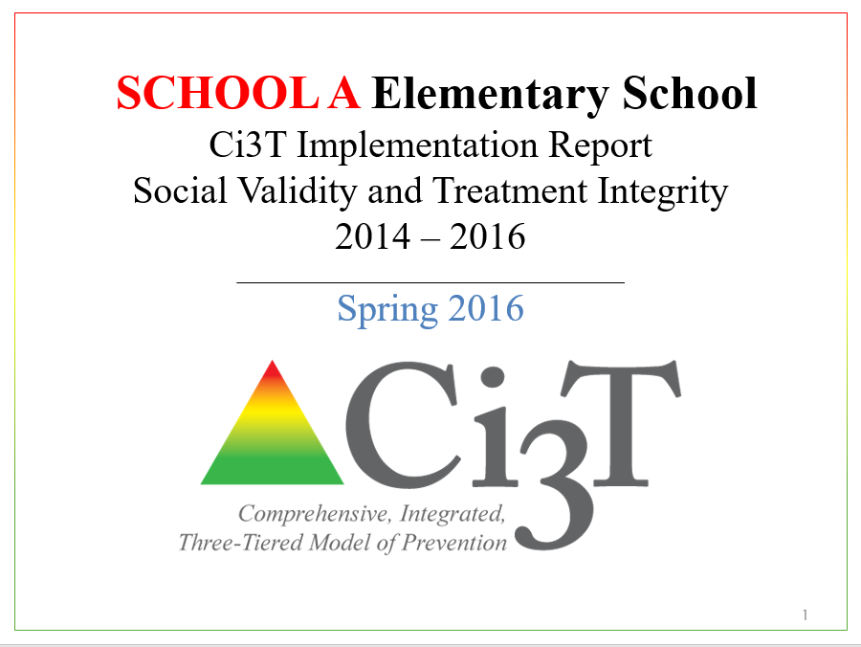
Essential Components of Primary Prevention Efforts
Social Validity
Systematic Screening
Academic
Behavior
Treatment Integrity

Slide 14
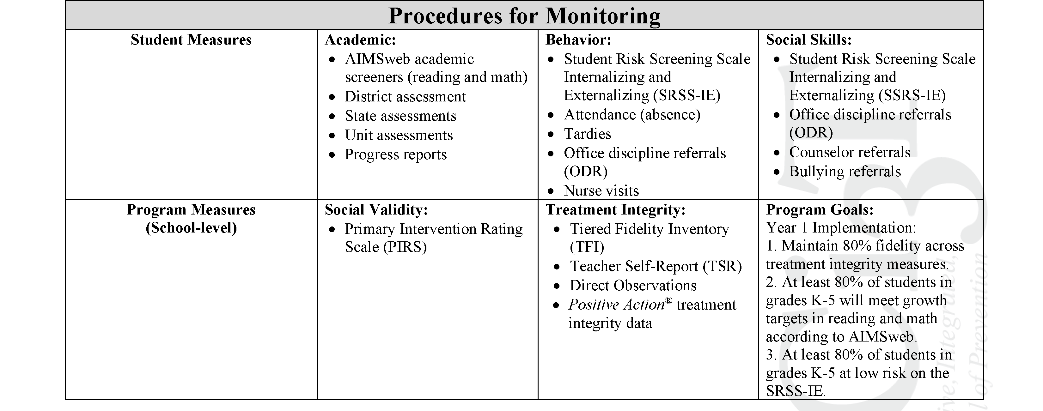
Ci3T Primary Plan Procedures for Monitoring: Elementary
Program Measures and Goals

Slide 15
Sample Elementary Assessment Schedule
Measure | Aug | Sep | Oct | Nov | Dec | Jan | Feb | Mar | Apr | May
School Demographics
Student Demographic Information | X | X | X | X | X | X | X | X | X | X
Screening Measures
Behavior Screeners: SRSS-IE |  | X |  |  | X |  |  |  | X
Academic Screeners: AIMSWeb | X | X |  |  |  | X |  |  |  | X
Student Outcome Measures - Academic
State & District assessment |  |  |  |  |  |  |  | X | X
Progress reports |  |  |  | X |  |  | X |  |  | X
Student Outcome Measures - Behavior
Absences |  | X | X | X | X | X | X | X | X
Office discipline referrals (ODR) |  | X |  |  | X |  |  |  | X
Counselor referrals | X | X | X | X | X | X | X | X | X | X
Nurse visits | X | X | X | X | X | X | X | X | X | X
Program Measures
Primary Intervention Rating Scale |  |  | X |  |  |  |  | X
School-wide Evaluation Tool |  |  | X |  |  |  |  | X
Ci3T TI: Teacher Self-Report |  |  | X |  |  |  |  | X
Ci3T TI: Direct Observation |  |  | X |  |  |  |  | X
Second Step® Treatment Integrity |  |  | X |  |  |  |  | X
Adapted from Lane, K. L., Oakes, W. P., Cantwell, E. D., & Royer, D. J. (2018). Building and installing comprehensive, integrated, three-tiered (Ci3T) models of prevention: A practical guide to supporting school success V1.2. KOI Education. (Interactive eBook)

Slide 16
Procedures for Monitoring
Review your School’s Social Validity & Treatment Integrity Data
Review your School’s Spring Screening Data

Slide 17
Treatment Integrity and Social Validity Data Sources
Primary Intervention Rating Scale (Social Validity)
Ci3T Treatment Integrity: Teacher Self Report
Ci3T Treatment Integrity: Direct Observation
Tiered Fidelity Inventory

Slide 18
Social Validity How do stakeholders view the plan?
Social validity refers to the level of:
Social significance of intervention goals
Social acceptability of intervention procedures
Social importance of intervention outcomes
(Wolf, 1978)
Assessed using the Primary Intervention Rating Scale (PIRS)
Social Validity: PIRS Results
Year | Fall |  | Spring
 | n | % (SD) | n | % (SD)
2020-2021 | 32 | 85.39 (8.89) | TBD | TBD

Slide 19
Treatment Integrity Is Ci3T being implemented as planned?
Three measures of treatment integrity:
Ci3T Treatment Integrity: Teacher Self-Report (Ci3T TI: TSR)
Ci3T Treatment Integrity: Direct Observation (Ci3T TI: DO)
Tiered Fidelity Inventory (TFI)

Slide 20
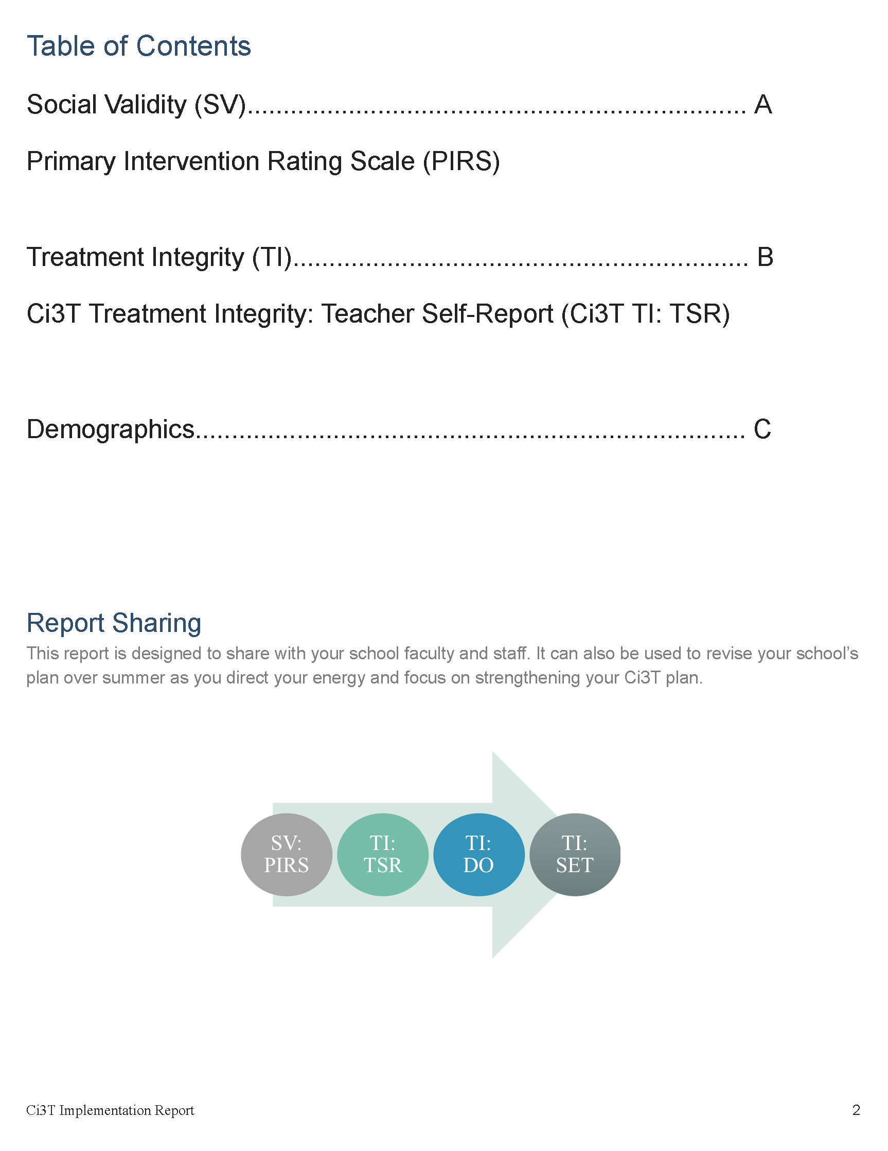

Slide 21
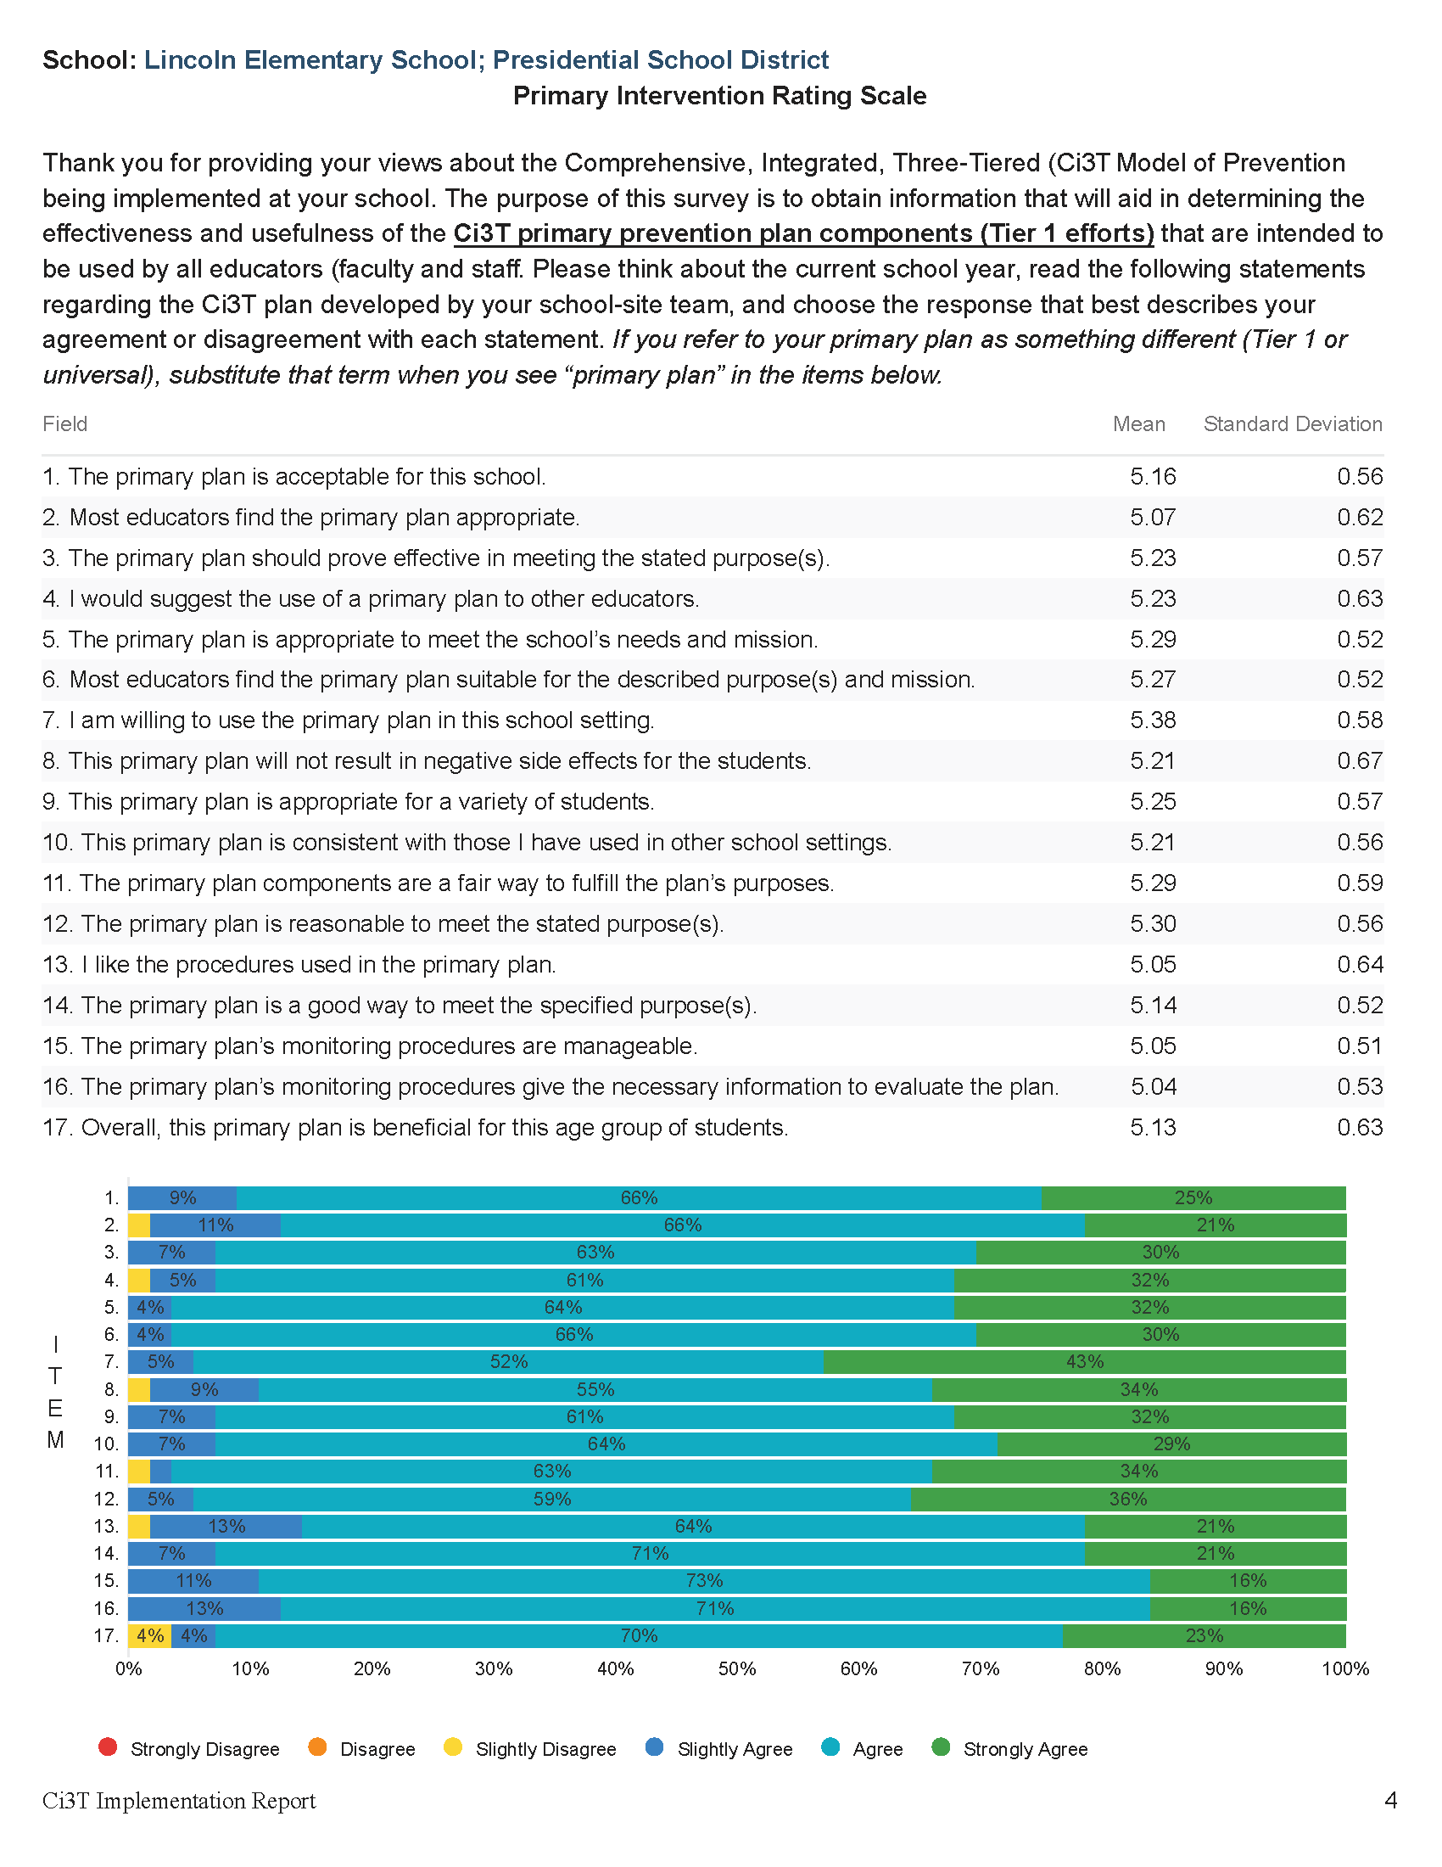

Slide 24
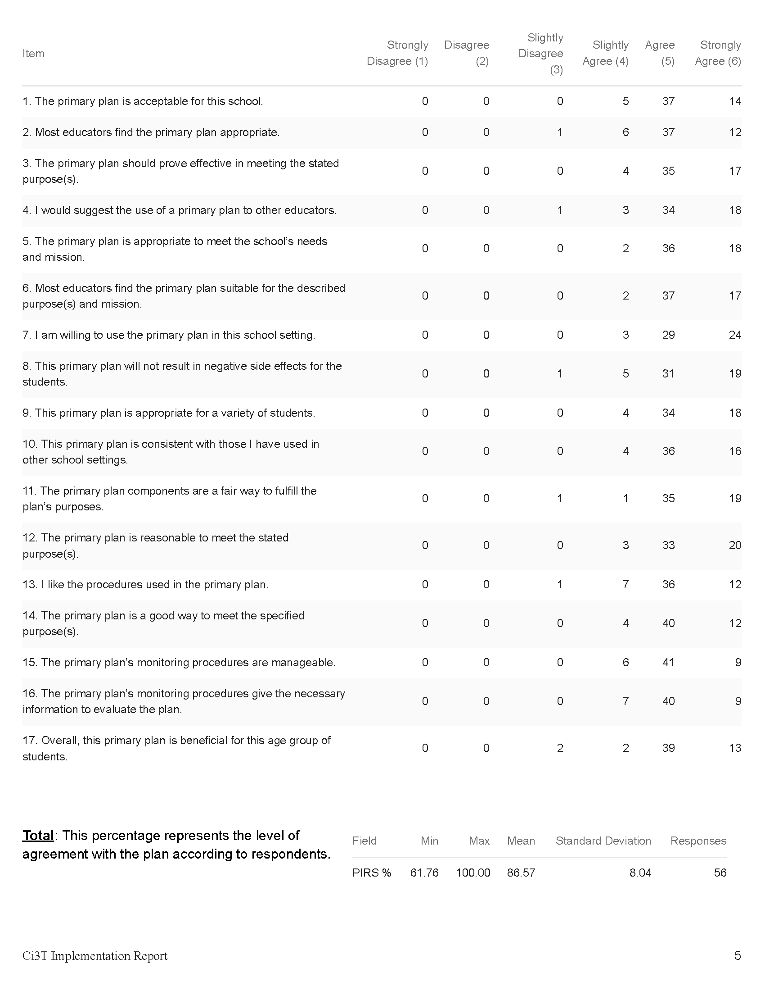

Slide 26
Open-Ended Questions:
A) What do you feel is most beneficial about this primary prevention plan’s components (Tier 1 efforts)? B) What is the least beneficial part?
Do you think that your and your students’ participation in this Ci3T plan will cause your students’ behavior, social, and/or learning problems to improve? Why or why not? Or if so, how?
What would you change about this plan (components, design, implementation etc.) to make it more student-friendly and educator-friendly?
What other information would you like to contribute about this plan?
Read through comments
Highlight success (literally!)
Look for themes for celebrations and focus areas

Slide 27
Treatment Integrity and Social Validity Data Sources
Primary Intervention Rating Scale (Social Validity)
Ci3T Treatment Integrity: Teacher Self Report
Ci3T Treatment Integrity: Direct Observation
Tiered Fidelity Inventory

Slide 28
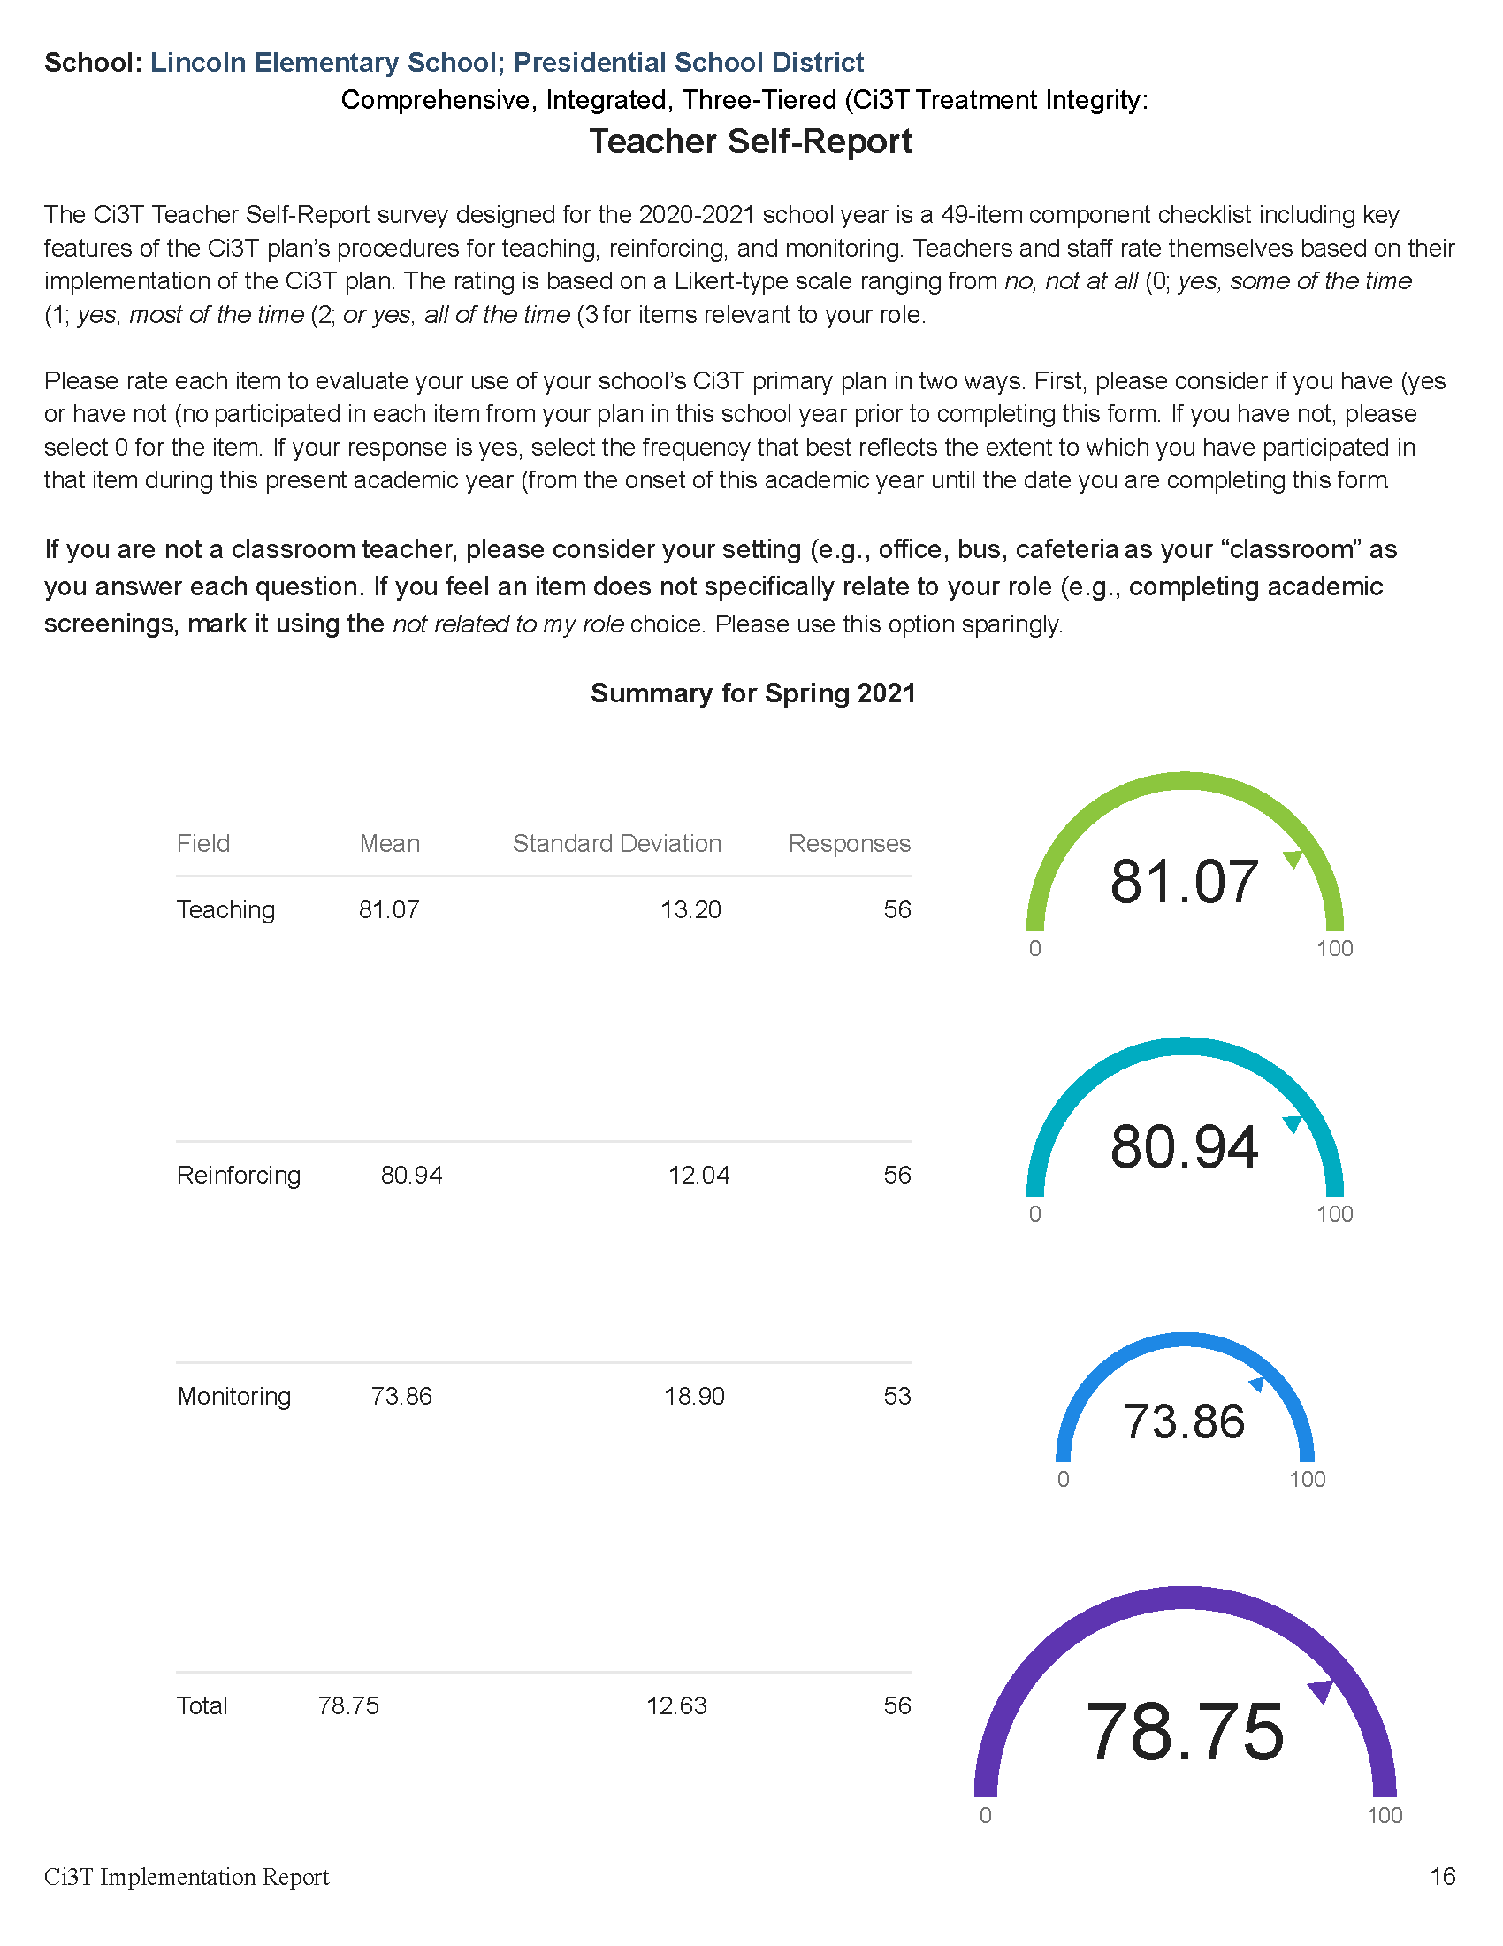

Slide 30
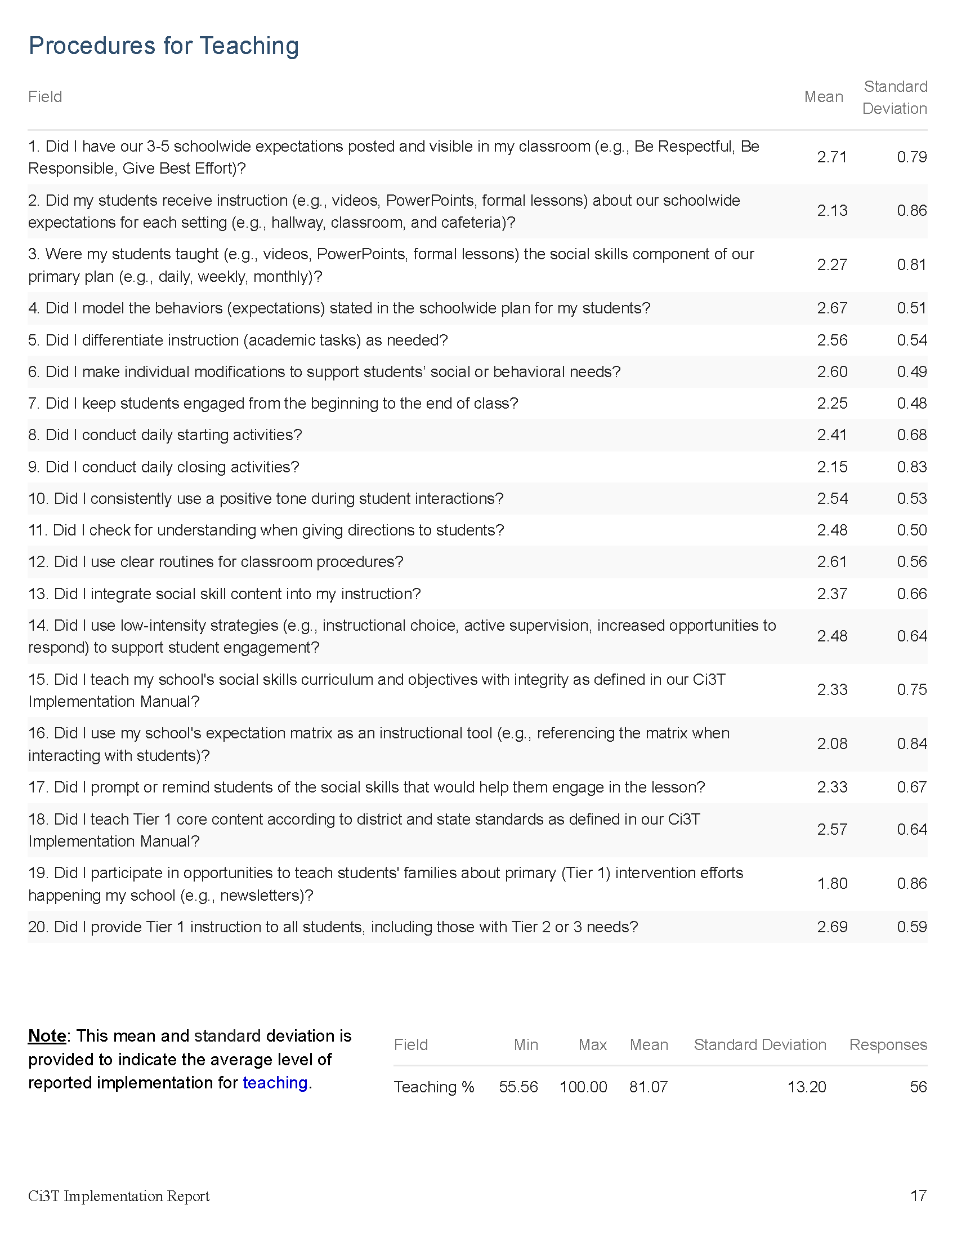

Slide 32
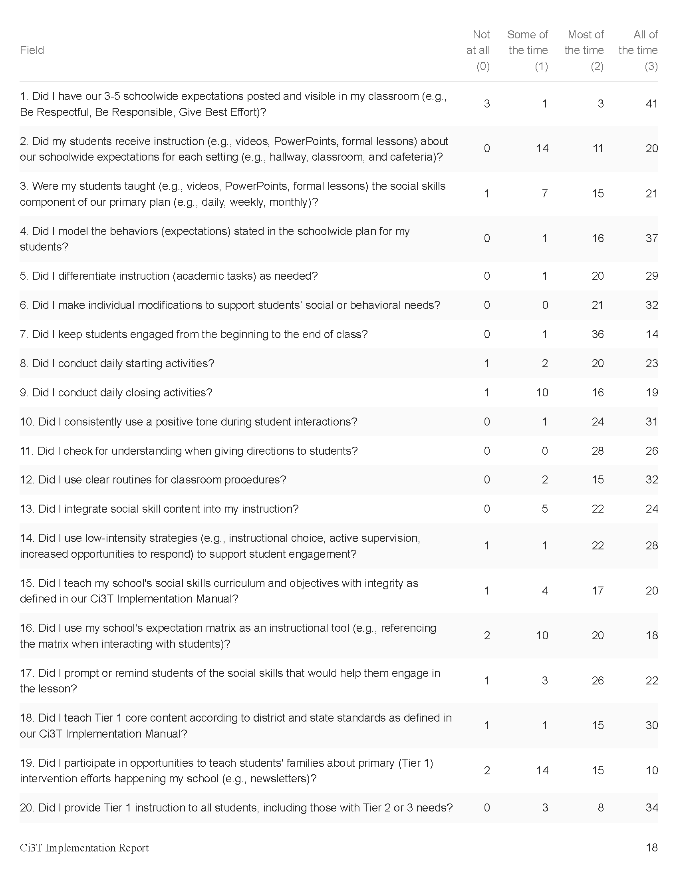

Slide 34
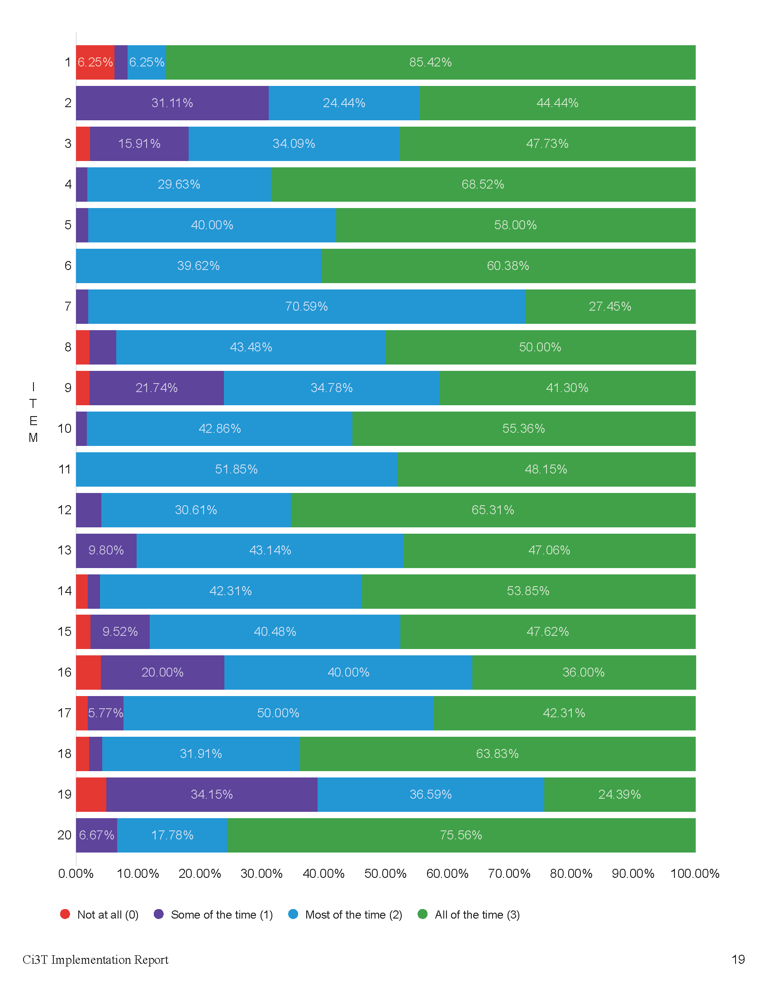

Slide 36
Treatment Integrity and Social Validity Data Sources
Primary Intervention Rating Scale (Social Validity)
Ci3T Treatment Integrity: Teacher Self Report
Ci3T Treatment Integrity: Direct Observation
Tiered Fidelity Inventory

Slide 37
Ci3T Treatment Integrity Direct Observation (Ci3T TI: DO)
Subset of Ci3T TI: TSR
Stratified, random selection of educators
Personnel who directly instruct students
Observers trained to criterion
30-min observations
Educator perspective
Observer perspective
CC0 No rights reserved

Slide 38
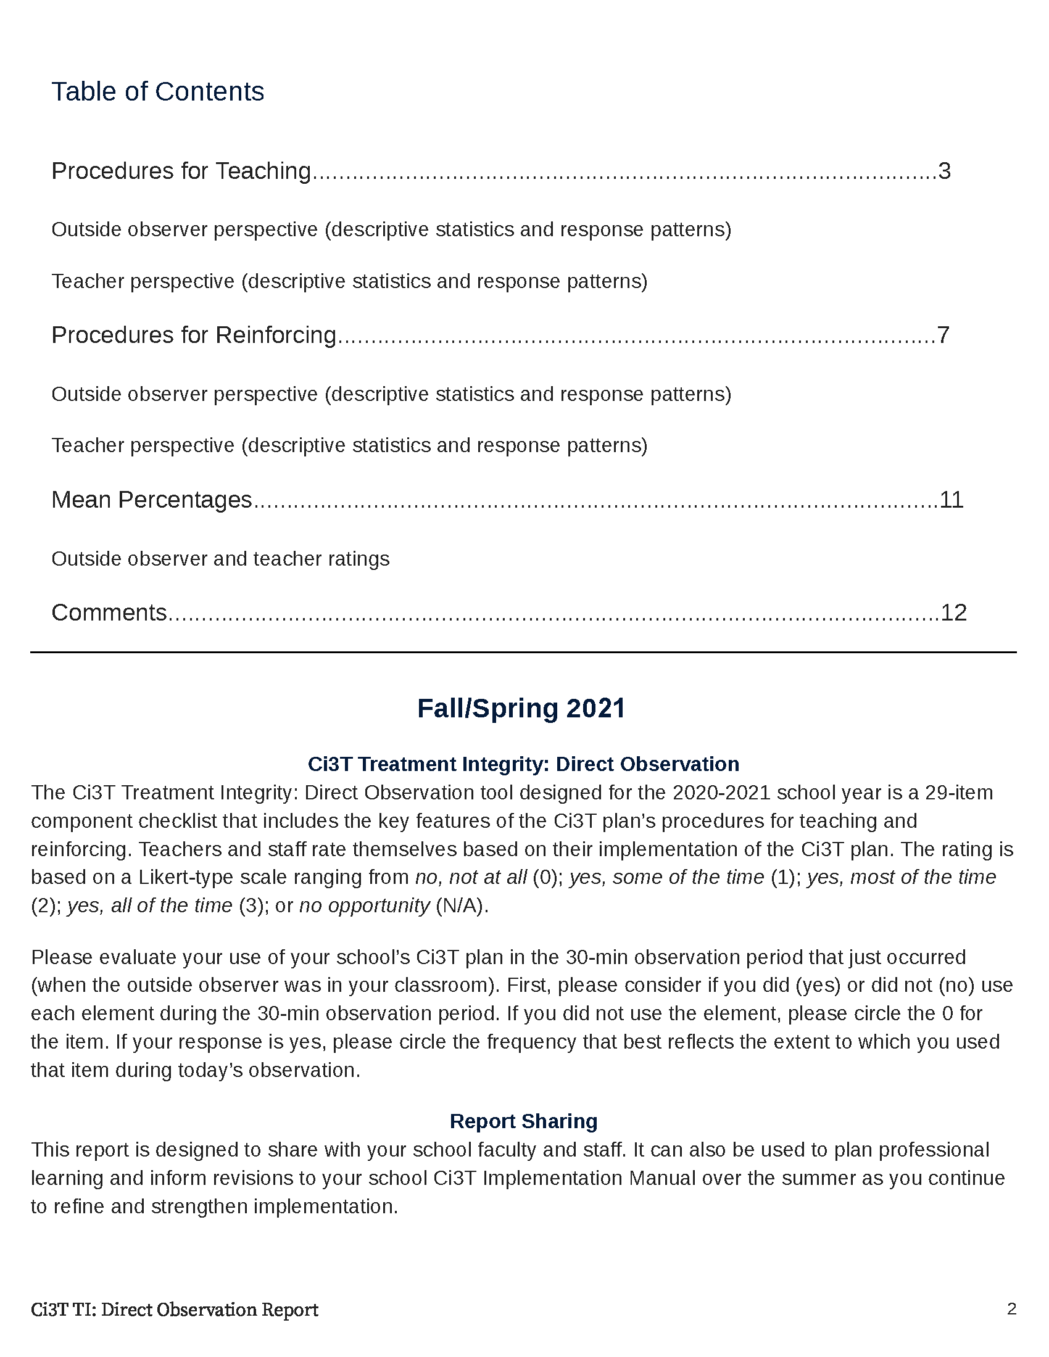

Slide 39
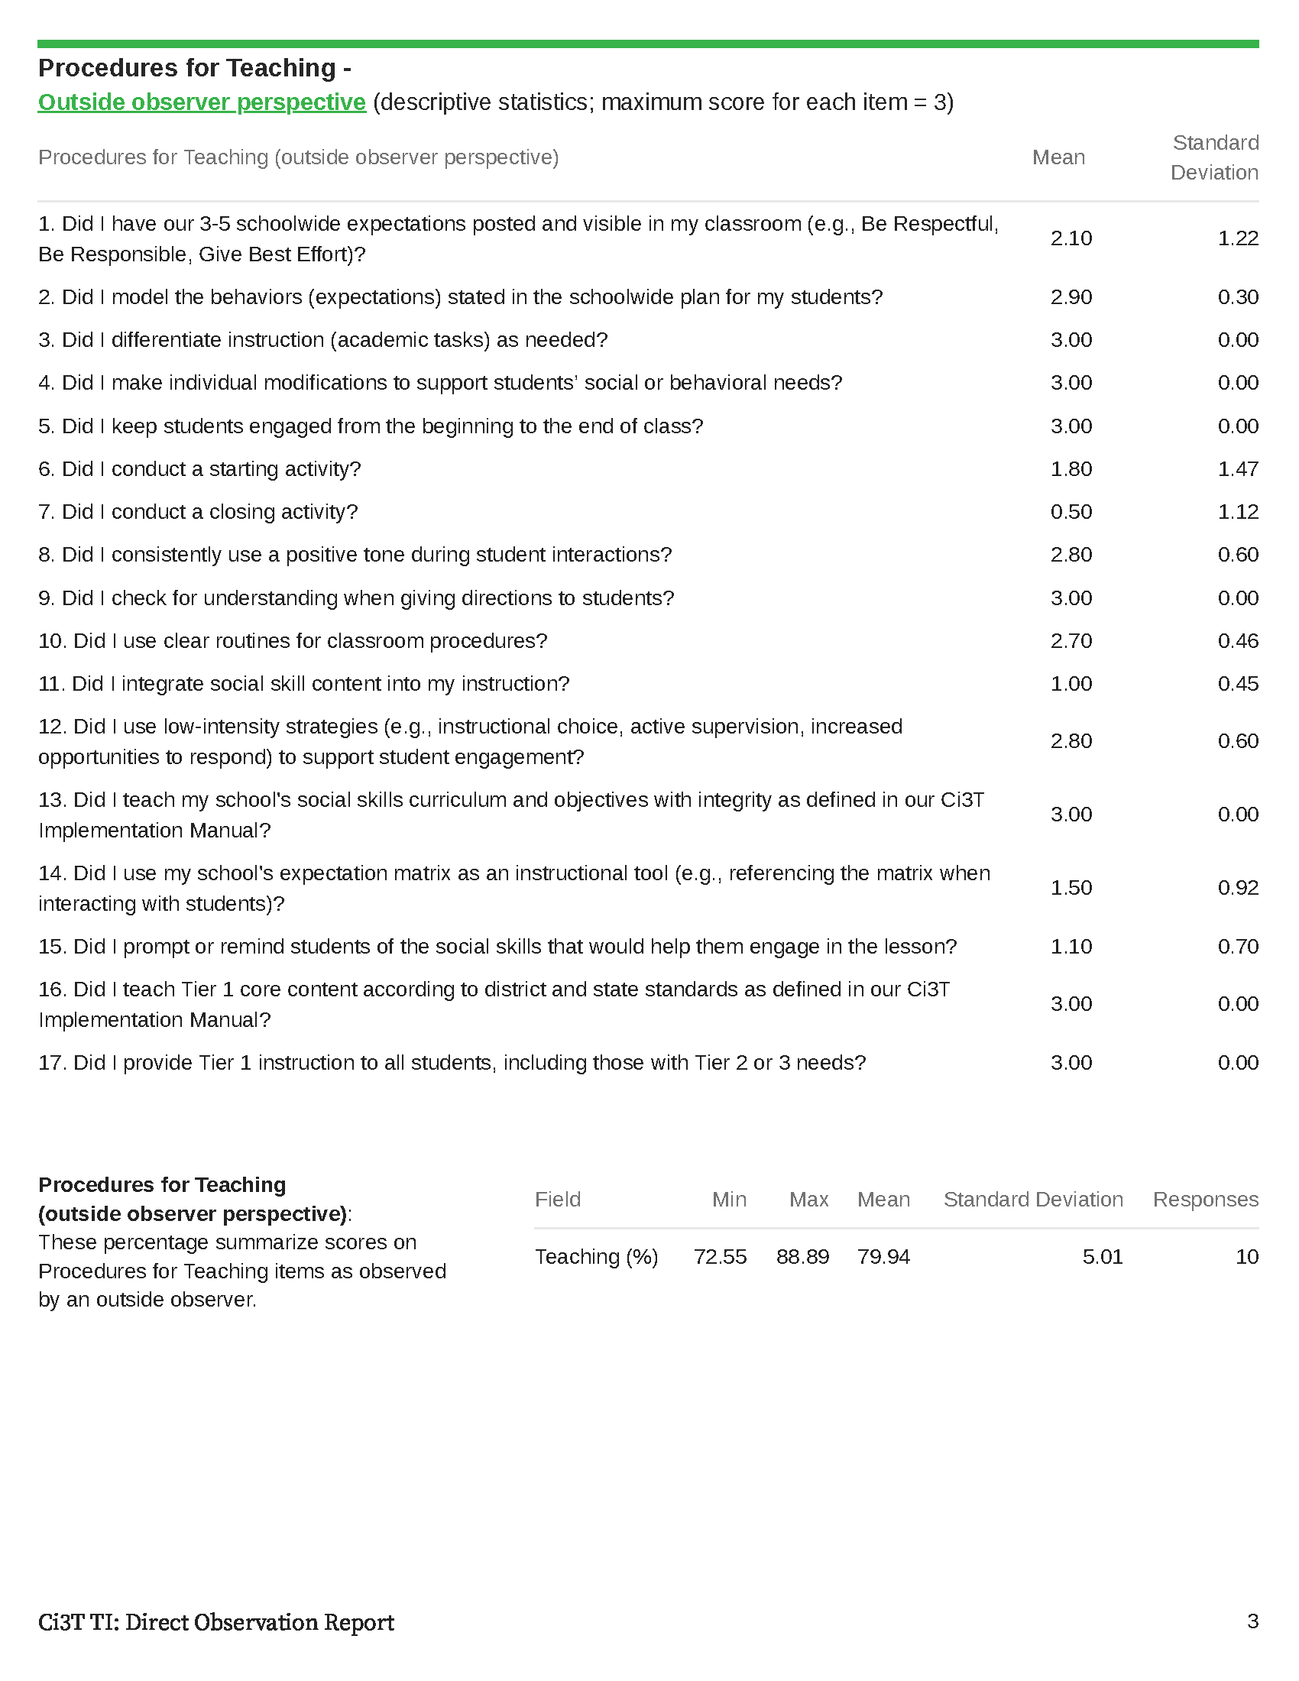

Slide 42
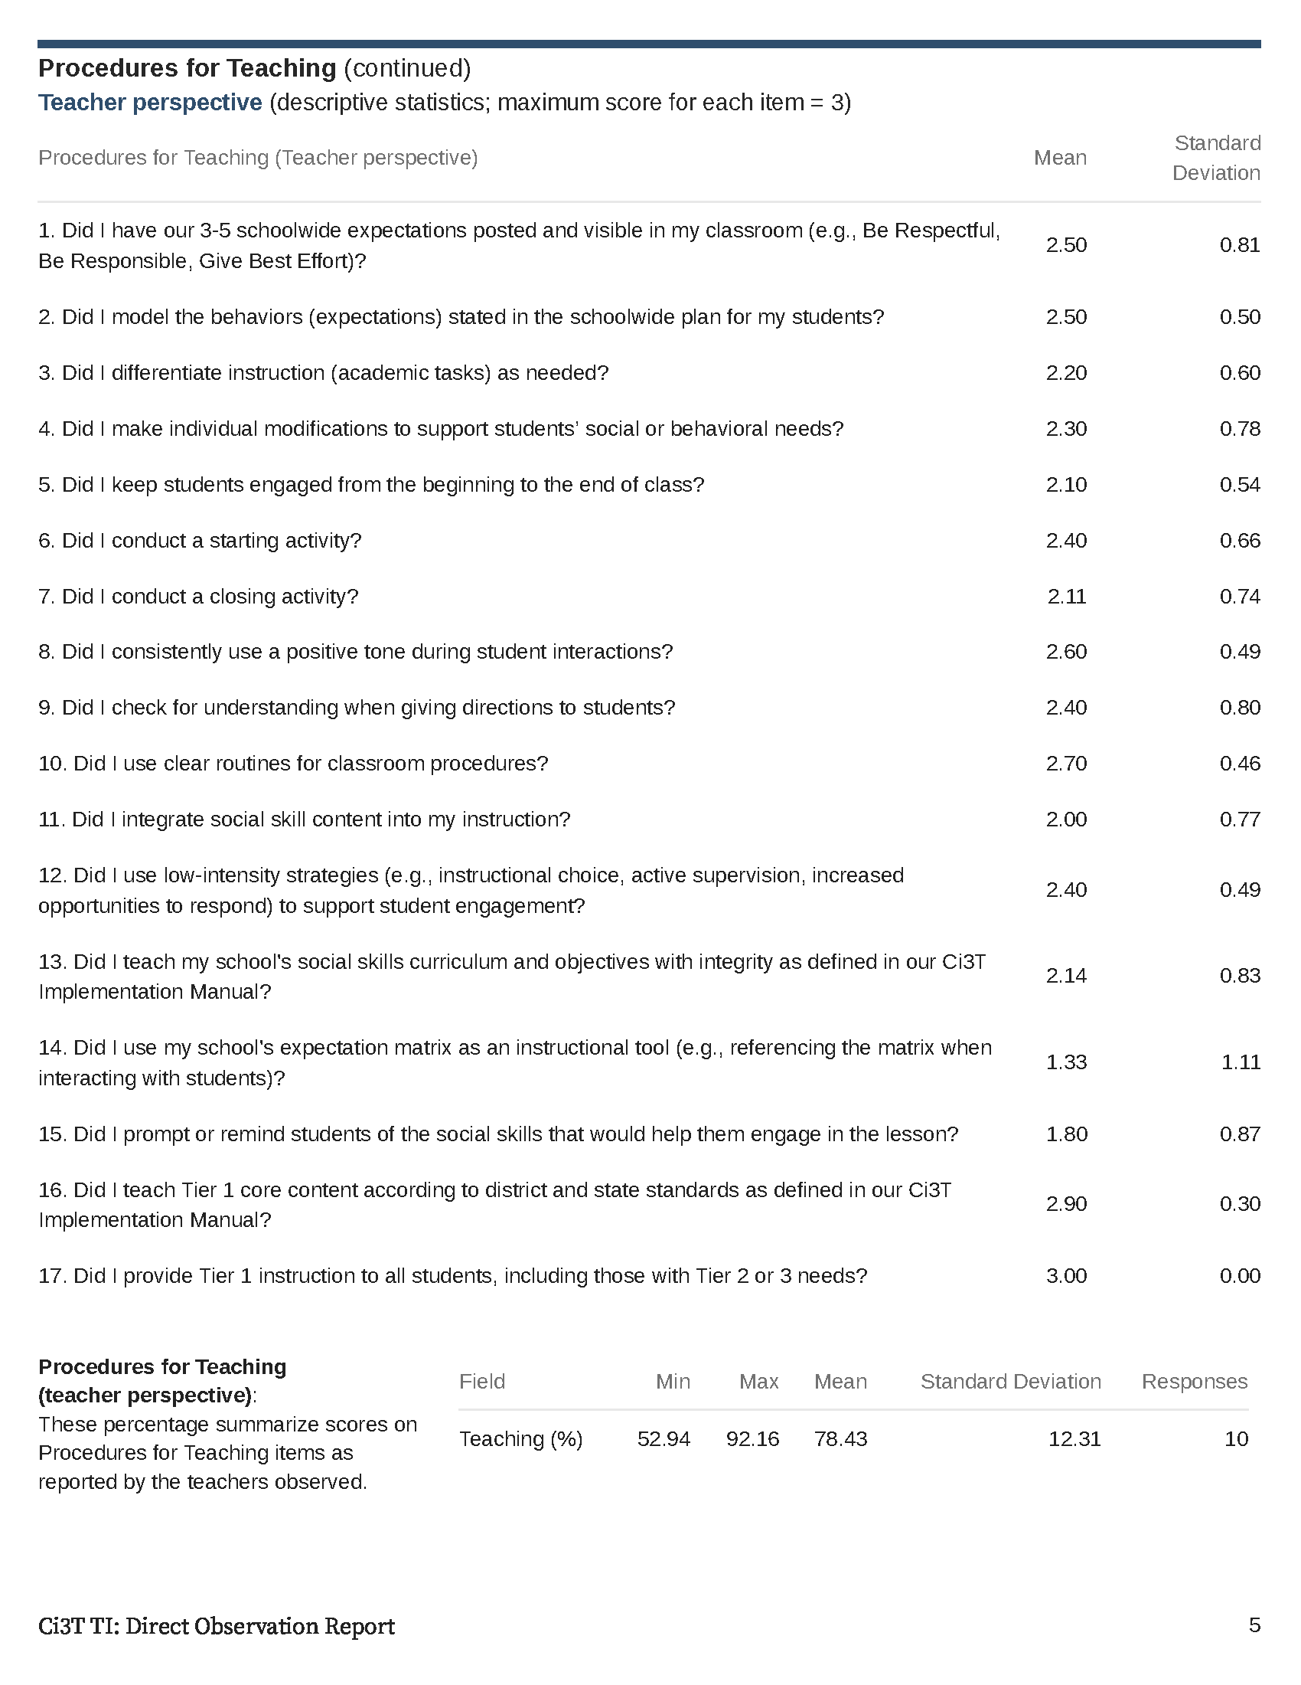

Slide 43
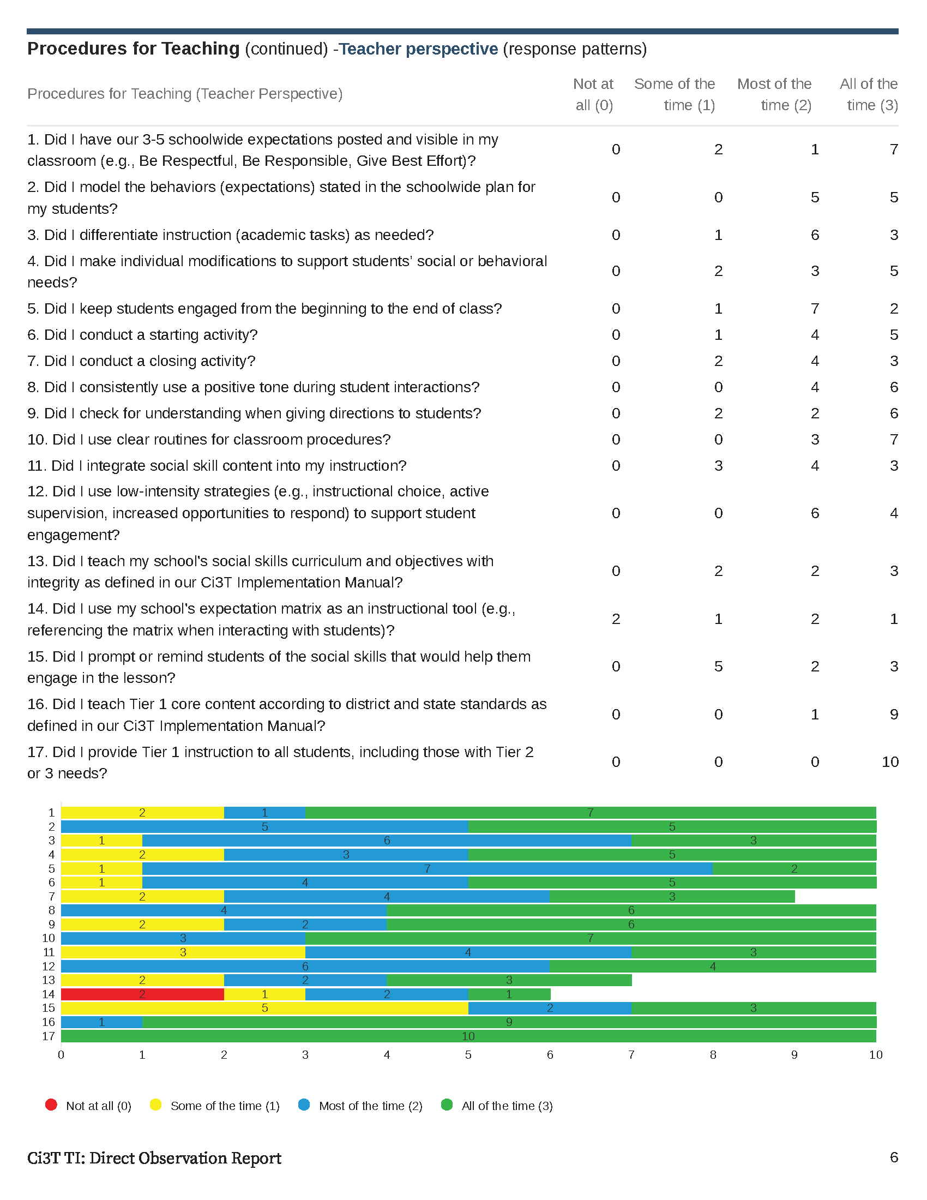

Slide 44
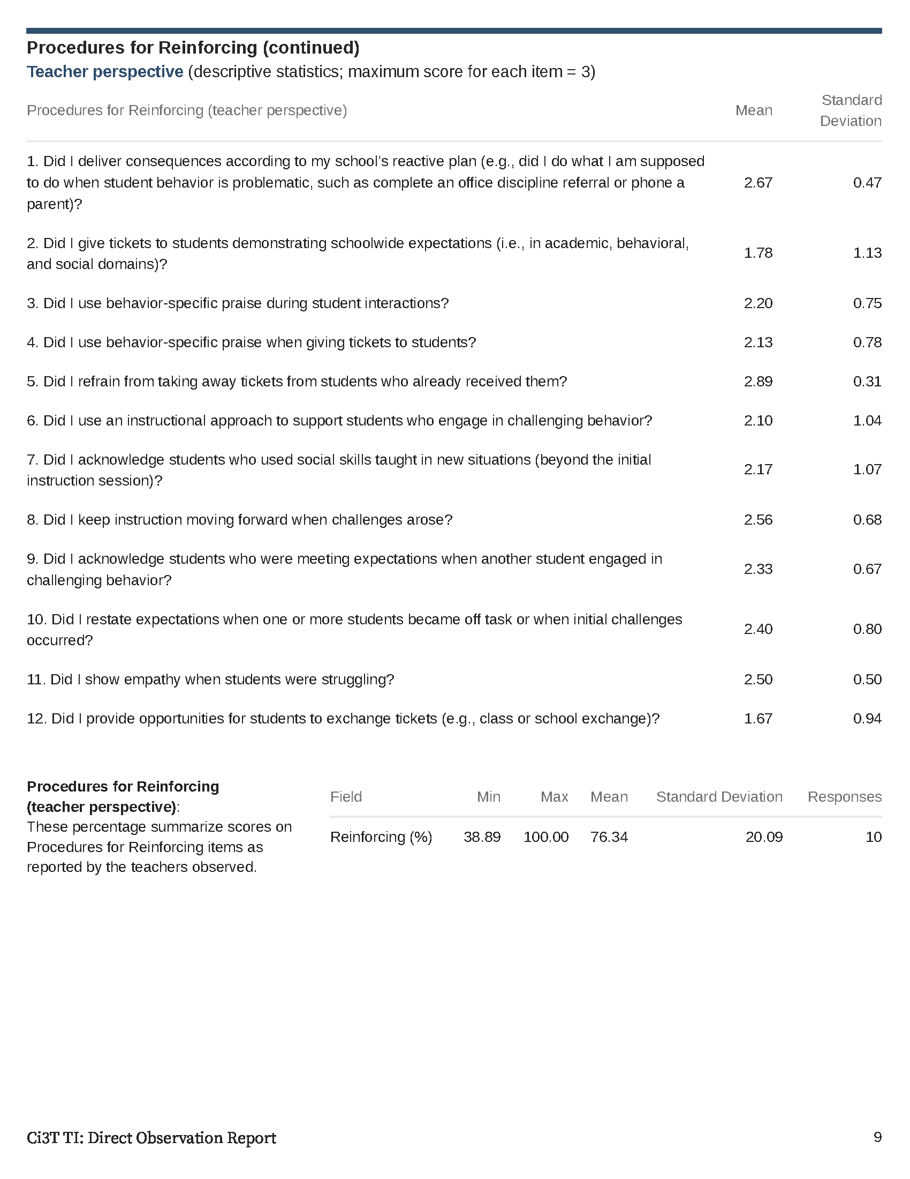
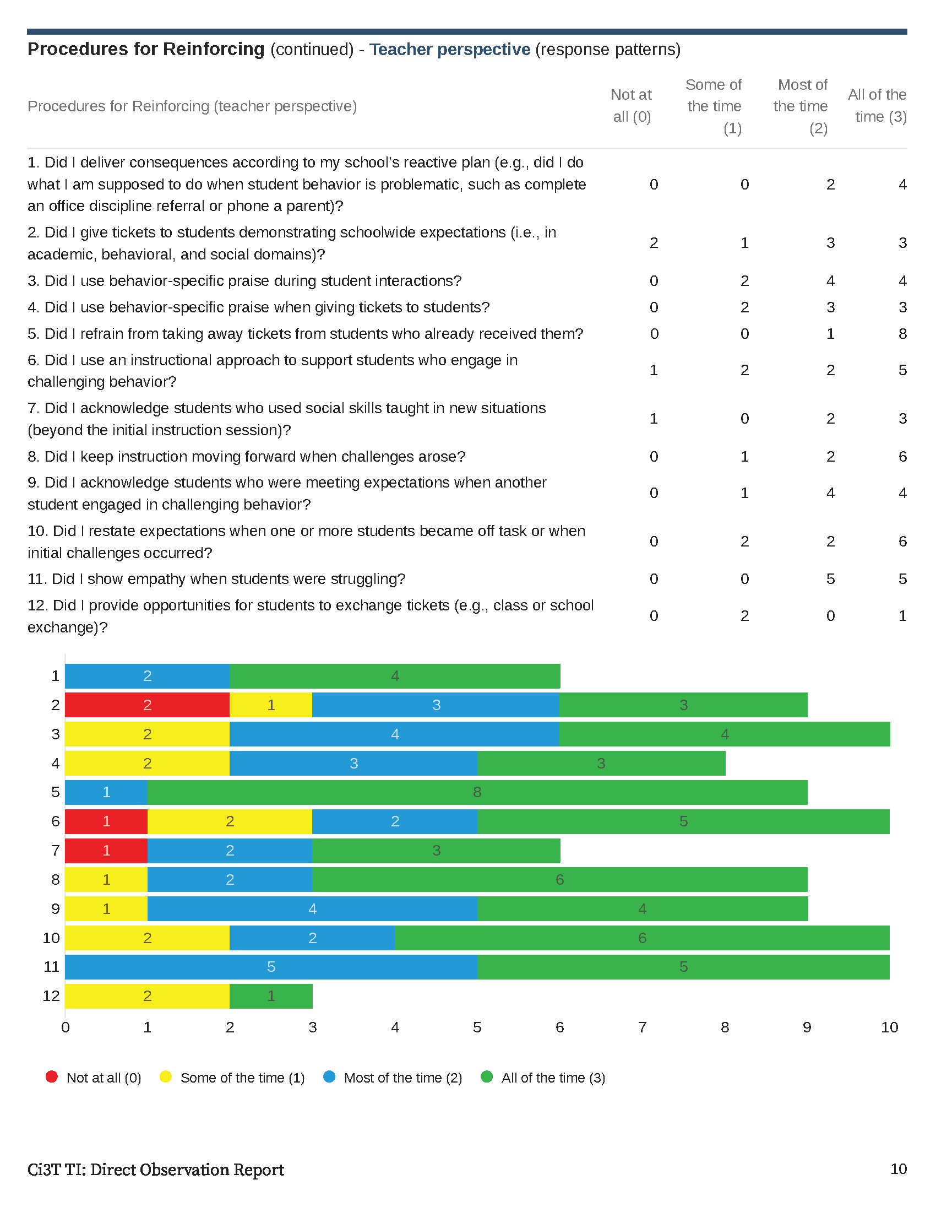

Slide 45
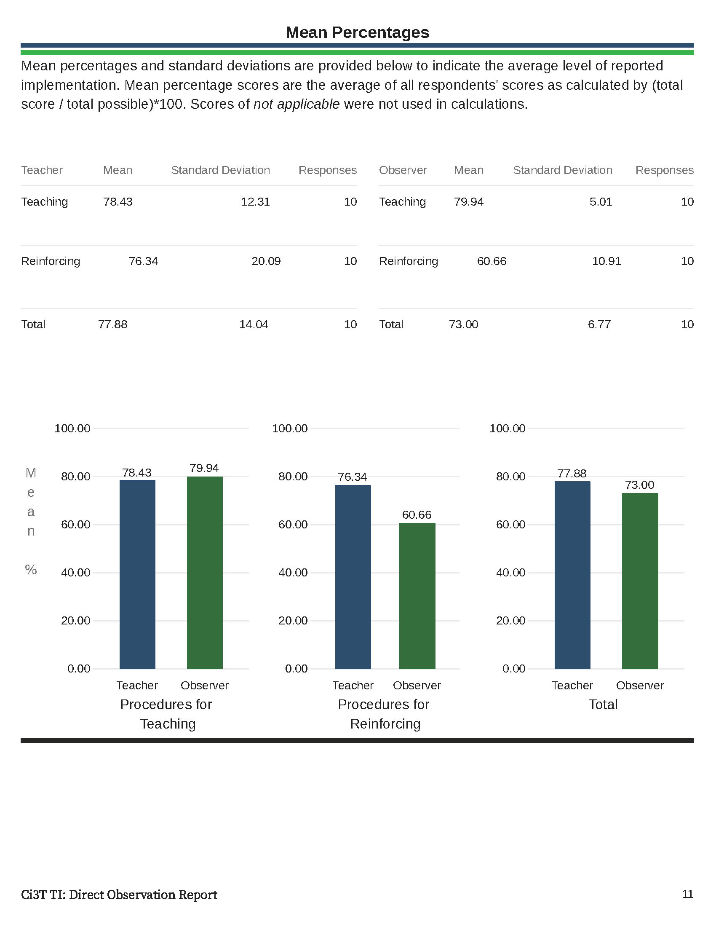

Slide 47
Treatment Integrity and Social Validity Data Sources
Primary Intervention Rating Scale (Social Validity)
Ci3T Treatment Integrity: Teacher Self Report
Ci3T Treatment Integrity: Direct Observation
Tiered Fidelity Inventory

Slide 48
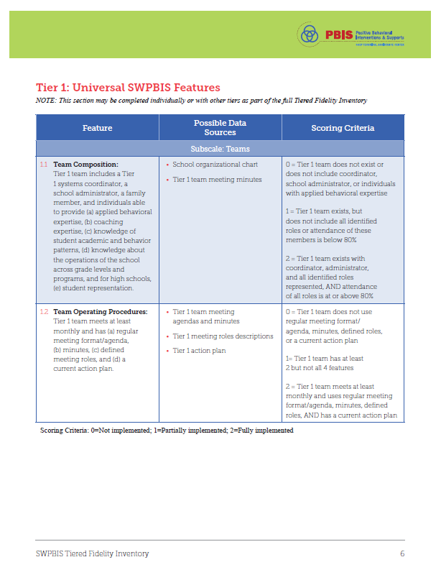
Tiered Fidelity Inventory (TFI)

Slide 49
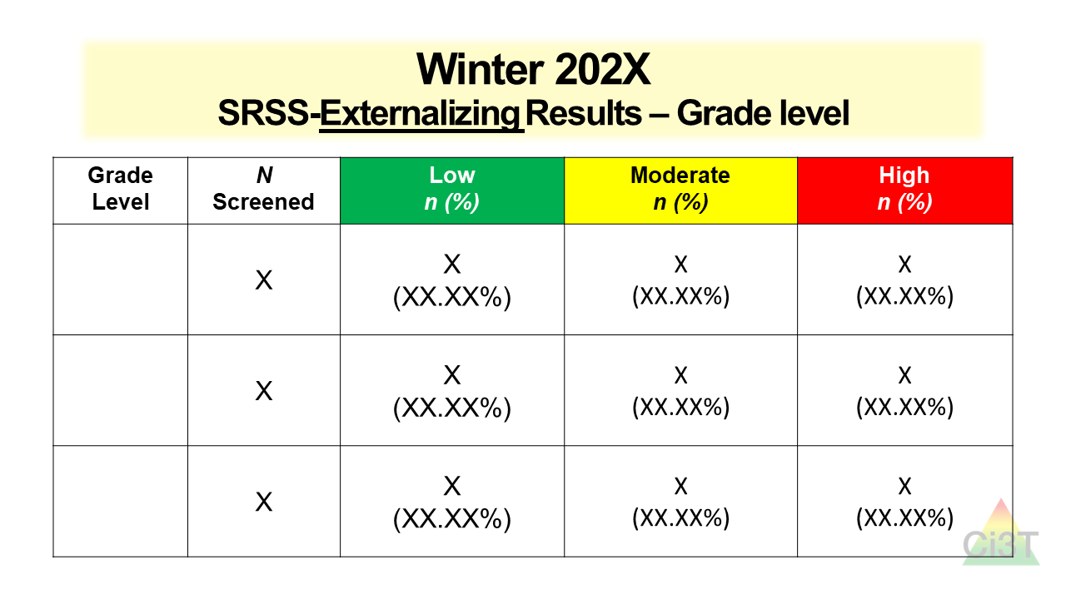
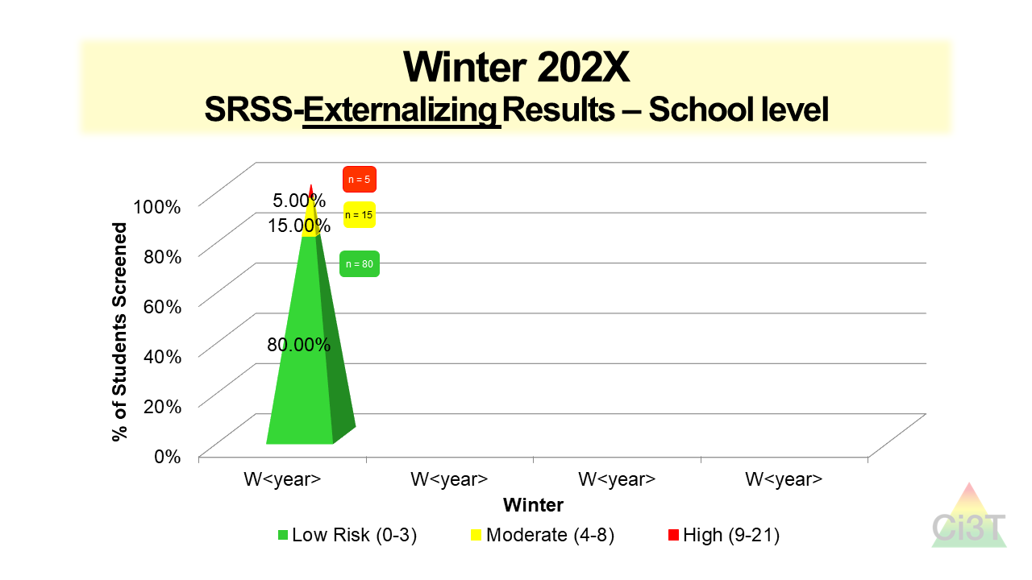
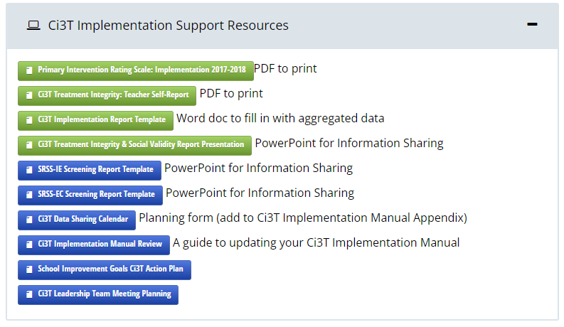
Sharing Screening Data with Faculty and Staff

Slide 50
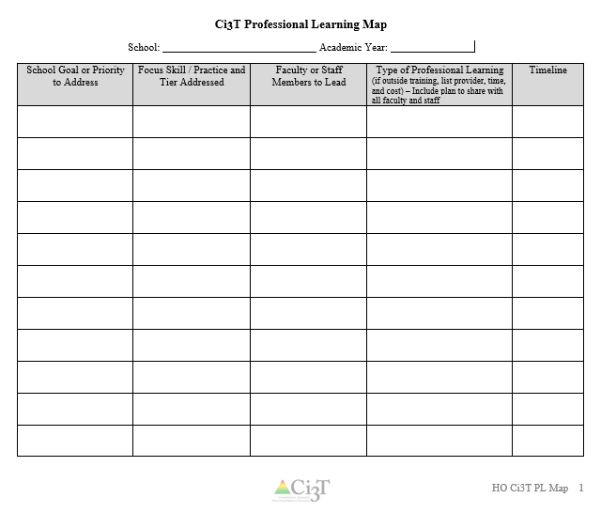
Let’s Talk!
Locate your school’s Ci3T Implementation Report and Ci3T Treatment Integrity: Direct Observation Report.
Then:
Highlight the positives
Discuss concerns and plans for addressing these focus areas
Make plans to share data and plans back with stakeholders
Write action items on HO Ci3T PL Map
Notes:
10-min timer

Slide 51
Procedures for Monitoring
Review your School’s Social Validity & Treatment Integrity Data
Review your School’s Spring Screening Data

Slide 52
Academic Screening
Group Screening Reports
(e.g., provided by subtests and compared to district scores; scored by benchmark or norms)
District
School

Slide 53
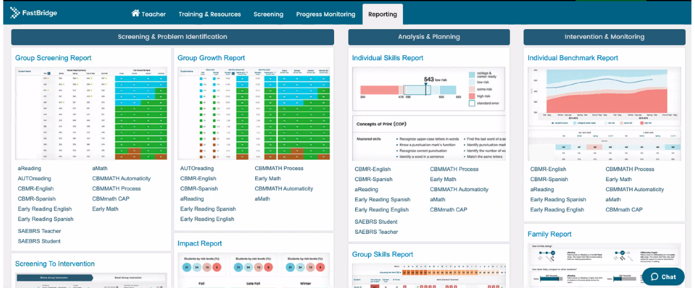
Academic Screening

Slide 54
Academic Screening

Slide 55
Academic Screening

Slide 56
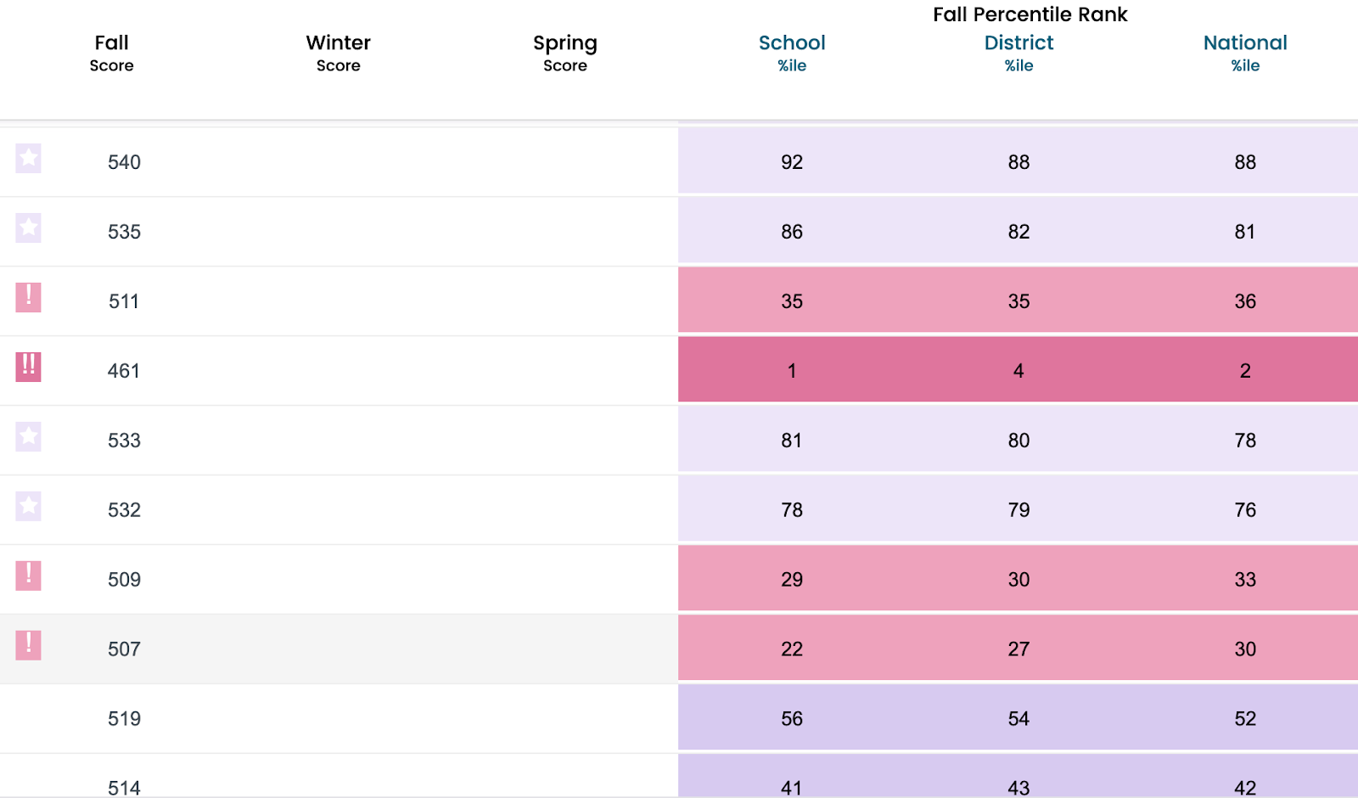
Academic Screening
Detailed Group Report (e.g., early Reading; can be pulled by class or grade)
Group Screening Report

Slide 57
Academic Screening

Slide 58
Spring 2021 SRSS-Externalizing Results – School level
n = 70
n = 43
n = 45
n = 5
n = 43
n = 129
n = 123
n = 110
n = 11
n = 103
n = 241
n = 298
n = 289
n = 31
n = 288
Notes:
Fill in <year> based on current academic year. This is located in column A of the data sheet. Edit by right clicking and selecting “Edit data”.

Slide 59
Spring 2021 SRSS-Internalizing Results – School level
n = 54
n = 42
n = 36
n = 103
n = 70
n = 68
n = 283
n = 352
n = 340
Cut scores vary by school level:
Elementary (I5): Low (0-1), Moderate (2-3), High (4-15)
Middle and High (I6): Low (0-3), Moderate (4-5), High (6-18)
Notes:
Fill in <year> based on current academic year. This is located in column A of the data sheet. Edit by right clicking and selecting “Edit data”.
IMPORTANT NOTE: The INTERNALIZING subscale and CUT SCORES are specific to school level.
Elementary: SRSS-I5, Items 8-12, 0-1 = low risk, 2-3 = moderate risk, 4-15 = high risk
Middle and High: SRSS-I6, Items 4, 8-12, 0-3 = low risk, 4-5 = moderate risk, 6-18 = high risk

Slide 60
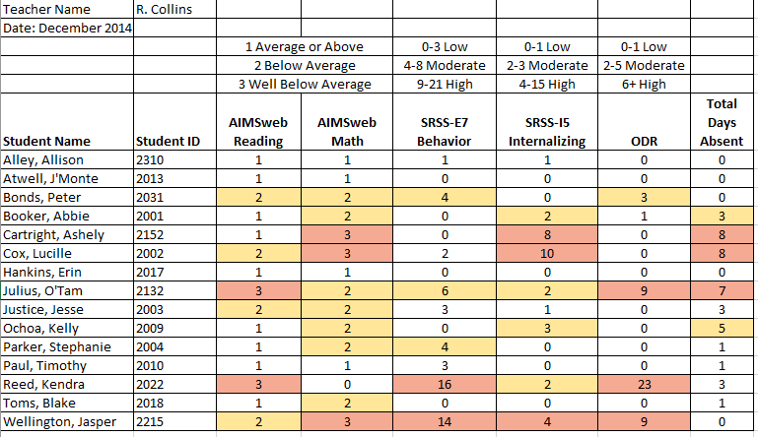
Consider this class….

Slide 62
Sharing Screening Data with Faculty and Staff

Slide 63
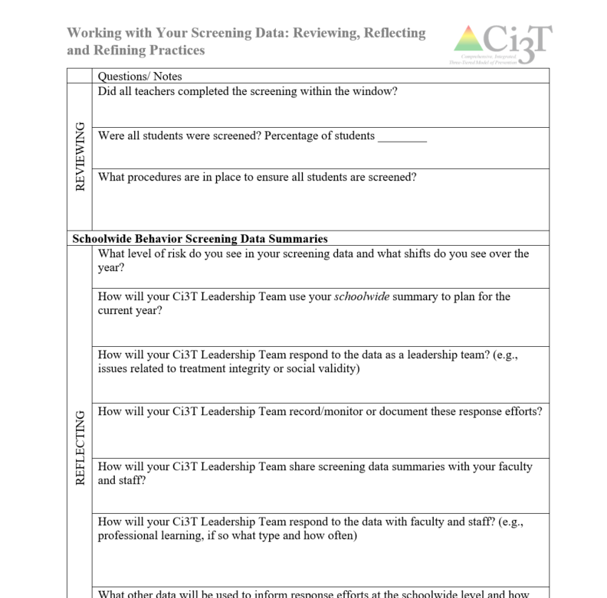
Reflect & Plan
Review spring screening data (if available). Consider implications for:
Primary (Tier 1) prevention efforts
Teacher-delivered, low-intensity supports
Secondary (Tier 2) and Tertiary (Tier 3) supports
What professional learning is necessary to respond these data?
Make plans to share your data – and corresponding plans – with faculty and staff?
Notes:
10-min timer

Slide 64
Planning for the Year Ahead 2023-2024
Ci3T District Masters A Careful Look at Your Ci3T Implementation Manual Using Data to Revise Your Ci3T Plan

Slide 65
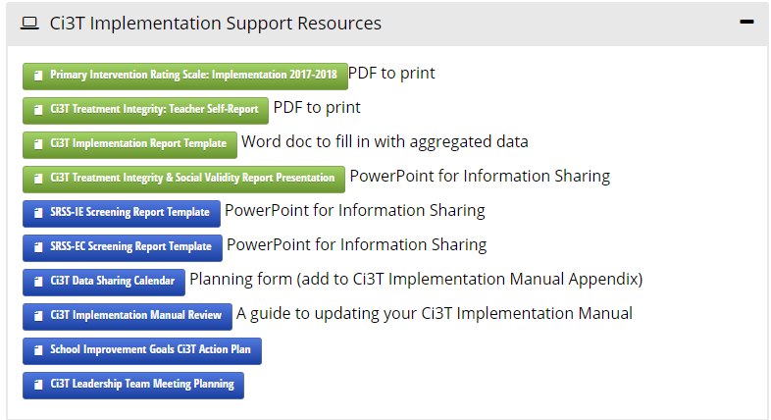
Tool for Revising Plans: 2023 2024 Ci3T Imp Manual Review

Slide 66
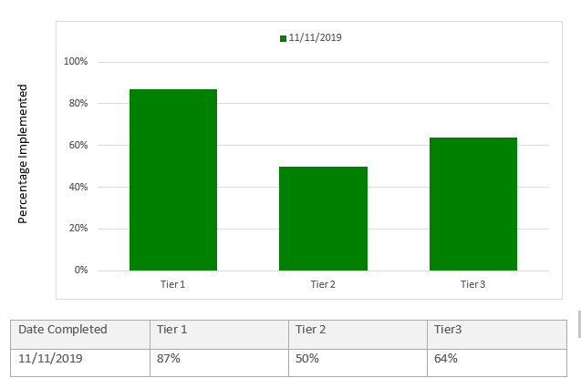
Using Data to Revise Your Ci3T Plan
Add in plans for Tier 2 & 3

Slide 67
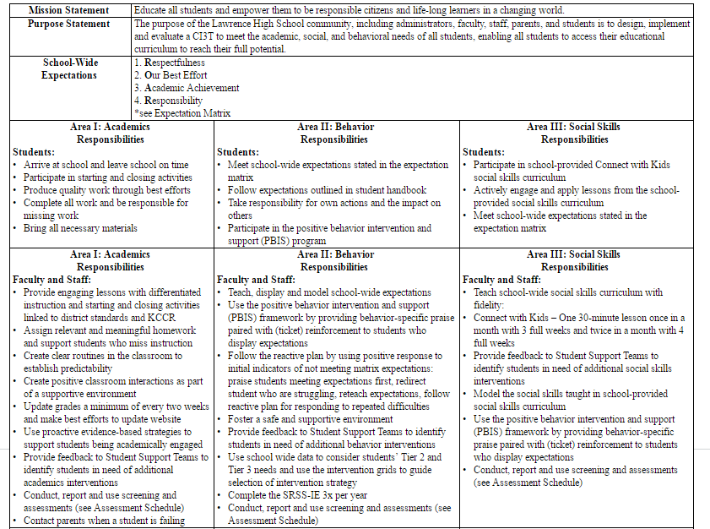
Check to see if your district has updated their District Master Blueprint
Teach, display, and model school-wide expectations
Teach school-wide social skills…, model social skills
Notes:
As you look at your Primary Plan where to you see this expectations for teachers. If you so not see it explicitly stated consider adding this to your summer revision list.

Slide 68
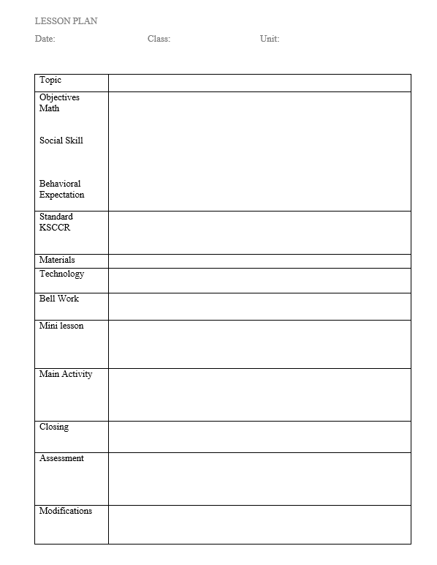
Look at the sample lesson
Review the learning objectives.
Discuss with your partner ideas to meet these objectives within the lesson.
Where are the opportunities for learning and practice?
What low-intensity strategies can be used in this lesson and where?
BSP
OTR
Active Supervision
Choice
Precorrection
Notes:
This is a Danielson framework-like lesson format. The blue box shows the slight modification to begin. Lets practice with this one.
With your partner…. Discuss one idea for an activity for this lesson (sample). Remember that the use of low-intensity strategies are great ways to support teachers in integrating social and behavioral skill support and practice.
Teams discuss – 3 min – share a few ideas. Then follow up with BSP and precorrection as examples if not shared.

Slide 69
Secondary (Tier 2) Intervention Grid
Support | Description | School-wide Data: Entry Criteria | Data to Monitor Progress | Exit Criteria
READ 180 (Stage C) Reading Intervention | Students participate in a 50 min reading instructional block during their study hall period. Students meet in the computer lab for participation in the online portion 20 min daily. Instruction is relevant to high school students. Students use a progress management system to monitor and track their own progress. Instruction is taught by special education teachers and general education teachers with training in the READ 180 Curriculum. | (1) Students in grades 9 – 12. (2) Reading performance basic or below basic on state assessment (but above 4th grade reading level). (3) SRSS risk scores in the moderate range (4 – 8). | Student Measures: Meeting individual READ 180 reading goals: (1) Progress Monitoring with Scholastic Reading Inventory (2) Writing Assessments (3) formative assessments (vocabulary, comprehension and spelling) (4) Curriculum-based Assessments (5) Attendance in class Treatment Integrity: Teachers monitor performance and attendance in class. Completion of weekly checklists for activities completed. Social Validity: Students and teachers complete surveys regarding the importance of the goals, program procedures, and outcomes. | Students meet instructional reading goals. SRSS score in the low risk category (0 – 3) on the next screening time point.
Kathleen Lynne Lane, Wendy Peia Oakes, Holly Mariah Menzies, Juli Oyer & Abbie Jenkins (2013) Working Within the Context of Three-Tiered Models of Prevention: Using Schoolwide Data to Identify High School Students for Targeted Supports, Journal of Applied School Psychology, 29:2, 203-229, DOI: 10.1080/15377903.2013.778773

Slide 70
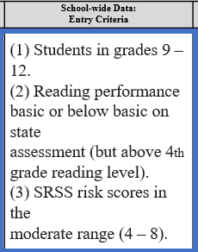
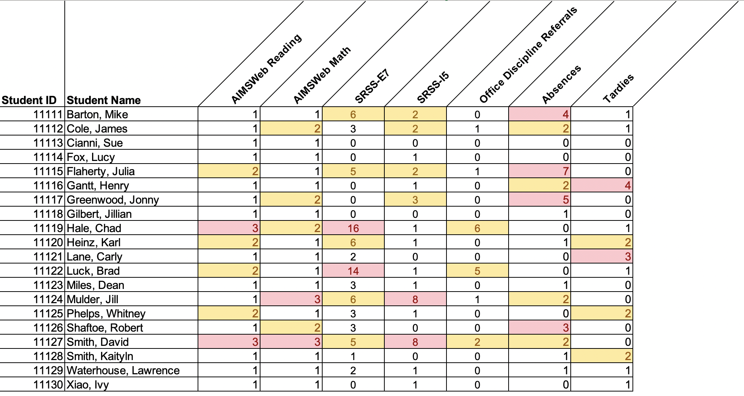
Data in action

Slide 71
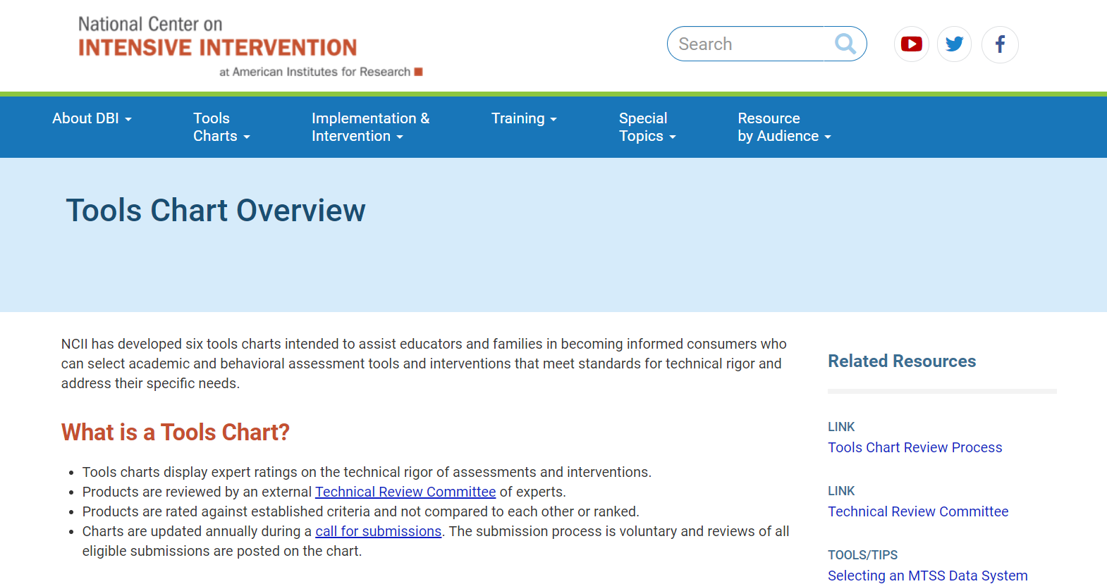
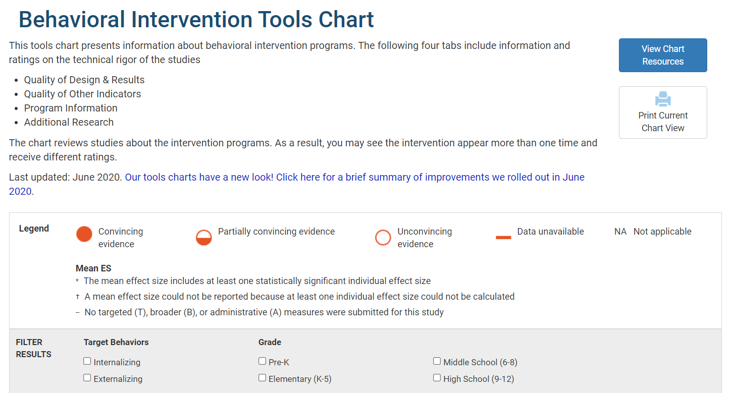
Tier 2 and Tier 3 Considerations
Academic and behavioral interventions
Information on group size
Duration of intervention
Study Results
Evidence base
Academic and behavioral progress monitoring
Psychometric standards
Progress monitoring standards
Data-based individualization standards
mtss4success.org
intensiveintervention.org

Slide 72
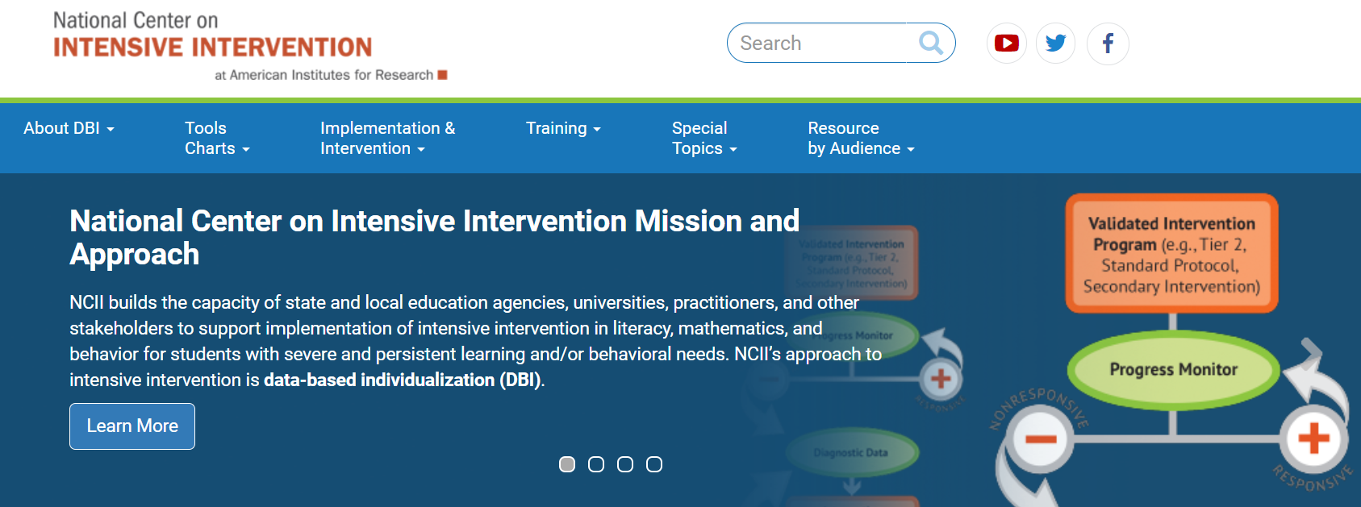
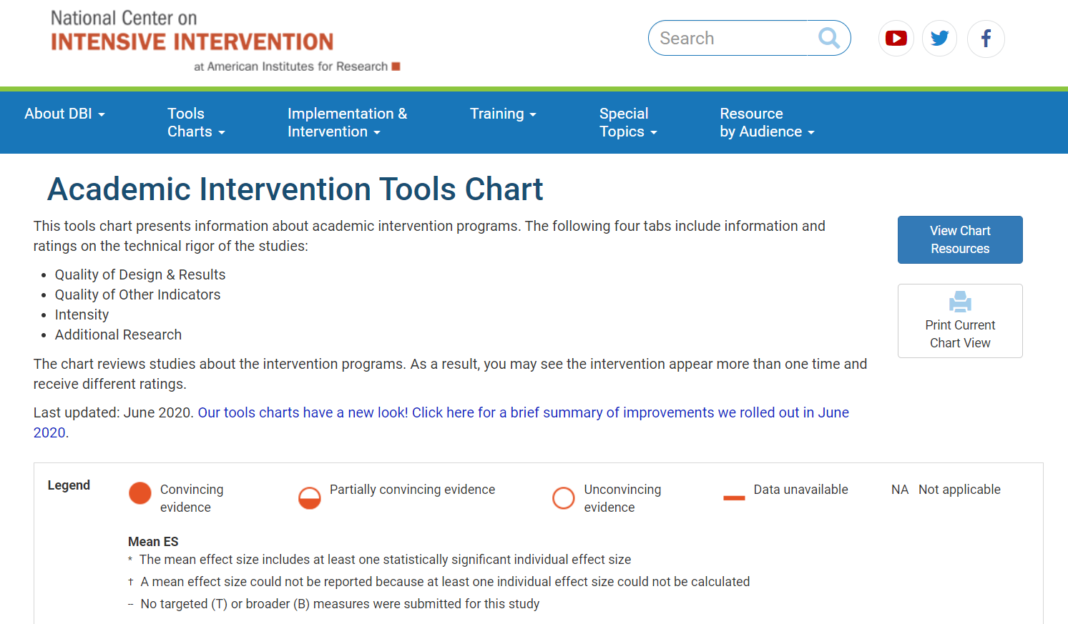
Tier 2 and Tier 3 Considerations
National Center on Intensive Intervention http://www.intensiveintervention.org

Slide 73
Focusing on Data-Informed Professional Learning
Ci3T Monthly Ci3T Leadership Team Meetings
Project EMPOWER: Building Capacity
Ci3T Trainer and Coaches Calls
Ci3T Summer Symposium

Slide 74
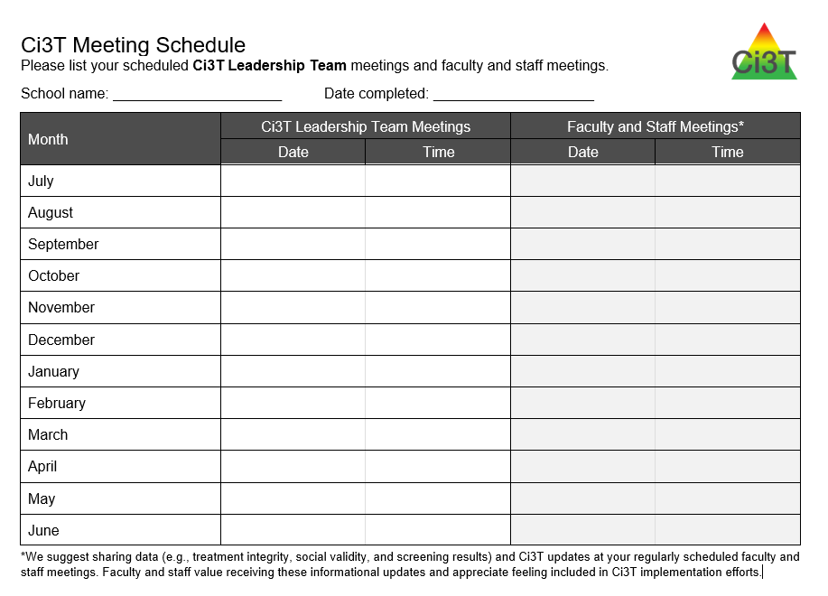
Ci3T Monthly Leadership Team Meetings

Slide 75
Ci3T Professional Learning Calendar
 | July | Aug | Sep | Oct | Nov | Dec | Jan | Feb | Mar | Apr | May | Jun
Ci3T Training |  |  |  |  | Ci3T Professional Learning Series Session 1 | Ci3T Professional Learning Series Session 2 | Ci3T Professional Learning Series Session 3 | Ci3T Professional Learning Series Session 4 |  | Ci3T Professional Learning Series Session 5 | Ci3T Professional Learning Series Session 6
Ci3T Implementation Support | Ci3T Implementation Series Prep Session |  | Ci3T Implementation Series Session 1 |  | Ci3T Implementation Series Session 2 |  | Ci3T Implementation Series Session 3 |  | Ci3T Implementation Series Session 4 | Ci3T Implementation Series Session 5
Ci3T EMPOWER |  |  | Ci3T EMPOWER Session 1 | Ci3T EMPOWER Session 2 | Ci3T EMPOWER Session 3 |  | Ci3T EMPOWER Session 4 |  | Ci3T EMPOWER Session 5 | Ci3T EMPOWER Session 6
Ci3T Trainers & Coaches Calls |  | Trainers & Coaches Call Session 1 | Trainers & Coaches Call Session 2 | Trainers & Coaches Call Session 3 | Trainers & Coaches Call Session 4 | Trainers & Coaches Call Session 5 | Trainers & Coaches Call Session 6 | Trainers & Coaches Call Session 7 | Trainers & Coaches Call Session 8 | Trainers & Coaches Call Session 9 | Trainers & Coaches Call Session 10

Slide 76
Building Capacity & Supporting Sustainability Professional Learning Offerings for 2023-2024
2023-2024 Empower information will be posted online after session 6 this year!

Slide 77
Project EMPOWER – Traditional 2023-2024
Ci3T EMPOWER Sessions Location: Remote via Zoom Attended by: School Ci3T Leadership Teams, Ci3T District Trainers and Coaches, Faculty and Staff, Families (adults only). Community Members |  | Times (Pacific) | Times (Central) | Times (Eastern)
1. Getting Started | Sep. 19, 2023 (Tu) | 3:00 – 5:00 p.m. | 5:00 – 7:00 p.m. | 6:00 – 8:00 p.m.
2. Screening | Oct. 19, 2023 (Th) | 3:00 – 5:00 p.m. | 5:00 – 7:00 p.m. | 6:00 – 8:00 p.m.
3. Low Intensity Supports (2) | Nov. 30, 2023 (Th) | 3:00 – 5:00 p.m. | 5:00 – 7:00 p.m. | 6:00 – 8:00 p.m.
4. Tier 2 | Jan. 9, 2024 (Tu) | 3:00 – 5:00 p.m. | 5:00 – 7:00 p.m. | 6:00 – 8:00 p.m.
5. Tier 3 | Mar. 28, 2024 (Th) | 3:00 – 5:00 p.m. | 5:00 – 7:00 p.m. | 6:00 – 8:00 p.m.
6. Moving Forward | Apr. 23, 2024 (Tu) | 3:00 – 5:00 p.m. | 5:00 – 7:00 p.m. | 6:00 – 8:00 p.m.

Slide 78
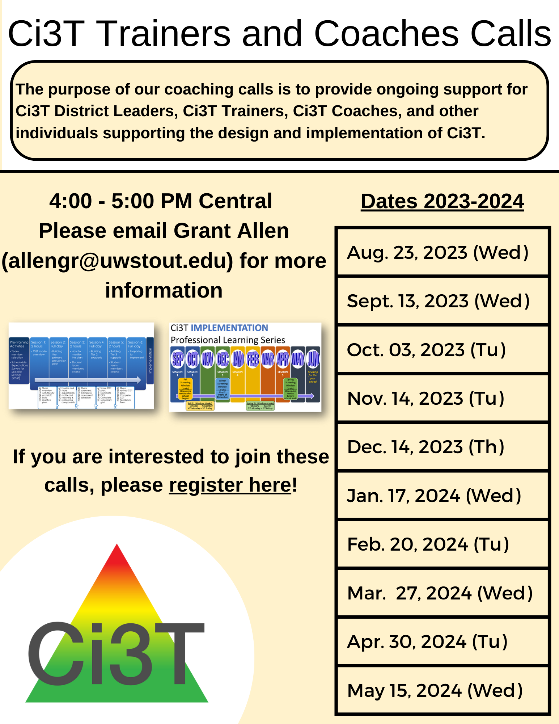
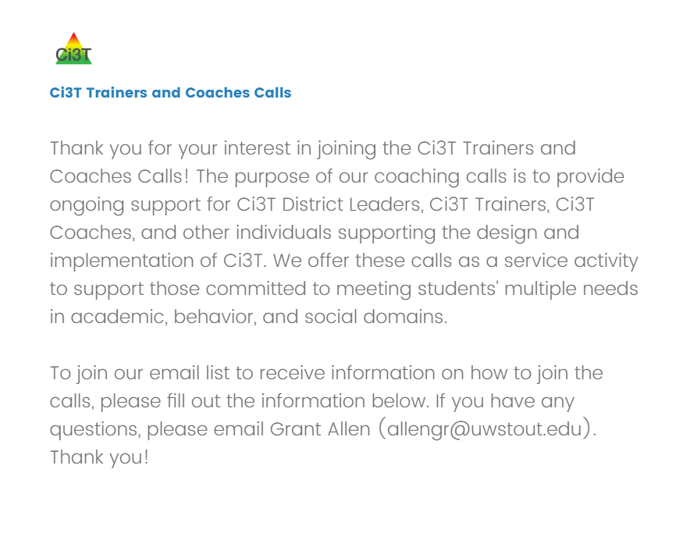
Ci3T Trainers and Coaches Calls
2023-2024 Ci3T Trainers and Coaches Call information will be posted online after the last call this year!

Slide 79
Ci3T Trainers and Coaches Calls
2023-2024
Ci3T Trainers & Coaches Calls Location: Remote via Zoom Attended by: Ci3T Trainers, Coaches, or Leadership Team Members; open to interested parties Zoom link: Available at Registration |  | Times (Central)
Ci3T Trainers and Coaches Call 1 | Aug. 23, 2023 (Wed) | 4:00 – 5:00 p.m.
Ci3T Trainers and Coaches Call 2 | Sept. 13, 2023 (Wed) | 4:00 – 5:00 p.m.
Ci3T Trainers and Coaches Call 3 | Oct. 03, 2023 (Tu) | 4:00 – 5:00 p.m.
Ci3T Trainers and Coaches Call 4 | Nov. 14, 2023 (Tu) | 4:00 – 5:00 p.m.
Ci3T Trainers and Coaches Call 5 | Dec. 14, 2023 (Th) | 4:00 – 5:00 p.m.
Ci3T Trainers and Coaches Call 6 | Jan. 17, 2024 (Wed) | 4:00 – 5:00 p.m.
Ci3T Trainers and Coaches Call 7 | Feb. 20, 2024 (Tu) | 4:00 – 5:00 p.m.
Ci3T Trainers and Coaches Call 8 | Mar. 27, 2024 (Wed) | 4:00 – 5:00 p.m.
Ci3T Trainers and Coaches Call 9 | Apr. 30, 2024 (Tu) | 4:00 – 5:00 p.m.
Ci3T Trainers and Coaches Call 10 | May 15, 2024 (Wed) | 4:00 – 5:00 p.m.

Slide 80
Ci3T Implementers Symposium
Thursday, June 22, 2023
7:30 a.m. – 1:30 p.m. (Pacific)
9:30 a.m. – 3:30 p.m. (Central)
10:30 a.m. – 4:30 p.m. (Eastern)

Slide 81
Reflect & Plan
Plan and schedule action items for closing out 2022-2023 and preparing for 2023-2024 Identify potential Ci3T Implementation Manual revisions Schedule time with your Ci3T Leadership Team to: complete Ci3T Implementation Manual revisions prepare for implementation in 2022-2023 Make plans for spring data sharing | What are strengths of our current communication systems? How can we share data with staff more regularly? What resources and professional learning do faculty and staff require? Consider: Ci3T Leadership Team Meetings Empower Sessions Ci3T Trainers and Coaches Calls
Use “Ci3T Imp Manual Review” to revise
Notes:
10-min timer

Slide 82
Wrapping Up and Moving Forward

Slide 83
Ci3T
Comprehensive Professional Learning Plan
Ci3T: Primary Prevention
Session 1:
Overview of Ci3T Prevention Models
Setting a Purpose
Establish team meetings and roles
Session 2:
Mission and Purpose
Establish Roles and Responsibilities
Procedures for Teaching
Procedures for Reinforcing
Reactive Plan
Session 3:
Procedures for Monitoring
Session 4:
Revise Primary Plan using Stakeholder feedback
Prepare presentation
Ci3T: Secondary Prevention
Session 5:
Overview of Teacher focused Strategies
Overview of Student Focused Strategies
Using data to determine which students may need Secondary (Tier 2) supports
Draft the Secondary Intervention Grid based on existing supports
Ci3T: Tertiary Prevention
Session 6:
Final revisions of Ci3T Plan based on stakeholder feedback
Draft Tertiary (Tier 3) Prevention Intervention Grids
Design Implementation Manual and Plan for roll out to faculty, students, and parents
Ci3T Leadership Team Training Sequence
Implementation Stages of Tier 2 and 3 within Ci3T
Additional Professional Development on Specific Topics
Core Content Curriculum
Check In - Check Out
Functional Assessment-based Interventions
Reading, Math, Writing Benchmarking and Progress Monitoring Tools
Interventions, Strategies, & Practices
Additional Tier 3 Supports
Instructional Techniques to Improve Students’ Motivation; Classroom Management Practices;
Low-Intensity Behavior Supports

Slide 84
Ci3T Professional Learning Calendar
 | July | Aug | Sep | Oct | Nov | Dec | Jan | Feb | Mar | Apr | May | Jun
Ci3T Training |  |  |  |  | Ci3T Professional Learning Series Session 1 | Ci3T Professional Learning Series Session 2 | Ci3T Professional Learning Series Session 3 | Ci3T Professional Learning Series Session 4 |  | Ci3T Professional Learning Series Session 5 | Ci3T Professional Learning Series Session 6
Ci3T Implementation Support | Ci3T Implementation Series Prep Session |  | Ci3T Implementation Series Session 1 |  | Ci3T Implementation Series Session 2 |  | Ci3T Implementation Series Session 3 |  | Ci3T Implementation Series Session 4 | Ci3T Implementation Series Session 5
Ci3T EMPOWER |  |  | Ci3T EMPOWER Session 1 | Ci3T EMPOWER Session 2 | Ci3T EMPOWER Session 3 |  | Ci3T EMPOWER Session 4 |  | Ci3T EMPOWER Session 5 | Ci3T EMPOWER Session 6
Ci3T Trainers & Coaches Calls |  | Trainers & Coaches Call Session 1 | Trainers & Coaches Call Session 2 | Trainers & Coaches Call Session 3 | Trainers & Coaches Call Session 4 | Trainers & Coaches Call Session 5 | Trainers & Coaches Call Session 6 | Trainers & Coaches Call Session 7 | Trainers & Coaches Call Session 8 | Trainers & Coaches Call Session 9 | Trainers & Coaches Call Session 10

Slide 85
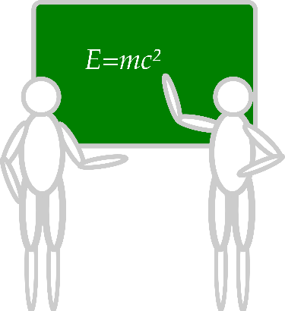
Sustaining and Disseminating Professional Learning
Designate two staff to attend trainings to become on-site coaches
10 min @ next Faculty and Staff meeting
Ci3T Setting Up for Success
Systematic Screening
Low-Intensity Supports
Tier 2
Planning Ahead
Tier 3

Slide 86
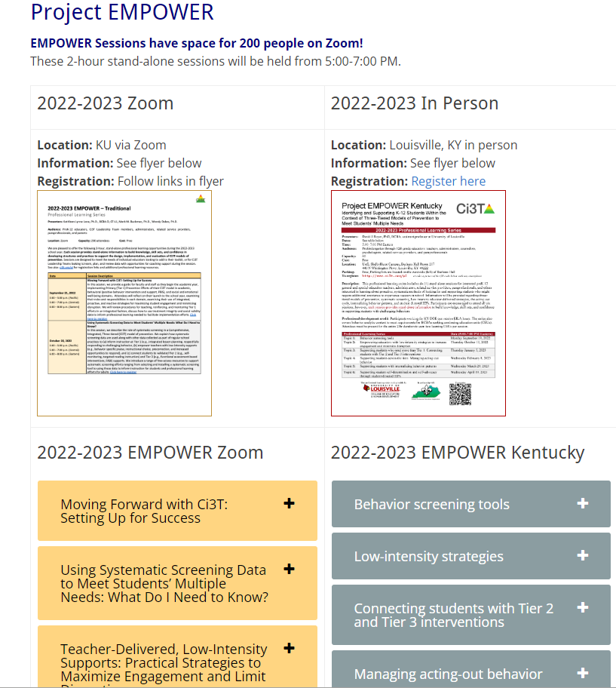
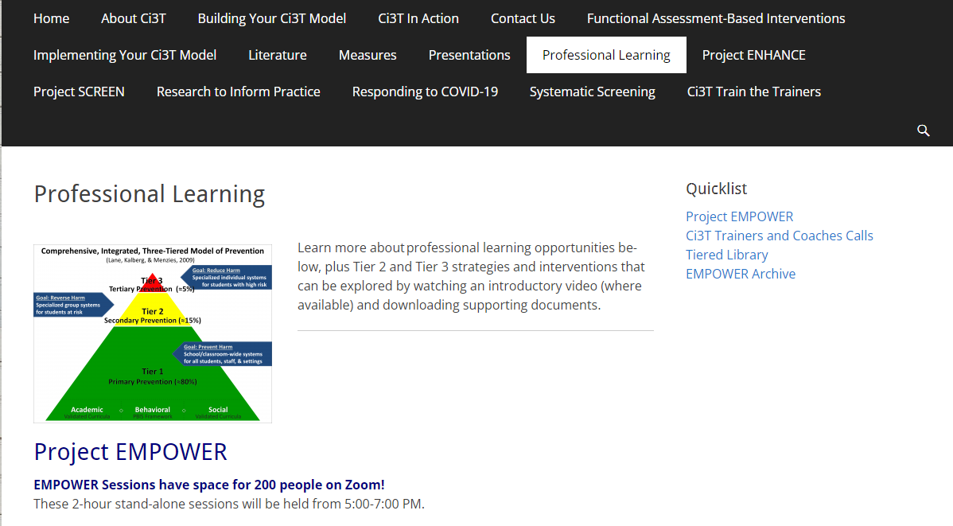
Accessing Project EMPOWER Professional Learning

Slide 87
Project EMPOWER - Traditional
Ci3T EMPOWER Sessions Location: Remote via Zoom Attended by: School Ci3T Leadership Teams, Ci3T District Trainers and Coaches, Faculty and Staff, Families (adults only). Community Members |  | Times (Pacific) | Times (Central) | Times (Eastern)
1. Getting Started | Sep. 21, 2022 (Wed) | 3:00 – 5:00 p.m. | 5:00 – 7:00 p.m. | 6:00 – 8:00 p.m.
2. Screening | Oct. 20, 2022 (Th) | 3:00 – 5:00 p.m. | 5:00 – 7:00 p.m. | 6:00 – 8:00 p.m.
3. Low Intensity Supports (2) | Nov. 15, 2022 (Tu) | 3:00 – 5:00 p.m. | 5:00 – 7:00 p.m. | 6:00 – 8:00 p.m.
4. Tier 2 | Jan. 11, 2023 (Wed) | 3:00 – 5:00 p.m. | 5:00 – 7:00 p.m. | 6:00 – 8:00 p.m.
5. Tier 3 | Mar. 22, 2023 (Wed) | 3:00 – 5:00 p.m. | 5:00 – 7:00 p.m. | 6:00 – 8:00 p.m.
6. Moving Forward | Apr. 27, 2023 (Th) | 3:00 – 5:00 p.m. | 5:00 – 7:00 p.m. | 6:00 – 8:00 p.m.

Slide 88
Wrap Up and Preview
Today
Next Steps
Procedures for Monitoring
Review your School’s Social Validity & Treatment Integrity Data
Review your School’s Spring Screening Data
Planning for the Year Ahead 2023-2024
Focusing on Data-Informed Professional Learning
Summer Support
Ci3T Implementation Professional Learning Series 2023-2024
Ci3T EMPOWER Sessions 2023-2024
We hope you have a wonderful conclusion to the school year!

Slide 89
Please Take a Minute to Get Organized
Please stay until all materials are organized.
Team Materials:
Make sure your notes are in your Ci3T Leadership Team agenda and that document is saved in your Ci3T Leadership Team Drive.
Clearly identify the person(s) on your team in charge of each action item listed on the agenda.
Thank you!

Slide 90
Homework
At your next Ci3T Leadership Team meeting:
Begin planning updates to your Ci3T Implementation Manual for next year; consider:
Takeaways from data reviews conducted this year (social validity, treatment integrity, student outcomes)
District Master updates
Update your Ci3T Leadership Team structures for next year, including membership, meeting dates, agendas
Plan data-informed professional learning to support your staff in 2023-2024
At your next faculty meeting:
Share successes
Share spring implementation report and screening data
Share revisions to Ci3T Implementation Manual based on spring data
Share professional learning resources and opportunities

