Slide 1
Moving Forward with Ci3T: Planning for Success
EMPOWER Session 6
Kathleen Lynne Lane, Ph.D., BCBA-D, CF-L2
Rebecca Sherod, MSE
Mark Buckman, Ph.D.
Wendy Oakes, Ph.D.

Slide 2
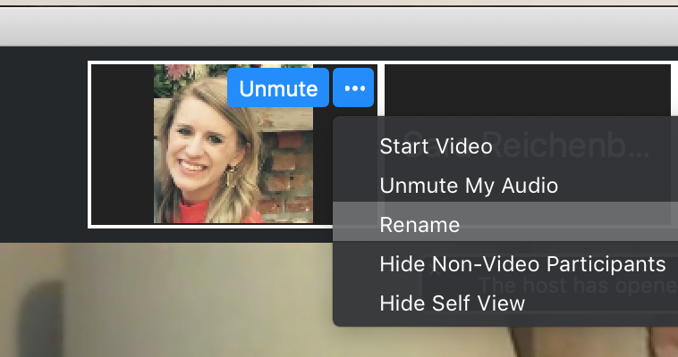
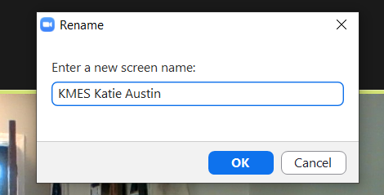
Renaming: School Initials + First and Last Name
To help us put you in breakout rooms with your colleagues today…
1. Click the three dots at the top
right corner of your video square.
2. Rename yourself with your
school initials then first and last name.

Slide 4
Ci3T Professional Learning Calendar
 | July | Aug | Sep | Oct | Nov | Dec | Jan | Feb | Mar | Apr | May | Jun
Ci3T Training |  |  |  |  | Ci3T Professional Learning Series Session 1 | Ci3T Professional Learning Series Session 2 | Ci3T Professional Learning Series Session 3 | Ci3T Professional Learning Series Session 4 |  | Ci3T Professional Learning Series Session 5 | Ci3T Professional Learning Series Session 6
Ci3T Implementation Support | Ci3T Implementation Series Prep Session |  | Ci3T Implementation Series Session 1 |  | Ci3T Implementation Series Session 2 |  | Ci3T Implementation Series Session 3 |  | Ci3T Implementation Series Session 4 | Ci3T Implementation Series Session 5
Ci3T EMPOWER |  |  | Ci3T EMPOWER Session 1 | Ci3T EMPOWER Session 2 | Ci3T EMPOWER Session 3 |  | Ci3T EMPOWER Session 4 |  | Ci3T EMPOWER Session 5 | Ci3T EMPOWER Session 6
Ci3T Trainers & Coaches Calls |  | Trainers & Coaches Call Session 1 | Trainers & Coaches Call Session 2 | Trainers & Coaches Call Session 3 | Trainers & Coaches Call Session 4 | Trainers & Coaches Call Session 5 | Trainers & Coaches Call Session 6 | Trainers & Coaches Call Session 7 | Trainers & Coaches Call Session 8 | Trainers & Coaches Call Session 9 | Trainers & Coaches Call Session 10

Slide 5
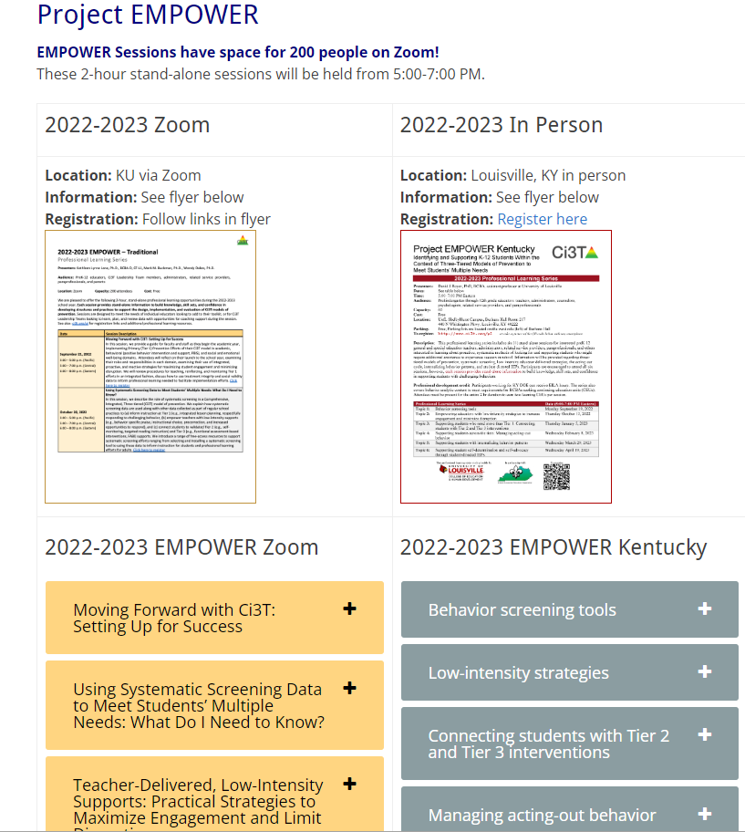
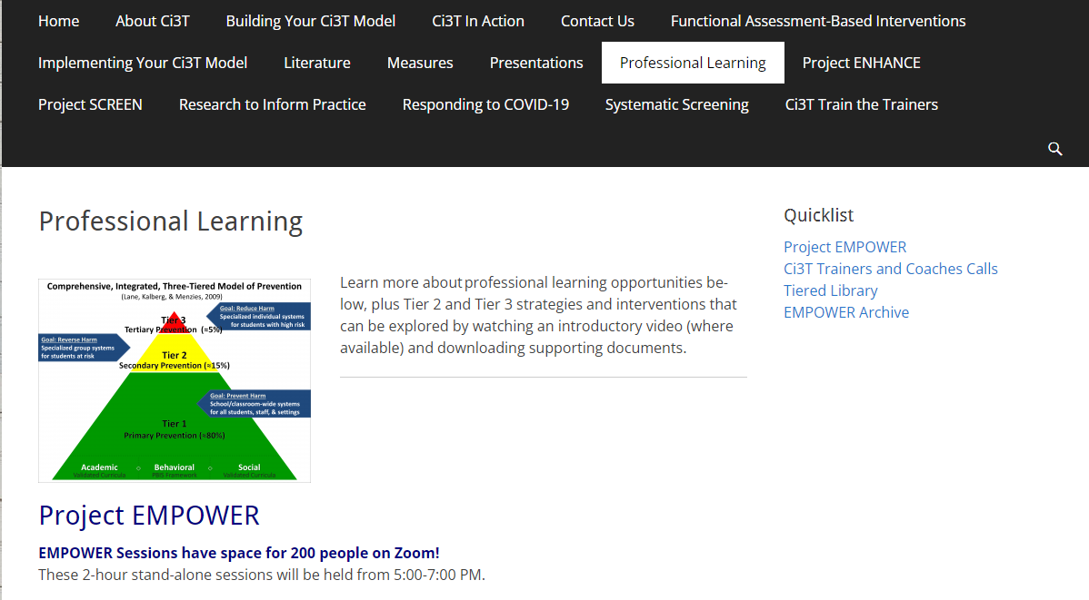
Accessing Project EMPOWER Professional Learning

Slide 6
Agenda
Welcome
Overview of Ci3T: Identifying Successes and Areas for Refinement
Closing out the School Year: Positive, Productive Learning Environments
Planning for the 2023-2024 Academic Year
Establishing Professional Learning Goals
Wrapping Up and Moving Forward

Slide 7
Welcome

Slide 8
Accessing Project EMPOWER Professional Learning

Slide 9
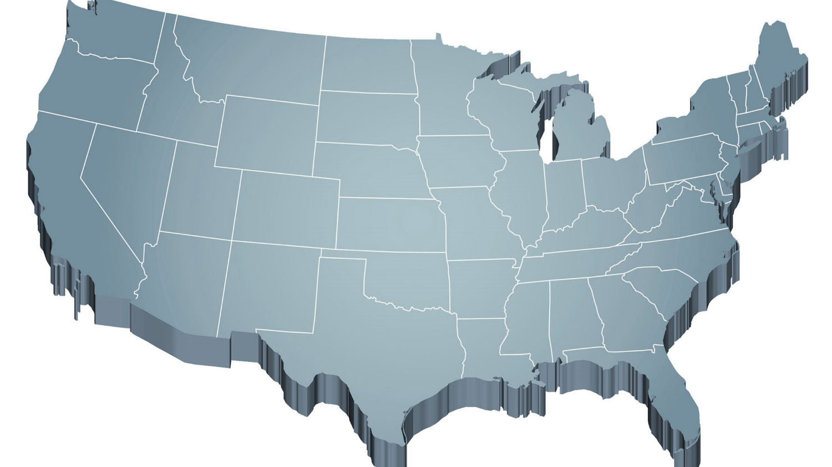
Thank you for your commitment
Shift to a systems level perspective
Internalizing
Externalizing
ED <1%
EBD 12-20%
Source: Forness, S.R., Freeman, S.F., Paparella, T., Kauffman, J.M., & Walker, H.M. (2012). Special education implications of point and cumulative prevalence for children with emotional or behavioral disorders. Journal of Emotional and Behavioral Disorders, 20, 4-18.

Slide 10
The Journey of Ci3T: Respectful Partnerships
1997
Notes:
CA & AZ start→ Tennessee → North Carolina→ Kansas
Trainings (MO, KANSAS, VERMONT, AZ)
MO, KS, UAB
HI

Slide 12
Overview of Ci3T: Identifying Successes and Areas for Refinement

Slide 13
Comprehensive, Integrated, Three-Tiered Model of Prevention
(Lane, Kalberg, & Menzies, 2009)
Tier 3
Tertiary Prevention (≈5%)
Tier 2
Secondary Prevention (≈15%)
Tier 1
Primary Prevention (≈80%)
Academic ◇ Behavioral ◇ Social
Validated Curricula PBIS Framework Validated Curricula

Slide 14
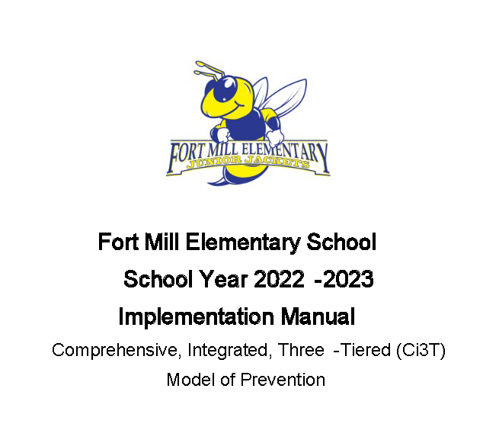
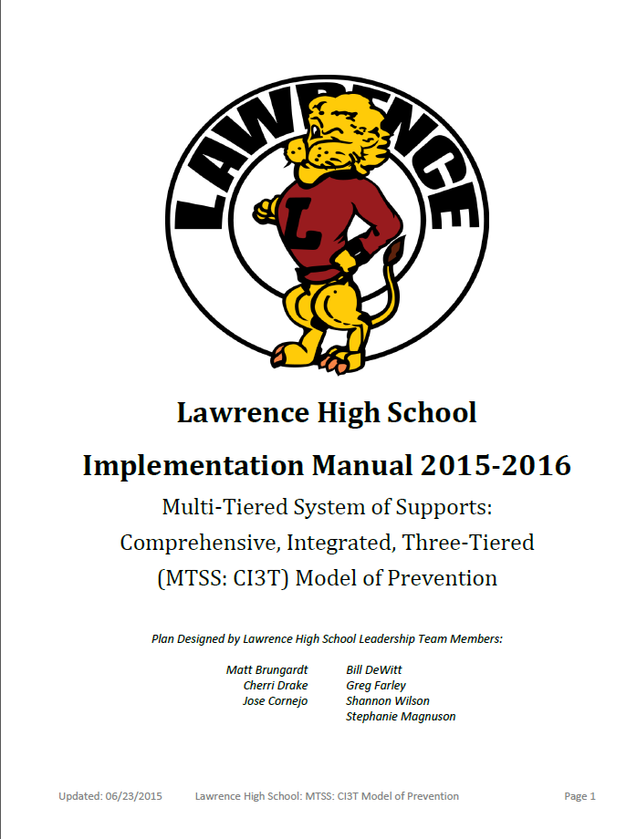
Ci3T Implementation Manuals

Slide 15
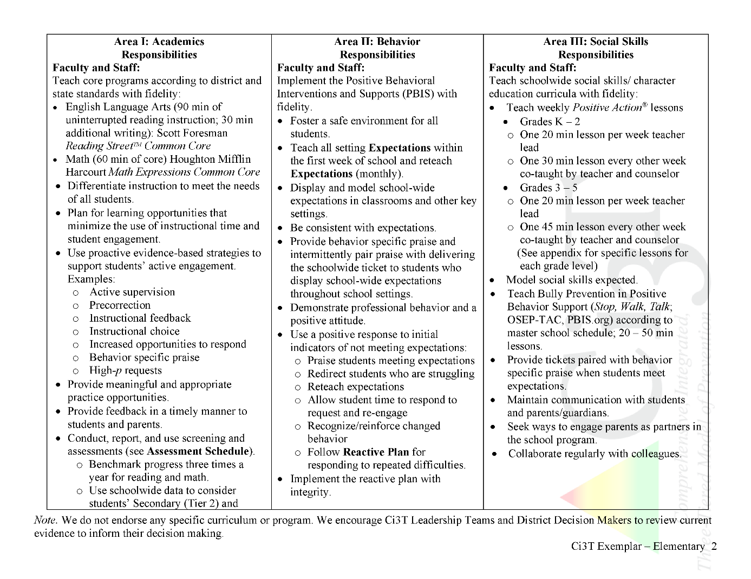
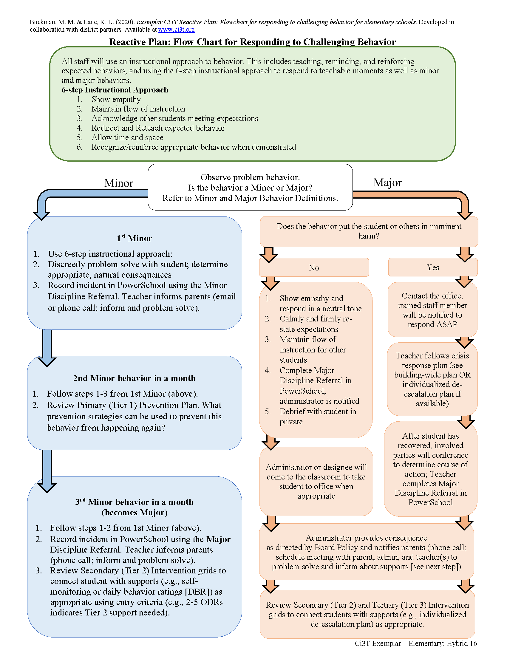
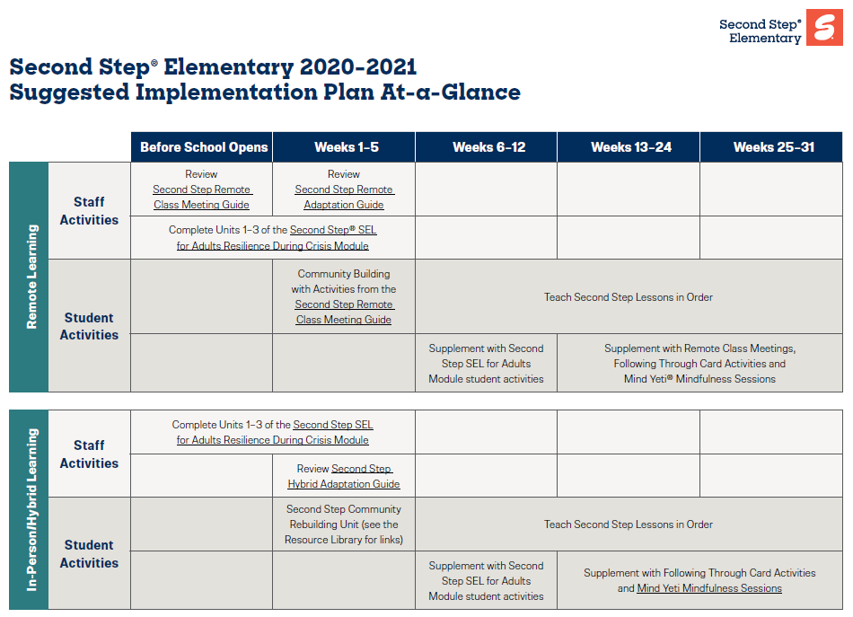
Ci3T Primary Plan: Procedures for Teaching
Opportunities to Respond
Behavior-Specific Praise
Ci3T Primary Plan: Procedures for Reinforcing
Active Supervision
Instructional Feedback
High-p Requests
Ci3T Primary Plan: Procedures for Monitoring
Precorrection
Instructional Choice
Notes:
Continued to keep implementation manuals, which are foundational to Ci3T, updated and current

Slide 16
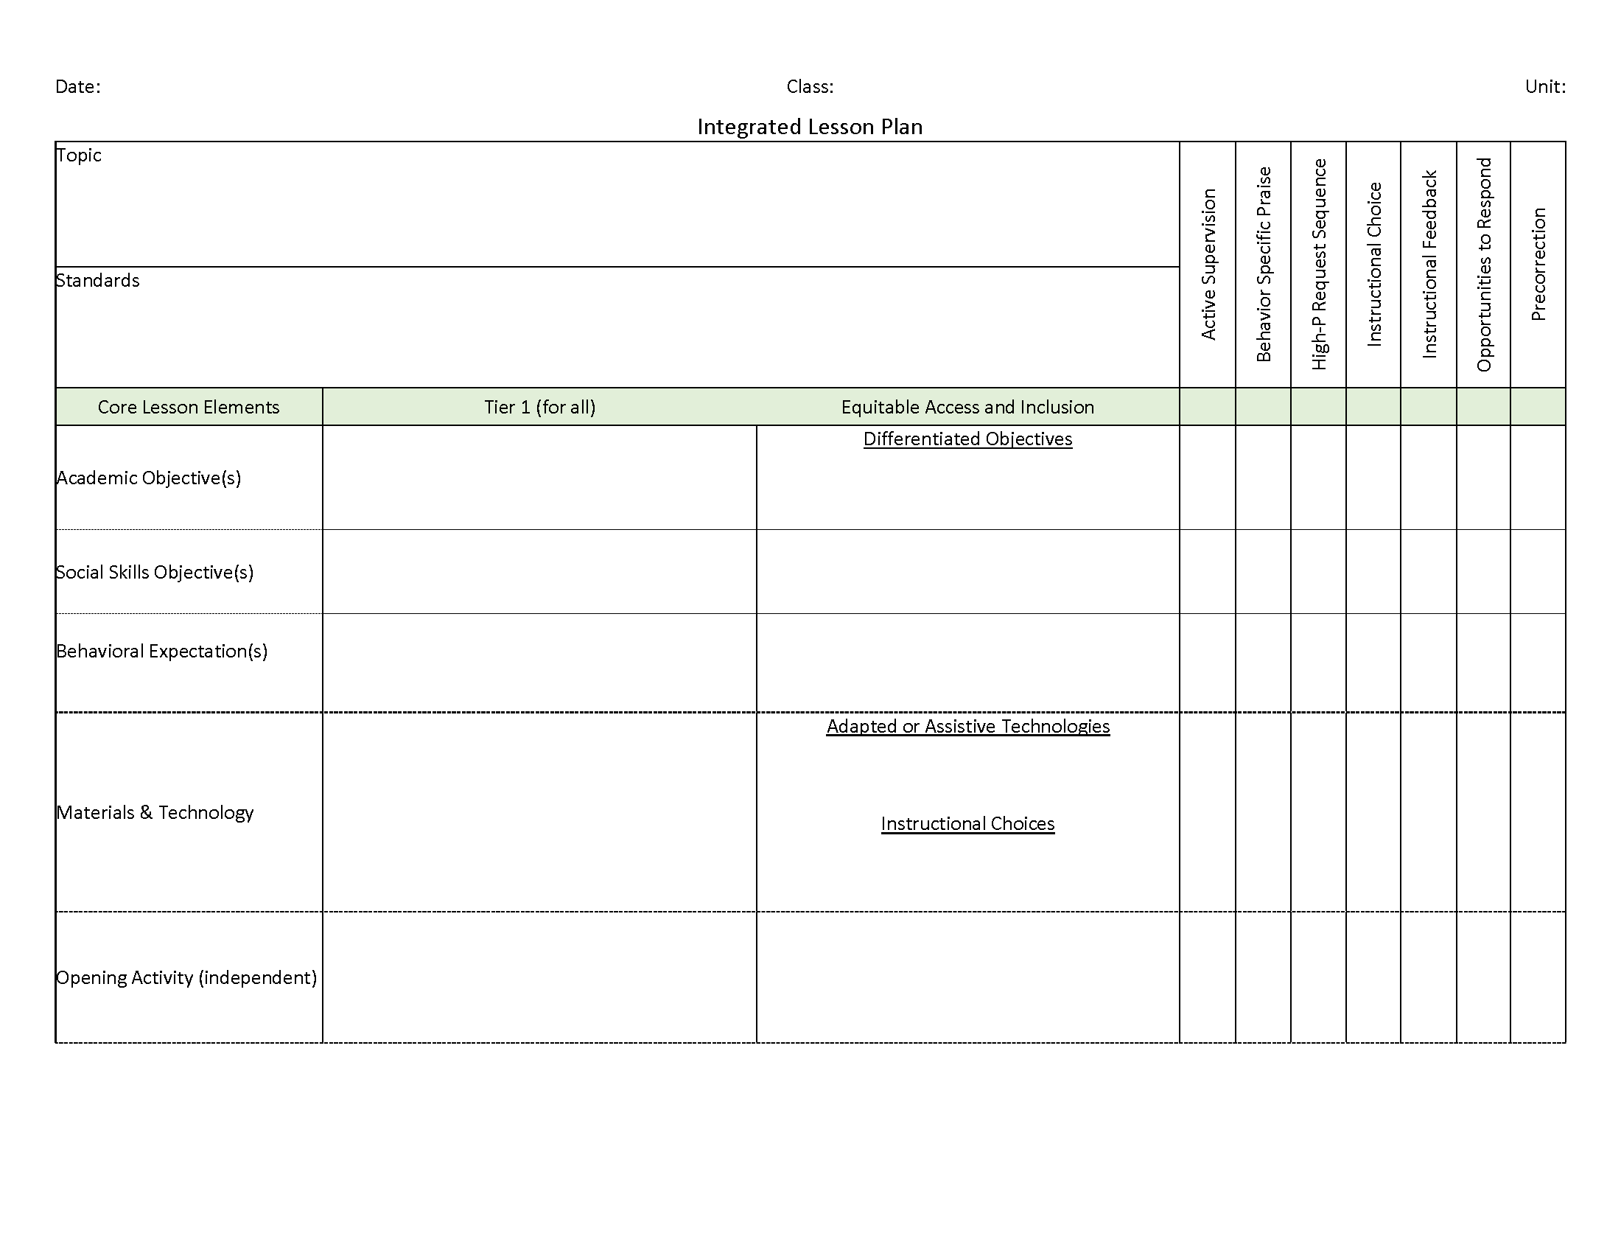
Ci3T: Integrated Lesson Planning

Slide 17
Essential Components of Primary Prevention Efforts
Social Validity
Systematic Screening
Academic
Behavior
Treatment Integrity
Notes:
We support our school partners in administering surveys to their faculty and staff to garner understanding of social validity, conduct observations and self-reports to assess treatment integrity, and support systematic screening of all students for academics and behavior. We believe that schools thrive when faculty and staff are keenly aware of their school-wide data (show the next three slides)
KEEP THIS FOR LATER IN SLIDE: All schools wanted to continue “how” not “should”

Slide 20
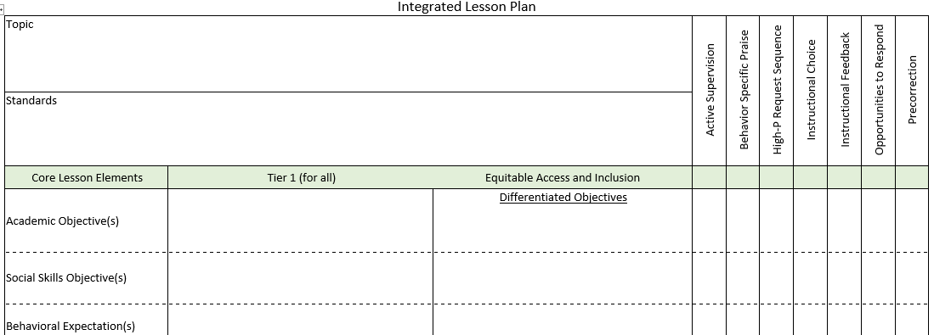
Integrated Lesson Planning

Slide 21
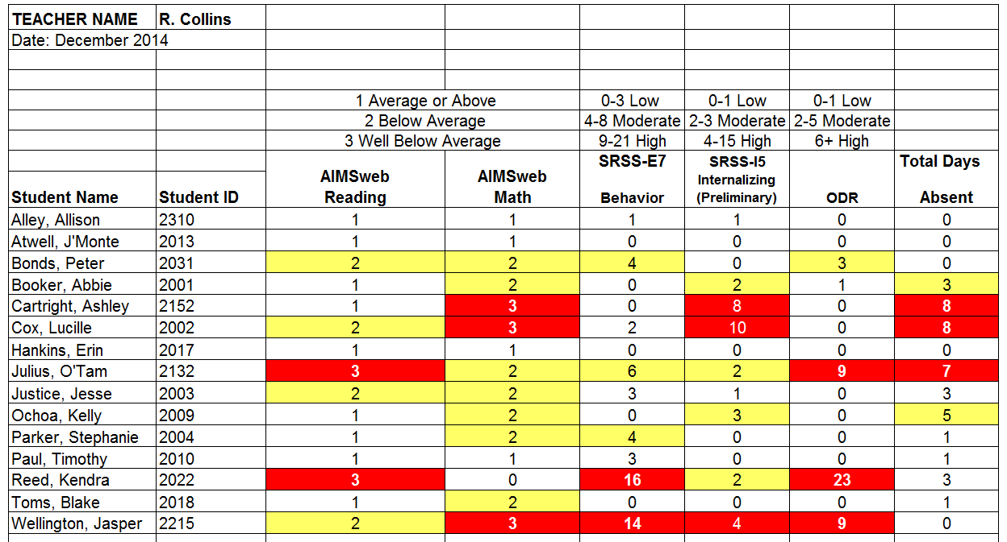
Examining Academic and Behavioral Data
Lane, K. L., Menzies, H. M., Ennis, R. P., & Oakes, W. P. (2015). Supporting Behavior for School Success: A Step-by-Step Guide to Key Strategies. Guilford Press.
Notes:
Lane, K. L., Oakes, W. P., Ennis, R. P., & Hirsch, S. E. (2014). Identifying students for secondary and tertiary prevention efforts: How do we determine which students have Tier 2 and Tier 3 needs? Preventing School Failure, 58, 171-182, DOI: 10.1080/1045988X.2014.895573

Slide 22
Low-Intensity Strategies for Academics and Behavior
Opportunities to Respond
Behavior-Specific Praise
Active Supervision
Instructional Feedback
High p Requests
Precorrection
Instructional Choice
Lane, K. L., Menzies, H. M., Ennis, R. P., & Oakes, W. P. (2015). Supporting behavior for school success: A step-by-step guide to key strategies. New York, NY: Guildford Press.

Slide 23
Consider Teacher-Delivered Strategies Across Tiers
Opportunites to Respond
Behavior-Specific Praise
Active Supervision
Instructional Feedback
High-Probability Requests
Precorrection
Instructional Choice

Slide 24
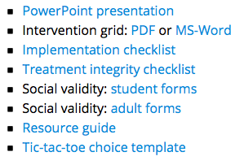
Professional Learning Resources ci3t.org/pl
Notes:
NEXT: log in to the website and present ONE strategy; spend 20 minutes working through the steps and then on slide 46, we would run two 10 min timers (one for them to “pick a card” and learn about a strategy and then a second to discuss with a person)

Slide 25
Low-Intensity Strategy | Franklin High School On-Site Expert
Behavior-Specific Praise: Identifying the specific expectation the student met. “Niama, I noticed you outlined your paper and used the graphic organizer to draft your essay. Well done!” “Justice, thank you for pushing in your chair to keep the walkway safe.” | Eric Common, Behavior Specialist Mark Buckman, Special Education Grant Allen, Parent Volunteer Paloma Pérez-Clark, School Psychologist
Opportunities to Respond: Providing 4-6 opportunities per minute for students to respond individually, choral, verbal, written, gesture, or symbol. “Show me thumbs or thumbs down if...” “Show me on your white board what…” “Turn to your elbow partner and say…” “All together now, what is…” | David Royer, Administration Emily Cantwell, 12th Grade Scarlett Lane, 11rd Grade Mallory Messenger, Counselor
Instructional Choice: Providing within-task or between task choices to increase academic engaged time and motivation. “Ronaldo, our of our 3 learning objectives today, which would you like to work on first?” “Suzy, do you want to work on the laptop, or handwrite your answers for this assignment?” | Abbie Jenkins, 10th Grade Scarlett Lane, 11th Grade José Sousa, PE Liane Johl, 9th Grade

Slide 26
Building a Ci3T Tier Library
Teacher Delivered Strategies
Tier 1
Tier 2
Tier 3

Slide 27
Essential Components of Primary Prevention Efforts
Social Validity
Systematic Screening
Academic
Behavior
Treatment Integrity

Slide 31
Example- Using Treatment Integrity and Social Validity Data to Revise your Ci3T Plan

Slide 32
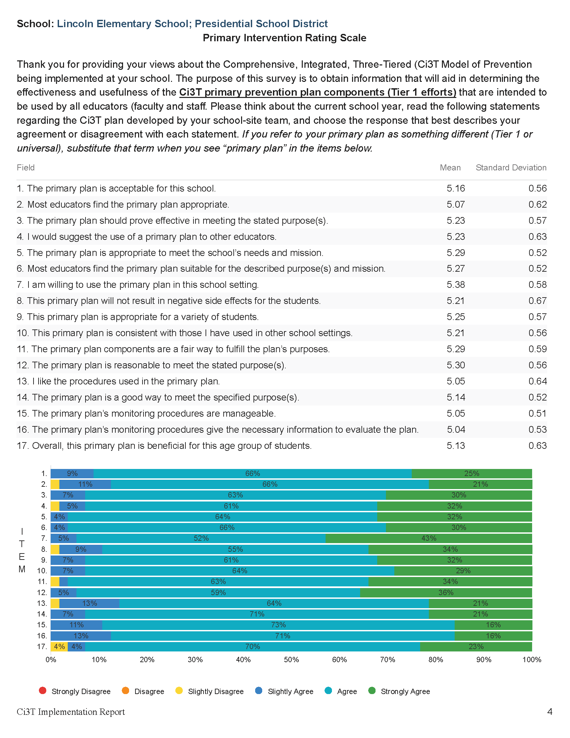
What changes could we make to our monitoring procedures to make them more manageable?
Schedule next year’s windows to avoid overlap with other deadlines
Extend the data collection windows for next year (e.g. 7 days -> 10 days)
Build time into existing PD for staff to complete their survyes

Slide 33
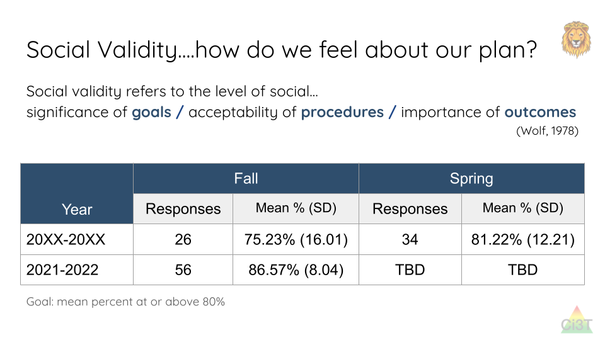
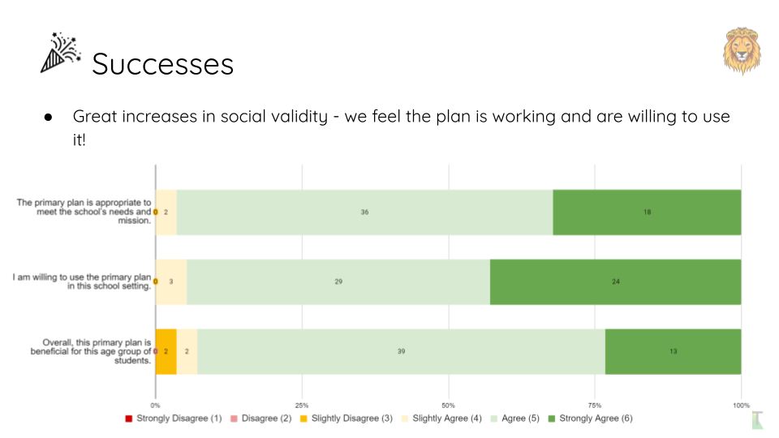
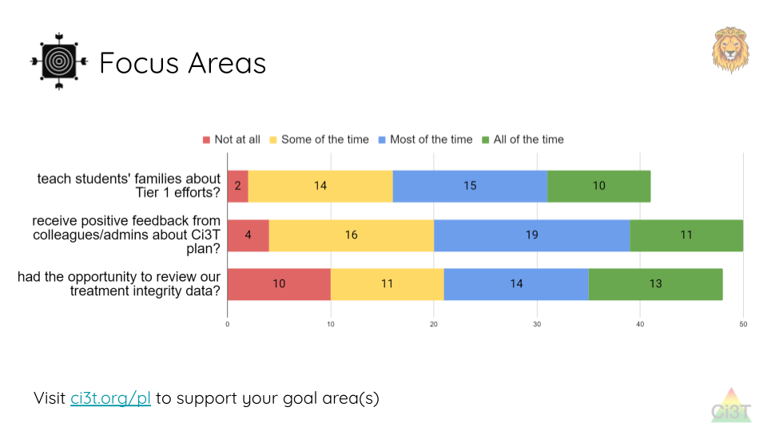
How can we more effectively share our monitoring data to help staff see the connection between the data and the changes we’re making?

Slide 34
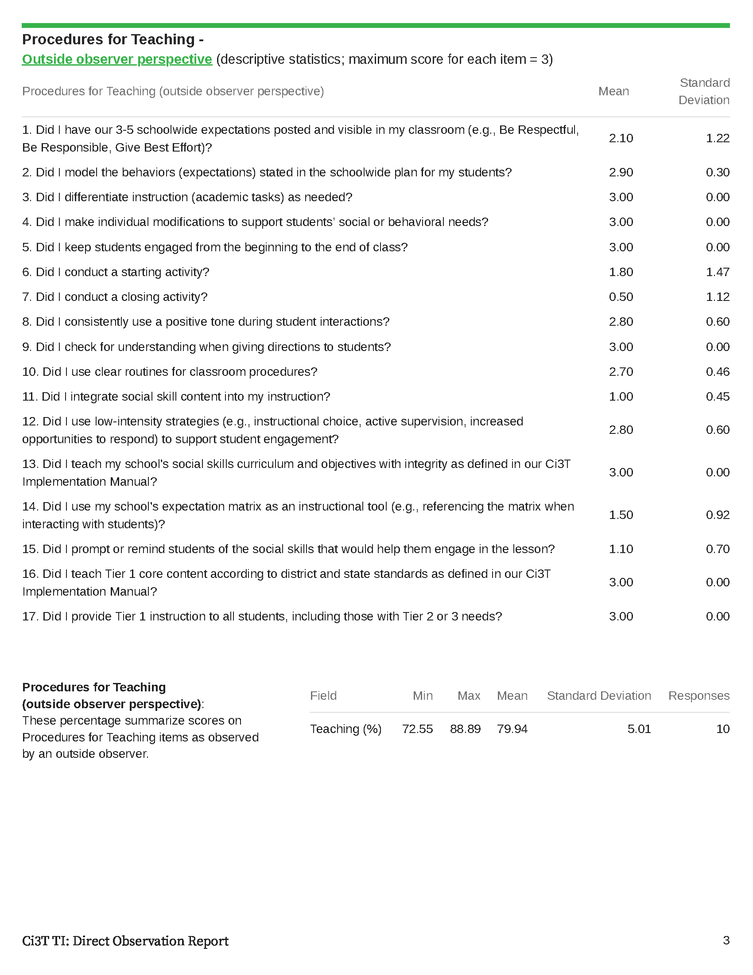

Slide 35
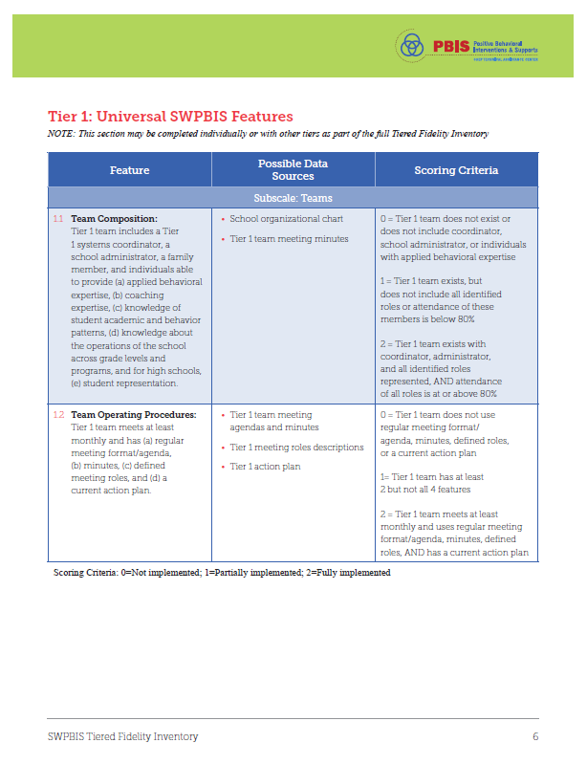
Tiered Fidelity Inventory (TFI)

Slide 36
Identifying Successes and Areas for Refinement
Looking back at the 2021-2023, please post in the chat:
a success
an area for refinement

Slide 37
Closing out the School Year: Positive, Productive Learning Environments

Slide 39
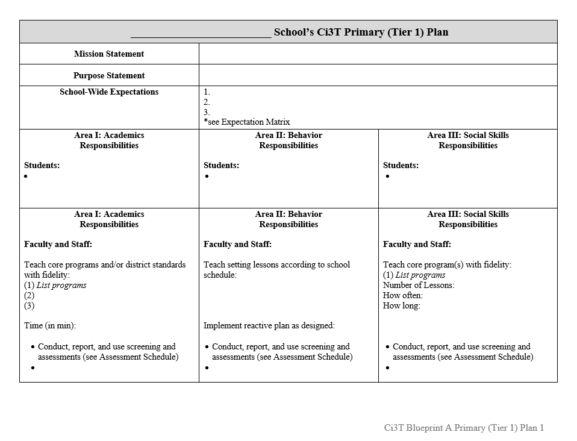
Ci3T Implementation Manual Primary (Tier 1) Plan
What are ALL students accessing?

Slide 40
Ci3T Primary Plan: Procedures for Teaching
Ci3T Primary Plan: Procedures for Reinforcing
Ci3T Primary Plan: Procedures for Monitoring
Notes:
Continued to keep implementation manuals, which are foundational to Ci3T, updated and current

Slide 41
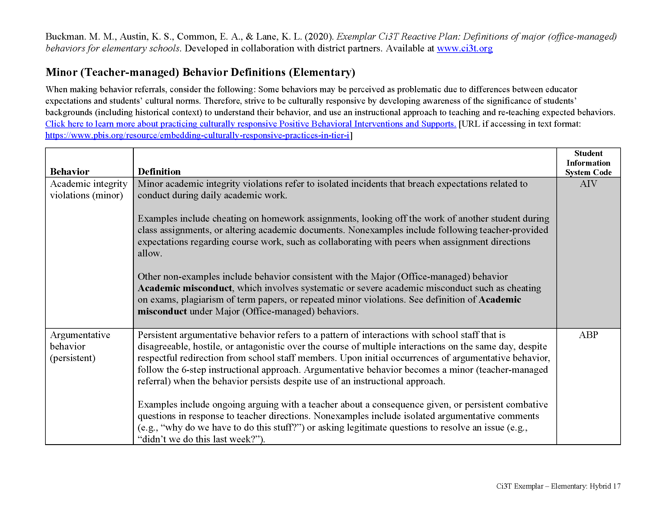
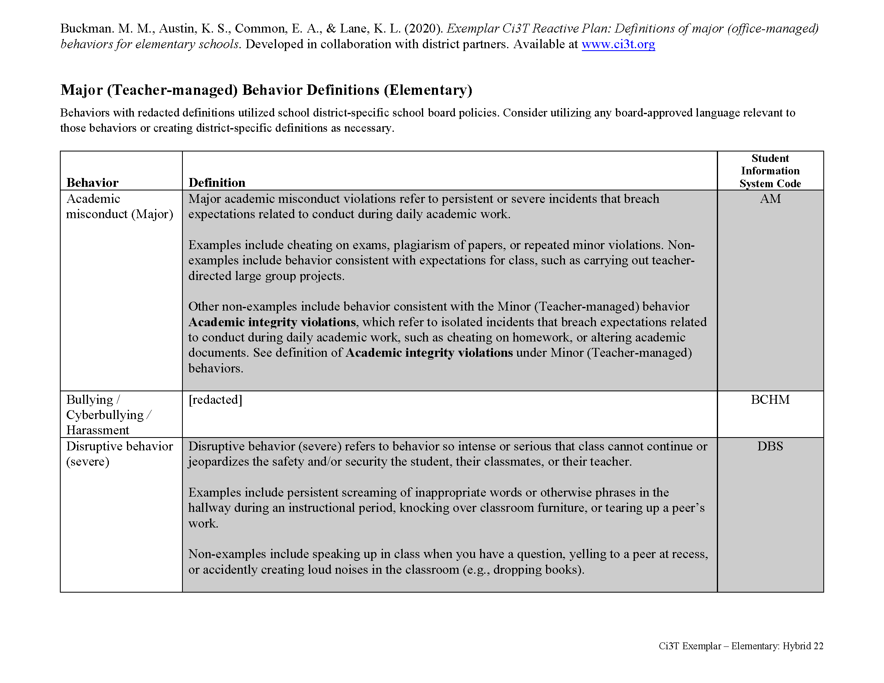
Behavioral
Area II: Academics Responsibilities Faculty and Staff: Teach core programs according to district and state standards with integrity: Use teacher-delivered, low-intensity strategies to support students’ active engagement | Area II: Behavior Responsibilities Faculty and Staff: Implement Positive Behavioral Interventions and Supports (PBIS) with integrity. Teach all setting Expectations within the first week of school and reteach Expectations (monthly). Display and model school-wide expectations in classrooms and other key settings. Implement the reactive plan with integrity. | Area II: Social Responsibilities Faculty and Staff: Teach schoolwide social skills/ character education curricula with integrity: Teach daily Second Step ® lessons (link to grade level instructional schedules) Seek ways to engage parents as partners in the school program

Slide 44
Integrated Lesson Planning

Slide 45
Consider Teacher-Delivered Strategies Across Tiers
Opportunites to Respond
Behavior-Specific Praise
Active Supervision
Instructional Feedback
High-Probability Requests
Precorrection
Instructional Choice

Slide 46
Professional Learning Resources ci3t.org/pl
Notes:
NEXT: log in to the website and present ONE strategy; spend 20 minutes working through the steps and then on slide 46, we would run two 10 min timers (one for them to “pick a card” and learn about a strategy and then a second to discuss with a person)

Slide 47
Closing out the School Year Commitments
How can you leverage Ci3T implementation to maintain positive, productive learning environments as you close out the school year ?

Slide 48
Successes & Challenges
Tier 1
Consider your school’s Procedures for Teaching, Reinforcing, and Monitoring.
What do you feel confident in using?
Where can you grow as you head into next year (e.g., Integrated Lesson Planning, Low Intensity, Teacher-Delivered Supports).
Tier 2 and Tier 3…
Consider your use of data-informed decision-making.
What data do you currently have to make decisions about Tier 2 and Tier 3?
What data have you found that are not available or would be helpful?
How have you used your Secondary (Tier 2) and Tertiary (Tier 3) Intervention Grids to connect students to supports?
What support do you need in terms of professional learning to be more successful in supporting implementation of Tier 2 and Tier 3 interventions?

Slide 49
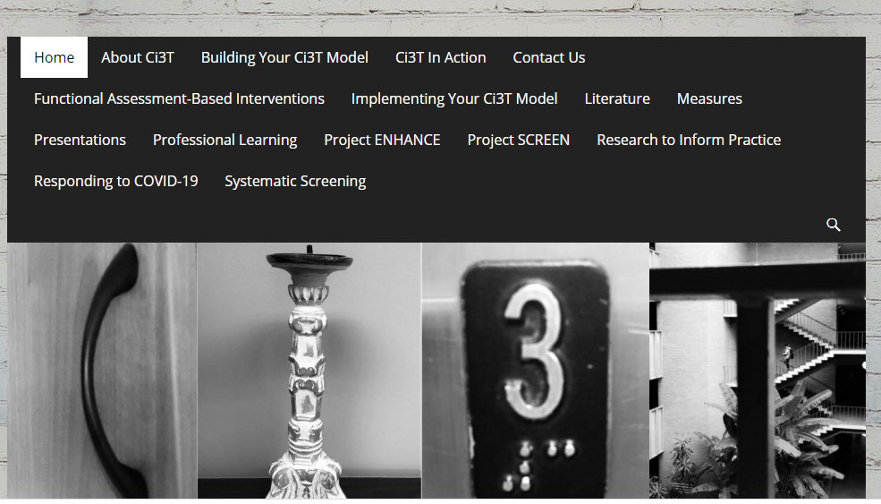
Planning for the 2023-2024 Academic Year

Slide 50
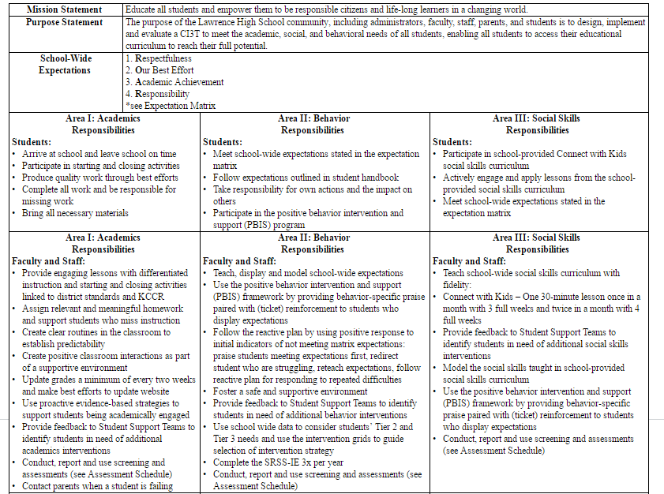
Review the updated Ci3T Implementation Manual for the following academic year
Teach, display, and model school-wide expectations
Teach school-wide social skills…, model social skills
Notes:
As you look at your Primary Plan where to you see this expectations for teachers. If you so not see it explicitly stated consider adding this to your summer revision list.

Slide 51
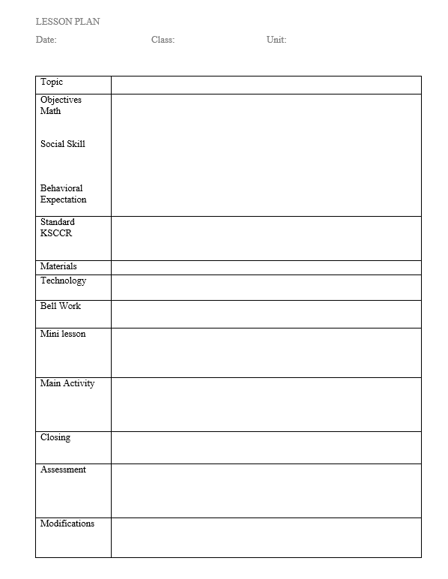
Look at the sample lesson
Review the learning objectives.
Discuss with your partner ideas to meet these objectives within the lesson.
Where are the opportunities for learning and practice?
What low-intensity strategies can be used in this lesson and where?
BSP
OTR
Active Supervision
Choice
Precorrection
Notes:
This is a Danielson framework-like lesson format. The blue box shows the slight modification to begin. Lets practice with this one.
With your partner…. Discuss one idea for an activity for this lesson (sample). Remember that the use of low-intensity strategies are great ways to support teachers in integrating social and behavioral skill support and practice.
Teams discuss – 3 min – share a few ideas. Then follow up with BSP and precorrection as examples if not shared.

Slide 52
Secondary (Tier 2) Intervention Grid
Support | Description | School-wide Data: Entry Criteria | Data to Monitor Progress | Exit Criteria
READ 180 (Stage C) Reading Intervention | Students participate in a 50 min reading instructional block during their study hall period. Students meet in the computer lab for participation in the online portion 20 min daily. Instruction is relevant to high school students. Students use a progress management system to monitor and track their own progress. Instruction is taught by special education teachers and general education teachers with training in the READ 180 Curriculum. | (1) Students in grades 9 – 12. (2) Reading performance basic or below basic on state assessment (but above 4th grade reading level). (3) SRSS risk scores in the moderate range (4 – 8). | Student Measures: Meeting individual READ 180 reading goals: (1) Progress Monitoring with Scholastic Reading Inventory (2) Writing Assessments (3) formative assessments (vocabulary, comprehension and spelling) (4) Curriculum-based Assessments (5) Attendance in class Treatment Integrity: Teachers monitor performance and attendance in class. Completion of weekly checklists for activities completed. Social Validity: Students and teachers complete surveys regarding the importance of the goals, program procedures, and outcomes. | Students meet instructional reading goals. SRSS score in the low risk category (0 – 3) on the next screening time point.
Kathleen Lynne Lane, Wendy Peia Oakes, Holly Mariah Menzies, Juli Oyer & Abbie Jenkins (2013) Working Within the Context of Three-Tiered Models of Prevention: Using Schoolwide Data to Identify High School Students for Targeted Supports, Journal of Applied School Psychology, 29:2, 203-229, DOI: 10.1080/15377903.2013.778773

Slide 53
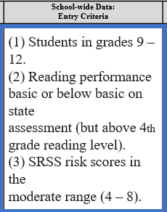
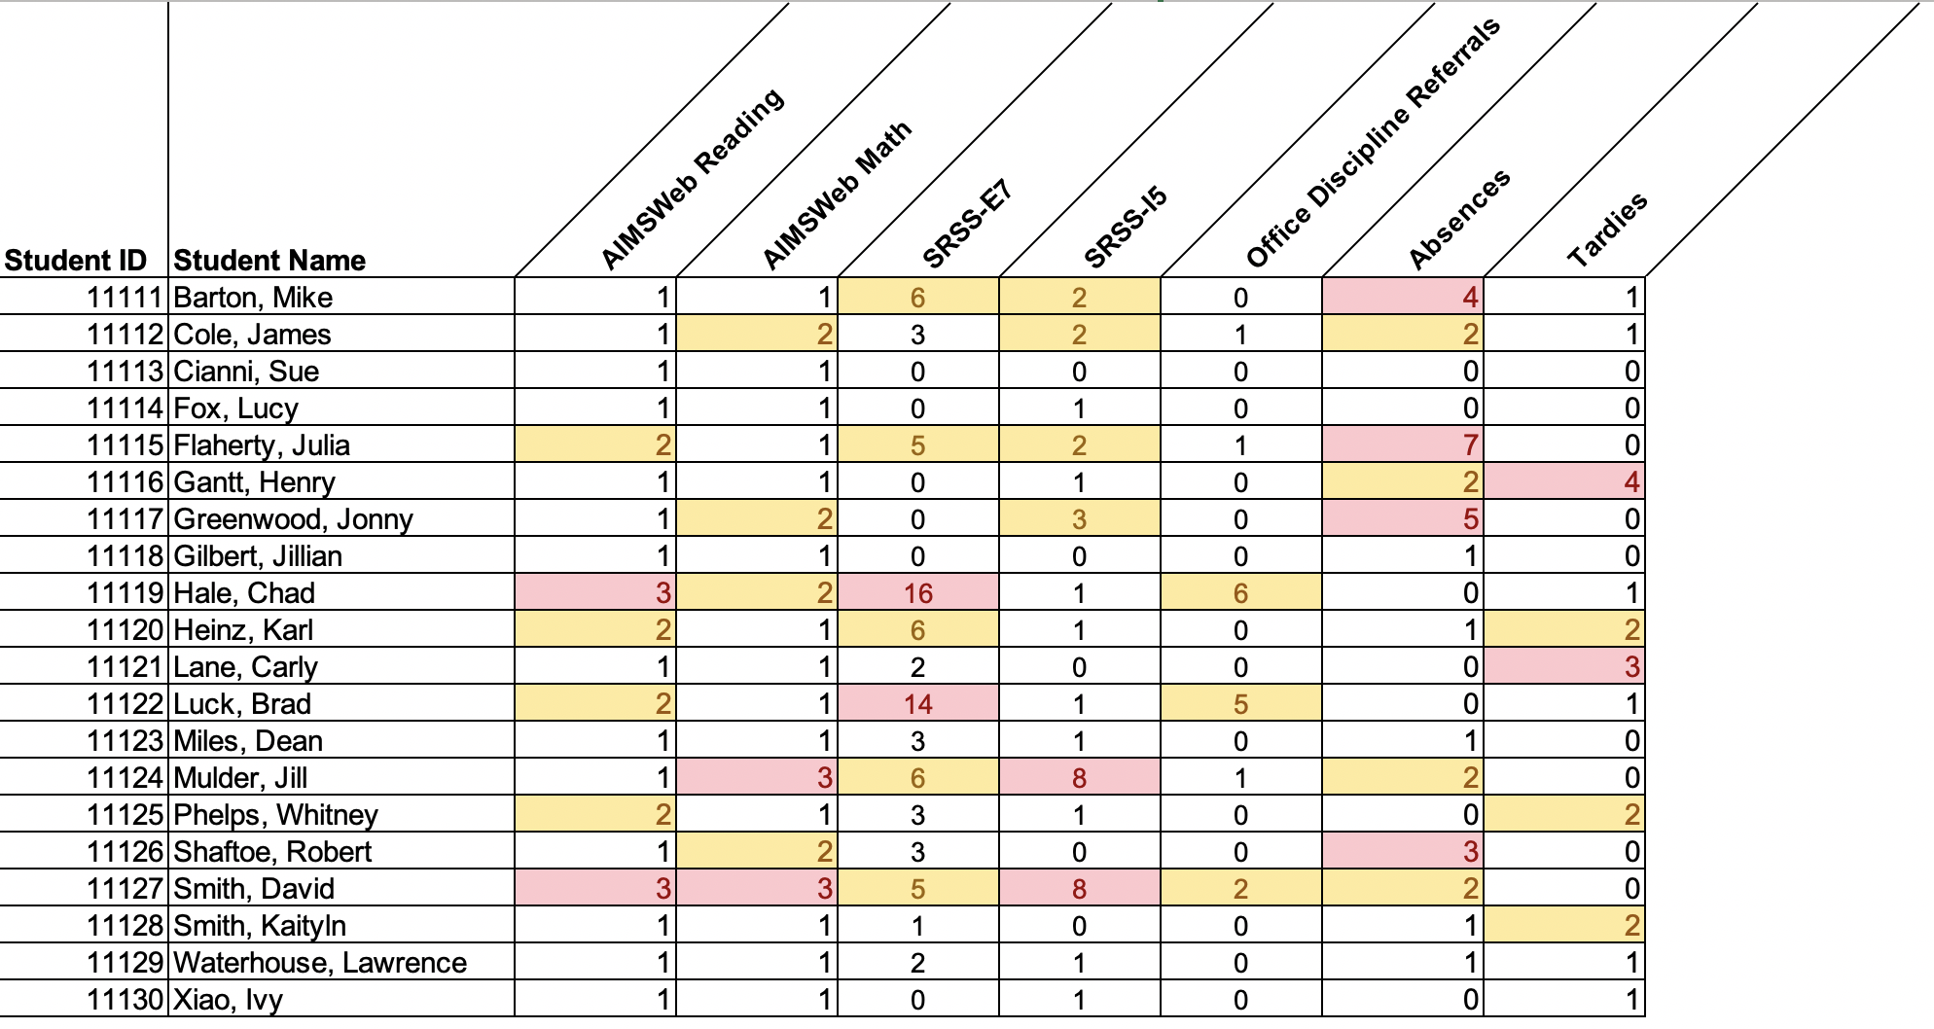
Data in action

Slide 54
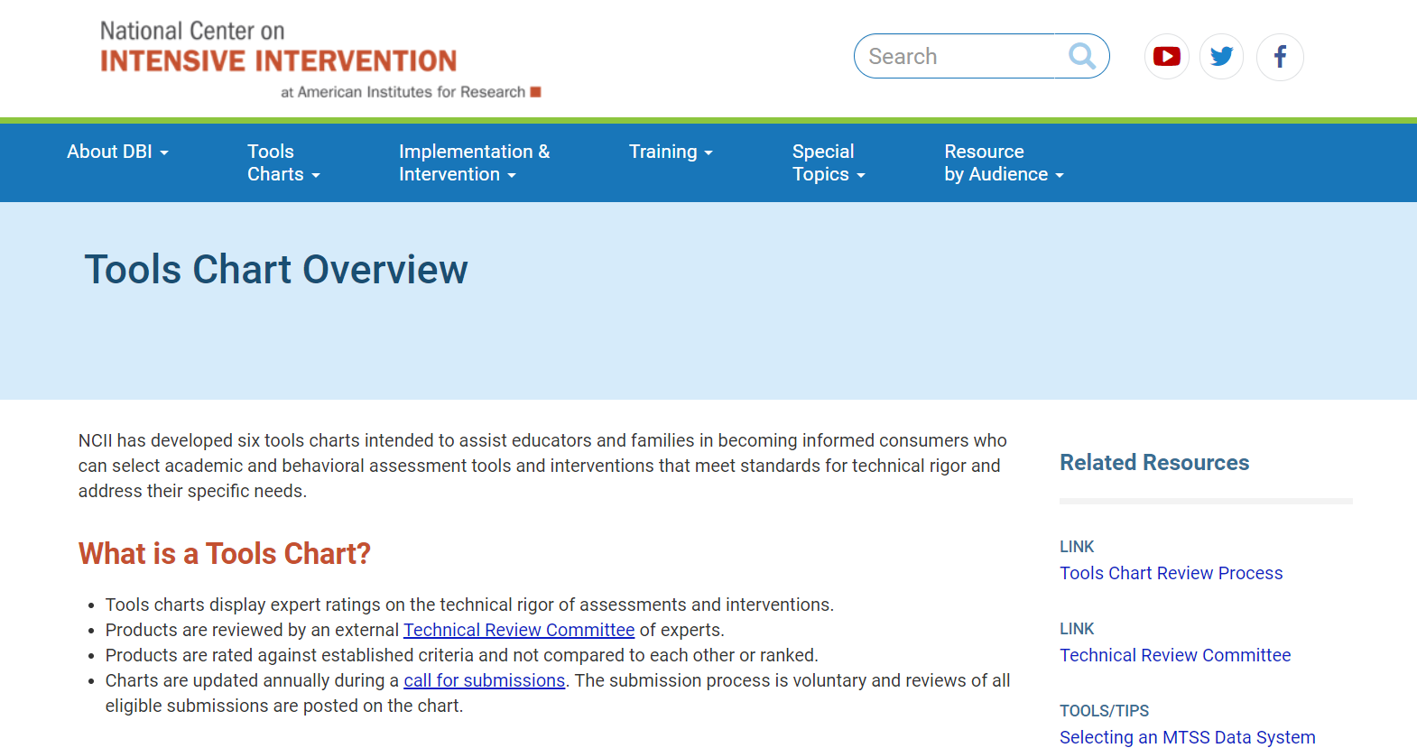
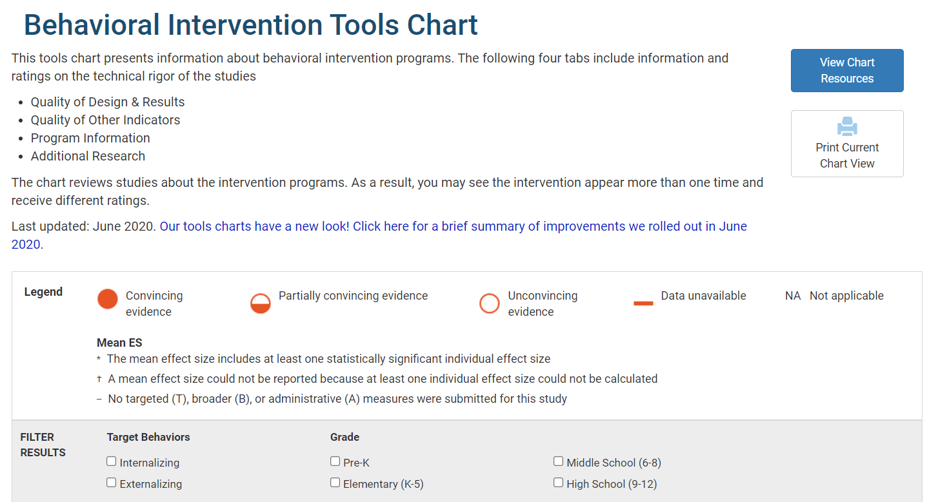
Tier 2 and Tier 3 Considerations
Academic and behavioral interventions
Information on group size
Duration of intervention
Study Results
Evidence base
Academic and behavioral progress monitoring
Psychometric standards
Progress monitoring standards
Data-based individualization standards
mtss4success.org
intensiveintervention.org

Slide 55
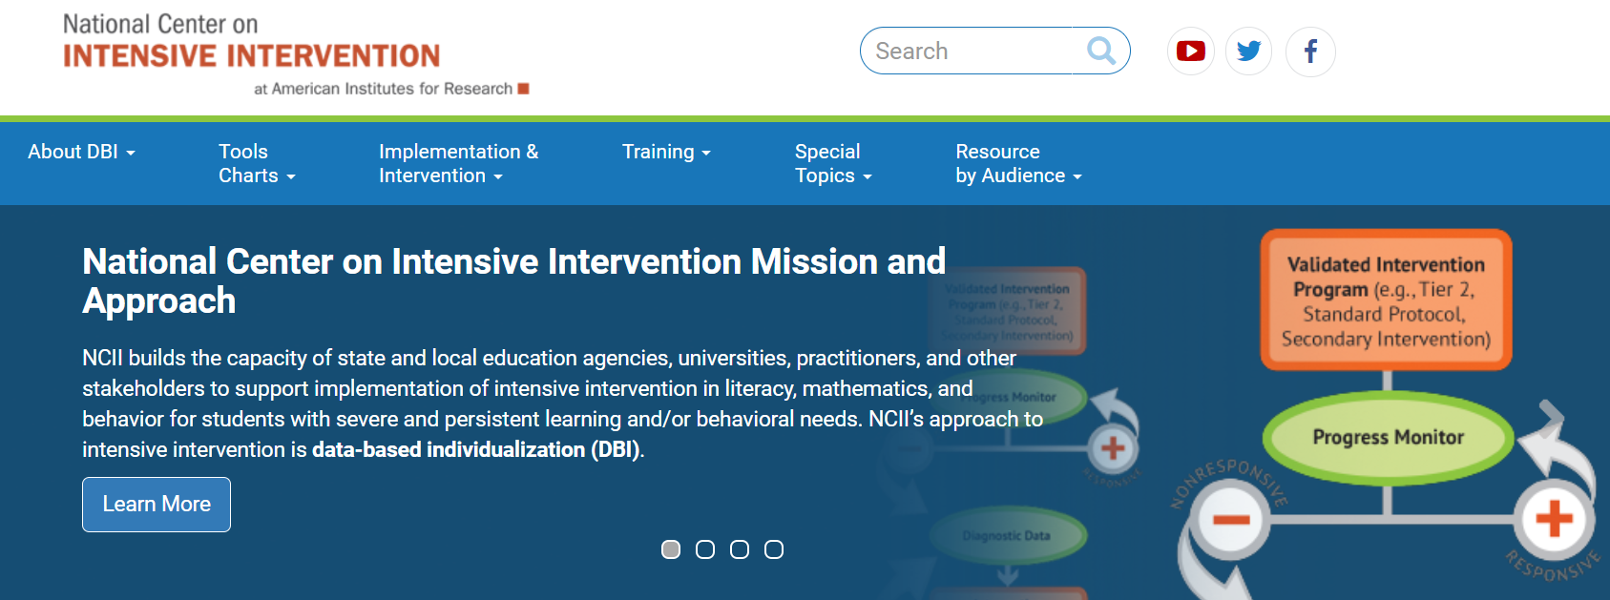
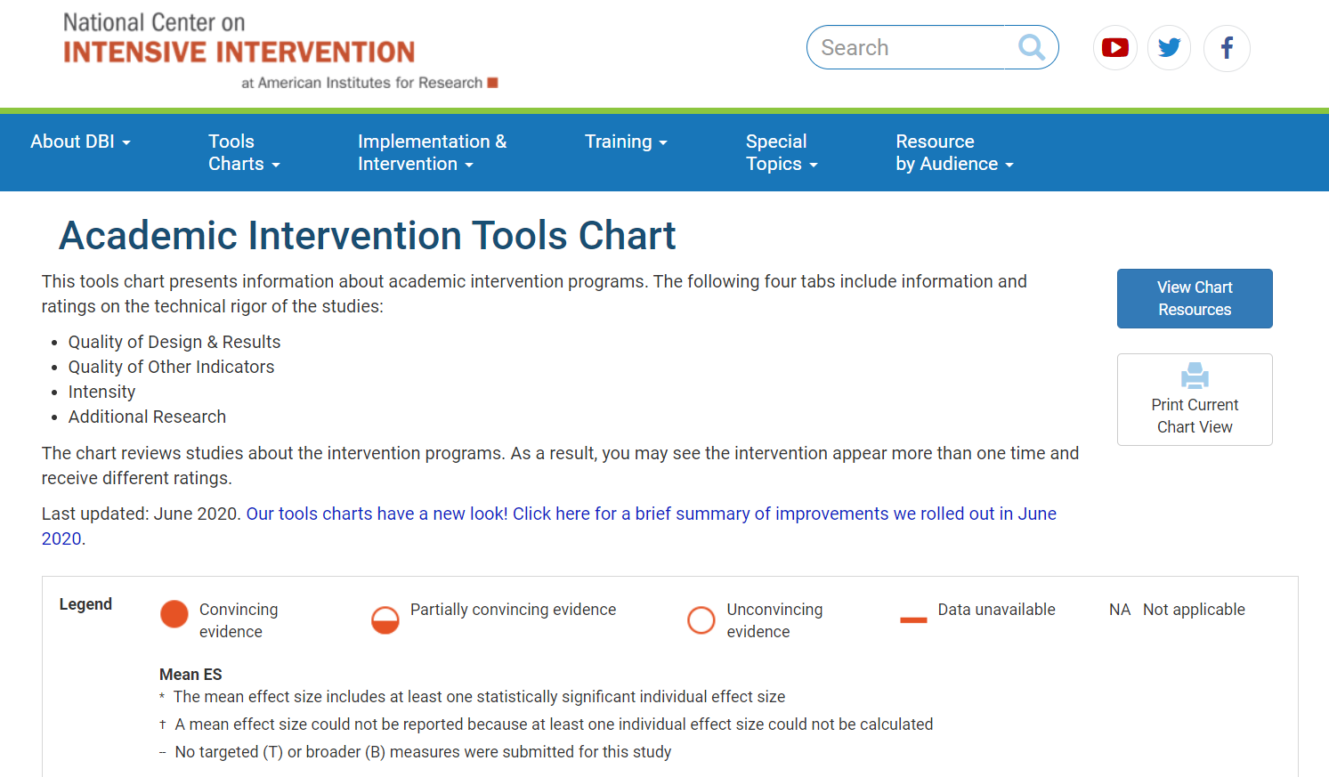
Tier 2 and Tier 3 Considerations
National Center on Intensive Intervention http://www.intensiveintervention.org

Slide 56
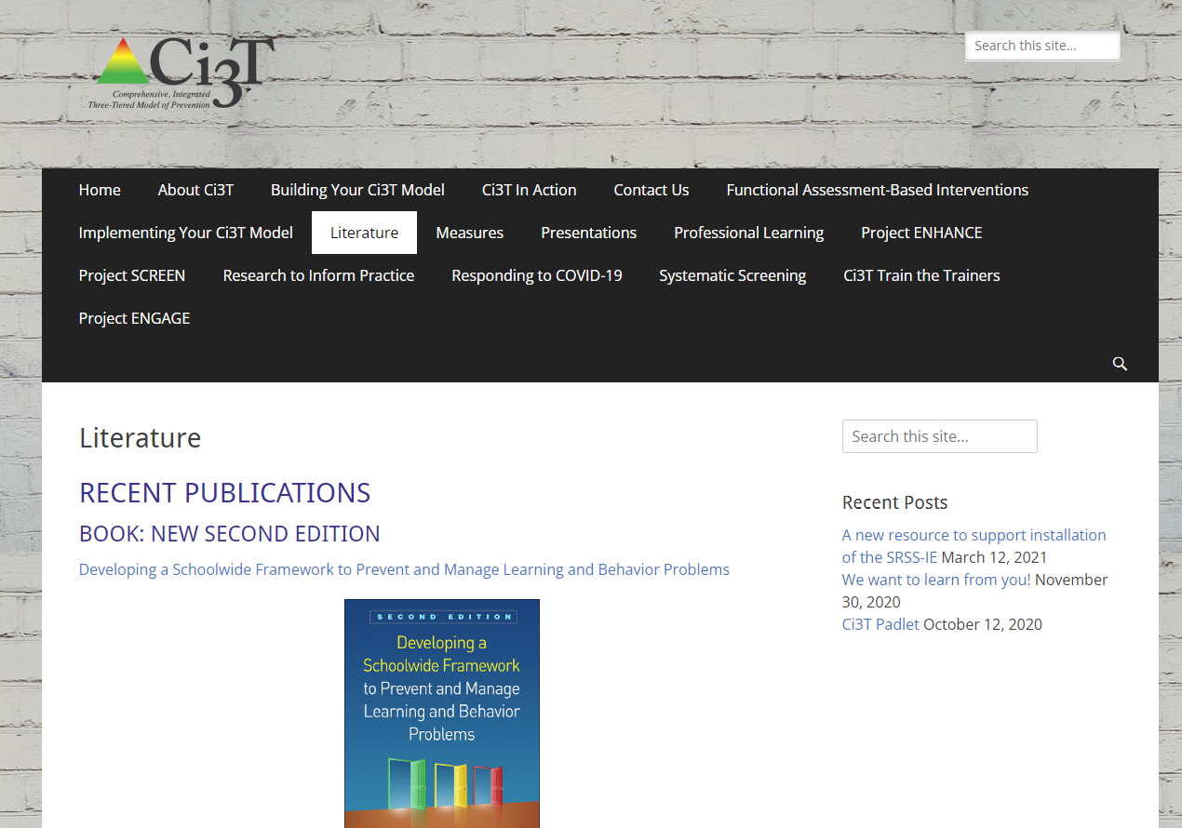
Books to Support Your Work

Slide 57
Planning for 2023 2024
How can you use feedback from Treatment Integrity and Social Validity data to revise your school-wide plan?
Which professional learning opportunities could be helpful in preparing for Ci3T implementation next year?

Slide 58
Establishing Professional Learning Goals

Slide 59
School Ci3T Implementation Calendar
Sun. | Mon. | Tues. | Wed. | Thurs. | Fri. | Sat.
1 | 2 | 3 | 4 | 5 | 6 Professional learning session: Internalizing | 7
8 | 9 | 10 Ci3T Team Meeting | 11 | 12 Teach Social Skills Lesson | 13 | 14
15 | 16 Faculty meeting with a look at BSP | 17 | 18 | 19 | 20 | 21
22 | 23 | 24 | 25 | 26 Teach Social Skills Lesson | 27 | 28
Notes:
.

Slide 60
Ci3T Professional Learning Calendar
 | July | Aug | Sep | Oct | Nov | Dec | Jan | Feb | Mar | Apr | May | Jun
Ci3T Training |  |  |  |  | Ci3T Professional Learning Series Session 1 | Ci3T Professional Learning Series Session 2 | Ci3T Professional Learning Series Session 3 | Ci3T Professional Learning Series Session 4 |  | Ci3T Professional Learning Series Session 5 | Ci3T Professional Learning Series Session 6
Ci3T Implementation Support | Ci3T Implementation Series Prep Session |  | Ci3T Implementation Series Session 1 |  | Ci3T Implementation Series Session 2 |  | Ci3T Implementation Series Session 3 |  | Ci3T Implementation Series Session 4 | Ci3T Implementation Series Session 5
Ci3T EMPOWER |  |  | Ci3T EMPOWER Session 1 | Ci3T EMPOWER Session 2 | Ci3T EMPOWER Session 3 |  | Ci3T EMPOWER Session 4 |  | Ci3T EMPOWER Session 5 | Ci3T EMPOWER Session 6
Ci3T Trainers & Coaches Calls |  | Trainers & Coaches Call Session 1 | Trainers & Coaches Call Session 2 | Trainers & Coaches Call Session 3 | Trainers & Coaches Call Session 4 | Trainers & Coaches Call Session 5 | Trainers & Coaches Call Session 6 | Trainers & Coaches Call Session 7 | Trainers & Coaches Call Session 8 | Trainers & Coaches Call Session 9 | Trainers & Coaches Call Session 10

Slide 61
Building Capacity & Supporting Sustainability Professional Learning Offerings for 2023-2024
2023-2024 Empower information will be posted online after session 6 this year!

Slide 62
Project EMPOWER – Traditional 2023-2024
Ci3T EMPOWER Sessions Location: Remote via Zoom Attended by: School Ci3T Leadership Teams, Ci3T District Trainers and Coaches, Faculty and Staff, Families (adults only). Community Members |  | Times
1. Setting up for Success with Ci3T | Sep. 19, 2023 (Tu) | 3:00 - 5:00 p.m. (Pacific) 5:00 - 7:00 p.m. (Central) 6:00 - 8:00 p.m. (Eastern)
2. Systematic Screening: What Do I Need to Know? | Oct. 19, 2023 (Th) | 3:00 - 5:00 p.m. (Pacific) 5:00 - 7:00 p.m. (Central) 6:00 - 8:00 p.m. (Eastern)
3. Practical Strategies to Maximize Engagement and Limit Disruption | Nov. 30, 2023 (Th) | 3:00 - 5:00 p.m. (Pacific) 5:00 - 7:00 p.m. (Central) 6:00 - 8:00 p.m. (Eastern)
4. Secondary (Tier 2) interventions in Ci3T Models: Logistics and Illustrations | Jan. 9, 2024 (Tu) | 3:00 - 5:00 p.m. (Pacific) 5:00 - 7:00 p.m. (Central) 6:00 - 8:00 p.m. (Eastern)
5. Tertiary (Tier 3) Interventions in Ci3T Models: Logistics and Illustrations | Mar. 28, 2024 (Th) | 3:00 - 5:00 p.m. (Pacific) 5:00 - 7:00 p.m. (Central) 6:00 - 8:00 p.m. (Eastern)
6. Closing Out and Moving Forward | Apr. 23, 2024 (Tu) | 3:00 - 5:00 p.m. (Pacific) 5:00 - 7:00 p.m. (Central) 6:00 - 8:00 p.m. (Eastern)

Slide 63
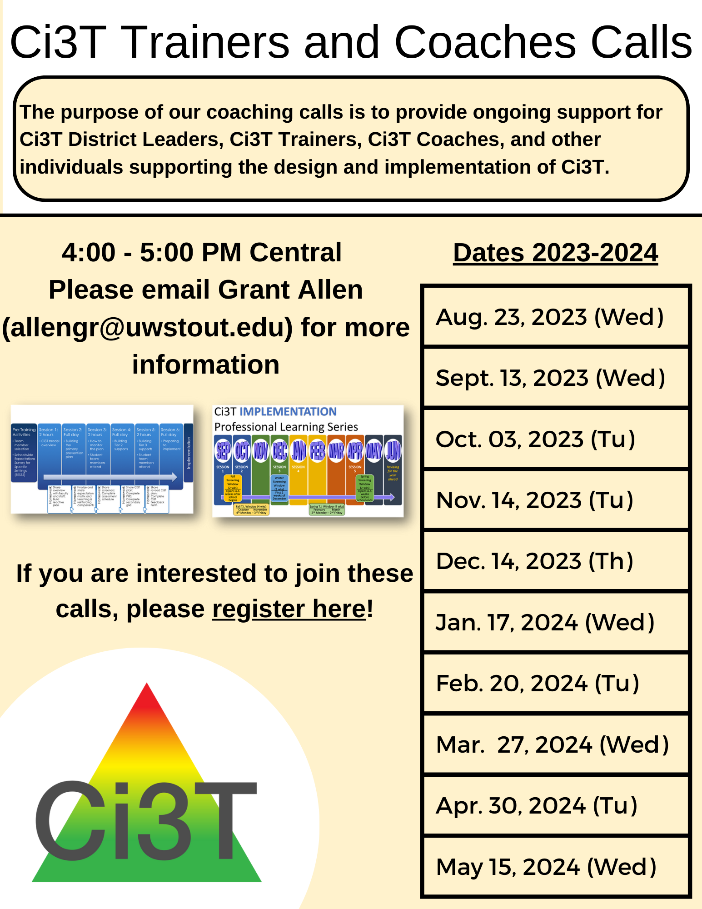
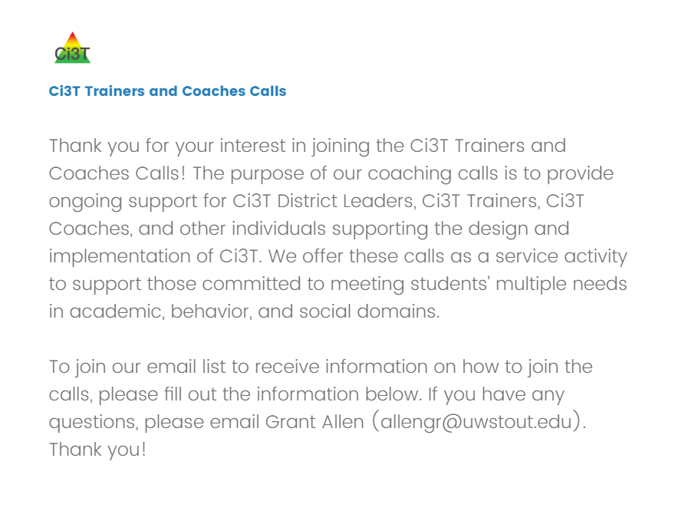
Ci3T Trainers and Coaches Calls
2023-2024 Ci3T Trainers and Coaches Call information will be posted online after the last call this year!

Slide 64
Ci3T Trainers and Coaches Calls
2023-2024
Ci3T Trainers & Coaches Calls Location: Remote via Zoom Attended by: Ci3T Trainers, Coaches, or Leadership Team Members; open to interested parties Zoom link: Available at Registration |  | Times (Central)
Ci3T Trainers and Coaches Call 1 | Aug. 23, 2023 (Wed) | 4:00 – 5:00 p.m.
Ci3T Trainers and Coaches Call 2 | Sept. 13, 2023 (Wed) | 4:00 – 5:00 p.m.
Ci3T Trainers and Coaches Call 3 | Oct. 03, 2023 (Tu) | 4:00 – 5:00 p.m.
Ci3T Trainers and Coaches Call 4 | Nov. 14, 2023 (Tu) | 4:00 – 5:00 p.m.
Ci3T Trainers and Coaches Call 5 | Dec. 14, 2023 (Th) | 4:00 – 5:00 p.m.
Ci3T Trainers and Coaches Call 6 | Jan. 17, 2024 (Wed) | 4:00 – 5:00 p.m.
Ci3T Trainers and Coaches Call 7 | Feb. 20, 2024 (Tu) | 4:00 – 5:00 p.m.
Ci3T Trainers and Coaches Call 8 | Mar. 27, 2024 (Wed) | 4:00 – 5:00 p.m.
Ci3T Trainers and Coaches Call 9 | Apr. 30, 2024 (Tu) | 4:00 – 5:00 p.m.
Ci3T Trainers and Coaches Call 10 | May 15, 2024 (Wed) | 4:00 – 5:00 p.m.

Slide 65
Establishing Professional Learning Goals
What resources and professional learning are available to me? Consider: District-wide Professional Learning Offerings Empower Sessions Ci3T Trainers and Coaches Calls | In thinking about your successes and challenges from this school year, consider setting goals: Tier 1: Procedures for Teaching, Reinforcing, and Monitoring Tier 2 and Tier 3: Review your school’s intervention grids

Slide 66
Wrapping Up and Moving Forward

Slide 67
Ci3T
Comprehensive Professional Learning Plan
Ci3T: Primary Prevention
Session 1:
Overview of Ci3T Prevention Models
Setting a Purpose
Establish team meetings and roles
Session 2:
Mission and Purpose
Establish Roles and Responsibilities
Procedures for Teaching
Procedures for Reinforcing
Reactive Plan
Session 3:
Procedures for Monitoring
Session 4:
Revise Primary Plan using Stakeholder feedback
Prepare presentation
Ci3T: Secondary Prevention
Session 5:
Overview of Teacher focused Strategies
Overview of Student Focused Strategies
Using data to determine which students may need Secondary (Tier 2) supports
Draft the Secondary Intervention Grid based on existing supports
Ci3T: Tertiary Prevention
Session 6:
Final revisions of Ci3T Plan based on stakeholder feedback
Draft Tertiary (Tier 3) Prevention Intervention Grids
Design Implementation Manual and Plan for roll out to faculty, students, and parents
Ci3T Leadership Team Training Sequence
Implementation Stages of Tier 2 and 3 within Ci3T
Additional Professional Development on Specific Topics
Core Content Curriculum
Check In - Check Out
Functional Assessment-based Interventions
Reading, Math, Writing Benchmarking and Progress Monitoring Tools
Interventions, Strategies, & Practices
Additional Tier 3 Supports
Instructional Techniques to Improve Students’ Motivation; Classroom Management Practices;
Low-Intensity Behavior Supports

Slide 68
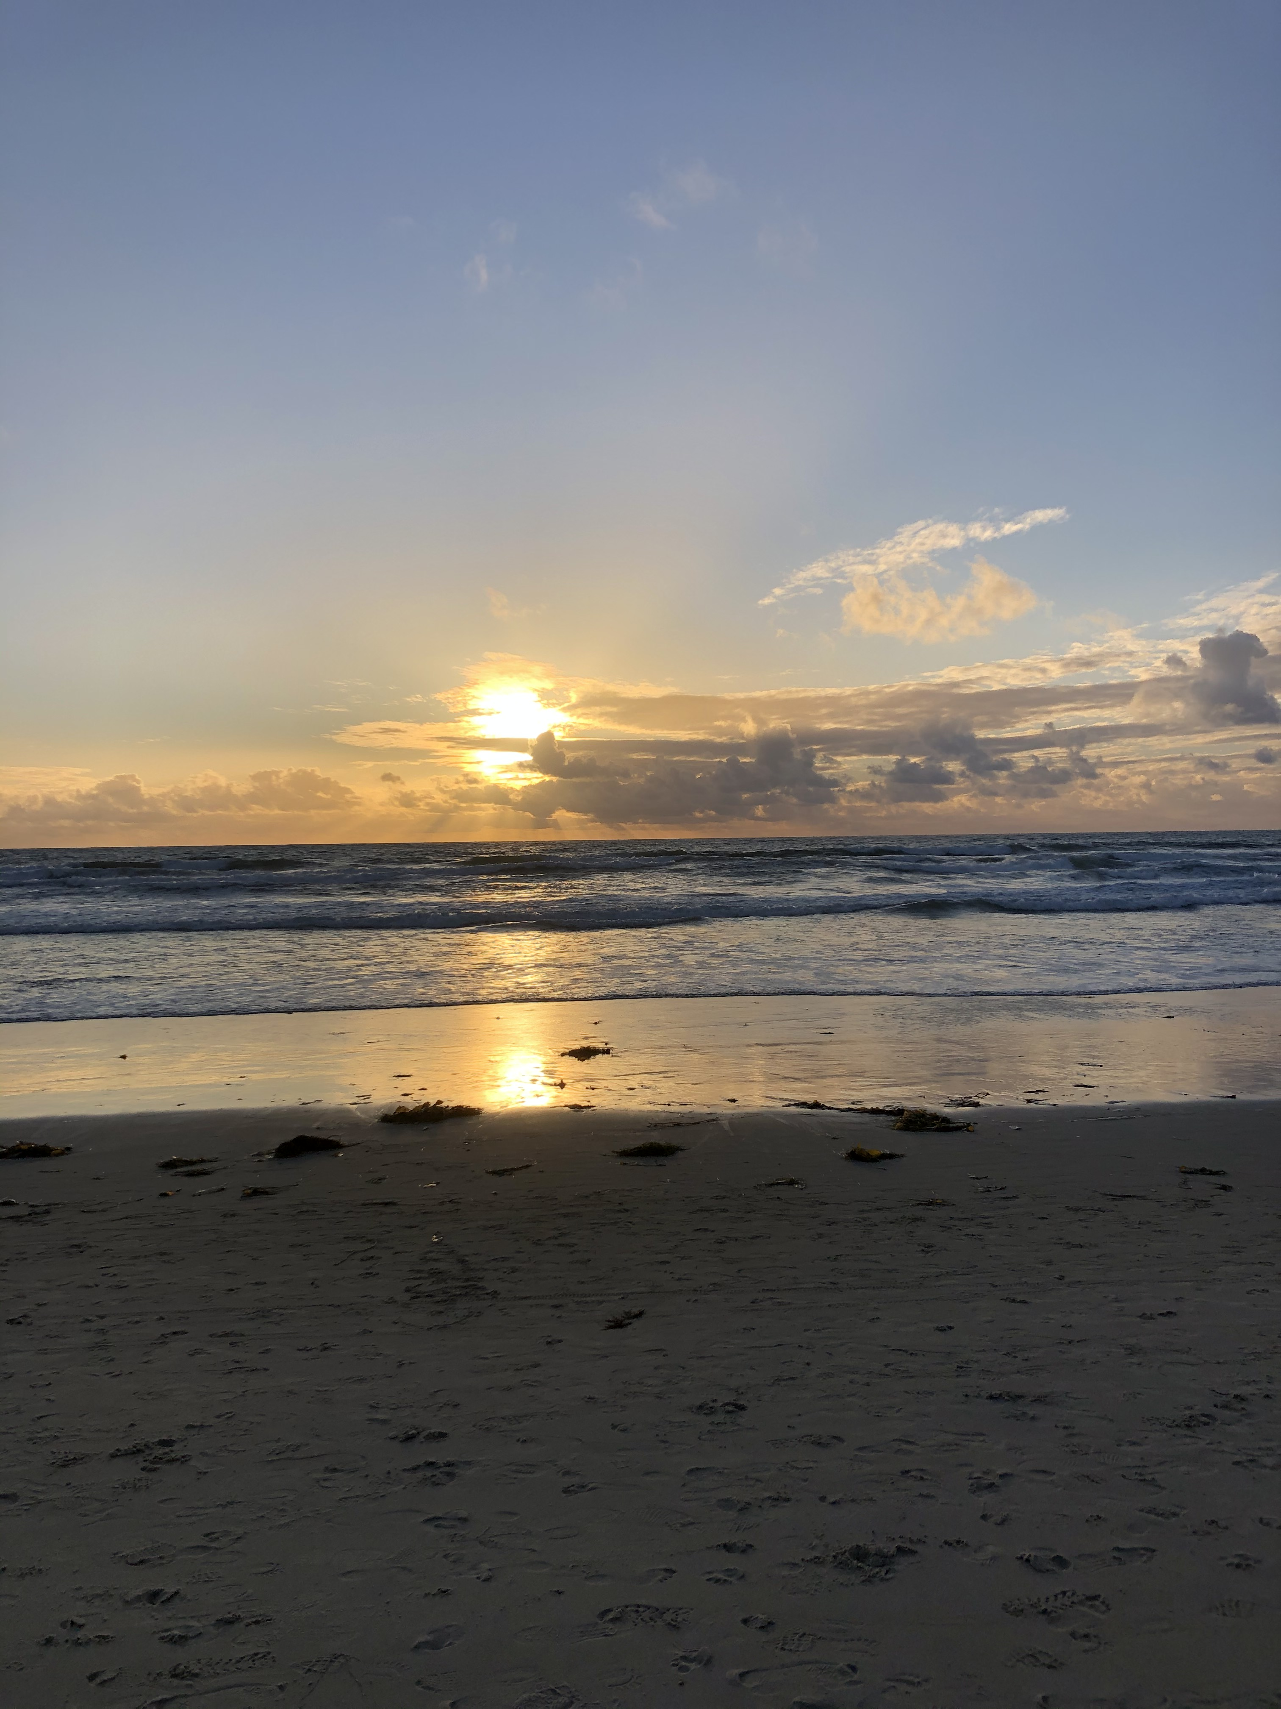
Wrapping Up & Next Steps
Today
Next Year
Overview of Ci3T: Identifying Successes and Areas for Refinement
Closing out the School Year: Positive, Productive Learning Environments
Planning for the 2023-2024 Academic Year
Establishing Professional Learning Goals
Ci3T Implementation Professional Learning Series 2023-2024
Ci3T EMPOWER Sessions 2023-2024
We hope you have a wonderful conclusion to the school year!

Slide 69
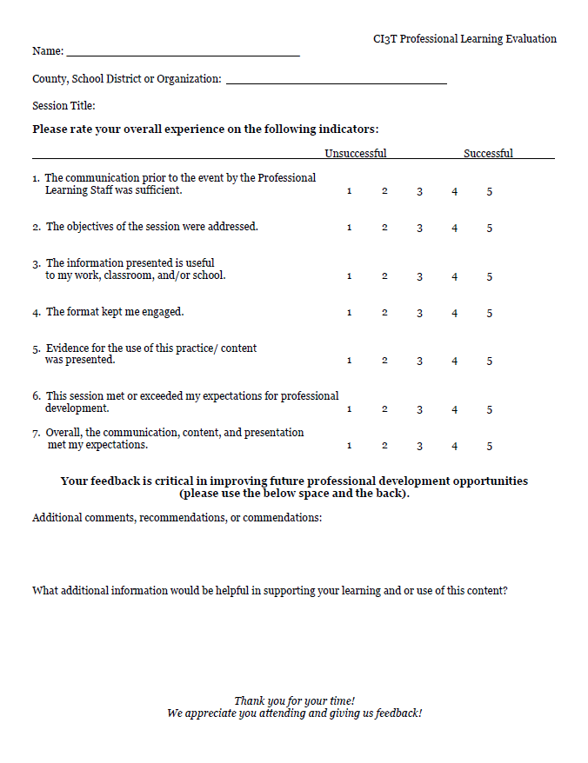
kathleen.lane@ku.edu
Thank you!

