Slide 1
Implementing Comprehensive, Integrated, Three-tiered (Ci3T) Models:
Supporting Student Success Across the Tiers
Ci3T Implementation Series and Delivery – Session 4
Kathleen Lynne Lane, Ph.D., BCBA-D, CF-L2
Mark Buckman, Ph.D.

Slide 3
Ci3T Professional Learning Calendar
 | July | Aug | Sep | Oct | Nov | Dec | Jan | Feb | Mar | Apr | May | Jun
Ci3T Training |  |  |  |  | Ci3T Professional Learning Series Session 1 | Ci3T Professional Learning Series Session 2 | Ci3T Professional Learning Series Session 3 | Ci3T Professional Learning Series Session 4 |  | Ci3T Professional Learning Series Session 5 | Ci3T Professional Learning Series Session 6
Ci3T Implementation Support | Ci3T Implementation Series Prep Session |  | Ci3T Implementation Series Session 1 |  | Ci3T Implementation Series Session 2 |  | Ci3T Implementation Series Session 3 |  | Ci3T Implementation Series Session 4 | Ci3T Implementation Series Session 5
Ci3T EMPOWER |  |  | Ci3T EMPOWER Session 1 | Ci3T EMPOWER Session 2 | Ci3T EMPOWER Session 3 |  | Ci3T EMPOWER Session 4 |  | Ci3T EMPOWER Session 5 | Ci3T EMPOWER Session 6
Ci3T Trainers & Coaches Calls |  | Trainers & Coaches Call Session 1 | Trainers & Coaches Call Session 2 | Trainers & Coaches Call Session 3 | Trainers & Coaches Call Session 4 | Trainers & Coaches Call Session 5 | Trainers & Coaches Call Session 6 | Trainers & Coaches Call Session 7 | Trainers & Coaches Call Session 8 | Trainers & Coaches Call Session 9 | Trainers & Coaches Call Session 10

Slide 4
Agenda
Welcome
Data-Informed Decision-Making
  Sharing Data with Stakeholders
  Using Data to Inform Professional Learning and Instruction
Integrated Lesson Planning at Tier 1
Planning and Implementing Tier 2 Interventions
Planning and Implementing Tier 3 Interventions
Wrapping Up and Moving Forward

Slide 5
Review and Preview
Last Time
Today…
Procedures for Monitoring
  Review your School’s Social Validity & Treatment Integrity Data
  Review your School’s Winter Screening Data
Data-informed Decision-making
  Professional Learning Targets and Resources
  Communication Plans
Data-Informed Decision-Making
  Sharing Data with Stakeholders
  Using Data to Inform Professional Learning and Instruction
Integrated Lesson Planning at Tier 1
Planning and Implementing Tier 2 Interventions
Planning and Implementing Tier 3 Interventions

Slide 6
Welcome
Please pull up your Ci3T Implementation Manual

Slide 7
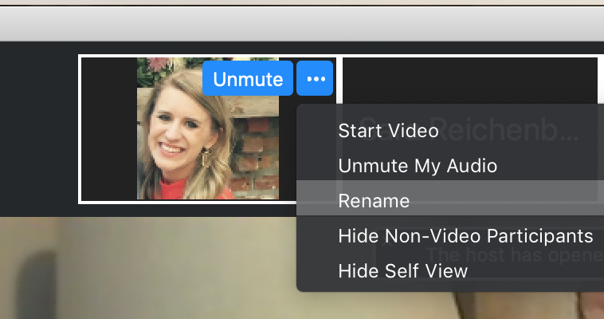
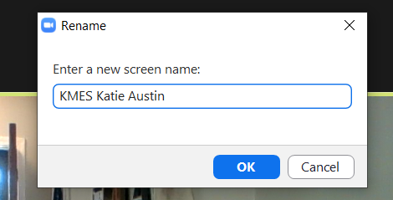
Renaming: School Initials + First and Last Name
To help us put you in breakout rooms with your colleagues today…
1. Click the three dots at the top
right corner of your video square.
2. Rename yourself with your
school initials then first and last name.

Slide 8
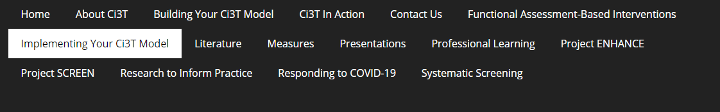
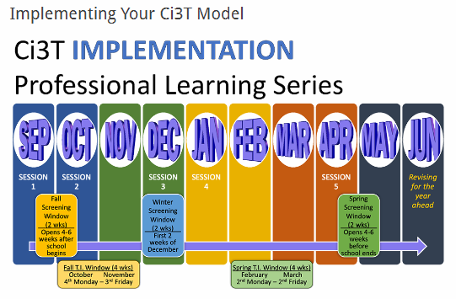
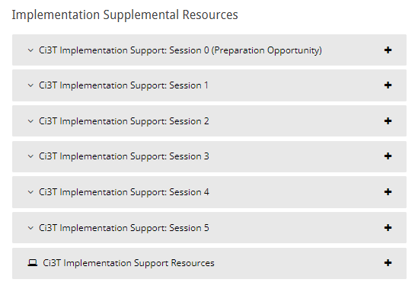
Accessing Professional Learning Materials
Navigate to ci3t.org/imp

Slide 9

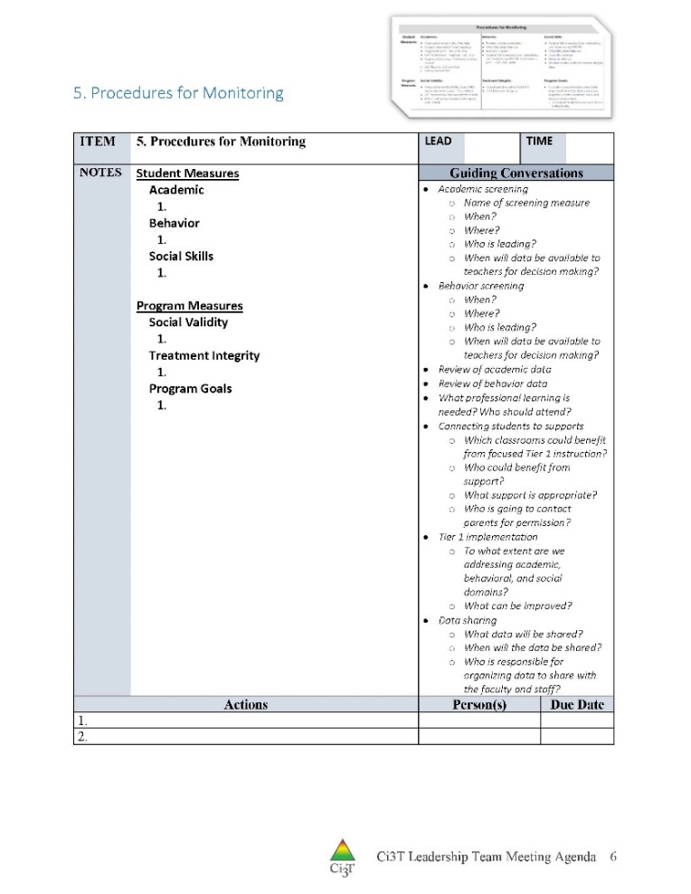
IM18 Ci3T Leadership Team Meeting Agenda TEMPLATE
Predictability

Slide 10

Goals for this Implementation Year
Establish effective Ci3T leadership structures
Gain a deeper understanding of Ci3T models of prevention
Implement your school’s plan with high fidelity
Collect and use social validity and treatment integrity data to monitor Ci3T plan implementation
Collect student academic and behavioral outcome data to inform Ci3T implementation efforts
Share data with all stakeholders regularly (e.g., monthly, quarterly)
Identify areas of additional professional learning for faculty and staff and support faculty and staff access to professional learning
Address any barriers to implementing your Ci3T model

Slide 11
Data-Informed Decision-Making
Sharing Data with Stakeholders
Using Data to Inform Professional Learning and Instruction

Slide 12
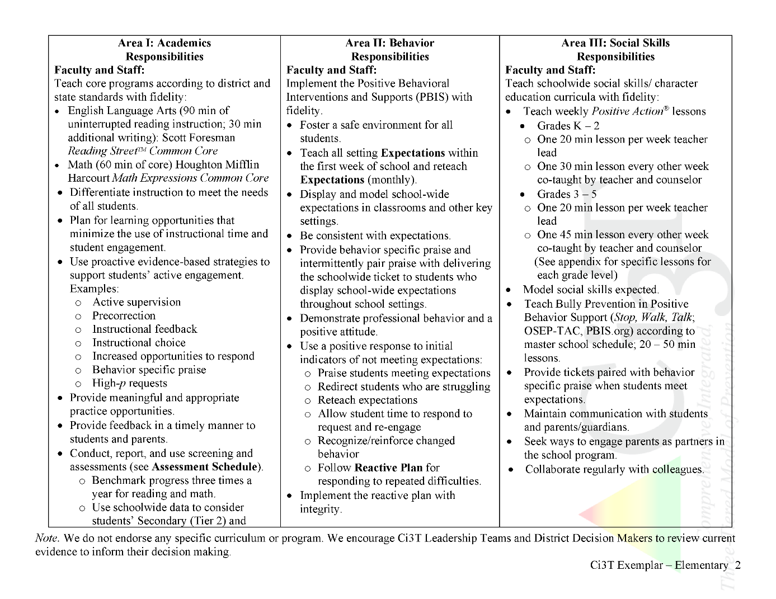

Slide 13
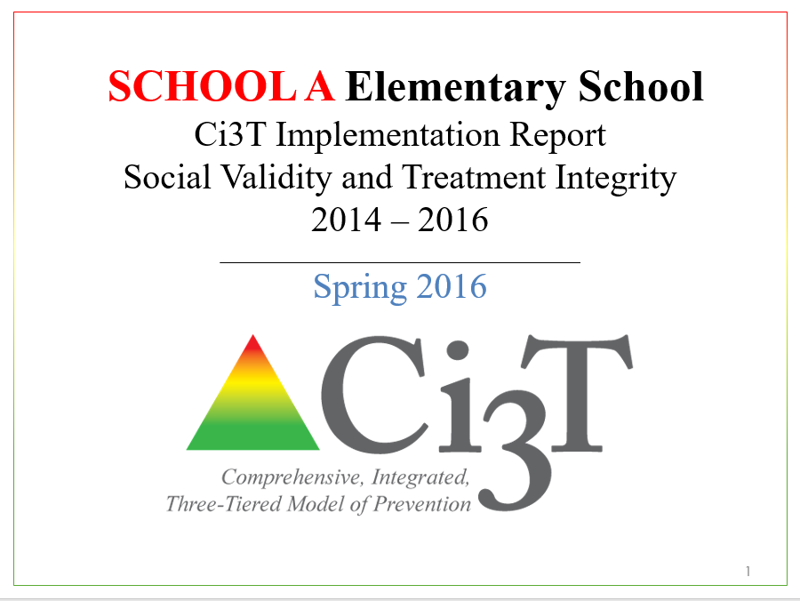
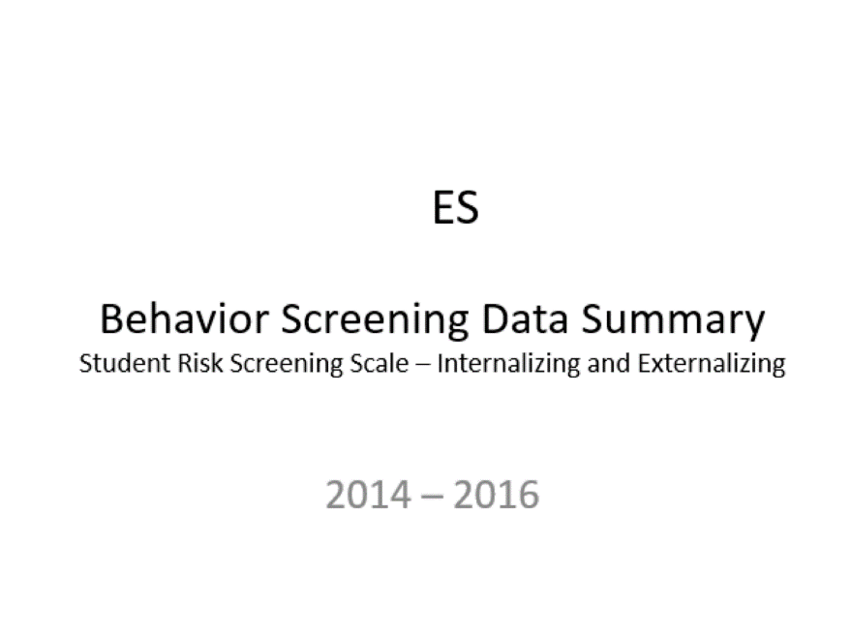
Essential Components of
Primary Prevention Efforts
Social Validity
Systematic Screening
Academic
Behavior
Treatment Integrity

Slide 14
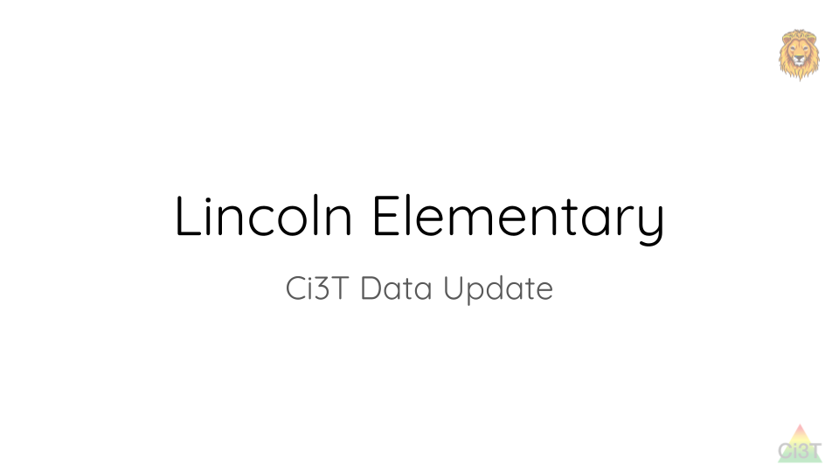
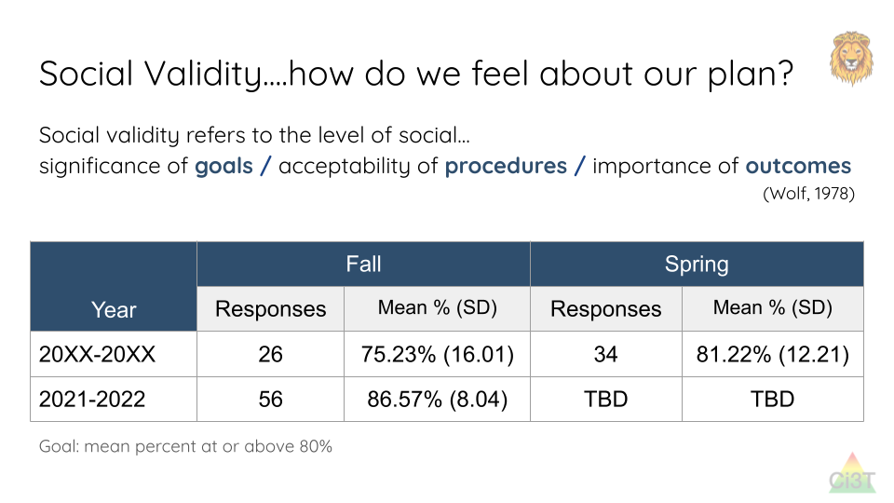
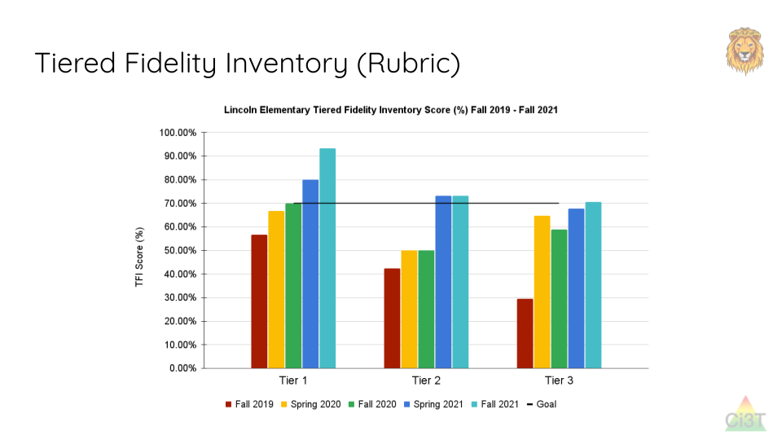
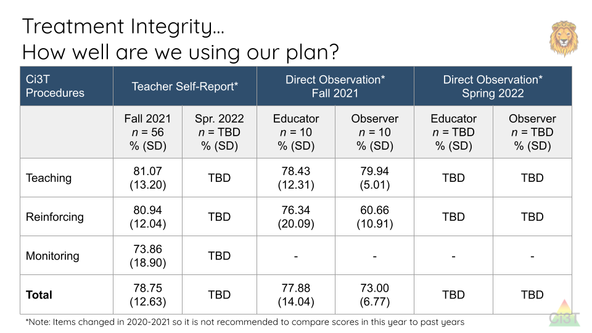
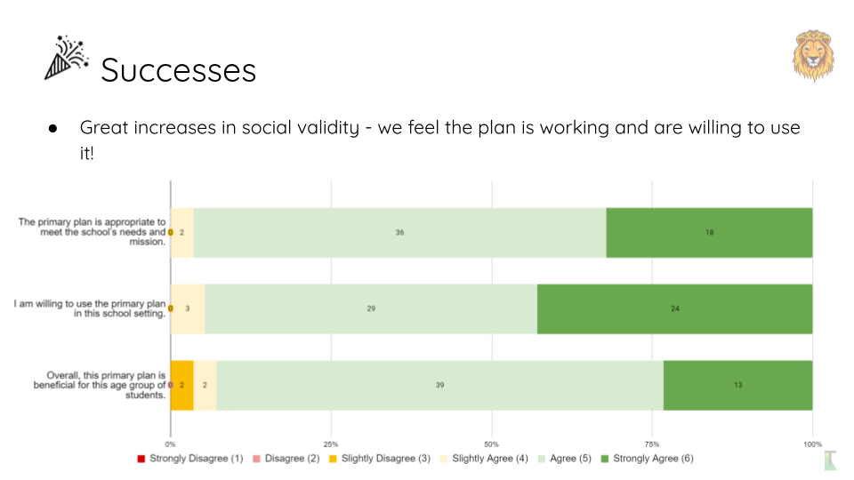
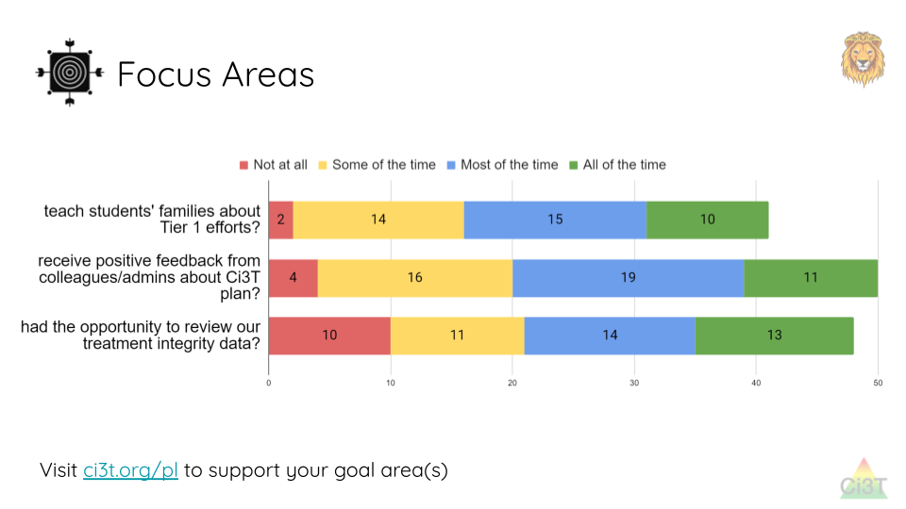
Sharing and Using Your Data

Slide 15
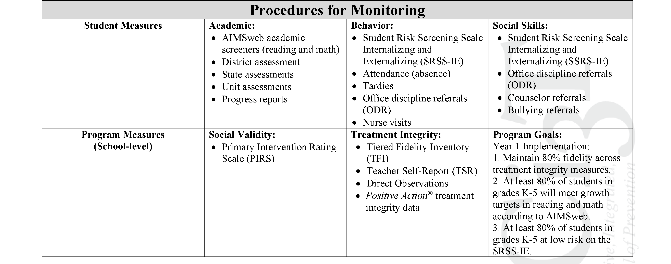
Ci3T Primary Plan
Procedures for Monitoring: Elementary
Program Measures and Goals

Slide 16
Sample Elementary Assessment Schedule
Measure | Aug | Sep | Oct | Nov | Dec | Jan | Feb | Mar | Apr | May
School Demographics
Student Demographic Information | X | X | X | X | X | X | X | X | X | X
Screening Measures
Behavior Screeners: SRSS-IE |  | X |  |  | X |  |  |  | X
Academic Screeners: AIMSWeb | X | X |  |  |  | X |  |  |  | X
Student Outcome Measures - Academic
State & District assessment |  |  |  |  |  |  |  | X | X
Progress reports |  |  |  | X |  |  | X |  |  | X
Student Outcome Measures - Behavior
Absences |  | X | X | X | X | X | X | X | X
Office discipline referrals (ODR) |  | X |  |  | X |  |  |  | X
Counselor referrals | X | X | X | X | X | X | X | X | X | X
Nurse visits | X | X | X | X | X | X | X | X | X | X
Program Measures
Primary Intervention Rating Scale |  |  | X |  |  |  |  | X
School-wide Evaluation Tool |  |  | X |  |  |  |  | X
Ci3T TI: Teacher Self-Report |  |  | X |  |  |  |  | X
Ci3T TI: Direct Observation |  |  | X |  |  |  |  | X
Second Step® Treatment Integrity |  |  | X |  |  |  |  | X
Adapted from Lane, K. L., Oakes, W. P., Cantwell, E. D., & Royer, D. J. (2018). Building and installing comprehensive, integrated, three-tiered (Ci3T) models of prevention: A practical guide to supporting school success V1.2. KOI Education. (Interactive eBook)

Slide 17
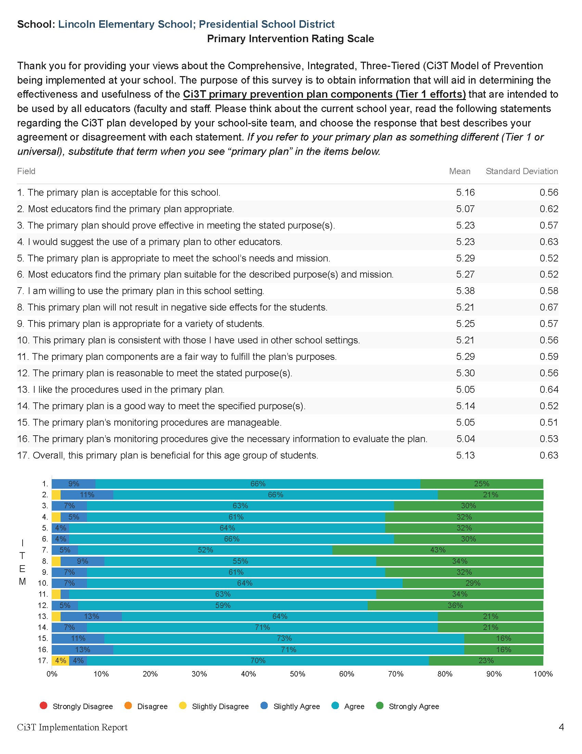

Slide 18
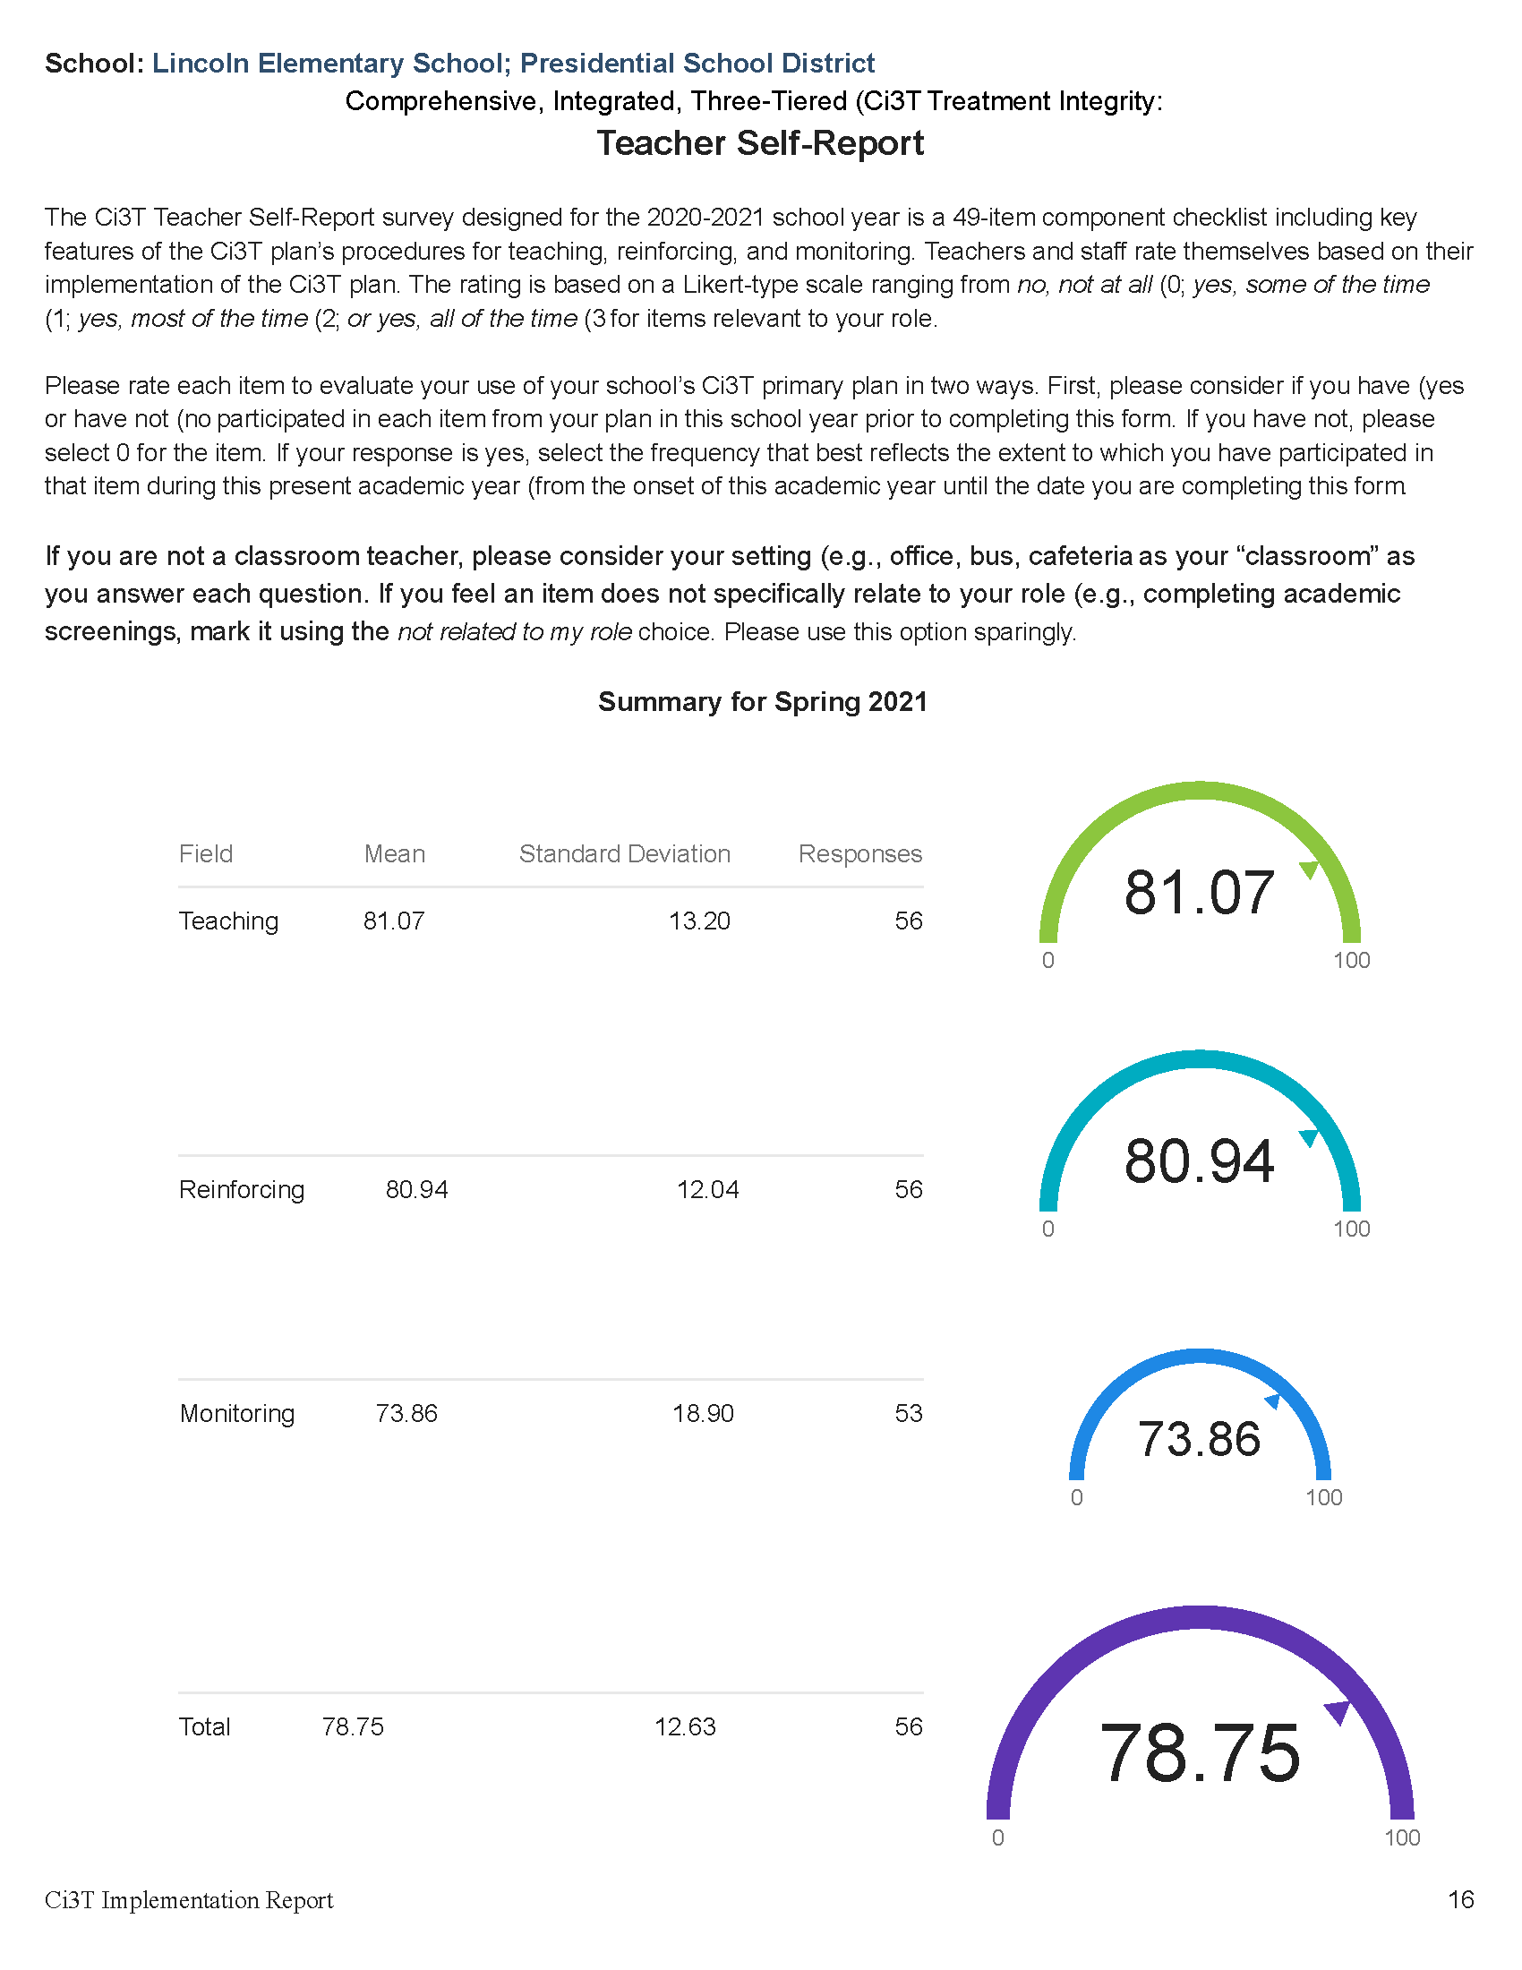

Slide 19
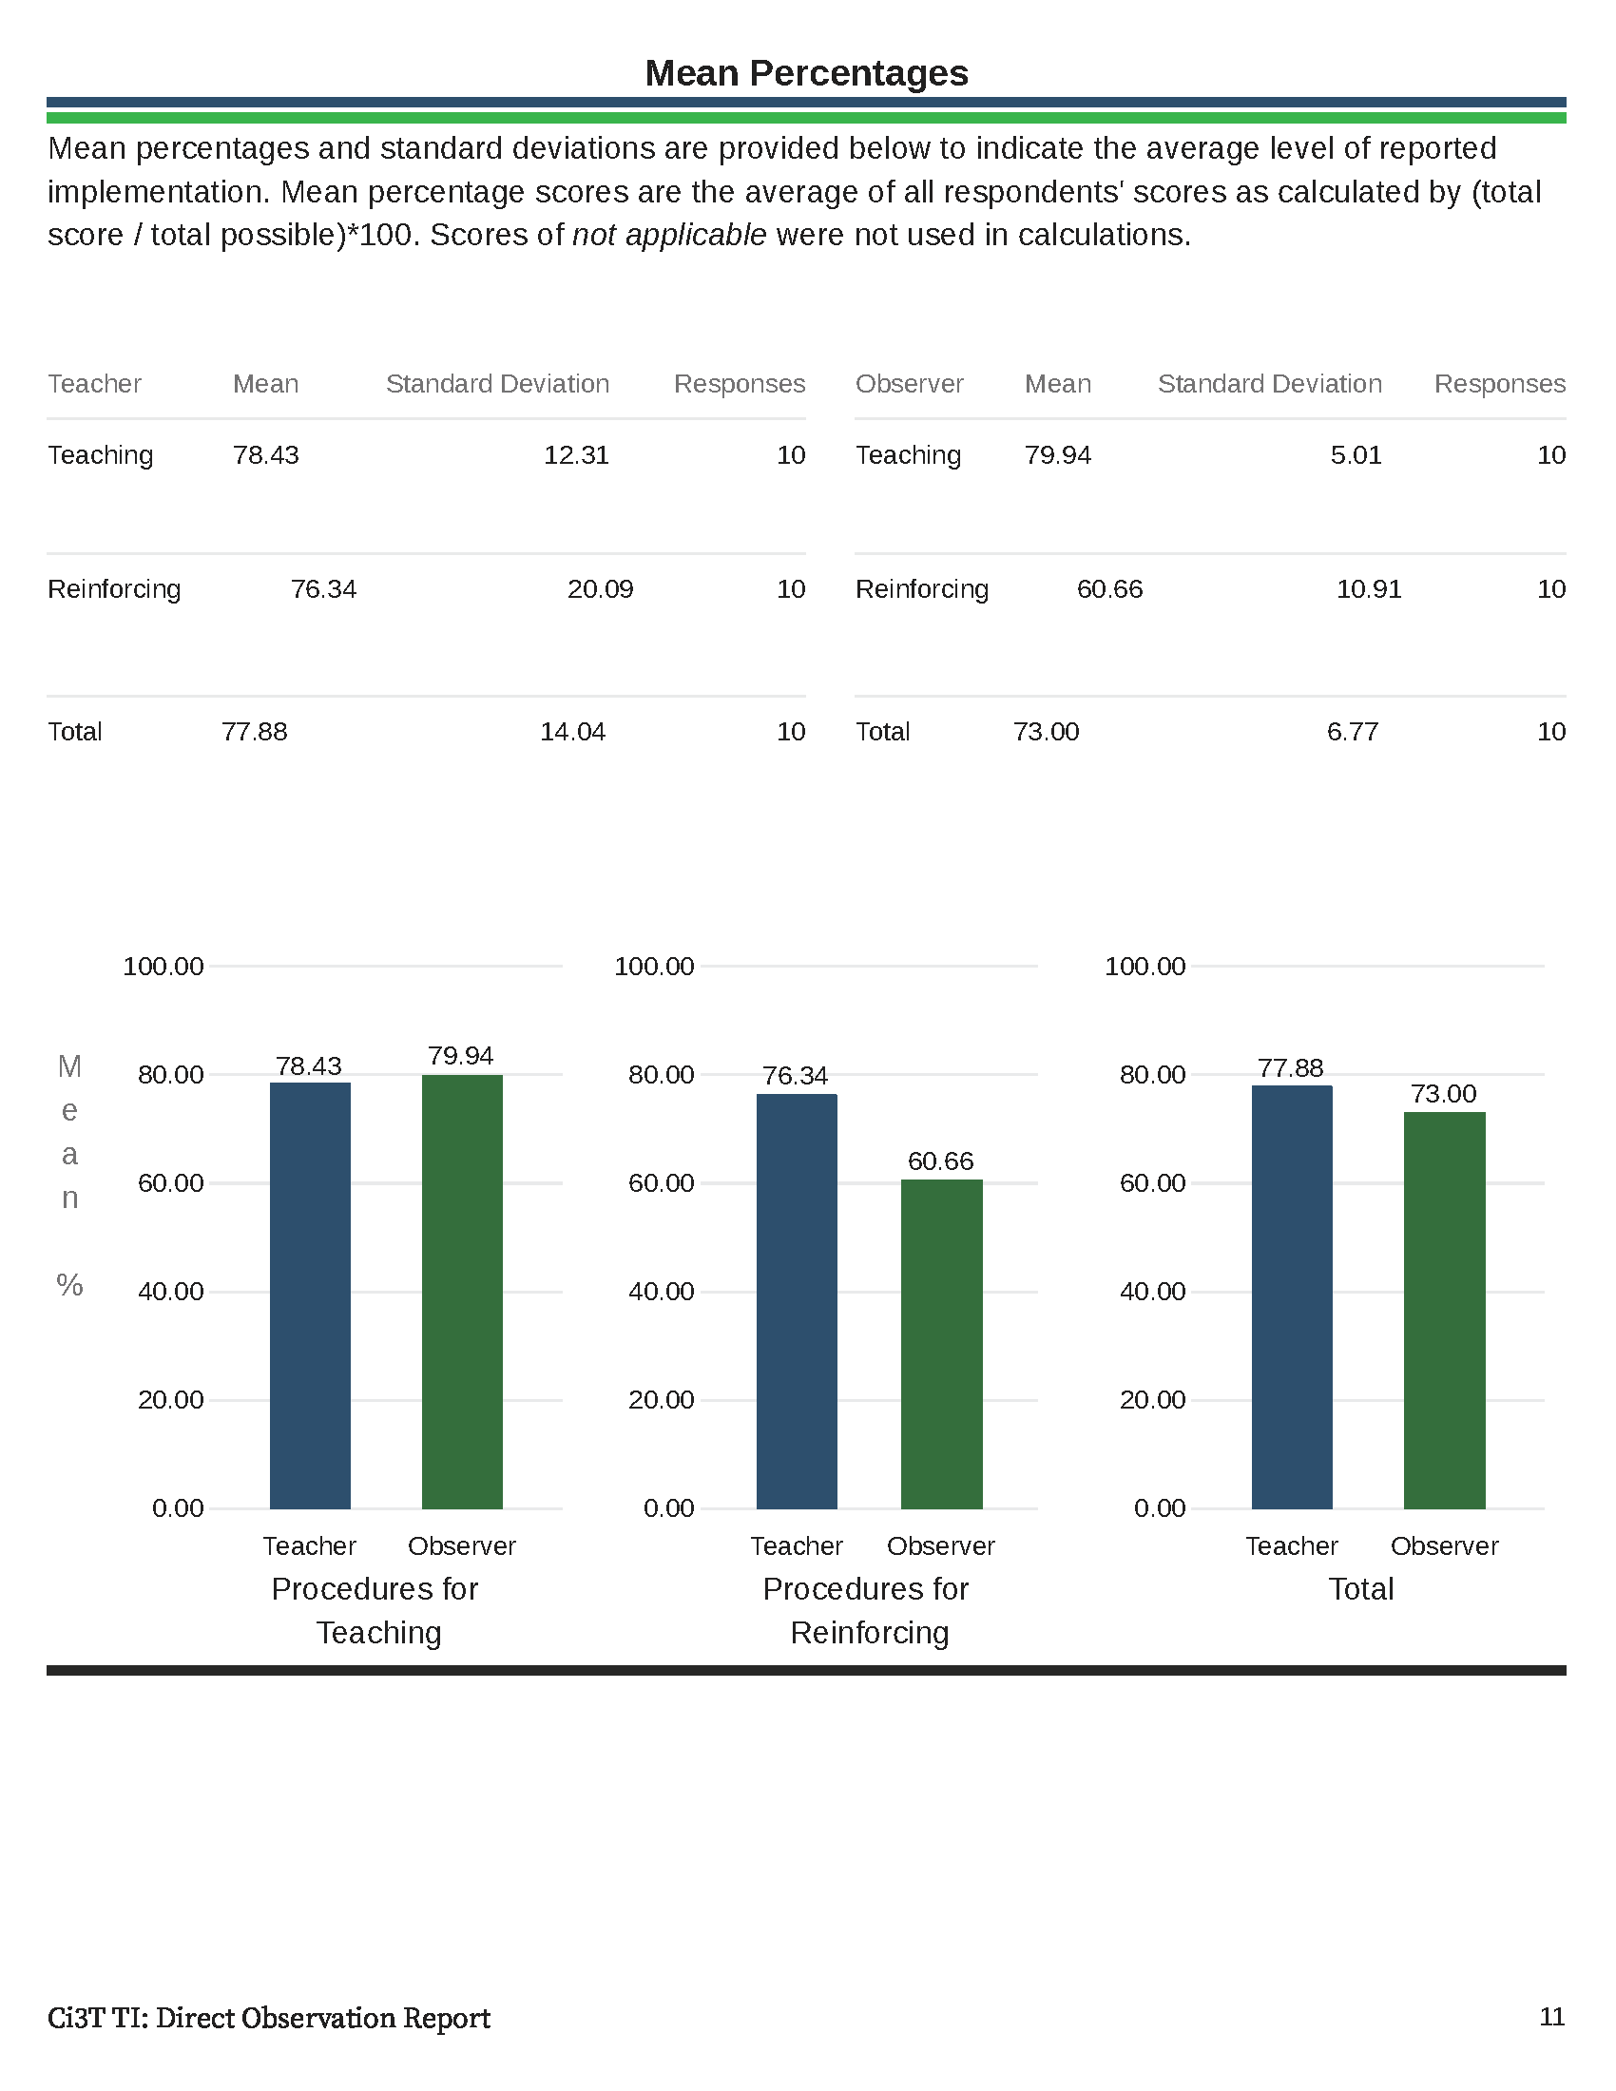

Slide 20
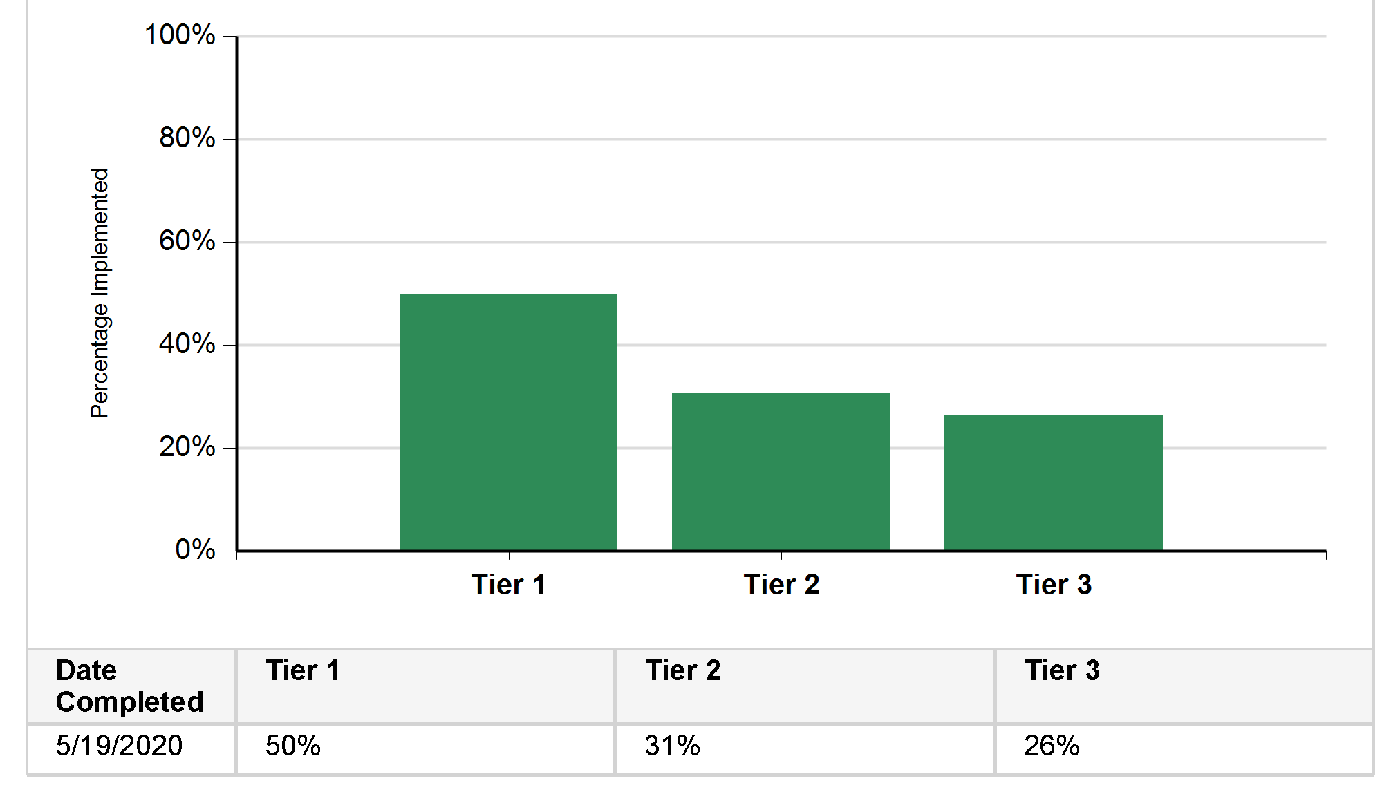
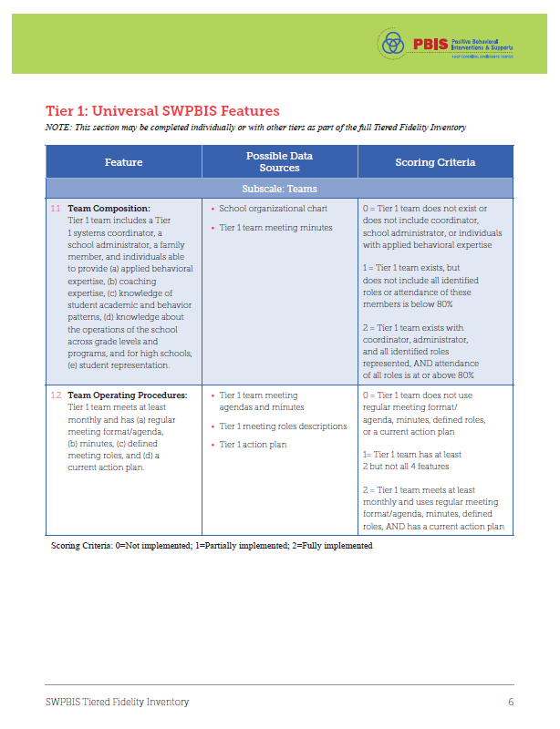
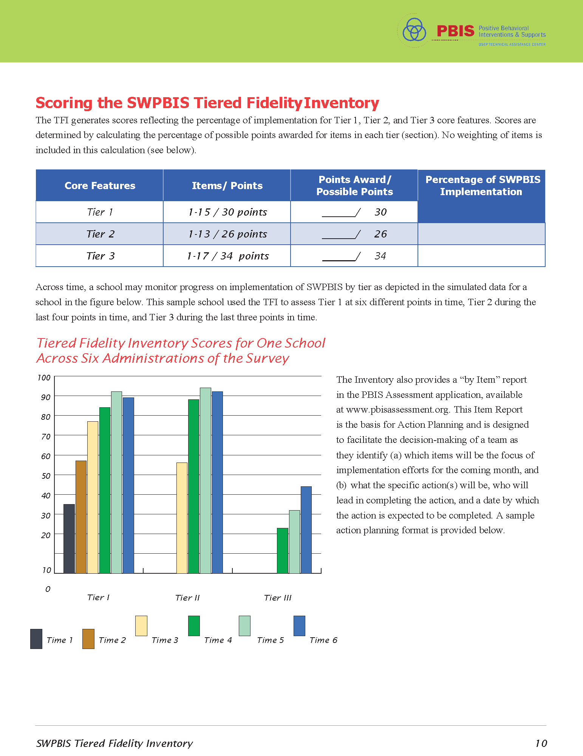

Tiered Fidelity Inventory (TFI)

Slide 21
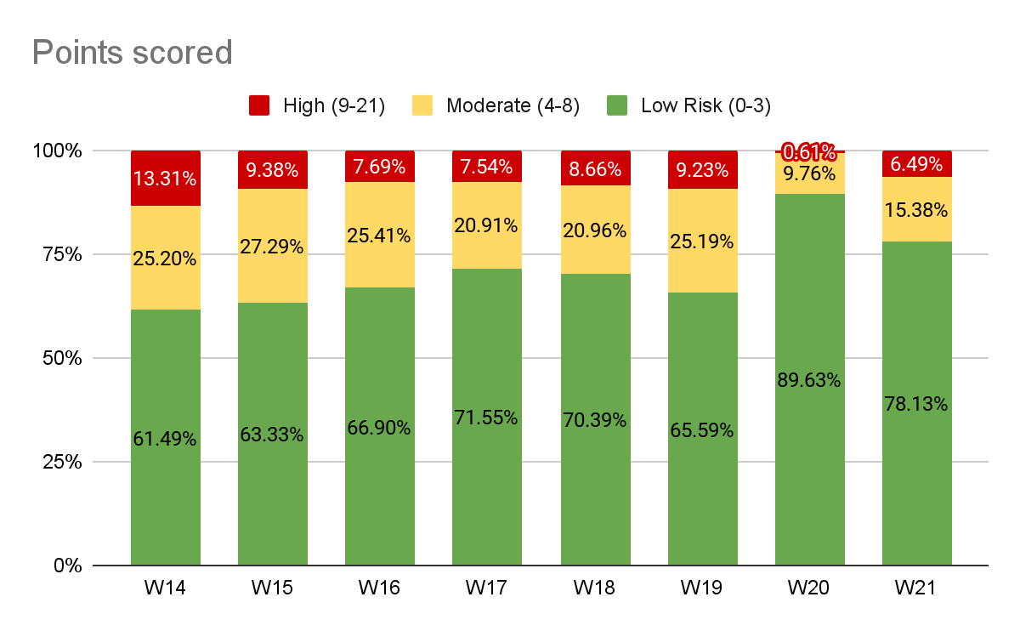
Winter 2021
SRSS-Externalizing Results – School level
Notes:
Fill in <year> based on current academic year. This is located in column A of the data sheet. Edit by right clicking and selecting “Edit data”.

Slide 22
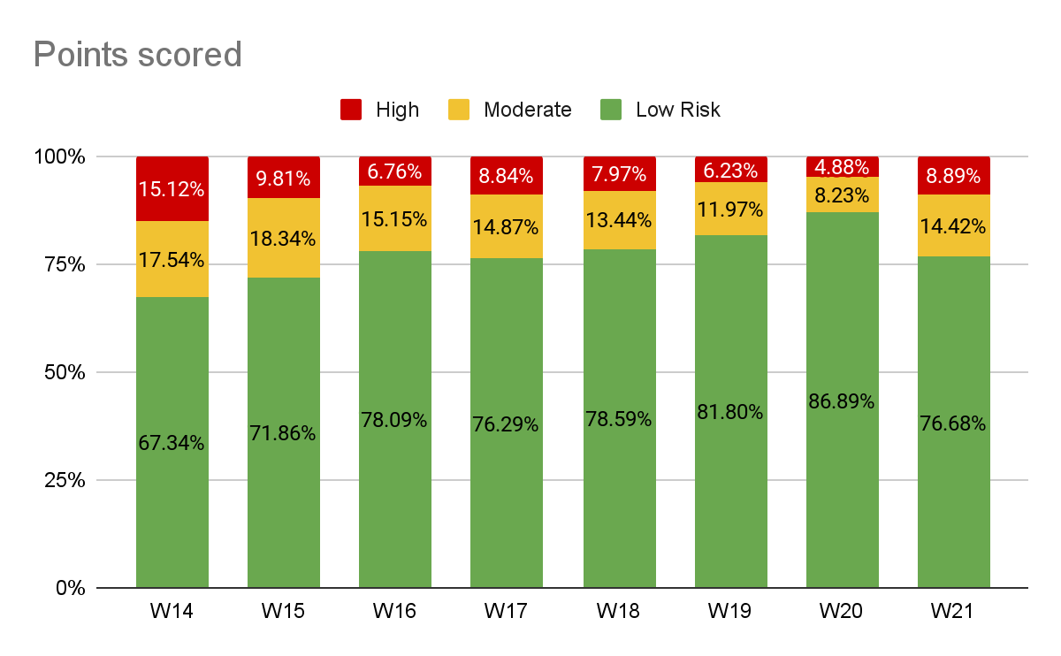
Winter 2021
SRSS-Internalizing Results – School level
Notes:
Fill in <year> based on current academic year. This is located in column A of the data sheet. Edit by right clicking and selecting “Edit data”.
IMPORTANT NOTE: The INTERNALIZING subscale and CUT SCORES are specific to school level.
Elementary: SRSS-I5, Items 8-12, 0-1 = low risk, 2-3 = moderate risk, 4-15 = high risk
Middle and High: SRSS-I6, Items 4, 8-12, 0-3 = low risk, 4-5 = moderate risk, 6-18 = high risk

Slide 23
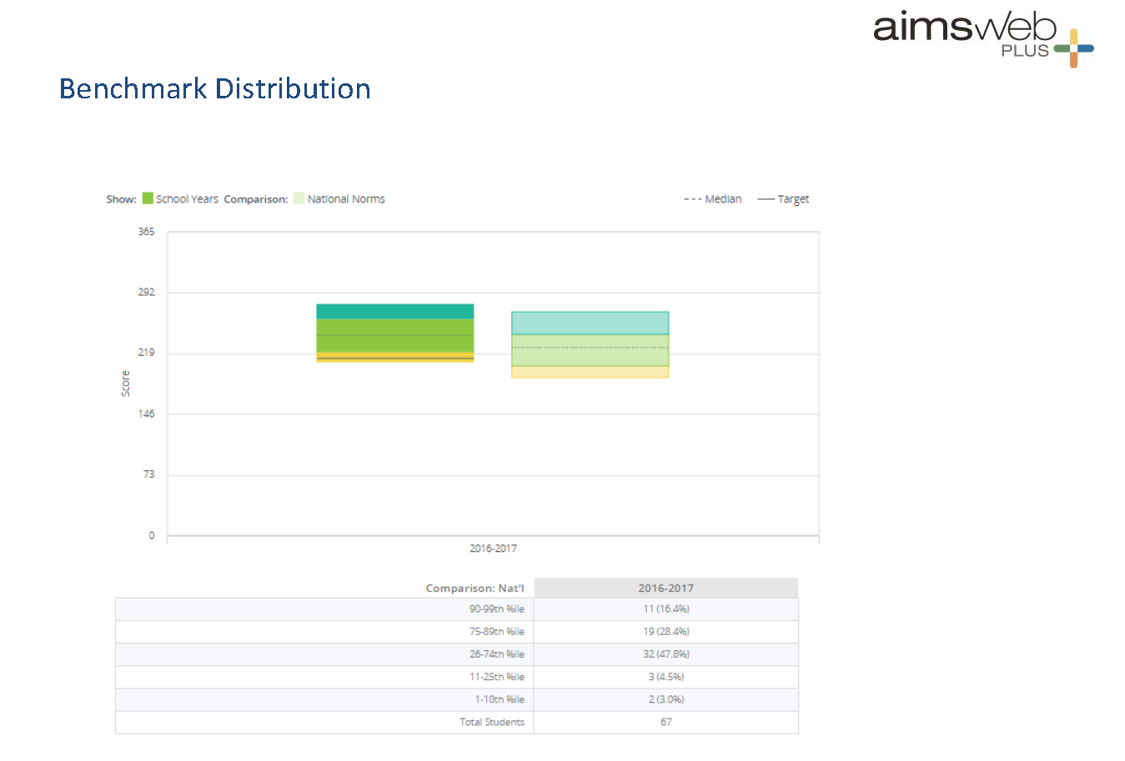
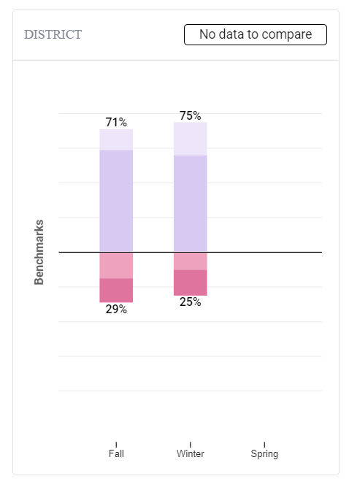
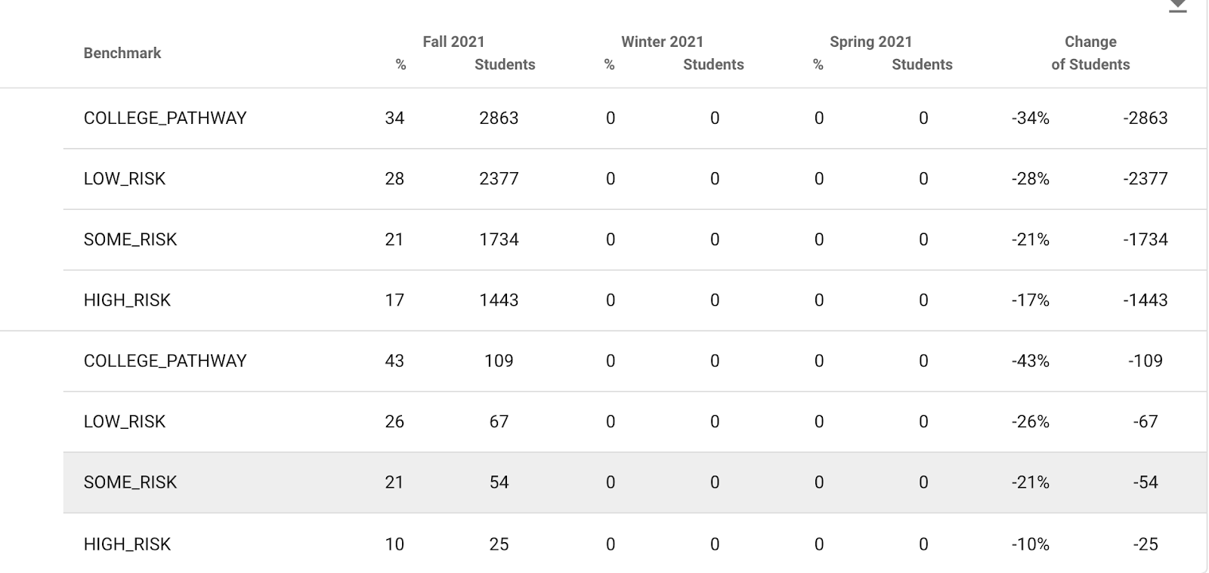

Academic Screening
Group Screening Reports
(e.g., provided by subtests and compared to district scores; scored by benchmark or norms)
District
School

Slide 24
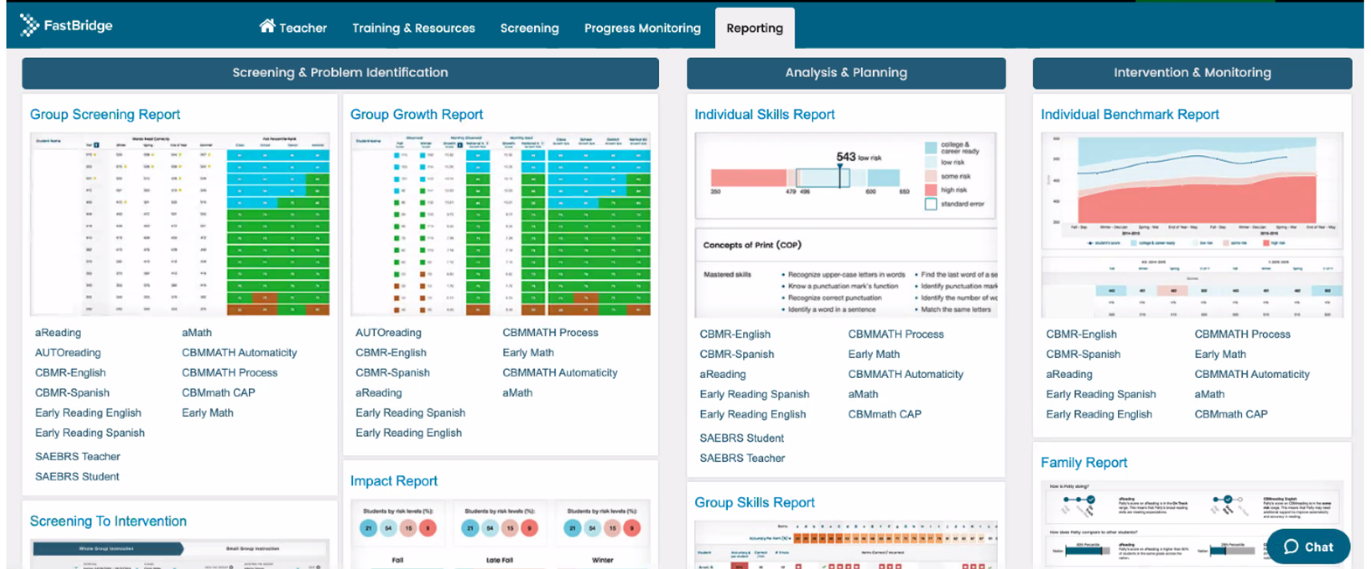
Academic Screening

Slide 25
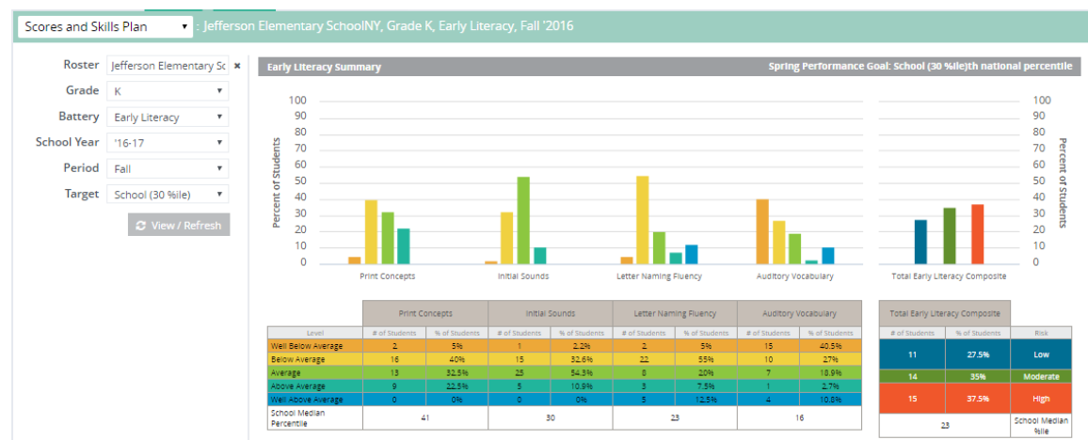
Academic Screening

Slide 26
Integrating Data Sources
Academic screening
Behavioral screening
Other school-wide data
Attendance
Office discipline referrals
Nurse visits
Common formative assessments
Remember treatment integrity and social validity data – is Tier 1 in place?

Slide 27
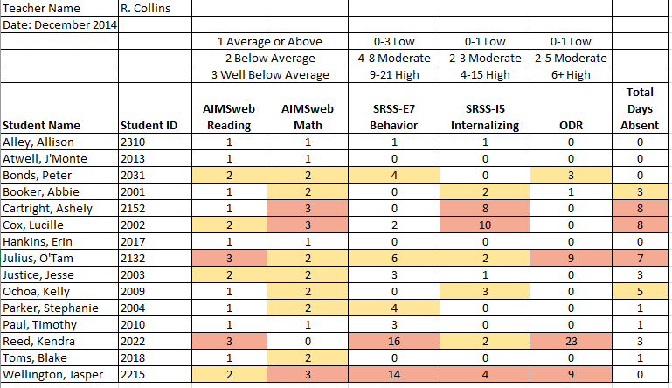
Consider this class….

Slide 28
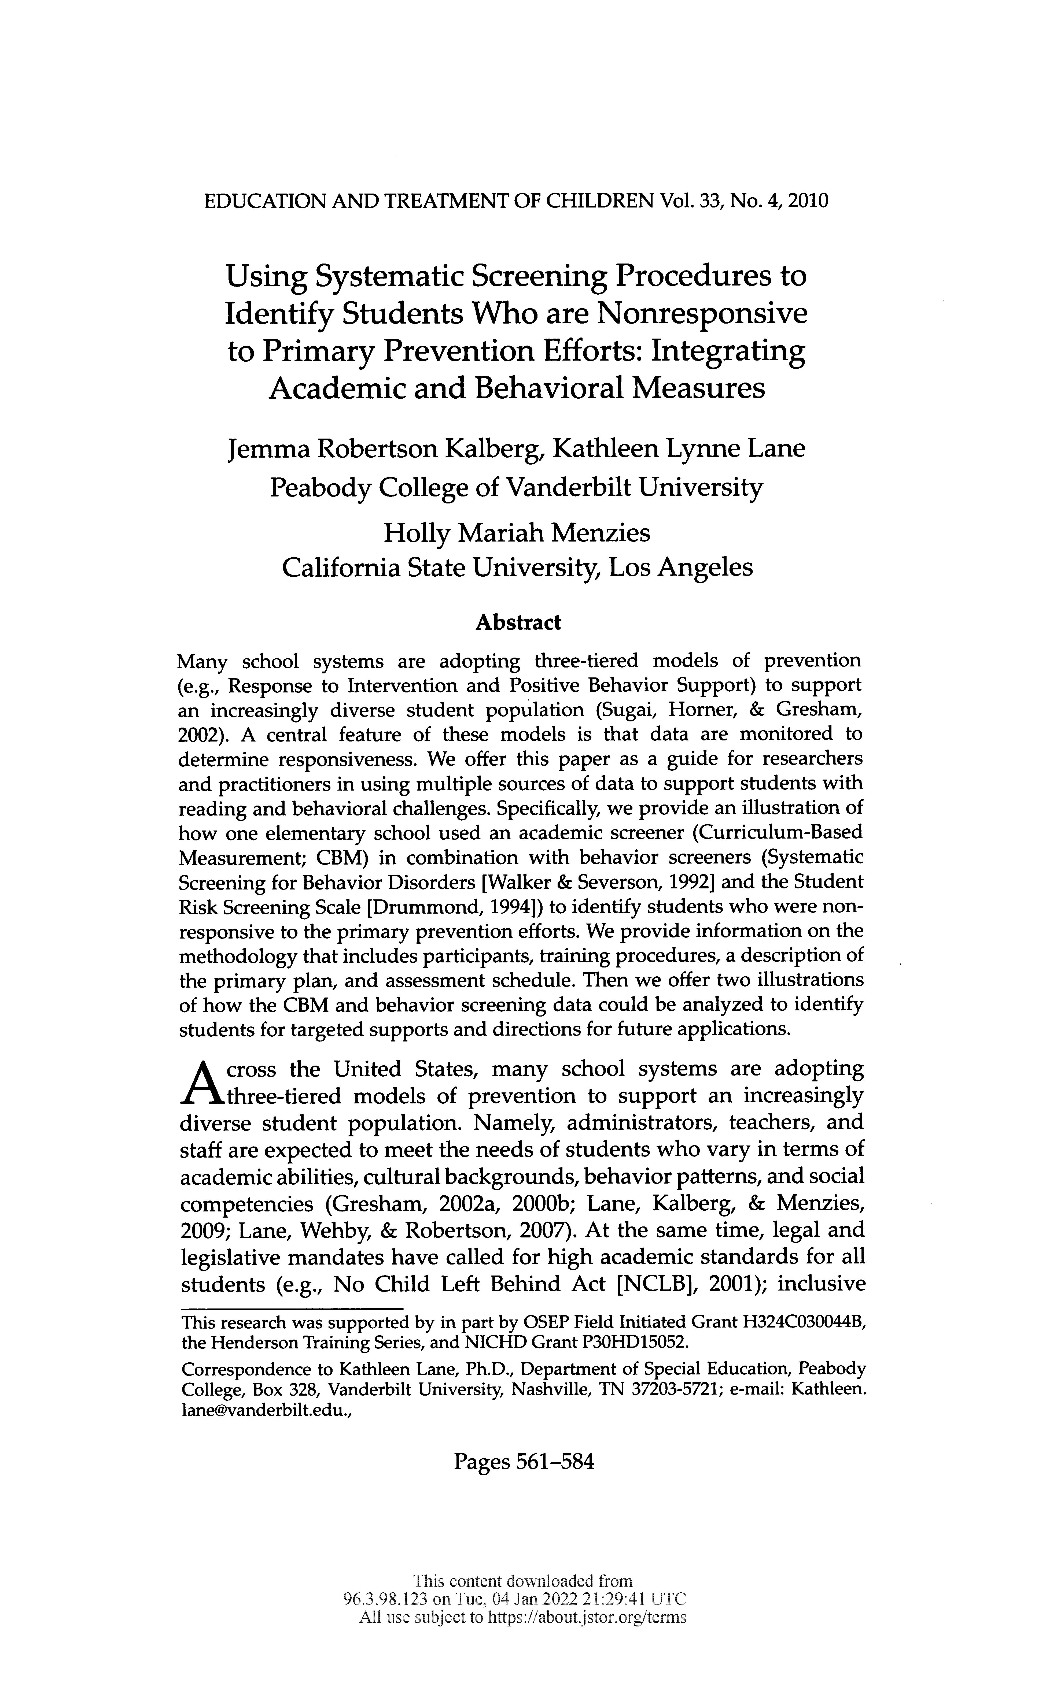
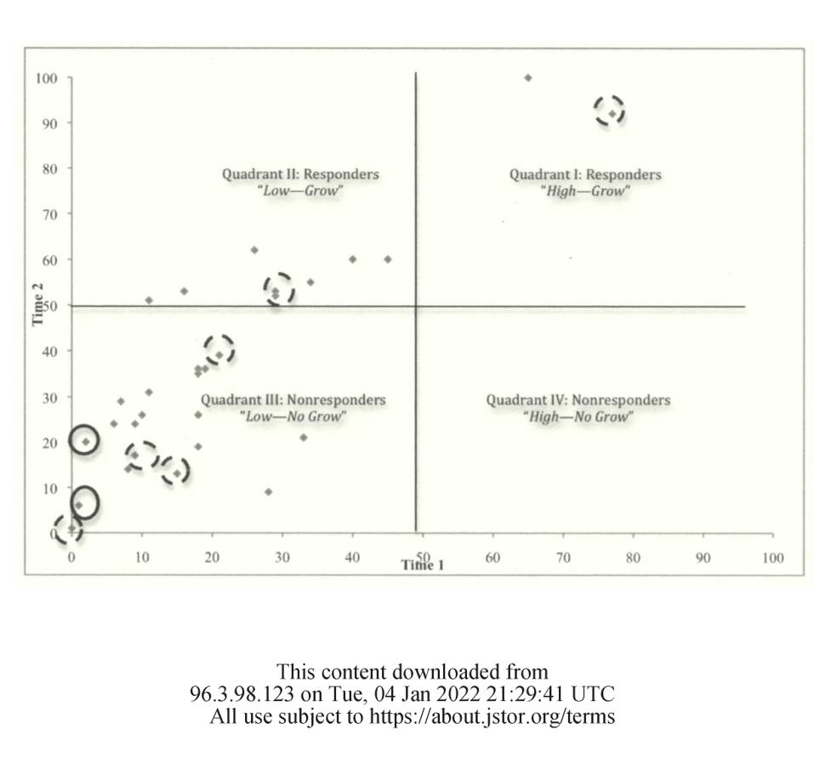

Slide 29
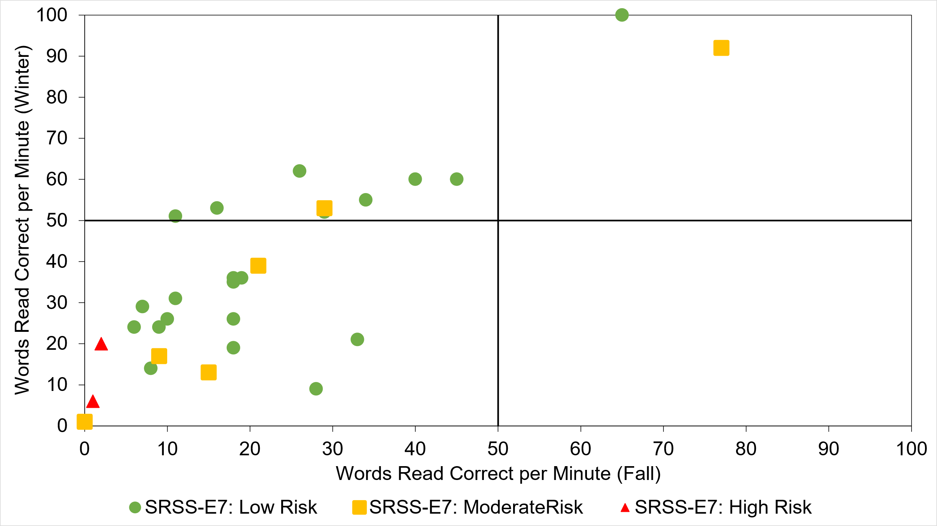
Quadrant 2: Responsive
“Low—Grow”
Quadrant 1: Responsive
“High—Grow”
Quadrant 3: Not responding
“Low—No Grow”
Quadrant 4: Not responding
“High—No Grow”

Slide 30
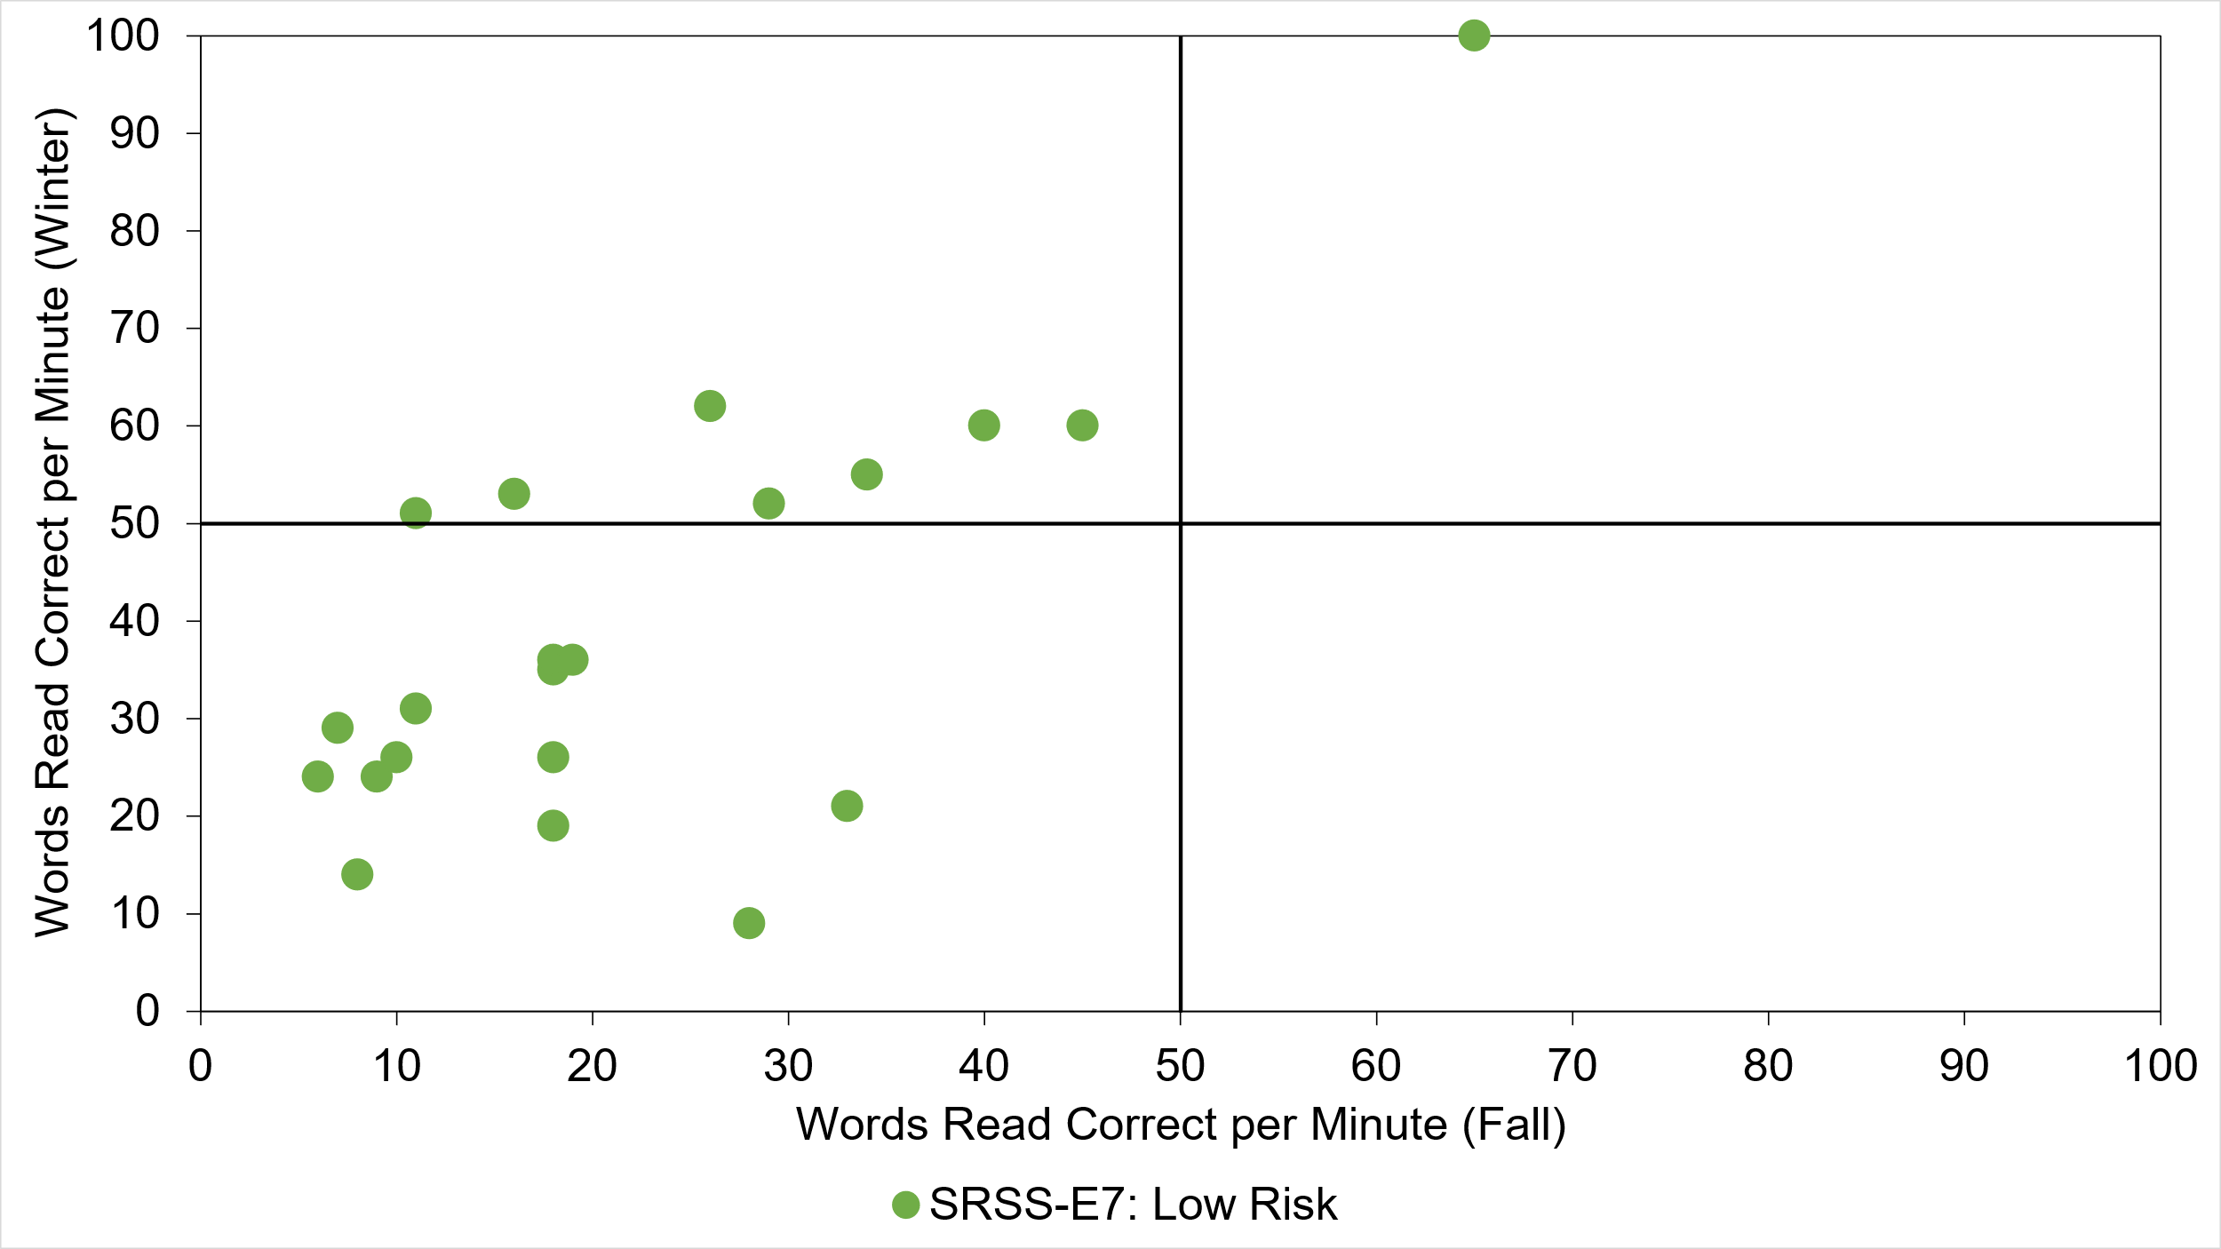
Quadrant 2: Responsive
“Low—Grow”
Quadrant 1: Responsive
“High—Grow”
Quadrant 3: Not responding
“Low—No Grow”
Quadrant 4: Not responding
“High—No Grow”

Slide 31
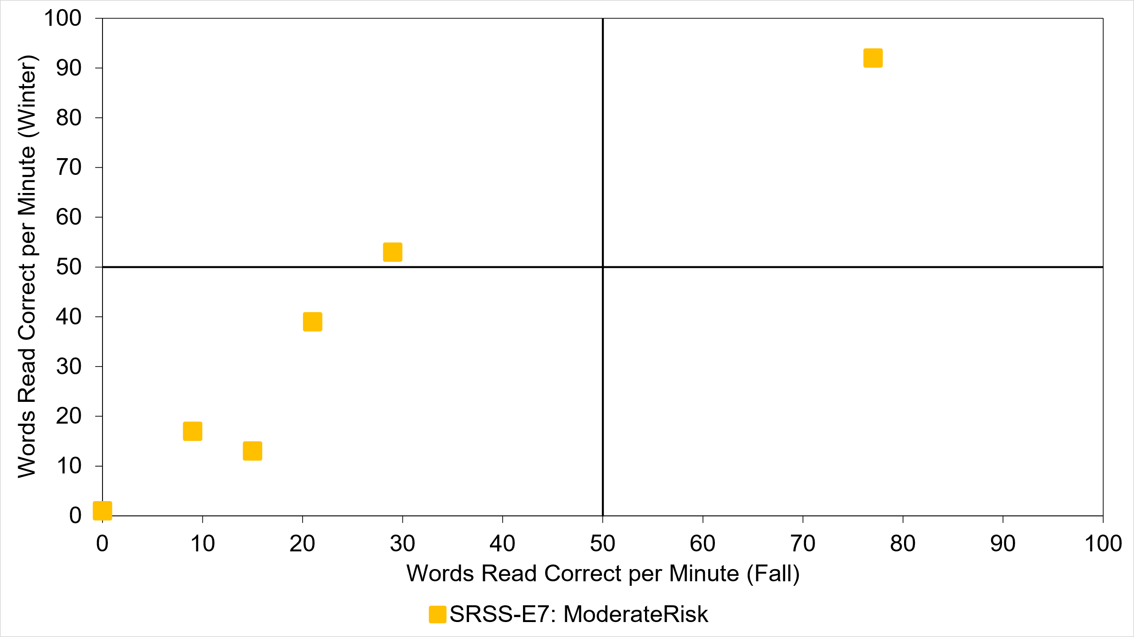
Quadrant 2: Responsive
“Low—Grow”
Quadrant 1: Responsive
“High—Grow”
Quadrant 3: Not responding
“Low—No Grow”
Quadrant 4: Not responding
“High—No Grow”

Slide 32
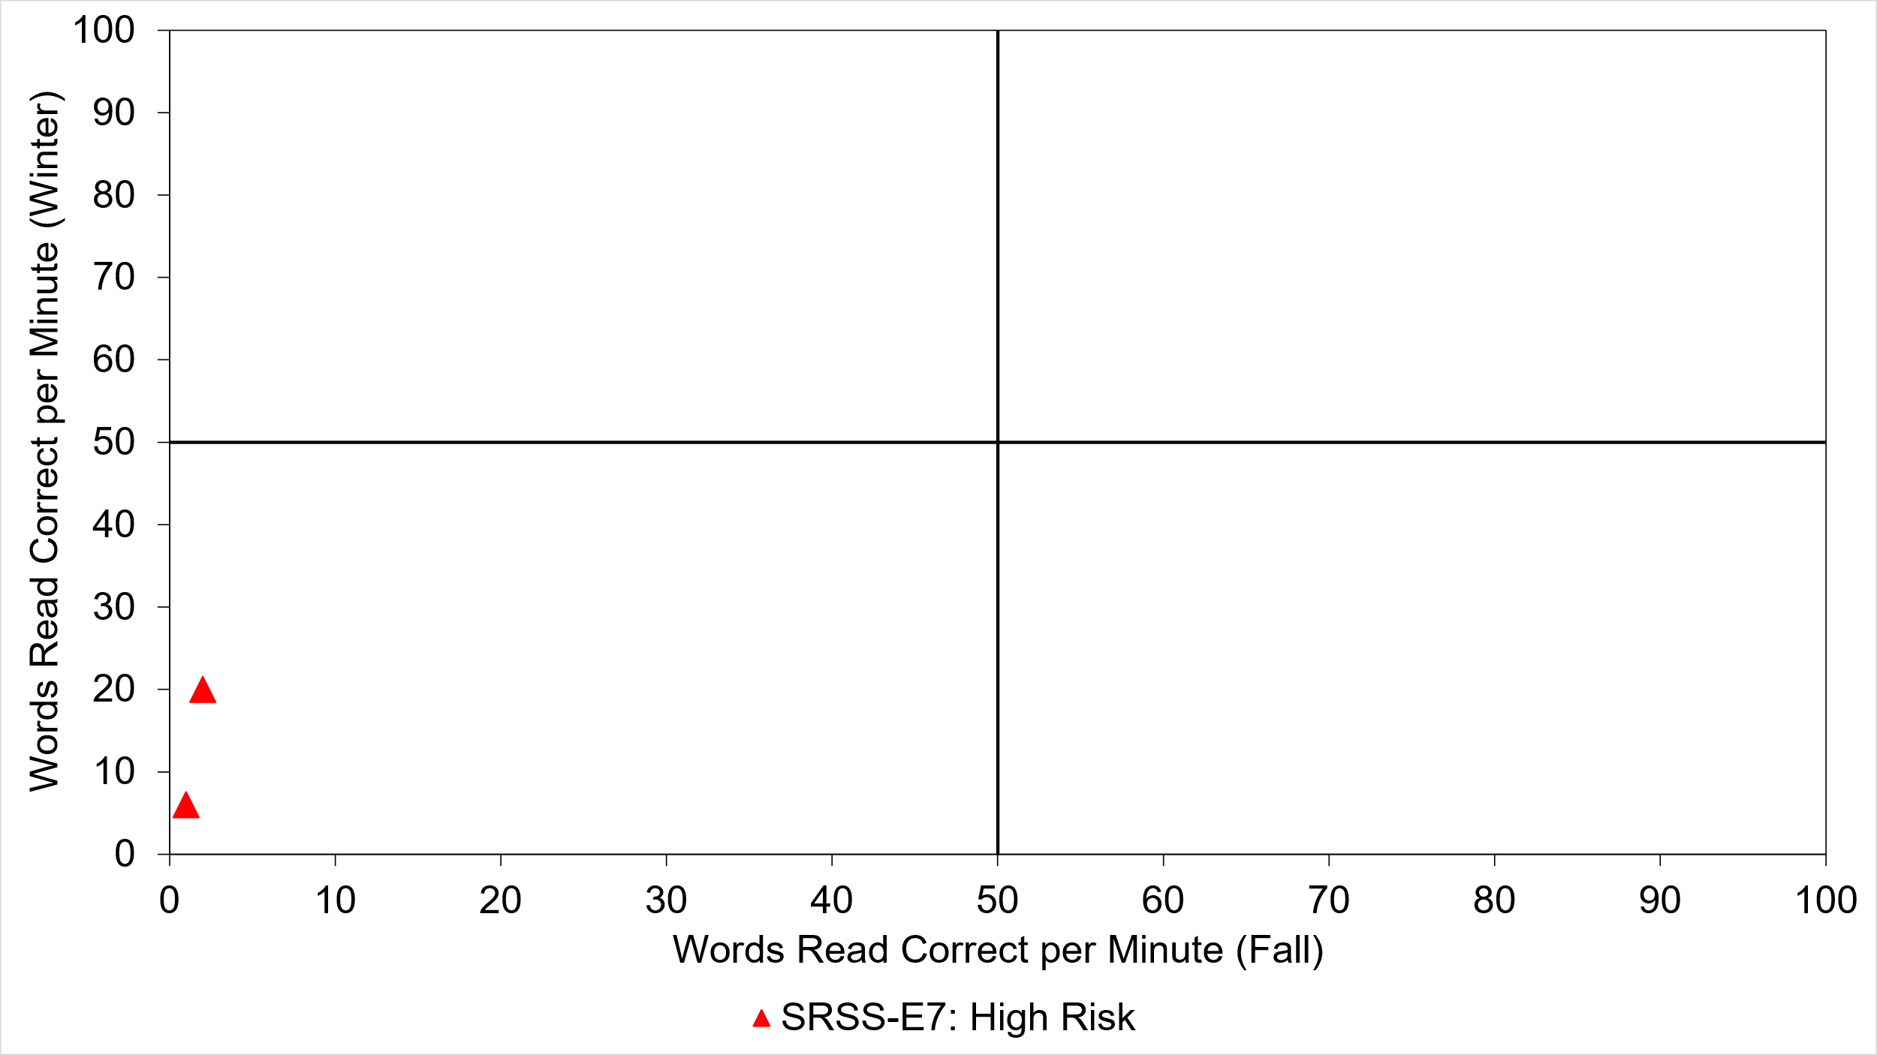


Quadrant 2: Responsive
“Low—Grow”
Quadrant 1: Responsive
“High—Grow”
Quadrant 3: Not responding
“Low—No Grow”
Quadrant 4: Not responding
“High—No Grow”

Slide 33
Quadrant 2: Responsive
“Low—Grow”
Quadrant 1: Responsive
“High—Grow”
Quadrant 3: Not responding
“Low—No Grow”
Quadrant 4: Not responding
“High—No Grow”

Slide 34

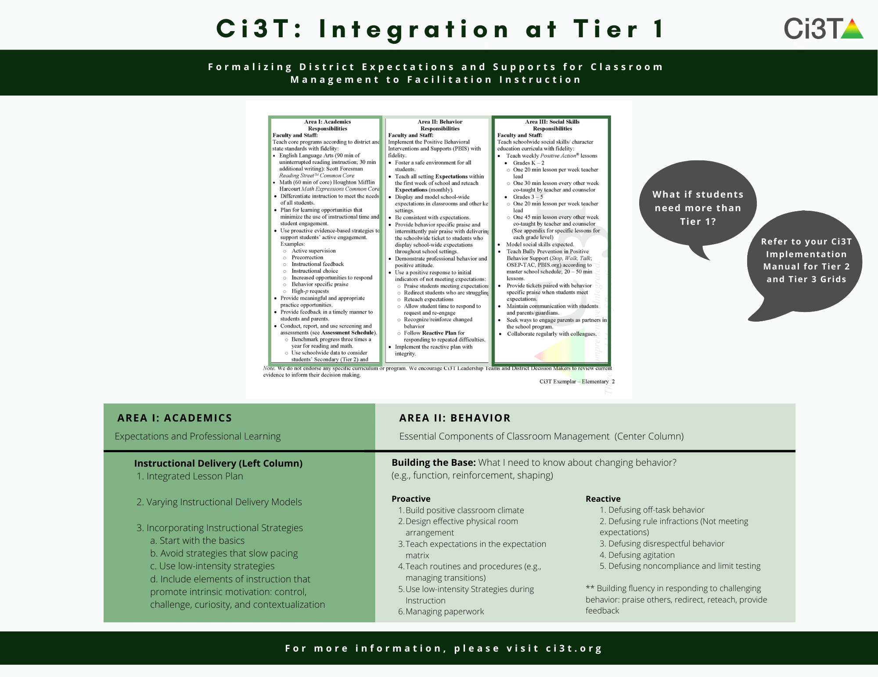







What if we need to focus on Tier 1?
Structured Literacy

Slide 35
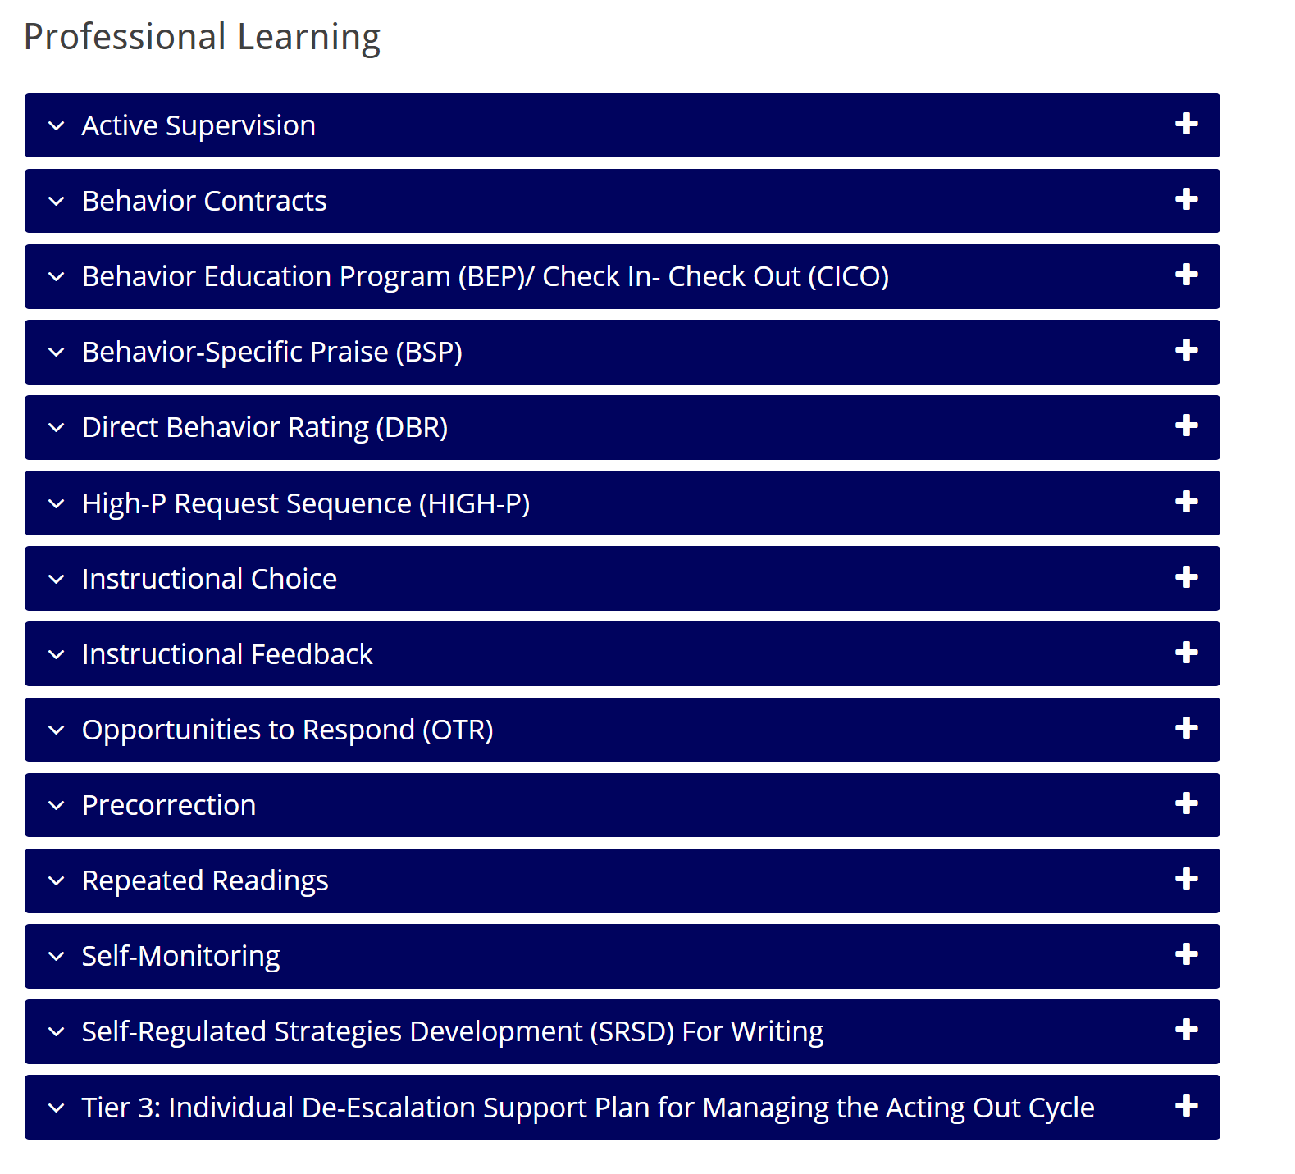

Solutions-based planning
Identify areas of strength
Identify focus areas
Let the data drive the conversation
Connect to available resources for professional learning

Slide 36
Integrated Lesson Planning at Tier 1

Slide 38
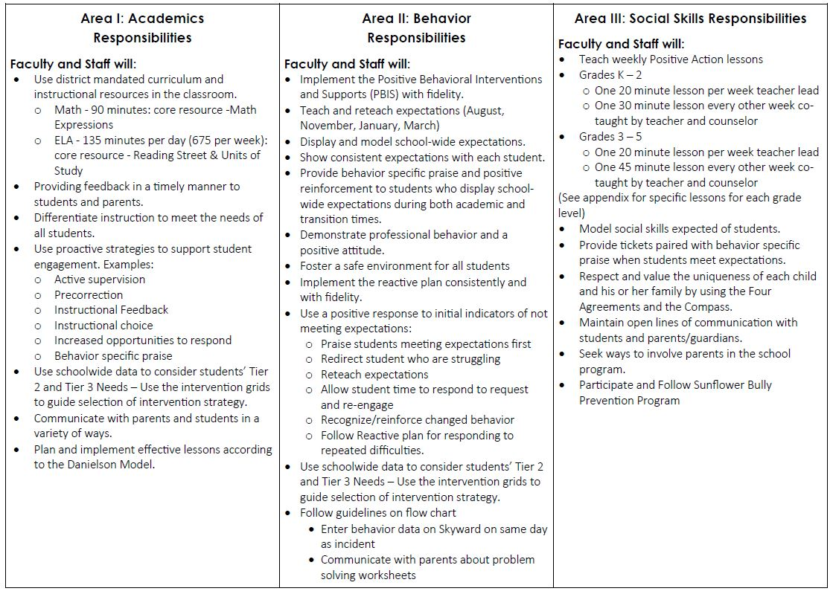
Ci3T Primary (Tier 1) Plan: Procedures for
Teaching
Ci3T Primary (Tier 1) Plan: Procedures for Reinforcing
Ci3T Primary (Tier 1) Plan: Procedures for Monitoring

Slide 39
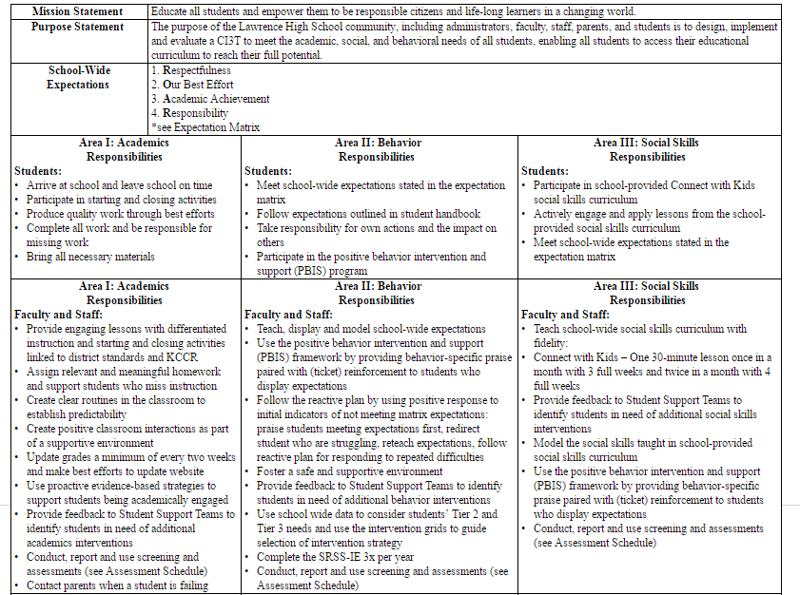
Teach, display, and model school-wide expectations
Teach school-wide social skills; model social skills

Slide 40
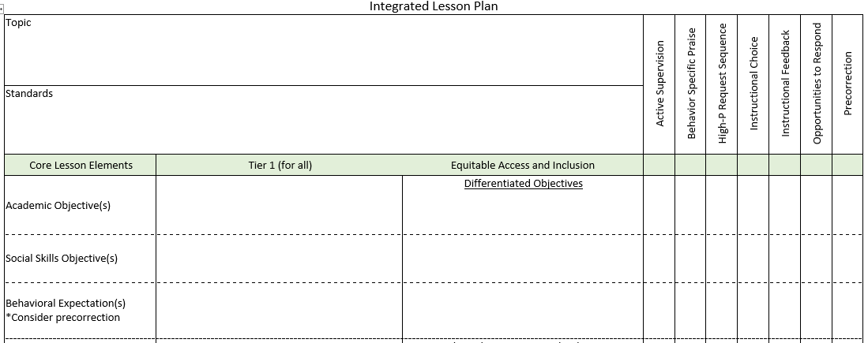
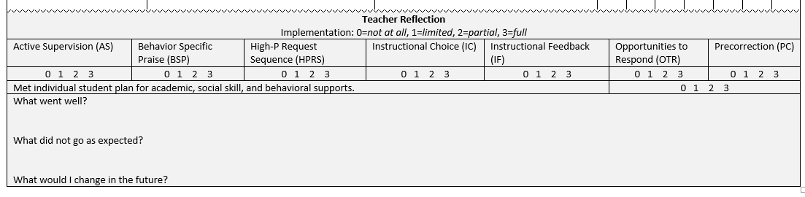
Planning for an integrated approach

Slide 41
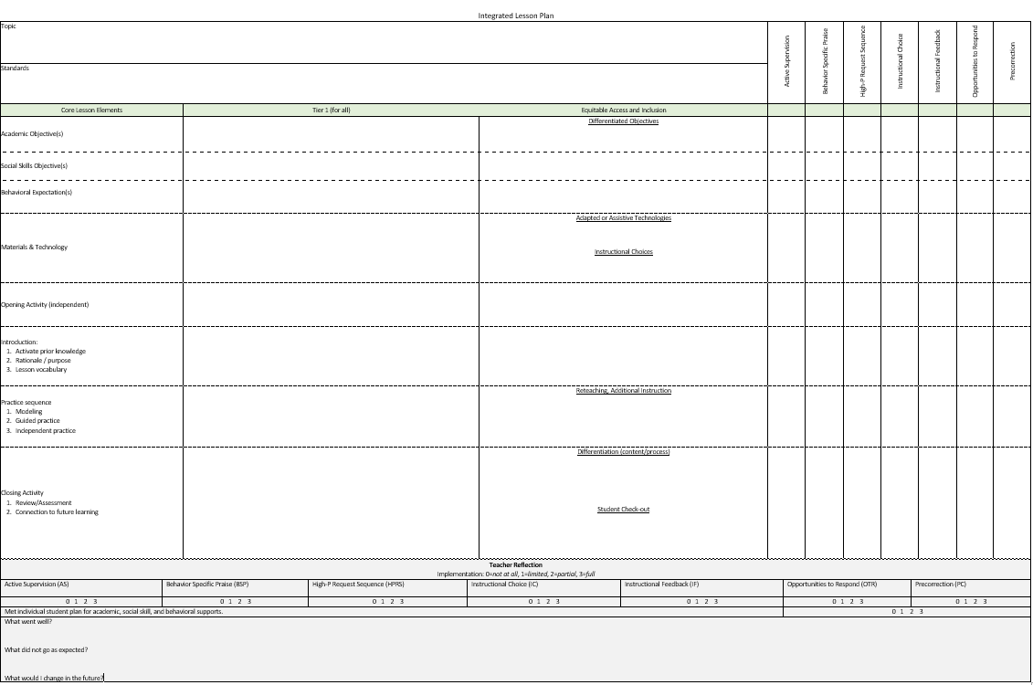
Comprehensive, Integrated Lesson Plans
Identify the academic learning objectives.
Identify the social skills objectives.
Selected the behavioral expectations needed.
Core Lesson Elements
Academic Objective(s)
Social Skills Objective(s)
Behavioral Expectation(s)
Notes:
Activity 1 – using the shared lesson plan, each table is given a large card with a strategy on it. They are then to find natural places for the strategy to be used within the sample lesson to support the A/B and Social objectives. SHARE
With your partner…. Discuss one idea for an activity for this lesson (sample). Remember that the use of low-intensity strategies are great ways to support teachers in integrating social and behavioral skill support and practice.
Teams discuss – 3 min – share a few ideas. Then follow up with BSP and precorrection as examples if not shared.

Slide 42
Student deficits in either academics or behavior puts them at risk for long-term negative outcomes.
Academic
Difficulties
Behavioral or Social Difficulties
Source: Morgan, P. L., Farkas, G., Tufis, P. A., & Sperling, R. A. (2008). Are reading and behavior problems risk factors for each other? Journal of Learning Disabilities, 41, 417-436.

Slide 43
Clearly Define Objectives
Identify the academic learning objectives and standards for the lesson.
Plan lesson activities.
Consider what social skill(s) have been taught and/or are needed for successful participation by all.
Select the specific behavioral expectations that will be important for prosocial lesson engagement.
Notes:
For example,
Does the lesson require team work? Discussions from multiple perspectives? Sharing materials? Use of digital media? Use of classroom materials?
Social skills needed to engage in those activities… respect ideas different than you own, seek to understand the perspective of others, take turns, offer your own ideas, listen to others, use of reliable resources online,
Behaviors: treat materials with care, look at the speaker, one speaker at a time, keep unrelated materials put away, ask for a turn, ask questions to understand others, include only your original work or properly cited work in your assignment.

Slide 44

Embedding Social Skill Objectives in Academic Instruction
Linking social skills taught to classroom activities
Promote generalization
Maximize engagement

Slide 45
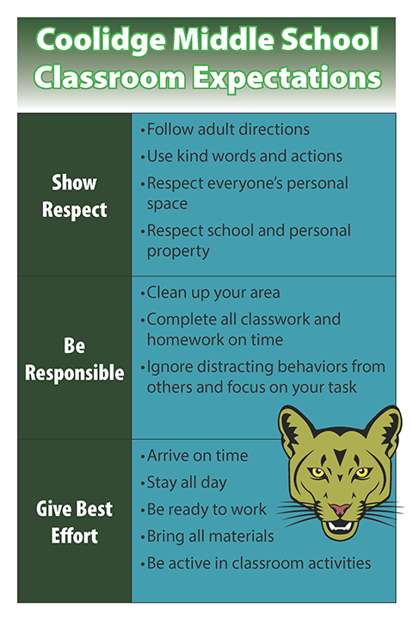
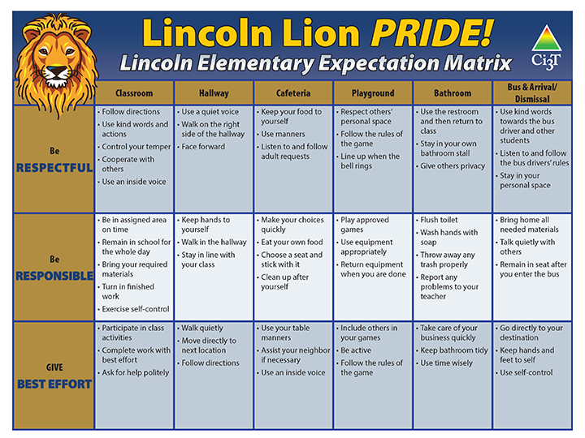

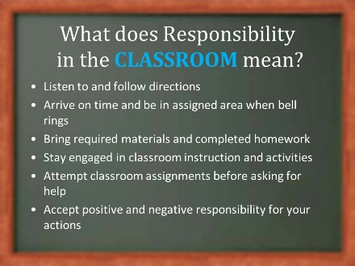
Teaching and Re-teaching Behavior Expectations

Slide 47












Let’s Talk!
In what ways does your school take an integrated approach to supporting students’ academic, behavioral, and social needs?
Where and how might you make integrations stronger within your own classroom or school?
How do your data support areas to target, and how can you share those data with stakeholders (e.g., faculty and staff, district administrators, families)?
Notes:
10-min timer

Slide 48
Planning and Implementing Tier 2 Interventions

Slide 49

Secondary (Tier 2) Intervention Grids

Slide 50
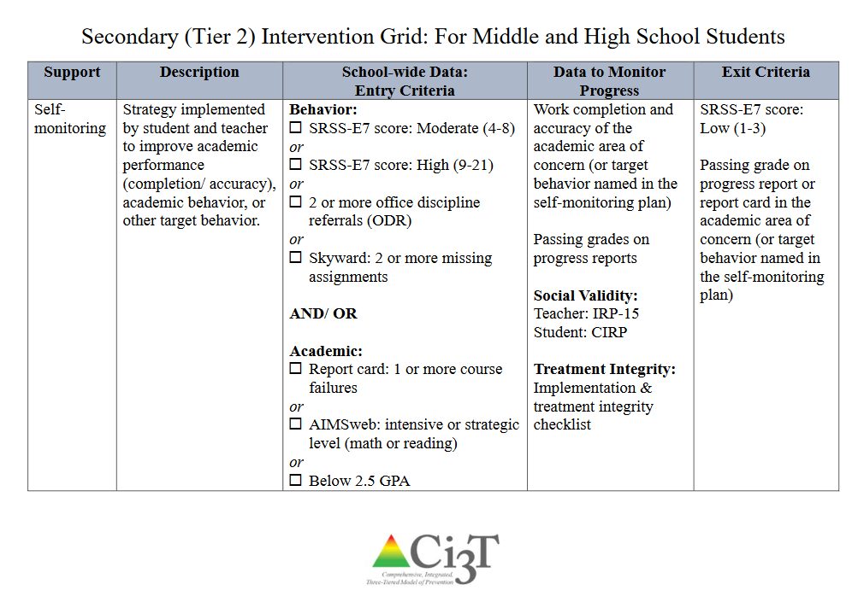

Slide 51
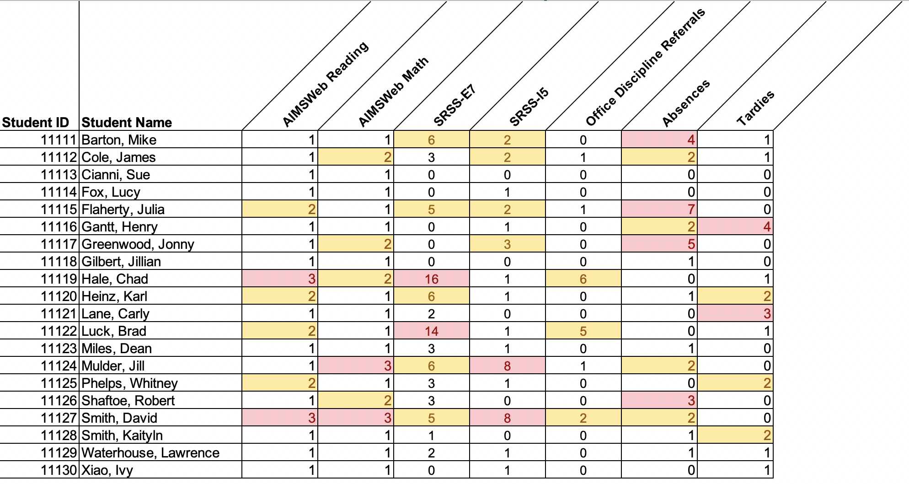
Data in action

Slide 52
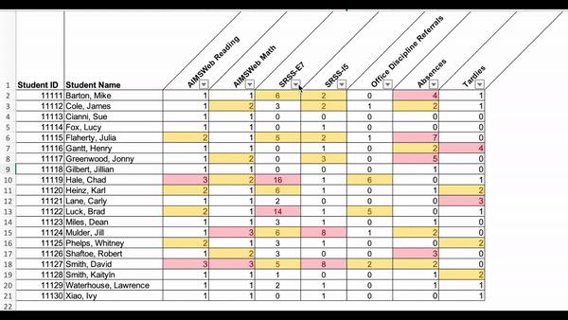
Data in action

Slide 53
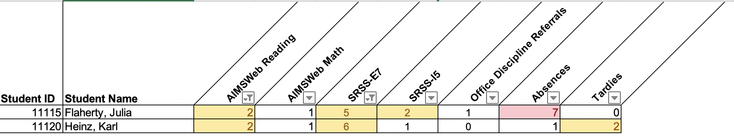
Data in action
Other Tier 2 options…
Precorrection
Behavior Contracts
Behavior Specific Praise
Instructional Choice

Slide 54
Planning Tier 2 Supports
Considering Treatment Integrity data to inform next steps:
TFI Item 2.3
Screening: Tier 2 team uses decision rules and multiple sources of data (e.g., ODRs, academic progress, screening tools, attendance, teacher/ family/student nominations) to identify students who require Tier 2 supports. | Multiple data sources used (e.g., ODRs, time out of instruction, attendance, academic performance) Team decision rubric Team meeting minutes School policy | 0 = No specific rules for identifying students who qualify for Tier 2 supports 1 = Data decision rules established but not consistently followed or used with only one data source 2 = Written policy exists that (a) uses multiple data sources for identifying students, and (b) ensures that families are notified promptly when students enter Tier 2 supports

Slide 55


Planning Tier 2 Supports
TFI Item 2.6
Options for Tier 2 Interventions: Tier 2 team has multiple ongoing behavior support interventions with documented evidence of effectiveness matched to student need. | School Tier 2 handbook Targeted Interventions Reference Guide | 0 = No Tier 2 interventions with documented evidence of effectiveness are in use 1 = Only 1 Tier 2 intervention with documented evidence of effectiveness is in use 2 = Multiple Tier 2 interventions with documented evidence of effectiveness matched to student need

Slide 56

Planning Tier 2 Supports:
An Example

Slide 57





Slide 58
What is Direct Behavior Rating (DBR)?
Brief rating during a specific time-period or instructional periods (e.g., whole group reading instruction, 1st period - Introduction to Algebra; Riley-Tillman et al., 2007)
Check-in with students before and after rating
  Opportunity to:
    Provide behavior specific praise
    Provide instructional feedback
Rating may be tied to reinforcement system
  Universal (Tier 1) reinforcement system if available (Chafouleas et al., n.d.)
Chafouleas, S. M., Riley-Tillman, T. C., Briesch, A., Christ, T. J., Fabiano, G. A., Kilgus, S. P., Miller, F. G., Sanetti, L. M., Welsh, M. E. (n.d.). Direct Behavior Ratings. https://dbr.education.uconn.edu/
Riley-Tillman, T.C., Chafouleas, S.M., & Briesch, A.M. (2007). A school practitioner’s guide to using daily behavior report cards to monitor student behavior. Psychology in the Schools, 44(1), 77-89. doi:10.1002/pits.20207

Slide 59
What is Direct Behavior Rating (DBR)?
Tool for sharing student’s successes and challenges with parents/guardians
Similar to Check-in/Check-out but does not require mentor or dedicated time at the beginning and end of school day
May include self-monitoring component
  Students may rate their own behavior alongside teacher-completed DBR

Slide 60



Examples of Direct Behavior Rating (DBR)

Slide 61
Direct Behavior Ratings (DBR):
Uses and Applications
Assessment
Intervention
Identify and define behaviors of concern and/or behaviors to increase (e.g., academic engagement)
Communication
Determine who/where/how often to collect behavior ratings
Regularly graph data to evaluate behavior, intervention
Adapted from: https://dbr.education.uconn.edu/
Notes:
WPO – the behavior or concern is used to set the goal for behavior to increase (true?)

Slide 62
Direct Behavior Ratings (DBR):
Uses and Applications
Assessment
Communication
Intervention
Tool to provide consistent feedback about student behavior to stakeholders (student, parent/guardians)
Encourage shared responsibility for student success
Encourages opportunities to celebrate pro-social behavior at school and at home
Adapted from: https://dbr.education.uconn.edu/

Slide 63
Direct Behavior Ratings (DBR):
Uses and Applications
Assessment
Communication
Intervention
Presents a format for goal setting, systematic feedback, and establishing reinforcement to promote positive behavior and reduce undesirable behavior
Provides opportunity to teach students to monitor and evaluate their own behavior
Adapted from: https://dbr.education.uconn.edu/

Slide 64
Why is Direct Behavior Rating (DBR) effective?
DBR is an efficient way to monitor change in behavior over time (Chafouleas et al, 2012)
DBR is a potential tool to facilitate home-school communication (Vannest et al. 2010)
DBR provides structured opportunities for teachers to provide
  Pre-correction
  Instructive feedback
  Behavior specific praise
Chafouleas, S. M., Sanetti, L. M., Kilgus, S. P., & Maggin, D. M. (2012). Evaluating sensitivity to behavioral change using direct behavior rating single-item scales. Exceptional Children, 78(4), 491-505.
Vannest, K. J., Davis, J. L., Davis, C. R., Mason, B. A., & Burke, M. D. (2010). Effective intervention for behavior with a daily behavior report card: A meta-analysis. School Psychology Review, 39(4), 654-672.

Slide 65
What does the supporting research for Direct Behavior Rating (DBR) say?
DBR effective in improving a variety of classroom behaviors including :
  Academic engagement
  Reducing disruption
Research on DBR shows positive effects for:
  Elementary or secondary students (Vannest et al. 2010)
  Students with ADHD (Fabiano et al, 2010; Jurbergs et al., 2010)
DBR is particularly effective when used to facilitate positive school-home communication (Vannest et al. 2010)
Fabiano, G. A., Vujnovic, R. K., Pelham, W. E., Waschbusch, D. A., Massetti, G. M., Pariseau, M. E., ... & Greiner, A. R. (2010). Enhancing the effectiveness of special education programming for children with attention deficit hyperactivity disorder using a daily report card. School Psychology Review, 39(2), 219.
Jurbergs, N., Palcic, J. L., & Kelley, M. L. (2010). Daily behavior report cards with and without home-based consequences: Improving classroom behavior in low income, African American children with ADHD. Child & Family Behavior Therapy, 32(3), 177-195.

Slide 66


Resources to support implementation of Direct Behavior Rating (DBR)
See “Direct Behavior Rating (DBR) Resource Guide” for additional supporting research and information.

Slide 67
What are the benefits and challenges?
Benefits
Requires fewer resources (e.g., time, people) than similar interventions (i.e., Check-in/Check-out)
Customizable to address specific needs
Online resources available for training
Potential to improve a variety of important classroom behaviors
Provides structure for increasing positive student-teacher interactions and attention
Challenges
Care needed to maintain positive communication with students when providing corrective feedback
Care needed to maintain positive communication with parents and families when providing feedback
Consider the needs of students motivated by escaping tasks or activities rather than accessing teacher attention

Slide 68

How do I implement Direct Behavior Rating (DBR) in my classroom? Implementation Checklist
Step 1
Identify students who might benefit using entry criteria from Ci3T Implementation Manual Secondary (Tier 2) Intervention Grid
Step 2
Define 1-3 behaviors to target (e.g., academic engagement).
Step 3
Determine specified observation periods/activities (i.e., time[s] of day or content area[s] to address [e.g., English and Language Arts, Science] and frequency of ratings [e.g., once daily, every 60 min]).
Step 4
Prepare the DBR form, establishing scale (e.g., 1-10) and anchors (e.g., not at all, half the time, all the time).

Slide 69
How do I implement Direct Behavior Rating (DBR) in my classroom? Implementation Checklist
Step 5
Seek input on DBR form and procedures from stakeholders (i.e., student, parent/caregiver) and incorporate feedback.
Step 6
Practice rating using online DBR Training Site (complete training until criteria is met).
Step 7
Teach the student the DBR procedures (reference DBR podcast for examples).
Step 8
Implement DBR procedures (see 05_DBR_Treatment_Integrity_Checklist)

Slide 70
How do I implement Direct Behavior Rating (DBR) in my classroom? Implementation Checklist
Step 9
Review data weekly.
Step 10
Seek input from student and families after 2-3 weeks

Slide 71

How do I use Direct Behavior Rating (DBR) in my classroom? Implementation Checklist

Slide 72
How well is it working?
Examining the Effects
Treatment Integrity
Is it happening?
Social Validity
What do stakeholders think about the goals, procedures, and outcomes?
Experimental Design
How well did this support work for this student?

Slide 73



Ensuring Direct Behavior Rating (DBR) is in place: Treatment Integrity
Have structures in place to monitor whether DBR carried out as intended.
Treatment Integrity Checklist:
I let the student know DBR would be used before starting each period/activity.
I regularly observed student throughout each period/activity.
I rated student’s behavior(s) during each period/activity.
I checked-in with the student after rating and provided behavior specific praise and instructional feedback.
I recorded the student’s behavior and treatment integrity data.
I shared the DBR with the parent/caregiver, noting one thing to praise and one to practice.

Slide 74


What does the student think about it?
Pre-
Post-

Slide 75


What does the teacher think about it?
See “Social Validity Adapted-IRP15 Adult”
Completed by the teacher(s) and parent(s) involved in the intervention at two time points:
Pre
and
Post
Intervention

Slide 76
Data to Progress Monitor –
Direct Behavior Rating (DBR)

Slide 77
Data to Progress Monitor –
Treatment Integrity

Slide 78

Data to Progress Monitor – Treatment Integrity

Slide 79
Sample Elementary Intervention Grid
Support | Description | School-wide Data: Entry Criteria | Data to Monitor Progress | Exit Criteria
Direct Behavior Rating (DBR) or Daily Behavior Report Card (DBRC) | DBR is typically completed daily following specified observation period(s) (e.g., math intervention; ELA core instruction). The most appropriate rater is a person who can directly observe the student during the observation period, typically the teacher. DBR is used to monitor specific behaviors identified as relevant for the student and setting. For example, many DBRs monitor academic engagement, respect, and disruption as core school-based behavioral competencies, and may adapt or add a behavior based on the student’s specific needs. After each observation period, the rater uses the provided scale to indicate the degree to which the student displayed each behavior. When used as part of a Tier 2 intervention, the rater reminds the students of the expected behaviors prior beginning the observation. At the conclusion of each observation, the rater uses the provided scale to indicate the degree to which the student displayed each behavior. The rater meets briefly with the student to share the DBR rating, providing behavior specific praise and instructional feedback. Home-school communication procedures may be established (e.g., information is shared with parent/caregiver daily, with return acknowledgement and possible home consequences). | Behavior SRSS-E7 score: Moderate (4-8) and/or SRSS-I5 score: Moderate (2-3) AND Evidence of teacher implementation of Ci3T primary (Tier 1) plan [treatment integrity: direct observation] AND Parent permission, in accordance with district policy | Student measures Direct Behavior Rating (DBR; daily) Social validity Teacher: IRP-15 Student: DBR Student Social Validity form/interview Treatment integrity DBR treatment integrity measure | Student goals met for 10-12 weeks (team review of progress to determine) SRSS-E7 and I5 scores are in the low risk category

Slide 81
Planning and Implementing Tier 3 Interventions

Slide 82

Tertiary (Tier 3) Intervention Grids

Slide 83
Schoolwide Positive
Behavior Support
Comprehensive, Integrative,
Three-Tiered (Ci₃T)
Models of Support
Low-Intensity Strategies
Basic Classroom Management
Effective Instruction
Low-Intensity Strategies
Behavior Contracts
Self-Monitoring
- -
Functional Assessment-Based
Interventions
Higher-Intensity
Strategies
Assess, Design, Implement,
and
Evaluate
Assessment

Slide 84



Slide 85

Changes in Harry’s Behavior
Cox, M., Griffin, M. M., Hall, R., Oakes, W. P., & Lane, K. L. (2012). Using a functional assessment-based intervention to increase academic engaged time in an inclusive middle school setting. Beyond Behavior, 2, 44 – 54.

Slide 86





Slide 87


Slide 89



Ci3T Professional Learning Resources

Slide 90
Let’s Talk!
Read over the list of Tier 2 and Tier 3 supports listed in your school’s Ci3T Implementation Manual.
Jigsaw: For this breakout session, divide up your team members to attend these sessions:
  Tier 2 Direct Behavior Rating
  Tier 2 Self-monitoring
  Tier 2 Self-regulated Strategy Development (SRSD) for writing
  Tier 3 Individualized De-escalation Plan
  Tier 3 Functional Assessment-based Intervention (FABI)
Post in the chat the one you would like to attend so your Ci3T Leadership Team members can divide up to learn more!
Notes:
10-min timer

Slide 91
Tier 2 Direct Behavior Rating

Slide 92
Tier 2 Self-monitoring

Slide 93
Tier 2 Self-regulated Strategy Development (SRSD) for Writing

Slide 94
Tier 3 Individualized De-escalation Plan

Slide 95
Tier 3 Functional Assessment-based Intervention (FABI)

Slide 96


Building a Ci3T Tier Library
Teacher-Delivered Strategies (T1 T2)
Tier 1
Tier 2
Tier 3

Slide 97



Planning Tier 2 and Tier 3 Supports:
Structures for Success
Example of Tier 2 Intervention Drive in shared digital space

Slide 98

Planning Tier 2 and Tier 3 Supports:
Structures for Success

Slide 99
Find students who need support
Identify classrooms in which Tier 1 is implemented with integrity
Use screening data to find students with moderate risk
Consider students demonstrating risk across academic
and
behavioral domains…

Slide 100

Planning Tier 2 and Tier 3 Supports
Monitor who is receiving Tier 2 and Tier 3 supports
Store data in a secure location accessible to relevant parties

Slide 101
Planning Tier 2 and Tier 3 Supports
Considering Treatment Integrity data to inform next steps:
TFI Item 2.3
Level of Use: Team follows written process to track proportion of students participating in Tier 2 supports, and access is proportionate. | Tier 2 enrollment data Tier 2 team meeting minutes Progress monitoring tool | 0 = Team does not track number of students responding to Tier 2 interventions 1 = Team defines criteria for responding to each Tier 2 intervention and tracks students, but fewer than 5% of students are enrolled 2 = Team defines criteria and tracks proportion, with at least 5% of students receiving Tier 2 supports

Slide 102

Planning Tier 2 and Tier 3 Supports :
Structures for Success

Slide 103

Planning Tier 2 and Tier 3 Supports :
Structures for Success

Slide 104


Planning Tier 2 and Tier 3 Supports

Slide 105
Planning Tier 2 and Tier 3 Supports

Slide 106
Let’s Talk!
Share out with your team:
  Tier 2 Direct Behavior Rating
  Tier 2 Self-monitoring
  Tier 2 Self-regulated Strategy Development (SRSD) for writing
  Tier 3 Individualized De-escalation Plan
  Tier 3 Functional Assessment-based Intervention (FABI)
What structures are in place to support teachers using data to connect students to Tier 2 and 3 supports?
Action Planning: What would you like to share out with your faculty and staff about Tier 2 and Tier 3 supports?
Notes:
10-min timer

Slide 107

Ci3T TI: Direct Observation
  Survey for all faculty and staff
  Measures treatment integrity and social validity of Tier 1 Ci3T implementation
  Observe 25% of instructional staff
  Measures treatment integrity of Tier 1 Ci3T implementation
  Educator and observer perspectives
  Tier 1, 2, and 3 protocols completed by Ci3T Leadership Team
  Measures treatment integrity of SW-PBIS
  Tier 1 Walkthrough
Ci3T Treatment Integrity:
Teacher Self-Report
&
Primary Intervention Rating Scale
Survey
Tiered Fidelity Inventory (TFI)

Slide 108
Wrapping Up and Moving Forward

Slide 109
Ci3T
Comprehensive Professional Learning Plan
Ci3T: Primary Prevention
Session 1:
Overview of Ci3T Prevention Models
Setting a Purpose
Establish team meetings and roles
Session 2:
Mission and Purpose
Establish Roles and Responsibilities
Procedures for Teaching
Procedures for Reinforcing
Reactive Plan
Session 3:
Procedures for Monitoring
Session 4:
Revise Primary Plan using Stakeholder feedback
Prepare presentation
Ci3T: Secondary Prevention
Session 5:
Overview of Teacher focused Strategies
Overview of Student Focused Strategies
Using data to determine which students may need Secondary (Tier 2) supports
Draft the Secondary Intervention Grid based on existing supports
Ci3T: Tertiary Prevention
Session 6:
Final revisions of Ci3T Plan based on stakeholder feedback
Draft Tertiary (Tier 3) Prevention Intervention Grids
Design Implementation Manual and Plan for roll out to faculty, students, and parents
Ci3T Leadership Team Training Sequence
Implementation Stages of Tier 2 and 3 within Ci3T
Additional Professional Development on Specific Topics
Core Content Curriculum
Check In - Check Out
Functional Assessment-based Interventions
Reading, Math, Writing Benchmarking and Progress Monitoring Tools
Interventions, Strategies, & Practices
Additional Tier 3 Supports
Instructional Techniques to Improve Students’ Motivation; Classroom Management Practices;
Low-Intensity Behavior Supports

Slide 110
Ci3T Professional Learning Calendar
 | July | Aug | Sep | Oct | Nov | Dec | Jan | Feb | Mar | Apr | May | Jun
Ci3T Training |  |  |  |  | Ci3T Professional Learning Series Session 1 | Ci3T Professional Learning Series Session 2 | Ci3T Professional Learning Series Session 3 | Ci3T Professional Learning Series Session 4 |  | Ci3T Professional Learning Series Session 5 | Ci3T Professional Learning Series Session 6
Ci3T Implementation Support | Ci3T Implementation Series Prep Session |  | Ci3T Implementation Series Session 1 |  | Ci3T Implementation Series Session 2 |  | Ci3T Implementation Series Session 3 |  | Ci3T Implementation Series Session 4 | Ci3T Implementation Series Session 5
Ci3T EMPOWER |  |  | Ci3T EMPOWER Session 1 | Ci3T EMPOWER Session 2 | Ci3T EMPOWER Session 3 |  | Ci3T EMPOWER Session 4 |  | Ci3T EMPOWER Session 5 | Ci3T EMPOWER Session 6
Ci3T Trainers & Coaches Calls |  | Trainers & Coaches Call Session 1 | Trainers & Coaches Call Session 2 | Trainers & Coaches Call Session 3 | Trainers & Coaches Call Session 4 | Trainers & Coaches Call Session 5 | Trainers & Coaches Call Session 6 | Trainers & Coaches Call Session 7 | Trainers & Coaches Call Session 8 | Trainers & Coaches Call Session 9 | Trainers & Coaches Call Session 10

Slide 111


Accessing Project EMPOWER Professional Learning

Slide 112

Project EMPOWER - Traditional
Ci3T EMPOWER Sessions Location: Remote via Zoom Attended by: School Ci3T Leadership Teams, Ci3T District Trainers and Coaches, Faculty and Staff, Families (adults only). Community Members |  | Times (Pacific) | Times (Central) | Times (Eastern)
1. Getting Started | Sep. 21, 2022 (Wed) | 3:00 – 5:00 p.m. | 5:00 – 7:00 p.m. | 6:00 – 8:00 p.m.
2. Screening | Oct. 20, 2022 (Th) | 3:00 – 5:00 p.m. | 5:00 – 7:00 p.m. | 6:00 – 8:00 p.m.
3. Low Intensity Supports (2) | Nov. 15, 2022 (Tu) | 3:00 – 5:00 p.m. | 5:00 – 7:00 p.m. | 6:00 – 8:00 p.m.
4. Tier 2 | Jan. 11, 2023 (Wed) | 3:00 – 5:00 p.m. | 5:00 – 7:00 p.m. | 6:00 – 8:00 p.m.
5. Tier 3 | Mar. 22, 2023 (Wed) | 3:00 – 5:00 p.m. | 5:00 – 7:00 p.m. | 6:00 – 8:00 p.m.
6. Moving Forward | Apr. 27, 2023 (Th) | 3:00 – 5:00 p.m. | 5:00 – 7:00 p.m. | 6:00 – 8:00 p.m.

Slide 113
Wrap Up and Preview
Today
Next time
Data-Informed Decision-Making
Integrated Lesson Planning at Tier 1
Planning and Implementing Tier 2 Interventions
Planning and Implementing Tier 3 Interventions
Procedures for Monitoring
  Review your School’s Social Validity & Treatment Integrity Data
  Review your School’s Spring Screening Data
Planning for the Year Ahead 2023-2024
Focusing on Data-Informed Professional Learning

Slide 114
Please Take a Minute to Get Organized
Please stay until all materials are organized.
Team Materials:
  Make sure your notes are in your Ci3T Leadership Team agenda and that document is saved in your Ci3T Leadership Team Drive.
  Clearly identify the person(s) on your team
  in charge of each action item listed on the agenda.
Thank you!

Slide 115

Homework
At your next Ci3T Leadership Team meeting:
  Confirm plans to support completion of spring screening
  Refine and implement plans to share resources and support faculty and staff around Tier 2 and Tier 3 supports
  Make preliminary plans for faculty and staff to complete
    Treatment integrity and social validity surveys during the spring timepoint
    Teacher well-being and input measures during the spring timepoint
  Complete Tiered Fidelity Inventory (TFI) protocols for the spring timepoint
At your next faculty meeting:
  Share professional learning resources and opportunities around Tier 2 and Tier 3 interventions (see ci3t.org/pl and ci3t.org/fabi)

Slide 116


