Slide 1
Systematic Screening in Integrated Tiered Systems:
What do I need to know?
Kentucky Council for Children with Behavior Disorders (KY CCBD)
June 17, 2022
Kathleen Lynne Lane, Ph.D., BCBA-D, CF-L1
Notes:
Abstract: In this session, we introduce systematic screening in integrated tiered systems of support. We provided illustrations of how we have collaborated with district partners to use data from the Student Risk Screening Scale for Internalizing and Externalizing (SRSS-IE) behaviors – a free access systematic screening tool – within Comprehensive, Integrated, Three-tiered (Ci3T) models of prevention designed to meet students’ academic, behavioral, and social and emotional well-being needs – with Positive Behavioral Interventions and Supports (PBIS) as the center stone of this integrated tiered systems. We provide information on screening logistics ranging from selecting, installing, and using screening data. Illustrations include information on how to (a) inform instruction at Tier 1, (b) select teacher-delivered strategies, and (c) connect students to validated Tier 2 and Tier 3 supports. We share free-access resources and tools.

Slide 2

ci3t.org

Slide 3
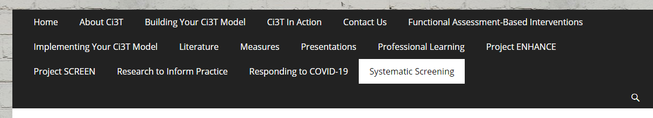
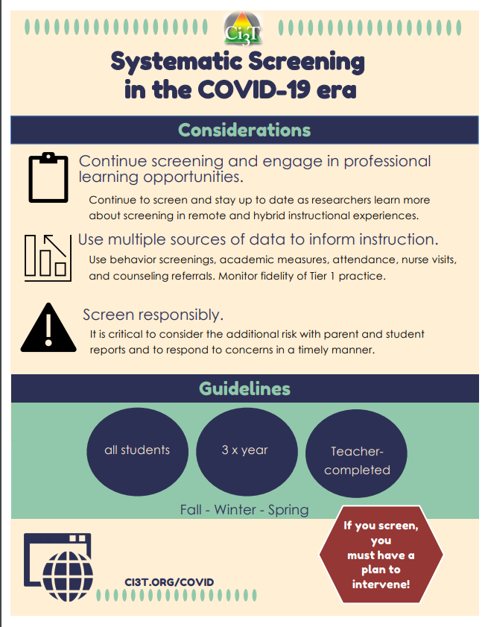
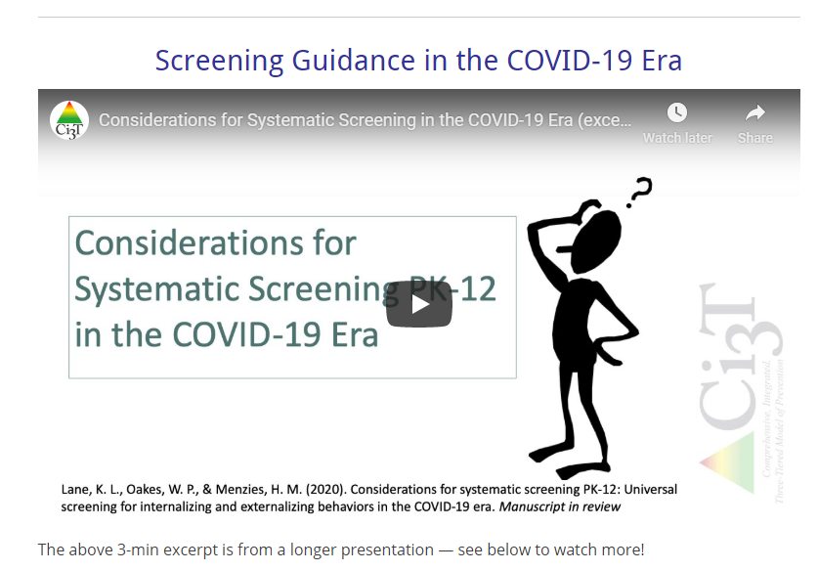
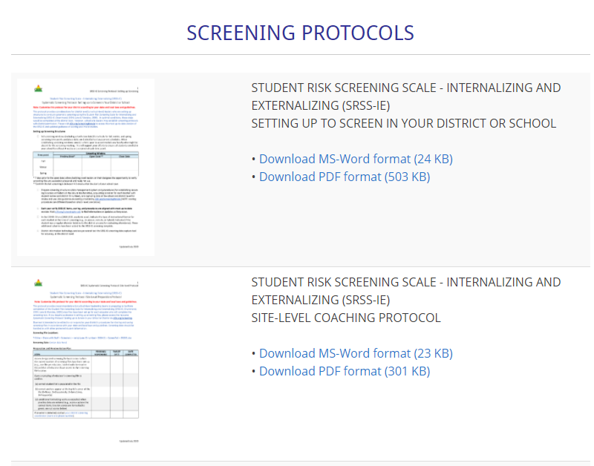

Slide 4
Agenda
Introducing Ci3T… a Comprehensive, Integrated, Three-Tiered Model of Prevention
A Closer Look at the Student Risk Screening Scale for Internalizing & Externalizing Behaviors (SRSS-IE)
The Role of Screening: Using Screening Data to Inform Instruction
  At Tier 1: Primary Preventions Efforts
  At all Tiers: Teacher-delivered Strategies
  At Tiers 2 & 3: Secondary & Tertiary Prevention Efforts
Systematic Screening Logistics:
  Selecting
  Installing
  Using
Planning for Next Steps

Slide 5
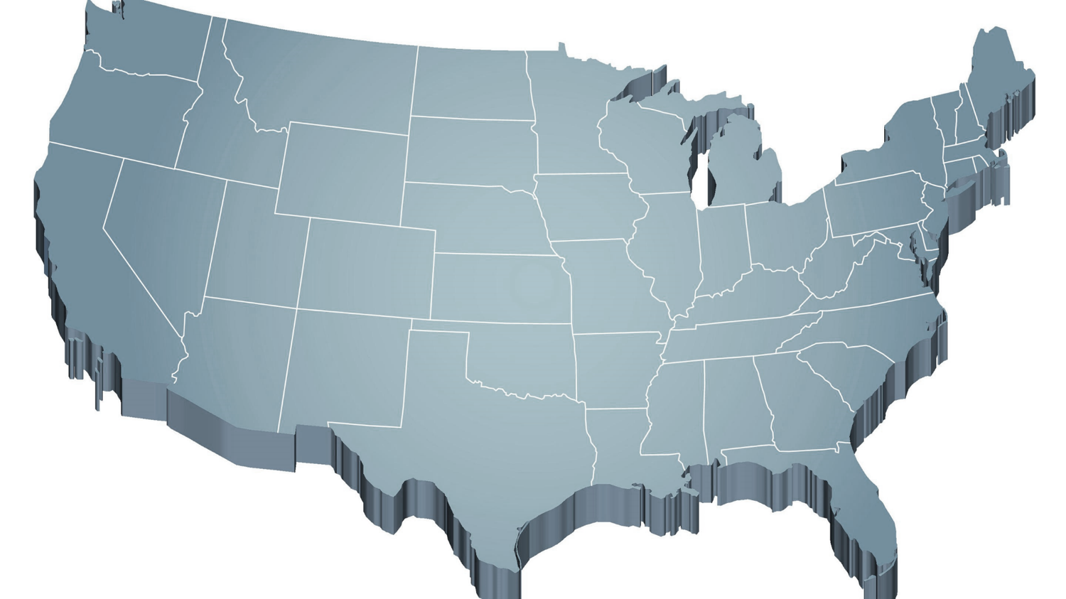
Thank you…
For Your Commitment
Internalizing
Externalizing
ED <1%
EBD 12-20%
Source: Forness, S.R., Freeman, S.F., Paparella, T., Kauffman, J.M., & Walker, H.M. (2012). Special education implications of point and cumulative prevalence for children with emotional or behavioral disorders. Journal of Emotional and Behavioral Disorders, 20, 4-18.

Slide 6
Agenda
Introducing Ci3T… a Comprehensive, Integrated, Three-Tiered Model of Prevention
A Closer Look at the Student Risk Screening Scale for Internalizing & Externalizing Behaviors (SRSS-IE)
The Role of Screening: Using Screening Data to Inform Instruction
  At Tier 1: Primary Preventions Efforts
  At all Tiers: Teacher-delivered Strategies
  At Tiers 2 & 3: Secondary & Tertiary Prevention Efforts
Systematic Screening Logistics:
  Selecting
  Installing
  Using
Planning for Next Steps

Slide 7
Comprehensive, Integrated, Three-Tiered Model of Prevention
(Lane, Kalberg, & Menzies, 2009)
Tier 3
Tertiary Prevention (≈5%)
Tier 2
Secondary Prevention (≈15%)
Tier 1
Primary Prevention (≈80%)
Academic ◇ Behavioral ◇ Social
Validated Curricula PBIS Framework Validated Curricula

Slide 8




The Journey of Ci3T: Respectful Partnerships
1997
Notes:
CA & AZ start→ Tennessee → North Carolina→ Kansas
Trainings (MO, KANSAS, VERMONT, AZ)
MO, KS, UAB
HI

Slide 9
Comprehensive, Integrated, Three-Tiered Model of Prevention
(Lane, Kalberg, & Menzies, 2009)
Tier 3
Tertiary Prevention (≈5%)
Tier 2
Secondary Prevention (≈15%)
District & State Standards
High Quality Instruction
Tier 1
Primary Prevention (≈80%)
Academic ◇ Behavioral ◇ Social
Validated Curricula PBIS Framework Validated Curricula

Slide 10
Comprehensive, Integrated, Three-Tiered Model of Prevention
(Lane, Kalberg, & Menzies, 2009)
Tier 3
Tertiary Prevention (≈5%)
Tier 2
Secondary Prevention (≈15%)
Positive Behavior Interventions and Supports (PBIS)
Tier 1
Primary Prevention (≈80%)
Academic ◇ Behavioral ◇ Social
Validated Curricula PBIS Framework Validated Curricula

Slide 11
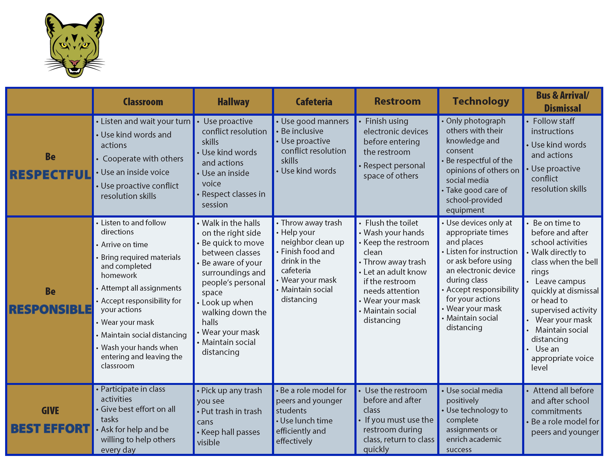
Coolidge Middle School
Expectation Matrix
Establish, Clarify, Define Expectations

Slide 12




Comprehensive, Integrated, Three-Tiered Model of Prevention
(Lane, Kalberg, & Menzies, 2009)
Tier 3
Tertiary Prevention (≈5%)
Tier 2
Secondary Prevention (≈15%)
Positive Action
Tier 1
Primary Prevention (≈80%)
Academic ◇ Behavioral ◇ Social
Validated Curricula PBIS Framework Validated Curricula

Slide 13
The Five Social and Emotional Learning Core Competencies
Self-awareness
Responsible Decision making
Relationship Skills
Social Awareness
Self-management
Social & Emotional Learning
(CASEL, 2020)

Slide 14
Outcomes Associated with Social Skills Training
Explicit social-emotional learning (SEL) skills instruction
SEL skills acquisition
Improved attitudes about self, others, and school
Positive social behavior
Fewer conduct problems
Less emotional distress
Academic success
(CASEL, 2020)

Slide 15
Social Component:
Examples of Schoolwide Programs
Social-emotional
Connect With Kids
connectwithkids.com
Character Education
A curricula using real stories presented through documentary-style videos, non-fiction books, teaching guides and patent resources.
Attendance and achievement
Bullying and violence prevention
Character and Life skills
Digital citizenship
Alcohol and drug prevention
Health and Wellness
Customizable units are:
Positive Action
www.positiveaction.net
Improves academics, behavior, and character
Curriculum-based approach
Effectively increases positive behaviors and decreases negative behaviors
6-7 units per grade
Optional components:
  site-wide climate development
  drug education
  bullying / conflict resolution
  counselor, parent, and family classes
  community/coalition components

Slide 16
Top 10 School-related Social Skills
Listens to Others
Follows Directions
Follows Classroom Rules
Ignores Peer Distractions
Asks for Help
Takes Turns in Conversations
Cooperates With Others
Controls Temper in Conflict Situations
Acts Responsibly With Others
Shows Kindness to Other
(Lane et al. 2004, 2007; Gresham & Elliott, 2008)

Slide 17
Comprehensive, Integrated, Three-Tiered Model of Prevention
(Lane, Kalberg, & Menzies, 2009)
Tier 3
Tertiary Prevention (≈5%)
Tier 2
Secondary Prevention (≈15%)
Tier 1
Primary Prevention (≈80%)
Academic ◇ Behavioral ◇ Social
Validated Curricula PBIS Framework Validated Curricula

Slide 18
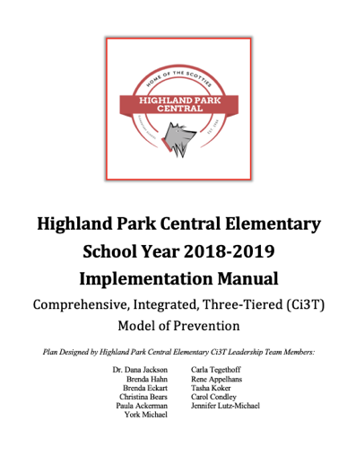
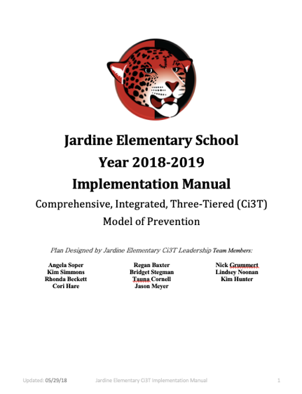
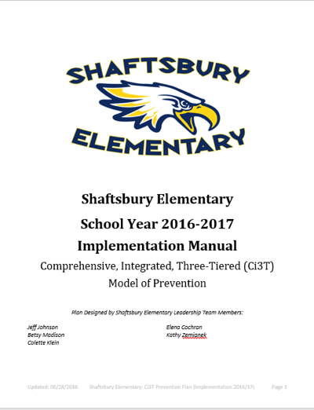
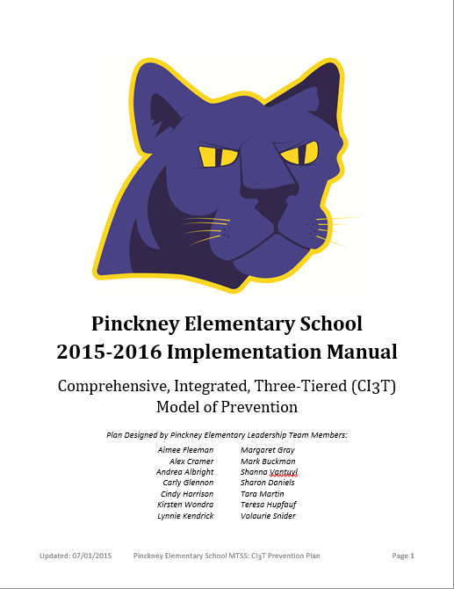
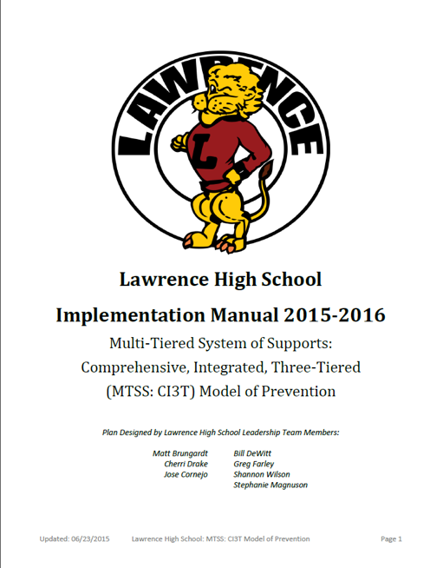
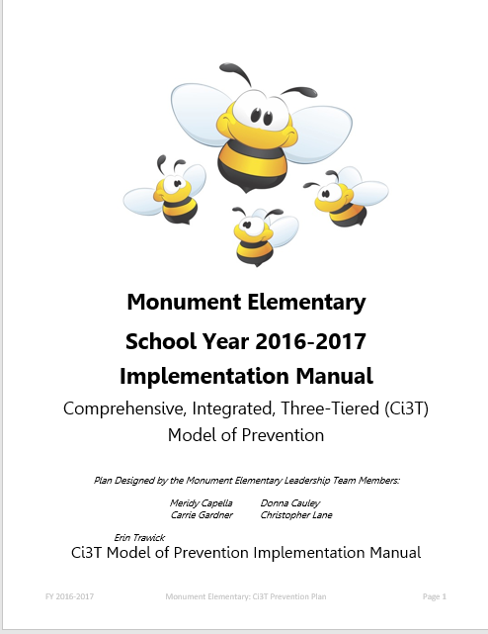
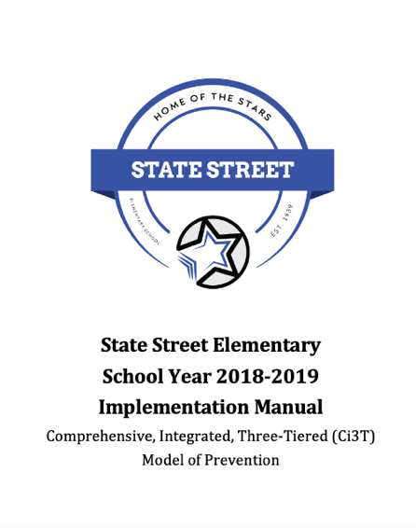
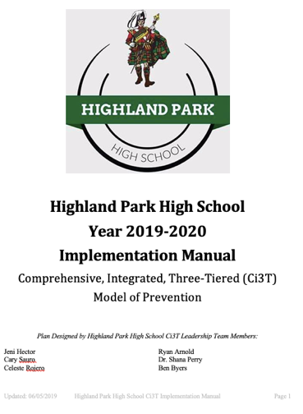

Slide 19
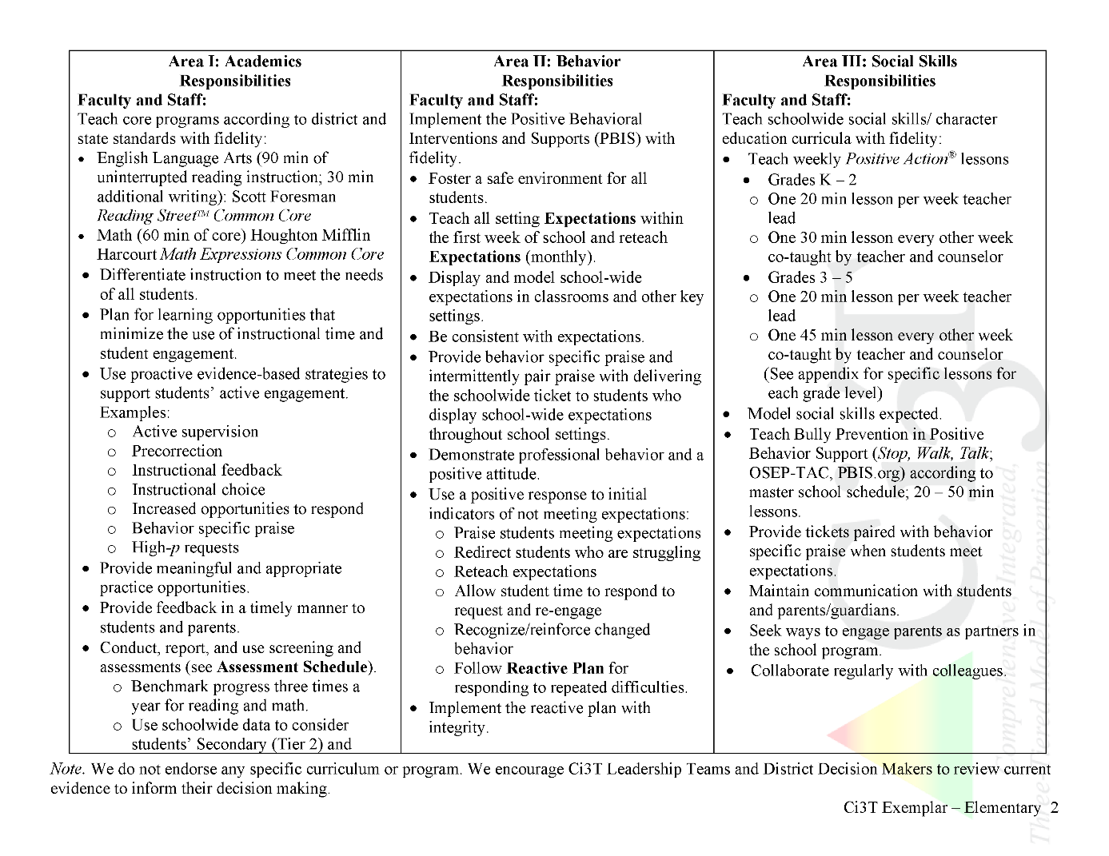

Ci3T Primary Plan: Procedures for Teaching
Ci3T Primary Plan: Procedures for Reinforcing
Ci3T Primary Plan: Procedures for Monitoring
Notes:
Continued to keep implementation manuals, which are foundational to Ci3T, updated and current

Slide 20
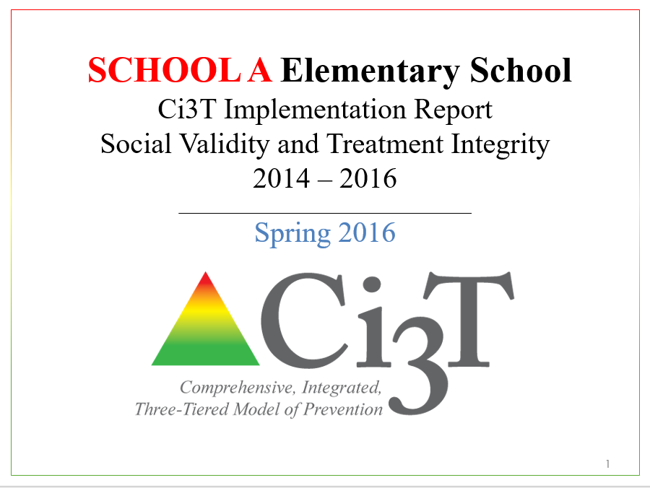
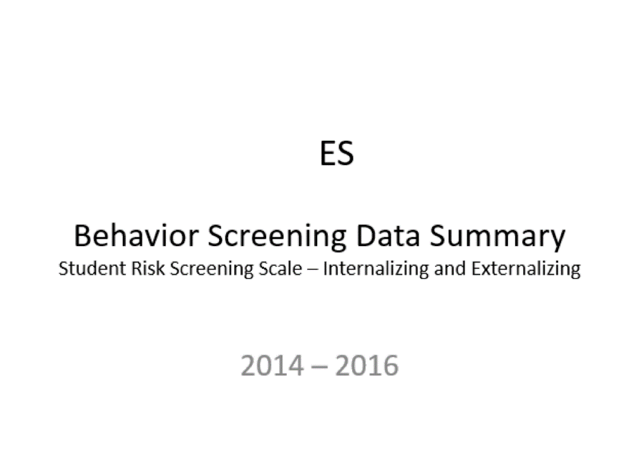
Essential Components of
Primary Prevention Efforts
Social Validity
Systematic Screening
Academic
Behavior
Treatment Integrity
Notes:
We support our school partners in administering surveys to their faculty and staff to garner understanding of social validity, conduct observations and self-reports to assess treatment integrity, and support systematic screening of all students for academics and behavior. We believe that schools thrive when faculty and staff are keenly aware of their school-wide data (show the next three slides)
KEEP THIS FOR LATER IN SLIDE: All schools wanted to continue “how” not “should”

Slide 21


Slide 22


Slide 23
Comprehensive, Integrated, Three-Tiered Model of Prevention
(Lane, Kalberg, & Menzies, 2009)
Tier 3
Tertiary Prevention (≈5%)
Tier 2
Secondary Prevention (≈15%)
Tier 1
Primary Prevention (≈80%)
Academic ◇ Behavioral ◇ Social
Validated Curricula PBIS Framework Validated Curricula

Slide 24
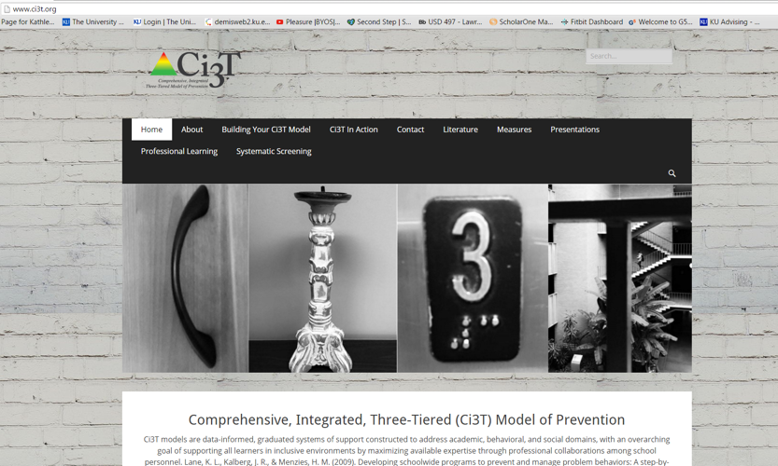
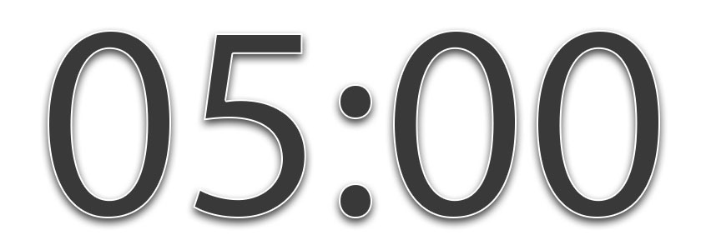

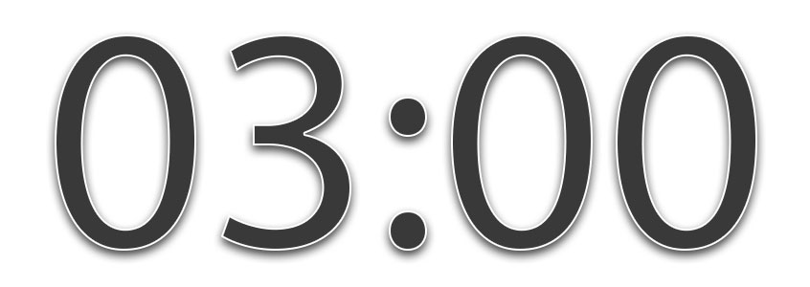
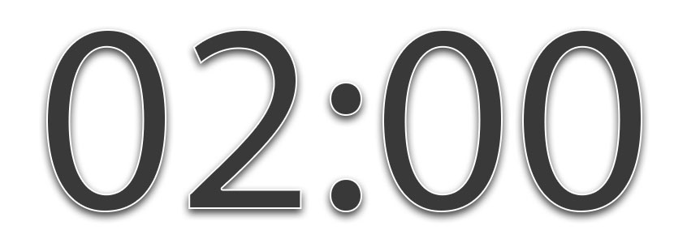



How do you currently look for students who need more than Tier 1 efforts?
Notes:
5-min timer

Slide 25
Agenda
Introducing Ci3T… a Comprehensive, Integrated, Three-Tiered Model of Prevention
A Closer Look at the Student Risk Screening Scale for Internalizing & Externalizing Behaviors (SRSS-IE)
The Role of Screening: Using Screening Data to Inform Instruction
  At Tier 1: Primary Preventions Efforts
  At all Tiers: Teacher-delivered Strategies
  At Tiers 2 & 3: Secondary & Tertiary Prevention Efforts
Systematic Screening Logistics:
  Selecting
  Installing
  Using
Planning for Next Steps

Slide 26
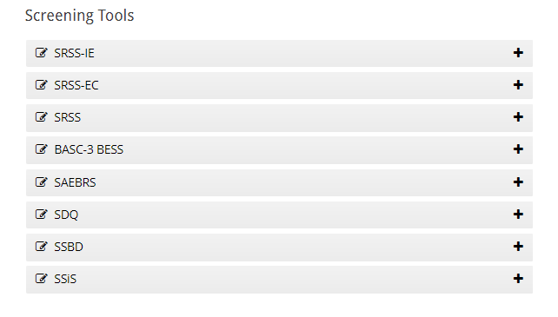
Student Risk Screening Scale – Internalizing and Externalizing (SRSS-IE)
Drummond, 1994; Lane & Menzies, 2009

Slide 27
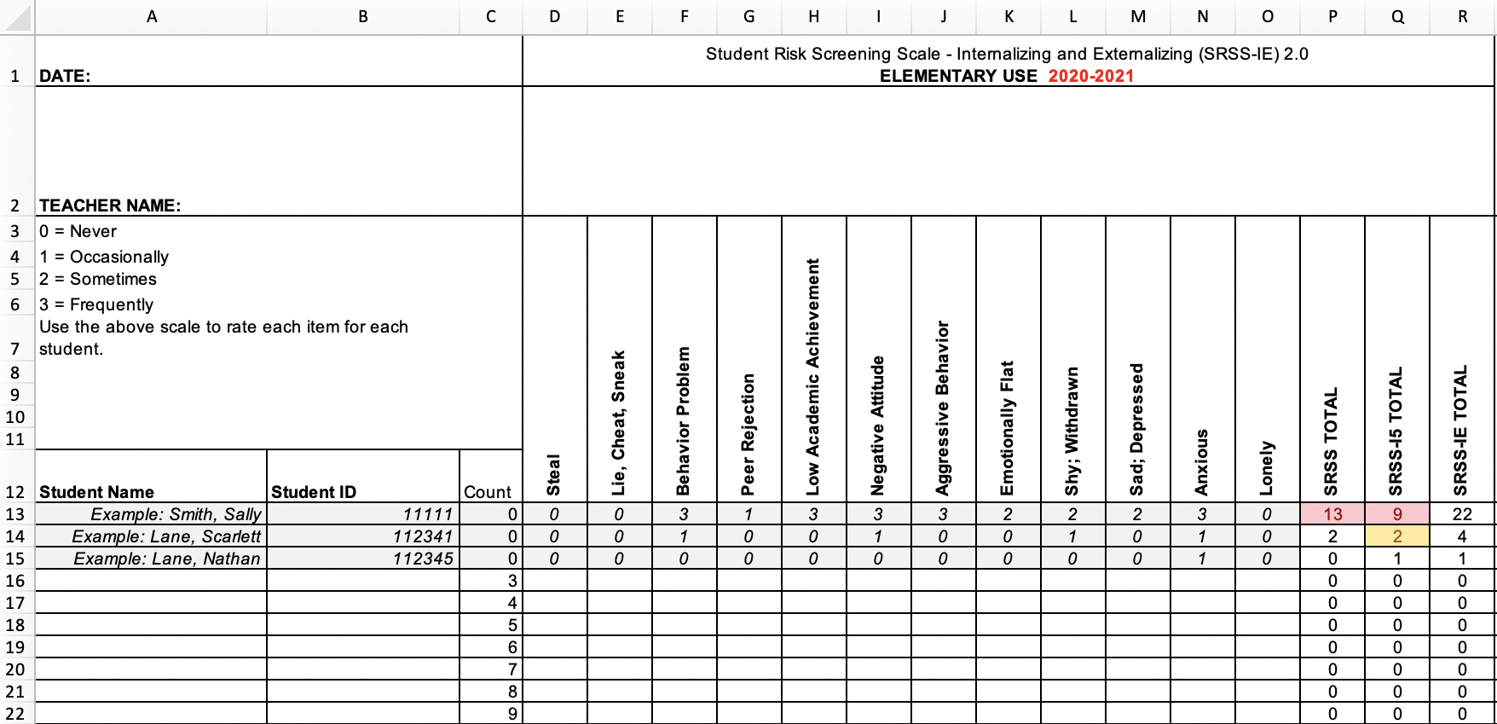
Student Risk Screening Scale – Internalizing and Externalizing (SRSS-IE; Drummond, 1994; Lane & Menzies, 2009)
Elementary

Slide 28
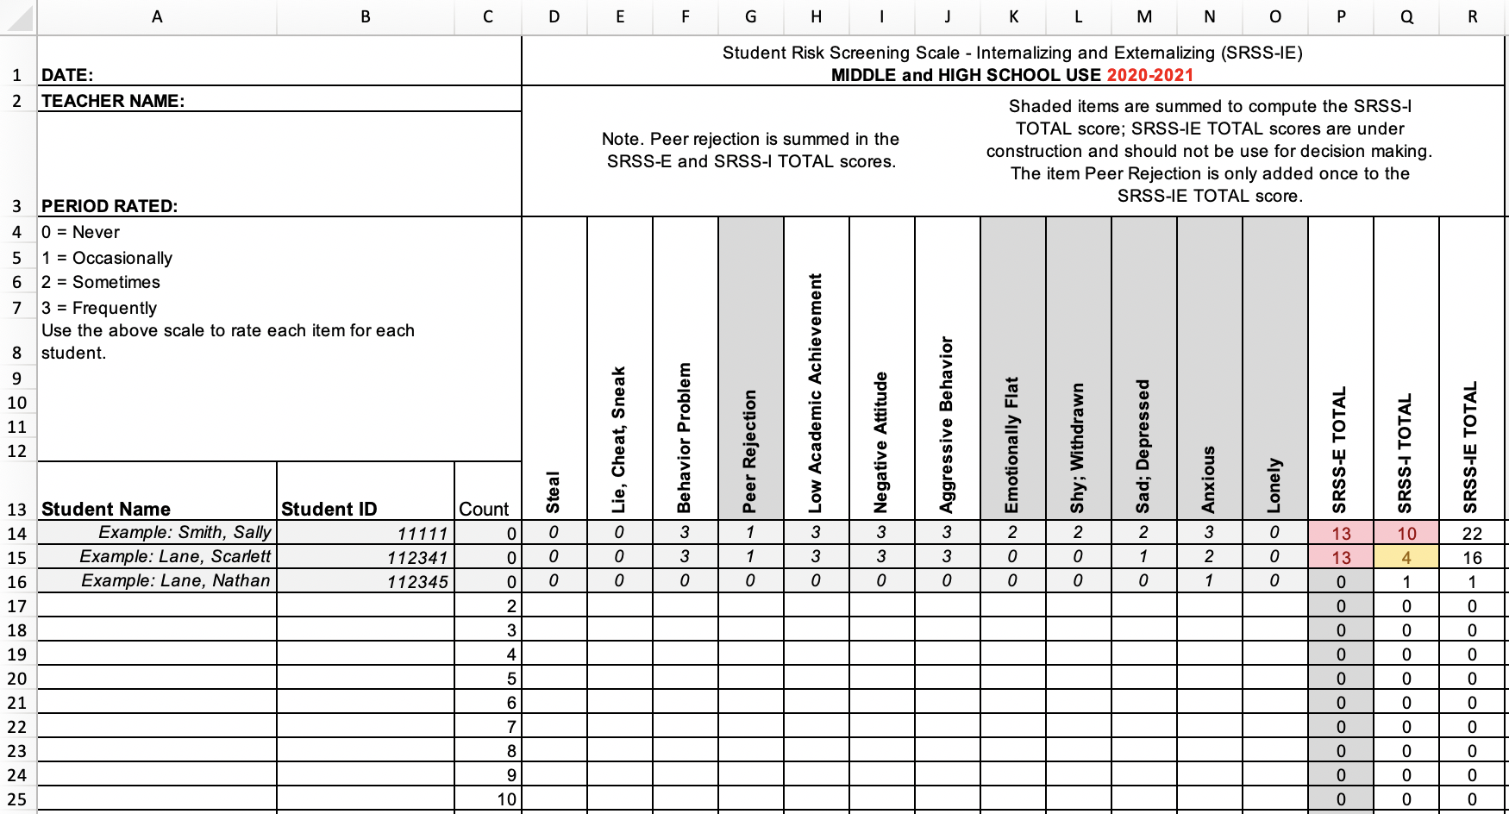
Student Risk Screening Scale – Internalizing and Externalizing (SRSS-IE; Drummond, 1994; Lane & Menzies, 2009)
Secondary

Slide 29
SRSS-IE: Cut Scores
Elementary School |  | Middle and High School
SRSS-E7 | SRSS-I5 | SRSS-E7 | SRSS-I6
Items 1-7 | Items 8-12 | Items 1-7 | Items 4, 8-12
0-3 = low risk 4-8 = moderate risk 9-21 = high risk | 0-1 = low risk 2-3 = moderate risk 4-15 = high risk | 0-3 = low risk 4-8 = moderate risk 9-21 = high risk | 0-3 = low risk 4-5 = moderate risk 6-18 = high risk
Elementary School Level:
Lane, K. L., Oakes, W. P., Swogger, E. D., Schatschneider, C., Menzies, H., M., & Sanchez, J. (2015). Student risk screening scale for internalizing and externalizing behaviors: Preliminary cut scores to support data-informed decision making. Behavioral Disorders, 40, 159-170.
Middle and High School Levels:
Lane, K. L., Oakes, W. P., Cantwell, E. D., Schatschneider, C., Menzies, H., Crittenden, M., & Messenger, M. (2016). Student Risk Screening Scale for Internalizing and Externalizing Behaviors: Preliminary cut scores to support data-informed decision making in middle and high schools. Behavioral Disorders, 42(1), 271-284

Slide 30
Fall 2021
SRSS-Externalizing Results – School level
n = 34
n = 40
n = 33
n = 10
n = 19
n = 35
n = 34
n = 35
n = 41
n = 52
n = 42
n = 26
n = 35
n = 52
n = 52
n = 61
n = 153
n = 135
n = 127
n = 146
n = 137
n = 109
n = 91
n = 135
Notes:
Fill in <year> based on current academic year. This is located in column A of the data sheet. Edit by right clicking and selecting “Edit data”.

Slide 31
Fall 2021
SRSS-Internalizing Results – School level
n = 31
n = 42
n = 39
n = 49
n = 18
n = 26
n = 61
n = 46
n = 44
n = 37
n = 35
n = 46
n = 27
n = 31
n = 38
n = 30
n = 153
n = 148
n = 128
n = 136
n = 137
n = 134
n = 97
n = 101
Cut scores vary by school level:
Elementary (I5): Low (0-1), Moderate (2-3), High (4-15)
Middle and High (I6): Low (0-3), Moderate (4-5), High (6-18)
Notes:
Fill in <year> based on current academic year. This is located in column A of the data sheet. Edit by right clicking and selecting “Edit data”.
IMPORTANT NOTE: The INTERNALIZING subscale and CUT SCORES are specific to school level.
Elementary: SRSS-I5, Items 8-12, 0-1 = low risk, 2-3 = moderate risk, 4-15 = high risk
Middle and High: SRSS-I6, Items 4, 8-12, 0-3 = low risk, 4-5 = moderate risk, 6-18 = high risk

Slide 32
Fall 2020
SRSS-Externalizing Results – Grade level
Grade Level | N Screened | Low n (%) | Moderate n (%) | High n (%)
K | 69 | 65 (94.20%) | 3 (4.35%) | 1 (1.45%)
1 | 47 | 44 (93.62%) | 2 (4.26%) | 1 (2.13%)
2 | 68 | 56 (82.35%) | 10 (14.71%) | 2 (2.94%)

Slide 33
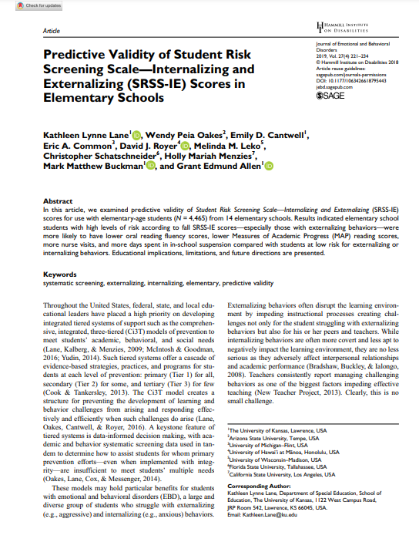
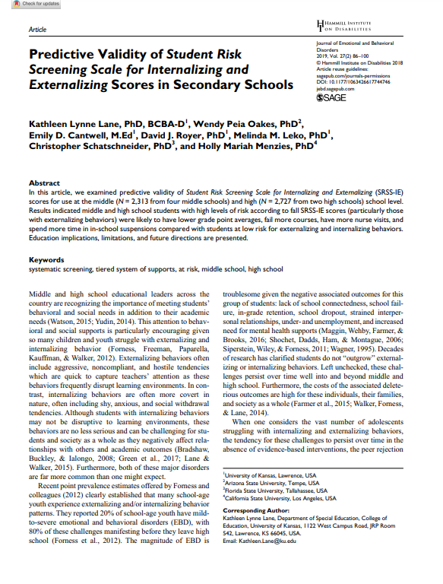
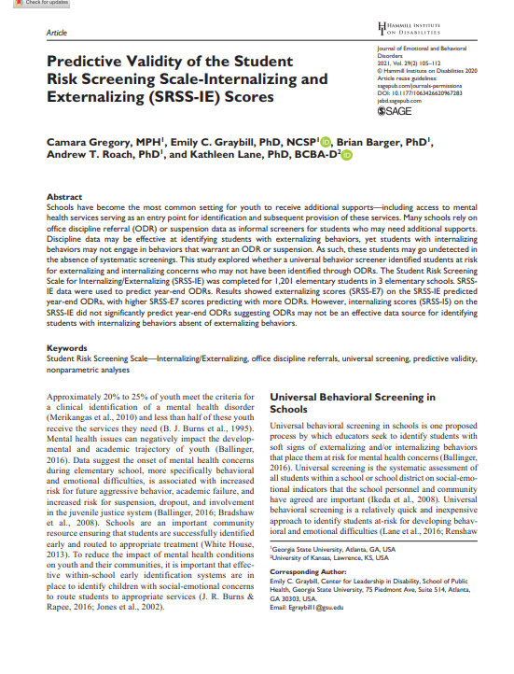

Slide 34
Results:
SRSS-IE: Externalizing Subscale Elementary
Fall Externalizing
Winter
Spring
ORF
MAP Reading
Nurse Visit
Suspensions
Variable | Risk |  |  | Significance Testing
 | Low M (SD) n | Moderate M (SD) n | High M (SD) n
Oral Reading Fluency | 163.23 (39.66) 468 | 138.62 (42.70) 107 | 115.82 (46.21) 46 | L > M > H
MAP Reading | 66.54 (26.48) 2,047 | 42.91 (30.37) 443 | 33.32 (29.82) 199 | L > M > H
Nurse Visits | 6.14 (6.81) 3,256 | 9.18 (9.59) 820 | 11.83 (9.89) 389 | L < M < H
In-School Suspensions | 0.0052 (0.08) 3,256 | 0.0427 (0.30) 820 | 0.1080 (0.46) 389 | L < M < H
Lane, K. L., Oakes, W. P., Cantwell, E. D., Common, E. A., Royer, D. J., Leko, M., Schatschneider, C., Menzies, H. M., Buckman, M. M., & Allen G., E. (2019). Predictive validity of Student Risk Screening Scale for Internalizing and Externalizing (SRSS-IE) scores in elementary schools. Journal of Emotional and Behavioral Disorders, 27(4), 221-234. https://doi.org/10.1177/1063426618795443

Slide 35
Results:
SRSS-IE: Internalizing Subscale Elementary
Variable | Risk |  |  | Significance Testing
 | Low M (SD) n | Moderate M (SD) n | High M (SD) n
Oral Reading Fluency | 159.04 (41.45) 459 | 150.59 (45.76) 88 | 139.18 (46.53) 74 | L > H L = M; M = H
MAP Reading | 63.38 (28.32) 2,070 | 53.93 (32.15) 356 | 43.57 (30.47) 263 | L > M > H
Nurse Visits | 6.84 (7.37) 3,387 | 7.59 (8.05) 628 | 9.33 (10.81) 450 | L < M < H
In-School Suspensions | 0.0142 (0.15) 3,387 | 0.0510 (0.36) 628 | 0.0311 (0.20) 450 | L < M, H M = H
Fall Internalizing
Winter Internalizing
Spring
ORF*
MAP Reading
Nurse Visit
Suspensions*
Lane, K. L., Oakes, W. P., Cantwell, E. D., Common, E. A., Royer, D. J., Leko, M., Schatschneider, C., Menzies, H. M., Buckman, M. M., & Allen G., E. (2019). Predictive validity of Student Risk Screening Scale for Internalizing and Externalizing (SRSS-IE) scores in elementary schools. Journal of Emotional and Behavioral Disorders, 27(4), 221-234. https://doi.org/10.1177/1063426618795443

Slide 36
Student Risk Screening Scale Fall 2004 – 2012 Middle School
Source: Lane, K. L., Oakes, W. P., & Magill, L. M., (2014). Primary prevention efforts: How do we implement and monitor the Tier 1 component of our comprehensive, integrated, three-tiered model of prevention. Preventing School Failure, 58, 143-158. 10.1080/1045988X.2014.893978 [Figure 4. Middle school behavior screening data over time at the fall time point. Adapted from Figure 4.6 p. 127 Lane, K. L., Menzies, H. M, Oakes, W. P., & Kalberg, J. R. (2012). Systematic screenings of behavior to support instruction: From preschool to high school. Guilford Press.]

Slide 37
Middle School Study 1: Behavioral & Academic Characteristics of SRSS Risk Groups
Variable |  | Risk
 | Low (n = 422) M (SD) | Moderate (n = 51) M (SD) | High (n = 12) M (SD) | Significance Testing
ODR | 1.50 (2.85) | 5.02 (5.32) | 8.42 (7.01) | L<M<H
In-School Suspensions | 0.08 (0.38) | 0.35 (1.04) | 1.71 (2.26) | L<M<H
GPA | 3.35 (0.52) | 2.63 (0.65) | 2.32 (0.59) | L>M, H M=H
Course Failures | 0.68 (1.50) | 2.78 (3.46) | 4.17 (3.49) | L<M, H M=H
(Lane, Parks, Kalberg, & Carter, 2007)

Slide 38
SRSS-IE: Externalizing Subscale Middle school
Variable |  | Risk |  | Significance Testing
 | Low M (SD) n | Moderate M (SD) n | High M (SD) n
GPA | 3.56 (0.47) 1,670 | 3.07 (0.58) 279 | 2.74 (0.61) 84 | L > M > H
Course Failures | 0.38 (1.15) 1,830 | 1.37 (2.12) 328 | 2.78 (3.03) 93 | L < M < H
Nurse Visits | 4.01 (16.20) 1,830 | 6.67 (8.65) 328 | 9.66 (11.65) 93 | L < M, H M = H
Office discipline referrals | 0.03 (0.24) 1,830 | 0.17 (0.63) 328 | 0.75 (2.13) 93 | L < M < H
In-School Suspensions | 0.11 (0.89) 1,830 | 0.67 (2.74) 328 | 1.56 (3.22) 93 | L < M < H
Fall Externalizing
Winter
Spring
GPA
Course Failures
Nurse Visit*
ODR
Suspensions
Lane, K. L., Oakes, W. P., Cantwell, E. D., Royer, D. J., Leko, M., Schatschneider, C., & Menzies, H. M. (2019). Predictive validity of Student Risk Screening Scale for Internalizing and Externalizing (SRSS-IE) scores in secondary schools. Journal of Emotional and Behavioral Disorders, 27(2), 86-100. doi:10.1177/1063426617744746

Slide 39
SRSS-IE: Internalizing Subscale Middle school
Variable |  | Risk |  | Significance Testing
 | Low M (SD) n | Moderate M (SD) n | High M (SD) n
GPA | 3.51 (0.51) 1,642 | 3.33 (0.55) 167 | 3.16 (0.64) 224 | L > M > H
Course Failures | 0.52 (1.42) 1,820 | 0.86 (1.85) 181 | 1.22 (2.06) 250 | L < M, H M = H
Nurse Visits | 4.32 (16.39) 1,820 | 4.85 (6.92) 181 | 6.77 (9.56) 250 | L < H L = M M = H
Office discipline referrals | 0.06 (0.40) 1,820 | 0.17 (1.24) 181 | 0.19 (0.75) 250 | N.S.
In-School Suspensions | 0.18 (1.10) 1,820 | 0.67 (3.59) 181 | 0.45 (1.47) 250 | L < M, H M = H
Fall Internalizing
Winter Internalizing
Spring
GPA
Course Failures*
Nurse Visit*
Suspensions*
Lane, K. L., Oakes, W. P., Cantwell, E. D., Royer, D. J., Leko, M., Schatschneider, C., & Menzies, H. M. (2019). Predictive validity of Student Risk Screening Scale for Internalizing and Externalizing (SRSS-IE) scores in secondary schools. Journal of Emotional and Behavioral Disorders, 27(2), 86-100. doi:10.1177/1063426617744746

Slide 40
Screening Data: High School Years 1-3
Fall SRSSIE-I |  | Low |  | Moderate |  | High |  | Fall SRSSIE-E |  | Low |  | Moderate |  | High
2016 |  | 80.28% |  | 10.36% |  | 9.36% |  | 2016 |  | 89.56% |  | 8.02% |  | 2.42%
2017 |  | 90.18% |  | 4.16% |  | 5.66% |  | 2017 |  | 91.29% |  | 6.18% |  | 2.54%
2018 |  | 90.91% |  | 3.86% |  | 5.23% |  | 2018 |  | 92.22% |  | 6.20% |  | 1.58%
Winter SRSSIE-I |  | Low |  | Moderate |  | High |  | Winter SRSSIE-E |  | Low |  | Moderate |  | High
2016 |  | 87.25% |  | 9.49% |  | 3.26% |  | 2016 |  | 87.25% |  | 9.49% |  | 3.26%
2017 |  | 86.14% |  | 9.02% |  | 4.85% |  | 2017 |  | 86.14% |  | 9.02% |  | 4.85%
2018 |  | 88.79% |  | 8.52% |  | 2.69% |  | 2018 |  | 88.79% |  | 8.52% |  | 2.69%
Partner school data chart. Used with permission.

Slide 41
SRSS-IE: Externalizing Subscale High school
Variable |  | Risk |  | Significance Testing
 | Low M (SD) n = 2,363 | Moderate M (SD) n = 212 | High M (SD) n = 59
GPA | 3.07 (0.79) | 2.08 (0.81) | 1.96 (0.89) | L > M, H M = H
Course Failures | 1.16 (2.07) | 3.45 (3.18) | 3.08 (2.84) | L < M, H M = H
Nurse Visits | 1.34 (3.19) | 4.00 (5.62) | 5.85 (7.66) | L < M, H M = H
In-School Suspensions | 0.07 (0.44) | 0.67 (1.48) | 1.03 (1.86) | L < M, H M = H
Fall
Winter
Spring
GPA
Course Failures
Nurse Visit
ODR
Suspensions
L < M, H
M = H
Lane, K. L., Oakes, W. P., Cantwell, E. D., Royer, D. J., Leko, M., Schatschneider, C., & Menzies, H. M. (2019). Predictive validity of Student Risk Screening Scale for Internalizing and Externalizing (SRSS-IE) scores in secondary schools. Journal of Emotional and Behavioral Disorders, 27(2), 86-100. doi:10.1177/1063426617744746

Slide 42
SRSS-IE: Internalizing Subscale High school
Variable |  | Risk |  | Significance Testing
 | Low M (SD) n = 2,379 | Moderate M (SD) n = 123 | High M (SD) n = 132
GPA | 3.04 (0.82) | 2.44 (0.83) | 2.27 (0.98) | L > M, H M = H
Course Failures | 1.25 (2.17) | 2.59 (2.66) | 2.83 (3.21) | L < M, H M = H
Nurse Visits | 1.43 (3.33) | 3.54 (6.05) | 4.04 (5.80) | L < M, H M = H
In-School Suspensions | 0.11 (0.57) | 0.41 (1.36) | 0.42 (1.28) | L < M, H M = H
Fall Internalizing
Winter Internalizing
Spring
GPA
Course Failures
Nurse Visit
ODR
Suspensions
L < M, H
M = H
Lane, K. L., Oakes, W. P., Cantwell, E. D., Royer, D. J., Leko, M., Schatschneider, C., & Menzies, H. M. (2019). Predictive validity of Student Risk Screening Scale for Internalizing and Externalizing (SRSS-IE) scores in secondary schools. Journal of Emotional and Behavioral Disorders, 27(2), 86-100. doi:10.1177/1063426617744746

Slide 43

Principal Meeting
Collect:
1. Deidentified fall screening data
2. Student demographic data
Teacher Consenting Meetings
Complete:
1. Consent form
2. Demographic form
3. Parent consent envelopes
Collect Parent Consent
Follow Up Meeting
Complete:
Send home envelopes with parent consent forms
TRF rating scales for four students with parent consent
Turn in completed forms to District Liaison

Slide 44





Slide 45
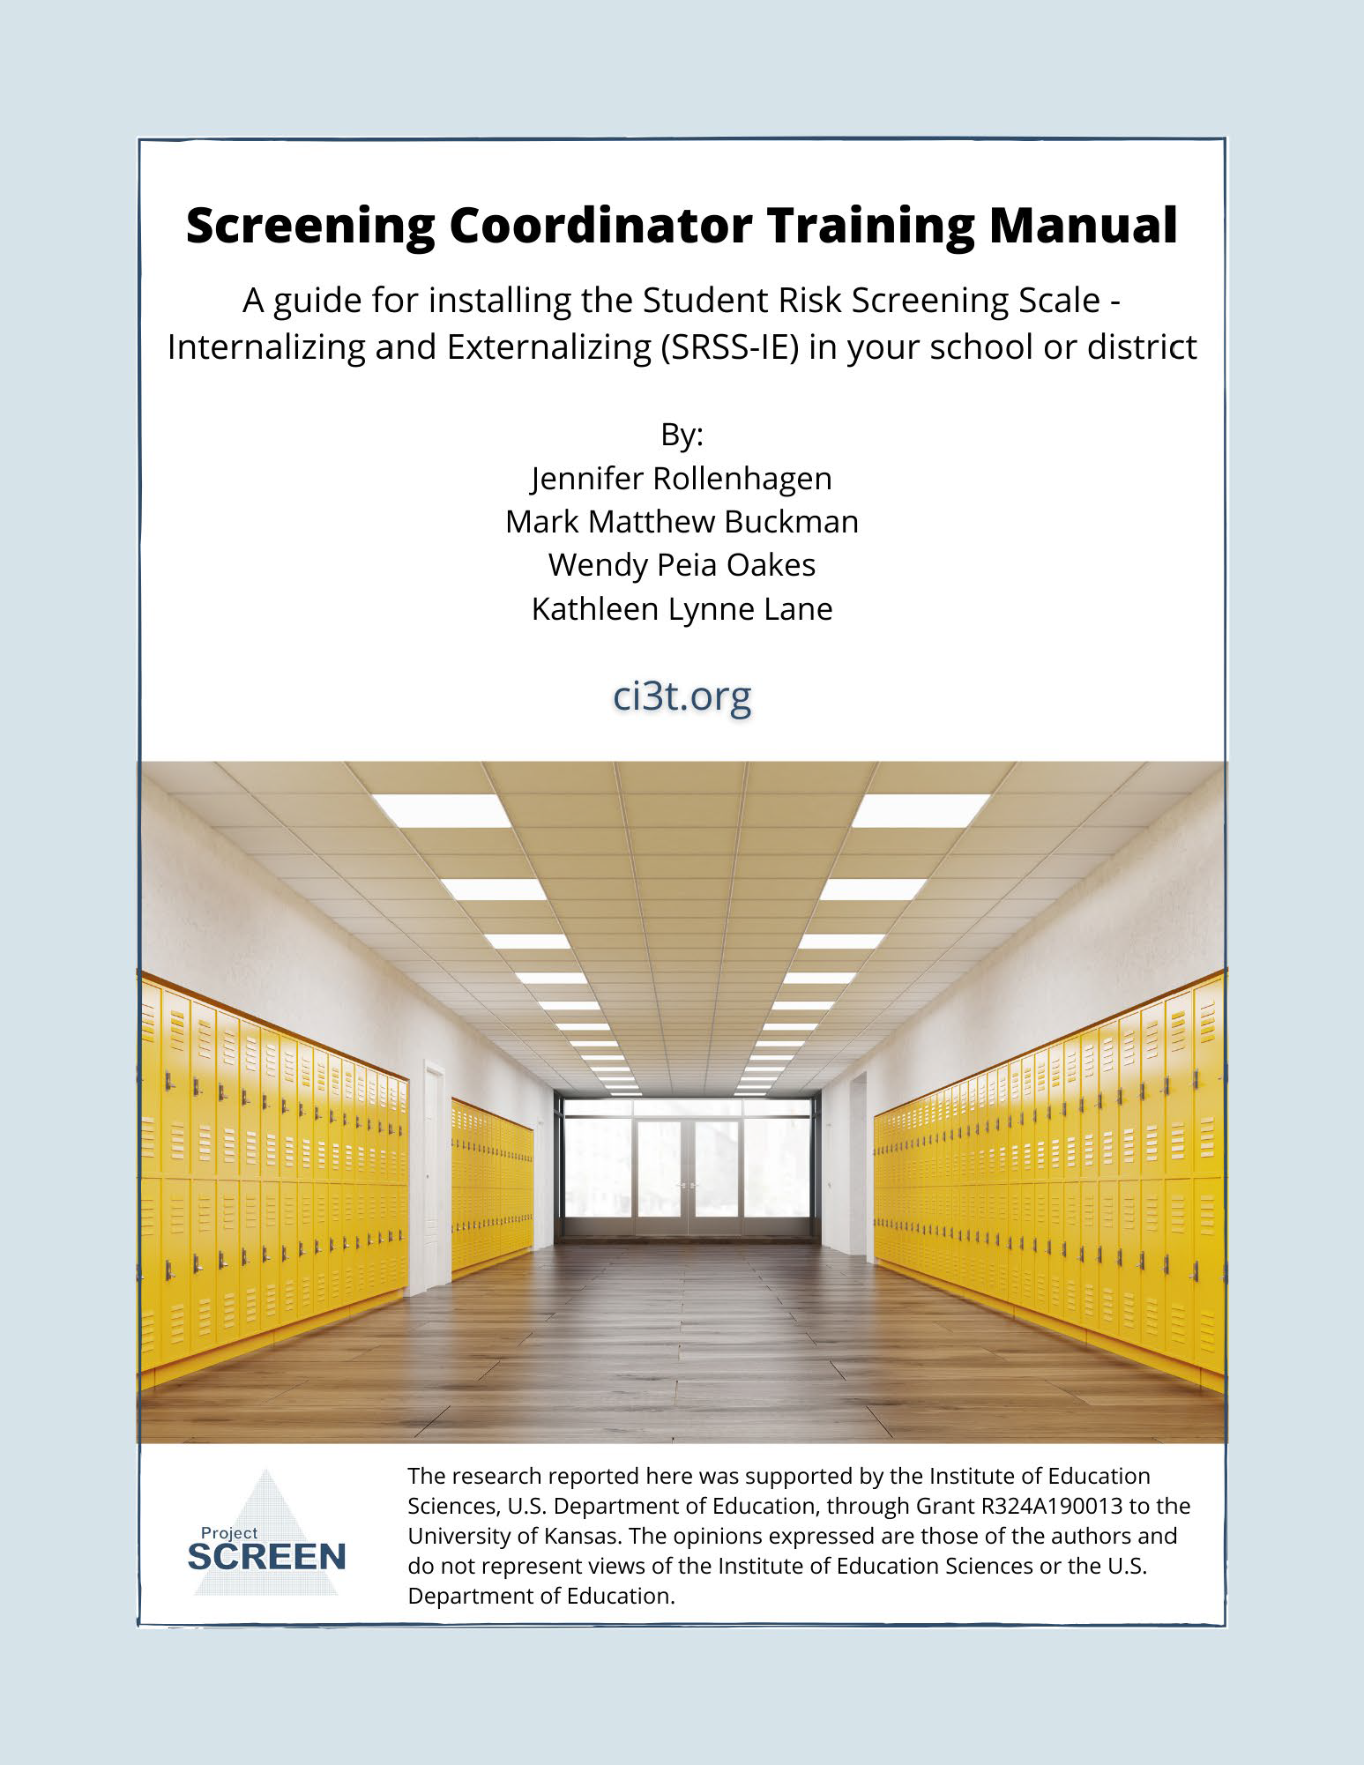
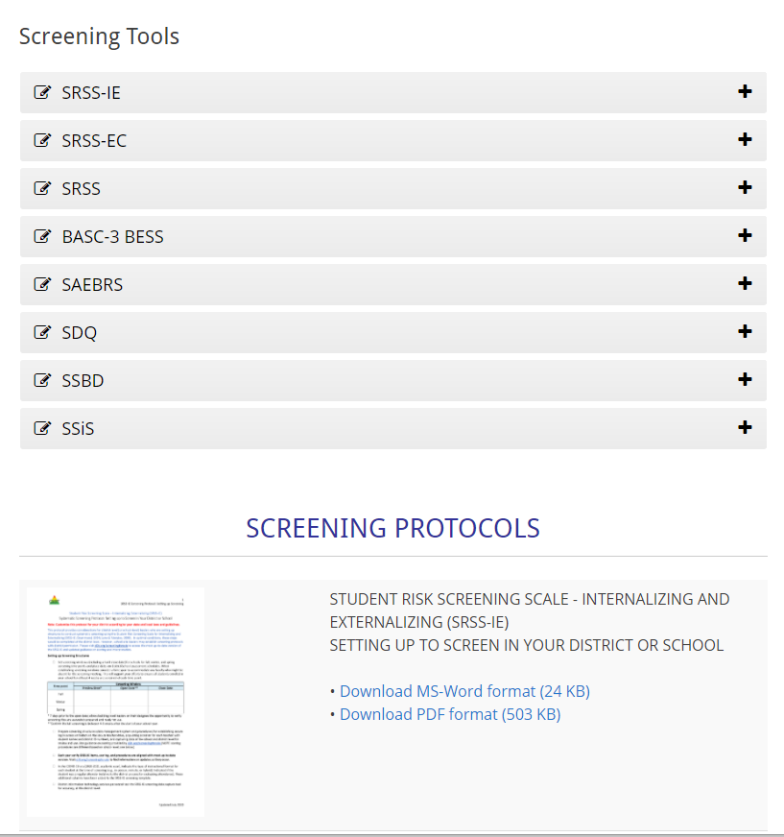

Slide 46
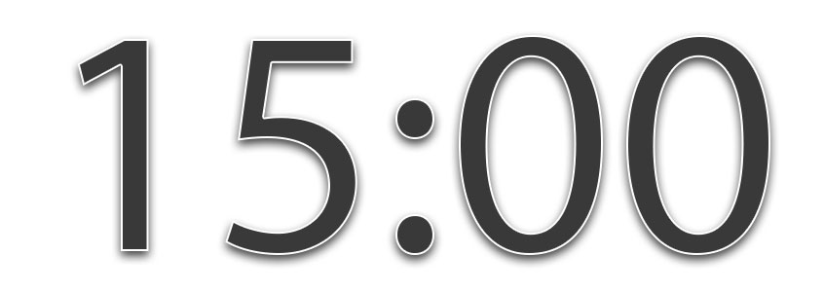

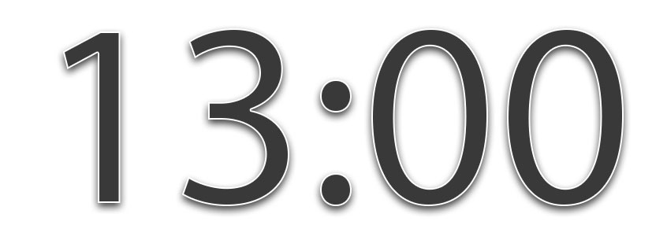



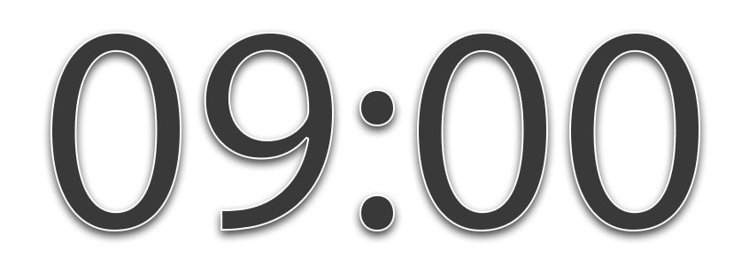
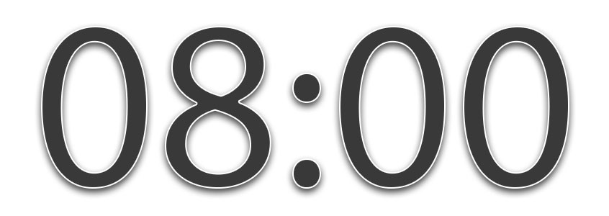
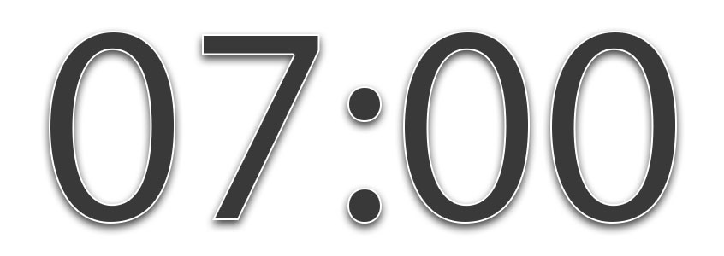

What are some of the potential benefits of systematic screening? Challenges? Questions?
Notes:
15-min timer

Slide 47
Agenda
Introducing Ci3T… a Comprehensive, Integrated, Three-Tiered Model of Prevention
A Closer Look at the Student Risk Screening Scale for Internalizing & Externalizing Behaviors (SRSS-IE)
The Role of Screening: Using Screening Data to Inform Instruction
  At Tier 1: Primary Preventions Efforts
  At all Tiers: Teacher-delivered Strategies
  At Tiers 2 & 3: Secondary & Tertiary Prevention Efforts
Systematic Screening Logistics:
  Selecting
  Installing
  Using
Planning for Next Steps

Slide 48
Comprehensive, Integrated, Three-Tiered Model of Prevention
(Lane, Kalberg, & Menzies, 2009)
Tier 3
Tertiary Prevention (≈5%)
Tier 2
Secondary Prevention (≈15%)
Tier 1
Primary Prevention (≈80%)
Academic ◇ Behavioral ◇ Social
Validated Curricula PBIS Framework Validated Curricula

Slide 49
Social Skills Improvement System – Performance Screening Guide Spring 2012 – Total School
N = 54
N = 22
N = 35
N = 31
N = 223
N = 233
N = 180
N = 187
N = 212
N = 235
N = 275
N = 271
n = 489 n = 490 n = 490 n = 489
Lane, K. L., Oakes, W. P., & Magill, L. (2013). Primary prevention efforts: How do we implemented and monitor the Tier 1 component of our Comprehensive, Integrated, Three-Tiered (Ci3T) Model?, Preventing School Failure, 58(1), 143-158.

Slide 50
Student Risk Screening Scale Fall 2004 – 2012 Middle School
Source: Lane, K. L., Oakes, W. P., & Magill, L. M., (2014). Primary prevention efforts: How do we implement and monitor the Tier 1 component of our comprehensive, integrated, three-tiered model of prevention. Preventing School Failure, 58, 143-158. doi:10.1080/1045988X.2014.893978 [Figure 4. Middle school behavior screening data over time at the fall time point. Adapted from Figure 4.6 p. 127 Lane, K. L., Menzies, H. M, Oakes, W. P., & Kalberg, J. R. (2012). Systematic screenings of behavior to support instruction: From preschool to high school. Guilford Press.]

Slide 51
Agenda
Introducing Ci3T… a Comprehensive, Integrated, Three-Tiered Model of Prevention
Systematic Screening Logistics:
  Selecting
  Installing
  Using
A Closer Look at the Student Risk Screening Scale for Internalizing & Externalizing Behaviors (SRSS-IE)
The Role of Screening: Using Screening Data to Inform Instruction
  At Tier 1: Primary Preventions Efforts
  At all Tiers: Teacher-delivered Strategies
  At Tiers 2 & 3: Secondary & Tertiary Prevention Efforts
Planning for Next Steps

Slide 52
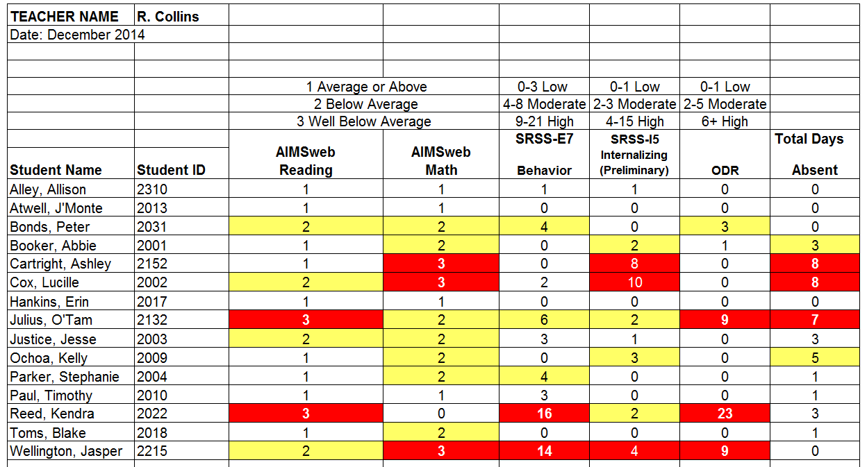
Examining Academic and Behavioral Data
Lane, K. L., Menzies, H. M., Ennis, R. P., & Oakes, W. P. (2015). Supporting Behavior for School Success: A Step-by-Step Guide to Key Strategies. Guilford Press.
Notes:
Lane, K. L., Oakes, W. P., Ennis, R. P., & Hirsch, S. E. (2014). Identifying students for secondary and tertiary prevention efforts: How do we determine which students have Tier 2 and Tier 3 needs? Preventing School Failure, 58, 171-182, DOI: 10.1080/1045988X.2014.895573

Slide 53
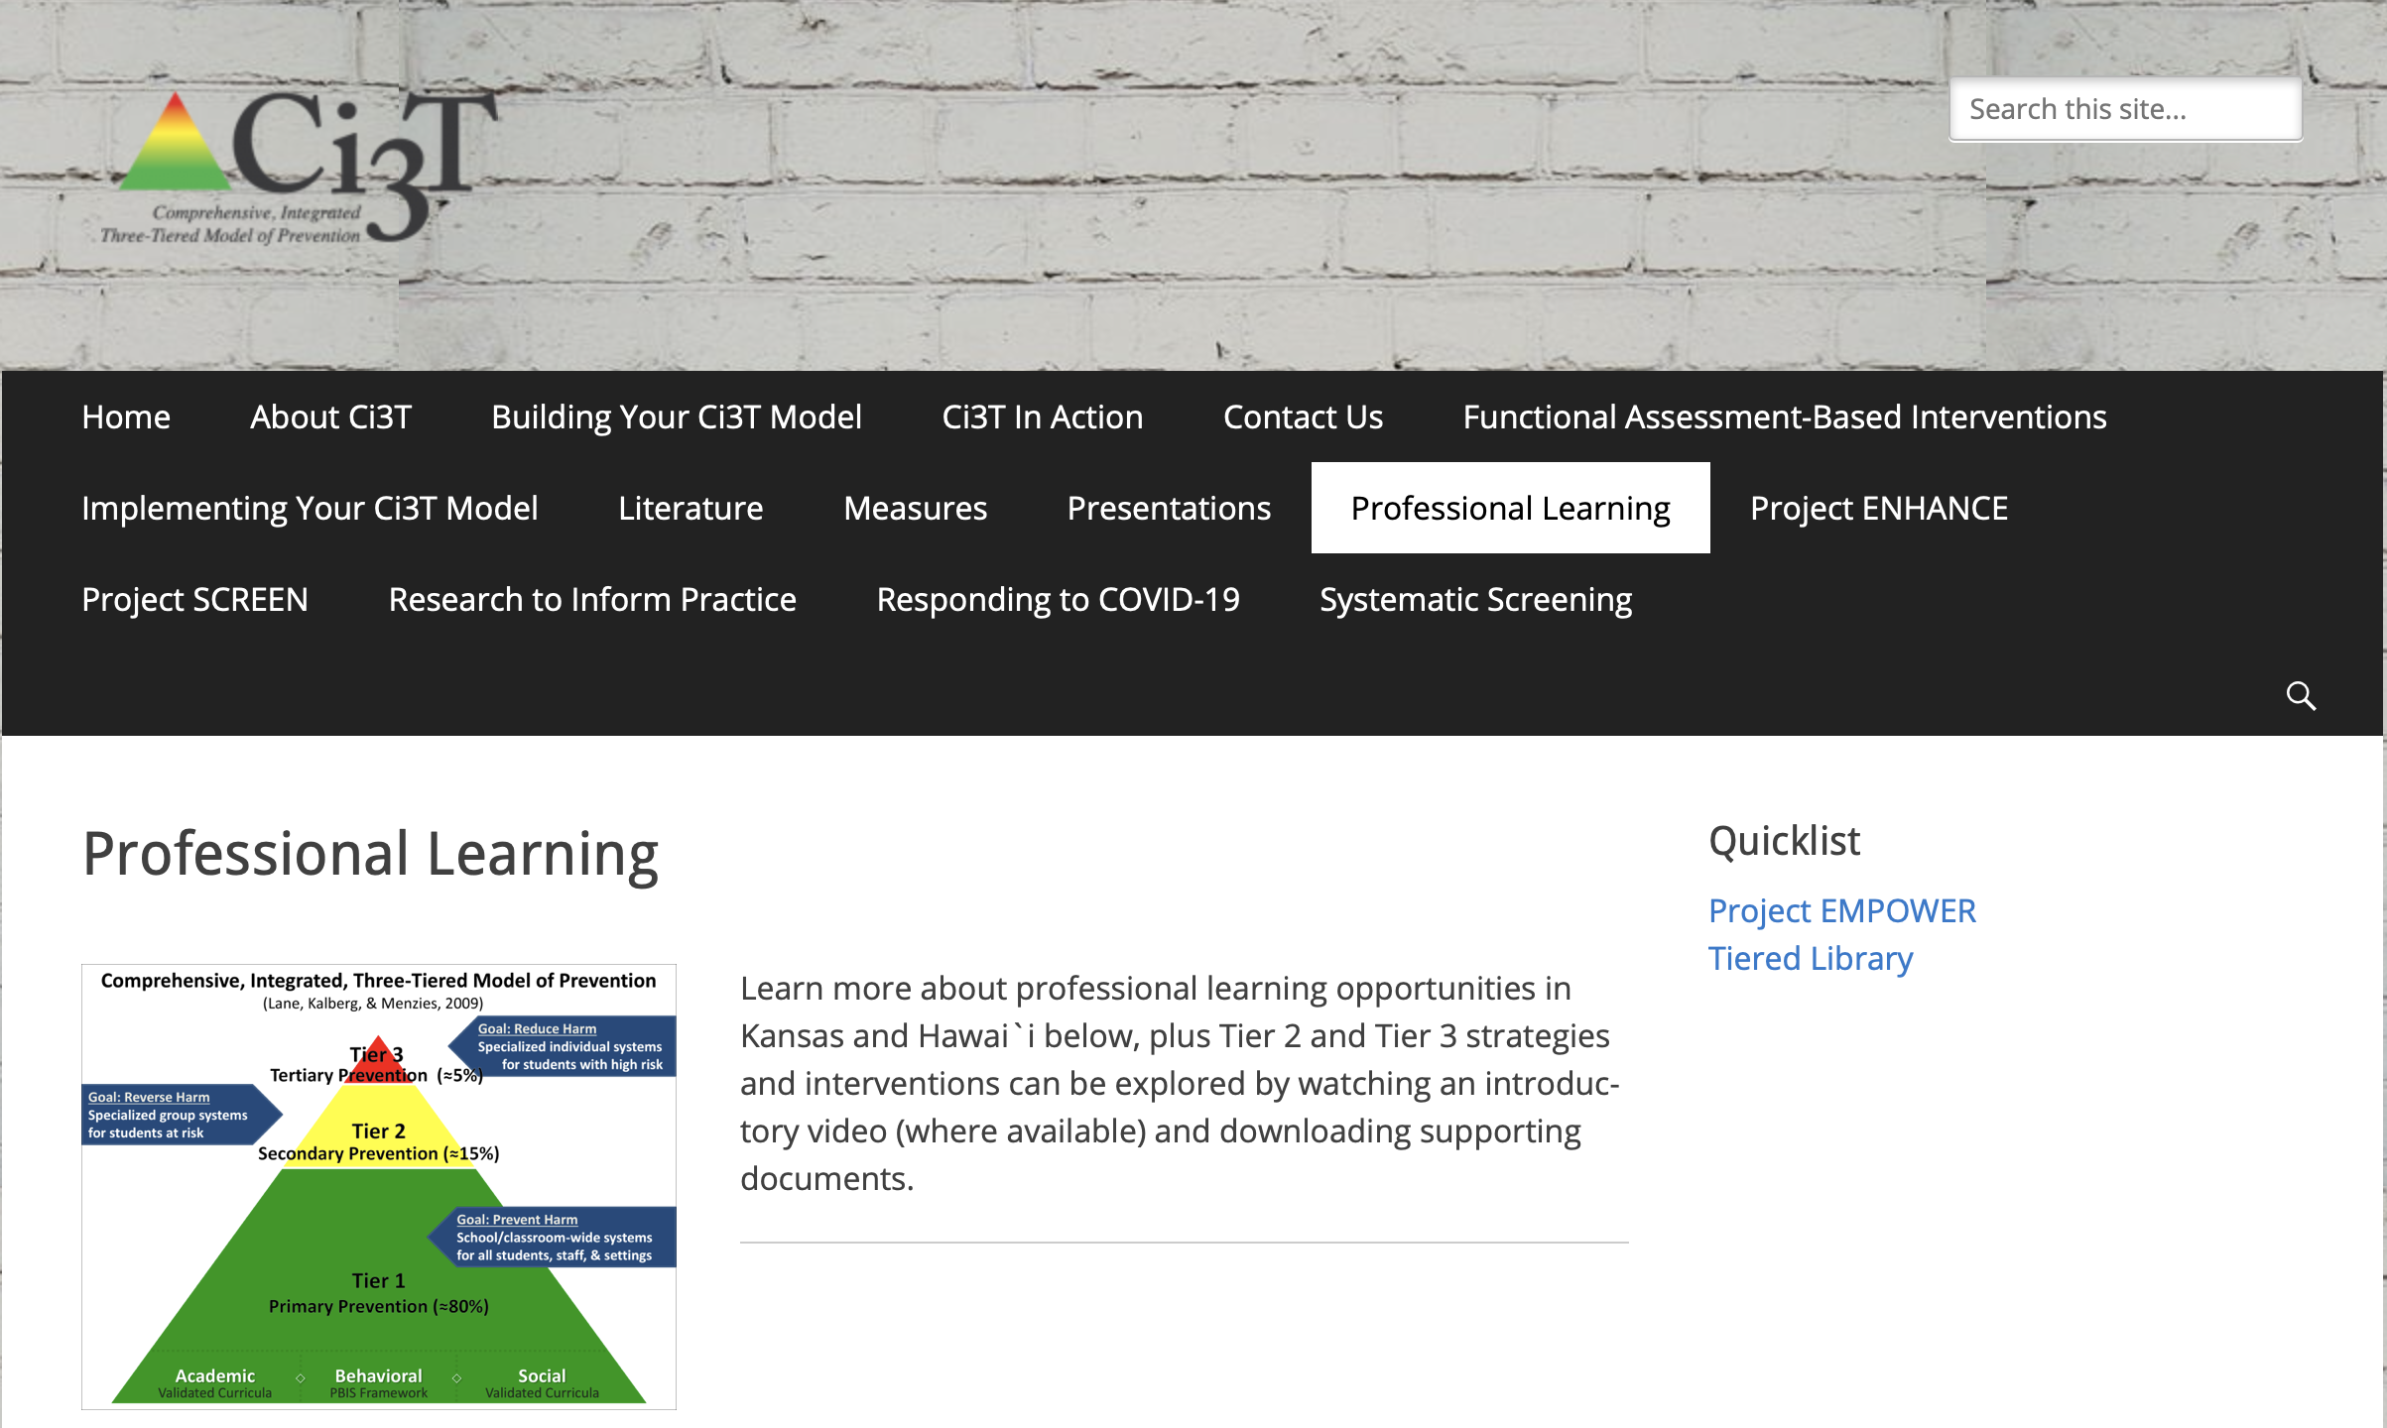
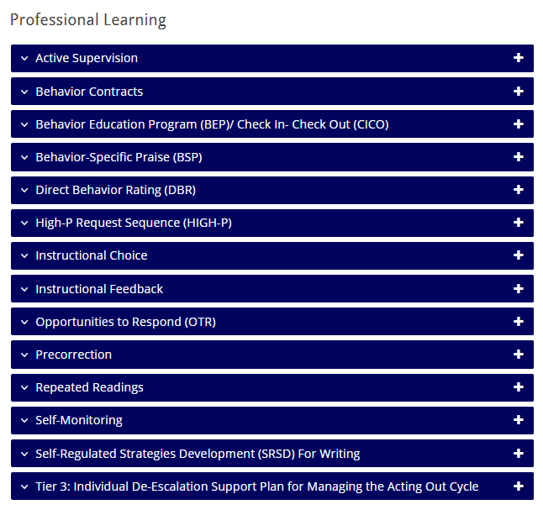


Low-Intensity Strategies

Slide 54
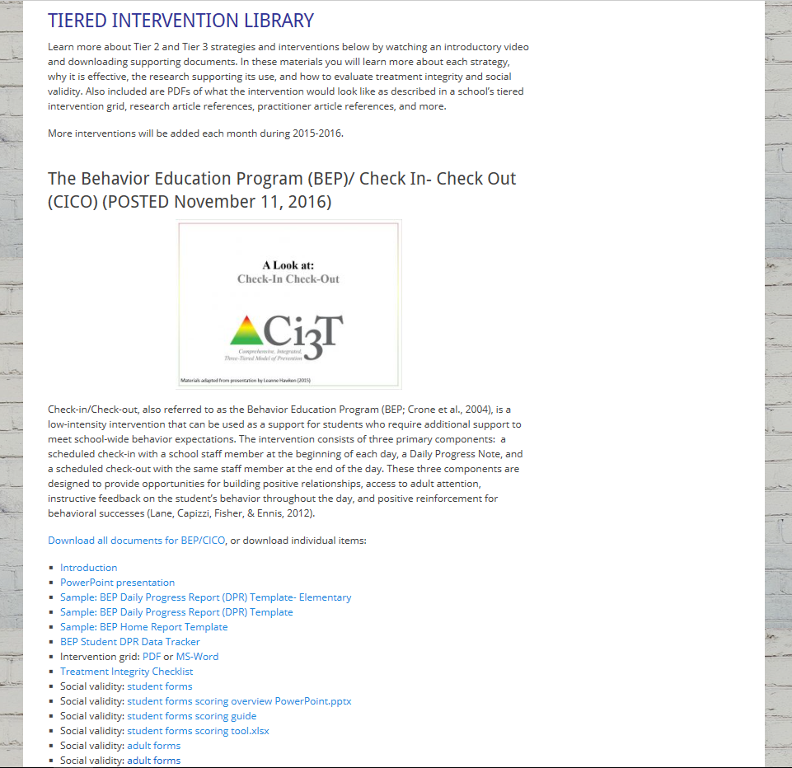
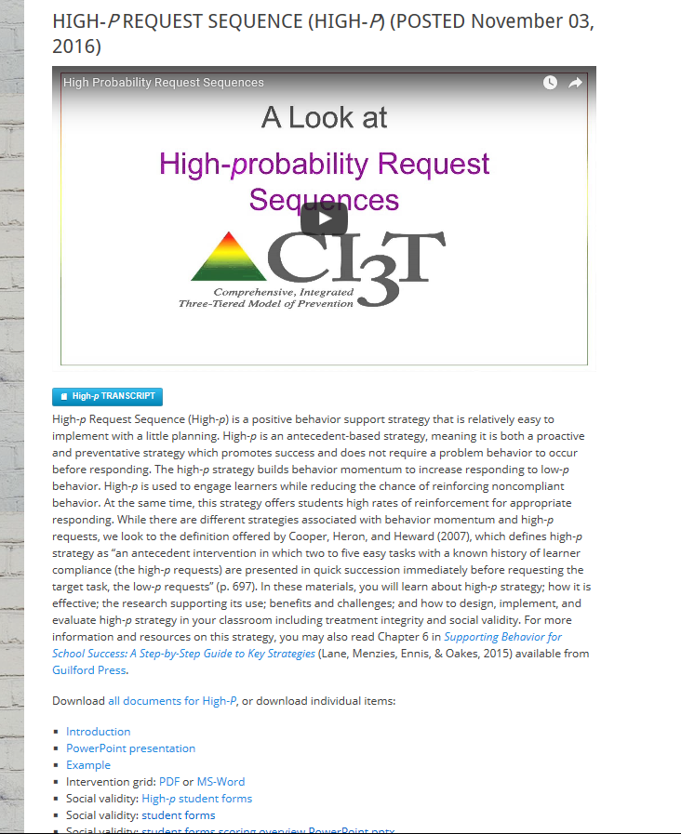
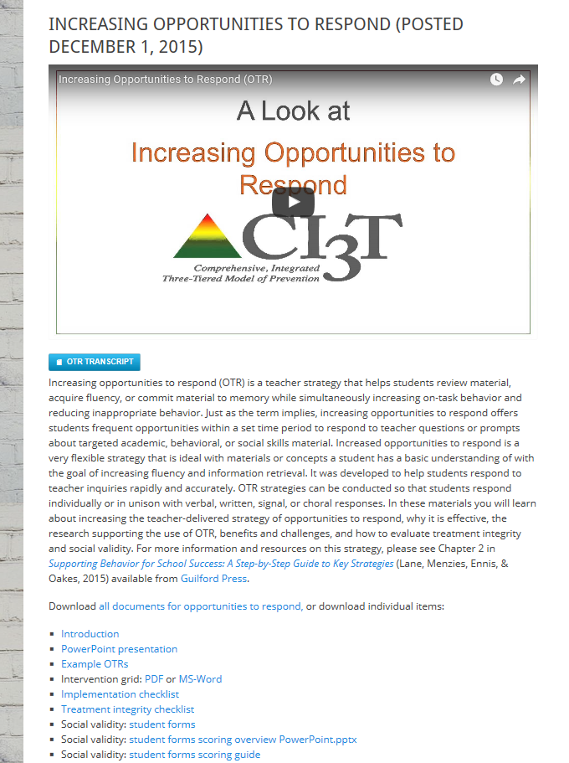
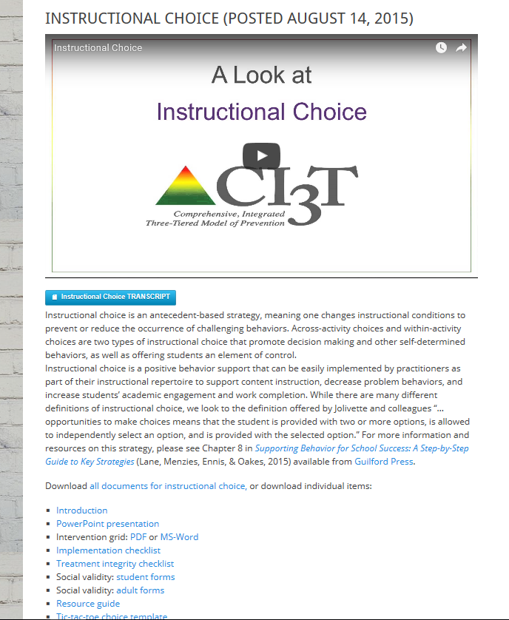
ci3t.org
Professional Learning tab

Slide 55
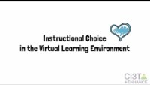
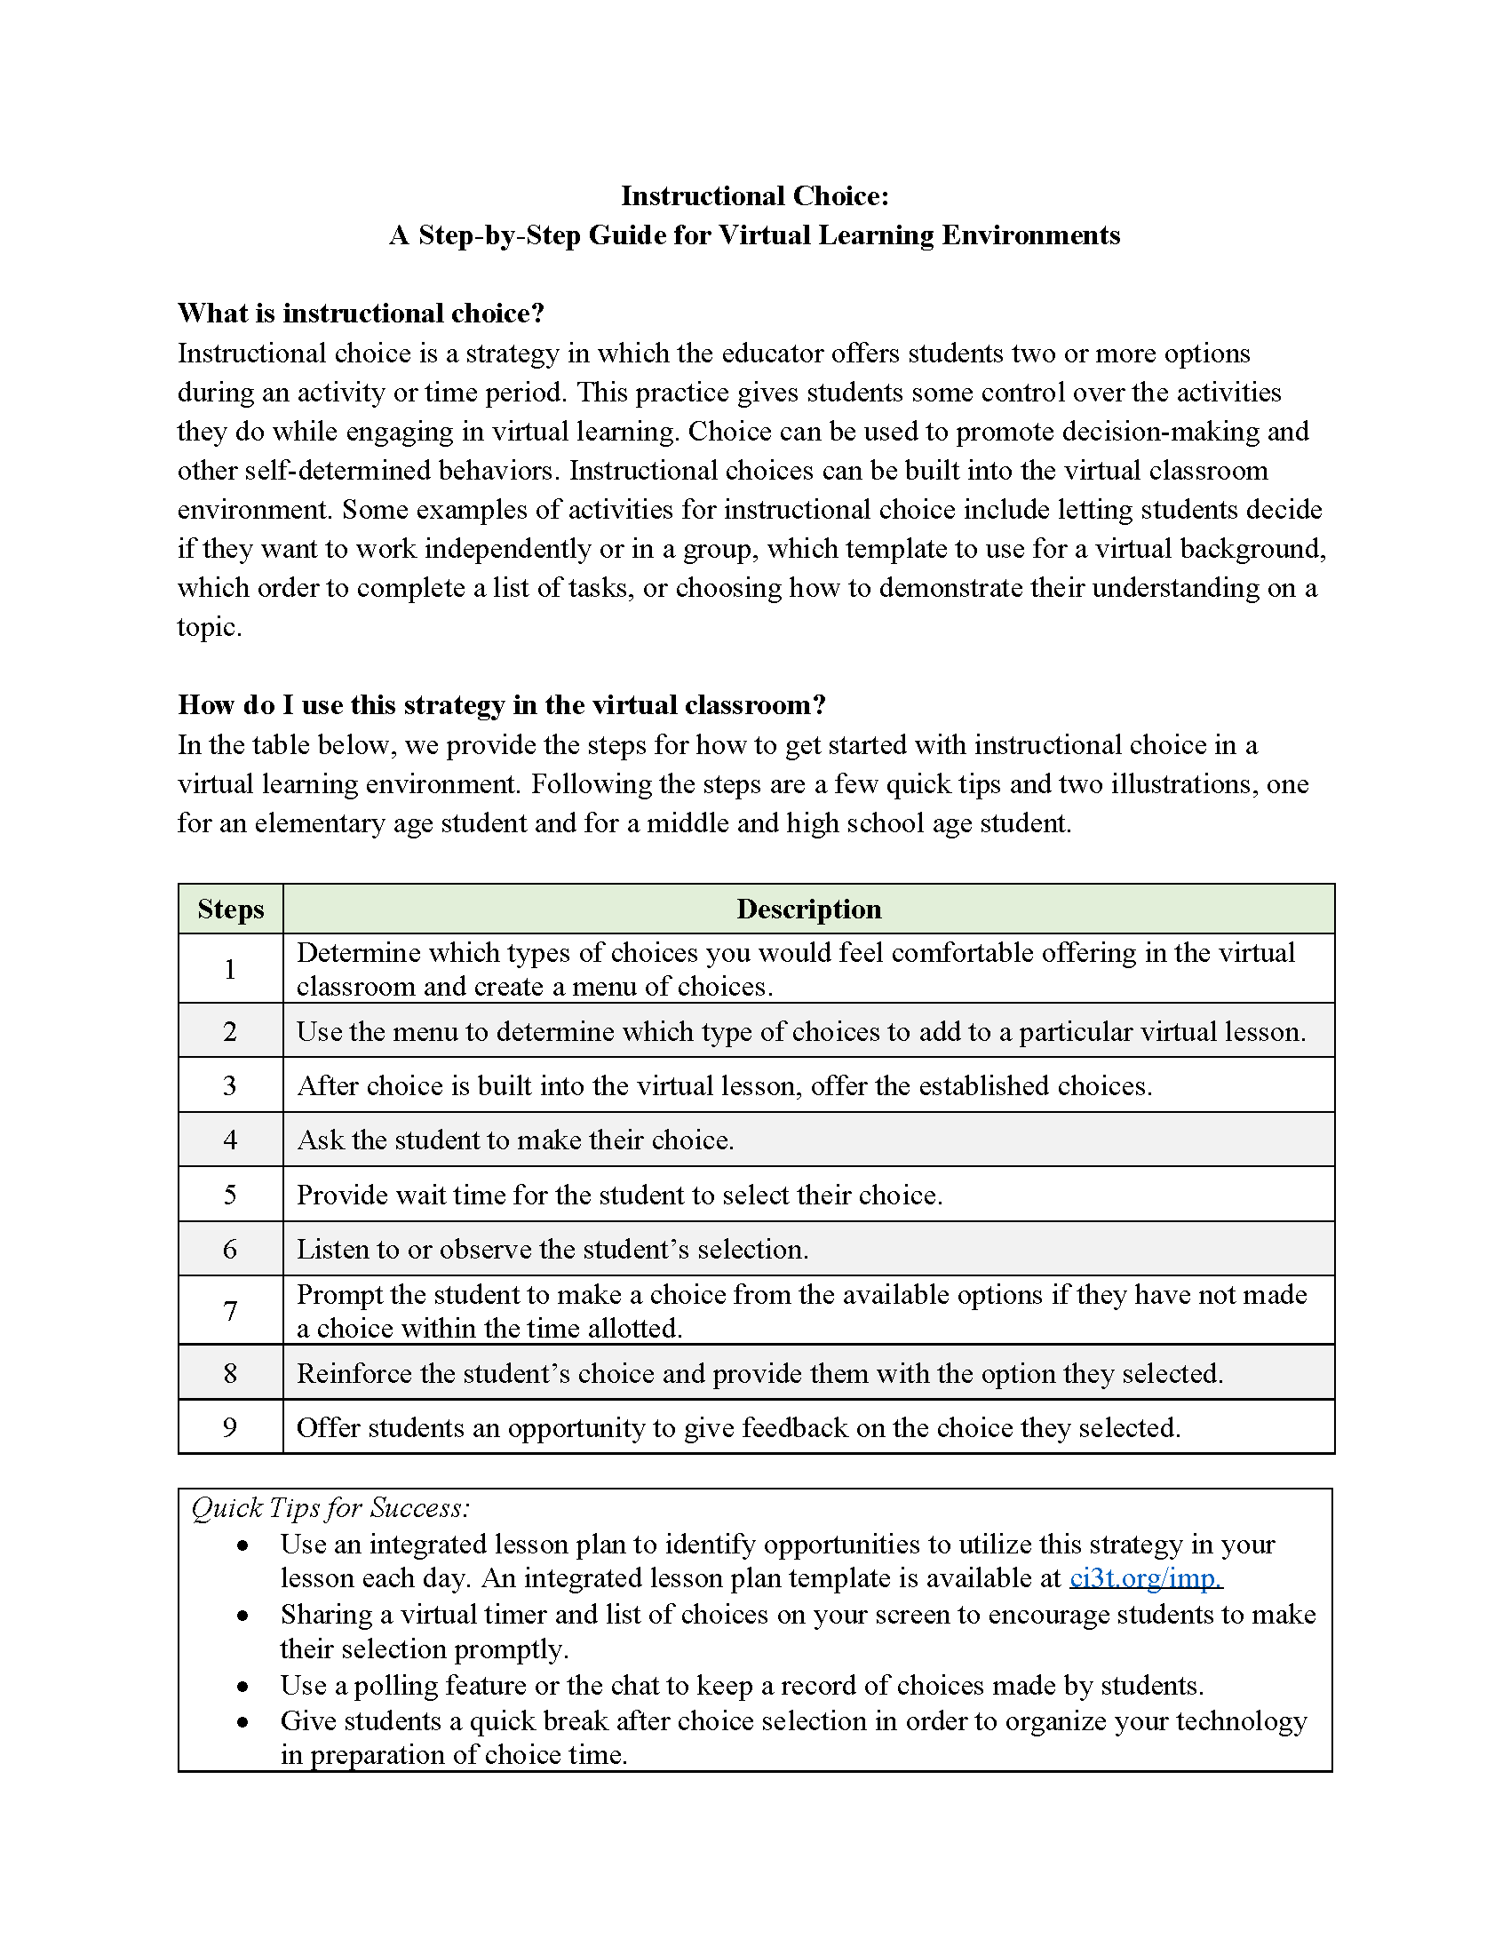
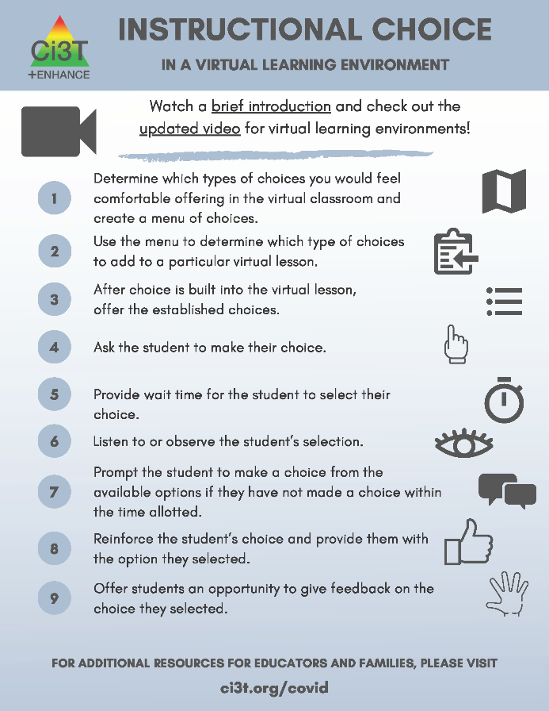

www.ci3t.org/covid
Choice
Materials to support remote learning
Step-by-step Video
Step-by-step Checklist
Infographic

Slide 56
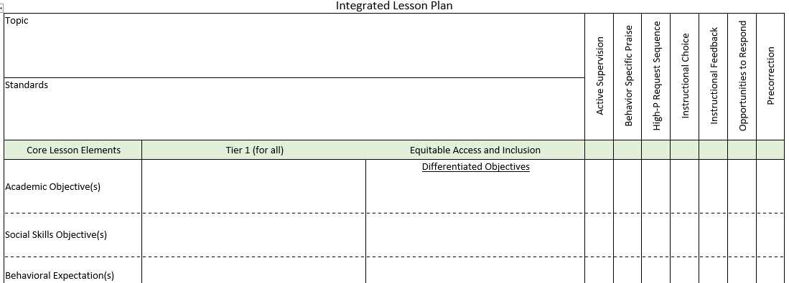
Integrated Lesson Planning

Slide 57
Low-Intensity Strategy | Franklin High School On-Site Expert
Behavior-Specific Praise: Identifying the specific expectation the student met. “Niama, I noticed you outlined your paper and used the graphic organizer to draft your essay. Well done!” “Justice, thank you for pushing in your chair to keep the walkway safe.” | Eric Common, Behavior Specialist Mark Buckman, Special Education Grant Allen, Parent Volunteer Paloma Pérez-Clark, School Psychologist
Opportunities to Respond: Providing 4-6 opportunities per minute for students to respond individually, choral, verbal, written, gesture, or symbol. “Show me thumbs or thumbs down if...” “Show me on your white board what…” “Turn to your elbow partner and say…” “All together now, what is…” | David Royer, Administration Emily Cantwell, 12th Grade Scarlett Lane, 11rd Grade Mallory Messenger, Counselor
Instructional Choice: Providing within-task or between task choices to increase academic engaged time and motivation. “Ronaldo, our of our 3 learning objectives today, which would you like to work on first?” “Suzy, do you want to work on the laptop, or handwrite your answers for this assignment?” | Abbie Jenkins, 10th Grade Scarlett Lane, 11th Grade José Sousa, PE Liane Johl, 9th Grade

Slide 58
Exploring Teacher-Delivered, Low-Intensity Supports …
Ci3T Professional Learning Tab
Notes:
15-min timer

Slide 59
Agenda
Introducing Ci3T… a Comprehensive, Integrated, Three-Tiered Model of Prevention
A Closer Look at the Student Risk Screening Scale for Internalizing & Externalizing Behaviors (SRSS-IE)
The Role of Screening: Using Screening Data to Inform Instruction
  At Tier 1: Primary Preventions Efforts
  At all Tiers: Teacher-delivered Strategies
  At Tiers 2 & 3: Secondary & Tertiary Prevention Efforts
Systematic Screening Logistics:
  Selecting
  Installing
  Using
Planning for Next Steps

Slide 60
Comprehensive, Integrated, Three-Tiered Model of Prevention
(Lane, Kalberg, & Menzies, 2009)
Tier 3
Tertiary Prevention (≈5%)
Tier 2
Secondary Prevention (≈15%)
Secondary (Tier 2) Intervention Grids
Tier 1
Primary Prevention (≈80%)
Academic ◇ Behavioral ◇ Social
Validated Curricula PBIS Framework Validated Curricula

Slide 61
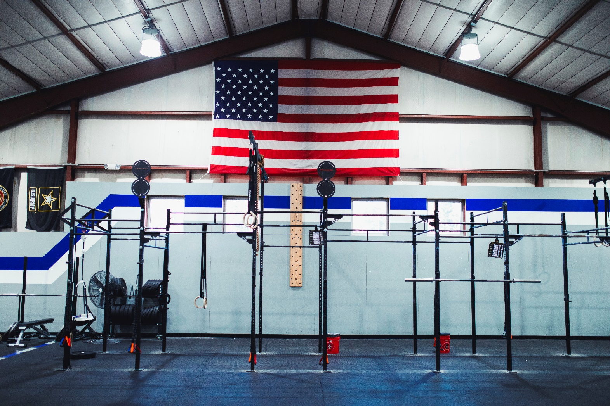

Slide 62
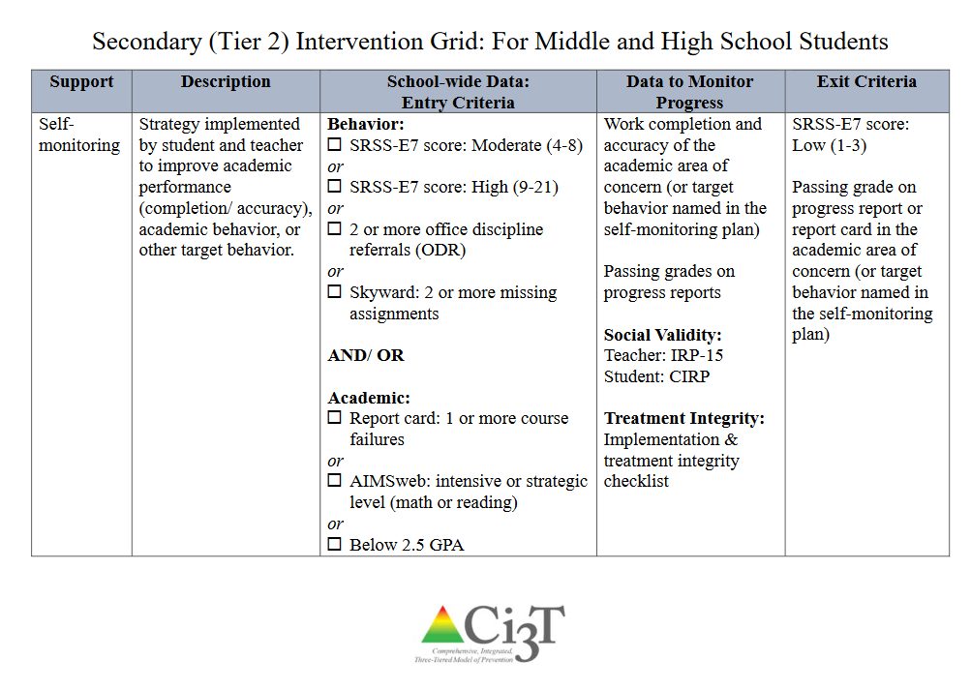

Slide 63
An illustration
Support | Description | Schoolwide Data: Entry Criteria | Data to Monitor Progress: | Exit Criteria
Small group reading instruction with self-monitoring | Small group reading instruction (30 min, 3 days per week). Students monitored their participation in the reading instructional tasks. Students used checklists of reading lesson components each day to complete and compare to teachers’ rating. K – 1. | Students who: Behavior: Fall SRSS at moderate (4 -8) or high (9 – 21) risk Academic: Fall AIMSweb LNF at the strategic or intensive level | AIMSweb reading PSF and NWF progress monitoring probes (weekly). Daily self-monitoring checklists Treatment Integrity Social Validity | Meet AIMSweb reading benchmark at next screening time point. Low Risk on SRSS at next screening time point.

Slide 64
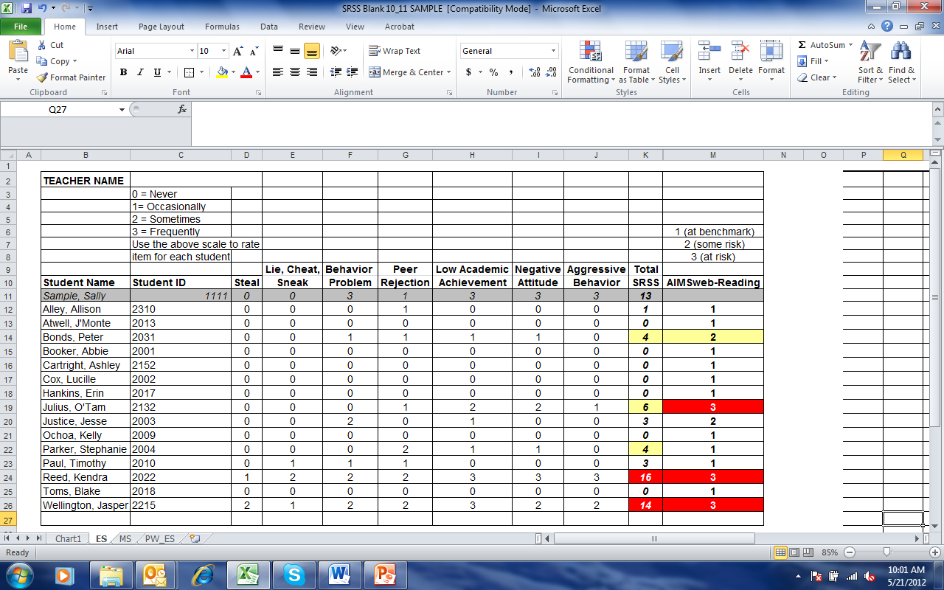
Small group Reading Instruction with Self-Monitoring
Lane, K. L., Oakes, W. P., & Magill, L. (2013). Primary prevention efforts: How do we implemented and monitor the Tier 1 component of our Comprehensive, Integrated, Three-Tiered (Ci3T) Model?, Preventing School Failure, 58(1), 143-158.
Notes:
Citation: Lane, K.L., & Oakes, W. P. (2012). Identifying Students for Secondary and Tertiary Prevention Efforts: How do we determine which students have Tier 2 and Tier 3 needs? In preparation.

Slide 65
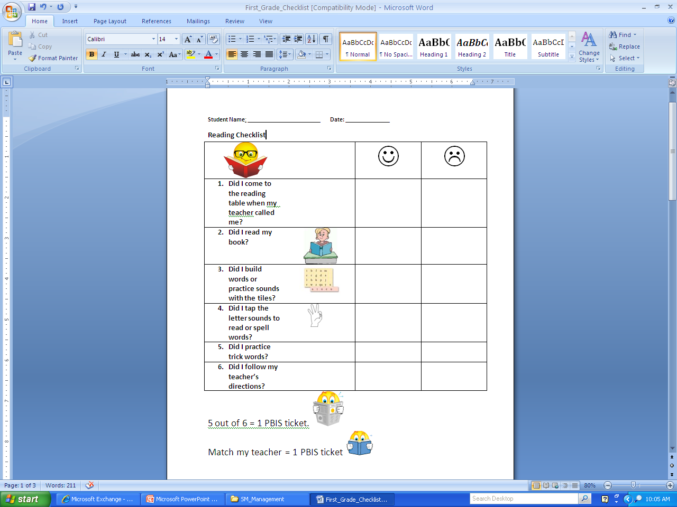
First Grade Students’ Self Monitoring Form
Altmann, S. A. (2010). Project support and include: the additive benefits of self-monitoring on students’ reading acquisition. Unpublished master’s thesis, Vanderbilt University.

Slide 66
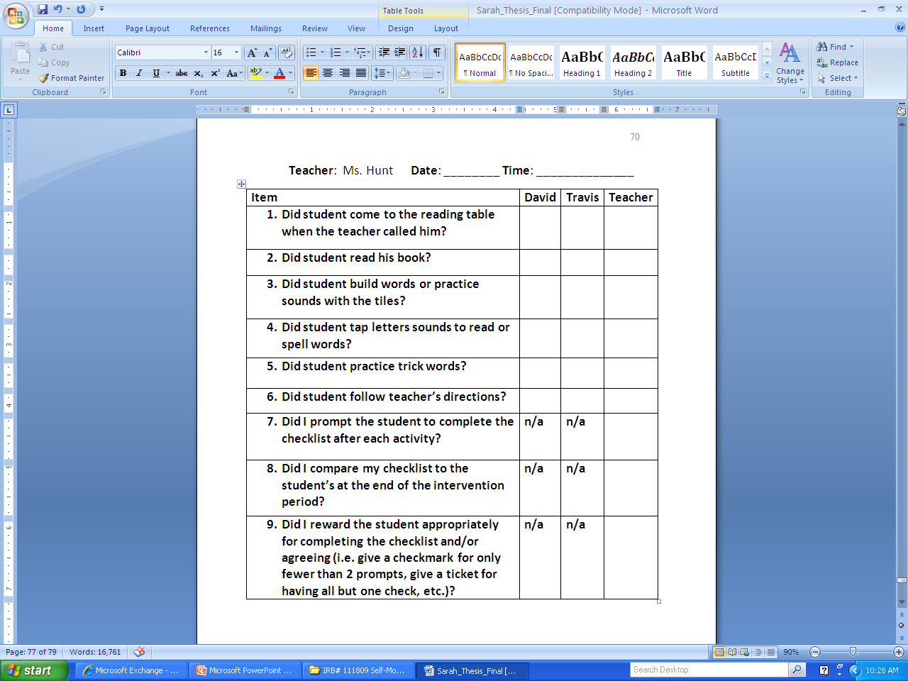
Treatment Integrity
Social Validity
Monitor student progress
Altmann, S. A. (2010). Project support and include: the additive benefits of self-monitoring on students’ reading acquisition. Unpublished master’s thesis, Vanderbilt University.

Slide 67
Sample Elementary Intervention Grid: SSiS
Support | Description | School-wide Data: Entry Criteria | Data to Monitor Progress | Exit Criteria
Social Skills Improvement System (SSiS) – counselor-led small group | Counselors and/or social workers will lead small group SSiS sessions for approximately 30-40 min 2-3 days per week. Students will acquire new skills, learn how to engage more fully in instructional experiences, and learn how to meet more school-wide expectations. Small groups will run for up to 24 sessions (8 to 12 weeks depending on the number of sessions conducted per week) using a subset of SSiS lessons appropriate for student skillsets as identified using SSiS-Rating Scale (teacher and parent version). | Behavior SRSS-E7 score: Moderate (4-8) and/or SRSS-I5 score: Moderate (2-3) AND 2 or fewer absences in first 3 months of school AND Evidence of teacher implementation of Ci3T primary (Tier 1) plan [treatment integrity: direct observation] AND Parent permission AND Academic Student is in grade 2 or 3 | Student measures SSiS-Rating Scale (Pre/Post) Skills for Greatness (Pre/Post) Daily behavior report (DBR; daily) Attendance and tardies Social validity Teacher: IRP-15 Student: CIRP Treatment integrity Tier 2 treatment integrity measures Ci3T TI: Direct observation (30 min if needed) | Review student progress at end of 24 sessions Team agrees goals have been met or no further SSiS small group sessions are warranted SRSS-E7 and I5 scores are in the low risk category

Slide 68
Support | Description | Schoolwide Data: Entry Criteria | Data to Monitor Progress: | Exit Criteria
READ 180 (Stage C) Reading Intervention | Students participate in a 50 min reading instructional block during their study hall period. Students meet in the computer lab for participation in the online portion 20 min daily. Instruction is relevant to high school students. Students use a progress management system to monitor and track their own progress. Instruction is taught by special education teachers and general education teachers with training in the READ 180 Curriculum. | (1) Students in grades 9 – 12. (2) Reading performance basic or below basic on state assessment (but above 4th grade reading level). (3) SRSS risk scores in the moderate range (4 – 8). | Student Measures: Meeting individual READ 180 reading goals: (1) Progress Monitoring with Scholastic Reading Inventory (2) Writing Assessments (3) formative assessments (vocabulary, comprehension and spelling) (4) Curriculum-based Assessments (5) Attendance in class Treatment Integrity: Teachers monitor performance and attendance in class. Completion of weekly checklists for activities completed. Social Validity: Students and teachers complete surveys | Students meet instructional reading goals. SRSS score in the low risk category (0 – 3) on the next screening time point.
Lane, K. L., Oakes, W. P., Menzies, H. M., Oyer, J., & Jenkins, A. (2013). Working within the context of three-tiered models of prevention: Using school wide data to identify high school students for targeted supports. Journal of Applied School Psychology, 29, 203-229.

Slide 69
Support | Description | Schoolwide Data: Entry Criteria | Data to Monitor Progress: | Exit Criteria
Targeted Algebra II Study Hall | Direct, targeted instruction of Algebra II learning targets by math teachers. Time will be used to re-teach concepts, provide one-on-one or small group instruction and offer greater supports for students struggling to pass the graduation requirement course. 50 min per day until exit criteria is met. | (1) 12th graders (2) Algebra II grade drops below a 75 at any point in the semester (3) Have study hall time available and permission of 5th period teacher (4) Self-selecting to engage in study hall | Student Measures: Algebra II classroom grades Daily class average if grade is ≤ 75 Treatment Integrity: Daily monitoring of the lessons covered and student attendance Social Validity: Pre and Post Student Surveys | Algebra II Grade increases to satisfactory level (above 75%).
Lane, K. L., Oakes, W. P., Menzies, H. M., Oyer, J., & Jenkins, A. (2013). Working within the context of three-tiered models of prevention: Using school wide data to identify high school students for targeted supports. Journal of Applied School Psychology, 29, 203-229.

Slide 70
Comprehensive, Integrated, Three-Tiered Model of Prevention
(Lane, Kalberg, & Menzies, 2009)
Tier 3
Tertiary Prevention (≈5%)
Tier 2
Secondary Prevention (≈15%)
Tertiary (Tier 3) Intervention Grids
Tier 1
Primary Prevention (≈80%)
Academic ◇ Behavioral ◇ Social
Validated Curricula PBIS Framework Validated Curricula

Slide 71
Tertiary (Tier 3) Intervention Grid: For Middle and High School Students
Support | Description | Schoolwide Data: Entry Criteria | Data to Monitor Progress | Exit Criteria
Functional Assessment-based Intervention | FABIs are interventions based on the function of the target behavior, as determined by the functional assessment and determined with the aid of the Function Matrix. The Function-Based Intervention Decision Model is used to determine the intervention focus, including: Method 1: Teach the replacement behavior; Method 2: Improve the environment; Method 3: Adjust the contingencies; and a combination of Method 1 and Method 2. A package intervention is designed and implemented, including antecedent adjustments, reinforcement adjustments, and extinction procedures directly linked to the function of the target behavior. | One or more of the following: Behavior: SRSS-E7: High (9-21) SRSS-I6: High (6-18) Office discipline referrals (ODRs) 6 or more within a grading period AND/OR Academic: Progress report: 1 or more course failures Missing Assignments 5 or more within a grading period AIMSweb: intensive level (math or reading) Below 2.5 GPA | Student behavior targeted for improvement (e.g., target or replacement behavior) using direct observation Treatment integrity FABI Step checklists Treatment integrity checklist Social validity IRP-15 (teacher) CIRP (student) | The FABI will be faded once a functional relation is demonstrated using a validated single-case research design (e.g., withdrawal) and: Behavior objective for the student is met (See Behavior Intervention Plan [BIP]).

Slide 72

Changes in Harry’s Behavior
Cox, M., Griffin, M. M., Hall, R., Oakes, W. P., & Lane, K. L. (2012). Using a functional assessment-based intervention to increase academic engaged time in an inclusive middle school setting. Beyond Behavior, 2, 44 – 54.

Slide 73





Slide 74
Using Screening Data to Connect Students to Tier 2 and Tier 3 Interventions
Notes:
15-min timer

Slide 75
Agenda
Introducing Ci3T… a Comprehensive, Integrated, Three-Tiered Model of Prevention
A Closer Look at the Student Risk Screening Scale for Internalizing & Externalizing Behaviors (SRSS-IE)
The Role of Screening: Using Screening Data to Inform Instruction
  At Tier 1: Primary Preventions Efforts
  At all Tiers: Teacher-delivered Strategies
  At Tiers 2 & 3: Secondary & Tertiary Prevention Efforts
Systematic Screening Logistics:
  Selecting
  Installing
  Using
Planning for Next Steps

Slide 76

Selecting
www.ci3t.org

Slide 77


Installing

Slide 78




Protocols

Slide 79




Manual

Slide 81

EMPOWER Sessions
Using

Slide 82

Ci3T Trainers and Coaches Calls

Slide 83

Sample Middle School: Fall
SRSS-E7 Results – All Students
N = 26
N = 12
N = 89
N = 66
N = 554
N = 550

Slide 84



Data sharing…
Schoolwide data
  …decisions related to primary prevention efforts
Grade / Department / Class
  …implications for teachers’ practice
Individual student
  …decisions about student-based interventions

Slide 86
Agenda
Introducing Ci3T… a Comprehensive, Integrated, Three-Tiered Model of Prevention
A Closer Look at the Student Risk Screening Scale for Internalizing & Externalizing Behaviors (SRSS-IE)
The Role of Screening: Using Screening Data to Inform Instruction
  At Tier 1: Primary Preventions Efforts
  At all Tiers: Teacher-delivered Strategies
  At Tiers 2 & 3: Secondary & Tertiary Prevention Efforts
Systematic Screening Logistics:
  Selecting
  Installing
  Using
Planning for Next Steps

Slide 87


Slide 88



Resources for screening available on PBIS.org…

Slide 89


Tips for Communicating with Your Community about Systematic Screening

Slide 90





District Decision Makers

Slide 91
MTSS: CI3T Training Series
CI3T: Primary Prevention
Session 1:
Overview of CI3T Prevention Models
Setting a Purpose
Establish team meetings and roles
Session 2:
Mission and Purpose
Establish Roles and Responsibilities
Procedures for Teaching
Procedures for Reinforcing
Reactive Plan
Session 3:
Procedures for Monitoring
Session 4:
Revise Primary Plan using Stakeholder feedback
Prepare presentation
CI3T: Secondary Prevention
Session 5:
Overview of Teacher focused Strategies
Overview of Student Focused Strategies
Using data to determine
Draft the Secondary Intervention Grid based on existing supports
CI3T: Tertiary Prevention
Session 6:
Final revisions of CI3T Plan based on stakeholder feedback
Draft Tertiary Prevention Intervention Grids
Design Implementation Manual and Plan for roll out to faculty, students, and parents
CI3T Team Training Sequence
Implementation Stages of Tier 2 and 3 within CI3T
Additional Professional Development on Specific Topics
Core Content Curriculum
Check In - Check Out
Functional Assessment-based Interventions
Reading, Math, Writing Benchmarking and Progress Monitoring Tools
Student Driven Interventions, Strategies, & Practices
Additional Tier 3 Supports
Teacher Drive Supports: Instructional Techniques to Improve Students’ Motivation; General Classroom Management Practices; Low Intensity Behavior Supports

Slide 92


Slide 93
Kathleen.Lane@ku.edu
Thank you!

