Slide 1
Academic Writing and Publishing
Office of Special Education Programs (OSEP)
March 9, 2022
www.ci3t.org
Kathleen Lynne Lane, Ph.D., BCBA-D, CF-LI
University of Kansas
Lane, K. L., Cabell, S. Q., & Drew, S. V. (2021). A productive scholar’s guide to respectful, responsible inquiry during the COVID-19 pandemic: Moving forward. Journal of Learning Disabilities. 54(5), 388-399. https://doi.org/10.1177/00222194211023186

Slide 2
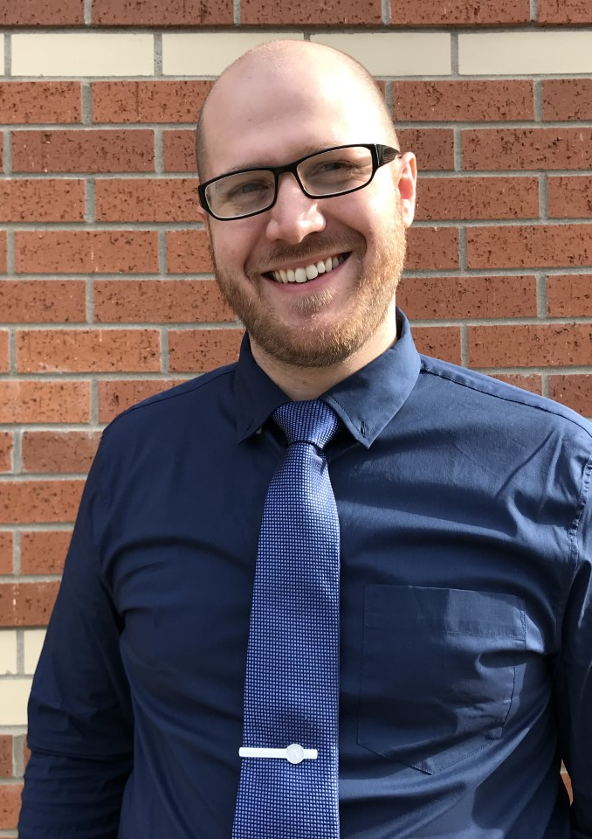
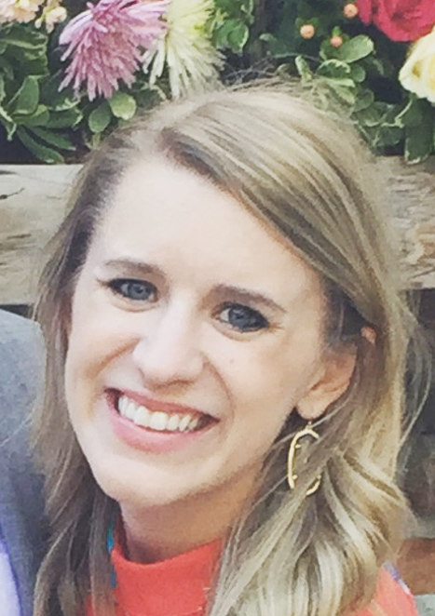
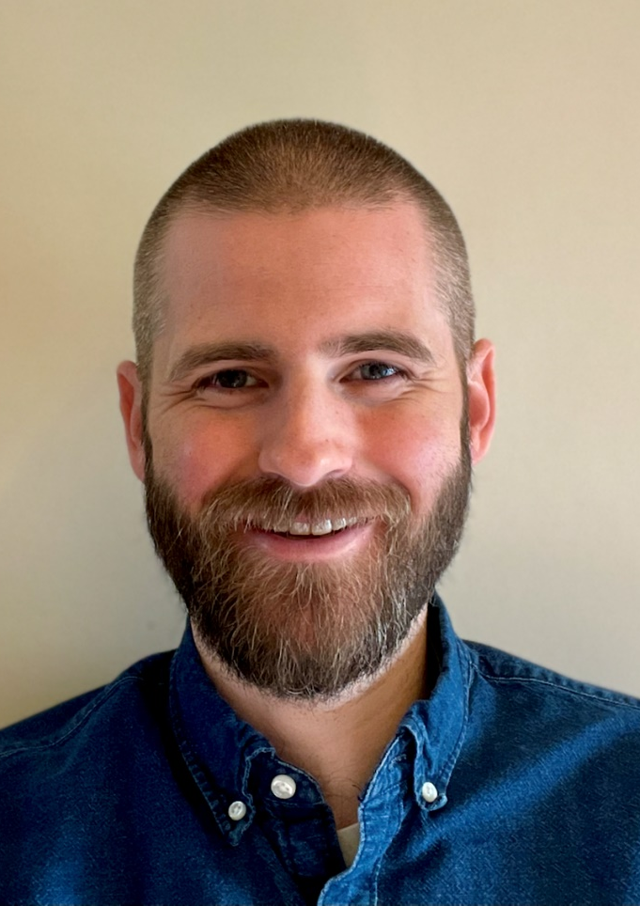
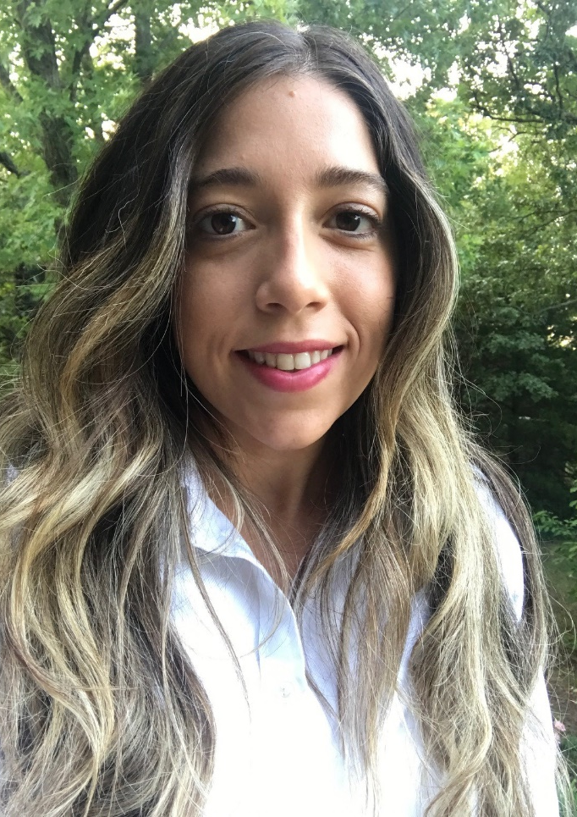
Grant E. Allen, Ph.D.
Katie S. Austin, M.S.
Mark M. Buckman, Ph.D.
Paloma Pérez-Clark, Ed.S.
KU RITE Scholars

Slide 3
Department of Special Education, Distinguished Professor
Teaching
Research
Service
Associate Vice Chancellor for Research
Kathleen Lynne Lane Ph.D., BCBA-D, CF-L1
Research
Teaching
Service
Project ENHANCE (IES Network)
Editorial
Project SCREEN (IES Measurement)
Professional Leadership
University
SRSS-EC: Inquiry (unfunded)
College
OSEP KU RITE Leadership Grant
OSEP PBIS 5 Content Expert
Department
Community

Slide 4
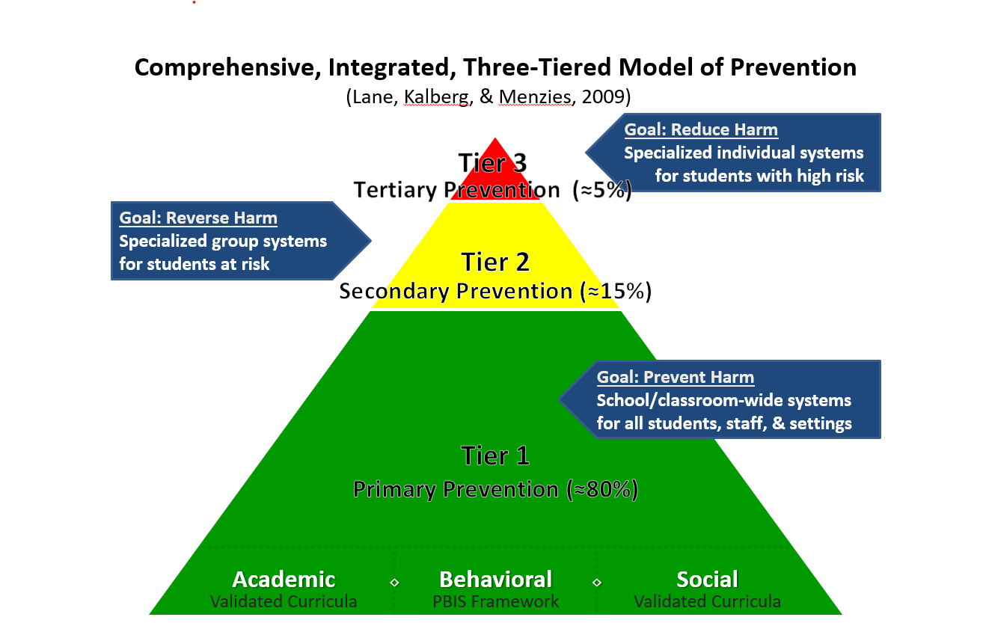
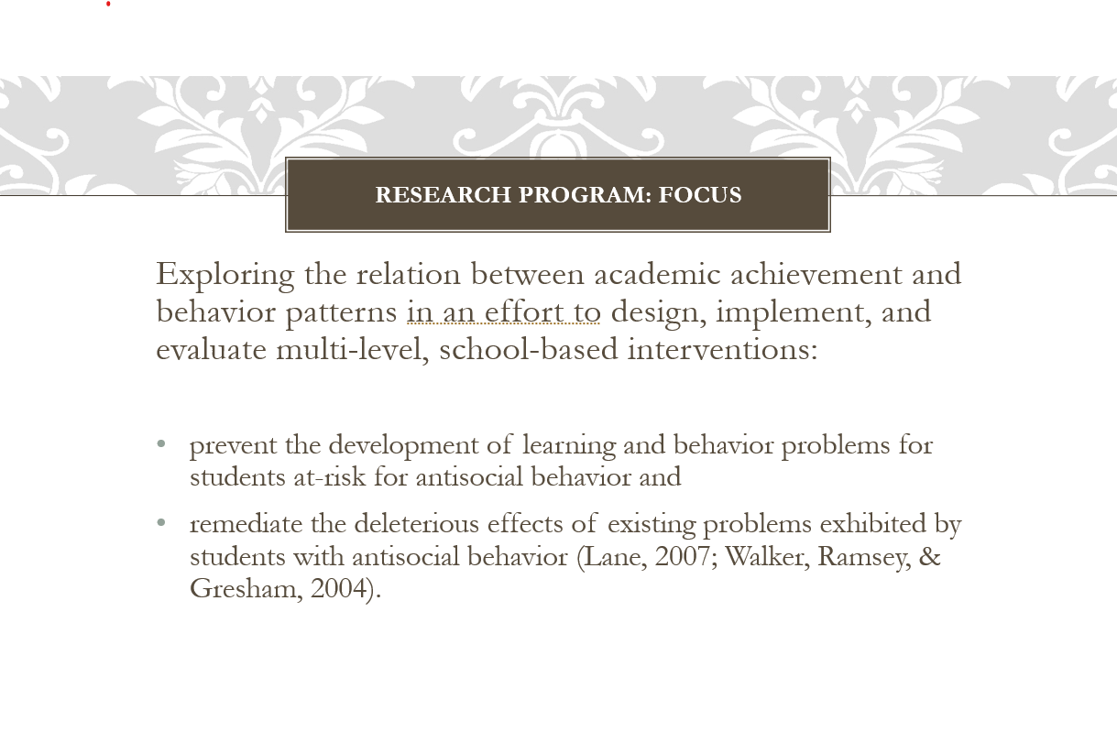
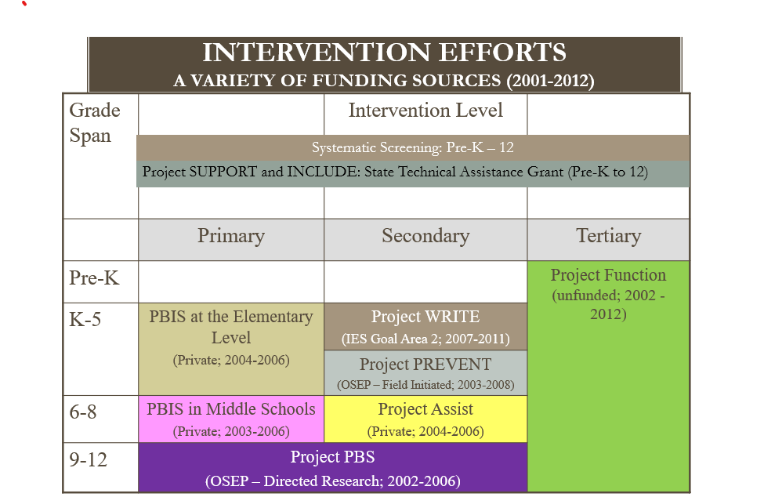
Revisit and Refine Programmatic Lines of Inquiry

Slide 5
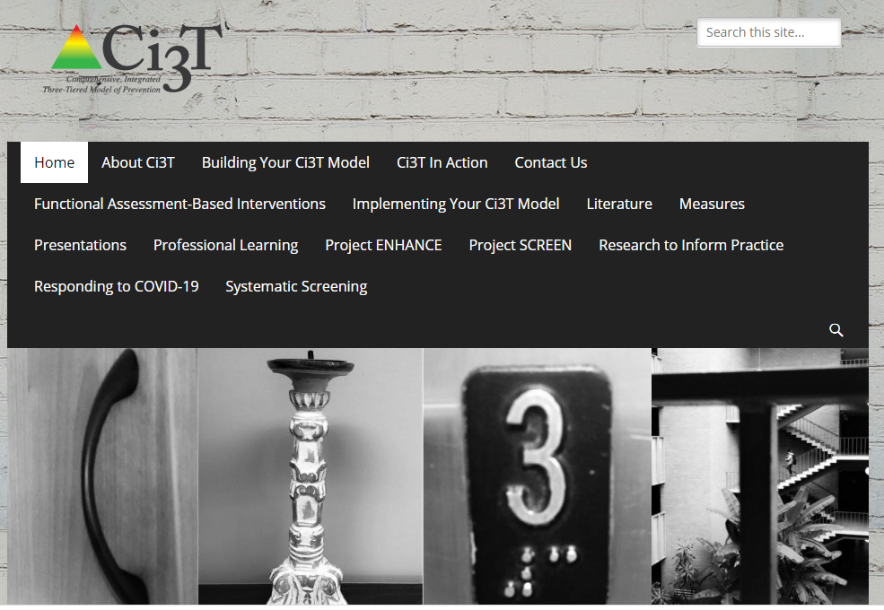
Develop Structures, Routines, & Reinforcement Procedures

Slide 6
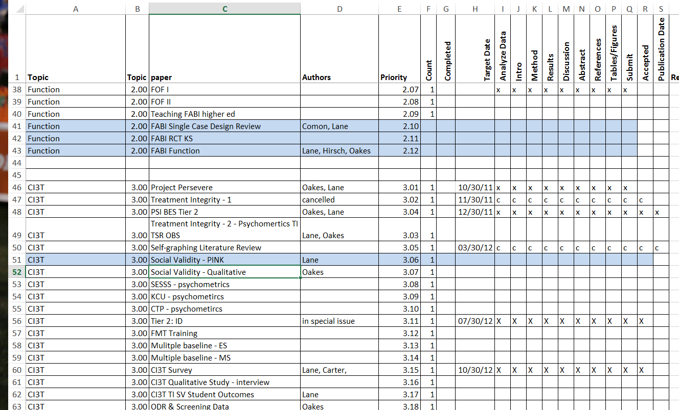
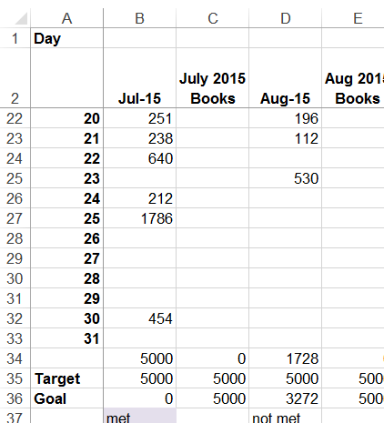
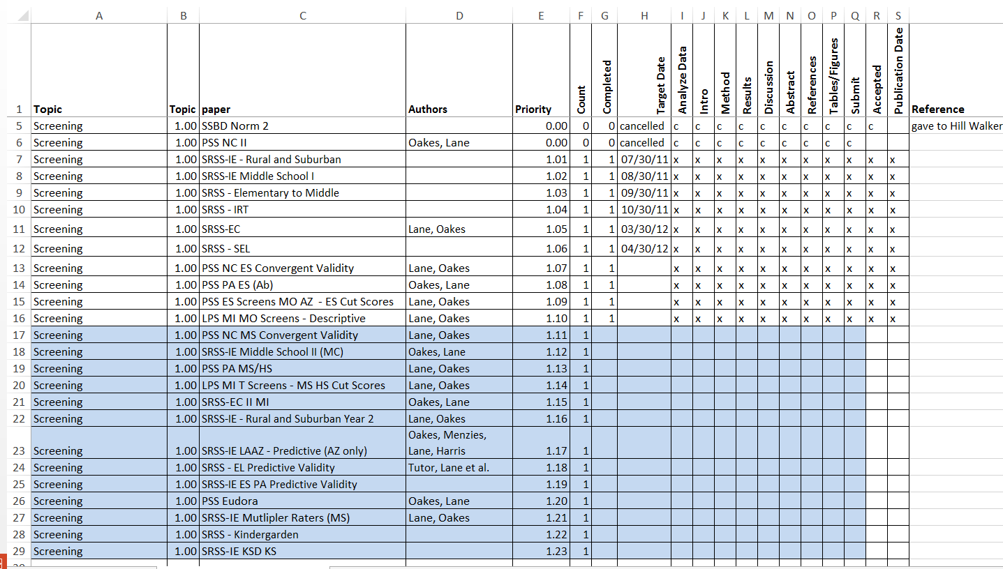
Establish Long Term & Short-Term Goals
Establish a writing plan linked to research strands
Develop monthly goals aligned with research, teaching, and service
Set daily or weekly writing goals
Build a self-monitoring system
Celebrate success

Slide 7
Dissemination Activities Over Time
Part-time Administrative Position
Number
Year

Slide 8
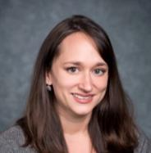
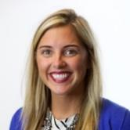
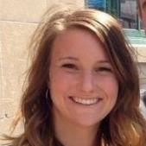
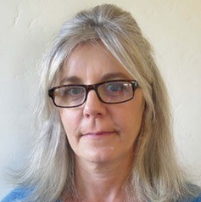
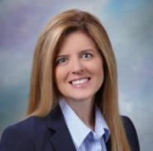
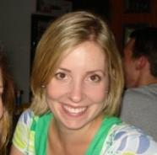
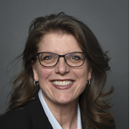
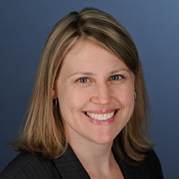
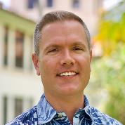
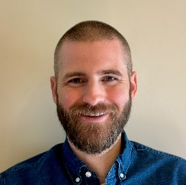
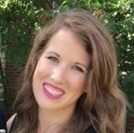
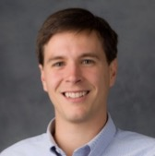
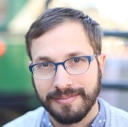
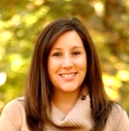
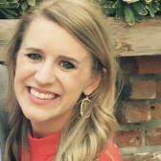
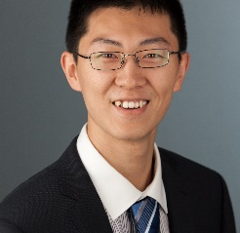
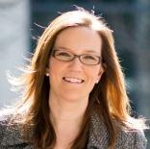
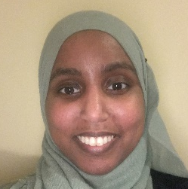
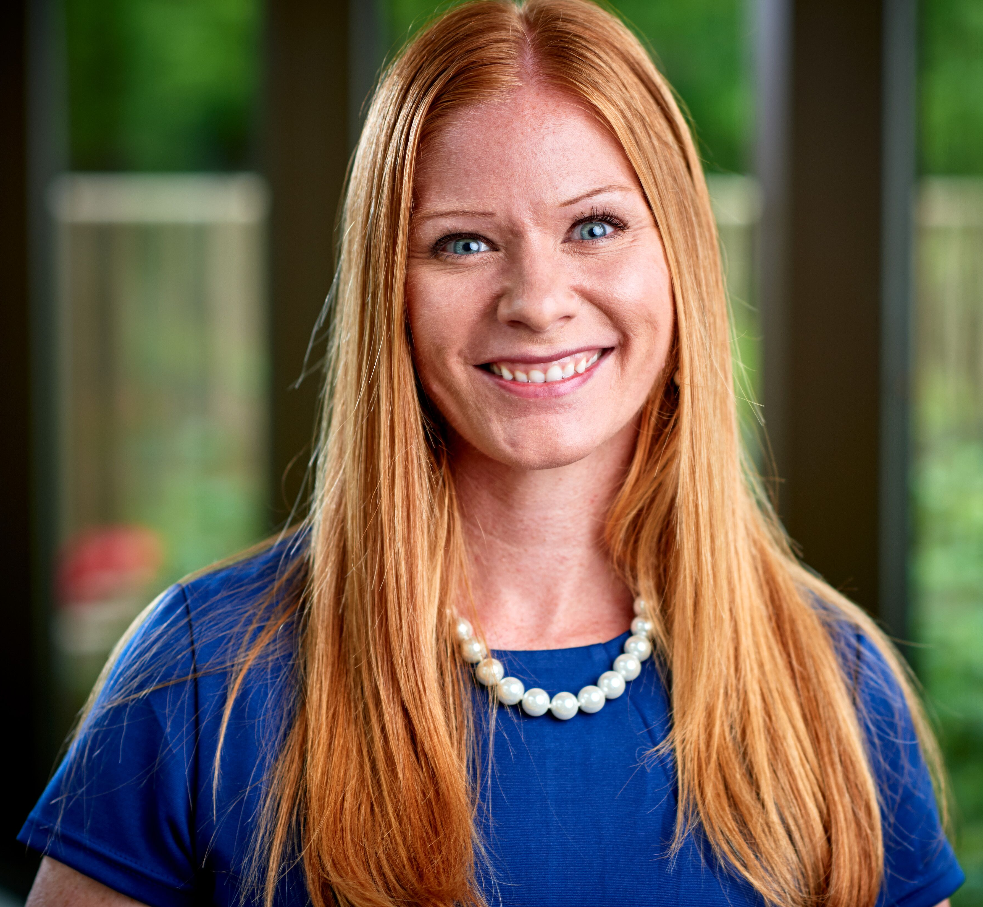
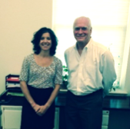
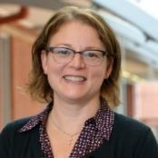
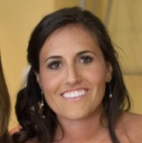
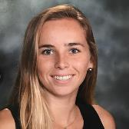
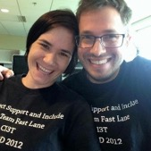
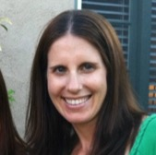
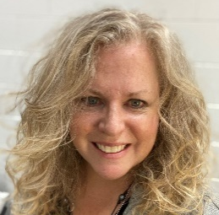
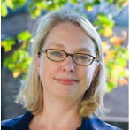
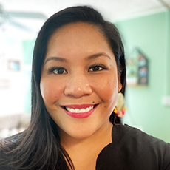
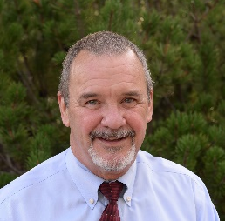
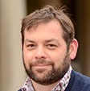
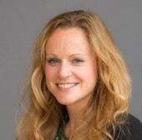
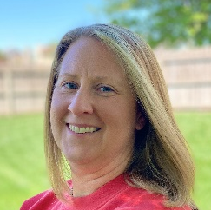
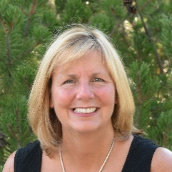
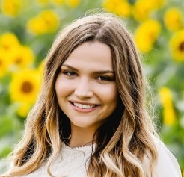
Ci3T Partners

Slide 9
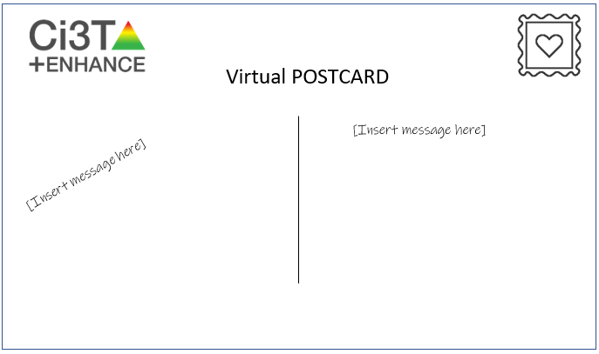
Appreciate and Acknowledge Those Who Helped Facilitate Research
kathleen.lane@ku.edu
Productive Scholars
Writing Group

