Slide 1
Where did that come from? Understanding and Managing Acting Out Behavior
Kathleen Lynne Lane, Ph.D., BCBA-D, CF-L1 Mark Matthew Buckman, Ph.D.
Wendy Peia Oakes, Ph.D.
Rebecca Lee Sherod, MSE Paloma Pérez-Clark, Ed.S. Katie S. Austin, M.Ed.

Slide 2
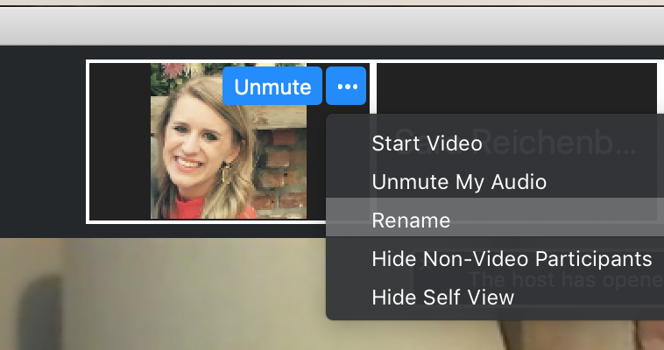
Renaming: First and Last Name
To help us interact and collaborate today, please ensure the name that appears on your zoom square is your first and last name.
Click the three dots at the top right corner of your video square.
Rename yourself with your First and Last Name
Notes:
https://support.zoom.us/hc/en-us/articles/115005769646 (scroll to self-selecting breakout room)

Slide 3
ci3t.org

Slide 4
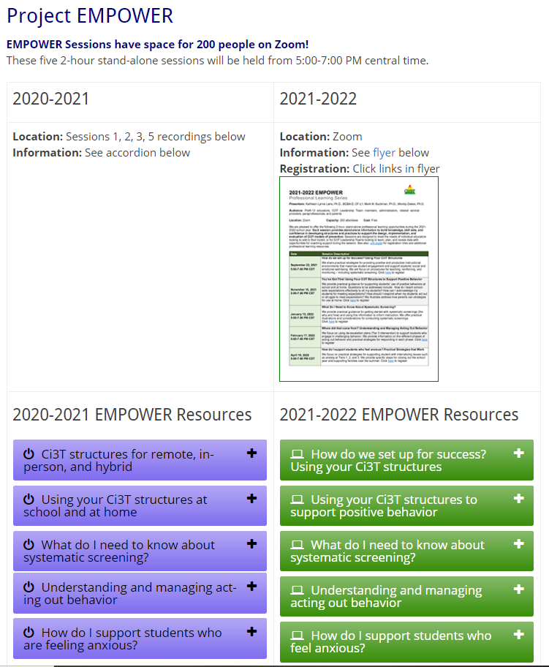
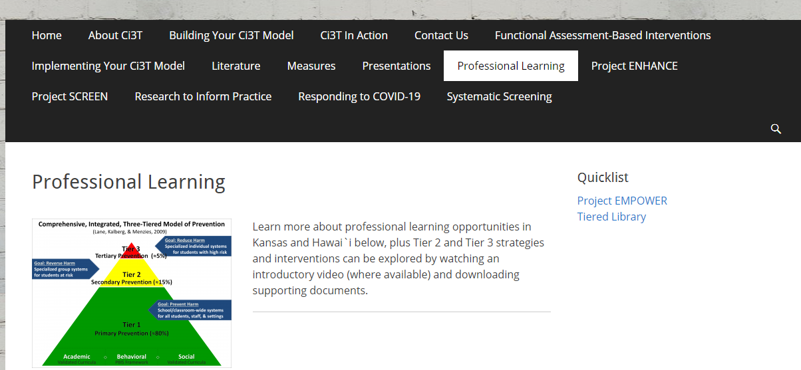
Accessing Project EMPOWER Professional Learning

Slide 5
Agenda
Welcome & Overview of Ci3T
A Look at Acting Out Behavior: Timing is Everything!
Managing Acting Out Behavior: Seven Phases
Pathways to Success: Understanding Educator-Student Interactions
Tier 3: Building a De-escalation Plan
Wrapping up: Resources and Questions

Slide 6
Welcome & Overview of Ci3T

Slide 8
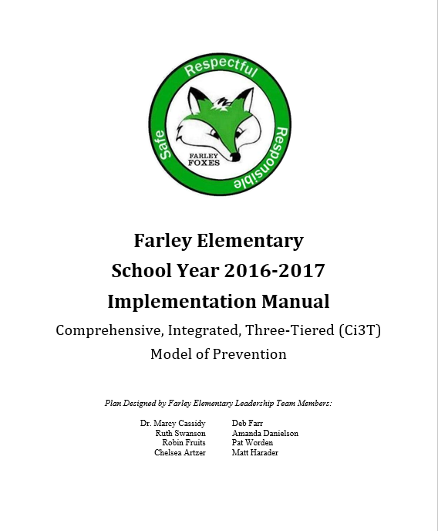
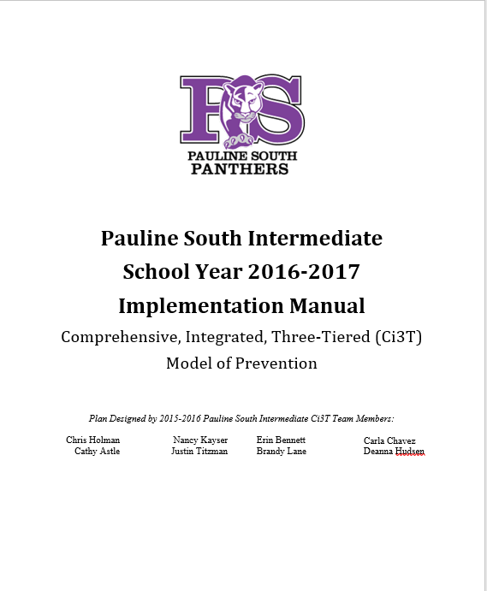
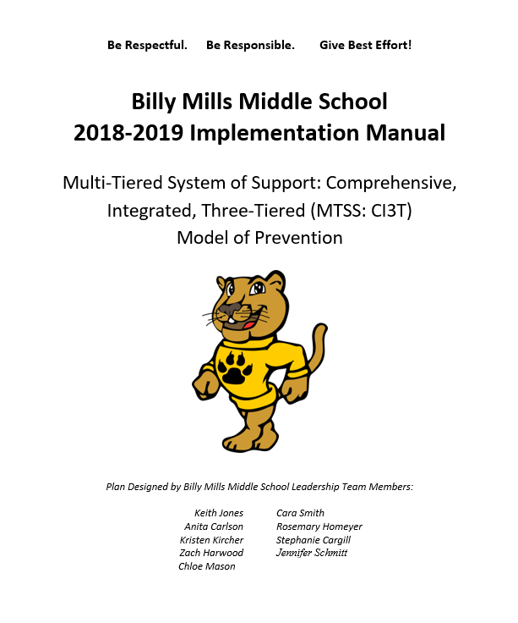
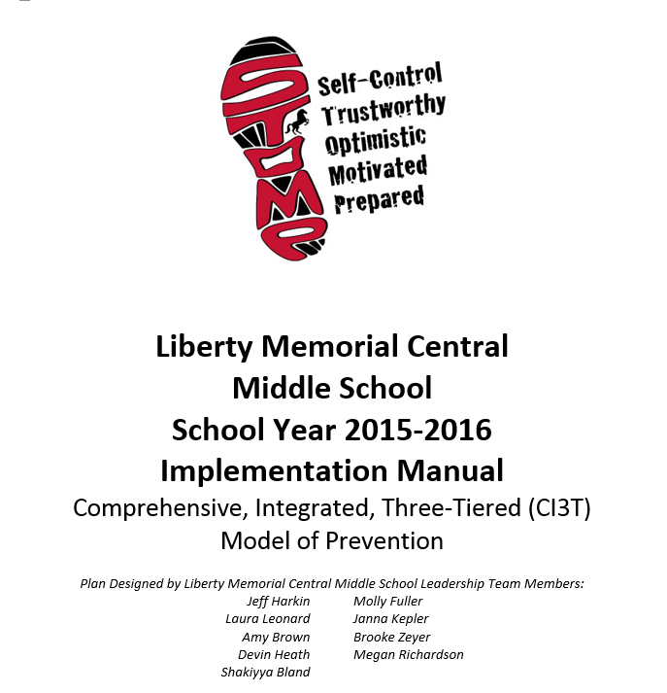
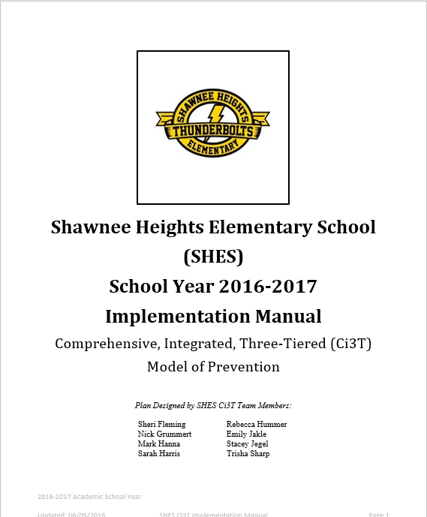
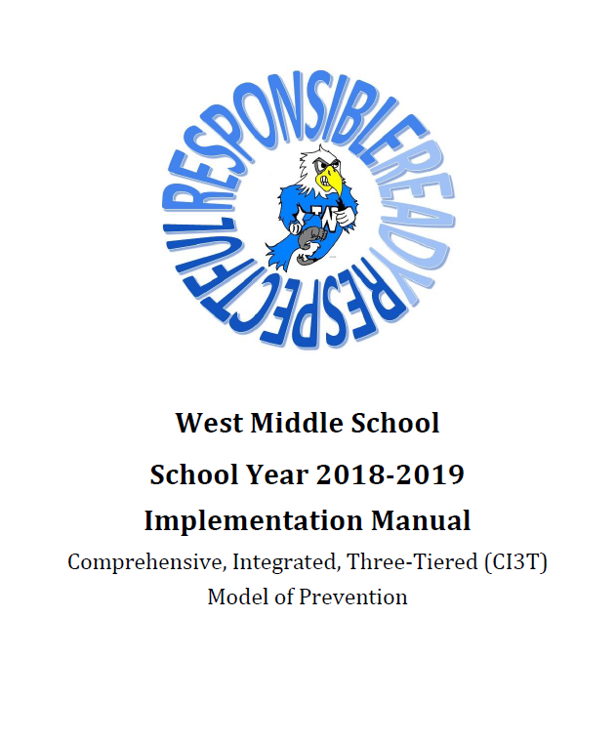
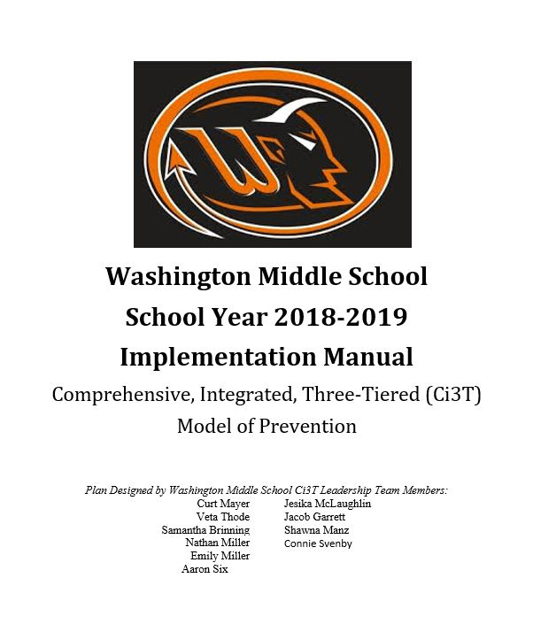
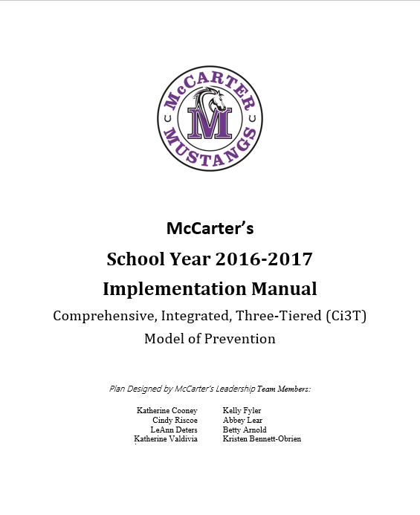
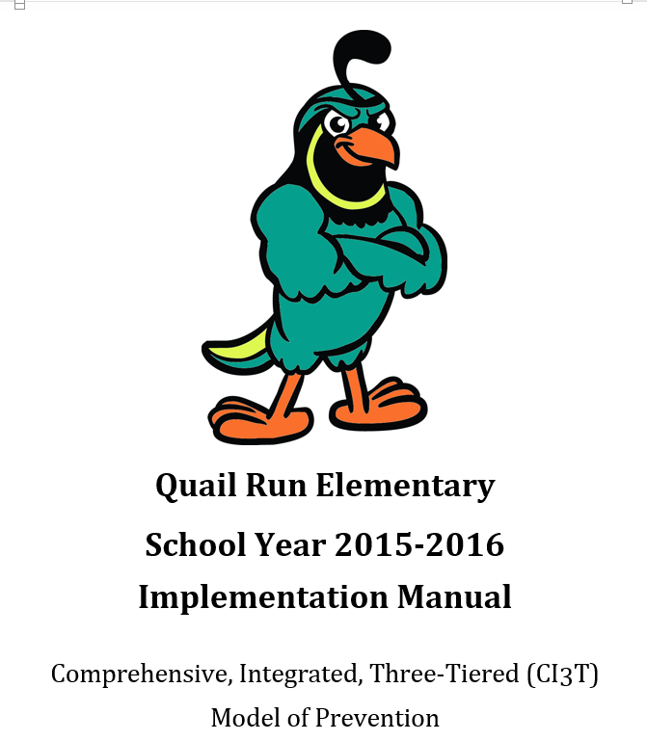
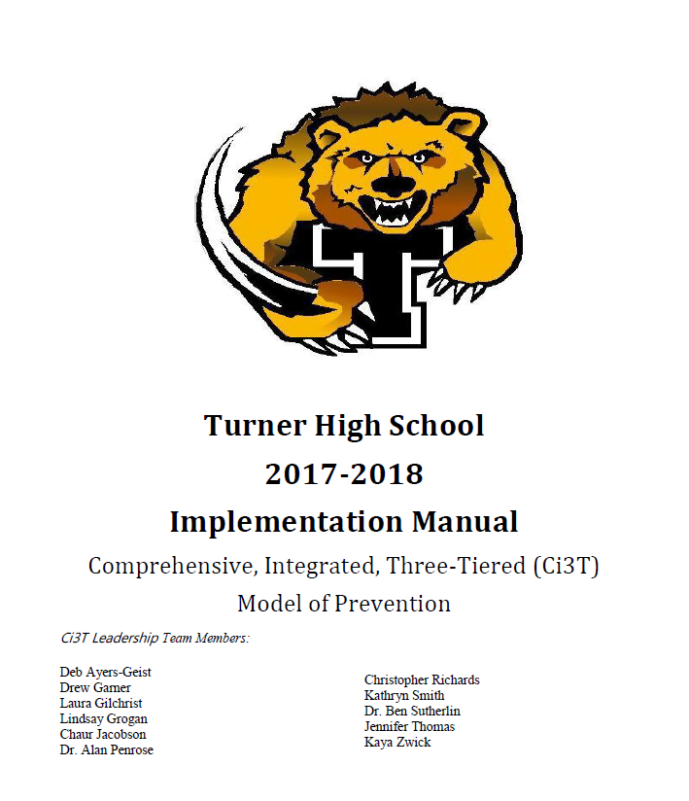
Ci3T Implementation Manuals

Slide 9
Reading Street
District & State Standards
High Quality Instruction

Slide 11
Positive Behavior Interventions and Supports (PBIS)

Slide 12
Positive Action

Slide 14
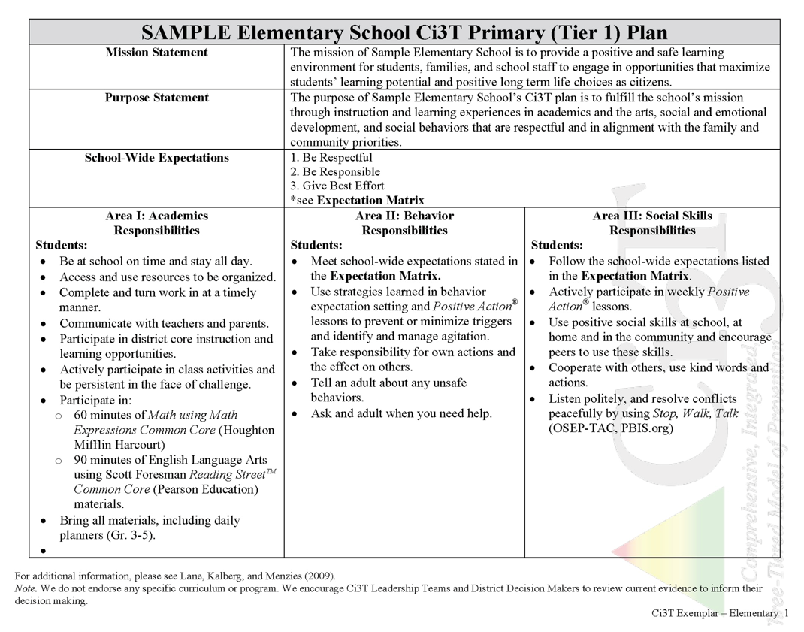
District & State Standards
High Quality Instruction
Positive Behavior Interventions and Supports (PBIS)
Social and Emotional Learning

Slide 15
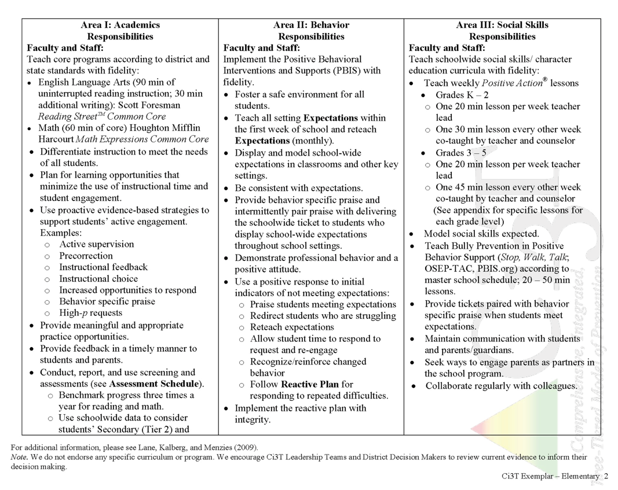
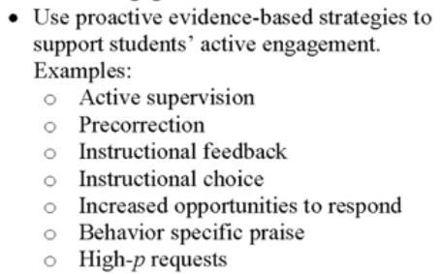
What do I need to know?

Slide 16
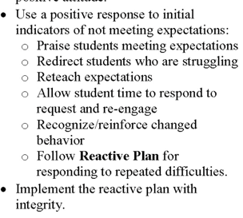
What do I need to know?

Slide 17
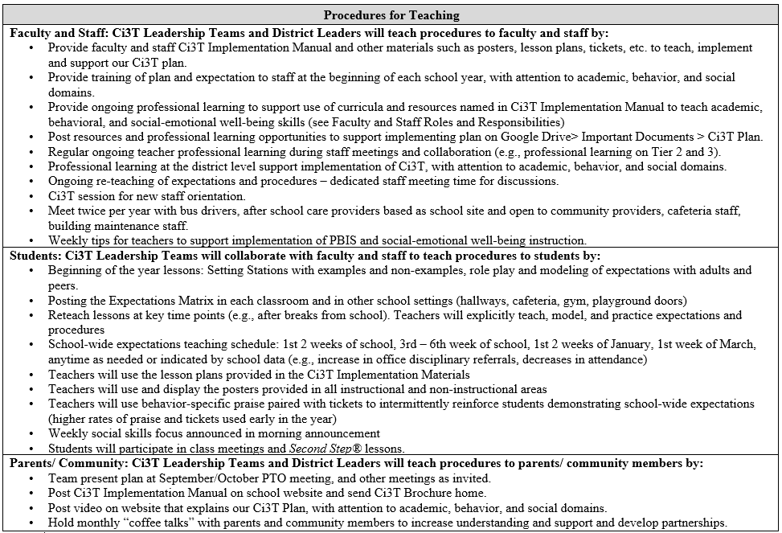
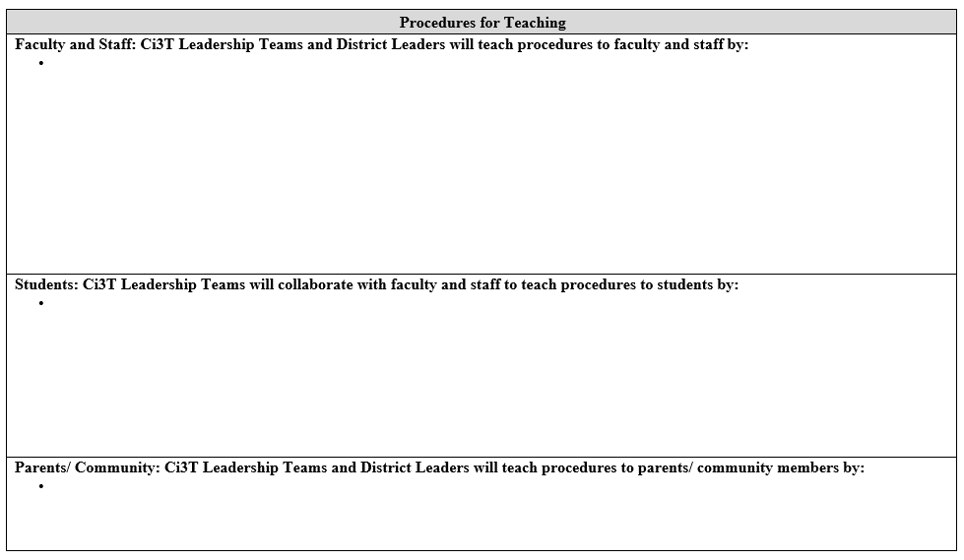
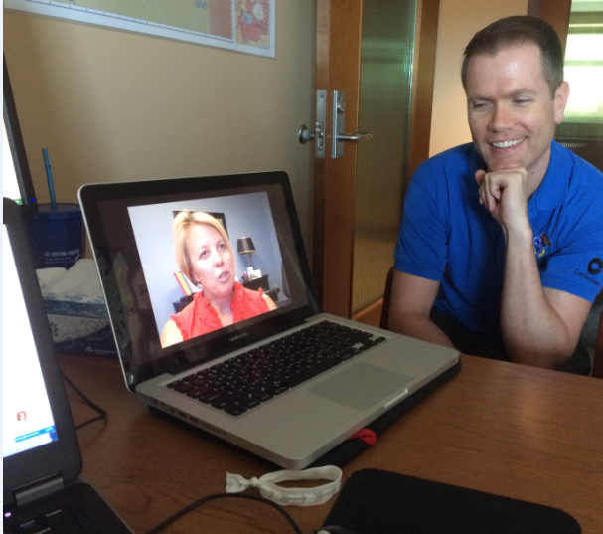
https://youtu.be/b4swsa_knYE
Lane & Oakes 2012

Slide 18
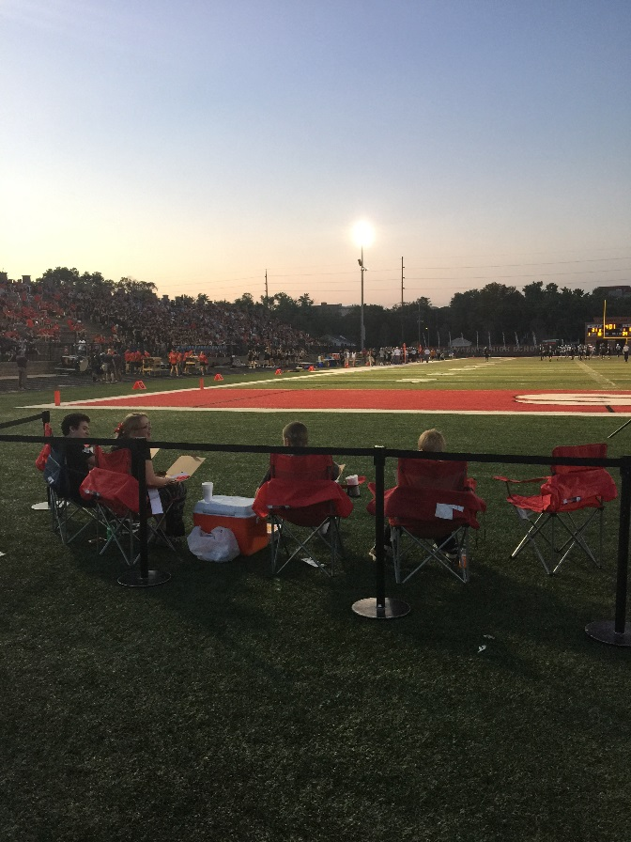
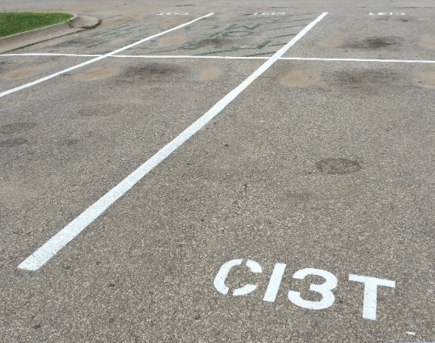
Procedures for Reinforcing
Faculty and Staff:
Students:
Parents/ Community:
Located in your Ci3T Implementation Manual
Donation Coupon:
1 box of Macaroni and Cheese to Community Food Drive

Slide 19
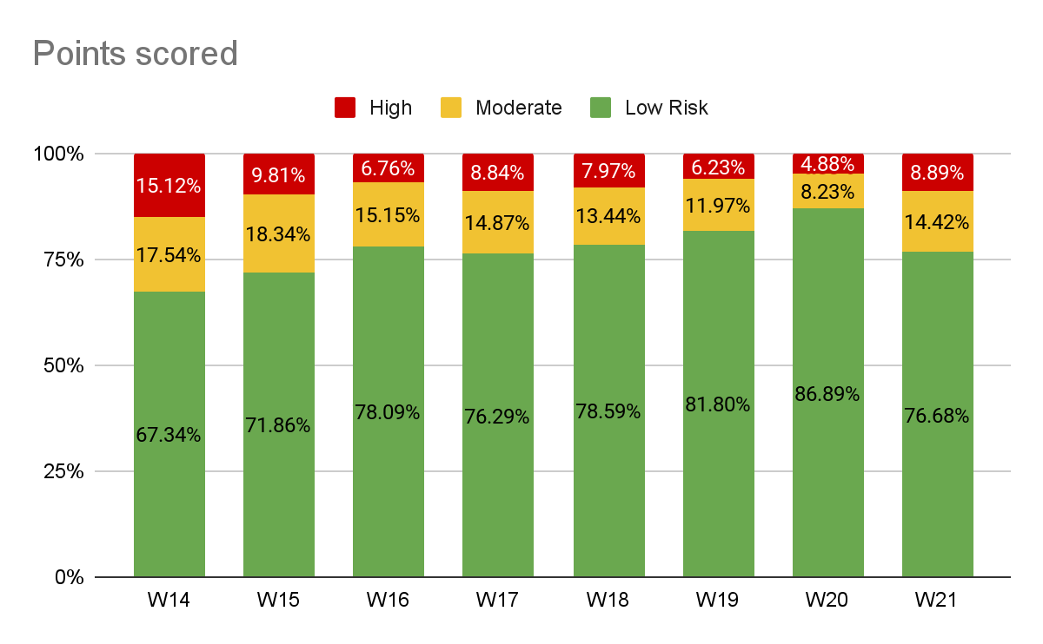
Winter 2021 SRSS-Internalizing Results – School level
Notes:
Fill in <year> based on current academic year. This is located in column A of the data sheet. Edit by right clicking and selecting “Edit data”.
IMPORTANT NOTE: The INTERNALIZING subscale and CUT SCORES are specific to school level.
Elementary: SRSS-I5, Items 8-12, 0-1 = low risk, 2-3 = moderate risk, 4-15 = high risk
Middle and High: SRSS-I6, Items 4, 8-12, 0-3 = low risk, 4-5 = moderate risk, 6-18 = high risk

Slide 20
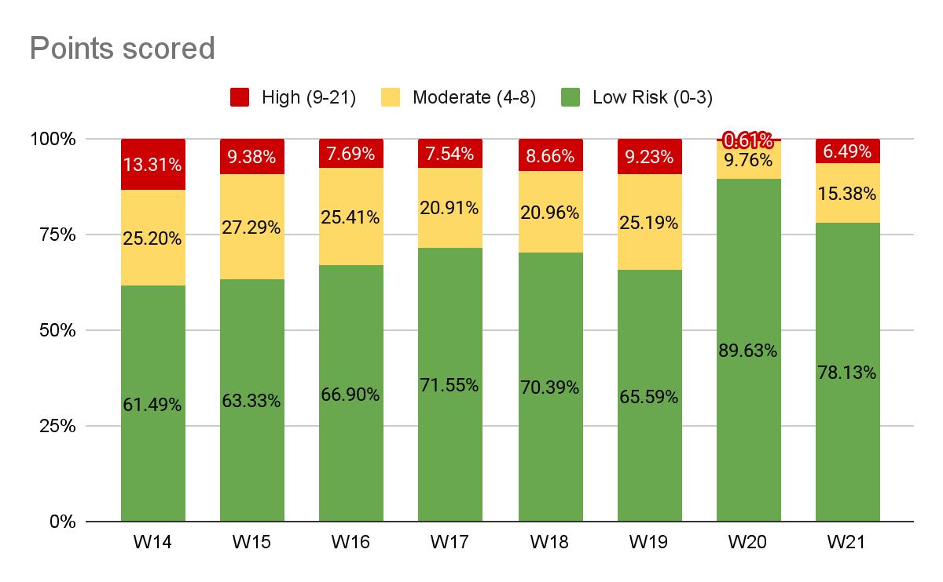
Winter 2021 SRSS-Externalizing Results – School level
Notes:
Fill in <year> based on current academic year. This is located in column A of the data sheet. Edit by right clicking and selecting “Edit data”.

Slide 21
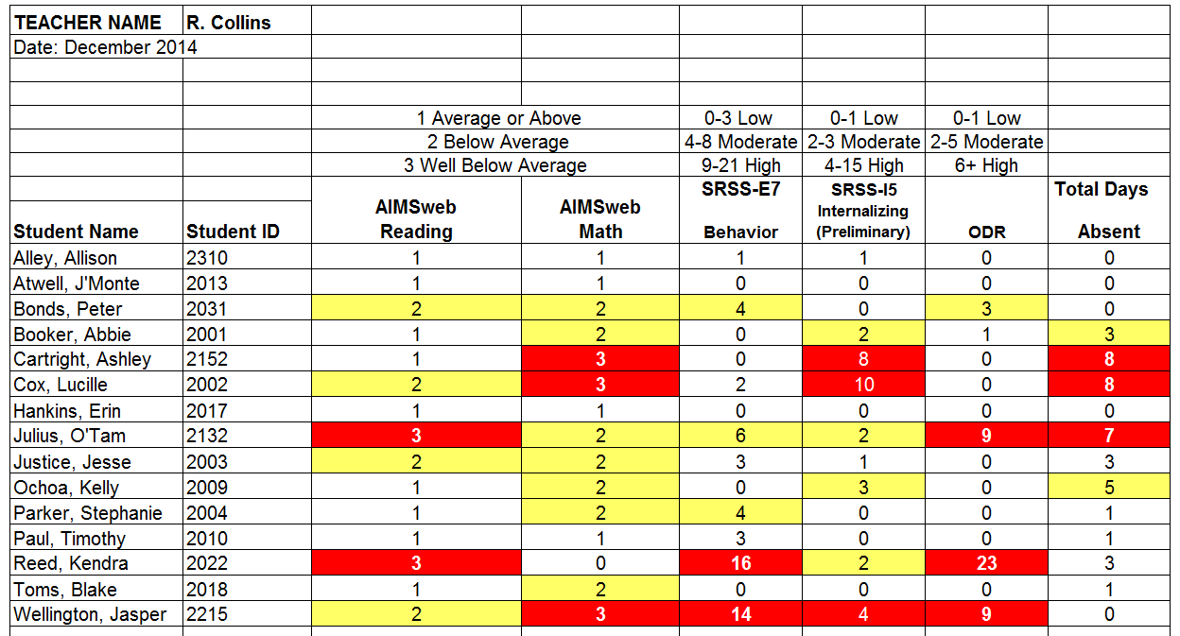
Examining Academic and Behavioral Data:
Elementary School Level
Lane, K. L., Menzies, H. M., Ennis, R. P., & Oakes, W. P. (2015). Supporting Behavior for School Success: A Step-by-Step Guide to Key Strategies. New York, NY: Guilford Press.
Notes:
Lane, K. L., Oakes, W. P., Ennis, R. P., & Hirsch, S. E. (2014). Identifying students for secondary and tertiary prevention efforts: How do we determine which students have Tier 2 and Tier 3 needs? Preventing School Failure, 58, 171-182, DOI: 10.1080/1045988X.2014.895573

Slide 22
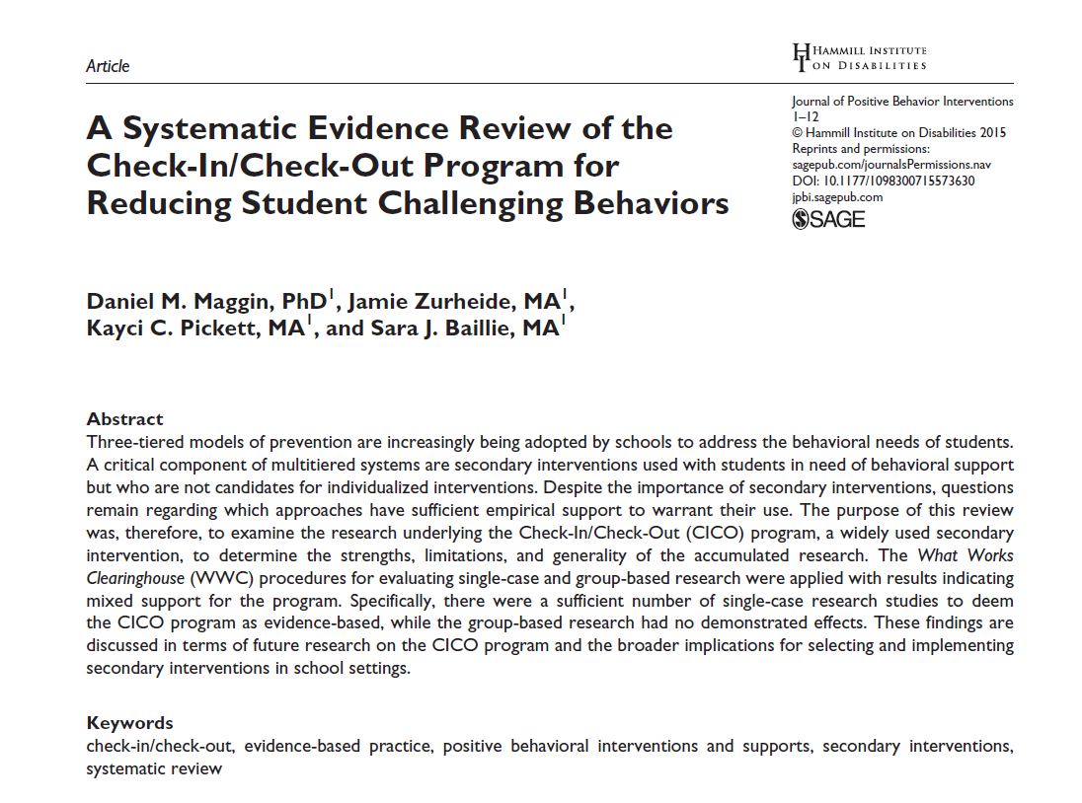
Low-Intensity Strategies
Opportunities to Respond
Behavior Specific Praise
Active Supervision
Instructional Feedback
High p Requests
Precorrection
Incorporating Choice
Self-monitoring
Behavior Contracts
Notes:
Lane, K. L., Oakes, W. P., Ennis, R. P., & Hirsch, S. E. (2014). Identifying students for secondary and tertiary prevention efforts: How do we determine which students have Tier 2 and Tier 3 needs? Preventing School Failure, 58, 171-182, DOI: 10.1080/1045988X.2014.895573

Slide 23
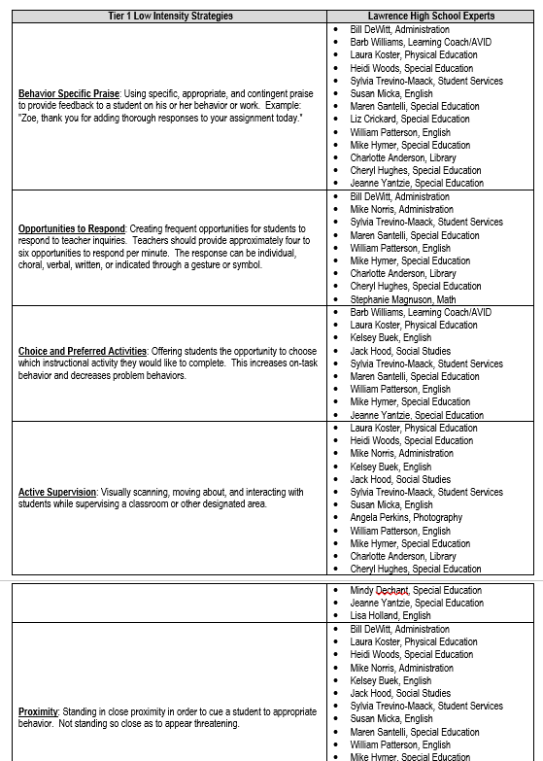
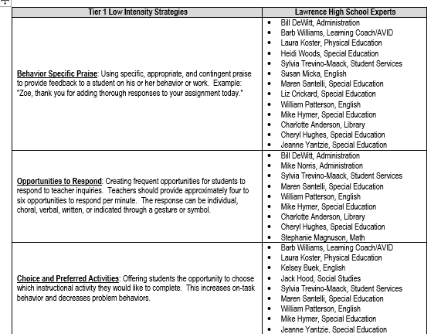

Slide 24
A Look at Acting Out Behavior: Timing is Everything!

Slide 25
Antecedents -Behavior - Consequences
Function!
A
B
C
Precorrection: Identifies predictable contexts that often result in problem behavior and provides students with supports, prompts, and reinforcement for engaging in appropriate behavior

Slide 26
Managing Acting Out Behaviors
ED … <1%
EBD … 12%
Classrooms are becoming increasingly more diverse
Culturally
Academically
Behaviorally
Social skill sets
(Lane, Wehby, & Robertson, 2008)
Students with exceptionalities are accommodated in inclusive settings (MacMillian, Gresham, & Forness, 1996)

Slide 27
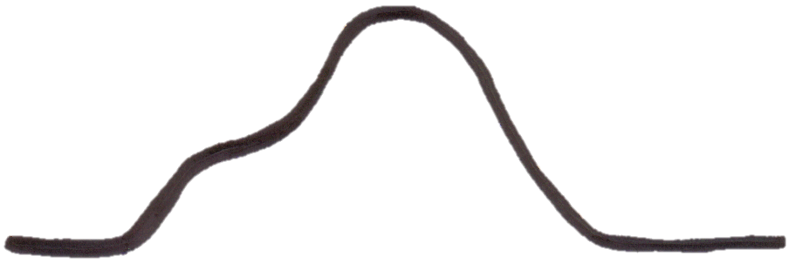
The Acting-Out Cycle
5. Peak
4. Acceleration
6. De-escalation
2. Trigger
1. Calm 7. Recovery
Whether the problem behavior is managed safely or not
or is defused
in a large measure depends on
YOUR INITIAL RESPONSE
-Dr. Geoff Colvin
Intensity
3. Agitation
Time
Colvin, 2004
Overview of the Acting Out Cycle--Vanderbilt IRIS Module

Slide 28
Behavior Chains
Each ensuing behavior in a given behavior chain becomes more serious than the one preceding it.
(Walker, Ramsey, & Gresham, 2004)

Slide 29
Change the Behavioral Momentum (Nevin, 1970)
Interrupt the behavioral chain at any time to prevent the occurrence of more serious types of behavior.

Slide 30
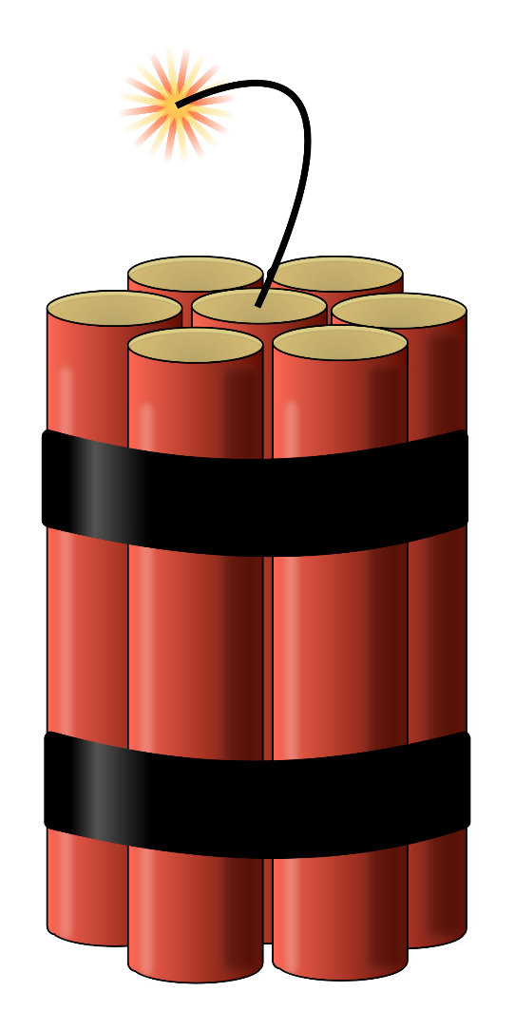
Stages of the Acting Out Cycle Colvin (1992)
Calm
Triggers
Agitation
Acceleration
Peak
De-Escalation
Recovery

Slide 31
A Look at Tier 1…
What supports are in place to support students across the three domains
Academic
Behavioral
Social
Look at the Professional Learning tab on ci3t.org. What low-intensity strategies are currently in place?
What questions do you have?

Slide 32
Managing Acting Out Behavior: Seven Phases
Notes:
10-min timer

Slide 33
The Model: Seven Phases of The Escalation or Acting-out Cycle
5. Peak
4. Acceleration
6. De-escalation
2. Trigger
1. Calm 7. Recovery
Whether the problem behavior is managed safely or not
or is defused
in a large measure depends on
YOUR INITIAL RESPONSE
-Dr. Geoff Colvin
Intensity
3. Agitation
Time
Colvin, 2004
Overview of the Acting Out Cycle--Vanderbilt IRIS Module

Slide 34
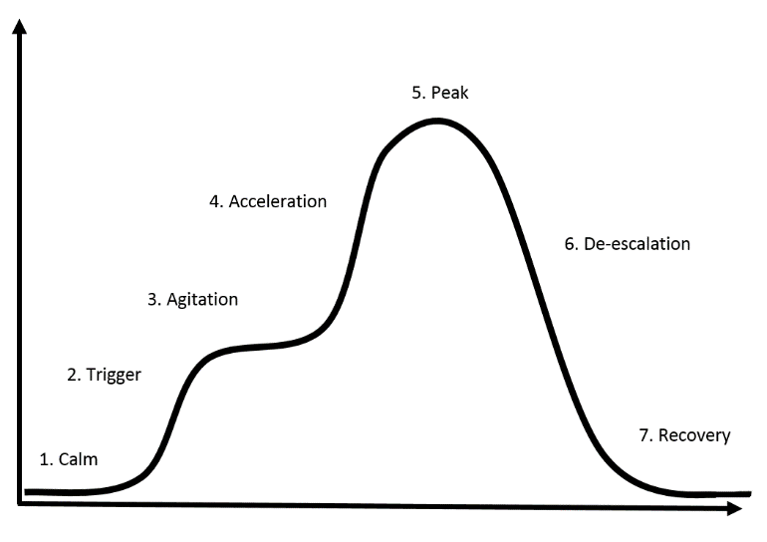
Calm Overall behavior is cooperative, compliant, and desirable.
Academically Engaged
Following Rules & Expectations
Responsive to Praise and Feedback
Initiates Interactions
Goal Directed Behaviors
Colvin, G., & Scott, T. (2015). Managing the cycle of acting-out behavior in the classroom (2nd Edition). Thousand Oaks, CA: Corwin.

Slide 35
Calm O
Strategies:
Intervention is focused on proactive strategies. Focus on instruction and positive behavior support.
Implement the schoolwide Ci3T plan
Vary instructional delivery
Provide behavior specific praise
Implement low-intensity teacher managed strategies (e.g. precorrection, active supervision, providing opportunities to respond)
Carefully plan instruction and implement clear routines and procedures
Attend to the physical environment for potential problem areas
Colvin, G., & Scott, T. (2015). Managing the cycle of acting-out behavior in the classroom (2nd Edition). Thousand Oaks, CA: Corwin.

Slide 36
Triggers Overall behavior involve a series of unresolved problems.
School-Based Triggers
Nonschool-Based Triggers
Conflicts
Changes in Routine
Peer Provocations
Pressure
Ineffective Problem Solving
Facing Errors in Instruction
Facing Correction Procedures
Denial of Something Needed
Dysfunctional Home Life
Health Problems
Nutritional Needs
Inadequate Sleep
Substance Abuse
Gangs
Colvin, G., & Scott, T. (2015). Managing the cycle of acting-out behavior in the classroom (2nd Edition). Thousand Oaks, CA: Corwin.

Slide 37
Triggers Overall behavior involve a series of unresolved problems.
Strategies:
Intervention is focused on prevention and redirection.
Identify the situation where the behavior is likely to occur.
Use precorrection to teach appropriate response.
Rehearse the expectations, prompt or remind students as needed, provide specific praise and reinforcement.
Work with all staff and faculty to teach and reinforce social skills.
Group social skills, anger management, community services.
Work with families for outside supports of nonschool-based triggers
Colvin, G., & Scott, T. (2015). Managing the cycle of acting-out behavior in the classroom (2nd Edition). Thousand Oaks, CA: Corwin.

Slide 38
Low-Intensity Strategies
Opportunities to Respond
Behavior Specific Praise
Active Supervision
Instructional Feedback
High p Requests
Precorrection
Incorporating Choice
Self-monitoring
Behavior Contracts
Notes:
Lane, K. L., Oakes, W. P., Ennis, R. P., & Hirsch, S. E. (2014). Identifying students for secondary and tertiary prevention efforts: How do we determine which students have Tier 2 and Tier 3 needs? Preventing School Failure, 58, 171-182, DOI: 10.1080/1045988X.2014.895573

Slide 39
Agitation Overall behavior is unfocused and off task.
Increases in Behavior
Decreases in Behavior
Darting Eyes
Non-conversational Language
Busy Hands
Moving In and Out of Groups
Off-task, Then On-task Behavior
Staring into Space
Veiled Eyes
Non-conversational Language
Contained Hands
Withdrawal
Colvin, G., & Scott, T. (2015). Managing the cycle of acting-out behavior in the classroom (2nd Edition). Thousand Oaks, CA: Corwin.

Slide 40
Agitation Overall behavior is unfocused and off task.
Strategies:
Intervention is focused on reducing anxiety.
Show empathy
Provide reasonable options and choices
Allow wait time for student to decide (usually less than a minute)
During wait time, walk away from student, attend to other students, or engage in some other task
Involve in successful engagement (behavior momentum)
Colvin, G., & Scott, T. (2015). Managing the cycle of acting-out behavior in the classroom (2nd Edition). Thousand Oaks, CA: Corwin.

Slide 41
Acceleration Overall behavior is teacher-engaging.
Questioning and Arguing
Noncompliance and Defiance
Off-Task Behavior
Provocation of Others
Compliance with Accompanying Inappropriate Behaviors
Criterion Problems
Whining and Crying
Avoidance and Escape
Threats, Intimidation
Destruction of Property
Verbal Abuse
Colvin, G., & Scott, T. (2015). Managing the cycle of acting-out behavior in the classroom (2nd Edition). Thousand Oaks, CA: Corwin.

Slide 42
Acceleration Overall behavior is teacher-engaging.
Strategies:
Intervention is focused on safety.
Remove all triggering factors
Avoid escalating prompts
Maintain calmness, respect and detachment
Approach the student in a nonthreatening manner
Utilize non-confrontational limit-setting procedures
Colvin, G., & Scott, T. (2015). Managing the cycle of acting-out behavior in the classroom (2nd Edition). Thousand Oaks, CA: Corwin.

Slide 43
Peak Overall behavior is out of control.
Serious Destruction of Property
Assault
Self-Abuse
Severe Tantrums
Hyperventilation
Running Away/Elopement
Colvin, G., & Scott, T. (2015). Managing the cycle of acting-out behavior in the classroom (2nd Edition). Thousand Oaks, CA: Corwin.

Slide 44
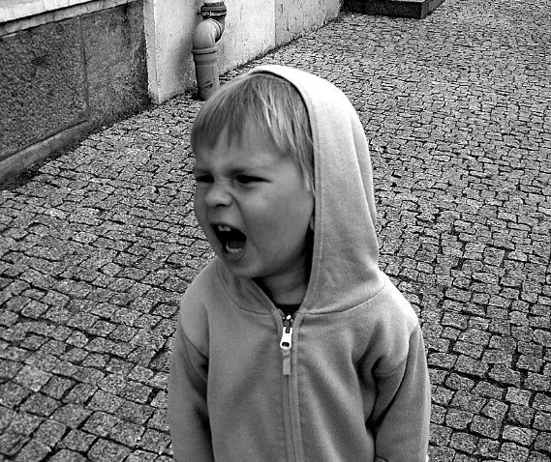
Peak Overall behavior is out of control.
Strategies:
Focus on safety only!
Remain calm
Crisis management
Safe strategies- emergency safety intervention (ESI) if there is immediate danger (if ESI used, document & notify)
Learn from it…(FBA, BIP, Mental Health Assessment, etc.)
Colvin, G., & Scott, T. (2015). Managing the cycle of acting-out behavior in the classroom (2nd Edition). Thousand Oaks, CA: Corwin.

Slide 45
De-Escalation Overall behavior displays confusion
Confusion
Reconciliation
Withdrawal
Denial
Blaming Others
Responsiveness to Directions
Responsive to Manipulative or Mechanical Tasks
Avoidance of Discussion
Avoidance of Debriefing
Colvin, G., & Scott, T. (2015). Managing the cycle of acting-out behavior in the classroom (2nd Edition). Thousand Oaks, CA: Corwin.

Slide 46
De-Escalation Overall behavior displays confusion
Strategies:
Intervention is focused on monitoring for re-escalation of behavior.
Monitor for health/safety of all involved
Avoid blaming- provide opportunity for non-judgmental discussion
Allow cool-down time and space
Engage in independent work- provide easy/concrete tasks
Colvin, G., & Scott, T. (2015). Managing the cycle of acting-out behavior in the classroom (2nd Edition). Thousand Oaks, CA: Corwin.

Slide 47
Recovery Overall behaviors show eagerness for busy work and reluctance to interact or discuss.
Eagerness for Independent Work or Activity
Subdued Behavior in Group Work
Subdued Behavior in Class Discussions
Defensive Behavior
Avoidance of Debriefing
Colvin, G., & Scott, T. (2015). Managing the cycle of acting-out behavior in the classroom (2nd Edition). Thousand Oaks, CA: Corwin.

Slide 48
Recovery Overall behaviors show eagerness for busy work and reluctance to interact or discuss.
Strategies:
Intervention focuses on returning to normal activities.
Follow through with consequences-but do not disrupt flow of instruction.
Positively reinforce any displays of appropriate behavior
Debrief/rehearse problem solving routine
Colvin, G., & Scott, T. (2015). Managing the cycle of acting-out behavior in the classroom (2nd Edition). Thousand Oaks, CA: Corwin.

Slide 49
Debriefing Session
Facilitates transition back to task/activity… not further negative consequence.
Goal is to increase appropriate behavior
Focus on problem solving
Pinpoint events that contributed to the incident
Teach replacement behaviors
Debriefing activities and forms

Slide 50
The Acting Out Cycle…
Reflect on each phase
What phases do you feel most knowledgeable about?
What strategies do you feel comfortable implementing?
What professional learning avenues would be useful for building knowledge and confidence?

Slide 51
Pathways to Success: Understanding Educator-Student Interactions

Slide 52
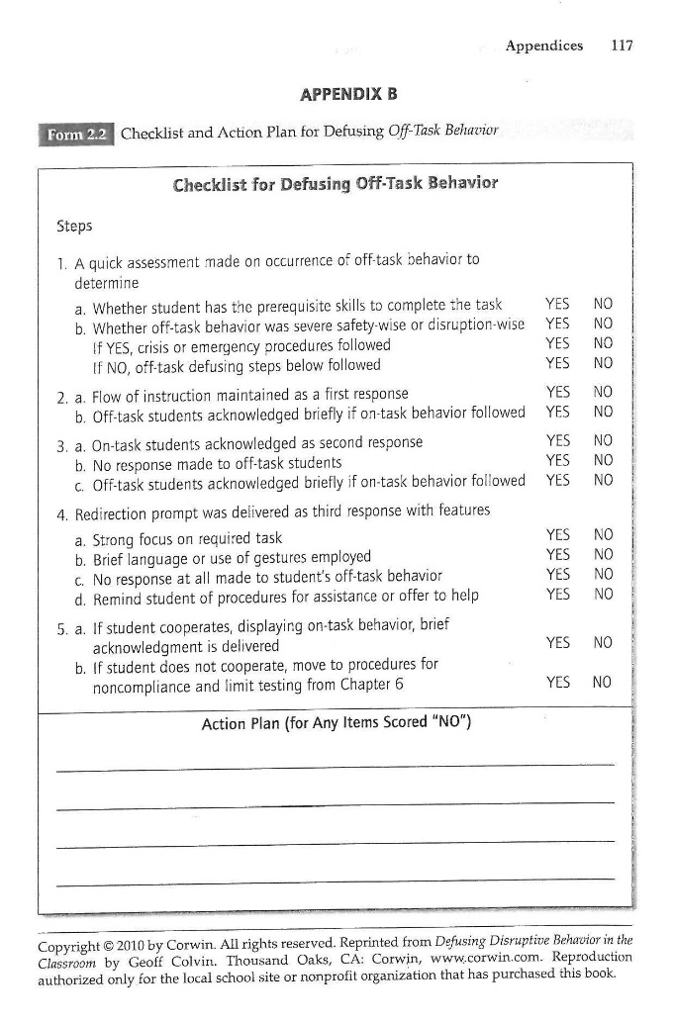
Defusing Off-Task Behavior
Assess the situation: determine “can’t do” or “won’t do” (Is it an emergency situation? If so, follow crisis procedures. If not, follow off-task defusing steps).
Maintain the flow of instruction.
Recognize on-task students, making no response to off-task students.
Redirect (focus on task, brief language/gestures, prompt student of procedures for asking for help).
Praise compliance.

Slide 53
Four Key Strategies
Take an instructional approach to behavior school wide.
Intervene early in the acting out cycle.
Learn strategies to intervene at each stage in the acting out cycle.
Be respectful at all times.

Slide 54
Tier 3: Building a De-escalation Plan

Slide 55
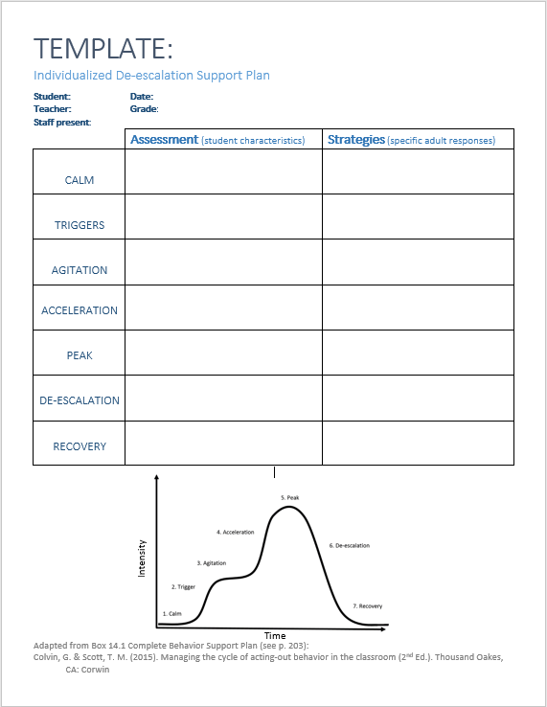
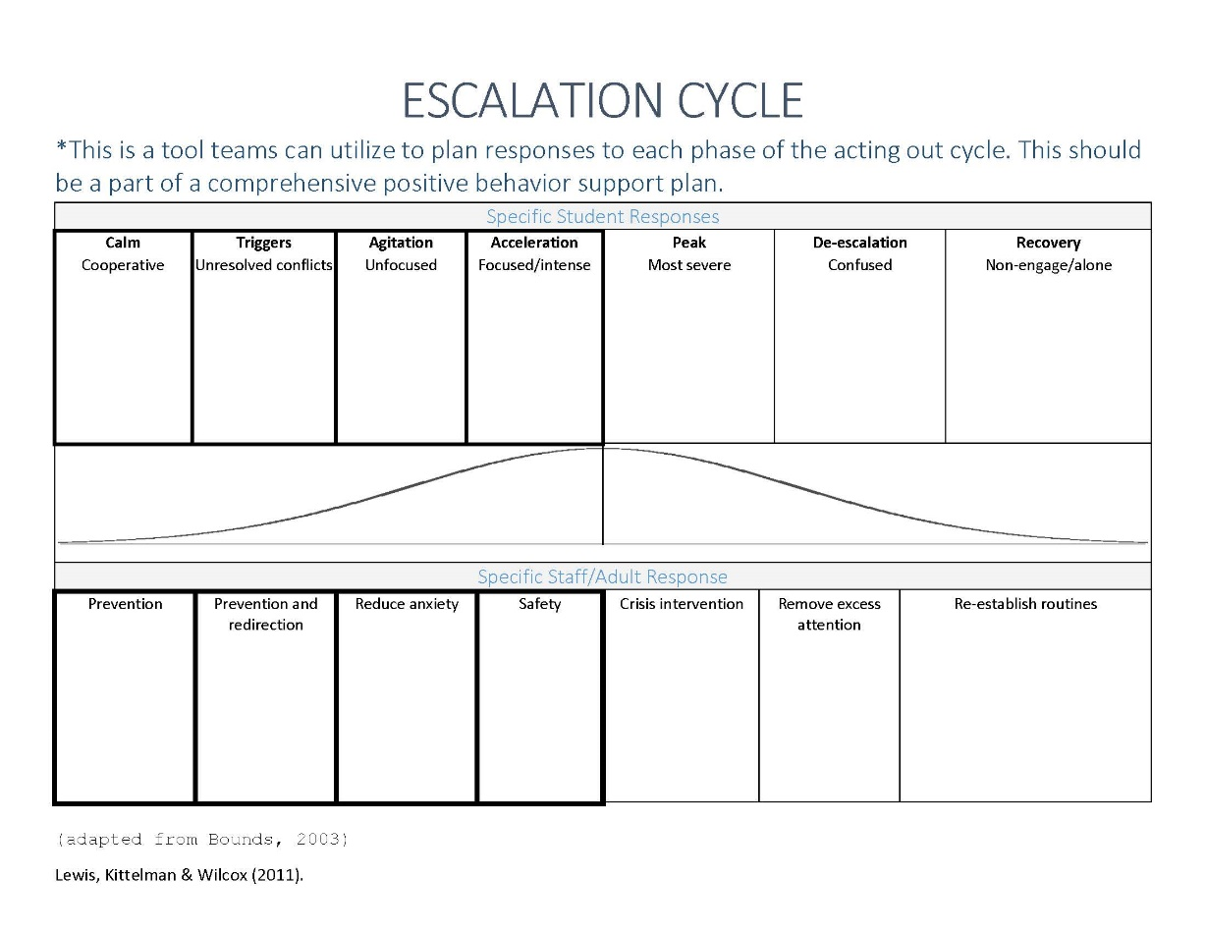
Planning
See Implementation folder for
“Individualized De-escalation Support Plan”

Slide 56
Sample Intervention Grid
Support | Description | School-wide Data: Entry Criteria | Data to Monitor Progress | Exit Criteria
Individualized De-escalation Plan | Ongoing strategy involving identifying specific student characteristics for each phase of the De-escalation cycles and implementing appropriate and evidence-based adult responses to managing student acting out behavior. | One or more of the following: Behavior: SRSS-E7: High (9-21) Office discipline referrals (ODRs) 6 or more within a grading period | Identify a target behavior for the individual student. Include: (a) label for the behavior, (b) definition, (c) examples, and (d) non examples Set behavioral goal based on baseline performance of the behavior. Direct observation of the target behavior with data points graphed for decision making. Treatment Integrity: Treatment integrity checklist Social Validity: Teacher: IRP-15 Student: CIRP | SRSS-E7 score: Low (0-3) Observation data demonstrate behavior is consistently within expected level (per goal; three consecutive data points) – then transition to maintenance plan and monitor behavior during transition.

Slide 57
Individual De-escalation Support Plan…
Visit the Professional Learning tab on ci3t.org and explore resources available for the “Tier 3: Individual De-Escalation Support Plan for Managing the Acting Out Cycle”
Do you have this in place as a Tier 3 intervention?
How might this be useful for the work you do?
What questions do you have?

Slide 58
Wrapping up: Resources and Questions

Slide 59
Resources
Addressing Disruptive and Noncompliant Behaviors: Understanding the Acting-Out Cycle with Kathleen Lane: http://iris.peabody.vanderbilt.edu/module/bi1/
Midwest Symposium for Leadership in Behavior Disorders: www.mslbd.org
Association for Positive Behavior Support: www.apbs.org
Dr. Geoff Colvin’s Behavior Associates: http://www.behaviorassociates.org/
Building and Sustaining Student Engagement Project: (strategy briefs) http://k12engagement.unl.edu/

Slide 60
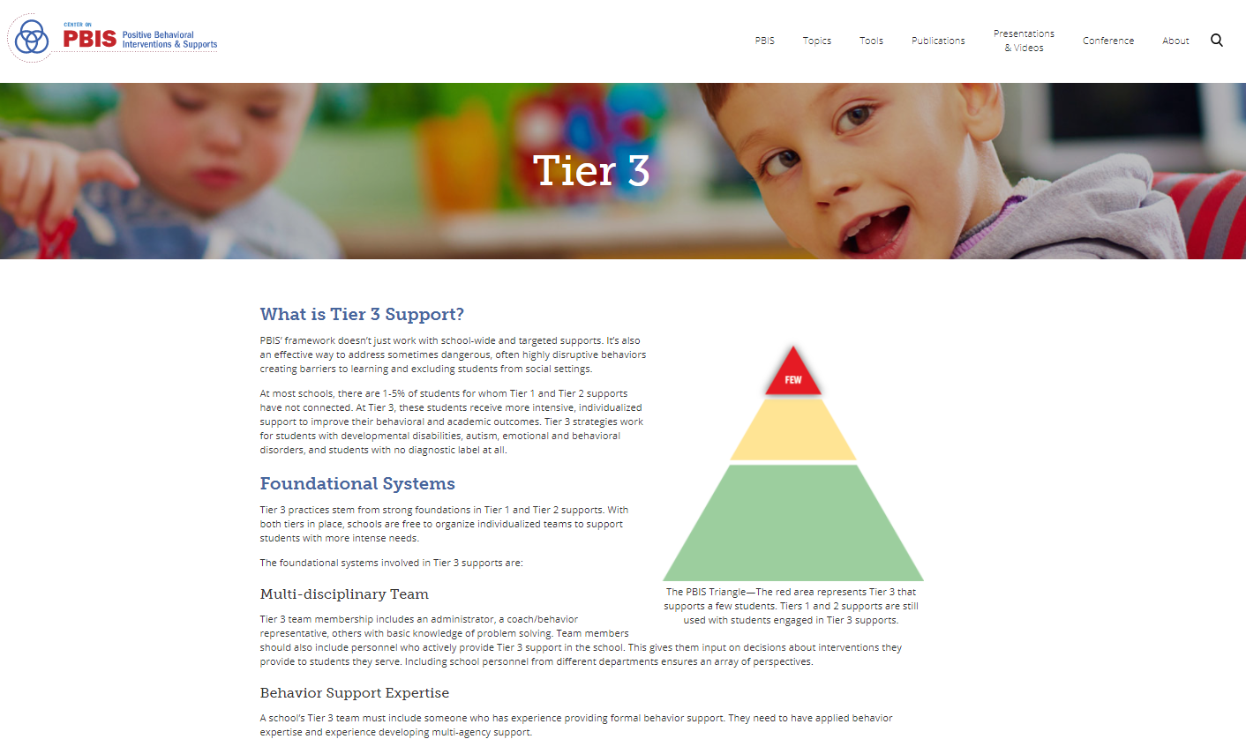
PBIS.org
On Demand Resources
Very useful to find research on specific interventions
PowerPoint presentations are available for some interventions
Training modules are available on PBIS aspects and interventions
Some tools and measures are available to be viewed
Quick FAQs on secondary and tertiary interventions

Slide 61
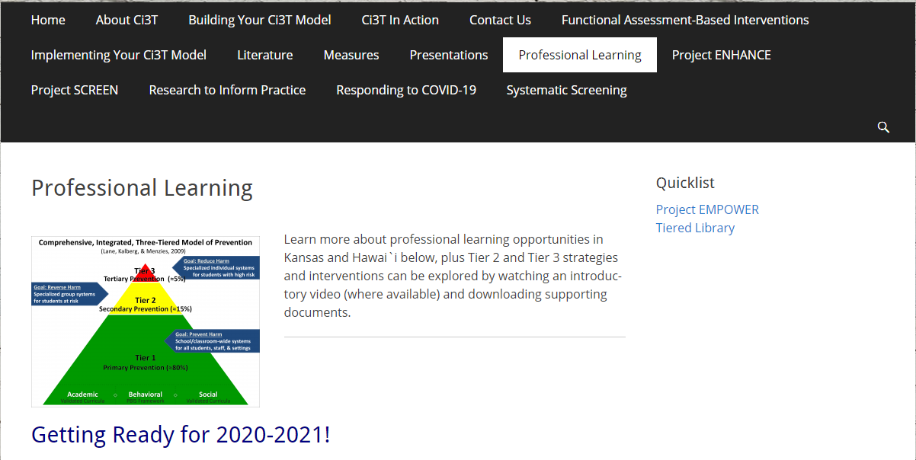
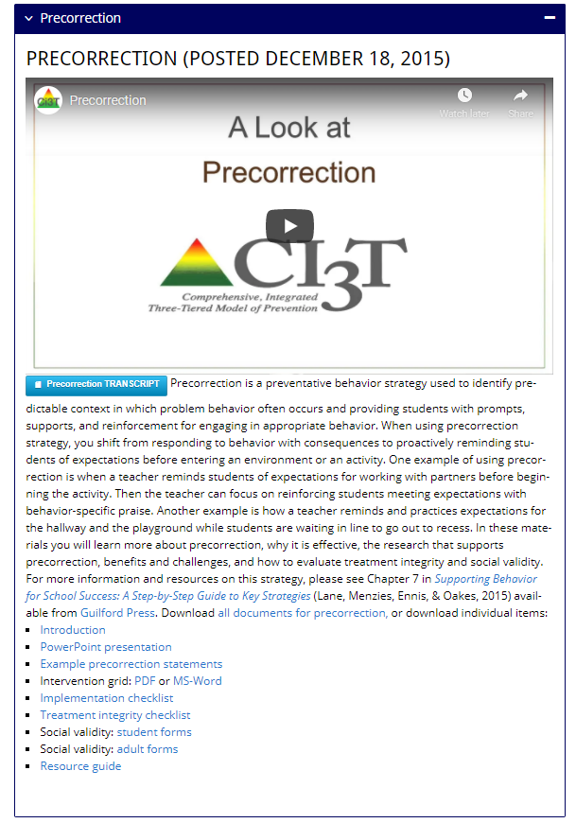
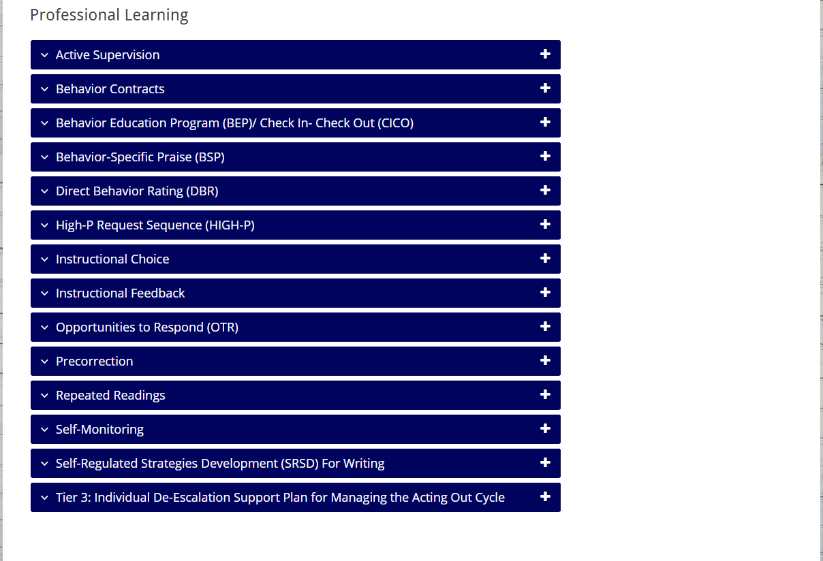
Ci3T.org

Slide 62
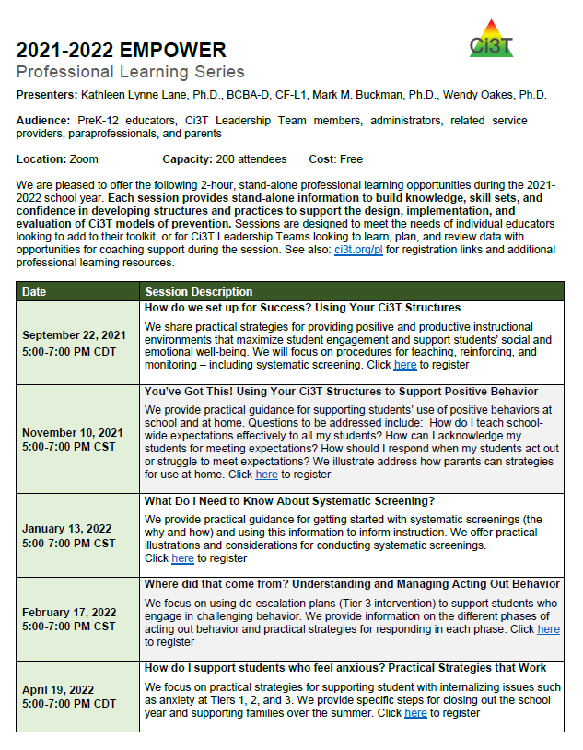
Ci3T EMPOWER Sessions Location: Remote via Zoom Attended by: School Ci3T Leadership Teams Ci3T District Trainers and Coaches Faculty and Staff Families (adults only) Community Members |  | Times CST All Times Tentative
How do we set up for Success? Using Your Ci3T Structures | September 22, 2021 | 5:00 p.m. – 7:00 p.m.
You’ve Got This! Using Your Ci3T Structures to Support Positive Behavior | November 10, 2021 | 5:00 p.m. – 7:00 p.m.
What Do I Need to Know About Screening? | January 13, 2022 | 5:00 p.m. – 7:00 p.m.
Where did that come from? Understanding and Managing Acting Out Behavior | February 17, 2022 | 5:00 p.m. – 7:00 p.m.
How do I support students who are feeling anxious? Practical Strategies that Work | April 19, 2022 | 5:00 p.m. – 7:00 p.m.

Slide 63
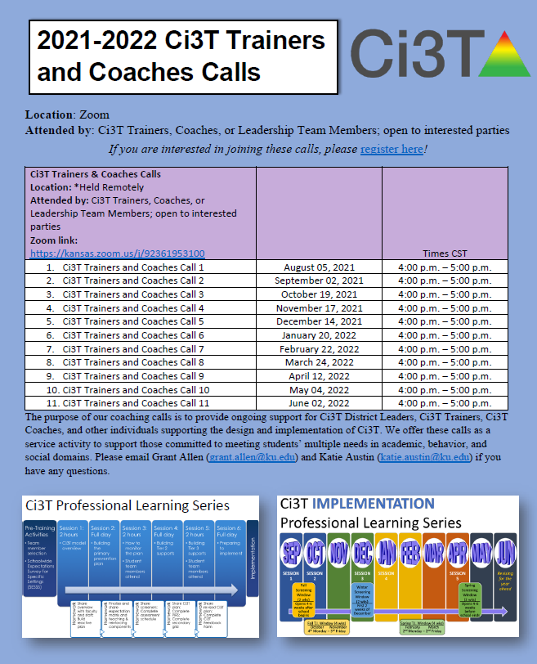
Ci3T Trainers & Coaches Calls Location: *Held Remotely Attended by: Ci3T Trainers, Coaches, or Leadership Team Members; open to interested parties Zoom link: https://kansas.zoom.us/j/92361953100 |  | Times CST
Ci3T Trainers and Coaches Call 1 | August 05, 2021 | 4:00 p.m. – 5:00 p.m.
Ci3T Trainers and Coaches Call 2 | September 02, 2021 | 4:00 p.m. – 5:00 p.m.
Ci3T Trainers and Coaches Call 3 | October 19, 2021 | 4:00 p.m. – 5:00 p.m.
Ci3T Trainers and Coaches Call 4 | November 17, 2021 | 4:00 p.m. – 5:00 p.m.
Ci3T Trainers and Coaches Call 5 | December 14, 2021 | 4:00 p.m. – 5:00 p.m.
Ci3T Trainers and Coaches Call 6 | January 20, 2022 | 4:00 p.m. – 5:00 p.m.
Ci3T Trainers and Coaches Call 7 | February 22, 2022 | 4:00 p.m. – 5:00 p.m.
Ci3T Trainers and Coaches Call 8 | March 24, 2022 | 4:00 p.m. – 5:00 p.m.
Ci3T Trainers and Coaches Call 9 | April 12, 2022 | 4:00 p.m. – 5:00 p.m.
Ci3T Trainers and Coaches Call 10 | May 04, 2022 | 4:00 p.m. – 5:00 p.m.
Ci3T Trainers and Coaches Call 11 | June 02, 2022 | 4:00 p.m. – 5:00 p.m.

Slide 64
Thank you!

