Slide 1
Project ENHANCE: Implementing and Sustaining Comprehensive, Integrated, Three-tiered (Ci3T) Models of Prevention
Annual IES Principal Investigators Meeting
January 25-27, 2022
Advancing Equity and Inclusion in the Education Sciences
Kathleen Lynne Lane and Mark Buckman, University of Kansas
Wendy Peia Oakes, Arizona State University
Sandra Chafouleas, University of Connecticut
Amy Briesch, Northeastern University
David J. Royer, University of Louisville, Kentucky
Eric A. Common, University of Michigan - Flint

Slide 2
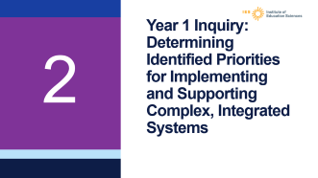


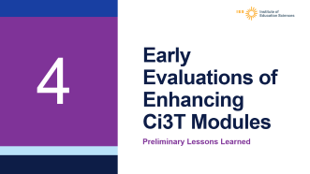
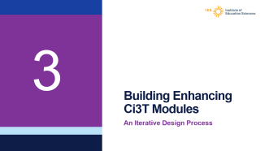
Agenda

Slide 3
Project ENHANCE Overview
1

Slide 4
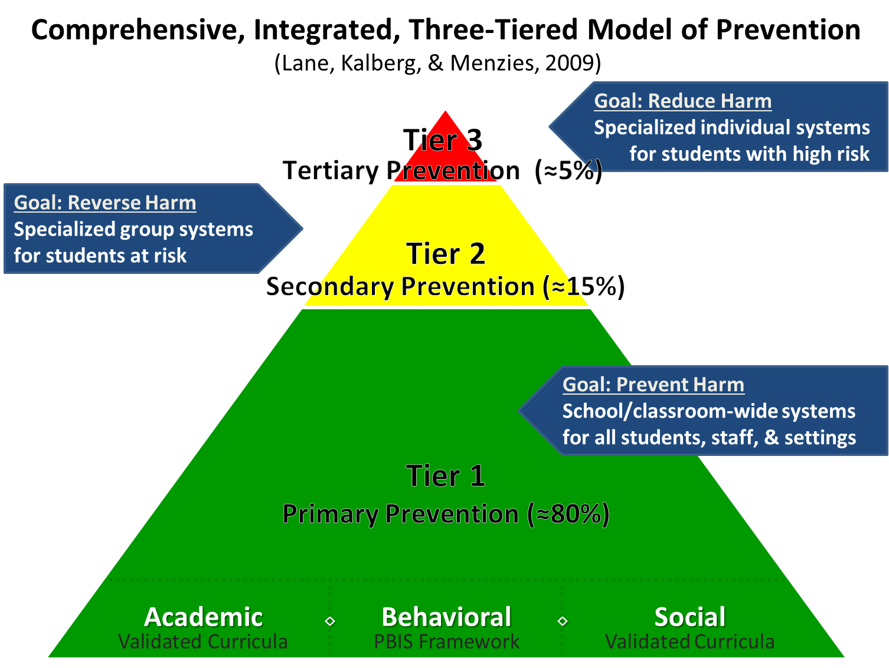
Ci3T
Ci3T

Slide 5
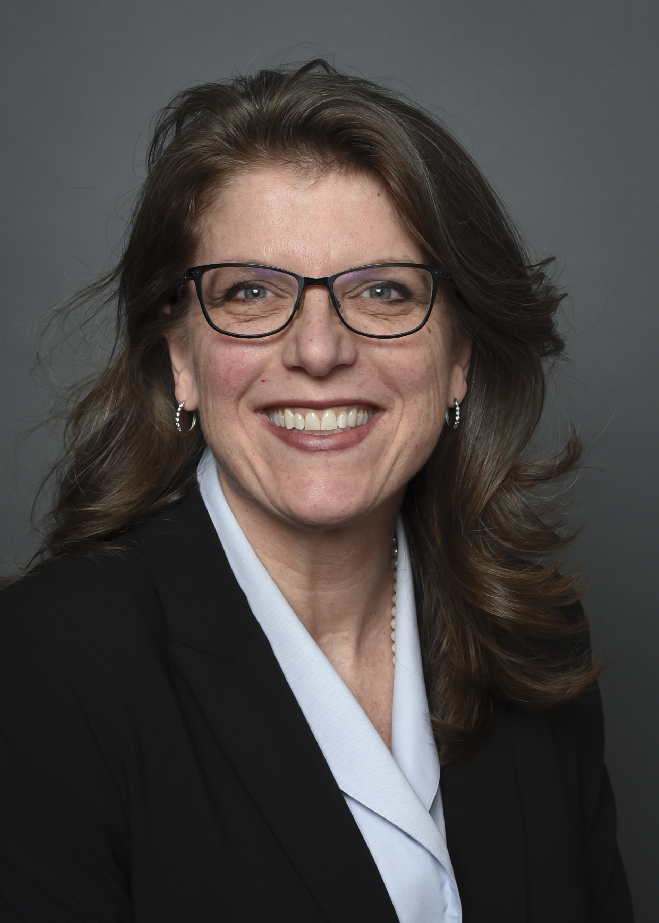

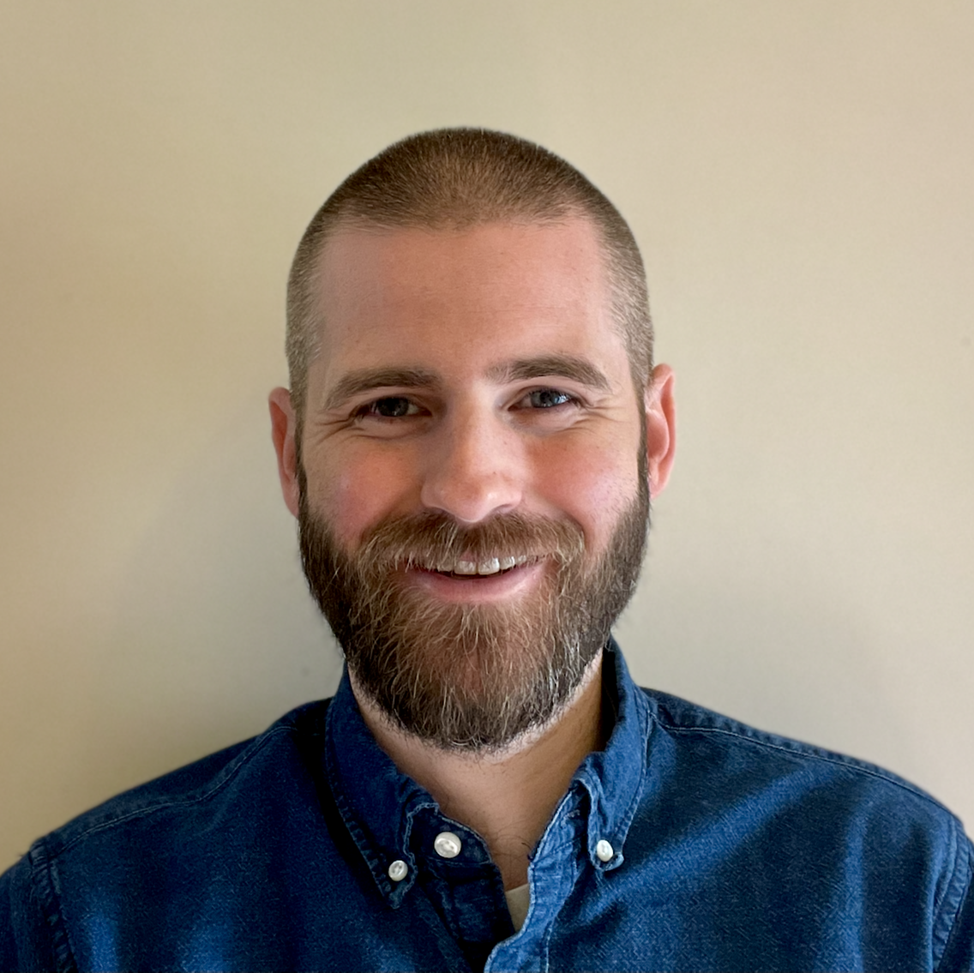
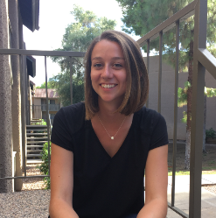



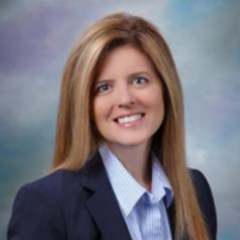



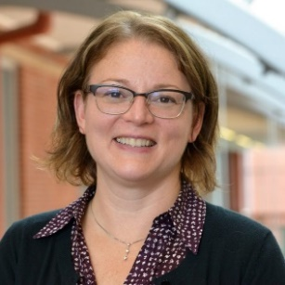

Project Primary Investigators and Staff

Slide 6
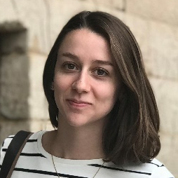

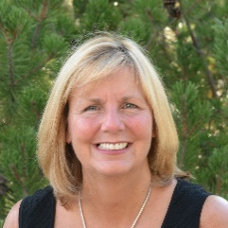
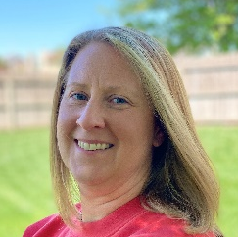
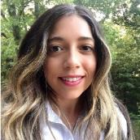
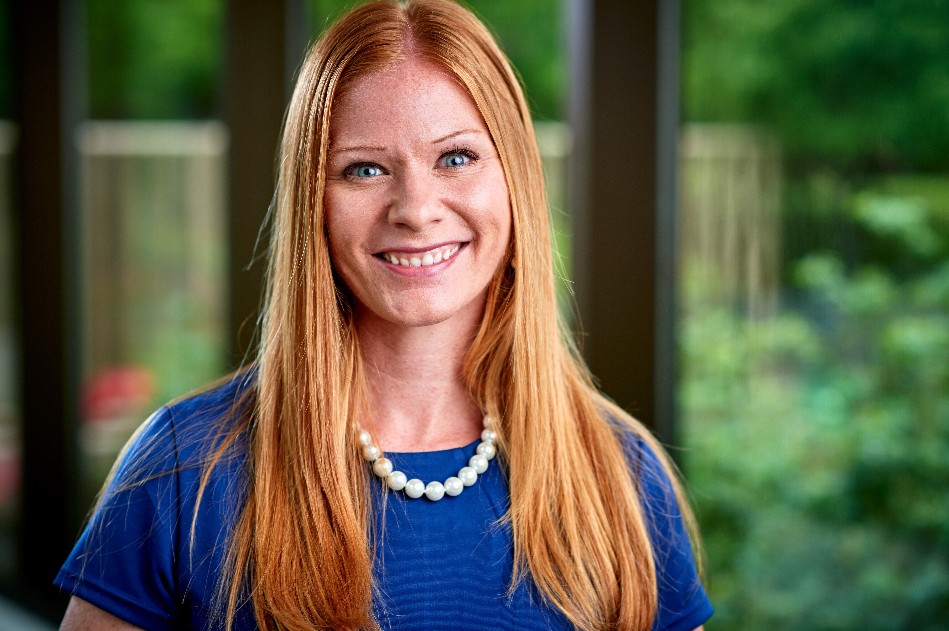
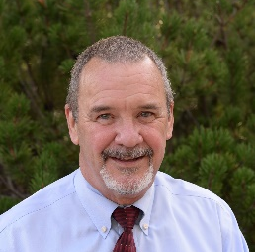
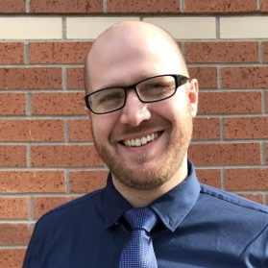
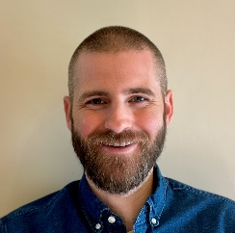
Project ENHANCE Coaching Support

Slide 7
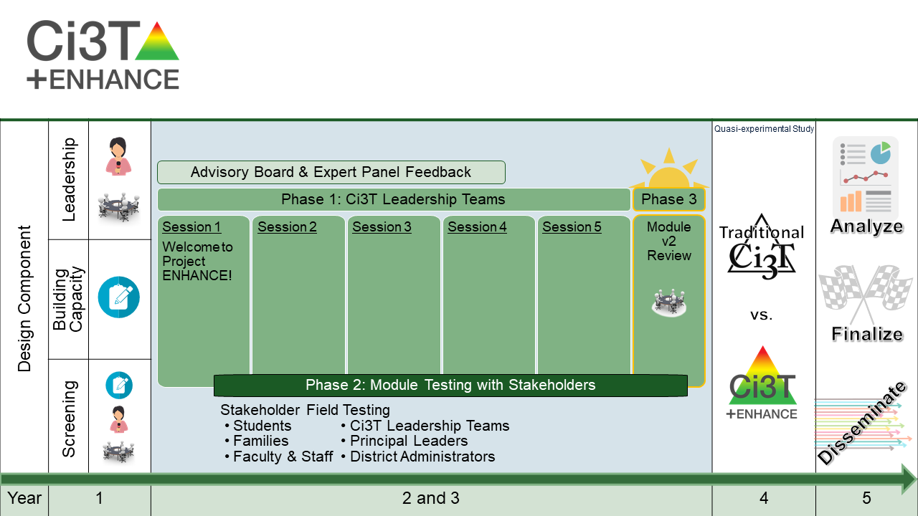
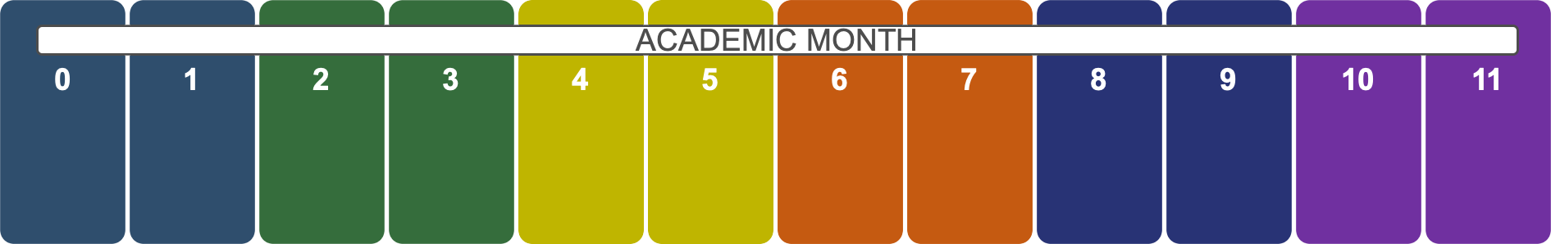
Project ENHANCE

Slide 8
Project ENHANCE con’t
Using data to identify needs and inform professional learning
Building capacity and leadership through Enhancing Ci3T Modules

Slide 9
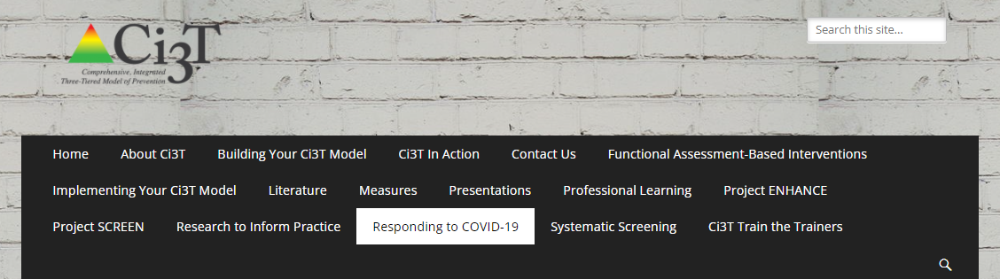
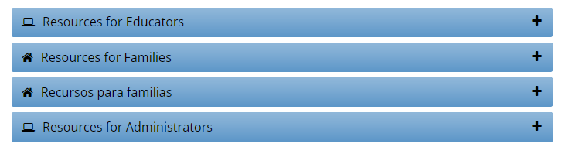
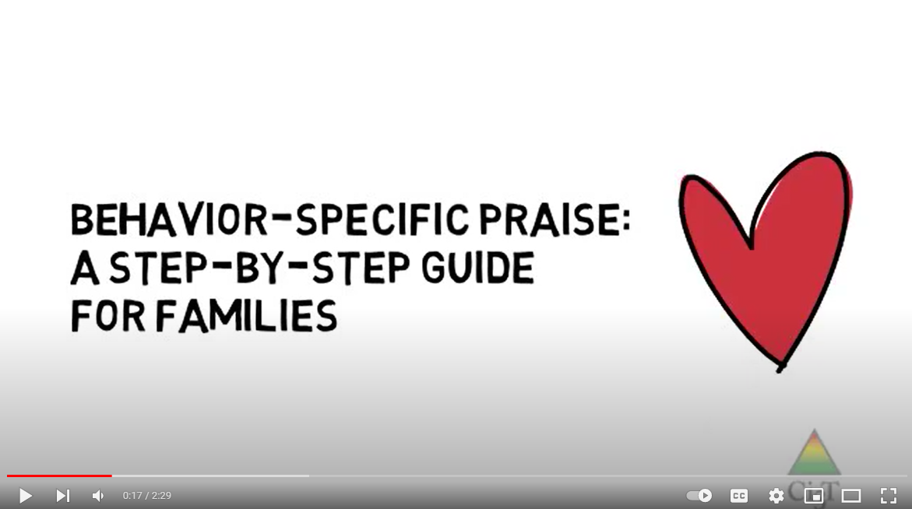
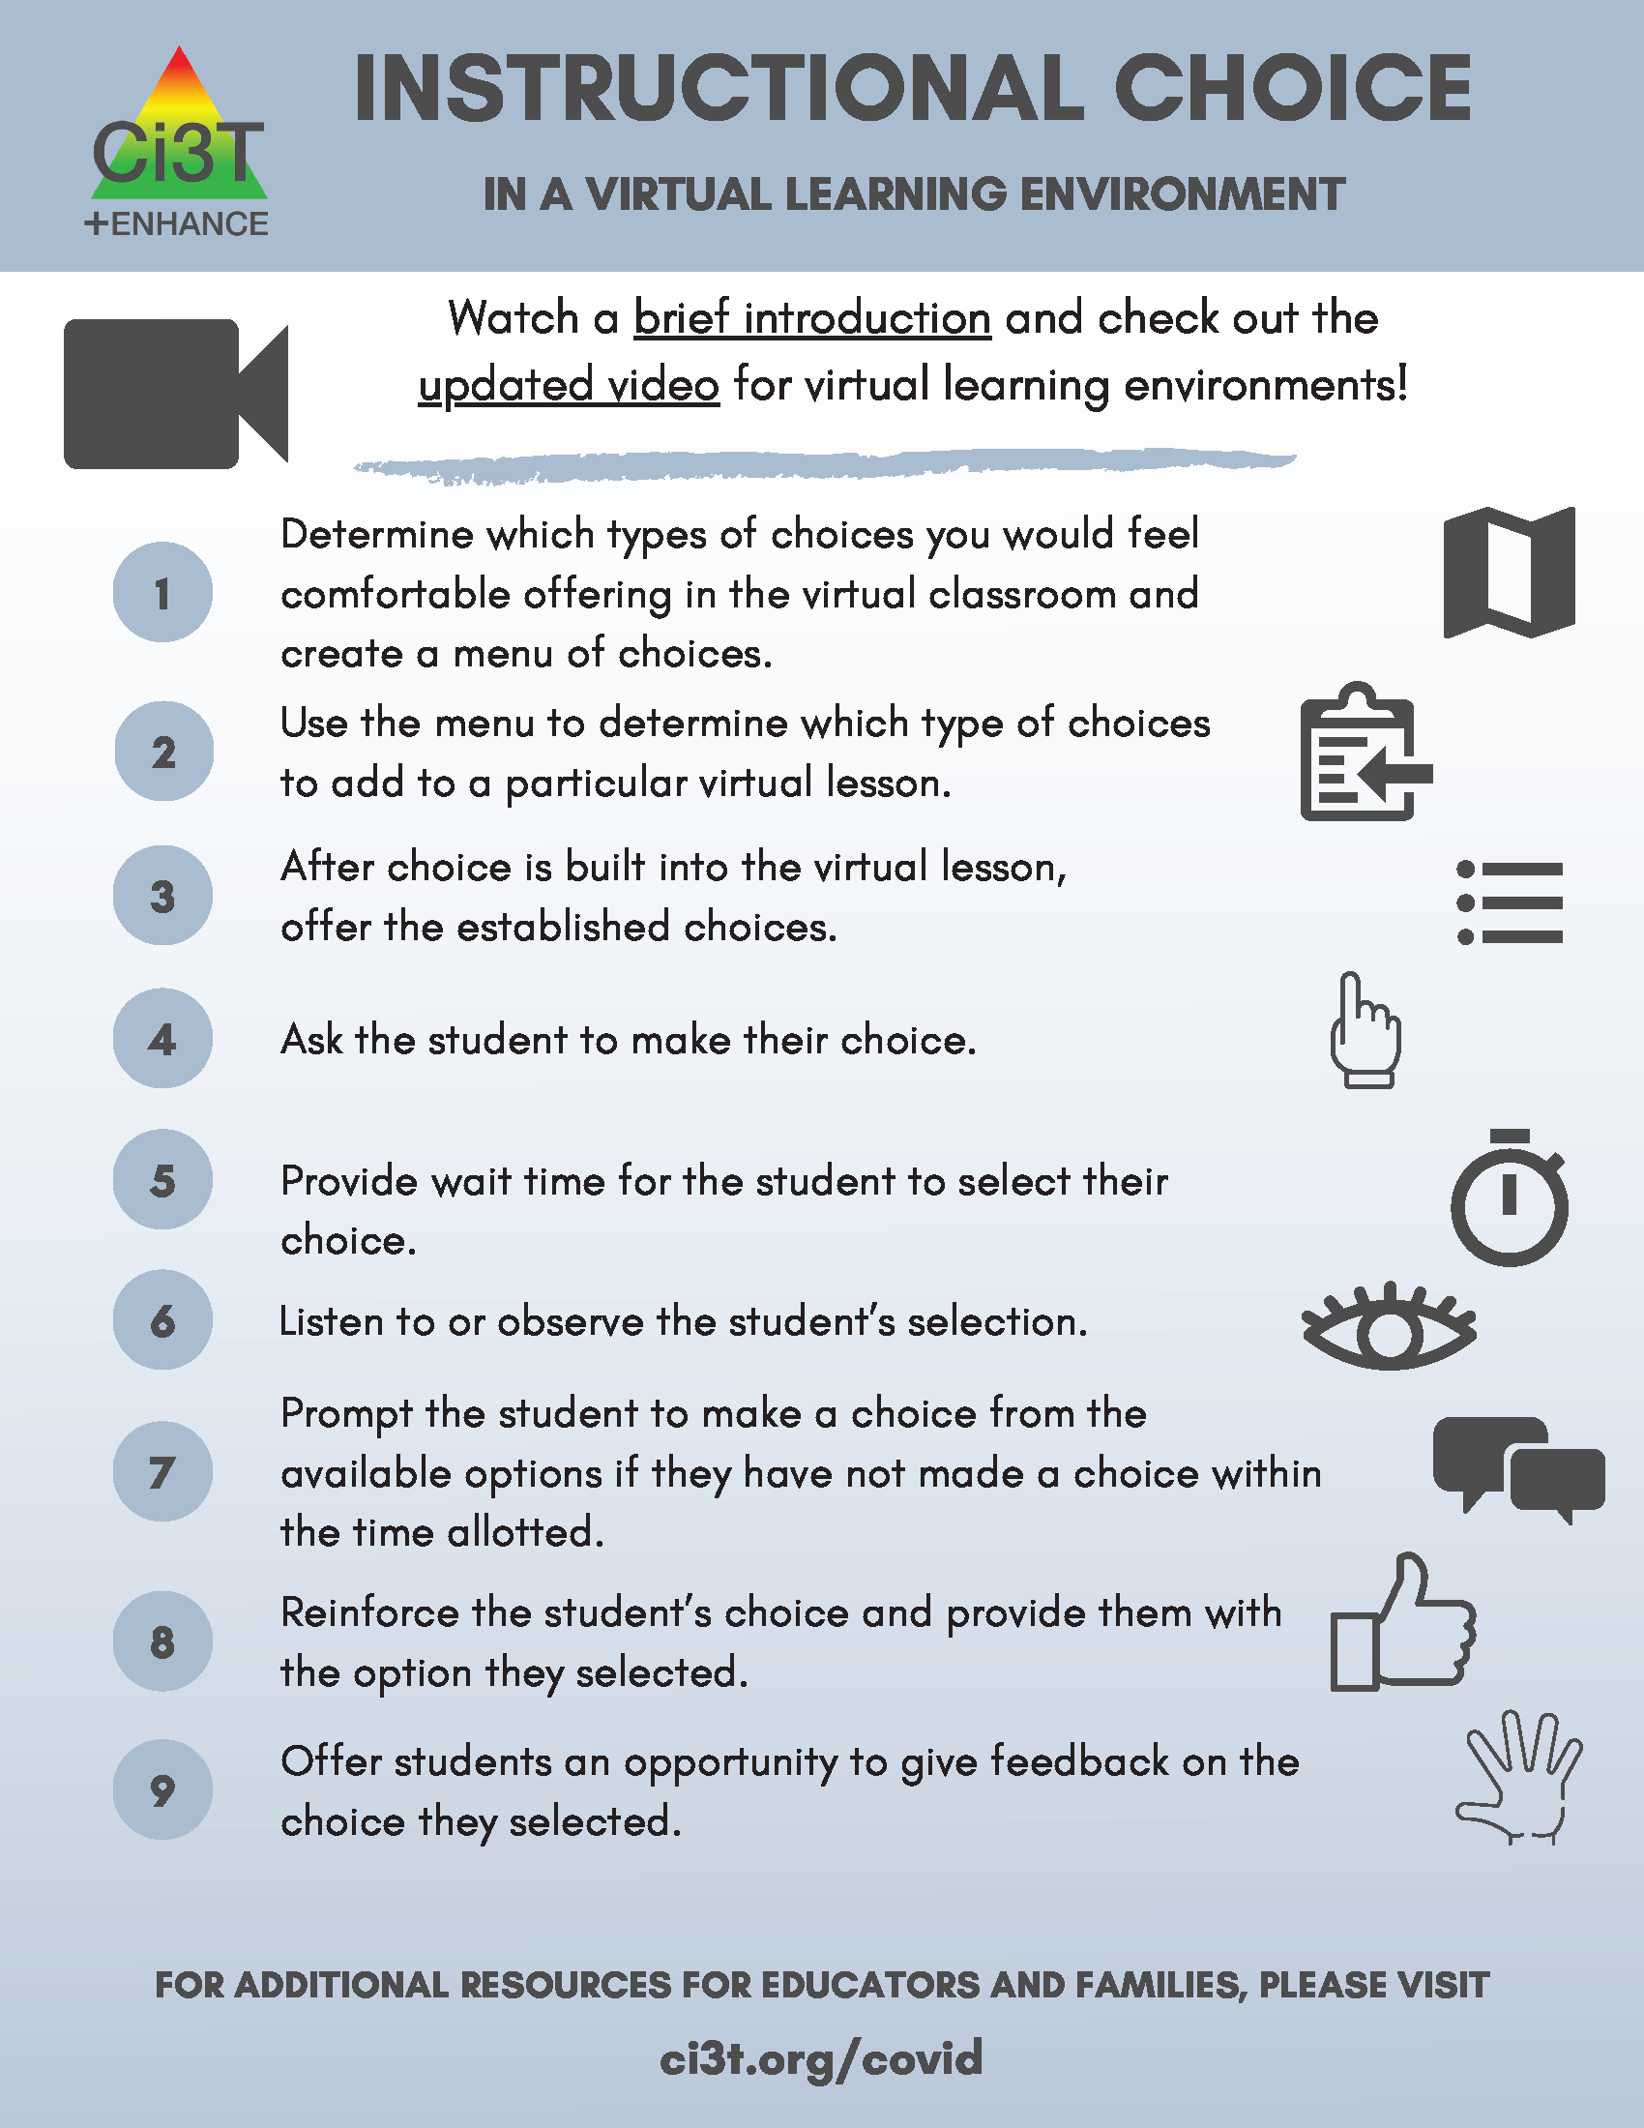
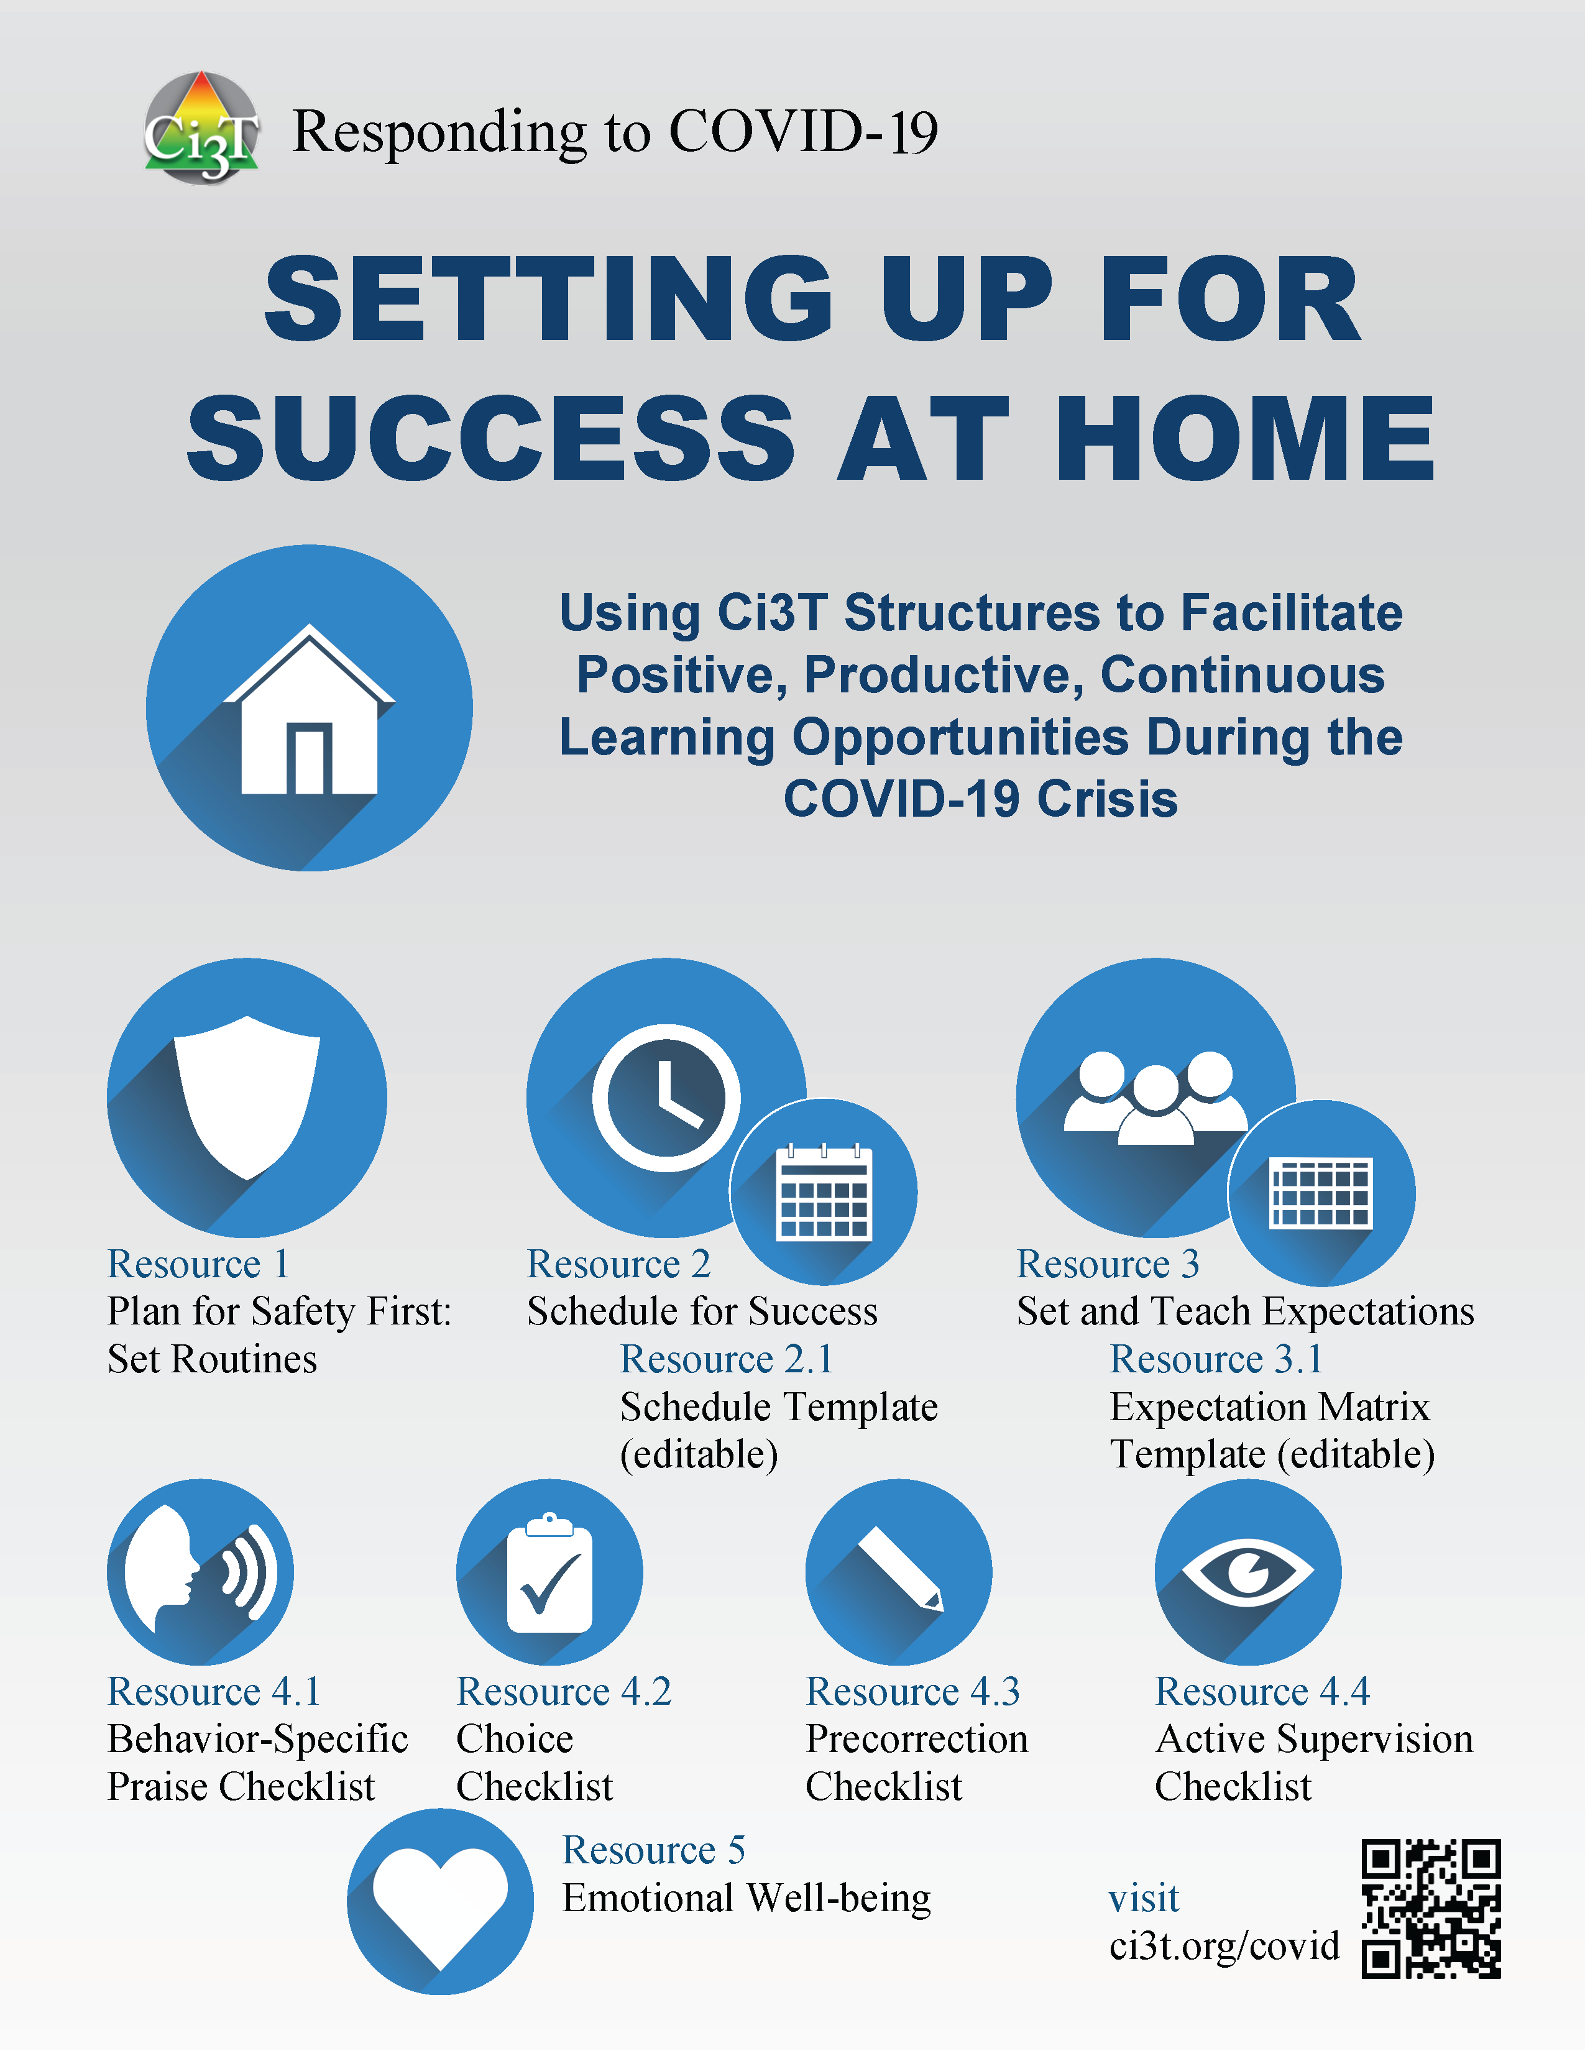
ci3t.org/covid
Use big image

Slide 10
Year 1 Inquiry:
Determining Identified Priorities for Implementing and Supporting Complex, Integrated Systems
2

Slide 11
Project ENHANCE Year 1

Slide 12
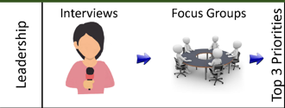
District and School Leaders Learning Resources Needs
District and School
Learning Resources Needs
Onboarding and Training
Communicating the Vision of Ci3T
Providing Professional Learning for Faculty and Staff
Royer, D. J., Oakes, W. P., Briesch, A. M., Chafouleas, S. M., Lane, K. L., Buckman, M. M., Sherod, R. L., & Common, E. A. (2021). Ci3T leadership team members’ perceived facilitators and barriers to implementation. Manuscript submitted for review.

Slide 13

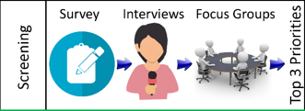
Systematic Screening:
Resources and Needs
Benefits
Assists with early identification (especially internalizing)
Understanding school functioning
and needs
Normalizes the process for determining intervention needs
Common, E. A., Buckman, M. M., Lane, K. L., Oakes, W. P., Royer, D. J., Chafouleas, S., Briesch, A., & Sherod, R. (2021). Project ENHANCE: Assessing Professional Learning Needs for Implementing Comprehensive, Integrated, Three-Tiered (Ci3T) Models of Prevention. Education and Treatment of Children. https://doi.org/10.1007/s43494-021-00049-z

Slide 14
Systematic Screening:
Resources and Needs
Barriers and Needs
Inconsistencies across respondents
Limited understanding impacts buy-in
Limited understanding of coordinated data use
Need for training and resources to
address behavior concerns
Briesch, A. M., Chafouleas, S. M., Iovino, E. A., Abdulkerim, N., Sherod, R. L., Oakes, W. P., Lane. K. L., Common, E. A., Royer, D. J., & Buckman, M. (2021). Exploring directions for professional learning to enhance behavior screening within a comprehensive, integrated three-tiered model of prevention. Journal of Positive Behavior https://doi.org/10.1177/10983007211050424

Slide 15
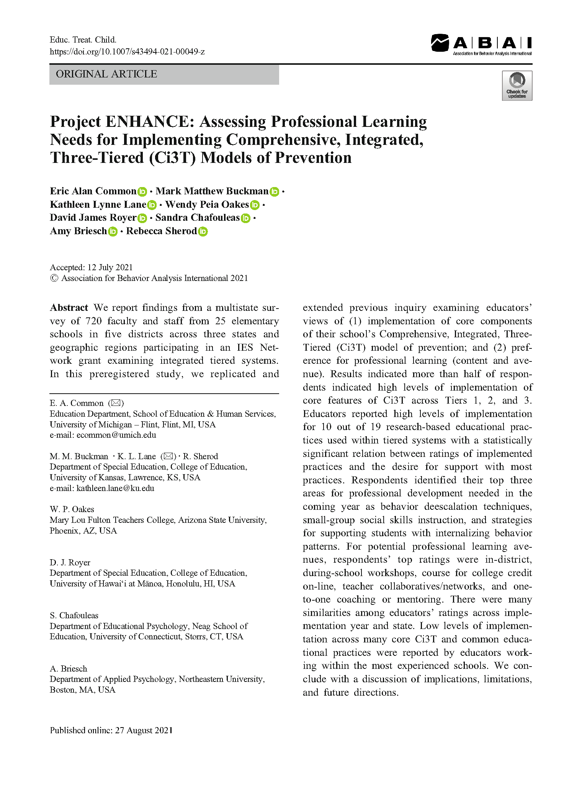
Assessing Professional Learning Needs
Top Professional
Learning Needs
De-escalation techniques
Social skill instruction
Supports for students with internalizing behavior patterns
Common, E. A., Buckman, M. M., Lane, K. L., Oakes, W. P., Royer, D. J., Chafouleas, S., Briesch, A., & Sherod, R. (2021). Project ENHANCE: Assessing Professional Learning Needs for Implementing Comprehensive, Integrated, Three-Tiered (Ci3T) Models of Prevention. Education and Treatment of Children. https://doi.org/10.1007/s43494-021-00049-z

Slide 16
Assessing Professional Learning Needs con’t
Preferred Professional
Learning Avenues
In-district workshops
(during school hours)
Online courses for college credit
Teacher collaborative networks
Asynchronous opportunities
(e.g., web-based modules, webinars)
Common, E. A., Buckman, M. M., Lane, K. L., Oakes, W. P., Royer, D. J., Chafouleas, S., Briesch, A., & Sherod, R. (2021). Project ENHANCE: Assessing Professional Learning Needs for Implementing Comprehensive, Integrated, Three-Tiered (Ci3T) Models of Prevention. Education and Treatment of Children. https://doi.org/10.1007/s43494-021-00049-z

Slide 17
Project ENHANCE: Years 2 & 3

Slide 18
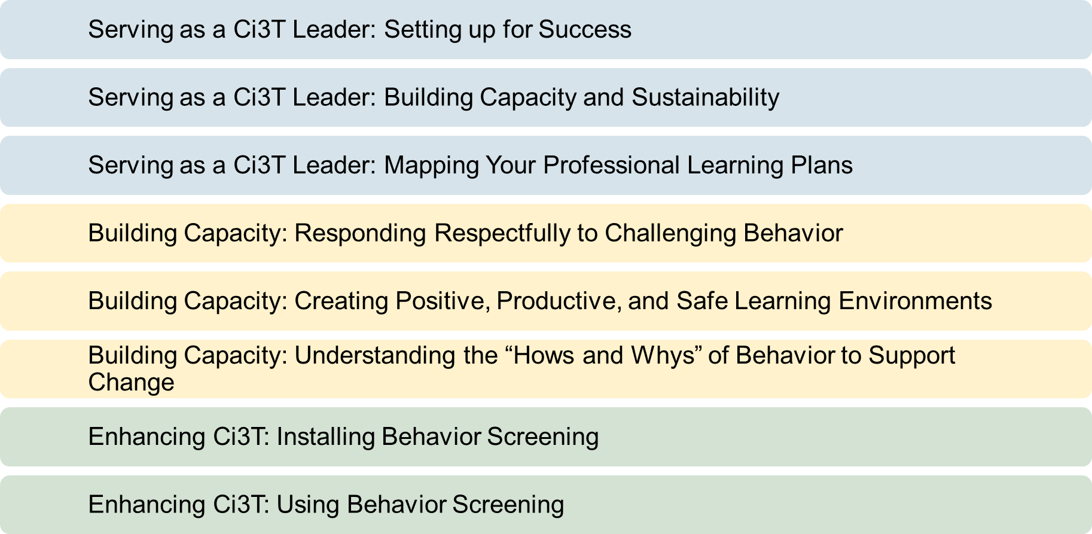
Plan for 8 modules

Slide 19
Project ENHANCE: What Comes Next

Slide 20
Project ENHANCE: What Comes Next con’t 2

Slide 21
Building Enhancing Ci3T Modules
3
An Iterative Design Process

Slide 22
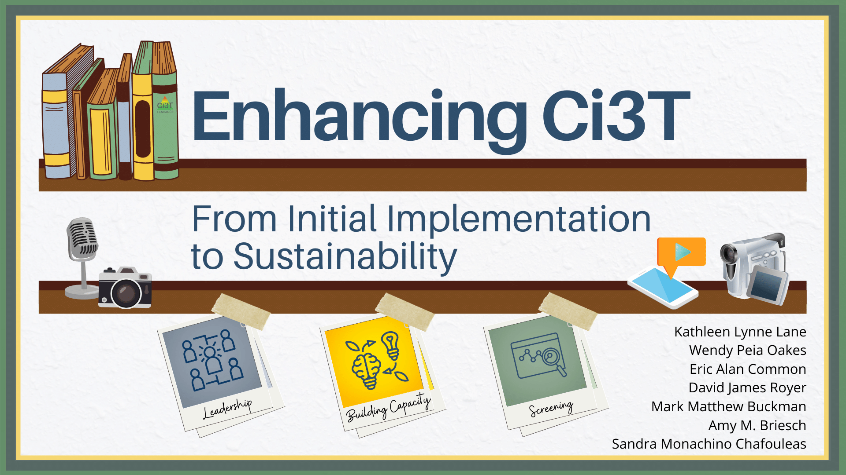
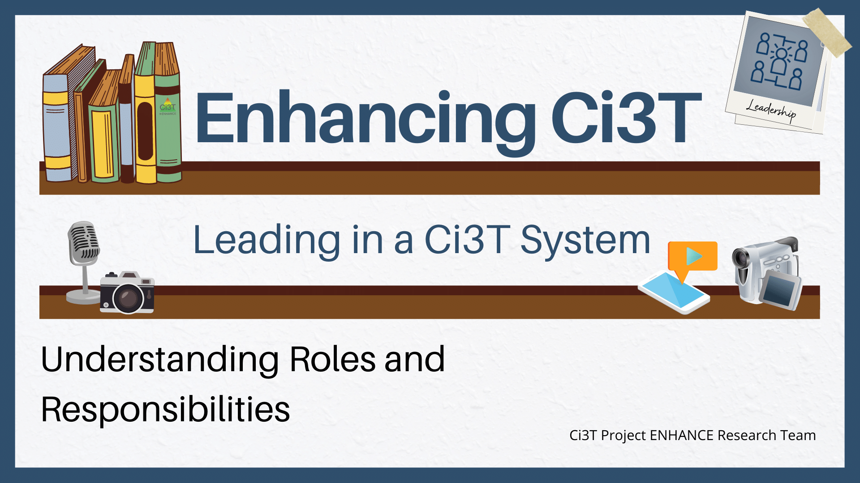
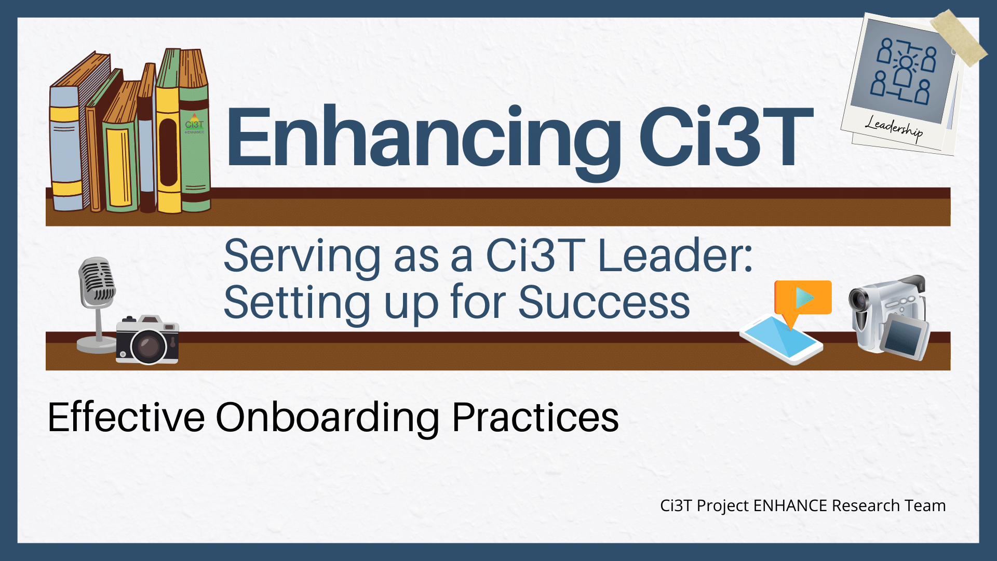
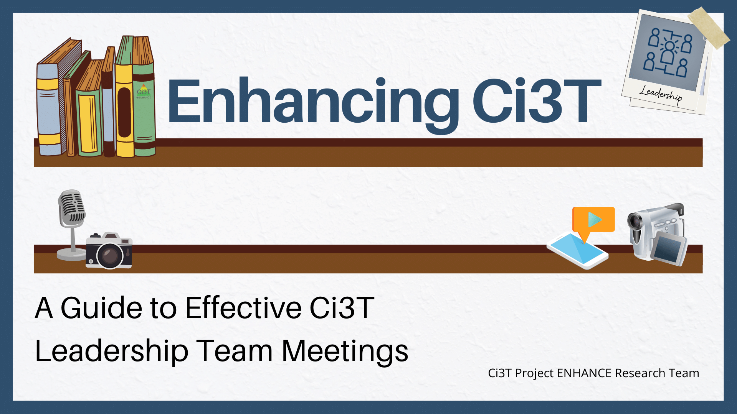
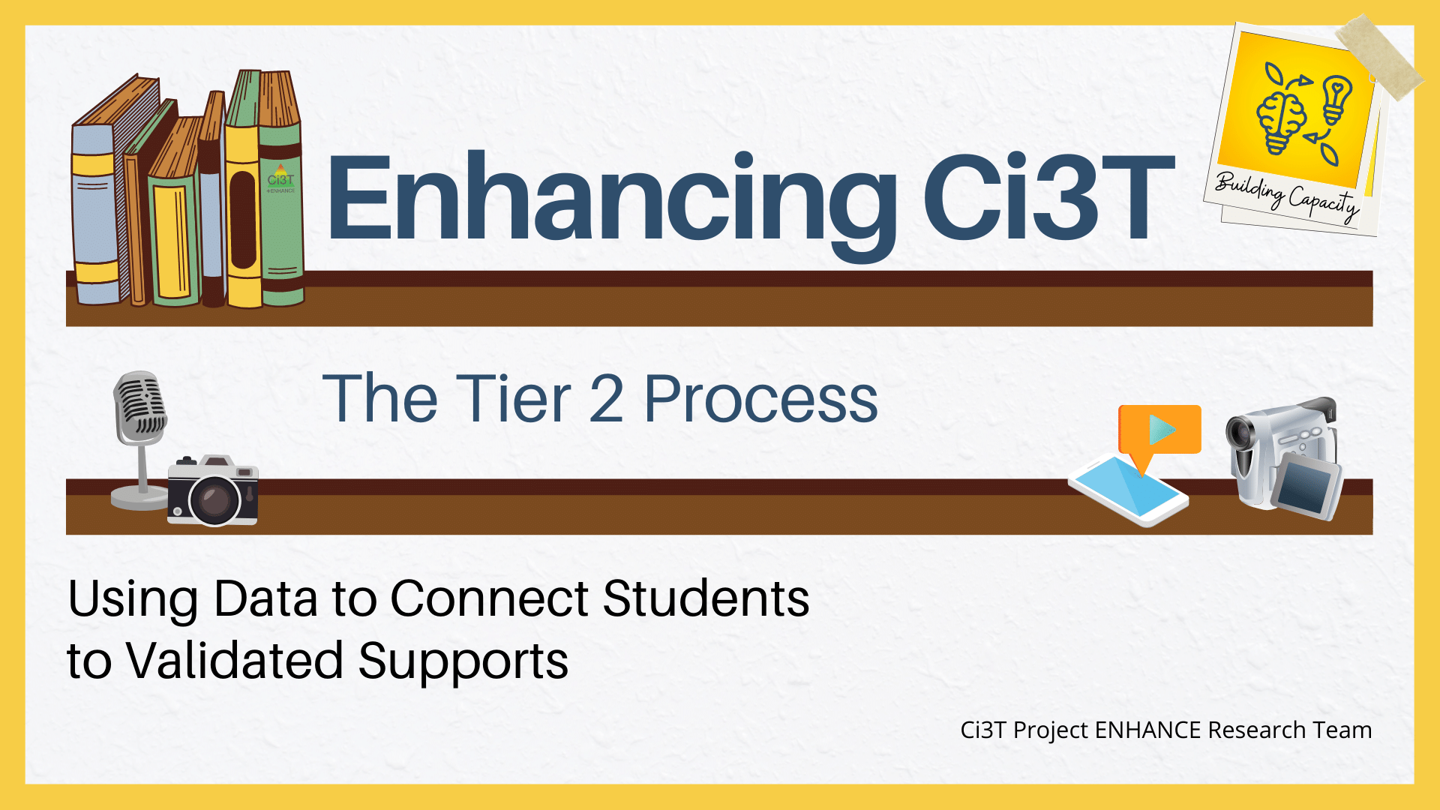
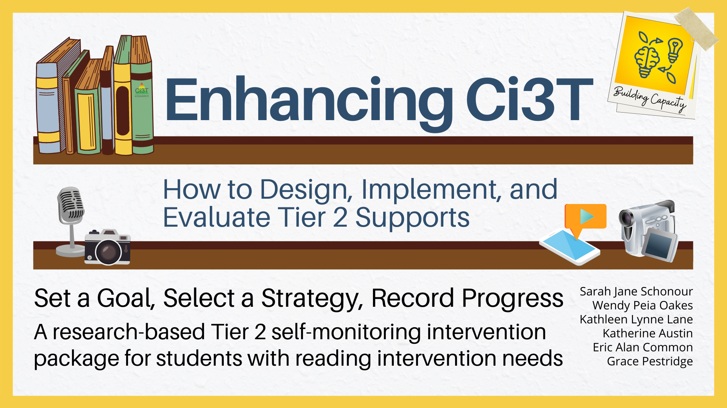
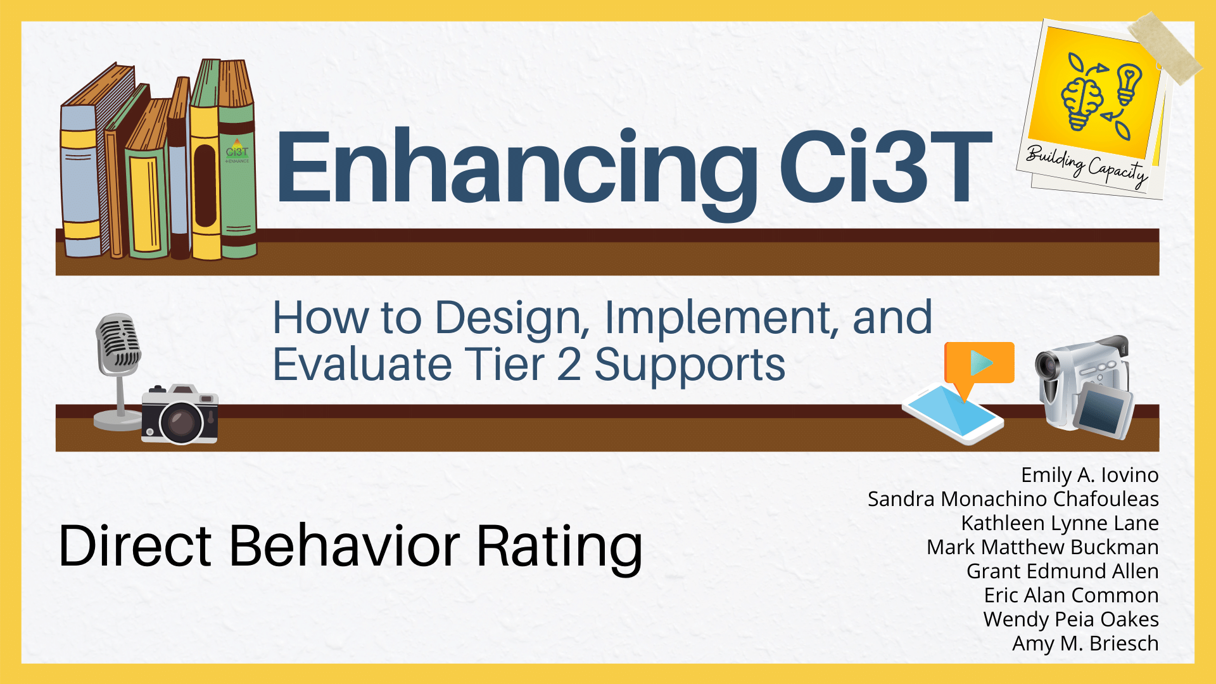
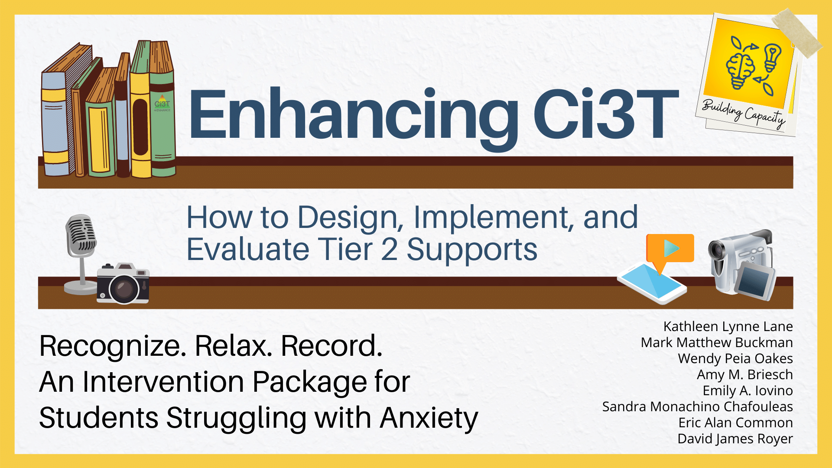
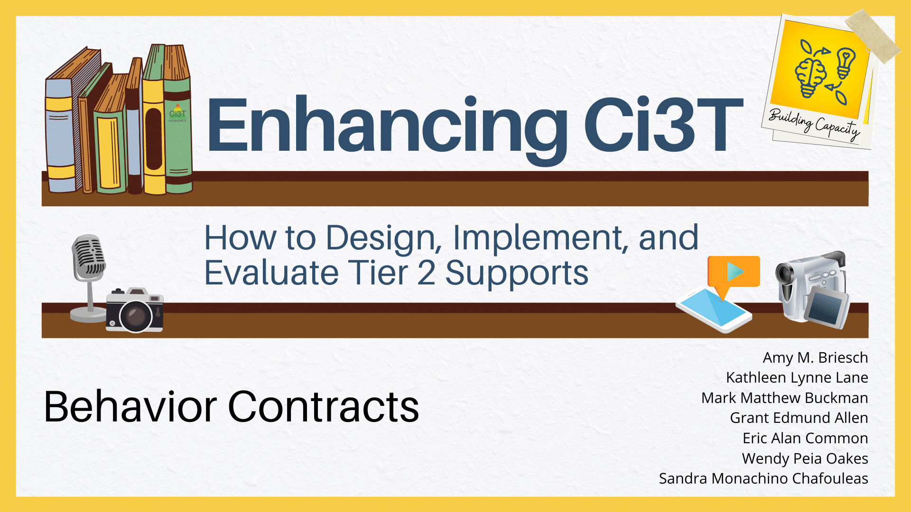
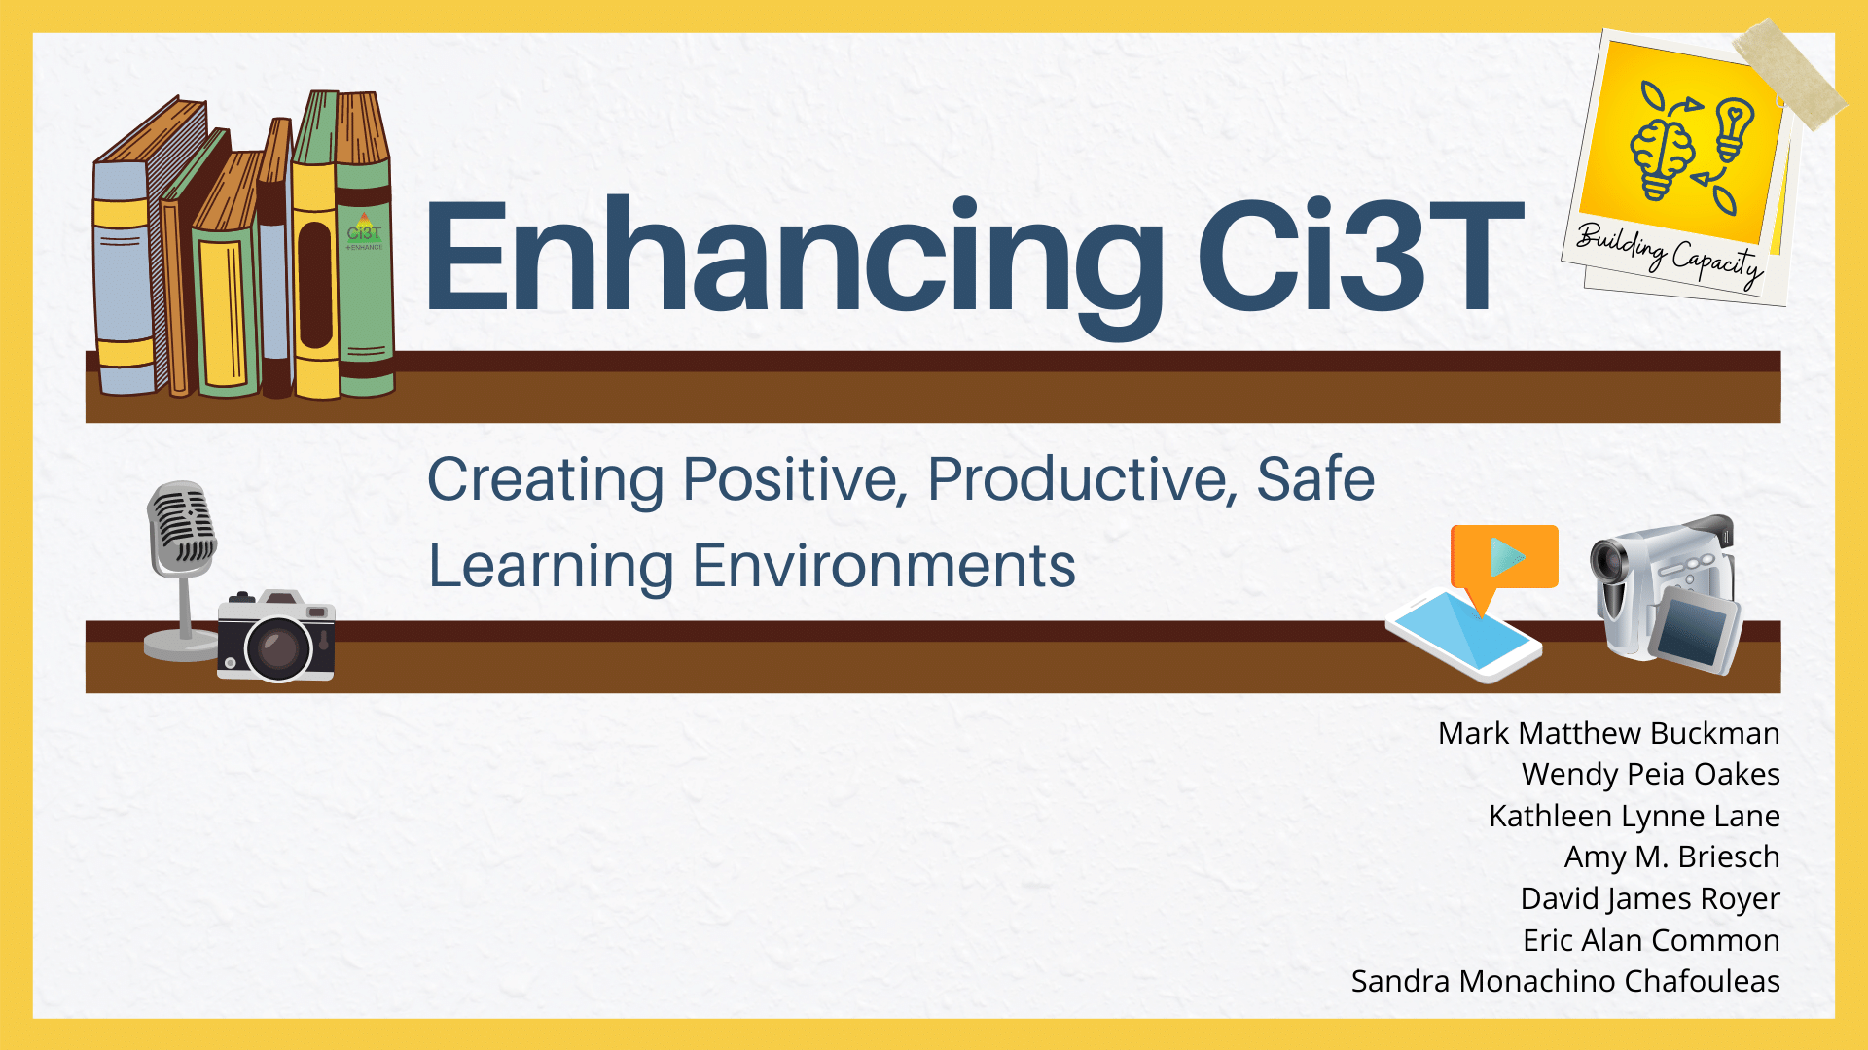
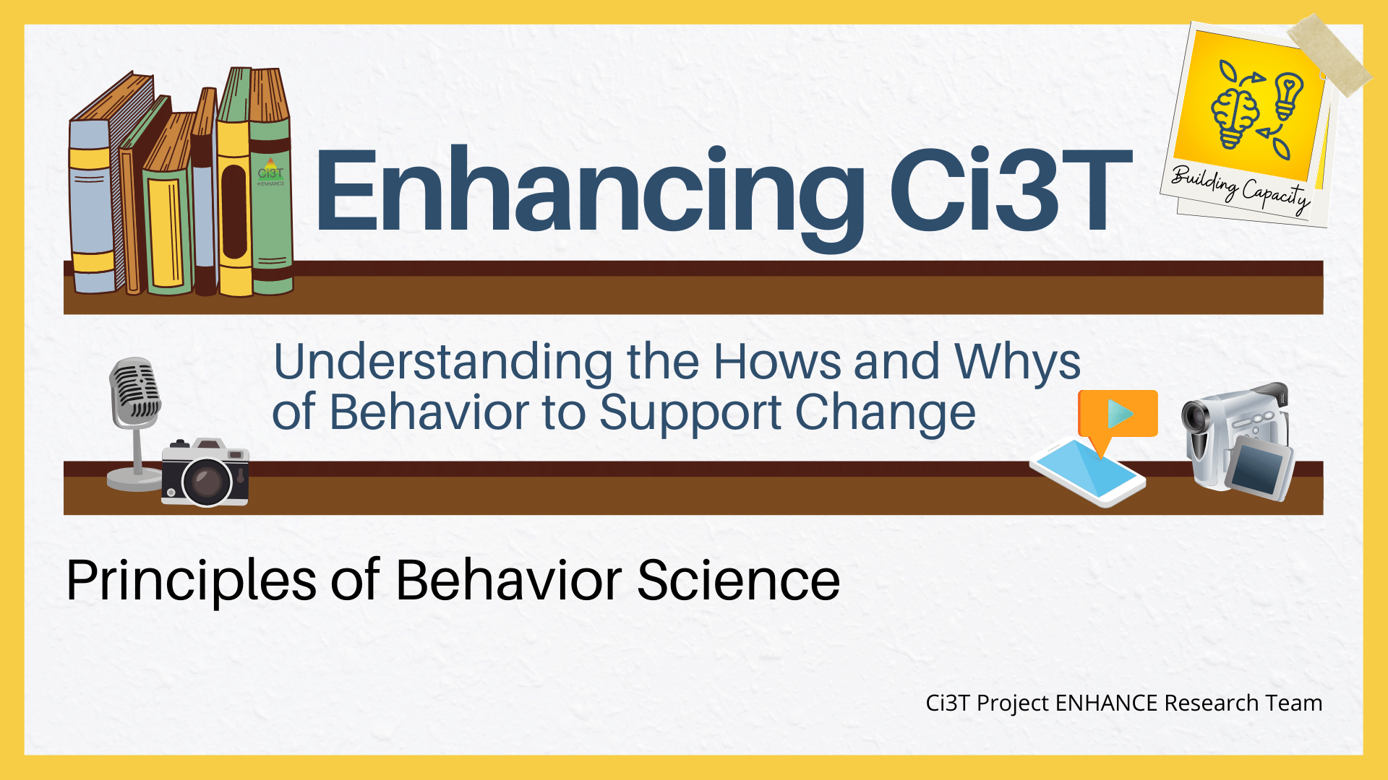
Enhancing Ci3T Modules

Slide 23
Enhancing CI3T module: Recognize. Relax. Record.

Slide 24
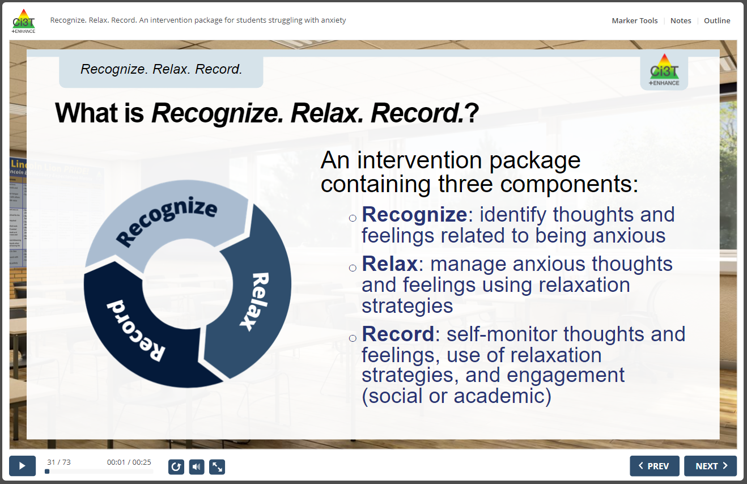
Recognize. Relax. Record.

Slide 25
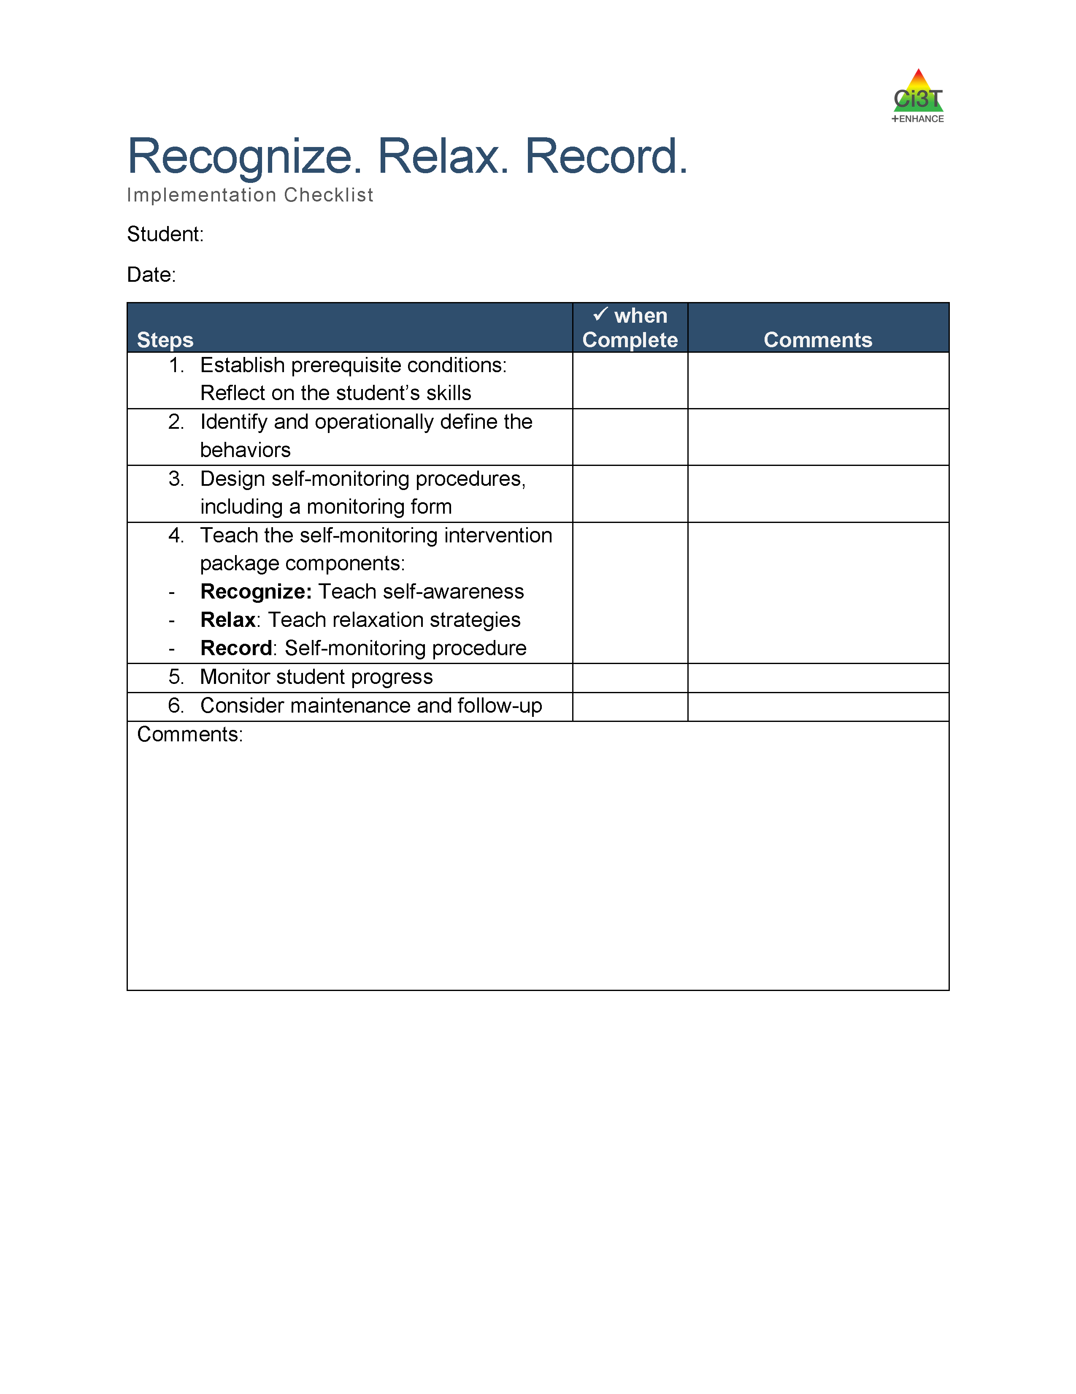
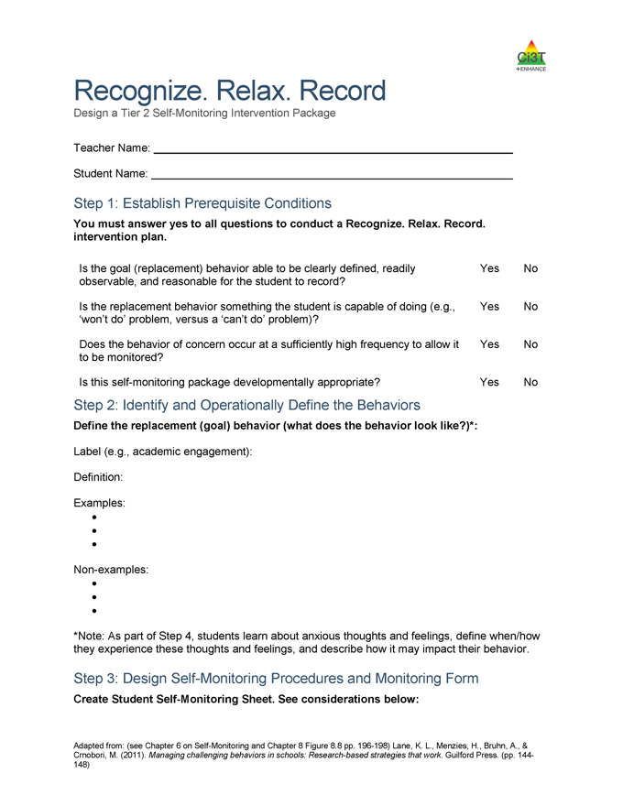
Recognize. Relax. Record. con’t

Slide 26
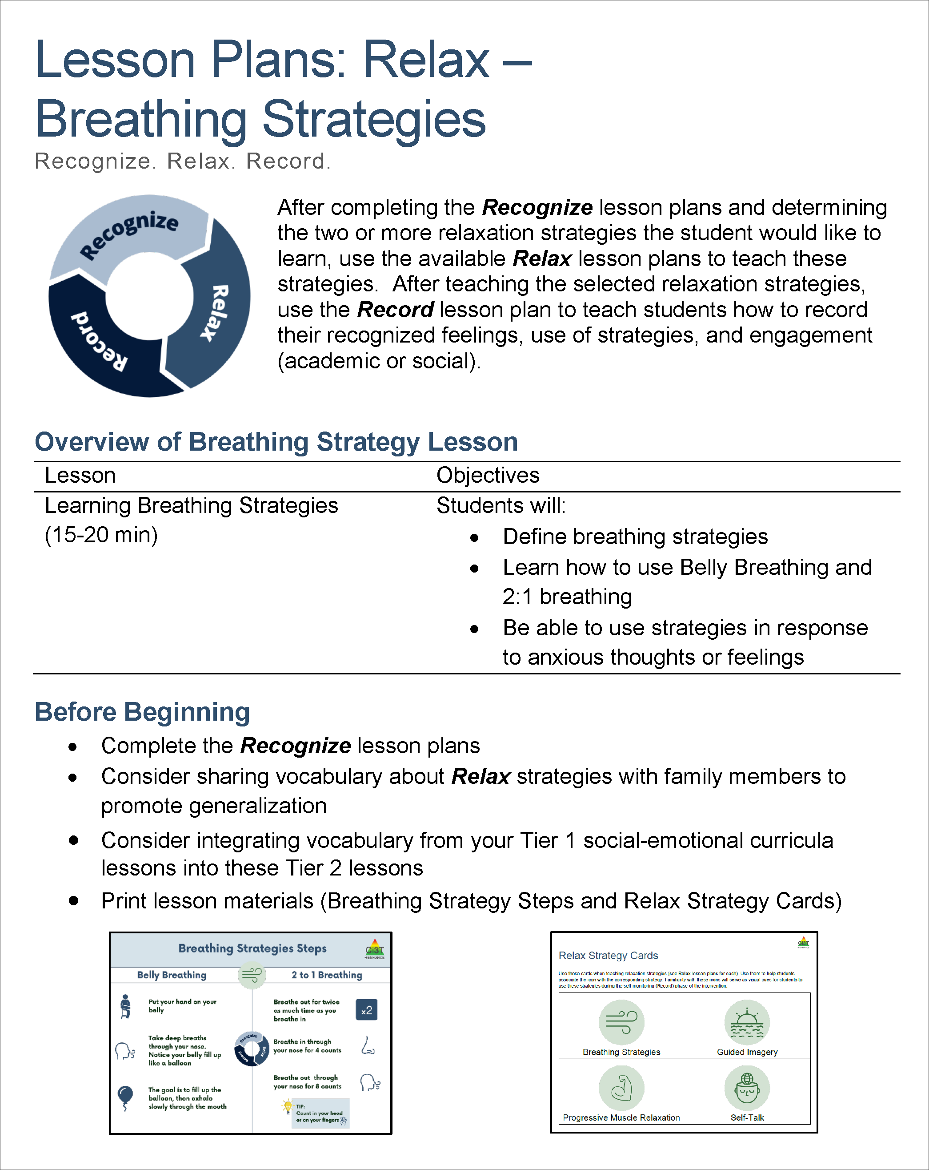
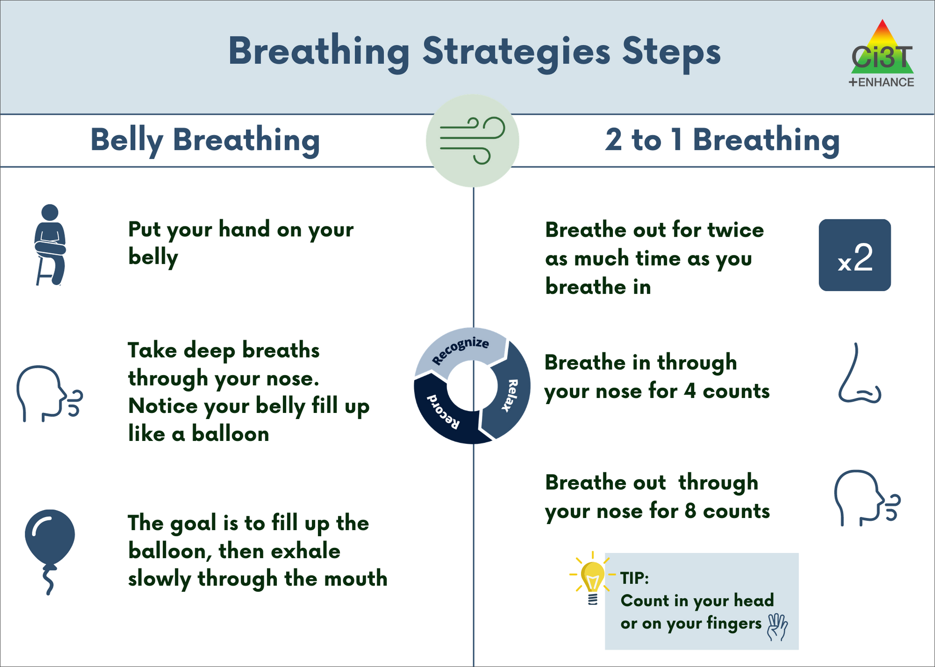
Recognize. Relax. Record. con’t 2

Slide 27
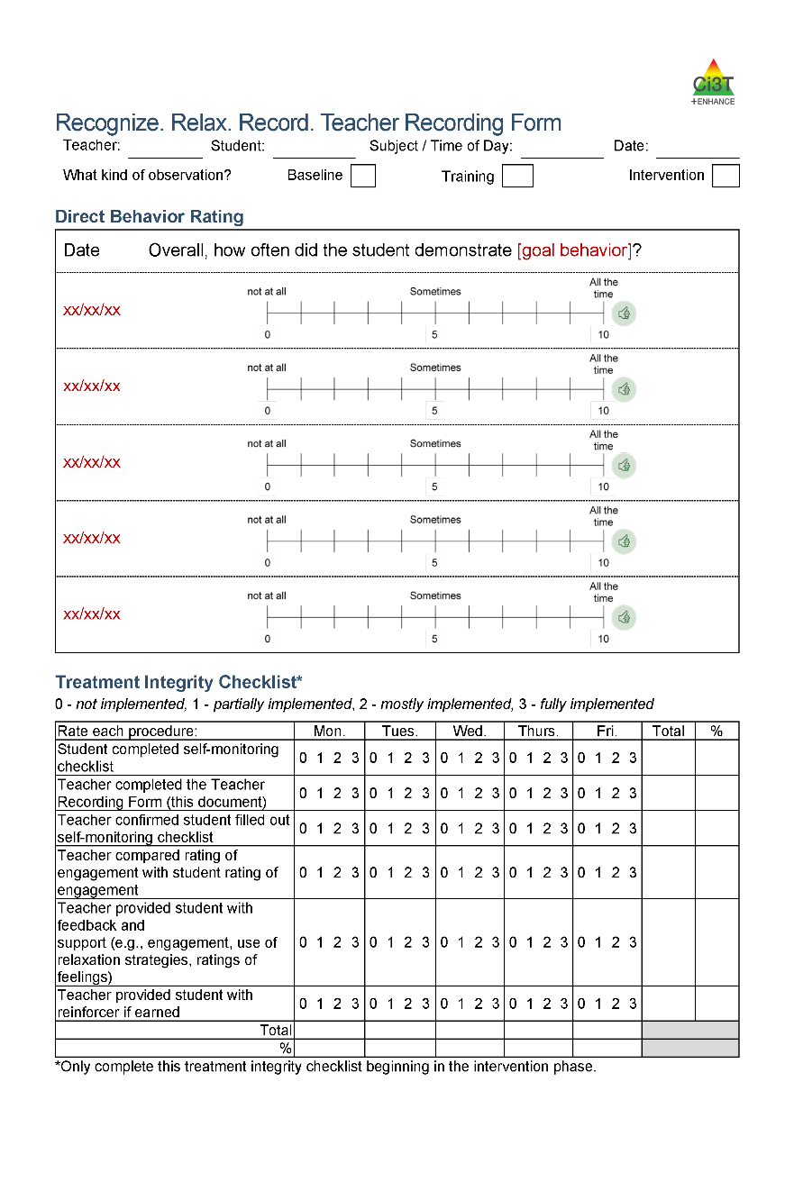
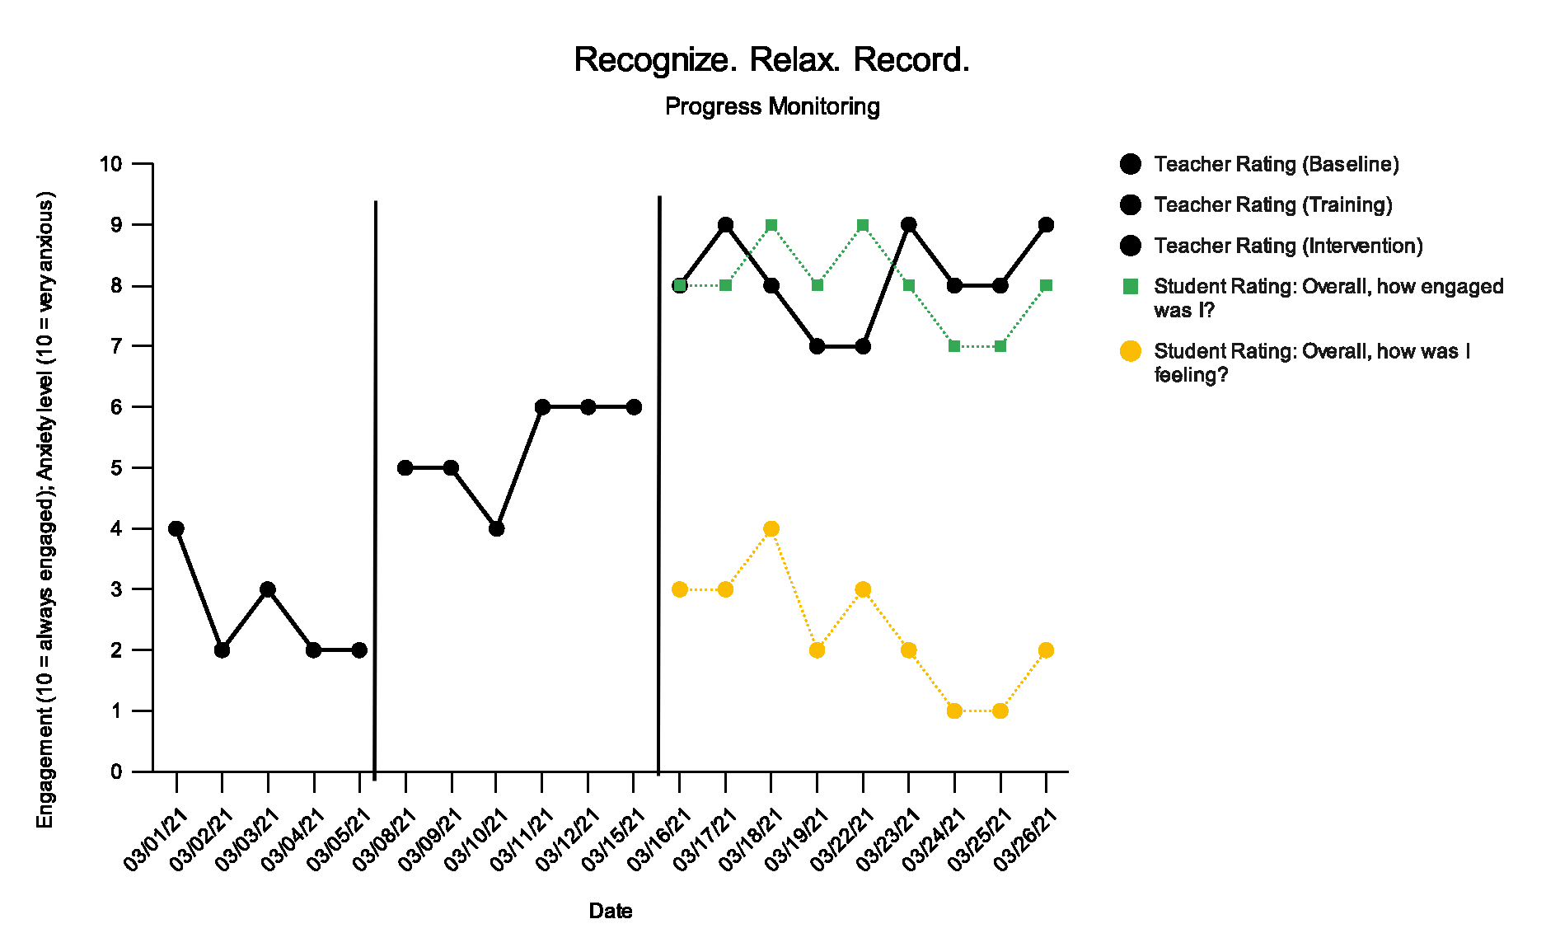
Recognize. Relax. Record. con’t 3

Slide 28
Enhancing Ci3T Modules con’t 2

Slide 29
Enhancing Ci3T module: Effective Onboarding Practices

Slide 30
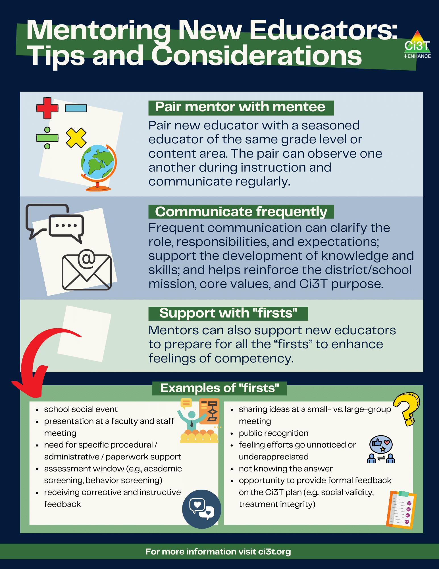
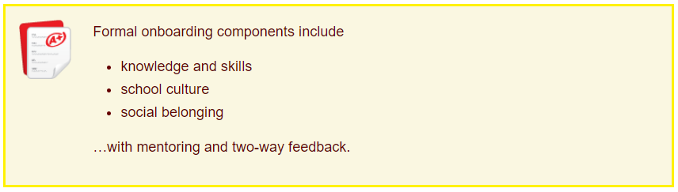
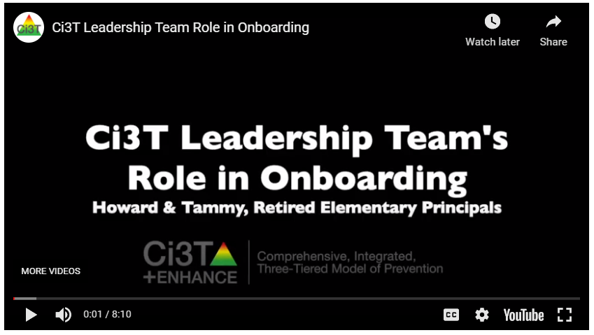
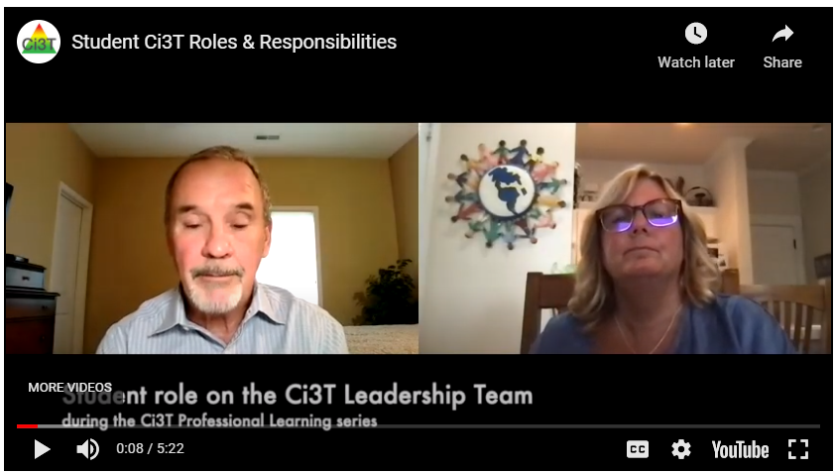
Onboarding new faculty and staff con’t 2

Slide 31
Enhancing Ci3T Modules con’t 3

Slide 32
Early Evaluations of Enhancing Ci3T Modules
4
Preliminary Lessons Learned

Slide 33

Module Evaluation Timeline con’t

Slide 34


Building Positive, Productive, Safe Learning Environments con’t

Slide 35


Expert Panel
(Advisory Board Pilot Review)
Test 1: n = 10 (100% response rate
    70% Faculty
    10% Professional Development Coordinator
    10% Director (e.g., Autism Spectrum Disorder Specialist)
    10% Clinician (e.g., Senior Clinical Supervisor, BCBA)
Test 2: n = 6 (75%% response rate
    50% Faculty
    16% Director
    16% Educational Consultant
    16% Sr. Researcher/Technical Assistance Consultant
Test 3: n = 5 (63% response rate
    60% Faculty
    20% Director
    20% Consultant
Design Features
Assessment
Open-ended Feedback

Slide 36
Ci3T Usability Rating Profiles (URP)
9 acceptability items
1 “global” item for each of the following categories:
  A – acceptability • SC – system climate: admin
  F – feasibility • SC – system climate: colleagues
  U – understanding • SS – system support
  • FS – family-school collaboration
Proximal
Distal
Phase 1: Initial Module Test – Ci3T Leadership Team members completed immediately following experience with module
Phase 1: Initial Module Test – Ci3T Leadership Team members completed
~6 weeks following experience with module

Slide 37

Proximal con’t
Proximal

Slide 38

Distal
Distal

Slide 39

Distal con’t 2
Distal

Slide 40
Distal con’t 3
Distal

Slide 41

Knowledge, Confidence, and
Usefulness (KCU)
Two-part measure asking participants to rate key concepts pertaining to perceived knowledge, confidence, and how useful
Rating Scale
…how knowledgeable you are about each concept or strategy.
…how confident you are in your ability to use or implement each concept or strategy.
…how useful each concept or strategy is for you.
Open-ended
Tell us what you know about these topics in the space provided

Slide 42
Next Steps
5

Slide 43


Revisions

Slide 44
Ci3T ENHANCE

Slide 45


Thank you!
ci3t.org

