Slide 1
A9 – Systematic Screening: Detecting & Supporting Students with Internalizing Behaviors Presenters: Kathleen Lynne Lane, University of Kansas Michele Johnson, Duval County Public Schools (FL) Wendy Peia Oakes, Arizona State University Rebecca Sherod, University of Kansas
Topic: Data-based Decision Making
Keywords: Screening, Behavior, Tier 1
Notes:
To preserve the appearance of this slide, a picture file has been created. An editable version is behind it.

Slide 2
Agenda
Welcome & Introduction to Systematic Screening
Systematic Screening: An Illustration
Transparency, Access, & Collaboration
Considerations for Screening PK-12 in the COVID-19 Era
Planning for Next Steps

Slide 3
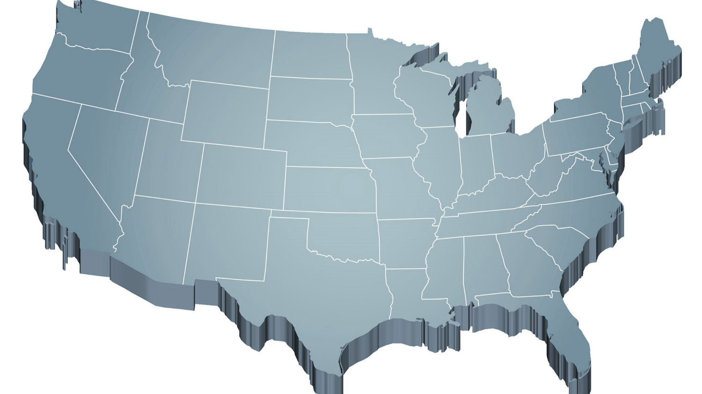
Internalizing
Externalizing
ED <1%
EBD 12-20%
Source: Forness, S.R., Freeman, S.F., Paparella, T., Kauffman, J.M., & Walker, H.M. (2012). Special education implications of point and cumulative prevalence for children with emotional or behavioral disorders. Journal of Emotional and Behavioral Disorders, 20, 4-18.

Slide 4
A Shift … from Reactive to Proactive

Slide 5
Comprehensive, Integrated, Three-Tiered Model of Prevention
(Lane, Kalberg, & Menzies, 2009)
Tier 3
Tertiary Prevention (≈5%)
Tier 2
Secondary Prevention (≈15%)
Tier 1
Primary Prevention (≈80%)
Academic ◇ Behavioral ◇ Social
Validated Curricula PBIS Framework Validated Curricula

Slide 6
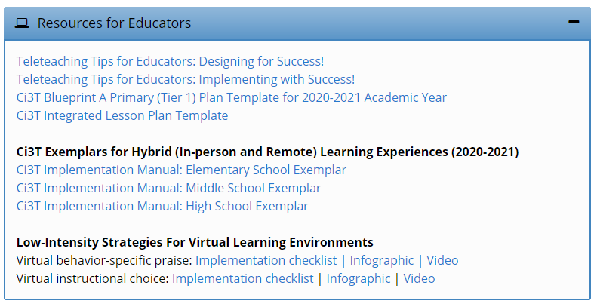
Opportunities to Respond
Area II: Academics Responsibilities Faculty and Staff: Teach core programs according to district and state standards with integrity: Use proactive evidence-based strategies to support students’ active engagement
Behavior-Specific Praise
Active Supervision
Opportunities to Respond
Instructional Feedback
High p Requests
Behavior-Specific Praise
Precorrection
Active Supervision
Remote Learning Use proactive evidence-based strategies to support students’ active engagement. Maintain online classroom platforms with learning activities connected to the weekly learning outcomes. Communicate at least weekly with families and students.
Incorporating Choice
Instructional Feedback
High-p Requests
Precorrection
Incorporating Choice

Slide 7
Area II: Behavior Responsibilities Faculty and Staff: Implement Positive Behavioral Interventions and Supports (PBIS) with integrity. Teach all setting Expectations within the first week of school and reteach Expectations (monthly). Display and model school-wide expectations in classrooms and other key settings.
Remote Learning Teach Expectations for remote learning. Set clear Expectations for your students’ learning times allowing for flexibility for unique family needs.

Slide 8
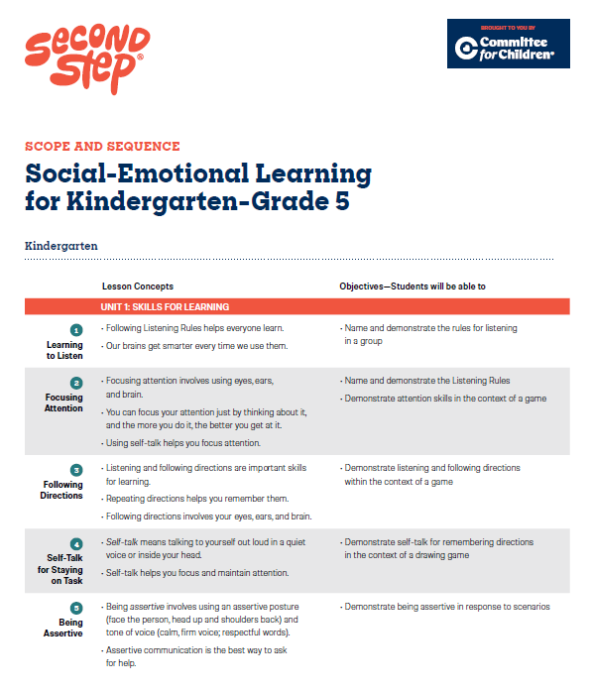
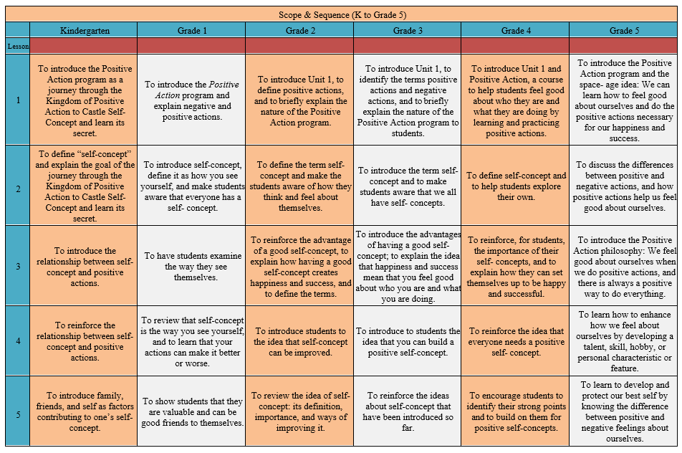
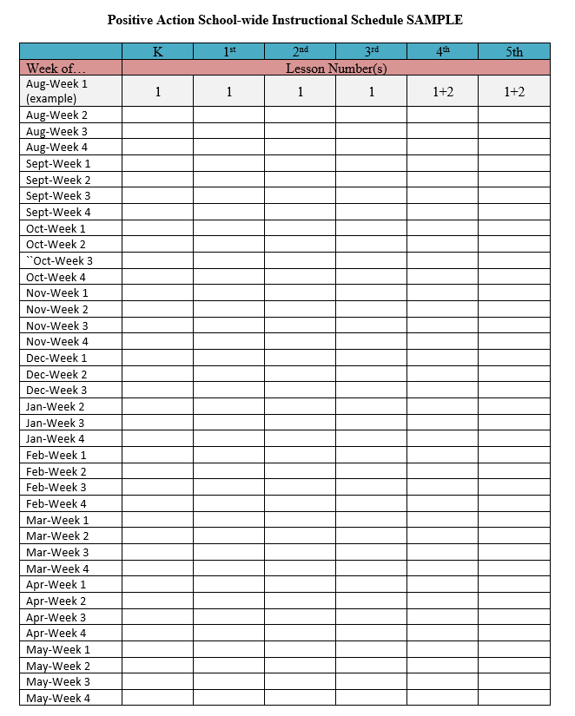
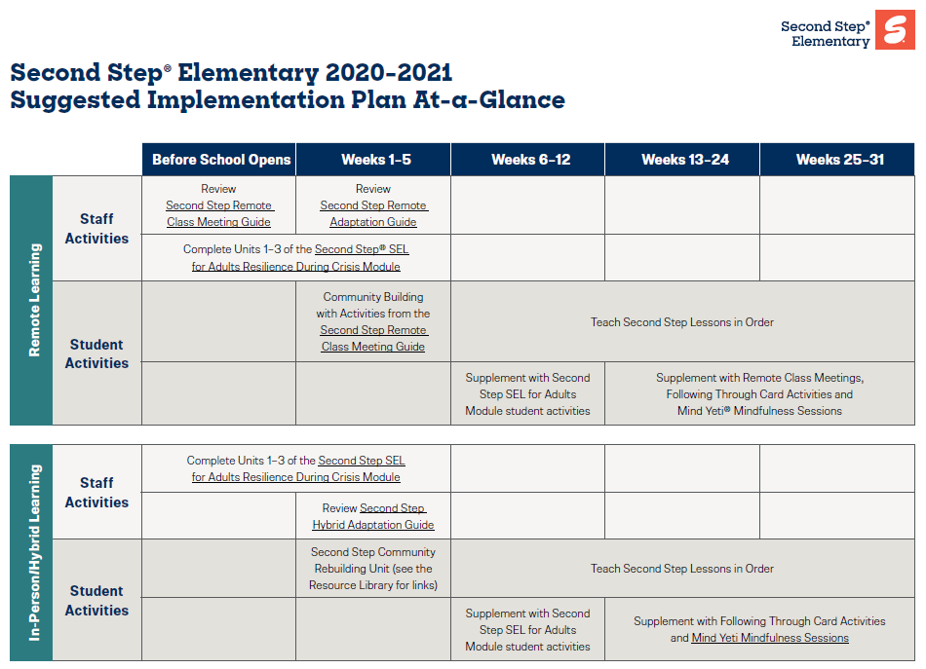
Area II: Social Responsibilities Faculty and Staff: Teach schoolwide social skills/ character education curricula with integrity: Teach daily Second Step® lessons (link to grade level instructional schedules) Seek ways to engage parents as partners in the school program
Remote Learning Begin each lesson with a connection to the social skills needed to fully engage in the lesson. Utilize online Second Step® resources to continue regular social skill lessons with asynchronous activities as well as synchronous lessons.

Slide 9
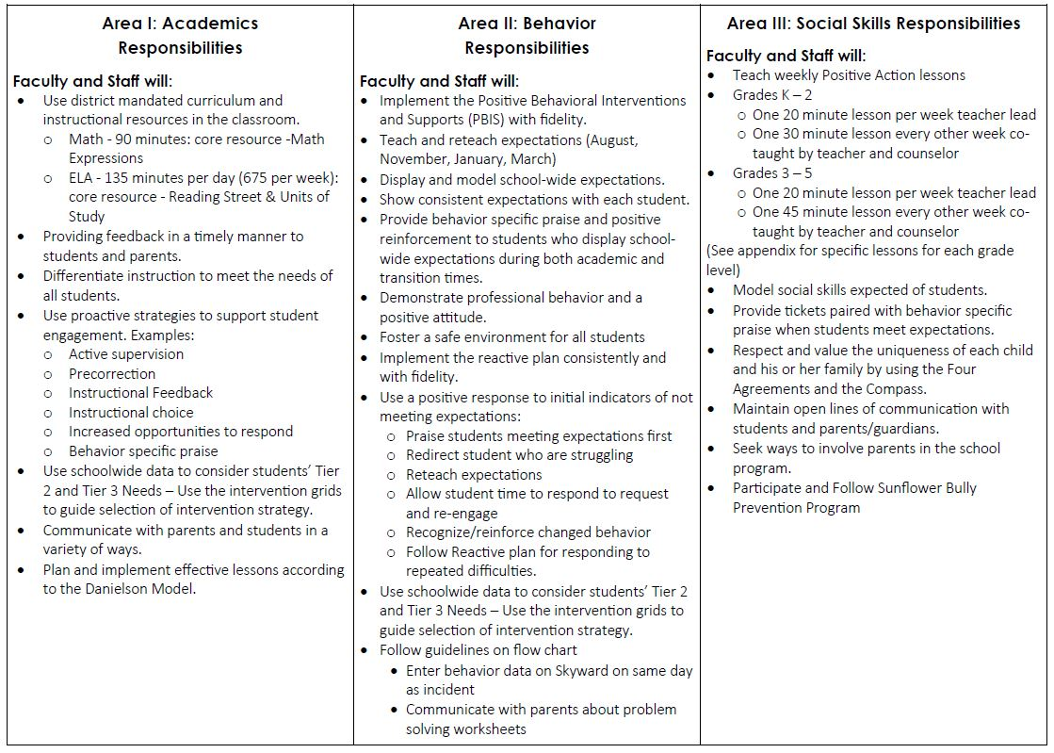
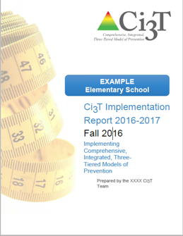
Ci3T Primary Plan: Procedures for Teaching
Ci3T Primary Plan: Procedures for Reinforcing
Ci3T Primary Plan: Procedures for Monitoring

Slide 10
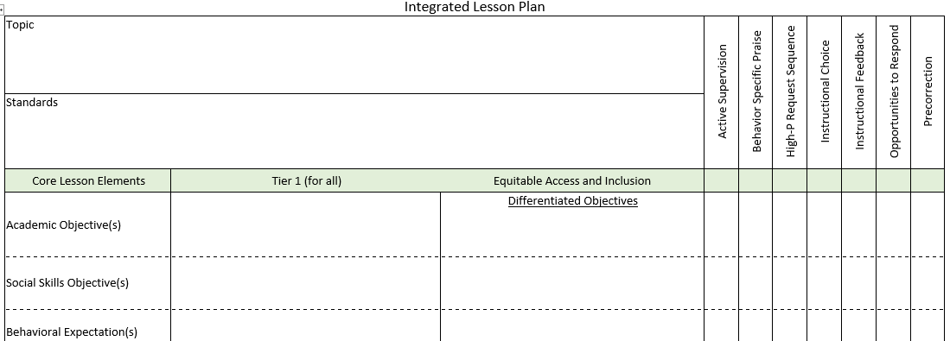
Ci3T Primary Plan: Procedures for Teaching
BSP
OTR
Active Supervision
Choice
Precorrection

Slide 11
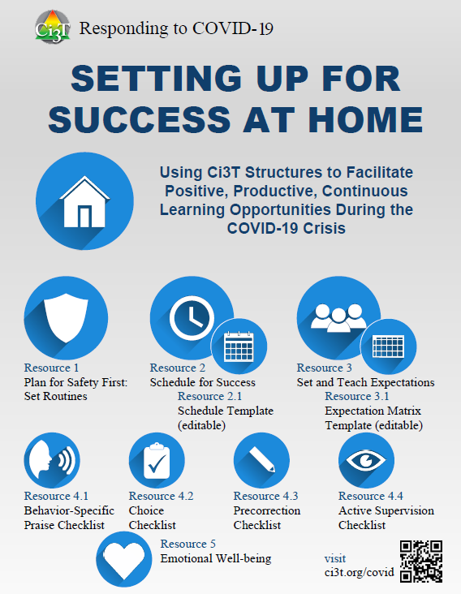
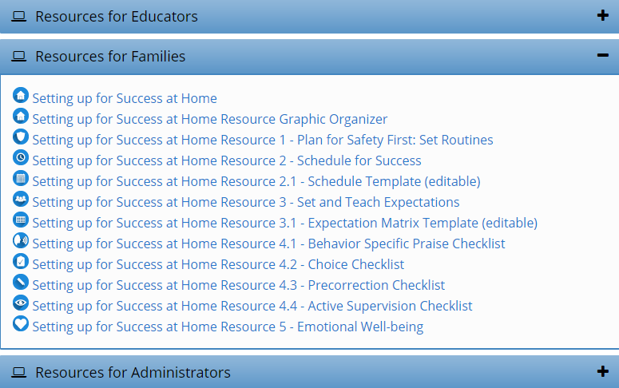
Setting up for Success at Home
Ci3T Primary Plan: Procedures for Teaching
http://www.ci3t.org/covid

Slide 12
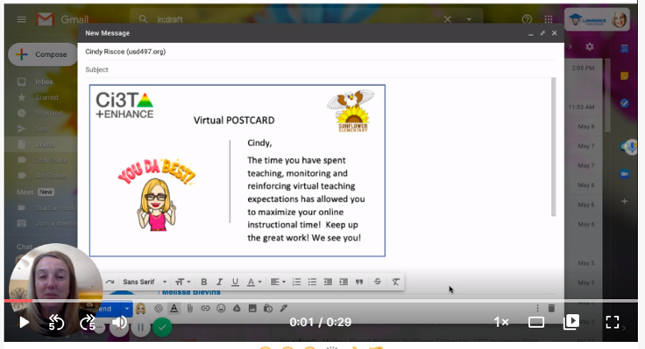
Ci3T Primary Plan: Procedures for Reinforcing

Slide 13
Essential Components of Primary Prevention Efforts
Social Validity
Systematic Screening
Academic
Behavior
Treatment Integrity
Ci3T Primary Plan: Procedures for Monitoring

Slide 14
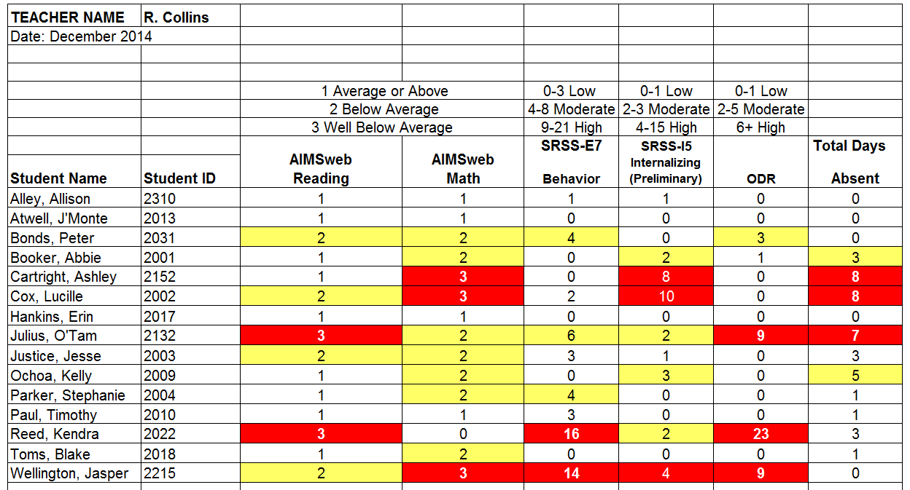
Examining Academic and Behavioral Data
Lane, K. L., Menzies, H. M., Ennis, R. P., & Oakes, W. P. (2015). Supporting Behavior for School Success: A Step-by-Step Guide to Key Strategies. Guilford Press.
Notes:
Lane, K. L., Oakes, W. P., Ennis, R. P., & Hirsch, S. E. (2014). Identifying students for secondary and tertiary prevention efforts: How do we determine which students have Tier 2 and Tier 3 needs? Preventing School Failure, 58, 171-182, DOI: 10.1080/1045988X.2014.895573

Slide 15
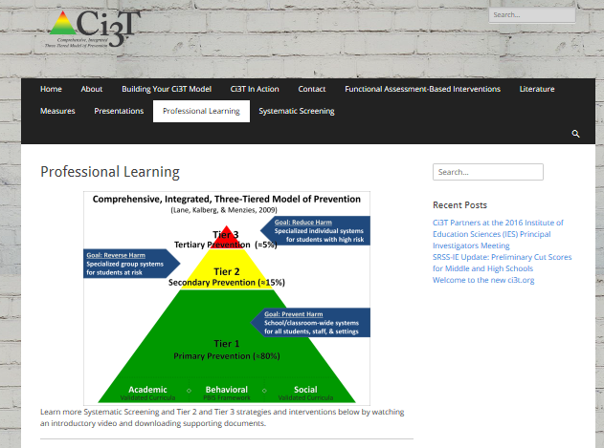
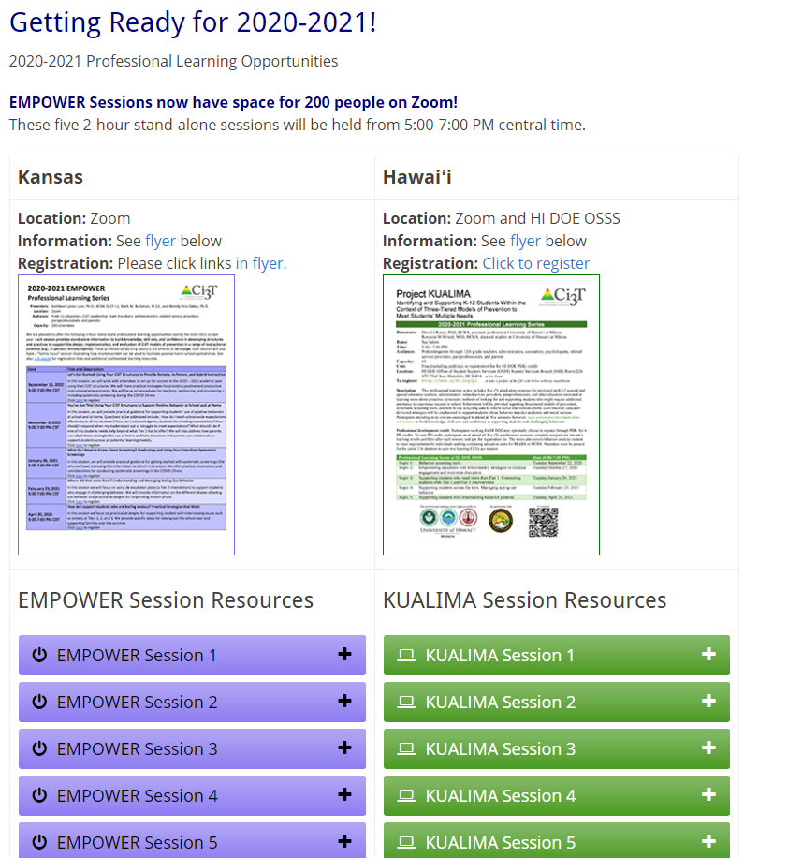
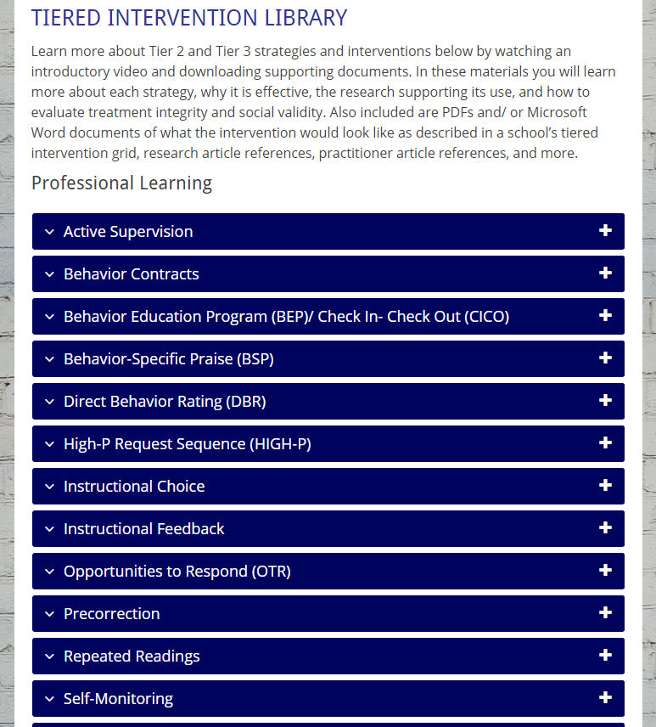
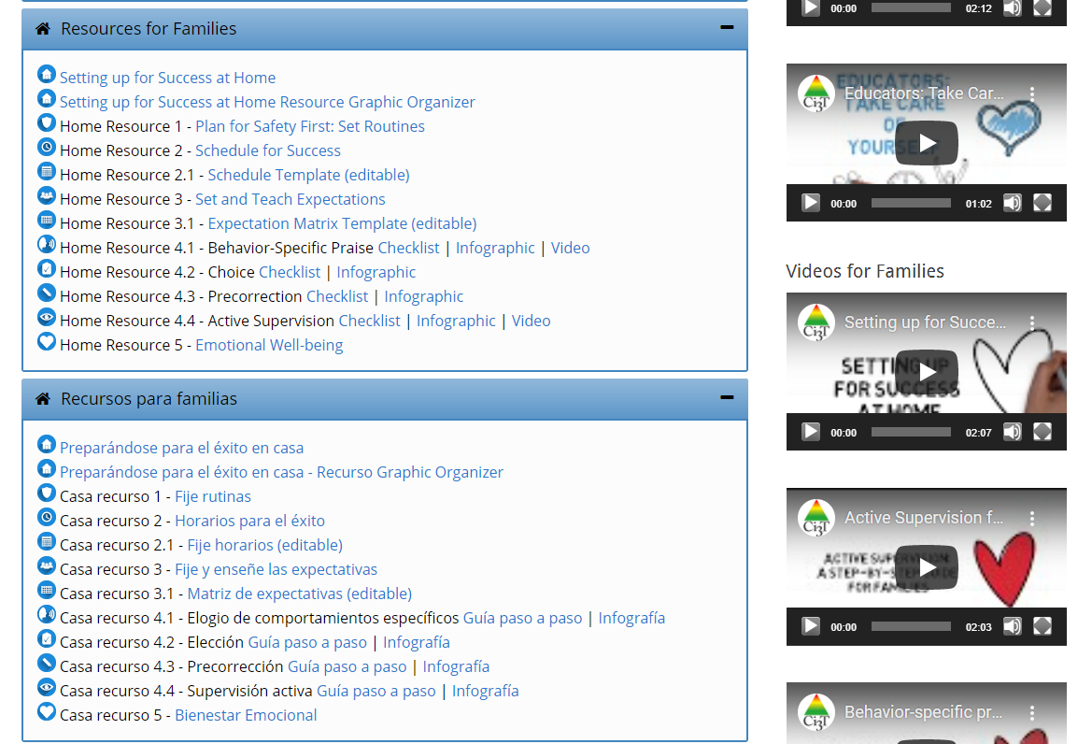

Slide 16
Comprehensive, Integrated, Three-Tiered Model of Prevention
(Lane, Kalberg, & Menzies, 2009)
Tier 3
Tertiary Prevention (≈5%)
Tier 2
Secondary Prevention (≈15%)
Secondary (Tier 2) Intervention Grids
Tier 1
Primary Prevention (≈80%)
Academic ◇ Behavioral ◇ Social
Validated Curricula PBIS Framework Validated Curricula

Slide 17
Comprehensive, Integrated, Three-Tiered Model of Prevention
(Lane, Kalberg, & Menzies, 2009)
Tier 3
Tertiary Prevention (≈5%)
Tier 2
Secondary Prevention (≈15%)
Tertiary (Tier 3) Intervention Grids
Tier 1
Primary Prevention (≈80%)
Academic ◇ Behavioral ◇ Social
Validated Curricula PBIS Framework Validated Curricula

Slide 18
Implementation Science Adapted from Fixsen & Blasé, 2005
Exploration & Adoption
Installation
Initial Implementation
We think we know what we need so we are planning to move forward (evidence-based)
Let’s make sure we’re ready to implement (capacity infrastructure)
Let’s give it a try & evaluate (demonstration)
Full Implementation
Let’s make it our way of doing business (institutionalized use)
Sustainability & Continuous Regeneration
That worked, let’s do it for real (investment)

Slide 19
Comprehensive, Integrated, Three-Tiered Model of Prevention
(Lane, Kalberg, & Menzies, 2009)
Tier 3
Tertiary Prevention (≈5%)
Tier 2
Secondary Prevention (≈15%)
Tier 1
Primary Prevention (≈80%)
Academic ◇ Behavioral ◇ Social
Validated Curricula PBIS Framework Validated Curricula

Slide 21
Systematic Screening: An Illustration
Michele Johnson, Duval County Public Schools (FL)

Slide 22
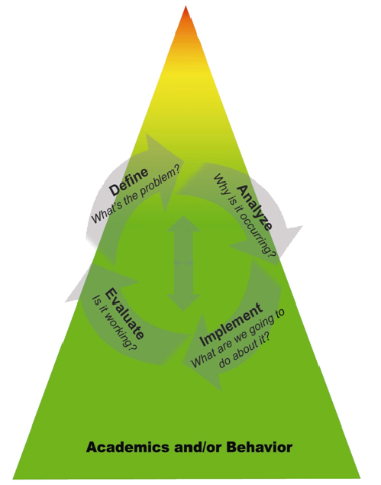
Universal Social-Emotional Screening within a Multi-Tiered System of Support Duval County Public School’s Journey

Slide 23
Universal Social and Emotional Screening System: What and Why?
Grant Objective: target schools will use an evidence-based universal mental health screening procedure to identify youth in need of additional mental health supports
Screening as part of a coordinated and comprehensive school mental health program
Florida Senate Bill 7026/7030 Marjorie Stoneman Douglas High School Public Safety Act

Slide 24
Youth Mental Health
Negative Indicators
(Mental Illness Symptoms)
Positive Indicators
(Well-Being)
Internalizing Problems, such as Anxiety and Depression
Disruptive Behaviors, such as Defiance, Rule Violations, Substance Use
Life Satisfaction and Positive Emotions, such as Happiness
Building blocks of well-being, (gratitude, empathy, persistence)
Strong Social Relationships
Trauma and other environ-mental stressors
Risky/ unsafe settings
Inconsistent rules and expectations across settings
Basic needs are met
Social and emotional skills
Healthy interactions and safe, nurturing settings (minimal bullying, high support)
Thinking errors, behavioral withdrawal
Risk Factors
Resilience Factors

Slide 25
The Process of Implementing the Screening System into MTSS at Duval
Planning
Obtaining district, staff and family buy-in
Allocating resources through grant funding
Addressing ethical and legal/liability considerations
Selecting the right standardized screener for our school/district
Ongoing training and professional development
Identifying and coordinating resources at all Tiers

Slide 26
BIMAS 2 Behavior Intervention Monitoring System
Measure of social, emotional and behavioral functioning
Behavioral Concern Scales-Identify Risks
Adaptive Scales-Identify Strengths
34 question instrument
Administration time 5-10 minutes
Online web-based data management system
Teacher report ages 5-18
Student Self report ages 12-18 years
Notes:
Opt out letters sent home prior to screening for approval.

Slide 27
Why we selected the BIMAS-2
Examines strengths in addition to areas of concern
Brief instrument
Progress Monitoring component
Data Package
Data used to address school-wide trends and identify students at risk
Grant funding for purchase

Slide 28
Implementation of the BIMAS 2
Initial small sample size 6 schools one grade level
Yearly scaled up
Year 3 District Wide Screening in grades 3, 6 and 9
Whole school screening for 8 RISE grant Middle Schools
Professional Development for school coordinators
SharePoint site for all documents, videos and resources
Passive consent parent letters distributed in multiple languages
Data team loaded the platform into student email for self-report
Administered in the ELA classes on staggered administration window
Online monitoring during administration for highest risk item

Slide 29
Data Presentation

Slide 30
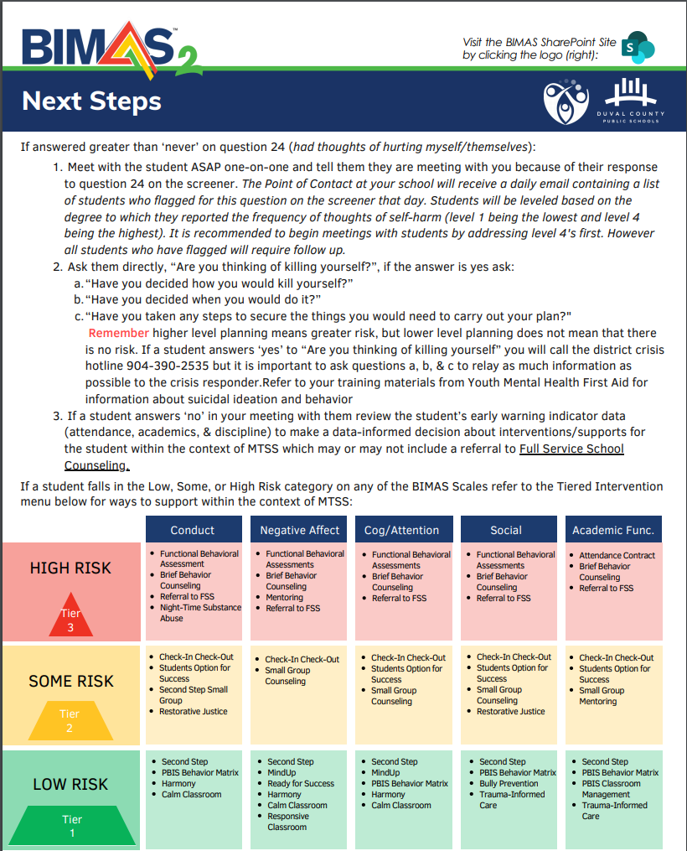
Next Steps
Students completed the self-report version of the instrument
Guidance provided by the district for review of data
T2/T3 team reviewed overall data to determine if students needed additional support
T1 team to address universal supports for “social” category
Gated screening process for students at high risk, especially for suicide

Slide 31
Teams and Decision Making
Facilitation Tools To Review Data:
Growing the Green Guide
Tier 1 and Tier 2/3
Excel Tool To Track Interventions

Slide 32
Screening Data Over Time
2016
443
2017
945
2018
13, 537
2019
16, 577
2020
7, 035
Fall 2021 Screening Window 10/4-12/3

Slide 33
Lessons Learned on the Journey
Data Platform was AMAZING
Scale up
Implementation requires Professional Development/support yearly
Establish/strengthen MTSS on Data Utilization
Be mindful of the screening window
Prepare for unexpected events and circumstances

Slide 34
Transparency, Access, & Collaboration
Benefits of Integrated Tiered Systems

Slide 35
Comprehensive, Integrated, Three-Tiered Model of Prevention
(Lane, Kalberg, & Menzies, 2009)
Tier 3
Tertiary Prevention (≈5%)
Tier 2
Secondary Prevention (≈15%)
Tier 1
Primary Prevention (≈80%)
Academic ◇ Behavioral ◇ Social
Validated Curricula PBIS Framework Validated Curricula

Slide 36
Sample Data – SSBD
2007-2011 Risk Status for Nominated Students
Externalizing
Number of students
47
13
57
9
66
11
78
14
63
7
6.8%
2.17%
2.41%
2.61%
1.5%
Note. The numbers represent totals for the students for whom the SSBD was completed.
Notes:
36

Slide 37
Sample Data – SSBD
2007-2011 Risk Status for Nominated Students
Internalizing
Number of students
46
17
66
12
78
12
55
13
60
6
4.4%
2.78%
1.44%
2.63%
2.24%
Note. The numbers represent totals for the students for whom the SSBD was completed.
Notes:
37

Slide 38
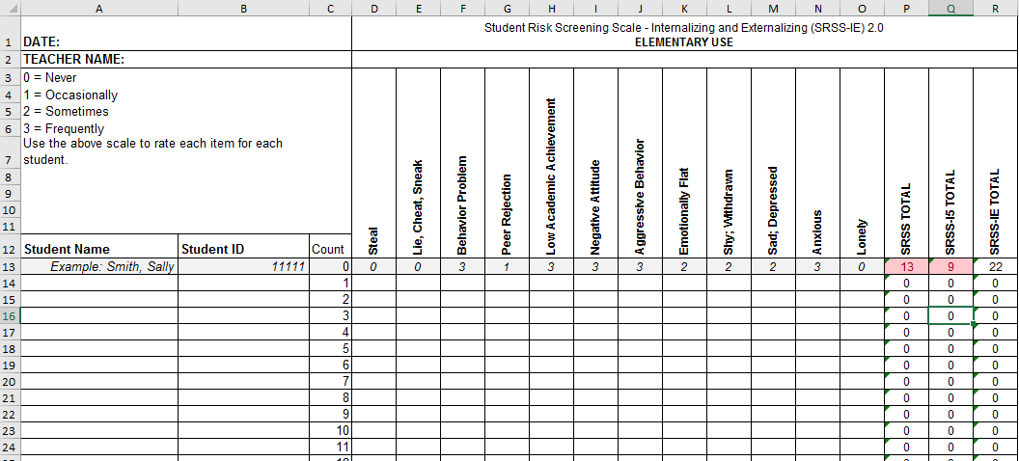
Student Risk Screening Scale for Internalizing and Externalizing (SRSS-IE; Drummond, 1994; Lane & Menzies, 2009)

Slide 39
SRSS-IE: Cut Scores
Elementary School |  | Middle and High School
SRSS-E7 | SRSS-I5 | SRSS-E7 | SRSS-I6
Items 1-7 | Items 8-12 | Items 1-7 | Items 4, 8-12
0-3 = low risk 4-8 = moderate risk 9-21 = high risk | 0-1 = low risk 2-3 = moderate risk 4-15 = high risk | 0-3 = low risk 4-8 = moderate risk 9-21 = high risk | 0-3 = low risk 4-5 = moderate risk 6-18 = high risk
Elementary School Level:
Lane, K. L., Oakes, W. P., Swogger, E. D., Schatschneider, C., Menzies, H., M., & Sanchez, J. (2015). Student risk screening scale for internalizing and externalizing behaviors: Preliminary cut scores to support data-informed decision making. Behavioral Disorders, 40, 159-170.
Middle and High School Levels:
Lane, K. L., Oakes, W. P., Cantwell, E. D., Schatschneider, C., Menzies, H., Crittenden, M., & Messenger, M. (2016). Student Risk Screening Scale for Internalizing and Externalizing Behaviors: Preliminary cut scores to support data-informed decision making in middle and high schools. Behavioral Disorders, 42(1), 271-284

Slide 40
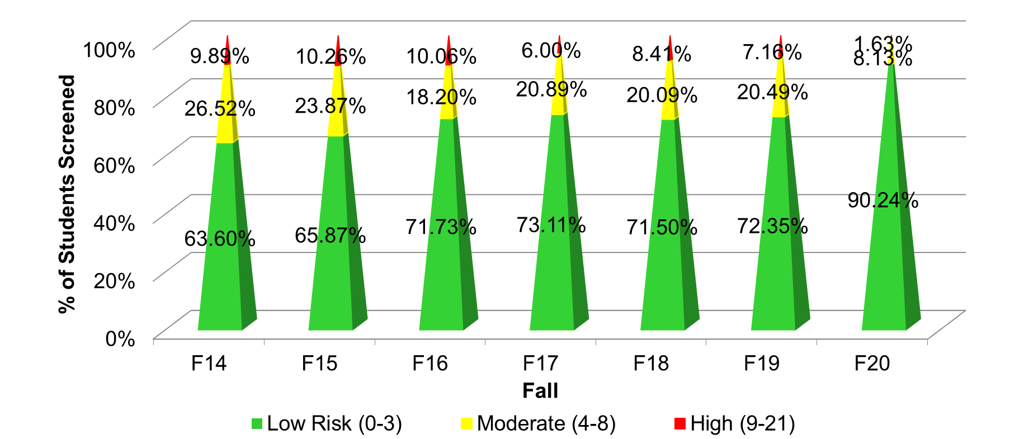
Fall 2020 SRSS-Externalizing Results – School level
n = 44
n = 43
n = 47
n = 27
n = 36
n = 29
n = 6
n = 118
n = 100
n = 85
n = 94
n = 86
n = 83
n = 30
n = 283
n = 276
n = 335
n = 329
n = 306
n = 293
n = 333

Slide 41
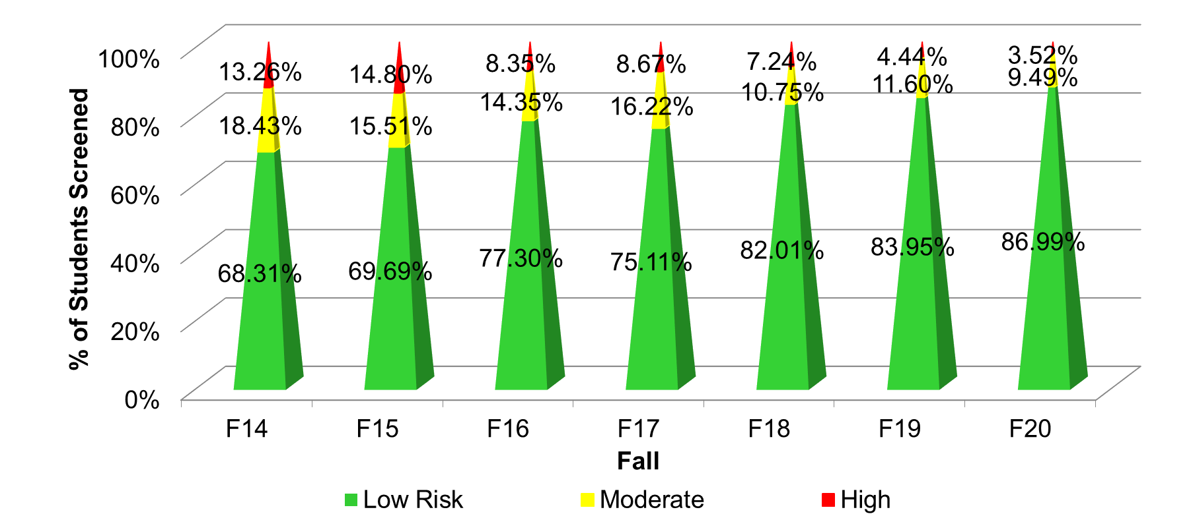
Fall 2020 SRSS-Internalizing Results – School level
n = 59
n = 62
n = 39
n = 39
n = 31
n = 18
n = 13
n = 82
n = 65
n = 67
n = 73
n = 46
n = 47
n = 35
n = 304
n = 292
n = 361
n = 338
n = 351
n = 340
n = 321
Cut scores vary by school level:
Elementary (I5): Low (0-1), Moderate (2-3), High (4-15)
Middle and High (I6): Low (0-3), Moderate (4-5), High (6-18)

Slide 42
Results:
SRSS-IE: internalizing Subscale Elementary
Variable | Risk |  |  | Significance Testing
 | Low M (SD) n | Moderate M (SD) n | High M (SD) n
Oral Reading Fluency | 159.04 (41.45) 459 | 150.59 (45.76) 88 | 139.18 (46.53) 74 | L > H L = M; M = H
MAP Reading | 63.38 (28.32) 2,070 | 53.93 (32.15) 356 | 43.57 (30.47) 263 | L > M > H
Nurse Visits | 6.84 (7.37) 3,387 | 7.59 (8.05) 628 | 9.33 (10.81) 450 | L < M < H
In-School Suspensions | 0.0142 (0.15) 3,387 | 0.0510 (0.36) 628 | 0.0311 (0.20) 450 | L < M, H M = H
Fall Internalizing
Winter Internalizing
Spring
ORF*
MAP Reading
Nurse Visit
Suspensions*

Slide 43
Screening Data: High School Yrs1-3
Fall- SRSSIE-I |  | Low |  | Moderate |  | High |  | Fall- SRSSIE-E |  | Low |  | Moderate |  | High
2016 |  | 80.28% |  | 10.36% |  | 9.36% |  | 2016 |  | 89.56% |  | 8.02% |  | 2.42%
2017 |  | 90.18% |  | 4.16% |  | 5.66% |  | 2017 |  | 91.29% |  | 6.18% |  | 2.54%
2018 |  | 90.91% |  | 3.86% |  | 5.23% |  | 2018 |  | 92.22% |  | 6.20% |  | 1.58%
WTR-SRSSIE-I |  | Low |  | Moderate |  | High |  | WTR-SRSSIE-E |  | Low |  | Moderate |  | High
2016 |  | 87.25% |  | 9.49% |  | 3.26% |  | 2016 |  | 87.25% |  | 9.49% |  | 3.26%
2017 |  | 86.14% |  | 9.02% |  | 4.85% |  | 2017 |  | 86.14% |  | 9.02% |  | 4.85%
2018 |  | 88.79% |  | 8.52% |  | 2.69% |  | 2018 |  | 88.79% |  | 8.52% |  | 2.69%

Slide 44
SRSS-IE: Internalizing Subscale
High school
Variable |  | Risk |  | Significance Testing
 | Low M (SD) n = 2,379 | Moderate M (SD) n = 123 | High M (SD) n = 132
GPA | 3.04 (0.82) | 2.44 (0.83) | 2.27 (0.98) | L > M, H M = H
Course Failures | 1.25 (2.17) | 2.59 (2.66) | 2.83 (3.21) | L < M, H M = H
Nurse Visits | 1.43 (3.33) | 3.54 (6.05) | 4.04 (5.80) | L < M, H M = H
In-School Suspensions | 0.11 (0.57) | 0.41 (1.36) | 0.42 (1.28) | L < M, H M = H
Fall Internalizing
Winter Internalizing
Spring
GPA
Course Failures
Nurse Visit
ODR
Suspensions
L < M, H
M = H

Slide 46
Sample Middle School: Fall
SRSS-E7 Results – All Students
N = 26
N = 12
N = 89
N = 66
N = 554
N = 550

Slide 47
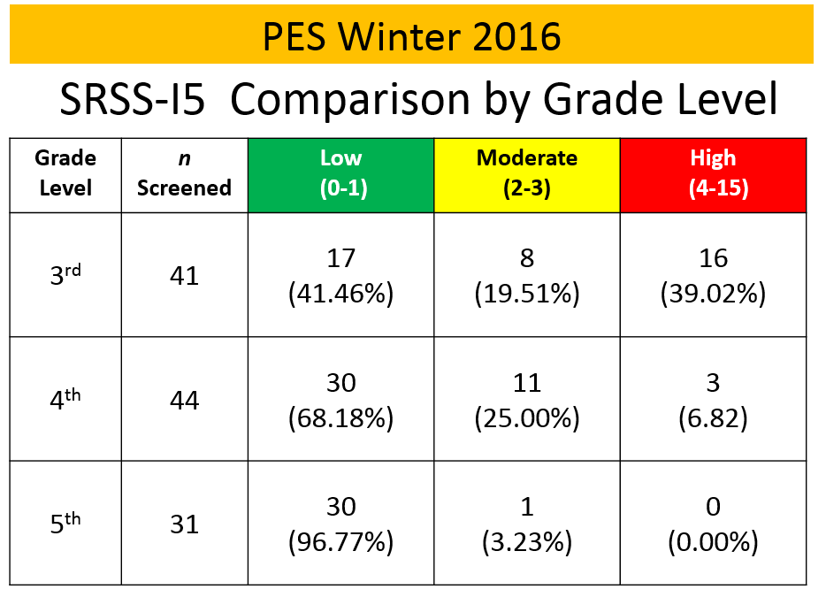
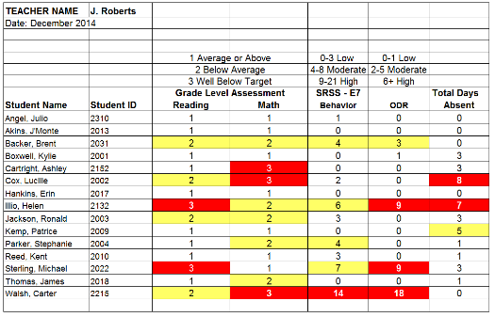
Data sharing…
Schoolwide data
…decisions related to primary prevention efforts
Grade / Department / Class
…implications for teachers’ practice
Individual student
…decisions about student-based interventions

Slide 48
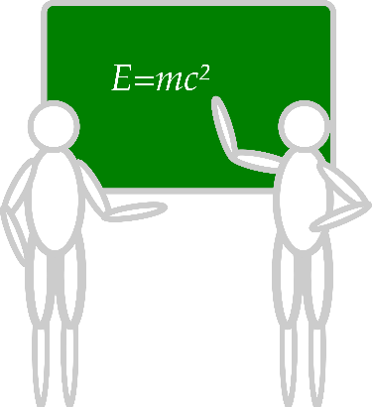
Communication and Continuous Improvement
Effective
Teams
Ci3T District Leadership Team
College & Career
Ci3T School Leadership Team
Ci3T School Leadership Team
Ci3T School Leadership Team
Ci3T School Leadership Team
Ci3T School Leadership Team
Ci3T School Leadership Team
Ci3T School Leadership Team
Ci3T School Leadership Team
Ci3T School Leadership Team
Ci3T School Leadership Team
Ci3T School Leadership Team
Ci3T School Leadership Team
Ci3T School Leadership Team
Ci3T School Leadership Team
Ci3T School Leadership Team
High
Ci3T School Leadership Team
Ci3T School Leadership Team
Middle
Ci3T School Leadership Team
Ci3T School Leadership Team
Ci3T School Leadership Team
Ci3T School Leadership Team
Elementary

Slide 49
Considerations for Screening PK-12 in the COVID-19 Era

Slide 50
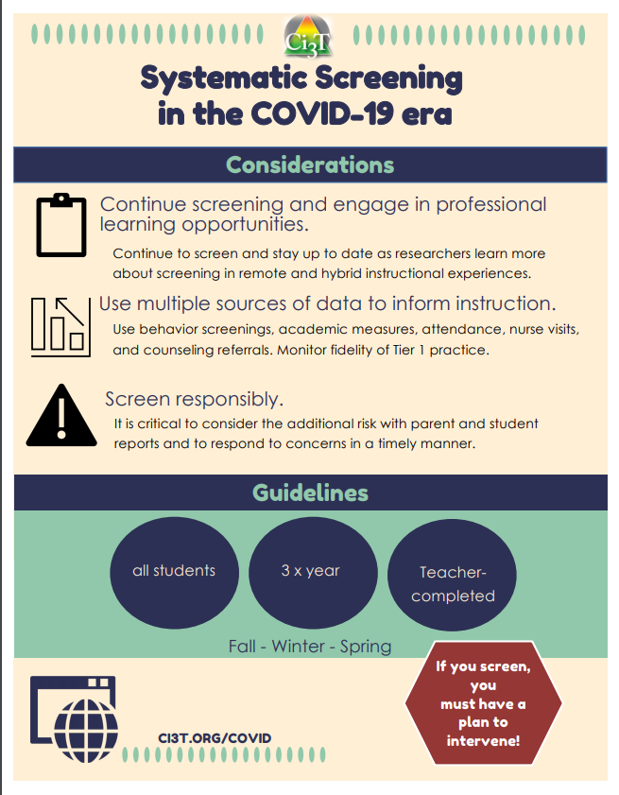
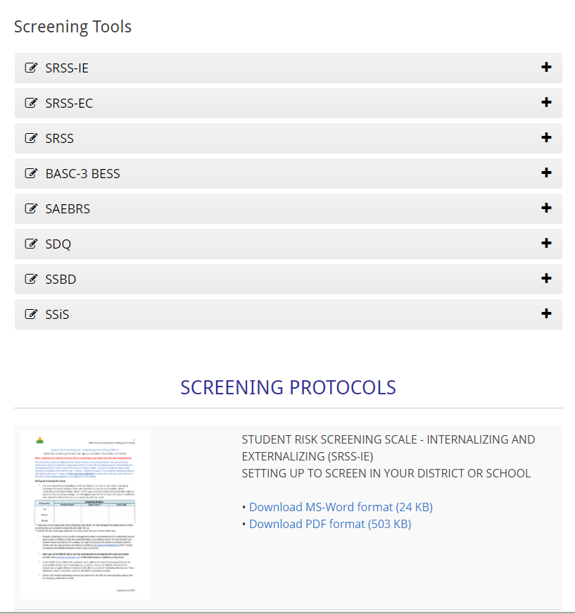

Slide 51
pbis.org

Slide 52
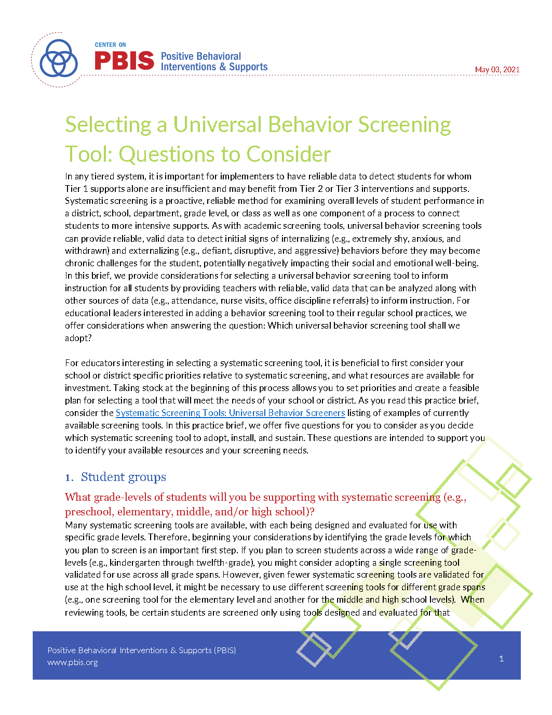
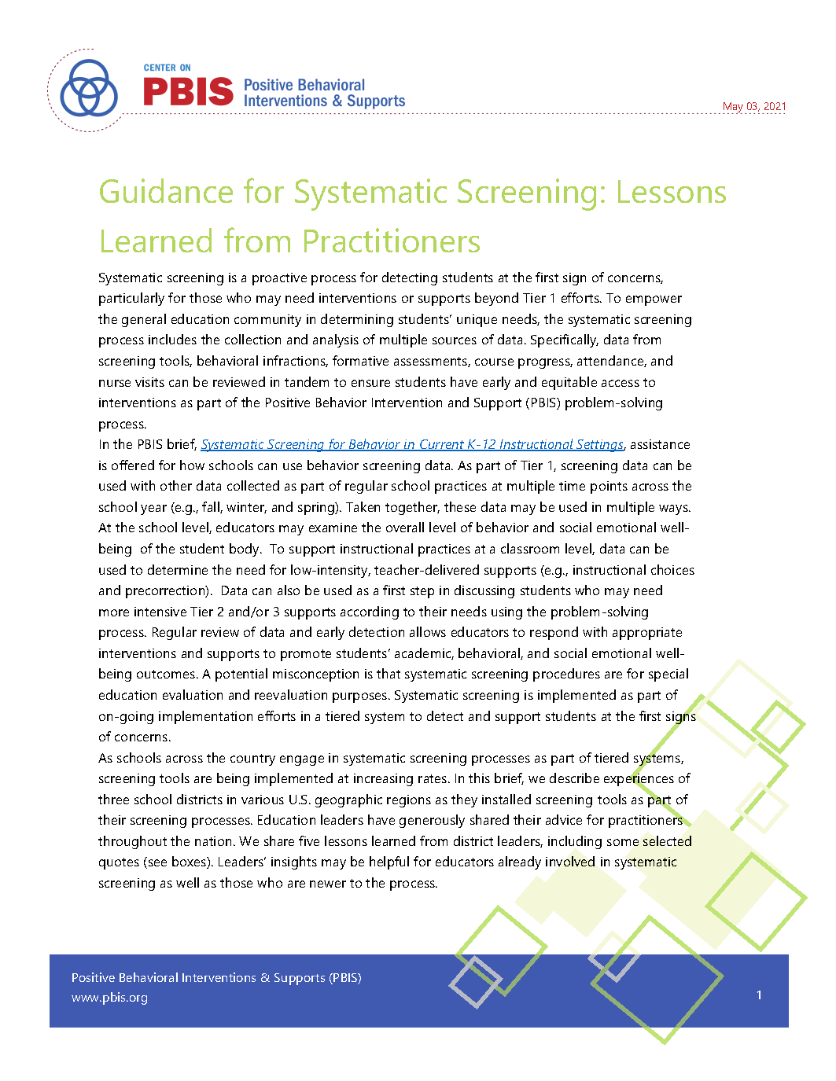
Resources for screening available on PBIS.org…
Guidance for Systematic Screening: Lessons Learned from Practitioners
Selecting a Universal Behavior Screening Tool: Questions to consider

Slide 53
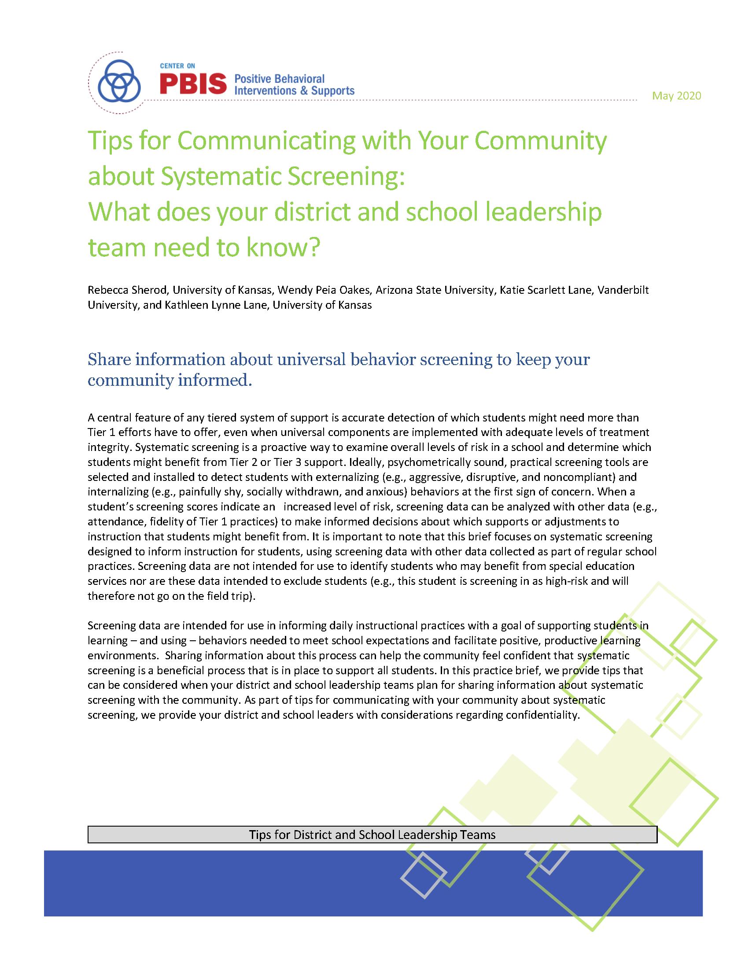
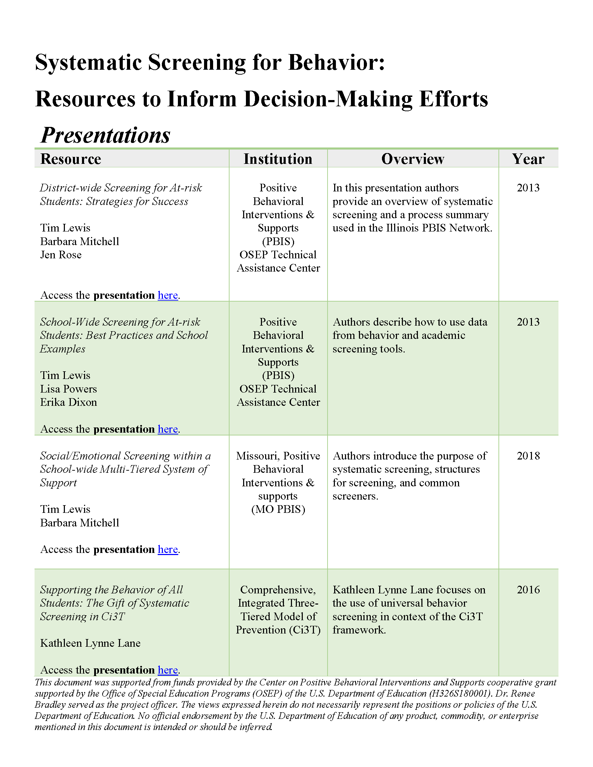
Resources for screening available on PBIS.org…
Screening Resources
Tips for Communicating with Your Community about Systematic Screening: What does your district and school leadership team need to know?

Slide 54
Resources for screening available on PBIS.org…
Installing a Universal Behavior Screening Tool: Questions to consider
Interpreting Universal Behavior Screening Data: Questions to consider
The Whys and Hows of Screening: Frequently Asked Questions for Families​

Slide 55
ci3t.org

Slide 56
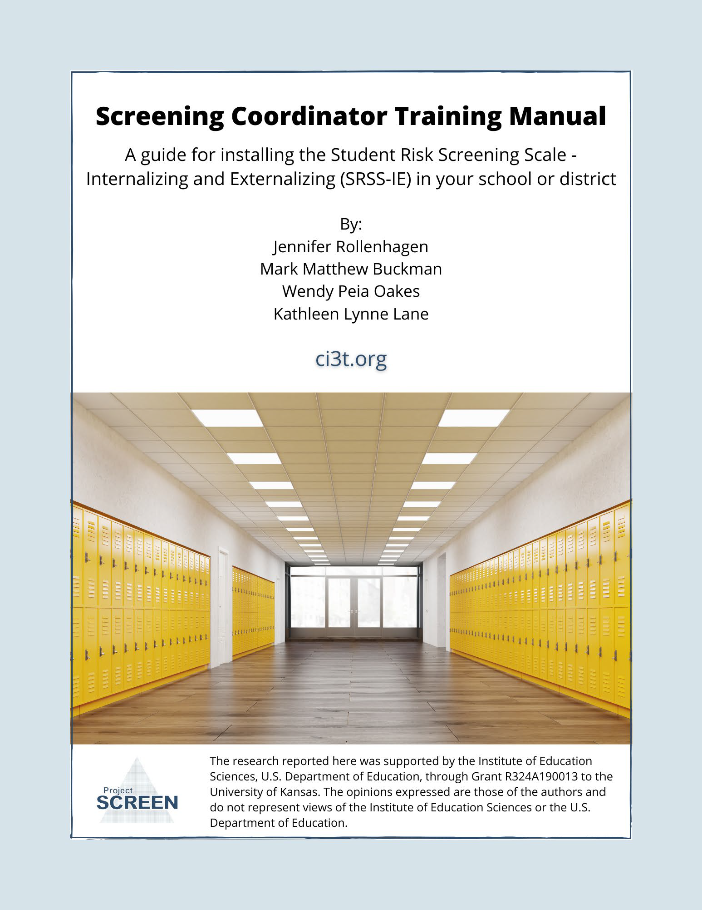
Project SCREEN

Slide 57
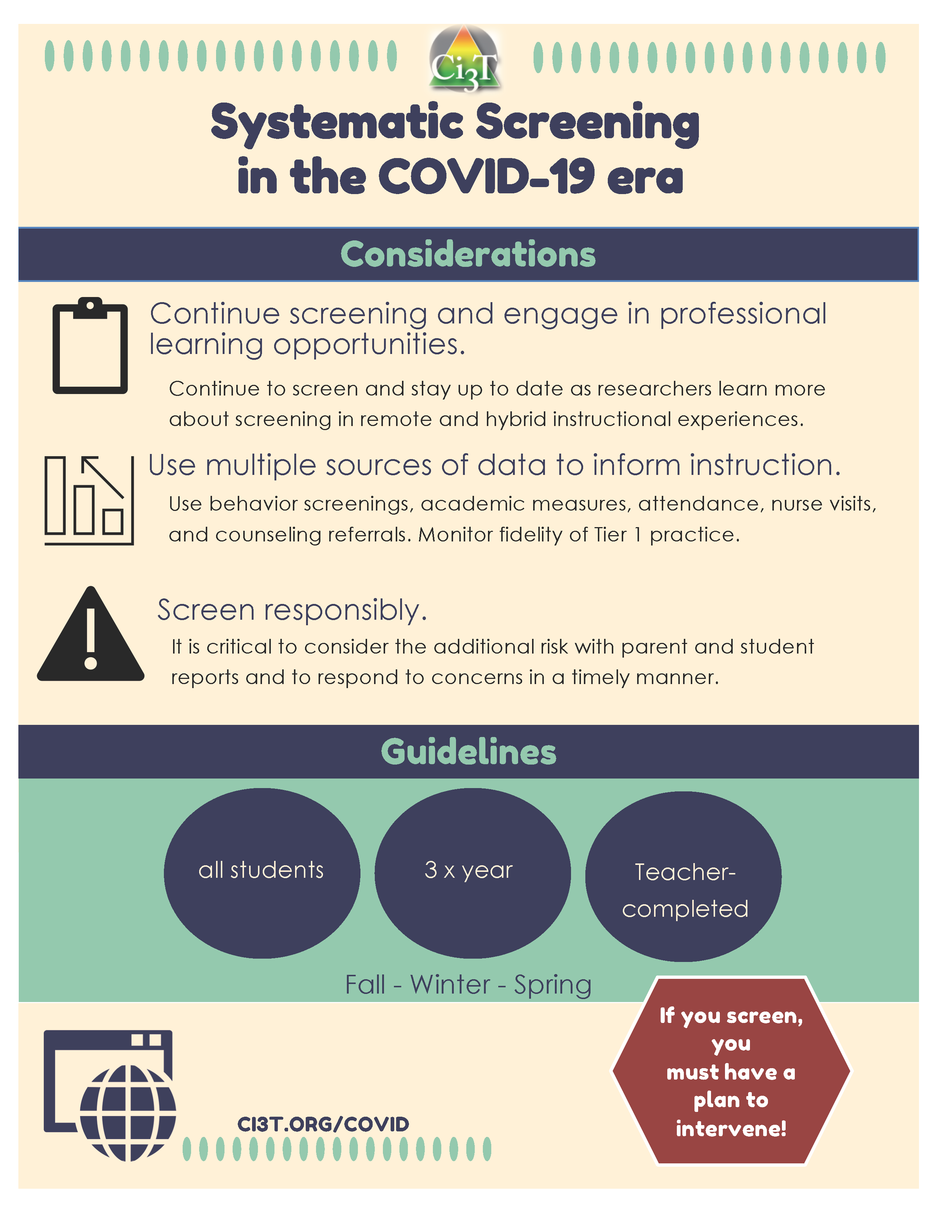
Resources for screening on Ci3t.org
Systematic Screening in the COVID-19 Era
Screening Coordinator Training Manual: A Guide for Installing the SRSS-IE in your School or District
Considerations for Systematic Screening PK-12 in the COVID-19 Era

Slide 58
Planning for Next Steps

Slide 59
Comprehensive, Integrated, Three-Tiered Model of Prevention
(Lane, Kalberg, & Menzies, 2009)
Tier 3
Tertiary Prevention (≈5%)
Tier 2
Secondary Prevention (≈15%)
Tier 1
Primary Prevention (≈80%)
Academic ◇ Behavioral ◇ Social
Validated Curricula PBIS Framework Validated Curricula

Slide 60
Comprehensive, Integrated, Three-Tiered Model of Prevention
(Lane, Kalberg, & Menzies, 2009)
Tier 3
Tertiary Prevention (≈5%)
Tier 2
Secondary Prevention (≈15%)
Secondary (Tier 2) Intervention Grids
Tier 1
Primary Prevention (≈80%)
Academic ◇ Behavioral ◇ Social
Validated Curricula PBIS Framework Validated Curricula

Slide 61
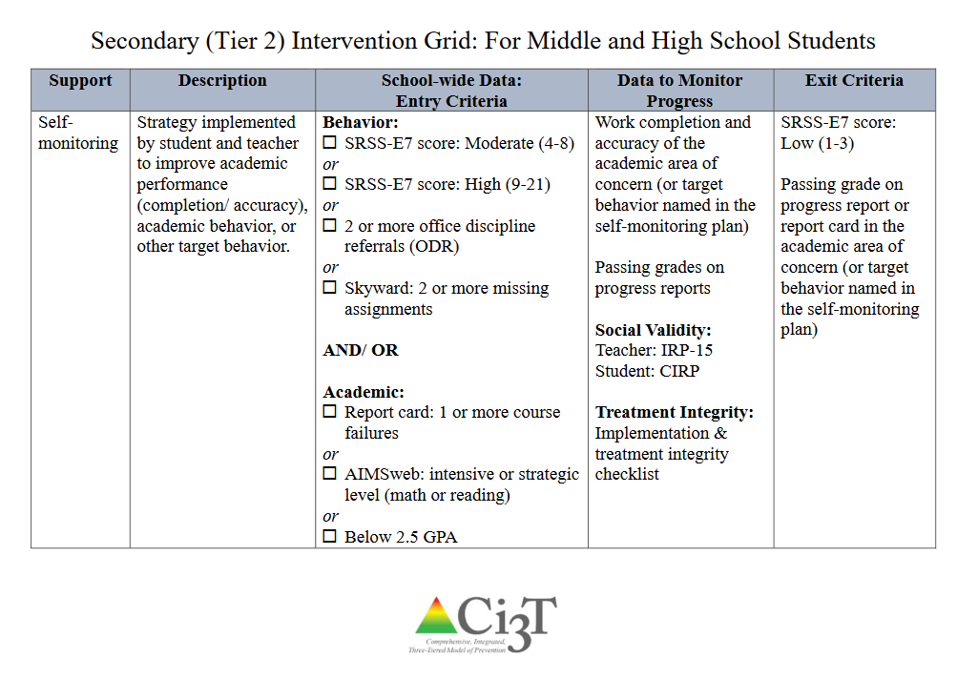

Slide 62
MTSS: CI3T Training Series
CI3T: Primary Prevention
Session 1:
Overview of CI3T Prevention Models
Setting a Purpose
Establish team meetings and roles
Session 2:
Mission and Purpose
Establish Roles and Responsibilities
Procedures for Teaching
Procedures for Reinforcing
Reactive Plan
Session 3:
Procedures for Monitoring
Session 4:
Revise Primary Plan using Stakeholder feedback
Prepare presentation
CI3T: Secondary Prevention
Session 5:
Overview of Teacher focused Strategies
Overview of Student Focused Strategies
Using data to determine
Draft the Secondary Intervention Grid based on existing supports
CI3T: Tertiary Prevention
Session 6:
Final revisions of CI3T Plan based on stakeholder feedback
Draft Tertiary Prevention Intervention Grids
Design Implementation Manual and Plan for roll out to faculty, students, and parents
CI3T Team Training Sequence
Implementation Stages of Tier 2 and 3 within CI3T
Additional Professional Development on Specific Topics
Core Content Curriculum
Check In - Check Out
Functional Assessment-based Interventions
Reading, Math, Writing Benchmarking and Progress Monitoring Tools
Student Driven Interventions, Strategies, & Practices
Additional Tier 3 Supports
Teacher Drive Supports: Instructional Techniques to Improve Students’ Motivation; General Classroom Management Practices; Low Intensity Behavior Supports

Slide 63
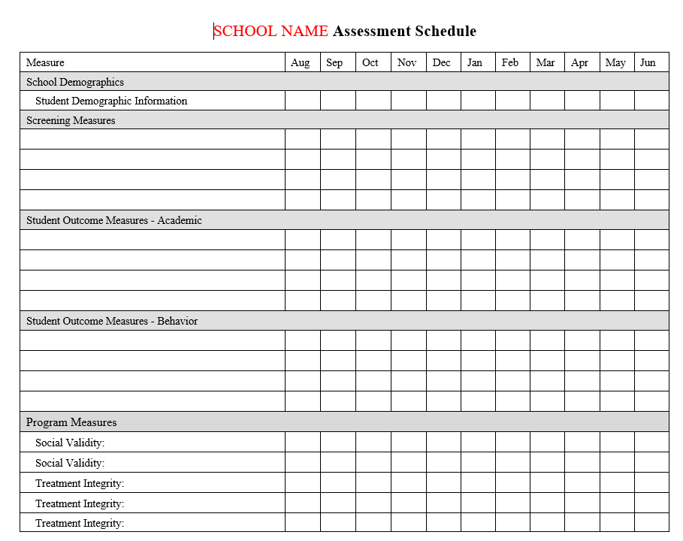
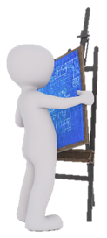
Ci3T: Monitoring for Success: Using Data to Inform Instruction
… Action Planning

Slide 64
Thank you!

Slide 65
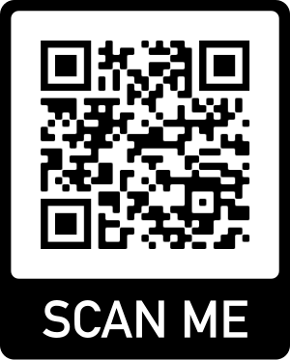
Please Complete this Session’s Evaluation Session #A9 - Systematic Screening: Detecting & Supporting Students with Internalizing Behaviors
In the Event Platform/App:
In “Files” tab,
In “Evaluations” in the navigation menu
In “Chat”
OR
2. QR Code
AFTER YOU SUBMIT EACH SESSION EVALUATION, CLICK THE LINK TO ENTER THE GIFT CARD RAFFLE
Evaluations are anonymous! We send reminder emails to all participants.
Notes:
https://forms.gle/jwzf5M5oG87Jy58M7
To preserve the appearance of this slide, a picture file has been created. An editable version is behind it.

