Slide 1
Implementing Comprehensive, Integrated, Three-Tiered (Ci3T) Models Structured Flexibility: Using Your Ci3T Structures to Provide Positive, Productive, and Safe Learning Environments
Please pull up
your Ci3T
Implementation Manual
Ci3T Implementation: Session 2

Slide 2
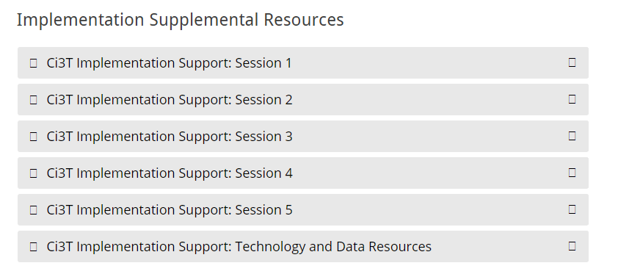
Accessing Professional Learning
Navigate to ci3t.org/imp
Scroll down to the Implementation Supplemental Resources and click to open Session 2

Slide 3
Welcome, School Teams!
We are excited to welcome you to this session of the Ci3T implementation professional learning series.
Your dedication to systems change for helping all students succeed academically, behaviorally, and socially is appreciated!
Notes:
Instructions: Insert the name of the participating schools and districts.
Participating school district(s) logos can be added as well.

Slide 4
Goals for this Implementation Year
Establish effective Ci3T leadership structures
Gain a deeper understanding of Ci3T models of prevention
Implement your school’s plan with high fidelity
Collect and use social validity and treatment integrity data to monitor Ci3T plan implementation
Collect student academic and behavioral outcome data to inform Ci3T implementation efforts
Share data with all stakeholders regularly (e.g., monthly, quarterly)
Identify areas of additional professional learning for faculty and staff and support faculty and staff access to professional learning
Address any barriers to implementing your Ci3T model

Slide 5
Agenda
Welcome
Structured Flexibility: Using Ci3T Structures to Provide Positive, Productive, and Safe Learning Environments – Managing Transitions
Using Data to Focus Ci3T Leadership Team Efforts: How are we doing?
Completing the Tier 1 Protocol of the Tiered Fidelity Inventory (TFI)
Reviewing Fall Screening Data
Looking Ahead

Slide 6
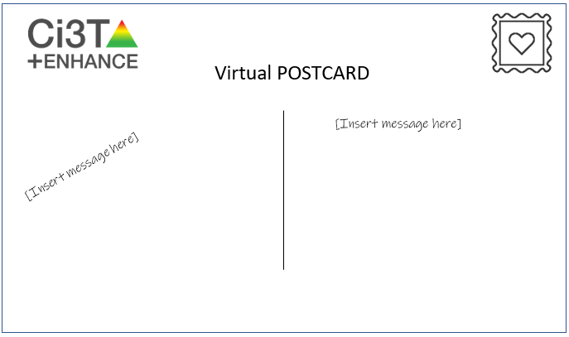
Welcome
Structured Flexibility

Slide 7
Structured Flexibility: Using Ci3T Structures to Provide Positive, productive, and Safe Learning Environments
Using your Ci3T model to:
Plan for transitions and communicate with stakeholders
Support teaching, modeling, and reinforcing of COVID-19 safety procedures

Slide 8
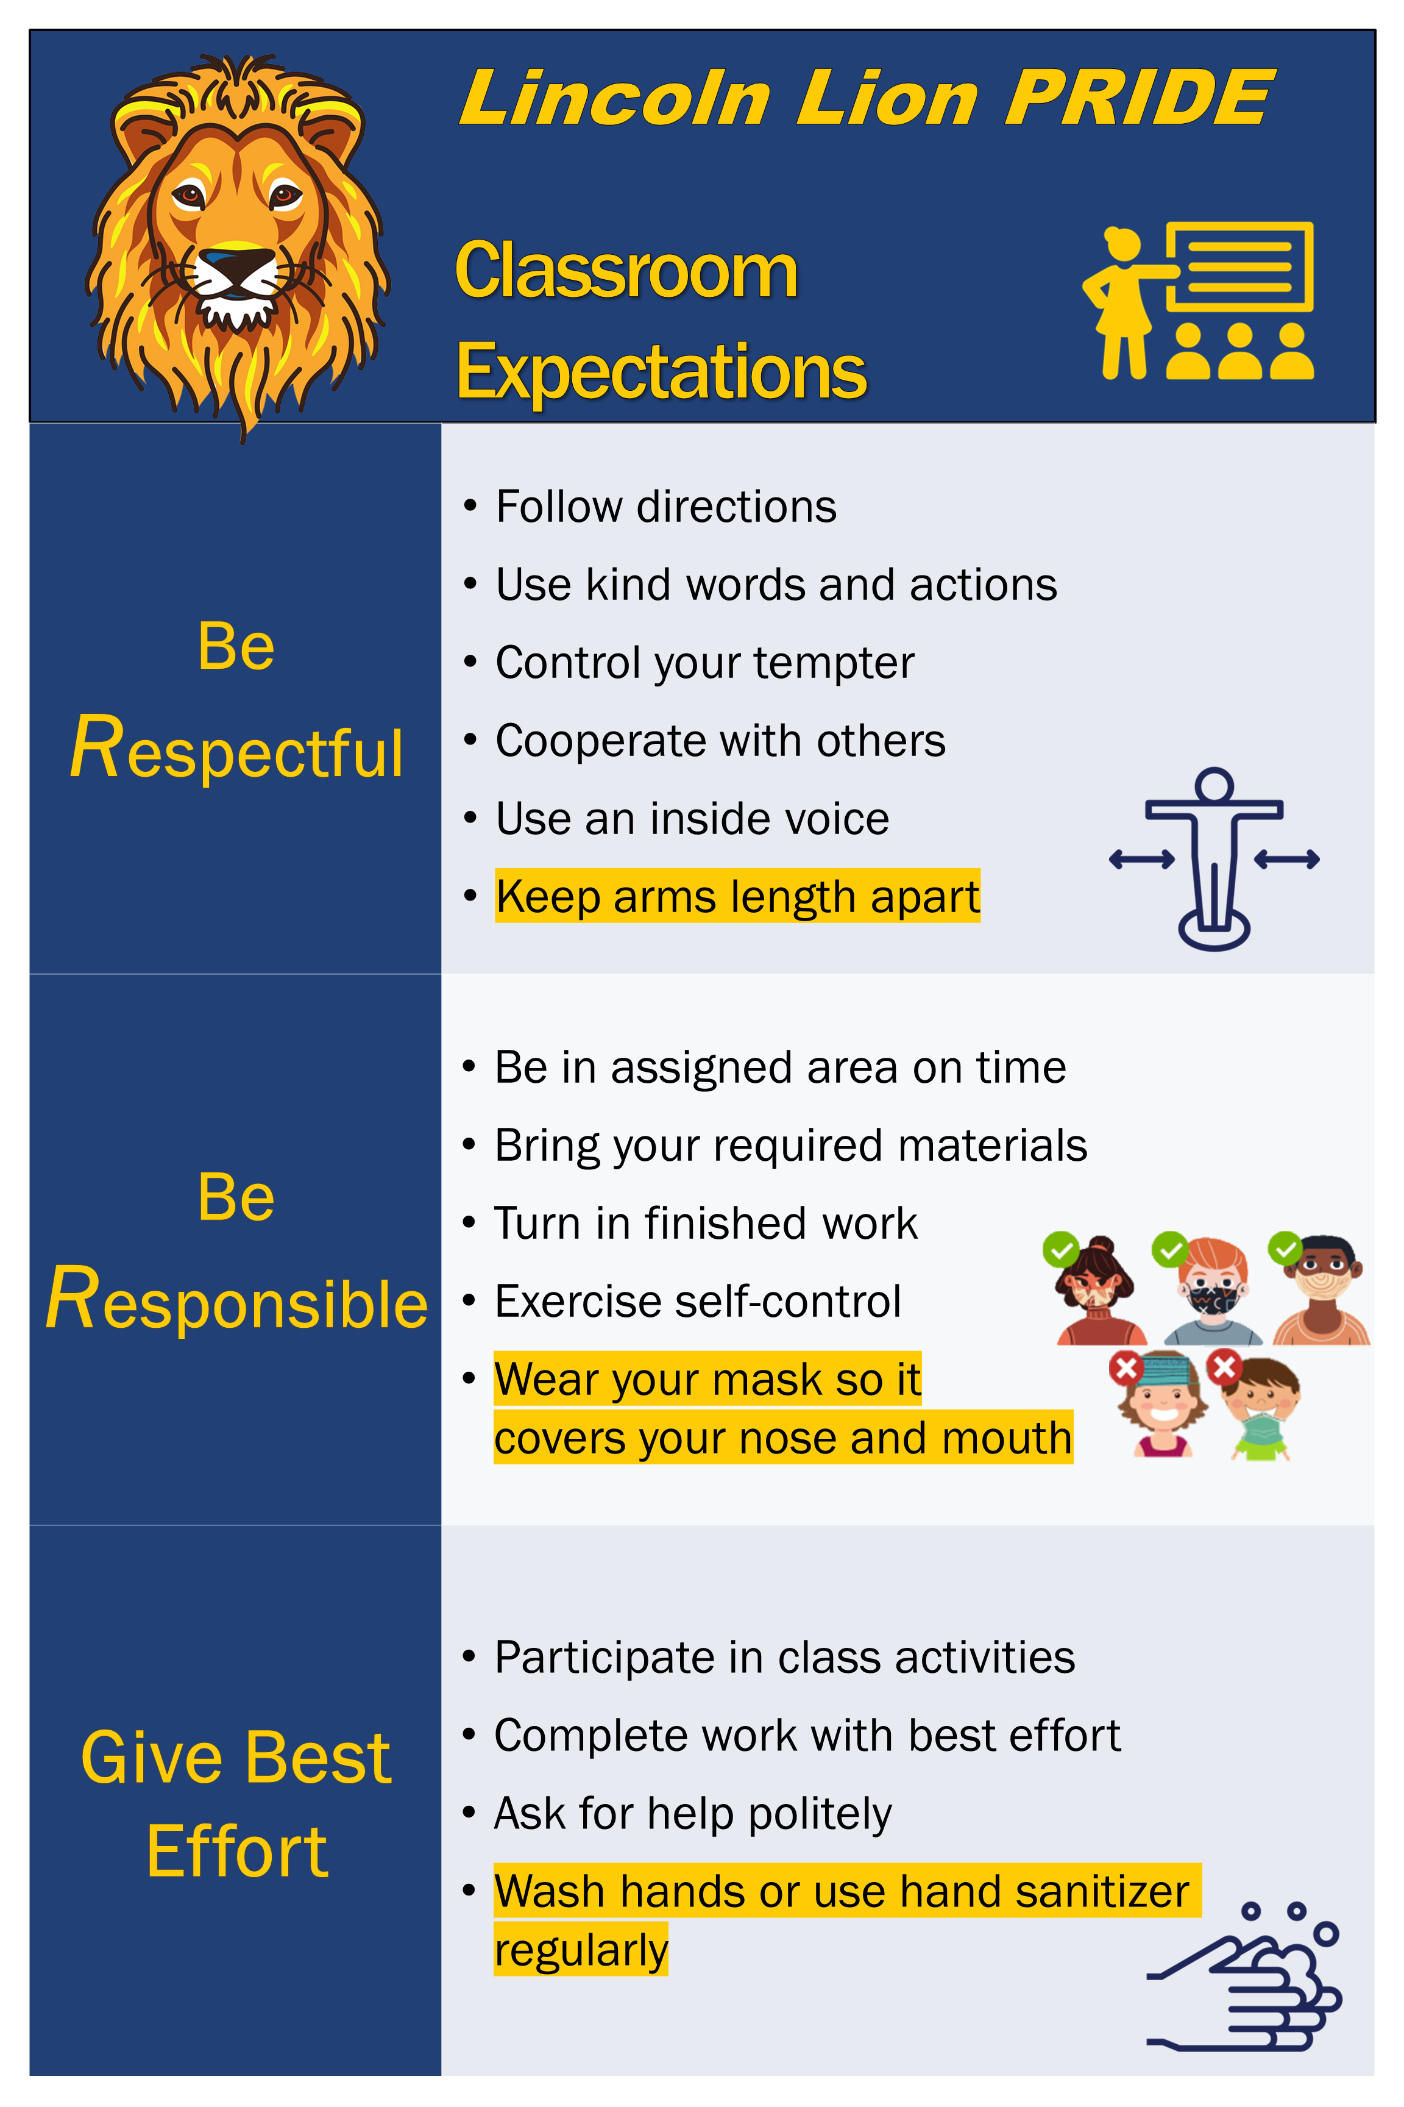
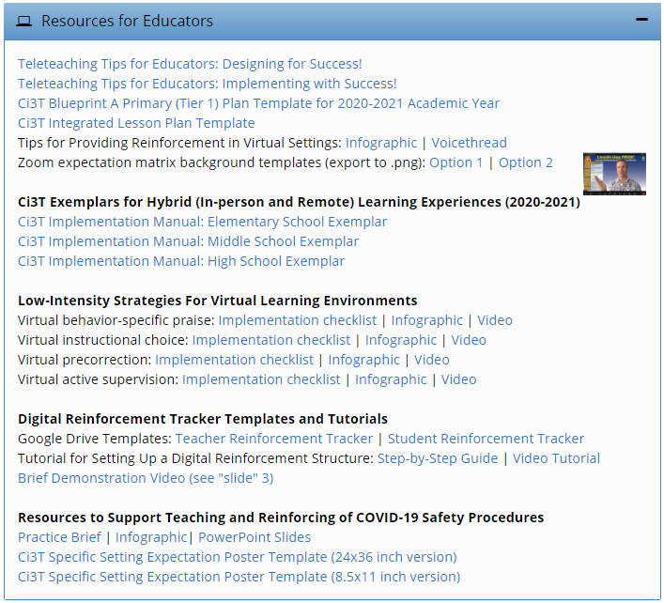
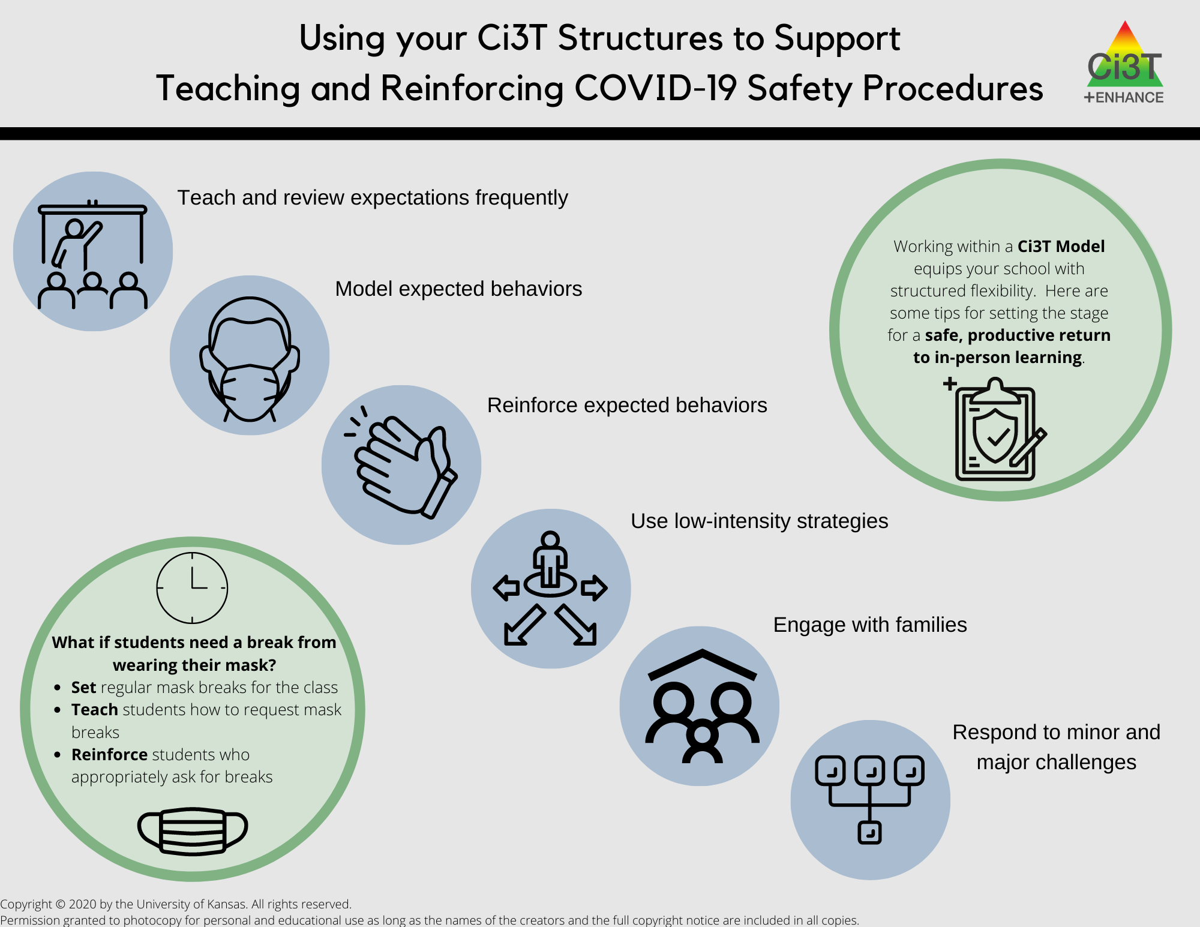
new resources!

Slide 9
Setting up for Success
Teach and review expectations frequently
Model expected behaviors
Reinforce expected behaviors
Use low-intensity strategies to support students in meeting expectations
Engage with families
Respond to minor and major challenges

Slide 11
Teach and review expectations frequently Model expected behaviors Reinforce expected behaviors
Teach
Model
Reinforce

Slide 13
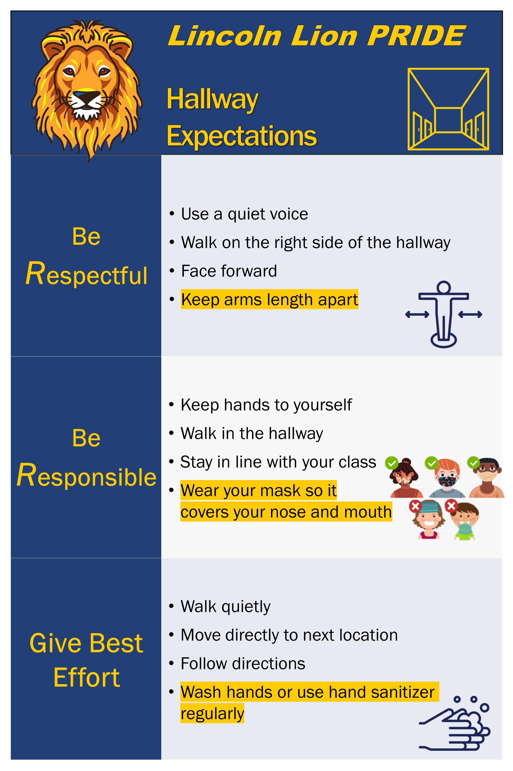

Slide 14
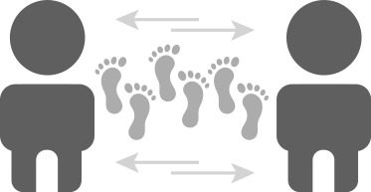
Lincoln Lion PRIDE Hallway Expectations
Be Responsible | Keep arms length apart
Be Respectful | Wear your mask so it covers your nose and mouth
Be Safe | Wash hands or use hand sanitizer regularly

Slide 15
Reinforce expected behaviors

Slide 16
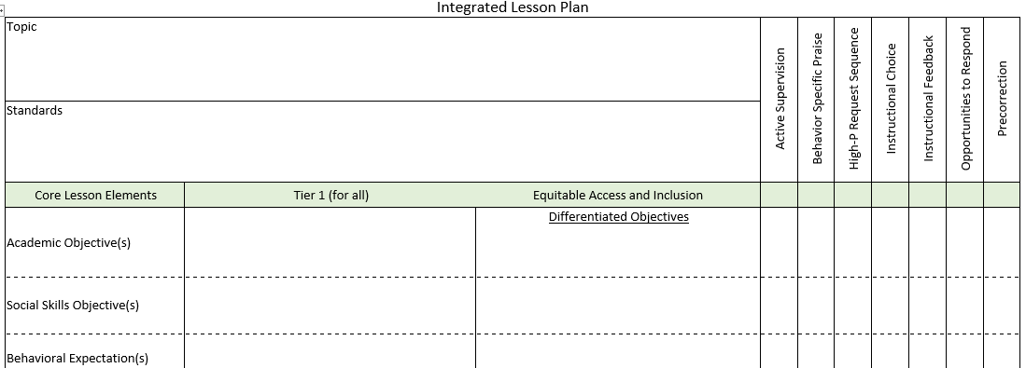
Use low intensity strategies to support students in meeting expectations

Slide 17
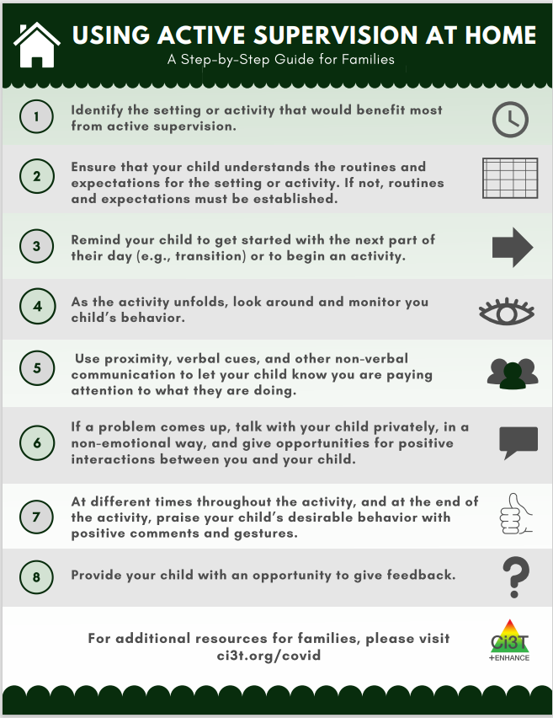
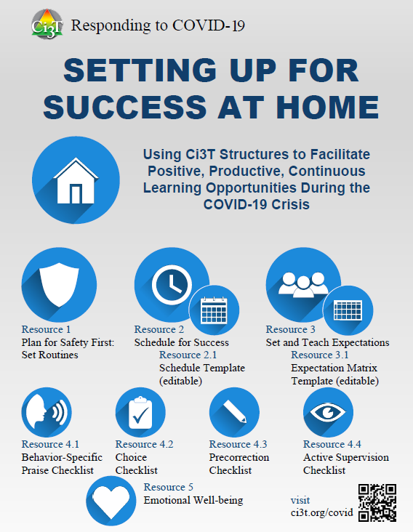
Engage with families

Slide 18
Respond to minor and major challenges
Consider behaviors related to COVID-19 safety procedures that you will need a plan for respond to
Clearly define these behaviors in your reactive plan as minors or majors.
Provide updated materials to teachers with professional learning for accurate reporting
Discuss with faculty and staff examples of when the behaviors are minor and when they are major

Slide 19
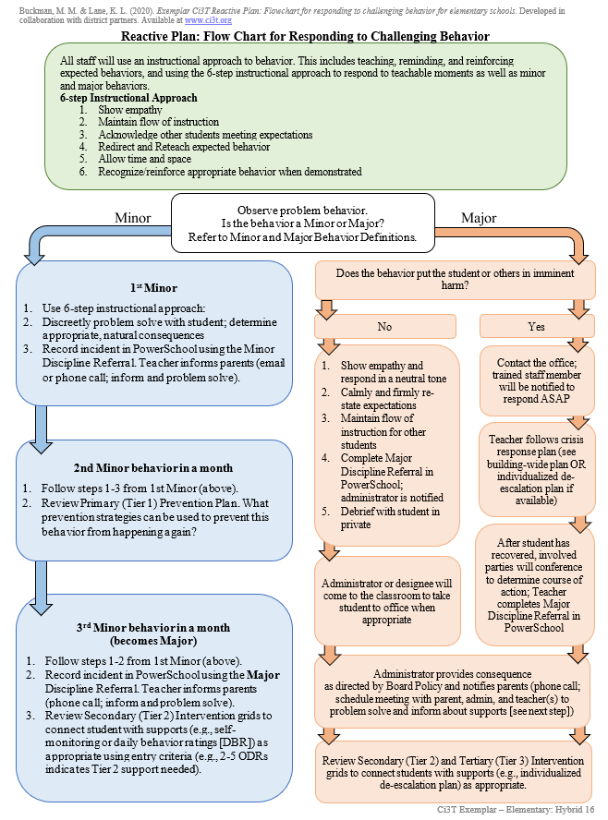
Follow your reactive plan

Slide 20
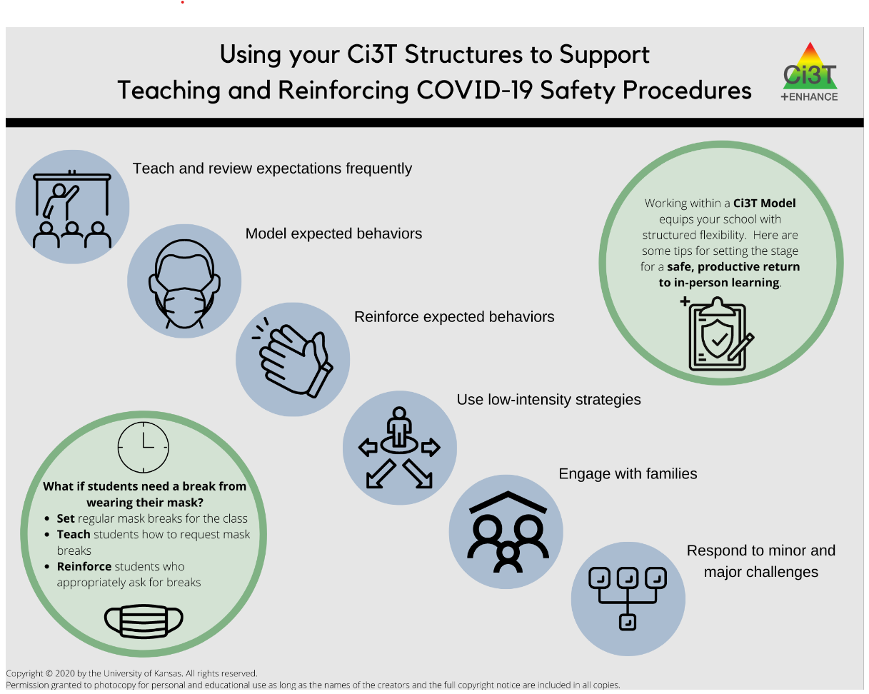

Slide 21
Team Time!
How are you able to use your Ci3T Structure to support in-person, remote, and hybrid instruction?
Notes:
20-min timer

Slide 22
What comes next?

Slide 23
Using Data to Focus Ci3T Leadership Team Efforts: How are we doing?
Completing the Tier 1 Protocol of the Tiered Fidelity Inventory (TFI) Reviewing Fall Screening Data

Slide 24
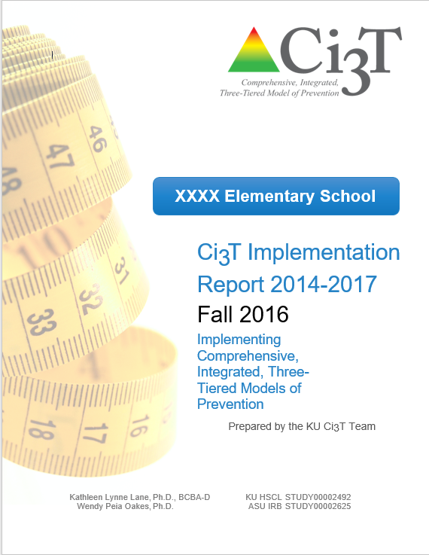
Essential Components of Primary Prevention Efforts
Social Validity
Systematic Screening
Academic
Behavior
Treatment Integrity

Slide 25
Using Data to Focus Ci3T Leadership Team Efforts
Individualized Feedback and Coaching
Data-informed
Linked to school-wide plan
Professional Learning for all Staff
On-demand resources
Free-access PL
Revising the Ci3T Plan
Annual revisions based on stakeholder feedback and values

Slide 26
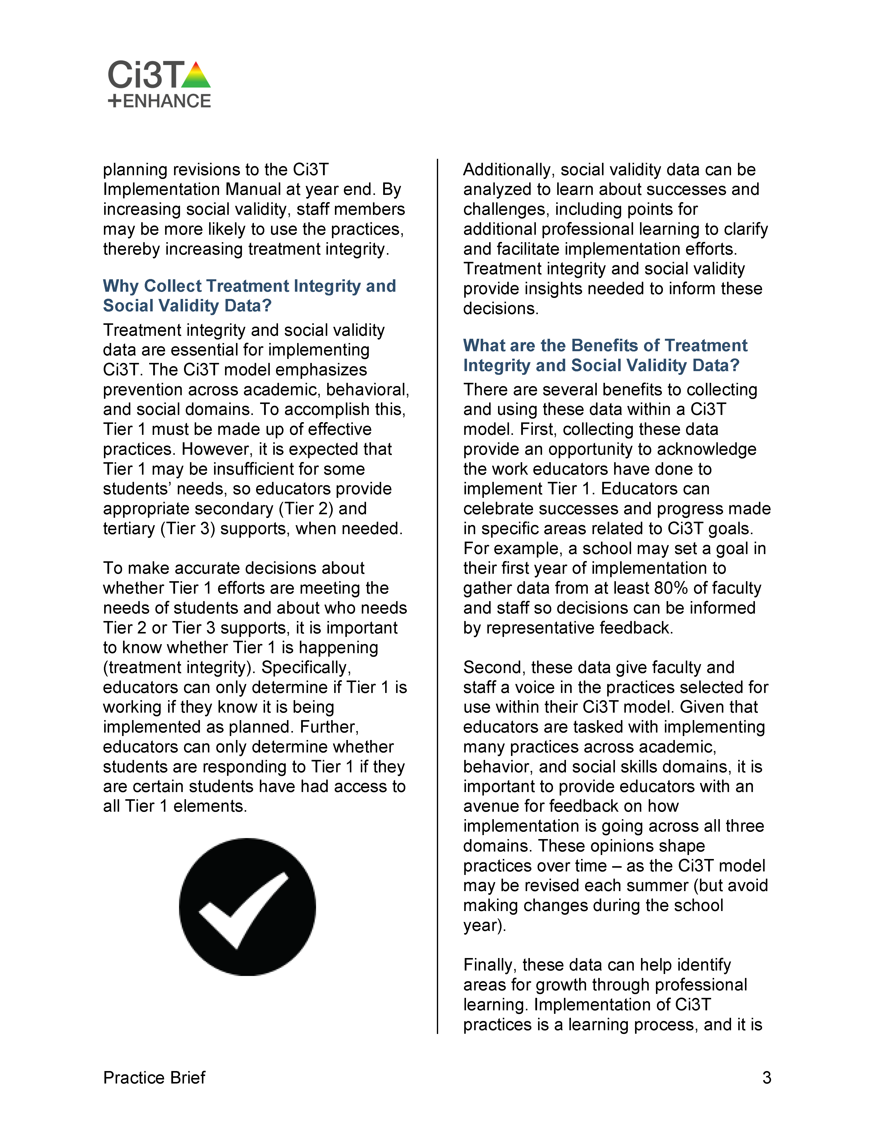
New resources to communicate the ‘why’ of treatment integrity & social validity

Slide 27
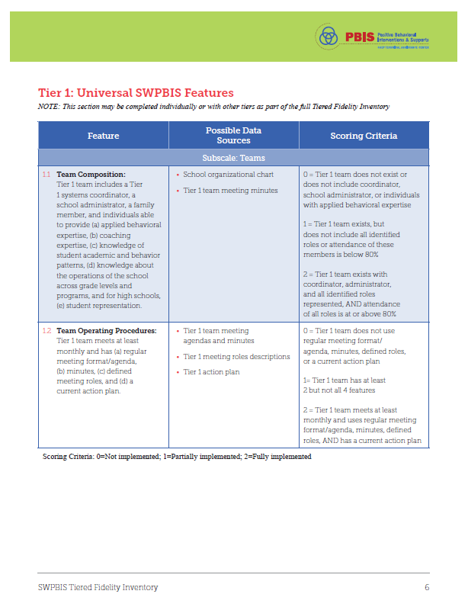
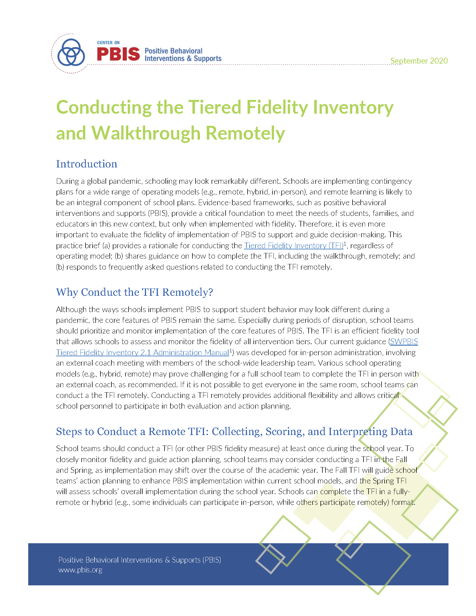
Completing the Tiered Fidelity Inventory – Tier 1
Select a Record Keeper who will keep track of team’s responses in Tier 1 protocol
For each item:
Each member holds up fingers to ‘vote’ for each item (0, 1, or 2)
Majority rules
Minimize conversation (return to disagreements when action planning)
Action: Send completed Tier 1 protocol to your coach before close of the session
Notes:
You can access the full brief here

Slide 28
Team Time!
Tiered Fidelity Inventory (TFI)
Complete Tier 1 Protocol
Plan for how to collect student and staff interviews to complete Tier 1 of TFI (if needed)
Make plans for Tier 2 and Tier 3 protocols of TFI
Fall Screening SRSS-IE Results
Review fall screening data
Make plans for sharing data with your faculty and staff
Notes:
45-min timer

Slide 29
Looking Ahead
Next steps and action items

Slide 30
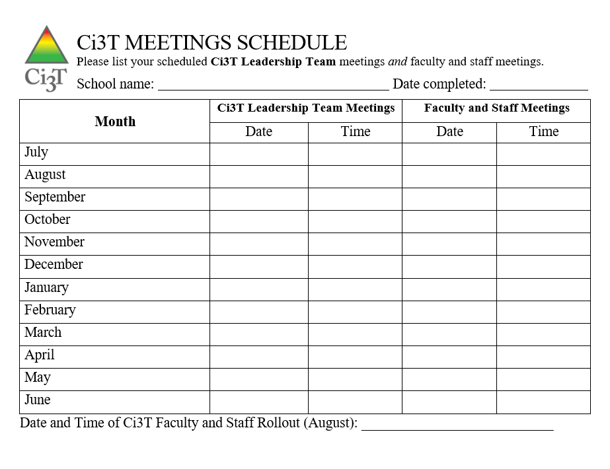
Ci3T Monthly Leadership Team Meetings

Slide 31
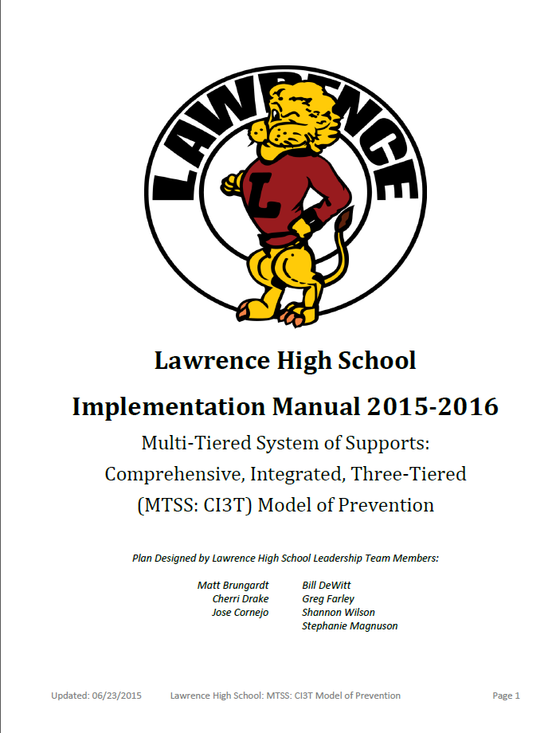
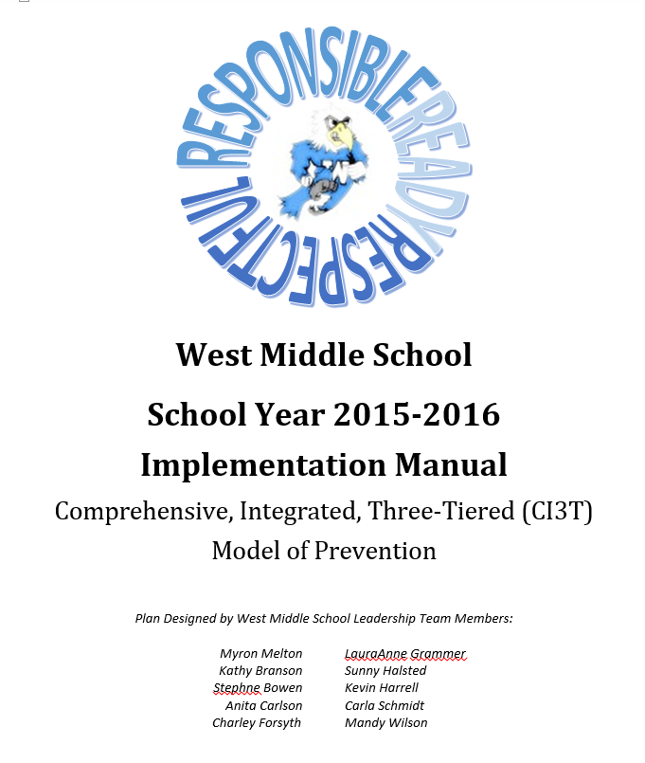
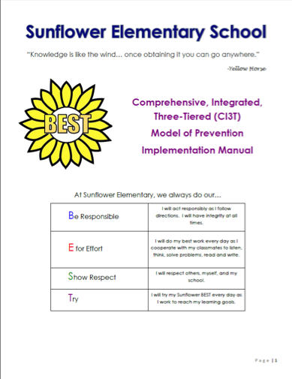
Ci3T 20XX – 20XX
Use your Ci3T Structure to Support Transitions
Share you Ci3T Implementation Manual with your Faculty and Staff as Changes Occur

Slide 32
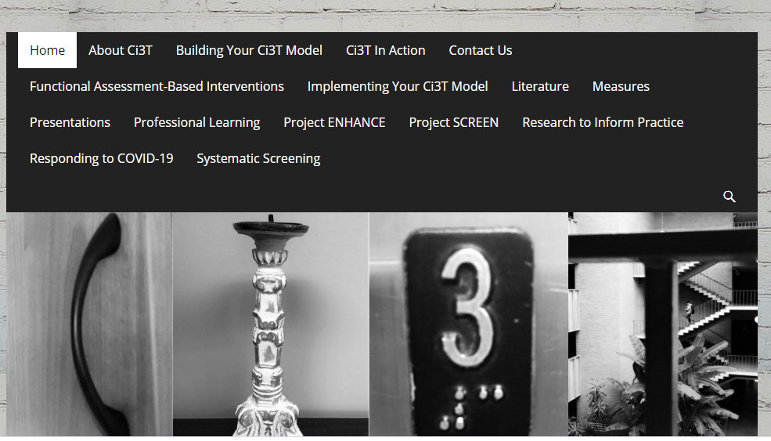
Thank You!

