Slide 1
Implementing Comprehensive, Integrated, Three-Tiered (Ci3T) Models: Setting Up for Success
Ci3T Implementation: Session 1

Slide 2
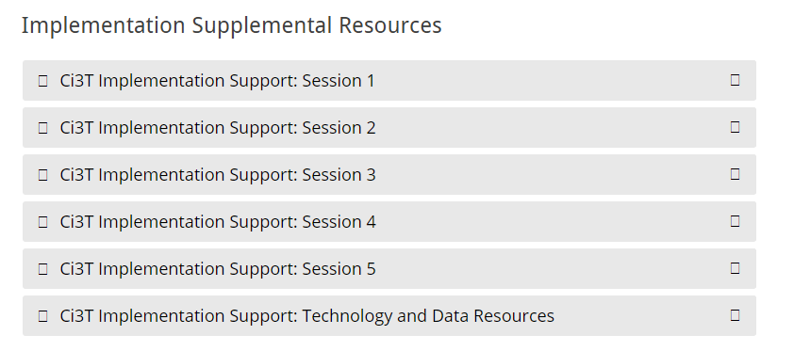
Accessing Professional Learning
Navigate to ci3t.org/imp
Scroll down to the Implementation Supplemental Resources and click to open Session 1

Slide 3
Welcome, School Teams!
We are excited to welcome you to the first session of the Ci3T implementation professional learning series.
Your dedication to helping all students succeed in academics, behavior, and social skills is appreciated!
Notes:
Instructions: Insert the name of the participating schools and districts.
Participating school district(s) logos can be added as well.

Slide 4
Goals for this Implementation Year
Establish effective Ci3T leadership structures
Gain a deeper understanding of Ci3T models of prevention
Implement your school’s plan with high fidelity
Collect and use social validity and treatment integrity data to monitor Ci3T plan implementation
Collect student academic and behavioral outcome data to inform Ci3T implementation efforts
Share data with all stakeholders regularly (e.g., monthly, quarterly)
Identify areas of additional professional learning for faculty and staff and support faculty and staff access to professional learning
Address any barriers to implementing your Ci3T model

Slide 5
Agenda
Welcome
Scheduling for Success
Implementing Your Primary (Tier 1) Prevention Efforts
Wrapping Up and Moving Forward
Professional Learning Opportunities

Slide 6
Welcome

Slide 8
Primary (Tier 1) Prevention
All students are eligible for participation (Lane, Robertson et al., 2006)
About 80% of students respond to this level (Gresham, Sugai, Horner, Quinn, & McInerney, 1998; Sugai & Horner, 2006)
Examples of primary (Tier 1) prevention
Validated literacy curricula
Violence prevention
Conflict resolution programs
Anti-bullying programs
Schoolwide social skills instruction
Character education programs
Sources: Gresham, F. M., Sugai, G., Horner, R. H., Quinn, M. M., & McInerney, M. (1998). Classroom and schoolwide practices that support students’ social competence: A synthesis of research. Washington, DC: Office of Special Education Programs.
Lane, K. L., Robertson, E. J., & Graham-Bailey, M. A. L. (2006). An examination of school-wide interventions with primary level efforts conducted in secondary schools: Methodological considerations. In T. E. Scruggs & M. A. Mastropieri (Eds.) Applications of research methodology: Advances in learning and behavioral disabilities (Vol. 19), pp. 157-199. Oxford, UK: Elsevier.
Sugai, G., & Horner, R.R. (2006). A promising approach for expanding and sustaining school-wide positive behavior support. School psychology review, 35, 245.

Slide 9
Secondary (Tier 2) Prevention
Students who need more than the primary prevention plan, 10-15% of students
Focused intervention to address academic, behavior, and/or social concerns
Acquisition (can’t do)
Fluency (trouble doing)
Performance (won’t do)
Examples of secondary (Tier 2) prevention
Small group instruction in anger management
Reading comprehension strategies
Source: Lane, K.L., Oakes, W.P., Ennis, R.P., & Hirsch, S.E. (2014). Identifying students for secondary and tertiary prevention efforts: How do we determine which students have tier 2 and tier 3 needs? Preventing School Failure, 58, 171-182.

Slide 10
Tertiary (Tier 3) Prevention
Students who need more than primary or secondary prevention, 5-7% of students
Intensive individualized interventions
Examples of tertiary (Tier 3) prevention
Functional assessment-based interventions (Umbreit, Ferro, Liaupsin, & Lane, 2007)
Multisystemic therapy program (Schoenwald, Brown, & Henggeler, 2000)
Sources: Lane, K.L., Oakes, W.P., Ennis, R.P., & Hirsch, S.E. (2014). Identifying students for secondary and tertiary prevention efforts: How do we determine which students have Tier 2 and Tier 3 needs? Preventing School Failure, 58, 171-182.
Schoenwald, S. K., Brown, T. L., & Henggeler, S. W. (2000). Inside multisystemic therapy therapist, supervisory, and program practices. Journal of Emotional and Behavioral Disorders, 8, 113-127.
Umbreit, J., Ferro, J.B., Liaupsin, C.J., & Lane, K.L. (2007). Functional behavioral assessment and function-based intervention: An effective, practical approach. Upper Saddle River, NJ: Prentice-Hall.

Slide 12
Core Features

Slide 13
Academic Component
Coordinated instruction within and across grade levels
Instruction linked to College and Career-Ready Standards, early learning standards, state, or district standards
Benchmarking student progress to inform instruction
Progress monitoring for students identified for secondary (Tier 2) and tertiary (Tier 3) supports
Source: Lane, K.L., Oakes, W.P., & Menzies, H.M. (2014). Comprehensive, integrated, three-tiered models of prevention: Why does my school—and district—need an integrated approach to meet students’ academic, behavioral, and social needs? Preventing School Failure: Alternative Education for Children and Youth, 58, 121-128.

Slide 14
Social Component: Identifying a Validated Curriculum
Violence Prevention
Second Step Violence Prevention (www.cfchildren.org)
Character Education
Positive Action (www.positiveaction.net)
Caring School Community (www.characterplus.org)
Social Skills
Social Skills Improvement System: Classwide Intervention Program (Elliott & Gresham, 2007)
Source: Elliott, S. N., & Gresham, F. M. (2007). Social Skills Improvement System: Classwide intervention program teacher’s guide. Bloomington, MN: Pearson Assessments.

Slide 15
Social Component: Examples of Schoolwide Programs
Social Skills Improvement System (SSiS)
Violence Prevention
Elliott and Gresham, 2008
www.pearsonassessments.com
Includes a range of tools and intervention materials
Linking the Interests of Families and Teachers (LIFT)
Eddy, Reid, and Fetrow, 2000
Social Skills
www.cfchildren.org
The Second Step Violence Prevention Program
Committee for Children, 1992
$159 per grade (elementary, middle, high school, families, Spanish)
Sources: Committee for Children (1992). Second Step: A violence prevention curriculum grades 1-3. Seattle, WA: Author.
Eddy, J. M., Reid, J. B., & Fetrow, R. A. (2000). An elementary school-based prevention program targeting modifiable antecedents of youth delinquency and violence: Linking the interests of families and teachers (LIFT). Journal of Emotional and Behavioral Disorders, 8, 165-176.
Elliott, S. N., & Gresham, F. M. (2007). Social Skills Improvement System: Classwide intervention program teacher’s guide. Bloomington, MN: Pearson Assessments.

Slide 16
Social Component: Examples of Schoolwide Programs
Social-emotional
Connect With Kids connectwithkids.com
Character Education
A curricula using real stories presented through documentary-style videos, non-fiction books, teaching guides and patent resources.
Attendance and achievement
Bullying and violence prevention
Character and Life skills
Digital citizenship
Alcohol and drug prevention
Health and Wellness
Customizable units are:
Positive Action www.positiveaction.net
Improves academics, behavior, and character
Curriculum-based approach
Effectively increases positive behaviors and decreases negative behaviors
6-7 units per grade
Optional components:
site-wide climate development
drug education
bullying / conflict resolution
counselor, parent, and family classes
community/coalition components

Slide 17
Behavioral Component: Positive Behavioral Interventions and Supports (PBIS)
A Framework, Not a Curriculum
Establish, clarify, and define expectations
Teach all students the expectations, planned and implemented by all adults in the school
Give opportunities to practice
Reinforce students consistently, facilitate success
Consider rules, routines, and physical arrangements
Monitor the plan using school-wide data to identify students who need more support
Monitor student progress
Source: Horner, R.H., & Sugai, G. (2015). School-wide PBIS: An example of applied behavior analysis implemented at a scale of social importance. Behavior Analysis in Practice, 8, 80-85.

Slide 18
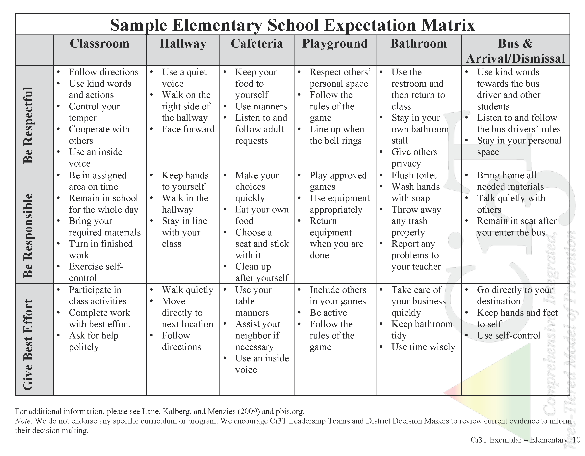
Establish, Teach, Acknowledge

Slide 19
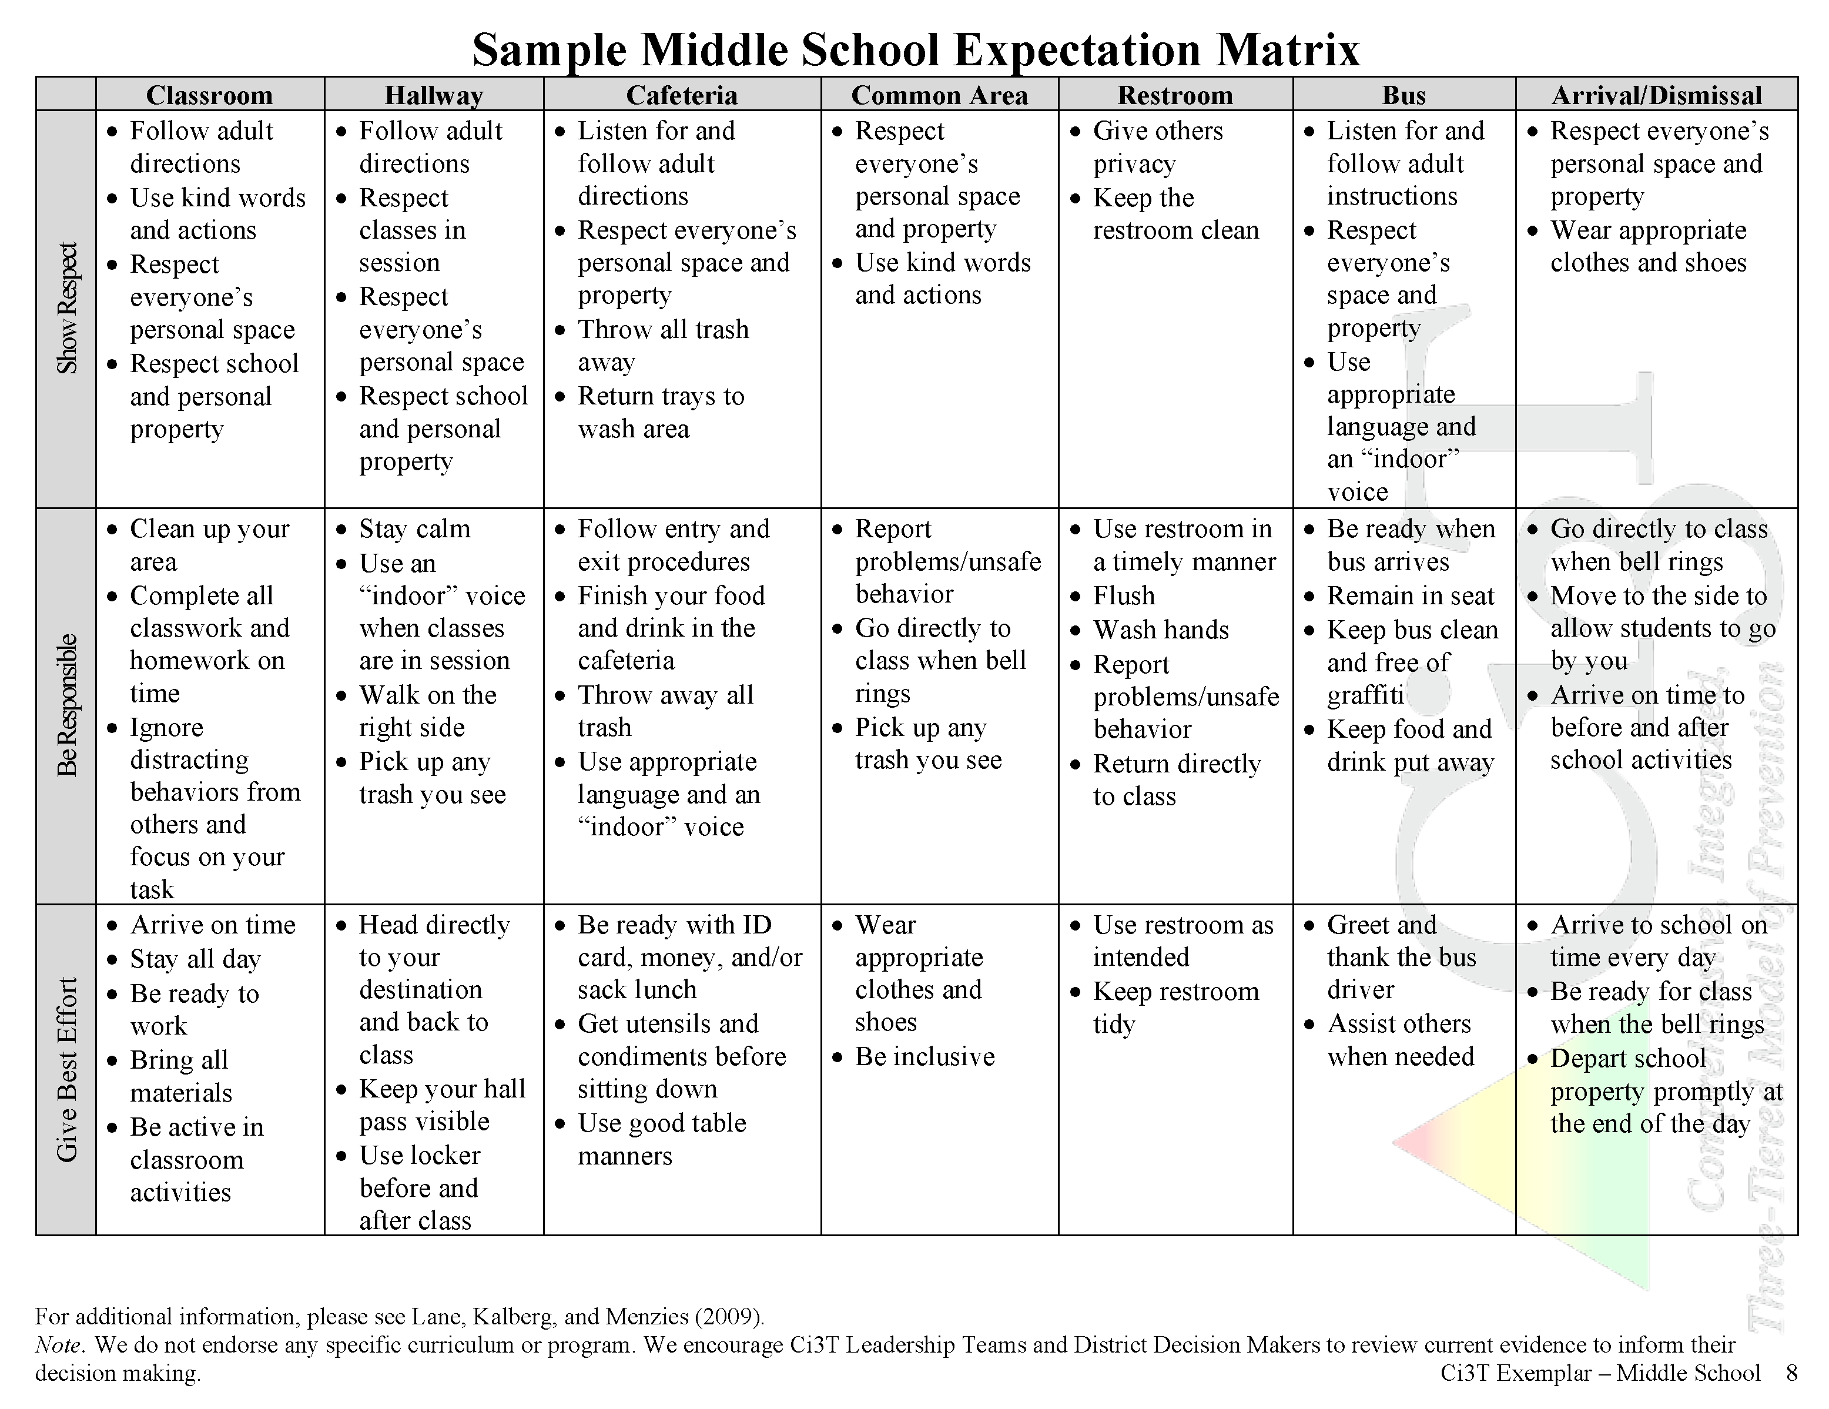
Establish, Teach, Acknowledge

Slide 20
Hybrid or Remote Learning
Procedures for Teaching
Faculty and Staff: Ci3T Leadership Teams and District Leaders will teach procedures to faculty and staff by: Provide faculty and staff Ci3T Implementation Manual and other materials such as posters, lesson plans, tickets, etc. to teach, implement and support our Ci3T plan. Professional learning opportunities at the district level to support implementation and sustainability of Ci3T, with attention to academic, behavior, and social domains. Expectations Matrix taught and posted. Ongoing re-teaching of expectations and procedures – dedicated staff meeting time for discussions.
Continued Learning: Ci3T Leadership Teams and District Leaders will teach procedures to faculty and staff by: Providing faculty and staff materials for remote access to the Ci3T Implementation Manual, digital ‘posters’ and e-tickets. Professional learning sessions and access guides for online materials for teaching social skills lessons. Beginning of year online meeting small-group breakout rooms for faculty and staff to review Ci3T Implementation Manual updates, get questions answered, and share ideas

Slide 22
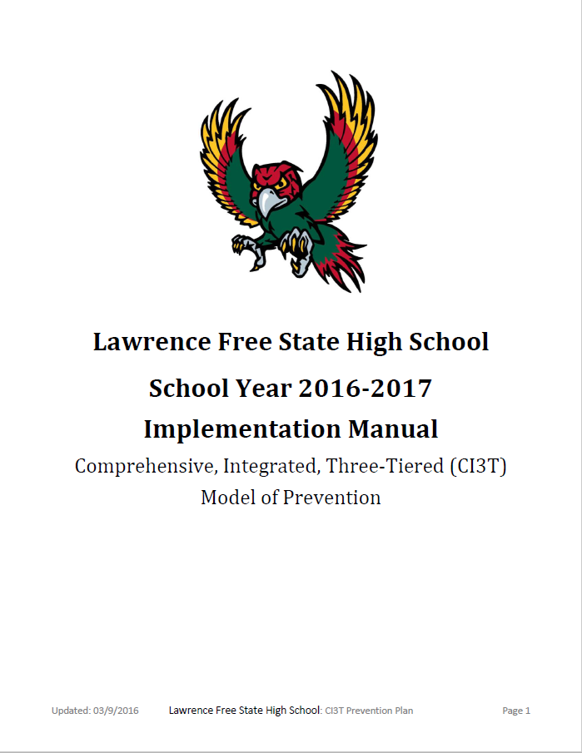
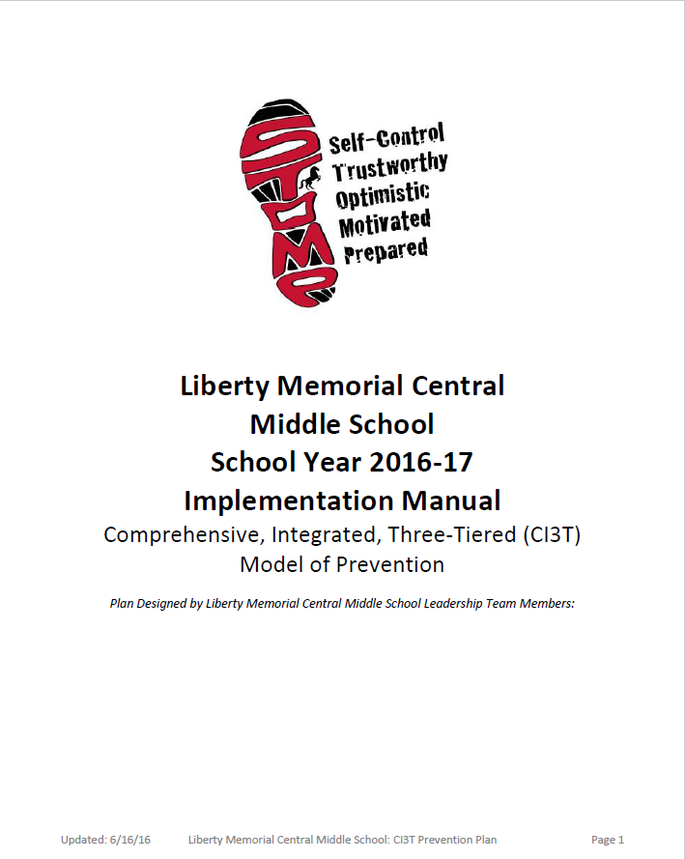
Ci3T Implementation Manuals
Shared with permission.

Slide 23
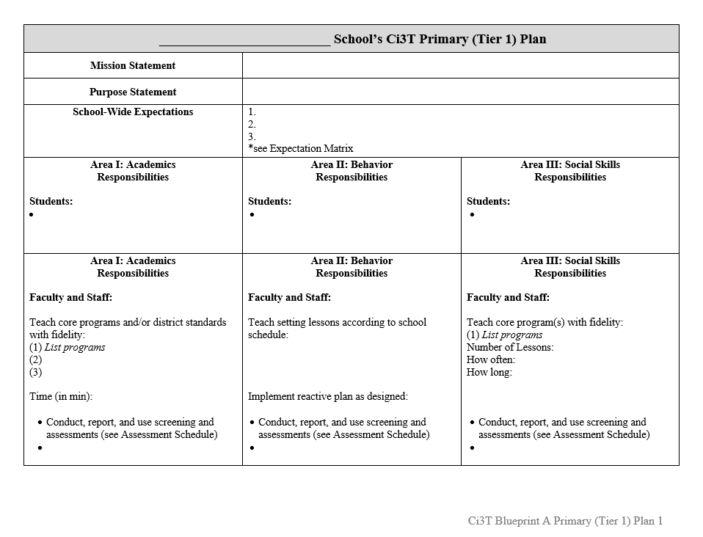
Ci3T Implementation Manual Primary (Tier 1) Plan
What are ALL students accessing?

Slide 24
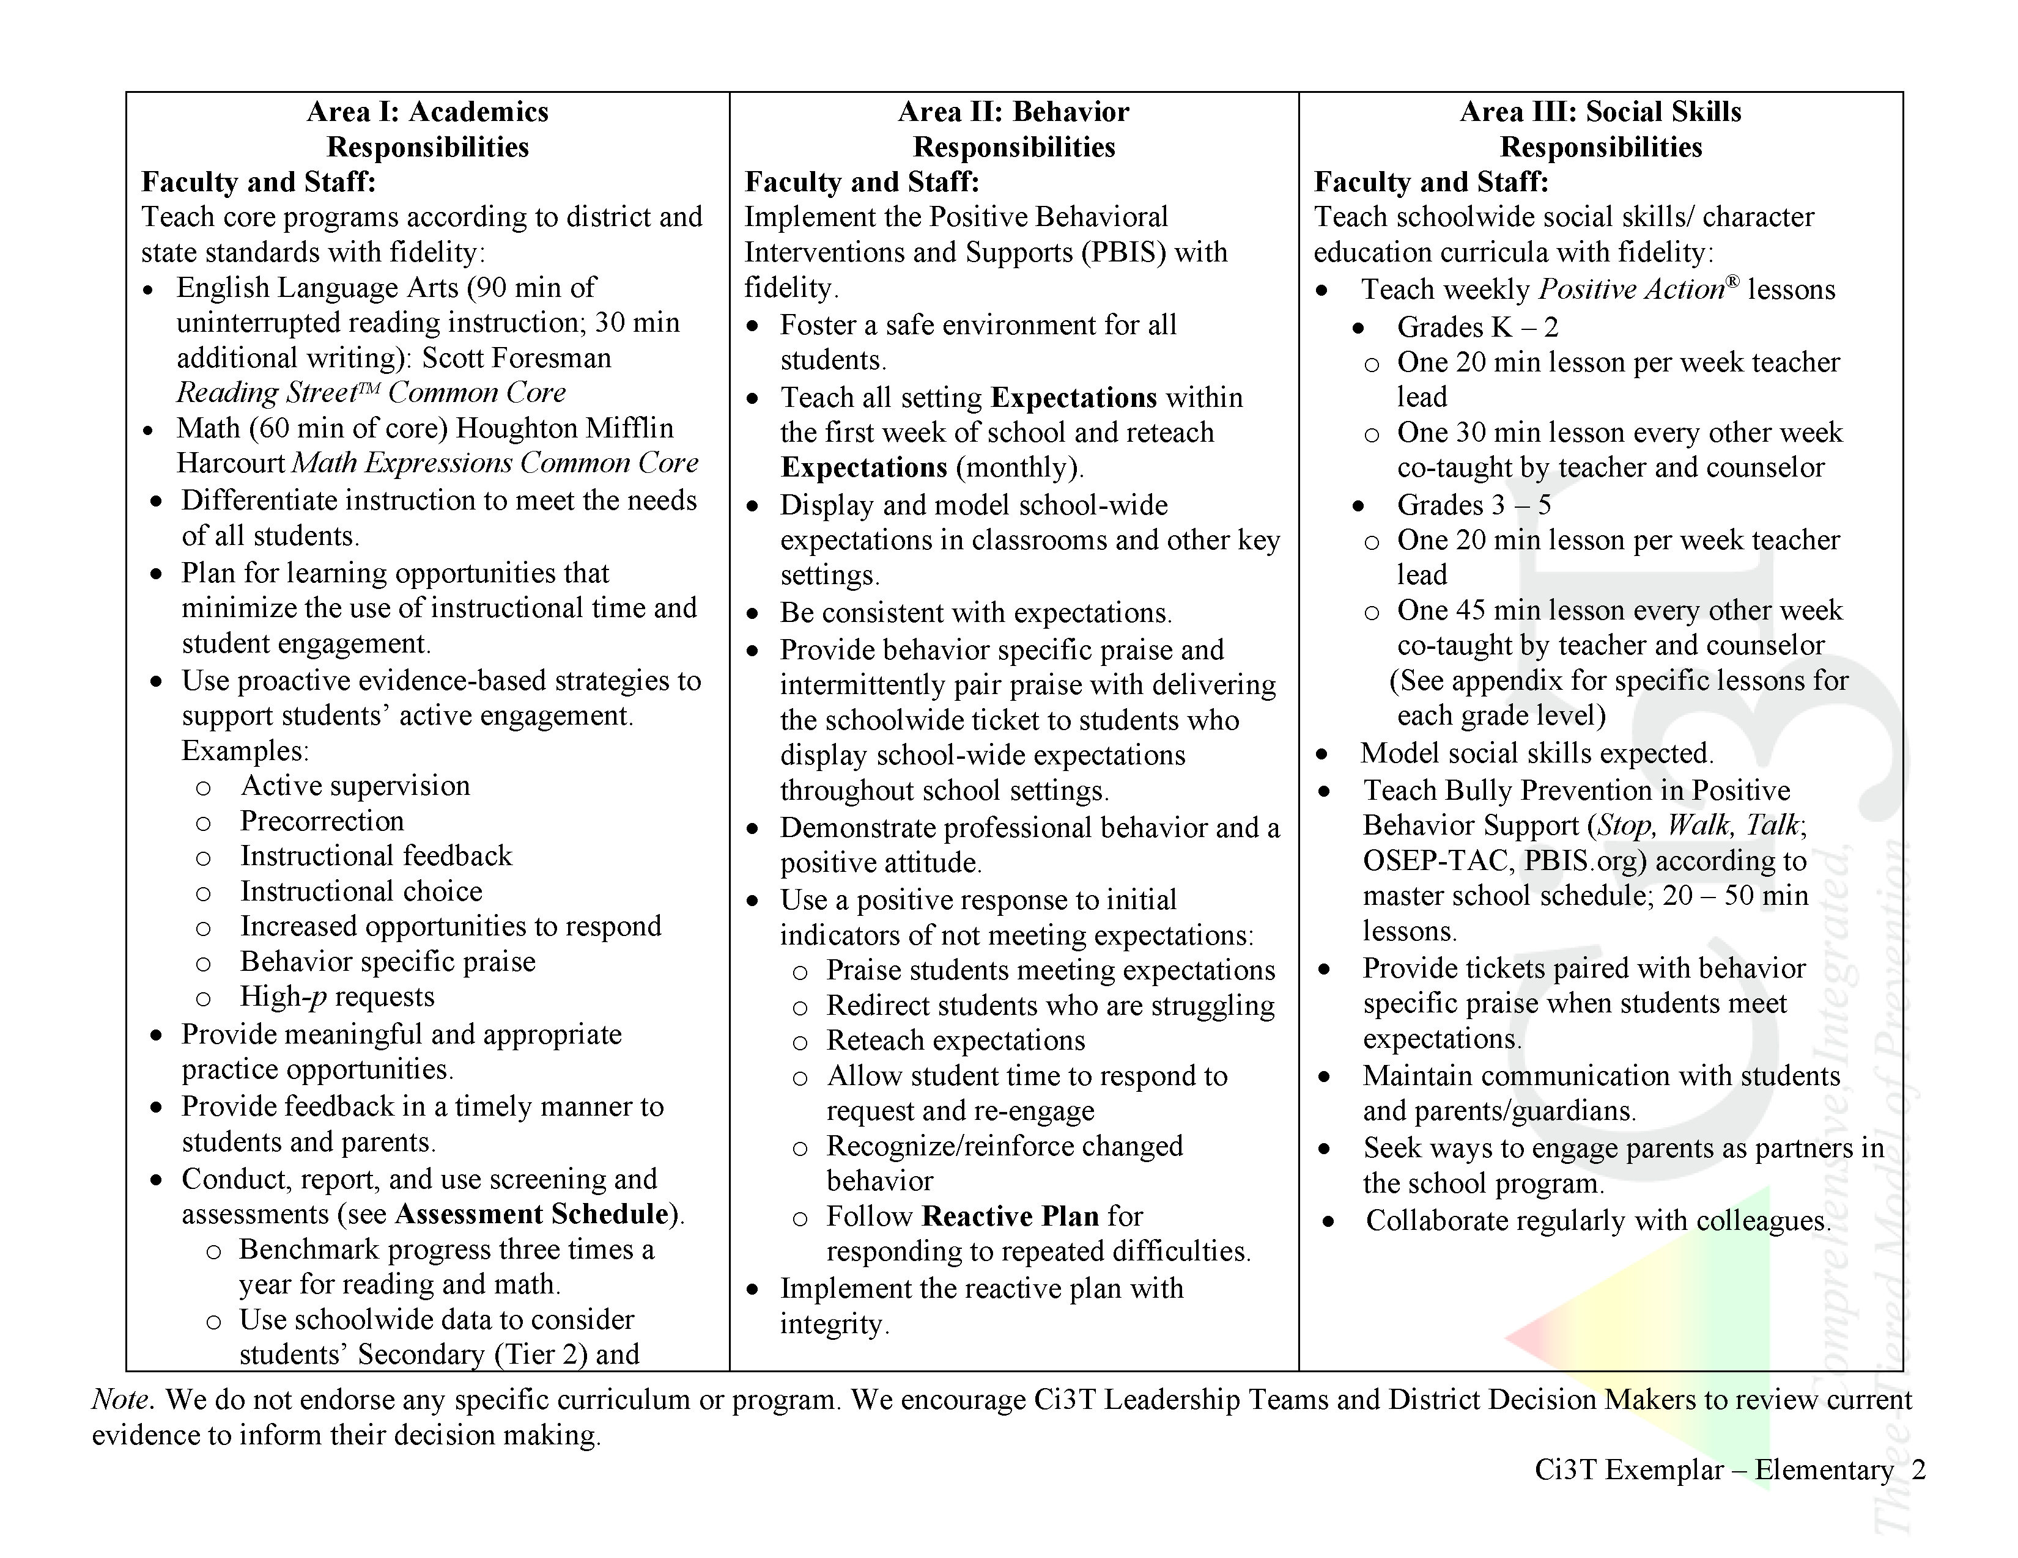
What do I need to know?
Ci3T Exemplar - Elementary
Notes:
Put in exemplars

Slide 25
SAMPLE High School Ci3T Primary (Tier 1) Plan
Mission Statement | Our district and school mission is to educate and prepare all students for post-secondary options of continued education and employment and to increase experiences leading to students becoming responsible global citizens and life-long learners.
Purpose Statement | The purpose of our Ci3T plan is to bring our community, administrators, faculty, staff, parents, and students with common language as we work together to meet the academic, behavior, and social needs of ALL students, enabling them to become self-determined, self-regulated learners at school and beyond.
School-Wide Expectations | Be Respectful Be Responsible Be Ready to Learn See behavior expectation matrix for detailed behavior expectations in various school settings.
Area I: Academics Responsibilities |  | Area II: Behavior Responsibilities | Area III: Social Skills Responsibilities
Students: Arrive on time and stay all day Attempt all assignments Do all work with best effort Turn in all assignments, on time Seek support for missing work, especially when absent Be prepared with completed homework and all necessary materials |  | Students: Meet school-wide expectations stated in the Expectation Matrix Take responsibility for own actions Participate in the Positive Behavioral Interventions and Supports (PBIS; OSEP-TAC; see pbis.org) program | Students: Actively engage in Too Good for Drugs & Violence (Mendez Foundation, 2000) social skills curriculum Apply lessons from Too Good for Drugs & Violence to daily interactions with peers and adults
Area I: Academics Responsibilities |  | Area II: Behavior Responsibilities | Area III: Social Skills Responsibilities
Faculty and Staff: Create and teach lesson plans that follow the effective elements of essential instruction: anticipatory set, daily objective, direct instruction, modeling, guided practice, and independent practice Provide engaging lessons with starting (warm up) and closing activities daily, linked to district and state standards |  | Faculty and Staff: Teach, model, and reinforce school- wide expectations with students and staff Create clear routines in the classroom to establish predictability and use PBIS tickets to facilitate routines Provide behavior-specific praise paired with PBIS tickets to reinforce | Faculty and Staff: Teach two 30 min Too Good for Drugs & Violence lessons each month Document Too Good for Drugs & Violence components taught (treatment integrity) Model the social skills taught in Too Good for Drugs & Violence with students and adults

Slide 26
SAMPLE High School Ci3T Primary (Tier 1) Plan: Hybrid Instruction
Mission Statement | Our district and school mission is to educate and prepare all students for post-secondary options of continued education and employment and to increase experiences leading to students becoming responsible global citizens and life-long learners.
Purpose Statement | The purpose of our Ci3T plan is to bring our community, administrators, faculty, staff, parents, and students with common language as we work together to meet the academic, behavior, and social needs of ALL students, enabling them to become self-determined, self-regulated learners at school and beyond.
 | Continued Learning (2020-2021) The purpose of our 2020-2021 Ci3T plan updates (shaded areas) is to fulfill Sample High School’s purpose (stated above) in close partnership with families through both in-person and continued learning instruction in academic, behavioral, and social skills aligned to family and community priorities.
School-Wide Expectations | Be Respectful Be Responsible Be Ready to Learn See behavior expectation matrix (in person and remote) for detailed behavior expectations in various school settings.
Area I: Academics Responsibilities Students will: Arrive on time and stay all day Attempt all assignments Do all work with best effort Turn in all assignments, on time Seek support for missing work, especially when absent Be prepared with completed homework and all necessary materials |  | Area II: Behavior Responsibilities Students will: Meet school-wide expectations stated in the Expectation Matrix Take responsibility for own actions Participate in the Positive Behavioral Interventions and Supports (PBIS; OSEP-TAC; see pbis.org) program | Area III: Social Skills Responsibilities Students will: Actively engage in Too Good for Drugs & Violence (Mendez Foundation, 2000) social skills curriculum Apply lessons from Too Good for Drugs & Violence to daily interactions with peers and adults
Ci3T.org/COVID

Slide 27
Area II: Academics Responsibilities Faculty and Staff: Create and teach lesson plans that follow the effective elements of essential instruction: anticipatory set, daily objective, direct instruction, modeling, guided practice, and independent practice Use proactive evidence-based strategies to support students’ active engagement | Area II: Behavior Responsibilities Faculty and Staff: Teach, model, and reinforce school-wide expectations with students and staff Create clear routines in the classroom to establish predictability and use PBIS tickets to facilitate routines | Area II: Social Responsibilities Faculty and Staff: Teach schoolwide social skills/ character education curricula with integrity: Teach two 30 min Connect with Kids Lessons each month Model the social skills taught in Connect with Kids with students and adults
Remote Learning Create a safe and respectful online classroom using the district approved platform Offer appropriate high-quality learning activities to students in more than one format (e.g., synchronous, asynchronous, electronic, paper-and-pencil) Use proactive evidence-based strategies to support students’ active engagement | Remote Learning Teach, model, and reinforce behavior expectations during synchronous events with students Integrate online behavior expectations into each lesson plan | Remote Learning Integrate Connect with Kids language and lesson material into all online instruction Utilize online Connect with Kids resources to continue regular social skill lessons with asynchronous activities as well as synchronous lessons.

Slide 28
Scheduling for Success
Long-range Planning: The Importance of Planning Ahead
Structuring your Ci3T Team
Conducting Effective Meetings
Communicating with Your Stakeholders

Slide 29
Long-range Planning: The Importance of Planning Ahead
Keeping the values that lead our mission statement in mind:
Where are we and how are we doing as of today?
Establish clear and explicit objectives: Mission-based
Prioritize objectives
Establish timelines, due dates, and persons responsible for each objective with regular check-ins

Slide 30
School Ci3T Implementation Calendar
Sun. | Mon. | Tues. | Wed. | Thurs. | Fri. | Sat.
1 | 2 | 3 | 4 | 5 | 6 Professional learning session: OTR | 7
8 | 9 | 10 Ci3T Team Meeting | 11 | 12 Teach Social Skills Lesson | 13 | 14
15 | 16 Faculty meeting with a look at BSP | 17 | 18 | 19 | 20 | 21
22 | 23 | 24 | 25 | 26 Teach Social Skills Lesson | 27 | 28
Schedule time for communication
Notes:
.

Slide 31
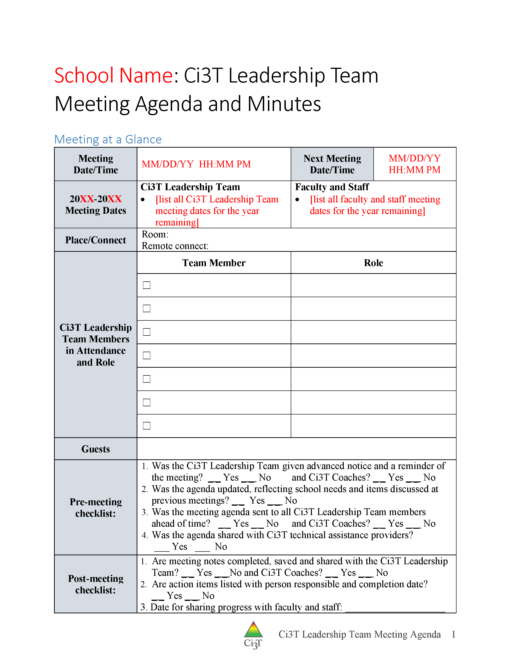
Scheduling Your Ci3T Leadership Team Meetings

Slide 32
Structuring your Ci3T Team
Administrator(s)
General education teachers representative of your school
Elementary: a lower-grades and an upper-grades teacher
Secondary: a teacher from each grade level or department
Special education teacher(s)
Support staff
e.g., counselor, psychologist, social worker
Parent representative(s)
Student representative(s) such as from student council

Slide 33
Conducting Effective Meetings
Notes:
Honor those who are on time
Starting the meeting on time
Start with sharing successes
Respect everyone’s time
End the meeting on time, one hour maximum
Assign tasks to individuals or temporary subcommittees as needed to keep the meeting on track
Schedule a follow-up meeting as needed or make plans to conduct final business by email
Be efficient with time
Be solution-based, spending time on action plans instead of “admiring the problem

Slide 34
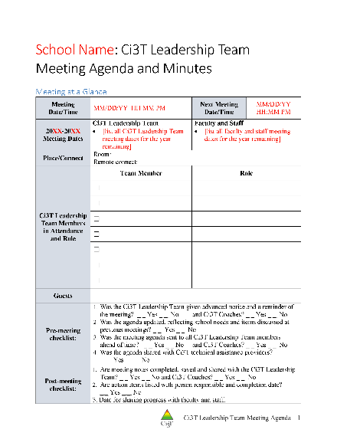
Using your Ci3T Meeting Agenda
Meeting logistics
Date, time, who is present, who is absent
Next meeting date/time/location/roles
Discussion points for current meeting
Procedural Checklist
Record of discussion according to key Ci3T features
Procedures for teaching, reinforcing and monitoring
Academics
Behavior
Social skills
Data (student level, program level, Ci3T reports)

Slide 35
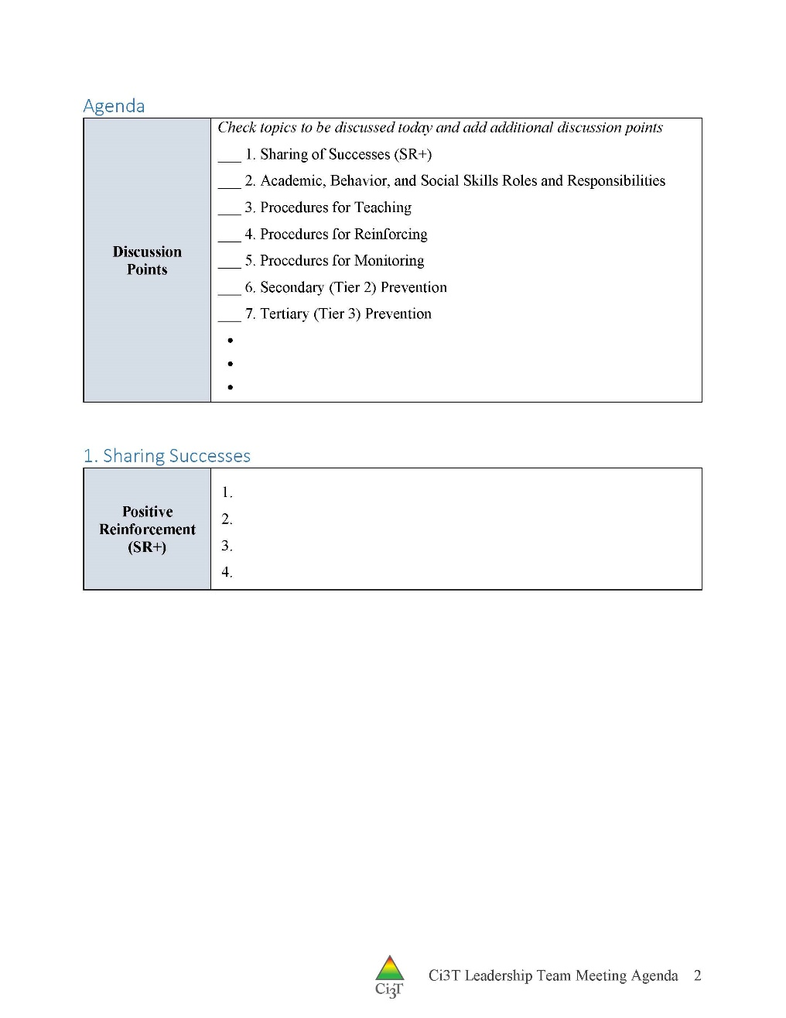
Using your Ci3T Meeting Agenda
Meeting logistics
Date, time, who is present, who is absent
Next meeting date/time/location/roles
Discussion points for current meeting
Procedural Checklist
Record of discussion according to key Ci3T features
Procedures for teaching, reinforcing and monitoring
Academics
Behavior
Social skills
Data (student level, program level, Ci3T reports)

Slide 36
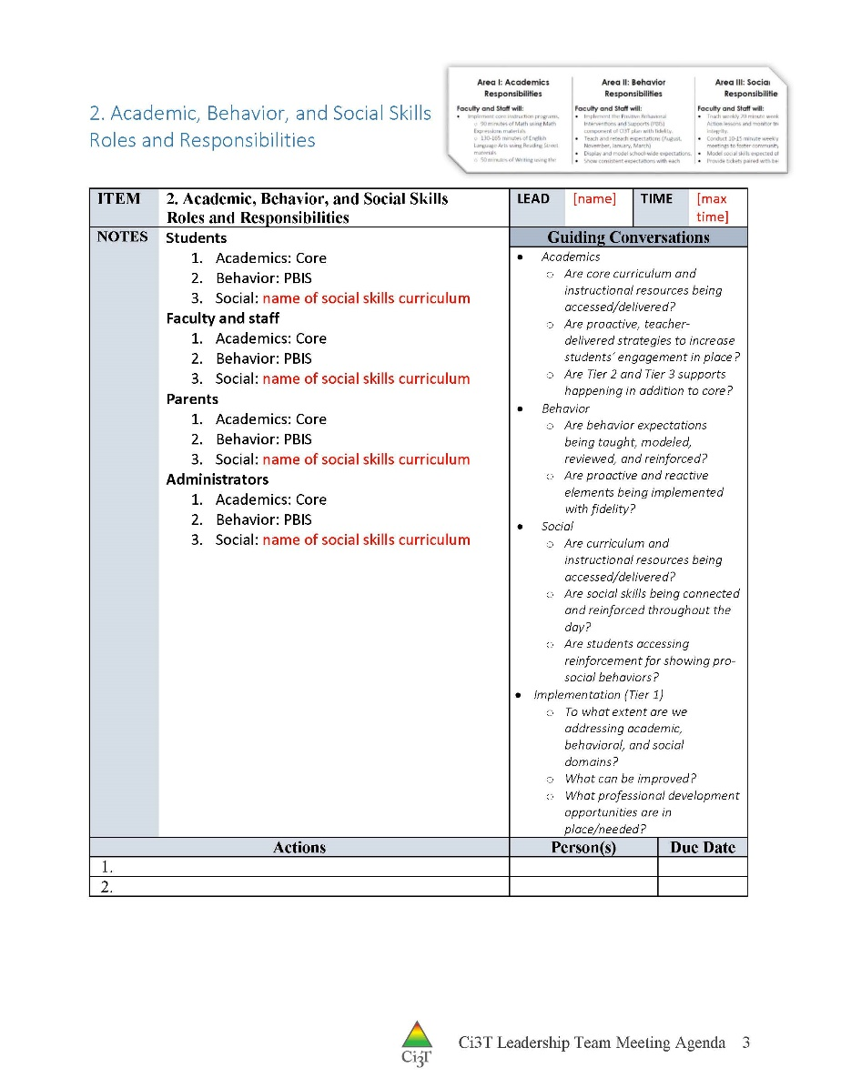
Primary Prevention: Academics, Behavior, and Social Skills

Slide 37
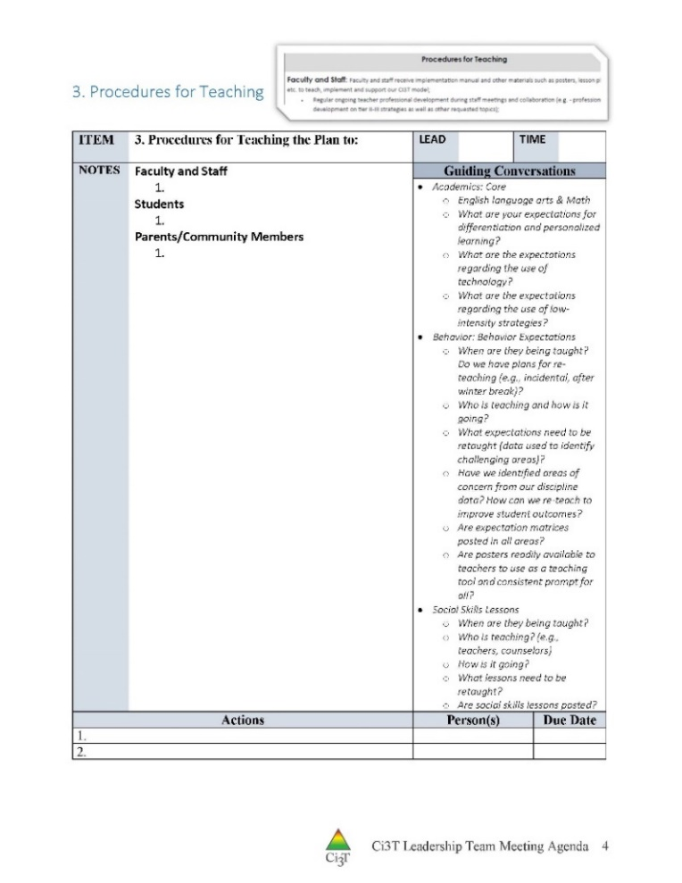
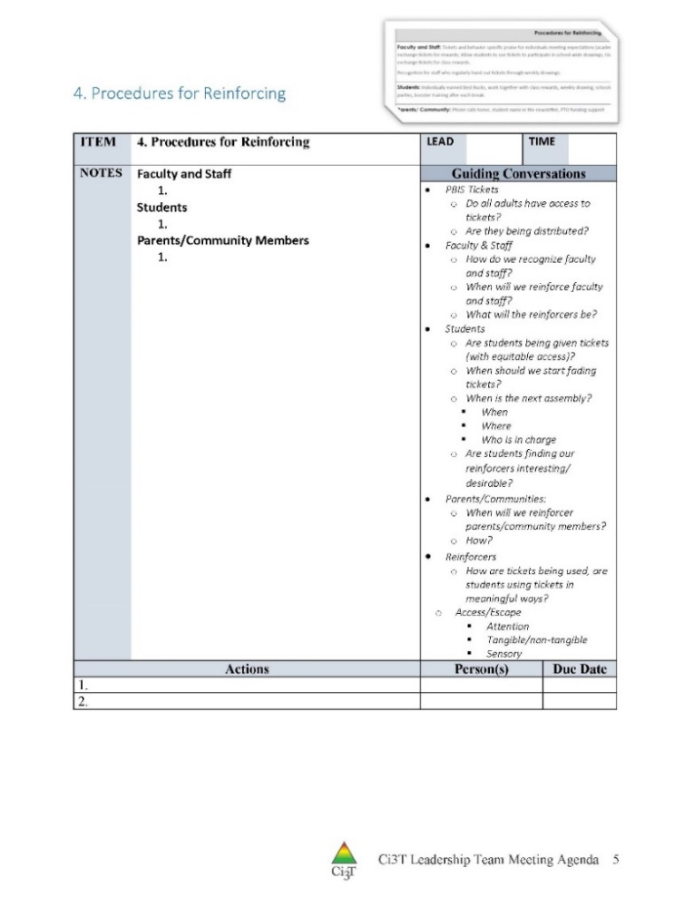
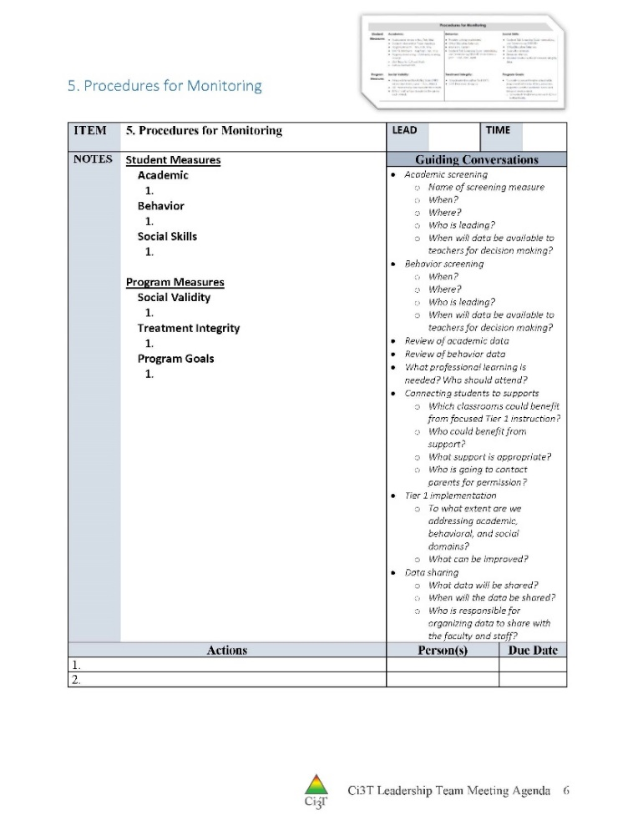
Procedures for Teaching, Reinforcing, and Monitoring

Slide 38
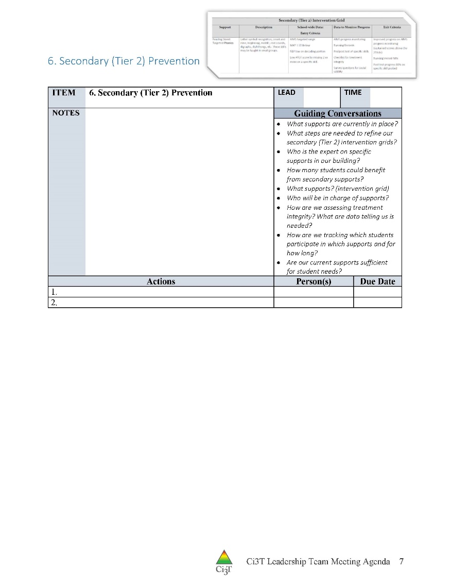
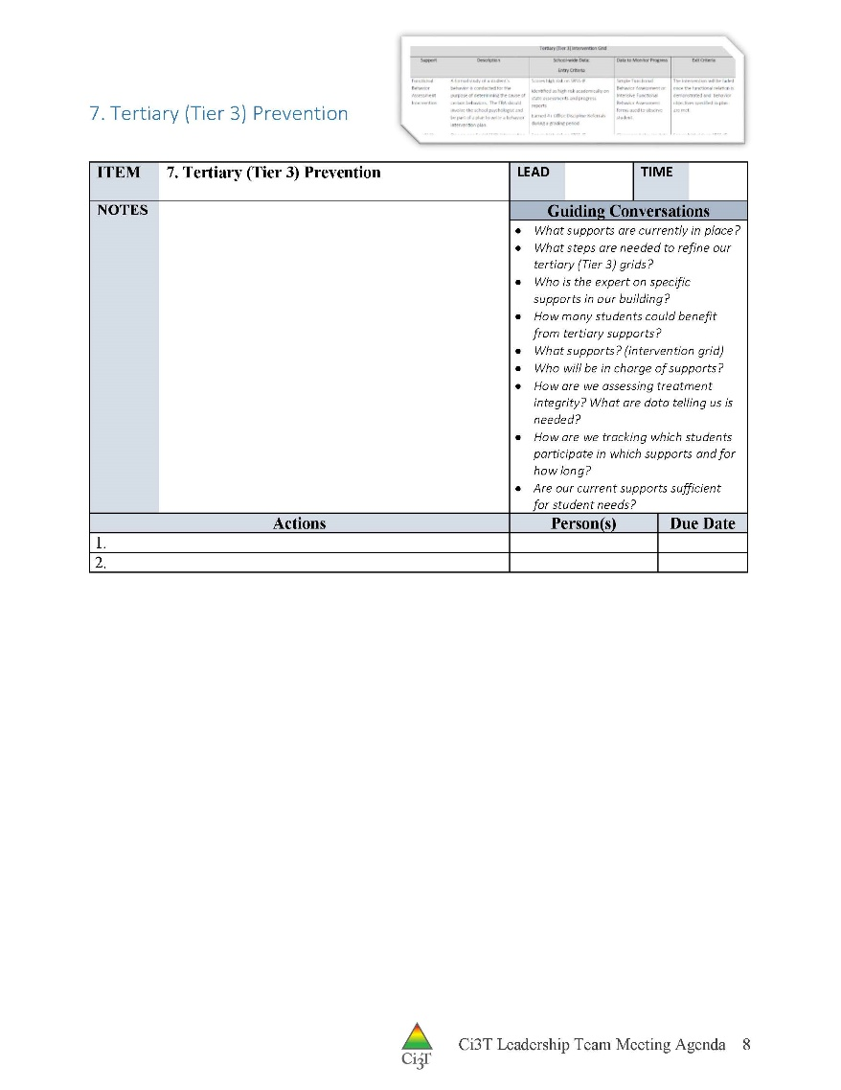
Secondary and Tertiary Prevention Discussions
Notes:
Need to emphasize collaborative teaming for BCBA Task List G-06 Provide behavior-analytic services in collaboration with others who support and/or provide services to one’s clients …
ALSO: I think Tier 2 and Tier 3 interventions are likely underdiscussed in many meetings. Emphasize the need to have solutions-based discussions about providing interventions at scale (using CICO, self-monitoring, other Tier 2 supports) AND TRACKING WHO RECEIVES THOSE SUPPORTS

Slide 39
IM18 Ci3T Leadership Team Meeting Agenda TEMPLATE
Predictability
Assign roles

Slide 40
Let’s talk!
Explore IM18 Ci3T Leadership Team Meeting Agenda
Schedule Ci3T Leadership Team meetings
Schedule faculty and staff meetings
Assign responsibilities
Facilitator
Minute taker
Data analyst
Active team member
Administrator
Predictability
Notes:
10 min: Using this PowerPoint break timer
This PowerPoint slide uses images, custom animation, and timing to provide a countdown timer that you can use in any presentation. When you open the template, you’ll notice that the timer is set at 00:00. However, when you start the slide show, the timer will start at the correct time and count down by 1-minute intervals until it gets to 1 minute. At that point, it will count down in two 30-seconds intervals to 00:00.
To insert this slide into your presentation
Save this template as a presentation (.ppt file) on your computer.
Open the presentation that will contain the timer.
On the Slides tab, place your insertion point after the slide that will precede the timer. (Make sure you don't select a slide. Your insertion point should be between the slides.)
On the Insert menu, click Slides from Files.
In the Slide Finder dialog box, click the Find Presentation tab.
Click Browse, locate and select the timer presentation, and then click Open.
In the Slides from Files dialog box, select the timer slide.
Select the Keep source formatting check box. If you do not select this check box, the copied slide will inherit the design of the slide that precedes it in the presentation.
Click Insert.
Click Close.

Slide 41
Communicating with Your Stakeholders
How will you share data and Ci3T Leadership Team updates with stakeholders?
Faculty and staff
Include plans for sharing updates with cafeteria, custodial, transportation, office, paraeducators, itinerant related service providers, and others
District leaders
Students
Parents
Community
Consider dedicating space on school website to give parents and community members access to updates

Slide 42
Implementing Your Primary (Tier 1) Prevention Efforts
Rolling out Tier 1
Implementing Procedures

Slide 43
Rolling out Tier 1
What were your successes?
What feedback did you receive from stakeholders?
How closely did your rollout follow your kickoff plans?
What changes would you make for spring review and for rolling out the plan next fall?

Slide 44
What do I need to know?
Ci3T Exemplar - Elementary

Slide 45
Rolling out at Tier 1: Academic Domain
Teaching
Reinforcing
Monitoring

Slide 46
Ci3T Primary Plan: Faculty and Staff Roles and Responsibilities
Notes:
BCBA Task List K-02 Identify the contingencies governing the behavior of those responsible for carrying out behavior-change procedures and design interventions accordingly – emphasize shift to clearly stating expectations for staff and students

Slide 47
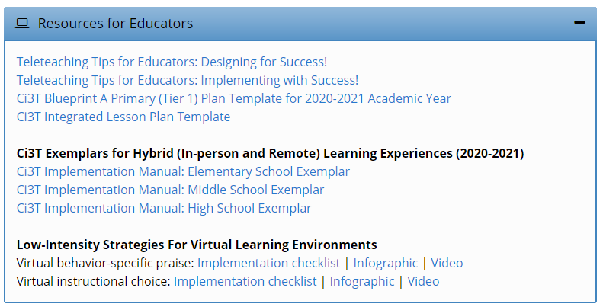
Opportunities to Respond
Area II: Academics Responsibilities Faculty and Staff: Create and teach lesson plans that follow the effective elements of essential instruction: anticipatory set, daily objective, direct instruction, modeling, guided practice, and independent practice Use proactive evidence-based strategies to support students’ active engagement
Behavior-Specific Praise
Active Supervision
Opportunities to Respond
Instructional Feedback
High p Requests
Behavior-Specific Praise
Precorrection
Active Supervision
Remote Learning Create a safe and respectful online classroom using the district approved platform Offer appropriate high-quality learning activities to students in more than one format (e.g., synchronous, asynchronous, electronic, paper-and-pencil) Use proactive evidence-based strategies to support students’ active engagement
Incorporating Choice
Instructional Feedback
High-p Requests
Precorrection
Incorporating Choice

Slide 48
Rolling out at Tier 1: Academics
Reviewing Roles & Responsibilities
What do I need to know?
Procedures for Teaching
How am I doing with using low-intensity supports?
Procedures for Reinforcing
How have I been reinforcing students for meeting expectations?
Procedures for Monitoring
How am I doing with implementation?
Questions & Considerations?
Successes!

Slide 50
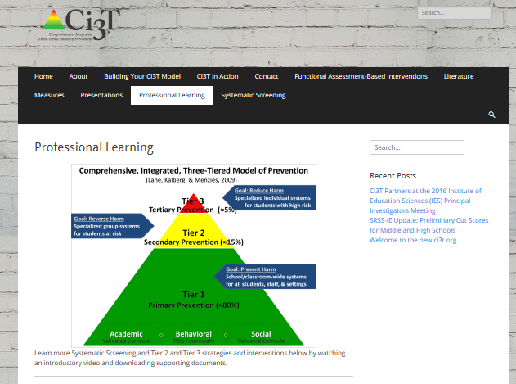
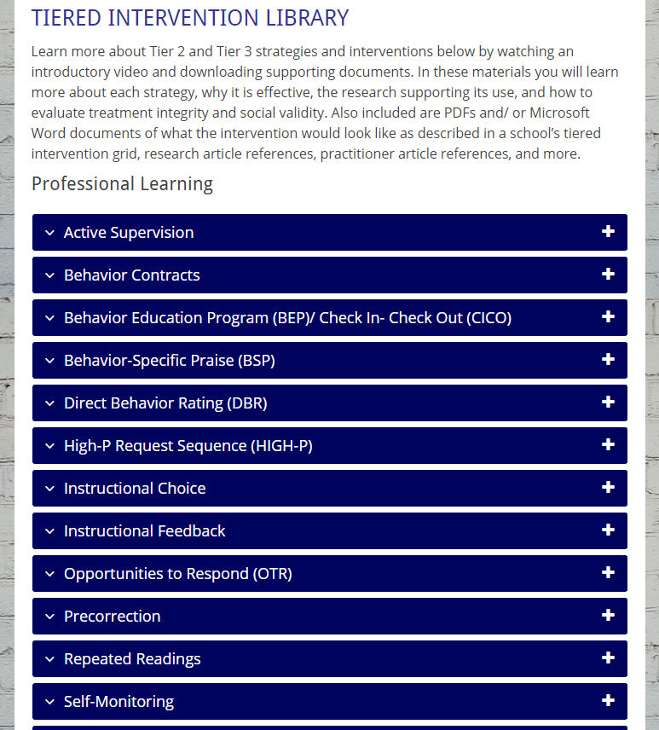
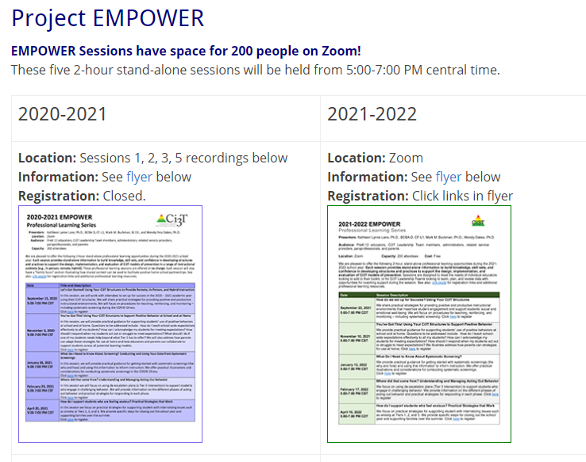

Slide 51
What do I need to know?
Ci3T Exemplar - Elementary
Notes:
BCBA Task List K-02 Identify the contingencies governing the behavior of those responsible for carrying out behavior-change procedures and design interventions accordingly – emphasize shift to clearly stating expectations for staff and students

Slide 52
Let’s talk… and make plans!
Reviewing Roles & Responsibilities
What do I need to know?
Procedures for Teaching
How am I doing with using low-intensity supports?
Procedures for Reinforcing
How have I been reinforcing students for meeting expectations?
Procedures for Monitoring
How am I doing with implementation?
Questions & Considerations?
Notes:
10 min Using this PowerPoint break timer
This PowerPoint slide uses images, custom animation, and timing to provide a countdown timer that you can use in any presentation. When you open the template, you’ll notice that the timer is set at 00:00. However, when you start the slide show, the timer will start at the correct time and count down by 1-minute intervals until it gets to 1 minute. At that point, it will count down in two 30-seconds intervals to 00:00.
To insert this slide into your presentation
Save this template as a presentation (.ppt file) on your computer.
Open the presentation that will contain the timer.
On the Slides tab, place your insertion point after the slide that will precede the timer. (Make sure you don't select a slide. Your insertion point should be between the slides.)
On the Insert menu, click Slides from Files.
In the Slide Finder dialog box, click the Find Presentation tab.
Click Browse, locate and select the timer presentation, and then click Open.
In the Slides from Files dialog box, select the timer slide.
Select the Keep source formatting check box. If you do not select this check box, the copied slide will inherit the design of the slide that precedes it in the presentation.
Click Insert.
Click Close.

Slide 53
Rolling out at Tier 1: Behavioral Domain
Teaching
Reinforcing
Monitoring

Slide 54
Ci3T Primary Plan: Faculty and Staff Roles and Responsibilities

Slide 55
Area II: Behavior Responsibilities Faculty and Staff: Teach, model, and reinforce school-wide expectations with students and staff Create clear routines in the classroom to establish predictability and use PBIS tickets to facilitate routines
Remote Learning Teach, model, and reinforce behavior expectations during synchronous events with students Integrate online behavior expectations into each lesson plan

Slide 56
Rolling out at Tier 1: Behavior
Reviewing Roles & Responsibilities
What do I need to know?
Procedures for Teaching
How am I doing with teaching expectations for specific settings?
Procedures for Reinforcing
How have I been reinforcing students for meeting expectations?
Procedures for Monitoring
How am I doing with implementation?
Questions & Considerations?
Successes!
Notes:
Added callouts to teaching and reinforcing to emphasize direct instruction and reinforcement of behavior expectations based on BCBA alignment (BCBA Task List K-02 )

Slide 57
What do I need to know?
Ci3T Exemplar - Elementary

Slide 58
Rolling out at Tier 1: Social
Teaching
Reinforcing
Monitoring

Slide 59
Ci3T Primary Plan: Faculty and Staff Roles and Responsibilities
Notes:
BCBA Task List K-02 Identify the contingencies governing the behavior of those responsible for carrying out behavior-change procedures and design interventions accordingly – Emphasize shift to clearly stating expectations for staff and students

Slide 60
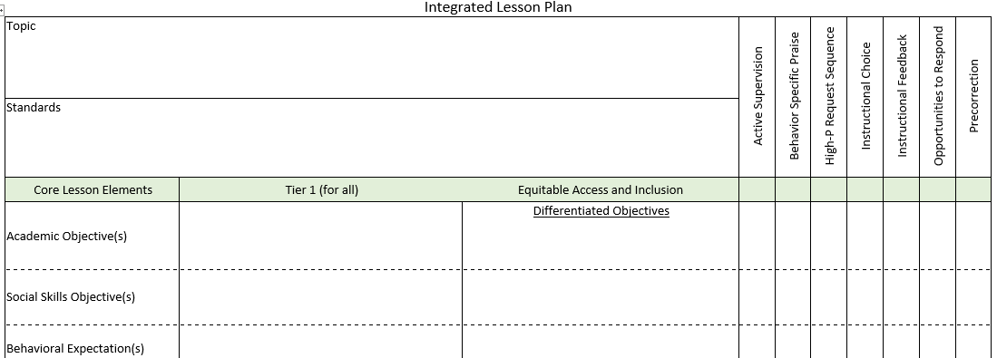
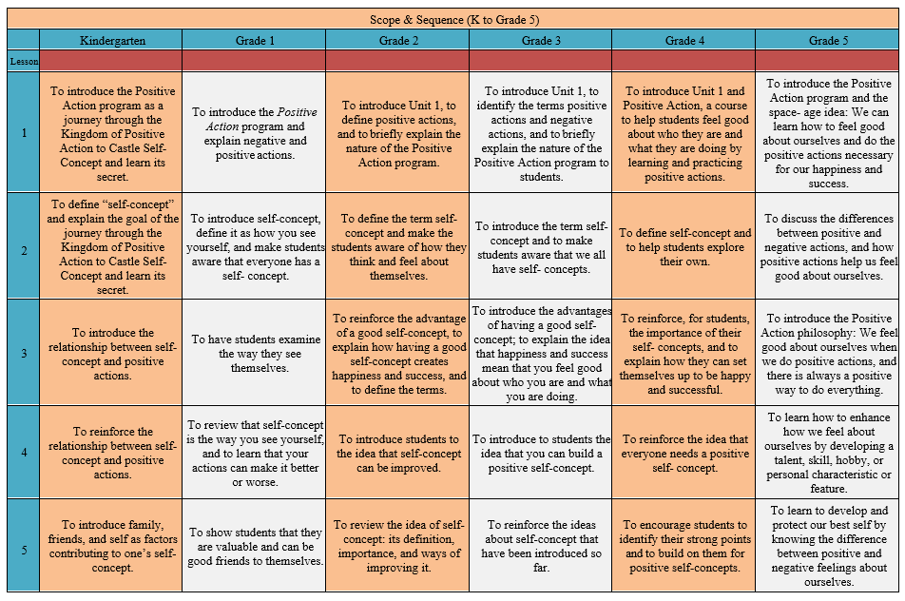
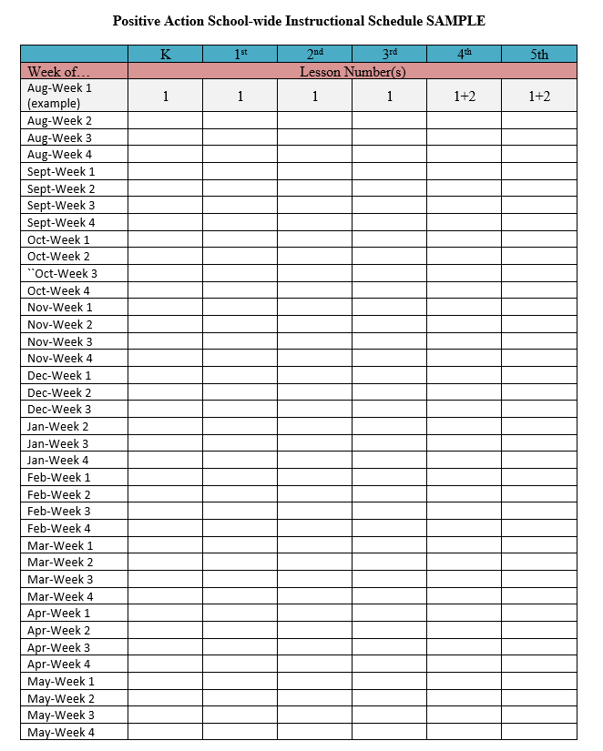
Area II: Social Responsibilities Faculty and Staff: Teach schoolwide social skills/ character education curricula with integrity: Teach two 30 min Connect with Kids Lessons each month Model the social skills taught in Connect with Kids with students and adults
Remote Learning Integrate Connect with Kids language and lesson material into all online instruction Utilize online Connect with Kids resources to continue regular social skill lessons with asynchronous activities as well as synchronous lessons.

Slide 61
Rolling out at Tier 1: Social Skills
Reviewing Roles & Responsibilities
What do I need to know?
Procedures for Teaching
How am I doing with teaching the validated social skills curriculum?
Procedures for Reinforcing
How have I been reinforcing students for meeting expectations?
Procedures for Monitoring
How am I doing with implementation?
Questions & Considerations?
Successes!

Slide 62
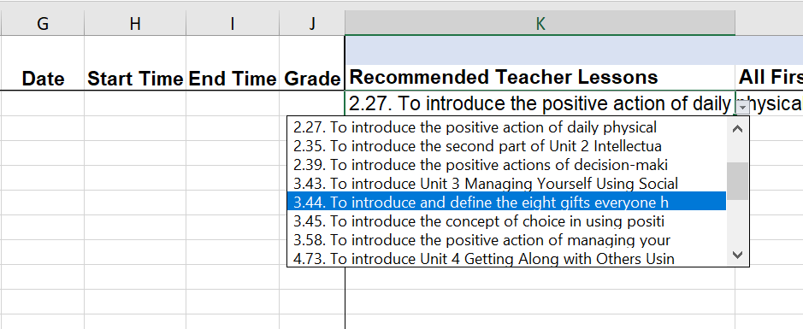
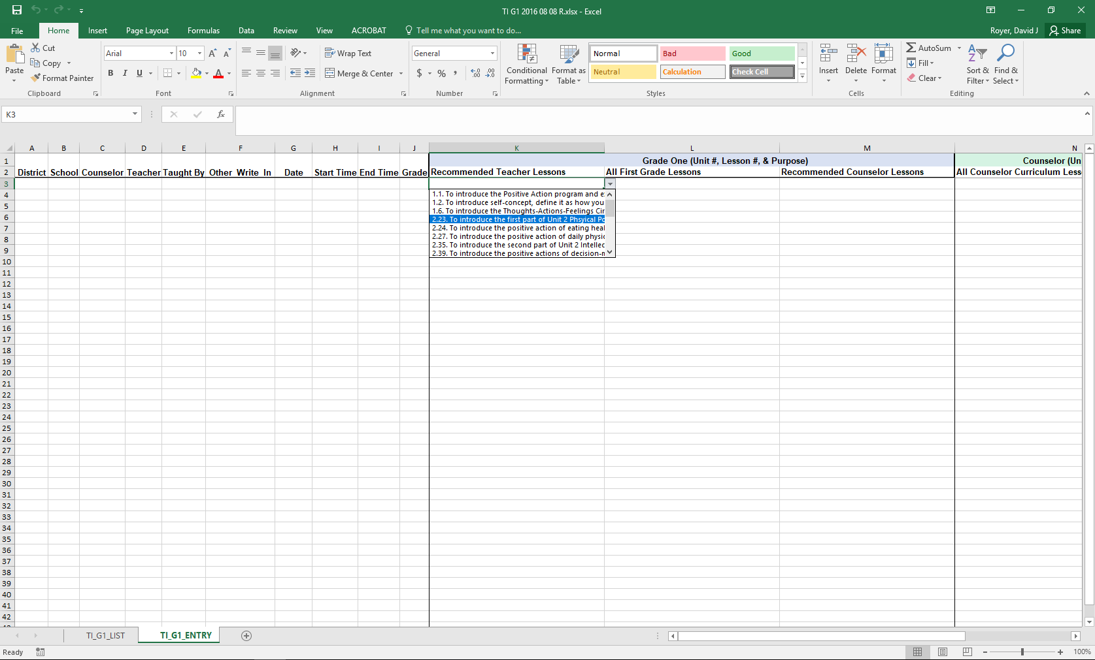
Treatment Integrity: Tracking Lessons Taught
Example social skills lesson implementation tracker

Slide 63
Let’s talk… and make plans!
Reviewing Roles & Responsibilities
What do I need to know?
Procedures for Teaching
How am I doing with teaching expectations for specific settings?
How am I doing with teaching the validated social skills curriculum?
Procedures for Reinforcing
How have I been reinforcing students for meeting expectations?
Procedures for Monitoring
How am I doing with implementation?
Questions & Considerations?
Notes:
10 min Using this PowerPoint break timer
**Is timer set to correct time. Do we want 25 or 10? Same question for above slide.
This PowerPoint slide uses images, custom animation, and timing to provide a countdown timer that you can use in any presentation. When you open the template, you’ll notice that the timer is set at 00:00. However, when you start the slide show, the timer will start at the correct time and count down by 1-minute intervals until it gets to 1 minute. At that point, it will count down in two 30-seconds intervals to 00:00.
To insert this slide into your presentation
Save this template as a presentation (.ppt file) on your computer.
Open the presentation that will contain the timer.
On the Slides tab, place your insertion point after the slide that will precede the timer. (Make sure you don't select a slide. Your insertion point should be between the slides.)
On the Insert menu, click Slides from Files.
In the Slide Finder dialog box, click the Find Presentation tab.
Click Browse, locate and select the timer presentation, and then click Open.
In the Slides from Files dialog box, select the timer slide.
Select the Keep source formatting check box. If you do not select this check box, the copied slide will inherit the design of the slide that precedes it in the presentation.
Click Insert.
Click Close.

Slide 64
Implementing Procedures
Procedures for Teaching
Procedures for Reinforcing
Procedures for Monitoring
Notes:
BCBA Task List K-02 Identify the contingencies governing the behavior of those responsible for carrying out behavior-change procedures and design interventions accordingly – Emphasize shift to clearly stating expectations for staff and students

Slide 65
A Look at Tier 1 …
Teaching
Reinforcing
Monitoring

Slide 66
Procedures for Teaching the Plan to:
Faculty and Staff
Students
Parents and Community
Focuses on teaching more appropriate functional skills that promote success in the school environment and provides a context for the practice and reinforcement of these skills
Lewis, T. J., Powers, L. J., Kely, M. J., & Newcomer, L. L. (2002). Reducing problem behaviors on the playground: An investigation of the application of schoolwide positive behavior supports. Psychology in the Schools, 39(2), 181-190; Turnbull, A., Edmonson, H., Griggs, P., Wickham, D., Sailor, W., Freeman, R., ... & Riffel, L. (2002). A blueprint for schoolwide positive behavior support: Implementation of three components. Exceptional Children, 68(3), 377-402.
Notes:
More than preventing problem behavior from occurring.

Slide 67
Locate in your Ci3T Implementation Manual

Slide 68
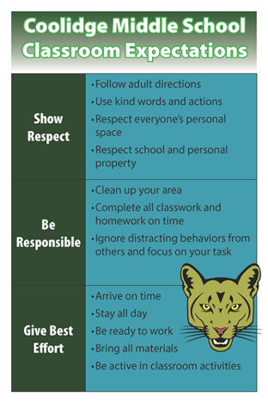
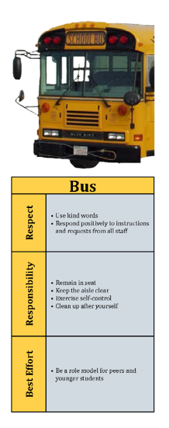
How will primary prevention (Tier 1) efforts be taught to all stakeholders?
Faculty and Staff
Implementation manual
Expectation matrix
Bookmarks
Collaborative teams
Posters
Ticket tip sheet
Professional learning
Students
Lessons
Posters
Videos
Parents and Community
Letters to parents
Contacts with community businesses
Shared with permission.
Notes:
Lessons: setting expectations, social skills
Posters: setting expectations, full expectation matrix

Slide 69
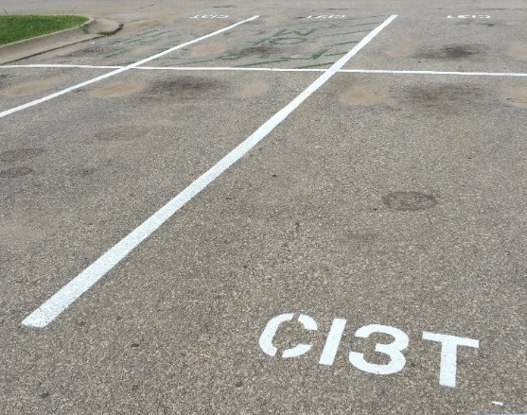
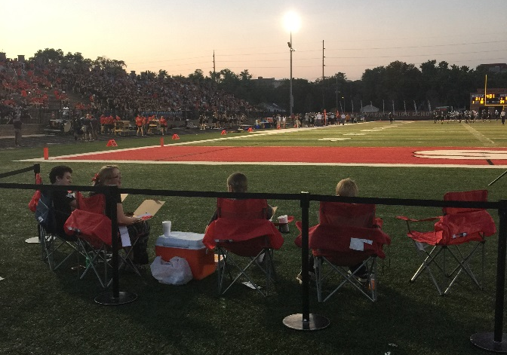
Locate in your Ci3T Implementation Manual
Procedures for Reinforcing
Faculty and Staff:
Students: ROAR station Parking spaces
Parents/ Community:
Donation Coupon:
1 box of Macaroni and Cheese to Community Food Drive

Slide 70
Procedures for Reinforcing
How will you reinforce?
Faculty and staff for
Participation and support
Modeling schoolwide expectations
Taking an instructional approach to behavior
Implementing the Ci3T plan with fidelity
Making instructional shifts in traditional practices
Students for
Demonstrating the expectations across academic, behavioral, and social skill domains
Parents and community for
Communication with school staff
Reinforcing expectations
Supporting the social skills lessons at home and in the community
Notes:
4

Slide 71
Ticket Tip Sheet
Ticket Tip Sheet
When giving a ticket for positive behavior, always pair behavior specific praise. Example, “Lori, thank you for walking down the hallway with a quiet voice and your hands at your side. For showing responsibility, you have earned a PAWS ticket.”
In the first days and weeks of implementing a Positive Behavior Interventions and Support system, flood students with tickets to increase effectiveness. Overtime fade tickets and provide intermittent reinforcement.
School staff should try to be consistent with ticket distribution. Portions of staff meetings can be used to discuss ticket distribution.
To ensure student buy-in, survey students to gain an understanding of what reinforcements are desired.
Explicitly teach students how tickets can be earned and what tickets can be used for once they are received.
Weekly emails

Slide 72
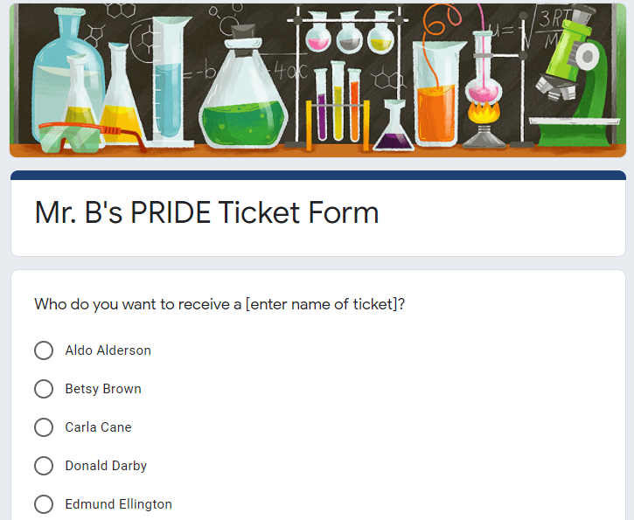
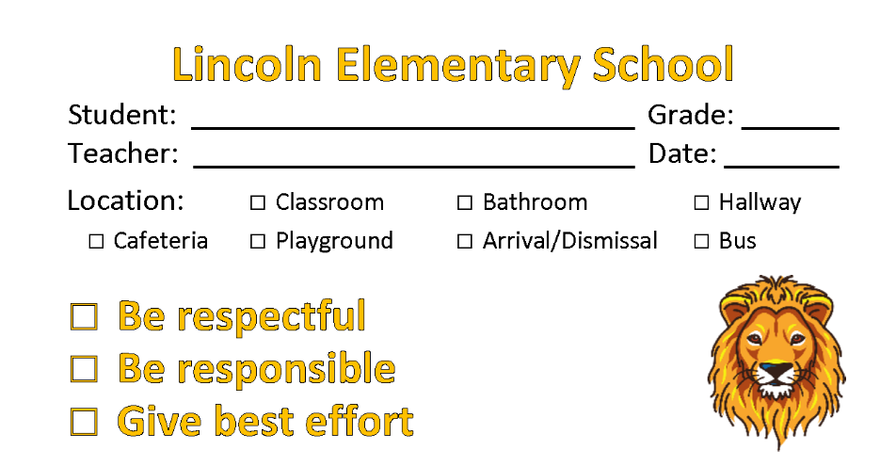
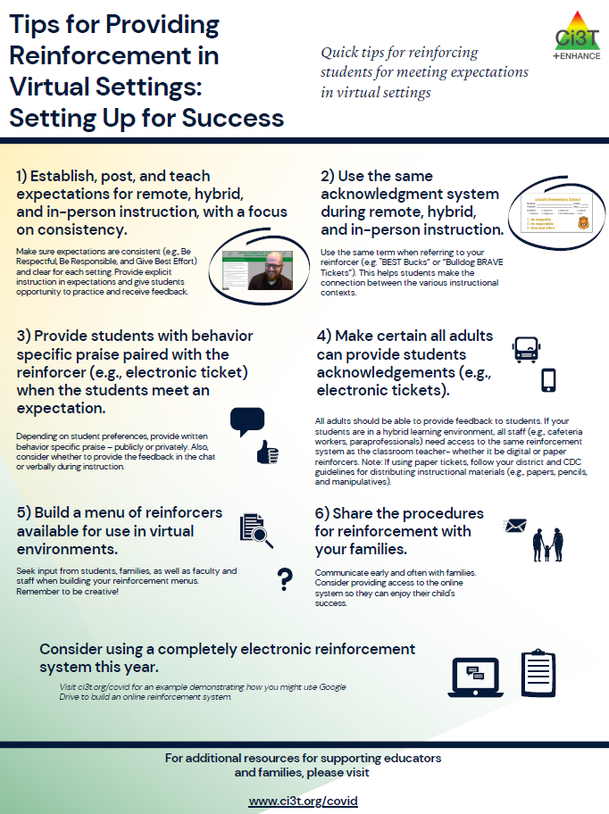
Notes:
Here’s an example of a high-school based tracker using Google Drive:
https://www.youtube.com/watch?v=1-mZ_z7RYPc

Slide 73
Review your Ci3T Implementation Manual
Do faculty and staff have access to the plan?
How did you roll out your plan?
How did you teach roles and responsibilities to each stakeholder?
How will you review and reteach the plan?
How are behavior-specific praise and tickets being used in your school?
What types of reinforcers are most meaningful to your students?
Write any action items in your IM18 agenda
Notes:
5 min: Using this PowerPoint break timer
This PowerPoint slide uses images, custom animation, and timing to provide a countdown timer that you can use in any presentation. When you open the template, you’ll notice that the timer is set at 00:00. However, when you start the slide show, the timer will start at the correct time and count down by 1-minute intervals until it gets to 1 minute. At that point, it will count down in two 30-seconds intervals to 00:00.
To insert this slide into your presentation
Save this template as a presentation (.ppt file) on your computer.
Open the presentation that will contain the timer.
On the Slides tab, place your insertion point after the slide that will precede the timer. (Make sure you don't select a slide. Your insertion point should be between the slides.)
On the Insert menu, click Slides from Files.
In the Slide Finder dialog box, click the Find Presentation tab.
Click Browse, locate and select the timer presentation, and then click Open.
In the Slides from Files dialog box, select the timer slide.
Select the Keep source formatting check box. If you do not select this check box, the copied slide will inherit the design of the slide that precedes it in the presentation.
Click Insert.
Click Close.

Slide 74
Review your Ci3T Implementation Manual
How will you continue to teach and reinforce faculty and students?
How do you plan to re-teach expectations?
How do you plan to adjust reinforcement rates?
How will you involve your student leaders?
Write any action items in your IM18 agenda
Notes:
5 min: Using this PowerPoint break timer
This PowerPoint slide uses images, custom animation, and timing to provide a countdown timer that you can use in any presentation. When you open the template, you’ll notice that the timer is set at 00:00. However, when you start the slide show, the timer will start at the correct time and count down by 1-minute intervals until it gets to 1 minute. At that point, it will count down in two 30-seconds intervals to 00:00.
To insert this slide into your presentation
Save this template as a presentation (.ppt file) on your computer.
Open the presentation that will contain the timer.
On the Slides tab, place your insertion point after the slide that will precede the timer. (Make sure you don't select a slide. Your insertion point should be between the slides.)
On the Insert menu, click Slides from Files.
In the Slide Finder dialog box, click the Find Presentation tab.
Click Browse, locate and select the timer presentation, and then click Open.
In the Slides from Files dialog box, select the timer slide.
Select the Keep source formatting check box. If you do not select this check box, the copied slide will inherit the design of the slide that precedes it in the presentation.
Click Insert.
Click Close.

Slide 75
A Look at Tier 1 …
Teaching
Reinforcing
Monitoring

Slide 76
Essential Components of Primary Prevention Efforts
Social Validity
Systematic Screening
Academic
Behavior
Treatment Integrity

Slide 77
Monitoring Your Plan

Slide 78
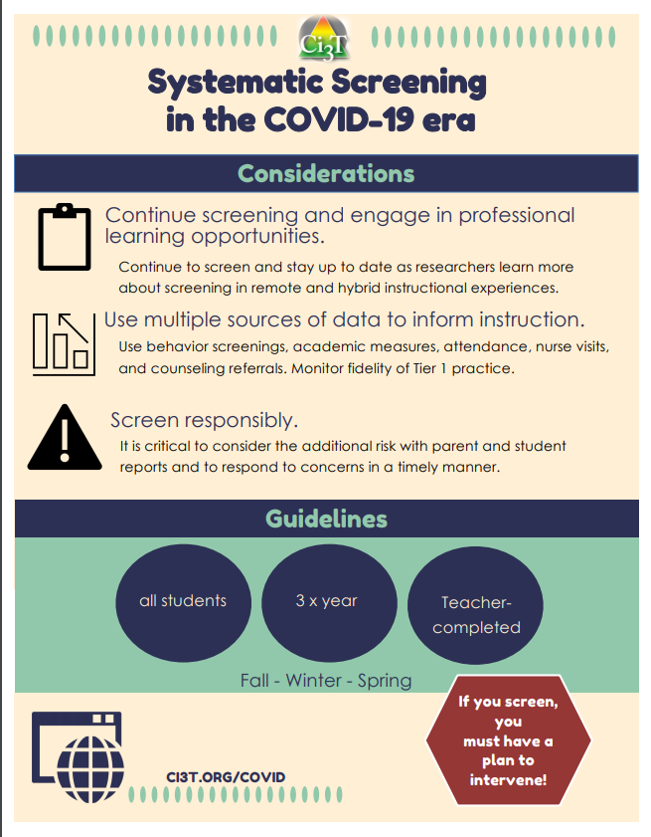
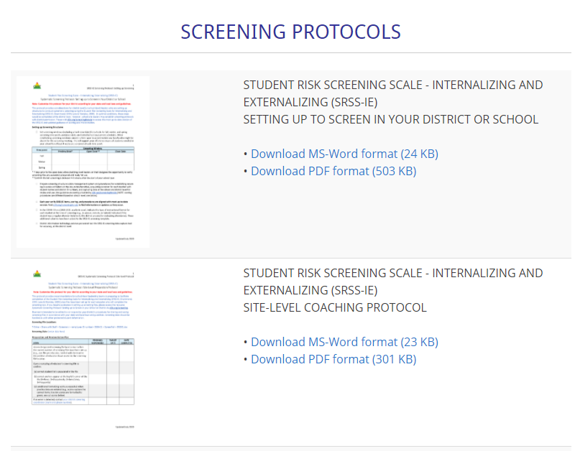

Slide 79
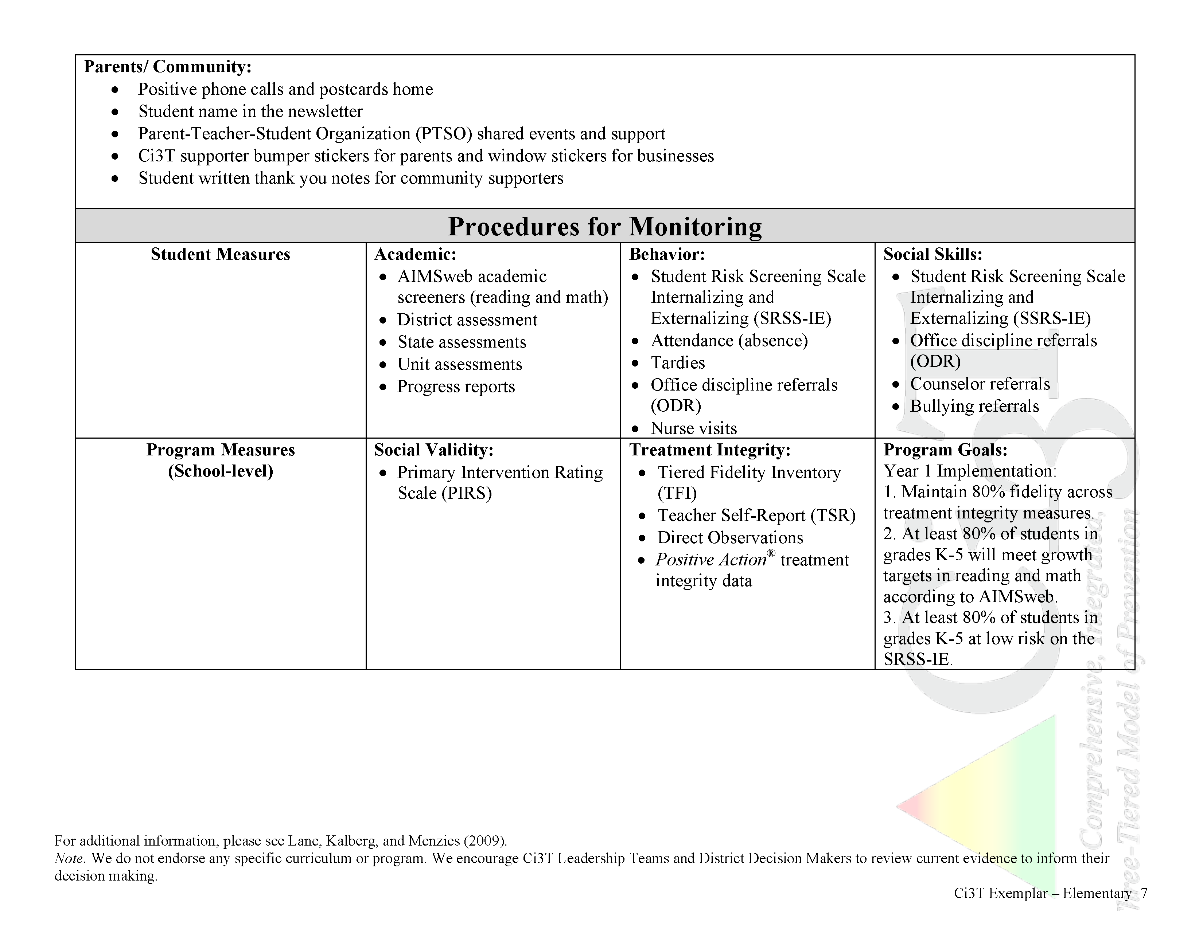
In future years, consider alternative program goals.
80% of students meeting reading and math targets on assessments
Locate in your Ci3T Implementation Manual

Slide 80
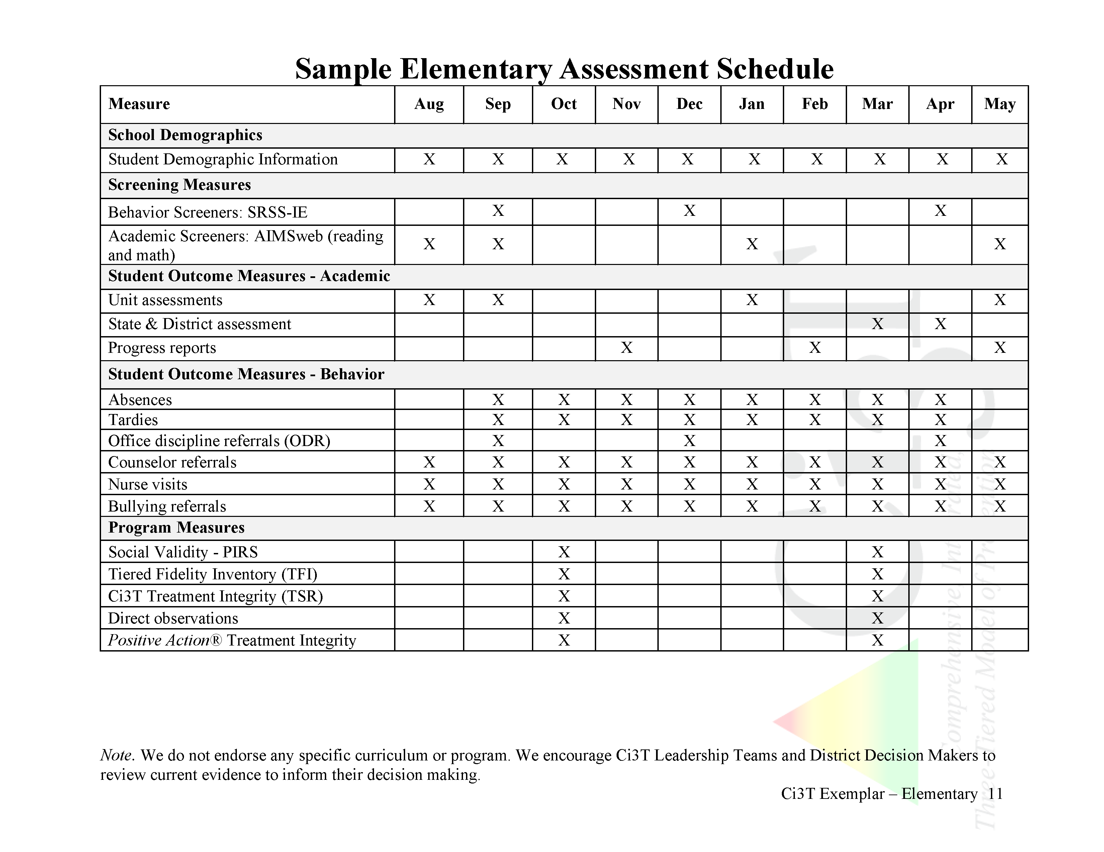

Slide 81
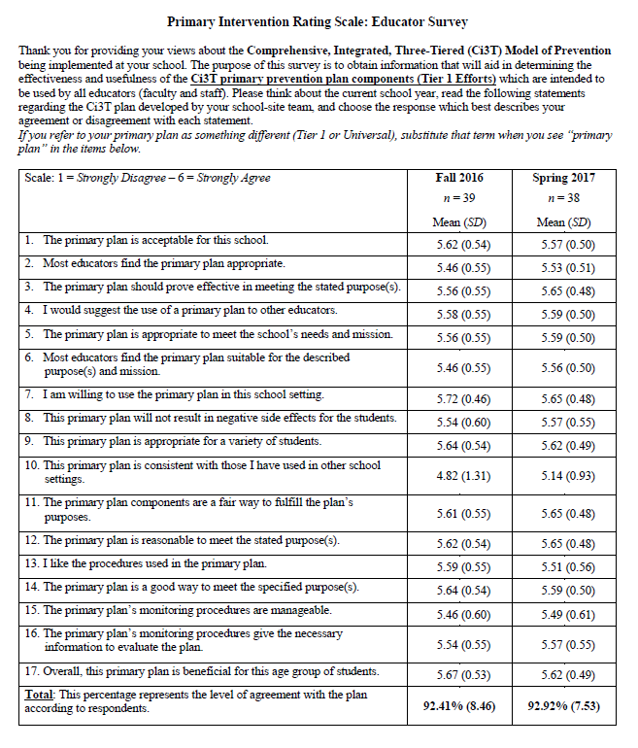
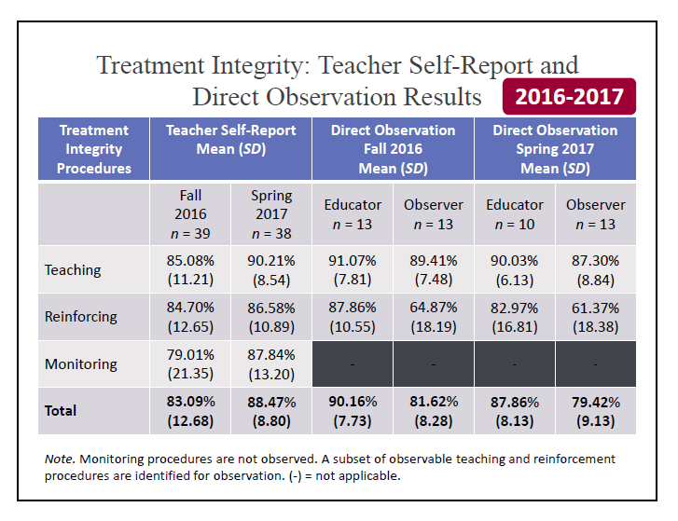
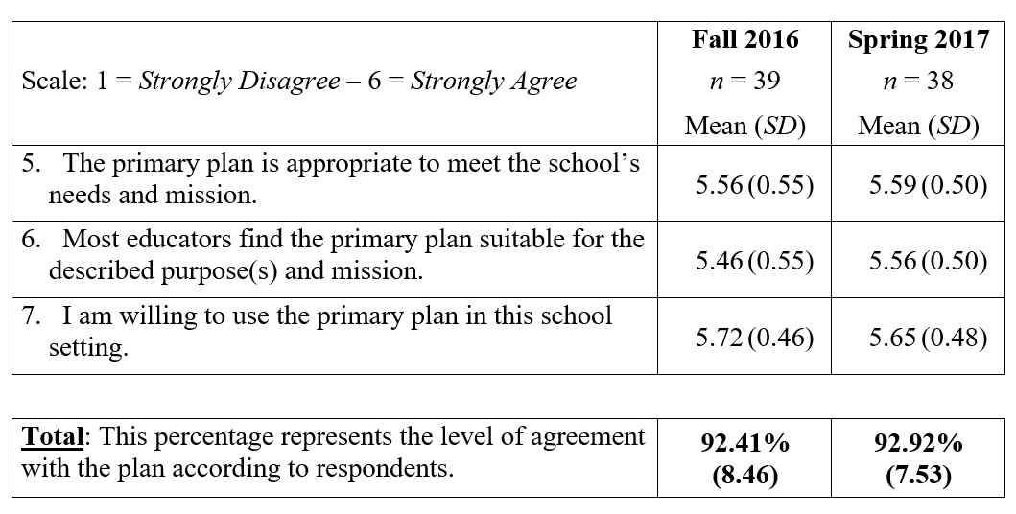
Why monitor implementation?
Do our students have access to Tier 1?
What are our strengths and areas for growth?
What professional learning opportunities can we give our staff?
How can we improve our plan?

Slide 82
Social Validity & Treatment Integrity
Schools will receive fall and spring reports outlining:
…faculty and staff opinions about the Ci3T plan at the start of the year and after it has been implemented for the majority of the school year.
…degree to which the practices of your Ci3T plan are being implemented.

Slide 83
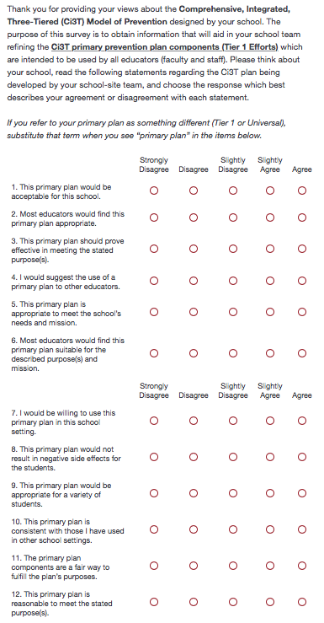
Social Validity
Used during training and implementation
AFTER the person has had an opportunity to learn about the plan
PIRS scores have predicted implementation in previous studies

Slide 84
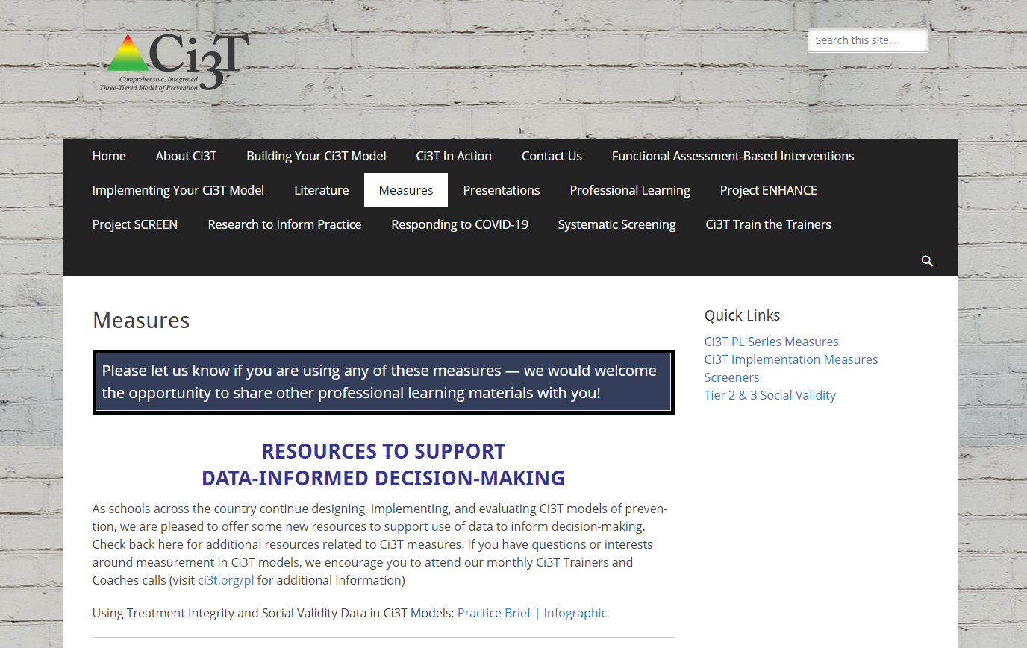
Treatment Integrity

Slide 85
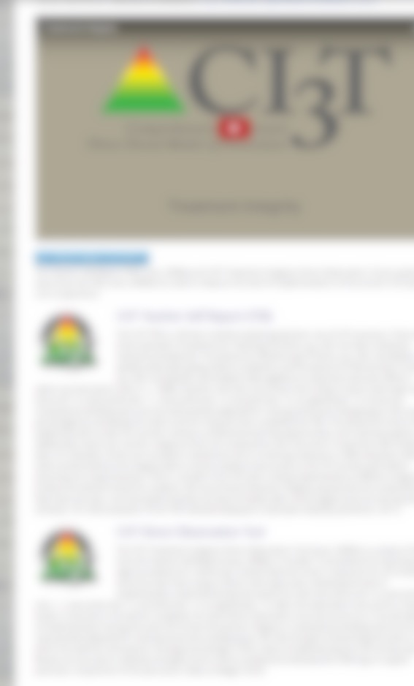
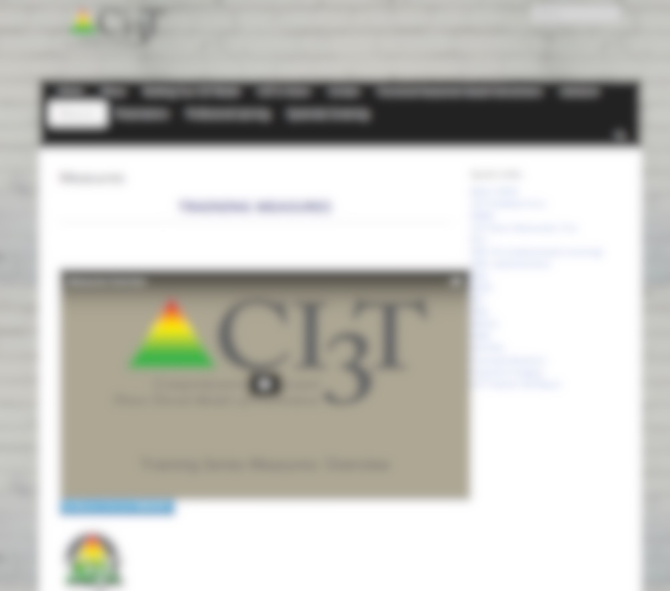
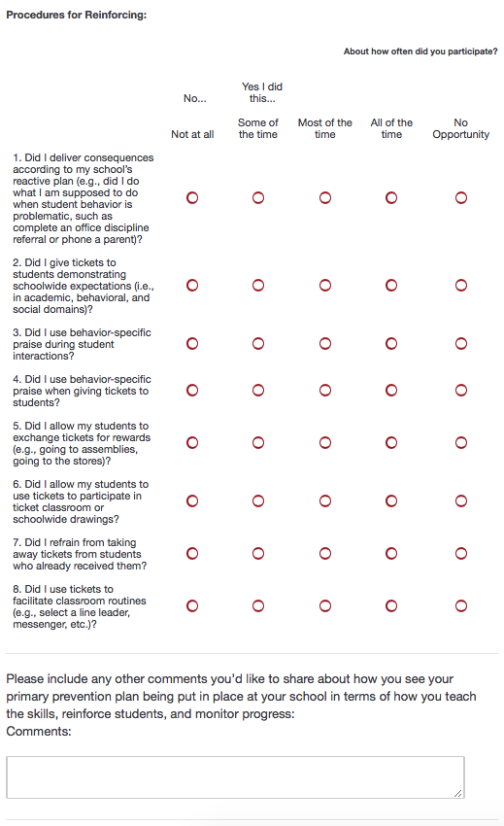
Treatment Integrity
Ci3T TI: Teacher Self-Report
Ci3T TI: Direct Observation

Slide 86
Treatment Integrity
"Tiered Fidelity Inventory" and “Schoolwide Evaluation Tool Interview and Observation Form” are products developed as part of the U.S. Department of Education’s Office of Special Education Programs National Technical Assistance Center on Positive Behavioral Interventions and Supports.

Slide 87
Let’s talk… Procedures for Monitoring
How will you know what faculty and staff think about Tier 1 efforts?
How will you know if Tier 1 is happening?
How will you know how students are responding?
What resources are needed to support our faculty and staff in Tier 1 implementation?
What can our Ci3T leadership team provide?
Notes:
10 min Using this PowerPoint break timer
This PowerPoint slide uses images, custom animation, and timing to provide a countdown timer that you can use in any presentation. When you open the template, you’ll notice that the timer is set at 00:00. However, when you start the slide show, the timer will start at the correct time and count down by 1-minute intervals until it gets to 1 minute. At that point, it will count down in two 30-seconds intervals to 00:00.
To insert this slide into your presentation
Save this template as a presentation (.ppt file) on your computer.
Open the presentation that will contain the timer.
On the Slides tab, place your insertion point after the slide that will precede the timer. (Make sure you don't select a slide. Your insertion point should be between the slides.)
On the Insert menu, click Slides from Files.
In the Slide Finder dialog box, click the Find Presentation tab.
Click Browse, locate and select the timer presentation, and then click Open.
In the Slides from Files dialog box, select the timer slide.
Select the Keep source formatting check box. If you do not select this check box, the copied slide will inherit the design of the slide that precedes it in the presentation.
Click Insert.
Click Close.

Slide 88
Wrapping up and Moving Forward

Slide 89
Ci3T Training Series
Ci3T: Primary Prevention
Session 1:
Overview of Ci3T Prevention Models
Setting a Purpose
Establish team meetings and roles
Session 2:
Mission and Purpose
Establish Roles and Responsibilities
Procedures for Teaching
Procedures for Reinforcing
Reactive Plan
Session 3:
Procedures for Monitoring
Session 4:
Revise Primary Plan using Stakeholder feedback
Prepare presentation
Ci3T: Secondary Prevention
Session 5:
Overview of Teacher focused Strategies
Overview of Student Focused Strategies
Using data to determine
Draft the Secondary Intervention Grid based on existing supports
Ci3T: Tertiary Prevention
Session 6:
Final revisions of Ci3T Plan based on stakeholder feedback
Draft Tertiary Prevention Intervention Grids
Design Implementation Manual and Plan for roll out to faculty, students, and parents
Ci3T Team Training Sequence
Implementation Stages of Tier 2 and 3 within Ci3T
Additional Professional Development on Specific Topics
Core Content Curriculum
Check In - Check Out
Functional Assessment-based Interventions
Reading, Math, Writing Benchmarking and Progress Monitoring Tools
Student Driven Interventions, Strategies, & Practices
Additional Tier 3 Supports
Teacher Driven Supports: Instructional Techniques to Improve Students’ Motivation; General Classroom Management Practices; Low-Intensity Behavior Supports
Notes:
Lane and Oakes 2014.

Slide 90
Sample: 2021-2022 Professional Learning

Slide 91
Sample Ci3T Team Implementation Support
9/5/19
8:00 – 11:00 am
5:00 – 7:00 pm
Supporting Success: A Look at Tier 1
10/29/19
8:00 – 11:00 am
5:00 – 7:00 pm
Planning for Success: Monitoring and Communication
12/4/19
8:00 – 11:00 am
5:00 – 7:00 pm
Using Your Data to Inform Instruction
1/15/20
8:00 – 11:00 am
5:00 – 7:00 pm
Supporting Students Across the Tiers
4/2/20
8:00 – 11:00 am
5:00 – 7:00 pm
Planning for the Year Ahead

Slide 93
Wrap Up and Preview
Today’s Review
Next Session Preview
Gained an understanding of
long-range planning
conducting effective meetings
communicating with stakeholders
Reviewed rollout of and implementation procedures for
teaching, reinforcing, and monitoring the academic, behavior, and social skills components of your Ci3T model of prevention
Prepare to collect social validity and treatment integrity data
Use screening data to inform instruction at Tier 1, Tier 2, and Tier 3
Communication with all stakeholders:
District
Ci3T Leadership Team
Faculty and staff
Students, parents, community

Slide 94
Please Take a Minute to Get Organized
Please stay until all materials are organized.
Team Materials:
Save all documents with your school initials at the beginning and the date at the end of the file name.
XXS IM18 Ci3T Leadership Team Meeting Agenda YYYY MM DD.docx
Save to your school’s Dropbox folder
Clearly identify the person(s) on your team in charge of each action item listed on the agenda.
Thank you!

Slide 95
Homework
Consider sending calendar invites for each action item due date on your agenda
Send the agenda to team members in a week-before reminder email to give time to finish action items
At your next Ci3T Leadership Team meeting:
Use IM18 Ci3T Leadership Team Meeting Agenda to conduct an effective meeting with
clearly defined roles and responsibilities of team members
action items, persons responsible, and due dates
At your next faculty meeting:
Share successes
Review implementation procedures

Slide 96
Let’s talk… and make plans!
What did I learn?
How will I take this information back to my faculty, staff, and parents?
Notes:
10 min: Using this PowerPoint break timer
This PowerPoint slide uses images, custom animation, and timing to provide a countdown timer that you can use in any presentation. When you open the template, you’ll notice that the timer is set at 00:00. However, when you start the slide show, the timer will start at the correct time and count down by 1-minute intervals until it gets to 1 minute. At that point, it will count down in two 30-seconds intervals to 00:00.
To insert this slide into your presentation
Save this template as a presentation (.ppt file) on your computer.
Open the presentation that will contain the timer.
On the Slides tab, place your insertion point after the slide that will precede the timer. (Make sure you don't select a slide. Your insertion point should be between the slides.)
On the Insert menu, click Slides from Files.
In the Slide Finder dialog box, click the Find Presentation tab.
Click Browse, locate and select the timer presentation, and then click Open.
In the Slides from Files dialog box, select the timer slide.
Select the Keep source formatting check box. If you do not select this check box, the copied slide will inherit the design of the slide that precedes it in the presentation.
Click Insert.
Click Close.

