Slide 1
Tiered Systems ... Comprehensive, Integrated, Three-tiered (Ci3T) Model of Prevention
Delta Kappa Gamma
March 27, 2021
Kathleen Lynne Lane, University of Kansas

Slide 2
ci3t.org

Slide 3
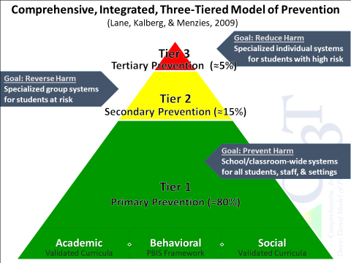
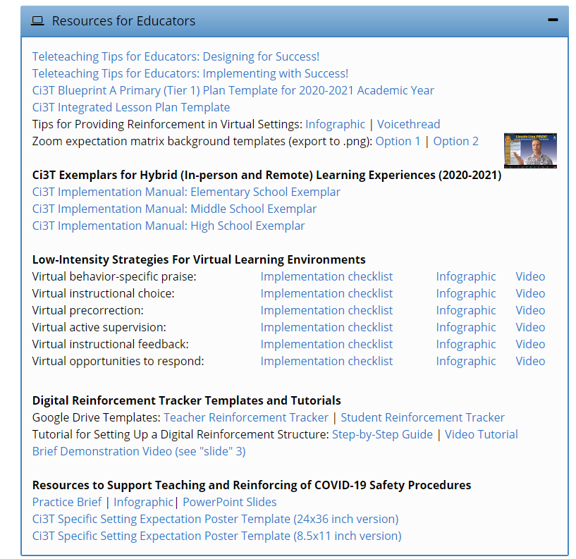
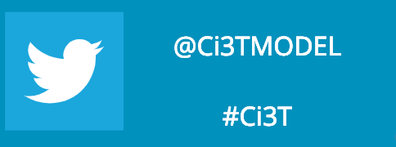

Slide 4
Agenda
Introducing Ci3T … a Comprehensive, Integrated, Three-Tiered Model of Prevention
Resources
Questions and Comments

Slide 5
Thank you…
Internalizing
Externalizing
ED <1%
EBD 12-20%
Source: Forness, S.R., Freeman, S.F., Paparella, T., Kauffman, J.M., & Walker, H.M. (2012). Special education implications of point and cumulative prevalence for children with emotional or behavioral disorders. Journal of Emotional and Behavioral Disorders, 20, 4-18.

Slide 6
Comprehensive, Integrated, Three-Tiered Model of Prevention
(Lane, Kalberg, & Menzies, 2009)
Tier 3
Tertiary Prevention (≈5%)
Tier 2
Secondary Prevention (≈15%)
Tier 1
Primary Prevention (≈80%)
Academic ◇ Behavioral ◇ Social
Validated Curricula PBIS Framework Validated Curricula

Slide 7
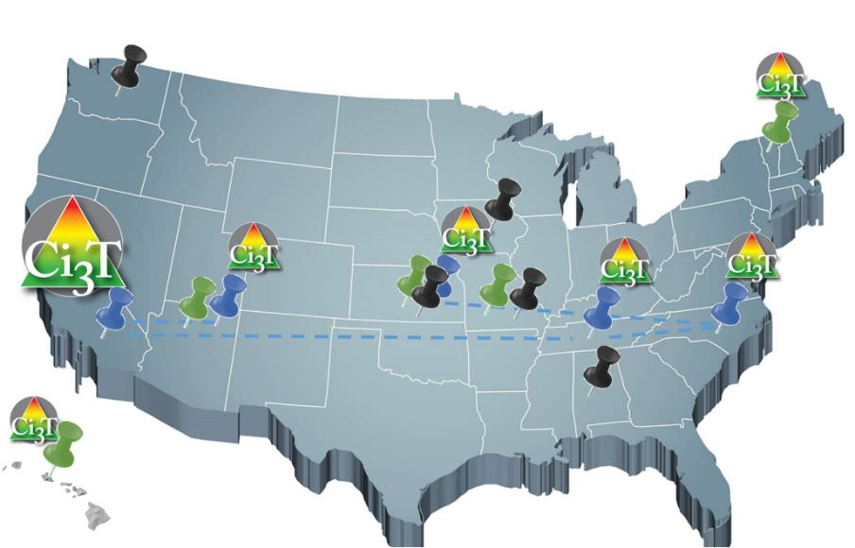
Implementing Ci3T Models: A Respectful Partnership

Slide 8
Comprehensive, Integrated, Three-Tiered Model of Prevention
(Lane, Kalberg, & Menzies, 2009)
Tier 3
Tertiary Prevention (≈5%)
Reading Street
Tier 2
Secondary Prevention (≈15%)
District & State Standards
High Quality Instruction
Tier 1
Primary Prevention (≈80%)
Academic ◇ Behavioral ◇ Social
Validated Curricula PBIS Framework Validated Curricula

Slide 9
Comprehensive, Integrated, Three-Tiered Model of Prevention
(Lane, Kalberg, & Menzies, 2009)
Tier 3
Tertiary Prevention (≈5%)
Tier 2
Secondary Prevention (≈15%)
Positive Behavior Interventions and Supports (PBIS)
Tier 1
Primary Prevention (≈80%)
Academic ◇ Behavioral ◇ Social
Validated Curricula PBIS Framework Validated Curricula

Slide 10
A look at Procedures for Teaching at Tier 1
Procedures for Teaching
Faculty and Staff: Ci3T Leadership Teams and District Leaders will teach procedures to faculty and staff by: Provide faculty and staff Ci3T Implementation Manual and other materials such as posters, lesson plans, tickets, etc. to teach, implement and support our Ci3T plan. Professional learning opportunities at the district level to support implementation and sustainability of Ci3T, with attention to academic, behavior, and social domains. Expectations Matrix taught and posted. Ongoing re-teaching of expectations and procedures – dedicated staff meeting time for discussions.
Continued Learning: Ci3T Leadership Teams and District Leaders will teach procedures to faculty and staff by: Providing faculty and staff materials for remote access to the Ci3T Implementation Manual, digital ‘posters’ and e-tickets. Professional learning sessions and access guides for online materials for teaching social skills lessons. Beginning of year online meeting small-group breakout rooms for faculty and staff to review Ci3T Implementation Manual updates, get questions answered, and share ideas
Ci3T Primary Plan: Procedures for Teaching

Slide 11
ELEMENTARY | Settings
 | Classroom | Hallway | Cafeteria | Playground | Bathroom | Bus
Respect | - Follow directions -Use kind words and actions - Control your temper - Cooperate with others - Use an inside voice | - Use a quiet voice - Walk on the right side of the hallway - Keep hands to yourself | - Use an inside voice - Use manners - Listen to and follow adult requests | - Respect other peoples’ personal space - Follow the rules of the game | - Use the restroom and then return to class - Stay in your own bathroom stall - Little talking | - Use kind words towards the bus driver and other students - Listen to and follow the bus drivers’ rules
Responsibility | - Arrive to class on time - Remain in school for the whole day - Bring your required materials - Turn in finished work - Exercise self-control | - Keep hands to yourself - Walk in the hallway - Stay in line with your class | - Make your choices quickly - Eat your own food - Choose a seat and stick with it - Clean up after yourself | - Play approved games - Use equipment appropriately - Return equipment when you are done - Line up when the bell rings | - Flush toilet - Wash hands with soap - Throw away any trash properly - Report any problems to your teacher | - Talk quietly with others - Listen to and follow the bus drivers’ rules - Remain in seat after you enter the bus - Use self-control
Best Effort | - Participate in class activities - Complete work with best effort - Ask for help politely | - Walk quietly - Walk directly to next location | - Use your table manners - Use an inside voice | - Include others in your games - Be active - Follow the rules of the game | - Take care of your business quickly - Keep bathroom tidy | - Listen to and follow the bus drivers’ rules - Keep hands and feet to self
Establish, Clarify, Define Expectations
Source: Lane, K.L., Kalberg, J.R., & Menzies, H.M. (2009). Developing schoolwide programs to prevent and manage problem behaviors: A step-by-step approach. Guilford Press.

Slide 12
Comprehensive, Integrated, Three-Tiered Model of Prevention
(Lane, Kalberg, & Menzies, 2009)
Tier 3
Tertiary Prevention (≈5%)
Tier 2
Secondary Prevention (≈15%)
Positive Action
Tier 1
Primary Prevention (≈80%)
Academic ◇ Behavioral ◇ Social
Validated Curricula PBIS Framework Validated Curricula

Slide 13
The Five Social and Emotional Learning Core Competencies
Self-awareness
Responsible Decision making
Relationship Skills
Social Awareness
Self-management
Social & Emotional Learning
(CASEL, 2013)

Slide 14
Outcomes Associated with Social Skills Training
Explicit social-emotional learning (SEL) skills instruction
SEL skills acquisition
Improved attitudes about self, others, and school
Positive social behavior
Fewer conduct problems
Less emotional distress
Academic success
(CASEL, 2013)

Slide 15
Social Component: Examples of Schoolwide Programs
Social-emotional
Connect With Kids connectwithkids.com
Character Education
A curricula using real stories presented through documentary-style videos, non-fiction books, teaching guides and patent resources.
Attendance and achievement
Bullying and violence prevention
Character and Life skills
Digital citizenship
Alcohol and drug prevention
Health and Wellness
Customizable units are:
Positive Action www.positiveaction.net
Improves academics, behavior, and character
Curriculum-based approach
Effectively increases positive behaviors and decreases negative behaviors
6-7 units per grade
Optional components:
site-wide climate development
drug education
bullying / conflict resolution
counselor, parent, and family classes
community/coalition components

Slide 16
Top 10 School-related Social Skills
Listens to Others
Follows Directions
Follows Classroom Rules
Ignores Peer Distractions
Asks for Help
Takes Turns in Conversations
Cooperates With Others
Controls Temper in Conflict Situations
Acts Responsibly With Others
Shows Kindness to Other
(Lane et al. 2004, 2007; Gresham & Elliott, 2008)

Slide 17
Comprehensive, Integrated, Three-Tiered Model of Prevention
(Lane, Kalberg, & Menzies, 2009)
Tier 3
Tertiary Prevention (≈5%)
Tier 2
Secondary Prevention (≈15%)
Tier 1
Primary Prevention (≈80%)
Academic ◇ Behavioral ◇ Social
Validated Curricula PBIS Framework Validated Curricula

Slide 19
The Journey … Ci3T Training & Implementation
Phase |  |  |  | Year
 | 2013-14 | 14-15 | 15-16 | 16-17 | 17-18 | 18-19 | 19-20
Elementary School
Ci3T Training
Implementation Year 1
Implementation Year 2
Sustain and Develop Practices
Middle and High Schools
Ci3T Training
Implementation Year 1
Implementation Year 2
Sustain and Develop Practices
College and Career Center
Ci3T Training
Implementation Year 1
Implementation Year 2
Sustain and Develop Practices

Slide 20
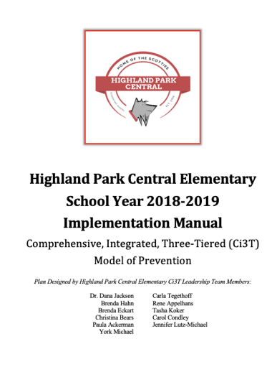
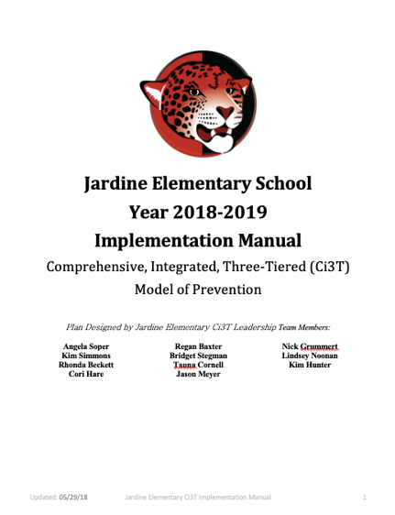
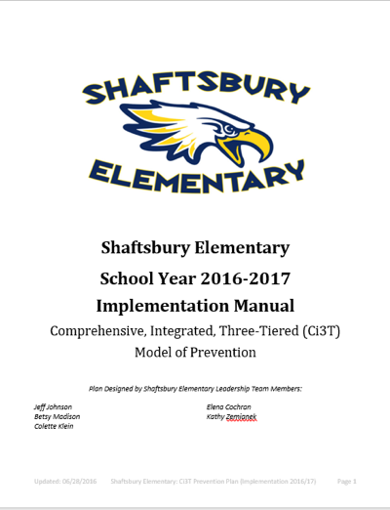
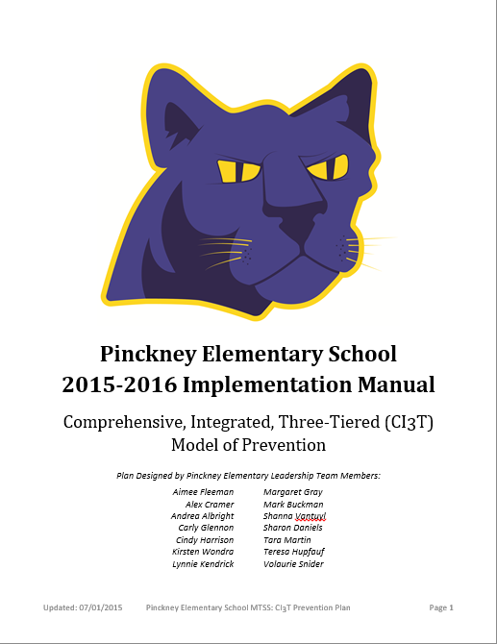
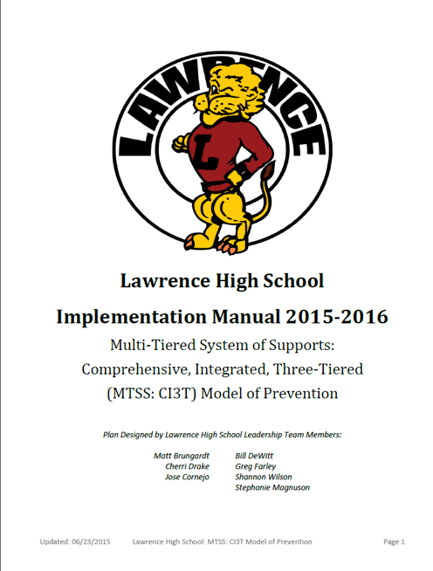
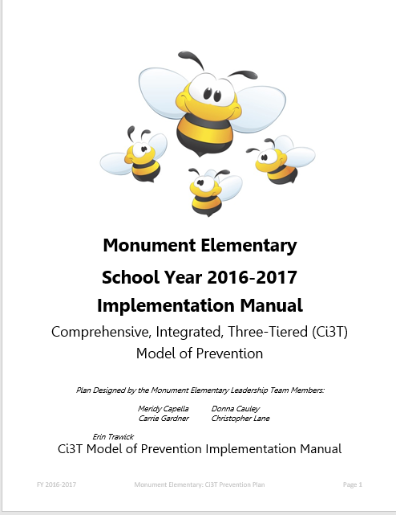
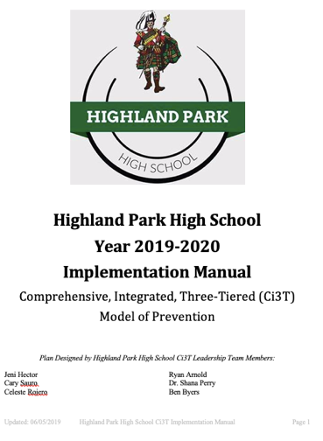

Slide 21
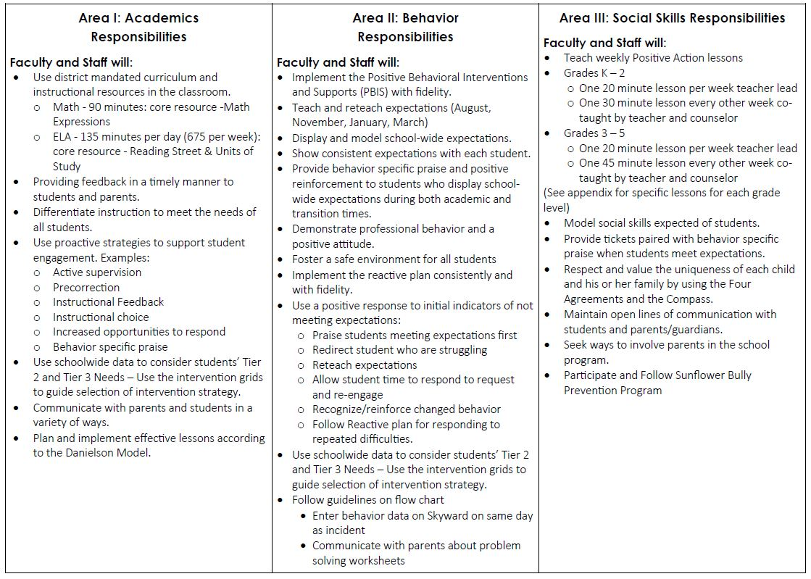
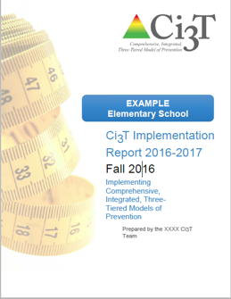
Ci3T Primary Plan: Procedures for Teaching
Ci3T Primary Plan: Procedures for Reinforcing
Ci3T Primary Plan: Procedures for Monitoring

Slide 22
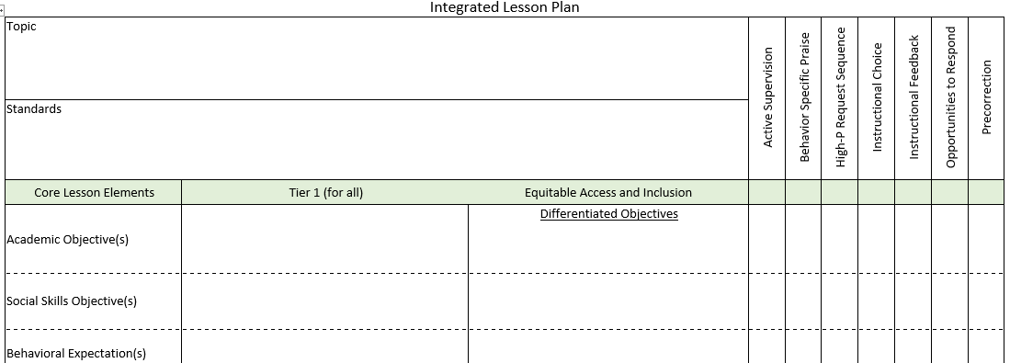
Ci3T Primary Plan: Procedures for Teaching
BSP
OTR
Active Supervision
Choice
Precorrection

Slide 23
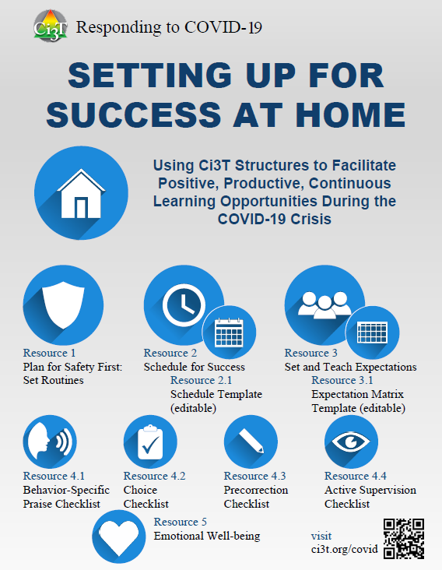
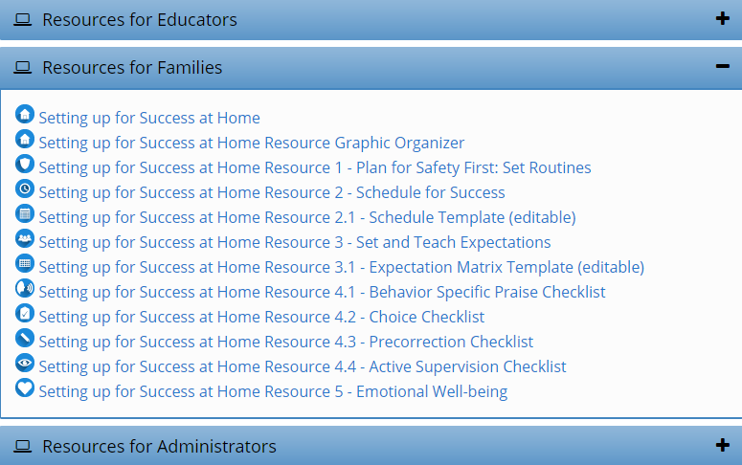
Setting up for Success at Home
Ci3T Primary Plan: Procedures for Teaching
http://www.ci3t.org/covid

Slide 24
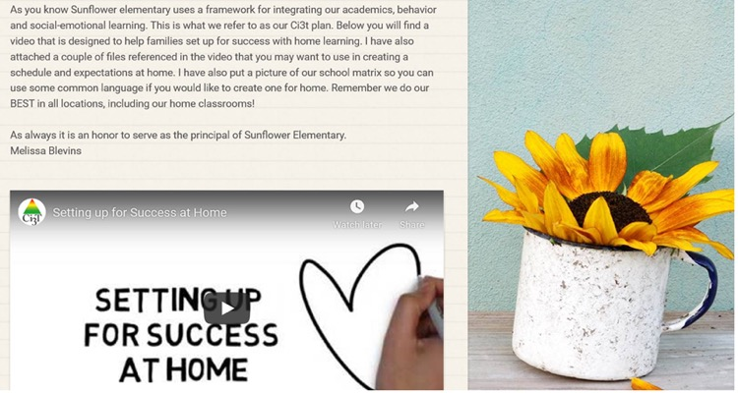
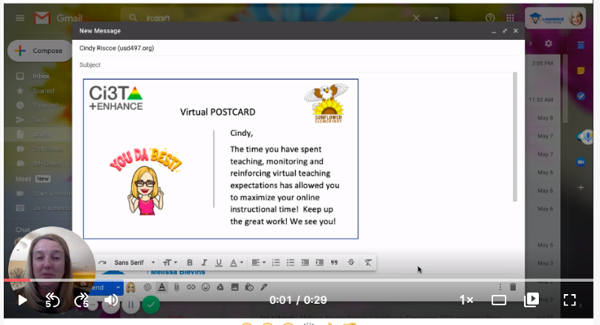
Ci3T Primary Plan: Procedures for Reinforcing

Slide 25
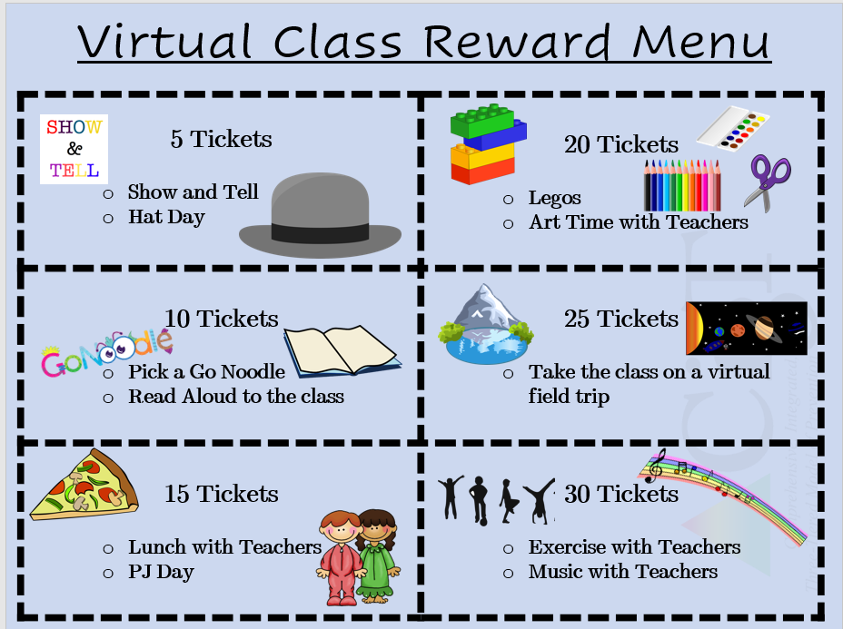
Virtual Learning Incentives
FREE Incentives:
Stay after on ZOOM with a friend for a chat
Virtual lunch date with the teacher, principal, etc. (check with that staff member before offering them up of course)
Teacher wears stickers or has a sign with the student’s name
Dress up ZOOM day (hats, PJs, costumes, etc.)
Virtual Greeting Cards (sent via email)
Show & Tell Time (or some kind of star student spotlight time)
Personalized stickers in See Saw (2nd grade has been using this)
Virtual Class Reinforcement Menu
Ci3T Primary Plan: Procedures for Reinforcing
Adapted and shared with permission from a district partner

Slide 26
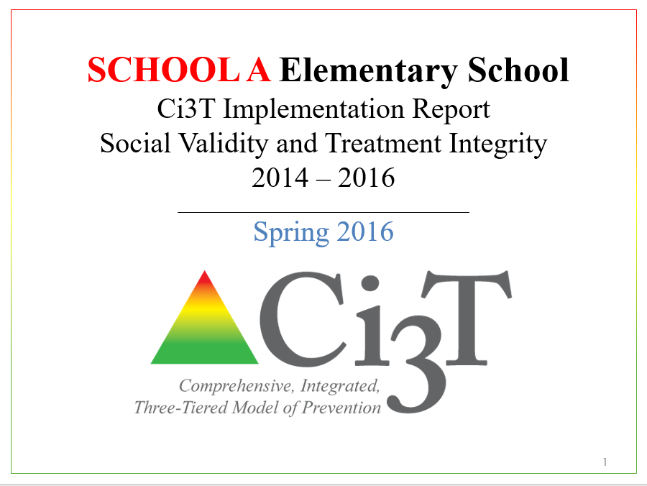
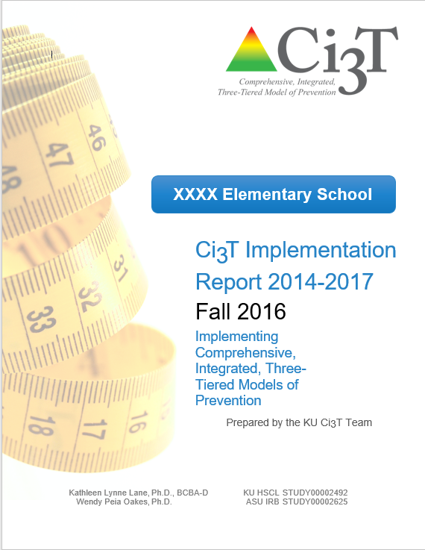
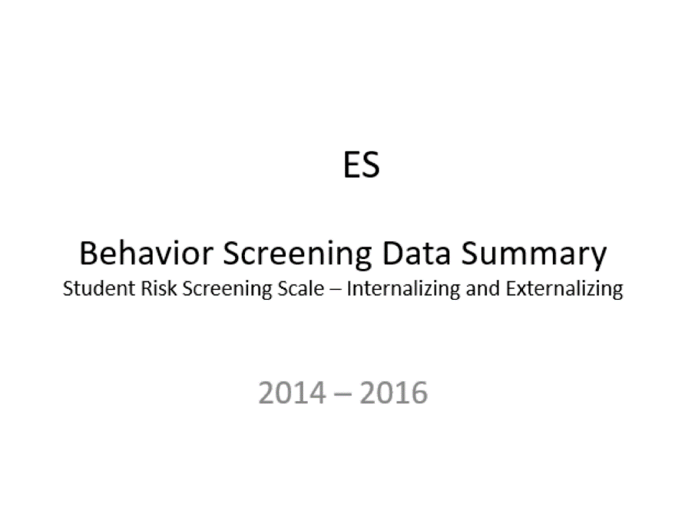
Essential Components of Primary Prevention Efforts
Social Validity
Systematic Screening
Academic
Behavior
Treatment Integrity

Slide 27
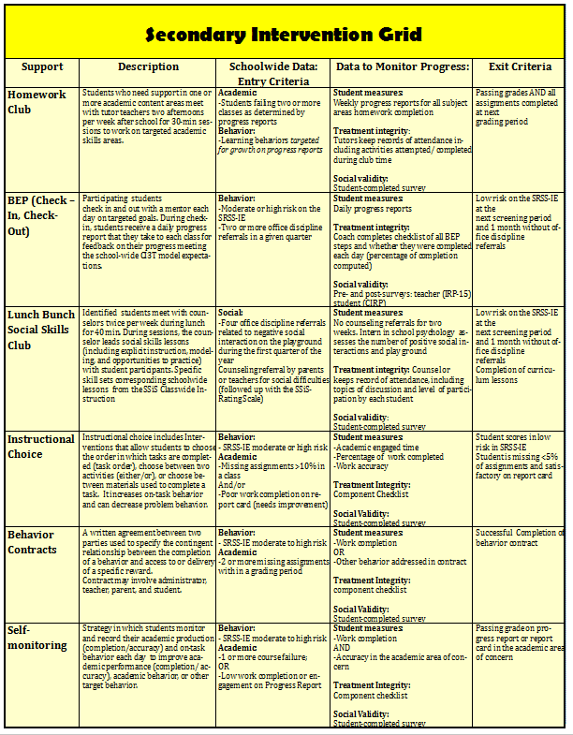
Comprehensive, Integrated, Three-Tiered Model of Prevention
(Lane, Kalberg, & Menzies, 2009)
Tier 3
Tertiary Prevention (≈5%)
Tier 2
Secondary Prevention (≈15%)
Secondary (Tier 2) Intervention Grids
Tier 1
Primary Prevention (≈80%)
Academic ◇ Behavioral ◇ Social
Validated Curricula PBIS Framework Validated Curricula

Slide 28
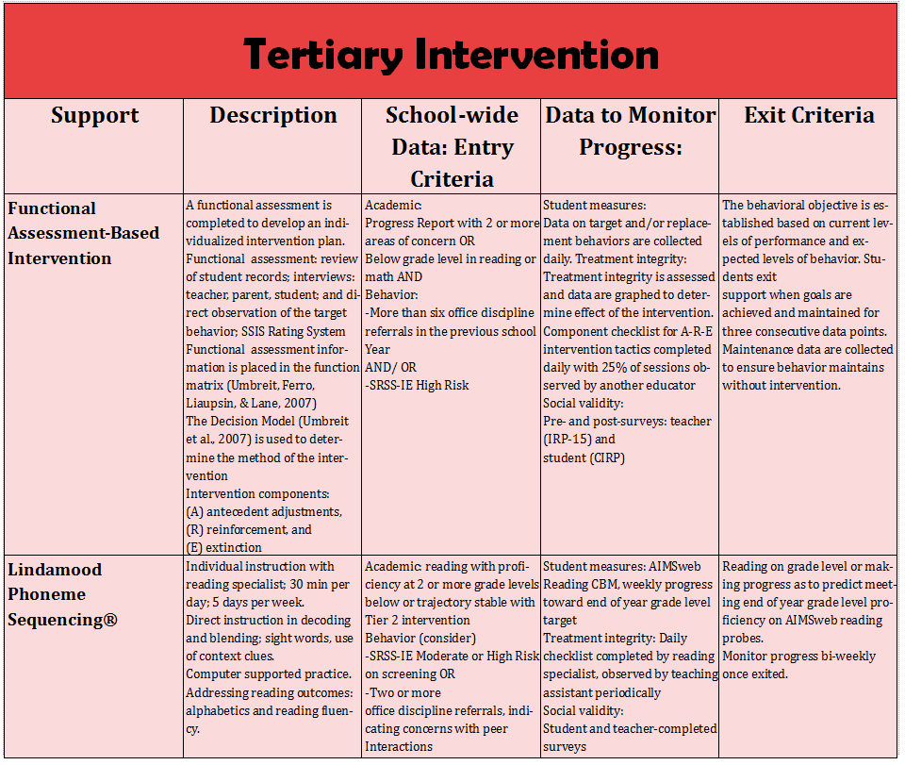
Comprehensive, Integrated, Three-Tiered Model of Prevention
(Lane, Kalberg, & Menzies, 2009)
Tier 3
Tertiary Prevention (≈5%)
Tier 2
Secondary Prevention (≈15%)
Tertiary (Tier 3) Intervention Grids
Tier 1
Primary Prevention (≈80%)
Academic ◇ Behavioral ◇ Social
Validated Curricula PBIS Framework Validated Curricula

Slide 29
Implementation Science Adapted from Fixsen & Blasé, 2005
Exploration & Adoption
Installation
Initial Implementation
We think we know what we need so we are planning to move forward (evidence-based)
Let’s make sure we’re ready to implement (capacity infrastructure)
Let’s give it a try & evaluate (demonstration)
Full Implementation
Let’s make it our way of doing business (institutionalized use)
Sustainability & Continuous Regeneration
That worked, let’s do it for real (investment)

Slide 30
Kathleen.Lane@ku.edu
Thank you!

