Slide 1
How do I support students who are feeling anxious? Practical Strategies that Work
Kathleen Lynne Lane, Ph.D., CF-L1
Mark Matthew Buckman, Ph.D.
Rebecca Lee Sherod, MSE
Wendy Peia Oakes, Ph.D.

Slide 2
Agenda
Welcome & Overview of Ci3T
Internalizing Behaviors: What do I need to know?
Anxiety: Strategies Across the Tiers
Tiers 1-3: Relaxation Training
Tier 2: Self-monitoring
Tier 3: Cognitive Restructuring
Tier 3: Functional Assessment-based Interventions (FABI)
Anxiety: Strategies to Share with Parents
Wrapping up: Resources and Questions

Slide 3
Welcome & Overview of Ci3T

Slide 4
Thank you for your commitment
Shift to a systems level perspective
Internalizing
Externalizing
ED <1%
EBD 12-20%
Source: Forness, S.R., Freeman, S.F., Paparella, T., Kauffman, J.M., & Walker, H.M. (2012). Special education implications of point and cumulative prevalence for children with emotional or behavioral disorders. Journal of Emotional and Behavioral Disorders, 20, 4-18.

Slide 5
Reading Street
District & State Standards
High Quality Instruction

Slide 6
Positive Behavior Interventions and Supports (PBIS)

Slide 7
Positive Action

Slide 8
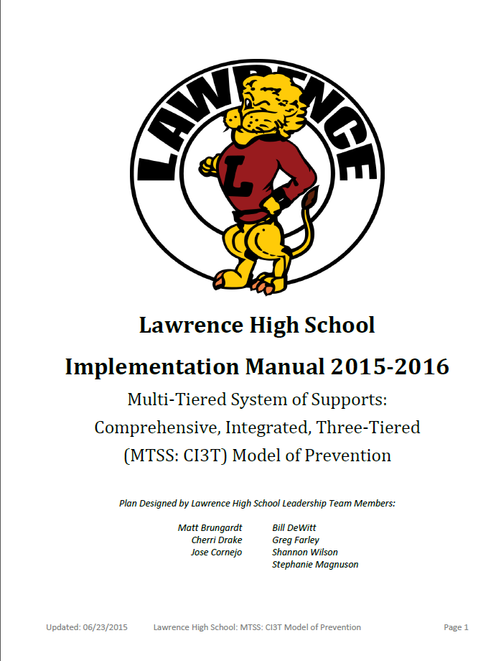
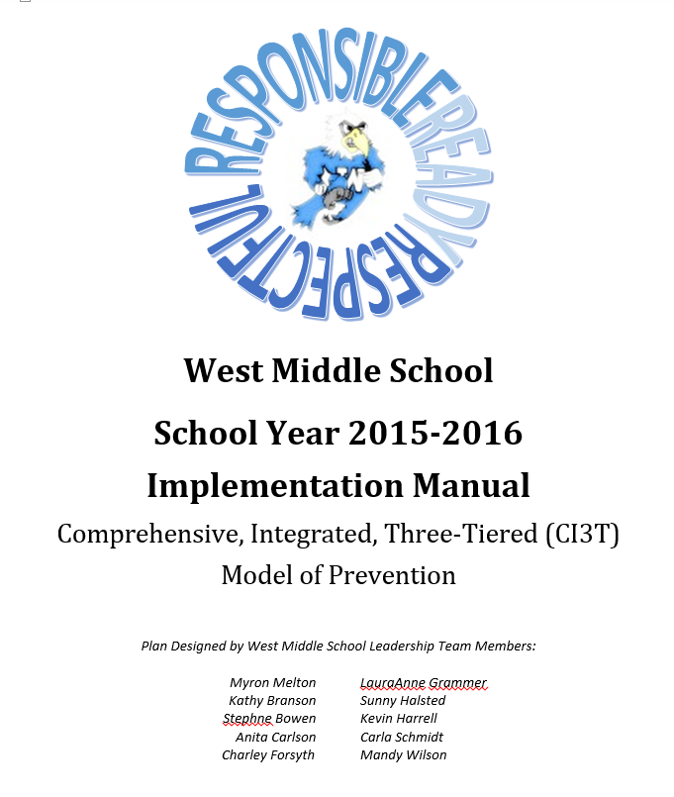
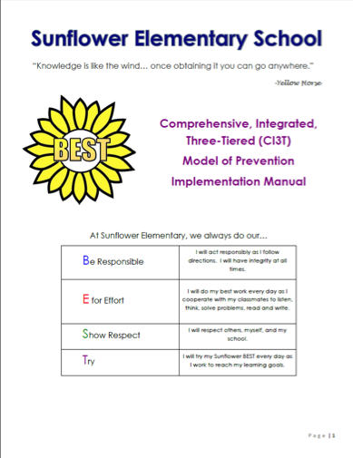
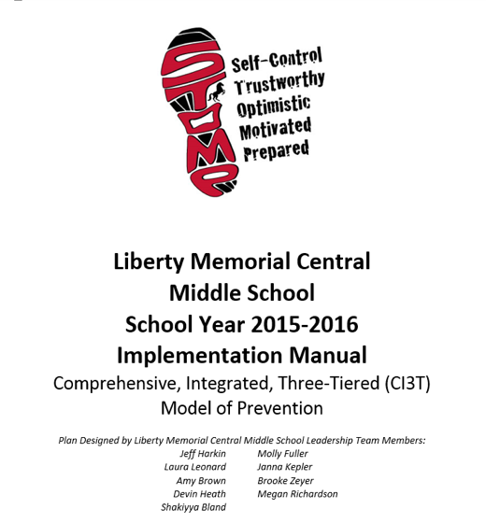
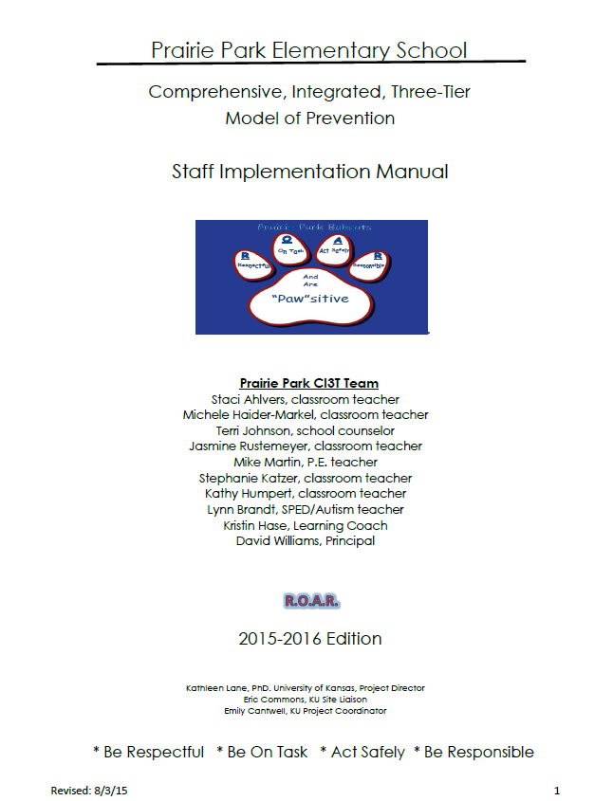
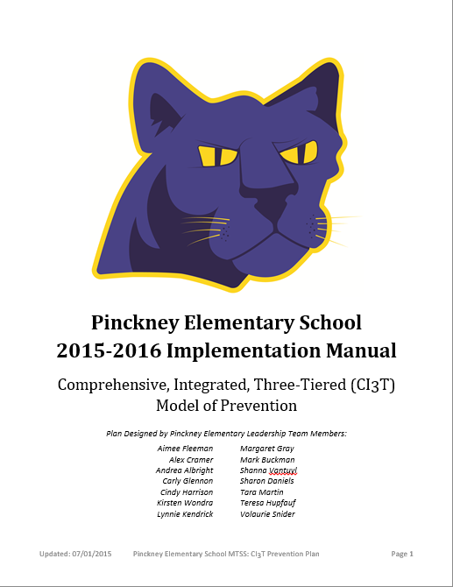
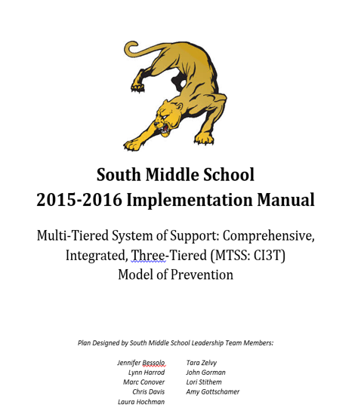
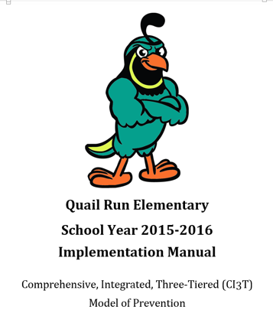

Slide 9
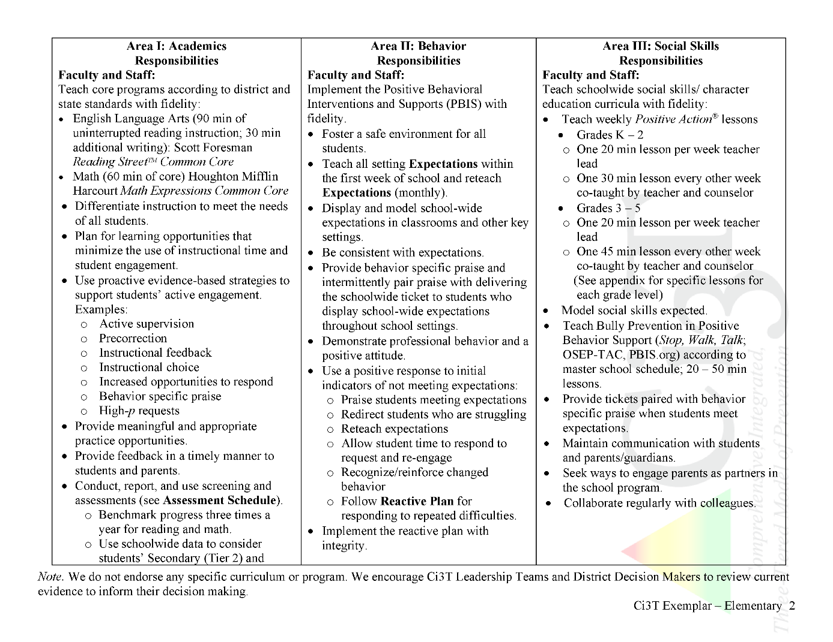
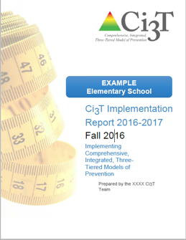
Ci3T Primary Plan: Procedures for Teaching
Ci3T Primary Plan: Procedures for Reinforcing
Ci3T Primary Plan: Procedures for Monitoring

Slide 10
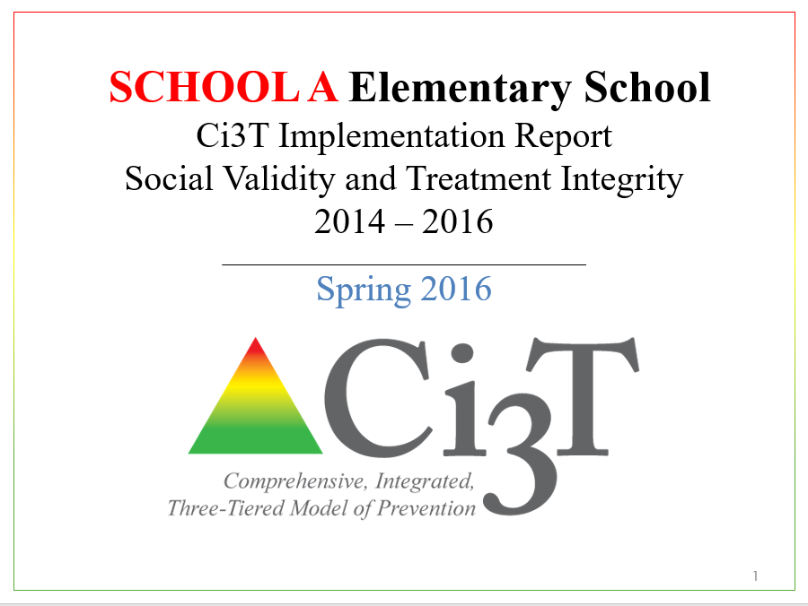
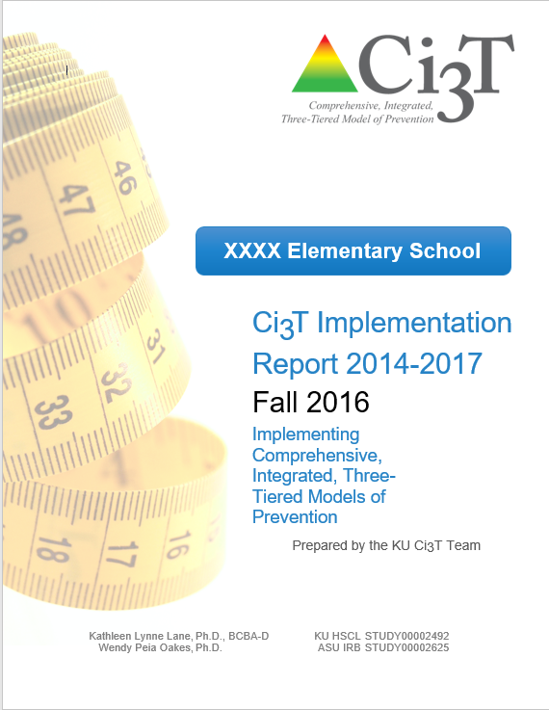
Essential Components of Primary Prevention Efforts
Social Validity
Systematic Screening
Academic
Behavior
Treatment Integrity

Slide 11
Student Risk Screening Scale – Internalizing and Externalizing (SRSS-IE; Drummond, 1994; Lane & Menzies, 2009) Elementary

Slide 12
Student Risk Screening Scale – Internalizing and Externalizing (SRSS-IE; Drummond, 1994; Lane & Menzies, 2009) Secondary

Slide 13
SRSS-IE: Cut Scores
Elementary School |  | Middle and High School
SRSS-E7 | SRSS-I5 | SRSS-E7 | SRSS-I6
Items 1-7 | Items 8-12 | Items 1-7 | Items 4, 8-12
0-3 = low risk 4-8 = moderate risk 9-21 = high risk | 0-1 = low risk 2-3 = moderate risk 4-15 = high risk | 0-3 = low risk 4-8 = moderate risk 9-21 = high risk | 0-3 = low risk 4-5 = moderate risk 6-18 = high risk
Elementary School Level:
Lane, K. L., Oakes, W. P., Swogger, E. D., Schatschneider, C., Menzies, H., M., & Sanchez, J. (2015). Student risk screening scale for internalizing and externalizing behaviors: Preliminary cut scores to support data-informed decision making. Behavioral Disorders, 40, 159-170.
Middle and High School Levels:
Lane, K. L., Oakes, W. P., Cantwell, E. D., Schatschneider, C., Menzies, H., Crittenden, M., & Messenger, M. (2016). Student Risk Screening Scale for Internalizing and Externalizing Behaviors: Preliminary cut scores to support data-informed decision making in middle and high schools. Behavioral Disorders, 42(1), 271-284

Slide 14
Sample Elementary School Fall SRSS-E7 (externalizing) Results – All Students
N = 25
N = 16
N = 17
N = 12
N = 12
N = 86
N = 35
N = 57
N = 36
N = 50
N = 250
N = 300
N = 250
N = 255
N = 255

Slide 15
Sample Elementary School Fall SRSS-I5 (internalizing) Results – All Students
N = 72
N = 19
N = 18
N = 32
N = 24
N = 85
N = 43
N = 45
N = 40
N = 45
N = 204
N = 289
N = 261
N = 231
N = 248

Slide 16
Fall 2018 SRSS-Externalizing Results: Grade level
Grade Level | N Screened | Low n (%) | Moderate n (%) | High n (%)
K | 58 | 51 (87.93%) | 6 (10.34%) | 1 (1.72%)
1st | 52 | 40 (76.92%) | 8 (15.38%) | 4 (7.69%)
2nd | 61 | 51 (83.61%) | 6 (9.84%) | 4 (6.56%)

Slide 17
Internalizing Behaviors
What do I need to know?

Slide 18
Anxiety
Depression
Social Withdrawal
Somatic Complaints
Lembke, E. (2012). Tier 2 interventions for internalizing behavior problems. In M. Stormont, W.M. Reinke, K.C. Herman, & E. Lembke (Eds.), Academic and behavior supports for at-risk students: Tier 2 interventions (pp. 69-100). Guilford Press.

Slide 19
Anxiety Disorders
Include …
panic disorders,
obsessive-compulsive disorder (OCD),
post-traumatic stress disorder (PTSD),
social phobia (social anxiety disorder),
specific phobias,
and generalized anxiety disorder (GAD) American Psychiatric Association, 2013
Symptoms for each of these disorders are different, but the commonality is an excessive and/or irrational level of fear and worry.

Slide 20
How many students experience these challenges?
20% of students have or are at risk for Emotional and Behavioral Disorders (EBD), which includes internalizing and externalizing challenges (Forness et al., 2012)
30.1% of people experience an anxiety disorder at some time during adolescence (Merikangas et al., 2010)
12.5% of adolescents experienced a major depressive episode in 2015 (Center for Behavioral Health Statistics and Quality, 2016)

Slide 21
What does anxiety look like in children and youth?
Easily overwhelmed
Sense of dread
Anxiety
Obsessive or intrusive thoughts
Somatic complaints
Lembke, E. (2012). Tier 2 interventions for internalizing behavior problems. In M. Stormont, W.M. Reinke, K.C. Herman, & E. Lembke (Eds.), Academic and behavior supports for at-risk students: Tier 2 interventions (pp. 69-100). Guilford Press.

Slide 22
What does anxiety look like in children and youth?
Overwhelmed easily
Sense of dread
Experience obsessive, intrusive, and bothersome thoughts.
Often accompanied by somatic complaints (e.g., muscle weakness, cramps, fatigue, frequent bathroom trips)
May itself be a symptom of depression

Slide 23
How does anxiety impact school experiences?
Students with anxiety may…
have difficulty with academic engagement
experience social withdrawal
Internalizing behaviors may lead to social and academic impairments (Mychailyszyn, Mendez, & Kendall, 2010)
(Erath, 2007; Rapee & Heimberg, 1997)

Slide 24
Students with internalizing concerns
Discuss
How do internalizing concerns (anxiety, depression, somatic complaints, social withdrawal) impact students you work with?
What are some of the challenges associated with helping these students?
Do you have a systematic approach in place for locating students with internalizing concerns and connecting them with supports?
Have you noticed changes in patterns of students with internalizing concerns this year (e.g., COVID-19)?
Notes:
10-min timer

Slide 25
Anxiety
Strategies across the Tiers

Slide 26
Intervention Name | Prevent | Early Intervention | Intensive Intervention
Cognitive Behavior Therapy
Cognitive Restructuring
Contingency Management
Exposure-Based Techniques
Family Therapy
Modeling (live and video)
Psychoeducation
Relaxation Training
Self-Monitoring / Self-Assessment
TBD
TBD
TBD

Slide 27
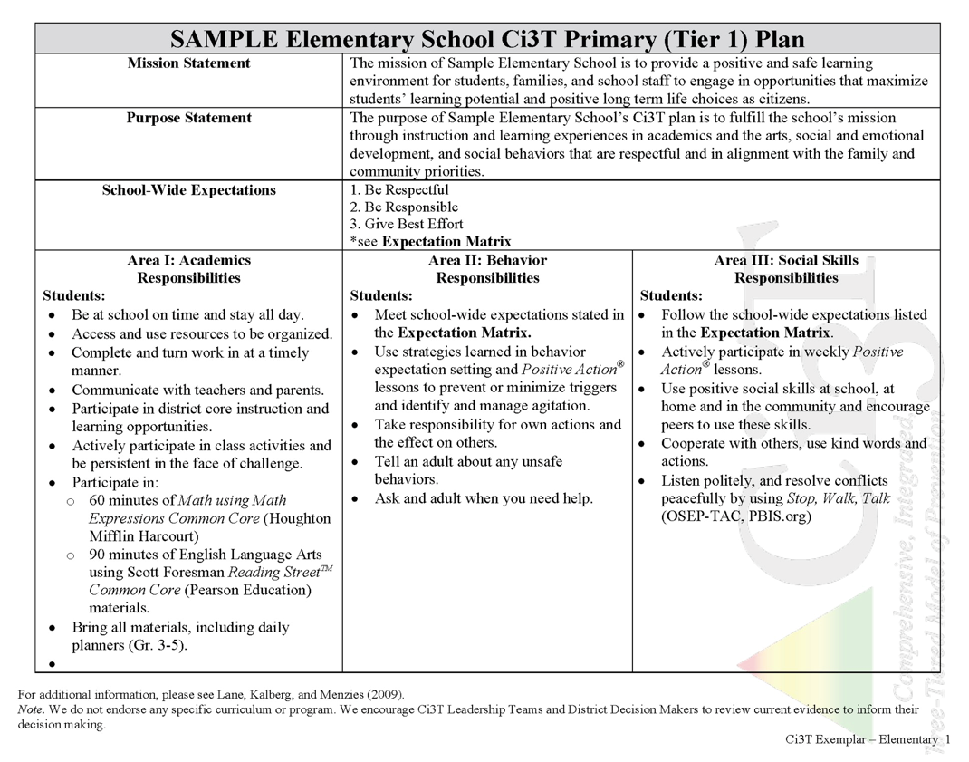

Slide 28
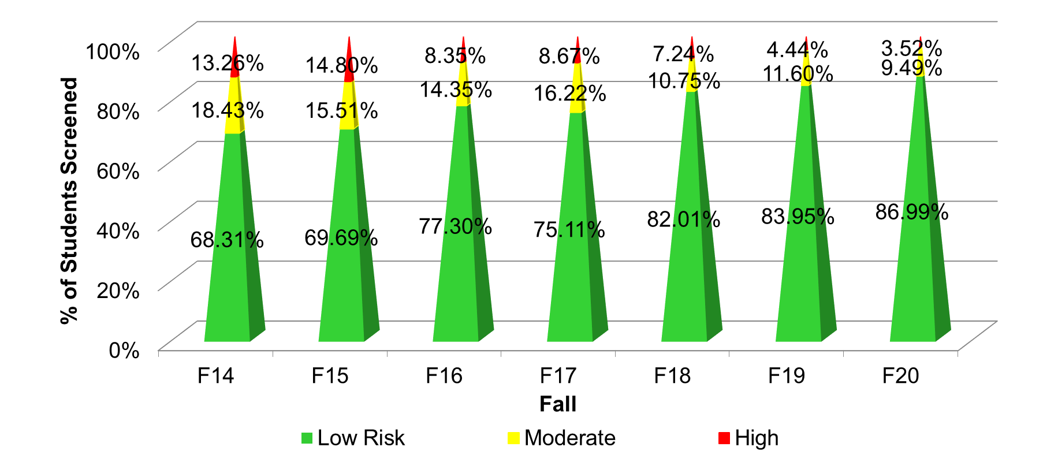
Fall 2020 SRSS-Internalizing Results – School level
n = 59
n = 62
n = 39
n = 39
n = 31
n = 18
n = 13
n = 82
n = 65
n = 67
n = 73
n = 46
n = 47
n = 35
n = 304
n = 292
n = 361
n = 338
n = 351
n = 340
n = 321
Cut scores vary by school level:
Elementary (I5): Low (0-1), Moderate (2-3), High (4-15)
Middle and High (I6): Low (0-3), Moderate (4-5), High (6-18)
Notes:
Fill in <year> based on current academic year. This is located in column A of the data sheet. Edit by right clicking and selecting “Edit data”.
IMPORTANT NOTE: The INTERNALIZING subscale and CUT SCORES are specific to school level.
Elementary: SRSS-I5, Items 8-12, 0-1 = low risk, 2-3 = moderate risk, 4-15 = high risk
Middle and High: SRSS-I6, Items 4, 8-12, 0-3 = low risk, 4-5 = moderate risk, 6-18 = high risk

Slide 29
Relaxation Training
A strategy for use across the tiers

Slide 30
What is Relaxation Training?
Relaxation training teaches children to begin using ways to relax
Monitoring muscle tension created by stressful situations and events and by controlling irregular breathing

Slide 31
GOAL: Relaxation lowers anxiety through physiologic responses to slower breathing and slower thinking.
Identify the context in which anxiety occur.
Provide options for relaxation training based on student strengths and interest.
Teach procedures through modeling, practice, and feedback.

Slide 32
Why Relaxation Training?
Physical discomfort caused by tension can exacerbate common anxiety symptoms, causing a child to become even more anxious.
Relaxation techniques include counting, breathing exercises, recall, mental imagery, and progressive muscle relaxation (Kahn, Kehle, Jenson, & Clarke, 1990).

Slide 33
Relaxation Protocol
Photo credit. Rebecca Sherod
Morris, R. J., Shah, K., & Morris, Y. P. (2002). Internalizing behavior disorders. In K. L. Lane, F. M. Gresham, & T.E., O’Shaughnessy (Ed.) Interventions for children with or at risk for emotional and behavioral disorders (pp. 223-241). Allyn & Bacon.​

Slide 34
Secondary (Tier 2) Intervention Grids

Slide 35
Self-Monitoring
A secondary (Tier 2) intervention for students experiencing internalizing challenges

Slide 36
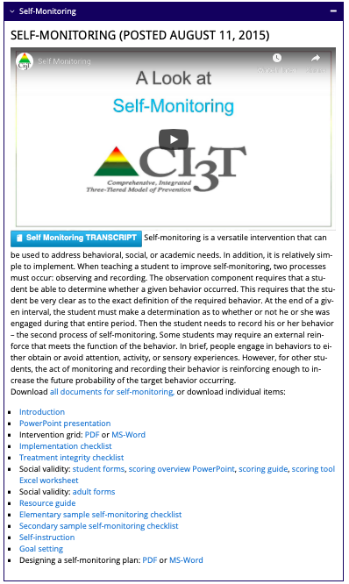
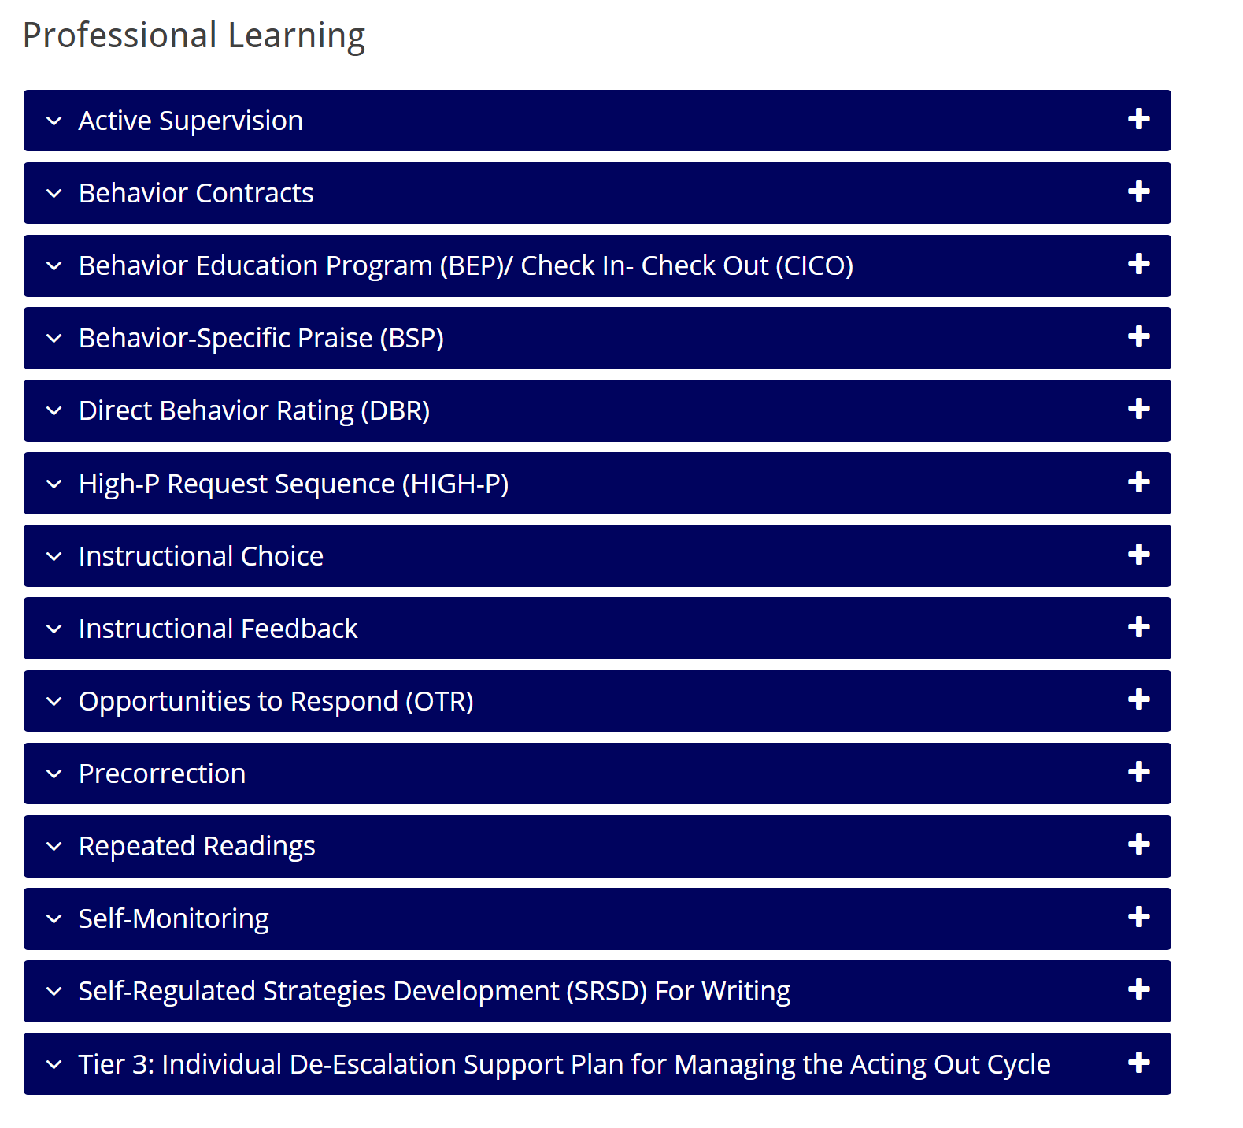

Slide 37
What is self-monitoring?
One commonly used self-management strategy
Involves teaching students to:
Observe, or determine if a behavior occurred using an operational definition
Record whether or not the behavior occurred

Slide 38
Why is self-monitoring effective?
Easy
Convenient
High social validity (students like it)
Promotes independency and self-determined behaviors
Impacts behavior and academic components

Slide 39
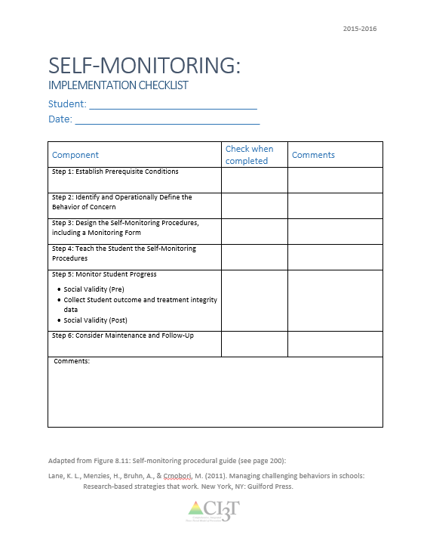
Implementing Self-Monitoring in Your Classroom: Implementation Checklist
Step 1: Establish Prerequisite Conditions
Step 2: Identify and Operationally Define the Behaviors
Step 3: Design the Self-Monitoring Procedures, Including a Monitoring Form
Step 4: Teach the Self-Monitoring Procedures
Step 5: Monitor Student Progress
Step 6: Consider Maintenance and Follow-Up
See Implementation folder for
“Self-Monitoring Implementation Checklist”

Slide 40
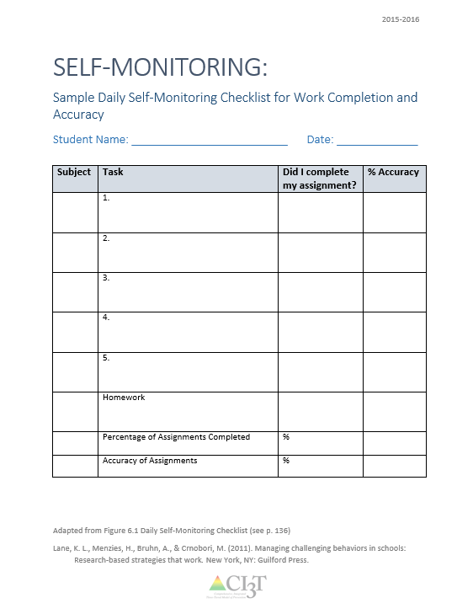
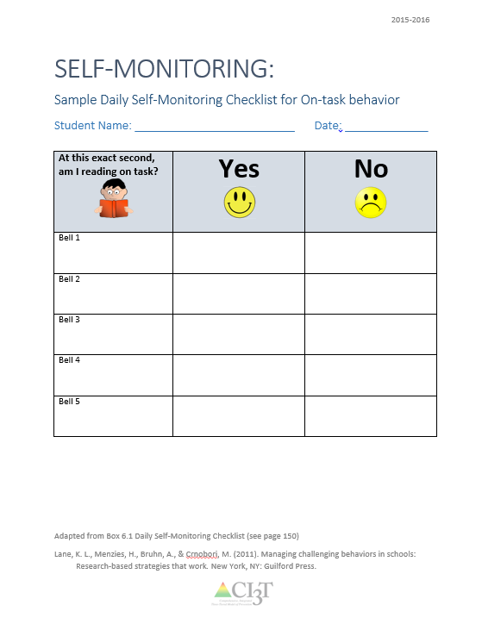
Example: Daily Self-Monitoring Checklist
See Implementation folder for
“Self-Monitoring Secondary Sample Checklist”
See Implementation folder for
“Self-Monitoring Elementary Sample Checklist”

Slide 41
Sample Elementary Secondary (Tier 2) Intervention Grid
Support | Description | School-wide Data: Entry Criteria | Data to Monitor Progress | Exit Criteria
Self-monitoring | Strategy implemented by student and teacher to improve academic performance (completion/ accuracy), academic behavior, or other target behavior. | Behavior: SRSS-E7 score: Moderate (4-8) SRSS-I5 score: Moderate (2-3) or SRSS-E7 score: High (9-21) SRSS-I5 score: High (4-15) or 2 or more office discipline referrals (ODR) AND/OR Academic: Progress report: 1 or more course failures or AIMSweb: intensive or strategic level (math or reading) or Progress report: Targeted for Growth for academic learning behaviors | Work completion and accuracy of the academic area of concern (or target behavior named in the self-monitoring plan) Grades on progress reports Social Validity: Teacher: IRP-15 Student: CIRP Treatment Integrity: Implementation & treatment integrity checklist | SRSS-E7 score: Low (1-3) SRSS-I5 score: Low (1-2) Passing grade on progress report or report card in the academic area of concern (or target behavior named in the self-monitoring plan)
Notes:
Sample

Slide 42
Self-monitoring internalizing behaviors
Recognize anxious feelings
Learn relaxation strategies
Record feelings, strategies, & engagement

Slide 43
Tertiary (Tier 3) Intervention Grids

Slide 44
Cognitive Restructuring
A tertiary (Tier 3) intervention for students experiencing internalizing challenges

Slide 45
GOAL: To modify the cognitions associated with anxiety, thereby reducing it.
Identify erroneous beliefs or anxious thinking.
Challenge the reality of these beliefs or thoughts.
Change the thinking to something more rational or probable.

Slide 46
What is Cognitive Restructuring?
Includes teaching students to:
Identify irrational thoughts and replace them with more realistic ones
Identify and classify irrational thoughts during anxiety-provoking events
Modify irrational thoughts by making realistic appraisals of the events

Slide 47
Cognitive Restructuring
De-catastrophizing
Rational analysis
Decentering
Re-attribution training
Reframing / relabeling

Slide 48
Sample Elementary Tertiary (Tier 3) Intervention Grid
Support | Description | School-wide Data: Entry Criteria | Data to Monitor Progress | Exit Criteria
Cognitive Restructuring | Individual or small group intervention lead by related service provider (e.g., counselor) using strategies rooted in Cognitive Behavior Therapy (CBT) to teach students to identify irrational emotions or thoughts, test the reality of those thoughts, and develop rational thoughts to replace depressive/anxious ones (Vannest et al., 2015). Intervention provided over 5-12 sessions. | Behavior: SRSS-E7 score: Moderate (4-8) SRSS-I5 score: Moderate (2-3) AND/OR 2 or more office discipline referrals (ODR) AND/OR 4 or more nurse visits AND/OR 2 or more unexcused absences over the past 4 weeks AND Parent permission | Student measures: Attendance Student record of self-monitoring Permanent products (e.g., assignments completed) Treatment integrity: Treatment integrity checklist (e.g., adherence to intervention protocol) Social validity: Teacher: IRP 15 Student: CIRP | SRSS-E7 score: Low (0-3) SRSS-I5 score: Low (0-1) AND/OR no ODR over last 6 weeks AND/OR No nurse visits over 4-week period (except for visits necessary for medication, injury, illness) AND/OR Attendance: no unexcused absences over 4-week period
Notes:
Sample

Slide 49
Functional Assessment-based Interventions (FABI)
A tertiary (Tier 3) intervention for students experiencing internalizing challenges

Slide 51
Strategies across the tiers
Which strategies would you like to explore?
Relaxation Training: Tiers 1-3
Self-Monitoring: Tier 2
Cognitive Restructuring: Tier 3
Functional Assessment-based Interventions (FABI)
Notes:
10-min timer

Slide 52
Anxiety
Strategies to Share with Parents

Slide 53
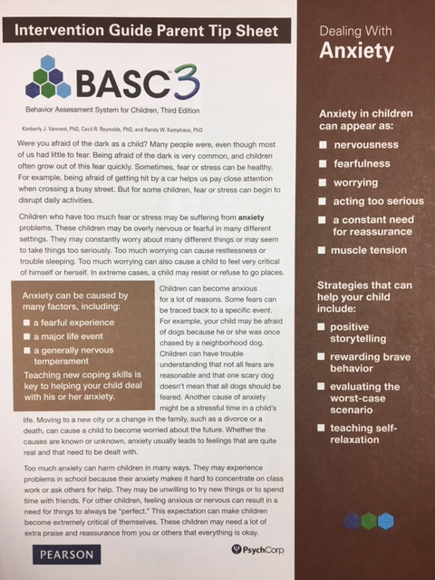
Strategies and resources
Positive storytelling
Rewarding brave behavior
Evaluating the worst-case scenario
Teaching self-relaxation
Sharable resources available as part of the BASC3 (via pearsonassessments.com)
Notes:
https://www.pearsonassessments.com/store/usassessments/en/Store/Professional-Assessments/Behavior/Comprehensive/BASC-3-Intervention-Guide-%26-Materials/p/100001522.html

Slide 54
Positive storytelling
Parents can use a narrative or “story” to help children understand and navigate anxiety-provoking situations
Steps:
Identify one event that causes worry.
Create a story describing child as the main character
Use details to illustrate how to handle the situation
Use positive descriptions to describe actions, feeling
Visualize the worry as a cartoon character
Teach child to think about story when worrying
Provide positive feedback

Slide 55
Positive storytelling
When Josef hears thunder, he hides in his closet. Josef’s father sat with him after dinner and told a story about space travel. Josef loved any story with stars or planets. His father asked Josef to imagine himself in his own spaceship, with its curved windows, its dials and levers, and the black space and stars outside. Josef’s father asked him to imagine a planet exploding. It was loud, like thunder, but Josef wasn’t afraid because his spaceship kept him safe. Josef’s father had him imagine his spaceship during the next storm, and Josef felt braver when he heard thunder.

Slide 56
Rewarding brave behavior
Parents can encourage a child to face anxious or fearful situations by using reward
Steps:
Make a list of brave behaviors with the child
Start small, move toward bigger/harder behaviors
Work together, then gradually withdraw to encourage independence
Choose rewards for each behavior that are
realistic,
of value, and
available immediately after performing behavior
Be generous with praise!

Slide 57
Rewarding brave behavior
Nadia has always been shy, and her eighth-grade teacher asks every student to make speeches. Nadia often complains of a headache and misses school on days when it’s her turn to talk in front of the class. Nadia’s mom talks with her about having similar feelings when she was in high school. They agree on some rewards for taking small steps and facing her fear. If she goes to school without complaints on speech days, she would be excused from washing dishes that night. When she gives a speech, she could spend extra time with her friends at the mall. When she passes the class, she could choose a new music CD or DVD.

Slide 58
Evaluating the worst-case scenario
Parents can help a child who feels anxiety by showing how unlikely the worst-scenario is or by providing reassurances
Steps:
Ask the child to tell you the worst-case scenario of a situation or fear
Listen for all-or-nothing statements about the bad things that may happen (e.g., saying, “everyone will hate me,” or “no one ever believes me”)
Ask your child the likelihood that the worst-case scenario might really happen.
Encourage realistic thinking by asking, ”Then what?” and listen for reasonable responses.
Describe the child’s concerns using less extreme language,or discuss how likely something is to happen.
Follow up with giving ideas for more realistic outcomes if the child is frustrated or upset.
Continue until the worst-case scenario becomes something the child can manage

Slide 59
Evaluating the worst-case scenario
Deshawn complained a lot about his after-school job and was critical of himself. He said that the other workers at the library didn’t like him. “What is the worst thing that could happen if all your co-workers don’t like you?” his father asked. He suggested Deshawn could ask for tasks he could do by himself. What if he couldn’t work alone? Deshawn realized that he could find another job. What if he couldn’t find another job? Deshawn and his father agreed that was unlikely but that he could do volunteer work instead. Once he saw that staying at the library was his choice, Deshawn decided to stay on and see what happens.

Slide 60
Teaching self-relaxation
Parents can help a child to relax the body and thereby, reduce anxiety and worry
Steps:
Ask the child to remember the last time he or she felt anxious and explain how it affects his or her body to enter the state of getting ready for danger
Choose a relaxation signal.
For example, when the child feels anxious, he or she could make tight fists. During the relaxation training, the child could try to relax, starting with the hands, while taking slow deep breaths.
Practice when and how to use relaxation by acting it out
Give positive feedback about specific changes in the child’s behavior.

Slide 61
Teaching self-relaxation
Whenever Carly had to go to the doctor, she couldn’t sleep the night before her appointment. She would cry getting into her car, and in the waiting room she could feel her heart beating fast and her shoulders tensing up. Her mom helped Carly make a plan to relax when these feelings came on. Whenever she started to feel scared, she would make a tight fist. Then she would relax her hand and take some deep breaths and try or feel any other tight muscles, relaxing them as well. She could keep her eyes closed until she felt calm. Carly still doesn’t like the doctor’s office, but she can practice being calm at every step.

Slide 62
Strategies to share with parents
Keeping your students in mind, which strategy might be beneficial? Do you feel confident in implementing and sharing them with parents?
Positive Storytelling
Rewarding Brave Behavior
Evaluating the Worst-Case Scenario
Teaching Self-Relaxation
Notes:
10-min timer

Slide 63
Wrapping Up

Slide 64
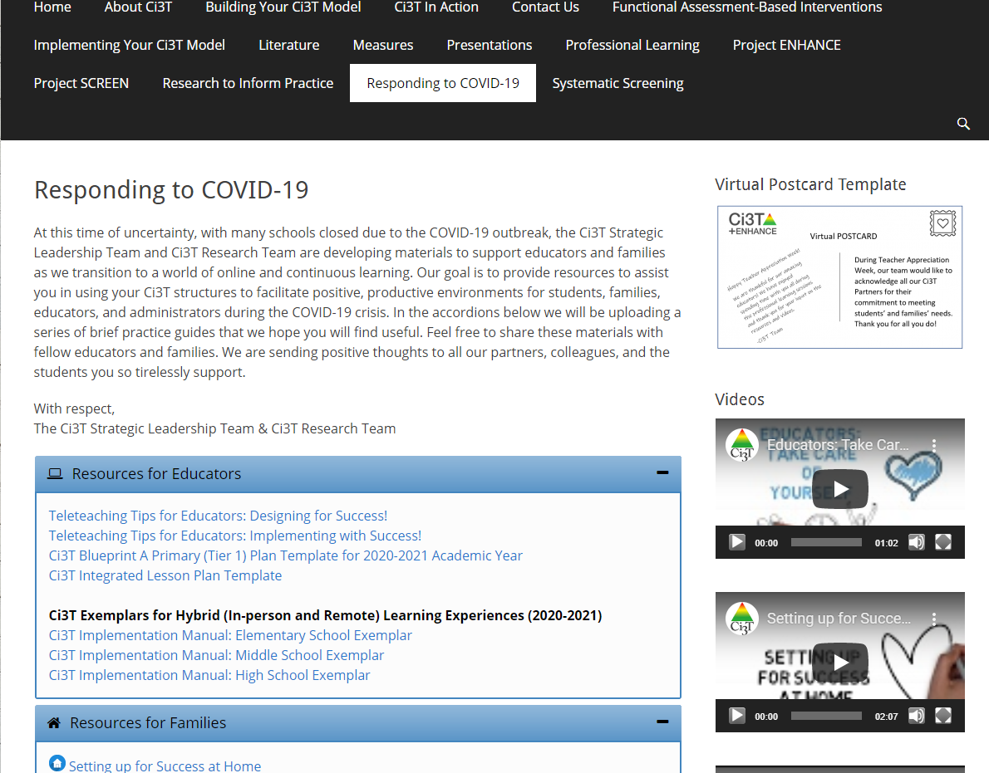
Resources for Responding to COVID-19

Slide 65
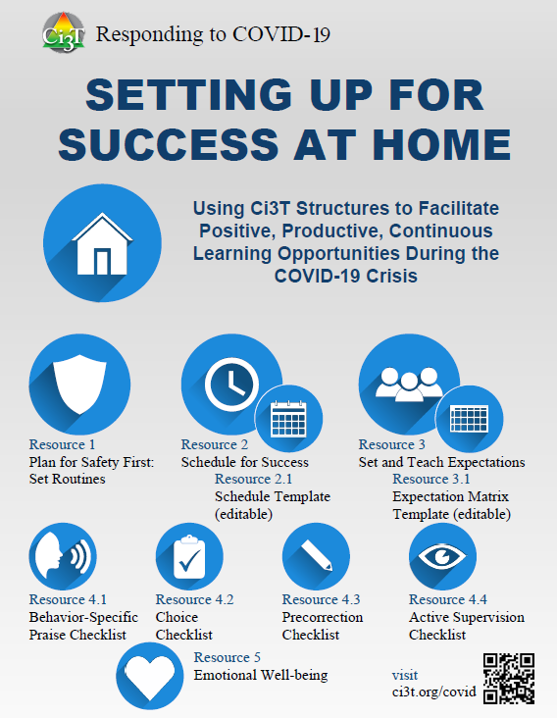
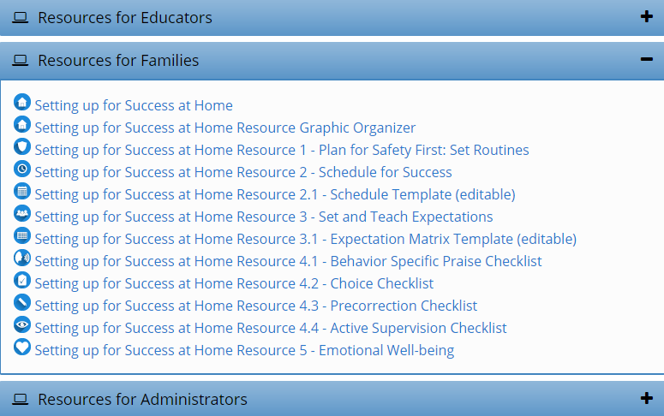
Setting up for Success at Home
http://www.ci3t.org/covid
Notes:
In the accordions below we will be uploading a series of brief practice guides that we hope you will find useful. Feel free to share these materials with fellow educators and families. We are sending positive thoughts to all our partners, colleagues, and the students you so tirelessly support.
Materials to support educators and families as we transition to continuous learning
Using your Ci3T structures to facilitate positive, productive environments for students, families, educators, and administrators

Slide 66
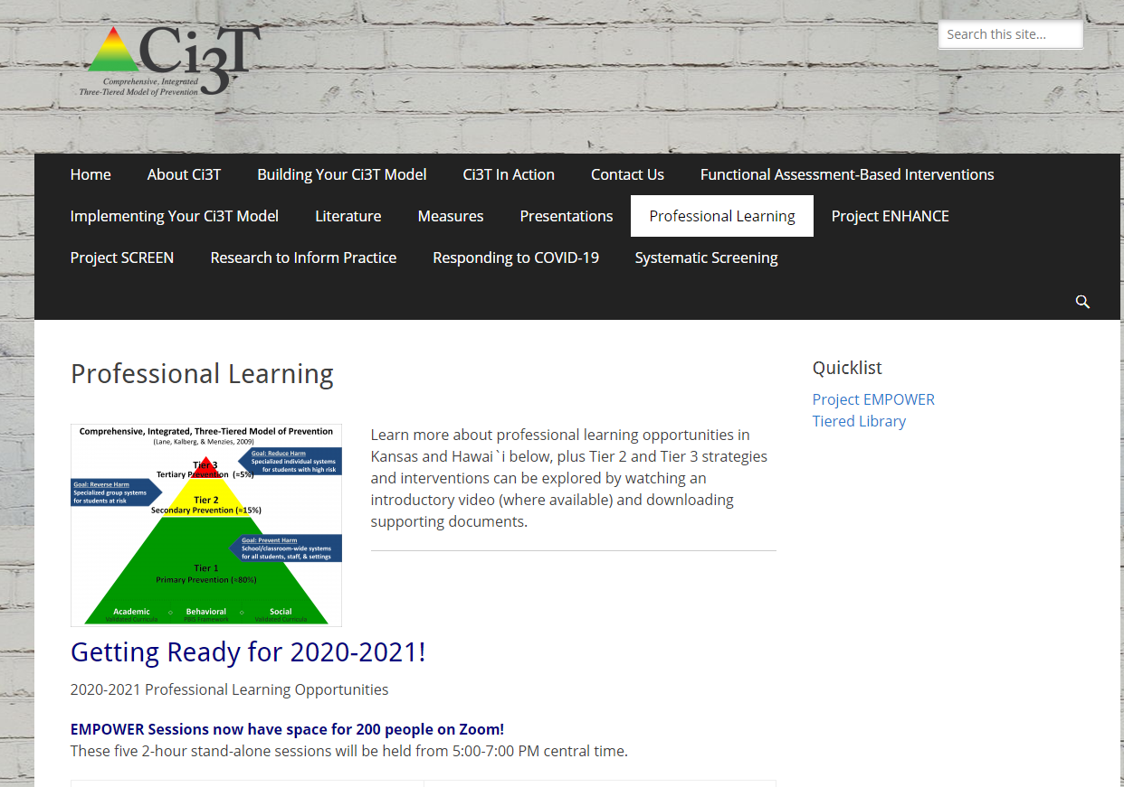
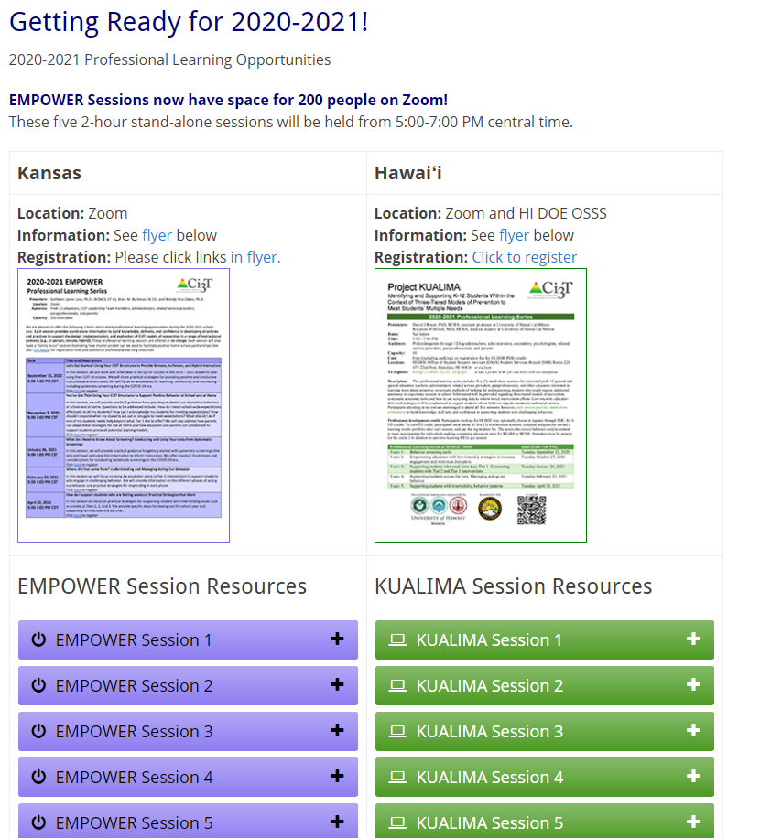
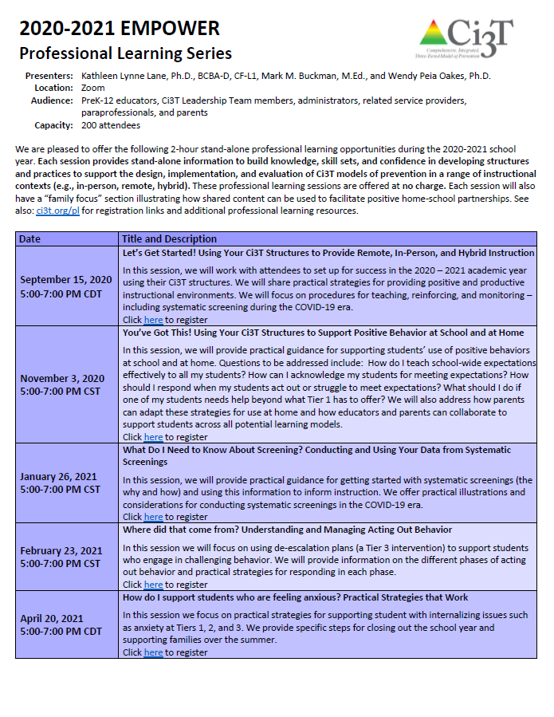
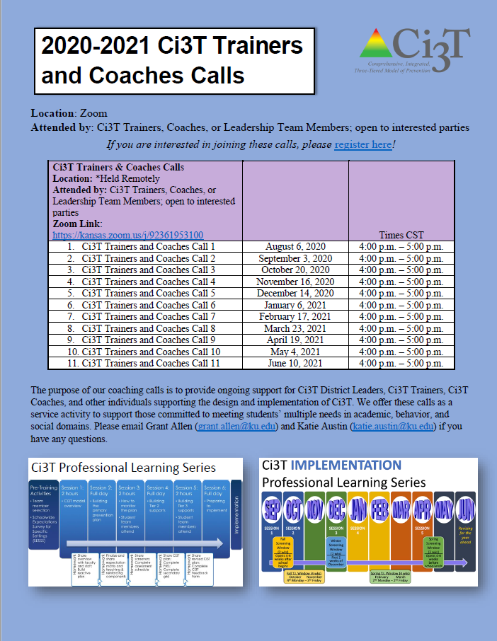
Resources for Responding to COVID-19

Slide 67
Thank you!

