Slide 1
Using your Data to Inform Instruction
Kathleen Lynne Lane, Ph.D., BCBA-D, CF-L1
Wendy Peia Oakes, Ph.D.
Mark M. Buckman, MS.Ed.
David James Royer, Ph.D., BCBA
CI3T IMPLEMENTATION SERIES
Session 3 2020-2021

Slide 2
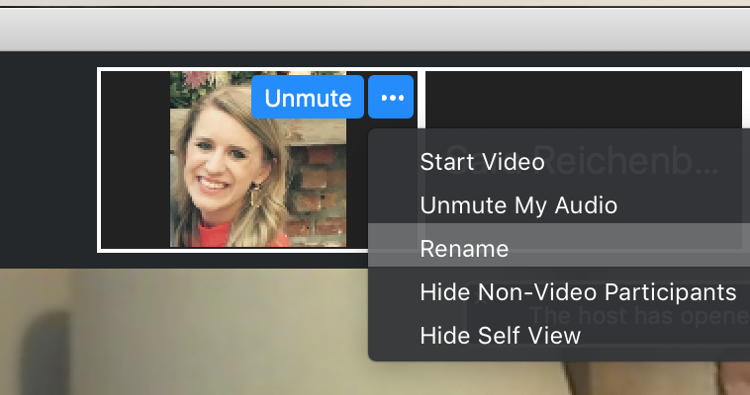
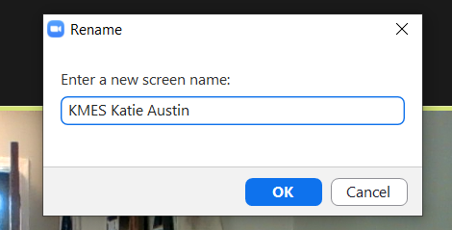
Renaming: School Initials + First and Last Name
To help us put you in breakout rooms with your colleagues today…
1. Click the three dots at the top
right corner of your video square.
2. Rename yourself with your
school name or initials then first and last name.

Slide 3
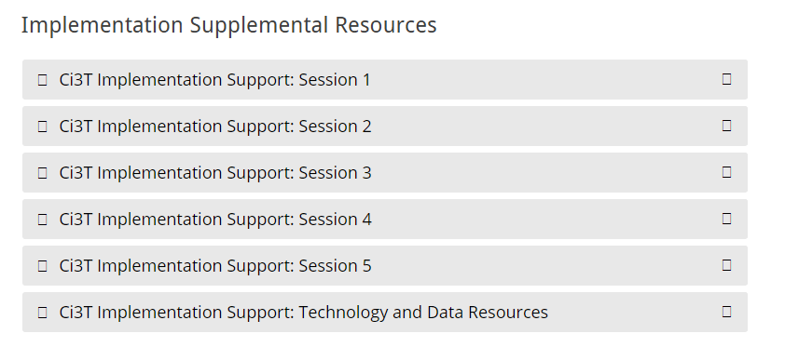
Accessing Professional Learning
Navigate to ci3t.org/imp
Scroll down to the Implementation Supplemental Resources and click to open Session 3

Slide 5
Agenda
Welcome
Procedures for Monitoring
Reviewing your treatment integrity data
Reviewing your social validity data
Reviewing your screening data
Preparing action plans for Spring 2021
Looking Ahead

Slide 6
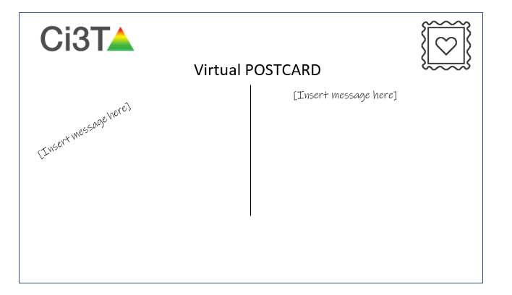
Welcome
Structured Flexibility
Check out new resources on www.ci3t.org

Slide 7
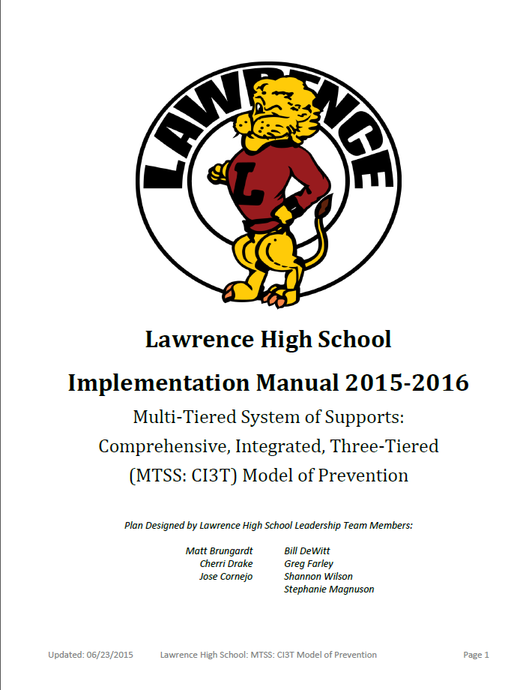
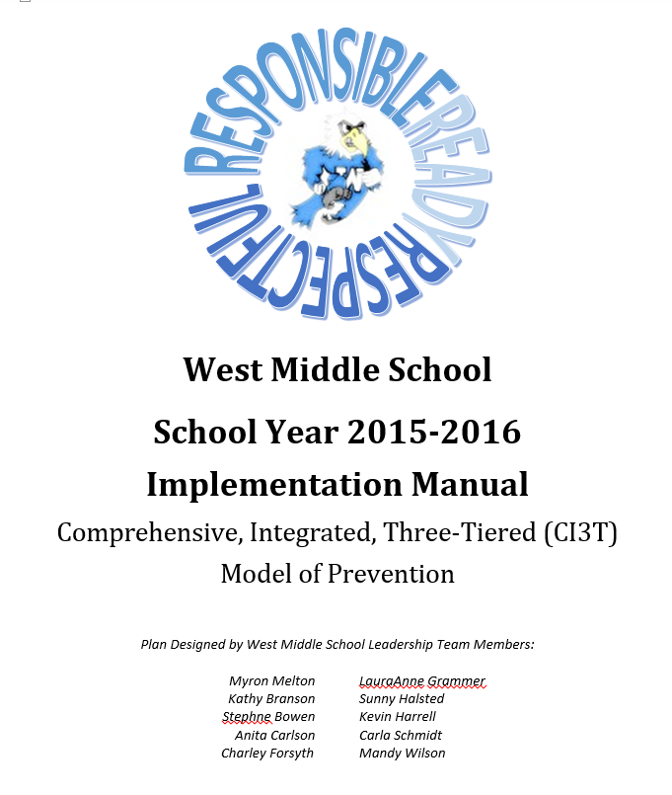
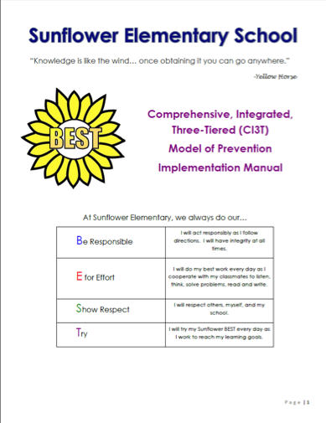
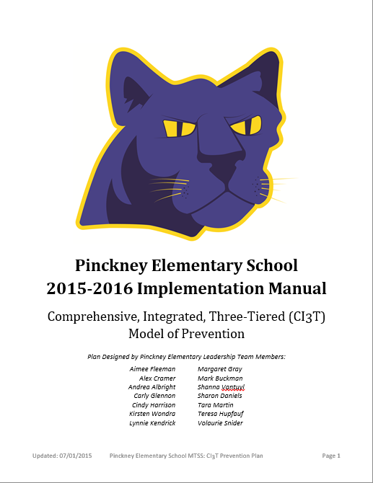
Ci3T 2020 - 2021
Use your Ci3T Structure to Support Transitions
Share you Ci3T Implementation Manual with your Faculty and Staff as Changes Occur

Slide 8
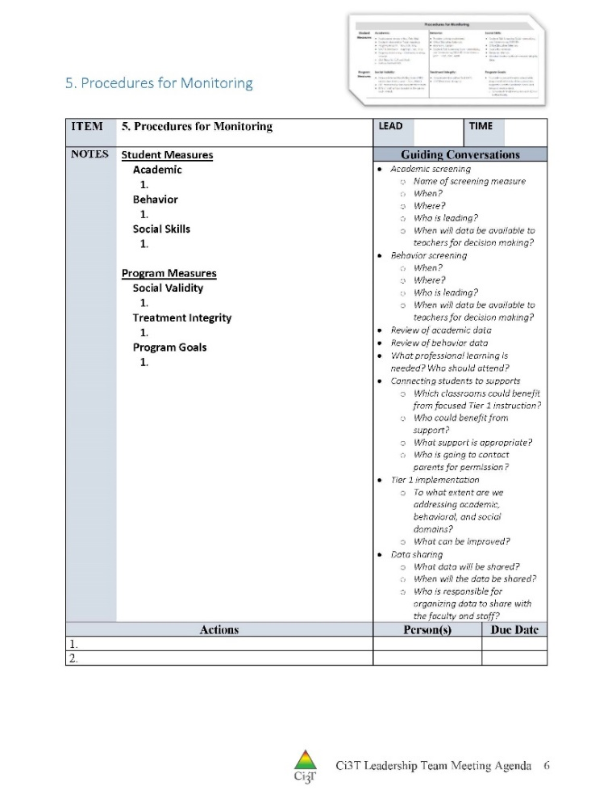
IM18 Ci3T Leadership Team Meeting Agenda TEMPLATE
Predictability

Slide 9
Procedures for Monitoring
Reviewing your treatment integrity data
Reviewing your social validity data
Reviewing your screening data

Slide 10
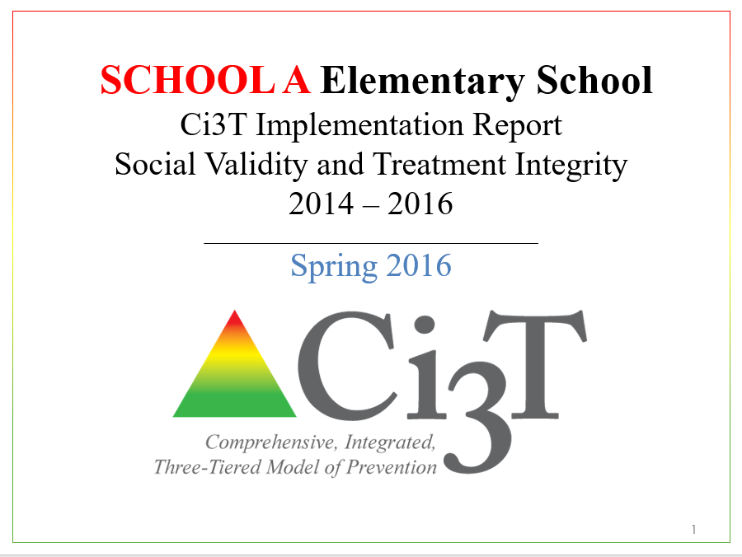
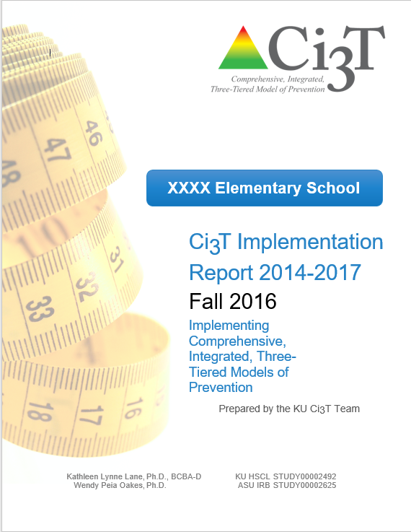
Essential Components of Primary Prevention Efforts
Social Validity
Systematic Screening
Academic
Behavior
Treatment Integrity

Slide 11
Sample Elementary Assessment Schedule
Measure | Aug | Sep | Oct | Nov | Dec | Jan | Feb | Mar | Apr | May
School Demographics
Student Demographic Information | X | X | X | X | X | X | X | X | X | X
Screening Measures
Behavior Screeners: SRSS-IE |  | X |  |  | X |  |  |  | X
Academic Screeners: AIMSWeb | X | X |  |  |  | X |  |  |  | X
Student Outcome Measures - Academic
State & District assessment |  |  |  |  |  |  |  | X | X
Progress reports |  |  |  | X |  |  | X |  |  | X
Student Outcome Measures - Behavior
Absences |  | X | X | X | X | X | X | X | X
Office discipline referrals (ODR) |  | X |  |  | X |  |  |  | X
Counselor referrals | X | X | X | X | X | X | X | X | X | X
Nurse visits | X | X | X | X | X | X | X | X | X | X
Program Measures
Primary Intervention Rating Scale |  |  | X |  |  |  |  | X
School-wide Evaluation Tool |  |  | X |  |  |  |  | X
Ci3T TI: Teacher Self-Report |  |  | X |  |  |  |  | X
Ci3T TI: Direct Observation |  |  | X |  |  |  |  | X
Second Step® Treatment Integrity |  |  | X |  |  |  |  | X
Adapted from Lane, K. L., Oakes, W. P., Cantwell, E. D., & Royer, D. J. (2018). Building and installing comprehensive, integrated, three-tiered (Ci3T) models of prevention: A practical guide to supporting school success V1.2. KOI Education. (Interactive eBook)

Slide 12
Treatment Integrity Is Ci3T being implemented as planned?
Three measures of treatment integrity:
Ci3T Treatment Integrity: Teacher Self-Report (Ci3T TI: TSR)
Ci3T Treatment Integrity: Direct Observation (Ci3T TI: DO)
Tiered Fidelity Inventory (TFI)
Not completed this fall in some districts

Slide 13
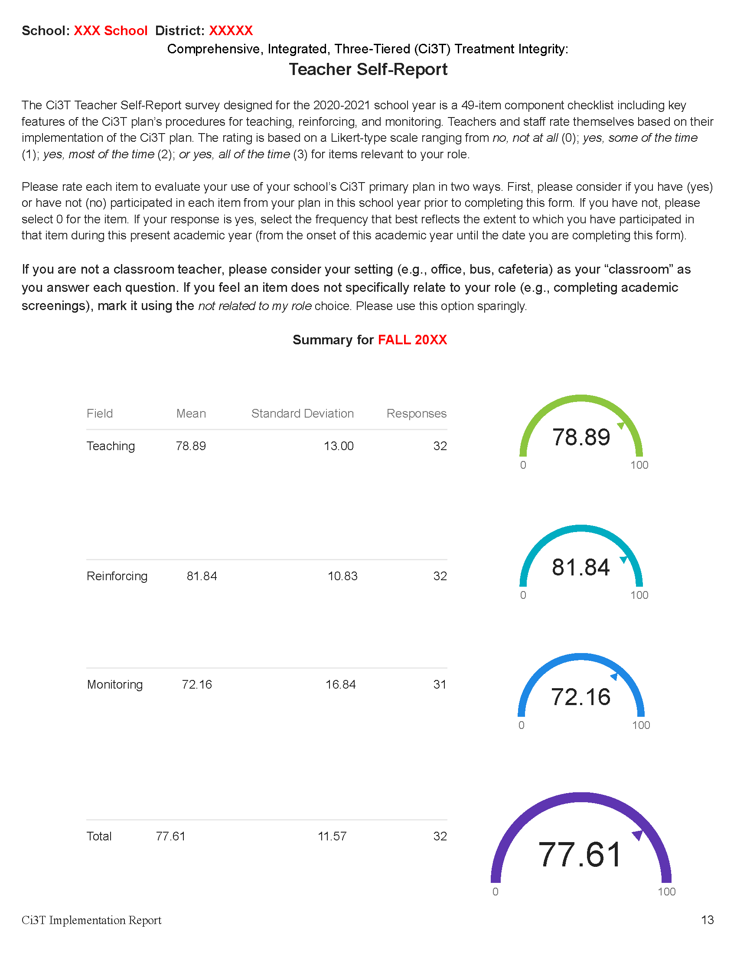
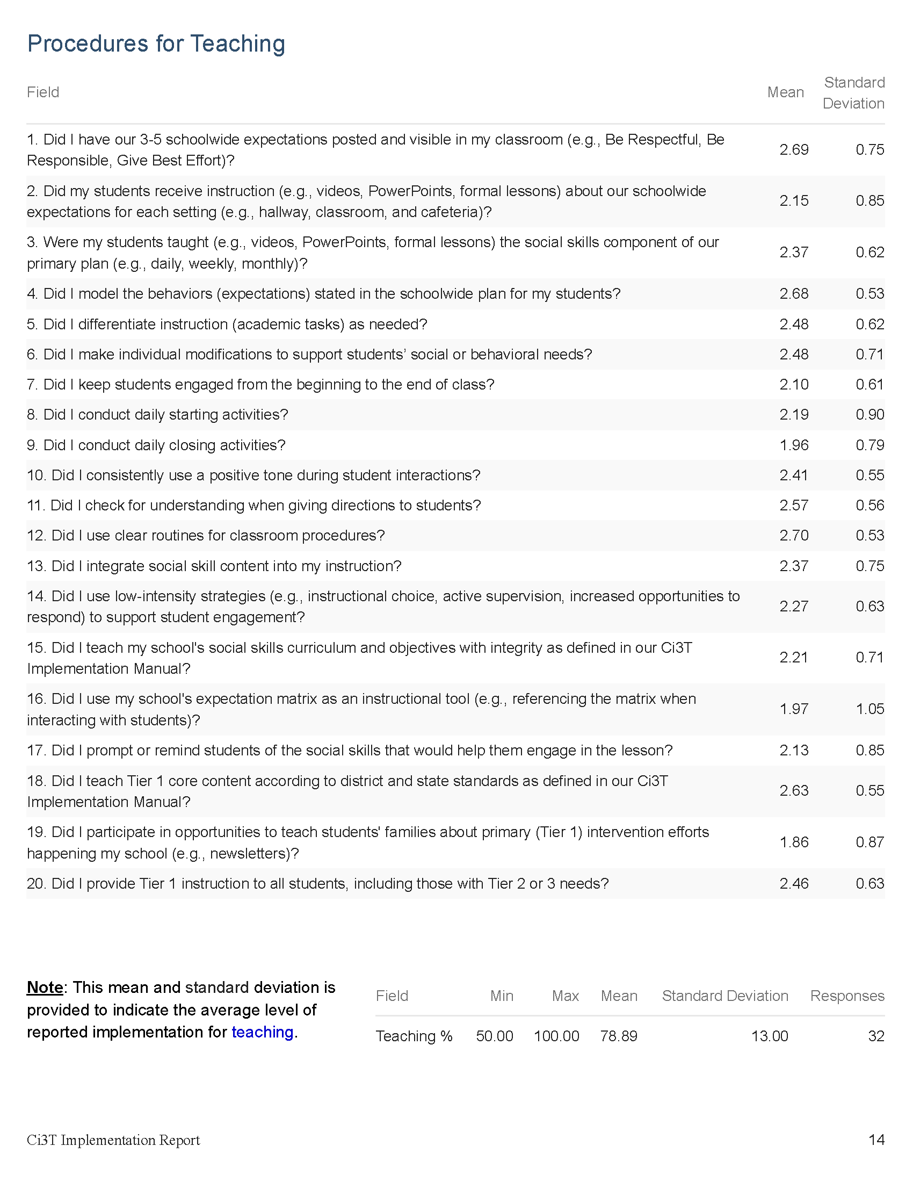
Updated for 2020
*examine only for the 2020-2021 year

Slide 14
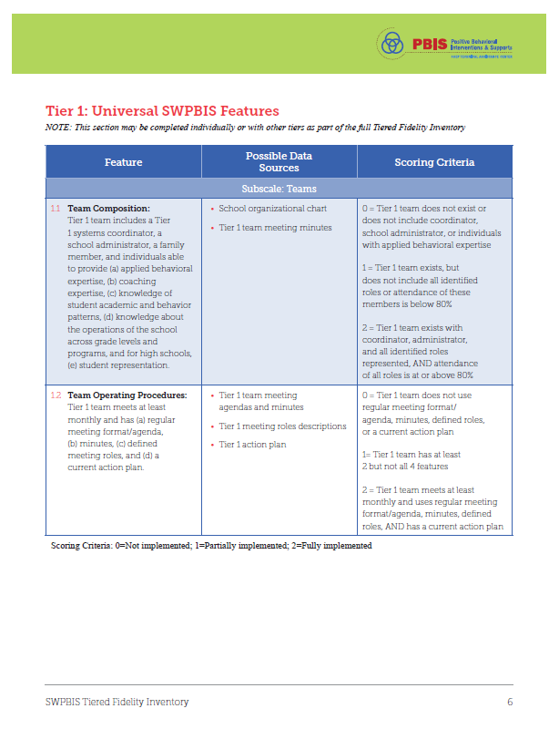

Slide 15
Social Validity How do stakeholders view the plan?
Social validity refers to the level of:
Social significance of intervention goals
Social acceptability of intervention procedures
Social importance of intervention outcomes
(Wolf, 1978)
Assessed using the Primary Intervention Rating Scale (PIRS)
Social Validity: PIRS Results
Year | Fall |  | Spring
 | n | % (SD) | n | % (SD)
2020-2021 | 32 | 85.39 (8.89) | TBD | TBD

Slide 16
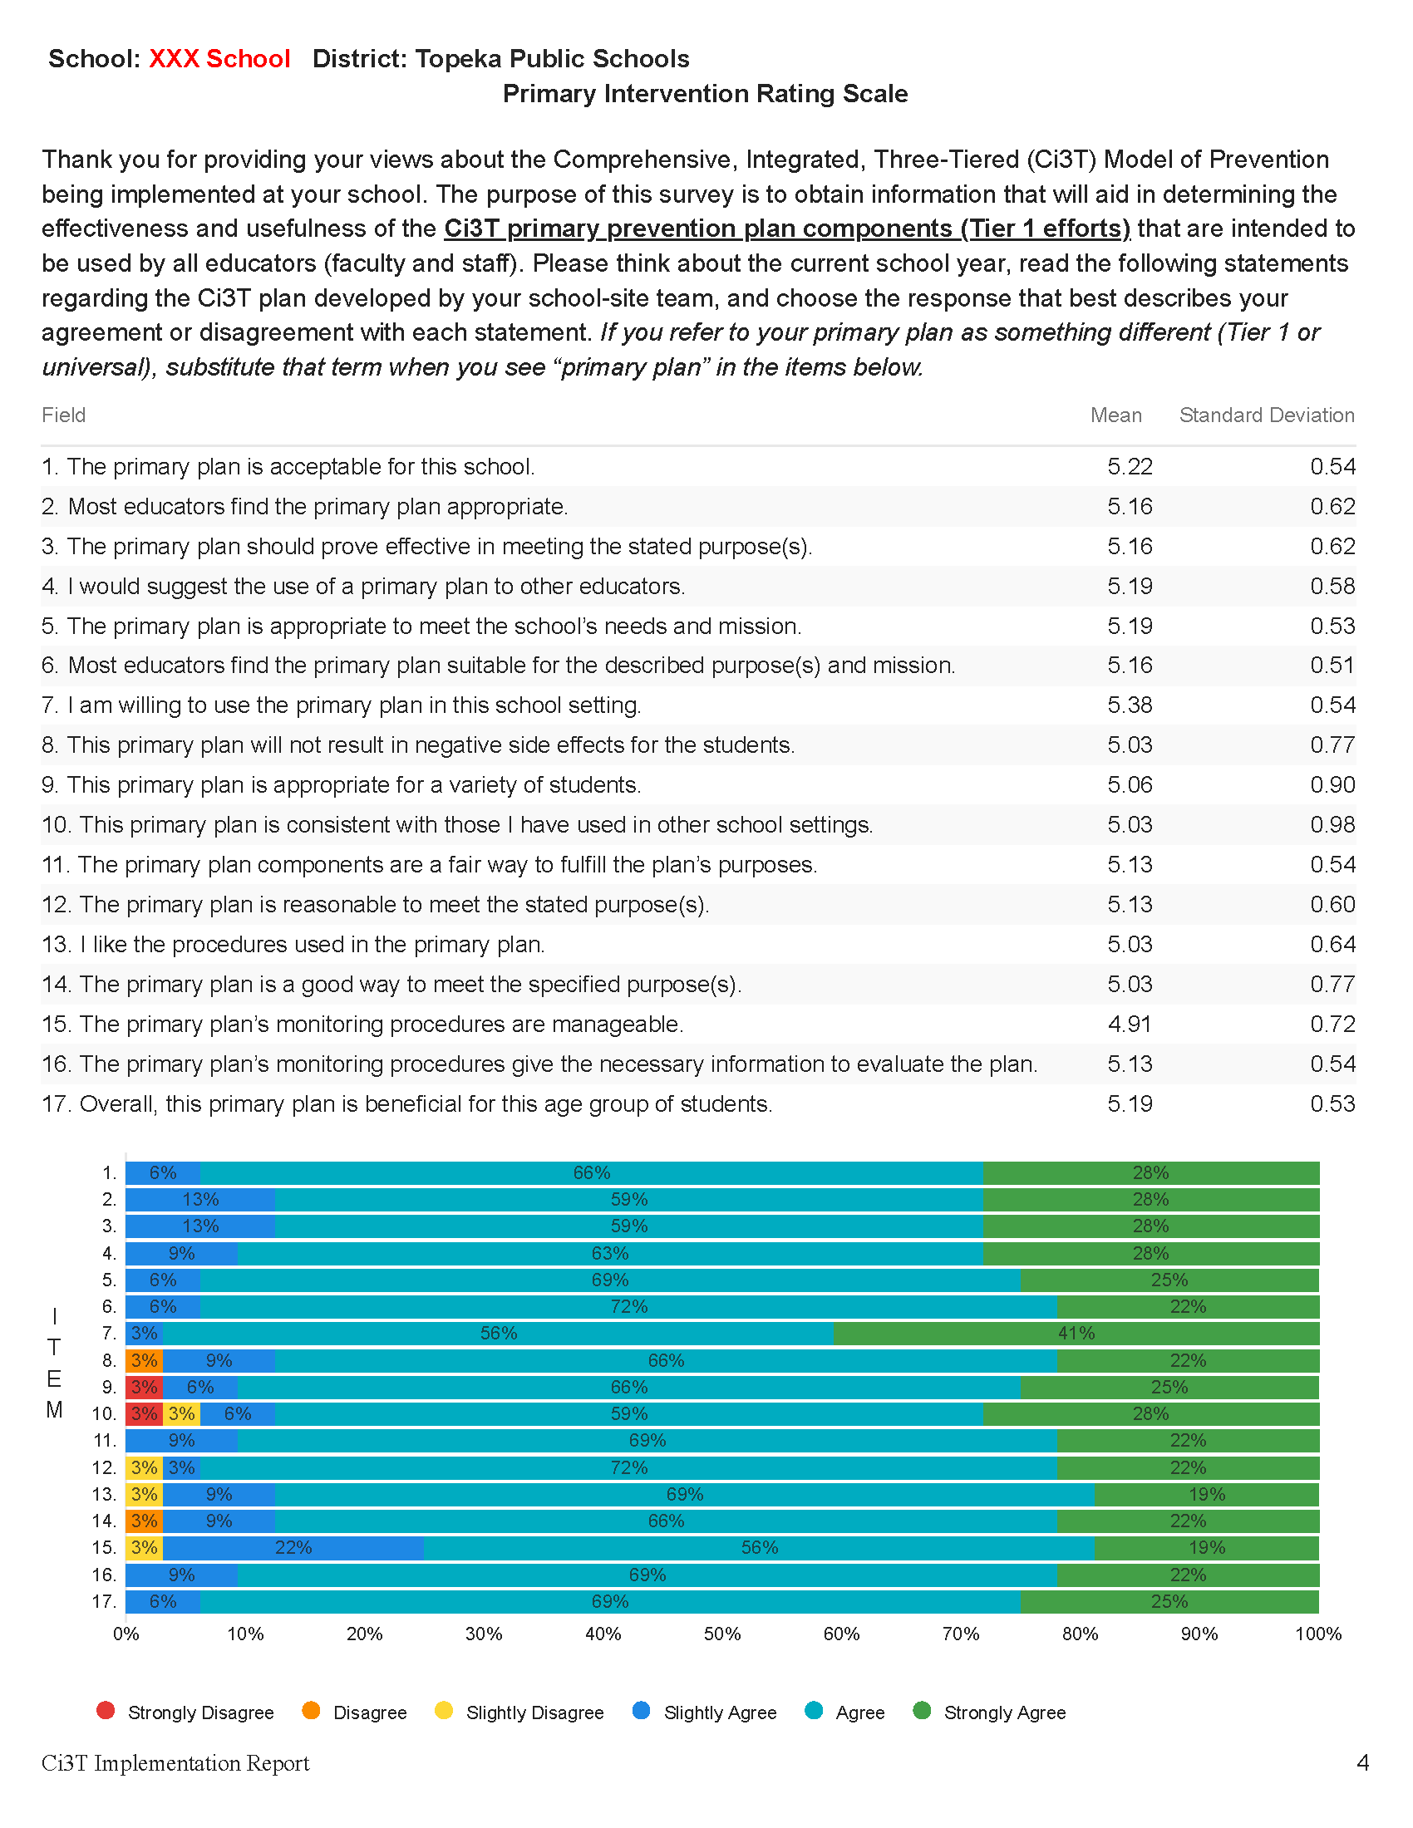
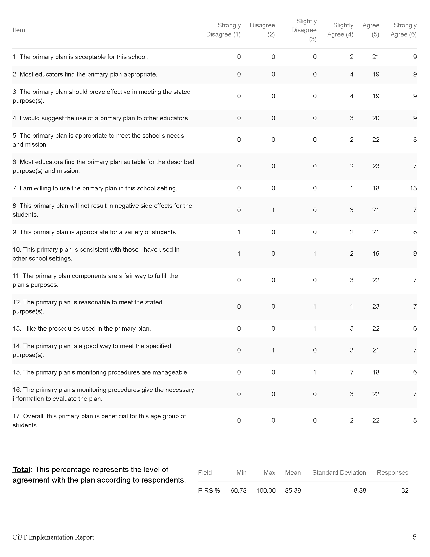

Slide 17
Team Time!
Review data and reports from the following sources:
Primary Intervention Rating Scale (PIRS)
Ci3T Treatment Integrity: Teacher Self Report (Ci3T TI: TSR)
Tiered Fidelity Inventory (TFI)
If you had time to complete Tier 2 and Tier 3 protocols of TFI, review these outcome
Identify successes and areas targeted for growth.
Notes:
20-min timer

Slide 18
Procedures for Monitoring
Reviewing your treatment integrity data
Reviewing your social validity data
Reviewing your screening data

Slide 19
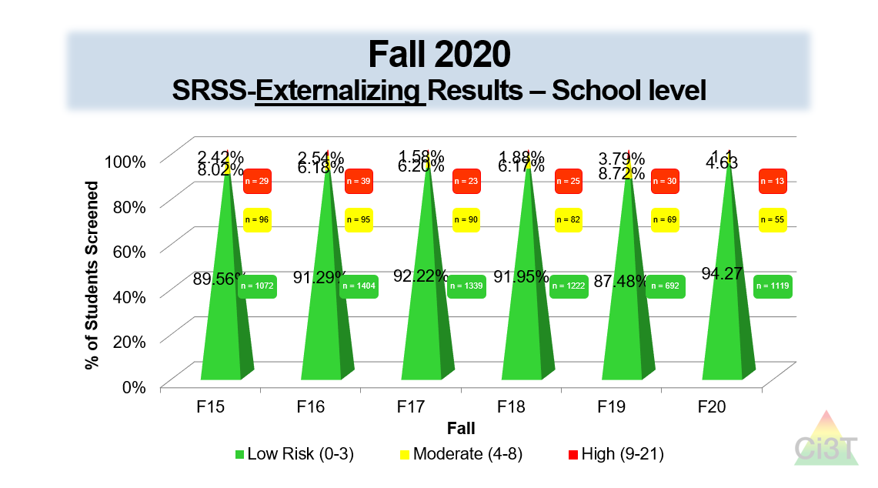

Slide 21
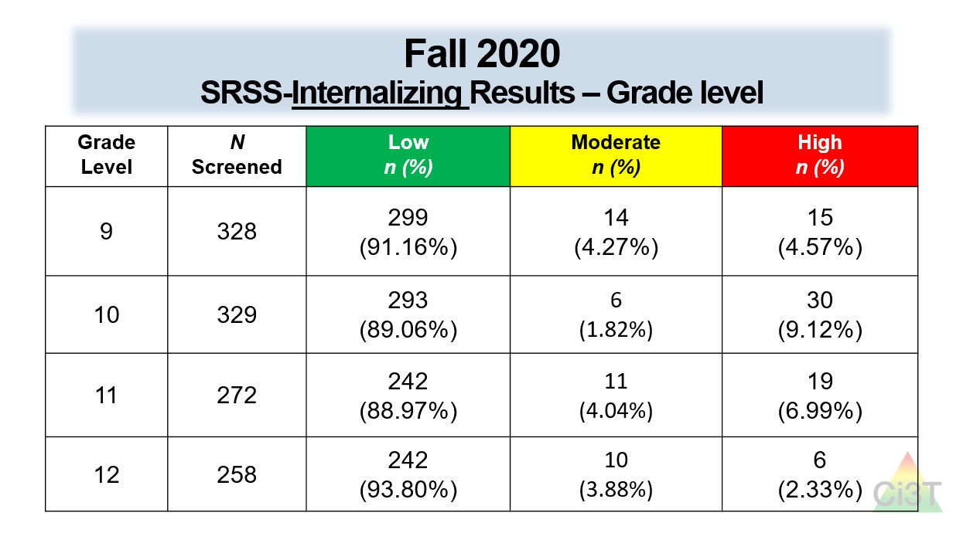

Slide 23
Preparing action plans for Spring 2021

Slide 24
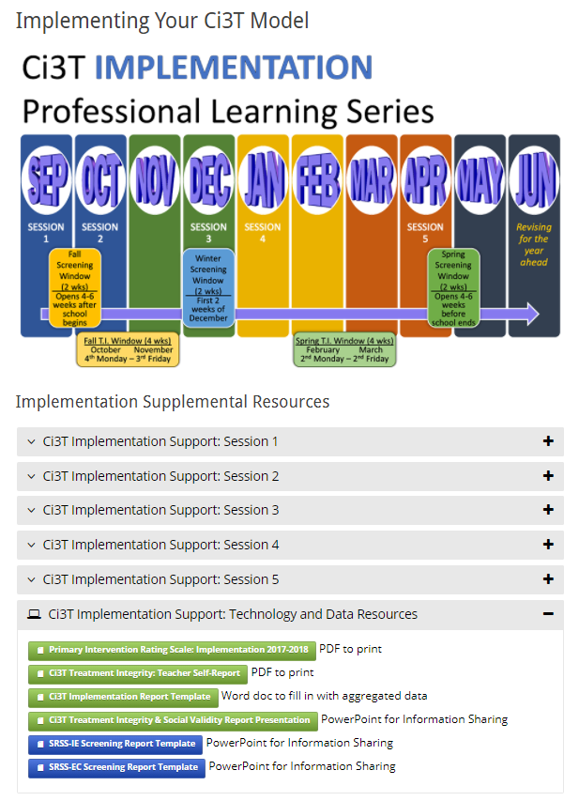
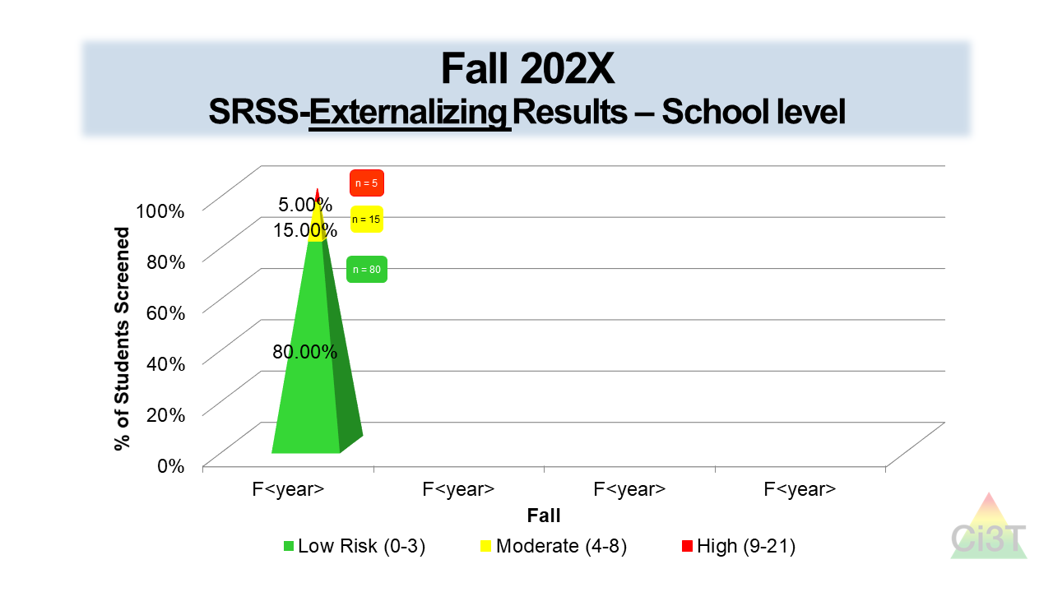
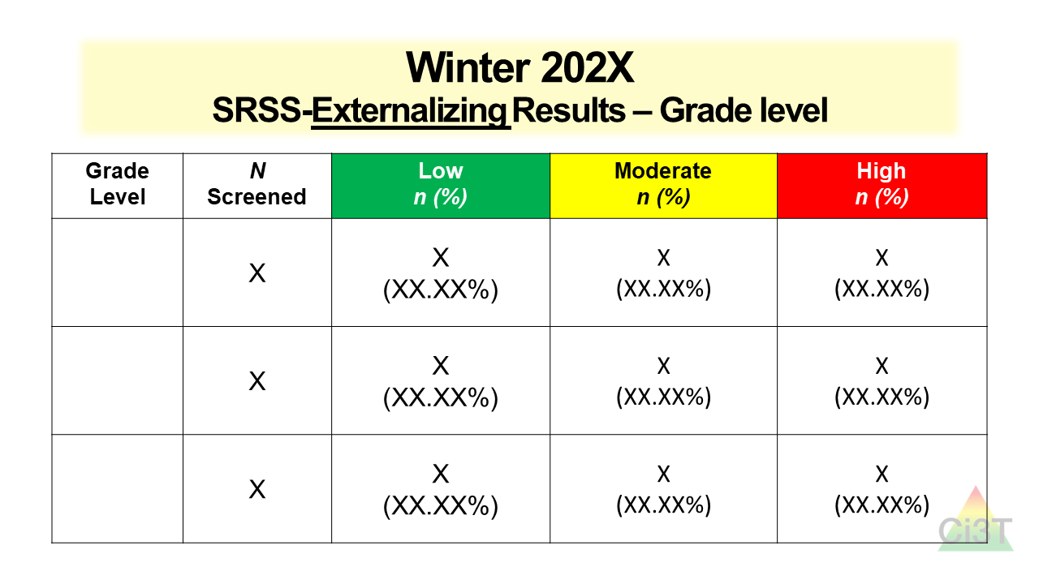
Sharing Screening Data with Faculty and Staff

Slide 25
Data-Informed Decision Making
Non-evaluative
Solutions-based
Identify areas of strength
Let the data drive the conversation

Slide 26
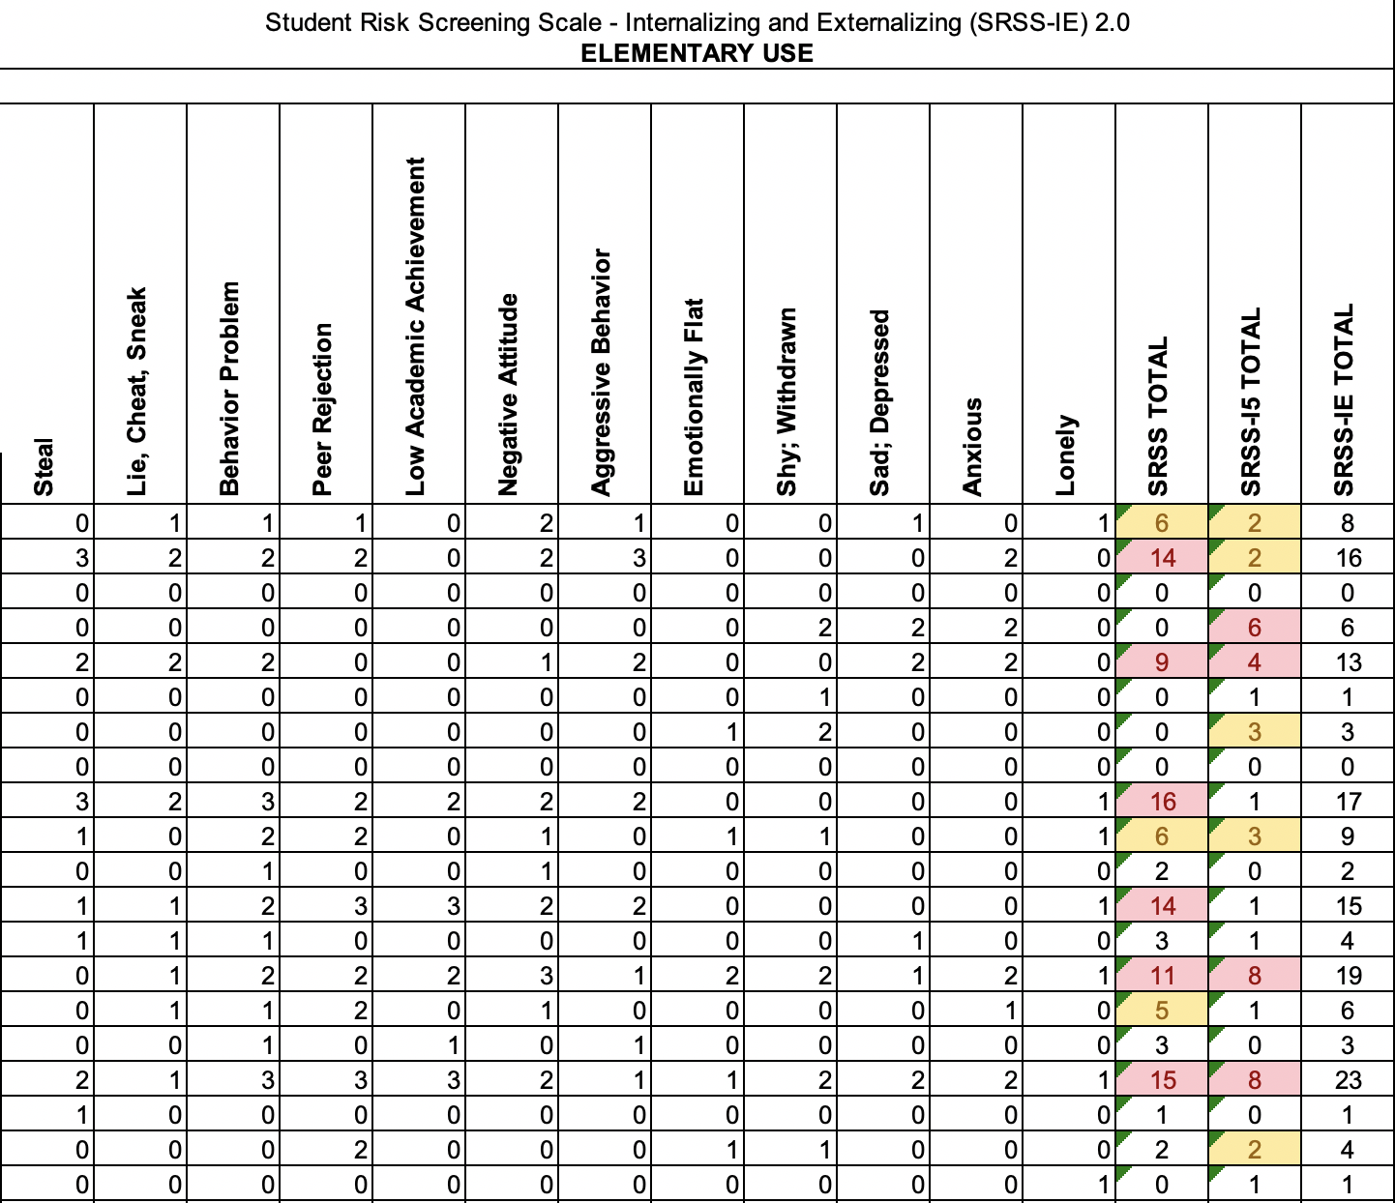
An Illustration
 | Low Risk | Moderate Risk | High Risk
Externalizing | 11 (55%) | 3 (15%) | 6 (30%)
Internalizing | 11 (55%) | 5 (25%) | 4 (20%)

Slide 27
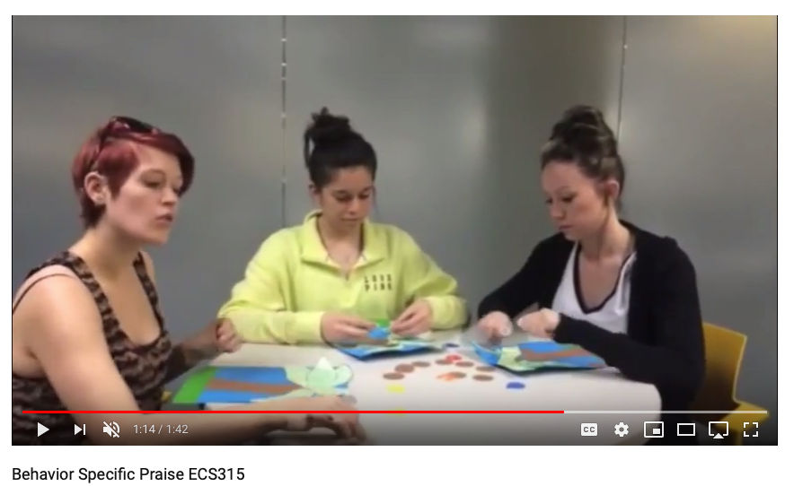
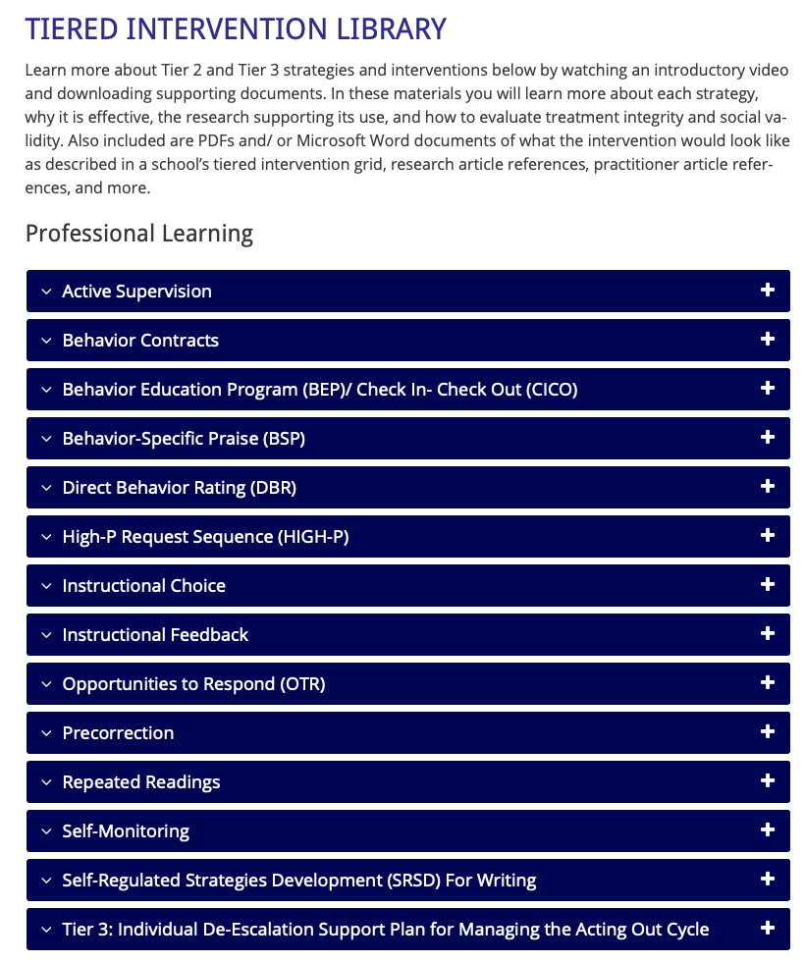
Solutions-based Planning
Re-teach Behavior Specific Praise
An Illustration
Notes:
This slide intended to cover some ideas…e.g., teacher who struggles to engage students and has not taught Social skill curriculum..idea: have learning coach or strong instructional lead co-teach PA lessons while modeling 1 low-intensity strategy (e.g., our “on-site expert” idea). Try to model how effective programs can be when combined with effective instructional strategies.

Slide 28
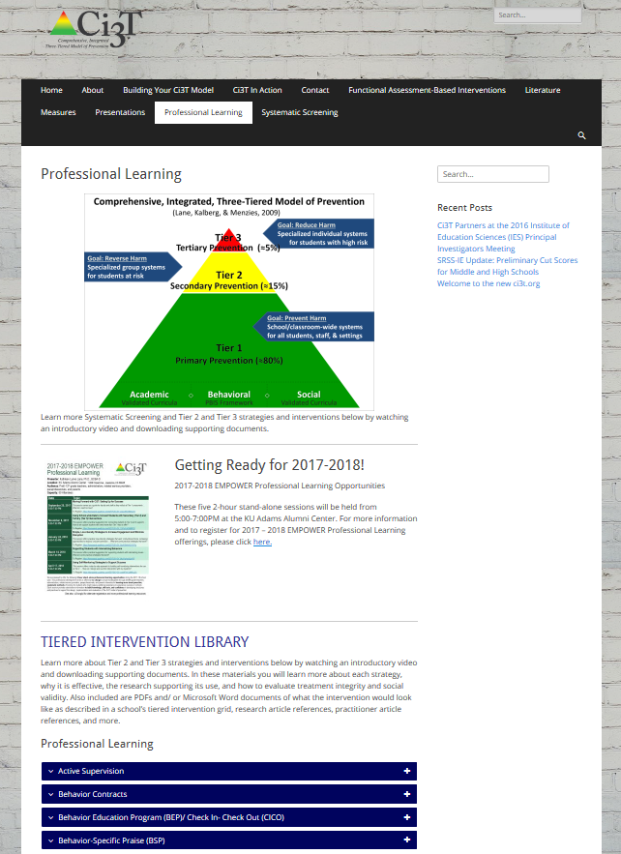
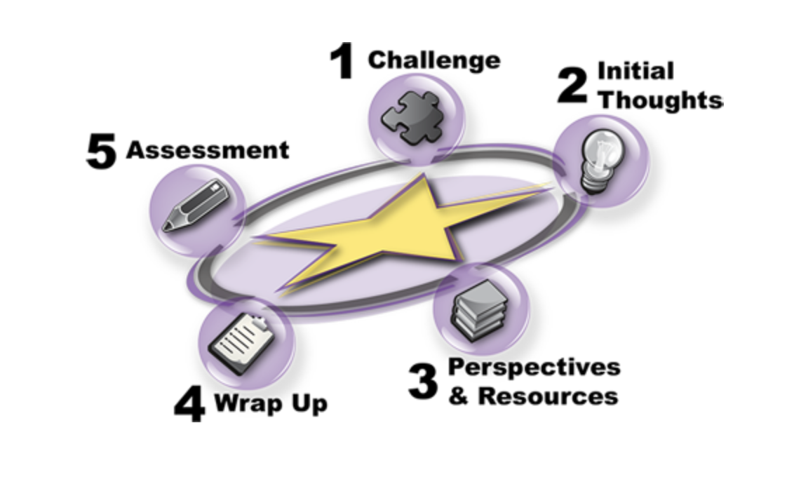
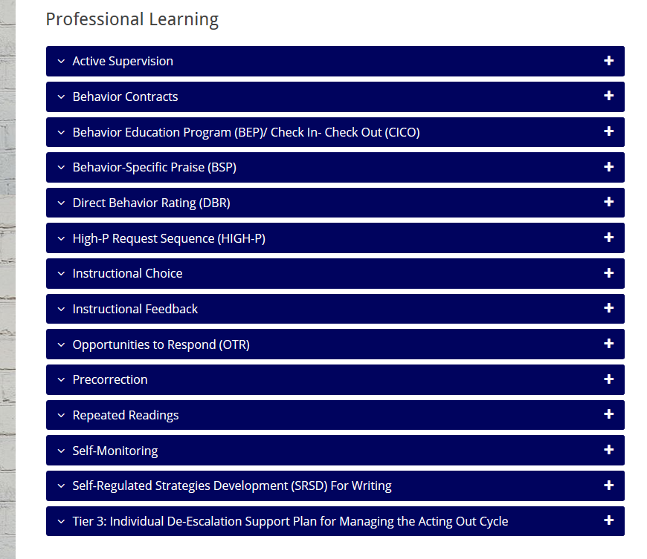
Solutions-based Planning
Connect to Ci3T Implementation Manual
Connect to evidence-based practices
An Illustration

Slide 29
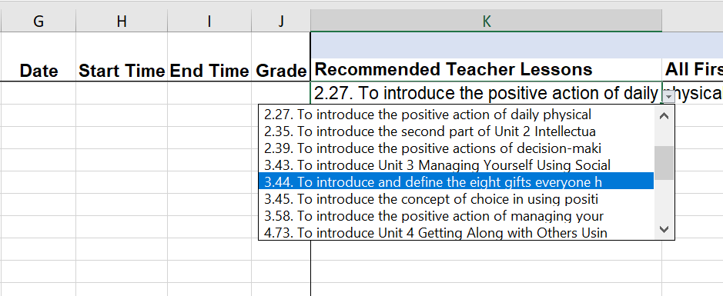
Solutions-based Planning
Data-based planning and collaboration
Emphasize integration of Tier 1 components
An Illustration
Notes:
This slide intended to cover some ideas…e.g., teacher who struggles to engage students and has not taught Social skill curriculum..idea: have learning coach or strong instructional lead co-teach PA lessons while modeling 1 low-intensity strategy (e.g., our “on-site expert” idea). Try to model how effective programs can be when combined with effective instructional strategies.

Slide 30
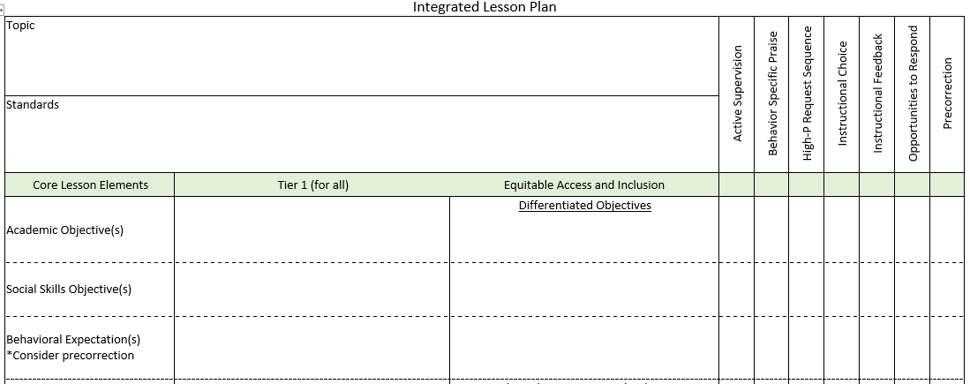
Planning for an integrated approach
An Illustration

Slide 31
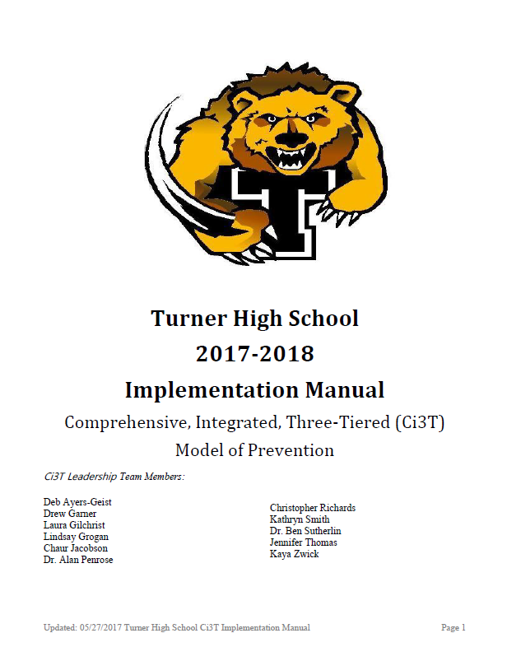
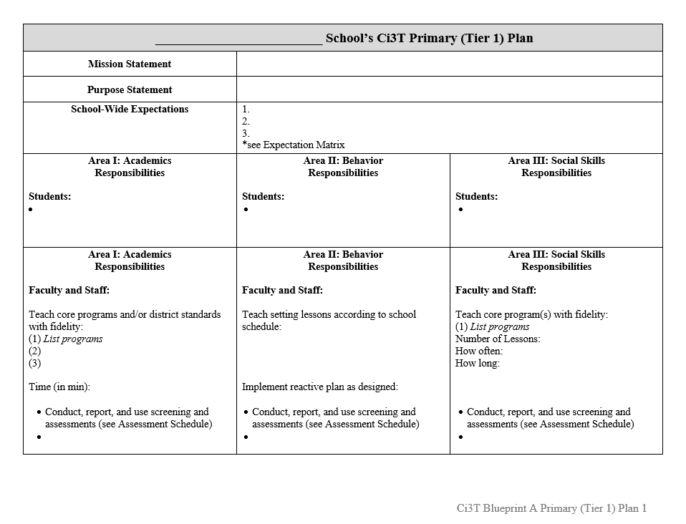
Solutions-based Planning
Grounded in Ci3T Implementation Manual
Goal setting
Connecting to resources
A plan for follow through
An Illustration
Roles and Responsibilities
Notes:
Picture source: https://pixabay.com/en/goal-setting-goal-dart-target-plan-1955809/https://pixabay.com/en/goal-setting-goal-dart-target-plan-1955809/

Slide 32
Antecedents - Behavior - Consequences
Function!
A
B
C
Precorrection: Identifies predictable contexts that often result in problem behavior and provides students with supports, prompts, and reinforcement for engaging in appropriate behavior
Notes:
Managing behavior with precorrections:
Anticipate what activities may cause inappropriate behaviors
“Getting in front” of problem behaviors
Example: Gentle reminder of expected behaviors in the hallway before dismissing for lunch

Slide 33
The Acting-Out Cycle
5. Peak
4. Acceleration
6. De-escalation
2. Trigger
1. Calm 7. Recovery
Whether the problem behavior is managed safely or not
or is defused
in a large measure depends on
YOUR INITIAL RESPONSE
-Dr. Geoff Colvin
3. Agitation
Intensity
Time
Colvin, 2004
Overview of the Acting Out Cycle--Vanderbilt IRIS Module

Slide 34
Team Time!
How will you use these data to empower your
faculty and staff?
Write action items on your agenda
Notes:
20-min timer

Slide 35
Building a Ci3T Tier Library
Teacher-Delivered Strategies (T1 T2)
Tier 1
Tier 2
Tier 3

Slide 36
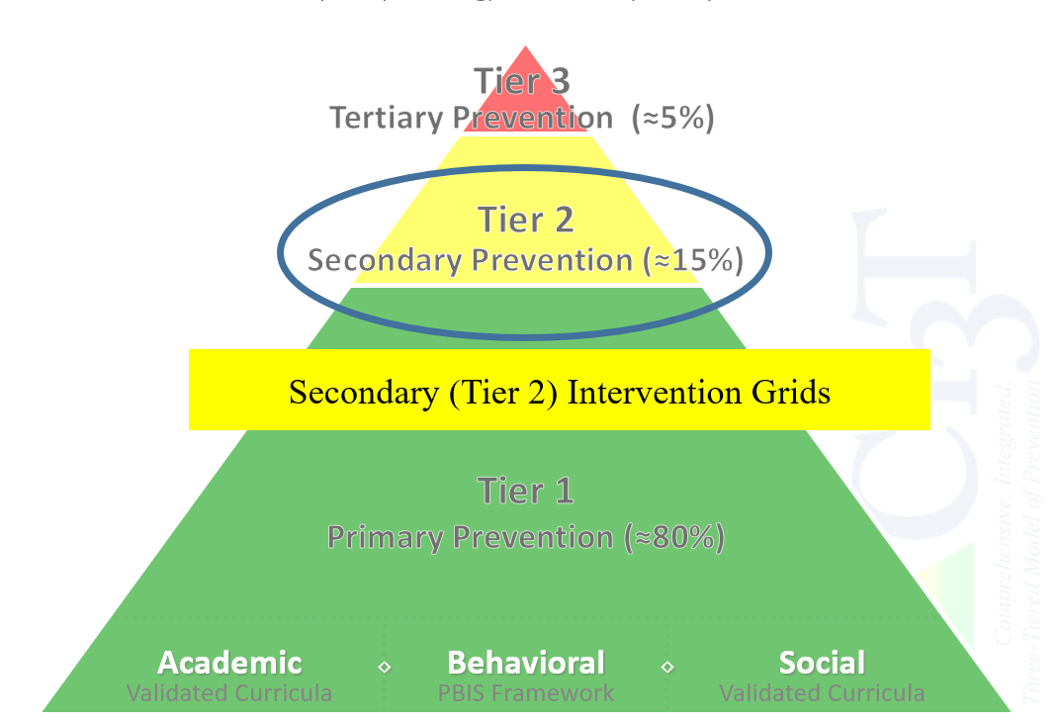

Slide 37
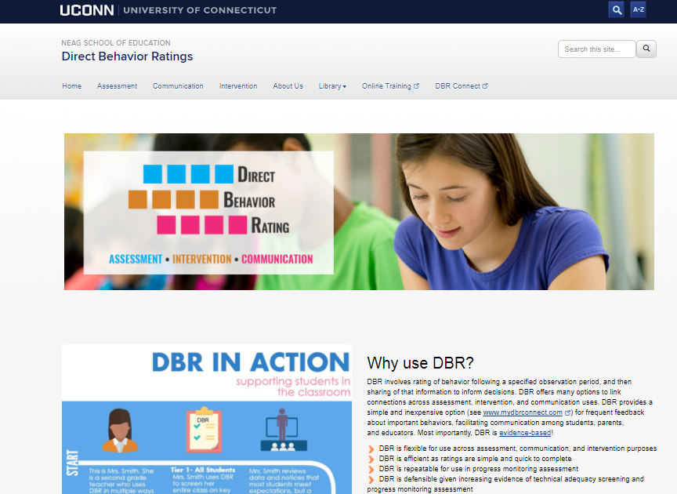
Daily Behavior Report Cards
Support | Description | School-wide Data: Entry Criteria | Data to Monitor Progress | Exit Criteria
Daily Behavior Report (DBR) Card | DBR will be completed by the classroom teacher during daily observation periods (e.g., core instruction during English Language Arts) and parents will sign the form each day. DBR will be used to rate academic engagement, respect, and disruption. At the conclusion of each observation period, the teacher will indicate the degree to which the student displayed each behavior. The teacher will meet briefly with the student to share the teacher’s DBR rating and home-school communication procedures will be established for student to bring a paper copy or email to parent or caregiver each day DBR was implemented for a parent/caregiver to sign. | Behavior SRSS-E7 score: Moderate (4-8) and/or SRSS-I5 score: Moderate (2-3) AND Evidence of teacher implementation of Ci3T primary (Tier 1) plan [treatment integrity: direct observation] AND Parent permission AND Academic Student is in grade 2 or 3 | Student measures Daily behavior report (DBR; daily) Attendance and tardies Social validity Teacher: IRP-15 Student: CIRP Treatment integrity Tier 2 treatment integrity measures Ci3T TI: Direct observation (30 min if needed) | Review student progress at end of 24 sessions Team agrees goals have been met or no further Positive Action small group sessions are warranted SRSS-E7 and I5 scores are in the low risk category
http://dbr.education.uconn.edu/

Slide 38
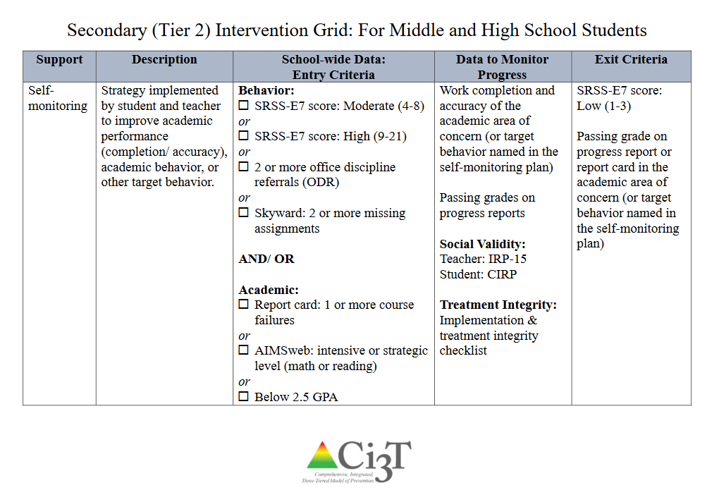

Slide 39
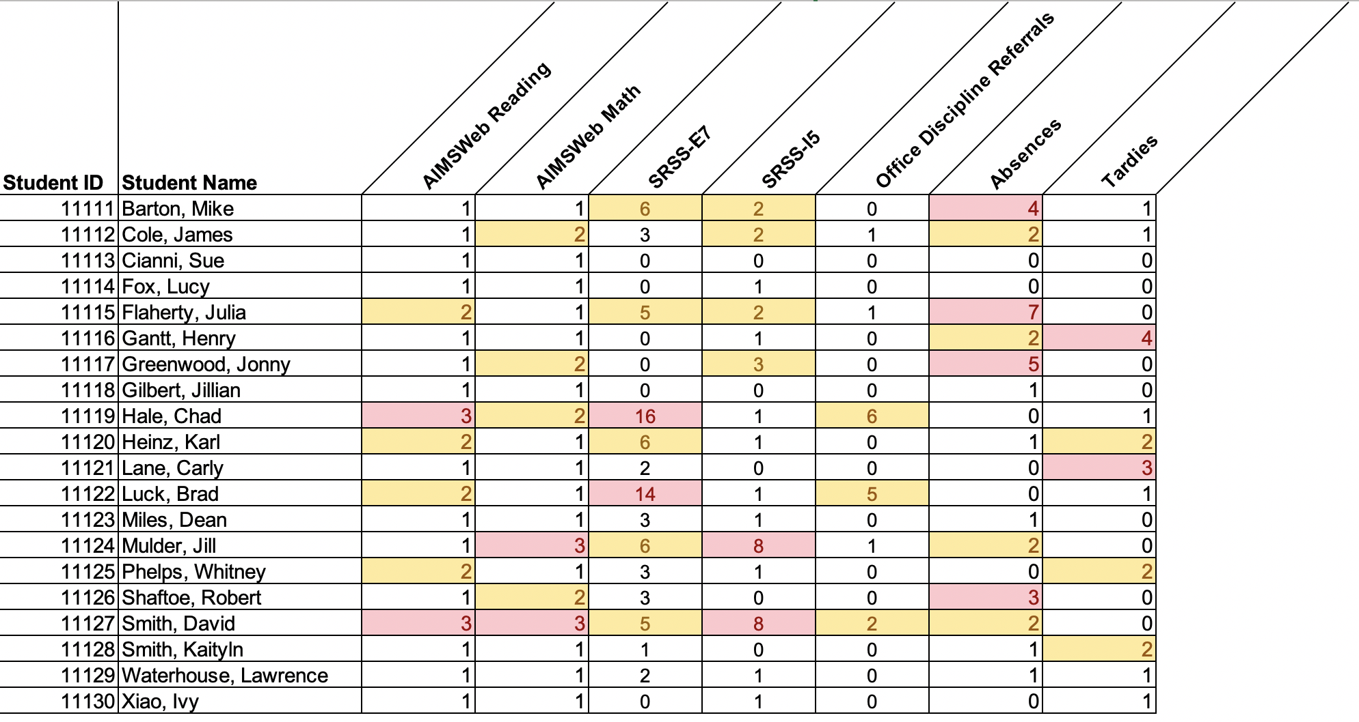
Data in action

Slide 40
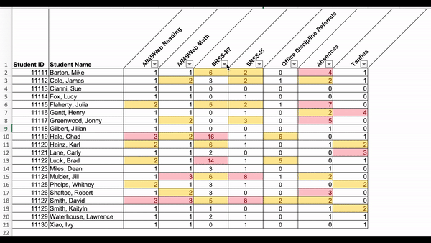
Data in action

Slide 41
Data in action
Other Tier 2 options…
Precorrection
Behavior Contracts
Behavior Specific Praise
Instructional Choice

Slide 43
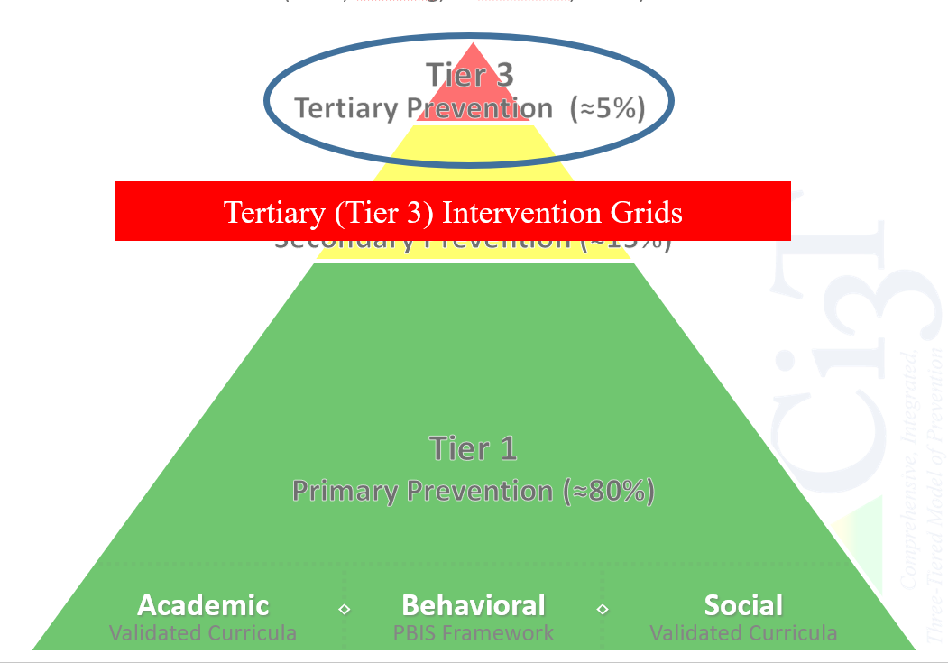

Slide 44
Schoolwide Positive
Behavior Support
Comprehensive, Integrative,
Three-Tiered (Ci₃T)
Models of Support
Low-Intensity Strategies
Basic Classroom Management
Effective Instruction
Low-Intensity Strategies
Behavior Contracts
Self-Monitoring
- -
Functional Assessment-Based
Interventions
Higher-Intensity
Strategies
Assess, Design, Implement,
and
Evaluate
Assessment

Slide 45
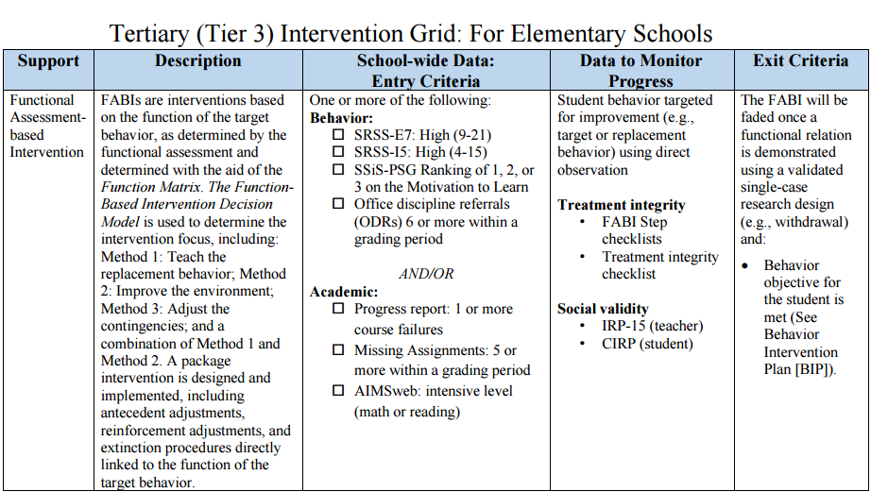

Slide 46
Team Time!
What structures are in place to data-based decision making?
How do we keep track of which students receive supports and monitor their progress?
What are potential barriers to these processes? How can these be addressed?
Write action items on your agenda
Notes:
20-min timer

Slide 47
Looking Ahead
Next steps and action items

Slide 48
Next Steps
At your next Ci3T Leadership Team meeting:
Use IM18 Ci3T Leadership Team Meeting Agenda to conduct an effective meeting with
clearly defined roles and responsibilities of team members
action items, persons responsible, and due dates
Finalize implementation and screening reports
Discuss fall and winter data and any professional learning needs
At your next faculty meeting:
Share successes
Review Ci3T Implementation Report and Screening Data
Consider showing the PowerPoint
Consider sharing the full report PDF with all stakeholders by email

Slide 49
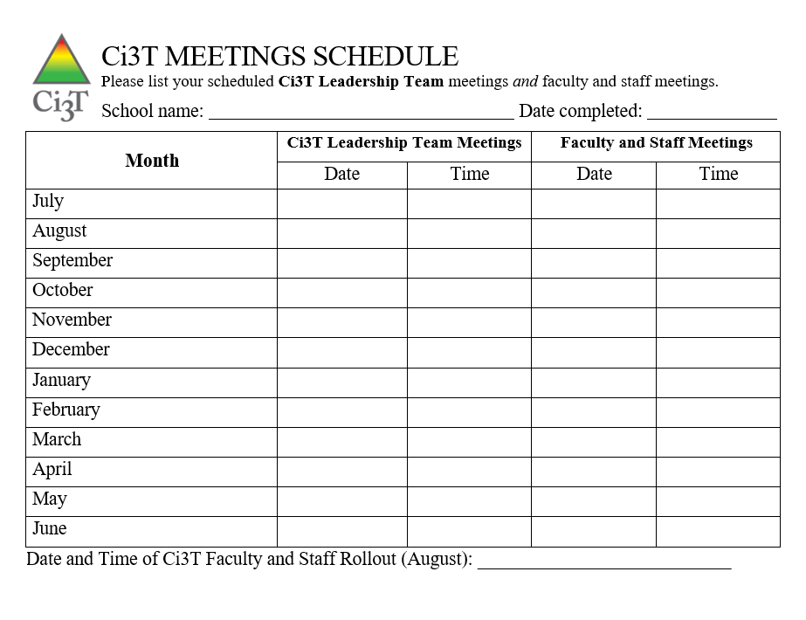
Ci3T Monthly Leadership Team Meetings

Slide 50
Ci3T 2020 - 2021
Use your Ci3T Structure to Support Transitions
Share you Ci3T Implementation Manual with your Faculty and Staff as Changes Occur

Slide 51
Vermont
Sessions | Date | Time (CST) | Location
Session 1 | September 29, 2020 | 3:15 p.m. – 5:15 p.m. | Remote Session via Zoom
Session 2 | November 17, 2020 | 3:15 p.m. – 5:15 p.m. | Remote Session via Zoom
Session 3 | January 19, 2021 | 3:15 p.m. – 5:15 p.m. | Remote Session via Zoom
Session 4 | March 30, 2021 | 3:15 p.m. – 5:15 p.m. | Remote Session via Zoom
Session 5 | May 11, 2021 | 3:15 p.m. – 5:15 p.m. | Remote Session via Zoom

Slide 52
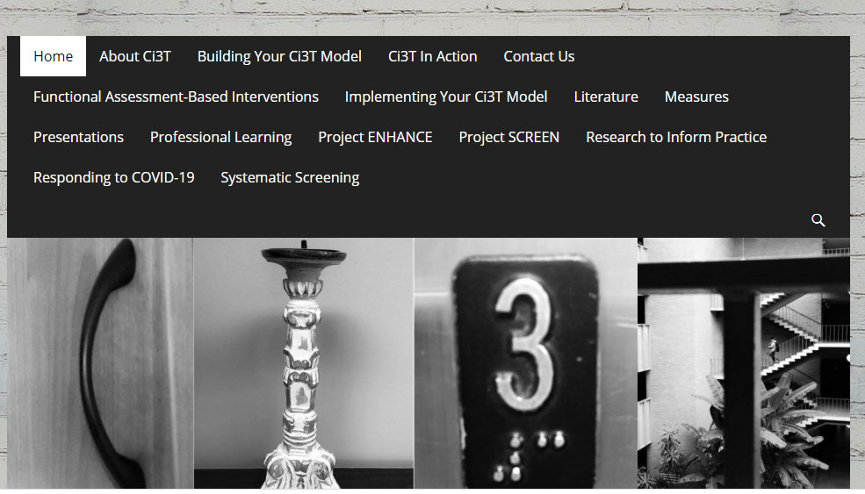
Thank You!

