Slide 1
Using Ci3T Structures in the Covid-19 Era: 10/10 Topics
Kathleen Lane, Wendy Oakes, Grant Allen, Katie Austin, Nelson Brunsting, Mark Buckman, Eric Common, Jamie Jones, Katie Lane, Nathan Lane, Paloma Pérez-Clark, David Royer, Rebecca Sherod
Strand: Students With or At Risk for Behavior Disorders: Identification, Assessment, & Intervention
Notes:
Description: This 2-hour session reviews current works in progress that focus on students with or at-risk for emotional and behavioral disorders (EBD) across the K-12 span in the COVID-19 Era using Ci3T structures. Content will focus on 10-10 updates on our most recent lessons learned within tiered systems of prevention, with an emphasis on systematic screening. We feature a 10-minute update, and 10-minute conversation for each of the following topics in this years’ remote strand:
1. Introduction & Welcome
2. Update: How do I use my Ci3T structures in in-person, remote, and hybrid instruction?
3. Update: How is Ci3T professional learning taking place in the COVID-19 Era?
4. Update: What do I need to know about screening in the COVID-19 Era?
5. Update: How do teachers fare in Ci3T Models?
6. Update: How can we support district and school leaders with implementing Ci3T?
7. Closing: Next Steps

Slide 2
Agenda
Introduction & welcome
Updates:
How do I use my Ci3T structures in in-person, remote, and hybrid instruction?
How is Ci3T professional learning taking place in the COVID-19 era?
What do I need to know about screening in the COVID-19 era?
How do teachers fare in Ci3T models?
How can we support district and school leaders with implementing Ci3T?
Closing: Next steps

Slide 3
Welcome & Introduction
Using Ci3T Structures to Meet Students’ Needs in the COVID-19 Era:
Kathleen Lynne Lane & Wendy Peia Oakes
Strand: Students With or At Risk for Behavior Disorders: Identification, Assessment, & Intervention

Slide 4
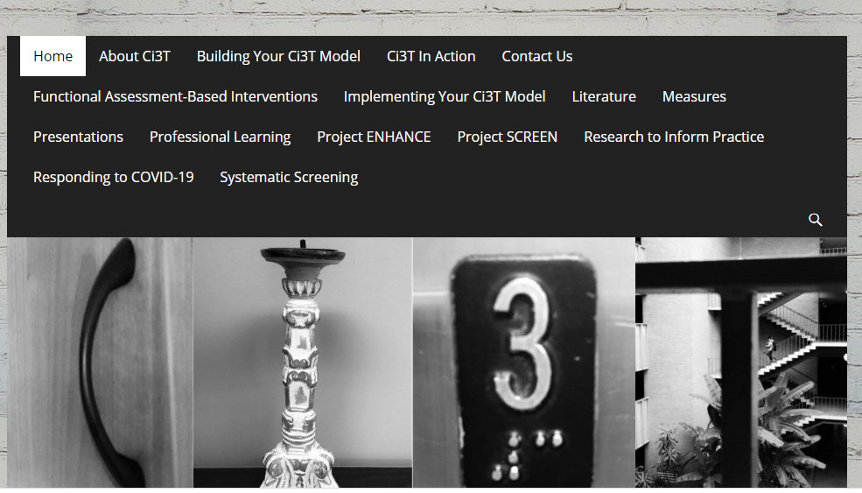
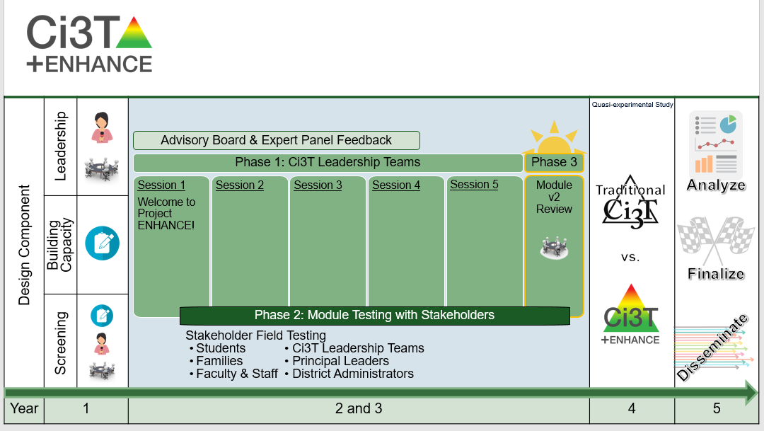

Slide 5
How do I use my Ci3T structures in in-person, remote, and hybrid instruction?
Using Ci3T Structures to Meet Students’ Needs in the COVID-19 Era:
Mark Matthew Buckman & Katie Scarlett Lane
Strand: Students With or At Risk for Behavior Disorders: Identification, Assessment, & Intervention

Slide 6
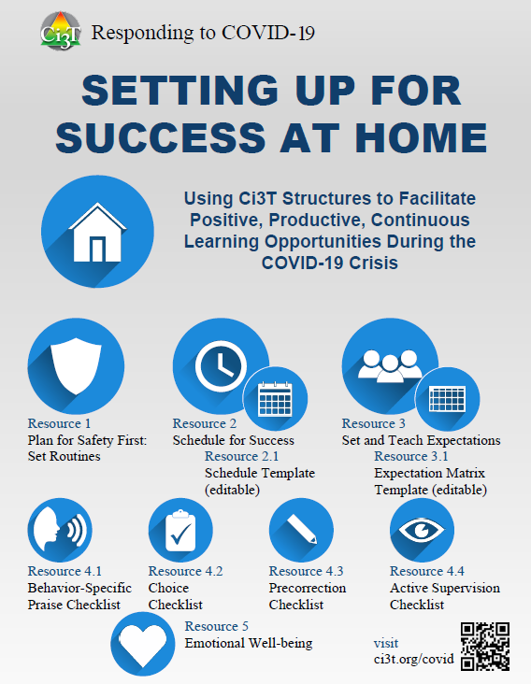
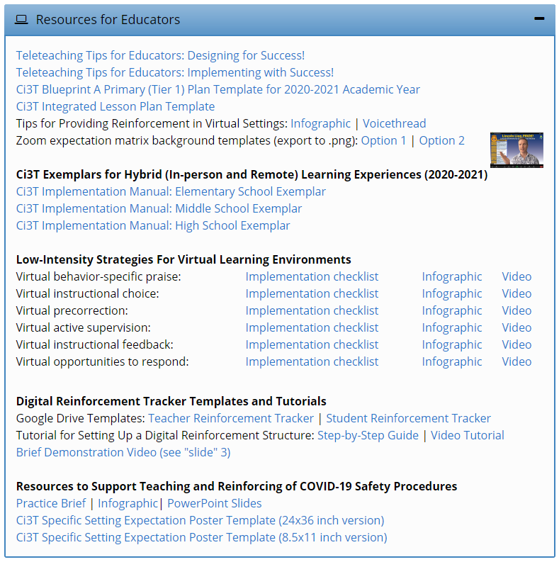
ci3t.org/covid

Slide 7
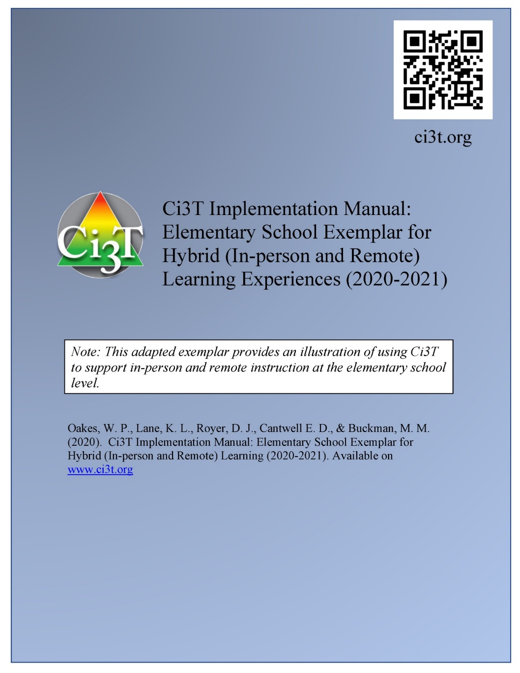
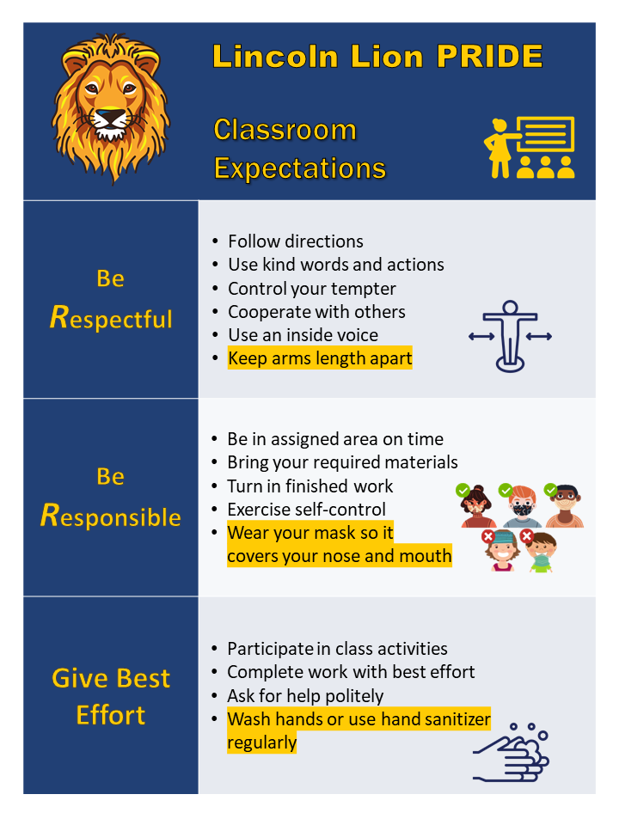
A look at Procedures for Teaching at Tier 1
Procedures for Teaching
Faculty and Staff: Ci3T Leadership Teams and District Leaders will teach procedures to faculty and staff by: Provide faculty and staff Ci3T Implementation Manual and other materials such as posters, lesson plans, tickets, etc. to teach, implement and support our Ci3T plan. Professional learning opportunities at the district level to support implementation and sustainability of Ci3T, with attention to academic, behavior, and social domains. Expectations Matrix taught and posted. Ongoing re-teaching of expectations and procedures – dedicated staff meeting time for discussions.
Continued Learning: Ci3T Leadership Teams and District Leaders will teach procedures to faculty and staff by: Providing faculty and staff materials for remote access to the Ci3T Implementation Manual, digital ‘posters’ and e-tickets. Professional learning sessions and access guides for online materials for teaching social skills lessons. Beginning of year online meeting small-group breakout rooms for faculty and staff to review Ci3T Implementation Manual updates, get questions answered, and share ideas

Slide 8
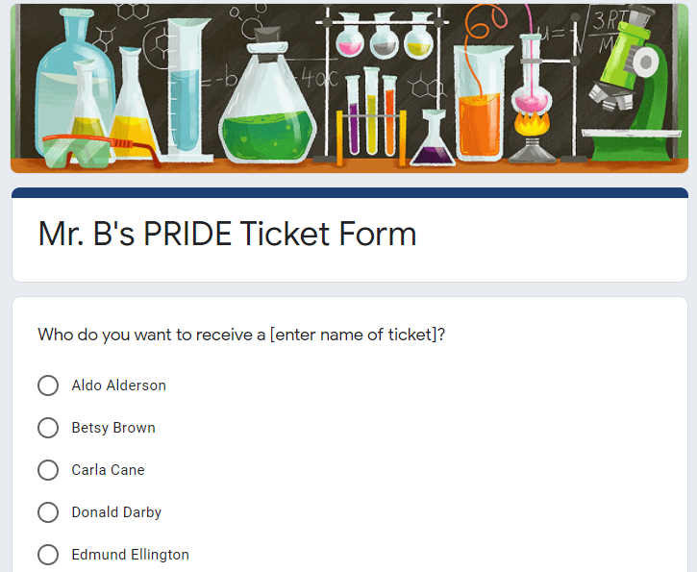
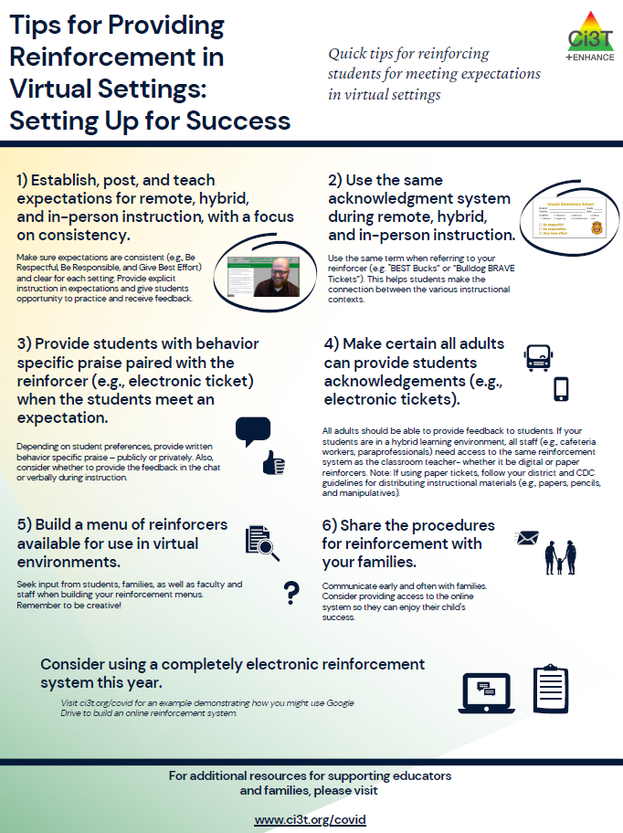
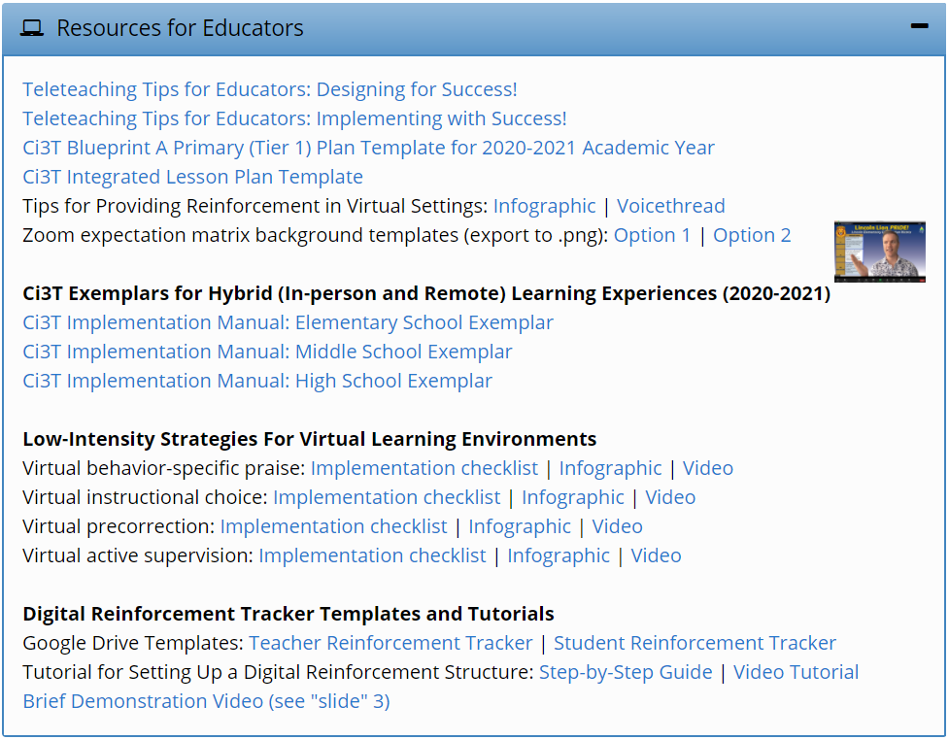
ci3t.org/covid

Slide 9
How is Ci3T professional learning taking place in the COVID-19 Era?
Using Ci3T Structures to Meet Students’ Needs in the COVID-19 Era:
Paloma Pérez-Clark, Eric Alan Common, & Jamie Jones
Strand: Students With or At Risk for Behavior Disorders: Identification, Assessment, & Intervention

Slide 10
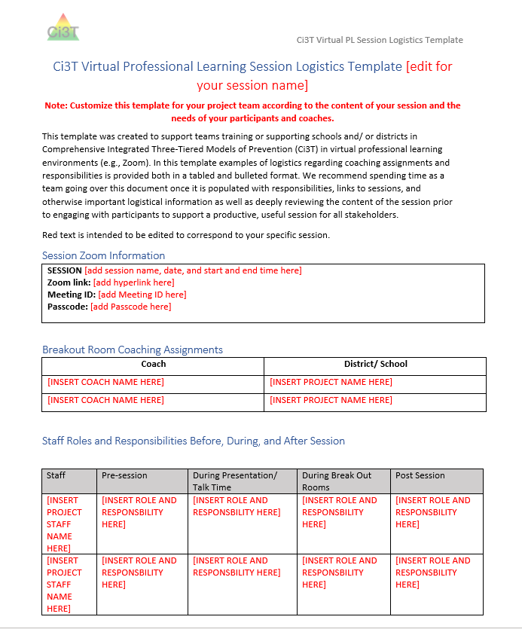
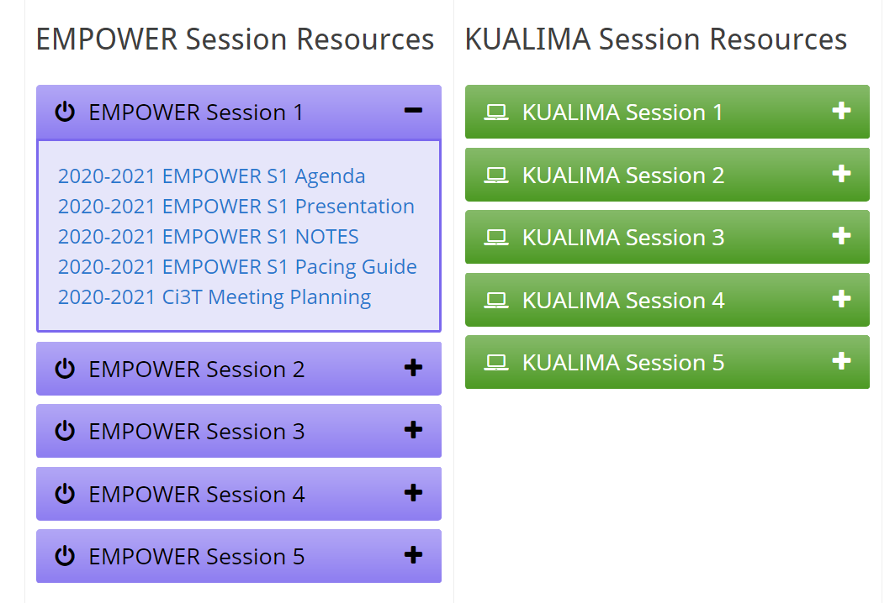
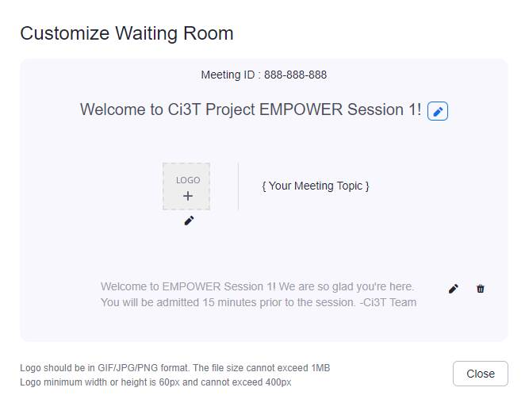
Considerations

Slide 11
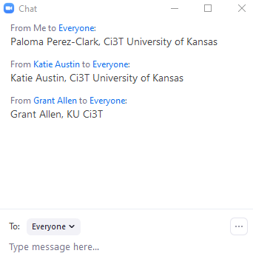
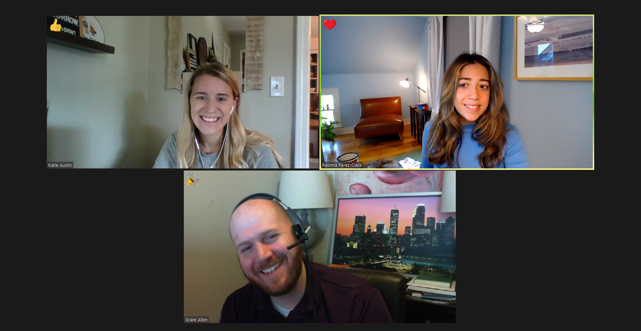
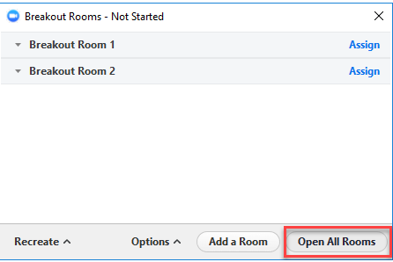
Session Engagement

Slide 12
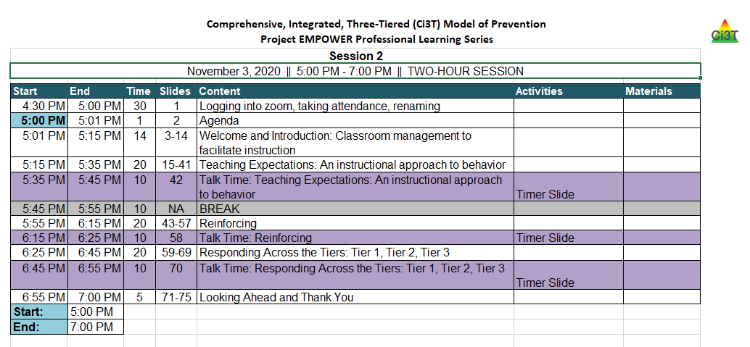
Coaches Play Roles
This Photo by Unknown Author is licensed under CC BY-SA

Slide 13
What do I need to know about screening in the COVID-19 Era?
Using Ci3T Structures to Meet Students’ Needs in the COVID-19 Era:
Grant Edmund Allen, Rebecca Lee Sherod & Jamie Jones
Strand: Students With or At Risk for Behavior Disorders: Identification, Assessment, & Intervention

Slide 14
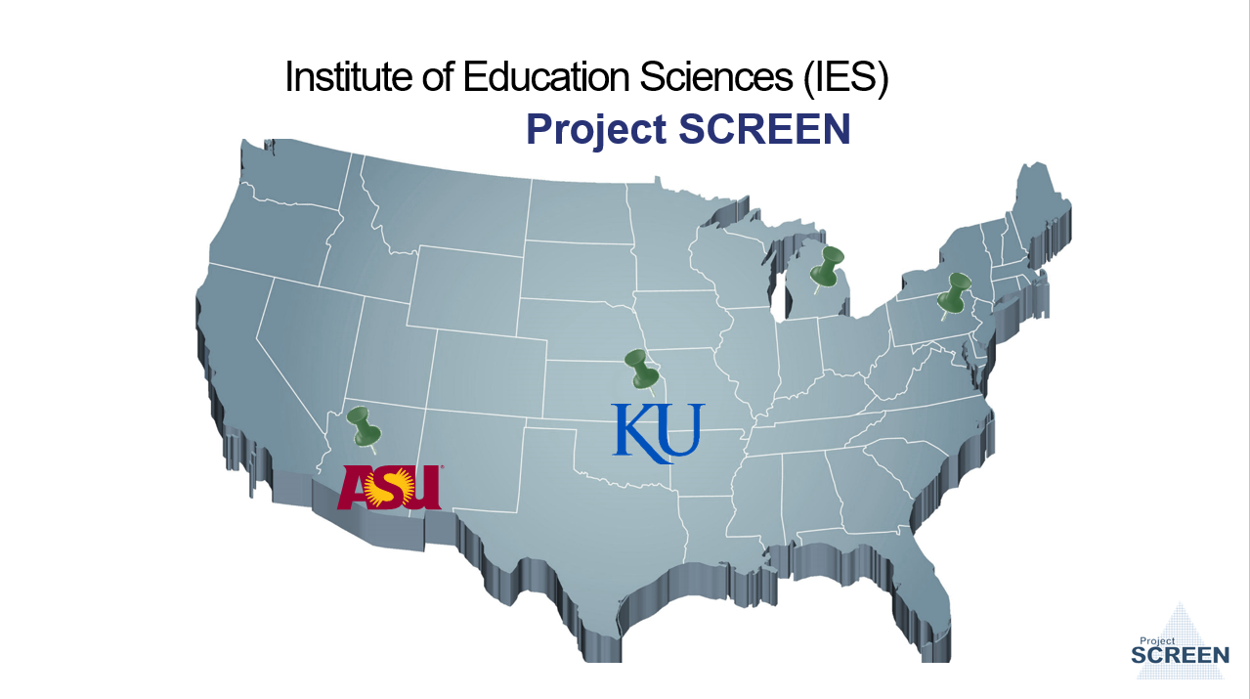
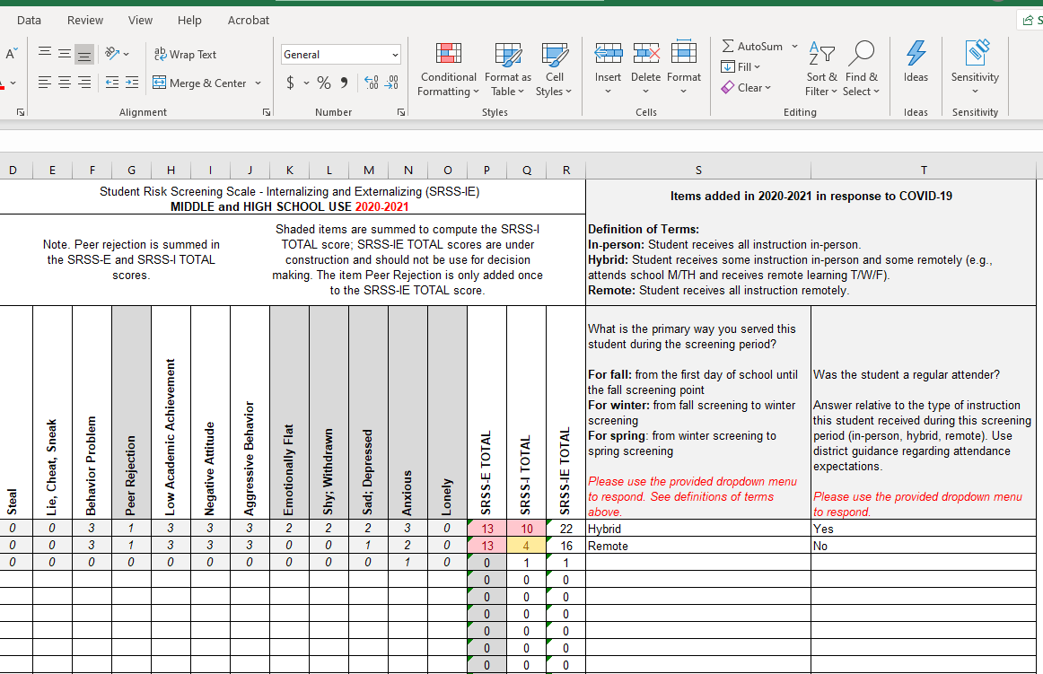
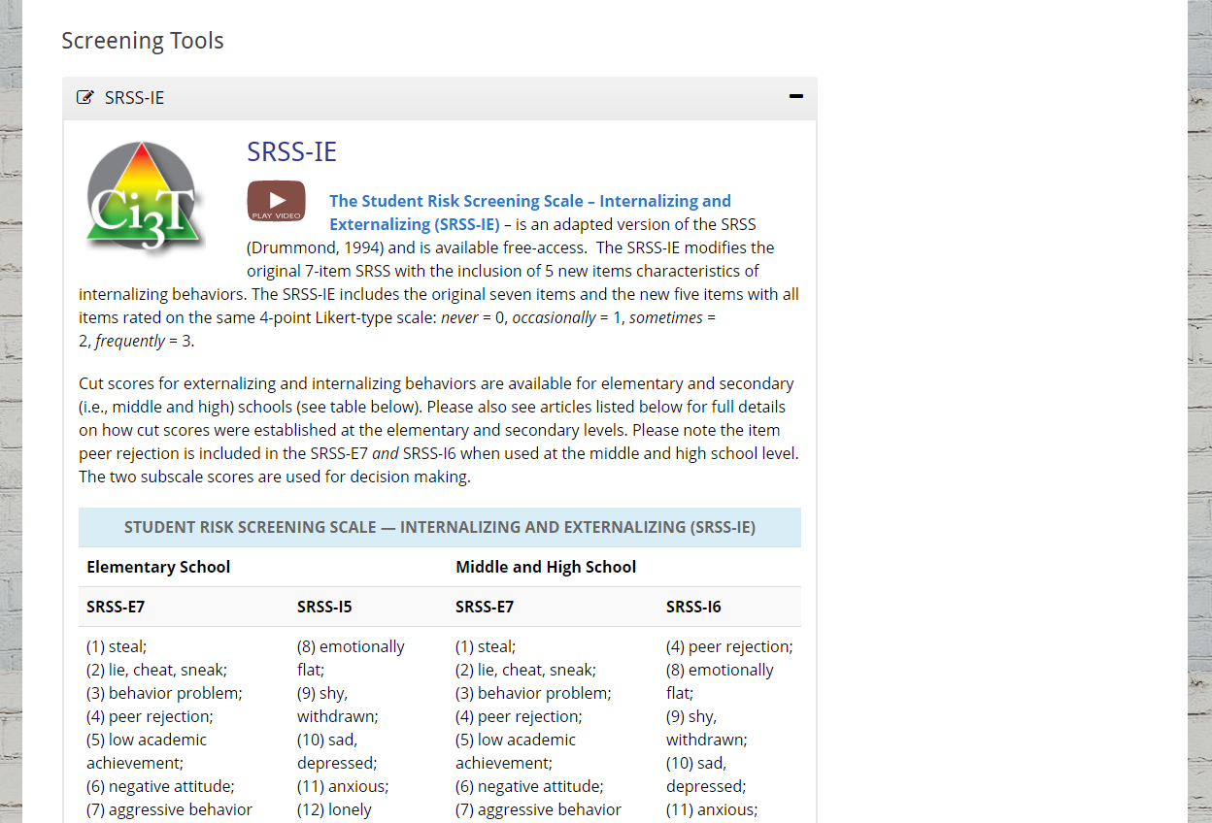
Continued Inquiry on Behavior Screening

Slide 15
Systematic Behavior Screening to Inform Instruction
Three times per year
All students
Data-informed decision making

Slide 16
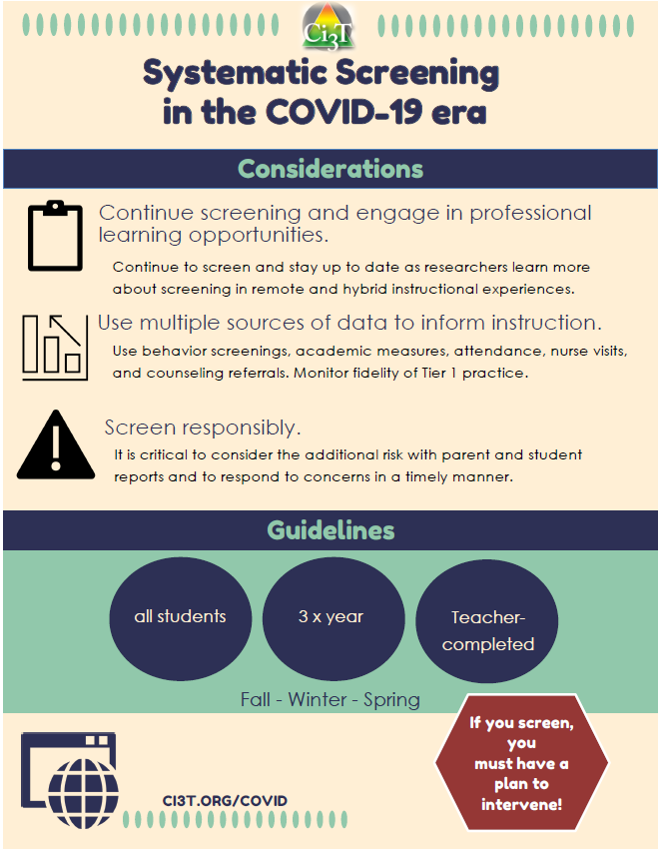
What do I need to know about screening in the COVID-19 Era?
Successful Screening involves:
Building expertise
Developing structures
IF YOU SCREEN, YOU MUST HAVE A PLAN TO INTERVENE!

Slide 17
How do teachers fare in Ci3T Models?
Using Ci3T Structures to Meet Students’ Needs in the COVID-19 Era:
Nelson C. Brunsting, Katie S. Austin, & Mark Matthew Buckman
Strand: Students With or At Risk for Behavior Disorders: Identification, Assessment, & Intervention

Slide 18
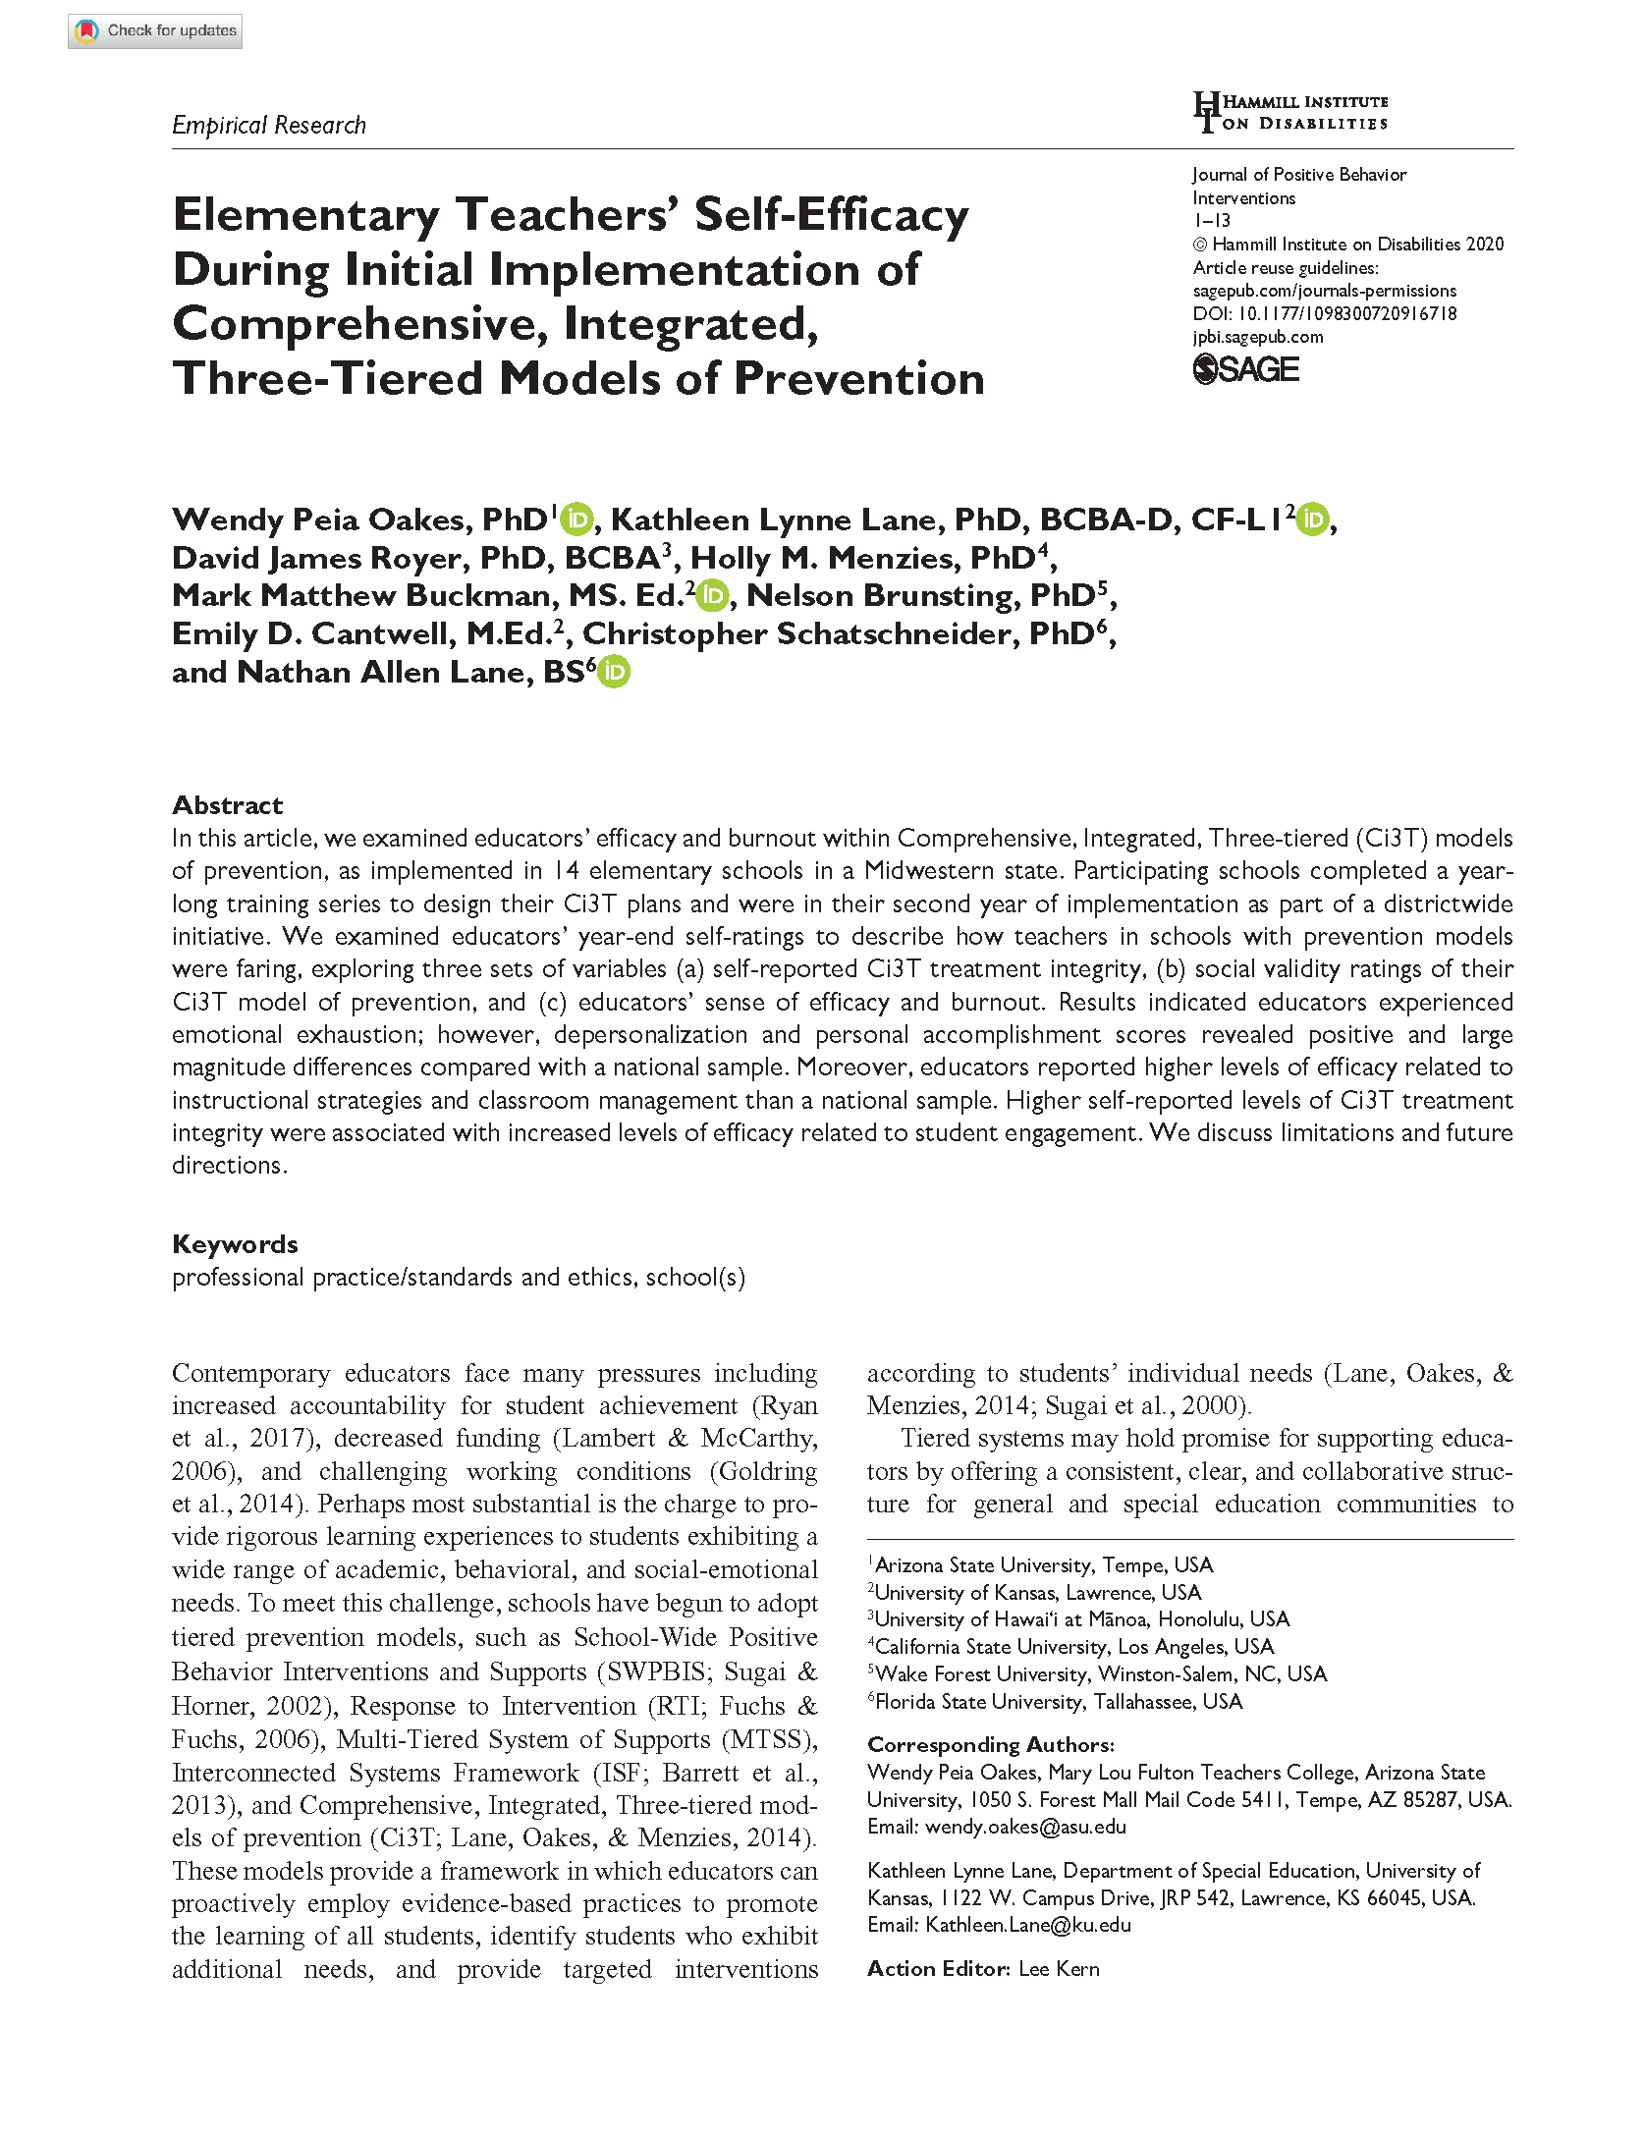
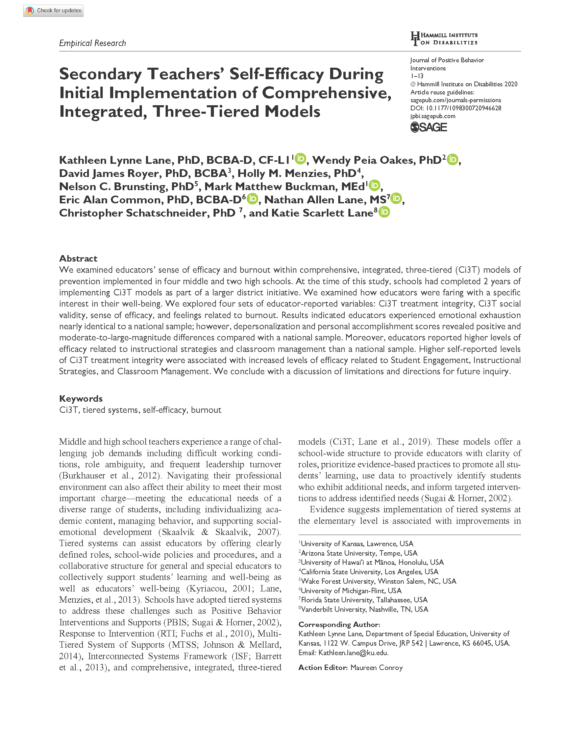
Educator Burnout and Sense of Efficacy
Work stress can lead to…
Emotional Exhaustion
Depersonalization
Lack of Personal Accomplishment
Belief in ability to help students achieve
Reliance on punishment, risk of burnout
Low Efficacy
High Efficacy

Slide 19
Monitoring Progress
Treatment Integrity
Is it happening?
Social Validity
What do stakeholders think about the goals, procedures, and outcomes?
Experimental Design
How well did this support work for this student?

Slide 20
Evidence in Ci3T Schools
Elementary (Oakes et al., 2020)
Elementary schools w/ 2 yrs implementing Ci3T
Compared to national sample:
Emotional exhaustion*
Depersonalization (g = -0.91)
Personal accomplishment (g = 1.01)
Self-efficacy correlated with treatment integrity
Implementing Ci3T with fidelity associated with greater self-efficacy across student engagement, instructional strategies, and classroom management
Middle – High School (Lane et al., 2020)
4 middle and 2 high schools implementing Ci3T
Compared to national sample:
Emotional exhaustion*
Depersonalization (g = -0.93)
Personal accomplishment (g = 0.88)
Self-efficacy correlated with treatment integrity
Implementing Ci3T with fidelity associated with greater self-efficacy across student engagement, instructional strategies, and classroom management
*g = 0.24, not statistically significant
*g = 0.01, not statistically significant

Slide 21
How can we support district and school leaders with implementing Ci3T?
Using Ci3T Structures to Meet Students’ Needs in the COVID-19 Era:
David James Royer & Rebecca Lee Sherod
Strand: Students With or At Risk for Behavior Disorders: Identification, Assessment, & Intervention

Slide 22
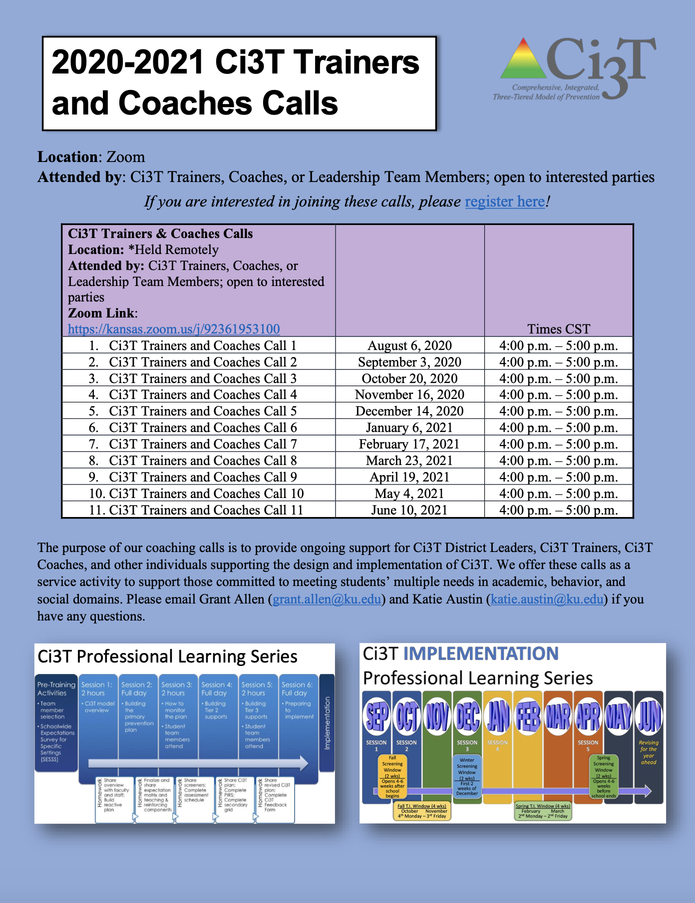
Ci3T Trainers & Coaches Calls

Slide 23
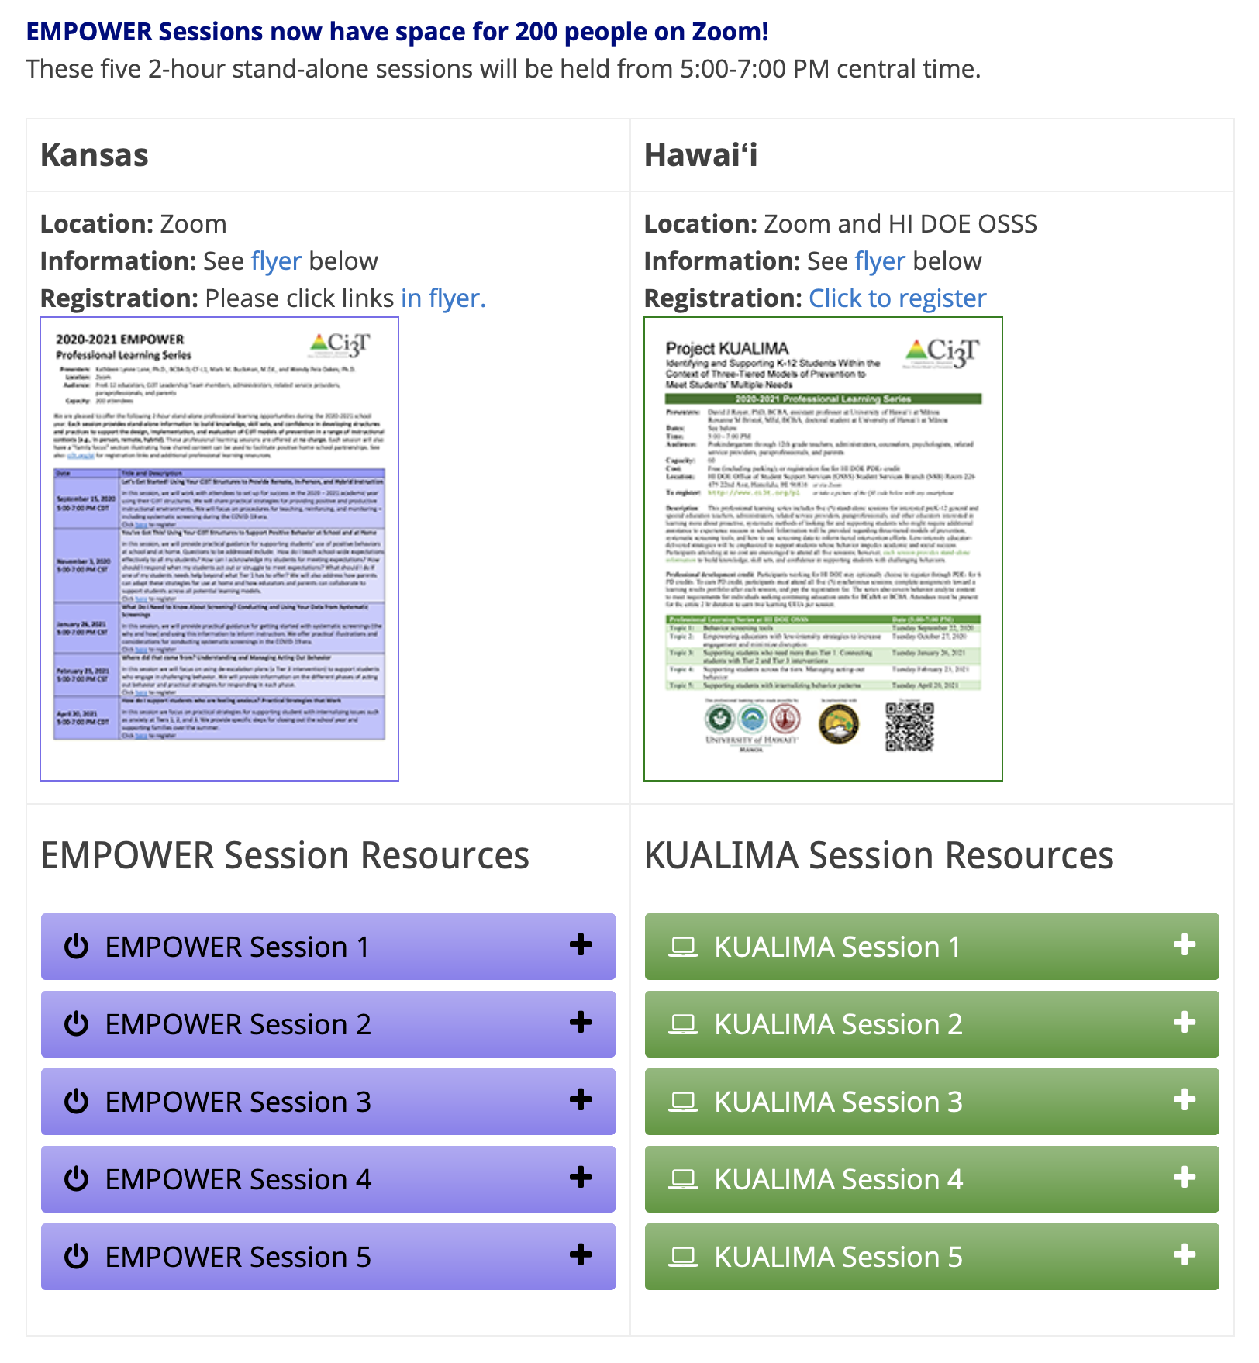
Project EMPOWER

Slide 24
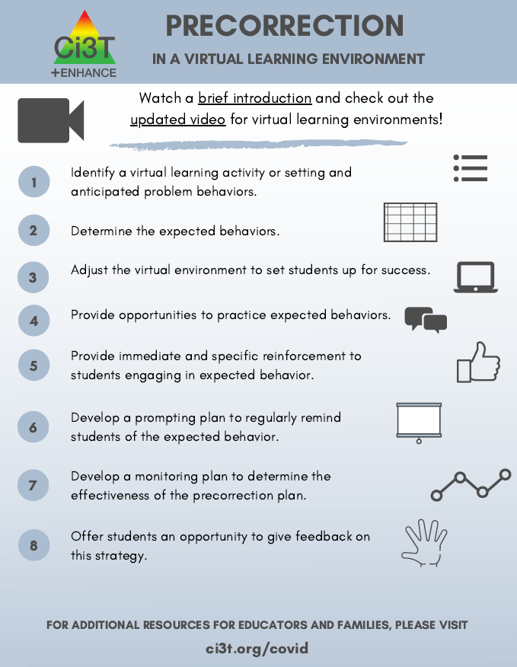
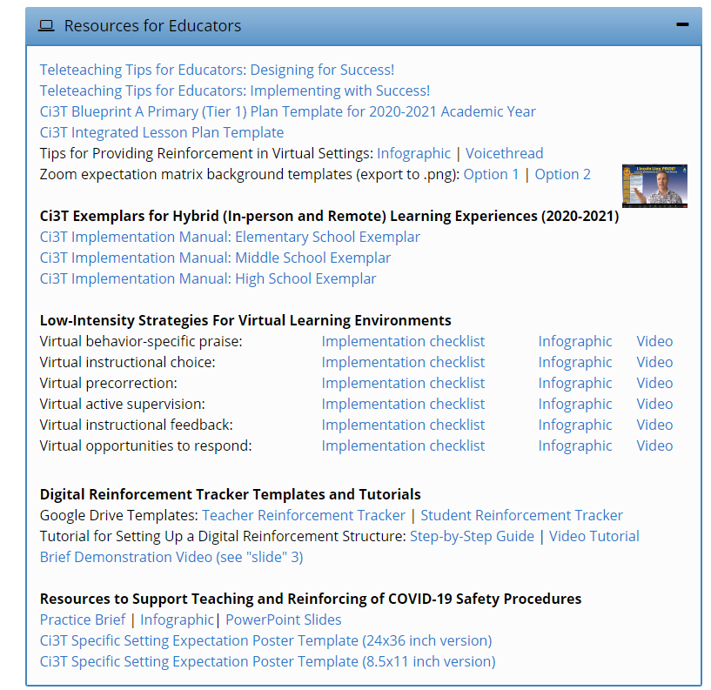
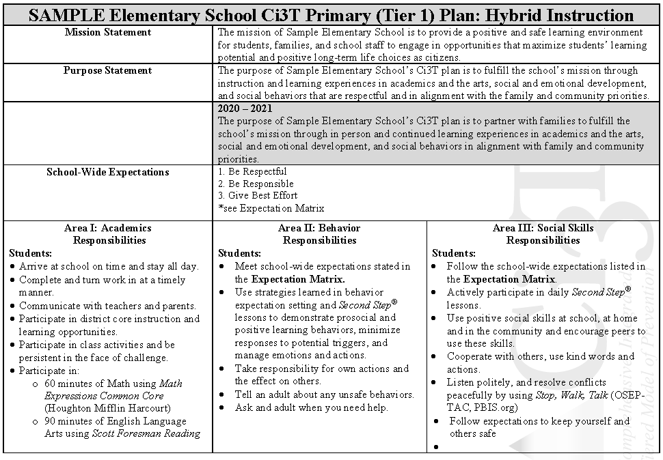

Slide 25
Closing: Next Steps
Wendy Peia Oakes, Kathleen Lynne Lane, & Eric Alan Common

Slide 26
www.ci3t.org
Thank you!

