Slide 1
Ci3T Specific Setting Expectation Poster Template Adapted to assist in teaching COVID-19 safety procedures
This PowerPoint file provides:
An example of a poster for a specific setting that has been modified to include COVID-19 safety procedures (slide 2)
A template you can use to design a poster for your school (slide 3)
Considerations:
Before creating posters, review guidance provided in the practice brief Using your Ci3T Structures to Support Teaching and Reinforcing COVID-19 Safety Procedures (available on ci3t.org/covid)
Once customized for your school, you can duplicate your poster to make one per setting (e.g., cafeteria, hallway)
The slides in this file are customized to be printed as 24x36 posters
If you prefer to print posters on 8.5x11 in. paper, please access the other template at ci3t.org/covid)

Slide 2
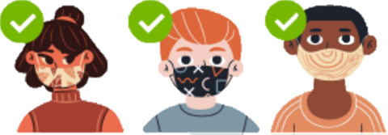
Lincoln Lion PRIDE
Classroom Expectations
Be Respectful | Follow directions Use kind words and actions Control your tempter Cooperate with others Use an inside voice Keep arms length apart
Be Responsible | Be in assigned area on time Bring your required materials Turn in finished work Exercise self-control Wear your mask so it covers your nose and mouth
Give Best Effort | Participate in class activities Complete work with best effort Ask for help politely Wash hands or use hand sanitizer regularly

Slide 3
SCHOOL NAME
ADD SCHOOL MASCOT OR LOGO HERE
SETTING Expectations
EXPECTATION 1 | Paste expectations from matrix Paste expectations from matrix Paste expectations from matrix Enter relevant COVID-19 safety expectation as needed
EXPECTATION 2 | Paste expectations from matrix Paste expectations from matrix Paste expectations from matrix Enter relevant COVID-19 safety expectation as needed
EXPECTATION 3 | Paste expectations from matrix Paste expectations from matrix Paste expectations from matrix Enter relevant COVID-19 safety expectation as needed

