Slide 1
Considerations for Systematic Screening in the COVID-19 Era: Universal Screening for Internalizing and Externalizing Behaviors
School Climate Transformation Grant (SCTG) Webinar
November 4, 2020
Kathleen Lynne Lane, University of Kansas
Wendy Peia Oakes, Arizona State University
Rebecca Sherod, University of Kansas
Notes:
Topic Summary: In the wake of the COVID-19 pandemic, PK-12 schools across the United States closed and educators quickly pivoted to remote and continuous learning opportunities to protect students and society as a whole from the deadly coronavirus – COVID-19. As educational leaders across the country navigate the complexities for providing instruction during the 2020-2021 academic year, questions have arisen regarding systematic screening practices. In this presentation, we offer considerations for conducting systematic screenings for internalizing and externalizing behaviors in the COVID-19 era. We recommend educators continue to screen, use multiple sources of data to inform programming, and screen responsibly.

Slide 2

ci3t.org

Slide 3
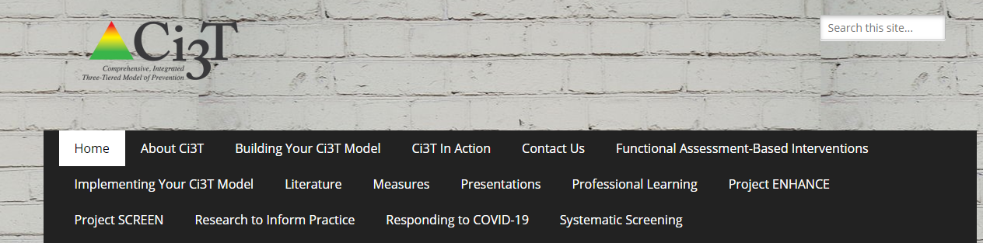
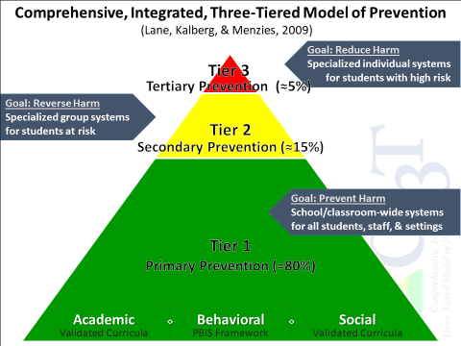
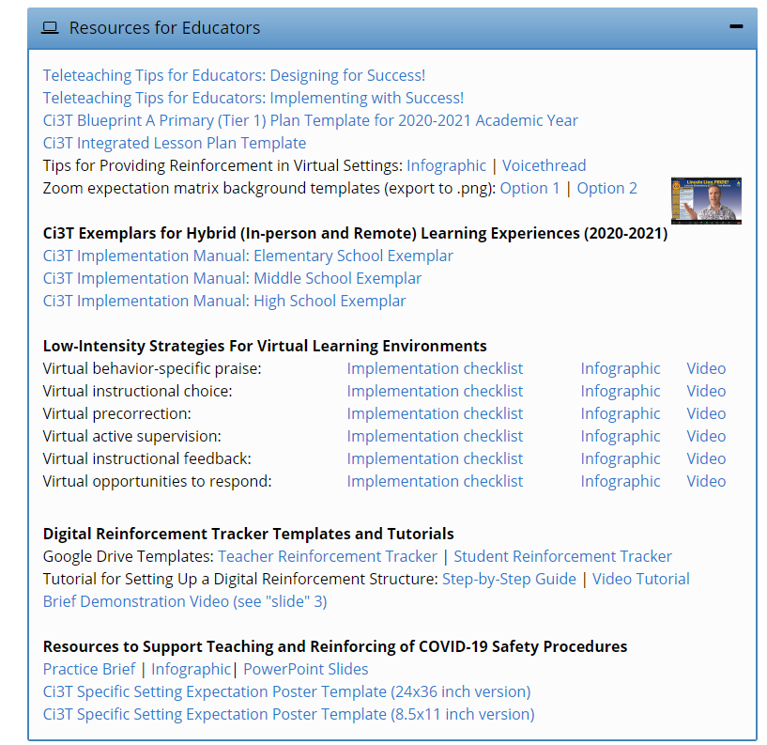
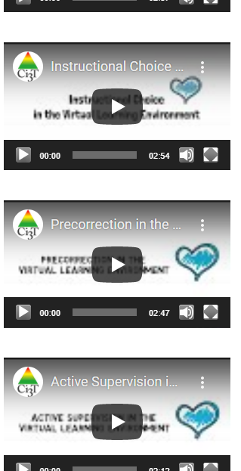


Slide 4
Agenda
Introducing Ci3T … a Comprehensive, Integrated, Three-Tiered Model of Prevention
The Role of Screening: Using Screening Data to Shape Instruction
  At Tier 1: Primary Preventions Efforts
  At all Tiers: Teacher-delivered Strategies
  At Tiers 2 & 3: Secondary & Tertiary Prevention Efforts
Considerations for Screening PK-12 in the COVID-19 Era
Planning for Next Steps

Slide 5
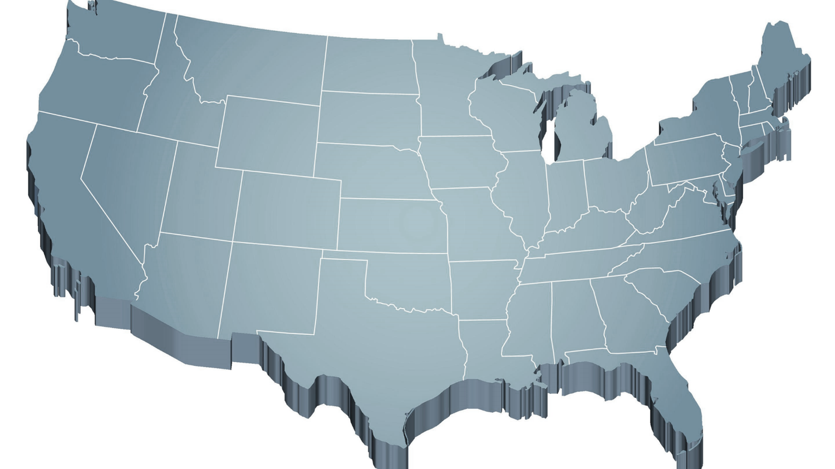
Thank you…
For Your Commitment
Internalizing
Externalizing
ED <1%
EBD 12-20%
Source: Forness, S.R., Freeman, S.F., Paparella, T., Kauffman, J.M., & Walker, H.M. (2012). Special education implications of point and cumulative prevalence for children with emotional or behavioral disorders. Journal of Emotional and Behavioral Disorders, 20, 4-18.

Slide 6
Agenda
Introducing Ci3T … a Comprehensive, Integrated, Three-Tiered Model of Prevention
The Role of Screening: Using Screening Data to Shape Instruction
  At Tier 1: Primary Preventions Efforts
  At all Tiers: Teacher-delivered Strategies
  At Tiers 2 & 3: Secondary & Tertiary Prevention Efforts
Considerations for Screening PK-12 in the COVID-19 Era
Planning for Next Steps

Slide 7
Comprehensive, Integrated, Three-Tiered Model of Prevention
(Lane, Kalberg, & Menzies, 2009)
Tier 3
Tertiary Prevention (≈5%)
Tier 2
Secondary Prevention (≈15%)
Tier 1
Primary Prevention (≈80%)
Academic ◇ Behavioral ◇ Social
Validated Curricula PBIS Framework Validated Curricula

Slide 8
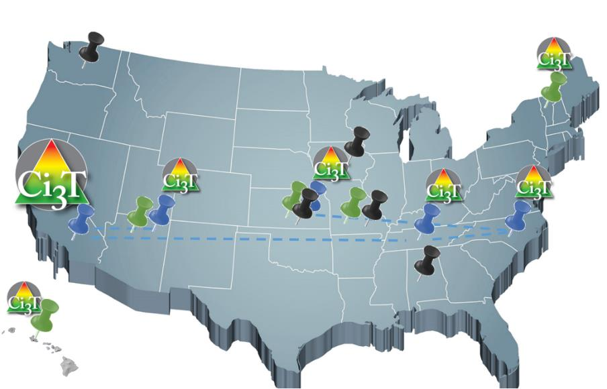
Implementing Ci3T Models:
A Respectful Partnership

Slide 9
Comprehensive, Integrated, Three-Tiered Model of Prevention
(Lane, Kalberg, & Menzies, 2009)
Tier 3
Tertiary Prevention (≈5%)
Tier 2
Secondary Prevention (≈15%)
Tier 1
Primary Prevention (≈80%)
Academic ◇ Behavioral ◇ Social
Validated Curricula PBIS Framework Validated Curricula

Slide 11
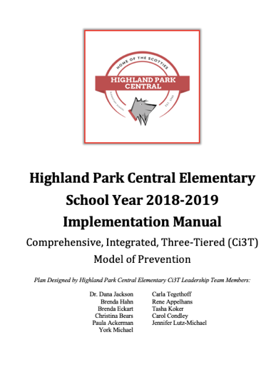
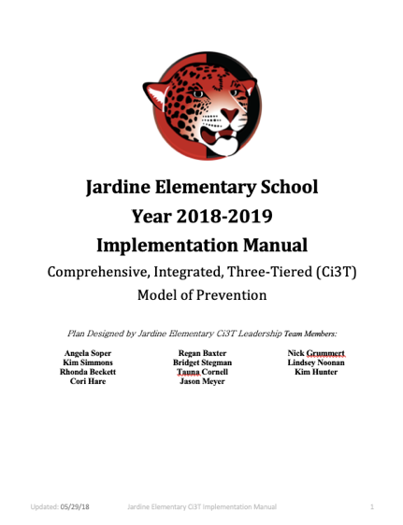
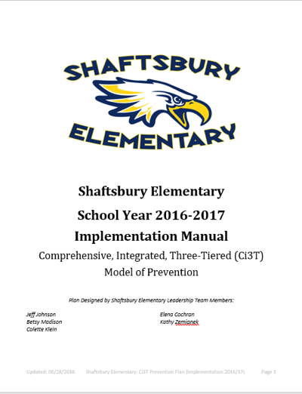
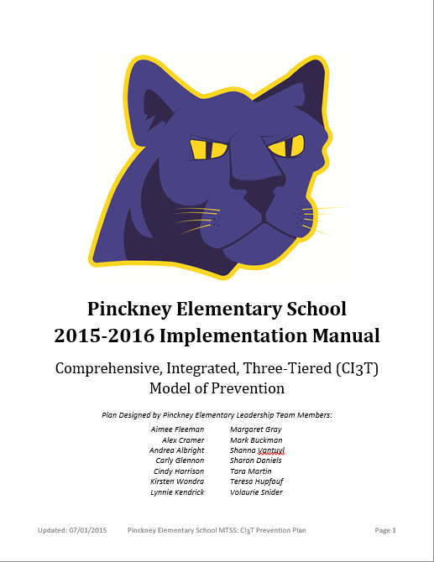
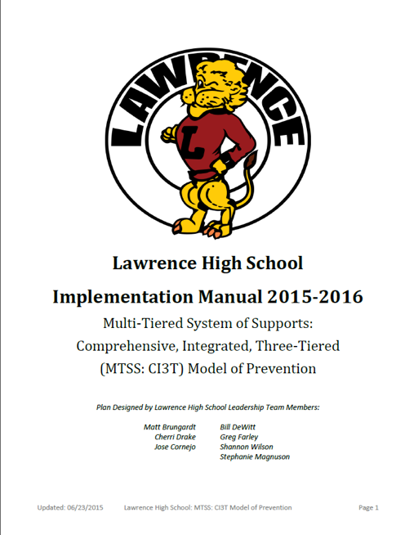
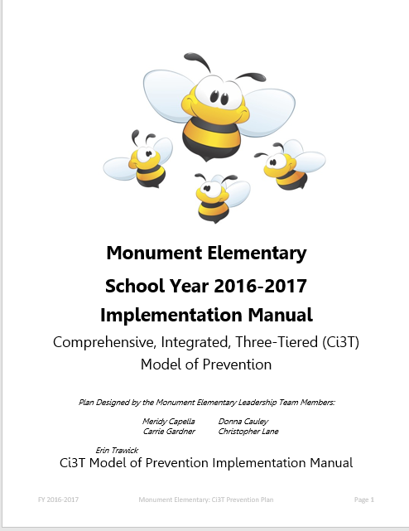
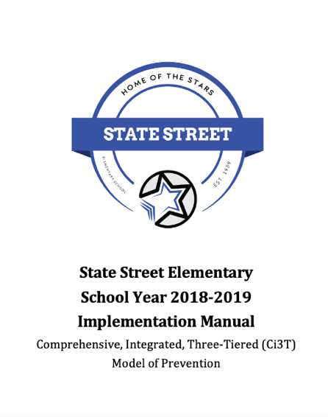
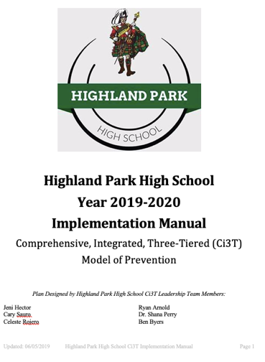

Slide 12
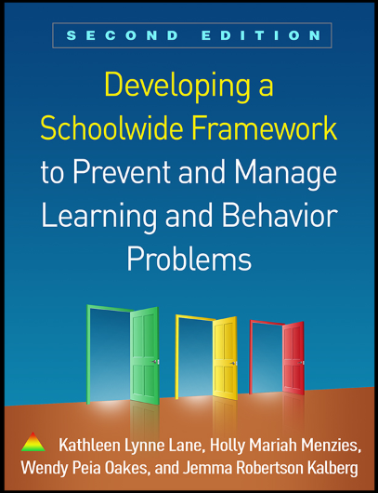
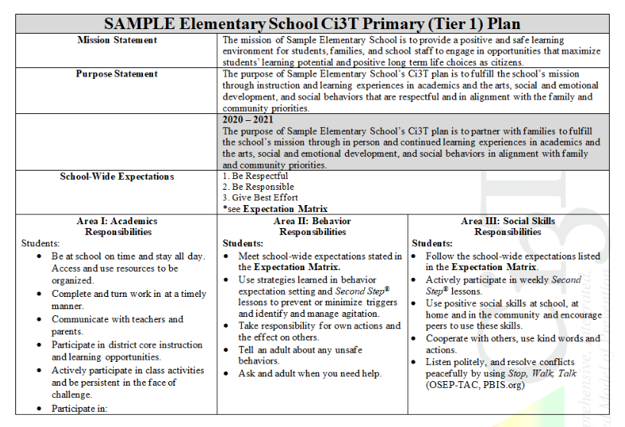
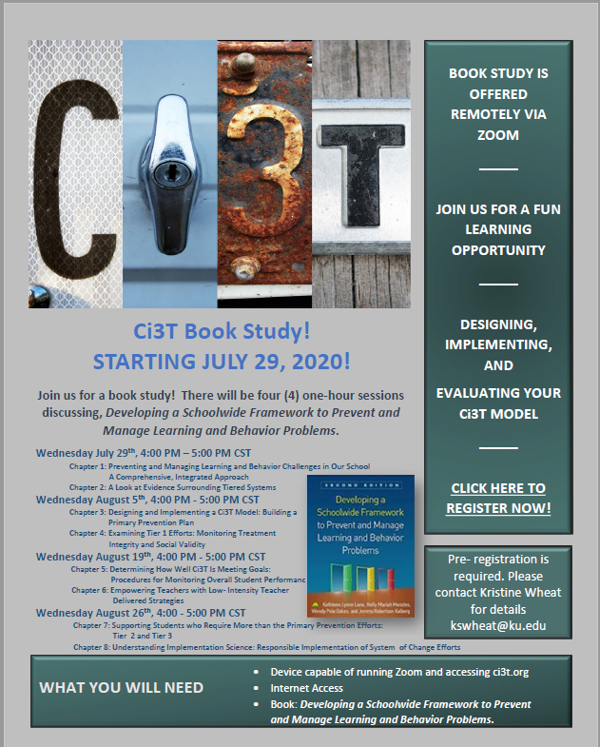

Slide 13
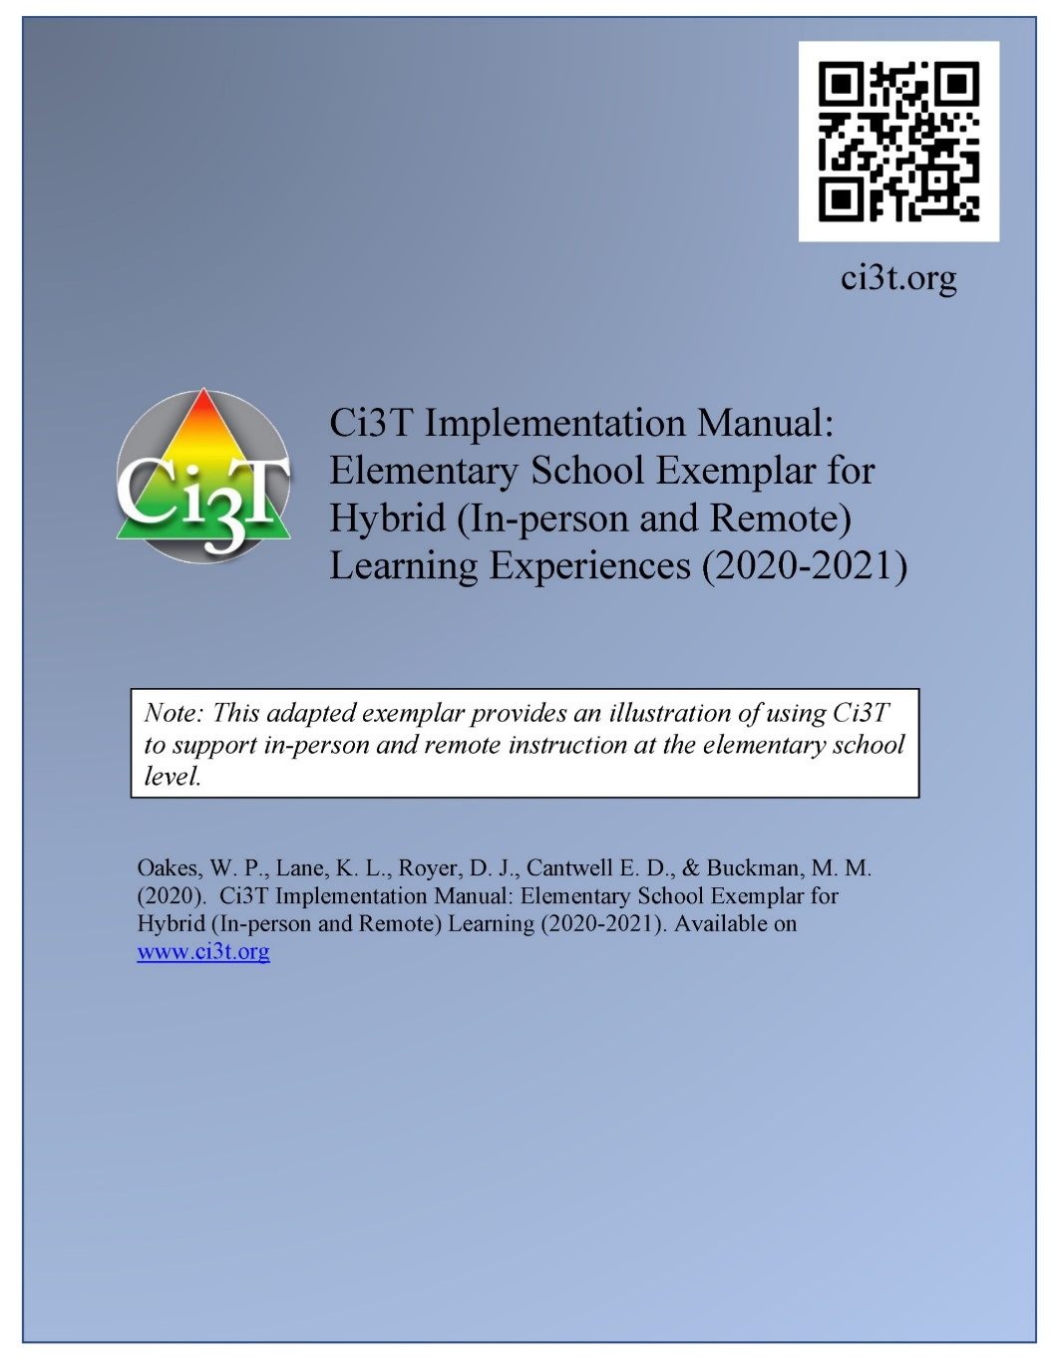
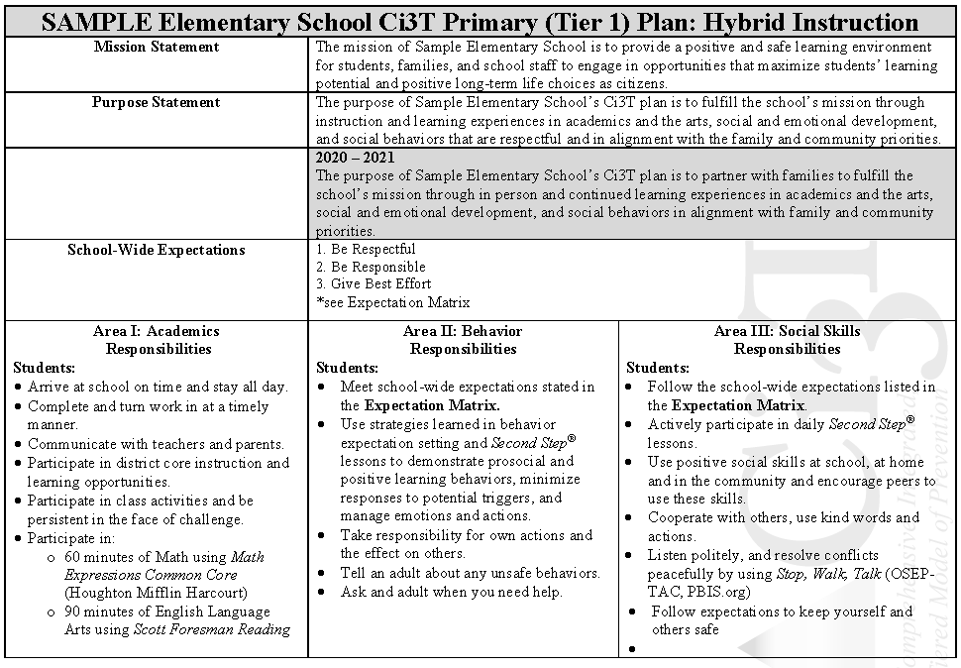
Ci3T.org/COVID

Slide 14
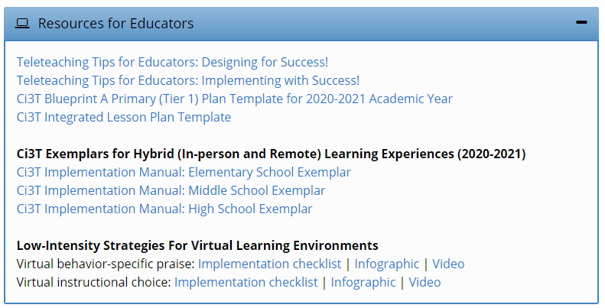

Opportunities to Respond
Area II: Academics Responsibilities Faculty and Staff: Teach core programs according to district and state standards with integrity: Use proactive evidence-based strategies to support students’ active engagement
Behavior-Specific Praise
Active Supervision
Opportunities to Respond
Instructional Feedback
High p Requests
Behavior-Specific Praise
Precorrection
Active Supervision
Remote Learning Use proactive evidence-based strategies to support students’ active engagement. Maintain online classroom platforms with learning activities connected to the weekly learning outcomes. Communicate at least weekly with families and students.
Incorporating Choice
Instructional Feedback
High-p Requests
Precorrection
Incorporating Choice

Slide 15
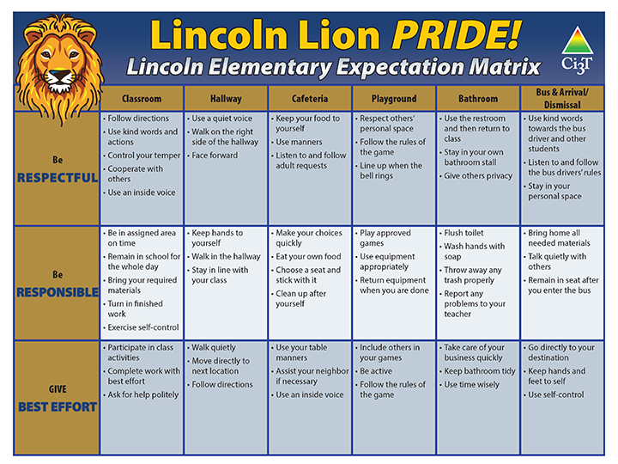

Area II: Behavior Responsibilities Faculty and Staff: Implement Positive Behavioral Interventions and Supports (PBIS) with integrity. Teach all setting Expectations within the first week of school and reteach Expectations (monthly). Display and model school-wide expectations in classrooms and other key settings.
Remote Learning Teach Expectations for remote learning. Set clear Expectations for your students’ learning times allowing for flexibility for unique family needs.

Slide 16
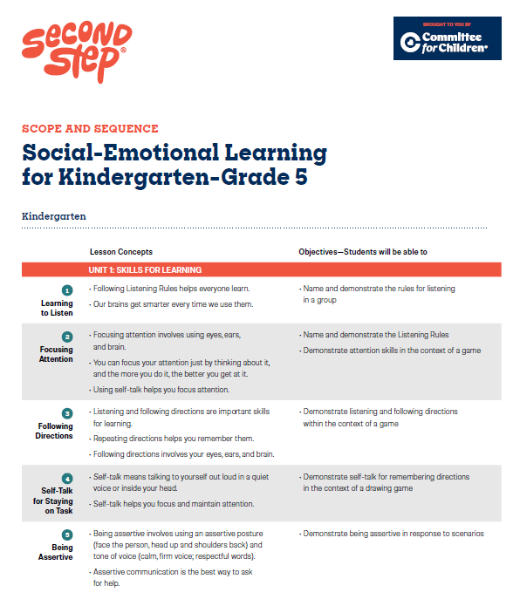
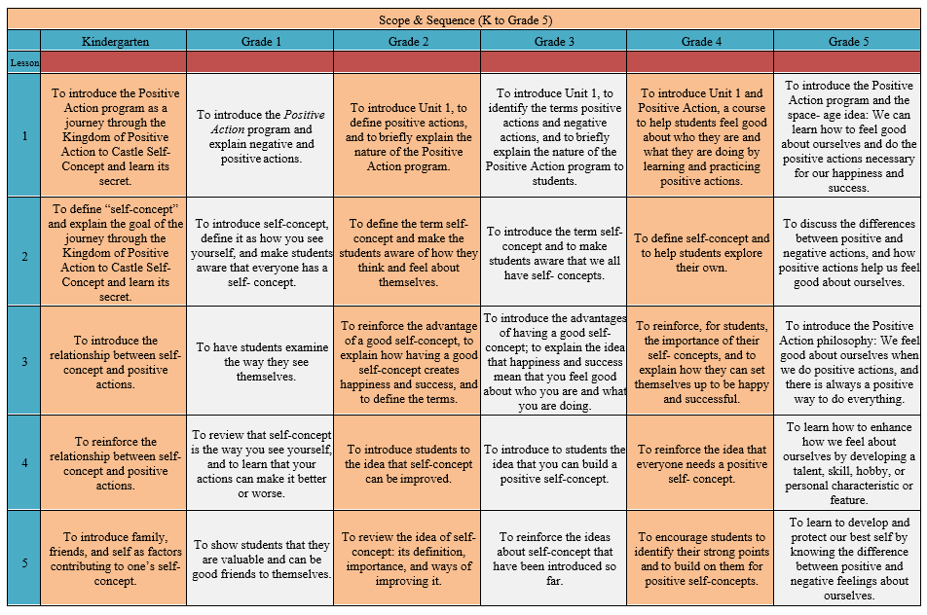
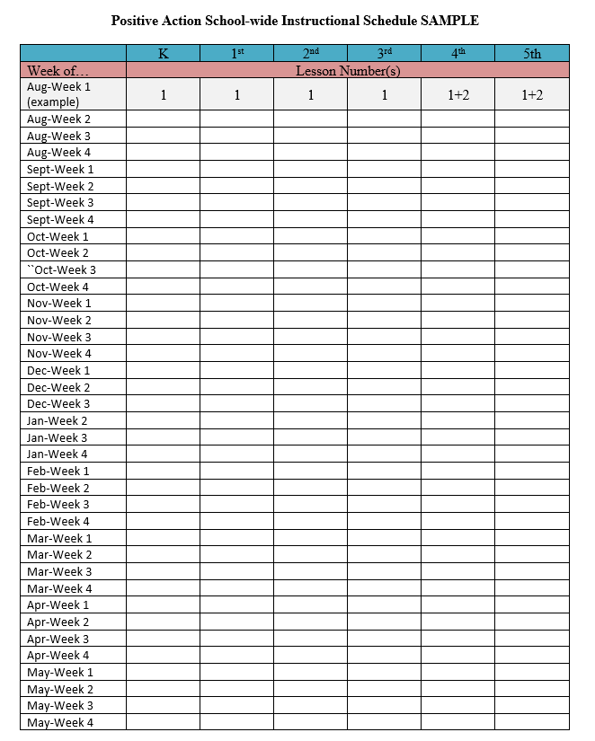
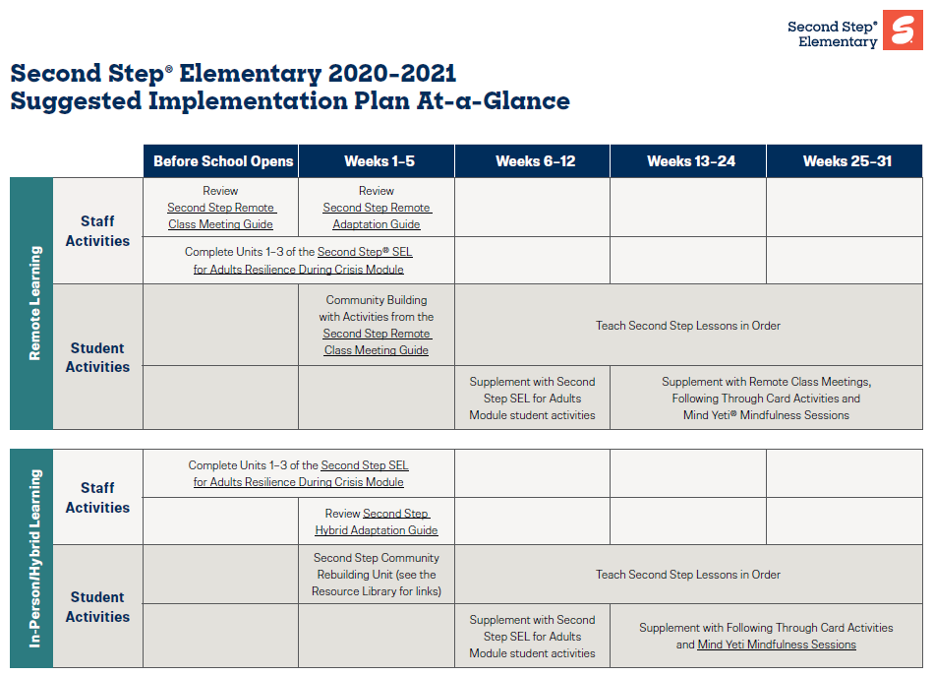
Area II: Social Responsibilities Faculty and Staff: Teach schoolwide social skills/ character education curricula with integrity: Teach daily Second Step® lessons (link to grade level instructional schedules) Seek ways to engage parents as partners in the school program
Remote Learning Begin each lesson with a connection to the social skills needed to fully engage in the lesson. Utilize online Second Step® resources to continue regular social skill lessons with asynchronous activities as well as synchronous lessons.

Slide 17
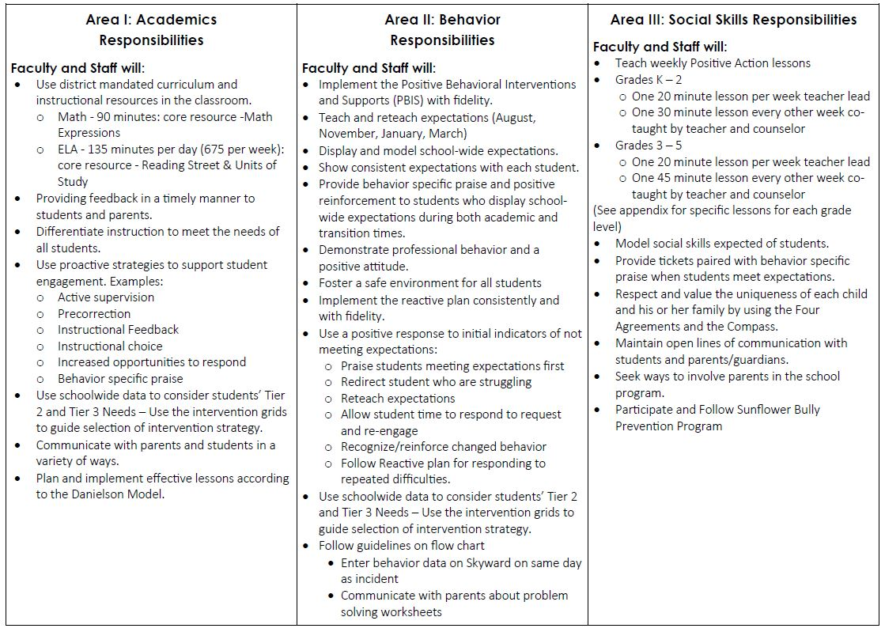
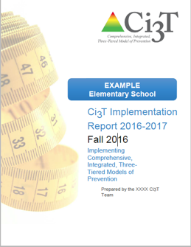
Ci3T Primary Plan: Procedures for Teaching
Ci3T Primary Plan: Procedures for Reinforcing
Ci3T Primary Plan: Procedures for Monitoring

Slide 18
A look at Procedures for Teaching at Tier 1
Procedures for Teaching
Faculty and Staff: Ci3T Leadership Teams and District Leaders will teach procedures to faculty and staff by: Provide faculty and staff Ci3T Implementation Manual and other materials such as posters, lesson plans, tickets, etc. to teach, implement and support our Ci3T plan. Professional learning opportunities at the district level to support implementation and sustainability of Ci3T, with attention to academic, behavior, and social domains. Expectations Matrix taught and posted. Ongoing re-teaching of expectations and procedures – dedicated staff meeting time for discussions.
Continued Learning: Ci3T Leadership Teams and District Leaders will teach procedures to faculty and staff by: Providing faculty and staff materials for remote access to the Ci3T Implementation Manual, digital ‘posters’ and e-tickets. Professional learning sessions and access guides for online materials for teaching social skills lessons. Beginning of year online meeting small-group breakout rooms for faculty and staff to review Ci3T Implementation Manual updates, get questions answered, and share ideas

Slide 19
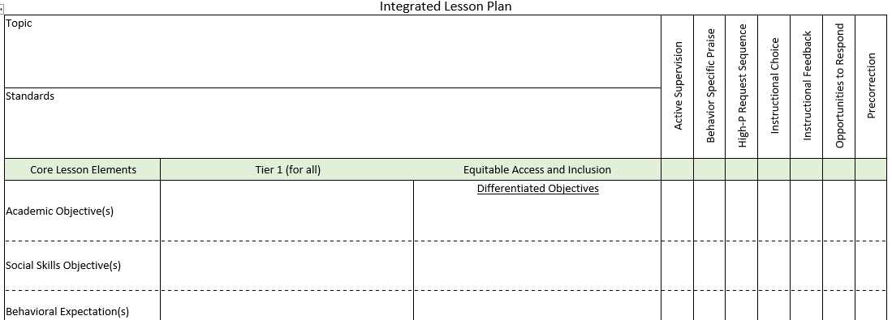
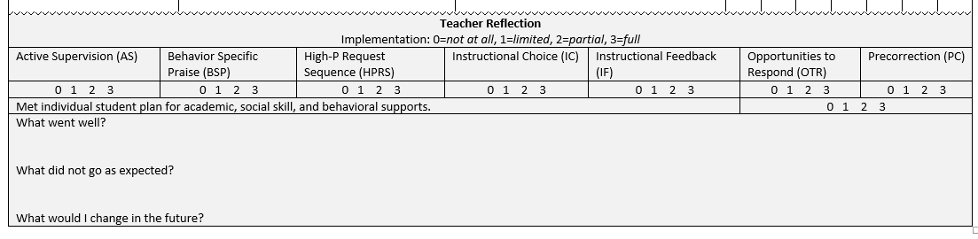

BSP
OTR
Active Supervision
Choice
Precorrection

Slide 20
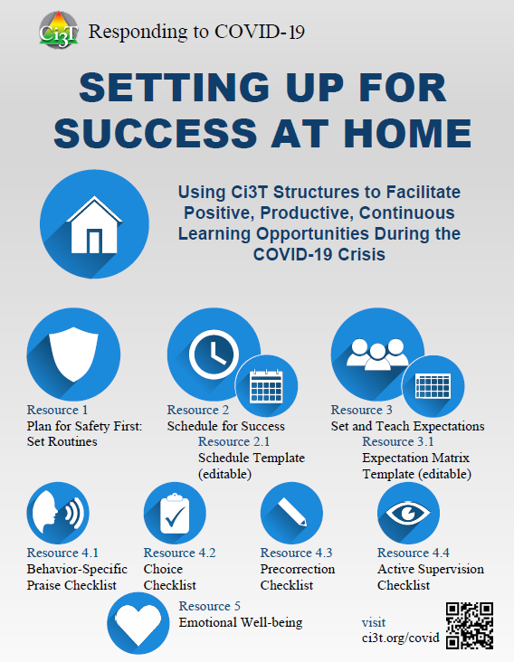
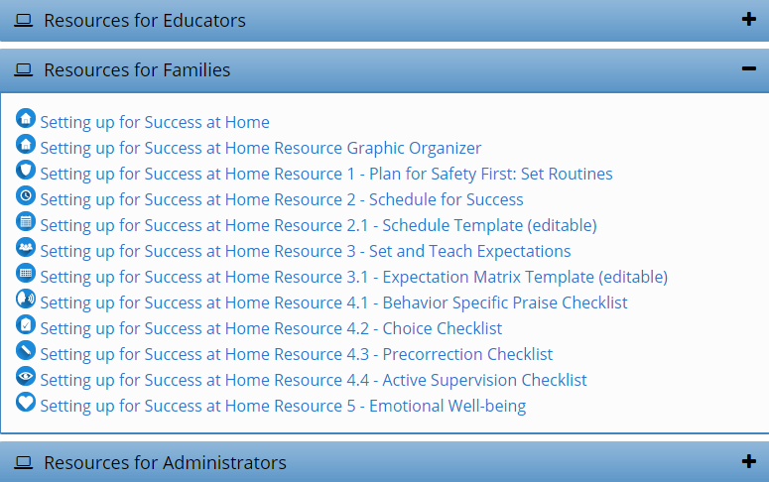
Setting up for Success at Home
http://www.ci3t.org/covid

Slide 21
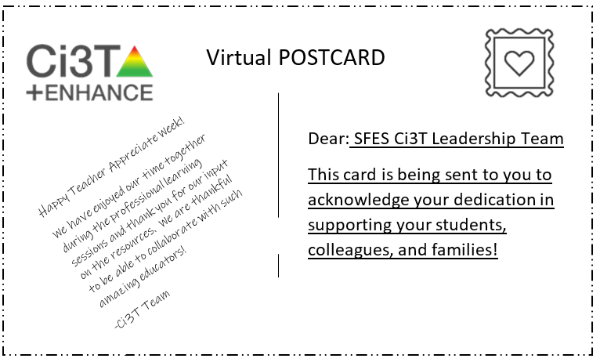
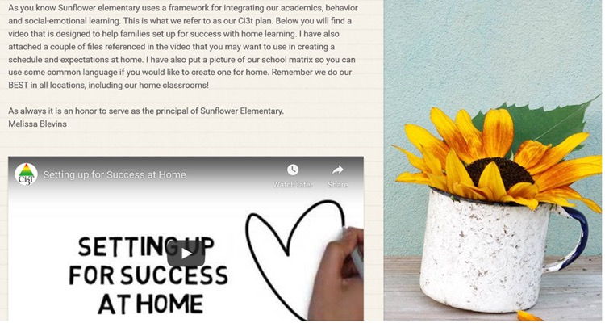
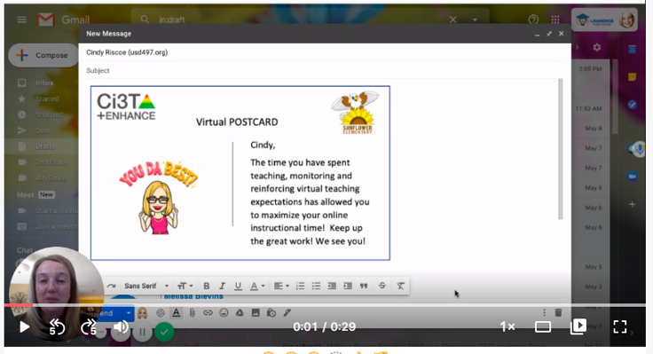


Slide 22
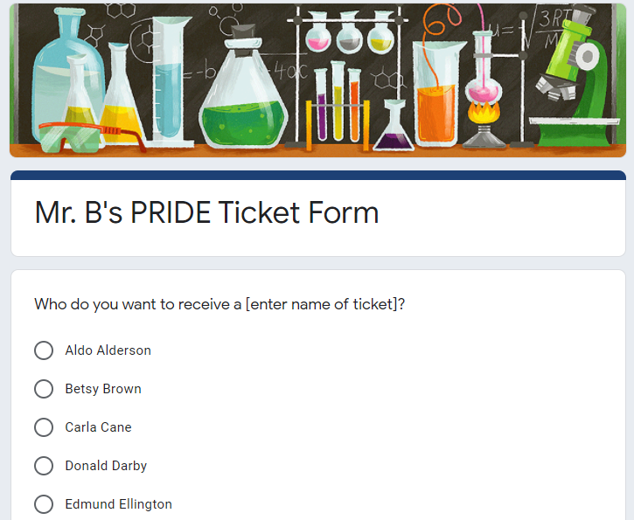
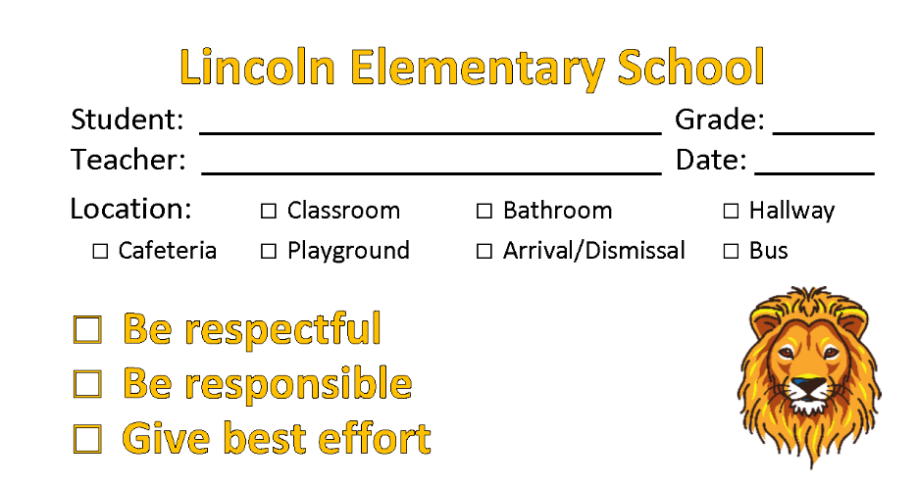

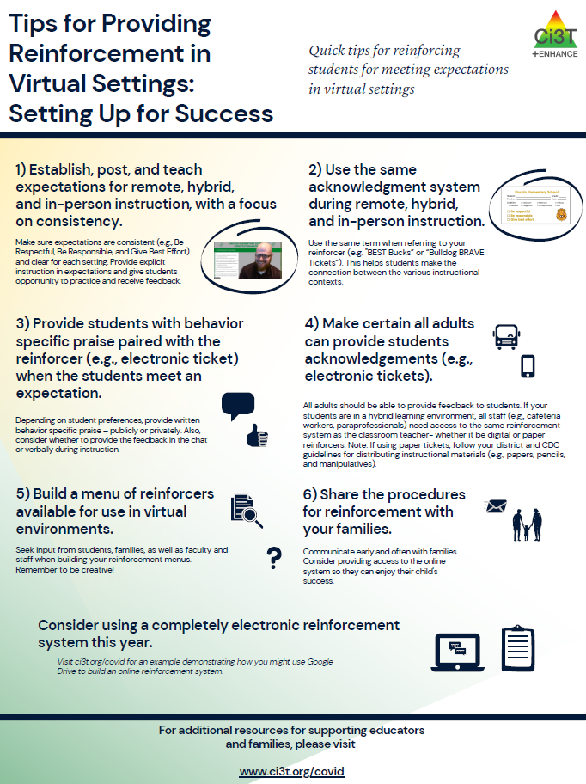

Slide 23
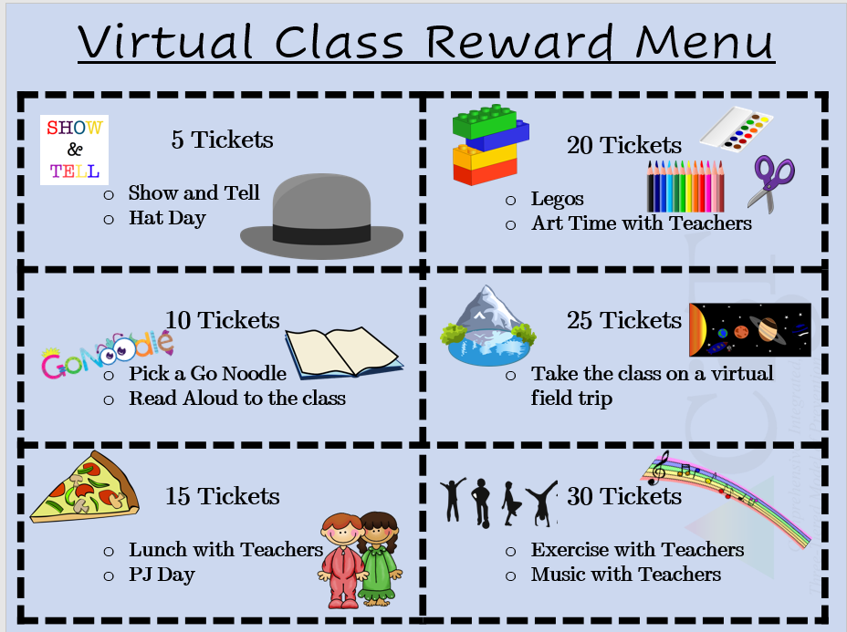
Virtual Learning Incentives
FREE Incentives:
Stay after on ZOOM with a friend for a chat
Virtual lunch date with the teacher, principal, etc.
(check with that staff member before offering them up of course)
Teacher wears stickers or has a sign with the student’s name
Dress up ZOOM day (hats, PJs, costumes, etc.)
Virtual Greeting Cards (sent via email)
Show & Tell Time (or some kind of star student spotlight time)
Personalized stickers in See Saw (2nd grade has been using this)
Virtual Class Reinforcement Menu
Adapted and shared with permission from a district partner

Slide 24
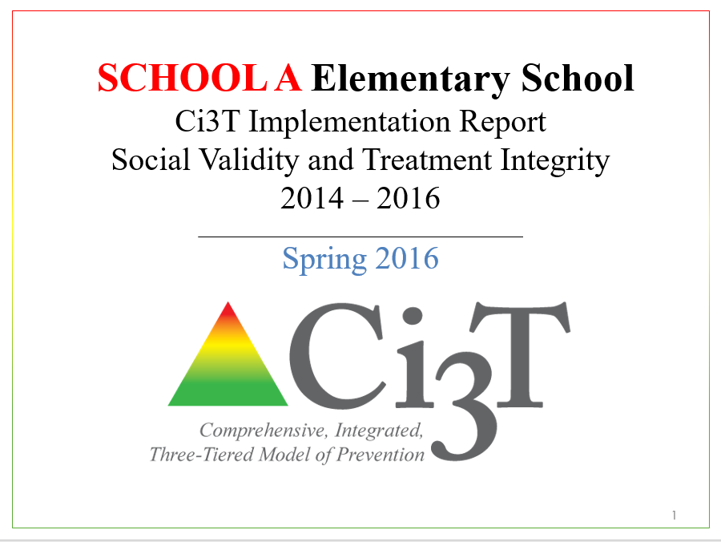
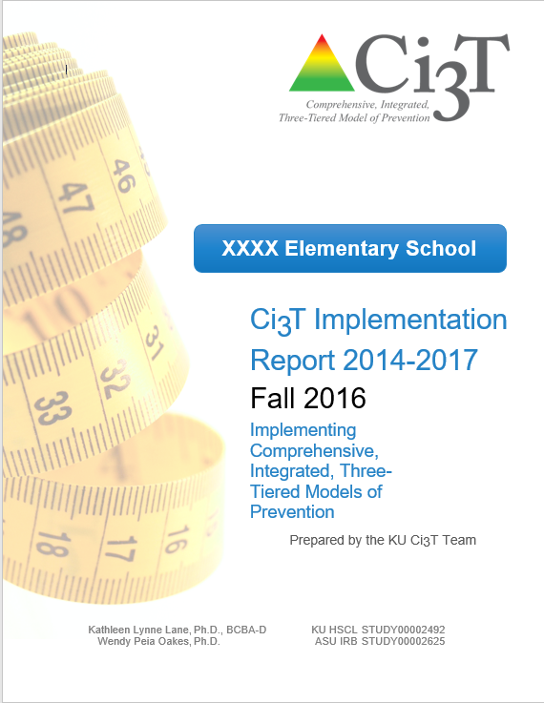
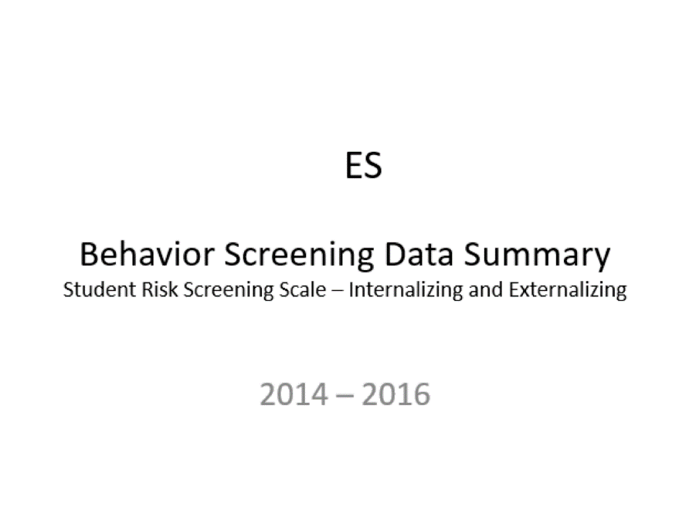
Essential Components of
Primary Prevention Efforts
Social Validity
Systematic Screening
Academic
Behavior
Treatment Integrity

Slide 25

Comprehensive, Integrated, Three-Tiered Model of Prevention
(Lane, Kalberg, & Menzies, 2009)
Tier 3
Tertiary Prevention (≈5%)
Tier 2
Secondary Prevention (≈15%)
Secondary (Tier 2) Intervention Grids
Tier 1
Primary Prevention (≈80%)
Academic ◇ Behavioral ◇ Social
Validated Curricula PBIS Framework Validated Curricula

Slide 26

Comprehensive, Integrated, Three-Tiered Model of Prevention
(Lane, Kalberg, & Menzies, 2009)
Tier 3
Tertiary Prevention (≈5%)
Tier 2
Secondary Prevention (≈15%)
Tertiary (Tier 3) Intervention Grids
Tier 1
Primary Prevention (≈80%)
Academic ◇ Behavioral ◇ Social
Validated Curricula PBIS Framework Validated Curricula

Slide 27
Implementation Science
Adapted from Fixsen & Blasé, 2005
Exploration & Adoption
Installation
Initial Implementation
We think we know what we need so we are planning to move forward (evidence-based)
Let’s make sure we’re ready to implement (capacity infrastructure)
Let’s give it a try & evaluate (demonstration)
Full Implementation
Let’s make it our way of doing business (institutionalized use)
Sustainability & Continuous Regeneration
That worked, let’s do it for real (investment)

Slide 28
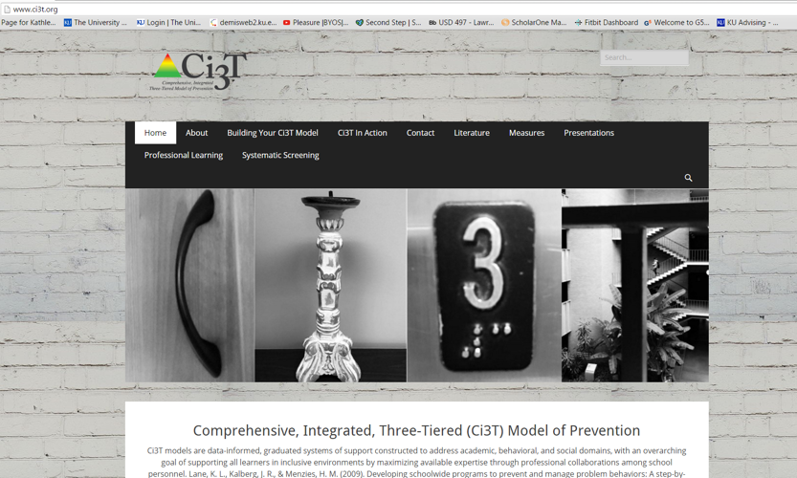

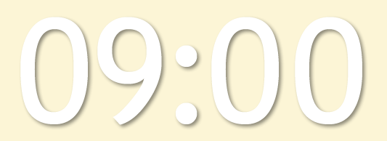
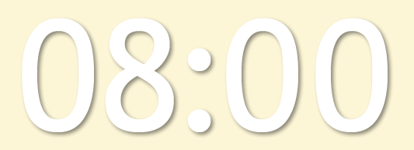
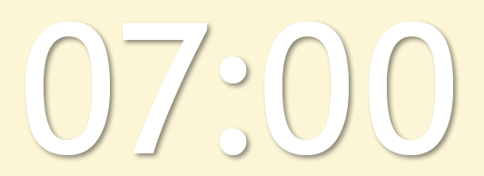
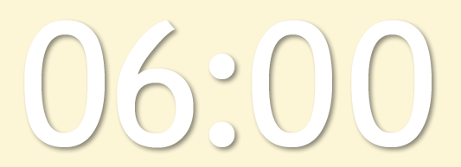







Notes:
10 min Using this PowerPoint break timer
**Is timer set to correct time. Do we want 25 or 10? Same question for above slide.
This PowerPoint slide uses images, custom animation, and timing to provide a countdown timer that you can use in any presentation. When you open the template, you’ll notice that the timer is set at 00:00. However, when you start the slide show, the timer will start at the correct time and count down by 1-minute intervals until it gets to 1 minute. At that point, it will count down in two 30-seconds intervals to 00:00.
To insert this slide into your presentation
Save this template as a presentation (.ppt file) on your computer.
Open the presentation that will contain the timer.
On the Slides tab, place your insertion point after the slide that will precede the timer. (Make sure you don't select a slide. Your insertion point should be between the slides.)
On the Insert menu, click Slides from Files.
In the Slide Finder dialog box, click the Find Presentation tab.
Click Browse, locate and select the timer presentation, and then click Open.
In the Slides from Files dialog box, select the timer slide.
Select the Keep source formatting check box. If you do not select this check box, the copied slide will inherit the design of the slide that precedes it in the presentation.
Click Insert.
Click Close.

Slide 29
Agenda
Introducing Ci3T … a Comprehensive, Integrated, Three-Tiered Model of Prevention
The Role of Screening: Using Screening Data to Shape Instruction
  At Tier 1: Primary Preventions Efforts
  At all Tiers: Teacher-delivered Strategies
  At Tiers 2 & 3: Secondary & Tertiary Prevention Efforts
Considerations for Screening PK-12 in the COVID-19 Era
Planning for Next Steps

Slide 30
Comprehensive, Integrated, Three-Tiered Model of Prevention
(Lane, Kalberg, & Menzies, 2009)
Tier 3
Tertiary Prevention (≈5%)
Tier 2
Secondary Prevention (≈15%)
Tier 1
Primary Prevention (≈80%)
Academic ◇ Behavioral ◇ Social
Validated Curricula PBIS Framework Validated Curricula

Slide 31
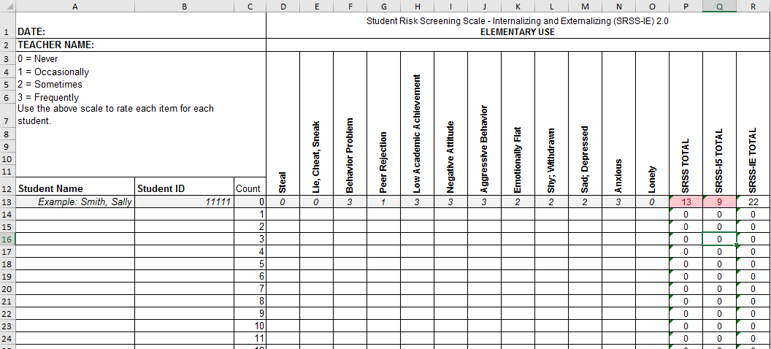
Student Risk Screening Scale for Internalizing and Externalizing (SRSS-IE; Drummond, 1994; Lane & Menzies, 2009) for Elementary Schools

Slide 32
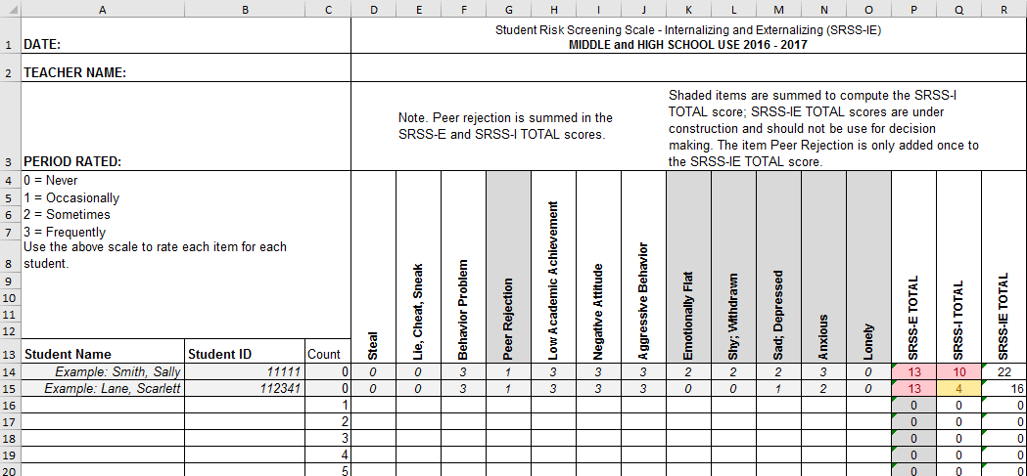
Student Risk Screening Scale for Internalizing and Externalizing (SRSS-IE; Drummond, 1994; Lane & Menzies, 2009)

Slide 33
SRSS-IE: Cut Scores
Elementary School |  | Middle and High School
SRSS-E7 | SRSS-I5 | SRSS-E7 | SRSS-I6
Items 1-7 | Items 8-12 | Items 1-7 | Items 4, 8-12
0-3 = low risk 4-8 = moderate risk 9-21 = high risk | 0-1 = low risk 2-3 = moderate risk 4-15 = high risk | 0-3 = low risk 4-8 = moderate risk 9-21 = high risk | 0-3 = low risk 4-5 = moderate risk 6-18 = high risk
Elementary School Level:
Lane, K. L., Oakes, W. P., Swogger, E. D., Schatschneider, C., Menzies, H., M., & Sanchez, J. (2015). Student risk screening scale for internalizing and externalizing behaviors: Preliminary cut scores to support data-informed decision making. Behavioral Disorders, 40, 159-170.
Middle and High School Levels:
Lane, K. L., Oakes, W. P., Cantwell, E. D., Schatschneider, C., Menzies, H., Crittenden, M., & Messenger, M. (2016). Student Risk Screening Scale for Internalizing and Externalizing Behaviors: Preliminary cut scores to support data-informed decision making in middle and high schools. Behavioral Disorders, 42(1), 271-284

Slide 34
SRSS-E7 (externalizing) Results – All Students
Sample Elementary School Fall
N = 25
N = 16
N = 17
N = 12
N = 12
N = 86
N = 35
N = 57
N = 36
N = 50
N = 250
N = 300
N = 250
N = 255
N = 255

Slide 35
SRSS-I5 (internalizing) Results – All Students
Sample Elementary School Fall
N = 72
N = 18
N = 32
N = 85
N = 43
N = 45
N = 40
N = 204
N = 289
N = 261
N = 231

Slide 36
SRSS-Externalizing Results: Grade level
Fall 2018
Grade Level | N Screened | Low n (%) | Moderate n (%) | High n (%)
K | 58 | 51 (87.93%) | 6 (10.34%) | 1 (1.72%)
1st | 52 | 40 (76.92%) | 8 (15.38%) | 4 (7.69%)
2nd | 61 | 51 (83.61%) | 6 (9.84%) | 4 (6.56%)

Slide 37
Student Risk Screening Scale Fall 2004 – 2012 Middle School
Source: Lane, K. L., Oakes, W. P., & Magill, L. M., (2014). Primary prevention efforts: How do we implement and monitor the Tier 1 component of our comprehensive, integrated, three-tiered model of prevention. Preventing School Failure, 58, 143-158. doi: 10.1080/1045988X.2014.893978 [Figure 4. Middle school behavior screening data over time at the fall time point. Adapted from Figure 4.6 p. 127 Lane, K. L., Menzies, H. M, Oakes, W. P., & Kalberg, J. R. (2012). Systematic screenings of behavior to support instruction: From preschool to high school. New York, NY: Guilford Press.]

Slide 38
Middle School Study 1: Behavioral & Academic Characteristics of SRSS Risk Groups
Variable |  | Risk
 | Low (n = 422) M (SD) | Moderate (n = 51) M (SD) | High (n = 12) M (SD) | Significance Testing
ODR | 1.50 (2.85) | 5.02 (5.32) | 8.42 (7.01) | L<M<H
In-School Suspensions | 0.08 (0.38) | 0.35 (1.04) | 1.71 (2.26) | L<M<H
GPA | 3.35 (0.52) | 2.63 (0.65) | 2.32 (0.59) | L>M, H M=H
Course Failures | 0.68 (1.50) | 2.78 (3.46) | 4.17 (3.49) | L<M, H M=H
(Lane, Parks, Kalberg, & Carter, 2007)

Slide 39
Screening Data: High School Yrs1-3
Fall- SRSSIE-I |  | Low |  | Moderate |  | High |  | Fall- SRSSIE-E |  | Low |  | Moderate |  | High
2016 |  | 80.28% |  | 10.36% |  | 9.36% |  | 2016 |  | 89.56% |  | 8.02% |  | 2.42%
2017 |  | 90.18% |  | 4.16% |  | 5.66% |  | 2017 |  | 91.29% |  | 6.18% |  | 2.54%
2018 |  | 90.91% |  | 3.86% |  | 5.23% |  | 2018 |  | 92.22% |  | 6.20% |  | 1.58%
WTR-SRSSIE-I |  | Low |  | Moderate |  | High |  | WTR-SRSSIE-E |  | Low |  | Moderate |  | High
2016 |  | 87.25% |  | 9.49% |  | 3.26% |  | 2016 |  | 87.25% |  | 9.49% |  | 3.26%
2017 |  | 86.14% |  | 9.02% |  | 4.85% |  | 2017 |  | 86.14% |  | 9.02% |  | 4.85%
2018 |  | 88.79% |  | 8.52% |  | 2.69% |  | 2018 |  | 88.79% |  | 8.52% |  | 2.69%

Slide 40
Notes:
Data security – teamwork to create, populate, collect and synthesize data – planning ahead to calendar screening as all other data collection – SHARE the information with faculty and staff

Slide 41
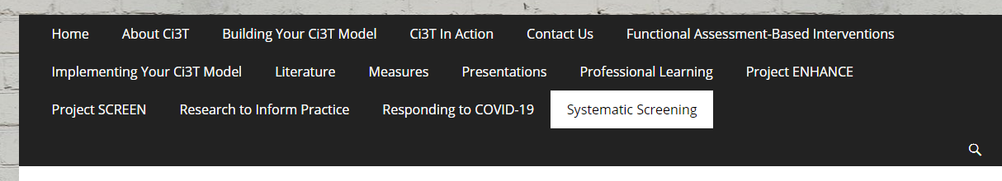
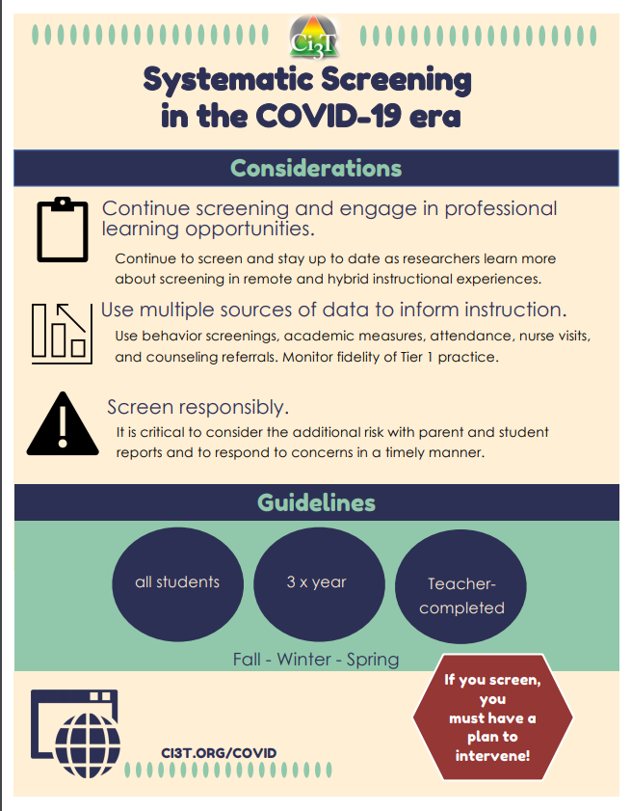



Slide 42
Agenda
Introducing Ci3T … a Comprehensive, Integrated, Three-Tiered Model of Prevention
The Role of Screening: Using Screening Data to Shape Instruction
  At Tier 1: Primary Preventions Efforts
  At all Tiers: Teacher-delivered Strategies
  At Tiers 2 & 3: Secondary & Tertiary Prevention Efforts
Considerations for Screening PK-12 in the COVID-19 Era
Planning for Next Steps

Slide 43
Social Skills Improvement System – Performance Screening Guide Spring 2012 – Total School
N = 54
N = 22
N = 35
N = 31
N = 223
N = 233
N = 180
N = 187
N = 212
N = 235
N = 275
N = 271
n = 489 n = 490 n = 490 n = 489
Lane, K. L., Oakes, W. P., & Magill, L. (2013). Primary prevention efforts: How do we implemented and monitor the Tier 1 component of our Comprehensive, Integrated, Three-Tiered (CI3T) Model?

Slide 44
Student Risk Screening Scale Fall 2004 – 2012 Middle School
Source: Lane, K. L., Oakes, W. P., & Magill, L. M., (2014). Primary prevention efforts: How do we implement and monitor the Tier 1 component of our comprehensive, integrated, three-tiered model of prevention. Preventing School Failure, 58, 143-158. doi: 10.1080/1045988X.2014.893978 [Figure 4. Middle school behavior screening data over time at the fall time point. Adapted from Figure 4.6 p. 127 Lane, K. L., Menzies, H. M, Oakes, W. P., & Kalberg, J. R. (2012). Systematic screenings of behavior to support instruction: From preschool to high school. New York, NY: Guilford Press.]

Slide 45
Agenda
Introducing Ci3T … a Comprehensive, Integrated, Three-Tiered Model of Prevention
The Role of Screening: Using Screening Data to Shape Instruction
  At Tier 1: Primary Preventions Efforts
  At all Tiers: Teacher-delivered Strategies
  At Tiers 2 & 3: Secondary & Tertiary Prevention Efforts
Considerations for Screening PK-12 in the COVID-19 Era
Planning for Next Steps

Slide 46

Examining Academic and Behavioral Data:
Elementary School Level
Lane, K. L., Menzies, H. M., Ennis, R. P., & Oakes, W. P. (2015). Supporting Behavior for School Success: A Step-by-Step Guide to Key Strategies. New York, NY: Guilford Press.
Notes:
Lane, K. L., Oakes, W. P., Ennis, R. P., & Hirsch, S. E. (2014). Identifying students for secondary and tertiary prevention efforts: How do we determine which students have Tier 2 and Tier 3 needs? Preventing School Failure, 58, 171-182, DOI: 10.1080/1045988X.2014.895573

Slide 47





Low-Intensity Strategies
Opportunities to Respond
Behavior Specific Praise
Active Supervision
Instructional Feedback
High p Requests
Precorrection
Incorporating Choice
Self-monitoring
Behavior Contracts
Notes:
Lane, K. L., Oakes, W. P., Ennis, R. P., & Hirsch, S. E. (2014). Identifying students for secondary and tertiary prevention efforts: How do we determine which students have Tier 2 and Tier 3 needs? Preventing School Failure, 58, 171-182, DOI: 10.1080/1045988X.2014.895573

Slide 48




Notes:
Ci3T.org: On-demand Professional Learning Resources

Slide 49




ci3t.org
Professional Learning tab

Slide 50
Agenda
Introducing Ci3T … a Comprehensive, Integrated, Three-Tiered Model of Prevention
The Role of Screening: Using Screening Data to Shape Instruction
  At Tier 1: Primary Preventions Efforts
  At all Tiers: Teacher-delivered Strategies
  At Tiers 2 & 3: Secondary & Tertiary Prevention Efforts
Considerations for Screening PK-12 in the COVID-19 Era
Planning for Next Steps

Slide 51
Comprehensive, Integrated, Three-Tiered Model of Prevention
(Lane, Kalberg, & Menzies, 2009)
Tier 3
Tertiary Prevention (≈5%)
Tier 2
Secondary Prevention (≈15%)
Secondary (Tier 2) Intervention Grids
Tier 1
Primary Prevention (≈80%)
Academic ◇ Behavioral ◇ Social
Validated Curricula PBIS Framework Validated Curricula

Slide 52


Slide 53


Slide 54





Slide 55
Agenda
Introducing Ci3T … a Comprehensive, Integrated, Three-Tiered Model of Prevention
The Role of Screening: Using Screening Data to Shape Instruction
  At Tier 1: Primary Preventions Efforts
  At all Tiers: Teacher-delivered Strategies
  At Tiers 2 & 3: Secondary & Tertiary Prevention Efforts
Considerations for Screening PK-12 in the COVID-19 Era
Planning for Next Steps

Slide 56

Considerations for Systematic Screening PK-12 in the COVID-19 Era
Lane, K. L., Oakes, W. P., & Menzies, H. M. (2020). Considerations for systematic screening PK-12: Universal screening for internalizing and externalizing behaviors in the COVID-19 era. Manuscript in review

Slide 57

Recommendations to Consider:
Pre-COVID-19
Recommendation #1: Build Stakeholders’ Expertise
Recommendation #2: Develop the Structures to Sustain and Improve Practices
Recommendation #3: Conduct Screenings in a Responsible Fashion
Recommendation #4: Consider Legal Implications- know your state laws

Slide 58
Recommendations to Consider:
Screening in the COVID-19 Era
Recommendation 1: Continue Screening and Engage in Professional Learning Opportunities
Recommendation 2: Use Multiple Sources of Data to Inform Instruction
Recommendation 3: Screen Responsibly
Lane, K. L., Oakes, W. P., & Menzies, H. M. (2020). Considerations for systematic screening PK-12: Universal screening for internalizing and externalizing behaviors in the COVID-19 era. Manuscript in review

Slide 59



Slide 60
Agenda
Introducing Ci3T … a Comprehensive, Integrated, Three-Tiered Model of Prevention
The Role of Screening: Using Screening Data to Shape Instruction
  At Tier 1: Primary Preventions Efforts
  At all Tiers: Teacher-delivered Strategies
  At Tiers 2 & 3: Secondary & Tertiary Prevention Efforts
Considerations for Screening PK-12 in the COVID-19 Era
Planning for Next Steps

Slide 61

Looking Ahead

Slide 62

Resources for Responding to COVID-19

Slide 63
Setting up for Success at Home
  A Look at Expectations
http://www.ci3t.org/covid
Notes:
In the accordions below we will be uploading a series of brief practice guides that we hope you will find useful. Feel free to share these materials with fellow educators and families. We are sending positive thoughts to all our partners, colleagues, and the students you so tirelessly support.
Materials to support educators and families as we transition to continuous learning
Using your Ci3T structures to facilitate positive, productive environments for students, families, educators, and administrators

Slide 64


Ci3T: Monitoring for Success: Using Data to Inform Instruction
… Action Planning

Slide 65


Ci3T Monthly Leadership Team Meetings

Slide 66



Resources for Responding to COVID-19

Slide 67


  A Look at Expectations

Slide 68

Guide to Systematic Screening
Tools
Click the image to access the whole
table.

Slide 69


Screening Resources

Slide 70


What is screening & why do we do it?
Select RDQ 18 on page 2 of 2019’s materials.

Slide 71


Tips for Communicating with Your Community about Systematic Screening

Slide 72
Kathleen.Lane@ku.edu
Thank you!

