Slide 1
Systematic Screening in PK-12:
A Look at the
Student Risk Screening Scale for Internalizing and Externalizing (SRSS-IE)
&
Student Risk Screening Scale for Early Childhood (SRSS-EC)
State of South Carolina Department of Education: Social Emotional Learning (SEL) Screener Showcase hosted by the Office of Early Learning and Literacy (OELL)
Kathleen Lynne Lane, Ph.D., BCBA-D, CF-L1, University of Kansas
Wendy Peia Oakes, Ph.D., Arizona State University
Mark M. Buckman, MS. Ed., University of Kansas

Slide 2
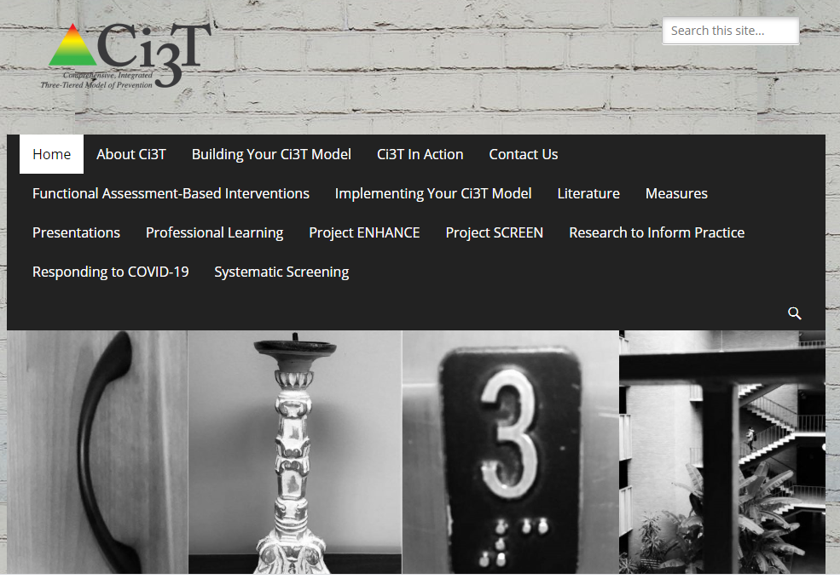
ci3t.org

Slide 3
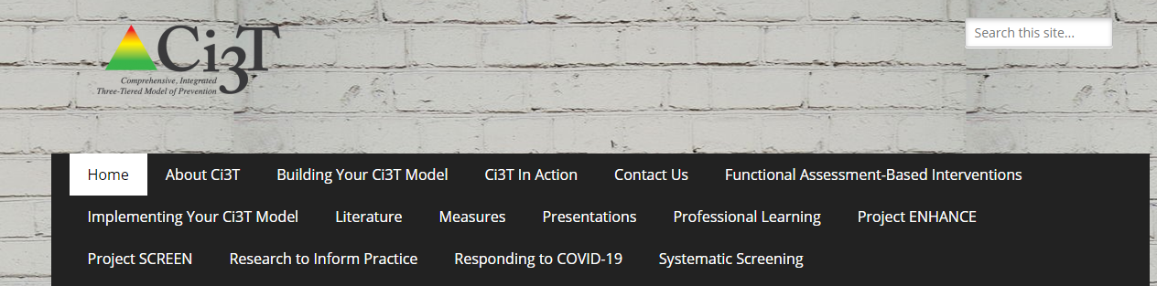
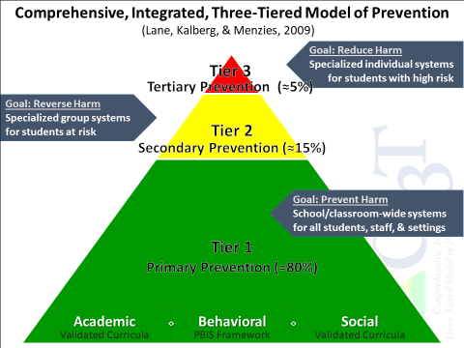
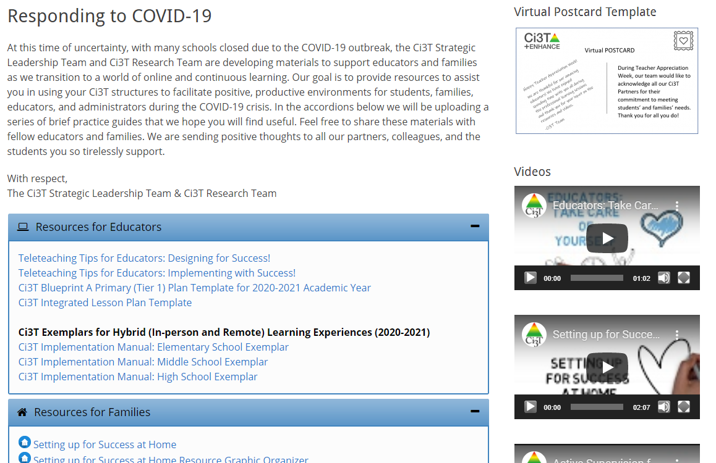


Slide 4
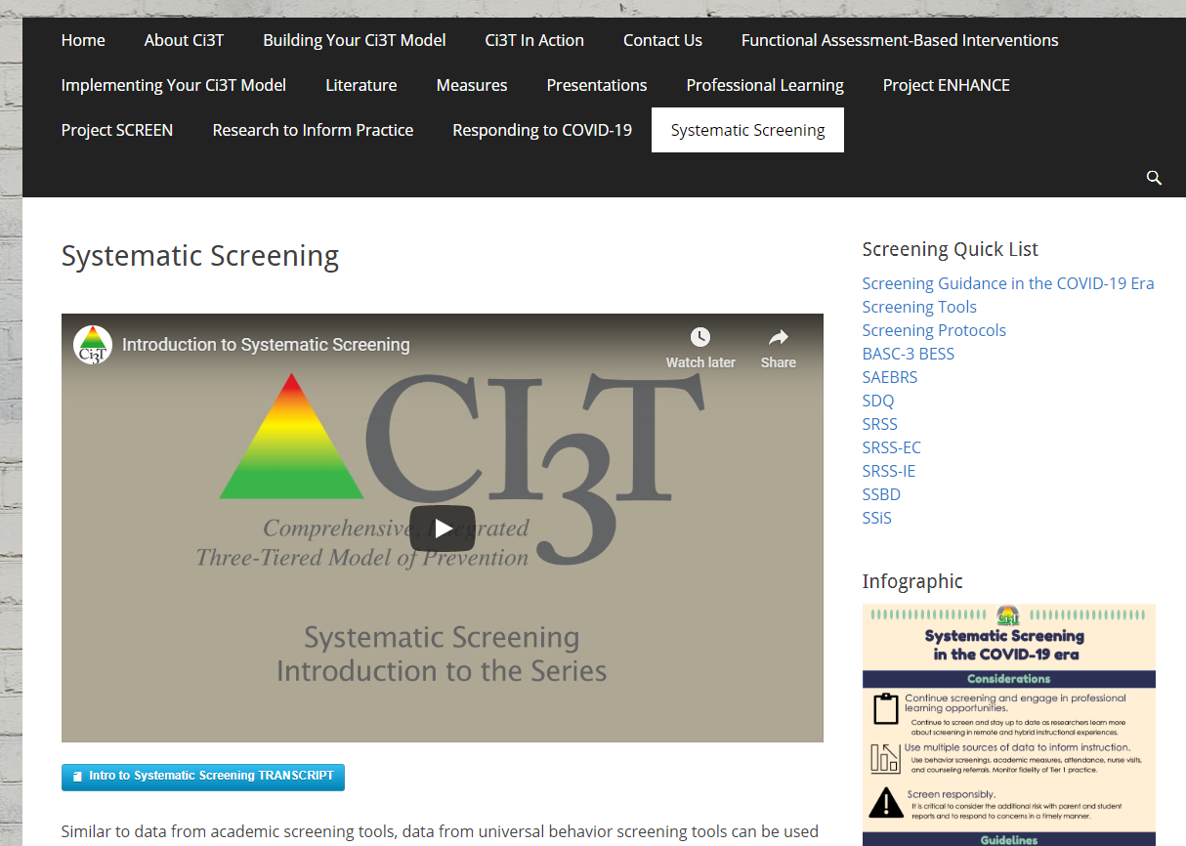
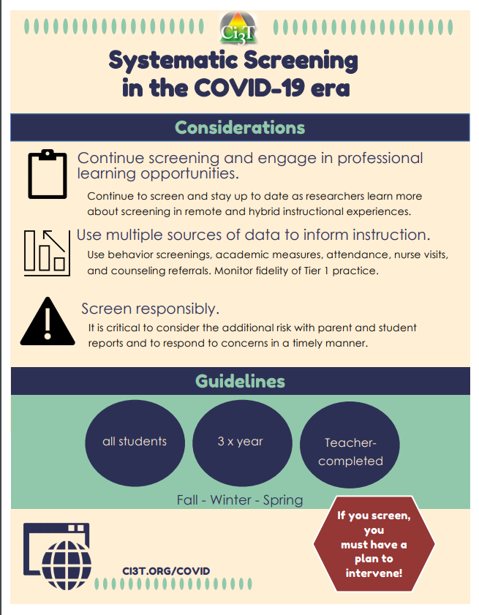
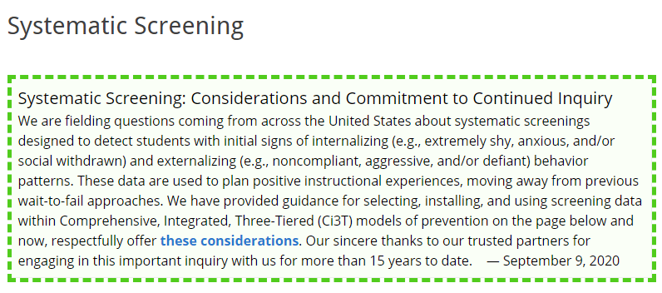
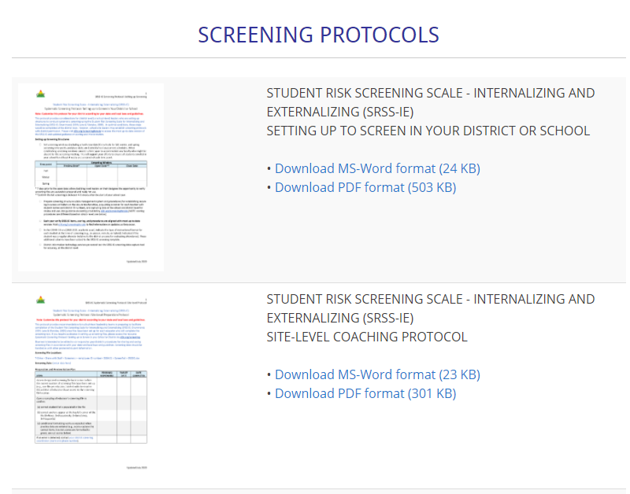
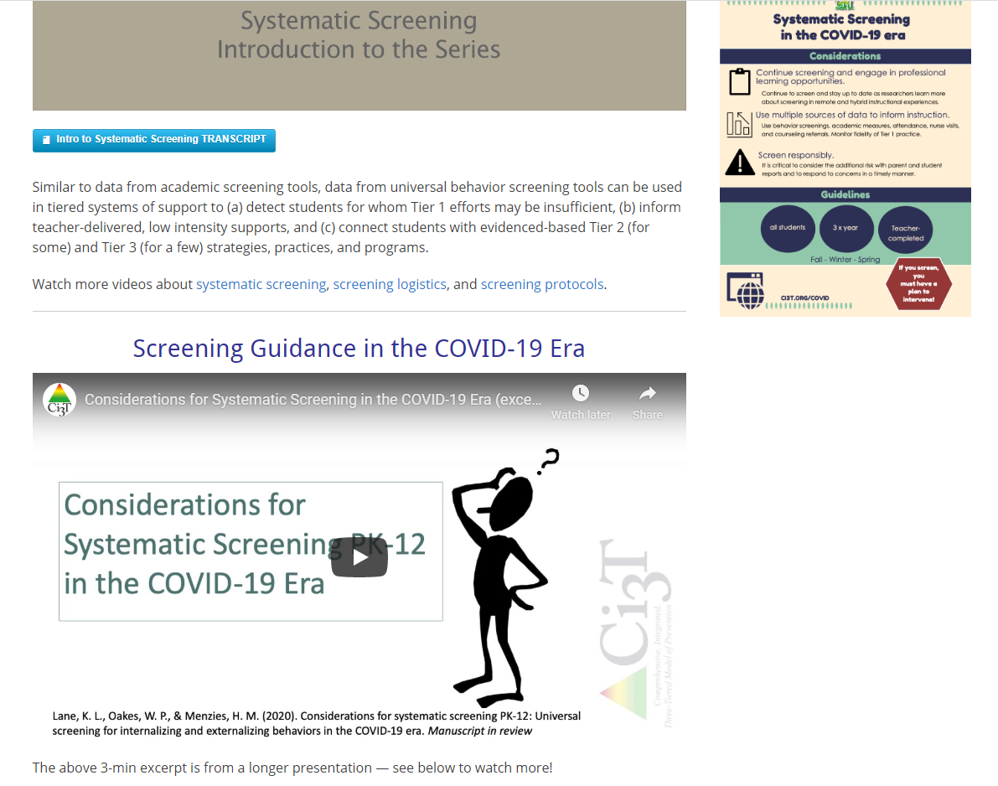

Slide 5
Agenda
Introducing Ci3T … a Comprehensive, Integrated, Three-Tiered Model of Prevention
A Look at …
  Student Risk Screening Scale – Internalizing and Externalizing (SRSS-IE)
  Student Risk Screening Scale for Early Childhood (SRSS-EC)
The Role of Screening: Using Screening Data to Shape Instruction
  At Tier 1: Primary Preventions Efforts
  At all Tiers: Teacher-delivered Strategies
  At Tiers 2 & 3: Secondary & Tertiary Prevention Efforts
Planning for Next Steps

Slide 6
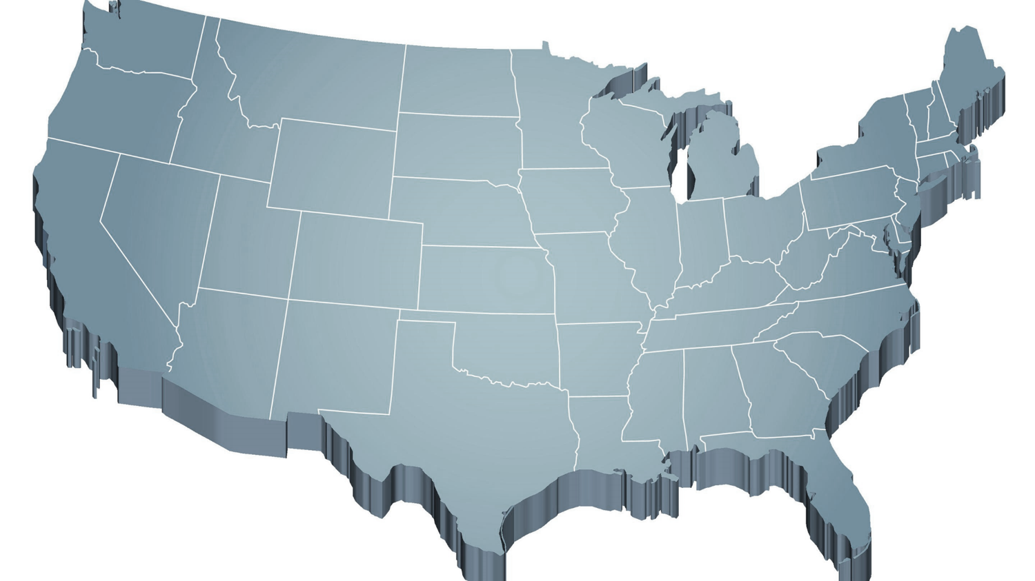
Thank you for your commitment
Shift to a systems level perspective
Internalizing
Externalizing
ED <1%
EBD 12-20%
Source: Forness, S.R., Freeman, S.F., Paparella, T., Kauffman, J.M., & Walker, H.M. (2012). Special education implications of point and cumulative prevalence for children with emotional or behavioral disorders. Journal of Emotional and Behavioral Disorders, 20, 4-18.

Slide 7




The Journey of Ci3T
Notes:
CA & AZ start→ Tennessee → North Carolina→ Kansas
Trainings (MO, KANSAS, VERMONT, AZ)
MO, KS, UAB
HI

Slide 8
Comprehensive, Integrated, Three-Tiered Model of Prevention
(Lane, Kalberg, & Menzies, 2009)
Tier 3
Tertiary Prevention (≈5%)
Tier 2
Secondary Prevention (≈15%)
Tier 1
Primary Prevention (≈80%)
Academic ◇ Behavioral ◇ Social
Validated Curricula PBIS Framework Validated Curricula

Slide 9

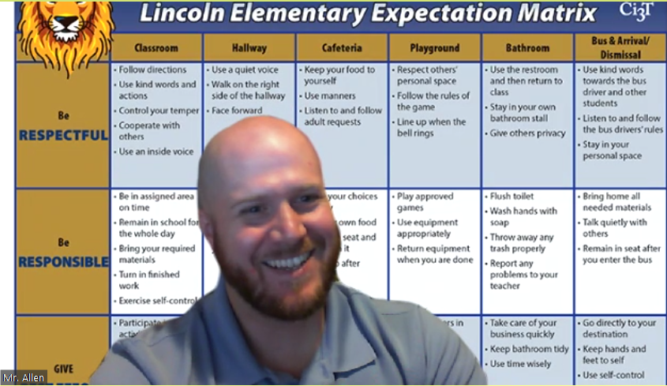

Slide 10
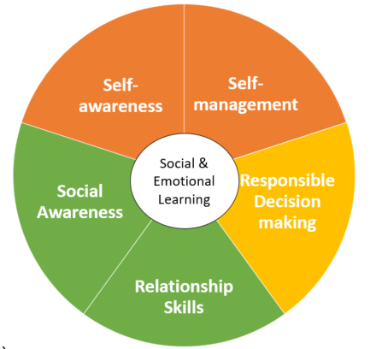
The Five Social and Emotional Learning Core Competencies
Self-awareness
(CASEL, 2013)

Slide 11
Social Component:
Examples of Schoolwide Programs
Social-emotional
Connect With Kids
connectwithkids.com
Character Education
A curricula using real stories presented through documentary-style videos, non-fiction books, teaching guides and patent resources.
Attendance and achievement
Bullying and violence prevention
Character and Life skills
Digital citizenship
Alcohol and drug prevention
Health and Wellness
Customizable units are:
Positive Action
www.positiveaction.net
Improves academics, behavior, and character
Curriculum-based approach
Effectively increases positive behaviors and decreases negative behaviors
6-7 units per grade
Optional components:
  site-wide climate development
  drug education
  bullying / conflict resolution
  counselor, parent, and family classes
  community/coalition components

Slide 12
Top 10 School-related Social Skills
Listens to Others
Follows Directions
Follows Classroom Rules
Ignores Peer Distractions
Asks for Help
Takes Turns in Conversations
Cooperates With Others
Controls Temper in Conflict Situations
Acts Responsibly With Others
Shows Kindness to Other
(Lane et al. 2004, 2007; Gresham & Elliott, 2008)

Slide 13
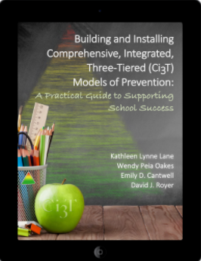

Slide 14
Ci3T Training & Implementation at Lawrence Public Schools
Phase |  |  |  | Year
 | 2013-14 | 14-15 | 15-16 | 16-17 | 17-18 | 18-19 | 19-20
Elementary School
Ci3T Training
Implementation Year 1
Implementation Year 2
Sustain and Develop Practices
Middle and High Schools
Ci3T Training
Implementation Year 1
Implementation Year 2
Sustain and Develop Practices
College and Career Center
Ci3T Training
Implementation Year 1
Implementation Year 2
Sustain and Develop Practices

Slide 15
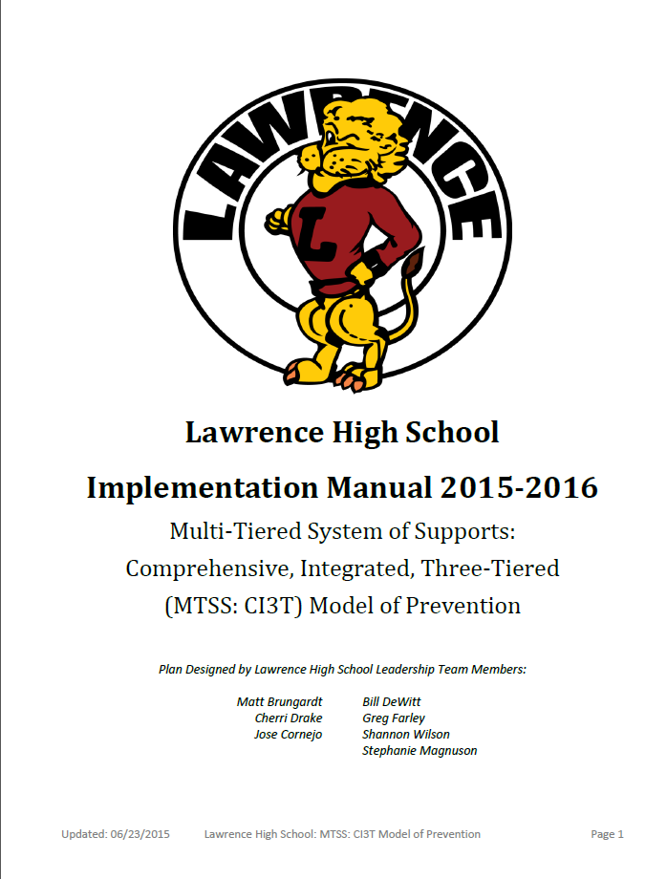
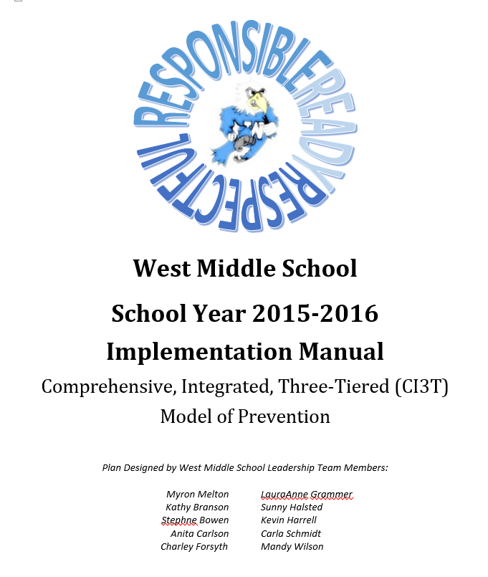
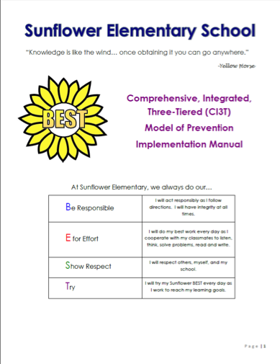
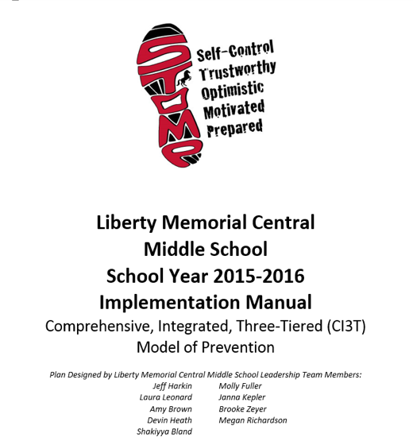
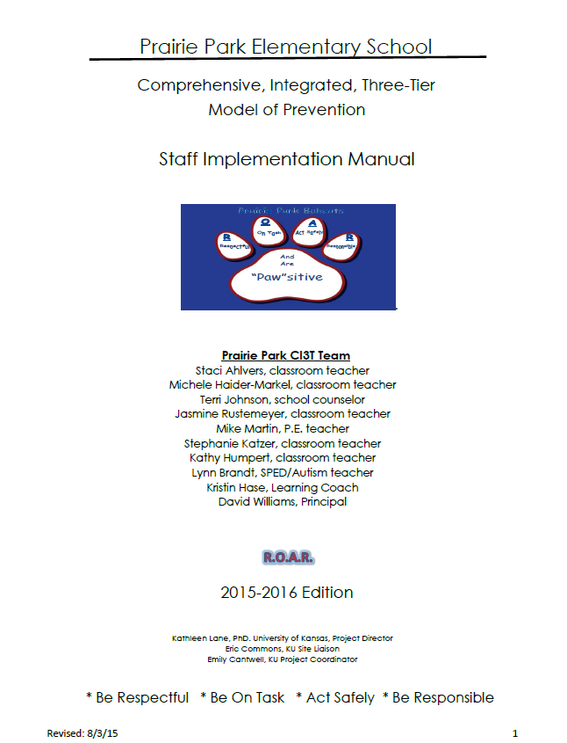
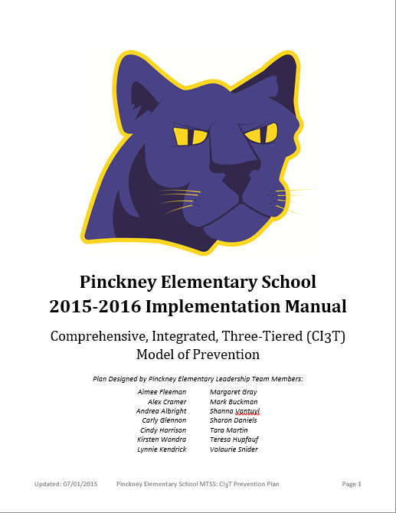
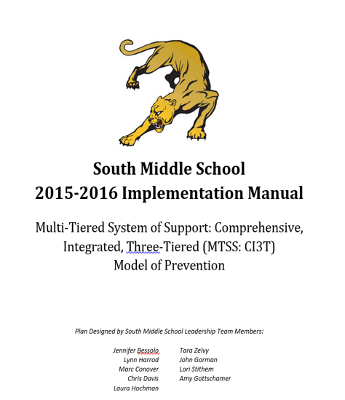
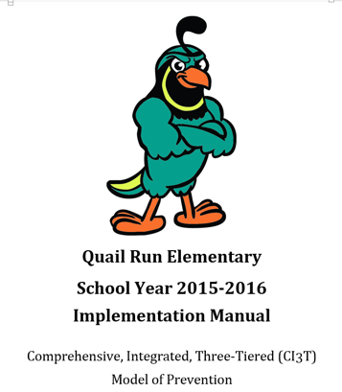

Slide 16
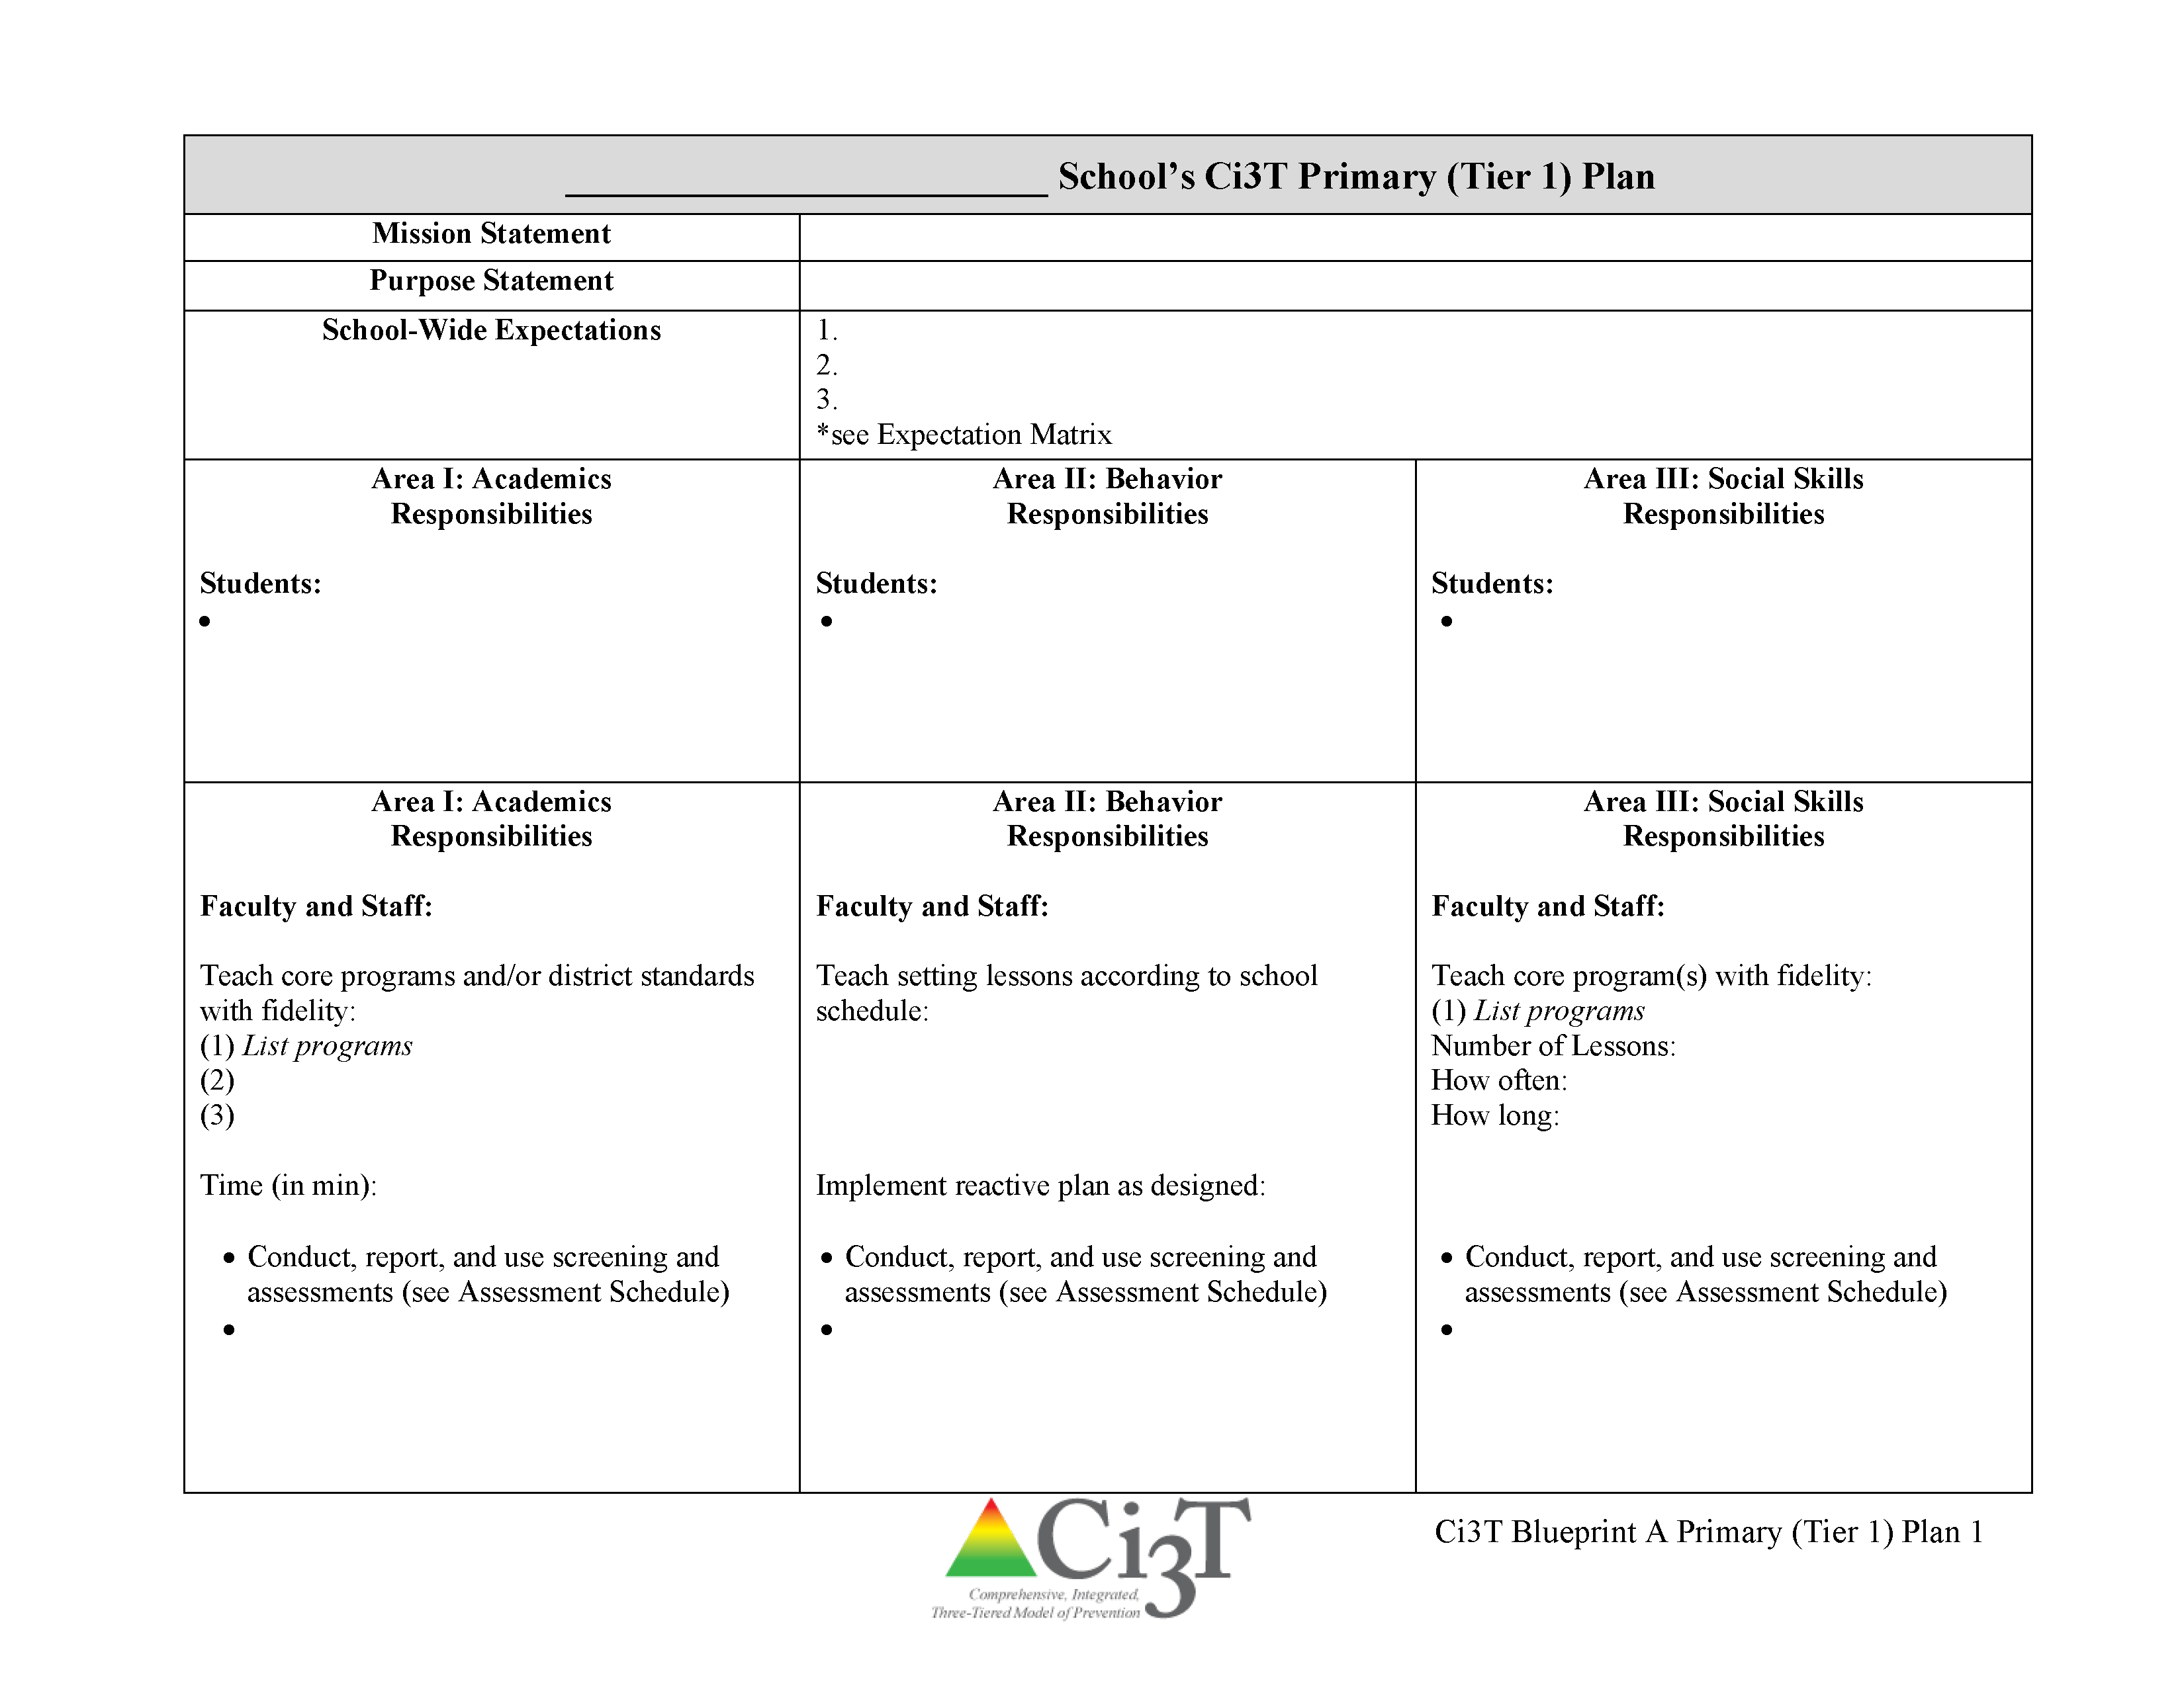
Ci3T Primary Plan: Roles and Responsibilities
all stakeholder groups

Slide 17
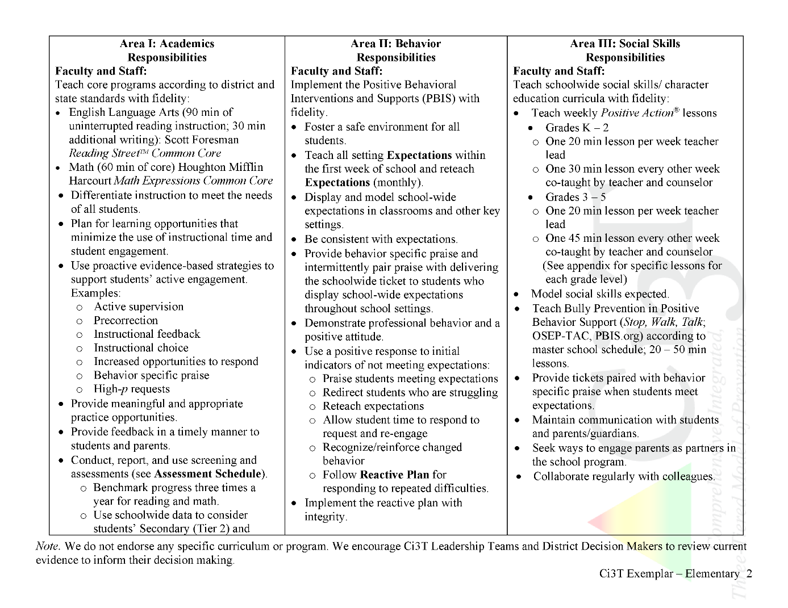
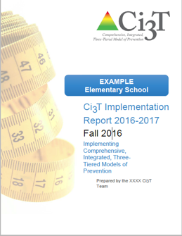
Ci3T Primary Plan: Procedures for Teaching
Ci3T Primary Plan: Procedures for Reinforcing
Ci3T Primary Plan: Procedures for Monitoring

Slide 18
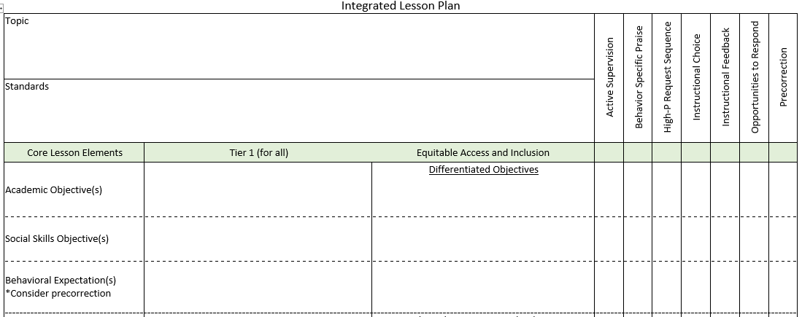
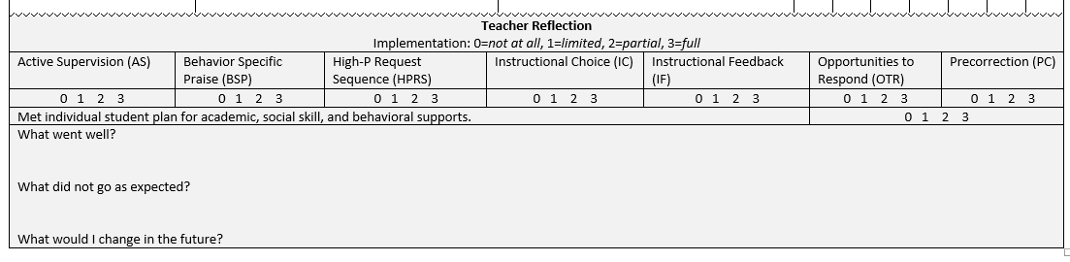

Planning for an Integrated Approach
OTR
BSP
Precorrection
Active Supervision
Choice

Slide 19
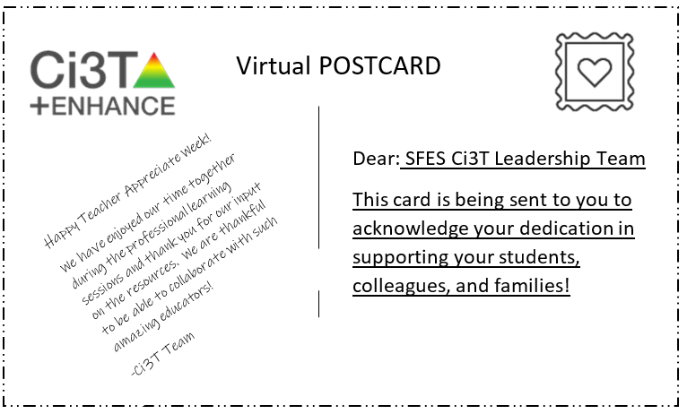
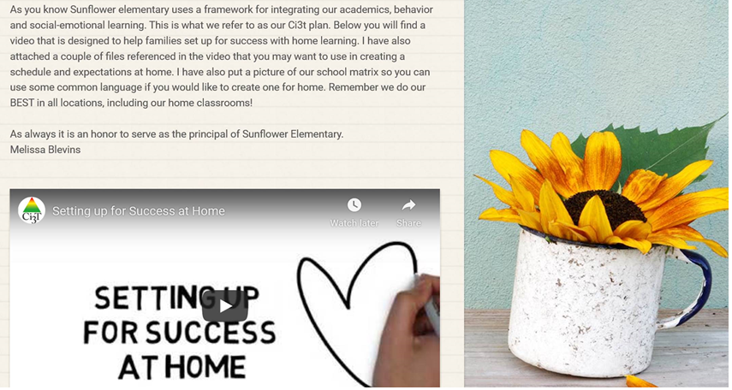
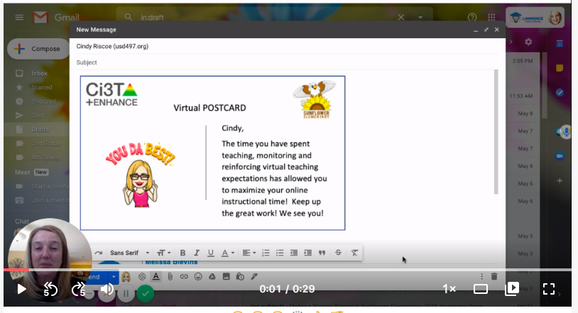
Notes:
Click the purple box or here for video of SFES postcard.
https://nam10.safelinks.protection.outlook.com/?url=https%3A%2F%2Fwww.loom.com%2Fshare%2F43fbc52da3574ab5b909be112b107e3a&data=02%7C01%7Ck923l138%40ku.edu%7C401b969e6afe4704827e08d7f44d3923%7C3c176536afe643f5b96636feabbe3c1a%7C0%7C0%7C637246484818641093&sdata=MLYWnPe9OXhrLRVrc2Bm73J0B0eJQJ89ZjiAQtmrkdk%3D&reserved=0

Slide 20
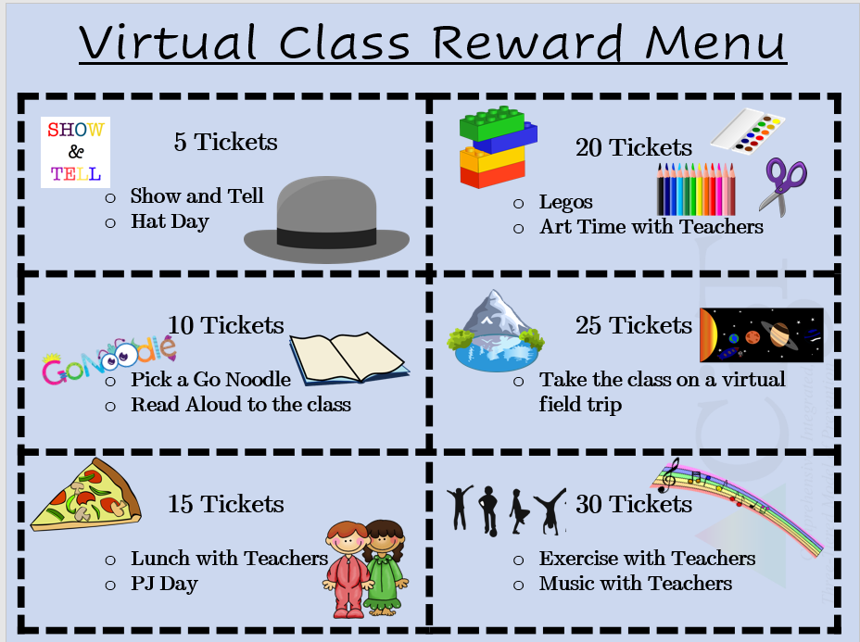
Virtual Learning Incentives
FREE Incentives:
Stay after on ZOOM with a friend for a chat
Virtual lunch date with the teacher, principal, etc.
(check with that staff member before offering them up of course)
Teacher wears stickers or has a sign with the student’s name
Dress up ZOOM day (hats, PJs, costumes, etc.)
Virtual Greeting Cards (sent via email)
Show & Tell Time (or some kind of star student spotlight time)
Personalized stickers in See Saw (2nd grade has been using this)
Virtual Class Reinforcement Menu
Adapted and shared with permission from a district partner

Slide 21
Essential Components of
Primary Prevention Efforts
Social Validity
Systematic Screening
Academic
Behavior
Treatment Integrity

Slide 22

Secondary (Tier 2) Intervention Grids

Slide 23

Tertiary (Tier 3) Intervention Grids

Slide 24
Agenda
Introducing Ci3T … a Comprehensive, Integrated, Three-Tiered Model of Prevention
A Look at …
  Student Risk Screening Scale – Internalizing and Externalizing (SRSS-IE)
  Student Risk Screening Scale for Early Childhood (SRSS-EC)
The Role of Screening: Using Screening Data to Shape Instruction
  At Tier 1: Primary Preventions Efforts
  At all Tiers: Teacher-delivered Strategies
  At Tiers 2 & 3: Secondary & Tertiary Prevention Efforts
Planning for Next Steps

Slide 25
Student Risk Screening Scale Internalizing and Externalizing SRSS-IE
Drummond, 1994; Lane & Menzies, 2009

Slide 26
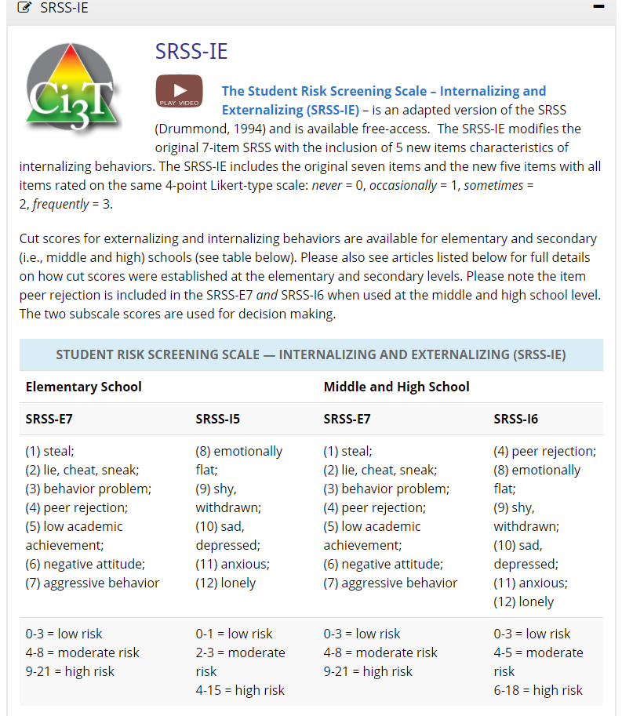
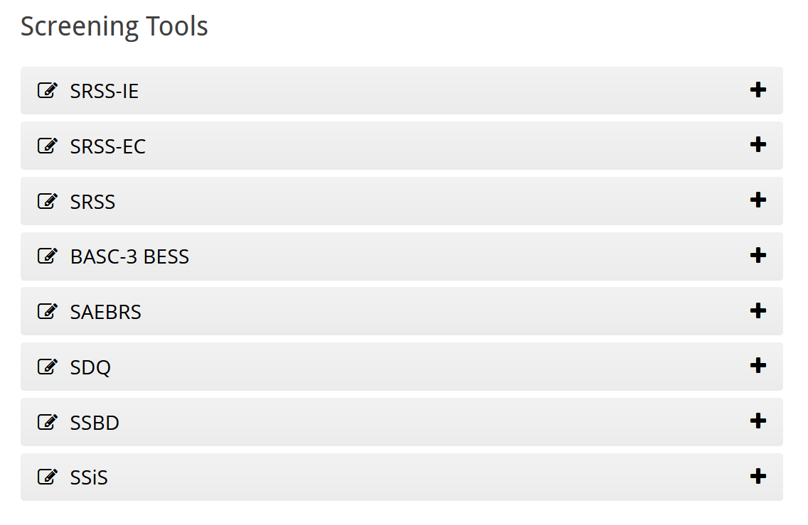


Slide 27
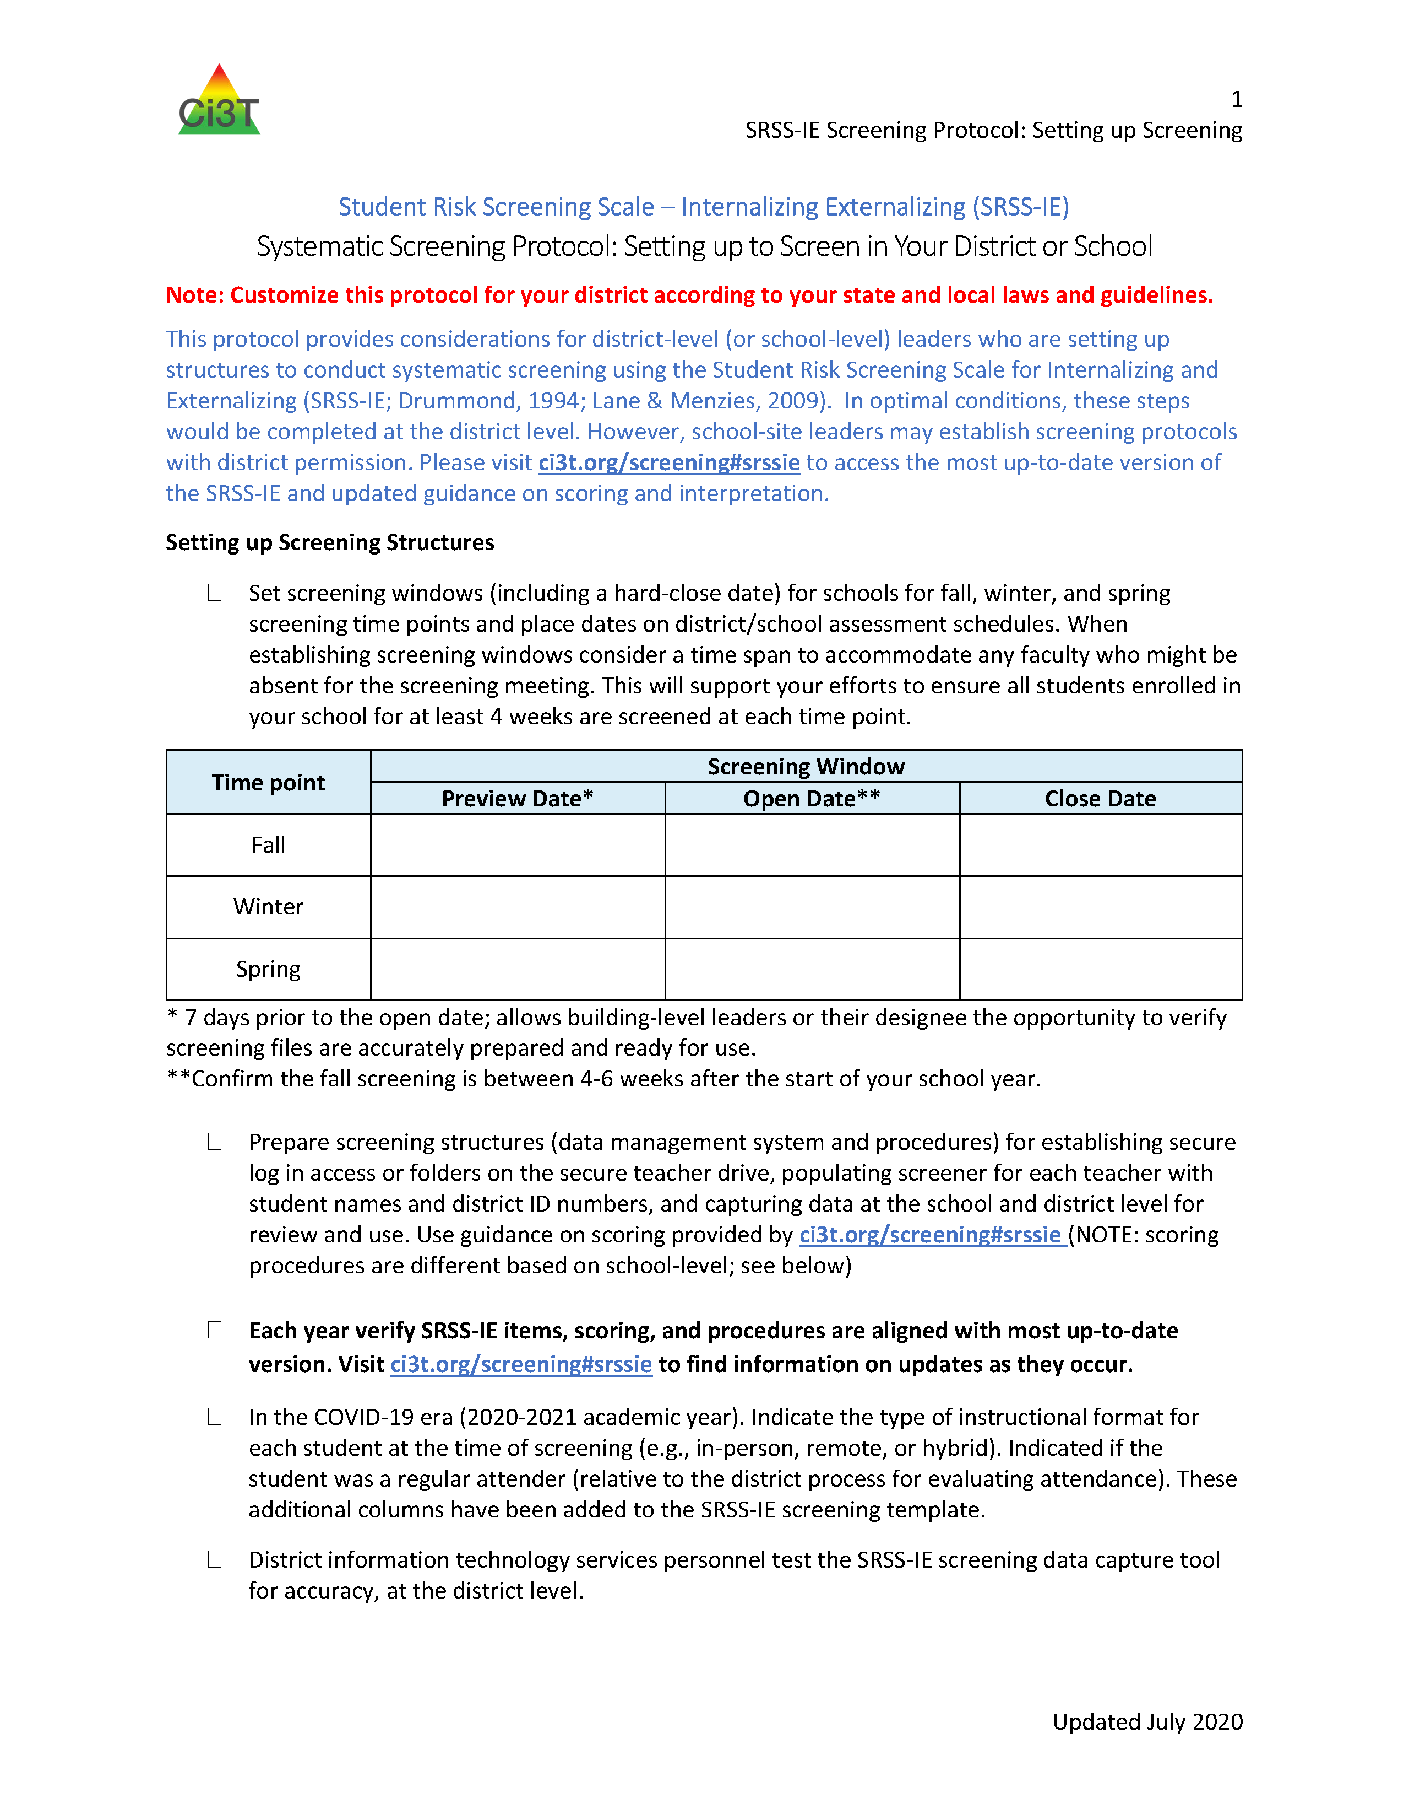
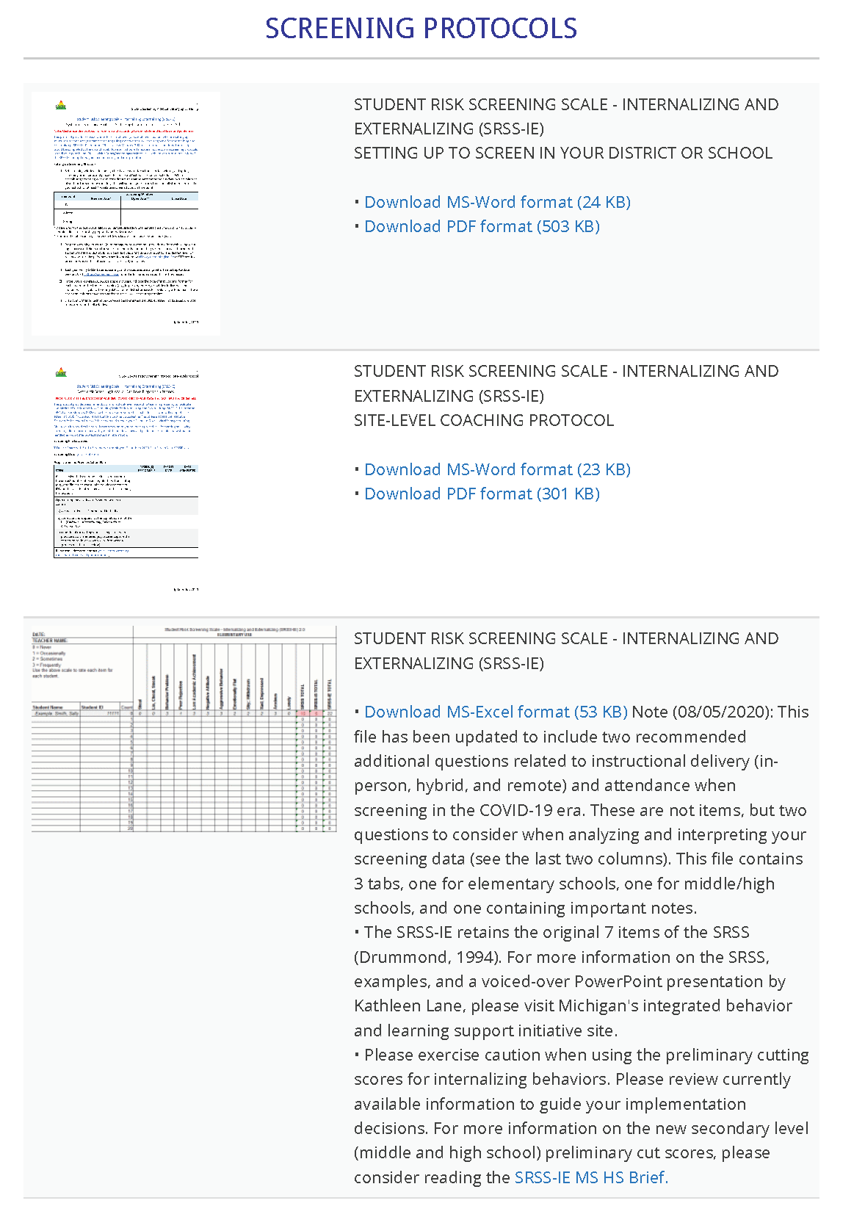

ci3t.org/screening

Slide 28
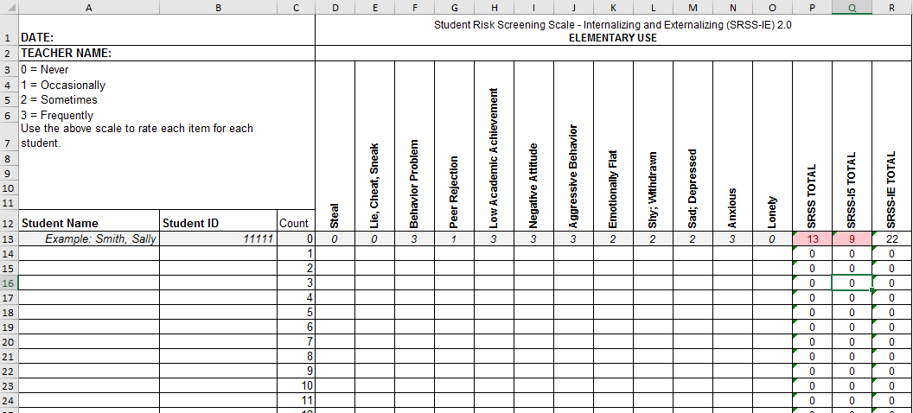
Student Risk Screening Scale for Internalizing and Externalizing (SRSS-IE; Drummond, 1994; Lane & Menzies, 2009) for Elementary Schools

Slide 29
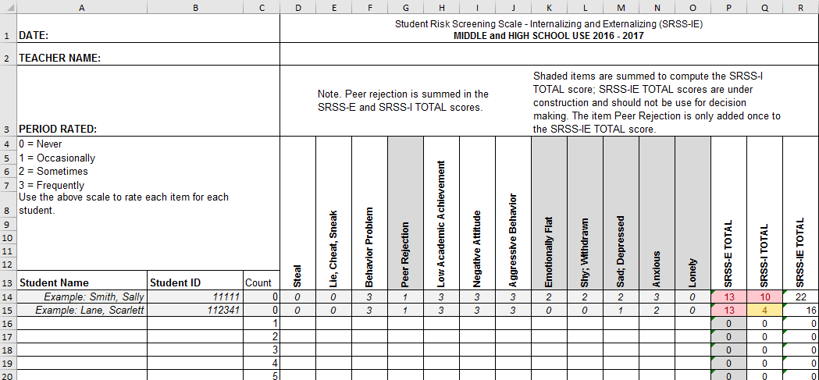
Student Risk Screening Scale for Internalizing and Externalizing (SRSS-IE; Drummond, 1994; Lane & Menzies, 2009) for Middle and High Schools

Slide 30
SRSS-IE: Cut Scores
Elementary School |  | Middle and High School
SRSS-E7 | SRSS-I5 | SRSS-E7 | SRSS-I6
Items 1-7 | Items 8-12 | Items 1-7 | Items 4, 8-12
0-3 = low risk 4-8 = moderate risk 9-21 = high risk | 0-1 = low risk 2-3 = moderate risk 4-15 = high risk | 0-3 = low risk 4-8 = moderate risk 9-21 = high risk | 0-3 = low risk 4-5 = moderate risk 6-18 = high risk
Elementary School Level:
Lane, K. L., Oakes, W. P., Swogger, E. D., Schatschneider, C., Menzies, H., M., & Sanchez, J. (2015). Student risk screening scale for internalizing and externalizing behaviors: Preliminary cut scores to support data-informed decision making. Behavioral Disorders, 40, 159-170.
Middle and High School Levels:
Lane, K. L., Oakes, W. P., Cantwell, E. D., Schatschneider, C., Menzies, H., Crittenden, M., & Messenger, M. (2016). Student Risk Screening Scale for Internalizing and Externalizing Behaviors: Preliminary cut scores to support data-informed decision making in middle and high schools. Behavioral Disorders, 42(1), 271-284

Slide 31
SRSS-E7 (externalizing) Results – All Students
Sample Elementary School Fall
n = 25
n = 16
n = 17
n = 12
n = 12
n = 86
n = 35
n = 57
n = 36
n = 50
n = 250
n = 300
n = 250
n = 255
n = 255

Slide 32
SRSS-I5 (internalizing) Results – All Students
Sample Elementary School Fall
n = 72
n = 18
n = 32
n = 85
n = 43
n = 45
n = 40
n = 204
n = 289
n = 261
n = 231

Slide 33
Fall 2018
SRSS-Externalizing Results: Grade level
Grade Level | N Screened | Low n (%) | Moderate n (%) | High n (%)
K | 58 | 51 (87.93%) | 6 (10.34%) | 1 (1.72%)
1st | 52 | 40 (76.92%) | 8 (15.38%) | 4 (7.69%)
2nd | 61 | 51 (83.61%) | 6 (9.84%) | 4 (6.56%)

Slide 34
Student Risk Screening Scale Fall 2004 – 2012 Middle School
Source: Lane, K. L., Oakes, W. P., & Magill, L. M., (2014). Primary prevention efforts: How do we implement and monitor the Tier 1 component of our comprehensive, integrated, three-tiered model of prevention. Preventing School Failure, 58, 143-158. doi: 10.1080/1045988X.2014.893978 [Figure 4. Middle school behavior screening data over time at the fall time point. Adapted from Figure 4.6 p. 127 Lane, K. L., Menzies, H. M, Oakes, W. P., & Kalberg, J. R. (2012). Systematic screenings of behavior to support instruction: From preschool to high school. Guilford Press.]

Slide 35
Middle School
Behavior & Academic Characteristics of SRSS Risk Groups
Variable |  | Risk
 | Low (n = 422) M (SD) | Moderate (n = 51) M (SD) | High (n = 12) M (SD) | Significance Testing
ODR | 1.50 (2.85) | 5.02 (5.32) | 8.42 (7.01) | L<M<H
In-School Suspensions | 0.08 (0.38) | 0.35 (1.04) | 1.71 (2.26) | L<M<H
GPA | 3.35 (0.52) | 2.63 (0.65) | 2.32 (0.59) | L>M, H M=H
Course Failures | 0.68 (1.50) | 2.78 (3.46) | 4.17 (3.49) | L<M, H M=H
(Lane, Parks, Kalberg, & Carter, 2007)

Slide 36
Results:
SRSS-IE: Externalizing Subscale Elementary
Variable | Risk |  |  | Significance Testing
 | Low M (SD) n | Moderate M (SD) n | High M (SD) n
Oral Reading Fluency | 163.23 (39.66) 468 | 138.62 (42.70) 107 | 115.82 (46.21) 46 | L > M > H
MAP Reading | 66.54 (26.48) 2,047 | 42.91 (30.37) 443 | 33.32 (29.82) 199 | L > M > H
Nurse Visits | 6.14 (6.81) 3,256 | 9.18 (9.59) 820 | 11.83 (9.89) 389 | L < M < H
In-School Suspensions | 0.0052 (0.08) 3,256 | 0.0427 (0.30) 820 | 0.1080 (0.46) 389 | L < M < H
Fall Externalizing
Winter
Spring
ORF
MAP Reading
Nurse Visit
Suspensions
Lane, K. L., Oakes, W. P., Cantwell, E. D., Common, E. A., Royer, D. J., Leko, M. M., Schatschneider, C., Menzies, H. M., Buckman, M. M., & Allen, G. E. (2019). Predictive validity of Student Risk Screening Scale—Internalizing and Externalizing (SRSS-IE) scores in elementary schools. Journal of Emotional and Behavioral Disorders, 27(4), 221–234. https://doi.org/10.1177/1063426618795443

Slide 37
Results:
SRSS-IE: Internalizing Subscale Elementary
Variable | Risk |  |  | Significance Testing
 | Low M (SD) n | Moderate M (SD) n | High M (SD) n
Oral Reading Fluency | 159.04 (41.45) 459 | 150.59 (45.76) 88 | 139.18 (46.53) 74 | L > H L = M; M = H
MAP Reading | 63.38 (28.32) 2,070 | 53.93 (32.15) 356 | 43.57 (30.47) 263 | L > M > H
Nurse Visits | 6.84 (7.37) 3,387 | 7.59 (8.05) 628 | 9.33 (10.81) 450 | L < M < H
In-School Suspensions | 0.0142 (0.15) 3,387 | 0.0510 (0.36) 628 | 0.0311 (0.20) 450 | L < M, H M = H
Fall Internalizing
Winter Internalizing
Spring
ORF*
MAP Reading
Nurse Visit
Suspensions*
Lane, K. L., Oakes, W. P., Cantwell, E. D., Common, E. A., Royer, D. J., Leko, M. M., Schatschneider, C., Menzies, H. M., Buckman, M. M., & Allen, G. E. (2019). Predictive validity of Student Risk Screening Scale—Internalizing and Externalizing (SRSS-IE) scores in elementary schools. Journal of Emotional and Behavioral Disorders, 27(4), 221–234. https://doi.org/10.1177/1063426618795443

Slide 38
SRSS-IE: Externalizing Subscale Middle school
Variable |  | Risk |  | Significance Testing
 | Low M (SD) n | Moderate M (SD) n | High M (SD) n
GPA | 3.56 (0.47) 1,670 | 3.07 (0.58) 279 | 2.74 (0.61) 84 | L > M > H
Course Failures | 0.38 (1.15) 1,830 | 1.37 (2.12) 328 | 2.78 (3.03) 93 | L < M < H
Nurse Visits | 4.01 (16.20) 1,830 | 6.67 (8.65) 328 | 9.66 (11.65) 93 | L < M, H M = H
Office discipline referrals | 0.03 (0.24) 1,830 | 0.17 (0.63) 328 | 0.75 (2.13) 93 | L < M < H
In-School Suspensions | 0.11 (0.89) 1,830 | 0.67 (2.74) 328 | 1.56 (3.22) 93 | L < M < H
Fall Externalizing
Winter
Spring
GPA
Course Failures
Nurse Visit*
ODR
Suspensions
Lane, K. L., Oakes, W. P., Cantwell, E. D., Royer, D. J., Leko, M., Schatschneider, C., & Menzies, H. M. (2018). Predictive validity of Student Risk Screening Scale for Internalizing and Externalizing (SRSS-IE) scores in secondary schools. Journal of Emotional and Behavioral Disorders, 27(2), 86-100. doi:10.1177/1063426617744746

Slide 39
SRSS-IE: Internalizing Subscale Middle school
Variable |  | Risk |  | Significance Testing
 | Low M (SD) n | Moderate M (SD) n | High M (SD) n
GPA | 3.51 (0.51) 1,642 | 3.33 (0.55) 167 | 3.16 (0.64) 224 | L > M > H
Course Failures | 0.52 (1.42) 1,820 | 0.86 (1.85) 181 | 1.22 (2.06) 250 | L < M, H M = H
Nurse Visits | 4.32 (16.39) 1,820 | 4.85 (6.92) 181 | 6.77 (9.56) 250 | L < H L = M M = H
Office discipline referrals | 0.06 (0.40) 1,820 | 0.17 (1.24) 181 | 0.19 (0.75) 250 | N.S.
In-School Suspensions | 0.18 (1.10) 1,820 | 0.67 (3.59) 181 | 0.45 (1.47) 250 | L < M, H M = H
Fall Internalizing
Winter Internalizing
Spring
GPA
Course Failures*
Nurse Visit*
Suspensions*
Lane, K. L., Oakes, W. P., Cantwell, E. D., Royer, D. J., Leko, M., Schatschneider, C., & Menzies, H. M. (2018). Predictive validity of Student Risk Screening Scale for Internalizing and Externalizing (SRSS-IE) scores in secondary schools. Journal of Emotional and Behavioral Disorders, 27(2), 86-100. doi:10.1177/1063426617744746

Slide 40
SRSS-IE: Externalizing Subscale High school
Variable |  | Risk |  | Significance Testing
 | Low M (SD) n = 2,363 | Moderate M (SD) n = 212 | High M (SD) n = 59
GPA | 3.07 (0.79) | 2.08 (0.81) | 1.96 (0.89) | L > M, H M = H
Course Failures | 1.16 (2.07) | 3.45 (3.18) | 3.08 (2.84) | L < M, H M = H
Nurse Visits | 1.34 (3.19) | 4.00 (5.62) | 5.85 (7.66) | L < M, H M = H
In-School Suspensions | 0.07 (0.44) | 0.67 (1.48) | 1.03 (1.86) | L < M, H M = H
Fall
Winter
Spring
GPA
Course Failures
Nurse Visit
ODR
Suspensions
L < M, H
M = H
Lane, K. L., Oakes, W. P., Cantwell, E. D., Royer, D. J., Leko, M., Schatschneider, C., & Menzies, H. M. (2018). Predictive validity of Student Risk Screening Scale for Internalizing and Externalizing (SRSS-IE) scores in secondary schools. Journal of Emotional and Behavioral Disorders, 27(2), 86-100. doi:10.1177/1063426617744746

Slide 41
SRSS-IE: Internalizing Subscale High school
Variable |  | Risk |  | Significance Testing
 | Low M (SD) n = 2,379 | Moderate M (SD) n = 123 | High M (SD) n = 132
GPA | 3.04 (0.82) | 2.44 (0.83) | 2.27 (0.98) | L > M, H M = H
Course Failures | 1.25 (2.17) | 2.59 (2.66) | 2.83 (3.21) | L < M, H M = H
Nurse Visits | 1.43 (3.33) | 3.54 (6.05) | 4.04 (5.80) | L < M, H M = H
In-School Suspensions | 0.11 (0.57) | 0.41 (1.36) | 0.42 (1.28) | L < M, H M = H
Fall Internalizing
Winter Internalizing
Spring
GPA
Course Failures
Nurse Visit
ODR
Suspensions
L < M, H
M = H
Lane, K. L., Oakes, W. P., Cantwell, E. D., Royer, D. J., Leko, M., Schatschneider, C., & Menzies, H. M. (2018). Predictive validity of Student Risk Screening Scale for Internalizing and Externalizing (SRSS-IE) scores in secondary schools. Journal of Emotional and Behavioral Disorders, 27(2), 86-100. doi:10.1177/1063426617744746

Slide 42
Screening Data: High School Years 1-3
Fall SRSSIE-I |  | Low |  | Moderate |  | High |  | Fall SRSSIE-E |  | Low |  | Moderate |  | High
2016 |  | 80.28% |  | 10.36% |  | 9.36% |  | 2016 |  | 89.56% |  | 8.02% |  | 2.42%
2017 |  | 90.18% |  | 4.16% |  | 5.66% |  | 2017 |  | 91.29% |  | 6.18% |  | 2.54%
2018 |  | 90.91% |  | 3.86% |  | 5.23% |  | 2018 |  | 92.22% |  | 6.20% |  | 1.58%
Winter SRSSIE-I |  | Low |  | Moderate |  | High |  | Winter SRSSIE-E |  | Low |  | Moderate |  | High
2016 |  | 87.25% |  | 9.49% |  | 3.26% |  | 2016 |  | 87.25% |  | 9.49% |  | 3.26%
2017 |  | 86.14% |  | 9.02% |  | 4.85% |  | 2017 |  | 86.14% |  | 9.02% |  | 4.85%
2018 |  | 88.79% |  | 8.52% |  | 2.69% |  | 2018 |  | 88.79% |  | 8.52% |  | 2.69%
Shared with permission from district partner.

Slide 43
Student Risk Screening Scale for Early Childhood
SRSS-EC
Lane & Menzies, 2009

Slide 44
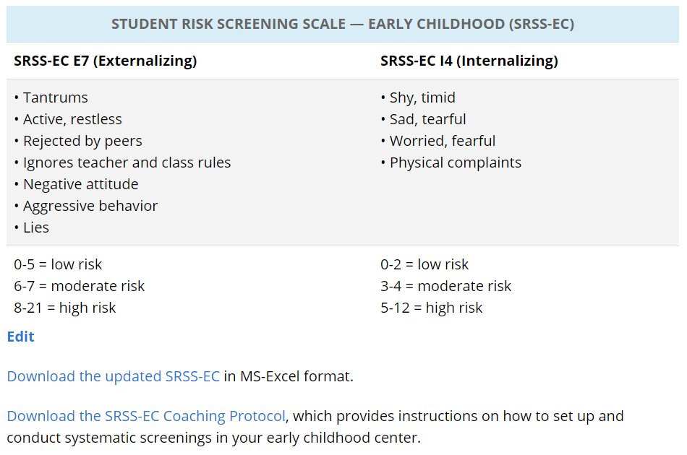

Slide 45
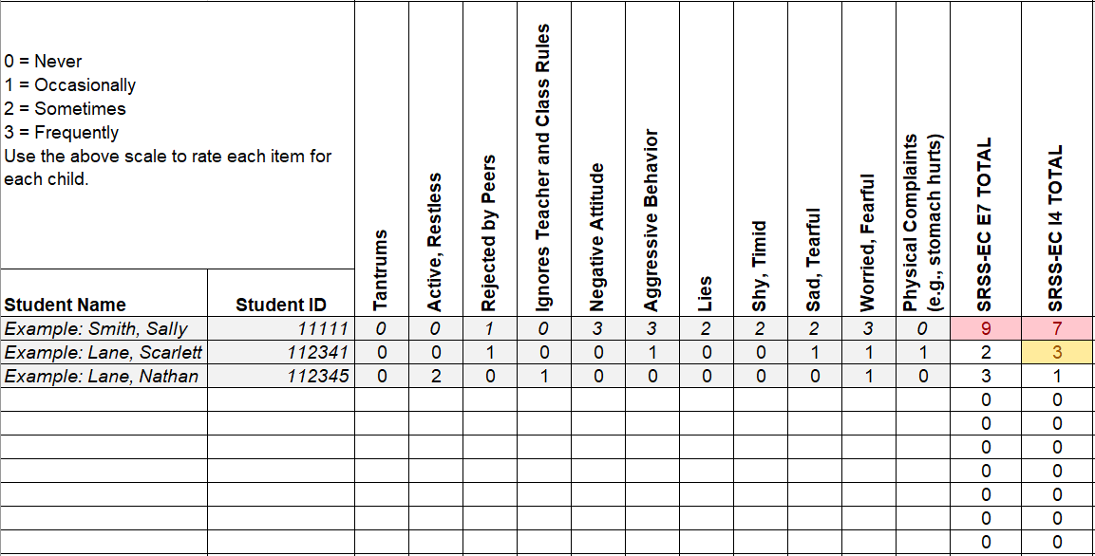
Student Risk Screening Scale for Early Childhood
(SRSS-EC; Lane & Menzies, 2009)

Slide 46
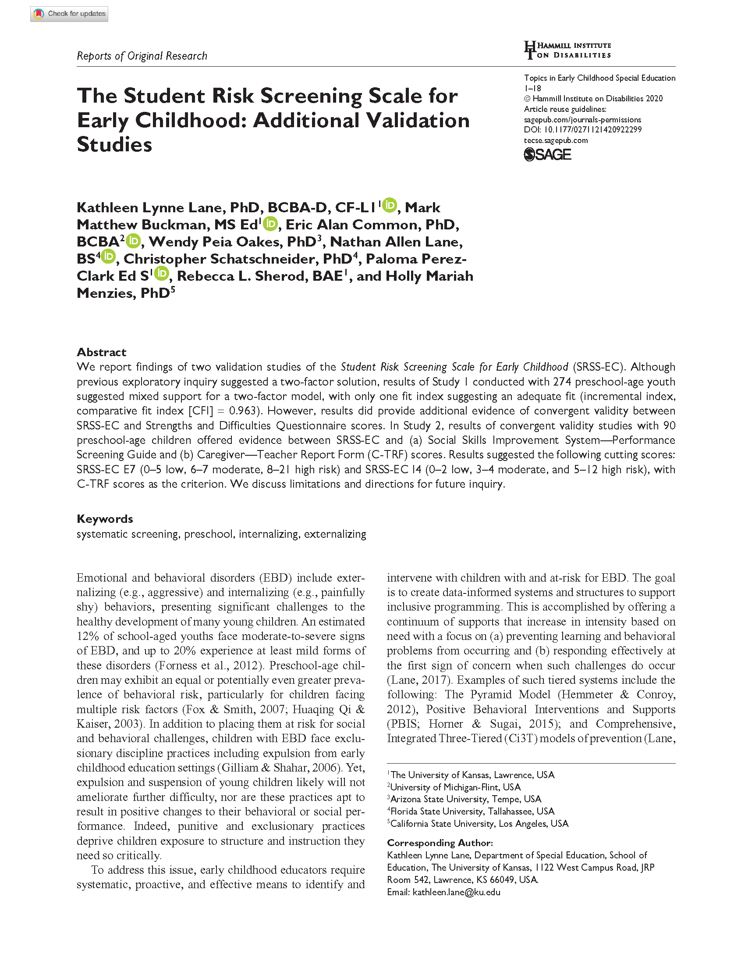
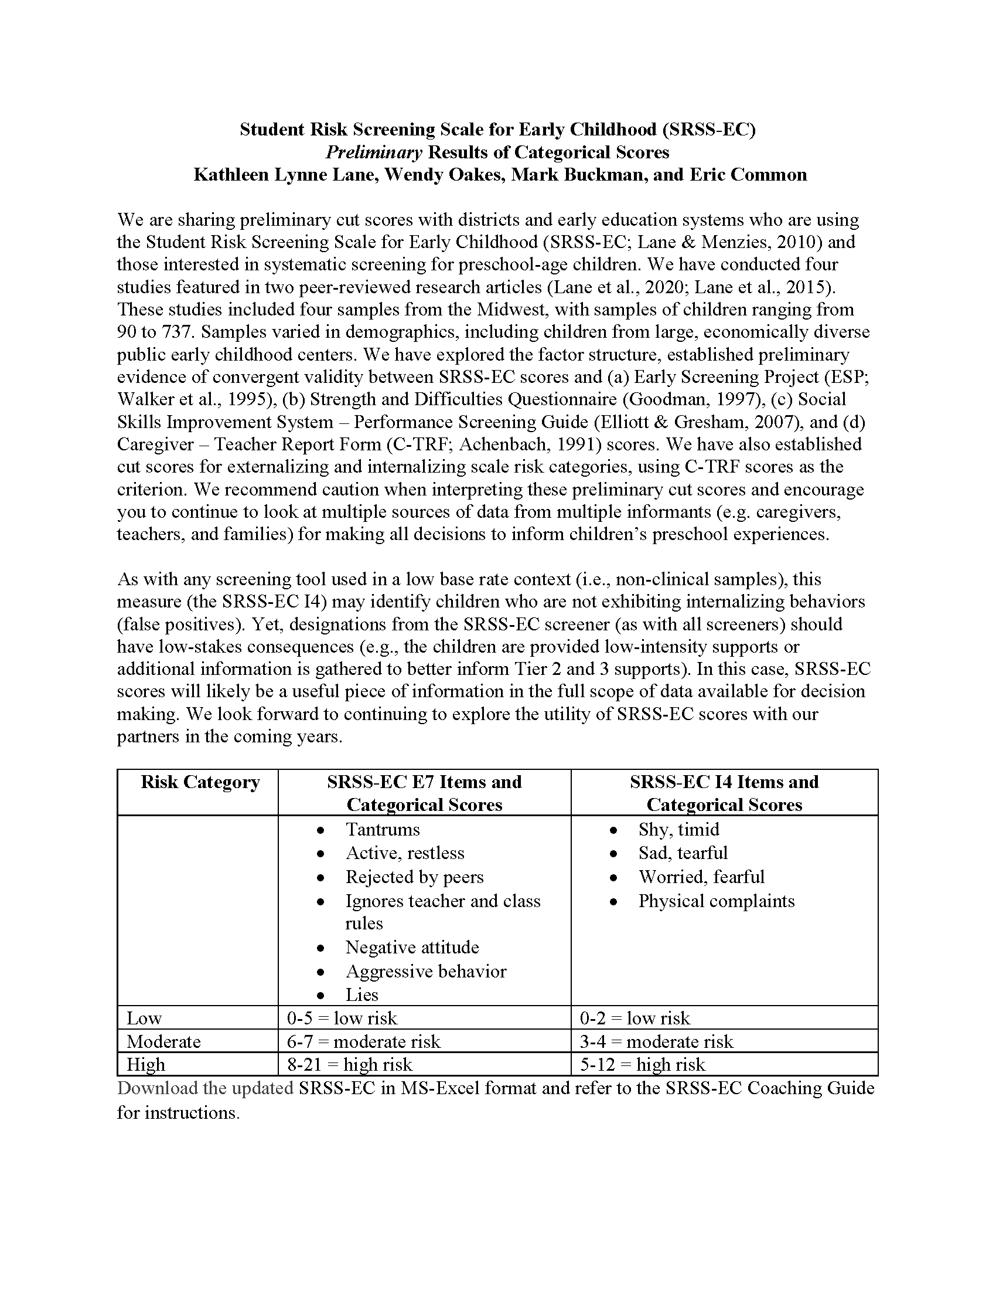
SRSS-EC: Initial Evidence
Research brief available on ci3t.org/screening

Slide 47
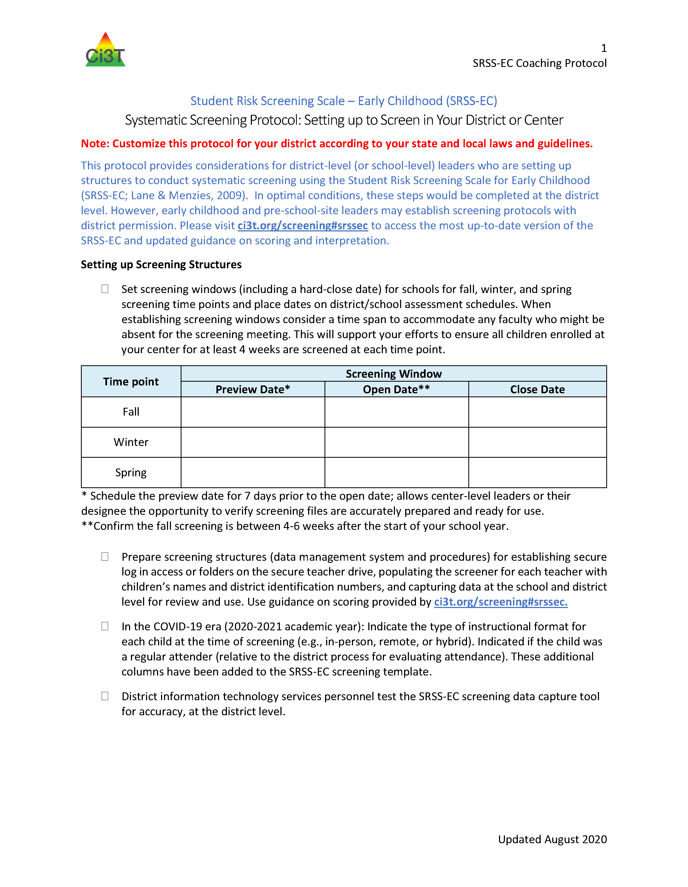
SRSS-EC Protocol:
Setting up to Screen in your District or Center

Slide 48
Notes:
Data security – teamwork to create, populate, collect and synthesize data – planning ahead to calendar screening as all other data collection – SHARE the information with faculty and staff

Slide 49
Agenda
Introducing Ci3T … a Comprehensive, Integrated, Three-Tiered Model of Prevention
A Look at …
  Student Risk Screening Scale – Internalizing and Externalizing (SRSS-IE)
  Student Risk Screening Scale for Early Childhood (SRSS-EC)
The Role of Screening: Using Screening Data to Shape Instruction
  At Tier 1: Primary Preventions Efforts
  At all Tiers: Teacher-delivered Strategies
  At Tiers 2 & 3: Secondary & Tertiary Prevention Efforts
Planning for Next Steps

Slide 50
SRSS-I5 (internalizing) Results – All Students
Sample Elementary School Fall
n = 72
n = 18
n = 32
n = 85
n = 43
n = 45
n = 40
n = 204
n = 289
n = 261
n = 231

Slide 51
Student Risk Screening Scale Fall 2004 – 2012 Middle School
Source: Lane, K. L., Oakes, W. P., & Magill, L. M., (2014). Primary prevention efforts: How do we implement and monitor the Tier 1 component of our comprehensive, integrated, three-tiered model of prevention. Preventing School Failure, 58, 143-158. doi: 10.1080/1045988X.2014.893978 [Figure 4. Middle school behavior screening data over time at the fall time point. Adapted from Figure 4.6 p. 127 Lane, K. L., Menzies, H. M, Oakes, W. P., & Kalberg, J. R. (2012). Systematic screenings of behavior to support instruction: From preschool to high school. Guilford Press.]

Slide 52
Agenda
Introducing Ci3T … a Comprehensive, Integrated, Three-Tiered Model of Prevention
A Look at …
  Student Risk Screening Scale – Internalizing and Externalizing (SRSS-IE)
  Student Risk Screening Scale for Early Childhood (SRSS-EC)
The Role of Screening: Using Screening Data to Shape Instruction
  At Tier 1: Primary Preventions Efforts
  At all Tiers: Teacher-delivered Strategies
  At Tiers 2 & 3: Secondary & Tertiary Prevention Efforts
Planning for Next Steps

Slide 53
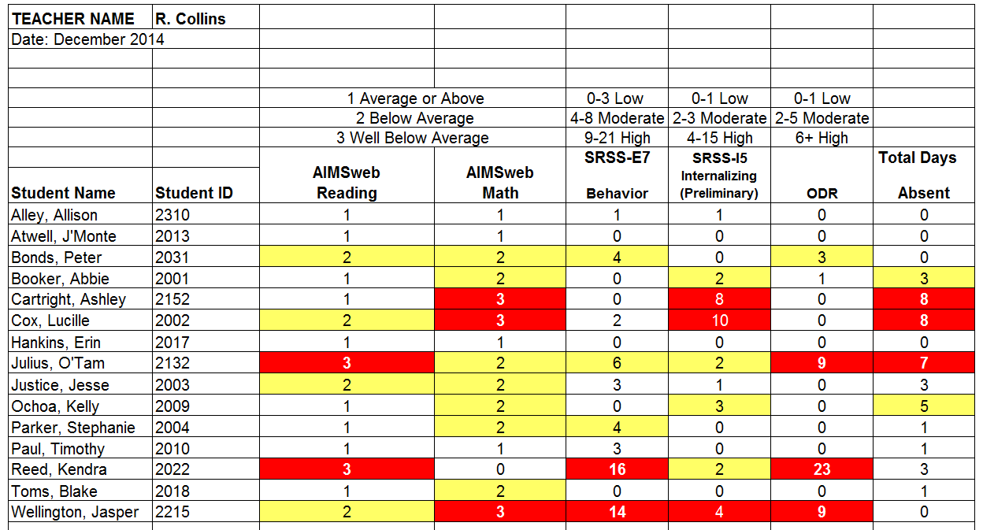
Examining Academic and Behavioral Data:
Elementary School Level
Lane, K. L., Menzies, H. M., Ennis, R. P., & Oakes, W. P. (2015). Supporting Behavior for School Success: A Step-by-Step Guide to Key Strategies. Guilford Press.
Notes:
Lane, K. L., Oakes, W. P., Ennis, R. P., & Hirsch, S. E. (2014). Identifying students for secondary and tertiary prevention efforts: How do we determine which students have Tier 2 and Tier 3 needs? Preventing School Failure, 58, 171-182, DOI: 10.1080/1045988X.2014.895573

Slide 54
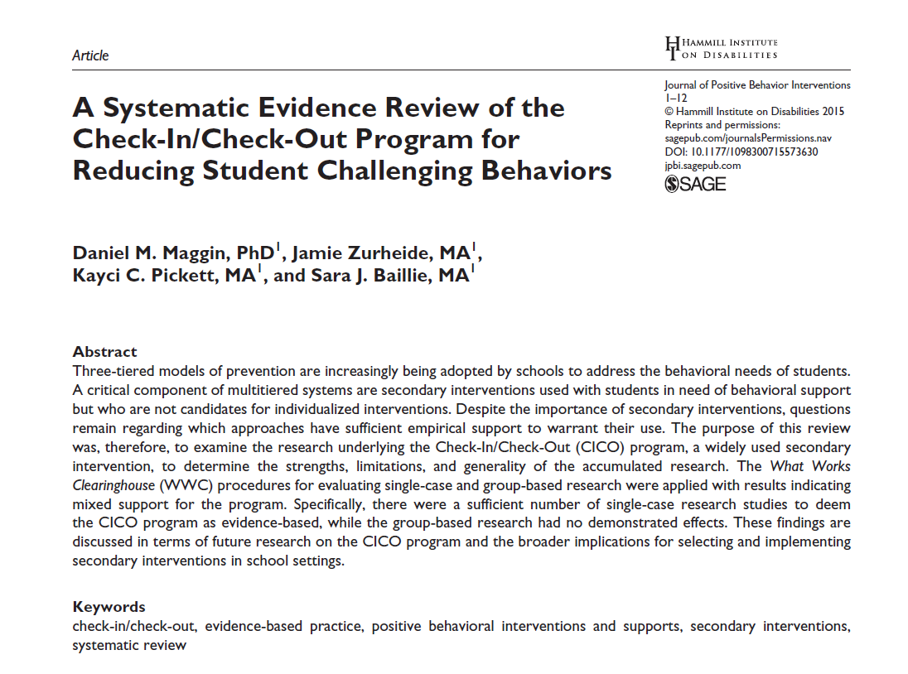




Low-Intensity Strategies
Opportunities to Respond
Behavior-Specific Praise
Active Supervision
Proximity
Overlappingness
Instructional Feedback
With-it-ness
High-p Requests
Pacing
Precorrection
Self-Monitoring
Incorporating Choice
Behavior Contracts

Slide 55
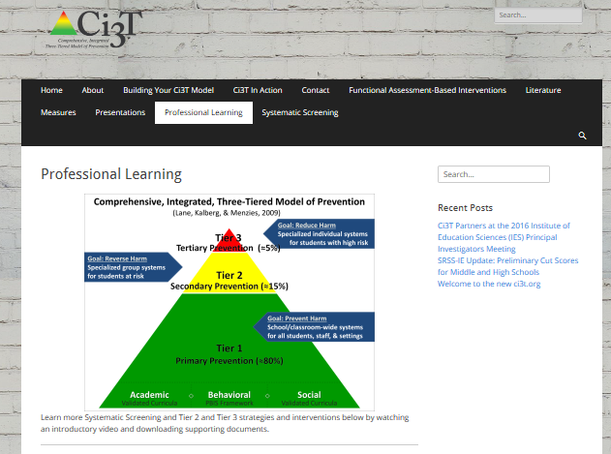
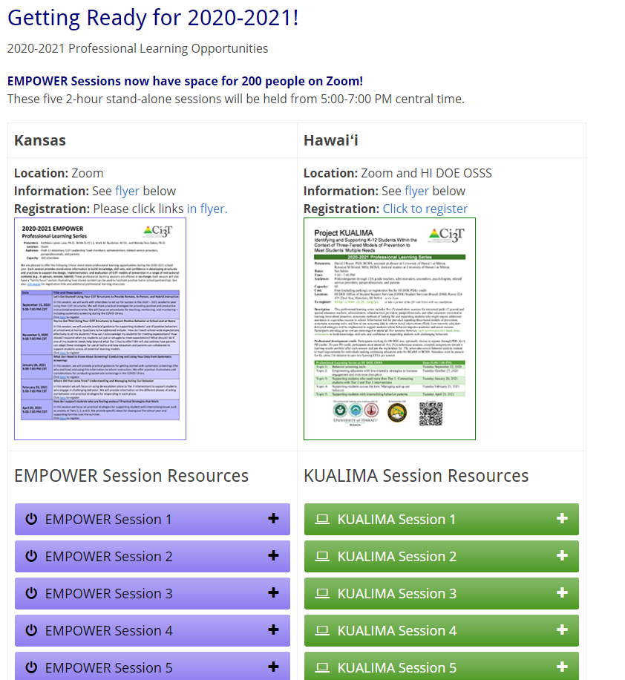
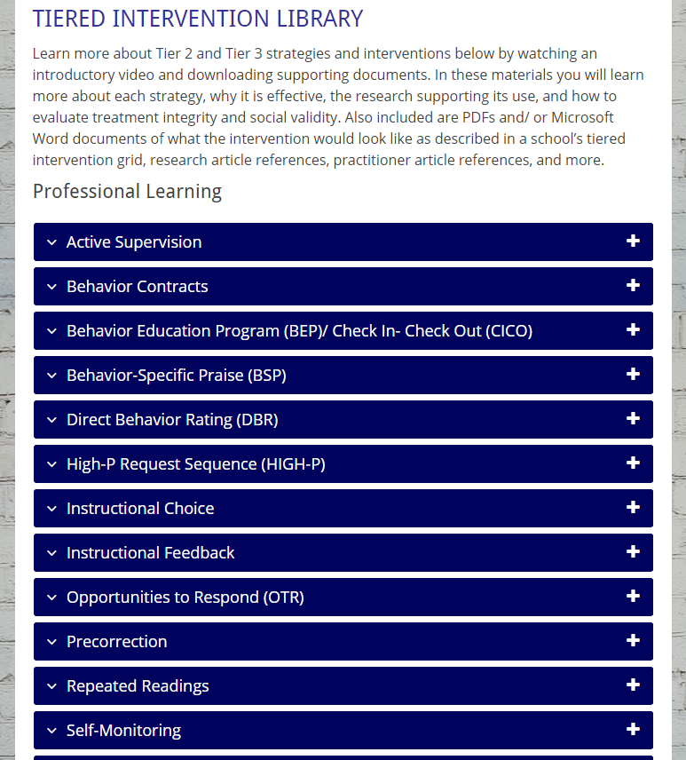
Notes:
Ci3T.org: On-demand Professional Learning Resources

Slide 56
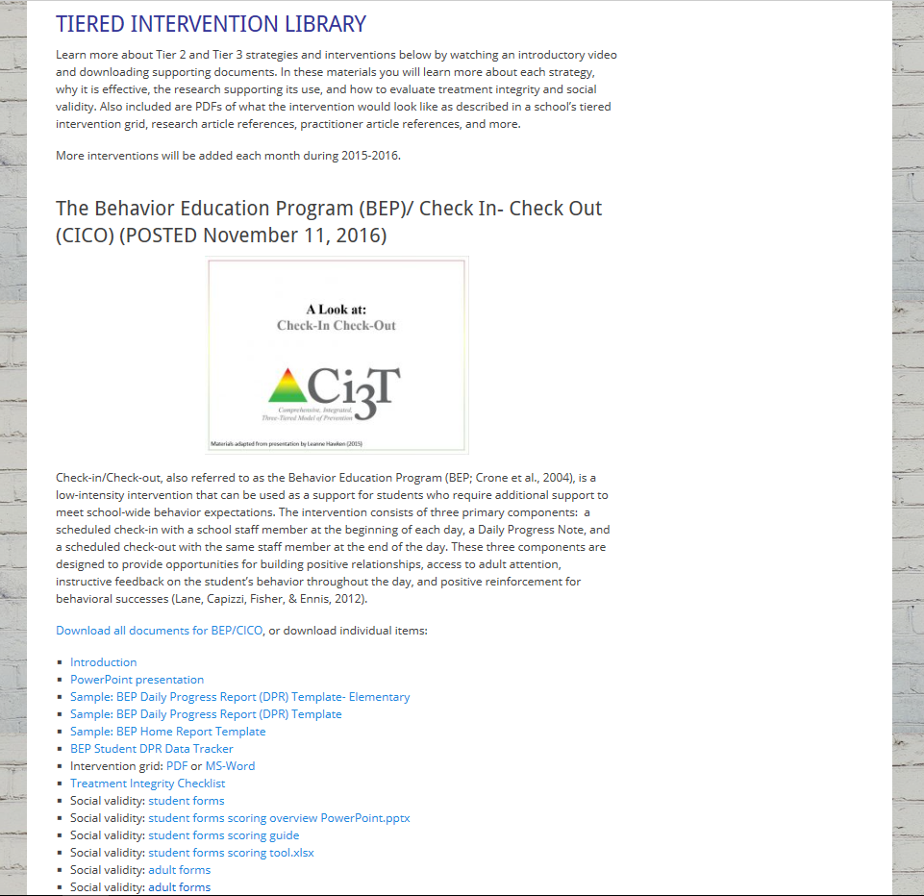
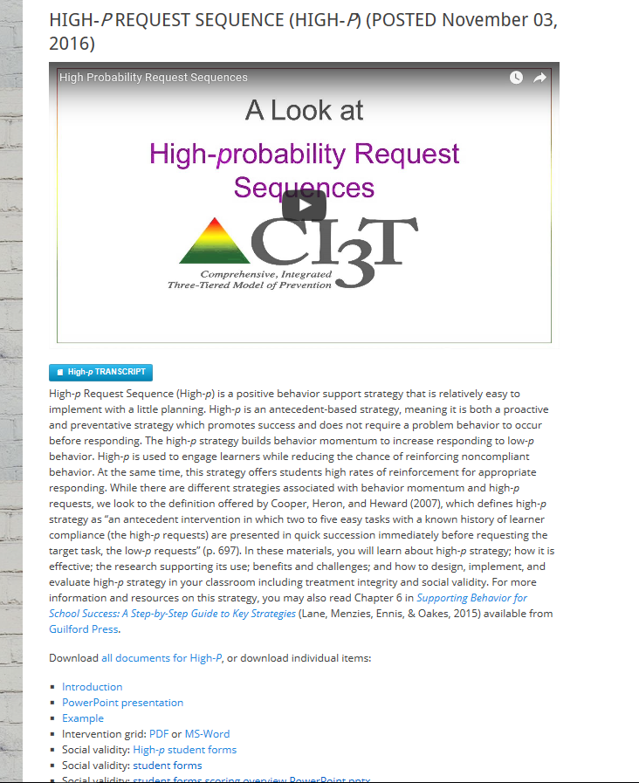
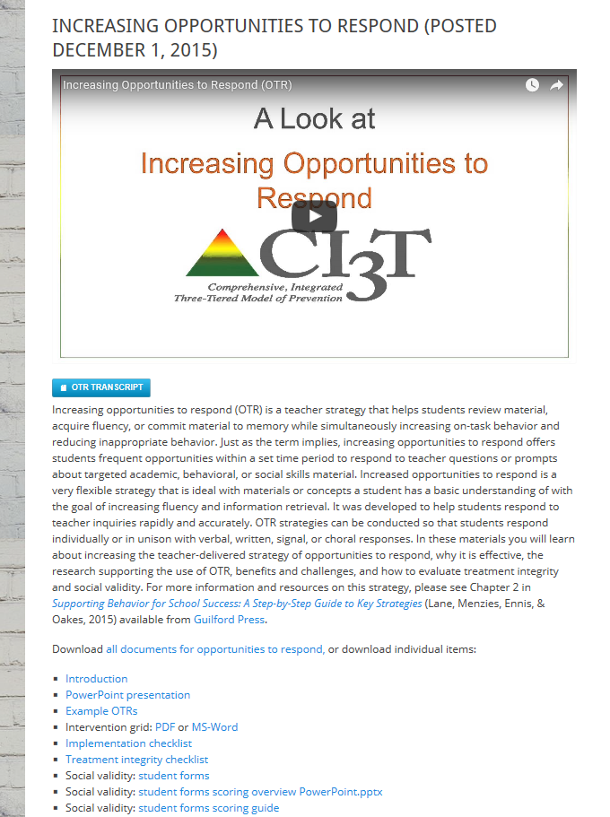
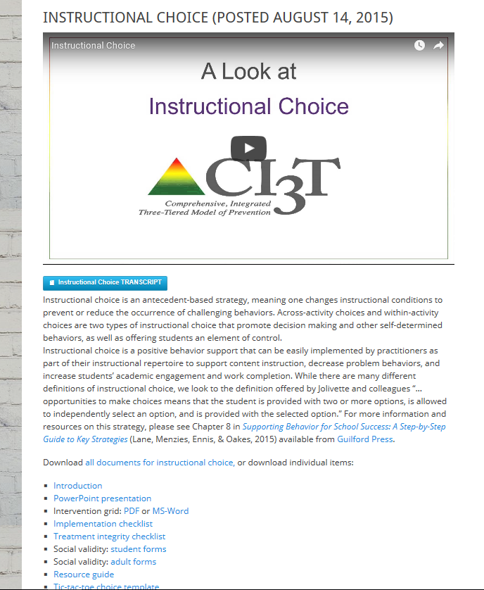
ci3t.org
Professional Learning tab

Slide 57
Agenda
Introducing Ci3T … a Comprehensive, Integrated, Three-Tiered Model of Prevention
A Look at …
  Student Risk Screening Scale – Internalizing and Externalizing (SRSS-IE)
  Student Risk Screening Scale for Early Childhood (SRSS-EC)
The Role of Screening: Using Screening Data to Shape Instruction
  At Tier 1: Primary Preventions Efforts
  At all Tiers: Teacher-delivered Strategies
  At Tiers 2 & 3: Secondary & Tertiary Prevention Efforts
Planning for Next Steps

Slide 58
Secondary (Tier 2) Intervention Grids

Slide 59


Slide 60


Slide 61
Tertiary (Tier 3) Intervention Grids

Slide 62





Slide 63
Agenda
Introducing Ci3T … a Comprehensive, Integrated, Three-Tiered Model of Prevention
A Look at …
  Student Risk Screening Scale – Internalizing and Externalizing (SRSS-IE)
  Student Risk Screening Scale for Early Childhood (SRSS-EC)
The Role of Screening: Using Screening Data to Shape Instruction
  At Tier 1: Primary Preventions Efforts
  At all Tiers: Teacher-delivered Strategies
  At Tiers 2 & 3: Secondary & Tertiary Prevention Efforts
Planning for Next Steps

Slide 64

Action Planning

Slide 65

Considerations for Systematic Screening PK-12 in the COVID-19 Era
Lane, K. L., Oakes, W. P., & Menzies, H. M. (2020). Considerations for systematic screening PK-12: Universal screening for internalizing and externalizing behaviors in the COVID-19 era. Manuscript in review

Slide 66

Recommendations to Consider:
Pre-COVID-19
Recommendation #1: Build stakeholders’ expertise
Recommendation #2: Develop the structures to sustain and improve practices
Recommendation #3: Conduct screenings in a responsible fashion
Recommendation #4: Consider legal implications- know your state laws

Slide 67
Recommendations to Consider:
Screening in the COVID-19 Era
Recommendation 1: Continue screening and engage in professional learning opportunities
Recommendation 2: Use multiple sources of data to inform instruction
Recommendation 3: Screen responsibly
Lane, K. L., Oakes, W. P., & Menzies, H. M. (2020). Considerations for systematic screening PK-12: Universal screening for internalizing and externalizing behaviors in the COVID-19 era. Manuscript in review

Slide 69


Resources for Responding to COVID-19

Slide 70

Opportunities to Respond
Area II: Academics Responsibilities Faculty and Staff: Teach core programs according to district and state standards with integrity: Use proactive evidence-based strategies to support students’ active engagement
Behavior-Specific Praise
Active Supervision
Opportunities to Respond
Instructional Feedback
High p Requests
Behavior-Specific Praise
Precorrection
Active Supervision
Remote Learning Use proactive evidence-based strategies to support students’ active engagement. Maintain online classroom platforms with learning activities connected to the weekly learning outcomes. Communicate at least weekly with families and students.
Incorporating Choice
Instructional Feedback
High-p Requests
Precorrection
Incorporating Choice

Slide 71

Area II: Behavior Responsibilities Faculty and Staff: Implement Positive Behavioral Interventions and Supports (PBIS) with integrity. Teach all setting Expectations within the first week of school and reteach Expectations (monthly). Display and model school-wide expectations in classrooms and other key settings.
Remote Learning Teach Expectations for remote learning. Set clear Expectations for your students’ learning times allowing for flexibility for unique family needs.

Slide 72




Area II: Social Responsibilities Faculty and Staff: Teach schoolwide social skills/ character education curricula with integrity: Teach daily Second Step® lessons (link to grade level instructional schedules) Seek ways to engage parents as partners in the school program
Remote Learning Begin each lesson with a connection to the social skills needed to fully engage in the lesson. Utilize online Second Step® resources to continue regular social skill lessons with asynchronous activities as well as synchronous lessons.

Slide 73


Setting up for Success at Home
  A Look at Expectations
http://www.ci3t.org/covid
Notes:
In the accordions below we will be uploading a series of brief practice guides that we hope you will find useful. Feel free to share these materials with fellow educators and families. We are sending positive thoughts to all our partners, colleagues, and the students you so tirelessly support.
Materials to support educators and families as we transition to continuous learning
Using your Ci3T structures to facilitate positive, productive environments for students, families, educators, and administrators

Slide 74


Resources for Responding to COVID-19

Slide 75
www.ci3t.org
Kathleen.Lane@ku.edu
Wendy.Oakes@asu.edu
Buckman@ku.edu

