Slide 1
Considerations for Systematic Screening PK-12: Universal Screening for Internalizing and Externalizing Behaviors in the COVID-19 Era
Kathleen Lynne Lane, Ph.D., BCBA-D, CF-L1
University of Kansas
Wendy Peia Oakes, Ph.D
Arizona State University

Slide 2
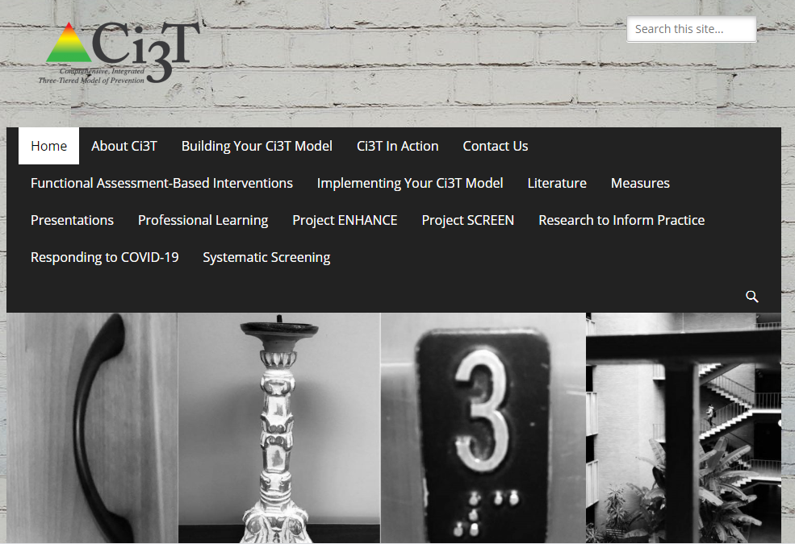
ci3t.org

Slide 3
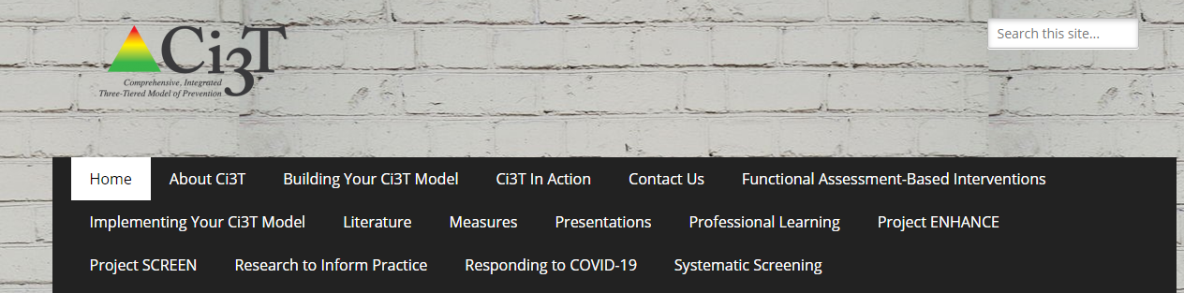
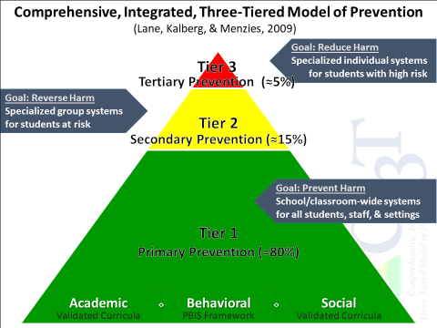
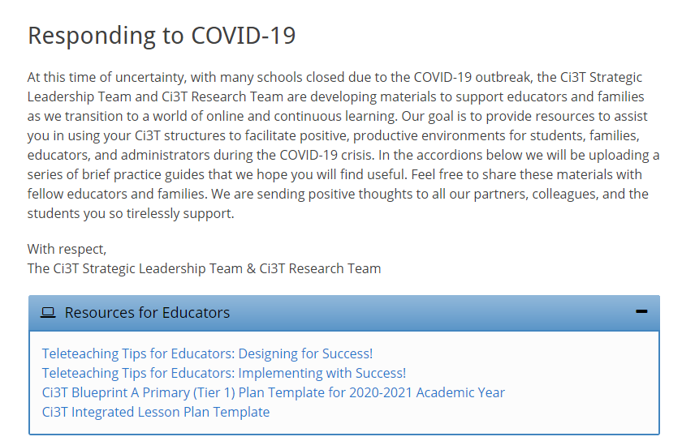


Slide 4
Agenda
Introducing Ci3T … a Comprehensive, Integrated, Three-Tiered Model of Prevention
The Role of Screening: Using Screening Data to Shape Instruction
  At Tier 1: Primary Preventions Efforts
  At all Tiers: Teacher-delivered Strategies
  At Tiers 2 & 3: Secondary & Tertiary Prevention Efforts
Considerations for Screening PK-12 in the COVID-19 Era
Planning for Next Steps

Slide 5
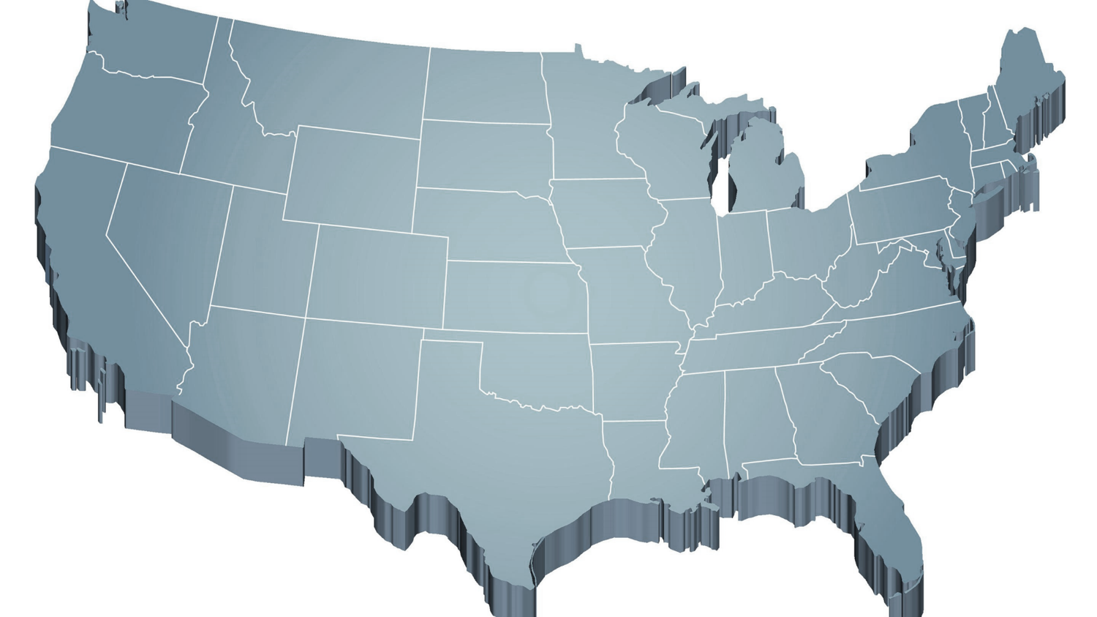
Thank you…
For Your Commitment
Shift to a systems level perspective
Internalizing
Externalizing
ED <1%
EBD 12-20%
Source: Forness, S.R., Freeman, S.F., Paparella, T., Kauffman, J.M., & Walker, H.M. (2012). Special education implications of point and cumulative prevalence for children with emotional or behavioral disorders. Journal of Emotional and Behavioral Disorders, 20, 4-18.

Slide 6
Agenda
Introducing Ci3T … a Comprehensive, Integrated, Three-Tiered Model of Prevention
The Role of Screening: Using Screening Data to Shape Instruction
  At Tier 1: Primary Preventions Efforts
  At all Tiers: Teacher-delivered Strategies
  At Tiers 2 & 3: Secondary & Tertiary Prevention Efforts
Considerations for Screening PK-12 in the COVID-19 Era
Planning for Next Steps

Slide 7
Comprehensive, Integrated, Three-Tiered Model of Prevention
(Lane, Kalberg, & Menzies, 2009)
Tier 3
Tertiary Prevention (≈5%)
Tier 2
Secondary Prevention (≈15%)
Tier 1
Primary Prevention (≈80%)
Academic ◇ Behavioral ◇ Social
Validated Curricula PBIS Framework Validated Curricula

Slide 8
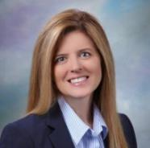
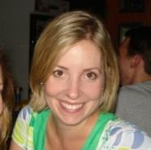
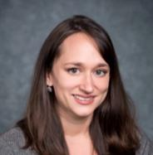
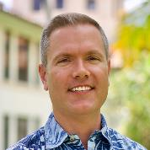
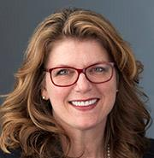

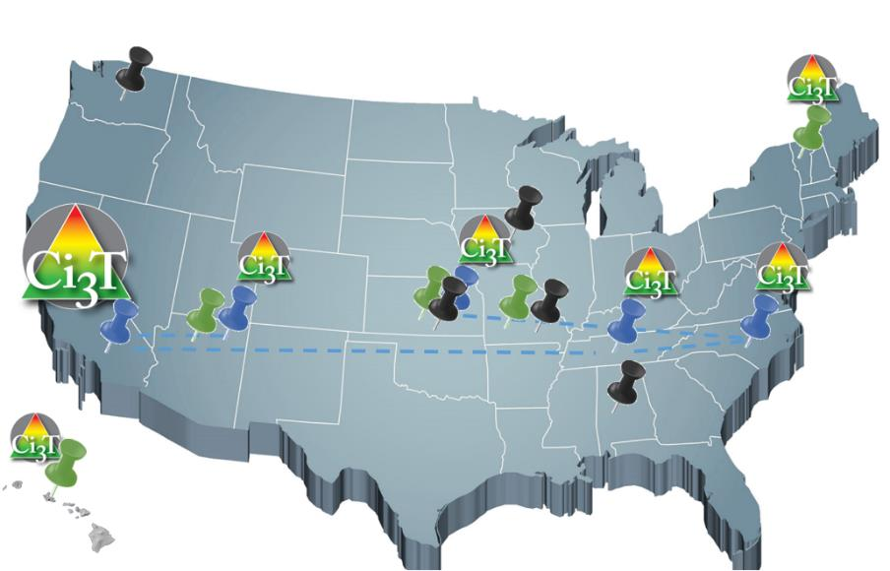
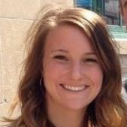
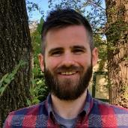
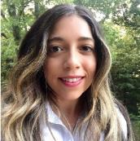
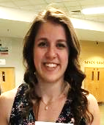
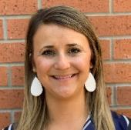
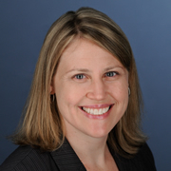
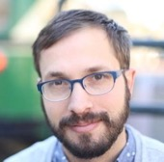

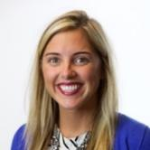
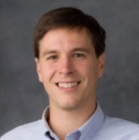
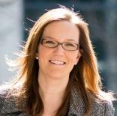
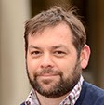
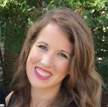
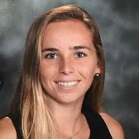
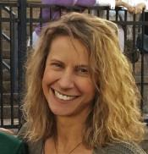
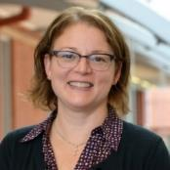
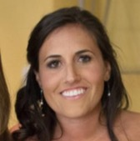
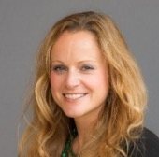
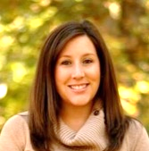

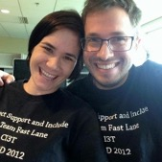
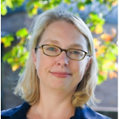
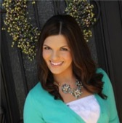
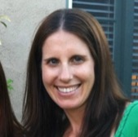
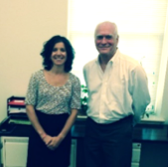
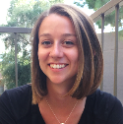
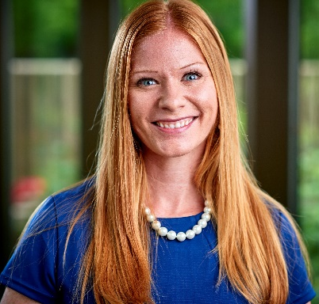

Implementing Ci3T Models:
A Respectful Partnership

Slide 9
Comprehensive, Integrated, Three-Tiered Model of Prevention
(Lane, Kalberg, & Menzies, 2009)
Tier 3
Tertiary Prevention (≈5%)
Tier 2
Secondary Prevention (≈15%)
Tier 1
Primary Prevention (≈80%)
Academic ◇ Behavioral ◇ Social
Validated Curricula PBIS Framework Validated Curricula

Slide 10

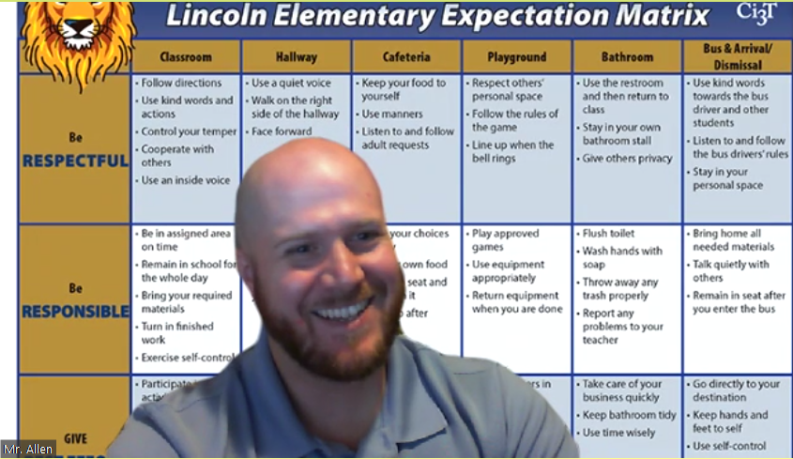
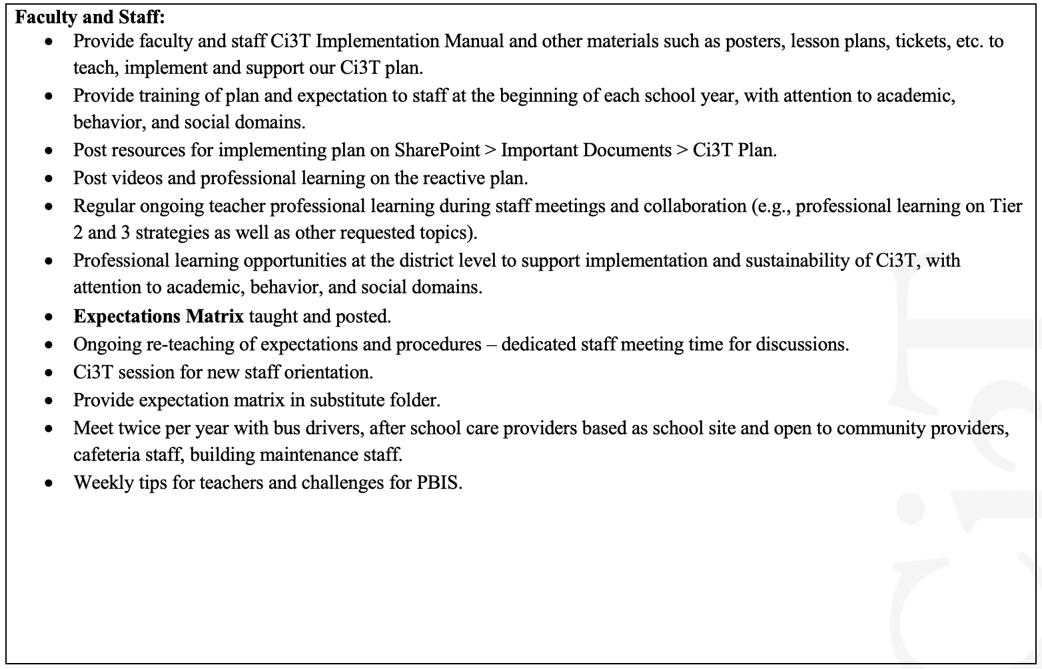

    A Look at Procedures for Teaching at Tier 1
Continued Learning
Procedures for teaching the Ci3T plan for continued learning environments to all faculty and staff include:

Slide 11
Social Component:
Examples of Schoolwide Programs
Social-emotional
Connect With Kids
connectwithkids.com
Character Education
A curricula using real stories presented through documentary-style videos, non-fiction books, teaching guides and patent resources.
Attendance and achievement
Bullying and violence prevention
Character and Life skills
Digital citizenship
Alcohol and drug prevention
Health and Wellness
Customizable units are:
Positive Action
www.positiveaction.net
Improves academics, behavior, and character
Curriculum-based approach
Effectively increases positive behaviors and decreases negative behaviors
6-7 units per grade
Optional components:
  site-wide climate development
  drug education
  bullying / conflict resolution
  counselor, parent, and family classes
  community/coalition components

Slide 13
Practitioner University Partnership … Ci3T Training & Implementation
Phase |  |  |  | Year
 | 2013-14 | 14-15 | 15-16 | 16-17 | 17-18 | 18-19 | 19-20
Elementary School
Ci3T Training
Implementation Year 1
Implementation Year 2
Sustain and Develop Practices
Middle and High Schools
Ci3T Training
Implementation Year 1
Implementation Year 2
Sustain and Develop Practices
College and Career Center
Ci3T Training
Implementation Year 1
Implementation Year 2
Sustain and Develop Practices

Slide 14


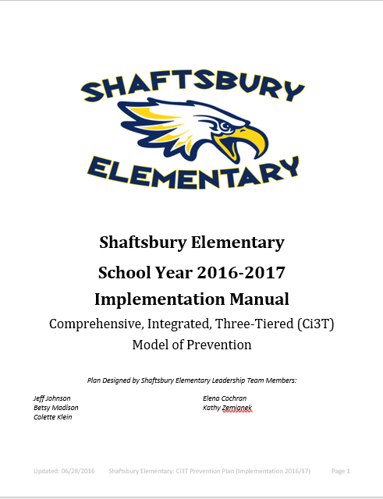
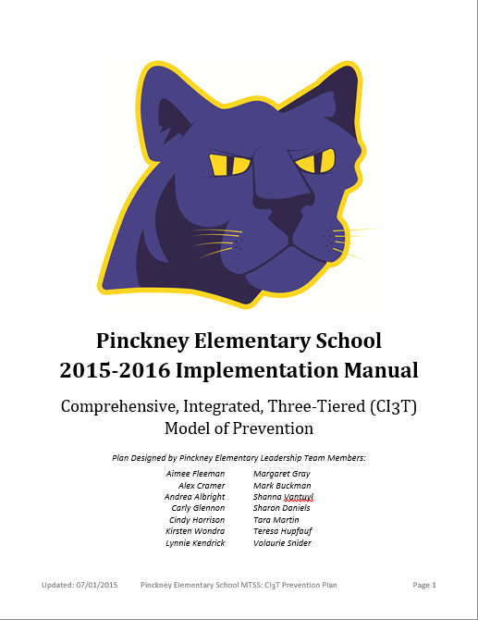
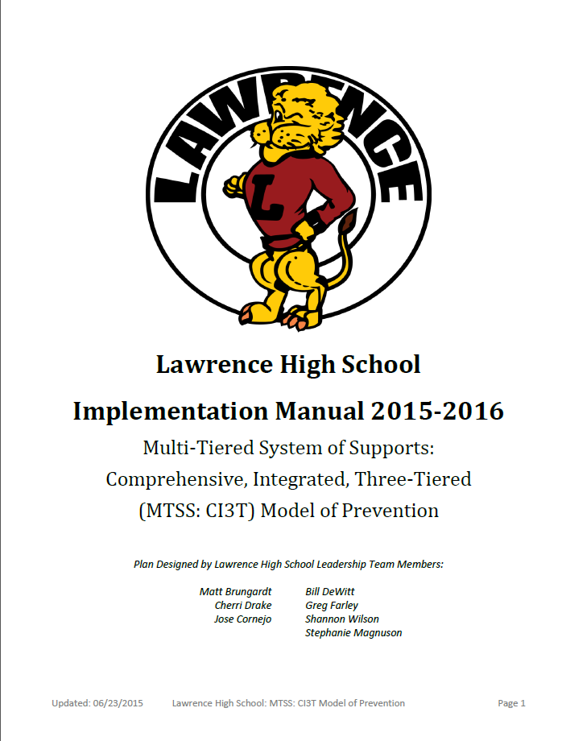
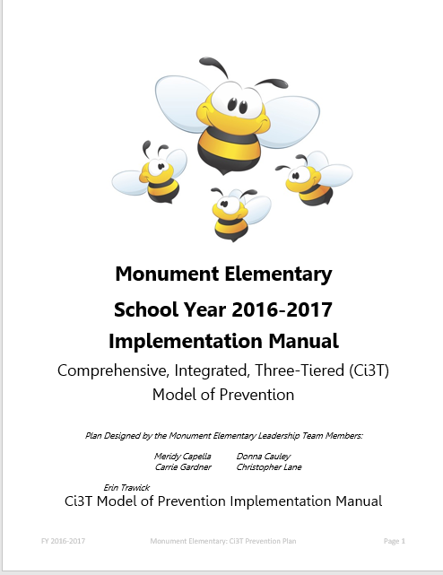



Slide 15
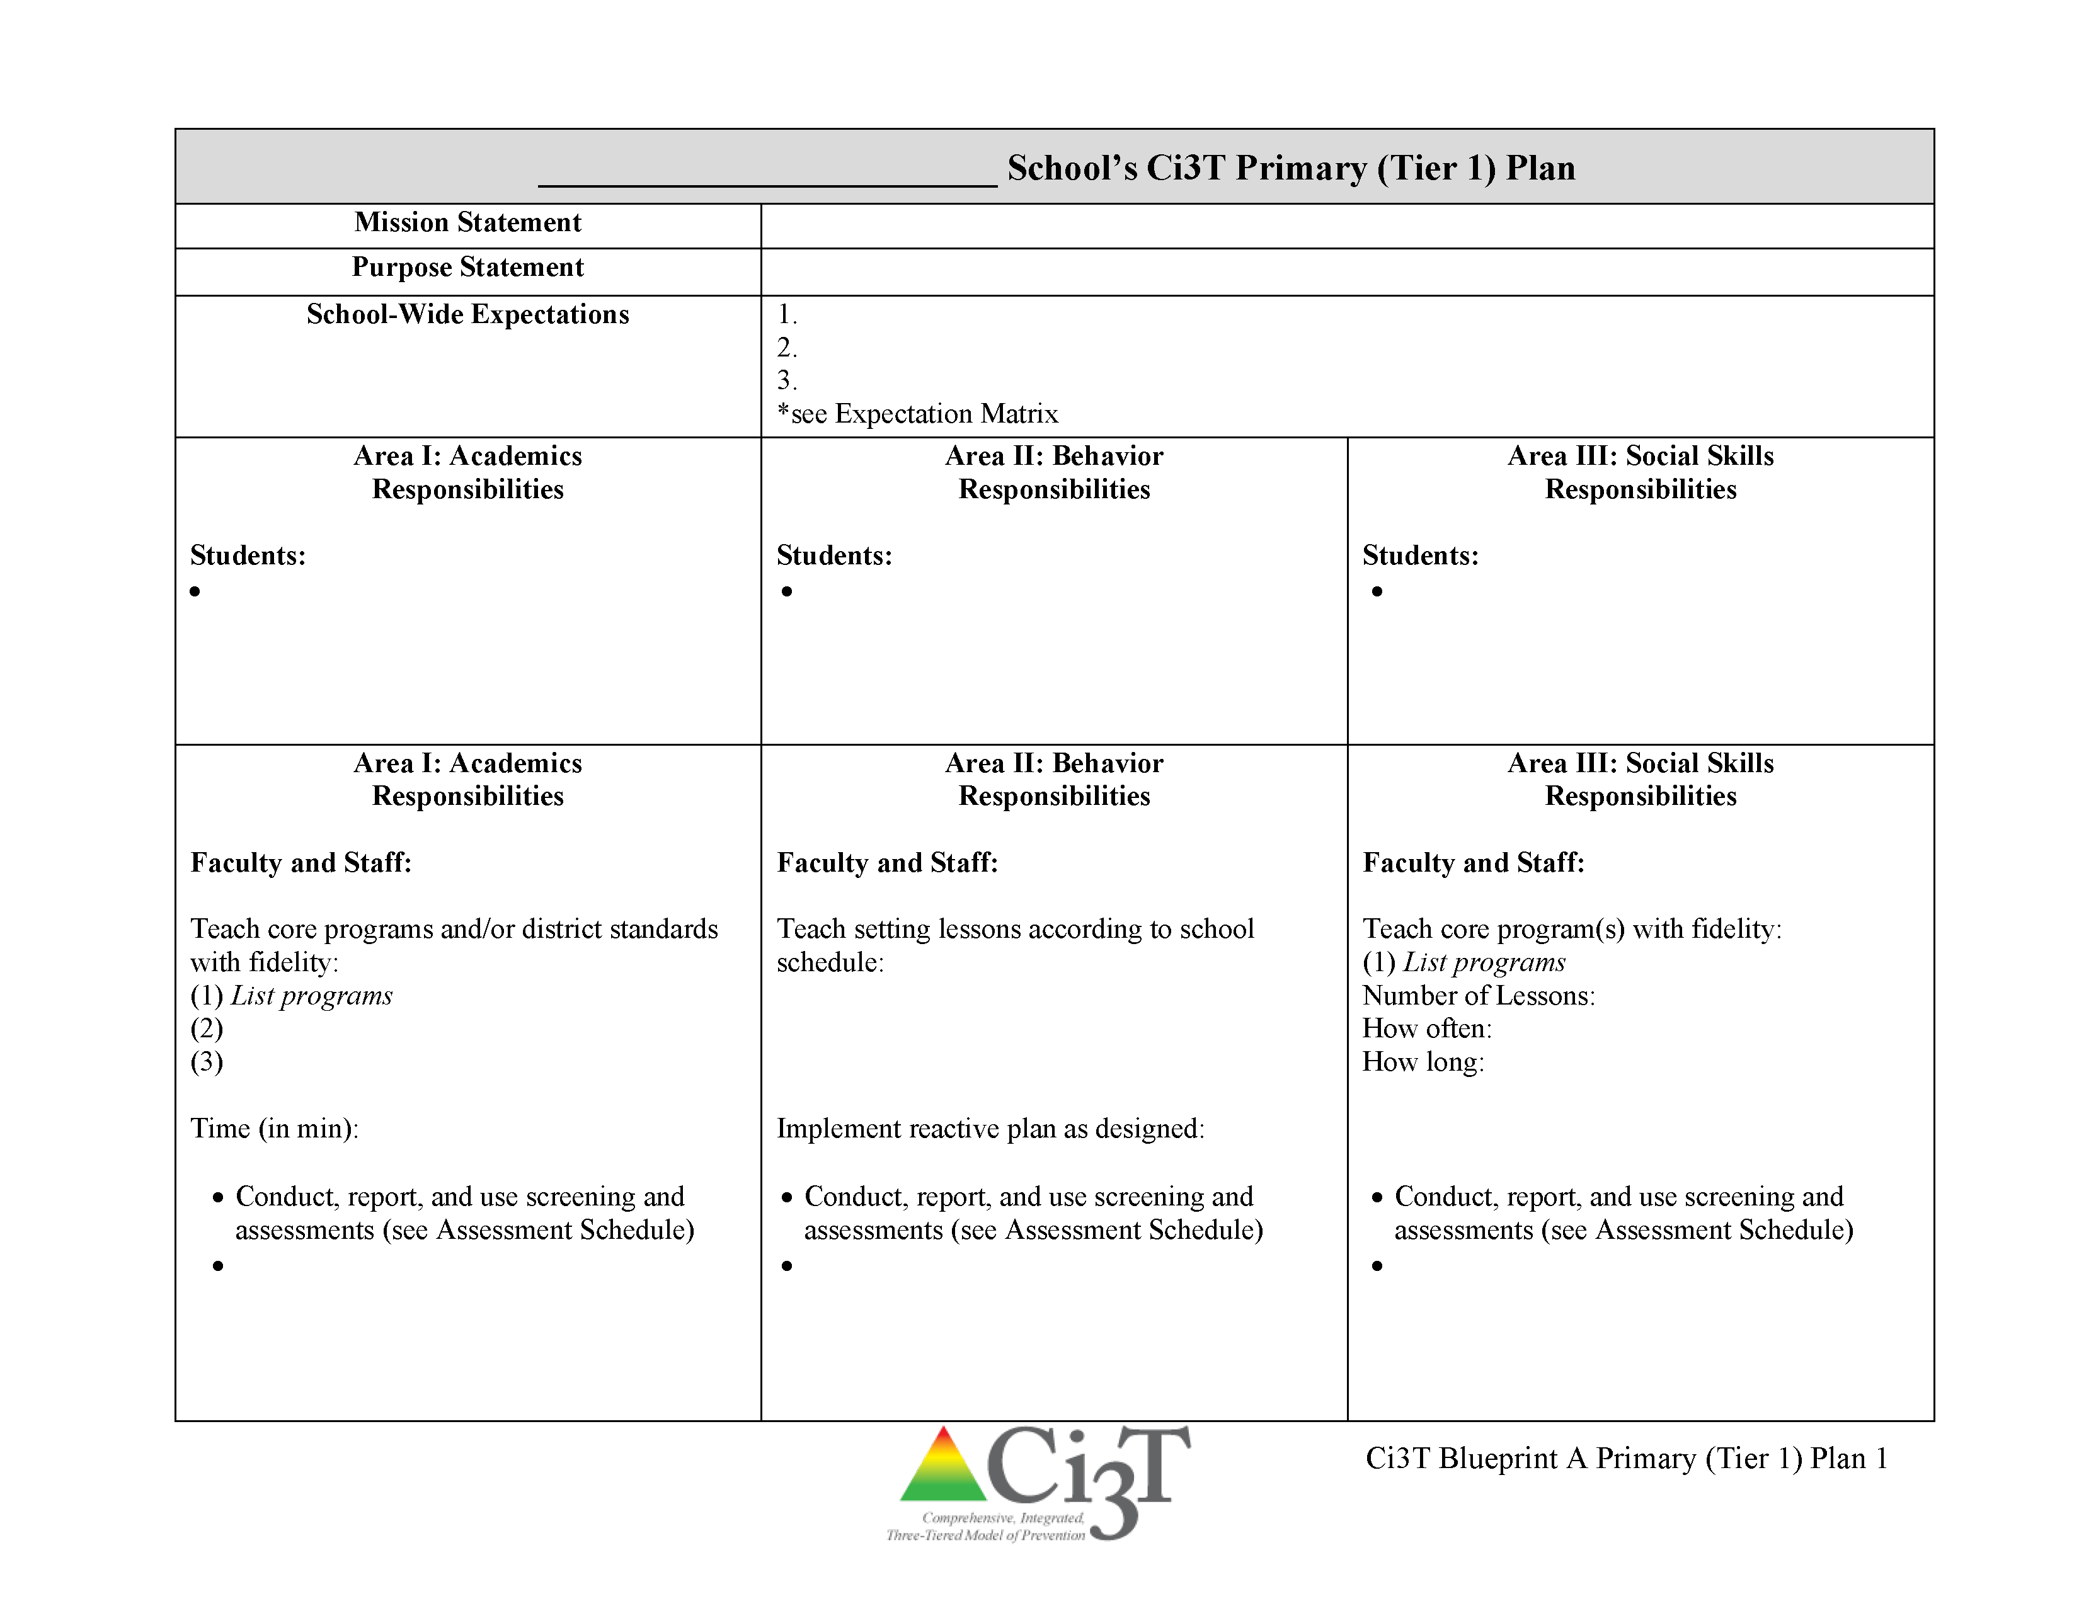
Ci3T Primary Plan: Roles and Responsibilities
all stakeholder groups

Slide 16
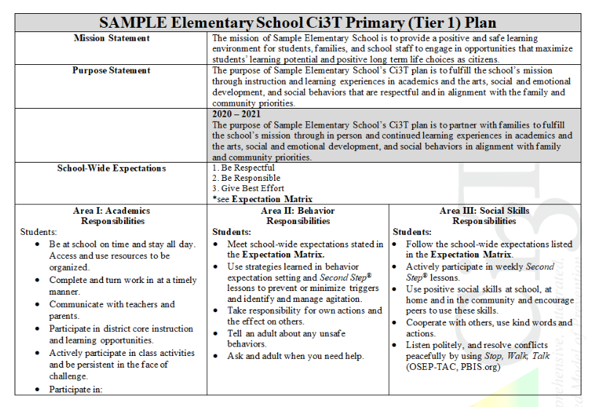
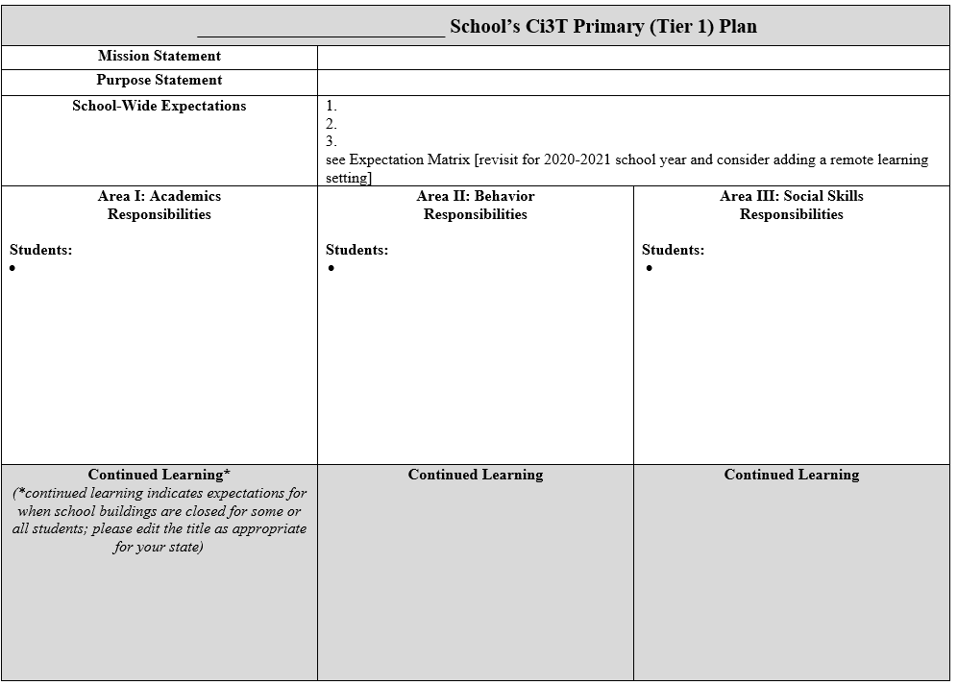
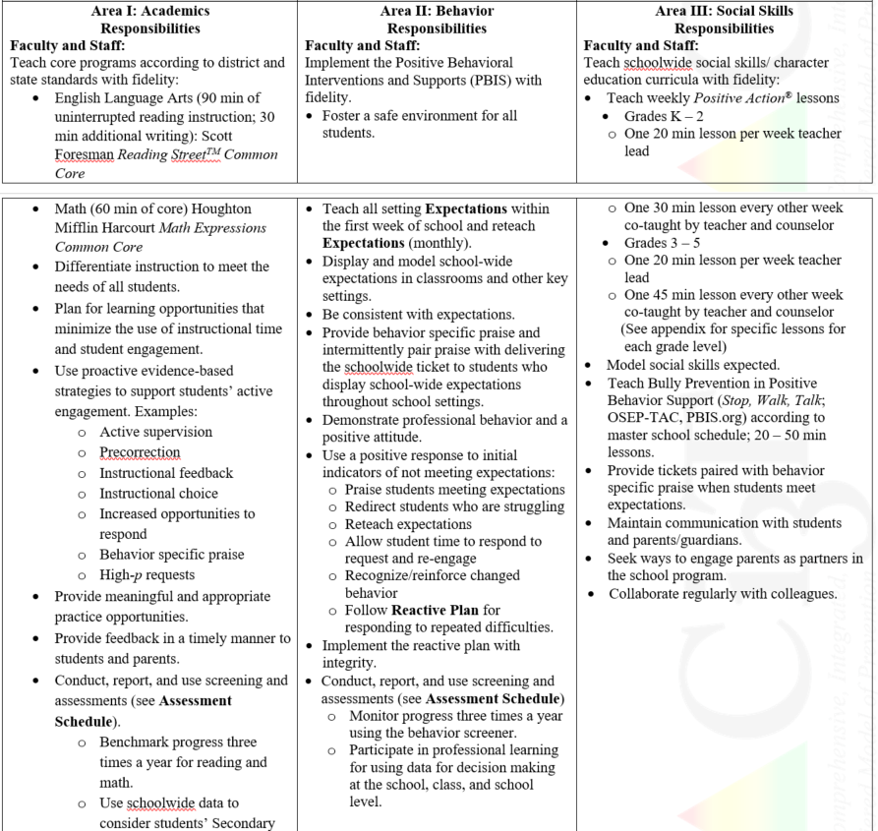
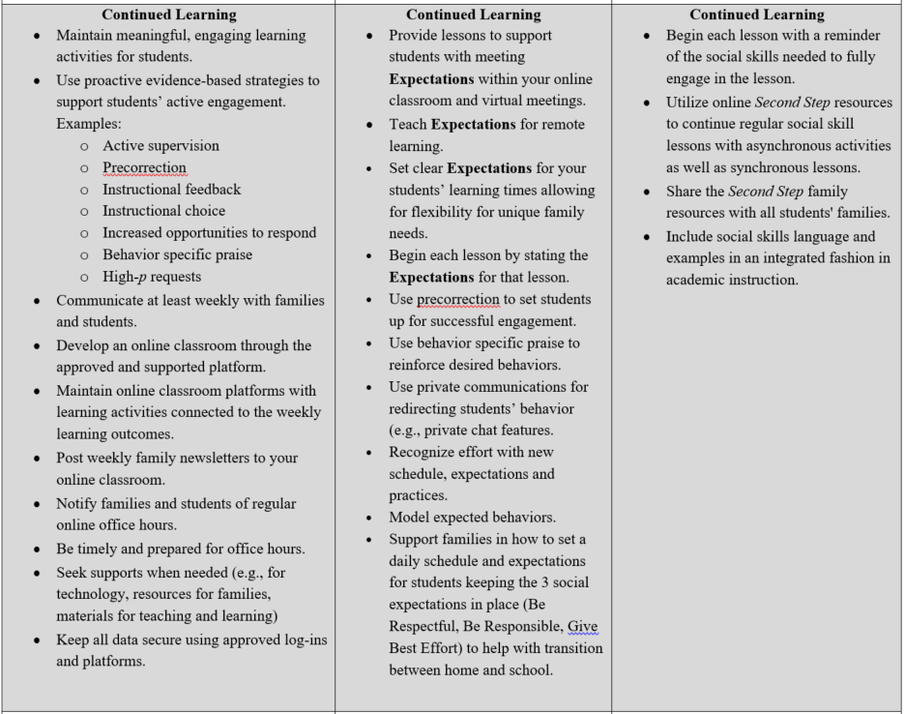
  A Look at Roles & Responsibilities in
  Academic, Behavioral, & Social Domains

Slide 17
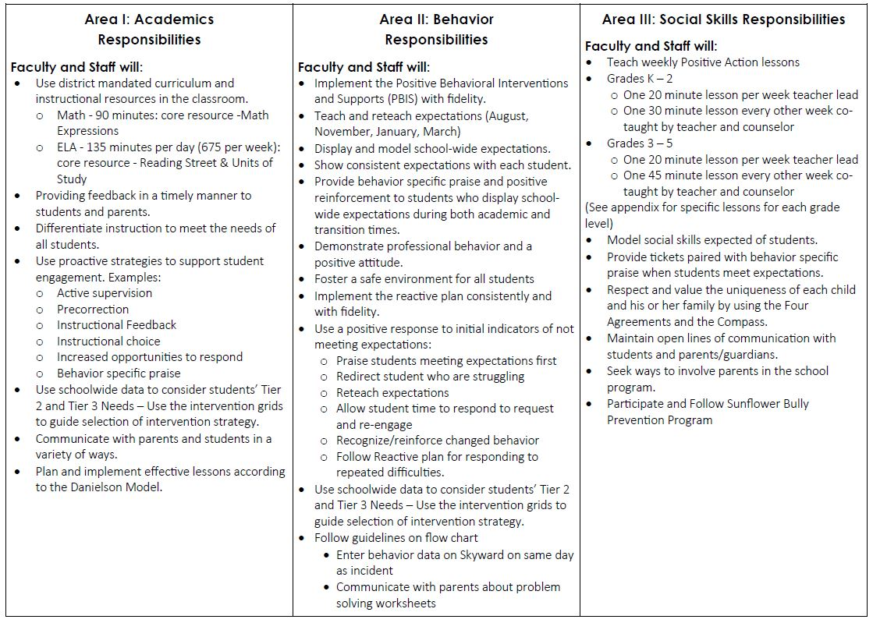
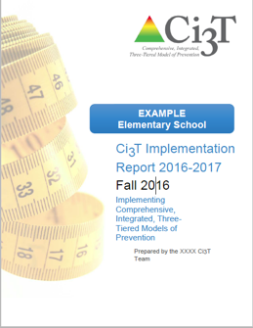
Ci3T Primary Plan: Procedures for Teaching
Ci3T Primary Plan: Procedures for Reinforcing
Ci3T Primary Plan: Procedures for Monitoring

Slide 18
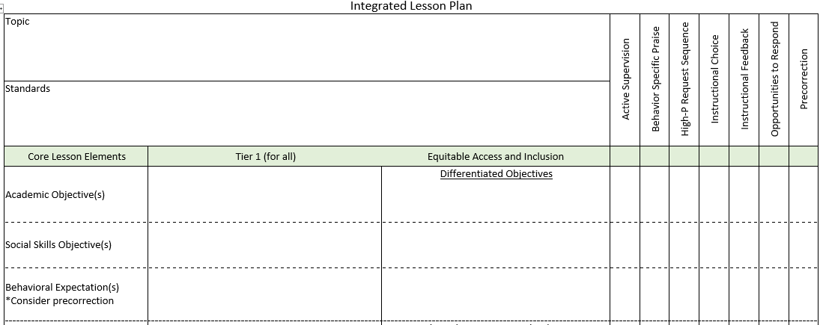


Planning for an Integrated Approach
BSP
OTR
Active Supervision
Choice
Precorrection

Slide 19



Notes:
Click the purple box or here for video of SFES postcard.
https://nam10.safelinks.protection.outlook.com/?url=https%3A%2F%2Fwww.loom.com%2Fshare%2F43fbc52da3574ab5b909be112b107e3a&data=02%7C01%7Ck923l138%40ku.edu%7C401b969e6afe4704827e08d7f44d3923%7C3c176536afe643f5b96636feabbe3c1a%7C0%7C0%7C637246484818641093&sdata=MLYWnPe9OXhrLRVrc2Bm73J0B0eJQJ89ZjiAQtmrkdk%3D&reserved=0

Slide 20

Virtual Learning Incentives
FREE Incentives:
Stay after on ZOOM with a friend for a chat
Virtual lunch date with the teacher, principal, etc.
(check with that staff member before offering them up of course)
Teacher wears stickers or has a sign with the student’s name
Dress up ZOOM day (hats, PJs, costumes, etc.)
Virtual Greeting Cards (sent via email)
Show & Tell Time (or some kind of star student spotlight time)
Personalized stickers in See Saw (2nd grade has been using this)
Adapted and shared with permission from a district partner

Slide 21
Social Validity
Treatment Integrity
Systematic Screening
Academic
Behavior

Slide 22

Comprehensive, Integrated, Three-Tiered Model of Prevention
(Lane, Kalberg, & Menzies, 2009)
Tier 3
Tertiary Prevention (≈5%)
Tier 2
Secondary Prevention (≈15%)
Secondary (Tier 2) Intervention Grids
Tier 1
Primary Prevention (≈80%)
Academic ◇ Behavioral ◇ Social
Validated Curricula PBIS Framework Validated Curricula

Slide 23

Comprehensive, Integrated, Three-Tiered Model of Prevention
(Lane, Kalberg, & Menzies, 2009)
Tier 3
Tertiary Prevention (≈5%)
Tier 2
Secondary Prevention (≈15%)
Tertiary (Tier 3) Intervention Grids
Tier 1
Primary Prevention (≈80%)
Academic ◇ Behavioral ◇ Social
Validated Curricula PBIS Framework Validated Curricula

Slide 24
Implementation Science
Adapted from Fixsen & Blasé, 2005
Exploration & Adoption
Installation
Initial Implementation
We think we know what we need so we are planning to move forward (evidence-based)
Let’s make sure we’re ready to implement (capacity infrastructure)
Let’s give it a try & evaluate (demonstration)
Full Implementation
Let’s make it our way of doing business (institutionalized use)
Sustainability & Continuous Regeneration
That worked, let’s do it for real (investment)

Slide 25













Notes:
10 min Using this PowerPoint break timer
**Is timer set to correct time. Do we want 25 or 10? Same question for above slide.
This PowerPoint slide uses images, custom animation, and timing to provide a countdown timer that you can use in any presentation. When you open the template, you’ll notice that the timer is set at 00:00. However, when you start the slide show, the timer will start at the correct time and count down by 1-minute intervals until it gets to 1 minute. At that point, it will count down in two 30-seconds intervals to 00:00.
To insert this slide into your presentation
Save this template as a presentation (.ppt file) on your computer.
Open the presentation that will contain the timer.
On the Slides tab, place your insertion point after the slide that will precede the timer. (Make sure you don't select a slide. Your insertion point should be between the slides.)
On the Insert menu, click Slides from Files.
In the Slide Finder dialog box, click the Find Presentation tab.
Click Browse, locate and select the timer presentation, and then click Open.
In the Slides from Files dialog box, select the timer slide.
Select the Keep source formatting check box. If you do not select this check box, the copied slide will inherit the design of the slide that precedes it in the presentation.
Click Insert.
Click Close.

Slide 26
Agenda
Introducing Ci3T … a Comprehensive, Integrated, Three-Tiered Model of Prevention
The Role of Screening: Using Screening Data to Shape Instruction
  At Tier 1: Primary Preventions Efforts
  At all Tiers: Teacher-delivered Strategies
  At Tiers 2 & 3: Secondary & Tertiary Prevention Efforts
Considerations for Screening PK-12 in the COVID-19 Era
Planning for Next Steps

Slide 27
Comprehensive, Integrated, Three-Tiered Model of Prevention
(Lane, Kalberg, & Menzies, 2009)
Tier 3
Tertiary Prevention (≈5%)
Tier 2
Secondary Prevention (≈15%)
Tier 1
Primary Prevention (≈80%)
Academic ◇ Behavioral ◇ Social
Validated Curricula PBIS Framework Validated Curricula

Slide 28

Student Risk Screening Scale for Internalizing and Externalizing (SRSS-IE; Drummond, 1994; Lane & Menzies, 2009) for Elementary Schools

Slide 29

Student Risk Screening Scale for Internalizing and Externalizing (SRSS-IE; Drummond, 1994; Lane & Menzies, 2009)

Slide 30
SRSS-IE: Cut Scores
Elementary School |  | Middle and High School
SRSS-E7 | SRSS-I5 | SRSS-E7 | SRSS-I6
Items 1-7 | Items 8-12 | Items 1-7 | Items 4, 8-12
0-3 = low risk 4-8 = moderate risk 9-21 = high risk | 0-1 = low risk 2-3 = moderate risk 4-15 = high risk | 0-3 = low risk 4-8 = moderate risk 9-21 = high risk | 0-3 = low risk 4-5 = moderate risk 6-18 = high risk
Elementary School Level:
Lane, K. L., Oakes, W. P., Swogger, E. D., Schatschneider, C., Menzies, H., M., & Sanchez, J. (2015). Student risk screening scale for internalizing and externalizing behaviors: Preliminary cut scores to support data-informed decision making. Behavioral Disorders, 40, 159-170.
Middle and High School Levels:
Lane, K. L., Oakes, W. P., Cantwell, E. D., Schatschneider, C., Menzies, H., Crittenden, M., & Messenger, M. (2016). Student Risk Screening Scale for Internalizing and Externalizing Behaviors: Preliminary cut scores to support data-informed decision making in middle and high schools. Behavioral Disorders, 42(1), 271-284

Slide 31
SRSS-E7 (externalizing) Results – All Students
Sample Elementary School Fall
N = 25
N = 16
N = 17
N = 12
N = 12
N = 86
N = 35
N = 57
N = 36
N = 50
N = 250
N = 300
N = 250
N = 255
N = 255

Slide 32
SRSS-I5 (internalizing) Results – All Students
Sample Elementary School Fall
N = 72
N = 18
N = 32
N = 85
N = 43
N = 45
N = 40
N = 204
N = 289
N = 261
N = 231

Slide 33
SRSS-Externalizing Results: Grade level
Fall 2018
Grade Level | N Screened | Low n (%) | Moderate n (%) | High n (%)
K | 58 | 51 (87.93%) | 6 (10.34%) | 1 (1.72%)
1st | 52 | 40 (76.92%) | 8 (15.38%) | 4 (7.69%)
2nd | 61 | 51 (83.61%) | 6 (9.84%) | 4 (6.56%)

Slide 34
Student Risk Screening Scale Fall 2004 – 2012 Middle School
Source: Lane, K. L., Oakes, W. P., & Magill, L. M., (2014). Primary prevention efforts: How do we implement and monitor the Tier 1 component of our comprehensive, integrated, three-tiered model of prevention. Preventing School Failure, 58, 143-158. doi: 10.1080/1045988X.2014.893978 [Figure 4. Middle school behavior screening data over time at the fall time point. Adapted from Figure 4.6 p. 127 Lane, K. L., Menzies, H. M, Oakes, W. P., & Kalberg, J. R. (2012). Systematic screenings of behavior to support instruction: From preschool to high school. New York, NY: Guilford Press.]

Slide 35
Middle School Study 1: Behavioral & Academic Characteristics of SRSS Risk Groups
Variable |  | Risk
 | Low (n = 422) M (SD) | Moderate (n = 51) M (SD) | High (n = 12) M (SD) | Significance Testing
ODR | 1.50 (2.85) | 5.02 (5.32) | 8.42 (7.01) | L<M<H
In-School Suspensions | 0.08 (0.38) | 0.35 (1.04) | 1.71 (2.26) | L<M<H
GPA | 3.35 (0.52) | 2.63 (0.65) | 2.32 (0.59) | L>M, H M=H
Course Failures | 0.68 (1.50) | 2.78 (3.46) | 4.17 (3.49) | L<M, H M=H
(Lane, Parks, Kalberg, & Carter, 2007)

Slide 36
Screening Data: High School Yrs1-3
Fall- SRSSIE-I |  | Low |  | Moderate |  | High |  | Fall- SRSSIE-E |  | Low |  | Moderate |  | High
2016 |  | 80.28% |  | 10.36% |  | 9.36% |  | 2016 |  | 89.56% |  | 8.02% |  | 2.42%
2017 |  | 90.18% |  | 4.16% |  | 5.66% |  | 2017 |  | 91.29% |  | 6.18% |  | 2.54%
2018 |  | 90.91% |  | 3.86% |  | 5.23% |  | 2018 |  | 92.22% |  | 6.20% |  | 1.58%
WTR-SRSSIE-I |  | Low |  | Moderate |  | High |  | WTR-SRSSIE-E |  | Low |  | Moderate |  | High
2016 |  | 87.25% |  | 9.49% |  | 3.26% |  | 2016 |  | 87.25% |  | 9.49% |  | 3.26%
2017 |  | 86.14% |  | 9.02% |  | 4.85% |  | 2017 |  | 86.14% |  | 9.02% |  | 4.85%
2018 |  | 88.79% |  | 8.52% |  | 2.69% |  | 2018 |  | 88.79% |  | 8.52% |  | 2.69%

Slide 37
Notes:
Data security – teamwork to create, populate, collect and synthesize data – planning ahead to calendar screening as all other data collection – SHARE the information with faculty and staff

Slide 38



Ci3t.org/screening
Systematic Screening
Notes:
QR code still functional?

Slide 39
Agenda
Introducing Ci3T … a Comprehensive, Integrated, Three-Tiered Model of Prevention
The Role of Screening: Using Screening Data to Shape Instruction
  At Tier 1: Primary Preventions Efforts
  At all Tiers: Teacher-delivered Strategies
  At Tiers 2 & 3: Secondary & Tertiary Prevention Efforts
Considerations for Screening PK-12 in the COVID-19 Era
Planning for Next Steps

Slide 40
Social Skills Improvement System – Performance Screening Guide
Spring 2012 – Total School
N = 54
N = 22
N = 35
N = 31
N = 223
N = 233
N = 180
N = 187
N = 212
N = 235
N = 275
N = 271
n = 489 n = 490 n = 490 n = 489
Lane, K. L., Oakes, W. P., & Magill, L. (2013). Primary prevention efforts: How do we implemented and monitor the Tier 1 component of our Comprehensive, Integrated, Three-Tiered (CI3T) Model?

Slide 41
Student Risk Screening Scale Fall 2004 – 2012 Middle School
Source: Lane, K. L., Oakes, W. P., & Magill, L. M., (2014). Primary prevention efforts: How do we implement and monitor the Tier 1 component of our comprehensive, integrated, three-tiered model of prevention. Preventing School Failure, 58, 143-158. doi: 10.1080/1045988X.2014.893978 [Figure 4. Middle school behavior screening data over time at the fall time point. Adapted from Figure 4.6 p. 127 Lane, K. L., Menzies, H. M, Oakes, W. P., & Kalberg, J. R. (2012). Systematic screenings of behavior to support instruction: From preschool to high school. New York, NY: Guilford Press.]

Slide 42
Agenda
Introducing Ci3T … a Comprehensive, Integrated, Three-Tiered Model of Prevention
The Role of Screening: Using Screening Data to Shape Instruction
  At Tier 1: Primary Preventions Efforts
  At all Tiers: Teacher-delivered Strategies
  At Tiers 2 & 3: Secondary & Tertiary Prevention Efforts
Considerations for Screening PK-12 in the COVID-19 Era
Planning for Next Steps

Slide 43

Examining Academic and Behavioral Data:
Elementary School Level
Lane, K. L., Menzies, H. M., Ennis, R. P., & Oakes, W. P. (2015). Supporting Behavior for School Success: A Step-by-Step Guide to Key Strategies. New York, NY: Guilford Press.
Notes:
Lane, K. L., Oakes, W. P., Ennis, R. P., & Hirsch, S. E. (2014). Identifying students for secondary and tertiary prevention efforts: How do we determine which students have Tier 2 and Tier 3 needs? Preventing School Failure, 58, 171-182, DOI: 10.1080/1045988X.2014.895573

Slide 44





Low-Intensity Strategies
Opportunities to Respond
Behavior Specific Praise
Active Supervision
Instructional Feedback
High p Requests
Precorrection
Incorporating Choice
Self-monitoring
Behavior Contracts
Notes:
Lane, K. L., Oakes, W. P., Ennis, R. P., & Hirsch, S. E. (2014). Identifying students for secondary and tertiary prevention efforts: How do we determine which students have Tier 2 and Tier 3 needs? Preventing School Failure, 58, 171-182, DOI: 10.1080/1045988X.2014.895573

Slide 45



Notes:
Ci3T.org: On-demand Professional Learning Resources

Slide 46




ci3t.org
Professional Learning tab

Slide 47
Agenda
Introducing Ci3T … a Comprehensive, Integrated, Three-Tiered Model of Prevention
The Role of Screening: Using Screening Data to Shape Instruction
  At Tier 1: Primary Preventions Efforts
  At all Tiers: Teacher-delivered Strategies
  At Tiers 2 & 3: Secondary & Tertiary Prevention Efforts
Considerations for Screening PK-12 in the COVID-19 Era
Planning for Next Steps

Slide 48
Comprehensive, Integrated, Three-Tiered Model of Prevention
(Lane, Kalberg, & Menzies, 2009)
Tier 3
Tertiary Prevention (≈5%)
Tier 2
Secondary Prevention (≈15%)
Secondary (Tier 2) Intervention Grids
Tier 1
Primary Prevention (≈80%)
Academic ◇ Behavioral ◇ Social
Validated Curricula PBIS Framework Validated Curricula

Slide 49


Slide 50


Slide 51





Slide 52
Notes:
10 min Using this PowerPoint break timer
**Is timer set to correct time. Do we want 25 or 10? Same question for above slide.
This PowerPoint slide uses images, custom animation, and timing to provide a countdown timer that you can use in any presentation. When you open the template, you’ll notice that the timer is set at 00:00. However, when you start the slide show, the timer will start at the correct time and count down by 1-minute intervals until it gets to 1 minute. At that point, it will count down in two 30-seconds intervals to 00:00.
To insert this slide into your presentation
Save this template as a presentation (.ppt file) on your computer.
Open the presentation that will contain the timer.
On the Slides tab, place your insertion point after the slide that will precede the timer. (Make sure you don't select a slide. Your insertion point should be between the slides.)
On the Insert menu, click Slides from Files.
In the Slide Finder dialog box, click the Find Presentation tab.
Click Browse, locate and select the timer presentation, and then click Open.
In the Slides from Files dialog box, select the timer slide.
Select the Keep source formatting check box. If you do not select this check box, the copied slide will inherit the design of the slide that precedes it in the presentation.
Click Insert.
Click Close.

Slide 53
Agenda
Introducing Ci3T … a Comprehensive, Integrated, Three-Tiered Model of Prevention
The Role of Screening: Using Screening Data to Shape Instruction
  At Tier 1: Primary Preventions Efforts
  At all Tiers: Teacher-delivered Strategies
  At Tiers 2 & 3: Secondary & Tertiary Prevention Efforts
Considerations for Screening PK-12 in the COVID-19 Era
Planning for Next Steps

Slide 54

Considerations for Systematic Screening PK-12 in the COVID-19 Era
Lane, K. L., Oakes, W. P., & Menzies, H. M. (2020). Considerations for systematic screening PK-12: Universal screening for internalizing and externalizing behaviors in the COVID-19 era. Manuscript in review

Slide 55

Recommendations to Consider:
Pre-COVID-19
Recommendation #1: Build Stakeholders’ Expertise
Recommendation #2: Develop the Structures to Sustain and Improve Practices
Recommendation #3: Conduct Screenings in a Responsible Fashion
Recommendation #4: Consider Legal Implications- know your state laws

Slide 56
Recommendations to Consider:
Screening in the COVID-19 Era
Recommendation 1: Continue Screening and Engage in Professional Learning Opportunities
Recommendation 2: Use Multiple Sources of Data to Inform Instruction
Recommendation 3: Screen Responsibly
Lane, K. L., Oakes, W. P., & Menzies, H. M. (2020). Considerations for systematic screening PK-12: Universal screening for internalizing and externalizing behaviors in the COVID-19 era. Manuscript in review

Slide 57
  A Look at Roles & Responsibilities in
  Academic, Behavioral, & Social Domains

Slide 58

  A Look at Roles & Responsibilities in
  Academic, Behavioral, & Social Domains
Continued Learning
Follow directions for maintaining communication with school
Utilize technologies and resources appropriately for learning.
Follow the new learning schedule, whether at home or school.
Ask for help and clarification, when needed.
Attend remote learning sessions and class meetings.
Designate a space for learning

Slide 59



  A Look at Roles & Responsibilities in
  Academic, Behavioral, & Social Domains
Continued Learning
Follow directions for maintaining communication with school
Meet school-wide expectations stated in the Expectation Matrix for remote learning
Follow home expectations set by families
Ask for help from your family and teachers, when needed
Maintain technologies and materials by keeping devices charged, clean and stored safely

Slide 60

  A Look at Roles & Responsibilities in
  Academic, Behavioral, & Social Domains
Continued Learning
Actively participate in Second Step lessons.
Talk with families to share lessons learned
Use social skills in your interactions with others
Show respect for others by maintaining the recommended personal distance

Slide 61


  A Look at Roles & Responsibilities in
  Academic, Behavioral, & Social Domains

Slide 62

  A Look at Roles & Responsibilities in
  Academic, Behavioral, & Social Domains
Continued Learning Provide lessons to support students with meeting Expectations within your online classroom and virtual meetings Teach Expectations for remote learning Set clear Expectations for your students’ learning times allowing for flexibility for unique family needs Begin each lesson by stating the Expectations for that lesson Use precorrection to set students up for successful engagement Use behavior specific praise to reinforce desired behaviors Use private communications for redirecting students’ behavior (e.g., private chat features Recognize effort with new schedule, expectations and practices. Model expected behaviors Support families in how to set a daily schedule and expectations for students keeping the 3 social expectations in place (Be Respectful, Be Responsible, Give Best Effort) to help with transition between home and school

Slide 63

Planning for 2020-2021: Structured Flexibility
Roles and Responsibilities
Continued Learning
Begin each lesson with a reminder of the social skills needed to fully engage in the lesson
Utilize online Second Step resources to continue regular social skill lessons with asynchronous activities as well as synchronous lessons
Share the Second Step family resources with all students' families.
Include social skills language and examples in an integrated fashion in academic instruction
Participate in available professional learning for flexible learning engagement strategies

Slide 64
Agenda
Introducing Ci3T … a Comprehensive, Integrated, Three-Tiered Model of Prevention
The Role of Screening: Using Screening Data to Shape Instruction
  At Tier 1: Primary Preventions Efforts
  At all Tiers: Teacher-delivered Strategies
  At Tiers 2 & 3: Secondary & Tertiary Prevention Efforts
Considerations for Screening PK-12 in the COVID-19 Era
Planning for Next Steps

Slide 65

Action Planning

Slide 66

Resources for Responding to COVID-19

Slide 67


Setting up for Success at Home
  A Look at Expectations
http://www.ci3t.org/covid
Notes:
In the accordions below we will be uploading a series of brief practice guides that we hope you will find useful. Feel free to share these materials with fellow educators and families. We are sending positive thoughts to all our partners, colleagues, and the students you so tirelessly support.
Materials to support educators and families as we transition to continuous learning
Using your Ci3T structures to facilitate positive, productive environments for students, families, educators, and administrators

Slide 68


  A Look at Expectations

Slide 69


Ci3T: Monitoring for Success: Using Data to Inform Instruction
… Action Planning

Slide 70


Ci3T Monthly Leadership Team Meetings

Slide 71


Building Capacity & Supporting Sustainability
Professional Learning Offerings for 2020 -2021
Ci3T EMPOWER Sessions Location: TBA Attended by: Faculty and Staff Families (adults only) Community Members School Ci3T Leadership Teams Ci3T District Trainers and Coaches |  | Times CST
TBA | September 15, 2020 | 5:00 – 7:00 p.m.
TBA | November 3, 2020 | 5:00 – 7:00 p.m.
TBA | January 26, 2021 | 5:00 – 7:00 p.m.
TBA | February 23, 2021 | 5:00 – 7:00 p.m.
TBA | April 20, 2021 | 5:00 – 7:00 p.m.
Notes:
Exploring format possibilities.

Slide 72

Ci3T Training and Coaching Calls
Ci3T Trainer & Coaches Conference Calls Location: *Held Remotely Attended by: Ci3T Trainers, Coaches, or Leadership Team Members; open to interested parties | Date | Times CST
Ci3T Conference Call 1 | August 06, 2020 | 4:00 p.m. – 5:00 p.m.
2. Ci3T Conference Call 2 | September 03, 2020 | 4:00 p.m. – 5:00 p.m.
3. Ci3T Conference Call 3 | October 20, 2020 | 4:00 p.m. – 5:00 p.m.
4. Ci3T Conference Call 4 | November 16, 2020 | 4:00 p.m. – 5:00 p.m.
5. Ci3T Conference Call 5 | December 14, 2020 | 4:00 p.m. – 5:00 p.m.
6. Ci3T Conference Call 6 | January 06, 2021 | 4:00 p.m. – 5:00 p.m.
7. Ci3T Conference Call 7 | February 17, 2021 | 4:00 p.m. – 5:00 p.m.
8. Ci3T Conference Call 8 | March 23, 2021 | 4:00 p.m. – 5:00 p.m.
9. Ci3T Conference Call 9 | April 19, 2021 | 4:00 p.m. – 5:00 p.m.
10. Ci3T Conference Call 10 | May 04, 2021 | 4:00 p.m. – 5:00 p.m.
11. Ci3T Conference Call 11 | June 10, 2021 | 4:00 p.m. – 5:00 p.m.

Slide 73
www.ci3t.org
Kathleen.Lane@ku.edu
Wendy.Oakes@asu.edu

