Slide 1
Wouldn’t it be great if … Systematic Screening in Ci3T Models
Kathleen Lynne Lane, Ph.D., BCBA-D, CF-L1
University of Kansas

Slide 2

Wouldn’t it be great if … students could be detected at the first sign of concern?

Slide 3






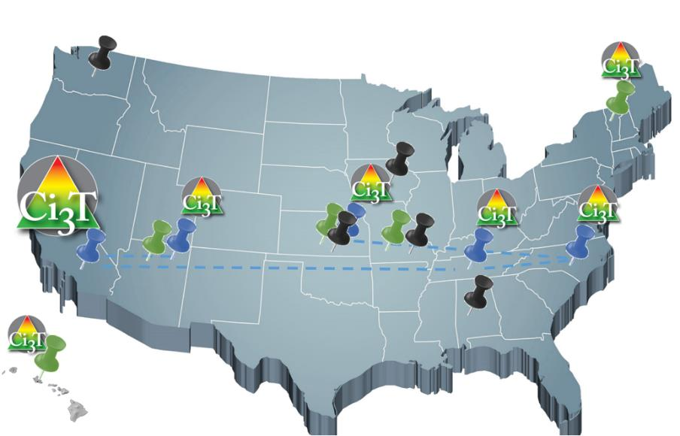




















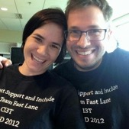



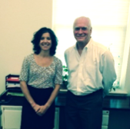



Implementing Ci3T Models:
A Respectful Partnership

Slide 4
Comprehensive, Integrated, Three-Tiered Model of Prevention
(Lane, Kalberg, & Menzies, 2009)
Tier 3
Tertiary Prevention (≈5%)
Tier 2
Secondary Prevention (≈15%)
Tier 1
Primary Prevention (≈80%)
Academic ◇ Behavioral ◇ Social
Validated Curricula PBIS Framework Validated Curricula

Slide 5
Thank you…
For Your Commitment
Internalizing
Externalizing
Shift to a systems level perspective
ED <1%
EBD 12-20%

Slide 6
Social Validity
Treatment Integrity
Systematic Screening
Academic
Behavior

Slide 7
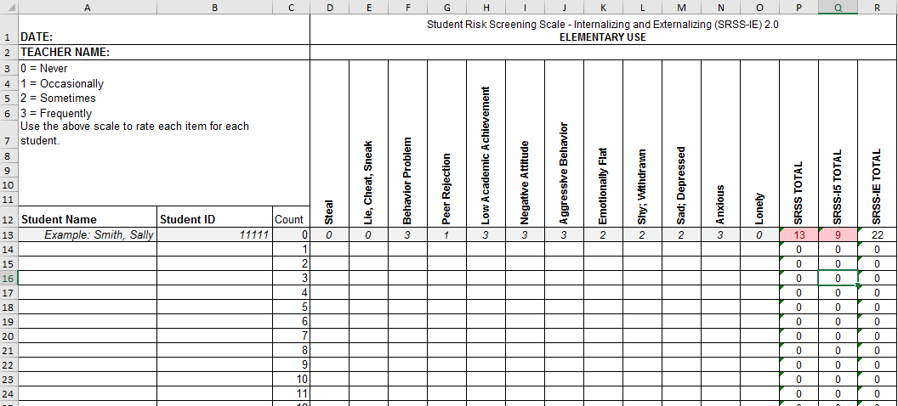
Student Risk Screening Scale for Internalizing and Externalizing (SRSS-IE; Drummond, 1994; Lane & Menzies, 2009) for Elementary Schools

Slide 8
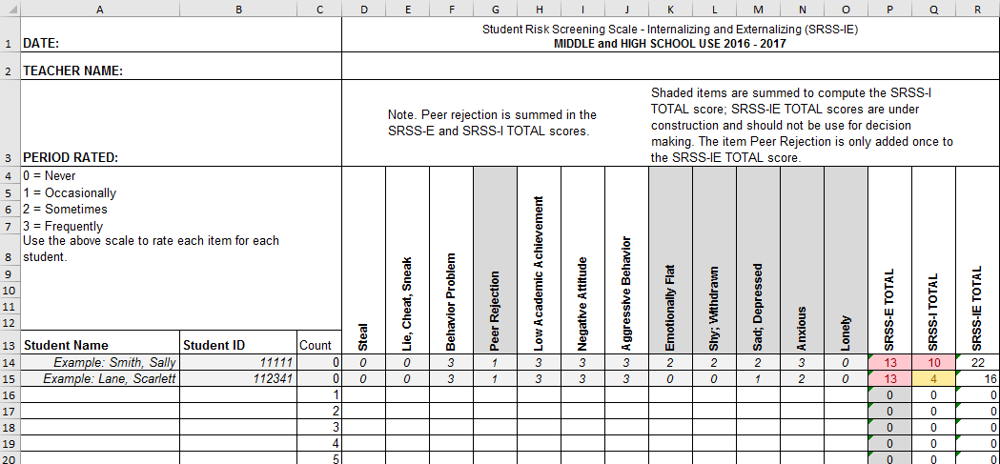
Student Risk Screening Scale for Internalizing and Externalizing (SRSS-IE; Drummond, 1994; Lane & Menzies, 2009)

Slide 9
SRSS-IE: Cut Scores
Elementary School |  | Middle and High School
SRSS-E7 | SRSS-I5 | SRSS-E7 | SRSS-I6
Items 1-7 | Items 8-12 | Items 1-7 | Items 4, 8-12
0-3 = low risk 4-8 = moderate risk 9-21 = high risk | 0-1 = low risk 2-3 = moderate risk 4-15 = high risk | 0-3 = low risk 4-8 = moderate risk 9-21 = high risk | 0-3 = low risk 4-5 = moderate risk 6-18 = high risk
Elementary School Level:
Lane, K. L., Oakes, W. P., Swogger, E. D., Schatschneider, C., Menzies, H., M., & Sanchez, J. (2015). Student risk screening scale for internalizing and externalizing behaviors: Preliminary cut scores to support data-informed decision making. Behavioral Disorders, 40, 159-170.
Middle and High School Levels:
Lane, K. L., Oakes, W. P., Cantwell, E. D., Schatschneider, C., Menzies, H., Crittenden, M., & Messenger, M. (2016). Student Risk Screening Scale for Internalizing and Externalizing Behaviors: Preliminary cut scores to support data-informed decision making in middle and high schools. Behavioral Disorders, 42(1), 271-284

Slide 10
SRSS-E7 (externalizing) Results – All Students
Sample Elementary School Fall
N = 25
N = 16
N = 17
N = 12
N = 12
N = 86
N = 35
N = 57
N = 36
N = 50
N = 250
N = 300
N = 250
N = 255
N = 255

Slide 11
SRSS-Externalizing Results: Grade level
Fall 2018
Grade Level | N Screened | Low n (%) | Moderate n (%) | High n (%)
K | 58 | 51 (87.93%) | 6 (10.34%) | 1 (1.72%)
1st | 52 | 40 (76.92%) | 8 (15.38%) | 4 (7.69%)
2nd | 61 | 51 (83.61%) | 6 (9.84%) | 4 (6.56%)

Slide 12
SRSS-I5 (internalizing) Results – All Students
Sample Elementary School Fall
N = 72
N = 18
N = 32
N = 85
N = 43
N = 45
N = 40
N = 204
N = 289
N = 261
N = 231

Slide 13
Student Risk Screening Scale Fall 2004 – 2012
Middle School
Source: Lane, K. L., Oakes, W. P., & Magill, L. M., (2014). Primary prevention efforts: How do we implement and monitor the Tier 1 component of our comprehensive, integrated, three-tiered model of prevention. Preventing School Failure, 58, 143-158. doi: 10.1080/1045988X.2014.893978 [Figure 4. Middle school behavior screening data over time at the fall time point. Adapted from Figure 4.6 p. 127 Lane, K. L., Menzies, H. M, Oakes, W. P., & Kalberg, J. R. (2012). Systematic screenings of behavior to support instruction: From preschool to high school. New York, NY: Guilford Press.]

Slide 14
Middle School Study 1: Behavioral & Academic Characteristics of SRSS Risk Groups
Variable |  | Risk
 | Low (n = 422) M (SD) | Moderate (n = 51) M (SD) | High (n = 12) M (SD) | Significance Testing
ODR | 1.50 (2.85) | 5.02 (5.32) | 8.42 (7.01) | L<M<H
In-School Suspensions | 0.08 (0.38) | 0.35 (1.04) | 1.71 (2.26) | L<M<H
GPA | 3.35 (0.52) | 2.63 (0.65) | 2.32 (0.59) | L>M, H M=H
Course Failures | 0.68 (1.50) | 2.78 (3.46) | 4.17 (3.49) | L<M, H M=H
(Lane, Parks, Kalberg, & Carter, 2007)

Slide 15
Screening Data: High School Yrs1-3
Fall- SRSSIE-I |  | Low |  | Moderate |  | High |  | Fall- SRSSIE-E |  | Low |  | Moderate |  | High
2016 |  | 80.28% |  | 10.36% |  | 9.36% |  | 2016 |  | 89.56% |  | 8.02% |  | 2.42%
2017 |  | 90.18% |  | 4.16% |  | 5.66% |  | 2017 |  | 91.29% |  | 6.18% |  | 2.54%
2018 |  | 90.91% |  | 3.86% |  | 5.23% |  | 2018 |  | 92.22% |  | 6.20% |  | 1.58%
WTR-SRSSIE-I |  | Low |  | Moderate |  | High |  | WTR-SRSSIE-E |  | Low |  | Moderate |  | High
2016 |  | 87.25% |  | 9.49% |  | 3.26% |  | 2016 |  | 87.25% |  | 9.49% |  | 3.26%
2017 |  | 86.14% |  | 9.02% |  | 4.85% |  | 2017 |  | 86.14% |  | 9.02% |  | 4.85%
2018 |  | 88.79% |  | 8.52% |  | 2.69% |  | 2018 |  | 88.79% |  | 8.52% |  | 2.69%

Slide 16

www.ci3t.org

Slide 17
Wouldn’t it be great if … each school had a comprehensive, integrated, three-tiered model to meet students’ multiple needs?

Slide 18
Comprehensive, Integrated, Three-Tiered Model of Prevention
(Lane, Kalberg, & Menzies, 2009)
Tier 3
Tertiary Prevention (≈5%)
Tier 2
Secondary Prevention (≈15%)
Tier 1
Primary Prevention (≈80%)
Academic ◇ Behavioral ◇ Social
Validated Curricula PBIS Framework Validated Curricula

Slide 19
Practitioner University Partnership … Ci3T Training & Implementation
Phase |  |  |  | Year
 | 2013-14 | 14-15 | 15-16 | 16-17 | 17-18 | 18-19 | 19-20
Elementary School
Ci3T Training
Implementation Year 1
Implementation Year 2
Sustain and Develop Practices
Middle and High Schools
Ci3T Training
Implementation Year 1
Implementation Year 2
Sustain and Develop Practices
College and Career Center
Ci3T Training
Implementation Year 1
Implementation Year 2
Sustain and Develop Practices

Slide 20
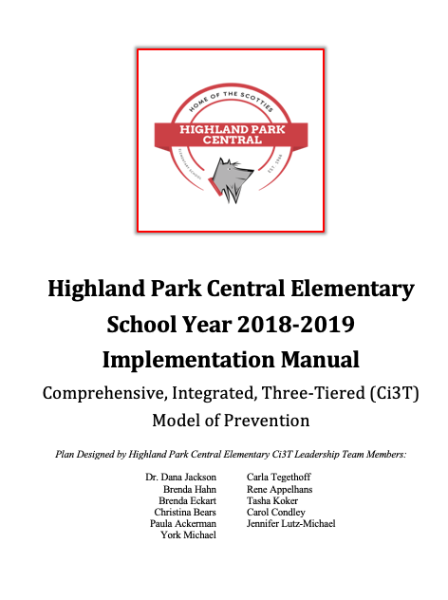
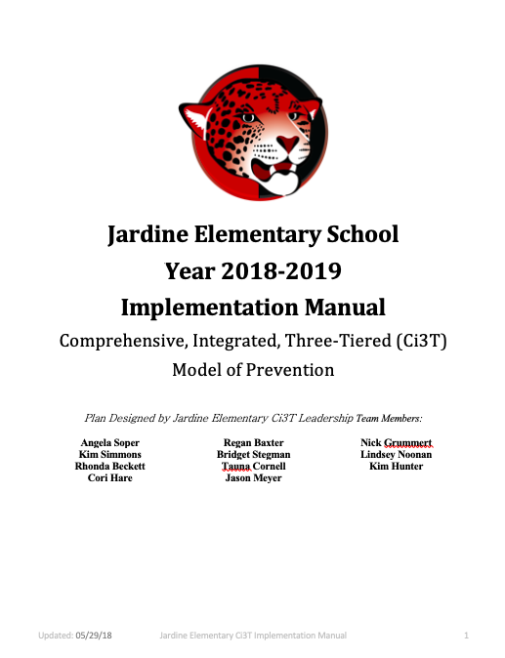
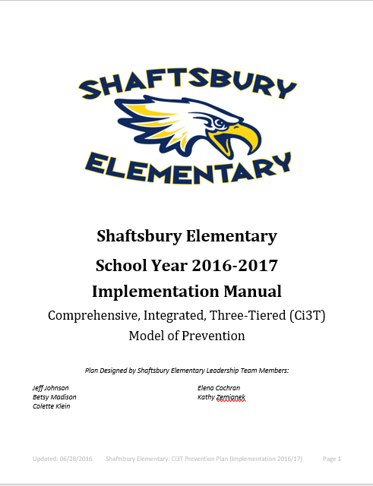
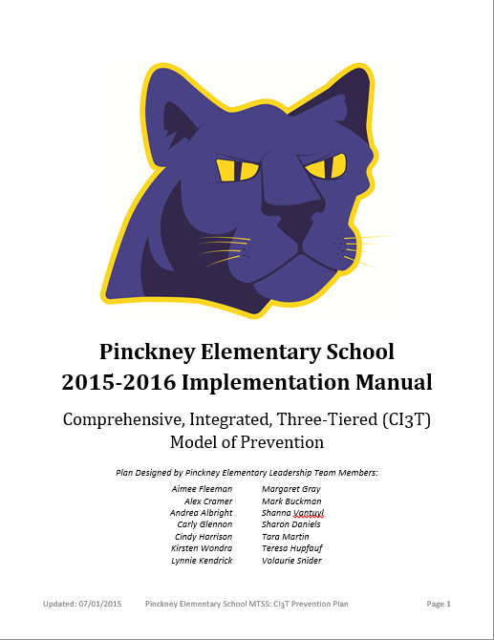
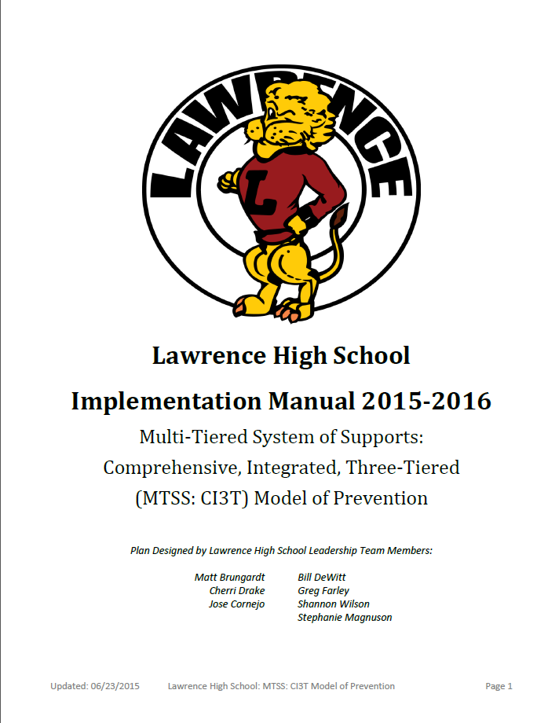
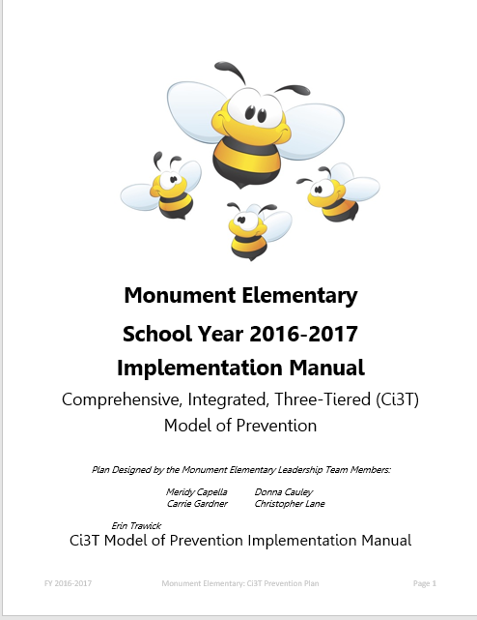
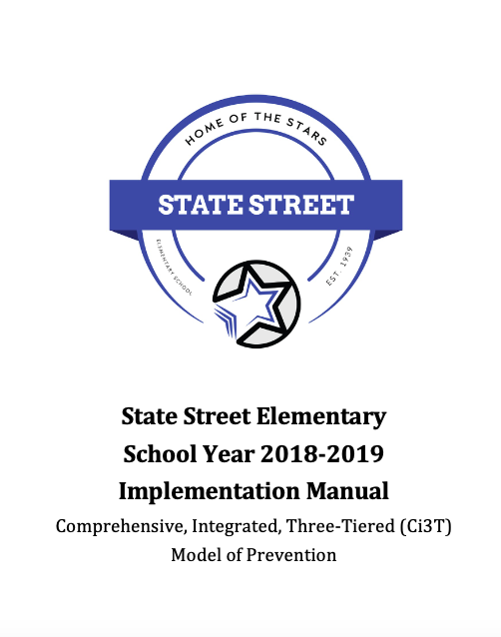
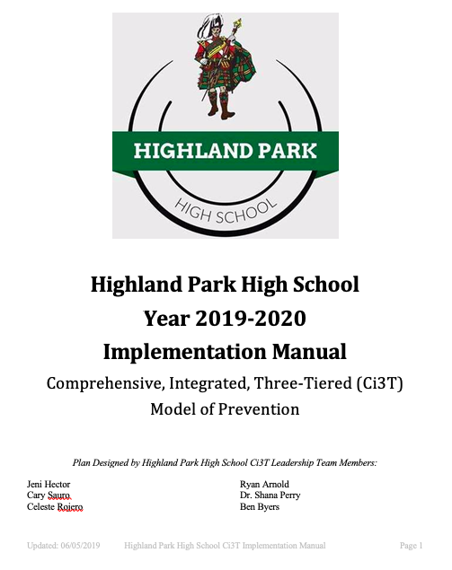

Slide 21
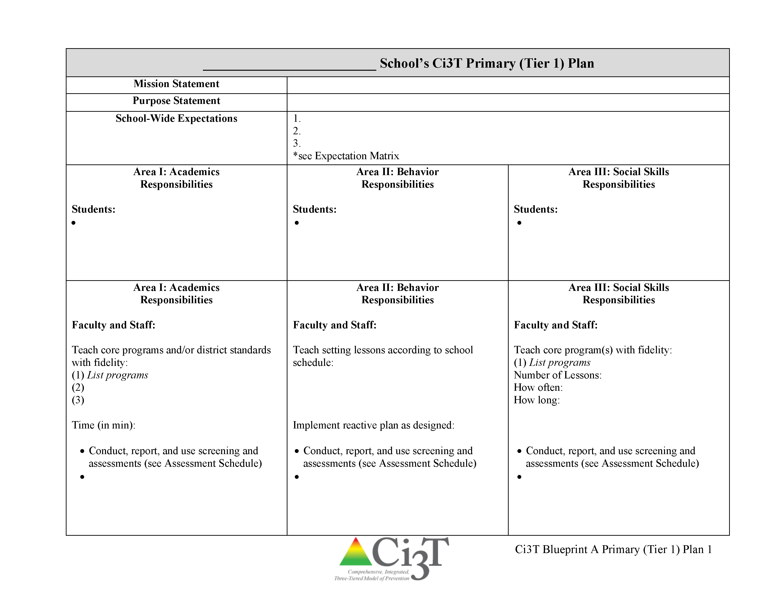
Ci3T Primary Plan: Roles and Responsibilities
all stakeholder groups

Slide 22
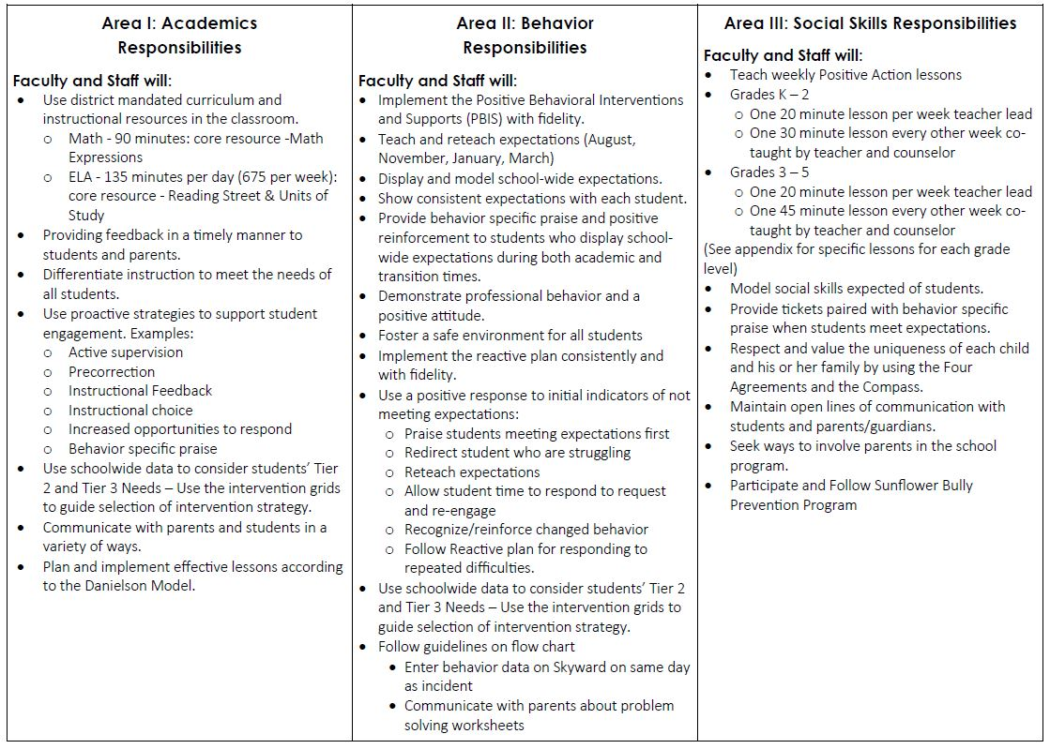
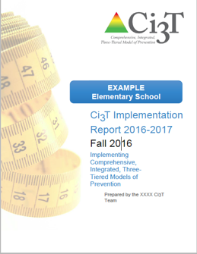
Ci3T Primary Plan: Procedures for Teaching
Ci3T Primary Plan: Procedures for Reinforcing
Ci3T Primary Plan: Procedures for Monitoring

Slide 23

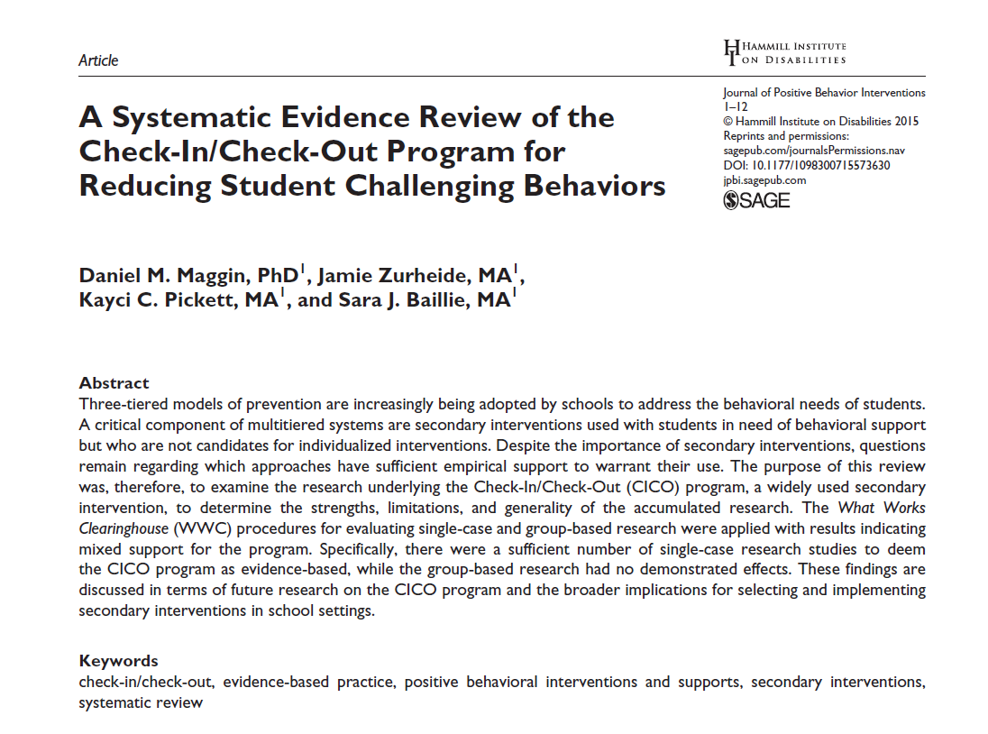



Low-Intensity Strategies
Opportunities to Respond
Behavior Specific Praise
Active Supervision
Instructional Feedback
High p Requests
Precorrection
Incorporating Choice
Self-monitoring
Behavior Contracts
Notes:
Lane, K. L., Oakes, W. P., Ennis, R. P., & Hirsch, S. E. (2014). Identifying students for secondary and tertiary prevention efforts: How do we determine which students have Tier 2 and Tier 3 needs? Preventing School Failure, 58, 171-182, DOI: 10.1080/1045988X.2014.895573

Slide 24
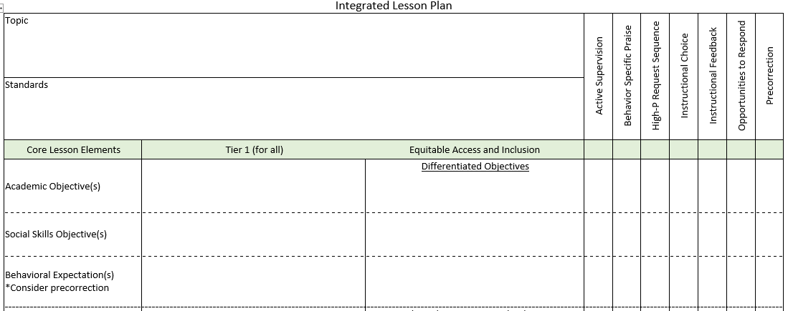
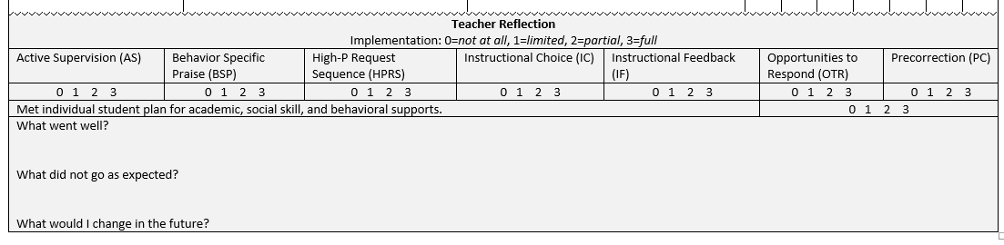
Planning for an integrated approach

Slide 25
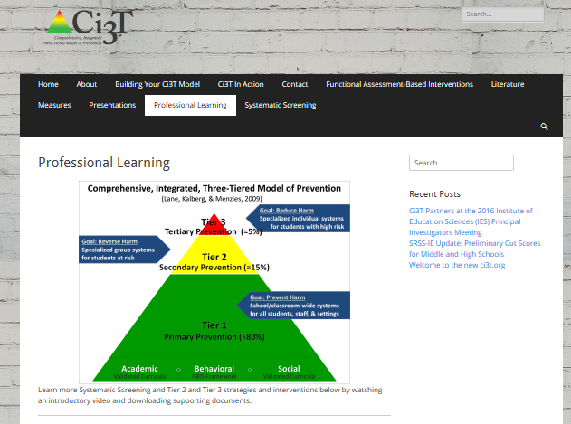
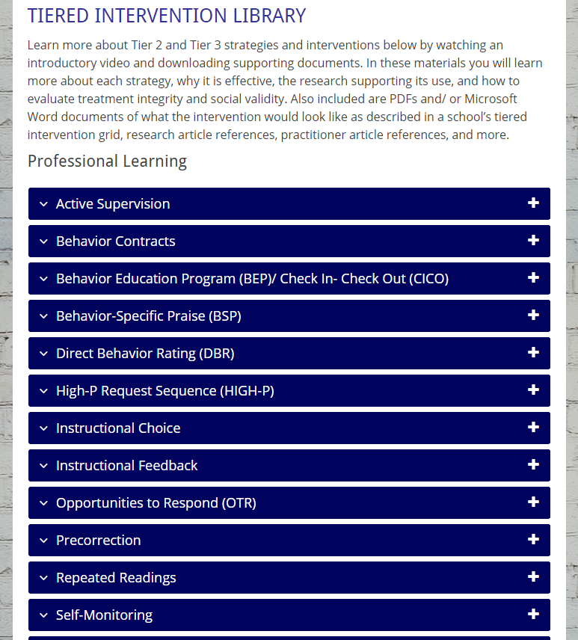
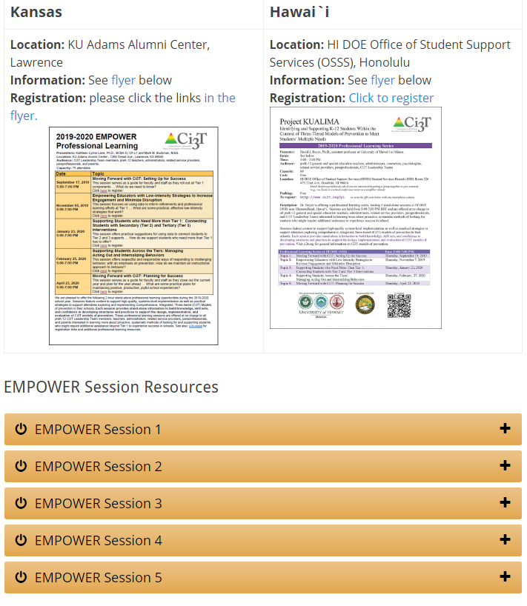
Notes:
Ci3T.org: On-demand Professional Learning Resources

Slide 26
Comprehensive, Integrated, Three-Tiered Model of Prevention
(Lane, Kalberg, & Menzies, 2009)
Tier 3
Tertiary Prevention (≈5%)
Tier 2
Secondary Prevention (≈15%)
Tier 1
Primary Prevention (≈80%)
Academic ◇ Behavioral ◇ Social
Validated Curricula PBIS Framework Validated Curricula

Slide 27

Comprehensive, Integrated, Three-Tiered Model of Prevention
(Lane, Kalberg, & Menzies, 2009)
Tier 3
Tertiary Prevention (≈5%)
Tier 2
Secondary Prevention (≈15%)
Secondary (Tier 2) Intervention Grids
Tier 1
Primary Prevention (≈80%)
Academic ◇ Behavioral ◇ Social
Validated Curricula PBIS Framework Validated Curricula

Slide 28
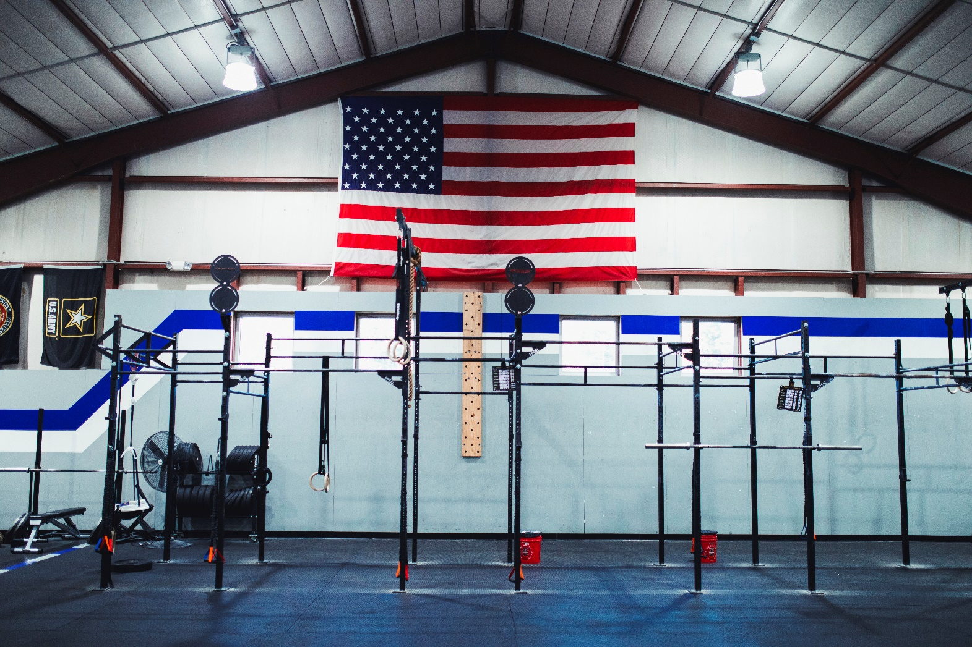
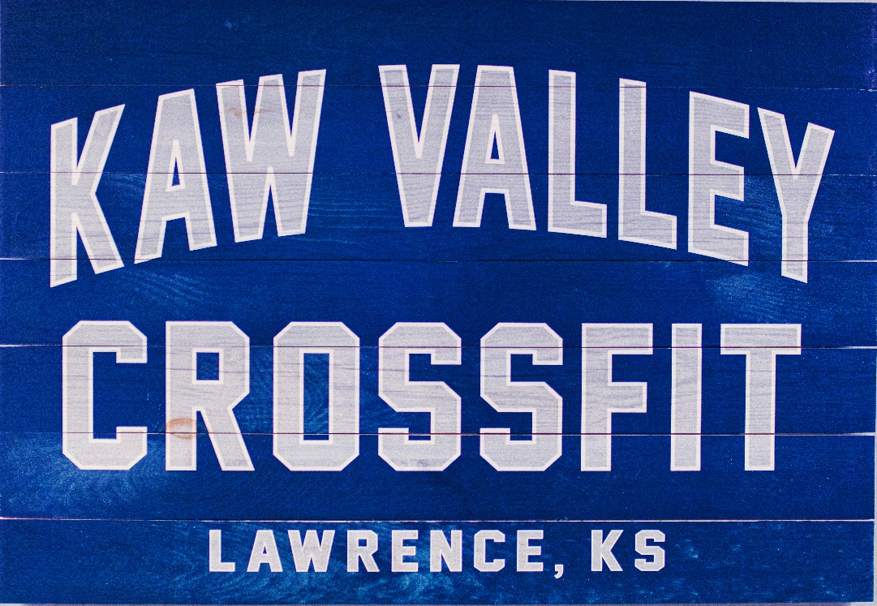

Slide 29
Sample Elementary Intervention Grid
Support | Description | School-wide Data: Entry Criteria | Data to Monitor Progress | Exit Criteria
Direct Behavior Rating (DBR) or Daily Behavior Report Card (DBRC) | DBR is typically completed daily following specified observation period(s) (e.g., math intervention; ELA core instruction). The most appropriate rater is a person who can directly observe the student during the observation period, typically the teacher. DBR is used to monitor specific behaviors identified as relevant for the student and setting. For example, many DBRs monitor academic engagement, respect, and disruption as core school-based behavioral competencies, and may adapt or add a behavior based on the student’s specific needs. After each observation period, the rater uses the provided scale to indicate the degree to which the student displayed each behavior. When used as part of a Tier 2 intervention, the rater reminds the students of the expected behaviors prior beginning the observation. At the conclusion of each observation, the rater uses the provided scale to indicate the degree to which the student displayed each behavior. The rater meets briefly with the student to share the DBR rating, providing behavior specific praise and instructional feedback. Home-school communication procedures may be established (e.g., information is shared with parent/caregiver daily, with return acknowledgement and possible home consequences). | Behavior SRSS-E7 score: Moderate (4-8) and/or SRSS-I5 score: Moderate (2-3) AND Evidence of teacher implementation of Ci3T primary (Tier 1) plan [treatment integrity: direct observation] AND Parent permission, in accordance with district policy | Student measures Direct Behavior Rating (DBR; daily) Social validity Teacher: IRP-15 Student: DBR Student Social Validity form/interview Treatment integrity DBR treatment integrity measure | Student goals met for 10-12 weeks (team review of progress to determine) SRSS-E7 and I5 scores are in the low risk category

Slide 30

Comprehensive, Integrated, Three-Tiered Model of Prevention
(Lane, Kalberg, & Menzies, 2009)
Tier 3
Tertiary Prevention (≈5%)
Tier 2
Secondary Prevention (≈15%)
Tertiary (Tier 3) Intervention Grids
Tier 1
Primary Prevention (≈80%)
Academic ◇ Behavioral ◇ Social
Validated Curricula PBIS Framework Validated Curricula

Slide 31
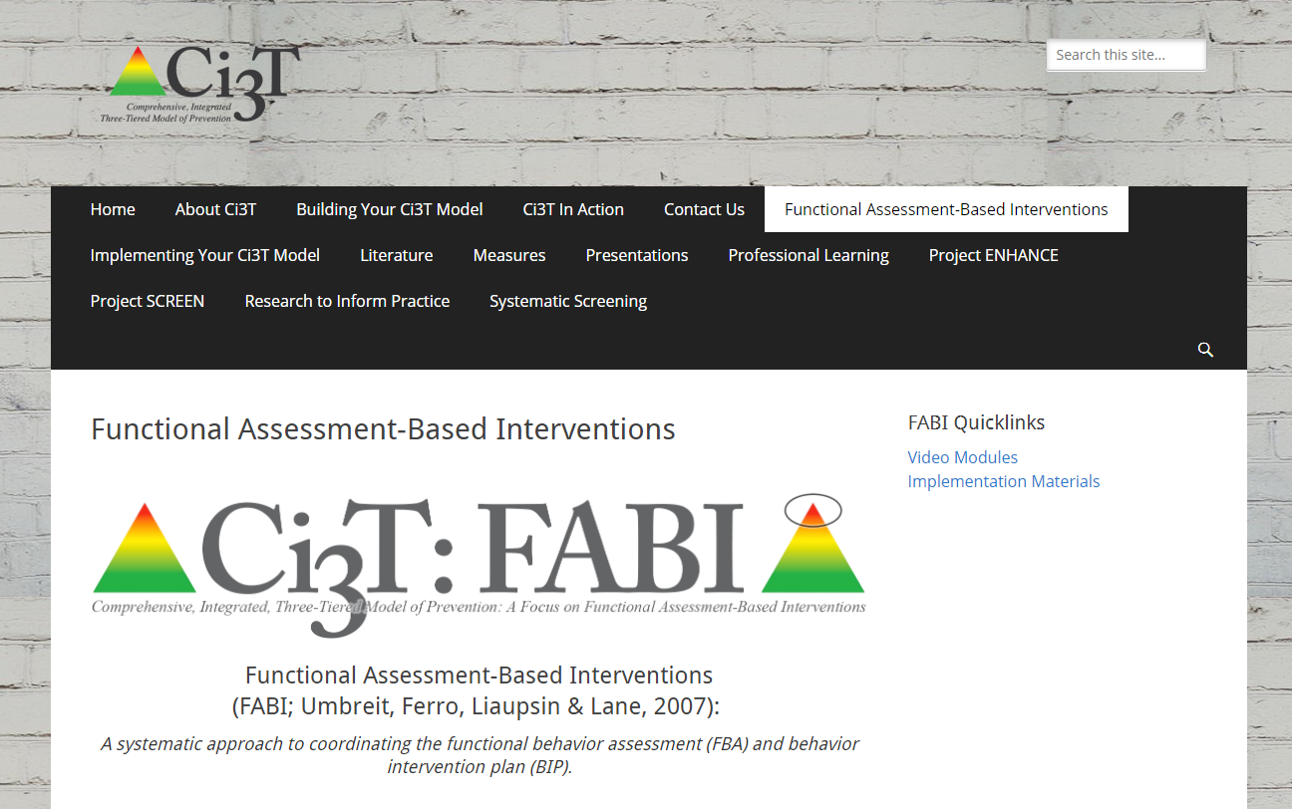
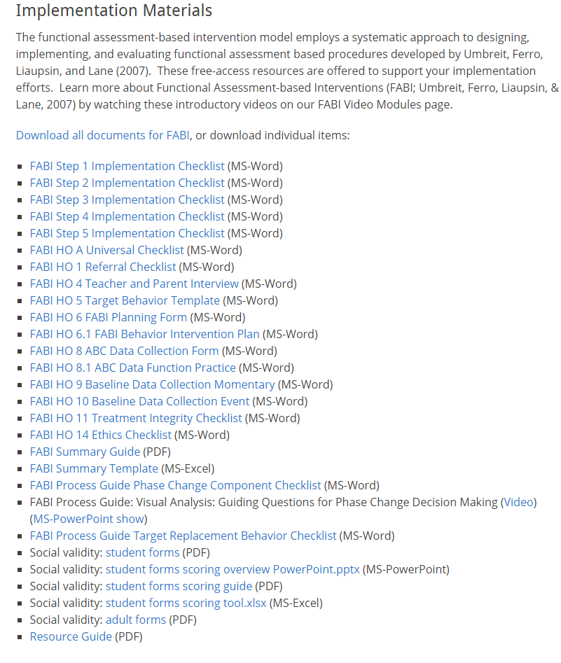
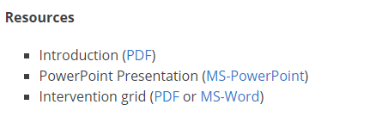
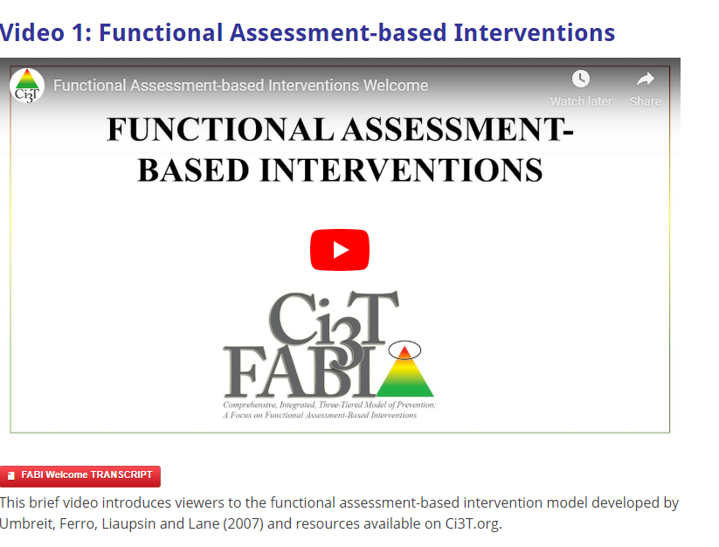

Slide 32
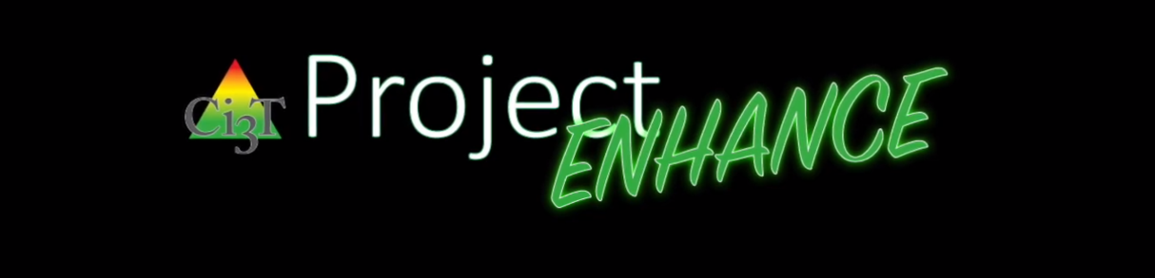
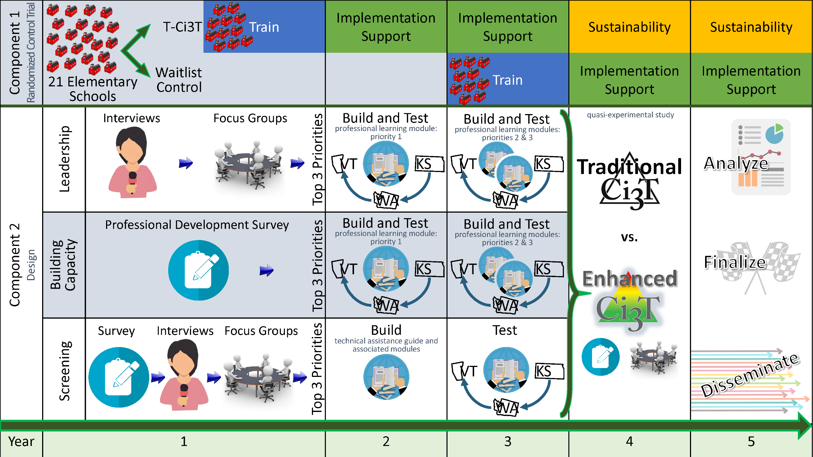

Slide 33
Project ENHANCE Overview

Slide 34
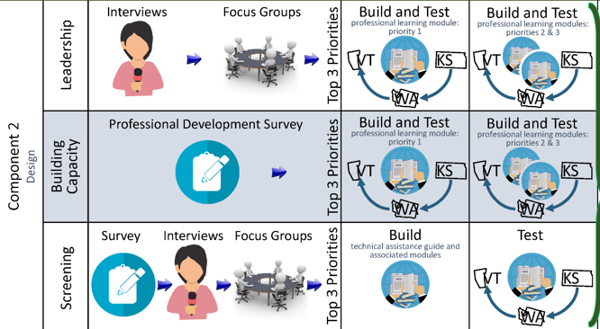
Project ENHANCE Overview

Slide 35
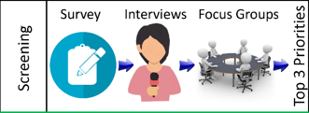
Project ENHANCE Overview

Slide 36
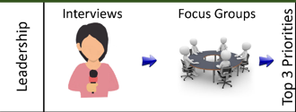
Project ENHANCE Overview

Slide 37
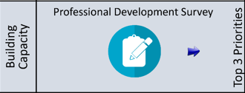
Project ENHANCE Overview

Slide 38
Project ENHANCE Overview

Slide 39
www.ci3t.org

