Slide 1
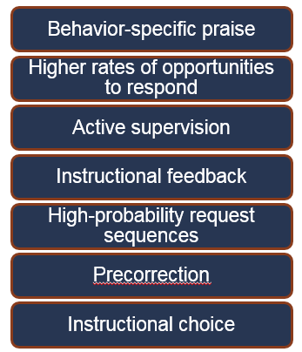


Supporting School Success! Feasible Strategies for Supporting Engagement and Reducing
Challenging Behavior
Kathleen Lynne Lane, Ph.D., BCBA-D, CF-L1
2019 Pennsylvania Positive Behavior
Implementers’ Forum
www.ci3t.org

Slide 3
Working collaboratively to support learning for all students

Slide 4
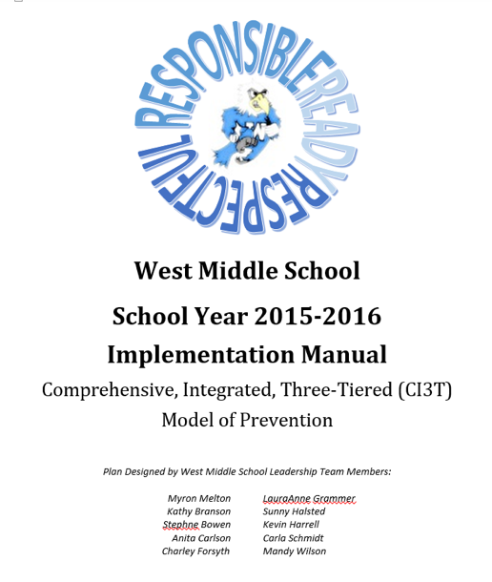
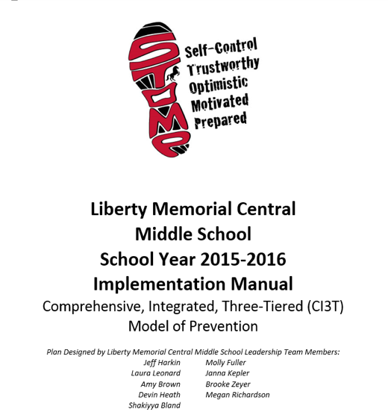
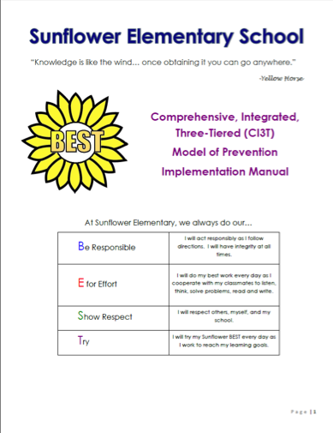

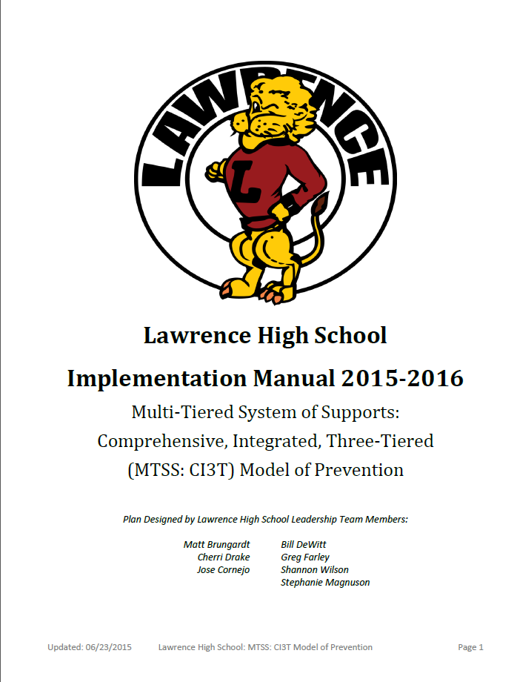





Slide 5
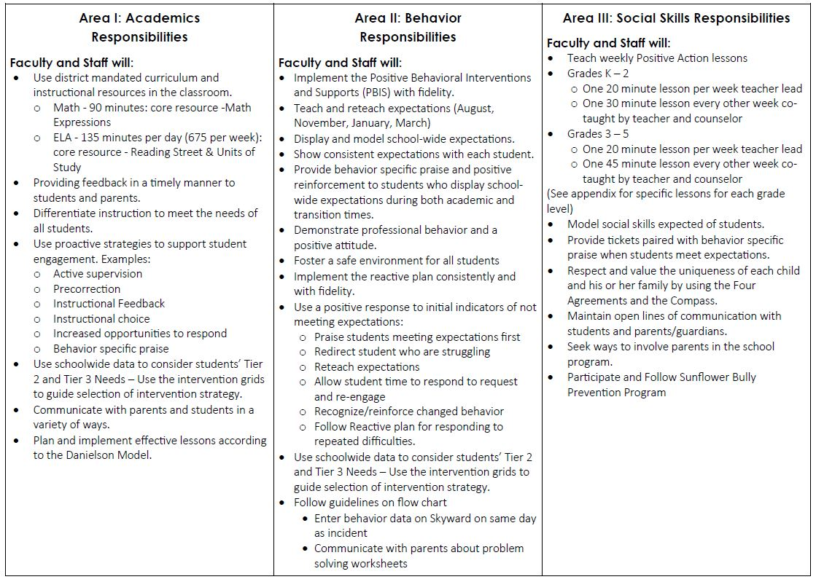
Ci3T Primary (Tier 1) Plan: Procedures for
Teaching
Ci3T Primary (Tier 1) Plan: Procedures for Reinforcing
Ci3T Primary (Tier 1) Plan: Procedures for Monitoring

Slide 6

Secondary (Tier 2) Intervention Grids

Slide 7

Tertiary (Tier 3) Intervention Grids

Slide 8
Transparency and Access
Benefits of Ci3T Models

Slide 9
A Focus on Teacher-Level Strategies

Slide 11
Schoolwide Positive Behavioral
Interventions and Supports
Comprehensive, Integrated,
Three-Tiered (Ci3T)
Models of Prevention
Low-Intensity Strategies
Basic Classroom Management
Effective Instruction
Low-Intensity Strategies
Behavior Contracts
Self-Monitoring
- -
Functional Assessment-Based
Interventions
Higher-Intensity Strategies
Assess, Design, Implement,
and Evaluate
Adapted from Lane, K. L., Menzies, H. M., Bruhn, A. L., & Crnobori, M. (2011). Managing challenging behaviors in schools: Research-based strategies that work. New York, NY: Guilford Press.
Assessment

Slide 12
Low-Intensity Strategies for Academics and Behavior
Opportunities to Respond
Behavior-Specific Praise
Active Supervision
Instructional Feedback
High p Requests
Precorrection
Incorporating Choice
Lane, K. L., Menzies, H. M., Ennis, R. P., & Oakes, W. P. (2015). Supporting behavior for school success: A step-by-step guide to key strategies. New York, NY: Guildford Press.

Slide 13

ci3t.org

Slide 14


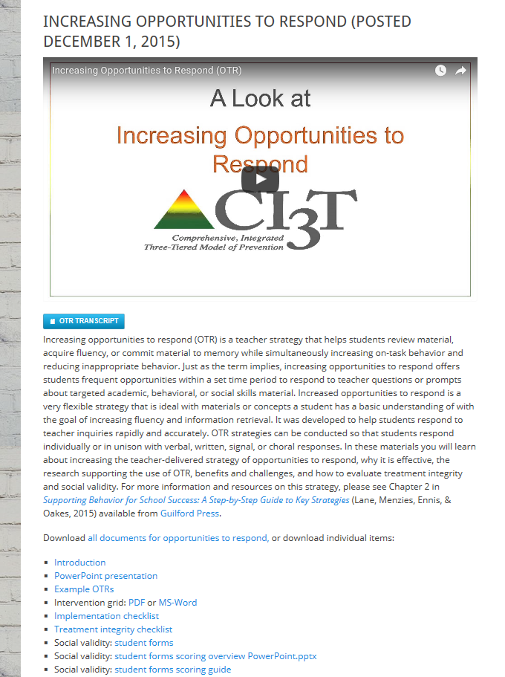
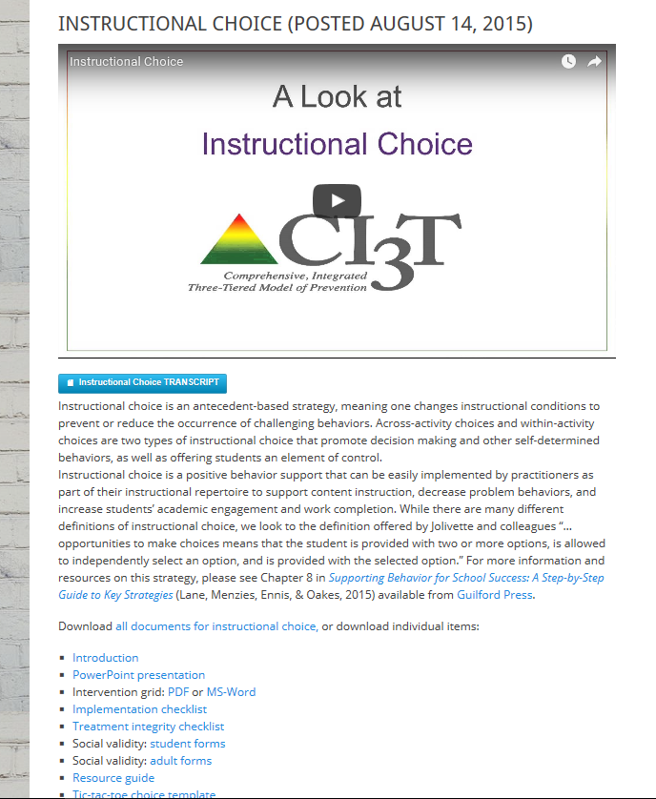
Ci3T.org
ci3t.org
Professional Learning tab

Slide 15
Monitoring Progress
Treatment Integrity
Is it happening?
Social Validity
What do stakeholders think about the goals, procedures, and outcomes?
Experimental Design
How well did this support work for this student?
Notes:
Lane, K. L., Oakes, W. P., Ennis, R. P., & Hirsch, S. E. (2014). Identifying students for secondary and tertiary prevention efforts: How do we determine which students have Tier 2 and Tier 3 needs? Preventing School Failure, 58, 171-182, DOI: 10.1080/1045988X.2014.895573

Slide 16

Building Your Toolbox
Instructional choice
Opportunities to respond
Precorrection

Slide 17













Explore “Professional Learning” on ci3t.org.
Download Instructional Choice
Opportunities to Respond
Precorrection
Notes:
10 minute timer

Slide 18
Low Intensity Strategies:
A Look at Instructional Choice

Slide 19


Agenda
Comprehensive, Integrated, Three-Tiered (CI3T) Models of Prevention
A Look at Instructional Choice
  What is instructional choice?
  Why is instructional choice effective?
  What does the supporting research for instructional choice say?
  What are the benefits and challenges?
  How do I implement instructional choice in my classroom?
Implementation Checklist
  How well is it working? Examining the Effects

Slide 20
Comprehensive, Integrated, Three-Tiered Model of Prevention (Lane, Kalberg, & Menzies, 2009)
Goal: Reduce Harm
Specialized Individual Systems
for Students with High-Risk
≈5%
Tertiary Prevention (Tier 3)
Goal: Reverse Harm
Specialized Group Systems
for Students At-Risk
≈15%
Secondary Prevention (Tier 2)
Goal: Prevent Harm
School/Classroom-Wide Systems for All Students, Staff, & Settings
PBIS Framework
≈80%
Validated Curricula
Primary Prevention (Tier 1)
Academic Behavioral Social
Notes:
Lane, K. L., Oakes, W. P., Ennis, R. P., & Hirsch, S. E. (2014). Identifying students for secondary and tertiary prevention efforts: How do we determine which students have Tier 2 and Tier 3 needs? Preventing School Failure, 58, 171-182, DOI: 10.1080/1045988X.2014.895573

Slide 21
Schoolwide Positive Behavior
Support
Comprehensive, Integrative,
Three-tiered (CI3T)
Models of Support
Low Intensity Strategies
Basic Classroom Management
Effective Instruction
Low Intensity Strategies
Behavior Contracts
Self-Monitoring
- -
Functional Assessment-Based
Interventions
Higher Intensity Strategies
Assess, Design, Implement, and
Evaluate
Assessment

Slide 22


What is instructional choice?
Instructional Choice
  “…opportunities to make choices means that the student is provided with two or more options, is allowed to independently select an option, and is provided with the selected option" (Jolivette, Stichter, & McCormick, 2002, p. 28).
  Types of instructional choices (Rispoli et al., 2013)
  Across-activity choices
  Within-activity choices

Slide 23
Examples of instructional choice
Across-activities Choices
Within-activity Choices
Paper, presentation, or YouTube video to show me what you know?
Which activity would you like to do first?
Pick a learning center?
Make your schedule for the day.
Think-Tac-Toe Boards
Crayons or sparkly markers?
At your desk or in the library?
In the reading corner or at your desk?
Work independently or with a partner?
Which book would you like to read?
Finish in class or at home?
Typed or handwritten?
Even or odds?

Slide 24



Why is instructional choice effective?
Easy
Little time
Offers students control
Promotes decision making and other self-determined behaviors

Slide 25

What does the supporting research for instructional choice say?
Increasing Engagement and Decreasing Disruption in Elementary Self-Contained Classrooms (Dunlap et al., 1994)
Increasing Time On-Task, Task Completion, and Accuracy in Residential Facilities (Ramsey, Jolivette, Patterson,& Kennedy, 2010)
Increasing Task Engagement and Improving Academic Performance in an Inclusive Setting (Skerbetz & Kostweicz, 2013)

Slide 26

Supporting Research
See “Instructional Choice Resource Guide” for additional supporting research and information.

Slide 27
What are the benefits & challenges?
Benefits
Challenges
feasible, does not require excessive preparation, is easy to implement, and supports content instruction (Kern & State, 2008; Morgan, 2006; Ramsey et al., 2010).
teaches self-determined behaviors
challenges in preparing independent tasks for the time provided
important to think about procedures for collecting and evaluating different types of assignments

Slide 28

How do I implement instructional choice in my classroom?
Implementation Checklist
!
Step 1
Determine which type of choices you feel comfortable offering and create a menu of choices.
Step 2
Use the menu to determine which type of choice to add to a particular lesson.
Step 3
After choice is built into the lesson, offer the established choices.
Step 4
Ask the student to make his or her choice.

Slide 29
How do I implement instructional choice in my classroom?
Implementation Checklist
Step 5
Provide wait time for the student to select their choice.
Step 6
Listen to (or observe) the student’s response
Step 7
Prompt the student to make a choice from one of the available options if the student has not made a choice within the time allotted.
Step 8
Reinforce the student’s choice, providing them with the option they selected.

Slide 30
How do I implement instructional choice in my classroom?
Implementation Checklist
Step 9
Offer students an opportunity to give feedback on the choice they selected.

Slide 31

How do I implement instructional choice in my classroom?
Step 1: Determine which type of choices you would feel comfortable offering to students in your classroom and create a menu of choices.
  Consider within activity or across activity choices.
Step 2: Use the menu to determine which type of choices to add to a particular lesson.
Step 3: After choice is built into the lesson, offer the established choices
Step 4: Ask the student to make his or her choice.
See “Instructional Choice Implementation Checklist”

Slide 32
How do I implement instructional choice in my classroom?
Step 5: Provide wait time for the student to select their choice.
Step 6: Listen to (or observe) the student’s response.
Step 7: Prompt the student to make a choice from one of the available options if the student has not made a choice within the time allotted.
Step 8: Reinforce the student’s choice, providing them with the option they selected.
Step 9: Offer students an opportunity to give feedback on the choice they selected.

Slide 33
How well is it working?
Examining the Effects
Treatment Integrity
Is it happening?
Social Validity
What do stakeholders think about the goals, procedures, and outcomes?
Experimental Design
How well did this support work for this student?

Slide 34
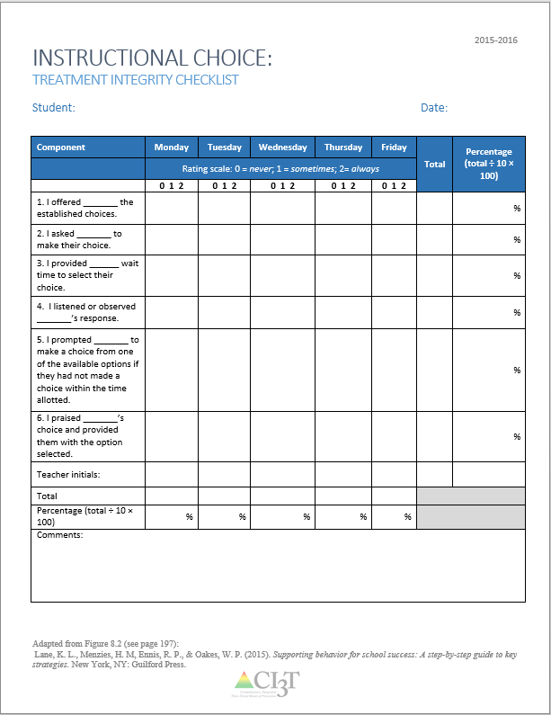
Making Certain the Strategy is in Place: Treatment Integrity
Have structures in place to monitor whether instructional choice is carried out as intended:
Treatment integrity checklist
  Example items:
    I offered _______ the established choices.
    I asked _______ to make their choice.
    I provided ______ wait time to select their choice.
    I listened or observed _______’s response.
    I prompted _______ to make a choice from one of the available options if they had not made a choice within the time allotted.
    I praised _______’s choice and provided them with the option selected.
See “Instructional Choice Treatment Integrity Checklist”

Slide 35
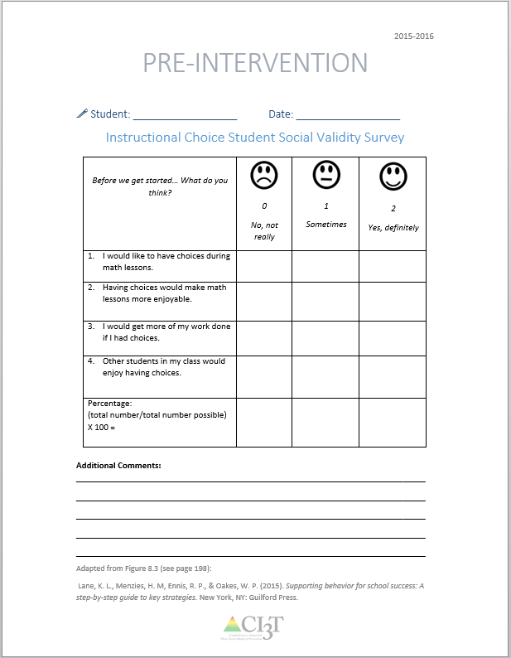
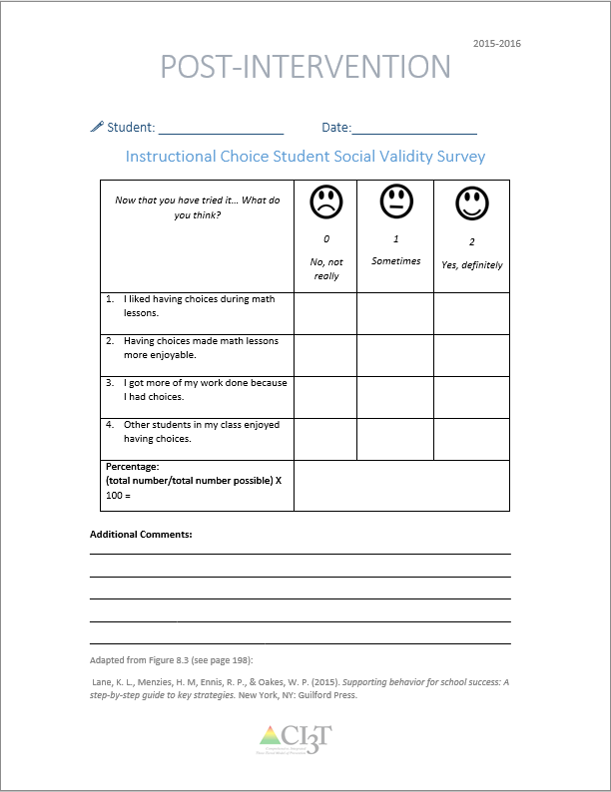
What does the student think about it?
See “Instructional Choice Social Validity Student”
Completed by the student participating in the intervention at two time points: Pre and Post Intervention

Slide 36
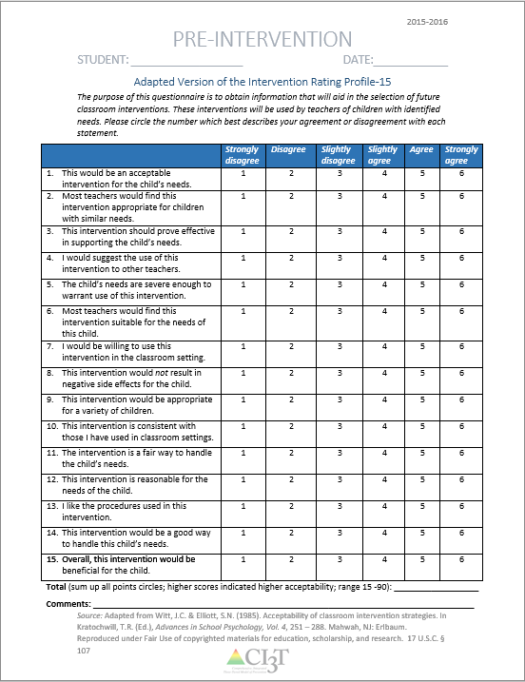
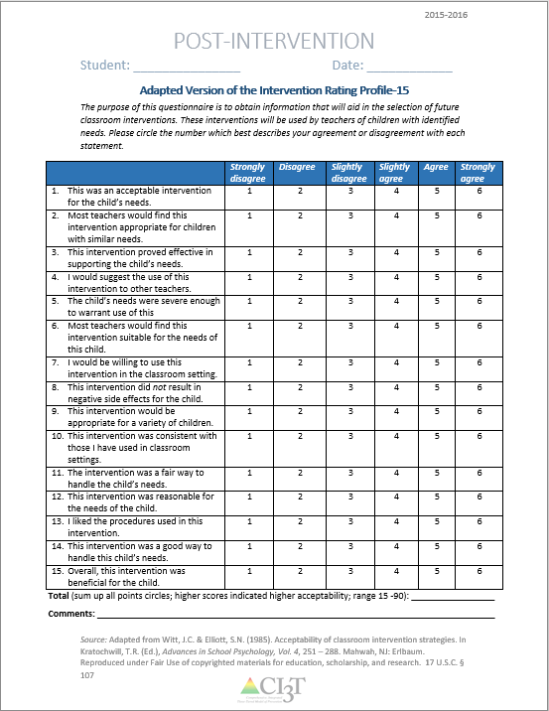
What does the teacher think about it?
See “Social Validity Adapted-IRP15 Adult”
Completed by the teacher and/or parent participating in the intervention at two time points: Pre and post intervention

Slide 37
Sample Primary Intervention Grid
Support | Description | Schoolwide Data: Entry Criteria | Data to Monitor Progress | Exit Criteria
Instructional Choice | Within- and across-task choices offered during instruction (e.g., language arts assignments, math lessons, etc.) | One or more of the following: Behavior: SRSS-E7 Score: Moderate (4-8) SRSS-I5 Score: Moderate (2-3) ___ AND ___ OR Academic: □ Progress Reports; Successful Learning Behaviors - Targeted for growth □ Gradebook: 2+ incomplete assignments | Student Performance Academic engaged time Percentage of work completed Treatment Integrity Implementation & TI checklist Social Validity Student & teacher pre/post survey | Progress Reports: Five consecutive weeks of daily academic engagement 80% or better and work completion at 90% or better.
(Lane, Menzies, Ennis, & Oakes, 2015)

Slide 38
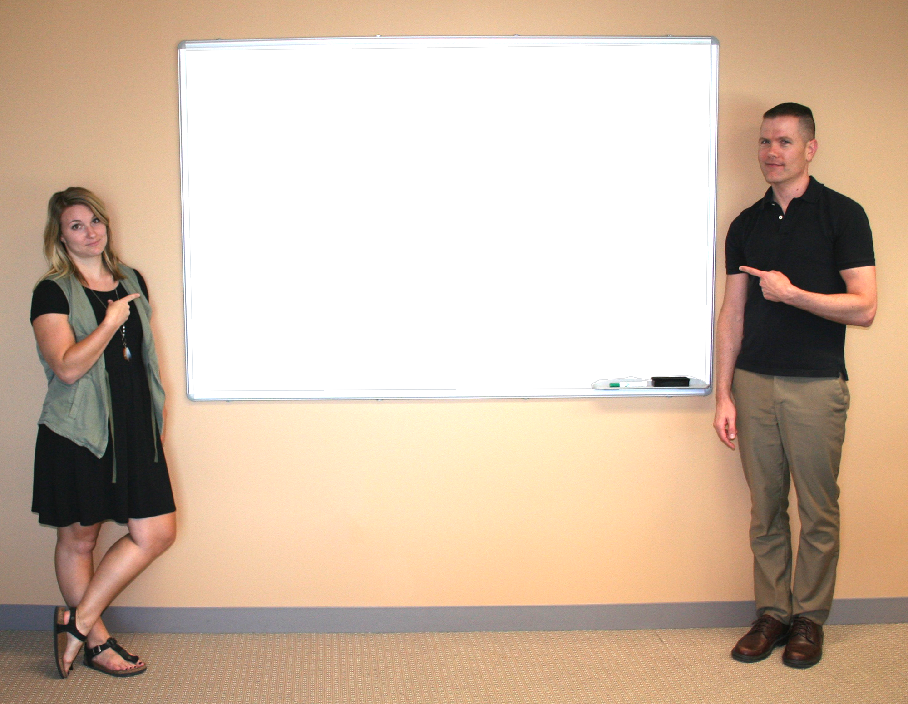


Work with a neighbor to review the Instructional Choice Checklist for Success from ci3t.org.
Step 1: Determine which type of choices you would feel comfortable offering to students in your classroom and create a menu of choices. Consider within-activity and across-activity choices.
Step 2: Use the menu to determine which type of choices to add to a particular lesson.
Notes:
10-min timer

Slide 39
Low-Intensity Strategies:
Using Opportunities to Respond to Support Instruction

Slide 40



Low-Intensity Strategies for Academics and Behavior
Opportunities to Respond
Behavior Specific Praise
Active Supervision
Instructional Feedback
High p Requests
Precorrection
Incorporating Choice
Self-monitoring
Behavior Contracts
Notes:
Lane, K. L., Oakes, W. P., Ennis, R. P., & Hirsch, S. E. (2014). Identifying students for secondary and tertiary prevention efforts: How do we determine which students have Tier 2 and Tier 3 needs? Preventing School Failure, 58, 171-182, DOI: 10.1080/1045988X.2014.895573

Slide 41


Agenda
Introduction:
  What is OTR?
  Why is OTR effective?
  What does the supporting research for OTR say?
  What are the benefits and challenges?
  How do I OTR in my classroom?
  Implementation Checklist
  How well is it working? Examining the Effects

Slide 42
What is OTR?
Opportunities to respond (OTR) is a strategy for students to:
review material, acquire skill fluency,
commit information to memory, and
increase on-task behavior and reduce misbehavior.
Allows for frequent opportunities, within a set time period, to respond to teacher questions or prompts about targeted academic materials.
Best used when material or concepts have been taught… promotes student engagement as they practice the information or skill.
Students respond individually or in unison (choral)
(Lane, Menzies, Ennis, & Oakes, 2015)

Slide 43
What is OTR? (cont.)
Verbal Responding
Non-Verbal Responding
Choral Response (Haydon et al., 2009)
  Every student answers question/prompt
Questioning
  Think, Pair, Share
  Partners
Signal
  Thumbs up/down
Response Card
  Agree/Disagree, A/B/C/D, True/False
Individual white boards
Guided Notes
Student Response Systems (Clickers; Blood & Gulchak, 2013)

Slide 44
Example
Illustration: Activities to demonstrate knowledge using white boards:
Cue: “Class, please solve for the product of 28 X 4.”
Wait: After 10 seconds: “Hold up your whiteboards.”
Prompt “What is the answer?”
Feedback: “I see almost all of you found the correct answer
is 112. Nice work!”
Next Question: “This is individual, solve for the product
of 32 X 3.”

Slide 45
Why is OTR effective?
Whole-group OTR allows teacher to quickly determine:
  students’ proficiency with the material,
  if more practice is needed, and
  which students may require more intensive supports.
Promotes fluency and automaticity, freeing students to tackle more complex concepts.
Increases active participation, even during whole-group delivery.
Feedback is rapid and matter-of-fact, which reduces the pressure of answering correctly. “Correct” or “That is not correct, the answer is X” (Haydon et al., 2010)
(Lane, Menzies, Ennis, & Oakes, 2015)

Slide 46
What does the supporting research for OTR say?
Effectiveness demonstrated from preschool (Godfrey et al., 2003) to middle school (Haydon & Hunter, 2011).
Increasing participation in elementary and secondary classrooms (Haydon & Hunter, 2011; Maheady et al., 2002; Narayan et al., 1990; Wood et al., 2009).
Decreasing disruptive behavior in elementary classrooms (Haydon et al., 2010; Haydon et al., 2009).
Improving academic outcomes for students with emotional and behavioral disorders (Sutherland et al., 2003).
(Lane, Menzies, Ennis, & Oakes, 2015)

Slide 47
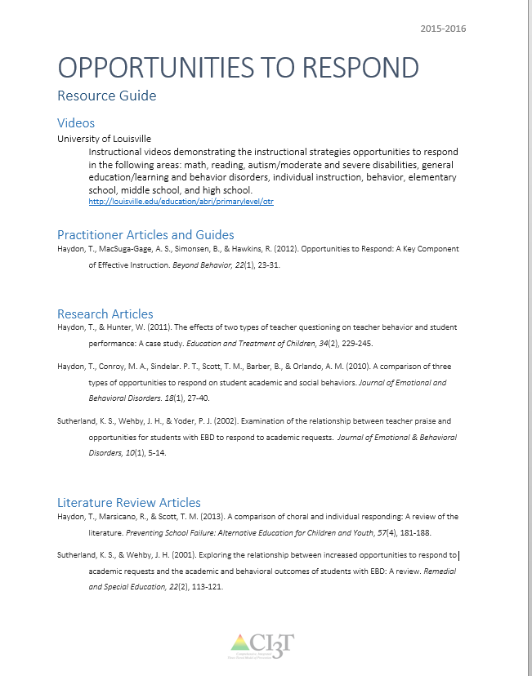
Supporting Research
See “OTR Resource Guide” for additional supporting research and information.

Slide 48
What are the benefits and challenges
Benefits
Challenges
Instructional format that is efficient and engaging
Facilitates participation of all students
Review of material or concepts in promoting fluency and engagement
Supports teachers in reaching levels of engagement for effective instruction – 75-80% academic engaged time
Requires relatively little preparation and can be used for a variety of lessons across all grade levels
Teacher’s adjustment to the rapid pacing
Preparation of sufficient number or prompts or questions as part of lesson planning
Monitoring student performance and adjusting level of difficulty for successful practice
(Kounin, 1970; Lane, Menzies, Ennis, & Oakes, 2015; Sutherland & Wright, 2013; Walker & Severson, 1992)

Slide 49
How do I implement OTR in my classroom?
Step 1
Identify the lesson content to be taught and the instructional objective.
Step 2
Prepare a list of questions, prompts, or cues related to the content.
Step 3
Determine the modality by which content will be delivered.
Step 4
Determine the modality by which students will respond.

Slide 50
How do I implement OTR in my classroom?
Step 5
Explain to students how the format works and the rationale for using it.
Step 6
Conduct the lesson with a minimum of three opportunities to respond per minute using either single-student or unison responding.
Step 7
Respond to student answers with evaluative and encouraging feedback.
Step 8
Offer students an opportunity to give feedback.

Slide 51
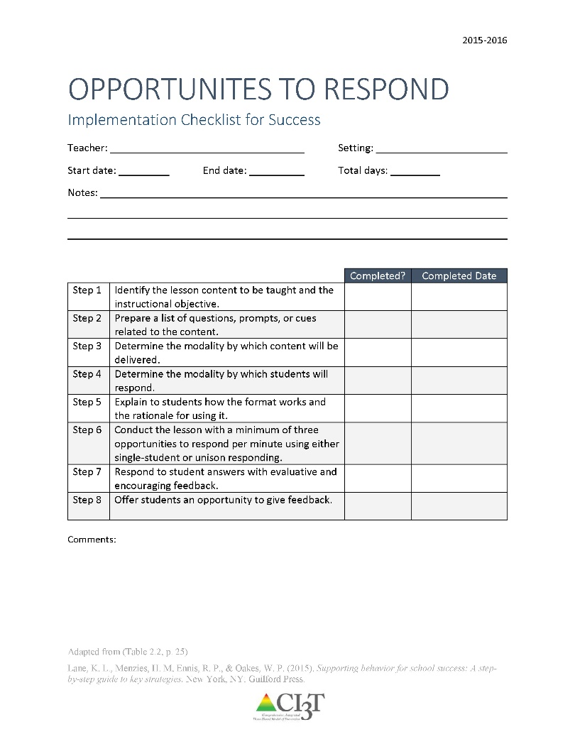
How do I increase OTR in my classroom? Checklist for Success
Step 1: Identify the lesson content to be taught and the instructional objective.
Step 2: Prepare a list of questions, prompts, or cues related to the content.
Step 3: Determine the modality by which content will be delivered.
Step 4: Determine the modality by which students will respond.
Step 5: Explain to students how the format works and the rationale for using it.
Step 6: Conduct the lesson with a minimum of three opportunities to respond per minute using either single-student or unison responding.
Step 7: Respond to student answers with evaluative and encouraging feedback.
Step 8: Offer students an opportunity to give feedback.
See “OTR Implementation Checklist for Success”

Slide 52
How well is it working?
Examining the Effects
Treatment Integrity
Is it happening?
Social Validity
What do stakeholders think about the goals, procedures, and outcomes?
Experimental Design
How well did this support work for this student?

Slide 53
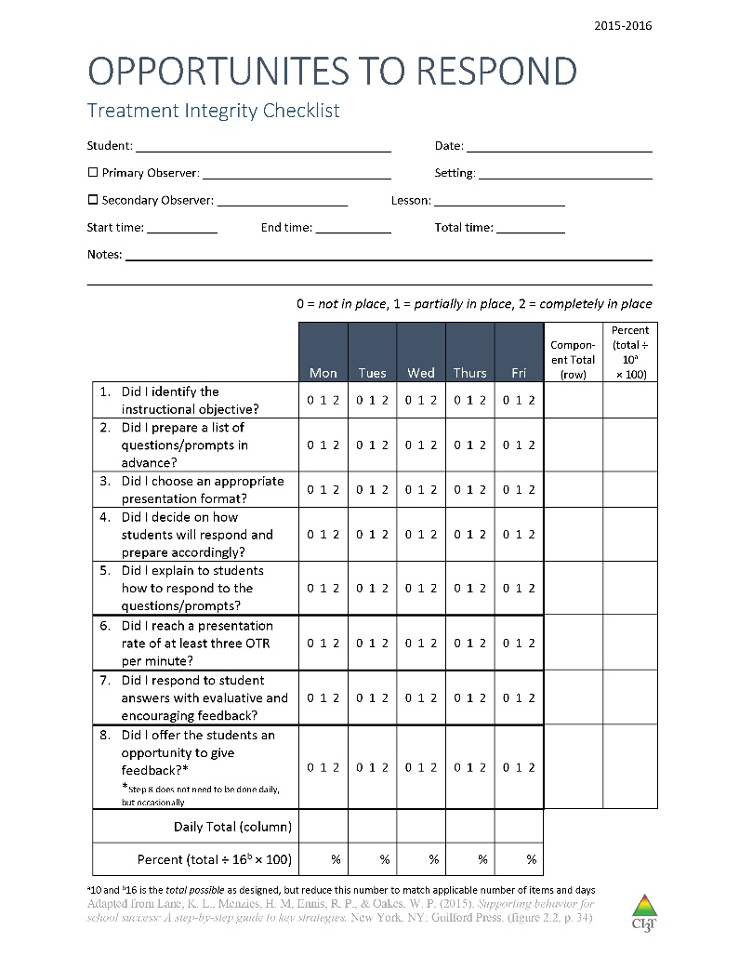
Ensuring the Strategy is in Place: Treatment Integrity
Treatment integrity checklist items:
Did I identify the instructional objective?
Did I prepare a list of questions/prompts in advance?
Did I choose an appropriate presentation format?
Did I decide on how students will respond and prepare accordingly?
Did I explain to students how to respond to the questions/prompts?
Did I reach a presentation rate of at least three OTR per minute?
Did I respond to student answers with evaluative and encouraging feedback?
Did I offer the students an opportunity to give feedback?
See “OTR Treatment Integrity Checklist”

Slide 54
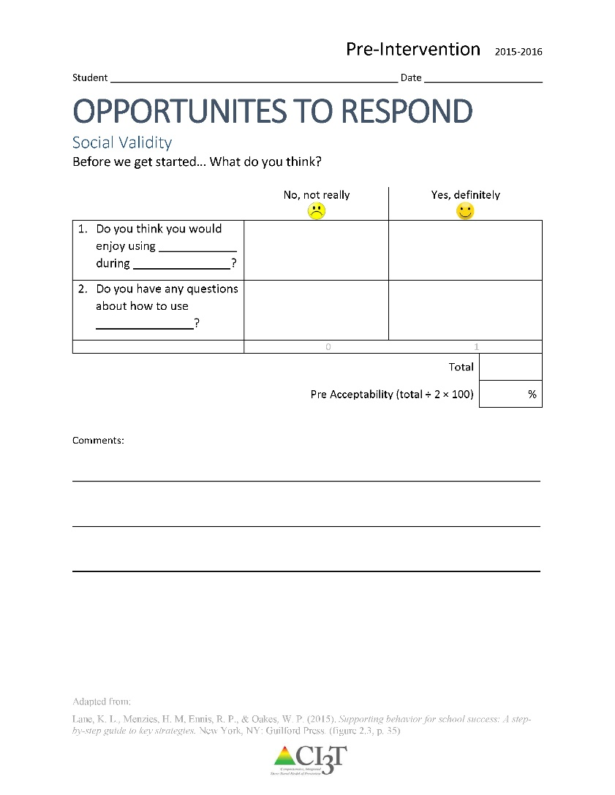
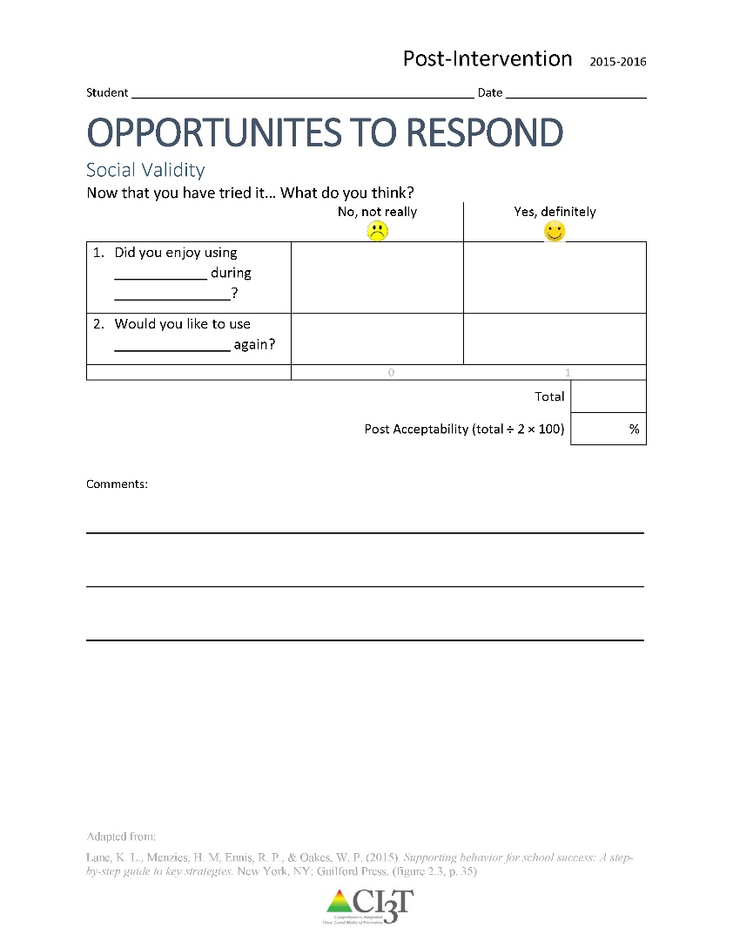
Social Validity: What does the student think about it?
See “OTR SV STUDENT”
for Pre and Post
Completed by the student(s) participating in the intervention at two time points:
Pre and Post Intervention

Slide 55
Social Validity: What does the teacher think about it?
See “Social Validity Adapted-IRP15 Adult”
for Pre and Post
Completed by the teacher and/or parent participating in the intervention at two time points: pre and post intervention

Slide 56
Sample Elementary Intervention Grid
Support | Description | School-wide Data: Entry Criteria | Data to Monitor Progress | Exit Criteria
Opportunities to respond | Increasing students’ opportunities to respond (OTR) is a strategy that helps students review material, acquire skill fluency, and commit information to memory while simultaneously increasing on-task behavior and reducing misbehavior. OTR strategy is designed to offer students frequent opportunities (i.e., 3 or more OTR per min) using either single-student (e.g., hand raising) or unison responding (e.g., choral responding), within a set time period (e.g., 10 min.) to respond to teacher questions or prompts about targeted academic material. This is best done with materials or concepts in which students have a basic understanding. | One or more of the following: Behavior: SRSS-E7: Moderate (4-8) SRSS-I5: Moderate (2-3) SRSS-E7: High (9-21) SRSS-I5: High (4-15) SSiS-PSG Ranking of 1, 2, or 3 on the Motivation to Learn Office discipline referrals (ODRs) 2 or more within a grading period AND/OR Academic: Missing Assignments 2 of more within a grading period Progress report: Passing (K-3 Progressing or higher; 4-5 C or higher) in subject area targeted | Student behavior targeted for improvement (e.g., academic engaged time, on-task, disruption; % of intervals) or weekly progress monitoring (e.g., weekly quiz score) Treatment integrity Implementation checklist Treatment integrity checklist Social validity IRP-15 (teacher) CIRP or OTR Social Validity Form(student) | ODRs 0-1 in a grading period and No missing assignments in a grading period and SRSS-E7: Low (0-3) SRSS-I5: Low (0-1) or SSiS-PSG Ranking of 4 or 5 on the Motivation to Learn subscale

Slide 57
Sample Middle/ High Intervention Grid
Support | Description | School-wide Data: Entry Criteria | Data to Monitor Progress | Exit Criteria
Opportunities to respond | Increasing students’ opportunities to respond (OTR) is a strategy that helps students review material, acquire skill fluency, and commit information to memory while simultaneously increasing on-task behavior and reducing misbehavior. OTR strategy is designed to offer students frequent opportunities (i.e., 3 or more OTR per min) using either single-student (e.g., hand raising) or unison responding (e.g., choral responding), within a set time period (e.g., 10 min.) to respond to teacher questions or prompts about targeted academic material. This is best done with materials or concepts in which students have a basic understanding. | One or more of the following: Behavior: SRSS - E7: Moderate (4-8) SRSS - E7: High (9-21) SSiS – PSG Ranking of 1, 2, or 3 on the Motivation to Learn subscale Office discipline referrals (ODRs) 2 or more within a grading period AND/OR Academic: Missing Assignments: 2 or more within a grading period in a class AIMSweb: intensive or strategic level (math or reading) GPA Below 2.5 Progress report: C or higher in subject area targeted | Student behavior targeted for improvement (e.g., academic engaged time, on-task, disruption; % of intervals) or weekly progress monitoring (e.g., weekly quiz score) Treatment integrity Implementation checklist Treatment integrity checklist Social validity IRP-15 (teacher) CIRP or OTR Social Validity Form (student) | ODRs 0-1 in a grading period and GPA 2.5 or higher No missing assignments the target class in a grading period and SRSS - E7: Low (0-3) or SSiS-PSG Ranking of 4 or 5 on the Motivation to Learn subscale

Slide 58
Work with a neighbor to review the OTR Checklist for Success from ci3t.org.
Notes:
10-min timer

Slide 59
Low Intensity Strategies:
A Look at Precorrection

Slide 60
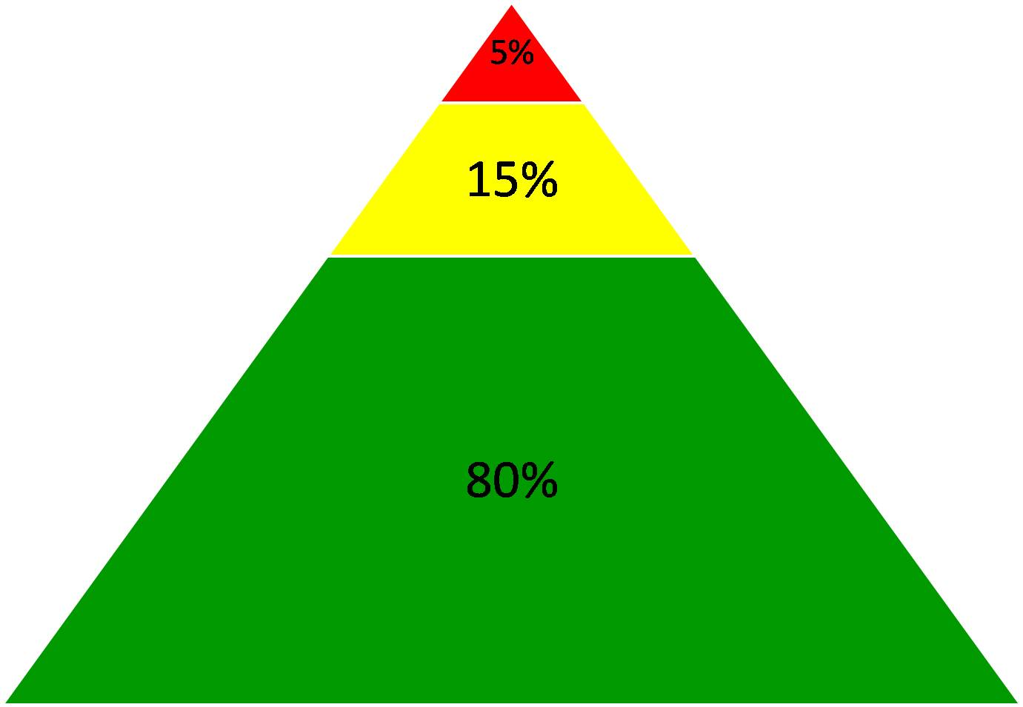
Comprehensive, Integrated, Three-Tiered Model of Prevention
Goal: Reduce Harm
Specialized individual systems for students with high-risk
(Lane, Kalberg, & Menzies, 2009)
≈5%
Tertiary Prevention (Tier 3)
Goal: Reverse Harm
Specialized group systems
for students at-risk
≈15%
Secondary Prevention (Tier 2)
Goal: Prevent Harm
School/classroom-wide systems for all students, staff, & settings
PBIS Framework
≈80%
Validated Curricula
Primary Prevention (Tier 1)
Academic Behavioral Social

Slide 61
Schoolwide Positive Behavior
Support
Comprehensive, Integrative,
Three-tiered (CI3T)
Models of Support
Low Intensity Strategies
Basic Classroom Management
Effective Instruction
Low Intensity Strategies
Behavior Contracts
Self-Monitoring
- -
Functional Assessment-Based
Interventions
Higher Intensity Strategies
Assess, Design, Implement, and
Evaluate
Assessment

Slide 62
Low-Intensity Strategies for Academics and Behavior
Opportunities to Respond
Behavior Specific Praise
Active Supervision
Instructional Feedback
High p Requests
Precorrection
Self-monitoring
Incorporating Choice
Behavior Contracts
Notes:
Lane, K. L., Oakes, W. P., Ennis, R. P., & Hirsch, S. E. (2014). Identifying students for secondary and tertiary prevention efforts: How do we determine which students have Tier 2 and Tier 3 needs? Preventing School Failure, 58, 171-182, DOI: 10.1080/1045988X.2014.895573

Slide 63
Agenda
What is a precorrection?
Why is precorrection effective?
What does the supporting research for precorrection say?
What are the benefits and challenges?
How do I implement precorrection in my classroom?
Checklist for Success
How well is it working? Examining the Effects

Slide 64
What is a Precorrection?
A
B
C
Antecedent Behavior Consequence
Identifies predictable contexts that often result in problem behavior and provides students with supports, prompts, and reinforcement for engaging in appropriate behavior
Notes:
Managing behavior with precorrections:
An antecedent-based strategy: anticipate what activities may cause inappropriate behaviors
Identifies predictable contexts that often result in problem behavior and provides students with supports, prompts, and reinforcement for engaging in appropriate behavior
A shift from controlling behavior with consequence alone

Slide 65
What is a Precorrection?
Managing behavior with precorrection:
Managing behavior with consequences:
Anticipate what activities may cause inappropriate behaviors
“Getting in front” of problem behaviors
Example: Gentle reminder of expected behaviors in the hallway before dismissing for lunch
Requires waiting until the behavior occurs to respond
Example: Creating an action plan for three alternatives to yelling at a peer
vs.

Slide 66
Seven-step precorrection strategy
(Colvin, Sugai, & Patching, 1993)
Identify the context and predictably challenging behaviors
Define the expected behavior
Modify the context to support student success
Provide students with an opportunity to practice the expected behavior
Provide students with strong reinforcement for completing the expected behavior
Create a prompting plan to remind students to engage in the expected behavior
Develop a monitoring plan to determine the effectiveness of the precorrection plan

Slide 67
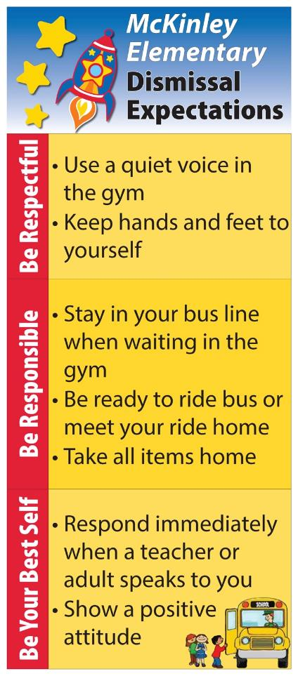
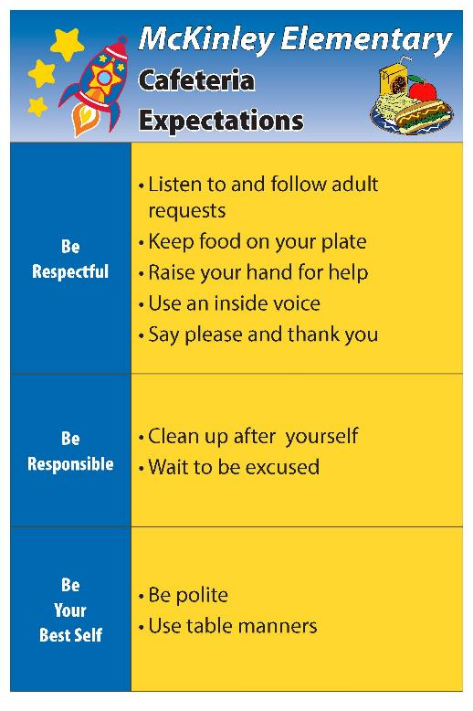
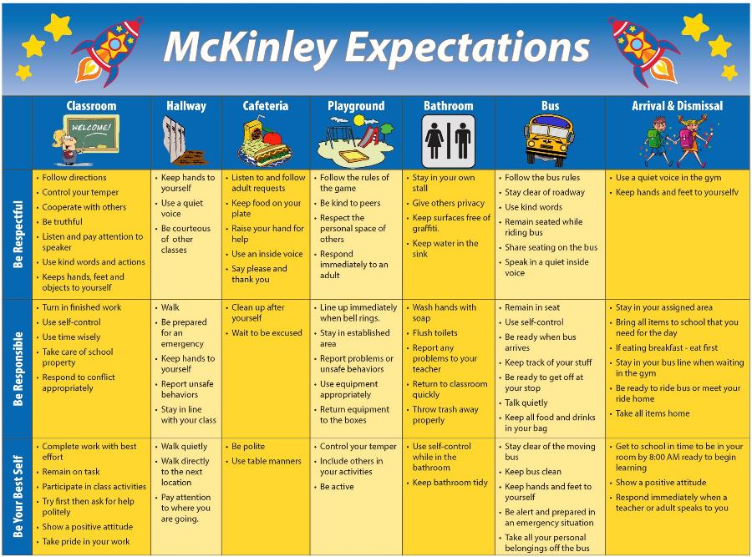
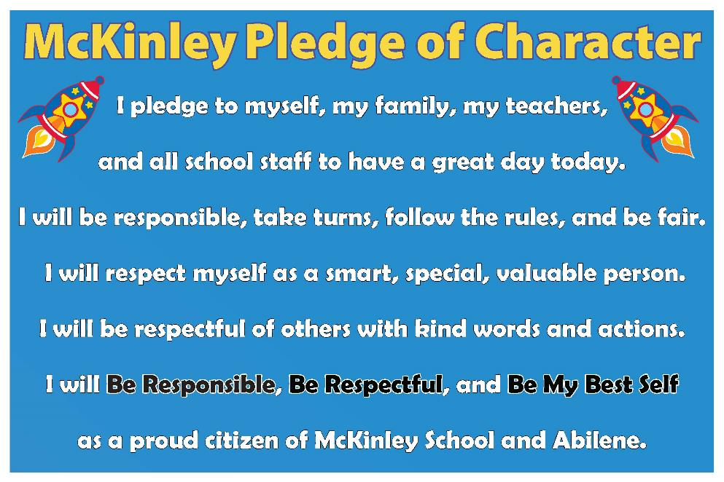

Examples

Slide 68
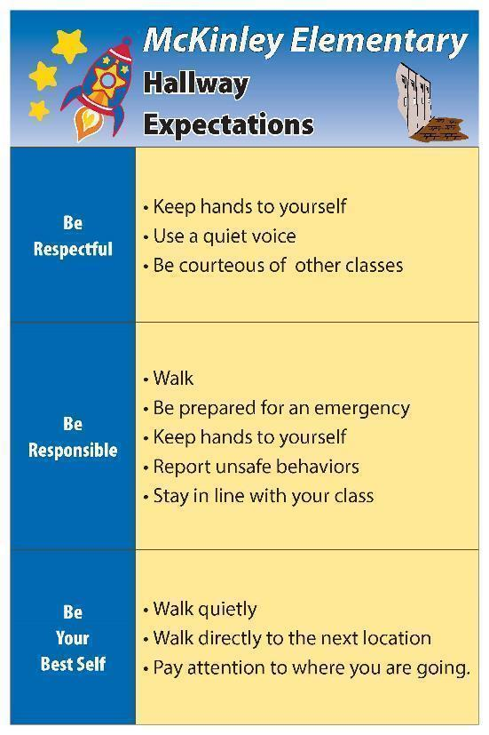
Examples
“It’s almost time to walk down to PE – who can remind us of one way we show respect in the hallway?”
“In order to line up for lunch, raise your hand if you can tell us one way to be responsible in the cafeteria?”

Slide 69
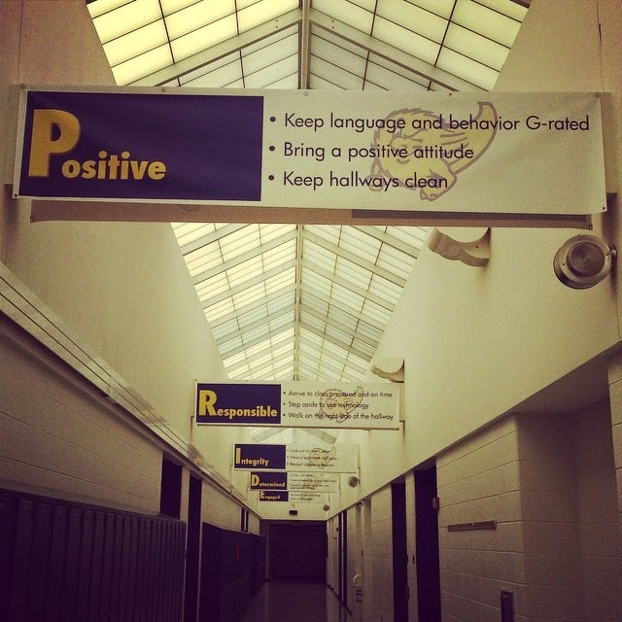
Why is Precorrection Effective?
Where might students currently have challenges?
Precorrection:
Get in front of problem behavior!
Manipulation of antecedents and consequences
Anticipates activities, settings, or time of day that could potentially result in problem behavior
Proactive
Focuses on what students should do instead of problem behaviors
Prevents the potential for escalating behavior patterns and allows more time for positive student-teacher interactions (Colvin et al, 1993)

Slide 70
Why is Precorrection Effective?
Fits seamlessly in a Ci3T framework
  Proactive strategy that seeks to teach, monitor, and reinforce appropriate behavior
  Used to teach behavioral expectations for common areas in the building where problem behaviors occur (e.g. lunchroom)
  May be used as a Tier 2 intervention
    Target a group of students

Slide 71
What does the supporting research for precorrection say?
Decreasing problem behaviors in Head Start classrooms
  Stormont, Smith, & Lewis, 2007
Decreasing problem behavior on an elementary school playground
  Lewis, Colvin, & Sugai, 2000
Decreasing problem behaviors during morning gym
  Haydon & Scott, 2008

Slide 72
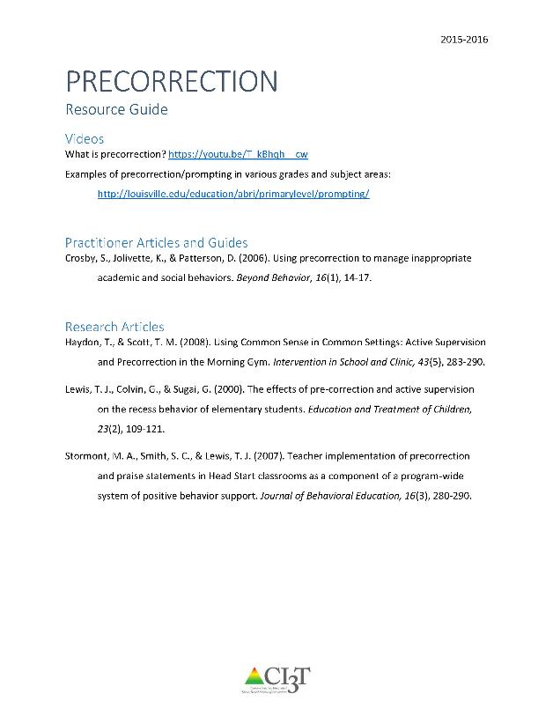
Supporting Research
See “Precorrection Resource Guide” for additional supporting research and information.

Slide 73
What are the benefits and challenges?
Benefits
Making contextual changes to activities/settings that traditionally occasion problem behaviors
Proactive
Varying levels of intensity
Challenges
Shift in thinking
Need to reflect on daily schedule and routines to anticipate when problem behaviors may arise
Must have some knowledge of a given setting

Slide 74
How do I implement a precorrection in my classroom?
Checklist for Success
Step 1
Identify contexts and anticipated behaviors
Step 2
Determine the expected behaviors
Step 3
Adjust the environment
Step 4
Provide opportunities for behavioral rehearsal

Slide 75
How do I implement a precorrection in my classroom?
Checklist for Success
Step 5
Provide strong reinforcement to students
engaging in expected behaviors
Step 6
Develop a prompting plan to remind students
about the expected behavior
Step 7
Develop a monitoring plan to determine the effectiveness of the precorrection plan
Step 8
Offer students an opportunity to
give feedback on this strategy

Slide 76
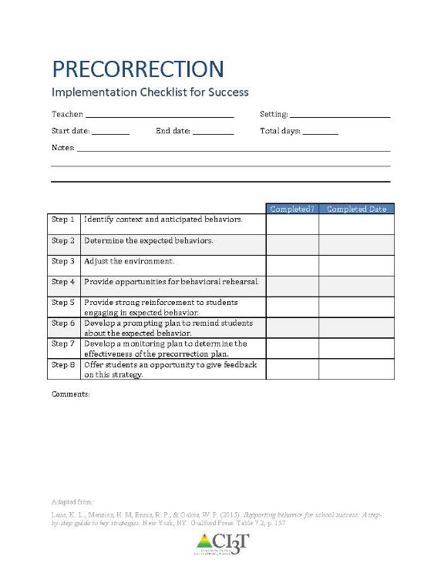
How do I implement precorrection in my classroom?
Identify context and anticipated behaviors.
Determine the expected behaviors.
Adjust the environment.
Provide opportunities for behavioral rehearsal.
Provide strong reinforcement to students engaging in expected behavior.
Develop a prompting plan to remind students about the expected behavior.
Develop a monitoring plan to determine the effectiveness of the precorrection plan.
Offer students an opportunity to give feedback on this strategy.
See “Precorrection Implementation Checklist for Success”

Slide 77
How well is it working?
Examining the Effects
Treatment Integrity
Is it happening?
Social Validity
What do stakeholders think about the goals, procedures, and outcomes?
Experimental Design
How well did this support work for this student?

Slide 78
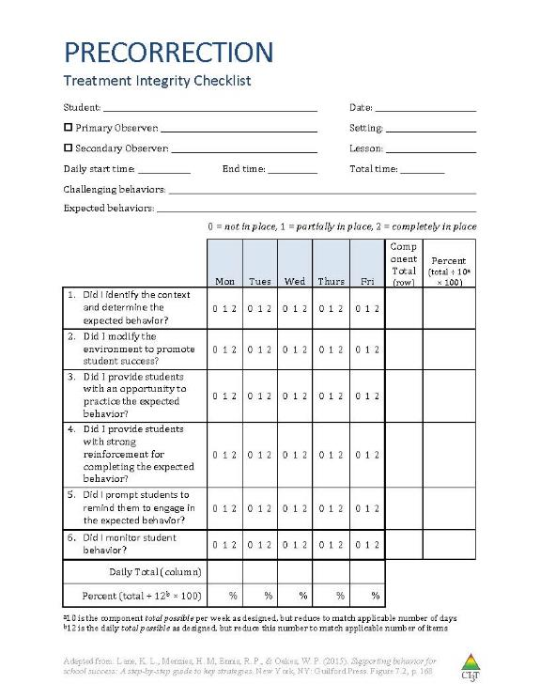
Ensuring the Strategy is in Place: Treatment Integrity
Have structures in place to monitor whether precorrection is carried out as intended:
Treatment integrity checklist
Example items:
Did I identify the context and determine the expected behavior?
Did I modify the environment to promote student success?
Did I provide students with an opportunity to practice the expected behavior?
Did I provide students with strong reinforcement for completing the expected behavior?
Did I prompt students to remind them to engage in the expected behavior?
Did I monitor student behavior?
See “Precorrection Treatment Integrity Checklist”

Slide 79
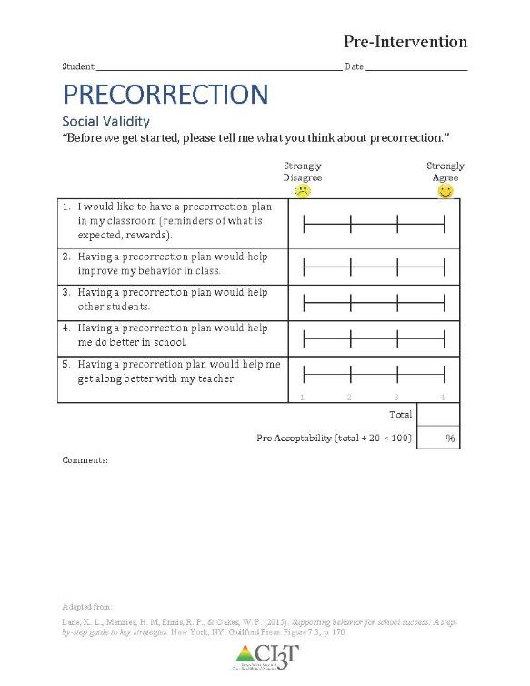
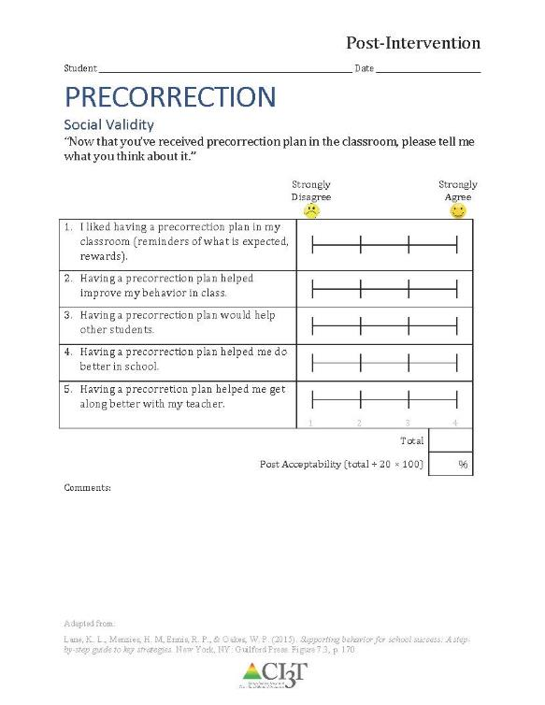
What do students think about it?
See “Precorrection Social Validity Student”
Completed by the student(s) participating in the intervention at two time points:
Pre and Post
Intervention

Slide 80
What does the teacher think about it?
See “Social Validity Adapted-IRP15 Adult”
Completed by the teacher(s) and parent(s) involved in the intervention at two time points:
Pre and Post
Intervention

Slide 81
Comprehensive, Integrated, Three-Tiered Model of Prevention
Goal: Reduce Harm
Specialized individual systems for students with high-risk
(Lane, Kalberg, & Menzies, 2009)
≈5%
Tertiary Prevention (Tier 3)
Goal: Reverse Harm
Specialized group systems
for students at-risk
≈15%
Secondary Prevention (Tier 2)
Goal: Prevent Harm
School/classroom-wide systems for all students, staff, & settings
PBIS Framework
≈80%
Validated Curricula
Primary Prevention (Tier 1)
Academic Behavioral Social

Slide 82
Sample Elementary Intervention Grid
Support | Description | School-Wide Data: Entry Criteria | Data to Monitor Progress | Exit Criteria
Pre-correction | Plan to modify teacher behavior and environmental contexts where problem behaviors are likely to occur by providing supports, prompts, and reinforcement for appropriate student behavior, preventing problem behaviors from occurring | One or more of the following: Behavior SRSS-E7: Moderate (4-8) SRSS-I5: Moderate (2-3) SRSS-E7: High (9-21) SRSS-I5: High (4-15) 2 or more ODRs per day in a class __ AND __ OR Academic Consistent, predictable pattern of academic errors | Student Performance direct measure of student behavior targeted for improvement Treatment integrity implementation checklist treatment integrity checklist Social validity IRP-15 (teacher) student-completed survey | Meets targeted behavior criterion for 3 consecutive weeks Two consecutive weeks of zero discipline referrals during target time / activity and SRSS-E7: low risk (0-3) SRSS-I5: low risk (0-1)
(Lane, Menzies, Ennis, & Oakes, 2015)

Slide 83
Sample Middle/High School Intervention Grid
Support | Description | School-Wide Data: Entry Criteria | Data to Monitor Progress | Exit Criteria
Pre-correction | Plan to modify teacher behavior and environmental contexts where problem behaviors are likely to occur by providing supports, prompts, and reinforcement for appropriate student behavior, preventing problem behaviors from occurring | One or more of the following: Behavior SRSS-E7: Moderate (4-8) SRSS-E7: High (9-21) 2 or more ODRs per day in a class __ AND __ OR Academic Consistent, predictable pattern of academic errors | Student Performance direct measure of student behavior targeted for improvement Treatment integrity implementation checklist treatment integrity checklist Social validity IRP-15 (teacher) student-completed survey | Meets targeted behavior criterion for 3 consecutive weeks Two consecutive weeks of zero discipline referrals during target time / activity and SRSS-E7: low risk (0-3)
(Lane, Menzies, Ennis, & Oakes, 2015)

Slide 84
Work with a neighbor to review the Precorrection Checklist for Success from ci3t.org.
Notes:
10-min timer

Slide 85
Expanding Your Toolbox
Opportunities to respond
High-probability request sequences
Instructional choice

Slide 86
ci3t.org

Slide 87

Monthly Faculty Presentations
For faculty & staff during contract hours
3 PM: Behavior- Specific Praise

Slide 88
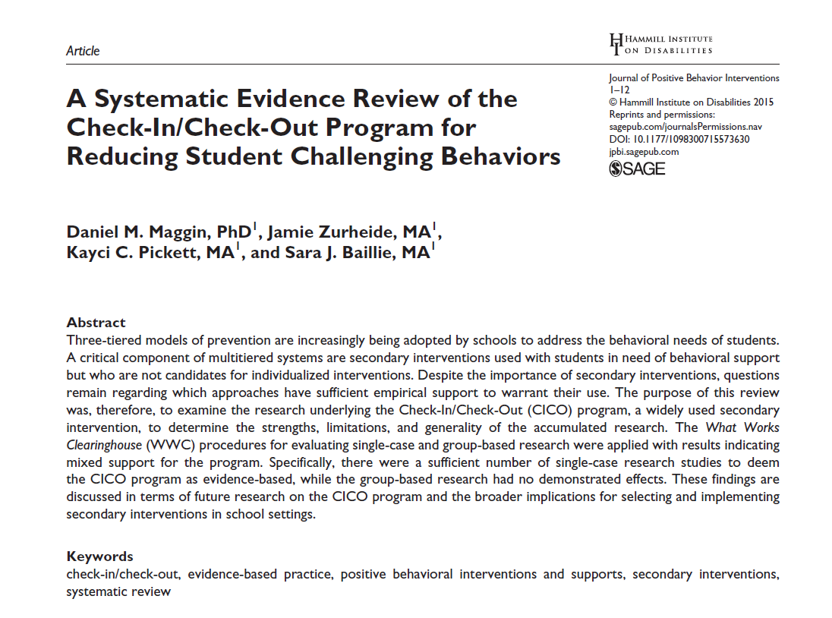



Consider a Book Study
kathleen.lane@ku.edu
eric.common@ku.edu
david.royer@ku.edu
Opportunities to Respond
Behavior-Specific Praise
Active Supervision
Classroom Management
Instructional Feedback
Instructional Delivery
High p Requests
Low-Intensity Strategies
Precorrection
Self-Monitoring
Incorporating Choice
Behavior Contracts
Notes:
Lane, K. L., Oakes, W. P., Ennis, R. P., & Hirsch, S. E. (2014). Identifying students for secondary and tertiary prevention efforts: How do we determine which students have Tier 2 and Tier 3 needs? Preventing School Failure, 58, 171-182, DOI: 10.1080/1045988X.2014.895573

Slide 89
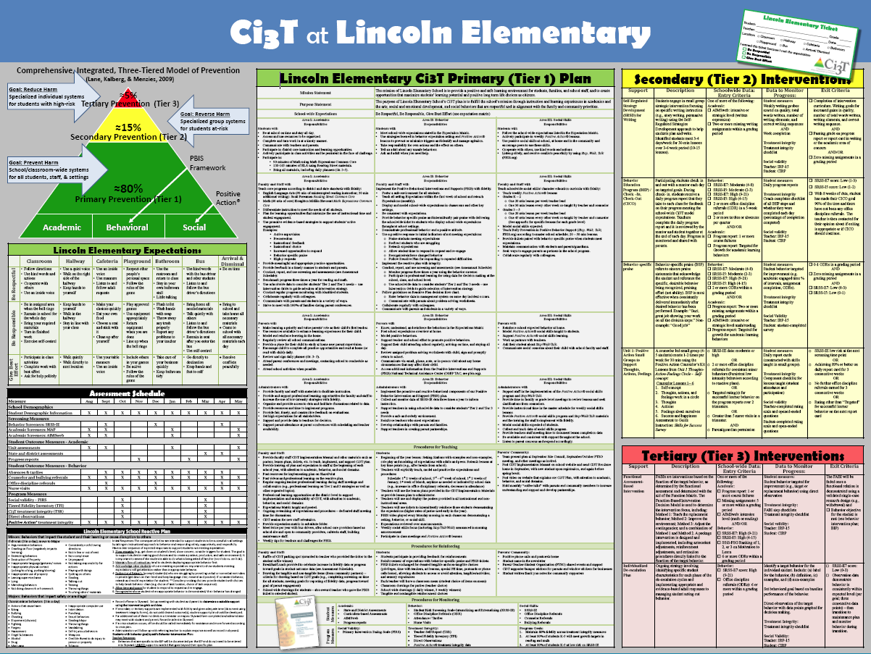
Connect it to your Primary Plan
Include teacher-delivered strategies for teaching, reinforcing, and monitoring across academic, behavior, and social responsibilities.

Slide 90


Building a Ci3T Tier Library
Teacher Delivered Strategies (T1 T2)
Tier 1
Tier 2
Tier 3

Slide 91

Consider Teacher-Delivered Strategies Across Tiers
Opportunites to Respond
Behavior-Specific Praise
Active Supervision
Instructional Feedback
High-Probability Requests
Precorrection
Instructional Choice

Slide 92
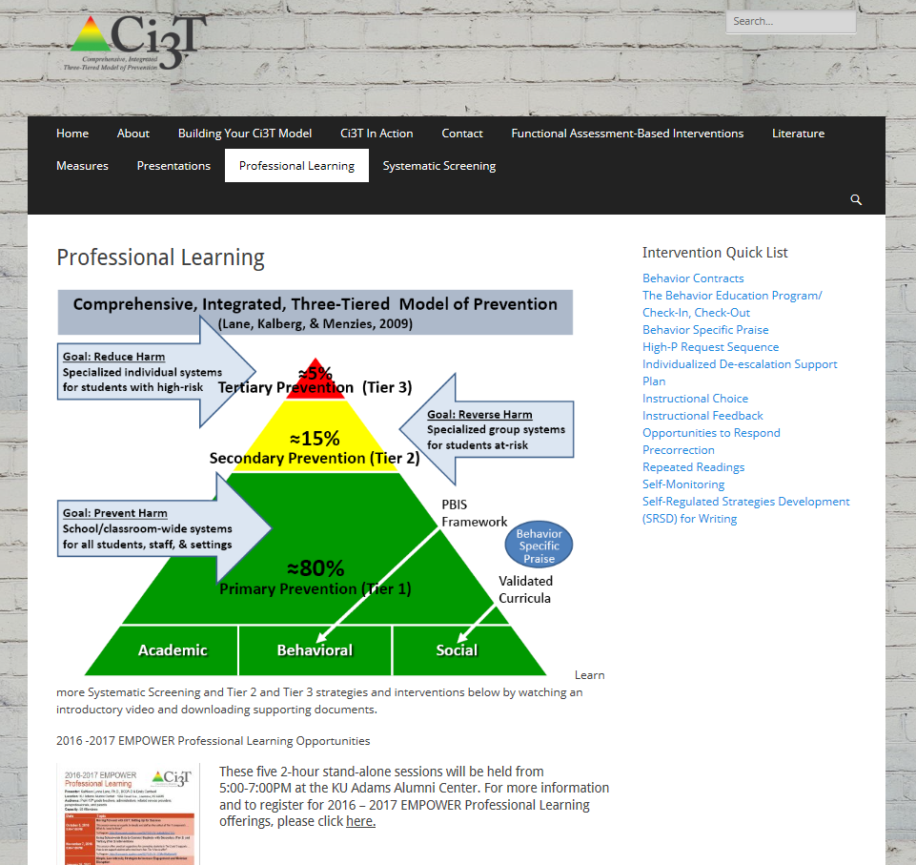
ci3t.org

Slide 93

Thank You
(for being engaged!)
Please visit
.org
kathleen.lane@ku.edu

