Slide 1
Tier 3 Strategies: A Look at
Functional Assessment-Based Interventions (FABI)

Slide 2
Agenda
Comprehensive, Integrated, Three-Tiered (CI3T) Models of Prevention
Overview of functional assessment-based interventions (FABI)
  Function-based interventions
  What are FABIs?
  Why are FABIs effective?
  What does the supporting research for FABIs say?
  What are the benefits and challenges?
How do I implement FABIs in my classroom?
  Step 1: Identifying students who need a FABI
  Step 2: Conducting the functional assessment
  Step 3: Collecting baseline data
  Step 4: Designing the intervention: Using the Function-Based Intervention Decision Model
  Step 5: Testing the intervention
  Ethical Considerations
  Generalization and Maintenance
Frequently Asked Questions (FAQ): What if Scenarios

Slide 3
Comprehensive, Integrated, Three-Tiered Model of Prevention (Lane, Kalberg, & Menzies, 2009)
Goal: Reduce Harm
Specialized individual systems for students with high-risk
≈5%
Tertiary Prevention (Tier 3)
Goal: Reverse Harm
Specialized group systems
for students at-risk
≈15%
Secondary Prevention (Tier 2)
Goal: Prevent Harm
School/classroom-wide systems for all students, staff, & settings
PBIS Framework
≈80%
Validated Curricula
Primary Prevention (Tier 1)
Academic Behavioral Social
Notes:
Lane, K. L., Oakes, W. P., Ennis, R. P., & Hirsch, S. E. (2014). Identifying students for secondary and tertiary prevention efforts: How do we determine which students have Tier 2 and Tier 3 needs? Preventing School Failure, 58, 171-182, DOI: 10.1080/1045988X.2014.895573

Slide 4
Schoolwide Positive Behavior
Support
Comprehensive, Integrative,
Three-tiered (CI3T)
Models of Support
Low Intensity Strategies
Basic Classroom Management
Effective Instruction
Low Intensity Strategies
Behavior Contracts
Self-Monitoring
- -
Functional Assessment-Based
Interventions
Higher Intensity Strategies
Assess, Design, Implement, and
Evaluate
Assessment
(Lane, Menzies, Bruhn, & Crnobori, 2011)

Slide 5

Overview of functional assessment-based interventions (FABI)

Slide 6
Function-based Interventions
In this presentation, one systematic approach to functional based interventions using the FABI Model is presented.
However, there are many variations to conducting functional behavior assessment (FBA) and writing behavior intervention plans (BIP).

Slide 7
What are FABIs?
FABI refers to an intervention that is constructed based on the function of the behavior, determined by conducting a functional assessment.
The function of the behavior refers to the purpose the behavior serves:
  to get (access) something or
  to get out of (avoid) something

Slide 8
Unique Features: FABI Model
Function Matrix to analyze data to determine the hypothesis
Form of Reinforcement: Access (positive reinforcement) or Avoid (negative reinforcement)
Stimulus: attention; activity or tangible; sensory
Function-Based Intervention Decision Model to determine the intervention focus
Method 1: Teach the Replacement Behavior
Method 2: Improve the Environment
Method 1 and 2: Teach the Replacement Behavior and Improve the Environment
Method 3: Adjust the Contingencies
ARE Components: a systematic method of constructing the intervention
Antecedent Adjustments
Reinforcement Adjustments
Extinction
(Umbreit, Ferro, Liaupsin, & Lane 2007)

Slide 9
Why are FABIs effective?
Emphasis is on skill building and supporting pro-social behavior (replacement behavior) that serve the same function(s) as the target behavior (problem behavior).
The intervention is based on the communicative intent of target behavior.
That is, what the student is trying to access or avoid:
  Attention
  Tangibles / Activities
  Sensory

Slide 10

The Acting-Out Cycle
5. Peak
4. Acceleration
Intensity
6. De-escalation
3. Agitation
2. Trigger
1. Calm
7. Recovery
Time
(Colvin & Scott, 2014)

Slide 11

Identifying the target behavior is

Slide 12
Behavioral Chains
Each ensuing behavior in a given behavior chain becomes more serious than the one preceding it.

Slide 13
Change the Behavior Momentum
Interrupt the behavioral chain at any time to prevent the occurrence of more serious types of behavior.
(Nevin, 1970)

Slide 14
What does the supporting research for FABIs say?
Student populations | Target Behavior | Method
Autism spectrum disorder (Gann et al., 2014) Attention-related difficulties (Stahr et al., 2006) With or at-risk for emotional/behavioral disorders (Janney et al., 2013; Lane et al., 2006; ) Challenging behaviors (Umbreit et al., 2004) Early childhood settings (Wood et al., 2007) Elementary settings (Germer et al., 2011; Lane et al., 2009) Secondary settings (Lane et al., 2007; Liaupsin et al., 2006; Majeika et al., 2011) | Noncompliance (Lane et al., 2007) Nonparticipation (Lane et al, 2007) Off-task (Gann et al., 2004; Lane et al., 2009; Wood et al., 2007) Profanity and negative social interactions (Lane et al., 2007; Turton et al., 2007) Disruptive behaviors (Lane et al., 2007; Turton et al., 2011) | Method 1: Teach the replacement behavior (Liaupsin et al., 2006) Method 2: Improve the environment (Germer et al., 2011; Majeika et al., 2011) Method 3: Adjust the contingencies (Wood et al., 2007) Method 1 & 2: Teach the replacement behavior and improve the environment (Gann et al., 2014; Liaupsin et al., 2006; Turton et al., 2007)

Slide 15
What are the benefits and challenges?
Benefits
Challenges
Proactive rather than reactive
Yield desired outcomes for a variety of students with a range of target behaviors and in a variety of environments (Lane, Rogers et al., 2007)
Team-based approach with opportunities to include parent and student voice
Can be resource intensive
Requires training and practice
Time for teams to work together and collect data

Slide 16

How do I implement FABI in my classroom?

Slide 17
How do I implement FABIs in my classroom?
Steps
1
2
3
4
5
Identify Students
Functional Assessment
Baseline Data
Intervention Development
Testing the Intervention

Slide 18
Step 1: Identify Students
Support | Description | Schoolwide Data: Entry Criteria | Data to Monitor Progress | Exit Criteria
Functional Assessment-based Intervention | FABIs are interventions based on the function of the target behavior, as determined by the functional assessment and determined with the aid of the Function Matrix. The Function-Based Intervention Decision Model is used to determine the intervention focus, including: Method 1: Teach the replacement behavior; Method 2: Improve the environment; Method 3: Adjust the contingencies; and a combination of Method 1 and Method 2. A package intervention is designed and implemented, including antecedent adjustments, reinforcement adjustments, and extinction procedures directly linked to the function of the target behavior. | One or more of the following: Behavior: SRSS-E7: High (9-21) SRSS-I5: High (4-15) SSiS-PSG Ranking of 1, 2, or 3 on the Motivation to Learn Office discipline referrals (ODRs) 6 or more within a grading period AND/OR Academic: Progress report: 1 or more course failures Missing Assignments: 5 or more within a grading period AIMSweb: intensive level (math or reading) | Student behavior targeted for improvement (e.g., target or replacement behavior) using direct observation Treatment integrity FABI Step checklists Treatment integrity checklist Social validity IRP-15 (teacher) CIRP (student) | The FABI will be faded once a functional relation is demonstrated using a validated single-case research design (e.g., withdrawal) and: Behavior objective for the student is met (See Behavior Intervention Plan [BIP]).
1
Identify Students

Slide 19

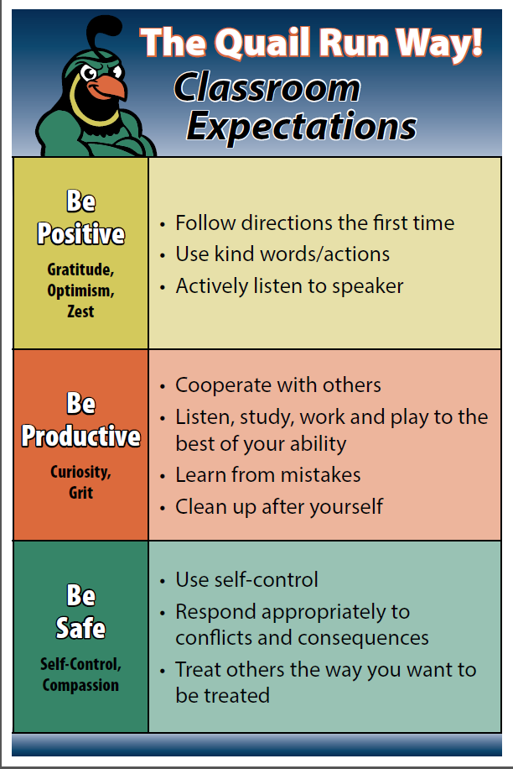

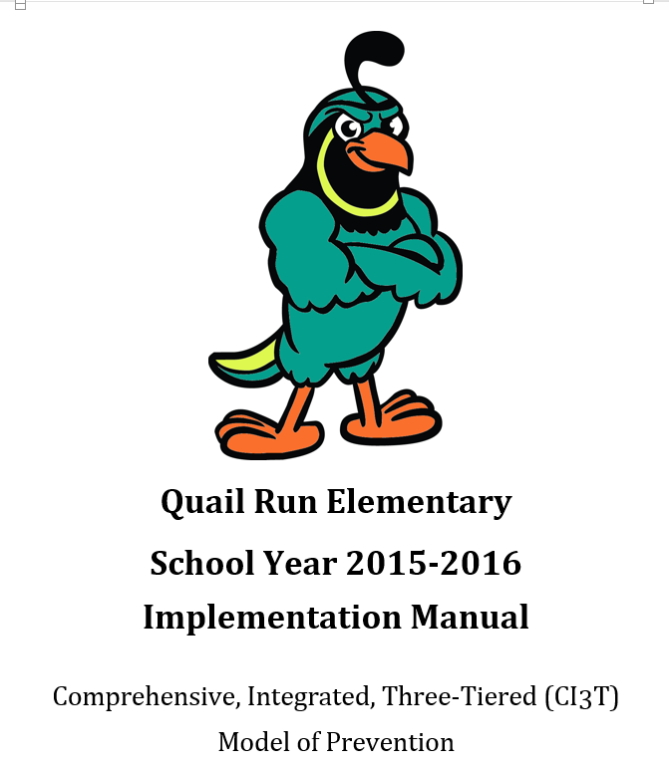
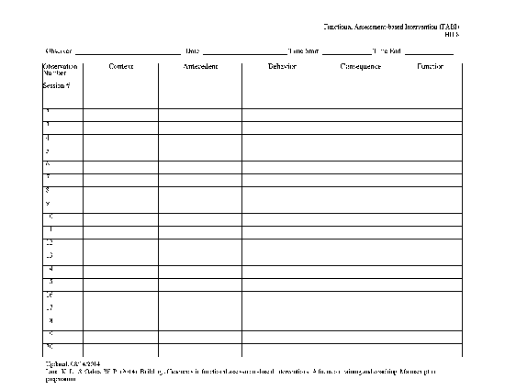


Step 2: Functional Assessment
Functional Assessment Methods
  Informal Observation
  Records Review
  Interviews (Teacher, Parent, Student)
  Rating Scales
  A-B-C Data Collection
2
Functional Assessment

Slide 20
Operational Definitions
Operational definitions include:
  Label
  Definition
  Examples
  Nonexamples
Pass the following criterion
  Measurable, observable, repeatable
  Dead man’s test
  Stranger test

Slide 21
A = Antecedent
The entire set of conditions in which a behavior occurs.
Includes the context in which the behavior occurs and specific events immediately preceding the behavior.

Slide 22
B = Behavior
The activity of living organisms.
The organism’s interaction with its environment that results in a measurable change in at least one aspect of the environment.
During the observations: Focus on the identified target behavior.

Slide 23
C = Consequences
The event(s) that follows the behavior.
If the consequence makes the behavior more likely to occur it is called a reinforcer.
If it makes it less likely to occur, it is called a punisher.

Slide 24
A-B-C Data: Example
A teacher hands out math computation worksheet, starts the timer, and tells students they will be timed in completing the math worksheet. The student then tears up the worksheet. The teacher scolds the student and has the student clean up the mess without completing the worksheet.
A B C
The teacher hands out a math computation worksheet, starts the timer, and tells students that they will be timed in completing the math worksheet
The teacher scolds the student and has the student clean up the mess (without completing the worksheet)
The student tears up the worksheet

Slide 25
Identify the function of the A-B-C Data
Let’s
Practice

Slide 26
 | Context | Antecedent | Behavior | Consequence | Function
1.1 | Morning circle time | Teachers asks question to class | Rolling around on rug | No response from teacher or peers. Student continues to roll. | Avoid activity, access sensory
1.2 | Morning circle time | Peers talking to each other | He quits listening to teacher and watches peers | No response from teacher or peers, continues to watch peers | Avoid activity
2.1 | Spanish—Rug time | Students are participating | He hits rug, fights with hands | No attention from teacher, but other students get PBIS tickets. | Access sensory
2.2 | Spanish—Rug time | Teacher rewards other students | Rolling on floor with hands on head | Teacher ignores him and he continues. | Avoid activity, Access sensory
2.3 | Spanish— Activity | Teacher told students to get a partner and no one chose him | He walks away screaming | Teacher approaches and asks him to be her partner. | Access attention
HO 8.1
(Lane, 2014)
Notes:
26

Slide 27
Identifying the Function of the Behavior
Step 2: Functional Assessment
They want to GET something
They want to AVOID something
Attention
Activities/ Tangibles
Sensory
Function – Examine the consequences that resulted from the behavior

Slide 28
Function Matrix
The function matrix helps to visually identify the function of the behavior .
Enter the data gathered from the records review; teacher, parent, and student interviews; and
A-B-C data.
Use the matrix to create a hypothesis statement.
 | Positive Reinforcement (Access something) | Negative Reinforcement (Avoid something)
Attention
Tangibles/ Activities
Sensory
(Umbreit et al., 2007)
Notes:
28

Slide 29
Illustration: Function Matrix
(Germer et al., 2011)
 | Positive Reinforcement | Negative Reinforcement
Attention | ABC data: 97 incidences during morning work time. 1.1, 1.2, 1.3, 1.6, 1.8, 1.10, 1.15, 1.16, 1.17, 1.18, 1.20, 1.21, 1.22, 1.23, 1.24, 1.25, 1.26, 1.27, 1.30ª, 1.31, 1.34ª, 1.37, 1.38ª, 1.40ª, 1.41ª, 1.42, 1.43, 1.46ª, 1.48ª, 1.50, 1.51, 1.53, 1.54ª, 1.55, 1.56ª, 1.58, 1.59ª, 1.60, 1.61ª, 1.62ª, 1.63ª, 1.64ª, 1.66ª, 1.67ª, 1.68, 2.2ª, 2.5ª, 2.6ª, 2.7, 2.9, 2.12, 2.13ª, 2.14ª, 2.15ª, 2.16, 2.18, 2.19ª, 2.20ª, 2.21, 2.22, 2.23, 2.24, 2.25ª, 2.27ª, 2.28ª, 2.29ª, 2.30ª, 2.32ª, 2.33, 2.34, 2.35ª, 2.37, 2.38ª, 2.39, 2.41ª, 2.42ª, 2.43ª, 2.44ª; 3.1ª, 3.3, 3.4ª, 3.5ª, 3.7, 3.8, 3.9, 3.10, 3.11ª, 3.12, 3.15^{c}, 3.18ª, 3.19, 3.20, 3.23, 3.24ª, 3.25, 3.26, 3.28 Student interview: “They be falling on the floor on purpose… so people look at them and the teacher gets annoying [sic]… to get the teacher’s attention”
Activities/Tangibles | ABC data: 3 incidences during morning work time. 1.4^{b}, 2.8, 3.6^{b} Teacher interview: Motivated to finish morning math work, but does not complete during assigned time; finishes by copying during review of work, likes to turn it in.
Sensory | ABC data: 2 incidences during morning work time. 3.15^{c}, 3.21^{d} Teacher interview: “He’s not an unreasonable child… he intends to behave, but can’t. He’s not physically able to sit still.” Student interview: Tends to be off-task “when I feel ticklish”
ABC data: 84 incidences during morning work time. 1.4^{b}, 1.5, 1.7, 1.9, 1.11, 1.12, 1.13, 1.14, 1.19, 1.28, 1.29, 1.30ª, 1.32, 1.33, 1.34ª, 1.35, 1.36, 1.38ª, 1.39, 1.40ª, 1.41ª, 1.44, 1.45, 1.46ª, 1.47, 1.48ª, 1.49, 1.52, 1.54ª, 1.56ª, 1.57, 1.59ª, 1.61ª, 1.62ª, 1.63ª, 1.64ª, 1.65, 1.66ª, 1.67ª, 1.69; 2.1, 2.2ª, 2.3, 2.4, 2.5ª, 2.6ª, 2.10, 2.11, 2.13ª, 2.14ª, 2.15ª, 2.17, 2.19ª, 2.20ª, 2.25ª, 2.26, 2.27ª, 2.28ª, 2.29ª, 2.30ª, 2.32ª, 2.35ª, 2.36, 2.38ª, 2.40, 2.41ª, 2.42ª, 2.43ª, 2.44ª; 3.1ª, 3.2, 3.4ª, 3.5ª, 3.6^{b}, 3.11ª, 3.13, 3.14, 3.16, 3.17, 3.18ª, 3.21^{d}, 3.22, 3.24ª, 3.27
Teacher interview:
“He never finishes an assignment”
It typically happens during independent work, “when I’m not directing it… he takes advantage of the freedom.”
The 2nd grade level work might be too hard but he has average math and reading ability compared to class.
There’s “nothing that interests him enough.”
Notes:
Source: Germer, K. A., Kaplan, L. M., Giroux, L. N., Markham, E. H., Ferris, G., Oakes, W. P., & Lane, K. L. (2011). A function-based intervention to increase a second-grade student’s on-task behavior in a general education classroom. Beyond Behavior, 20, 19-30.

Slide 30
Illustration: Hypothesized Function
When presented with an instructional task, David engages in off-task behavior (such as leaving instructional areas, inappropriately making comments, and engaging in unassigned tasks) to access attention and/or to escape tasks.
In other words, when David is off-task he gets attention from his teacher and peers and does not have to complete assignments (positive reinforcement-attention and negative reinforcement-activity).
Germer et al., 2011
Notes:
Source: Germer, K. A., Kaplan, L. M., Giroux, L. N., Markham, E. H., Ferris, G., Oakes, W. P., & Lane, K. L. (2011). A function-based intervention to increase a second-grade student’s on-task behavior in a general education classroom. Beyond Behavior, 20, 19-30.

Slide 31
Selecting a Replacement Behavior
If a student is not engaging in the target behavior, they must do something in its place.
The selection of the replacement behavior requires information gathered via the teacher and parent interview.
The replacement behavior either needs to be in the student’s repertoire or taught explicitly so the student can do the replacement behavior.

Slide 32
Step 3: Baseline Data
B₂
In some phases the intervention IS NOT in place.
A₂
A₁ represents baseline (current practices in place).
A₂ represents a withdrawal of the intervention (return to baseline practices).
A₁
B₁
3
Baseline Data

Slide 33
In other phases the intervention IS in place.
B₁
A₂
B₂
A₁
B₁ represents the first introduction of the intervention.
B₂ represents the reintroduction of the intervention.

Slide 34
Step 3: Baseline Data
Baseline – Establish current level of behavior BEFORE intervention begins
Intervention
Withdrawal
Reintroduction
3
Baseline Data

Slide 35
Step 3: Baseline Data
Baseline – Establish current level of behavior BEFORE intervention begins
Intervention
Withdrawal
Reintroduction
3
Baseline Data

Slide 36
Measurement
Collect data to establish current level of the behavior
Measure the effect of the intervention on the behavior
Establish that the change was due to the intervention
Monitor effects in other settings or across time
(Umbreit et al., 2007)

Slide 37
Dimensions of Behavior
Frequency: | The number of times a response occurs
Rate: | The number of times a response occurs within a given period of time or per opportunity
Duration: | The length of time the response occurs
Latency: | The length of time that elapses between the antecedent and response
Topography: | The shape of the behavior (what it looks like)
Force/ Intensity: | The degree to which the behavior occurs
(Cooper, Heron, & Heward, 2007)

Slide 38
Behavior
Numerical dimension
of behavior
Discrete
Discrete or continuous
Temporal dimension
of behavior
Prior to response initiation
Event recording
Time b/t response and termination
Occurring at high frequency
Occurring at moderate frequency
Latency recording
Duration recording
Interval recording
Time sampling

Slide 39
Step 4: Intervention Development
(Umbreit et al., 2007)
Conduct FBA
4
Select Replacement Behavior
Intervention Development
Can the student perform the replacement behavior?
NO
YES
Do antecedent conditions represent effective practices?
Do antecedent conditions represent effective practices?
YES
NO
NO
YES
Method 1: Teach the replacement behavior
Method 1 & 2: Teach the replacement behavior and improve the environment
Method 2: Improve the environment
Method 3: Adjust the contingencies

Slide 40

A - R - E Intervention Components
Adjust Antecedents
  Physical room arrangement
  Visual/audio cues
  Securing attention
  Self-monitoring checklists
Adjust Reinforcement Rates
  Tangible or non-tangible
  Behavior specific praise
  Make it contingent upon performing replacement behavior
Extinguish Target Behavior
  Brief verbal prompt, then ignore
  Removing the student, or removing the class
  Emergency procedures
(Umbreit et al., 2007)

Slide 41
Function-Based Intervention Decision Model
Method 1
Method 2
Method 3
Teach the Replacement Behavior
Improve the Environment
Adjust the Contingencies
Method 1 and 2
(Umbreit et al., 2007)

Slide 42
Step 5: Testing the Intervention
Using visual analysis, we can determine if the desired behavior is occurring when the intervention is in place and not occurring when the intervention is not in place.
A₁
B₁
A₂
B₂
5
Testing the Intervention

Slide 43
How well is it working?
Examining the Effects
Treatment Integrity
Is it happening?
Social Validity
What do stakeholders think about the goals, procedures, and outcomes?
Experimental Design
How well did this support work for this student?

Slide 44

Treatment Integrity
Definition: The degree to which intervention procedures are implemented as intended.
Assessing Treatment Fidelity:
Direct Systematic Observation
Self-reporting
Rating Scales
Permanent Product

Slide 45

Collecting Data
1
Identify Students
Monitor with:
FABI Step 5 Summary Template.xls
2
Student outcome-data
Identify the behavioral dimension
Select measurement system
  Event-based methods
  Example: Event recording
  Time-based methods
    Example: Momentary Time Sampling
Collect Data
Assess interobserver agreement
Graph Data
Functional Assessment
3
Baseline Data
4
Intervention Development
5
Testing the Intervention

Slide 46
A-R-E Intervention Components
Components |  | Intervention Tactics
Antecedent | A1 | David sat facing the whiteboard.
 | A2 | Stop Light was affixed to the side of David’s desk; David used a clothespin to signal which “light” he was on.
 | A3 | A copy of David’s self-monitoring form was displayed on his desk.
 | A4 | The teacher reviewed the picture schedule for the morning work period prior to the work period.
 | A5 | The teacher checked in with David at the beginning of independent tasks to ensure that he understood the assignment.
Reinforcement | R1 | The teacher provided behavior-specific praise when David was on-task.
 | R2 | The teacher acknowledged David’s need for help when his clothespin was on red and assisted him as quickly as possible.
 | R3 | The teacher checked David’s work upon completion, provided praise, and allowed him to take a short break.
 | R4 | At the end of the morning independent work period, the teacher helped David complete his self-monitoring form and wrote one specific incidence of good behavior at the bottom.
Extinction | E1 | The teacher provided no praise or attention when David was off-task, with the exception of one verbal or gestural redirect per minute.
 | E2 | The teacher provided assistance without praise and with minimal interaction when David’s clothespin was on red.
 | E3 | When David was off-task, the teacher praised other students who were behaving appropriately.
(Germer et al., 2011)
Notes:
Source: Germer, K. A., Kaplan, L. M., Giroux, L. N., Markham, E. H., Ferris, G., Oakes, W. P., & Lane, K. L. (2011). A function-based intervention to increase a second-grade student’s on-task behavior in a general education classroom. Beyond Behavior, 20, 19-30.
Added period to A2

Slide 47
Sample Treatment Integrity Checklist
Intervention Tactics | Mon. | Tue. | Wed. | Thur. | Fri. | Component Total | %
A1. David sat facing the whiteboard. | 0 1 2 | 0 1 2 | 0 1 2 | 0 1 2 | 0 1 2
A2. Stop Light was affixed to the side of David’s desk; David used a clothespin to signal which “light” he was on. | 0 1 2 | 0 1 2 | 0 1 2 | 0 1 2 | 0 1 2
A3. A copy of David’s self-monitoring form was displayed on his desk. | 0 1 2 | 0 1 2 | 0 1 2 | 0 1 2 | 0 1 2
A4. The teacher reviewed the picture schedule for the morning work period prior to the work period. | 0 1 2 | 0 1 2 | 0 1 2 | 0 1 2 | 0 1 2
A5. The teacher checked in with David at the beginning of independent tasks to ensure that he understood the assignment. | 0 1 2 | 0 1 2 | 0 1 2 | 0 1 2 | 0 1 2
R1. The teacher provided behavior-specific praise when David was on-task. | 0 1 2 | 0 1 2 | 0 1 2 | 0 1 2 | 0 1 2
R2. The teacher acknowledged David’s need for help when his clothespin was on red and assisted him as quickly as possible. | 0 1 2 | 0 1 2 | 0 1 2 | 0 1 2 | 0 1 2
R3. The teacher checked David’s work upon completion, provided praise, and allowed him to take a short break. | 0 1 2 | 0 1 2 | 0 1 2 | 0 1 2 | 0 1 2
R4. At the end of the morning independent work period, the teacher helped David complete his self-monitoring form and wrote one specific incidence of good behavior at the bottom. | 0 1 2 | 0 1 2 | 0 1 2 | 0 1 2 | 0 1 2
E1. The teacher provided no praise or attention when David was off-task, with the exception of one verbal or gestural redirect per minute. | 0 1 2 | 0 1 2 | 0 1 2 | 0 1 2 | 0 1 2
E2. The teacher provided assistance without praise and with minimal interaction when David’s clothespin was on red. | 0 1 2 | 0 1 2 | 0 1 2 | 0 1 2 | 0 1 2
E3. When David was off-task, the teacher praised other students who were behaving appropriately. | 0 1 2 | 0 1 2 | 0 1 2 | 0 1 2 | 0 1 2
Daily Total (column)
Percent (total ÷ 16 × 100)
Monitor with:
FABI Step 5 Summary Template.xls
Notes:
Source: Germer, K. A., Kaplan, L. M., Giroux, L. N., Markham, E. H., Ferris, G., Oakes, W. P., & Lane, K. L. (2011). A function-based intervention to increase a second-grade student’s on-task behavior in a general education classroom. Beyond Behavior, 20, 19-30.
Added period to A2

Slide 48
How well is it working?
Examining the Effects
Treatment Integrity
Is it happening?
Social Validity
What do stakeholders think about the goals, procedures, and outcomes?
Experimental Design
How well did this support work for this student?

Slide 49
Social Validity
Social significance
  The value recipients place on the goals and specific behaviors target for intervention
  Do benefits of intervention outweigh costs?
Social acceptability
  Is treatment appropriate for the problem behavior?
  Is it fair and reasonable? Or is it intrusive?
  Is it something the treatment agent wants to do?
Social importance of effects
  Does change have habilitative validity? (Hawkins, 1991)
  Is new behavior functional and acceptable?
(Wolf, 1978)

Slide 50
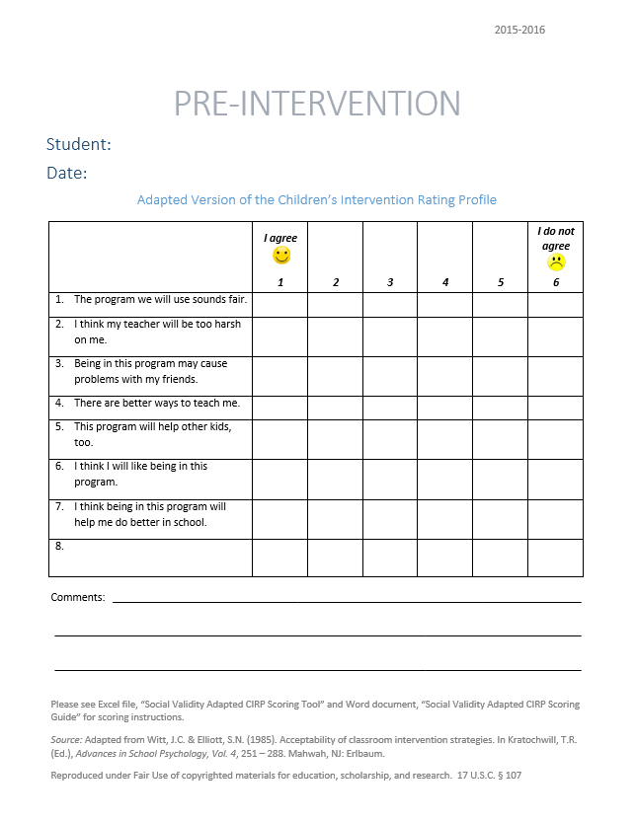
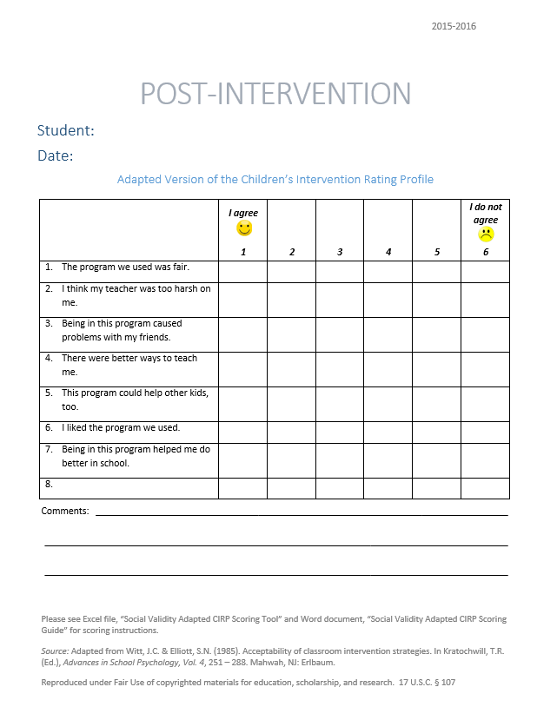
What does the student think about it?
Completed by the student participating in the intervention at two time points:
Pre and Post Intervention
Monitor with:
FABI Step 5 Summary Template.xls

Slide 51
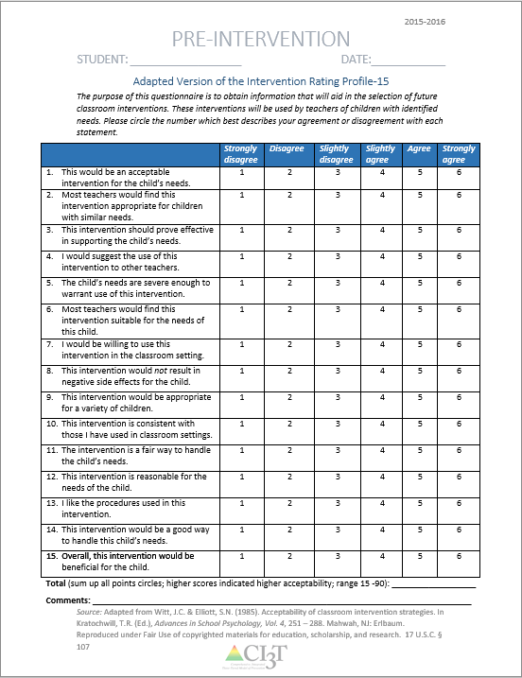
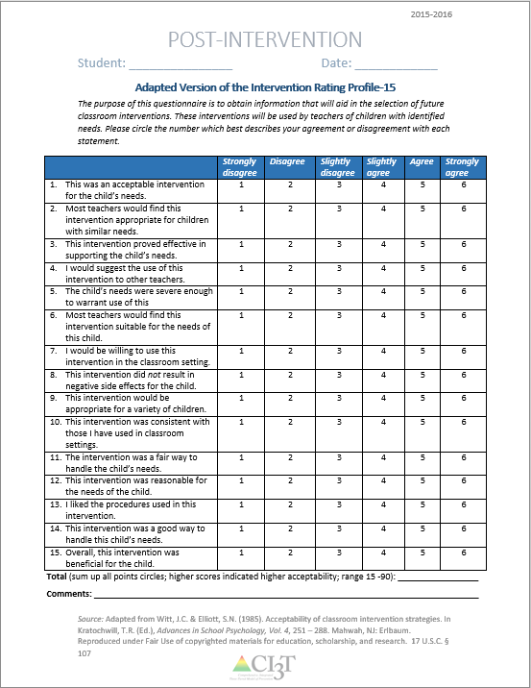
What do the adults think about it?
Completed by adults (e.g., teachers, paraeducators, parents) participating in the intervention at two time points: Pre and post intervention
Monitor with:
FABI Step 5 Summary Template.xls

Slide 52
How well is it working?
Examining the Effects
Treatment Integrity
Is it happening?
Social Validity
What do stakeholders think about the goals, procedures, and outcomes?
Experimental Design
How well did this support work for this student?

Slide 53


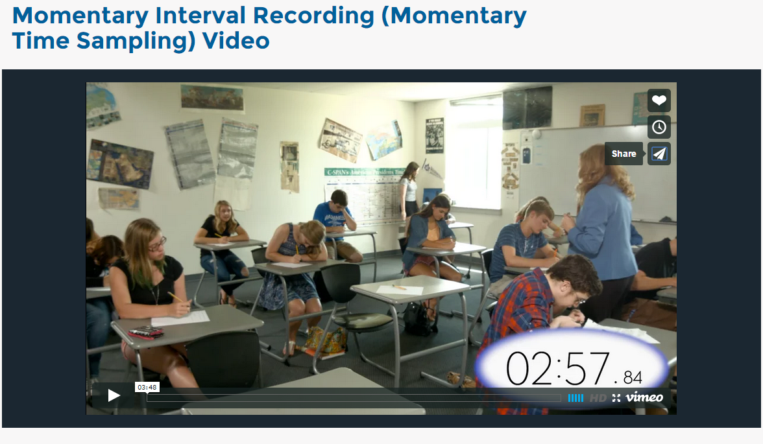
Collecting Data
Defining Behavior
http://iris.peabody.vanderbilt.edu/wp-content/uploads/pdf_case_studies/ics_defbeh.pdf
Event Recording
Momentary Time Sampling
https://vimeo.com/137862234
https://vimeo.com/138030792

Slide 54
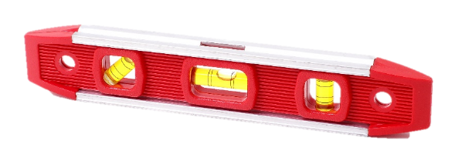
Is my student’s behavior low, moderate, or high?
Low
Moderate
High
A₁
A₁
A₁
Level

Slide 55

Is my student’s behavior increasing, decreasing, or staying the same (flat)?
Increasing Trend
Decreasing Trend
Flat/Zero Trend
Trend

Slide 56

Is my student’s behavior stable?
Stable
Variable
A₁
A₁
Stability

Slide 57
More on...
…representing conditions.
Summary of Graphic Elements: Notation System
Notation | Explanation
A | Represents a baseline condition in which the intervention is not in place.
B | Represents the first intervention introduced into the data series.
A₁-B₁-A₂-B₂ | A numeral placed at the lower right of a letter (subscript) indicates whether this was the first, second, third, etc. time this condition was introduced into during the FABI.
C | Represents the second (if introduced) intervention (ARE) introduced or maintenance condtion.
’ | Primes (’) are used to show a slight variation from the original procedure, as opposed to a new intervention.
Adopted from: Gast, D. L. & Spriggs, A. D. (2014). Visual analysis of graphic data. In D. L. Gast & J. R. Ledford (Eds.), Single-Case Research Methodology: Applications in Special Education and Behavioral Sciences. New York, NY: Routledge.

Slide 58
A-B-A-B Design with Maintenance
= Average of 3 data points = Average of 2 data points
Lane, K. L., Eisner, S. L., Kretzer, J. M., Bruhn, A. L., Crnobori, M. E., Funke, L. M., Lerner, T. J., & Casey, A. M. (i2009).
Outcomes of functional assessment-based interventions for students with and at risk for emotional and behavioral disorders in a job-share setting. Education and Treatment of Children., 32, 573-604.
Notes:
58

Slide 59
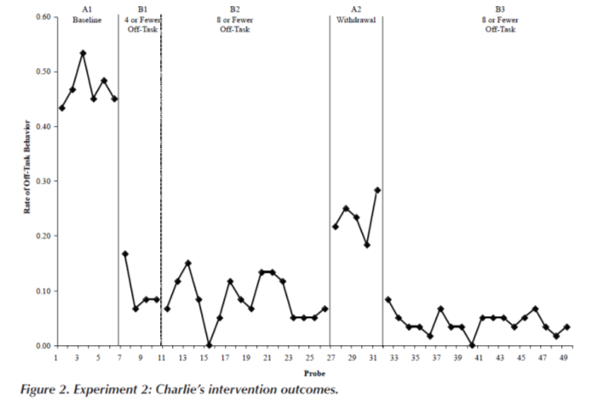
A-B-B'-A-B' Design
Intervention was modified
to increase access to
reinforcement.
Lane, K. L., Weisenbach, J. L., Phillips, A., & Wehby, J. (2007). Designing, implementing, and evaluating function-based interventions using a systematic, feasible approach. Behavioral Disorders, 32, 122-139.

Slide 60

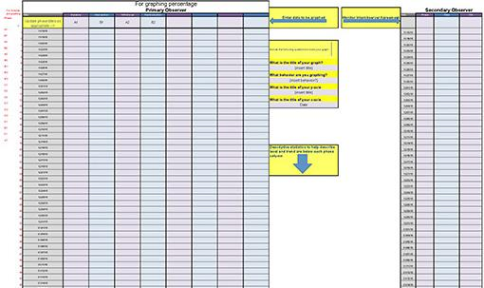
How well is it working?
Examining the Effects
Treatment Integrity
Social Validity
Experimental Design
Monitor with:
FABI Step 5 Summary Template.xls

Slide 61
Generalization and Maintenance

Slide 62
Generalization
Assess the degree to which the new behavior is observed:
  In other settings
  With other people
Programming for generalization by focusing on function.
Assessing in other setting, with other people, and looking for generalization of behavior.

Slide 63
Facilitating Generalization
Teaching the replacement behavior in the naturally-occurring setting.
Selecting antecedents that are natural to the classroom environment.
  Importance of teacher selecting most feasible tactics prior to finalizing intervention.
Selecting reinforcement tactics that are natural consequences in the classroom.
  Importance of keeping reinforcement consistent with schoolwide system for reinforcement (PBIS practices).
  The replacement behavior will elicit positive responses natural (e.g. work completion, on task, completion, compliance).

Slide 64
Maintenance
When deciding how soon or how swiftly to withdraw intervention components consider:
  Complexity of the intervention
  Ease or speed with which the behavior changed
  Availability of natural existing contingencies of reinforcement of the new behavior
Assess the degree to which the new behavior is observed:
  After a portion or all of the intervention has been discontinued
  With other people
(Cooper, Heron, & Heward, 2007)

Slide 65
Facilitating Maintenance
Teaching in natural settings.
Share intervention tactics and results with other teachers.
Gradually shift any artificial tactics to those that naturally occur in the classroom:
  e.g., From extra token reinforcements to schoolwide system, as planned, and social attention (praise).
Shift from continuous to intermittent reinforcement.

Slide 66
Generalization and Maintenance
Setting/situation generalization
Response
maintenance
Extent to which a learner emits the desired behavior in a setting or stimulus situation that is different from the instructional setting.
Extent to which a learner continues to perform the desired behavior after a portion or all of the intervention responsible for the behavior has been terminated.
(Cooper, Heron, & Heward, 2007)

Slide 67
Illustration 1:
Aaron
8th Grader
Lane, K. L., Rogers, L. A., Parks, R. J., Weisenbach, J. L., Mau, A.C., Merwin, M. T., Bergman. W. A. (207). Function-based interventions for students who are nonresponsive to primary and secondary efforts. Journal of Emotional and Behavioral Disorders, 15, 169-183.
Notes:
Source: Lane, K. L., Rogers, L. A., Parks, R. J., Weisenbach, J. L., Mau, A.C., Merwin, M. T., Bergman. W. A. (207). Function-based interventions for students who are nonresponsive to primary and secondary efforts. Journal of Emotional and Behavioral Disorders, 15, 169-183.

Slide 68
Function Matrix
(Umbreit, Ferro, Liaupsin, & Lane, 2007)
 | Positive Reinforcement | Negative Reinforcement
Attention | ABC data instances: 11 observations suggest teacher reinforcement and 2 observations suggest peer reinforcement. Teacher, parent, and student interviews: Aaron: “I like it when the girl next to me helps me. I get to talk to others. I like to work together. I always get help when I need it.” Aaron’s teacher: “Aaron, do your .... Take out your .... I’m on him right away I do think he likes the attention.”
Activities/Tangibles |  | ABC data instances: Three observations suggest escape from task. Peer interview: Aaron stated, “Sometimes I don’t understand and then I just sit there.”
Sensory
(Lane et al., 2007)
Notes:
Source: Lane, K. L., Rogers, L. A., Parks, R. J., Weisenbach, J. L., Mau, A.C., Merwin, M. T., Bergman. W. A. (207). Function-based interventions for students who are nonresponsive to primary and secondary efforts. Journal of Emotional and Behavioral Disorders, 15, 169-183.

Slide 69
Hypothesized Function
When presented with daily board work activities, Aaron engages in non-compliant behavior (staring away from his paper without writing, talking to peers about things unrelated to his board work assignments) access teacher attention and escape assigned task.
In other words, when Aaron is non-compliant he gets attention from his teacher and does not have to complete assignments (positive reinforcement-attention and negative reinforcement-activity).
(Lane et al., 2007)
Notes:
Source: Lane, K. L., Rogers, L. A., Parks, R. J., Weisenbach, J. L., Mau, A.C., Merwin, M. T., Bergman. W. A. (207). Function-based interventions for students who are nonresponsive to primary and secondary efforts. Journal of Emotional and Behavioral Disorders, 15, 169-183.

Slide 70
Method 2: Improve the environment was selected as the basis for the intervention.
Function-Based Intervention
Decision Model
Conduct FBA
Select Replacement Behavior
Can the student perform the replacement behavior?
NO
YES
Do antecedent conditions represent effective practices?
Do antecedent conditions represent effective practices?
YES
NO
NO
YES
Method 1: Teach the replacement behavior
Method 1 & 2: Teach the replacement behavior and improve the environment
Method 2: Improve the environment
Method 3: Adjust the contingencies
(Lane et al., 2007)
Notes:
Source: Lane, K. L., Rogers, L. A., Parks, R. J., Weisenbach, J. L., Mau, A.C., Merwin, M. T., Bergman. W. A. (207). Function-based interventions for students who are nonresponsive to primary and secondary efforts. Journal of Emotional and Behavioral Disorders, 15, 169-183.

Slide 71
A-R-E Intervention Components
Components |  | Intervention Tactics
Antecedent Adjustments | A1 | Teacher provides Aaron with a checklist of tasks to complete during board work.
 | A2 | Teacher ensures board work question and answers (written on the board after students complete activity) remain visible to Aaron until he completely copies the questions and answers to his notebook.
Adjust the reinforcement | R1 | Teacher and special education aide give Aaron attention (positive reinforcement) only after he successfully completes board work assignment.
 | R2 | Teacher to allow Aaron to choose a group of peers to sit with once he has successfully completed five checklists.
 | R3 | Teacher-delivered bonus points (paired with behavior specific praise) for completing checklist.
Extinction | E1 | When Aaron exhibits non-compliance, the teacher or assistance gives a verbal redirect lasting no longer than 2 s; all other attention withheld.
 | E2 | Teacher does not provide any verbal attention until Aaron finishes and raises his hand to indicate he is done. Teacher immediately approaches inspects checklist, gives verbal praise, and signs name on the checklist
 | E3 | Students work independently at work table during board work activities.
(Lane et al., 2007)
Notes:
Source: Lane, K. L., Rogers, L. A., Parks, R. J., Weisenbach, J. L., Mau, A.C., Merwin, M. T., Bergman. W. A. (207). Function-based interventions for students who are nonresponsive to primary and secondary efforts. Journal of Emotional and Behavioral Disorders, 15, 169-183.

Slide 72
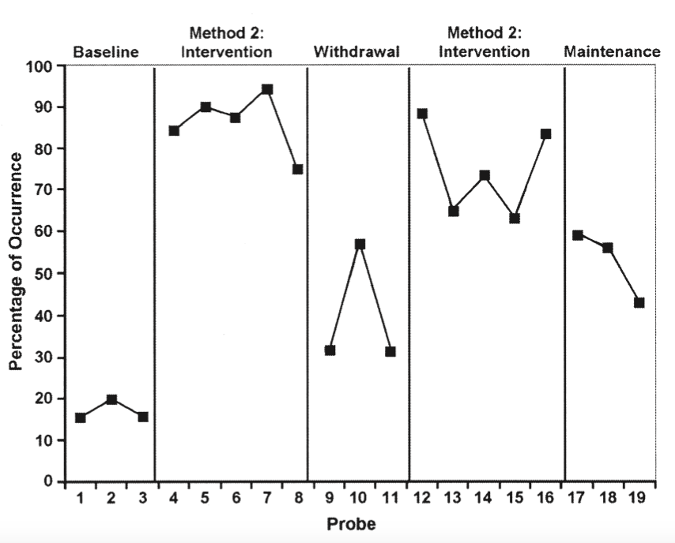
Programming for Generalization and Maintenance
Daily checklist completed by Aaron’s teacher asked her to rate Aaron’s compliant behavior for the remainder of the class period.
Quarterly GPA was monitored as a generalization measure.
Follow-up data were collected over three days, seven weeks following intervention.
(Lane et al., 2007)
Notes:
Source: Lane, K. L., Rogers, L. A., Parks, R. J., Weisenbach, J. L., Mau, A.C., Merwin, M. T., Bergman. W. A. (207). Function-based interventions for students who are nonresponsive to primary and secondary efforts. Journal of Emotional and Behavioral Disorders, 15, 169-183.
“Maintenance data were also collected (B'), showing Aaron’s behavior maintained a higher level of compliance relative to baseline with a mean of 52.67% (SD= 8.60; range = 42.9%–59.1%). Compliance did decrease relative to the second intervention phase. Yet the teacher changed the intervention procedures during the maintenance phase. Specifically, Aaron’s teacher discontinued the use of Aaron’s self-monitoring sheets and did not collect treatment fidelity. Aaron’s teacher stated that Aaron only received praise contingent upon successful completion of board work activities.” (pp. 178-179)
“Aaron’s teacher also reported supplemental findings related to Aaron’s overall science grades (course percentage). Grades were calculated in Aaron’s school every 9 weeks. The intervention was conducted during the second 9-week session, and maintenance data were collected during the third 9-week session. His teacher stated she was excited to see his science GPA go from 55% during the first 9-week session to 78% during the second 9-week session and maintain at 82% during the third 9-week session. Further, Aaron’s cumulative GPA increased from 1.67 in the first and second quarters to 2.17 in the third quarter. “ (p. 179)
“Maintenance data indicated decreased levels of compliance, which may have been caused by changes in the procedures. Aaron’s teacher restructured the board work activity for the entire class. She had the students write answers on small index cards and tape the answers inside of a folder. She also left the answers to questions up for the entire period. At the same time, Aaron requested that the checklists no longer be used. The teacher agreed given that (a) the above modification was an attempt to have the entire class self-monitor, and (b) Aaron’s grade in science continued to remain above average and stable. Aaron’s teacher stated that she continued to give Aaron extra points on his assessments per successful completion of board work assignments but did not give him opportunities to choose peers for group work and did not record whether she only gave him attention for compliant behavior.” (p. 180)

Slide 73
Illustration 2:
David
2nd Grader
Germer, K. A., Kaplan, L. M., Giroux, L. N., Markham, E. H., Ferris, G., Oakes, W., & Lane, K. L. (2011). A function-based intervention to increase a second-grade student’s on-task behavior in a general education classroom. Beyond Behavior, 20, 19-30.
Notes:
Source: Germer, K. A., Kaplan, L. M., Giroux, L. N., Markham, E. H., Ferris, G., Oakes, W. P., & Lane, K. L. (2011). A function-based intervention to increase a second-grade student’s on-task behavior in a general education classroom. Beyond Behavior, 20, 19-30.

Slide 74
Function Matrix
(Umbreit, Ferro, Liaupsin, & Lane, 2007)
 | Positive Reinforcement | Negative Reinforcement
Attention | ABC data: 97 incidences during morning work time. 1.1, 1.2, 1.3, 1.6, 1.8, 1.10, 1.15, 1.16, 1.17, 1.18, 1.20, 1.21, 1.22, 1.23, 1.24, 1.25, 1.26, 1.27, 1.30ª, 1.31, 1.34ª, 1.37, 1.38ª, 1.40ª, 1.41ª, 1.42, 1.43, 1.46ª, 1.48ª, 1.50, 1.51, 1.53, 1.54ª, 1.55, 1.56ª, 1.58, 1.59ª, 1.60, 1.61ª, 1.62ª, 1.63ª, 1.64ª, 1.66ª, 1.67ª, 1.68, 2.2ª, 2.5ª, 2.6ª, 2.7, 2.9, 2.12, 2.13ª, 2.14ª, 2.15ª, 2.16, 2.18, 2.19ª, 2.20ª, 2.21, 2.22, 2.23, 2.24, 2.25ª, 2.27ª, 2.28ª, 2.29ª, 2.30ª, 2.32ª, 2.33, 2.34, 2.35ª, 2.37, 2.38ª, 2.39, 2.41ª, 2.42ª, 2.43ª, 2.44ª; 3.1ª, 3.3, 3.4ª, 3.5ª, 3.7, 3.8, 3.9, 3.10, 3.11ª, 3.12, 3.15^{c}, 3.18ª, 3.19, 3.20, 3.23, 3.24ª, 3.25, 3.26, 3.28 Student interview: “They be falling on the floor on purpose… so people look at them and the teacher gets annoying [sic]… to get the teacher’s attention”
Activities/Tangibles | ABC data: 3 incidences during morning work time. 1.4^{b}, 2.8, 3.6^{b} Teacher interview: Motivated to finish morning math work, but does not complete during assigned time; finishes by copying during review of work, likes to turn it in.
Sensory | ABC data: 2 incidences during morning work time. 3.15^{c}, 3.21^{d} Teacher interview: “He’s not an unreasonable child… he intends to behave, but can’t. He’s not physically able to sit still.” Student interview: Tends to be off-task “when I feel ticklish”
ABC data: 84 incidences during morning work time. 1.4^{b}, 1.5, 1.7, 1.9, 1.11, 1.12, 1.13, 1.14, 1.19, 1.28, 1.29, 1.30ª, 1.32, 1.33, 1.34ª, 1.35, 1.36, 1.38ª, 1.39, 1.40ª, 1.41ª, 1.44, 1.45, 1.46ª, 1.47, 1.48ª, 1.49, 1.52, 1.54ª, 1.56ª, 1.57, 1.59ª, 1.61ª, 1.62ª, 1.63ª, 1.64ª, 1.65, 1.66ª, 1.67ª, 1.69; 2.1, 2.2ª, 2.3, 2.4, 2.5ª, 2.6ª, 2.10, 2.11, 2.13ª, 2.14ª, 2.15ª, 2.17, 2.19ª, 2.20ª, 2.25ª, 2.26, 2.27ª, 2.28ª, 2.29ª, 2.30ª, 2.32ª, 2.35ª, 2.36, 2.38ª, 2.40, 2.41ª, 2.42ª, 2.43ª, 2.44ª; 3.1ª, 3.2, 3.4ª, 3.5ª, 3.6^{b}, 3.11ª, 3.13, 3.14, 3.16, 3.17, 3.18ª, 3.21^{d}, 3.22, 3.24ª, 3.27
Teacher interview:
“He never finishes an assignment”
It typically happens during independent work, “when I’m not directing it… he takes advantage of the freedom.”
The 2nd grade level work might be too hard but he has average math and reading ability compared to class.
There’s “nothing that interests him enough.”
(Germer et al., 2011)
Notes:
Source: Germer, K. A., Kaplan, L. M., Giroux, L. N., Markham, E. H., Ferris, G., Oakes, W. P., & Lane, K. L. (2011). A function-based intervention to increase a second-grade student’s on-task behavior in a general education classroom. Beyond Behavior, 20, 19-30.

Slide 75
Hypothesized Function
When presented with an instructional task, David engages in off-task behavior (such as leaving instructional areas, inappropriately making comments, and engaging in unassigned tasks) to access attention and/or to escape tasks.
In other words, when David is off-task he gets attention from his teacher and peers and does not have to complete assignments (positive reinforcement-attention and negative reinforcement-activity).
(Germer et al., 2011)
Notes:
Source: Germer, K. A., Kaplan, L. M., Giroux, L. N., Markham, E. H., Ferris, G., Oakes, W. P., & Lane, K. L. (2011). A function-based intervention to increase a second-grade student’s on-task behavior in a general education classroom. Beyond Behavior, 20, 19-30.

Slide 76
Method 2: Improve the environment was selected as the basis for the intervention.
Function-Based Intervention
Decision Model
Conduct FBA
Select Replacement Behavior
Can the student perform the replacement behavior?
NO
YES
Do antecedent conditions represent effective practices?
Do antecedent conditions represent effective practices?
YES
NO
NO
YES
Method 1: Teach the replacement behavior
Method 1 & 2: Teach the replacement behavior and improve the environment
Method 2: Improve the environment
Method 3: Adjust the contingencies
(Germer et al., 2011)
Notes:
Source: Germer, K. A., Kaplan, L. M., Giroux, L. N., Markham, E. H., Ferris, G., Oakes, W. P., & Lane, K. L. (2011). A function-based intervention to increase a second-grade student’s on-task behavior in a general education classroom. Beyond Behavior, 20, 19-30.

Slide 77
A-R-E Intervention Components
Components |  | Intervention Tactics
Antecedent Adjustments | A1 | David sat facing the whiteboard.
 | A2 | Stop Light was affixed to the side of David’s desk; David used a clothespin to signal which “light” he was on.
 | A3 | A copy of David’s self-monitoring form was displayed on his desk.
 | A4 | The teacher reviewed the picture schedule for the morning work period prior to the work period.
 | A5 | The teacher checked in with David at the beginning of independent tasks to ensure that he understood the assignment.
Adjust the reinforcement | R1 | The teacher provided behavior-specific praise when David was on-task.
 | R2 | The teacher acknowledged David’s need for help when his clothespin was on red and assisted him as quickly as possible.
 | R3 | The teacher checked David’s work upon completion, provided praise, and allowed him to take a short break.
 | R4 | At the end of the morning independent work period, the teacher helped David complete his self-monitoring form and wrote one specific incidence of good behavior at the bottom.
Extinction | E1 | The teacher provided no praise or attention when David was off-task, with the exception of one verbal or gestural redirect per minute.
 | E2 | The teacher provided assistance without praise and with minimal interaction when David’s clothespin was on red.
 | E3 | When David was off-task, the teacher praised other students who were behaving appropriately.
(Germer et al., 2011 )
Notes:
Source: Germer, K. A., Kaplan, L. M., Giroux, L. N., Markham, E. H., Ferris, G., Oakes, W. P., & Lane, K. L. (2011). A function-based intervention to increase a second-grade student’s on-task behavior in a general education classroom. Beyond Behavior, 20, 19-30.

Slide 78
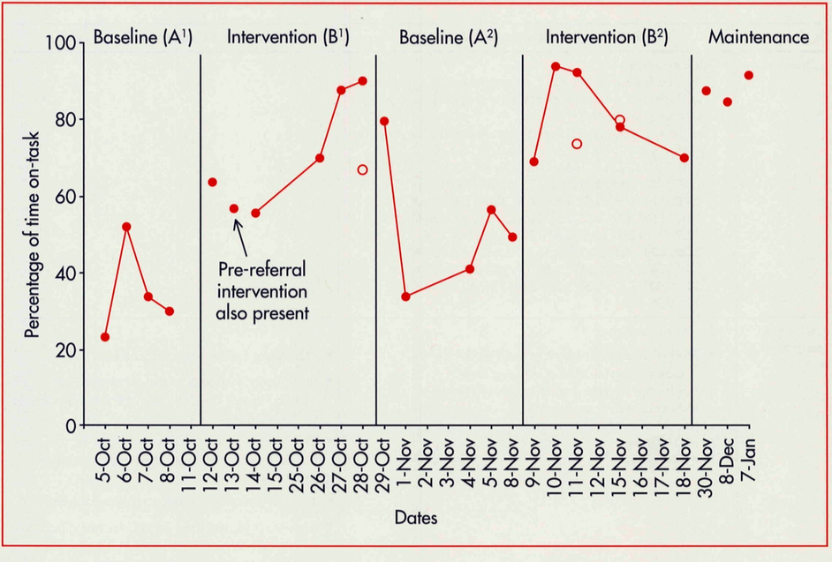
Programming for Generalization and Maintenance
Generalization data taken during afternoon instructional periods during both intervention phases.
Maintenance probes at the completion of the intervention.
(Germer et al., 2011)
Notes:
Source: Germer, K. A., Kaplan, L. M., Giroux, L. N., Markham, E. H., Ferris, G., Oakes, W. P., & Lane, K. L. (2011). A function-based intervention to increase a second-grade student’s on-task behavior in a general education classroom. Beyond Behavior, 20, 19-30.

Slide 79
Frequently Asked Questions (FAQ): What if Scenarios

Slide 80
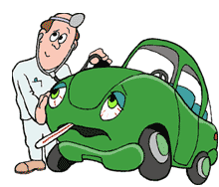
What if…
… the student’s behavior does not improve with the introduction of the intervention?
Does treatment integrity and social validity data suggest re-teaching or coaching are needed?
Does the intervention need slight revision or does a new intervention need to be designed?
Examine the plan:
  The function of the target behavior
  Did you determine the correct function?
  The intervention method
    Did you select the correct method?
  The ARE components
    Are all three components tied to function?

Slide 81

What if…
…the student’s behavior does not deteriorate (reverse) during withdrawal?
Examine treatment integrity and social validity data:
  Were all intervention components removed?
  What elements were still in place?
Ask yourself:
  Has the student’s behavior generalized?
  Is the student accessing natural reinforcement?
  Has learning occurred?
Treat as a limitation and continue to monitor for generalization and maintenance

Slide 82

What if…
…the student asks for the intervention back during withdrawal?
Examine student outcome data:
  Consider shortening length of the withdrawal phase.
Consider this as additional evidence of social validity.
We are going to see how things are going for just a short time.

Slide 83
What if…
… situations outside the context of the classroom change significantly (e.g., new meds, changes in home)? How do you represent this?
Indicate this with the introduction of new phase
  Label this phase, with a prime (’). For example, B₁ becomes B₁’.
Illustration: Change in medication
Alan started a new medication
A₁
B₁
B_{1’}

Slide 84
What if…
...you change the intervention, or introduce a new intervention? How do you represent this?
  Indicate with the introduction of a new phase:
    For an adjustment to the intervention, label as a prime
    (e.g., B1 becomes B1’).
    For a change or new condition represented by a new letter
    (e.g., B1 becomes C1).
Illustration: Change in method
Change intervention from
Method 3 to Method 2
A₁
B₁
C₁

Slide 85
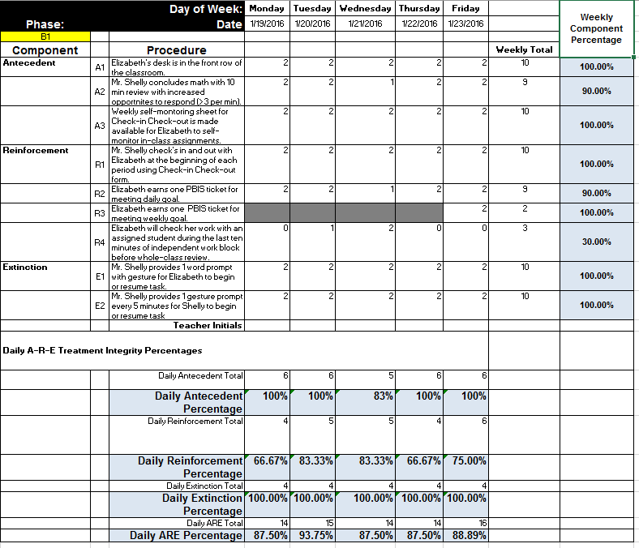
What if…
...a functional relation was established, but treatment integrity was low?
Examine treatment integrity:
What elements were implemented with higher integrity, which elements were lower?
What other situations, if anything have changed for the child?

Slide 86
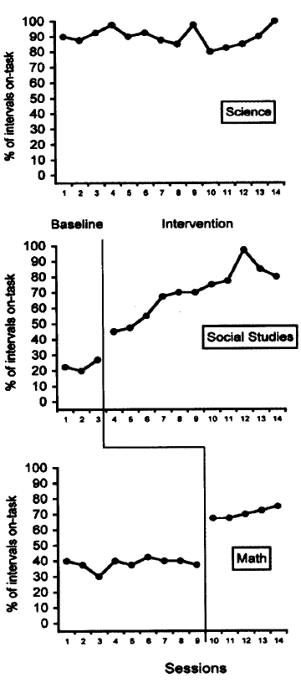
What if…
…the intervention cannot be withdrawn
(e.g., when learning is involved, when behavior is a serious safety concern)?
Consider other single-case designs.
Multiple Baseline
Changing Criterion Designs
(Lane, Rogers, Parks, Weisenbach, Mau, Merwin, & Bergman, 2007).
(Liaupsin, Umbreit, Ferro, Urso, & Upreti, 2006)

Slide 87













Will you please...
Discuss:
What are your “take aways” from this session?
How might you use FABIs with your students?
Let’s talk …
And make plans!
Notes:
10 min Using this PowerPoint break timer
**Is timer set to correct time. Do we want 25 or 10? Same question for above slide.
This PowerPoint slide uses images, custom animation, and timing to provide a countdown timer that you can use in any presentation. When you open the template, you’ll notice that the timer is set at 00:00. However, when you start the slide show, the timer will start at the correct time and count down by 1-minute intervals until it gets to 1 minute. At that point, it will count down in two 30-seconds intervals to 00:00.
To insert this slide into your presentation
Save this template as a presentation (.ppt file) on your computer.
Open the presentation that will contain the timer.
On the Slides tab, place your insertion point after the slide that will precede the timer. (Make sure you don't select a slide. Your insertion point should be between the slides.)
On the Insert menu, click Slides from Files.
In the Slide Finder dialog box, click the Find Presentation tab.
Click Browse, locate and select the timer presentation, and then click Open.
In the Slides from Files dialog box, select the timer slide.
Select the Keep source formatting check box. If you do not select this check box, the copied slide will inherit the design of the slide that precedes it in the presentation.
Click Insert.
Click Close.

Slide 88

Recommended Resources
Questions:
wendy.oakes@asu.edu
kathleen.lane@ku.edu
Thank you!
Umbreit, J., Ferro, J. B., Liaupsin, C. J., & Lane, K. L. (2007). Functional behavioral assessment and function-based intervention: An effective, practical approach. New York, NY: Pearson.
Functional assessment-based Interventions: A university-district partnership to promote learning and success (2011). A special issue of Beyond Behavior, volume 20, issue 3
FABI Textbook
FABI Illustrations

Slide 89


Recommended Resources
Lane, K. L., Menzies, H. M., Bruhn, A.L., & Crnobori, M. (2011). Managing Challenging Behaviors in Schools: Research-Based Strategies That Work. New York, NY: Guilford Press.
Lane, K. L., Menzies, H. M., Ennis, R. P., & Oakes, W. P. (2015). Supporting behavior for school success: A step-by-step guide to key strategies. New York, NY: Guilford Press.
FABI Planning Forms as well as strategies to consider as part of A-R-E
Low intensity strategies to consider as part of A-R-E

Slide 90

Recommended Resources
Cooper, J. O., Heron, T. E., & Heward, W. L. (2007). Applied Behavior Analysis (2nd ed.). Upper Saddle River, NJ: Pearson.
Applied Behavior Analysis Textbook

