Slide 1
Precorrection
A Low-Intensity Strategy

Slide 2


Agenda
Comprehensive, integrated, three-tiered (Ci3T) model of prevention
A look at precorrection
  What is precorrection?
  Why is precorrection effective?
  What does the supporting research for precorrection say?
  What are the benefits and challenges?
  How do I implement precorrection in my classroom?
    Implementation checklist
  How well is it working?
    Examining the effects

Slide 4


Schoolwide Positive
Behavior Support
Comprehensive, Integrated,
Three-Tiered (Ci3T)
Models of Support
Low-Intensity Strategies
Basic Classroom Management
Effective Instruction
Low-Intensity Strategies
Behavior Contracts
Self-Monitoring
- -
Functional Assessment-Based
Interventions
Higher-Intensity Strategies
Assess, Design, Implement, and
Evaluate
Assessment
Adapted from Lane, K. L., Menzies, H. M., Bruhn, A. L., & Crnobori, M. (2011). Managing challenging behaviors in schools: Research-based strategies that work. New York, NY: Guilford Press.

Slide 5

What is precorrection?
Proactive strategy that helps solve everyday problems with minimal planning
Antecedent-based positive behavior support that emphasizes changing the environment to promote engagement and reduce the likelihood of challenging behavior
“Gets in front” of disruptive behaviors that are predictable or readily anticipated, reducing or eliminating likeliness of problem behavior occurring
Preplanning with the preventative strategy of precorrection means problem behaviors are dealt with before they occur instead of reacting to them after they occur

Slide 6
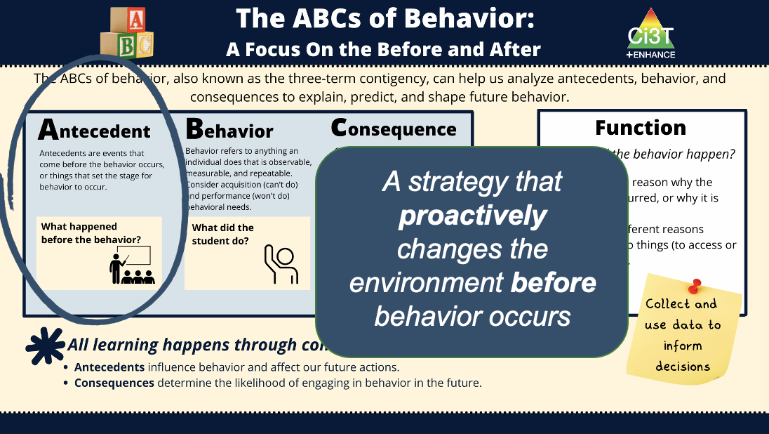
What are antecedent-based strategies?
Antecedent: Event that occurs before a behavior
Antecedent-based strategies alter the environment before a behavior occurs
Aims to prevent undesired behavior and/or increase odds desired behaviors will occur; more likely student will follow directions or complete their work
Appreciated by teachers as they are proactive (i.e., used before challenging behaviors occur) and set the stage for preferred behaviors

Slide 7
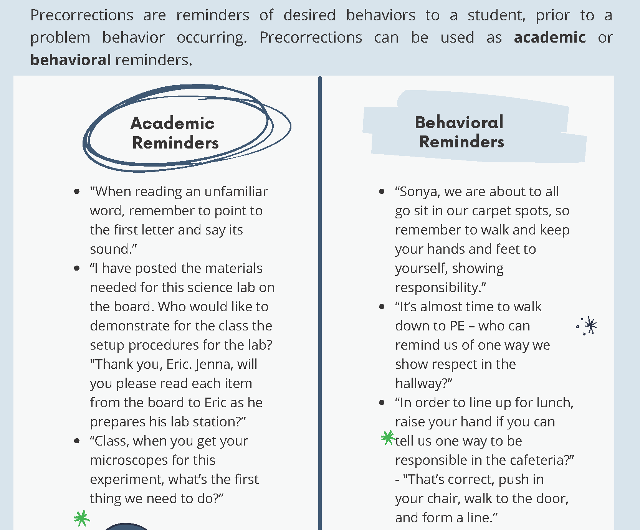
Examples of precorrection

Slide 8



Why is Precorrection Effective?
Proactive – involves anticipating activities, settings, or times of day that could potentially result in challenging behavior
Reduce likelihood of challenging behavior occurring in the first place
Focuses on expected behaviors
Reduces potential for escalating behavior patterns
Promotes positive student-teacher interactions

Slide 9
What does the supporting research say?
Positive effects have been documented with students in:
preschool (e.g., Stormont et al., 2007; Smith, Lewis et al., 2011),
elementary (e.g., Colvin, Sugai, & Good, 1997; De Pry & Sugai, 2000),
middle school (e.g., Faul et al., 2012; Haydon & DeGreg, 2012), and
high school levels (e.g., Haydon & Kroeger, 2016)
Head Start classrooms (e.g., Stormont et al., 2007; Smith, Lewis et al., 2011)
general education classrooms (e.g., DePry & Sugai, 2002; Haydon & DeGreg, 2012)
non-classroom settings (e.g., hallways, lunchroom) (e.g., Colvin, Sugai, & Good, 1997)

Slide 10
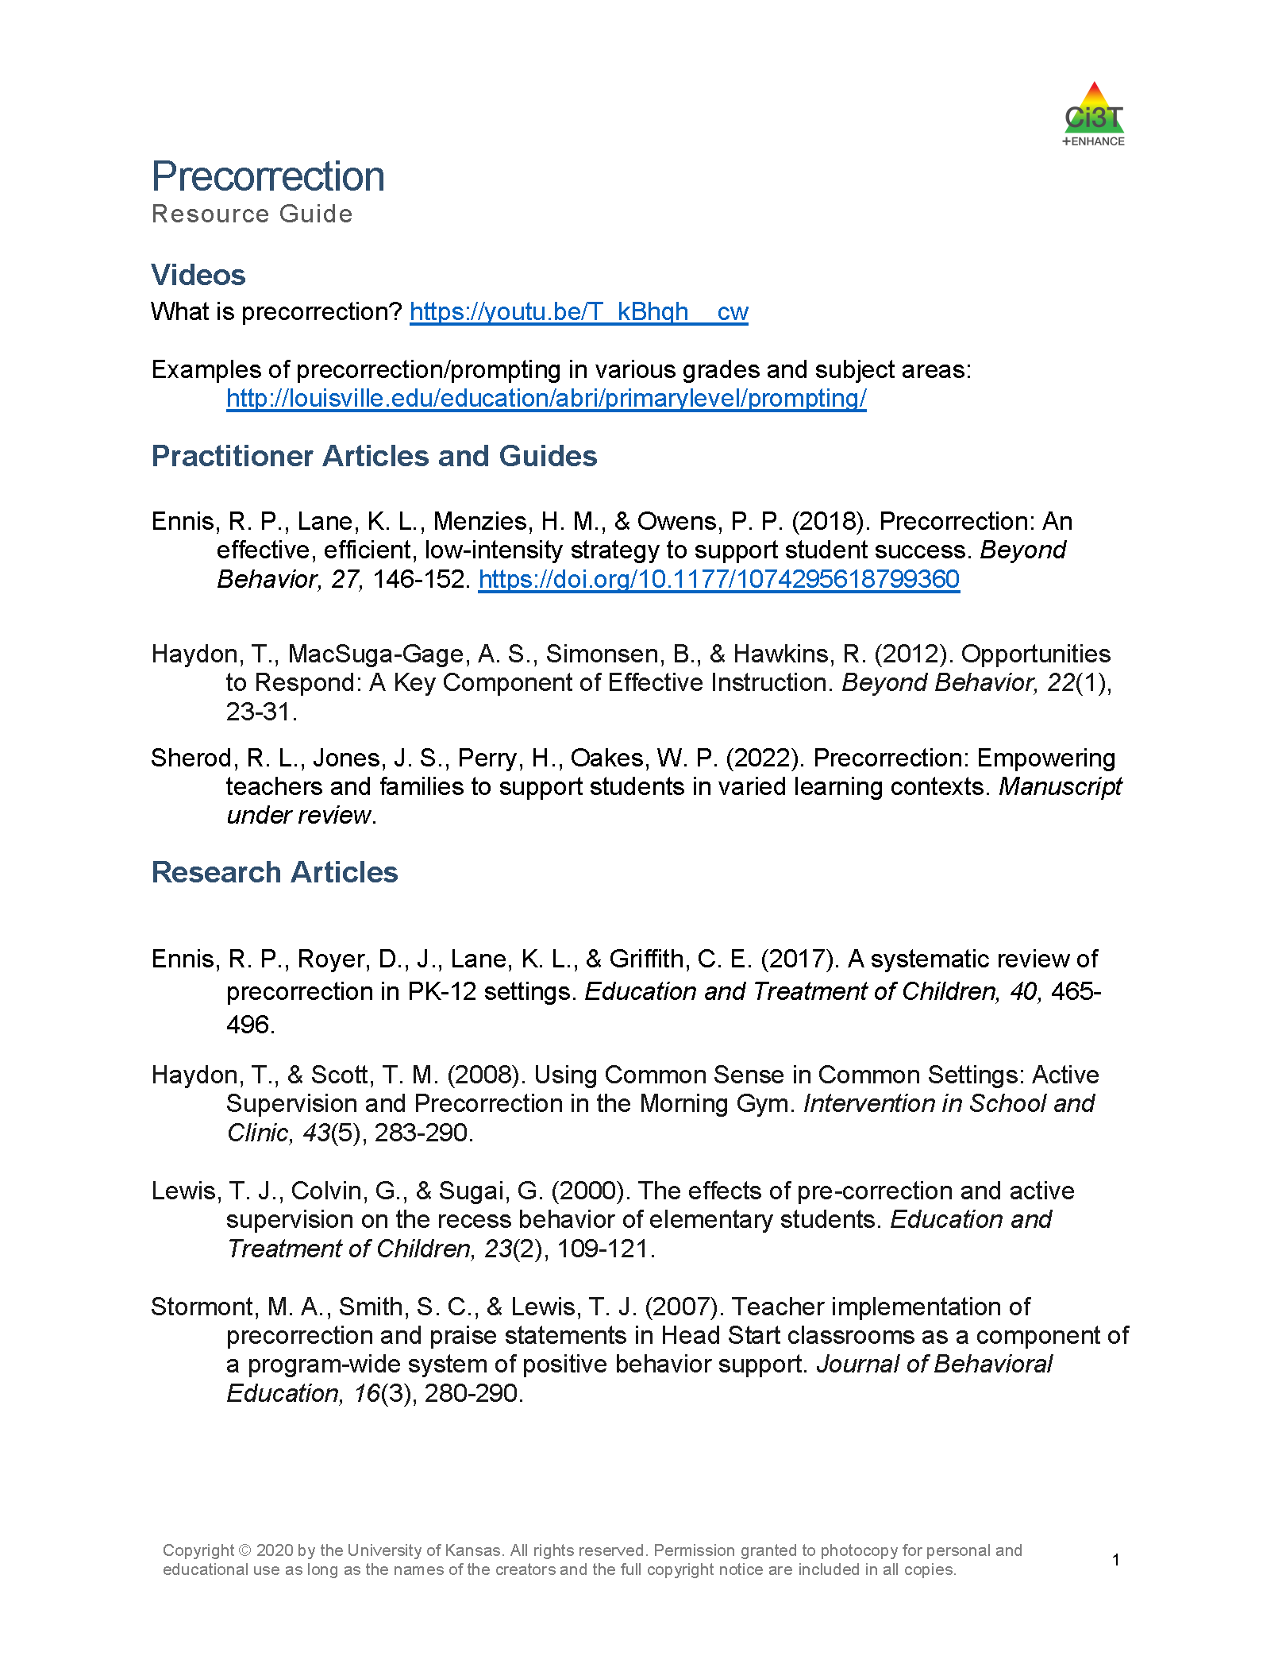
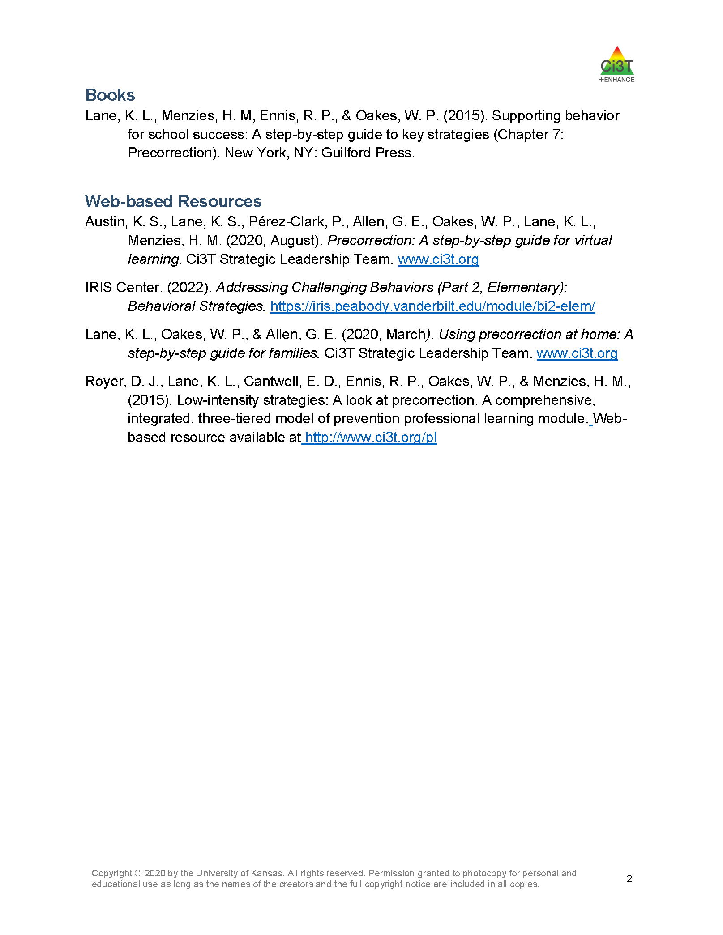

Resources to support implementation of precorrection
See “Precorrection Resource Guide” for additional supporting research and information.
Include .png images of the strategy’s resource guide PDF here.

Slide 11
What are the benefits and challenges?
Benefits
Challenges
Proactive rather than reactive
  Prevent problem behaviors from occurring less stress for teachers and more time for instruction
Can be implemented at varying levels of intensity depending on the specific situation
  From simple, brief reminder for all to individualized precorrection plan
Utilizing proactive strategies like precorrection often requires a shift in thinking
  Traditionally schools have used reactive ways of addressing challenging behaviors
To use effectively, necessary to have some knowledge of a given setting
  Needed to anticipate when challenging behaviors may arise

Slide 12

How do I implement precorrection in my classroom? Implementation Checklist
Step 1
Adjust the environment
Step 2
Provide opportunities for behavioral rehearsal
Step 6
Provide strong reinforcement to students engaging in expected behaviors
Step 5
Determine the expected behaviors
Identify contexts and anticipated behaviors
Step 3
Step 4
Develop a prompting plan to remind students about the expected behavior
Step 7
Develop a monitoring plan to determine the effectiveness of the precorrection plan
Step 8
Offer students an opportunity to give feedback on this strategy

Slide 13
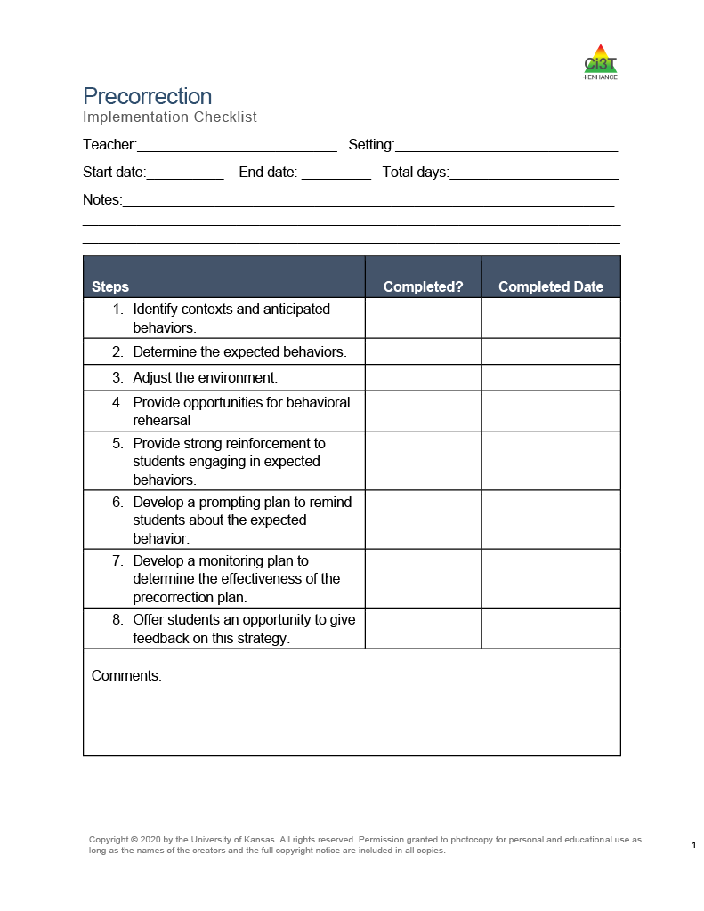
How do I implement precorrection in my classroom? Implementation Checklist
Step 1: Identify contexts and anticipated behaviors
Step 2: Determine the expected behaviors
Step 3: Adjust the environment
Step 4: Provide opportunities for behavioral rehearsal
Step 5: Provide strong reinforcement to students engaging in expected behaviors
Step 6: Develop a prompting plan to remind students about the expected behavior
Step 7: Develop a monitoring plan to determine the effectiveness of the precorrection plan
Step 8: Offer students an opportunity to give feedback on this strategy
Include .png image of the strategy’s implementation checklist PDF here.

Slide 14
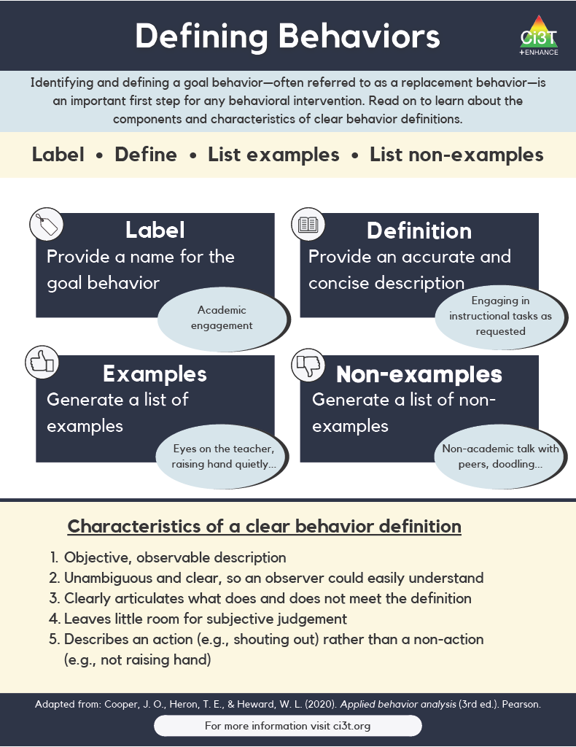

Step 1: Identify contexts and anticipated behaviors

Slide 15


Step 2: Determine the expected behaviors

Slide 16


Step 3: Adjust the environment

Slide 17
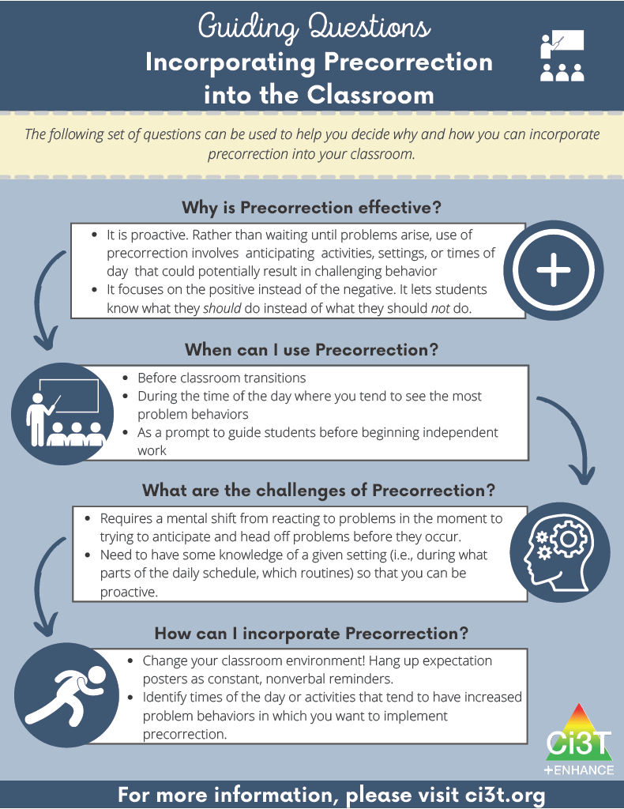

Step 4: Provide opportunities for behavioral rehearsal

Slide 18

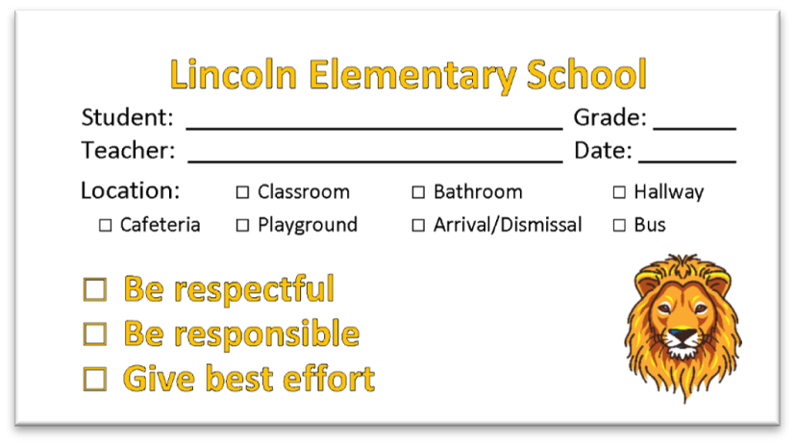
Step 5: Provide strong reinforcement to students engaging in expected behaviors

Slide 19

Step 6: Develop a prompting plan to remind students about the expected behavior

Slide 20

Step 7: Develop a monitoring plan to determine the effectiveness of the precorrection plan

Slide 21


Step 8: Offer students an opportunity to give feedback on this strategy

Slide 22

How well is it working?
Examining the effects
Treatment Integrity
Is it happening?
Social Validity
What do stakeholders think about the goals, procedures, and outcomes?
Experimental Design
How well did this support work for this student?

Slide 23
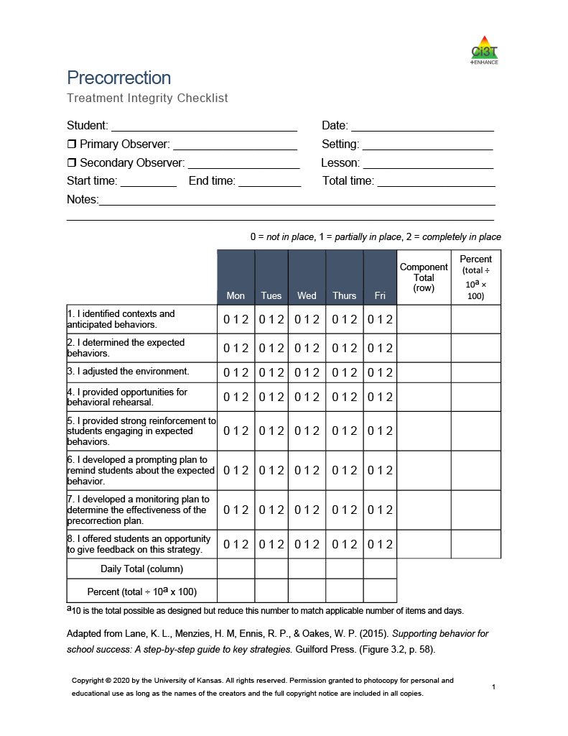
Ensuring precorrection is in place: Treatment integrity
Have structures in place to monitor whether precorrection are carried out as intended. Treatment integrity checklist items:
I identified contexts and anticipated behaviors.
I determined the expected behaviors.
I adjusted the environment.
I provided opportunities for behavioral rehearsal.
I provided strong reinforcement to students engaging in expected behaviors.
I developed a prompting plan to remind students about the expected behavior.
I developed a monitoring plan to determine the effectiveness of the precorrection plan.
I offered students an opportunity to give feedback on this strategy.
Include .png image of the strategy’s TI checklist PDF in the right column.

Slide 24
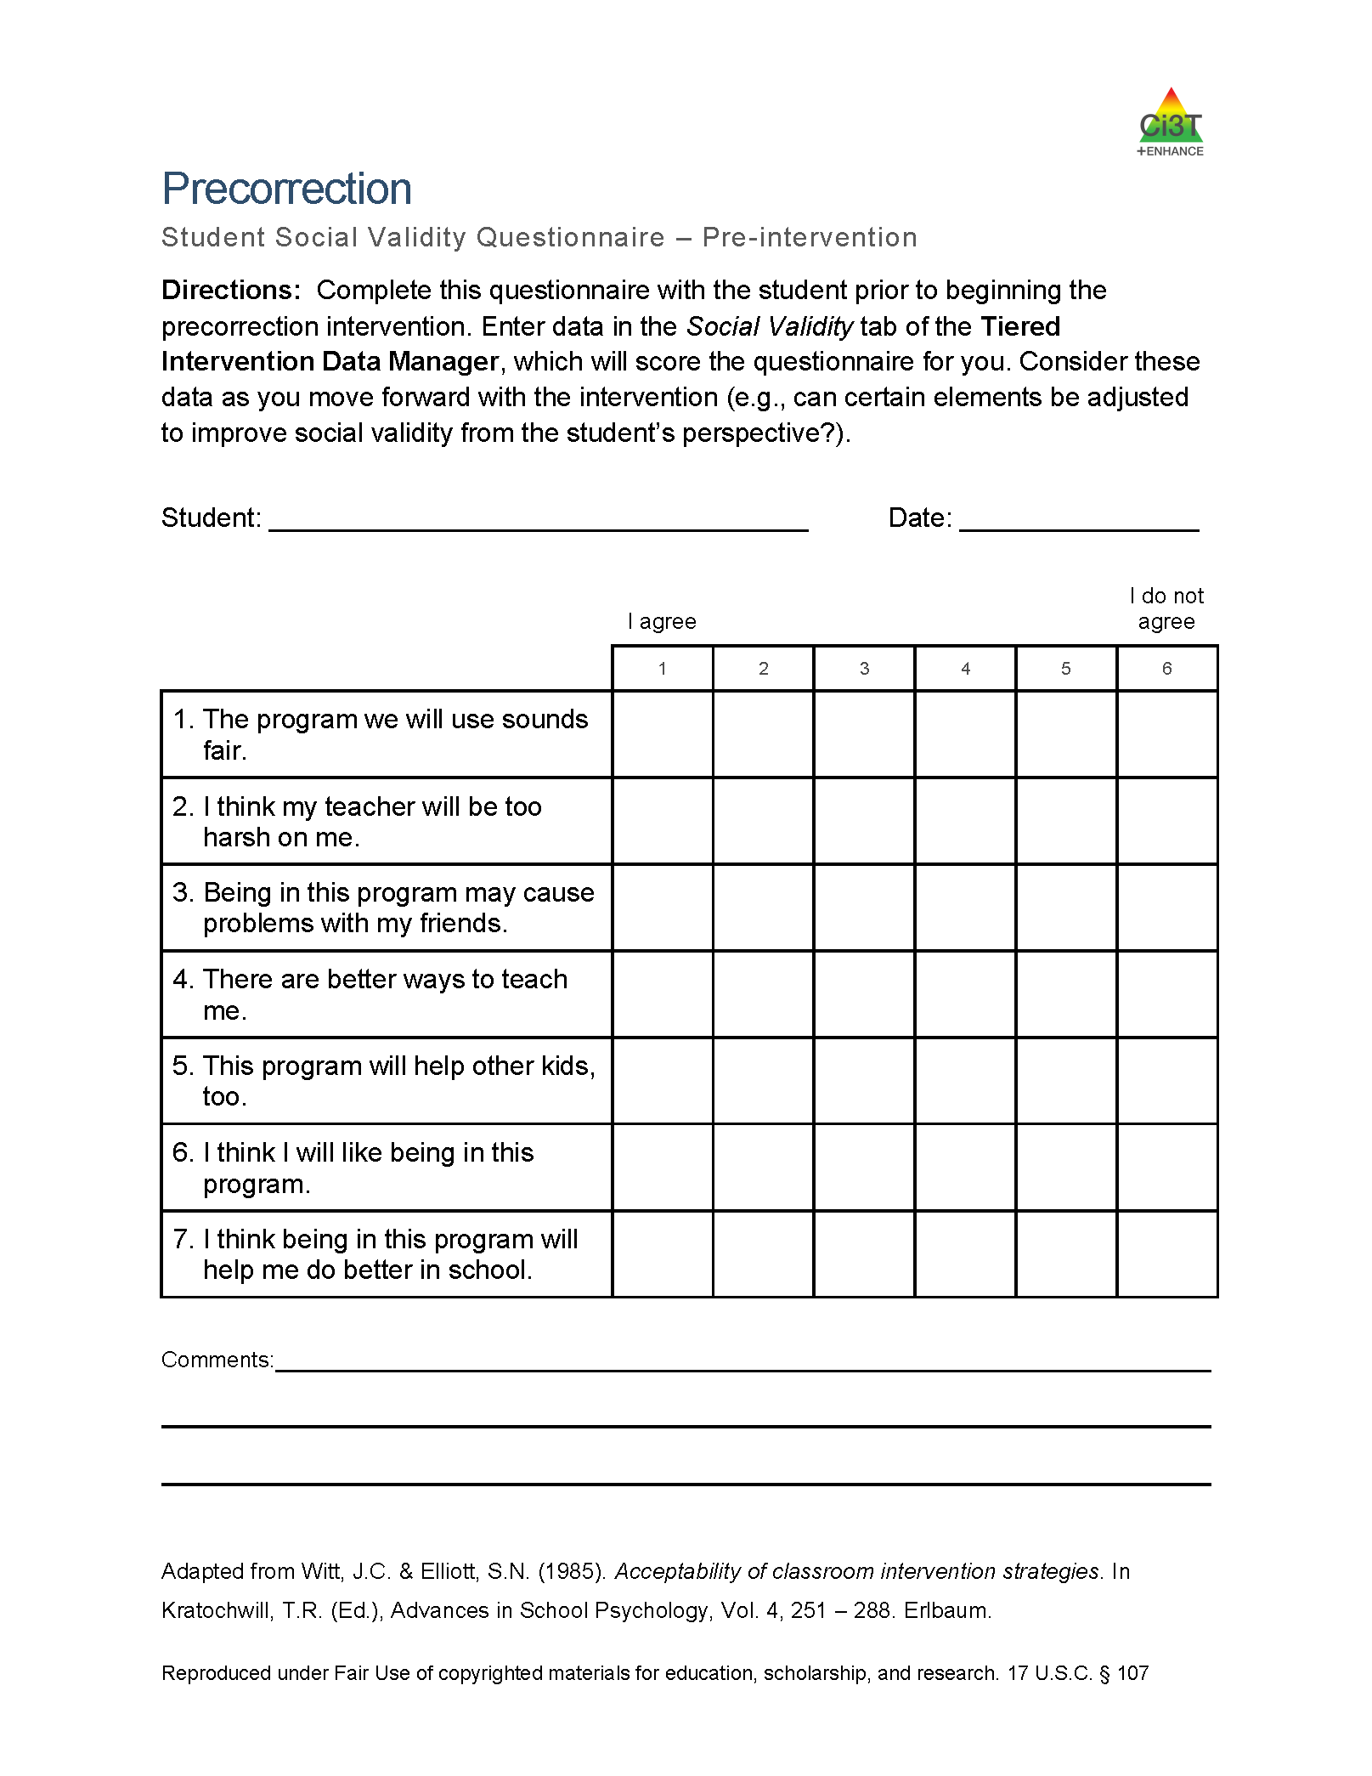
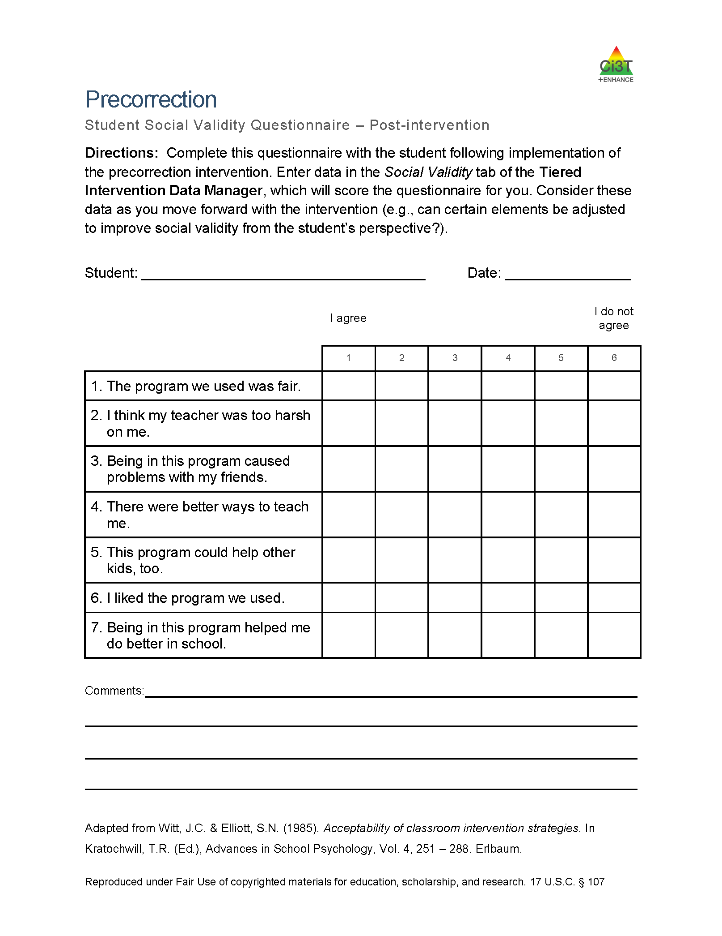
What does the student think about it?
See “Precorrection Student Social Validity Questionnaire”
Completed by the teacher(s), paraeducator(s), and parent(s) involved in the intervention at two time points:
pre- and post-
intervention
Pre-
Post-
Include .png images of the strategy’s student SV PDFs here, pre on left, post on right.

Slide 25
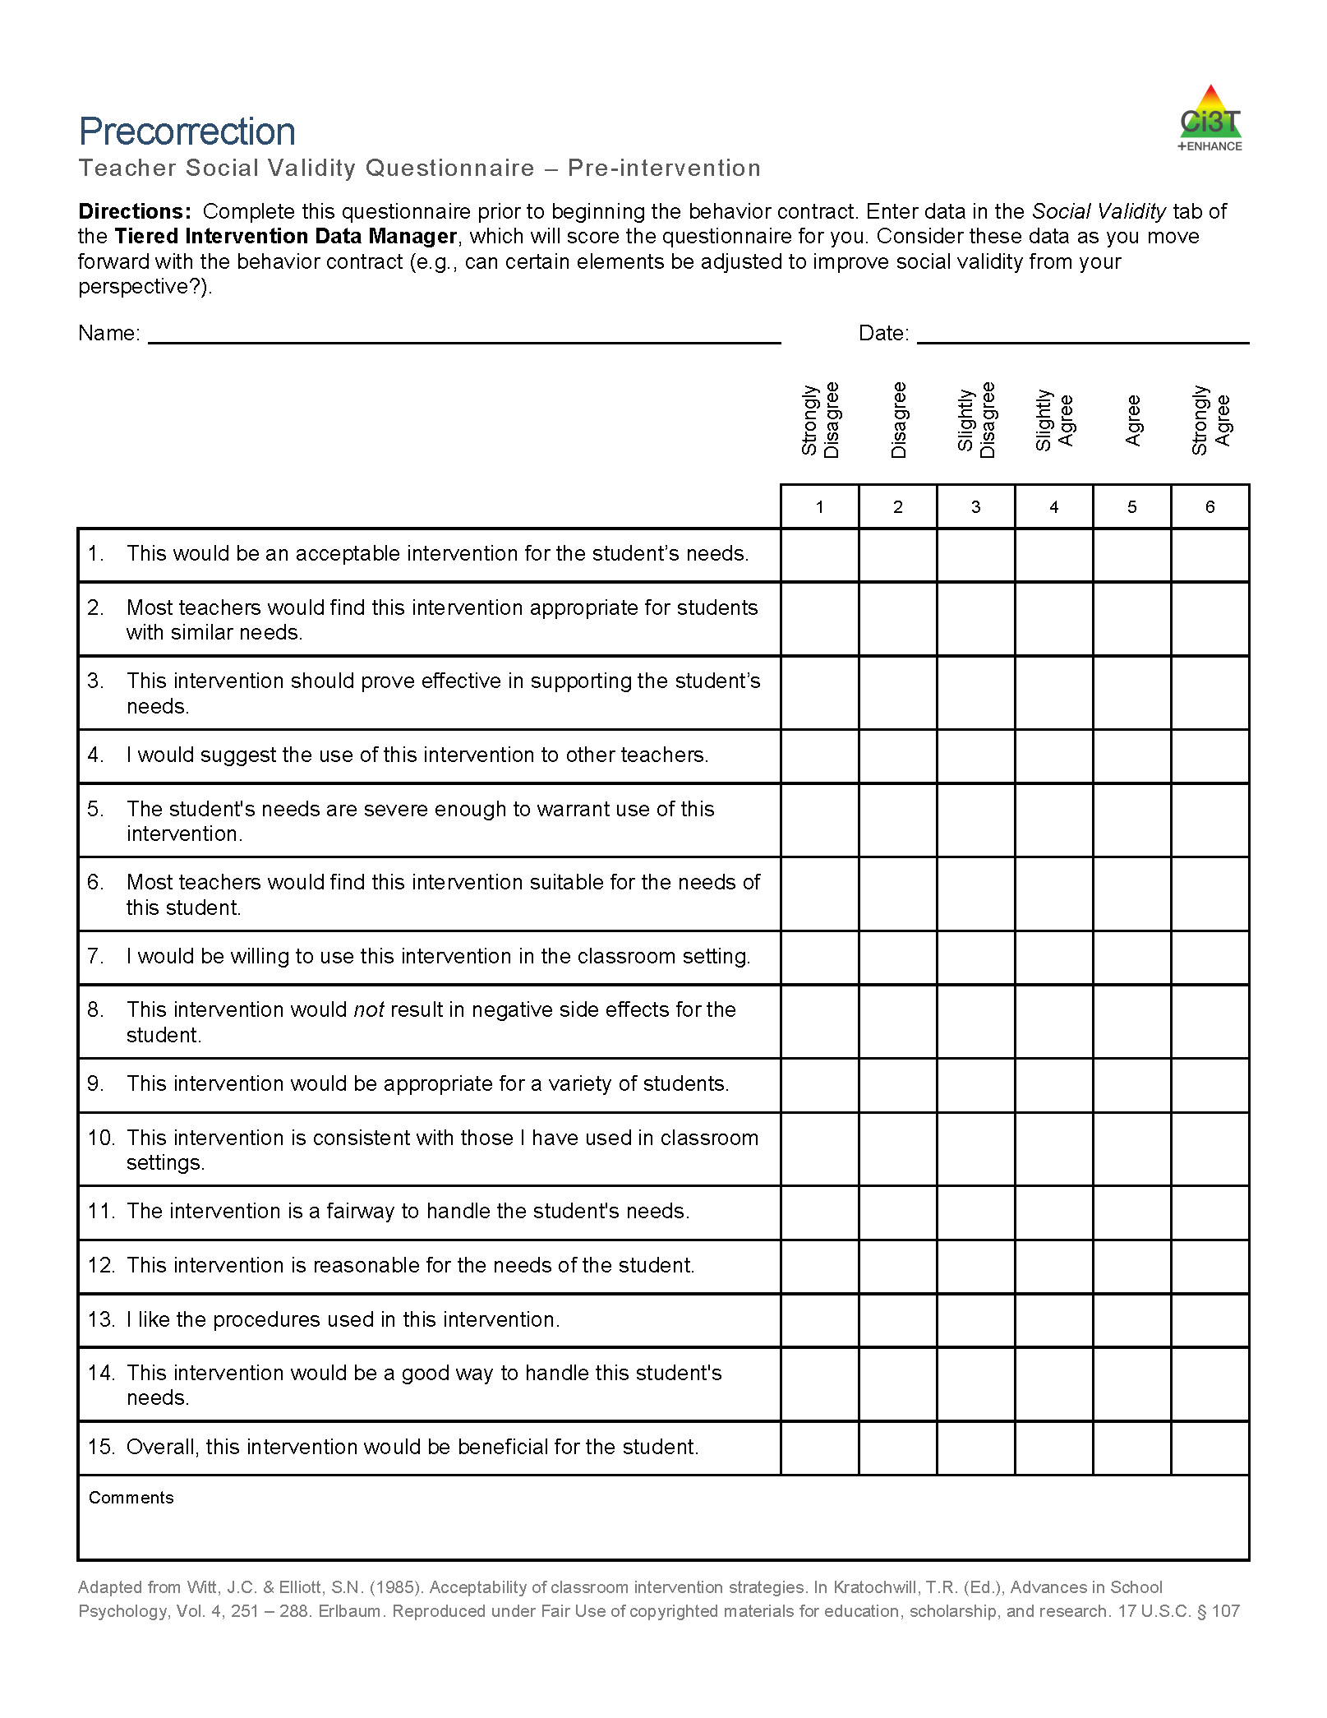
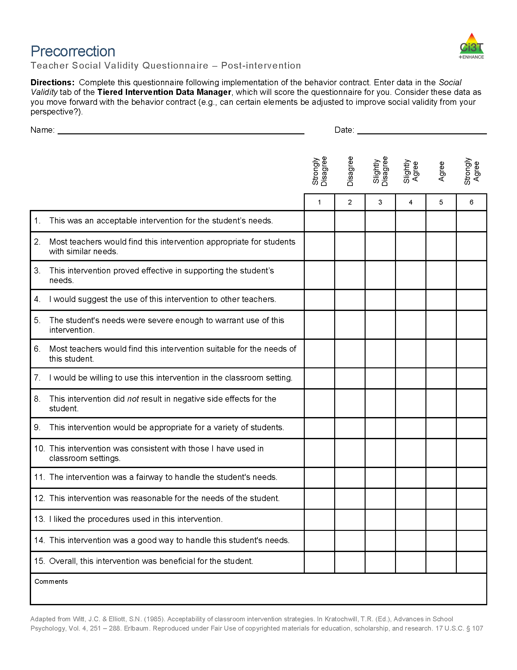
What do the adults think about it?
See “Precorrection Teacher Social Validity Questionnaire”
Completed by the teacher(s), paraeducator(s), and parent(s) involved in the intervention at two time points:
pre- and post-
intervention

Slide 26
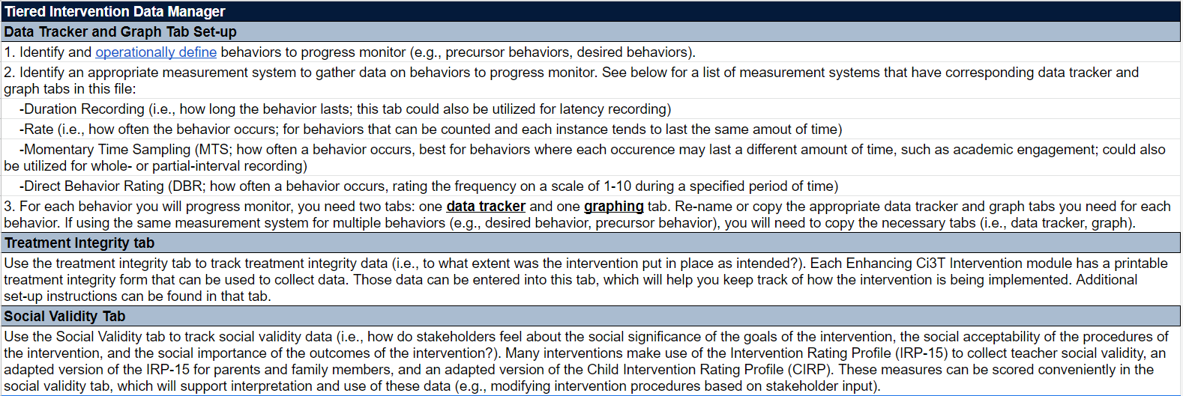
Data to progress monitor precorrection
Include A-B-A-B graph or other experimental design

Slide 27
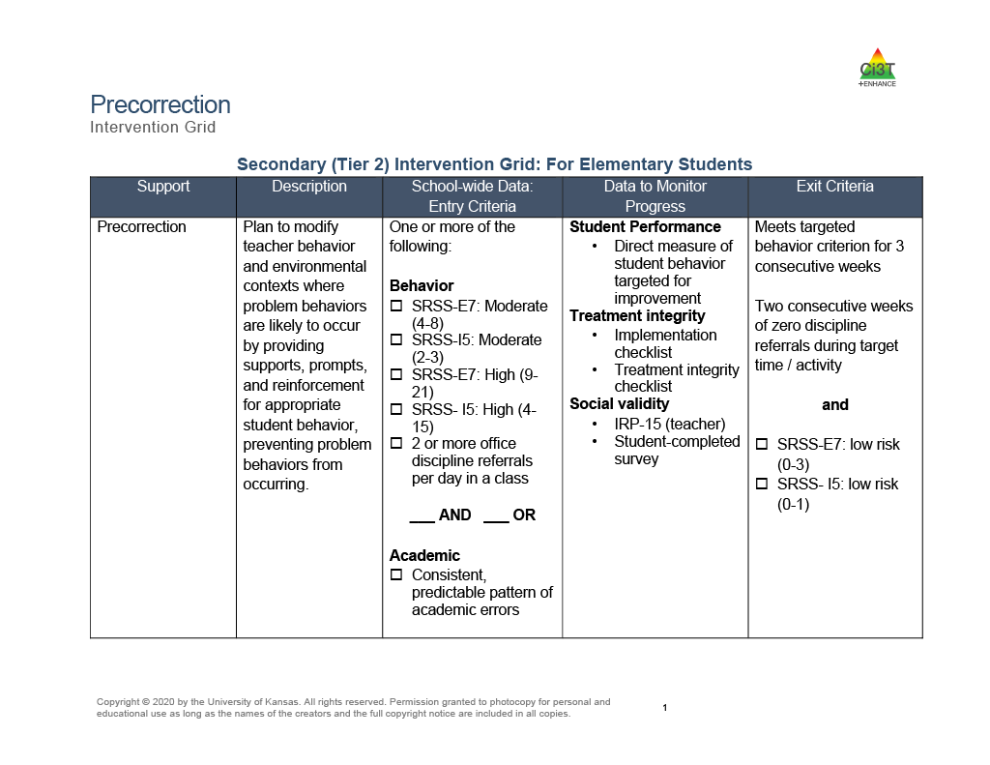
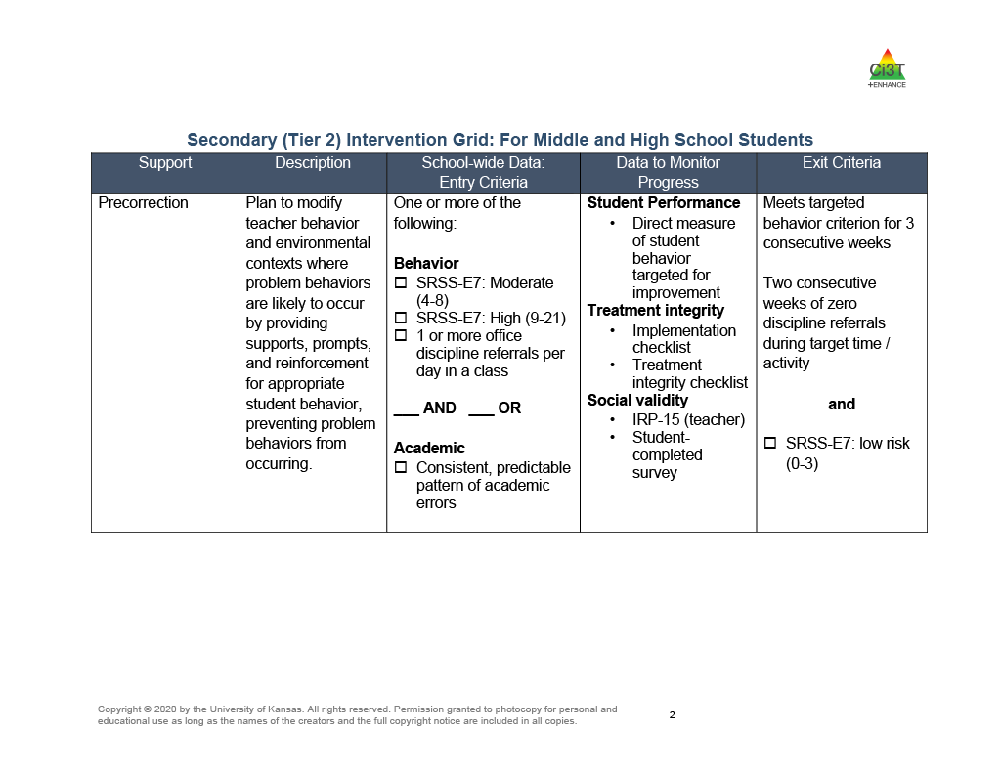
Sample secondary intervention grids

Slide 28




Resources
ci3t.org
Customize with books and websites applicable to the strategy or support topic.

