Slide 1
Secondary (Tier 2) Interventions in Ci3T Models: Logistics and Illustrations
EMPOWER Session 4
Presenters and Contributors | Contributors
Allison M. Bernard | Elise Sarasin
Mark M. Buckman | Rebecca L. Sherod
Kathleen Lynne Lane | Stacie Williams
Wendy Peia Oakes

Slide 3
Let’s Connect on Social Media!
Tag us in your Ci3T highlights- we’d love to see Ci3T in action!
Follow us on Twitter or Instagram for updates and links to resources!
@Ci3TModel

Slide 4
Ci3T Professional Learning Calendar
 | July | Aug | Sep | Oct | Nov | Dec | Jan | Feb | Mar | Apr | May | Jun
Ci3T Training |  |  |  |  | Ci3T Professional Learning Series Session 1 | Ci3T Professional Learning Series Session 2 | Ci3T Professional Learning Series Session 3 | Ci3T Professional Learning Series Session 4 |  | Ci3T Professional Learning Series Session 5 | Ci3T Professional Learning Series Session 6
Ci3T Implementation Support | Ci3T Implementation Series Prep Session |  | Ci3T Implementation Series Session 1 |  | Ci3T Implementation Series Session 2 |  | Ci3T Implementation Series Session 3 |  | Ci3T Implementation Series Session 4 | Ci3T Implementation Series Session 5
Ci3T EMPOWER |  |  | Ci3T EMPOWER Session 1 | Ci3T EMPOWER Session 2 | Ci3T EMPOWER Session 3 |  | Ci3T EMPOWER Session 4 |  | Ci3T EMPOWER Session 5 | Ci3T EMPOWER Session 6
Ci3T Trainers & Coaches Calls |  | Trainers & Coaches Call Session 1 | Trainers & Coaches Call Session 2 | Trainers & Coaches Call Session 3 | Trainers & Coaches Call Session 4 | Trainers & Coaches Call Session 5 | Trainers & Coaches Call Session 6 | Trainers & Coaches Call Session 7 | Trainers & Coaches Call Session 8 | Trainers & Coaches Call Session 9 | Trainers & Coaches Call Session 10

Slide 5
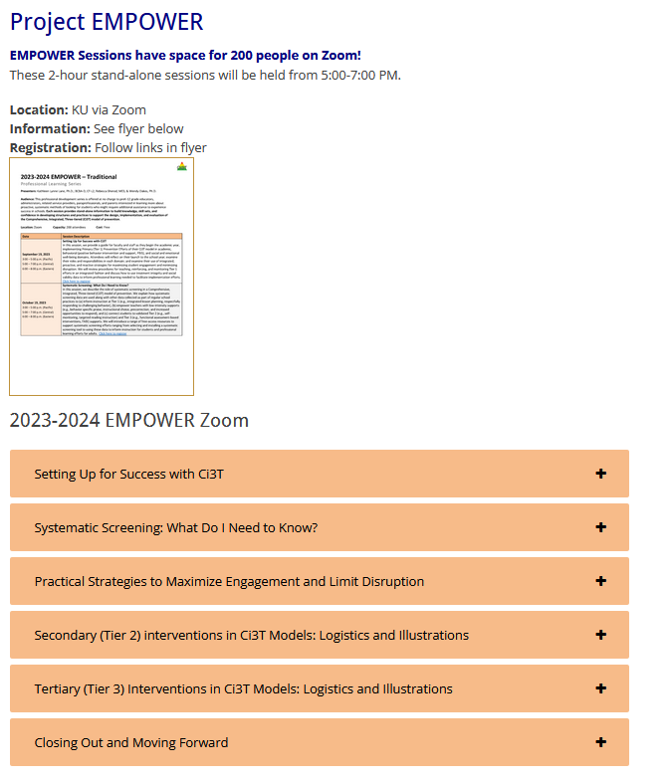
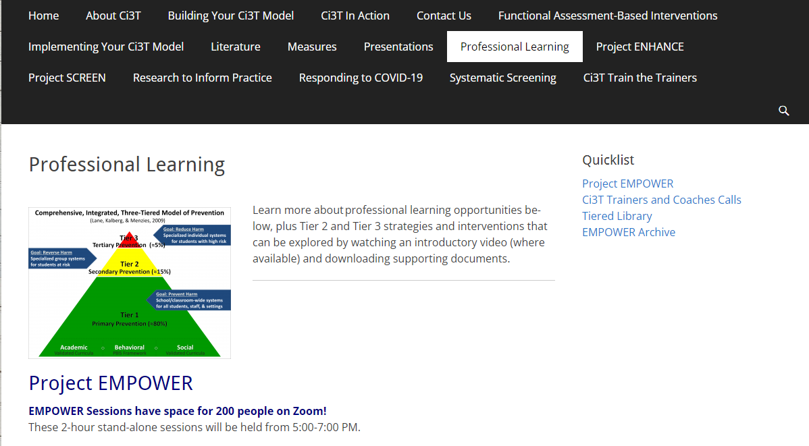
Accessing Project EMPOWER Professional Learning

Slide 6
Agenda
Welcome
Overview of Secondary (Tier 2) Interventions in Ci3T Models: Data-informed Decision-making
Intervention 1: Behavior Contracts as a Tier 2 Intervention
Intervention 2: Self-Regulated Strategy Development (SRSD) for Writing as a Tier 2 Intervention
Exploring Other Secondary (Tier 2) Interventions in Ci3T Models
Wrapping Up and Moving Forward

Slide 7
Welcome

Slide 8
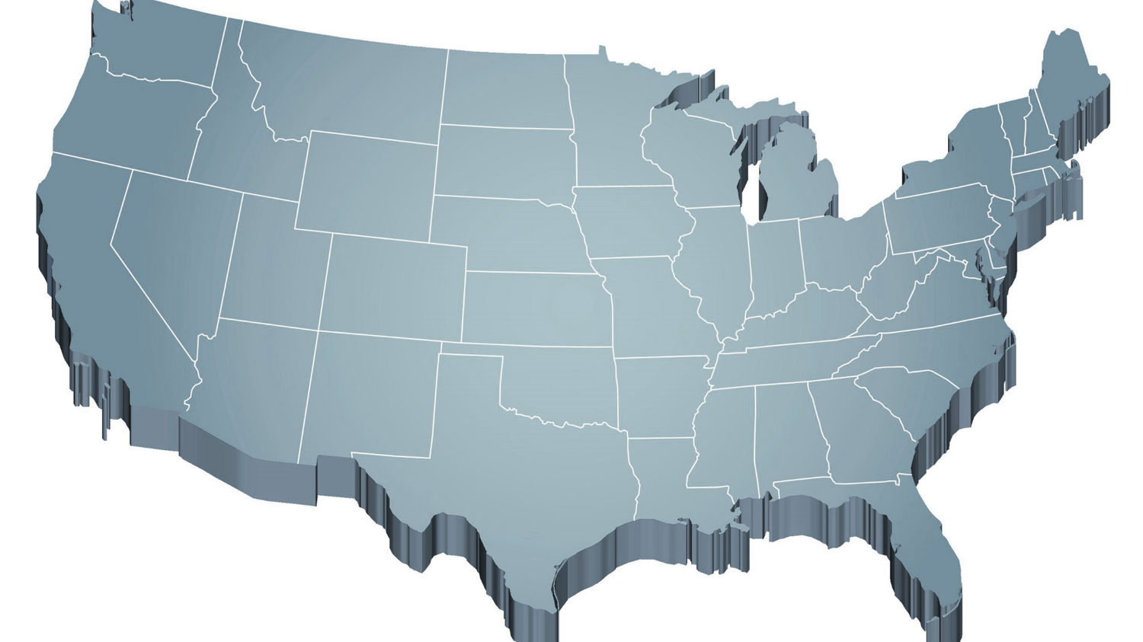
The Journey of Ci3T: Respectful Partnerships
1997
Notes:
CA & AZ start→ Tennessee → North Carolina→ Kansas
Trainings (MO, KANSAS, VERMONT, AZ)
MO, KS, UAB
HI

Slide 10
Overview of Secondary (Tier 2) Intervention in Ci3T Models: Data-informed Decision-making

Slide 11
Comprehensive, Integrated, Three-Tiered Model of Prevention
(Lane, Kalberg, & Menzies, 2009)
Tier 3
Tertiary Prevention (≈5%)
Tier 2
Secondary Prevention (≈15%)
Tier 1
Primary Prevention (≈80%)
Academic ◇ Behavioral ◇ Social
Validated Curricula PBIS Framework Validated Curricula

Slide 12
Ci3T Implementation Manual

Slide 13
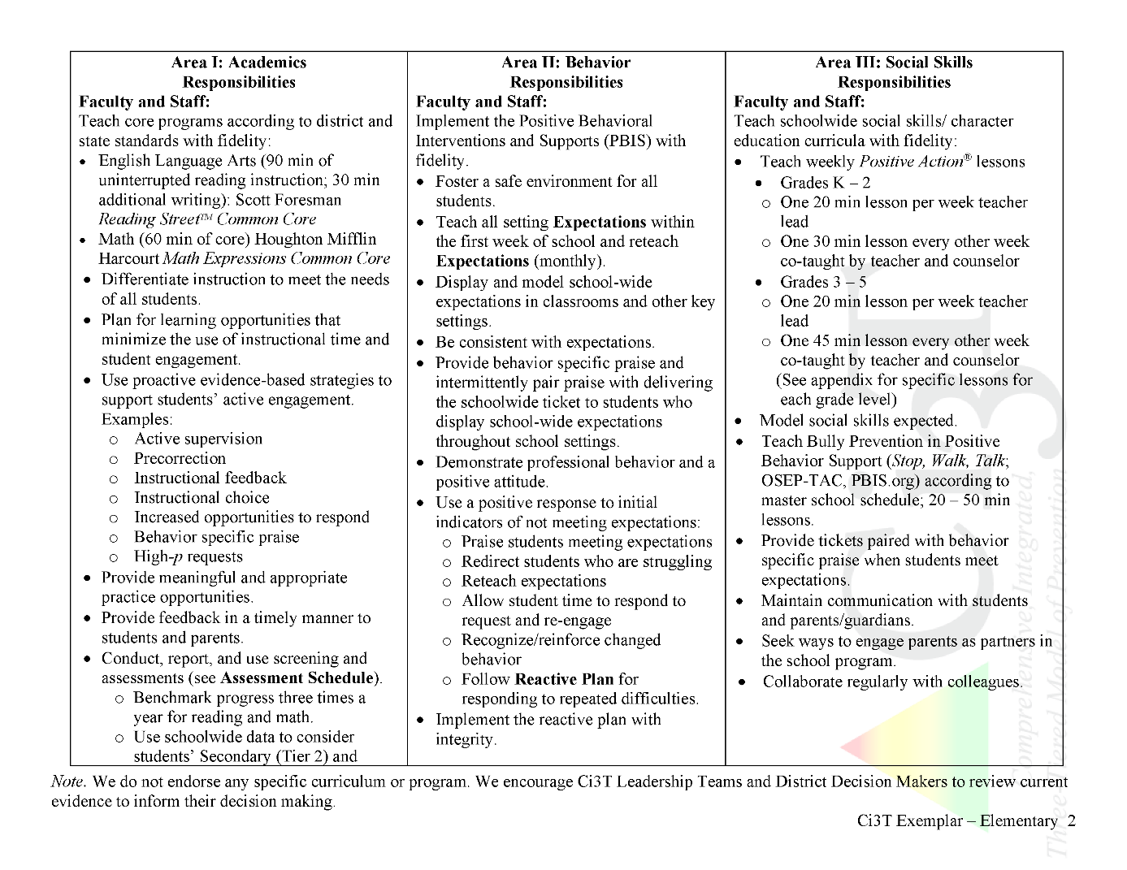
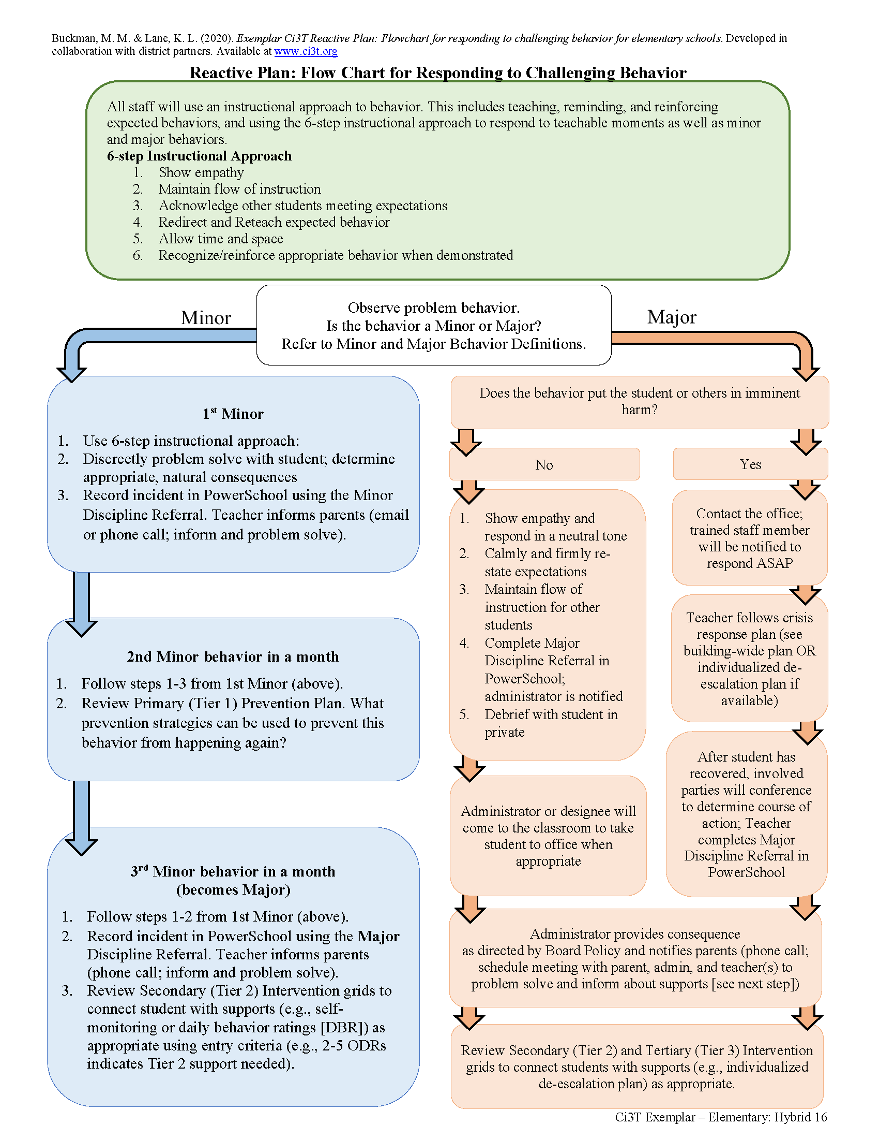
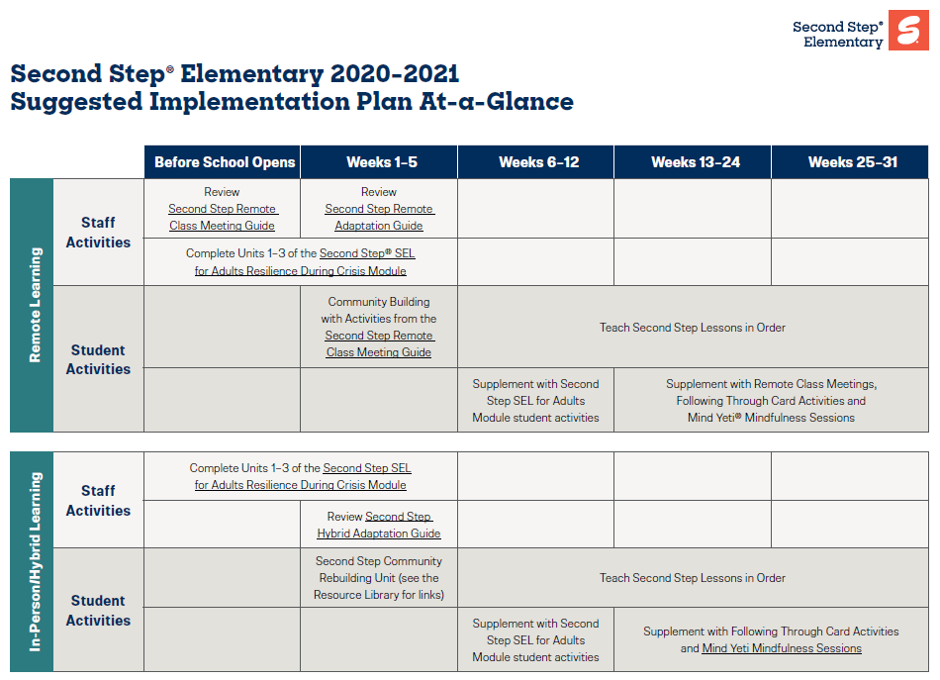
Ci3T Primary Plan: Procedures for Teaching
Opportunities to Respond
Behavior-Specific Praise
Ci3T Primary Plan: Procedures for Reinforcing
Active Supervision
Instructional Feedback
High-p Requests
Ci3T Primary Plan: Procedures for Monitoring
Precorrection
Instructional Choice
Notes:
Continued to keep implementation manuals, which are foundational to Ci3T, updated and current

Slide 14
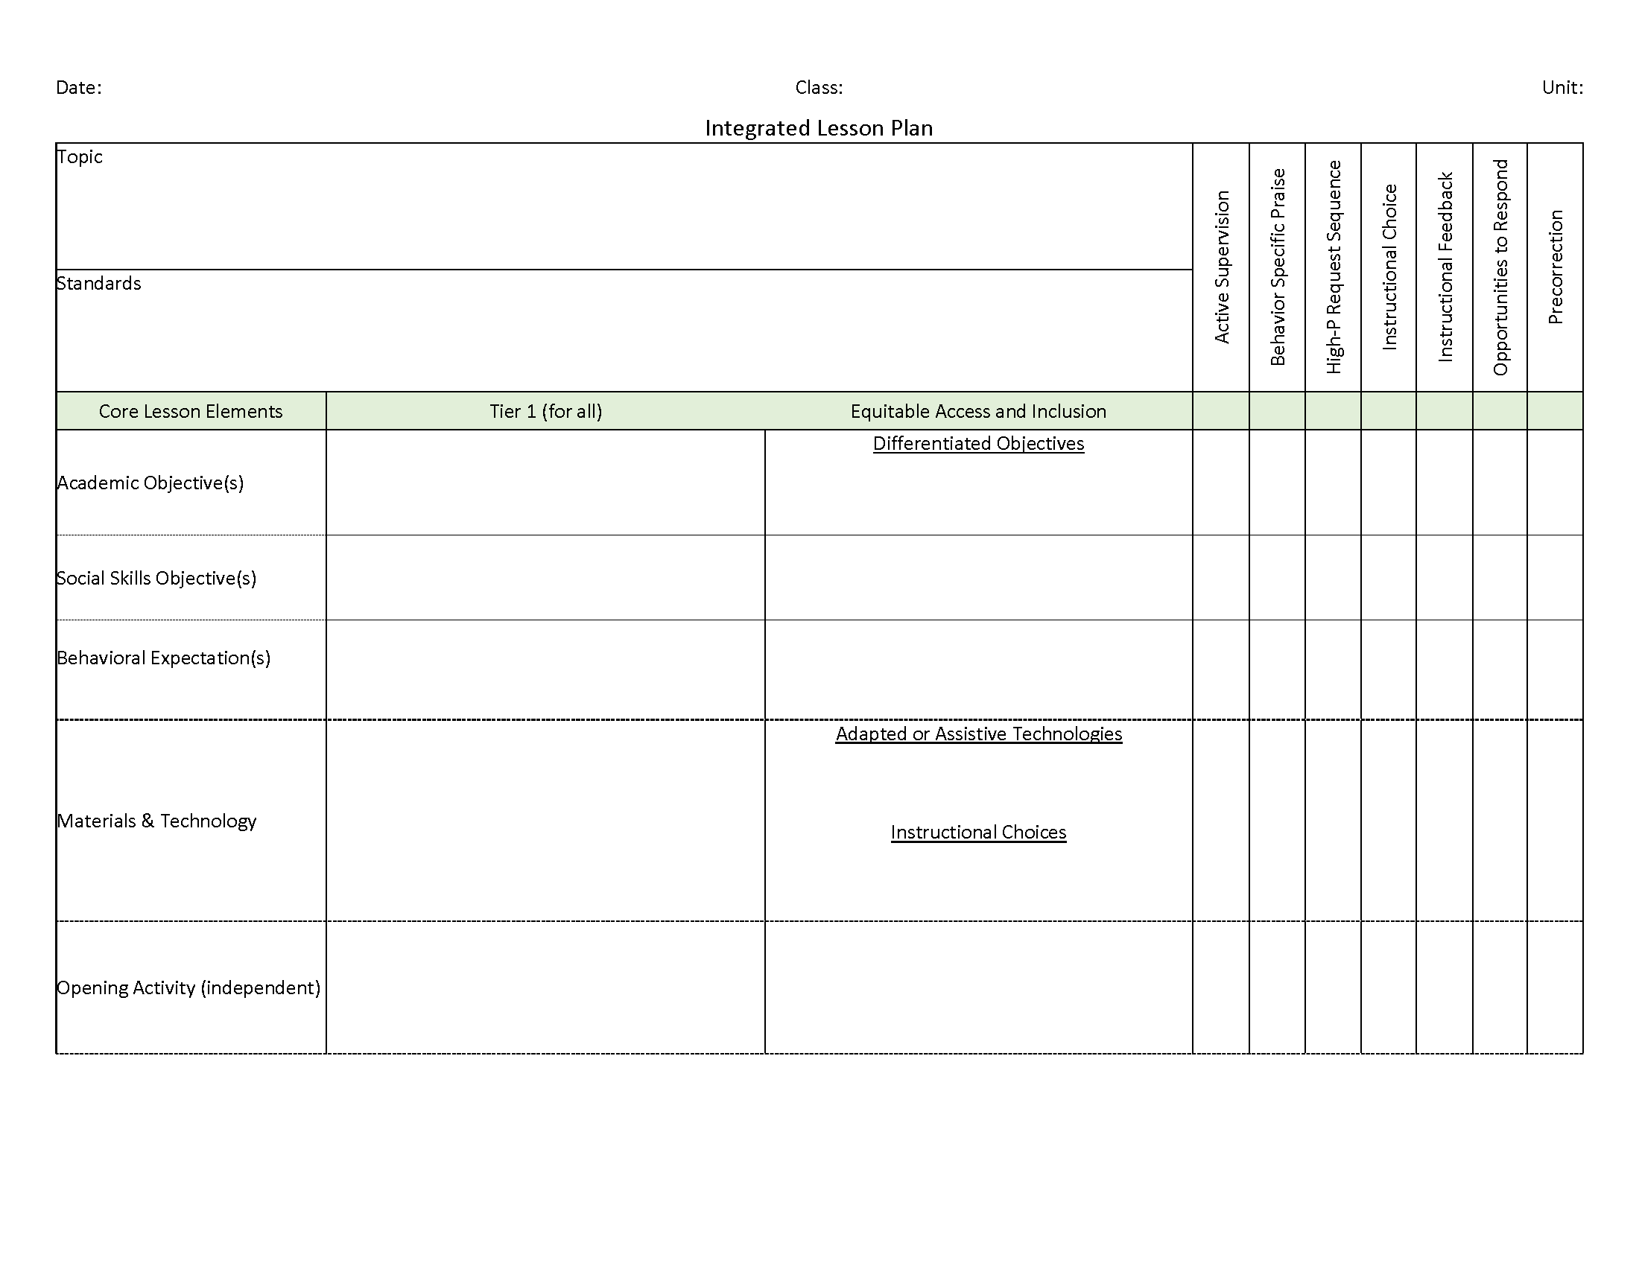
Ci3T: Integrated Lesson Planning
Integrated lesson planning is a core feature of Ci3T. Please visit https://www.ci3t.org/covid to learn more!

Slide 15
Essential Components of Primary Prevention Efforts
Social Validity
Systematic Screening
Academic
Behavior
Treatment Integrity
ci3t.org/measures
Notes:
Infographic - https://www.ci3t.org/measures

Slide 18
Comprehensive, Integrated, Three-Tiered Model of Prevention
(Lane, Kalberg, & Menzies, 2009)
Tier 3
Tertiary Prevention (≈5%)
Tier 2
Secondary Prevention (≈15%)
Tier 1
Primary Prevention (≈80%)
Academic ◇ Behavioral ◇ Social
Validated Curricula PBIS Framework Validated Curricula

Slide 19
Winter 2022 SRSS-Externalizing Results – Elementary School Level
n = 66
n = 44
n = 33
n = 35
n = 38
n = 37
n = 2
n = 17
n = 32
n = 32
n = 69
n = 74
n = 128
n = 109
n = 97
n = 92
n = 101
n = 125
n = 305
n = 297
n = 287
n = 332
n = 309
n = 263
n = 294
n = 346
n = 355
Notes:
***note to presenter*** If you would like to feature middle or high school data – hide the elementary slides (19-20) and unhide the middle or high school slides
If you would like to update this slide with data from your school or district- Fill in <year> based on current academic year. This is located in column A of the data sheet. Edit by right clicking and selecting “Edit data”.

Slide 20
Winter 2022 SRSS-Internalizing Results – Elementary School Level
n = 75
n = 46
n = 29
n = 41
n = 35
n = 25
n = 16
n = 40
n = 38
n = 27
n = 65
n = 69
n = 59
n = 48
n = 69
n = 72
n = 87
n = 86
n = 334
n = 337
n = 335
n = 354
n = 354
n = 328
n = 285
n = 346
n = 351
Notes:
If you would like to update this slide with data from your school or district- Fill in <year> based on current academic year. This is located in column A of the data sheet. Edit by right clicking and selecting “Edit data”.

Slide 21
Winter 2022 SRSS-Externalizing Results – Middle School Level
n = 21
n = 27
n = 27
n = 13
n = 6
n = 17
n = 26
n = 47
n = 96
n = 68
n = 71
n = 53
n = 42
n = 54
n = 491
n = 448
n = 383
n = 346
n = 445
n = 518
n = 527
Notes:
If you would like to update this slide with data from your school or district- Fill in <year> based on current academic year. This is located in column A of the data sheet. Edit by right clicking and selecting “Edit data”.

Slide 22
Winter 2022 SRSS-Internalizing Results – Middle School Level
n = 79
n = 52
n = 54
n = 60
n = 23
n = 44
n = 42
n = 41
n = 37
n = 40
n = 32
n = 45
n = 30
n = 31
n = 55
n = 70
n = 306
n = 312
n = 356
n = 342
n = 349
n = 351
n = 432
n = 229
Notes:
If you would like to update this slide with data from your school or district- Fill in <year> based on current academic year. This is located in column A of the data sheet. Edit by right clicking and selecting “Edit data”.

Slide 23
Winter 2022 SRSS-Externalizing Results – High School Level
n = 47
n = 72
n = 36
n = 36
n = 40
n = 8
n = 17
n = 38
n = 119
n = 113
n = 47
n = 137
n = 134
n = 114
n = 90
n = 65
n = 1259
n = 1280
n = 1188
n = 994
n = 447
n = 717
n = 750
n = 920
Notes:
If you would like to update this slide with data from your school or district- Fill in <year> based on current academic year. This is located in column A of the data sheet. Edit by right clicking and selecting “Edit data”.

Slide 24
Winter 2022 SRSS-Internalizing Results – High School Level
n = 165
n = 106
n = 83
n = 99
n = 55
n = 65
n = 52
n = 87
n = 73
n = 65
n = 50
n = 34
n = 59
n =48
n = 56
n = 167
n = 1111
n = 1307
n = 1109
n = 1000
n = 445
n = 691
n = 710
n = 923
Notes:
If you would like to update this slide with data from your school or district- Fill in <year> based on current academic year. This is located in column A of the data sheet. Edit by right clicking and selecting “Edit data”.

Slide 25
Comprehensive, Integrated, Three-Tiered Model of Prevention
(Lane, Kalberg, & Menzies, 2009)
Tier 3
Tertiary Prevention (≈5%)
Tier 2
Secondary Prevention (≈15%)
Secondary (Tier 2) Intervention Grids
Tier 1
Primary Prevention (≈80%)
Academic ◇ Behavioral ◇ Social
Validated Curricula PBIS Framework Validated Curricula

Slide 26
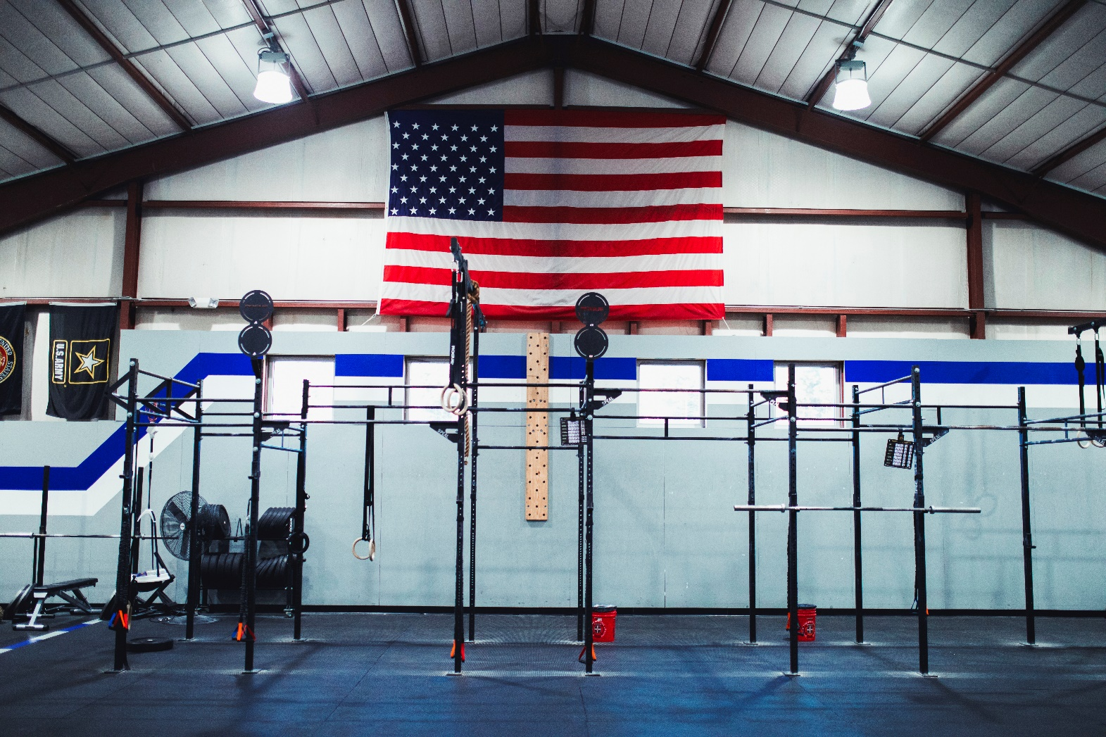

Slide 27
Building a Ci3T Tier Library
Teacher Delivered Strategies
Tier 1
Tier 2
Tier 3

Slide 28
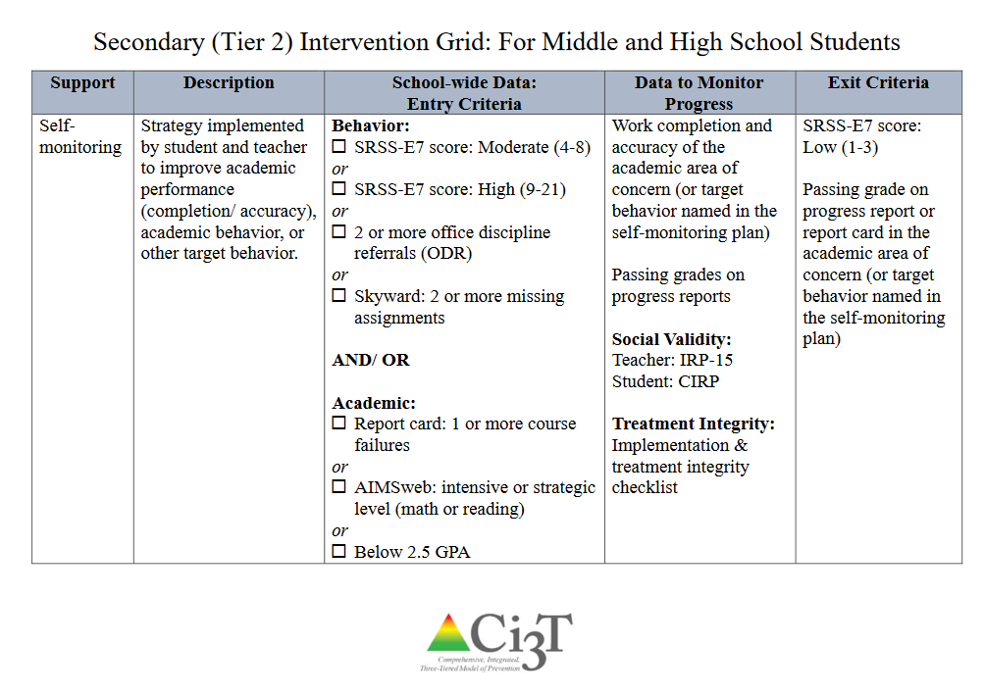

Slide 29
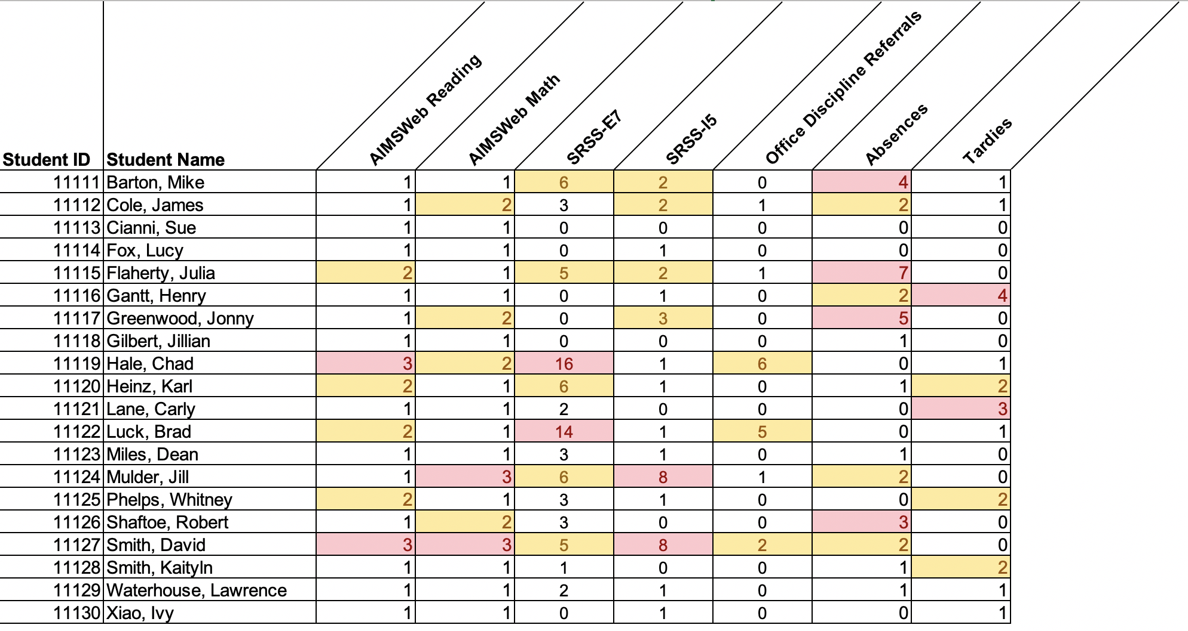
Data in action

Slide 30
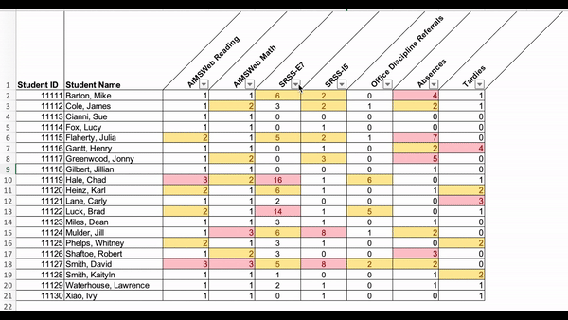
Data in action

Slide 31
Data in action
Other Tier 2 options…
Precorrection
Behavior Contracts
Behavior Specific Praise
Direct Behavior Rating

Slide 32
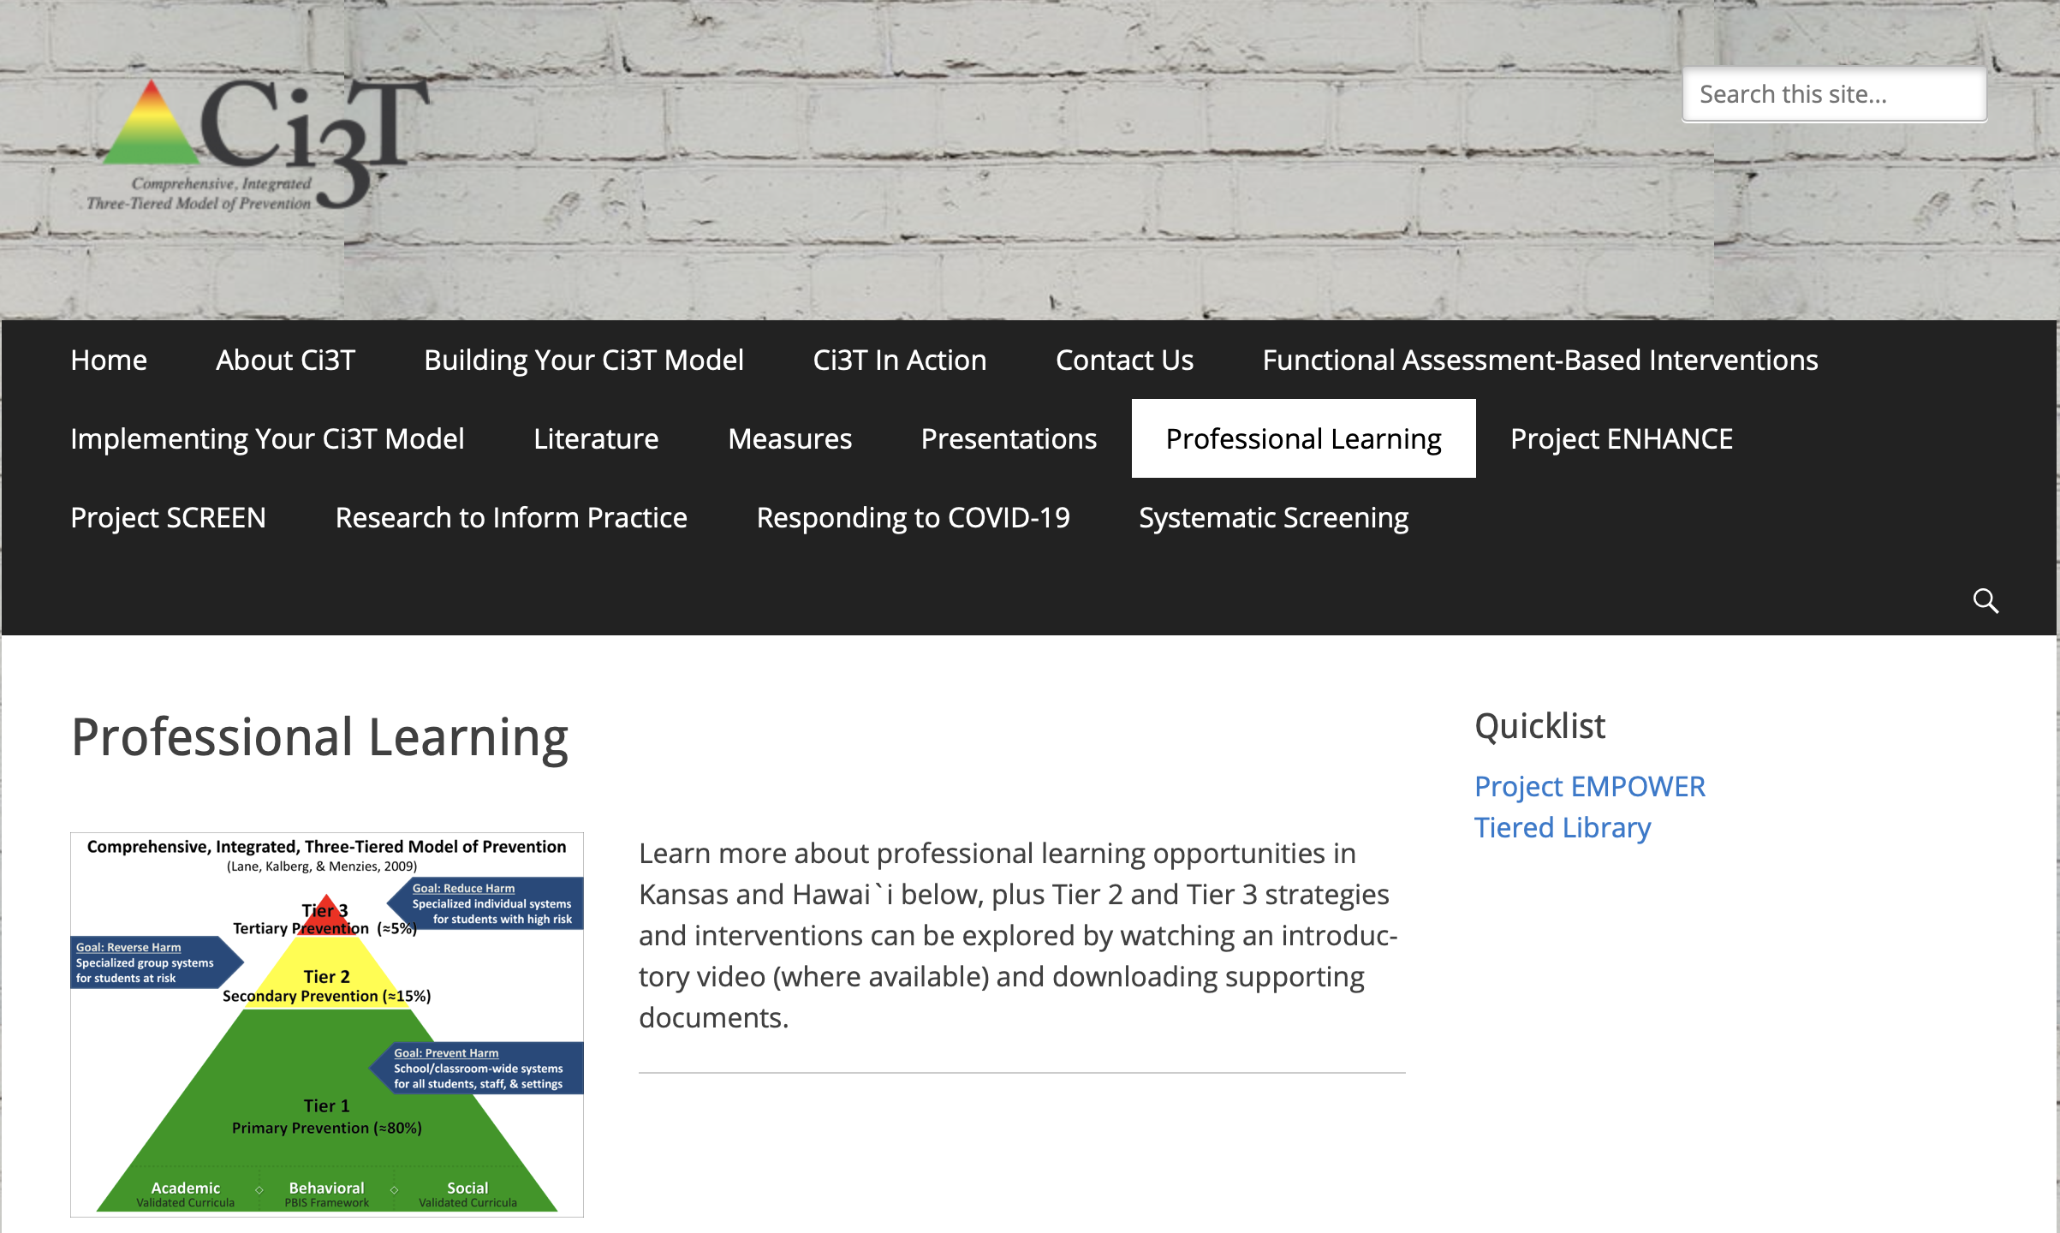
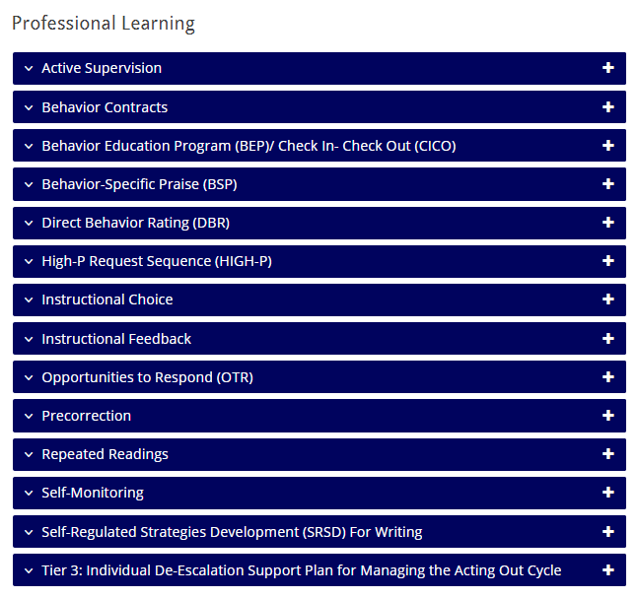
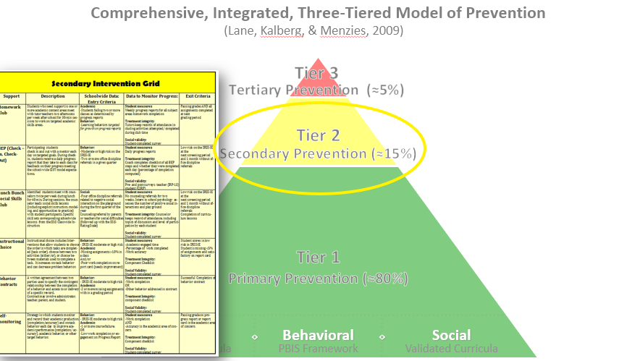
Tiered Intervention Library

Slide 33
Intervention 1: Behavior Contracts as a Tier 2 Intervention

Slide 34
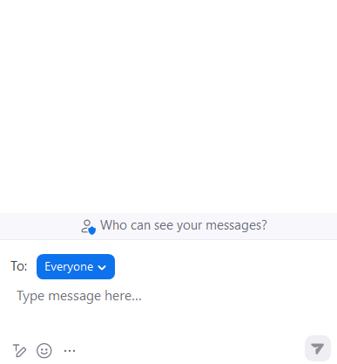
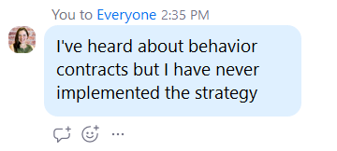
Behavior Contracts
What is your experience with behavior contracts?

Slide 35
https://www.ci3t.org/pl
https://www.ci3t.org/literature
Notes:
Information about behavior contracts can be found on our professional learning tab in the blue accordion OR on the literature tab where you will find links to practitioner friendly books outlining the steps to implementation.

Slide 36
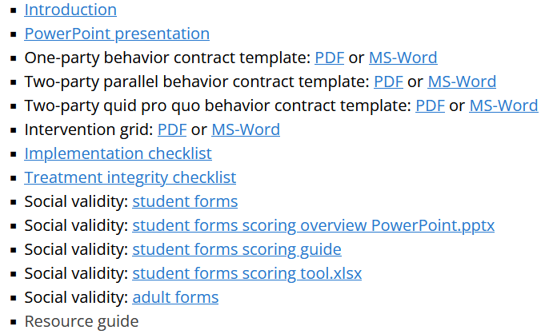
Behavior Contracts
https://www.ci3t.org/pl
Notes:
This slide is a prompt for the presenter to pause, navigate to the website, download the behavior contracts PowerPoint, and use that to present for 15 minutes (see pacing guide)

Slide 37
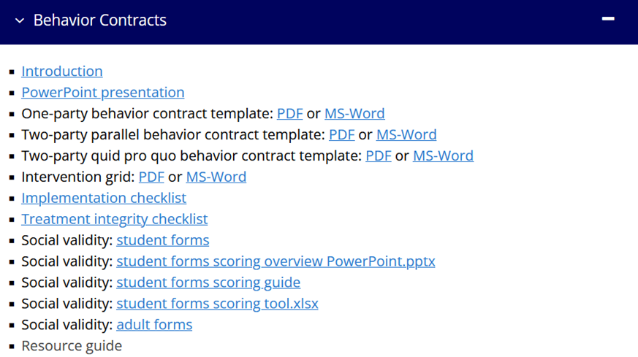
Talk Time
https://www.ci3t.org/pl
Choose a breakout room based on your role:
I will implement behavior contracts with students
I will train others to implement behavior contracts with their students
Notes:
15-min timer
Breakout room(s) for practitioners focuses on - how might you incorporate behavior contracts in your classroom? Emphasize module materials for implementation (implementation checklist, TI/SV)
Breakout room(s) for trainers focuses on - how might you share this strategy with others? Emphasize module materials for training (e.g., tiered library PowerPoint, interactions, videos)

Slide 38
Intervention 2: Self-Regulated Strategy Development (SRSD) for Writing as a Tier 2 Intervention

Slide 39
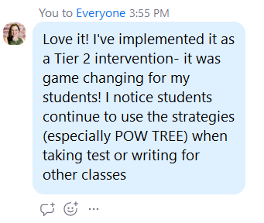
Self-Regulated Strategy Development (SRSD) for Writing
What is your experience with self-regulated strategy development (SRSD) for writing?

Slide 40
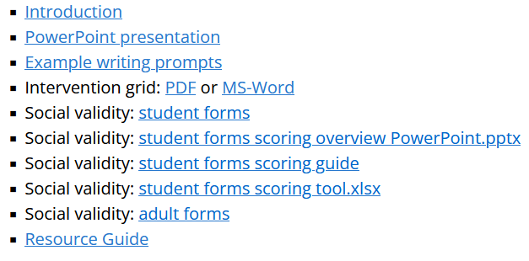
SRSD for Writing
https://www.ci3t.org/pl
Notes:
Information about self-regulated strategy development for writing can be found on our professional learning tab in the blue accordion.
This slide is a prompt for the presenter to pause, navigate to the website, download the SRSD for writing PowerPoint, and use that to present for 15 minutes (see pacing guide)

Slide 41
Talk Time
https://www.ci3t.org/pl
Choose a breakout room based on your role:
I will implement SRSD for writing with students
I will train others to implement SRSD for writing with their students
Notes:
15-min timer
Breakout room(s) for practitioners focuses on - how might you incorporate SRSD for writing in your classroom? Emphasize module materials for implementation (implementation checklist, TI/SV)
Breakout room(s) for trainers focuses on - how might you share this strategy with others? Emphasize module materials for training (e.g., tiered library PowerPoint, interactions, videos)

Slide 42
Exploring Other Secondary (Tier 2) Interventions in Ci3T Models

Slide 43
Let’s Chat
What Tier 2 interventions are listed in your Ci3T implementation manual?
What is one intervention from your Secondary (Tier 2) Intervention Grid you would like to explore?
Notes:
10 minutes
If using breakout rooms, the exploration is not facilitated (e.g., do not share screen / present) – this is time for participants to explore on their own

Slide 44
Wrapping Up and Moving Forward

Slide 45
Project EMPOWER - Traditional
Ci3T EMPOWER Sessions Location: Remote via Zoom Attended by: School Ci3T Leadership Teams, Ci3T District Trainers and Coaches, Faculty and Staff, Families (adults only). Community Members |  | Times (Pacific) | Times (Central) | Times (Eastern)
1. Getting Started | Sep. 19, 2023 (Tu) | 3:00 – 5:00 p.m. | 5:00 – 7:00 p.m. | 6:00 – 8:00 p.m.
2. Screening | Oct. 19, 2023 (Th) | 3:00 – 5:00 p.m. | 5:00 – 7:00 p.m. | 6:00 – 8:00 p.m.
3. Low Intensity Strategies | Nov. 30, 2023 (Th) | 3:00 – 5:00 p.m. | 5:00 – 7:00 p.m. | 6:00 – 8:00 p.m.
4. Tier 2 | Jan. 9, 2024 (Tu) | 3:00 – 5:00 p.m. | 5:00 – 7:00 p.m. | 6:00 – 8:00 p.m.
5. Tier 3 | Mar. 28, 2024 (Th) | 3:00 – 5:00 p.m. | 5:00 – 7:00 p.m. | 6:00 – 8:00 p.m.
6. Moving Forward | Apr. 23, 2024 (Tu) | 3:00 – 5:00 p.m. | 5:00 – 7:00 p.m. | 6:00 – 8:00 p.m.

Slide 46
Ci3T
Comprehensive Professional Learning Plan
Ci3T: Primary Prevention
Session 1:
Overview of Ci3T Prevention Models
Setting a Purpose
Establish team meetings and roles
Session 2:
Mission and Purpose
Establish Roles and Responsibilities
Procedures for Teaching
Procedures for Reinforcing
Reactive Plan
Session 3:
Procedures for Monitoring
Session 4:
Revise Primary Plan using Stakeholder feedback
Prepare presentation
Ci3T: Secondary Prevention
Session 5:
Overview of Teacher focused Strategies
Overview of Student Focused Strategies
Using data to determine which students may need Secondary (Tier 2) supports
Draft the Secondary Intervention Grid based on existing supports
Ci3T: Tertiary Prevention
Session 6:
Final revisions of Ci3T Plan based on stakeholder feedback
Draft Tertiary (Tier 3) Prevention Intervention Grids
Design Implementation Manual and Plan for roll out to faculty, students, and parents
Ci3T Leadership Team Training Sequence
Implementation Stages of Tier 2 and 3 within Ci3T
Additional Professional Development on Specific Topics
Core Content Curriculum
Check In - Check Out
Functional Assessment-based Interventions
Reading, Math, Writing Benchmarking and Progress Monitoring Tools
Interventions, Strategies, & Practices
Additional Tier 3 Supports
Instructional Techniques to Improve Students’ Motivation; Classroom Management Practices;
Low-Intensity Behavior Supports

Slide 47
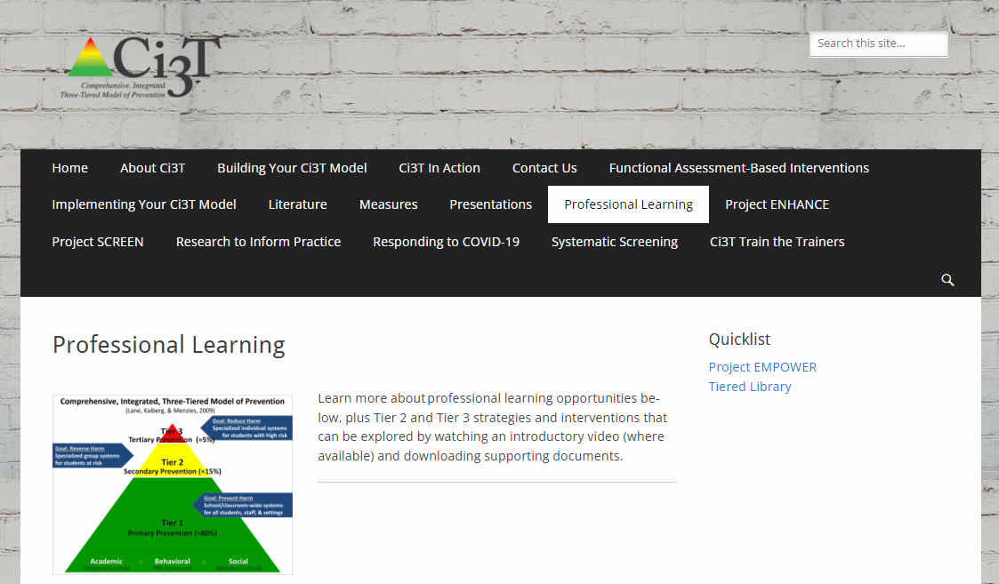
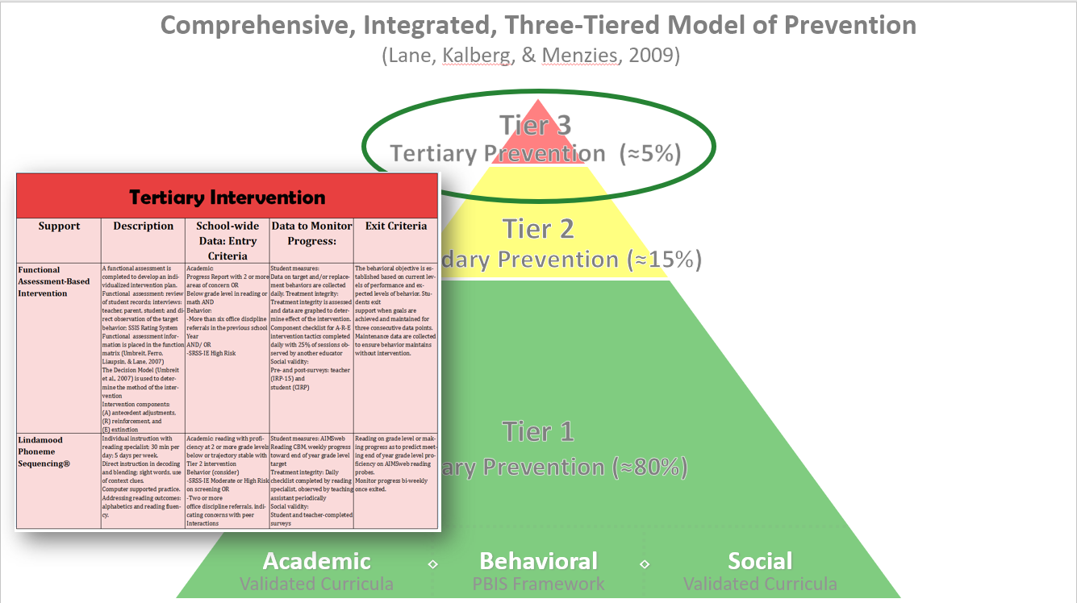
Tiered Intervention Library

Slide 48
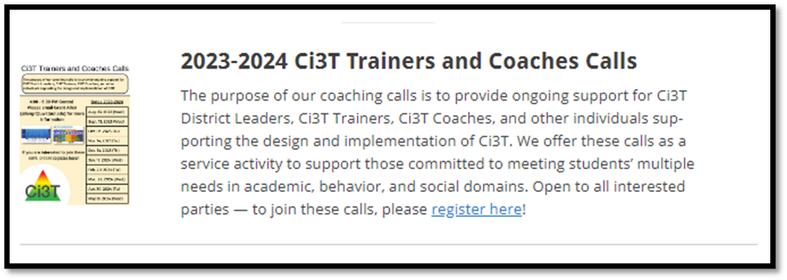
Ci3T Trainer and Coaches Calls

Slide 49
Ci3T Professional Learning Calendar
 | July | Aug | Sep | Oct | Nov | Dec | Jan | Feb | Mar | Apr | May | Jun
Ci3T Training |  |  |  |  | Ci3T Professional Learning Series Session 1 | Ci3T Professional Learning Series Session 2 | Ci3T Professional Learning Series Session 3 | Ci3T Professional Learning Series Session 4 |  | Ci3T Professional Learning Series Session 5 | Ci3T Professional Learning Series Session 6
Ci3T Implementation Support | Ci3T Implementation Series Prep Session |  | Ci3T Implementation Series Session 1 |  | Ci3T Implementation Series Session 2 |  | Ci3T Implementation Series Session 3 |  | Ci3T Implementation Series Session 4 | Ci3T Implementation Series Session 5
Ci3T EMPOWER |  |  | Ci3T EMPOWER Session 1 | Ci3T EMPOWER Session 2 | Ci3T EMPOWER Session 3 |  | Ci3T EMPOWER Session 4 |  | Ci3T EMPOWER Session 5 | Ci3T EMPOWER Session 6
Ci3T Trainers & Coaches Calls |  | Trainers & Coaches Call Session 1 | Trainers & Coaches Call Session 2 | Trainers & Coaches Call Session 3 | Trainers & Coaches Call Session 4 | Trainers & Coaches Call Session 5 | Trainers & Coaches Call Session 6 | Trainers & Coaches Call Session 7 | Trainers & Coaches Call Session 8 | Trainers & Coaches Call Session 9 | Trainers & Coaches Call Session 10

Slide 50
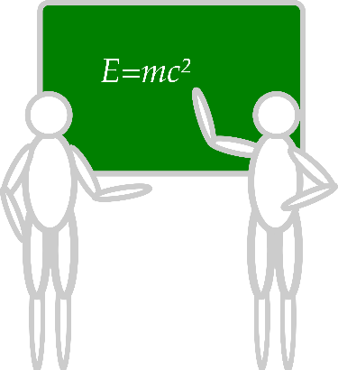
Sustaining and Disseminating Professional Learning
Designate two staff to attend trainings to become on-site coaches
10 min @ next Faculty and Staff meeting
Ci3T Setting Up for Success
Systematic Screening
Low-Intensity Strategies
Tier 2
Planning Ahead
Tier 3

Slide 51
Accessing Project EMPOWER Professional Learning

Slide 52
Wrapping Up & Previewing Next Session
Today
Next time
Overview of Secondary (Tier 2) Interventions in Ci3T Models: Data-informed Decision-making
Intervention 1: Behavior Contracts as a Tier 2 Intervention
Intervention 2: Self-Regulated Strategy Development (SRSD) for writing as a Tier 2 Intervention
Exploring Other Secondary (Tier 2) Interventions in Ci3T Models
Overview of Tertiary (Tier 3) Interventions in Ci3T Models: Data-informed Decision-making
Illustrations: Supporting Students with Intensive Intervention Needs
Supporting students with acting out behaviors
Supporting students with internalizing issues
Exploring Other Tertiary (Tier 3) Interventions in Ci3T Models

Slide 53
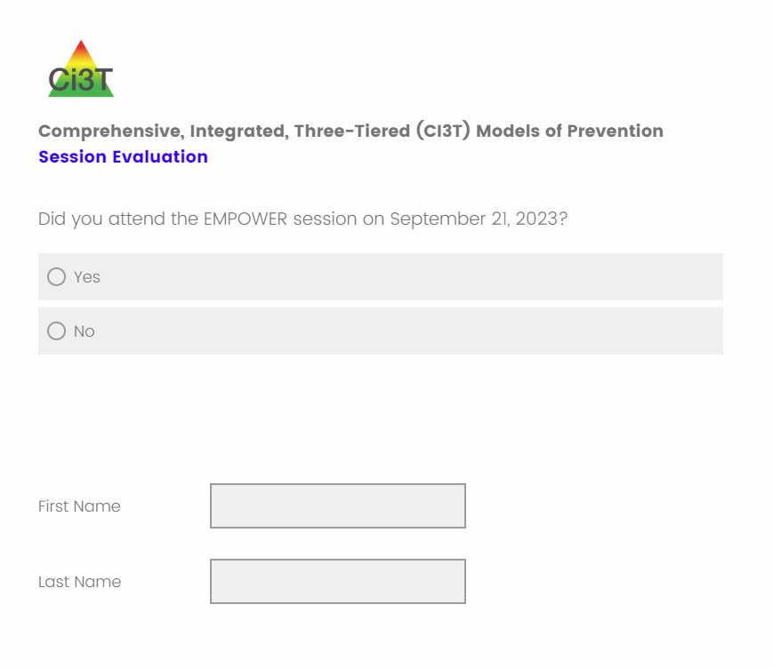
Comprehensive, Integrated, Three-Tiered Model of Prevention
(Lane, Kalberg, & Menzies, 2009)
Thank you!
Notes:
Tag us in your Ci3T highlights- we’d love to see Ci3T in action! Follow us on Twitter or Instagram for updates and links to resources! @Ci3TModel
You will receive a brief session evaluation – we value your feedback and would greatly appreciate you taking a few minutes to share your thoughts on what you liked about the session and how we can improve

