Slide 1

Tiered Systems …
A Comprehensive, Integrated Approach:
Introducing Ci3T Models
Kathleen Lynne Lane, Ph.D., BCBA-D, CF-L1
Olympic ESD 114
Bremerton, Washington
www.ci3t.org

Slide 2
Agenda
Introducing Ci3T … working collaboratively and efficiently
Systematic Screening Tools & Logistics
Using Screening Data to Inform Instruction
  Tier 1 practices
  Teacher-delivered strategies
  Tier 2 and 3 supports
Action Plans: Moving Forward

Slide 3
Thank you…
For Your Commitment
Students with emotional and behavioral disorders (EBD) represent a diverse and challenging group of students to teach (Forness, Freeman, Paparella, Kauffman, & Walker, 2011)
Historically as a field we have
  viewed behavioral and social challenges to be within individual deficits (Landrum & Tankersley, 2013)
  relied on reactive approaches to address these challenges (Horner & Sugai, 2015)
Internalizing
Externalizing
Shift to a systems level perspective
ED <1%
EBD 12-20%

Slide 4
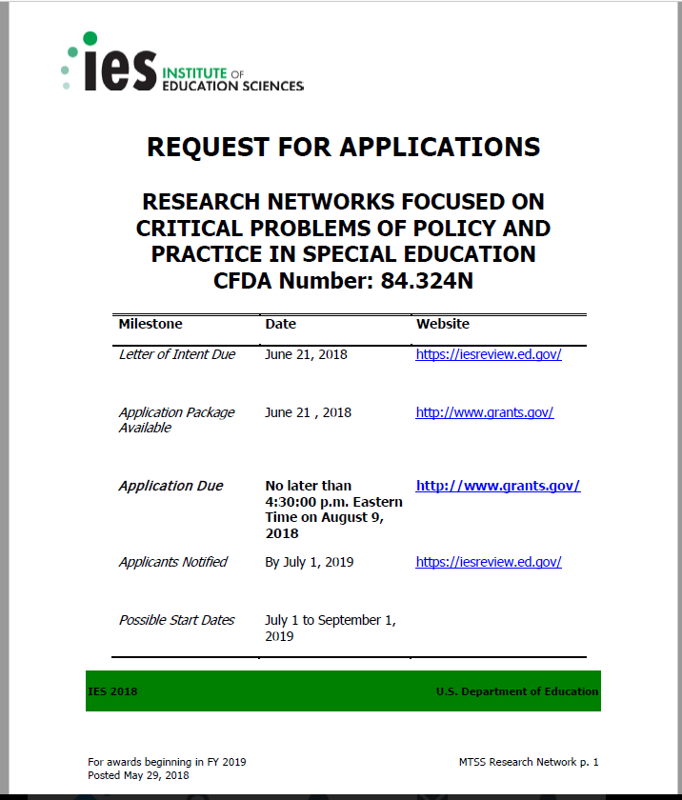
Michael Yudin urged educators and educational system leaders to “pay as much attention to students’ social and behavioral needs as we do academics” …
2014 National PBIS Leadership Conference, Michael Yudin, Assistant Secretary for the Office of Special Education and Rehabilitation of the United States Department of Education

Slide 5
Agenda
Introducing Ci3T … working collaboratively and efficiently
Systematic Screening Tools & Screening Logistics
Using Screening Data to Inform Instruction
  Tier 1 practices
  Teacher-delivered strategies
  Tier 2 and 3 supports
Action Plans: Moving Forward

Slide 7
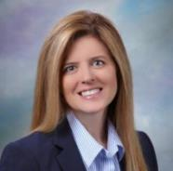

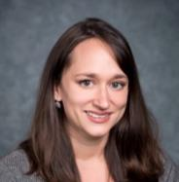

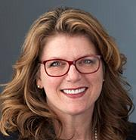

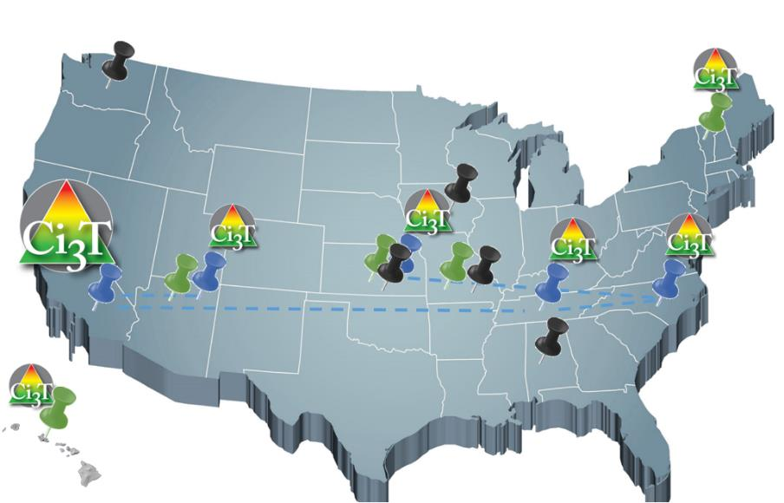
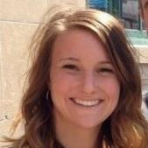


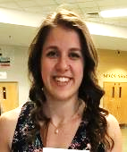
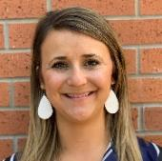
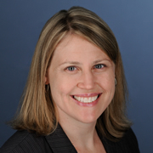







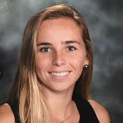


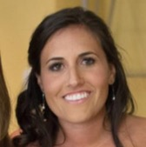



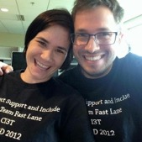



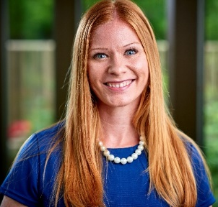
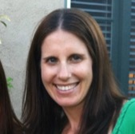
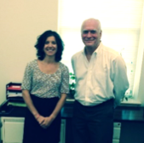

Implementing Ci3T Models:
A Respectful Partnership

Slide 8
Reading Street
District & State Standards
High Quality Instruction

Slide 9
Positive Behavior Interventions and Supports (PBIS)

Slide 10
Behavioral Component:
Positive Behavioral Interventions and Supports (PBIS)
A Framework, Not a Curriculum
Establish, clarify, and define expectations
Teach all students the expectations, planned and implemented by all adults in the school
Give opportunities to practice
Reinforce students consistently, facilitate success
Consider rules, routines, and physical arrangements
Monitor the plan using school-wide data to identify students who need more support
Monitor student progress
Source: Horner, R.H., & Sugai, G. (2015). School-wide PBIS: An example of applied behavior analysis implemented at a scale of social importance. Behavior Analysis in Practice, 8, 80-85.

Slide 11
ELEMENTARY | Settings
 | Classroom | Hallway | Cafeteria | Playground | Bathroom | Bus
Respect | - Follow directions -Use kind words and actions - Control your temper - Cooperate with others - Use an inside voice | - Use a quiet voice - Walk on the right side of the hallway - Keep hands to yourself | - Use an inside voice - Use manners - Listen to and follow adult requests | - Respect other peoples’ personal space - Follow the rules of the game | - Use the restroom and then return to class - Stay in your own bathroom stall - Little talking | - Use kind words towards the bus driver and other students - Listen to and follow the bus drivers’ rules
Responsibility | - Arrive to class on time - Remain in school for the whole day - Bring your required materials - Turn in finished work - Exercise self-control | - Keep hands to yourself - Walk in the hallway - Stay in line with your class | - Make your choices quickly - Eat your own food - Choose a seat and stick with it - Clean up after yourself | - Play approved games - Use equipment appropriately - Return equipment when you are done - Line up when the bell rings | - Flush toilet - Wash hands with soap - Throw away any trash properly - Report any problems to your teacher | - Talk quietly with others - Listen to and follow the bus drivers’ rules - Remain in seat after you enter the bus - Use self-control
Best Effort | - Participate in class activities - Complete work with best effort - Ask for help politely | - Walk quietly - Walk directly to next location | - Use your table manners - Use an inside voice | - Include others in your games - Be active - Follow the rules of the game | - Take care of your business quickly - Keep bathroom tidy | - Listen to and follow the bus drivers’ rules - Keep hands and feet to self
Establish, Clarify, Define Expectations
Source: Lane, K.L., Kalberg, J.R., & Menzies, H.M. (2009). Developing schoolwide programs to prevent and manage problem behaviors: A step-by-step approach. New York, NY: Guilford Press.

Slide 12




Positive Action
Notes:
Emily, could you please link the Connect with Kids logo with this arrow

Slide 13
The Five Social and Emotional Learning Core Competencies
Self-awareness
Responsible Decision making
Relationship Skills
Social Awareness
Self-management
Social & Emotional Learning
(CASEL, 2013)

Slide 14
Outcomes Associated with Social Skills Training
Explicit social-emotional learning (SEL) skills instruction
SEL skills acquisition
Improved attitudes about self, others, and school
Positive social behavior
Fewer conduct problems
Less emotional distress
Academic success
(CASEL, 2013)

Slide 15
Social Component:
Examples of Schoolwide Programs
Social-emotional
Connect With Kids
connectwithkids.com
Character Education
A curricula using real stories presented through documentary-style videos, non-fiction books, teaching guides and patent resources.
Attendance and achievement
Bullying and violence prevention
Character and Life skills
Digital citizenship
Alcohol and drug prevention
Health and Wellness
Customizable units are:
Positive Action
www.positiveaction.net
Improves academics, behavior, and character
Curriculum-based approach
Effectively increases positive behaviors and decreases negative behaviors
6-7 units per grade
Optional components:
  site-wide climate development
  drug education
  bullying / conflict resolution
  counselor, parent, and family classes
  community/coalition components

Slide 16
Top 10 School-related Social Skills
Listens to Others
Follows Directions
Follows Classroom Rules
Ignores Peer Distractions
Asks for Help
Takes Turns in Conversations
Cooperates With Others
Controls Temper in Conflict Situations
Acts Responsibly With Others
Shows Kindness to Other
(Lane et al. 2004, 2007; Gresham & Elliott, 2008)

Slide 19
Lawrence Public Schools … Ci3T Training & Implementation
Phase |  |  |  | Year
 | 2013-14 | 14-15 | 15-16 | 16-17 | 17-18 | 18-19 | 19-20
Elementary School
Ci3T Training
Implementation Year 1
Implementation Year 2
Sustain and Develop Practices
Middle and High Schools
Ci3T Training
Implementation Year 1
Implementation Year 2
Sustain and Develop Practices
College and Career Center
Ci3T Training
Implementation Year 1
Implementation Year 2
Sustain and Develop Practices

Slide 20

USD 497 MTSS-CI3T Model of Support
High
≈5%
Tertiary Support
(Tier 3)
≈15%
Secondary Support
(Tier 2)
Differentiation
Positive Behavioral Interventions and Supports (PBIS) Framework
Personalized Learning
Support Intensity
Blended Learning Environments
Validated Core Resource
ELA
Math
≈80%
Culturally Responsive Teaching
Validated Curricula
Primary Support
(Tier 1)
Academic Behavioral Social
Low
excellence • equity • engagement
CI3T – Comprehensive Integrated 3-Tiered Model of Prevention
(Lane, Kalberg, & Menzies, 2009)
USD 497 School Board Priorities: The Foundation

Slide 21


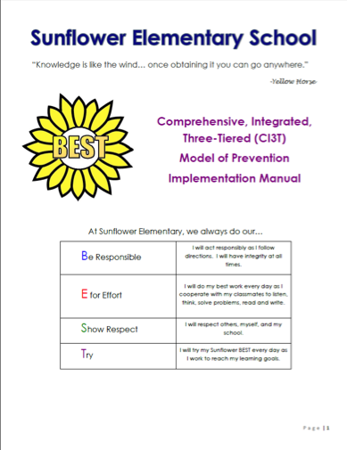






Slide 22
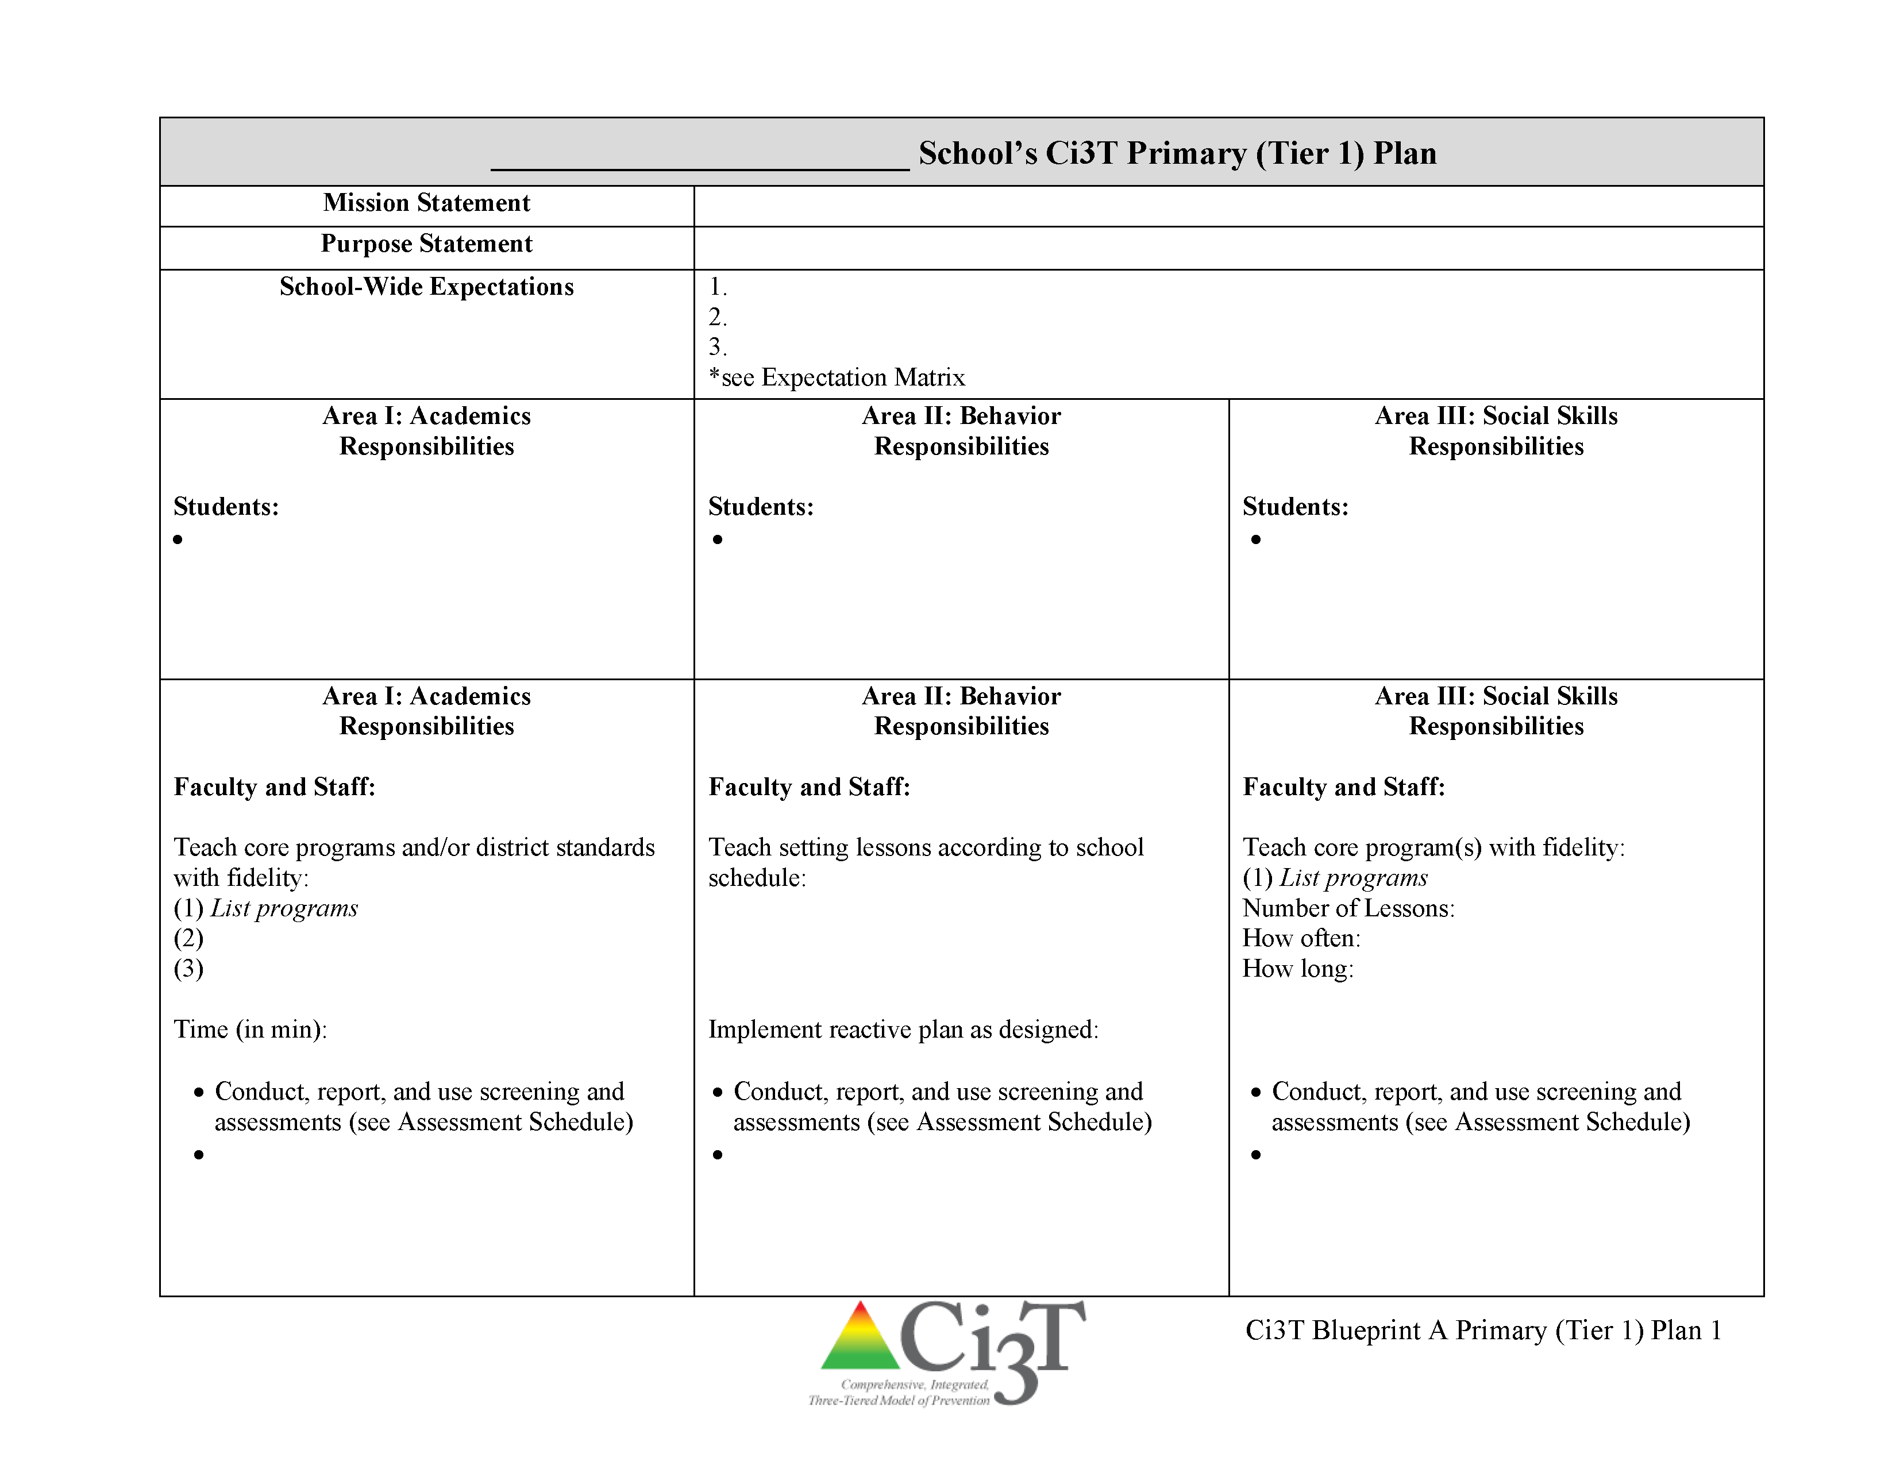
Ci3T Primary Plan: Roles and Responsibilities
all stakeholder groups

Slide 23
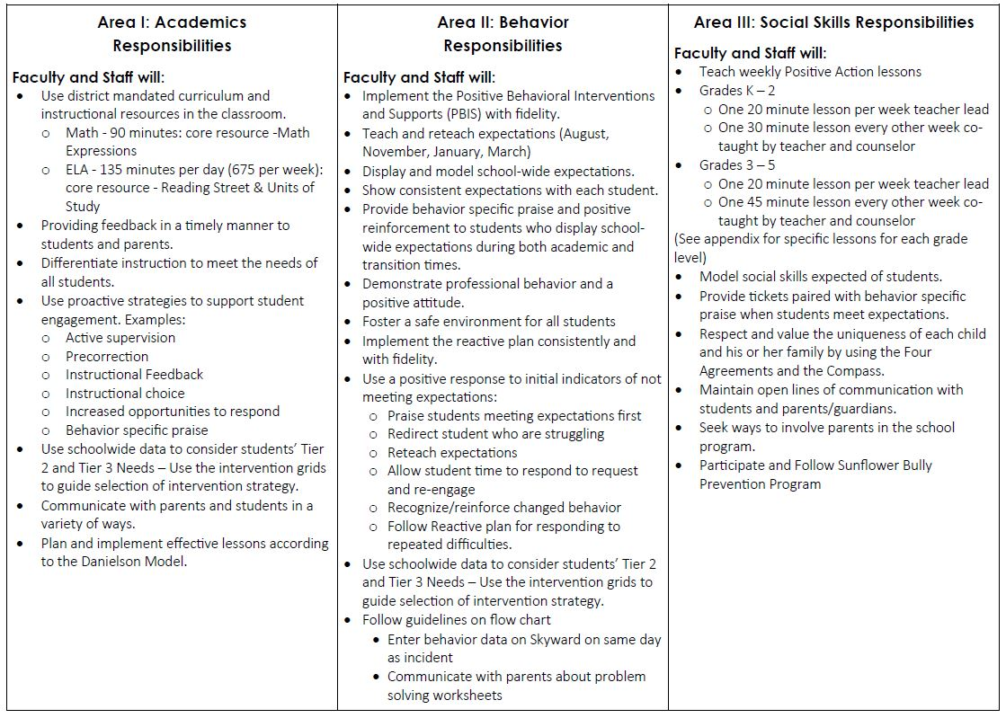

Ci3T Primary Plan: Procedures for Teaching
Ci3T Primary Plan: Procedures for Reinforcing
Ci3T Primary Plan: Procedures for Monitoring

Slide 24
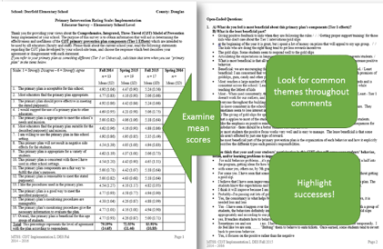

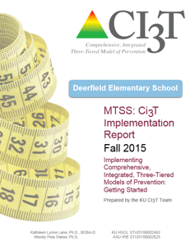

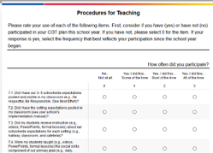
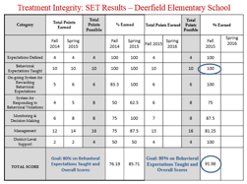


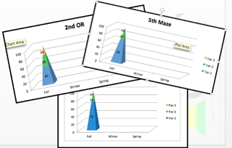
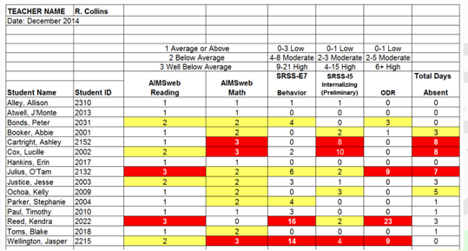
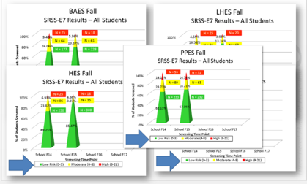
Communication:
Soliciting Feedback, Sharing Progress, Providing Professional Learning
Social Validity
Treatment Integrity
Systematic Screening
Academic
Behavior

Slide 25

Secondary (Tier 2) Intervention Grids

Slide 26

Tertiary (Tier 3) Intervention Grids

Slide 27
Implementation Science
Adapted from Fixsen & Blasé, 2005
Exploration & Adoption
Installation
Initial Implementation
We think we know what we need so we are planning to move forward (evidence-based)
Let’s make sure we’re ready to implement (capacity infrastructure)
Let’s give it a try & evaluate (demonstration)
Full Implementation
Let’s make it our way of doing business (institutionalized use)
Sustainability & Continuous Regeneration
That worked, let’s do it for real (investment)

Slide 28
Transparency, Access,
& Collaboration
Benefits of Ci3T Models

Slide 29

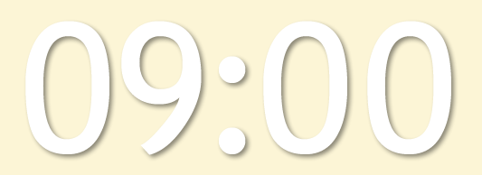










Notes:
10 min Using this PowerPoint break timer
**Is timer set to correct time. Do we want 25 or 10? Same question for above slide.
This PowerPoint slide uses images, custom animation, and timing to provide a countdown timer that you can use in any presentation. When you open the template, you’ll notice that the timer is set at 00:00. However, when you start the slide show, the timer will start at the correct time and count down by 1-minute intervals until it gets to 1 minute. At that point, it will count down in two 30-seconds intervals to 00:00.
To insert this slide into your presentation
Save this template as a presentation (.ppt file) on your computer.
Open the presentation that will contain the timer.
On the Slides tab, place your insertion point after the slide that will precede the timer. (Make sure you don't select a slide. Your insertion point should be between the slides.)
On the Insert menu, click Slides from Files.
In the Slide Finder dialog box, click the Find Presentation tab.
Click Browse, locate and select the timer presentation, and then click Open.
In the Slides from Files dialog box, select the timer slide.
Select the Keep source formatting check box. If you do not select this check box, the copied slide will inherit the design of the slide that precedes it in the presentation.
Click Insert.
Click Close.

Slide 30
Agenda
Introducing Ci3T … working collaboratively and efficiently
Systematic Screening Tools & Screening Logistics
Using Screening Data to Inform Instruction
  Tier 1 practices
  Teacher-delivered practices
  Tier 2 and 3 supports
Action Plans: Moving Forward

Slide 31
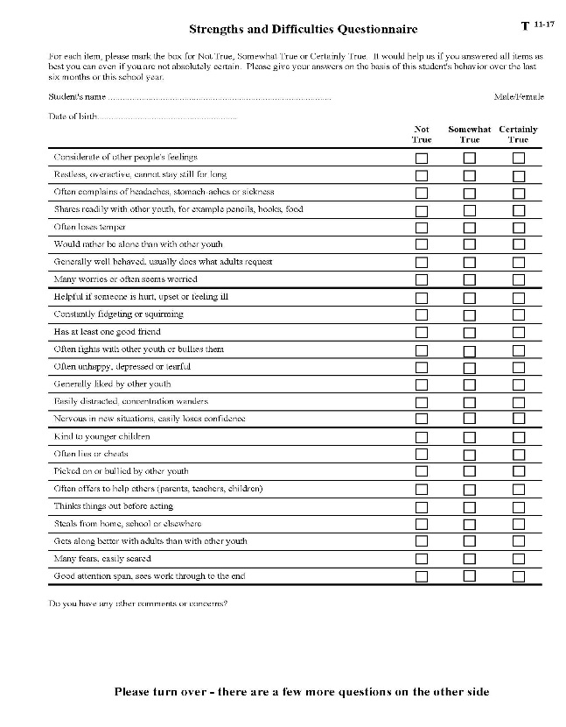


What screening tools are available?
See Lane, Menzies, Oakes, and Kalberg (2012)

Slide 32


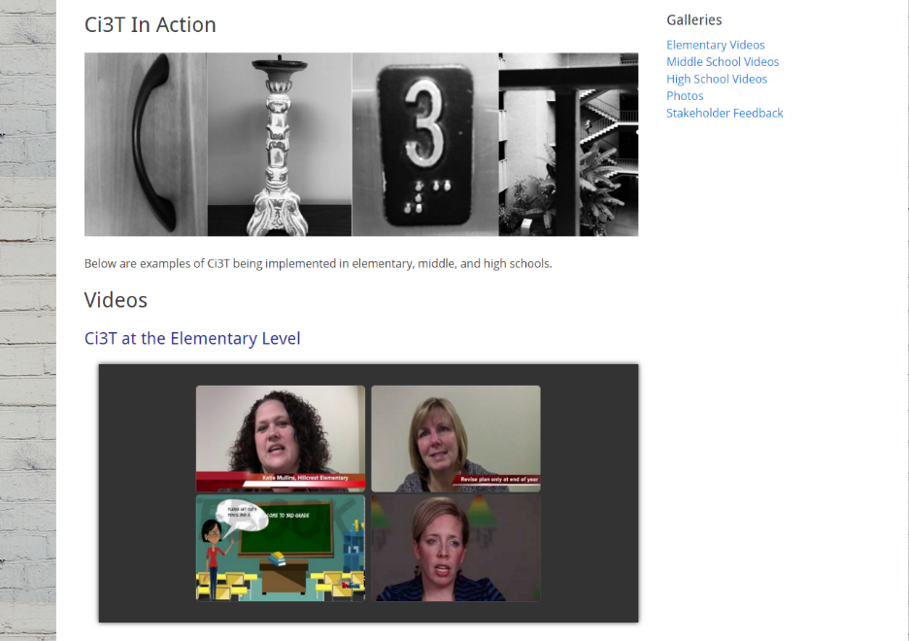
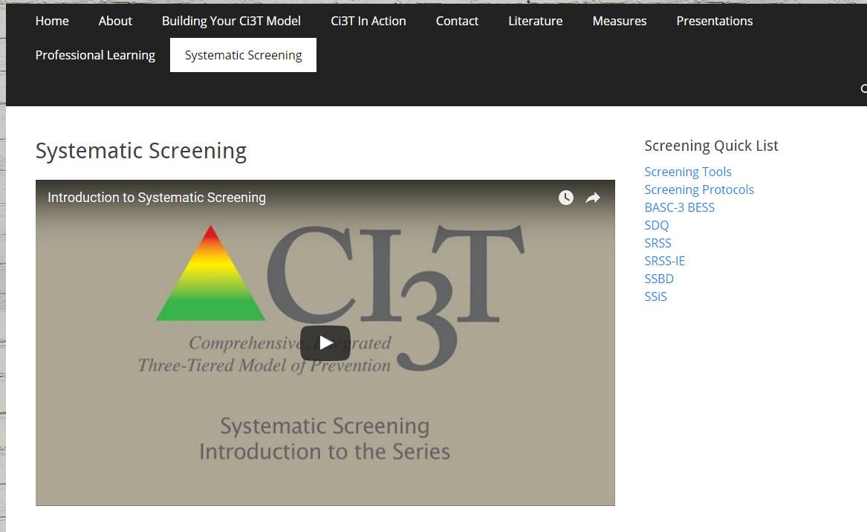
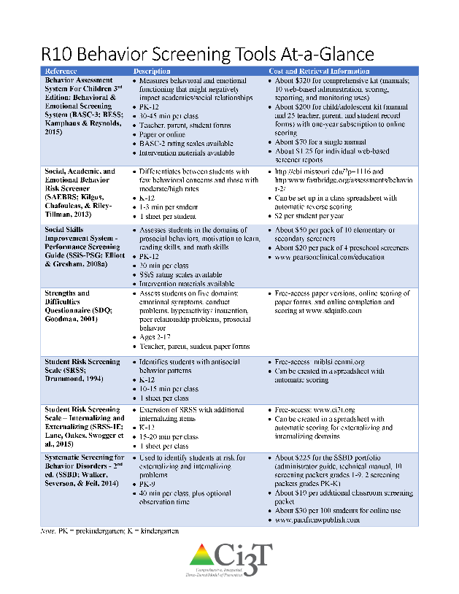

www.ci3t.org
Systematic Screening

Slide 33

Systematic Screener for Behavior Disorders
Available from
Pacific Northwest Publishing
(SSBD 2nd ed.; Walker, Severson, & Feil, 2014)
Notes:
https://pacificnwpublish.com/products/SSBD-Online.html

Slide 34
SSBD Results – Winter 2007 through Winter 2009
Risk Status of Nominated Students
Externalizing
% computed based on total # students screened
6.18%
3.50%
3.18%
8.90%
6.50%
2.73%
1.44%
Source. Lane, Menzies, Oakes, & Kalberg, 2012. Figure 2.2 WES Elementary Systematic Screening for Behavior Disorders (SSBD; Walker & Severson, 1992) results comparing the percentage of students nominated and exceeding normative criteria for both externalizing and internalizing behavior disorders over a three year period.
Notes:
34

Slide 35
Sample Data – SSBD
2007-2011 Risk Status for Nominated Students
Externalizing
Number of students
47
13
57
9
66
11
78
14
63
7
6.8%
2.17%
2.41%
2.61%
1.5%
Note. The numbers represent totals for the students for whom the SSBD was completed.
Notes:
35

Slide 36
Sample Data – SSBD
2007-2011 Risk Status for Nominated Students
Internalizing
Number of students
46
17
66
12
78
12
55
13
60
6
4.4%
2.78%
1.44%
2.63%
2.24%
Note. The numbers represent totals for the students for whom the SSBD was completed.
Notes:
36

Slide 37
SAMPLE DATA: SSBD
WINTER 2009-2010
CRITICAL NEED COMPARISON BY GRADE LEVEL
Grade Level | Total Number of Students Screened | Students Nominated | Students w/ Critical Need | Critical Internalizing | Critical Externalizing
K | 72 *5 | 24 | 4 (5.56%) | 1 (1.39%) | 3 (4.17%)
1st | 66 *9E/ 8I | 24 | 1 (1.54%) | 0 (0.00%) | 1 (1.54%)
2nd | 60 *10 | 18 | 3 (5.00%) | 2 (3.33%) | 1 (1.67%)
* Students missing
Notes:
37

Slide 38
Notes:
10 min Using this PowerPoint break timer
**Is timer set to correct time. Do we want 25 or 10? Same question for above slide.
This PowerPoint slide uses images, custom animation, and timing to provide a countdown timer that you can use in any presentation. When you open the template, you’ll notice that the timer is set at 00:00. However, when you start the slide show, the timer will start at the correct time and count down by 1-minute intervals until it gets to 1 minute. At that point, it will count down in two 30-seconds intervals to 00:00.
To insert this slide into your presentation
Save this template as a presentation (.ppt file) on your computer.
Open the presentation that will contain the timer.
On the Slides tab, place your insertion point after the slide that will precede the timer. (Make sure you don't select a slide. Your insertion point should be between the slides.)
On the Insert menu, click Slides from Files.
In the Slide Finder dialog box, click the Find Presentation tab.
Click Browse, locate and select the timer presentation, and then click Open.
In the Slides from Files dialog box, select the timer slide.
Select the Keep source formatting check box. If you do not select this check box, the copied slide will inherit the design of the slide that precedes it in the presentation.
Click Insert.
Click Close.

Slide 39
Student Risk Screening Scale
Available from ci3t.org and miblsi.org
(SRSS; Drummond, 1994)

Slide 40
Student Risk Screening Scale
(Drummond, 1994)
The SRSS is 7-item mass screener used to identify students who are at risk for antisocial behavior.
Uses 4-point Likert-type scale:
never = 0, occasionally = 1, sometimes = 2, frequently = 3
Teachers evaluate each student on the following items
  - Steal - Low Academic Achievement
  - Lie, Cheat, Sneak - Negative Attitude
  - Behavior Problems - Aggressive Behavior
  - Peer Rejection
Student Risk is divided into 3 categories
  Low 0 – 3
  Moderate 4 – 8
  High 9 - 21 (SRSS; Drummond, 1994)

Slide 41
Student Risk Screening Scale
(Drummond, 1994)

Slide 42
Student Risk Screening Scale
Fall 2004 – 2012
Middle School
Source: Lane, K. L., Oakes, W. P., & Magill, L. M., (2014). Primary prevention efforts: How do we implement and monitor the Tier 1 component of our comprehensive, integrated, three-tiered model of prevention. Preventing School Failure, 58, 143-158. doi: 10.1080/1045988X.2014.893978 [Figure 4. Middle school behavior screening data over time at the fall time point. Adapted from Figure 4.6 p. 127 Lane, K. L., Menzies, H. M, Oakes, W. P., & Kalberg, J. R. (2012). Systematic screenings of behavior to support instruction: From preschool to high school. New York, NY: Guilford Press.]

Slide 43
sample data: SRSS
Middle School Study 1: Behavioral & Academic Characteristics of SRSS Risk Groups
Variable |  | Risk
 | Low (n = 422) M (SD) | Moderate (n = 51) M (SD) | High (n = 12) M (SD) | Significance Testing
ODR | 1.50 (2.85) | 5.02 (5.32) | 8.42 (7.01) | L<M<H
In-School Suspensions | 0.08 (0.38) | 0.35 (1.04) | 1.71 (2.26) | L<M<H
GPA | 3.35 (0.52) | 2.63 (0.65) | 2.32 (0.59) | L>M, H M=H
Course Failures | 0.68 (1.50) | 2.78 (3.46) | 4.17 (3.49) | L<M, H M=H
(Lane, Parks, Kalberg, & Carter, 2007)

Slide 44
Student Risk Screening Scale
High School: Behavioral & Academic Characteristics of SRSS Risk Groups
Non-Instructional Raters
Variable |  | Risk
 | Low (n = 328) M (SD) | Moderate (n = 52) M (SD) | High (n = 35) M (SD) | Significance Testing
ODR | 3.53 (5.53) | 8.27 (7.72) | 8.97 (9.39) | L < M, H M = H
GPA | 3.10 (0.82) | 2.45 (0.84) | 2.38 (0.88) | L > M, H M = H
(Lane, Kalberg, Parks, & Carter, 2008)

Slide 45
Sample Data: SRSS by Grade
Grade Level | Number of Students in Grade Level | Low (0-3) | Moderate (4-8) | High (9 +)
K | 99 | 73 (73.74%) | 16 (16.16%) | 10 (10.10%)
1st | 100 | 85 (85.00%) | 9 (9.00%) | 6 (6.00%)
2nd | 99 | 89 (89.90%) | 9 (9.09%) | 1 (1.01%)
Percentage refers to the percentage of the grade level population screened.
Notes:
PGES

Slide 46
Notes:
10 min Using this PowerPoint break timer
**Is timer set to correct time. Do we want 25 or 10? Same question for above slide.
This PowerPoint slide uses images, custom animation, and timing to provide a countdown timer that you can use in any presentation. When you open the template, you’ll notice that the timer is set at 00:00. However, when you start the slide show, the timer will start at the correct time and count down by 1-minute intervals until it gets to 1 minute. At that point, it will count down in two 30-seconds intervals to 00:00.
To insert this slide into your presentation
Save this template as a presentation (.ppt file) on your computer.
Open the presentation that will contain the timer.
On the Slides tab, place your insertion point after the slide that will precede the timer. (Make sure you don't select a slide. Your insertion point should be between the slides.)
On the Insert menu, click Slides from Files.
In the Slide Finder dialog box, click the Find Presentation tab.
Click Browse, locate and select the timer presentation, and then click Open.
In the Slides from Files dialog box, select the timer slide.
Select the Keep source formatting check box. If you do not select this check box, the copied slide will inherit the design of the slide that precedes it in the presentation.
Click Insert.
Click Close.

Slide 47
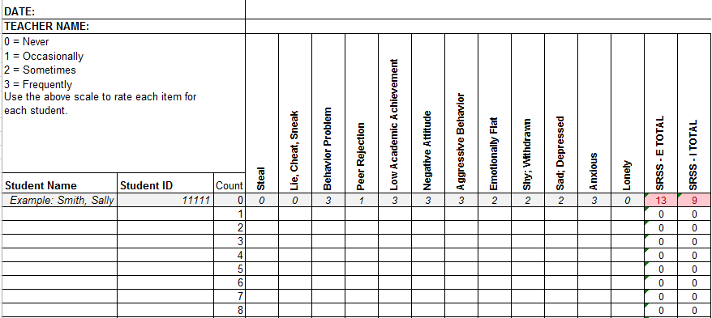
Student Risk Screening Scale for Internalizing and Externalizing
Available on ci3t.org
(SRSS-IE; Drummond, 1994 and Lane & Menzies, 2009)

Slide 48
Student Risk Screening Scale-IE
12 items scale for use at the elementary, middle, and high schools
Subscale scores used for interpretation.
No total scale score.

Slide 49
SRSS-IE: Cut Scores
Enter ‘practice’ data into that one sheet so that the total scores and conditional formatting are tested.
Confirm the “Count” column is completed (students’ numbered sequentially). Formulas are anchored by the “Count” column; it must contain a number for each student listed for accurate total formulas.
Elementary School |  | Middle and High School
SRSS-E7 | SRSS-I5 | SRSS-E7 | SRSS-I6
Items 1-7 | Items 8-12 | Items 1-7 | Items 4, 8-12
0-3 = low risk 4-8 = moderate risk 9-21 = high risk | 0-1 = low risk 2-3 = moderate risk 4-15 = high risk | 0-3 = low risk 4-8 = moderate risk 9-21 = high risk | 0-3 = low risk 4-5 = moderate risk 6-18 = high risk
Elementary School Level:
Lane, K. L., Oakes, W. P., Swogger, E. D., Schatschneider, C., Menzies, H., M., & Sanchez, J. (2015). Student risk screening scale for internalizing and externalizing behaviors: Preliminary cut scores to support data-informed decision making. Behavioral Disorders, 40, 159-170.
Middle and High School Levels:
Lane, K. L., Oakes, W. P., Cantwell, E. D., Schatschneider, C., Menzies, H., Crittenden, M., & Messenger, M. (in press). Student Risk Screening Scale for Internalizing and Externalizing Behaviors: Preliminary cut scores to support data-informed decision making in middle and high schools. Behavioral Disorders.

Slide 50
Elementary School - Fall
SRSS-E7 Results – All Students
N = 25
N = 16
N = 17
N = 12
N = 86
N = 35
N = 57
N = 36
N = 250
N = 300
N = 250
N = 255

Slide 51
Elementary School - Fall
SRSS-I5 Results – All Students
N = 72
N = 18
N = 32
N = 85
N = 43
N = 45
N = 40
N = 204
N = 289
N = 261
N = 231

Slide 52
SRSS-Externalizing Results: Grade level
Fall 2017
Grade Level | N Screened | Low n (%) | Moderate n (%) | High n (%)
3rd | 45 | 39 (86.67%) | 3 (6.67%) | 3 (6.67%)
4th | 46 | 35 (76.09%) | 10 (21.74%) | 1 (2.17%)
5th | 61 | 53 (86.89%) | 6 (9.84%) | 2 (3.28%)
Notes:
IMPORTANT NOTE: Use this slide for the SRSS-E7 to enter the results by grade level: number of students and percent of students for each grade level.
The cut scores for the Externalizing subscale (SRSS-E7) are different than the Internalizing subscale. The SRSS-E7 can be used for grades K-12.

Slide 53
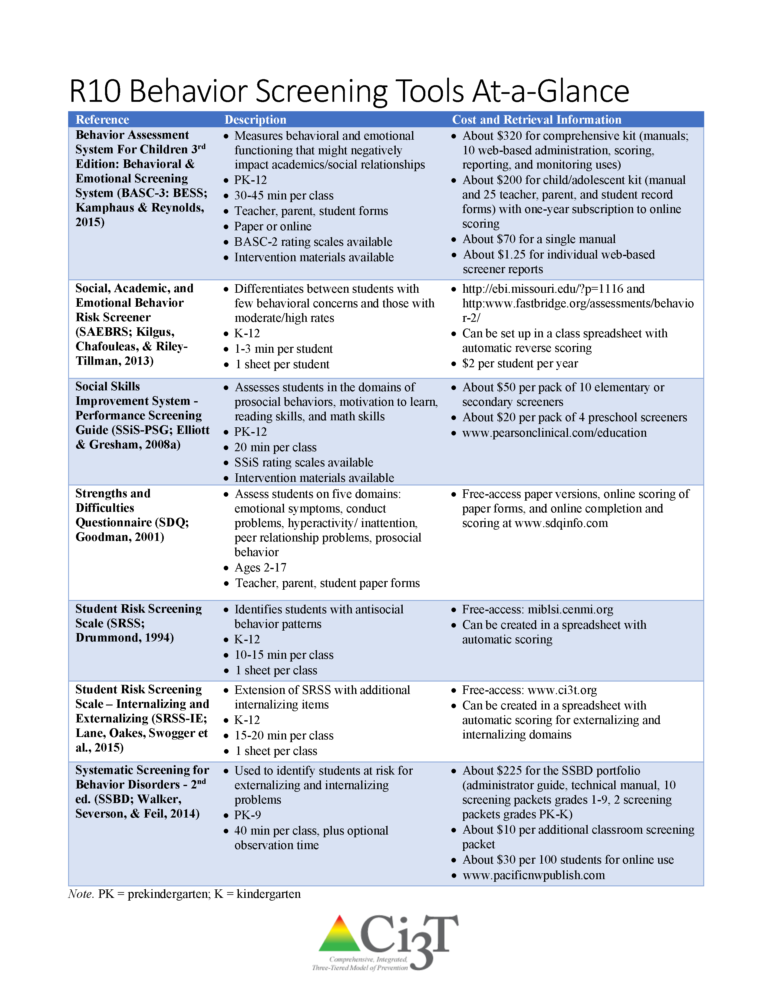
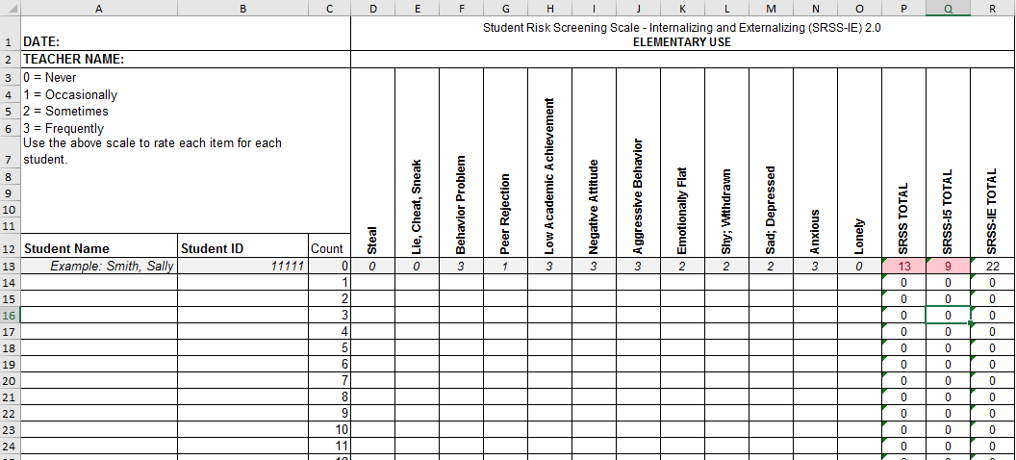
Procedures
Fall
Winter
Spring

Slide 54
Results:
SRSS-IE: Externalizing Subscale Elementary
Fall Externalizing
Winter
Spring
ORF
MAP Reading
Nurse Visit
Suspensions
Variable | Risk |  |  | Significance Testing
 | Low M (SD) n | Moderate M (SD) n | High M (SD) n
Oral Reading Fluency | 163.23 (39.66) 468 | 138.62 (42.70) 107 | 115.82 (46.21) 46 | L > M > H
MAP Reading | 66.54 (26.48) 2,047 | 42.91 (30.37) 443 | 33.32 (29.82) 199 | L > M > H
Nurse Visits | 6.14 (6.81) 3,256 | 9.18 (9.59) 820 | 11.83 (9.89) 389 | L < M < H
In-School Suspensions | 0.0052 (0.08) 3,256 | 0.0427 (0.30) 820 | 0.1080 (0.46) 389 | L < M < H

Slide 55
Results:
SRSS-IE: internalizing Subscale Elementary
Variable | Risk |  |  | Significance Testing
 | Low M (SD) n | Moderate M (SD) n | High M (SD) n
Oral Reading Fluency | 159.04 (41.45) 459 | 150.59 (45.76) 88 | 139.18 (46.53) 74 | L > H L = M; M = H
MAP Reading | 63.38 (28.32) 2,070 | 53.93 (32.15) 356 | 43.57 (30.47) 263 | L > M > H
Nurse Visits | 6.84 (7.37) 3,387 | 7.59 (8.05) 628 | 9.33 (10.81) 450 | L < M < H
In-School Suspensions | 0.0142 (0.15) 3,387 | 0.0510 (0.36) 628 | 0.0311 (0.20) 450 | L < M, H M = H
Fall Internalizing
Winter Internalizing
Spring
ORF*
MAP Reading
Nurse Visit
Suspensions*

Slide 56
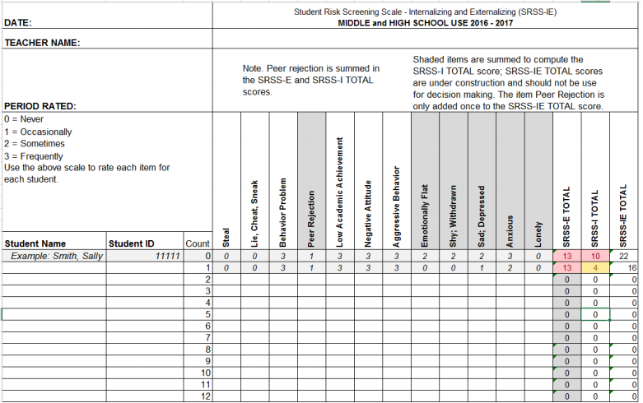
SRSS-IE Middle and High School Scoring

Slide 57
SRSS-IE: Cut Scores
Enter ‘practice’ data into that one sheet so that the total scores and conditional formatting are tested.
Confirm the “Count” column is completed (students’ numbered sequentially). Formulas are anchored by the “Count” column; it must contain a number for each student listed for accurate total formulas.
Elementary School |  | Middle and High School
SRSS-E7 | SRSS-I5 | SRSS-E7 | SRSS-I6
Items 1-7 | Items 8-12 | Items 1-7 | Items 4, 8-12
0-3 = low risk 4-8 = moderate risk 9-21 = high risk | 0-1 = low risk 2-3 = moderate risk 4-15 = high risk | 0-3 = low risk 4-8 = moderate risk 9-21 = high risk | 0-3 = low risk 4-5 = moderate risk 6-18 = high risk
Elementary School Level:
Lane, K. L., Oakes, W. P., Swogger, E. D., Schatschneider, C., Menzies, H., M., & Sanchez, J. (2015). Student risk screening scale for internalizing and externalizing behaviors: Preliminary cut scores to support data-informed decision making. Behavioral Disorders, 40, 159-170.
Middle and High School Levels:
Lane, K. L., Oakes, W. P., Cantwell, E. D., Schatschneider, C., Menzies, H., Crittenden, M., & Messenger, M. (in press). Student Risk Screening Scale for Internalizing and Externalizing Behaviors: Preliminary cut scores to support data-informed decision making in middle and high schools. Behavioral Disorders.

Slide 58
Sample High School Fall (Externalizing)
SRSS-E7 Results – All Students
N = 29
N = 39
N = 96
N = 95
N = 1072
N = 1404

Slide 59
SRSS-E7 Comparison by Grade Level
Sample High School Fall (Externalizing) 2016
Grade Level | N Screened | Low (0-3) | Moderate (4-8) | High (9-21)
9th | 397 | 361 (90.93%) | 29 (7.30%) | 7 (1.76%)
10th | 428 | 381 (89.02%) | 32 (7.48%) | 15 (3.50%)
11th | 396 | 363 (91.67%) | 24 (6.06%) | 9 (2.27%)
12th | 317 | 299 (94.32%) | 10 (3.15%) | 8 (2.52%)
Notes:
N = 1498

Slide 60
Sample High School Fall (Internalizing)
SRSS-I6 Results – All Students
N = 87
N = 64
N = 1387

Slide 61
SRSS-I6 Comparison by Grade Level
Sample High School Fall (Internalizing) 2016
Grade Level | N Screened | Low (0-3) | Moderate (4-5) | High (6-18)
9th | 397 | 353 (88.92%) | 24 (6.05%) | 20 (5.04%)
10th | 428 | 388 (90.65%) | 14 (3.27%) | 26 (6.07%)
11th | 396 | 353 (89.14%) | 16 (4.04%) | 27 (6.82%)
12th | 317 | 293 (92.43%) | 10 (3.15%) | 14 (4.42%)
Notes:
IMPORTANT NOTE: The cut scores for the Internalizing subscale (SRSS-I5) are different than the Externalizing subscale and is ONLY for use at the Elementary Level. The cut scores for the Internalizing subscale (SRSS-I5) are preliminary scores. Be cautious in interpreting these results.
Be cautious when coping and pasting this slide to add additional grade levels.
Use this slide for the SRSS-I5 to enter the results by grade level: number of students and percent of students for each grade level.

Slide 62
Notes:
10 min Using this PowerPoint break timer
**Is timer set to correct time. Do we want 25 or 10? Same question for above slide.
This PowerPoint slide uses images, custom animation, and timing to provide a countdown timer that you can use in any presentation. When you open the template, you’ll notice that the timer is set at 00:00. However, when you start the slide show, the timer will start at the correct time and count down by 1-minute intervals until it gets to 1 minute. At that point, it will count down in two 30-seconds intervals to 00:00.
To insert this slide into your presentation
Save this template as a presentation (.ppt file) on your computer.
Open the presentation that will contain the timer.
On the Slides tab, place your insertion point after the slide that will precede the timer. (Make sure you don't select a slide. Your insertion point should be between the slides.)
On the Insert menu, click Slides from Files.
In the Slide Finder dialog box, click the Find Presentation tab.
Click Browse, locate and select the timer presentation, and then click Open.
In the Slides from Files dialog box, select the timer slide.
Select the Keep source formatting check box. If you do not select this check box, the copied slide will inherit the design of the slide that precedes it in the presentation.
Click Insert.
Click Close.

Slide 63

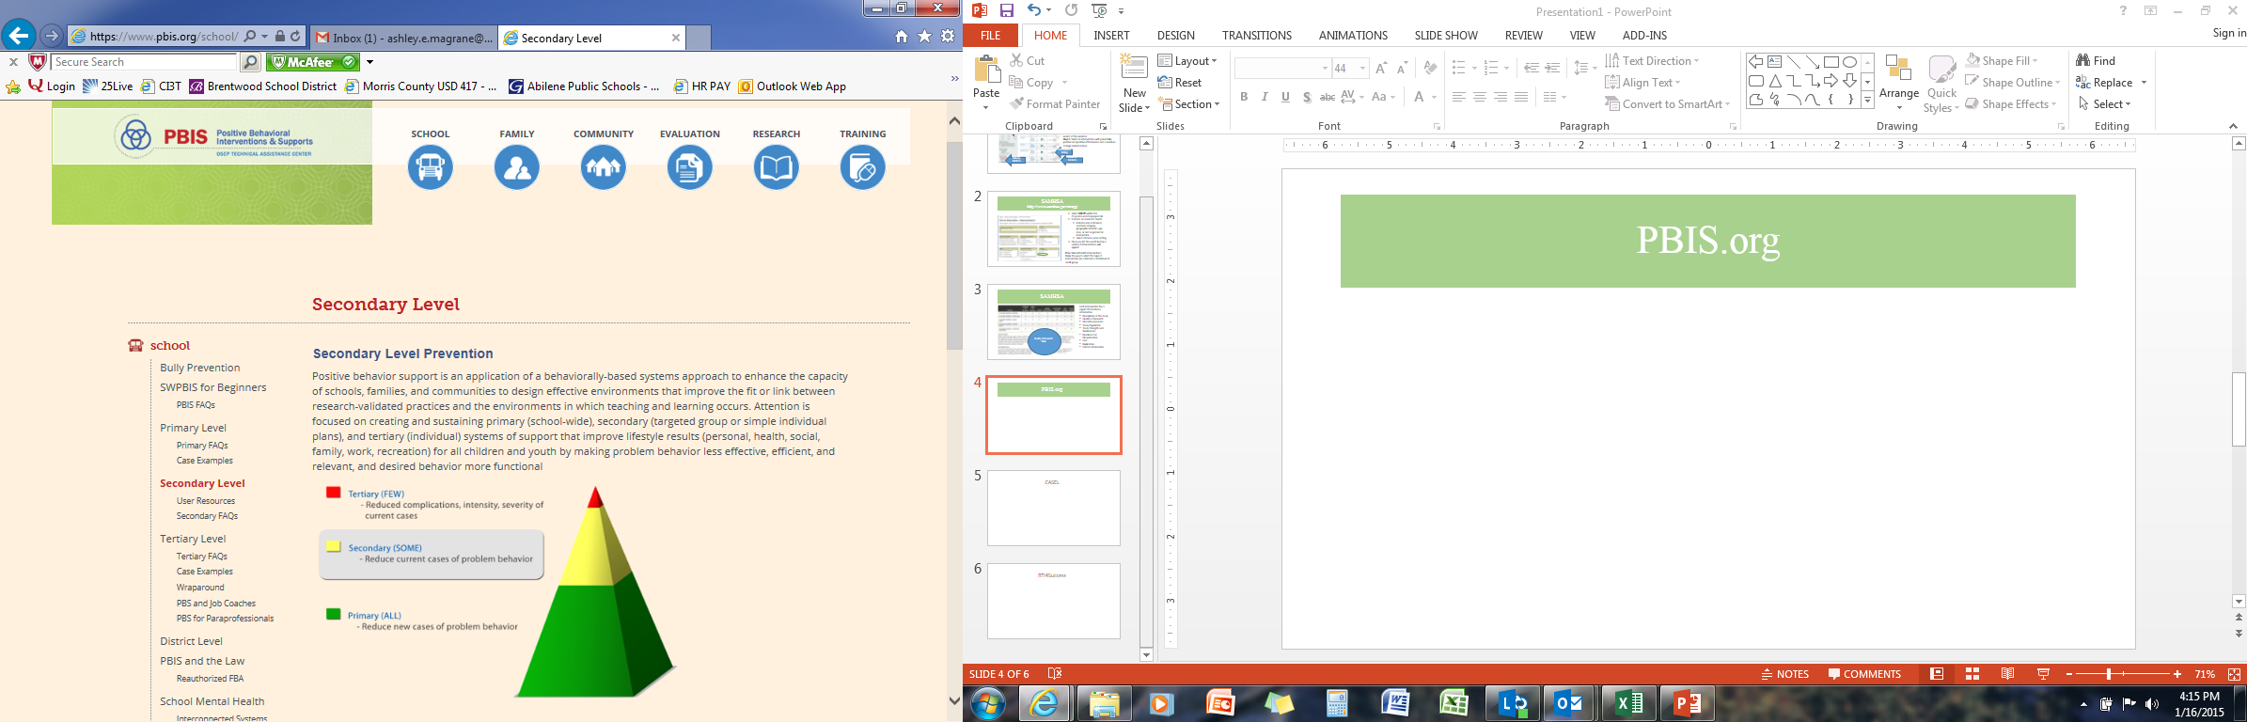
Screening …
Considering the Logistics & Ci3T in Action

Slide 64
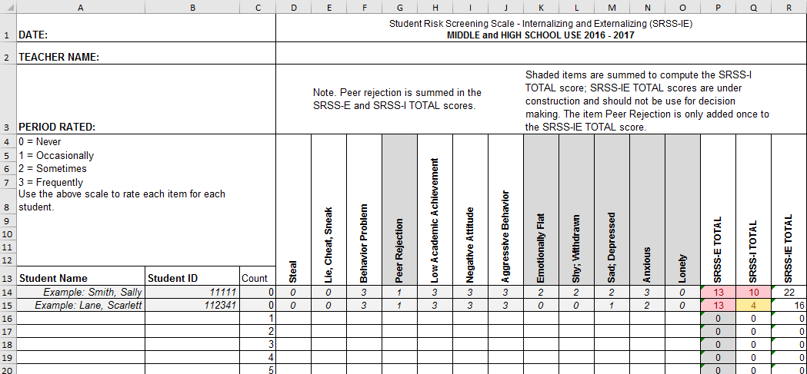
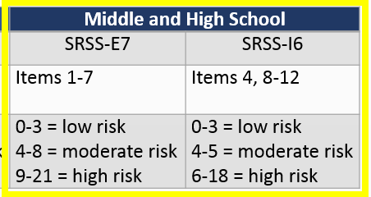
Starting the year with Ci3T…
Screening Practices
District system …
Preparing…
Previewing …
Dedicating time …
Reminding …
Supporting …
Following through …
Summarizing …
Using data to inform
instruction...
Notes:
District system …
Preparing…
Previewing …
Dedicating time …
Reminding …
Supporting …
Following through …
Summarizing …

Slide 65
Notes:
Data security – teamwork to create, populate, collect and synthesize data – planning ahead to calendar screening as all other data collection – SHARE the information with faculty and staff

Slide 66
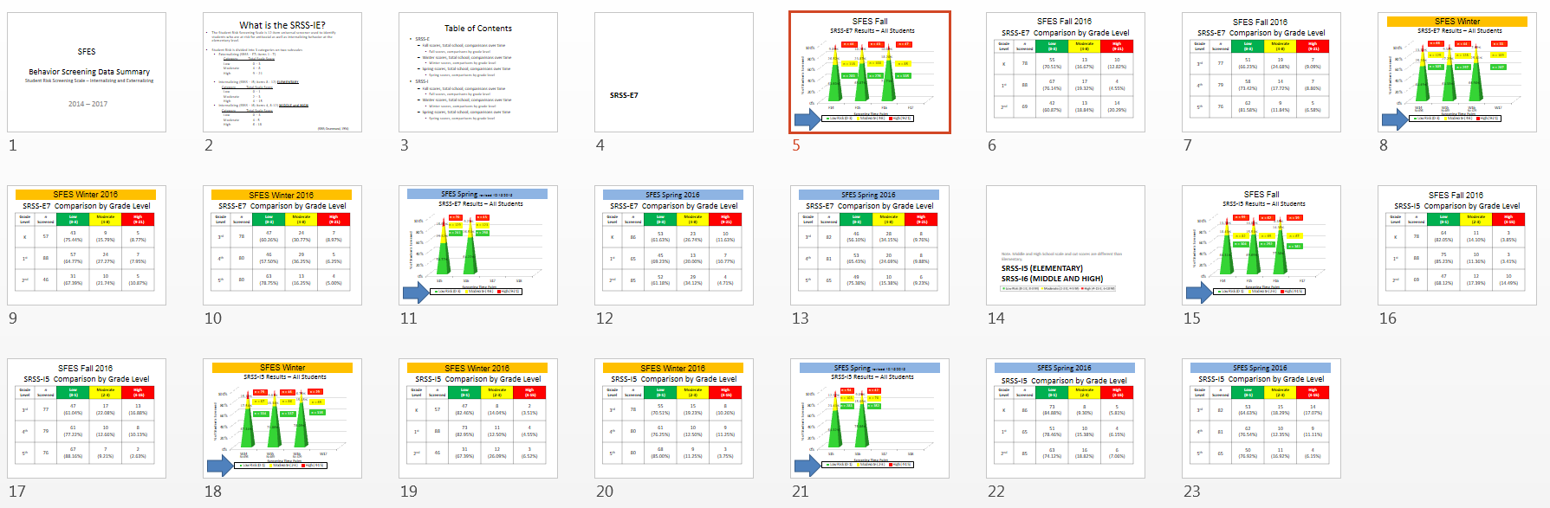
Sample Middle School: Fall
SRSS-E7 Results – All Students
N = 26
N = 12
N = 89
N = 66
N = 554
N = 550

Slide 67
Screening Data: High School Yrs1-3
Fall- SRSSIE-I |  | Low |  | Moderate |  | High |  | Fall- SRSSIE-E |  | Low |  | Moderate |  | High
2016 |  | 80.28% |  | 10.36% |  | 9.36% |  | 2016 |  | 89.56% |  | 8.02% |  | 2.42%
2017 |  | 90.18% |  | 4.16% |  | 5.66% |  | 2017 |  | 91.29% |  | 6.18% |  | 2.54%
2018 |  | 90.91% |  | 3.86% |  | 5.23% |  | 2018 |  | 92.22% |  | 6.20% |  | 1.58%
WTR-SRSSIE-I |  | Low |  | Moderate |  | High |  | WTR-SRSSIE-E |  | Low |  | Moderate |  | High
2016 |  | 87.25% |  | 9.49% |  | 3.26% |  | 2016 |  | 87.25% |  | 9.49% |  | 3.26%
2017 |  | 86.14% |  | 9.02% |  | 4.85% |  | 2017 |  | 86.14% |  | 9.02% |  | 4.85%
2018 |  | 88.79% |  | 8.52% |  | 2.69% |  | 2018 |  | 88.79% |  | 8.52% |  | 2.69%

Slide 68
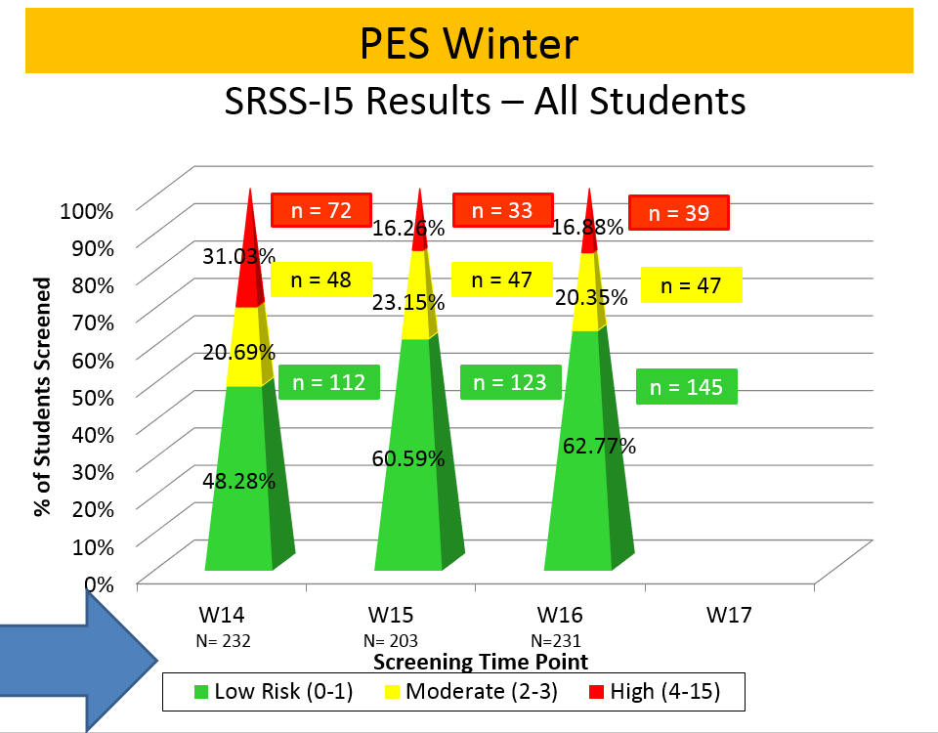
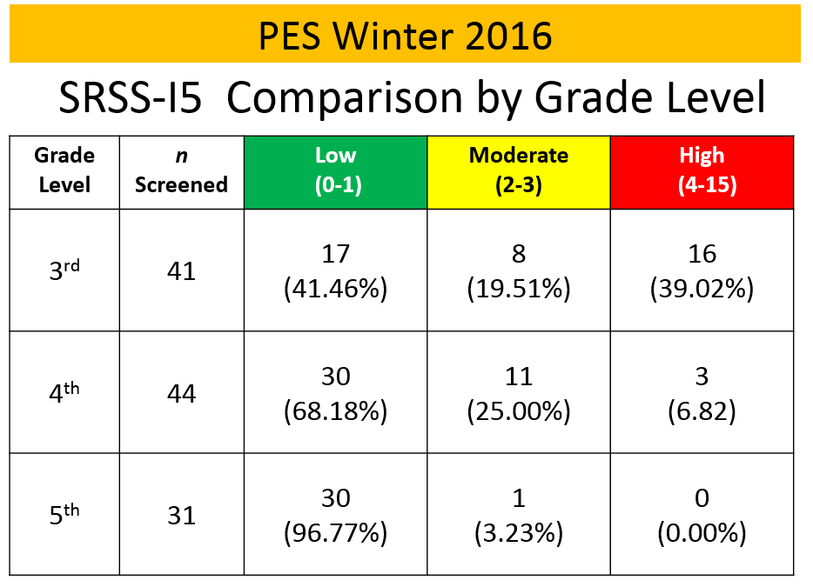
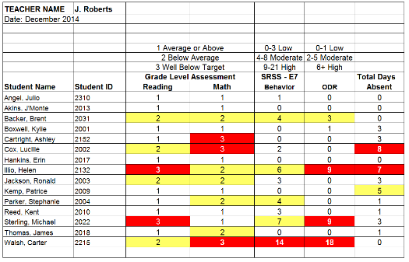
Data sharing…
Schoolwide data
  …decisions related to primary prevention efforts
Grade / Department / Class
  …implications for teachers’ practice
Individual student
  …decisions about student-based interventions

Slide 69
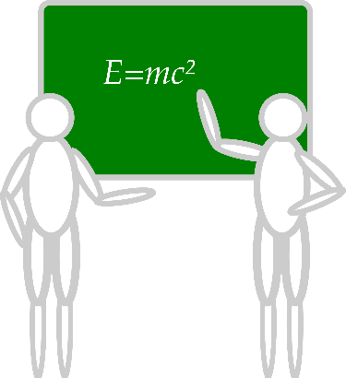






Communication and Continuous Improvement
Effective
Teams
Ci3T District Leadership Team
College & Career
Ci3T School Leadership Team
Ci3T School Leadership Team
Ci3T School Leadership Team
Ci3T School Leadership Team
Ci3T School Leadership Team
Ci3T School Leadership Team
Ci3T School Leadership Team
Ci3T School Leadership Team
Ci3T School Leadership Team
Ci3T School Leadership Team
Ci3T School Leadership Team
Ci3T School Leadership Team
Ci3T School Leadership Team
Ci3T School Leadership Team
Ci3T School Leadership Team
High
Ci3T School Leadership Team
Ci3T School Leadership Team
Middle
Ci3T School Leadership Team
Ci3T School Leadership Team
Ci3T School Leadership Team
Ci3T School Leadership Team
Elementary
Notes:
Structure for positive, productive discussions
Data-informed professional development

Slide 70
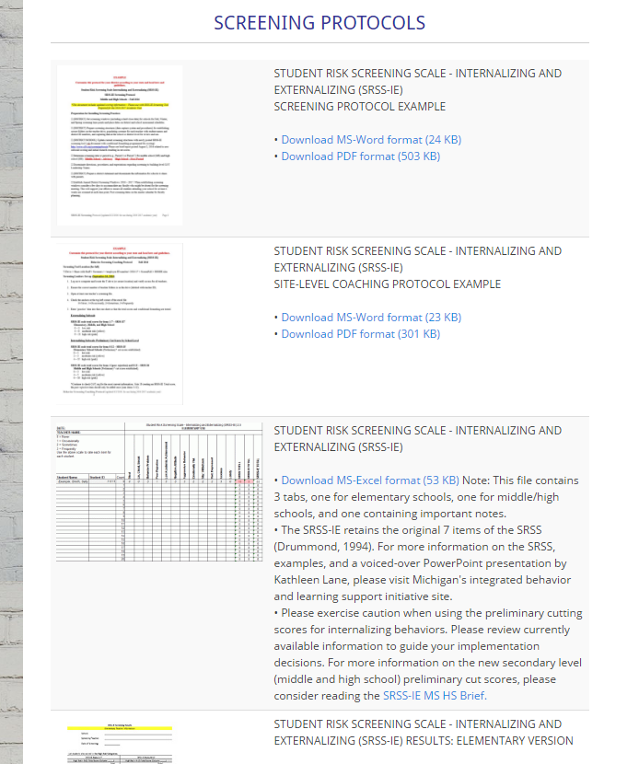
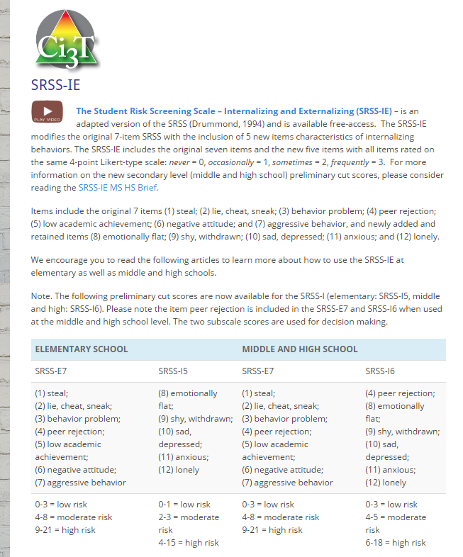
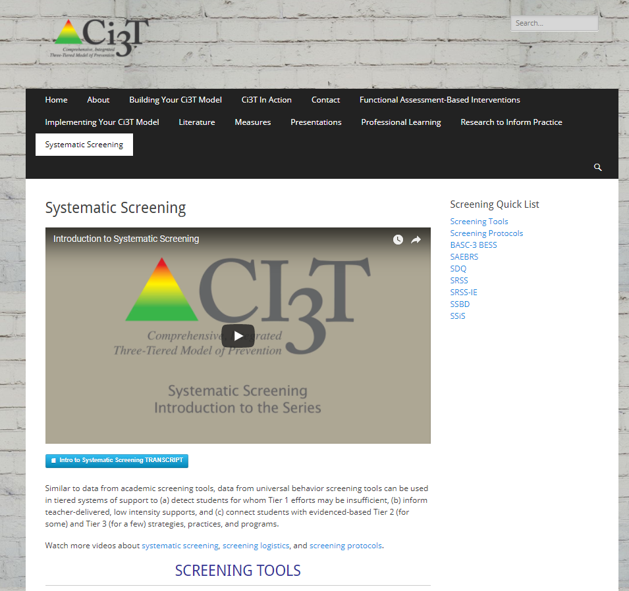
Ci3t.org/screening
Systematic Screening
Notes:
QR code still functional?

Slide 71
Notes:
10 min Using this PowerPoint break timer
**Is timer set to correct time. Do we want 25 or 10? Same question for above slide.
This PowerPoint slide uses images, custom animation, and timing to provide a countdown timer that you can use in any presentation. When you open the template, you’ll notice that the timer is set at 00:00. However, when you start the slide show, the timer will start at the correct time and count down by 1-minute intervals until it gets to 1 minute. At that point, it will count down in two 30-seconds intervals to 00:00.
To insert this slide into your presentation
Save this template as a presentation (.ppt file) on your computer.
Open the presentation that will contain the timer.
On the Slides tab, place your insertion point after the slide that will precede the timer. (Make sure you don't select a slide. Your insertion point should be between the slides.)
On the Insert menu, click Slides from Files.
In the Slide Finder dialog box, click the Find Presentation tab.
Click Browse, locate and select the timer presentation, and then click Open.
In the Slides from Files dialog box, select the timer slide.
Select the Keep source formatting check box. If you do not select this check box, the copied slide will inherit the design of the slide that precedes it in the presentation.
Click Insert.
Click Close.

Slide 72
Agenda
Introducing Ci3T … working collaboratively and efficiently
Systematic Screening Tools & Screening Logistics
Using Screening Data to Inform Instruction
  Tier 1 practices
  Teacher-delivered strategies
  Tier 2 and 3 supports
Action Plans: Moving Forward

Slide 73
Examining your screening data …
… implications for Tier 1 practices
… implications for teacher-delivered strategies
… implications for Tier 2 and Tier 3 supports
See Lane, Menzies, Bruhn, and Crnobori (2011)

Slide 74
Social Skills Improvement System – Performance Screening Guide
Spring 2012 – Total School
N = 54
N = 22
N = 35
N = 31
N = 223
N = 233
N = 180
N = 187
N = 212
N = 235
N = 275
N = 271
n = 489 n = 490 n = 490 n = 489
Lane, K. L., Oakes, W. P., & Magill, L. (2013). Primary prevention efforts: How do we implemented and monitor the Tier 1 component of our Comprehensive, Integrated, Three-Tiered (CI3T) Model?

Slide 75
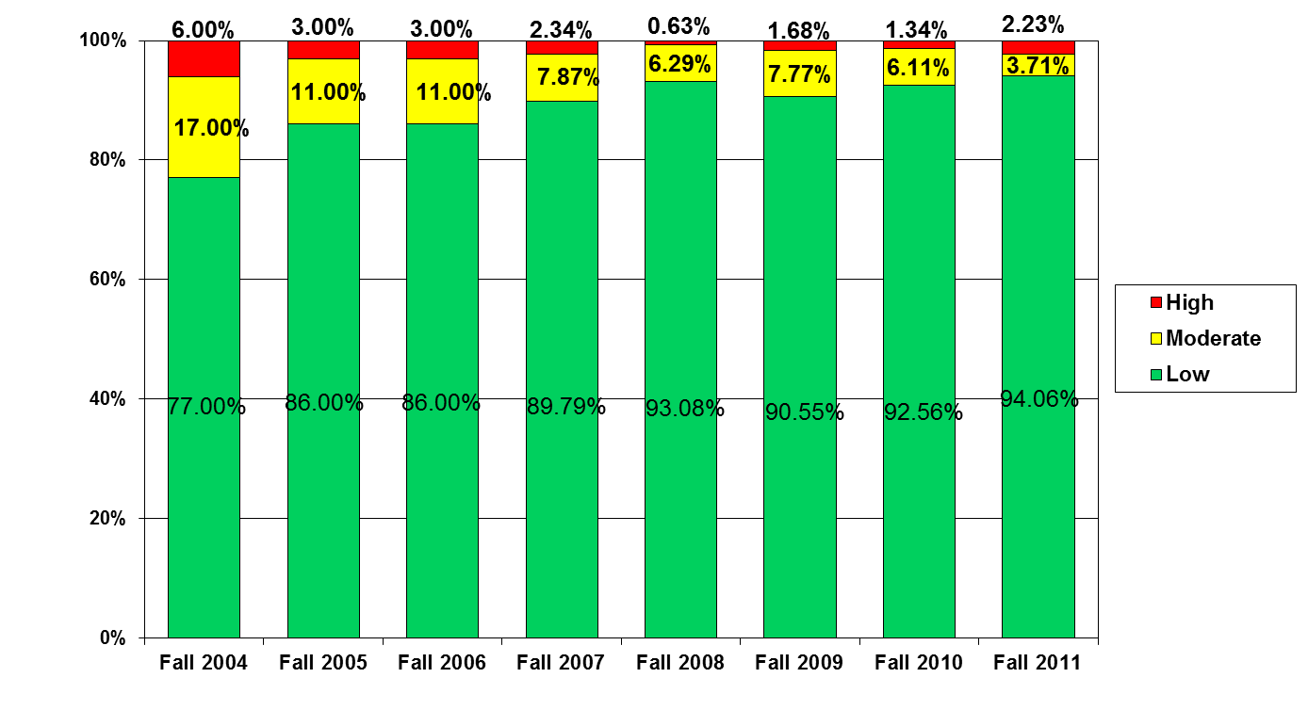
Student Risk Screening Scale
Middle School Fall 2004 - Fall 2011
n = 12
n = 20
n = 507
Percentage of Students
N=534
N=502
N=454
N=470
N=477
N=476
N=524
N= 539
Fall Screeners

Slide 76
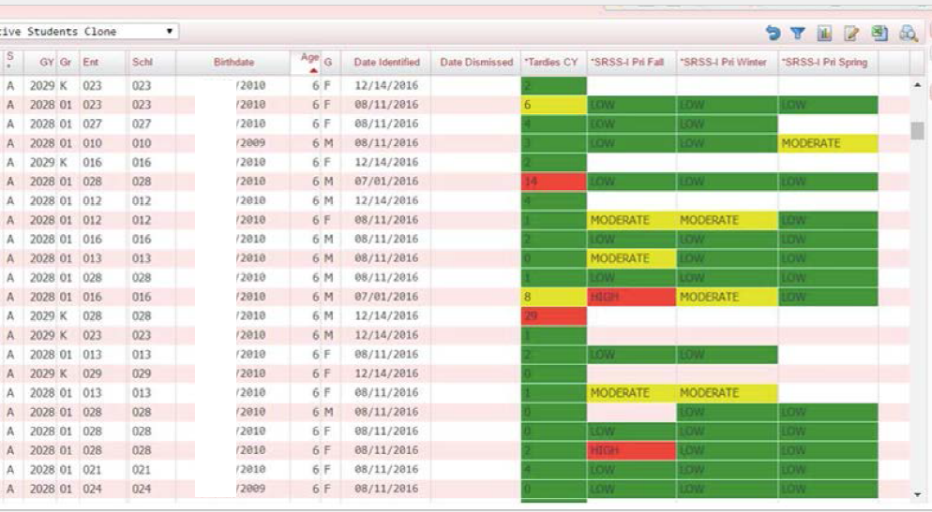
Data-Informed Decision Making
A work in progress

Slide 77
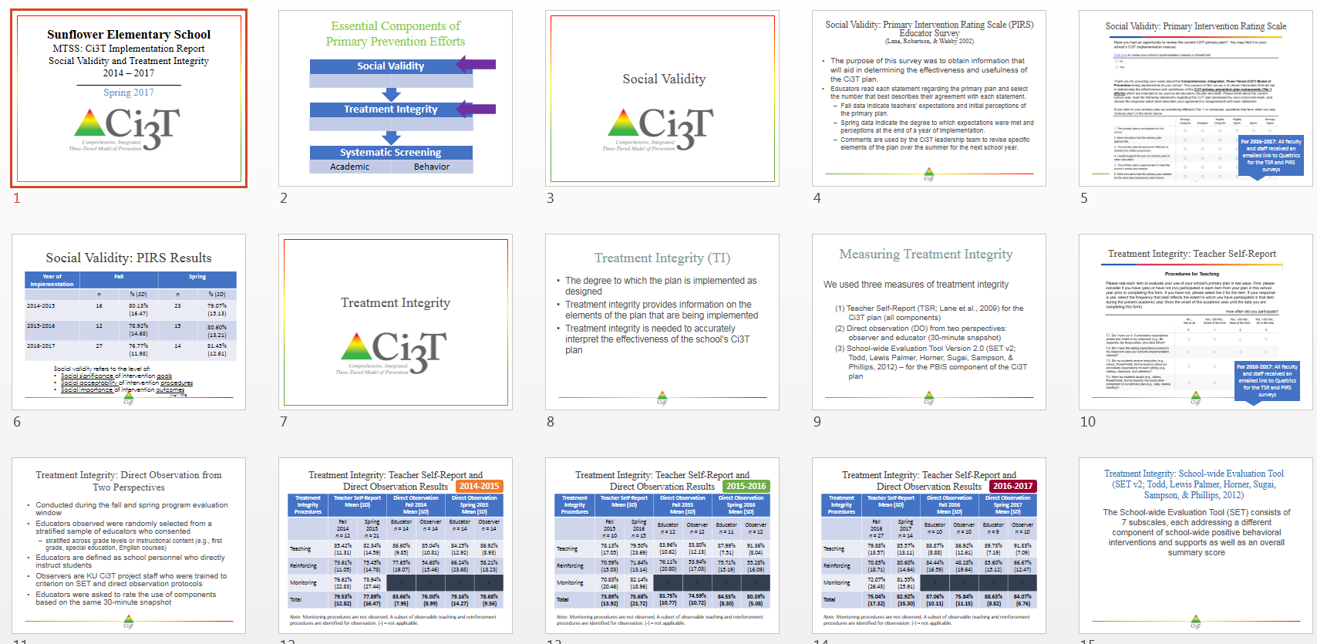
Implementation …
Data-Informed Decision Making

Slide 78
Notes:
10 min Using this PowerPoint break timer
**Is timer set to correct time. Do we want 25 or 10? Same question for above slide.
This PowerPoint slide uses images, custom animation, and timing to provide a countdown timer that you can use in any presentation. When you open the template, you’ll notice that the timer is set at 00:00. However, when you start the slide show, the timer will start at the correct time and count down by 1-minute intervals until it gets to 1 minute. At that point, it will count down in two 30-seconds intervals to 00:00.
To insert this slide into your presentation
Save this template as a presentation (.ppt file) on your computer.
Open the presentation that will contain the timer.
On the Slides tab, place your insertion point after the slide that will precede the timer. (Make sure you don't select a slide. Your insertion point should be between the slides.)
On the Insert menu, click Slides from Files.
In the Slide Finder dialog box, click the Find Presentation tab.
Click Browse, locate and select the timer presentation, and then click Open.
In the Slides from Files dialog box, select the timer slide.
Select the Keep source formatting check box. If you do not select this check box, the copied slide will inherit the design of the slide that precedes it in the presentation.
Click Insert.
Click Close.

Slide 79
Examining your screening data …
… implications for Tier 1 practices
… implications for teacher-delivered strategies
… implications for Tier 2 and Tier 3 supports
See Lane, Menzies, Bruhn, and Crnobori (2011)

Slide 80


Schoolwide Positive
Behavior Support
Comprehensive, Integrative,
Three-tiered (CI₃T)
Models of Support
Low Intensity Strategies
Basic Classroom Management
Effective Instruction
Low Intensity Strategies
Behavior Contracts
Self-Monitoring
- -
Functional Assessment-Based
Interventions
Higher Intensity
Strategies
Assess, Design, Implement,
and
Evaluate
Assessment

Slide 81
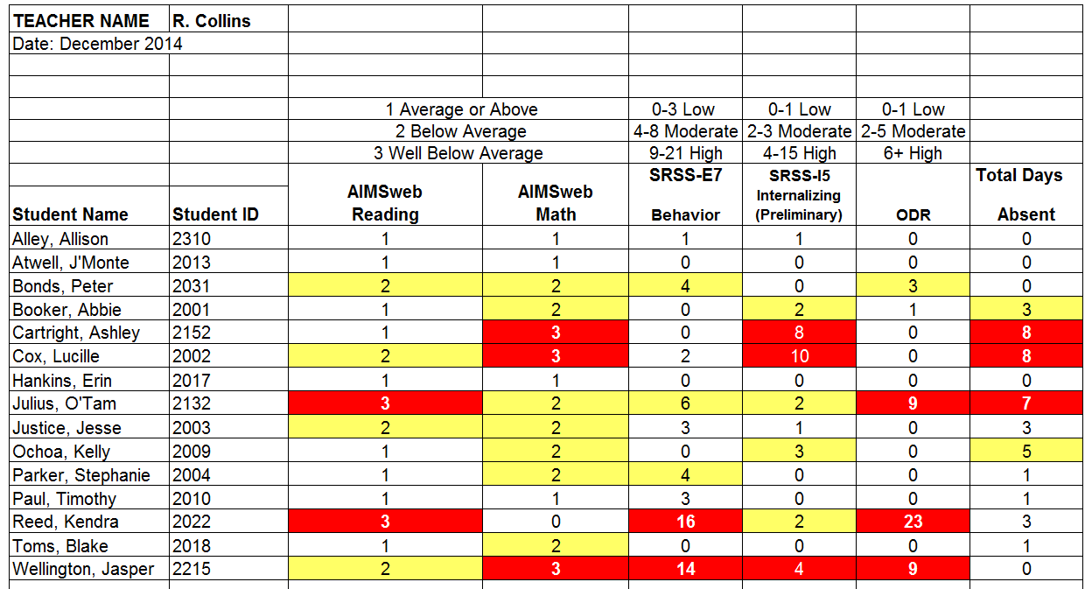
Examining Academic and Behavioral Data:
Elementary School Level
Lane, K. L., Menzies, H. M., Ennis, R. P., & Oakes, W. P. (2015). Supporting Behavior for School Success: A Step-by-Step Guide to Key Strategies. New York, NY: Guilford Press.
Notes:
Lane, K. L., Oakes, W. P., Ennis, R. P., & Hirsch, S. E. (2014). Identifying students for secondary and tertiary prevention efforts: How do we determine which students have Tier 2 and Tier 3 needs? Preventing School Failure, 58, 171-182, DOI: 10.1080/1045988X.2014.895573

Slide 82

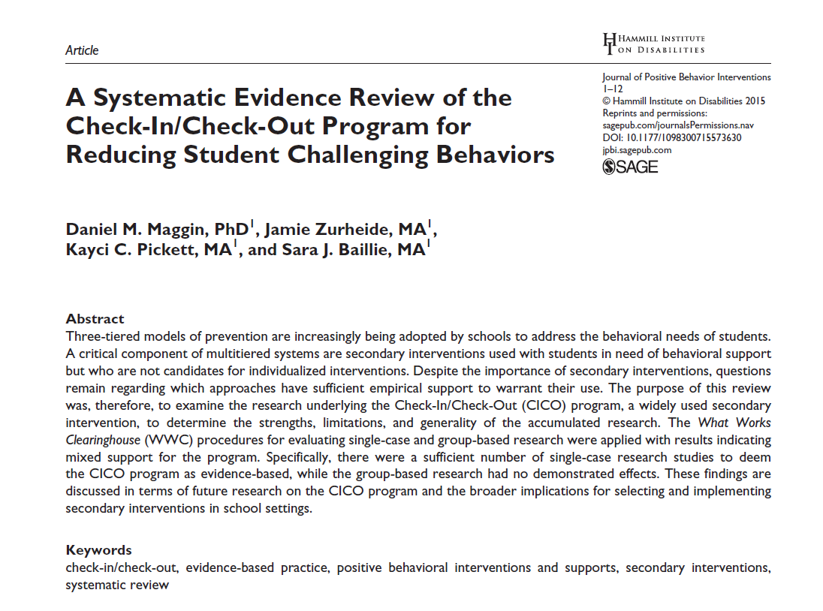

Low-Intensity Strategies
Opportunities to Respond
Behavior Specific Praise
Active Supervision
Instructional Feedback
High p Requests
Precorrection
Incorporating Choice
Self-monitoring
Behavior Contracts
Notes:
Lane, K. L., Oakes, W. P., Ennis, R. P., & Hirsch, S. E. (2014). Identifying students for secondary and tertiary prevention efforts: How do we determine which students have Tier 2 and Tier 3 needs? Preventing School Failure, 58, 171-182, DOI: 10.1080/1045988X.2014.895573

Slide 83



Slide 84
Low-Intensity Strategy | Lincoln Elementary On-Site Expert
Behavior-Specific Praise: Identifying the specific expectation the student met. “Niama, great job using your graphic organizer to draft your essay.” “Justice, thank you for pushing in your chair to keep the walkway safe.” | Eric Common, Behavior Specialist Mark Buckman, Special Education Grant Allen, Parent Volunteer
Opportunities to Respond: Providing 4-6 opportunities per minute for students to respond individually, choral, verbal, written, gesture, or symbol. “Show me thumbs or thumbs down if...” “Show me on your white board what…” “Turn to your elbow partner and say…” “All together now, what is…” | David Royer, Administration Emily Cantwell, 5th Grade Scarlett Lane, 3rd Grade Mallory Messenger, Counselor
Instructional Choice: Providing within-task or between task choices to increase academic engaged time and motivation. “Ronaldo, of these 3 tasks today, which would you like to work on first?” “Suzy, do you want to work with colored pencils, crayons, or sparkly markers?” | Abbie Jenkins, 2nd Grade Scarlett Lane, 3rd Grade Bryan Simmons, PE Liane Johl, Kindergarten
Notes:
Identify on-site experts!

Slide 85

ci3t.org

Slide 86

Professional Learning! www.ci3t.org/pl

Slide 87




ci3t.org
Professional Learning tab

Slide 88
Notes:
10 min Using this PowerPoint break timer
**Is timer set to correct time. Do we want 25 or 10? Same question for above slide.
This PowerPoint slide uses images, custom animation, and timing to provide a countdown timer that you can use in any presentation. When you open the template, you’ll notice that the timer is set at 00:00. However, when you start the slide show, the timer will start at the correct time and count down by 1-minute intervals until it gets to 1 minute. At that point, it will count down in two 30-seconds intervals to 00:00.
To insert this slide into your presentation
Save this template as a presentation (.ppt file) on your computer.
Open the presentation that will contain the timer.
On the Slides tab, place your insertion point after the slide that will precede the timer. (Make sure you don't select a slide. Your insertion point should be between the slides.)
On the Insert menu, click Slides from Files.
In the Slide Finder dialog box, click the Find Presentation tab.
Click Browse, locate and select the timer presentation, and then click Open.
In the Slides from Files dialog box, select the timer slide.
Select the Keep source formatting check box. If you do not select this check box, the copied slide will inherit the design of the slide that precedes it in the presentation.
Click Insert.
Click Close.

Slide 89
Examining your screening data …
… implications for Tier 1 practices
… implications for teacher-delivered strategies
… implications for Tier 2 and Tier 3 supports
See Lane, Menzies, Bruhn, and Crnobori (2011)

Slide 90
Secondary (Tier 2) Intervention Grids

Slide 91
BASC² – Behavior and Emotional Screening Scale
Spring 2012
N = 24
N = 67
N = 533
N = 624 n = 219 n = 202 n = 203

Slide 92
Schoolwide Positive Behavior
Support
Comprehensive, Integrative,
Three-tiered (CI3T)
Models of Support
Low Intensity Strategies
Basic Classroom Management
Effective Instruction
Low Intensity Strategies
Behavior Contracts
Self-Monitoring
- -
Functional Assessment-Based
Interventions
Higher Intensity Strategies
Assess, Design, Implement,
and
Evaluate
Assessment

Slide 93
Sample Secondary Intervention Grid
Sample Secondary Intervention Grid
Support | Description | Schoolwide Data: Entry Criteria | Data to Monitor Progress | Exit Criteria
Behavior Contract | A written agreement between two parties used to specify the contingent relationship between the completion of a behavior and access to or delivery of a specific reward. Contract may involve administrator, teacher, parent, and student. | Behavior: SRSS - mod to high risk Academic: 2 or more missing assignments with in a grading period | Work completion, or other behavior addressed in contract Treatment Integrity Social Validity | Successful Completion of behavior contract
Self-monitoring | Students will monitor and record their academic production (completion/ accuracy) and on-task behavior each day. | Behavior: Students who score in the abnormal range for H and CP on the SDQ; Academic: course failure or at risk on CBM | Work completion and accuracy in the academic area of concern; passing grades Treatment Integrity Social Validity | Passing grade on the report card in the academic area of concern
Lane, Kalberg, & Menzies (2009). pp. 131 - 137, Boxes 6.1 - 6.4

Slide 94


Slide 95
An illustration
Support | Description | Schoolwide Data: Entry Criteria | Data to Monitor Progress: | Exit Criteria
Small group reading instruction with self-monitoring | Small group reading instruction (30 min, 3 days per week). Students monitored their participation in the reading instructional tasks. Students used checklists of reading lesson components each day to complete and compare to teachers’ rating. K – 1. | Students who: Behavior: Fall SRSS at moderate (4 -8) or high (9 – 21) risk Academic: Fall AIMSweb LNF at the strategic or intensive level | AIMSweb reading PSF and NWF progress monitoring probes (weekly). Daily self-monitoring checklists Treatment Integrity Social Validity | Meet AIMSweb reading benchmark at next screening time point. Low Risk on SRSS at next screening time point.
Notes:
Add more description

Slide 96

Small group Reading Instruction with Self-Monitoring
Lane, K.L., & Oakes, W. P. (2012). Identifying Students for Secondary and Tertiary Prevention Efforts: How do we determine which students have Tier 2 and Tier 3 needs? In preparation.
Notes:
Citation: Lane, K.L., & Oakes, W. P. (2012). Identifying Students for Secondary and Tertiary Prevention Efforts: How do we determine which students have Tier 2 and Tier 3 needs? In preparation.

Slide 97

First Grade Students’ Self Monitoring Form
Altmann, S. A. (2010). Project support and include: the additive benefits of self-monitoring on students’ reading acquisition. Unpublished master’s thesis, Vanderbilt University.

Slide 98

Treatment Integrity
Social Validity
Monitor student progress
Altmann, S. A. (2010). Project support and include: the additive benefits of self-monitoring on students’ reading acquisition. Unpublished master’s thesis, Vanderbilt University.

Slide 99
Sample Elementary Intervention Grid: PA
Support | Description | School-wide Data: Entry Criteria | Data to Monitor Progress | Exit Criteria
Positive Action (PA) – counselor-led small group | Counselors and/or social workers will lead small group Positive Action sessions for approximately 30-40 min 2-3 days per week. Students will acquire new skills, learn how to engage more fully in instructional experiences, and learn how to meet more school-wide expectations. Small groups will run for up to 24 sessions (8 to 12 weeks depending on the number of sessions conducted per week) using a subset of Positive Action lessons appropriate for student skillsets as identified using Skills For Greatness (teacher, counselor, parent versions) and SSiS-Rating Scale (teacher and parent version). | Behavior SRSS-E7 score: Moderate (4-8) and/or SRSS-I5 score: Moderate (2-3) AND 2 or fewer absences in first 3 months of school AND Evidence of teacher implementation of Ci3T primary (Tier 1) plan [treatment integrity: direct observation] AND Parent permission AND Academic Student is in grade 2 or 3 | Student measures SSiS-Rating Scale (Pre/Post) Skills for Greatness (Pre/Post) Daily behavior report (DBR; daily) Attendance and tardies Social validity Teacher: IRP-15 Student: CIRP Treatment integrity Tier 2 treatment integrity measures Ci3T TI: Direct observation (30 min if needed) | Review student progress at end of 24 sessions Team agrees goals have been met or no further Positive Action small group sessions are warranted SRSS-E7 and I5 scores are in the low risk category

Slide 100
Sample Elementary Intervention Grid: SSiS
Support | Description | School-wide Data: Entry Criteria | Data to Monitor Progress | Exit Criteria
Social Skills Improvement System (SSiS) – counselor-led small group | Counselors and/or social workers will lead small group SSiS sessions for approximately 30-40 min 2-3 days per week. Students will acquire new skills, learn how to engage more fully in instructional experiences, and learn how to meet more school-wide expectations. Small groups will run for up to 24 sessions (8 to 12 weeks depending on the number of sessions conducted per week) using a subset of SSiS lessons appropriate for student skillsets as identified using SSiS-Rating Scale (teacher and parent version). | Behavior SRSS-E7 score: Moderate (4-8) and/or SRSS-I5 score: Moderate (2-3) AND 2 or fewer absences in first 3 months of school AND Evidence of teacher implementation of Ci3T primary (Tier 1) plan [treatment integrity: direct observation] AND Parent permission AND Academic Student is in grade 2 or 3 | Student measures SSiS-Rating Scale (Pre/Post) Skills for Greatness (Pre/Post) Daily behavior report (DBR; daily) Attendance and tardies Social validity Teacher: IRP-15 Student: CIRP Treatment integrity Tier 2 treatment integrity measures Ci3T TI: Direct observation (30 min if needed) | Review student progress at end of 24 sessions Team agrees goals have been met or no further SSiS small group sessions are warranted SRSS-E7 and I5 scores are in the low risk category

Slide 101



Active Supervision
https://eclkc.ohs.acf.hhs.gov/safety-practices

Slide 102
Support | Description | Schoolwide Data: Entry Criteria | Data to Monitor Progress: | Exit Criteria
READ 180 (Stage C) Reading Intervention | Students participate in a 50 min reading instructional block during their study hall period. Students meet in the computer lab for participation in the online portion 20 min daily. Instruction is relevant to high school students. Students use a progress management system to monitor and track their own progress. Instruction is taught by special education teachers and general education teachers with training in the READ 180 Curriculum. | (1) Students in grades 9 – 12. (2) Reading performance basic or below basic on state assessment (but above 4th grade reading level). (3) SRSS risk scores in the moderate range (4 – 8). | Student Measures: Meeting individual READ 180 reading goals: (1) Progress Monitoring with Scholastic Reading Inventory (2) Writing Assessments (3) formative assessments (vocabulary, comprehension and spelling) (4) Curriculum-based Assessments (5) Attendance in class Treatment Integrity: Teachers monitor performance and attendance in class. Completion of weekly checklists for activities completed. Social Validity: Students and teachers complete surveys | Students meet instructional reading goals. SRSS score in the low risk category (0 – 3) on the next screening time point.
Lane, K. L., Oakes, W. P., Menzies, H. M., Oyer, J., & Jenkins, A. (2013). Working within the context of three-tiered models of prevention: Using school wide data to identify high school students for targeted supports. Journal of Applied School Psychology, 29, 203-229.

Slide 103
Support | Description | Schoolwide Data: Entry Criteria | Data to Monitor Progress: | Exit Criteria
Mentoring Program (Sophomores/ Juniors/ Seniors) | Focus is on academic achievement, character development, problem-solving skills, improving self-esteem, relationships with adults and peers, and school attendance. Volunteer teachers serve as mentors; meeting weekly (30 – 60 min) with students during the school day. | (1) 10th/11th/ 12th graders (2) Behavior: SRSS: High (9-21) or Moderate (4-8) by either 2nd or 7th period teacher ODR ≥ 2 Absences ≥ 5 days in one grading period (3) Academic: GPA ≤ 2.75 | Student Measures: (1) Increase of GPA at mid-term and semester report cards. (2) Decrease of ODR monitored weekly. (3) Reduced absences (fewer than one per quarter) Treatment Integrity: Mentors complete weekly mentoring checklists to report meeting time and activities. Social Validity: Pre and post surveys for students and mentors. | Yearlong support Students who no longer meet criteria next fall Seniors: graduation
Lane, K. L., Oakes, W. P., Menzies, H. M., Oyer, J., & Jenkins, A. (2013). Working within the context of three-tiered models of prevention: Using school wide data to identify high school students for targeted supports. Journal of Applied School Psychology, 29, 203-229.

Slide 104
Support | Description | Schoolwide Data: Entry Criteria | Data to Monitor Progress: | Exit Criteria
Targeted Algebra II Study Hall | Direct, targeted instruction of Algebra II learning targets by math teachers. Time will be used to re-teach concepts, provide one-on-one or small group instruction and offer greater supports for students struggling to pass the graduation requirement course. 50 min per day until exit criteria is met. | (1) 12th graders (2) Algebra II grade drops below a 75 at any point in the semester (3) Have study hall time available and permission of 5th period teacher (4) Self-selecting to engage in study hall | Student Measures: Algebra II classroom grades Daily class average if grade is ≤ 75 Treatment Integrity: Daily monitoring of the lessons covered and student attendance Social Validity: Pre and Post Student Surveys | Algebra II Grade increases to satisfactory level (above 75%).
Lane, K. L., Oakes, W. P., Menzies, H. M., Oyer, J., & Jenkins, A. (2013). Working within the context of three-tiered models of prevention: Using school wide data to identify high school students for targeted supports. Journal of Applied School Psychology, 29, 203-229.

Slide 105
Notes:
10 min Using this PowerPoint break timer
**Is timer set to correct time. Do we want 25 or 10? Same question for above slide.
This PowerPoint slide uses images, custom animation, and timing to provide a countdown timer that you can use in any presentation. When you open the template, you’ll notice that the timer is set at 00:00. However, when you start the slide show, the timer will start at the correct time and count down by 1-minute intervals until it gets to 1 minute. At that point, it will count down in two 30-seconds intervals to 00:00.
To insert this slide into your presentation
Save this template as a presentation (.ppt file) on your computer.
Open the presentation that will contain the timer.
On the Slides tab, place your insertion point after the slide that will precede the timer. (Make sure you don't select a slide. Your insertion point should be between the slides.)
On the Insert menu, click Slides from Files.
In the Slide Finder dialog box, click the Find Presentation tab.
Click Browse, locate and select the timer presentation, and then click Open.
In the Slides from Files dialog box, select the timer slide.
Select the Keep source formatting check box. If you do not select this check box, the copied slide will inherit the design of the slide that precedes it in the presentation.
Click Insert.
Click Close.

Slide 106
Tertiary (Tier 3) Intervention Grids

Slide 107
SAMPLE TERTIARY (Tier 3) INTERVENTION GRID
Support | Description | Schoolwide Data: Entry Criteria | Data to Monitor Progress | Exit Criteria
Functional Assessment-Based Intervention | Individualized interventions developed by the behavior specialist and PBS team | Students who: Behavior -scored in the high risk category on the Student Risk Screening Scale (SRSS), or scored in the clinical range on one following Strengths and Difficulties (SDQ) subscales: Emotional Symptoms, Conduct Problems, Hyperactivity, or Prosocial Behavior, -earned more than 5 office discipline referrals (ODR) for major events during a grading period OR Academic identified at highest risk for school failure: recommended for retention; or scored far below basic on state-wide or district-wide assessments | Data will be collected on both the (a) target (problem) behavior and (b) replacement (desirable) behavior identified by the team on an on-going basis. Weekly teacher report on academic status ODR data collected weekly Treatment Integrity Social Validity | The function-based intervention will be faded once a functional relation is demonstrated using a validated single case methodology design (e.g., withdrawal design) and the behavioral objectives specified in the plan are met.
State of Tennessee DOE Technical Assistance Grant IRB # 090935

Slide 108

Changes in Harry’s Behavior
Cox, M., Griffin, M. M., Hall, R., Oakes, W. P., & Lane, K. L. (2012). Using a functional assessment-based intervention to increase academic engaged time in an inclusive middle school setting. Beyond Behavior, 2, 44 – 54.

Slide 109










Slide 110
Notes:
10 min Using this PowerPoint break timer
**Is timer set to correct time. Do we want 25 or 10? Same question for above slide.
This PowerPoint slide uses images, custom animation, and timing to provide a countdown timer that you can use in any presentation. When you open the template, you’ll notice that the timer is set at 00:00. However, when you start the slide show, the timer will start at the correct time and count down by 1-minute intervals until it gets to 1 minute. At that point, it will count down in two 30-seconds intervals to 00:00.
To insert this slide into your presentation
Save this template as a presentation (.ppt file) on your computer.
Open the presentation that will contain the timer.
On the Slides tab, place your insertion point after the slide that will precede the timer. (Make sure you don't select a slide. Your insertion point should be between the slides.)
On the Insert menu, click Slides from Files.
In the Slide Finder dialog box, click the Find Presentation tab.
Click Browse, locate and select the timer presentation, and then click Open.
In the Slides from Files dialog box, select the timer slide.
Select the Keep source formatting check box. If you do not select this check box, the copied slide will inherit the design of the slide that precedes it in the presentation.
Click Insert.
Click Close.

Slide 111
Agenda
Introducing Ci3T … working collaboratively and efficiently
Systematic Screening Tools & Screening Logistics
Using Screening Data to Inform Instruction
  Tier 1 practices
  Teacher-delivered strategies
  Tier 2 and 3 supports
Action Plans: Moving Forward

Slide 112

Recommendations to Consider
Recommendation #1: Build Stakeholders’ Expertise
Recommendation #2: Develop the Structures to Sustain and Improve Practices
Recommendation #3: Conduct Screenings in a Responsible Fashion
Recommendation #4: Consider Legal Implications- know your state laws

Slide 113





District Decision Makers
Notes:
District decision-making guide, behavior screening tools at-a-glance, screening protocol (district level), training application, sample budget.

Slide 114
Ci3T Professional Learning Series
Pre-Training Activities
  Team member selection
  Schoolwide Expectations Survey for Specific Settings (SESSS)
Session 1:
2 hours
  Ci3T model overview
Session 2:
Full day
  Building the primary prevention plan
Session 3:
2 hours
  How to monitor the plan
  Student team members attend
Session 4:
Full day
  Building Tier 2 supports
Session 5:
2 hours
  Building Tier 3 supports
  Student team members attend
Session 6:
Full day
  Preparing to implement
Implementation
Homework
Share overview with faculty and staff; Build reactive plan
Homework
Finalize and share expectation matrix and teaching & reinforcing components
Homework
Share screeners; Complete assessment schedule
Homework
Homework
Share Ci3T plan; Complete PIRS; Complete secondary grid
Share revised Ci3T plan; Complete Ci3T Feedback Form

Slide 115
MTSS: CI3T Training Series
CI3T: Primary Prevention
Session 1:
Overview of CI3T Prevention Models
Setting a Purpose
Establish team meetings and roles
Session 2:
Mission and Purpose
Establish Roles and Responsibilities
Procedures for Teaching
Procedures for Reinforcing
Reactive Plan
Session 3:
Procedures for Monitoring
Session 4:
Revise Primary Plan using Stakeholder feedback
Prepare presentation
CI3T: Secondary Prevention
Session 5:
Overview of Teacher focused Strategies
Overview of Student Focused Strategies
Using data to determine
Draft the Secondary Intervention Grid based on existing supports
CI3T: Tertiary Prevention
Session 6:
Final revisions of CI3T Plan based on stakeholder feedback
Draft Tertiary Prevention Intervention Grids
Design Implementation Manual and Plan for roll out to faculty, students, and parents
CI3T Team Training Sequence
Implementation Stages of Tier 2 and 3 within CI3T
Additional Professional Development on Specific Topics
Core Content Curriculum
Check In - Check Out
Functional Assessment-based Interventions
Reading, Math, Writing Benchmarking and Progress Monitoring Tools
Student Driven Interventions, Strategies, & Practices
Additional Tier 3 Supports
Teacher Drive Supports: Instructional Techniques to Improve Students’ Motivation; General Classroom Management Practices; Low Intensity Behavior Supports
Notes:
Lane and Oakes 2014.

Slide 116
Upcoming Professional Development
Sep | Oct | Nov | Dec | Jan | Feb | Mar | Apr | May
 |  | KU Ci3T Day 1 11/13/18 5:00-7:00PM | KU Ci3T Day 2 12/05/18 8:00AM-4:00PM | KU Ci3T Day 3 01/15/19 5:00-7:00PM | KU Ci3T Day 4 02/12/19 8:00AM-4:00PM |  | KU Ci3T Day 5 04/03/19 5:00-7:00PM | KU Ci3T Day 6 05/09/19 8:00AM-4:00PM
KU Ci3T IMP Day 1 09/19/18 |  | KU Ci3T IMP Day 2 11/14/18 |  | KU Ci3T IMP Day 3 01/16/19 |  | KU Ci3T IMP Day 4 03/19/19 | KU Ci3T IMP Day 5 04/02/19
Technology Training Day 1 09/20/18 9:00AM-12:00PM |  | Technology Training Day 2 11/28/18 5:00-7:00PM
TOT Coaching Call Session 1 09/20/18 |  | TOT Coaching Call Session 2 11/16/18 | TOT Coaching Call Session 3 12/07/18 | TOT Coaching Call Session 4 01/17/19 | TOT Coaching Call Session 5 02/13/19 | TOT Coaching Call Session 6 03/21/19 | TOT Coaching Call Session 7 04/04/19 | TOT Coaching Call Session 8 05/03/19
 | KU Ci3T EMPOWER Session 1 10/03/18 | KU Ci3T EMPOWER Session 2 11/15/18 |  | KU Ci3T EMPOWER Session 3 01/24/19 |  | KU Ci3T EMPOWER Session 4 03/20/19 | KU Ci3T EMPOWER Session 5 04/17/19
KU Ci3T TRAINING
KU Ci3T IMPLEMENTATION
5:00-7:00 PM
Trainer of Trainers Coaching Calls
4:00-5:30 PM
Register 2-3 colleagues today!
KU Project EMPOWER
5:00-7:00 PM

Slide 117


Slide 118
Let’s talk… and make plans!
What did I learn?
How will I take this information back to my faculty, staff, and parents?
Notes:
5 min: Using this PowerPoint break timer
This PowerPoint slide uses images, custom animation, and timing to provide a countdown timer that you can use in any presentation. When you open the template, you’ll notice that the timer is set at 00:00. However, when you start the slide show, the timer will start at the correct time and count down by 1-minute intervals until it gets to 1 minute. At that point, it will count down in two 30-seconds intervals to 00:00.
To insert this slide into your presentation
Save this template as a presentation (.ppt file) on your computer.
Open the presentation that will contain the timer.
On the Slides tab, place your insertion point after the slide that will precede the timer. (Make sure you don't select a slide. Your insertion point should be between the slides.)
On the Insert menu, click Slides from Files.
In the Slide Finder dialog box, click the Find Presentation tab.
Click Browse, locate and select the timer presentation, and then click Open.
In the Slides from Files dialog box, select the timer slide.
Select the Keep source formatting check box. If you do not select this check box, the copied slide will inherit the design of the slide that precedes it in the presentation.
Click Insert.
Click Close.

Slide 119





Thank you
Kathleen.Lane@KU.edu
WendyOakes@ASU.edu
www.ci3t.org

