Slide 1
Researchers in Intensive interventions, Tiered systems, and Evidence-based practices (KU RITE)
A DOCTORAL TRAINING OPPORTUNITY AT THE TOP-RANKED UNIVERSITY OF KANSAS
KU RITE will provide a stipend and tuition package for scholars, admitted through a competitive process.
Key areas of research and teaching experience will include:
Intensive interventions for students with learning disabilities (LD), emotional and behavioral disorders (EBD), and Autism Spectrum Disorder (ASD) Tiered systems of prevention and intervention Evidence-based practices for students with or at risk for disabilities School-based inquiry
Scholars will:
Develop skills in research, teaching, and service that prepare them to assume the responsibilities of university-level special education faculty positions. Develop skills to engage in rigorous and relevant research and transformational interventions. Be able to select a research specialization in quantitative, qualitative, mixed-methods, or single subject methodologies. Experience internships that allow for meaningful application of research training within your specialization. Be published in peer-reviewed journals. Be expected to complete the KU RITE program in four years and assume university-level personnel preparation faculty positions.
For more information contact Dr. Kathleen Lane via email at Kathleen.lane@ku.edu

Slide 2
Supporting Students Across the Tiers: Managing Acting Out and Internalizing Behaviors Kathleen Lynne Lane, Ph.D., BCBA-D, CF-L1 Mark Matthew Buckman, MS.Ed. Paloma Pérez-Clark, Ed.S. Katie S. Austin, M.Ed.

Slide 3
Agenda
Welcome & Introduction
Managing Acting Out Behavior
Stages & Strategies
Individualized De-Escalation Support Plans
Supporting Students with Internalizing Behaviors
Primary (Tier 1) Prevention … for all
Secondary (Tier 2) Prevention … for some
Tertiary (Tier 3) Prevention … for a few
Wrapping up: Resources and Questions

Slide 4
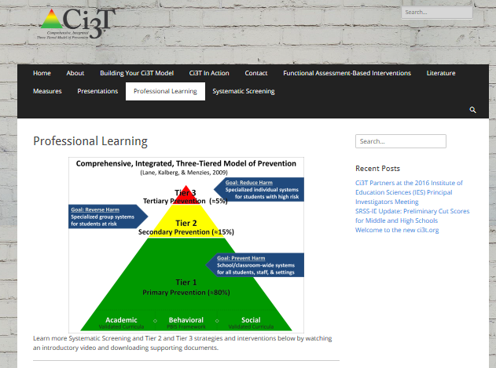
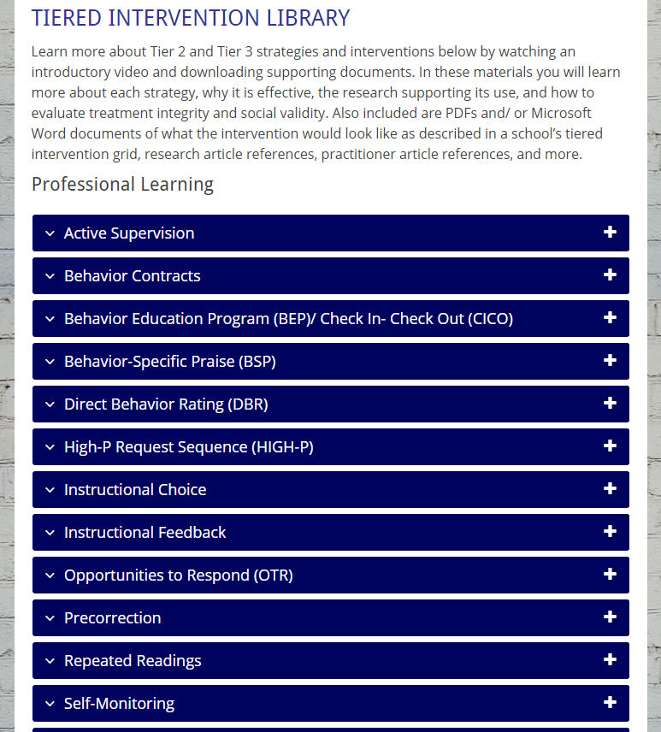
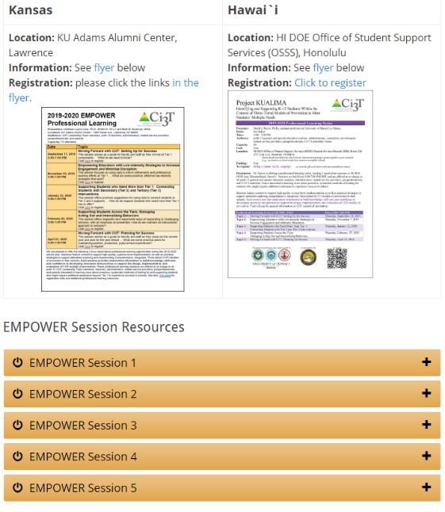

Slide 5
Welcome!
Ci3T Leadership Teams | Individuals
If you are part of a Ci3T Leadership Team: Please open your Ci3T Implementation Manual Treat this as a team meeting Use IM18 Ci3T Leadership Team Meeting Agenda from ci3t.org/building Materials for this session can be found at ci3t.org/pl Welcome to EMPOWER! | If you are here to learn with us as an individual: Materials for this session can be found at ci3t.org/pl Create a space on your computer to download today’s materials Consider building a structure to organize your learning for future EMPOWER sessions Think of ways to share your learning with colleagues Welcome to EMPOWER!

Slide 6
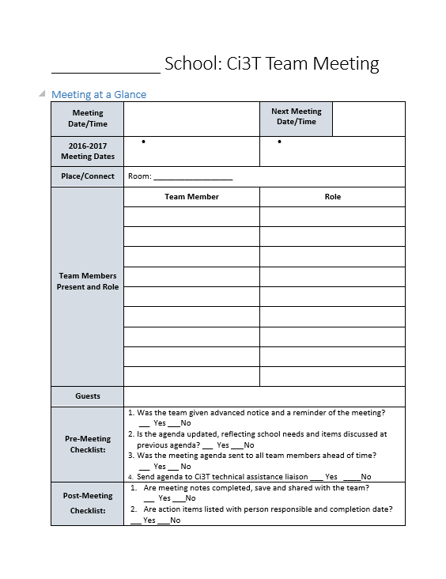
IM18 Ci3T Leadership Team Meeting Agenda TEMPLATE
Predictability

Slide 7
Comprehensive, Integrated, Three-tiered (Ci3T) Models of Prevention

Slide 8
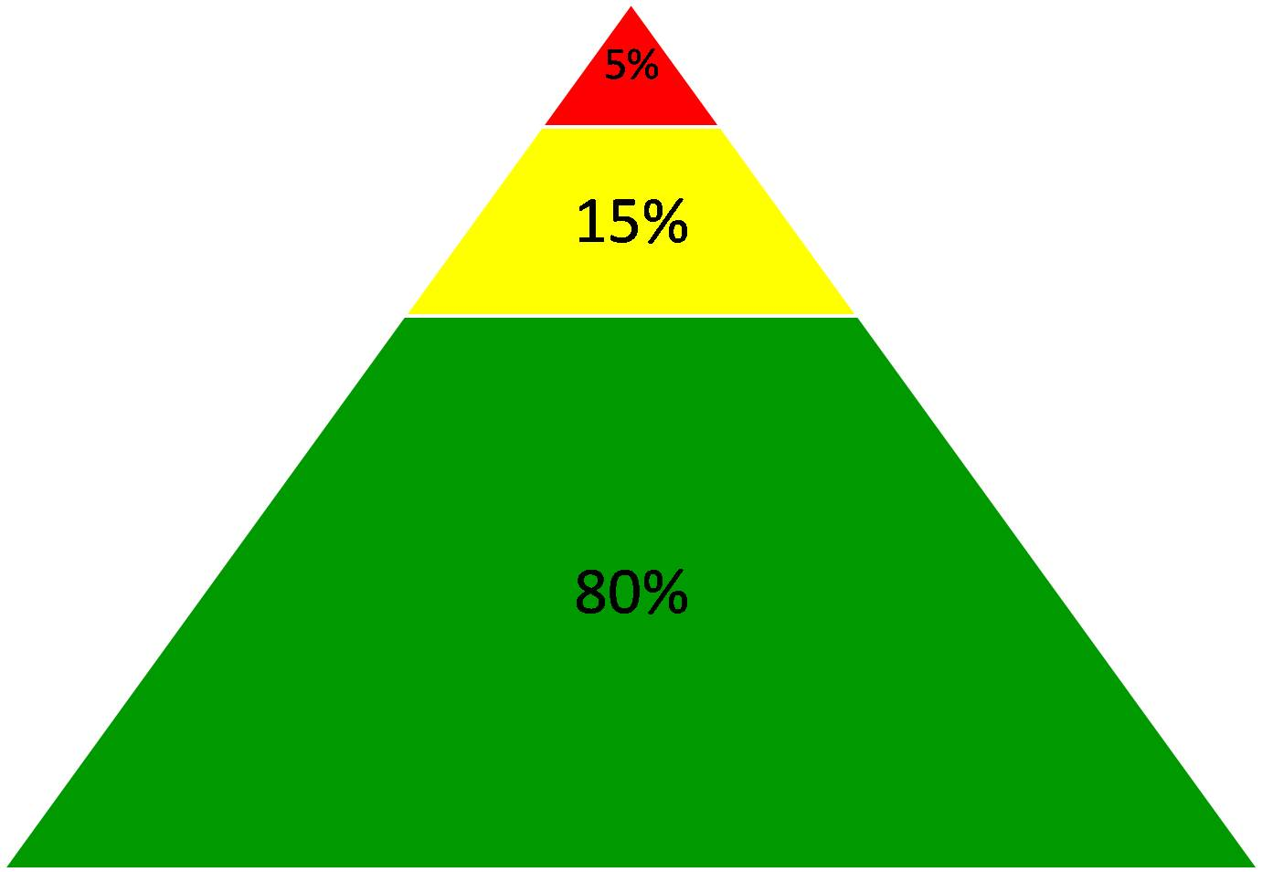

Slide 9
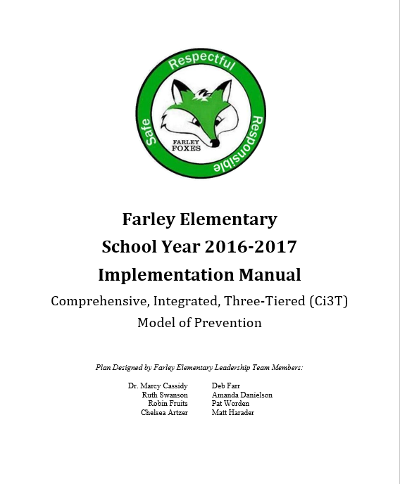
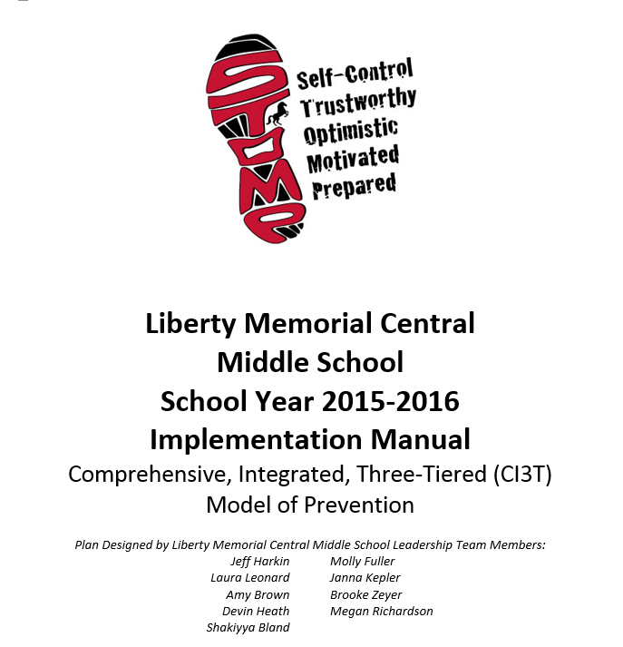
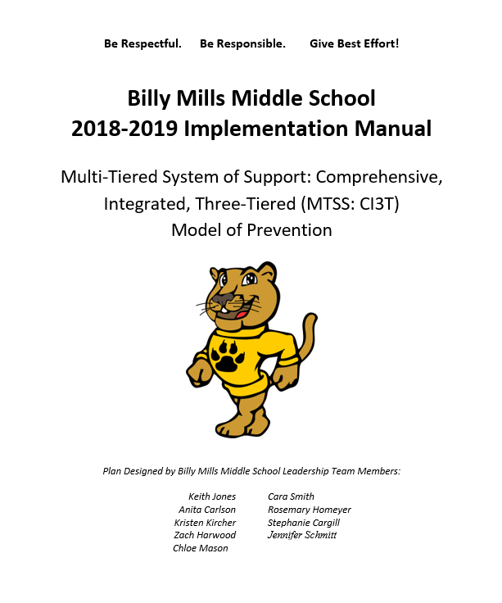
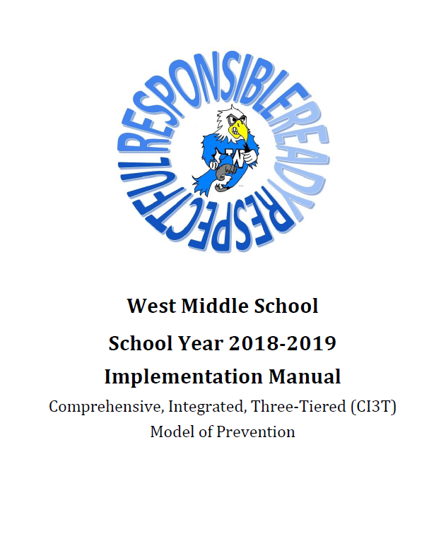
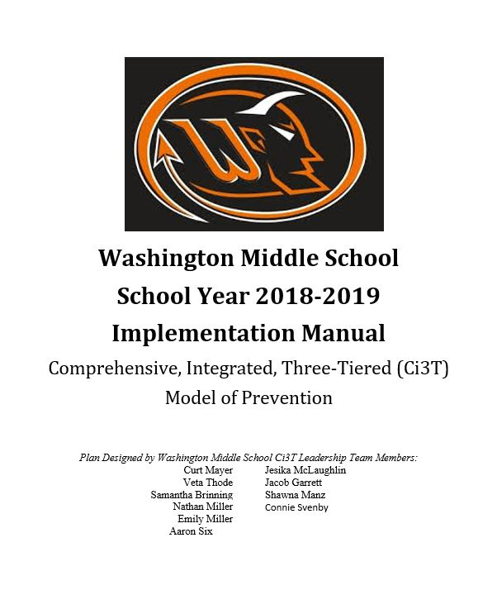
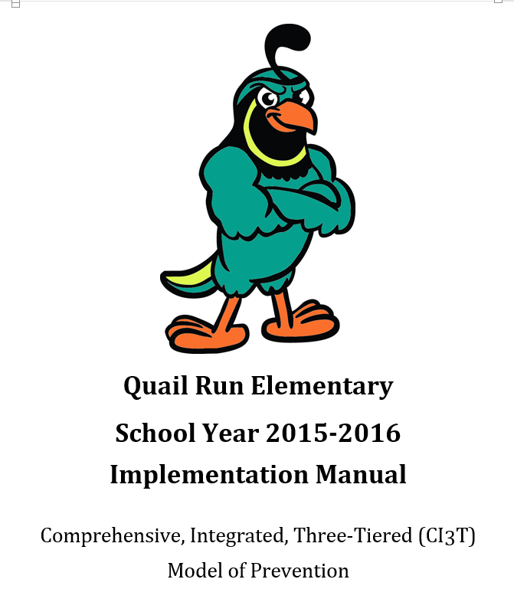
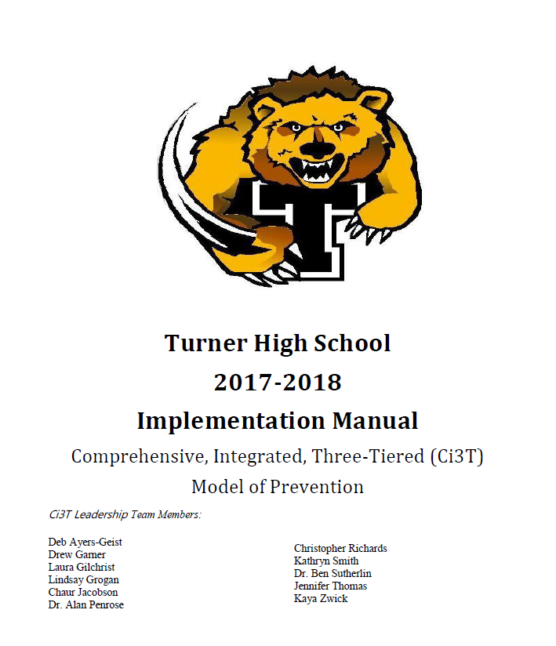
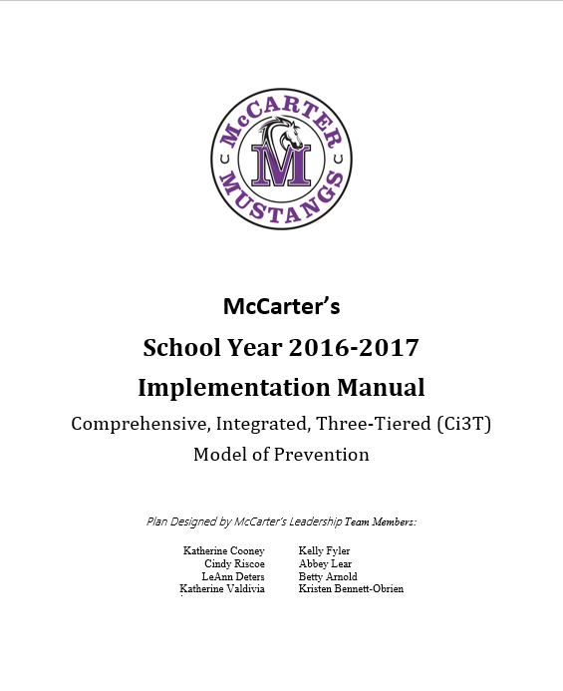
Ci3T Implementation Manuals
Shared with permission.

Slide 10
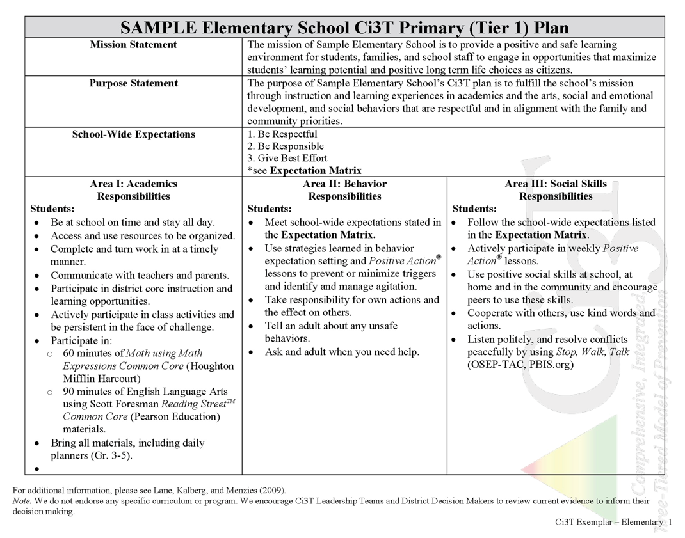
District & State Standards
High Quality Instruction
Positive Behavior Interventions and Supports (PBIS)
Social and Emotional Learning
Notes:
Put in exemplars

Slide 11
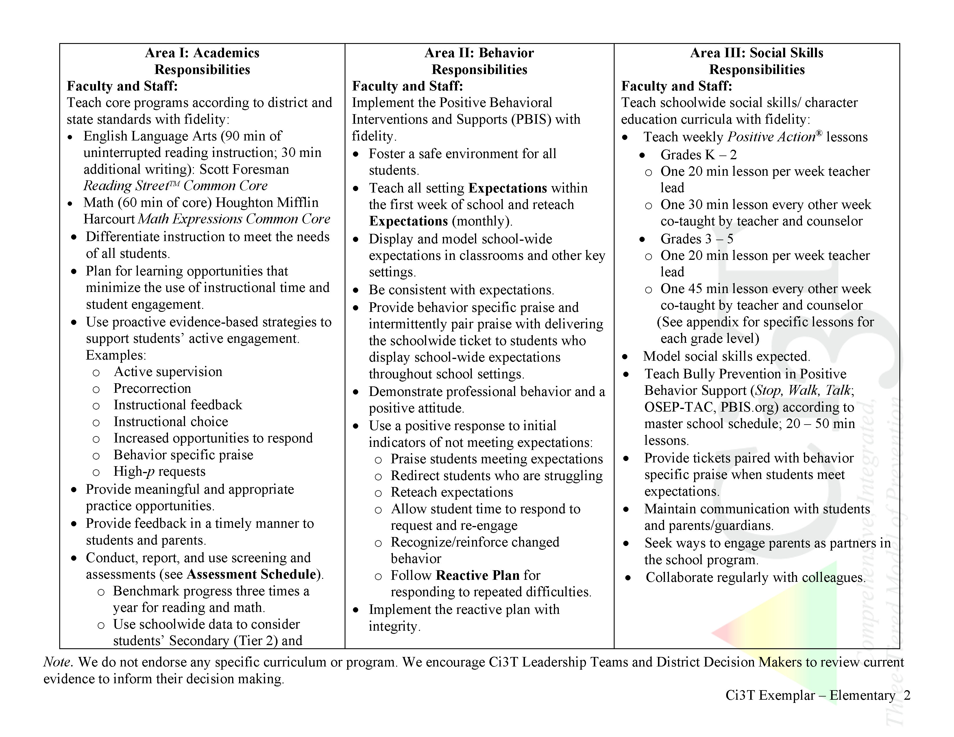
What do I need to know?
Ci3T Exemplar - Elementary
Notes:
Put in exemplars

Slide 12
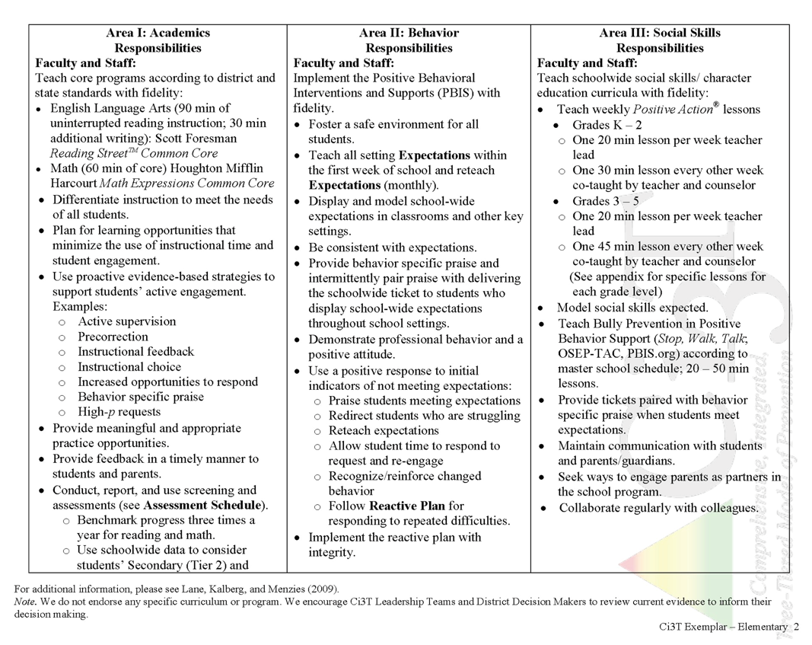
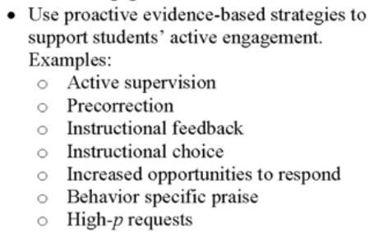
What do I need to know?
Notes:
Put in exemplars

Slide 13
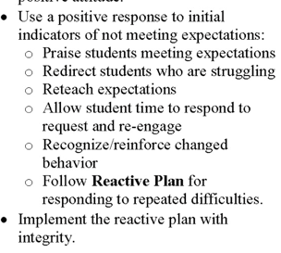
What do I need to know?
Notes:
Put in exemplars

Slide 14
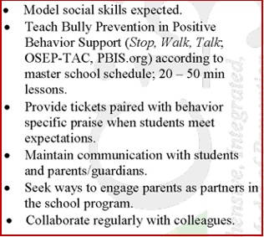
What do I need to know?
Notes:
Put in exemplars

Slide 15
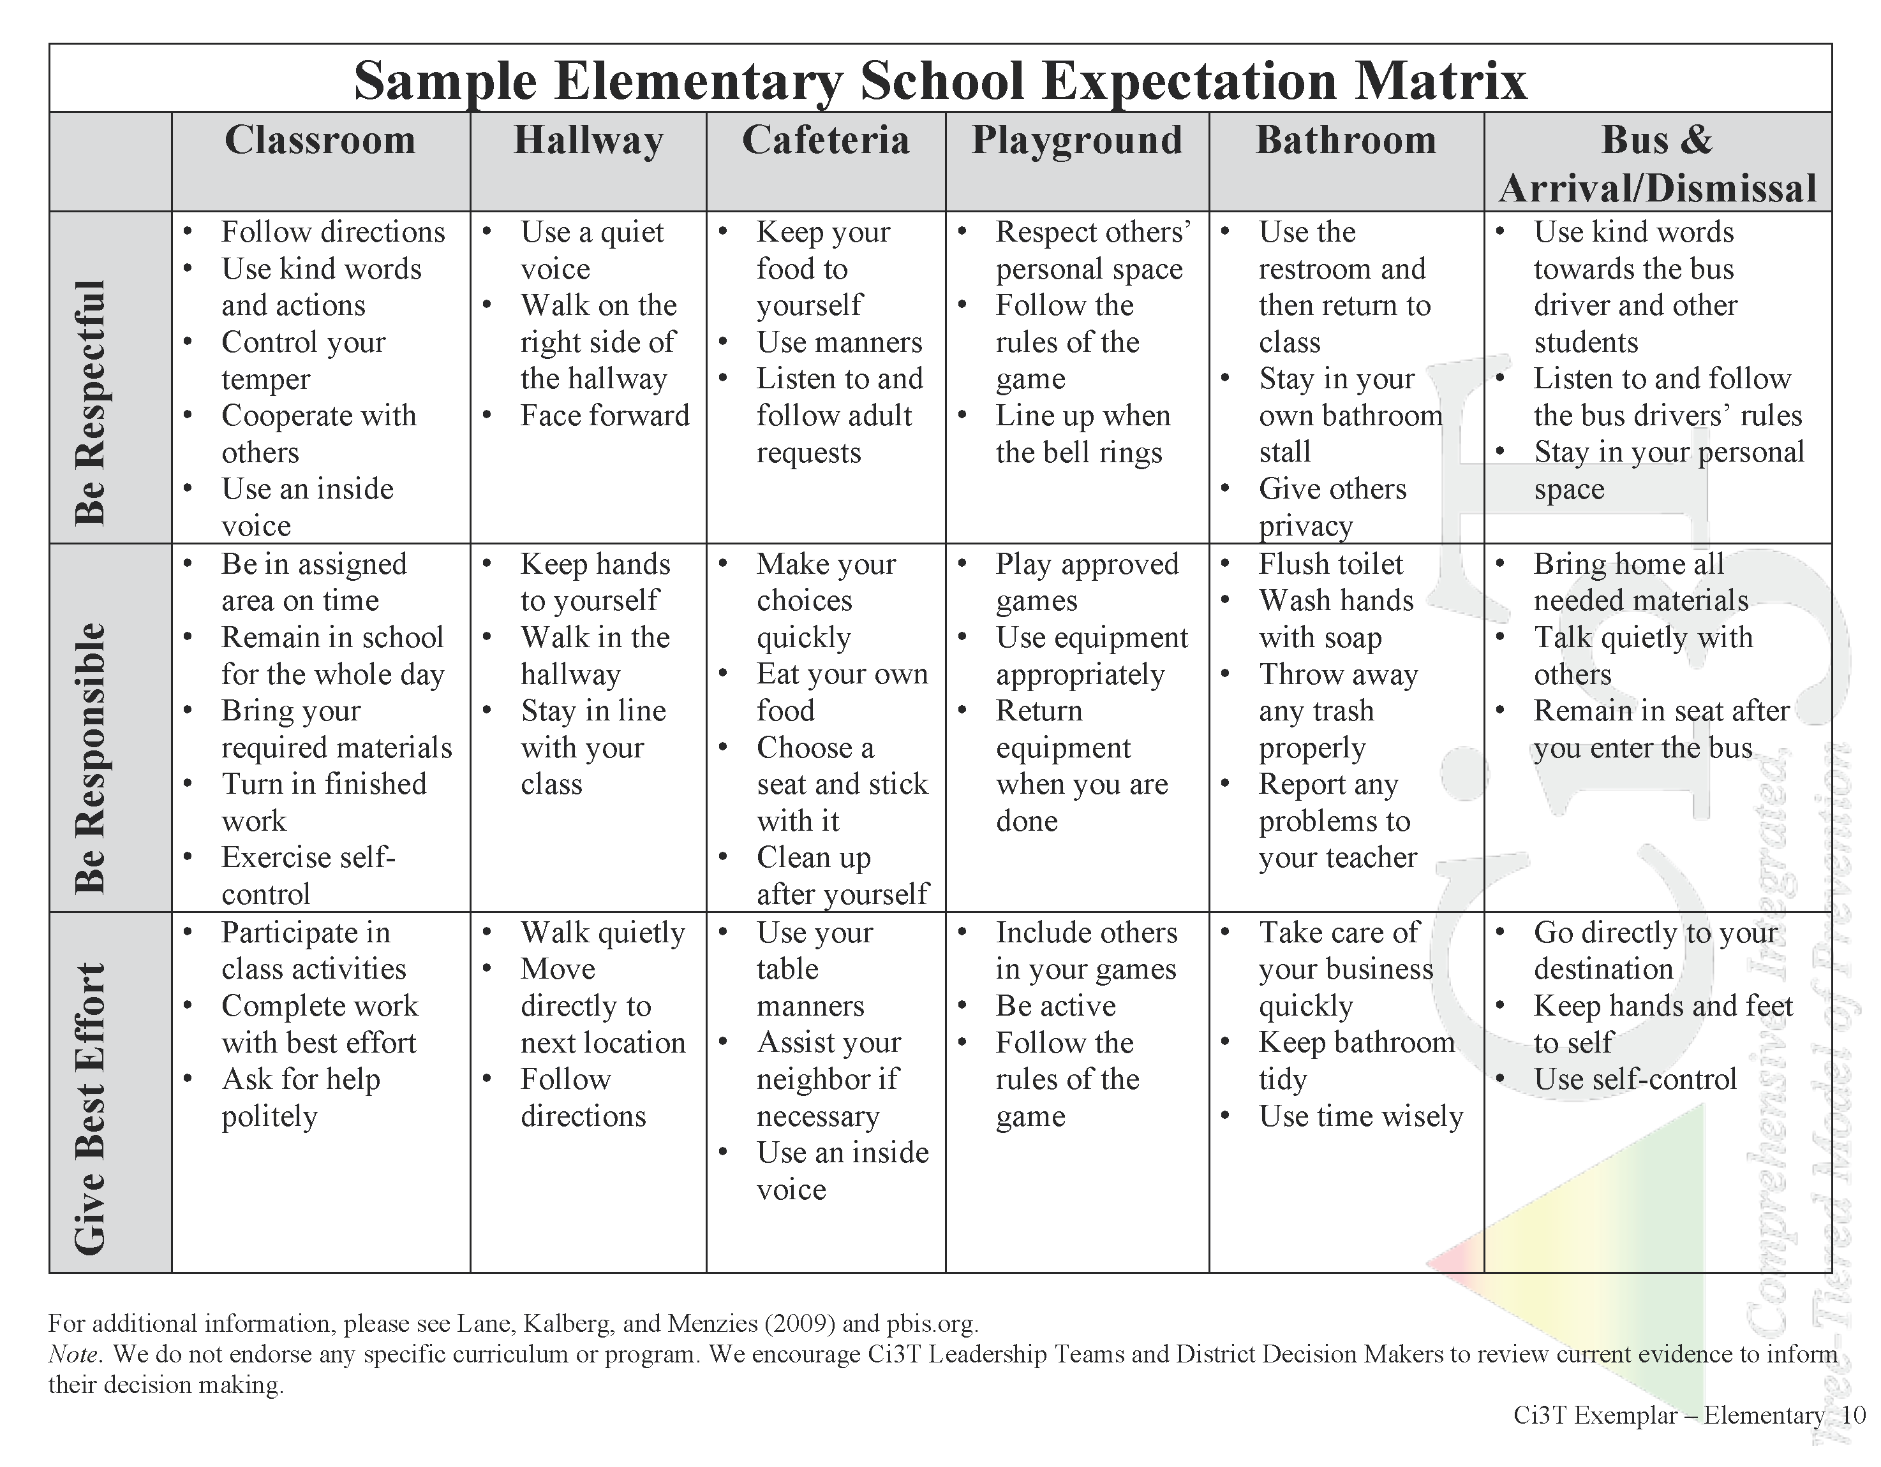
Establish, Teach, Acknowledge
Notes:
Put in exemplars

Slide 16
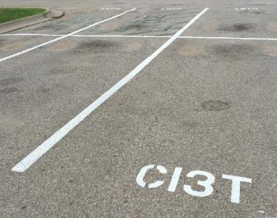
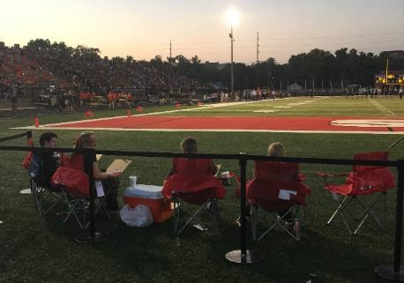
Locate in your Ci3T Implementation Manual
Procedures for Reinforcing
Faculty and Staff:
Students: ROAR zone Parking spaces
Parents/ Community:
Donation Coupon:
1 box of Macaroni and Cheese to Community Food Drive

Slide 17
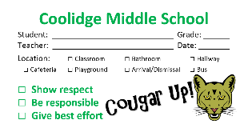
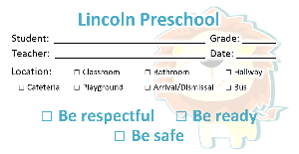
Procedures for Reinforcing
How will you reinforce…
Faculty and staff for
Participation and support
Modeling schoolwide expectations
Taking an instructional approach to behavior
Implementing the Ci3T plan with fidelity
Making instructional shifts in traditional practices
Students for
Demonstrating the expectations across academic, behavioral, and social skill domains
Families and community for
Communication with school staff
Reinforcing expectations
Supporting the social skills lessons at home and in the community
Notes:
4

Slide 18
Ticket Tip Sheet
Ticket Tip Sheet
When giving a ticket for positive behavior, always pair behavior specific praise. Example, “Lori, thank you for walking down the hallway with a quiet voice and your hands at your side. For showing responsibility, you have earned a PAWS ticket.”
In the first days and weeks of implementing a Positive Behavior Interventions and Support system, flood students with tickets to increase effectiveness. Overtime fade tickets and provide intermittent reinforcement.
School staff should try to be consistent with ticket distribution. Portions of staff meetings can be used to discuss ticket distribution.
To ensure student buy-in, survey students to gain an understanding of what reinforcements are desired.
Explicitly teach students how tickets can be earned and what tickets can be used for once they are received.
Weekly emails

Slide 19
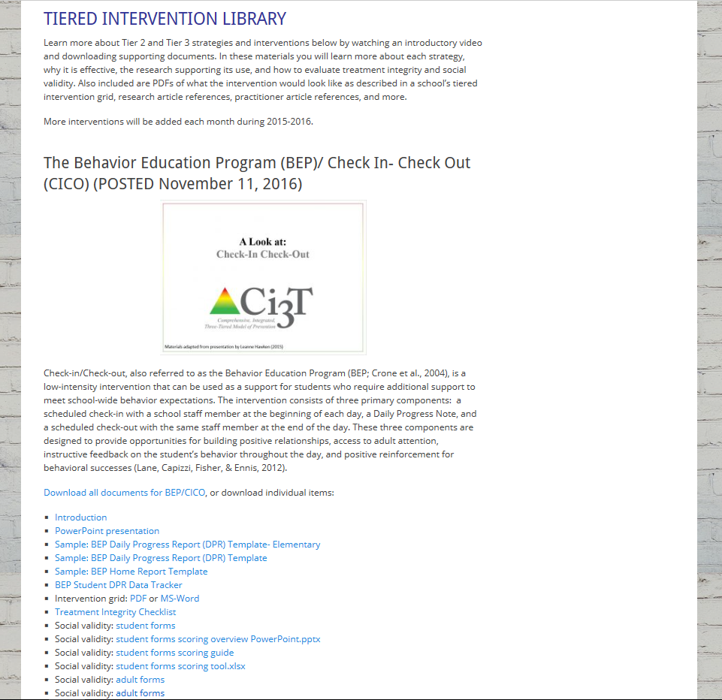
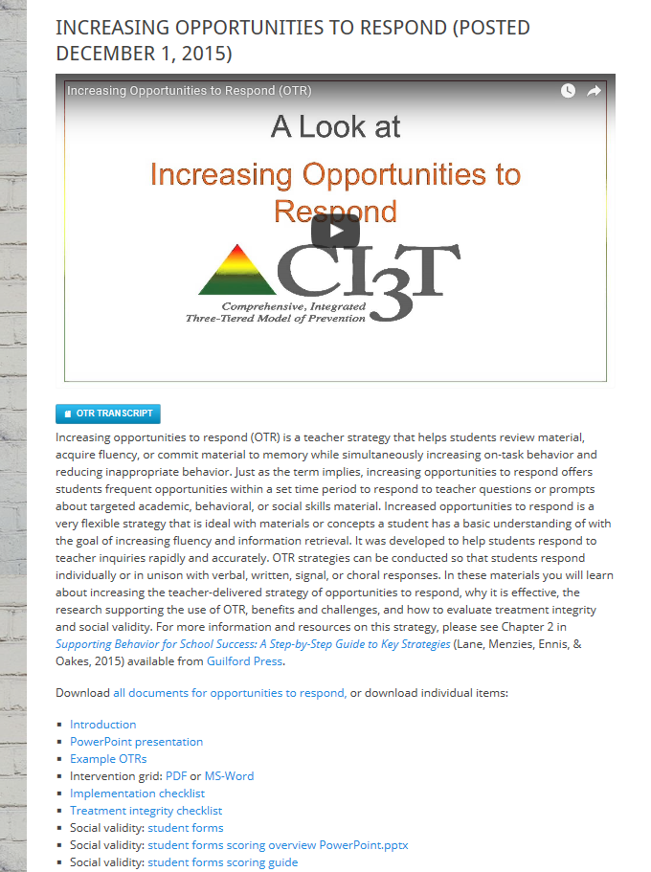
ci3t.org
Professional Learning tab

Slide 20
Managing Acting Out Behavior
Stages & Strategies
Individualized De-Escalation Support Plans

Slide 21
Antecedent- Behavior- Consequence
Function!
A
B
C
Precorrection: Identifies predictable contexts that often result in problem behavior and provides students with supports, prompts, and reinforcement for engaging in appropriate behavior
Notes:
Managing behavior with precorrections:
Anticipate what activities may cause inappropriate behaviors
“Getting in front” of problem behaviors
Example: Gentle reminder of expected behaviors in the hallway before dismissing for lunch

Slide 22
The Acting-Out Cycle
5. Peak
4. Acceleration
Intensity
6. De-escalation
3. Agitation
2. Trigger
1. Calm
7. Recovery
Time
(Colvin & Scott, 2015)
Overview of the Acting Out Cycle--Vanderbilt IRIS Module

Slide 23
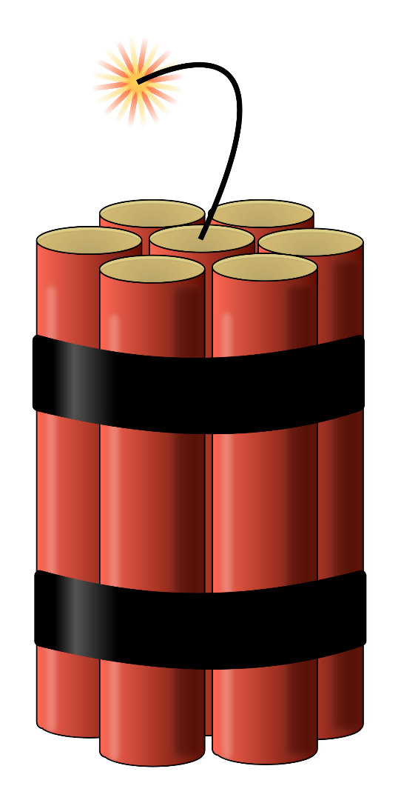
Stages of the Acting Out Cycle Colvin (1992)
Calm
Triggers
Agitation
Acceleration
Peak
De-Escalation
Recovery
Notes:
Teachers, as well as parents and peers, are often inadvertently trapped in escalating social interactions with antisocial students that prove to be extremely disruptive and damaging to relationships.
Students with antisocial behavior patterns carry high levels of agitation due to the stresses they are under and the neglect and abuse to which they are exposed in nonschool settings.
Agitation … fuel that drives a coercive behavioral process that is often triggered by innocuous events.

Slide 24
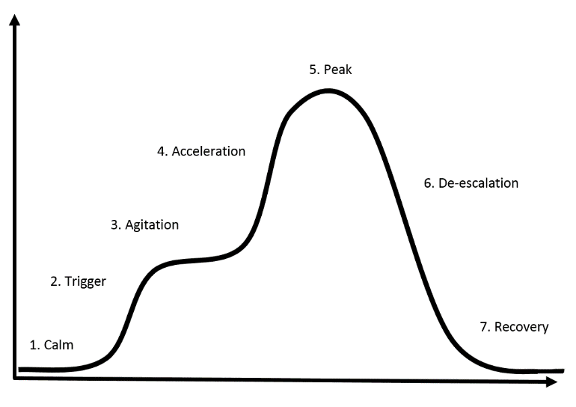
Calm
Overall behavior is cooperative, compliant, and desirable.
Behaviors
Academically Engaged
Following Rules & Expectations
Responsive to Praise and Feedback
Initiates Interactions
Goal Directed Behaviors
Colvin, G., & Scott, T. (2015). Managing the cycle of acting-out behavior in the classroom (2nd Edition). Thousand Oaks, CA: Corwin.
Notes:
On-task behavior
Initiate interactions … sharing or providing assistance to peers; prosocial behaviors
Goal directed behavior … work towards goals they feel they are likely to accomplish

Slide 25
Calm
Intervention focused on proactive strategies.
Emphasis on instruction and positive behavior support.
Strategies
Implement schoolwide Ci3T plan
Vary instructional delivery
Low-intensity strategies (e.g. precorrection, active supervision, providing opportunities to respond)
Well-constructed instruction
Clear routines and procedures
Thoughtful physical environment
Colvin, G., & Scott, T. (2015). Managing the cycle of acting-out behavior in the classroom (2nd Edition). Thousand Oaks, CA: Corwin.
Notes:
On-task behavior
Initiate interactions … sharing or providing assistance to peers; prosocial behaviors
Goal directed behavior … work towards goals they feel they are likely to accomplish

Slide 26
Triggers
Overall behaviors involve a series of unresolved problems.
School-Based Triggers
Conflicts
Changes in Routine
Peer Provocations
Pressure
Ineffective Problem Solving
Facing Errors in Instruction
Facing Correction Procedures
Denial of Something Needed
Non-school-Based Triggers
Dysfunctional Home Life
Health Problems
Nutritional Needs
Inadequate Sleep
Substance Abuse
Gangs
Colvin, G., & Scott, T. (2015). Managing the cycle of acting-out behavior in the classroom (2nd Edition). Thousand Oaks, CA: Corwin.
Notes:
On-task behavior
Initiate interactions … sharing or providing assistance to peers; prosocial behaviors
Goal directed behavior … work towards goals they feel they are likely to accomplish

Slide 27
Triggers
Intervention is focused on prevention and redirection.
Strategies
Identify the situation where the behavior is likely to occur.
Use precorrection to teach appropriate response.
Rehearse the expectations, prompt or remind students as needed, provide specific praise and reinforcement.
Work with all staff and faculty to teach and reinforce social skills.
Group social skills, anger management, community services.
Work with families for outside supports of nonschool-based triggers.
Colvin, G., & Scott, T. (2015). Managing the cycle of acting-out behavior in the classroom (2nd Edition). Thousand Oaks, CA: Corwin.
Notes:
On-task behavior
Initiate interactions … sharing or providing assistance to peers; prosocial behaviors
Goal directed behavior … work towards goals they feel they are likely to accomplish

Slide 28
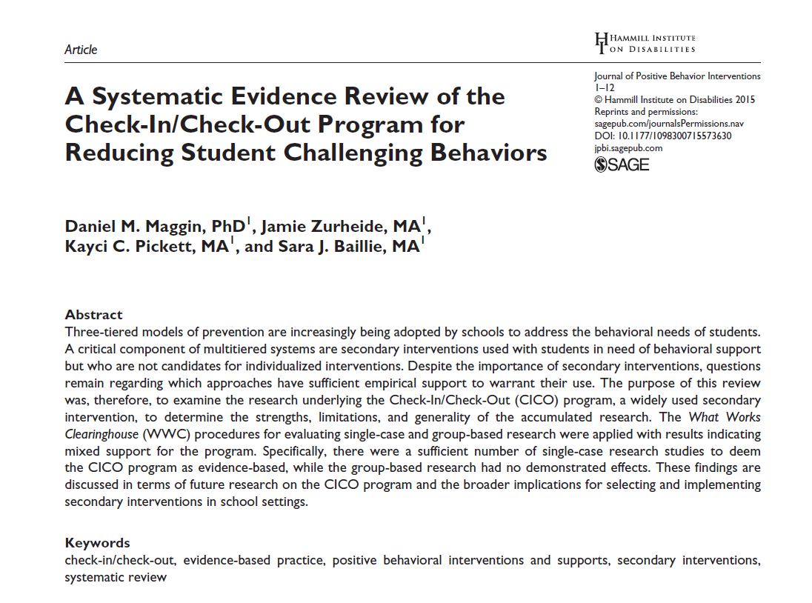
Low-Intensity Strategies
Opportunities to Respond
Behavior Specific Praise
Active Supervision
Instructional Feedback
Self-monitoring
High p Requests
Behavior Contracts
Precorrection
Incorporating Choice
Notes:
Lane, K. L., Oakes, W. P., Ennis, R. P., & Hirsch, S. E. (2014). Identifying students for secondary and tertiary prevention efforts: How do we determine which students have Tier 2 and Tier 3 needs? Preventing School Failure, 58, 171-182, DOI: 10.1080/1045988X.2014.895573

Slide 29
Agitation
Overall behavior is unfocused and off-task.
Increases in
behavior
Darting Eyes
Non-conversational Language
Busy Hands
Moving In and Out of Groups
Off-task, Then On-task Behavior
Decreases in behavior
Staring into Space
Veiled Eyes
Nonconversational Language
Contained Hands
Withdrawal
Colvin, G., & Scott, T. (2015). Managing the cycle of acting-out behavior in the classroom (2nd Edition). Thousand Oaks, CA: Corwin.
Notes:
On-task behavior
Initiate interactions … sharing or providing assistance to peers; prosocial behaviors
Goal directed behavior … work towards goals they feel they are likely to accomplish

Slide 30
Agitation
Intervention is focused on reducing anxiety.
Strategies
Show Empathy
Give Options and Choices
Wait Time for Students to Decide (< 1 minute)
During wait time, walk away from student, attend to other students, or engage in some other task
Involve in successful engagement (behavior momentum)
Colvin, G., & Scott, T. (2015). Managing the cycle of acting-out behavior in the classroom (2nd Edition). Thousand Oaks, CA: Corwin.
Notes:
On-task behavior
Initiate interactions … sharing or providing assistance to peers; prosocial behaviors
Goal directed behavior … work towards goals they feel they are likely to accomplish

Slide 31
Placeholder slide
See video example on slide 33
Notes:
Additional video not available on the internet.
See slide 33 for videos to show.
Recommend hiding this slide before presenting.

Slide 32
Placeholder slide
See video example on slide 33
Notes:
Additional video not available on the internet.
See slide 33 for videos to show.
Recommend hiding this slide before presenting.

Slide 33
Disruptive Behavior
See the video
Supporting Students with Disruptive Behavior
(access link in notes box)
Notes:
https://vimeo.com/196772953
6:15-7:05

Slide 34
Acceleration
Overall behavior is teacher-engaging.
Behaviors
Questioning and Arguing
Noncompliance and Defiance
Off-Task Behavior
Provocation of Others
Compliance with Accompanying Inappropriate Behaviors
Criterion Problems
Whining and Crying
Avoidance and Escape
Threats, Intimidation
Destruction of Property
Verbal Abuse
Colvin, G., & Scott, T. (2015). Managing the cycle of acting-out behavior in the classroom (2nd Edition). Thousand Oaks, CA: Corwin.

Slide 35
Acceleration
Intervention if focused on safety.
Strategies
Remove all triggering factors
Avoid escalating prompts
Maintain calmness, respect and detachment
Approach the student in a nonthreatening manner
Utilize non-confrontational limit-setting procedures
Colvin, G., & Scott, T. (2015). Managing the cycle of acting-out behavior in the classroom (2nd Edition). Thousand Oaks, CA: Corwin.

Slide 36
Peak
Focus on safety only!
Behaviors
Serious Destruction of Property
Assault
Self-Abuse
Severe Tantrums
Hyperventilation
Running Away/ Elopement
Colvin, G., & Scott, T. (2015). Managing the cycle of acting-out behavior in the classroom (2nd Edition). Thousand Oaks, CA: Corwin.

Slide 37
Peak
Overall behavior is out of control.
Strategies
Remain calm
Crisis management
Safe strategies- emergency safety intervention (ESI) if there is immediate danger (if ESI used, document & notify)
Learn from it…(FBA, BIP, Mental Health Assessment, etc.)
Colvin, G., & Scott, T. (2015). Managing the cycle of acting-out behavior in the classroom (2nd Edition). Thousand Oaks, CA: Corwin.
Notes:
Recognize conditions under which fights are likely and attempt to prevent using:
Assigned seats
Space, options, preferred activities
Independent activities
Relaxation activities
Teacher proximity – stay between as long as there is no physicality
If altercation becomes verbal - intervene verbally:
Provide specific and concrete directions
Redirect – get attention off altercation
If altercation becomes physical:
Initiate crisis procedures
Provide clear and concrete directions to both students
Keep other students safe
Wait for assistance
Separate as much as possible without placing hands on students

Slide 38
De-Escalation
Overall behavior displays confusion.
Behaviors
Confusion
Reconciliation
Withdrawal
Denial
Blaming Others
Responsiveness to Directions
Responsive to Manipulative or Mechanical Tasks
Avoidance of Discussion
Avoidance of Debrief
Colvin, G., & Scott, T. (2015). Managing the cycle of acting-out behavior in the classroom (2nd Edition). Thousand Oaks, CA: Corwin.

Slide 39
De-Escalation
Intervention is focused on monitoring for re-escalation of behavior.
Strategies
Monitor for health/safety of all involved
Avoid blaming- provide opportunity for non-judgmental discussion
Allow cool-down time and space
Engage in independent work- provide easy/concrete tasks
Colvin, G., & Scott, T. (2015). Managing the cycle of acting-out behavior in the classroom (2nd Edition). Thousand Oaks, CA: Corwin.

Slide 40
Recovery
Overall behaviors shows eagerness for busy work and reluctance to interact or discuss.
Behaviors
Eagerness for Independent Work or Activity
Subdued Behavior in Group Work
Subdued Behavior in Class Discussions
Defensive Behavior
Avoidance of Debriefing
Colvin, G., & Scott, T. (2015). Managing the cycle of acting-out behavior in the classroom (2nd Edition). Thousand Oaks, CA: Corwin.

Slide 41
Recovery
Intervention focuses on returning to normal activities.
Strategies
Follow through with consequences-but do not disrupt flow of instruction.
Positively reinforce any displays of appropriate behavior
Debrief/rehearse problem solving routine
Colvin, G., & Scott, T. (2015). Managing the cycle of acting-out behavior in the classroom (2nd Edition). Thousand Oaks, CA: Corwin.

Slide 42
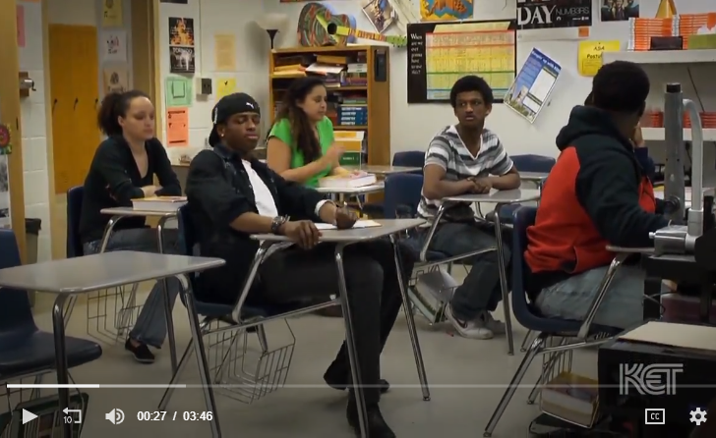
Disruptive Classroom: Non-example
Notes:
Both non-example and example included here: https://kcpt.pbslearningmedia.org/resource/ket-pd-deescalation3/disruptive-behavior/#.XlPX1ihTkdU
Non-example occurs at: 0:12 into the video
Example occurs at: 1:59 into the video

Slide 43
Disruptive Classroom: Example
Notes:
Both non-example and example included here: https://kcpt.pbslearningmedia.org/resource/ket-pd-deescalation3/disruptive-behavior/#.XlPX1ihTkdU
Non-example occurs at: 0:12 into the video
Example occurs at: 1:59 into the video

Slide 44
Acting Out Cycle Example
See the video
Signs of Escalation
(access link in notes box)
Notes:
https://vimeo.com/196772653
1:03-2:40

Slide 45
Tier 3: Building a De-escalation Plan

Slide 46
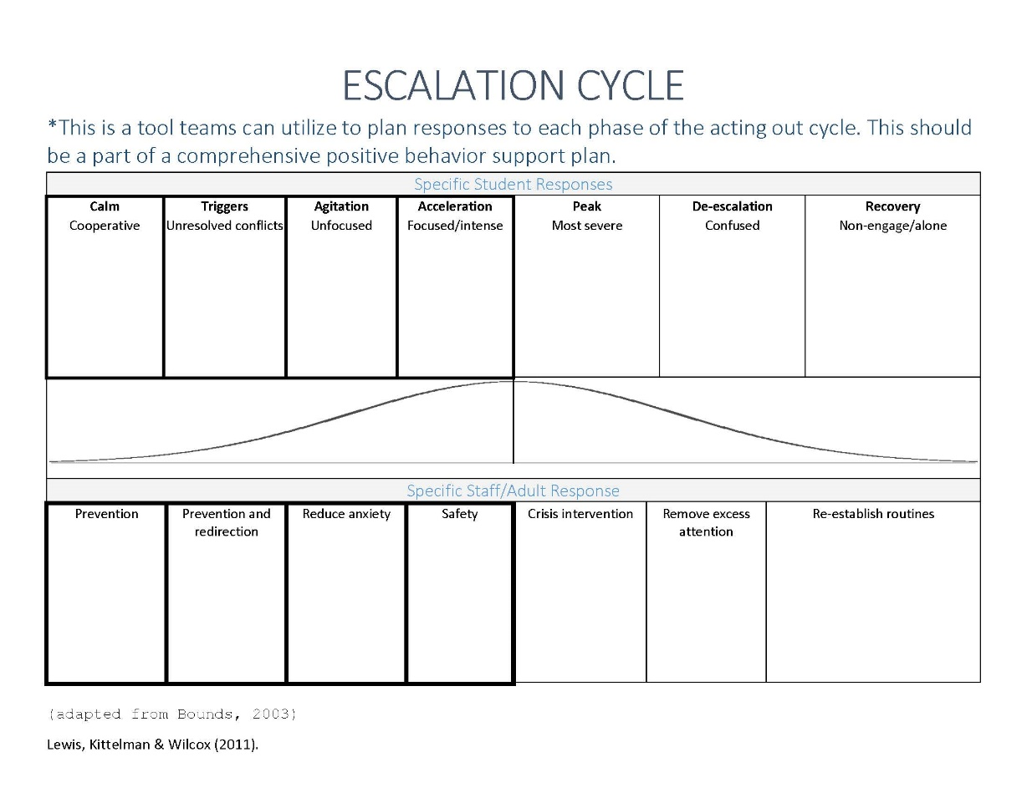
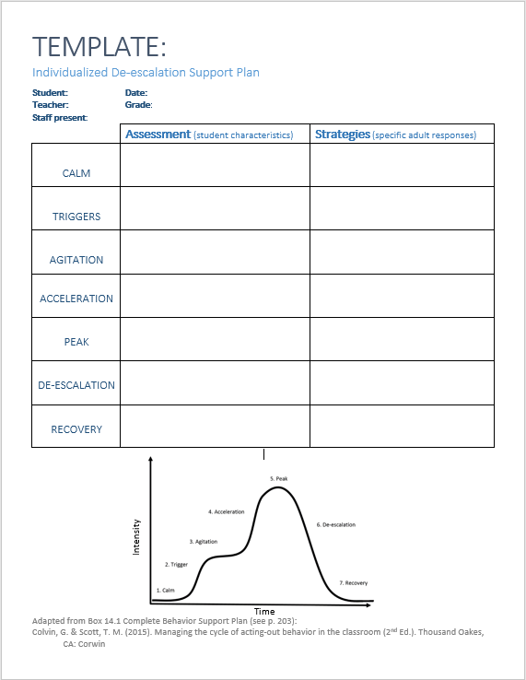
Planning
See ci3t.org Tiered Library for
“Individualized De-escalation Support Plan”

Slide 47
Sample Intervention Grid
Support | Description | School-wide Data: Entry Criteria | Data to Monitor Progress | Exit Criteria
Individualized De-escalation Plan | Ongoing strategy involving identifying specific student characteristics for each phase of the De-escalation cycles and implementing appropriate and evidence-based adult responses to managing student acting out behavior. | One or more of the following: Behavior: SRSS-E7: High (9-21) Office discipline referrals (ODRs) 6 or more within a grading period | Identify a target behavior for the individual student. Include: (a) label for the behavior, (b) definition, (c) examples, and (d) non examples Set behavioral goal based on baseline performance of the behavior. Direct observation of the target behavior with data points graphed for decision making. Treatment Integrity: Treatment integrity checklist Social Validity: Teacher: IRP-15 Student: CIRP | SRSS-E7 score: Low (0-3) Observation data demonstrate behavior is consistently within expected level (per goal; three consecutive data points) – then transition to maintenance plan and monitor behavior during transition.

Slide 48
Reflection and Action Planning
Managing Acting Out Behavior
Stages & strategies
Individualized de-escalation support plans
Notes:
10 min Using this PowerPoint break timer
To insert this slide into your presentation
Save this template as a presentation (.ppt file) on your computer.
Open the presentation that will contain the timer.
On the Slides tab, place your insertion point after the slide that will precede the timer. (Make sure you don't select a slide. Your insertion point should be between the slides.)
On the Insert menu, click Slides from Files.
In the Slide Finder dialog box, click the Find Presentation tab.
Click Browse, locate and select the timer presentation, and then click Open.
In the Slides from Files dialog box, select the timer slide.
Select the Keep source formatting check box. If you do not select this check box, the copied slide will inherit the design of the slide that precedes it in the presentation.
Click Insert.
Click Close.

Slide 49
Supporting Students with Internalizing Behaviors
Primary (Tier 1) Prevention … for All Secondary (Tier 2) Prevention … for Some Tertiary (Tier 3) Prevention … for A Few

Slide 50
Internalizing Behaviors: What do I need to know?

Slide 51
What are Internalizing Behaviors?
Anxiety
Depression
Social Withdrawal
Somatic Complaints
Notes:
Patterns of behavior directed inward, toward the self, rather than outward upon the environment
Social and academic difficulties are associated with internalizing behaviors
An internalizing problem can be classified as a mental health issue as well as a behavioral challenge (McIntosh, Ty, & Miller, 2014).
Internalizing behavior challenges can be characterized by four general categories (Merrell & Gueldner, 2010):
Anxiety
Depression
Social withdrawal
Somatic complaints
Internalizing behaviors may lead to social and academic impairments (Mychailyszyn, Mendez, & Kendall, 2010).

Slide 52
Anxiety Disorders
Include …
panic disorders,
obsessive-compulsive disorder (OCD),
post-traumatic stress disorder (PTSD),
social phobia (social anxiety disorder),
specific phobias,
and generalized anxiety disorder (GAD) American Psychiatric Association, 2013
Symptoms for each of these disorders are different, but the commonality is an excessive and/or irrational level of fear and worry.
Notes:
A mental health issue as well as a behavioral challenge
Patterns of behavior directed inward, toward the self, rather than outward upon the environment
Social and academic impairments are associated with internalizing behaviors

Slide 53
How many students experience these challenges?
20% of students have or are at risk for Emotional and Behavioral Disorders (EBD)
(Forness et al., 2014)
30.1% of adolescents experience an anxiety disorder at some time
(Merikangas et al., 2010)
12.5% of adolescents experienced a major depressive episode in 2015
(Center for Behavioral Health Statistics and Quality, 2016)

Slide 54
What does anxiety look like in children and youth?
Overwhelmed easily
Sense of dread
Experience obsessive, intrusive, and bothersome thoughts.
Often accompanied by somatic complaints (e.g., muscle weakness, cramps, fatigue, frequent bathroom trips)
May itself be a symptom of depression
Notes:
A detailed examination of a child’s symptoms is needed in order to determine whether the symptoms are caused by an anxiety disorder, somatoform disorder, depressive disorder, or a combination thereof.

Slide 55
How does anxiety impact school experiences?
Students with anxiety may…
have difficulty with academic engagement
experience social withdrawal
Internalizing behaviors may lead to social and academic impairments (Mychailyszyn, Mendez, & Kendall, 2010)
(Erath, 2007; Rapee & Heimberg, 1997)

Slide 56
Intervention Name | Prevent | Early Intervention | Intensive Intervention
Cognitive Behavior Therapy (includes internet and integrated)
Cognitive Restructuring | TBD
Contingency Management
Exposure-Based Techniques
Family Therapy
Modeling (live and video)
Psychoeducation | TBD
Relaxation Training
Self-Monitoring / Self-Assessment | TBD

Slide 57
Notes:
Put in exemplars

Slide 58
Sample Elementary School: Fall (Internalizing)
SRSS-I5 Results – All Students
N = 55
N = 46
N = 35
N = 90
N = 77
N = 64
N = 359
N = 391
N = 335

Slide 59
Relaxation Training
A primary (Tier 1) prevention strategy to support all students

Slide 60
What is Relaxation Training?
Relaxation training teaches children to begin using ways to relax
Monitoring muscle tension created by stressful situations and events and by controlling irregular breathing
Notes:
For instance, by monitoring muscle tension created by stressful situations and events and by controlling irregular breathing (i.e., teaching the child to slowly breathe in through the nose and out through the mouth; Kearney, 2005; Ollendick & Cerny, 1981).
Physical discomfort caused by tension can exacerbate common anxiety symptoms, causing a child to become even more anxious.
Relaxation techniques include counting, breathing exercises, recall, mental imagery, and progressive muscle relaxation (Kahn, Kehle, Jenson, & Clarke, 1990).

Slide 61
GOAL: Relaxation lowers anxiety through physiologic responses to slower breathing and slower thinking.
BASICS:
Identify the context in which anxiety occur.
Provide options for relaxation training based on student strengths and interest.
Teach procedures through modeling, practice, and feedback.

Slide 62
Why Relaxation Training?
Physical discomfort caused by tension can exacerbate common anxiety symptoms, causing a child to become even more anxious.
Relaxation techniques include counting, breathing exercises, recall, mental imagery, and progressive muscle relaxation (Kahn, Kehle, Jenson, & Clarke, 1990).

Slide 63
Relaxation Protocol
Morris, R. J., Shah, K. E. T. K. I., & Morris, Y. P. (2002). Internalizing behavior disorders. Interventions for children with or at risk for emotional and behavioral disorders, 223-241.​

Slide 64
Secondary (Tier 2) Intervention Grids

Slide 65
Sample Elementary School: Fall (Internalizing)
SRSS-I5 Results – All Students
N = 55
N = 46
N = 35
N = 90
N = 77
N = 64
N = 359
N = 391
N = 335

Slide 66
Self-Monitoring
A secondary (Tier 2) intervention for students experiencing internalizing challenges

Slide 67
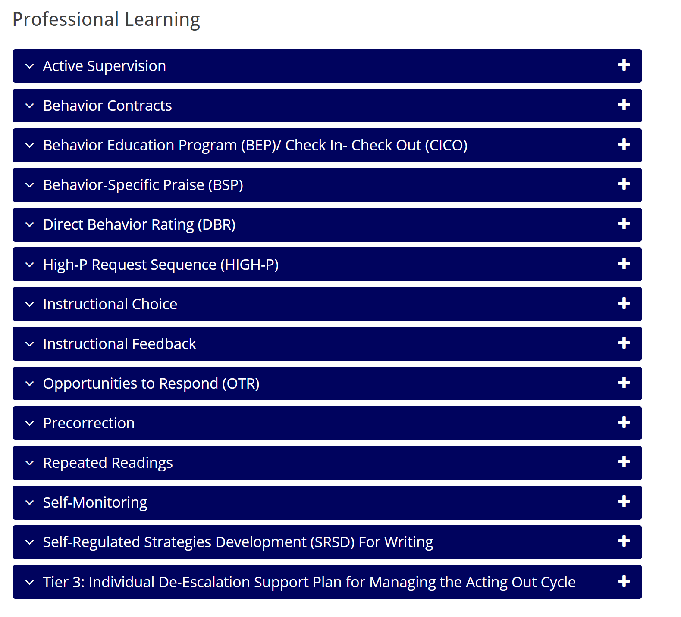

Slide 68
A Look at: Self-Monitoring
Chapter 6

Slide 69
What is self-monitoring?
One commonly used self-management strategy
Involves teaching students to:
Observe, or determine if a behavior occurred using an operational definition
Record whether or not the behavior occurred

Slide 70
Why is self-monitoring effective?
Easy
Convenient
High social validity (students like it)
Promotes independency and self-determined behaviors
Impacts behavior and academic components

Slide 71
Implementing Self-Monitoring in Your Classroom: Implementation Checklist
Step 1: Establish Prerequisite Conditions
Step 2: Identify and Operationally Define the Behaviors
Step 3: Design the Self-Monitoring Procedures, Including a Monitoring Form
Step 4: Teach the Self-Monitoring Procedures
Step 5: Monitor Student Progress
Step 6: Consider Maintenance and Follow-Up
See Implementation folder for
“Self-Monitoring Implementation Checklist”

Slide 72
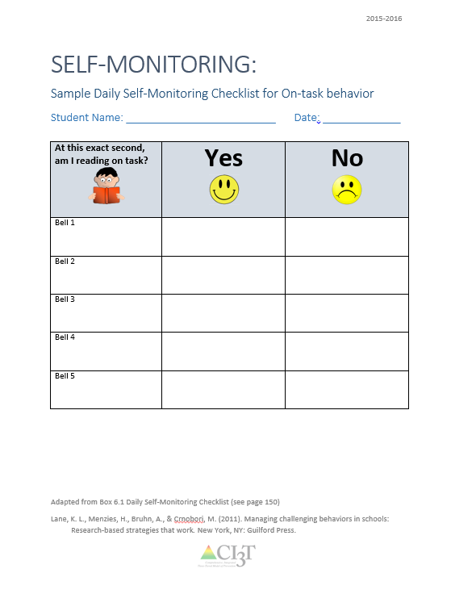
Example: Daily Self-Monitoring Checklist
See Implementation folder for
“Self-Monitoring Secondary Sample Checklist”
See Implementation folder for
“Self-Monitoring Elementary Sample Checklist”

Slide 73
Sample Elementary Intervention Grid
Support | Description | School-wide Data: Entry Criteria | Data to Monitor Progress | Exit Criteria
Self-monitoring | Strategy implemented by student and teacher to improve academic performance (completion/ accuracy), academic behavior, or other target behavior. | Behavior: SRSS-E7 score: Moderate (4-8) SRSS-I5 score: Moderate (2-3) or SRSS-E7 score: High (9-21) SRSS-I5 score: High (4-15) or 2 or more office discipline referrals (ODR) AND/OR Academic: Progress report: 1 or more course failures or AIMSweb: intensive or strategic level (math or reading) or Progress report: Targeted for Growth for academic learning behaviors | Work completion and accuracy of the academic area of concern (or target behavior named in the self-monitoring plan) Grades on progress reports Social Validity: Teacher: IRP-15 Student: CIRP Treatment Integrity: Implementation & treatment integrity checklist | SRSS-E7 score: Low (1-3) SRSS-I5 score: Low (1-2) Passing grade on progress report or report card in the academic area of concern (or target behavior named in the self-monitoring plan)
Notes:
Sample

Slide 74
Cognitive Restructuring

Slide 75
GOAL: To modify the cognitions associated with anxiety, thereby reducing it.
Identify erroneous beliefs or anxious thinking.
Challenge the reality of these beliefs or thoughts.
Change the thinking to something more rational or probable.
BASICS:
Notes:
DESCRIPTION: Cognitive restructuring teaches students to identify their own negative irrational thoughts and supplant them with healthier, more realistic thoughts.
Students are taught to identify and classify the irrational thoughts they have during anxiety-provoking events and to modify their irrational thoughts by making realistic appraisals of the events
Cognitive restructuring strategies can be used to reinforce positive thinking and promote more positive and productive behaviors.
These techniques include:
Rational analysis (examining evidence for and against thoughts)
De-catastrophising (reconsidering how bad the worst-case scenario actually is)
Cognitive self-control
Decentering (increasing awareness through perspective shifting of focus from self to other)
Reattribution training (helping students determine attributes of failure that are not internal global, or stable in nature)
Reframing/relabeling
Conducting behavioral experiments
Using verbal self-instruction
Engaging in cognitive rehearsa

Slide 76
What is Cognitive Restructuring?
Includes teaching students to:
Identify irrational thoughts and replace them with more realistic ones
Identify and classify irrational thoughts during anxiety-provoking events
Modify irrational thoughts by making realistic appraisals of the events
Vannest, K. J. (2015). Interventions for Anxiety. Council for Children with Behavioral Disorders. Atlanta, GA September 25-27, 2015. Vannest, K. J., Reynolds, C. R., & Kamphaus, R. (2015). The BASC-3 Behavioral Intervention Guide. Pearson Minneapolis, MN.
Notes:
Teaches students to identify their own negative irrational thoughts and supplant them with healthier, more realistic thoughts
Students are taught to identify and classify the irrational thoughts they have during anxiety-provoking events and to modify their irrational thoughts by making realistic appraisals of the events
Strategies can be used to reinforce positive thinking and promote more positive and productive behaviors.
Techniques:
Rational analysis
De-catastrophizing
Cognitive self-control
Decentering
Reattribution training
Reframing/relabeling
Conducting behavioral experiments
Using verbal self-instruction
Engaging in cognitive rehearsal

Slide 77
Cognitive Restructuring
De- catastrophizing
Rational Analysis
Decentering
Re-attribution training
Reframing/
relabeling
Vannest, K. J. (2015). Interventions for Anxiety. Council for Children with Behavioral Disorders. Atlanta, GA September 25-27, 2015. Vannest, K. J., Reynolds, C. R., & Kamphaus, R. (2015). The BASC-3 Behavioral Intervention Guide. Pearson Minneapolis, MN.
Notes:
Rational analysis (examining evidence for and against thoughts)
De-catastrophizing (reconsidering the worst-case scenario)
Decentering (increasing awareness through perspective shifting: from self to others)
Reattribution training (helping students determine attributes of failure that are not internal global, or stable in nature)
Reframing/relabeling
Conducting behavioral experiments
Using verbal self-instruction
Engaging in cognitive rehearsal.

Slide 78
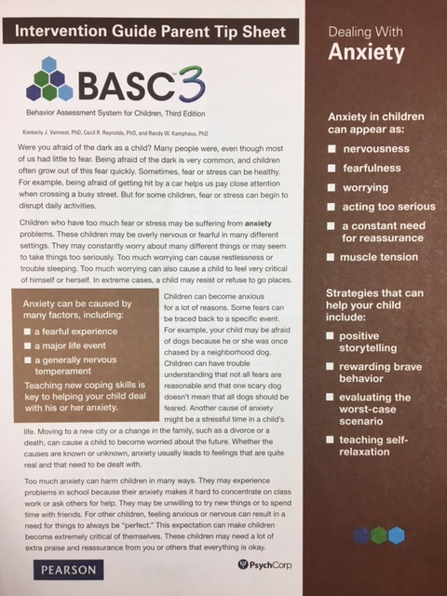
Strategies to Share with Parents to Address Anxiety
Positive Storytelling
Rewarding Brave Behavior
Evaluating the Worst-Case Scenario
Teaching Self-Relaxation

Slide 79
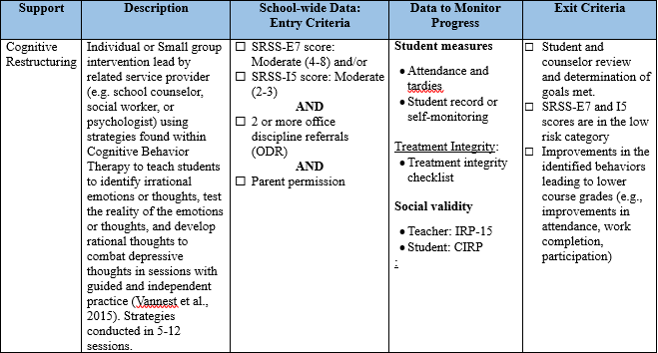
Secondary (Tier 2) Intervention Grid For Elementary Students

Slide 80
Secondary (Tier 2) Intervention Grid For Middle and High School Students

Slide 81
Tertiary (Tier 3) Intervention Grids

Slide 83
Strategy Exploration
Supporting Students with Internalizing Behaviors
Primary (Tier 1) Prevention … for all
Secondary (Tier 2) Prevention … for some
Tertiary (Tier 3) Prevention … for a few
Notes:
10 min Using this PowerPoint break timer
To insert this slide into your presentation
Save this template as a presentation (.ppt file) on your computer.
Open the presentation that will contain the timer.
On the Slides tab, place your insertion point after the slide that will precede the timer. (Make sure you don't select a slide. Your insertion point should be between the slides.)
On the Insert menu, click Slides from Files.
In the Slide Finder dialog box, click the Find Presentation tab.
Click Browse, locate and select the timer presentation, and then click Open.
In the Slides from Files dialog box, select the timer slide.
Select the Keep source formatting check box. If you do not select this check box, the copied slide will inherit the design of the slide that precedes it in the presentation.
Click Insert.
Click Close.

Slide 84
Wrapping up and Moving Forward

Slide 85
Ci3T
Comprehensive Professional Learning Plan
Ci3T: Primary Prevention
Session 1:
Overview of Ci3T Prevention Models
Setting a Purpose
Establish team meetings and roles
Session 2:
Mission and Purpose
Establish Roles and Responsibilities
Procedures for Teaching
Procedures for Reinforcing
Reactive Plan
Session 3:
Procedures for Monitoring
Session 4:
Revise Primary Plan using Stakeholder feedback
Prepare presentation
Ci3T: Secondary Prevention
Session 5:
Overview of Teacher focused Strategies
Overview of Student Focused Strategies
Using data for decision-making
Draft the Secondary Intervention Grid based on existing supports
Ci3T: Tertiary Prevention
Session 6:
Final revisions of Ci3T Plan based on stakeholder feedback
Draft Tertiary Prevention Intervention Grids
Design Implementation Manual and Plan for roll out to faculty, students, and parents
Ci3T Leadership Team Training Sequence
Additional Professional Development on Specific Topics
Core Content Curriculum
Check In - Check Out
Functional Assessment-based Interventions
Reading, Math, Writing Benchmarking and Progress Monitoring Tools
Interventions, Strategies, & Practices
Additional Tier 3 Supports
Instructional Techniques to Improve Students’ Motivation; Classroom Management Practices;
Low-Intensity Behavior Supports

Slide 86
2019 – 2020 Professional Learning
Aug | Sep | Oct | Nov | Dec | Jan | Feb | Mar | Apr | May | June
 |  |  | KU Ci3T Day 1 11/13/19 4:30-6:30PM | KU Ci3T Day 2 12/03/19 8:00AM-4:00PM | KU Ci3T Day 3 01/14/20 4:30-6:30PM | KU Ci3T Day 4 02/20/20 8:00AM-4:00PM |  | KU Ci3T Day 5 04/07/20 4:30-6:30PM | KU Ci3T Day 6 05/07/20 8:00AM-4:00PM
 | KU Ci3T IMP Day 1 09/05/19 | KU Ci3T IMP Day 2 10/29/19 |  | KU Ci3T IMP Day 3 12/04/19 | KU Ci3T IMP Day 4 01/15/20 |  |  | KU Ci3T IMP Day 5 04/02/20
 | KU Ci3T EMPOWER Session 1 09/17/19 |  | KU Ci3T EMPOWER Session 2 11/05/19 |  | KU Ci3T EMPOWER Session 3 01/23/20 | KU Ci3T EMPOWER Session 4 02/25/20 |  | KU Ci3T EMPOWER Session 5 04/23/20
Trainers & Coaches Call Session 1 08/01/19 Session 2 08/28/19 |  | Trainers & Coaches Call Session 3 10/22/19 | Trainers & Coaches Call Session 4 11/04/19 Session 5 11/21/19 |  | Trainers & Coaches Call Session 6 01/09/20 | Trainers & Coaches Call Session 7 02/10/20 | Trainers & Coaches Call Session 8 03/24/20 | Trainers & Coaches Call Session 9 04/30/20 |  | Trainers & Coaches Call Session 10 06/02/20
P. ENHANCE Ci3T TRAINING
Register today!
P. ENHANCE Ci3T IMPLEMENTATION
AM/PM
KU Project EMPOWER
5:00-7:00 PM
Ci3T Trainers & Coaches Conference Calls
4:00-5:30 PM
= You Are Here

Slide 87
EMPOWER Professional Learning Series
9/17/19
5:00 – 7:00 pm
Moving Forward with Ci3T: Setting up for Success
COMPLETED!
11/05/19
5:00 – 7:00 pm
Empowering Educators with Low-Intensity Strategies to Increase Engagement and Minimize Disruption
COMPLETED!
1/23/20
5:00 – 7:00 pm
Supporting Students who Need More Than Tier 1: Connecting students with Secondary (Tier 2) and Tertiary (Tier 3) Interventions
Cancelled due to weather
2/25/20
5:00 – 7:00 pm
Supporting Students Across the Tiers: Managing Acting Out and Internalizing Behaviors
COMPLETED!
4/23/20
5:00 – 7:00 pm
Moving Forward with Ci3T: Planning for Success

Slide 88
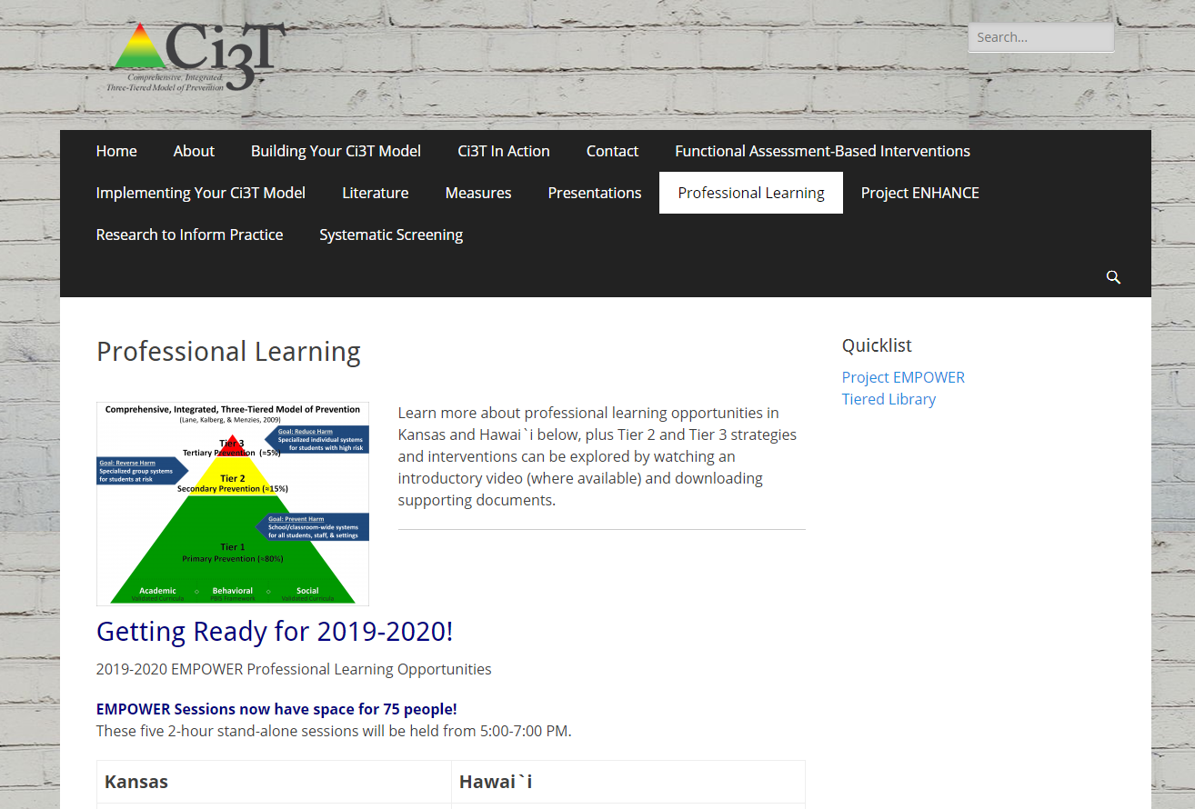
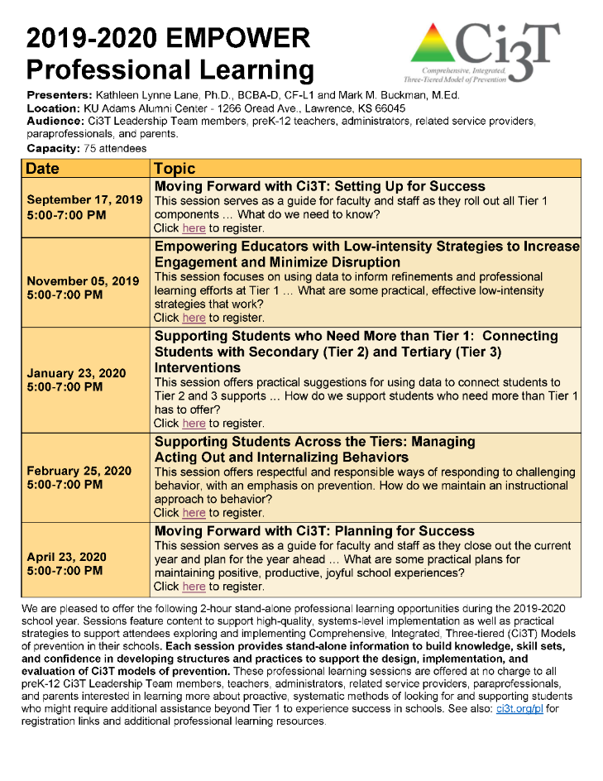

Slide 90
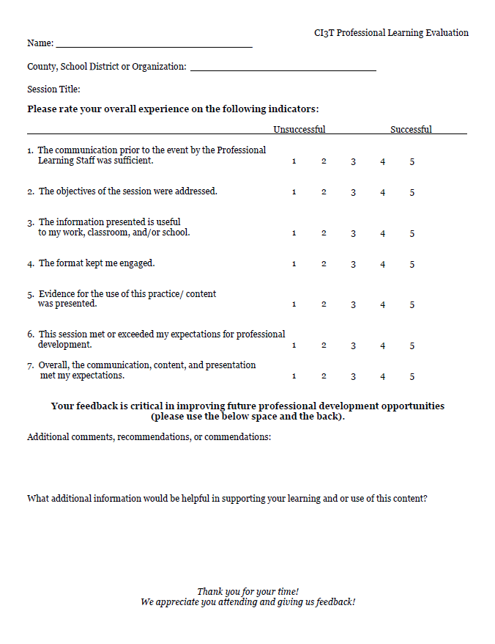
Updates to ci3t.org
Check out the newly updated Ci3T iBook v1.3 today!

