Slide 1

Direct Behavior Rating (DBR)
as a
Secondary (Tier 2) Intervention

Slide 2


Agenda
Comprehensive, Integrated, Three-Tiered (CI3T) Models of Prevention
A Look at Direct Behavior Rating?
  What is Direct Behavior Rating (DBR)?
  Why is DBR effective?
  What does the supporting research for DBR say?
  What are the benefits and challenges?
  How do I implement DBR in my classroom?
  Implementation Checklist
  How well is it working? Examining the effects?

Slide 3
Comprehensive, Integrated, Three-Tiered Model of Prevention (Lane, Kalberg, & Menzies, 2009)
Goal: Reduce Harm
Specialized Individual Systems
for Students with High-Risk
≈5%
Tertiary Prevention (Tier 3)
Goal: Reverse Harm
Specialized Group Systems
for Students At-Risk
≈15%
Secondary Prevention (Tier 2)
Goal: Prevent Harm
School/Classroom-Wide Systems for All Students, Staff, & Settings
PBIS Framework
≈80%
Validated Curricula
Primary Prevention (Tier 1)
Academic Behavioral Social
Notes:
Lane, K. L., Oakes, W. P., Ennis, R. P., & Hirsch, S. E. (2014). Identifying students for secondary and tertiary prevention efforts: How do we determine which students have Tier 2 and Tier 3 needs? Preventing School Failure, 58, 171-182, DOI: 10.1080/1045988X.2014.895573

Slide 4
What is Direct Behavior Rating (DBR)?
Brief rating during a specific time-period or instructional periods (e.g., whole group reading instruction, 1st period - Introduction to Algebra; Riley-Tillman et al., 2007)
Check-in with students before and after rating
  Opportunity to:
    Provide behavior specific praise
    Provide instructional feedback
Rating may be tied to reinforcement system
  Universal (Tier 1) reinforcement system if available (Chafouleas et al., n.d.)
Chafouleas, S. M., Riley-Tillman, T. C., Briesch, A., Christ, T. J., Fabiano, G. A., Kilgus, S. P., Miller, F. G., Sanetti, L. M., Welsh, M. E. (n.d.). Direct Behavior Ratings. https://dbr.education.uconn.edu/
Riley-Tillman, T.C., Chafouleas, S.M., & Briesch, A.M. (2007). A school practitioner’s guide to using daily behavior report cards to monitor student behavior. Psychology in the Schools, 44(1), 77-89. doi:10.1002/pits.20207

Slide 5
What is Direct Behavior Rating (DBR)?
Tool for sharing student’s successes and challenges with parents/guardians
Similar to Check-in/Check-out but does not require mentor or dedicated time at the beginning and end of school day
May include self-monitoring component
  Students may rate their own behavior alongside teacher-completed DBR

Slide 6
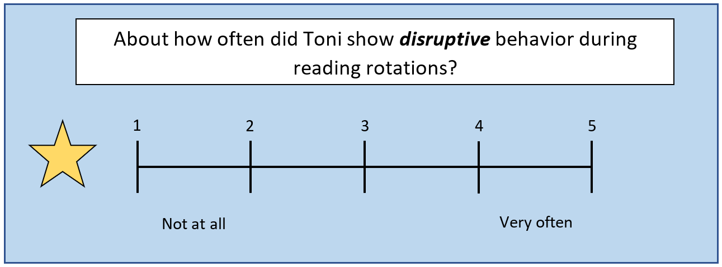
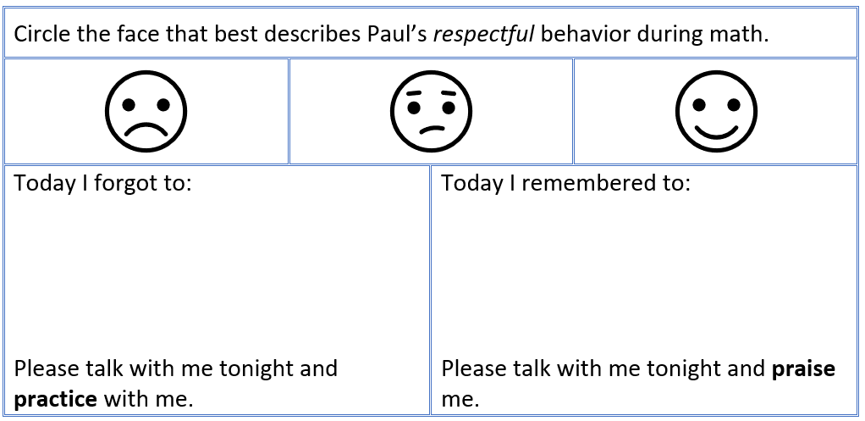
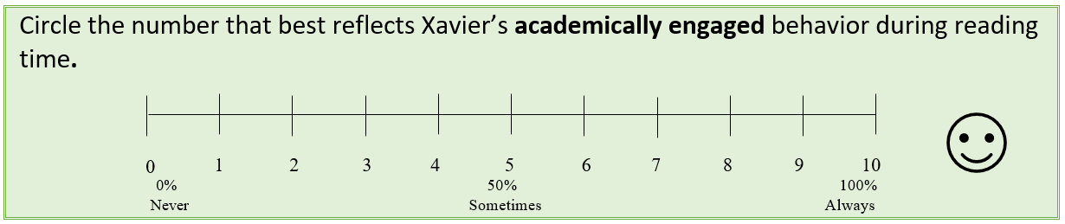
Examples of Direct Behavior Rating (DBR)

Slide 7
Direct Behavior Ratings (DBR):
Uses and Applications
Assessment
Intervention
Identify and define behaviors of concern and/or behaviors to increase (e.g., academic engagement)
Communication
Determine who/where/how often to collect behavior ratings
Regularly graph data to evaluate behavior, intervention
Adapted from: https://dbr.education.uconn.edu/
Notes:
WPO – the behavior or concern is used to set the goal for behavior to increase (true?)

Slide 8
Direct Behavior Ratings (DBR):
Uses and Applications
Assessment
Communication
Intervention
Tool to provide consistent feedback about student behavior to stakeholders (student, parent/guardians)
Encourage shared responsibility for student success
Encourages opportunities to celebrate pro-social behavior at school and at home
Adapted from: https://dbr.education.uconn.edu/

Slide 9
Direct Behavior Ratings (DBR):
Uses and Applications
Assessment
Communication
Intervention
Presents a format for goal setting, systematic feedback, and establishing reinforcement to promote positive behavior and reduce undesirable behavior
Provides opportunity to teach students to monitor and evaluate their own behavior
Adapted from: https://dbr.education.uconn.edu/

Slide 10
Why is Direct Behavior Rating (DBR) effective?
DBR is an efficient way to monitor change in behavior over time (Chafouleas et al, 2012)
DBR is a potential tool to facilitate home-school communication (Vannest et al. 2010)
DBR provides structured opportunities for teachers to provide
  Pre-correction
  Instructive feedback
  Behavior specific praise
Chafouleas, S. M., Sanetti, L. M., Kilgus, S. P., & Maggin, D. M. (2012). Evaluating sensitivity to behavioral change using direct behavior rating single-item scales. Exceptional Children, 78(4), 491-505.
Vannest, K. J., Davis, J. L., Davis, C. R., Mason, B. A., & Burke, M. D. (2010). Effective intervention for behavior with a daily behavior report card: A meta-analysis. School Psychology Review, 39(4), 654-672.

Slide 11
What does the supporting research for Direct Behavior Rating (DBR) say?
DBR effective in improving a variety of classroom behaviors including :
  Academic engagement
  Reducing disruption
Research on DBR shows positive effects for:
  Elementary or secondary students (Vannest et al. 2010)
  Students with ADHD (Fabiano et al, 2010; Jurbergs et al., 2010)
DBR is particularly effective when used to facilitate positive school-home communication (Vannest et al. 2010)
Fabiano, G. A., Vujnovic, R. K., Pelham, W. E., Waschbusch, D. A., Massetti, G. M., Pariseau, M. E., ... & Greiner, A. R. (2010). Enhancing the effectiveness of special education programming for children with attention deficit hyperactivity disorder using a daily report card. School Psychology Review, 39(2), 219.
Jurbergs, N., Palcic, J. L., & Kelley, M. L. (2010). Daily behavior report cards with and without home-based consequences: Improving classroom behavior in low income, African American children with ADHD. Child & Family Behavior Therapy, 32(3), 177-195.

Slide 12
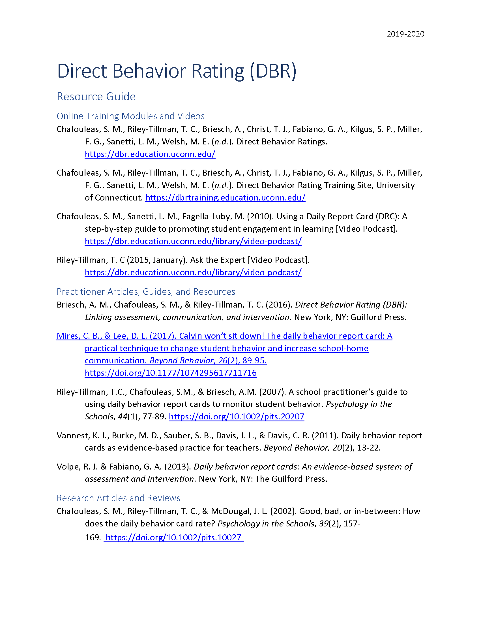
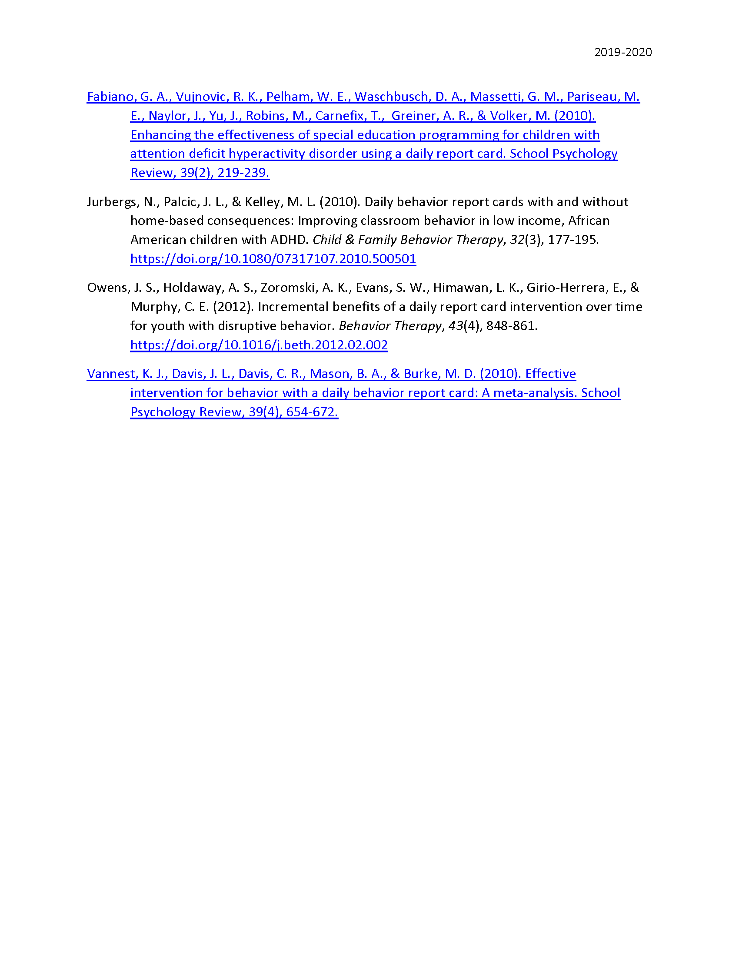
Resources to support implementation of Direct Behavior Rating (DBR)
See “Direct Behavior Rating (DBR) Resource Guide” for additional supporting research and information.

Slide 13
What are the benefits and challenges?
Benefits
Requires fewer resources (e.g., time, people) than similar interventions (i.e., Check-in/Check-out)
Customizable to address specific needs
Online resources available for training
Potential to improve a variety of important classroom behaviors
Provides structure for increasing positive student-teacher interactions and attention
Challenges
Care needed to maintain positive communication with students when providing corrective feedback
Care needed to maintain positive communication with parents and families when providing feedback
Consider the needs of students motivated by escaping tasks or activities rather than accessing teacher attention

Slide 14

How do I implement Direct Behavior Rating (DBR) in my classroom? Implementation Checklist
Step 1
Identify students who might benefit using entry criteria from Ci3T Implementation Manual Secondary (Tier 2) Intervention Grid
Step 2
Define 1-3 behaviors to target (e.g., academic engagement).
Step 3
Determine specified observation periods/activities (i.e., time[s] of day or content area[s] to address [e.g., English and Language Arts, Science] and frequency of ratings [e.g., once daily, every 60 min]).
Step 4
Prepare the DBR form, establishing scale (e.g., 1-10) and anchors (e.g., not at all, half the time, all the time).

Slide 15
How do I implement Direct Behavior Rating (DBR) in my classroom? Implementation Checklist
Step 5
Seek input on DBR form and procedures from stakeholders (i.e., student, parent/caregiver) and incorporate feedback.
Step 6
Practice rating using online DBR Training Site (complete training until criteria is met).
Step 7
Teach the student the DBR procedures (reference DBR podcast for examples).
Step 8
Implement DBR procedures (see 05_DBR_Treatment_Integrity_Checklist)

Slide 16
How do I implement Direct Behavior Rating (DBR) in my classroom? Implementation Checklist
Step 9
Review data weekly.
Step 10
Seek input from student and families after 2-3 weeks

Slide 17
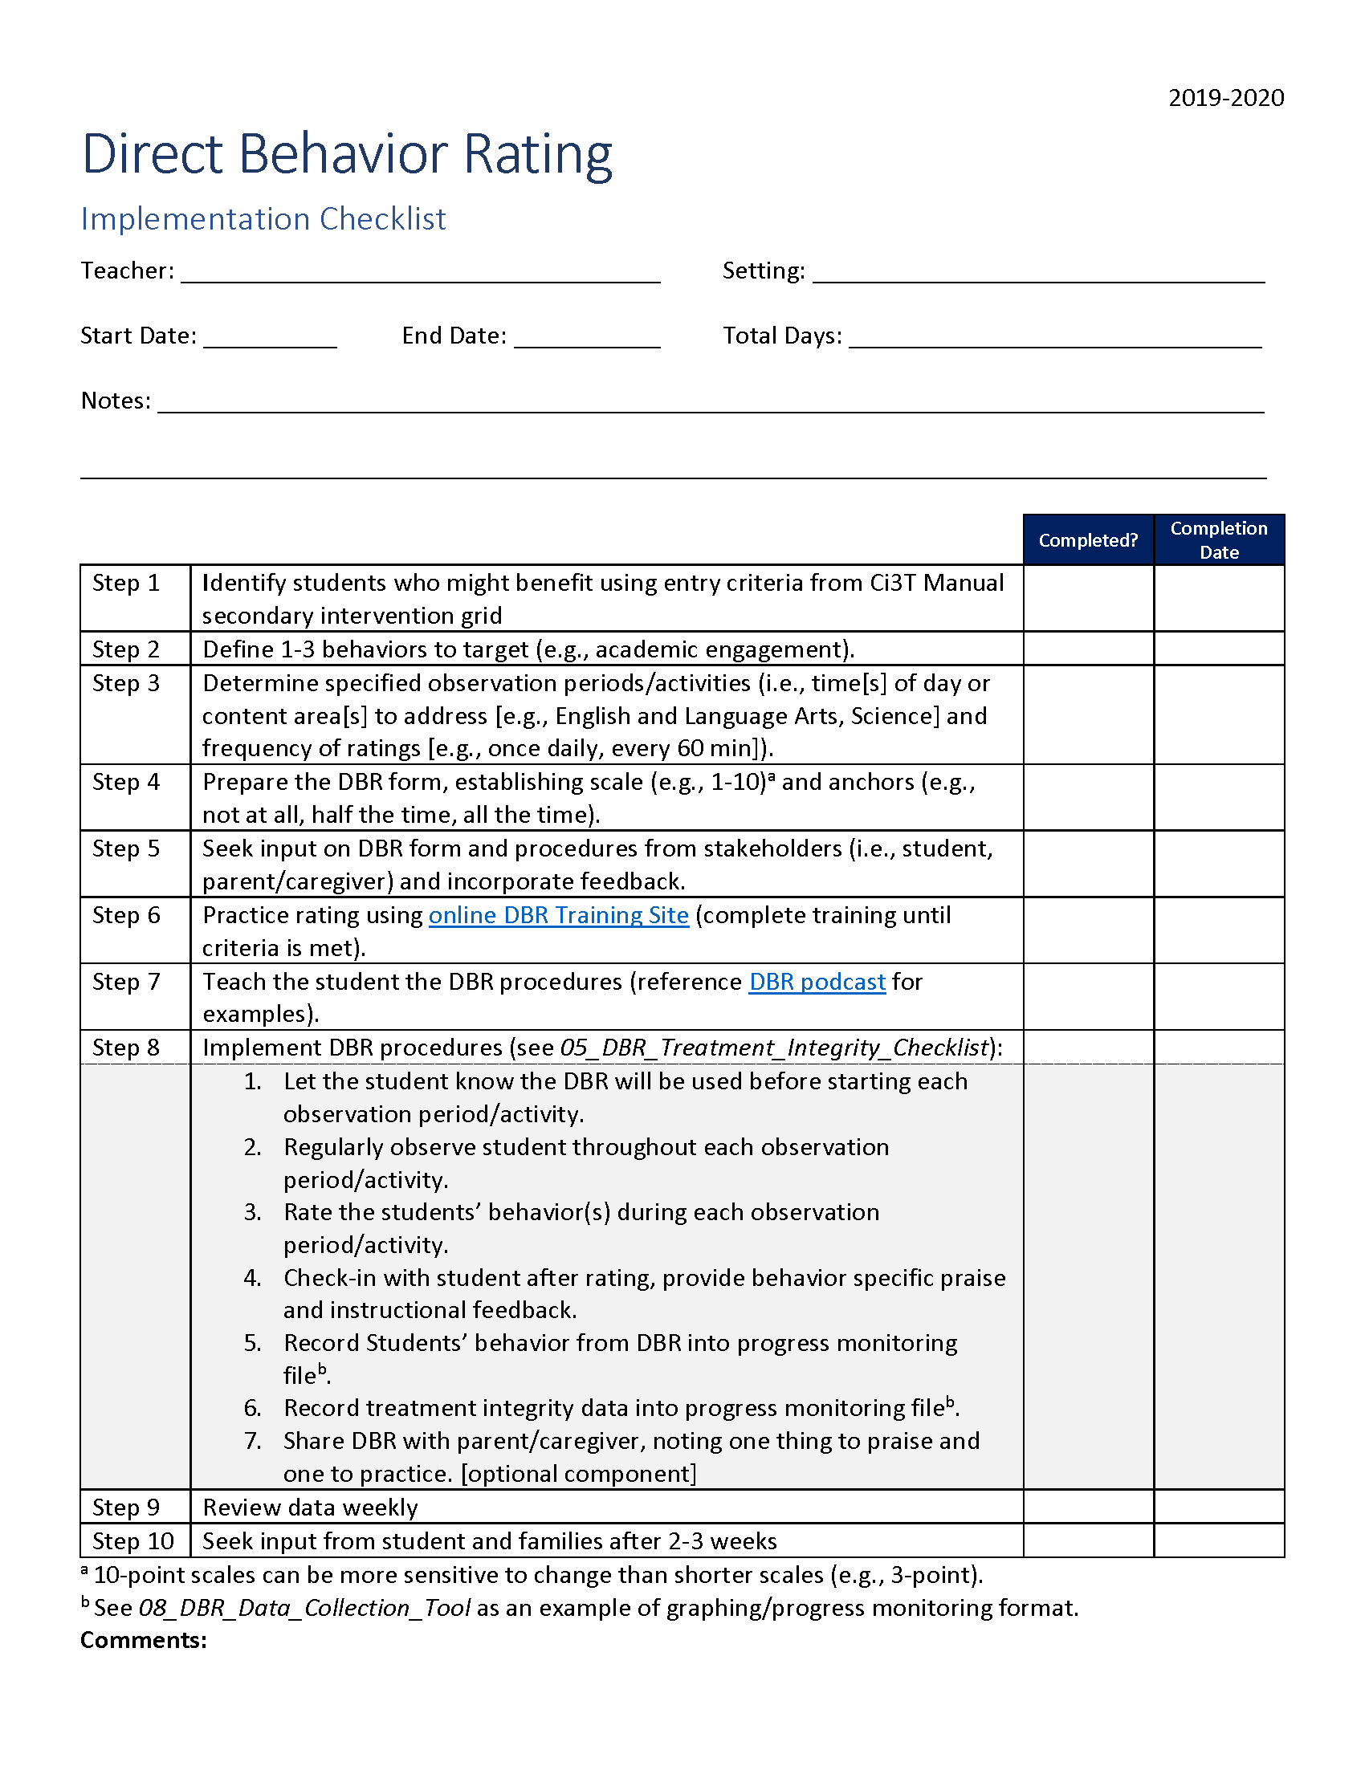
How do I use Direct Behavior Rating (DBR) in my classroom? Implementation Checklist

Slide 18
How well is it working?
Examining the Effects
Treatment Integrity
Is it happening?
Social Validity
What do stakeholders think about the goals, procedures, and outcomes?
Experimental Design
How well did this support work for this student?

Slide 19
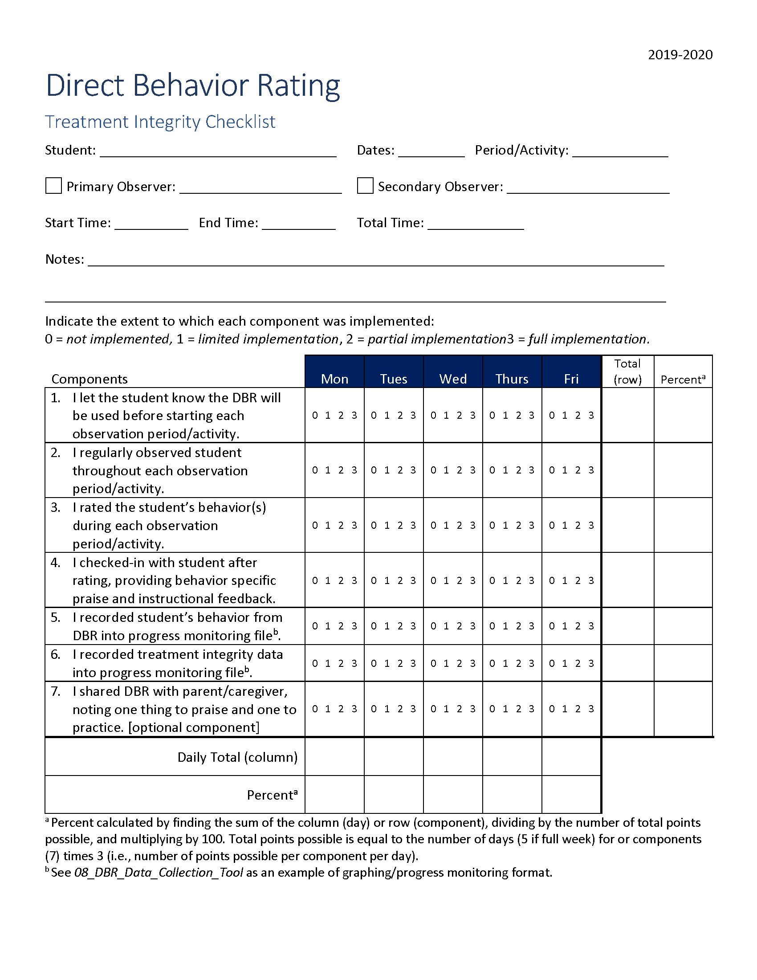
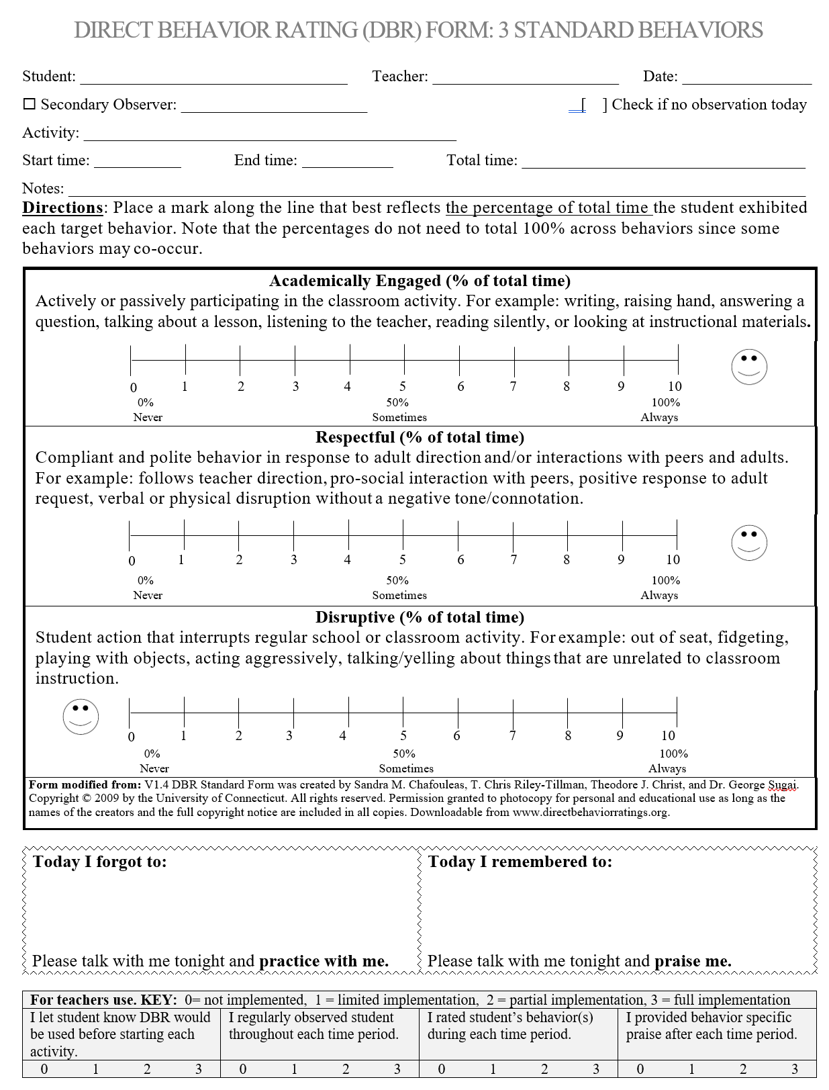
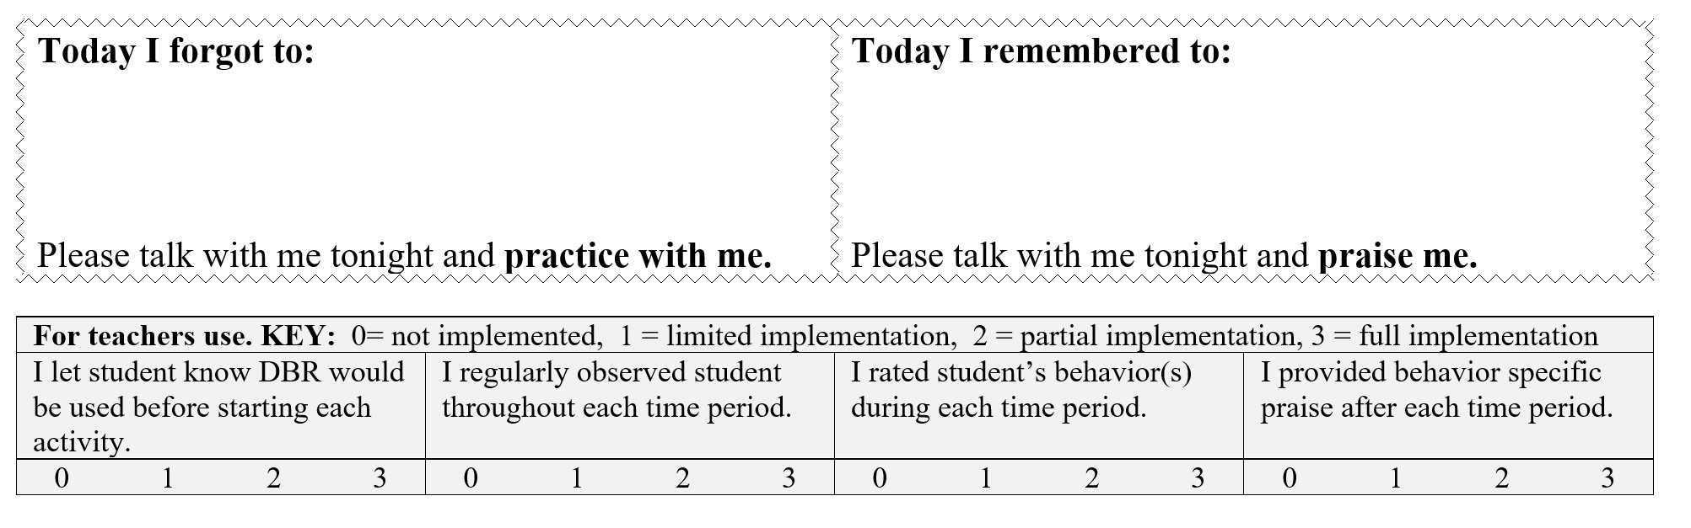
Ensuring Direct Behavior Rating (DBR) is in place: Treatment Integrity
Have structures in place to monitor whether DBR carried out as intended.
Treatment Integrity Checklist:
I let the student know DBR would be used before starting each period/activity.
I regularly observed student throughout each period/activity.
I rated student’s behavior(s) during each period/activity.
I checked-in with the student after rating and provided behavior specific praise and instructional feedback.
I recorded the student’s behavior and treatment integrity data.
I shared the DBR with the parent/caregiver, noting one thing to praise and one to practice.

Slide 20
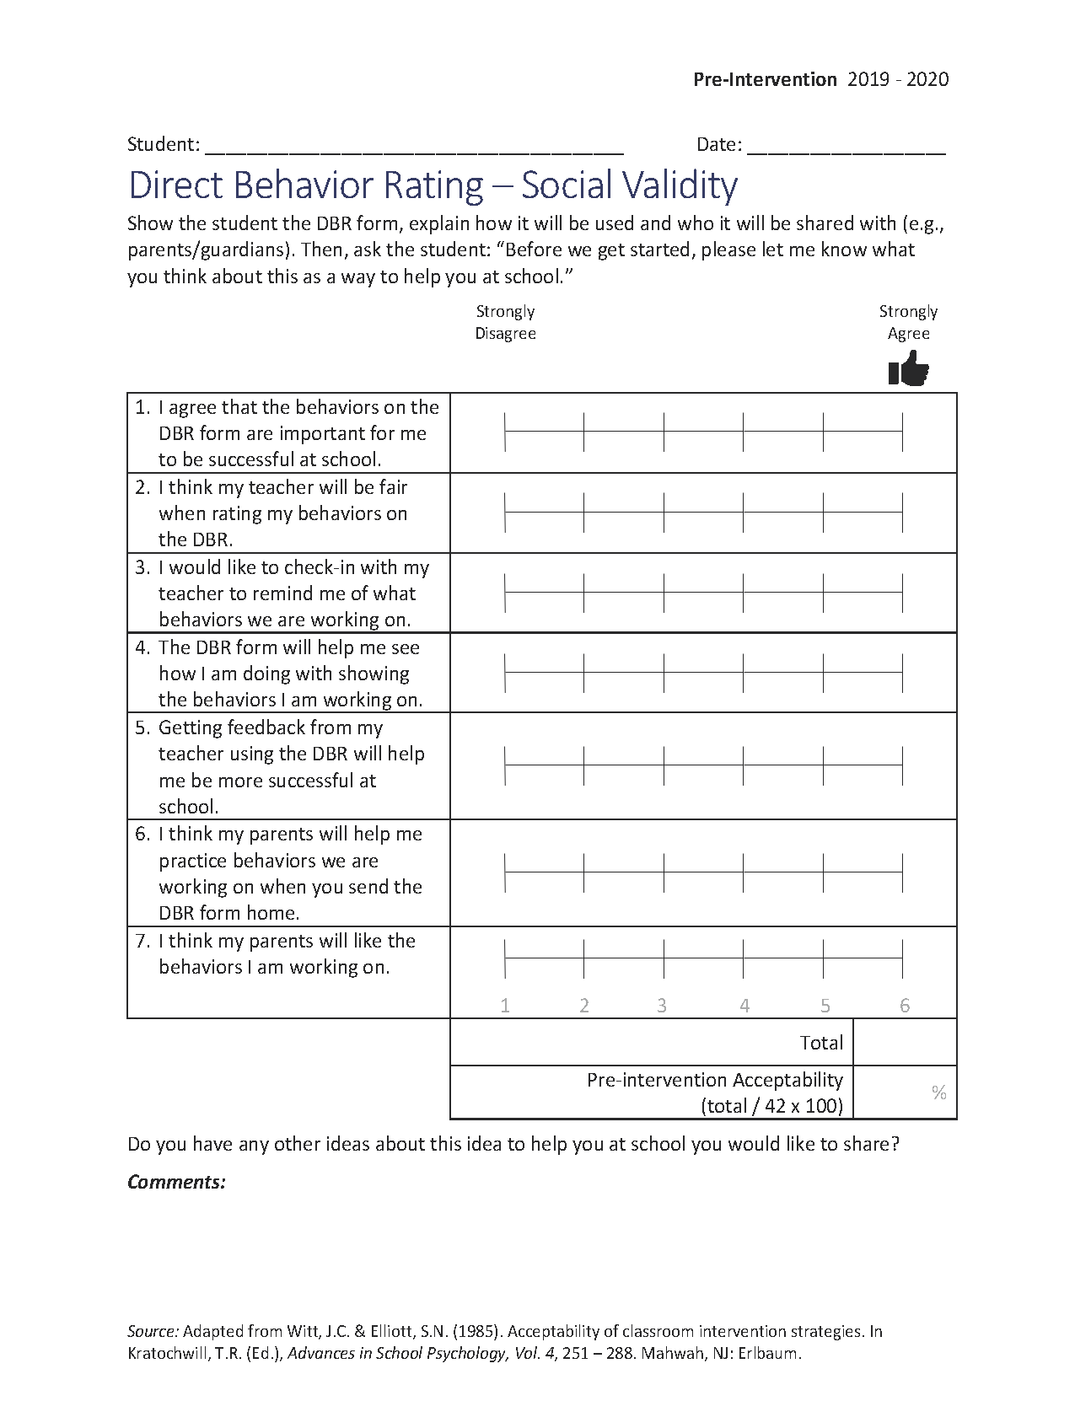
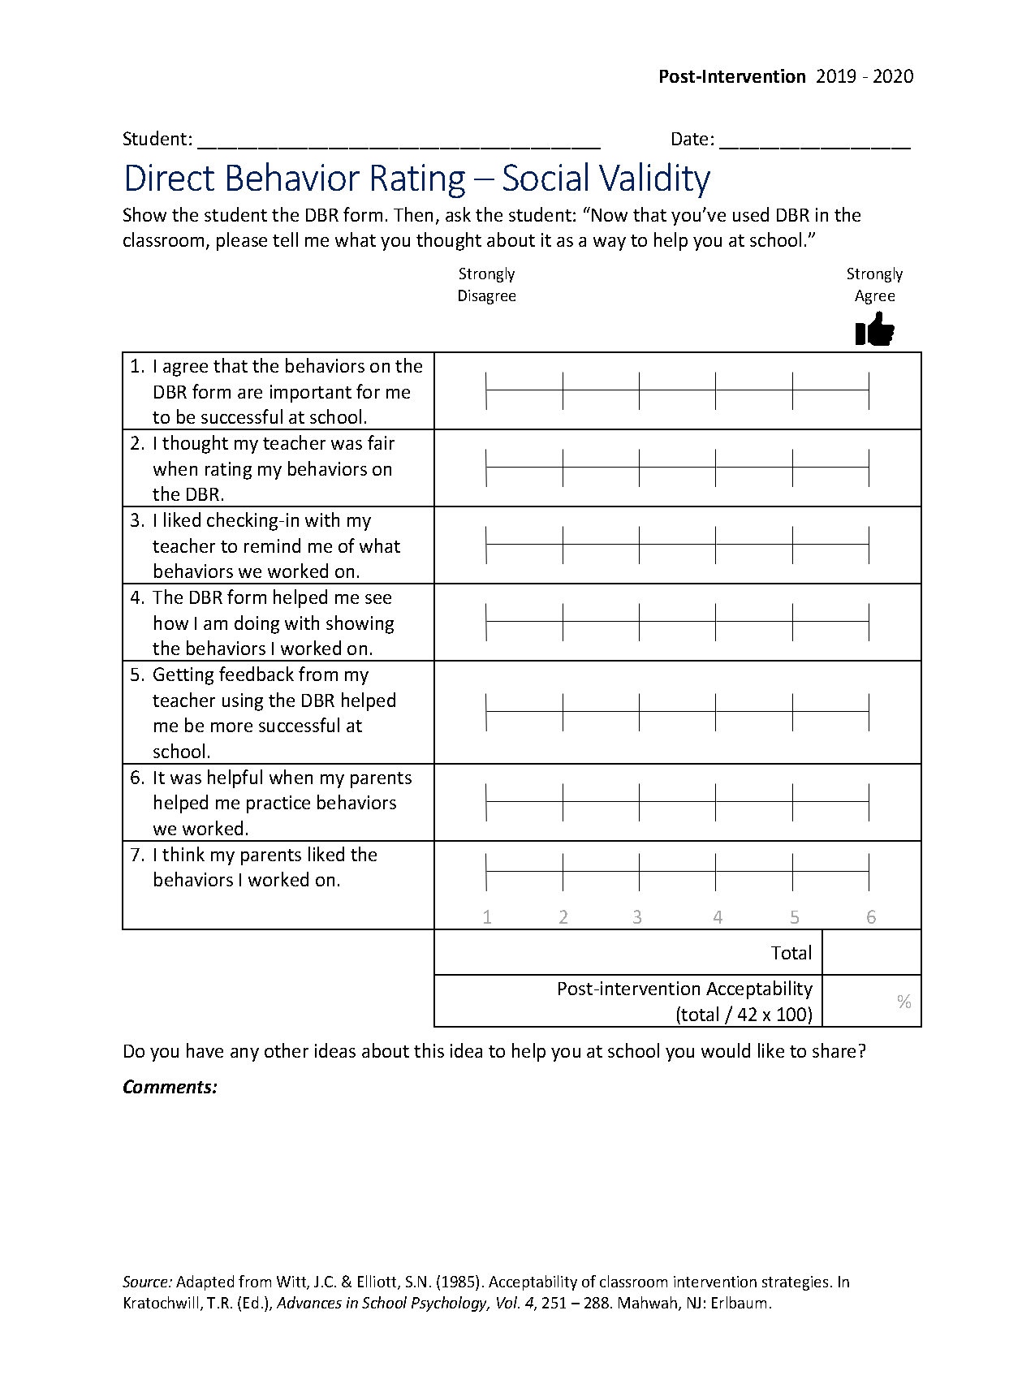
What does the student think about it?
Pre-
Post-

Slide 21
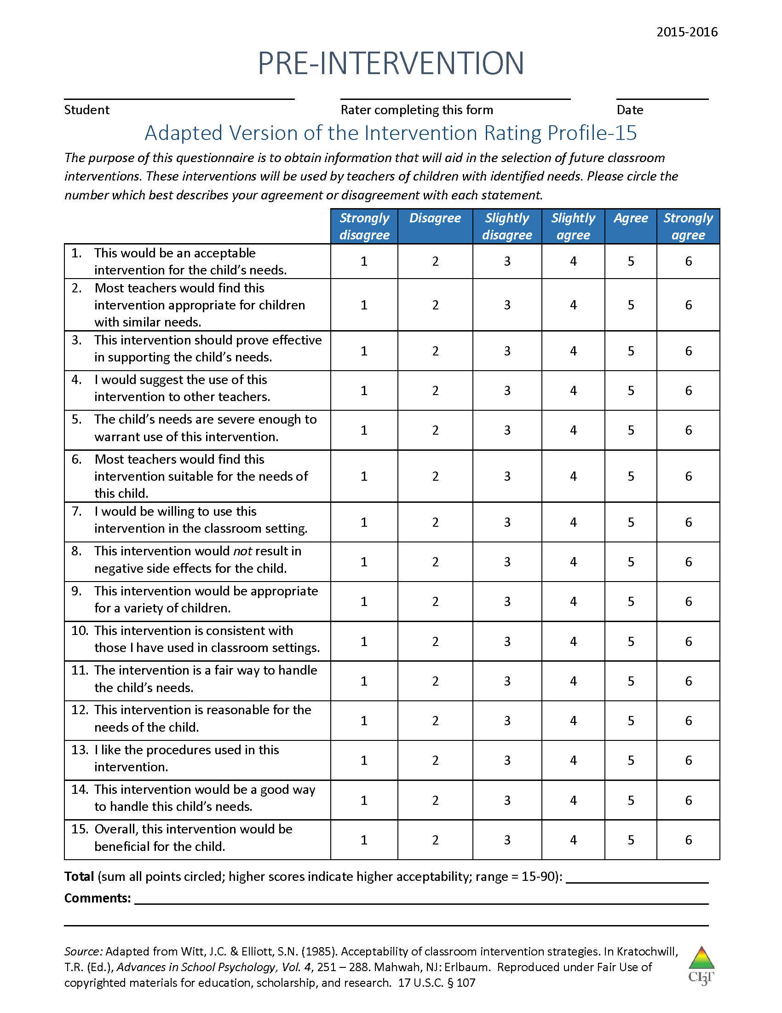
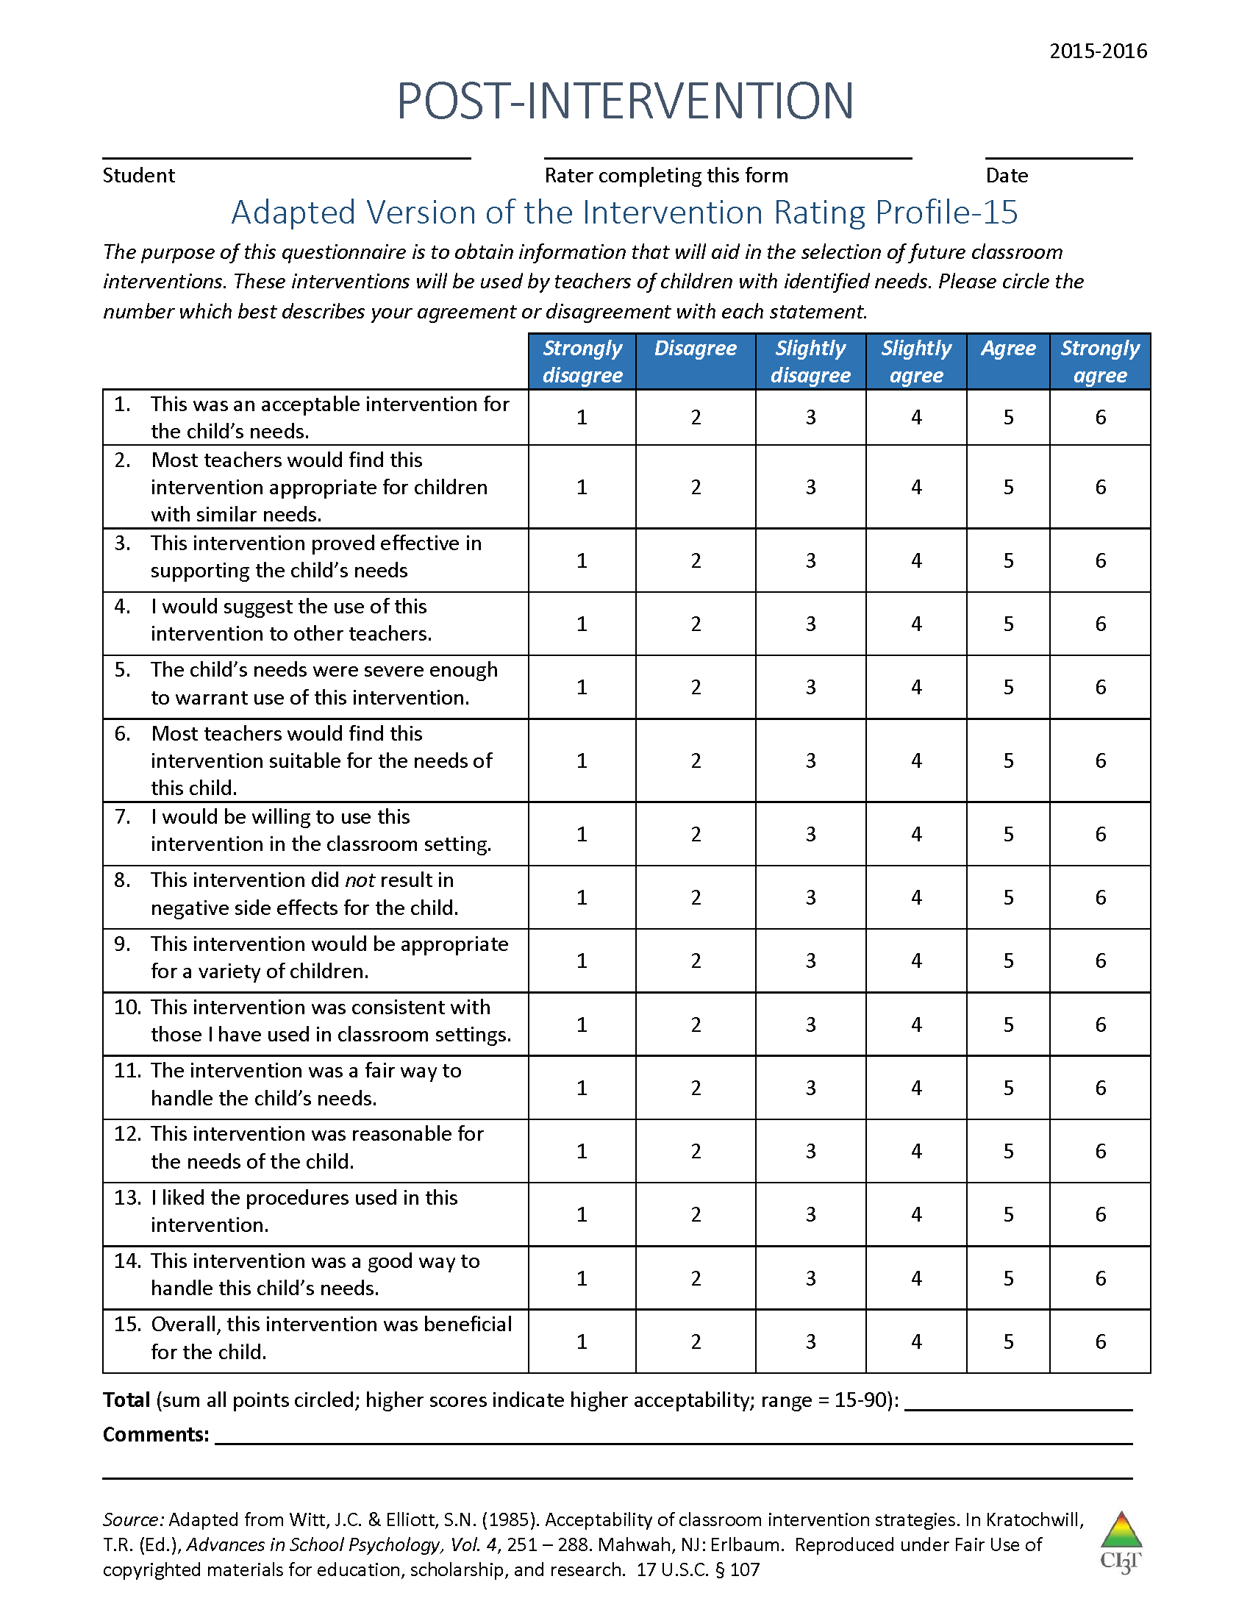
What does the teacher think about it?
See “Social Validity Adapted-IRP15 Adult”
Completed by the teacher(s) and parent(s) involved in the intervention at two time points:
Pre
and
Post
Intervention

Slide 22
Data to Progress Monitor –
Direct Behavior Rating (DBR)

Slide 23
Data to Progress Monitor –
Treatment Integrity

Slide 24
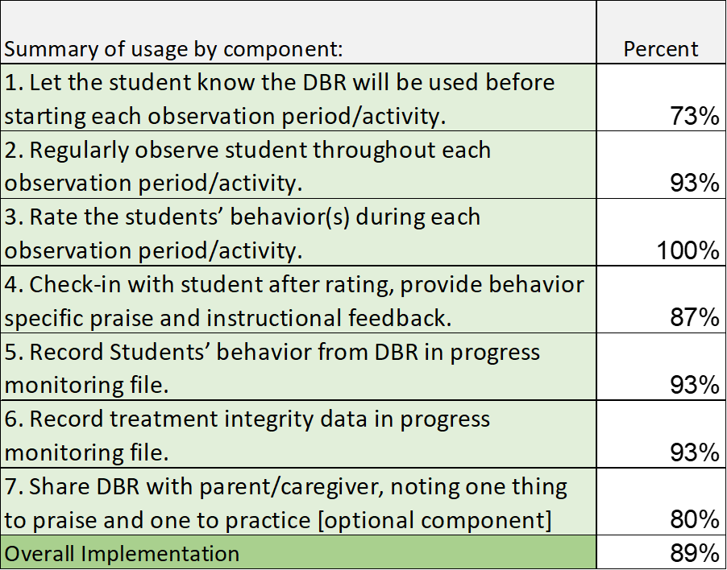
Data to Progress Monitor – Treatment Integrity

Slide 25
Sample Elementary Intervention Grid
Support | Description | School-wide Data: Entry Criteria | Data to Monitor Progress | Exit Criteria
Direct Behavior Rating (DBR) or Daily Behavior Report Card (DBRC) | DBR is typically completed daily following specified observation period(s) (e.g., math intervention; ELA core instruction). The most appropriate rater is a person who can directly observe the student during the observation period, typically the teacher. DBR is used to monitor specific behaviors identified as relevant for the student and setting. For example, many DBRs monitor academic engagement, respect, and disruption as core school-based behavioral competencies, and may adapt or add a behavior based on the student’s specific needs. After each observation period, the rater uses the provided scale to indicate the degree to which the student displayed each behavior. When used as part of a Tier 2 intervention, the rater reminds the students of the expected behaviors prior beginning the observation. At the conclusion of each observation, the rater uses the provided scale to indicate the degree to which the student displayed each behavior. The rater meets briefly with the student to share the DBR rating, providing behavior specific praise and instructional feedback. Home-school communication procedures may be established (e.g., information is shared with parent/caregiver daily, with return acknowledgement and possible home consequences). | Behavior SRSS-E7 score: Moderate (4-8) and/or SRSS-I5 score: Moderate (2-3) AND Evidence of teacher implementation of Ci3T primary (Tier 1) plan [treatment integrity: direct observation] AND Parent permission, in accordance with district policy | Student measures Direct Behavior Rating (DBR; daily) Social validity Teacher: IRP-15 Student: DBR Student Social Validity form/interview Treatment integrity DBR treatment integrity measure | Student goals met for 10-12 weeks (team review of progress to determine) SRSS-E7 and I5 scores are in the low risk category

Slide 26
Sample Secondary Intervention Grid
Support | Description | School-wide Data: Entry Criteria | Data to Monitor Progress | Exit Criteria
Direct Behavior Rating (DBR) or Daily Behavior Report Card (DBRC) | DBR is typically completed daily following specified observation period(s) (e.g., second period Math). The most appropriate rater is a person who can directly observe the student during the observation period, typically the teacher. DBR is used to monitor specific behaviors identified as relevant for the student and setting. For example, many DBRs monitor academic engagement, respect, and disruption as core school-based behavioral competencies, and may adapt or add a behavior based on the student’s specific needs. After each observation period, the rater uses the provided scale to indicate the degree to which the student displayed each behavior. When used as part of a Tier 2 intervention, the rater reminds the students of the expected behaviors prior beginning the observation. At the conclusion of each observation, the rater uses the provided scale to indicate the degree to which the student displayed each behavior. The rater meets briefly with the student to share the DBR rating, providing behavior specific praise and instructional feedback. Home-school communication procedures may be established (e.g., information is shared with parent/caregiver daily, with return acknowledgement and possible home consequences). | Behavior SRSS-E7 score: Moderate (4-8) and/or SRSS-I6 score: Moderate (4-5) AND Evidence of teacher implementation of Ci3T primary (Tier 1) plan [treatment integrity: direct observation] AND Parent permission, in accordance with district policy | Student measures Direct Behavior Rating (DBR; daily) Social validity Teacher: IRP-15 Student: DBR Student Social Validity form/interview Treatment integrity DBR treatment integrity measure | Student goals met for 10-12 weeks (team review of progress to determine) SRSS-E7 and I6 scores are in the low risk category

Slide 27



















Will you please ….
Draft ….
Plan …
Implementation Checklist for Success: DBR
Let’s talk …
Notes:
Using this PowerPoint break timer 10 MIN
This PowerPoint slide uses images, custom animation, and timing to provide a countdown timer that you can use in any presentation. When you open the template, you’ll notice that the timer is set at 00:00. However, when you start the slide show, the timer will start at the correct time and count down by 1-minute intervals until it gets to 1 minute. At that point, it will count down in two 30-seconds intervals to 00:00.
To insert this slide into your presentation
Save this template as a presentation (.ppt file) on your computer.
Open the presentation that will contain the timer.
On the Slides tab, place your insertion point after the slide that will precede the timer. (Make sure you don't select a slide. Your insertion point should be between the slides.)
On the Insert menu, click Slides from Files.
In the Slide Finder dialog box, click the Find Presentation tab.
Click Browse, locate and select the timer presentation, and then click Open.
In the Slides from Files dialog box, select the timer slide.
Select the Keep source formatting check box. If you do not select this check box, the copied slide will inherit the design of the slide that precedes it in the presentation.
Click Insert.
Click Close.

Slide 28
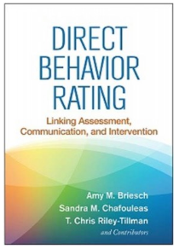

Resources
Thank you!
Questions:
kathleen.lane@ku.edu

