Slide 1

Empowering Educators with Low-Intensity Strategies to Increase Engagement and Minimize Disruption
Kathleen Lynne Lane, Ph.D., BCBA-D, CF-L1
Mark Matthew Buckman, MS.ED.
Wendy Peia Oakes, Ph.D.
Paloma Pérez-Clark, Ed.S.

Slide 2

Agenda
Welcome
Preparing to Collect Social Validity & Treatment Integrity Data
Using Screening Data to Inform Instruction
Low-Intensity Strategies: Building Capacity Through Professional Learning
Wrapping Up and Next Steps

Slide 3
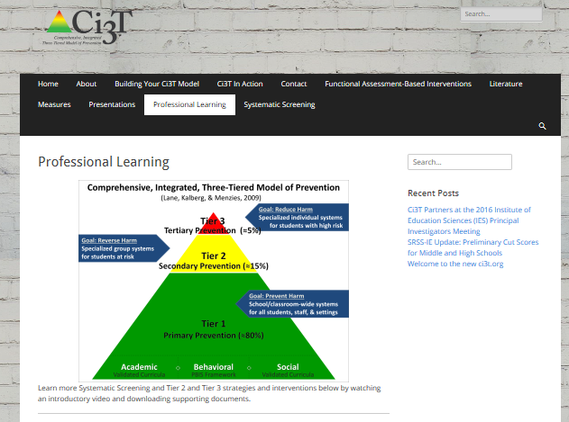
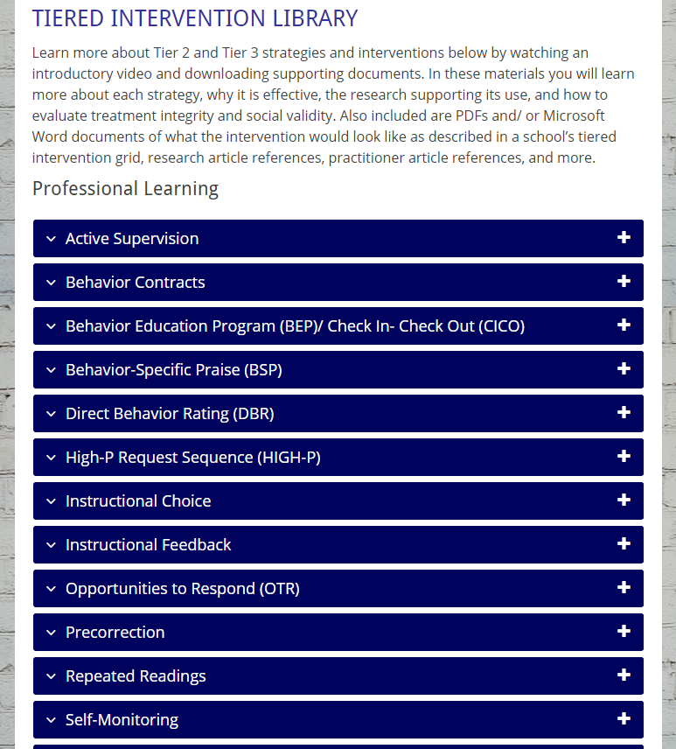
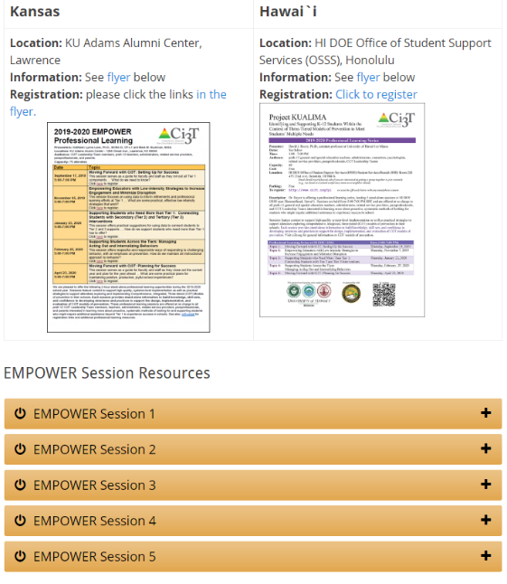

Slide 4


Welcome!
Ci3T Leadership Teams | Individuals
If you are part of a Ci3T Leadership Team: Please open your Ci3T Implementation Manual Treat this as a team meeting Use IM18 Ci3T Leadership Team Meeting Agenda from ci3t.org/building Materials for this session can be found at ci3t.org/pl Welcome to EMPOWER! | If you are here to learn with us as an individual: Materials for this session can be found at ci3t.org/pl Create a space on your computer to download today’s materials Consider building a structure to organize your learning for future EMPOWER sessions Think of ways to share your learning with colleagues Welcome to EMPOWER!

Slide 5


IM18 Ci3T Leadership Team Meeting Agenda TEMPLATE
Predictability

Slide 6
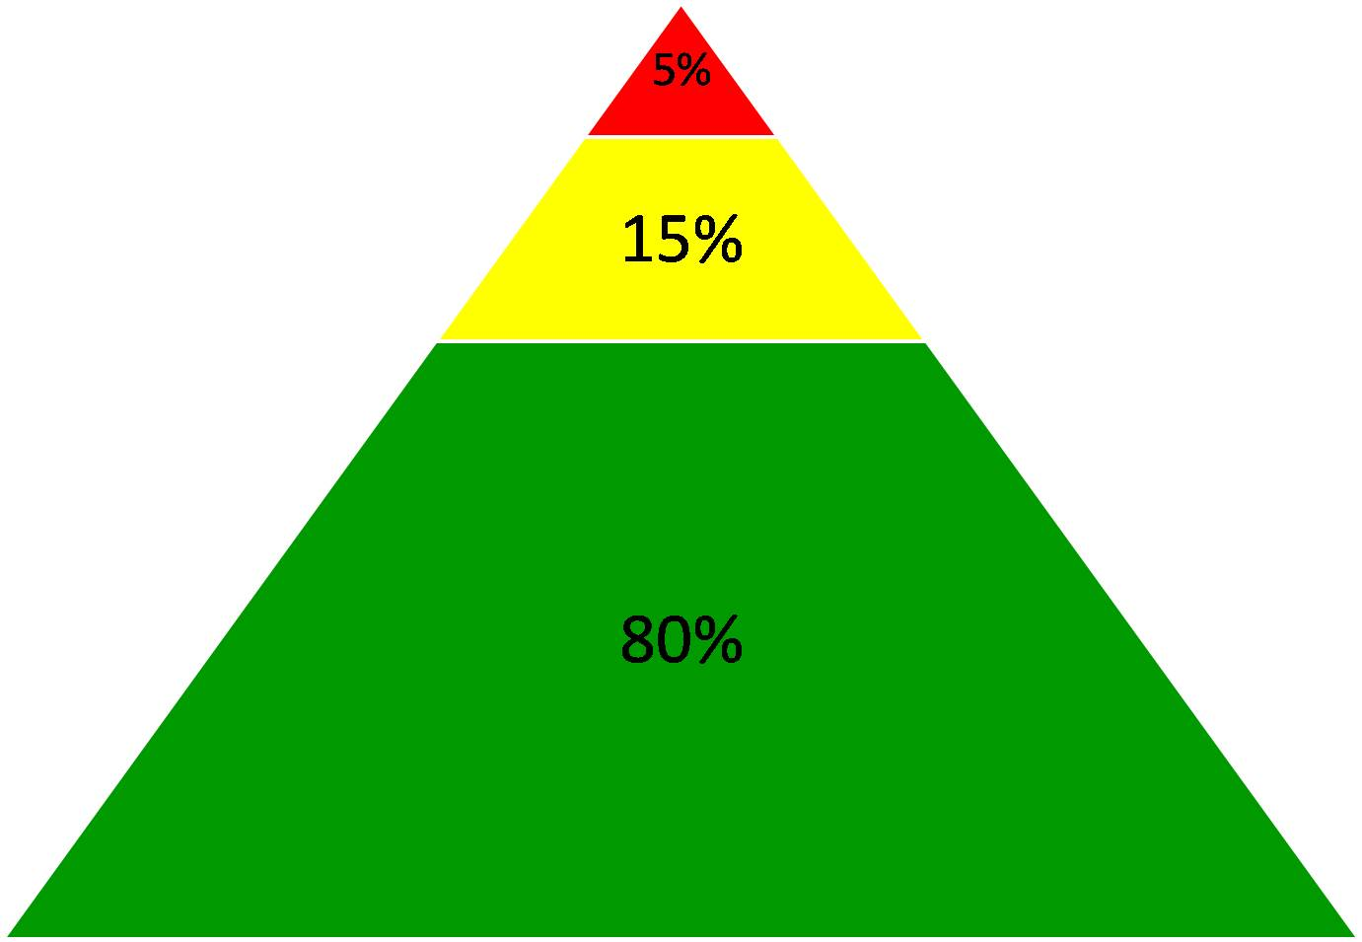
Comprehensive, Integrated, Three-Tiered Model of Prevention
(Lane, Kalberg, & Menzies, 2009)
Goal: Reduce Harm
Specialized individual systems
for students with high risk
Tier 3
Tertiary Prevention (≈5%)
Goal: Reverse Harm
Specialized group systems
for students at risk
Tier 2
Secondary Prevention (≈15%)
Goal: Prevent Harm
School/classroom-wide systems for all students, staff, & settings
Tier 1
Primary Prevention (≈80%)
Academic ◇ Behavioral ◇ Social
Validated Curricula PBIS Framework Validated Curricula

Slide 7


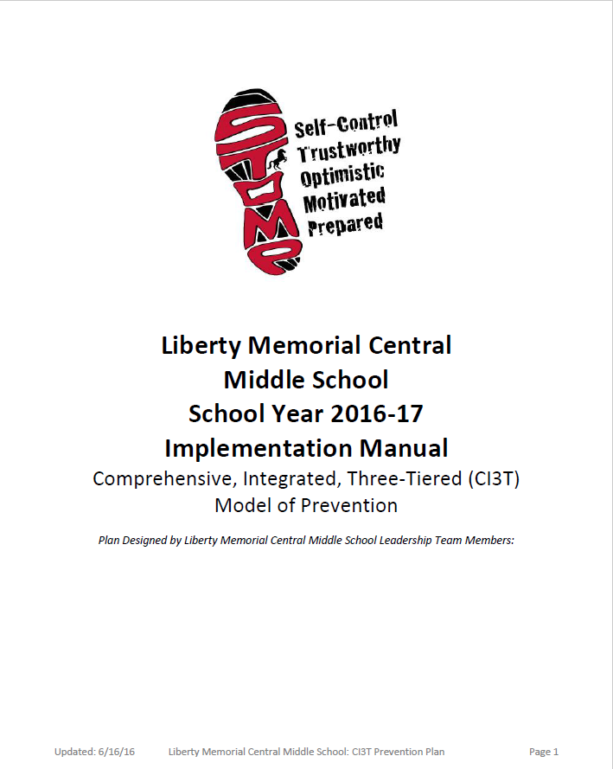



If you are here with your Ci3T Leadership Team, please pull up your Ci3T Implementation Manual 2019-2020
Ci3T Implementation Manuals
Shared with permission.

Slide 8
Preparing to Collect Social Validity & Treatment Integrity Data

Slide 9
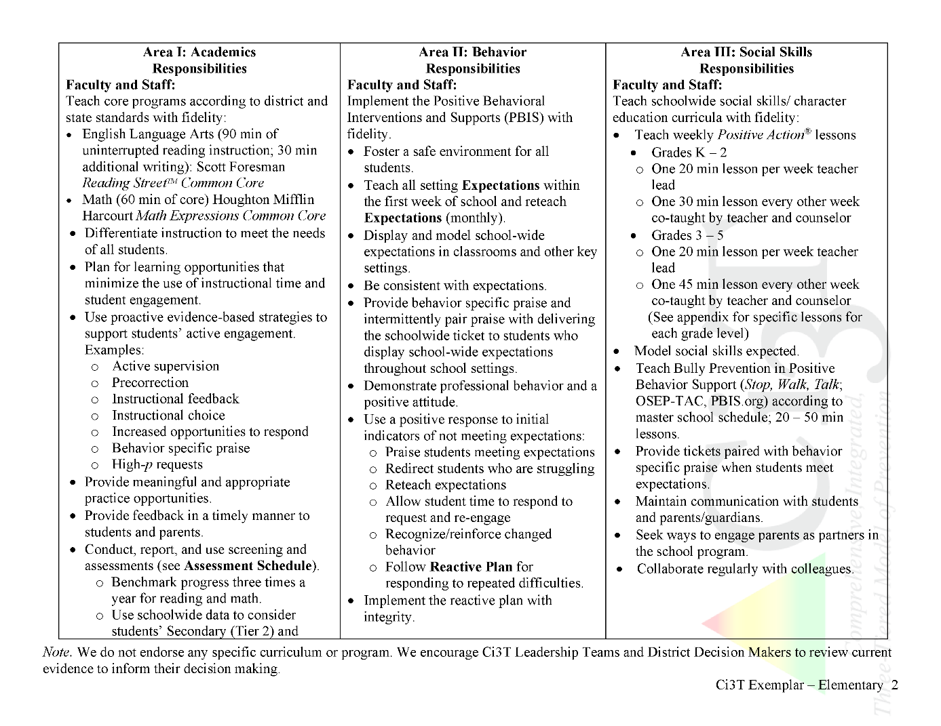

Ci3T Primary (Tier 1) Plan: Procedures for
Teaching
Ci3T Primary (Tier 1) Plan: Procedures for Reinforcing
Ci3T Primary (Tier 1) Plan: Procedures for Monitoring

Slide 10

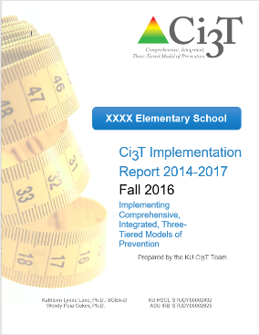
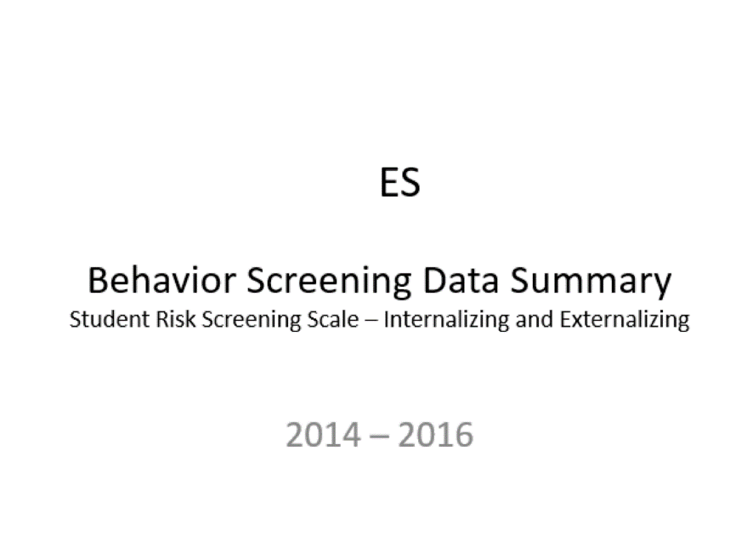
Essential Components of Primary Prevention Efforts
Social Validity
Systematic Screening
Academic
Behavior
Treatment Integrity

Slide 11
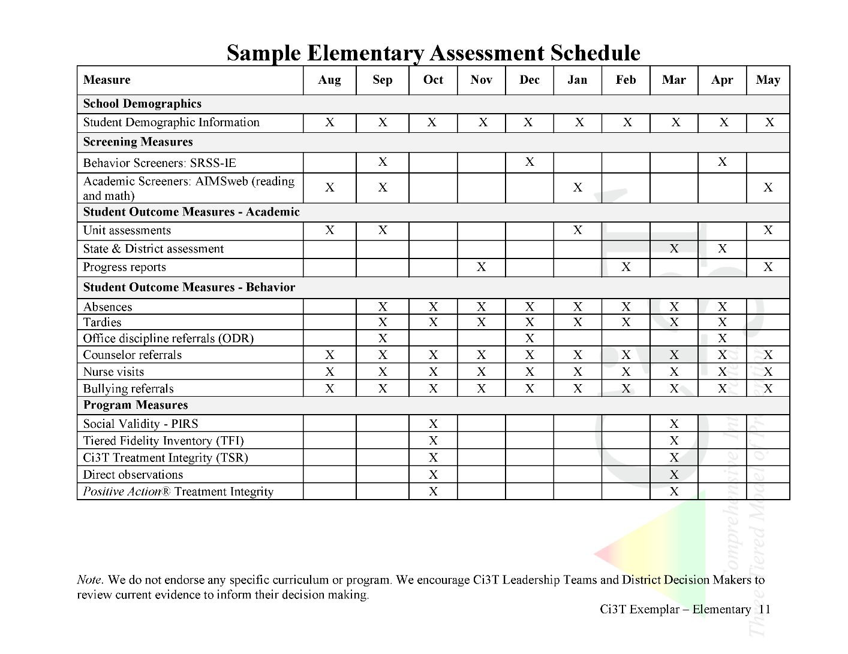
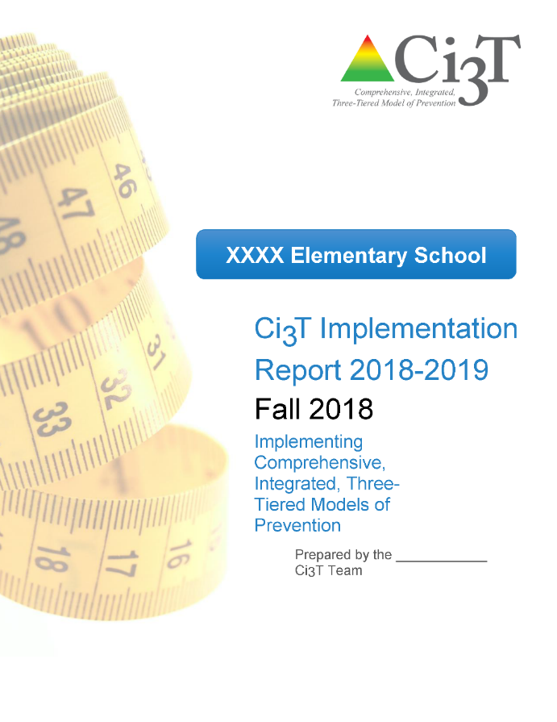

Slide 12
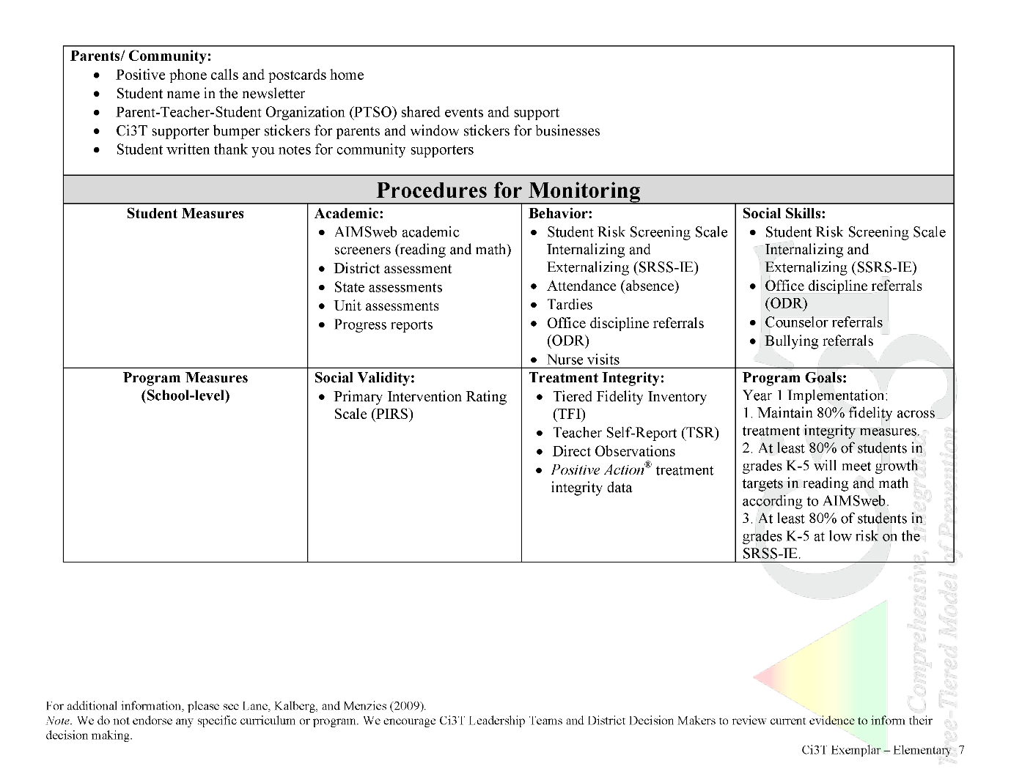


In future years, consider alternative program goals.
80% of students meeting reading and math targets on assessments
Locate in your Ci3T Implementation Manual

Slide 13
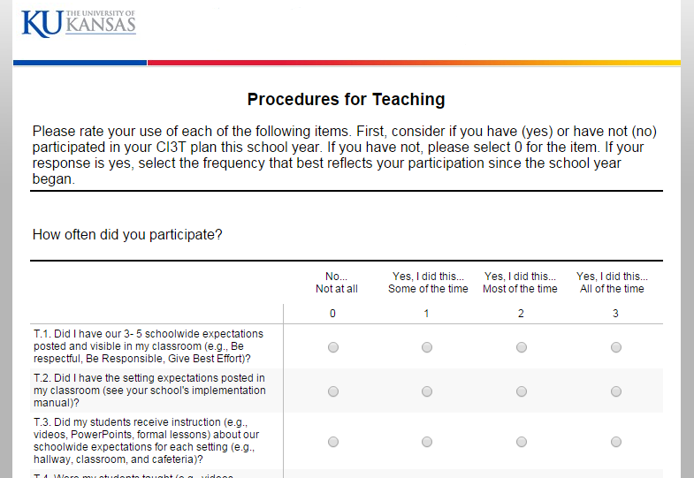
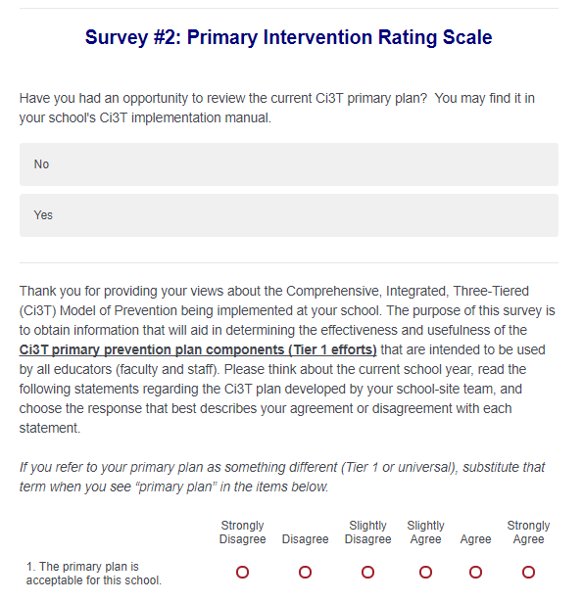
Social Validity: Primary Intervention Rating Scale
Ensure all faculty and staff receive an emailed link to Qualtrics for the PIRS and TSR surveys
Year of Implementation | Fall |  | Spring
 | n | % (SD) | n | % (SD)
2017-2018 | 39 | 92.41 (8.46) | 37 | 92.92 (7.53)

Slide 14
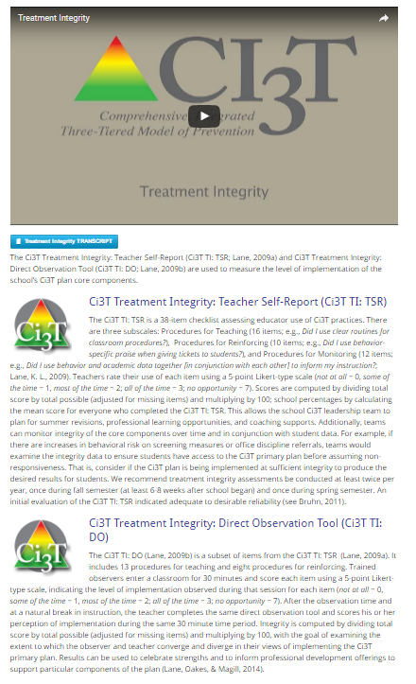

Treatment Integrity

Slide 15
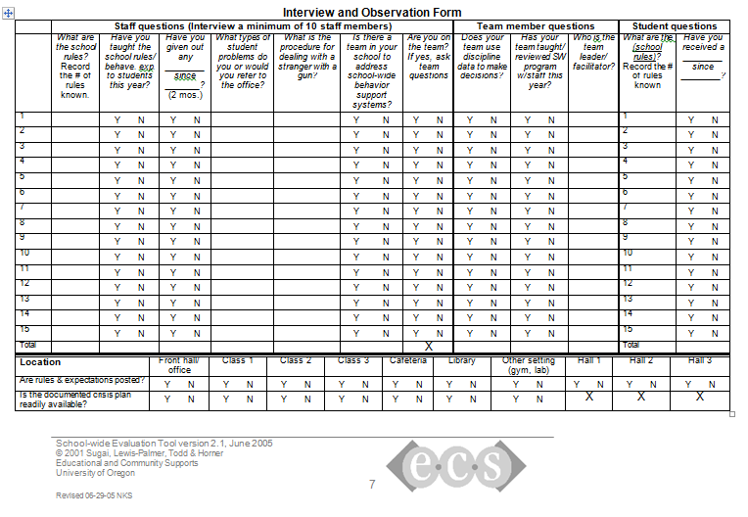


Treatment Integrity
"Tiered Fidelity Inventory" and “Schoolwide Evaluation Tool Interview and Observation Form” are products developed as part of the U.S. Department of Education’s Office of Special Education Programs National Technical Assistance Center on Positive Behavioral Interventions and Supports.

Slide 16
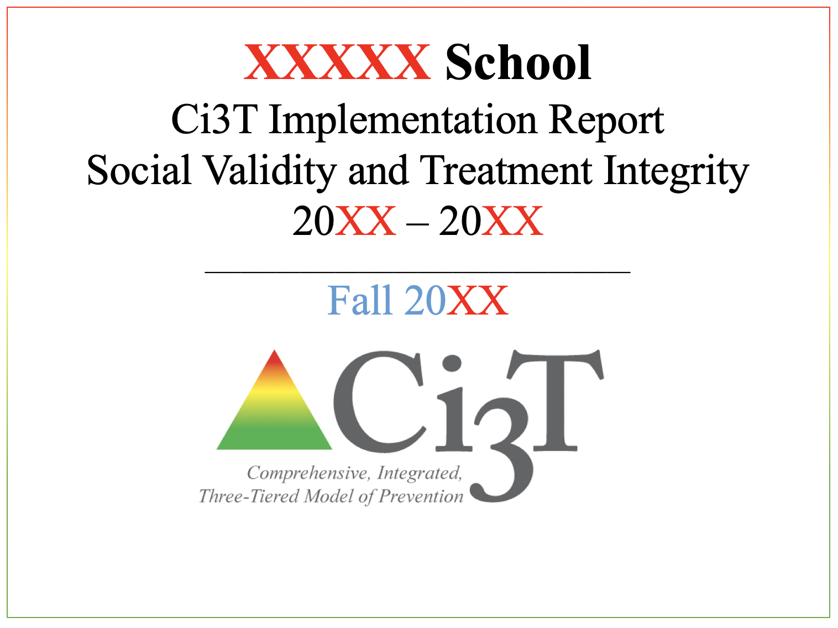
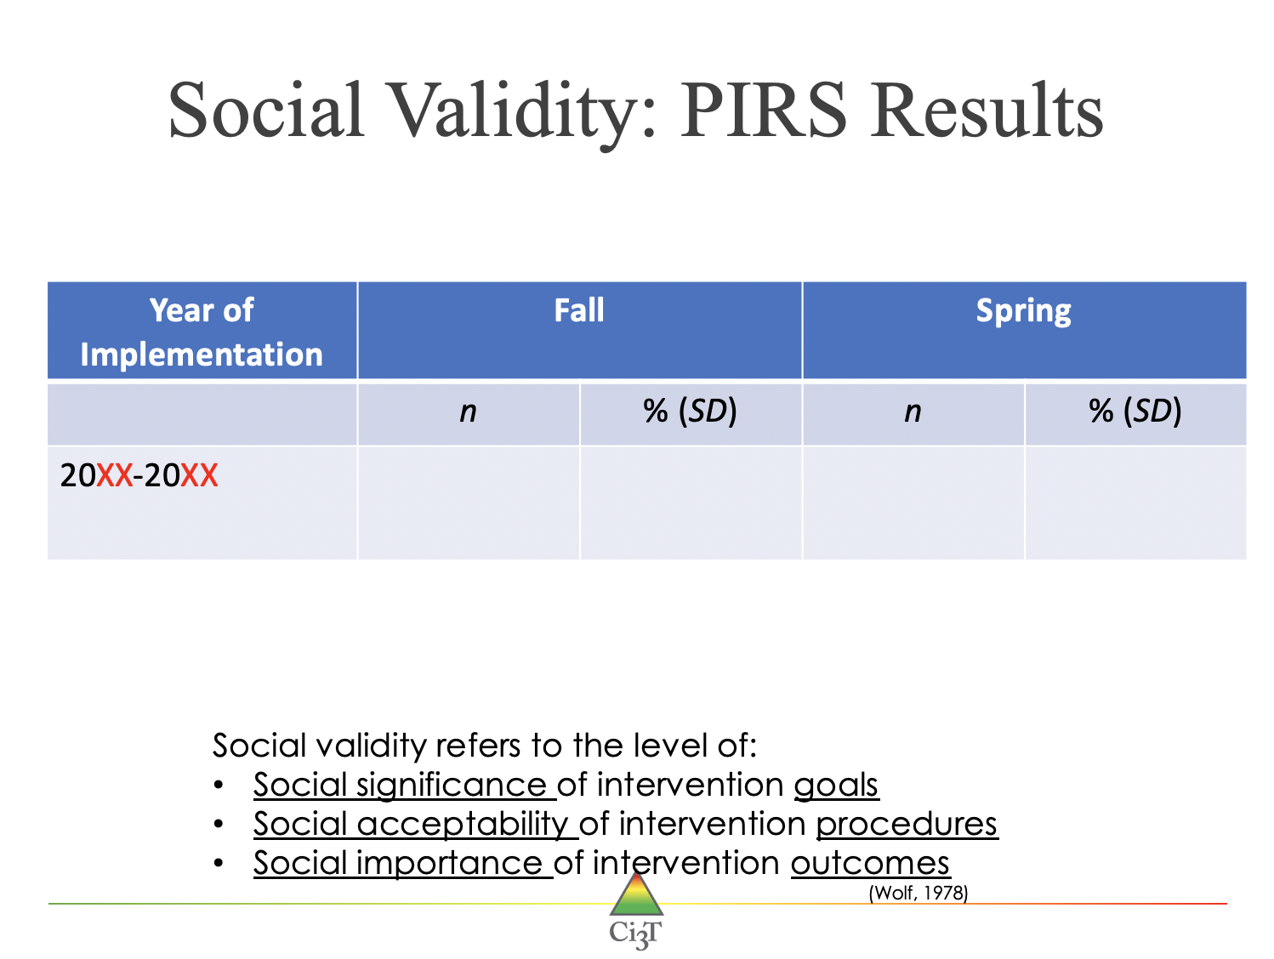
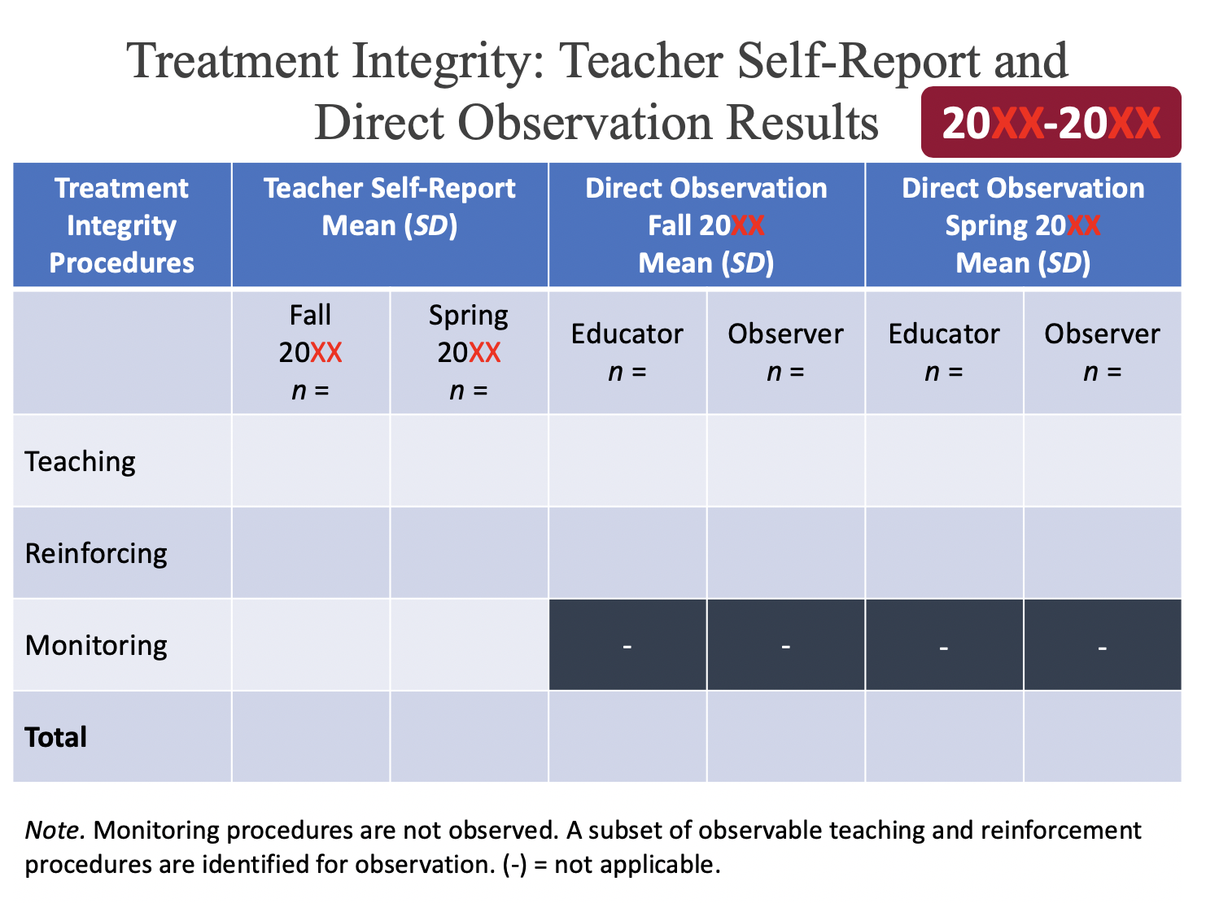
Sharing Data with Faculty and Staff
Templates available at ci3t.org/imp

Slide 17

















Let’s talk… and make plans!
Ci3T Leadership Teams | Individuals
How did we use multiple sources of data, and to what extent did we share these data with faculty and staff? How can we strengthen our data collection procedures? | What social validity and/or treatment integrity data does your school collect? How can collecting and sharing SV and/or TI data with your full faculty and staff help your school?
Time point | Open Date | Close Date
Fall | 10/16/2019 | 11/19/2019
Spring | 02/10/2020 | 03/20/2020
Notes:
15 min

Slide 18

Using Screening Data to Inform Instruction

Slide 19
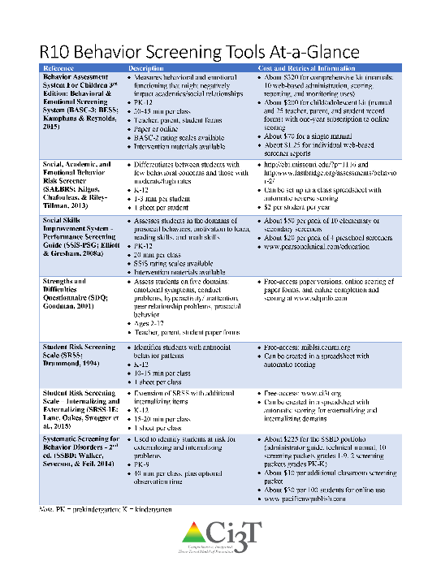
Examining your screening data…
…implications for primary prevention efforts
…implications for teachers
…implications for student-based interventions
See Lane, Menzies, Bruhn, and Crnobori (2011)

Slide 20





Notes:
Data security – teamwork to create, populate, collect and synthesize data – planning ahead to calendar screening as all other data collection – SHARE the information with faculty and staff

Slide 21
Academic Screening Data
n = 700, 713, 768
n = 723, 723, 721

Slide 22
SRSS-E7 (externalizing) Results – All Students
Sample Elementary School Fall
N = 25
N = 16
N = 17
N = 12
N = 12
N = 86
N = 35
N = 57
N = 36
N = 50
N = 250
N = 300
N = 250
N = 255
N = 255

Slide 23
SRSS-I5 (internalizing) Results – All Students
Sample Elementary School Fall
N = 72
N = 18
N = 32
N = 85
N = 43
N = 45
N = 40
N = 204
N = 289
N = 261
N = 231

Slide 24
Student Risk Screening Scale
Fall 2004 – 2012
Middle School
Source: Lane, K. L., Oakes, W. P., & Magill, L. M., (2014). Primary prevention efforts: How do we implement and monitor the Tier 1 component of our comprehensive, integrated, three-tiered model of prevention. Preventing School Failure, 58, 143-158. doi: 10.1080/1045988X.2014.893978 [Figure 4. Middle school behavior screening data over time at the fall time point. Adapted from Figure 4.6 p. 127 Lane, K. L., Menzies, H. M, Oakes, W. P., & Kalberg, J. R. (2012). Systematic screenings of behavior to support instruction: From preschool to high school. New York, NY: Guilford Press.]

Slide 25
Screening Data: High School Yrs1-3
Fall- SRSSIE-I |  | Low |  | Moderate |  | High |  | Fall- SRSSIE-E |  | Low |  | Moderate |  | High
2016 |  | 80.28% |  | 10.36% |  | 9.36% |  | 2016 |  | 89.56% |  | 8.02% |  | 2.42%
2017 |  | 90.18% |  | 4.16% |  | 5.66% |  | 2017 |  | 91.29% |  | 6.18% |  | 2.54%
2018 |  | 90.91% |  | 3.86% |  | 5.23% |  | 2018 |  | 92.22% |  | 6.20% |  | 1.58%
WTR-SRSSIE-I |  | Low |  | Moderate |  | High |  | WTR-SRSSIE-E |  | Low |  | Moderate |  | High
2016 |  | 87.25% |  | 9.49% |  | 3.26% |  | 2016 |  | 87.25% |  | 9.49% |  | 3.26%
2017 |  | 86.14% |  | 9.02% |  | 4.85% |  | 2017 |  | 86.14% |  | 9.02% |  | 4.85%
2018 |  | 88.79% |  | 8.52% |  | 2.69% |  | 2018 |  | 88.79% |  | 8.52% |  | 2.69%

Slide 26
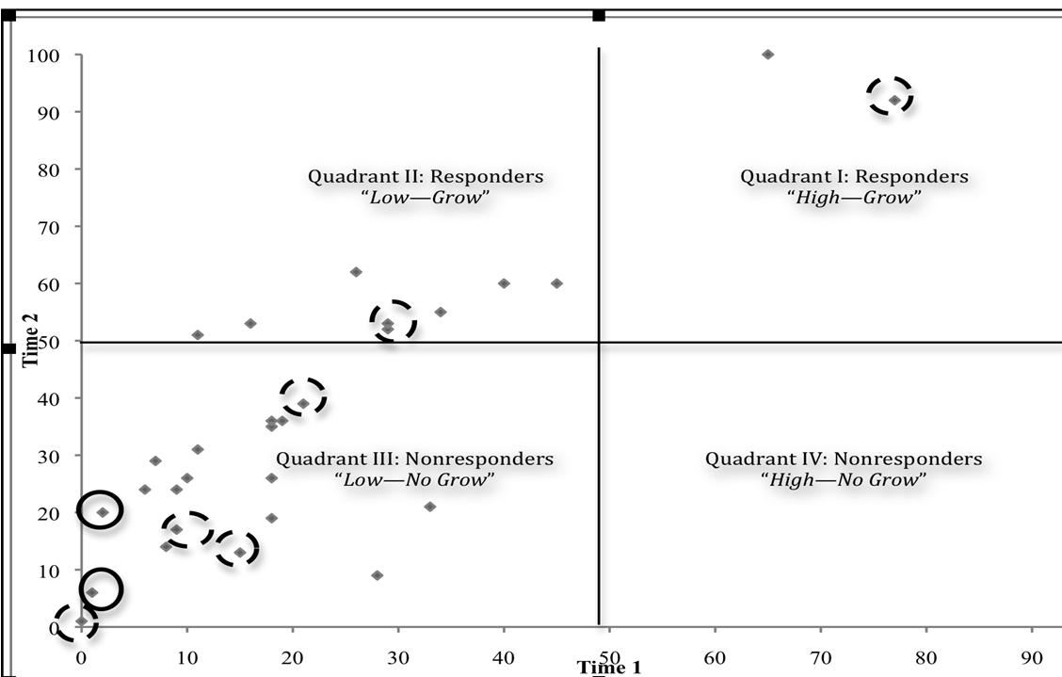
First Grade Illustration: Academic (Curriculum-Based Measurement) and Behavior (Student Risk Screening Scale) Screeners
Kalberg, J. R., Lane, K. L., & Menzies, H. M. (2010). Using systematic screening procedures to identify students who are nonresponsive to primary prevention efforts: Integrating academic and behavioral measures. Education and Treatment of Children, 33(4), 561-584.
Notes:
Note. Diamonds refer to an individual student’s combined Time 1 (fall) and Time 2 (Winter) curriculum-based measures (CBM) score. Solid circles indicate a student that scored in the high risk range (9-21) on the Student Risk Screening Scale (SRSS; Drummond, 1994) during Time 2 (Winter) administration. Dashed circles indicate a student that scored in the moderate risk range (4-8) on the SRSS during Time 2 administration.
26

Slide 27
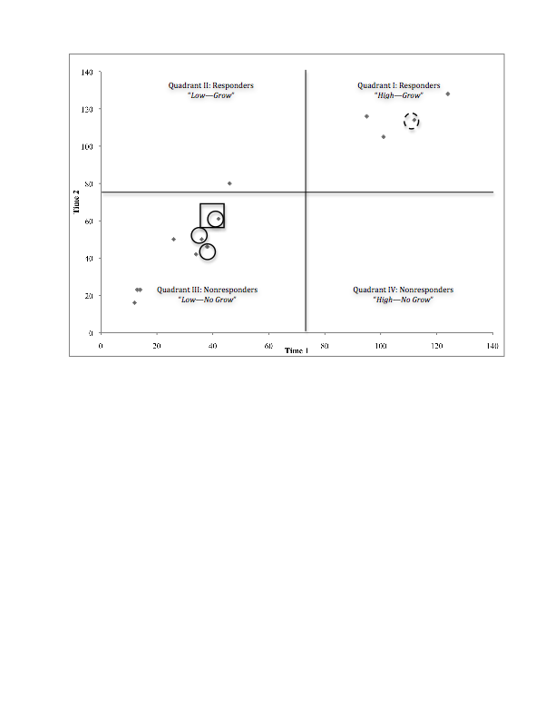
Second Grade Illustration: Academic (Curriculum-Based Measurement) and Behavior (Student Risk Screening Scale & Systematic Screening for Behavior Disorder) Screeners
Kalberg, J. R., Lane, K. L., & Menzies, H. M. (2010). Using systematic screening procedures to identify students who are nonresponsive to primary prevention efforts: Integrating academic and behavioral measures. Education and Treatment of Children, 33(4), 561-584.
Notes:
Note. Diamonds refer to an individual student’s combined Time 1 (fall) and Time 2 (Winter) curriculum-based measures (CBM) score. Solid circles indicate a student that scored in the high risk range (9-21) on the Student Risk Screening Scale (SRSS; Drummond, 1994) during Time 2 (Winter) administration. Dashed circles indicate a student that scored in the moderate risk range (4-8) on the SRSS during Time 2 administration. Solid squares indicated a student who exceeded normative criteria on Stage 2 of the Systematic Screening for Behavior Disorders (SSBD; Walker & Severson, 1992) on the externalizing dimension during Time 2 administration.
27

Slide 28
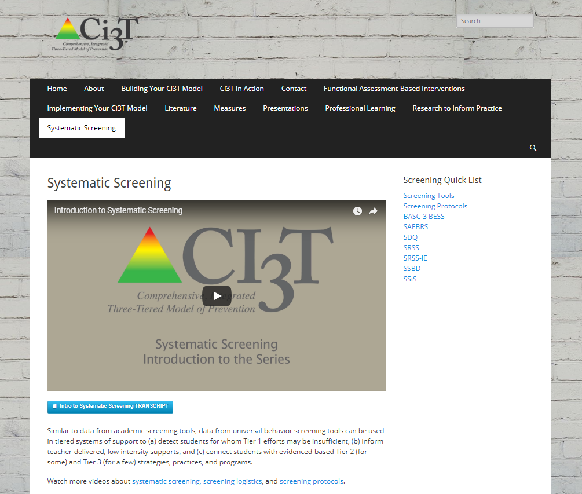
Additional Information …
Look under the Systematic Screening tab

Slide 29
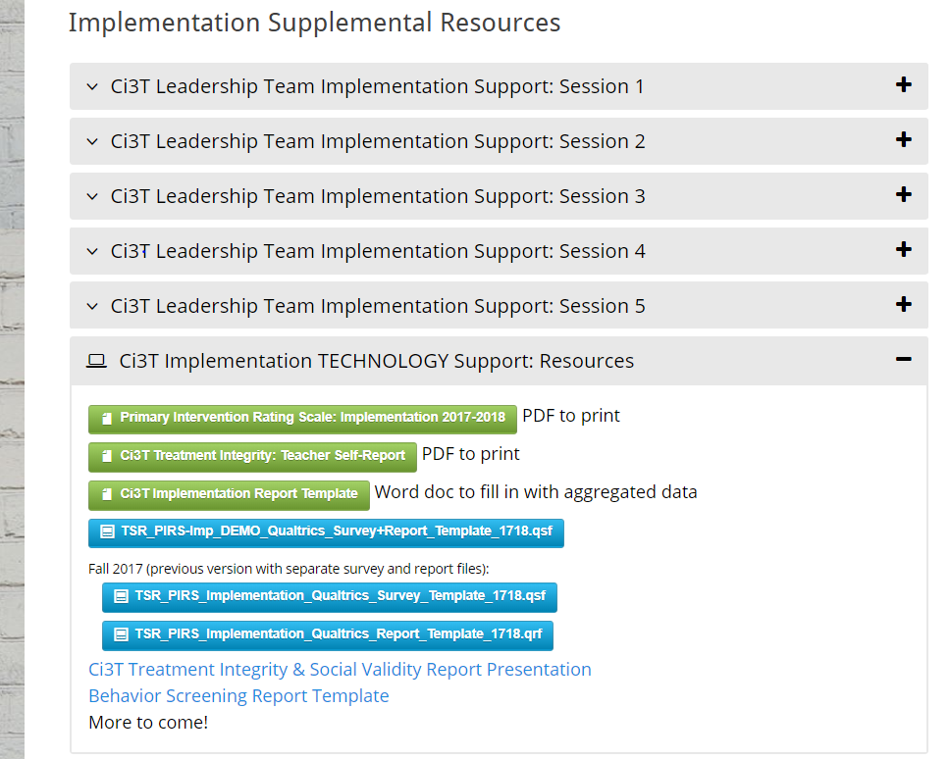
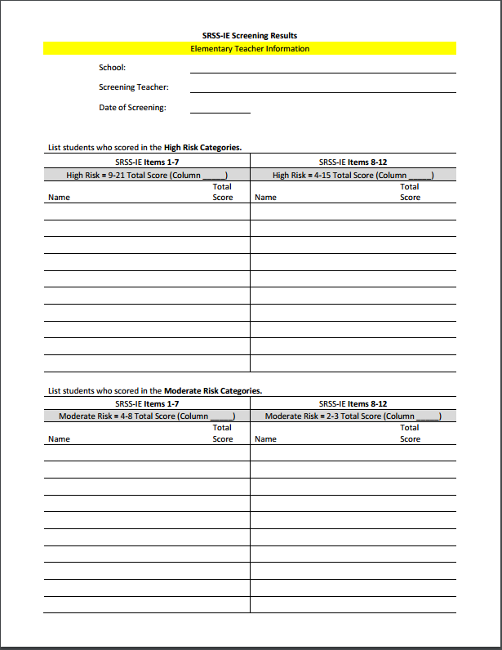
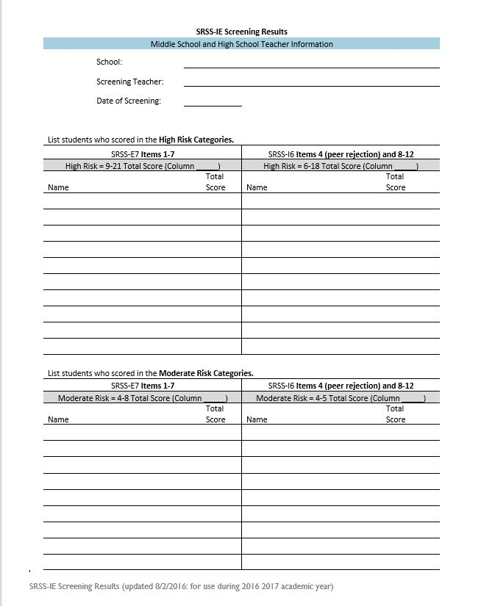
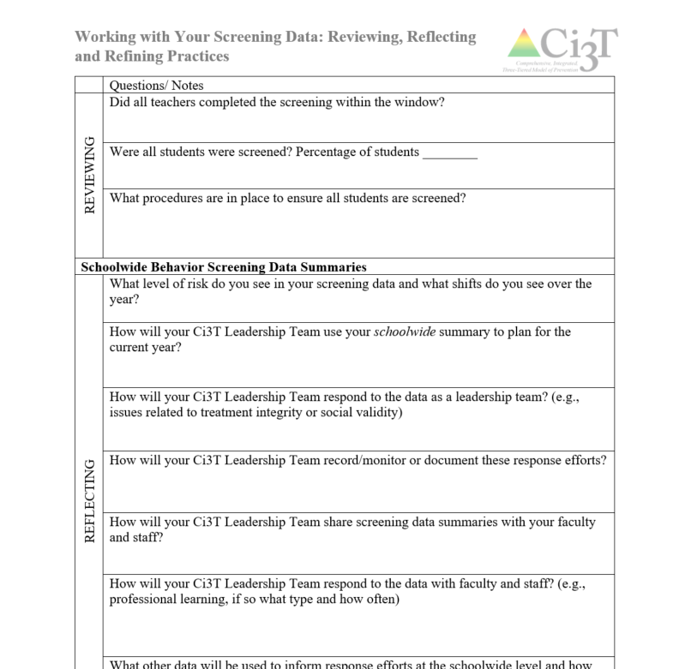
Screening Results
Sharing Screening Results with your Staff!
Elementary Screening
Middle and High School

Slide 30
Let’s talk… and make plans!
Ci3T Leadership Teams | Individuals
How do you support faculty and staff to use screening data? If possible, look at your screening data for Tier 1 discuss next steps with your team consider professional learning needs of faculty and staff | Discuss and list questions on screening procedures.
Notes:
15 min

Slide 31
Examining your screening data…
…implications for primary prevention efforts
…implications for teachers
…implications for student-based interventions
See Lane, Menzies, Bruhn, and Crnobori (2011)

Slide 32


Schoolwide Positive
Behavior Support
Comprehensive, Integrated,
Three-Tiered (Ci3T)
Models of Support
Low-Intensity Strategies
Basic Classroom Management
Effective Instruction
Low-Intensity Strategies
Behavior Contracts
Self-Monitoring
- -
Functional Assessment-Based
Interventions
Higher-Intensity Strategies
Assess, Design, Implement, and
Evaluate
Adapted from Lane, K. L., Menzies, H. M., Bruhn, A. L., & Crnobori, M. (2011). Managing challenging behaviors in schools: Research-based strategies that work. New York, NY: Guilford Press.
Assessment

Slide 33

Consider a book study to build school site capacity
Classroom management
Instructional delivery
Low-intensity strategies
Self-Monitoring
Behavior Contracts
See Lane, K. L., Menzies, H. M., Bruhn, A. L., & Crnobori, M. (2011). Managing challenging behaviors in schools: Research-based strategies that work. New York, NY: Guilford Press.

Slide 34


Essential Components of
Classroom Management
Classroom climate
Physical room arrangement
Routines and procedures
Managing paperwork
See Lane, K. L., Menzies, H. M., Bruhn, A. L., & Crnobori, M. (2011). Managing challenging behaviors in schools: Research-based strategies that work. New York, NY: Guilford Press.

Slide 35
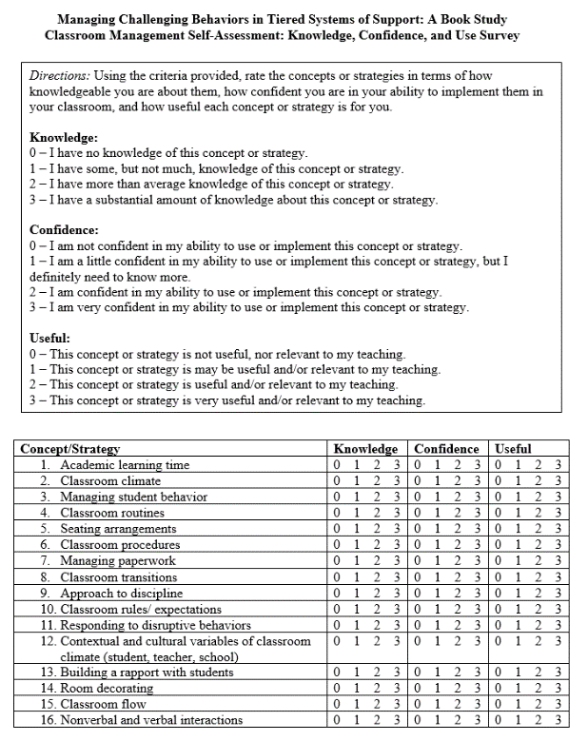
Identify site-level experts using self-assessment tools
Instructional choice
Behavior-specific praise
Increased opportunities to respond
Active supervision
Lane, K. L., Menzies, H. M., Bruhn, A. L., & Crnobori, M. (2011). Managing challenging behaviors in schools: Research-based strategies that work. New York, NY: Guilford Press.
Oakes, W. P., Cantwell, E. D., Lane, K. L., Royer, D. J., & Common, E. A. (2019). Examining educator’s views of classroom management and instructional strategies: School-site capacity for supporting students’ behavioral needs. Preventing School Failure.

Slide 36

Low-Intensity Strategies for Academics and Behavior
Opportunities to Respond
Behavior-Specific Praise
Active Supervision
Instructional Feedback
High p Requests
Precorrection
Incorporating Choice
Lane, K. L., Menzies, H. M., Ennis, R. P., & Oakes, W. P. (2015). Supporting behavior for school success: A step-by-step guide to key strategies. New York, NY: Guildford Press.

Slide 37
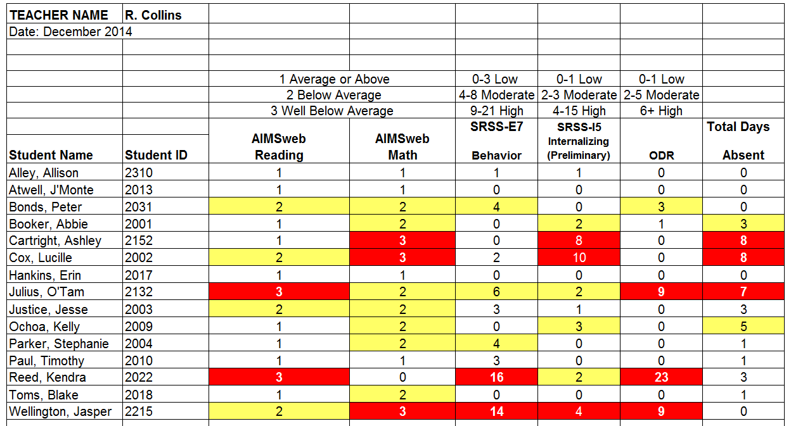
Consider this class….
Low-Intensity Strategies
Classroom Management
Practices
Classroom Climate
Physical Room Arrangement
Routines and Procedures
Managing Paper Work
Opportunities to Respond
Behavior-Specific Praise
Active Supervision
Instructional Feedback
High p Requests
Precorrection
Incorporating Choice

Slide 38
Low-Intensity Strategies: Building Capacity Through Professional Learning

Slide 39
Low-Intensity Strategy | Lincoln Elementary On-Site Expert
Behavior-Specific Praise: Identifying the specific expectation the student met. “Niama, great job using your graphic organizer to draft your essay.” “Justice, thank you for pushing in your chair to keep the walkway safe.” | Eric Common, Behavior Specialist Mark Buckman, Special Education Grant Allen, Parent Volunteer
Opportunities to Respond: Providing 4-6 opportunities per minute for students to respond individually, choral, verbal, written, gesture, or symbol. “Show me thumbs or thumbs down if...” “Show me on your white board what…” “Turn to your elbow partner and say…” “All together now, what is…” | David Royer, Administration Emily Cantwell, 5th Grade Scarlett Lane, 3rd Grade Mallory Messenger, Counselor
Instructional Choice: Providing within-task or between task choices to increase academic engaged time and motivation. “Ronaldo, of these 3 tasks today, which would you like to work on first?” “Suzy, do you want to work with colored pencils, crayons, or sparkly markers?” | Abbie Jenkins, 2nd Grade Scarlett Lane, 3rd Grade Bryan Simmons, PE Liane Johl, Kindergarten
Notes:
Identify on-site experts!

Slide 41

Building Your Toolbox
Behavior-Specific Praise
Precorrection
Active Supervision
Instructional Choice
Opportunities to Respond

Slide 42
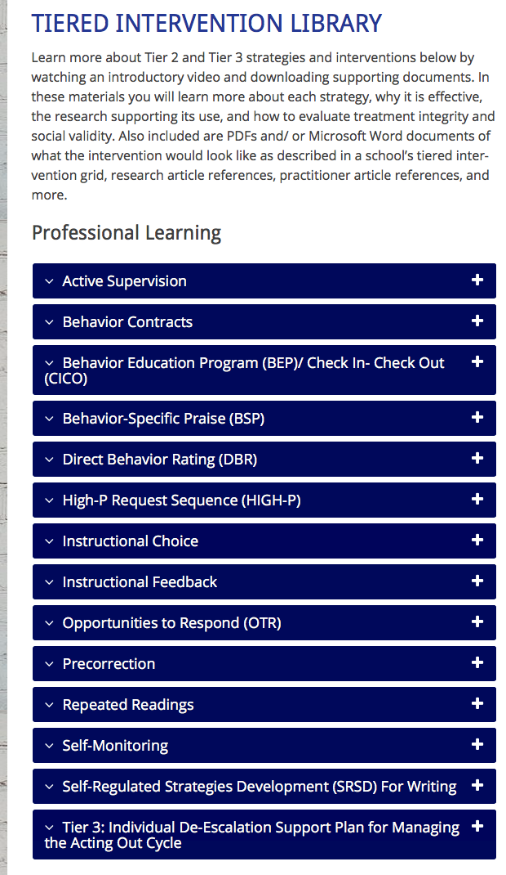
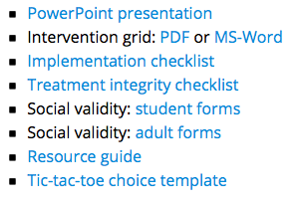
Professional Learning Resources ci3t.org/pl
Notes:
NEXT: log in to the website and present ONE strategy; spend 20 minutes working through the steps and then on slide 46, we would run two 10 min timers (one for them to “pick a card” and learn about a strategy and then a second to discuss with a person)

Slide 43
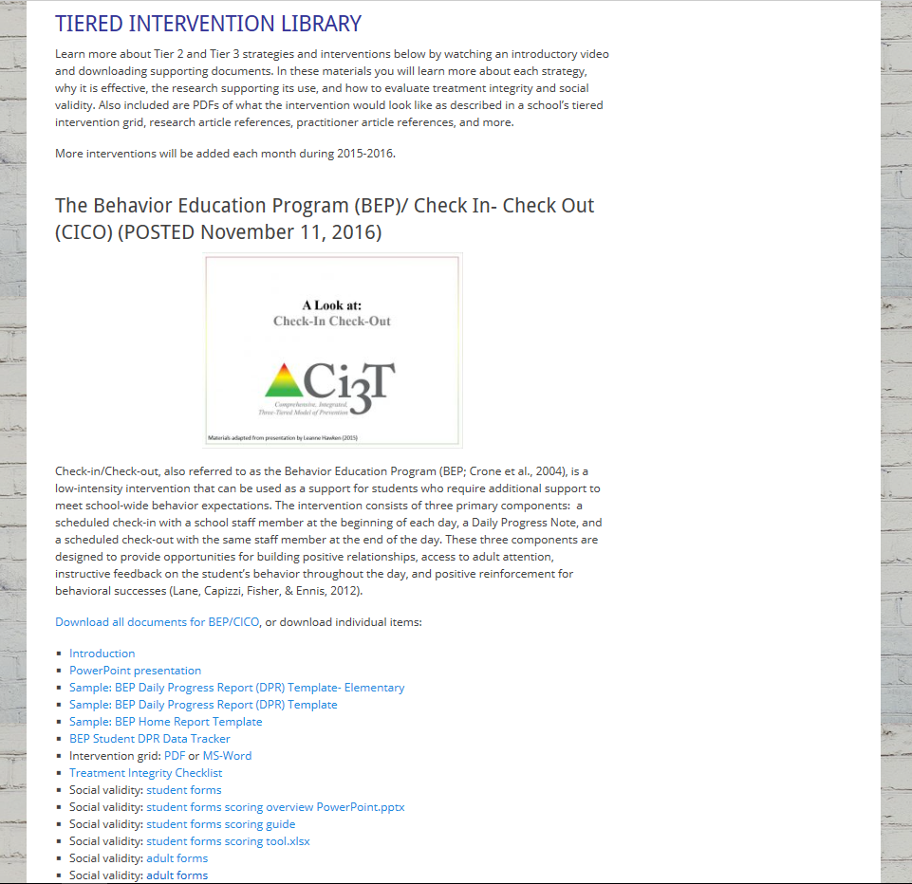
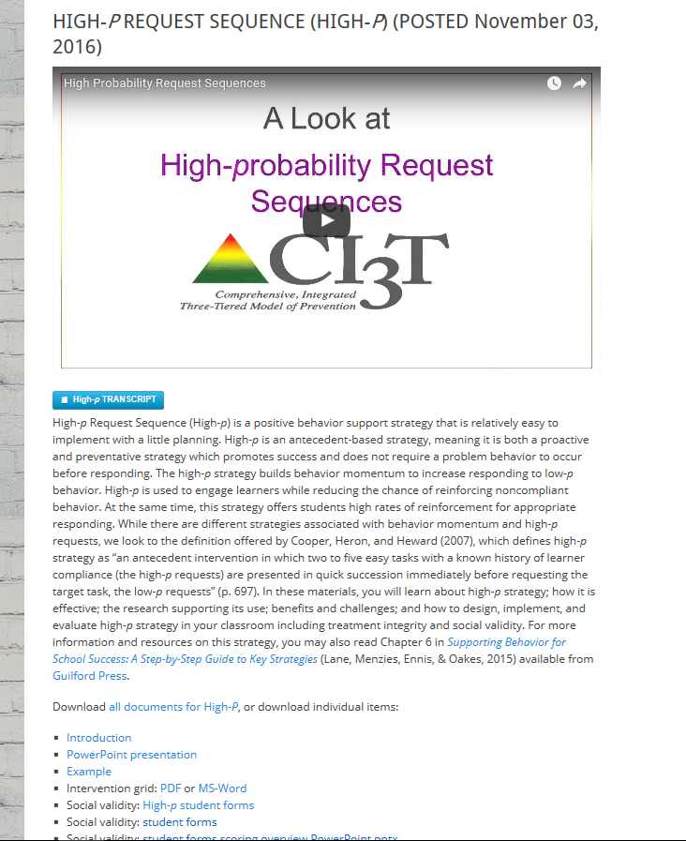

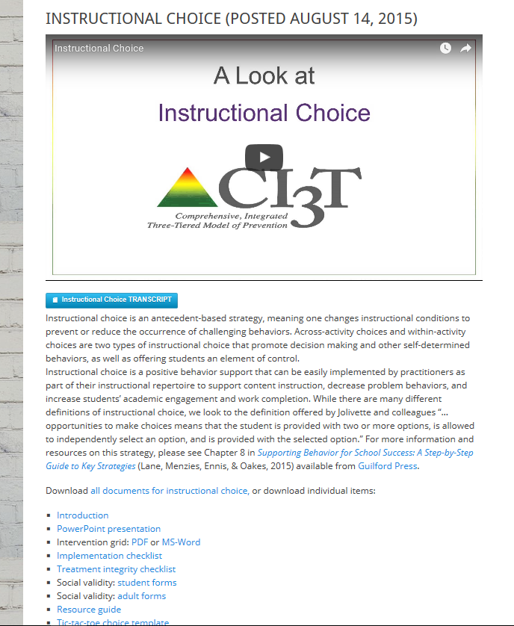
Ci3T.org
ci3t.org
Professional Learning tab
Notes:
NEXT: log in to the website and present ONE strategy; spend 20 minutes working through the steps and then on slide 46, we would run two 10 min timers (one for them to “pick a card” and learn about a strategy and then a second to discuss with a person)

Slide 44
Let’s talk… and make plans!
Ci3T Leadership Teams | Individuals
Pick a low-intensity strategy Review the Step-by-Step procedures Share your strategy with a partner How can we build our capacity to use these strategies as part of Tier 1 instruction? Or in more targeted ways for students needing more than Tier 1? | Pick a low-intensity strategy Review the Step-by-Step procedures Share your strategy with a partner How can I use this information? With whom could I share this information?
Notes:
10 min– RUN TIMER TWICE – show next slide

Slide 46
Wrapping Up and Next Steps

Slide 47
Comprehensive, Integrated, Three-Tiered Model of Prevention
(Lane, Kalberg, & Menzies, 2009)
Goal: Reduce Harm
Specialized individual systems
for students with high risk
Tier 3
Tertiary Prevention (≈5%)
Goal: Reverse Harm
Specialized group systems
for students at risk
Tier 2
Secondary Prevention (≈15%)
Goal: Prevent Harm
School/classroom-wide systems for all students, staff, & settings
Tier 1
Primary Prevention (≈80%)
Academic ◇ Behavioral ◇ Social
Validated Curricula PBIS Framework Validated Curricula

Slide 48
Building Your Toolbox
Behavior-Specific Praise
Precorrection
Active Supervision
Instructional Choice
Opportunities to Respond

Slide 49
Ci3T
Comprehensive Professional Learning Plan
Ci3T: Primary Prevention
Session 1:
Overview of Ci3T Prevention Models
Setting a Purpose
Establish team meetings and roles
Session 2:
Mission and Purpose
Establish Roles and Responsibilities
Procedures for Teaching
Procedures for Reinforcing
Reactive Plan
Session 3:
Procedures for Monitoring
Session 4:
Revise Primary Plan using Stakeholder feedback
Prepare presentation
Ci3T: Secondary Prevention
Session 5:
Overview of Teacher focused Strategies
Overview of Student Focused Strategies
Using data to determine
Draft the Secondary Intervention Grid based on existing supports
Ci3T: Tertiary Prevention
Session 6:
Final revisions of Ci3T Plan based on stakeholder feedback
Draft Tertiary Prevention Intervention Grids
Design Implementation Manual and Plan for roll out to faculty, students, and parents
Ci3T Leadership Team Training Sequence
Implementation Stages of Tier 2 and 3 within Ci3T
Additional Professional Development on Specific Topics
Core Content Curriculum
Check In - Check Out
Functional Assessment-based Interventions
Reading, Math, Writing Benchmarking and Progress Monitoring Tools
Interventions, Strategies, & Practices
Additional Tier 3 Supports
Instructional Techniques to Improve Students’ Motivation; Classroom Management Practices;
Low-Intensity Behavior Supports

Slide 50
Sample Professional Learning
Aug | Sep | Oct | Nov | Dec | Jan | Feb | Mar | Apr | May | June
 |  |  | KU Ci3T Day 1 11/13/19 4:30-6:30PM | KU Ci3T Day 2 12/03/19 8:00AM-4:00PM | KU Ci3T Day 3 01/14/20 4:30-6:30PM | KU Ci3T Day 4 02/20/20 8:00AM-4:00PM |  | KU Ci3T Day 5 04/07/20 4:30-6:30PM | KU Ci3T Day 6 05/07/20 8:00AM-4:00PM
 | KU Ci3T IMP Day 1 09/05/19 | KU Ci3T IMP Day 2 10/29/19 |  | KU Ci3T IMP Day 3 12/04/19 | KU Ci3T IMP Day 4 01/15/20 |  |  | KU Ci3T IMP Day 5 04/02/20
 | KU Ci3T EMPOWER Session 1 09/17/19 |  | KU Ci3T EMPOWER Session 2 11/05/19 |  | KU Ci3T EMPOWER Session 3 01/23/20 | KU Ci3T EMPOWER Session 4 02/25/20 |  | KU Ci3T EMPOWER Session 5 04/23/20
Trainers & Coaches Call Session 1 08/01/19 Session 2 08/28/19 |  | Trainers & Coaches Call Session 3 10/22/19 | Trainers & Coaches Call Session 4 11/04/19 Session 5 11/21/19 |  | Trainers & Coaches Call Session 6 01/09/20 | Trainers & Coaches Call Session 7 02/10/20 | Trainers & Coaches Call Session 8 03/24/20 | Trainers & Coaches Call Session 9 04/30/20 |  | Trainers & Coaches Call Session 10 06/02/20
P. ENHANCE Ci3T TRAINING
Register today!
P. ENHANCE Ci3T IMPLEMENTATION
AM/PM
KU Project EMPOWER
5:00-7:00 PM
Ci3T Trainers & Coaches Conference Calls
4:00-5:30 PM
= You Are Here

Slide 51
Sample EMPOWER Professional Learning Series
9/17/19
5:00 – 7:00 pm
Moving Forward with Ci3T: Setting up for Success
COMPLETED!
11/05/19
5:00 – 7:00 pm
Empowering Educators with Low-Intensity Strategies to Increase Engagement and Minimize Disruption
COMPLETED!
1/23/20
5:00 – 7:00 pm
Supporting Students who Need More Than Tier 1: Connecting students with Secondary (Tier 2) and Tertiary (Tier 3) Interventions
2/25/20
5:00 – 7:00 pm
Supporting Students Across the Tiers: Managing Acting Out and Internalizing Behaviors
4/23/20
5:00 – 7:00 pm
Moving Forward with Ci3T: Planning for Success

Slide 52
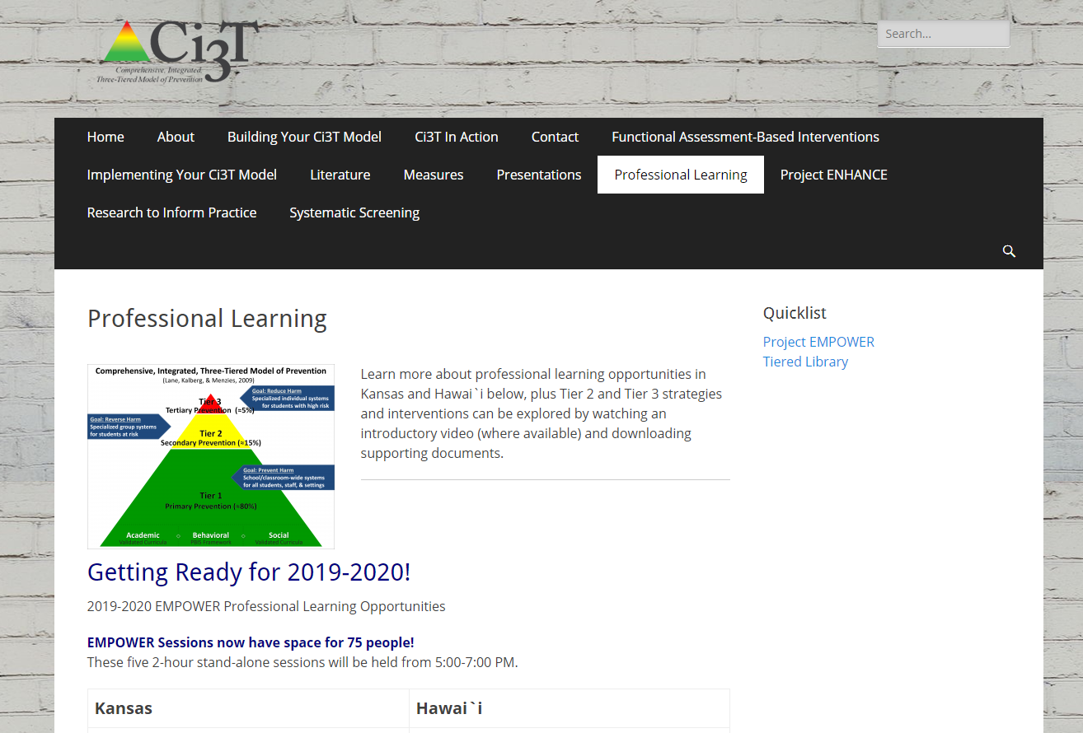
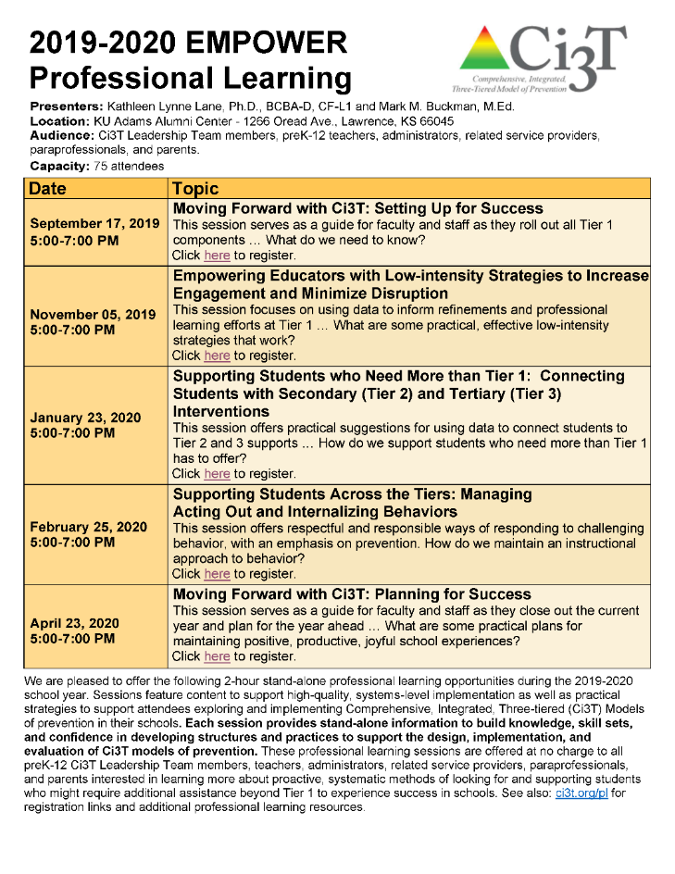


Slide 53


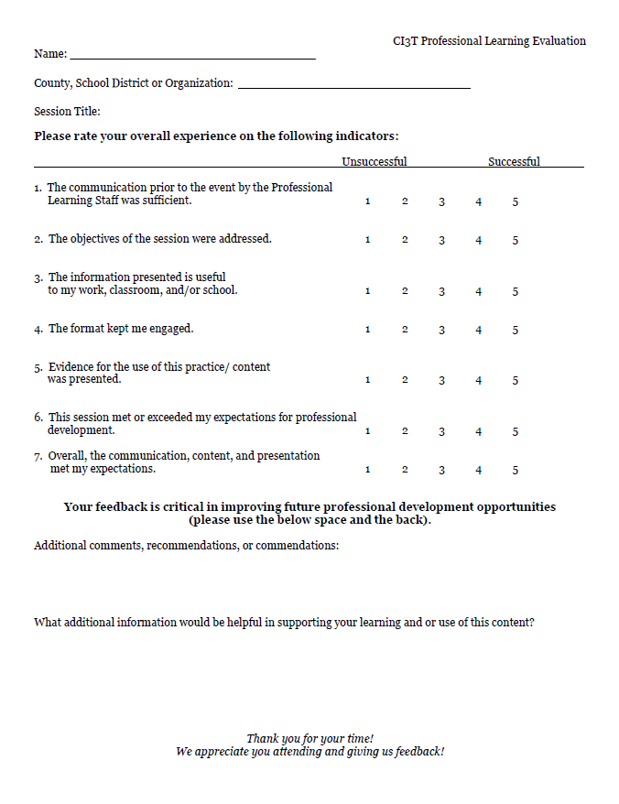
Updates to the Website! www.ci3t.org
Check out the newly updated Ci3T iBook v1.3 today!

