Slide 1
Moving Forward with Ci3T: Setting Up for Success Kathleen Lynne Lane, Ph.D., BCBA-D, CF-L1 Mark Matthew Buckman, M.S.Ed.

Slide 2
Agenda
Overview of Ci3T
Rolling out Your Plan … Sharing Successes!
Implementing Tier 1
Academics
Behavior: Positive Behavior Intervention and Supports (PBIS)
Social Skills
Procedures for
Teaching
Reinforcing
Monitoring
Recommendations and Wrap Up

Slide 3
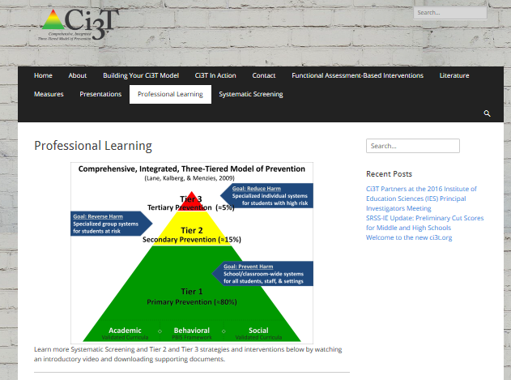
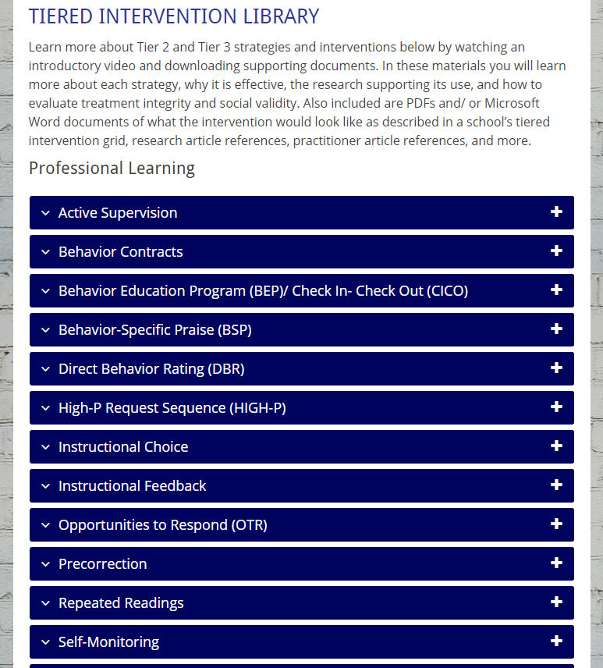
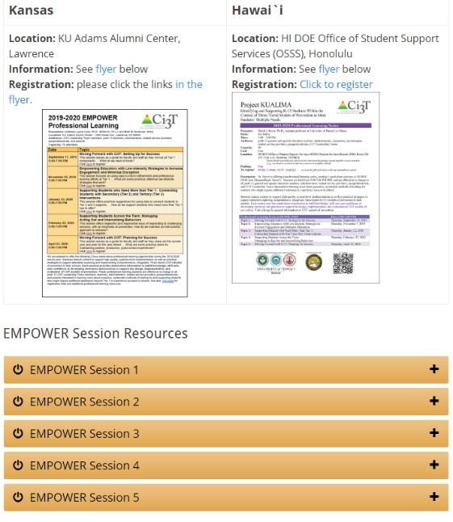

Slide 4
Welcome!
Ci3T Leadership Teams | Individuals
If you are part of a Ci3T Leadership Team: Please open your Ci3T Implementation Manual Treat this as a team meeting Use IM18 Ci3T Leadership Team Meeting Agenda from ci3t.org/building Materials for this session can be found at ci3t.org/pl Welcome to EMPOWER! | If you are here to learn with us as an individual: Materials for this session can be found at ci3t.org/pl Create a space on your computer to download today’s materials Consider building a structure to organize your learning for future EMPOWER session Think of ways to share your learning with colleagues Welcome to EMPOWER!

Slide 5
Open your school’s folder on dropbox.com
Open your school’s Ci3T Implementation Manual
Make a copy of IM18 Ci3T Leadership Team Meeting Agenda and rename to add the date to the end of the file name
Make a copy of R04 Ci3T Professional Learning Plan and rename to add the date to the end of the file name
Notes:
Use the “Hide Slide” feature to hide the file sharing system not being used. Do not delete the slide. Hiding the slide will preserve correspondence to the pacing guide slide numbers.

Slide 6
Open your school’s Google Drive folder online
Open the “Ci3T Blueprint Materials” folder
Find your school’s Ci3T Implementation Manual
Make a copy of IM18 Ci3T Leadership Team Meeting Agenda and rename to add the date to the end of the file name
Make a copy of R04 Ci3T Professional Learning Plan and rename to add the date to the end of the file name
Ex: LES Ci3T Implementation Manual 2021 11 14
Notes:
Use the “Hide Slide” feature to hide the file sharing system not being used. Do not delete the slide. Hiding the slide will preserve correspondence to the pacing guide slide numbers.

Slide 7
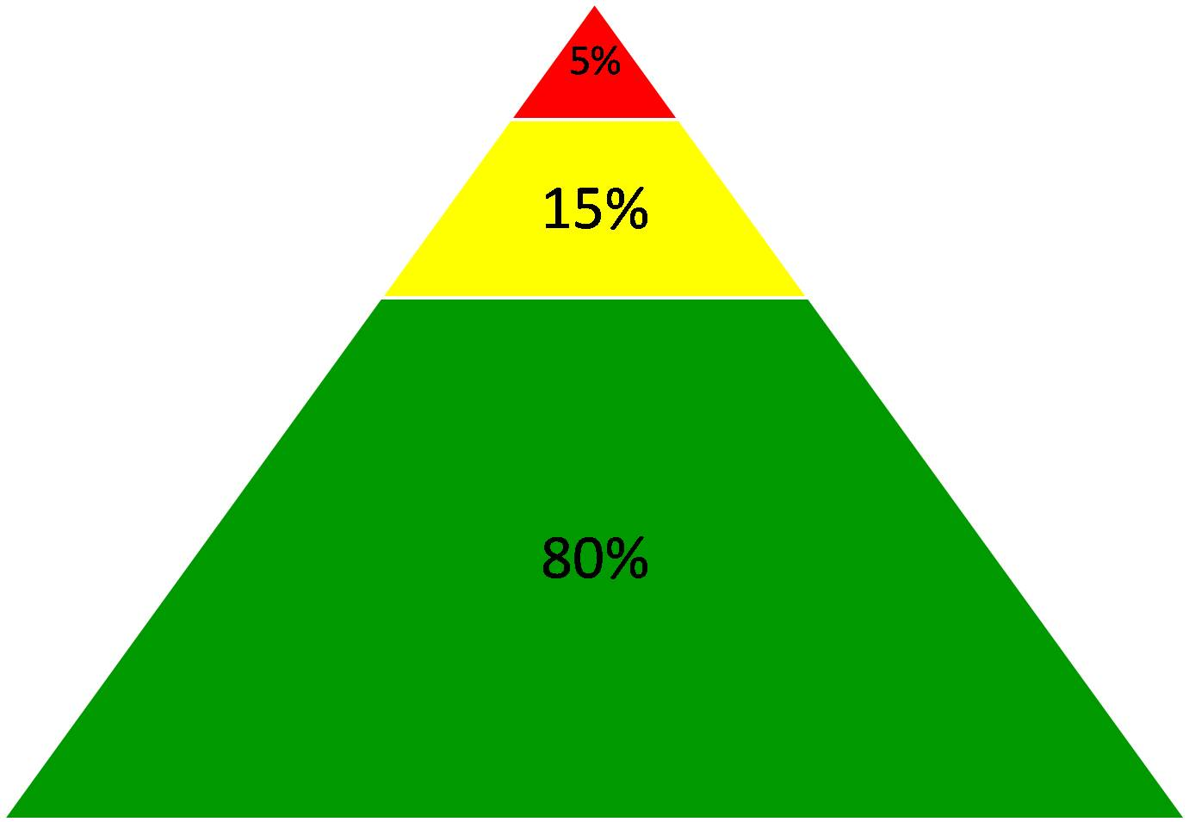
Comprehensive, Integrated, Three-Tiered Model of Prevention
(Lane, Kalberg, & Menzies, 2009)
Goal: Reduce Harm
Specialized individual systems for students with high risk
Tier 3
Tertiary Prevention (≈5%)
Goal: Reverse Harm
Specialized group systems
for students at risk
Tier 2
Secondary Prevention (≈15%)
Goal: Prevent Harm
School/classroom-wide systems for all students, staff, & settings
Tier 1
Primary Prevention (≈80%)
Academic ◇ Behavioral ◇ Social
Validated Curricula PBIS Framework Validated Curricula

Slide 9
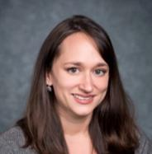
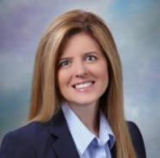
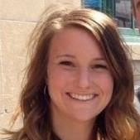
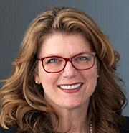
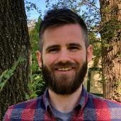
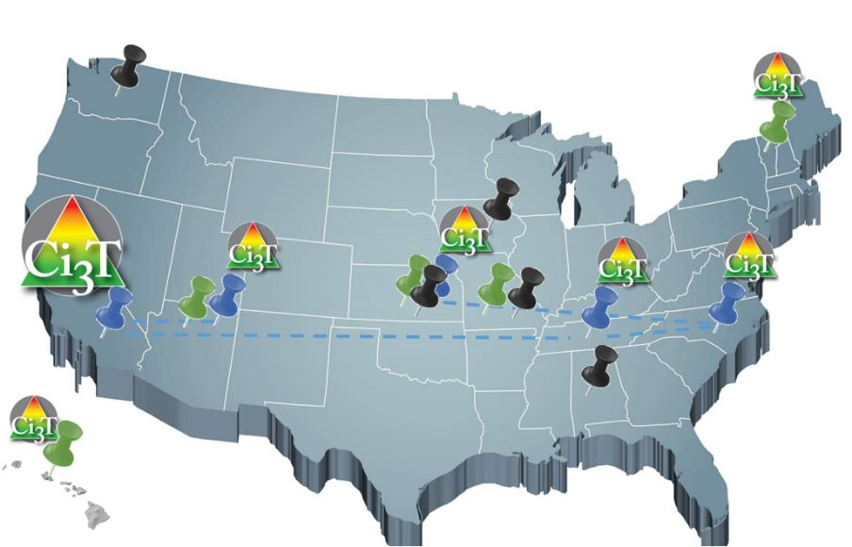
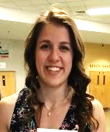
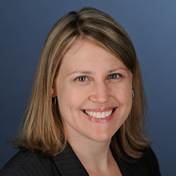
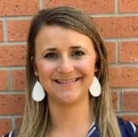
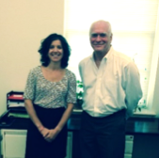
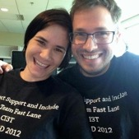
Implementing Ci3T Models: A Respectful Partnership

Slide 10
Primary (Tier 1) Prevention
All students are eligible for participation (Lane, Robertson et al., 2006)
About 80% of students respond to this level (Gresham, Sugai, Horner, Quinn, & McInerney, 1998; Sugai & Horner, 2006)
Examples of primary (Tier 1) prevention
Validated literacy curricula
Violence prevention
Conflict resolution programs
Anti-bullying programs
Schoolwide social skills instruction
Character education programs
Sources: Gresham, F. M., Sugai, G., Horner, R. H., Quinn, M. M., & McInerney, M. (1998). Classroom and schoolwide practices that support students’ social competence: A synthesis of research. Washington, DC: Office of Special Education Programs.
Lane, K. L., Robertson, E. J., & Graham-Bailey, M. A. L. (2006). An examination of school-wide interventions with primary level efforts conducted in secondary schools: Methodological considerations. In T. E. Scruggs & M. A. Mastropieri (Eds.) Applications of research methodology: Advances in learning and behavioral disabilities (Vol. 19), pp. 157-199. Oxford, UK: Elsevier.
Sugai, G., & Horner, R.R. (2006). A promising approach for expanding and sustaining school-wide positive behavior support. School psychology review, 35, 245.

Slide 11
Secondary (Tier 2) Prevention
Students who need more than the primary prevention plan, 10-15% of students
Focused intervention to address academic, behavior, and/or social concerns
Acquisition (can’t do)
Fluency (trouble doing)
Performance (won’t do)
Examples of secondary (Tier 2) prevention
Small group instruction in anger management
Reading comprehension strategies
Source: Lane, K.L., Oakes, W.P., Ennis, R.P., & Hirsch, S.E. (2014). Identifying students for secondary and tertiary prevention efforts: How do we determine which students have tier 2 and tier 3 needs? Preventing School Failure, 58, 171-182.

Slide 12
Tertiary (Tier 3) Prevention
Students who need more than primary or secondary prevention, 5-7% of students
Intensive individualized interventions
Examples of tertiary (Tier 3) prevention
Functional assessment-based interventions (Umbreit, Ferro, Liaupsin, & Lane, 2007)
Multisystemic therapy program (Schoenwald, Brown, & Henggeler, 2000)
Sources: Lane, K.L., Oakes, W.P., Ennis, R.P., & Hirsch, S.E. (2014). Identifying students for secondary and tertiary prevention efforts: How do we determine which students have Tier 2 and Tier 3 needs? Preventing School Failure, 58, 171-182.
Schoenwald, S. K., Brown, T. L., & Henggeler, S. W. (2000). Inside multisystemic therapy therapist, supervisory, and program practices. Journal of Emotional and Behavioral Disorders, 8, 113-127.
Umbreit, J., Ferro, J.B., Liaupsin, C.J., & Lane, K.L. (2007). Functional behavioral assessment and function-based intervention: An effective, practical approach. Upper Saddle River, NJ: Prentice-Hall.

Slide 13
Three Core Features

Slide 14
Core features of the Ci3T model of prevention
Academic
Behavior
Social

Slide 15
Academic Component
Coordinated instruction within and across grade levels
Instruction linked to College and Career-Ready Standards, early learning standards, state, or district standards
Benchmarking student progress to inform instruction
Progress monitoring for students identified for secondary (Tier 2) and tertiary (Tier 3) supports
Source: Lane, K.L., Oakes, W.P., & Menzies, H.M. (2014). Comprehensive, integrated, three-tiered models of prevention: Why does my school—and district—need an integrated approach to meet students’ academic, behavioral, and social needs? Preventing School Failure: Alternative Education for Children and Youth, 58, 121-128.

Slide 16
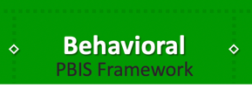
Behavioral Component: Positive Behavioral Interventions and Supports (PBIS)
A Framework, Not a Curriculum
Establish, clarify, and define expectations
Teach all students the expectations, planned and implemented by all adults in the school
Give opportunities to practice
Reinforce students consistently, facilitate success
Consider rules, routines, and physical arrangements
Monitor the plan using school-wide data to identify students who need more support
Monitor student progress
Source: Horner, R.H., & Sugai, G. (2015). School-wide PBIS: An example of applied behavior analysis implemented at a scale of social importance. Behavior Analysis in Practice, 8, 80-85.

Slide 17
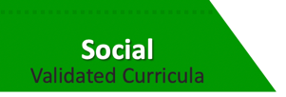
Social Component: Identifying a Validated Curriculum
Violence Prevention
Second Step Violence Prevention (www.cfchildren.org)
Character Education
Positive Action (www.positiveaction.net)
Caring School Community (www.characterplus.org)
Social Skills
Social Skills Improvement System: Classwide Intervention Program (Elliott & Gresham, 2007)
Source: Elliott, S. N., & Gresham, F. M. (2007). Social Skills Improvement System: Classwide intervention program teacher’s guide. Bloomington, MN: Pearson Assessments.

Slide 19
Ci3T Blueprint A Primary (Tier 1) Plan

Slide 20
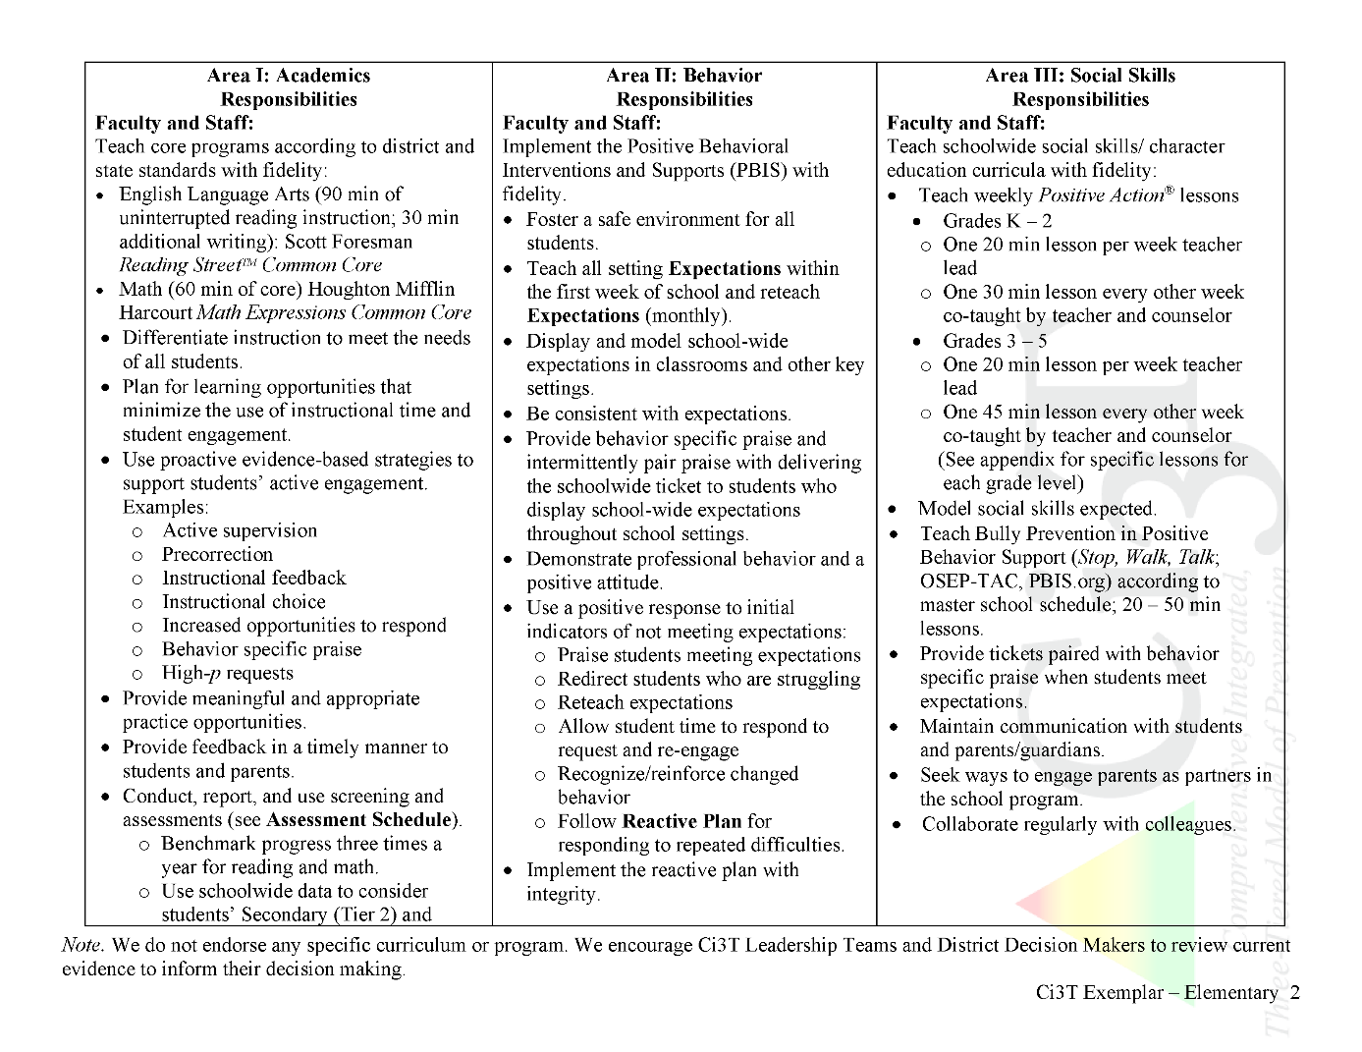
What do I need to know?
Ci3T Exemplar - Elementary

Slide 21
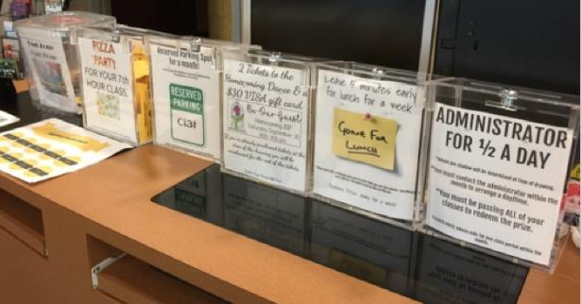
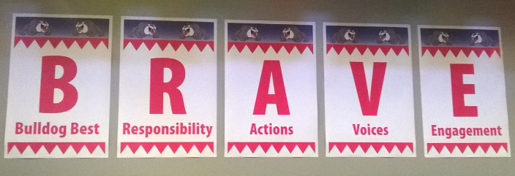
Rolling out Your Plan … Sharing Successes!
Do you know where your Ci3T Implementation Manual is located?
What have you seen done well at your building?
What are you looking forward to in the coming year?

Slide 22
What do I need to know?
Ci3T Exemplar - Elementary

Slide 23
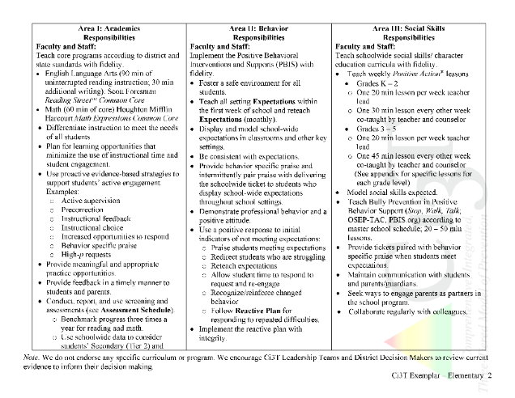
Rolling out at Tier 1: Academic Domain
Teaching
Reinforcing
Monitoring

Slide 24
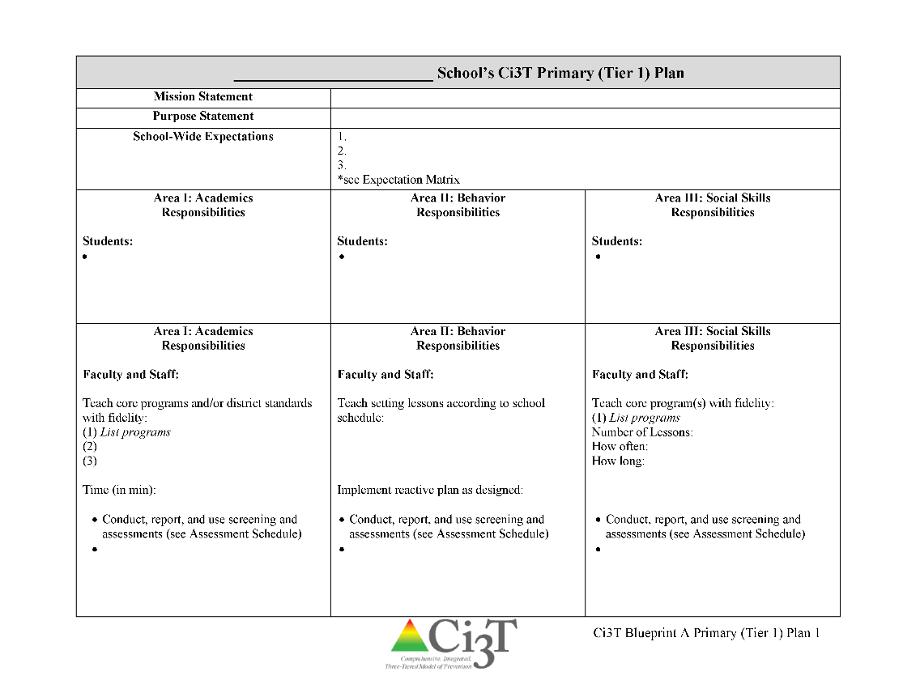
Ci3T Primary Plan: Faculty and Staff Roles and Responsibilities
Notes:
BCBA Task List K-02 Identify the contingencies governing the behavior of those responsible for carrying out behavior-change procedures and design interventions accordingly – emphasize shift to clearly stating expectations for staff and students

Slide 25
Rolling out at Tier 1: Academics
Reviewing Roles & Responsibilities
What do I need to know?
Procedures for Teaching
How am I doing with using low-intensity supports?
Procedures for Reinforcing
How have I been reinforcing students for meeting expectations?
Procedures for Monitoring
How am I doing with implementation?
Questions & Considerations?
Successes!

Slide 28
What do I need to know?
Ci3T Exemplar - Elementary
Notes:
BCBA Task List K-02 Identify the contingencies governing the behavior of those responsible for carrying out behavior-change procedures and design interventions accordingly – emphasize shift to clearly stating expectations for staff and students

Slide 29
Let’s talk… and make plans!
Ci3T Leadership Teams | Individuals
Reviewing Roles & Responsibilities How effective are we at communicating roles and responsibilities to ALL stakeholders? Procedures for Teaching How have we used and developed capacity in our staff to use low-intensity supports? Procedures for Reinforcing How have we refined and updated our procedures for reinforcing expectations when students meet them? Procedures for Monitoring How have we developed capacity in our staff to collect and analyze data to monitor implementation? | Reviewing Roles & Responsibilities Do I know what my roles and responsibilities are in teaching academic skills? Procedures for Teaching How often am I implementing low-intensity strategies? Do I receive support or offer support to others? Procedures for Reinforcing How have I been reinforcing expectations when students meet them? Procedures for Monitoring Who monitors implementation of low-intensity strategies and our school-wide plan?
Notes:
10 min

Slide 30
Rolling out at Tier 1: Behavioral Domain
Teaching
Reinforcing
Monitoring

Slide 31
Ci3T Primary Plan: Faculty and Staff Roles and Responsibilities

Slide 32
Rolling out at Tier 1: Behavior
Reviewing Roles & Responsibilities
What do I need to know?
Procedures for Teaching
How am I doing with teaching expectations for specific settings?
Procedures for Reinforcing
How have I been reinforcing students for meeting expectations?
Procedures for Monitoring
How am I doing with implementation?
Questions & Considerations?
Successes!

Slide 33
What do I need to know?
Ci3T Exemplar - Elementary

Slide 34
Rolling out at Tier 1: Social
Teaching
Reinforcing
Monitoring

Slide 35
Ci3T Primary Plan: Faculty and Staff Roles and Responsibilities
Notes:
BCBA Task List K-02 Identify the contingencies governing the behavior of those responsible for carrying out behavior-change procedures and design interventions accordingly – Emphasize shift to clearly stating expectations for staff and students

Slide 36
Rolling out at Tier 1: Social Skills
Reviewing Roles & Responsibilities
What do I need to know?
Procedures for Teaching
How am I doing with teaching the validated social skills curriculum?
Procedures for Reinforcing
How have I been reinforcing students for meeting expectations?
Procedures for Monitoring
How am I doing with implementation?
Questions & Considerations?
Successes!

Slide 37
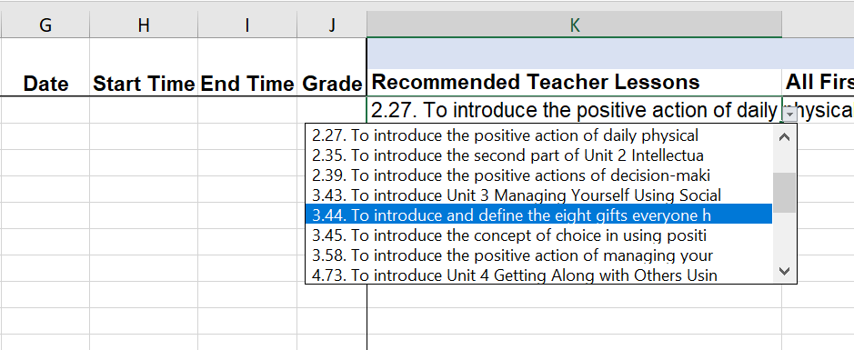
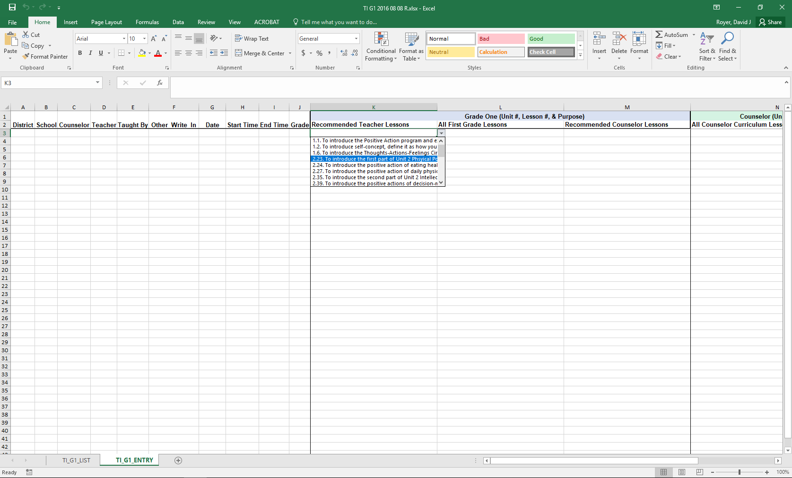
Treatment Integrity: Tracking Lessons Taught
Example social skills lesson implementation tracker

Slide 38
Let’s talk… and make plans!
Ci3T Leadership Teams | Individuals
Reviewing Roles & Responsibilities How effective are we at communicating roles and responsibilities to ALL stakeholders? Procedures for Teaching How have we been using and developing capacity in our staff to teach setting expectations? Procedures for Reinforcing How have we refined and updated our procedures for reinforcing expectations when students meet them? Procedures for Monitoring How do we know behavior expectations are taught? | Reviewing Roles & Responsibilities Do I know what my roles and responsibilities are in teaching behavioral skills? Procedures for Teaching How often am I teaching specific setting expectations? Do I receive support or offer support to others? Procedures for Reinforcing How have I been reinforcing expectations when students meet them? Procedures for Monitoring How will I know I am teaching setting expectations with fidelity?
Notes:
15 min

Slide 39
A Look at Tier 1
Teaching
Reinforcing
Monitoring

Slide 40
Procedures for Teaching the Plan to:
Faculty and Staff
Students
Families and Community
Focuses on teaching more appropriate functional skills that promote success in the school environment and provides a context for the practice and reinforcement of these skills
Lewis, T. J., Powers, L. J., Kely, M. J., & Newcomer, L. L. (2002). Reducing problem behaviors on the playground: An investigation of the application of schoolwide positive behavior supports. Psychology in the Schools, 39(2), 181-190; Turnbull, A., Edmonson, H., Griggs, P., Wickham, D., Sailor, W., Freeman, R., ... & Riffel, L. (2002). A blueprint for schoolwide positive behavior support: Implementation of three components. Exceptional Children, 68(3), 377-402.
Notes:
More than preventing problem behavior from occurring.

Slide 41
Locate in your Ci3T Implementation Manual

Slide 42
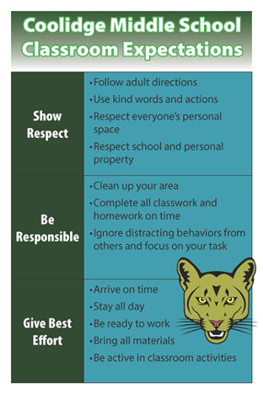
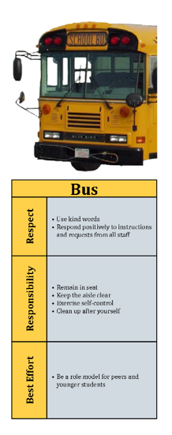
How will primary prevention (Tier 1) efforts be taught to all stakeholders?
Faculty and Staff
Implementation manual
Expectation matrix
Bookmarks
Collaborative teams
Posters
Ticket tip sheet
Professional learning
Students
Lessons
Posters
Videos
Parents and Community
Letters to parents
Contacts with community businesses
Shared with permission.
Notes:
Lessons: setting expectations, social skills
Posters: setting expectations, full expectation matrix

Slide 43
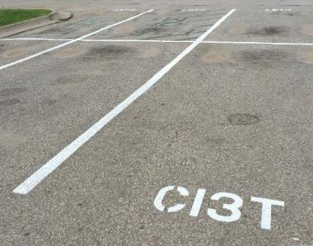
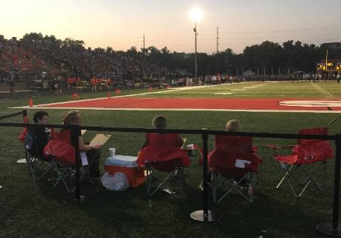
Locate in your Ci3T Implementation Manual
Procedures for Reinforcing
Faculty and Staff:
Students: ROAR zone Parking spaces
Parents/ Community:
Donation Coupon:
1 box of Macaroni and Cheese to Community Food Drive

Slide 44
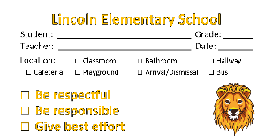
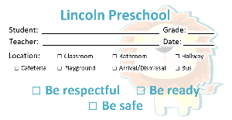
Procedures for Reinforcing
How will you reinforce…
Faculty and staff for
Participation and support
Modeling schoolwide expectations
Taking an instructional approach to behavior
Implementing the Ci3T plan with fidelity
Making instructional shifts in traditional practices
Students for
Demonstrating the expectations across academic, behavioral, and social skill domains
Families and community for
Communication with school staff
Reinforcing expectations
Supporting the social skills lessons at home and in the community
Notes:
4

Slide 45
Ticket Tip Sheet
Ticket Tip Sheet
When giving a ticket for positive behavior, always pair behavior specific praise. Example, “Lori, thank you for walking down the hallway with a quiet voice and your hands at your side. For showing responsibility, you have earned a PAWS ticket.”
In the first days and weeks of implementing a Positive Behavior Interventions and Support system, flood students with tickets to increase effectiveness. Overtime fade tickets and provide intermittent reinforcement.
School staff should try to be consistent with ticket distribution. Portions of staff meetings can be used to discuss ticket distribution.
To ensure student buy-in, survey students to gain an understanding of what reinforcements are desired.
Explicitly teach students how tickets can be earned and what tickets can be used for once they are received.
Weekly emails

Slide 46
Let’s talk… Procedures for Teaching and Reinforcing
Ci3T Leadership Teams | Individuals
What have traditionally been our strengths and successes rolling out Ci3T? How can we continue to teach faculty and staff about their Tier 1 responsibilities? How can we involve additional staff in the planning and implementation of our Ci3T roll out? How do we ensure new changes in our Ci3T plan are communicated during roll out? | How did I perceive the roll out of my school’s plan? What opportunities did I have to learn about my Tier 1 responsibilities? How am I reinforcing expectations when students meet them? How am I using tickets? What is highly preferred by my students? What would they like to earn for meeting expectations?
Notes:
10 min

Slide 47
A Look at Tier 1
Teaching
Reinforcing
Monitoring

Slide 48
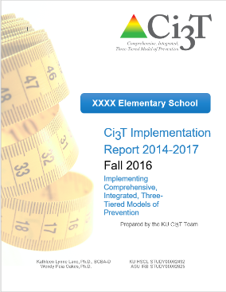
Essential Components of Primary Prevention Efforts
Social Validity
Systematic Screening
Academic
Behavior
Treatment Integrity

Slide 49
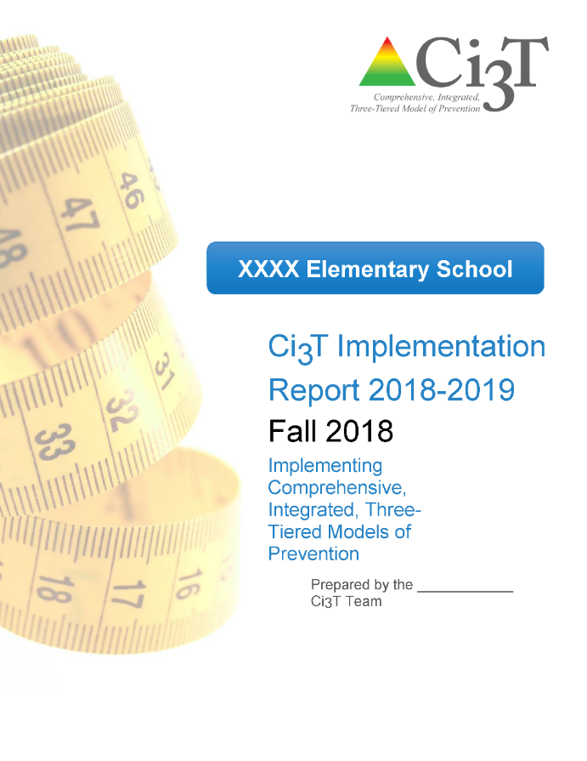
Monitoring Your Plan

Slide 50
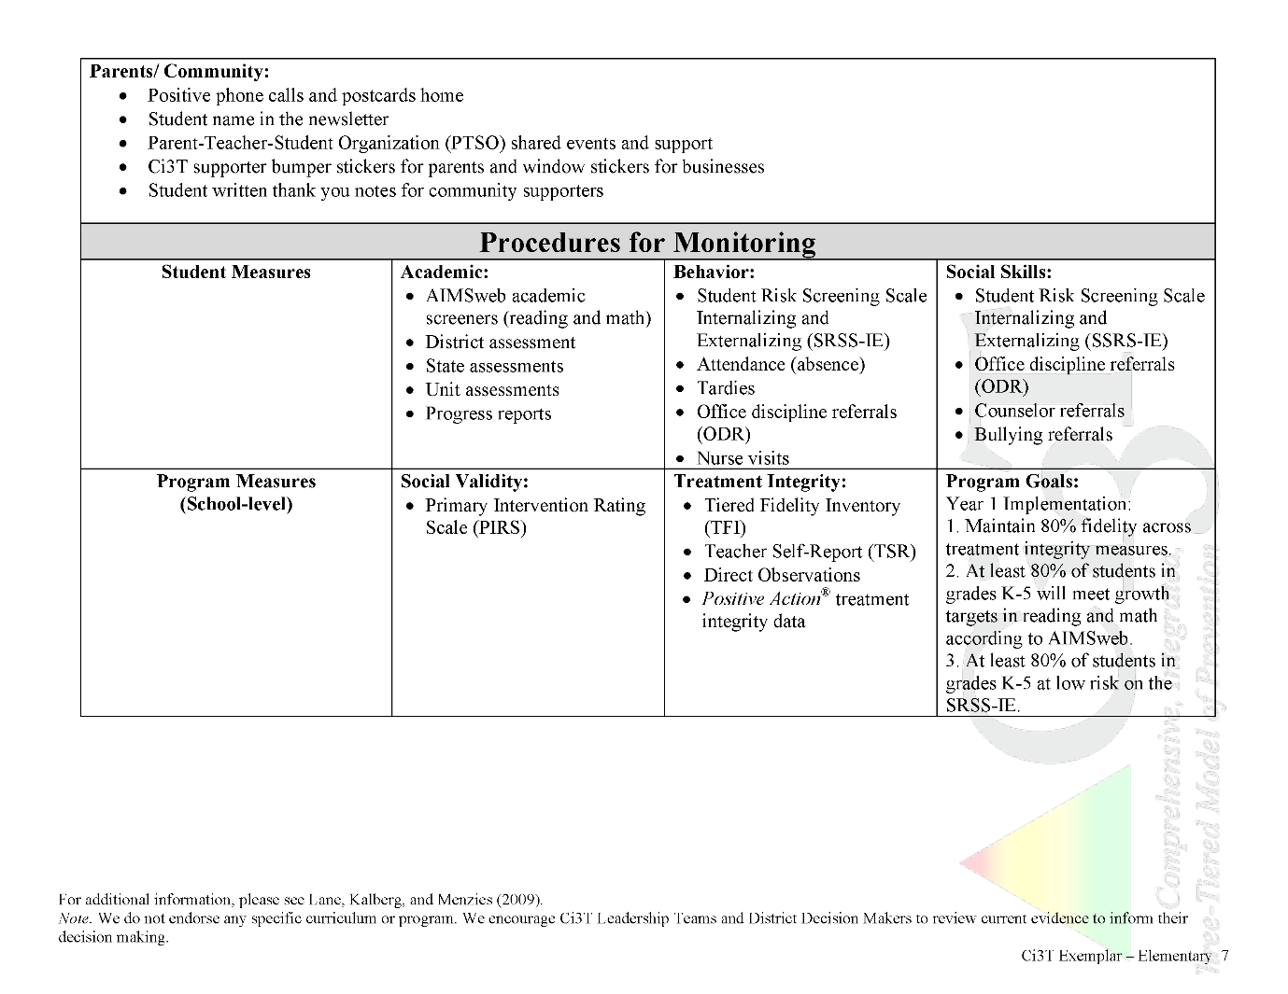
In future years, consider alternative program goals.
80% of students meeting reading and math targets on assessments
Locate in your Ci3T Implementation Manual

Slide 51
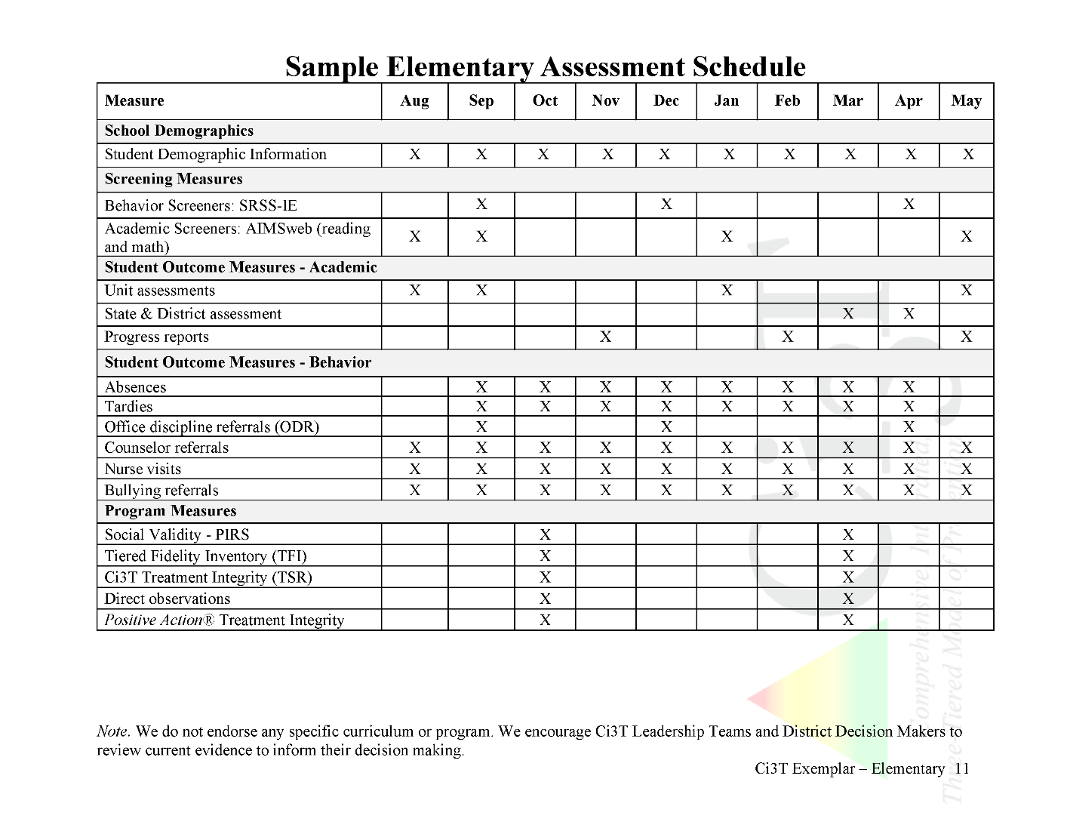

Slide 52
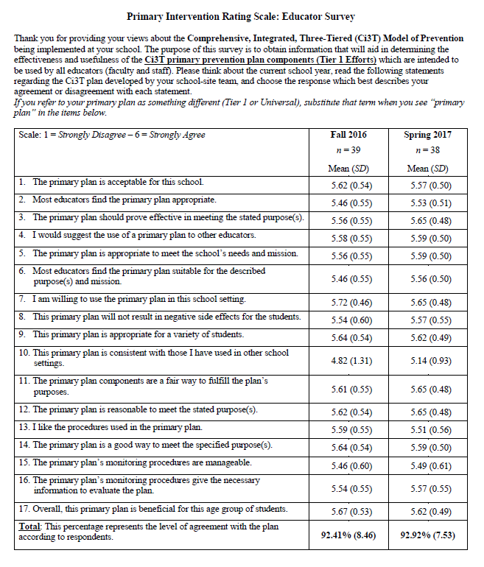
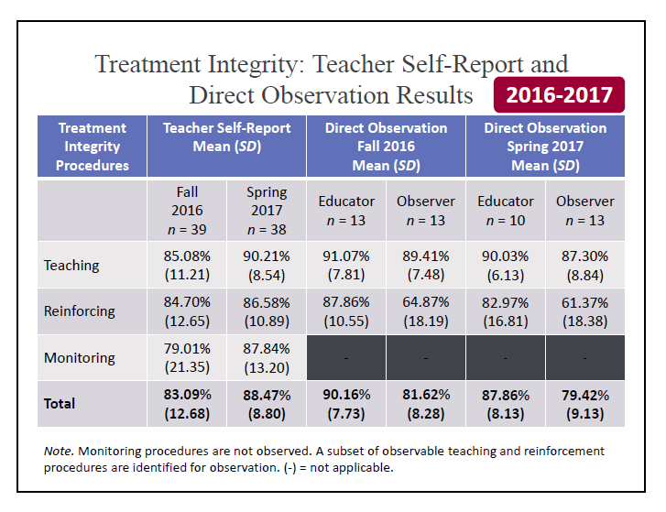
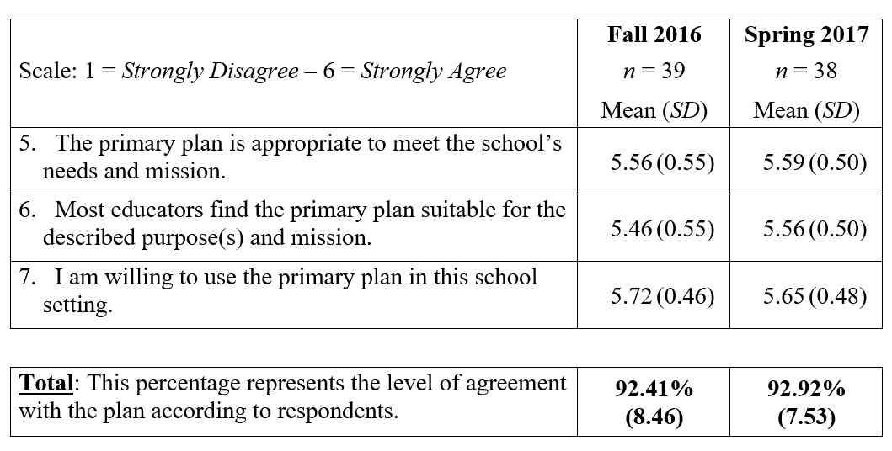
Why monitor implementation?
Do our students have access to Tier 1?
What are our strengths and areas for growth?
What professional learning opportunities can we give our staff?
How can we improve our plan?

Slide 53
Social Validity & Treatment Integrity
Schools receive fall and spring reports outlining:
…faculty and staff opinions about the Ci3T plan
…degree to which the Ci3T plan is being implemented

Slide 54
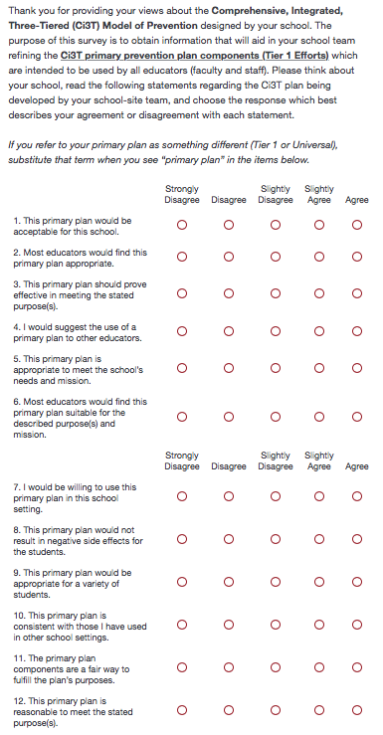
Social Validity
Used during building and implementation
AFTER the person has had an opportunity to learn about the plan
PIRS scores have predicted implementation in previous studies

Slide 55
Treatment Integrity

Slide 56
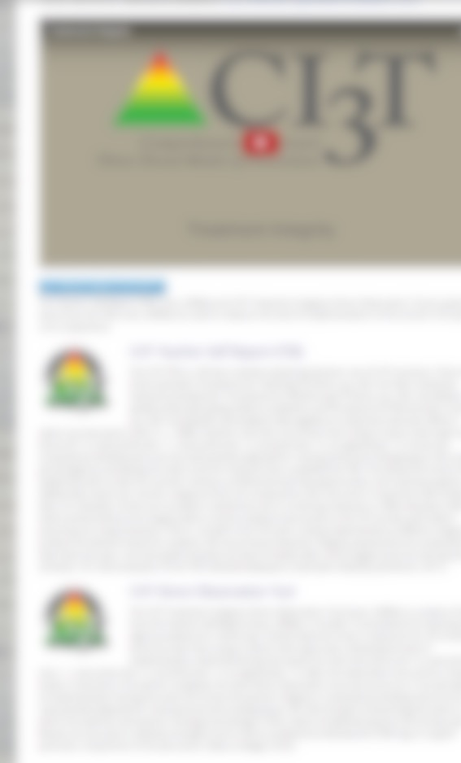
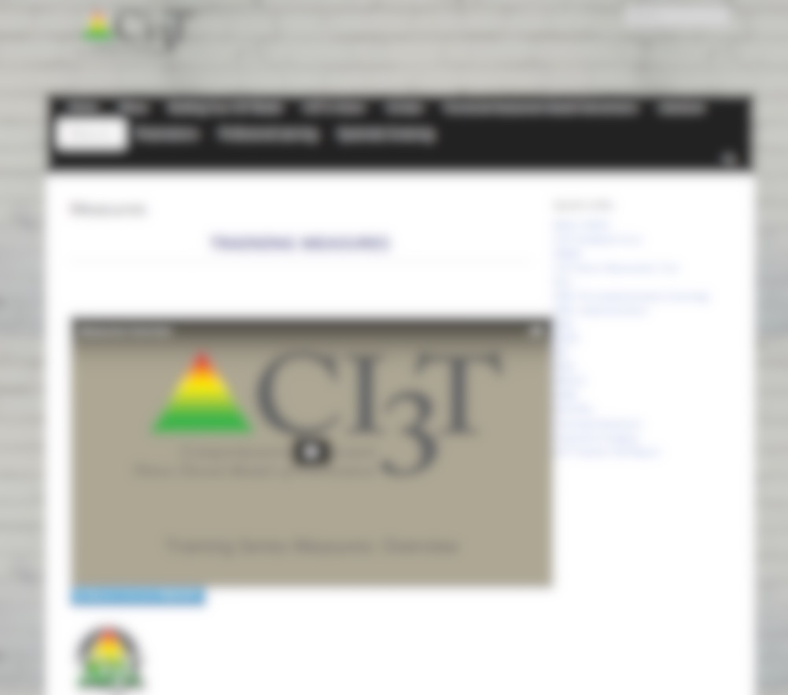
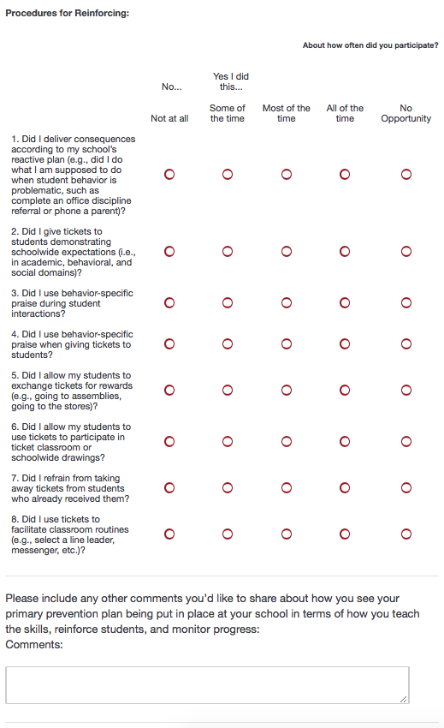
Treatment Integrity
Ci3T TI: Teacher Self-Report
Ci3T TI: Direct Observation

Slide 57
Treatment Integrity
"Tiered Fidelity Inventory" and “Schoolwide Evaluation Tool Interview and Observation Form” are products developed as part of the U.S. Department of Education’s Office of Special Education Programs National Technical Assistance Center on Positive Behavioral Interventions and Supports.

Slide 58
Let’s talk… Procedures for Monitoring
Ci3T Leadership Teams | Individuals
How can we effectively share back treatment integrity and social validity with faculty and staff? What additional resources do we need to support our faculty and staff in Tier 1 efforts? How will we continue to build capacity as a Ci3T Leadership Team to collect and analyze treatment integrity and social validity data? | What do I think about the Tier 1 efforts being implemented at my school? How can I share this with my leadership team? How can I tell if Tier 1 is happening? How can I see if my students are responding to Tier 1 strategies? What resources do I need to improve my capacity to implement Tier 1? What role did my school’s leadership team play in supporting Tier 1?
Notes:
10 min

Slide 59
What data do we currently collect and how do these data inform decision making?

Slide 60
Examining your screening data…
…implications for primary prevention efforts
…implications for teachers
…implications for student-based interventions
See Lane, Menzies, Bruhn, and Crnobori (2011)

Slide 61
Student Risk Screening Scale Fall 2004 – 2012 Middle School
Source: Lane, K. L., Oakes, W. P., & Magill, L. M., (2014). Primary prevention efforts: How do we implement and monitor the Tier 1 component of our comprehensive, integrated, three-tiered model of prevention. Preventing School Failure, 58, 143-158. doi: 10.1080/1045988X.2014.893978 [Figure 4. Middle school behavior screening data over time at the fall time point. Adapted from Figure 4.6 p. 127 Lane, K. L., Menzies, H. M, Oakes, W. P., & Kalberg, J. R. (2012). Systematic screenings of behavior to support instruction: From preschool to high school. New York, NY: Guilford Press.]

Slide 62
SRSS-E7 (externalizing) Results – All Students
Sample Elementary School Fall
N = 25
N = 16
N = 17
N = 12
N = 12
N = 86
N = 35
N = 57
N = 36
N = 50
N = 250
N = 300
N = 250
N = 255
N = 255

Slide 63
SRSS-I5 (internalizing) Results – All Students
Sample Elementary School Fall
N = 72
N = 18
N = 32
N = 85
N = 43
N = 45
N = 40
N = 204
N = 289
N = 261
N = 231

Slide 64
Additional Information
Systematic Screening tab

Slide 65
Examining your screening data…
…implications for primary prevention efforts
…implications for teachers
…implications for student-based interventions
See Lane, Menzies, Bruhn, and Crnobori (2011)

Slide 66
Schoolwide Positive
Behavior Support
Comprehensive, Integrated,
Three-Tiered (Ci3T)
Models of Support
Low-Intensity Strategies
Basic Classroom Management
Effective Instruction
Low-Intensity Strategies
Behavior Contracts
Self-Monitoring
- -
Functional Assessment-Based
Interventions
Higher-Intensity Strategies
Assess, Design, Implement, and
Evaluate
Adapted from Lane, K. L., Menzies, H. M., Bruhn, A. L., & Crnobori, M. (2011). Managing challenging behaviors in schools: Research-based strategies that work. New York, NY: Guilford Press.
Assessment

Slide 67
Consider a book study to build school site capacity
Classroom management
Instructional delivery
Low-intensity strategies
Self-Monitoring
Behavior Contracts
See Lane, K. L., Menzies, H. M., Bruhn, A. L., & Crnobori, M. (2011). Managing challenging behaviors in schools: Research-based strategies that work. New York, NY: Guilford Press.

Slide 68
Essential Components of Classroom Management
Classroom climate
Physical room arrangement
Routines and procedures
Managing paperwork
See Lane, K. L., Menzies, H. M., Bruhn, A. L., & Crnobori, M. (2011). Managing challenging behaviors in schools: Research-based strategies that work. New York, NY: Guilford Press.

Slide 69
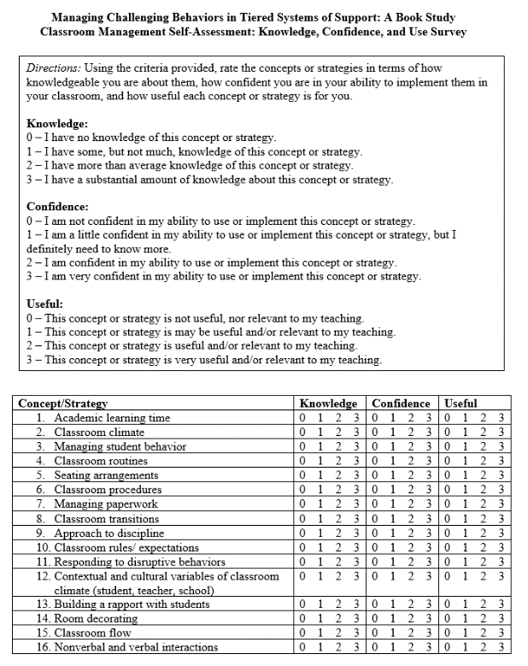
Identify site-level experts using self-assessment tools
Instructional choice
Behavior-specific praise
Increased opportunities to respond
Active supervision
Lane, K. L., Menzies, H. M., Bruhn, A. L., & Crnobori, M. (2011). Managing challenging behaviors in schools: Research-based strategies that work. New York, NY: Guilford Press.
Oakes, W. P., Cantwell, E. D., Lane, K. L., Royer, D. J., & Common, E. A. (2019). Examining educator’s views of classroom management and instructional strategies: School-site capacity for supporting students’ behavioral needs. Preventing School Failure.

Slide 70
Low-Intensity Strategies for Academics and Behavior
Opportunities to Respond
Behavior-Specific Praise
Active Supervision
Instructional Feedback
High p Requests
Precorrection
Incorporating Choice
Lane, K. L., Menzies, H. M., Ennis, R. P., & Oakes, W. P. (2015). Supporting behavior for school success: A step-by-step guide to key strategies. New York, NY: Guildford Press.

Slide 71
Examining your screening data…
…implications for primary prevention efforts
…implications for teachers
…implications for student-based interventions
See Lane, Menzies, Bruhn, and Crnobori (2011)

Slide 72
Schoolwide Positive
Behavior Support
Comprehensive, Integrated,
Three-Tiered (Ci3T)
Models of Support
Low-Intensity Strategies
Basic Classroom Management
Effective Instruction
Low-Intensity Strategies
Behavior Contracts
Self-Monitoring
- -
Functional Assessment-Based
Interventions
Higher-Intensity Strategies
Assess, Design, Implement, and
Evaluate
Adapted from Lane, K. L., Menzies, H. M., Bruhn, A. L., & Crnobori, M. (2011). Managing challenging behaviors in schools: Research-based strategies that work. New York, NY: Guilford Press.
Assessment

Slide 73
Commonly Used Secondary (Tier 2) Interventions to Support Behavior
Check in/check out
Social groups
Focused academic intervention
Behavior plan / contract
Daily pre-teaching

Slide 74
Connect it to your Secondary Intervention Grid
Behavior Contracts
Self-Monitoring
Homework Club
BEP
(Check in Check Out)
Lunch Bunch
Social Skills Club

Slide 75
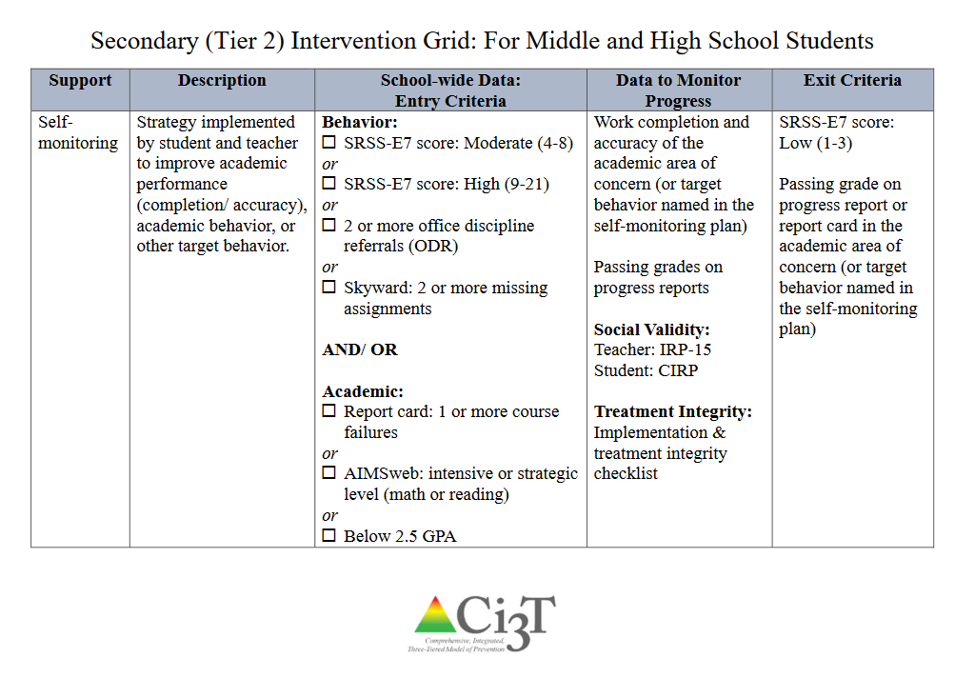

Slide 76
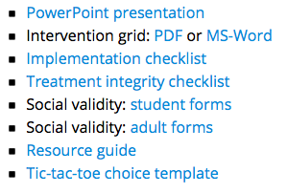
Professional Learning Resources ci3t.org/pl

Slide 77
Let’s talk… And Make Plans!
Ci3T Leadership Teams | Individuals
What have been some common questions about systematic screening? Explore Professional Learning Resources: Low-intensity Strategies Write your Action Items: R04 Ci3T Professional Learning Plan | What questions do I have about systematic screening? Explore Professional Learning Resources: Low-intensity Strategies Write your Action Items: R04 Ci3T Professional Learning Plan
Notes:
10 min

Slide 78
Let’s Talk… And Make Plans!
Ci3T Leadership Teams | Individuals
What are some new insights from today’s session? How will I communicate to faculty, staff, and families the important information and lessons learned today? | What is something new I learned today? How will I share what I learned today with my colleagues? How will I use this information to support my colleagues, students, and students’ families?
Notes:
5 min

Slide 79
Ci3T
Comprehensive Professional Learning Plan
Ci3T: Primary Prevention
Session 1:
Overview of Ci3T Prevention Models
Setting a Purpose
Establish team meetings and roles
Session 2:
Mission and Purpose
Establish Roles and Responsibilities
Procedures for Teaching
Procedures for Reinforcing
Reactive Plan
Session 3:
Procedures for Monitoring
Session 4:
Revise Primary Plan using Stakeholder feedback
Prepare presentation
Ci3T: Secondary Prevention
Session 5:
Overview of Teacher focused Strategies
Overview of Student Focused Strategies
Using data to determine
Draft the Secondary Intervention Grid based on existing supports
Ci3T: Tertiary Prevention
Session 6:
Final revisions of Ci3T Plan based on stakeholder feedback
Draft Tertiary Prevention Intervention Grids
Design Implementation Manual and Plan for roll out to faculty, students, and parents
Ci3T Leadership Team Training Sequence
Additional Professional Development on Specific Topics
Core Content Curriculum
Check In - Check Out
Functional Assessment-based Interventions
Reading, Math, Writing Benchmarking and Progress Monitoring Tools
Interventions, Strategies, & Practices
Additional Tier 3 Supports
Instructional Techniques to Improve Students’ Motivation; Classroom Management Practices;
Low-Intensity Behavior Supports

Slide 80
Sample Professional Learning
Aug | Sep | Oct | Nov | Dec | Jan | Feb | Mar | Apr | May | June
 |  |  | KU Ci3T Day 1 11/20/19 4:30-6:30PM | KU Ci3T Day 2 12/11/19 8:00AM-4:00PM | KU Ci3T Day 3 01/22/20 4:30-6:30PM | KU Ci3T Day 4 02/26/20 8:00AM-4:00PM |  | KU Ci3T Day 5 04/08/20 4:30-6:30PM | KU Ci3T Day 6 05/06/20 8:00AM-4:00PM
 |  |  | KU Ci3T Day 1 11/13/19 4:30-6:30PM | KU Ci3T Day 2 12/03/19 8:00AM-4:00PM | KU Ci3T Day 3 01/14/20 4:30-6:30PM | KU Ci3T Day 4 02/20/20 8:00AM-4:00PM |  | KU Ci3T Day 5 04/07/20 4:30-6:30PM | KU Ci3T Day 6 05/07/20 8:00AM-4:00PM
 | KU Ci3T IMP Day 1 09/05/19 | KU Ci3T IMP Day 2 10/29/19 |  | KU Ci3T IMP Day 3 12/04/19 | KU Ci3T IMP Day 4 01/15/20 |  |  | KU Ci3T IMP Day 5 04/02/20
 | KU Ci3T EMPOWER Session 1 09/17/19 |  | KU Ci3T EMPOWER Session 2 11/05/19 |  | KU Ci3T EMPOWER Session 3 01/23/20 | KU Ci3T EMPOWER Session 4 02/25/20 |  | KU Ci3T EMPOWER Session 5 04/23/20
Trainers & Coaches Call Session 1 08/01/19 Session 2 08/28/19 |  | Trainers & Coaches Call Session 3 10/22/19 | Trainers & Coaches Call Session 4 11/04/19 Session 5 11/21/19 |  | Trainers & Coaches Call Session 6 01/09/20 | Trainers & Coaches Call Session 7 02/10/20 | Trainers & Coaches Call Session 8 03/24/20 | Trainers & Coaches Call Session 9 04/30/20 |  | Trainers & Coaches Call Session 10 06/02/20
Ci3T TRAINING
P. ENHANCE Ci3T TRAINING
Register today!
P. ENHANCE Ci3T IMPLEMENTATION
AM/PM
KU Project EMPOWER
5:00-7:00 PM
Ci3T Trainers & Coaches Conference Calls
4:00-5:30 PM
= You Are Here

Slide 81
Sample EMPOWER Professional Learning Series
9/17/19
5:00 – 7:00 pm
Moving Forward with Ci3T: Setting up for Success
COMPLETED!
11/05/19
5:00 – 7:00 pm
Empowering Educators with Low-Intensity Strategies to Increase Engagement and Minimize Disruption
1/23/20
5:00 – 7:00 pm
Supporting Students who Need More Than Tier 1: Connecting students with Secondary (Tier 2) and Tertiary (Tier 3) Interventions
2/25/20
5:00 – 7:00 pm
Supporting Students Across the Tiers: Managing Acting Out and Internalizing Behaviors
4/23/20
5:00 – 7:00 pm
Moving Forward with Ci3T: Planning for Success

Slide 82
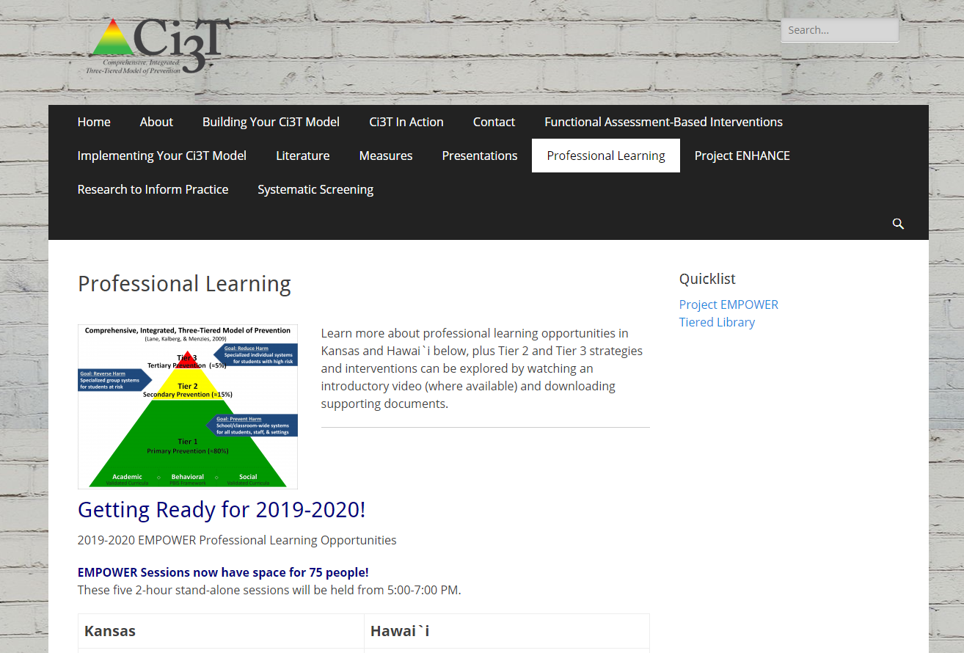
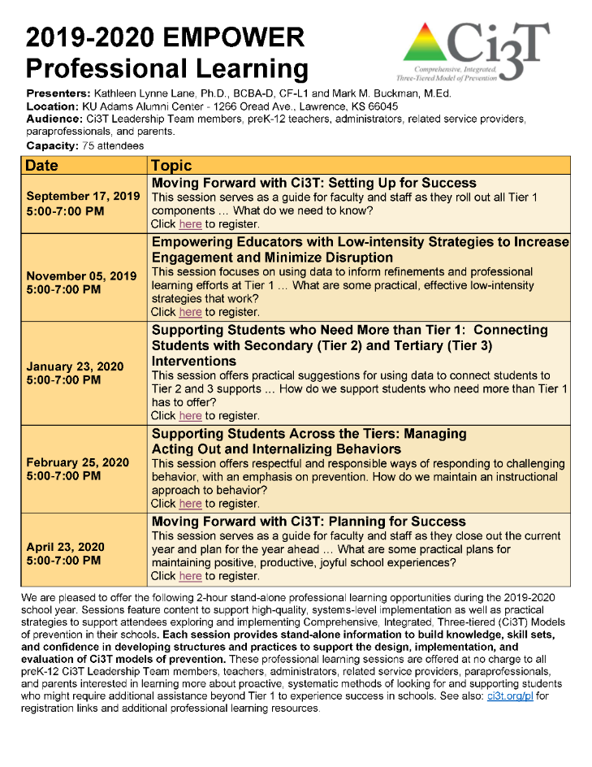

Slide 83
Updates to the Website! www.ci3t.org
Check out the newly updated Ci3T iBook v1.3 today!

Slide 84
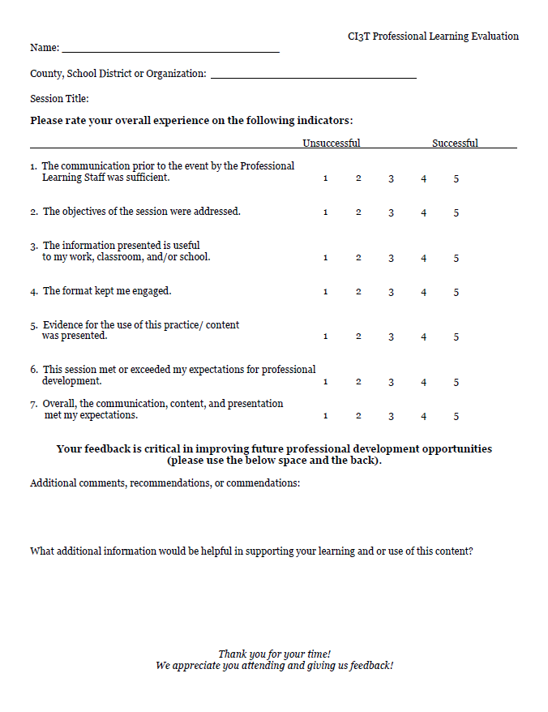
Thank you!
Please complete a session evaluation

